Slide 1
Optimal Utilization of PARP Inhibitors in Patients with Hormone-Sensitive and Castration-Resistant Metastatic Prostate Cancer Oncology Today – Research To Practice with Dr. Neil Love
Wassim Abida MD, PhD
Director of Translational Research, Prostate Cancer
Associate Member
Genitourinary Oncology Service
Memorial Sloan Kettering Cancer Center
Associate Professor of Medicine, Weill Cornell Medical College

Slide 2
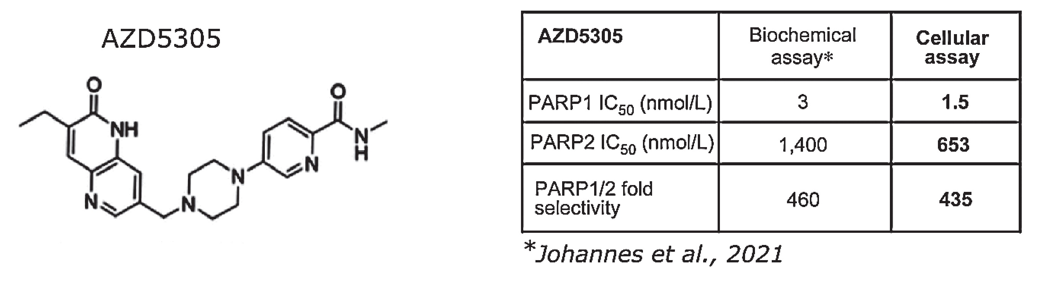
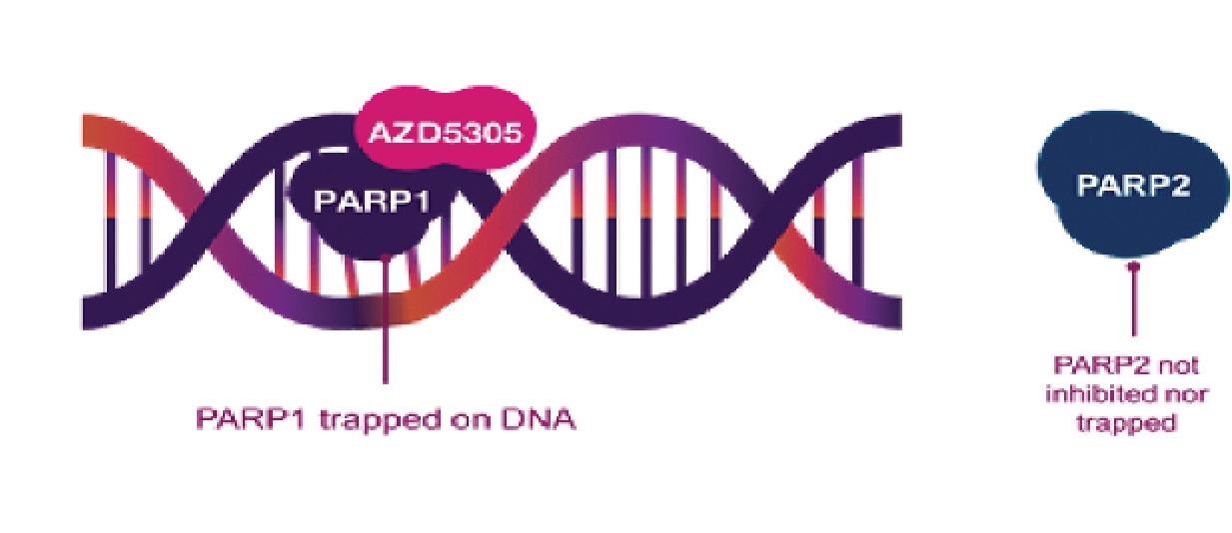
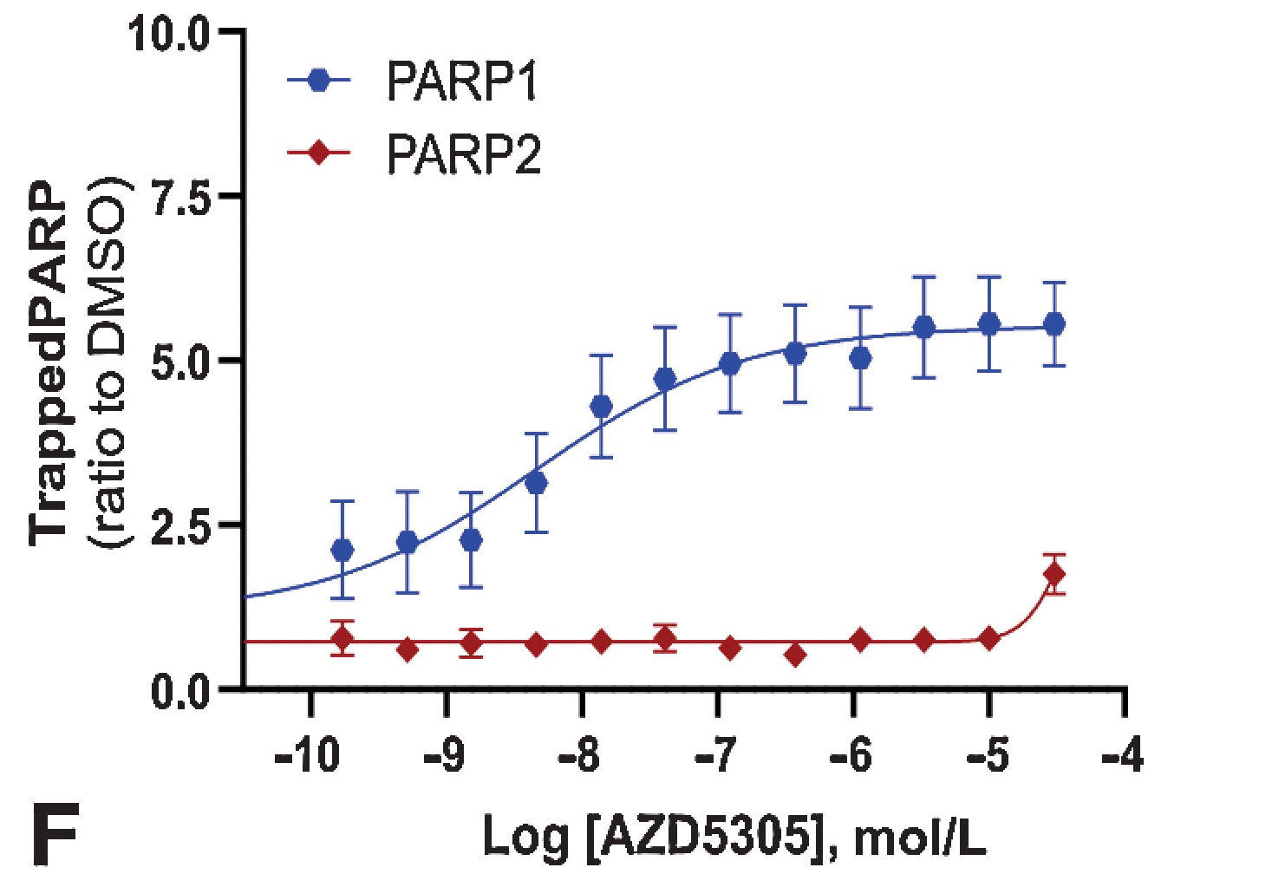
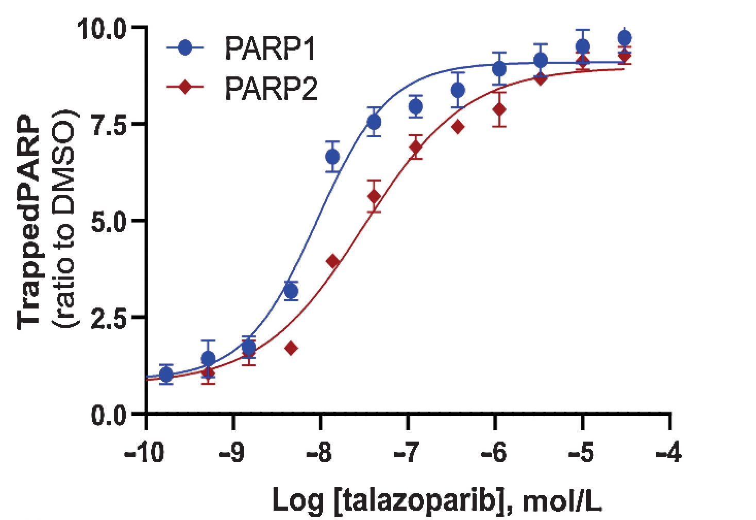
Saruparib (AZD5305): PARP1-Selective Inhibition
Selectively inhibits PARP1
compared to other PARPi’s,
reducing hematologic toxicities
Illuzzi G et al. Clin Cancer Res 2022;28(21):4724-36.

Slide 3
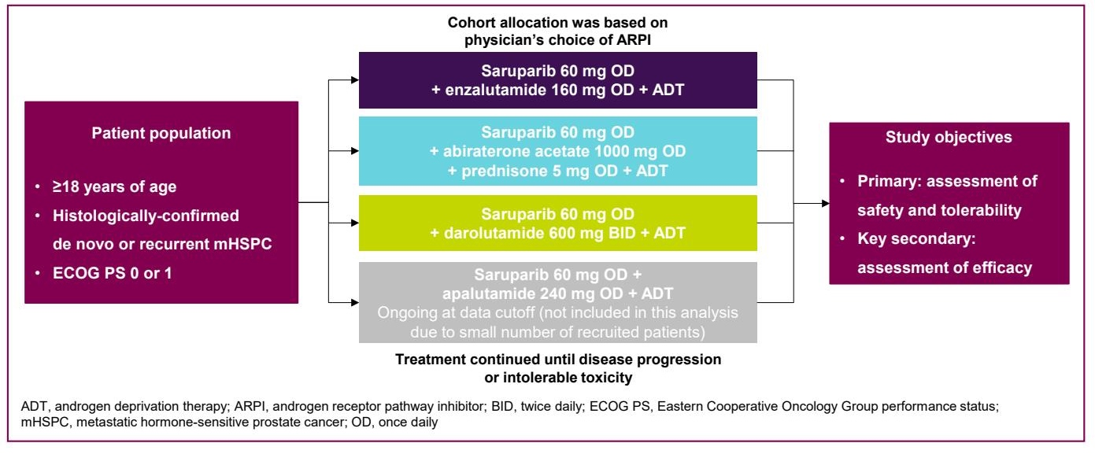
Phase I/II PETRANHA Study Design
Azad A et al. Genitourinary Cancers Symposium 2026;Abstract 177.

Slide 4
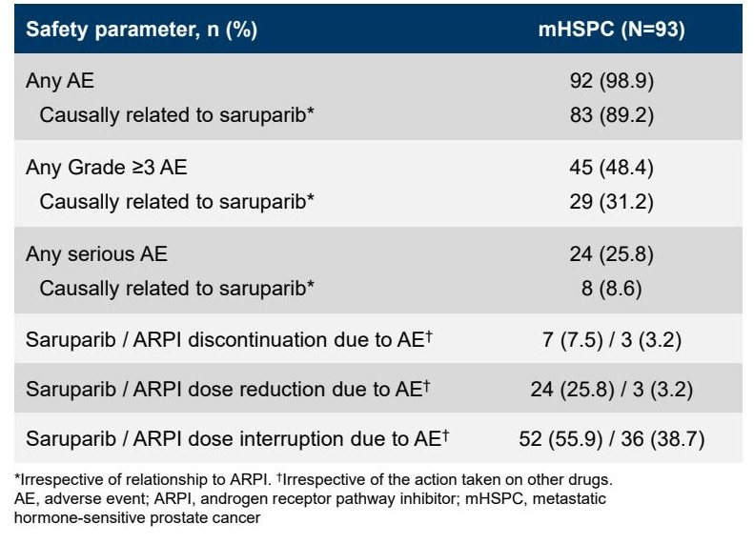
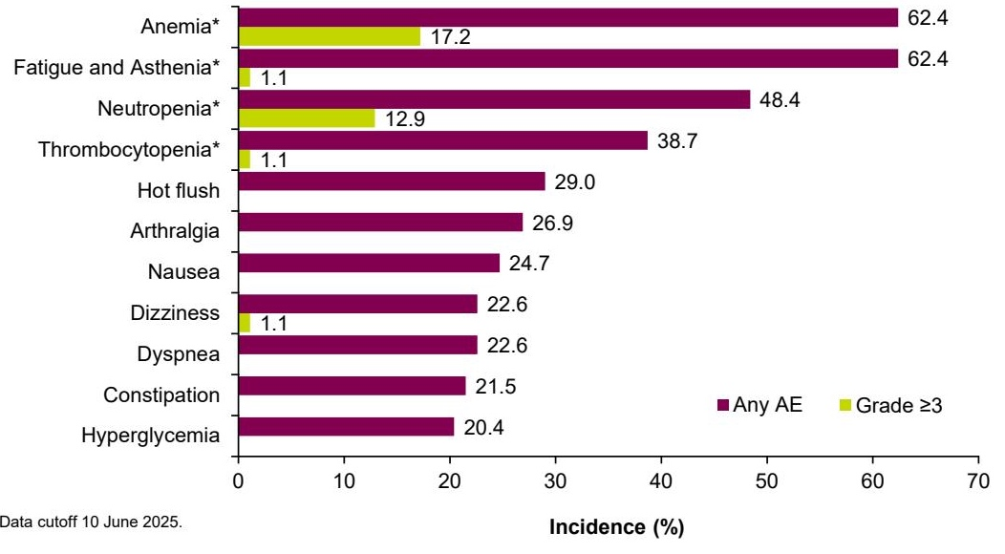

Phase I/II PETRANHA: Safety Data, Common AEs
Azad A et al. Genitourinary Cancers Symposium 2026;Abstract 177.

Slide 5
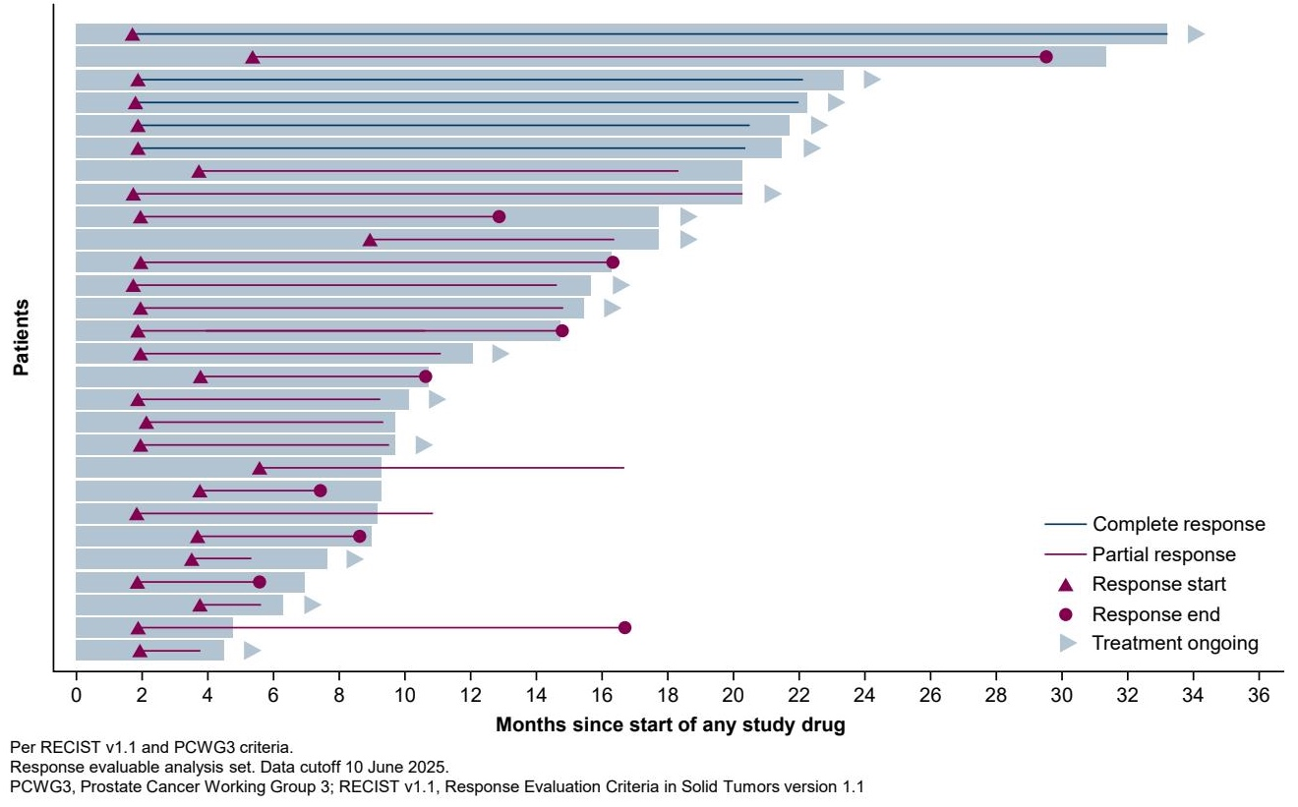
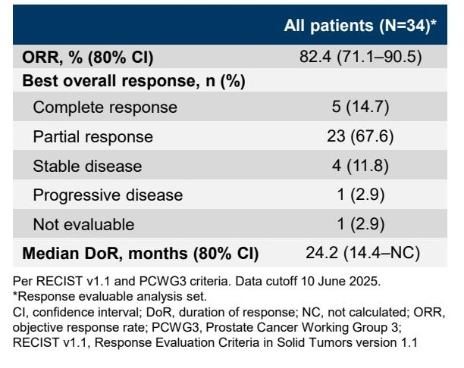
Phase I/II PETRANHA: Responses
Azad A et al. Genitourinary Cancers Symposium 2026;Abstract 177.

