Slide 1
CDK4/6 Inhibitors in the Management of HR-Positive Breast Cancer
Recent Advances in Cancer Care — New Paradigms,
Novel Agents and What It Means for the Oncology Nurse
A Complimentary NCPD Symposium Series Held During the 51st Annual ONS Congress
Saturday, May 16, 2026
6:00 AM – 7:30 AM
Faculty
Kelly Fischer, MSN, FNP-BC
Marissa Marti-Smith, DNP, APRN, AGNP-C, AOCNP
Ruth M O’Regan, MD
Moderator
Rita Nanda, MD

Slide 2




Faculty
Kelly Fischer, MSN, FNP-BC
Family Nurse Practitioner
Dana-Farber Cancer Institute
Boston, Massachusetts
Ruth M O’Regan, MD
Charles A Dewey Professor of Medicine and Oncology
Chair, Department of Medicine
University of Rochester Medical Center
Physician-in-Chief
Strong Memorial Hospital
Associate Director of Education and Mentoring
Wilmot Cancer Institute
Rochester, New York
Marissa Marti-Smith, DNP, APRN, AGNP-C, AOCNP
Nurse Practitioner
Texas Oncology-Baylor Charles A Sammons
Cancer Center
Dallas, Texas
Moderator
Rita Nanda, MD
Director, Breast Oncology
Associate Professor of Medicine
Section of Hematology/Oncology
The University of Chicago
Chicago, Illinois

Slide 3
Ms Fischer — Disclosures
No relevant financial relationships to disclose.

Slide 4
Ms Marti-Smith — Disclosures
Consulting Agreements | Amplity
Speakers Bureaus | AstraZeneca Pharmaceuticals LP, Biotheranostics Inc, A Hologic Company, Daiichi Sankyo Inc, Stemline Therapeutics Inc
Nonrelevant Financial Relationships | ASCO Quality Care Symposium, Clinical Care Options, Kaplan, OncLive, Oncology Nursing News

Slide 5
Dr O’Regan — Disclosures
Advisory Committees | Biotheranostics Inc, A Hologic Company
Consulting Agreements | Biotheranostics Inc, A Hologic Company, Gilead Sciences Inc, Lilly, Puma Biotechnology Inc, Regor Pharmaceuticals
Contracted Research | Novartis, Puma Biotechnology Inc
Data and Safety Monitoring Boards/Committees | Gilead Sciences Inc

Slide 6
Dr Nanda — Disclosures
Advisory Committees | AstraZeneca Pharmaceuticals LP, Corcept Therapeutics Inc, Daiichi Sankyo Inc, Exact Sciences Corporation, Gilead Sciences Inc, Lilly, Mabwell Therapeutics Inc, Merck, Pfizer Inc, Summit Therapeutics
Contracted Research | Arvinas, AstraZeneca Pharmaceuticals LP, Corcept Therapeutics Inc, Genentech, a member of the Roche Group, Gilead Sciences Inc, Jazz Pharmaceuticals Inc, Mabwell Therapeutics Inc, Merck, Pfizer Inc, Relay Therapeutics

Slide 7
Commercial Support
This activity is supported by educational grants from Lilly and Novartis.
Research To Practice NCPD Planning Committee Members,
Staff and Reviewers
Planners, scientific staff and independent reviewers for Research To Practice have no relevant financial relationships to disclose.

Slide 8
This educational activity contains discussion of
non-FDA-approved uses of agents and regimens. Please refer to official prescribing information for each product for approved indications.

Slide 9
Agenda
Introduction: Advent of CDK4/6 Inhibitors in HR-Positive Breast Cancer (BC)
Module 1: Risk Assessment for Patients with HR-Positive, HER2-Negative Localized BC
Module 2: Adjuvant CDK4/6 Inhibitor Therapy
Module 3: Practical Considerations with CDK4/6 Inhibitors
Module 4: Monitoring and Management of Cytopenias
Module 5: CDK4/6 Inhibitors in HR-Positive Metastatic BC
Module 6: Management of Gastrointestinal Adverse Events
Module 7: CDK4/6 Inhibitors in Unique Populations
Module 8: Rarer CDK4/6 Inhibitor-Associated Toxicities

Slide 10
Agenda
Introduction: Advent of CDK4/6 Inhibitors in HR-Positive Breast Cancer (BC)
Module 1: Risk Assessment for Patients with HR-Positive, HER2-Negative Localized BC
Module 2: Adjuvant CDK4/6 Inhibitor Therapy
Module 3: Practical Considerations with CDK4/6 Inhibitors
Module 4: Monitoring and Management of Cytopenias
Module 5: CDK4/6 Inhibitors in HR-Positive Metastatic BC
Module 6: Management of Gastrointestinal Adverse Events
Module 7: CDK4/6 Inhibitors in Unique Populations
Module 8: Rarer CDK4/6 Inhibitor-Associated Toxicities

Slide 11


The Advent of CDK 4/6 Inhibitors
Before 2015, aromatase inhibitors, fulvestrant, tamoxifen, and everolimus were the only endocrine options we had for treating HR+ breast cancer
After that, patients had to move on to capecitabine and then to IV chemotherapies, making prognosis and quality of life quite limited
In 2015, palbociclib, the first CDK 4/6 inhibitor, was approved
In 2018, ribociclib and abemaciclib followed
These drugs very quickly changed the landscape for patients with metastatic HR+ breast cancer
J Clin Oncol 42, 994-1000(2024). npj Breast Cancer volume 8, Article number: 114 (2022)
Courtesy of Jane Lowe Meisel, MD

Slide 12

CDK 4/6 Inhibitors in High-Risk Early-Stage Disease
A decade ago, CDK 4/6 inhibitors revolutionized the care of women with stage IV HR+ breast cancer and became a mainstay of first-line treatment
As history has shown, the next step for many drugs that do well in the metastatic setting (especially if well tolerated) is to study them upfront
Can we cure more high-risk patients with early-stage disease if we use these newer agents in the adjuvant setting?
Courtesy of Jane Lowe Meisel, MD

Slide 13
Agenda
Introduction: Advent of CDK4/6 Inhibitors in HR-Positive Breast Cancer (BC)
Module 1: Risk Assessment for Patients with HR-Positive, HER2-Negative Localized BC
Module 2: Adjuvant CDK4/6 Inhibitor Therapy
Module 3: Practical Considerations with CDK4/6 Inhibitors
Module 4: Monitoring and Management of Cytopenias
Module 5: CDK4/6 Inhibitors in HR-Positive Metastatic BC
Module 6: Management of Gastrointestinal Adverse Events
Module 7: CDK4/6 Inhibitors in Unique Populations
Module 8: Rarer CDK4/6 Inhibitor-Associated Toxicities

Slide 14
Risk Assessment for Patients with HR+/HER2-
Early Breast Cancer (BC): Rationale for CDK4/6 Inhibitors in Those at High Risk for Recurrence
Rita Nanda, M.D.
RTP Satellite Symposium at ONS
May 16, 2026

Slide 15
Clinicopathologic Factors Impacting Risk of Recurrence in HR+/HER2- Early-Stage Breast Cancer
Size, node status, grade/Ki-67, ER/PR expression level, LVI
Genomic assay results
  Oncotype Dx, MammaPrint, Breast Cancer Index
Response to NAT
Age, menopausal status
Type of treatment
  +/-chemo, AI vs tam, +/- OS, 5yrs vs extended, +/-CDK4/6i
Duration of ET
  5 yrs vs extended
Adherence to ET
  Up to 40% non-adherent; higher rates in young women and Black women

Slide 16
Summary of Longterm Outcomes by Treatment
Population | Treatment | Key Outcome | References
T1N0 (EBCTCG) | 5 yr ET | 20-yr distant recurrence: ~13% | Pan et al, NEJM 2017
T2N4–9 (EBCTCG) | 5 yr ET | 20-yr distant recurrence: ~41%
Node-negative, RS 0–10 | ET alone | 12-yr distant recurrence-free: 93.2% | Sparano et al, NEJM 2024
Node-negative, RS 11–25 | ET alone vs. Chemo+ET | 1% difference at 12 yr (all endpoints)
Node-negative, RS 26–100 | Chemo+ET | 5-yr freedom from distant recurrence: 93% | Sparano et al, JAMA Onc 2020
Premenopausal (SOFT) | Exemestane + OFS | 15-yr DFS: 73.5% | Francis et al, JCO 2025
 | Tamoxifen alone | 15-yr DFS: 67.0%

Slide 17
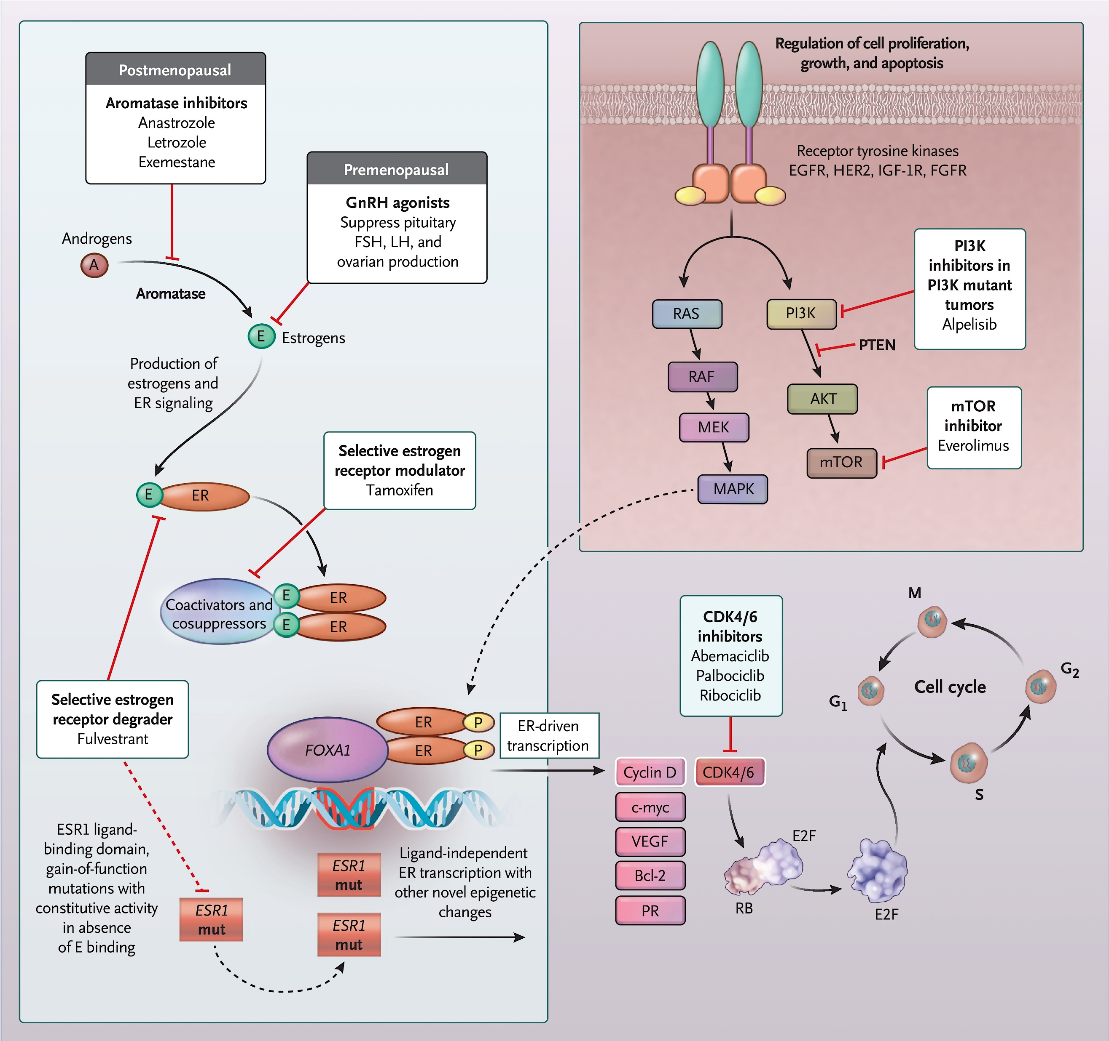
Mechanism of Action of CDK4/6 Inhibitors and
Rationale for Adding CDK4/6i to ET
Estrogen → turns the ignition key (cyclin D1) → starts the engine (CDK4/6) → releases the brake (Rb) → cell divides
Cancer cells can develop resistance to ET by making more cyclin D1
ET turns off the fuel supply (estrogen/ER → cyclin D1)
CDK4/6 inhibitors shut down the engine (CDK4/6 → Rb)
Burstein et al, NEJM 2020

Slide 18
Adjuvant CDK4/6 Inhibitors
Trial | monarchE | NATALEE
Drug | Abemaciclib | Ribociclib
Schedule | 150 mg PO BID continuously | 400 mg PO QD, 3 on /1 off
Duration of CDK4/6i | 2 years | 3 years
Endocrine Partner | Tamoxifen or AI | NSAI + OS (in premen/men)
N (randomized) | 5,637 | 5,101
Eligible Population | ≥4+ LN 1-3+LN and gr 3 or T ≥5 cm 1-3+ LN and Ki-67 ≥20% | stage IIA (high-risk N0 or N1) IIB III
Chemotherapy | ~58% received (neo)adjuvant chemo | ~58% received (neo)adjuvant chemo
Median Follow-Up | 76.2 months (~6.4 years) | 55.4 months (~4.6 years)
Primary Endpoint | iDFS | iDFS
iDFS HR (latest) | 0.734 (95% CI 0.657–0.820) | 0.716 (95% CI 0.618–0.829)
Absolute iDFS Benefit | 6.5% at 7 years (77.4% vs 70.9%) | 4.5% at 5 years (86.1% vs 81.6%)
DRFS / DDFS HR | DRFS: 0.746 (95% CI 0.662–0.840) | DDFS: 0.72 (95% CI 0.60–0.85) at 4 yr
Overall Survival HR | 0.842 (95% CI 0.722–0.981; P = 0.027) significant | 0.800 (95% CI 0.637–1.003; P = 0.026) not yet significant
OS Absolute Benefit | 1.8% at 7 years (86.8% vs 85.0%) | Trend favoring ribociclib; data immature
Johnston et al, Annals of Oncology 2026; Crown et al, ESMO Open 2025.

Slide 19
Case Presentation

Slide 20
Case Presentation: EBC
35 yo premenopausal woman presents with palpable right breast mass
Imaging reveals a 2.5 cm breast mass with 2 suspicious LNs
Bx of mass and LN reveal grade 3, IDC, which is ER/PR+, HER2-, Ki-67 of 25%
MammaPrint testing is performed and she is found to have MP-high risk disease; germline genetic testing is negative for gBRCA
She receives NACT with T-AC
Has lumpectomy and TAD, pathology reveals residual disease in breast and axilla; RCB II
She undergoes adjuvant radiation therapy

Slide 21
Case Presentation: EBC
After completion of NACT, surgery, and radiation, she presents for discussion of adjuvant ET. What would you recommend:
Tamoxifen
Tamoxifen + Ovarian Suppression
Aromatase Inhibitor + Ovarian Suppression
Aromatase Inhibitor + Ovarian Suppression + CDK4/6 Inhibitor

Slide 22
Discussion Questions
Are you offering an adjuvant CDK4/6 inhibitor to all of your patients with high-risk, HR-positive, HER2-negative early BC who would have met the enrollment criteria for monarchE or NATALEE? When do you not do so?
Would you consider an adjuvant CDK4/6 inhibitor for any patients who would NOT have been eligible for the pivotal studies?

Slide 23
Agenda
Introduction: Advent of CDK4/6 Inhibitors in HR-Positive Breast Cancer (BC)
Module 1: Risk Assessment for Patients with HR-Positive, HER2-Negative Localized BC
Module 2: Adjuvant CDK4/6 Inhibitor Therapy
Module 3: Practical Considerations with CDK4/6 Inhibitors
Module 4: Monitoring and Management of Cytopenias
Module 5: CDK4/6 Inhibitors in HR-Positive Metastatic BC
Module 6: Management of Gastrointestinal Adverse Events
Module 7: CDK4/6 Inhibitors in Unique Populations
Module 8: Rarer CDK4/6 Inhibitor-Associated Toxicities

Slide 24
Role of Adjuvant CDK4/6 Inhibitor Therapy in High-Risk, HR-Positive, HER2-Negative Early BC
Ruth M O’Regan, MD
Charles A Dewey Professor of Medicine and Oncology
Chair, Department of Medicine
University of Rochester Medical Center
Physician-in-Chief
Strong Memorial Hospital
Associate Director of Education and Mentoring
Wilmot Cancer Institute
Rochester, New York

Slide 25
Case history
58-year-old postmenopausal female presents with a right breast mass
Biopsy: Invasive ductal cancer, grade 3,
ER 80%, PR 50%, HER2 IHC 0, Ki67 25% with involved axillary node
Clinical stage cT2, cN1
Received neo-adjuvant chemotherapy
Undergoes mastectomy with residual disease ypT2 (3mm), ypN1 (2 positive nodes)
Completes radiation and aromatase inhibitor planned

Slide 26
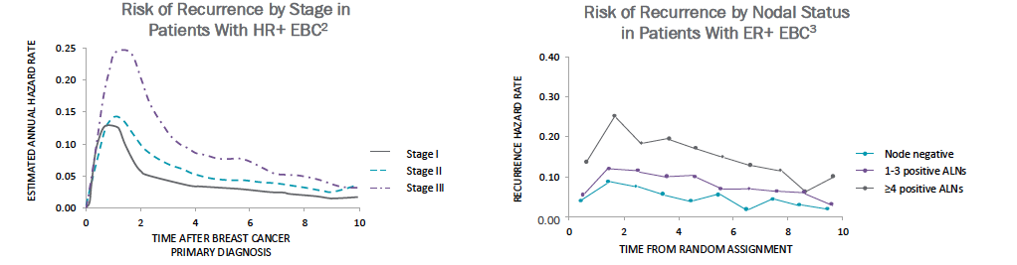
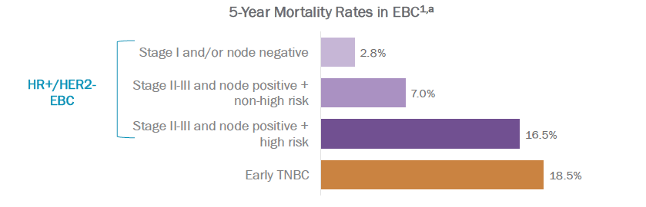
Recurrence rates for early hormone receptor (HR)-positive breast cancer
Almost 30% of patients with node-positive,
HR-positive breast cancer will experience
disease recurrence or death within 5 years
of diagnosis
Cheng et al Cancer Epidemiol Biomarkers 2012, Colleoni et al J Clin Oncol 2016, Nelson et al Plos One 2022

Slide 27
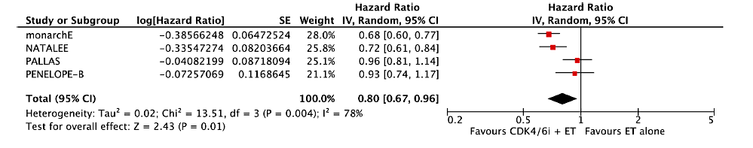
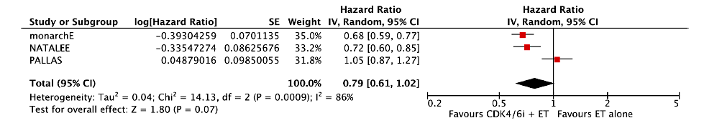
Meta-analysis of CDKi adjuvant trials
CDKis improve invasive disease-free survival
CDKis improve distant disease-free survival
Alexiou et al Cancers 2025

Slide 28
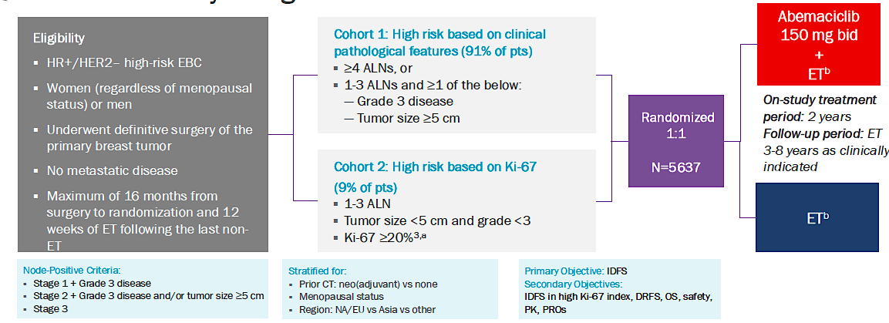
MonarchE: Study design
All patients had node-positive, HR-positive breast cancer
Abemaciclib given continuously twice daily for 2 years
https://clinicaltrials.gov/study/NCT03155997

Slide 29
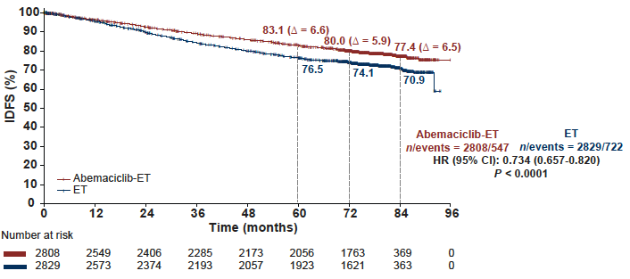
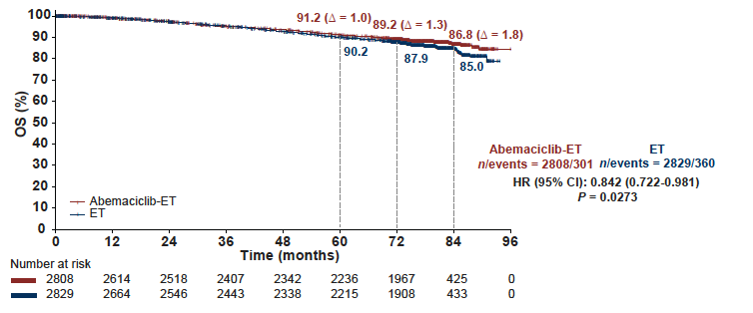
MonarchE: Outcomes at 7 years
 | ABEMA + ET | ET | Difference | P value
Invasive DFS | 77% | 71% | 6% | P<.0001
Distant RFS | 80% | 75% | 5% | P<.0001
Overall survival | 87% | 85% | 2% | P=.027
Living with MBC | 6% | 9% | 3%
Johnston et al Ann Oncol 2025

Slide 30
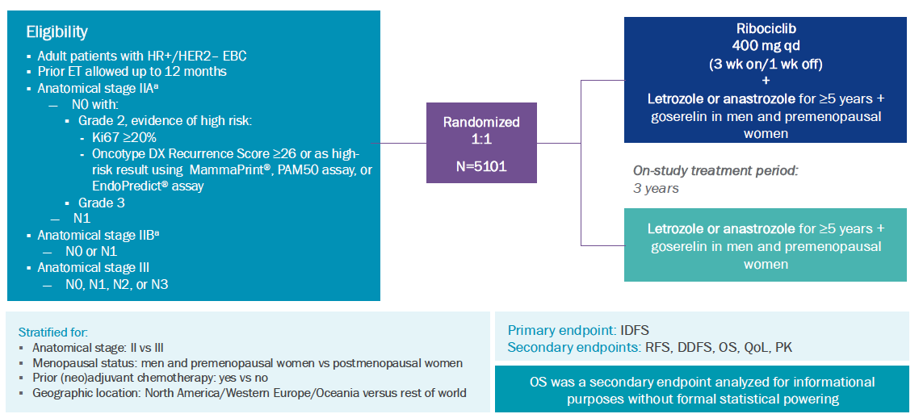
NATALEE: Study design
Patients had node-positive or high risk node-negative, HR-positive breast cancer
If node-negative had to have T2 with high-risk biology, T3 or T4 disease
Ribociclib 400mg once daily for 3 out of 4 weeks for 3 years
https://clinicaltrials.gov/study/NCT03701334

Slide 31
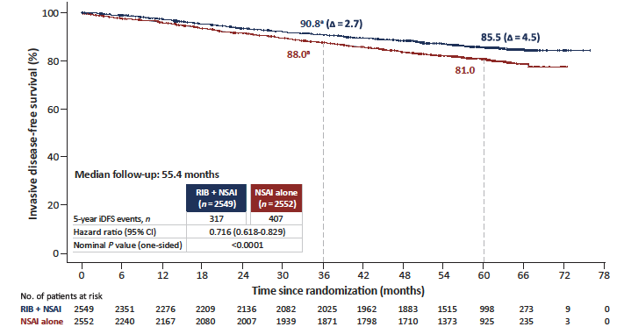
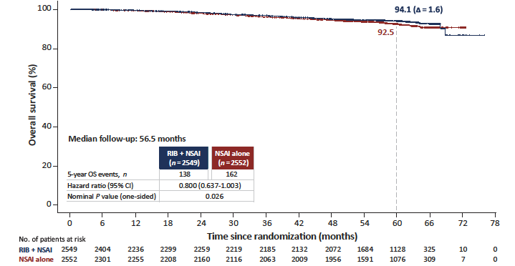
NATALEE: Outcomes at 5 years
 | RIBO + ET | ET | Difference | P value
Invasive DFS | 86% | 81% | 5% | P<.0001
Distant RFS | 88% | 84% | 4% | P<.0001
Overall survival | 94% | 93% | 1.5% | P=.026
Crown et al Ann Oncol 2025

Slide 32
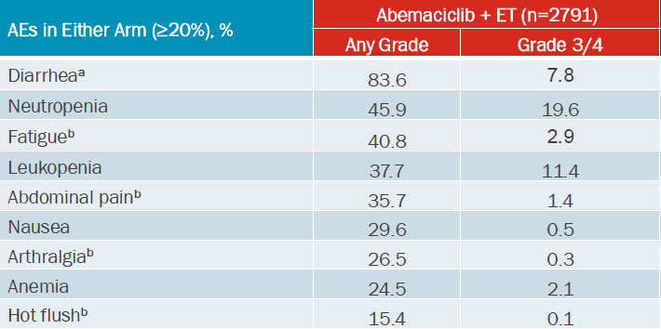
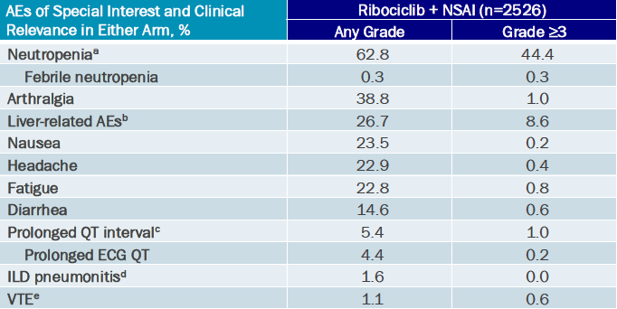
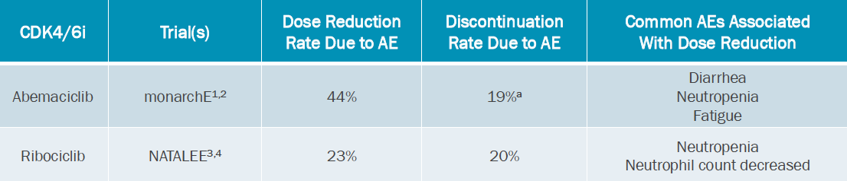
MonarchE and NATALEE: Adverse events
Dose reductions did
not impact efficacy
Johnston et al Lancet Onc 2023, Barrios et al ESMO Breast 2024, Goetz et al NPJ Breast Cancer 2024, Hamilton et al SABCS 2024

Slide 33
FDA-approved indications and identification of appropriate candidates
Abemaciclib
Ribociclib
In combination with fulvestrant for women with HR+, HER2- advanced or mBC with disease progression on ET
As monotherapy for women with HR+, HER2- advanced or mBC with disease progression on ET and prior CT in the metastatic setting
In combination with AI as adjuvant therapy in women with HR+, HER2- stage II/III early BC and high risk of recurrence
For women with HR+, HER2- advanced or mBC with AI as initial ET or fulvestrant as initial ET or ET following disease progression
Abemaciclib PI; Ribociclib PI

Slide 34
Case History
58-year-old with stage IIB, node-positive, hormone receptor-positive breast cancer
Completed neo-adjuvant therapy, surgery and radiation
Aromatase inhibitor planned
Meets criteria for both MonarchE and NATALEE
Abemaciclib used for only 2 years but more diarrhea though dose escalation decreases this risk
Ribociclib given for 3 years with different side-effect profile

Slide 35
Discussion Questions
How are you selecting between abemaciclib and ribo­ciclib in the adjuvant setting? How do their tolerability/toxicity profiles affect your selection between them for individual patients?

Slide 36
Agenda
Introduction: Advent of CDK4/6 Inhibitors in HR-Positive Breast Cancer (BC)
Module 1: Risk Assessment for Patients with HR-Positive, HER2-Negative Localized BC
Module 2: Adjuvant CDK4/6 Inhibitor Therapy
Module 3: Practical Considerations with CDK4/6 Inhibitors
Module 4: Monitoring and Management of Cytopenias
Module 5: CDK4/6 Inhibitors in HR-Positive Metastatic BC
Module 6: Management of Gastrointestinal Adverse Events
Module 7: CDK4/6 Inhibitors in Unique Populations
Module 8: Rarer CDK4/6 Inhibitor-Associated Toxicities

Slide 37
Practical Considerations with CDK4/6 Inhibitors
Kelly Fischer, MSN, FNP-BC
Family Nurse Practitioner
Dana-Farber Cancer Institute
Boston, Massachusetts

Slide 38
Optimal dosing and dose-adjustment strategies for CDK4/6 inhibitors in patients with localized and metastatic BC
Localized (adjuvant)
Abemaciclib → 150 mg BID
Ribociclib → 400 mg once daily x 21 days on, 7 days off
Metastatic
Abemaciclib → 150 mg BID
Ribociclib → 600 mg daily x 21 days on, 7 days off
Palbociclib → 125 mg daily x 21 days on, 7 days off
Fasching PA et al. JAMA Oncol. 2025;11(11):1364–1372.
Johnston SRD et al. J Clin Oncol. 2020 Dec 1;38(34):3987-3998.

Slide 39
Recommended duration of CDK4/6 inhibitor therapy in the adjuvant setting: Abemaciclib and Ribociclib
Monarch-E
Adjuvant abemaciclib for a total of two years
Abemaciclib + endocrine therapy demonstrated superior invasive disease-free survival vs endocrine therapy alone (IDFS rates of 92.2% vs 88.7%)
NATALEE
Adjuvant ribociclib for a total of three years
Ribociclib + endocrine therapy demonstrated 3-year iDFS rates of 90.8% vs 88.1%, and 4-year rates of 88.5% vs 83.6%
HR-positive, HER2-negative, node positive, high risk early stage disease
HR-positive, HER2-negative, stage II or III early breast cancer
Fasching PA et al. JAMA Oncol. 2025;11(11):1364–1372.
Johnston SRD et al. J Clin Oncol. 2020 Dec 1;38(34):3987-3998.

Slide 40
Approaches for encouraging and assessing adherence in patients receiving CDK4/6 inhibitor therapy
Recommend more frequent visits initially to assess side effect profile, tolerability, and lab monitoring
  Check labs every 2 weeks for the first 2 months on CDK4/6 inhibitor therapy, then space out to monthly thereafter
Ensure patients are aware of dosing and schedule
  Palbociclib is taken once daily for 3 weeks on, 1 week off
  Abemaciclib is taken twice a day
  Ribociclib is taken once daily for 3 weeks on, 1 week off
Ensure patients are set up for success at home
  Loperamide at home to take as needed for diarrhea
  Antiemetic RX’s to take as needed for nausea
If issues with tolerability, dose reduce/change/discontinue therapy if appropriate

Slide 41
Drug-drug interactions to consider with CDK4/6 inhibitor therapy
CDK4/6 inhibitors interact with drugs that are metabolized by the CYP3A4 enzyme pathway
  Increased toxicity with CYP3A4 inhibitors
  Reduced efficacy with CYP3A4 inducers
Strong CYP3A4 inhibitors: clarithromycin (azithromycin may be used in place of clarithromycin), ketoconazole, ritonavir
Strong CYP3A4 inducers: rifampin, enzalutamide, phenytoin, St. John’s wort
QT-prolonging agents (caution with ribociclib): tricyclic antidepressants, some antipsychotics, amiodarone, moxifloxacin
Gastric pH-elevating agents (caution with palbociclib): PPIs may reduce palbociclib absorption
Grapefruit = strong inhibitor of CYP3A4
https://www.uspharmacist.com/article/drug-interactions-associated-with-cdk-4-6-inhibitors

Slide 42
Case Presentation

Slide 43
A 53 y/o female with HR-positive, HER2-negative breast cancer: Adjuvant CDK4/6 inhibitor therapy
March 2025: Abnormal mammogram leads to biopsy
  Right breast biopsy → invasive lobular carcinoma, grade 3, ER+, PR+, HER2 neg (0)
May 2025: Bilateral mastectomy → right breast ILC multifocal, spanning 7.5 cm, + skin invasion into dermis. 1 of 4 SLN with microinvasion of 1.5 mm; 2 with ITCs. Oncotype = 13
July/August: Radiation therapy
September 2025: Starts adjuvant letrozole/leuprolide/ribociclib
  Baseline LFTs normal
October-November 2025: Ribociclib discontinued after LFTs greater than 2000. Hospitalized for persistent transaminitis and hyperbilirubinemia. Responded to high dose steroids
March 2026: Initiates abemaciclib at 50 mg daily dose
  Slowly increased abemaciclib to 100 mg BID over a 2-month period with weekly lab monitoring, LFTs remained normal

Slide 44
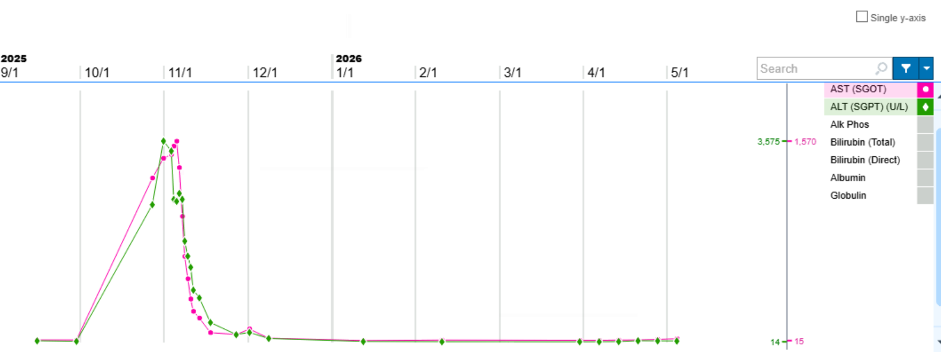

Slide 45
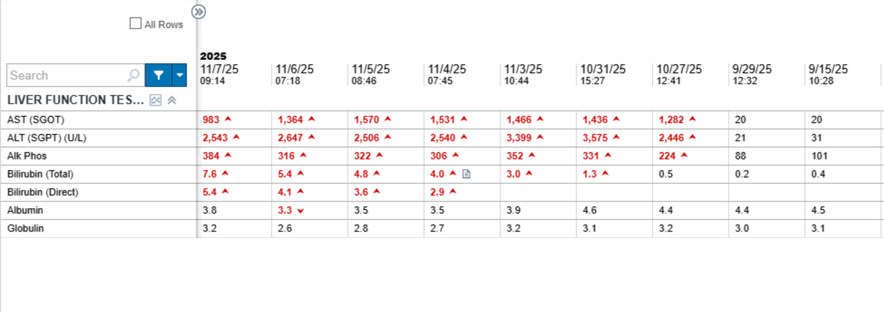

Slide 46
Agenda
Introduction: Advent of CDK4/6 Inhibitors in HR-Positive Breast Cancer (BC)
Module 1: Risk Assessment for Patients with HR-Positive, HER2-Negative Localized BC
Module 2: Adjuvant CDK4/6 Inhibitor Therapy
Module 3: Practical Considerations with CDK4/6 Inhibitors
Module 4: Monitoring and Management of Cytopenias
Module 5: CDK4/6 Inhibitors in HR-Positive Metastatic BC
Module 6: Management of Gastrointestinal Adverse Events
Module 7: CDK4/6 Inhibitors in Unique Populations
Module 8: Rarer CDK4/6 Inhibitor-Associated Toxicities

Slide 47
Cytopenias Associated with CDK4/6 Inhibitors
Marissa Marti-Smith
DNP, APRN, AGNP-C, AOCNP

Slide 48
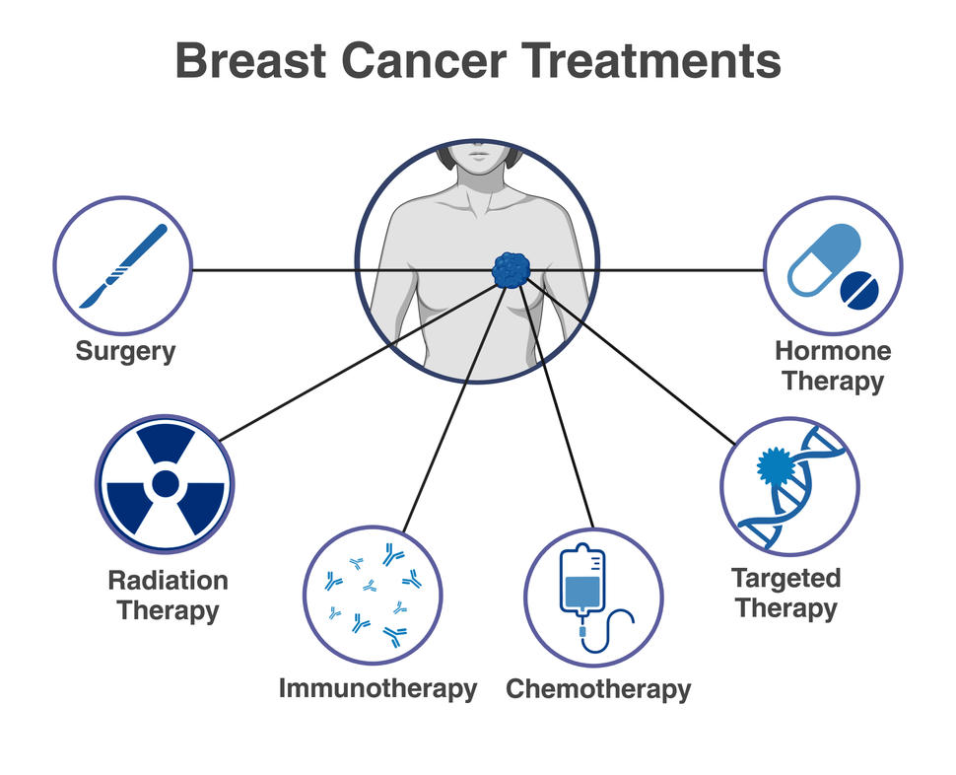
Clinical Overview & Toxicities
CDK4/6 inhibitors (Palbociclib, Ribociclib, Abemaciclib) have revolutionized the treatment landscape for HR+/HER2– breast cancer.
FOCUS:
  Frequency & severity of hematologic toxicities
  Routine lab monitoring
  Nursing management
  Dose modification strategies

Slide 49
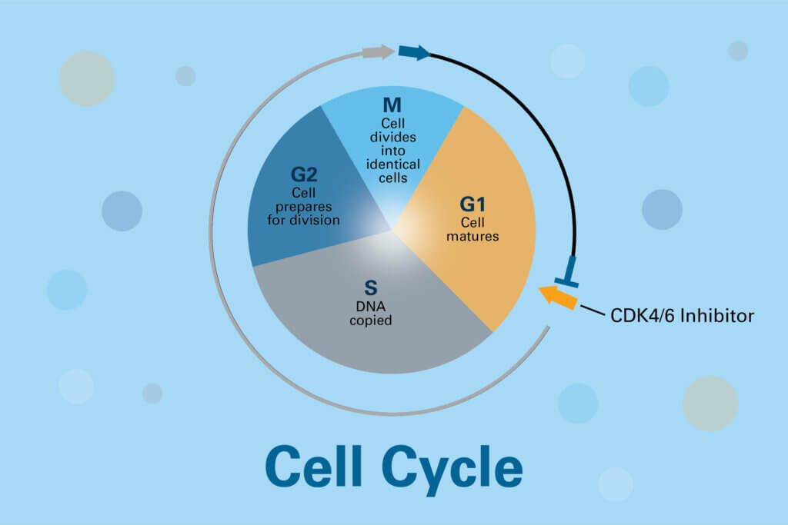
CDK 4/6 Inhibitor Mechanism
Palbociclib, Ribociclib, & Abemaciclib
in combo w/ endocrine therapy
Cell
cycle
arrest
Bone marrow suppression
Photo https://blog.dana-farber.org/insight/2018/02/cdk46-inhibitors-stop-breast-cancer-growth/

Slide 50

Incidence of Grade 3-4 Neutropenia
Palbociclib & Ribociclib:
75% to 80% of patients
Grade 3/4 >50% of patients
Abemaciclib :
46% of patients
Grade 3/4 - 19.6% in MonarchE trial
Anemia (grade 1-2) and Thrombocytopenia – less frequent with all agents
Freq grade 3/4 neutropenia
  decreases with extended therapy, cumulative toxicity is unlikely and that dose adjustments adequately treat neutropenia
(Anders et al., 2020) (

Slide 51
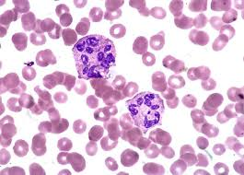
Predictability & Reversibility
Key Clinical Insights for Nursing Assessment:
• Predictable:
Typically occurs during the first 1-2 cycles of treatment.
• Reversible:
Neutrophil counts recover rapidly (median 7 days) upon treatment interruption.
• Safety:
Febrile neutropenia is exceptionally rare (incidence <2.5%).
Spring et al. (2020)

Slide 52





Monitoring Protocols
CBC prior to
initiating therapy
1st 2 cycles
CBC q2 weeks
Future
Monitor monthly (C3+)
Adjust frequency if Grade 3 or 4 toxicity
observed
ASCO (2023). Breast Cancer Management Guidelines: Practical Management of Targeted Therapy.

Slide 53
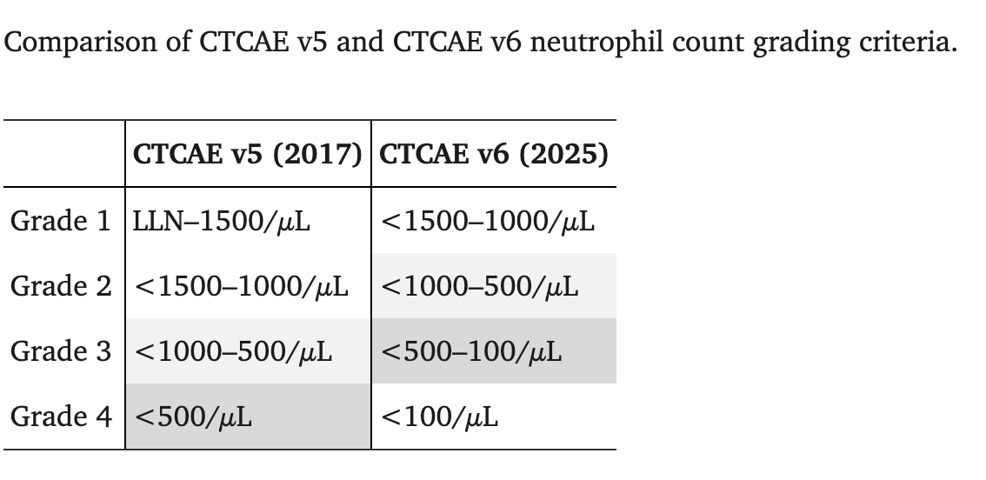
Change in Common Terminology Criteria for Adverse Events
  (Merz, 2025)

Slide 54
Interruption vs. Discontinuation
Resumption criteria:
Interrupt therapy for persistent Grade 3 or any Grade 4 cytopenia
Resume only after recovery to Grade 2 (ANC>= 1000)
Permanent dose reduction is preferred over growth factor support for chronic issues.
1,000
ANC Threshold for resumption

Slide 55

Supportive Care Considerations
G-CSF: Rarely indicated
Infrequently associated with febrile neutropenia and responds rapidly to drug withdrawal
Anemia management: if symptomatic may require iron / blood transfusion
Gold standard >>>>>>>
Dose interruption & modification if needed

Slide 56
Case Presentation

Slide 57

Case Study
51 yo female
T2 pN1a , left lumpectomy
Adjuvant AC, weekly paclitaxel, followed by XRT
Tamoxifen initially, leuprolide + AI, zoledronic acid IV 2x year
Ins denied Ribociclib, given Abemaciclib 150mg PO BID
Hx depression, controlled.
Moved prior to initiating this CDK4/6 therapy

Slide 58

Management & Takeaway
Q2 week lab checks x 2 months
Diarrhea f/u
At 2 week check, leukopenia WBC 3.8, but ANC 0.4
Oral antibx while neutropenic
Neutropenic precautions
HELD x1 week till ANC >1
Dose reduced to 100mg PO BID

Slide 59
Agenda
Introduction: Advent of CDK4/6 Inhibitors in HR-Positive Breast Cancer (BC)
Module 1: Risk Assessment for Patients with HR-Positive, HER2-Negative Localized BC
Module 2: Adjuvant CDK4/6 Inhibitor Therapy
Module 3: Practical Considerations with CDK4/6 Inhibitors
Module 4: Monitoring and Management of Cytopenias
Module 5: CDK4/6 Inhibitors in HR-Positive Metastatic BC
Module 6: Management of Gastrointestinal Adverse Events
Module 7: CDK4/6 Inhibitors in Unique Populations
Module 8: Rarer CDK4/6 Inhibitor-Associated Toxicities

Slide 60
CDK4/6 Inhibitors in HR+/HER2
Metastatic BC (MBC)
Rita Nanda, M.D.
May 16, 2026
RTP Satellite Symposium at ONS
San Antonio, TX

Slide 61
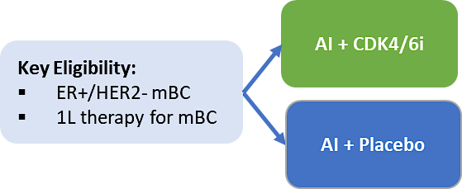
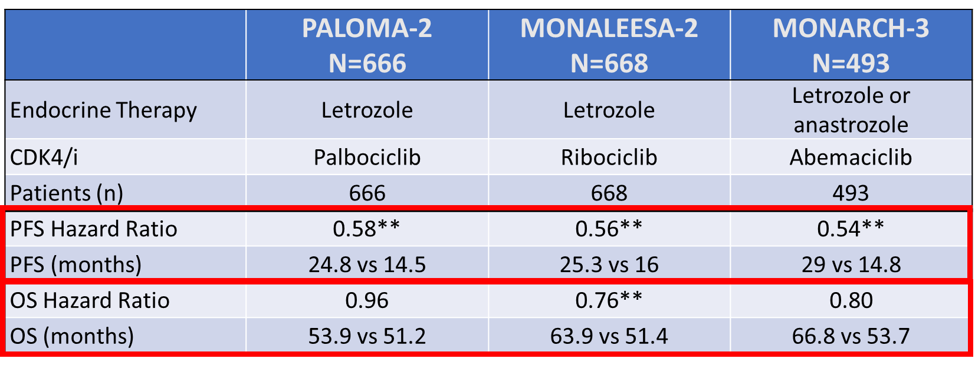
HR+ MBC: Frontline Therapy with AI +/- CDK4/6i
** statistically signficant
Finn NEJM 2016; Hortobagyi NEJM 2016; Goetz J Clin Oncol 2017; Finn, ASCO 2022; Hortobagyi NEJM 2022; Goetz SABCS 2023; GS01-12

Slide 62
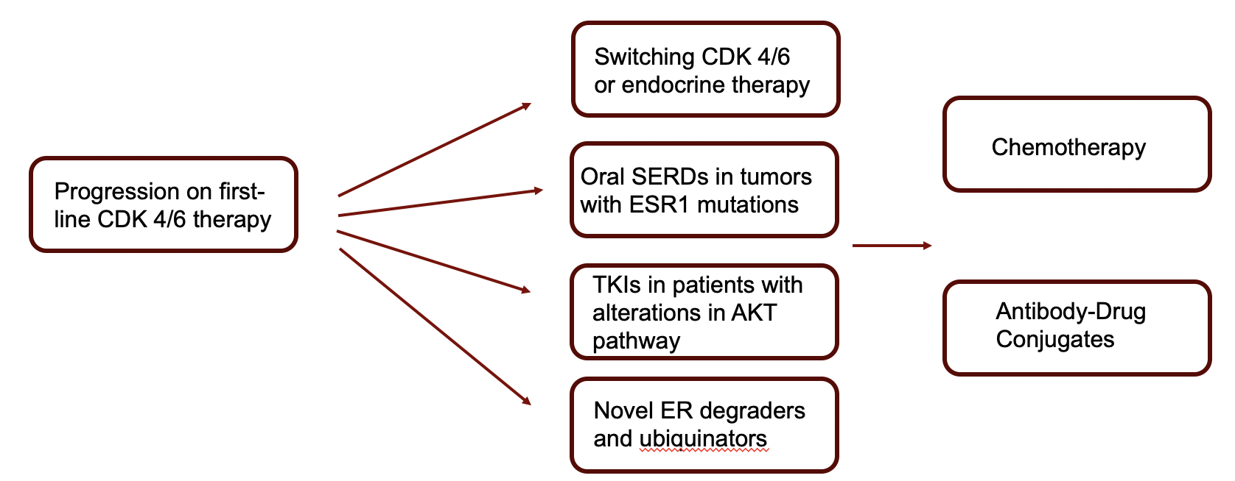
Treatment in Second Line Setting
After Progression on CDK4/6 Inhibition
ubiquinators

Slide 63
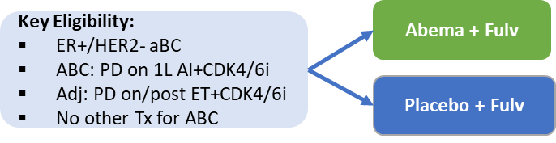
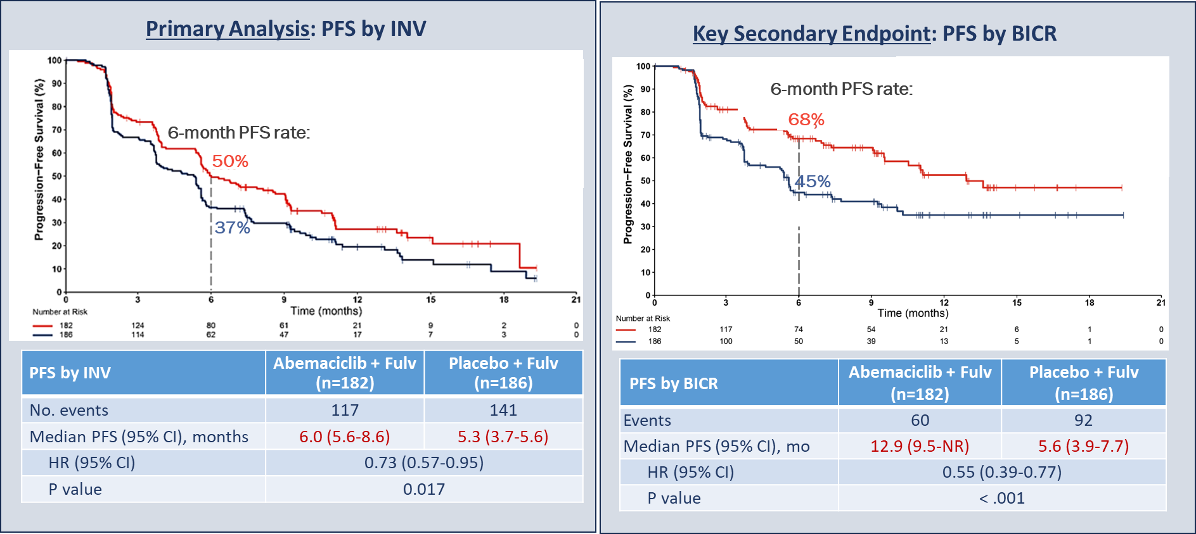
CDK4/6i post Progression on CDK4/6i:
The postMONARCH Randomized Phase 3 Trial
Kalinsky et al, JCO 2025

Slide 64
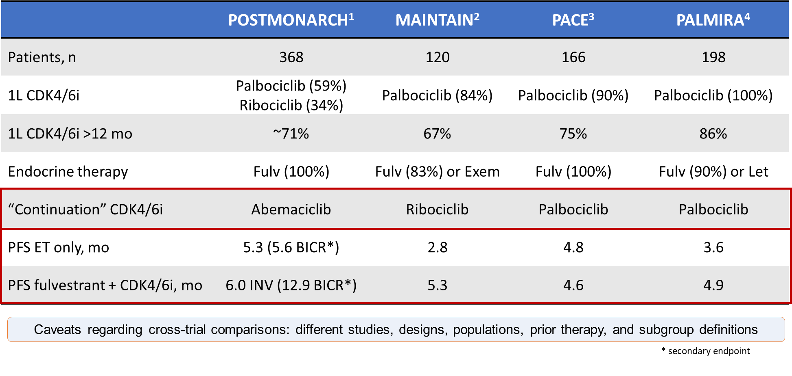
CDK4/6i After Progression on First-Line CDK4/6i
1.Kalinsky K, et al. ASCO 2024. LBA1001. 2. Kalinsky K et al. J Clin Oncol. 2023;41:4004-4013. 3. Mayer EL et al. SABCS 2022. Abstract GS3-06.
4. Llombart-Cussac A et al. ASCO 2023. Abstract 1001.

Slide 65
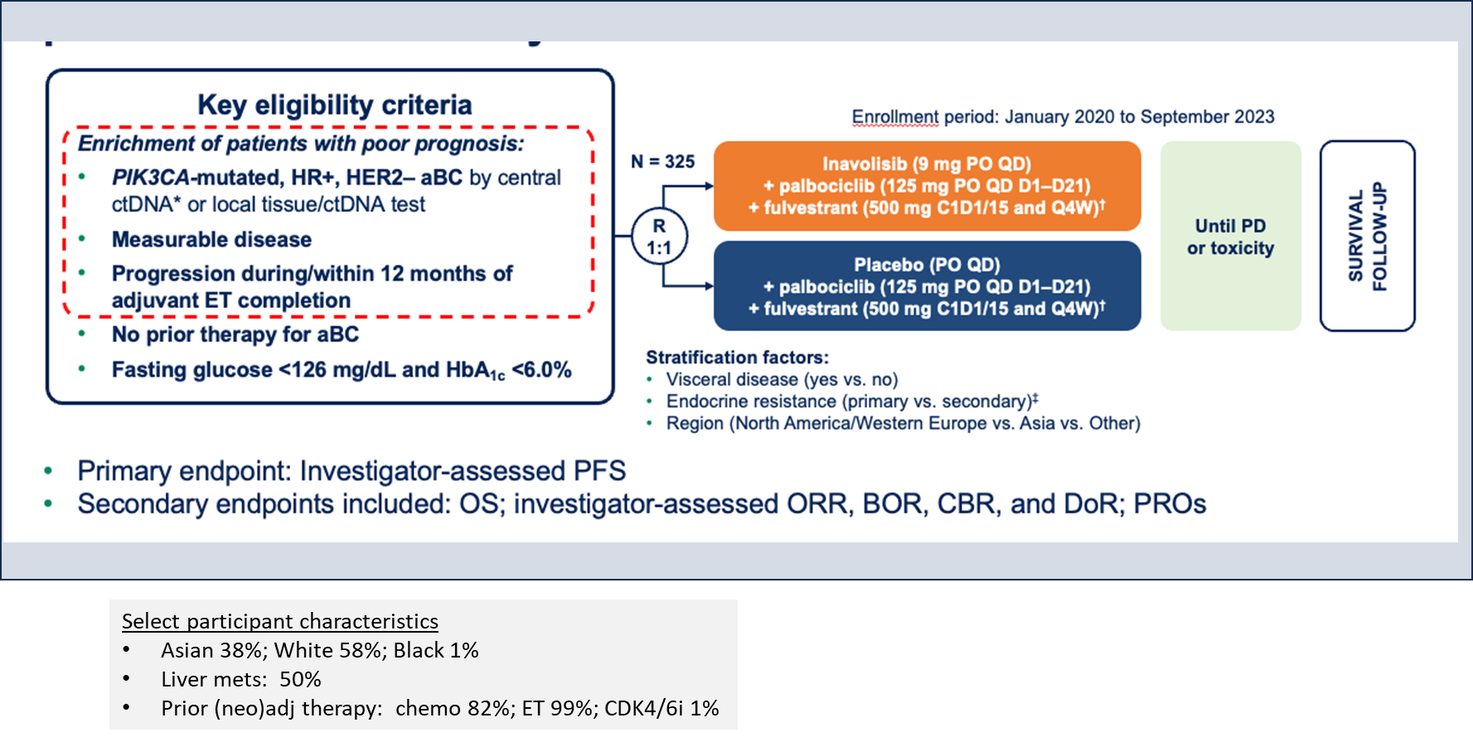
INAVO120: Palbo + Fulvestrant +/- Inavolisib in Patients with
PIK3CAm progressing ≤ 12 mos of completing adjuvant ET
Enrollment period:
Turner et al. NEJM 2024; Jhaveri et al. NEJM 2025

Slide 66
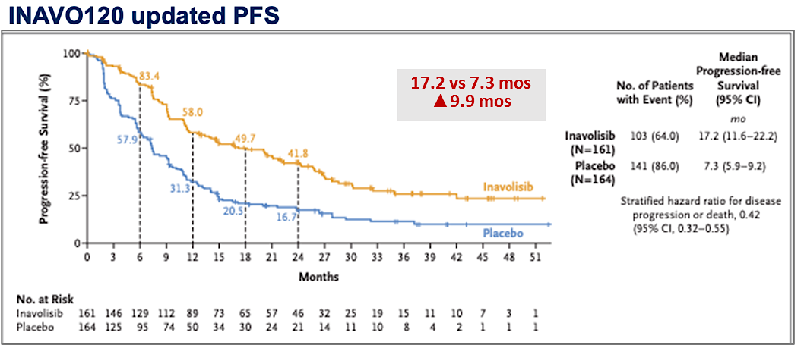
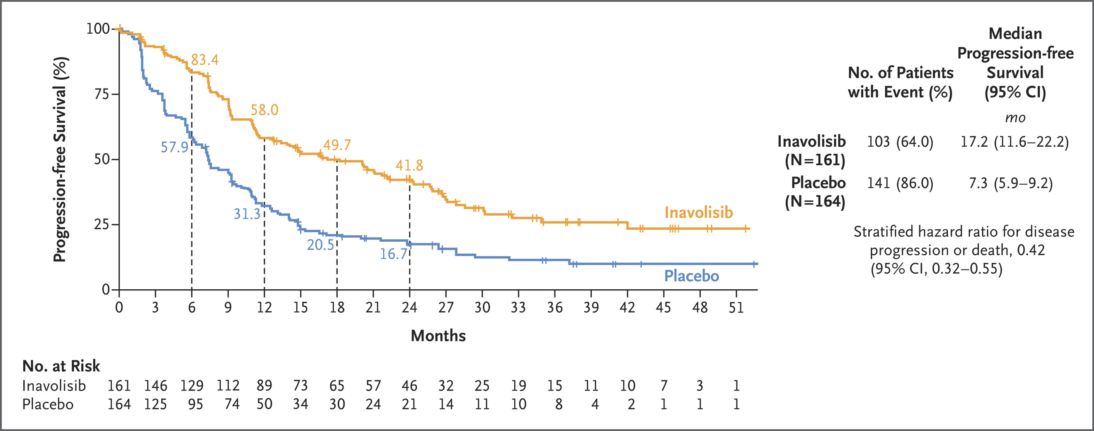
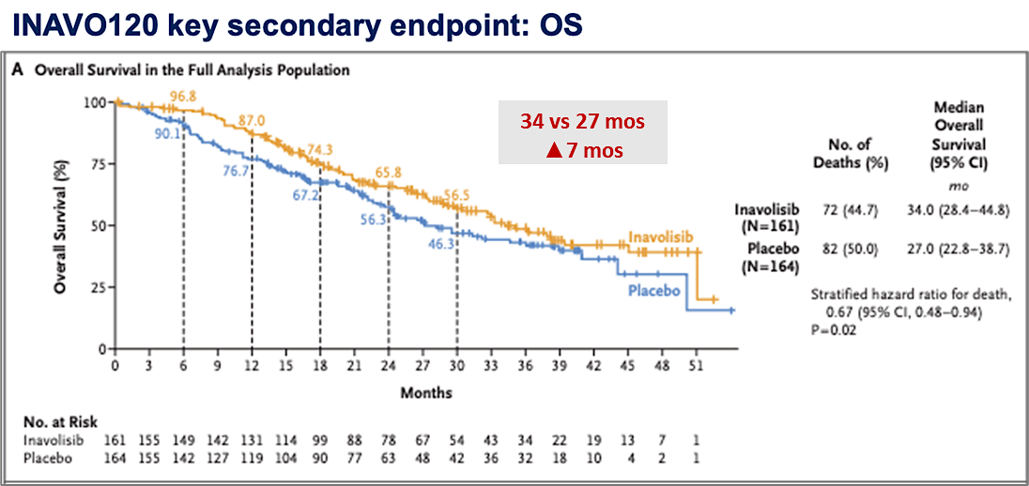
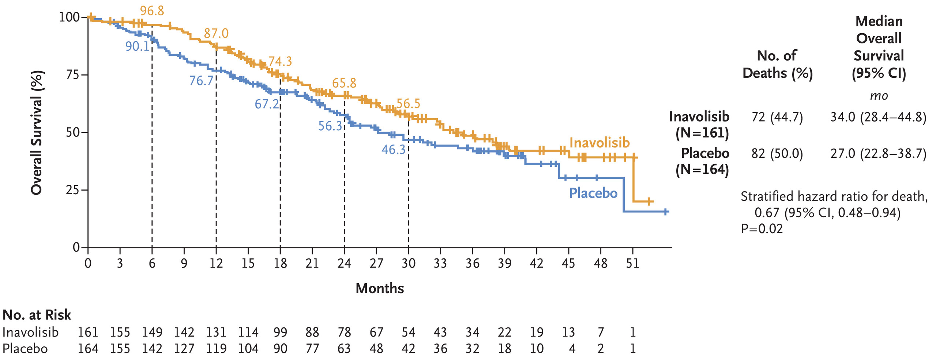
INAVO120: Palbo + Fulvestrant +/- Inavolisib
17.2 vs 7.3 mos
∆ 9.9 mos
Time to 1st chemo: 35.6 vs 12.6 mo (HR 0.43, CI 0.3-0.6)
Subsequent therapies (including 3L+)
  Pbo arm: 15% PI3Ki 2L+
  Pbo arm: more ADC (T-DXd 29% vs 12% inavo)
34 vs 27mos
∆ 7 mos
Turner et al. NEJM 2024
Jhaveri et al. NEJM 2025

Slide 67
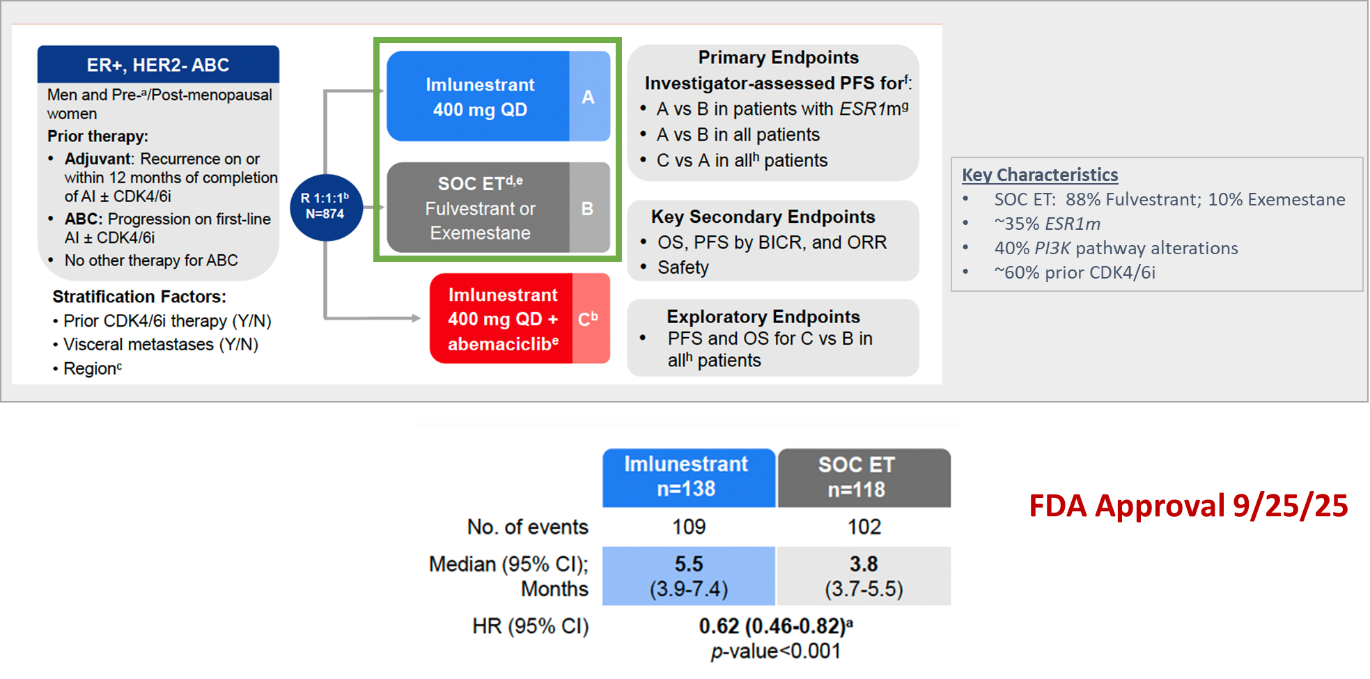
Ember 3 Trial: Imlunestrant (oral SERD) vs SOC ET
Jhaveri K, et al. NEJM 2025;392:12.

Slide 68
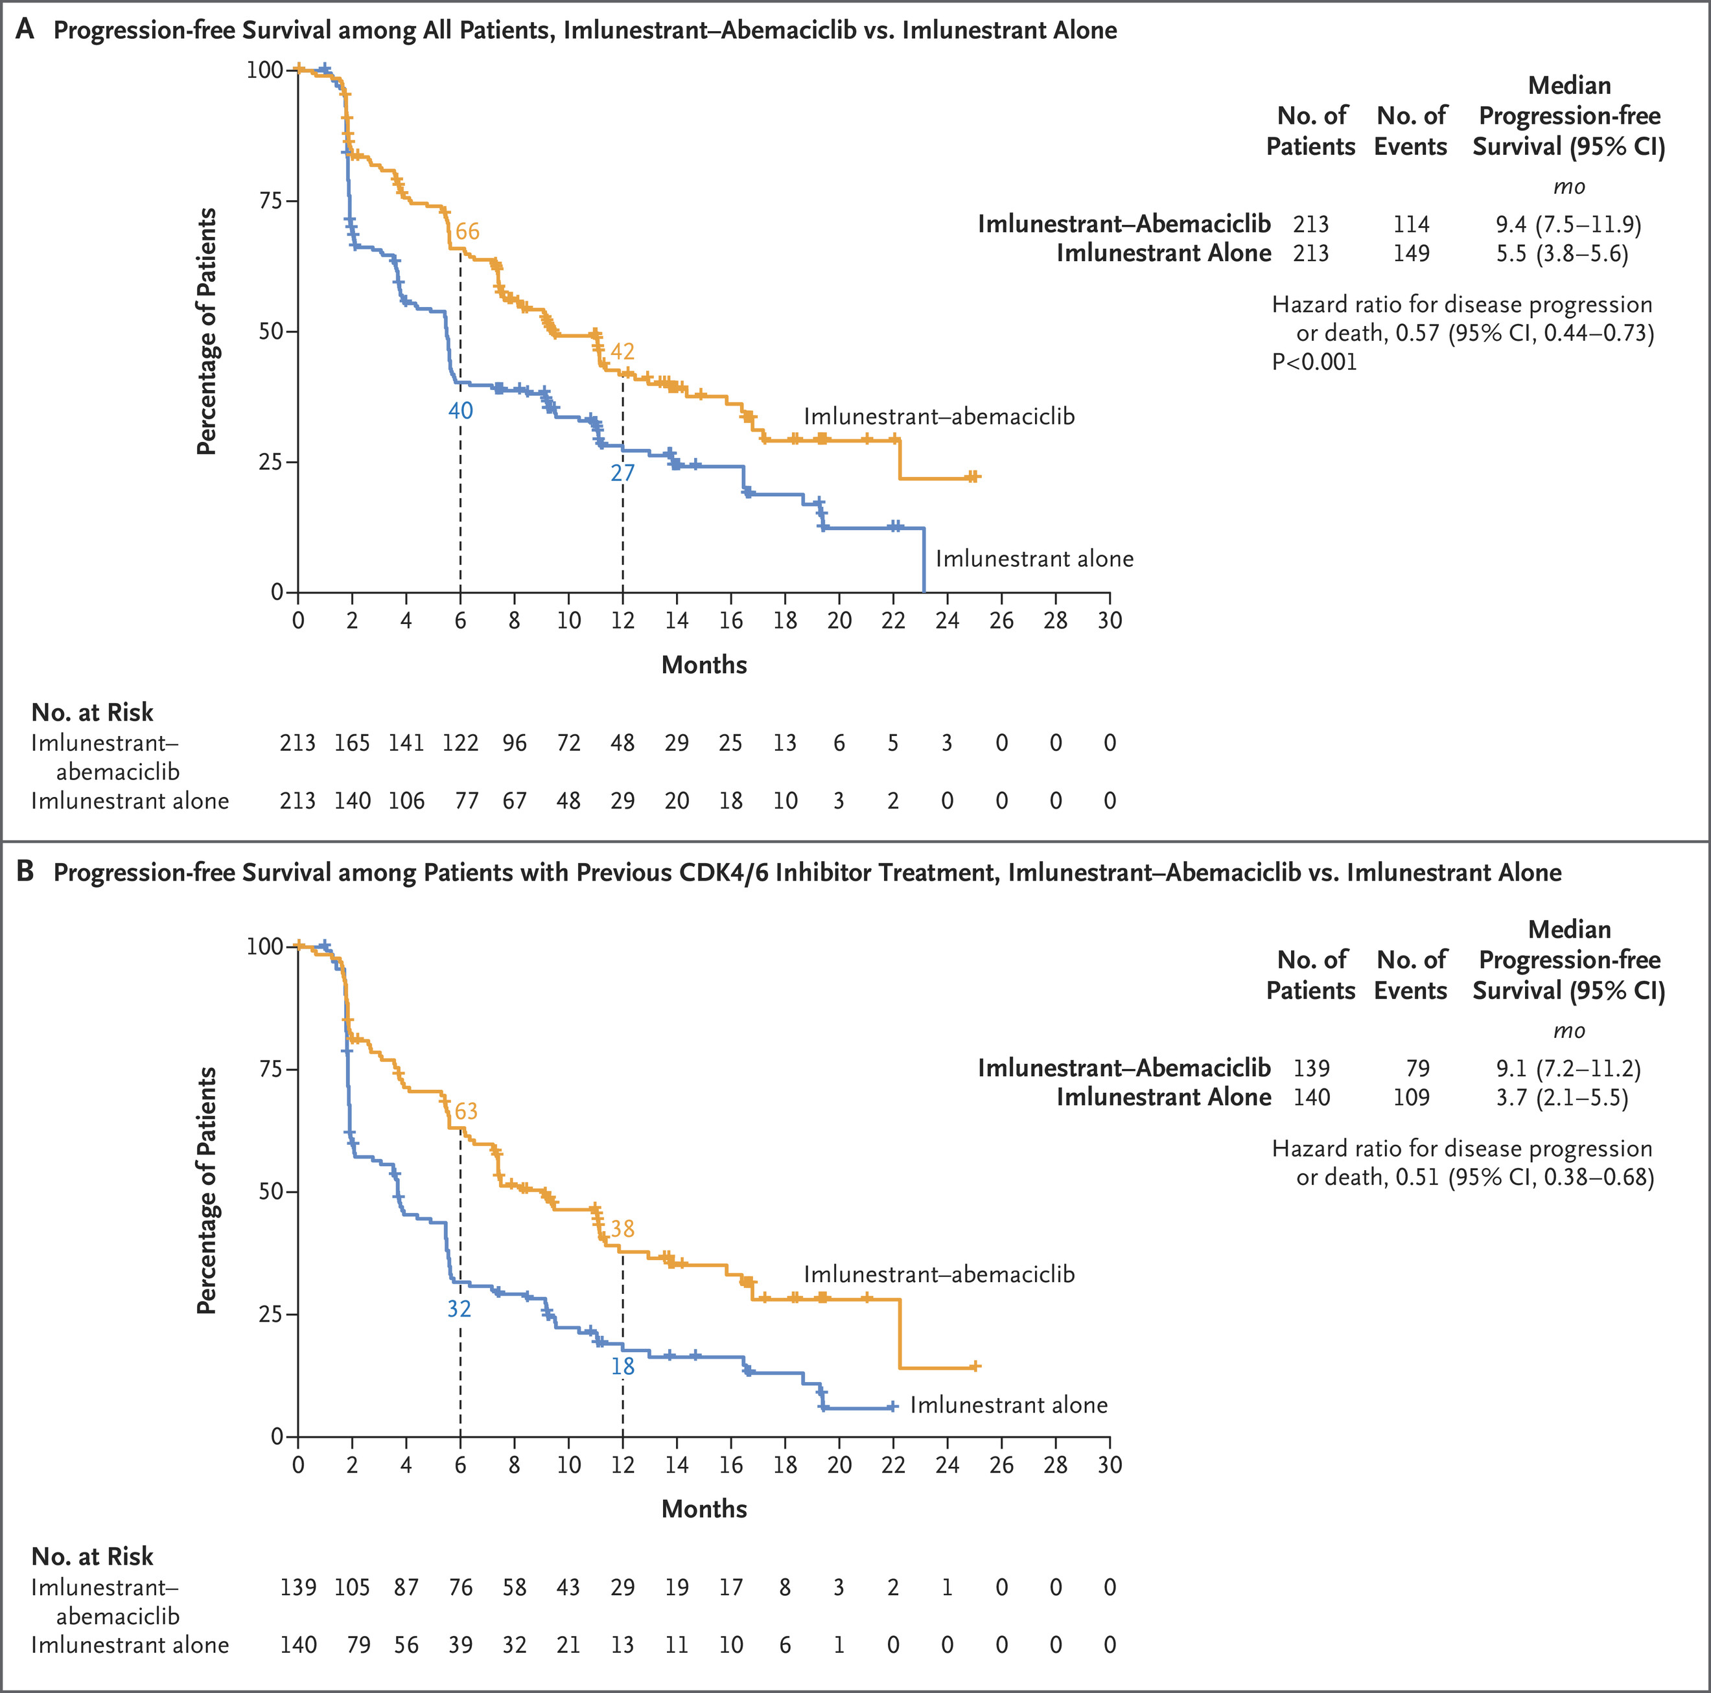
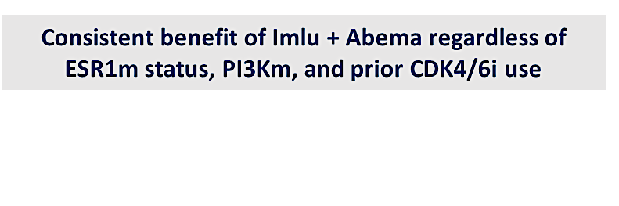
EMBER-3: Imlunestrant +/- Abemaciclib
PFS Imlu + Abema vs Imlu Alone: Overall Population
mPFS 9.4 vs 5.5 mos
(∆ 3.9 mos)
HR = 0.57 (0.44-0.73)
PFS Imlu + Abema vs Imlu Alone: Prior CDK4/6i
mPFS 9.1 vs 3.7 mos
(∆ 5.4 mos)
HR = 0.51 (0.38-0.68)
Jhaveri K, et al. NEJM 2025;392:12.

Slide 69
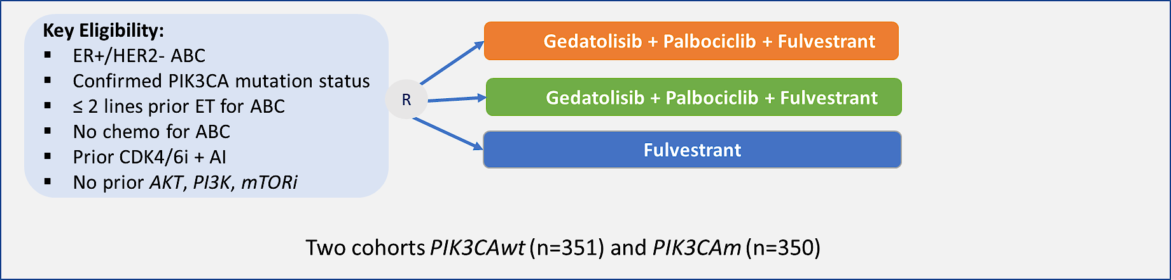
VIKTORIA-1: Randomized Phase 3 Trial of ET + CDK4/6i
+/- Gedatolisib (pan PI3K and mTORC1/2 Inhibitor)
Gedatolisib triplet:
  mPFS (BICR) 9.3 mo triplet vs 2.0 mo fulv alone (HR, 0.24; 95% CI, 0.17–0.35; P <.0001).
Gedatolisib doublet:
  mPFS (BICR) 7.4 mo doublet vs 2.0 mo fulv alone (HR, 0.33; 95% CI, 0.24–0.48; P <.0001).
Hurvitz et al, JCO 2026

Slide 70
Case Presentation

Slide 71
Case: HR+/HER2- MBC
55 yo woman is diagnosed with de novo metastatic HR+/HER2- breast cancer to the bones after presenting with lower back pain
NGS and germline genetic testing are performed at baseline and are unremarkable
She begins treatment with letrozole plus palbociclib and zoledronic acid
She does well until 9 years later, when she develops progressive bone metastases in multiple bones on bone scan (remains asymptomatic)
A liquid biopsy is performed and is negative for actionable alterations (specifically NO ESR1 or AKT pathway alterations are present)

Slide 72
Case: HR+/HER2- MBC Continued
She is now 65 yo and presents for next steps. What treatment would you recommend next:
Continue letrozole plus palbociclib as she has done so well for so long
Continue the letrozole but switch to abemaciclib
Switch to fulvestrant plus abemaciclib
Discontinue endocrine therapy-based therapy and proceed with chemotherapy

Slide 73
Discussion Questions
Do you generally include a CDK4/6 inhibitor as part of first-line therapy for all of your patients with HR-positive, HER2-negative mBC? In which situations, if any, do you not?
How do you select among the three available CDK4/6 inhibitors in the metastatic setting, and what factors influence this decision?
In what situations, if any, do you rechallenge with a CDK4/6 inhibitor after disease progression on first-line CDK4/6 inhibitor/endocrine therapy?

Slide 74
Agenda
Introduction: Advent of CDK4/6 Inhibitors in HR-Positive Breast Cancer (BC)
Module 1: Risk Assessment for Patients with HR-Positive, HER2-Negative Localized BC
Module 2: Adjuvant CDK4/6 Inhibitor Therapy
Module 3: Practical Considerations with CDK4/6 Inhibitors
Module 4: Monitoring and Management of Cytopenias
Module 5: CDK4/6 Inhibitors in HR-Positive Metastatic BC
Module 6: Management of Gastrointestinal Adverse Events
Module 7: CDK4/6 Inhibitors in Unique Populations
Module 8: Rarer CDK4/6 Inhibitor-Associated Toxicities

Slide 75
GI Adverse Events Documented with CDK4/6 Inhibitors
Kelly Fischer, MSN, FNP-BC
Family Nurse Practitioner
Dana-Farber Cancer Institute
Boston, Massachusetts

Slide 76
Rates of various GI issues in patients taking CDK4/6 inhibitor therapy
Adverse Reaction | Abemaciclib | Ribociclib | Palbociclib
Diarrhea | 82.2% | 15.0% | 19.1%
Nausea | 27.9% | 23.0% | 35.0%
Vomiting | 16.3% | 8.0% | 18.0%
Constipation | 10.3% | 13.2% | 17.0%
Abdominal pain | 34.0% | 11.0% | 10.0%
Dean B et al. J Adv Pract Oncol. 2024 Jul 22:1-8. Slamon D et al. N Engl J Med. 2024 Mar 21;390(12):1080-1091. Metzger O et al. N Engl J Med. 2026 Jan 29;394(5):451-462.

Slide 77
Strategies to mitigate and manage treatment-related GI AEs with CDK4/6 inhibitors
Start over-the-counter loperamide at first sign of diarrhea and take as needed
Stay hydrated and drink 8-10 glasses of water/clear liquids daily
Modify diet if needed – limit alcohol and caffeine intake, avoid spicy foods, refrain from lactose-containing food or drink
Start antiemetic like ondansetron or prochlorperazine at the first sign of nausea. Increase fluid intake
Dose escalation approach with abemaciclib may help with diarrhea

Slide 78
The TRADE study: A phase 2 trial to assess the tolerability of abemaciclib dose escalation in early-stage HR+/HER2- breast cancer
A prospective, single-arm study assessing whether dose escalation of abemaciclib improves tolerability
All patients started abemaciclib at 50 mg BID x 2 weeks, then increased to 100 mg BID x 2 weeks, then increased to 150 mg BID thereafter
  In order to increase to next dose level, patients could not be experiencing grade 3 or 4 or persistent grade 2 toxicity
Use of dose escalation abemaciclib allowed 70.8% of patients enrolled on the study to reach and continue the 150 mg BID dose at 12-week
There was a reduced incidence and severity of toxicity, such as diarrhea, with this dose escalation strategy
Mayer EL et al. ASCO 2025;Abstract 517

Slide 79
Role of nutritional counseling and diet modifications during CDK4/6 inhibitor treatment
Avoid grapefruit and pomegranate
Since abemaciclib can cause diarrhea, counsel patients to avoid foods that may worsen diarrhea, such as spicy, fatty, greasy, high-fiber foods
  Bland/”BRAT” diet is best with diarrhea (bananas, rice, applesauce, toast)
Small, frequent meals are recommended
Avoid/limit alcohol intake
Increase fluid intake, particularly if having diarrhea
  Don’t forget electrolytes (broth, popsicles, OTC rehydration drink)

Slide 80
Case Presentation

Slide 81
A 51 y/o female with pT1cN2a ER+, PR+, HER2- invasive lobular carcinoma
11/29/23: Left breast lumpectomy/SLN: 1.6 cm invasive carcinoma with ductal and lobular features (predominantly lobular features) grade 2. 3/4 positive SLN (largest metastatic focus is 1.2 cm, 1 macromet, 2 micromet), ENE present in association with macrometastases. Oncotype RS 12.
12/29/23 Left axillary ALND and re-excision: metastatic ductal carcinoma in 2 of 10 LN (1 macromet and 1 micromet, largest micromet focus 0.3 cm). Re-excision of left inferior and medial margin (DCIS is present on the inked margins). In total, 5/14 nodes positive. pT1cN2a.
1/16/24 - 04/23/24 ddAC-T x 8 cycles.
3/12/24 Started leuprolide.
6/1/2024: Started adjuvant letrozole.
8/2024: Completed adjuvant radiation.
8/27/2024: Started adjuvant abemaciclib (on TRADE trial).
9/2024: Start adjuvant zoledronic acid.

Slide 82
A 51 y/o female with pT1cN2a ER+, PR+, HER2- invasive lobular carcinoma
Married, has two kids (13 y/o and 16 y/o), works remotely from home 3 days a week
Premenopausal at the time of diagnosis
Adjuvant therapy includes:
  Ovarian suppression with monthly leuprolide injections
  Letrozole
  Abemaciclib
Started to experience hot flashes and difficulty sleeping during chemotherapy, and has continued with similar side effect profile on OFS + AI
Has been tolerating abemaciclib at 150 mg BID dose very well
  Intermittent diarrhea (infrequent, ~2 episodes per month, well-controlled with PRN loperamide)

Slide 83
Agenda
Introduction: Advent of CDK4/6 Inhibitors in HR-Positive Breast Cancer (BC)
Module 1: Risk Assessment for Patients with HR-Positive, HER2-Negative Localized BC
Module 2: Adjuvant CDK4/6 Inhibitor Therapy
Module 3: Practical Considerations with CDK4/6 Inhibitors
Module 4: Monitoring and Management of Cytopenias
Module 5: CDK4/6 Inhibitors in HR-Positive Metastatic BC
Module 6: Management of Gastrointestinal Adverse Events
Module 7: CDK4/6 Inhibitors in Unique Populations
Module 8: Rarer CDK4/6 Inhibitor-Associated Toxicities

Slide 84
Role of CDK4/6 Inhibitors in Unique Populations of Patients with
HR-Positive mBC
Ruth M O’Regan, MD
Charles A Dewey Professor of Medicine and Oncology
Chair, Department of Medicine
University of Rochester Medical Center
Physician-in-Chief
Strong Memorial Hospital
Associate Director of Education and Mentoring
Wilmot Cancer Institute
Rochester, New York

Slide 85
Case history
65-year-old female presents with 6-week history of abdominal pain with nausea
Admits to 6-month history of back pain.
Examination reveals a right breast mass with palpable axillary nodes and hepatomegaly
Systemic imaging reveals extensive metastatic disease in her liver and bones and confirms the right breast mass and axillary nodes
Liver biopsy: metastatic carcinoma consistent with a breast primary, ER-positive, PR-negative, HER2-negative
LFTs with mild elevation in transaminases and normal bilirubin

Slide 86
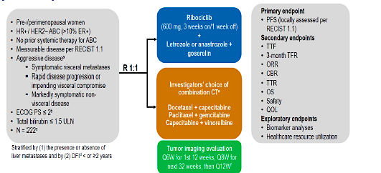
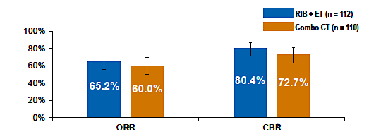
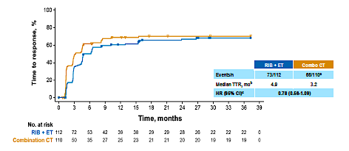
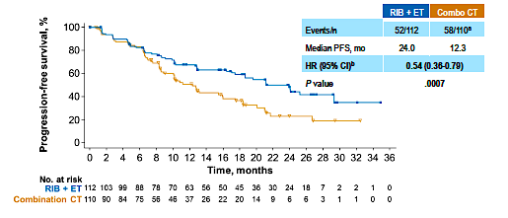
RIGHT Choice (Phase 2): Ribociclib + endocrine therapy vs chemotherapy for patients with HR+/HER2− advanced breast cancer
Time to response
Progression-free survival
Treatment discontinued due to adverse events 6.3% with ribo/ET versus 27% with chemo
No difference in PFS for patients with visceral crisis (n=88)
Gao M et al. Miami Breast Cancer Conference 2023; Lu et al J Clin Oncol 2024:42:2812

Slide 87
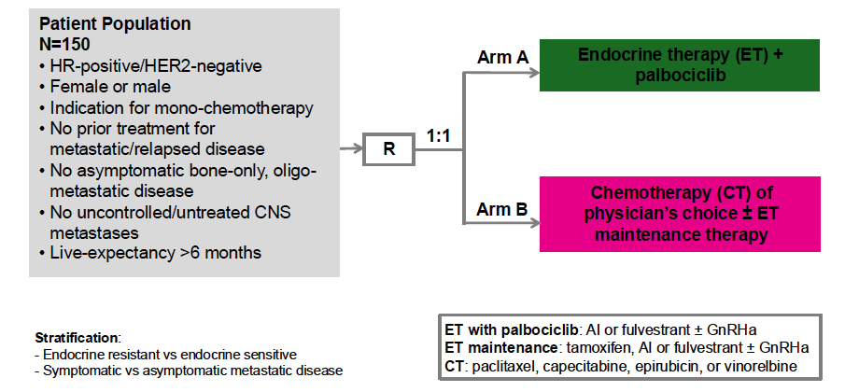
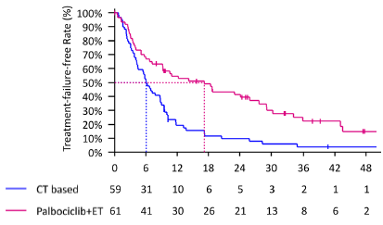
PADMA: Palbociclib plus endocrine therapy versus single agent chemotherapy
Time to Treatment Failure
HR 0.46 p<.001
17.2 months
6.1 months
Indication for chemotherapy:
Symptomatic visceral metastases
Aggressive disease with rapid progression
Prior endocrine-resistance
High disease burden
 | PALBO/ET | CHEMO | P VALUE
PFS | 18.7 mos | 7.8 mos. | P<.001
ORR | 59% | 40%
OS | 46 mos. | 37 mos.
Loibl et al SABCS 2024

Slide 88
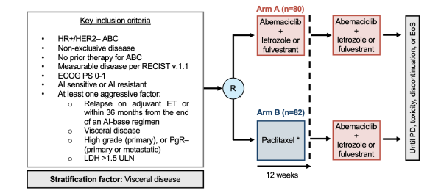
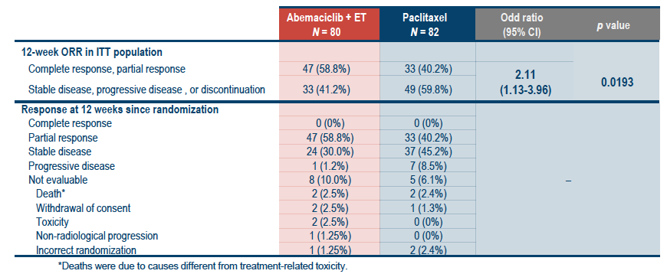
ABIGAIL Trial: Abemaciclib $±$ induction paclitaxel in HR+ metastatic breast cancer plus real-world data
UK real-world retrospective
study compared CDKi versus
Paclitaxel in patients (n=482)
with impending or documented
visceral crisis:
TTF 17 vs 4 months, OS 25 vs
4.5 months
Real-world analysis of 336
patients with visceral crisis:
Overall survival 11 months with
CDKi versus 6 months with
paclitaxel (p=.01)
De La Haba-Rodriquez et al ESMO 2024
Behrouzi et al BCRT 2023, Dawood JCO 2021

Slide 89
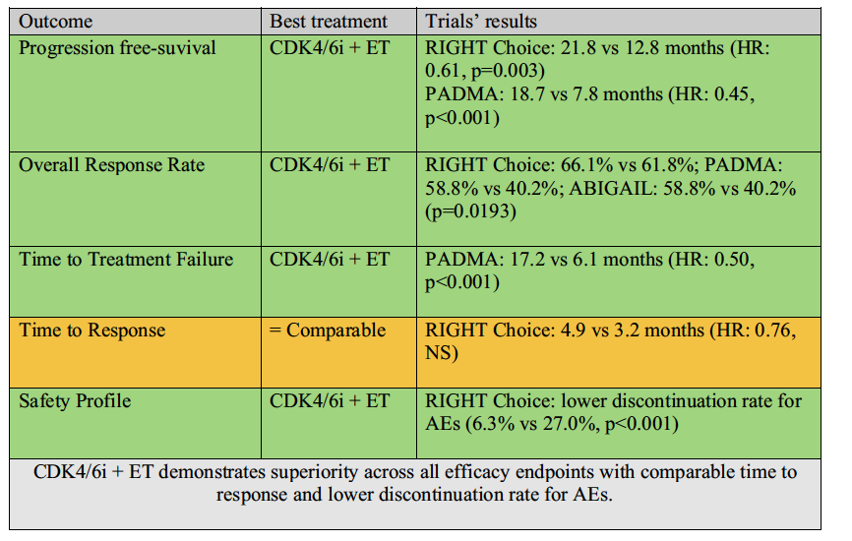
CDK4/6i versus chemotherapy in HR-positive aggressive disease
Orlandi Discover Oncology 2025

Slide 90
Phase II trial of abemaciclib in patients with HR-positive brain metastases
Patients with HR-positive, HER2-negative breast cancer with brain metastases (cohort A, n=55)
  Median number of brain mets was 2 and prior radiation in 82% (Whole brain 47%, SRS 35%)
  Intracranial objective response 5%, intracranial disease control at 6-months 24%, intracranial PFS 5-months
Patients with HR-positive leptomeningeal disease (cohort C, n=7)
  Intracranial disease control at 6-months 14%
CSF analysis showed high levels of abemaciclib compared to plasma
  Confirms preclinical studies showing abemaciclib crosses the blood-brain-barrier
Tolaney et al Clin Cancer Res 2020

Slide 91
Radiotherapy with CDKi in patients with
HR-positive brain metastases
Patients (n=24) received radiotherapy to the brain before (n=11), during (n=6), and after (n=7)
PFS at 6 months 77% and at 12 months 50%
Local control at 6 months 80% and at 12 months 69%
Radiotherapy with CDKi appears feasible (though patient numbers are small)
Kubeczko et al Clin Med 2023

Slide 92
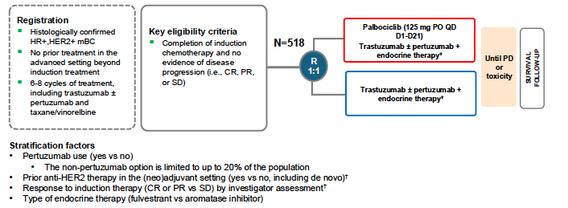
PATINA: Addition of palbociclib to maintenance HER2 and ER-directed therapy in HR-positive, HER2-positive MBC
Metzger et al SABCS 2024; Metzger et al N Eng J Med 2026

Slide 93
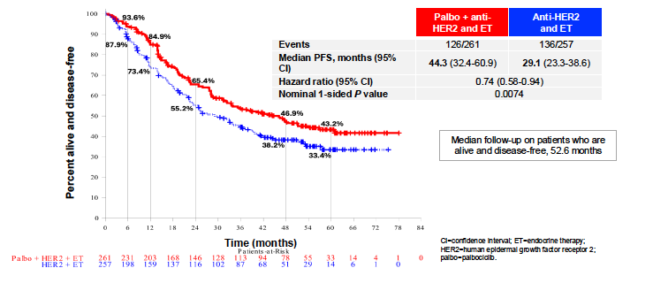
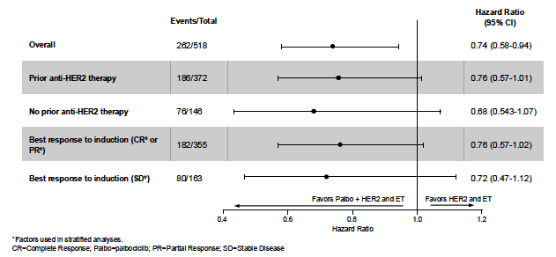
PATINA: Addition of palbociclib to maintenance HER2 and ER-directed therapy in HR-positive, HER2-positive MBC
Median lines of induction therapy = 6
CR/PR to induction therapy = 69%
SD following induction = 31%
Metzger et al SABCS 2024; Metzger et al N Eng J Med 2026

Slide 94
Discussion Questions
How do you think through the selection of initial therapy for patients with HR-positive, HER2-negative mBC with symptomatic visceral disease? How do you decide between a CDK4/6 inhibitor/endocrine therapy and chemotherapy?
How do CDK4/6 inhibitors fit into treatment for patients with brain metastases?

Slide 95
Agenda
Introduction: Advent of CDK4/6 Inhibitors in HR-Positive Breast Cancer (BC)
Module 1: Risk Assessment for Patients with HR-Positive, HER2-Negative Localized BC
Module 2: Adjuvant CDK4/6 Inhibitor Therapy
Module 3: Practical Considerations with CDK4/6 Inhibitors
Module 4: Monitoring and Management of Cytopenias
Module 5: CDK4/6 Inhibitors in HR-Positive Metastatic BC
Module 6: Management of Gastrointestinal Adverse Events
Module 7: CDK4/6 Inhibitors in Unique Populations
Module 8: Rarer CDK4/6 Inhibitor-Associated Toxicities

Slide 96
Rarer but Potentially Serious Toxicities Associated with One or More CDK 4/6 Inhibitors
Marissa Marti-Smith
DNP, APRN, AGNP-C, AOCNP

Slide 97
The Rare 5 Safety Concerns
Lung Health
ILD monitoring
Blood Clots
VTE, especially with abemaciclib.
Liver Safety
Liver enzyme monitoring
Cardiac
Monitoring the rhythm (QTc) during ribociclib therapy.
Skin toxicity
Rare, severe skin reactions
like SJS or DRESS.
(Spring et al., 2020)

Slide 98
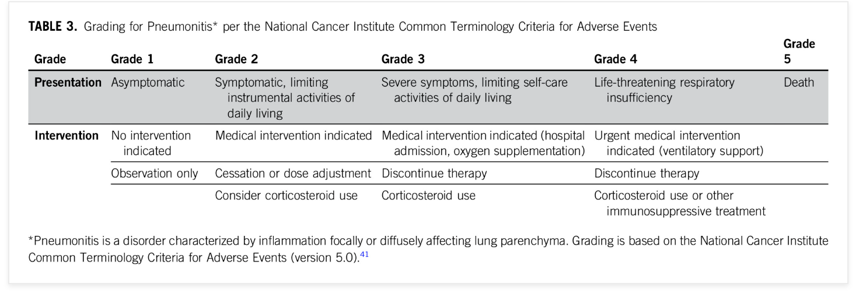
Managing ILD
Incidence: At the end of 2019, the FDA reviewed all clinical trials for the three approved CDK4/6 inhibitors and found that pneumonitis was identified in 1% to 3% of cases and less than 1% had a fatal outcome
Early Signs: New cough or shortness of breath.
Action: Hold treatment for any suspected symptoms. Scan.
(Anders et al., 2020)

Slide 99

ILD Management Algorithm
Stop drug OR dose reduction
Steroids if needed
Supportive measures
Rechallenge can be considered
(Anders et al., 2020)

Slide 100
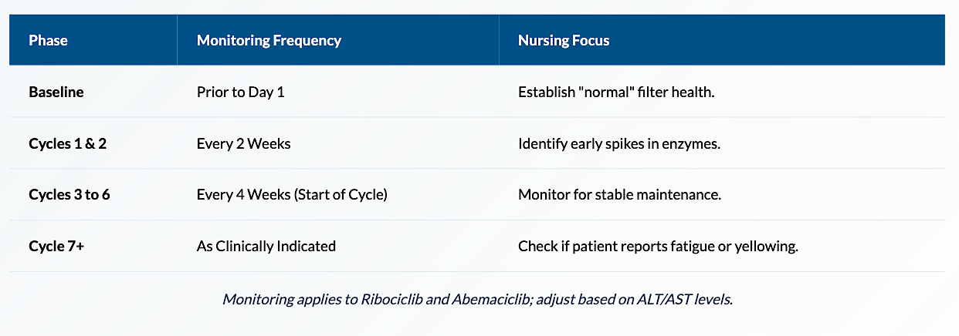
Liver Safety: Monitoring
(Lipsyc-Sharf et al., 2025)

Slide 101

Handling Liver Enzyme Stress
Silent laboratory spike (AST/ALT)
Pre-existing liver insufficiency, Fatty liver disease
Hepatitis
Hepatotoxic medications and alcohol abuse.
Grade 1 (>3x ULN) & Grade 2 (>3-5x ULN) no dose mod req
Persistent/Recurrent Grade 2 or Grade 3 (>5-20x ULN): Hold until Grade 1, then resume at lower dose.
Liver Injury: If bilirubin also rises (>2x ULN), discontinue therapy permanently.
(Wekking et al., 2023), (U.S. Food and Drug Administration, 2023) Prescribing Information

Slide 102
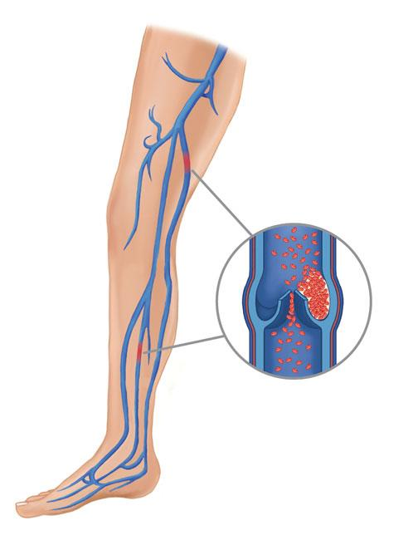
VTE & Blood Clots
Circulation Blockage:
  Blood clots can form in the legs (DVT) or lungs (PE). This risk is notably higher with abemaciclib.
Leg swelling, pain, redness, warmth, or sudden chest tightness.
Rate: ~2.3% in monarchE trial participants.
Screen for pre-existing risk factors at every cycle.
(Johnston et al., 2020)

Slide 103

Heart Rhythm: QTc monitoring
Ribociclib
Ensuring safe electrical activity w/ heart
QTcF <450 ms
Baseline ECG
ECG + check electrolytes (K, Mg, Phos, Ca)
Cycle 1 on D14 , Cycle 2 & as needed
Avoid QT prolonging drugs and/or strong CYP3A inhibitors
U.S. Food and Drug Administration. (2023). Ribociclib full prescribing information.

Slide 104

Skin Toxicities
Less frequent with CDK’s
Red Flag Signs
Painful rashes, mouth blisters, or peeling skin accompanied by a high fever.
Severe reactions (SJS/Toxic epidermal necrolysis TEN)
Drug-induced hypersensitivity syndrome (diHS)
Drug reaction with eosinophilia and systemic symptoms (DRESS)
(Anders et al., 2020),
U.S. Food and Drug Administration. (2023). ribociclib full prescribing information.

Slide 105
Case Presentation

Slide 106

Case Study
53 yo female
Metastatic Breast CA pt, extensive bone and pleural mets, nodal mets
Hx Fatty liver, Hypercholesterolemia, HTN
Fulvestrant + abemaciclib 150mg PO BID , 1st line
6 week check
AST 197, ALT 323, Alk Phos 250, Bili normal
No alcohol / Tylenol
Oxycodone for pain

Slide 107

Management & Takeaway
Held x3 weeks, LFTs did not improve off meds, hospitalized
U/S showed fatty liver, biopsy confirmed moderate to severe macrovesicular steatosis
IV steroids, d/c’ed on oral steroids
1 mo later AST 345/ ALT 929, Alk Phos 163, Bili 1.1
4 months off therapy, began palbociclib

