Slide 1
What Clinicians Want to Know: Optimizing the Management of Metastatic Triple-Negative Breast Cancer
A CME/MOC-Accredited Live Webinar
Thursday, April 30, 2026 5:00 PM – 6:00 PM ET
Faculty
Kevin Punie, MD
Tiffany A Traina, MD, FASCO
Moderator
Neil Love, MD

Slide 2



Faculty
Kevin Punie, MD Medical Oncologist ZAS Hospitals Antwerp, Belgium
MODERATOR
Neil Love, MD Research To Practice Miami, Florida
Tiffany A Traina, MD, FASCO Vice Chair, Department of Medicine Section Head Triple-Negative Breast Cancer Clinical Research Program Associate Attending Physician Breast Medicine Service Memorial Sloan Kettering Cancer Center Associate Professor Weill Cornell Medical College New York, New York

Slide 3
Commercial Support
This activity is supported by an educational grant from Gilead Sciences Inc.

Slide 4
Dr Love — Disclosures
Dr Love is president and CEO of Research To Practice. Research To Practice receives funds in the form of educational grants to develop CME activities from the following companies: Aadi Bioscience, AbbVie Inc, ADC Therapeutics, Agendia Inc, Alexion Pharmaceuticals, Amgen Inc, Array BioPharma Inc, a subsidiary of Pfizer Inc, Arvinas, Astellas, AstraZeneca Pharmaceuticals LP, Aveo Pharmaceuticals, Bayer HealthCare Pharmaceuticals, BeOne, Biotheranostics Inc, A Hologic Company, Black Diamond Therapeutics Inc, Blueprint Medicines, Boehringer Ingelheim Pharmaceuticals Inc, Bristol Myers Squibb, Celcuity, Clovis Oncology, Coherus BioSciences, Corcept Therapeutics Inc, CTI BioPharma, a Sobi Company, Daiichi Sankyo Inc, Eisai Inc, Elevation Oncology Inc, Exact Sciences Corporation, Exelixis Inc, Genentech, a member of the Roche Group, Genmab US Inc, Geron Corporation, Gilead Sciences Inc, GSK, Helsinn Therapeutics (US) Inc, ImmunoGen Inc, Incyte Corporation, Ipsen Biopharmaceuticals Inc, Jazz Pharmaceuticals Inc, Johnson & Johnson, Karyopharm Therapeutics, Kite, A Gilead Company, Kura Oncology, Legend Biotech, Lilly, MEI Pharma Inc, Merck, Mersana Therapeutics Inc, Mirati Therapeutics Inc, Mural Oncology Inc, Natera Inc, Novartis, Novartis Pharmaceuticals Corporation on behalf of Advanced Accelerator Applications, Novocure Inc, Nuvalent, Nuvation Bio Inc, Pfizer Inc, Pharmacyclics LLC, an AbbVie Company, Puma Biotechnology Inc, Regeneron Pharmaceuticals Inc, Revolution Medicines Inc, Rigel Pharmaceuticals Inc, R-Pharm US, Sanofi, Seagen Inc, Servier Pharmaceuticals LLC, SpringWorks Therapeutics Inc, Stemline Therapeutics Inc, Sumitomo Pharma America, Summit Therapeutics, Syndax Pharmaceuticals, Taiho Oncology Inc, Takeda Pharmaceuticals USA Inc, TerSera Therapeutics LLC, and Tesaro, A GSK Company.

Slide 5
Research To Practice CME Planning Committee Members, Staff and Reviewers
Planners, scientific staff and independent reviewers for Research To Practice have no relevant financial relationships to disclose.

Slide 6
Dr Punie — Disclosures
Advisory Committees and Consulting Agreements | AstraZeneca Pharmaceuticals LP, Eisai Inc, Exact Sciences Corporation, Focus Patient, Gilead Sciences Inc, Lilly, Medimix Specialty Pharmacy, Menarini Group, MSD, Mundipharma, Need, Nordic Group, Novartis, Pfizer Inc, Roche Laboratories Inc, Sanofi, Seagen Inc
Contracted Research | Novartis
Data and Safety Monitoring Boards/Committees | AstraZeneca Pharmaceuticals LP
Travel Assistance | AstraZeneca Pharmaceuticals LP, Gilead Sciences, Inc, MSD
Nonrelevant Financial Relationships | Medscape

Slide 7
Dr Traina — Disclosures
Advisory Committees and Consulting Agreements | Aktis Oncology, BioNTech SE, Bristol Myers Squibb, Corcept Therapeutics Inc, Daiichi Sankyo Inc, Ellipses Pharma, Exact Sciences Corporation, Genentech, a member of the Roche Group, Gilead Sciences Inc, Merck, Pfizer Inc, Stemline Therapeutics Inc, TerSera Therapeutics LLC, Veracyte Inc
Contracted Research | Astellas, AstraZeneca Pharmaceuticals LP, BioNTech SE, Daiichi Sankyo Inc, Genentech, a member of the Roche Group, Pfizer Inc

Slide 8
This educational activity contains discussion of non-FDA-approved uses of agents and regimens. Please refer to official prescribing information for each product for approved indications.

Slide 9
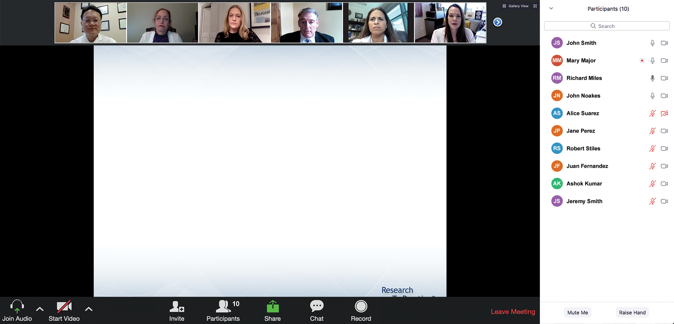

We Encourage Clinicians in Practice to Submit Questions
Feel free to submit questions now before the program begins and throughout the program.

Slide 10
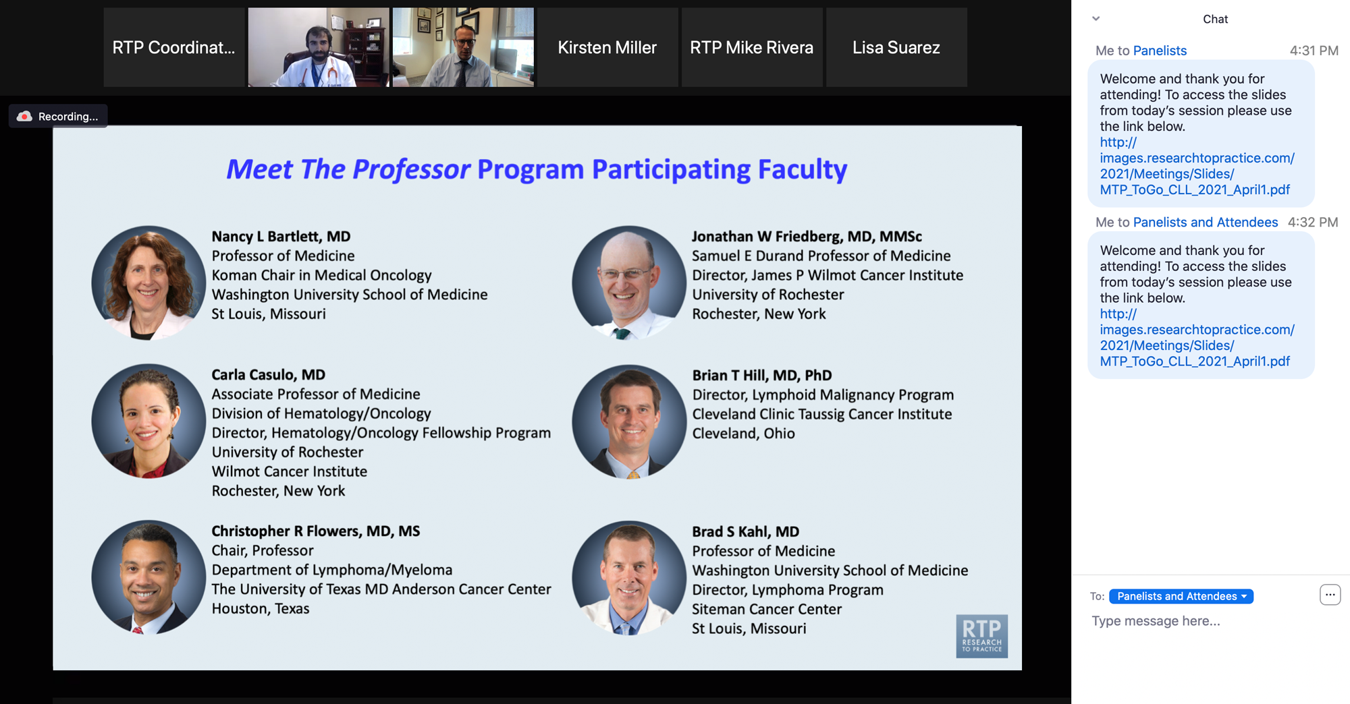
Familiarizing Yourself with the Zoom Interface
Expand chat submission box
Drag the white line above the submission box up to create more space for your message.

Slide 11
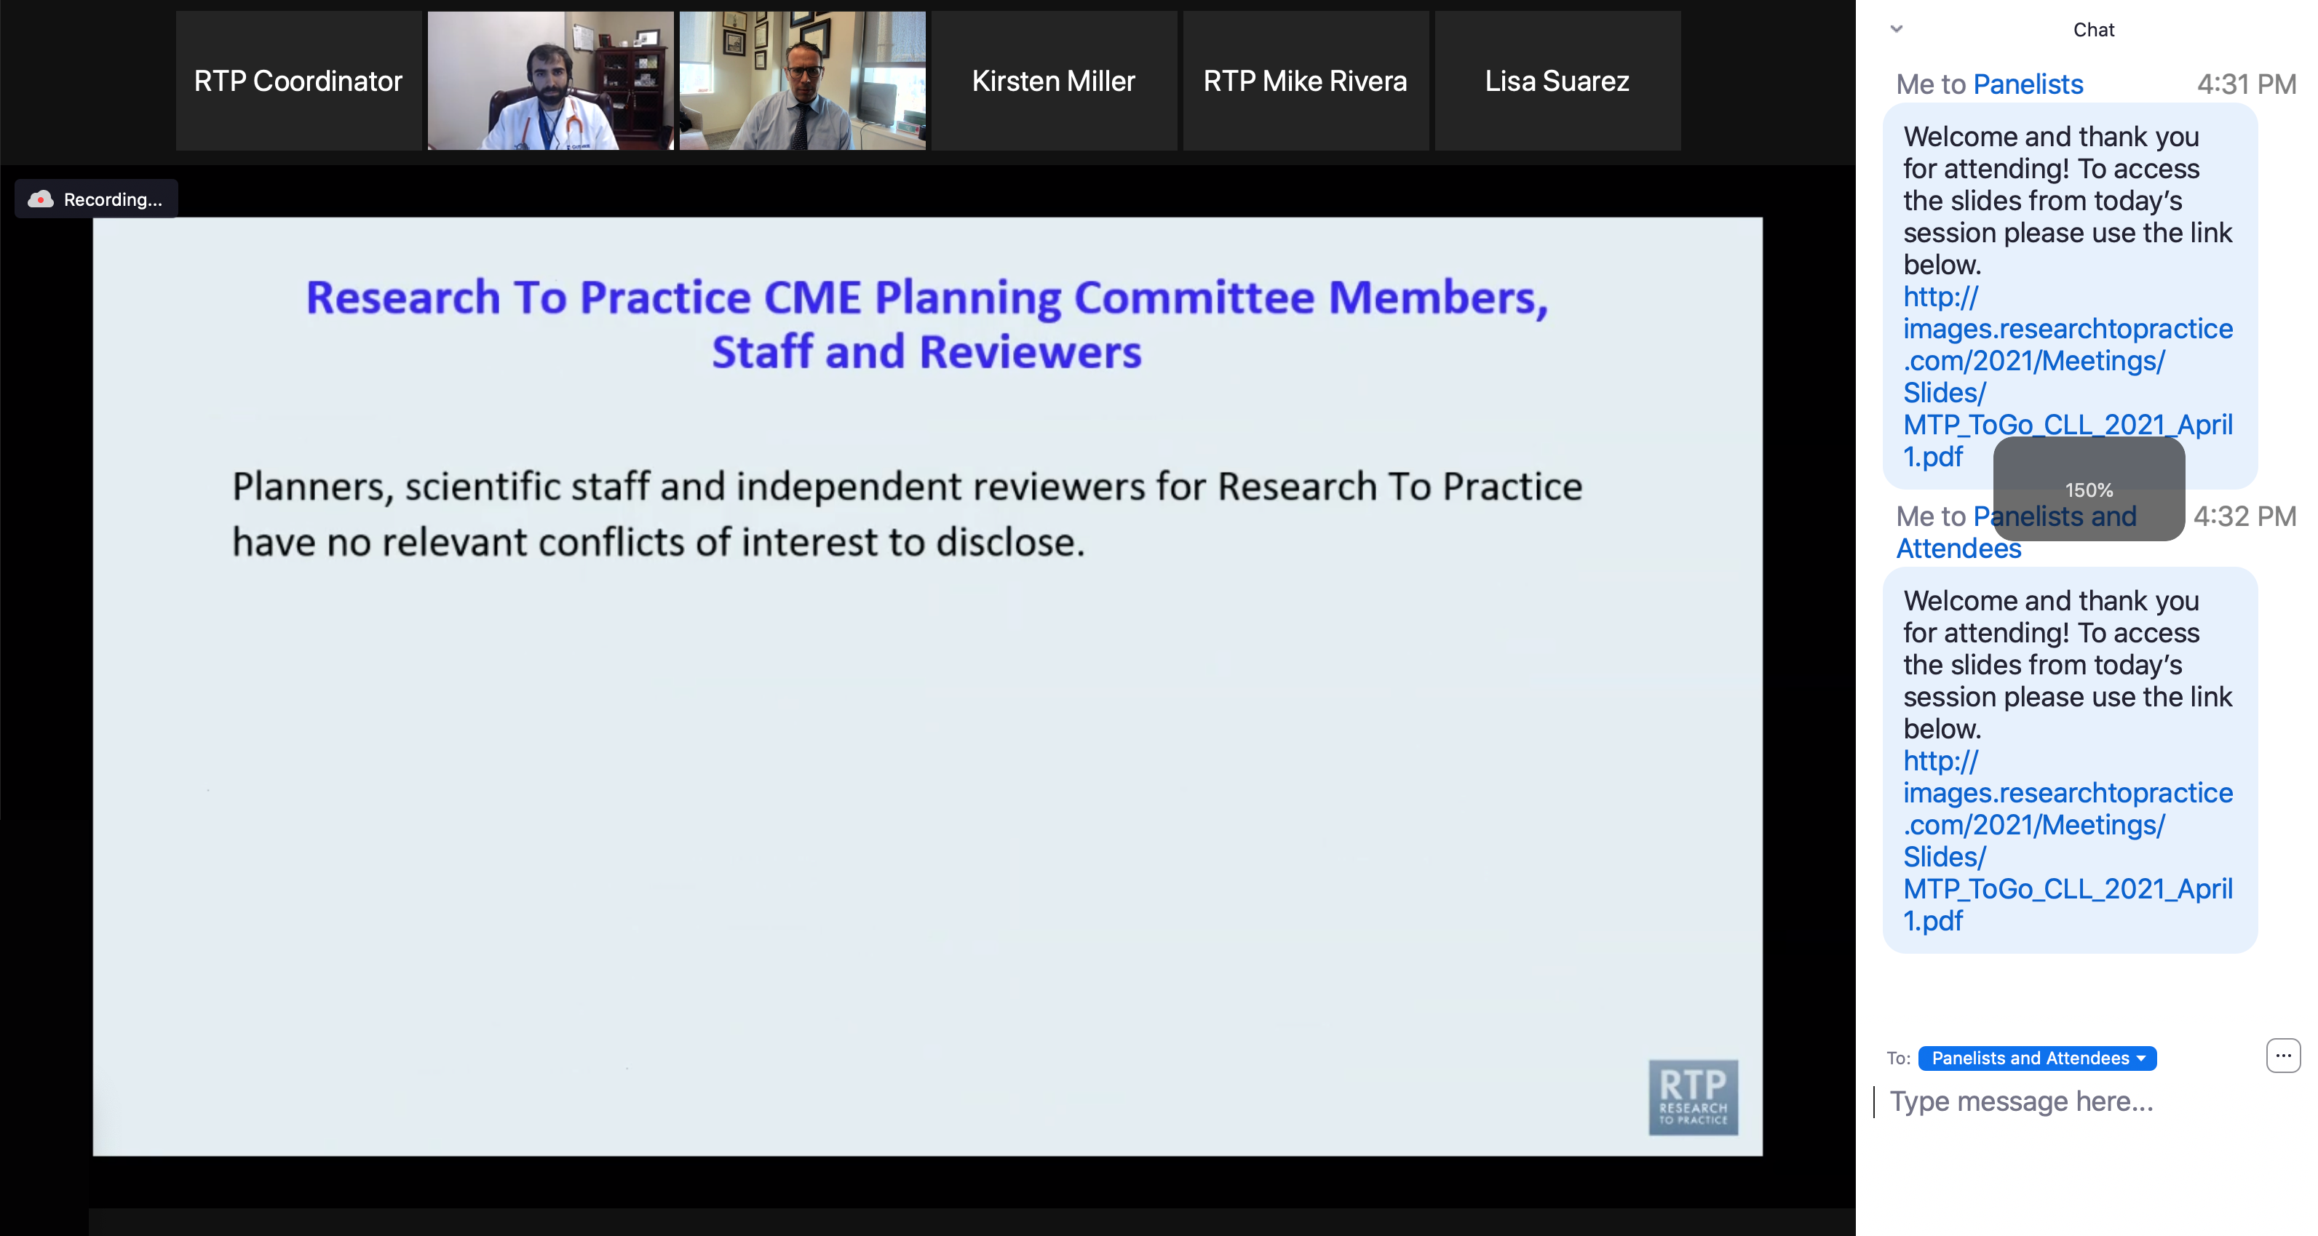
Familiarizing Yourself with the Zoom Interface
Increase chat font size
Press Command (for Mac) or Control (for PC) and the + symbol. You may do this as many times as you need for readability.

Slide 12
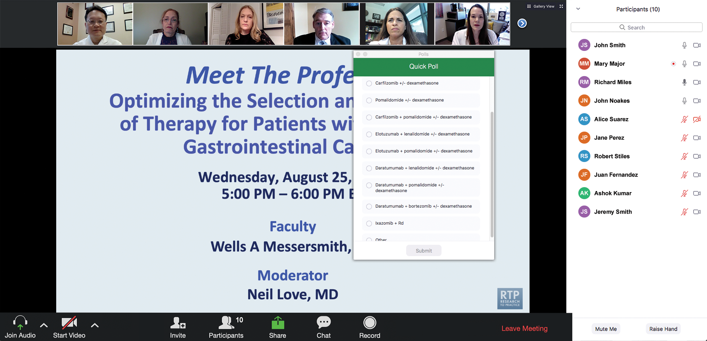
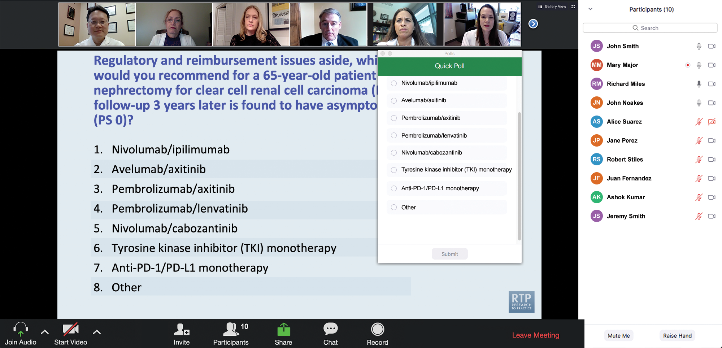
Clinicians in the Audience, Please Complete the Pre- and Postmeeting Surveys
Quick Survey
Quick Poll

Slide 13
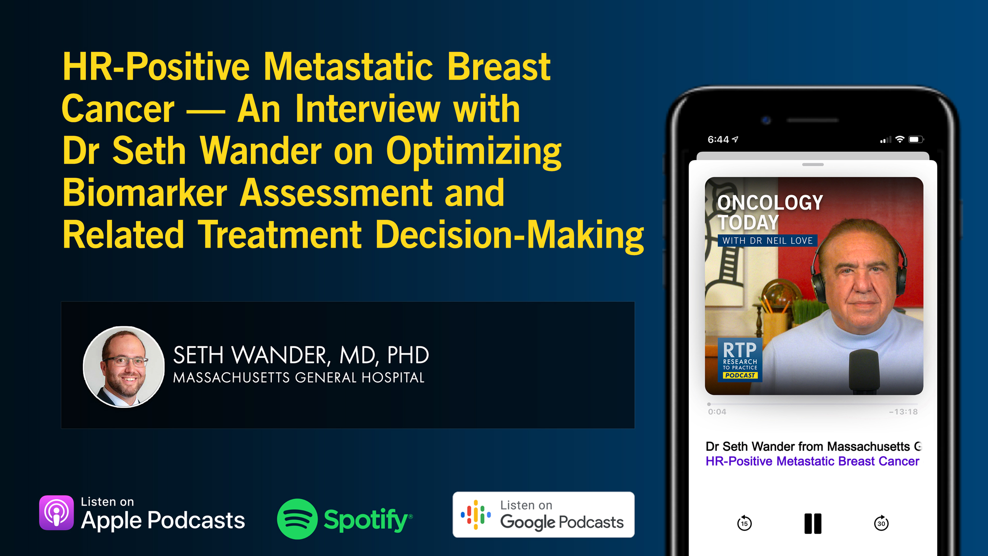

Slide 14
Year in Review: Clinical Investigator Perspectives on the Most Relevant New Datasets and Advances in Oncology
Non-Muscle-Invasive and Muscle-Invasive Bladder Cancer
A CME/MOC-Accredited Live Webinar
Tuesday, May 5, 2026 5:00 PM – 6:00 PM ET
Faculty
Ashish M Kamat, MD, MBBS
Thomas Powles, MBBS, MRCP, MD
Moderator
Neil Love, MD

Slide 15
Year in Review: Clinical Investigator Perspectives on the Most Relevant New Datasets and Advances in Oncology
Localized HR-Positive Breast Cancer
A CME/MOC-Accredited Live Webinar
Wednesday, May 6, 2026 5:00 PM – 6:00 PM ET
Faculty
Harold J Burstein, MD, PhD
Joyce O’Shaughnessy, MD
Moderator
Neil Love, MD

Slide 16
Recent Advances in Cancer Care — New Paradigms, Novel Agents and What It Means for the Oncology Nurse
A Complimentary NCPD Symposium Series Held During the 51st Annual ONS Congress May 13-16
San Antonio Marriott Rivercenter | San Antonio, Texas
Antibody-Drug Conjugates Wednesday, May 13, 2026 | 11:15 AM – 12:45 PM CT
Prostate Cancer Thursday, May 14, 2026 | 12:15 PM – 1:45 PM CT
Ovarian Cancer Wednesday, May 13, 2026 | 6:00 PM – 7:30 PM CT
Non-Muscle-Invasive and Muscle-Invasive Bladder Cancer Thursday, May 14, 2026 | 6:00 PM – 7:30 PM CT
Endometrial Cancer Thursday, May 14, 2026 | 6:00 AM – 7:30 AM CT
Pancreatic Cancer Friday, May 15, 2026 | 6:00 AM – 7:30 AM CT

Slide 17
Recent Advances in Cancer Care — New Paradigms, Novel Agents and What It Means for the Oncology Nurse
A Complimentary NCPD Symposium Series Held During the 51st Annual ONS Congress May 13-16
San Antonio Marriott Rivercenter | San Antonio, Texas
Targeting the PI3K/AKT/mTOR Pathway in HR-Positive Metastatic Breast Cancer Friday, May 15, 2026 | 12:15 PM – 1:45 PM CT
Relapsed/Refractory Multiple Myeloma Saturday, May 16, 2026 | 12:15 PM – 1:45 PM CT
Non-Hodgkin Lymphoma and Chronic Lymphocytic Leukemia Friday, May 15, 2026 | 6:00 PM – 8:00 PM CT
Oral SERDs for Breast Cancer Saturday, May 16, 2026 | 6:00 PM – 7:30 PM CT
CDK4/6 Inhibitors for HR-Positive Breast Cancer Saturday, May 16, 2026 | 6:00 AM – 7:30 AM CT

Slide 18
Second Opinion: Investigators Provide Perspectives on the Current and Future Management of Renal Cell Carcinoma and Prostate Cancer
A 2-Part CME Satellite Symposium Series Held in Conjunction with the 2026 American Urological Association Annual Meeting (AUA2026)
Renal Cell Carcinoma
Sunday, May 17, 2026
8:00 AM – 9:30 AM ET
Prostate Cancer
Sunday, May 17, 2026
5:30 PM – 7:30 PM ET

Slide 19
Grand Rounds
CME/MOC-Accredited Interactive Series
Regional Activities
Three Series
Optimizing Treatment for Patients with Relapsed/Refractory Chronic Lymphocytic Leukemia
Optimizing the Use of Novel Therapies for Patients with Diffuse Large B-Cell Lymphoma
Optimizing Therapy for Patients with Hormone Receptor-Positive Localized Breast Cancer
Host a 1-hour session at your institution: Email Meetings@ResearchToPractice.com or call (800) 233-6153

Slide 20
Thank you for joining us! Please take a moment to complete the survey currently up on Zoom. Your feedback is very important to us. Information on how to obtain CME, ABIM MOC and ABS credit will be provided at the conclusion of the activity in the Zoom chat room. Attendees will also receive an email in 1 to 3 business days with these instructions.

Slide 21
What Clinicians Want to Know: Optimizing the Management of Metastatic Triple-Negative Breast Cancer
A CME/MOC-Accredited Live Webinar
Thursday, April 30, 2026 5:00 PM – 6:00 PM ET
Faculty
Kevin Punie, MD
Tiffany A Traina, MD, FASCO
Moderator
Neil Love, MD

Slide 22
Faculty
Kevin Punie, MD Medical Oncologist ZAS Hospitals Antwerp, Belgium
MODERATOR
Neil Love, MD Research To Practice Miami, Florida
Tiffany A Traina, MD, FASCO Vice Chair, Department of Medicine Section Head Triple-Negative Breast Cancer Clinical Research Program Associate Attending Physician Breast Medicine Service Memorial Sloan Kettering Cancer Center Associate Professor Weill Cornell Medical College New York, New York

Slide 23
We Encourage Clinicians in Practice to Submit Questions
Feel free to submit questions now before the program begins and throughout the program.

Slide 24
Clinicians in the Audience, Please Complete the Pre- and Postmeeting Surveys
Quick Survey
Quick Poll

Slide 26
Year in Review: Clinical Investigator Perspectives on the Most Relevant New Datasets and Advances in Oncology
Non-Muscle-Invasive and Muscle-Invasive Bladder Cancer
A CME/MOC-Accredited Live Webinar
Tuesday, May 5, 2026 5:00 PM – 6:00 PM ET
Faculty
Ashish M Kamat, MD, MBBS
Thomas Powles, MBBS, MRCP, MD
Moderator
Neil Love, MD

Slide 27
Year in Review: Clinical Investigator Perspectives on the Most Relevant New Datasets and Advances in Oncology
Localized HR-Positive Breast Cancer
A CME/MOC-Accredited Live Webinar
Wednesday, May 6, 2026 5:00 PM – 6:00 PM ET
Faculty
Harold J Burstein, MD, PhD
Joyce O’Shaughnessy, MD
Moderator
Neil Love, MD

Slide 28
Recent Advances in Cancer Care — New Paradigms, Novel Agents and What It Means for the Oncology Nurse
A Complimentary NCPD Symposium Series Held During the 51st Annual ONS Congress May 13-16
San Antonio Marriott Rivercenter | San Antonio, Texas
Antibody-Drug Conjugates Wednesday, May 13, 2026 | 11:15 AM – 12:45 PM CT
Prostate Cancer Thursday, May 14, 2026 | 12:15 PM – 1:45 PM CT
Ovarian Cancer Wednesday, May 13, 2026 | 6:00 PM – 7:30 PM CT
Non-Muscle-Invasive and Muscle-Invasive Bladder Cancer Thursday, May 14, 2026 | 6:00 PM – 7:30 PM CT
Endometrial Cancer Thursday, May 14, 2026 | 6:00 AM – 7:30 AM CT
Pancreatic Cancer Friday, May 15, 2026 | 6:00 AM – 7:30 AM CT

Slide 29
Recent Advances in Cancer Care — New Paradigms, Novel Agents and What It Means for the Oncology Nurse
A Complimentary NCPD Symposium Series Held During the 51st Annual ONS Congress May 13-16
San Antonio Marriott Rivercenter | San Antonio, Texas
Targeting the PI3K/AKT/mTOR Pathway in HR-Positive Metastatic Breast Cancer Friday, May 15, 2026 | 12:15 PM – 1:45 PM CT
Relapsed/Refractory Multiple Myeloma Saturday, May 16, 2026 | 12:15 PM – 1:45 PM CT
Non-Hodgkin Lymphoma and Chronic Lymphocytic Leukemia Friday, May 15, 2026 | 6:00 PM – 8:00 PM CT
Oral SERDs for Breast Cancer Saturday, May 16, 2026 | 6:00 PM – 7:30 PM CT
CDK4/6 Inhibitors for HR-Positive Breast Cancer Saturday, May 16, 2026 | 6:00 AM – 7:30 AM CT

Slide 30
Second Opinion: Investigators Provide Perspectives on the Current and Future Management of Renal Cell Carcinoma and Prostate Cancer
A 2-Part CME Satellite Symposium Series Held in Conjunction with the 2026 American Urological Association Annual Meeting (AUA2026)
Renal Cell Carcinoma
Sunday, May 17, 2026
8:00 AM – 9:30 AM ET
Prostate Cancer
Sunday, May 17, 2026
5:30 PM – 7:30 PM ET

Slide 31
Grand Rounds
CME/MOC-Accredited Interactive Series
Regional Activities
Three Series
Optimizing Treatment for Patients with Relapsed/Refractory Chronic Lymphocytic Leukemia
Optimizing the Use of Novel Therapies for Patients with Diffuse Large B-Cell Lymphoma
Optimizing Therapy for Patients with Hormone Receptor-Positive Localized Breast Cancer
Host a 1-hour session at your institution: Email Meetings@ResearchToPractice.com or call (800) 233-6153

Slide 32
What Clinicians Want to Know: Optimizing the Management of Metastatic Triple-Negative Breast Cancer
A CME/MOC-Accredited Live Webinar
Thursday, April 30, 2026 5:00 PM – 6:00 PM ET
Faculty
Kevin Punie, MD
Tiffany A Traina, MD, FASCO
Moderator
Neil Love, MD

Slide 33
Dr Punie — Disclosures
Advisory Committees and Consulting Agreements | AstraZeneca Pharmaceuticals LP, Eisai Inc, Exact Sciences Corporation, Focus Patient, Gilead Sciences Inc, Lilly, Medimix Specialty Pharmacy, Menarini Group, MSD, Mundipharma, Need, Nordic Group, Novartis, Pfizer Inc, Roche Laboratories Inc, Sanofi, Seagen Inc
Contracted Research | Novartis
Data and Safety Monitoring Boards/Committees | AstraZeneca Pharmaceuticals LP
Travel Assistance | AstraZeneca Pharmaceuticals LP, Gilead Sciences, Inc, MSD
Nonrelevant Financial Relationships | Medscape

Slide 34
Dr Traina — Disclosures
Advisory Committees and Consulting Agreements | Aktis Oncology, BioNTech SE, Bristol Myers Squibb, Corcept Therapeutics Inc, Daiichi Sankyo Inc, Ellipses Pharma, Exact Sciences Corporation, Genentech, a member of the Roche Group, Gilead Sciences Inc, Merck, Pfizer Inc, Stemline Therapeutics Inc, TerSera Therapeutics LLC, Veracyte Inc
Contracted Research | Astellas, AstraZeneca Pharmaceuticals LP, BioNTech SE, Daiichi Sankyo Inc, Genentech, a member of the Roche Group, Pfizer Inc

Slide 35
Dr Love — Disclosures
Dr Love is president and CEO of Research To Practice. Research To Practice receives funds in the form of educational grants to develop CME activities from the following companies: Aadi Bioscience, AbbVie Inc, ADC Therapeutics, Agendia Inc, Alexion Pharmaceuticals, Amgen Inc, Array BioPharma Inc, a subsidiary of Pfizer Inc, Arvinas, Astellas, AstraZeneca Pharmaceuticals LP, Aveo Pharmaceuticals, Bayer HealthCare Pharmaceuticals, BeOne, Biotheranostics Inc, A Hologic Company, Black Diamond Therapeutics Inc, Blueprint Medicines, Boehringer Ingelheim Pharmaceuticals Inc, Bristol Myers Squibb, Celcuity, Clovis Oncology, Coherus BioSciences, Corcept Therapeutics Inc, CTI BioPharma, a Sobi Company, Daiichi Sankyo Inc, Eisai Inc, Elevation Oncology Inc, Exact Sciences Corporation, Exelixis Inc, Genentech, a member of the Roche Group, Genmab US Inc, Geron Corporation, Gilead Sciences Inc, GSK, Helsinn Therapeutics (US) Inc, ImmunoGen Inc, Incyte Corporation, Ipsen Biopharmaceuticals Inc, Jazz Pharmaceuticals Inc, Johnson & Johnson, Karyopharm Therapeutics, Kite, A Gilead Company, Kura Oncology, Legend Biotech, Lilly, MEI Pharma Inc, Merck, Mersana Therapeutics Inc, Mirati Therapeutics Inc, Mural Oncology Inc, Natera Inc, Novartis, Novartis Pharmaceuticals Corporation on behalf of Advanced Accelerator Applications, Novocure Inc, Nuvalent, Nuvation Bio Inc, Pfizer Inc, Pharmacyclics LLC, an AbbVie Company, Puma Biotechnology Inc, Regeneron Pharmaceuticals Inc, Revolution Medicines Inc, Rigel Pharmaceuticals Inc, R-Pharm US, Sanofi, Seagen Inc, Servier Pharmaceuticals LLC, SpringWorks Therapeutics Inc, Stemline Therapeutics Inc, Sumitomo Pharma America, Summit Therapeutics, Syndax Pharmaceuticals, Taiho Oncology Inc, Takeda Pharmaceuticals USA Inc, TerSera Therapeutics LLC, and Tesaro, A GSK Company.

Slide 36
Commercial Support
This activity is supported by an educational grant from Gilead Sciences Inc.
Research To Practice CME Planning Committee Members, Staff and Reviewers
Planners, scientific staff and independent reviewers for Research To Practice have no relevant financial relationships to disclose.

Slide 37
This educational activity contains discussion of non-FDA-approved uses of agents and regimens. Please refer to official prescribing information for each product for approved indications.

Slide 38
Agenda Metastatic Triple-Negative Breast Cancer
Introduction: Where We Are; Where We’re Heading
Module 1: First-Line Treatment of BRCA Wild-Type Disease
Module 2: First-Line Treatment of BRCA-Mutant Disease
Module 3: Novel Approaches
Module 4: ASCO 2026

Slide 39
Survey of 50 Community-Based General Medical Oncologists
Optimizing the Management of Metastatic Triple-Negative Breast Cancer
April 21 to 29, 2026

Slide 40
Agenda Metastatic Triple-Negative Breast Cancer
Introduction: Where We Are; Where We’re Heading
Module 1: First-Line Treatment of BRCA Wild-Type Disease
Module 2: First-Line Treatment of BRCA-Mutant Disease
Module 3: Novel Approaches
Module 4: ASCO 2026

Slide 41
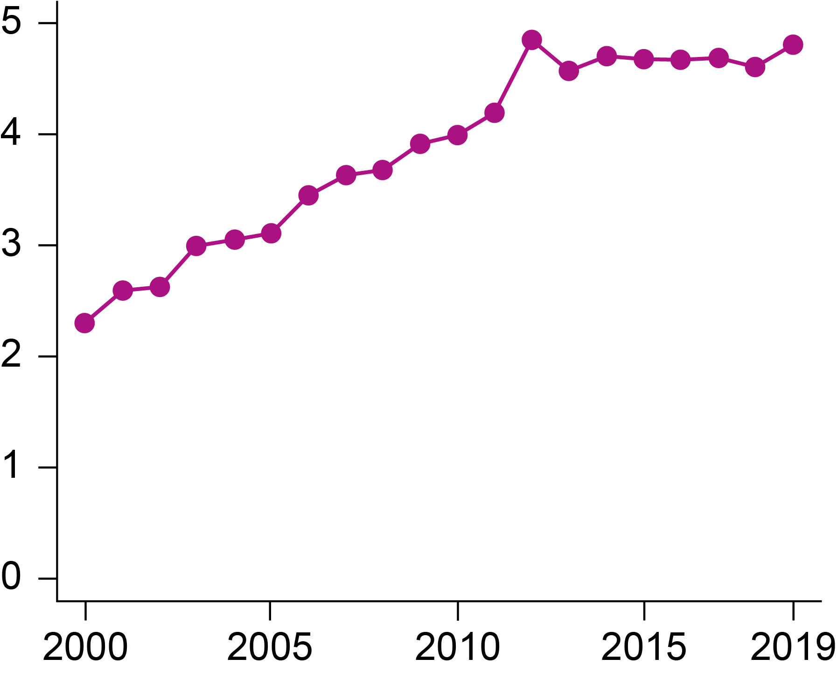
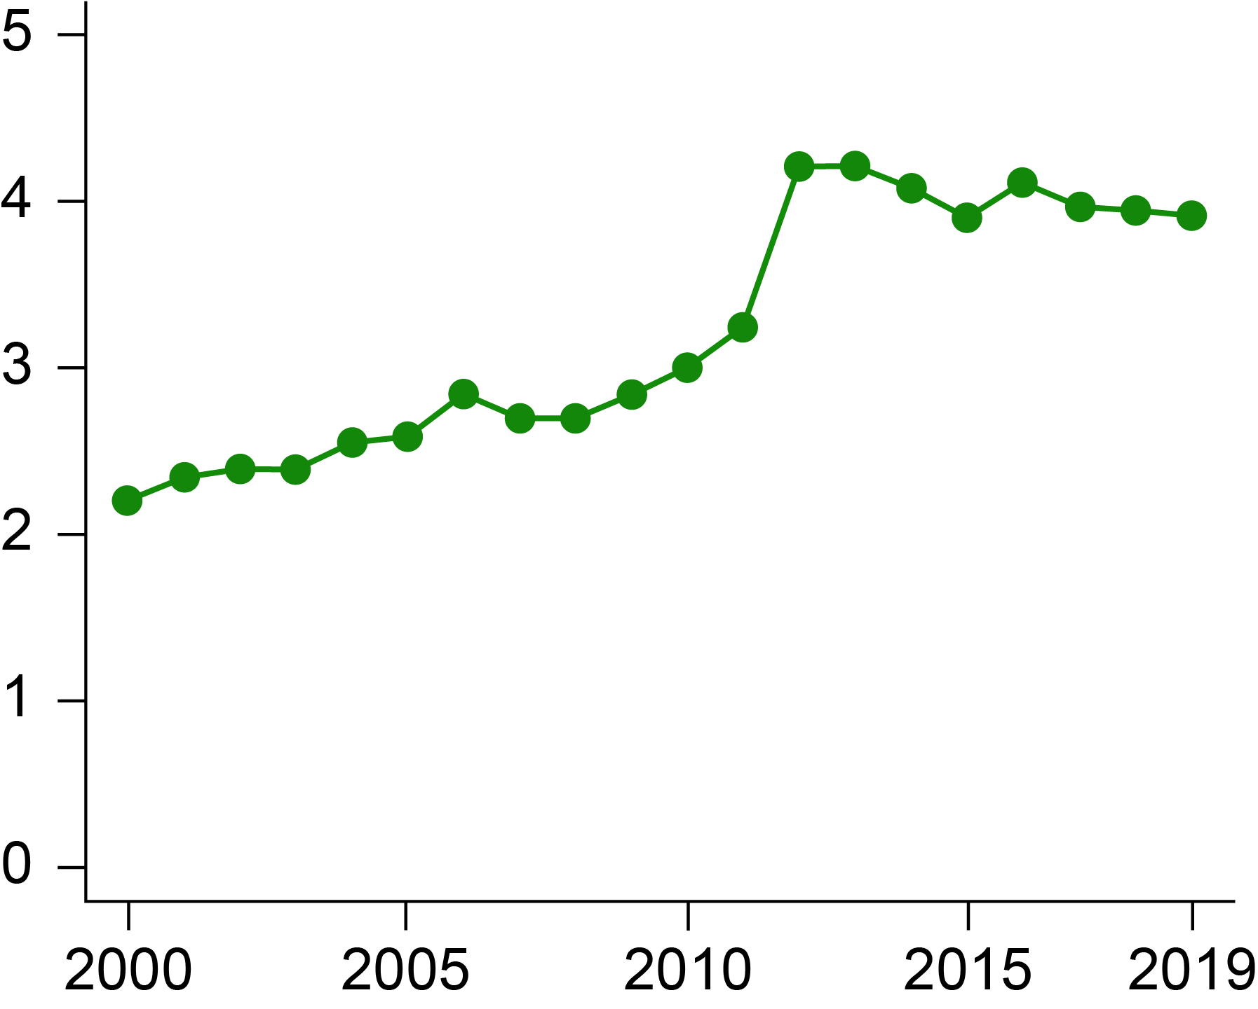
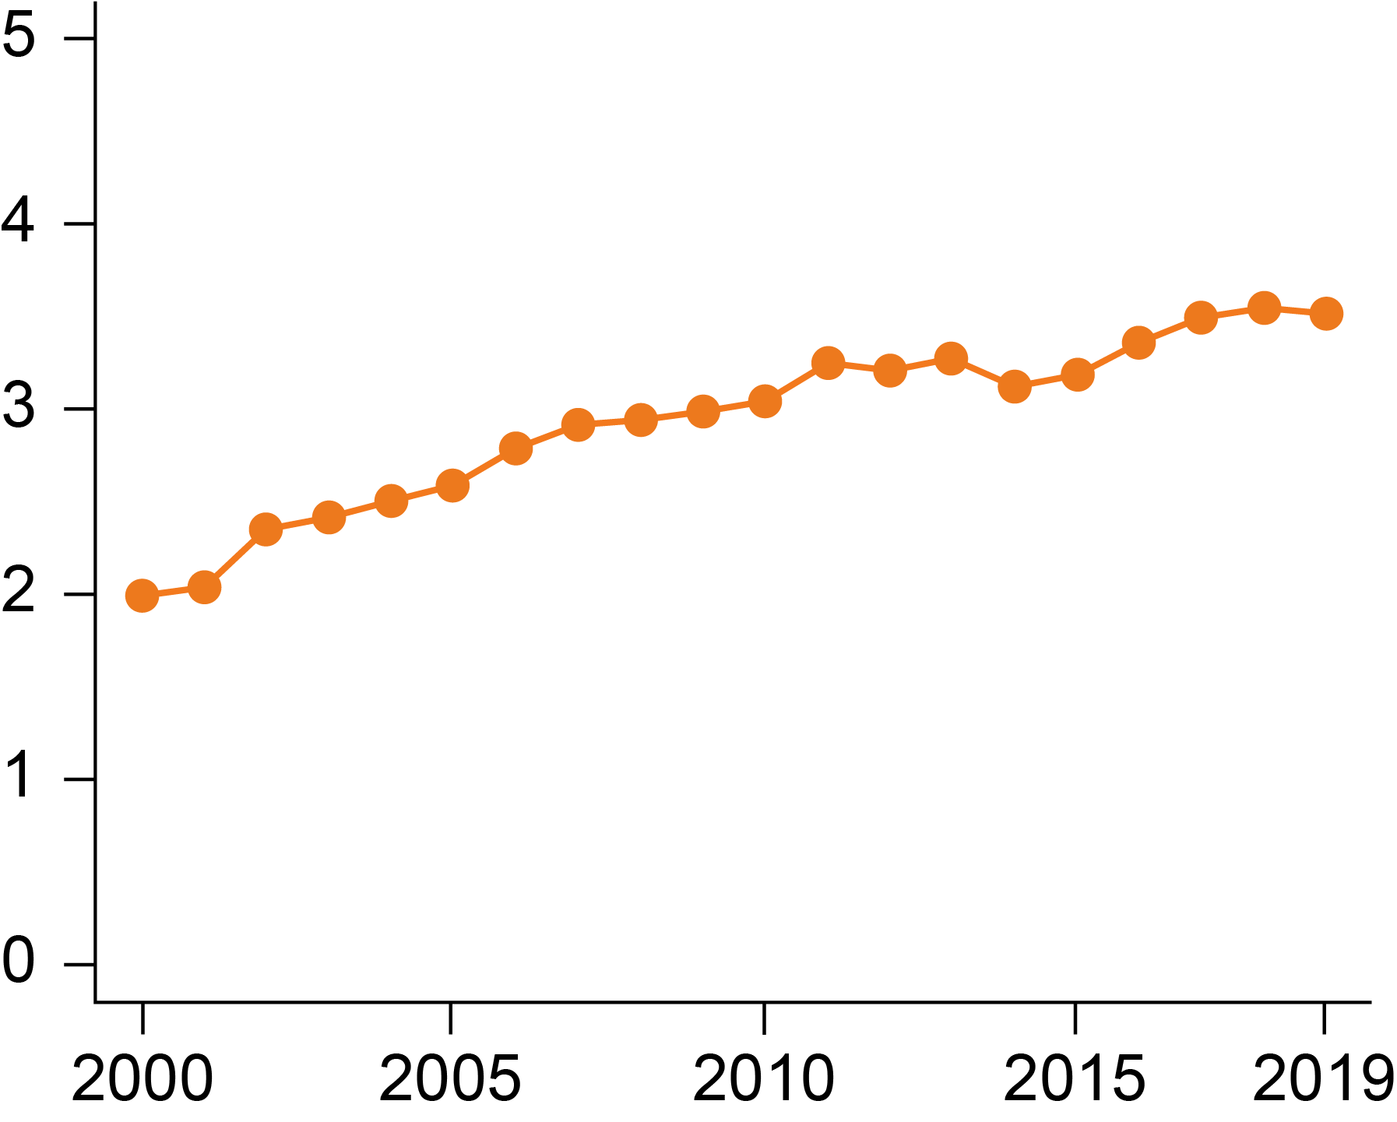
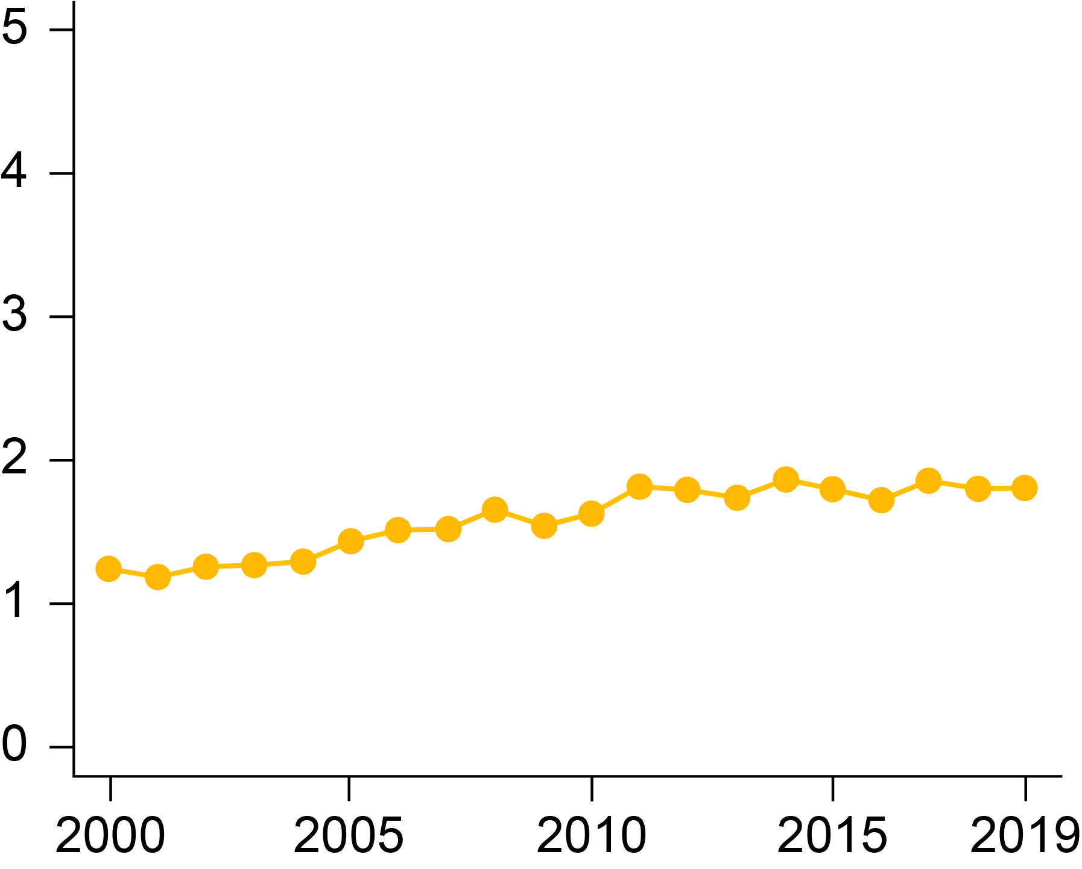
Improvement in Survival
ER+/HER2+ MBC
mOS₂₀₁₉ 4.8y
Δ_{2000→19} 2.5y
ER-/HER2+ MBC
mOS₂₀₁₉ 3.9y
Δ_{2000→19} 1.7y
ER+/HER2- MBC
mOS₂₀₁₉ 3.5y
Δ_{2000→19} 1.5y
ER-/HER2- MBC
mOS₂₀₁₉ 1.8y
Δ_{2000→19} 0.6y
4.8 years (3.5‒5.9)
3.5 years (2.5‒5.5)
3.9 years (2.5‒5.1)
Median survival after metastasis (years)
∆ 2.5 years (2‒3.4)
1.8 years (1‒2.8)
Median survival after metastasis (years)
∆ 1.7 years (1‒2.8)
∆ 1.5 years (0.5‒3)
Median survival after metastasis (years)
Median survival after metastasis (years)
2.3 years (1.5‒2.5)
2.2 years (1.5‒3.5)
2.0 years (1.5‒2.5)
1.2 years (0.5‒2.3)
∆ 0.6 years (0.4‒0.8)
Year of metastatic diagnosis
Year of metastatic diagnosis
Year of metastatic diagnosis
Year of metastatic diagnosis
Improvement of median OS in MBC

Slide 42
Real-World Data in Metastatic TNBC
Punie K et al. Unmet need for previously untreated metastatic triple-negative breast cancer: A real-world study of patients diagnosed from 2011 to 2022 in the United States. Oncologist 2025;30(3):oyaf034.
Collin SM et al. Real-world treatment patterns and outcomes for patients with metastatic triple-negative breast cancer in the United States: An observational study. JCO Oncol Pract 2026;[Online ahead of print].

Slide 43
Agenda Metastatic Triple-Negative Breast Cancer
Introduction: Where We Are; Where We’re Heading
Module 1: First-Line Treatment of BRCA Wild-Type Disease
Module 2: First-Line Treatment of BRCA-Mutant Disease
Module 3: Novel Approaches
Module 4: ASCO 2026

Slide 44
First-Line Treatment of Metastatic Disease
Borremans K et al. Expression of antibody-drug conjugate targets in post-mortem samples of breast cancer metastases and normal tissue. Nat Commun 2025;17(1):1080.
The LESLIE trial: Lifestyle intervention to enhance efficacy of neoadjuvant therapy in patients with triple negative breast cancer. NCT06831955. PI: Kevin Punie

Slide 45
Targets for Antibody-Drug Conjugates in Breast Cancer
MUC1
LIV1
CEACAM
ROR1/2
PTK7
FRa
TROP2
HER2
B7H4
HER3
Target Antigens:
Oncogenic driver (historic)
Antigens expressed on cancer cells
Antigens on tumour vasculature
Antigens in tumour stroma
CD166
Nectin4
Schmid P, Personal Communication
Bardia, NEJM 2021; Krop, SABCS 2021, Krop ASCO 2022, Modi JCO 2020 Tsai ESMO 2021
Courtesy of Professor Peter Schmid, FRCP, MD, PhD

Slide 46
A woman presents with de novo hormone receptor (HR)-negative, HER2 IHC 1+, PD-L1-positive (combined positive score [CPS] 10), BRCA wild-type metastatic breast cancer (mBC). Regulatory and reimbursement issues aside, which first-line therapy would you most likely recommend in each of the following scenarios?
Age 65, PS 0, asymptomatic bone metastases
Pembrolizumab/nab paclitaxel

Slide 47
A woman presents with de novo HR-negative, HER2 IHC 1+, PD-L1-positive (CPS 10), BRCA wild-type mBC. Regulatory and reimbursement issues aside, which first-line therapy would you most likely recommend in each of the following scenarios?
Age 65, PS 0, symptomatic visceral (including liver) metastases
Pembrolizumab/nab paclitaxel

Slide 48
A woman presents with de novo HR-negative, HER2 IHC 1+, PD-L1-positive (CPS 10), BRCA wild-type mBC. Regulatory and reimbursement issues aside, which first-line therapy would you most likely recommend in each of the following scenarios?
Age 65, PS 0, multiple brain metastases requiring stereotactic radiosurgery (SRS)
Pembrolizumab/nab paclitaxel

Slide 49
A woman presents with de novo HR-negative, HER2 IHC 1+, PD-L1-positive (CPS 10), BRCA wild-type mBC. Regulatory and reimbursement issues aside, which first-line therapy would you most likely recommend in each of the following scenarios?
Age 80, PS 2, asymptomatic bone metastases
Pembrolizumab/nab paclitaxel

Slide 50
A woman presents with de novo HR-negative, HER2 IHC 1+, PD-L1-negative (CPS 0), BRCA wild-type mBC. Regulatory and reimbursement issues aside, which first-line therapy would you most likely recommend in each of the following scenarios?
Age 65, PS 0, asymptomatic bone metastases
Nab paclitaxel

Slide 51
A woman presents with de novo HR-negative, HER2 IHC 1+, PD-L1-negative (CPS 0), BRCA wild-type mBC. Regulatory and reimbursement issues aside, which first-line therapy would you most likely recommend in each of the following scenarios?
Age 65, PS 0, symptomatic visceral (including liver) metastases
Nab paclitaxel

Slide 52
A woman presents with de novo HR-negative, HER2 IHC 1+, PD-L1-negative (CPS 0), BRCA wild-type mBC. Regulatory and reimbursement issues aside, which first-line therapy would you most likely recommend in each of the following scenarios?
Age 65, PS 0, multiple brain metastases requiring SRS
Nab paclitaxel

Slide 53
A woman presents with de novo HR-negative, HER2 IHC 1+, PD-L1-negative (CPS 0), BRCA wild-type mBC. Regulatory and reimbursement issues aside, which first-line therapy would you most likely recommend in each of the following scenarios?
Age 80, PS 2, asymptomatic bone metastases
Nab paclitaxel

Slide 54
A woman with HR-negative, HER2 IHC 1+, BRCA wild-type breast cancer receives the KEYNOTE-522 regimen (neoadjuvant pembrolizumab/chemotherapy and adjuvant pembrolizumab) but experiences relapse 18 months after completing adjuvant pembrolizumab (PD-L1-positive [CPS 10]). Regulatory and reimbursement issues aside, which first-line therapy would you most likely recommend in each of the following scenarios?
Age 65, PS 0, asymptomatic bone metastases
Pembrolizumab/nab paclitaxel

Slide 55
A woman with HR-negative, HER2 IHC 1+, BRCA wild-type breast cancer receives the KEYNOTE-522 regimen but experiences relapse 5 months after completing adjuvant pembrolizumab (PD-L1-positive [CPS 10]). Regulatory and reimbursement issues aside, which first-line therapy would you most likely recommend in each of the following scenarios?
Age 65, PS 0, asymptomatic bone metastases
Pembrolizumab/nab paclitaxel

Slide 56
Based on the published literature and your clinical experience, how would you indirectly compare the antitumor efficacy of datopotamab deruxtecan to that of sacituzumab govitecan for patients with previously untreated mTNBC?

Slide 57
A woman presenting with de novo PD-L1-positive, BRCA wild-type metastatic triple-negative breast cancer (mTNBC) receives first-line pembrolizumab/chemotherapy and initially responds but experiences disease progression 6 months later. Regulatory and reimbursement issues aside, which systemic therapy would you most likely recommend next in each of the following scenarios?
Age 65, PS 0, HER2-negative (IHC 0)

Slide 58
Cases from General Medical Oncologists
42 yo woman
Metastatic TNBC to liver, lung. PD-L1 CPS = 15. No comorbidities.
KEYNOTE-522 regimen (neoadjuvant pembrolizumab/chemotherapy and adjuvant pembrolizumab) completed 5 months ago.
With promising data on Dato-DXd and likely approval in the near future how would you sequence Saci vs Dato? Would you add immunotherapy and which one?
After progression on your first choice of ADC, what is your next treatment?

Slide 59
Cases from General Medical Oncologists
58 yo woman
mTNBC, PD-L1 CPS = 0, HRD-negative with metastases to liver, bone and LN. Prior HER2-positive BC in remission, prior DLBCL in remission. History of cardiomyopathy, heart failure, pacemaker.
Neoadjuvant TC for TNBC without path CR, then adjuvant capecitabine. ctDNA negative at end of adjuvant treatment but both ctDNA and radiological progression in 3 months. On sacituzumab govitecan for 4 years.
Do you retest PD-L1 status on progression? What are options for her as she has had R-CHOP, TCHP, TC, capecitabine and sacituzumab govitecan for different cancers, has cardiomyopathy but had durable response with saci? She is young and motivated with a very supportive spouse.

Slide 60
Cases from General Medical Oncologists
63 yo woman
De novo mTNBC, BRCA WT, PD-L1 CPS = 20 with symptomatic bone mets, several asymptomatic pulmonary mets. Hx of corneal abrasions (wears contact lenses).
Hx of IBS, wants a chemotherapy-free regimen.
Based on relevant clinical trials, would you select Datopotamab/Pembro or Sacituzumab/Pembro in terms of efficacy?
Would her hx of corneal abrasions/contact lenses and hx of controlled IBS influence your treatment decision?

Slide 61
Cases from General Medical Oncologists
68 yo woman
mTNBC with isolated brain metastases. Received KEYNOTE-522 regimen.
Patient has isolated brain mets s/p resection and SBRT, CT DNA negative, will give systemic therapy or monitor.
Is ctDNA use in TNBC prime time yet?

Slide 62
Cases from General Medical Oncologists
88 yo woman
De novo mTNBC, BRCA-negative, PD-L1 5%. Bone metastases. History of HTN, dyslipidemia, CAD.
How do you manage sacituzumab in very elderly patients? Proactive dose reduction vs using G-CSF/antidiarrheals? In general, how is the tolerability in elderly patients?

Slide 63
Cases from General Medical Oncologists
71 yo woman
De novo metastatic TNBC, PD-L1 negative, HER2 IHC 0. No prior systemic therapy for breast cancer.
Extensive liver metastases and peritoneal disease; anorexia, abdominal pain, rapidly declining performance status. Atrial fibrillation, diabetic neuropathy, frailty, ECOG 2 bordering on 3.
For an older frail patient with PD-L1–negative visceral crisis-type mTNBC, what regimen would you favor up front to maximize likelihood of rapid response while preserving tolerability?
At what point do you move from combination chemotherapy to single-agent therapy or best supportive care in this setting?

Slide 64
Cases from General Medical Oncologists
40 yo woman
Metastatic TNBC, BRCA WT, CPS = 10. Mets to lung, bone, lymph nodes.
She received KN-522 for an initial cT2N0 right breast TNBC. She developed type 1 DM after 2 doses of pembrolizumab. She elected to stop pembrolizumab at that point. She completed NACT and had b/l mastectomy with 2 cm of residual disease in the breast. She palpated a lump in the same breast right before starting radiation.
She then completed PMRT and had wide local excision with no residual disease found. She started capecitabine but had back pain after 1 cycle. Imaging showed metastatic recurrence to lungs, bones and abdominal lymph nodes. She was switched to sacituzumab for 11 months then experienced symptomatic and radiographic progression.
Would the faculty consider chemo/pembrolizumab at this point?

Slide 65
Cases from General Medical Oncologists
38 yo woman
mTNBC, HER2 IHC 1+ (low positive), PD-L1 CPS 2, MSI negative, TMB low, germline testing negative. Asymptomatic osseous involvement in the thoracic and lumbar spine, left scapula, sternum, left rib, bilateral iliac bones, and right femur. Indeterminate lesions in the liver and cervical lymph nodes.
This patient was treated with first-line paclitaxel, per the prior standard of care, and progressed after two months with new lesions on PET. She also progressed on second-line therapy with trastuzumab deruxtecan after just two months with new lesions on PET.
It is not typically favored to sequence ADCs; however, it felt like a de-escalation to try a single agent chemotherapy in the third line. She has been on sacituzumab govitecan 9 months now.

Slide 66
Cases from General Medical Oncologists
38 yo woman (continued)
Is there anything that would compel you to try sequencing ADCs?
Ideally both the antibody and payload would differ when sequencing ADCs, but does that actually matter when predicting response to therapy, or is having either a different antibody or a different payload enough?
Is there anything clinically or pathologically that may predict response to therapy otherwise?
At progression, what regimen would you treat her with next?

Slide 67
Cases from General Medical Oncologists
48 yo woman
Metastatic TNBC, germline BRCA1 pathogenic variant, PD-L1 CPS 2 (negative by ≥10 threshold).
Biopsy-confirmed liver metastases (3 lesions, largest 4.2 cm) and osseous metastases in thoracolumbar spine with moderate back pain. No CNS involvement on brain MRI.
History of contralateral prophylactic mastectomy, bilateral salpingo-oophorectomy, mild chronic kidney disease (eGFR 52), well-controlled depression on sertraline.
Diagnosed initially as stage IIA TNBC (pT2N0) 3 years ago. Received neoadjuvant dose-dense AC followed by paclitaxel with residual disease at surgery. Completed adjuvant capecitabine per CREATE-X for 6 cycles. No immunotherapy in the adjuvant setting.

Slide 68
Cases from General Medical Oncologists
48 yo woman (continued)
Now presents with metastatic recurrence 14 months after completing capecitabine.
Given her BRCA1 mutation, low PD-L1 (CPS 2), and prior capecitabine exposure, how would you sequence therapy — would you favor a PARP inhibitor (olaparib or talazoparib) over sacituzumab govitecan in the first-line metastatic setting, and what data support this decision given the absence of head-to-head trials?
If she achieves a partial response on first-line PARP inhibitor therapy but progresses after 11 months with new pulmonary nodules, would you consider sacituzumab govitecan–pembrolizumab combination (per TROPION or ASCENT-04/SACI-IO data) despite her low PD-L1, or proceed with sacituzumab govitecan monotherapy — and how do you weigh the TROP2 expression status in this decision?

Slide 69
Summary of Key First-Line Clinical Trials
Trial name | Phase | Randomization | Regimen | Study population | ORR | mPFS | mOS
ASCENT-03 | III | 1:1 | SG vs TPC | Ineligible for PD-(L)1 inhibitor | 48% vs 46% | 9.7 vs 6.9 (HR 0.62) | 21.5 vs 20.2 (0.98)
ASCENT-04 | III | 1:1 | SG + P vs TPC + P | PD-L1+ | 60% vs 53% | 11.2 vs 7.8 (HR 0.65) | NR vs NR (HR 0.89)
TROPION-Breast02 | III | 1:1 | Dato-DXd vs TPC | Ineligible for PD-(L)1 inhibitor | 63% vs 29% | 10.8 vs 5.6 (HR 0.57) | 23.7 vs 18.7 (HR 0.79)
OptiTROP-Breast05 | II | N/A | Sac-TMT | PD-L1+ or PD-L1- | 70.7% | 13.4 | NR
ORR = objective response rate; mPFS = median progression-free survival; mOS = median overall survival; SG = sacituzumab govitecan; TPC = treatment of physician's choice; P = pembrolizumab; NR = not reached; Dato-DXd = datopotamab deruxtecan; Sac-TMT = sacituzumab tirumotecan

Slide 70
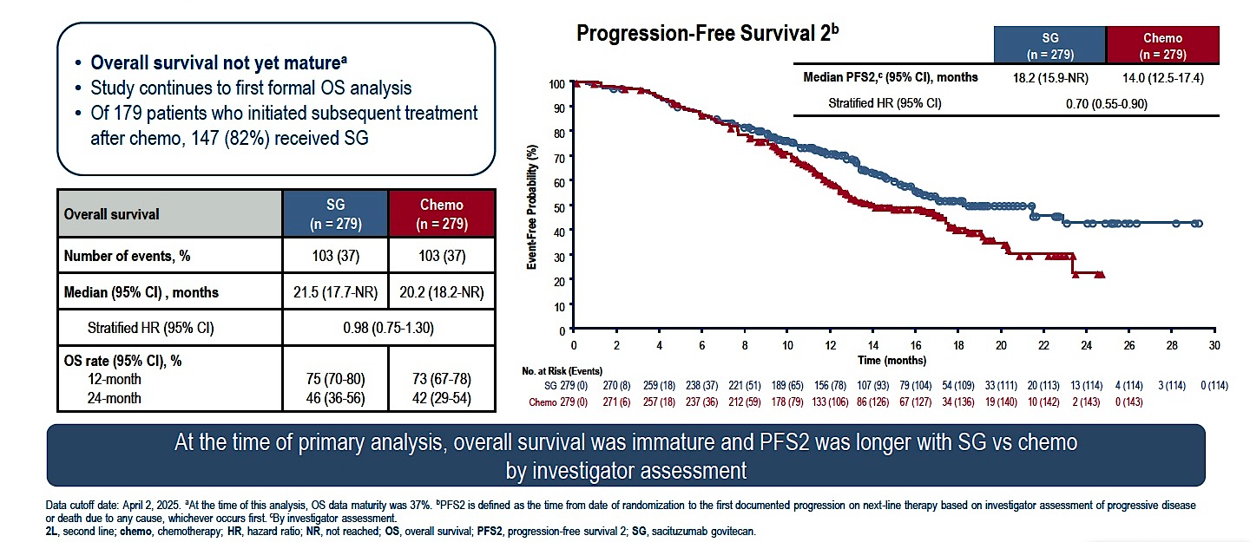
Phase III ASCENT-03: Descriptive Overall Survival and PFS2
Cortés J et al. ESMO 2025;Abstract LBA20.

Slide 71
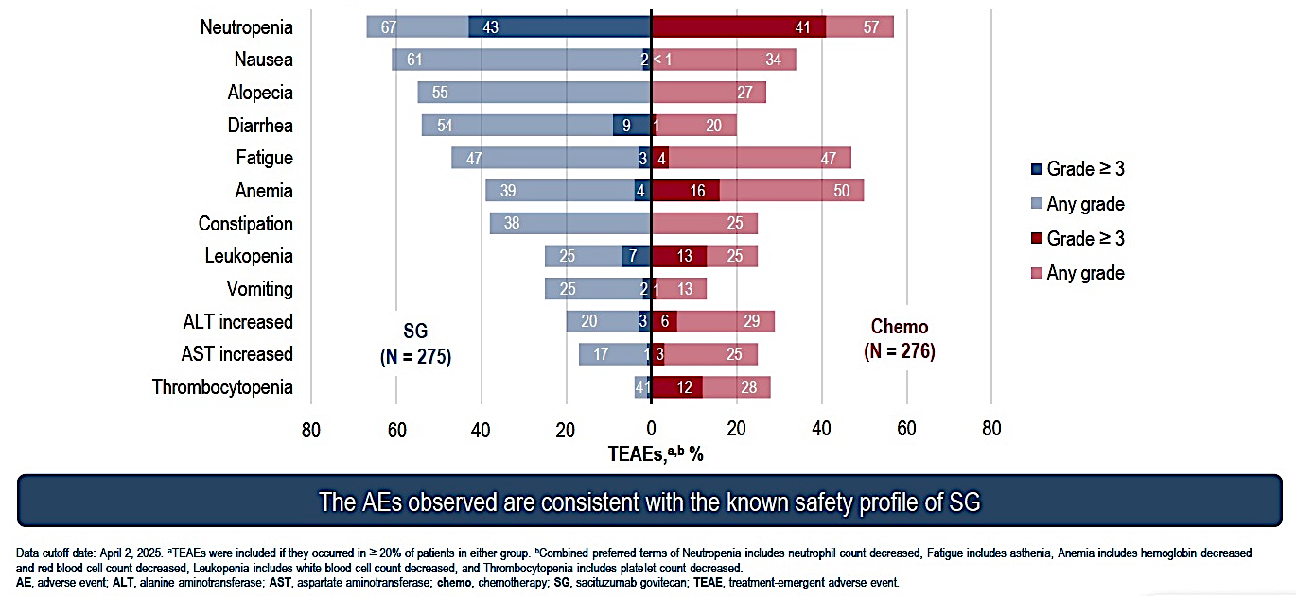
Phase III ASCENT-03: Common Adverse Events (AEs)
Cortés J et al. ESMO 2025;Abstract LBA20.

Slide 72
Summary of Key First-Line Clinical Trials
Trial name | Phase | Randomization | Regimen | Study population | ORR | mPFS | mOS
ASCENT-03 | III | 1:1 | SG vs TPC | Ineligible for PD-(L)1 inhibitor | 48% vs 46% | 9.7 vs 6.9 (HR 0.62) | 21.5 vs 20.2 (0.98)
ASCENT-04 | III | 1:1 | SG + P vs TPC + P | PD-L1+ | 60% vs 53% | 11.2 vs 7.8 (HR 0.65) | NR vs NR (HR 0.89)
TROPION-Breast02 | III | 1:1 | Dato-DXd vs TPC | Ineligible for PD-(L)1 inhibitor | 63% vs 29% | 10.8 vs 5.6 (HR 0.57) | 23.7 vs 18.7 (HR 0.79)
OptiTROP-Breast05 | II | N/A | Sac-TMT | PD-L1+ or PD-L1- | 70.7% | 13.4 | NR
SG = sacituzumab govitecan; P = pembrolizumab

Slide 73
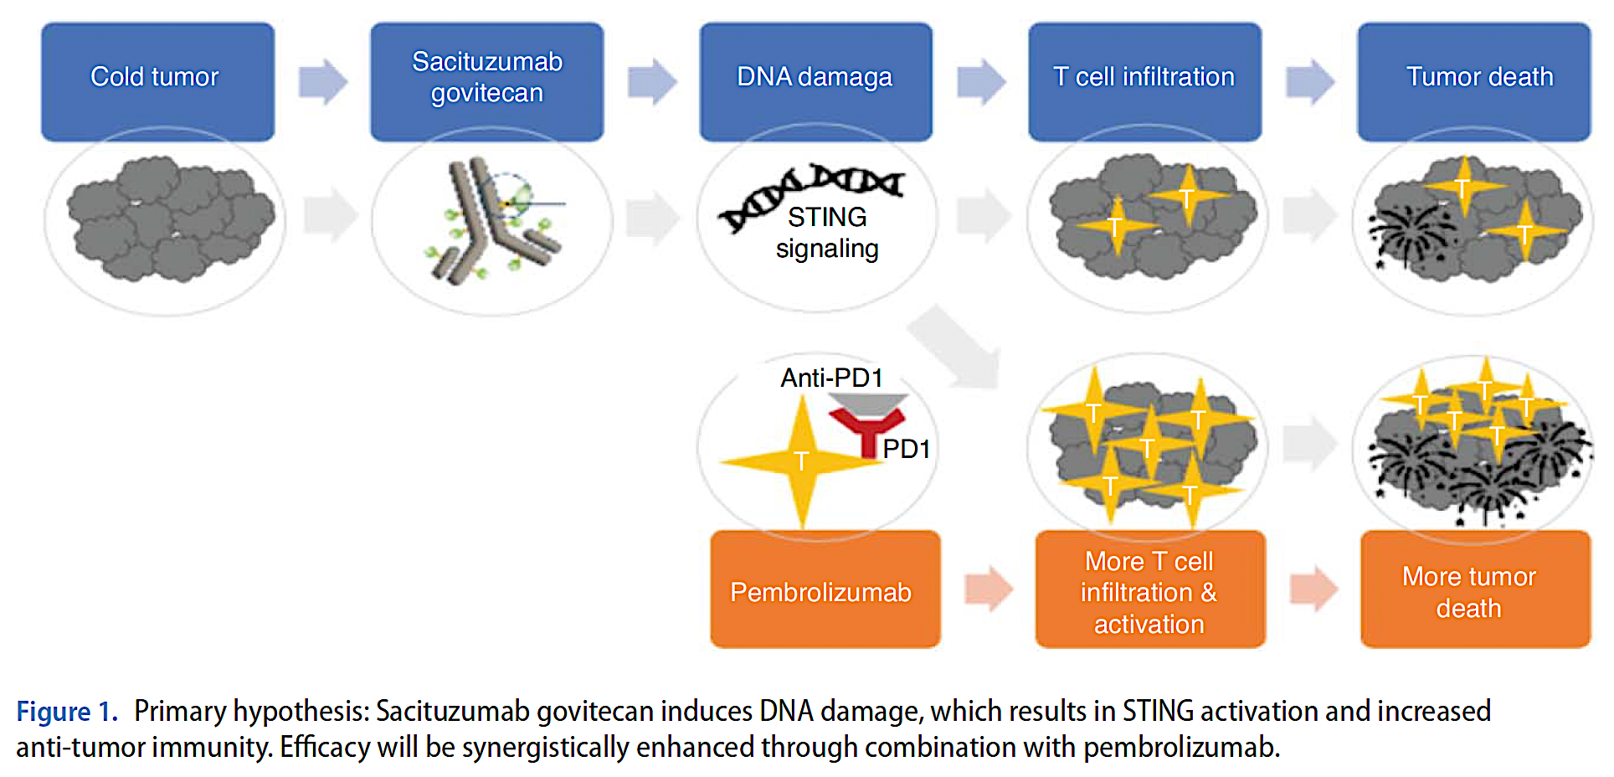
Rationale for Combining Sacituzumab Govitecan and Pembrolizumab
DNA damage
STING = stimulator of interferon genes
Tolaney SM et al. Future Oncol 2024;20(31):2343-55.

Slide 74
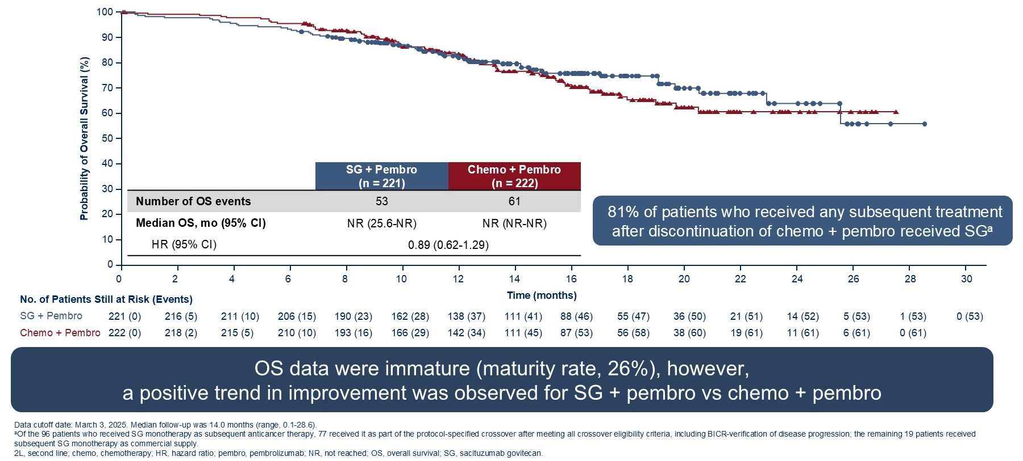
Phase III ASCENT-04/KEYNOTE-D19: Descriptive Overall Survival (OS) (Primary Analysis)
Tolaney SM et al. ASCO 2025;Abstract LBA109.

Slide 75
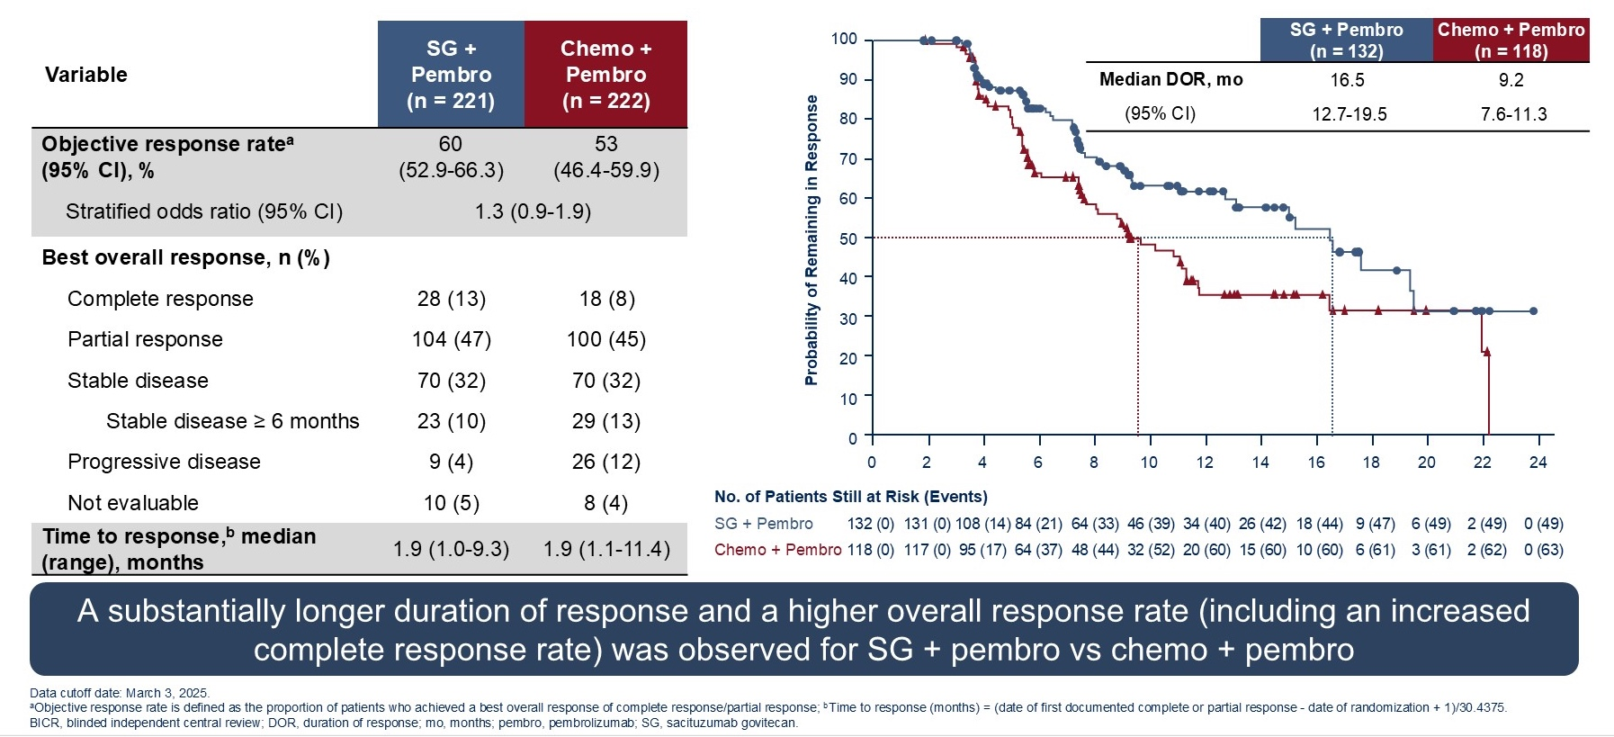
Phase III ASCENT-04/KEYNOTE-D19: Tumor Responses, Duration of Response
Tolaney SM et al. ASCO 2025;Abstract LBA109.

Slide 76
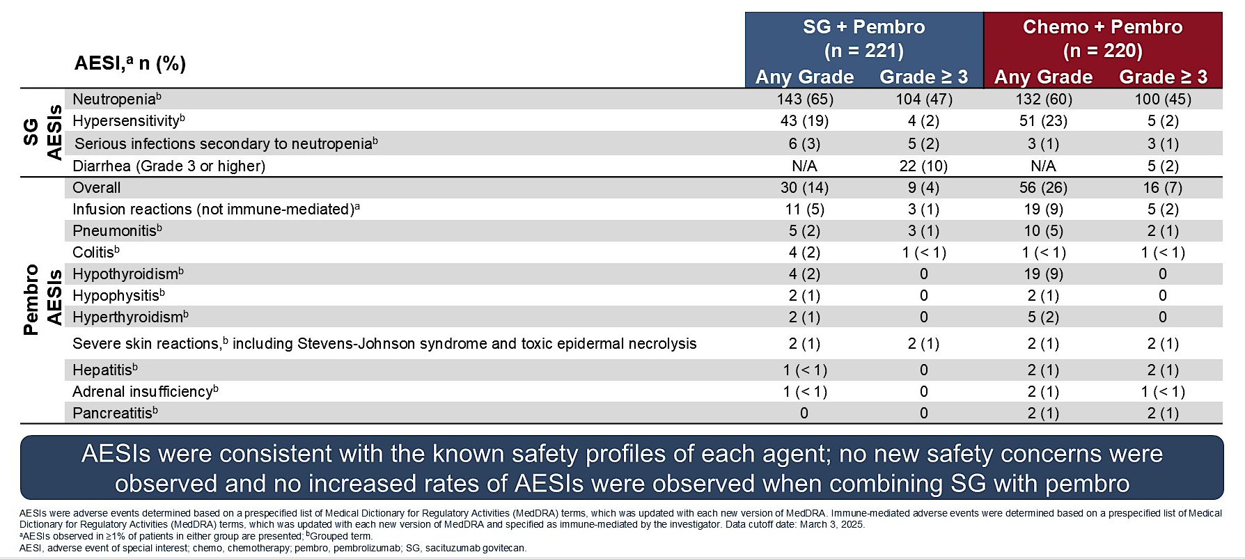
Phase III ASCENT-04/KEYNOTE-D19: AEs of Special Interest
Tolaney SM et al. ASCO 2025;Abstract LBA109.

Slide 77
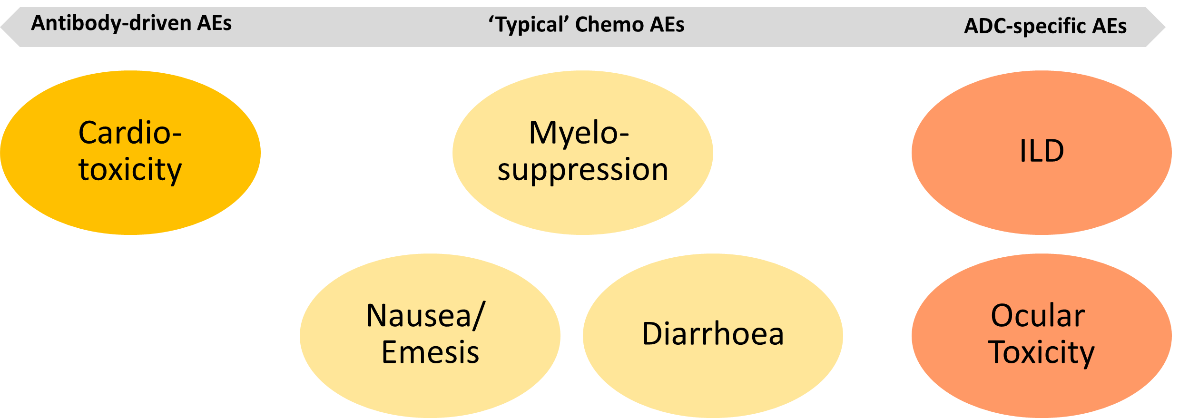
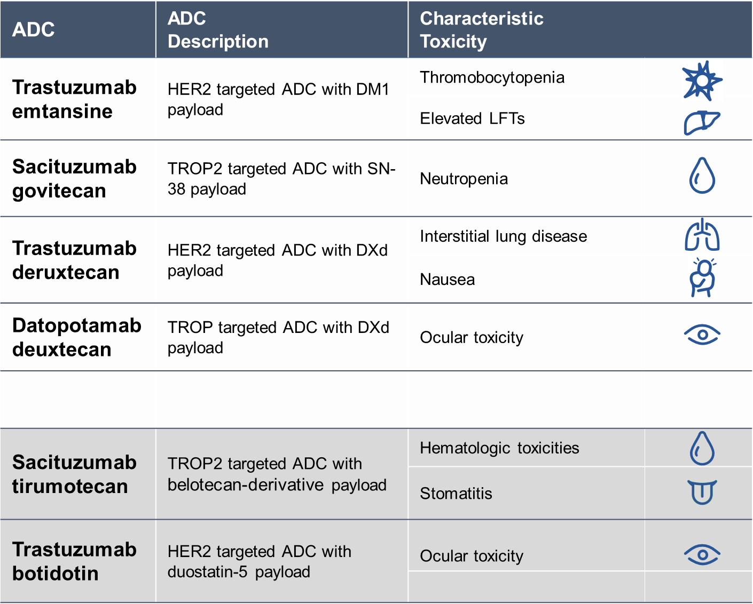
Is ADC-related toxicity truly better than that of chemotherapy?
Toxicities Are Not Inherent to the Antibody-Drug Conjugate Class
deruxtecan
While antibody–drug conjugates (ADCs) exhibit specific toxicity profiles, they do not invariably confer a reduction in systemic toxicity relative to conventional cytotoxic chemotherapy
Courtesy of Javier Cortés, MD, PhD
Table, modified from Hamilton E. ASCO 2024

Slide 78
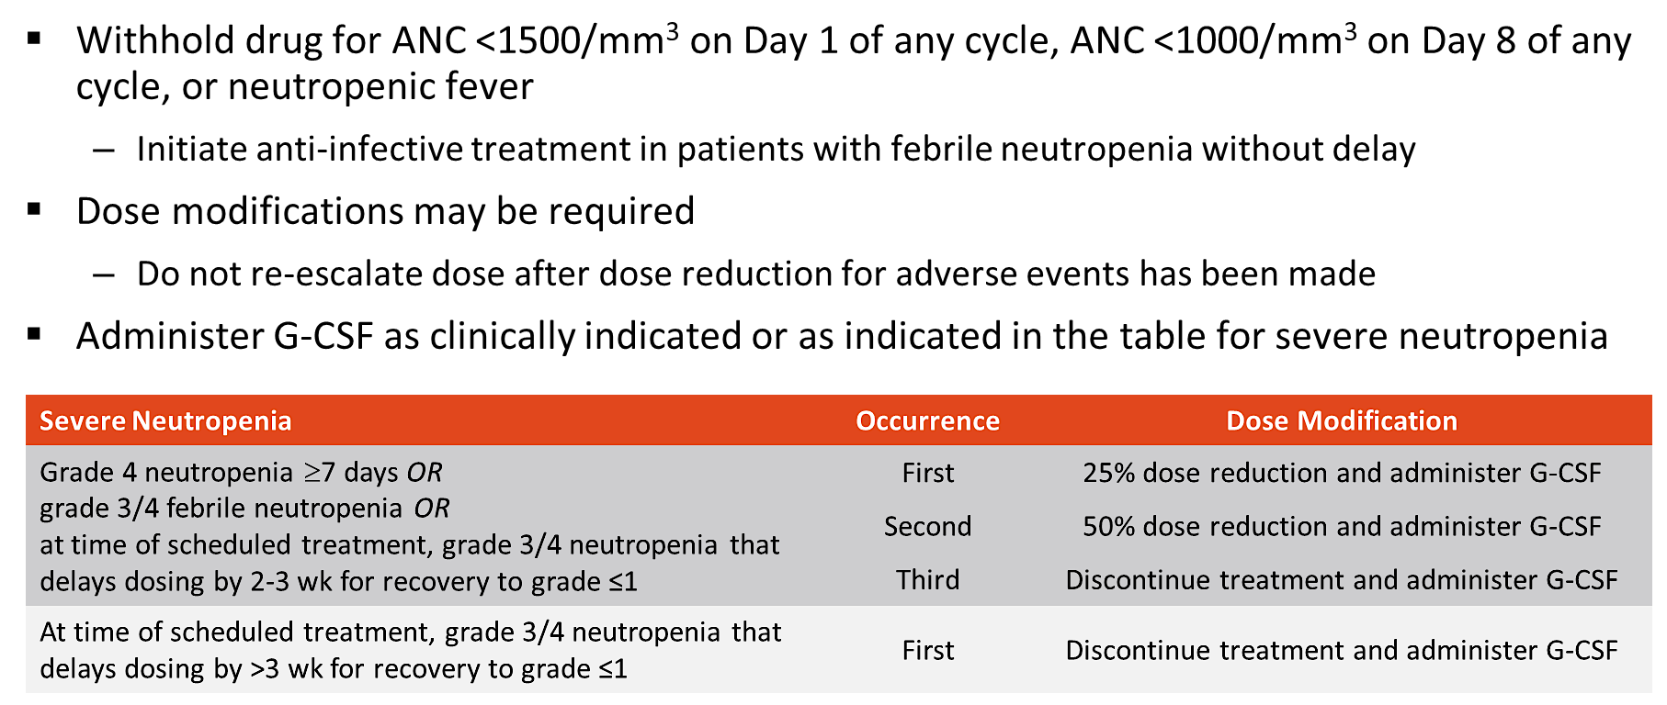
SG: Management of Neutropenia
Courtesy of Javier Cortés, MD, PhD

Slide 79

SG: PRIMED Strategy
Key Eligibility Criteria
Study Treatment
Study Endpoints
Patients ≥18 years old with mTNBC or metastatic HR+/HER2- breast cancer
Received at least 1 and up to 2 prior SOC chemotherapy regimens for metastatic disease
ECOG PS ≤1
Sacituzumab govitecan 10 mg/kg IV D1 and D8
Loperamide 2 mg PO BID, or 4 mg QD on D2, D3, D4, and D9, D10, D11 (First two cycles*)
G-CSF 0.5 MU/kg/day SC QD on D3, D4, and D10, D11 (First two cycles*)
Primary endpoints
Co-primary endpoints are incidence of grade ≥2 diarrhea and grade ≥3 neutropenia at cycle 2
Secondary endpoints
Tolerability and safety per NCI-CTCAE v5 at cycle 2
Discontinuation and dose reductions
Efficacy in terms of PFS, ORR, clinical benefit rate, time to response, DOR, and best percentage of change in tumor burden
Incidence in first 2 cycles, n (%) | Any grade | Grade 2 | Grade 3 | Grade 4
Neutropenia | 14 (28.0) | 4 (8.0) | 6 (12.0) | 2 (4.0)
Diarrhea | 17 (34.0) | 6 (12.0) | 2 (4.0) | 0
Courtesy of Javier Cortés, MD, PhD
Perez-Garcia-J, et al EClinicalMedicine 2025

Slide 80
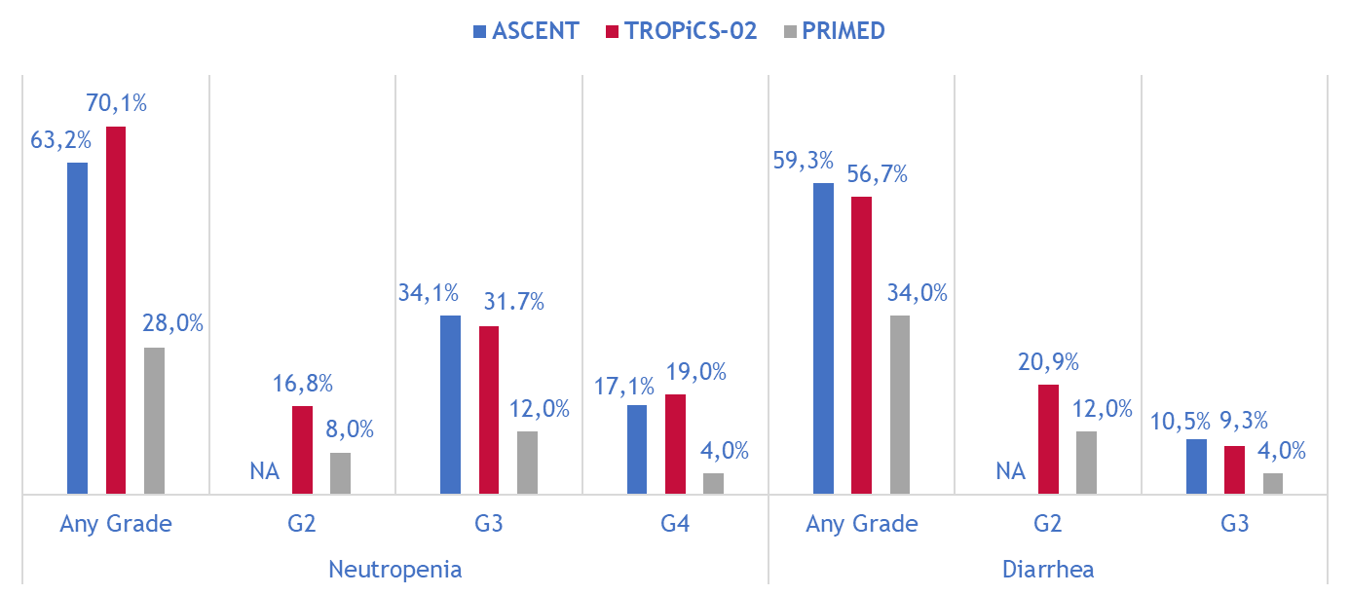
SG: PRIMED Strategy vs. ASCENT vs. TROPiCS-02
Courtesy of Javier Cortés, MD, PhD
Bardia A, et al. NEJM 2021; Rugo H, et al. JCO 2022; Perez-Garcia-J, et al EClinicalMedicine 2025

Slide 81
Based on the published literature and your clinical experience, how would you indirectly compare the global tolerability of datopotamab deruxtecan to that of sacituzumab govitecan for patients with previously untreated mTNBC?

Slide 82
Assuming equal access, which TROP2-targeted antibody-drug conjugate would you prefer for a patient with previously untreated PD-L1-negative mTNBC and a history of …
COPD?

Slide 83
Assuming equal access, which TROP2-targeted antibody-drug conjugate would you prefer for a patient with previously untreated PD-L1-negative mTNBC and a history of …
Lingering cytopenias after (neo)adjuvant chemotherapy?

Slide 84
Assuming equal access, which TROP2-targeted antibody-drug conjugate would you prefer for a patient with previously untreated PD-L1-negative mTNBC and a history of …
Inflammatory bowel disease?

Slide 85
Assuming equal access, which TROP2-targeted antibody-drug conjugate would you prefer for a patient with previously untreated PD-L1-negative mTNBC and a history of …
Contact lens use?

Slide 86
Do you routinely administer G-CSF prophylaxis for patients receiving …
Sacituzumab govitecan?
Datopotamab deruxtecan?

Slide 87
Do you use chest imaging to monitor for interstitial lung disease (ILD) in patients receiving datopotamab deruxtecan who otherwise do not require chest imaging?

Slide 88
At what grade of ILD would you permanently discontinue datopotamab deruxtecan treatment for patients with documented ILD?

Slide 89
Summary of Key First-Line Clinical Trials
Trial name | Phase | Randomization | Regimen | Study population | ORR | mPFS | mOS
ASCENT-03 | III | 1:1 | SG vs TPC | Ineligible for PD-(L)1 inhibitor | 48% vs 46% | 9.7 vs 6.9 (HR 0.62) | 21.5 vs 20.2 (0.98)
ASCENT-04 | III | 1:1 | SG + P vs TPC + P | PD-L1+ | 60% vs 53% | 11.2 vs 7.8 (HR 0.65) | NR vs NR (HR 0.89)
TROPION-Breast02 | III | 1:1 | Dato-DXd vs TPC | Ineligible for PD-(L)1 inhibitor | 63% vs 29% | 10.8 vs 5.6 (HR 0.57) | 23.7 vs 18.7 (HR 0.79)
OptiTROP-Breast05 | II | N/A | Sac-TMT | PD-L1+ or PD-L1- | 70.7% | 13.4 | NR
Dato-DXd = datopotamab deruxtecan

Slide 90
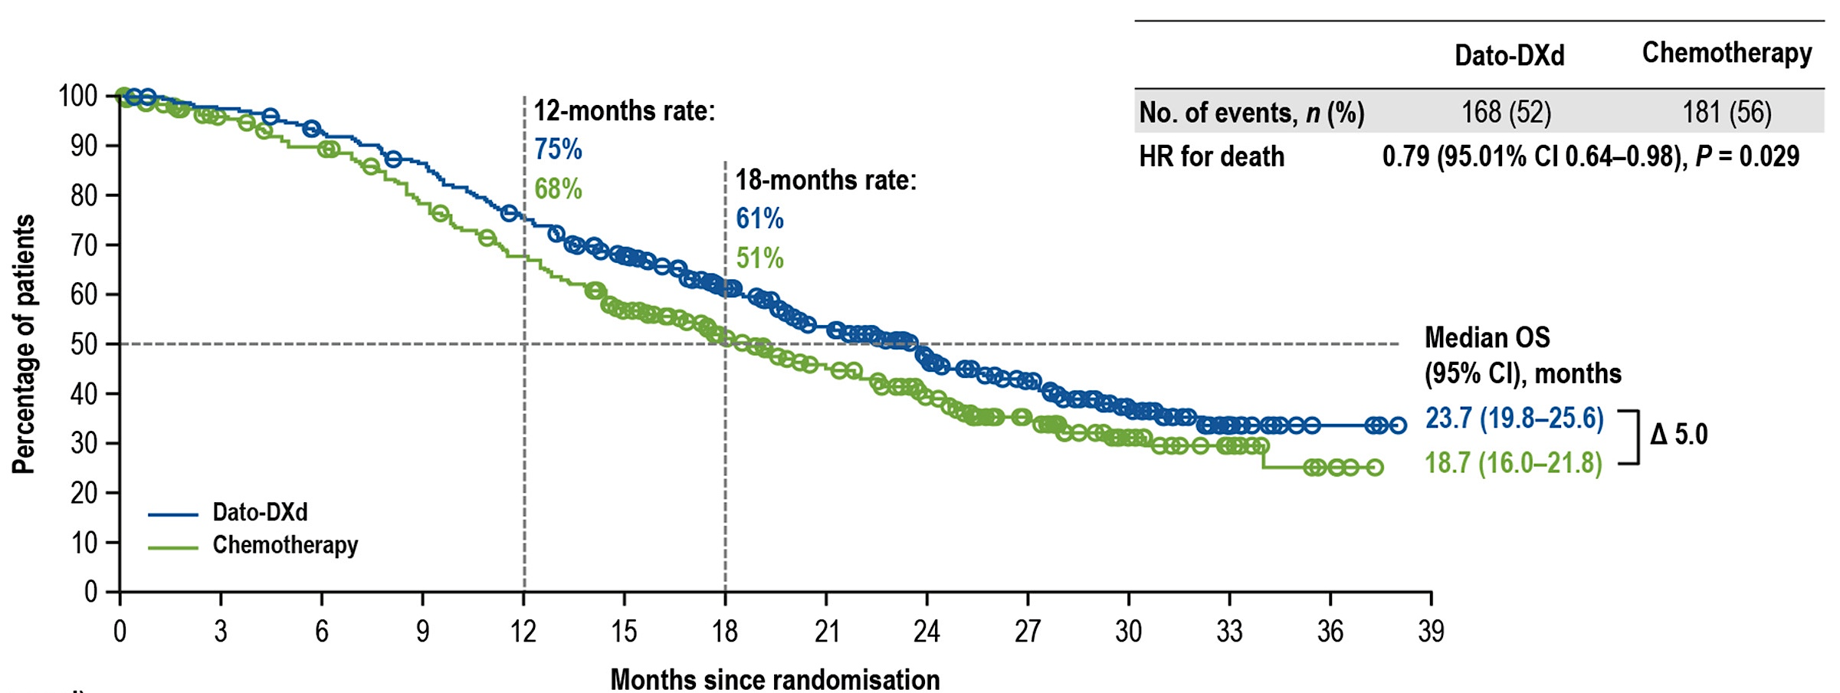
Phase III TROPION-Breast02: Overall Survival
Dent RA et al. Ann Oncol 2026 April 3:S0923-7534(26)00130-4.

Slide 91
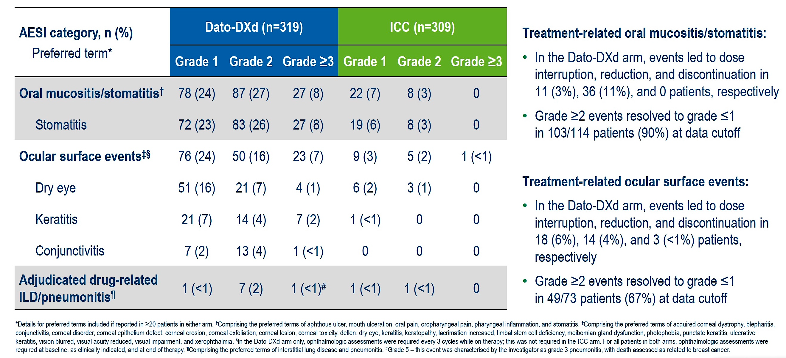
Phase III TROPION-Breast02: AEs of Special Interest with Dato-DXd
ICC = investigator's choice of chemotherapy; ILD = interstitial lung disease
Dent R et al ESMO 2025;Abstract LBA21.

Slide 92
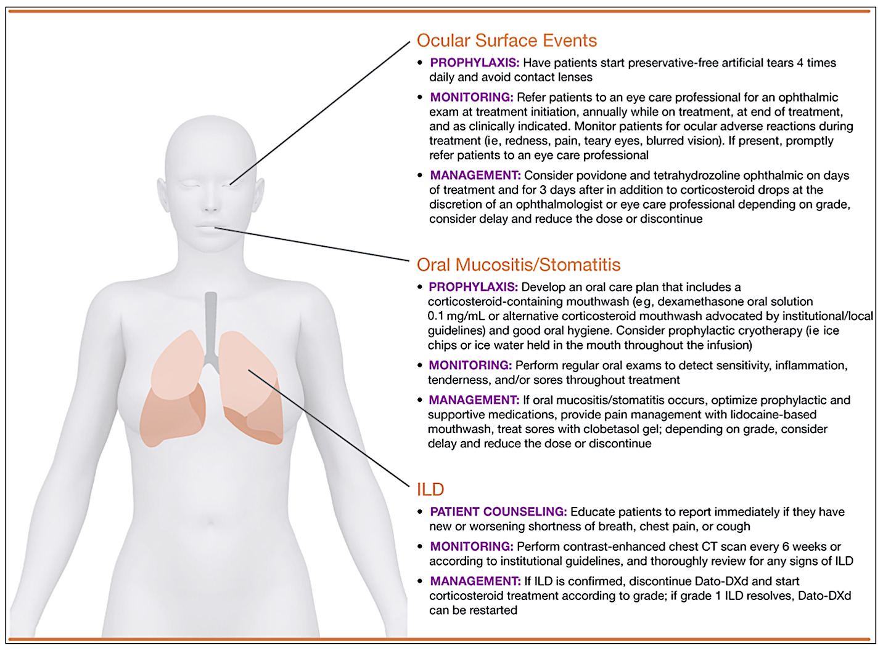
Managing Adverse Events Associated with Dato-DXd
Lisberg A et al. Oncologist 2025 September 1;30(9):oyaf225.

Slide 93
Prevention/Diagnostic
ADC-associated Ocular Surface Toxicity
Use lubricating eyedrops daily
Avoid the use of contact lenses
Ophthalmological Assessment
Dry Eye
Keratitis
Management
Stinging
Burning or scratchy sensation
Eye redness
Foreign body feeling
Sensitivity to light
Blurred vision
Difficulty with contact lenses
Symptoms of Dry Eye
Eye pain
Excess tears
Other discharge
Difficulty opening eyelid due to pain or irritation
Decreased vision
Ulceration
 | G1 | G2 | G3 | G4
ADC | Continue | Hold until <G2 | Hold until <G2 | Discontinue
Dose reduction | N/A | N/A | Reduce by 1 Level (if >7d) | Discontinue
Lubricating eyedrops: sodium hyaluronate night gel 4/d, Hypromellose eyedrops 4-5/d, carmellose sodium 4/d
Immune suppressive eyedrops: Ciclosporin eyedrops
Courtesy of Javier Cortés, MD, PhD
Schmid P. ESMO Breast Cancer Annual Congress. 2024.

Slide 94
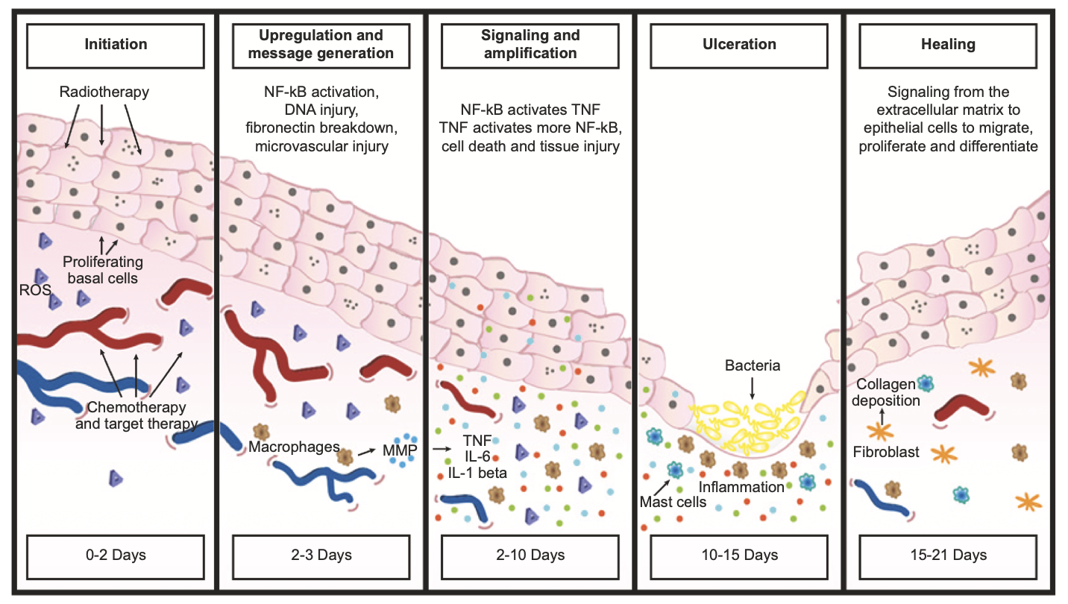
Pathogenesis of Oral Mucositis/Stomatitis
Meric-Bernstam F et al. Oncologist 2025 March 10;30(3):oyaf031.

Slide 95
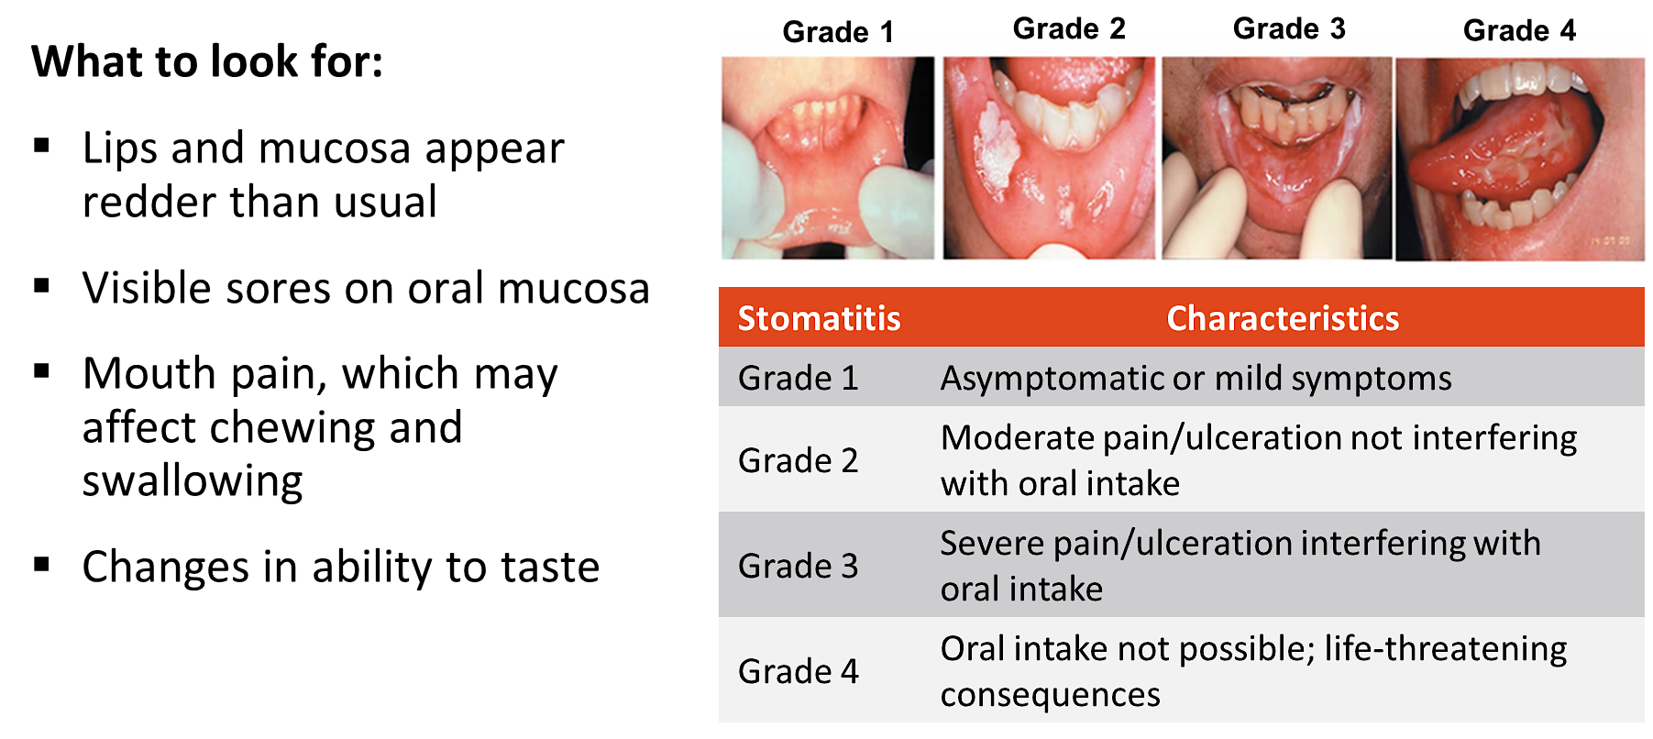
Dato-DXd: Identification of Mucositis/Stomatitis
Images reproduced under the terms of Creative Commons CC-BY license version 4.0 from Maria. Front Oncol 2017
Courtesy of Javier Cortés, MD, PhD

Slide 96
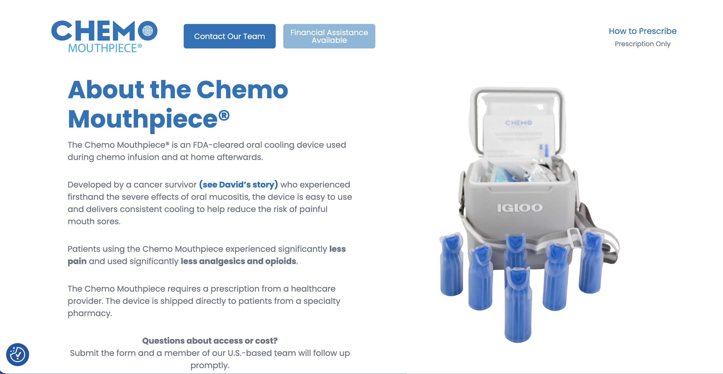

Slide 97
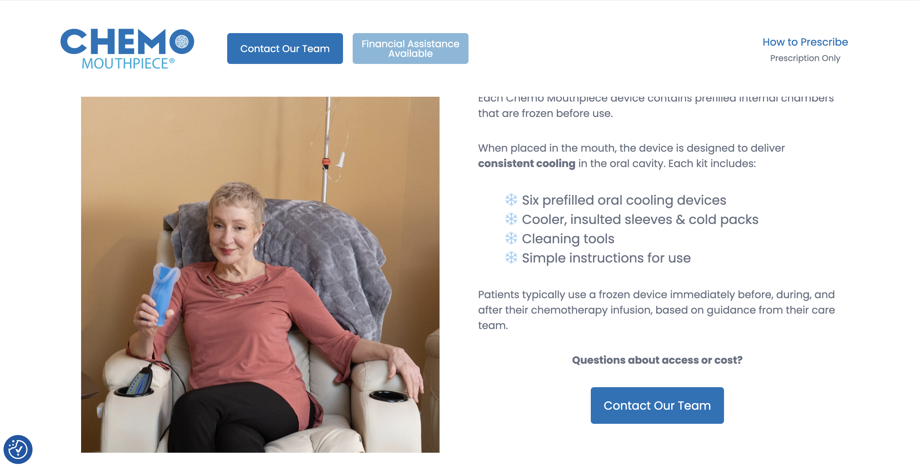
Cooler, insulated sleeves & cold packs

Slide 98
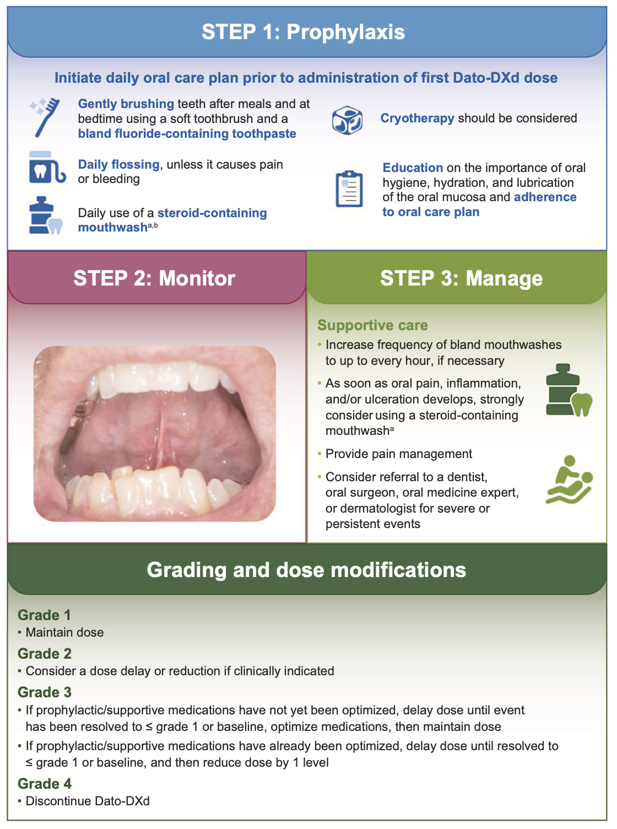
Management Recommendations for Stomatitis
Meric-Bernstam F et al. Oncologist 2025 March 10;30(3):oyaf031.

Slide 99
What is ILD?
ILD (Interstitial Lung Disease) is a broad term for a group of diffuse, parenchymal lung disorders including some types of pneumonitis
Symptoms
Clinical signs
Risk factors
Inflammation or scarring of the lung interstitium²
Chest radiographic abnormalities¹
Changes in pulmonary function tests reflecting decreased lung volume¹
Microscopic patterns of inflammation and fibrosis²
Patient history of ILD/pneumonitis or lung disease^{4,5}
Smoking status^{4,5}
Age >70 years⁵
Male⁵
Use of anticancer agents
Dose
Geographic Region
Nonspecific cough^{1,2}
Fever³
Shortness of breath (dyspnoea)²
Pneumonitis and idiopathic pulmonary fibrosis⁴
Courtesy of Javier Cortés, MD, PhD

Slide 100
Summary of Key First-Line Clinical Trials
Trial name | Phase | Randomization | Regimen | Study population | ORR | mPFS | mOS
ASCENT-03 | III | 1:1 | SG vs TPC | Ineligible for PD-(L)1 inhibitor | 48% vs 46% | 9.7 vs 6.9 (HR 0.62) | 21.5 vs 20.2 (0.98)
ASCENT-04 | III | 1:1 | SG + P vs TPC + P | PD-L1+ | 60% vs 53% | 11.2 vs 7.8 (HR 0.65) | NR vs NR (HR 0.89)
TROPION-Breast02 | III | 1:1 | Dato-DXd vs TPC | Ineligible for PD-(L)1 inhibitor | 63% vs 29% | 10.8 vs 5.6 (HR 0.57) | 23.7 vs 18.7 (HR 0.79)
OptiTROP-Breast05 | II | N/A | Sac-TMT | PD-L1+ or PD-L1- | 70.7% | 13.4 | NR
Sac-TMT = sacituzumab tirumotecan

Slide 101
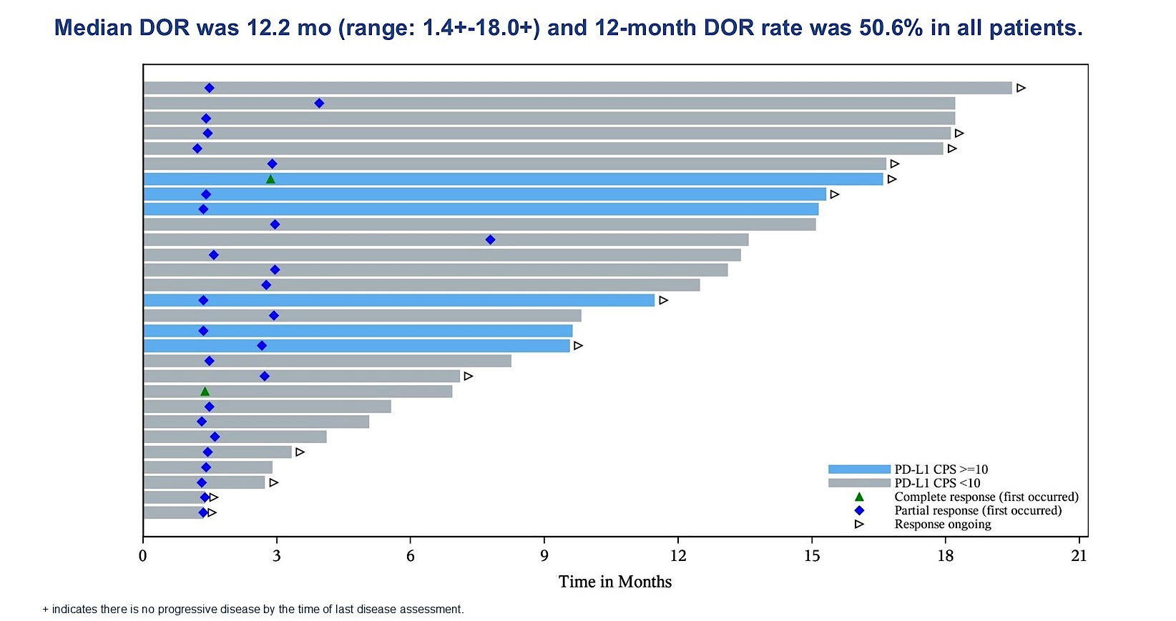
Phase II OptiTROP-Breast05: Duration of Response
Yin Y et al. ASCO 2025;Abstract 1019.

Slide 102
Agenda Metastatic Triple-Negative Breast Cancer
Introduction: Where We Are; Where We’re Heading
Module 1: First-Line Treatment of BRCA Wild-Type Disease
Module 2: First-Line Treatment of BRCA-Mutant Disease
Module 3: Novel Approaches
Module 4: ASCO 2026

Slide 103
A woman with a BRCA germline mutation presents with de novo HR-negative, HER2 IHC 1+, PD-L1-positive (CPS 10) mBC. Regulatory and reimbursement issues aside, which first-line therapy would you most likely recommend in each of the following scenarios?
Age 65, PS 0, asymptomatic bone metastases
Pembrolizumab/nab paclitaxel

Slide 104
A woman with a BRCA germline mutation presents with de novo HR-negative, HER2 IHC 1+, PD-L1-positive (CPS 10) mBC. Regulatory and reimbursement issues aside, which first-line therapy would you most likely recommend in each of the following scenarios?
Age 65, PS 0, symptomatic visceral (including liver) metastases
Pembrolizumab/nab paclitaxel

Slide 105
A woman with a BRCA germline mutation presents with de novo HR-negative, HER2 IHC 1+, PD-L1-positive (CPS 10) mBC. Regulatory and reimbursement issues aside, which first-line therapy would you most likely recommend in each of the following scenarios?
Age 65, PS 0, multiple brain metastases requiring SRS

Slide 106
A woman with a BRCA germline mutation presents with de novo HR-negative, HER2 IHC 1+, PD-L1-positive (CPS 10) mBC. Regulatory and reimbursement issues aside, which first-line therapy would you most likely recommend in each of the following scenarios?
Age 80, PS 2, asymptomatic bone metastases
Pembrolizumab/nab paclitaxel

Slide 107
Cases from General Medical Oncologists
56 yo woman
De novo mTNBC, BRCA-mutant, PD-L1 >10, HER2 2+ (FISH neg). Metastases to bone, liver and lymph nodes. History of HTN, HLD.
Recently started SG + pembrolizumab.
How would you decide olaparib vs SG + pembrolizumab? Would you use T-DXd after SG in this case? When do you choose Dato-DXd?

Slide 108
Cases from General Medical Oncologists
69 yo woman
mTNBC with metastases to bone, lungs and LN. PALB2-mutation, HER2-ultra-low. History of HTN.
Triple negative IDC of the R breast cT0N3M0 Stage III/ypT0N0 s/p KN-522 x 1 dose, surgery and RT then developed metastatic disease.
Currently on olaparib for 18 months.
Should she get SG or T-DXd next line? How do you decide?

Slide 109
Cases from General Medical Oncologists
45 yo woman
mTNBC, gBRCA-mutated, PD-L1 CPS 20. Metastases to bone and lung. History of asthma.
Locally advanced stage III, received KN-522 regimen, progressed on pembro maintenance 6 months after completing adjuvant pembro.
What first line treatment is appropriate? Does the time from pembro relapse (6-month interval) play a factor?
Would you do PARPi or rechallenge with a pembrolizumab regimen (pembro/sacituzumab)? What about Dato-DXd?

Slide 110
Cases from General Medical Oncologists
51 yo woman
mTNBC with metastases to brain, liver and lung. PD-L1 high, BRCA-positive. History of diabetes.
TNBC initially stage 3 2018, received AC-T. Diagnosed stage 4 in 2023, received nab paclitaxel x 6 with pembrolizumab and achieved a CR, she received maintenance pembrolizumab for 2 yrs with no side effects.
She is in CR — how long would you continue pembrolizumab? If she has no visible disease, would you offer olaparib?
Role of ctDNA in this patient?

Slide 111
Agenda Metastatic Triple-Negative Breast Cancer
Introduction: Where We Are; Where We’re Heading
Module 1: First-Line Treatment of BRCA Wild-Type Disease
Module 2: First-Line Treatment of BRCA-Mutant Disease
Module 3: Novel Approaches
Module 4: ASCO 2026

Slide 112
Novel Approaches
Borresman K, et al. Single arm phase II study with abemaciclib and bicalutamide in locoregionally advanced inoperable or metastatic androgen receptor-positive triple-negative breast cancer (ABBICAR). SABCS 2025;Abstract PS5-08-27.
Traina T et al. TBCRC 058: A randomized phase II study of enzalutamide, enzalutamide with mifepristone, and treatment of physician’s choice in patients with androgen receptor-positive metastatic triple-negative or estrogen receptor-low breast cancer (NCT06099769). ASCO 2026; Abstract TPS1162.
Feasibility study of adjuvant enzalutamide for the treatment of early stage AR(+) triple negative breast cancer. NCT02750358. PI: Tiffany Traina

Slide 113
Cases from General Medical Oncologists
74 yo woman
mTNBC with metastases to bone and lung. History of diabetes, chronic kidney disease.
Neoadjuvant AC-T chemotherapy 4 years prior to diagnosis of metastatic disease.
On Foundation testing at the time of mets she was found to have androgen receptor positivity.
Would you consider the use of bicalutamide or enzalutamide in this patient?
PD-L1 80% on NGS so could you also consider a single agent immunotherapy on this person?

Slide 114
Agenda Metastatic Triple-Negative Breast Cancer
Introduction: Where We Are; Where We’re Heading
Module 1: First-Line Treatment of BRCA Wild-Type Disease
Module 2: First-Line Treatment of BRCA-Mutant Disease
Module 3: Novel Approaches
Module 4: ASCO 2026

Slide 115
ASCO 2026 Abstract Titles to Look Out for
Schmid P et al. Neoadjuvant pembrolizumab or placebo plus chemotherapy followed by adjuvant pembrolizumab or placebo for high-risk early-stage TNBC: Final analysis results from the phase 3 KEYNOTE-522 study. Abstract 507.
Kalinsky K et al. Progression-free survival after next line of treatment (PFS2) and subsequent therapies (subs tx) in the ASCENT-04 study of participants (pts) with previously untreated PD-L1+ metastatic triple-negative breast cancer (mTNBC) treated with sacituzumab govitecan (SG) plus pembrolizumab (pembro) vs chemotherapy (chemo) plus pembro. Abstract LBA1000.
Hurvitz S et al. Progression-free survival after next line of treatment (PFS2) and subsequent therapies (subs tx) in the ASCENT-03 study of participants (pts) with previously untreated metastatic triple-negative breast cancer (mTNBC) treated with sacituzumab govitecan (SG) vs chemotherapy (chemo). Abstract 1001.

Slide 116
ASCO 2026 Abstract Titles to Look Out For
Cescon D et al. First-line datopotamab deruxtecan (Dato-DXd) vs chemotherapy in patients with locally recurrent inoperable or metastatic triple-negative breast cancer (TNBC) for whom immunotherapy was not an option: Additional efficacy endpoints from the TROPION-Breast02 study. Abstract 1002.
Tolaney S et al. ASCENT-04: Analysis of efficacy by biomarker subgroups with sacituzumab govitecan (SG) + pembrolizumab (pembro) vs chemotherapy (chemo) + pembro in participants (pts) with previously untreated PD-L1+ metastatic triple-negative breast cancer (mTNBC). Abstract 1013.
Barrios C et al. ASCENT-03: Efficacy by biomarker subgroup with sacituzumab govitecan (SG) vs chemotherapy (chemo) in participants (pts) with previously untreated advanced triple-negative breast cancer (TNBC) who are not candidates for PD-(L)1 inhibitors (PD-[L]1i). Abstract 1014.

Slide 117
Year in Review: Clinical Investigator Perspectives on the Most Relevant New Datasets and Advances in Oncology
Non-Muscle-Invasive and Muscle-Invasive Bladder Cancer
A CME/MOC-Accredited Live Webinar
Tuesday, May 5, 2026 5:00 PM – 6:00 PM ET
Faculty
Ashish M Kamat, MD, MBBS
Thomas Powles, MBBS, MRCP, MD
Moderator
Neil Love, MD

Slide 118
Thank you for joining us! Please take a moment to complete the survey currently up on Zoom. Your feedback is very important to us. The survey will remain open for 5 minutes after the meeting ends. Information on how to obtain CME, ABIM MOC and ABS credit is provided in the Zoom chat room. Attendees will also receive an email in 1 to 3 business days with these instructions.

