Slide 1
Patterns of Care: Exploring How
Community Oncologists Manage
Metastatic Triple-Negative Breast Cancer
A CME/MOC-Accredited Live Webinar
Tuesday, July 21, 2026
5:00 PM – 6:00 PM ET
Faculty
Professor Peter Schmid, FRCP, MD, PhD
Melinda Telli, MD, FASCO
Moderator
Neil Love, MD

Slide 2



Faculty
Professor Peter Schmid, FRCP, MD, PhD
Lead, Centre of Experimental Cancer Medicine
Barts Cancer Institute
London, United Kingdom
MODERATOR
Neil Love, MD
Research To Practice
Miami, Florida
Melinda Telli, MD, FASCO
Professor of Medicine
Director, Breast Cancer Program
Associate Director for Clinical Research
Stanford University School of Medicine
Stanford Cancer Institute
Stanford, California

Slide 3
Commercial Support
This activity is supported by an educational grant from Gilead Sciences Inc.

Slide 4
Dr Love — Disclosures
Dr Love is president and CEO of Research To Practice. Research To Practice receives funds in the form of educational grants to develop CME activities from the following companies: Aadi Bioscience, AbbVie Inc, ADC Therapeutics, Agendia Inc, Alexion Pharmaceuticals, Amgen Inc, Array BioPharma Inc, a subsidiary of Pfizer Inc, Arvinas, Astellas, AstraZeneca Pharmaceuticals LP, Aveo Pharmaceuticals, Bayer HealthCare Pharmaceuticals, BeOne, Biotheranostics Inc, A Hologic Company, Black Diamond Therapeutics Inc, Blueprint Medicines, Boehringer Ingelheim Pharmaceuticals Inc, Bristol Myers Squibb, Catalyst Pharmaceuticals Inc, Celcuity, Clovis Oncology, Coherus BioSciences, Corcept Therapeutics Inc, CTI BioPharma, a Sobi Company, Daiichi Sankyo Inc, Eisai Inc, Elevation Oncology Inc, Exact Sciences Corporation, Exelixis Inc, Genentech, a member of the Roche Group, Genmab US Inc, Geron Corporation, Gilead Sciences Inc, GSK, Helsinn Therapeutics (US) Inc, ImmunoGen Inc, Incyte Corporation, Ipsen Biopharmaceuticals Inc, Jazz Pharmaceuticals Inc, Johnson & Johnson, Karyopharm Therapeutics, Kite, A Gilead Company, Kura Oncology, Legend Biotech, Lilly, MEI Pharma Inc, Merck, Mersana Therapeutics Inc, Mirati Therapeutics Inc, Mural Oncology Inc, Natera Inc, Novartis, Novartis Pharmaceuticals Corporation on behalf of Advanced Accelerator Applications, Novocure Inc, Nuvalent, Nuvation Bio Inc, Pfizer Inc, Pharmacyclics LLC, an AbbVie Company, Puma Biotechnology Inc, Regeneron Pharmaceuticals Inc, Revolution Medicines Inc, Rigel Pharmaceuticals Inc, R-Pharm US, Sanofi, Seagen Inc, Servier Pharmaceuticals LLC, SpringWorks Therapeutics Inc, Stemline Therapeutics Inc, Sumitomo Pharma America, Summit Therapeutics, Syndax Pharmaceuticals, Taiho Oncology Inc, Takeda Pharmaceuticals USA Inc, TerSera Therapeutics LLC, Tesaro, A GSK Company, and Verastem Inc.

Slide 5
Research To Practice CME Planning Committee Members,
Staff and Reviewers
Planners, scientific staff and independent reviewers for Research To Practice have no relevant financial relationships to disclose.

Slide 6
Prof Schmid— Disclosures
Consulting Agreements | AstraZeneca Pharmaceuticals LP, Bayer HealthCare Pharmaceuticals, Boehringer Ingelheim Pharmaceuticals Inc, Celgene Corporation, Eisai Inc, Merck, Novartis, Pfizer Inc, Puma Biotechnology Inc, Roche Laboratories Inc

Slide 7
Dr Telli — Disclosures
Consulting Agreements | Arvinas, AstraZeneca Pharmaceuticals LP, BioNTech SE, Daiichi Sankyo Inc, Foresight Diagnostics, a wholly-owned subsidiary of Natera Inc, Genentech, a member of the Roche Group, Gilead Sciences Inc, GSK, Lilly, Merck, Natera Inc, Novartis, Pfizer Inc, Sanofi, Summit Therapeutics, Zentalis Pharmaceuticals
Contracted Research | Arvinas, AstraZeneca Pharmaceuticals LP, Blueprint Medicines, BioNTech SE, Genentech, a member of the Roche Group, GSK, Hummingbird Bioscience, Merck, Pfizer Inc
Data and Safety Monitoring Boards/Committees | Celcuity, G1 Therapeutics Inc, Gilead Sciences Inc

Slide 8
This educational activity contains discussion of
non-FDA-approved uses of agents and regimens. Please refer to official prescribing information for each product for approved indications.

Slide 9
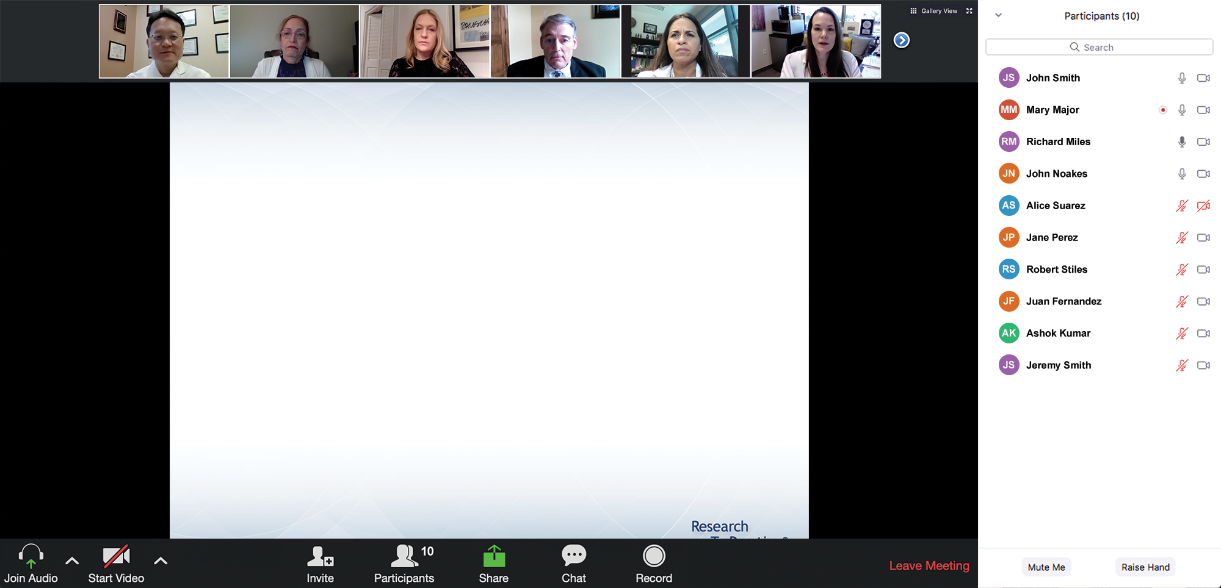

We Encourage Clinicians in Practice to Submit Questions
Feel free to submit questions now before the program begins and throughout the program.

Slide 10
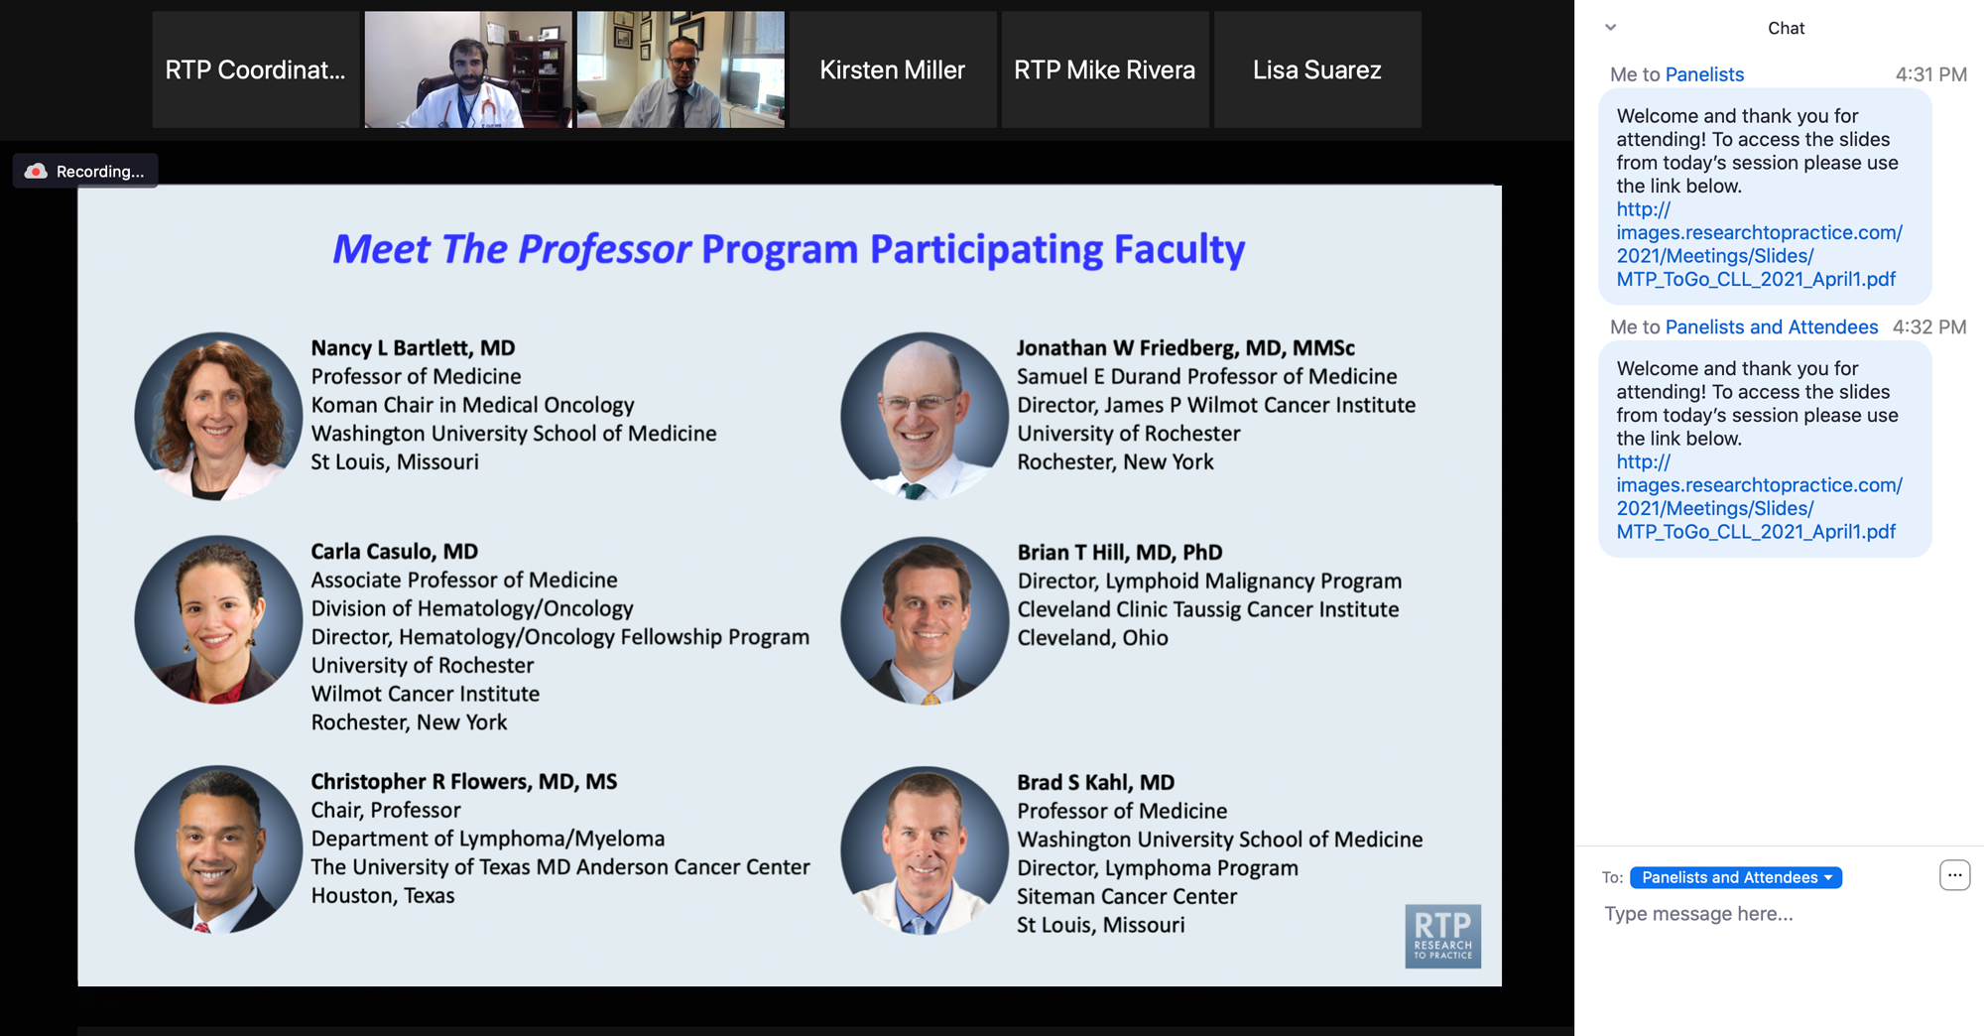
Familiarizing Yourself with the Zoom Interface
Expand chat submission box
Drag the white line above the submission box up to create
more space for your message.

Slide 11
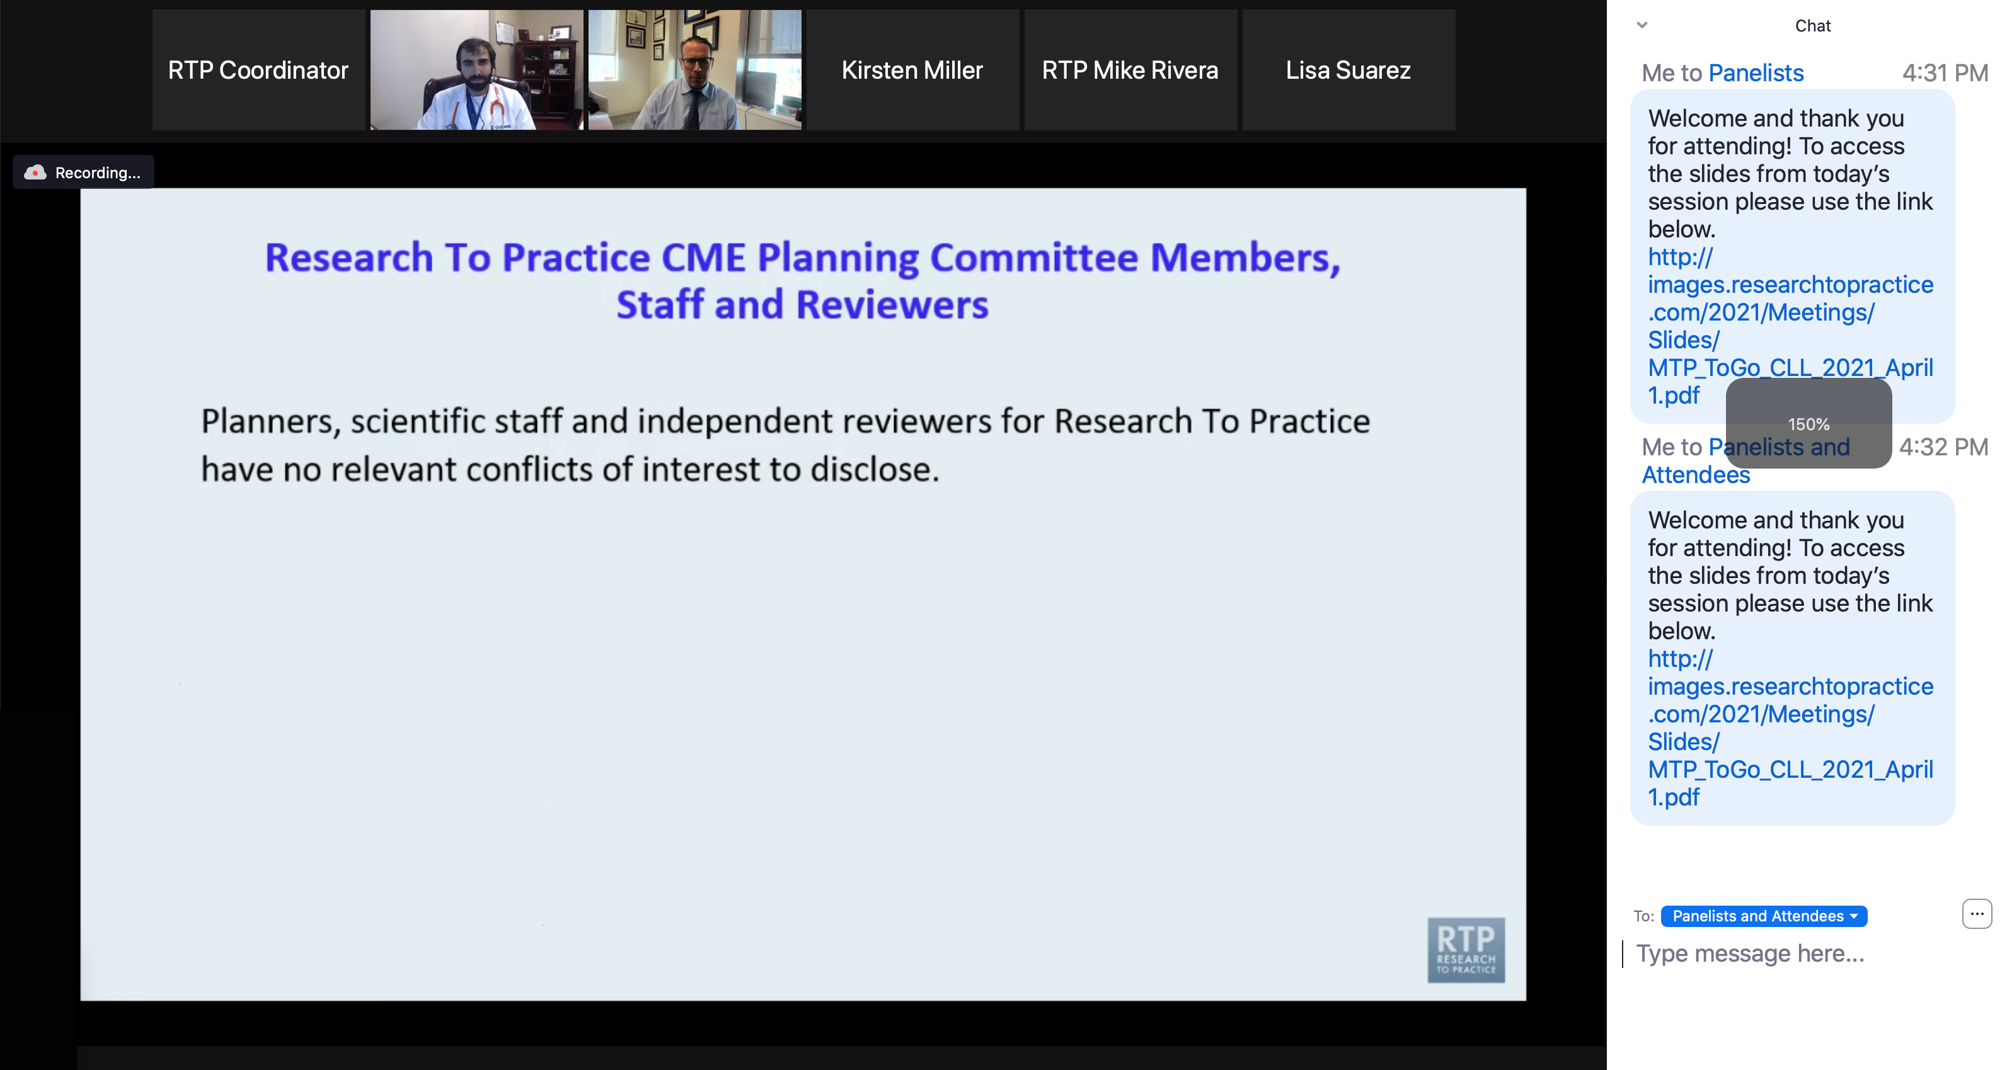
Familiarizing Yourself with the Zoom Interface
Increase chat font size
Press Command (for Mac) or Control (for PC) and the + symbol.
You may do this as many times as you need for readability.

Slide 12
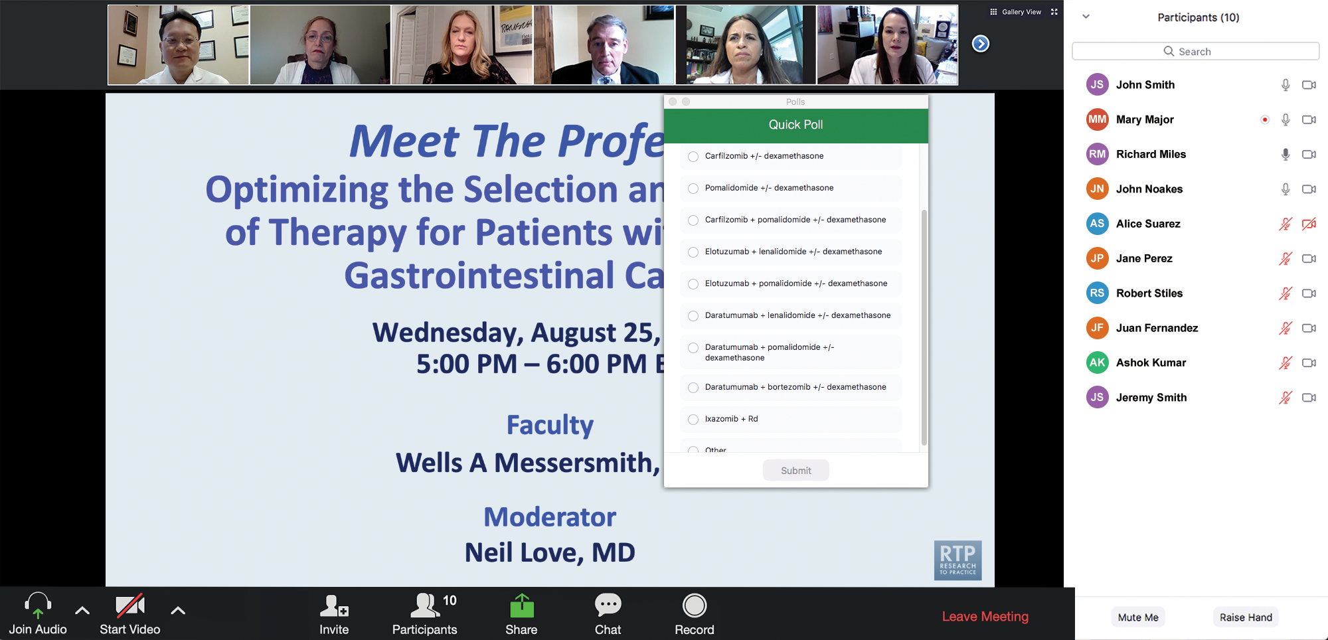
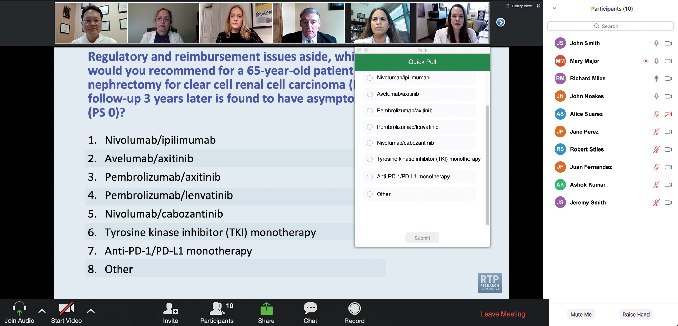
Clinicians in the Audience, Please Complete the Pre- and Postmeeting Surveys
Quick Survey
Quick Poll

Slide 13
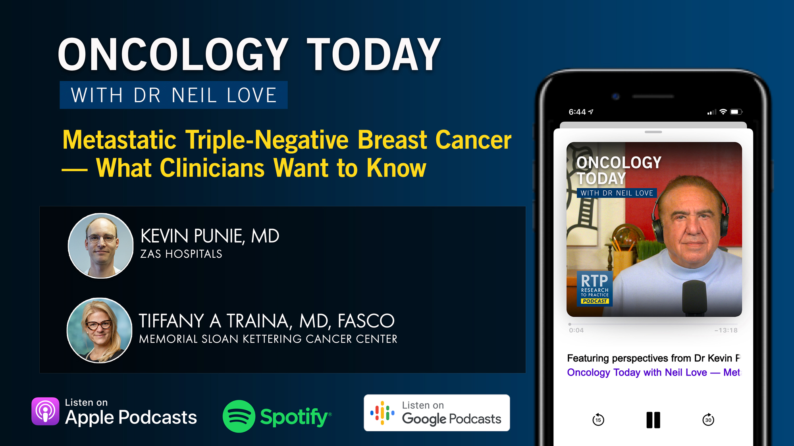

Slide 14
Bringing the Investigator into the Equation
— Optimal Use of Hormonal Therapy in the
Care of Patients with Prostate Cancer
A CME/MOC-Accredited Live Webinar
Wednesday, July 29, 2026
5:00 PM – 6:00 PM ET
Faculty
William K Oh, MD
Mary-Ellen Taplin, MD
Moderator
Neil Love, MD

Slide 15
The Implications of Recent Datasets for the Current and Future Management of Breast Cancer — An ASCO 2026 Review
A CME/MOC-Accredited Live Webinar
Thursday, July 30, 2026
5:00 PM – 6:30 PM ET
Faculty
Aditya Bardia, MD, MPH
Kevin Kalinsky, MD, MS, FASCO
Joyce O’Shaughnessy, MD
Moderator
Neil Love, MD

Slide 16
Integrating New Advances into the Care of Patients with Cancer
A Multitumor Symposium Hosted in Conjunction with the American Oncology Network
Join Us In Person or Virtually
Saturday, August 22, 2026
JW Marriott Nashville | Nashville, Tennessee
Chronic Lymphocytic Leukemia
9:00 AM – 9:50 AM CT
Diffuse Large B-Cell Lymphoma
12:35 PM – 1:25 PM CT
Gastroesophageal Cancers
9:50 AM – 10:40 AM CT
Lung Cancer
1:25 PM – 2:15 PM CT
Gynecologic Cancers
10:55 AM – 11:45 AM CT
Moderator
Stephen “Fred” Divers, MD

Slide 17
Grand Rounds
CME/MOC-Accredited Interactive Series
Regional Activities
Two Series
Optimizing the Use of
Novel Therapies for Patients with Diffuse Large B-Cell Lymphoma
Optimizing Therapy for Patients with Hormone Receptor-Positive
Localized Breast Cancer
Host a 1-hour session at your institution:
Email Meetings@ResearchToPractice.com
or call (800) 233-6153

Slide 18
Thank you for joining us! Please take a moment to complete the survey currently up on Zoom.
Your feedback is very important to us.
Information on how to obtain CME, ABIM MOC and ABS credit will be provided at the conclusion of the activity in the Zoom chat room. Attendees will also receive an email in 1 to 3 business days with these instructions.

Slide 19
Patterns of Care: Exploring How
Community Oncologists Manage
Metastatic Triple-Negative Breast Cancer
A CME/MOC-Accredited Live Webinar
Tuesday, July 21, 2026
5:00 PM – 6:00 PM ET
Faculty
Professor Peter Schmid, FRCP, MD, PhD
Melinda Telli, MD, FASCO
Moderator
Neil Love, MD

Slide 20
Faculty
Professor Peter Schmid, FRCP, MD, PhD
Lead, Centre of Experimental Cancer Medicine
Barts Cancer Institute
London, United Kingdom
MODERATOR
Neil Love, MD
Research To Practice
Miami, Florida
Melinda Telli, MD, FASCO
Professor of Medicine
Director, Breast Cancer Program
Associate Director for Clinical Research
Stanford University School of Medicine
Stanford Cancer Institute
Stanford, California

Slide 21
We Encourage Clinicians in Practice to Submit Questions
Feel free to submit questions now before the program begins and throughout the program.

Slide 22
Clinicians in the Audience, Please Complete the Pre- and Postmeeting Surveys
Quick Survey
Quick Poll

Slide 24
Bringing the Investigator into the Equation
— Optimal Use of Hormonal Therapy in the
Care of Patients with Prostate Cancer
A CME/MOC-Accredited Live Webinar
Wednesday, July 29, 2026
5:00 PM – 6:00 PM ET
Faculty
William K Oh, MD
Mary-Ellen Taplin, MD
Moderator
Neil Love, MD

Slide 25
The Implications of Recent Datasets for the Current and Future Management of Breast Cancer — An ASCO 2026 Review
A CME/MOC-Accredited Live Webinar
Thursday, July 30, 2026
5:00 PM – 6:30 PM ET
Faculty
Aditya Bardia, MD, MPH
Kevin Kalinsky, MD, MS, FASCO
Joyce O’Shaughnessy, MD
Moderator
Neil Love, MD

Slide 26
Integrating New Advances into the Care of Patients with Cancer
A Multitumor Symposium Hosted in Conjunction with the American Oncology Network
Join Us In Person or Virtually
Saturday, August 22, 2026
JW Marriott Nashville | Nashville, Tennessee
Chronic Lymphocytic Leukemia
9:00 AM – 9:50 AM CT
Diffuse Large B-Cell Lymphoma
12:35 PM – 1:25 PM CT
Gastroesophageal Cancers
9:50 AM – 10:40 AM CT
Lung Cancer
1:25 PM – 2:15 PM CT
Gynecologic Cancers
10:55 AM – 11:45 AM CT
Moderator
Stephen “Fred” Divers, MD

Slide 27
Grand Rounds
CME/MOC-Accredited Interactive Series
Regional Activities
Two Series
Optimizing the Use of
Novel Therapies for Patients with Diffuse Large B-Cell Lymphoma
Optimizing Therapy for Patients with Hormone Receptor-Positive
Localized Breast Cancer
Host a 1-hour session at your institution:
Email Meetings@ResearchToPractice.com
or call (800) 233-6153

Slide 28
Patterns of Care: Exploring How
Community Oncologists Manage
Metastatic Triple-Negative Breast Cancer
A CME/MOC-Accredited Live Webinar
Tuesday, July 21, 2026
5:00 PM – 6:00 PM ET
Faculty
Professor Peter Schmid, FRCP, MD, PhD
Melinda Telli, MD, FASCO
Moderator
Neil Love, MD

Slide 29
Prof Schmid— Disclosures
Consulting Agreements | AstraZeneca Pharmaceuticals LP, Bayer HealthCare Pharmaceuticals, Boehringer Ingelheim Pharmaceuticals Inc, Celgene Corporation, Eisai Inc, Merck, Novartis, Pfizer Inc, Puma Biotechnology Inc, Roche Laboratories Inc

Slide 30
Dr Telli — Disclosures
Consulting Agreements | Arvinas, AstraZeneca Pharmaceuticals LP, BioNTech SE, Daiichi Sankyo Inc, Foresight Diagnostics, a wholly-owned subsidiary of Natera Inc, Genentech, a member of the Roche Group, Gilead Sciences Inc, GSK, Lilly, Merck, Natera Inc, Novartis, Pfizer Inc, Sanofi, Summit Therapeutics, Zentalis Pharmaceuticals
Contracted Research | Arvinas, AstraZeneca Pharmaceuticals LP, Blueprint Medicines, BioNTech SE, Genentech, a member of the Roche Group, GSK, Hummingbird Bioscience, Merck, Pfizer Inc
Data and Safety Monitoring Boards/Committees | Celcuity, G1 Therapeutics Inc, Gilead Sciences Inc

Slide 31
Dr Love — Disclosures
Dr Love is president and CEO of Research To Practice. Research To Practice receives funds in the form of educational grants to develop CME activities from the following companies: Aadi Bioscience, AbbVie Inc, ADC Therapeutics, Agendia Inc, Alexion Pharmaceuticals, Amgen Inc, Array BioPharma Inc, a subsidiary of Pfizer Inc, Arvinas, Astellas, AstraZeneca Pharmaceuticals LP, Aveo Pharmaceuticals, Bayer HealthCare Pharmaceuticals, BeOne, Biotheranostics Inc, A Hologic Company, Black Diamond Therapeutics Inc, Blueprint Medicines, Boehringer Ingelheim Pharmaceuticals Inc, Bristol Myers Squibb, Catalyst Pharmaceuticals Inc, Celcuity, Clovis Oncology, Coherus BioSciences, Corcept Therapeutics Inc, CTI BioPharma, a Sobi Company, Daiichi Sankyo Inc, Eisai Inc, Elevation Oncology Inc, Exact Sciences Corporation, Exelixis Inc, Genentech, a member of the Roche Group, Genmab US Inc, Geron Corporation, Gilead Sciences Inc, GSK, Helsinn Therapeutics (US) Inc, ImmunoGen Inc, Incyte Corporation, Ipsen Biopharmaceuticals Inc, Jazz Pharmaceuticals Inc, Johnson & Johnson, Karyopharm Therapeutics, Kite, A Gilead Company, Kura Oncology, Legend Biotech, Lilly, MEI Pharma Inc, Merck, Mersana Therapeutics Inc, Mirati Therapeutics Inc, Mural Oncology Inc, Natera Inc, Novartis, Novartis Pharmaceuticals Corporation on behalf of Advanced Accelerator Applications, Novocure Inc, Nuvalent, Nuvation Bio Inc, Pfizer Inc, Pharmacyclics LLC, an AbbVie Company, Puma Biotechnology Inc, Regeneron Pharmaceuticals Inc, Revolution Medicines Inc, Rigel Pharmaceuticals Inc, R-Pharm US, Sanofi, Seagen Inc, Servier Pharmaceuticals LLC, SpringWorks Therapeutics Inc, Stemline Therapeutics Inc, Sumitomo Pharma America, Summit Therapeutics, Syndax Pharmaceuticals, Taiho Oncology Inc, Takeda Pharmaceuticals USA Inc, TerSera Therapeutics LLC, Tesaro, A GSK Company, and Verastem Inc.

Slide 32
Commercial Support
This activity is supported by an educational grant from Gilead Sciences Inc.
Research To Practice CME Planning Committee Members,
Staff and Reviewers
Planners, scientific staff and independent reviewers for Research To Practice have no relevant financial relationships to disclose.

Slide 33
This educational activity contains discussion of
non-FDA-approved uses of agents and regimens. Please refer to official prescribing information for each product for approved indications.

Slide 34
Agenda:
Metastatic Triple-Negative Breast Cancer (mTNBC)
Introduction: TROP2-Targeting Antibody-Drug Conjugates (ADCs) for mTNBC
Module 1: First-Line Therapy (PD-L1 Negative)
Module 2: First-Line Therapy (PD-L1 Positive)
Module 3: Second-Line Therapy (Sequencing)
Module 4: Adverse Events with TROP2-Targeting ADCs

Slide 35
RTP Education Elements
Research findings
Clinical scenarios
Real-world cases

Slide 36
Survey of 50 Community-Based
General Medical Oncologists
Optimizing the Management of Metastatic
Triple-Negative Breast Cancer
April 21 to 29, 2026

Slide 37
Agenda:
Metastatic Triple-Negative Breast Cancer (mTNBC)
Introduction: TROP2-Targeting Antibody-Drug Conjugates (ADCs) for mTNBC
Module 1: First-Line Therapy (PD-L1 Negative)
Module 2: First-Line Therapy (PD-L1 Positive)
Module 3: Second-Line Therapy (Sequencing)
Module 4: Adverse Events with TROP2-Targeting ADCs

Slide 38

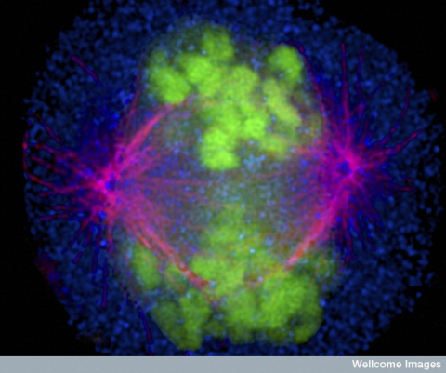

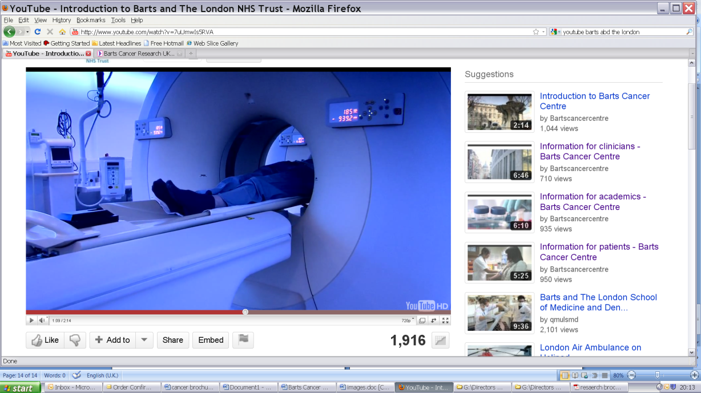



Evolving role TROP2-targeted ADCs in mTNBC
Professor Peter Schmid, MD PhD FRCP
Lead, Centre for Experimental Cancer Medicine
Barts Cancer Institute, St Bartholomew’s Hospital
Queen Mary University of London

Slide 39
Poor outcome of metastatic TNBC
Median OS 13.3 months
Initial
therapy
First distant
relapse
“Time on treatment”
12 weeks
9 weeks
4 weeks
Median
distant disease-free interval 18 months
First-line
chemotherapy
(100%)
Second-line
chemotherapy
(78%)
Third-line
chemotherapy
(49%)
Kassam, et al. Clin Breast Cancer 2009

Slide 40
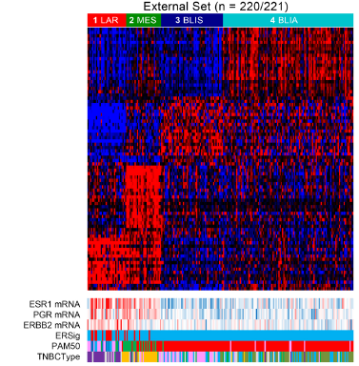
Understanding the Biology of TNBC
Heterogeneity of TNBC and Treatment Strategies
Gene Expression subtypes (Baylor)
Target/Population
Therapeutic Strategies
Immunotherapy
GE-Subtypes and
Therapeutic Subgroups not aligned
PD-L1+
Basal immune activated
Subgroups overlapping
PARP inhibitors
gBRCA-Mt+
ADC targets don’t need to be oncogenic drivers
TROP2
Antibody-Drug
Conjugates
HER2
Basal immune suppressed
HER3
LIV1
AKT Inhibitors
Mesenchymal
?
Luminal AR
Anti-androgen
AR+/LAR
Adapted from Burstein et al, CCR 2014
Schmid P, Personal Communication

Slide 41
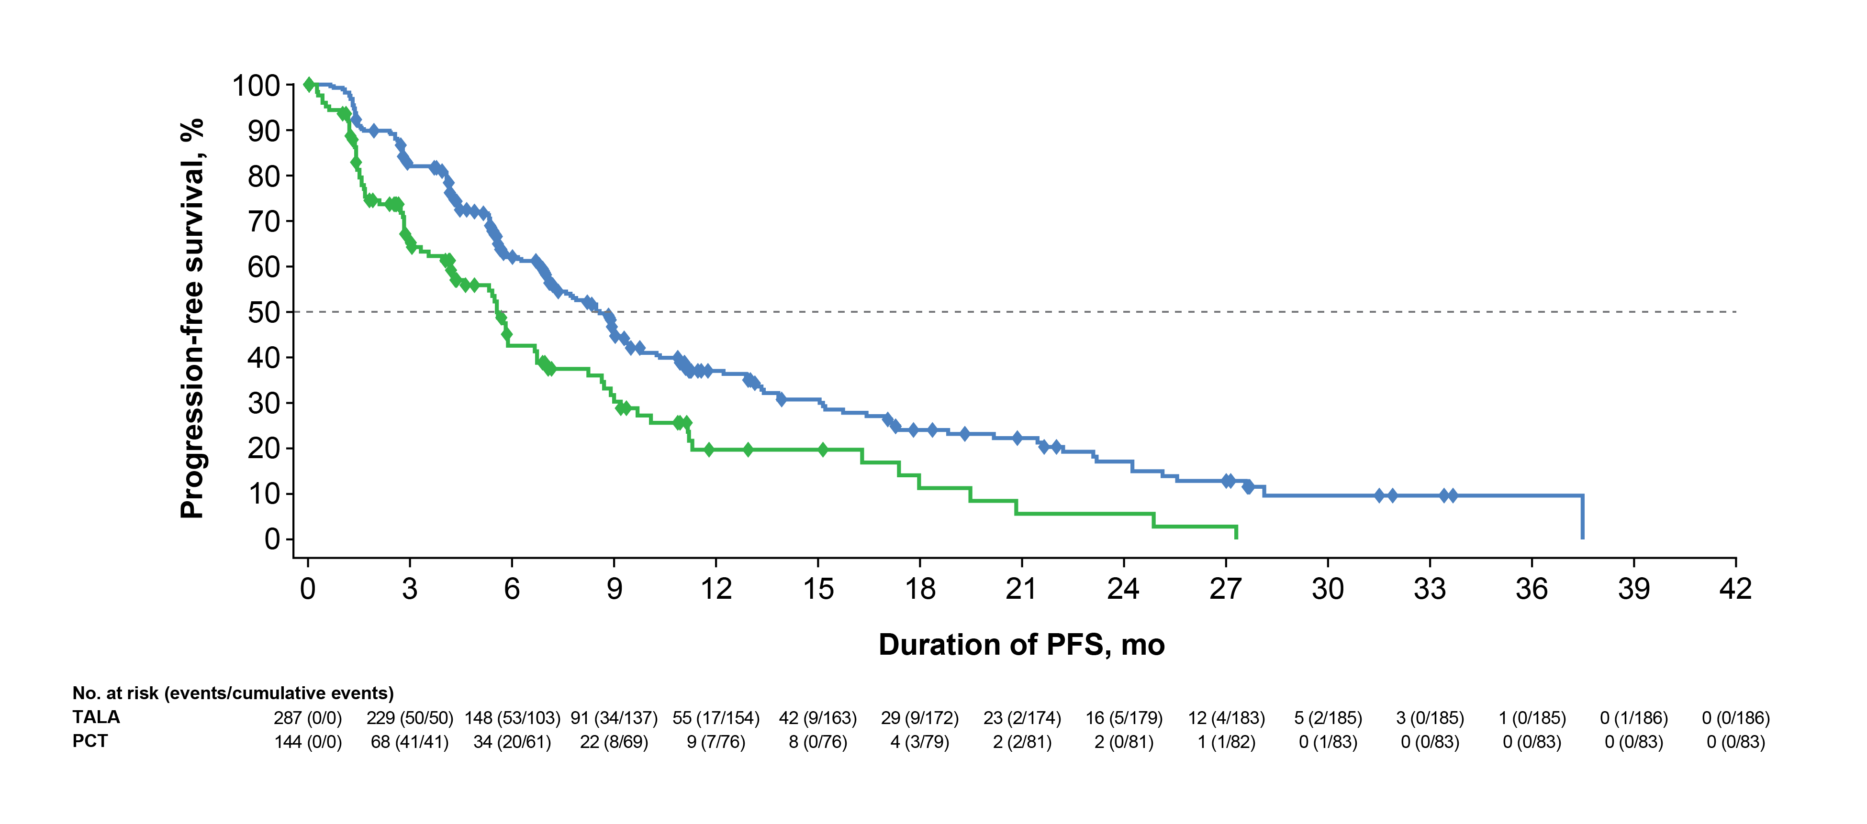
Targeting PARP in breast cancer
Potential impact of platinum-based therapy on PARPi remains to be defined as trial excluded patients progressing on platinum-based therapy
100
OlympiAD (Olaparib)
EMBRACA (Talazoparib)
90
80
70
Median PFS 7.0 vs 4.2 months
(HR 0.58; p = 0.0009)
Median PFS 8.6 vs 5.6 months
(HR 0.54; p < 0.0001)
60
PFS (%)
50
40
Is there a role for PARP beyond gBRCA-mt breast cancer?
30
20
10
    Germline mutation non-BRCA1/2 DDR
    ORR 33%
0
0
2
4
6
8
10
12
14
16
18
20
22
24
26
28
Months
RR | Olympia | EMBRACA
PARPi | 60% | 62.6%
Chemo | 29% | 27.2%
    Somatic BRCA1/2-Mt or non-BRCA1/2 DDR
    ORR 31%
    Carboplatin (TNT): ORR 68%
    Responses seen gPALB2 (82%) & sBRCA Mt (50%)
    No responses seen in ATM or CHEK2 Mt
Robson M, et al. NEJM 2017, Litton J, et al. NEJM 2018, Tutt A, et al Nature Med 2018
Tung, NM, et al. JCO 2020

Slide 42
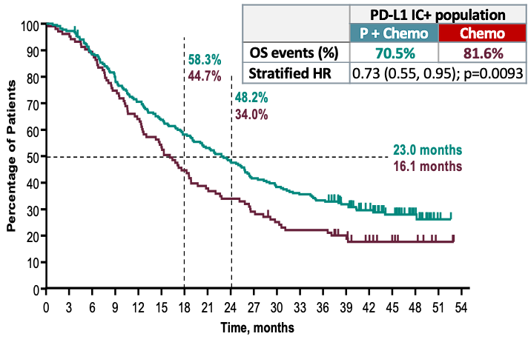
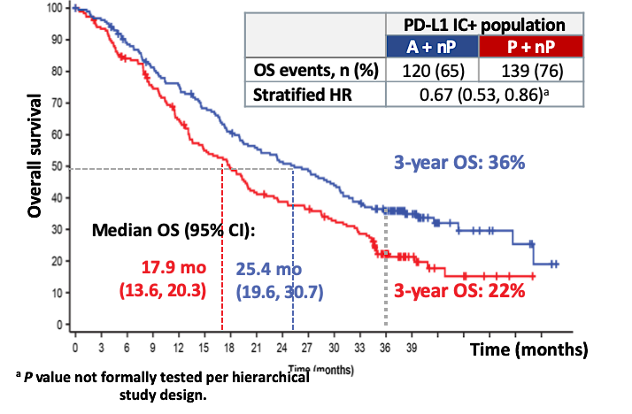
Immunotherapy provides OS benefit in PDL1+ mTNBC
IMpassion130 study design
KEYNOTE 355 study design
OS, SP142 ≥1%
OS, CPS ≥10
Schmid, NEJM 2018; Emens LA, ESMO 2020; Cortes, SABCS 2021

Slide 43
New antibody–drug conjugates
Tackle Target-positive
and negative cells
mAb targets tumour-specific antigens
Extracellular
drug release
Bystander Effect due to
Payload release before internalisation or membrane permeability
Tumour antigen internalised upon ADC binding
Potent
cytotoxic payload
Internalisation
Stable linker releases payload only in target cell
Intracellular
drug release
Lysosomal degradation
Cell cytotoxicity
Schmid P, Personal Communication
ADC, antibody–drug conjugates; DCR, disease control rate
Modi S, et al. Presented at SABCS 2017. Abstract PD3-07.

Slide 44
TROP2-targeting ADCs in Breast Cancer

Slide 45
Agenda:
Metastatic Triple-Negative Breast Cancer (mTNBC)
Introduction: TROP2-Targeting Antibody-Drug Conjugates (ADCs) for mTNBC
Module 1: First-Line Therapy (PD-L1 Negative)
Module 2: First-Line Therapy (PD-L1 Positive)
Module 3: Second-Line Therapy (Sequencing)
Module 4: Adverse Events with TROP2-Targeting ADCs

Slide 46
Cases from General Medical Oncologists
58 yo woman
mTNBC, PD-L1 CPS = 0, HER2-negative with metastases to liver, bone and LN. Prior DLBCL in remission. History of cardiomyopathy, heart failure, pacemaker.
Neoadjuvant TC for TNBC without path CR, then adjuvant capecitabine. ctDNA negative at end of adjuvant treatment but both ctDNA and radiological progression in 3 months. On sacituzumab govitecan for 4 years.
Do you retest PD-L1 status on progression? What are options for her as she has had
R-CHOP, TCHP, TC, capecitabine and sacituzumab govitecan for different cancers, has cardiomyopathy but had durable response with saci? She is young and motivated with a very supportive spouse.

Slide 47
Cases from General Medical Oncologists
71 yo woman
De novo metastatic TNBC, PD-L1 negative, HER2 IHC 0. No prior systemic therapy for breast cancer.
Extensive liver metastases and peritoneal disease; anorexia, abdominal pain, rapidly declining performance status. Atrial fibrillation, diabetic neuropathy, frailty, ECOG 2 bordering on 3.
For an older frail patient with PD-L1–negative visceral crisis-type mTNBC, what regimen would you favor up front to maximize likelihood of rapid response while preserving tolerability?
At what point do you move from combination chemotherapy to single-agent therapy or best supportive care in this setting?

Slide 48
  TROP2 ADCs in 1st line metastatic TNBC

Slide 49
Ongoing 1st line trials with TOPO1-ADCs in mTNBC
PD-L1 negative
PD-L1 positive
Trial positive
Trial positive
Trial positive
ASCENT-03
TROPION-Breast-02
ASCENT-04
Sacituzumab Govitecan
R
Datopotamab Deruxtecan
R
Sacituzumab Govitecan + Pembrolizumab
R
SOC Chemotherapy
SOC Chemotherapy
SOC Chemotherapy + Pembrolizumab
DIAMOND (Phase 2)
TroFuse-011
TROPION-Breast-05
Datopotamab Deruxtecan + Durvalumab
Sacituzumab Tirumotecan + Pembrolizumab
Datopotamab Deruxtecan + Durvalumab
R
R
Datopotamab Deruxtecan
R
Sacituzumab Tirumotecan
SOC Chemotherapy + Pembrolizumab
SOC Chemotherapy
IZABRIGHT-Breast01
R
IzaBren
SOC Chemotherapy

Slide 50
Datopotamab-Deruxtecan (Dato-DXd) in 1L TNBC
TROPION-Breast02 Trial¹
DFI:
de novo mTNBC 34%,
0-6m 15%, 0-12m 21%,
>12m 45%
No crossover offered.
Use of 2L SG NOT provided through the study
42%
of pts with subsequent Tx received SG
30% of all TPC pts with SG (72% had 2L+)
Progression-free Survival
PFS2 and time to 1st / 2nd Tx
Median PFS (95% CI)
10.8m (8.6–13.0) vs 5.6m (5.0–7.0)
Median follow-up 27.5 months
Dent R, et al. ESMO 2025, Cescon, ASCO 2026

Slide 51
Datopotamab-Deruxtecan (Dato-DXd) in 1L TNBC
TROPION-Breast02 Trial¹
Overall Survival
Median OS (95% CI)
23.7 mo (19.8–25.6) vs 18.7 mo (16.0–21.8)
Dato-DXd 323
Dent R, et al. ESMO 2025

Slide 52
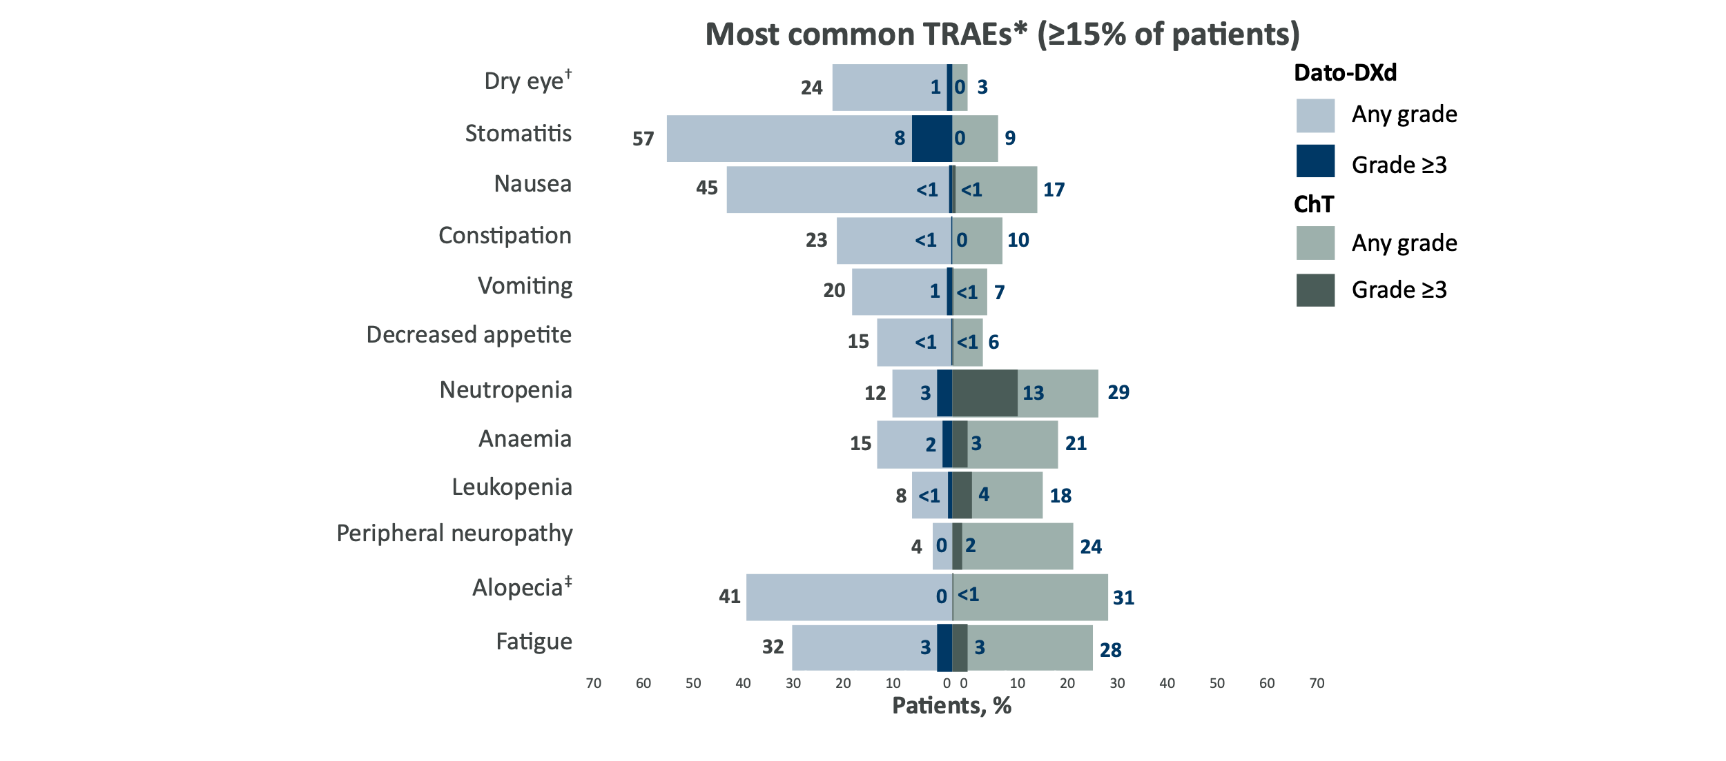
TROPION-Breast02: Summary of safety profile
Safety summary
Patients, n (%) | Dato-DXd (n=319) | ICC (n=309)
Any TRAE Grade ≥3 | 296 (93) 105 (33) | 257 (83) 89 (29)
Serious TRAEs | 29 (9) | 26 (8)
TRAEs leading to discontinuation | 14 (4) | 23 (7)
TRAEs leading to dose interruption | 76 (24) | 60 (19)
TRAEs leading to dose reduction | 85 (27) | 56 (18)
TRAEs leading to death | 0 | 0
Median total treatment duration, mo | 8.5 | 4.1
Patients with total exposure >12 mo, % | 35.1 | 9.4
Primary PFS and final OS analysis: DCO 25 August 2025, median follow-up: 27.5 months. *Combined preferred terms of neutropenia includes neutropenia and neutrophil count decreased, anaemia includes haemoglobin decreased, red blood cell count decreased, anaemia and haematocrit decreased, leukopenia includes white blood cell count decreased and leukopenia, peripheral neuropathy includes neuropathy peripheral, polyneuropathy, paraesthesia and peripheral sensory neuropathy, and fatigue includes fatigue, asthenia and malaise; †In the Dato-DXd arm, ophthalmologic assessments were required every 3 cycles while on therapy (this was not required in the ICC arm), for all patients in both arms, ophthalmologic assessments were required at baseline, as clinically indicated and at end of therapy; ‡For CTCAE v5.0, the minimum grade for alopecia is Grade 2.
Please see the slide notes for abbreviations and references.
Dent RA, et al. ESMO 2025;Abstract LBA21

Slide 53
TROPION-Breast02: PROs and QoL
Time to deterioration in QoL
Time to deterioration in Global Health Status/QoL
Interference of Stomatitis and Fatigue with daily activities
Time to deterioration in physical functioning
Schmid, et al. ESMO Breast 2026

Slide 54
Sacituzumab Govitecan (SG) in 1L TNBC
ASCENT-03 Trial¹
PFS in Subgroups
DFI:
de novo mTNBC 32%,
0-6m 0%, 0-12m 20%,
>12m 48%
Eligible patients offered crossover to 2L SG provided through the study
82%
of pts with subsequent Tx received SG
53% of all TPC pts with SG (62% had 2L+)
Progression-free Survival
PFS by TROP2-status
64% 2L+ therapy (14% still on 1L)
Cortes J, et al. ESMO 2025, Cortes NEJM 2025; Barrios ASCO 2026
Trop-2 H-score quartiles: Q1, 0-184; Q2, 185-239; Q3, 240-283; Q4, 284-300

Slide 55
Sacituzumab Govitecan (SG) in 1L TNBC
Descriptive Overall Survival
Progression-Free Survival 2
Overall survival not yet matureª
Study continues to first formal OS analysis
Of 179 patients who initiated subsequent treatment, 147 (82%) received SG
 | SG (n = 279) | Chemo (n = 279)
Median PFS2,^{c} (95% CI), m | 18.2 (15.9-NR) | 14.0 (12.5-17.4)
Stratified HR (95% CI) | 0.70 (0.55-0.90)
100
90
80
70
Overall survival | SG (n = 279) | Chemo (n = 279)
Number of events, % | 103 (37) | 103 (37)
Median (95% CI) , months | 21.5 (17.7-NR) | 20.2 (18.2-NR)
Stratified HR (95% CI) | 0.98 (0.75-1.30)
OS rate (95% CI), % 12-month 24-month | 75 (70-80) 46 (36-56) | 73 (67-78) 42 (29-54)
60
Event-Free Probability (%)
50
40
Median TFST & TSST
30
TFST: 11.2 vs 7.9 months
TSST: 17.3 vs 16.6 months
20
10
0
0
2
4
6
8
10
12
14
16
18
20
22
24
26
28
30
Time (months)
Almost twice as many participants in the SG group (27%) remained on study treatment
compared with the chemo group (14%) at the time of data cutoff
No. at Risk (Events)
SG
279 (0)
270 (8)
259 (18)
238 (37)
221 (51)
189 (65)
156 (78)
107 (93)
79 (104)
54 (109)
33 (111)
20 (113)
13 (114)
4 (114)
3 (114)
0 (114)
Chemo
279 (0)
271 (6)
257 (18)
237 (36)
212 (59)
178 (79)
133 (106)
86 (126)
67 (127)
34 (136)
19 (140)
10 (142)
2 (143)
0 (143)
At the time of primary analysis, overall survival was immature and PFS2 was longer with SG vs chemo
by investigator assessment
Data cutoff date: April 2, 2025. ªAt the time of this analysis, OS data maturity was 37%. ^{b}PFS2 is defined as the time from date of randomization to the first documented progression on next-line therapy based on investigator assessment of progressive disease or death due to any cause, whichever occurs first. ^{c}By investigator assessment.
2L, second line; chemo, chemotherapy; HR, hazard ratio; NR, not reached; OS, overall survival; PFS2, progression-free survival 2; SG, sacituzumab govitecan.
Cortes J, et al. ESMO 2025, Hurvitz ASCO 2026

Slide 56
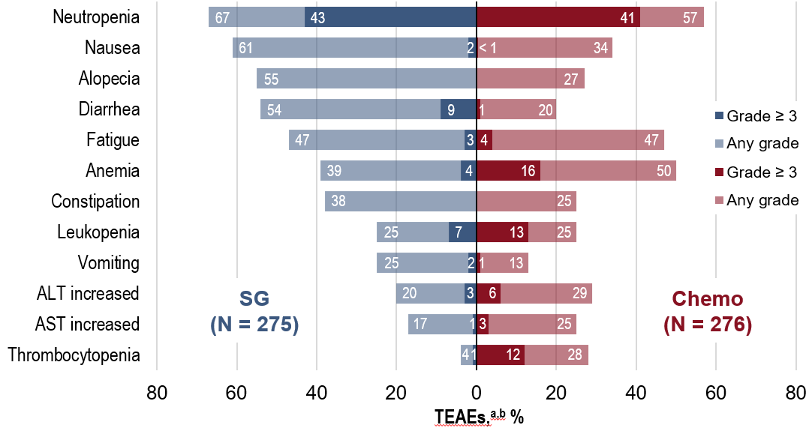
Sacituzumab Govitecan in 1L TNBC: Safety
Most Common Adverse Events
TEAEs, n (%) | SG (n = 275) | Chemo (n = 276)
Any TEAE | 273 (99) | 269 (97)
Grade ≥ 3 TEAEs | 181 (66) | 171 (62)
Treatment-related | 167 (61) | 147 (53)
Treatment-emergent SAE | 71 (26) | 67 (24)
Treatment-related | 46 (17) | 37 (13)
TEAEs leading to treatment discontinuation | 10 (4) | 33 (12)
TEAEs leading to dose interruption | 181 (66) | 171 (62)
TEAEs leading to dose reduction | 101 (37) | 124 (45)
TEAEs leading to death | 7 (3) | 1 (< 1)
Treatment-related | 6 (2) | 1 (< 1)
The AEs observed were consistent with the known safety profile of SG, with no new safety concerns¹
Data cutoff date: April 2, 2025. TEAEs were defined as any AEs that began or worsened on or after the first dose date of study drug up to 30 days after the last dose date of study drug or the initiation of subsequent anticancer therapy (including crossover treatment), whichever occurred first. ªTEAEs were included if they occurred in ≥ 20% of patients in either group. ^{b}Combined preferred terms of Neutropenia includes neutrophil count decreased, Fatigue includes asthenia, Anemia includes hemoglobin decreased and red blood cell count decreased, Leukopenia includes white blood cell count decreased, and Thrombocytopenia includes platelet count decreased.
AE, adverse event; ALT, alanine aminotransferase; AST, aspartate aminotransferase; chemo, chemotherapy; SAE, serious adverse event; SG, sacituzumab govitecan; TEAE, treatment-emergent adverse event. 1. Cortés J, et al. N Engl J Med. 2025;393:1912-25.
Hurvitz ASCO 2026

Slide 57
A 65-year-old woman presents with de novo HR-negative,
HER2 IHC 1+, PD-L1-negative (combined positive score [CPS] 0), BRCA wild-type metastatic breast cancer (mBC).
Regulatory and reimbursement issues aside, which first-line therapy would you most likely recommend in each of the following scenarios?
Asymptomatic, bone metastases
Symptomatic visceral (including liver) metastases
Multiple brain metastases requiring stereotactic radiosurgery (SRS)

Slide 58
A 65-year-old woman presents with de novo HR-negative,
HER2 IHC 1+, PD-L1-negative (CPS 0), BRCA-mutated mBC.
Regulatory and reimbursement issues aside, which first-line therapy would you most likely recommend in each of the following scenarios?
Asymptomatic, bone metastases
Symptomatic visceral (including liver) metastases
Multiple brain metastases requiring SRS

Slide 59
Based on the published literature and your clinical experience, how would you indirectly compare the antitumor efficacy of datopotamab deruxtecan to that of sacituzumab govitecan for patients with previously untreated mTNBC?

Slide 60
Assuming equal access, which TROP2-targeted antibody-drug conjugate would you prefer for a patient with previously untreated PD-L1-negative mTNBC based on relevant comorbidities?

Slide 61
Agenda:
Metastatic Triple-Negative Breast Cancer (mTNBC)
Introduction: TROP2-Targeting Antibody-Drug Conjugates (ADCs) for mTNBC
Module 1: First-Line Therapy (PD-L1 Negative)
Module 2: First-Line Therapy (PD-L1 Positive)
Module 3: Second-Line Therapy (Sequencing)
Module 4: Adverse Events with TROP2-Targeting ADCs

Slide 62
Cases from General Medical Oncologists
40 yo woman
Metastatic TNBC, BRCA WT, HER2 1+, CPS = 10. Mets to lung, bone, lymph nodes.
She received KN-522 for an initial cT2N0 right breast TNBC. She developed type 1 DM after 2 doses of pembrolizumab. She elected to stop pembrolizumab at that point. She completed NACT and had b/l mastectomy with 2 cm of residual disease in the breast. She palpated a lump in the same breast right before starting radiation.
She then completed PMRT and had wide local excision with no residual disease found. She started capecitabine but had back pain after 1 cycle. Imaging showed metastatic recurrence to lungs, bones and abdominal lymph nodes. She was switched to sacituzumab for 11 months then experienced symptomatic and radiographic progression.
What would the faculty consider at this point?

Slide 63
Cases from General Medical Oncologists
63 yo woman
De novo mTNBC, BRCA WT, PD-L1 CPS = 20 with symptomatic bone mets, several asymptomatic pulmonary mets. Hx of corneal abrasions (wears contact lenses).
Hx of IBS, wants a chemotherapy-free regimen.
Based on relevant clinical trials, would you select Datopotamab/Pembro or Sacituzumab/Pembro in terms of efficacy?
Would her hx of corneal abrasions/contact lenses and hx of controlled IBS influence your treatment decision?

Slide 64
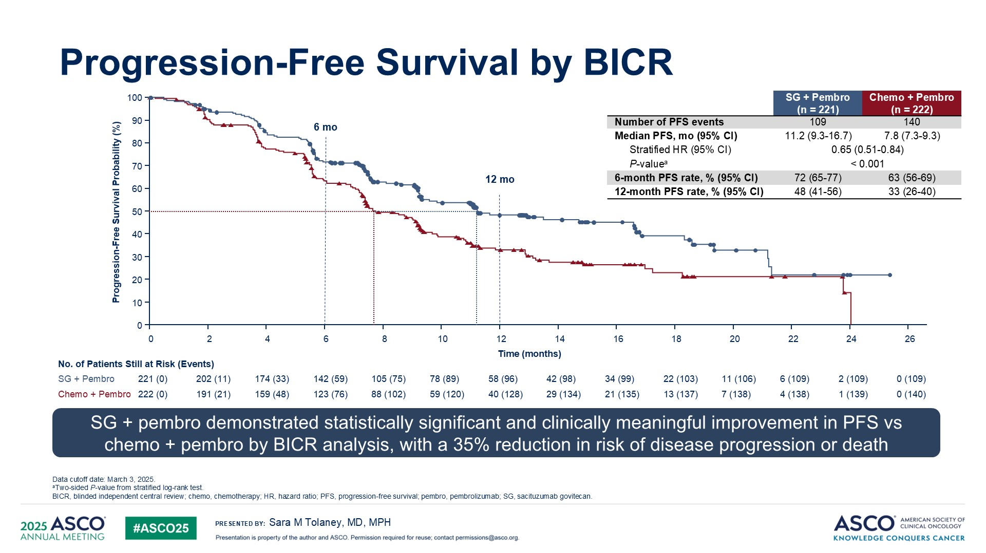
Sacituzumab Govitecan + Pembro in PDL1+ 1L TNBC
Ascent04
DFI:
de novo mTNBC 34%,
0-6m 0%, 0-12m 18%,
>12m 48%
Eligible patients offered crossover to 2L SG provided through the study
81%
of pts with subsequent Tx received SG
Progression-free Survival
PFS by TROP2-status
Trop-2 H-score quartiles: Q1, 0-224; Q2, 225-279; Q3, 280-298; Q4, 299-300.
Tolaney et al, ASCO 2025, Tolaney ASCO 2026

Slide 65
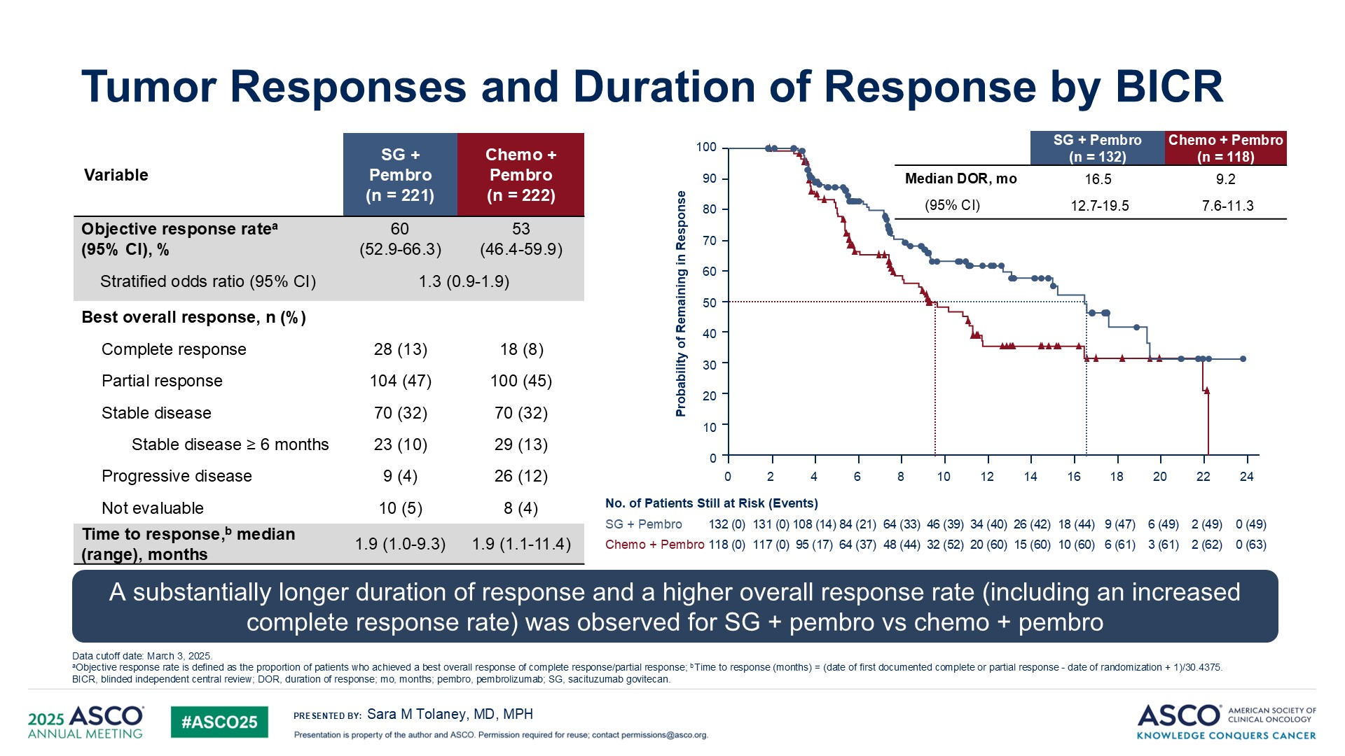
Sacituzumab Govitecan + Pembro in PDL1+ 1L TNBC
Ascent04
Objective response
Duration of Response
Progression-Free Survival 2
60%
60%
53%
50%
40%
Objective Response Rate (%)
30%
Median TFST & TSST
20%
TFST: 17.3 vs 9.8 months
TSST: NR vs 21.0 months
10%
0%
SG
Chemo
Almost twice as many participants in the SG + pembro group (43%) remained on study treatment compared with the chemo + pembro group (23%) at the time of data cutoff
Tolaney et al, ASCO 2025, Kalinsky, ASCO 2026

Slide 66
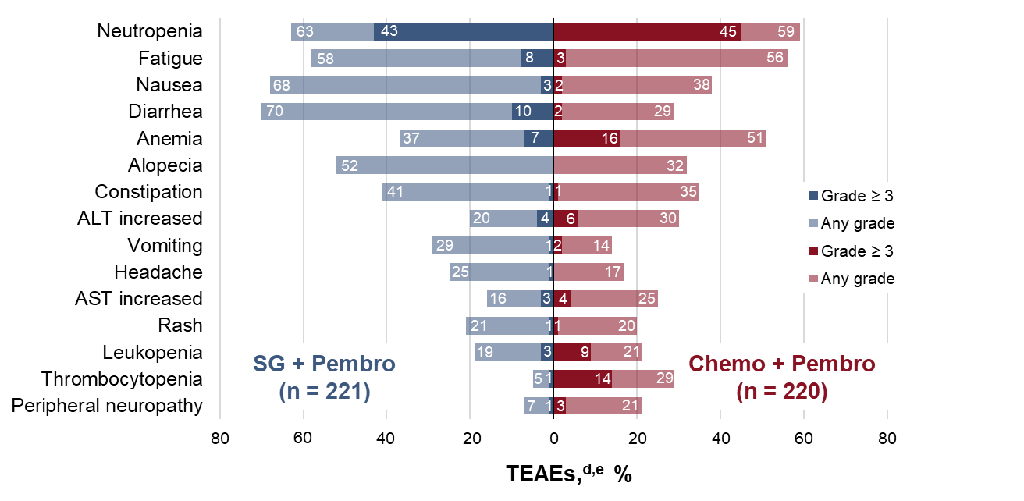
Sacituzumab Govitecan + Pembro: Safety and PROs
Most Common Adverse Events
n (%) | SG + Pembro (n = 221) | Chemo + Pembro (n = 220)
Any TEAE | 220 (> 99) | 219 (> 99)
Grade ≥ 3 | 158 (71) | 154 (70)
Treatment-emergent SAE | 84 (38) | 68 (31)
Treatment-related | 61 (28) | 42 (19)
TEAEs leading to treatment discontinuationª | 26 (12) | 68 (31)
TEAEs leading to dose interruption | 171 (77) | 162 (74)
TEAEs leading to dose reduction | 78 (35) | 96 (44)
TEAEs leading to death^{c} | 7 (3) | 6 (3)
Treatment-related | 3 (1) | 1 (< 1)
Time to deterioration in physical functioning
Time to deterioration in Global Health Status/QoL
Kalinsky, ASCO 2026, de Azambuja, ESMO 2025

Slide 67
Resistance to ADCs
Resistance to Payload and/or Target:
Resistance can be subclonal -> targeted Tx for Oligo-progression
Rational sequences
Combination of payloads and/or Targets
Combination with immunotherapy
Serial biopsies of tumour lesions at progression on Sacituzumab
Altered TROP2 binding
(Target resistance)
Failed SN38/TOP1 binding
(Payload resistance)
Coates et al, Cancer Discovery 2021

Slide 68
A 65-year-old woman presents with de novo hormone receptor
(HR)-negative, HER2 IHC 1+, PD-L1-positive (CPS 10),
BRCA wild-type mBC.
Regulatory and reimbursement issues aside, which first-line therapy would you most likely recommend in each of the following scenarios?
Asymptomatic, bone metastases
Symptomatic visceral (including liver) metastases
Multiple brain metastases requiring SRS

Slide 69
A 65-year-old woman with HR-negative, HER2 IHC 1+, BRCA wild-type breast cancer receives the KEYNOTE-522 regimen (neoadjuvant pembrolizumab/chemotherapy and adjuvant pembrolizumab) but experiences relapse after completing adjuvant pembrolizumab: PD-L1-positive (CPS 10).
Regulatory and reimbursement issues aside, which first-line therapy would you most likely recommend in each of the following scenarios?
Relapse 18 months after completing adjuvant pembrolizumab
Relapse 5 months after completing adjuvant pembrolizumab

Slide 70
A 65-year-old woman with a BRCA germline mutation presents with de novo HR-negative, HER2 IHC 1+, PD-L1-positive (CPS 10) mBC.
Regulatory and reimbursement issues aside, which first-line therapy would you most likely recommend in each of the following scenarios?
Asymptomatic, bone metastases
Symptomatic, visceral (including liver) metastases
Multiple brain metastases requiring SRS

Slide 71
Agenda:
Metastatic Triple-Negative Breast Cancer (mTNBC)
Introduction: TROP2-Targeting Antibody-Drug Conjugates (ADCs) for mTNBC
Module 1: First-Line Therapy (PD-L1 Negative)
Module 2: First-Line Therapy (PD-L1 Positive)
Module 3: Second-Line Therapy (Sequencing)
Module 4: Adverse Events with TROP2-Targeting ADCs

Slide 72
Cases from General Medical Oncologists
45 yo woman
mTNBC, gBRCA-mutated, HER2 1+, PD-L1 CPS 20. Metastases to bone and lung. History of asthma.
Locally advanced stage III, received KN-522 regimen, progressed after completing adjuvant pembro.
What first line treatment is appropriate? Does the time from pembro relapse (6-month interval) play a factor?
Would you do PARPi or rechallenge with a pembrolizumab regimen (pembro/sacituzumab)? What about Dato-DXd?

Slide 73
Cases from General Medical Oncologists
48 yo woman
Presents with metastatic recurrence 14 months after completing capecitabine.
She has a BRCA1 mutation, HER2 2+, low PD-L1 (CPS 2), and prior capecitabine exposure: How would you sequence therapy — would you favor a PARP inhibitor (olaparib or talazoparib) over sacituzumab govitecan in the first-line metastatic setting, and what data support this decision given the absence of head-to-head trials?
If she achieves a partial response on first-line PARP inhibitor therapy but progresses after 11 months with new pulmonary nodules, would you consider sacituzumab govitecan–pembrolizumab combination (per TROPION or ASCENT-04/SACI-IO data) despite her low PD-L1, or proceed with sacituzumab govitecan monotherapy — and how do you weigh the TROP2 expression status in this decision?

Slide 74
  TROP2 ADCs in pretreated metastatic TNBC

Slide 75
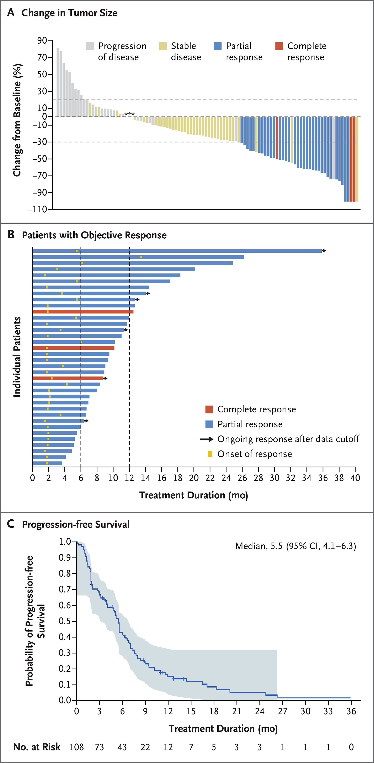
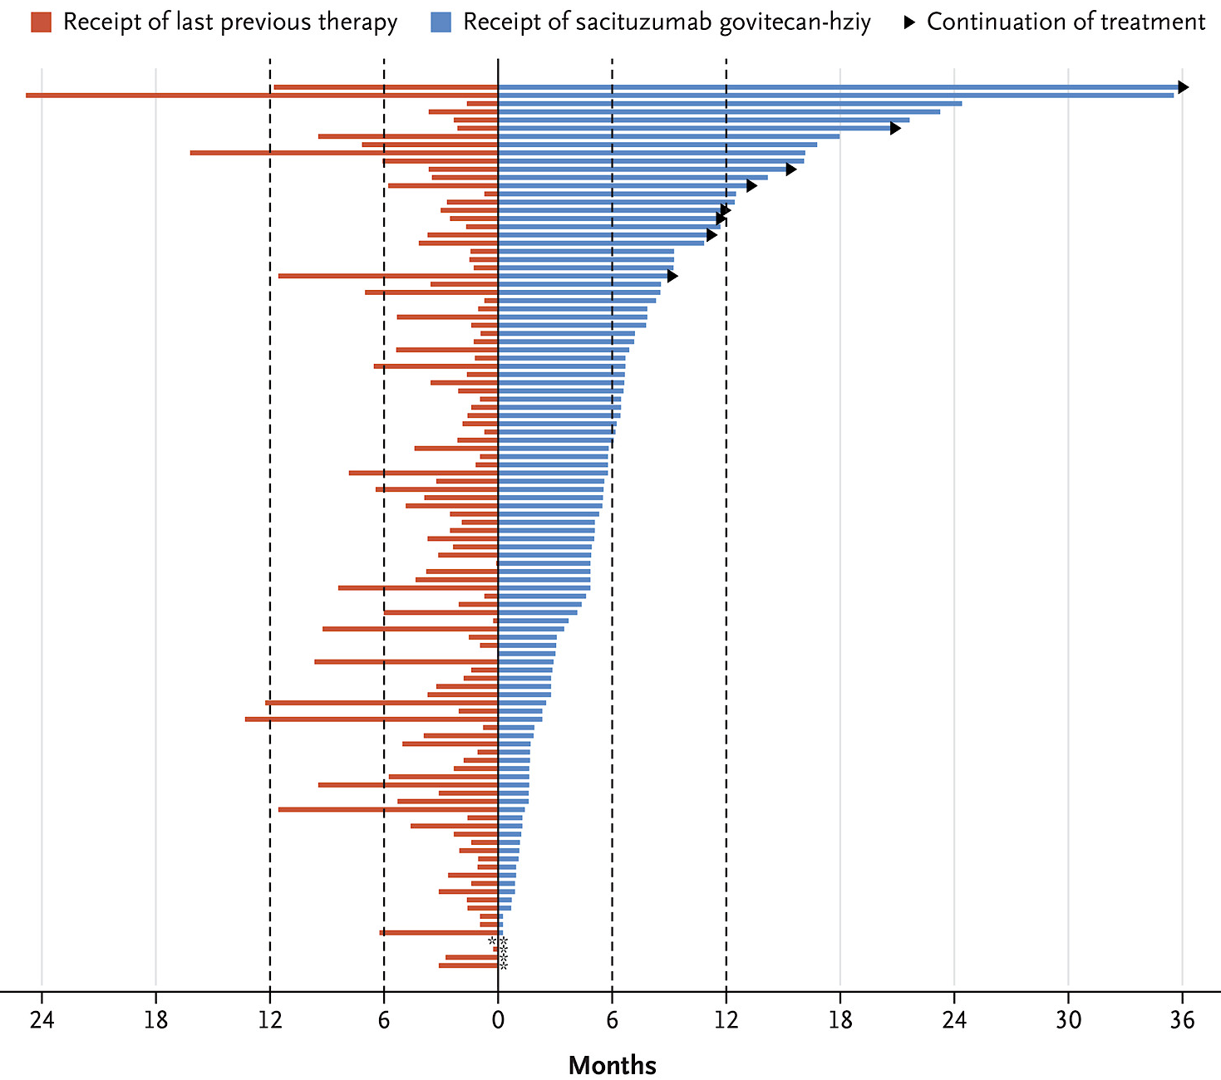
TROP2 ADCs in TNBC: Sacituzumab Govitecan
Phase I Activity (≥3L)
Duration of Sacituzumab and prior therapy
ORR: 33.3%; CBR: 45.4%
DOR: 7.7 months (4.9-10.8)
PFS: 5.5 months (4.1-6.3)
OS: 13 mths (11.2-13.7)
Bardia A, et al. NEJM 2019

Slide 76
Sacituzumab Govitecan in pretreated mTNBC
Ascent trial
Progression-free Survival
Overall Survival
Objective Response
Secondary endpoint (PFS) in the full population (BM positive/negative): HR=0.43 [0.35–0.54], P<0.0001).
Bardia A, et al. NEJM 2021; Bardia A, et al Ann Oncol 2021.

Slide 77
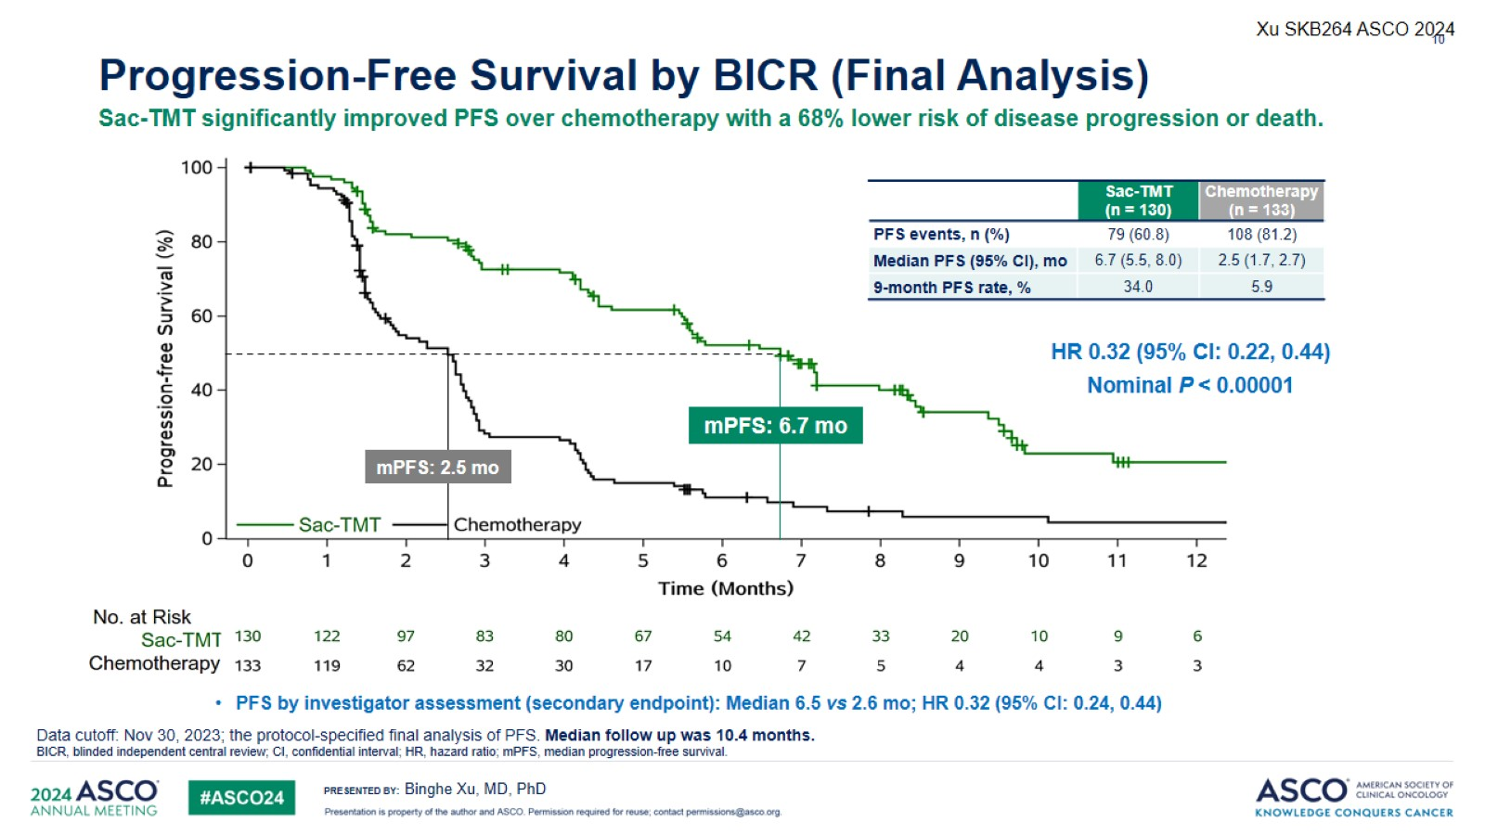
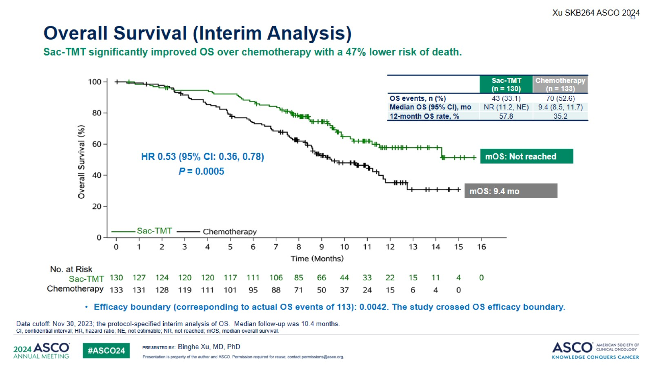
Sacituzumab Tirumotecan (Sac-TMT) in mTNBC
OptiTROP-Breast01
Progression-free Survival
Overall Survival
Objective Response
Xu B, et al. ASCO 2024

Slide 78
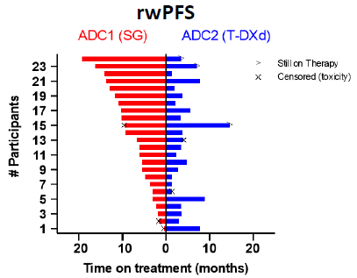
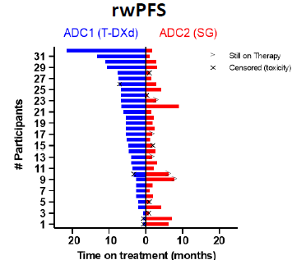
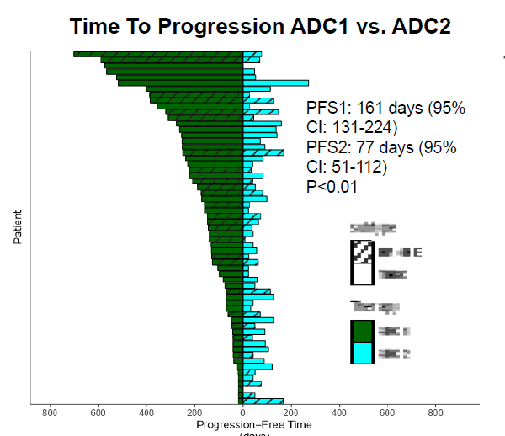
Sequencing of ADCs
Greatest magnitude of benefit generally derived from the 1st ADC used
Sequencing T-DXd and SG in HER2-low MBC
Sequencing ADCs in HER2-neg MBC
HR+/HER2-
TNBC
ADC1
ADC2
A3 study
Real world evidence study
Huppert L et al. SABCS 2023, Abelman R et al. ASCO 2023

Slide 79
A 65-year-old woman presenting with PD-L1-positive,
BRCA wild-type, HER2-low (IHC 1+) mTNBC receives the following first-line therapy.
Regulatory and reimbursement issues aside, which systemic therapy would you most likely recommend next?
First line: Pembrolizumab/chemotherapy
First line: Pembrolizumab/Sacituzumab govitecan

Slide 80
A 65-year-old woman presenting with PD-L1-negative,
BRCA wild-type, HER2-low (IHC 1+) mTNBC receives the following first-line therapy.
Regulatory and reimbursement issues aside, which systemic therapy would you most likely recommend next?
First line: Chemotherapy
First line: Sacituzumab govitecan
First line: Datopotamab deruxtecan

Slide 81
A 65-year-old woman presenting with PD-L1-positive,
BRCA-mutated, HER2-low (IHC 1+) mTNBC receives the following first-line therapy.
Regulatory and reimbursement issues aside, which systemic therapy would you most likely recommend next?
First line: Pembrolizumab/chemotherapy
First line: Sacituzumab govitecan/pembrolizumab

Slide 82
A 65-year-old woman presenting with PD-L1-negative,
BRCA-mutated, HER2-low (IHC 1+) mTNBC receives the following first-line therapy.
Regulatory and reimbursement issues aside, which systemic therapy would you most likely recommend next?
First line: Chemotherapy
First line: Sacituzumab govitecan
First line: Datopotamab deruxtecan

Slide 83
Cases from General Medical Oncologists
38 yo woman
mTNBC, HER2 IHC 1+ (low positive), PD-L1 CPS 2, MSI negative, TMB low, germline testing negative. Asymptomatic osseous involvement in the thoracic and lumbar spine, left scapula, sternum, left rib, bilateral iliac bones, and right femur. Indeterminate lesions in the liver and cervical lymph nodes.
This patient was treated with first-line paclitaxel, per the prior standard of care, and progressed after two months with new lesions on PET. She also progressed on second-line therapy with trastuzumab deruxtecan after just two months with new lesions on PET.
It is not typically favored to sequence ADCs; however, it felt like a de-escalation to try a single agent chemotherapy in the third line. She has been on sacituzumab govitecan 9 months now.

Slide 84
Agenda:
Metastatic Triple-Negative Breast Cancer (mTNBC)
Introduction: TROP2-Targeting Antibody-Drug Conjugates (ADCs) for mTNBC
Module 1: First-Line Therapy (PD-L1 Negative)
Module 2: First-Line Therapy (PD-L1 Positive)
Module 3: Second-Line Therapy (Sequencing)
Module 4: Adverse Events with TROP2-Targeting ADCs

Slide 85

Mitigation and Management of Toxicities with TROP2-Targeted ADCs
Melinda Telli, MD, FASCO
Professor of Medicine
Stanford University School of Medicine
Director, Breast Cancer Program
Associate Director for Clinical Research
Stanford Cancer Institute
July 21, 2026

Slide 86
Patient Case:
A 67-year-old postmenopausal woman is diagnosed with a T1miN0M0 IDC of the right breast associated with a 4 cm area of DCIS
  ER 0%
  PR 0%
  HER2-negative (0 by IHC; FISH negative)
She is treated with lumpectomy surgery and completes whole breast irradiation.
No systemic chemotherapy is recommended.
She tests negative for germline pathogenic variants in BRCA1 & BRCA2

Slide 87
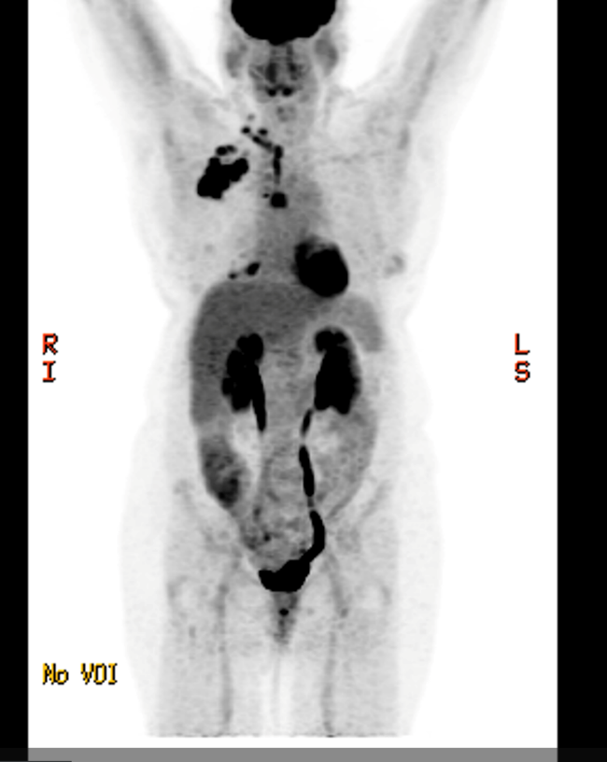
Patient Case:
2 years later, she is found to have suspicious right axillary adenopathy on routine breast imaging.
Core biopsy of the right axillary node reveals recurrent IDC ER 0%, PR 0%, and HER2 0 (FISH negative)
She undergoes PET/CT imaging for systemic staging which reveals:
  Hypermetabolic right lower cervical, supraclavicular, internal mammary, cardiophrenic, axillary, subpectoral and mediastinal lymphadenopathy concerning for nodal metastatic disease.
Biopsy of a mediastinal node reveals recurrent TNBC
  PD-L1 CPS = 1
  NGS reveals a somatic BRCA2 pathogenic variant

Slide 88
Patient Case:
She initiates 1st line sacituzumab govitecan 10 mg/kg IV days 1 & 8 of a 21-day schedule
On C1D8 she is found to have grade 3 neutropenia with an ANC of 700
  Treatment is held and G-CSF is initiated with improvement
She also endorses an increase of 5-6 loose bowel movements per day over baseline (grade 2 diarrhea)
  She had not started the loperamide she was prescribed
  She initiates loperamide BID with improvement to grade 1

Slide 89
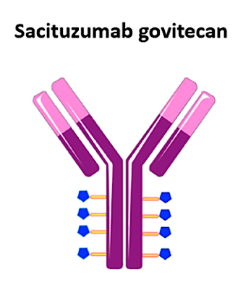
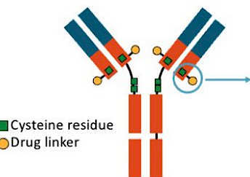
TROP2 antibody-drug conjugates
Datopotamab deruxtecan
(Dato-DXd)
 | Sacituzumab Govitecan (SG) | Datopotamab Deruxtecan (Dato-DXd)
Linker cleavage | pH and enzymatic | Yes
Membrane- permeable payload | Yes | Yes
Payload MOA | SN-38/Topo 1 inhibitor | Topo 1 inhibitor
Drug-antibody ratio | 7.6:1 | 4:1
Key Toxicities | Neutropenia, diarrhea, nausea, fatigue | Nausea, ocular toxicity, stomatitis, ILD
Notes:
89

Slide 90
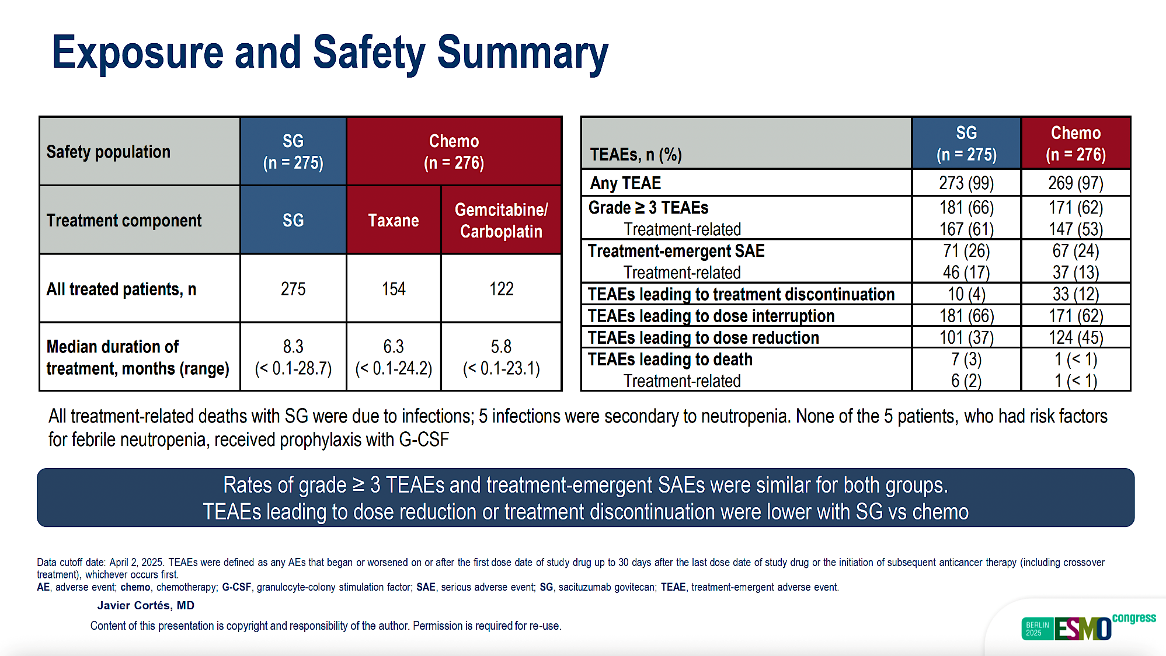
ASCENT-03
Cortes J et al. ESMO 2025;Abstract LBA20

Slide 91
ASCENT-03: Most Common Adverse Events
Neutropenia
Nausea Alopecia Diarrhea Fatigue Anemia Constipation Leukopenia Vomiting
ALT increased AST increased Thrombocytopenia
67
43 41 57
61 2 < 1 34
55
27
54
9 1
20
47
3 4
47
Grade ≥ 3 Any grade Grade ≥ 3 Any grade
39 4
16
50
38
25
25
7
13
25
25
2 1 13
SG
20
3 6
29
Chemo (N = 276)
(N = 275)
17 1 3
41 12
25
28
80
60
40
20
0
TEAEs,^{a,b} %
20
40
60
80
-80
-60
-40
-20
The AEs observed are consistent with the known safety profile of SG
Data cutoff date: April 2, 2025. ªTEAEs were included if they occurred in ≥ 20% of patients in either group. ^{b}Combined preferred terms of Neutropenia includes neutrophil count decreased, Fatigue includes asthenia, Anemia includes hemoglobin decreased and red blood cell count decreased, Leukopenia includes white blood cell count decreased, and Thrombocytopenia includes platelet count decreased.
AE, adverse event; ALT, alanine aminotransferase; AST, aspartate aminotransferase; chemo, chemotherapy; SG, sacituzumab govitecan; TEAE, treatment-emergent adverse event.
Javier Cortés, MD
Cortes J et al. ESMO 2025;Abstract LBA20

Slide 92
Sacituzumab govitecan toxicity management
Nausea
High emetogenic risk
Premedicate: Dexamethasone + 5-HT3 receptor antagonist or NK1 receptor antagonist
Neutropenia
Intermediate risk by NCCN Guidelines
Primary prophylaxis for patients with risk factors
  Prior chemotherapy or neutropenia, older patients, organ dysfunction, poor PFS
Diarrhea
  Rule out infection
  Initiate loperamide and supportive measures
Other premedications
History of infusion reaction: antipyretic, H1/H2 blockers, corticosteroid
History of cholinergic reaction: Atropine

Slide 93

SG: PRIMED Strategy
Key Eligibility Criteria
Study Treatment
Study Endpoints
Patients ≥18 years old with mTNBC or metastatic HR+/HER2- breast cancer
Received at least 1 and up to 2 prior SOC chemotherapy regimens for metastatic disease
ECOG PS ≤1
Sacituzumab govitecan
10 mg/kg IV D1 and D8
Loperamide
2 mg PO BID, or 4 mg QD on D2, D3, D4, and D9, D10, D11 (First two cycles*)
G-CSF
0.5 MU/kg/day SC QD on D3, D4, and D10, D11
(First two cycles*)
Primary endpoints
Co-primary endpoints are incidence of grade ≥2 diarrhea and grade ≥3 neutropenia at cycle 2
Secondary endpoints
Tolerability and safety per NCI-CTCAE v5 at cycle 2
Discontinuation and dose reductions
Efficacy in terms of PFS, ORR, clinical benefit rate, time to response, DOR, and best percentage of change in tumor burden
Incidence in first 2 cycles, n (%) | Any grade | Grade 2 | Grade 3 | Grade 4
Neutropenia | 14 (28.0) | 4 (8.0) | 6 (12.0) | 2 (4.0)
Diarrhea | 17 (34.0) | 6 (12.0) | 2 (4.0) | 0
Courtesy of Javier Cortés, MD, PhD
Perez-Garcia-J, et al EClinicalMedicine 2025

Slide 94
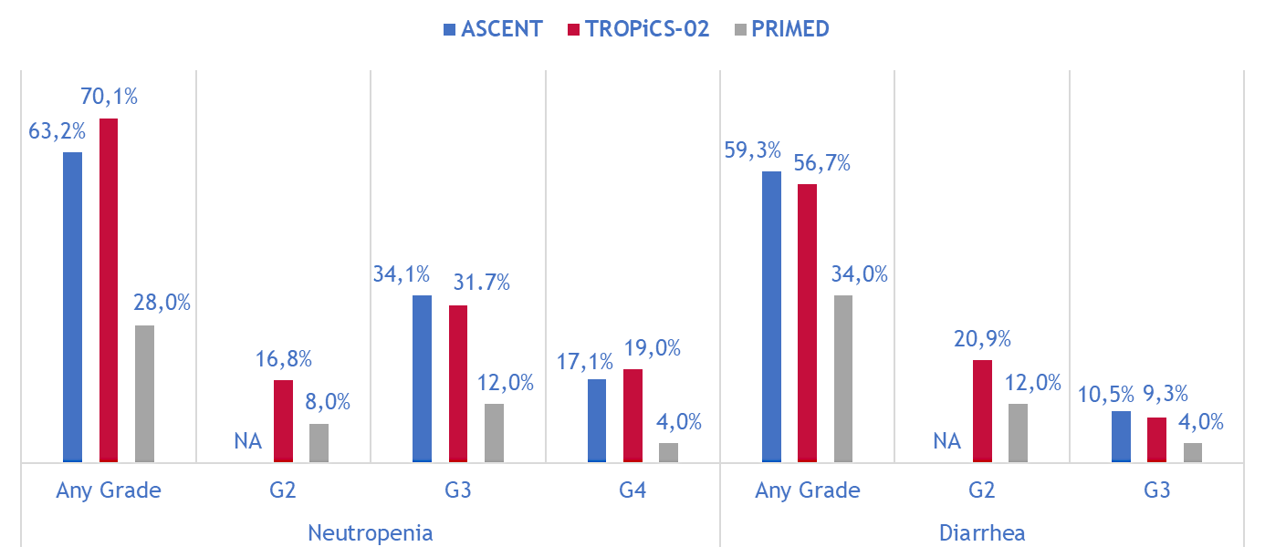
SG: PRIMED Strategy vs. ASCENT vs. TROPiCS-02
Courtesy of Javier Cortés, MD, PhD
Bardia A, et al. NEJM 2021; Rugo H, et al. JCO 2022; Perez-Garcia-J, et al EClinicalMedicine 2025

Slide 95
Patient Case:
A 54-year-old woman self-palpates a right breast mass
Diagnostic mammogram shows 4.8 cm right breast mass and ultrasound demonstrates multiple atypical axillary nodes
Core biopsy reveals grade 3 IDC:
  ER 0%
  PR 0%
  HER2 IHC 1+
  HER2 FISH negative
Staging PET/CT demonstrates FDG avid disease in the right breast, axilla, and internal mammary region
Clinical anatomic stage is T2N3M0 (stage 3C)

Slide 96
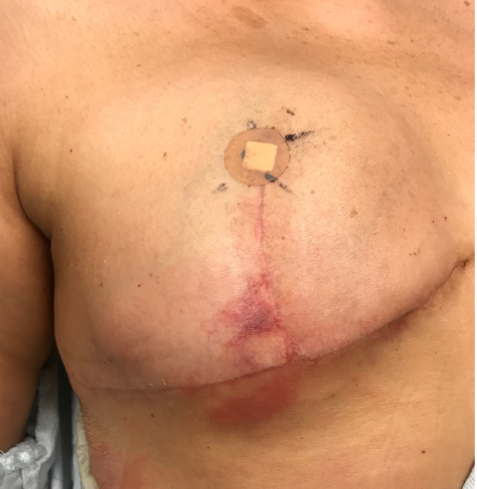
Patient Case:
She initiates neoadjuvant chemotherapy and pembrolizumab per KN-522 with clinical response
She undergoes right mastectomy and ALND:
  No residual primary tumor
  12/21 lymph nodes involved, largest focus 1.8 cm, extensive lymphovascular invasion
  Pathologic Stage = ypT0 ypN3
While receiving post-mastectomy radiation, she develops biopsy-proven chest wall recurrence
Restaging PET/CT shows new mediastinal nodes and pulmonary nodules

Slide 97
Patient Case:
She initiates datopotamab deruxtecan 6 mg/kg IV every 3 weeks
She completes 2 cycles with clinical response on her chest wall, but presents for cycle 3 reporting increased oral pain with mouth sores
  She is able to eat, but is experiencing pain and can only tolerate liquids and soft foods
She states that she has not been using her prescribed dexamethasone oral solution regularly

Slide 98

TROPION-Breast02 Overall Safety Summary
Treatment-related AEs, n (%) | Dato-DXd (n=319) | ICC (n=309)
Any grade | 296 (93) | 257 (83)
Grade ≥3 | 105 (33) | 89 (29)
Serious TRAEs | 29 (9) | 26 (8)
Associated with dose interruption | 76 (24) | 60 (19)
Associated with dose reduction | 85 (27) | 56 (18)
Associated with discontinuation | 14 (4) | 23 (7)
Associated with death | 0 | 0
Median total treatment duration:
  Dato-DXd: 8.5 months (range 0.7–38.0)
  ICC: 4.1 months (range 0.1–32.0)
Patients with total exposure >12 months:
  Dato-DXd: 35.1%
  ICC: 9.4%
Despite more than double the median duration of treatment in the Dato-DXd arm, rates of grade ≥3 and
serious treatment-related AEs were similar, and discontinuations were lower, with Dato-DXd vs ICC
Dent R et al ESMO 2025;Abstract LBA21.
TRAEs, treatment-related adverse events.

Slide 99
TROPION-Breast02
Most Common Treatment-Related AEs (≥15% of Patients)
 | Treatment-related AEs, n (%) | Dato-DXd (n=319) |  | ICC (n=309)
 |  | Any Grade | Grade ≥3 | Any Grade | Grade ≥3
 | Dry eye* | 76 (24) | 4 (1) | 9 (3) | 0
 | Stomatitis | 182 (57) | 27 (8) | 27 (9) | 0
 | Nausea | 142 (45) | 2 (<1) | 53 (17) | 2 (<1)
 | Constipation | 72 (23) | 1 (<1) | 31 (10) | 0
 | Vomiting | 65 (20) | 4 (1) | 23 ( 7) | 1 (<1)
 | Decreased appetite | 49 (15) | 1 (<1) | 20 (6) | 1 (<1)
 | Neutropenia† | 39 (12) | 10 (3) | 90 (29) | 40 (13)
 | Anaemia‡ | 48 (15) | 6 (2) | 64 (21) | 10 (3)
 | Leukopenia§ | 27 (8) | 3 (<1) | 55 (18) | 13 (4)
 | Peripheral neuropathy¶ | 14 (4) | 0 | 75 (24) | 5 (2)
 | Alopecia | 130 (41) | 0 | 96 (31) | 1 (<1)^{ǁ}
 | Fatigue# | 101 (32) | 8 (3) | 86 (28) | 9 (3)
*In the Dato-DXd arm only, ophthalmologic assessments were required every 3 cycles while on therapy; this was not required in the ICC arm. For all patients in both arms, ophthalmologic assessments were required at baseline, as clinically indicated, and at end of therapy.
†Grouped term comprising preferred terms of neutropenia and neutrophil count decreased. ‡Grouped term comprising preferred terms of haemoglobin decreased, red blood cell count decreased, anaemia, and haematocrit decreased. §Grouped term comprising preferred terms of white blood cell count decreased and leukopenia. ¶Grouped term comprising preferred terms of neuropathy peripheral, peripheral motor neuropathy, polyneuropathy, paraesthesia, and peripheral sensory neuropathy. #Grouped term comprising preferred terms of fatigue, asthenia, and malaise. ^{ǁ}Per Common Terminology Criteria for Adverse Events version 5.0, the maximum grade for alopecia is grade 2.
Dent R et al ESMO 2025;Abstract LBA21.

Slide 100
TROPION-Breast02 Treatment-Related AESIs for Dato-DXd
AESI category, n (%) Preferred term* | Dato-DXd (n=319) |  |  | ICC (n=309)
 | Grade 1 | Grade 2 | Grade ≥3 | Grade 1 | Grade 2 | Grade ≥3
Oral mucositis/stomatitis† | 78 (24) | 87 (27) | 27 (8) | 22 (7) | 8 (3) | 0
Stomatitis | 72 (23) | 83 (26) | 27 (8) | 19 (6) | 8 (3) | 0
Ocular surface events‡§ | 76 (24) | 50 (16) | 23 (7) | 9 (3) | 5 (2) | 1 (<1)
Dry eye | 51 (16) | 21 (7) | 4 (1) | 6 (2) | 3 (1) | 0
Keratitis | 21 (7) | 14 (4) | 7 (2) | 1 (<1) | 0 | 0
Conjunctivitis | 7 (2) | 13 (4) | 1 (<1) | 0 | 0 | 0
Adjudicated drug-related ILD/pneumonitis¶ | 1 (<1) | 7 (2) | 1 (<1)# | 1 (<1) | 1 (<1) | 0
Treatment-related oral mucositis/stomatitis:
In the Dato-DXd arm, events led to dose interruption, reduction, and discontinuation in 11 (3%), 36 (11%), and 0 patients, respectively
Grade ≥2 events resolved to grade ≤1
in 103/114 patients (90%) at data cutoff
Treatment-related ocular surface events:
In the Dato-DXd arm, events led to dose interruption, reduction, and discontinuation in 18 (6%), 14 (4%), and 3 (<1%) patients, respectively
Grade ≥2 events resolved to grade ≤1
in 49/73 patients (67%) at data cutoff
*Details for preferred terms included if reported in ≥20 patients in either arm. †Comprising the preferred terms of aphthous ulcer, mouth ulceration, oral pain, oropharyngeal pain, pharyngeal inflammation, and stomatitis. ‡Comprising the preferred terms of acquired corneal dystrophy, blepharitis, conjunctivitis, corneal disorder, corneal epithelium defect, corneal erosion, corneal exfoliation, corneal lesion, corneal toxicity, dellen, dry eye, keratitis, keratopathy, lacrimation increased, limbal stem cell deficiency, meibomian gland dysfunction, photophobia, punctate keratitis, ulcerative keratitis, vision blurred, visual acuity reduced, visual impairment, and xerophthalmia. §In the Dato-DXd arm only, ophthalmologic assessments were required every 3 cycles while on therapy; this was not required in the ICC arm. For all patients in both arms, ophthalmologic assessments were required at baseline, as clinically indicated, and at end of therapy. ¶Comprising the preferred terms of interstitial lung disease and pneumonitis. #Grade 5 – this event was characterised by the investigator as grade 3 pneumonitis, with death assessed as related to breast cancer.
Dent R et al ESMO 2025;Abstract LBA21.
AESI, adverse event of special interest; ILD, interstitial lung disease.

Slide 101
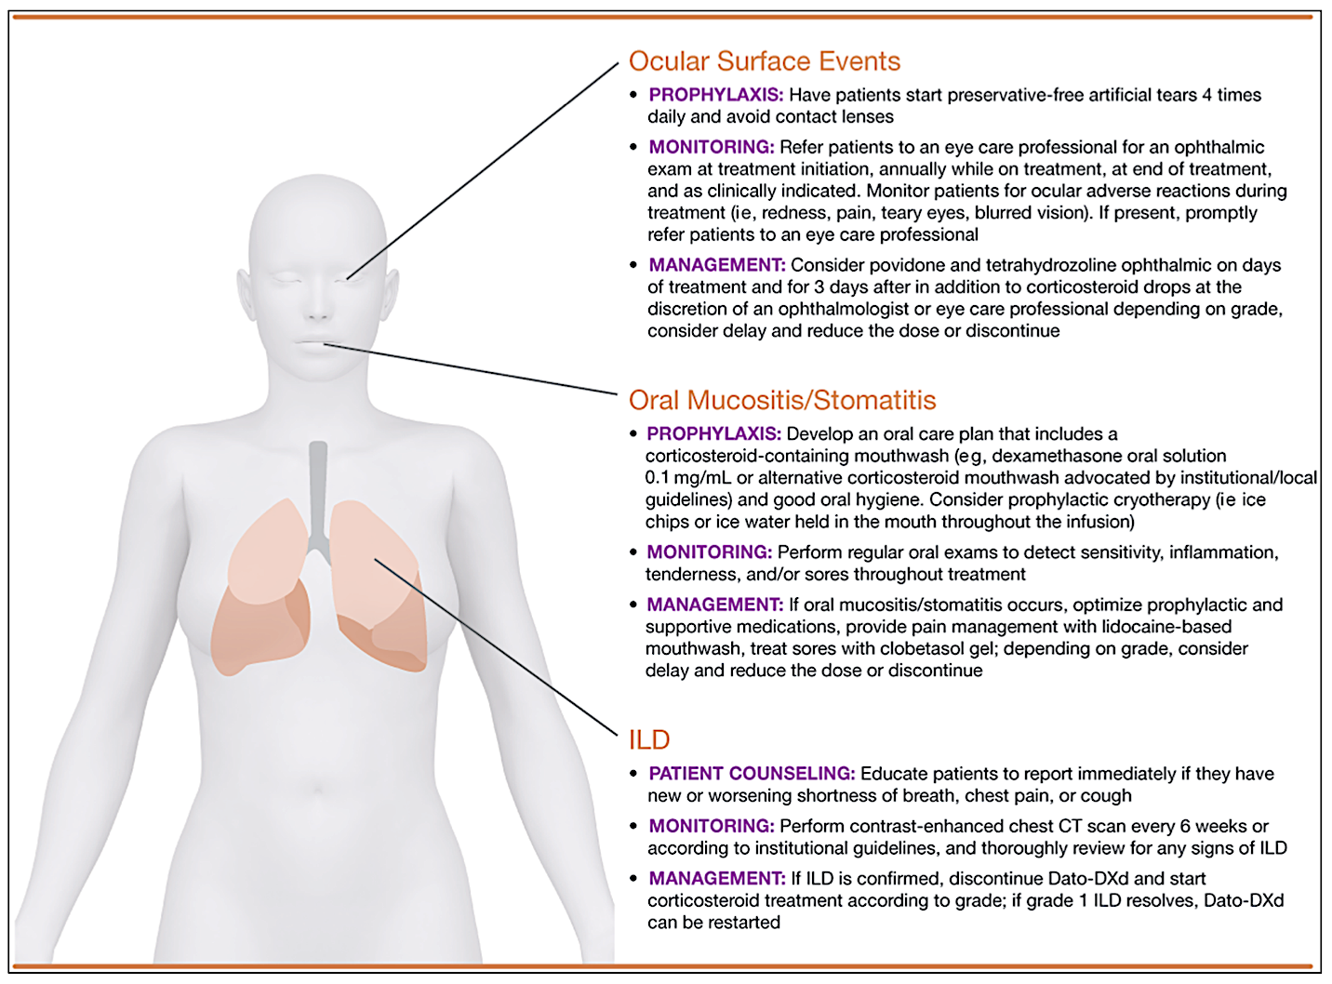
Managing Dato-DXd Adverse Events
Nausea & Vomiting
High emetogenic risk
Olanzapine
NK1 receptor antagonist
5-HT3 receptor antagonist
Dexamethasone
Lisberg A et al. Oncologist 2025 September 1;30(9):oyaf225; NCCN Antiemesis Guideline V2.2026 available at nccn.org

Slide 102
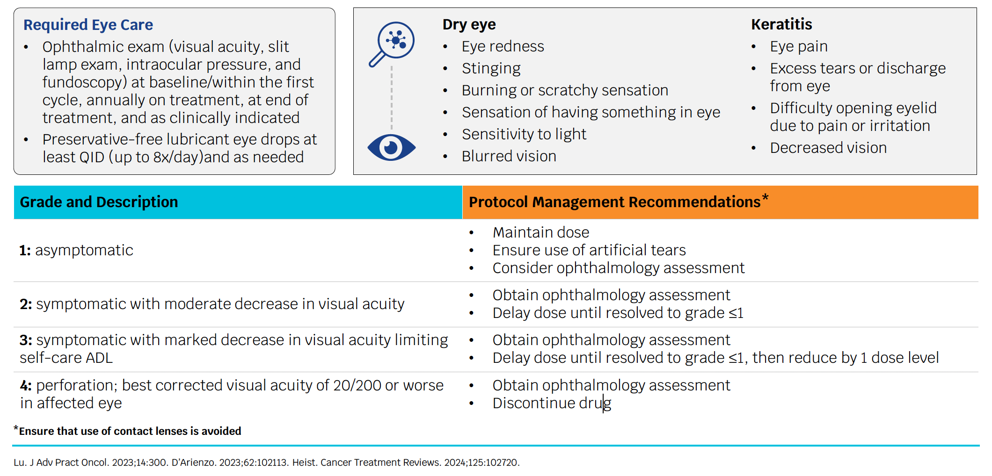
Management of ADC-associated Ocular Surface Toxicity

Slide 103
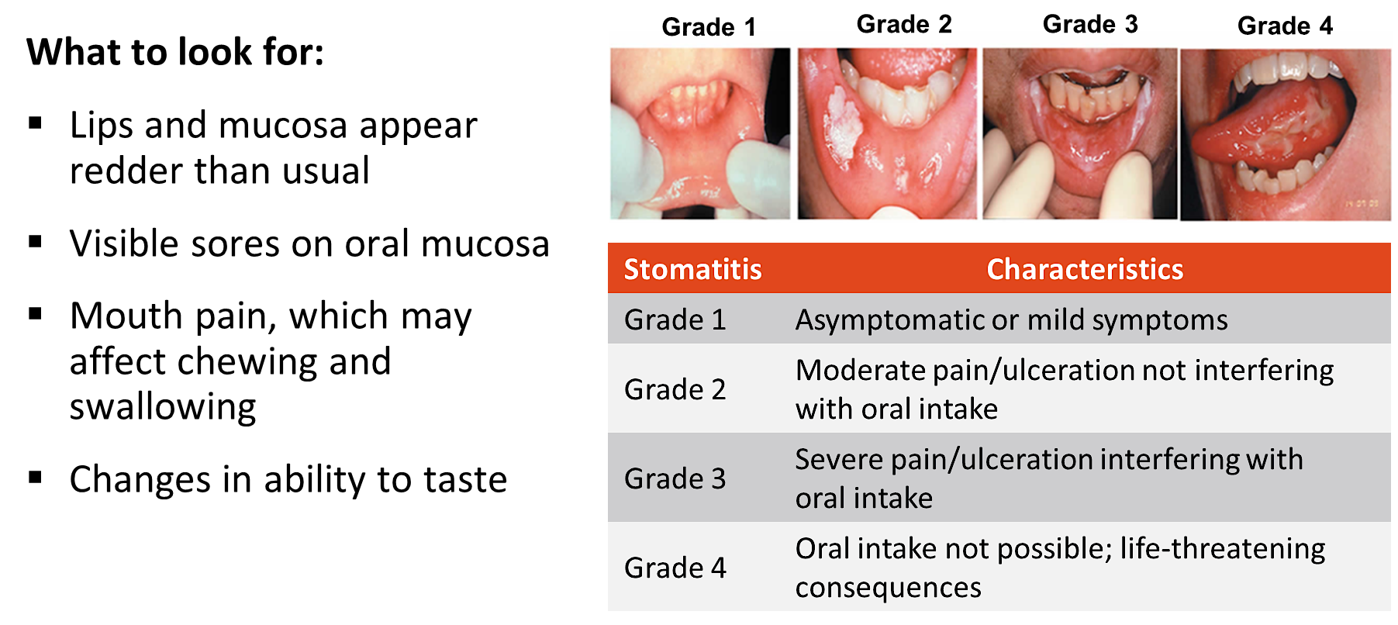
Dato-DXd: Identification & Grading of Mucositis/Stomatitis
Images reproduced under the terms of Creative Commons CC-BY license version 4.0 from Maria. Front Oncol 2017
Courtesy of Javier Cortés, MD, PhD

Slide 104
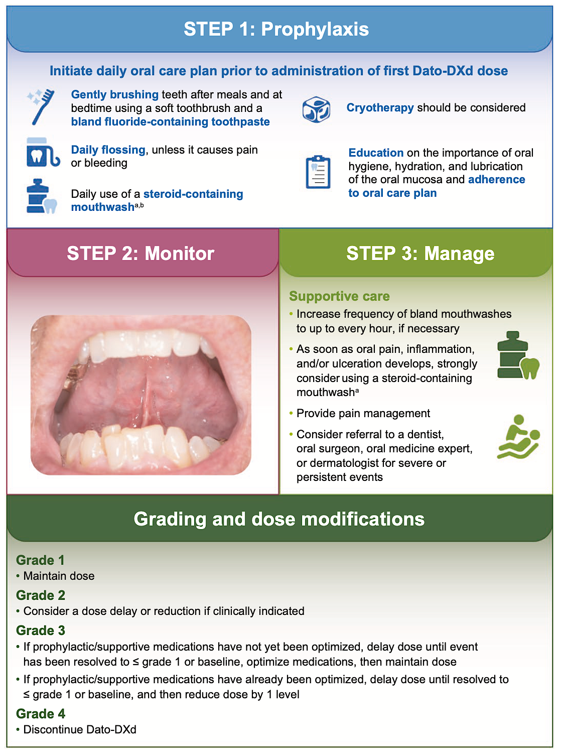
Management Recommendations for Stomatitis
Meric-Bernstam F et al. Oncologist 2025 March 10;30(3):oyaf031.

Slide 105
Cases from General Medical Oncologists
88 yo woman
De novo mTNBC, BRCA-negative, HER2 1+, PD-L1 5%. Bone metastases. History of HTN, dyslipidemia, CAD.
How would you treat this patient? What do we know about TROP2 ADCs in the very elderly?

Slide 106
Case 1
42 y/o woman
gBRCA1 wildtype
Resolved after 2 days
Dose reduction?
No
Yes
Diarrhoea: What to do?
Continue
Hold treatment until ≦G1
Loperamide
Discontinue
Diarrhoea: What to do?
Hold treatment until ≦G1
Loperamide
Patient reports diarrhoea 7x/d.
Metastatic recurrence with liver, bone & LN metastases.
PDL1-positive, HER2 IHC1+
PD
liver, new peritoneal mets
Good PR,
PNP G1-2
G3 diarrhoea
New TNBC
cT3 cN1
Surgery
ypT1b ypN1
Neoadjuvant
AC/CarboP
Nab-Paclitaxel + Atezolizumab
Atezolizumab
Sacituzumab Govitecan
RT
10/2015
03/2016
11/2019
06/2020
02/2022

Slide 107
How do you approach prevention and management of neutropenia and diarrhea in patients receiving sacituzumab govitecan?

Slide 108
How do you approach prevention and management of mucositis, pneumonitis and ocular keratitis in patients receiving datopotamab deruxtecan?

Slide 109
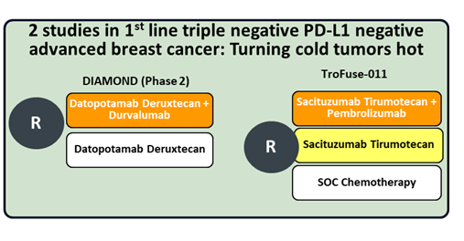
Dato-DXd plus Durvalumab in 1st line mTNBC (87% PDL1-negative)
Is there a role for ICI in PDL1- if combined with ADC?
Objective Response rate 79%
Median PFS 14.0 months Median DoR 17.8 months
Schmid, et al. ESMO 2025
Ongoing Trials

Slide 110
Case 2
53 y/o woman
gBRCA1 wildtype
What would you do?
Sacituzumab Govitecan
Dato-DXd
T-DXd
Eribulin
What would you do?
Continue (no change)
RFA or Cyberknife, continue Dato-DXd
Eribulin
T-DXd
PD
New 2cm liver met, rest PR
Metastatic recurrence with liver, lung & LN.
TNBC, PDL1-negative,
HER2 IHC1+
Good PR
New TNBC
cT2 cN2
Surgery
ypT1b ypN2
(5/12, 3 fibrosis)
Neoadjuvant
Adjuvant
Carbo/Pac/Pembro – AC/Pembro
RT
Capecitabine + Pembro
Dato-DXd
RFA
Dato-DXd
06/2024
12/2024
07/2025
11/2025
05/2025

Slide 111
TNBC Management in 2026
Primary breast cancer
MBC 1st line
MBC 2nd line
MBC >2nd line
Stage I
Adjuvant chemo
PDL1 +
Chemo + CIT
Sacituzumab
(early relapse)
Sacituzumab
Neoadjuvant Chemo
ADC + CIT
PDL1 -
Chemo
Chemo
Trastuzumab-Deruxtecan
(HER2 low)
Stage II & III
Chemo + CIT
TROP2 ADC
BRCA mt
PARP inhibitor
BRCA mt
PARP inhibitor
Eribulin
pCR
Non pCR
CIT
(Stage II/III)
CIT
(Stage II/III)
Cape-citabine
Olaparib (BRCA1/2)

Slide 112
Bringing the Investigator into the Equation
— Optimal Use of Hormonal Therapy in the
Care of Patients with Prostate Cancer
A CME/MOC-Accredited Live Webinar
Wednesday, July 29, 2026
5:00 PM – 6:00 PM ET
Faculty
William K Oh, MD
Mary-Ellen Taplin, MD
Moderator
Neil Love, MD

Slide 113
Thank you for joining us!
Please take a moment to complete the survey currently up on Zoom. Your feedback is very important to us.
The survey will remain open for
5 minutes after the meeting ends.
Information on how to obtain CME, ABIM MOC and ABS credit is provided in the Zoom chat room.
Attendees will also receive an email in 1 to 3 business days with these instructions.

