Slide 1
Year in Review: Clinical Investigator Perspectives on the
Most Relevant New Datasets and Advances in Oncology
Localized HR-Positive Breast Cancer
A CME/MOC-Accredited Live Webinar
Wednesday, May 6, 2026
5:00 PM – 6:00 PM ET
Faculty
Harold J Burstein, MD, PhD
Joyce O’Shaughnessy, MD
Moderator
Neil Love, MD

Slide 2



Faculty
Harold J Burstein, MD, PhD
Director of Academic Partnerships
Institute Physician
Dana-Farber Cancer Institute
Professor of Medicine
Harvard Medical School
Boston, Massachusetts
MODERATOR
Neil Love, MD
Research To Practice
Miami, Florida
Joyce O’Shaughnessy, MD
Celebrating Women Chair in Breast Cancer Research
Baylor University Medical Center
Director, Breast Cancer Research Program
Texas Oncology
Sarah Cannon Research Institute
Dallas, Texas

Slide 3
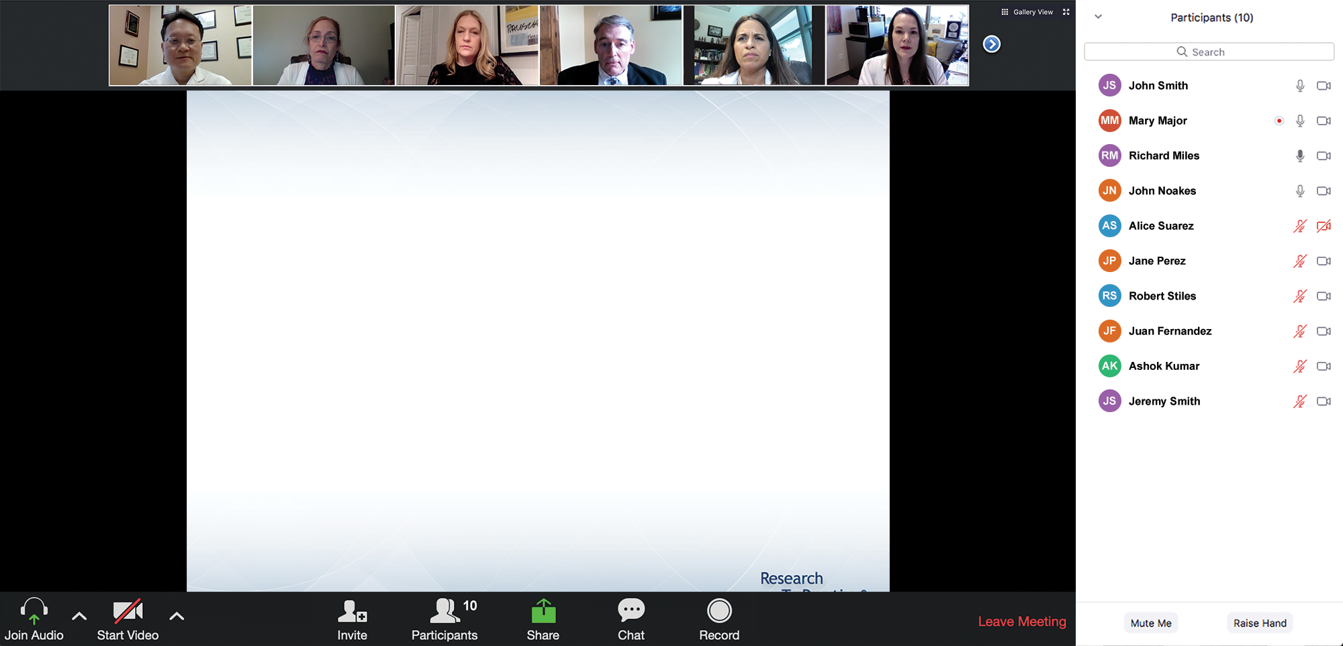

We Encourage Clinicians in Practice to Submit Questions
Feel free to submit questions now before the program begins and throughout the program.

Slide 4
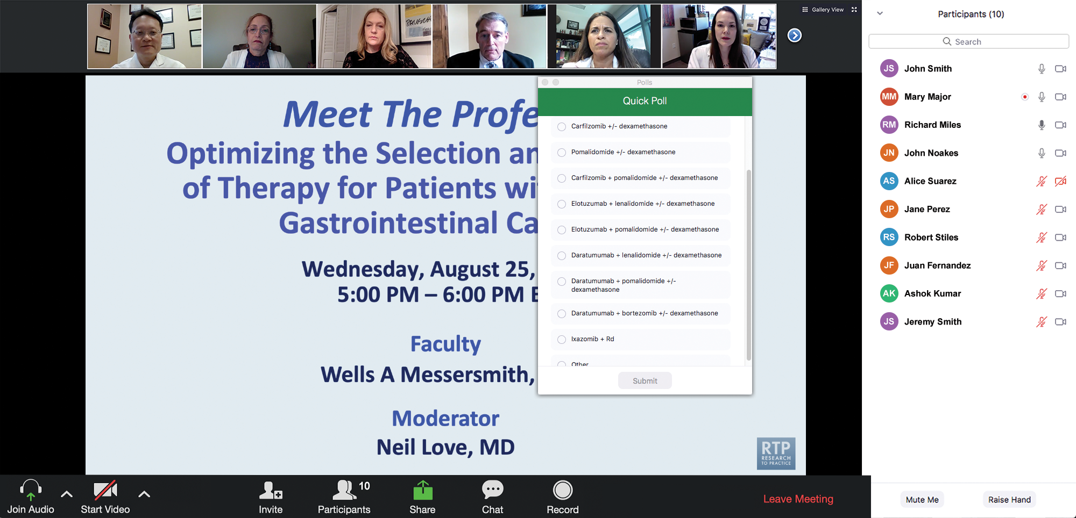
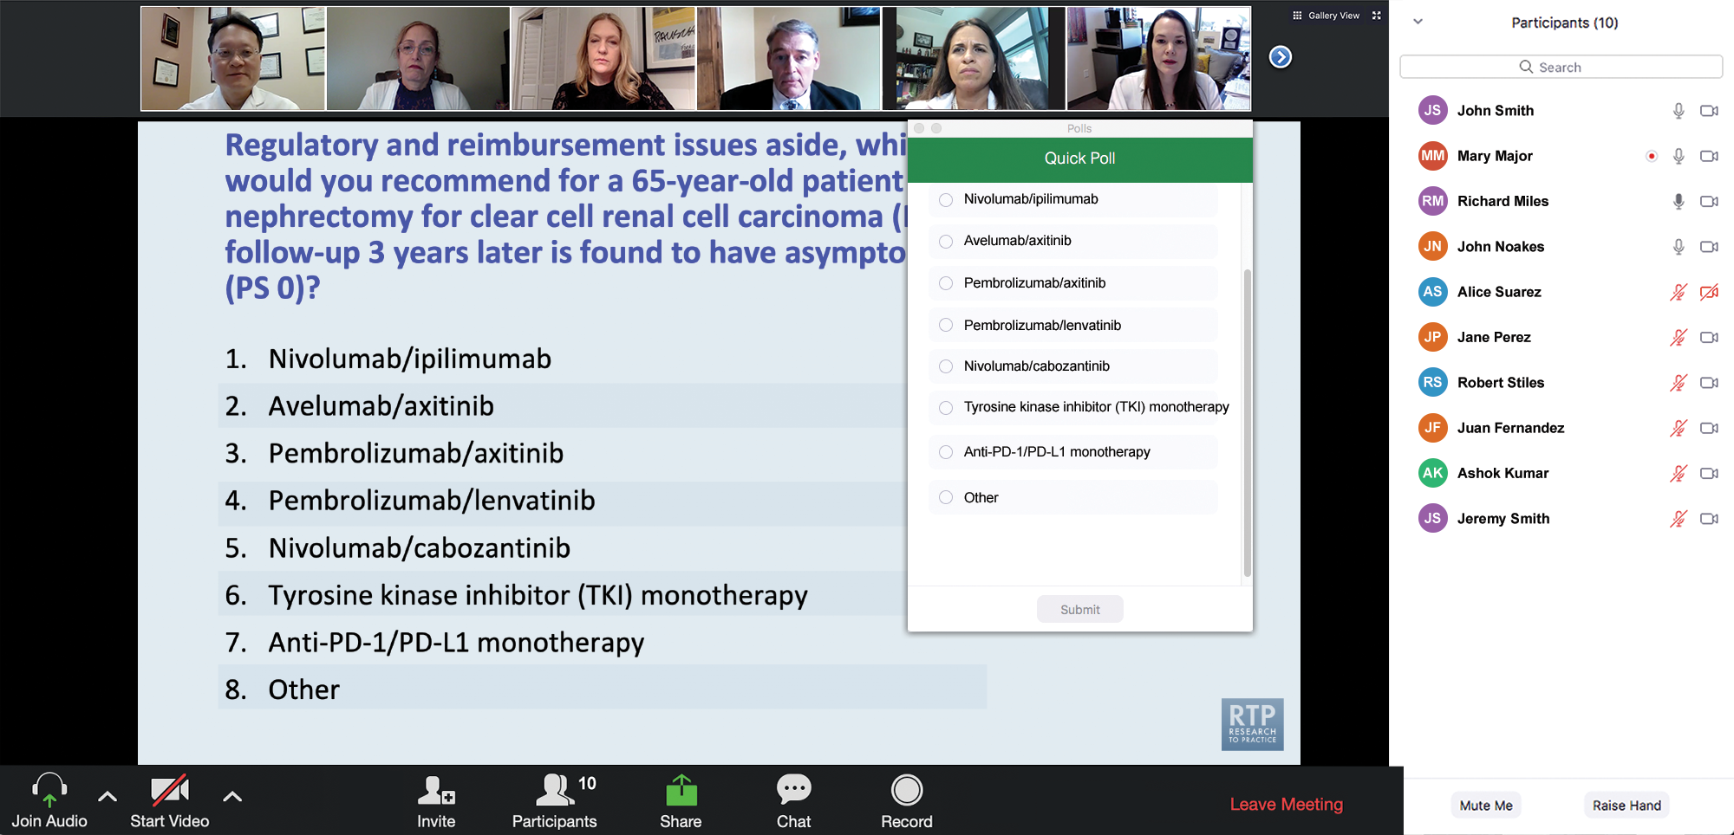
Clinicians in the Audience, Please Complete the Pre- and Postmeeting Surveys
Quick Survey
Quick Poll

Slide 5


Slide 6
Recent Advances in Cancer Care — New Paradigms,
Novel Agents and What It Means for the Oncology Nurse
A Complimentary NCPD Symposium Series Held During the 51st Annual ONS Congress May 13-16
San Antonio Marriott Rivercenter | San Antonio, Texas
Antibody-Drug Conjugates
Wednesday, May 13, 2026 | 11:15 AM – 12:45 PM CT
Prostate Cancer
Thursday, May 14, 2026 | 12:15 PM – 1:45 PM CT
Ovarian Cancer
Wednesday, May 13, 2026 | 6:00 PM – 7:30 PM CT
Non-Muscle-Invasive and
Muscle-Invasive Bladder Cancer
Thursday, May 14, 2026 | 6:00 PM – 7:30 PM CT
Endometrial Cancer
Thursday, May 14, 2026 | 6:00 AM – 7:30 AM CT
Pancreatic Cancer
Friday, May 15, 2026 | 6:00 AM – 7:30 AM CT

Slide 7
Recent Advances in Cancer Care — New Paradigms,
Novel Agents and What It Means for the Oncology Nurse
A Complimentary NCPD Symposium Series Held During the 51st Annual ONS Congress May 13-16
San Antonio Marriott Rivercenter | San Antonio, Texas
Targeting the PI3K/AKT/mTOR Pathway in
HR-Positive Metastatic Breast Cancer
Friday, May 15, 2026 | 12:15 PM – 1:45 PM CT
Relapsed/Refractory Multiple Myeloma
Saturday, May 16, 2026 | 12:15 PM – 1:45 PM CT
Non-Hodgkin Lymphoma and
Chronic Lymphocytic Leukemia
Friday, May 15, 2026 | 6:00 PM – 8:00 PM CT
Oral SERDs for Breast Cancer
Saturday, May 16, 2026 | 6:00 PM – 7:30 PM CT
CDK4/6 Inhibitors for HR-Positive
Breast Cancer
Saturday, May 16, 2026 | 6:00 AM – 7:30 AM CT

Slide 8
Second Opinion: Investigators Provide Perspectives on the Current and Future Management of
Renal Cell Carcinoma and Prostate Cancer
A 2-Part CME Satellite Symposium Series Held in Conjunction with the
2026 American Urological Association Annual Meeting (AUA2026)
Renal Cell Carcinoma
Sunday, May 17, 2026
8:00 AM – 9:30 AM ET
Prostate Cancer
Sunday, May 17, 2026
5:30 PM – 7:30 PM ET

Slide 9
Research To Practice CME Symposia
Held Adjunct with the 2026 ASCO® Annual Meeting
Hilton Chicago | 720 South Michigan Avenue | Chicago, Illinois
Friday, May 29, 2026
EGFR-Mutated Non-Small Cell Lung Cancer
6:30 PM – 8:30 PM CT (7:30 PM – 9:30 PM ET)
Chronic Lymphocytic Leukemia
6:30 PM – 8:30 PM CT (7:30 PM – 9:30 PM ET)
Saturday, May 30, 2026
Ovarian Cancer
7:00 PM – 9:00 PM CT (8:00 PM – 10:00 PM ET)
Prostate Cancer
7:00 PM – 9:00 PM CT (8:00 PM – 10:00 PM ET)
Small Cell Lung Cancer
7:00 PM – 9:00 PM CT (8:00 PM – 10:00 PM ET)

Slide 10
Research To Practice CME Symposia
Held Adjunct with the 2026 ASCO® Annual Meeting
Hilton Chicago | 720 South Michigan Avenue | Chicago, Illinois
Sunday, May 31, 2026
Targeting the PI3K/AKT/mTOR
Pathway in Breast Cancer
7:00 PM – 9:00 PM CT (8:00 PM – 10:00 PM ET)
Endometrial Cancer
7:00 PM – 8:30 PM CT (8:00 PM – 9:30 PM ET)
CAR T-Cell Therapy and Bispecific
Antibodies for Non-Hodgkin Lymphoma
7:00 PM – 9:00 PM CT (8:00 PM – 10:00 PM ET)
Monday, June 1, 2026
ADCs for Breast Cancer
7:00 PM – 9:00 PM CT (8:00 PM – 10:00 PM ET)

Slide 11
Grand Rounds
CME/MOC-Accredited Interactive Series
Regional Activities
Three Series
Optimizing Treatment
for Patients with Relapsed/Refractory Chronic Lymphocytic Leukemia
Optimizing the Use of
Novel Therapies for Patients with Diffuse
Large B-Cell Lymphoma
Optimizing Therapy for Patients with Hormone Receptor-Positive
Localized Breast Cancer
Host a 1-hour session at your institution:
Email Meetings@ResearchToPractice.com
or call (800) 233-6153

Slide 12
Year in Review: Clinical Investigator Perspectives on the
Most Relevant New Datasets and Advances in Oncology
Localized HR-Positive Breast Cancer
A CME/MOC-Accredited Live Webinar
Wednesday, May 6, 2026
5:00 PM – 6:00 PM ET
Faculty
Harold J Burstein, MD, PhD
Joyce O’Shaughnessy, MD
Moderator
Neil Love, MD

Slide 13
Commercial Support
This activity is supported by educational grants from Biotheranostics Inc, A Hologic Company, Exact Sciences Corporation, Genentech, a member of the Roche Group, Lilly, and Novartis.
Research To Practice CME Planning Committee Members,
Staff and Reviewers
Planners, scientific staff and independent reviewers for Research To Practice have no relevant conflicts of interest to disclose.

Slide 14
Dr Burstein — Disclosures
No relevant financial relationships to disclose.

Slide 15
Dr O’Shaughnessy — Disclosures
Advisory Committees and Consulting Agreements | Aadi Bioscience, Agendia Inc, Amgen Inc, Aptitude Health, AstraZeneca Pharmaceuticals LP, BioNTech SE, Bristol Myers Squibb, Daiichi Sankyo Inc, Duality Biologics, Eisai Inc, Ellipses Pharma, Exact Sciences Corporation, G1 Therapeutics Inc, Genentech, a member of the Roche Group, Gilead Sciences Inc, Guardant Health, HiberCell, Jazz Pharmaceuticals Inc, Johnson & Johnson, Lilly, Menarini Group, Merck, Mersana Therapeutics Inc, Natera Inc, Novartis, Pfizer Inc, Pierre Fabre, Puma Biotechnology Inc, RayzeBio, Roche Laboratories Inc, Sanofi, Seagen Inc, Stemline Therapeutics Inc, Summit Therapeutics, Tempus, TerSera Therapeutics LLC

Slide 16
Dr Love — Disclosures
Dr Love is president and CEO of Research To Practice. Research To Practice receives funds in the form of educational grants to develop CME activities from the following companies: Aadi Bioscience, AbbVie Inc, ADC Therapeutics, Agendia Inc, Alexion Pharmaceuticals, Amgen Inc, Array BioPharma Inc, a subsidiary of Pfizer Inc, Arvinas, Astellas, AstraZeneca Pharmaceuticals LP, Aveo Pharmaceuticals, Bayer HealthCare Pharmaceuticals, BeOne, Biotheranostics Inc, A Hologic Company, Black Diamond Therapeutics Inc, Blueprint Medicines, Boehringer Ingelheim Pharmaceuticals Inc, Bristol Myers Squibb, Celcuity, Clovis Oncology, Coherus BioSciences, Corcept Therapeutics Inc, CTI BioPharma, a Sobi Company, Daiichi Sankyo Inc, Eisai Inc, Elevation Oncology Inc, Exact Sciences Corporation, Exelixis Inc, Genentech, a member of the Roche Group, Genmab US Inc, Geron Corporation, Gilead Sciences Inc, GSK, Helsinn Therapeutics (US) Inc, ImmunoGen Inc, Incyte Corporation, Ipsen Biopharmaceuticals Inc, Jazz Pharmaceuticals Inc, Johnson & Johnson, Karyopharm Therapeutics, Kite, A Gilead Company, Kura Oncology, Legend Biotech, Lilly, MEI Pharma Inc, Merck, Mersana Therapeutics Inc, Mirati Therapeutics Inc, Mural Oncology Inc, Natera Inc, Novartis, Novartis Pharmaceuticals Corporation on behalf of Advanced Accelerator Applications, Novocure Inc, Nuvalent, Nuvation Bio Inc, Pfizer Inc, Pharmacyclics LLC, an AbbVie Company, Puma Biotechnology Inc, Regeneron Pharmaceuticals Inc, Revolution Medicines Inc, Rigel Pharmaceuticals Inc, R-Pharm US, Sanofi, Seagen Inc, Servier Pharmaceuticals LLC, SpringWorks Therapeutics Inc, Stemline Therapeutics Inc, Sumitomo Pharma America, Summit Therapeutics, Syndax Pharmaceuticals, Taiho Oncology Inc, Takeda Pharmaceuticals USA Inc, TerSera Therapeutics LLC, and Tesaro, A GSK Company.

Slide 17
This educational activity contains discussion of
non-FDA-approved uses of agents and regimens. Please refer to official prescribing information for each product for approved indications.

Slide 18



Slide 19
Key Datasets
Joyce O’Shaughnessy, MD
Abdou Y et al. Race and clinical outcomes in hormone receptor-positive, HER2-negative, node-positive breast cancer in the randomized RxPONDER trial. J Natl Cancer Inst 2025;117(5):889-97.
Hwang RF et al. Sentinel lymph node biopsy and clinical outcome of patients with node-positive breast cancer in the RxPONDER trial (S1007). San Antonio Breast Cancer Symposium 2025;Abstract PD12-05.
Pusztai L et al. Development and validation of the RSClinN+ tool to predict prognosis and chemotherapy benefit for hormone receptor-positive, node-positive breast cancer. J Clin Oncol 2025;43(8):919-28.
Mamounas E et al. A phase III trial evaluating addition of adjuvant chemotherapy to ovarian function suppression + endocrine therapy in premenopausal women with pN0-1, HR+/HER2- breast cancer (BC) and Oncotype Recurrence Score (RS) ≤25 (OFSET): NRG-BR009. ASCO 2025;Abstract TPS615.
Sparano JA et al. Multimodal artificial intelligence (AI) models integrating image, clinical, and molecular data for predicting early and late breast cancer recurrence in TAILORx. San Antonio Breast Cancer Symposium 2025;Abstract GS1-08.
Samiian L et al. Molecular insights into HR+/HER2+ early-stage breast cancer: Neoadjuvant therapy responses by MammaPrint® and BluePrint® genomic subtypes. ASCO 2025;Abstract 605.

Slide 20
Key Datasets
Joyce O’Shaughnessy, MD (continued)
Brufsky AM et al. MammaPrint predicts chemotherapy benefit in HR+HER2- early breast cancer: FLEX Registry real-world data. JNCI Cancer Spectr 2025;9(5).
O’Shaughnessy J et al. Improved 3-year IDFS with anthracycline-based therapy for patients with 70-gene signature High 2, Luminal B, HR+HER2- early-stage breast cancer. San Antonio Breast Cancer Symposium 2025;Abstract PS2-07-03.
Sanft T et al. Prospective decision impact study of the Breast Cancer Index: Results from the BCI Registry study. ASCO 2025;Abstract 531.
O’Regan R et al. Assessment of adjuvant endocrine therapy with ovarian function suppression by breast cancer index. JAMA Netw Open 2025;8(11).
O’Regan R et al. Identifying premenopausal patients with early-stage hormone receptor-positive breast cancer at minimal risk of distant recurrence by breast cancer index. Breast 2026;86:104714.
Mamounas E et al. Evaluation of the Sensitivity to Endocrine Therapy (SET ER/PR) assay to predict benefit from extended endocrine therapy in the NRG/NSABP B-42 trial. San Antonio Breast Cancer Symposium 2025;Abstract GS3-05.

Slide 21
Key Datasets
Harold J Burstein, MD, PhD
Francis P et al. 15-year outcomes for women with premenopausal hormone receptor-positive early breast cancer (BC) in the SOFT and TEXT trials assessing benefits from adjuvant exemestane (E) + ovarian function suppression (OFS) or tamoxifen (T)+OFS. ASCO 2025;Abstract 505.
Johnston S et al. Overall survival with abemaciclib in early breast cancer. Ann Oncol 2026;37(2):155-65.
Martin M et al. MonarchE: Evaluation of prognostic and predictive value of Ki-67 index pre and post neoadjuvant chemotherapy (NAC) and changes following NAC. ESMO 2025;Abstract 295MO.
Cortes J et al. monarchE: Subgroup analysis of adjuvant abemaciclib + endocrine therapy for HR+, HER2-, high-risk early breast cancer by nodal status. San Antonio Breast Cancer Symposium 2025;Abstract PS1-08-08.
Mayer E et al. TRADE: A phase II trial to assess the tolerability of abemaciclib dose escalation in early-stage HR-positive/HER2-negative breast cancer. Ann Oncol 2026 January;37(1):117-24.
Schlam I et al. Trade: 6-month abemaciclib tolerability after initial dose escalation in early HR+/HER2- breast cancer. San Antonio Breast Cancer Symposium 2025;Abstract PD1-08.
Crown J et al. Adjuvant ribociclib plus nonsteroidal aromatase inhibitor therapy in patients with HR-positive/HER2-negative early breast cancer: 5-year follow-up of NATALEE efficacy outcomes and updated overall survival. ESMO Open 2025;10(11):105858.

Slide 22
Key Datasets
Harold J Burstein, MD, PhD (continued)
Hurvitz S et al. Five-year analysis of distant disease-free survival (DDFS) across key subgroups from the phase 3 NATALEE trial of ribociclib (RIB) plus a nonsteroidal aromatase inhibitor (NSAI) in patients with HR+/HER2− early breast cancer (EBC). San Antonio Breast Cancer Symposium 2025;Abstract PS3-09-08.
McAndrew NP et al. Impact of neoadjuvant chemotherapy (NACT) response on clinical outcomes with ribociclib (RIB) in HR+/HER2− EBC: A subgroup analysis from the phase 3 NATALEE trial. ESMO 2025;Abstract 366P.
Cottu PH et al. Risk of recurrence (ROR) after neoadjuvant ribociclib plus ET in clinically high-risk ER+/HER2− BC: Preliminary analysis of the SOLTI-RIBOLARIS trial. ESMO 2025;Abstract 296O.
Martín M et al. Neoadjuvant abemaciclib plus letrozole versus chemotherapy in patients with HR+/HER2- highly proliferative breast cancer. Clin Cancer Res 2026 March 2;32(5):850-8.
Bardia A et al. Giredestrant vs standard-of-care endocrine therapy as adjuvant treatment for patients with estrogen receptor-positive, HER2-negative early breast cancer: Results from the global phase III lidERA Breast Cancer trial. San Antonio Breast Cancer Symposium 2025;Abstract GS1-10.
Cussac AL et al. Preoperative window-of-opportunity study with giredestrant or tamoxifen (tam) in premenopausal women with estrogen receptor-positive (ER+)/human epidermal growth factor receptor 2-negative (HER2-) and Ki67≥10% early breast cancer (EBC): The EMPRESS study. ESMO 2025;Abstract 294MO.

Slide 23
Year in Review:
Localized HR-Positive Breast Cancer
INTRODUCTION: ODAC – April 30, 2026
MODULE 1: Adjuvant CDK4/6 Inhibitors
MODULE 2: Adjuvant Oral Selective Estrogen Receptor Degraders
MODULE 3: Premenopausal Patients
MODULE 4: Duration of Adjuvant Endocrine Treatment
MODULE 5: Genomic Predictors of Chemotherapy Benefit
MODULE 6: Neoadjuvant Treatment

Slide 24
Year in Review:
Localized HR-Positive Breast Cancer
INTRODUCTION: ODAC – April 30, 2026
MODULE 1: Adjuvant CDK4/6 Inhibitors
MODULE 2: Adjuvant Oral Selective Estrogen Receptor Degraders
MODULE 3: Premenopausal Patients
MODULE 4: Duration of Adjuvant Endocrine Treatment
MODULE 5: Genomic Predictors of Chemotherapy Benefit
MODULE 6: Neoadjuvant Treatment

Slide 25
Oncologic Drugs Advisory Committee Meeting:
April 30, 2026
“The morning session focused on the results of the SERENA-6 trial, which was intended to support a new drug application (NDA) for camizestrant, an oral selective estrogen receptor degrader (SERD), for the treatment of patients with HR+/HER2- metastatic breast cancer. The committee evaluated whether a novel treatment-switching paradigm—where patients receiving an aromatase inhibitor (AI) and CDK4/6 inhibitor switched to camizestrant upon detection of an ESR1 mutation, rather than at radiographic progression—provided adequate evidence of clinically meaningful benefit on camizestrant.
The afternoon session focused on the results of the CAPItello-281 trial, intended to support a supplemental NDA (sNDA) for the addition of capivasertib, a pan-AKT kinase inhibitor, to abiraterone and prednisone. The committee considered whether the trial demonstrated that the benefits outweigh the risks for patients with PTEN-deficient metastatic hormone-sensitive prostate cancer (mHSPC).”
https://friendsofcancerresearch.org/blog/stakeholder-connect-insights-from-the-april-30-odac-meeting/

Slide 26
Oncologic Drugs Advisory Committee Meeting:
April 30, 2026
“The committee voted 6-3 that the SERENA-6 trial did not demonstrate clinically meaningful benefit for camizestrant treatment. Those in favor cited the magnitude of PFS improvement, the favorable early OS trend, and plausibility of the early treatment switching approach. Those opposed pointed to the trial’s inability to determine whether earlier treatment switching improves patient outcomes, particularly in the absence of a statistically significant OS benefit or a crossover design to isolate treatment timing. Thus, the committee concluded that, although camizestrant appears active, the trial design could not establish whether the observed PFS gain represents a real, clinically meaningful benefit from the earlier treatment switching.
The committee voted (7-1, 1 abstain) that the benefits of adding capivasertib to abiraterone and prednisone treatment outweighed the risks for the proposed indication. Members voting ‘yes’ cited the unmet need in PTEN-deficient aggressive disease, manageable toxicity with appropriate monitoring infrastructure, the importance of patient choice, and the biological plausibility reinforced by the biomarker dose-response signal. The ‘no’ voter cited marginal magnitude of benefit relative to the toxicity burden and duration.”
https://friendsofcancerresearch.org/blog/stakeholder-connect-insights-from-the-april-30-odac-meeting/

Slide 27

Rana R McKay, MD, FASCO
May 5, 2026

Slide 28
Year in Review:
Localized HR-Positive Breast Cancer
INTRODUCTION: ODAC – April 30, 2026
MODULE 1: Adjuvant CDK4/6 Inhibitors
MODULE 2: Adjuvant Oral Selective Estrogen Receptor Degraders
MODULE 3: Premenopausal Patients
MODULE 4: Duration of Adjuvant Endocrine Treatment
MODULE 5: Genomic Predictors of Chemotherapy Benefit
MODULE 6: Neoadjuvant Treatment

Slide 29
Select Key Datasets
Adjuvant CDK4/6 Inhibitors
Johnston S et al. Overall survival with abemaciclib in early breast cancer. Ann Oncol 2026;37(2):155-65.
Martin M et al. MonarchE: Evaluation of prognostic and predictive value of Ki-67 index pre and post neoadjuvant chemotherapy (NAC) and changes following NAC. ESMO 2025;Abstract 295MO.
Cortes J et al. monarchE: Subgroup analysis of adjuvant abemaciclib + endocrine therapy for HR+, HER2-, high-risk early breast cancer by nodal status. San Antonio Breast Cancer Symposium 2025;Abstract PS1-08-08.
Mayer E et al. TRADE: A phase II trial to assess the tolerability of abemaciclib dose escalation in early-stage HR-positive/HER2-negative breast cancer. Ann Oncol 2026 January;37(1):117-24.

Slide 30
Select Key Datasets
Adjuvant CDK4/6 Inhibitors
Schlam I et al. Trade: 6-month abemaciclib tolerability after initial dose escalation in early HR+/HER2- breast cancer. San Antonio Breast Cancer Symposium 2025;Abstract PD1-08.
Hurvitz S et al. Five-year analysis of distant disease-free survival (DDFS) across key subgroups from the phase 3 NATALEE trial of ribociclib (RIB) plus a nonsteroidal aromatase inhibitor (NSAI) in patients with HR+/HER2− early breast cancer (EBC). San Antonio Breast Cancer Symposium 2025;Abstract PS3-09-08.
McAndrew NP et al. Impact of neoadjuvant chemotherapy (NACT) response on clinical outcomes with ribociclib (RIB) in HR+/HER2− EBC: A subgroup analysis from the phase 3 NATALEE trial. ESMO 2025;Abstract 366P.

Slide 31
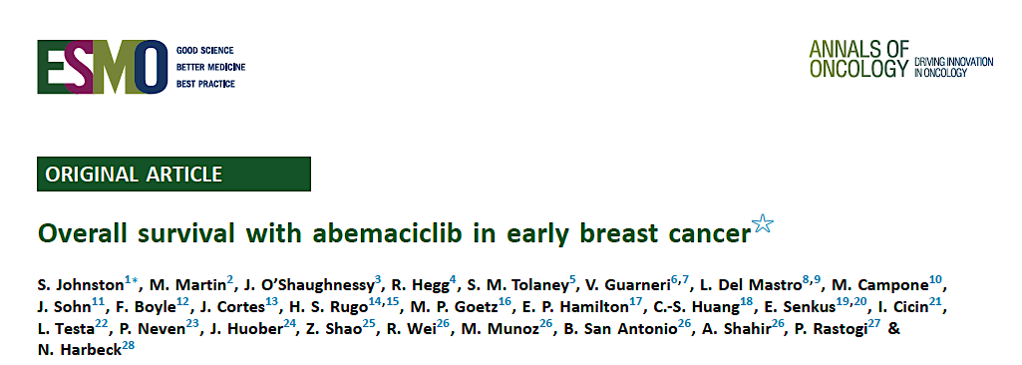
2026;37(2):155-65

Slide 32
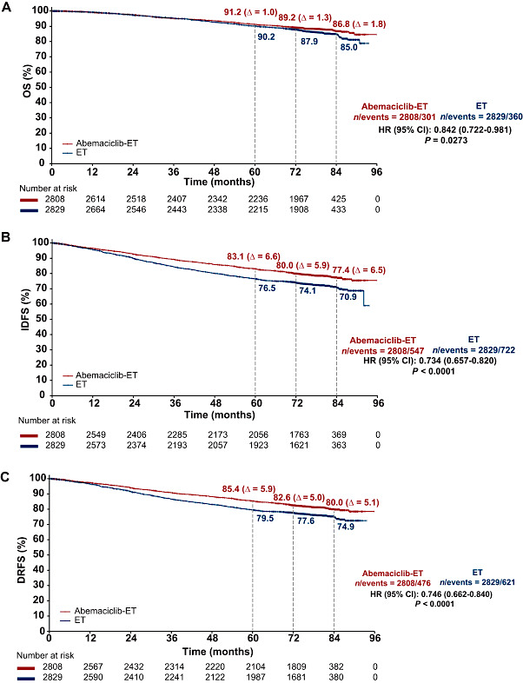
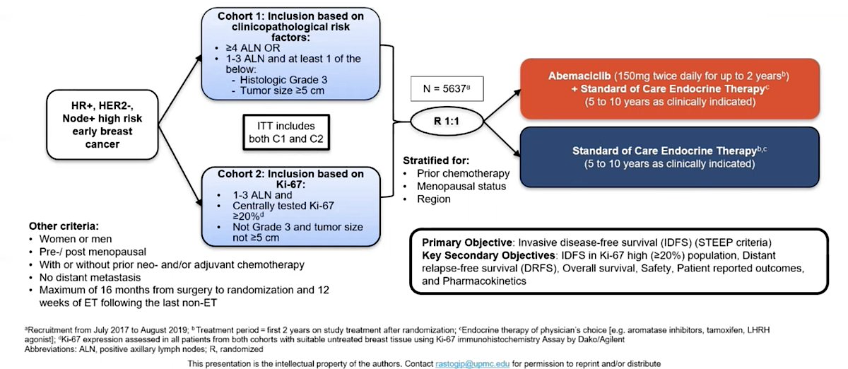
MONARCH-E
Johnston S, et al. Ann Oncol 2026:37:155

Slide 33

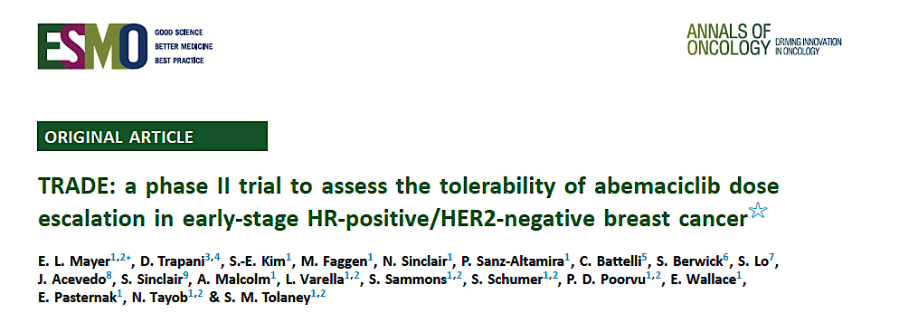
SABCS 2025; Abstract PD1-08
2026;37(1):117-24

Slide 34
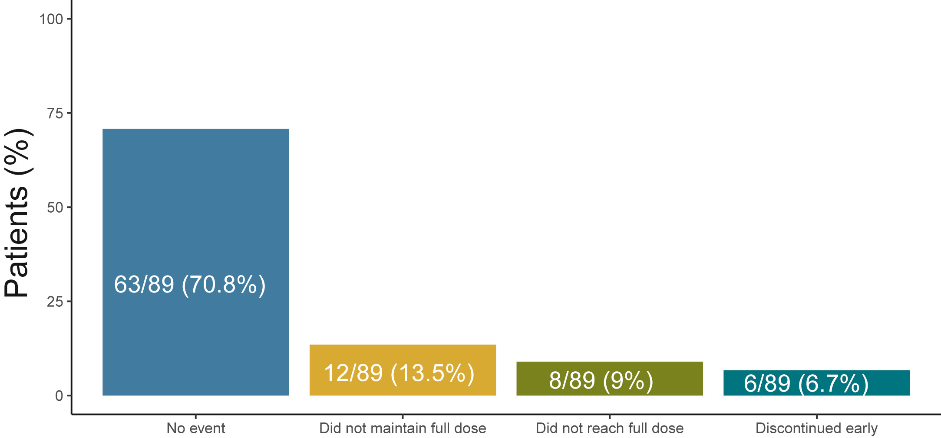
TRADE Study: Feasibility of Abemaciclib Dose Escalation
Schema:
50 mg BID x 2 weeks →
100 mg BID x 2 weeks →
150 mg BID
Endpoint:
Full dose at 12 weeks
Discontinuation at 24 weeks = 19%
Mayer EL, et al. Ann Oncol 2026; Schlamm I, et al. SABCS 2025

Slide 35
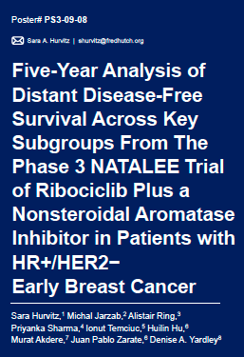
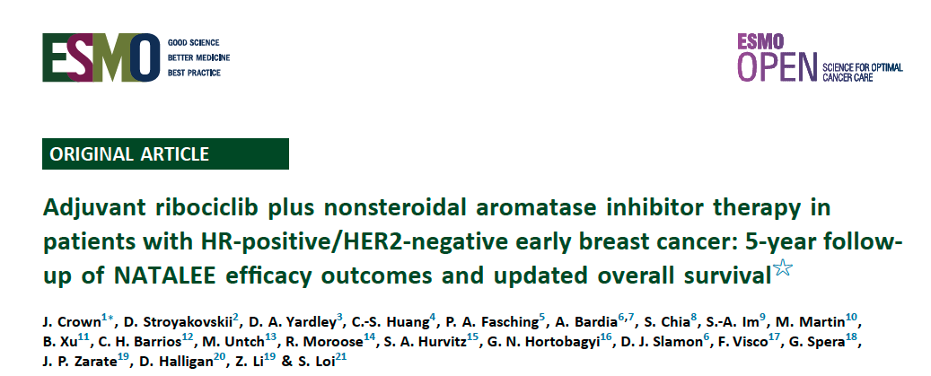
SABCS 2025
2025;10(11):105858

Slide 36
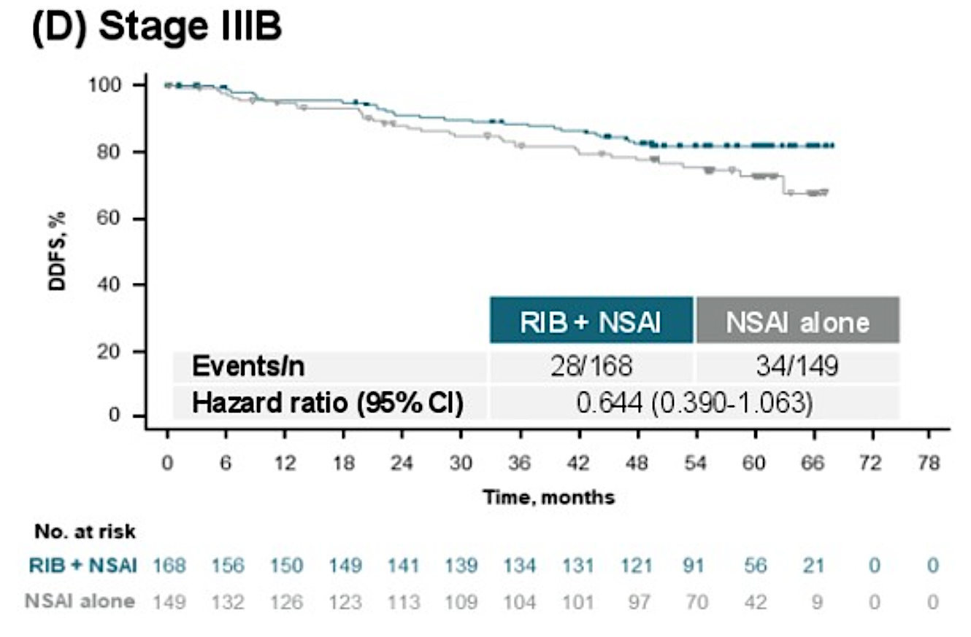
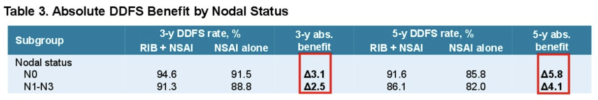
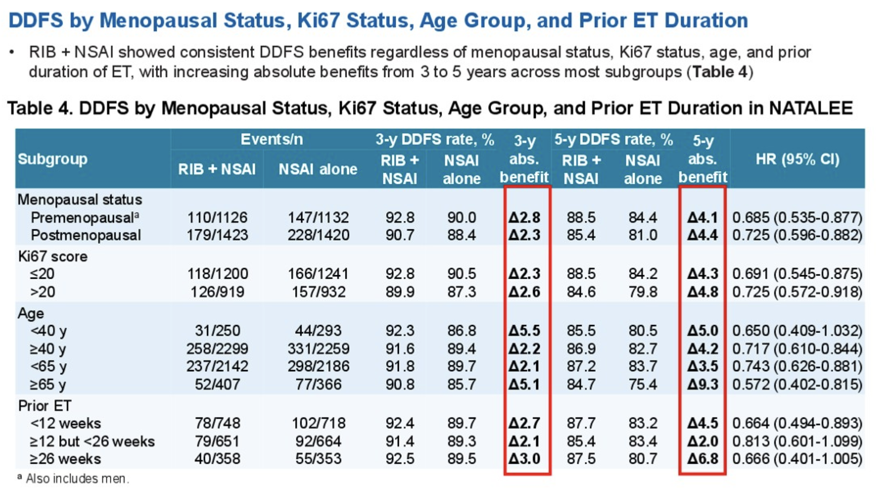
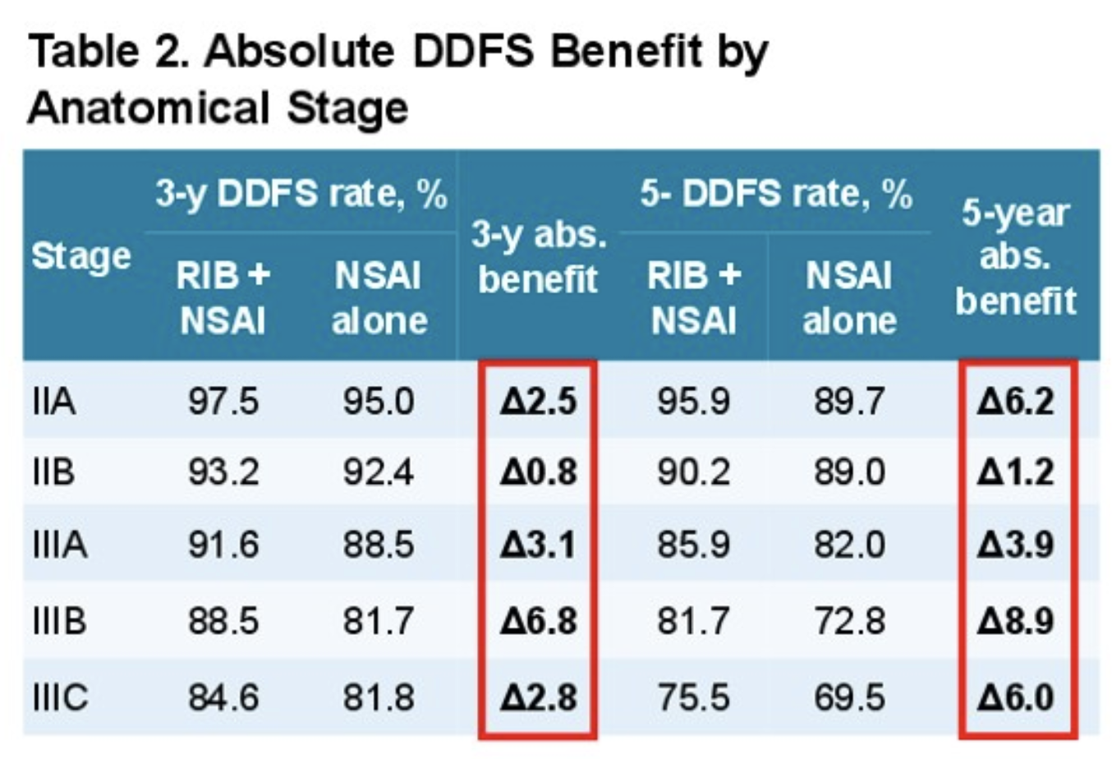
NATALEE: Subset Outcomes with 5 years of follow-up
Hurvitz S et al. SABCS 2025, abstract PS3-09-08

Slide 37
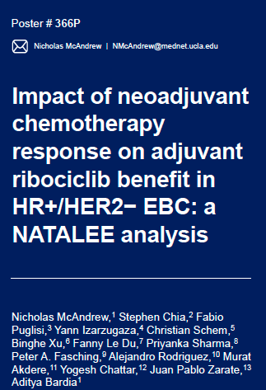
ESMO 2025

Slide 38
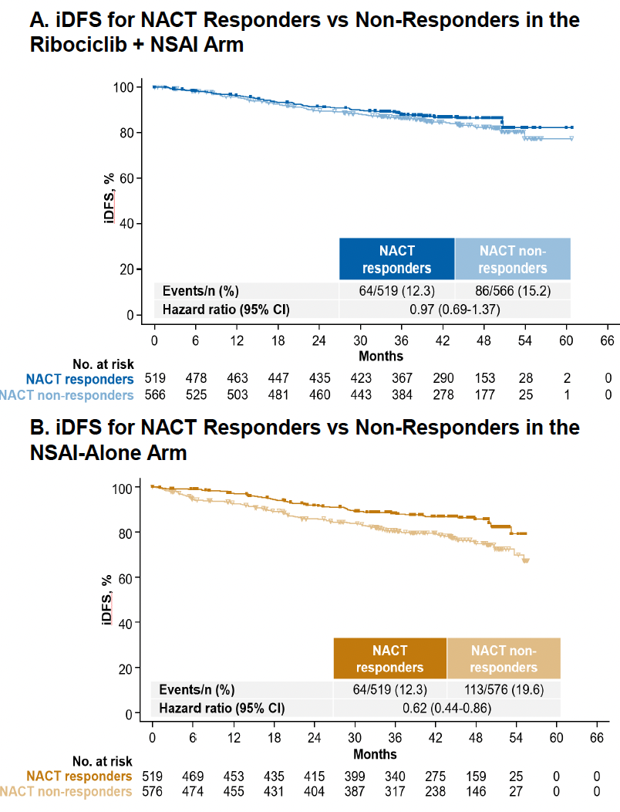
NATALEE: Outcomes as a Function of NACT Response
McAndrew NP, et al. ESMO 2025, abstract 366 P

Slide 39
Summary
Long-term follow-up for MonarchE and NATALEE show durable benefits
In the reports for MonarchE, there is now a survival benefit noted
Benefits are seen largely irrespective of clinical subsets
  Remember that trials were designed for a high risk cohort of patients defined by stage and/or tumor biology
There are persistent challenges in patient adherence given the side effects of CDK46i and the duration of therapy
Courtesy of Harold J Burstein, MD, PhD

Slide 40
Year in Review:
Localized HR-Positive Breast Cancer
INTRODUCTION: ODAC – April 30, 2026
MODULE 1: Adjuvant CDK4/6 Inhibitors
MODULE 2: Adjuvant Oral Selective Estrogen Receptor Degraders
MODULE 3: Premenopausal Patients
MODULE 4: Duration of Adjuvant Endocrine Treatment
MODULE 5: Genomic Predictors of Chemotherapy Benefit
MODULE 6: Neoadjuvant Treatment

Slide 41
Select Key Datasets
Adjuvant Oral Selective Estrogen Receptor Degraders
Bardia A et al. Giredestrant vs standard-of-care endocrine therapy as adjuvant treatment for patients with estrogen receptor-positive, HER2-negative early breast cancer: Results from the global phase III lidERA Breast Cancer trial. San Antonio Breast Cancer Symposium 2025;Abstract GS1-10.

Slide 42
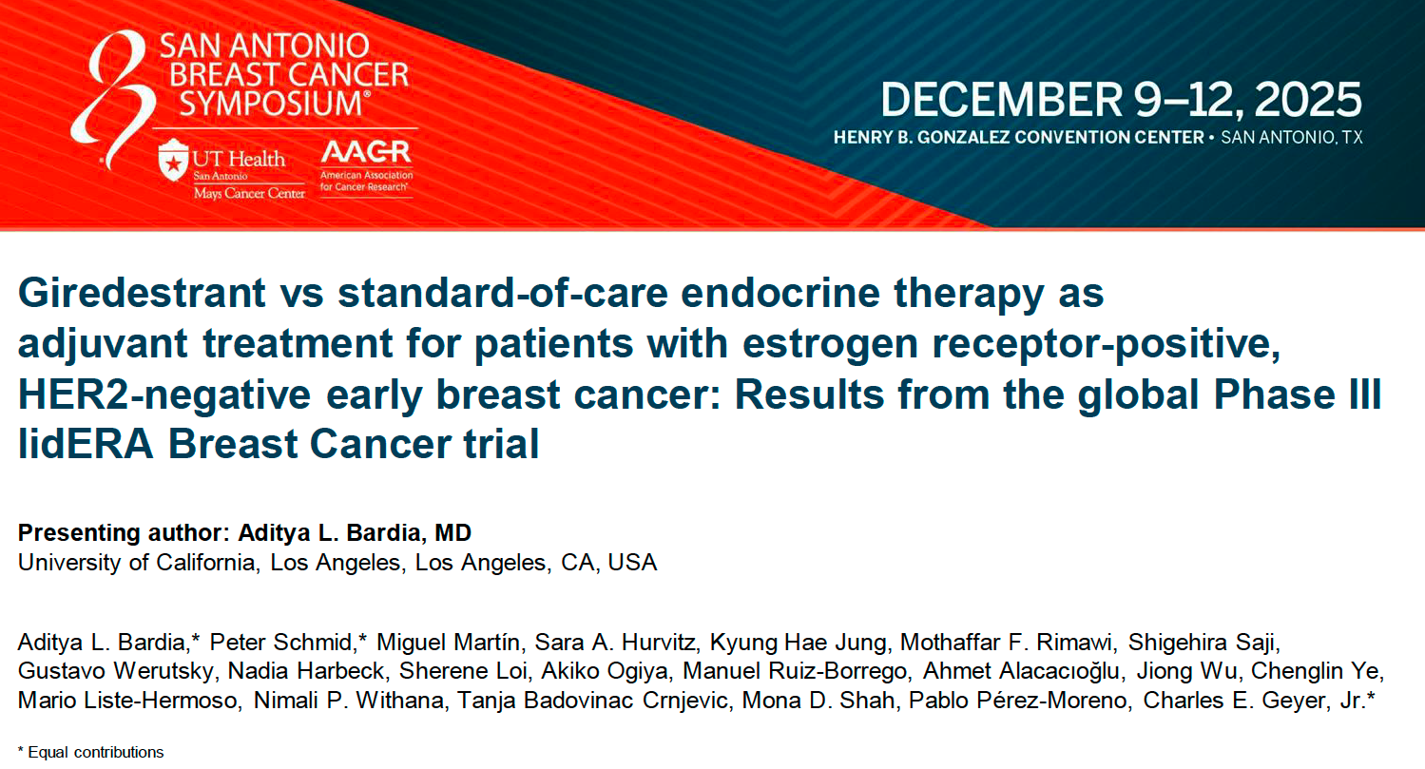
Abstract GS1-10

Slide 43
lidERA Breast Cancer study design
A global, randomized, open-label, multicenter Phase III trial
Key eligibility criteria
Participants with ER+, HER2-negative early breast cancer
Stage I–III disease (anatomical)
        pN0 and pT > 1 cm with Grade 3, or Ki67 ≥ 20%,
        or high score on genomic assay,* or pT4N0
        Node-positive
Pre- or post-menopausal†
Breast cancer surgery within 12 months
(Neo)adjuvant chemotherapy if indicated
At least 5-year treatment duration
5-year follow-up
N = 4170
Giredestrant (30 mg PO QD)
Long-term follow-up
R
1:1
SOC ET
Tamoxifen/anastrozole/letrozole/exemestane
Stratification factors
Risk: Medium-‡ vs high-risk§ Stage I–III breast cancer
Region: USA/Canada/Western Europe vs Asia–Pacific vs RoW
Previous chemotherapy: No vs yes
Menopausal status: Pre-menopausal vs post-menopausal
Primary endpoint
IDFS (excluding second primary non-breast cancer)
Key secondary endpoints
DFS, DRFI, IDFS (including second primary non-breast invasive cancer with exception of non-melanoma skin cancers and in situ carcinomas of any site), LRRFI, OS, safety
Giredestrant is currently also being investigated in combination with abemaciclib in the adjuvant setting (lidERA Breast Cancer substudy 1)
Enrollment: August 2021 to September 2023. Up to 12 weeks of ET ± CDK4/6i were allowed. ER+ was defined as ≥ 1% positive cells by immunohistochemistry. * OncotypeDx ≥ 26 or high-risk Mammaprint.
† Pre-menopausal patients on aromatase inhibitors or giredestrant had to receive ovarian function suppression with an approved luteinizing hormone-releasing hormone agonist. ‡ Medium risk: pN0 and primary tumor
> 1 cm with high-risk biologic features (Grade 3, or Ki67 ≥ 20%, or high score on genomic assay [if available]) and pN1 with low-risk biologic features (Grade 1/2 and Ki67 < 20% and tumor ≤ 5 cm and low score on genomic assay [if available]). § High risk: pT4, or pN2, or pN3 and pN1 with high-risk biologic features (Grade 3, or Ki67 ≥ 20%, or tumor > 5 cm, or high score on genomic assay [if available]).
CDK4/6i, cyclin-dependent kinase 4/6 inhibitor; DFS, disease-free survival; DRFI, distant recurrence-free interval; ER+, estrogen receptor-positive; ET, endocrine therapy; IDFS, invasive disease-free survival;
LRRFI, locoregional recurrence-free interval; OS, overall survival; PO, orally; QD, once daily; R, randomization; RoW, rest of the world; SOC, standard-of-care.
ClinicalTrials.gov number, NCT04961996. Adapted from Geyer CE, et al. ASCO 2023 (TPS616), with permission.
Presented by: Aditya L. Bardia, MD.
Bardia Proc SABCS 2025;Abstract GS1-10

Slide 44

Primary endpoint: IDFS
 | Giredestrant + everolimus (n = 102) | SOC ET + everolimus (n = 105)
Events, n (%) | 140 (6.7) | 196 (9.4)
Stratified HR (95% CI) | 0.70 (0.57, 0.87); p = 0.0014*
100
97.7%
94.6%
96.9%
92.4%
IDFS (%)
92.3%
89.6%
80
70
0
6
12
18
24
30
36
42
0
6
12
18
24
30
36
42
Time (months)
No. at risk
Giredestrant
SOC ET
2084
2086
2021
2016
1969
1958
1932
1898
1716
1683
1088
1048
345
325
26
25
Presented by: Aditya L. Bardia, MD.

Slide 45
AE overview (safety-evaluable population)
lidERA
Breast Cancer
Common TEAEs (≥ 7.5% of patients in either arm at any grade)
Selected AEs
Giredestrant n = 2060
SOC ET n = 2074
 | Giredestrant n = 2060 | SOC ET n = 2074
Patients, n (%) with treatment discontinuations due to AEs
Musculoskeletal disorders | 38 (1.8) | 92 (4.4)
Arthralgias (PT) | 32 (1.6) | 76 (3.7)
Vasomotor disorders | 2 (< 0.1) | 18 (0.9)
Hot flush (PT) | 1 (< 0.1) | 16 (0.8)
Arthralgia
Hot flush
Headache
Fatigue
Insomnia
Nausea
COVID-19
Asthenia
Back pain
Radiation skin injury
Hypertension
Urinary tract infection
Cough
Diarrhea
Pain in extremity
Constipation
1.5 / 46.5
45.3 / 1.8
0.3 / 27.1
28.5 / 0.3
0.1 / 15.2
13.1 / 0.1
 | Giredestrant n = 2060 |  |  | SOC ET n = 2074
Patients, n (%) with selected AEs by medical concept*
 | G1 | G2 | G3–4 | G1 | G2 | G3–4
Bradycardia† | 217 (10.5) | 15 (0.7) | 0 | 64 (3.1) | 2 (< 0.1) | 0
Venous thromboembolic events | 4 (0.2) | 12 (0.6) | 2 (< 0.1)‡ | 3 (0.1) | 7 (0.3) | 7 (0.3)
Giredestrant
SOC ET
G1–2
G3–4
Patients (%)
Presented by: Aditya L. Bardia, MD.
Bardia Proc SABCS 2025;Abstract GS1-10

Slide 46
Oral SERD Adjuvant Trials
Trial Name | N | Arms | Patient Population | Adjuvant CDK4/6i allowed | Trial Identifier
CAMBRIA-2 | 5500 | Camizestrant vs ET | High-risk ER+/HER2-, initial adjuvant therapy | Yes | NCT05952557
lidERA | 4200 | Giredestrant vs ET | Medium to high-risk ER+/HER2-, initial adjuvant therapy | No | NCT04961996
ELEGANT | 4220 | Elacestrant vs SoC | ER+/HER2-, Early Breast Cancer With High Risk of Recurrence; 2-5y of prior ET | Prior to trial entry | NCT06492616
EMBER-4 | 6000 | Imlunestrant vs ET | High-risk ER+/HER2-, 2-5 yr of adjuvant ET | Prior to trial entry | NCT05514054
CAMBRIA-1 | 4300 | Camizestrant vs ET | Intermediate to high-risk ER+/HER2-, 2-5 yr of adjuvant ET | Prior to trial entry | NCT05774951
TREAT ctDNA | 220 | Elacestrant vs ET | ↑ risk ER+/HER2-, ctDNA relapse, 2-7 yr adjuvant ET | ≥12 mo prior to trial entry | NCT05512364
Presented by: Lisa A Carey, MD, ScM.
Carey SABCS 2025;Abstract GS1-10 Discussant
This presentation is the intellectual property of the presenter. Contact lisa_carey@med.unc.edu for permission to reprint and/or distribute.

Slide 47
Year in Review:
Localized HR-Positive Breast Cancer
INTRODUCTION: ODAC – April 30, 2026
MODULE 1: Adjuvant CDK4/6 Inhibitors
MODULE 2: Adjuvant Oral Selective Estrogen Receptor Degraders
MODULE 3: Premenopausal Patients
MODULE 4: Duration of Adjuvant Endocrine Treatment
MODULE 5: Genomic Predictors of Chemotherapy Benefit
MODULE 6: Neoadjuvant Treatment

Slide 48
Select Key Datasets
Premenopausal Patients
Francis P et al. 15-year outcomes for women with premenopausal hormone receptor-positive early breast cancer (BC) in the SOFT and TEXT trials assessing benefits from adjuvant exemestane (E) + ovarian function suppression (OFS) or tamoxifen (T)+OFS. ASCO 2025;Abstract 505.
O’Regan R et al. Assessment of adjuvant endocrine therapy with ovarian function suppression by breast cancer index. JAMA Netw Open 2025;8(11).
O’Regan R et al. Identifying premenopausal patients with early-stage hormone receptor-positive breast cancer at minimal risk of distant recurrence by breast cancer index. Breast 2026;86:104714.
Mamounas E et al. A phase III trial evaluating addition of adjuvant chemotherapy to ovarian function suppression + endocrine therapy in premenopausal women with pN0-1, HR+/HER2- breast cancer (BC) and Oncotype Recurrence Score (RS) ≤25 (OFSET): NRG-BR009. ASCO 2025;Abstract TPS615.

Slide 49
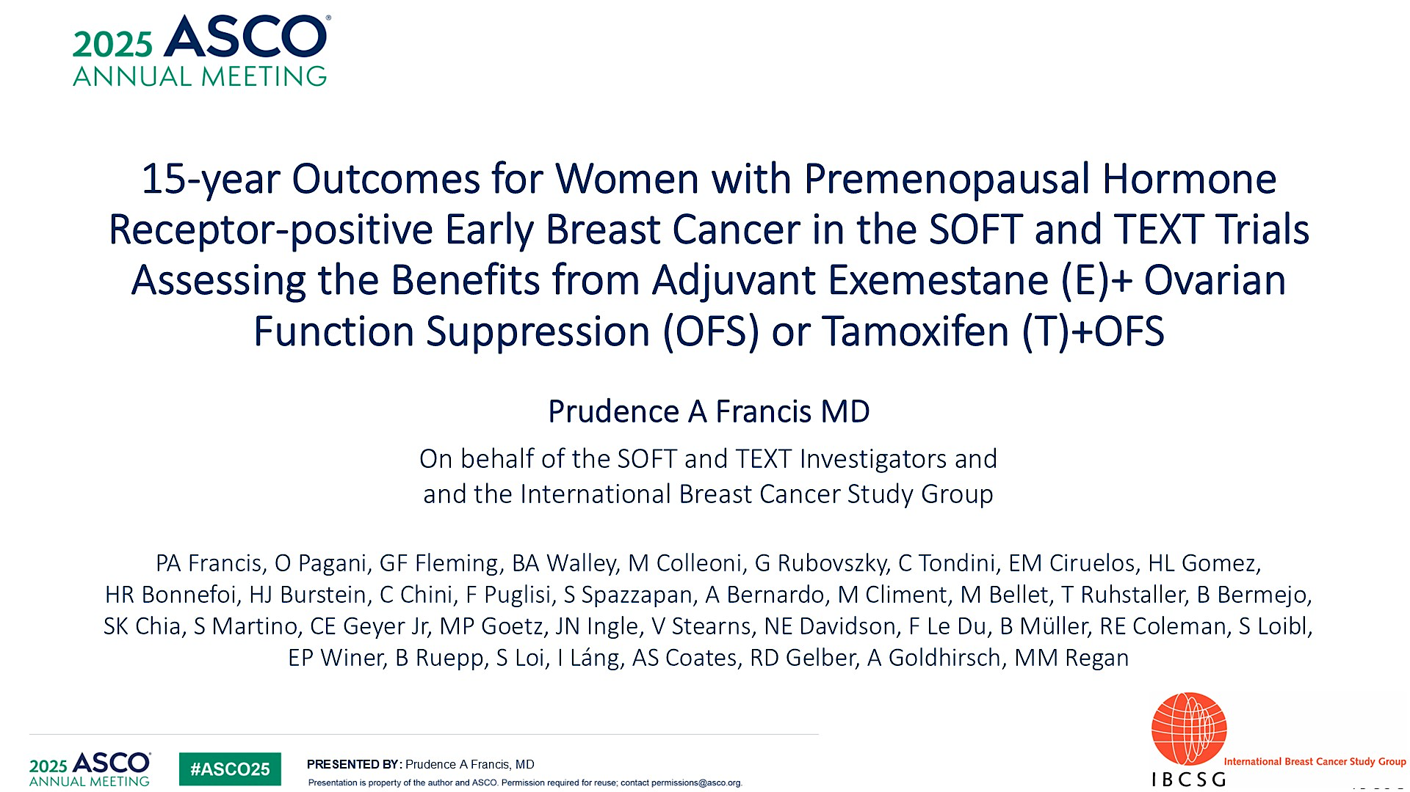
Abstract 505

Slide 50
Role of OFS in ER+ EBC
OFS is an effective treatment in premenopausal breast cancer
  Reduces risk in combination with tamoxifen
  Facilitates use of AI, which further lowers recurrence risk
  Enables adjuvant CDK46 inhibitor therapy
Longer durations beyond 5 years are of additional benefit
Studies need to optimize OFS
Courtesy of Harold J Burstein, MD, PhD

Slide 51
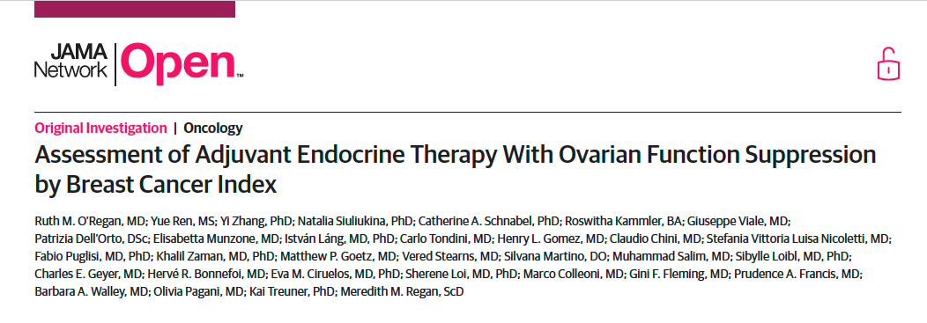
2025;8(11)

Slide 52
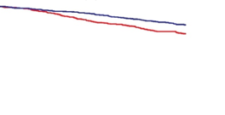
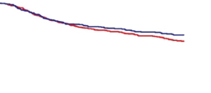
Results – Prediction
Predictive performance of BCI (H/I) for benefit of E-OFS vs T-OFS in SOFT+TEXT
BCI (H/I) – Low
BCI (H/I) – High
C
100
D
100
80
80
60
60
Breast cancer-free (%)
Breast cancer-free (%)
40
40
Biomarker | 12 yr Abs benefit, % | HR E+OFS v T+OFS (95% Cl)
BCI (H/I)-Low | 5.7 | 0.65 (0.50 – 0.83)
Biomarker | 12 yr Abs benefit, % | HR E+OFS v T+OFS (95% Cl)
BCI (H/I)-High | 4.2 | 0.86 (0.67 – 1.09)
20
20
0
0
0
2
4
6
8
10
12
0
2
4
6
8
10
12
Years since randomization
Years since randomization
T+OFS
E+OFS
844
848
803
794
746
768
695
719
652
675
541
582
389
393
T+OFS
E+OFS
603
601
554
543
498
495
458
451
423
413
360
339
245
240
O’Regan RM, et al. Presented at: ASCO 2025. Abstract 557 and JAMA Network OPEN, 2025.
Abs, absolute; BCI, breast cancer index; E, exemestane; H/I, HOXB13/IL17BR ratio; OFS, ovarian function suppression; T, tamoxifen.

Slide 53
Conclusions
BCI was confirmed as prognostic in premenopausal patients
BCI (H/I) did not clearly demonstrate differential benefit between exemestane-OFS and tamoxifen-OFS in this population, especially those with BCI (H/I)-high tumors
For patients with BCI (H/I)-low tumors, may benefit more from more intensive ET
with exemestane
Different findings by age
  The authors hypothesized this was possibly because of changing benefit from those older patients with BCI (H/I)-high tumors as they become postmenopausal over time
O’Regan RM, et al. Presented at: ASCO 2025. Abstract 557 and JAMA Network OPEN, 2025.
BCI, breast cancer index; ET, endocrine therapy; H/I, HOXB13/IL17BR ratio; OFS, ovarian function suppression.

Slide 54
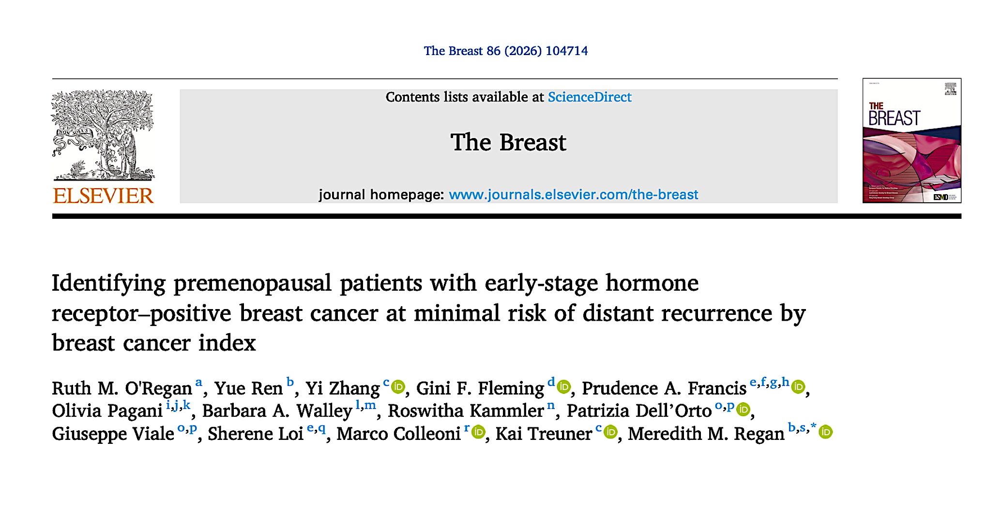

Slide 55
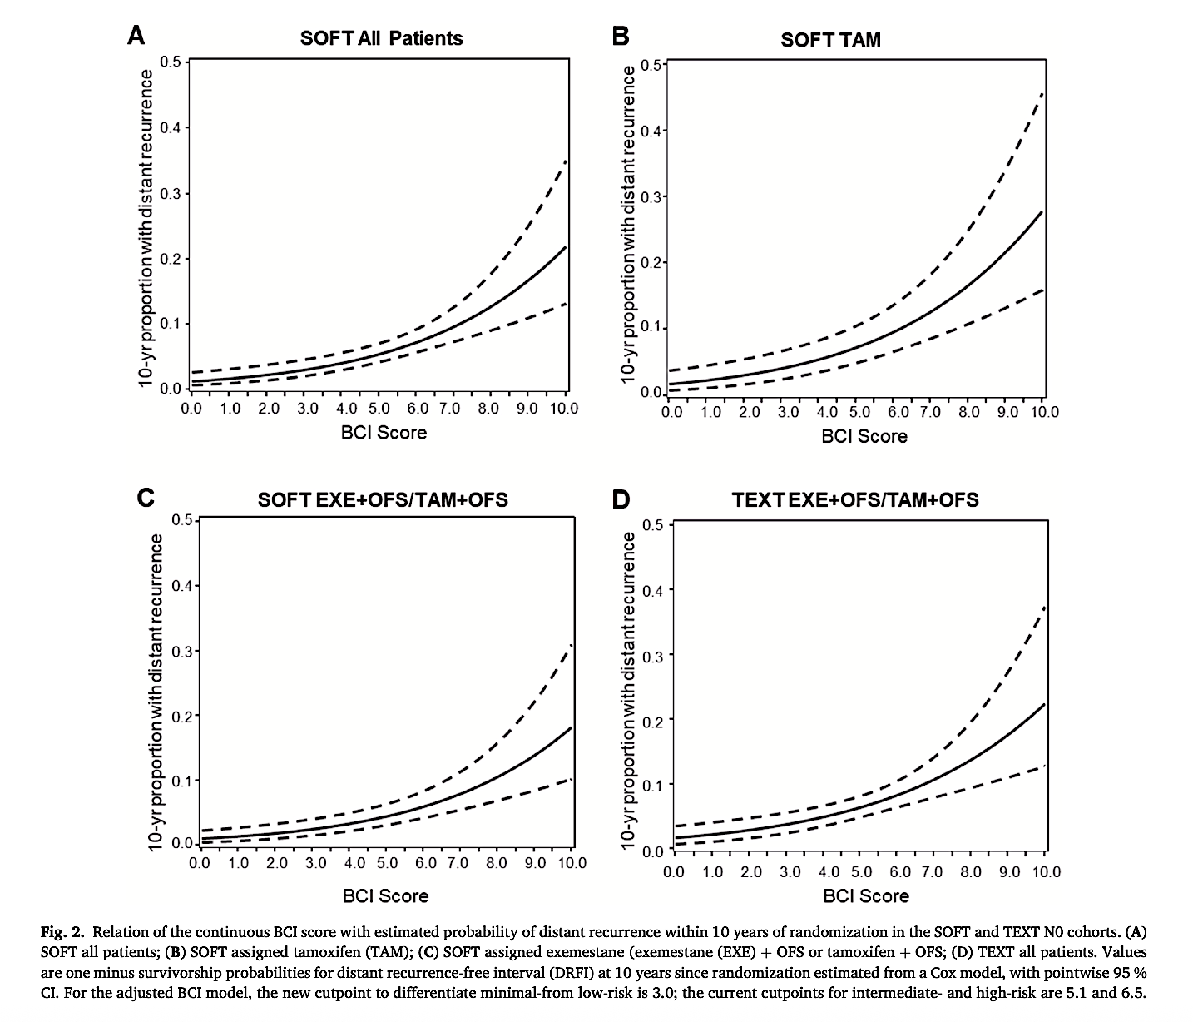
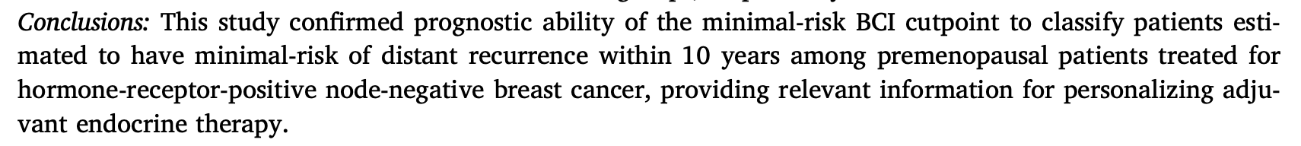
O’Regan R et al. The Breast, 2026

Slide 56
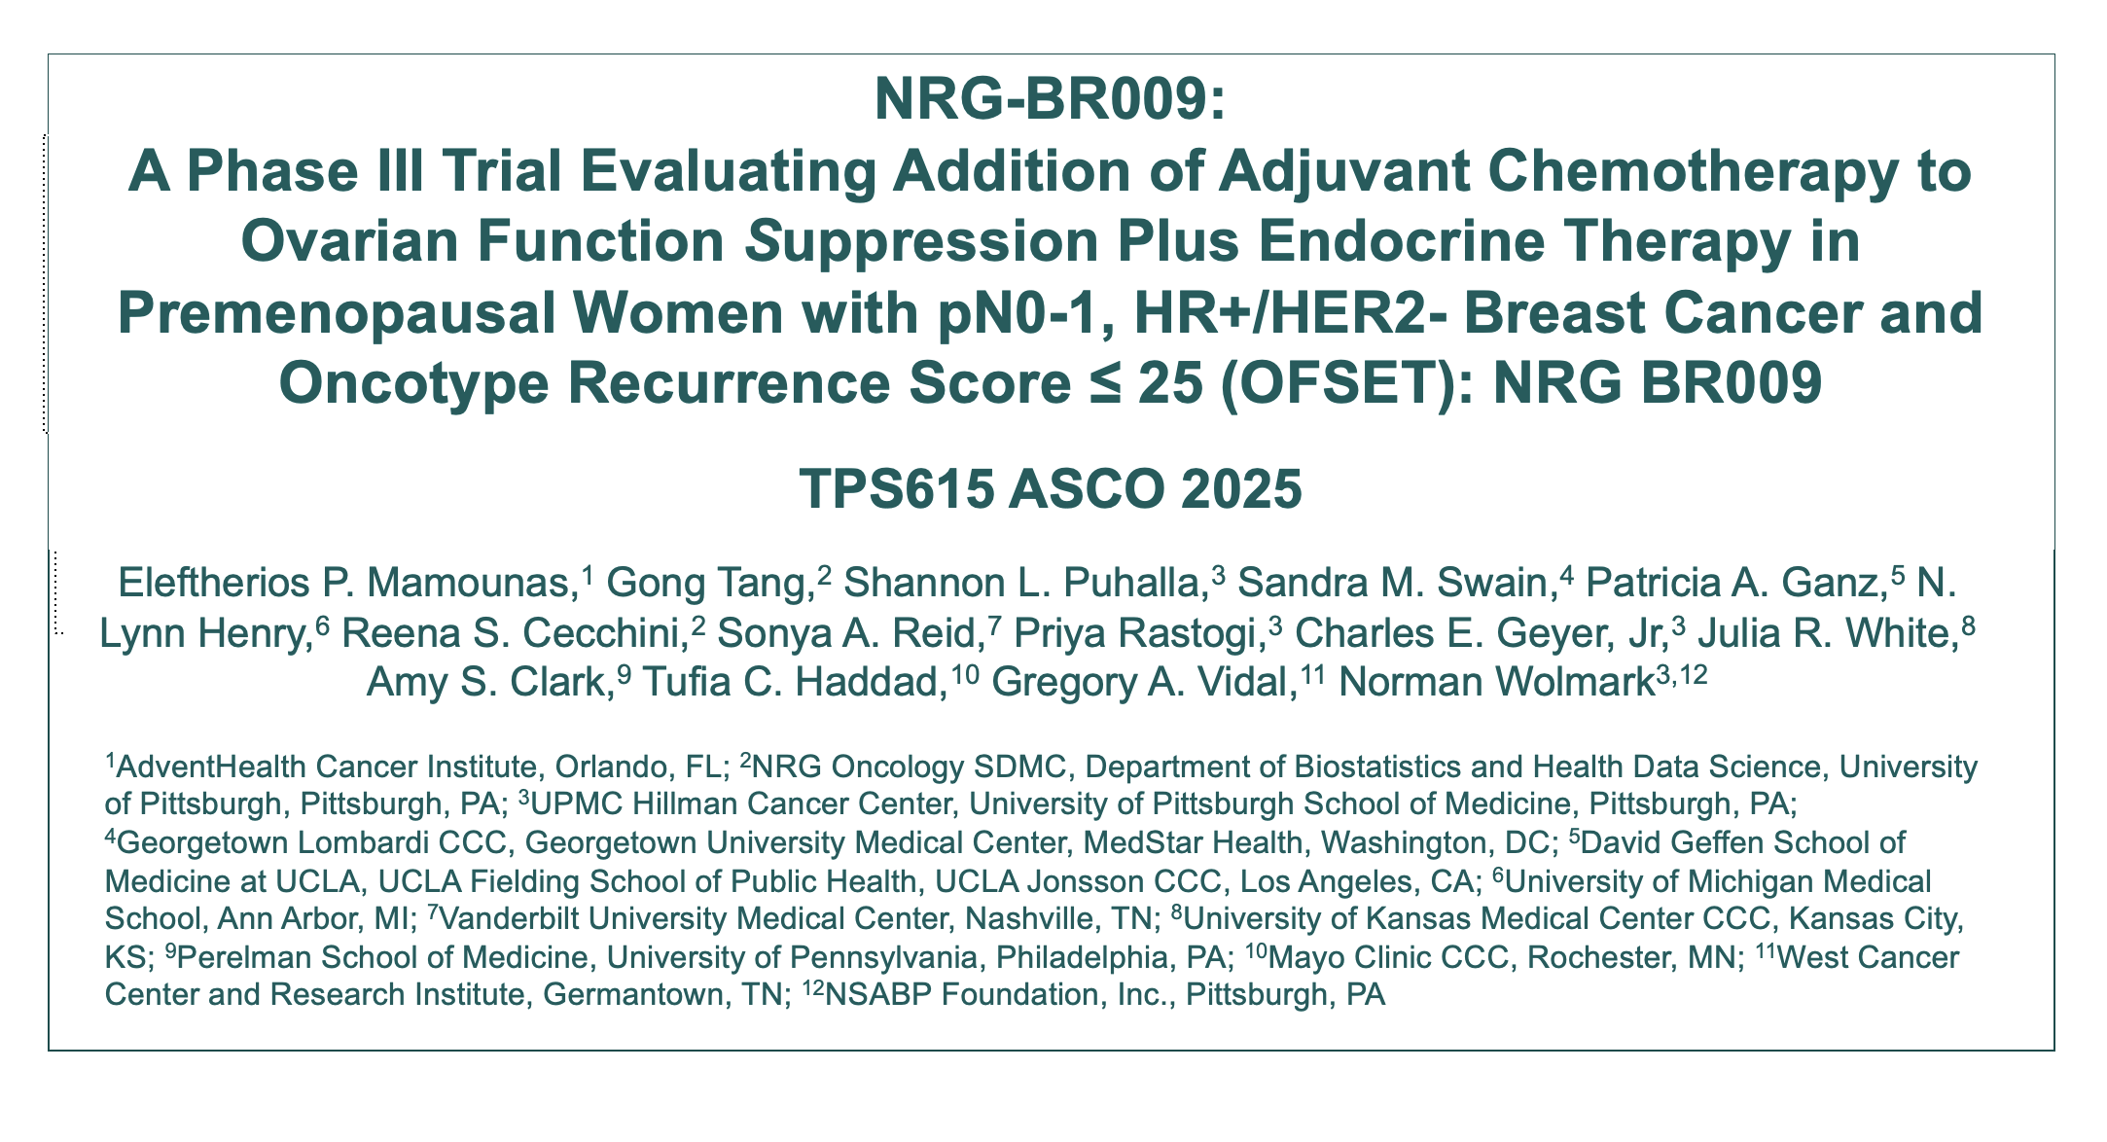

Slide 57
NRG-BR009 (OFSET): Schema
Chemotherapy +
ovarian function suppression +
aromatase inhibitor*
X 5 years
Stratification
Nodal status
(pN0 vs pN1)
Age >40 and <40
Intent to receive CDK4/6 inhibitor (yes; no)
Premenopausal; HR+/HER2- BC
pN0 with RS 16-20 (high clinical risk) or RS 21-25
pN1 with RS 0-25
Randomization
Ovarian function suppression +
aromatase inhibitor*
X 5 years
N=3960
* Tamoxifen can be used if AI is not tolerated
ClinicalTrials.gov. NCT05879926. Accessed September 2, 2025. https://www.clinicaltrials.gov/study/NCT05879926
AI, aromatase inhibitor; BC, breast cancer; CDK, cyclin-dependent kinase; HR, hormone receptor; N, node; RS, recurrence score.
Mamounas ASCO 2025;Abstract TPS615

Slide 58

Additional Treatment Considerations
Abemaciclib, ribociclib OK:
  Patients who meet criteria for adjuvant CDK 4/6 inhibitors may take this as per package label
  The intent to use CDK 4/6 inhibitors will have to be declared prior to randomization; need to be captured on the case report form
Bisphosphonates OK
CONCLUSIONS: Neo/Adjuvant Chemotherapy is SOC for HR+ N+ premenopausal pts
ClinicalTrials.gov. NCT05879926. Accessed September 2, 2025. https://www.clinicaltrials.gov/study/NCT05879926
Mamounas ASCO 2025;Abstract TPS615

Slide 59
Year in Review:
Localized HR-Positive Breast Cancer
INTRODUCTION: ODAC – April 30, 2026
MODULE 1: Adjuvant CDK4/6 Inhibitors
MODULE 2: Adjuvant Oral Selective Estrogen Receptor Degraders
MODULE 3: Premenopausal Patients
MODULE 4: Duration of Adjuvant Endocrine Treatment
MODULE 5: Genomic Predictors of Chemotherapy Benefit
MODULE 6: Neoadjuvant Treatment

Slide 60
Select Key Datasets
Duration of Adjuvant Endocrine Treatment
Sanft T et al. Prospective decision impact study of the Breast Cancer Index: Results from the BCI Registry study. ASCO 2025;Abstract 531.
Mamounas E et al. Evaluation of the Sensitivity to Endocrine Therapy (SET ER/PR) assay to predict benefit from extended endocrine therapy in the NRG/NSABP B-42 trial. San Antonio Breast Cancer Symposium 2025;Abstract GS3-05.

Slide 61
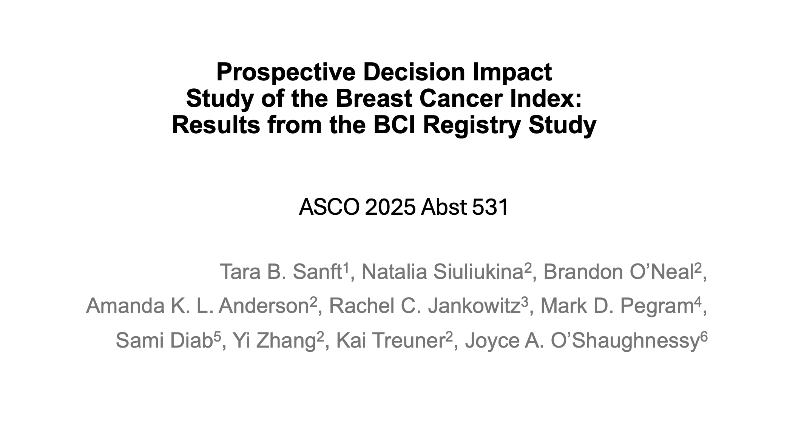

Slide 62
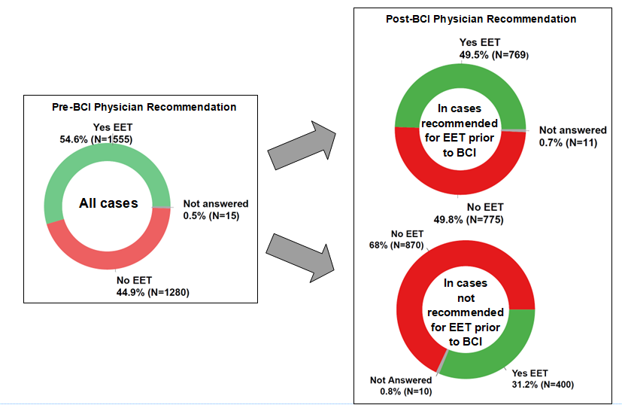
 | Total cohort (N = 3,005)
Age
<40 | 25 (0.8%)
40-49 | 205 (6.8%)
50-59 | 658 (21.9%)
60-74 | 1,546 (51.4%)
T stage
T1 | 2,194 (73.0%)
T2 | 749 (24.9%)
T3 | 62 (2.1%)
Grade
1 | 846 (28.2%)
2 | 1,609 (53.5%)
3 | 548 (18.2%)
Unknown | 2 (0.1%)
Nodal status
N0 | 2,299 (76.5%)
N1 | 697 (23.2%)
Unknown | 9 (0.3%)
Ki-67
<20 | 1,213 (40.4%)
≥20 | 978 (32.5%)
Unknown | 814 (27.1%)
Sanft ASCO 2025; Abstract 531

Slide 63
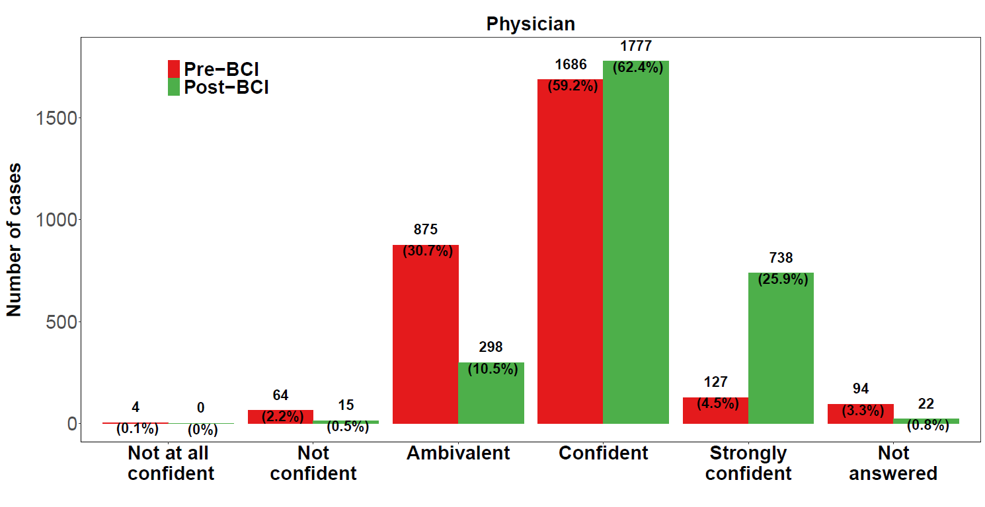
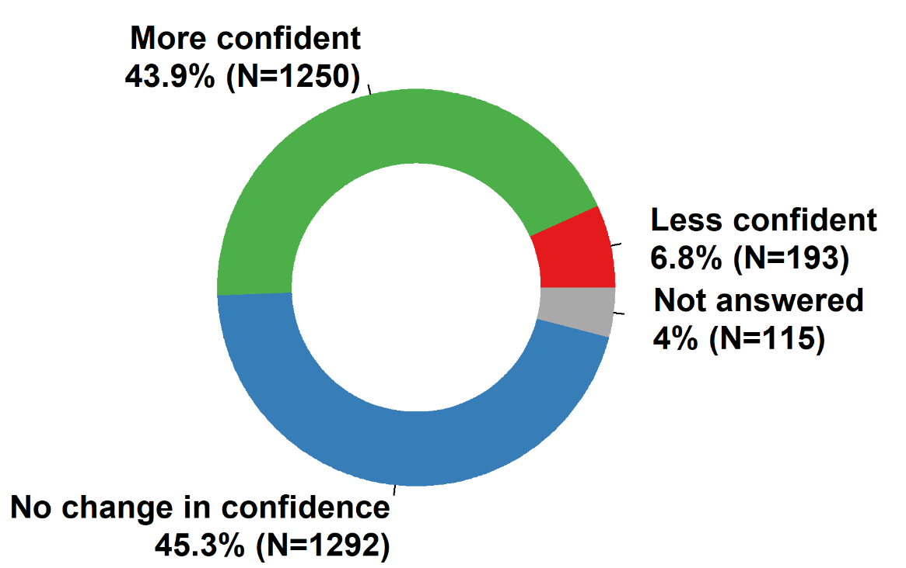
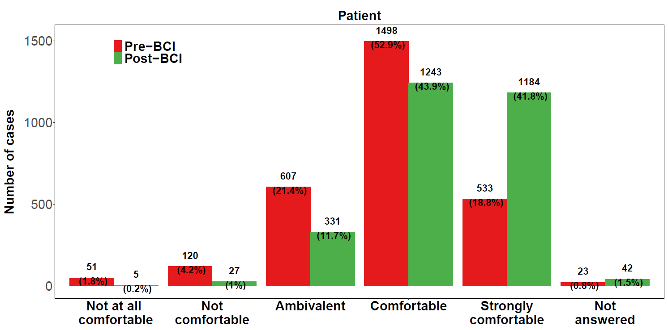
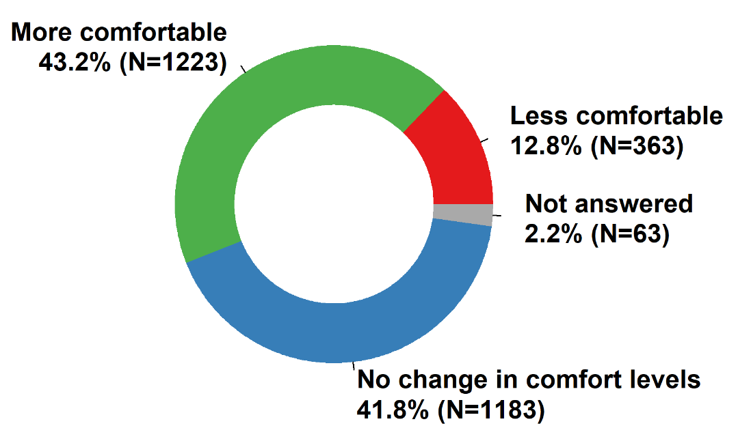
Sanft ASCO 2025; Abstract 531

Slide 64
CONCLUSIONS BCI Registry
Incorporating BCI into clinical practice resulted in changes in physician recommendations for EET in 41.2% cases
Following BCI testing, 43.9% of physicians felt more confident in their recommendation for EET.
BCI significantly increased physician confidence in their recommendation for EET
Changes in both physician recommendations and patient preferences for EET correlated with BCI test results
Following BCI testing, 43.2% of patients felt more comfortable with their EET decision
Compared with baseline, patient concerns regarding cost, drug safety and benefit of EET significantly decreased
Sanft ASCO 2025; Abstract 531

Slide 65
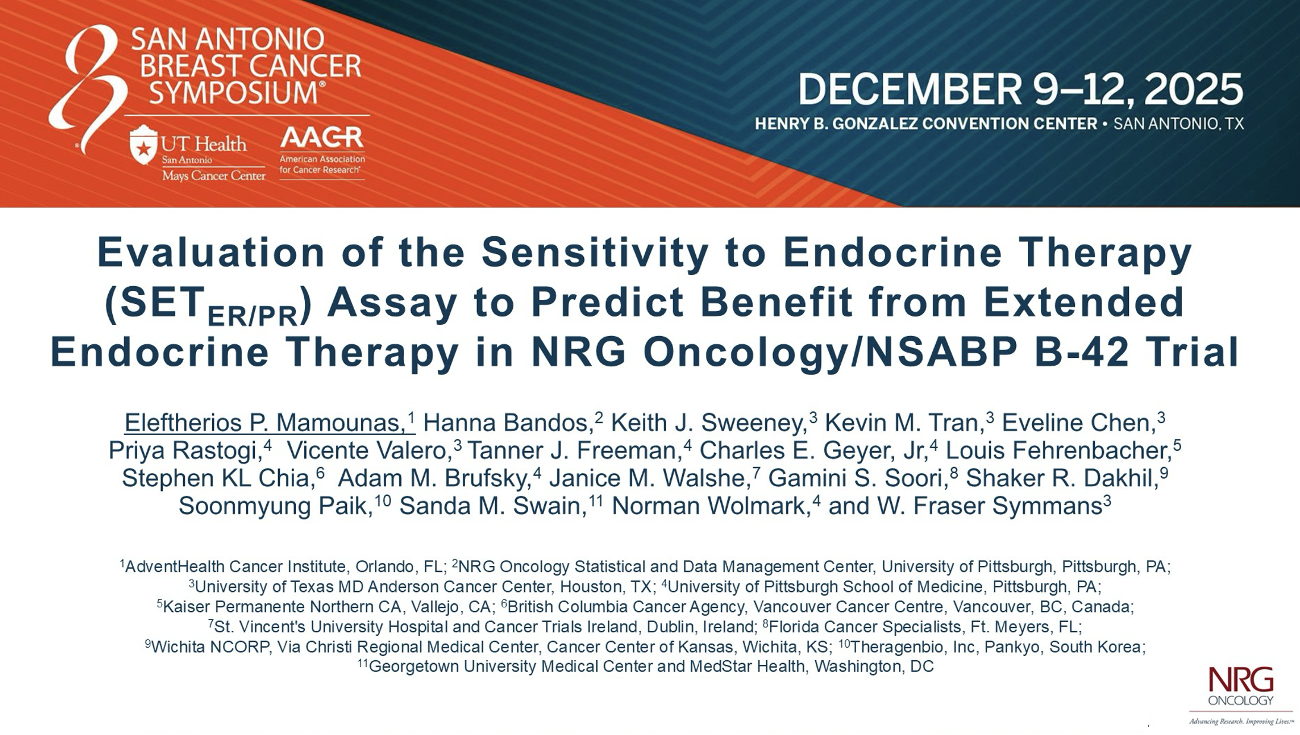
Abstract GS3-05

Slide 66
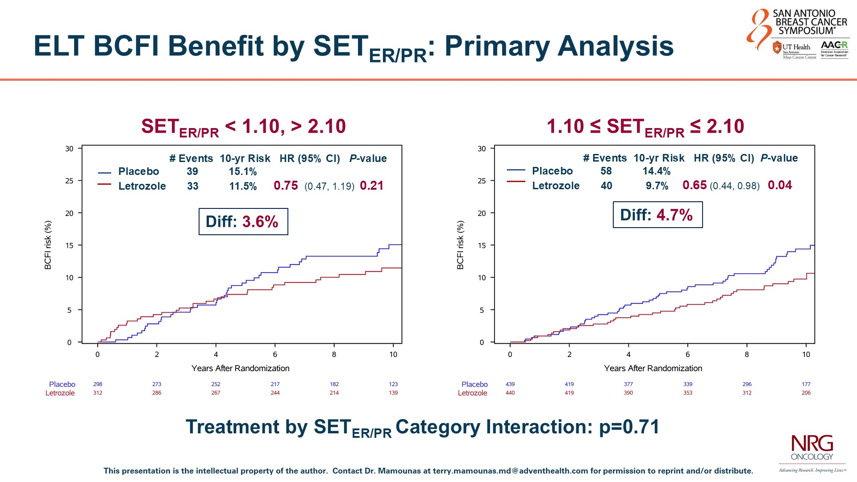
Mamounas SABCS 2025; Abstract GS3-05

Slide 67
Year in Review:
Localized HR-Positive Breast Cancer
INTRODUCTION: ODAC – April 30, 2026
MODULE 1: Adjuvant CDK4/6 Inhibitors
MODULE 2: Adjuvant Oral Selective Estrogen Receptor Degraders
MODULE 3: Premenopausal Patients
MODULE 4: Duration of Adjuvant Endocrine Treatment
MODULE 5: Genomic Predictors of Chemotherapy Benefit
MODULE 6: Neoadjuvant Treatment

Slide 68
Select Key Datasets
Genomic Predictors of Chemotherapy Benefit
Hwang RF et al. Sentinel lymph node biopsy and clinical outcome of patients with node-positive breast cancer in the RxPONDER trial (S1007). San Antonio Breast Cancer Symposium 2025;Abstract PD12-05.
Pusztai L et al. Development and validation of the RSClinN+ tool to predict prognosis and chemotherapy benefit for hormone receptor-positive, node-positive breast cancer. J Clin Oncol 2025;43(8):919-28.
Sparano JA et al. Multimodal artificial intelligence (AI) models integrating image, clinical, and molecular data for predicting early and late breast cancer recurrence in TAILORx. San Antonio Breast Cancer Symposium 2025;Abstract GS1-08.

Slide 69
Select Key Datasets
Genomic Predictors of Chemotherapy Benefit
Samiian L et al. Molecular insights into HR+/HER2+ early-stage breast cancer: Neoadjuvant therapy responses by MammaPrint® and BluePrint® genomic subtypes. ASCO 2025;Abstract 605.
Brufsky AM et al. MammaPrint predicts chemotherapy benefit in HR+HER2- early breast cancer: FLEX Registry real-world data. JNCI Cancer Spectr 2025;9(5).
O’Shaughnessy J et al. Improved 3-year IDFS with anthracycline-based therapy for patients with 70-gene signature High 2, Luminal B, HR+HER2- early-stage breast cancer. San Antonio Breast Cancer Symposium 2025;Abstract PS2-07-03.

Slide 70
Abstract PD12-05

Slide 71
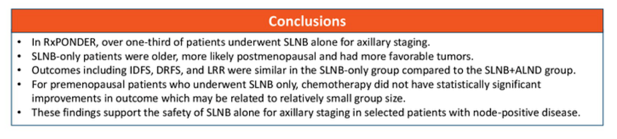
Hwang RF et al. SABCS 2025 PD12-05

Slide 72
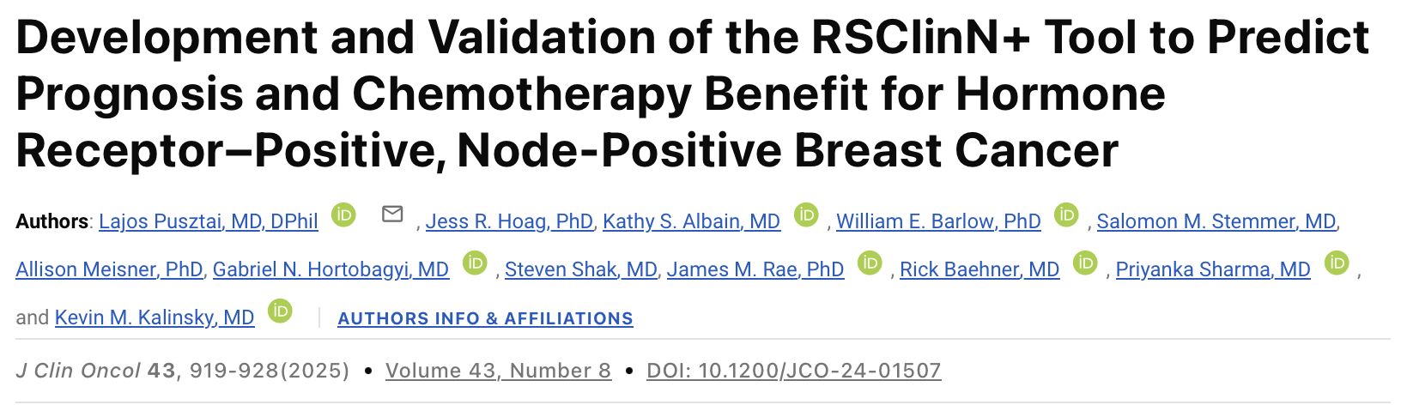

Slide 73
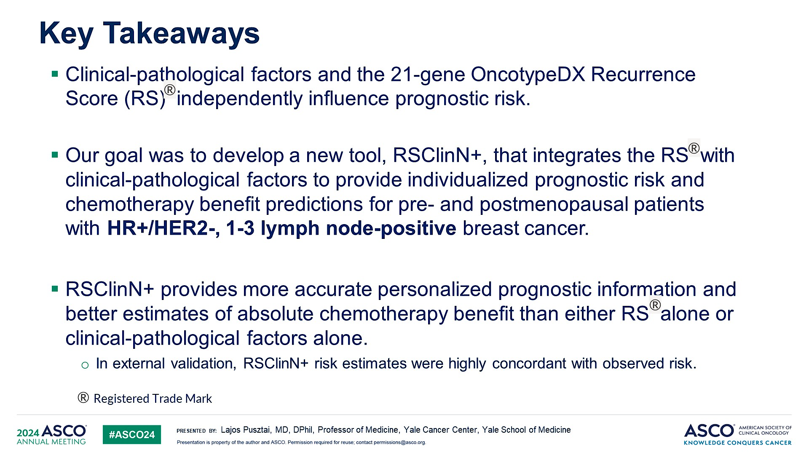
Key Takeaways
Pusztai L et al. J Clin Oncol 2025

Slide 74
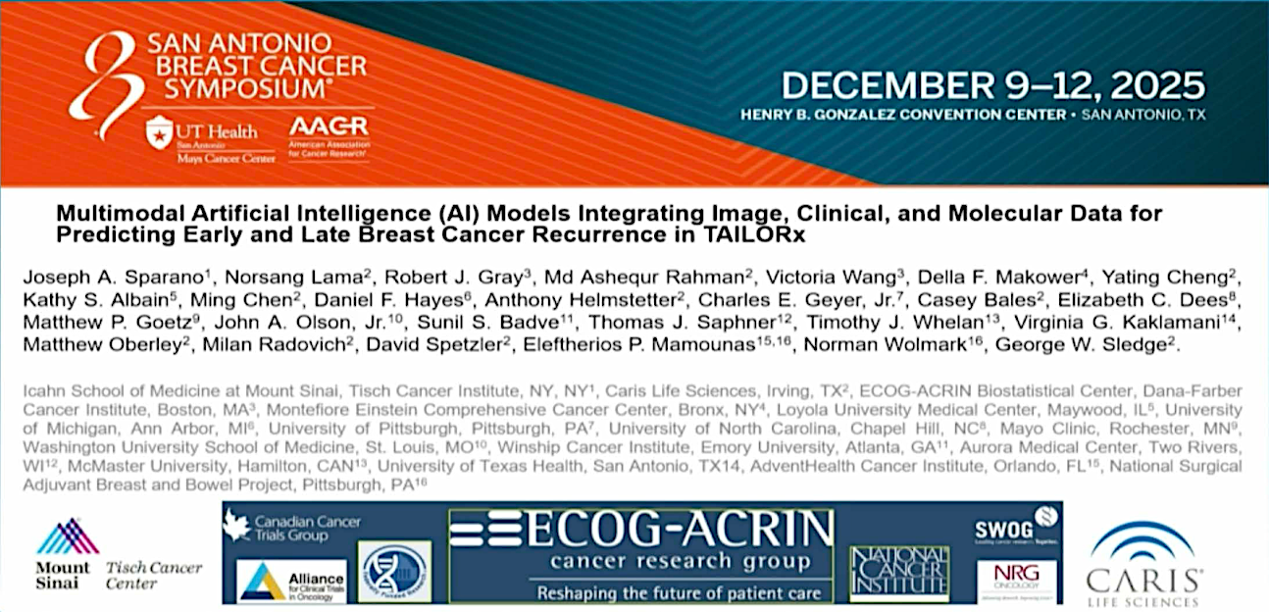
Abstract GS1-08

Slide 75
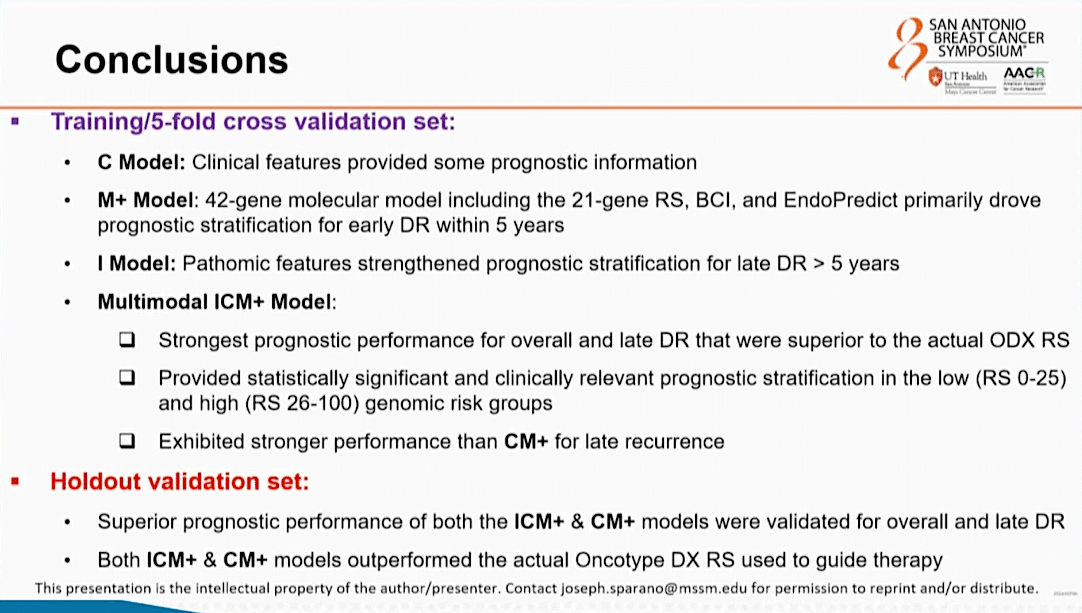
Sparano SABCS 2025;Abstract GS1-08

Slide 76
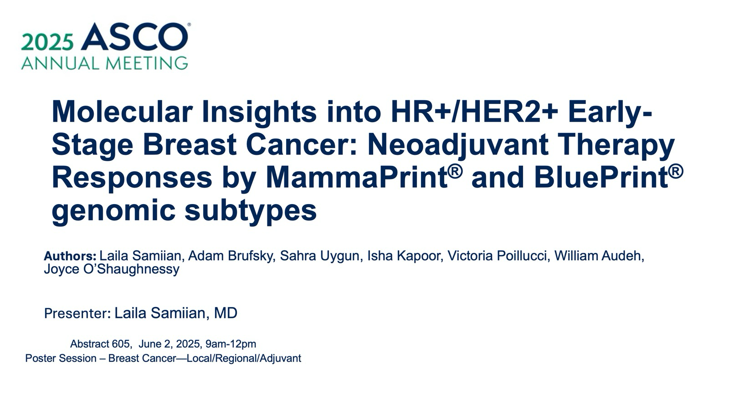

Slide 77
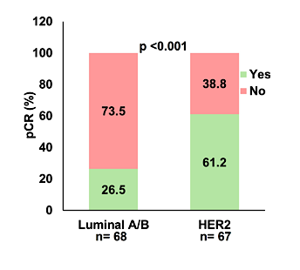
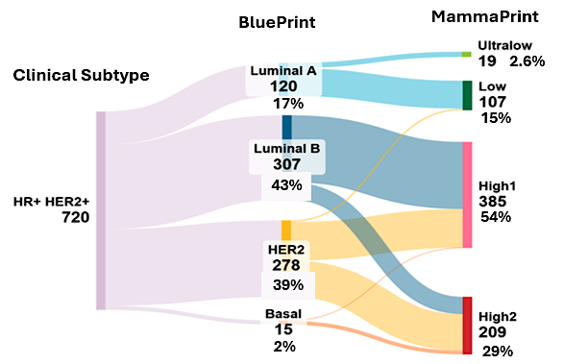
Molecular Insights into HR+/HER2+ Early-Stage Breast Cancer: Neoadjuvant Therapy Responses by MammaPrint and BluePrint genomic subtypes (Samiian et al., ASCO 2025)
Conclusions:
BP identified heterogeneity within HR+/HER2+ early stage cancers, with ~60% classified genomically as non-HER2-type
Consistent with I-SPY2, BP HER2 tumors showed higher pCR rates than Luminal A/B, underscoring the need for improved therapies for patients with Luminal A/B subtypes, and the potential value of BP subtyping in predicting HER2-targeted therapy response
WTA revealed differential gene expression between pCR and non-pCR in BP HER2 cancers, but findings were not statistically significant
Future WTA in larger cohorts of HR+/HER2+ EBC patients enrolled in FLEX, further classified by BP may elucidate the biology of these cancers from patients with pCR vs non-pCR
BP HER2 cancers showed significantly higher
pCR rates with NHT compared to Luminal A/B
Samiian ASCO 2025;Abstract 605

Slide 78
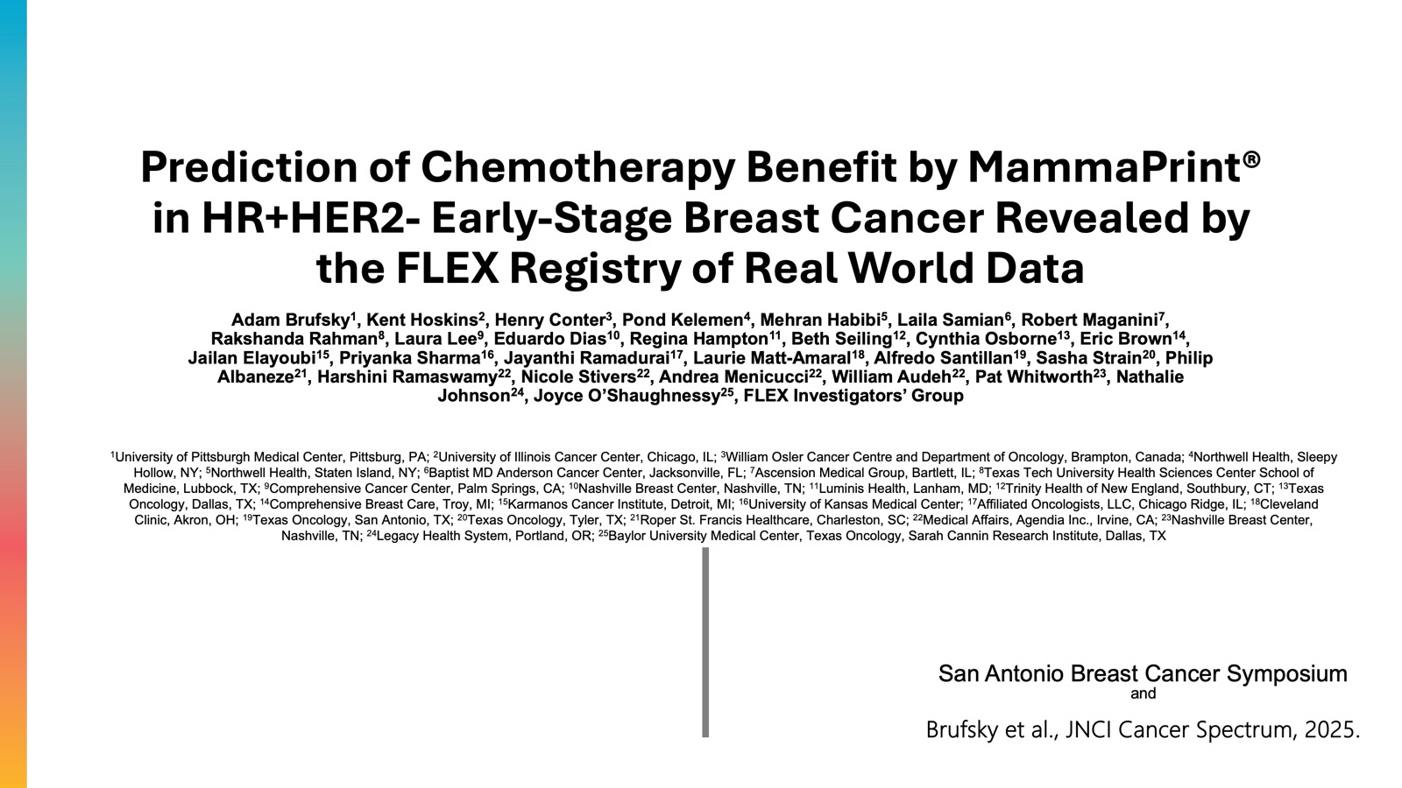

Slide 79
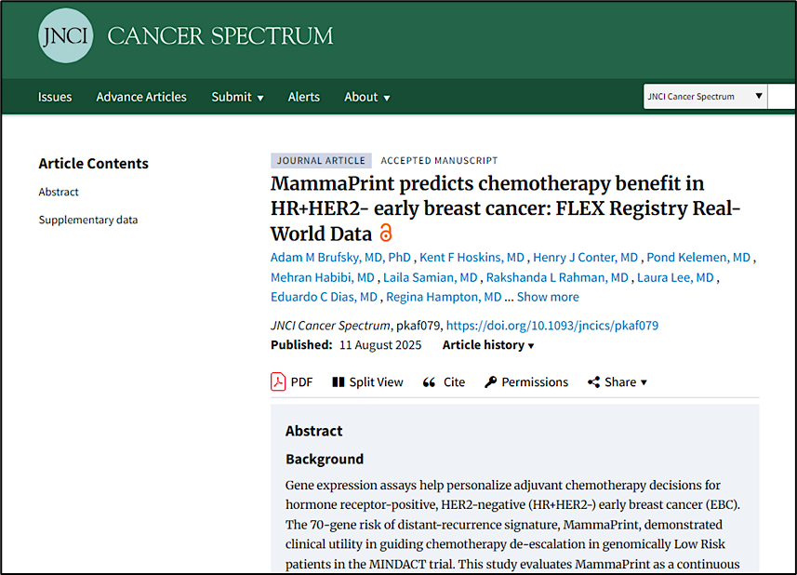
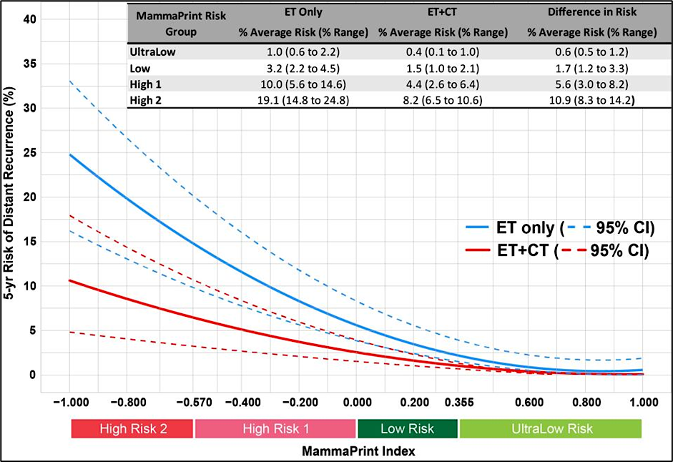
MammaPrint PREDICTS chemotherapy benefit in HR+HER2- early breast cancer: FLEX Registry Real-World Data (Brufsky et al., JNCI Cancer Spectrum)
Conclusions:
Patients with increasing MPI risk (High Risk) had significantly lower risk of DRFI events when treated with ET+CT compared to ET alone
Consistent with findings from MINDACT, patients with MammaPrint indices within Low and UltraLow Risk ranges did not derive significant CT benefit
CT benefit is not predicted by higher tumor grade after adjusting for MPI and clinical factors
These RWD confirm MammaPrint’s comprehensive utility, as prognostic of recurrence risk and predictive of CT benefit for patients with HR+HER2- early-stage breast cancer
ET pts propensity score matched with ET+CT patients based on menopausal status, tumor stage, and nodal status
Brufsky et al., JNCI Cancer Spectrum, 2025.

Slide 80
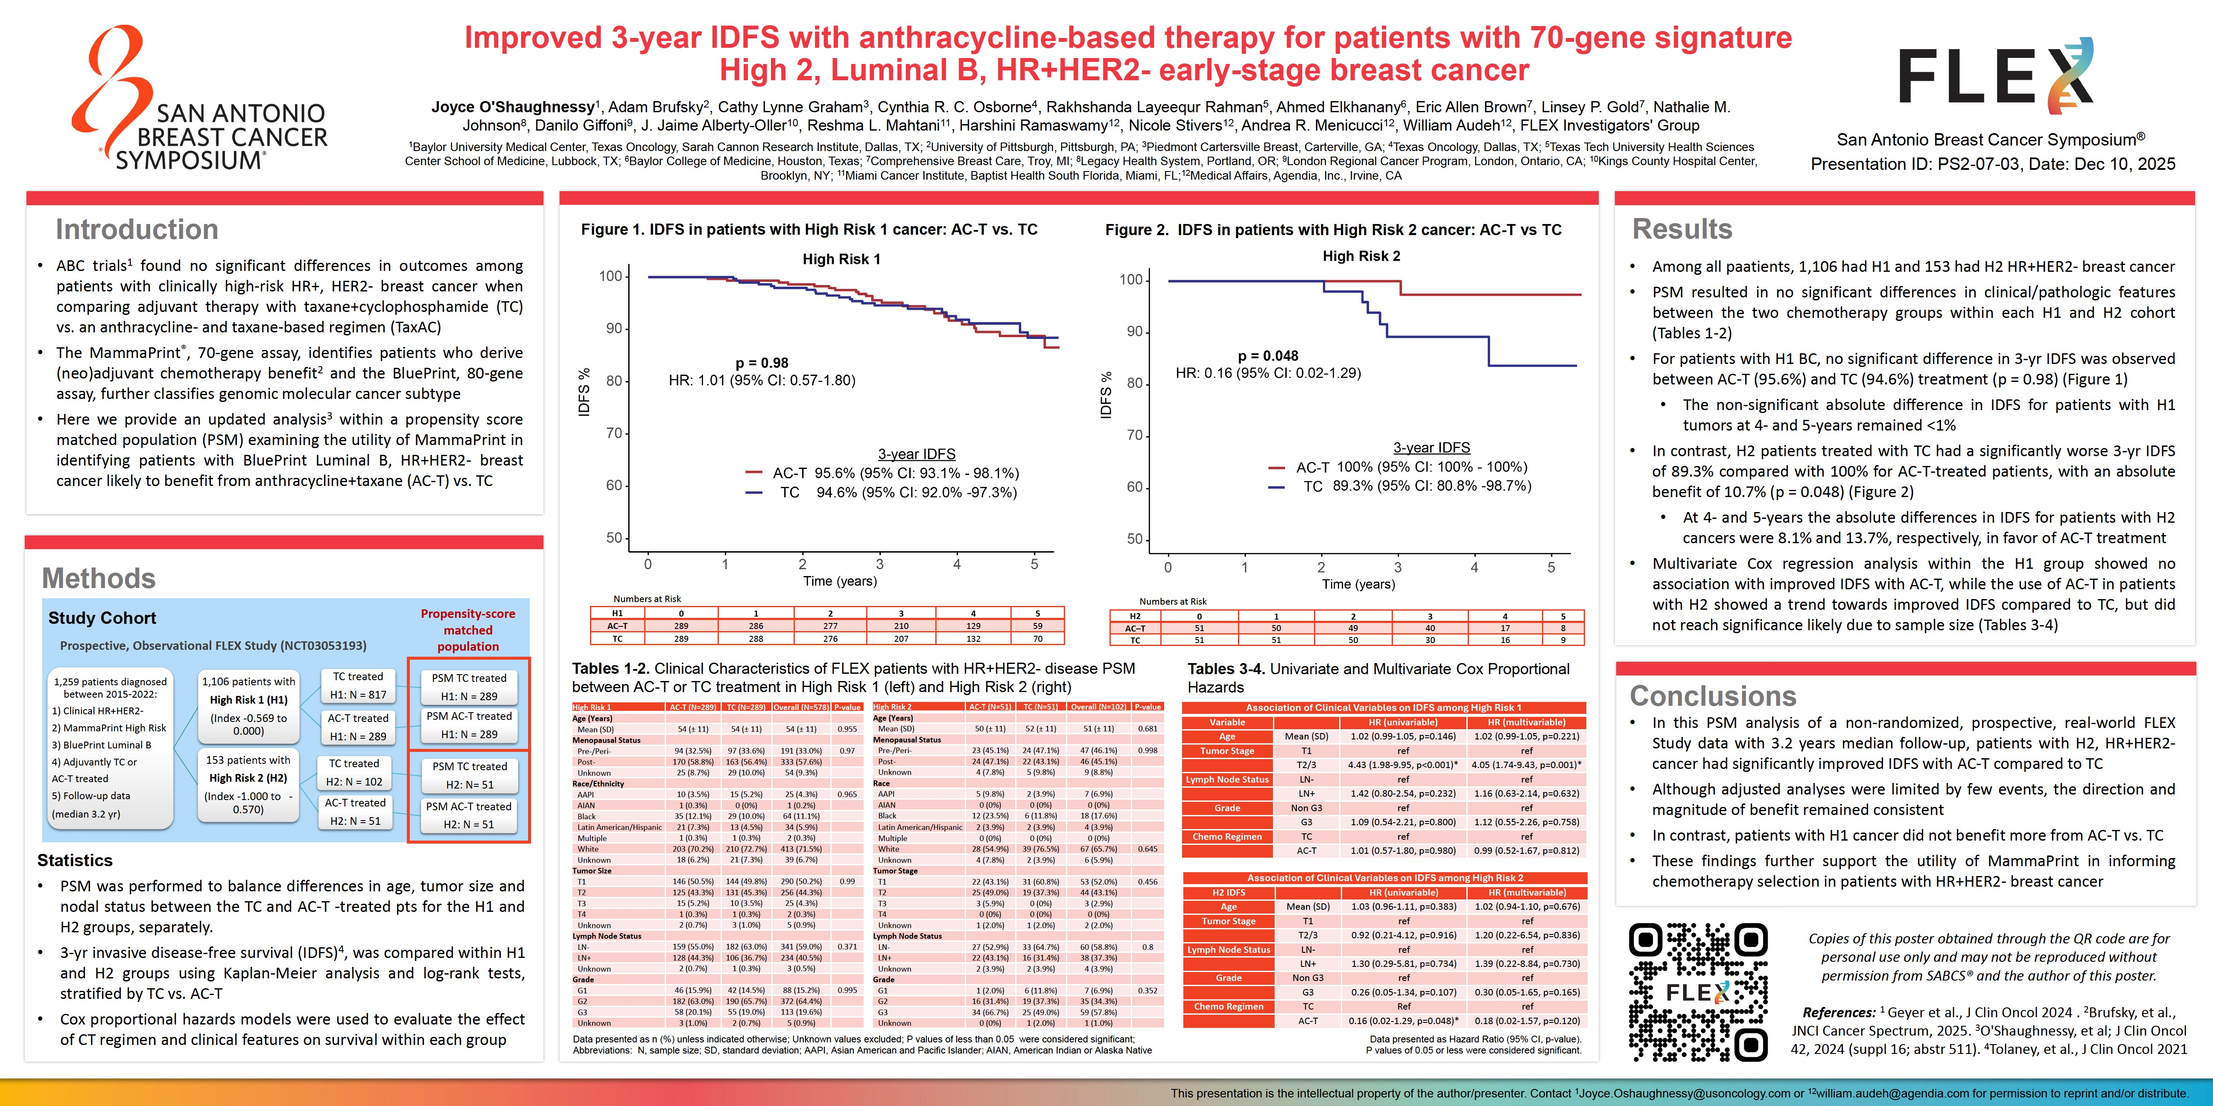
Abstract PS2-07-03

Slide 81
Conclusions
When matched for clinical risk features:
Patients with MammaPrint H2, Luminal B, HR+HER2- cancer had significantly improved IDFS with AC-T compared to TC, even with clinical low-risk features
Patients with MammaPrint H1 cancer did not benefit more from AC-T vs. TC, even with clinical high-risk features

Slide 82
Year in Review:
Localized HR-Positive Breast Cancer
INTRODUCTION: ODAC – April 30, 2026
MODULE 1: Adjuvant CDK4/6 Inhibitors
MODULE 2: Adjuvant Oral Selective Estrogen Receptor Degraders
MODULE 3: Premenopausal Patients
MODULE 4: Duration of Adjuvant Endocrine Treatment
MODULE 5: Genomic Predictors of Chemotherapy Benefit
MODULE 6: Neoadjuvant Treatment

Slide 83
Select Key Datasets
Neoadjuvant Treatment
Cottu PH et al. Risk of recurrence (ROR) after neoadjuvant ribociclib plus ET in clinically high-risk ER+/HER2− BC: Preliminary analysis of the SOLTI-RIBOLARIS trial. ESMO 2025;Abstract 296O.
Martín M et al. Neoadjuvant abemaciclib plus letrozole versus chemotherapy in patients with HR+/HER2- highly proliferative breast cancer. Clin Cancer Res 2026 March 2;32(5):850-8.
Cussac AL et al. Preoperative window-of-opportunity study with giredestrant or tamoxifen (tam) in premenopausal women with estrogen receptor-positive (ER+)/human epidermal growth factor receptor 2-negative (HER2-) and Ki67≥10% early breast cancer (EBC): The EMPRESS study. ESMO 2025;Abstract 294MO.

Slide 84

Abstract 296O

Slide 85
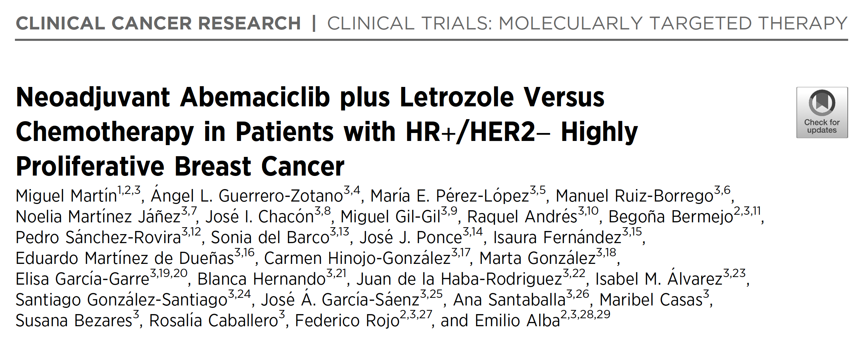
2026 March 2;32(5):850-8.

Slide 86
It is unclear that CDK46 inhibitor therapy can substitute for chemotherapy
In preoperative treatment, chemotherapy was better for group meeting the NATALEE eligibility criteria
RS was better predictor of chemo response than Ki-67
Lower rates of pCR observed with either approach in lower risk patients
Courtesy of Harold J Burstein, MD, PhD

Slide 87
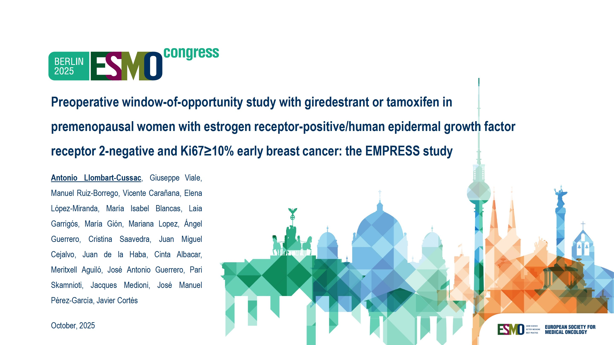
Abstract 294O

Slide 88
Recent Advances in Cancer Care — New Paradigms,
Novel Agents and What It Means for the Oncology Nurse
A Complimentary NCPD Symposium Series Held During the 51st Annual ONS Congress May 13-16
San Antonio Marriott Rivercenter | San Antonio, Texas
Antibody-Drug Conjugates
Wednesday, May 13, 2026 | 11:15 AM – 12:45 PM CT
Prostate Cancer
Thursday, May 14, 2026 | 12:15 PM – 1:45 PM CT
Ovarian Cancer
Wednesday, May 13, 2026 | 6:00 PM – 7:30 PM CT
Non-Muscle-Invasive and
Muscle-Invasive Bladder Cancer
Thursday, May 14, 2026 | 6:00 PM – 7:30 PM CT
Endometrial Cancer
Thursday, May 14, 2026 | 6:00 AM – 7:30 AM CT
Pancreatic Cancer
Friday, May 15, 2026 | 6:00 AM – 7:30 AM CT

Slide 89
Recent Advances in Cancer Care — New Paradigms,
Novel Agents and What It Means for the Oncology Nurse
A Complimentary NCPD Symposium Series Held During the 51st Annual ONS Congress May 13-16
San Antonio Marriott Rivercenter | San Antonio, Texas
Targeting the PI3K/AKT/mTOR Pathway in
HR-Positive Metastatic Breast Cancer
Friday, May 15, 2026 | 12:15 PM – 1:45 PM CT
Relapsed/Refractory Multiple Myeloma
Saturday, May 16, 2026 | 12:15 PM – 1:45 PM CT
Non-Hodgkin Lymphoma and
Chronic Lymphocytic Leukemia
Friday, May 15, 2026 | 6:00 PM – 8:00 PM CT
Oral SERDs for Breast Cancer
Saturday, May 16, 2026 | 6:00 PM – 7:30 PM CT
CDK4/6 Inhibitors for HR-Positive
Breast Cancer
Saturday, May 16, 2026 | 6:00 AM – 7:30 AM CT

Slide 90
Thank you for joining us!
Please take a moment to complete the survey currently up on Zoom. Your feedback is very important to us. The survey will remain open for 5 minutes after the meeting ends.
Information on how to obtain CME, ABIM MOC and ABS credit is provided in the Zoom chat room. Attendees will also receive an email in
1 to 3 business days with these instructions.

