Slide 1
Year in Review: Clinical Investigator Perspectives on the
Most Relevant New Datasets and Advances in Oncology
Therapeutic Targets Beyond
EGFR for Non-Small Cell Lung Cancer
A CME/MOC-Accredited Live Webinar
Tuesday, June 30, 2026
5:00 PM – 6:00 PM ET
Faculty
John V Heymach, MD, PhD
Maurice Pérol, MD
Moderator
Neil Love, MD

Slide 2

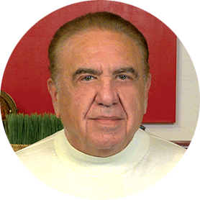

Faculty
John V Heymach, MD, PhD
Professor and Chair
Thoracic/Head and Neck Medical Oncology
The University of Texas MD Anderson Cancer Center
Houston, Texas
MODERATOR
Neil Love, MD
Research To Practice
Miami, Florida
Maurice Pérol, MD
Head of Thoracic Oncology Program
Department of Medical Oncology
Léon Bérard Centre
Lyon, France

Slide 3
Commercial Support
This activity is supported by educational grants from Boehringer Ingelheim Pharmaceuticals Inc, Genentech, a member of the Roche Group, and Nuvation Bio Inc.
Research To Practice CME Planning Committee Members,
Staff and Reviewers
Planners, scientific staff and independent reviewers for Research To Practice have no relevant financial relationships to disclose.

Slide 4
Dr Love — Disclosures
Dr Love is president and CEO of Research To Practice. Research To Practice receives funds in the form of educational grants to develop CME activities from the following companies: Aadi Bioscience, AbbVie Inc, ADC Therapeutics, Agendia Inc, Alexion Pharmaceuticals, Amgen Inc, Array BioPharma Inc, a subsidiary of Pfizer Inc, Arvinas, Astellas, AstraZeneca Pharmaceuticals LP, Aveo Pharmaceuticals, Bayer HealthCare Pharmaceuticals, BeOne, Biotheranostics Inc, A Hologic Company, Black Diamond Therapeutics Inc, Blueprint Medicines, Boehringer Ingelheim Pharmaceuticals Inc, Bristol Myers Squibb, Catalyst Pharmaceuticals Inc, Celcuity, Clovis Oncology, Coherus BioSciences, Corcept Therapeutics Inc, CTI BioPharma, a Sobi Company, Daiichi Sankyo Inc, Eisai Inc, Elevation Oncology Inc, Exact Sciences Corporation, Exelixis Inc, Genentech, a member of the Roche Group, Genmab US Inc, Geron Corporation, Gilead Sciences Inc, GSK, Helsinn Therapeutics (US) Inc, ImmunoGen Inc, Incyte Corporation, Ipsen Biopharmaceuticals Inc, Jazz Pharmaceuticals Inc, Johnson & Johnson, Karyopharm Therapeutics, Kite, A Gilead Company, Kura Oncology, Legend Biotech, Lilly, MEI Pharma Inc, Merck, Mersana Therapeutics Inc, Mirati Therapeutics Inc, Mural Oncology Inc, Natera Inc, Novartis, Novartis Pharmaceuticals Corporation on behalf of Advanced Accelerator Applications, Novocure Inc, Nuvalent, Nuvation Bio Inc, Pfizer Inc, Pharmacyclics LLC, an AbbVie Company, Puma Biotechnology Inc, Regeneron Pharmaceuticals Inc, Revolution Medicines Inc, Rigel Pharmaceuticals Inc, R-Pharm US, Sanofi, Seagen Inc, Servier Pharmaceuticals LLC, SpringWorks Therapeutics Inc, Stemline Therapeutics Inc, Sumitomo Pharma America, Summit Therapeutics, Syndax Pharmaceuticals, Taiho Oncology Inc, Takeda Pharmaceuticals USA Inc, TerSera Therapeutics LLC, Tesaro, A GSK Company, and Verastem Inc.

Slide 5
Dr Heymach — Disclosures
Advisory Committees and Contracted Research | AstraZeneca Pharmaceuticals LP, Bayer HealthCare Pharmaceuticals, BioNTech SE, Boehringer Ingelheim Pharmaceuticals Inc, Bristol Myers Squibb, GSK, Jazz Pharmaceuticals Inc, Johnson & Johnson, Lilly, Mirati Therapeutics Inc, ModeX Therapeutics, OncoHost, Ottimo Pharma, Pfizer Inc, Regeneron Pharmaceuticals Inc, Remunity Therapeutics, Spectrum Pharmaceuticals Inc, Synthekine, Takeda Pharmaceuticals USA Inc
Royalties and Licensing Fees | Spectrum Pharmaceuticals Inc

Slide 6
Dr Pérol — Disclosures
Advisory Committees | AbbVie Inc, Amgen Inc, AstraZeneca Pharmaceuticals LP, Bristol Myers Squibb, Daiichi Sankyo Inc, Eisai Inc, Ipsen Biopharmaceuticals Inc, Janssen Biotech Inc, MSD, Novocure Inc, Nuvation Bio Inc, Pfizer Inc, PharmaMar, Sanofi, Takeda Pharmaceutical Company Limited
Consulting Agreements | Bristol Myers Squibb, Daiichi Sankyo Inc, MSD, Pfizer Inc
Data and Safety Monitoring Boards/Committees | PharmaMar
Speakers Bureaus | Amgen Inc, AstraZeneca Pharmaceuticals LP, Bristol Myers Squibb, Chugai Pharmaceutical Co Ltd, Ipsen Biopharmaceuticals Inc, Janssen Biotech Inc, MSD, Novocure Inc, Pfizer Inc, Sanofi, Takeda Pharmaceutical Company Limited

Slide 7
This educational activity contains discussion of
non-FDA-approved uses of agents and regimens. Please refer to official prescribing information for each product for approved indications.

Slide 8

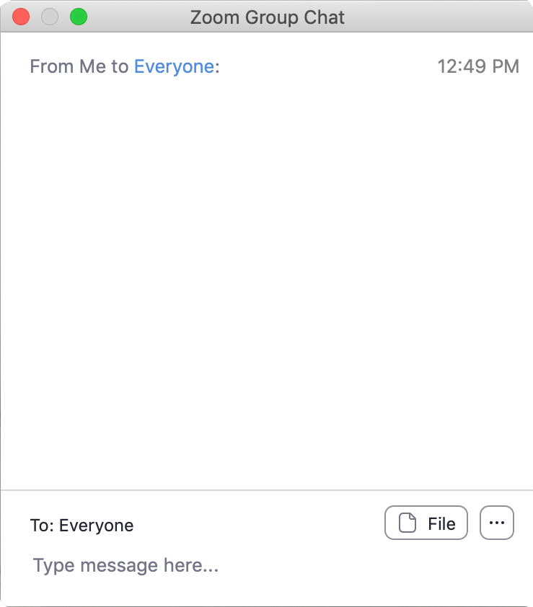
We Encourage Clinicians in Practice to Submit Questions
Feel free to submit questions now before the program begins and throughout the program.

Slide 9

Familiarizing Yourself with the Zoom Interface
Expand chat submission box
Drag the white line above the submission box up to create
more space for your message.

Slide 10

Familiarizing Yourself with the Zoom Interface
Increase chat font size
Press Command (for Mac) or Control (for PC) and the + symbol.
You may do this as many times as you need for readability.

Slide 11


Clinicians in the Audience, Please Complete the Pre- and Postmeeting Surveys
Quick Survey
Quick Poll

Slide 12
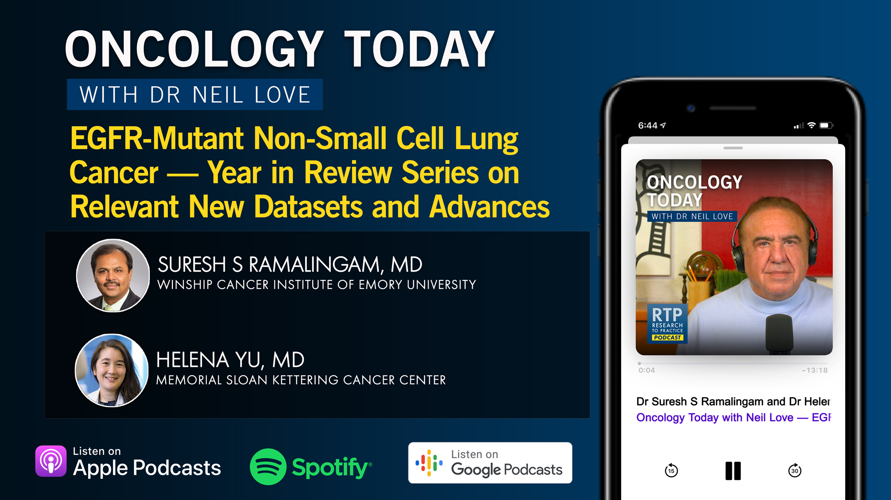

Slide 13
Patterns of Care: Exploring How
Community Oncologists Manage HR-Positive,
HER2-Positive Metastatic Breast Cancer
A CME/MOC-Accredited Live Webinar
Wednesday, July 1, 2026
5:00 PM – 6:00 PM ET
Faculty
Lisa A Carey, MD, ScM, FASCO
Reshma L Mahtani, DO
Moderator
Neil Love, MD

Slide 14
Year in Review: Clinical Investigator Perspectives on the
Most Relevant New Datasets and Advances in Oncology
PI3K/AKT/mTOR Pathway in
HR-Positive Metastatic Breast Cancer
A CME/MOC-Accredited Live Webinar
Wednesday, July 15, 2026
5:00 PM – 6:00 PM ET
Faculty
Virginia Kaklamani, MD, DSc
Hope S Rugo, MD
Moderator
Neil Love, MD

Slide 15
Patterns of Care: Exploring How
Community Oncologists Manage
Metastatic Triple-Negative Breast Cancer
A CME/MOC-Accredited Live Webinar
Tuesday, July 21, 2026
5:00 PM – 6:00 PM ET
Faculty
Professor Peter Schmid, FRCP, MD, PhD
Melinda Telli, MD, FASCO
Moderator
Neil Love, MD

Slide 16
Integrating New Advances into the Care of Patients with Cancer
A Multitumor Symposium in Partnership with the American Oncology Network
Join Us In Person or Virtually
Saturday, August 22, 2026
JW Marriott Nashville | Nashville, Tennessee
Chronic Lymphocytic Leukemia
9:00 AM – 9:50 AM CT
Diffuse Large B-Cell Lymphoma
12:35 PM – 1:25 PM CT
Gastroesophageal Cancers
9:50 AM – 10:40 AM CT
Lung Cancer
1:25 PM – 2:15 PM CT
Gynecologic Cancers
10:55 AM – 11:45 AM CT
Moderator
Stephen “Fred” Divers, MD

Slide 17
Grand Rounds
CME/MOC-Accredited Interactive Series
Regional Activities
Two Series
Optimizing the Use of
Novel Therapies for Patients with Diffuse Large B-Cell Lymphoma
Optimizing Therapy for Patients with Hormone Receptor-Positive
Localized Breast Cancer
Host a 1-hour session at your institution:
Email Meetings@ResearchToPractice.com
or call (800) 233-6153

Slide 18
Year in Review:
Therapeutic Targets Beyond
EGFR for Non-Small Cell Lung Cancer
INTRODUCTION: Relative Impact of Targeted Treatment
MODULE 1: HER2 Alterations
MODULE 2: KRAS Mutations
MODULE 3: MET Overexpression
MODULE 4: ALK Fusions
MODULE 5: ROS1 Fusions
MODULE 6: RET Fusions

Slide 19
Thank you for joining us!
Please take a moment to complete the survey currently up on Zoom.
Your feedback is very important to us.
Information on how to obtain CME, ABIM MOC and ABS credit will be provided in the Zoom chat room. Attendees will also receive an email in
1 to 3 business days with these instructions.

Slide 20
Year in Review: Clinical Investigator Perspectives on the
Most Relevant New Datasets and Advances in Oncology
Therapeutic Targets Beyond
EGFR for Non-Small Cell Lung Cancer
A CME/MOC-Accredited Live Webinar
Tuesday, June 30, 2026
5:00 PM – 6:00 PM ET
Faculty
John V Heymach, MD, PhD
Maurice Pérol, MD
Moderator
Neil Love, MD

Slide 21
Faculty
John V Heymach, MD, PhD
Professor and Chair
Thoracic/Head and Neck Medical Oncology
The University of Texas MD Anderson Cancer Center
Houston, Texas
MODERATOR
Neil Love, MD
Research To Practice
Miami, Florida
Maurice Pérol, MD
Head of Thoracic Oncology Program
Department of Medical Oncology
Léon Bérard Centre
Lyon, France

Slide 22
We Encourage Clinicians in Practice to Submit Questions
Feel free to submit questions now before the program begins and throughout the program.

Slide 23
Clinicians in the Audience, Please Complete the Pre- and Postmeeting Surveys
Quick Survey
Quick Poll

Slide 25
Patterns of Care: Exploring How
Community Oncologists Manage HR-Positive,
HER2-Positive Metastatic Breast Cancer
A CME/MOC-Accredited Live Webinar
Wednesday, July 1, 2026
5:00 PM – 6:00 PM ET
Faculty
Lisa A Carey, MD, ScM, FASCO
Reshma L Mahtani, DO
Moderator
Neil Love, MD

Slide 26
Year in Review: Clinical Investigator Perspectives on the
Most Relevant New Datasets and Advances in Oncology
PI3K/AKT/mTOR Pathway in
HR-Positive Metastatic Breast Cancer
A CME/MOC-Accredited Live Webinar
Wednesday, July 15, 2026
5:00 PM – 6:00 PM ET
Faculty
Virginia Kaklamani, MD, DSc
Hope S Rugo, MD
Moderator
Neil Love, MD

Slide 27
Patterns of Care: Exploring How
Community Oncologists Manage
Metastatic Triple-Negative Breast Cancer
A CME/MOC-Accredited Live Webinar
Tuesday, July 21, 2026
5:00 PM – 6:00 PM ET
Faculty
Professor Peter Schmid, FRCP, MD, PhD
Melinda Telli, MD, FASCO
Moderator
Neil Love, MD

Slide 28
Integrating New Advances into the Care of Patients with Cancer
A Multitumor Symposium in Partnership with the American Oncology Network
Join Us In Person or Virtually
Saturday, August 22, 2026
JW Marriott Nashville | Nashville, Tennessee
Chronic Lymphocytic Leukemia
9:00 AM – 9:50 AM CT
Diffuse Large B-Cell Lymphoma
12:35 PM – 1:25 PM CT
Gastroesophageal Cancers
9:50 AM – 10:40 AM CT
Lung Cancer
1:25 PM – 2:15 PM CT
Gynecologic Cancers
10:55 AM – 11:45 AM CT
Moderator
Stephen “Fred” Divers, MD

Slide 29
Grand Rounds
CME/MOC-Accredited Interactive Series
Regional Activities
Two Series
Optimizing the Use of
Novel Therapies for Patients with Diffuse Large B-Cell Lymphoma
Optimizing Therapy for Patients with Hormone Receptor-Positive
Localized Breast Cancer
Host a 1-hour session at your institution:
Email Meetings@ResearchToPractice.com
or call (800) 233-6153

Slide 30
Year in Review: Clinical Investigator Perspectives on the
Most Relevant New Datasets and Advances in Oncology
Therapeutic Targets Beyond
EGFR for Non-Small Cell Lung Cancer
A CME/MOC-Accredited Live Webinar
Tuesday, June 30, 2026
5:00 PM – 6:00 PM ET
Faculty
John V Heymach, MD, PhD
Maurice Pérol, MD
Moderator
Neil Love, MD

Slide 31
Commercial Support
This activity is supported by educational grants from Boehringer Ingelheim Pharmaceuticals Inc, Genentech, a member of the Roche Group, and Nuvation Bio Inc.
Research To Practice CME Planning Committee Members,
Staff and Reviewers
Planners, scientific staff and independent reviewers for Research To Practice have no relevant financial relationships to disclose.

Slide 32
Dr Heymach — Disclosures
Advisory Committees and Contracted Research | AstraZeneca Pharmaceuticals LP, Bayer HealthCare Pharmaceuticals, BioNTech SE, Boehringer Ingelheim Pharmaceuticals Inc, Bristol Myers Squibb, GSK, Jazz Pharmaceuticals Inc, Johnson & Johnson, Lilly, Mirati Therapeutics Inc, ModeX Therapeutics, OncoHost, Ottimo Pharma, Pfizer Inc, Regeneron Pharmaceuticals Inc, Remunity Therapeutics, Spectrum Pharmaceuticals Inc, Synthekine, Takeda Pharmaceuticals USA Inc
Royalties and Licensing Fees | Spectrum Pharmaceuticals Inc

Slide 33
Dr Pérol — Disclosures
Advisory Committees | AbbVie Inc, Amgen Inc, AstraZeneca Pharmaceuticals LP, Bristol Myers Squibb, Daiichi Sankyo Inc, Eisai Inc, Ipsen Biopharmaceuticals Inc, Janssen Biotech Inc, MSD, Novocure Inc, Nuvation Bio Inc, Pfizer Inc, PharmaMar, Sanofi, Takeda Pharmaceutical Company Limited
Consulting Agreements | Bristol Myers Squibb, Daiichi Sankyo Inc, MSD, Pfizer Inc
Data and Safety Monitoring Boards/Committees | PharmaMar
Speakers Bureaus | Amgen Inc, AstraZeneca Pharmaceuticals LP, Bristol Myers Squibb, Chugai Pharmaceutical Co Ltd, Ipsen Biopharmaceuticals Inc, Janssen Biotech Inc, MSD, Novocure Inc, Pfizer Inc, Sanofi, Takeda Pharmaceutical Company Limited

Slide 34
Dr Love — Disclosures
Dr Love is president and CEO of Research To Practice. Research To Practice receives funds in the form of educational grants to develop CME activities from the following companies: Aadi Bioscience, AbbVie Inc, ADC Therapeutics, Agendia Inc, Alexion Pharmaceuticals, Amgen Inc, Array BioPharma Inc, a subsidiary of Pfizer Inc, Arvinas, Astellas, AstraZeneca Pharmaceuticals LP, Aveo Pharmaceuticals, Bayer HealthCare Pharmaceuticals, BeOne, Biotheranostics Inc, A Hologic Company, Black Diamond Therapeutics Inc, Blueprint Medicines, Boehringer Ingelheim Pharmaceuticals Inc, Bristol Myers Squibb, Catalyst Pharmaceuticals Inc, Celcuity, Clovis Oncology, Coherus BioSciences, Corcept Therapeutics Inc, CTI BioPharma, a Sobi Company, Daiichi Sankyo Inc, Eisai Inc, Elevation Oncology Inc, Exact Sciences Corporation, Exelixis Inc, Genentech, a member of the Roche Group, Genmab US Inc, Geron Corporation, Gilead Sciences Inc, GSK, Helsinn Therapeutics (US) Inc, ImmunoGen Inc, Incyte Corporation, Ipsen Biopharmaceuticals Inc, Jazz Pharmaceuticals Inc, Johnson & Johnson, Karyopharm Therapeutics, Kite, A Gilead Company, Kura Oncology, Legend Biotech, Lilly, MEI Pharma Inc, Merck, Mersana Therapeutics Inc, Mirati Therapeutics Inc, Mural Oncology Inc, Natera Inc, Novartis, Novartis Pharmaceuticals Corporation on behalf of Advanced Accelerator Applications, Novocure Inc, Nuvalent, Nuvation Bio Inc, Pfizer Inc, Pharmacyclics LLC, an AbbVie Company, Puma Biotechnology Inc, Regeneron Pharmaceuticals Inc, Revolution Medicines Inc, Rigel Pharmaceuticals Inc, R-Pharm US, Sanofi, Seagen Inc, Servier Pharmaceuticals LLC, SpringWorks Therapeutics Inc, Stemline Therapeutics Inc, Sumitomo Pharma America, Summit Therapeutics, Syndax Pharmaceuticals, Taiho Oncology Inc, Takeda Pharmaceuticals USA Inc, TerSera Therapeutics LLC, Tesaro, A GSK Company, and Verastem Inc.

Slide 35
This educational activity contains discussion of
non-FDA-approved uses of agents and regimens. Please refer to official prescribing information for each product for approved indications.

Slide 36
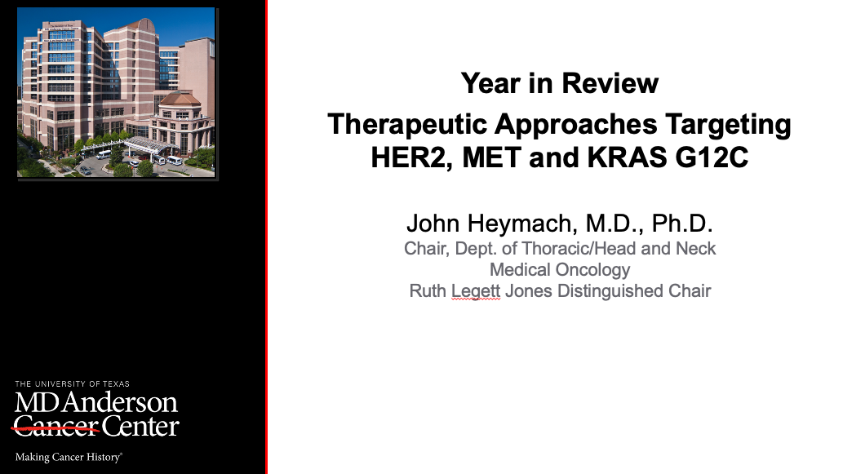
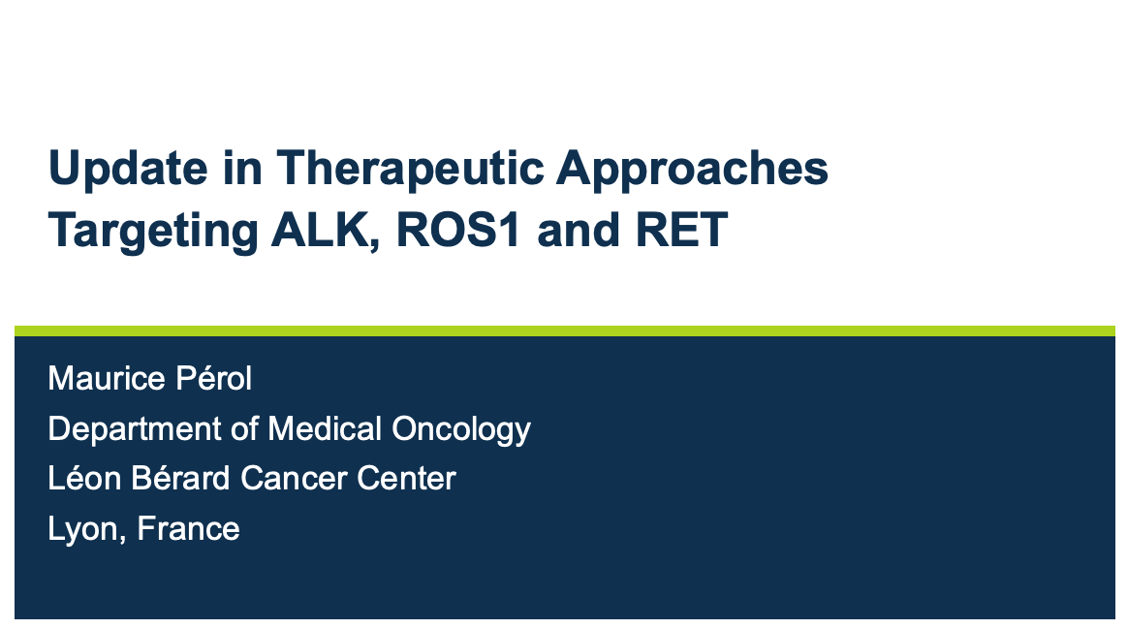

Slide 37
Key Datasets
John V Heymach, MD, PhD
Heymach JV et al. Zongertinib in previously treated HER2-mutant non-small-cell lung cancer. N Engl J Med 2025;392(23):2321-33.
Ruiter G et al. Zongertinib in patients with previously treated HER2-mutant NSCLC and brain metastases at baseline: Beamion LUNG-1. WCLC 2025;Abstract PT2.12.03.
Heymach JV et al. First-line zongertinib in advanced HER2-mutant non-small-cell lung cancer. N Engl J Med 2026;394(17):1675-84.
Loong HH et al. SOHO-01: Updated safety and efficacy of sevabertinib in patients with advanced HER2-mutant non-small cell lung cancer (NSCLC). ASCO 2026;Abstract 8622.
Heymach JV et al. Zongertinib in treatment-naïve patients with HER2-mutant NSCLC, including those with active brain metastases: Beamion LUNG-1. ELCC 2026;Abstract 6MO.
Jänne PA et al. Final analysis results and patient-reported outcomes from DESTINY-Lung02 — A dose-blinded, randomized, phase 2 study of trastuzumab deruxtecan in patients with HER2-mutant metastatic NSCLC. J Thorac Oncol 2025;20(12):1814-28.
Planchard D et al. Trastuzumab deruxtecan in patients with HER2-overexpressing NSCLC: Results from part 1 of the open-label, multicenter, phase 1b DESTINY-Lung03 trial. J Thorac Oncol 2026;
21(5):103541.

Slide 38
Key Datasets
John V Heymach, MD, PhD (continued)
Barlesi F et al. Adagrasib versus docetaxel in KRAS^{G12C}-mutated non-small-cell lung cancer (KRYSTAL-12): A randomised, open-label, phase 3 trial. Lancet 2025;406(10503):615-26.
Negrao MV et al. Efficacy and safety of 1L olomorasib + chemoimmunotherapy in KRAS G12C-mutant NSCLC: Results from LOXO-RAS-20001 and SUNRAY-01. WCLC 2025;Abstract OA08.02.
Johnson ML et al. Efficacy and safety of 1L olomorasib plus pembrolizumab in KRAS G12C-mutant NSCLC: Results from LOXO-RAS-20001 and SUNRAY-01. WCLC 2025;Abstract MA02.06.
Skoulidis F et al. First-line (1L) divarasib plus pembrolizumab (pembro) in advanced or metastatic KRAS G12C+ non-small cell lung cancer (NSCLC): Results from the Krascendo-170 study. ASCO 2026;Abstract 8510.
Sacher AG et al. Single-agent divarasib in patients with KRAS G12C-positive non-small cell lung cancer: Long-term follow-up of a phase I study. J Clin Oncol 2025;43(30):3249-53.
Girard N et al. Telisotuzumab vedotin monotherapy in patients with previously treated c-Met protein–overexpressing nonsquamous EGFR wildtype advanced NSCLC: Updated analysis of the LUMINOSITY trial. ELCC 2025;Abstract 18P.

Slide 39
Key Datasets
Maurice Pérol, MD
Dziadziuszko R et al. Updated results from the phase III ALINA study of adjuvant alectinib vs chemotherapy (chemo) in patients (pts) with early-stage ALK+ non-small cell lung cancer (NSCLC). ESMO 2025;Abstract 1787MO.
Peters S et al. Alectinib versus crizotinib in previously untreated ALK-positive advanced non-small cell lung cancer: Final overall survival analysis of the phase III ALEX study. Ann Oncol 2026 Jan;37(1):92-103.
Mok T et al. Lorlatinib vs crizotinib as first-line treatment for advanced ALK+ non-small cell lung cancer: 7-year update from the phase 3 CROWN study. ASCO 2026;Abstract 8502.
Lin J et al. ALKOVE-1: Efficacy and safety of neladalkib in patients with advanced ALK+ NSCLC. ASCO 2026;Abstract 8503.
Cho BC et al. Repotrectinib in patients with ROS1 fusion-positive (ROS1+) NSCLC: Long-term follow-up from the phase 1/2 TRIDENT-1 trial. WCLC 2025;Abstract MA02.03.
Bazhenova L et al. Taletrectinib in TKI-naïve patients with ROS1+ NSCLC: Updated data from TRUST-I and TRUST-II. AACR 2026;Abstract CT300.
Liu G et al. Taletrectinib in TKI-pretreated patients with ROS1+ non-small cell lung cancer: Updated data from TRUST-I and TRUST-II. AACR 2026;Abstract CT244.

Slide 40
Key Datasets
Maurice Pérol, MD (continued)
Drilon AE et al. Pivotal ARROS-1 efficacy and safety data: Zidesamtinib in TKI pre-treated patients with advanced/metastatic ROS1+ NSCLC. WCLC 2025;Abstract PL02.15.
Gautschi O et al. Selpercatinib in RET fusion-positive non-small cell lung cancer: Final safety and efficacy, including overall survival, from the LIBRETTO-001 phase I/II trial. J Clin Oncol 2025;43(15):1758-64.
Goldman J et al. Event-free survival with adjuvant selpercatinib in stage IB-IIIA RET fusion-positive NSCLC: Primary results of the phase 3 LIBRETTO-432 trial. ASCO 2026;Abstract LBA3.
Besse B et al. Final efficacy and safety data from the phase I/II ARROW study of pralsetinib in patients with advanced RET fusion-positive non-small cell lung cancer. J Clin Oncol 2026 May;44(13):1190-7.
Popat S et al. Efficacy and safety of pralsetinib as first-line treatment of RET fusion-positive advanced or metastatic non–small cell lung cancer (NSCLC): The phase 3 AcceleRET-Lung study. ASCO 2026;Abstract 8504.

Slide 41
Year in Review:
Therapeutic Targets Beyond
EGFR for Non-Small Cell Lung Cancer
INTRODUCTION: Relative Impact of Targeted Treatment
MODULE 1: HER2 Alterations
MODULE 2: KRAS Mutations
MODULE 3: MET Overexpression
MODULE 4: ALK Fusions
MODULE 5: ROS1 Fusions
MODULE 6: RET Fusions

Slide 42
Year in Review:
Therapeutic Targets Beyond
EGFR for Non-Small Cell Lung Cancer
INTRODUCTION: Relative Impact of Targeted Treatment
MODULE 1: HER2 Alterations
MODULE 2: KRAS Mutations
MODULE 3: MET Overexpression
MODULE 4: ALK Fusions
MODULE 5: ROS1 Fusions
MODULE 6: RET Fusions

Slide 43
ROS1 TKIs in TKI-naive ROS1 fusion+ NSCLC
 | Crizotinib Profile 1001 | Entrectinib ALKA 372-001 STARTRK-1 STARTRK-2 | Ceritinib Korean Phase II | Brigatinib Barossa Phase II | Lorlatinib Phase I/II | Foritinib Phase IIb Cohort 1 | Repotrectinib TRIDENT-1 Phase I/II | Taletrectinib TRUST I + II Phase II | Zidesamtinib ARROS Phase I/II
N | 53 | 168 | 30 | 28 | 21 | 56 | 71 | 157 | 35
ORR | 72% | 67.9% | 67% | 71.4% | 62% | 88% | 79% | 89.8% | 89%
Median PFS | 19.3 m | 15.7 m | 19.3 m | 12.0 m | 21.0 m | 22.1 m | 31.1 m | 46.1 m | NR
CNS activity IC- ORR | NR | 25/48 (52.1%) Measurable and non-measurable | 2/5 (40%) Measurable and non-measurable | 0/3 Measurable | 7/11 (64%) Measurable and non-measurable | 19/21 (90%) Measurable and non-measurable | 8/9 (89%) Measurable | 13/17 (76.5%) Measurable | 5/6 (83%) Measurable
Non-comparative data, for informational/descriptive purposes. Comparisons between trials should not be made due to differences in study design and patient populations.
Shaw A, Ann Oncol 2019; Fan Y, J Thorac Oncol 2022;17(suppl):Abstr MA13.04; Lim, JCO 2017; Shaw A, Lancet Oncol 2019; Drilon A, WCLC 2025; Li W, ELCC 2023. Krebs M, ESMO 2024;
Pérol M, JCO 2025; Niho,S, ESMO Open 2024; Yang JJ, Lancet Oncol 2024; Lu S, Signal Transduct Target Ther 2023; Bazhenova L et al., AACR 2026.

Slide 44
Year in Review:
Therapeutic Targets Beyond
EGFR for Non-Small Cell Lung Cancer
INTRODUCTION: Relative Impact of Targeted Treatment
MODULE 1: HER2 Alterations
MODULE 2: KRAS Mutations
MODULE 3: MET Overexpression
MODULE 4: ALK Fusions
MODULE 5: ROS1 Fusions
MODULE 6: RET Fusions

Slide 45
Evolution of the HER2 mutant NSCLC landscape with new approvals: 1L, 2L zongertinib, 2L sevabertinib
4 mo
8 mo
12 mo
16 mo
20 mo
24 mo
28 mo
32 mo
Platinum doublets ± CPI
mPFS 4-7 mos
Trastuzumab deruxtecan
mPFS 9.9 months
Docetaxel ± Ramu
mPFS
3 – 4.5 mos
Landscape summer 2025
With approval of 2L zongertinib
Platinum doublets ± CPI
mPFS 4-7 mos
Trastuzumab deruxtecan
Zongertinib or Sevabertinib
Docetaxel ± Ramu
mPFS
3 – 4.5 mos
Zongertinib
Trastuzumab deruxtecan
With approval of 2L sevabertinib
Sevabertinib
Zongertinib
Trastuzumab deruxtecan
Platinum doublets ± CPI mPFS 4-7m
Doce ± Ramu
With approval of 1L zongertinib
Platinum doublets ± CPI mPFS 4-7m
Trastuzumab deruxtecan
Sevabertinib
Sevabertinib
Trastuzumab deruxtecan
Platinum doublets ± CPI mPFS 4-7m

Slide 46
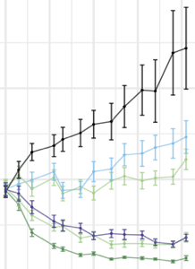
Zongertinib is an oral, HER2-specific, EGFR-sparing TKI
Zongertinib is highly selective for mutant HER2 over EGFR wild-type¹
Zongertinib resulted in tumor regressions in a
patient-derived NSCLC xenograft model carrying a HER2 exon 20 insertion (HER2^{YVMA})¹
HER2^{YVMA}
CTG-2543
600
Afatinib
Vehicle
Poziotinib, Afatinib
Olmutinib
Erlotinib 75 mg/kg QD
0
Osimertinib
400
Poziotinib 1 mg/kg QD
Poziotinib
Selectivity index
Erlotinib
Average tumor volume
± SEM (mm³)
Zongertinib 5 mg/kg BID
Gefitinib
Lapatinib
200
Zongertinib 30 mg/kg BID
-1
Neratinib
Zongertinib 100 mg/kg BID
Tucatinib
Pyrotinib
Zongertinib
0
Zongertinib
-2
0
10
20
30
40
Days
Zongertinib is a potent, covalent TKI that selectively inhibits HER2 while sparing EGFR wild-type, thereby potentially limiting associated toxicities
1. Wilding B et al. Cancer Discov. 2025;15:119–38
Plots by Wilding B et al. Cancer Discov. 2025; used under Creative Commons Attribution-NonCommercial-NoDerivatives 4.0 International License, with minor color amends

Slide 47
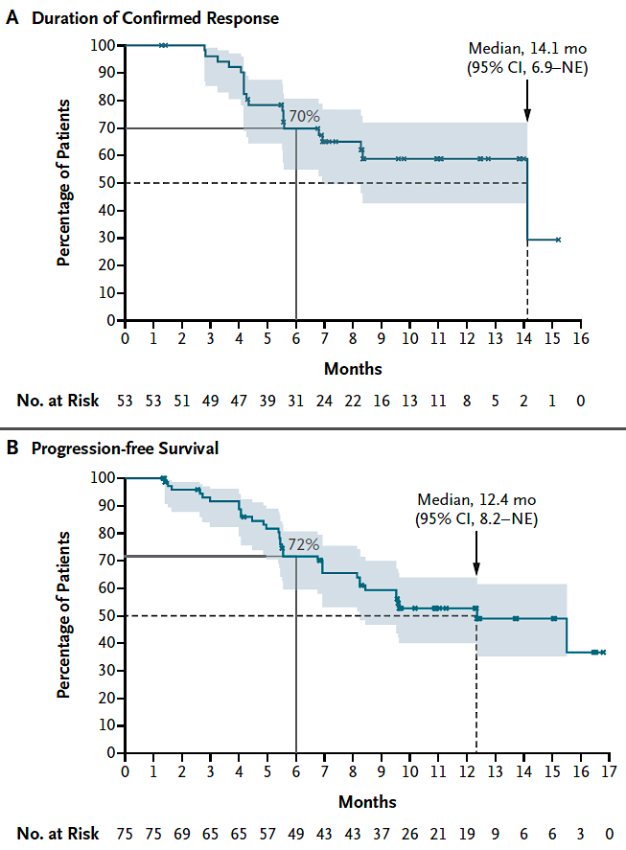
Zongertinib in patients with TKD HER2 mutations (Cohort 1, N=75): median PFS and mDoR
mPFS: 12.4 months (8.2–NE)
mDOR: 14.1 months (6.9–NE)
Median follow-up was 11.3 months (95% CI, 10.2–12.3)
August 8, 2025: FDA grants accelerated approval to zongertinib for non-squamous NSCLC with HER2 TKD activating mutations
Heymach et al. NEJM 2025

Slide 48
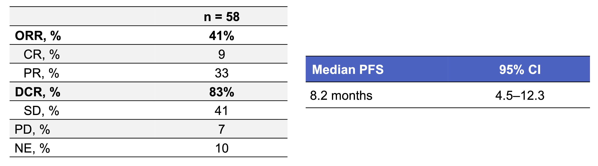
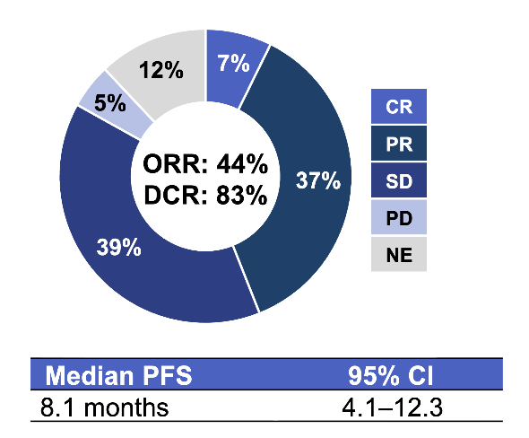
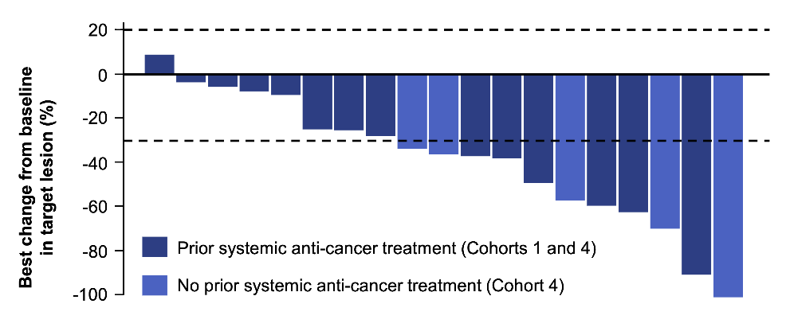
Zongertinib in previously treated HER2-mutant NSCLC with brain metastases at baseline
Confirmed intracranial response by RANO-BM
Pooled analysis of 58 patients with stable, asymptomatic or active brain metastases in Cohorts 1 and 4 (Cohort1: 28; Cohort 4: 30)*
Pooled analysis of 41 patients who had not received prior brain radiotherapy in Cohorts 1 and 4
Overall, 95% (18/19) of evaluable patients experienced a reduction in brain lesion size from baseline.
*Included patients who had received prior brain radiotherapy.
Ruiter G et al. WCLC 2025;Abstract PT2.12.03.

Slide 49
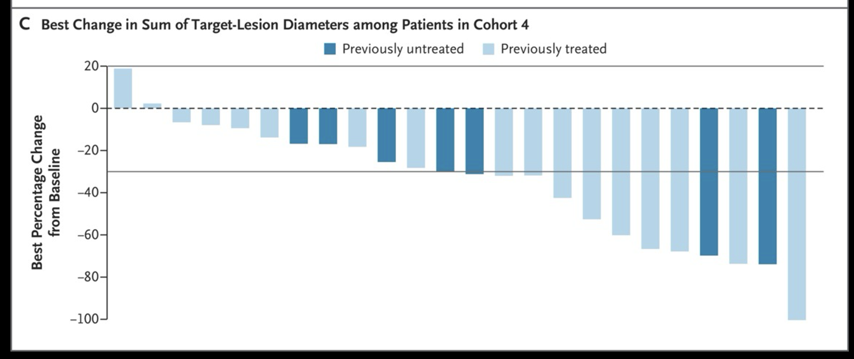
Zongertinib in previously treated HER2-mutant NSCLC with brain metastases
Heymach J et al. NEJM 2026;394:1675-1684.

Slide 50
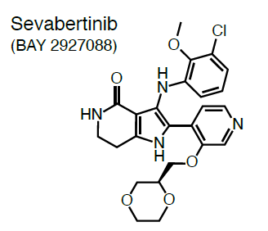
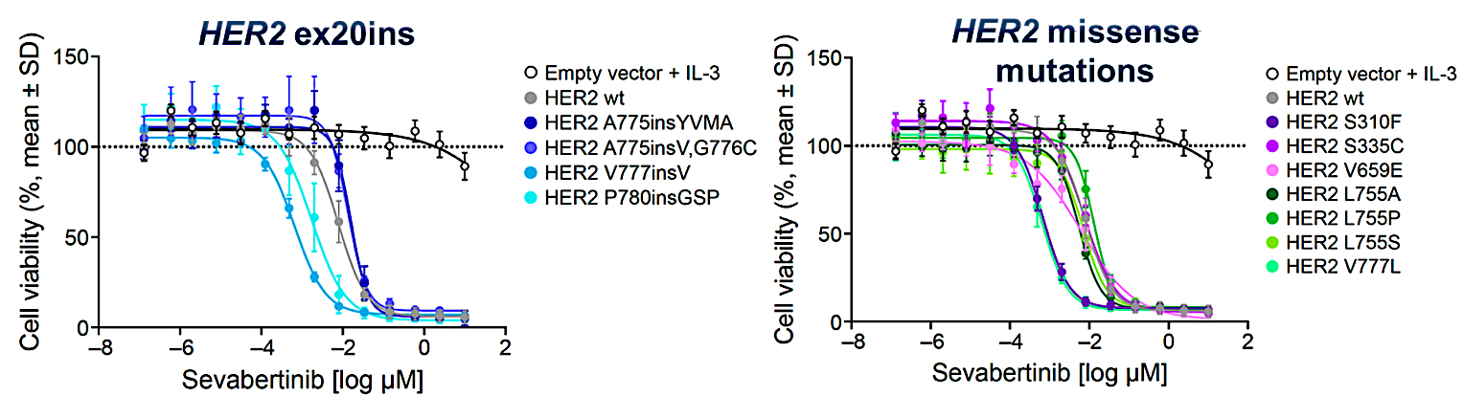
Sevabertinib is an oral, reversible HER2 TKI
Sevabertinib is an oral, reversible TKI that potently inhibits activating HER2 (ERBB2) mutations and has demonstrated efficacy against HER2 insertions and missense mutations, secondary resistance including irreversible binding site mutation (C805S), and gatekeeper mutations (T798M/T798I)¹
Sevabertinib has anti-tumor activity and a manageable safety profile in patients with HER2-mutant NSCLC²
In May 2025, the FDA granted NDA Priority Review for sevabertinib in patients with previously treated HER2-mutant NSCLC³
1. Siegel F et al. Cancer Discov 2025;16(1):81-94. 2. Girard N et al. J Clin Oncol 2024; 42 (17 Suppl): LBA8598; 3. Bayer. Sevabertinib (BAY 2927088) granted FDA Priority Review for the treatment of patients with HER2-mutant non-small cell lung cancer. May 28, 2025. https://www.bayer.com/en/us/news-stories/sevabertinib/. Accessed June 2026.
Le et al., ESMO 2025

Slide 51
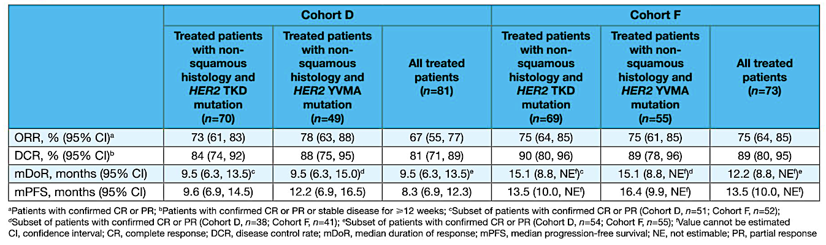
Sevabertinib in previously treated HER2- mutant NSCLC (SOHO1, Cohorts D, F)
Cohort D: Patients previously treated with systemic therapy but naïve to HER2 ex20ins-targeted therapy
Cohort F: Patients naïve to systemic treatment for locally advanced or metastatic disease
Nov. 19, 2025: Sevabertinib receives FDA approval for HER mutant NSCLC (TKD mutations)
Loong HH et al. ASCO 2026; abstract 8622.

Slide 52
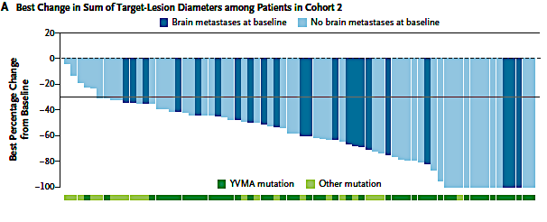
Zongertinib in 1L HER2-mutant NSCLC
ORR 76%
Confirmed response
by BICR (RECIST v1.1)
Cohort 2:
Treatment-naïve patients
N = 74
ORR | 76%
CR, n (%) | 8 (11)
PR, n (%) | 48 (65)
DCR | 96%
SD, n (%) | 15 (20)
PD, n (%) | 1 (1)*
Median time to objective response was
1.4 months (95% CI, 1.1 to 6.9)
February 26, 2026: FDA granted accelerated approval to zongertinib as 1L for HER2 mutant NSCLC harboring HER2 (ERBB2) tyrosine kinase domain activating mutations.
Heymach NEJM 2026; Heymach ELCC 2026

Slide 53
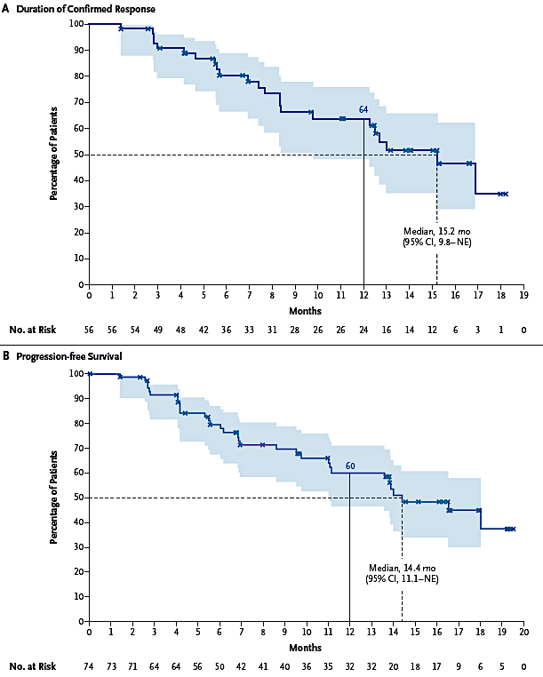
Zongertinib in 1L HER2-mutant NSCLC
mPFS 14.4 months
mDoR 15.2 months
Heymach NEJM 2026; Heymach ELCC 2026

Slide 54
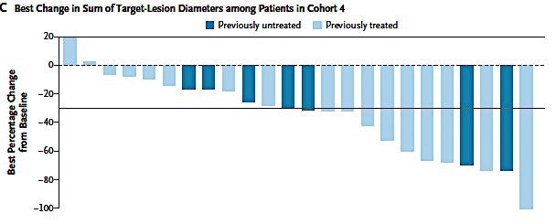
Zongertinib in 1L HER2-mutant NSCLC: Intracranial Tumor Response
ORR 47% (59% in those with no prior RT)
Cohort 4: Active brain metastases
Confirmed intracranial response by
BICR (RANO-BM)
N = 30
No prior brain RT and confirmed measurable intracranial disease
n = 17
ORR | 47% | 59%
CR, n (%) | 2 (7) | 1 (6)
PR, n (%) | 12 (40) | 9 (53)
DCR | 87% | 94%
SD, n (%) | 12 (40) | 6 (35)
NE, n (%) | 4 (13) | 1 (6)
Median DoR | 6.9 months | 6.2 months
95% CI | 2.9–NE | 2.7–NE
Median PFS | 8.2 months | NE
95% CI | 4.1–11.3 | NE
Heymach NEJM 2026; Heymach ELCC 2026

Slide 55
Beamion LUNG-1 Study Design
Phase Ib (dose expansion): patients with advanced HER2-mutant NSCLC
In Phase Ia, the MTD was not reached at 360 mg QD
In Phase Ib, the selected dose after interim futility analysis was zongertinib 120 mg QD
Current analysis
Additional cohorts not included in the current analysis
Cohort 2
Treatment-naïve patients with TKD mutations
Cohort 1
Primary endpoint: Objective response by BICR (RECIST v1.1)
Previously treated patients with TKD mutations
Cohort 3
Previously treated patients with non-TKD mutations
Cohort 4
Treatment-naïve or previously treated patients with TKD mutations
and active brain metastases at baseline
Primary endpoint: Objective response in CNS lesions by BICR (RANO-BM)
Cohort 5
Patients previously treated with
HER2-directed ADC and with TKD mutations
Here we present the efficacy and safety of zongertinib 120 mg
as 1L therapy, as well as findings in patients with
active brain metastases
Heymach et al, ELCC 2026

Slide 56
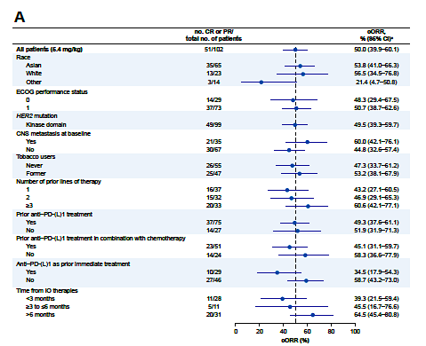
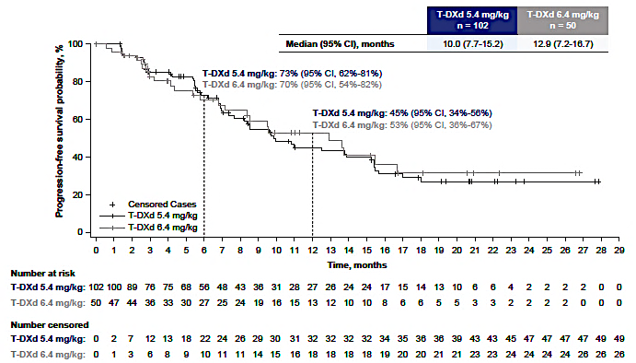
Final analysis from DESTINY-Lung02-A RP2 Study of Trastuzumab Deruxtecan in 2L+ HER2-mutant NSCLC
mPFS, 5.4 mg/kg: 10.0 (7.7-15.2)
Confirmed ORR: 50%
ORR by subgroups
Janne et al JTO 2025

Slide 57
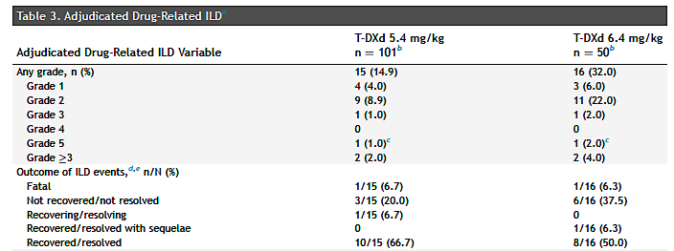
Final analysis from DESTINY-Lung02-A RP2 Study of Trastuzumab Deruxtecan in 2L+ HER2-mutant NSCLC
ILD: 14.9% (all grade) at 5.4 mg/kg dose
Janne et al JTO 2025

Slide 58
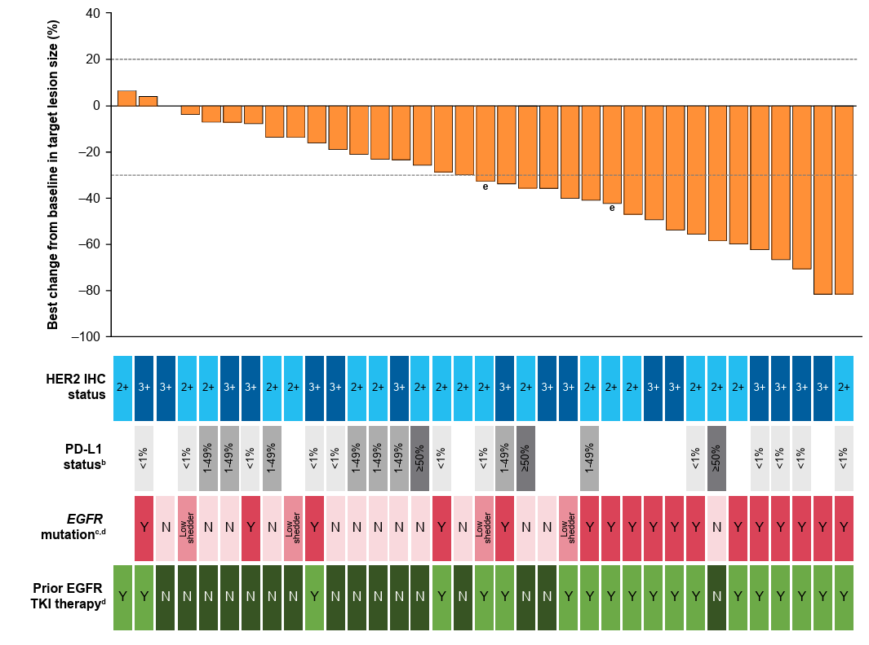
Trastuzumab deruxtecan in HER2-overexpressing NSCLC: DESTINY-Lung03 (part 1, T-DXd mono)
Confirmed ORR: 44.4%; Median DOR: 11.0 months;
Median PFS: 8.2 months
Drug-related AEs: 34 (94.4%)
Grade ≥3 drug-related AEs: 15 (41.7%)
Drug-related SAEs: 6 (16.7%)
Discontinuation: 3 (8.3%)
One patient (2.8%) died due to a drug-related AE (neutropenic colitis)
Adjudicated drug-related ILD/pneumonitis: 2 (5.6%)
LVEF decrease: 1 (2.8%)
Planchard D et al. J Thorac Oncol 2026;21(5):103541

Slide 59
Year in Review:
Therapeutic Targets Beyond
EGFR for Non-Small Cell Lung Cancer
INTRODUCTION: Relative Impact of Targeted Treatment
MODULE 1: HER2 Alterations
MODULE 2: KRAS Mutations
MODULE 3: MET Overexpression
MODULE 4: ALK Fusions
MODULE 5: ROS1 Fusions
MODULE 6: RET Fusions

Slide 60
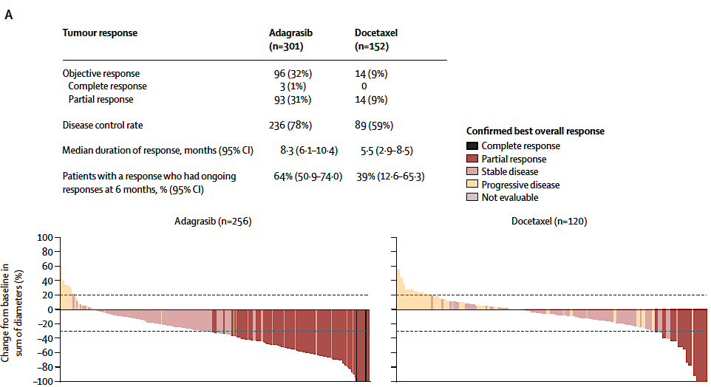
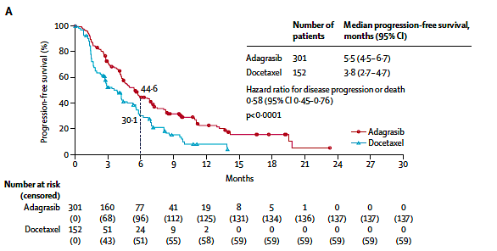
KRYSTAL-12: RP3 of adagrasib vs docetaxel in previously treated KRAS G12C mutant NSCLC
Ada Doc
mPFS (mo) 5.5 3.8
PFS HR 0.58 (p<0.001)
Ada Doc
ORR(%) 32 9
mDoR (mo) 8.3 5.5
Bottom line: Met its primary endpoint; slightly larger improvement in mPFS (1.7m) than CB200. FDA approved 2022; EMA 2024.
Barlesi F et al. Lancet 2025;406(10503):615-26.

Slide 61
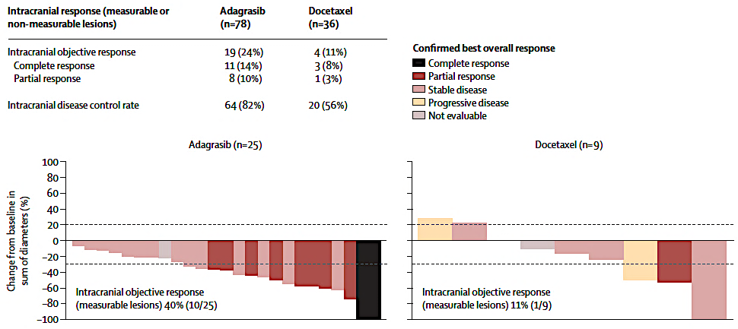
KRYSTAL-12: Intracranial activity of adagrasib vs sotorasib
Ada Doc
IC ORR(%) 24 11
IC control rate 82% 56%
Barlesi F et al. Lancet 2025;406(10503):615-26.

Slide 62
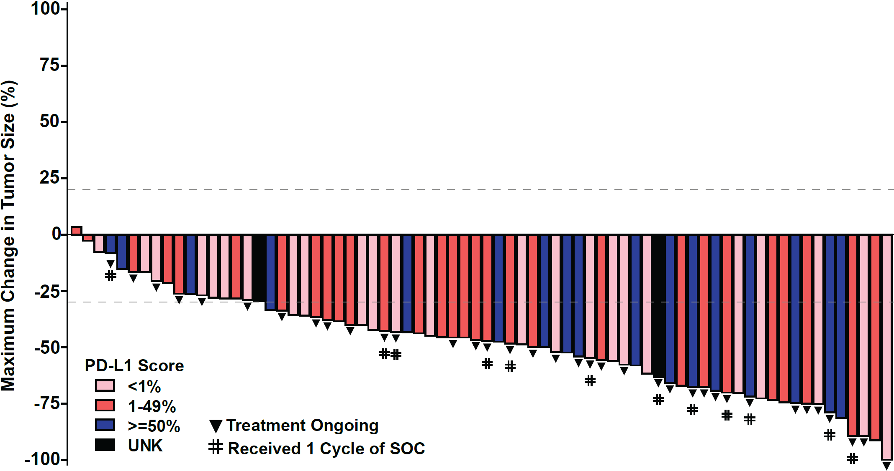
Efficacy of 1L Olomorasib+ Pembro +Pemetrexed+Platinum in KRAS G12C NSCLC
ORR: 61% (all PD-L1)
Olomorasib + Pembrolizumab + Pemetrexed + Platinum
Efficacy Evaluable Patientsª | All pts | Pts with | Pts with | Pts with
 | PD-L1 | PD-L1 | PD-L1 | PD-L1
 | 0-100% | <1% | 1-49% | ≥50%
 | N = 77^{b} | N = 26 | N = 31 | N = 18
ORR, (%) (95% CI) | 61 (49.2, 72.0) | 50 (29.9, 70.1) | 68 (48.6, 83.3) | 67 (41.0, 86.7)
BOR, n (%)
CR | 1 (1) | - | 1 (3) | -
PR^{b} | 46 (60) | 13 (50) | 20 (65) | 12 (67)
SD | 22 (29) | 9 (35) | 8 (26) | 5 (28)
PD | 3 (4) | 2 (8) | - | -
NE | 5 (7) | 2 (8) | 2 (7) | 1 (6)
DCR, (%) (95% CI) | 90 (80.6, 95.4) | 85 (65.1, 95.6) | 94 (78.6, 99.2) | 94 72.7, 99.9)
 |  |  |  |  |  | ​ |  |  |  |  |  |  |  | ​ | ​
Olomorasib dose: 50 mg BID 100 mg BID
Negrao et al WCLC 2025

Slide 63
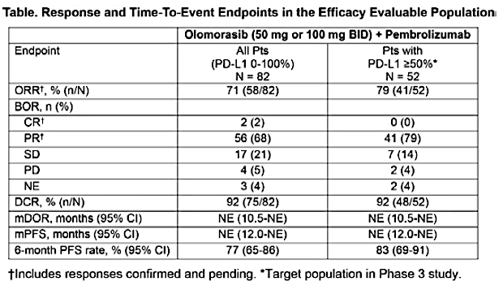
Efficacy and Safety of 1L Olomo + pembro in KRAS G12C-Mutant NSCLC: Results From LOXO-RAS-20001 and SUNRAY-01
Johnson et al WCLC 2025

Slide 64
SUNRAY 01: RP3 of Olomorasib in 1L
Part A: PD-L1 ≥50%
Part B: PD-L1 0%-100%
Key Eligibility Criteria
Histologically or cytologically confirmed NSCLC with stage IIIB-IIIC or stage IV disease not suitable for curative-intent radical surgery or RT, with measurable disease per RECIST v1.1
KRAS G12C mutation
Known PD-L1 expression
  Part A: ≥50%
  Part B: 0%-100%
ECOG PS 0-1
Life expectancy estimate ≥12 weeks
Key Eligibility Criteria
Histologically or cytologically confirmed NSCLC with stage IIIB-IIIC or stage IV disease not suitable for curative-intent radical surgery or RT, with measurable disease per RECIST v1.1
KRAS G12C mutation
Known PD-L1 expression
  Part A: ≥50%
  Part B: 0%-100%
ECOG PS 0-1
Life expectancy estimate ≥12 weeks
Olomorasib
Olomorasib^{b}
+
pembrolizumab^{c}
Olomorasib
Olomorasib^{b} + pembrolizumab^{c} + pemetrexed + platinum^{c,d}
R
1:1
R
1:1
Placebo
PBO^{b}
+
pembrolizumab^{c}
Placebo
PBO^{b} + pembrolizumab^{c} + pemetrexed + platinum^{c,d}
Key Efficacy Endpoint
PFS
Study also included a dose optimization and safety lead-in for olomorasib
Key Efficacy Endpoint
PFS
Study also included a dose optimization and safety lead-in for olomorasib
Nishio M et al. ASCO 2024. Abstract TPS218; https://clinicaltrials.gov/study/NCT06119581

Slide 65
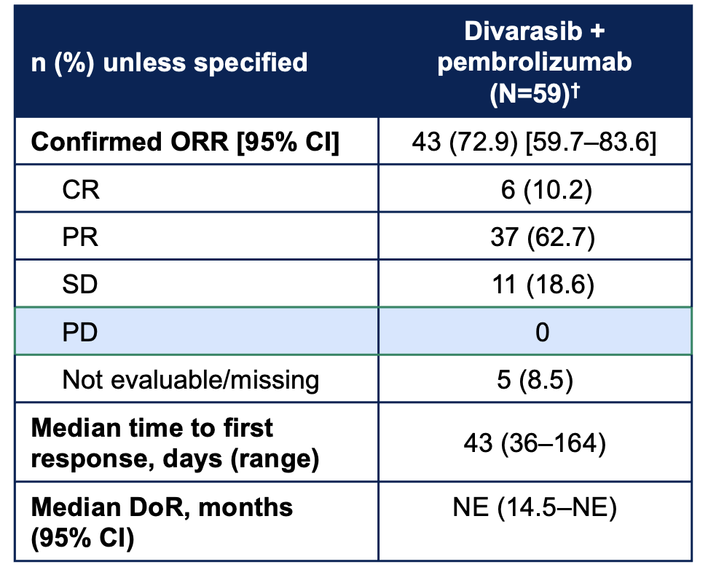
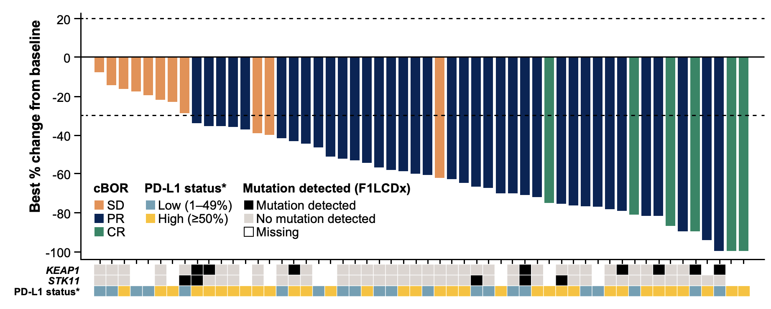
1L divarasib plus pembrolizumab in KRAS G12C+ NSCLC: the Krascendo 170 study
PD-L1 positive cohort (≥1%)
Confirmed ORR: 72.9%
mPFS: 19.3 months; data were immature
Skoulidis F et al. ASCO 2026; Abstract 8510

Slide 66
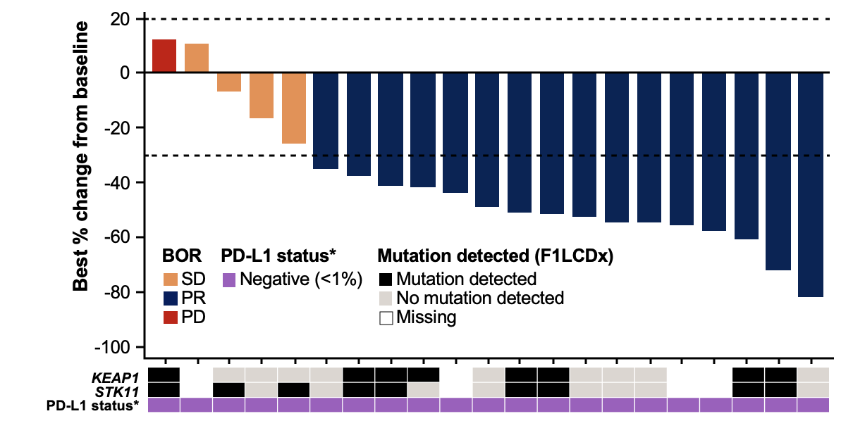
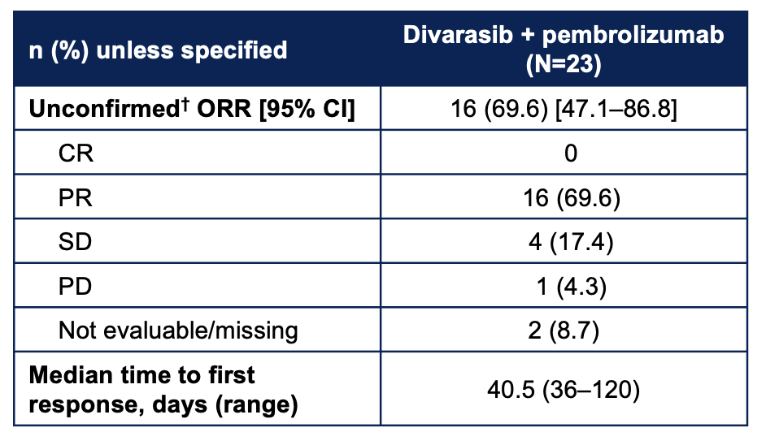
1L divarasib plus pembrolizumab in KRAS G12C+ mNSCLC: the Krascendo 170 study
PD-L1 negative cohort (<1%)
Unconfirmed ORR: 69.6%
Skoulidis F et al. ASCO 2026; Abstract 8510

Slide 67
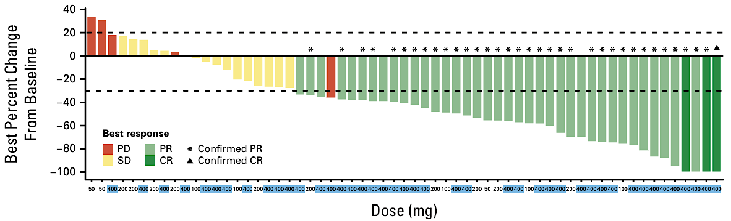
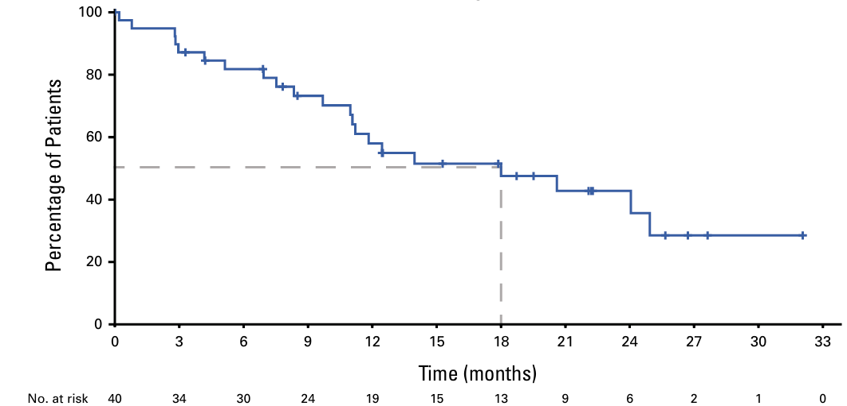
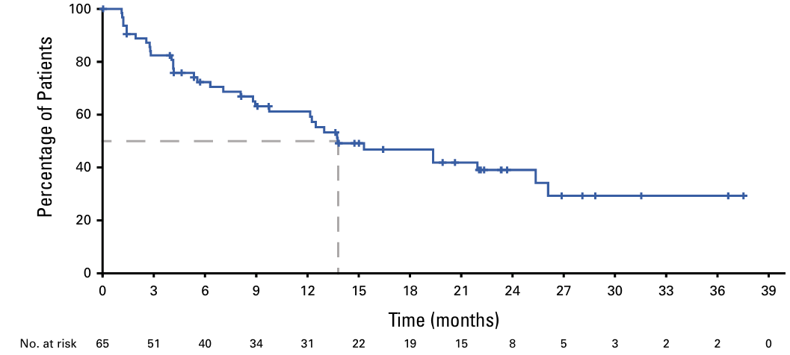
Single-agent divarasib in advanced KRAS G12C+ NSCLC
Confirmed ORR: 55.6%
DOR: 18 months
PFS: 13.8 months
Sacher AG et al. J Clin Oncol 2025;43(30):3249-53.

Slide 68
Year in Review:
Therapeutic Targets Beyond
EGFR for Non-Small Cell Lung Cancer
INTRODUCTION: Relative Impact of Targeted Treatment
MODULE 1: HER2 Alterations
MODULE 2: KRAS Mutations
MODULE 3: MET Overexpression
MODULE 4: ALK Fusions
MODULE 5: ROS1 Fusions
MODULE 6: RET Fusions

Slide 69
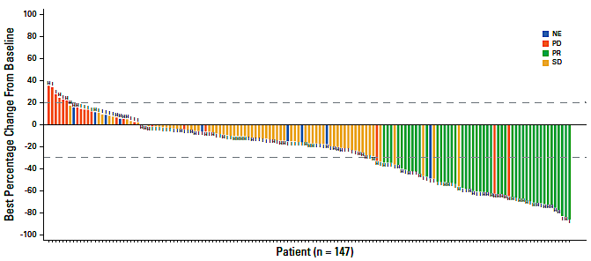
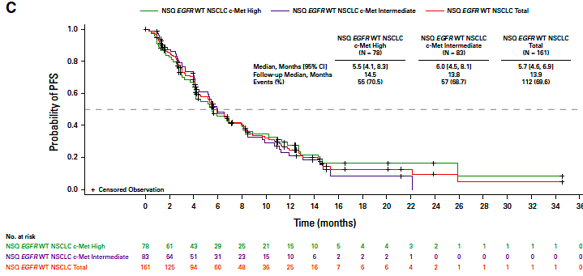
The LUMINOSITY trial: Teliso-V in previously treated patients with c-MET overexpression (wtEGFR)
ORR%
Overall 28.6%
c-MET high: 34.6%
c-MET int: 22.9%
mPFS 5.7m; not correlated with expression level
c-Met protein overexpression in NSQ EGFRwt: high ≥50% tumor cells with 3+ staining; intermediate ≥25%–<50%
May 14, 2025: FDA granted accelerated approval to Teliso-V for previously non-SQ NSCLC with high c-Met protein overexpression [≥50% of tumor cells with strong (3+) staining], as determined by an FDA-approved test,
Camidge et al, JCO 2024

Slide 70
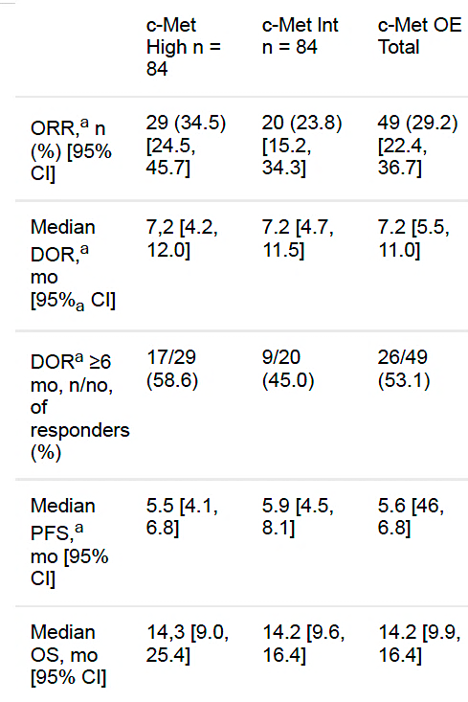
Updated results of LUMINOSITY trial: Teliso-V in previously treated patients with c-MET overexpression (wtEGFR)
ORR% mPFS (m) mOS
Overall 29.2% 5.6 14.2
c-MET high: 34.5% 5.5 14.3
c-MET int: 23.8% 5.9 14.2
Most common TRAE:
peripheral sensory neuropathy (31%, 7% >Gr3),
peripheral edema (16%)
fatigue (14%).
Girard N et al. ELCC 2025;Abstract 18P.

Slide 71
Year in Review:
Therapeutic Targets Beyond
EGFR for Non-Small Cell Lung Cancer
INTRODUCTION: Relative Impact of Targeted Treatment
MODULE 1: HER2 Alterations
MODULE 2: KRAS Mutations
MODULE 3: MET Overexpression
MODULE 4: ALK Fusions
MODULE 5: ROS1 Fusions
MODULE 6: RET Fusions

Slide 72
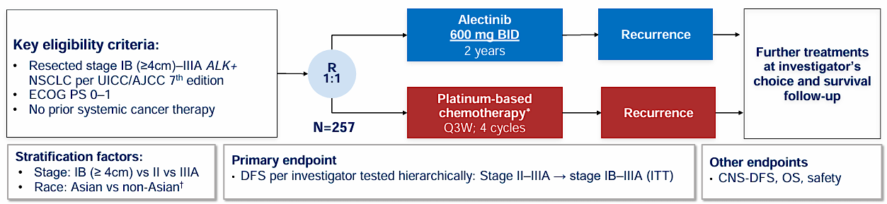
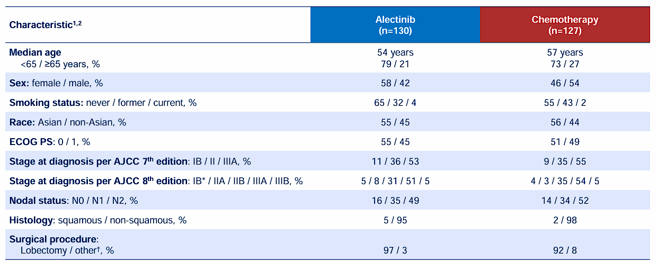
ALINA Updated Analysis
Adjuvant alectinib vs chemotherapy in patients with early-stage ALK+ NSCLC
Median follow up
of 4 years
Dziadziuszko R et al., ESMO 2025

Slide 73
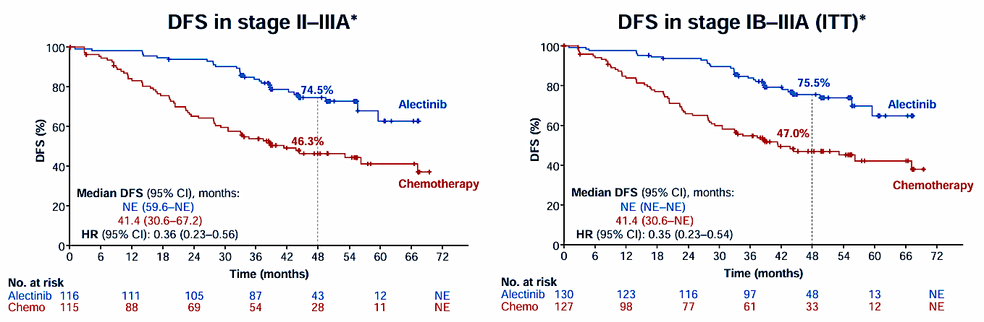
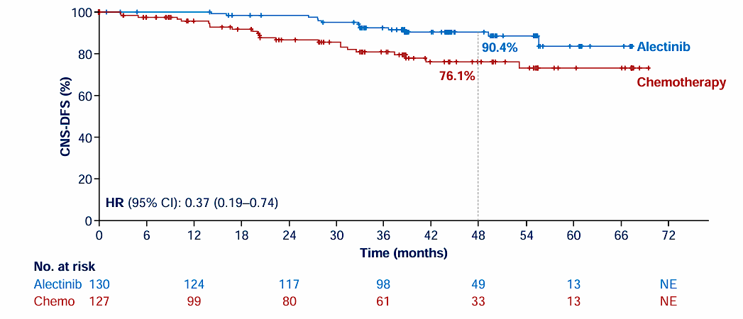
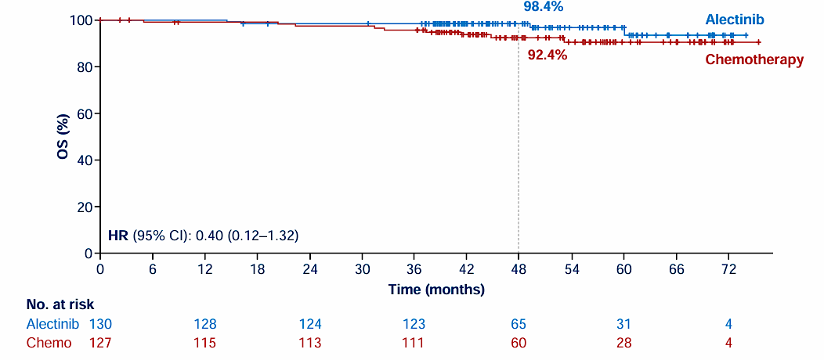
ALINA Updated Analysis
Adjuvant alectinib vs chemotherapy in patients with early-stage ALK+ NSCLC
Post-recurrence therapy in control arm:
systemic therapy 85% (ALK TKI 81.7%, chemotherapy 5%)
radiotherapy 16.7%
surgery 5%
CNS disease-free survival (ITT)
OS (ITT)
Dziadziuszko R et al., ESMO 2025

Slide 74
ALINA Updated Analysis
Adjuvant alectinib vs chemotherapy in patients with early-stage ALK+ NSCLC
Alectinib continues to demonstrate a durable DFS benefit over CT, including reduction of CNS relapses
OS data are still immature with a trend favoring the alectinib arm (82% of patients received ALK TKI at recurrence in the control arm)
There is still no DFS plateau at 4 years in the control arm (late relapses can occur)
More recurrences at the time of alectinib discontinuation in the experimental arm
Results reinforcing alectinib as the SoC after surgical resection of ALK+ NSCLC

Slide 75
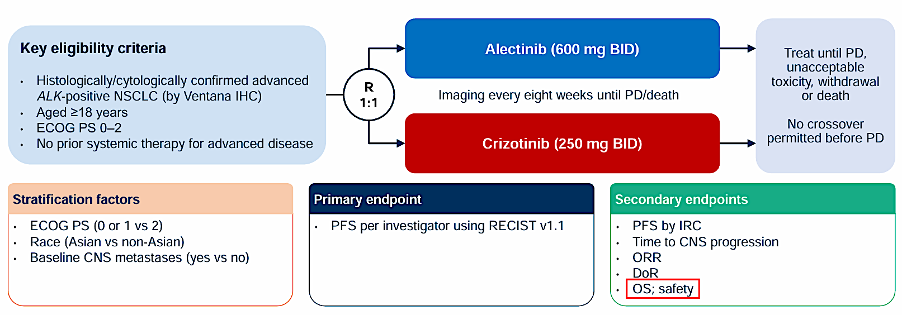
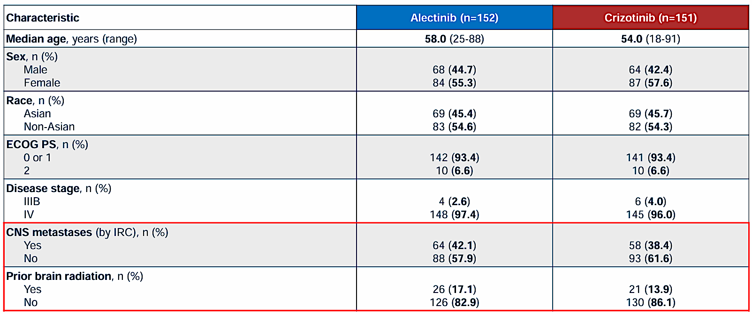
ALEX: study of alectinib vs crizotinib in advanced ALK+ NSCLC
Final overall survival and safety analysis
Mok T et al., ESMO 2025: Peters S et al., Ann Oncol 2026

Slide 76
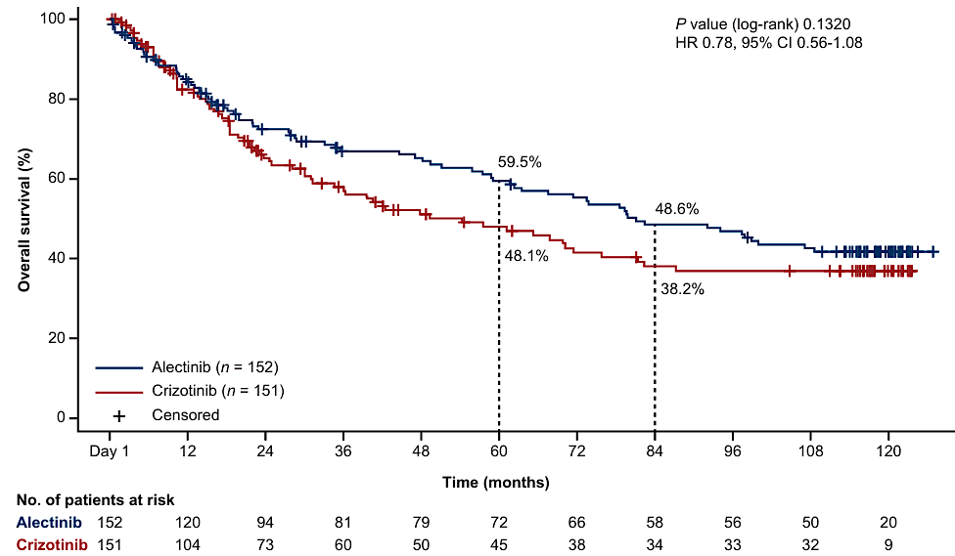
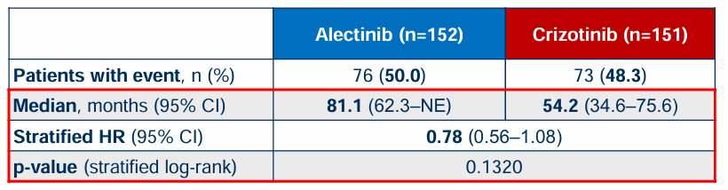
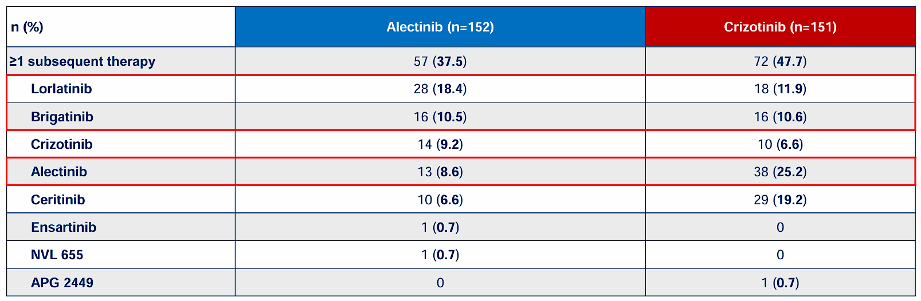
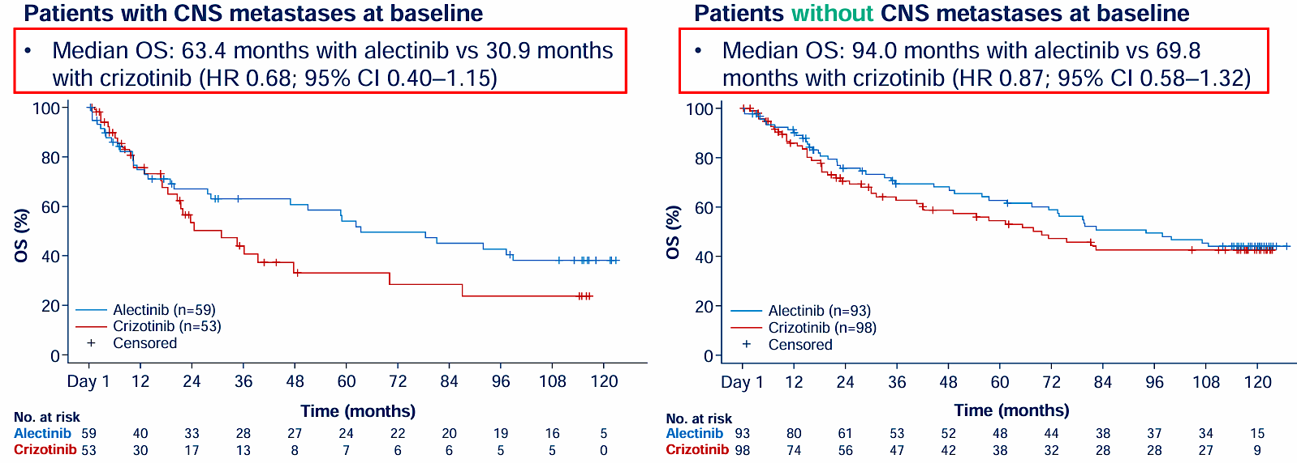
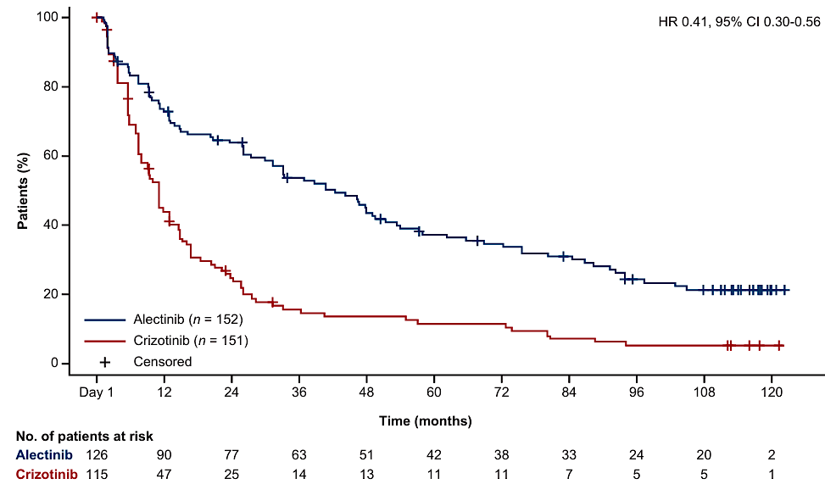
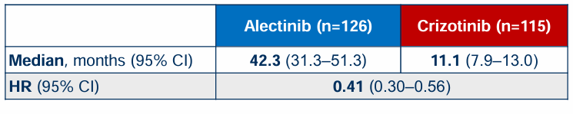
ALEX: study of alectinib vs crizotinib in advanced ALK+ NSCLC
Final overall survival and safety analysis
Subsequent anticancer therapy
No new safety signal with longer follow up
Duration of response
Mok T et al., ESMO 2025: Peters S et al., Ann Oncol 2026

Slide 77
ALEX: study of alectinib vs crizotinib in advanced ALK+ NSCLC
Final overall survival and safety analysis
Confirmation of the impact of 2nd generation ALK TKI on the natural history of the disease (median OS at 81.1 months)
Substantial but statistically not significant OS benefit despite the lack of cross over (only 25% of patients in the crizotinib arm received alectinib) and the relative low proportion of patients benefiting from subsequent therapy
Impressive duration of response with alectinib
No new safety signal but 17.8% of patients had to discontinue alectinib for safety reasons

Slide 78
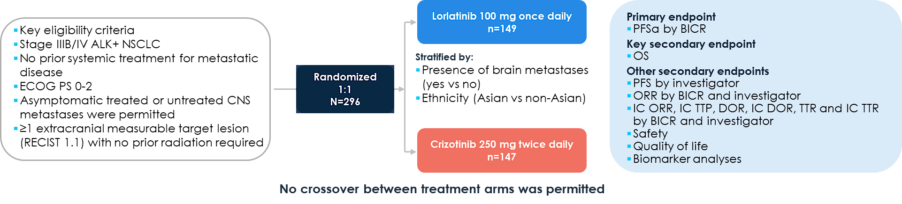




Lorlatinib vs crizotinib as first-line treatment for advanced ALK+ NSCLC: 7-year update from the phase 3 CROWN study
Time to IC Progression in the ITT Population
Mok T et al., ASCO 2026: Shaw A et al., Ann Oncol 2026

Slide 79

Lorlatinib vs crizotinib as first-line treatment for advanced ALK+ NSCLC: 7-year update from the phase 3 CROWN study
No increase in frequency of grade 3 or 4 AEs since the 5-year analysis (77%)
  Majority were due to an increase in lipid values
No increase in cardiovascular AEs compared with crizotinib
Frequency of CNS AEs was consistent with longer follow-up; most were grade 1 or 2
Dose reductions in 34% of patients in the lorlatinib group
All treatment-related discontinuations (5%) occurred within the first 26 months
Mok T et al., ASCO 2026: Shaw A et al., Ann Oncol 2026

Slide 80
Lorlatinib vs crizotinib as first-line treatment for advanced ALK+ NSCLC:
7-year update from the phase 3 CROWN study
7-year PFS rate of 55% with lorlatinib with a trend toward a plateau is extremely impressive
Results making lorlatinib as the undeniable SoC in first-line treatment of ALK+ advanced NSCLC
Management of toxicity is not trivial with insufficient follow up to evaluate long term consequences of hyperlipemia, approximately 25% of grade 3 weight gain (> 20% from baseline), 46% of neuropathy and 30% of cognitive effects
Dose reductions appear the main way to manage toxicities without impact on PFS
No ALK resistance mutations detected on lorlatinib
The majority of PD events occurred within the 1st year: early progressors have more TP53 and co-mutations at baseline

Slide 81


ALKOVE-1:
Efficacy and safety of neladalkib in patients with advanced ALK+ NSCLC
Lin J et al., ASCO 2026

Slide 82


ALKOVE-1:
Efficacy and safety of neladalkib in patients with advanced ALK+ NSCLC
ORR: 46% (29/63)
[33, 59]
Lin J et al., ASCO 2026

Slide 83




ALKOVE-1:
Efficacy and safety of neladalkib in patients with advanced ALK+ NSCLC
Advanced ALK+ NSCLC RECIST v1.1 by BICR | Lorlatinib-experienced (1–5 prior ALK TKIs ± chemotherapy) N = 190
ORR, % (n/N) [95% CI] | 26% (50/190) [20, 33]
Median DoR [95% CI] | 4.6 [2.8, 6.2]
Median PFS [95% CI] | 17.6 [6.9, NE]
Lin J et al., ASCO 2026

Slide 84
ALKOVE-1:
Efficacy and safety of neladalkib in patients with advanced ALK+ NSCLC
Neladalkib is an active new-generation ALK TKI with a good CNS penetration
In pre-treated patients
  Activity mainly in patients treated with 1st and 2nd generation TKIs as first-line of prior treatment: ORR 31%, median DoR not reached
  Activity is modest in lorlatinib pre-treated patients (ORR 26%, median PFS 4.6 months)
  The lack of ALK-dependent mechanisms of resistance after lorlatinib in 1st line suggests a low level of activity in this setting
Neladalkib should be placed as a 1st line treatment
  Preliminary evidence of high level of activity with CNS penetration
  Lower toxicity burden in comparison with lorlatinib
  The ALKAZAR phase III trial is ongoing with alectinib as the comparator

Slide 85
Year in Review:
Therapeutic Targets Beyond
EGFR for Non-Small Cell Lung Cancer
INTRODUCTION: Relative Impact of Targeted Treatment
MODULE 1: HER2 Alterations
MODULE 2: KRAS Mutations
MODULE 3: MET Overexpression
MODULE 4: ALK Fusions
MODULE 5: ROS1 Fusions
MODULE 6: RET Fusions

Slide 86


Entrectinib in Patients with ROS1 Fusion-Positive NSCLC
Updated Analysis of STARTRK-1 and -2 and ALKA-372-001
ORR in overall efficacy population (N=198) :
67.2% (95% CI: 60.2–73.7)
Krebs MG et al., ESMO 2024

Slide 87


Entrectinib in Patients with ROS1 Fusion-Positive NSCLC
Updated Analysis of STARTRK-1 and -2 and ALKA-372-001
Fan Y, et al. J Thorac Oncol 2022;17(suppl):Abstr MA13.04; Drilon A et al., Lancet Oncol 2020; Krebs M et al., ESMO 2024

Slide 88



Update on entrectinib in advanced ROS1+ NSCLC: BFAST Trial
N = 54 | IRF assessment
ORR, 95% CI | 81.5% (68.6-90.8)
Median DoR, 95% CI | 16.7 m (5.6-24.0)
Median time to CNS progression, 95% CI | NE (NE), 86.4% at 12 m
Median PFS, 95% CI | 14.8 m (7.2-24.0)
Median OS | 31.2 m (20.2-NE)
Peters S et al., Nature Med 2024

Slide 89
Entrectinib in advanced ROS1+ NSCLC
High systemic activity (ORR 75-80%)
High CNS penetration
But in comparison with new generation of ROS1 inhibitors
  Shorter duration of response
  Shorter PFS
  Safety profile less favorable (TRB inhibition) with weight gain, dizziness, dysgeusia
Ongoing phase III trial vs crizotinib

Slide 90



Updated analysis of Trident-1: repotrectinib in ROS1+ NSCLC
TKI pretreated = 1 prior TKI
Median PFS
  TKI-naïve: 31.1 months (21.9-NE)
  TKI-pretreated: 8.6 months (5.5-14.5)
Median DoR
  TKI-naïve: 36.8 months (27.4-NE)
  TKI-pretreated: 17.8 months (7.5-31.4)
IC-ORR
  TKI-naïve: 89% (8/9)
  TKI-pretreated: 38% (5/13)
Cho B et al., WCLC 2025

Slide 91


Repotrectinib in TKI-naive ROS1+ advanced NSCLC
Intracranial response rate: 89% (8/9)
Drilon A et al., NEJM 2023

Slide 92
Repotrectinib in ROS1+ advanced NSCLC
Highly active second generation agent in TKI-naïve ROS1+ advanced NSCLC
  ORR 79%, median DoR 36.8 months, median PFS 31.1 months
  High level of activity in CNS with CNS-protective effect
  Management of toxicity related to TRK-B inhibition is an issue (all grades dizziness 62%, dysgeusia 53%, ataxia 21%, muscular weakness 20%) leading to dose interruptions in 50% of patients and dose reduction in 38% of patients
Interesting activity after 1 prior TKI (ORR 41%, median DoR 17.8 months) with coverage of G2032R mutation but with relatively short PFS
Ongoing phase III trial (Trident-3) vs crizotinib

Slide 93


Taletrectinib in ROS1+ NSCLC: Pooled Analysis of Two Phase 2 Trials
1. Pérol M, et al. J Clin Oncol. 2025. 2. ClinicalTrials.gov. NCT04919811 . 3. Li W, et al. J Clin Oncol. 2024.

Slide 94




Taletrectinib in ROS1+ NSCLC: Pooled Analysis of Two Phase 2 Trials
TKI-naïve patients
Bazhenova L et al., AACR 2026

Slide 95



Taletrectinib in ROS1+ NSCLC: Pooled Analysis of Two Phase 2 Trials
TKI-pretreated patients (crizotinib or entrectinib)
Liu G et al. AACR 2026

Slide 96
Taletrectinib Safety Profile in the Integrated Safety Analysis (N=363)
Most frequent TEAEs (≥20% of patients), n (%) | Any grade | Grade 1 | Grade 2 | Grade ≥3
AST increased | 261 (71.9) | 166 (45.7) | 65 (17.9) | 30 (8.3)
ALT increased | 248 (68.3) | 143 (39.4) | 65 (17.9) | 40 (11.0)
Diarrhea | 234 (64.5) | 181 (49.9) | 44 (12.1) | 9 (2.5)
Nausea | 174 (47.9) | 131 (36.1) | 38 (10.5) | 5 (1.4)
Vomiting | 164 (45.2) | 127 (35.0) | 32 (8.8) | 5 (1.4)
Anemia | 139 (38.3) | 80 (22.0) | 44 (12.1) | 15 (4.1)
Dizziness | 78 (21.5) | 67 (18.5) | 10 (2.8) | 1 (0.3)
Electrocardiogram QT prolonged | 76 (20.9) | 52 (14.3) | 11 (3.0) | 13 (3.6)
Constipation | 74 (20.4) | 62 (17.1) | 12 (3.3) | 0
Blood creatinine increased | 73 (20.1) | 62 (17.1) | 11 (3.0) | 0
The most common (any grade) TEAEs were increased AST, increased ALT, diarrhea, nausea, and vomiting
Rates of neurologic TEAEs were low and mostly Grade 1 or 2
  Dizziness: 18.5% Grade 1; 2.8% Grade 2
  Dysgeusia: 13.2% Grade 1; 2.2% Grade 2
TEAEs led to dose interruptions in 42.7% of patients, dose reductions in 31.3%, and treatment discontinuations in 8.5%
Bazhenova L et al., AACR 2026

Slide 97
Taletrectinib in ROS1+ NSCLC: Pooled Analysis of Two Phase 2 Trials
Taletrectinib appears as a highly active agent in TKI-naïve ROS1+ advanced NSCLC
  ORR 90.3%
  Median DoR: 49.7 months
  Median PFS : 46.1 months
  Good CNS activity
The tolerance profile is adapted to a long duration of first-line treatment
  Short-term duration of GI toxicity
  Transaminases elevation is managed with dose reductions
  Without impact on PFS
Data based on a majority of Asian patients without obvious differences with Caucasian patients

Slide 98



ARROS-1: A Global First-in-Human Phase 1/2 Clinical Trial of Zidesamtinib in Advanced ROS1+ NSCLC
Drilon A et al., WCLC 2025

Slide 99





ARROS-1
Zidesamtinib in TKI Pretreated Patients with Advanced ROS1+ NSCLC
Median PFS 23.8 m
DoR
PFS
Median PFS 9.7 m
Drilon A et al., WCLC 2025

Slide 100

ARROS-1
Zidesamtinib in TKI Pretreated Patients with Advanced ROS1+ NSCLC
Drilon A et al., WCLC 2025

Slide 101
ARROS-1
Zidesamtinib in TKI Pretreated Patients with Advanced ROS1+ NSCLC
Zidesamtinib demonstrated in ROS1+ pretreated advanced NSCLC
  Durable activity, including in heavily pre-treated patients (even after prior repotrectinib or taletrectinib) and patients with the ROS1 G2032R resistance mutation
  Durable intracranial responses
  With a favorable tolerance profile with low rates of dose reduction (10%) and treatment discontinuation (2%), consistent with the TRK sparing design
Activity in TKI-naïve patients appears promising but needing a longer follow-up to be evaluated

Slide 102



Frontline Treatment of ROS1+ Advanced NSCLC
Similar to ALK+ NSCLC, the choice of first-line treatment appears crucial in altering the natural history of the disease and improving patient survival
The tolerance profile is also essential from the perspective of long-term treatment
Ongoing trials
  NCT04603807: entrectinib vs. crizotinib in 1st line (PFS in pts with brain mets)
  NCT06140836: repotrectinib vs. crizotinib in 1st line (PFS in ITT pts), Trident-3
  NCT06564324: taletrectinib vs. crizotinib in 1st line (China)
  NCT07154706, TRUST-IV: taletrectinib vs. placebo in adjuvant setting
Desilets A et al., Cancer 2025

Slide 103
Year in Review:
Therapeutic Targets Beyond
EGFR for Non-Small Cell Lung Cancer
INTRODUCTION: Relative Impact of Targeted Treatment
MODULE 1: HER2 Alterations
MODULE 2: KRAS Mutations
MODULE 3: MET Overexpression
MODULE 4: ALK Fusions
MODULE 5: ROS1 Fusions
MODULE 6: RET Fusions

Slide 104

Selpercatinib: final results of the LIBRETTO-001 Phase I/II Trial
 | Previous platinum CT | Treatment naïve
N | 247 | 69
Median age | 61.0 | 63.0
Female | 56.7% | 62.3%
Never smoker | 66.8% | 69.6%
ECOG PS 0/1/2, % | 36.4/60.7/2.8 | 36.2/58.0/5.8
Median No of prior lines | 2 | 0
RET fusion, % KIF5B-RET CCDC6-RET NCOA4-RET | 61.9 21.5 2.0 | 69.6 14.5 1.4
ORR, % (95% CI) | 61.5 (55.2-67.6) | 82.6 (71.6-90.7)
DoR, months, median (95% CI) | 31.6 (20.4-42.3) | 20.3 (15.4-29.5)
PFS, months, median, (95% CI) | 26.2 (19.3-35.7) | 22.0 (16.5-24.9)
OS, months, median, (95% CI) | 47.6 (35.9-NE) | NE (37.8-NE)
Gautschi O et al., JCO 2025

Slide 105




LIBRETTO-432 Trial: A multicenter, phase 3, double-blind, randomized, placebo-controlled study with adjuvant selpercatinib in stage IB-IIIA RET fusion-positive NSCLC
Primary Analysis Population
Stage II-IIIA
Stage IB-IIIA
Goldman J et al., ASCO 2026; Wu YL et al., NEJM 2026

Slide 106




LIBRETTO-432 Trial: A multicenter, phase 3, double-blind, randomized, placebo-controlled study with adjuvant selpercatinib in stage IB-IIIA RET fusion-positive NSCLC
Primary Analysis Population
Stage II-IIIA, inv. assessment
Stage IB-IIIA, inv. assessment
Goldman J et al., ASCO 2026; Wu YL et al., NEJM 2026

Slide 107
LIBRETTO-432 Trial: A multicenter, phase 3, double-blind, randomized, placebo-controlled study with adjuvant selpercatinib in stage IB-IIIA RET fusion-positive NSCLC
Libretto-432 defines a new standard of care for early-stage RET fusion-positive NSCLC.
Joining osimertinib and alectinib as proven adjuvant targeted therapies in early-stage NSCLC
Role of adjuvant chemotherapy in this setting?
Impact on OS needs a longer follow up
Management of side-effects is not trivial
  66.7% of patients experienced grade > 3 TEAE
  17.3% discontinued selpercatinib
  77.3% required dose interruption
  54.7% required dose reduction
Early-stage molecular testing must expand beyond EGFR, ALK, and PD-L1

Slide 108


Pralsetinib in patients with advanced RET fusion-positive NSCLC: Update from the ARROW trial
 | Previous platinum CT | Treatment naïve
N | 141 | 116
Median age | 59.0 | 62.5
Female | 60% | 51%
Never smoker | 63% | 59%
ECOG PS 0/1/2, % | 26/70/4 | 30/69/1
Median No of prior lines | 2 | 0
RET fusion, % KIF5B-RET CCDC6-RET NCOA4-RET | 70 19 1 | 70 16 1
ORR, % (95% CI) | 63 (54-71) | 78 (69-86)
DoR, months, median (95% CI) | 31.8 (15.1-40.4) | 13.4 (9.4-21.7)
PFS, months, median, (95% CI) | 16.4 (11.4-23.5) | 12.1 (9.2-16.6)
OS, months, median, (95% CI) | 39.7 (27.8-53.2) | 50.1 (28.3-NE)
Treatment-naïve pts
Besse B et al., JCO 2025

Slide 109



AcceleRET-Lung: Open-Label Phase 3 Trial of Pralsetinib in 1L RET Fusion-Positive mNSCLC
PFS
Popat S et al., ASCO 2026

Slide 110




AcceleRET-Lung: Open-Label Phase 3 Trial of Pralsetinib in 1L RET Fusion-Positive mNSCLC
Popat S et al., ASCO 2026

Slide 111
Pralsetinib in RET+ advanced NSCLC
Pralsetinib has undeniable efficacy in RET-positive NSCLC, demonstrating superiority over chemotherapy
However, its tolerability profile—characterized by hematologic toxicity and a significant risk of opportunistic infections—makes its use difficult compared with selpercatinib, which has at least comparable efficacy and is better tolerated.

Slide 112
Patterns of Care: Exploring How
Community Oncologists Manage HR-Positive,
HER2-Positive Metastatic Breast Cancer
A CME/MOC-Accredited Live Webinar
Wednesday, July 1, 2026
5:00 PM – 6:00 PM ET
Faculty
Lisa A Carey, MD, ScM, FASCO
Reshma L Mahtani, DO
Moderator
Neil Love, MD

Slide 113
Thank you for joining us!
Please take a moment to complete the survey currently up on Zoom. Your feedback is very important to us. The survey will remain open for 5 minutes after the meeting ends.
Information on how to obtain CME, ABIM MOC and ABS credit is provided in the Zoom chat room. Attendees will also receive an email in
1 to 3 business days with these instructions.

