Slide 1
Year in Review: Clinical Investigator Perspectives on the Most Relevant New Datasets and Advances in Oncology
Small Cell Lung Cancer
A CME/MOC-Accredited Live Webinar
Tuesday, April 14, 2026 5:00 PM – 6:00 PM ET
Faculty
Christine L Hann, MD, PhD
Jacob Sands, MD
Moderator
Neil Love, MD

Slide 2

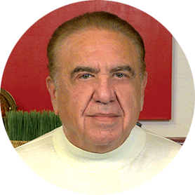

Faculty
Christine L Hann, MD, PhD
Associate Professor of Oncology
Director, Small Cell Lung Cancer Therapeutics
Sidney Kimmel Comprehensive Cancer Center
Johns Hopkins University School of Medicine
Baltimore, Maryland
MODERATOR
Neil Love, MD Research To Practice
Miami, Florida
Jacob Sands, MD
Associate Chief, Thoracic Oncology
Dana-Farber Cancer Institute
Assistant Professor
Harvard Medical School
Boston, Massachusetts

Slide 3
Commercial Support
This activity is supported by educational grants from AstraZeneca Pharmaceuticals LP, Daiichi Sankyo Inc, Merck, and Puma Biotechnology Inc.

Slide 4
Dr Love — Disclosures
Dr Love is president and CEO of Research To Practice. Research To Practice receives funds in the form of educational grants to develop CME activities from the following companies: Aadi Bioscience, AbbVie Inc, ADC Therapeutics, Agendia Inc, Alexion Pharmaceuticals, Amgen Inc, Array BioPharma Inc, a subsidiary of Pfizer Inc, Arvinas, Astellas, AstraZeneca Pharmaceuticals LP, Aveo Pharmaceuticals, Bayer HealthCare Pharmaceuticals, BeOne, Biotheranostics Inc, A Hologic Company, Black Diamond Therapeutics Inc, Blueprint Medicines, Boehringer Ingelheim Pharmaceuticals Inc, Bristol Myers Squibb, Celcuity, Clovis Oncology, Coherus BioSciences, Corcept Therapeutics Inc, CTI BioPharma, a Sobi Company, Daiichi Sankyo Inc, Eisai Inc, Elevation Oncology Inc, Exact Sciences Corporation, Exelixis Inc, Genentech, a member of the Roche Group, Genmab US Inc, Geron Corporation, Gilead Sciences Inc, GSK, Helsinn Therapeutics (US) Inc, ImmunoGen Inc, Incyte Corporation, Ipsen Biopharmaceuticals Inc, Jazz Pharmaceuticals Inc, Johnson & Johnson, Karyopharm Therapeutics, Kite, A Gilead Company, Kura Oncology, Legend Biotech, Lilly, MEI Pharma Inc, Merck, Mersana Therapeutics Inc, Mirati Therapeutics Inc, Mural Oncology Inc, Natera Inc, Novartis, Novartis Pharmaceuticals Corporation on behalf of Advanced Accelerator Applications, Novocure Inc, Nuvalent, Nuvation Bio Inc, Pfizer Inc, Pharmacyclics LLC, an AbbVie Company, Puma Biotechnology Inc, Regeneron Pharmaceuticals Inc, Revolution Medicines Inc, Rigel Pharmaceuticals Inc, R-Pharm US, Sanofi, Seagen Inc, Servier Pharmaceuticals LLC, SpringWorks Therapeutics Inc, Stemline Therapeutics Inc, Sumitomo Pharma America, Summit Therapeutics, Syndax Pharmaceuticals, Taiho Oncology Inc, Takeda Pharmaceuticals USA Inc, TerSera Therapeutics LLC, and Tesaro, A GSK Company.

Slide 5
Research To Practice CME Planning Committee Members, Staff and Reviewers
Planners, scientific staff and independent reviewers for Research To Practice have no relevant financial relationships to disclose.

Slide 6
Dr Hann — Disclosures
Advisory Committees | AstraZeneca Pharmaceuticals LP, Daiichi Sankyo Inc, Genentech, a member of the Roche Group
Consulting Agreements | AbbVie Inc
Contracted Research | Amgen Inc, AstraZeneca Pharmaceuticals LP, Daiichi Sankyo Inc

Slide 7
Dr Sands — Disclosures
Consulting Agreements | AbbVie Inc, Amgen Inc, AstraZeneca Pharmaceuticals LP, Catalyst Pharmaceuticals Inc, Daiichi Sankyo Inc, Fosun Pharma, Genentech, a member of the Roche Group, Gilead Sciences Inc, GSK, Lilly, Merck, Novartis, Pfizer Inc, PharmaMar, Sanofi
Contracted Research | Amgen Inc, Novartis

Slide 8
This educational activity contains discussion of non-FDA-approved uses of agents and regimens. Please refer to official prescribing information for each product for approved indications.

Slide 9
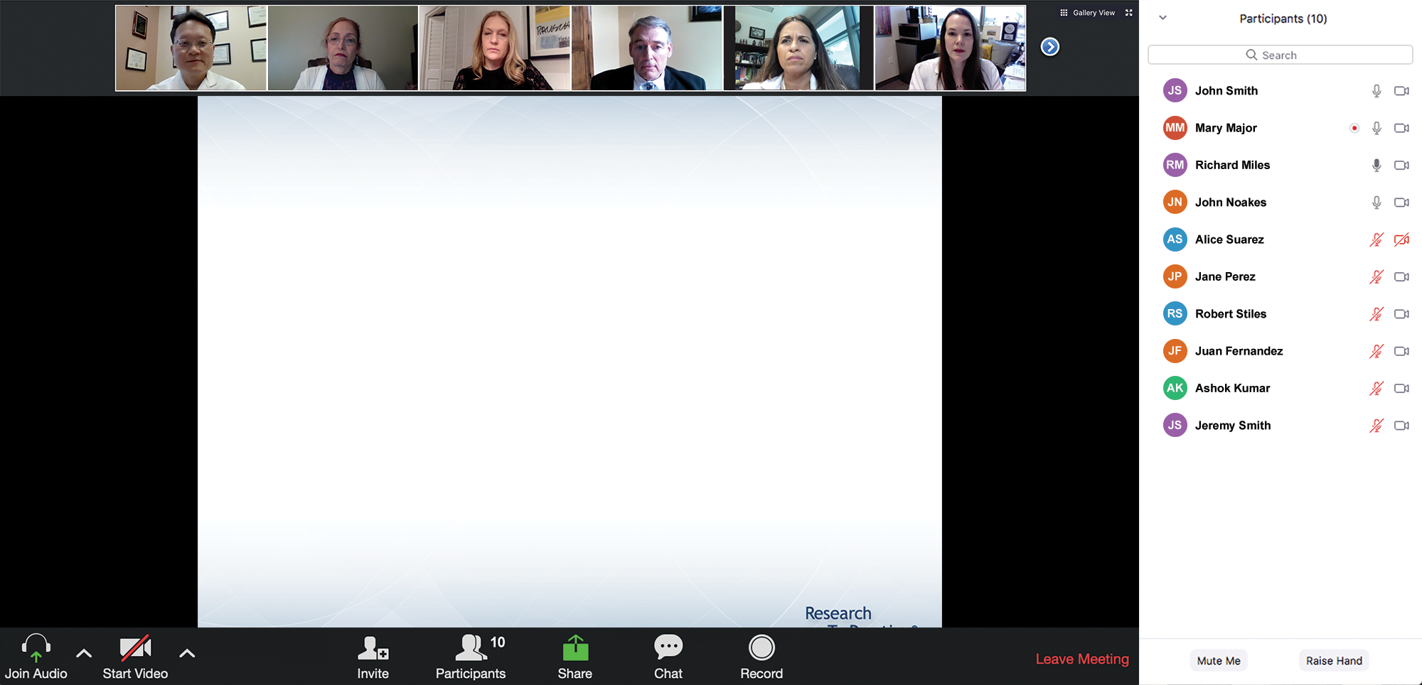
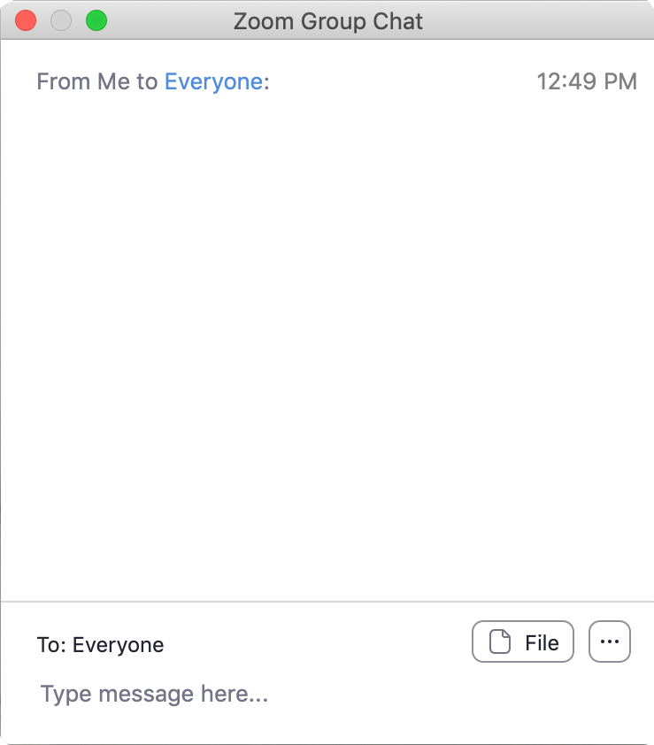
We Encourage Clinicians in Practice to Submit Questions
Feel free to submit questions now before the program begins and throughout the program.

Slide 10
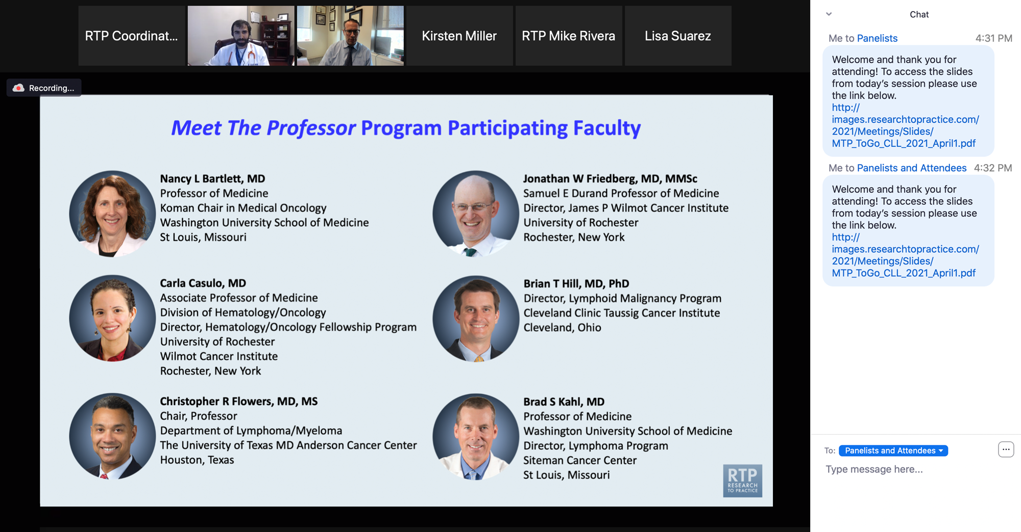
Familiarizing Yourself with the Zoom Interface
Expand chat submission box
Drag the white line above the submission box up to create more space for your message.

Slide 11
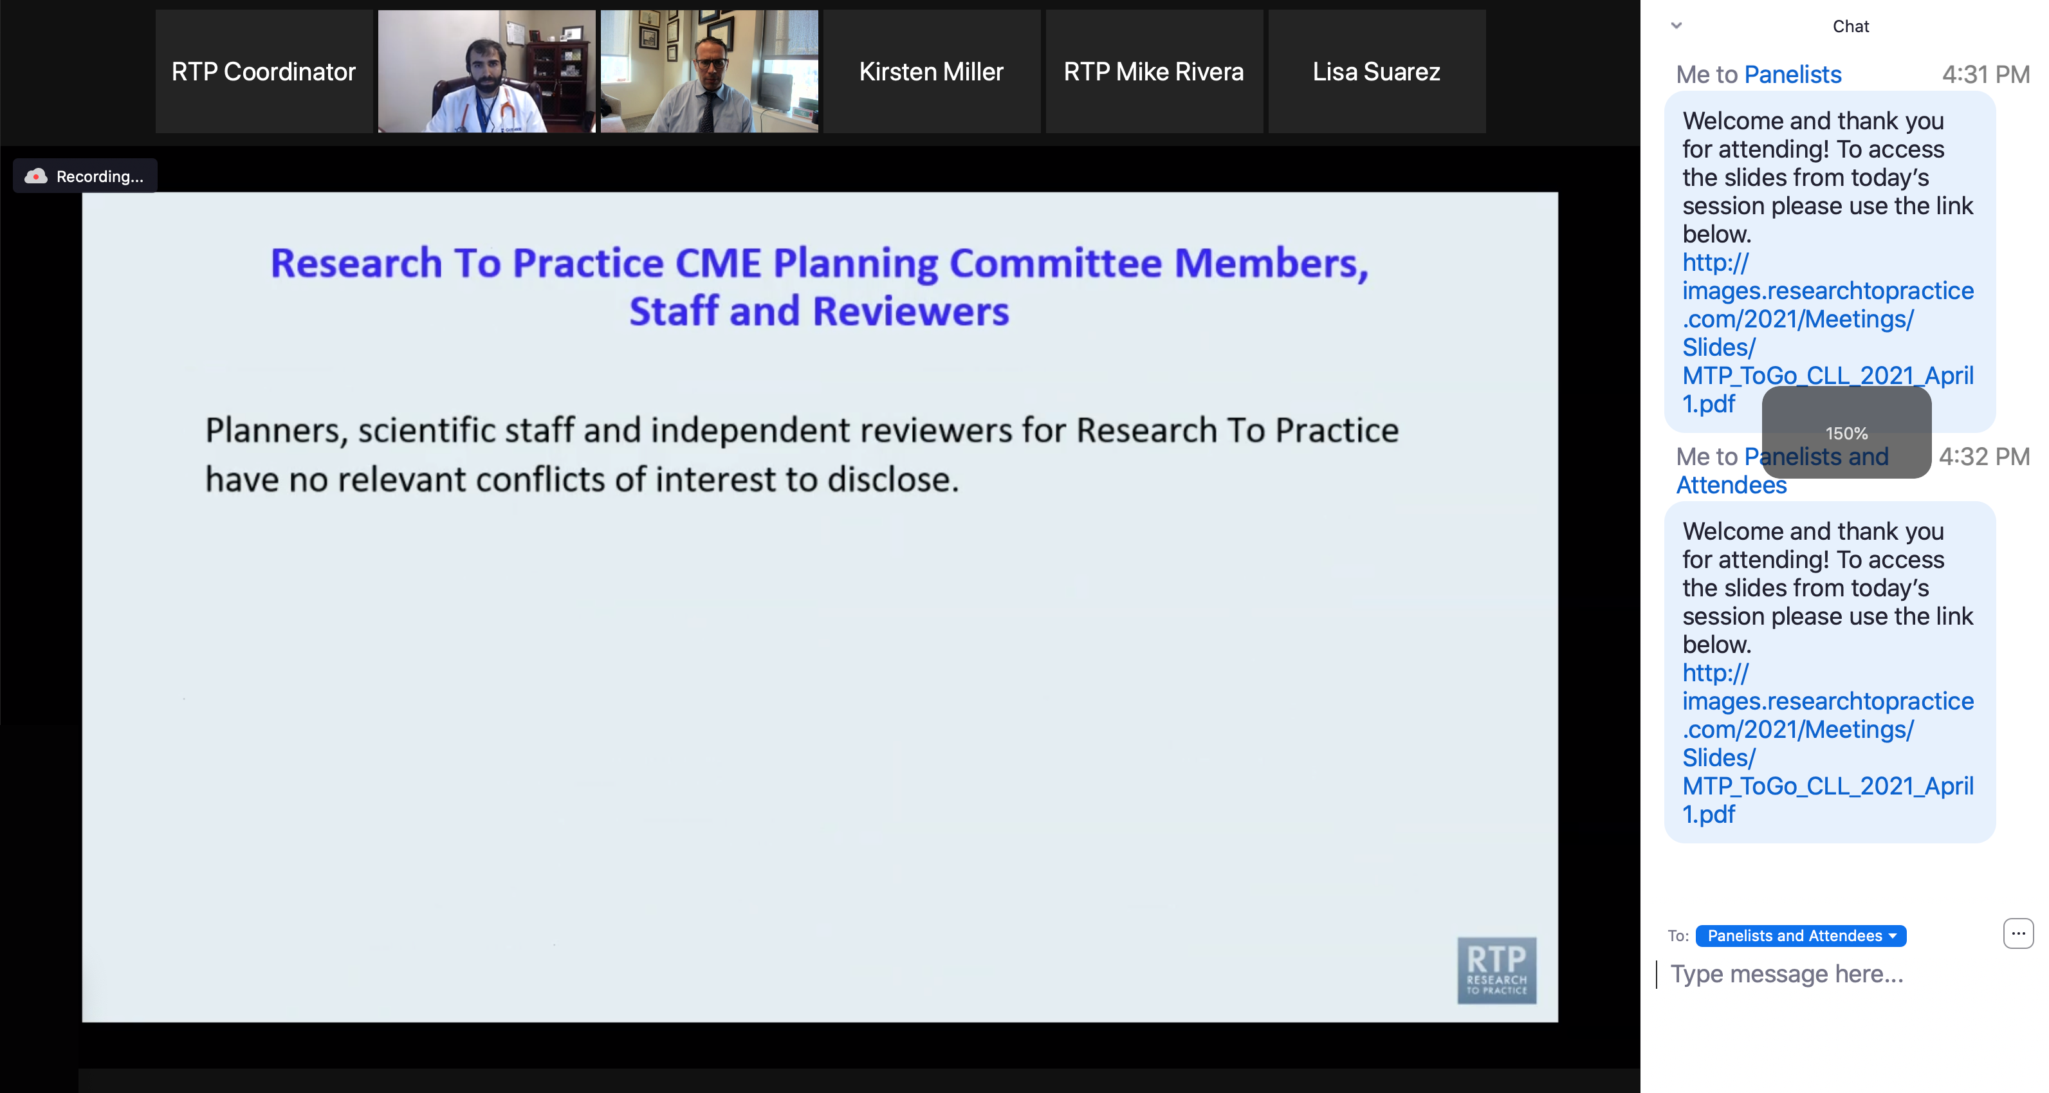
Familiarizing Yourself with the Zoom Interface
Increase chat font size
Press Command (for Mac) or Control (for PC) and the + symbol. You may do this as many times as you need for readability.

Slide 12
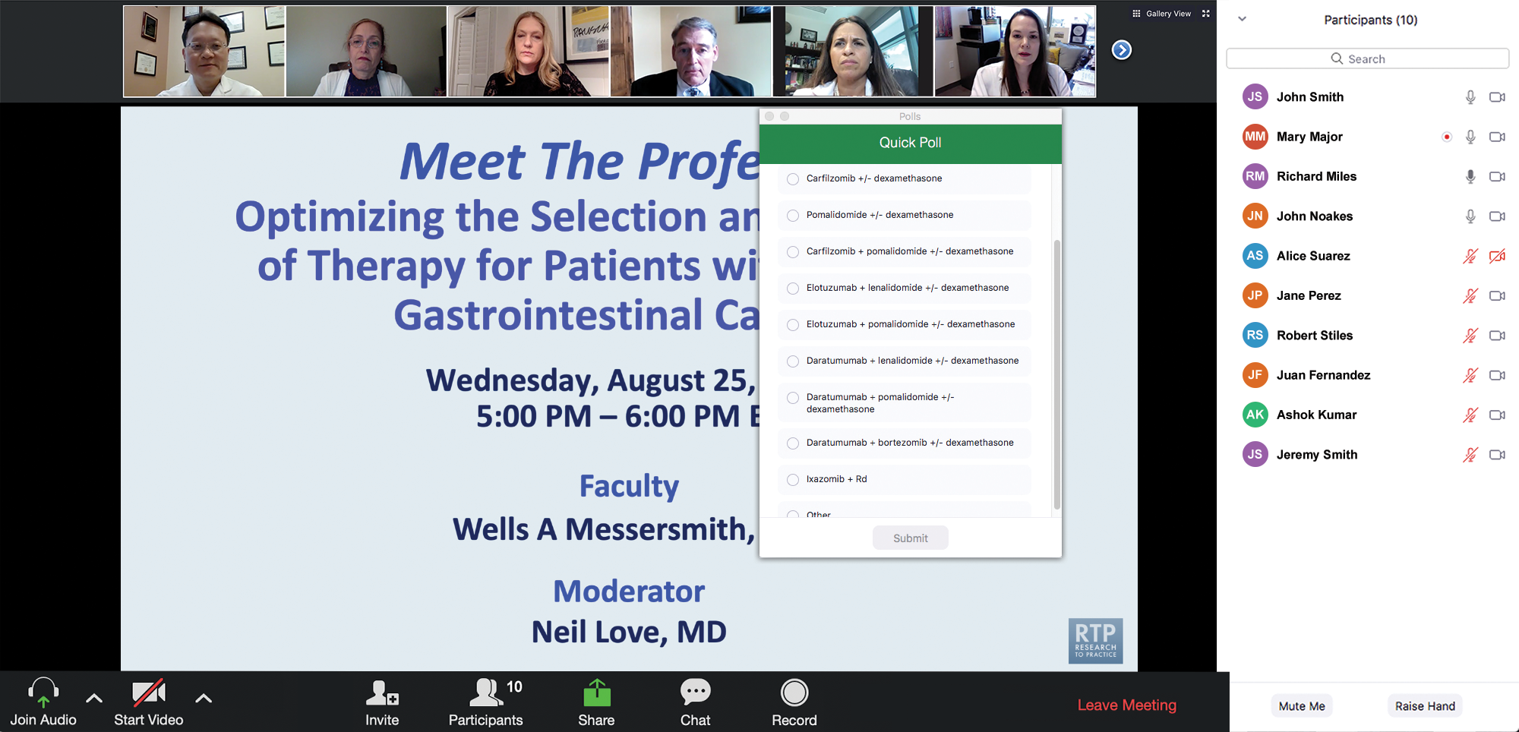
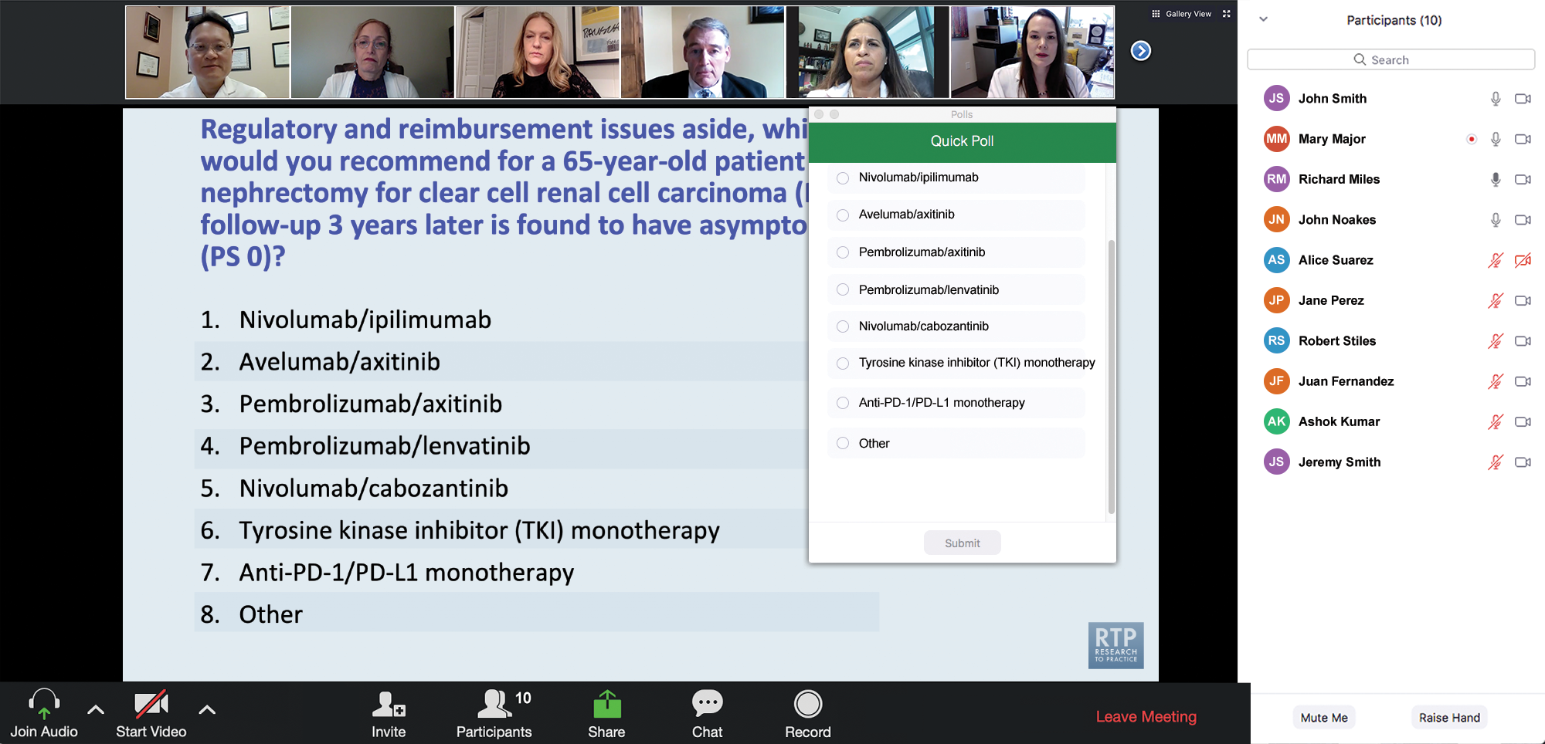
Clinicians in the Audience, Please Complete the Pre- and Postmeeting Surveys
Quick Survey
Quick Poll

Slide 13
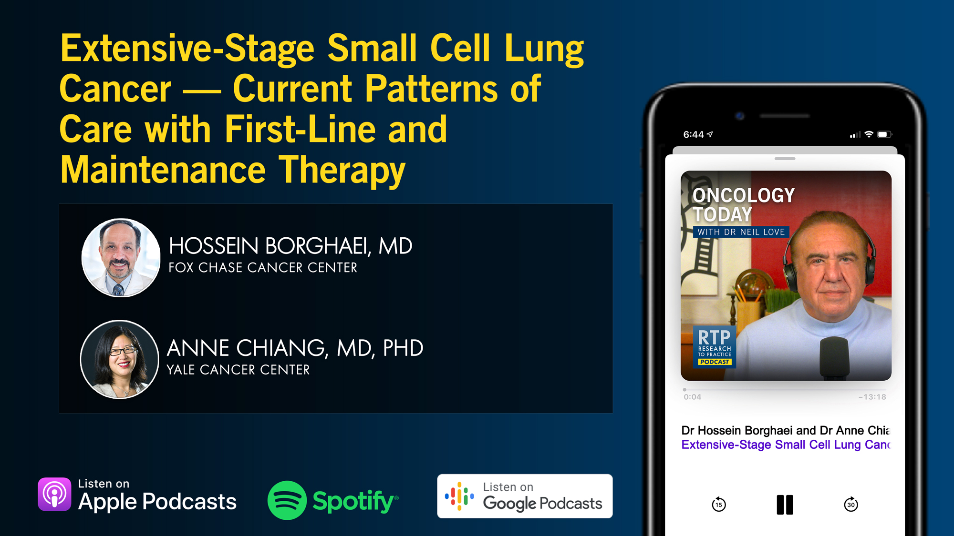

Slide 14
Consensus or Controversy? Clinical Investigators Discuss and Debate Current Approaches to First- and Second-Line Therapy for HR-Positive Metastatic Breast Cancer
A CME/MOC-Accredited Live Webinar
Wednesday, April 15, 2026 5:00 PM – 6:00 PM ET
Faculty
Sara A Hurvitz, MD, FACP
Virginia Kaklamani, MD, DSc
Moderator
Neil Love, MD

Slide 15
Year in Review: Clinical Investigator Perspectives on the Most Relevant New Datasets and Advances in Oncology
Colorectal Cancer
A CME/MOC-Accredited Live Webinar
Thursday, April 16, 2026 5:00 PM – 6:00 PM ET
Faculty
Arvind Dasari, MD, MS
Anwaar Saeed, MD
Moderator
Neil Love, MD

Slide 16
Fifth Annual National General Medical Oncology Summit
A Multitumor CME/MOC-, NCPD- and ACPE-Accredited Educational Conference
Developed in Partnership with Florida Cancer Specialists & Research Institute
The Ritz-Carlton Orlando, Grande Lakes | Orlando, Florida
Friday, April 24, 2026
Fellows Welcome!
7:00 PM – 9:00 PM
Keynote Session: Diffuse Large B-Cell Lymphoma and Follicular Lymphoma
Manali Kamdar, MD, MBBS Krish Patel, MD Gilles Salles, MD, PhD

Slide 17
Fifth Annual National General Medical Oncology Summit
Saturday, April 25, 2026
8:00 AM – 8:50 AM
Chronic Lymphocytic Leukemia
John N Allan, MD Adam Kittai, MD
8:50 AM – 9:40 AM
Pancreatic Cancer
Eileen M O’Reilly, MD Philip A Philip, MD, PhD
10:00 AM – 10:50 AM
Ovarian Cancer
Deborah K Armstrong, MD David M O’Malley, MD
10:50 AM – 11:40 AM
Relapsed/Refractory Multiple Myeloma
Hans Lee, MD Noopur Raje, MD
11:40 AM – 12:30 PM
Gastroesophageal Cancers
Yelena Y Janjigian, MD Samuel J Klempner, MD
1:20 PM – 2:10 PM
Desmoid Tumors and Soft Tissue Sarcoma
Mrinal Gounder, MD Richard F Riedel, MD

Slide 18
Fifth Annual National General Medical Oncology Summit
Saturday, April 25, 2026
Sunday, April 26, 2026
2:10 PM – 3:00 PM
Urothelial Bladder Cancer
Terence Friedlander, MD
Daniel P Petrylak, MD
3:20 PM – 4:10 PM
Triple-Negative Breast Cancer
Adam M Brufsky, MD, PhD
Kevin Kalinsky, MD, MS, FASCO
4:10 PM – 5:00 PM
HER2-Positive Breast Cancer
Erika Hamilton, MD Shanu Modi, MD
8:00 AM – 9:40 AM
HR-Positive Breast Cancer
Erika Hamilton, MD
Jane Lowe Meisel, MD
Joyce O’Shaughnessy, MD
Seth Wander, MD, PhD
9:40 AM – 10:30 AM
Colorectal Cancer
Kristen K Ciombor, MD, MSCI
John Strickler, MD

Slide 19
Fifth Annual National General Medical Oncology Summit
Sunday, April 26, 2026
10:50 AM – 11:40 AM
EGFR-Mutated Non-Small Cell Lung Cancer
Jonathan Goldman, MD
Zofia Piotrowska, MD, MHS
11:40 AM – 12:30 PM
Prostate Cancer
Neeraj Agarwal, MD, FASCO Alan H Bryce, MD
1:15 PM – 2:05 PM
Myelofibrosis and Systemic Mastocytosis
Anthony M Hunter, MD
Abdulraheem Yacoub, MD
2:05 PM – 2:55 PM
Targeted Therapies for Non-Small Cell Lung Cancer
Lyudmila Bazhenova, MD
Corey J Langer, MD
2:55 PM – 3:45 PM
Acute Myeloid Leukemia
Courtney D DiNardo, MD, MSCE
Harry Paul Erba, MD, PhD

Slide 20
What Clinicians Want to Know: Optimizing the Management of Metastatic Triple-Negative Breast Cancer
A CME/MOC-Accredited Live Webinar
Thursday, April 30, 2026 5:00 PM – 6:00 PM ET
Faculty
Kevin Punie, MD
Tiffany A Traina, MD, FASCO
Moderator
Neil Love, MD

Slide 21
Grand Rounds
CME/MOC-Accredited Interactive Series
Regional Activities
Three Series
Optimizing Treatment for Patients with Relapsed/Refractory Chronic Lymphocytic Leukemia
Optimizing the Use of Novel Therapies for Patients with Diffuse Large B-Cell Lymphoma
Optimizing Therapy for Patients with Hormone Receptor-Positive Localized Breast Cancer
Host a 1-hour session at your institution: Email Meetings@ResearchToPractice.com or call (800) 233-6153

Slide 22
Year in Review: Small Cell Lung Cancer
INTRODUCTION: Biopharmacology of SCLC – “Wildfire sparked in dry grass”
MODULE 1: Limited-Stage Disease
MODULE 2: Extensive-Stage Disease
MODULE 3: Paraneoplastic Syndromes – Lambert-Eaton Myasthenic Syndrome
MODULE 4: Bispecific T-Cell Engagers – Tarlatamab
MODULE 5: Antibody-Drug Conjugates – Ifinatamab Deruxtecan
MODULE 6: Other Novel Agents – Alisertib, CAR T-Cell Therapy

Slide 23
Year in Review: Clinical Investigator Perspectives on the Most Relevant New Datasets and Advances in Oncology
Small Cell Lung Cancer
A CME/MOC-Accredited Live Webinar
Tuesday, April 14, 2026 5:00 PM – 6:00 PM ET
Faculty
Christine L Hann, MD, PhD
Jacob Sands, MD
Moderator
Neil Love, MD

Slide 24
Faculty
Christine L Hann, MD, PhD
Associate Professor of Oncology
Director, Small Cell Lung Cancer Therapeutics
Sidney Kimmel Comprehensive Cancer Center
Johns Hopkins University School of Medicine
Baltimore, Maryland
MODERATOR
Neil Love, MD Research To Practice
Miami, Florida
Jacob Sands, MD
Associate Chief, Thoracic Oncology
Dana-Farber Cancer Institute
Assistant Professor
Harvard Medical School
Boston, Massachusetts

Slide 25
We Encourage Clinicians in Practice to Submit Questions
Feel free to submit questions now before the program begins and throughout the program.

Slide 26
Clinicians in the Audience, Please Complete the Pre- and Postmeeting Surveys
Quick Survey
Quick Poll

Slide 28
Consensus or Controversy? Clinical Investigators Discuss and Debate Current Approaches to First- and Second-Line Therapy for HR-Positive Metastatic Breast Cancer
A CME/MOC-Accredited Live Webinar
Wednesday, April 15, 2026 5:00 PM – 6:00 PM ET
Faculty
Sara A Hurvitz, MD, FACP
Virginia Kaklamani, MD, DSc
Moderator
Neil Love, MD

Slide 29
Year in Review: Clinical Investigator Perspectives on the Most Relevant New Datasets and Advances in Oncology
Colorectal Cancer
A CME/MOC-Accredited Live Webinar
Thursday, April 16, 2026 5:00 PM – 6:00 PM ET
Faculty
Arvind Dasari, MD, MS
Anwaar Saeed, MD
Moderator
Neil Love, MD

Slide 30
Fifth Annual National General Medical Oncology Summit
A Multitumor CME/MOC-, NCPD- and ACPE-Accredited Educational Conference
Developed in Partnership with Florida Cancer Specialists & Research Institute
The Ritz-Carlton Orlando, Grande Lakes | Orlando, Florida
Friday, April 24, 2026
Fellows Welcome!
7:00 PM – 9:00 PM
Keynote Session: Diffuse Large B-Cell Lymphoma and Follicular Lymphoma
Manali Kamdar, MD, MBBS Krish Patel, MD Gilles Salles, MD, PhD

Slide 31
Fifth Annual National General Medical Oncology Summit
Saturday, April 25, 2026
8:00 AM – 8:50 AM
Chronic Lymphocytic Leukemia
John N Allan, MD Adam Kittai, MD
8:50 AM – 9:40 AM
Pancreatic Cancer
Eileen M O’Reilly, MD Philip A Philip, MD, PhD
10:00 AM – 10:50 AM
Ovarian Cancer
Deborah K Armstrong, MD David M O’Malley, MD
10:50 AM – 11:40 AM
Relapsed/Refractory Multiple Myeloma
Hans Lee, MD Noopur Raje, MD
11:40 AM – 12:30 PM
Gastroesophageal Cancers
Yelena Y Janjigian, MD Samuel J Klempner, MD
1:20 PM – 2:10 PM
Desmoid Tumors and Soft Tissue Sarcoma
Mrinal Gounder, MD Richard F Riedel, MD

Slide 32
Fifth Annual National General Medical Oncology Summit
Saturday, April 25, 2026
Sunday, April 26, 2026
2:10 PM – 3:00 PM
Urothelial Bladder Cancer
Terence Friedlander, MD
Daniel P Petrylak, MD
3:20 PM – 4:10 PM
Triple-Negative Breast Cancer
Adam M Brufsky, MD, PhD
Kevin Kalinsky, MD, MS, FASCO
4:10 PM – 5:00 PM
HER2-Positive Breast Cancer
Erika Hamilton, MD Shanu Modi, MD
8:00 AM – 9:40 AM
HR-Positive Breast Cancer
Erika Hamilton, MD
Jane Lowe Meisel, MD
Joyce O’Shaughnessy, MD
Seth Wander, MD, PhD
9:40 AM – 10:30 AM
Colorectal Cancer
Kristen K Ciombor, MD, MSCI
John Strickler, MD

Slide 33
Fifth Annual National General Medical Oncology Summit
Sunday, April 26, 2026
10:50 AM – 11:40 AM
EGFR-Mutated Non-Small Cell Lung Cancer
Jonathan Goldman, MD
Zofia Piotrowska, MD, MHS
11:40 AM – 12:30 PM
Prostate Cancer
Neeraj Agarwal, MD, FASCO Alan H Bryce, MD
1:15 PM – 2:05 PM
Myelofibrosis and Systemic Mastocytosis
Anthony M Hunter, MD
Abdulraheem Yacoub, MD
2:05 PM – 2:55 PM
Targeted Therapies for Non-Small Cell Lung Cancer
Lyudmila Bazhenova, MD
Corey J Langer, MD
2:55 PM – 3:45 PM
Acute Myeloid Leukemia
Courtney D DiNardo, MD, MSCE
Harry Paul Erba, MD, PhD

Slide 34
What Clinicians Want to Know: Optimizing the Management of Metastatic Triple-Negative Breast Cancer
A CME/MOC-Accredited Live Webinar
Thursday, April 30, 2026 5:00 PM – 6:00 PM ET
Faculty
Kevin Punie, MD
Tiffany A Traina, MD, FASCO
Moderator
Neil Love, MD

Slide 35
Grand Rounds
CME/MOC-Accredited Interactive Series
Regional Activities
Three Series
Optimizing Treatment for Patients with Relapsed/Refractory Chronic Lymphocytic Leukemia
Optimizing the Use of Novel Therapies for Patients with Diffuse Large B-Cell Lymphoma
Optimizing Therapy for Patients with Hormone Receptor-Positive Localized Breast Cancer
Host a 1-hour session at your institution: Email Meetings@ResearchToPractice.com or call (800) 233-6153

Slide 36
Year in Review: Clinical Investigator Perspectives on the Most Relevant New Datasets and Advances in Oncology
Small Cell Lung Cancer
A CME/MOC-Accredited Live Webinar
Tuesday, April 14, 2026 5:00 PM – 6:00 PM ET
Faculty
Christine L Hann, MD, PhD
Jacob Sands, MD
Moderator
Neil Love, MD

Slide 37
Commercial Support
This activity is supported by educational grants from AstraZeneca Pharmaceuticals LP, Daiichi Sankyo Inc, Merck, and Puma Biotechnology Inc.
Research To Practice CME Planning Committee Members, Staff and Reviewers
Planners, scientific staff and independent reviewers for Research To Practice have no relevant financial relationships to disclose.

Slide 38
Dr Hann — Disclosures
Advisory Committees | AstraZeneca Pharmaceuticals LP, Daiichi Sankyo Inc, Genentech, a member of the Roche Group
Consulting Agreements | AbbVie Inc
Contracted Research | Amgen Inc, AstraZeneca Pharmaceuticals LP, Daiichi Sankyo Inc

Slide 39
Dr Sands — Disclosures
Consulting Agreements | AbbVie Inc, Amgen Inc, AstraZeneca Pharmaceuticals LP, Catalyst Pharmaceuticals Inc, Daiichi Sankyo Inc, Fosun Pharma, Genentech, a member of the Roche Group, Gilead Sciences Inc, GSK, Lilly, Merck, Novartis, Pfizer Inc, PharmaMar, Sanofi
Contracted Research | Amgen Inc, Novartis

Slide 40
Dr Love — Disclosures
Dr Love is president and CEO of Research To Practice. Research To Practice receives funds in the form of educational grants to develop CME activities from the following companies: Aadi Bioscience, AbbVie Inc, ADC Therapeutics, Agendia Inc, Alexion Pharmaceuticals, Amgen Inc, Array BioPharma Inc, a subsidiary of Pfizer Inc, Arvinas, Astellas, AstraZeneca Pharmaceuticals LP, Aveo Pharmaceuticals, Bayer HealthCare Pharmaceuticals, BeOne, Biotheranostics Inc, A Hologic Company, Black Diamond Therapeutics Inc, Blueprint Medicines, Boehringer Ingelheim Pharmaceuticals Inc, Bristol Myers Squibb, Celcuity, Clovis Oncology, Coherus BioSciences, Corcept Therapeutics Inc, CTI BioPharma, a Sobi Company, Daiichi Sankyo Inc, Eisai Inc, Elevation Oncology Inc, Exact Sciences Corporation, Exelixis Inc, Genentech, a member of the Roche Group, Genmab US Inc, Geron Corporation, Gilead Sciences Inc, GSK, Helsinn Therapeutics (US) Inc, ImmunoGen Inc, Incyte Corporation, Ipsen Biopharmaceuticals Inc, Jazz Pharmaceuticals Inc, Johnson & Johnson, Karyopharm Therapeutics, Kite, A Gilead Company, Kura Oncology, Legend Biotech, Lilly, MEI Pharma Inc, Merck, Mersana Therapeutics Inc, Mirati Therapeutics Inc, Mural Oncology Inc, Natera Inc, Novartis, Novartis Pharmaceuticals Corporation on behalf of Advanced Accelerator Applications, Novocure Inc, Nuvalent, Nuvation Bio Inc, Pfizer Inc, Pharmacyclics LLC, an AbbVie Company, Puma Biotechnology Inc, Regeneron Pharmaceuticals Inc, Revolution Medicines Inc, Rigel Pharmaceuticals Inc, R-Pharm US, Sanofi, Seagen Inc, Servier Pharmaceuticals LLC, SpringWorks Therapeutics Inc, Stemline Therapeutics Inc, Sumitomo Pharma America, Summit Therapeutics, Syndax Pharmaceuticals, Taiho Oncology Inc, Takeda Pharmaceuticals USA Inc, TerSera Therapeutics LLC, and Tesaro, A GSK Company.

Slide 41
This educational activity contains discussion of non-FDA-approved uses of agents and regimens. Please refer to official prescribing information for each product for approved indications.

Slide 42

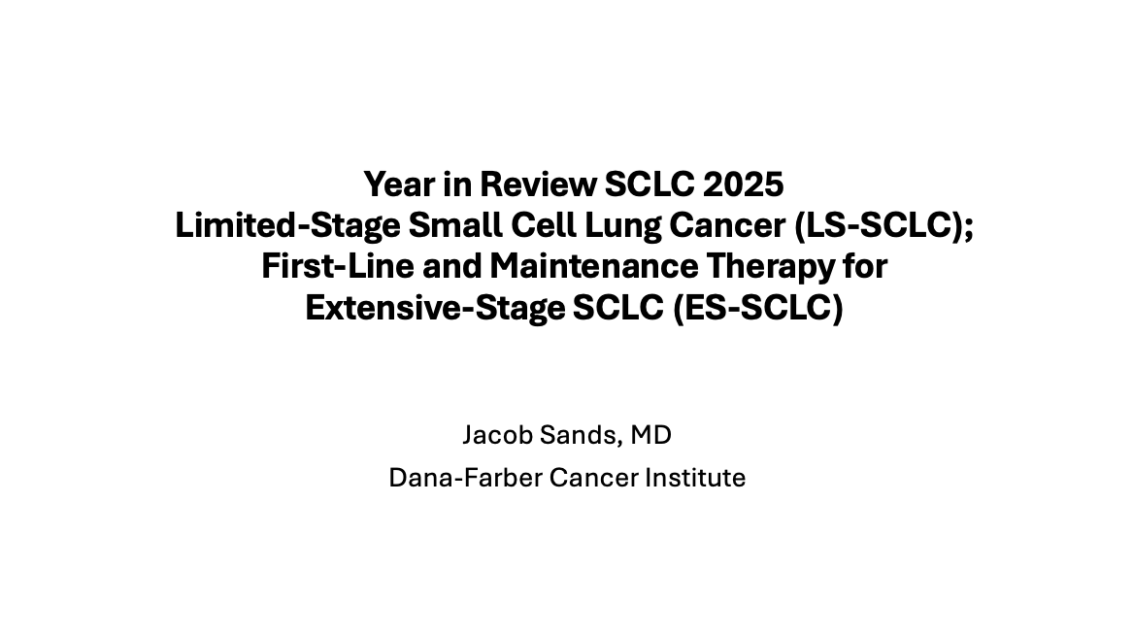

Slide 43
Key Datasets
Jacob Sands, MD
Higgins KA et al. Chemoradiation atezolizumab in limited-stage small cell lung cancer: Results of NRG Oncology/Alliance LU005. J Clin Oncol 2025;44(8):630-40.
Barbie DA et al. Clinical and molecular characteristics of early progressors (EPs) and long-term progression-free survivors (LTPs) from the phase 3 ADRIATIC trial of consolidation durvalumab (D) vs placebo (P) after concurrent chemoradiotherapy (cCRT) in limited-stage small-cell lung cancer (LS-SCLC). ASCO 2025;Abstract 8014.
Reinmuth N et al. Durvalumab plus platinum-etoposide in extensive-stage small-cell lung cancer: Outcomes in age, sex, and platinum subgroups from the phase 3 CASPIAN Study. Clin Lung Cancer 2025;26(8):626-41.
Paz-Ares L et al. Efficacy and safety of first-line maintenance therapy with lurbinectedin plus atezolizumab in extensive-stage small-cell lung cancer (IMforte): A randomised, multicentre, open-label, phase 3 trial. Lancet 2025;405(10495):2129-43.
Paz-Ares L et al. Patterns of disease progression (PD) and efficacy associated with tumour burden from the phase III IMforte study of lurbinectedin (lurbi) + atezolizumab (atezo) as first-line (1L) maintenance treatment (tx) in ES-SCLC. ESMO 2025;Abstract 2762MO.

Slide 44
Key Datasets
Jacob Sands, MD (continued)
Reck M et al. Safety of lurbinectedin + atezolizumab as 1L maintenance treatment in ES-SCLC: Results from the phase 3 IMforte study. WCLC 2025;Abstract MA11.04.
Paulson KG et al. Safety and activity of tarlatamab in combination with a PD-L1 inhibitor as first-line maintenance therapy after chemo-immunotherapy in patients with extensive-stage small-cell lung cancer (DeLLphi-303): A multicentre, non-randomised, phase 1b study. Lancet Oncol 2025;26(10):1300-11.
Peters S et al. DAREON®-8: A phase I trial of first-line obrixtamig plus chemotherapy and atezolizumab in extensive-stage small cell lung carcinoma (ES-SCLC). ESMO 2025;Abstract 2759MO.
Heymach JV et al. Global phase 2 randomized trial of BNT327 (pumitamig; PD-L1 x VEGF-A bsAb) + chemotherapy for 1L ES-SCLC: Dose optimization analysis. WCLC 2025;Abstract OA13.02.

Slide 45
Key Datasets
Christine L Hann, MD, PhD
Calles A et al. Lurbinectedin plus pembrolizumab in relapsed SCLC: The phase I/II LUPER study. J Thorac Oncol 2025;20(7):969-82.
Mountzios G et al. Tarlatamab in small-cell lung cancer after platinum-based chemotherapy. N Engl J Med 2025;393(4):349-61.
Schuler MH et al. Detailed safety analysis of DeLLphi-304: The first phase III study to evaluate tarlatamab versus chemotherapy for previously treated small cell lung cancer. ESMO 2025;Abstract LBA100.
Wermke M et al. Phase I dose-escalation results for the delta-like ligand 3/CD3 IgG-like T-cell engager obrixtamig (BI 764532) in patients with delta-like ligand 3+ small cell lung cancer or neuroendocrine carcinomas. J Clin Oncol 2025; 43(27):3021-31.
Beltran H et al. Updated results from a phase I/II study of gocatamig for small cell lung cancer (SCLC) and other neuroendocrine cancers. ESMO 2025;Abstract 2758MO.

Slide 46
Key Datasets
Christine L Hann, MD, PhD (continued)
Rudin CM et al. Ifinatamab deruxtecan in patients with extensive-stage small cell lung cancer: Primary analysis of the phase II IDeate-Lung01 Trial. J Clin Oncol 2026;44(4):261-73.
Simoes da Rocha PF et al. Intracranial activity of ifinatamab deruxtecan (I-DXd) in patients (pts) with extensive-stage (ES) small cell lung cancer (SCLC) and baseline (BL) brain metastases (BM): Primary analysis of IDeate-Lung01. ESMO 2025;Abstract 2760MO.
Dowlati A et al. Phase 2 open-label study of sacituzumab govitecan as second-line therapy in patients with extensive-stage SCLC: Results from TROPiCS-03. J Thorac Oncol 2025;20(6):799-808.
Owonikoko TK et al. Randomized phase II study of paclitaxel plus alisertib versus paclitaxel plus placebo as second-line therapy for SCLC: Primary and correlative biomarker analyses. J Thorac Oncol 2020;15(2):274-87.
Owonikoko TK et al. Alisertib in patients with extensive-stage small-cell lung cancer: The phase 2 ALISCA-Lung1 study. ASCO 2024;Abstract TPS8128.

Slide 47
Year in Review: Small Cell Lung Cancer
INTRODUCTION: Biopharmacology of SCLC – “Wildfire sparked in dry grass”
MODULE 1: Limited-Stage Disease
MODULE 2: Extensive-Stage Disease
MODULE 3: Paraneoplastic Syndromes – Lambert-Eaton Myasthenic Syndrome
MODULE 4: Bispecific T-Cell Engagers – Tarlatamab
MODULE 5: Antibody-Drug Conjugates – Ifinatamab Deruxtecan
MODULE 6: Other Novel Agents – Alisertib, CAR T-Cell Therapy

Slide 48
Expert Second Opinion: Investigators Provide Perspectives on the Best-Practice Use of Immunotherapy for Endometrial Cancer
An Independent CME Symposium During the SGO 2026 Annual Meeting on Women’s Cancer®
Saturday, April 11, 2026 12:45 PM – 2:15 PM AST
Faculty
Floor J Backes, MD
Matthew A Powell, MD
Moderator
Ritu Salani, MD, MBA

Slide 49
Expert Second Opinion: Investigators Provide Perspectives on the Best-Practice Management of Ovarian Cancer
An Independent CME Symposium During the SGO 2026 Annual Meeting on Women’s Cancer®
Sunday, April 12, 2026 1:30 PM – 3:00 PM AST
Faculty
Nicoletta Colombo, MD
Gottfried E Konecny, MD
Alexander B Olawaiye, MD
Moderator
Shannon N Westin, MD, MPH, FASCO, FACOG

Slide 50
Data + Perspectives: The Potential Role of TROP2- and CDH6-Directed Antibody-Drug Conjugates in Gynecologic Cancers
An Independent CME Symposium During the SGO 2026 Annual Meeting on Women’s Cancer®
Sunday, April 12, 2026 1:30 PM – 3:00 PM AST
Faculty
Ramez N Eskander, MD
Bradley J Monk, MD
Moderator
Kathleen N Moore, MD, MS

Slide 51
Expert Second Opinion: Investigators Provide Perspectives on the Management of HER2-Positive Gynecologic Cancers
An Independent CME Symposium During the SGO 2026 Annual Meeting on Women’s Cancer®
Saturday, April 11, 2026 12:45 PM – 2:15 PM AST
Faculty
Joyce F Liu, MD, MPH
Brian M Slomovitz, MD
Moderator
David M O’Malley, MD

Slide 52
Year in Review: Small Cell Lung Cancer
INTRODUCTION: Biopharmacology of SCLC – “Wildfire sparked in dry grass”
MODULE 1: Limited-Stage Disease
MODULE 2: Extensive-Stage Disease
MODULE 3: Paraneoplastic Syndromes – Lambert-Eaton Myasthenic Syndrome
MODULE 4: Bispecific T-Cell Engagers – Tarlatamab
MODULE 5: Antibody-Drug Conjugates – Ifinatamab Deruxtecan
MODULE 6: Other Novel Agents – Alisertib, CAR T-Cell Therapy

Slide 53
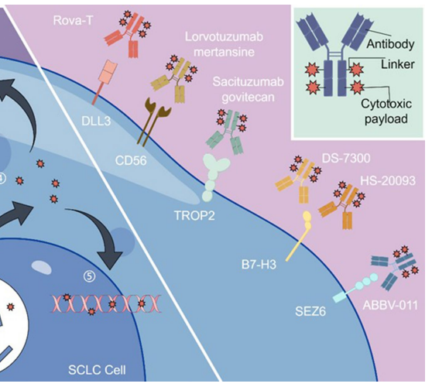
SCLC cell surface targets under active clinical evaluation
B7-H3 (CD276)
B7 family of immune checkpoint proteins
inhibits T-cell activation and promotes immune evasion
SCLC expression ~65%
DLL3 (Delta-like Ligand 3)
Inhibitory TM ligand of the Notch pathway
SCLC expression ~85%
SEZ6 (Seizure Related 6 Homolog)
TM protein on surface of selected neuronal lineage cells
Highly expressed in SCLC
TROP-2 (trophoblast cell-surface antigen 2)
TM glycoprotein involved in cell signaling, proliferation, and migration
SCLC expression low (~18%)
Bispecific EGFR/HER3-ADC: Izalontamab brengitecan (Iza-Bren)
Meng Y et al. Discov Oncol. 2024;15(1):327. Ajay A et al. npj Precis Oncol. 2025;9:1.

Slide 54
Year in Review: Small Cell Lung Cancer
INTRODUCTION: Biopharmacology of SCLC – “Wildfire sparked in dry grass”
MODULE 1: Limited-Stage Disease
MODULE 2: Extensive-Stage Disease
MODULE 3: Paraneoplastic Syndromes – Lambert-Eaton Myasthenic Syndrome
MODULE 4: Bispecific T-Cell Engagers – Tarlatamab
MODULE 5: Antibody-Drug Conjugates – Ifinatamab Deruxtecan
MODULE 6: Other Novel Agents – Alisertib, CAR T-Cell Therapy

Slide 55
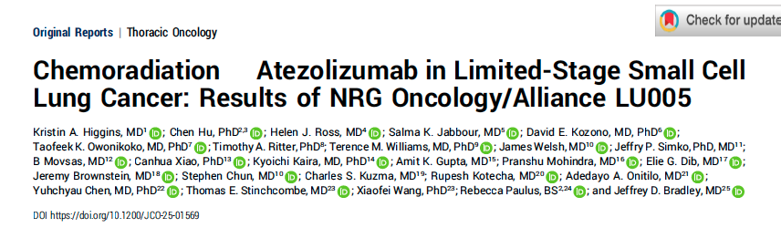
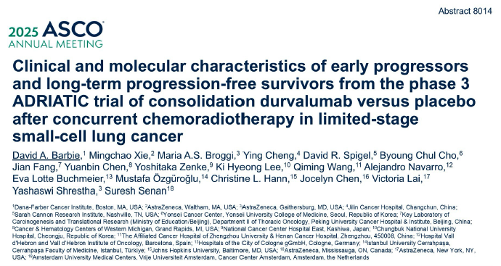
Chemoradiation ± Atezolizumab
J Clin Oncol 2026;44(8):630-40.

Slide 57
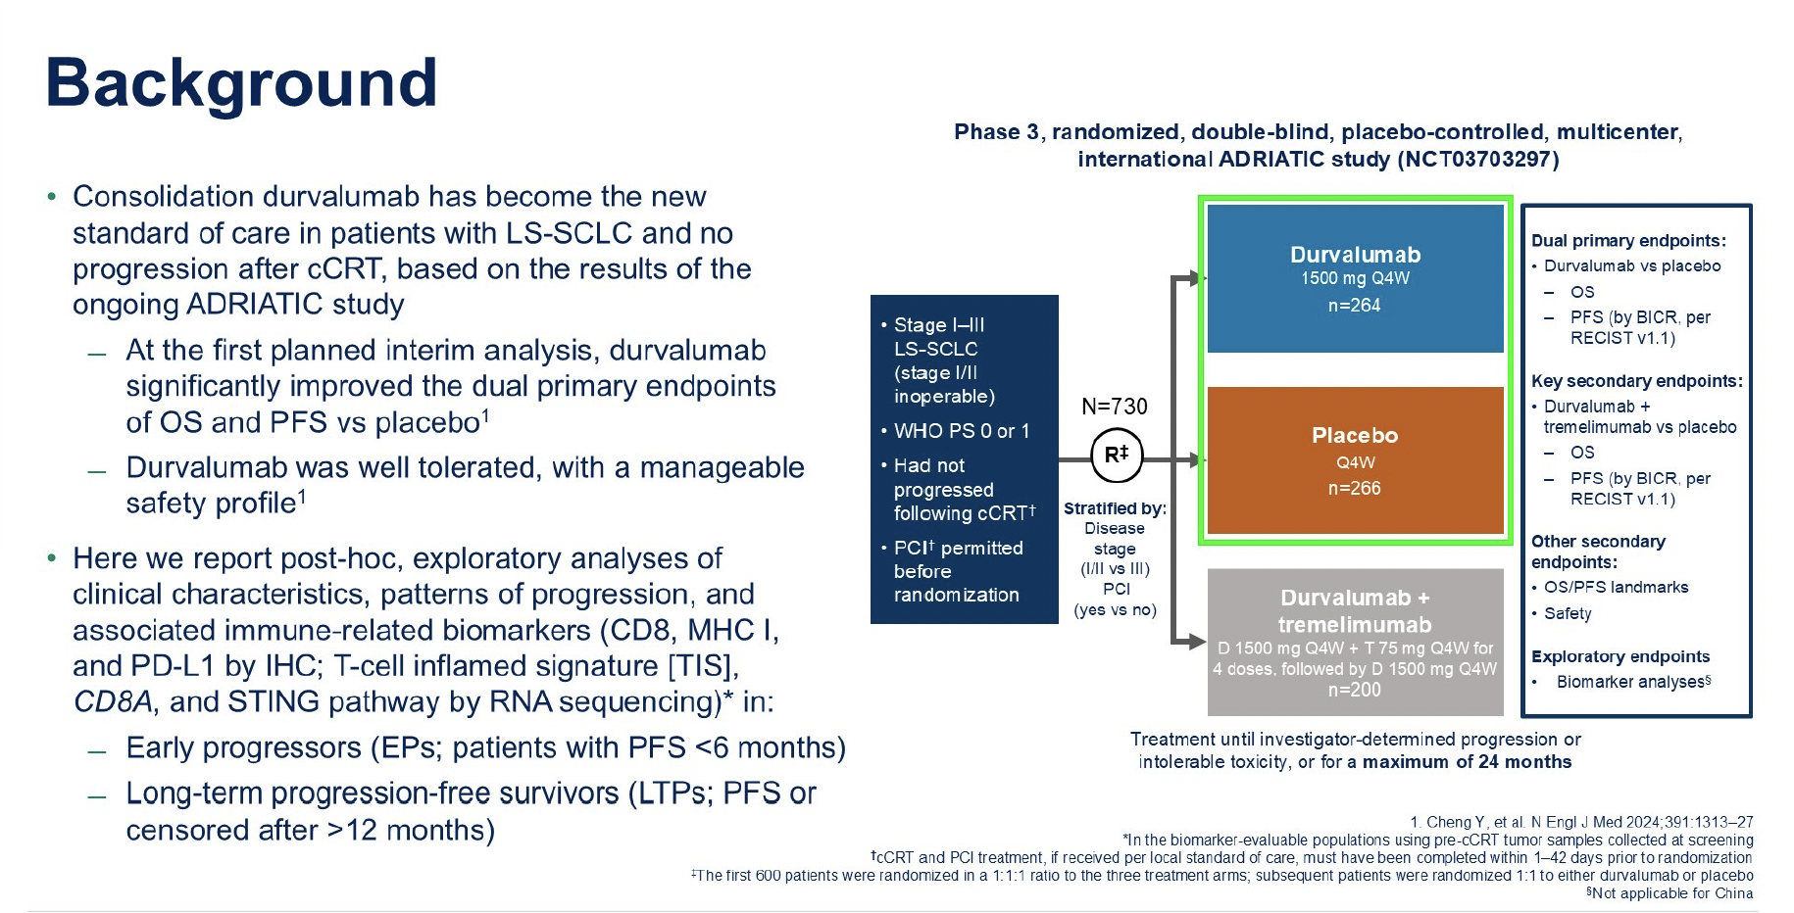
Barbie DA et al. ASCO 2025;Abstract 8014

Slide 58
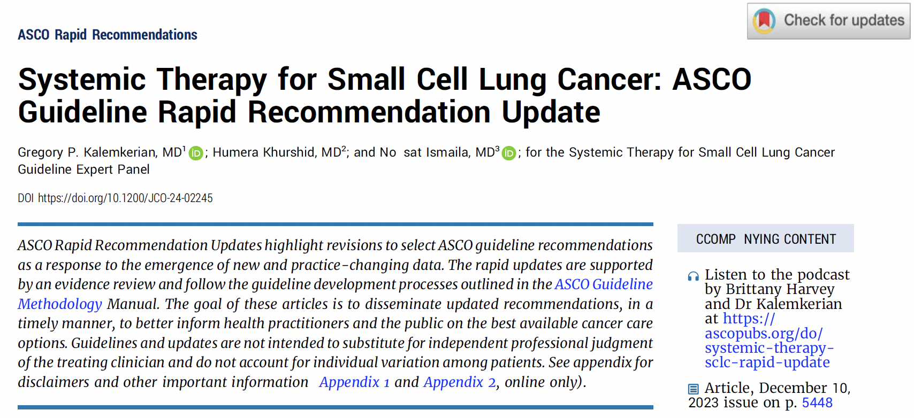
(Appendix 1 and Appendix 2, online only).
J Clin Oncol 2025.;43:101-5.

Slide 59
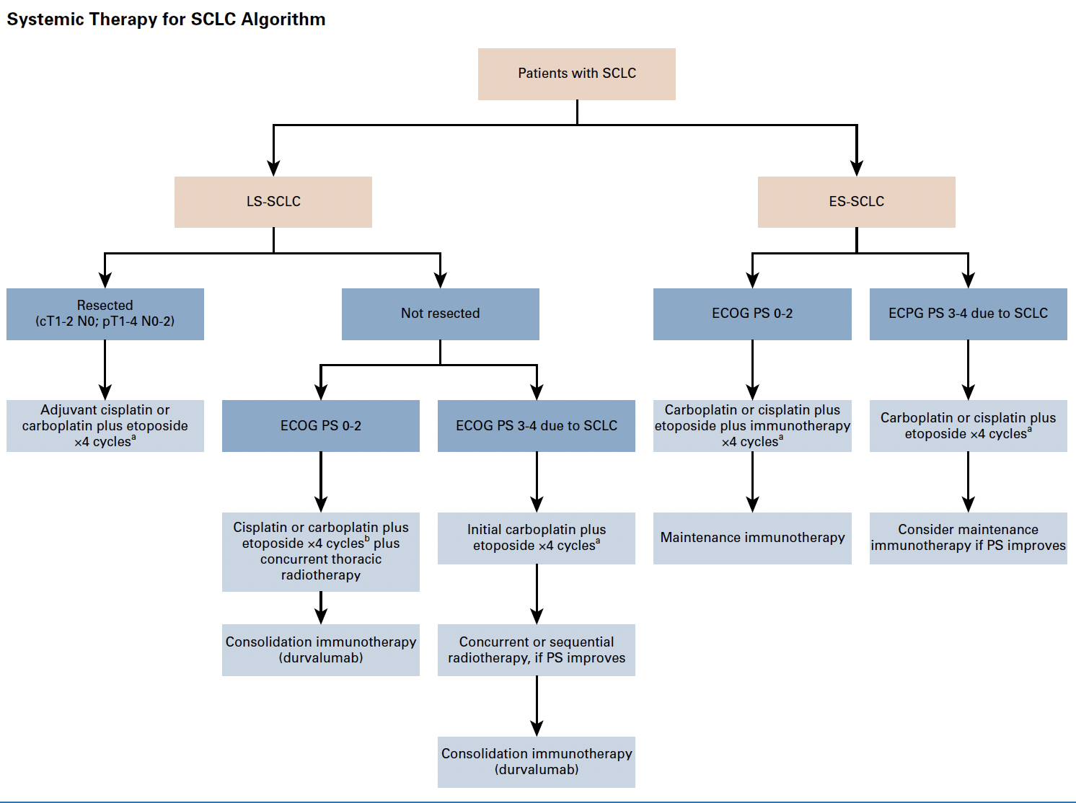
Systemic Therapy Algorithm for SCLC
Kalemkerian GP et al. J Clin Oncol 2025.;43:101-5.

Slide 60
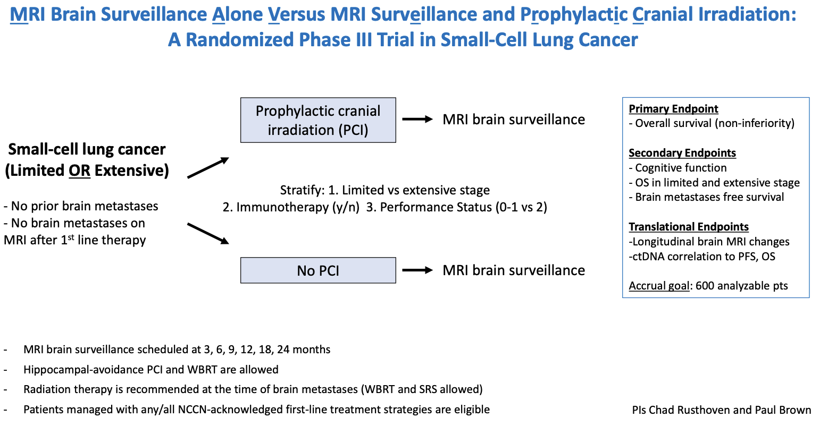
Phase III MAVERICK (SWOG 1827) Study Design
Rusthoven C. www.swog.org. Accessed April 2026.

Slide 61
Year in Review: Small Cell Lung Cancer
INTRODUCTION: Biopharmacology of SCLC – “Wildfire sparked in dry grass”
MODULE 1: Limited-Stage Disease
MODULE 2: Extensive-Stage Disease
MODULE 3: Paraneoplastic Syndromes – Lambert-Eaton Myasthenic Syndrome
MODULE 4: Bispecific T-Cell Engagers – Tarlatamab
MODULE 5: Antibody-Drug Conjugates – Ifinatamab Deruxtecan
MODULE 6: Other Novel Agents – Alisertib, CAR T-Cell Therapy

Slide 62
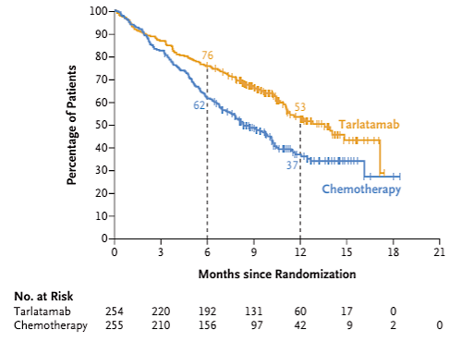
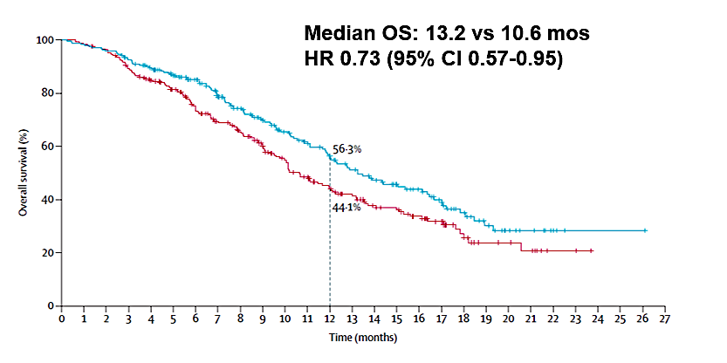
ES SCLC: current landscape
Maintenance
2nd Line
Chemo-ICB
ICB
Tarlatamab
Lurbinectedin
DeLLphi-301/304 improvement in mPFS, mOS
Full Approval Nov 2025
IMforte
improvement in mOS and mPFS
Approved May 2025
Median OS: 13.4 vs 8.3mos
HR 0.6 (95% CI 0.47-0.77)
Lurbinectedin + atezo
Atezo
Paz-Ares L et al. Lancet. 2025;405(10495):2129-2143. Mountzios G et al. N Engl J Med. 2025 Jul 24;393(4):349-361.

Slide 63
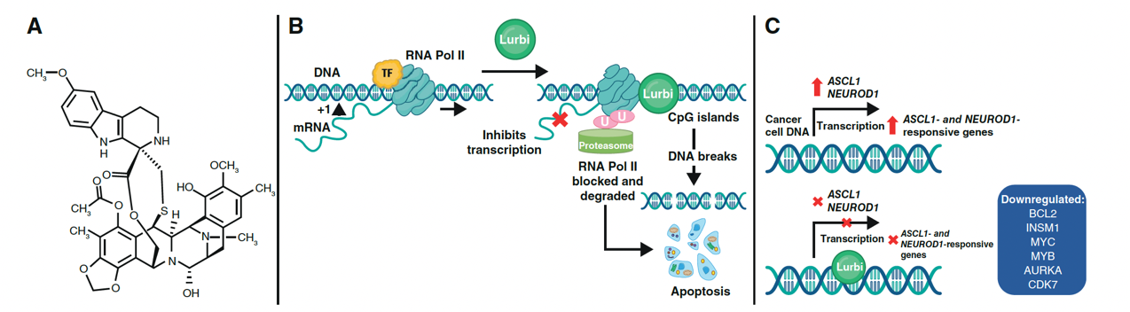
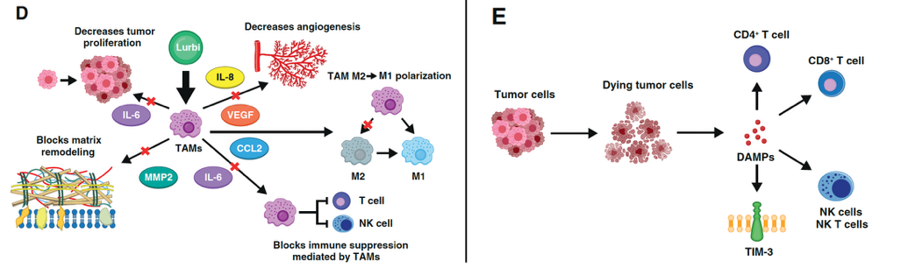
Lurbinectidin - Mode of Action
Calles A et al, Molecular Cancer Therapeutics 2025
Effect on Microenvironment
Indirect Effect on Immunogenicity
Courtesy of Martin Reck, MD

Slide 64
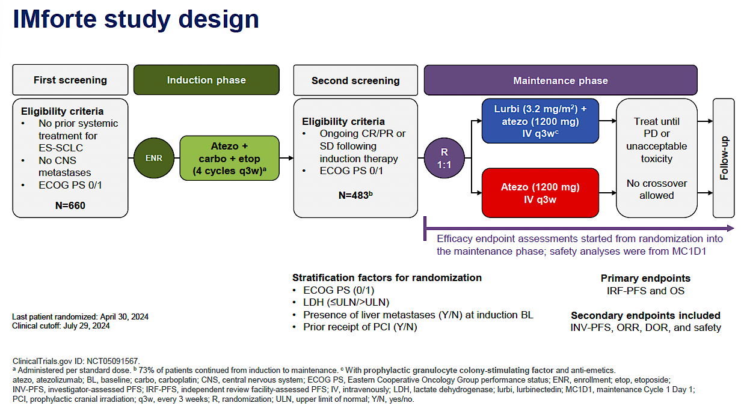
Paz-Ares et al. ASCO 2025;Abstract 8006

Slide 65
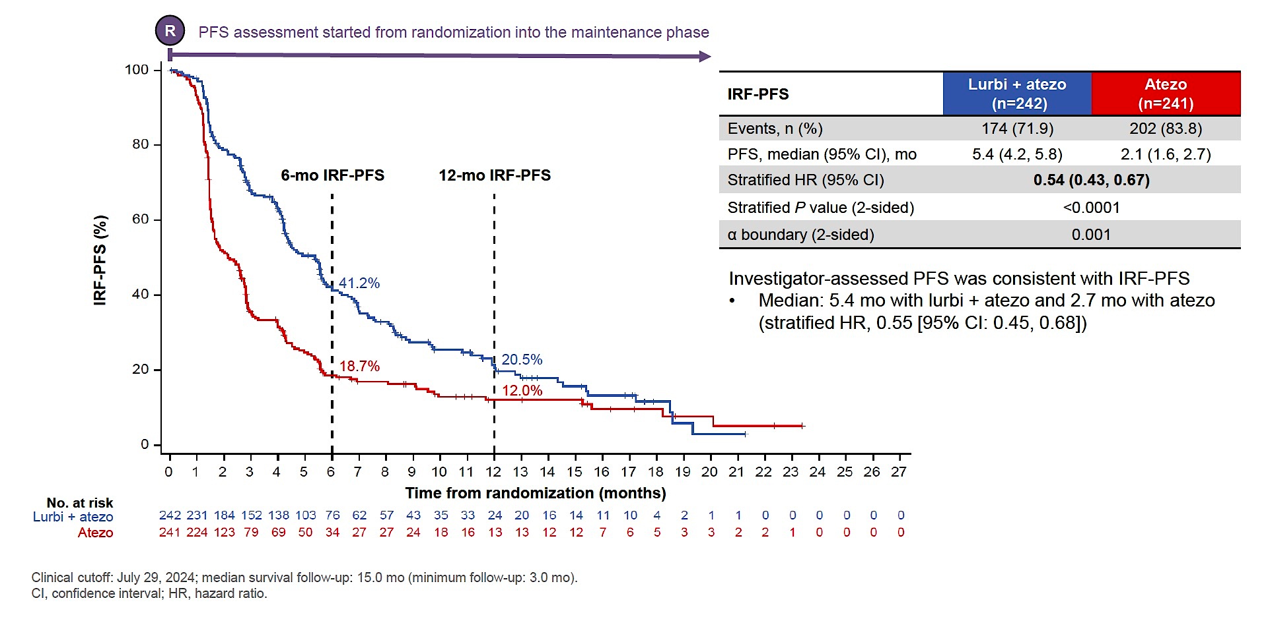
IMforte PFS
Paz-Ares et al. ASCO 2025;Abstract 8006

Slide 66
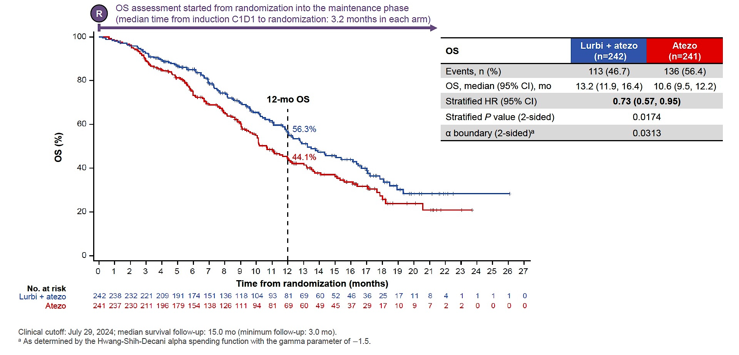
IMforte OS
Paz-Ares et al. ASCO 2025;Abstract 8006

Slide 67
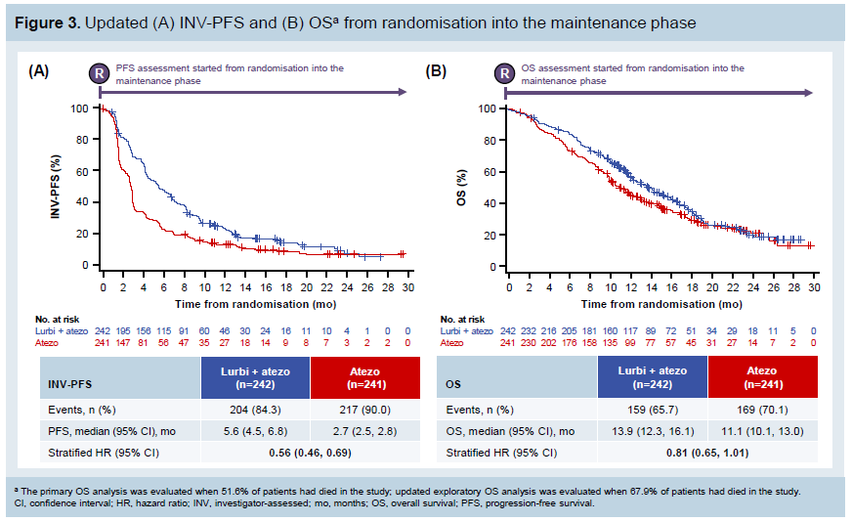
IMforte Updated Curves
Paz-Ares et al. ESMO 2025

Slide 68
Year in Review: Small Cell Lung Cancer
INTRODUCTION: Biopharmacology of SCLC – “Wildfire sparked in dry grass”
MODULE 1: Limited-Stage Disease
MODULE 2: Extensive-Stage Disease
MODULE 3: Paraneoplastic Syndromes – Lambert-Eaton Myasthenic Syndrome
MODULE 4: Bispecific T-Cell Engagers – Tarlatamab
MODULE 5: Antibody-Drug Conjugates – Ifinatamab Deruxtecan
MODULE 6: Other Novel Agents – Alisertib, CAR T-Cell Therapy

Slide 69
Year in Review: Small Cell Lung Cancer
INTRODUCTION: Biopharmacology of SCLC – “Wildfire sparked in dry grass”
MODULE 1: Limited-Stage Disease
MODULE 2: Extensive-Stage Disease
MODULE 3: Paraneoplastic Syndromes – Lambert-Eaton Myasthenic Syndrome
MODULE 4: Bispecific T-Cell Engagers – Tarlatamab
MODULE 5: Antibody-Drug Conjugates – Ifinatamab Deruxtecan
MODULE 6: Other Novel Agents – Alisertib, CAR T-Cell Therapy

Slide 70
Summary
Tarlatamab receives full approval after platinum-based therapy
Multiple other DLL3-TCEs under active development
Early data of tarlamatab in maintenance is extremely promising
ADCs are emerging as a novel therapeutic in SCLC
Early phase studies report response rates of > 50% without patient selection
Multiple Phase 3 RCT are being conducted in the relapsed setting
Multiple studies are ongoing to move ADCs earlier in therapy
Hematologic toxicities are expected given the Topo1i payload
ILD is a concern
Biomarker development is needed to help triage patients
ADC payloads are consistently Topo1 inhibitors, which may limit sequential ADCs
Courtesy of Christine L Hann, MD, PhD

Slide 71
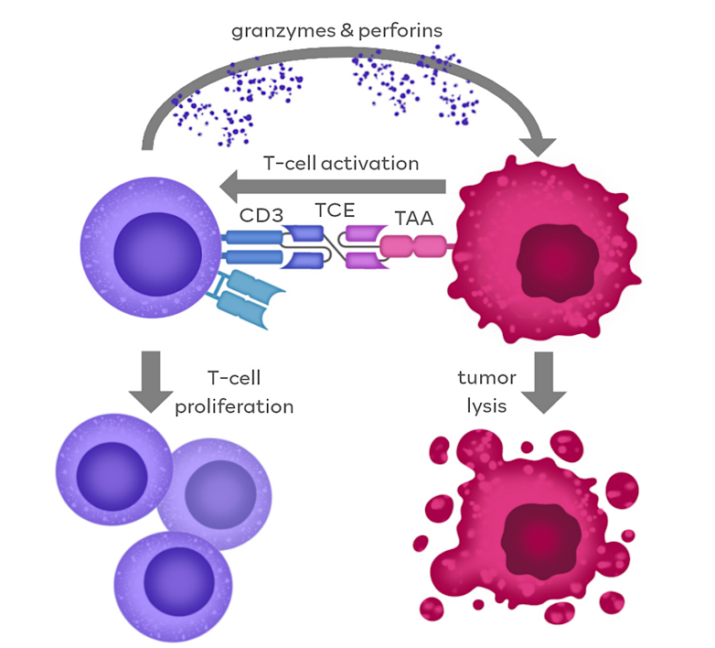
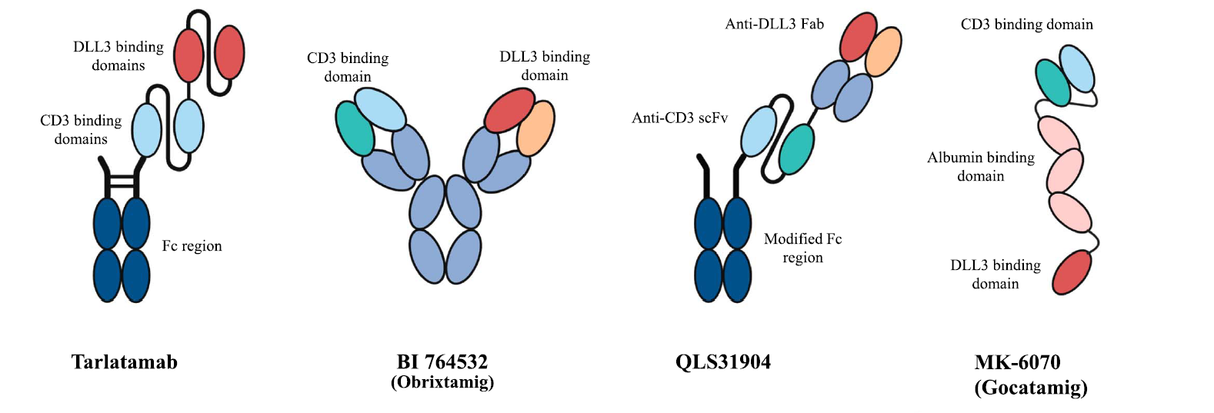
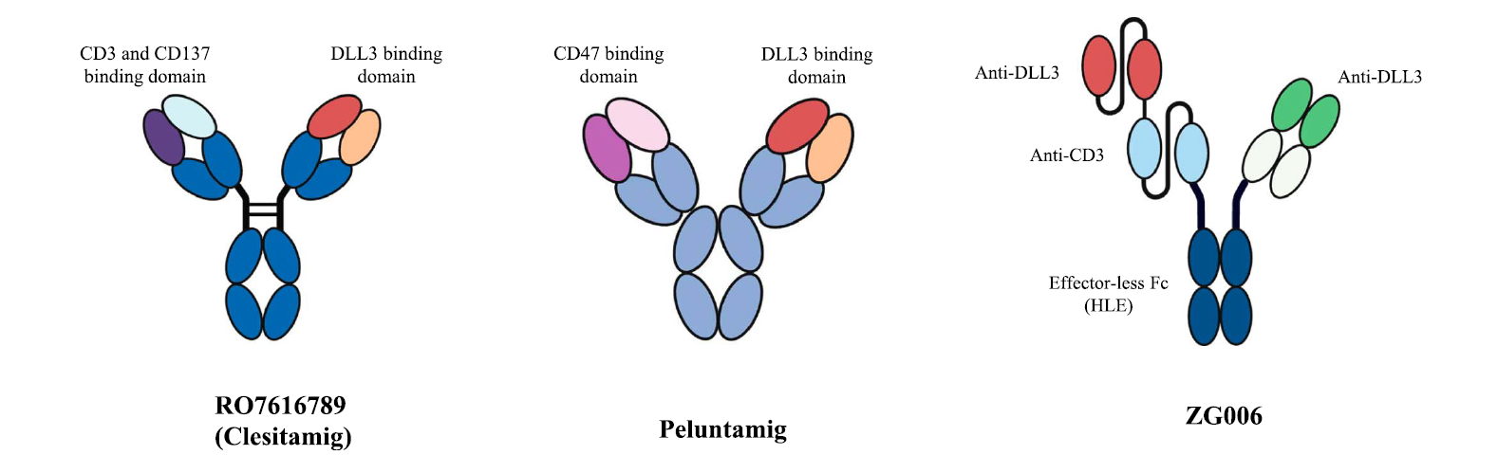
T-cell engagers in SCLC (and other DLL3+ tumors)
DLL3-TCE
Aijaz A et al. Am Soc Clin Oncol Educ Book. 2025 Jun;45(3):e472794.
Cech P et al. Cancers (Basel). 2024 Apr 20;16(8):1580.

Slide 72
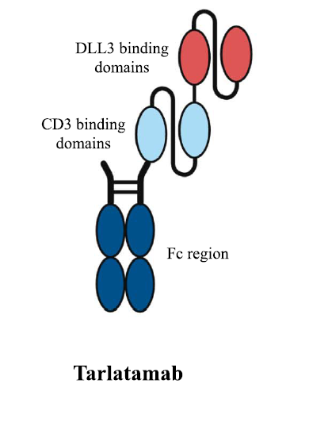
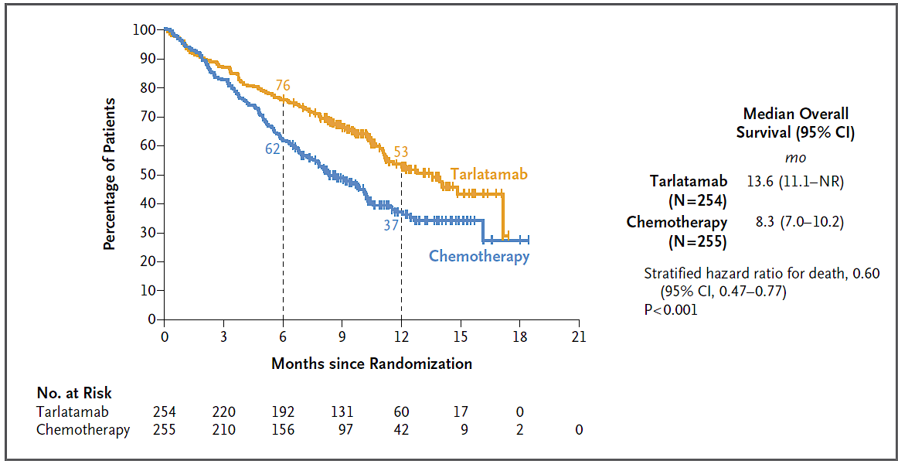
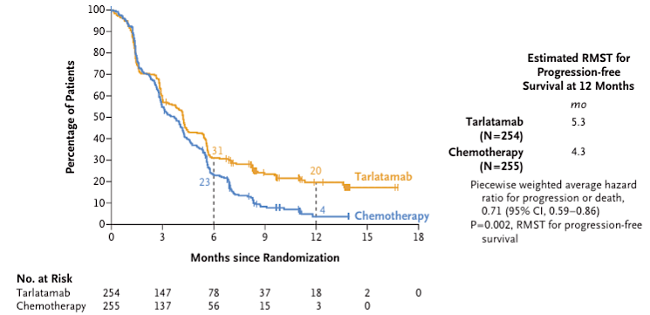
DLL3-TCE
DeLLphi-304: Tarlatamab vs TPC in SCLC after Platinum-Based Chemotherapy
Relapsed SCLC after first-line therapy
- N = 509, randomized to tarlatamab or TPC (topotecan, lurbinectedin, amrubicin)
Primary EP: OS (13.6mos vs 8.3 mos)
Mountzios G et al. Tarlatamab in Small-Cell Lung Cancer after Platinum-Based Chemotherapy. N Engl J Med 2025;393(4):349-61.

Slide 73
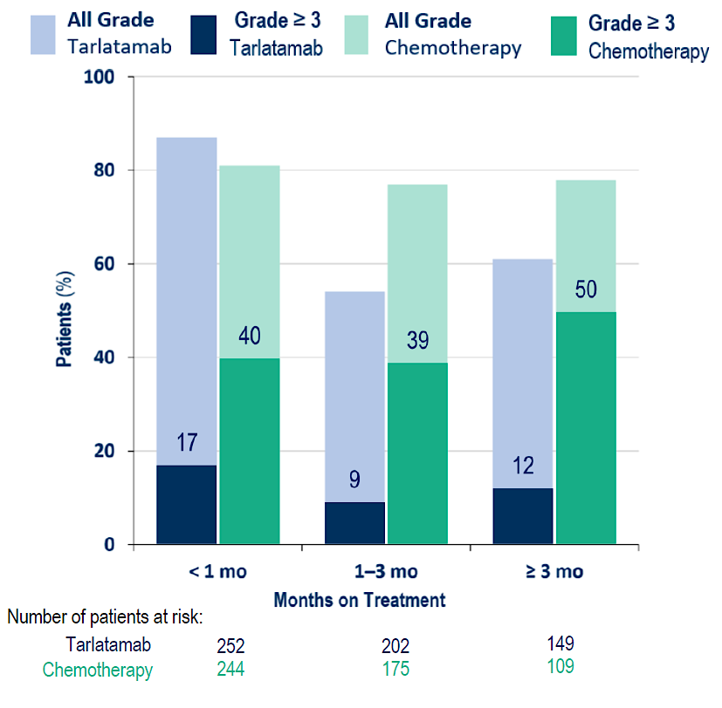
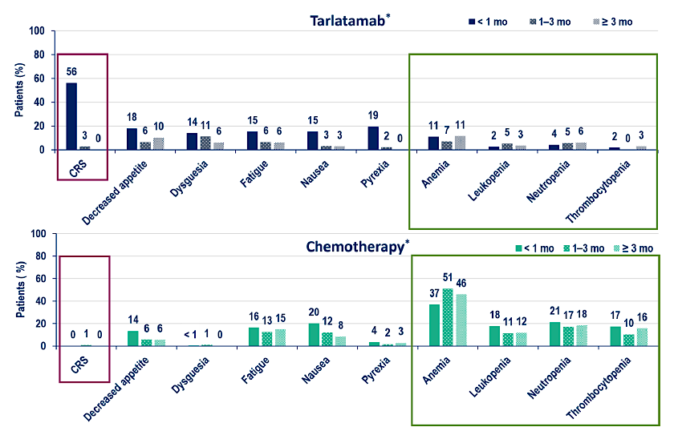
DeLLphi-304 Toxicities: tarlatamab vs chemotherapy
DLL3-TCE
Schuler MH et al. Detailed safety analysis of DeLLphi-304: The first phase III study to evaluate tarlatamab versus chemotherapy for previously treated small cell lung cancer. ESMO 2025;Abstract LBA100.

Slide 74
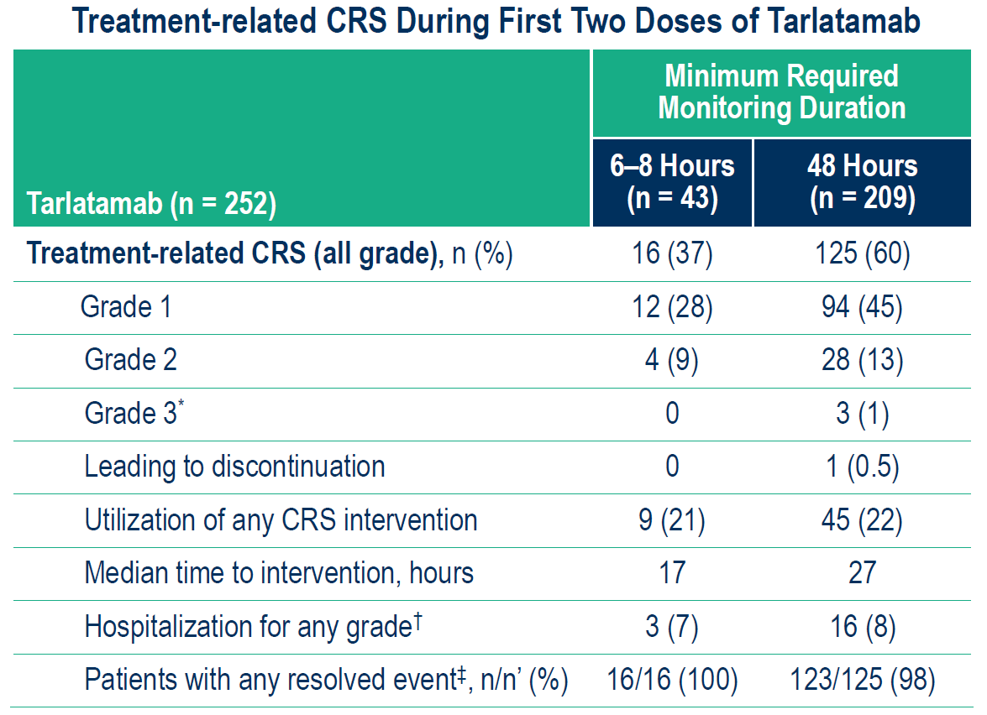
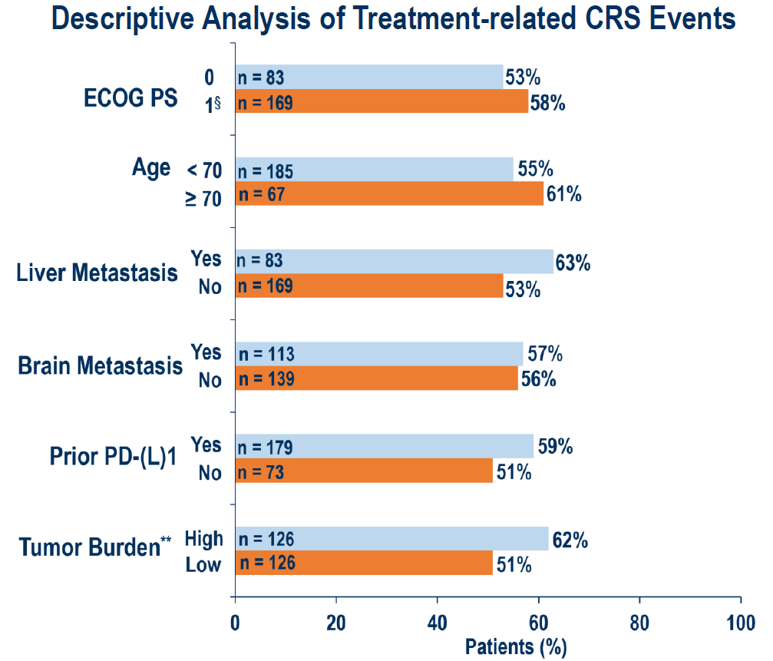
DeLLphi-304 Tarlatamab: CRS timing and subgroup analysis
DLL3-TCE
Schuler MH et al. Detailed safety analysis of DeLLphi-304: The first phase III study to evaluate tarlatamab versus chemotherapy for previously treated small cell lung cancer. ESMO 2025;Abstract LBA100.

Slide 75
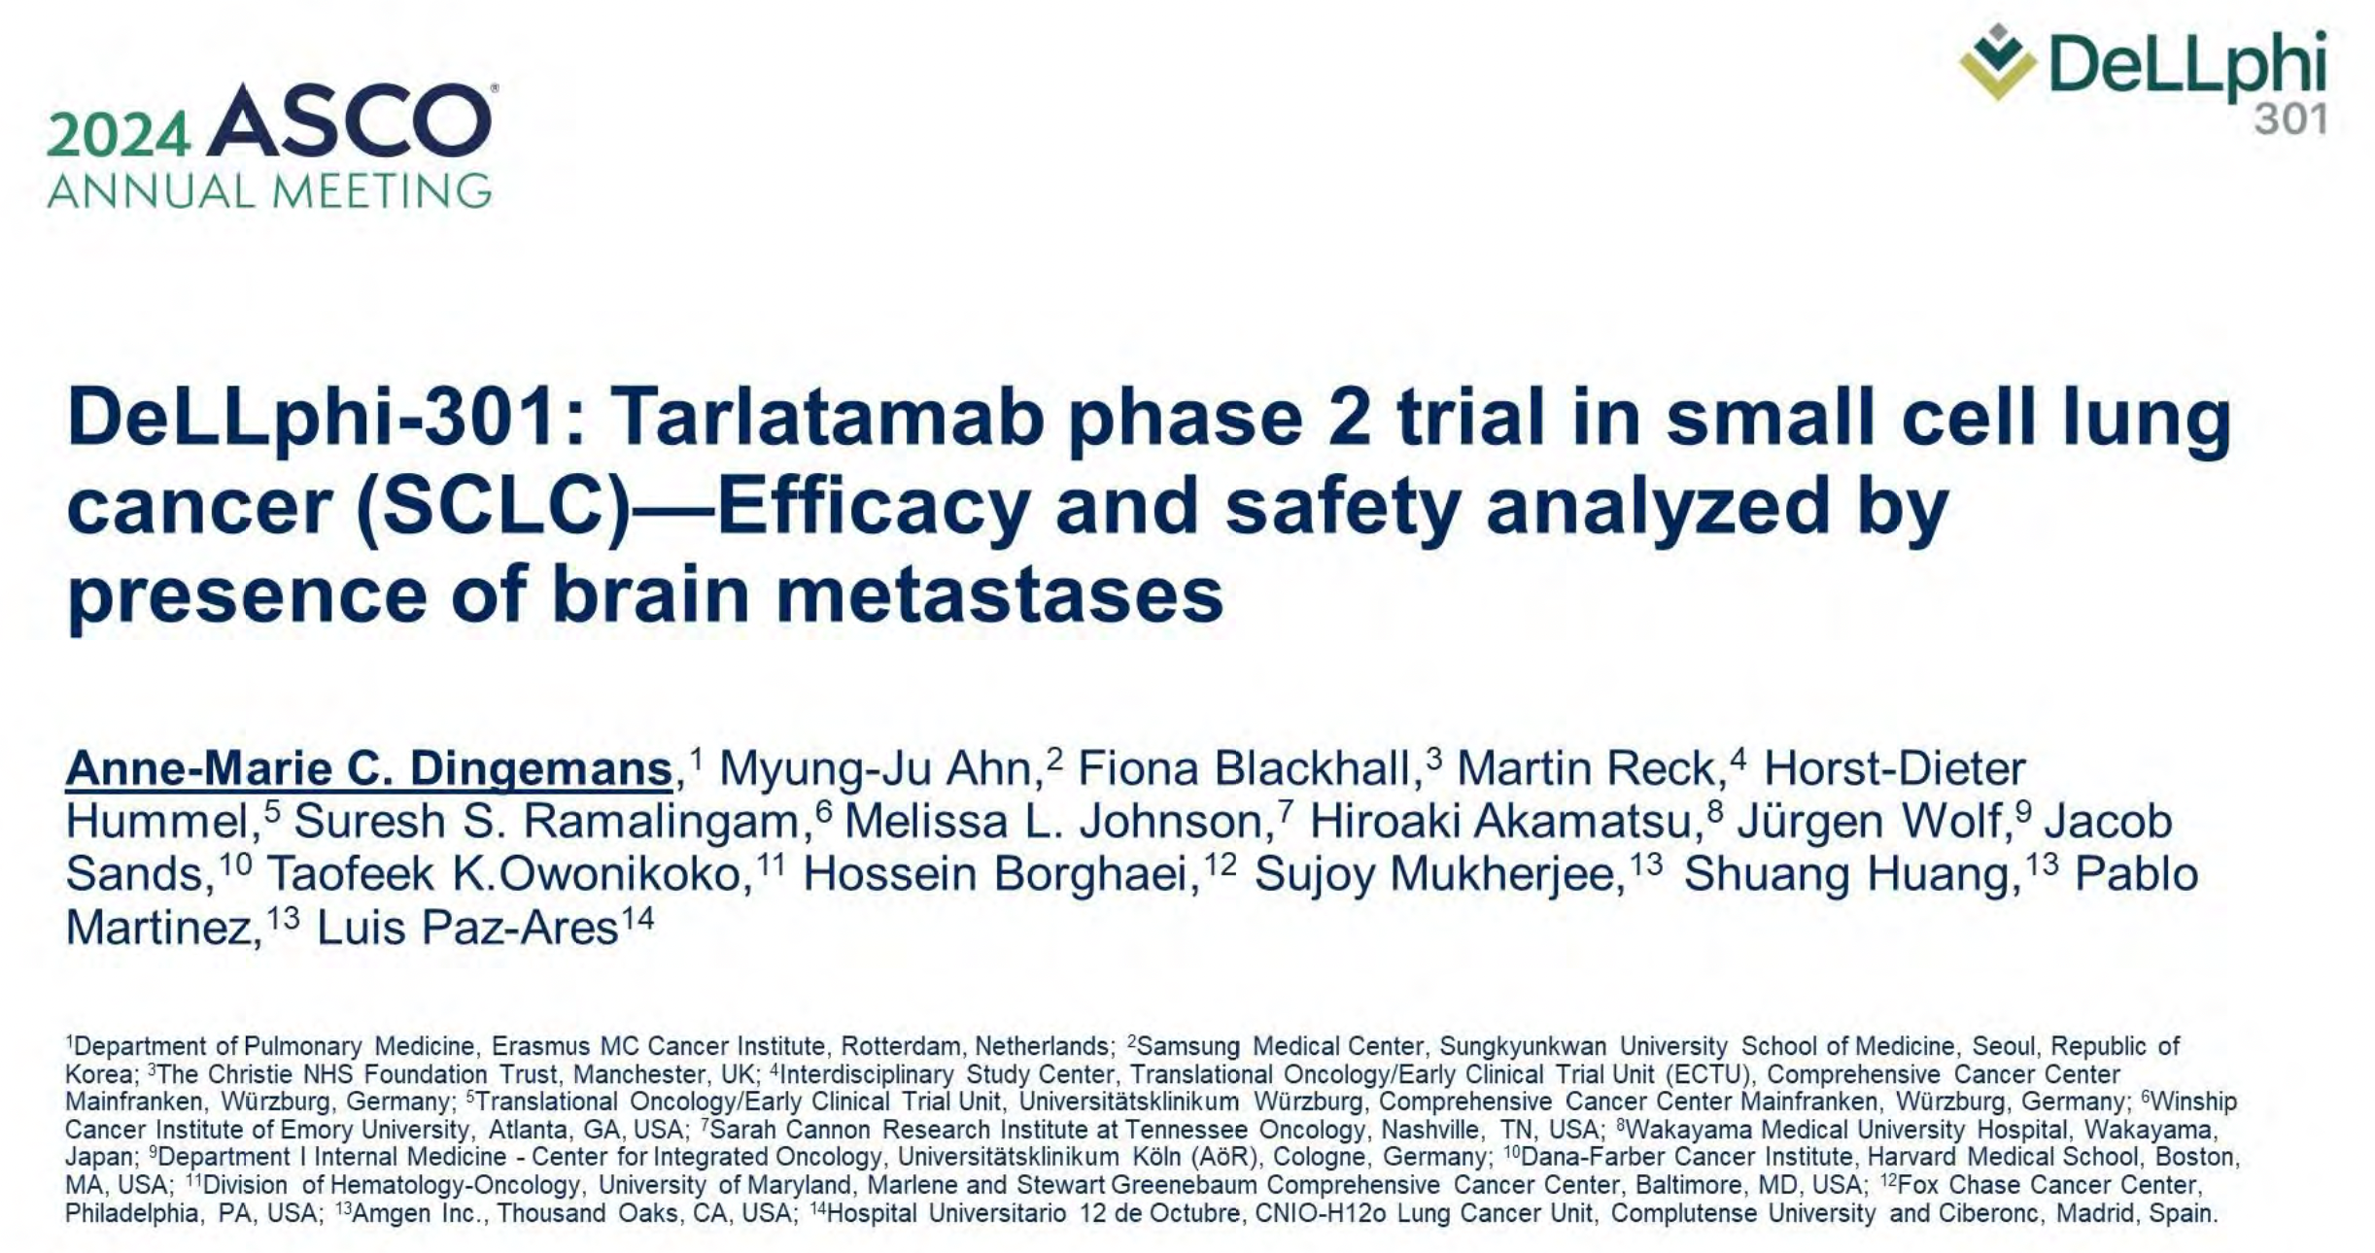

Slide 76
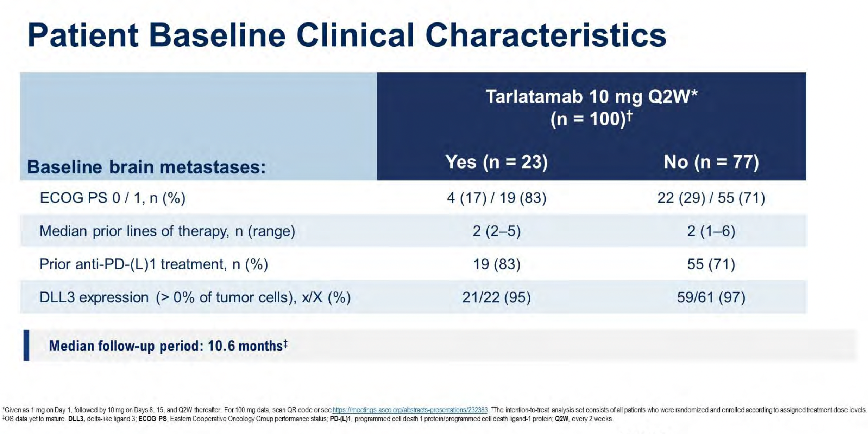
Dingemans A-M C et al. ASCO 2024;Abstract 8015

Slide 77
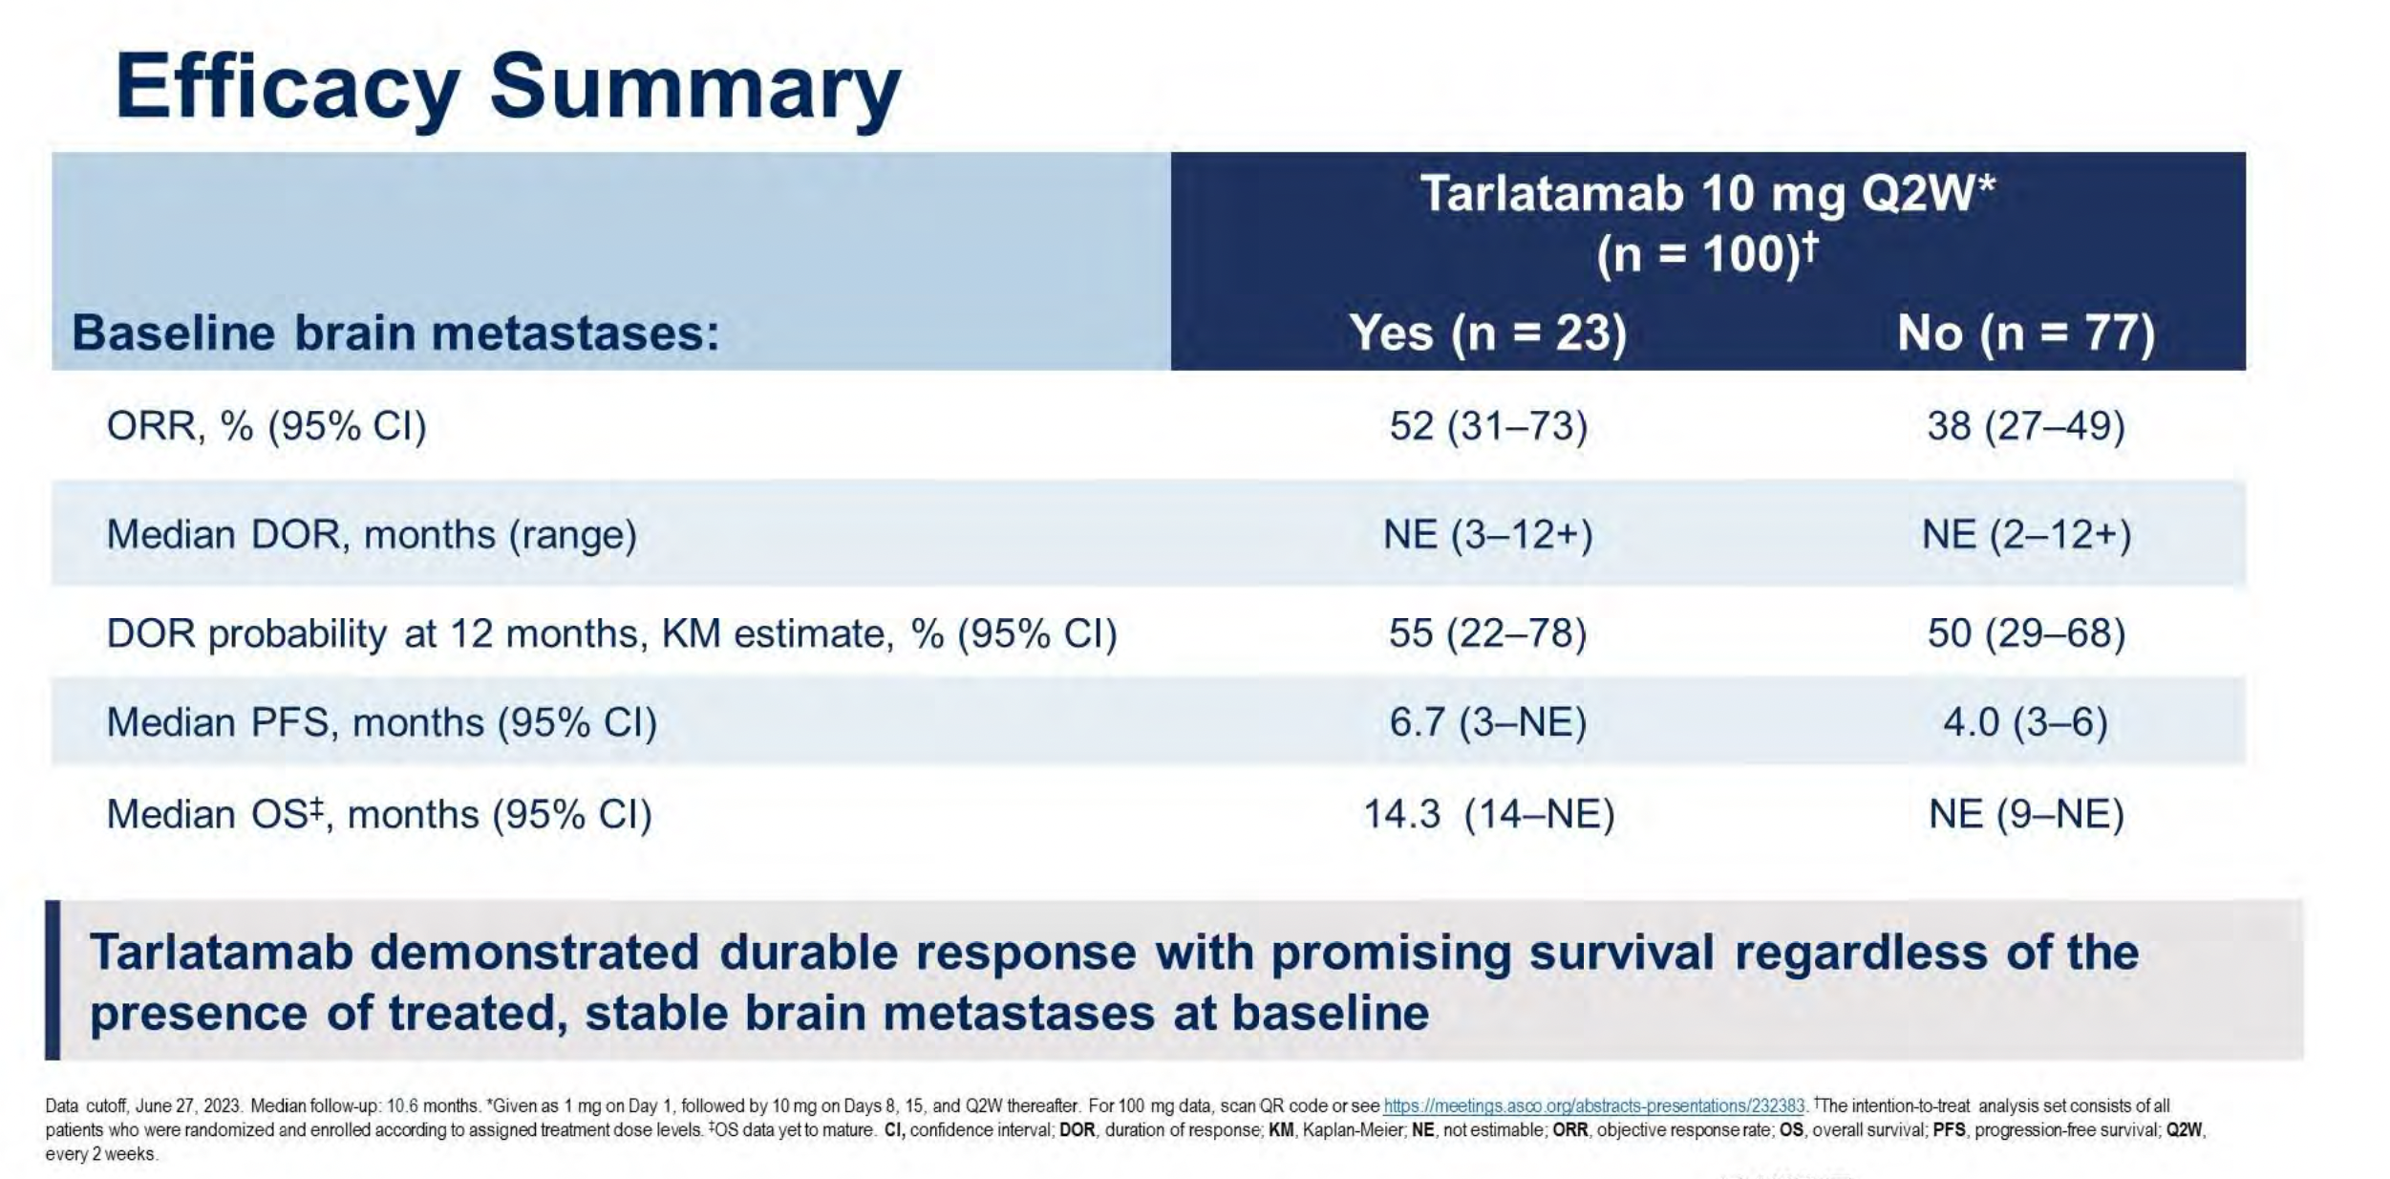
Dingemans A-MC et al. ASCO 2024;Abstract 8015.

Slide 78
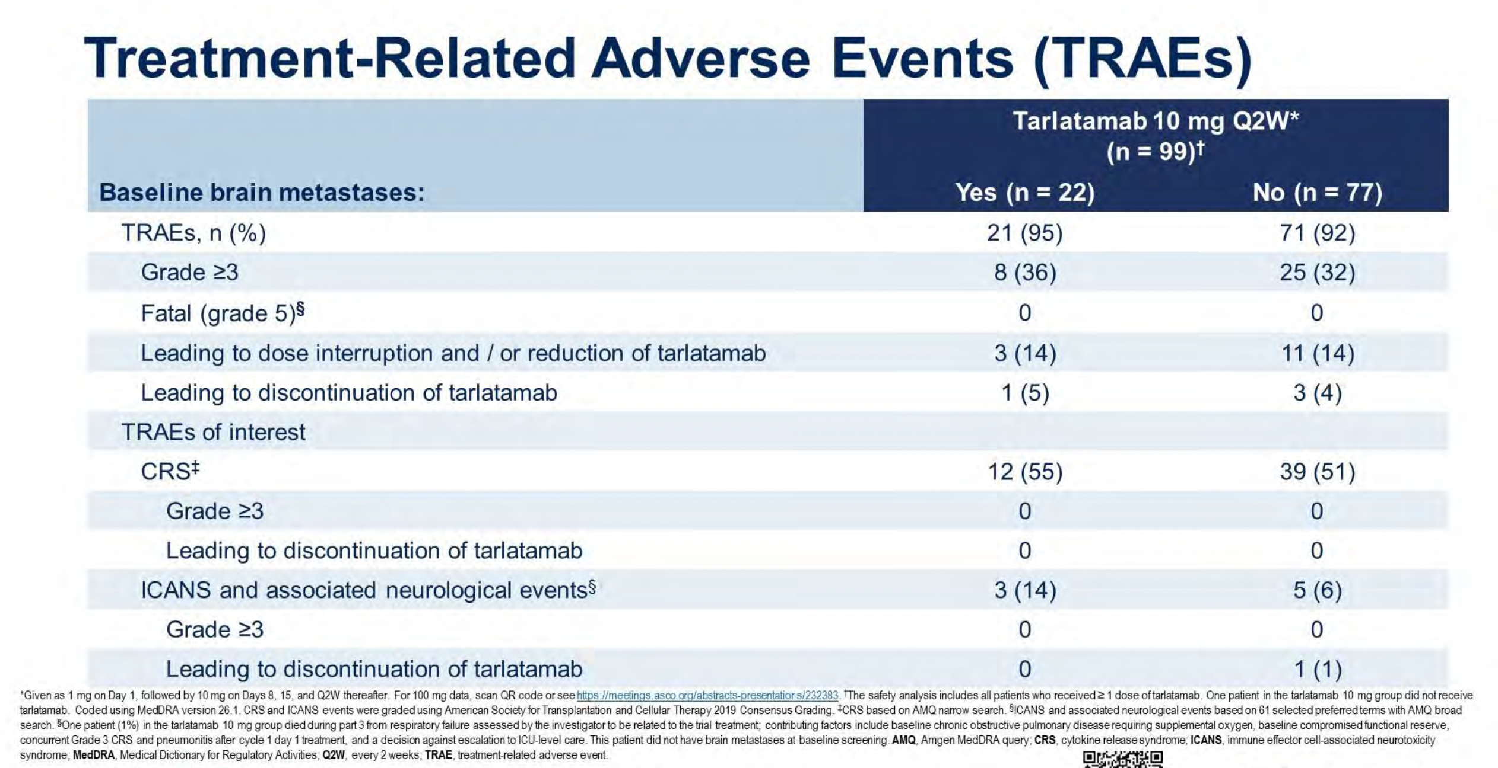
Dingemans A-MC et al. ASCO 2024;Abstract 8015.

Slide 79
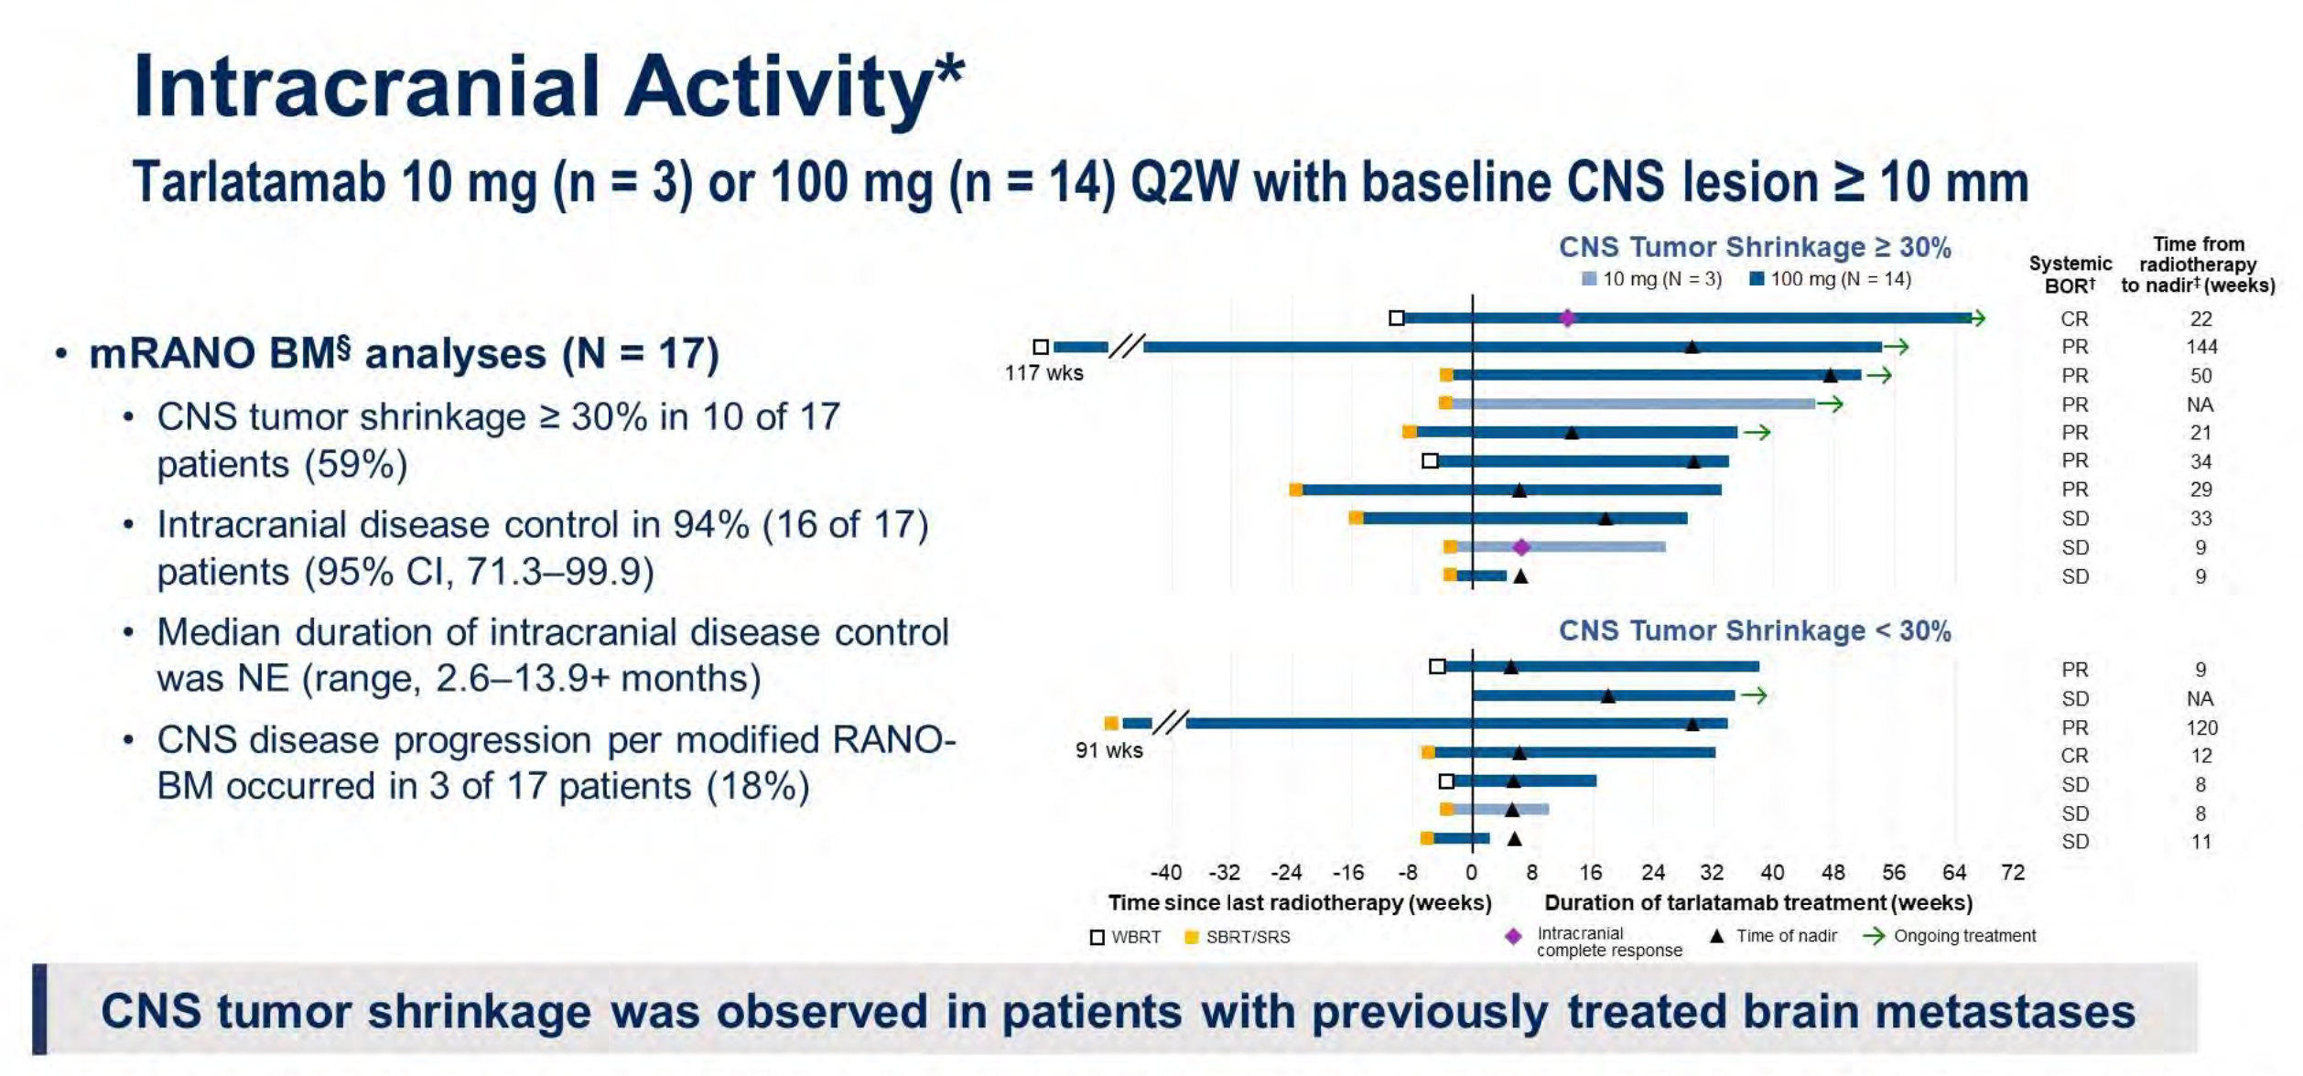
Dingemans A-MC et al. ASCO 2024;Abstract 8015.

Slide 80
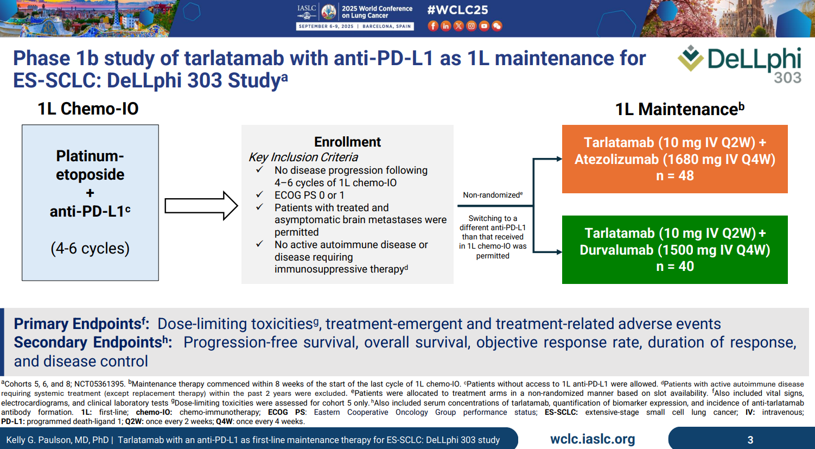

Slide 81
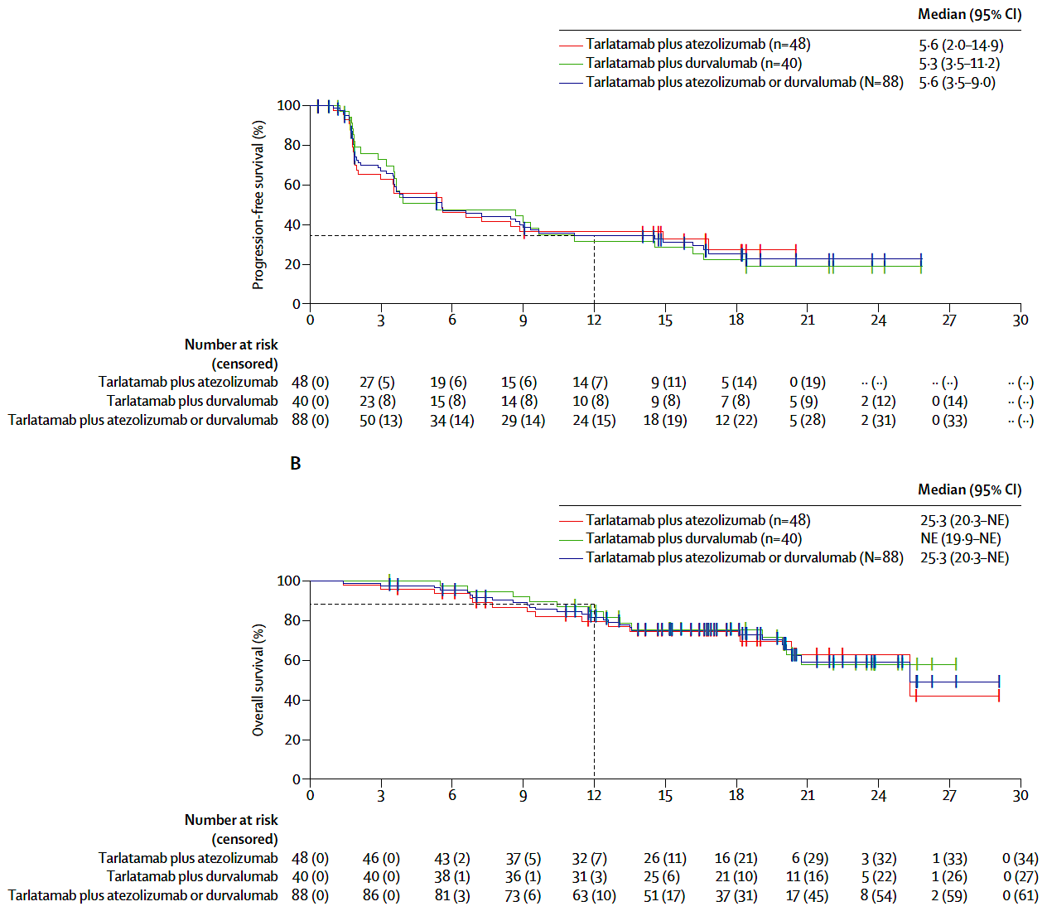
Paulson et al. Lancet Oncol. 2025

Slide 82
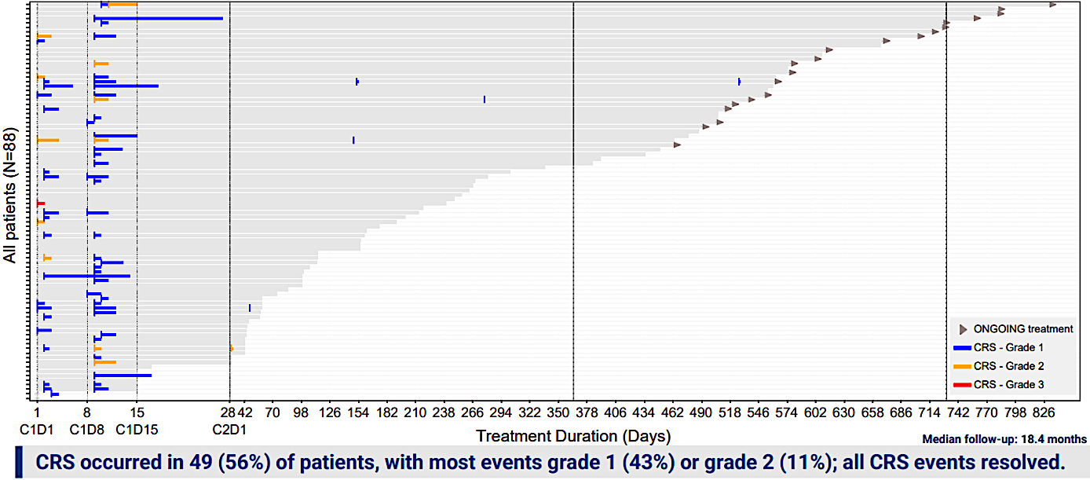
DeLLphi-303
Paulson et al. WCLC 2025

Slide 83
Tarlatamab Studies
DLL3-TCE
Trial number | Setting | Description | Phase | Estimated completion
NCT06117774 | LS SCLC consolidation | Tarlatamab after chemoRT (DeLLphi-306) | Ph 3 | 03/31/30
NCT07005128 | 1st line | Tarlatamab, Durvalumab, Carboplatin, and Etoposide Versus Durvalumab, Carboplatin, and Etoposide in First-line ES SCLC (DeLLphi-312) | Ph3 | 01/04/29
NCT06211036 | 1st line maintenance | Tarlatamab and Durvalumab Versus Durvalumab Alone following Platinum, Etoposide and Durvalumab (DeLLphi-305) | Ph3 | 07/05/27
NCT06745323 | Relapsed | Tarlatamab Dosing Regimens in Subjects With SCLC (DeLLphi-309) | Ph2 | 02/13/29
NCT06898957 | Multiple | Tarlatamab in Combination With YL201 With or Without Anti-programmed Death Ligand 1 (PD-L1) | Ph1b | 04/23/31
NCT06598306 | Relapsed | Subcutaneous Tarlatamab in Participants With ES SCLC (DeLLphi-308) | Ph1b | 01/02/27
NCT06957314 |  | Hospital-at-Home for People Receiving Tarlatamab |  | 4/23/28
Courtesy of Christine L Hann, MD, PhD

Slide 84
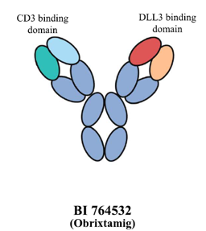
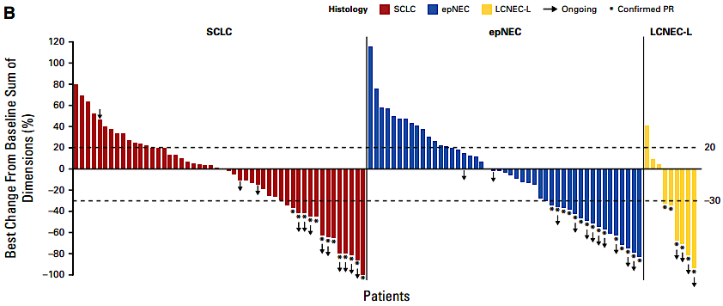
DLL3-TCE
Obrixtamig: Phase 1a dose-escalation
Obrixtamig is an IgG-like TCE, which allows for less frequent dosing
Relapsed SCLC (n = 61), epNEC, LCNEC, DLL3+
Doses: 4 dosing schedules: including 2 fixed doses (A, B1)
- B2) step-up dose qW x 2, target dose qW
- B3) Step-up dose qW x 3, target dose qW x 3; then q3W
Primary EP: MTD
Summary
B2/B3 - Step-up schedules moving forward
Doses: 90qW; 1,080 q3W mg/kg
MTD not reached
CRS 57% (G3+ 3%)
ORR 20% (B2, B3)
DCR 42.6%
Studies
+ PD-1 in DLL3+ SCLC/NEC
+ PD-1 1st line in DLL3+ NEC
Ph2 dose selection SCLC
With Topotecan in SCLC
1st ES SCLC
Wermke M et al. Phase I Dose-Escalation Results for the Delta-Like Ligand 3/CD3 IgG-Like T-Cell Engager Obrixtamig (BI 764532) in Patients With Delta-Like Ligand 3+ Small Cell Lung Cancer or Neuroendocrine Carcinomas. J Clin Oncol 2025;43(27):3021-31.(NCT04429087)

Slide 85
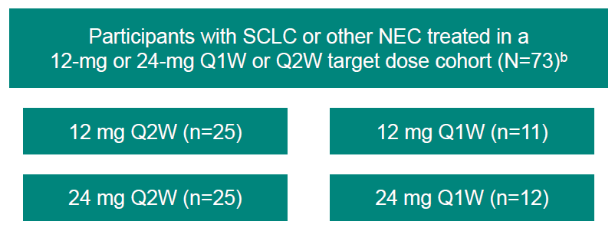
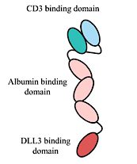
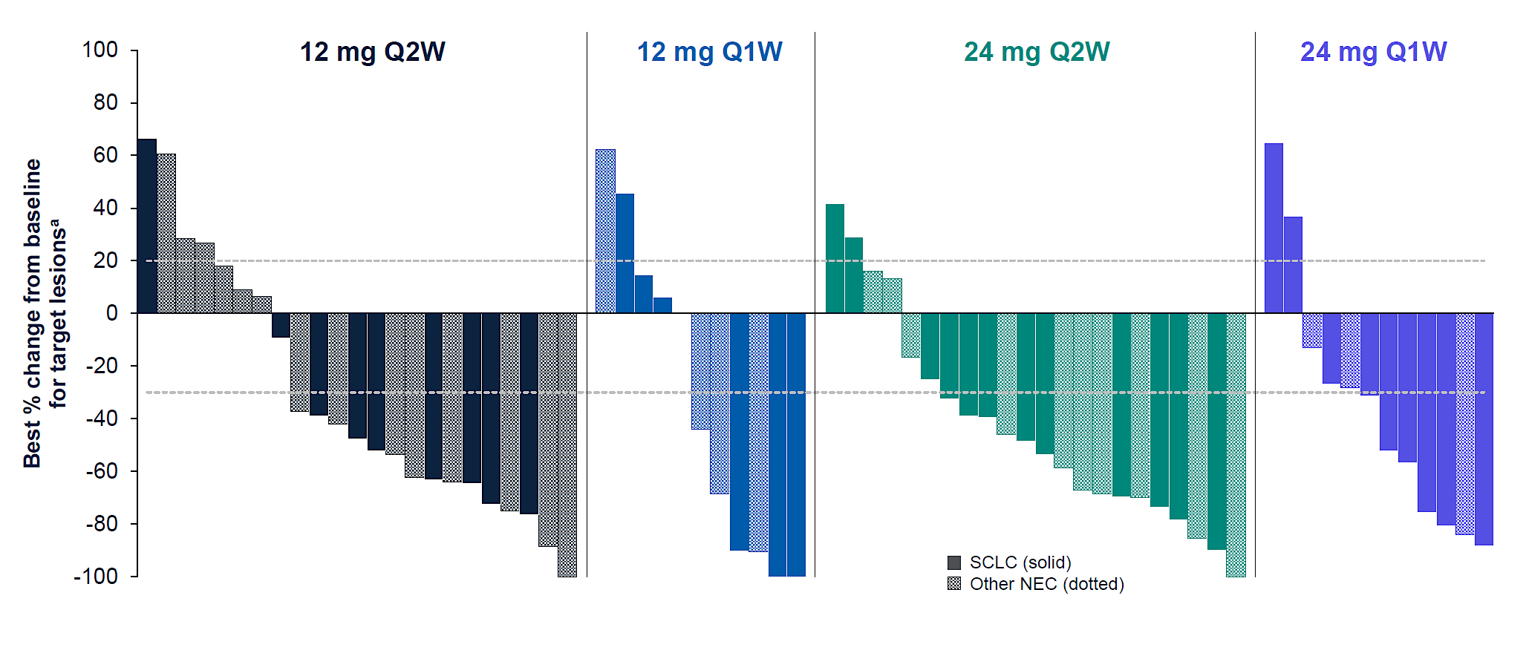
DLL3-TCE
Gocatamig: Phase 1/2 Study for SCLC and other NEC
Phase 1/2 study
- with 4 dosing schedules: either 1 or 2 step-up dosing
Relapsed SCLC or other NEC
Primary EP: Safety/tolerability
Summary
Monotherapy dose: 24mg q2W
Toxicities manageable
no DLTs, CRS Gr1-2 (98%)
SCLC ORR = 46%
Study
Phase 1b/2 of MK-6070 and I-DXd in Participants With Relapsed SCLC (NCT06780137)
DLL3-directed T-cell engager developed using the TriTAC®platform: small size (~50kDa), prolonged half-life (13.8 days)
Beltran H et al. Updated results from a phase I/II study of gocatamig for small cell lung cancer (SCLC) and other neuroendocrine cancers.
ESMO 2025;Abstract 2758MO.

Slide 86
Year in Review: Small Cell Lung Cancer
INTRODUCTION: Biopharmacology of SCLC – “Wildfire sparked in dry grass”
MODULE 1: Limited-Stage Disease
MODULE 2: Extensive-Stage Disease
MODULE 3: Paraneoplastic Syndromes – Lambert-Eaton Myasthenic Syndrome
MODULE 4: Bispecific T-Cell Engagers – Tarlatamab
MODULE 5: Antibody-Drug Conjugates – Ifinatamab Deruxtecan
MODULE 6: Other Novel Agents – Alisertib, CAR T-Cell Therapy

Slide 87
ADCs in SCLC: Summary & Challenges
Agent | Target | Payload | N | ORR | IC activity | Toxicities
IDXd (12 mg/kg) | B7-H3 | Topo1i | 137 | 48% | Y (38/58%) | ILD 12.3%
YL201 | B7-H3 | Topo1i | 53 | 64% | Y (30%) | ILD 1.3%
HS-20093 (8 mg/kg) | B7-H3 | Topo1i | 26 | 61% | NR | ILD 1%
MHB088C (2mg/kg) | B7-H3 | Topo1i | 33 | 42% | NR
SHR-4849/IDE849 | DLL3 | Topo1i | 100 | 73% | Y (83.3%) | NR
ZL-1310 | DLL3 | Topo1i | 89 | 47% | Y (33%) | ILD 10%
ABBV-706 | SEZ6 | Topo1i | 80 | 58% | Y (57%) | ILD 9%
Sacituzumab Govitecan | TROP2 | Topo1i | 43 | 42%
Iza-Bren | EGFR-HER3 | Topo1i | 58 | 48.1% | NR | Not reported
Conclusions
Active agents!
CNS activity reported
Challenges
Toxicities (ILD)
Lack of biomarkers
Same payload
Courtesy of Christine L Hann, MD, PhD

Slide 88
Ifinatamab Deruxtecan Granted Priority Review in the US for Adult Patients with Previously Treated Extensive-Stage SCLC Who Experienced Disease Progression on or After Platinum-Based Chemotherapy Press Release: April 13, 2026
“[On April 13, 2026, the manufacturer’s] Biologics License Application (BLA) for ifinatamab deruxtecan (I-DXd) has been accepted and granted Priority Review by the U.S. Food and Drug Administration (FDA) for the treatment of adult patients with extensive-stage small cell lung cancer (ES-SCLC) with disease progression on or after platinum-based chemotherapy.
The BLA is based on results from the IDeate-Lung01 phase 2 trial, with support from the IDeate-PanTumor01 phase 1/2 trial. Results from the primary analysis of IDeate-Lung01 were presented at the 2025 World Conference on Lung Cancer hosted by the International Association for the Study of Lung Cancer (#WCLC25) and published in the Journal of Clinical Oncology. Ifinatamab deruxtecan also was previously granted Breakthrough Therapy Designation by the FDA in August 2025 for the treatment of adult patients with ES-SCLC with disease progression on or after platinum-based chemotherapy.”
https://daiichisankyo.us/press-releases/-/article/ifinatamab-deruxtecan-granted-priority-review-in-the-us-for-adult-patients-with-previously-treated-extensive-stage-small-cell-lung-cancer-who-experienced-disease-progression-on-or-after-platinum-based-chemotherapy

Slide 89
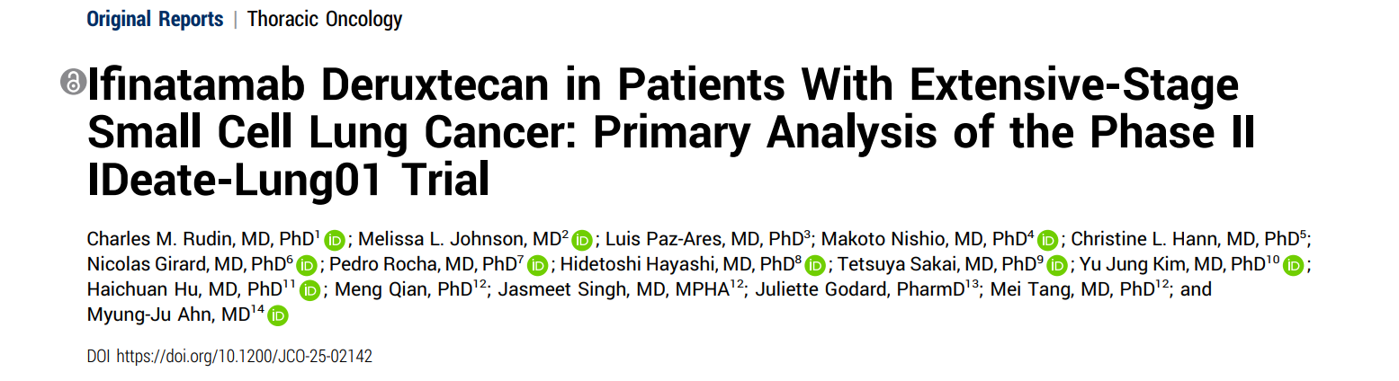

Slide 90
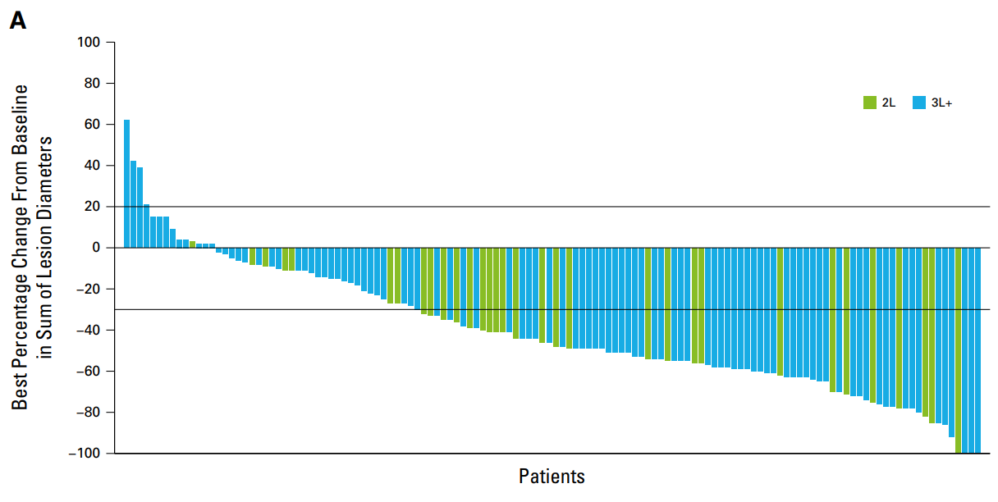
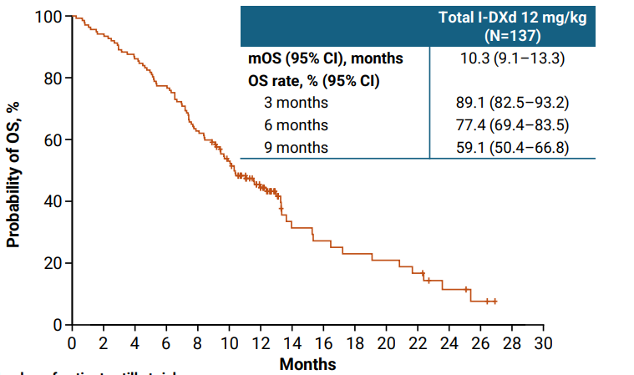
Ifinatamab Deruxtecan (IDXd)
B7-H3 ADC
IDeate-Lung01: Phase 2 randomized study relapsed SCLC
Dose optimization: 8mg/kg vs 12 mg/kg q3W
dose expansion: 12 mg/kg (n= 137 at 12 mg/kg)
Relapsed SCLC after platinum-based CT
Asymptomatic CNS disease
1 EP: ORR by BICR
Activity
ORR: 48.2% (56.3% 2L)
mDOR 5.3 mos
mPFS: 4.9 mos
mOS: 10.3 mos
IC responses observed in
38.5% (prior RT)
57.7% (no prior RT)
Responses observed post-tarla
ORR: 48.2%
Toxicities
36.5% ≥ G3 TRAEs
Hematologic (≤14%)
GI (<10%)
ILD-pneumonitis:
12.4% (most G1/2)
4.4% G3
3 G5, 1 related
Ahn MJ et al. WCLC 2025. Abstract OAO6.03. Rudin CM et al. J Clin Oncol. 2025;JCO-25-02142. Rocha P et al. ESMO 2025. Abstract 2760MO.

Slide 91


Phase II Ideate-Lung01 Trial: Antitumor Activity of I-DXd
Rudin CM et al. J Clin Oncol 2026;44:261-273.

Slide 92

Phase II Ideate-Lung01 Trial: Confirmed Response by BICR
Rudin CM et al. J Clin Oncol 2026;44:261-273.

Slide 93

IDeate-Lung01: intracranial activity of IDXd
B7-H3 ADC
Simoes da Rocha PF et al. Intracranial activity of ifinatamab deruxtecan (I-DXd) in patients (pts) with extensive-stage (ES) small cell lung cancer (SCLC) and baseline (BL) brain metastases (BM): Primary analysis of IDeate-Lung01. ESMO 2025;Abstract 2760MO.

Slide 94

Phase II Ideate-Lung01 Trial: Adverse Events
TEAE = treatment-emergent adverse event
Rudin CM et al. J Clin Oncol 2026;44:261-273.

Slide 95

Phase II Ideate-Lung01 Trial: Adverse Events
Rudin CM et al. J Clin Oncol 2026;44:261-273.

Slide 96


Slide 97

WCLC 2025;Abstract P3.18.73.

Slide 98


Slide 99
B7-H3 ADC
Multiple B7-H3 ADCs are under development
 | IDXd | YL-201 | MHB-088C | HS20093/ GSK 5764227
Payload | Topo-1 inhibitor (exatecan-derivative) | Novel Topo-1 inhibitor | Topo-1 inhibitor (“SuperTopo1”) payload | Topo-1 inhibitor (exatecan-derivative)
DAR | 4 | 8 | 4 | 4
Linker | Tetrapeptide-based cleavable linker | Protease-cleavable linker | Cleavable linker | Cleavable maleimide tetrapeptide linker
Trial reported | Phase 2 (n = 137) | Phase 1 | Phase 1 | Phase 1
Doses | 12 mg/kg for phase 3 | 2.0 or 2.4 mg/kg | 1.6-2.4 mg/kg | 8 vs 10 mg/kg
Setting | Relapsed | Relapsed | Relapsed | Relapsed
Courtesy of Christine L Hann, MD, PhD

Slide 100
B7-H3 Targeted ADCs: summary
 | IDXd | YL-201 | MHB-088C | HS20093/ GSK 5764227
Payload | Topo-1 inhibitor (exatecan-derivative) | Novel Topo-1 inhibitor | Topo-1 inhibitor (“SuperTopo1”) payload | Topo-1 inhibitor (exatecan-derivative)
DAR | 4 | 8 | 4 | 4
Linker | Tetrapeptide-based cleavable linker | Protease-cleavable linker | Cleavable linker | Cleavable maleimide tetrapeptide linker
Trial reported | Phase 2 (n = 137) | Phase 1 | Phase 1 | Phase 1
Doses | 12 mg/kg for phase 3 | 2.0 or 2.4 mg/kg | 1.6-2.4 mg/kg | 8 vs 10 mg/kg
Setting | Relapsed | Relapsed | Relapsed | Relapsed
ORR | 48.2% | ~64% | 42.4%% | ~61% (8 mg/kg)
mPFS | 4.9 mos | 5.7–7.6 mos |  | 5.9–7.3 mo
Intracranial activity (ORR/DCR) | Y | Y
Toxicities | Hematologic ILD/pneumonitis (12.4%) | Hematologic ILD rare (1.3%) | Hematologic ILD NR | Hematologic ILD Rare
Courtesy of Christine L Hann, MD, PhD

Slide 101
Ongoing B7-H3 ADC studies in SCLC
B7-H3 ADC
Phase/NCT | N | Arms | Endpoints | Dates
Phase 3 NCT06203210 | 540 | IDXd vs TPC (lurbi, topo, AMR) (IDeate-Lung02) | ORR, OS ORR, PFS | Start: 5/21/24 Primary comp: 4/30/27 Active, not recruiting
Phase 1/2 NCT06362252 | 123 | I-DXd + Atezolizumab +/- Carboplatin as 1st line induction or maintenance (IDeate-Lung03) | DLT, TRAEs PFS, ORR, DCR, CBR, TTR | Start: 7/22/24 Primary comp: 9/30/26
Phase 1/2 NCT04471727 | 232 | Gocatamig, +/- atezo or +/- IDXd in DLL3+ tumors | AEs/PKs ORR, BOR | Start: 12/14/20 Primary comp: 11/3/27
Phase 1 NCT06898957 | 200 | YL201 + tarlatamab +/- PD-L1 | DLTs, TEAEs ORR, DOR, TTR, OS, PK | Start: 5/16/25 Primary comp: 4/23/31
R Phase 3 NCT06612151 | 300 | YL201 vs topotecan in relapsed SCLC | OS PFS, ORR, DoR | Start: 12/17/24 Primary comp: 12/1/27
Phase 3 NCT07099898 | 300 | GSK5764227 (HS20093) vs topotecan in relapsed SCLC | ORR, OS ORR, PFS, DOR, DCR, AEs, Brain PFS/DOR/OS | Start: 8/11/25 Primary comp: 9/2/26
Phase 3 NCT06954246 (China) | 450 | MHB088C vs TPC | OS ORR, PFS, DOR, DCR, AEs, PK | Start: 6/4/25 Primary comp: 5/27
Courtesy of Christine L Hann, MD, PhD

Slide 102
SHR-4849/IDE849 Studies
DLL3 ADC
Phase/NCT | N | Study | Endpoints | Dates
Phase 1 NCT06443489* (SHR-4849/China only) | 80 | SHR-4849 in Patients With Advanced Solid Tumors | Safety, efficacy, and pharmacokinetics | Start: 6/26/24 Primary comp: 12/26
Phase 2 NCT07028281 (SHR-4849/China only) | 120 | SHR-4849 + Other Antitumor Drugs in Patients With Malignant Solid Tumors (PD-L1, CTLA-4, anti-VEGF, carboplatin, cisplatin) | DLT, AE/SAE, ORR ORR, DOR, PFS, OS | Start: 5/12/25 Primary comp: 12/26
Phase 1/2 NCT07174583 | 208 | IDE849 in Subjects With SCLC, High-Grade NEC, or Other DLL3-Expressing Tumors | DLT, TRAEs, ORR, DOR DCR, PFS, OS, PK | Start: 10/14/25 Primary comp: 5/29
Phase 1 NCT06179069 | 112 | ZL-1310 monotherapy, in combination with atezolizumab or atezo/carboplatin | Safety, efficacy, and pharmacokinetics | Start: 1/23/24 Primary comp: 5/30/27
Phase 1b/2 NCT06885281 | 86 | Selected solid tumors | TRAE, SAE, antitumor activity | Start: 5/12/25 Primary comp: 12/26
Phase 3 NCT07218146 | 480 | ZL-1310 compared to investigator's choice therapy (topotecan, lurbinectedin or amrubicin); prior tarla permitted | ORR by BICR, OS | Start: 11/30/25 Primary comp: 6/30/28
Courtesy of Christine L Hann, MD, PhD

Slide 103
SEZ6 and TROP2 ADC Studies
Phase/NCT | N | Arms | Endpoints | Dates
R Phase 2 NCT07155174 | 180 | 1st line ABBV-706/Atezo vs EP/atezo (SOC) | AEs, PFS ORR, DOR, DC, OS | Start: 11/25/25 Primary comp: 9/31
R Phase 3 NCT07365241 | 531 | ABBV-706 vs TPC in relapsed SCLC | ORR, OS PFS, DoR | Start 4/14/26 Primary comp: 9/30
Phase 1/2 NCT04826341 | 120 | Sacituzumab Govitecan Plus Berzosertib in SCLC, EP SCC, HR-deficient cancers resistant to PARP Inhibitors | Phase 1: MTD Phase 2: ORR | Start: 9/20/21 Primary comp: 3/1/26
Phase 3 NCT06801834 | 695 | Sacituzumab Govitecan Versus SOC in Participants With Previously Treated SCLC (EVOKE-SCLC-04) Comparators: topo/AMR | ORR, OS PFS, DOR | Start: 4/4/25 Primary comp: 10/29
Courtesy of Christine L Hann, MD, PhD

Slide 104

Sacituzumab Govitecan
TROP2 ADC
TROPICS-3 (NCT03964727)
Phase 2 basket study including 43 with relapsed SCLC
ES SCLC with progression after platinum-based CT
No CNS disease
Primary EP: ORR
Activity
ORR: 41.9% (N = 43)
DCR 83.7%
DOR 4.7 mo
mPFS:4.4 mos
mOS:13.6
Toxicities
74.4% had ≥ G3 TRAEs
Neutropenia (44%)
GI 9%
SAE: 37.2%
ILD NR
ORR 41.9%
Dowlati et al, JTO Vol. 20 No. 6: 799–808

Slide 105
Year in Review: Small Cell Lung Cancer
INTRODUCTION: Biopharmacology of SCLC – “Wildfire sparked in dry grass”
MODULE 1: Limited-Stage Disease
MODULE 2: Extensive-Stage Disease
MODULE 3: Paraneoplastic Syndromes – Lambert-Eaton Myasthenic Syndrome
MODULE 4: Bispecific T-Cell Engagers – Tarlatamab
MODULE 5: Antibody-Drug Conjugates – Ifinatamab Deruxtecan
MODULE 6: Other Novel Agents – Alisertib, CAR T-Cell Therapy

Slide 106
ES SCLC – the future?
Induction
Maintenance
2nd Line
Chemo-ICB
ICB
Tarlatamab
Lurbinectedin
Lurbinectedin?
Topotecan/CPT11
EP reinduction
ADC + ICB
Tarlatamab
ADCs
Bispecifics
(ivo, Iza-bren)
ADC + TCE + ICB
PRISM study – maintenance therapy based on molecular subtype
Other TCEs, CAR-T
Radioligand therapy
Other small molecule inhibitors (EZH2, LSD1, ATR)
Other small molecule inhibitors (EZH2, LSD1, ATR, VEGF)
Courtesy of Christine L Hann, MD, PhD

Slide 107

Alisertib, a Small-Molecule Aurora Kinase A (AURKA) Inhibitor
Owonikoko TK et al. ASCO 2024;Abstract TPS8128.

Slide 108

Phase II C14018 Trial of Alisertib with Paclitaxel: Progression-Free Survival (PFS) for Patients with Resistant or Refractory Disease Relapse
Owonikoko TK et al. J Thorac Oncol 2020 February;15(2):274-87.

Slide 109




Phase II C14018: Alisertib with Paclitaxel — PFS for Patients with and without Cell Cycle Gene Mutations
Owonikoko TK et al. J Thorac Oncol 2020 February;15(2):274-87.

Slide 110

Phase II ALISCA-Lung1 Study Design
Owonikoko TK et al. ASCO 2024;Abstract TPS8128.

Slide 111

Phase II ALISCA-Lung1: Planned Biomarker Analysis
Owonikoko TK et al. ASCO 2024;Abstract TPS8128.

Slide 112
ALISCA-Lung2 Trial: Dose Escalation with Alisertib for SCLC
Cohort 1
*Alisertib 30 mg BID + Paclitaxel
Pathologically confirmed SCLC with prior treatment of one platinum-based chemotherapy and an anti-PD-1/PD-L1 immunotherapy.
Up to one additional systemic anti-cancer therapy for SCLC is allowed, for up to 2 prior treatment regimens.
Cohort 2
*Alisertib 40 mg BID + Paclitaxel
~10 Patients per cohort
Cohort 3
*Alisertib 50 mg BID + Paclitaxel
Cohort 4
*Alisertib 60 mg BID + Paclitaxel
Primary Endpoint: Treatment-Related Adverse Events
Secondary Endpoints: ORR, DoR, DCR, PFS, OS
ORR = objective response rate; DoR = duration of response; DCR = disease control rate; PFS = progression-free survival; OS = overall survival; BID = twice a day
Cohort 5
Alisertib 70 mg BID + Paclitaxel
*Alisertib dose may be increased by 10 mg BID in the following cohort if 3 or fewer patients experience an event during cycle 1.
www.clinicaltrials.gov. NCT07465757. Accessed April 2026.

Slide 113

Heymach et al. WCLC 2025

Slide 114

Heymach et al. WCLC 2025

Slide 115

Heymach et al. WCLC 2025

Slide 116

Heymach et al. WCLC 2025

Slide 118

Phase I Study of LB2102: Efficacy Outcomes
Sands J et al. J Clin Oncol 2025;43:8104

Slide 119

Phase I Study of LB2102: Efficacy Outcomes
Sands J et al. J Clin Oncol 2025;43:8104

Slide 120

Phase I Study of LB2102: Treatment-Emergent Adverse Events
AESI = adverse event of special interest
Sands J et al. J Clin Oncol 2025;43:8104

Slide 121
Consensus or Controversy? Clinical Investigators Discuss and Debate Current Approaches to First- and Second-Line Therapy for HR-Positive Metastatic Breast Cancer
CME/MOC-Accredited Live Webinar
Wednesday, April 15, 2026 5:00 PM – 6:00 PM ET
Faculty
Sara A Hurvitz, MD, FACP
Virginia Kaklamani, MD, DSc
Moderator
Neil Love, MD

Slide 122
Thank you for joining us! Please take a moment to complete the survey currently up on Zoom. Your feedback is very important to us. The survey will remain open for 5 minutes after the meeting ends. Information on how to obtain CME, ABIM MOC and ABS credit is provided in the Zoom chat room. Attendees will also receive an email in 1 to 3 business days with these instructions.

