Slide 1
Year in Review: Clinical Investigator Perspectives on the
Most Relevant New Datasets and Advances in Oncology
Prostate Cancer
A CME/MOC-Accredited Live Webinar
Wednesday, March 25, 2026
5:00 PM – 6:00 PM ET
Faculty
Andrew J Armstrong, MD, ScM
Scott T Tagawa, MD, MS
Moderator
Neil Love, MD

Slide 2



Faculty
Andrew J Armstrong, MD, ScM
Professor of Medicine, Surgery, Pharmacology
and Cancer Biology
Director of Research
Duke Cancer Institute Center for Prostate
and Urologic Cancers
Division of Medical Oncology
Departments of Medicine and Urology
Duke University
Durham, North Carolina
MODERATOR
Neil Love, MD
Research To Practice
Miami, Florida
Scott T Tagawa, MD, MS
Professor of Medicine and Urology
Weill Cornell Medicine
Leader, GU Disease Management Team
Meyer Cancer Center
New York, New York

Slide 3
Commercial Support
This activity is supported by educational grants from AstraZeneca Pharmaceuticals LP, Merck, Novartis, and Sumitomo Pharma America and Pfizer Inc.

Slide 4
Dr Love — Disclosures
Dr Love is president and CEO of Research To Practice. Research To Practice receives funds in the form of educational grants to develop CME activities from the following companies: Aadi Bioscience, AbbVie Inc, ADC Therapeutics, Agendia Inc, Alexion Pharmaceuticals, Amgen Inc, Array BioPharma Inc, a subsidiary of Pfizer Inc, Arvinas, Astellas, AstraZeneca Pharmaceuticals LP, Aveo Pharmaceuticals, Bayer HealthCare Pharmaceuticals, BeOne, Biotheranostics Inc, A Hologic Company, Black Diamond Therapeutics Inc, Blueprint Medicines, Boehringer Ingelheim Pharmaceuticals Inc, Bristol Myers Squibb, Celcuity, Clovis Oncology, Coherus BioSciences, Corcept Therapeutics Inc, CTI BioPharma, a Sobi Company, Daiichi Sankyo Inc, Eisai Inc, Elevation Oncology Inc, Exact Sciences Corporation, Exelixis Inc, Genentech, a member of the Roche Group, Genmab US Inc, Geron Corporation, Gilead Sciences Inc, GSK, Helsinn Therapeutics (US) Inc, ImmunoGen Inc, Incyte Corporation, Ipsen Biopharmaceuticals Inc, Jazz Pharmaceuticals Inc, Johnson & Johnson, Karyopharm Therapeutics, Kite, A Gilead Company, Kura Oncology, Legend Biotech, Lilly, MEI Pharma Inc, Merck, Mersana Therapeutics Inc, Mirati Therapeutics Inc, Mural Oncology Inc, Natera Inc, Novartis, Novartis Pharmaceuticals Corporation on behalf of Advanced Accelerator Applications, Novocure Inc, Nuvalent, Nuvation Bio Inc, Pfizer Inc, Pharmacyclics LLC, an AbbVie Company, Puma Biotechnology Inc, Regeneron Pharmaceuticals Inc, Revolution Medicines Inc, Rigel Pharmaceuticals Inc, R-Pharm US, Sanofi, Seagen Inc, Servier Pharmaceuticals LLC, SpringWorks Therapeutics Inc, Stemline Therapeutics Inc, Sumitomo Pharma America, Summit Therapeutics, Syndax Pharmaceuticals, Taiho Oncology Inc, Takeda Pharmaceuticals USA Inc, TerSera Therapeutics LLC, and Tesaro, A GSK Company.

Slide 5
Research To Practice CME Planning Committee Members,
Staff and Reviewers
Planners, scientific staff and independent reviewers for Research To Practice have no relevant financial relationships to disclose.

Slide 6
Dr Armstrong — Disclosures
Advisory Committees | Astellas, AstraZeneca Pharmaceuticals LP, Bayer HealthCare Pharmaceuticals, Bristol Myers Squibb, Merck, Pfizer Inc, PrecedeBiosciences, Sumitomo Pharma America, Telix Pharmaceuticals Limited
Consulting Agreements | Amgen Inc, Astellas, Bayer HealthCare Pharmaceuticals, Janssen Biotech Inc, Novartis, Pfizer Inc
Contracted Research | Amgen Inc, Astellas, AstraZeneca Pharmaceuticals LP, Bayer HealthCare Pharmaceuticals, Bristol Myers Squibb, FibroGen Inc, Janssen Biotech Inc, Merck, Novartis, Pathos, Pfizer Inc

Slide 7
Dr Tagawa — Disclosures
Consulting Agreements | AbbVie Inc, Abdera Therapeutics, Bayer HealthCare Pharmaceuticals, Biohaven, Blue Earth Diagnostics, Boston Scientific Corporation, Clarity Pharmaceuticals, Convergent Therapeutics Inc, Daiichi Sankyo Inc, EMD Serono Inc, GE Healthcare, Gilead Sciences Inc, Johnson & Johnson, Lantheus, Lilly, Merck, Myovant Sciences, Novartis, Pfizer Inc, Regeneron Pharmaceuticals Inc, Telix Pharmaceuticals Limited
Contracted Research | AIQ Solutions, Bayer HealthCare Pharmaceuticals, Clarity Pharmaceuticals, Gilead Sciences Inc, Janux Therapeutics, Johnson & Johnson, Lilly, Merck, Novartis, Pfizer Inc, Telix Pharmaceuticals Limited
Data and Safety Monitoring Boards/Committees | Boston Scientific Corporation
Stock OPTIONS — Private Companies | Convergent Therapeutics

Slide 8
This educational activity contains discussion of
non-FDA-approved uses of agents and regimens. Please refer to official prescribing information for each product for approved indications.

Slide 9
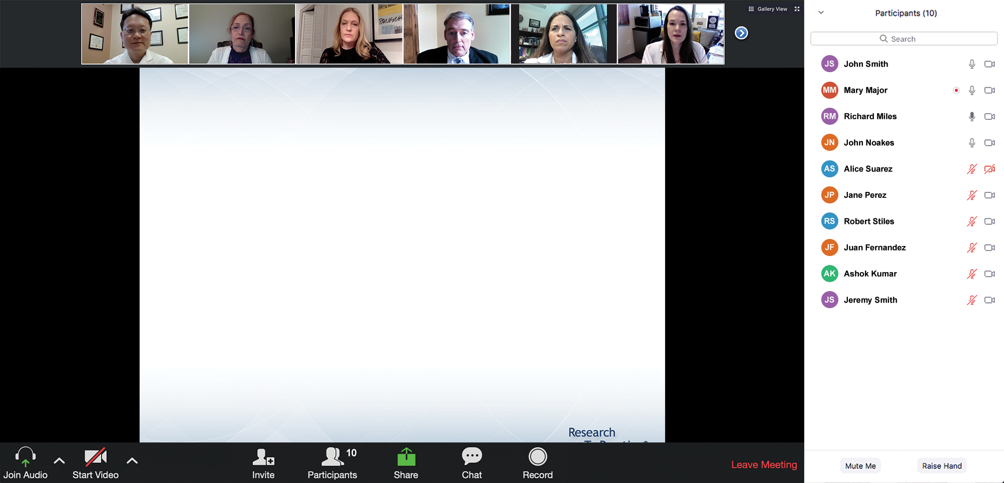

We Encourage Clinicians in Practice to Submit Questions
Feel free to submit questions now before the program begins and throughout the program.

Slide 10
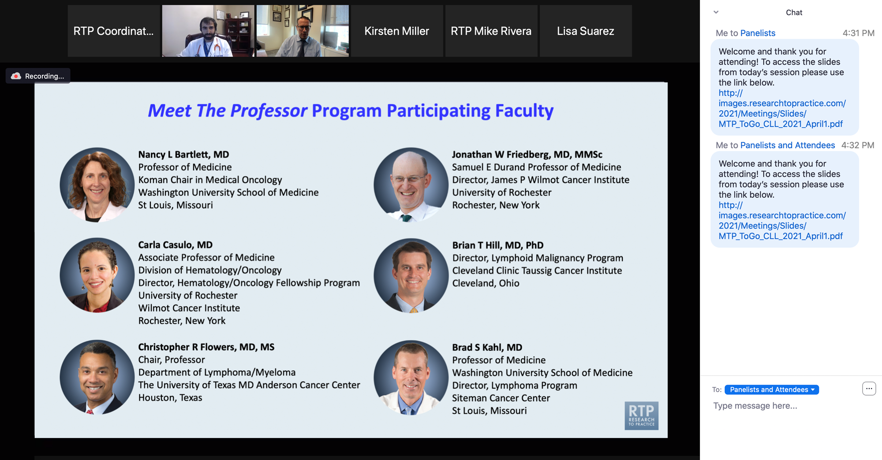
Familiarizing Yourself with the Zoom Interface
Expand chat submission box
Drag the white line above the submission box up to create
more space for your message.

Slide 11
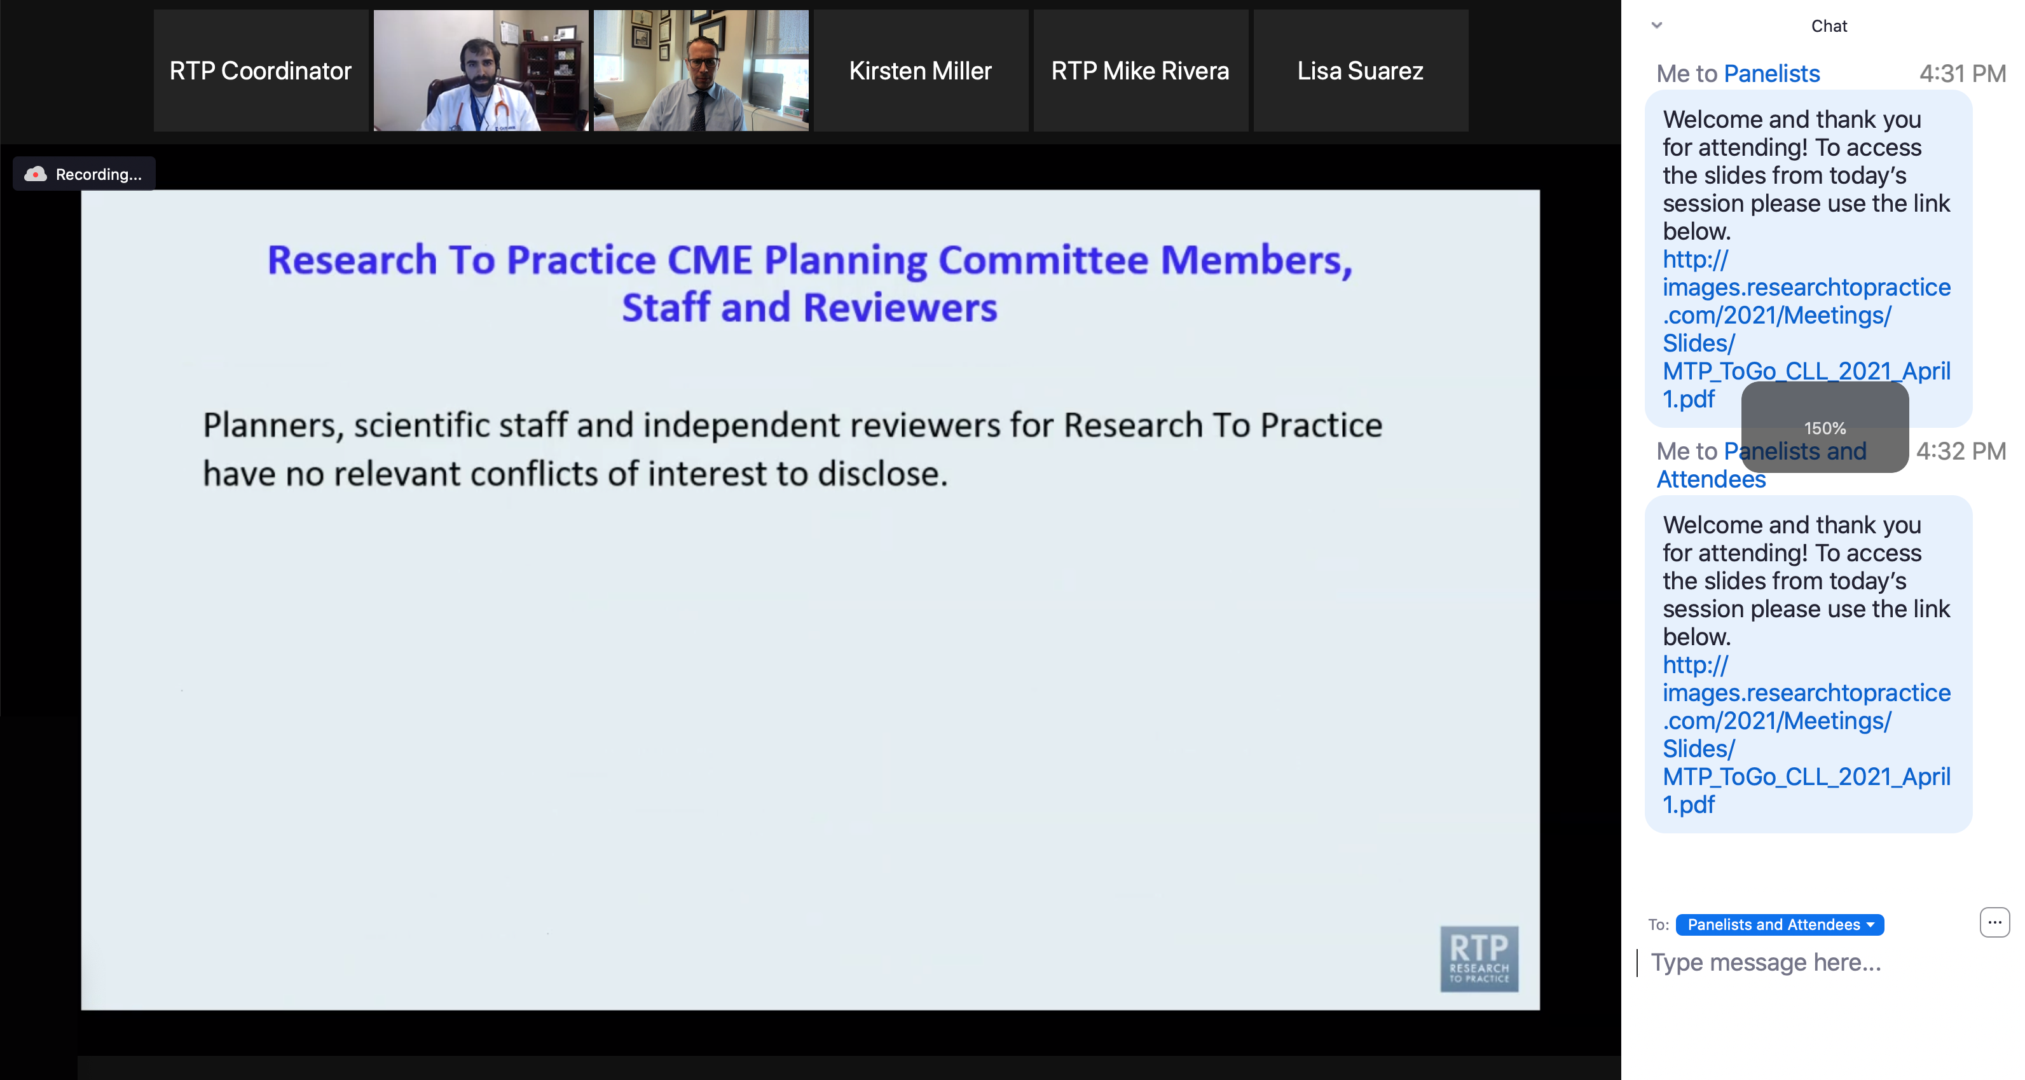
Familiarizing Yourself with the Zoom Interface
Increase chat font size
Press Command (for Mac) or Control (for PC) and the + symbol.
You may do this as many times as you need for readability.

Slide 12
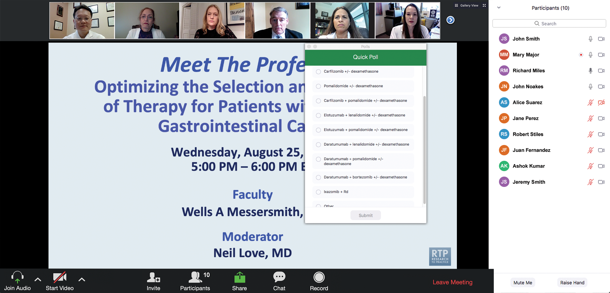
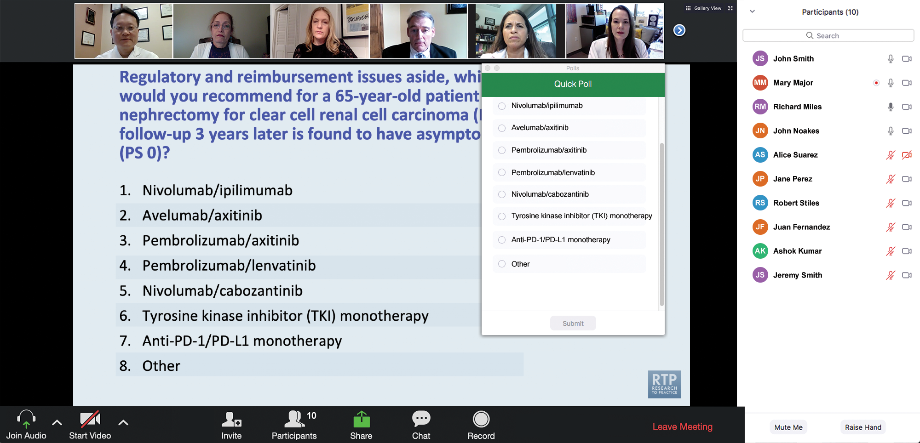
Clinicians in the Audience, Please Complete the Pre- and Postmeeting Surveys
Quick Survey
Quick Poll

Slide 13


Slide 14
Year in Review: Clinical Investigator Perspectives on the
Most Relevant New Datasets and Advances in Oncology
Menin Inhibitors in Acute Myeloid Leukemia
A CME/MOC-Accredited Live Webinar
Thursday, March 26, 2026
5:00 PM – 6:00 PM ET
Faculty
Amir Fathi, MD
Eunice S Wang, MD
Moderator
Neil Love, MD

Slide 15
Year in Review: Clinical Investigator Perspectives on the
Most Relevant New Datasets and Advances in Oncology
Oral SERDs for Breast Cancer
A CME/MOC-Accredited Live Webinar
Tuesday, March 31, 2026
5:00 PM – 6:00 PM ET
Faculty
Aditya Bardia, MD, MPH
Erica Mayer, MD, MPH, FASCO
Moderator
Neil Love, MD

Slide 16
Year in Review: Clinical Investigator Perspectives on the
Most Relevant New Datasets and Advances in Oncology
EGFR-Mutant Non-Small Cell Lung Cancer
A CME/MOC-Accredited Live Webinar
Tuesday, April 7, 2026
5:00 PM – 6:00 PM ET
Faculty
Suresh S Ramalingam, MD
Helena Yu, MD
Moderator
Neil Love, MD

Slide 17
Grand Rounds
CME/MOC-Accredited Interactive Series
Regional Activities
Three Series
Optimizing Treatment
for Patients with Relapsed/Refractory Chronic Lymphocytic Leukemia
Optimizing the Use of
Novel Therapies for Patients with Diffuse
Large B-Cell Lymphoma
Optimizing Therapy for Patients with Hormone Receptor-Positive
Localized Breast Cancer
Host a 1-hour session at your institution:
Email Meetings@ResearchToPractice.com
or call (800) 233-6153

Slide 18
Fifth Annual National General Medical Oncology Summit
A Multitumor CME/MOC-, NCPD- and ACPE-Accredited Educational Conference
Developed in Partnership with Florida Cancer Specialists & Research Institute
The Ritz-Carlton Orlando, Grande Lakes | Orlando, Florida
Friday, April 24, 2026
Fellows Welcome!
7:00 PM – 9:00 PM
Keynote Session: Diffuse Large B-Cell Lymphoma and Follicular Lymphoma
Manali Kamdar, MD, MBBS
Krish Patel, MD
Gilles Salles, MD, PhD

Slide 19
Fifth Annual National General Medical Oncology Summit
Saturday, April 25, 2026
8:00 AM – 8:50 AM
Chronic Lymphocytic Leukemia
John N Allan, MD
Additional faculty to be announced.
8:50 AM – 9:40 AM
Pancreatic Cancer
Eileen M O’Reilly, MD
Philip A Philip, MD, PhD
10:00 AM – 10:50 AM
Ovarian Cancer
Deborah K Armstrong, MD
David M O’Malley, MD
10:50 AM – 11:40 AM
Relapsed/Refractory Multiple Myeloma
Hans Lee, MD
Noopur Raje, MD
11:40 AM – 12:30 PM
Gastroesophageal Cancers
Yelena Y Janjigian, MD
Samuel J Klempner, MD
1:20 PM – 2:10 PM
Desmoid Tumors and Soft Tissue Sarcoma
Mrinal Gounder, MD
Richard F Riedel, MD

Slide 20
Fifth Annual National General Medical Oncology Summit
Saturday, April 25, 2026
Sunday, April 26, 2026
2:10 PM – 3:00 PM
Urothelial Bladder Cancer
Terence Friedlander, MD
Daniel P Petrylak, MD
3:20 PM – 4:10 PM
Triple-Negative Breast Cancer
Adam M Brufsky, MD, PhD
Kevin Kalinsky, MD, MS, FASCO
4:10 PM – 5:00 PM
HER2-Positive Breast Cancer
Shanu Modi, MD
Additional faculty to be announced.
8:00 AM – 9:40 AM
HR-Positive Breast Cancer
Erika Hamilton, MD
Jane Lowe Meisel, MD
Joyce O’Shaughnessy, MD
Seth Wander, MD, PhD
9:40 AM – 10:30 AM
Colorectal Cancer
Kristen K Ciombor, MD, MSCI
John Strickler, MD

Slide 21
Fifth Annual National General Medical Oncology Summit
Sunday, April 26, 2026
10:50 AM – 11:40 AM
EGFR-Mutated Non-Small Cell
Lung Cancer
Jonathan Goldman, MD
Zofia Piotrowska, MD, MHS
11:40 AM – 12:30 PM
Prostate Cancer
Neeraj Agarwal, MD, FASCO
Additional faculty to be announced.
1:15 PM – 2:05 PM
Myelofibrosis and Systemic Mastocytosis
Anthony M Hunter, MD
Additional faculty to be announced.
2:05 PM – 2:55 PM
Targeted Therapies for Non-Small Cell Lung Cancer
Lyudmila Bazhenova, MD
Corey J Langer, MD
2:55 PM – 3:45 PM
Acute Myeloid Leukemia
Courtney D DiNardo, MD, MSCE
Harry Paul Erba, MD, PhD

Slide 22
Agenda
Prostate Cancer
INTRODUCTION: Evolution of the prostate cancer model; Prostate Cancer Working Group 4 (PCWG4)
MODULE 1: Hormonal therapy
MODULE 2: Chemotherapy (docetaxel)
MODULE 3: PARP inhibition
MODULE 4: Radioligand therapy
MODULE 5: New agents

Slide 23
Thank you for joining us!
Please take a moment to complete the survey currently up on Zoom.
Your feedback is very important to us.
Information on how to obtain CME, ABIM MOC and ABS credit will be provided in the Zoom chat room. Attendees will also receive an email in
1 to 3 business days with these instructions.

Slide 24
Year in Review: Clinical Investigator Perspectives on the
Most Relevant New Datasets and Advances in Oncology
Prostate Cancer
A CME/MOC-Accredited Live Webinar
Wednesday, March 25, 2026
5:00 PM – 6:00 PM ET
Faculty
Andrew J Armstrong, MD, ScM
Scott T Tagawa, MD, MS
Moderator
Neil Love, MD

Slide 25
Faculty
Andrew J Armstrong, MD, ScM
Professor of Medicine, Surgery, Pharmacology
and Cancer Biology
Director of Research
Duke Cancer Institute Center for Prostate
and Urologic Cancers
Division of Medical Oncology
Departments of Medicine and Urology
Duke University
Durham, North Carolina
MODERATOR
Neil Love, MD
Research To Practice
Miami, Florida
Scott T Tagawa, MD, MS
Professor of Medicine and Urology
Weill Cornell Medicine
Leader, GU Disease Management Team
Meyer Cancer Center
New York, New York

Slide 26
We Encourage Clinicians in Practice to Submit Questions
Feel free to submit questions now before the program begins and throughout the program.

Slide 27
Clinicians in the Audience, Please Complete the Pre- and Postmeeting Surveys
Quick Survey
Quick Poll

Slide 29
Year in Review: Clinical Investigator Perspectives on the
Most Relevant New Datasets and Advances in Oncology
Menin Inhibitors in Acute Myeloid Leukemia
A CME/MOC-Accredited Live Webinar
Thursday, March 26, 2026
5:00 PM – 6:00 PM ET
Faculty
Amir Fathi, MD
Eunice S Wang, MD
Moderator
Neil Love, MD

Slide 30
Year in Review: Clinical Investigator Perspectives on the
Most Relevant New Datasets and Advances in Oncology
Oral SERDs for Breast Cancer
A CME/MOC-Accredited Live Webinar
Tuesday, March 31, 2026
5:00 PM – 6:00 PM ET
Faculty
Aditya Bardia, MD, MPH
Erica Mayer, MD, MPH, FASCO
Moderator
Neil Love, MD

Slide 31
Year in Review: Clinical Investigator Perspectives on the
Most Relevant New Datasets and Advances in Oncology
EGFR-Mutant Non-Small Cell Lung Cancer
A CME/MOC-Accredited Live Webinar
Tuesday, April 7, 2026
5:00 PM – 6:00 PM ET
Faculty
Suresh S Ramalingam, MD
Helena Yu, MD
Moderator
Neil Love, MD

Slide 32
Grand Rounds
CME/MOC-Accredited Interactive Series
Regional Activities
Three Series
Optimizing Treatment
for Patients with Relapsed/Refractory Chronic Lymphocytic Leukemia
Optimizing the Use of
Novel Therapies for Patients with Diffuse
Large B-Cell Lymphoma
Optimizing Therapy for Patients with Hormone Receptor-Positive
Localized Breast Cancer
Host a 1-hour session at your institution:
Email Meetings@ResearchToPractice.com
or call (800) 233-6153

Slide 33
Fifth Annual National General Medical Oncology Summit
A Multitumor CME/MOC-, NCPD- and ACPE-Accredited Educational Conference
Developed in Partnership with Florida Cancer Specialists & Research Institute
The Ritz-Carlton Orlando, Grande Lakes | Orlando, Florida
Friday, April 24, 2026
Fellows Welcome!
7:00 PM – 9:00 PM
Keynote Session: Diffuse Large B-Cell Lymphoma and Follicular Lymphoma
Manali Kamdar, MD, MBBS
Krish Patel, MD
Gilles Salles, MD, PhD

Slide 34
Fifth Annual National General Medical Oncology Summit
Saturday, April 25, 2026
8:00 AM – 8:50 AM
Chronic Lymphocytic Leukemia
John N Allan, MD
Additional faculty to be announced.
8:50 AM – 9:40 AM
Pancreatic Cancer
Eileen M O’Reilly, MD
Philip A Philip, MD, PhD
10:00 AM – 10:50 AM
Ovarian Cancer
Deborah K Armstrong, MD
David M O’Malley, MD
10:50 AM – 11:40 AM
Relapsed/Refractory Multiple Myeloma
Hans Lee, MD
Noopur Raje, MD
11:40 AM – 12:30 PM
Gastroesophageal Cancers
Yelena Y Janjigian, MD
Samuel J Klempner, MD
1:20 PM – 2:10 PM
Desmoid Tumors and Soft Tissue Sarcoma
Mrinal Gounder, MD
Richard F Riedel, MD

Slide 35
Fifth Annual National General Medical Oncology Summit
Saturday, April 25, 2026
Sunday, April 26, 2026
2:10 PM – 3:00 PM
Urothelial Bladder Cancer
Terence Friedlander, MD
Daniel P Petrylak, MD
3:20 PM – 4:10 PM
Triple-Negative Breast Cancer
Adam M Brufsky, MD, PhD
Kevin Kalinsky, MD, MS, FASCO
4:10 PM – 5:00 PM
HER2-Positive Breast Cancer
Shanu Modi, MD
Additional faculty to be announced.
8:00 AM – 9:40 AM
HR-Positive Breast Cancer
Erika Hamilton, MD
Jane Lowe Meisel, MD
Joyce O’Shaughnessy, MD
Seth Wander, MD, PhD
9:40 AM – 10:30 AM
Colorectal Cancer
Kristen K Ciombor, MD, MSCI
John Strickler, MD

Slide 36
Fifth Annual National General Medical Oncology Summit
Sunday, April 26, 2026
10:50 AM – 11:40 AM
EGFR-Mutated Non-Small Cell
Lung Cancer
Jonathan Goldman, MD
Zofia Piotrowska, MD, MHS
11:40 AM – 12:30 PM
Prostate Cancer
Neeraj Agarwal, MD, FASCO
Additional faculty to be announced.
1:15 PM – 2:05 PM
Myelofibrosis and Systemic Mastocytosis
Anthony M Hunter, MD
Additional faculty to be announced.
2:05 PM – 2:55 PM
Targeted Therapies for Non-Small Cell Lung Cancer
Lyudmila Bazhenova, MD
Corey J Langer, MD
2:55 PM – 3:45 PM
Acute Myeloid Leukemia
Courtney D DiNardo, MD, MSCE
Harry Paul Erba, MD, PhD

Slide 37
Year in Review: Clinical Investigator Perspectives on the
Most Relevant New Datasets and Advances in Oncology
Prostate Cancer
A CME/MOC-Accredited Live Webinar
Wednesday, March 25, 2026
5:00 PM – 6:00 PM ET
Faculty
Andrew J Armstrong, MD, ScM
Scott T Tagawa, MD, MS
Moderator
Neil Love, MD

Slide 38
Commercial Support
This activity is supported by educational grants from AstraZeneca Pharmaceuticals LP, Merck, Novartis, and Sumitomo Pharma America
and Pfizer Inc.
Research To Practice CME Planning Committee Members,
Staff and Reviewers
Planners, scientific staff and independent reviewers for Research To Practice have no relevant financial relationships to disclose.

Slide 39
Dr Armstrong — Disclosures
Advisory Committees | Astellas, AstraZeneca Pharmaceuticals LP, Bayer HealthCare Pharmaceuticals, Bristol Myers Squibb, Merck, Pfizer Inc, PrecedeBiosciences, Sumitomo Pharma America, Telix Pharmaceuticals Limited
Consulting Agreements | Amgen Inc, Astellas, Bayer HealthCare Pharmaceuticals, Janssen Biotech Inc, Novartis, Pfizer Inc
Contracted Research | Amgen Inc, Astellas, AstraZeneca Pharmaceuticals LP, Bayer HealthCare Pharmaceuticals, Bristol Myers Squibb, FibroGen Inc, Janssen Biotech Inc, Merck, Novartis, Pathos, Pfizer Inc

Slide 40
Dr Tagawa — Disclosures
Consulting Agreements | AbbVie Inc, Abdera Therapeutics, Bayer HealthCare Pharmaceuticals, Biohaven, Blue Earth Diagnostics, Boston Scientific Corporation, Clarity Pharmaceuticals, Convergent Therapeutics Inc, Daiichi Sankyo Inc, EMD Serono Inc, GE Healthcare, Gilead Sciences Inc, Johnson & Johnson, Lantheus, Lilly, Merck, Myovant Sciences, Novartis, Pfizer Inc, Regeneron Pharmaceuticals Inc, Telix Pharmaceuticals Limited
Contracted Research | AIQ Solutions, Bayer HealthCare Pharmaceuticals, Clarity Pharmaceuticals, Gilead Sciences Inc, Janux Therapeutics, Johnson & Johnson, Lilly, Merck, Novartis, Pfizer Inc, Telix Pharmaceuticals Limited
Data and Safety Monitoring Boards/Committees | Boston Scientific Corporation
Stock OPTIONS — Private Companies | Convergent Therapeutics

Slide 41
Dr Love — Disclosures
Dr Love is president and CEO of Research To Practice. Research To Practice receives funds in the form of educational grants to develop CME activities from the following companies: Aadi Bioscience, AbbVie Inc, ADC Therapeutics, Agendia Inc, Alexion Pharmaceuticals, Amgen Inc, Array BioPharma Inc, a subsidiary of Pfizer Inc, Arvinas, Astellas, AstraZeneca Pharmaceuticals LP, Aveo Pharmaceuticals, Bayer HealthCare Pharmaceuticals, BeOne, Biotheranostics Inc, A Hologic Company, Black Diamond Therapeutics Inc, Blueprint Medicines, Boehringer Ingelheim Pharmaceuticals Inc, Bristol Myers Squibb, Celcuity, Clovis Oncology, Coherus BioSciences, Corcept Therapeutics Inc, CTI BioPharma, a Sobi Company, Daiichi Sankyo Inc, Eisai Inc, Elevation Oncology Inc, Exact Sciences Corporation, Exelixis Inc, Genentech, a member of the Roche Group, Genmab US Inc, Geron Corporation, Gilead Sciences Inc, GSK, Helsinn Therapeutics (US) Inc, ImmunoGen Inc, Incyte Corporation, Ipsen Biopharmaceuticals Inc, Jazz Pharmaceuticals Inc, Johnson & Johnson, Karyopharm Therapeutics, Kite, A Gilead Company, Kura Oncology, Legend Biotech, Lilly, MEI Pharma Inc, Merck, Mersana Therapeutics Inc, Mirati Therapeutics Inc, Mural Oncology Inc, Natera Inc, Novartis, Novartis Pharmaceuticals Corporation on behalf of Advanced Accelerator Applications, Novocure Inc, Nuvalent, Nuvation Bio Inc, Pfizer Inc, Pharmacyclics LLC, an AbbVie Company, Puma Biotechnology Inc, Regeneron Pharmaceuticals Inc, Revolution Medicines Inc, Rigel Pharmaceuticals Inc, R-Pharm US, Sanofi, Seagen Inc, Servier Pharmaceuticals LLC, SpringWorks Therapeutics Inc, Stemline Therapeutics Inc, Sumitomo Pharma America, Summit Therapeutics, Syndax Pharmaceuticals, Taiho Oncology Inc, Takeda Pharmaceuticals USA Inc, TerSera Therapeutics LLC, and Tesaro, A GSK Company.

Slide 42
This educational activity contains discussion of
non-FDA-approved uses of agents and regimens. Please refer to official prescribing information for each product for approved indications.

Slide 43
Agenda
Prostate Cancer
INTRODUCTION: Evolution of the prostate cancer model; Prostate Cancer Working Group 4 (PCWG4)
MODULE 1: Hormonal therapy
MODULE 2: Chemotherapy (docetaxel)
MODULE 3: PARP inhibition
MODULE 4: Radioligand therapy
MODULE 5: New agents

Slide 44





Slide 45
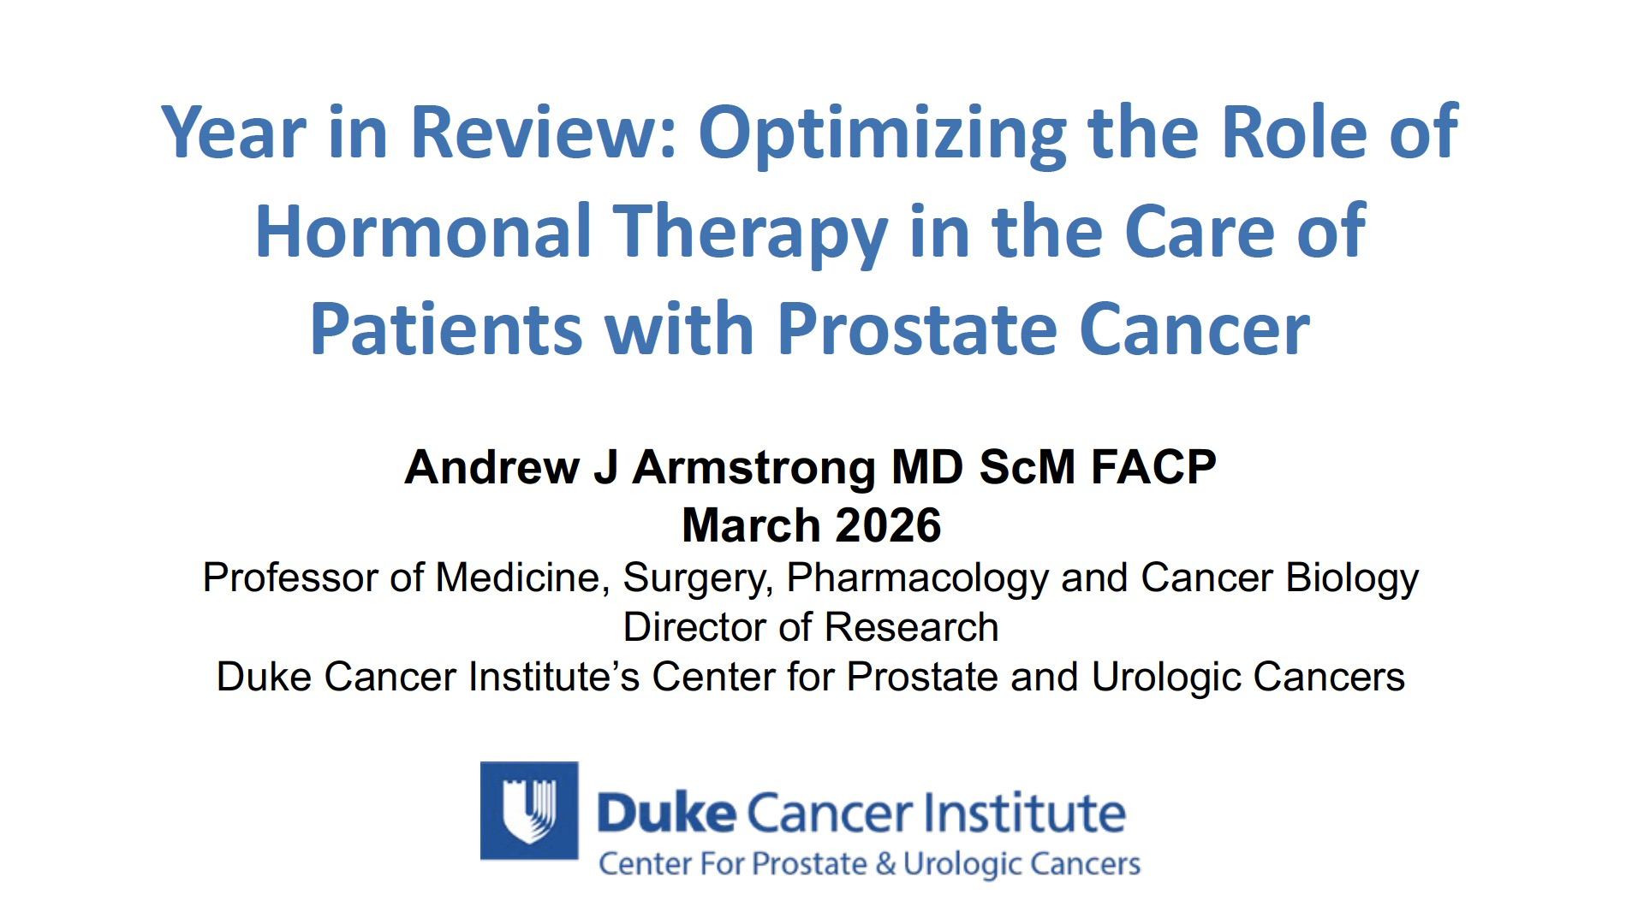
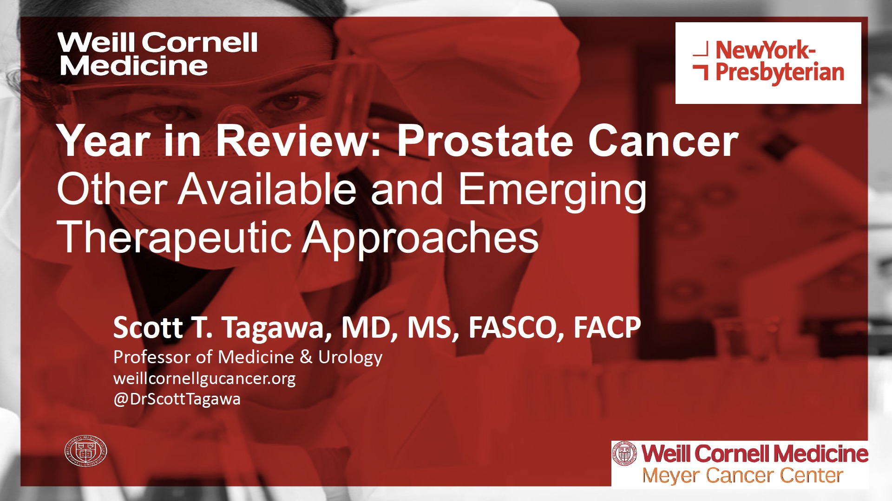

Slide 46
Key Datasets
Andrew Armstrong, MD, ScM
De La Cerda J et al. Safety and tolerability of relugolix in combination with abiraterone or apalutamide for treatment of patients with advanced prostate cancer: Data from a 52-week clinical trial. Target Oncol 2025;20(3):503-17.
McKay R et al. Quality of life, adherence, and adverse events among patients with advanced prostate cancer treated with relugolix: 6-month results of the OPTYX multicenter registry. Genitourinary Cancers Symposium 2026;Abstract 122.
Francolini G et al. Ultra-hypofractionated radiotherapy and concomitant oral relugolix for treatment of intermediate risk prostate cancer (ULTRA-HERO). Genitourinary Cancers Symposium 2026;Abstract TPS411.
Shore ND et al. Improved survival with enzalutamide in biochemically recurrent prostate cancer. N Engl J Med 2025;[Online ahead of print].
Freedland SJ et al. Effects of enzalutamide on the sexual activity of patients with biochemically recurrent prostate cancer: A post hoc analysis of patient-reported outcomes in the EMBARK study. Eur Urol 2025;87(5):507-11.
Aggarwal R et al. Final results from PRESTO: A phase III open-label study of combined androgen blockade in patients (pts) with high-risk biochemically relapsed prostate cancer (BRPC) (AFT-19). ESMO 2025;Abstract LBA88.

Slide 47
Key Datasets
Andrew Armstrong, MD, ScM (continued)
Morgans A et al. Health-related quality of life (HRQoL) outcomes with darolutamide in the phase 3 ARANOTE trial. ASCO 2025;Abstract 5004.
Grimm MO et al. 3-weekly docetaxel 75 mg/m² vs 2-weekly docetaxel 50 mg/m² in combination with darolutamide + ADT in patients with mHSPC: Results from the randomised phase III ARASAFE trial. ESMO 2025;Abstract LBA92.
Fizazi K et al. Capivasertib plus abiraterone in PTEN-deficient metastatic hormone-sensitive prostate cancer: CAPItello-281 phase III study. Ann Oncol 2026;37(1):53-68.
George DJ et al. Patient reported outcomes (PRO) and tolerability of capivasertib (capi) plus abiraterone (abi) versus placebo (pbo) plus abi in patients (pts) with PTEN-deficient metastatic hormone-sensitive prostate cancer (mHSPC): CAPItello-281. Genitourinary Cancers Symposium 2026;Abstract 14.
Fizazi K et al. OMAHA-004: Phase 3 trial of CYP11A1 inhibitor opevesostat versus androgen receptor pathway inhibitor (ARPI) switch in participants with metastatic castration-resistant prostate cancer (mCRPC) after a prior ARPI. Genitourinary Cancers Symposium 2026;Abstract TPS299.
Yu E et al. OMAHA-003: Phase 3 trial of CYP11A1 inhibitor opevesostat versus androgen receptor pathway inhibitor (ARPI) switch in participants (pts) with metastatic castration-resistant prostate cancer (mCRPC) after ARPI and taxane-based chemotherapy. Genitourinary Cancers Symposium 2026;Abstract TPS298.

Slide 48
Key Datasets
Scott Tagawa, MD, MS
Clarke NW et al. Efficacy and safety of olaparib plus abiraterone versus placebo plus abiraterone in the first-line treatment of patients with asymptomatic/mildly symptomatic and symptomatic metastatic castration-resistant prostate cancer: Analyses from the phase 3 PROpel Trial. Eur Urol Oncol 2025;8(2):394-406.
Chi KN et al. Niraparib and abiraterone acetate plus prednisone in metastatic castration-resistant prostate cancer: Final overall survival analysis for the phase 3 MAGNITUDE trial. Eur Urol Oncol 2025;8(4):986-98.
Agarwal N et al. Talazoparib plus enzalutamide in men with metastatic castration-resistant prostate cancer: Final overall survival results from the randomised, placebo-controlled, phase 3 TALAPRO-2 trial. Lancet 2025;406(10502):447-60.
Hussain M et al. Overall survival from the phase 2 trial of abiraterone, olaparib, or abiraterone + olaparib in first-line metastatic castration-resistant prostate cancer (mCRPC) with DNA repair defects (BRCAAway). Genitourinary Cancers Symposium 2026;Abstract 16.
Attard G et al. Niraparib and abiraterone acetate plus prednisone for HRR-deficient metastatic castration-sensitive prostate cancer: A randomized phase 3 trial. Nat Med 2025;31(12):4109-18.
Azad AA et al. First interim efficacy analysis of the phase I/II PETRANHA trial of saruparib + androgen receptor pathway inhibitors (ARPI) in patients (pts) with metastatic prostate cancer (mPC). ESMO 2025;Abstract 2384MO.

Slide 49
Key Datasets
Scott Tagawa, MD, MS (continued)
McKay R et al. Phase III, randomized, double-blind, placebo-controlled study of adjuvant saruparib (AZD5305) in patients with BRCAm localized high-risk prostate cancer who are receiving radiotherapy and androgen deprivation therapy (EvoPAR-Prostate02). Genitourinary Cancers Symposium 2026;Abstract TPS412.
Gallardo E et al. Final overall survival results from the EORTC 1333/PEACE-3 trial: Enzalutamide with or without radium-223 in metastatic castration-resistant prostate cancer. Genitourinary Cancers Symposium 2026;Abstract 15.
Fizazi K et al. Final overall survival and safety analyses of the phase III PSMAfore trial of [(177)Lu]Lu-PSMA-617 versus change of androgen receptor pathway inhibitor in taxane-naive patients with metastatic castration-resistant prostate cancer. Ann Oncol 2025;36(11):1319-30.
Tagawa ST et al. Phase III trial of [177Lu]Lu-PSMA-617 combined with ADT + ARPI in patients with PSMA-positive metastatic hormone-sensitive prostate cancer (PSMAddition). ESMO 2025;Abstract LBA6.
Stein MN et al. Pasritamig, a first-in-class, bispecific T-cell engager targeting human kallikrein 2, in metastatic castration-resistant prostate cancer: A phase I study. J Clin Oncol 2025;43(22):2515-26.
De Bono J et al. IDeate-Prostate02: A phase 1/2, open-label umbrella substudy of ifinatamab deruxtecan-based treatment combinations or as monotherapy in participants with previously treated metastatic castration-resistant prostate cancer. Genitourinary Cancers Symposium 2026;Abstract TPS297.

Slide 50
Key Datasets
Scott Tagawa, MD, MS (continued)
McKay R et al. IDeate-Prostate01: A phase 3, randomized, open-label study of ifinatamab deruxtecan versus docetaxel in participants with previously treated metastatic castration-resistant prostate cancer. Genitourinary Cancers Symposium 2026;Abstract TPS294.

Slide 51
Agenda
Prostate Cancer
INTRODUCTION: Evolution of the prostate cancer model; PCWG4
MODULE 1: Hormonal therapy
MODULE 2: Chemotherapy (docetaxel)
MODULE 3: PARP inhibition
MODULE 4: Radioligand therapy
MODULE 5: New agents

Slide 52
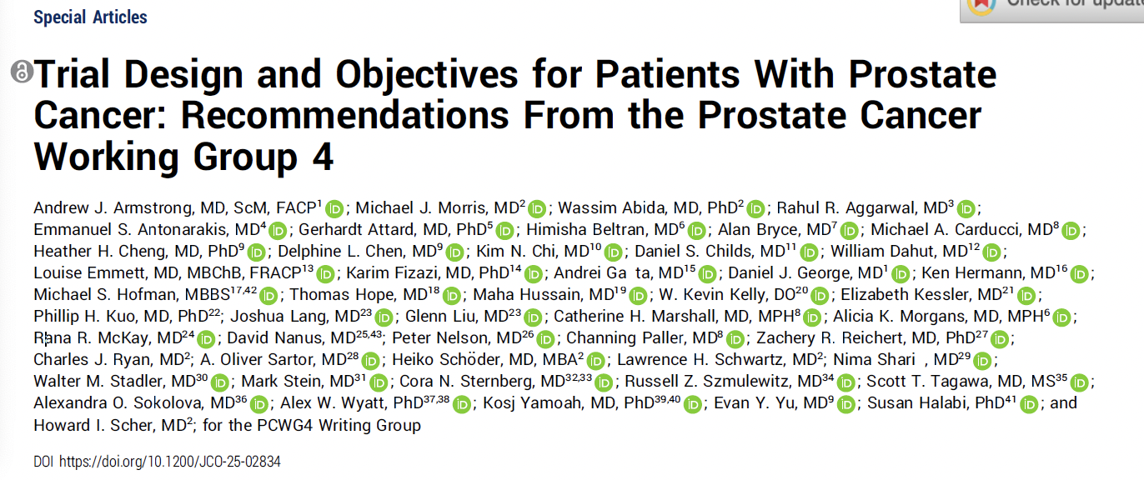

Slide 53
Prostate Cancer Working Group 4 (PCWG4)
“Our objective was to formulate updated criteria based on emerging evidence and clinical trial data in a biomarker context to provide guidance for clinical trial design, eligibility, and end point assessments for patients with advanced prostate cancer.”
“PCWG4 redefines terminology around the disease state and previous therapies in a patient-centric context and terminology focused on androgen pathway modulation.”
Armstrong AJ et al. J Clin Oncol 2026 February 26:JCO2502834.

Slide 54
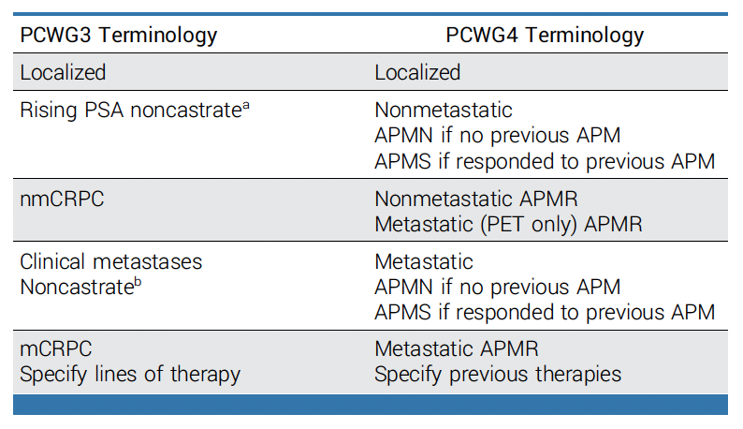
PCWG4: Updates to Disease State Terminology
APM = androgen pathway modulator; APMN/S/R = androgen pathway modulator-naïve/sensitive/resistant
Armstrong AJ et al. J Clin Oncol 2026 February 26:JCO2502834.

Slide 55
Agenda
Prostate Cancer
INTRODUCTION: Evolution of the prostate cancer model; PCWG4
MODULE 1: Hormonal therapy
MODULE 2: Chemotherapy (docetaxel)
MODULE 3: PARP inhibition
MODULE 4: Radioligand therapy
MODULE 5: New agents

Slide 56
2025 – Year of the Androgen Pathway Modulator-Naïve (APMN) Breakthrough
How do you think through the following in the management of APMN prostate cancer?
De novo versus metachronous metastatic disease
PSMA PET-positive, conventional imaging negative
Biomarker implications (eg, PTEN, BRCA, HER2, MSI)

Slide 57
mHSPC Algorithm 2026
Metastatic Hormone-Sensitive Prostate Cancer (mHSPC)
High-volume mHSPC
(based on conventional imaging)
Low-volume mHSPC
(based on conventional imaging)
Synchronous/de novo metastases
Metachronous/relapsed metastases
Synchronous/de novo metastases
Metachronous/
relapsed metastases
Triplet therapy:
Docetaxel + abiraterone + ADT
Niraparib + abi + ADT (BRCA2m)
Docetaxel + darolutamide + ADT
(preferred)
or
Docetaxel + ADT → ADT/enzalutamide
Docetaxel + ADT → ADT/apalutamide
Triplet therapy: Docetaxel + ARSI + ADT vs.
Doublet therapy:
ADT + ARSI or docetaxel
Triplet therapy: Docetaxel + ARSI + ADT or
Abi+ niraparib + ADT (BRCA2m)
vs.
Doublet therapy:
ADT + ARSI or docetaxel
+
Radiation to the primary (+/- pelvis)
Doublet therapy: ARSI + ADT
McManus HD, Armstrong AJ. J Clin Oncol. 2023 Jul 10;41(20):3576-3579.
Notes:
McManus HD, Armstrong AJ. J Clin Oncol. 2023 Jul 10;41(20):3576-3579.

Slide 58
PCWG4: new indications model and terminology
Non-Metastatic
APMN or APMS
Metastatic
APMN or APMS
Clinically Localized
APMR
Specified by Prior Therapy
Non-Metastatic
APMR
Metastatic
APMR
Androgen Pathway Modulation Sensitive (APMS) or Naïve (APMN)
Androgen Pathway Modulation Resistant (APMR)
Within each state, specify where relevant: 1) genotype (germline, somatic), 2) imaging modality used to define metastasis (PET, CT/MRI/bone scan), 3) disease characteristics and biomarkers critical for risk stratification, and 4) prior therapies.
APMN/S is the preferred term for hormone/castration naïve/sensitive disease (HSPC, CSPC) while APMR is the preferred term for castration/hormone resistant prostate cancer (CRPC/HRPC).
Armstrong AJ, Morris MJ…Scher HI PCWG4; J Clin Oncol 2026

Slide 59
Management of Biomarker-Negative APMN
When do you utilize intermittent endocrine therapy? Is this related to disease burden?
What have you observed in terms of relief of treatment-related side effects when intermittent therapy is used? Which side effects are relieved first?
In which situations, if any, are you offering enzalutamide or any other androgen blocker without ADT? How do you prevent gynecomastia, and what have you observed in terms of quality of life?

Slide 60
EMBARK study design
    Patient population:
    Screening PSA ≥1 ng/mL after RP and at least 2 ng/mL above the nadir for primary EBRT
    PSADT ≤9 mo
    No metastases on bone scan or CT/MRI per central read
    Testosterone ≥150 ng/dL
    Prior hormonal therapy ≥9 mo prior to R (neoadjuvant/adjuvant for ≤36 mo OR ≤6 mo for rising PSA)
    Stratification factors:
    Screening PSA (≤10 ng/mL vs. >10 ng/mL)
    PSADT (≤3 mo vs. >3 to ≤9 mo)
    Prior hormonal therapy (yes vs. no)
Enzalutamide (160 mg oral qd) + leuprolide acetate
(22.5 mg IM/q12w)
n = 355
Blinded
Week 37
Primary endpoint^{b}:
MFS by BICR, enzalutamide + leuprolide acetate vs. leuprolide acetate alone
Suspend treatment at week 37 Monitor PSA (reinitiate if PSA rises)ª
Yes
Key secondary endpoints^{b,c}:
    MFS by BICR, enzalutamide monotherapy vs. leuprolide acetate alone
    Time to PSA progression
    Time to first use of new antineoplastic therapy
    OS^{c}
    Other secondary endpoints:
    Safety^{d}
R
1:1:1
Placebo + leuprolide acetate (22.5 mg IM/q12w)
n = 358
Blinded
PSA <0.2 ng/mL at week 36
N = 1068
No
Remain on treatment
Enzalutamide monotherapy (160 mg oral qd)
n = 355
Unblinded
ªStudy treatment was suspended once at week 37 if PSA was <0.2 ng/mL and restarted when PSA was ≥5.0 ng/mL (without prior RP) and ≥2 ng/mL (prior RP). ^{b}Intent-to-treat population. ^{c}Primary endpoint and key secondary endpoints for enzalutamide combination and enzalutamide monotherapy are alpha-protected. P-value to determine significance for OS of combination and monotherapy treatment comparisons was dependent on outcomes of primary endpoint and key secondary endpoints. ^{d}Safety population. BICR, blinded independent central review; CT, computed tomography; d, day; EBRT, external beam radiotherapy; IM, intramuscular; MFS, metastasis-free survival; mo, month; MRI, magnetic resonance imaging; OS, overall survival; PSA, prostate-specific antigen; PSADT, PSA doubling time; q, every; R, randomization; RP, radical prostatectomy; w, weeks.
Courtesy of Andrew J Armstrong, MD, ScM
Notes:
MDV3100 protocol 2021/p34A/p35AFG/p36AB
MDV3100 protocol 2021/p31ACD/p85B
MDV3100 protocol 2021/p31B
MDV3100 protocol 2021/p31E
MDV3100 protocol 2021/p79D
MDV3100 protocol 2021/p30BC

Slide 61
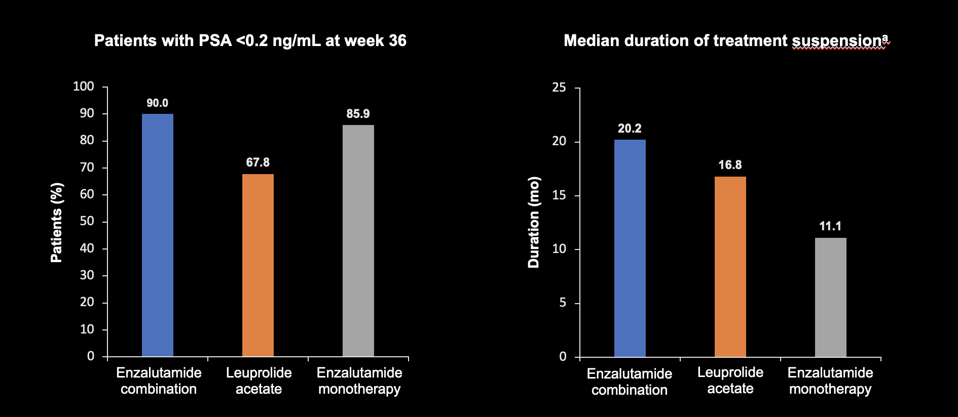
Secondary endpoint
Undetectable PSA and Duration of suspension
Freedland et al. NEJM Oct 2023

Slide 62
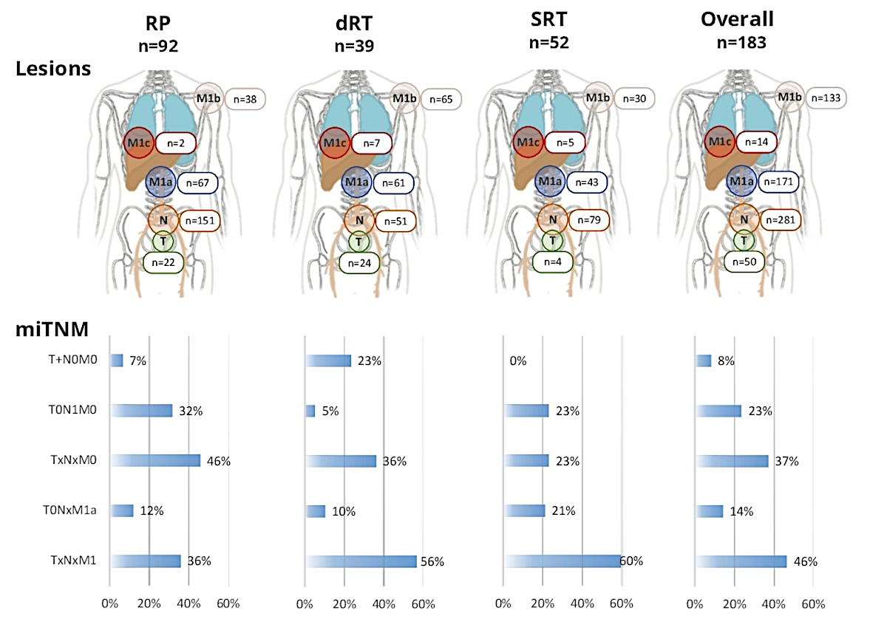
PSMA Imaging in EMBARK-like patients
In total, 182 patients met EMBARK enrolment criteria
  Median PSA 2.8 ng/ml
  Median PSADT 3.6 months
All had PSMA imaging
Overall, 84% were PSMA positive
46% had distant metastases
Holzgreve et al. JAMA Network Open. 2025
Armstrong WR et al. ASCO 2023;Abstract 5091

Slide 63
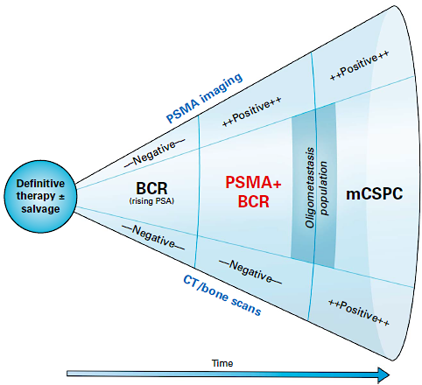
Who are EMBARK Patients?
EMBARK
Epstein et al J Clin Oncol. 2025 Dec;43(34):3672-3683.

Slide 64
Management of Biomarker-Negative APMN
In which situations, if any, are you using relugolix? Does this depend on how long you believe the patient’s treatment will be? Do you believe this is a benefit in terms of cardiovascular morbidity?

Slide 65
Management of Biomarker-Negative APMN
If capivasertib were approved, would you discuss or recommend it? Is NGS sufficient or IHC necessary? How would you factor in percent positivity? In addition to improved efficacy with 95% or 100%, is the prognosis worse? How would you decide between a docetaxel triplet and capi triplet?
What HbA1c level would you require to use it? Would you use it for a patient with well controlled Type 2 DM? Would you use preemptive phenformin?
What’s next for AKT inhibitors in prostate cancer? Do you anticipate that capivasertib will eventually be used in earlier settings or as a component of other combination strategies? Beyond PTEN deficiency, are there other genomic signatures that may predict benefit from capivasertib?

Slide 66
Management of Biomarker-Negative APMN
What is your approach to the use of local therapy for oligometastatic disease?

Slide 67

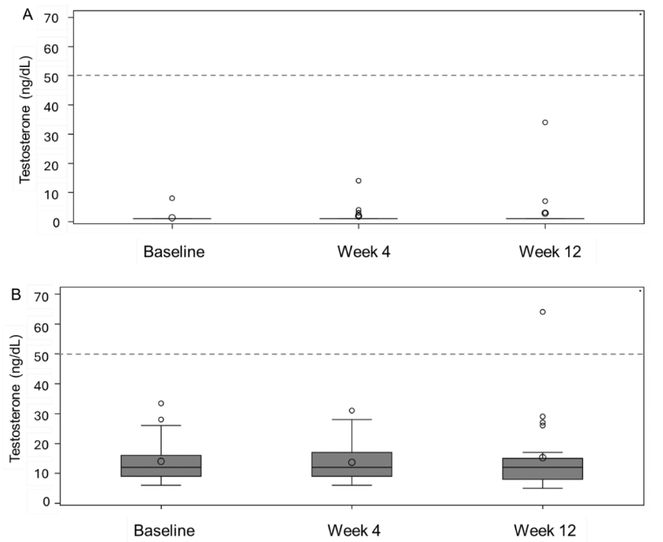
Key take-home point: if you give relugolix with apalutamide, the dose should be 240 mg/d (2x standard dose) due to CYP3A4/2C9/P-gp induction
No adjustments needed for abi (or enza/ darolutamide, not studied here)
Testosterone suppression and PSA decline efficacy was demonstrated
HTN seen with abi (25%) and rash seen with apa (21%)
Abi + relugolix
95% achieved <20 ng/dL
Apa + relugolix
83% achieved <20 ng/dL
De La Cerda J et al. Targeted Oncology 2025

Slide 68
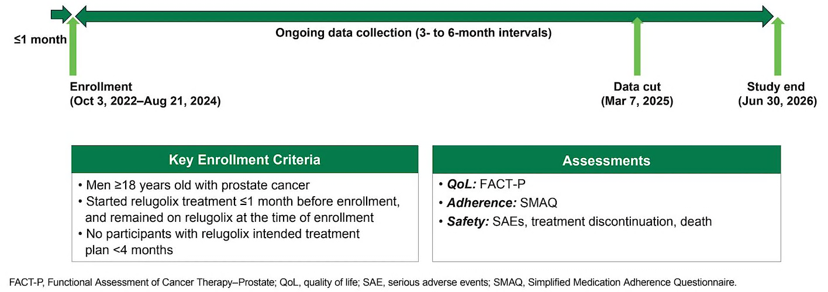
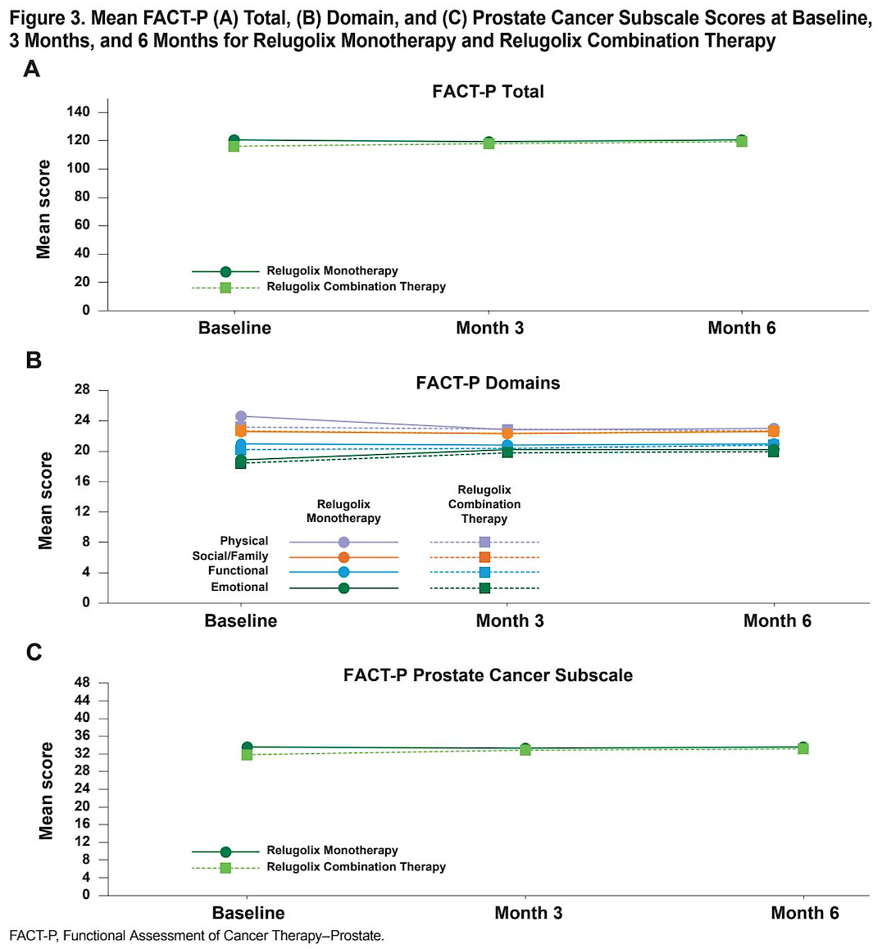
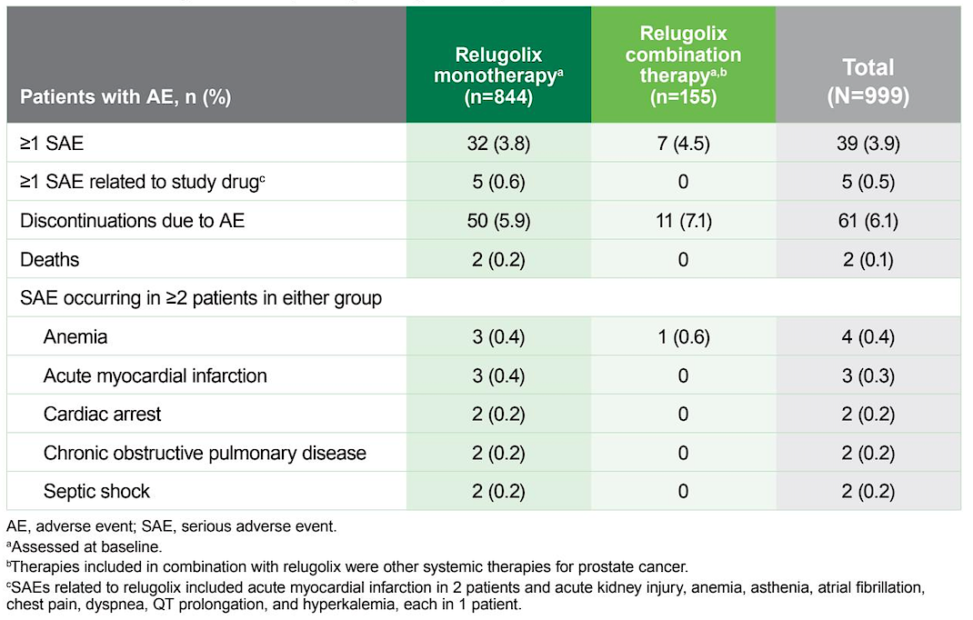
McKay R et al. Quality of life, adherence, and adverse events among patients with advanced prostate cancer treated with relugolix: 6-month results of the OPTYX multicenter registry. Genitourinary Cancer Symposium 2026;Abstract 122.
Take Home:
Real-world use of relugolix alone or with other systemic therapies was well tolerated with only 6-7% discontinuing due to side effects and 17% reporting a missed dose over 6 mo
CV AEs were very rare during this 6 mo follow up period
Remains unclear if GnRH agonist vs antagonist provides differential CV safety

Slide 69
CAPItello-281 Study Design
A global, multicentre, randomized, double-blind, Phase 3 study
Capivasertib
Patients with PTEN deficient
de novo mHSPC
400 mg BID
4 days on, 3 days off
Primary endpoint
Investigator assessed rPFS
Secondary endpoints
Overall survival
Time to first subsequent therapy
Symptomatic skeletal-event free survival
Time to pain progression
Time to castration resistance
Time to PSA progression
Exploratory post-hoc
PTEN deficiency subgroups
PTEN deficiency:
(diagnostic cut-off of ≥90% of
viable malignant cells with no
specific cytoplasmic staining by IHC)*
  i.e. <10% of cells expressing PTEN by IHC
Abiraterone/pred
+ ADT
1000 mg/5 mg QD
+ ADT
1,012 patients
(R 1:1)
Placebo
400 mg BID
4 days on, 3 days off
Abiraterone/pred
+ ADT
Of ~6,200 patients submitting tumour tissue 97% had a valid IHC result and
25% were PTEN deficient
1000 mg/5 mg QD
+ ADT
Current analysis
Stratification factors:†
M1 volume (CHAARTED criteria) and visceral mets
Geography
Study timeline
Enrolment period
13 July 2020–5 Feb 2024
Primary rPFS DCO
7 Oct 2024
Median rPFS follow-up:‡ ~18 mo
Final OS DCO
Planned for 522 deaths (52.2% maturity)
NCT04493853. Full eligibility criteria available in the online article. *Determined using investigational antibody for PTEN (SP218) (Roche Diagnostics).
†High-vol. disease with visceral mets, high-vol disease without visceral mets, low-vol. disease; North America; Western Europe and Australia; Latin America and Eastern Europe; Asia. ‡In censored patients.
ADT, androgen deprivation therapy; BID, twice daily; IHC, immunohistochemistry; mHSPC, metastatic hormone-sensitive prostate cancer; pred, prednisone/prednisolone; QD, once daily; rPFS, radiographic progression-free survival
Karim Fizazi MD, PhD
Abstract 2383O

Slide 70
CAPItello-281 Primary endpoint: investigator-assessed rPFS
1.0
 | Capi + abi (N=507) | Pbo + abi (N=505)
Events, n (%) | 183 (36.1) | 215 (42.6)
Median rPFS, months (95% CI) | 33.2 (25.8, 44.2) | 25.7 (22.0, 29.9)
HR (95% CI) | 0.81 (0.66, 0.98)
P-value | 0.034
0.8
0.6
Probability of rPFS
0.4
25.7 months
7.5 months
33.2 months
0.2
Capivasertib + Abiraterone (N=507)
Placebo + Abiraterone (N=505)
0.0
0
3
6
9
12
15
18
21
24
27
30
33
36
39
42
45
Time from randomisation (months)
Number of patients at risk
Capi + abi | 507 | 460 | 435 | 353 | 282 | 233 | 217 | 165 | 123 | 93 | 69 | 62 | 41 | 21 | 6 | 0
Pbo + abi | 505 | 479 | 440 | 359 | 276 | 215 | 198 | 154 | 113 | 83 | 59 | 51 | 37 | 23 | 8 | 0
A stratified log-rank test was used to calculate two-sided P values. HRs and 95% CIs were calculated using a stratified Cox proportional-hazards model. Median follow-up: 18.4 months (capi + abi), 18.5 months (pbo + abi)
abi, abiraterone; capi, capivasertib; CI, confidence interval; HR, hazard ratio; pbo, placebo; rPFS, radiographic progression-free survival
Karim Fizazi MD, PhD
Abstract 2383O

Slide 71
CAPItello-281: Interim OS
OS analysis was conducted at 26% maturity, further follow-up is planned
 | Capi + abi (N=507) | Pbo + abi (N=505)
Events, n (%) | 129 (25.4) | 138 (27.3)
Median OS, months (95% CI) | NC (42.5, NC) | NC (NC, NC)
HR (95% CI) | 0.90 (0.71, 1.15)
P-value | 0.401
1.0
0.8
0.6
Probability of OS
0.4
0.2
Capivasertib + Abiraterone (N=507)
Placebo + Abiraterone (N=505)
0.0
0
3
6
9
12
15
18
21
24
27
30
33
36
39
42
45
48
Number of patients at risk
Time from randomisation (months)
Capi + abi | 507 | 487 | 476 | 447 | 400 | 335 | 286 | 242 | 199 | 164 | 128 | 96 | 60 | 42 | 22 | 7 | 0
Pbo + abi | 505 | 494 | 479 | 449 | 388 | 330 | 273 | 227 | 188 | 153 | 113 | 88 | 56 | 33 | 19 | 7 | 0
A stratified log-rank test was used to calculate two-sided P values. HRs and 95% CIs were calculated using a stratified Cox proportional-hazards model.
CI, confidence interval; HR, hazard ratio; NC, not calculable; OS, overall survival; pbo, placebo
Karim Fizazi MD, PhD
Abstract 2383O

Slide 72
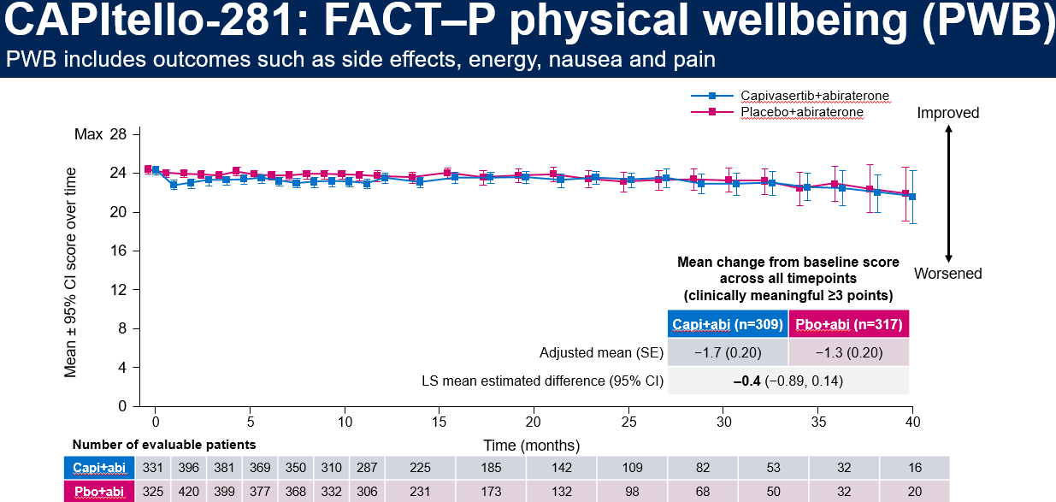
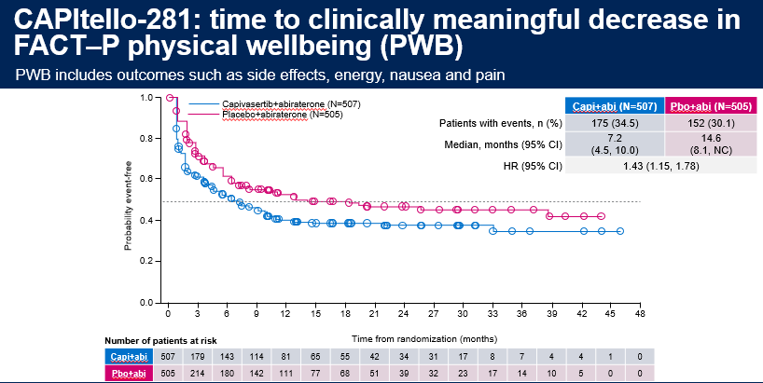
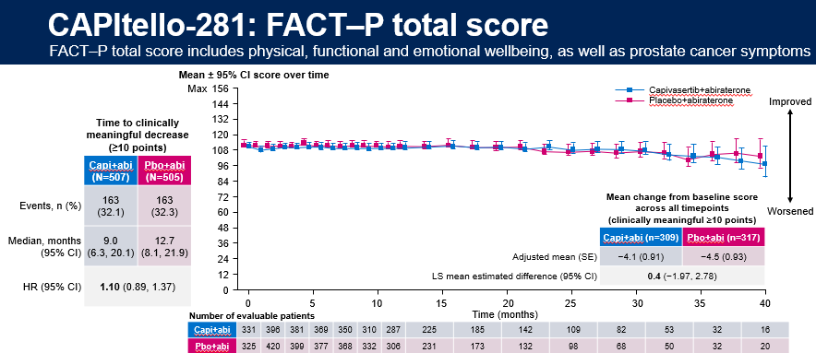
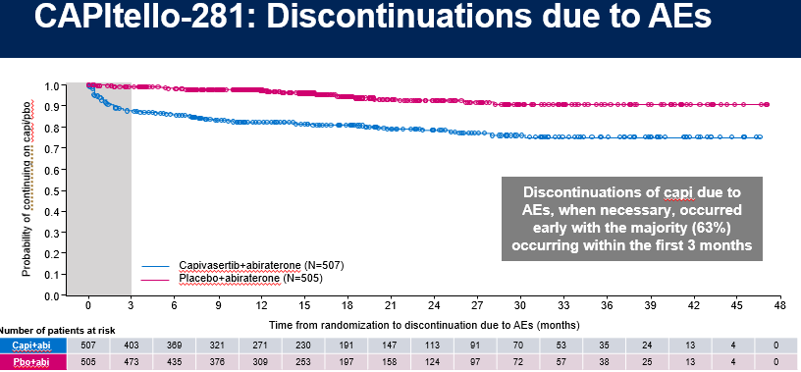
George DJ et al. Patient reported outcomes (PRO) and tolerability of capivasertib (capi) plus abiraterone (abi) versus placebo (pbo) plus abi in patients (pts) with PTEN-deficient metastatic hormone-sensitive prostate cancer (mHSPC): CAPItello-281. Genitourinary Cancer Symposium 2026;Abstract 14.

Slide 73
CAPItello-281: investigator-reported AEs (≥10% of patients)
Capi+abi (N=503)
Pbo+abi (N=503)
Total (%)/Grade ≥3 (%)
Grade 1
Grade 2
≥Grade 3
≥Grade 3
Grade 2
Grade 1
Total (%)/Grade ≥3 (%)
Diarrhea
51.9 / 6.2
8.0 / 0.4
Hyperglycemia*
38.0 / 10.3
12.9 / 0.6
Rash†
35.4 / 12.3
7.0 / 0.2
Anemia
23.9 / 5.2
12.7 / 1.0
Hypokalemia
22.1 / 8.7
12.7 / 4.8
Hypertension
19.9 / 5.8
23.9 / 7.8
Fatigue
15.9 / 0.4
12.5 / 0.8
ALT increased
14.1 / 4.4
13.3 / 3.4
Urinary tract infection
13.7 / 4.2
10.1 / 1.2
AST increased
12.9 / 2.6
11.7 / 2.0
Nausea
12.1 / 0.6
4.4 / 0.0
COVID-19
11.7 / 0.8
8.7 / 0.6
Asthenia
11.3 / 0.8
5.0 / 0.4
Pyrexia
10.9 / 1.2
2.8 / 0.0
Hot flush
10.5 / 0.2
13.5 / 0.0
Pruritus
10.5 / 0.2
2.6 / 0.0
Back pain
9.9 / 0.6
10.9 / 0.0
Constipation
8.3 / 0.2
11.9 / 0.0
Arthralgia
7.6 / 0.4
10.1 / 0.4
Diabetic ketoacidosis was reported in six patients (1.2%) in the capi+abi arm and zero patients in the pbo+abi arm
*Grouped term (includes the preferred terms of blood glucose increased, hyperglycemia); †Grouped term (includes the preferred terms of erythema, rash, rash erythematous, rash macular, rash maculo-papular, rash papular, rash pruritic). abi, abiraterone; AE, adverse event; ALT, alanine aminotransferase; AST, aspartate aminotransferase; capi, capivasertib; pbo, placebo; PTEN, phosphatase and tensin homolog
Professor Daniel J. George
Abstract 14

Slide 74
CAPItello-281: common AEs associated with
AKT inhibition
Rash*
Diarrhea
Hyperglycemia†
 | Capi+abi (N=503) | Pbo+abi (N=503)
Any grade AE, n (%) | 178 (35.4) | 35 (7.0)
Grade ≥3 AE,‡ n (%) | 62 (12.3) | 1 (0.2)
Median (IQR) time to onset, days | 13 (11–43) | 78 (37–195)
AE leading to, n (%)
Interruption of capi/pbo | 85 (16.9) | 3 (0.6)
Reduction of capi/pbo | 43 (8.5) | 2 (0.4)
Discontinuation of capi/pbo | 24 (4.8) | 0
Supportive treatment given, n (%) | 146 (29.0) | 20 (4.0)
Outcome at time of DCO, n (%) Recovered/recovering Not recovered | 164 (32.6) 24 (4.8) | 28 (5.6) 8 (1.6)
Capi+abi (N=503) | Pbo+abi (N=503)
261 (51.9) | 40 (8.0)
31 (6.2) | 2 (0.4)
12 (3–43) | 142 (28–339)
63 (12.5) | 1 (0.2)
22 (4.4) | 0
5 (1.0) | 0
167 (33.2) | 19 (3.8)
238 (47.3) 45 (8.9) | 36 (7.2) 4 (0.8)
Capi+abi (N=503) | Pbo+abi (N=503)
191 (38.0) | 65 (12.9)
52 (10.3) | 3 (0.6)
54 (15–114) | 114 (71–326)
55 (10.9) | 4 (0.8)
33 (6.6) | 1 (0.2)
5 (1.0) | 0
127 (25.2) | 23 (4.6)
140 (27.8) 65 (12.9) | 43 (8.5) 25 (5.0)
*Grouped term including the preferred terms of erythema, rash, rash erythematous, rash macular, rash maculopapular, rash papular, rash pruritic. †Grouped term including the preferred terms of blood glucose increased, hyperglycemia. ‡A diarrhea AE of Grade 4 was reported for one patient (0.2%) in the capi+abi arm only, hyperglycemia AEs of Grade 4 and Grade 5 were reported for one patient (0.2%) each in the capi+abi arm only, no Grade 4–5 AEs of rash were reported. No primary prophylaxis interventions were used during the CAPItello-281 trial for prospective AE management. Additional data on supportive treatment received are available via QR code.
abi, abiraterone; AE, adverse event; capi, capivasertib; DCO, data cutoff; IQR, interquartile range; pbo, placebo
Professor Daniel J. George
Abstract 14

Slide 75
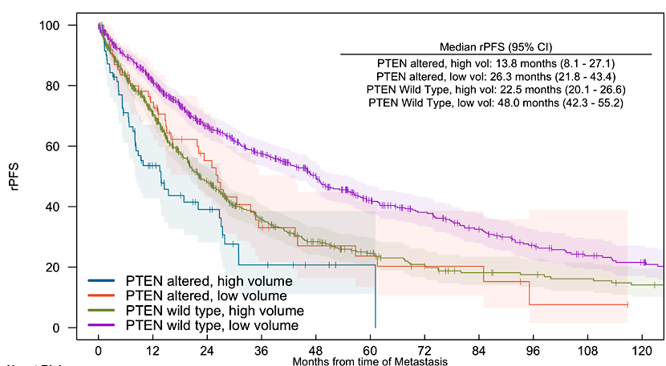
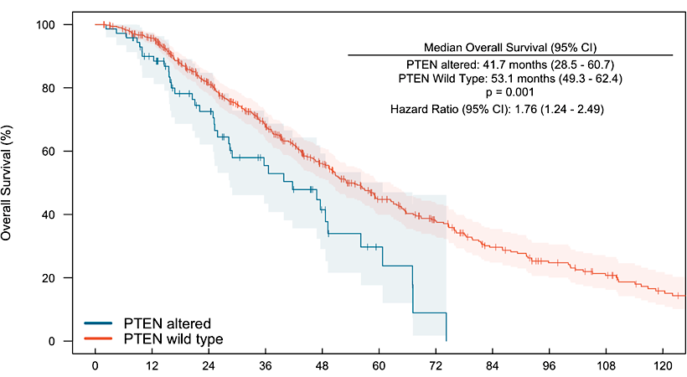
My Takeaways: Capitello-281
PTEN loss is associated with worse rPFS and OS with ADT/ARPI therapy in men with mHSPC. See our data from the PROMISE registry (Thapa and Kilmari, manuscript submitted)
Similar poor outcomes seen in Capitello-281 (25.7 mo vs LATTITUDE (33.0 mo), with frequent PSA-radiographic discordant progression
Capi/abi improves rPFS but does not yet improve OS, and is associated with more toxicities, short term worsening of QOL, and treatment discontinuations
Unclear if this will represent a new standard of care without improved survival
Courtesy of Andrew J Armstrong, MD, ScM

Slide 76
Agenda
Prostate Cancer
INTRODUCTION: Evolution of the prostate cancer model; PCWG4
MODULE 1: Hormonal therapy
MODULE 2: Chemotherapy (docetaxel)
MODULE 3: PARP inhibition
MODULE 4: Radioligand therapy
MODULE 5: New agents

Slide 77
Questions About Chemotherapy
In which situations in APMS disease do you use a docetaxel triplet?
For older, more frail patients, do you consider starting ADT with an AP blocker and using delayed docetaxel if the patient doesn’t have an optimal response? Would you enter patients on the TRIPLE-SWITCH trial?
In what situations if any do you utilize q2wk docetaxel?

Slide 78
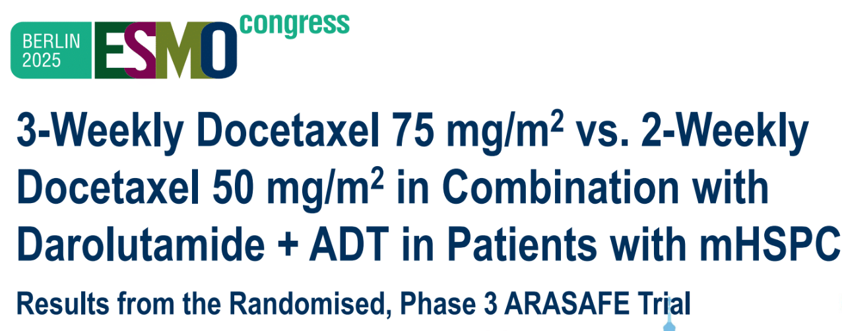
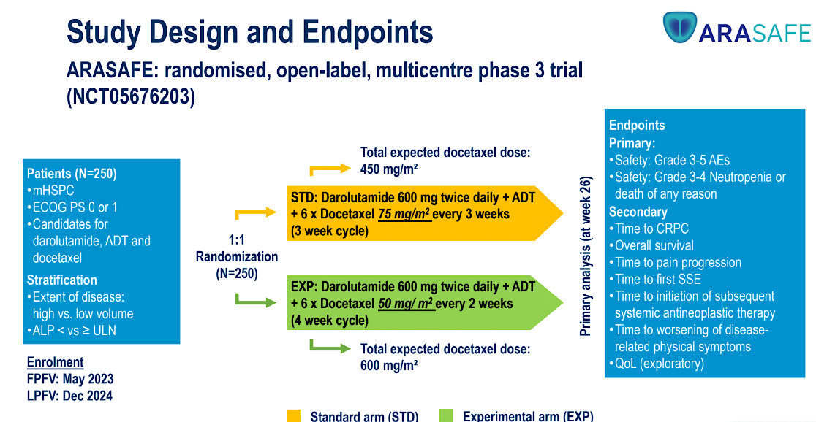
Can we improve docetaxel tolerability?
Primary endpoint: G3-5 AE rates and grade 3-4 neutropenia/death
Grimm et al ESMO 2025 LBA92

Slide 79
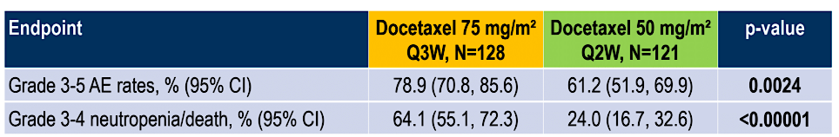
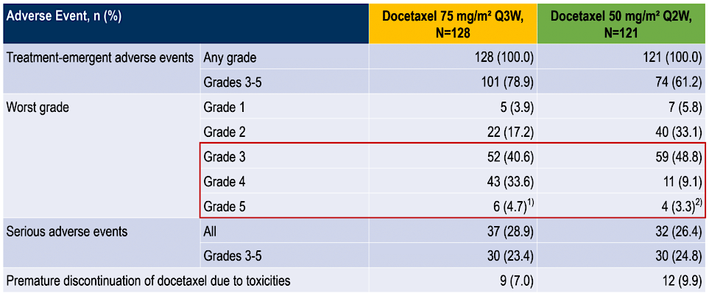
Q3 vs Q2 week docetaxel in mHSPC patients
Take home: q2 week Rx is safer and similarly effective
G3-5 Neutropenia: 56 vs 20%
Febrile neutropenia:
5.5% vs 1.7%
PSA <0.2 at week 26: 48.8 vs 41.3%
Courtesy of Andrew J Armstrong, MD, ScM

Slide 80
Agenda
Prostate Cancer
INTRODUCTION: Evolution of the prostate cancer model; PCWG4
MODULE 1: Hormonal therapy
MODULE 2: Chemotherapy (docetaxel)
MODULE 3: PARP inhibition
MODULE 4: Radioligand therapy
MODULE 5: New agents

Slide 81
Questions About PARP Inhibitors
In which clinical scenarios do you utilize a PARPi? How often do you evaluate a patient with disease progression on ADT but no prior Api, and what is the typical history? In those patients, for which genomic abnormalities will you use a PARPi, and which one? What are the common tolerability/toxicity issues encountered?
What was your take on the clinical and research implications of the BRCAAway study?
In which clinical scenarios do you utilize a PARPi for patients with APMS disease? Which one? BRCA2 somatic? Would you want to for BRCA1? ATM, CDK12?

Slide 82
Questions About PARP Inhibitors
What is the rationale for the use of saruparib, and what is known about treatment efficacy and tolerability compared to approved agents? What ongoing clinical trials are investigating this agent?

Slide 83
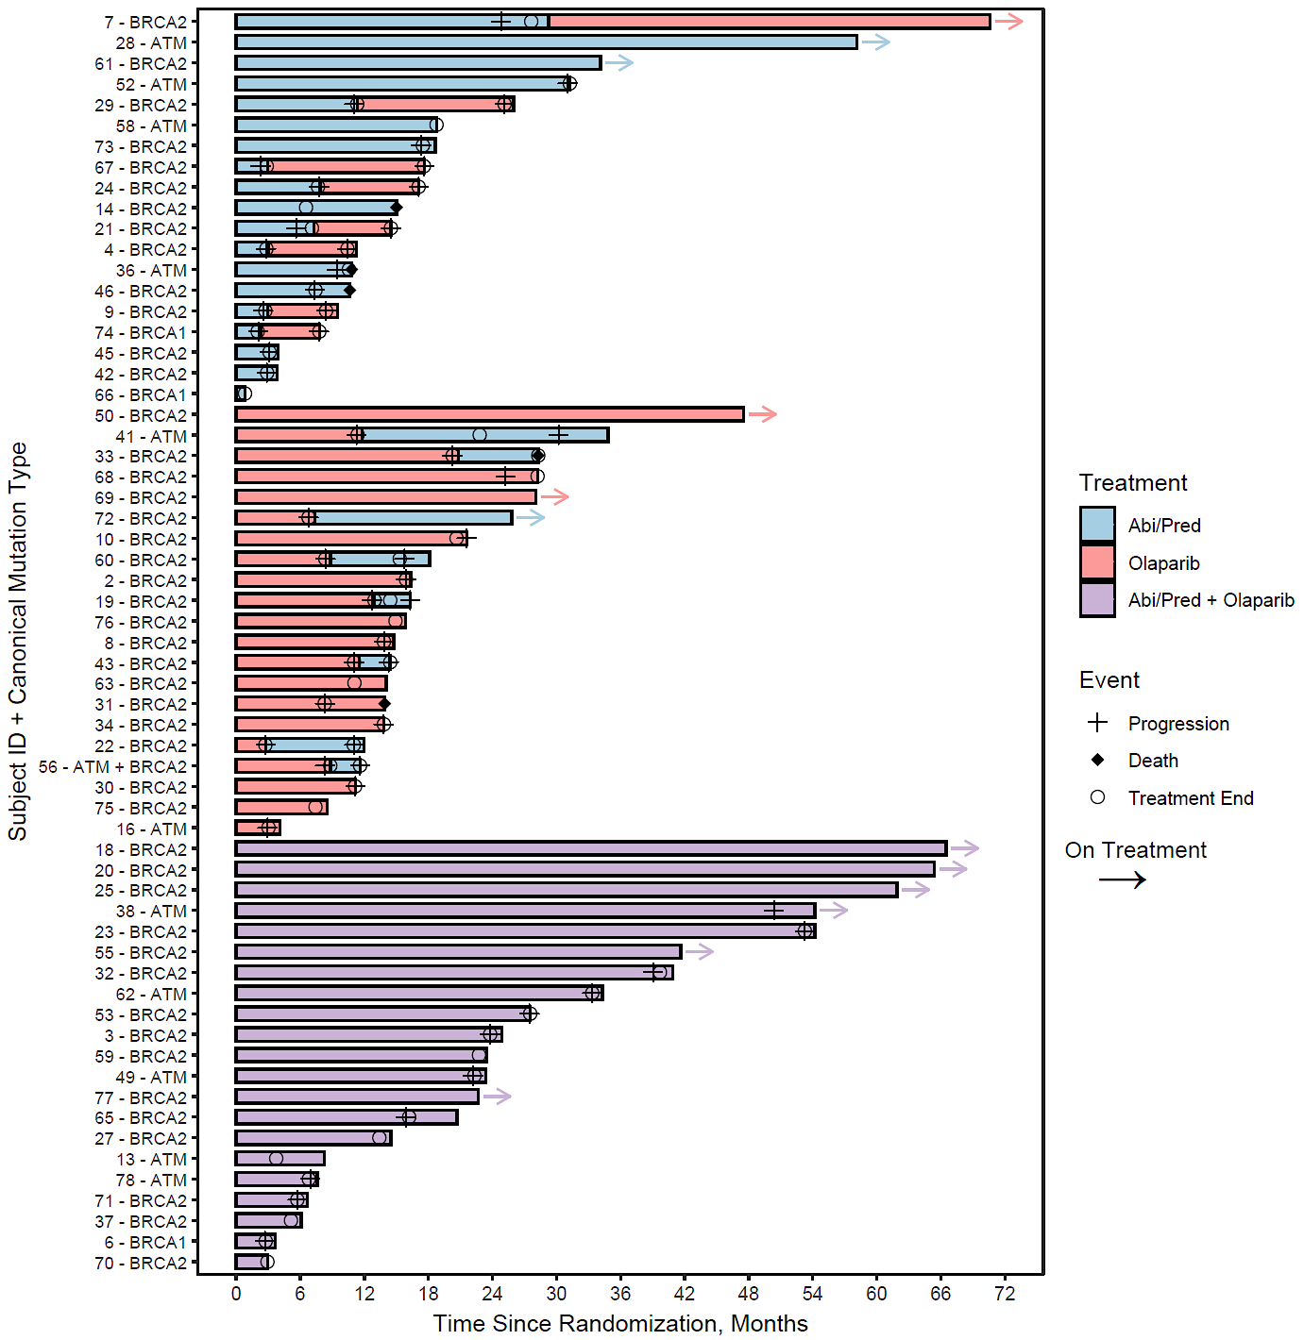
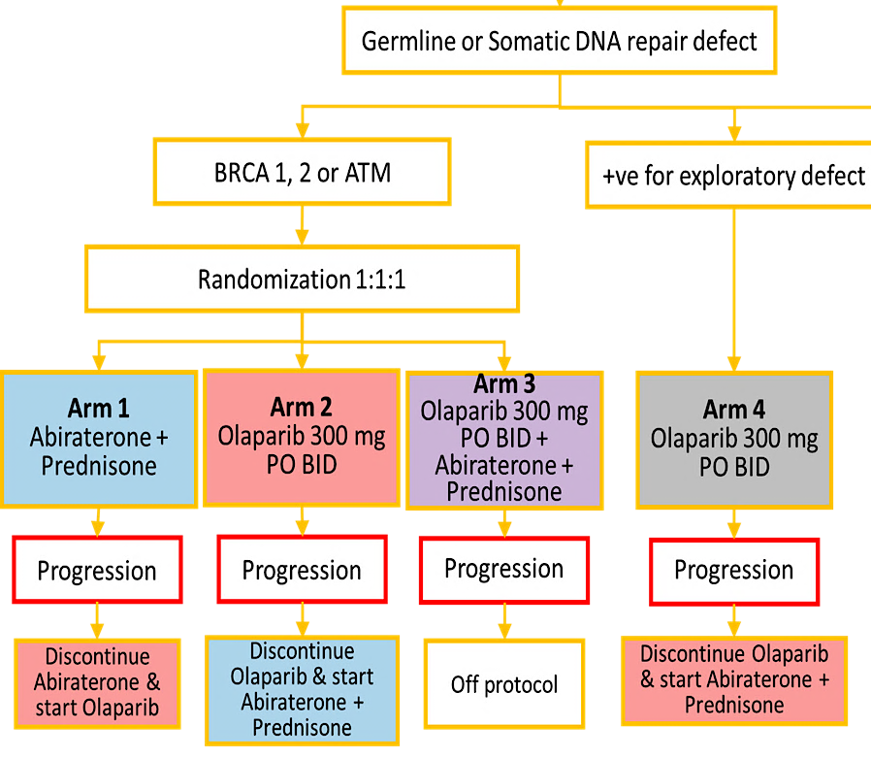
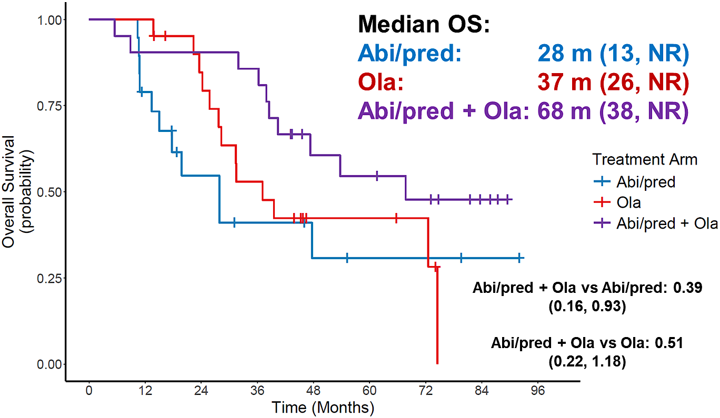
BRCAAway: Abi, Olaparib, or Abi + Ola for mAPMR PC
Hussain et al, ASCO GU 2026, Abst 16

Slide 84



AMPLITUDE: Abi/pred + niraparib/placebo for mAPMN/S PC
Placebo + AAP
N = 348
Subgroup Analysis
Trial Design
Niraparib +
AAP
N = 348
Randomized, double-blind, placebo-controlled, international phase 3 study
Niraparib + AAP
Placebo + AAP
(N = 191)
(N = 196)
BRCA subgroup
(median rPFS)
NE
26mo
Patient Population
Insert Patients with mAPMS
HRR gene alterations
ADT must have started ≥14d & ≤6mos prior to randomization & was continued during study Tx
Median rPFS (ITT)
rPFS HR: 0.52
95% CI: 0.37, 0.72; P < .0001
NE
29.5 mos
  HR 0.63
  (95% CI: 0.49, 0. 8), P < 0.0001
(N = 230)
(N = 226)
HRR effector subgroup
(median rPFS)
NE
27.6mo
NE
Median OS (BRCA)
(immature)
NE
rPFS HR: 0.57
95% CI: 0.42, 0.77; P = .0003
Endpoints
  HR 0.75
  (95% CI: 0.51, 1.11), P = 0.15
Primary: rPFS
Secondary: OS
75%
69%
BRCA2 exploratory cohort (N = 323):
rPFS: NE vs 26 months, HR: 0.46 (95% CI: 0.32, 0.66)
Grade 3-4 AEs
Grade 3-4 AEs
Attard G, et al. Nat Med. 2025;31(12):4109-4118l; U.S. Food and Drug Administration. FDA approves niraparib and abiraterone acetate plus prednisone for BRCA2-mutated metastatic castration-sensitive prostate cancer. Published December 12, 2025. Accessed February 9, 2026.

Slide 85
Talazoparib with Enzalutamide Significantly Improves Radiographic Progression-Free Survival in Metastatic Prostate Cancer
Press Release: March 19, 2026
“[The manufacturer] today announced positive topline results from the Phase 3 TALAPRO-3 study of talazoparib, an oral poly ADP-ribose polymerase (PARP) inhibitor, in combination with enzalutamide, an androgen receptor pathway inhibitor (ARPI), in people with homologous recombination repair (HRR) gene-mutated metastatic castration-sensitive prostate cancer (mCSPC), also known as metastatic hormone-sensitive prostate cancer (mHSPC).
The study met its primary endpoint, with talazoparib plus enzalutamide demonstrating a statistically significant and clinically meaningful improvement in radiographic progression-free survival (rPFS), compared to placebo plus enzalutamide.
At the time of the interim analysis, results showed a strong trend toward improved overall survival (OS), a key secondary endpoint. Benefits were also observed in other secondary endpoints, including overall response rate, duration of response, and time to Prostate-Specific Antigen (PSA) progression. The safety of talazoparib plus enzalutamide was consistent with the known safety profile of each medicine, and no new safety signals were identified.
Talazoparib plus XTANDI in HRR gene-mutated mCSPC is an investigational treatment regimen. The TALAPRO-3 results will be submitted for presentation at an upcoming medical congress and will be discussed with global health authorities for potential regulatory submissions.”
https://www.pfizer.com/news/press-release/press-release-detail/talzenna-plus-xtandi-significantly-improves-radiographic

Slide 86
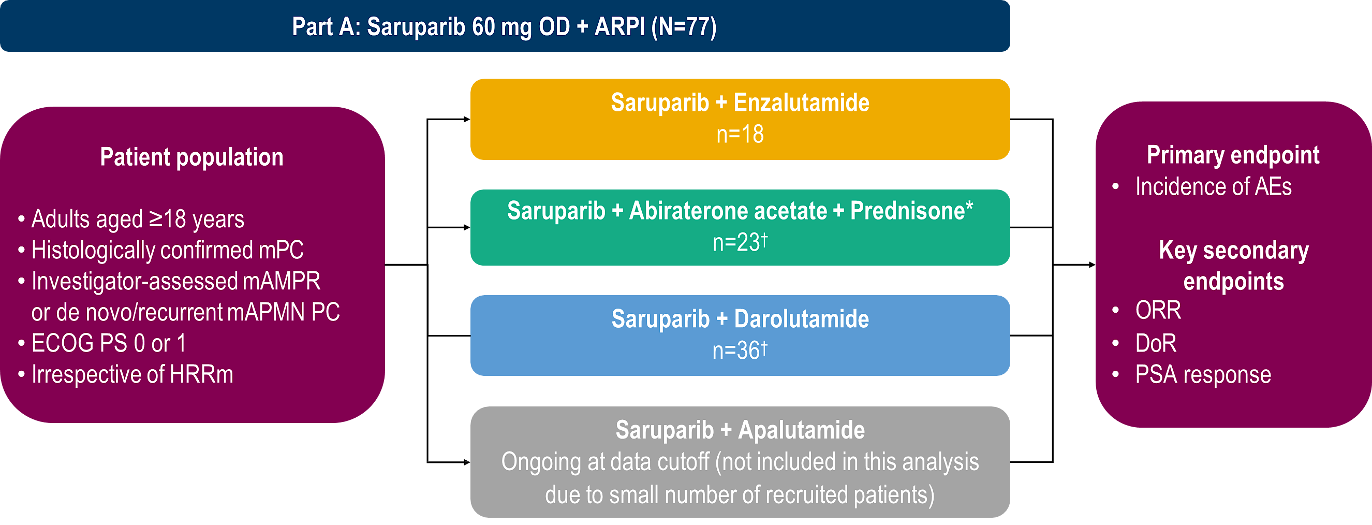
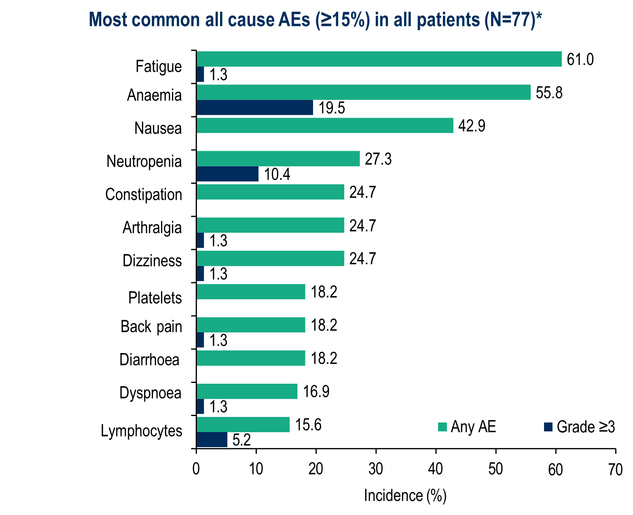
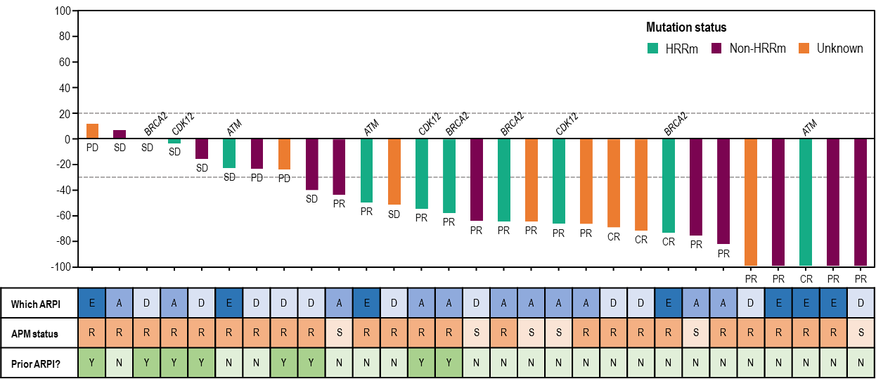
Phase 1/2 PETRANHA trial of saruparib + androgen receptor pathway inhibitors
Azad et al, Ann Oncol 2025, Abst 2384MO

Slide 87
EvoPAR-Prostate01: Phase 3 Trial Design (mHSPC)
A Phase III, 2-cohort, 2-arm, randomized, double-blind, placebo-controlled study evaluating the efficacy and safety of saruparib plus physician’s choice of NHA (abiraterone, darolutamide, or enzalutamide) versus placebo plus physician’s choice of NHA in participants with mCSPC
Eligibility criteria
≈550 patients
Saruparib 60 mg plus physician’s choice NHA
Select endpoints
HRRm
HRRm cohort
rPFS
OS
Non-HRRm cohort
rPFS
OS
Aged ≥18 years
Histologically confirmed mCSPC (de novo or recurrent low- or high-volume disease)
ECOG PS 0–1
Prospectively defined HRRm status*
Must be receiving ADT throughout the study or have undergone bilateral orchiectomy, and must be suitable for treatment with NHAs
No prior treatment with PARP inhibitors, CT, or NHAs in the metastatic setting†
No suspected or prior history of myelodysplastic syndrome/acute myeloid leukemia
R 1:1
Placebo plus
physician’s choice NHA
No crossover between cohorts
Saruparib 60 mg plus physician’s choice NHA
Statistical analyses
Non-HRRm
rPFS and OS will be tested for each cohort separately using a stratified log-rank test
R 1:1
Placebo plus
physician’s choice NHA
≈1250 patients
Treatment will continue until disease progression, unacceptable toxicity, or participant-initiated withdrawal
www.clinicaltrials.gov: (NCT06120491)
Agarwal N. et al, AUA 2024

Slide 88
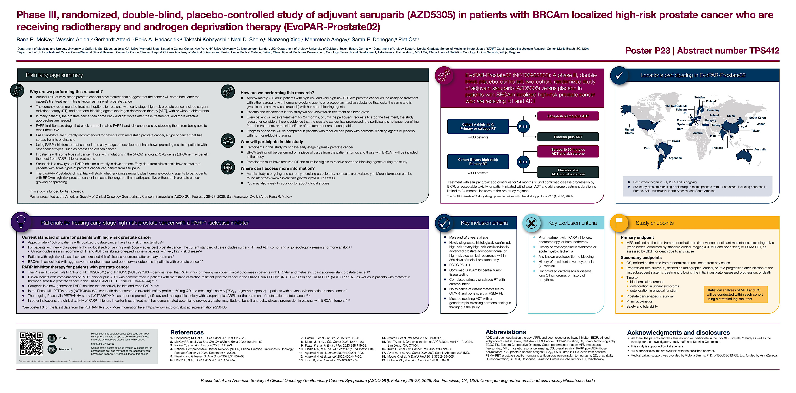

Slide 89
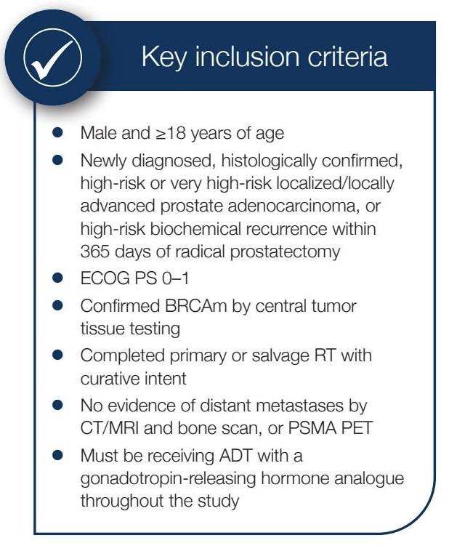
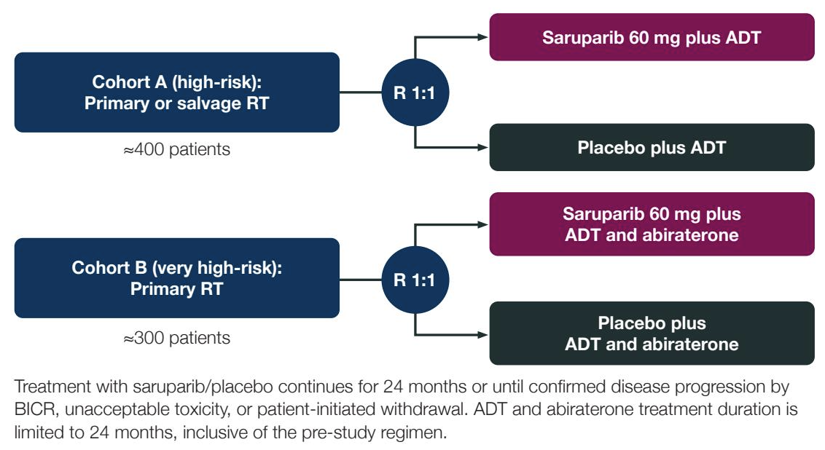
EvoPAR-Prostate02: Phase III Study of Adjuvant Saruparib in Patients with BRCAm Localized High-Risk Prostate Cancer Receiving RT and ADT
Trial Identifier: NCT06952803
Primary Endpoint: Metastasis-free survival
McKay RR et al. Genitourinary Cancer Symposium 2026;Abstract TPS412.

Slide 90
Agenda
Prostate Cancer
INTRODUCTION: Evolution of the prostate cancer model; PCWG4
MODULE 1: Hormonal therapy
MODULE 2: Chemotherapy (docetaxel)
MODULE 3: PARP inhibition
MODULE 4: Radioligand therapy
MODULE 5: New agents

Slide 91
Questions About Radioligand Therapy
What is your perspective on the use of lutetium Lu 177 vipivotide tetraxetan as part of treatment of APMS disease (PSMAddition trial)? If you could access this, in what situations would you utilize it?
What is your perspective on the long-term findings of the hematologic toxicity observed in the PSMAfore trials?
What other toxicities have you observed with lutetium Lu 177 vipivotide tetraxetan and how does this impact both your use of the agent and patient quality of life?

Slide 92
Questions About Radioligand Therapy
Based on recent data, what is your perspective on actinium-225-PSMA? How do you anticipate this radioligand therapy might ultimately be integrated into the treatment algorithm for patients with APMR disease?

Slide 93
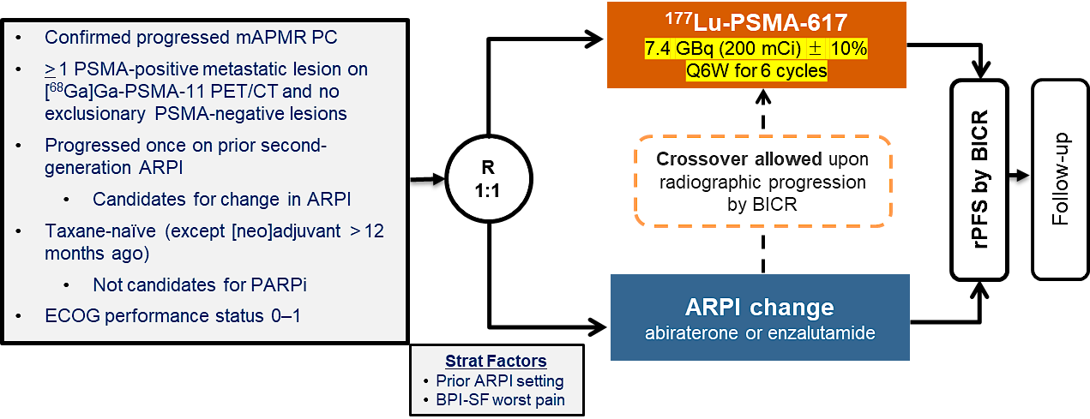
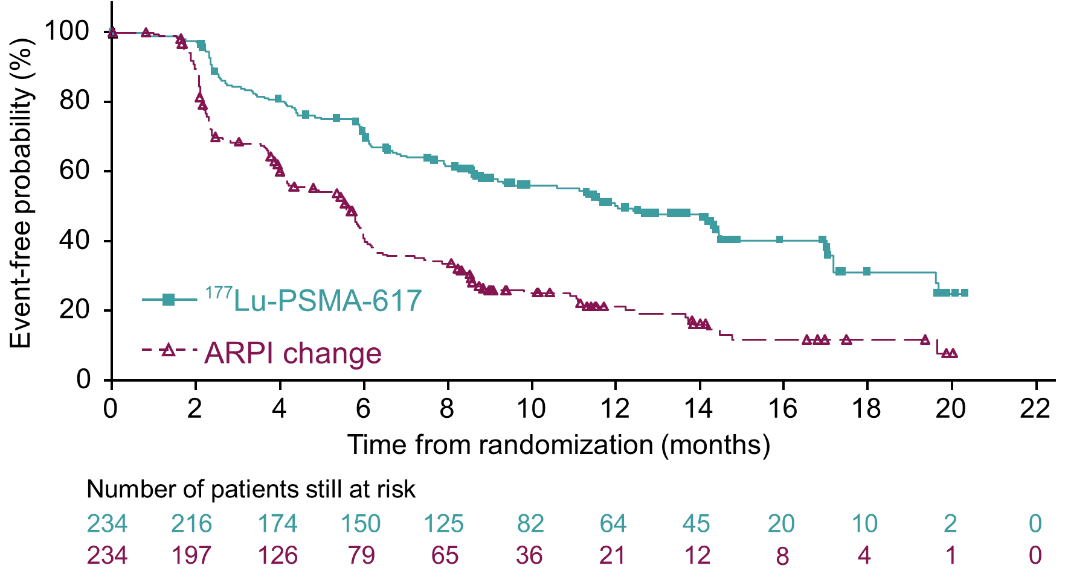
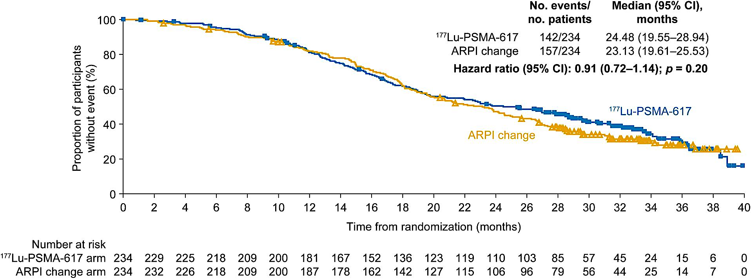
PSMAfore: ARPI-resistant, chemo-naïve mAPMR PC
rPFS
Final OS Analysis
Morris et al. Lancet. 2024; 404:1227-1239.
Fizazi et al, Ann Oncol 2025

Slide 94
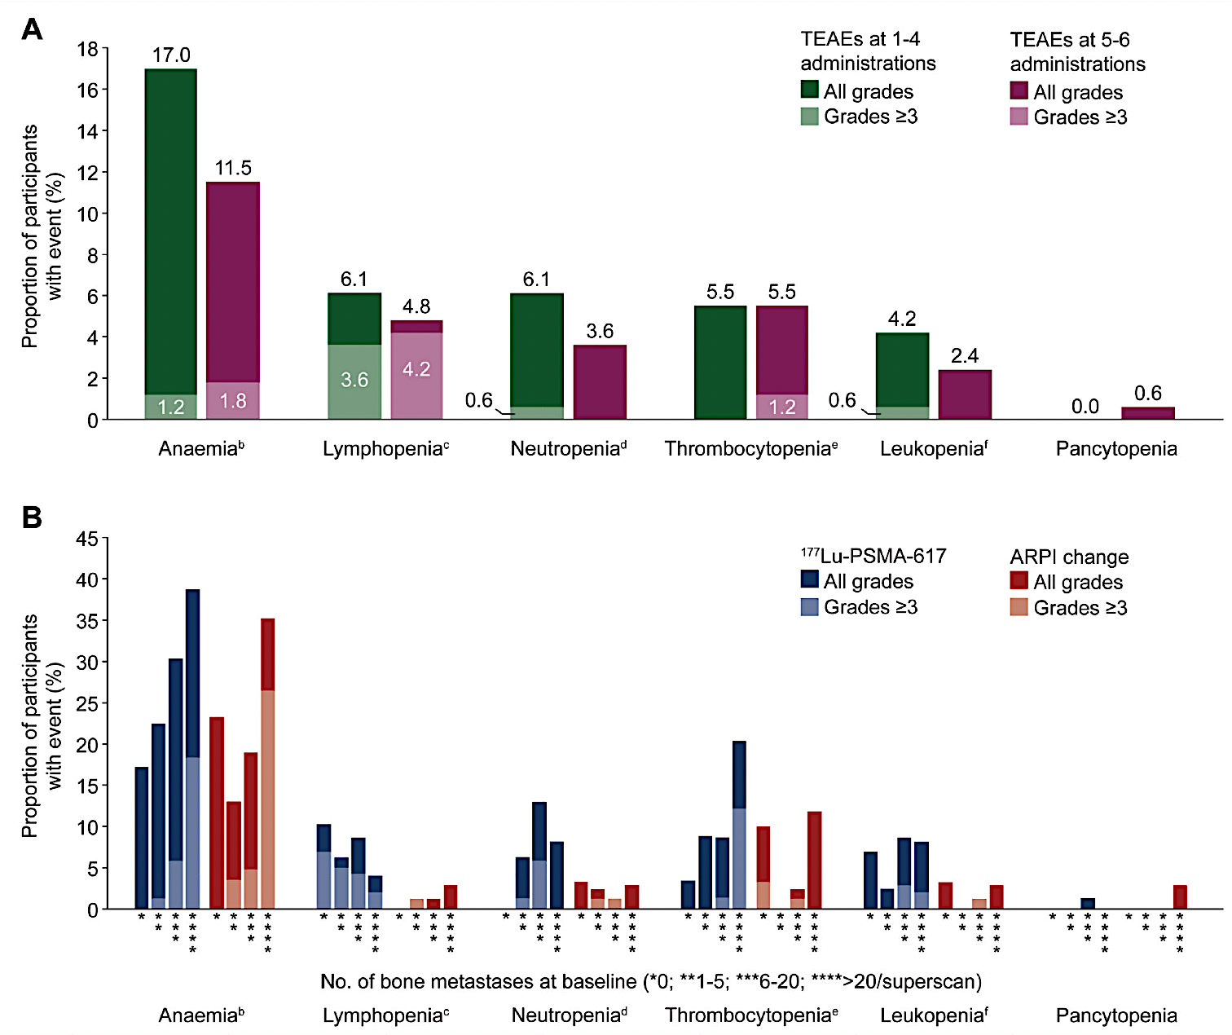
PSMAfore: Final Safety Analyses
Incidence of haematologic TEAEs by number of 177Lu-PSMA-617 administrations
Incidence of haematologic TEAEs by number of bone metastases at baseline
Fizazi et al, Ann Oncol 2025

Slide 95
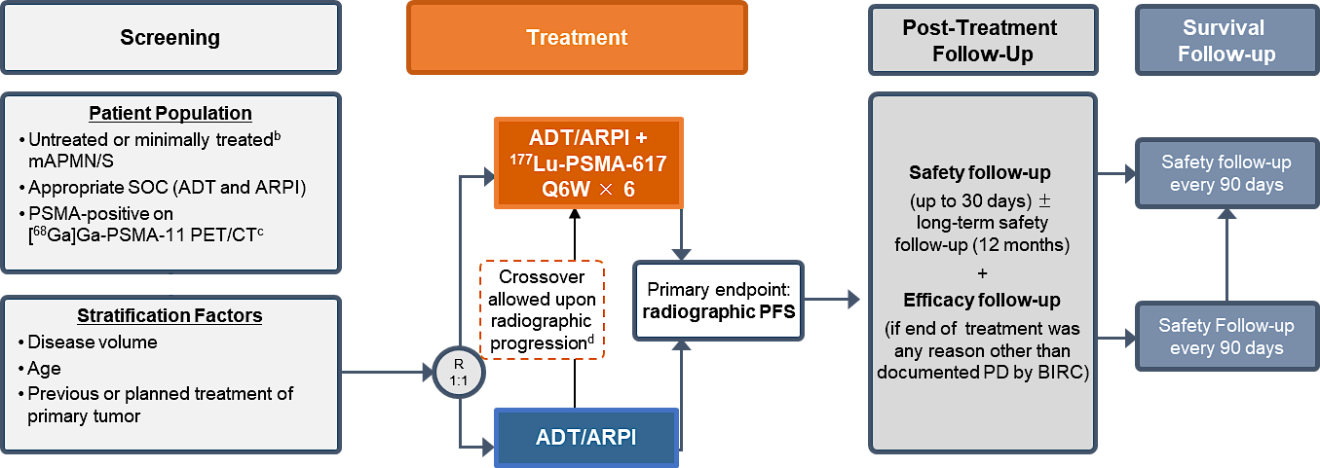
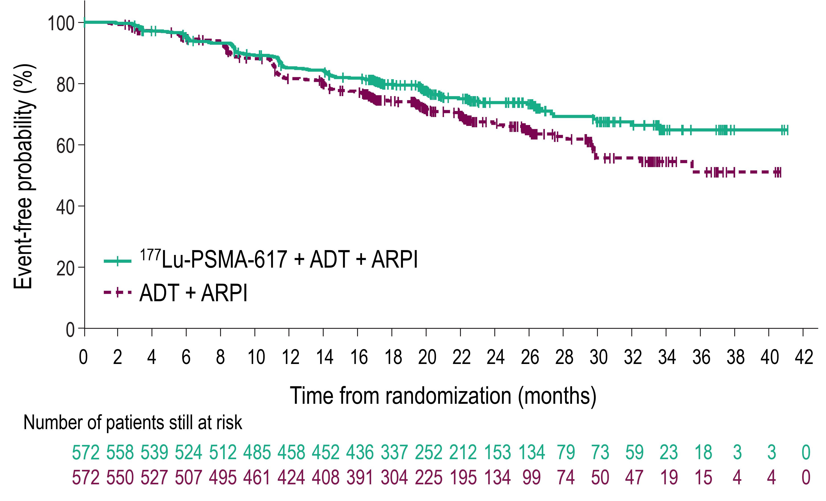
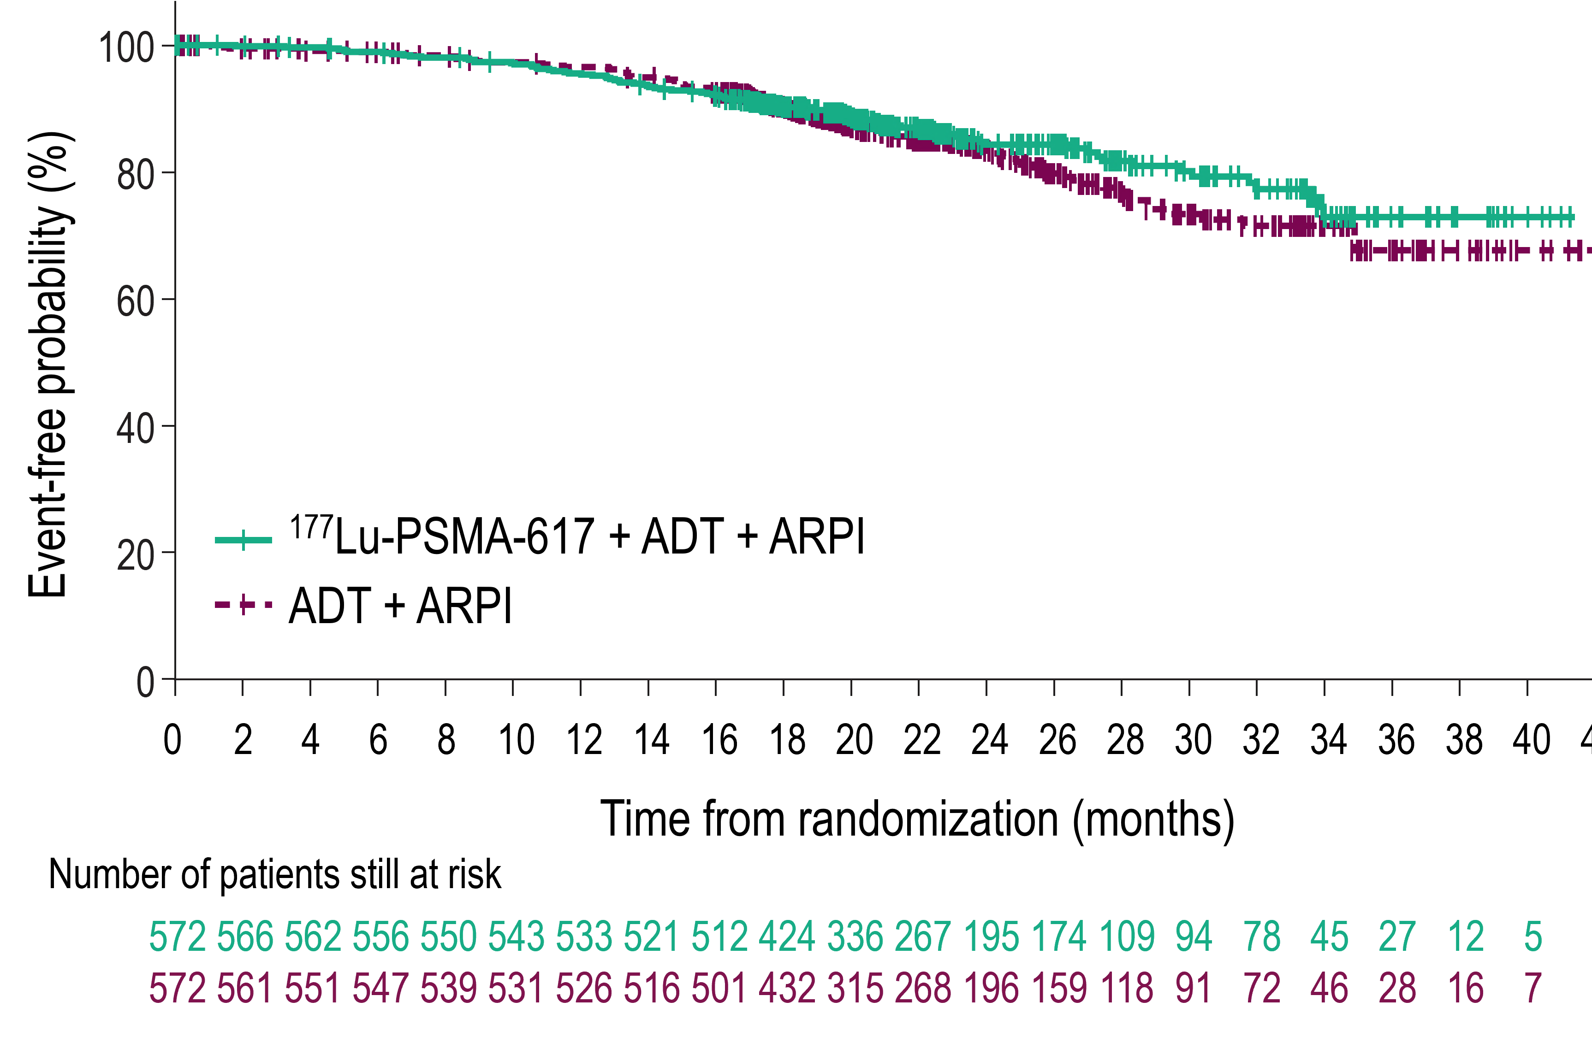
PSMAddition
Common TEAEs
Dry mouth (46%)
Fatigue (35%)
Nausea (34%)
Anemia (28%)
Neutropenia (15%)
Thrombocytopenia (11%)
rPFS
Interim OS
HR 0.72
95%CI 0.58-0.90
P=0.002
HR 0.84
95%CI 0.63-1.13
P=0.125
Tagawa T et al. Annals of Oncology 36 (2025): S1742-S1743; LBA6.

Slide 96
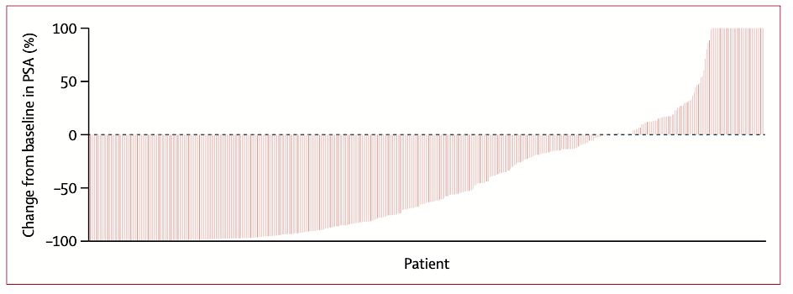
WARMTH Act: PSA Responses
Sathekge MM et al. Lancet Oncol 2024 February;25(2):175-83.

Slide 97
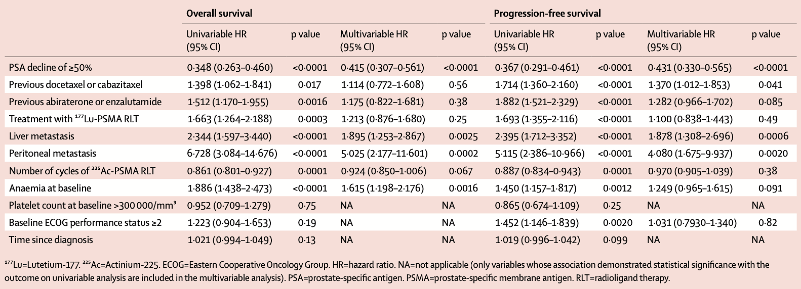
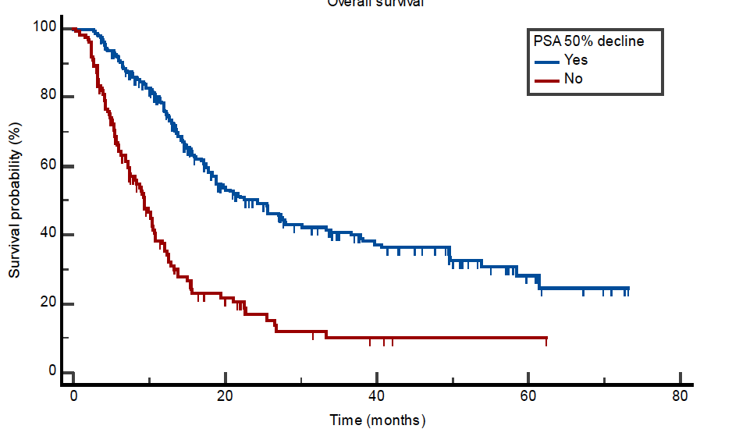
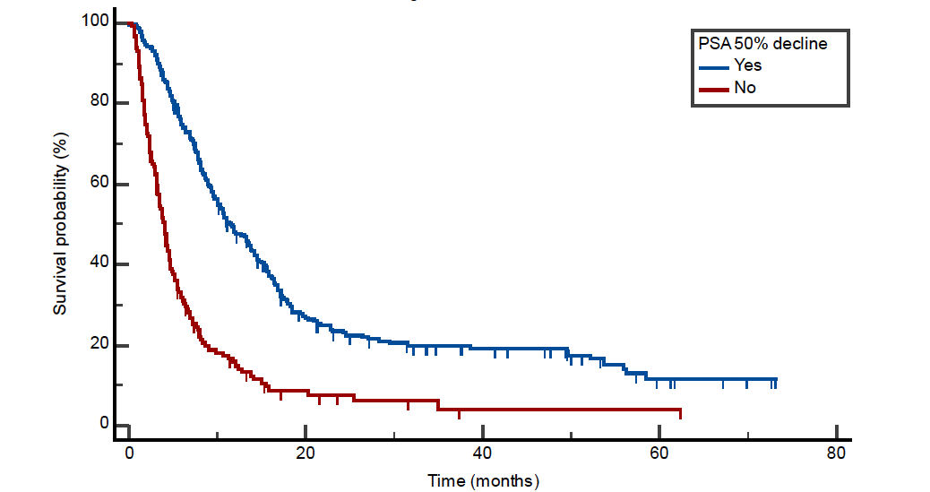
WARMTH Act: Survival Benefit with PSA Decline
Overall Survival
Progression-Free Survival
Sathekge MM et al. Lancet Oncol 2024 February;25(2):175-83.

Slide 98
Actinium-225-PSMA Radioligand Therapy: WARMTH Act
Survival Analysis
Sathekge MM et al. Lancet Oncol 2024 February;25(2):175-83.

Slide 99
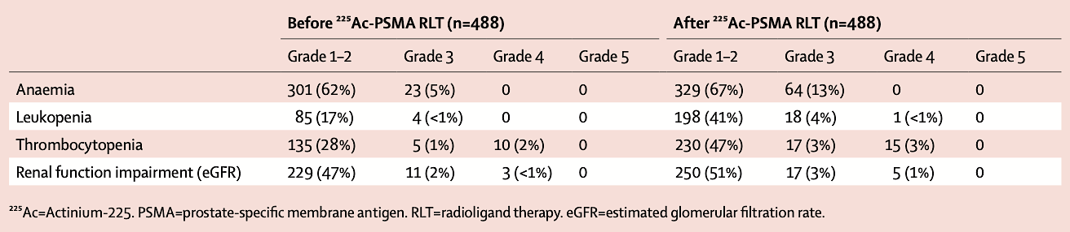
WARMTH Act: Bone Marrow Toxicity, Renal Function Impairment
Sathekge MM et al. Lancet Oncol 2024 February;25(2):175-83.

Slide 100
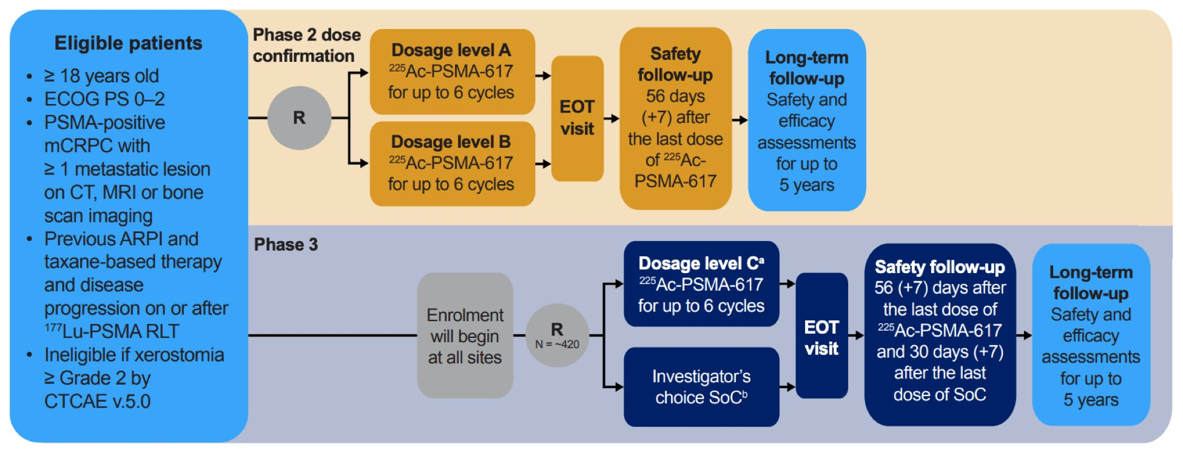
Phase II/III PSMAcTION Study Design
NCT06780670
Primary endpoints: Biochemical response rate, safety, tolerability
Secondary endpoints: rPFS, overall response rate
Emmett L et al. ESMO 2025;Abstract 2516TiP.

Slide 101
Agenda
Prostate Cancer
INTRODUCTION: Evolution of the prostate cancer model; PCWG4
MODULE 1: Hormonal therapy
MODULE 2: Chemotherapy (docetaxel)
MODULE 3: PARP inhibition
MODULE 4: Radioligand therapy
MODULE 5: New agents

Slide 102
Questions About New Agents
What has been your experience with efficacy and tolerability of B7-H3 ADCs such as ifinatamab deruxtecan? Do you believe these will eventually be used prior to the use of chemotherapy? What about combinations?
What has been your experience in detection of HER2-positive prostate cancer, and what experience if any do you have in the use of T-DXd in terms of efficacy and tolerability? How do you approach the use of preventive antiemetic regimens and screening and management of ILD?

Slide 103
Questions About New Agents
How would you describe the mechanism of action of opevesostat (CYP11A1 inhibitor) to that of abiraterone (CYP17A1 inhibitor)? What impact might this difference have on efficacy and tolerability?
If data with opevesostat are positive, how do you envision this agent being utilized in the clinical setting?

Slide 104
Questions About New Agents
What is the rationale and design of the TulmiSTAR trial? What are tulmimetostat and luxdegalutamide?

Slide 105
Questions About New Agents
What is your experience with the use of CD3 bispecific agents in prostate cancer, such as pasritamig? What have you observed in terms of treatment efficacy and tolerability, including experience with cytokine release syndrome?
What do you see as the future of finger-stick assays for PSA as an initial screening tool and perhaps self-testing?

Slide 106
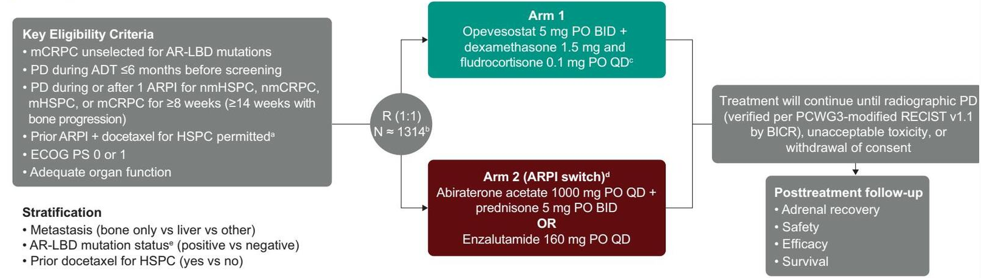
Emerging Therapy: Opevesostat (CYP11A1 Upstream Androgen Synthesis Inhibitor)
OMAHA-004
Primary endpoints: rPFS
N=400 AR LBD+
N=900 AR LBD-
Separately
OMAHA-003: Similar but requires 1-2 prior taxanes for mCRPC (n=1310). Primary: OS (separate analysis by AR LBD status)
Fizazi K et al. ASCO GU 2026
Yu E et al. ASCO GU 2026
AbstractsTPS298-9

Slide 107
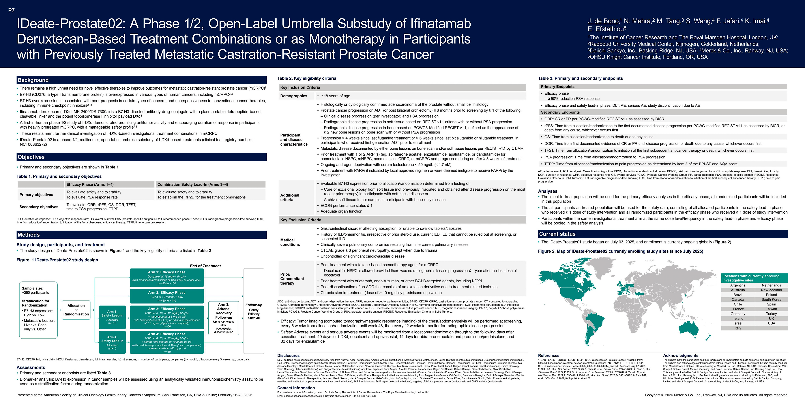

Slide 108


IDeate-Prostate02: Phase I/II Umbrella Substudy of Ifinatamab Deruxtecan-Based Treatment Combinations or as Monotherapy in Previously Treated mCRPC
Trial Identifier: NCT06863272
DeBono J et al. Genitourinary Cancer Symposium 2026;Abstract TPS297.

Slide 109

darolutamide) for nonmetastatic HSPC, mHSPC, nonmetastatic CRPC, or mCRPC and progressed during or

Slide 110


IDeate-Prostate01: Phase III Study of Ifinatamab Deruxtecan Versus Docetaxel in Previously Treated mCRPC
Trial Identifier: NCT06925737
McKay RR et al. Genitourinary Cancer Symposium 2026;Abstract TPS294.

Slide 111

Armstrong A et al. ASCO GU 2026
Notes:
TulmiSTAR-01:

Slide 112

TulmiSTAR01: Study Design
Armstrong A et al. ASCO GU 2026

Slide 113

TulmiSTAR01: Key Points
Armstrong A et al. ASCO GU 2026

Slide 114

Phase 1 trial of pasritamig for mAPMR PC – Baseline Patient
Characteristics
Stein MN et al, J Clin Oncol 2025; 43: 2516-26.

Slide 115

Phase 1 trial of pasritamig for mAPMR PC – Safety and RP2D
Stein MN et al, J Clin Oncol 2025; 43: 2516-26.

Slide 116

Phase 1 trial of pasritamig for mAPMR PC – RP2D Efficacy
Stein MN et al, J Clin Oncol 2025; 43: 2516-26.

Slide 117
Year in Review: Clinical Investigator Perspectives on the
Most Relevant New Datasets and Advances in Oncology
Menin Inhibitors in Acute Myeloid Leukemia
A CME/MOC-Accredited Live Webinar
Thursday, March 26, 2026
5:00 PM – 6:00 PM ET
Faculty
Amir Fathi, MD
Eunice S Wang, MD
Moderator
Neil Love, MD

Slide 118
Thank you for joining us!
Please take a moment to complete the survey currently up on Zoom. Your feedback is very important to us. The survey will remain open for 5 minutes after the meeting ends.
Information on how to obtain CME, ABIM
MOC and ABS credit is provided in the Zoom chat room. Attendees will also receive an email in 1 to 3 business days with these instructions.

