Slide 1
Year in Review: Clinical Investigator Perspectives on the
Most Relevant New Datasets and Advances in Oncology
PI3K/AKT/mTOR Pathway in
HR-Positive Metastatic Breast Cancer
A CME/MOC-Accredited Live Webinar
Wednesday, July 15, 2026
5:00 PM – 6:00 PM ET
Faculty
Virginia Kaklamani, MD, DSc
Hope S Rugo, MD
Moderator
Neil Love, MD

Slide 2



Faculty
Virginia Kaklamani, MD, DSc
Professor of Medicine
Ruth McLean Bowman Bowers Chair in Breast Cancer Research and Treatment
AB Alexander Distinguished Chair in Oncology
Leader, Breast Oncology Program
UT Health San Antonio MD Anderson Cancer Center
San Antonio, Texas
MODERATOR
Neil Love, MD
Research To Practice
Miami, Florida
Hope S Rugo, MD
Director, Women’s Cancers Program
Division Chief, Breast Medical Oncology
Professor, Department of Medical Oncology and Therapeutics Research
City of Hope Comprehensive Cancer Center
Duarte, California
Professor Emeritus, UCSF

Slide 3
Commercial Support
This activity is supported by educational grants from AstraZeneca Pharmaceuticals LP and Celcuity.
Research To Practice CME Planning Committee Members,
Staff and Reviewers
Planners, scientific staff and independent reviewers for Research To Practice have no relevant financial relationships to disclose.

Slide 4
Dr Love — Disclosures
Dr Love is president and CEO of Research To Practice. Research To Practice receives funds in the form of educational grants to develop CME activities from the following companies: Aadi Bioscience, AbbVie Inc, ADC Therapeutics, Agendia Inc, Alexion Pharmaceuticals, Amgen Inc, Array BioPharma Inc, a subsidiary of Pfizer Inc, Arvinas, Astellas, AstraZeneca Pharmaceuticals LP, Aveo Pharmaceuticals, Bayer HealthCare Pharmaceuticals, BeOne, Biotheranostics Inc, A Hologic Company, Black Diamond Therapeutics Inc, Blueprint Medicines, Boehringer Ingelheim Pharmaceuticals Inc, Bristol Myers Squibb, Catalyst Pharmaceuticals Inc, Celcuity, Clovis Oncology, Coherus BioSciences, Corcept Therapeutics Inc, CTI BioPharma, a Sobi Company, Daiichi Sankyo Inc, Eisai Inc, Elevation Oncology Inc, Exact Sciences Corporation, Exelixis Inc, Genentech, a member of the Roche Group, Genmab US Inc, Geron Corporation, Gilead Sciences Inc, GSK, Helsinn Therapeutics (US) Inc, ImmunoGen Inc, Incyte Corporation, Ipsen Biopharmaceuticals Inc, Jazz Pharmaceuticals Inc, Johnson & Johnson, Karyopharm Therapeutics, Kite, A Gilead Company, Kura Oncology, Legend Biotech, Lilly, MEI Pharma Inc, Merck, Mersana Therapeutics Inc, Mirati Therapeutics Inc, Mural Oncology Inc, Natera Inc, Novartis, Novartis Pharmaceuticals Corporation on behalf of Advanced Accelerator Applications, Novocure Inc, Nuvalent, Nuvation Bio Inc, Pfizer Inc, Pharmacyclics LLC, an AbbVie Company, Puma Biotechnology Inc, Regeneron Pharmaceuticals Inc, Revolution Medicines Inc, Rigel Pharmaceuticals Inc, R-Pharm US, Sanofi, Seagen Inc, Servier Pharmaceuticals LLC, SpringWorks Therapeutics Inc, Stemline Therapeutics Inc, Sumitomo Pharma America, Summit Therapeutics, Syndax Pharmaceuticals, Taiho Oncology Inc, Takeda Pharmaceuticals USA Inc, TerSera Therapeutics LLC, Tesaro, A GSK Company, and Verastem Inc.

Slide 5
Dr Kaklamani — Disclosures
Consulting Agreements | AstraZeneca Pharmaceuticals LP, Daiichi Sankyo Inc, Genentech, a member of the Roche Group, Gilead Sciences Inc, Lilly, Menarini Group, Novartis, Pfizer Inc
Speakers Bureaus | AstraZeneca Pharmaceuticals LP, Gilead Sciences Inc

Slide 6
Dr Rugo — Disclosures
Consulting Agreements | BioNTech SE, Bristol Myers Squibb, Helsinn Therapeutics (US) Inc, Napo Pharmaceuticals
Contracted Research | Ambrx, AstraZeneca Pharmaceuticals LP, Daiichi Sankyo Inc, Genentech, a member of the Roche Group, Gilead Sciences Inc, Lilly, Merck, Novartis, Pfizer Inc, Stemline Therapeutics Inc
Research Funding (to Institution) | ALX Oncology, Bicycle Therapeutics, Genentech, a member of the Roche Group, Mabwell Therapeutics Inc, Merck, Pfizer Inc, Phoenix Molecular Designs, Relay Therapeutics, Stemline Therapeutics Inc

Slide 7
This educational activity contains discussion of
non-FDA-approved uses of agents and regimens. Please refer to official prescribing information for each product for approved indications.

Slide 8


We Encourage Clinicians in Practice to Submit Questions
Feel free to submit questions now before the program begins and throughout the program.

Slide 9

Familiarizing Yourself with the Zoom Interface
Expand chat submission box
Drag the white line above the submission box up to create
more space for your message.

Slide 10

Familiarizing Yourself with the Zoom Interface
Increase chat font size
Press Command (for Mac) or Control (for PC) and the + symbol.
You may do this as many times as you need for readability.

Slide 11


Clinicians in the Audience, Please Complete the Pre- and Postmeeting Surveys
Quick Survey
Quick Poll

Slide 12


Slide 13
The Implications of Recent Datasets for the Current and Future Management of Genitourinary Cancers — An ASCO 2026 Review
A CME/MOC-Accredited Live Webinar
Thursday, July 16, 2026
5:00 PM – 6:30 PM ET
Faculty
Rahul Aggarwal, MD
Matthew D Galsky, MD
Tian Zhang, MD, MHS, FASCO
Moderator
Neil Love, MD

Slide 14
Patterns of Care: Exploring How
Community Oncologists Manage
Metastatic Triple-Negative Breast Cancer
A CME/MOC-Accredited Live Webinar
Tuesday, July 21, 2026
5:00 PM – 6:00 PM ET
Faculty
Professor Peter Schmid, FRCP, MD, PhD
Melinda Telli, MD, FASCO
Moderator
Neil Love, MD

Slide 15
Bringing the Investigator into the Equation
— Optimal Use of Hormonal Therapy in the
Care of Patients with Prostate Cancer
A CME/MOC-Accredited Live Webinar
Wednesday, July 29, 2026
5:00 PM – 6:00 PM ET
Faculty
William K Oh, MD
Mary-Ellen Taplin, MD
Moderator
Neil Love, MD

Slide 16
The Implications of Recent Datasets for the Current and Future Management of Breast Cancer — An ASCO 2026 Review
A CME/MOC-Accredited Live Webinar
Thursday, July 30, 2026
5:00 PM – 6:30 PM ET
Faculty
Kevin Kalinsky, MD, MS, FASCO
Joyce O’Shaughnessy, MD
Additional faculty to be announced.
Moderator
Neil Love, MD

Slide 17
Integrating New Advances into the Care of Patients with Cancer
A Multitumor Symposium in Partnership with the American Oncology Network
Join Us In Person or Virtually
Saturday, August 22, 2026
JW Marriott Nashville | Nashville, Tennessee
Chronic Lymphocytic Leukemia
9:00 AM – 9:50 AM CT
Diffuse Large B-Cell Lymphoma
12:35 PM – 1:25 PM CT
Gastroesophageal Cancers
9:50 AM – 10:40 AM CT
Lung Cancer
1:25 PM – 2:15 PM CT
Gynecologic Cancers
10:55 AM – 11:45 AM CT
Moderator
Stephen “Fred” Divers, MD

Slide 18
Grand Rounds
CME/MOC-Accredited Interactive Series
Regional Activities
Two Series
Optimizing the Use of
Novel Therapies for Patients with Diffuse Large B-Cell Lymphoma
Optimizing Therapy for Patients with Hormone Receptor-Positive
Localized Breast Cancer
Host a 1-hour session at your institution:
Email Meetings@ResearchToPractice.com
or call (800) 233-6153

Slide 19
Year in Review:
PI3K/AKT/mTOR Pathway in
HR-Positive Metastatic Breast Cancer
INTRODUCTION: San Antonio Memories
MODULE 1: PI3K/AKT/PTEN Alterations and Therapies
MODULE 2: Capivasertib
MODULE 3: Gedatolisib
MODULE 4: Inavolisib
MODULE 5: New Agents and Ongoing Trials

Slide 20
Thank you for joining us!
Please take a moment to complete the survey currently up on Zoom.
Your feedback is very important to us.
Information on how to obtain CME, ABIM MOC and ABS credit will be provided in the Zoom chat room. Attendees will also receive an email in
1 to 3 business days with these instructions.

Slide 21
Year in Review: Clinical Investigator Perspectives on the
Most Relevant New Datasets and Advances in Oncology
PI3K/AKT/mTOR Pathway in
HR-Positive Metastatic Breast Cancer
A CME/MOC-Accredited Live Webinar
Wednesday, July 15, 2026
5:00 PM – 6:00 PM ET
Faculty
Virginia Kaklamani, MD, DSc
Hope S Rugo, MD
Moderator
Neil Love, MD

Slide 22
Faculty
Virginia Kaklamani, MD, DSc
Professor of Medicine
Ruth McLean Bowman Bowers Chair
in Breast Cancer Research and Treatment
AB Alexander Distinguished Chair in Oncology
Leader, Breast Oncology Program
UT Health San Antonio MD Anderson Cancer Center
San Antonio, Texas
MODERATOR
Neil Love, MD
Research To Practice
Miami, Florida
Hope S Rugo, MD
Director, Women’s Cancers Program
Division Chief, Breast Medical Oncology
Professor, Department of Medical Oncology and Therapeutics Research
City of Hope Comprehensive Cancer Center
Duarte, California
Professor Emeritus, UCSF

Slide 23
We Encourage Clinicians in Practice to Submit Questions
Feel free to submit questions now before the program begins and throughout the program.

Slide 24
Clinicians in the Audience, Please Complete the Pre- and Postmeeting Surveys
Quick Survey
Quick Poll

Slide 26
The Implications of Recent Datasets for the Current and Future Management of Genitourinary Cancers — An ASCO 2026 Review
A CME/MOC-Accredited Live Webinar
Thursday, July 16, 2026
5:00 PM – 6:30 PM ET
Faculty
Rahul Aggarwal, MD
Matthew D Galsky, MD
Tian Zhang, MD, MHS, FASCO
Moderator
Neil Love, MD

Slide 27
Patterns of Care: Exploring How
Community Oncologists Manage
Metastatic Triple-Negative Breast Cancer
A CME/MOC-Accredited Live Webinar
Tuesday, July 21, 2026
5:00 PM – 6:00 PM ET
Faculty
Professor Peter Schmid, FRCP, MD, PhD
Melinda Telli, MD, FASCO
Moderator
Neil Love, MD

Slide 28
Bringing the Investigator into the Equation
— Optimal Use of Hormonal Therapy in the
Care of Patients with Prostate Cancer
A CME/MOC-Accredited Live Webinar
Wednesday, July 29, 2026
5:00 PM – 6:00 PM ET
Faculty
William K Oh, MD
Mary-Ellen Taplin, MD
Moderator
Neil Love, MD

Slide 29
The Implications of Recent Datasets for the Current and Future Management of Breast Cancer — An ASCO 2026 Review
A CME/MOC-Accredited Live Webinar
Thursday, July 30, 2026
5:00 PM – 6:30 PM ET
Faculty
Kevin Kalinsky, MD, MS, FASCO
Joyce O’Shaughnessy, MD
Additional faculty to be announced.
Moderator
Neil Love, MD

Slide 30
Integrating New Advances into the Care of Patients with Cancer
A Multitumor Symposium in Partnership with the American Oncology Network
Join Us In Person or Virtually
Saturday, August 22, 2026
JW Marriott Nashville | Nashville, Tennessee
Chronic Lymphocytic Leukemia
9:00 AM – 9:50 AM CT
Diffuse Large B-Cell Lymphoma
12:35 PM – 1:25 PM CT
Gastroesophageal Cancers
9:50 AM – 10:40 AM CT
Lung Cancer
1:25 PM – 2:15 PM CT
Gynecologic Cancers
10:55 AM – 11:45 AM CT
Moderator
Stephen “Fred” Divers, MD

Slide 31
Grand Rounds
CME/MOC-Accredited Interactive Series
Regional Activities
Two Series
Optimizing the Use of
Novel Therapies for Patients with Diffuse Large B-Cell Lymphoma
Optimizing Therapy for Patients with Hormone Receptor-Positive
Localized Breast Cancer
Host a 1-hour session at your institution:
Email Meetings@ResearchToPractice.com
or call (800) 233-6153

Slide 32
Year in Review: Clinical Investigator Perspectives on the
Most Relevant New Datasets and Advances in Oncology
PI3K/AKT/mTOR Pathway in
HR-Positive Metastatic Breast Cancer
A CME/MOC-Accredited Live Webinar
Wednesday, July 15, 2026
5:00 PM – 6:00 PM ET
Faculty
Virginia Kaklamani, MD, DSc
Hope S Rugo, MD
Moderator
Neil Love, MD

Slide 33
Commercial Support
This activity is supported by educational grants from AstraZeneca Pharmaceuticals LP and Celcuity.
Research To Practice CME Planning Committee Members,
Staff and Reviewers
Planners, scientific staff and independent reviewers for Research To Practice have no relevant financial relationships to disclose.

Slide 34
Dr Kaklamani — Disclosures
Consulting Agreements | AstraZeneca Pharmaceuticals LP, Daiichi Sankyo Inc, Genentech, a member of the Roche Group, Gilead Sciences Inc, Lilly, Menarini Group, Novartis, Pfizer Inc
Speakers Bureaus | AstraZeneca Pharmaceuticals LP, Gilead Sciences Inc

Slide 35
Dr Rugo — Disclosures
Consulting Agreements | BioNTech SE, Bristol Myers Squibb, Helsinn Therapeutics (US) Inc, Napo Pharmaceuticals
Contracted Research | Ambrx, AstraZeneca Pharmaceuticals LP, Daiichi Sankyo Inc, Genentech, a member of the Roche Group, Gilead Sciences Inc, Lilly, Merck, Novartis, Pfizer Inc, Stemline Therapeutics Inc
Research Funding (to Institution) | ALX Oncology, Bicycle Therapeutics, Genentech, a member of the Roche Group, Mabwell Therapeutics Inc, Merck, Pfizer Inc, Phoenix Molecular Designs, Relay Therapeutics, Stemline Therapeutics Inc

Slide 36
Dr Love — Disclosures
Dr Love is president and CEO of Research To Practice. Research To Practice receives funds in the form of educational grants to develop CME activities from the following companies: Aadi Bioscience, AbbVie Inc, ADC Therapeutics, Agendia Inc, Alexion Pharmaceuticals, Amgen Inc, Array BioPharma Inc, a subsidiary of Pfizer Inc, Arvinas, Astellas, AstraZeneca Pharmaceuticals LP, Aveo Pharmaceuticals, Bayer HealthCare Pharmaceuticals, BeOne, Biotheranostics Inc, A Hologic Company, Black Diamond Therapeutics Inc, Blueprint Medicines, Boehringer Ingelheim Pharmaceuticals Inc, Bristol Myers Squibb, Catalyst Pharmaceuticals Inc, Celcuity, Clovis Oncology, Coherus BioSciences, Corcept Therapeutics Inc, CTI BioPharma, a Sobi Company, Daiichi Sankyo Inc, Eisai Inc, Elevation Oncology Inc, Exact Sciences Corporation, Exelixis Inc, Genentech, a member of the Roche Group, Genmab US Inc, Geron Corporation, Gilead Sciences Inc, GSK, Helsinn Therapeutics (US) Inc, ImmunoGen Inc, Incyte Corporation, Ipsen Biopharmaceuticals Inc, Jazz Pharmaceuticals Inc, Johnson & Johnson, Karyopharm Therapeutics, Kite, A Gilead Company, Kura Oncology, Legend Biotech, Lilly, MEI Pharma Inc, Merck, Mersana Therapeutics Inc, Mirati Therapeutics Inc, Mural Oncology Inc, Natera Inc, Novartis, Novartis Pharmaceuticals Corporation on behalf of Advanced Accelerator Applications, Novocure Inc, Nuvalent, Nuvation Bio Inc, Pfizer Inc, Pharmacyclics LLC, an AbbVie Company, Puma Biotechnology Inc, Regeneron Pharmaceuticals Inc, Revolution Medicines Inc, Rigel Pharmaceuticals Inc, R-Pharm US, Sanofi, Seagen Inc, Servier Pharmaceuticals LLC, SpringWorks Therapeutics Inc, Stemline Therapeutics Inc, Sumitomo Pharma America, Summit Therapeutics, Syndax Pharmaceuticals, Taiho Oncology Inc, Takeda Pharmaceuticals USA Inc, TerSera Therapeutics LLC, Tesaro, A GSK Company, and Verastem Inc.

Slide 37
This educational activity contains discussion of
non-FDA-approved uses of agents and regimens. Please refer to official prescribing information for each product for approved indications.

Slide 38

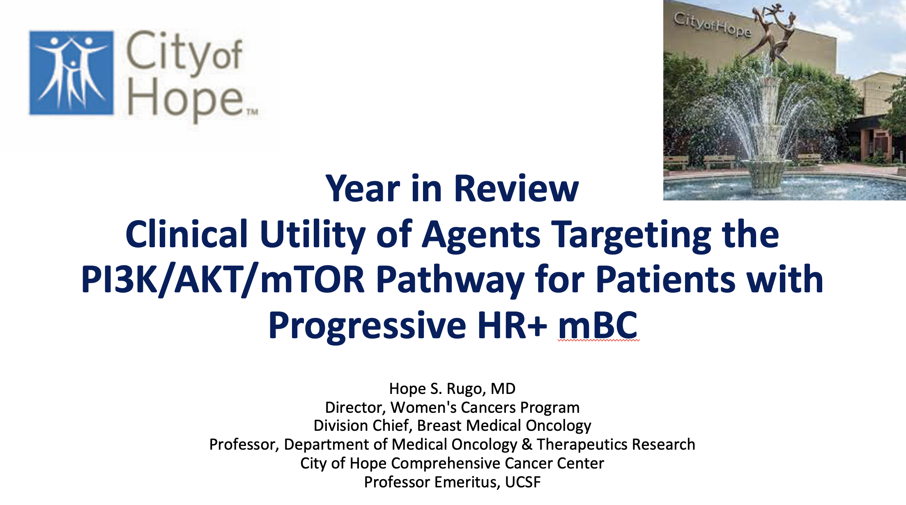

Slide 39
Key Datasets
Virginia Kaklamani, MD, DSc
Fernando S et al. PIK3R1 (p85α) alterations define a targetable subset of breast cancer with broad sensitivity to PI3K and AKT inhibitors. San Antonio Breast Cancer Symposium 2025;Abstract RF4-05.
Kalinsky K et al. Comparative analysis of blood- and tissue-based PIK3CA mutation detection methods in the pivotal phase 3 INAVO120 trial of palbociclib + fulvestrant ± inavolisib in hormone receptor-positive, HER2-negative advanced breast cancer. San Antonio Breast Cancer Symposium 2025;Abstract PS1-10-26.
Jhaveri KL et al. Overall survival with inavolisib in PIK3CA-mutated advanced breast cancer. N Engl J Med 2025;393(2):151-61.
Turner N et al. Molecular features of response to palbociclib + fulvestrant ± inavolisib in hormone receptor-positive, HER2-negative, PIK3CA-mutated advanced breast cancer as assessed from baseline circulating tumor DNA in the pivotal phase 3 INAVO120 trial. San Antonio Breast Cancer Symposium 2025;Abstract PD5-09.
Loibl S et al. Efficacy of inavolisib (INAVO) + palbociclib (PALBO) + fulvestrant (FULV) in patients (pts) with PIK3CA-mutated, hormone receptor-positive, HER2-negative (HER2-), endocrine-resistant advanced breast cancer (aBC) with and without hyperglycaemia (HG) in the phase III INAVO120 trial. ESMO Breast Cancer 2026;Abstract 420RO.

Slide 40
Key Datasets
Virginia Kaklamani, MD, DSc (continued)
Basho R et al. INAVO123: Phase 3 study of first-line inavolisib/placebo + a cyclin-dependent kinase 4/6 inhibitor + letrozole in participants with PIK3CA-mutated, hormone receptor-positive, HER2-negative, endocrine-sensitive advanced breast cancer. San Antonio Breast Cancer Symposium 2025;Abstract PS5-07-27.
Neven P et al. Capivasertib (C) + ribociclib (R) + fulvestrant (F) in patients (pts) with HR-positive/HER2-negative advanced breast cancer (ABC): CAPItello-292 phase Ib. ESMO Breast Cancer 2025;Abstract 316P.
Sudhan DR et al. Mechanisms of resistance to capivasertib in combination with CDK4/6 inhibitor (CDK4/6i) plus fulvestrant in patients with hormone receptor-positive/HER2-negative (HR+/HER2−) advanced breast cancer (ABC): Exploratory analysis from the phase 1b CAPItello-292 study. San Antonio Breast Cancer Symposium 2025;Abstract RF4-04.
Wesolowski R et al. Gedatolisib combined with palbociclib and letrozole in patients with no prior systemic therapy for hormone receptor-positive, HER2-negative advanced breast cancer. Clin Cancer Res 2025;31(19):4040-8.
VIKTORIA-2: A randomized, open-label, phase 3 study evaluating efficacy and safety of gedatolisib with endocrine therapy and palbociclib vs endocrine therapy and ribociclib as first-line treatment in patients with HR-positive and HER2-negative advanced breast cancer. NCT06757634.

Slide 41
Key Datasets
Hope S Rugo, MD
Rugo HS et al. Capivasertib (C) and fulvestrant (F) for patients (pts) with HR+/HER2- advanced breast cancer (ABC): Final overall survival (OS) results from the phase III CAPItello-291 trial. ESMO Breast Cancer 2026;Abstract 417O.
Rugo HS et al. Capivasertib plus fulvestrant as first and second-line endocrine-based therapy in PIK3CA/AKT1/PTEN-altered hormone receptor-positive advanced breast cancer: Subgroup analysis from the phase 3 CAPItello-291 trial. ESMO 2025;Abstract 526P.
Turner NC et al. Capivasertib plus fulvestrant in hormone receptor-positive (HR+) advanced breast cancer (ABC): Exploratory ctDNA analyses from the phase 3 CAPItello-291 trial. San Antonio Breast Cancer Symposium 2025;Abstract RF7-05.
Vaklavas C et al. Camizestrant in combination with capivasertib for women with ER-positive, HER2-negative advanced breast cancer: Results from SERENA-1. ESMO Open 2026;11(2):106049.
Pistilli B et al. Gedatolisib (Geda), a multitarget PI3K/AKT/mTOR (PAM) inhibitor, plus fulvestrant (Fulv) ± palbociclib (Palbo) for second-line (2L) treatment of patients (Pts) with HR+/HER2-/PIK3CA-wild type (WT) advanced breast cancer (ABC): Updated results from VIKTORIA-1. ESMO Breast Cancer 2026;Abstract 505P.

Slide 42
Key Datasets
Hope S Rugo, MD (continued)
Hurvitz S et al. A randomized, open-label, phase 3 study of gedatolisib + fulvestrant ± palbociclib vs standard of care in HR+/HER2−/PIK3CA-mutant (MT) advanced breast cancer (VIKTORIA-1 Study 2). ASCO 2026;Abstract LBA1008.
Jhaveri K et al. A phase 1/2 trial of tersolisib (LY4064809/STX-478), a pan-mutant-selective PI3Kα inhibitor (PI3Kαi), in PIK3CA-mutant advanced solid tumors: Updated results from PIKALO-1. ASCO 2026;Abstract 1072.
A phase 3, randomized, double-blind, placebo-controlled study of LY4064809 combined with a CDK4/6 inhibitor and endocrine therapy in adults with HR+, HER2- advanced breast cancer with a PIK3CA mutation who received no prior treatment for advanced breast cancer (PIKALO-2). NCT07174336.
Saura C et al. Efficacy of mutant-selective PI3Kα inhibitor RLY-2608 in combination with fulvestrant in patient (pt) subset populations, including pts with PIK3CA-mutant HR+/HER2- advanced breast cancer (BC) pre-treated with fulvestrant or other SERD. San Antonio Breast Cancer Symposium 2025;Abstract PD10-07.
Rugo H et al. ReDiscover-2, a phase 3 study of zovegalisib (zovega, RLY-2608) + fulvestrant (fulv) versus capivasertib (capi) + fulv as treatment for locally advanced or metastatic PIK3CA-mutant HR+/HER2- breast cancer following recurrence or progression on or after treatment with a CDK4/6 inhibitor. ASCO 2026;Abstract TPS1148.

Slide 43
Year in Review:
PI3K/AKT/mTOR Pathway in
HR-Positive Metastatic Breast Cancer
INTRODUCTION: San Antonio Memories
MODULE 1: PI3K/AKT/PTEN Alterations and Therapies
MODULE 2: Capivasertib
MODULE 3: Gedatolisib
MODULE 4: Inavolisib
MODULE 5: New Agents and Ongoing Trials

Slide 44
Year in Review:
PI3K/AKT/mTOR Pathway in
HR-Positive Metastatic Breast Cancer
INTRODUCTION: San Antonio Memories
MODULE 1: PI3K/AKT/PTEN Alterations and Therapies
MODULE 2: Capivasertib
MODULE 3: Gedatolisib
MODULE 4: Inavolisib
MODULE 5: New Agents and Ongoing Trials

Slide 45
Year in Review:
PI3K/AKT/mTOR Pathway in
HR-Positive Metastatic Breast Cancer
INTRODUCTION: San Antonio Memories
MODULE 1: PI3K/AKT/PTEN Alterations and Therapies
MODULE 2: Capivasertib
MODULE 3: Gedatolisib
MODULE 4: Inavolisib
MODULE 5: New Agents and Ongoing Trials

Slide 46
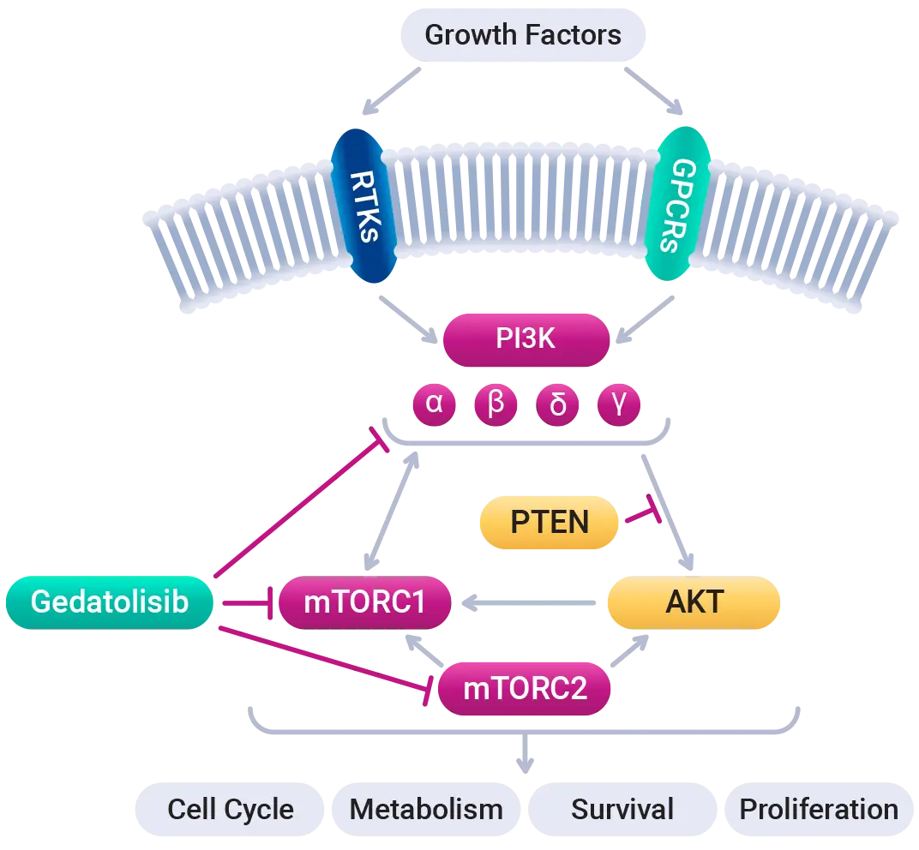
Gedatolisib Mechanism of Action
[From the manufacturer’s website]

Slide 47
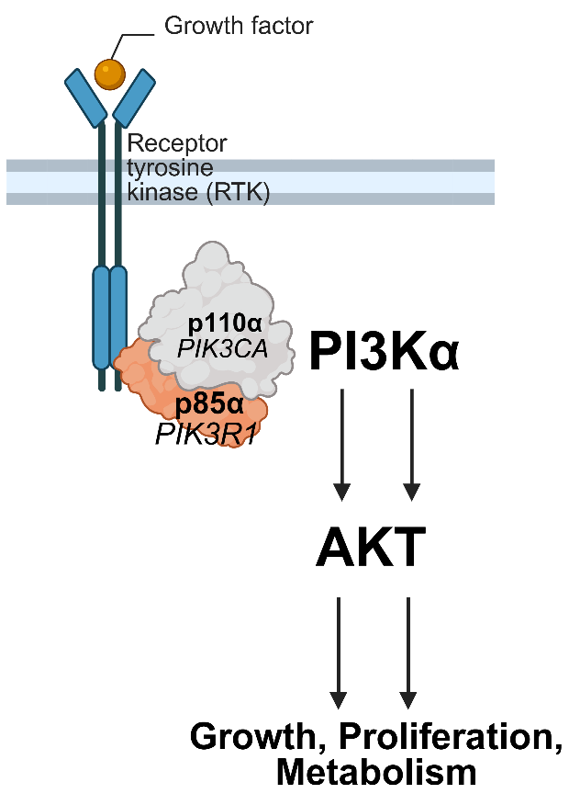
PIK3R1 (p85α) alterations define a targetable subset of breast cancer with broad sensitivity to PI3K and AKT inhibitors
PIK3R1 alterations are found in 3.2% of BC
PIK3R1 alterations predict sensitivity to AKTi, PI3Ki and mutant-selective PI3Ki
Fernando SABCS 2025;Abstract RF4-05

Slide 48
Next Steps in Targeting the PI3K/AKT/mTOR Pathway
Targeting PIK3CA with triplet therapy
  Endocrine sensitive disease in the 1st line setting:
    INAVO123 (invavolisib, NCT06790693)
    VIKTORIA-2 (gedatolisib, NCT06757634)
    PIKALO-2 (tersolisib, NCT07174336)
  Endocrine resistant disease in the 1st line setting:
    CAPItello-292 (capivasertib, NCT04862663)
    VIKTORIA-2 (gedatolisib, NCT06757634)
    PIKALO-2 (tersolisib; NCT07174336)
Targeting PIK3CA in the >1st line setting
  Re-discover
    RLY-2608-102 (zovegalisib; NCT06982521)

Slide 49
Year in Review:
PI3K/AKT/mTOR Pathway in
HR-Positive Metastatic Breast Cancer
INTRODUCTION: San Antonio Memories
MODULE 1: PI3K/AKT/PTEN Alterations and Therapies
MODULE 2: Capivasertib
MODULE 3: Gedatolisib
MODULE 4: Inavolisib
MODULE 5: New Agents and Ongoing Trials

Slide 50
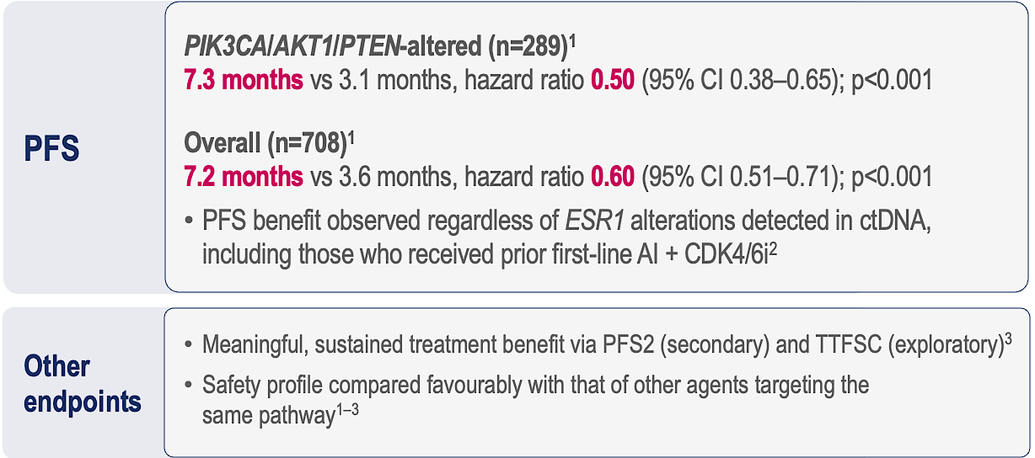
Capivasertib and Fulvestrant for HR+/HER2− MBC: Final OS Results from the Phase 3 CAPItello-291 Trial
Trial population
70% CDK4/6i
40% 1° end resistance
Med 1 line prior Rx
19% prior chemo for advanced disease
The study was designed with 90% power to detect a difference in OS between arms in the overall population, but was underpowered in the altered population with only 53% power
Rugo et al, ESMO Breast 2026;Abstract 417O

Slide 51
Results: Altered Population
Significant imbalance in subsequent therapy
Targeted therapy in subsequent Rx
  25.8% (Capi)
  42.5% (Pla)
Prior CDK4/6i
Time to 1st Chemo
PFS2
Rugo et al, ESMO Breast 2026;Abstract 417O

Slide 52
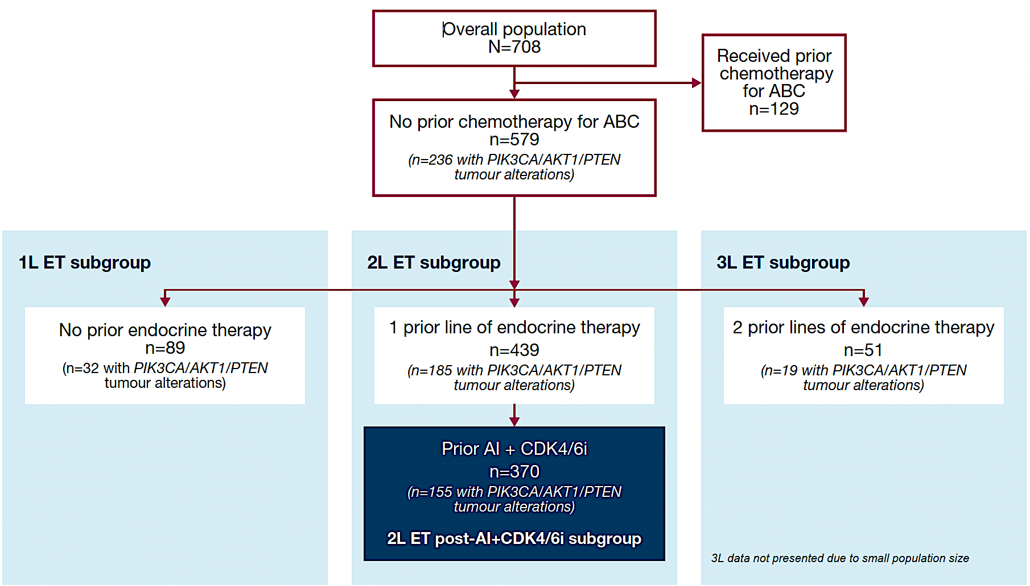
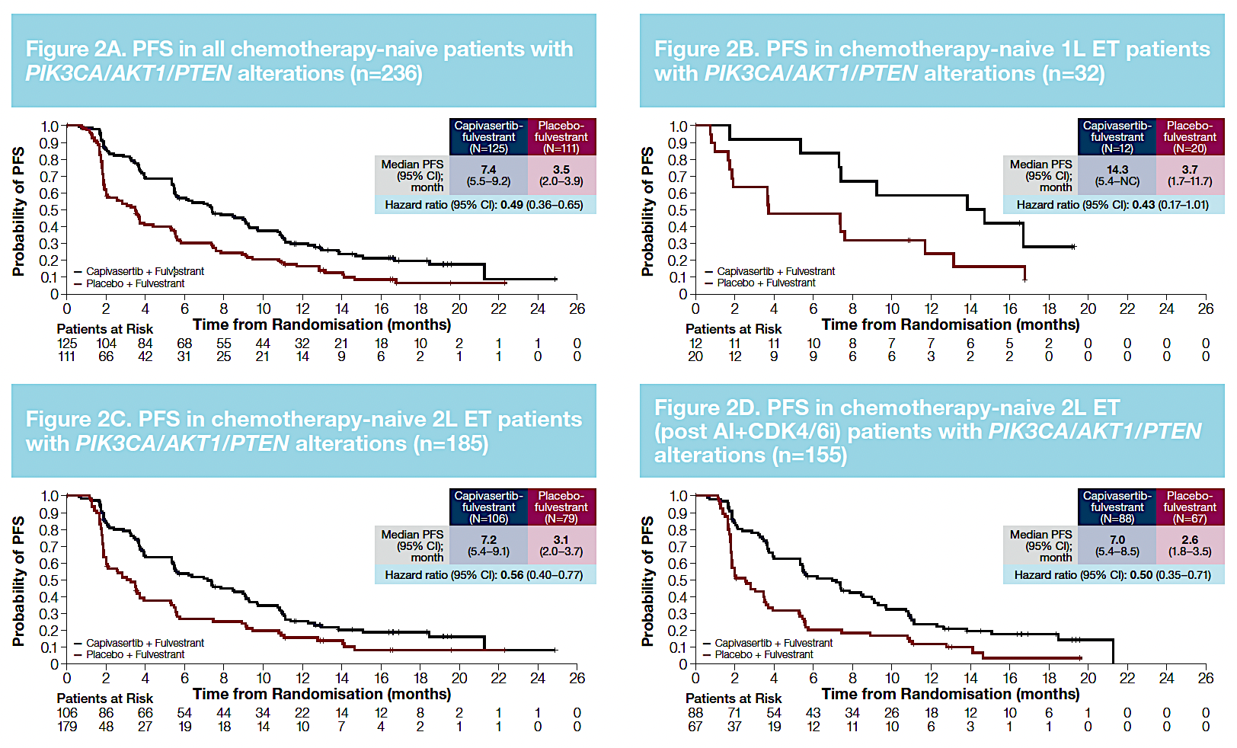
Capi/Fulv as 1st and 2nd Line ET in PIK3CA/AKT1/PTEN-altered HR+ MBC: Subgroup analysis from the CAPItello-291
In patients with PIK3CA/AKT1/PTEN altered, HR+ MBC:
  Capi and Fulv demonstrated a consistent PFS benefit in either the 1L (PD <12 months after adjuvant ET) or as 2L setting in patients without prior chemotherapy
The numbers are too small for definitive conclusions but diarrhea and rash were less frequent in the 1st line population
Rugo et al, ESMO 2025;Abstract 526P

Slide 53
Conclusions and Take-Home Message
Capivasertib–fulvestrant in the 2nd line setting for patients with PIK3CA/AKT1/PTEN-altered HR+/HER2- MBC resulted in:
  Statistically significant, clinically meaningful PFS benefits, improved PFS2, and delayed time to first subsequent chemotherapy
The OS hazard ratio (0.83) indicated a numerical trend in favour of capi/fulv in the altered population, but was not significant
  As a key secondary endpoint with 53% power, the study was underpowered to detect a benefit in OS for the altered population
  Marked imbalance in post-progression therapy likely confounded OS
  In PIK3CA/AKT1/PTEN-altered patients with prior CDK4/6i Rx, the
  OS hazard ratio was 0.78
Safety remained consistent and manageable with no new safety signals
Capivasertib–fulvestrant provides lasting treatment benefit vs placebo–fulvestrant, with manageable safety;
OS interpretation is limited by study power and post-progression treatment confounding

Slide 54
Capivasertib/Fulvestrant in HR+ PIK3CA/AKT1/PTEN-altered ABC: Exploratory ctDNA analyses from CAPItello-291
Guardant Infinity assay
  Large genomic (750+ genes) and epigenomic panel with dense probe coverage for certain genes, including PTEN & methylation-based tumor DNA tumor fraction
658/708 ctDNA samples; 279 pathway alteration, 149/279 co-occurring ESR1m
  Alterations detected by ctDNA only in 72/700 pts (10.3%)
    Detection of PTEN alterations was the most discordant between tissue and ctDNA
29+ by ctDNA only, 22+ by tissue only
Turner et al, SABCS 2025; Abstract RF7-05

Slide 55
PFS by ctDNA alteration status
PFS by ctDNA alteration status: post-IL ET/CDK4/6i for ABC
Turner et al, SABCS 2025; Abstract RF7-05

Slide 56
Conclusions
ctDNA testing has revolutionized testing for targetable mutations
  Offers a non-invasive option to identify PIK3CA/AKT1/PTEN alterations in HR+ ABC
  Important alternative for those without suitable tumor tissue analysis
PIK3CA/AKT1/PTEN alterations were detected by ctDNA only (non-altered or unknown by tissue) in ~10% of patients, and by tissue only in ~11% of patients
  Discordance between detection in ctDNA and tissue NGS was greatest for PTEN deletions
  PIK3CA pathway alterations are generally conserved
    Important to check NGS on tumor tissue AND ctDNA for optimal identification of pathway alterations
PFS benefit from capivasertib + fulvestrant in the ctDNA-altered group was consistent with primary tissue-based analysis, irrespective of ESR1m

Slide 57
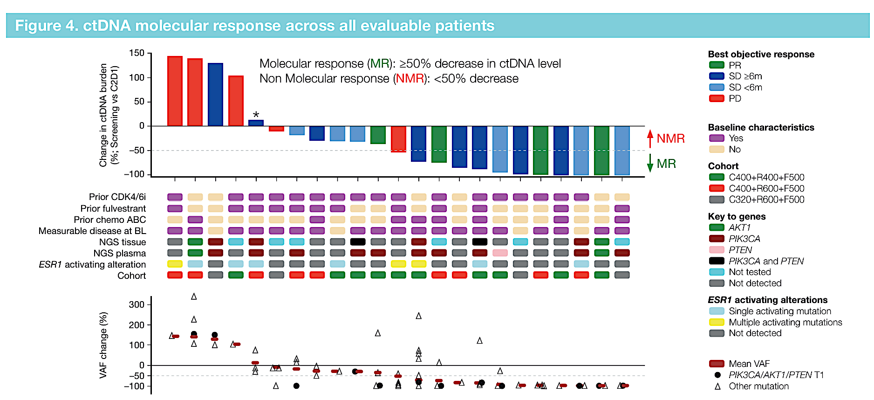
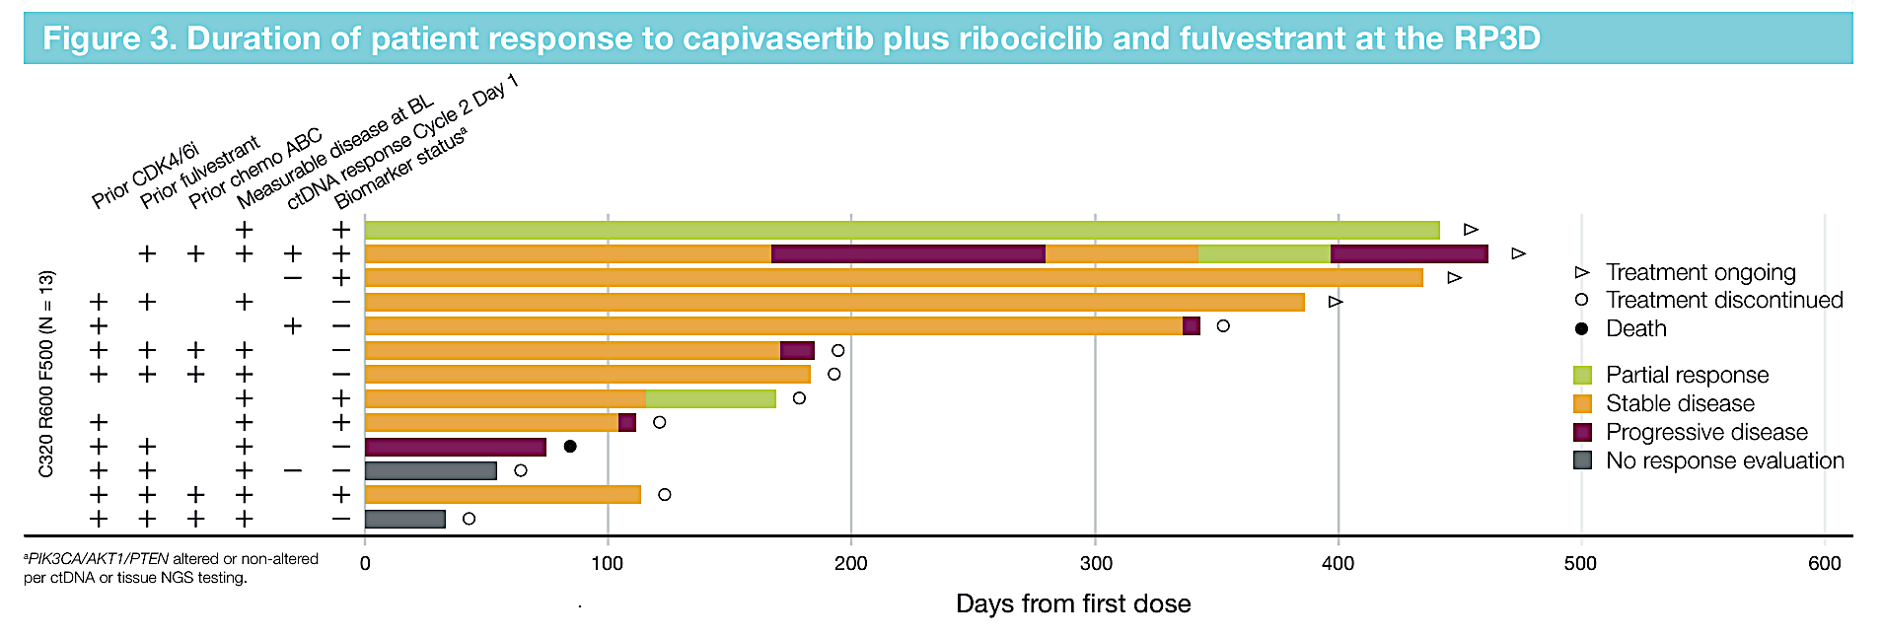
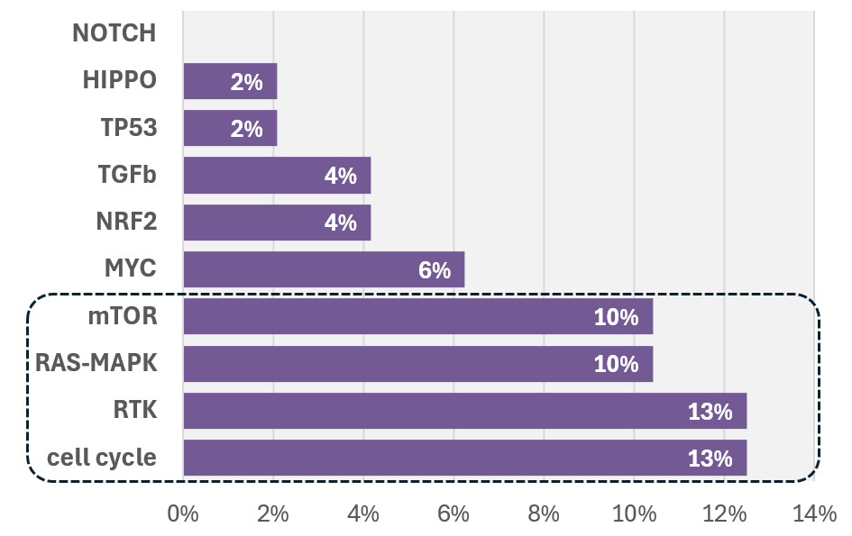
Capivasertib (C) + ribociclib (R) + fulvestrant (F) in patients (pts) with HR-positive/HER2-negative advanced breast cancer (ABC): CAPItello-292 Phase 1b
New PIK3CA/PTEN alterations were detected at EoT in 6% of patients, and no acquired AKT mutations were detected
This suggests robust PI3K/AKT pathway inhibition, i.e., that acquisition of AKT and upstream alterations does not confer survival advantage in the presence of capivasertib
Based on the PK and overall safety profile, capivasertib 320 mg + ribociclib 600 mg + fulvestrant 500 mg was selected as the RP3D
Prevalence of newly detected genomic alterations at EoT in key pathwaysª
CBR: 23.1%
Neven ESMO Breast 2025;Abstract 316P & Sudhan SABCS 2025;Abstract RF4-04

Slide 58
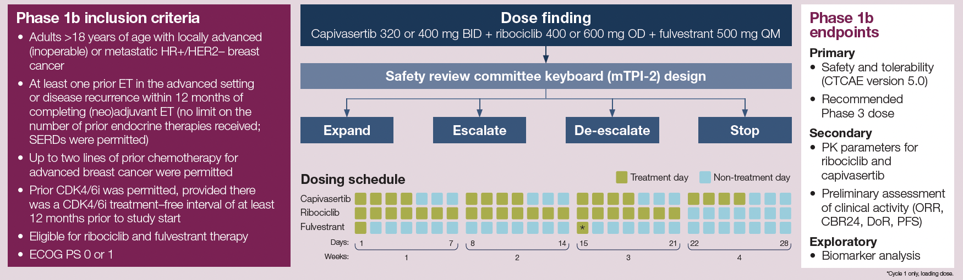
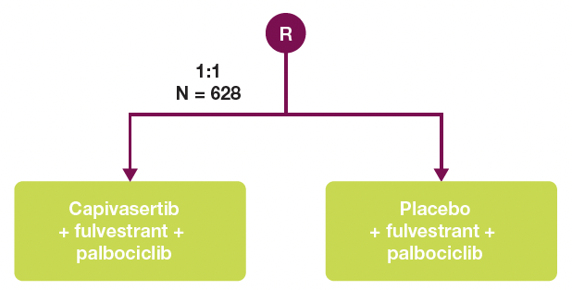
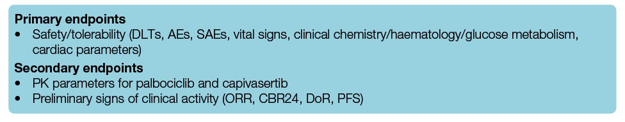
CAPItello-292 Phase Ib/III Study Design
Phase III endpoints
Neven P et al. ESMO 2024;Abstract 316P.
Hamilton EP et al. ESMO 2021;Abstract 338TiP.

Slide 59
SERENA-1: Phase I Study of Camizestrant and Capivasertib
29 patients treated with camizestrant 75 mg/d and capivasertib 400 mg 4d on, 3d off
  Median 2 lines prior therapy
  90% prior CDK4/6i, 55% prior fulvestrant,
  15 (52%) with PIK3CA/AKT/PTEN alterations, 17 (59%) with ESR1m
The mean (±SD) treatment duration was 8.6 ± 6.7 months for camizestrant and 7.3 ± 6.7 months for capivasertib.
Safety
  Most common TEAEs (all grade): diarrhea (75.9%) and nausea (44.8%)
  Most common grade ≥3 TEAE was diarrhea (3/10.3%); grade 3 rash (2/6.9%)
  All grade 1: sinus bradycardia (37.9%), photopsia (20.7%), visual impairment (20.7%)
Vaklavas et al, ESMO Open 2026

Slide 60
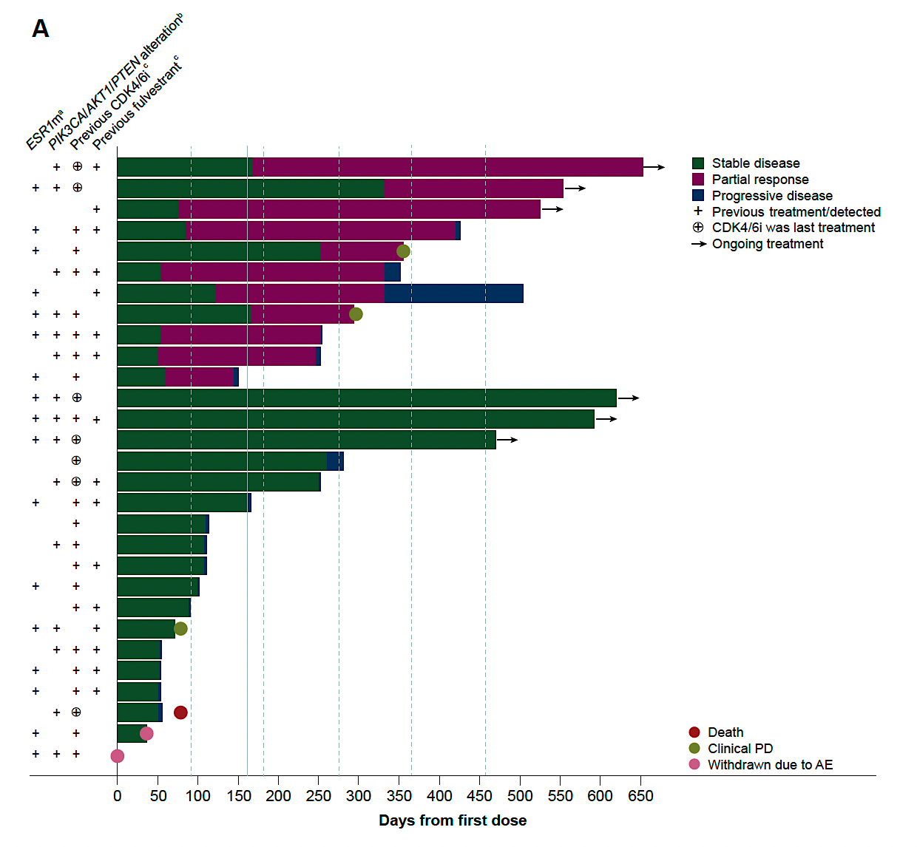
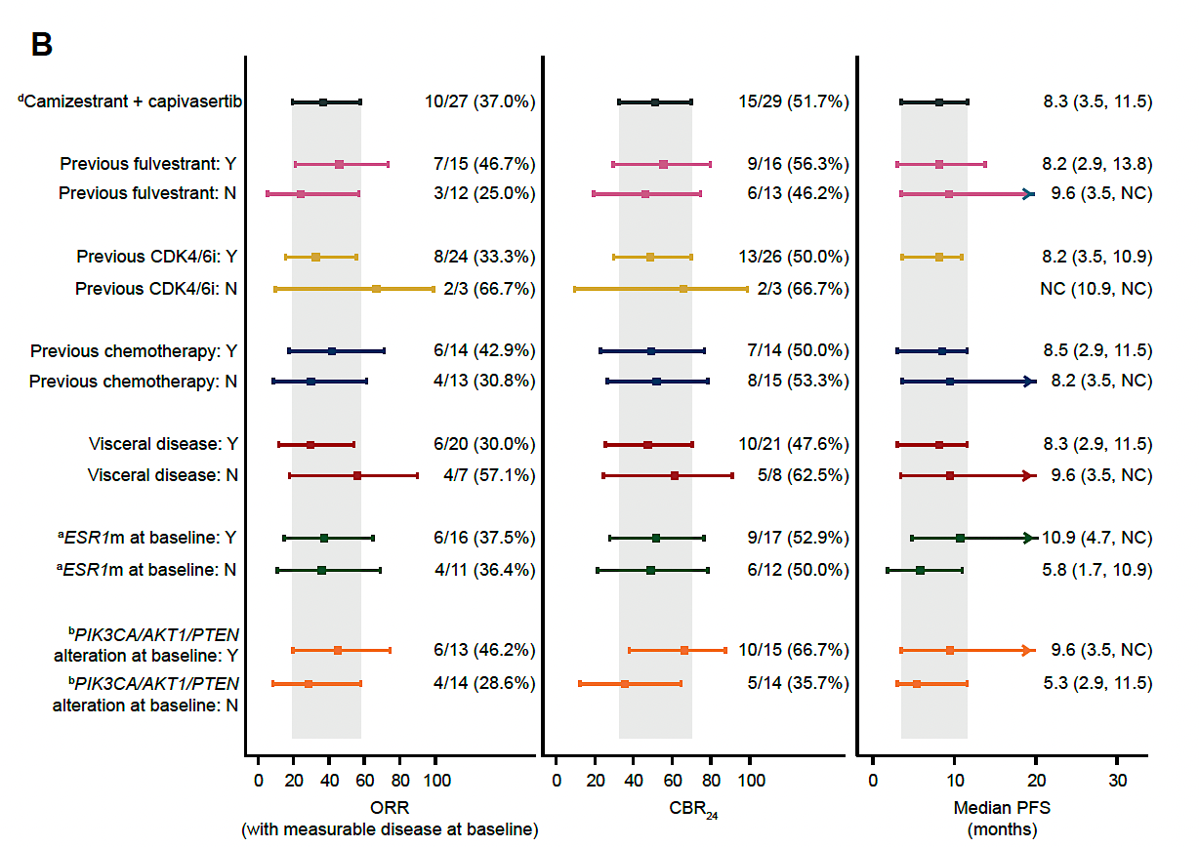
Clinical Efficacy
≥50% reduction from baseline in summed ESR1m VAF seen in 92% (11/12) treated with camizestrant plus capivasertib,
Clearance to undetectable levels seen in 67% (8/12)

Slide 61
Conclusions
The oral SERD camizestrant can be safely combined with the AKT inhibitor capivasertib
No new toxicity signals
All oral combination is appealing but needs further study in a larger population
The ongoing Elevate trial evaluated elacestrant and capivasertib in a phase II expansion cohort, enrollment completed

Slide 62
Key Datasets
Rugo HS et al. Capivasertib (C) and fulvestrant (F) for patients (pts) with HR+/HER2- advanced breast cancer (ABC): Final overall survival (OS) results from the phase III CAPItello-291 trial. ESMO Breast Cancer 2026;Abstract 417O.
Rugo HS et al. Capivasertib plus fulvestrant as first and second-line endocrine-based therapy in PIK3CA/AKT1/PTEN-altered hormone receptor-positive advanced breast cancer: Subgroup analysis from the phase 3 CAPItello-291 trial. ESMO 2025;Abstract 526P.
Turner NC et al. Capivasertib plus fulvestrant in hormone receptor-positive (HR+) advanced breast cancer (ABC): Exploratory ctDNA analyses from the phase 3 CAPItello-291 trial. San Antonio Breast Cancer Symposium 2025;Abstract RF7-05.
Neven P et al. Capivasertib (C) + ribociclib (R) + fulvestrant (F) in patients (pts) with HR-positive/HER2-negative advanced breast cancer (ABC): CAPItello-292 phase Ib. ESMO Breast Cancer 2025;Abstract 316P.
Sudhan DR et al. Mechanisms of resistance to capivasertib in combination with CDK4/6 inhibitor (CDK4/6i) plus fulvestrant in patients with hormone receptor-positive/HER2-negative (HR+/HER2−) advanced breast cancer (ABC): Exploratory analysis from the phase 1b CAPItello-292 study. San Antonio Breast Cancer Symposium 2025;Abstract RF4-04.
Vaklavas C et al. Camizestrant in combination with capivasertib for women with ER-positive, HER2-negative advanced breast cancer: Results from SERENA-1. ESMO Open 2026;11(2):106049.

Slide 63
Year in Review:
PI3K/AKT/mTOR Pathway in
HR-Positive Metastatic Breast Cancer
INTRODUCTION: San Antonio Memories
MODULE 1: PI3K/AKT/PTEN Alterations and Therapies
MODULE 2: Capivasertib
MODULE 3: Gedatolisib
MODULE 4: Inavolisib
MODULE 5: New Agents and Ongoing Trials

Slide 64
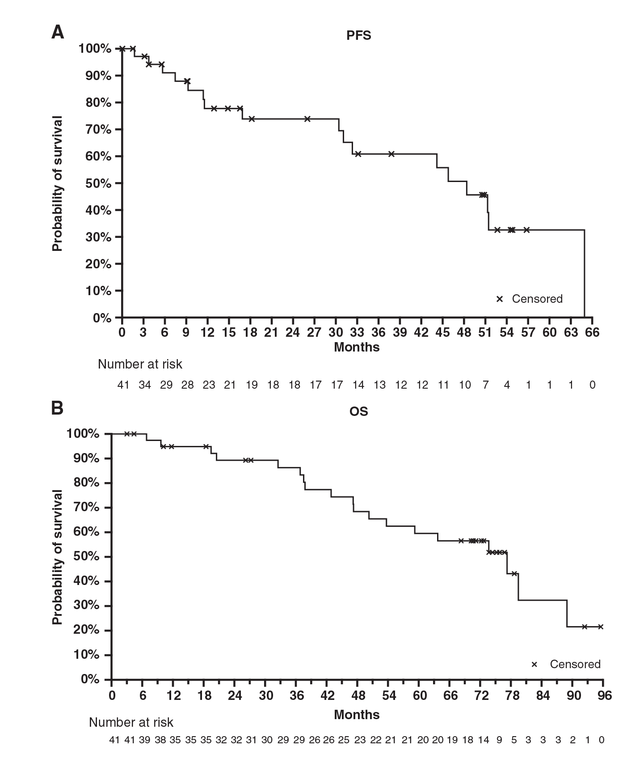
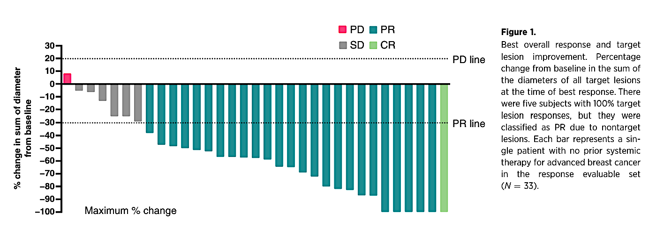
Gedatolisib Combined with Palbociclib and Letrozole in Patients with No Prior Systemic Therapy for Hormone Receptor–Positive, HER2-Negative Advanced Breast Cancer
ORR: 79%
mPFS: 48.4 months, and the mOS: 77.3 months.
The overall response rate and PFS were comparable in patients with and without PIK3CA mutations.
Wesolowski Clin Cancer Res 2025;31(19):4040-8.

Slide 65
VIKTORIA-1 (Phase 3): Gedatolisib + fulvestrant ± palbociclib vs fulvestrant for HR+, HER2−­­, PIK3CA WT advanced breast cancer
Gedatolisib is a multitarget PAM inhibitor of all class I P13K isoforms, mTORC1 and mTORC2
Aim: Evaluate gedatolisib in patients with HR+/HER2− advanced breast cancer after progression on CDK4/6i and NSAI
Key eligibility
HR+/HER2− ABC
Pre- & postmenopausal women & men
Progression on/after CDK4/6i + NSAI
≤2 lines of prior ET for ABC
Measurable disease, RECIST v1.1
Screening result for PIK3CA status
No T2DM with HbA1c >6.4% or T1DM
No prior mTORi, PI3Ki, or AKTi
No prior chemotherapy for ABC
Gedatolisib 180 mg IV QW
(3 weeks on, 1 week off)
+ palbociclib 125 mg QD
(21 days on, 7 days off)
+ fulvestrant 500 mg
(cycle 1: days 1 & 15, then Q4W)
Primary endpoint:
PFS (BICR):
Arm A vs Arm C;
Arm B vs Arm C
Secondary endpoints:
OS
Response
Safety
QOL
Arm A
STUDY 1
PIK3CA-WT
R
1:1:1
Gedatolisib 180 mg IV QW
(3 weeks on, 1 week off)
+ fulvestrant 500 mg
(same schedule)
N=392
Arm B
Assign
Fulvestrant 500 mg
(cycle 1: days 1 & 15, then Q4W)
Optional crossover to Arm A or Arm B
at progression
Arm C
STUDY 2
PIK3CA-MT
R
3:1:3
Gedatolisibª + palbociclib + fulvestrant
Gedatolisibª + fulvestrant
Alpelisib + fulvestrant
ªProphylactic use of a steroid-containing “swish and spit” regimen was protocol-mandated; oral non-sedating antihistamine therapy was recommended.
Hurvitz SA, et al. JCO 2026; Pistilli et al, ESMO BC 2026;Abstract 505P

Slide 66
VIKTORIA-1 (Phase 3): Gedatolisib + fulvestrant ± palbociclib vs fulvestrant for HR+, HER2−­­, PIK3CA WT advanced breast cancer
Gedatolisib is a multitarget PAM inhibitor of all class I P13K isoforms, mTORC1 and mTORC2
Aim: Evaluate gedatolisib in patients with HR+/HER2− advanced breast cancer after progression on CDK4/6i and NSAI
Study 1 Efficacy:
Gedatolisib + palbo + fulvestrant: mPFS 9.3 mo. (HR, 0.24; 95% CI, 0.17-0.35; P< 0.0001)
Gedatolisib + fulvestrant: mPFS 7.4 mo. (HR, 0.33; 95% CI, 0.24-0.48; P< 0.0001)
Treatment-related AEs associated with gedatolisib:
Mainly grade 1-2
Hyperglycemia and diarrhea were relatively uncommon
Grade 3 stomatitis: triplet, 19.2%; doublet, 12.3%
Key eligibility
HR+/HER2− ABC
Pre- & postmenopausal women & men
Progression on/after CDK4/6i + NSAI
≤2 lines of prior ET for ABC
Measurable disease, RECIST v1.1
Screening result for PIK3CA status
No T2DM with HbA1c >6.4% or T1DM
No prior mTORi, PI3Ki, or AKTi
No prior chemotherapy for ABC
Gedatolisib 180 mg IV QW
(3 weeks on, 1 week off)
+ palbociclib 125 mg QD
(21 days on, 7 days off)
+ fulvestrant 500 mg
(cycle 1: days 1 & 15, then Q4W)
Primary endpoint:
PFS (BICR):
Arm A vs Arm C;
Arm B vs Arm C
Secondary endpoints:
OS
Response
Safety
QOL
Arm A
STUDY 1
PIK3CA-WT
R
1:1:1
Gedatolisib 180 mg IV QW
(3 weeks on, 1 week off)
+ fulvestrant 500 mg
(same schedule)
N=392
Arm B
Assign
Fulvestrant 500 mg
(cycle 1: days 1 & 15, then Q4W)
Optional crossover to Arm A or Arm B
at progression
Stratification factors
Lung/liver metastases (yes/no)
TTP on immediate prior therapy
(6≤ or >6 months)
Region (US/Canada or ROW)
Arm C
STUDY 2
PIK3CA-MT
R
3:1:3
Gedatolisibª + palbociclib + fulvestrant
Gedatolisibª + fulvestrant
Alpelisib + fulvestrant
ªProphylactic use of a steroid-containing “swish and spit” regimen was protocol-mandated; oral non-sedating antihistamine therapy was recommended.
Hurvitz SA, et al. JCO 2026; Pistilli et al, ESMO BC 2026;Abstract 505P

Slide 67
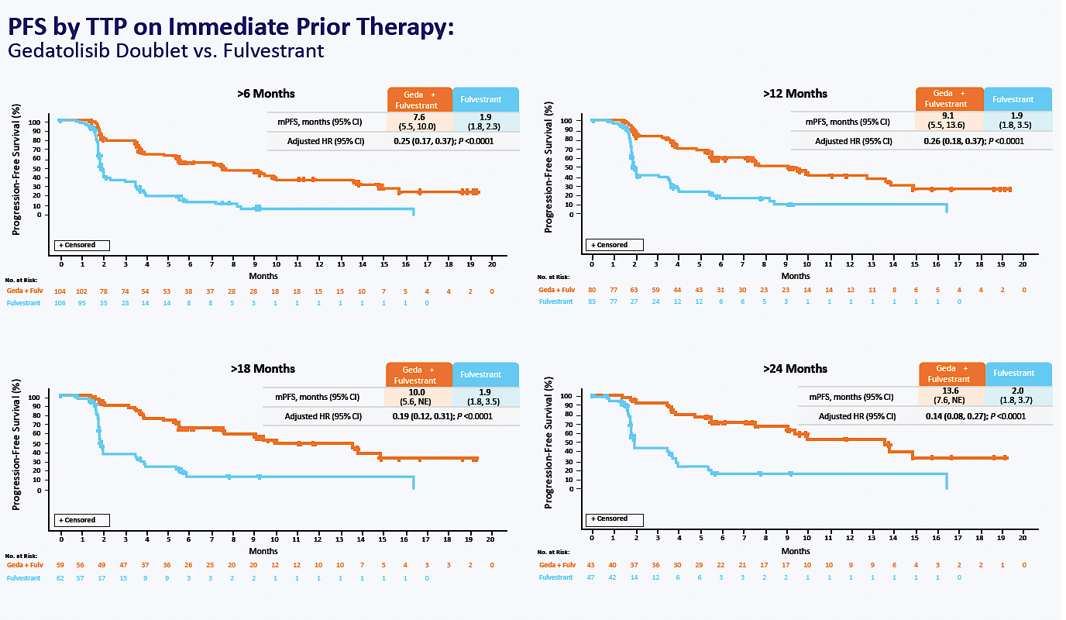
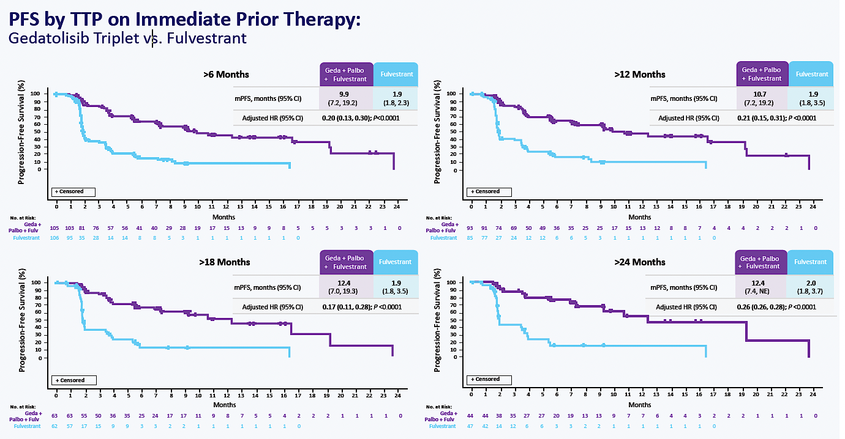
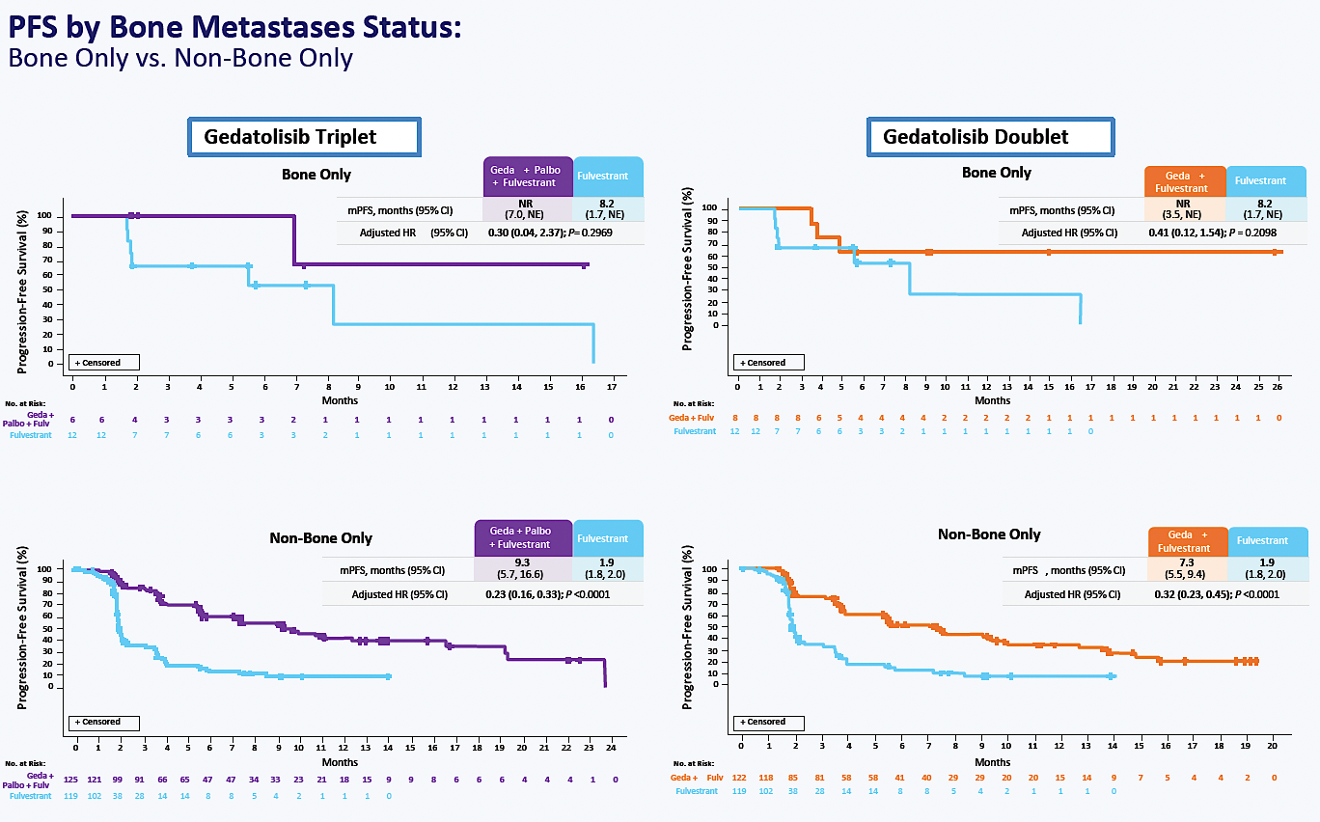
Updated Data: Study 1
Pistilli et al, ESMO BC 2026; Abstract 505P

Slide 68
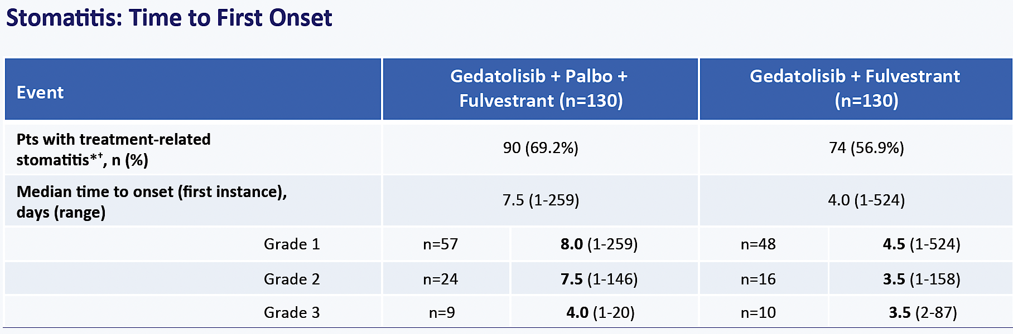
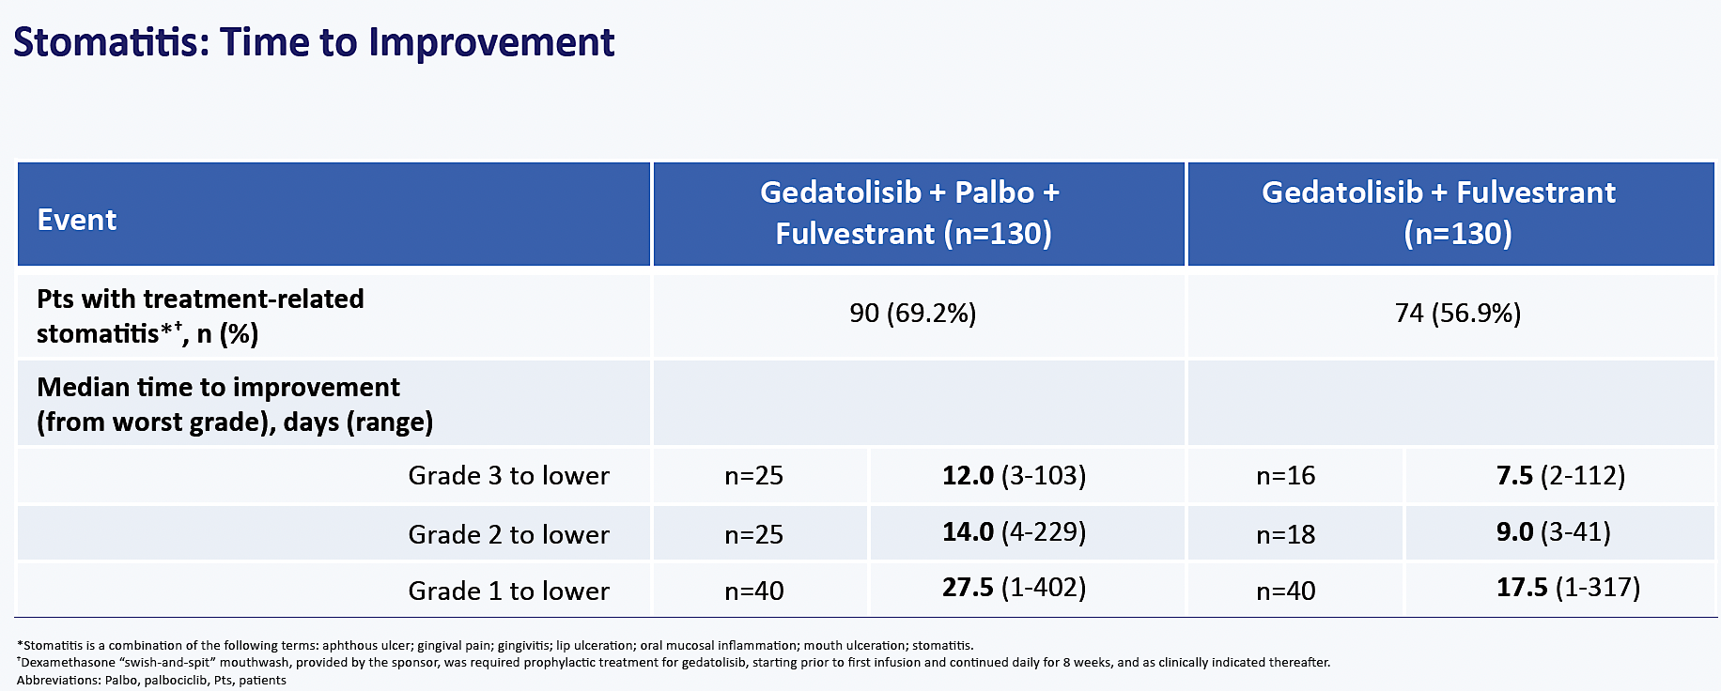
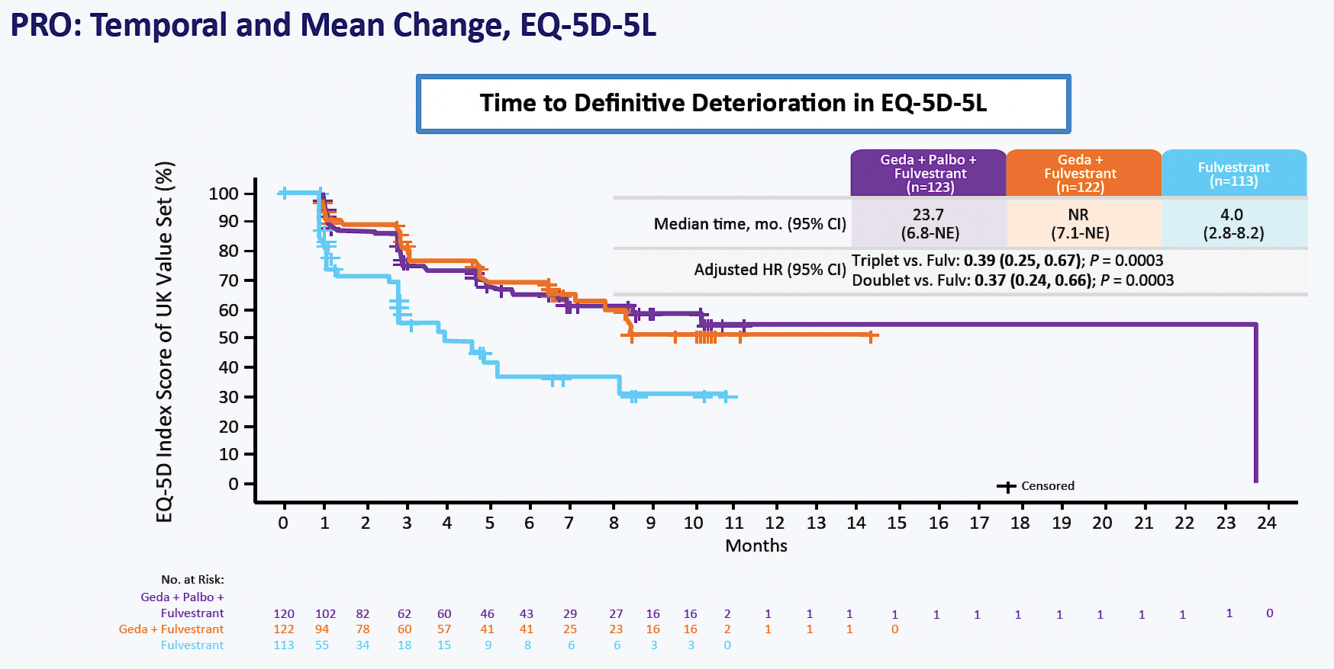
Efficacy with gedatolisib was observed regardless of duration of prior treatment
Stomatitis generally an early event, with resolution to a lower grade in ~2 weeks
Hyperglycemia rates were low, HgbA1c levels stable over time
The triplet and doublet delayed TTDD in well-being
Pistilli et al, ESMO BC 2026; Abstract 505P

Slide 69
FDA Approves Gedatolisib with Fulvestrant, with or without Palbociclib, for HR-Positive, HER2-Negative Locally Advanced or Metastatic Breast Cancer
Press Release: July 14, 2026
“On July 14, 2026, the Food and Drug Administration approved gedatolisib in combination with fulvestrant, with or without palbociclib, for adults with hormone receptor (HR)-positive, human epidermal growth factor receptor 2 (HER2)-negative locally advanced or metastatic breast cancer without a PIK3CA mutation detected following progression on or after treatment with at least one line of endocrine therapy in the metastatic setting.
Efficacy was evaluated in Study 1 of VIKTORIA-1 (NCT05501886), an open-label, randomized, multicenter trial that enrolled 392 adults with locally advanced (inoperable) or metastatic HR-positive, HER2-negative breast cancer. Patients were randomized (1:1:1) to receive either gedatolisib in combination with fulvestrant and palbociclib (Arm A), gedatolisib in combination with fulvestrant (Arm B), or fulvestrant alone (Arm C). Patients received treatment until disease progression or unacceptable toxicity.
There was a statistically significant improvement in PFS for Arm A vs Arm C, with a median PFS of 9.3 months (95% CI: 7.2, 16.6) in Arm A and 2.0 months (95% CI: 1.8, 2.3) in Arm C (hazard ratio [HR] 0.24 [95% CI: 0.17, 0.35]; p-value <0.0001). There was also a statistically significant improvement in PFS for Arm B vs Arm C with a median PFS of 7.4 months (95% CI: 5.5, 9.9) in Arm B and 2.0 months (95% CI: 1.8, 2.3) in Arm C (HR 0.33 [95% CI: 0.24, 0.48]; p-value <0.0001). At the time of the PFS analysis, OS data were not mature with 25% deaths in the overall population.”
https://www.fda.gov/drugs/resources-information-approved-drugs/fda-approves-gedatolisib-fulvestrant-or-without-palbociclib-hr-positive-her2-negative-locally

Slide 70
VIKTORIA-1: Study 2
N=155
N=52
N=155
Demographics
  85-90% had 1 line of prior therapy
    Median duration of prior CDK4/6i 17.5 – 22.1 mo
  14-17% progressed <6 mo on last therapy
  ~44% de novo mBC; 75% visceral mets
Hurvitz SA, et al. ASCO 2026;LBA1008

Slide 71
ORR:
49%, 36% and 26% (control)
Hurvitz SA, et al.
ASCO 2026;LBA1008

Slide 72
Safety and Tolerability
Safety Population in VIKTORIA-1 Study 2
Exposure | Arm D: Gedatolisib + Palbociclib + Fulvestrant (n=153) |  |  | Arm F: Gedatolisib + Fulvestrant (n=52) |  |  | Arm E: Alpelisib + Fulvestrant (n=152)
Median RDI, Geda (IQR) | 93.3 (80.6-100) |  |  | 100 (97.8-100) |  |  | --
Median RDI, Alpe (IQR) | -- |  |  | -- |  |  | 81.7 (64.8-96.2)
TRAE and TR-SAE, n (%)
Pts with ≥1 TRAE | 150 (98.0) |  |  | 50 (96.2) |  |  | 147 (96.7)
Study tx D/C for TRAE | 4 (2.6) |  |  | 2 (3.8) |  |  | 11 (7.1)
Pts with ≥1 TR-SAE | 16 (10.5) |  |  | 2 (3.8) |  |  | 20 (13.2)
Deaths due to TR-SAE* | 1 (0.7) |  |  | 0 |  |  | 2 (1.3)
TRAE, n (%)† | Any Grade | Grade 3 | Grade 4 | Any Grade | Grade 3 | Grade 4 | Any Grade | Grade 3 | Grade 4
Neutropenia‡ | 97 (63.4) | 73 (47.7) | 17 (11.1) | 1 (1.9) | 0 | 0 | 2 (1.3) | 0 | 1 (0.7)
Stomatitis‡ | 94 (61.4) | 25 (16.3) | 0 | 32 (61.5) | 3 (5.8) | 0 | 52 (34.2) | 8 (5.3) | 0
Nausea | 70 (45.8) | 5 (3.3) | 0 | 21 (40.4) | 1 (1.9) | 0 | 50 (32.9) | 2 (1.3) | 0
Rash‡ | 40 (26.1) | 10 (6.5) | 0 | 17 (32.7) | 3 (5.8) | 0 | 56 (36.8) | 23 (15.1) | 0
Vomiting | 39 (25.5) | 0 | 0 | 10 (19.2) | 0 | 0 | 23 (15.1) | 1 (0.7) | 0
Fatigue | 33 (21.6) | 5 (3.3) | 0 | 11 (21.2) | 1 (1.9) | 0 | 32 (21.1) | 4 (2.6) | 0
Diarrhea§ | 23 (15.0) | 2 (1.3) | 0 | 5 (9.6) | 0 | 0 | 61 (40.1) | 9 (5.9) | 1 (0.7)
Hyperglycemia‡,§ | 23 (15.0) | 4 (2.6) | 0 | 6 (11.5) | 0 | 0 | 88 (57.9) | 21 (13.8) | 1 (0.7)
*Grade 5 events include fatal cerebral hemorrhage (gedatolisib triplet), urosepsis (alpelisib + fulvestrant group), and general physical health decline (alpelisib + fulvestrant group)
†Shown are treatment-related adverse events of any grade that occurred in at least 20% of the patients in any trial group unless otherwise noted
‡For stomatitis, neutropenia, rash, and hyperglycemia, combined preferred terms are used in the table; if a patient experienced multiple terms, it was counted once for the highest grade.
§Additional events of clinical importance
Abbreviations: Alpe, alpelisib; D/C, discontinued; Geda, gedatolisib; IQR, interquartile range; Pts, patients; RDI, relative dose intensity; TRAE, treatment-related adverse event; TR-SAE, treatment-related serious adverse events; tx, treatment
Hurvitz SA, et al. ASCO 2026;LBA1008

Slide 73
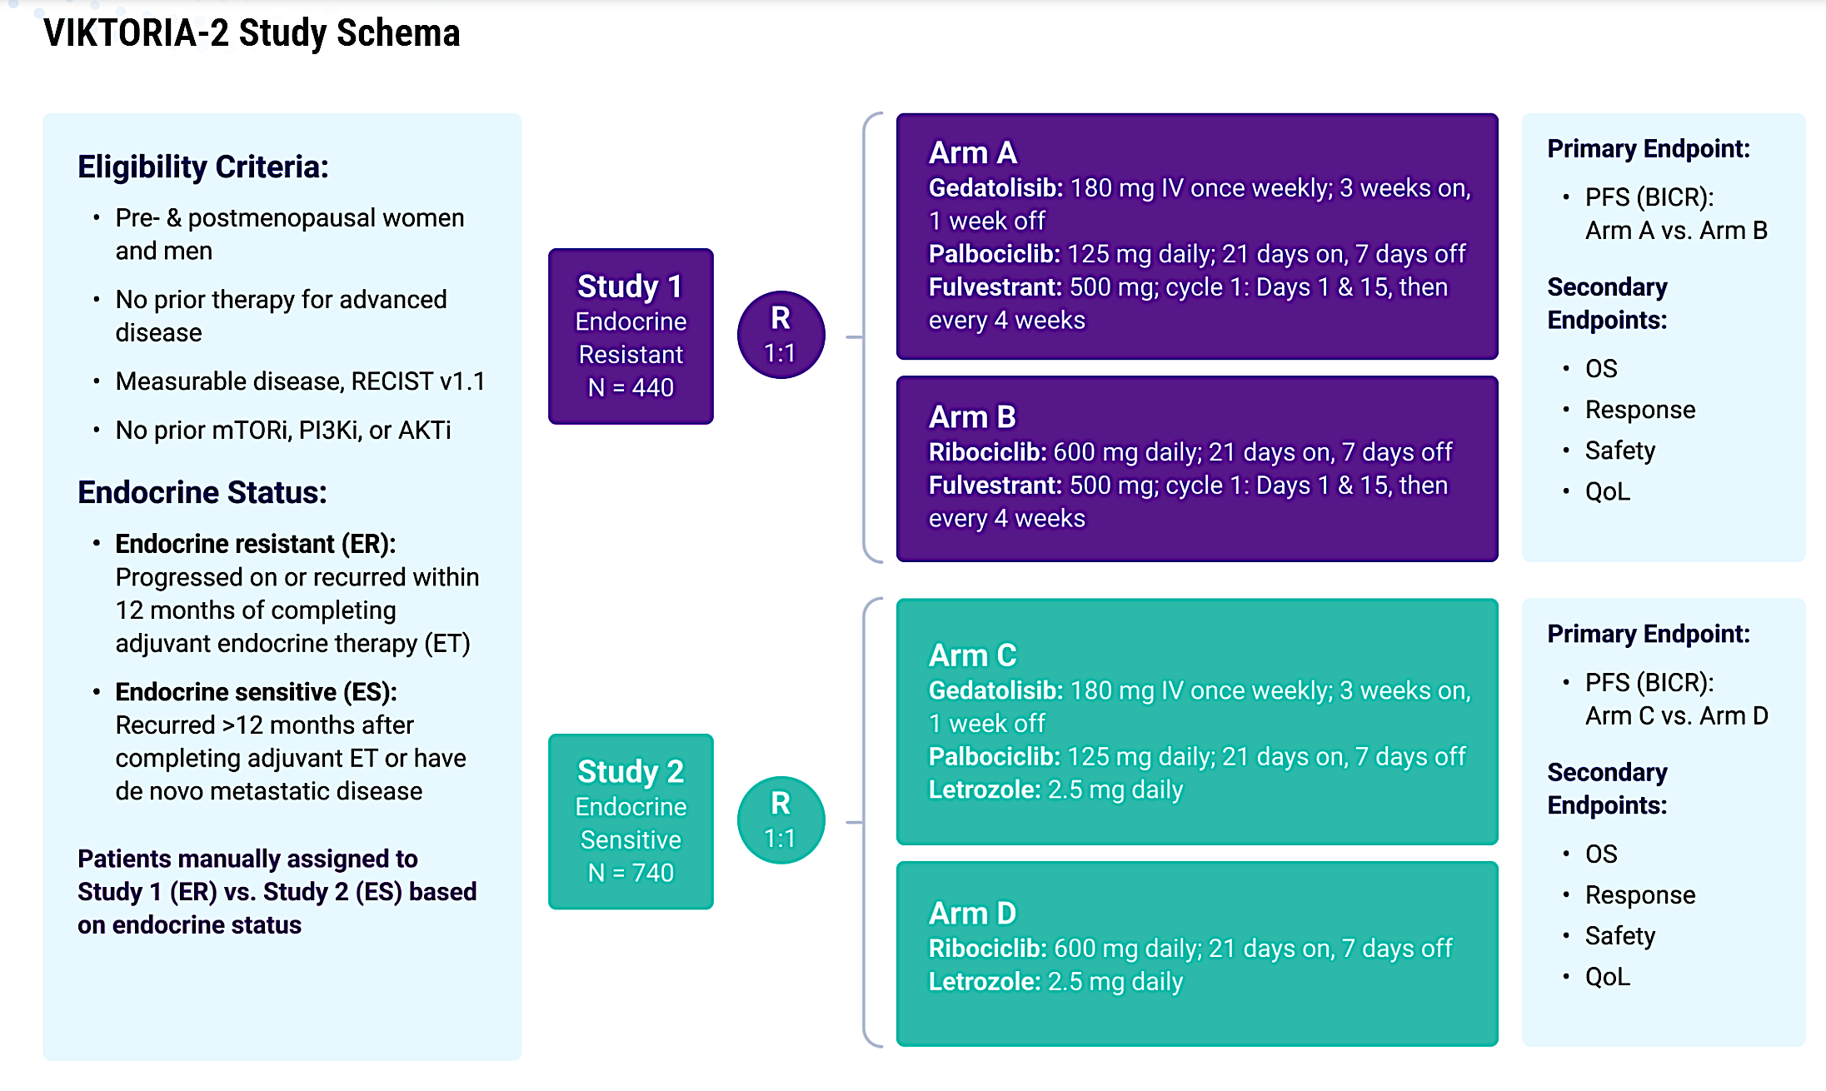
NCT06757634

Slide 74
Conclusions
Dual inhibition of PI3K and mTOR (‘PAM’ pathway) in combination with fulvestrant, with or without palbociclib:
  Markedly improves PFS and response compared to standard therapy in patients with progressive disease in an AI plus CDK4/6 inhibitor
    In PI3K wild-type compared to fulvestrant
      Independent of TTP on prior therapy or bone vs non bone-only disease
    In PI3K mutant disease compared to fulvestrant plus alpelisib
      Similar benefit seen with triplet and doublet, although doublet underpowered
  Less rash, hyperglycemia, diarrhea compared to other inhibitors of the PAM pathway
    Primary toxicity grade 3 stomatitis despite steroid mouthwash (was this used by all upfront?)
    Primary limitation IV dosing – 3 weeks out of each month
      Subcutaneous dosing formulation under development
  First-line VIKTORIA-2 trial (NCT06757634) in the ET-resistance and ET-sensitive populations

Slide 75
Key Datasets
Wesolowski R et al. Gedatolisib combined with palbociclib and letrozole in patients with no prior systemic therapy for hormone receptor-positive, HER2-negative advanced breast cancer. Clin Cancer Res 2025;31(19):4040-8.
Pistilli B et al. Gedatolisib (Geda), a multitarget PI3K/AKT/mTOR (PAM) inhibitor, plus fulvestrant (Fulv) ± palbociclib (Palbo) for second-line (2L) treatment of patients (Pts) with HR+/HER2-/PIK3CA-wild type (WT) advanced breast cancer (ABC): Updated results from VIKTORIA-1. ESMO Breast Cancer 2026;Abstract 505P.
Hurvitz S et al. A randomized, open-label, phase 3 study of gedatolisib + fulvestrant ± palbociclib vs standard of care in HR+/HER2−/PIK3CA-mutant (MT) advanced breast cancer (VIKTORIA-1 Study 2). ASCO 2026;Abstract LBA1008.
VIKTORIA-2: A randomized, open-label, phase 3 study evaluating efficacy and safety of gedatolisib with endocrine therapy and palbociclib vs endocrine therapy and ribociclib as first-line treatment in patients with HR-positive and HER2-negative advanced breast cancer. NCT06757634.

Slide 76
Year in Review:
PI3K/AKT/mTOR Pathway in
HR-Positive Metastatic Breast Cancer
INTRODUCTION: San Antonio Memories
MODULE 1: PI3K/AKT/PTEN Alterations and Therapies
MODULE 2: Capivasertib
MODULE 3: Gedatolisib
MODULE 4: Inavolisib
MODULE 5: New Agents and Ongoing Trials

Slide 77
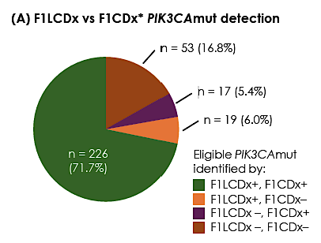
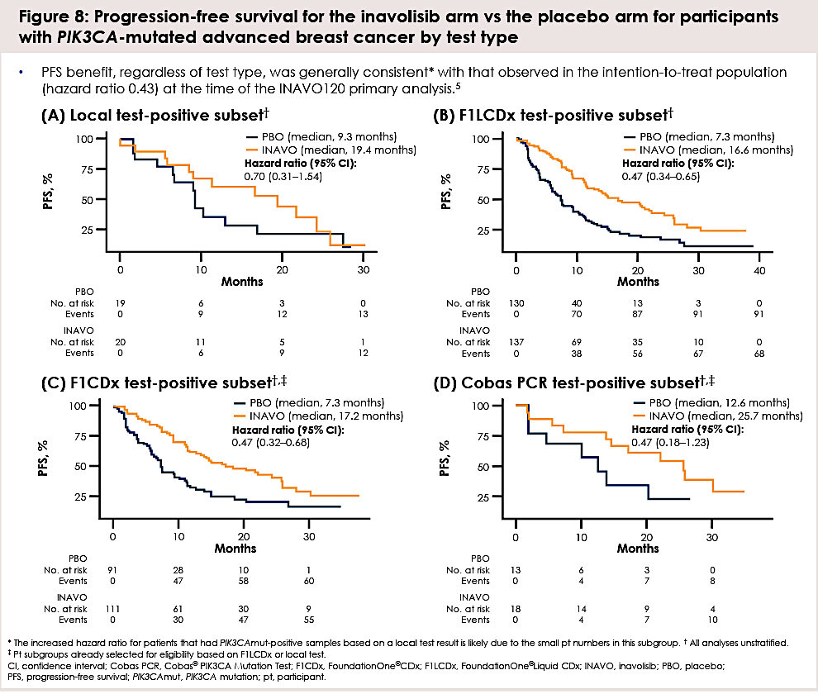
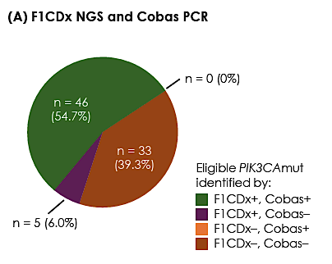
Comparative analysis of blood- and tissue-based PIK3CA mutation detection methods in the pivotal Phase 3 INAVO120 trial of palbociclib + fulvestrant ± inavolisib in hormone receptor-positive, HER2-negative advanced breast cancer
89% concordance between tissue and liquid
94% concordance between NGS and PCR with NGS more sensitive
Efficacy of Inavolisib regardless of assay used
Kalinsky SABCS 2025;Abstract PS1-10-26.

Slide 78
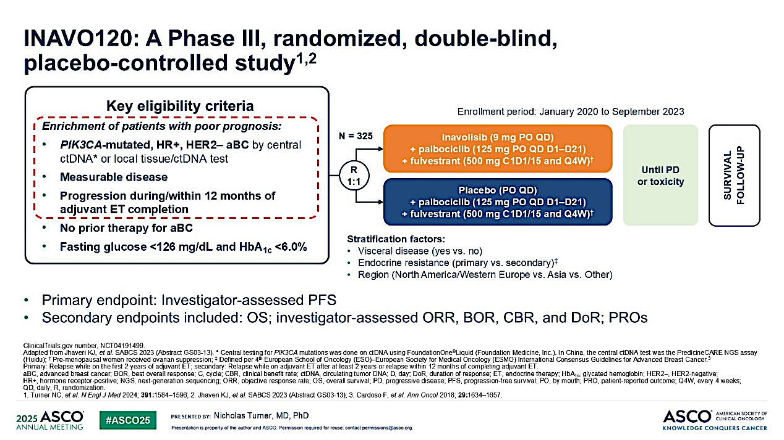
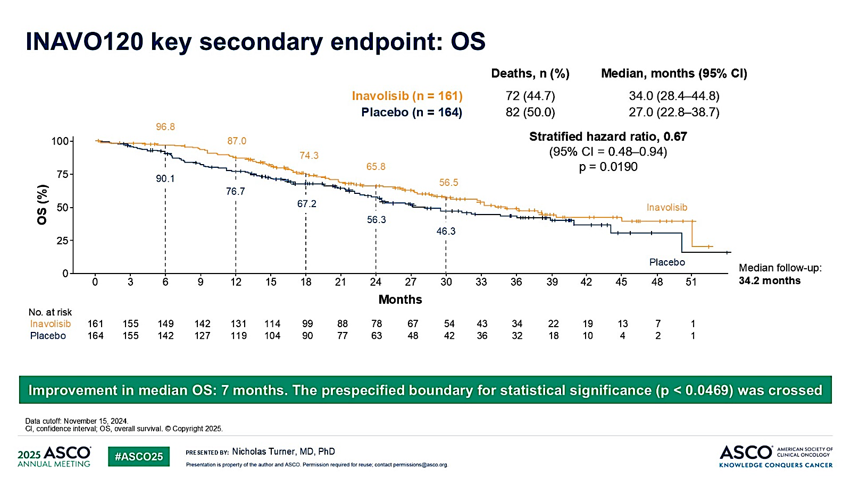
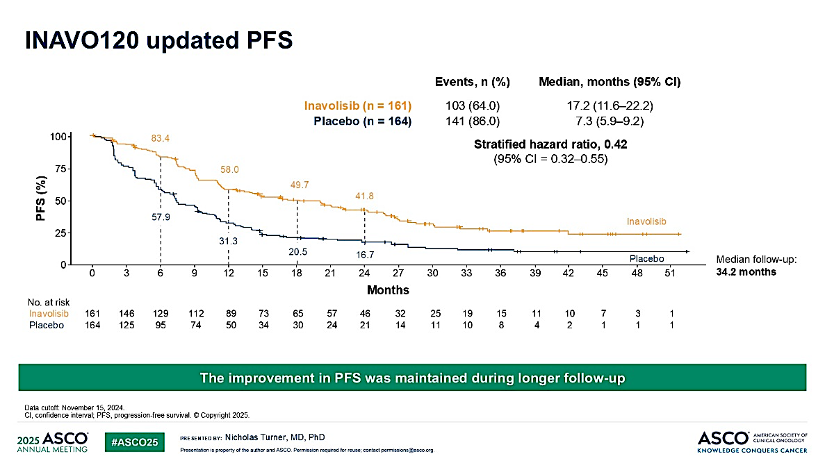
Turner ASCO 2025; Abstract 1003 & Jhaveri N Engl J Med 2025

Slide 79
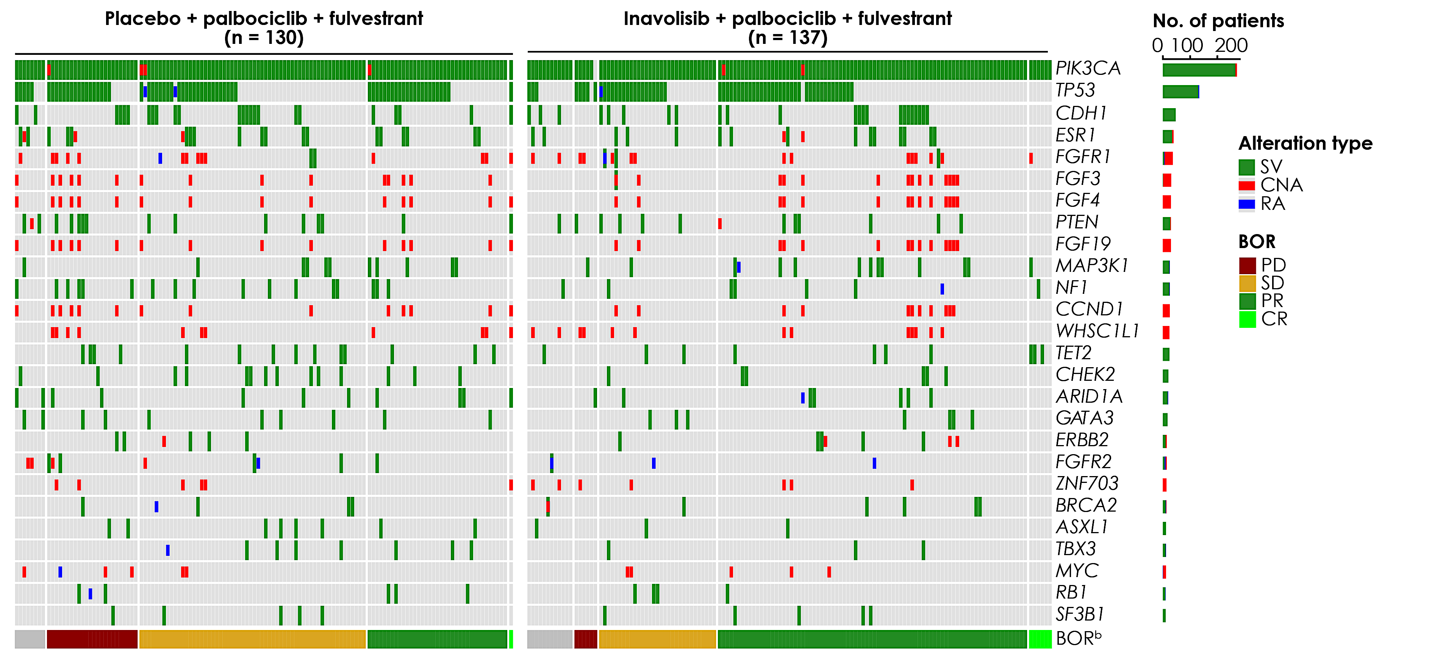
Molecular features of response to palbociclib + fulvestrant ± inavolisib in hormone receptor-positive, HER2-negative,
PIK3CA-mutated advanced breast cancer as assessed from baseline circulating tumor DNA in the pivotal Phase 3 INAVO120 trial
Of the 277 enrolled patients with F1LCDx-profiled plasma DNA, 267 had detectable ctDNA.
The most commonly-altered genes were:
  PIK3CA (99.6%; 266 / 267)^{c}
  TP53 (49.4%; 132 / 267)
  CDH1 (17.6%; 47 / 267)
  ESR1 (14.5%; 39 / 267)
ª Occurring in ≥ 10 samples. ^{b} BOR not available for n = 20 patients (dark gray boxes in BOR annotation). ^{c} A small number of patients were enrolled based on a PIK3CA-mutation-positive result from a locally-conducted molecular test; F1LCDx did not detect a PIK3CA mutation in one of these patients' ctDNA samples.
BOR, best overall response; CNA, copy number alteration; CR, complete response; mut, mutation; PD, progressive disease; PR, partial response; RA, rearrangement alteration; SD, stable disease; SV, short variant
Turner SABCS 2025;Abstract PD5-09

Slide 80
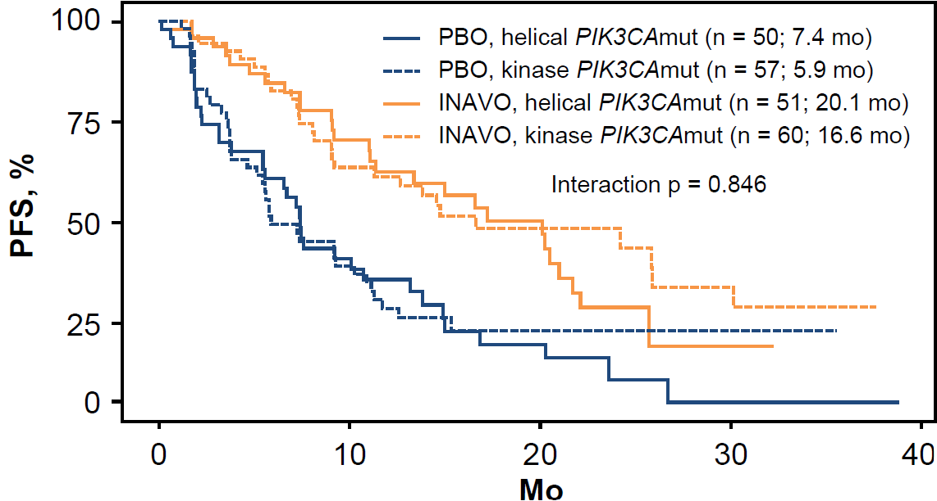
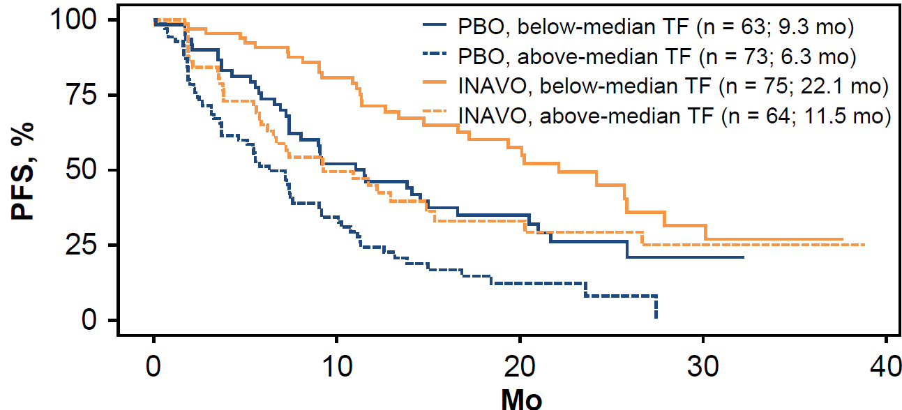
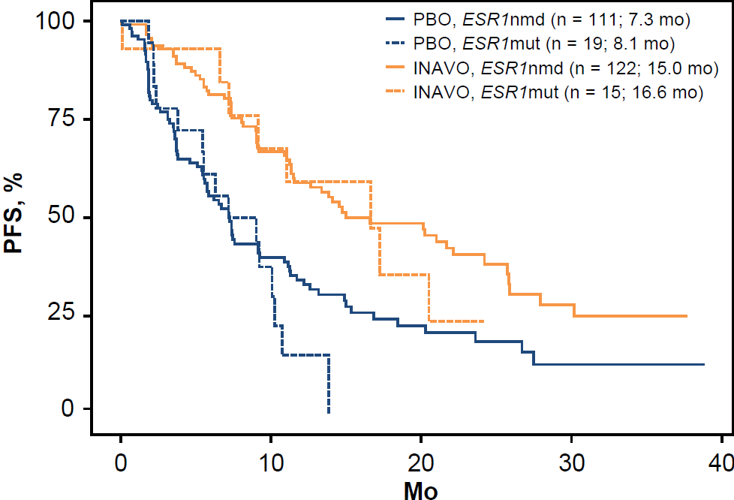
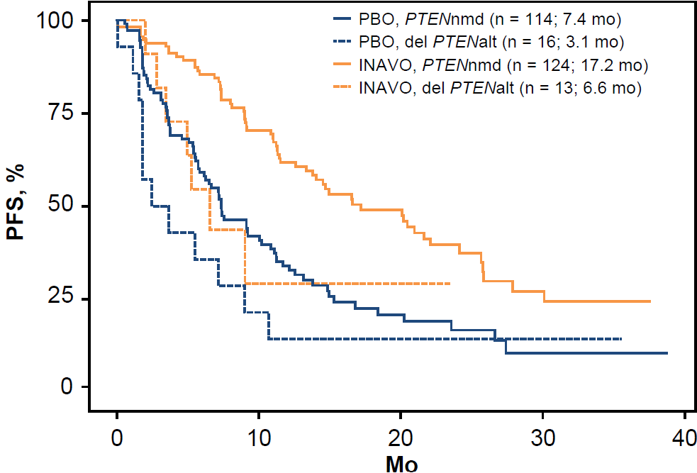
The efficacy of INAVO + PALBO + FULV was consistent across a variety of genomic subgroups and the ITT populationª
PIK3CA helical vs kinase domain mutations
Above- vs below-median ctDNA tumor fraction
 | Helical (n = 101) | Kinase (n = 117)
PFS HR (95% CI) | 0.5 (0.3–0.8) | 0.5 (0.3–0.8)
p-value | 0.003** | 0.003**
 | Below- median TF (n = 138) | Above- median TF (n = 137)
PFS HR (95% CI) | 0.5 (0.3–0.8) | 0.5 (0.3–0.8)
p-value | 0.007** | 0.001***
ESR1 mutation vs no mutation detected
Deleterious PTEN detected vs not detected
 | ESR1nmd (n = 233) | ESR1mut (n = 34)
PFS HR (95% CI) | 0.5 (0.4–0.7) | 0.2 (0.1–0.7)
p-value | 4.705 × 10^{–5}*** | 0.005**
 | PTENnmd (n = 238) | Del PTENalt (n = 29)
PFS HR (95% CI) | 0.5 (0.3–0.6) | 0.6 (0.2–1.4)
p-value | 7.120 × 10^{–6}*** | 0.215
HRs for INAVO vs PBO are shown herein. Mo are medians. ª INAVO120 ITT population HR 0.43 (95% CI 0.32–0.59); p < 0.001 (Turner NC, et al. N Engl J Med 2024; 391:1584–1596).
p-values from likelihood ratio test (significant p-values are indicated by asterisks). ESR1mut is defined here as any known / likely short variant alteration in ESR1; PTENalt is any known / likely oncogenic alt in the PTEN gene. Median ctDNA TF for enrolled subset was 3.8%. alt, alteration; CI, confidence interval; ctDNA, circulating tumor DNA; del, deleterious;
FULV, fulvestrant; HR, hazard ratio; INAVO, inavolisib; ITT, intent-to-treat population; mo, months; mut, mutation; nmd, no mutation detected; PALBO, palbociclib; PBO, placebo;
PFS, progression-free survival; TF, ctDNA tumor fraction.
Turner SABCS 2025;Abstract PD5-09

Slide 81
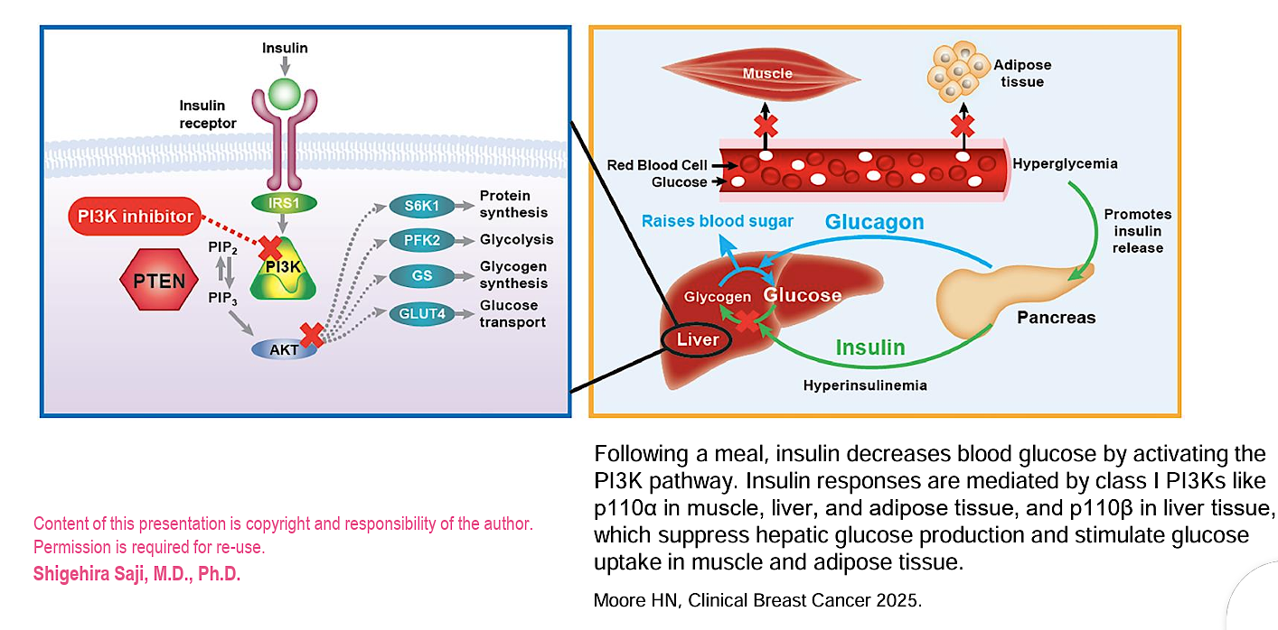
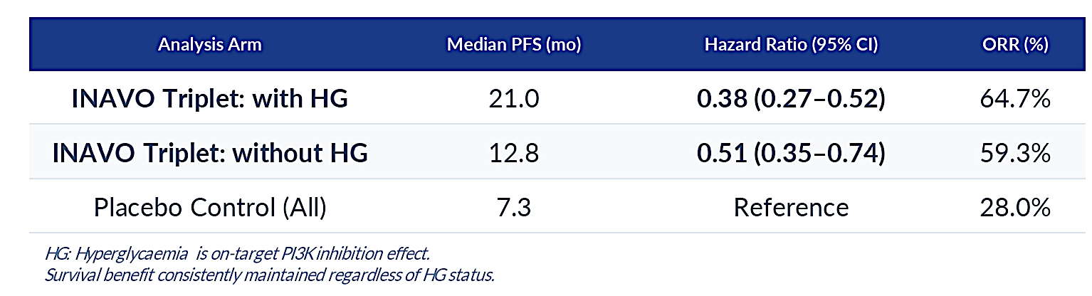
Efficacy of inavolisib (INAVO) + palbociclib (PALBO) + fulvestrant (FULV) in patients (pts) with PIK3CA-mutated, hormone receptor-positive, HER2-negative (HER2-), endocrine-resistant advanced breast cancer (aBC) with and without hyperglycaemia (HG) in the phase III INAVO120 trial
On target Hyperglycemia is associated with improved efficacy of inavolisib
Loibl ESMO Breast 2026;Abstract 420RO

Slide 82
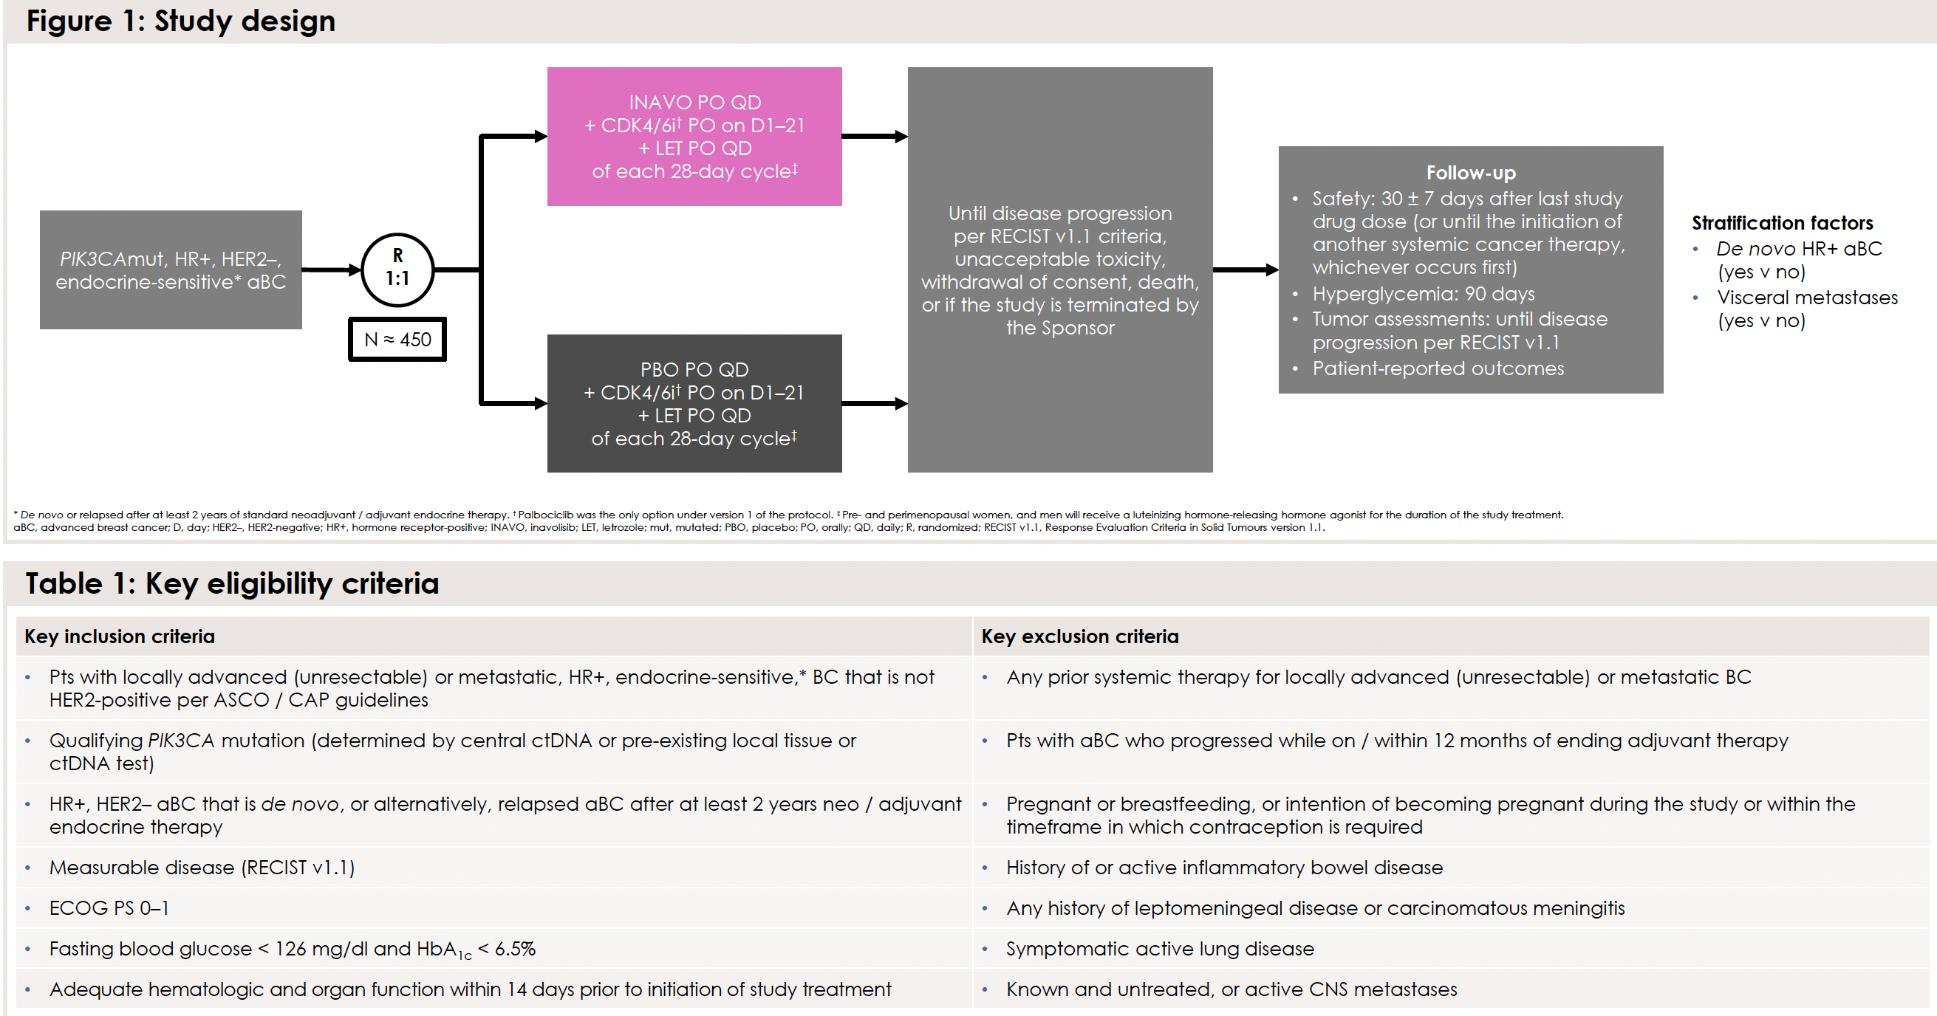
Basho SABCS 2025; Abstract PS5-07-27.

Slide 83
Key Datasets
Kalinsky K et al. Comparative analysis of blood- and tissue-based PIK3CA mutation detection methods in the pivotal phase 3 INAVO120 trial of palbociclib + fulvestrant ± inavolisib in hormone receptor-positive, HER2-negative advanced breast cancer. San Antonio Breast Cancer Symposium 2025;Abstract PS1-10-26.
Jhaveri KL et al. Overall survival with inavolisib in PIK3CA-mutated advanced breast cancer. N Engl J Med 2025;393(2):151-61.
Turner N et al. Molecular features of response to palbociclib + fulvestrant ± inavolisib in hormone receptor-positive, HER2-negative, PIK3CA-mutated advanced breast cancer as assessed from baseline circulating tumor DNA in the pivotal phase 3 INAVO120 trial. San Antonio Breast Cancer Symposium 2025;Abstract PD5-09.
Loibl S et al. Efficacy of inavolisib (INAVO) + palbociclib (PALBO) + fulvestrant (FULV) in patients (pts) with PIK3CA-mutated, hormone receptor-positive, HER2-negative (HER2-), endocrine-resistant advanced breast cancer (aBC) with and without hyperglycaemia (HG) in the phase III INAVO120 trial. ESMO Breast Cancer 2026;Abstract 420RO.
Basho R et al. INAVO123: Phase 3 study of first-line inavolisib / placebo + a cyclin-dependent kinase 4/6 inhibitor + letrozole in participants with PIK3CA-mutated, hormone receptor-positive, HER2-negative, endocrine-sensitive advanced breast cancer. San Antonio Breast Cancer Symposium 2025;Abstract PS5-07-27.

Slide 84
Year in Review:
PI3K/AKT/mTOR Pathway in
HR-Positive Metastatic Breast Cancer
INTRODUCTION: San Antonio Memories
MODULE 1: PI3K/AKT/PTEN Alterations and Therapies
MODULE 2: Capivasertib
MODULE 3: Gedatolisib
MODULE 4: Inavolisib
MODULE 5: New Agents and Ongoing Trials

Slide 85
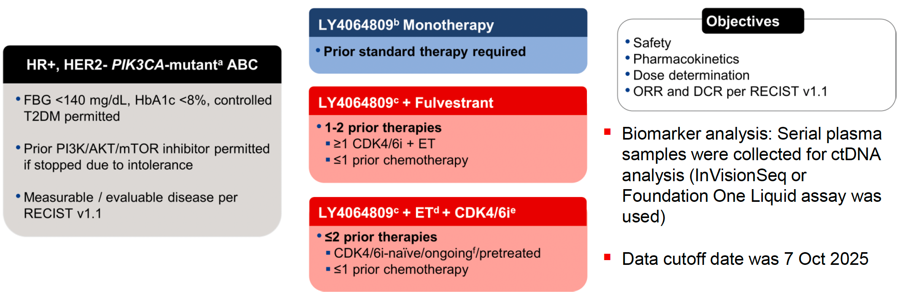
A Phase 1/2 trial of LY4064809 (STX-478, Tersolisib), a Pan-Mutant-Selective PI3Kα Inhibitor in HR+, HER2- MBC: Updated Results from PIKALO-1
N=50
Safety
Most common LY4064809 related AEs (TRAEs) were fatigue (27%), nausea (23%), hyperglycemia (23%; 33%/12% in pts with/without pre-DM/DM), and diarrhea (21%)
Grade ≥3 TRAEs occurred in 20% of patients, most commonly ALT/AST increased (7%), fatigue (4%), and neutropenia (4%)
1 patient discontinued due to a TRAE (AST increased in 100 mg LY4064809 + fulvestrant)
Minimal impact on glucose metabolism
N=41
N=63
Demographics, N=154
17-18% pre-diabetic
52% prior oral SERDs
Prior PI3Ki: 18% monotherapy arm
Prior chemo/ADC: 62%/24% monotherapy arm;
Palbociclib (49/63; 78%); Ribociclib (13/63; 21%); Abemaciclib (1/63; 2%).
Jhaveri et al, SABCS 2025;Abstract PS1-08-24

Slide 86
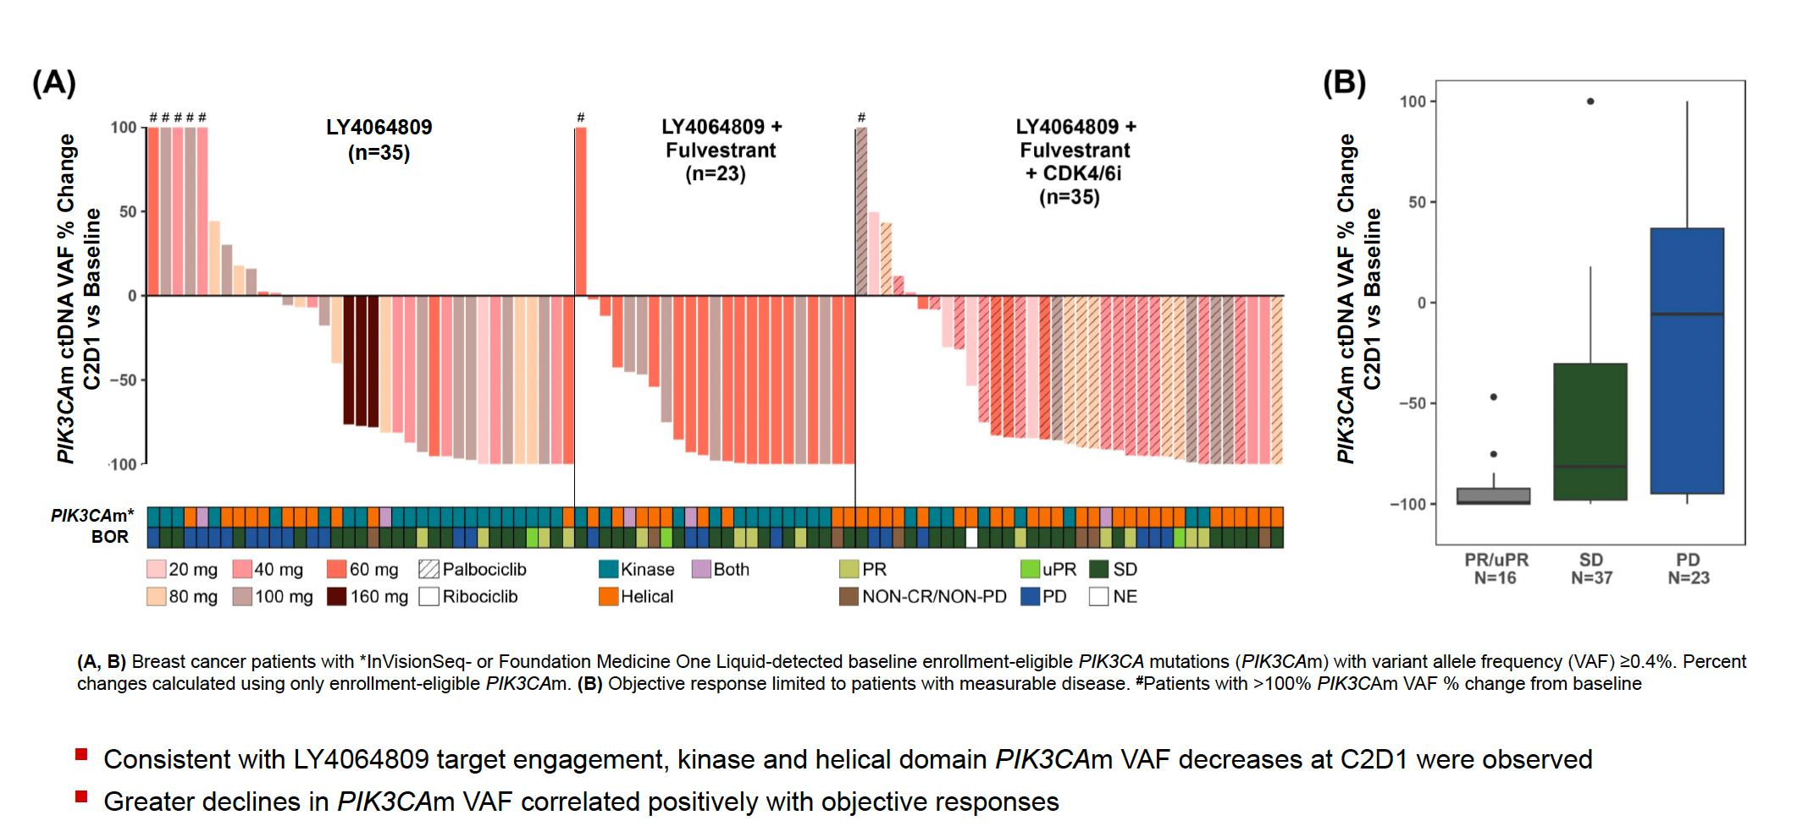
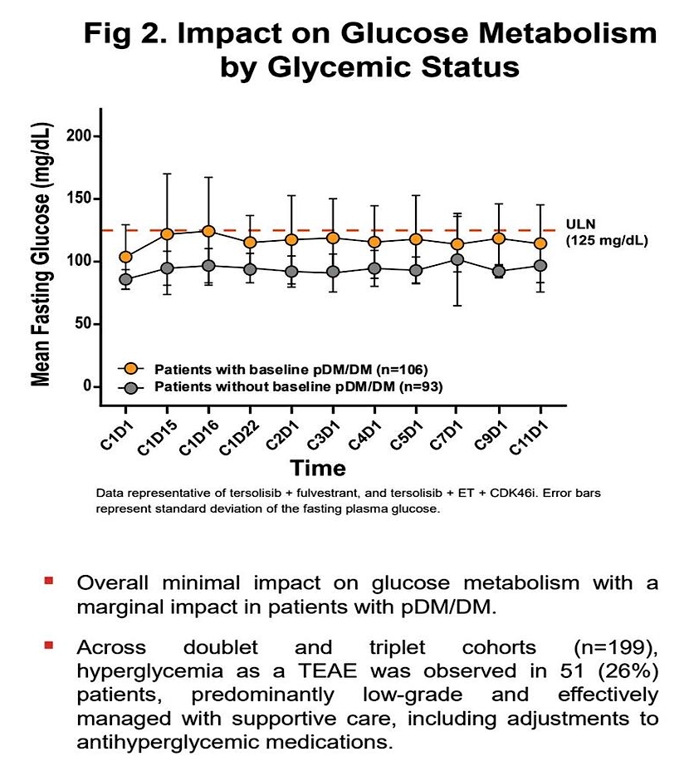
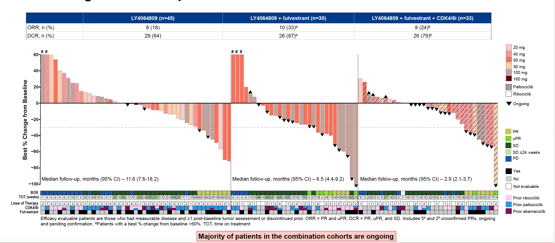
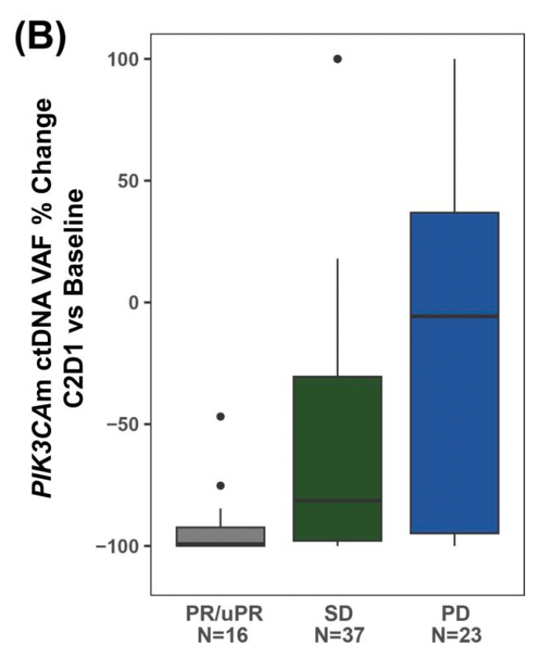
PIK3CAm ctDNA VAF Dynamics
Tumor Response in ABC Patients with Measurable Disease
Jhaveri et al, SABCS 2025;
Abstract PS1-08-24

Slide 87
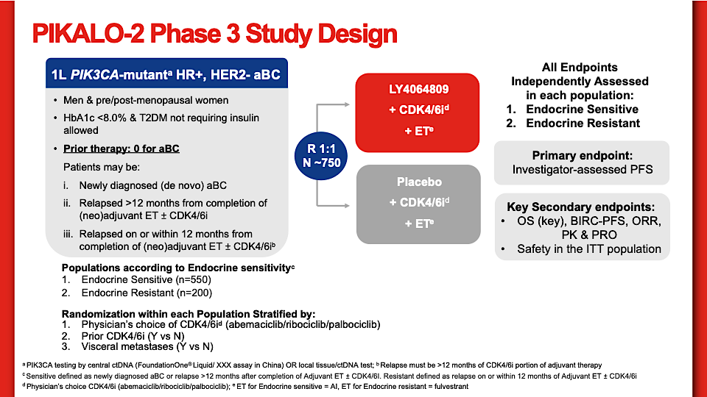
NCT07174336
Tersolisib
800

Slide 88
Conclusions
Tersolisib (LY4064809) alone or in combination with fulvestrant or fulvestrant/CDK4/6i was well-tolerated
  Low incidence of PI3K inhibitor (PI3Ki)-class toxicities
Promising antitumor activity observed in heavily pre-treated patients with PIK3CAm HR+, HER2- ABC
  Follow-up is short as many remain on therapy
PIKALO-2, a phase 3 global registrational trial investigating tersolisib in combination with ET and CDK4/6i is actively enrolling a dose optimization lead-in with phase III to open mid 2026 (NCT07174336)

Slide 89
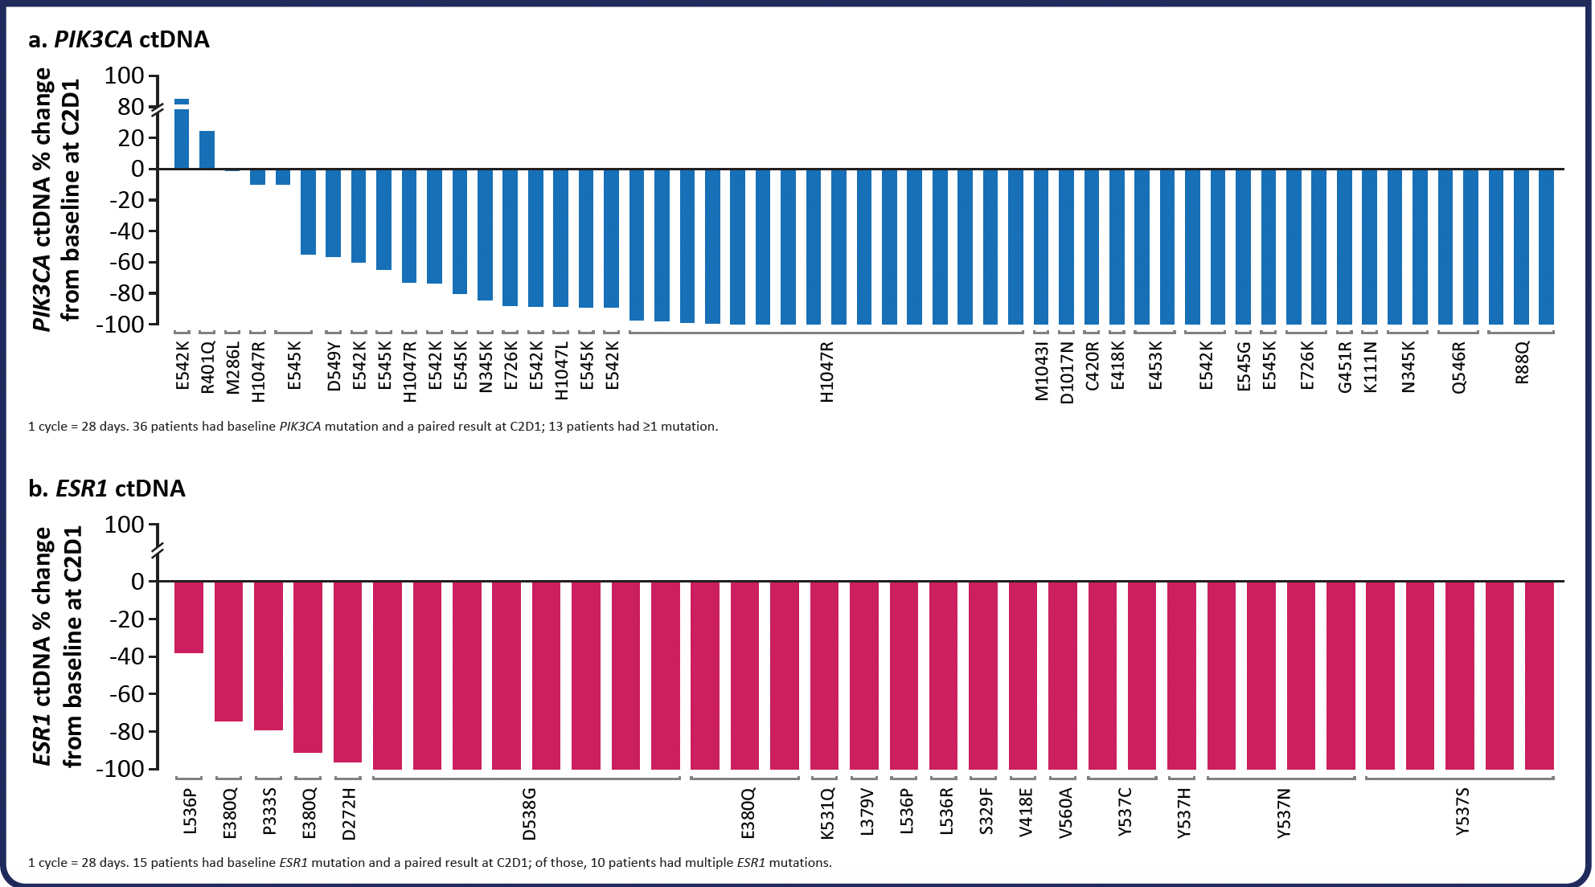
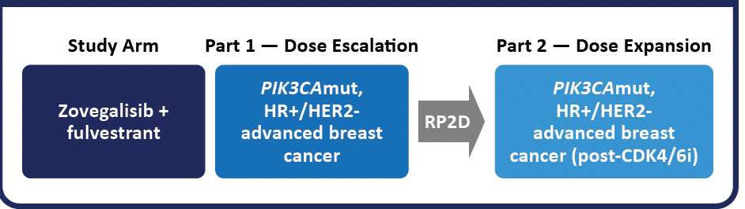
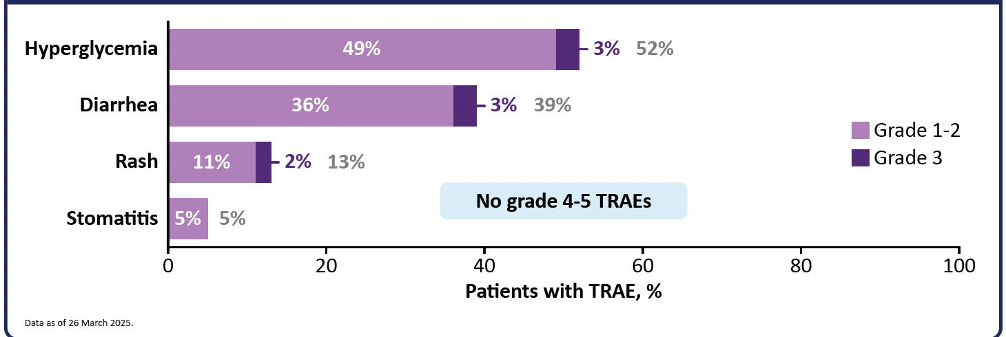
ReDiscover Trial: Zovegalisib (RLY-2608), a mutant‑selective PI3Kα inhibitor, plus fulvestrant in patient subsets, including pts with PIK3CA‑mutant HR+/ HER2‑ MBC
ctDNA at baseline and C2D1
Rapid decline across mutations
64 pts treated, all with mPIK3CA
  Zovegalisib 600 mg BID
Demographics
  34% BMI >30 or HgbA1c >5.7%
  55% one line, 44% 2+ lines Rx
  52% prior fulvestrant
  27% prior ADC/chemo
  29% ESR1m
Only 2 pts discontinued Rx due to AEs
Saura et al, SABCS 2025:Abstract PD10-07
Rugo et al, MBCC 2026

Slide 90
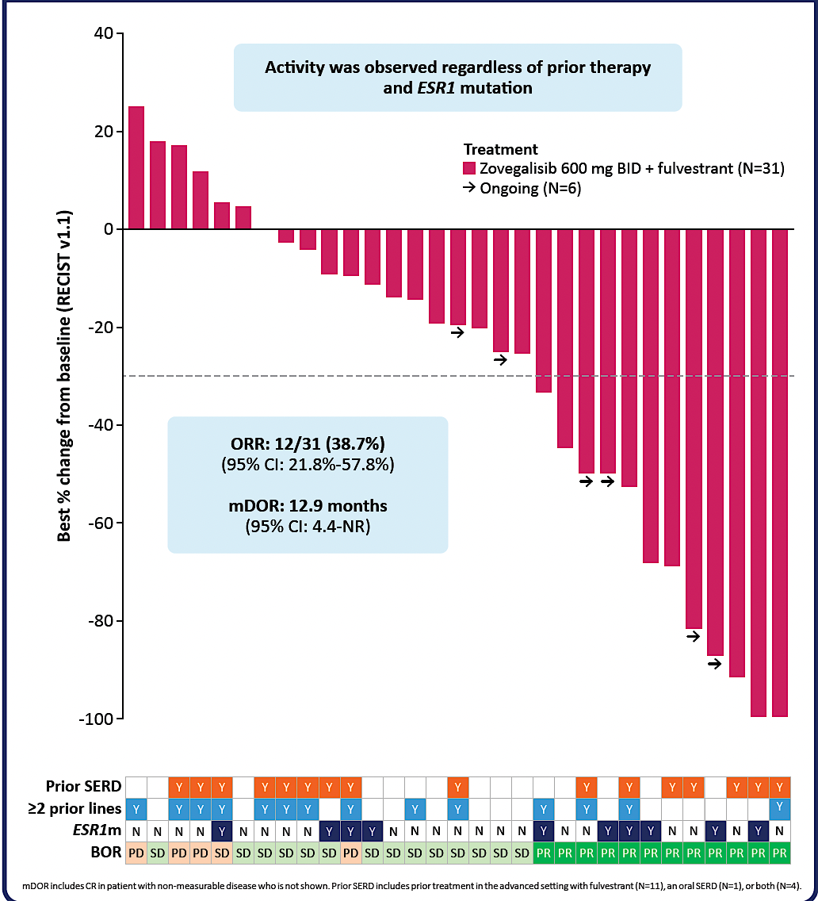
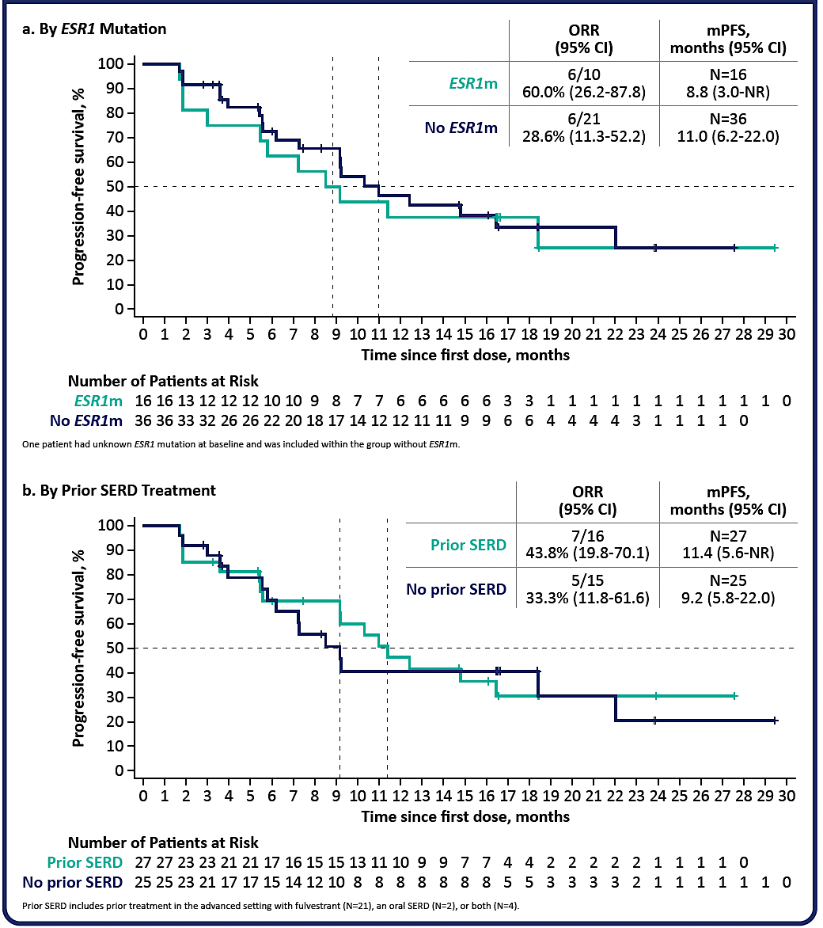
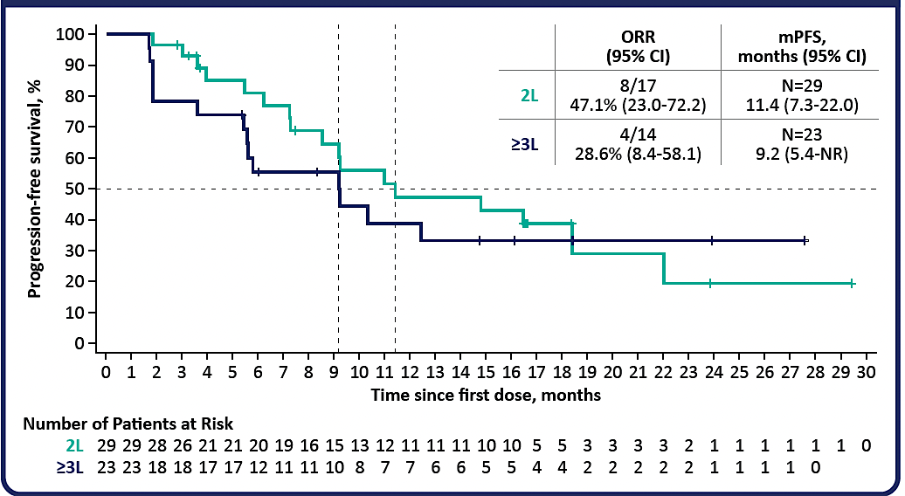
PFS by ESR1m and Prior SERD (N=52)
ORR per RECIST v1.1 (N=31)
Progression‑Free Survival by Line of Therapy (N=52)
Saura et al, SABCS 2025:Abstract Abstract PD10-07

Slide 91
Conclusions
Zovegalisib in combination with fulvestrant showed promising efficacy in patients with PIK3CA mutated HR+/HER2 negative MBC with disease progression on CDK4/6i
  Including those with co-mutations in ESR1
  Including those with prior exposure to SERDs
Discontinuation due to AEs is rare despite a high risk population
Encouraging PFS regardless of line of therapy
These findings support the ongoing ReDiscover 2 phase III global registration trial

Slide 92
Key Datasets
Jhaveri K et al. A phase 1/2 trial of tersolisib (LY4064809/STX-478), a pan-mutant-selective PI3Kα inhibitor (PI3Kαi), in PIK3CA-mutant advanced solid tumors: Updated results from PIKALO-1. ASCO 2026;Abstract 1072.
A phase 3, randomized, double-blind, placebo-controlled study of LY4064809 combined with a CDK4/6 inhibitor and endocrine therapy in adults with HR+, HER2-advanced breast cancer with a PIK3CA mutation who received no prior treatment for advanced breast cancer (PIKALO-2). NCT07174336.
Saura C et al. Efficacy of mutant-selective PI3Kα inhibitor RLY-2608 in combination with fulvestrant in patient (pt) subset populations, including pts with PIK3CA-mutant HR+/HER2- advanced breast cancer (BC) pre-treated with fulvestrant or other SERD. San Antonio Breast Cancer Symposium 2025;Abstract PD10-07.
Rugo H et al. ReDiscover-2, a phase 3 study of zovegalisib (zovega, RLY-2608) + fulvestrant (fulv) versus capivasertib (capi) + fulv as treatment for locally advanced or metastatic PIK3CA-mutant HR+/ HER2- breast cancer following recurrence or progression on or after treatment with a CDK4/6 inhibitor. ASCO 2026;Abstract TPS1148.

Slide 93
The Implications of Recent Datasets for the Current and Future Management of Genitourinary Cancers — An ASCO 2026 Review
A CME/MOC-Accredited Live Webinar
Thursday, July 16, 2026
5:00 PM – 6:30 PM ET
Faculty
Rahul Aggarwal, MD
Matthew D Galsky, MD
Tian Zhang, MD, MHS, FASCO
Moderator
Neil Love, MD

Slide 94
Thank you for joining us!
Please take a moment to complete the survey currently up on Zoom. Your feedback is very important to us. The survey will remain open for 5 minutes after the meeting ends.
Information on how to obtain CME, ABIM MOC and ABS credit is provided in the Zoom chat room. Attendees will also receive an email in
1 to 3 business days with these instructions.

