Slide 1
Year in Review: Clinical Investigator Perspectives on the
Most Relevant New Datasets and Advances in Oncology
Novel Treatment Approaches for Non-Hodgkin Lymphoma
A CME/MOC-Accredited Live Webinar
Wednesday, June 17, 2026
5:00 PM – 6:00 PM ET
Faculty
Matthew Matasar, MD
Sonali M Smith, MD
Moderator
Neil Love, MD

Slide 2

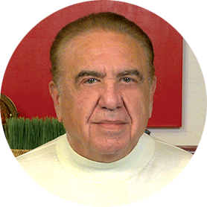

Faculty
Matthew Matasar, MD
Chief, Division of Blood Disorders
Rutgers Cancer Institute
Hematologist/Oncologist
Professor
Rutgers Robert Wood Johnson Medical School
New Brunswick, New Jersey
MODERATOR
Neil Love, MD
Research To Practice
Miami, Florida
Sonali M Smith, MD
Elwood V Jensen Professor of Medicine
Chief, Section of Hematology/Oncology
Co-Leader, Cancer Service Line
The University of Chicago
Chicago, Illinois

Slide 3
Commercial Support
This activity is supported by educational grants from AstraZeneca Pharmaceuticals LP and ADC Therapeutics.
Research To Practice CME Planning Committee Members,
Staff and Reviewers
Planners, scientific staff and independent reviewers for Research To Practice have no relevant financial relationships to disclose.

Slide 4
Dr Love — Disclosures
Dr Love is president and CEO of Research To Practice. Research To Practice receives funds in the form of educational grants to develop CME activities from the following companies: Aadi Bioscience, AbbVie Inc, ADC Therapeutics, Agendia Inc, Alexion Pharmaceuticals, Amgen Inc, Array BioPharma Inc, a subsidiary of Pfizer Inc, Arvinas, Astellas, AstraZeneca Pharmaceuticals LP, Aveo Pharmaceuticals, Bayer HealthCare Pharmaceuticals, BeOne, Biotheranostics Inc, A Hologic Company, Black Diamond Therapeutics Inc, Blueprint Medicines, Boehringer Ingelheim Pharmaceuticals Inc, Bristol Myers Squibb, Catalyst Pharmaceuticals Inc, Celcuity, Clovis Oncology, Coherus BioSciences, Corcept Therapeutics Inc, CTI BioPharma, a Sobi Company, Daiichi Sankyo Inc, Eisai Inc, Elevation Oncology Inc, Exact Sciences Corporation, Exelixis Inc, Genentech, a member of the Roche Group, Genmab US Inc, Geron Corporation, Gilead Sciences Inc, GSK, Helsinn Therapeutics (US) Inc, ImmunoGen Inc, Incyte Corporation, Ipsen Biopharmaceuticals Inc, Jazz Pharmaceuticals Inc, Johnson & Johnson, Karyopharm Therapeutics, Kite, A Gilead Company, Kura Oncology, Legend Biotech, Lilly, MEI Pharma Inc, Merck, Mersana Therapeutics Inc, Mirati Therapeutics Inc, Mural Oncology Inc, Natera Inc, Novartis, Novartis Pharmaceuticals Corporation on behalf of Advanced Accelerator Applications, Novocure Inc, Nuvalent, Nuvation Bio Inc, Pfizer Inc, Pharmacyclics LLC, an AbbVie Company, Puma Biotechnology Inc, Regeneron Pharmaceuticals Inc, Revolution Medicines Inc, Rigel Pharmaceuticals Inc, R-Pharm US, Sanofi, Seagen Inc, Servier Pharmaceuticals LLC, SpringWorks Therapeutics Inc, Stemline Therapeutics Inc, Sumitomo Pharma America, Summit Therapeutics, Syndax Pharmaceuticals, Taiho Oncology Inc, Takeda Pharmaceuticals USA Inc, TerSera Therapeutics LLC, Tesaro, A GSK Company, and Verastem Inc.

Slide 5
Dr Matasar — Disclosures
Advisory Committees and Consulting Agreements | AbbVie Inc, Allogene Therapeutics, Arvinas, Genentech, a member of the Roche Group, Genmab US Inc, Incyte Corporation, Merck, Novartis, Pfizer Inc, Roche Laboratories Inc, Visionary Pharmaceuticals
Contracted Research | Bayer HealthCare Pharmaceuticals, Genentech, a member of the Roche Group, Johnson & Johnson, Pharmacyclics LLC, an AbbVie Company, Roche Laboratories Inc, Seagen Inc
Expert Testimony | Recursion
Stock Options/Stock —Public Companies | Merck
Nonrelevant Financial Relationships | Arnold & Porter Kaye Scholer LLP

Slide 6
Dr Smith — Disclosures
Consulting Agreements | Foresight Diagnostics, a wholly-owned subsidiary of Natera Inc, Genmab US Inc, Regeneron Pharmaceuticals Inc
Contracted Research | Celgene Corporation, Genentech, a member of the Roche Group, Incyte Corporation, Ipsen Biopharmaceuticals Inc

Slide 7
This educational activity contains discussion of
non-FDA-approved uses of agents and regimens. Please refer to official prescribing information for each product for approved indications.

Slide 8

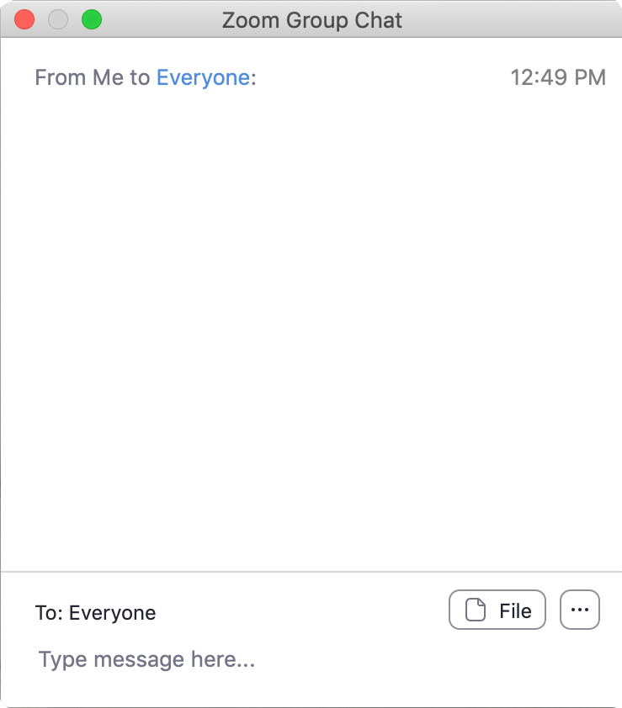
We Encourage Clinicians in Practice to Submit Questions
Feel free to submit questions now before the program begins and throughout the program.

Slide 9

Familiarizing Yourself with the Zoom Interface
Expand chat submission box
Drag the white line above the submission box up to create
more space for your message.

Slide 10

Familiarizing Yourself with the Zoom Interface
Increase chat font size
Press Command (for Mac) or Control (for PC) and the + symbol.
You may do this as many times as you need for readability.

Slide 11


Clinicians in the Audience, Please Complete the Pre- and Postmeeting Surveys
Quick Survey
Quick Poll

Slide 12
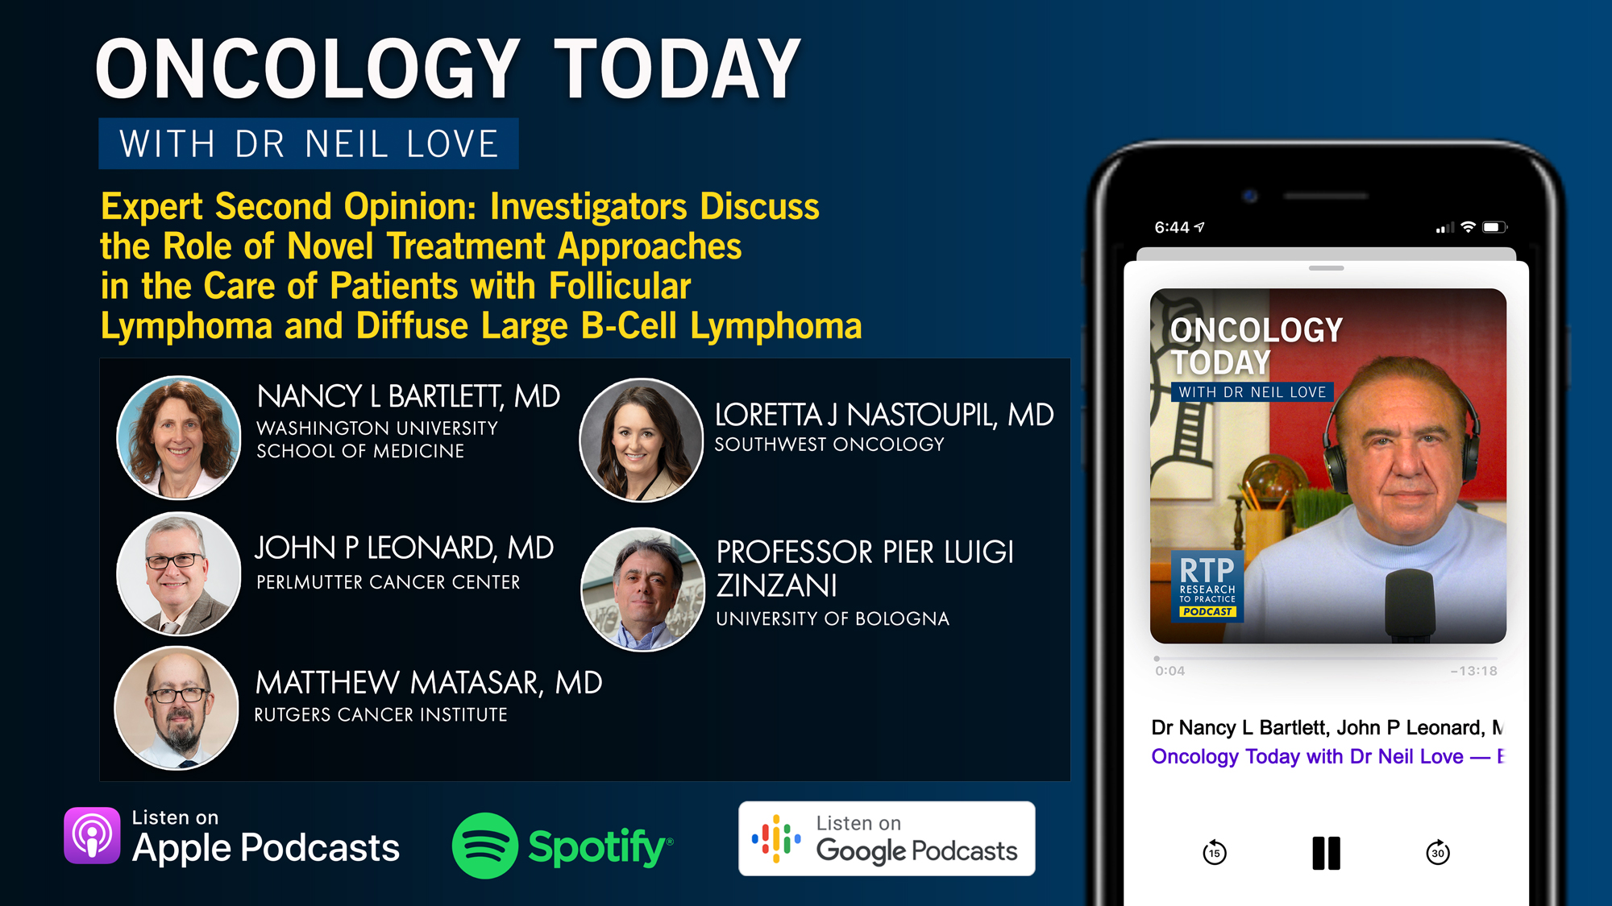

Slide 13
Year in Review: Clinical Investigator Perspectives on the
Most Relevant New Datasets and Advances in Oncology
Gastroesophageal Cancers
A CME/MOC-Accredited Live Webinar
Tuesday, June 23, 2026
5:00 PM – 6:00 PM ET
Faculty
David H Ilson, MD, PhD
Kohei Shitara, MD
Moderator
Neil Love, MD

Slide 14
Year in Review: Clinical Investigator Perspectives on the
Most Relevant New Datasets and Advances in Oncology
Multiple Myeloma
A CME/MOC-Accredited Live Webinar
Thursday, June 25, 2026
5:00 PM – 6:00 PM ET
Faculty
Amrita Krishnan, MD
Robert Z Orlowski, MD, PhD
Moderator
Neil Love, MD

Slide 15
Year in Review: Clinical Investigator Perspectives on the
Most Relevant New Datasets and Advances in Oncology
Therapeutic Targets Beyond
EGFR for Non-Small Cell Lung Cancer
A CME/MOC-Accredited Live Webinar
Tuesday, June 30, 2026
5:00 PM – 6:00 PM ET
Faculty
John V Heymach, MD, PhD
Maurice Pérol, MD
Moderator
Neil Love, MD

Slide 16
Patterns of Care: Exploring How
Community Oncologists Manage HR-Positive,
HER2-Positive Metastatic Breast Cancer
A CME/MOC-Accredited Live Webinar
Wednesday, July 1, 2026
5:00 PM – 6:00 PM ET
Faculty
Lisa A Carey, MD, ScM, FASCO
Reshma L Mahtani, DO
Moderator
Neil Love, MD

Slide 17
Grand Rounds
CME/MOC-Accredited Interactive Series
Regional Activities
Two Series
Optimizing the Use of
Novel Therapies for Patients with Diffuse Large B-Cell Lymphoma
Optimizing Therapy for Patients with Hormone Receptor-Positive
Localized Breast Cancer
Host a 1-hour session at your institution:
Email Meetings@ResearchToPractice.com
or call (800) 233-6153

Slide 18
Year in Review:
Novel Treatment Approaches for Non-Hodgkin Lymphoma
INTRODUCTION
MODULE 1: Novel Treatment Approaches for Diffuse Large B-Cell Lymphoma (DLBCL) — Dr Matasar
MODULE 2: Novel Treatment Approaches for Follicular Lymphoma (FL) and Mantle Cell Lymphoma (MCL) — Dr Smith

Slide 19
Thank you for joining us!
Please take a moment to complete the survey currently up on Zoom.
Your feedback is very important to us.
Information on how to obtain CME and ABIM MOC credit will be provided in the Zoom chat room. Attendees will also receive an email in
1 to 3 business days with these instructions.

Slide 20
Year in Review: Clinical Investigator Perspectives on the
Most Relevant New Datasets and Advances in Oncology
Novel Treatment Approaches for Non-Hodgkin Lymphoma
A CME/MOC-Accredited Live Webinar
Wednesday, June 17, 2026
5:00 PM – 6:00 PM ET
Faculty
Matthew Matasar, MD
Sonali M Smith, MD
Moderator
Neil Love, MD

Slide 21
Faculty
Matthew Matasar, MD
Chief, Division of Blood Disorders
Rutgers Cancer Institute
Hematologist/Oncologist
Professor
Rutgers Robert Wood Johnson Medical School
New Brunswick, New Jersey
MODERATOR
Neil Love, MD
Research To Practice
Miami, Florida
Sonali M Smith, MD
Elwood V Jensen Professor of Medicine
Chief, Section of Hematology/Oncology
Co-Leader, Cancer Service Line
The University of Chicago
Chicago, Illinois

Slide 22
We Encourage Clinicians in Practice to Submit Questions
Feel free to submit questions now before the program begins and throughout the program.

Slide 23
Clinicians in the Audience, Please Complete the Pre- and Postmeeting Surveys
Quick Survey
Quick Poll

Slide 25
Year in Review: Clinical Investigator Perspectives on the
Most Relevant New Datasets and Advances in Oncology
Gastroesophageal Cancers
A CME/MOC-Accredited Live Webinar
Tuesday, June 23, 2026
5:00 PM – 6:00 PM ET
Faculty
David H Ilson, MD, PhD
Kohei Shitara, MD
Moderator
Neil Love, MD

Slide 26
Year in Review: Clinical Investigator Perspectives on the
Most Relevant New Datasets and Advances in Oncology
Multiple Myeloma
A CME/MOC-Accredited Live Webinar
Thursday, June 25, 2026
5:00 PM – 6:00 PM ET
Faculty
Amrita Krishnan, MD
Robert Z Orlowski, MD, PhD
Moderator
Neil Love, MD

Slide 27
Year in Review: Clinical Investigator Perspectives on the
Most Relevant New Datasets and Advances in Oncology
Therapeutic Targets Beyond
EGFR for Non-Small Cell Lung Cancer
A CME/MOC-Accredited Live Webinar
Tuesday, June 30, 2026
5:00 PM – 6:00 PM ET
Faculty
John V Heymach, MD, PhD
Maurice Pérol, MD
Moderator
Neil Love, MD

Slide 28
Patterns of Care: Exploring How
Community Oncologists Manage HR-Positive,
HER2-Positive Metastatic Breast Cancer
A CME/MOC-Accredited Live Webinar
Wednesday, July 1, 2026
5:00 PM – 6:00 PM ET
Faculty
Lisa A Carey, MD, ScM, FASCO
Reshma L Mahtani, DO
Moderator
Neil Love, MD

Slide 29
Grand Rounds
CME/MOC-Accredited Interactive Series
Regional Activities
Two Series
Optimizing the Use of
Novel Therapies for Patients with Diffuse Large B-Cell Lymphoma
Optimizing Therapy for Patients with Hormone Receptor-Positive
Localized Breast Cancer
Host a 1-hour session at your institution:
Email Meetings@ResearchToPractice.com
or call (800) 233-6153

Slide 30
Year in Review: Clinical Investigator Perspectives on the
Most Relevant New Datasets and Advances in Oncology
Novel Treatment Approaches for Non-Hodgkin Lymphoma
A CME/MOC-Accredited Live Webinar
Wednesday, June 17, 2026
5:00 PM – 6:00 PM ET
Faculty
Matthew Matasar, MD
Sonali M Smith, MD
Moderator
Neil Love, MD

Slide 31
Commercial Support
This activity is supported by educational grants from AstraZeneca Pharmaceuticals LP and ADC Therapeutics.
Research To Practice CME Planning Committee Members,
Staff and Reviewers
Planners, scientific staff and independent reviewers for Research To Practice have no relevant financial relationships to disclose.

Slide 32
Dr Matasar — Disclosures
Advisory Committees and Consulting Agreements | AbbVie Inc, Allogene Therapeutics, Arvinas, Genentech, a member of the Roche Group, Genmab US Inc, Incyte Corporation, Merck, Novartis, Pfizer Inc, Roche Laboratories Inc, Visionary Pharmaceuticals
Contracted Research | Bayer HealthCare Pharmaceuticals, Genentech, a member of the Roche Group, Johnson & Johnson, Pharmacyclics LLC, an AbbVie Company, Roche Laboratories Inc, Seagen Inc
Expert Testimony | Recursion
Stock Options/Stock —Public Companies | Merck
Nonrelevant Financial Relationships | Arnold & Porter Kaye Scholer LLP

Slide 33
Dr Smith — Disclosures
Consulting Agreements | Foresight Diagnostics, a wholly-owned subsidiary of Natera Inc, Genmab US Inc, Regeneron Pharmaceuticals Inc
Contracted Research | Celgene Corporation, Genentech, a member of the Roche Group, Incyte Corporation, Ipsen Biopharmaceuticals Inc

Slide 34
Dr Love — Disclosures
Dr Love is president and CEO of Research To Practice. Research To Practice receives funds in the form of educational grants to develop CME activities from the following companies: Aadi Bioscience, AbbVie Inc, ADC Therapeutics, Agendia Inc, Alexion Pharmaceuticals, Amgen Inc, Array BioPharma Inc, a subsidiary of Pfizer Inc, Arvinas, Astellas, AstraZeneca Pharmaceuticals LP, Aveo Pharmaceuticals, Bayer HealthCare Pharmaceuticals, BeOne, Biotheranostics Inc, A Hologic Company, Black Diamond Therapeutics Inc, Blueprint Medicines, Boehringer Ingelheim Pharmaceuticals Inc, Bristol Myers Squibb, Catalyst Pharmaceuticals Inc, Celcuity, Clovis Oncology, Coherus BioSciences, Corcept Therapeutics Inc, CTI BioPharma, a Sobi Company, Daiichi Sankyo Inc, Eisai Inc, Elevation Oncology Inc, Exact Sciences Corporation, Exelixis Inc, Genentech, a member of the Roche Group, Genmab US Inc, Geron Corporation, Gilead Sciences Inc, GSK, Helsinn Therapeutics (US) Inc, ImmunoGen Inc, Incyte Corporation, Ipsen Biopharmaceuticals Inc, Jazz Pharmaceuticals Inc, Johnson & Johnson, Karyopharm Therapeutics, Kite, A Gilead Company, Kura Oncology, Legend Biotech, Lilly, MEI Pharma Inc, Merck, Mersana Therapeutics Inc, Mirati Therapeutics Inc, Mural Oncology Inc, Natera Inc, Novartis, Novartis Pharmaceuticals Corporation on behalf of Advanced Accelerator Applications, Novocure Inc, Nuvalent, Nuvation Bio Inc, Pfizer Inc, Pharmacyclics LLC, an AbbVie Company, Puma Biotechnology Inc, Regeneron Pharmaceuticals Inc, Revolution Medicines Inc, Rigel Pharmaceuticals Inc, R-Pharm US, Sanofi, Seagen Inc, Servier Pharmaceuticals LLC, SpringWorks Therapeutics Inc, Stemline Therapeutics Inc, Sumitomo Pharma America, Summit Therapeutics, Syndax Pharmaceuticals, Taiho Oncology Inc, Takeda Pharmaceuticals USA Inc, TerSera Therapeutics LLC, Tesaro, A GSK Company, and Verastem Inc.

Slide 35
This educational activity contains discussion of
non-FDA-approved uses of agents and regimens. Please refer to official prescribing information for each product for approved indications.

Slide 36
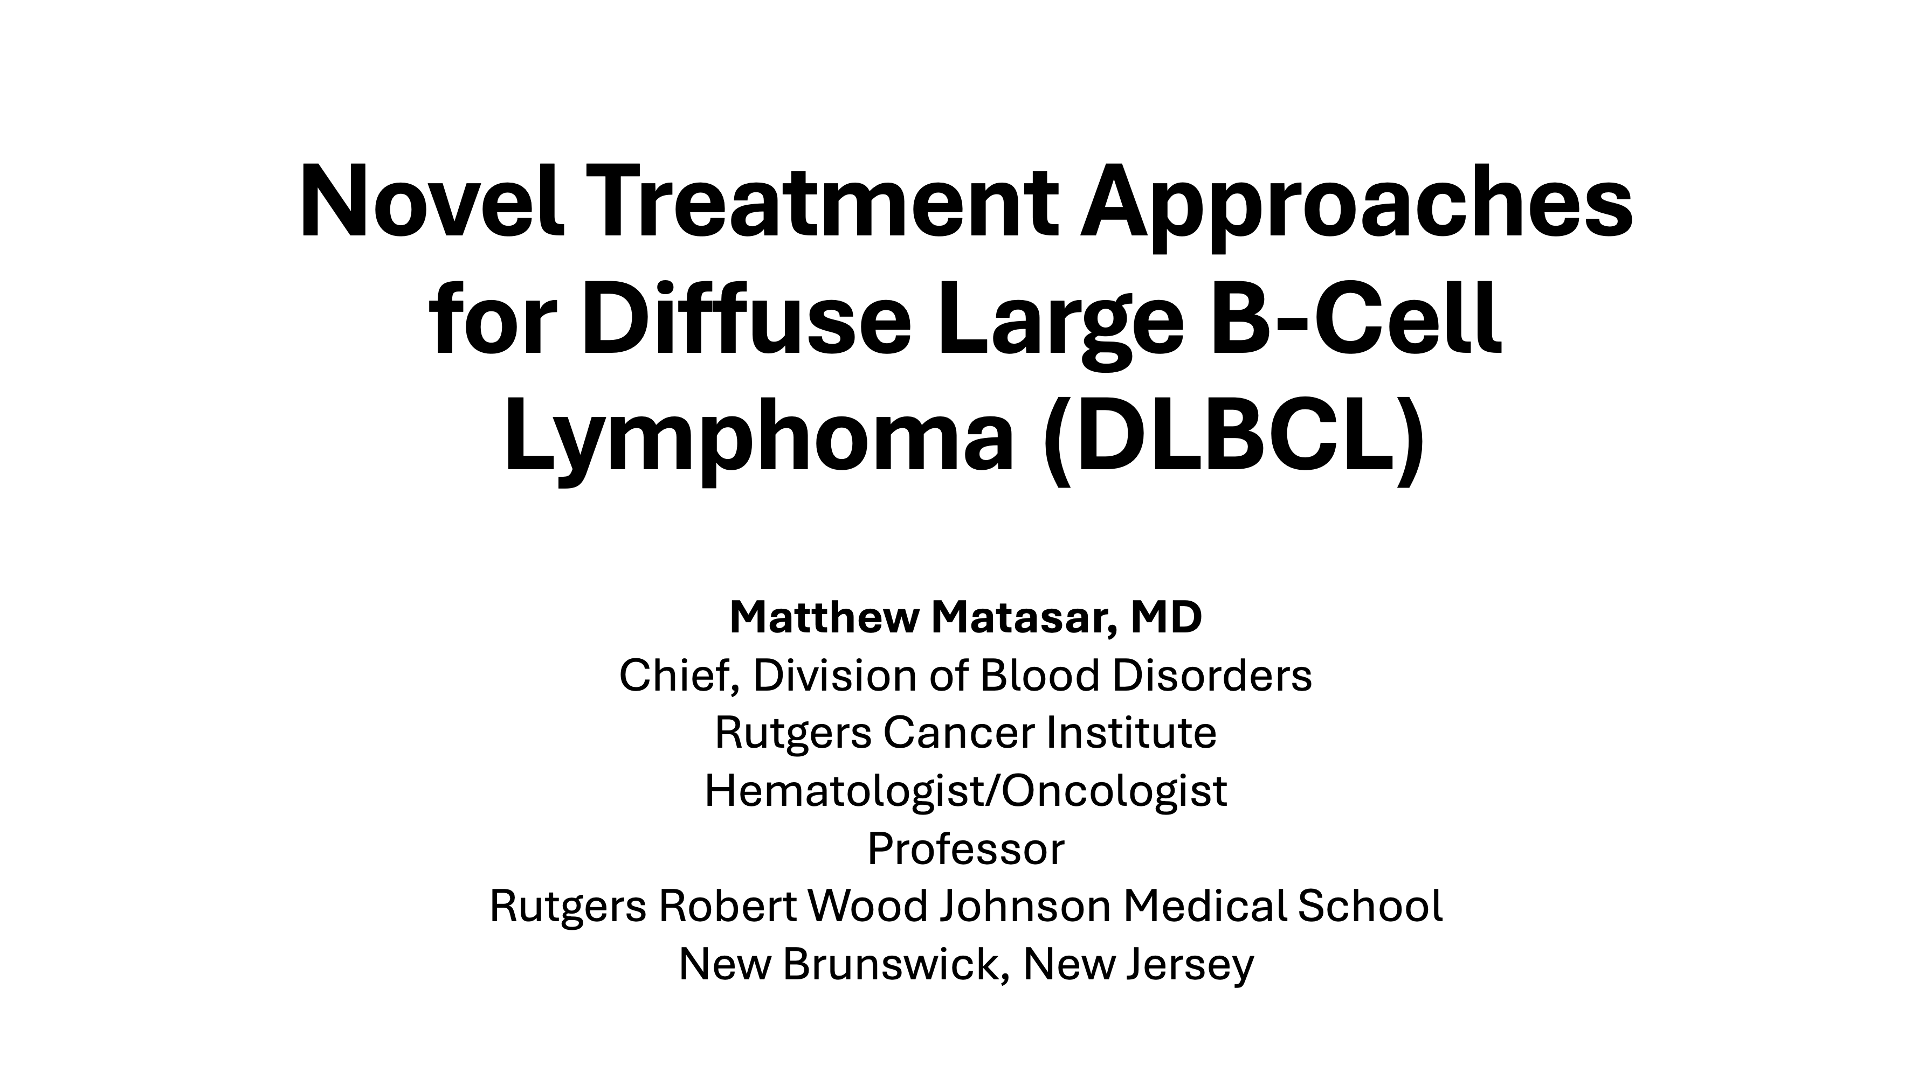
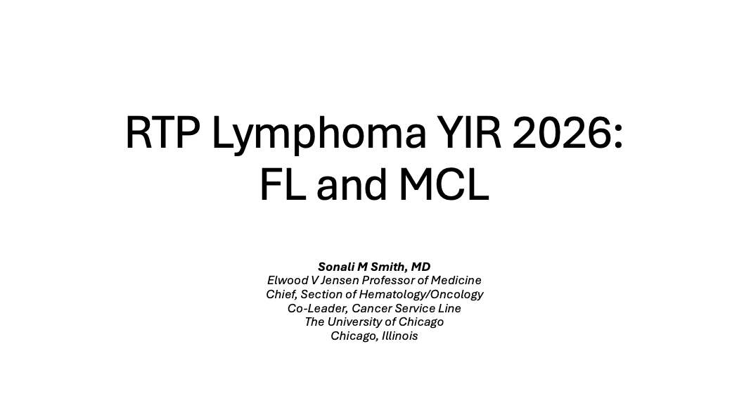

Slide 37
Key Datasets
Matthew Matasar, MD
Morschhauser F et al. Five-year outcomes of the POLARIX study comparing Pola-R-CHP and R-CHOP in patients with diffuse large B-cell lymphoma. J Clin Oncol 2025;43(35):3698-705.
Lenz G et al. frontMIND: Phase 3 study of tafasitamab (Tafa) plus lenalidomide (Len) and R-CHOP for patients (pts) with newly diagnosed diffuse large B-cell lymphoma (DLBCL). ASCO 2026;Abstract LBA7000.
Westin J et al. Primary analysis of the Smart Stop trial: Lenalidomide, tafasitamab, rituximab, and acalabrutinib alone and with combination chemotherapy in newly diagnosed diffuse large B-cell lymphoma. ASH 2025;Abstract 477.
Kim W et al. Mosunetuzumab plus polatuzumab vedotin (Mosun-Pola) versus rituximab, gemcitabine and oxaliplatin (R-GemOx) in patients with relapsed/refractory large B-cell lymphoma (R/R LBCL): Updated efficacy and safety from the phase 3 SUNMO study including in second-line (2L) versus third-line plus (3L+) patient subgroups. ASCO 2026;Abstract 7007.
Matasar M et al. Polatuzumab vedotin, rituximab, gemcitabine and oxaliplatin for R/R DLBCL: Results from the randomized phase III POLARGO trial. EHA 2025;Abstract S101.
Carlo-Stella C et al. Updated safety run-in results from LOTIS-5: A phase III, randomized trial of loncastuximab tesirine with rituximab versus immunochemotherapy in patients with R/R DLBCL/HGBL. EHA 2025;Abstract PS1957.

Slide 38
Key Datasets
Matthew Matasar, MD (continued)
Alderuccio JP et al. Initial results from LOTIS-7: A phase Ib study of loncastuximab tesirine plus glofitamab in patients with R/R DLBCL. EHA 2025;Abstract PS1911.
Armand P et al. WaveLINE-003: Phase II/III trial of zilovertamab vedotin plus standard of care in R/R DLBCL. ASCO 2025;Abstract 7005.
Kim TM et al. Surovatamig (AZD0486), a CD19xCD3 T-cell engager (TCE), demonstrates high rate of minimal residual disease (MRD)-negative complete responses in relapsed/refractory (R/R) diffuse large B-cell lymphoma (DLBCL), including in patients who previously progressed on CD20 TCE and CD19 CAR T-cell therapies. ASH 2025; Abstract 5514.
Jerkeman M et al. Safety data and initial pooled efficacy data from the Nordic Lymphoma Group phase 3 POLAR BEAR trial in elderly or frail patients with diffuse large cell lymphoma - R-Pola-mini-CHP vs. R-mini-CHOP. EHA 2026;Abstract S238.
Glass B et al. Polatuzumab vedotin plus rituximab, ifosfamide, carboplatin, etoposide (Pola-R-ICE) vs R-ICE as second line treatment in large B cell lymphoma (LBCL). Final analysis of a randomized phase 3 study. EHA 2026;Abstract S237.
Bouzani M et al. Golcadomide (GOLCA), a potential, first-in-class oral CELMoD + Pola-RCHP in patients (pts) with newly diagnosed aggressive B-cell lymphoma (A-BCL): Safety and 12-month efficacy from a phase 1b study. EHA 2026;Abstract S239.

Slide 39
Key Datasets
Sonali M Smith, MD
Sehn LH et al. Tafasitamab, lenalidomide, and rituximab in relapsed or refractory follicular lymphoma (inMIND): A global, phase 3, randomised controlled trial. Lancet 2026;407(10524):133-46.
Zinzani PL et al. Final analysis of the randomized phase 2 ROSEWOOD study of zanubrutinib + obinutuzumab vs obinutuzumab monotherapy in patients with relapsed/refractory follicular lymphoma. ASH 2025;Abstract 227.
Alderuccio JP et al. Loncastuximab tesirine with rituximab in patients with R/R FL: A single-centre, single-arm, phase II trial. Lancet Haematol 2025;12(1):e23-34.
Hou J-Z et al. Three-year follow-up of the phase 1 first-in-human study investigating surovatamig, a novel CD19xCD3 T-cell engager, in patients with relapsed/refractory (R/R) follicular lymphoma (FL). ASH 2025; Abstract 1005.
Wang ML et al. Time to third-line treatment after bendamustine-rituximab with or without acalabrutinib in patients with previously untreated mantle cell lymphoma: Updated analysis of the phase 3 ECHO trial after 50 months of follow-up. ASH 2025;Abstract 885.
Dreyling M et al. Efficacy of rituximab-bendamustine with or without acalabrutinib in patients with untreated, high-risk mantle cell lymphoma: An analysis of the phase 3 ECHO trial. EHA 2025;Abstract S233.

Slide 40
Key Datasets
Sonali M Smith, MD (continued)
Hawkes E et al. Acalabrutinib plus venetoclax and rituximab in patients with treatment-naive (TN) mantle cell lymphoma (MCL): Results from the phase 2 TrAVeRse study. ASH 2025;Abstract 884.
Jain P et al. Acalabrutinib in combination with rituximab is highly effective frontline treatment for older patients with MCL. ICML 2025;Abstract 272.
Wang M et al. Pirtobrutinib in relapsed/refractory (R/R) mantle cell lymphoma (MCL): Final update from the phase 1/2 BRUIN study. ASH 2025;Abstract 665.
Wang M et al. Sonrotoclax (BGB-11417) monotherapy in patients with relapsed/refractory (R/R) mantle cell lymphoma (MCL) previously treated with a Bruton tyrosine kinase (BTK) inhibitor: Early results from a phase 1/2 study. ASH 2025;Abstract 663.
Cheah CY et al. Surovatamig (AZD0486) plus rituximab in previously untreated follicular lymphoma (FL): Initial safety data from the phase 3 SOUNDTRACK-F1 trial. EHA 2026;Abstract S228.
Morillo D et al. Golcadomide (golca), a potential, first-in-class, oral CELMoD ±rituximab (R) in patients (pts) with relapsed/refractory (R/R) follicular lymphoma (FL): Phase (ph) 1/2 study long-term follow-up (f/u). EHA 2026;Abstract S227.

Slide 41
Year in Review:
Novel Treatment Approaches for Non-Hodgkin Lymphoma
INTRODUCTION: Lymphoma Survivorship
MODULE 1: Novel Treatment Approaches for Diffuse Large B-Cell Lymphoma
— Dr Matasar
MODULE 2: Novel Treatment Approaches for Follicular Lymphoma and Mantle Cell Lymphoma — Dr Smith

Slide 42
Year in Review:
Novel Treatment Approaches for Non-Hodgkin Lymphoma
INTRODUCTION: Lymphoma Survivorship
MODULE 1: Novel Treatment Approaches for Diffuse Large B-Cell Lymphoma
— Dr Matasar
MODULE 2: Novel Treatment Approaches for Follicular Lymphoma and Mantle Cell Lymphoma — Dr Smith

Slide 43
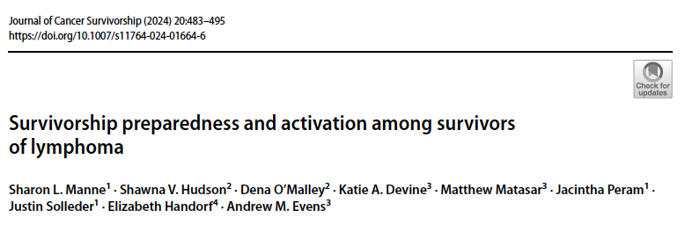

Slide 44
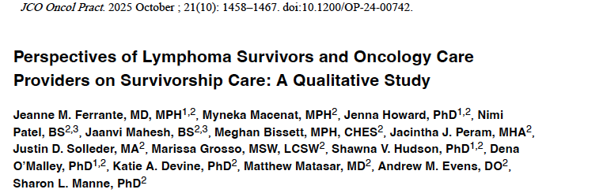

Slide 45
Emergent Themes
Theme 1: A Predominant Unmet Need Was How to Manage the Profound Fear of Recurrence and Anxiety Post-Treatment
Theme 2: There Were Diverse Views Regarding the Importance of Transition From Oncology to Primary Care Providers
Theme 3: Psychosocial Support, Wellness Services, and Assistance With Financial and Employment Programs Are Needed for an Ideal Survivorship Program
Ferrante JM et al. JCO Oncol Pract 2025;21(10):1458-67.

Slide 46
Year in Review:
Novel Treatment Approaches for Non-Hodgkin Lymphoma
INTRODUCTION: Lymphoma Survivorship
MODULE 1: Novel Treatment Approaches for Diffuse Large B-Cell Lymphoma
— Dr Matasar
MODULE 2: Novel Treatment Approaches for Follicular Lymphoma and Mantle Cell Lymphoma — Dr Smith

Slide 47
Novel Treatment Approaches for Diffuse Large B-Cell Lymphoma (DLBCL)
Matthew Matasar, MD
Chief, Division of Blood Disorders
Rutgers Cancer Institute
Hematologist/Oncologist
Professor
Rutgers Robert Wood Johnson Medical School
New Brunswick, New Jersey

Slide 48
POLARIX 5Y

Slide 49
POLARIX: PFS benefit with 5y follow-up
PFS in the global ITT population
100
Pola-R-CHP (n=440)
R-CHOP (n=439)
Censored
80
PFS (%)
60
40
Event-free rate, % (95% CI)
Primary analysis
3-year update† 5-year update‡
76.7 (72.7–80.8) 71.8 (67.1–76.5) 64.9 (59.8–70.0)
at 2 years*
20
Pola-R-CHP
R-CHOP
70.2 (65.8–74.6)
64.1 (59.1–69.1) 59.1 (54.0–64.3)
0
HR (95% CI)
0.73 (0.57–0.95)
0.76 (0.60–0.97) 0.77 (0.62–0.97)
0 | 6 | 12 | 18 | 24 | 30 | 36 | 42 | 48 | 54 | 60 | 66 | 72
Patients remaining at risk |  |  |  |  | Time (months)
Pola-R-CHP 440 | 407 | 357 | 335 | 318 | 303 292 280 |  |  | 258 | 213 | 100 | 56 | NE
R-CHOP 439 | 391 | 332 | 302 | 287 | 274 258 251 |  |  | 240 | 192 | 95 | 54 | NE
At the 5-year follow up, Pola-R-CHP had a sustained and significant PFS benefit,
confirming results from the primary analysis of PFS at 2 years of follow up (HR 0.73).¹
Salles ASH 2024 469 &
Morschhauser J Clin Oncol 2025

Slide 50
POLARIX: 5-year overall survival
OS in the global population*
100
80
60
40
Deaths, n§ | Pola-R-CHP (n=440) | R-CHOP (n=439)
Primary analysis at 2 years† | 53 | 57
5-year update* | 79 | 91
OS (%)
Event-free rate, %
Primary analysis at 2 years†
3-year update‡
5-year update*
Pola-R-CHP (n=440)
20
Pola-R-CHP
88.7 (85.7–91.7)
85.6 (82.3–88.9)
82.3 (78.7–85.9)
R-CHOP (n=439)
Censored
R-CHOP
88.6 (85.6–91.6)
85.6 (82.2–88.9)
79.5 (75.7–83.4)
0
HR (95% CI)
0.94 (0.65–1.37)
12 18 24
0.94 (0.67–1.33) 0.85 (0.63–1.15)
36 42 48 54
0 6
Patients remaining at risk
30
60
66
72
78
84
Time (months)
Pola-R-CHP | 440 | 424 | 399 | 389 | 381 | 373 | 366 | 355 | 343 | 338 | 319 | 124 | 12 | 1 | NE
R-CHOP | 439 | 415 | 403 | 382 | 372 | 361 | 357 | 347 | 338 | 329 | 311 | 128 | 13 | 1 | NE
After 5 years of follow-up, numerically fewer deaths were observed in the
Pola-R-CHP versus R-CHOP arm, with an associated HR of 0.85 (0.63–1.15).
*Data cut-off: July 5, 2024; †Data cut-off: June 28, 2021; ‡Data cut-off: June 15, 2022; §In addition to the known deaths, there were two patients (one in the Pola-R-CHP arm and one in the R-CHOP arm) who died due to an unknown cause and an unknown death date and were not counted as death events in the OS analysis.
Salles ASH 2024 469 &
Morschhauser J Clin Oncol 2025

Slide 51
FrontMIND

Slide 52
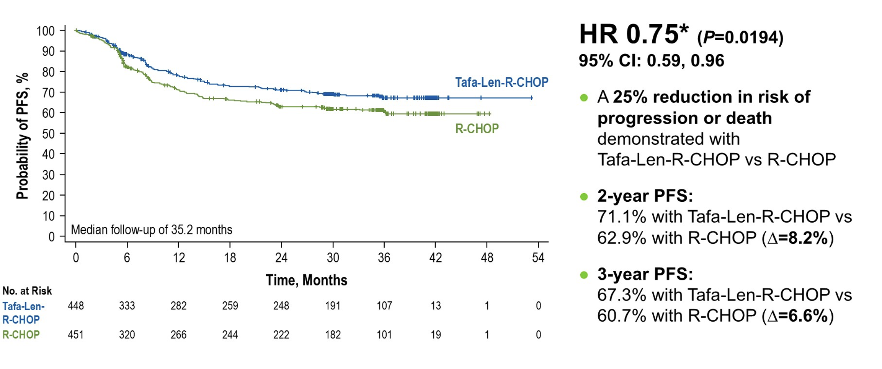
FrontMIND: Progression-free survival
Lenz ASCO 2026;Abstract LBA7000

Slide 53
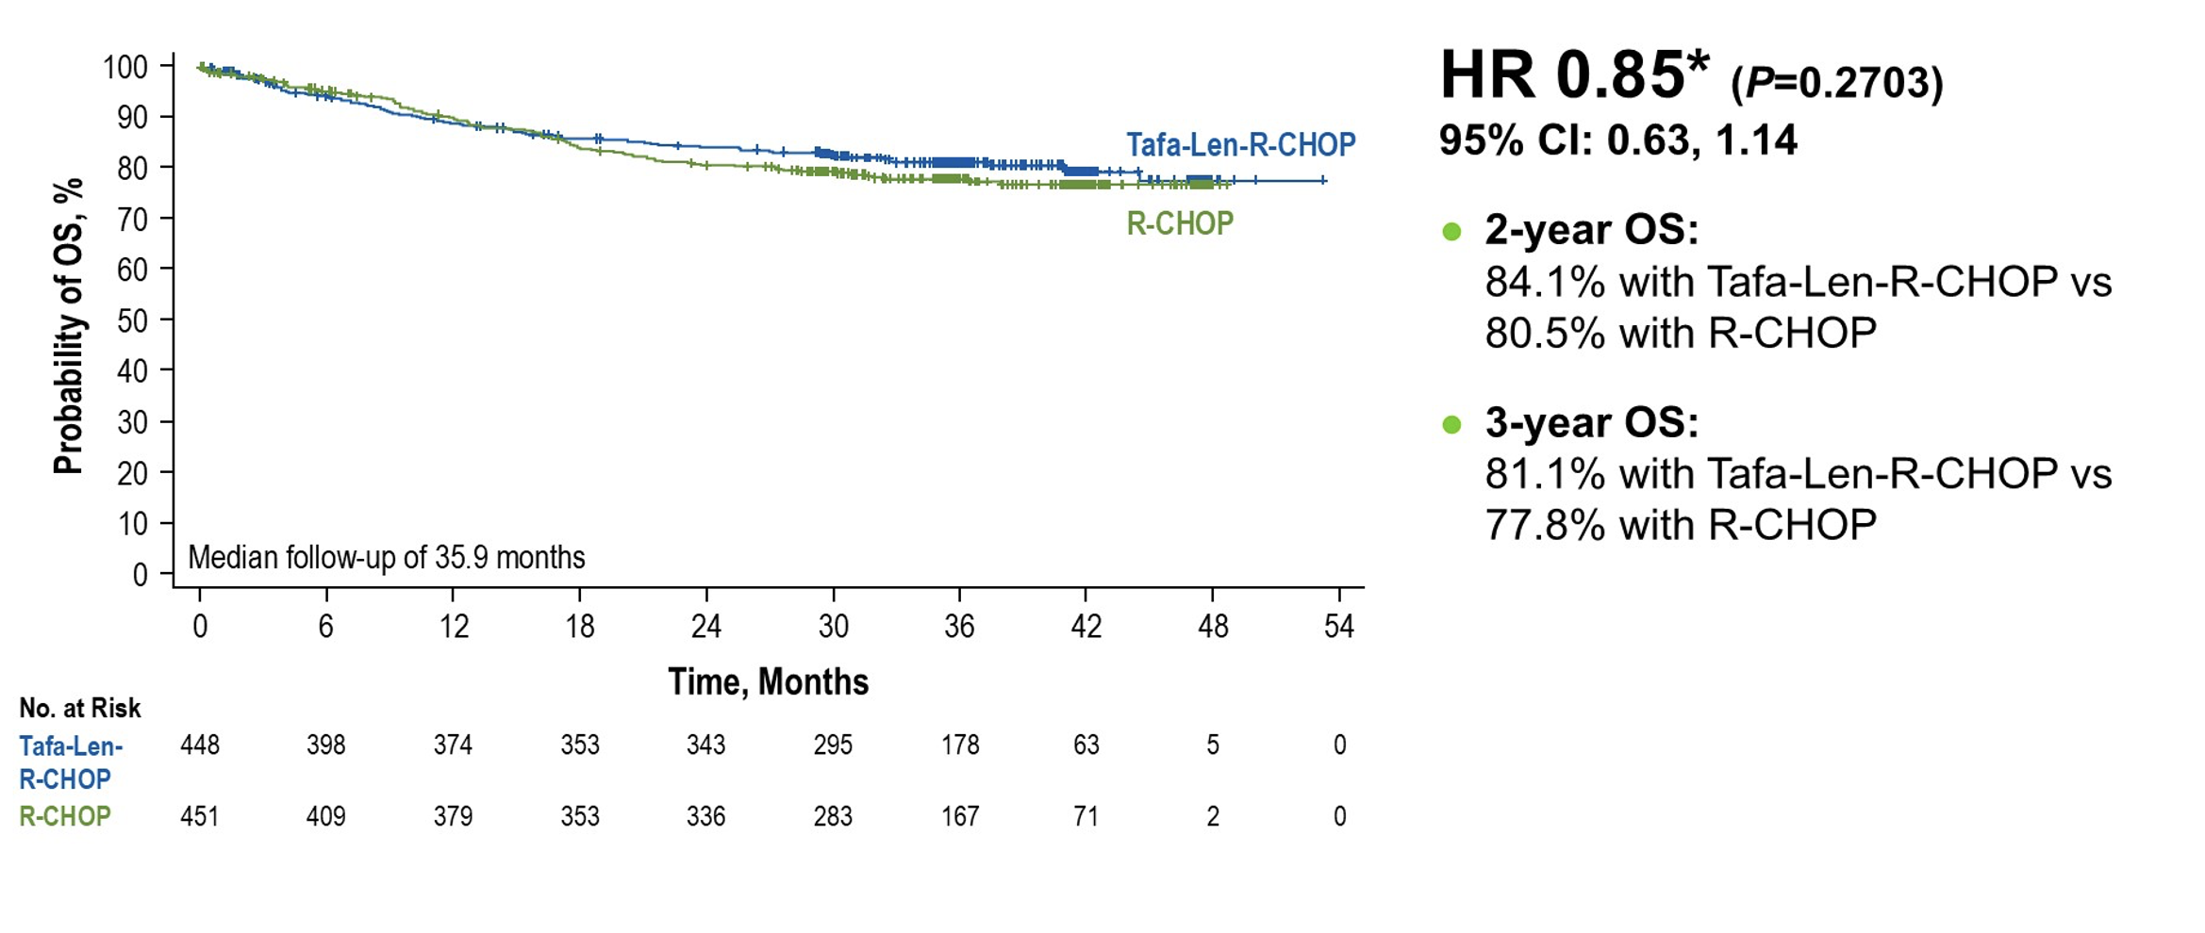
FrontMIND: Overall Survival
Lenz ASCO 2026;Abstract LBA7000

Slide 54
SMART-STOP

Slide 55
Phase 2 Smart Stop Trial: Acalabrutinib
CR
LTRA
LTRA
LTRA
LTRA
LTRA
LTRA
Key Eligibility Criteria
Aged 18+ with previously untreated DLBCL
Adequate organ and bone marrow function, with no known CNS involvement of lymphoma, recent thrombosis, or inability to tolerate prophylactic anticoagulation
CHOP
CHOP
Cohort 1
LTRA
4 Cycles
ctDNA monitoring
ctDNA monitoring
PR
LTRA
LTRA
LTRA
LTRA
LTRA
LTRA
SD
PD
CHOP
CHOP
CHOP
CHOP
CHOP
CHOP
At the end of all therapy, the CRR was 100%
47% of patients experienced rash and 40% of patients required a dose reduction of lenalidomide
LTRA is highly effective as an initial chemotherapy-free combination in patients with newly diagnosed DLBCL
and may permit for response-adapted reduction in chemotherapy
A, acalabrutinib; CHOP, cyclophosphamide, doxorubicin, vincristine, prednisone; CNS, central nervous system; CR, complete response; CRR, complete response rate; ctDNA, circulating tumor DNA; DLBCL, diffuse large B-cell lymphoma; L, lenalidomide; PD, progressive disease; PR, partial response; R, rituximab; SD, stable disease; T, tafasitamab.
Westin. Blood. 2023;142(Suppl 1):856.

Slide 56
Phase 2 Smart Stop Trial: Acalabrutinib
Complete Response
Partial Response
In remission
On treatment
2 cycles LTRA + CHOP
4 cycle LTRA
End of Treatment
2
4
6
8
10
12
14
16
A, acalabrutinib; CHOP, cyclophosphamide, doxorubicin, vincristine, prednisone; CNS, central nervous system; CR, complete response; CRR, complete response rate; ctDNA, circulating tumor DNA; DLBCL, diffuse large B-cell lymphoma; L, lenalidomide; PD, progressive disease; PR, partial response; R, rituximab; SD, stable disease; T, tafasitamab.
Westin. Blood. 2023;142(Suppl 1):856.

Slide 57
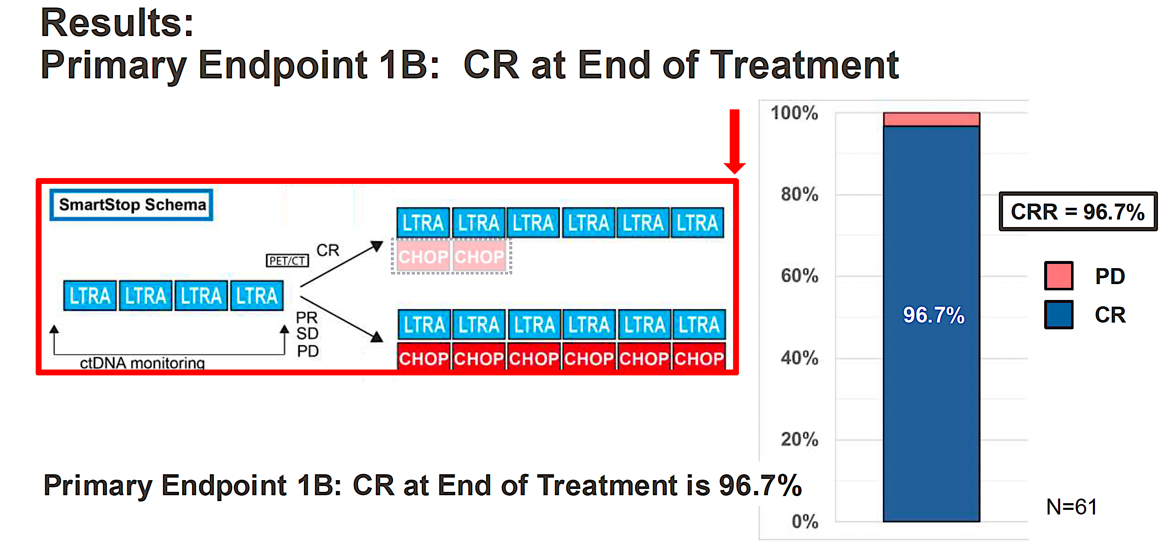
Phase 2 Smart Stop Trial
Westin ASH 2025; Abstract 477.

Slide 58
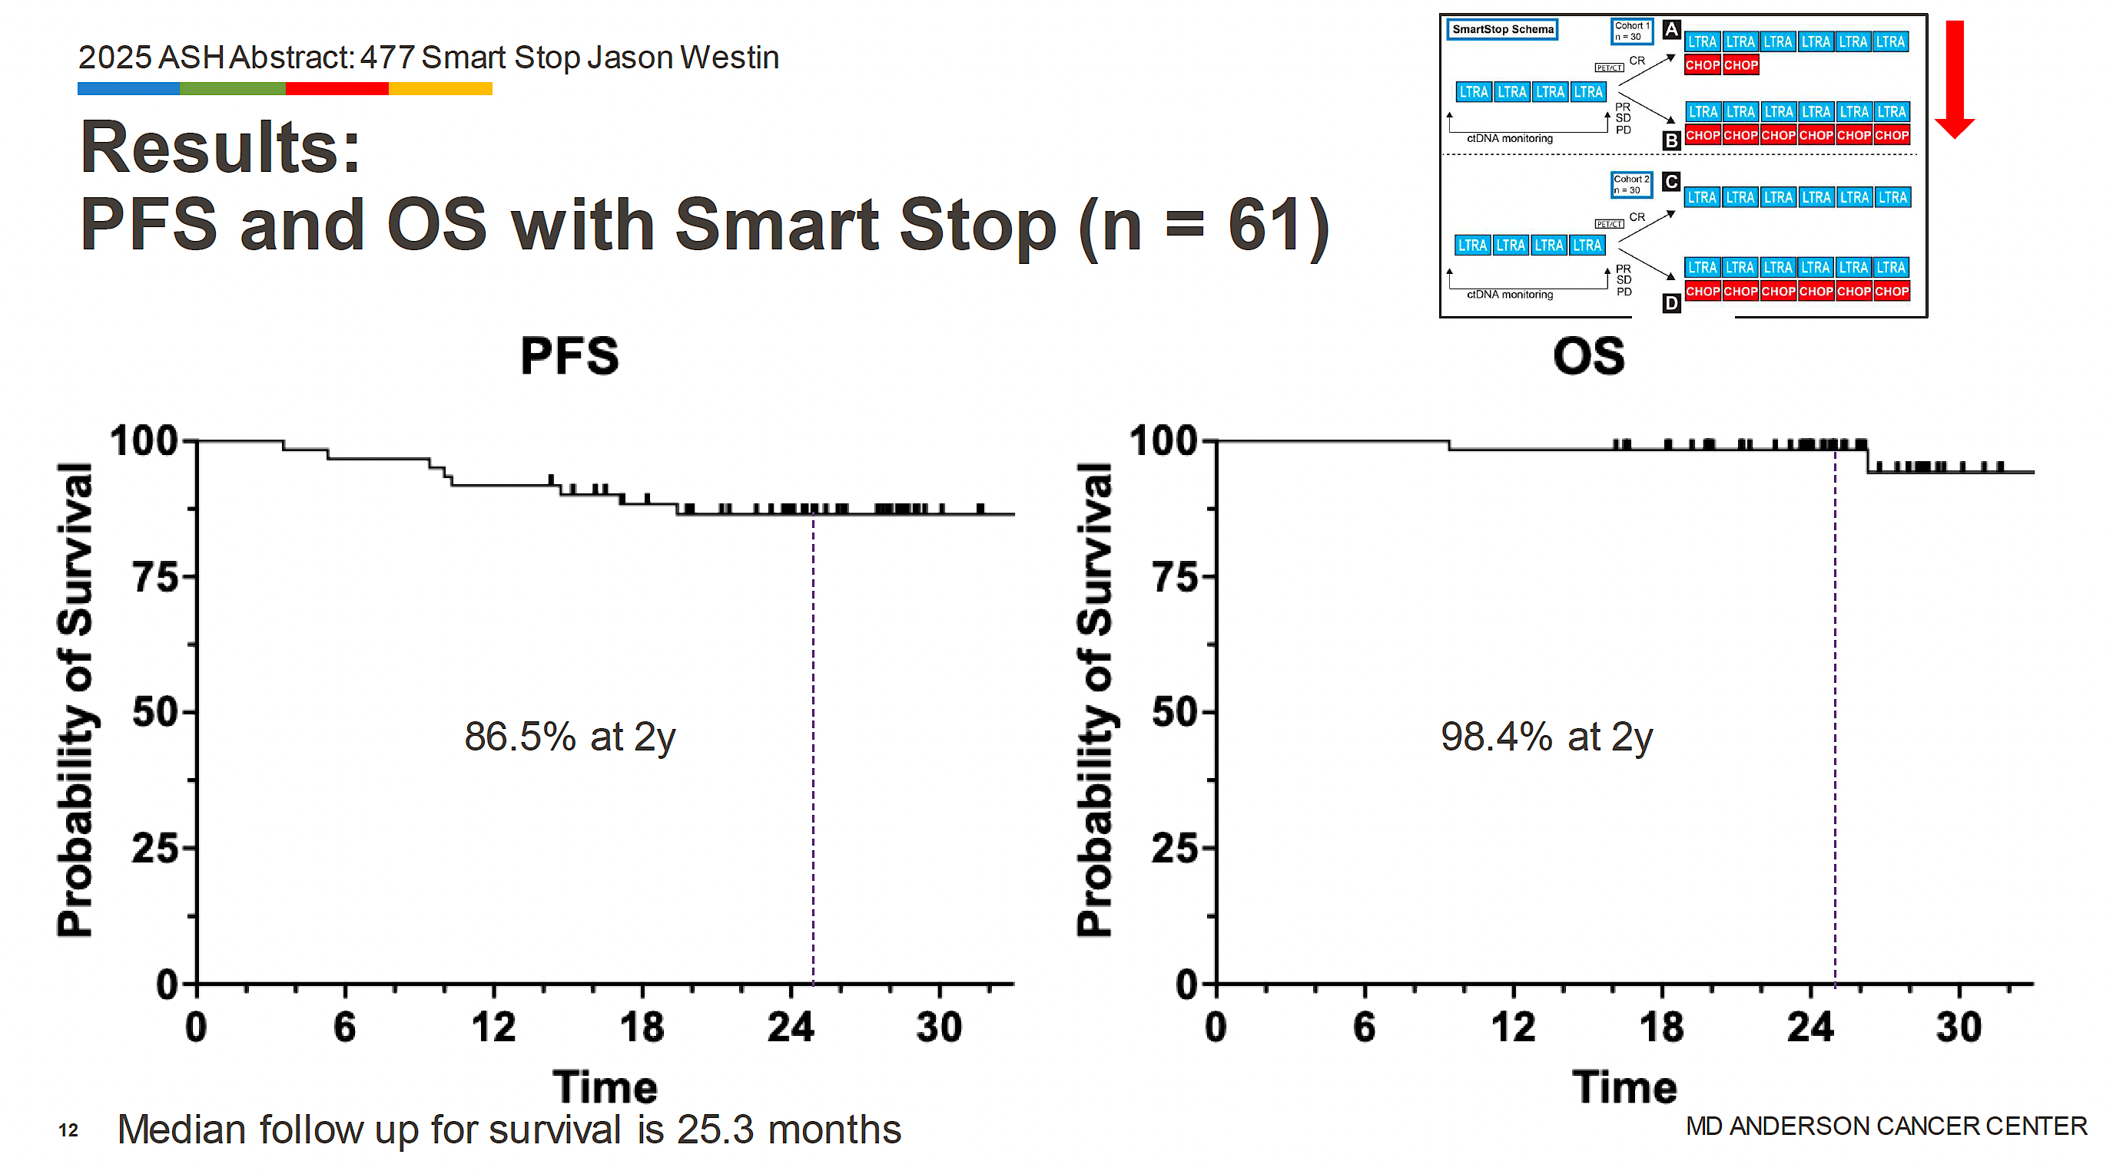

Slide 59
SUNMO

Slide 60
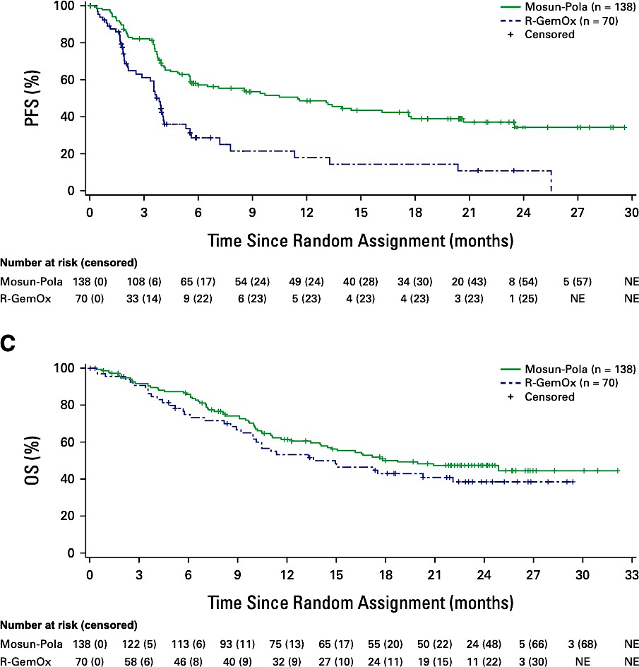
SUNMO: Mosunetuzumab + Polatuzumab in R/R DLBCL
Progression Free Survival
Phase III trial of patients with R/R LBCL who were ineligible for ASCT were randomly assigned (2:1) to receive Mosun-Pola or R-GemOx
Overall response rate was 70% for Mosun-Pola
versus 40% with R-GemOx
51% of patients receiving Mosun-Pola achieved a CR
Duration of CR was not reached with Mosun-Pola
Overall Survival
Progression Free Survival: HR 0.41 (0.3 – 0.6)
Overall Survival: 0.80 (0.5 – 1.2)
Budde LE et al. J Clin Oncol. 2025;00:1-13.

Slide 61
POLARGO

Slide 62
POLARGO: randomized Phase III trial in patients with transplant-ineligible R/R DLBCL
Safety run-in
Enrolled n=15
Pola-R-GemOx*
Q3W up to 8 cycles
Primary endpoint
Safety and tolerability
Key eligibility criteria
DLBCL, NOS or history of transformation of indolent disease to DLBCL
R/R disease after
≥1 prior line of treatment
Ineligible for transplant
Pola-R-GemOx*
n=129
Q3W up to 8 cycles
Primary endpoint
OS
Key secondary endpoints
PFS (by INV)
CR† (by IRC)
ORR† (by IRC)
Randomized phase
Enrolled n=255
R
1:1
R-GemOx
n=126
Q3W up to 8 cycles
Stratification Factors
Age (≤70 vs >70 years)
Prior lines of therapy (1 vs ≥2)
Relapsed vs refractory
*Polatuzumab vedotin (1.8 mg/kg) plus R-GemOx (R, 375 mg/m²; Gem, 1000 mg/m²; Ox, 100 mg/m²). †PET-CT at EOT.
EOT, end of treatment; INV, investigator; IRC, independent review committee; NOS, not otherwise specified; ORR, overall response rate;
PET-CT, positron emission tomography and computed tomography; Q3W, every 3 weeks.
Matasar EHA 2025;Abstract S101

Slide 63
Pola-R-GemOx significantly improved OS vs R-GemOx in patients with R/R DLBCL
Median OS follow-up: 24.6 months (95% CI: 23.0–26.0)
 | Pola-R-GemOx (n=129) | R-GemOx (n=126)
Median OS, months (95% CI) | 19.5 (13.3–NE) | 12.5 (8.9–15.8)
24-month OS, % (95% CI) | 44.0 (34.9–53.2) | 33.2 (24.5–41.8)
100
80
Stratified HR* 0.60 (95% CI: 0.43–0.83), p-value=0.0017†
60
OS (%)
40
20
Treatment group
Pola-R-GemOx
R-GemOx
Censored
0
0
6
12
18
24
30
Time (months)
Pola-R-GemOx
129
101
80
62
31
10
R-GemOx
126
76
58
43
21
6
*Stratified for age (≤70 vs >70 years), prior lines of systemic therapy (1 vs ≥2), outcome of last systemic therapy (relapsed vs refractory). †Log rank.
CI, confidence interval; HR, hazard ratio; NE, not estimable.
Matasar EHA 2025;Abstract S101

Slide 64
Survival benefit seen in both ABC and GCB cell of origin subgroups
Overall survival
Pola-R-GemOx
(n=129)
R-GemOx
(n=126)
 |  | Pola-R-GemOx (n=129) |  |  |  | R-GemOx (n=126)
Biomarker risk factors | Total n | N | Events | Median (months) |  | n | Events | Median (months) | HR | 95% Wald CI | Pola-R-GemOx better | R-GemOx better
All patients | 255 | 129 | 69 | 19.5 |  | 126 | 83 | 12.5 | 0.64 | (0.47–0.89)
Cell of origin (central)
ABC | 86 | 41 | 22 | 23.2 |  | 45 | 30 | 10.5 | 0.53 | (0.31–0.93)
GCB | 98 | 48 | 23 | 23.9 |  | 50 | 33 | 11.0 | 0.54 | (0.32–0.93)
Unclassified | 20 | 11 | 6 | 12.7 |  | 9 | 6 | 14.2 | 0.89 | (0.28–2.84)
Unknown | 51 | 29 | 18 | 16.5 |  | 22 | 14 | 18.2 | 1.01 | (0.50–2.02)
Pola-R-GemOx
better
R-GemOx
better
1/10
1
10
Progression-free survival
 |  | Pola-R-GemOx (n=129) |  |  |  | R-GemOx (n=126)
Biomarker risk factors | Total n | n | Events | Median (months) |  | n | Events | Median (months) | HR | 95% Wald CI | Pola-R-GemOx better | R-GemOx better
All patients | 255 | 129 | 84 | 7.4 |  | 126 | 98 | 2.7 | 0.46 | (0.34–0.62)
Cell of origin (central)
ABC | 86 | 41 | 31 | 7.4 |  | 45 | 40 | 2.6 | 0.35 | (0.21–0.57)
GCB | 98 | 48 | 28 | 7.9 |  | 50 | 36 | 2.8 | 0.47 | (0.28–0.77)
Unclassified | 20 | 11 | 6 | 10.3 |  | 9 | 9 | 2.6 | 0.42 | (0.14–1.24)
Unknown | 51 | 29 | 19 | 4.3 |  | 22 | 13 | 4.7 | 0.79 | (0.39–1.61)
Pola-R-GemOx
(n=129)
R-GemOx
(n=126)
Pola-R-GemOx
better
R-GemOx
better
1/10
1
10
Cell of origin based on GEP.
Matasar EHA 2025;Abstract S101

Slide 65
LOTIS-5

Slide 66
Phase III LOTIS-5
Treatment Period
Follow-Up Period
Lonca 0.15 mg/kg +
rituximab 375 mg/m²
Q3W for 2 cycles, then
Lonca 0.075 mg/kg +
rituximab 375 mg/m²
Q3W for up to 6 additional cycles
Lonca 0.15 mg/kg + rituximab 375 mg/m²
Q3W for 2 cycles, then
Lonca 0.075 mg/kg + rituximab 375 mg/m²
Q3W for up to 6 additional cycles
For both parts of the study,
irrespective of disease status,
patients will be followed for
up to 4 years after EOT until withdrawal of consent,
loss to follow-up, or death—whichever occurs first
Nonrandomized
Safety Run-in
N=20
Randomized 1:1
Target N=420
End of Treatment
R-GemOx: rituximab 375 mg/m² +
gemcitabine 1000 mg/m² +
oxaliplatin 100 mg/m²
Q2W for up to 8 cycles
KEY INCLUSION/EXCLUSION CRITERIA
Adults with a pathologic diagnosis of R/R DLBCL (including DLBCL transformed from indolent lymphoma) or HGBCL, with MYC and BCL2 and/or BCL6 rearrangements R/R disease following ≥1 multi-agent systemic treatment regimen Measurable disease (2014 Lugano classification) Not a candidate for SCT based on performance status, advanced age, and/or significant medical comorbidities (as considered by the investigator) If patient had received previous CD19 directed therapy, biopsy proven CD19 expression required ECOG performance status of 0-2 Excludes previous treatment with Lonca or R-GemOx
PRIMARY ENDPOINTS
SECONDARY ENDPOINTS
PFSª by independent central review
OS, ORR, CRR, DOR
Frequency and severity of AEs and laboratory parameters
PK parameters, for Lonca total Ab,
PBD-conjugated Ab, and free SG3199
ADA titers to Lonca
Changes in PROs from baseline
Carlo-Stella C. EHA 2025

Slide 67
Safety Run-in: Baseline Characteristics and Safety
Baseline characteristics | N=20
Sex, female, n (%) | 11 (55)
Median (range) age, years | 74.5 (35-93)
Race, white, n (%) | 20 (100)
ECOG score, n (%) Grade 0-1 | 16 (80)
Disease stage (Lugano criteria), n (%) Stage III-IV | 12 (60)
Histology, n (%) DLBCL, NOS HGBCL, with MYC and BCL2 and/or BCL6 rearrangements | 18 (90) 2 (10)
Median (range) number of prior therapy | 1 (1-7)
≥2 prior therapies, n (%) | 1 (5)
First line prior systemic response, n (%) Relapsed Refractory | 18 (90) 2 (10)
Response to last prior therapy, n (%) Relapsed Refractory | 9 (45) 11 (55)
Safety endpoints, n (%) | N=20
All TEAEs | 20 (100)
Grade ≥3 TEAEs Increased GGT Neutropenia COVID-19/COVID-19 pneumonia | 11 (55) 5 (25) 4 (20) 3 (15)
Serious AEs Infection Hyponatremia Anaphylactic shock Pleural effusion Malaise Neurological decompensation | 9 (45) 6 (30) 1 (5) 1 (5) 1 (5) 1 (5) 1 (5)
TEAEs leading to any study drug withdrawal | 8 (40)
Carlo Stella C. EHA 2025

Slide 68
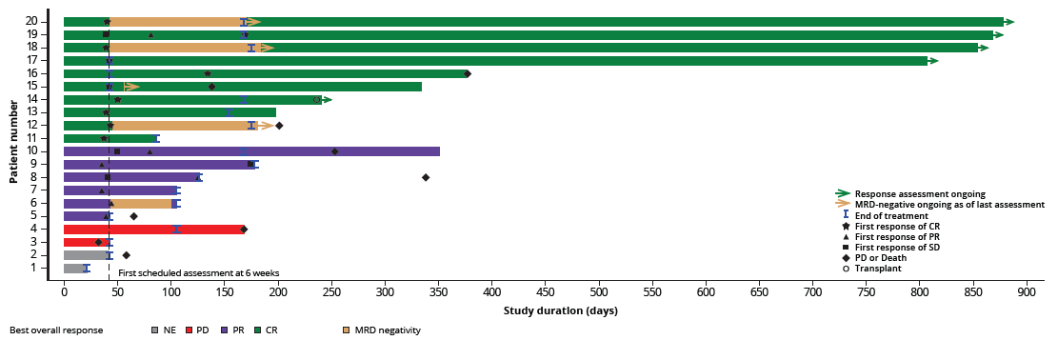
Safety Run-in: Efficacy Assessment
Efficacy outcomes in safety run-in population (N=20)
ORR (95% CI), % | 80.0 (56.3, 94.3)
CR rate (95% CI), % | 50.0 (27.2-72.8)
Median DOR (95% CI), months | 8.0 (3.2-NE)
Median PFS (95% CI), months | 8.3 (4.5, NE)
Efficacy outcomes in responders (n=16)
Median DOR (95% CI), months | 8.0 (3.19-NE)
Events (%), n | 5 (31.3)
Efficacy outcomes in complete responders (n=10)
Median DOR (95% CI), months | NE (3.19-NE)
Events (%), n | 3 (30.0)
MRD results in patients with ctDNA measurements (n=8)
CR and MRD negative (%), n | 4 (50.0)
MRD negative at end of treatment (%), n | 4 (50.0)
Carlo Stella C. EHA 2025

Slide 69
Results from the Phase III LOTIS-5 Confirmatory Clinical Trial of Loncastuximab Tesirine-lpyl in Combination with Rituximab for Relapsed or Refractory Diffuse Large B-Cell Lymphoma
Press Release: June 3, 2026
“[The manufacturer] today announced topline data from its Phase 3 LOTIS-5 confirmatory trial evaluating loncastuximab tesirine-lpyl in combination with rituximab in patients with relapsed or refractory diffuse large B-cell lymphoma (r/r DLBCL). Loncastuximab tesirine-lpyl plus rituximab achieved statistical significance on the trial’s primary endpoint of progression-free survival (PFS) and demonstrated no detrimental effect on the key secondary efficacy endpoint of overall survival (OS). In addition, a higher complete response (CR) rate and duration of CRs (DoCR) were observed with loncastuximab tesirine-lpyl plus rituximab.
Overall, treatment emergent adverse event (TEAE) rates were similar between arms. Similar rates of overall Grade ≥3 TEAEs greater than 5% were observed across both arms, with hematologic TEAEs higher in the control arm and infection, hepatotoxicity, and edema/effusion higher in the test arm. Serious adverse events (SAEs), TEAEs leading to study drug withdrawal, and Grade 5 events were higher in the test arm, with the majority of Grade 5 TEAEs in the test arm occurring in patients aged 75 years or older.”
https://ir.adctherapeutics.com/2026-06-03-ADC-Therapeutics-Announces-Results-From-LOTIS-5-Phase-3-Confirmatory-Clinical-Trial-of-ZYNLONTA-R-in-Combination-with-Rituximab-in-Relapsed-or-Refractory-Diffuse-Large-B-Cell-Lymphoma

Slide 70
LOTIS-7

Slide 71
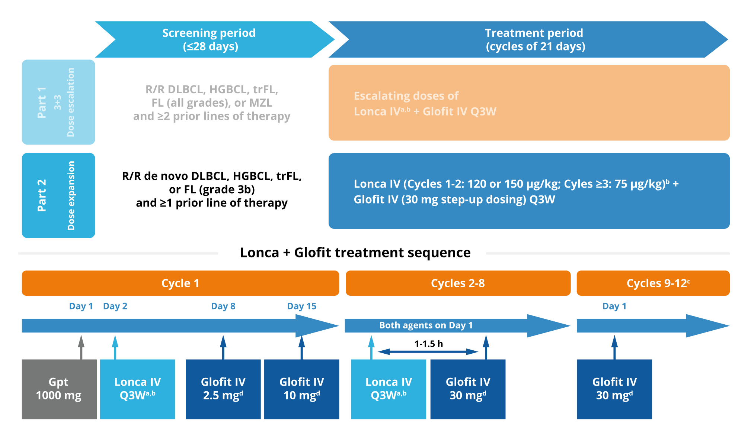
Phase Ib LOTIS-7
Study population
Patients with 3L+ R/R B-NHL (part 1) and
2L+ R/R LBCL (part 2)
ECOG PS score of 0-2
Prior autologous SCT (>100 days) or
CAR-T therapy (>100 days) is allowed
Measurable disease (per 2014 Lugano Classification)
Excludes patients with clinically significant third-space fluid accumulation
Endpoints
Primary: safety and tolerability; MTD
and/or RDE
Secondary: ORR, DOR, CR rate, PFS,
RFS, and OS; PK and immunogenicity
Exploratory: Glofit concentration in circulation; biomarker and PK correlations with clinical outcomes
Cycles ≥3:
Dex:
D1
D2
D3
D8
D15
D0
D1
D2
Alderuccio JP. ICML 2025

Slide 72
Safety Results
 | 120 µg/kg^{b} n = 20 | 150 µg/kg^{b} n = 21 | All n = 41
Grade 3/4 TEAEs (> 5% of patients) | 11 (55%) | 12 (57.1%) | 23 (56.1%)
Neutropenia | 4 (20%) | 6 (28.6%) | 10 (24.4%)
Anemia | 1 (5%) | 3 (14.3%) | 4 (9.8%)
AST increased | 2 (10%) | 1 (4.8%) | 3 (7.3%)
GGT increase | 1 (5%) | 2 (9.5%) | 3 (7.3%)
Thrombocytopenia | 2 (10%) | 1 (4.8%) | 3 (7.3%)
Grade 3/4 AESI (all patients)ª
Febrile neutropenia | 0 | 1 (4.8%) | 1 (2.4%)
Thrombocytopenia | 2 (10%) | 1 (4.8%) | 3 (7.3%)
GGT increase | 1 (5%) | 2 (9.5%) | 3 (7.3%)
Generalized oedema | 1 (5%) | 1 (4.8%) | 2 (4.9%)
Rash | 1 (5%) | 0 | 1 (2.4%)
Photosensitivity reaction | 0 | 1 (4.8%) | 1 (2.4%)
Sepsis | 1 (5%) | 0 | 1 (2.4%)
Upper respiratory infection | 1 (5%) | 0 | 1 (2.4%)
Pneumonia | 1 (5%) | 0 | 1 (2.4%)
Serious TEAE | 11 (55%) | 9 (42.9%) | 20 (48.8%)
No Grade 5 TEAEs occurred
Alderuccio JP. ICML 2025

Slide 73
 | 120 µg/kg n = 20 | 150 µg/kg n = 21 | All n = 41
Cytokine Release Syndrome
Any grade | 11 (55%) | 5 (23.8%) | 16 (39.0%)
Grade 1 | 7 (35%) | 5 (23.8%) | 12 (29.3%)
Grade 2 | 3 (15%) | 0 | 3 (7.3%)
Grade 3 | 1 (5%) | 0 | 1 (2.4%)
Grade 4/5 | 0 | 0 | 0
ICANS
Any grade | 2 (10%) | 1 (4.8%) | 3 (7.3%)
Grade 1 | 1 (5%) | 0 | 1 (2.4%)
Grade 2 | 1 (5%) | 1 (4.8%) | 2 (4.9%)
Grade > 3 | 0 | 0 | 0
Alderuccio JP. ICML 2025

Slide 74
Efficacy Assessment (n= 30)
Best overall response
Duration of response
ORR: 93.3
ORR: 93.3
ORR: 93.3
Characteristic, n (%) | Glofit + Lonca, 120 μg/kg (n=15) | Glofit + Lonca, 150 μg/kg (n=15) | All dose levels (N=30)
DOR^{d} Median | (n=14) NE | (n=14) NE | (n=28) NE
Time to first response (CR or PR) Median, days | (n=14) 42.0 | (n=14) 42.0 | (n=28) 42.0
Time to first CR Median, days | (n=13) 80.0 | (n=13) 42.0 | (n=26) 70.5
CR
PR
Glofit + Lonca, 120 μg/kg (n= 15)
Glofit + Lonca, 150 μg/kg (n= 15)
All dose levels (n= 30)
Alderuccio JP. ICML 2025

Slide 75
Surovatamig

Slide 76
Study Design
Ongoing phase 1 study of surovatamig in R/R DLBCL
Overall Study Design
Fixed-dose escalation
0.03 mg to 2.4 mg Q2W
n=4
Single step-up (1SUD)
C1D1: 0.27 mg or 1.0 mg
C1D15 then Q2W: TD (0.8–10 mg)
n=12
Double step-up (2SUD)
C1D1: 0.27 mg, C1D8: 1 mg
C1D15 then Q2W: TD (2.4–25 mg)
n=72
TD 25 mg
TD 15 mg
TD 7.2 mg
TD 2.4 mg
2SUD Treatment Schedule
Surovatamig is administered intravenously
2SUD on C1D1, C1D8 with TD on C1D15, then on D1, D15 each 28-day cycle up to 2 years
  Cycle 1 doses were inpatient
Patients with CR on 2 consecutive scans may receive surovatamig every 4 weeks after C6
2SUD
TD
TD
TD
1.0 mg
0.27 mg
C1:
D1, 8, 15
C2–24:
D1, 15
NCT04594642; data cutoff: 14 January 2025.
C, cycle; CR, complete response; D/d, day; Q2W, every 2 weeks; SUD, step-up dosing; TD, target dose.

Slide 77
Overall and Complete Response Rates
High response rates with dose-dependent increases in OR and CR rates overall and by prior CAR-T status (surovatamig TD ≥7.2 mg)
 |  | Overall (N=58) |  |  | CAR-T Naive (n=31) |  |  | CAR-T Exposed (n=27)
 | n | ORR | CR rate | n | ORR | CR rate | n | ORR | CR rate
7.2 mg | 24 | 46% | 33% | 9 | 67% | 44% | 15 | 33% | 27%
15 mg | 26 | 62% | 39% | 16 | 75% | 38% | 10 | 40% | 40%
25 mg | 8 | 75% | 63% | 6 | 83% | 67% | 2 | 50% | 50%
CAR-T, chimeric antigen receptor T-cell therapy; CR, complete response; ORR, overall response rate.
Hun-Yoon et al. EHA 2025;Abstract PS1927

Slide 78
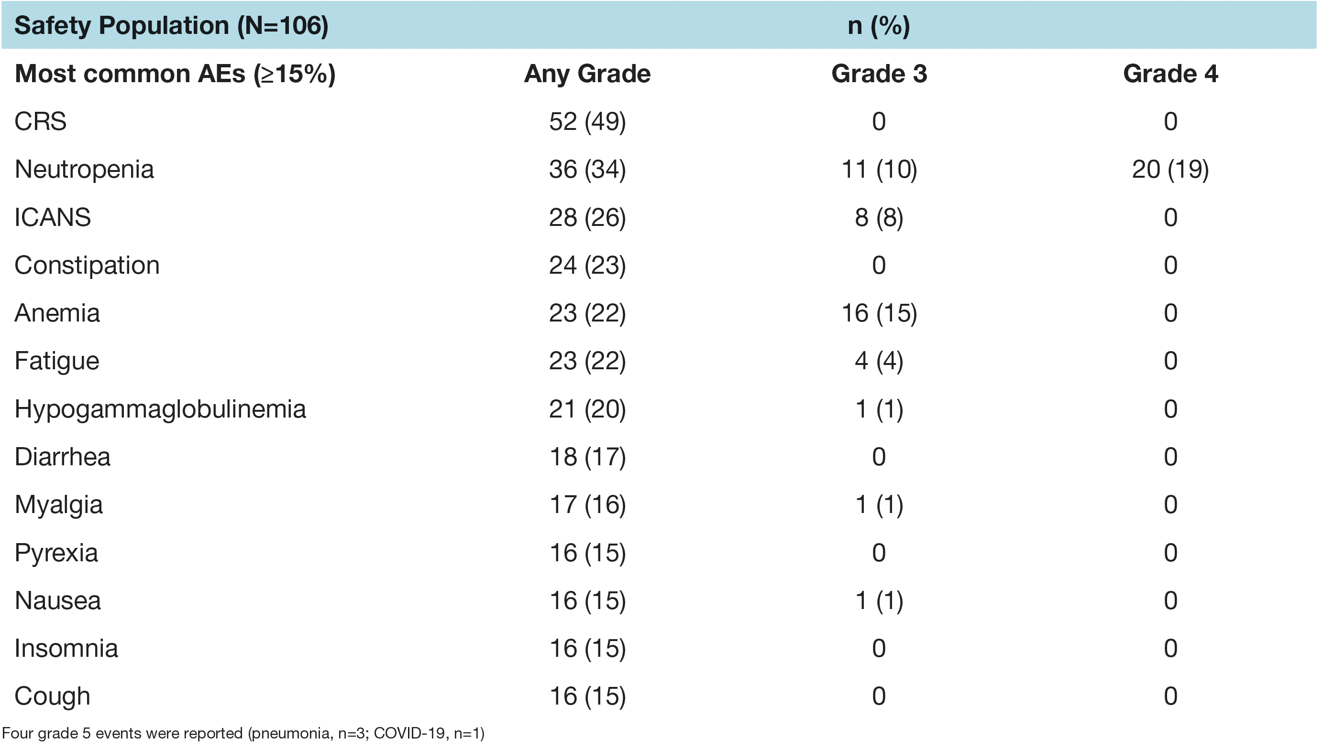
Summary of Adverse Events in All Schedules
Most common AEs were consistent with other TCEs
.
Kim ASH 2025; Abstract 5514

Slide 79
Zilovertamab

Slide 80
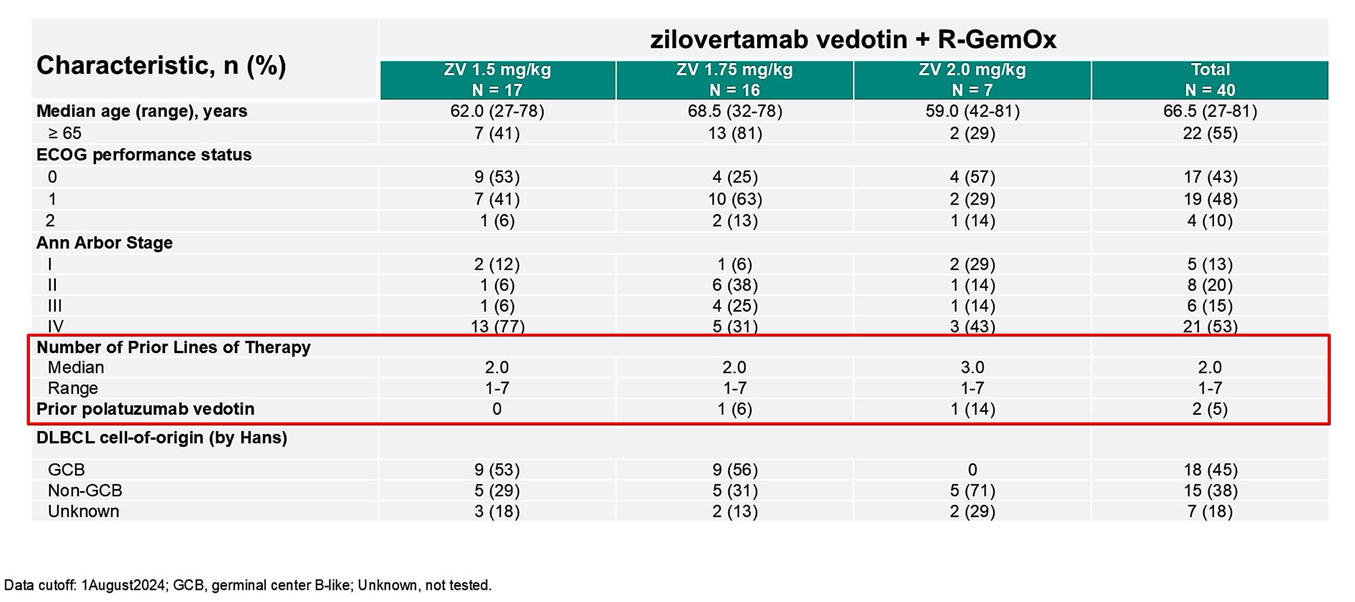
Zilovertamab + R-GemOx in R/R DLBCL
Armand P. et al. ASCO 2025;Abstract 7005

Slide 81
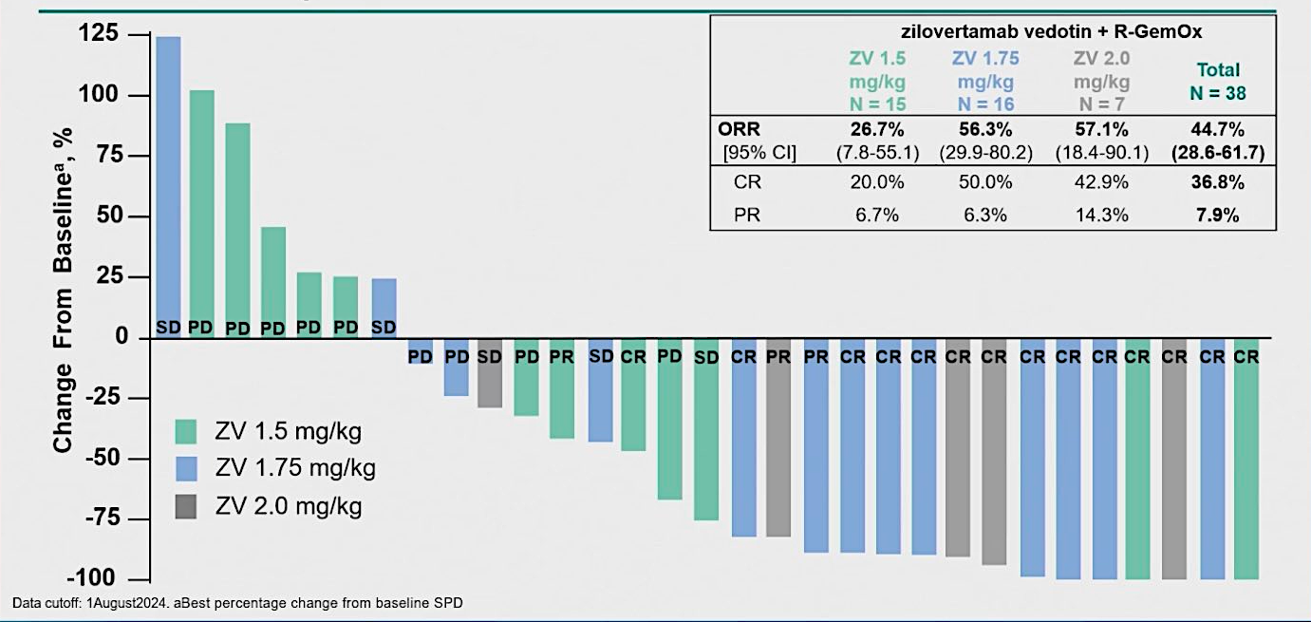
Zilovertamab + R-GemOx in R/R DLBCL: ORR
Armand P. et al. ASCO 2025;Abstract 7005

Slide 82
POLAR BEAR: Pola+R-Mini-CHOP in Elderly People With DLBCL
Study Design
Arm A:
R-mini-CHOP
Pola Placebo
Q21D x 6 Cycles
Patient Population:
Previously untreated DLBCL
≥ 80 years, or frail ≥ 75 years
ECOG PS 0–3
N = 200
R
1:1
Arm B:
Pola 1.8 mg/kg
R-mini-CHP + vincristine placebo
Q21D x 6 Cycles
Primary endpoint: PFS
DLBCL, diffuse large B-cell lymphoma; ECOG PS, Eastern Cooperative Oncology Group performance status; PFS, progression-free survival; Pola, polatuzumab vedotin; Q21D, every 21 days; R, randomized; R-mini-CHP, rituximab, cyclophosphamide, doxorubicin, prednisone; R-mini-CHOP, rituximab, cyclophosphamide, doxorubicin, vincristine, prednisone.
Jerkeman. Hemasphere. 2023;7(Suppl):e91359ec.

Slide 83
POLAR BEAR: Pola+R-mini-CHOP in Elderly People With DLBCL
No Increased Toxicity Signal
No difference in terms of grade 3–4 hematological toxicity between treatment groups
Gastrointestinal toxicity > grade 1 occurred twice as frequently in the R-pola-miniCHP polatuzumab group than in recipients of standard R-miniCHP
Relevant clinical consideration for select patients
Anemia
Grade 1
Neutropenia
Grade 2
Thrombocytopenia
Grade 3
Other hematological toxicity
Infection
Grade 4
Gastrointestinal tract
Grade 5
Cardiovascular
Unknown grade
Respiratory
Renal
Liver/Hepatic
Rash
Other skin
Osteoarticular/Muscular
Central nervous system
Peripheral nervous system
Behavioral
Other
Unknown organ
80
60
40
20
0
20
40
60
80
R-mini-CHOP
Pola-R-mini-CHP
Pola-R-mini-CHP, polatuzumab vedotin, rituximab, cyclophosphamide, doxorubicin, prednisone; R-mini-CHOP, rituximab, cyclophosphamide, doxorubicin, vincristine, prednisone.
Jerkeman. Hemasphere. 2023;7(Suppl):e91359ec.

Slide 84
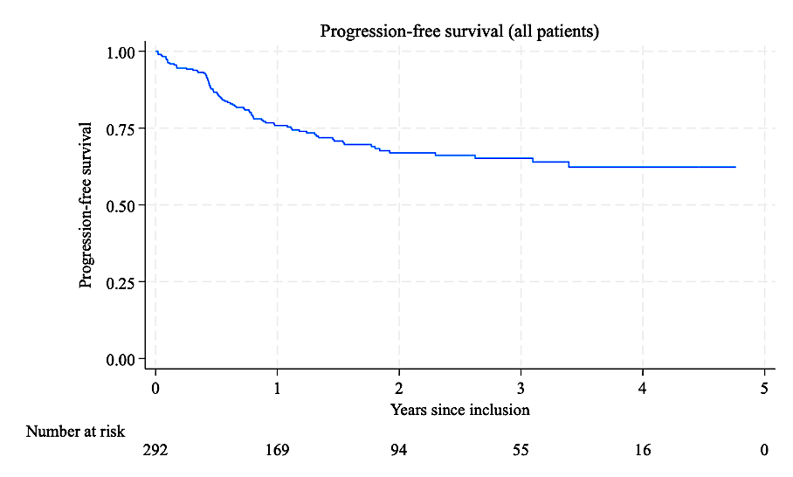
POLAR BEAR
Jerkeman M. et al. EHA 2026; Abstract S238

Slide 85
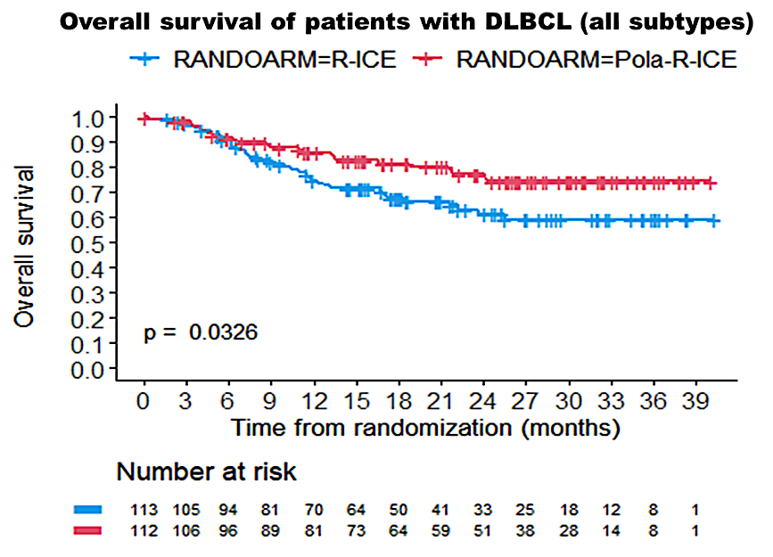
Pola-RICE vs. RICE in R/R DLBCL
Glass B. et al. EHA 2026;Abstract S237

Slide 86
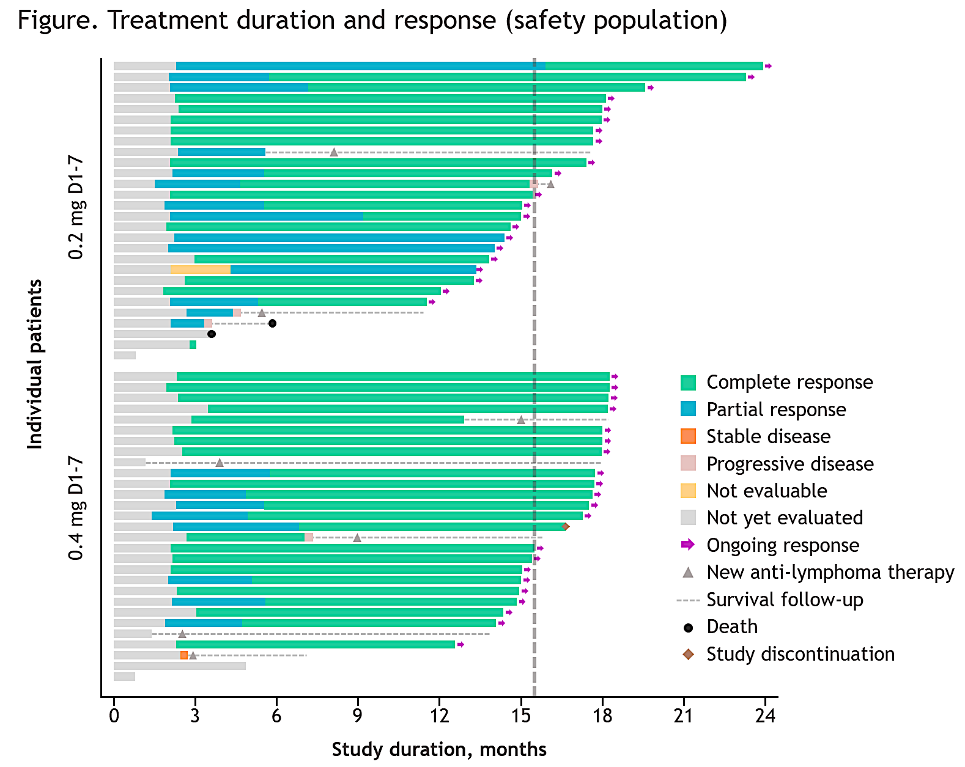
Golca+PolaRCHP in newly diagnosed DLBCL
Bouzani M. et al. EHA 2026;Abstract S239

Slide 87
Year in Review:
Novel Treatment Approaches for Non-Hodgkin Lymphoma
INTRODUCTION: Lymphoma Survivorship
MODULE 1: Novel Treatment Approaches for Diffuse Large B-Cell Lymphoma
— Dr Matasar
MODULE 2: Novel Treatment Approaches for Follicular Lymphoma and Mantle Cell Lymphoma — Dr Smith

Slide 88
RTP Lymphoma YIR 2026:
FL and MCL
Sonali M Smith, MD
Elwood V Jensen Professor of Medicine
Chief, Section of Hematology/Oncology
Co-Leader, Cancer Service Line
The University of Chicago
Chicago, Illinois

Slide 89
FOLLICULAR LYMPHOMA

Slide 90
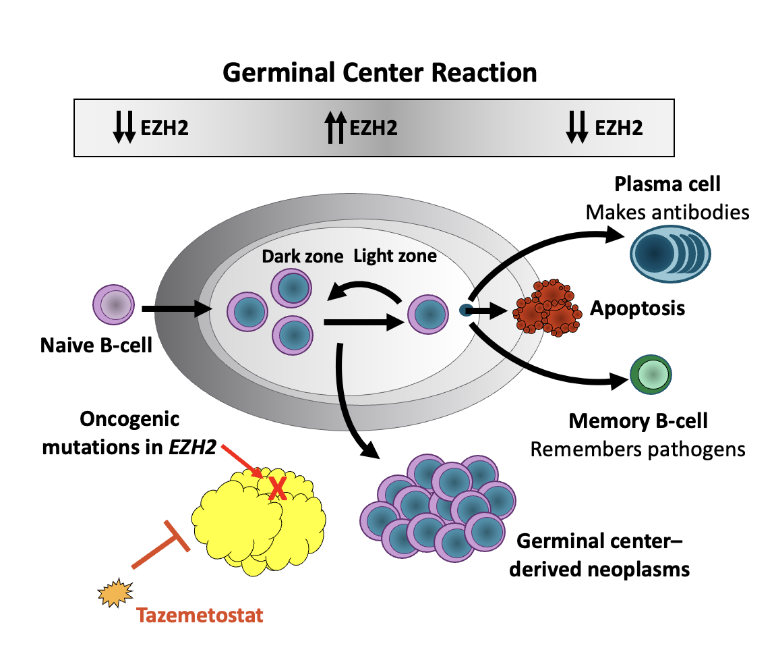
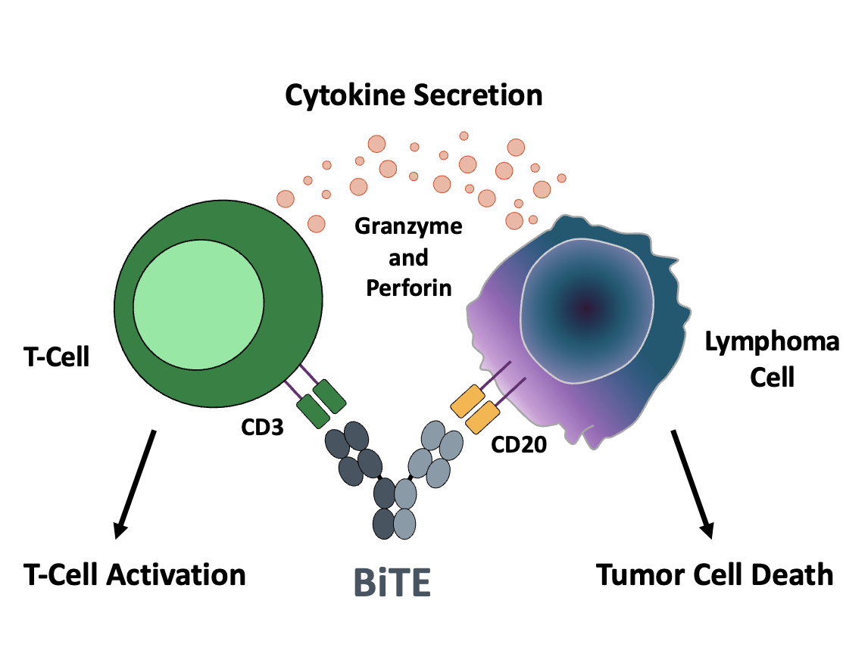
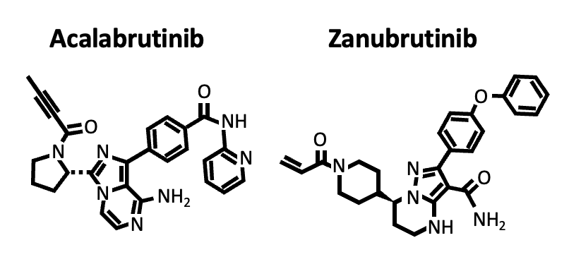
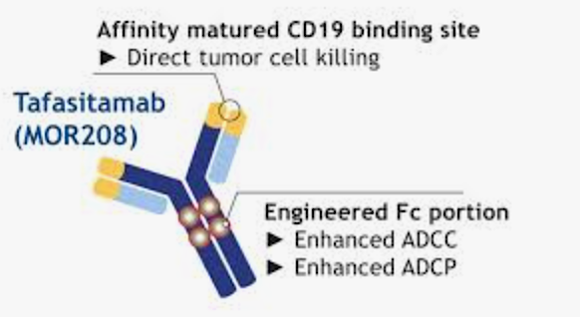
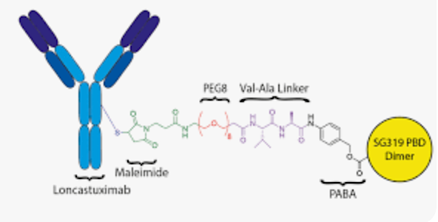
NOVEL APPROACHES FOR R/R FL:
(approved and unapproved)
EZH2 inhibitors
Bispecific agents
BTK inhibitors
antiCD19 moAb
antiCD19 ADC
CELMoDs

Slide 91
AUGMENT--RP3 of LenR vs PBO-R in relapsed (not refractory) FL: 5-Yr Survival
100
Median PFS
Mo, (95% CI)
80
Len + rituximab
27.6 (22.1-60.5)
PBO + rituximab
14.3 (12.4-17.7)
60
HR: 0.50 (95% CI: 0.38-0.66; P<.0001)
Median follow-up: 65.9 mo
PFS (%)
40
Lenalidomide + rituximab
20
Placebo + rituximab
0
Can (and should) LenR be a backbone for future drug development?
0
6
12
18
24
30
36
42
48
54
60
66
72
78
84
Patients at Risk, n
Mo
Len + rituximab
178
151
128
107
79
62
49
34
18
13
6
4
3
1
0
PBO + rituximab
180
141
98
69
53
41
29
21
13
5
3
2
1
0
0
100
83%
80
Lenalidomide + rituximab
Median OS
Mo, (95% CI)
77%
60
Placebo + rituximab
OS (%)
Len + rituximab
NE (NE-NE)
40
PBO + rituximab
NE (NE-NE)
20
HR: 0.59 (95% CI: 0.37-0.95; P = .0285)
0
0
6
12
18
24
30
36
42
48
54
60
66
72
78
84
90
96
Patients at Risk, n
Mo
Len + rituximab
178
167
155
149
144
137
131
130
126
120
110
90
63
36
11
1
0
PBO + rituximab
180
176
167
151
143
135
132
129
125
121
108
87
53
32
11
3
0
Leonard. ASH 2022. Abstr 230.

Slide 92
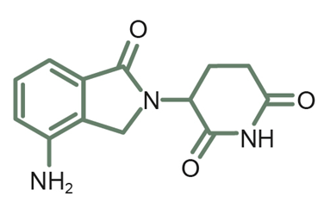
Background: Tafasitamab
Tafasitamab targets CD19 on malignant B cells
The engineered Fc region increases affinity to immune effector cells
Lenalidomide expands and activates effector cell activation and increases ADCC, ACDP, and direct cell death caused by tafasitamab
Tafasitamab + Lenalidomide Synergism in B-cell Lymphomas*
Tafasitamab
(Fc-modified, anti-CD19 mAb)¹⁻⁴
Affinity-matured
CD19-binding site
Lenalidomide
Direct cytotoxicity
(CD19 binding site)¹
Modified
Fc portion
NK cell
Malignant
Macrophage
B cell
ADCC
(Fc portion)¹
CD19
ADCP (Fc portion)¹

Slide 93
Sehn LH et al. Tafasitamab, lenalidomide, and rituximab in relapsed or refractory follicular lymphoma (inMIND): A global, phase 3, randomised controlled trial. Lancet 2026;407(10524):133-46.

Slide 94
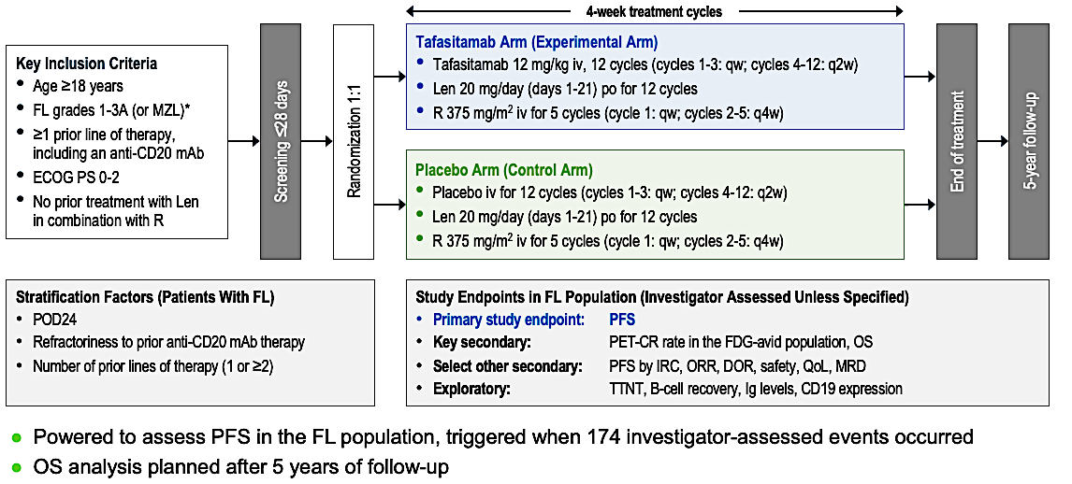
inMIND: RP3 Double-Blind, Placebo-Controlled, International, Multicenter Study of LenR +/- tafasitamab
Primary endpoint: PFS
Primary endpoint: PFS
Sehn LH et al. Lancet 2026;407(10524):133-46.

Slide 95
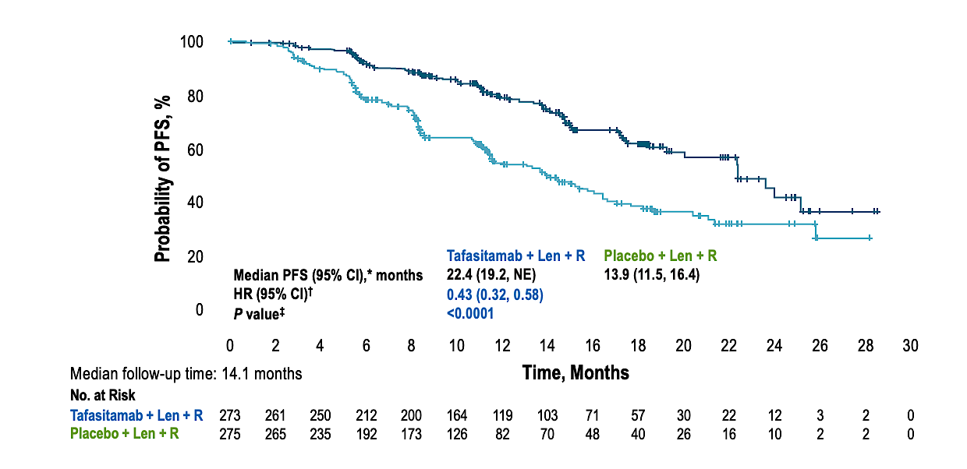
Primary Endpoint: PFS by Investigator Assessment
Key Results:
Med PFS 22.4m vs 13.9m
2L: 24m v 16m
3L+: 22.4m v 11.5m
Works in all subgroups
Improved PET-CR (49.4% v 39.8%) and ORR rates with tafa
Sehn LH et al. Lancet 2026;407(10524):133-46.

Slide 96
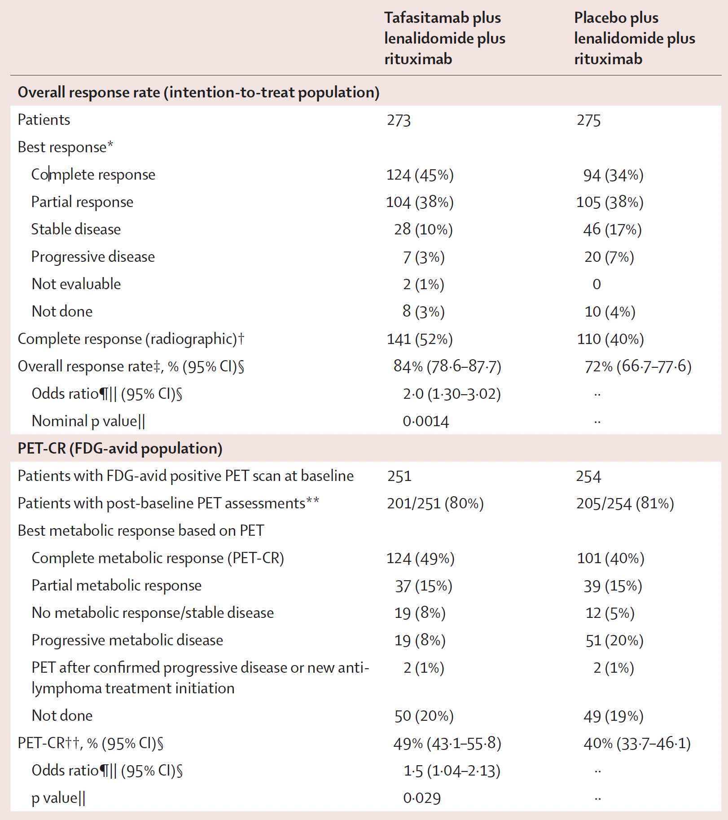
InMIND: Response (ORR, PET response) and Toxicity
Most common toxicities: cytopenias, infection
Slight increase in tafa arm but no significant difference between the groups
Sehn LH et al. Lancet 2026;407(10524):133-46.

Slide 97
InMIND: Take home points
Improved PFS, DoR, TTNT for Tafa-LenR
Activity in relapsed and refractory FL, including high-risk subsets
Fixed-duration therapy
Manageable toxicity profile
NOTE: 23/24 post-treatment lymphoma samples retained CD19 expression
A new standard of care for relapsed/refractory FL

Slide 98
Zinzani PL et al. Final analysis of the randomized phase 2 ROSEWOOD study of zanubrutinib + obinutuzumab vs obinutuzumab monotherapy in patients with relapsed/refractory follicular lymphoma. ASH 2025;Abstract 227.

Slide 99
ROSEWOOD: Take home points
Another option for RR FL
Addition of Zanubrutinib to obinutuzumab improved ORR, CR, PFS, DOR
Similar and manageable safety profile without new signals
MAHOGANY study: RP3 of ZO vs LenR ongoing

Slide 100
Alderuccio JP et al. Loncastuximab tesirine with rituximab in patients with R/R FL: A single-centre, single-arm, Phase II trial. Lancet Haematol 2025;12(1):e23-e34.

Slide 101
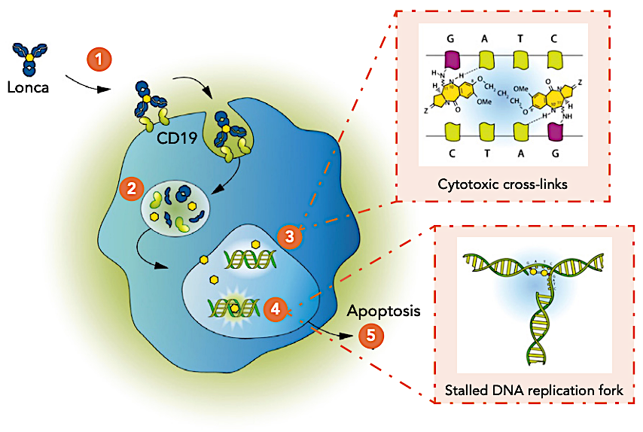
Loncastuximab tesirine is an ADC against CD19 with a PBD dimer payload
Calabretta Blood Volume 140, Issue 4, 28 July 2022, Pages 303-308

Slide 102
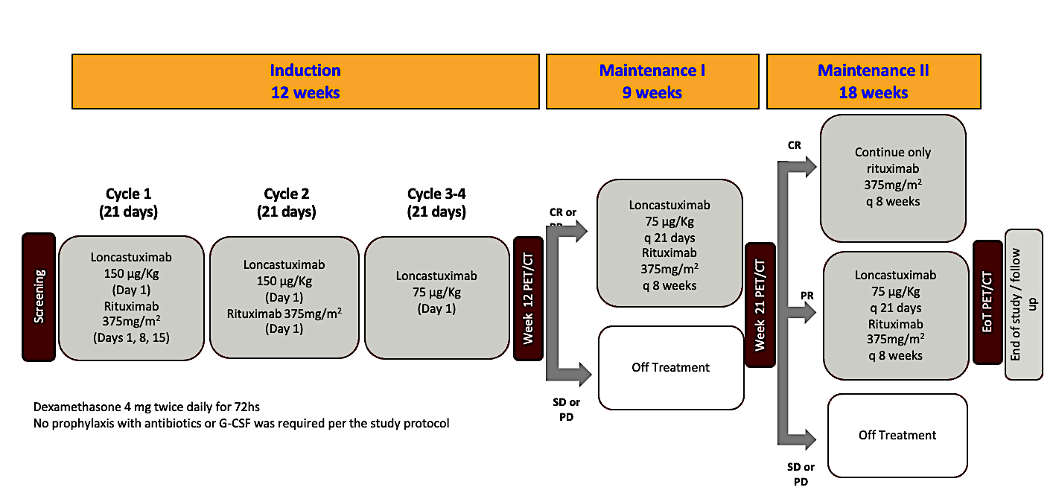
U Miami: Loncastuximab tesirine plus rituximab: single arm, single center phase 2 study in RR FL
Induction
12 weeks
Maintenance I
9 weeks
Maintenance II
18 weeks
Continue only rituximab 375mg/m²
q 8 weeks
CR
Cycle 1
(21 days)
Cycle 2
(21 days)
Cycle 3-4
(21 days)
CR or PR
Loncastuximab
75 µg/Kg
q 21 days
Rituximab 375mg/m²
q 8 weeks
CR or PR
Loncastuximab
150 µg/Kg
(Day 1)
Rituximab 375mg/m²
(Days 1, 8, 15)
Loncastuximab
150 µg/Kg
(Day 1)
Rituximab 375mg/m²
(Day 1)
Loncastuximab
75 µg/Kg
(Day 1)
Loncastuximab
75 µg/Kg
q 21 days
Rituximab 375mg/m²
q 8 weeks
Screening
Week 12 PET/CT
PR
End of study / follow up
Week 21 PET/CT
EoT PET/CT
Off Treatment
Dexamethasone 4 mg twice daily for 72hs
No prophylaxis with antibiotics or G-CSF was required per the study protocol
SD or PD
Off Treatment
SD or PD
Alderuccio ASH 2024, abstract 337

Slide 103
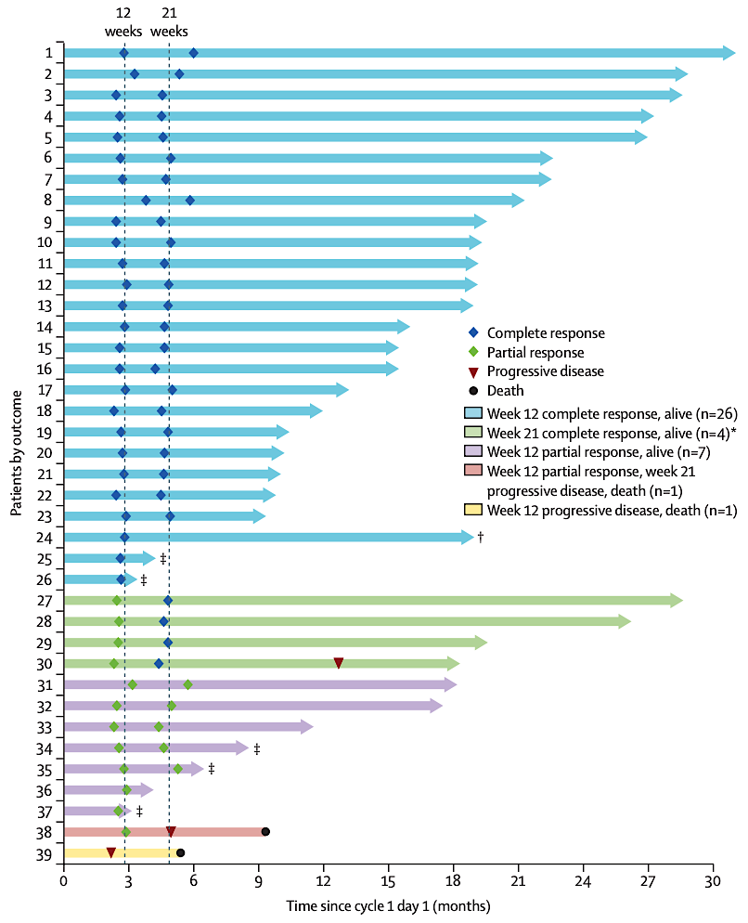
Loncastuximab plus rituximab in RR FL: Results
Toxicity:
Cytopenias
Generalized edema
(***elderly DLBCL data from LOTIS-5***)
Alderuccio ASH 2024, abstract 337; Alderuccio Lancet Haematology 2025 Jan;12(1):e23-e34

Slide 104
Hou J-Z et al. Three-year follow-up of the Phase 1 first-in-human study investigating surovatamig, a novel CD19xCD3 T-cell engager, in patients with relapsed/refractory (R/R) follicular lymphoma (FL). ASH 2025; Abstract 1005.

Slide 105
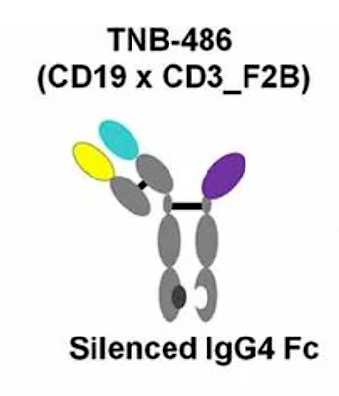
Surovatamig (TNB-486, AZD0486) CD19xCD3 bispecific antibody
TNB-486 is a fully human bispecific antibody engaging CD19 and CD3 (a) TNB-486 was constructed using knobs-into-holes technology.
Malik-Chaudhry HK et al. MAbs. 2021 Jan-Dec;13(1):1890411.

Slide 106
Hou J-Z et al. ASH 2025; Abstract 1005.

Slide 107
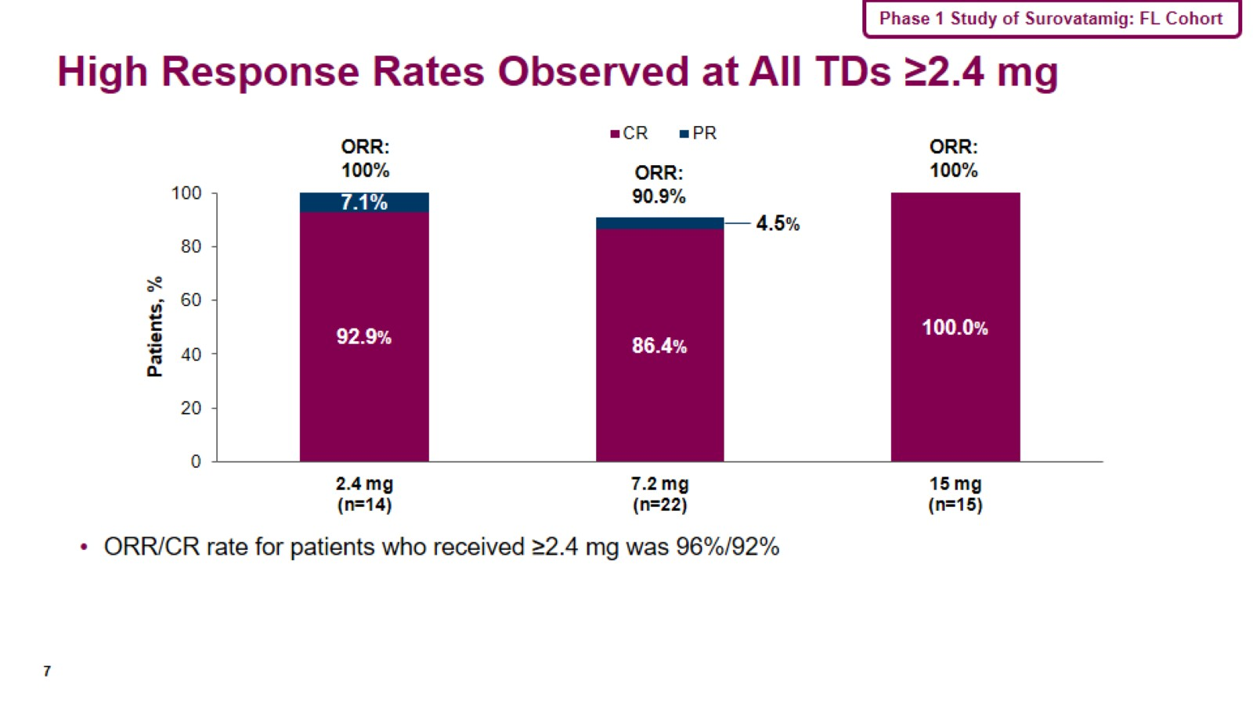
Hou J-Z et al. ASH 2025; Abstract 1005.

Slide 108
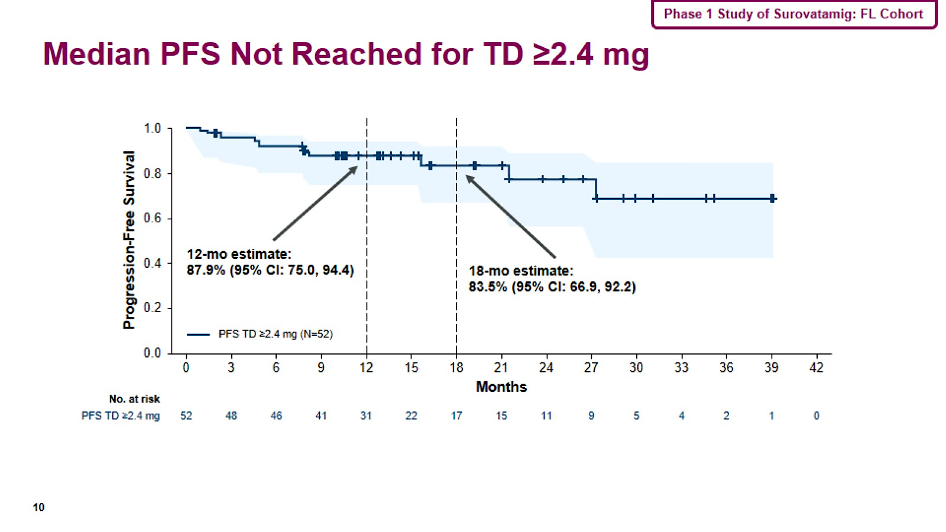
Hou J-Z et al. ASH 2025; Abstract 1005.

Slide 109
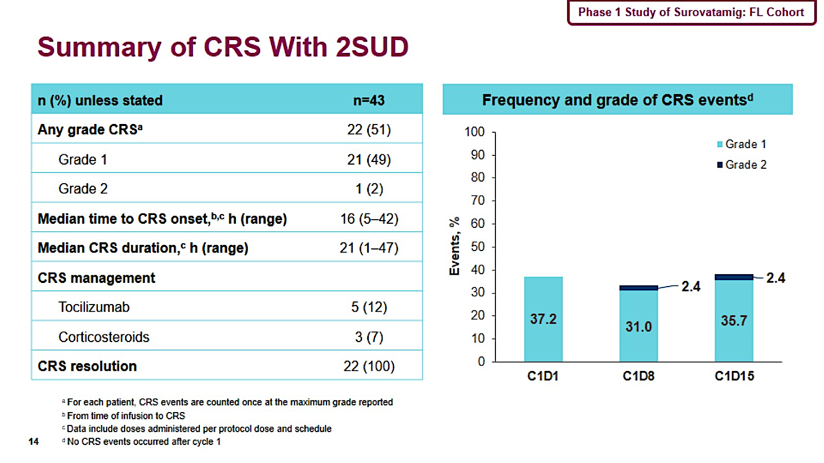
Hou J-Z et al. ASH 2025; Abstract 1005.

Slide 110
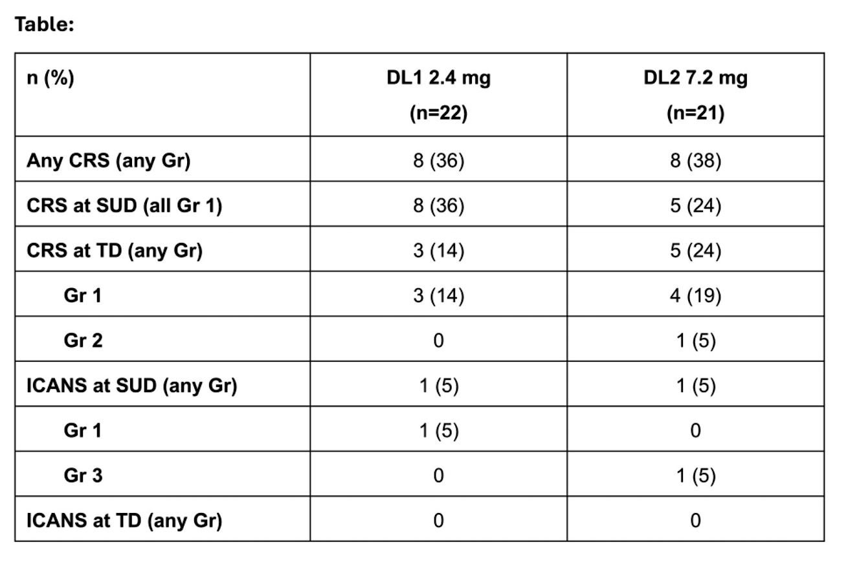
EHA 2026: SUROVATAMIG (AZD0486) PLUS RITUXIMAB IN PREVIOUSLY UNTREATED FOLLICULAR LYMPHOMA (FL): INITIAL SAFETY DATA FROM THE PHASE 3 SOUNDTRACK-F1 TRIAL
43 pts (DL1=22 and DL2=21)
Short follow up 6.3m
ORR 95-100%, CR ~85% and 100% MRD negativity in DL2
TEAE: grade 1-2 CRS
Cheah CY et al. EHA 2026;Abstract S228.

Slide 111
Morillo D et al. Golcadomide (golca), a potential, first-in-class, oral CELMoD ±rituximab (R) in patients (pts) with relapsed/refractory (R/R) follicular lymphoma (FL): Phase (Ph) 1/2 study long-term follow-up (f/u). EHA 2026;Abstract S227.

Slide 112
Ubiquitin-Proteasome System (UPS)
Recycled Ubiquitin monomers
Ub
Ub
Ub
Ub
Ub
Ub
+
Ub
Ub
E3
Substrate
E3
Substrate
Ubiquitin chain
DUBs
Substrate
E3
Substrate
Substrate
Non-degraded
Ub
Ub
K48/K11
Ub
Ub
E2
E1
E2
E2
Ub
Ub
Ub
26S Proteasome
Ub
Ub
Ub
Ub
ATP
Ub
AMP + iPP
Ub
Ub
Ub
Repeated cycles
Ub
Ubiquitin chain
Ub
Ub
E1
E1
E2
Ub
Ub
Recycled Ubiquitin monomers
Degraded substrate
Bhat. Curr Opin Pharmacol. 2022;67:102310.

Slide 113
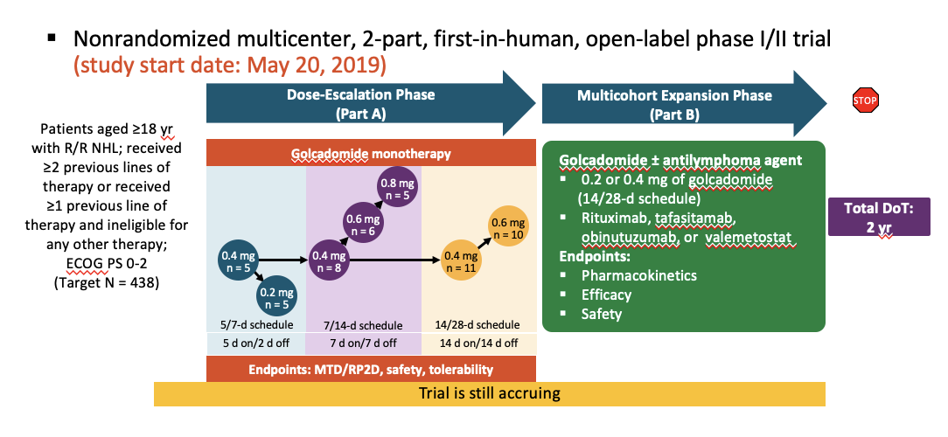
CC-99282-NHL-001: Phase I/II First-in-Human Trial of Golcadomide in R/R NHL
FIXED DURATION
(up to 24m)

Slide 114
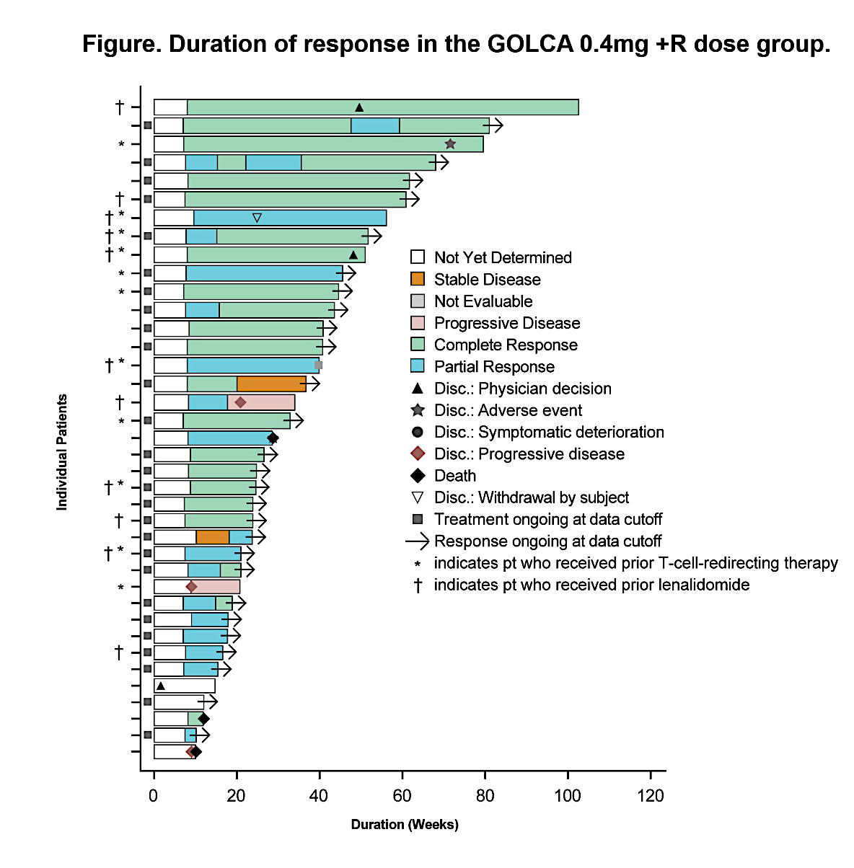
2+ prior lines of therapy
Golca schedule 14/28d
Median follow up 6 months (3-24)
Treatment duration with Golca up to 2 years
Golcadomide with or without rituximab R in 2L+ FL:
EHA 2025
Cordoba R et al. EHA 2025;Abstract 441.

Slide 115
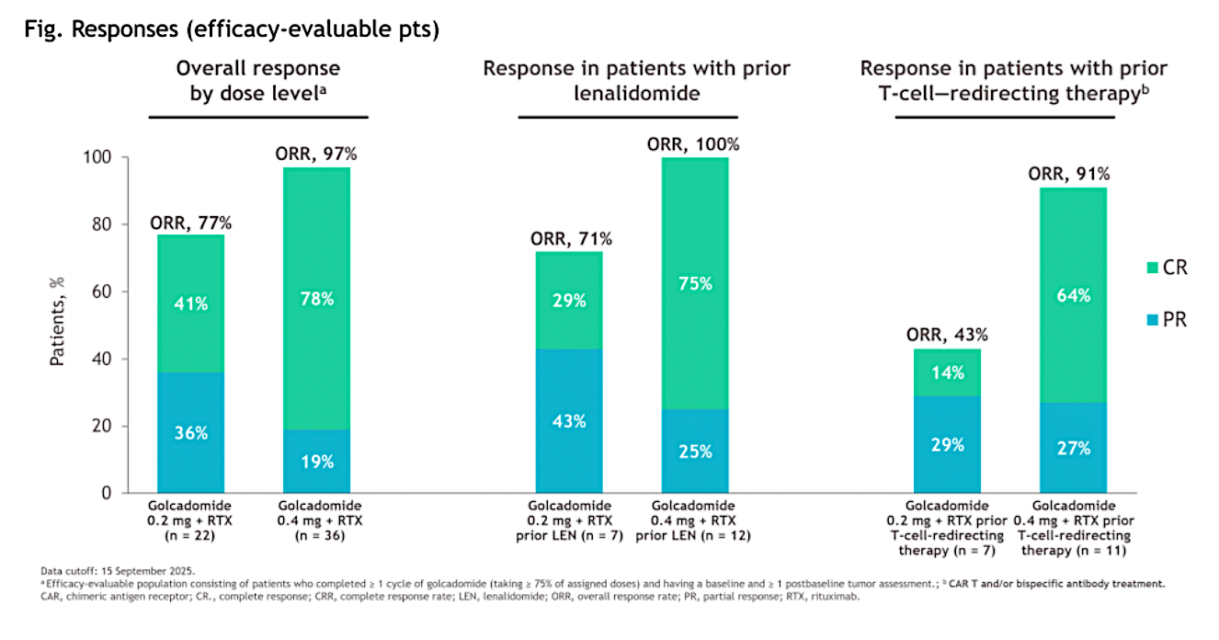
Golcadomide EHA 2026 update: RR FL
TOXICITY: Neutropenia was most common grade 3/4 TEAE occurring in 59% and 68% of pts at 0.2 and 0.4 mg, followed by anemia (9% and 16%) and febrile neutropenia (9%and 8%).
Morillo D et al. EHA 2026;Abstract S227.

Slide 116
Golcadomide plus rituximab: author’s conclusions
With longer f/u, GOLCA + R demonstrated promising efficacy with durable responses and no new safety signals.
0.4 mg group had higher ORR and CRR than 0.2 mg, including in pts with prior LEN-based and/or T-cell–redirecting Tx, with a manageable safety profile at both doses
The results support the development of GOLCA + R as a fixed-duration, chemotherapy-free outpatient Tx in the Ph 3 GOLSEEK-4 study in 2L+ FL (NCT06911502)

Slide 117
Overall thoughts about RR FL
Increasing number of options
  Lenalidomide-rituximab (often used as comparator for new regimens): exciting data with EpcoR2
  Bispecific agents (CD20xCD3, CD19xCD3)
  CD19 targeting agents (tafa-len, loncastuximab)
  BTKi
  CAR-T
  CelMods
  New agents (i.e. degraders) and new means of risk stratification (i.e. MRD)
Still no precision or subgroup approaches –POD24? Transformation risk?
Still no data on sequencing
  But some regimens have impressive activity in 2L setting—is LenR going to be replaced?

Slide 118
MANTLE CELL LYMPHOMA

Slide 119
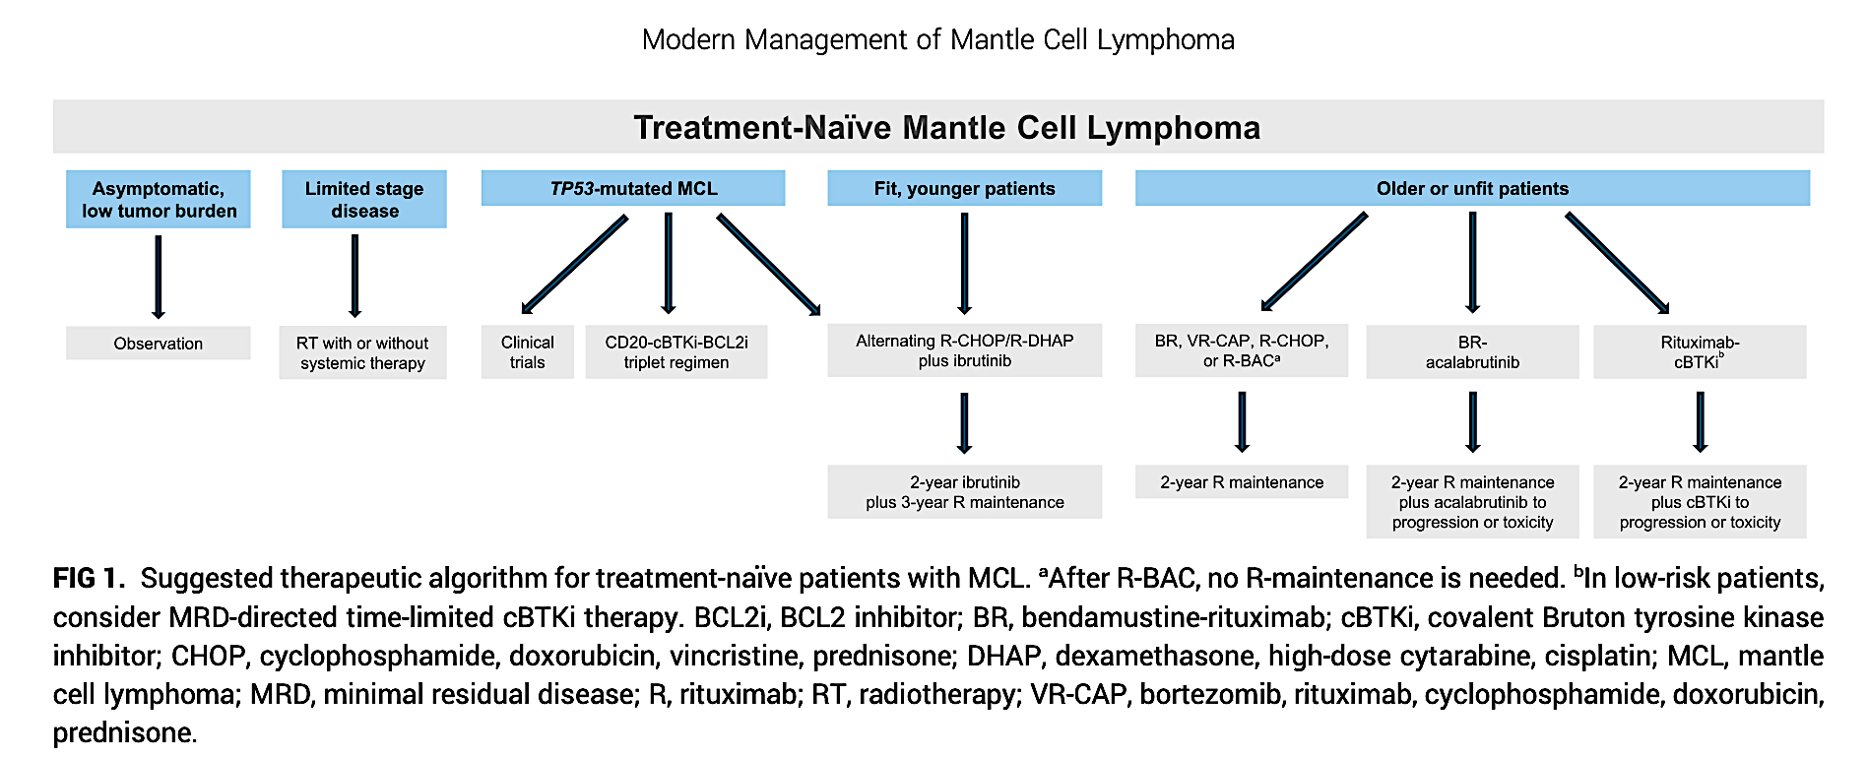
Consideration of age/fitness
Three major RF’s for high-risk disease:
Ki67 > 30%, blastoid morphology, p53 mutation
Dreyling ASCO 2026 Ed Program

Slide 120
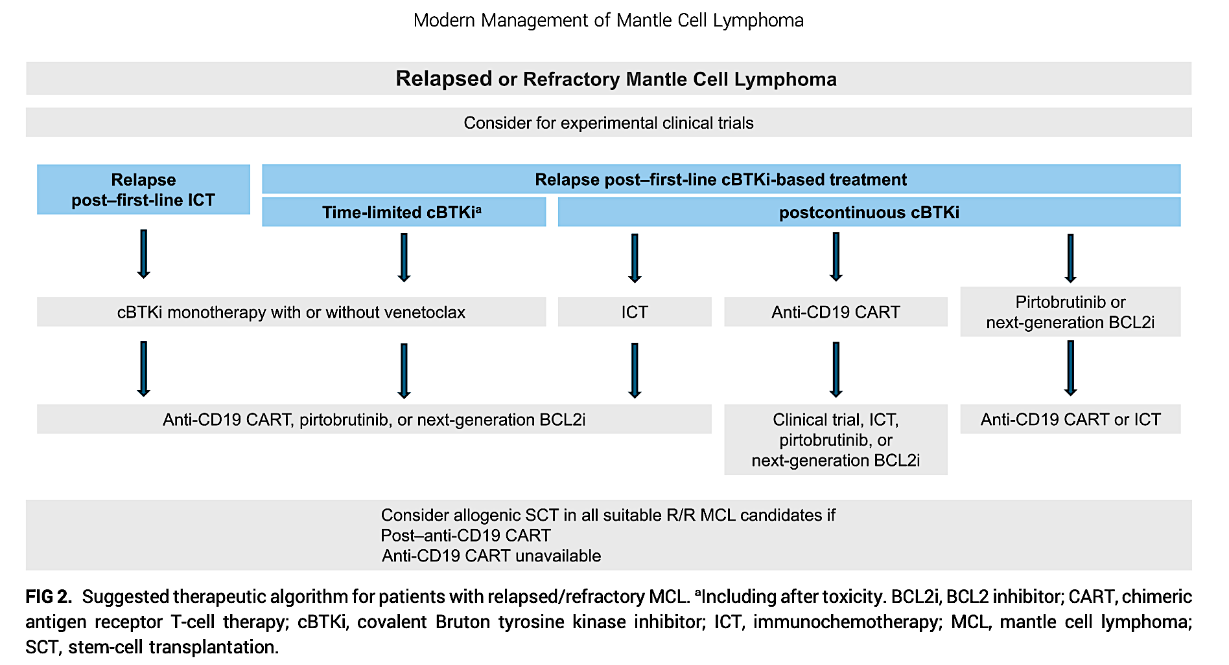
Dreyling ASCO 2026 Ed Program

Slide 121
Wang ML et al. Time to third-line treatment after bendamustine-rituximab with or without acalabrutinib in patients with previously untreated mantle cell lymphoma: Updated analysis of the phase 3 ECHO trial after 50 months of follow-up. ASH 2025;Abstract 885.
Dreyling M et al. Efficacy of rituximab-bendamustine with or without acalabrutinib in patients with untreated, high-risk mantle cell lymphoma: An analysis of the phase 3 ECHO trial. EHA 2025;Abstract S233.

Slide 122
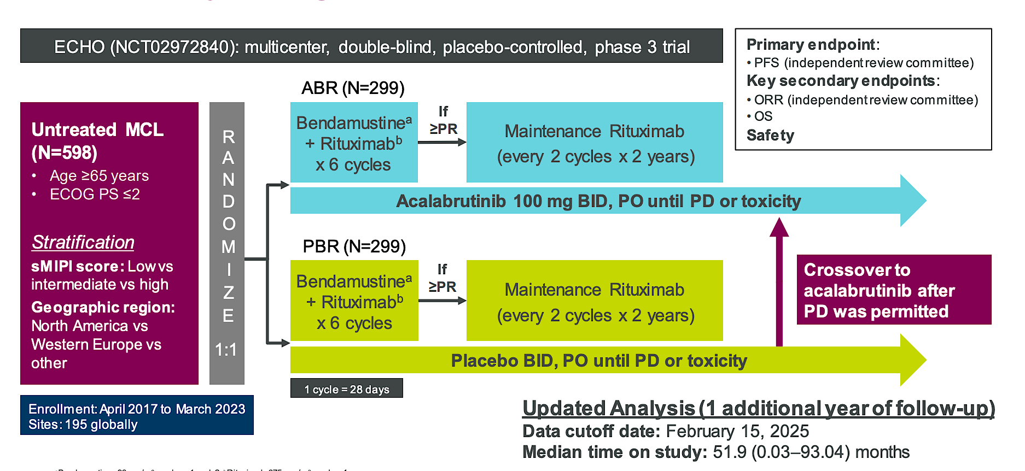
ECHO: RP3 trial of BR +/- acalabrutinib in TN MCL
Wang ASH 2025 Abstract 885

Slide 123
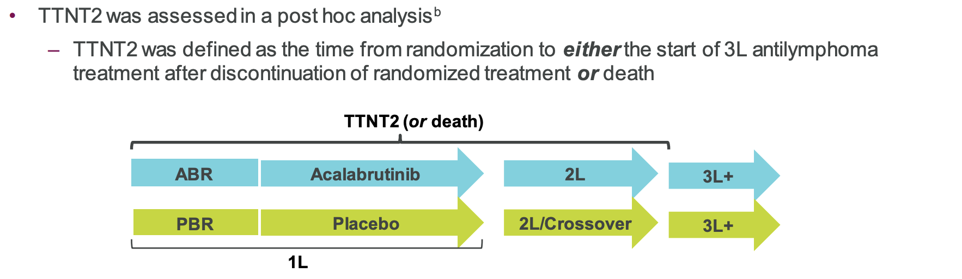
ASH 2025 Update: Wang ML et al. Time to third-line treatment after bendamustine-rituximab with or without acalabrutinib in patients with previously untreated mantle cell lymphoma: Updated analysis of the phase 3 ECHO trial after 50 months of follow-up. ASH 2025;Abstract 885.
Wang ASH 2025 Abstract 885

Slide 124
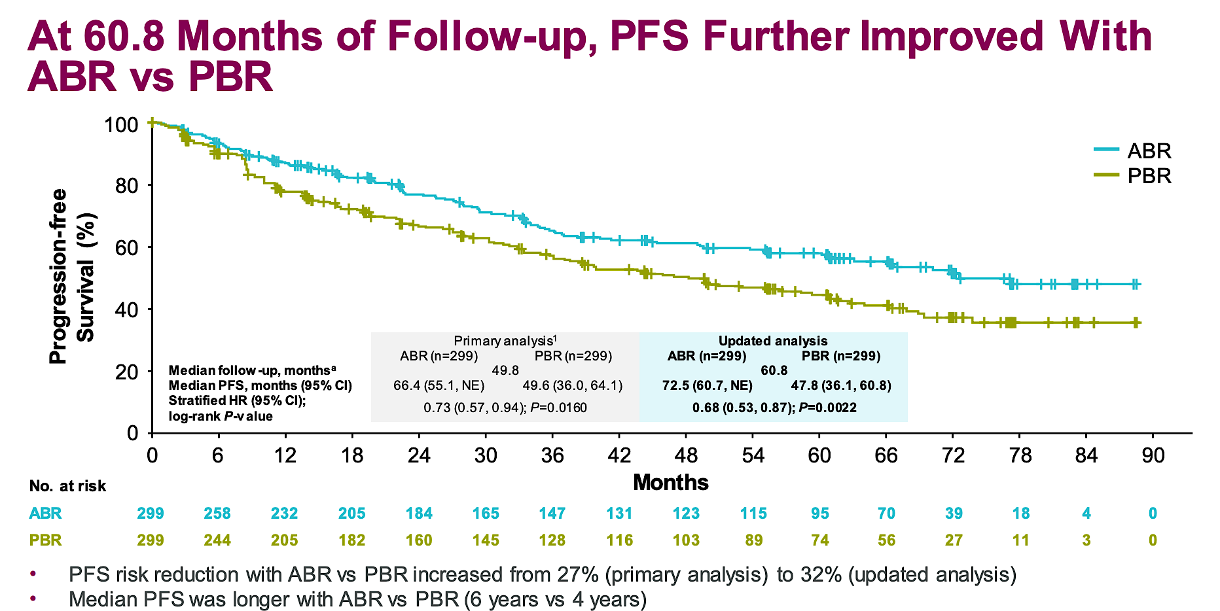
ECHO ASH 2025 update: outcome with mature follow up
Wang ASH 2025 Abstract 885

Slide 125
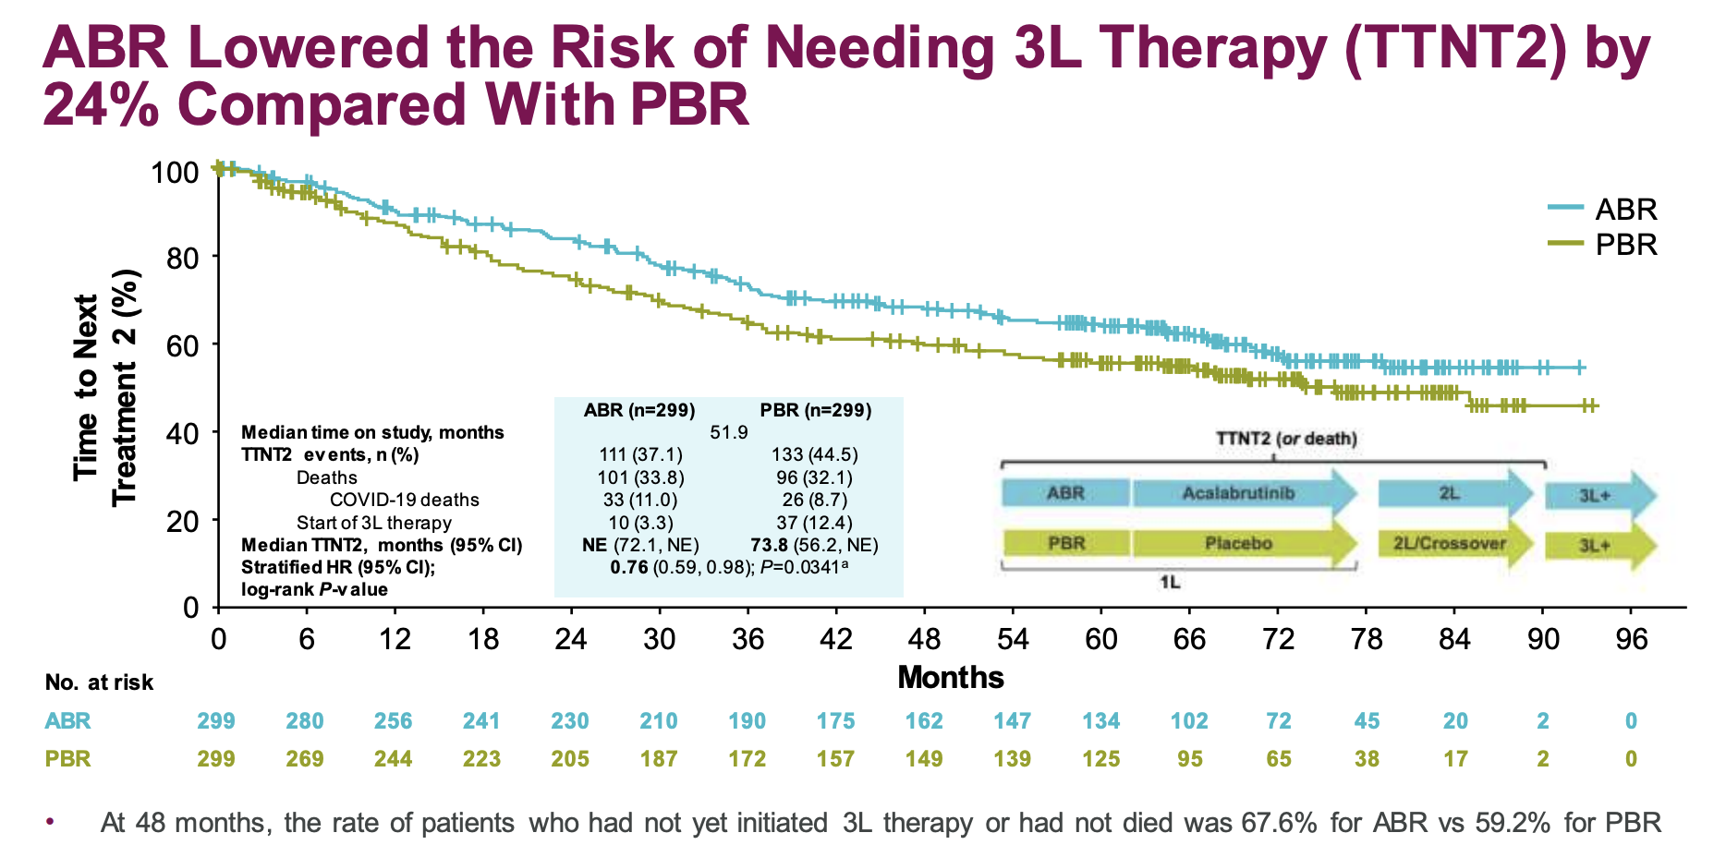
ECHO: TTNT2 results
Need for subsequent anticancer therapy was 3-fold higher with PBR (11% v 33%)
No new safety signals
PFS of ABR v PBR is 72.5m vs 47.8m
Med TTNT2 was NR vs 73.8m
No new safety signals
No OS differences
Author’s take-home point: no need to “save” BTKi for relapse
Wang ASH 2025 Abstract 885

Slide 126
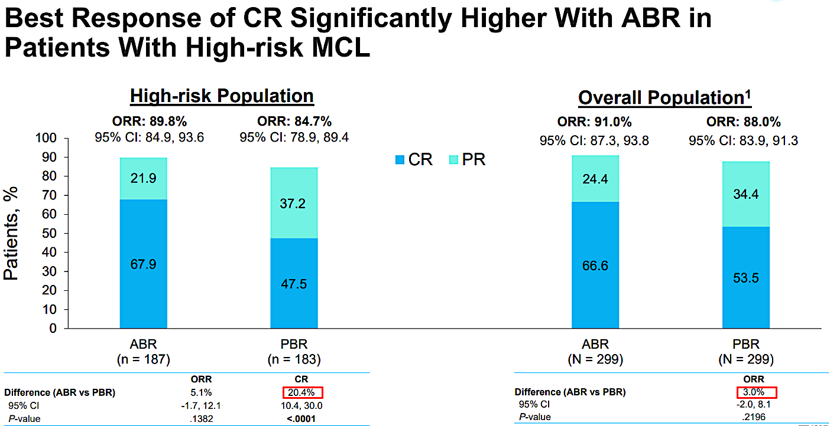
ECHO: RP3 trial of BR +/- acalabrutinib in TN MCL—focus on high-risk MCL
EHA 2025
N=598 pts
Dreyling M et al. EHA 2025;Abstract S233.

Slide 127
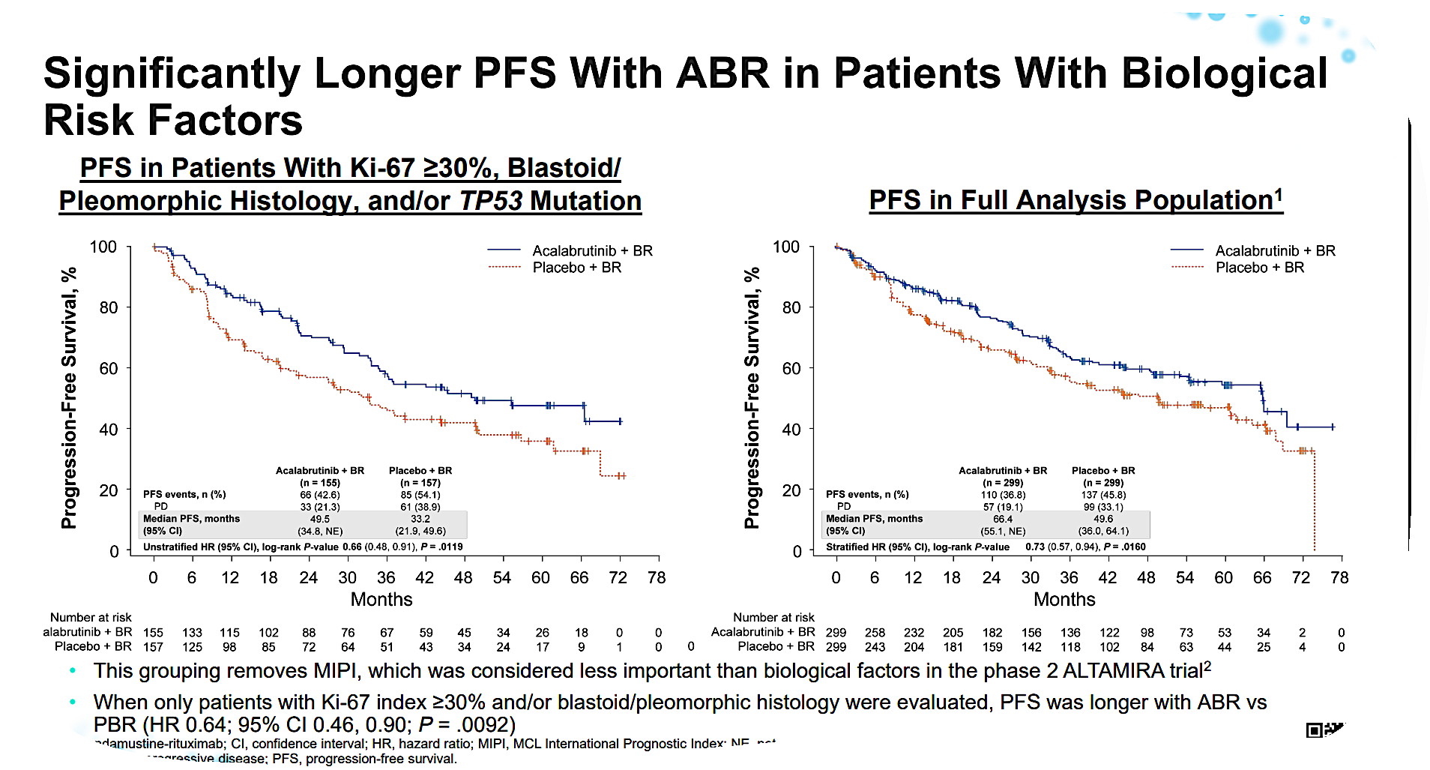
Acalabrutinib
EHA 2025
When to stop acala? “MRD is your friend” (Michael Wang)
Dreyling M et al. EHA 2025;Abstract S233.

Slide 128
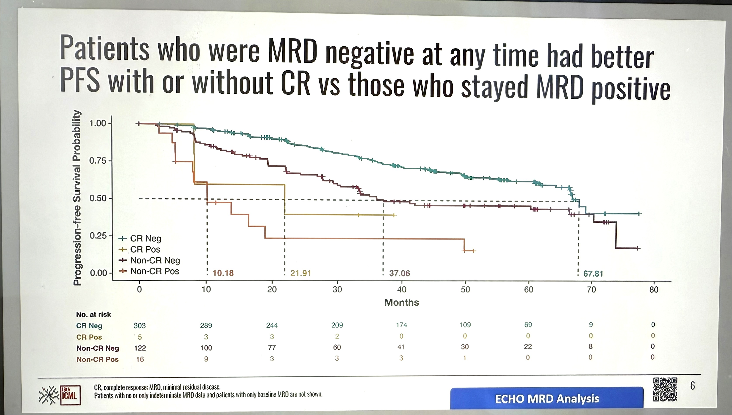
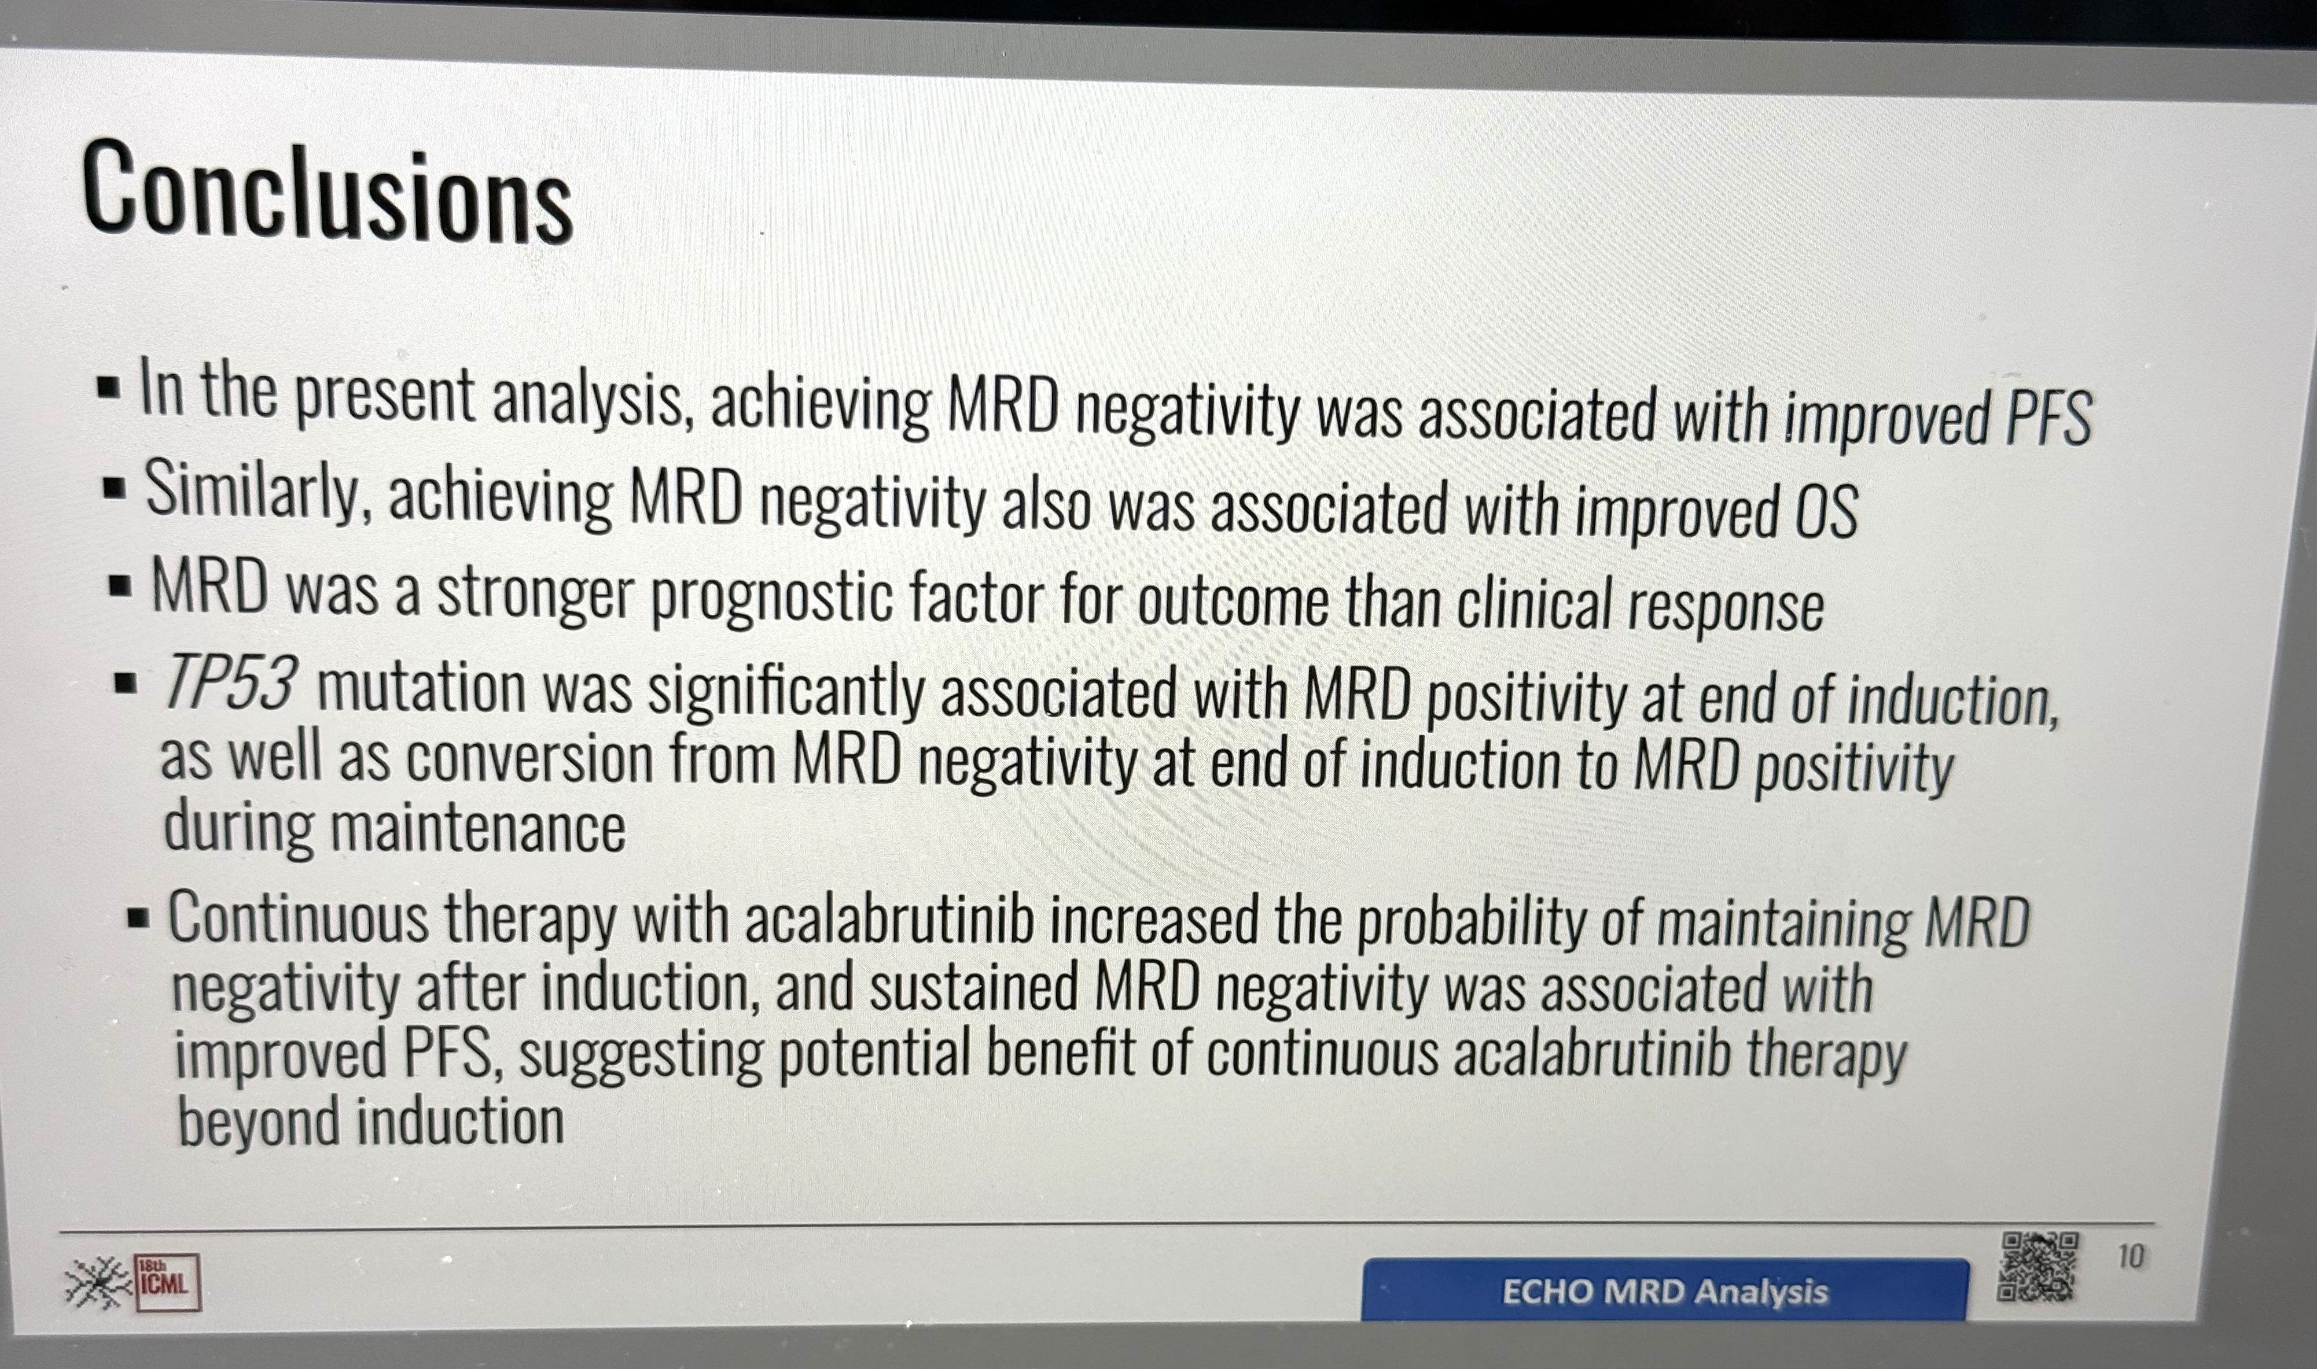
MRD Results from ECHO Trial
Zinzani PL EHA 2025 Oral 136

Slide 129
Hawkes E et al. Acalabrutinib plus venetoclax and rituximab in patients with treatment-naive (TN) mantle cell lymphoma (MCL): Results from the phase 2 TrAVeRse study. ASH 2025;Abstract 884.

Slide 130
Triplet therapy for p53 mutated and high-risk MCL→ now moving to other populations

Slide 131

Preliminary Results From a Phase 2 Study of BOVen (Zanubrutinib + Obinutuzumab + Venetoclax) as 1L Therapy for Older Patients With MCL
Key Eligibility Criteria
Previously untreated MCL
Aged ≥65 years or with comorbidities precluding ASCT
ECOG PS ≤2
Baseline Characteristics |  | All Patients (N=50)
Age, years | Median (range) | 72 (47-89)
 | ≥75 years, n (%) | 17 (34)
MCL histology, n (%) | Classical | 35 (73)
Most recent therapy line | Blastoid/pleomorphic | 7 (15)
 | Non-nodal leukemic | 6 (13)
MIPI, n (%) | Low | 4 (8)
 | Intermediate | 11 (22)
 | High | 35 (70)
Ki-67 proliferation rate, n (%) | <30% | 24 (49)
 | ≥30% and <50% | 11 (22)
 | ≥50% | 14 (29)
Cytogenetics, n (%) | TP53 mutation | 13 (28)
 | del(17p) | 10 (20)
 | del(17p) and TP53 mutation | 7 (14)
1 2 3 4 5 6 7 8 9 10 11…
Zanubrutinib
Minimum of 24 cycles
Obinutuzumab
Venetoclax
Zanu 160 mg
po bid
Obin 1000 mg IV
Cycle 1: D1, D8, D15
Cycle 2-8: D1
Ven 400 mg po qd
5-week ramp-up:
1 week of each 20, 50, 100, 200, 400 mg po qd
After 24 cycles, MRD-driven approach to treatment duration
If CR and uMRD6: Stop treatment
<CR and/or dMRD6: Continue Zanu and Ven
Primary endpoint: 3-year PFS (promising 3-year PFS rate ≥70%;
unacceptable rate ≤50% [historical comparison to BR])
Kumar A, et al. ASH 2025. Abstract 888.

Slide 132


Preliminary Results From a Phase 2 Study of BOVen as 1L Therapy for Older Patients With MCL: PFS, OS, Response, and MRD
PFS
OS
2-year PFS: 86% (95% CI, 77-97)
Median PFS: not reached
2-year OS: 92% (95% CI, 84-100)
Median OS: not reached
Response
Metabolic response: 48 patients (96%) achieved CMR; 1 patient (2%) achieved PMR
30 patients (60%) completed treatment (C24) and achieved CR, no patient has progressed off treatment (4 PD on therapy)
PB MRD (clonoSEQ)
uMRD6: 39/45 patients (87%) at C13;
28/30 patients (93%) at C24 (EOT)
Median follow-up: 25 months.
Kumar A, et al. ASH 2025. Abstract 888.

Slide 133
Results From the Phase 2 TrAVeRse Study of Acalabrutinib + Venetoclax + Rituximab (AVR) in Patients With MCL
Key Eligibility Criteria
Aged ≥18 years with untreated MCL
Ann Arbor stage II-IV
ECOG PS 0-2/3
Baseline Characteristics |  | AVR (N=108)
Median age (range), years |  | 69 (40-89)
Aged <65 years, n (%) |  | 42 (38.9)
Ann Arbor stage IV, n (%) |  | 99 (91.7)
Extranodal involvement, n (%) |  | 102 (94.4)
BM involvement, n (%) |  | 90 (83.3)
Ki-67 ≥30%, n (%) |  | 41 (38.0)
Blastoid/pleomorphic histology, n (%) |  | 9 (8.3)
Positive p53 expression by IHC, n (%) |  | 34 (31.5)
TP53 mutation by NGS, n (%) |  | 17 (15.7)
Simplified MIPI, n (%) | Low risk (0-3) | 30 (27.8)
 | Intermediate risk (4-5) | 45 (41.7)
 | High risk (≥6) | 33 (30.6)
Acala 100 mg bid until PD
MRD-neg CR^{b}
RANDOMIZED 1:1
AVR Inductionª
Observation
PD
Acala Retreatment
MRD-pos CR, PR, SD^{b}
Acala 100 mg bid until PD
Cycles 1-13
1 cycle=28 days
Cycle 15 to EOT
Median follow-up: 14.9 months (range, 1-19)
Primary endpoint: MRD-neg CR rate^{b} at end of induction
Other endpoints: ORR/CR rate, MRD-neg rate, DOR, PFS, OS, safety
ª Acala 100 mg bid (C1-C13; C14 postinduction); Ven (C2-C13 [5-week ramp-up in C2: 20 mg to ≥400 mg qd]);
Ritux 375 mg/m² D1 of C1-12). ^{b} MRD assessed by NGS (10⁻⁵) in PB (clonoSEQ).
Hawkes EA, et al. ASH 2025. Abstract 884.

Slide 134



Results From the Phase 2 TrAVeRse Study of AVR in Patients With MCL: Outcomes in Patients With TP53 Mutation
PFS
Outcomes at End of Induction in Patients With TP53mut
OS
DOR
Responses were durable, regardless of TP53mut status
  DOR rate at 6 months: 98.0% overall and
  100% in patients with TP53mut
  DOR rate at 12 months: 97.0% overall and
  93.3% in patients with TP53mut
Hawkes EA, et al. ASH 2025. Abstract 884.

Slide 135
Jain P et al. Acalabrutinib in combination with rituximab is highly effective frontline treatment for older patients with MCL. ICML 2025;Abstract 272.

Slide 136

Acalabrutinib plus rituximab in older adults with MCL
Single arm, single institution trial
N=50 pts
Treatment with R weekly x 4, then monthly x 12, and then every 2m up to 24m
indefinite acala
Jain P et al. ICML 2025;Abstract 272.

Slide 137

Evolving landscape of trials for older adults with MCL
CHEMO-BASED
LenR
BTKi
Munoz Leukemia & Lymphoma Volume 66, 2025 - Issue 3

Slide 138
Wang M et al. Pirtobrutinib in relapsed/refractory (R/R) mantle cell lymphoma (MCL): Final update from the Phase 1/2 BRUIN study. ASH 2025;Abstract 665.

Slide 139

BRUIN phase 1/2 trial of pirtobrutinib monotherapy:
n=166 with RR MCL
92% with prior cBTKi (84% stopping for PD and 10% stopping for toxicity)
Med age 70yo with 3 PLOT
Wang M et al. ASH 2025;Abstract 665.

Slide 140

Wang M et al. ASH 2025;Abstract 665.

Slide 141

Wang M et al. ASH 2025;Abstract 665.

Slide 142
Wang M et al. Sonrotoclax (BGB-11417) monotherapy in patients with relapsed/refractory (R/R) mantle cell lymphoma (MCL) previously treated with a Bruton tyrosine kinase (BTK) inhibitor: Early results from a phase 1/2 study. ASH 2025;Abstract 663.

Slide 143
Sonrotoclax (BGB-11417): next gen BCL2 inhibitor
no drug accumulation
Wang M et al. ASH 2025;Abstract 663.

Slide 144
Sonrotoclax in RR MCL: Outcomes (RP2 dose of 320mg/d)
DOR
Median follow up 14.2m
Med DOR 15.8m
Med PFS 6.5m
Med OS NR
Wang M et al. ASH 2025;Abstract 663.

Slide 145
FDA Grants Accelerated Approval to Sonrotoclax for Relapsed or Refractory Mantle Cell Lymphoma
Press Release: May 13, 2026
“On May 13, 2026, the Food and Drug Administration granted accelerated approval to sonrotoclax, a BCL-2 inhibitor, for adults with relapsed or refractory mantle cell lymphoma (MCL) after at least two lines of systemic therapy, including a Bruton’s tyrosine kinase (BTK) inhibitor.
Efficacy was evaluated in BGB-11417-201 (NCT05471843), a single-arm, multicenter trial in 103 adults with relapsed or refractory MCL who previously received anti-CD20-based therapy and a BTK inhibitor.
Efficacy was established based on overall response rate (ORR) and duration of response (DOR), as assessed by an independent review committee (IRC) using Lugano criteria. ORR was 52% (95% CI: 42, 62), with a median time to response of 1.9 months. The median DOR was 15.8 months (95% CI: 7.4, not estimable), after an estimated median follow-up of 11.9 months.
The prescribing information includes warnings and precautions for tumor lysis syndrome (TLS), serious infections, and neutropenia. Of 115 patients with MCL evaluated for safety, serious adverse reactions occurred in 37%, most frequently from pneumonia (10%).”
https://www.fda.gov/drugs/resources-information-approved-drugs/fda-grants-accelerated-approval-sonrotoclax-relapsed-or-refractory-mantle-cell-lymphoma

Slide 146
Overall thoughts about MCL
Moving away from “younger/fit versus older/unfit” dichotomy
More selective (or nonexistent) use of autologous stem cell transplant
Key biologic risk factors will influence treatment decisions
  (Ki67, p53 status, blastoid morphology)
We are evolving in how we think about BTKi
  “save the best” for the future mentality is going away
  Fixed duration is needed
  MRD will change how we treat this disease
New agents and classes of agents are likely to significantly change our treatment paradigm in the next several years
  Bispecific agents, BTK degraders, safer CAR-T

Slide 147
Year in Review: Clinical Investigator Perspectives on the
Most Relevant New Datasets and Advances in Oncology
Gastroesophageal Cancers
A CME/MOC-Accredited Live Webinar
Tuesday, June 23, 2026
5:00 PM – 6:00 PM ET
Faculty
David H Ilson, MD, PhD
Kohei Shitara, MD
Moderator
Neil Love, MD

Slide 148
Thank you for joining us!
Please take a moment to complete the survey currently up on Zoom. Your feedback is very important to us. The survey will remain open for 5 minutes after the meeting ends.
Information on how to obtain CME and ABIM MOC credit is provided in the Zoom chat room.
Attendees will also receive an email in
1 to 3 business days with these instructions.

