Slide 1
Year in Review: Clinical Investigator Perspectives on the
Most Relevant New Datasets and Advances in Oncology
Multiple Myeloma
A CME/MOC-Accredited Live Webinar
Thursday, June 25, 2026
5:00 PM – 6:00 PM ET
Faculty
Amrita Krishnan, MD
Robert Z Orlowski, MD, PhD
Moderator
Neil Love, MD

Slide 2

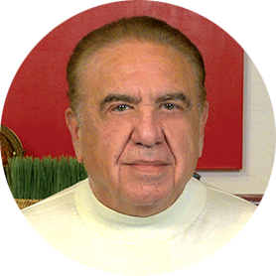
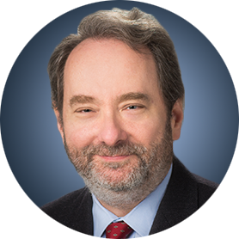
Faculty
Amrita Krishnan, MD
Director of the Judy and Bernard Briskin Center
for Multiple Myeloma Research
Nason Hollingsworth Family Chair in Myeloma
Professor of Hematology/Hematopoietic Cell Transplantation
Executive Medical Director of Hematology
City of Hope Orange County
City of Hope Cancer Center
Duarte, California
MODERATOR
Neil Love, MD
Research To Practice
Miami, Florida
Robert Z Orlowski, MD, PhD
Florence Maude Thomas Cancer Research Professor
Department of Lymphoma and Myeloma
Professor, Department of Experimental Therapeutics
Vice Chair, Myeloma Translational Research
Division of Cancer Medicine
The University of Texas MD Anderson Cancer Center
Houston, Texas

Slide 3
Commercial Support
This activity is supported by educational grants from GSK, Johnson & Johnson, and Regeneron Pharmaceuticals Inc.
Research To Practice CME Planning Committee Members,
Staff and Reviewers
Planners, scientific staff and independent reviewers for Research To Practice have no relevant financial relationships to disclose.

Slide 4
Dr Love — Disclosures
Dr Love is president and CEO of Research To Practice. Research To Practice receives funds in the form of educational grants to develop CME activities from the following companies: Aadi Bioscience, AbbVie Inc, ADC Therapeutics, Agendia Inc, Alexion Pharmaceuticals, Amgen Inc, Array BioPharma Inc, a subsidiary of Pfizer Inc, Arvinas, Astellas, AstraZeneca Pharmaceuticals LP, Aveo Pharmaceuticals, Bayer HealthCare Pharmaceuticals, BeOne, Biotheranostics Inc, A Hologic Company, Black Diamond Therapeutics Inc, Blueprint Medicines, Boehringer Ingelheim Pharmaceuticals Inc, Bristol Myers Squibb, Catalyst Pharmaceuticals Inc, Celcuity, Clovis Oncology, Coherus BioSciences, Corcept Therapeutics Inc, CTI BioPharma, a Sobi Company, Daiichi Sankyo Inc, Eisai Inc, Elevation Oncology Inc, Exact Sciences Corporation, Exelixis Inc, Genentech, a member of the Roche Group, Genmab US Inc, Geron Corporation, Gilead Sciences Inc, GSK, Helsinn Therapeutics (US) Inc, ImmunoGen Inc, Incyte Corporation, Ipsen Biopharmaceuticals Inc, Jazz Pharmaceuticals Inc, Johnson & Johnson, Karyopharm Therapeutics, Kite, A Gilead Company, Kura Oncology, Legend Biotech, Lilly, MEI Pharma Inc, Merck, Mersana Therapeutics Inc, Mirati Therapeutics Inc, Mural Oncology Inc, Natera Inc, Novartis, Novartis Pharmaceuticals Corporation on behalf of Advanced Accelerator Applications, Novocure Inc, Nuvalent, Nuvation Bio Inc, Pfizer Inc, Pharmacyclics LLC, an AbbVie Company, Puma Biotechnology Inc, Regeneron Pharmaceuticals Inc, Revolution Medicines Inc, Rigel Pharmaceuticals Inc, R-Pharm US, Sanofi, Seagen Inc, Servier Pharmaceuticals LLC, SpringWorks Therapeutics Inc, Stemline Therapeutics Inc, Sumitomo Pharma America, Summit Therapeutics, Syndax Pharmaceuticals, Taiho Oncology Inc, Takeda Pharmaceuticals USA Inc, TerSera Therapeutics LLC, Tesaro, A GSK Company, and Verastem Inc.

Slide 5
Dr Krishnan — Disclosures
Consulting Agreements | AbbVie Inc, AstraZeneca Pharmaceuticals LP, Bristol Myers Squibb, GSK, Johnson & Johnson, Pfizer Inc, Roche Laboratories Inc, Sanofi
Stock Options/Stock — Public Companies | Bristol Myers Squibb

Slide 6
Dr Orlowski — Disclosures
Advisory Committees and Consulting Agreements | AbbVie Inc, Adaptive Biotechnologies Corporation, Asylia Therapeutics Inc, Biotheryx, Bristol Myers Squibb, DEM BioPharma, GSK, IASO Bio, Karyopharm Therapeutics, Lytica Therapeutics, Meridian Therapeutics, Monte Rosa Therapeutics, MYELOMA360, Neurogene Inc, Oncopeptides, Pfizer Inc, Regeneron Pharmaceuticals Inc, Sanofi, Sporos Bioventures, Takeda Pharmaceuticals USA Inc
Contracted Research | Asylia Therapeutics Inc, Biotheryx, Heidelberg Pharma, Regeneron Pharmaceuticals Inc
Data and Safety Monitoring Boards/Committees | Sanofi

Slide 7
This educational activity contains discussion of
non-FDA-approved uses of agents and regimens. Please refer to official prescribing information for each product for approved indications.

Slide 8

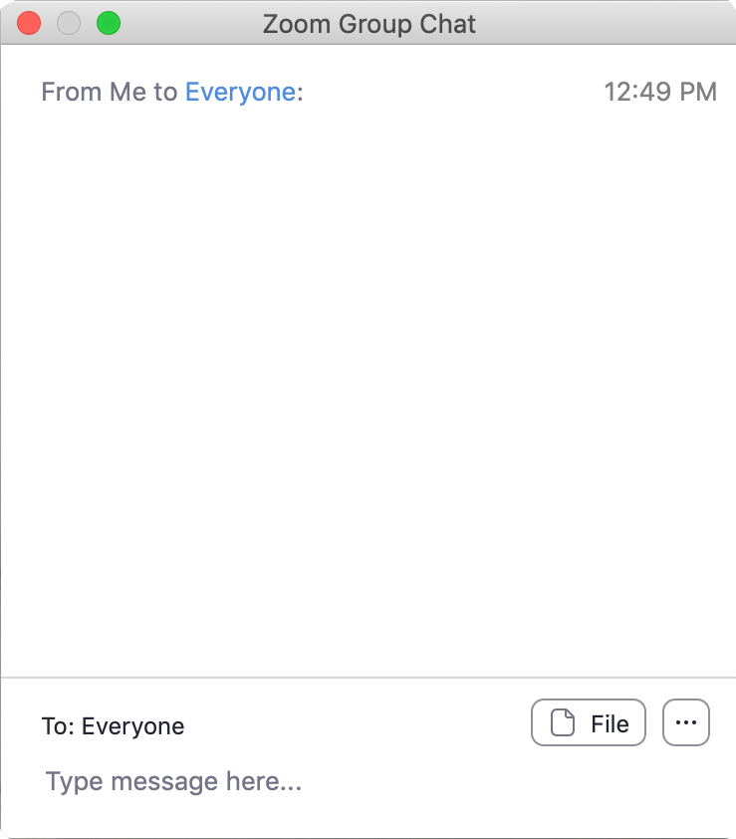
We Encourage Clinicians in Practice to Submit Questions
Feel free to submit questions now before the program begins and throughout the program.

Slide 9

Familiarizing Yourself with the Zoom Interface
Expand chat submission box
Drag the white line above the submission box up to create
more space for your message.

Slide 10

Familiarizing Yourself with the Zoom Interface
Increase chat font size
Press Command (for Mac) or Control (for PC) and the + symbol.
You may do this as many times as you need for readability.

Slide 11


Clinicians in the Audience, Please Complete the Pre- and Postmeeting Surveys
Quick Survey
Quick Poll

Slide 12


Slide 13
Year in Review: Clinical Investigator Perspectives on the
Most Relevant New Datasets and Advances in Oncology
Therapeutic Targets Beyond
EGFR for Non-Small Cell Lung Cancer
A CME/MOC-Accredited Live Webinar
Tuesday, June 30, 2026
5:00 PM – 6:00 PM ET
Faculty
John V Heymach, MD, PhD
Maurice Pérol, MD
Moderator
Neil Love, MD

Slide 14
Patterns of Care: Exploring How
Community Oncologists Manage HR-Positive,
HER2-Positive Metastatic Breast Cancer
A CME/MOC-Accredited Live Webinar
Wednesday, July 1, 2026
5:00 PM – 6:00 PM ET
Faculty
Lisa A Carey, MD, ScM, FASCO
Reshma L Mahtani, DO
Moderator
Neil Love, MD

Slide 15
Grand Rounds
CME/MOC-Accredited Interactive Series
Regional Activities
Two Series
Optimizing the Use of
Novel Therapies for Patients with Diffuse Large B-Cell Lymphoma
Optimizing Therapy for Patients with Hormone Receptor-Positive
Localized Breast Cancer
Host a 1-hour session at your institution:
Email Meetings@ResearchToPractice.com
or call (800) 233-6153

Slide 16
Year in Review:
Multiple Myeloma
INTRODUCTION: Up-Front PFS for Standard-Risk Disease — 2006, 2016
MODULE 1: Current and Emerging Therapeutic Approaches — Dr Orlowski
MODULE 2: Chimeric Antigen Receptor T-Cell Therapy, Bispecific Antibodies and Antibody-Drug Conjugates — Dr Krishnan
MODULE 3: ASCO and EHA 2026

Slide 17
Thank you for joining us!
Please take a moment to complete the survey currently up on Zoom.
Your feedback is very important to us.
Information on how to obtain CME and ABIM MOC credit will be provided in the Zoom chat room. Attendees will also receive an email in
1 to 3 business days with these instructions.

Slide 18
Year in Review: Clinical Investigator Perspectives on the
Most Relevant New Datasets and Advances in Oncology
Multiple Myeloma
A CME/MOC-Accredited Live Webinar
Thursday, June 25, 2026
5:00 PM – 6:00 PM ET
Faculty
Amrita Krishnan, MD
Robert Z Orlowski, MD, PhD
Moderator
Neil Love, MD

Slide 19
Faculty
Amrita Krishnan, MD
Director of the Judy and Bernard Briskin Center
for Multiple Myeloma Research
Nason Hollingsworth Family Chair in Myeloma
Professor of Hematology/Hematopoietic Cell Transplantation
Executive Medical Director of Hematology
City of Hope Orange County
City of Hope Cancer Center
Duarte, California
MODERATOR
Neil Love, MD
Research To Practice
Miami, Florida
Robert Z Orlowski, MD, PhD
Florence Maude Thomas Cancer Research Professor
Department of Lymphoma and Myeloma
Professor, Department of Experimental Therapeutics
Vice Chair, Myeloma Translational Research
Division of Cancer Medicine
The University of Texas MD Anderson Cancer Center
Houston, Texas

Slide 20
We Encourage Clinicians in Practice to Submit Questions
Feel free to submit questions now before the program begins and throughout the program.

Slide 21
Clinicians in the Audience, Please Complete the Pre- and Postmeeting Surveys
Quick Survey
Quick Poll

Slide 23
Year in Review: Clinical Investigator Perspectives on the
Most Relevant New Datasets and Advances in Oncology
Therapeutic Targets Beyond
EGFR for Non-Small Cell Lung Cancer
A CME/MOC-Accredited Live Webinar
Tuesday, June 30, 2026
5:00 PM – 6:00 PM ET
Faculty
John V Heymach, MD, PhD
Maurice Pérol, MD
Moderator
Neil Love, MD

Slide 24
Patterns of Care: Exploring How
Community Oncologists Manage HR-Positive,
HER2-Positive Metastatic Breast Cancer
A CME/MOC-Accredited Live Webinar
Wednesday, July 1, 2026
5:00 PM – 6:00 PM ET
Faculty
Lisa A Carey, MD, ScM, FASCO
Reshma L Mahtani, DO
Moderator
Neil Love, MD

Slide 25
Grand Rounds
CME/MOC-Accredited Interactive Series
Regional Activities
Two Series
Optimizing the Use of
Novel Therapies for Patients with Diffuse Large B-Cell Lymphoma
Optimizing Therapy for Patients with Hormone Receptor-Positive
Localized Breast Cancer
Host a 1-hour session at your institution:
Email Meetings@ResearchToPractice.com
or call (800) 233-6153

Slide 26
Year in Review: Clinical Investigator Perspectives on the
Most Relevant New Datasets and Advances in Oncology
Multiple Myeloma
A CME/MOC-Accredited Live Webinar
Thursday, June 25, 2026
5:00 PM – 6:00 PM ET
Faculty
Amrita Krishnan, MD
Robert Z Orlowski, MD, PhD
Moderator
Neil Love, MD

Slide 27
Commercial Support
This activity is supported by educational grants from GSK, Johnson & Johnson, and Regeneron Pharmaceuticals Inc.
Research To Practice CME Planning Committee Members,
Staff and Reviewers
Planners, scientific staff and independent reviewers for Research To Practice have no relevant financial relationships to disclose.

Slide 28
Dr Krishnan — Disclosures
Consulting Agreements | AbbVie Inc, AstraZeneca Pharmaceuticals LP, Bristol Myers Squibb, GSK, Johnson & Johnson, Pfizer Inc, Roche Laboratories Inc, Sanofi
Stock Options/Stock — Public Companies | Bristol Myers Squibb

Slide 29
Dr Orlowski — Disclosures
Advisory Committees and Consulting Agreements | AbbVie Inc, Adaptive Biotechnologies Corporation, Asylia Therapeutics Inc, Biotheryx, Bristol Myers Squibb, DEM BioPharma, GSK, IASO Bio, Karyopharm Therapeutics, Lytica Therapeutics, Meridian Therapeutics, Monte Rosa Therapeutics, MYELOMA360, Neurogene Inc, Oncopeptides, Pfizer Inc, Regeneron Pharmaceuticals Inc, Sanofi, Sporos Bioventures, Takeda Pharmaceuticals USA Inc
Contracted Research | Asylia Therapeutics Inc, Biotheryx, Heidelberg Pharma, Regeneron Pharmaceuticals Inc
Data and Safety Monitoring Boards/Committees | Sanofi

Slide 30
Dr Love — Disclosures
Dr Love is president and CEO of Research To Practice. Research To Practice receives funds in the form of educational grants to develop CME activities from the following companies: Aadi Bioscience, AbbVie Inc, ADC Therapeutics, Agendia Inc, Alexion Pharmaceuticals, Amgen Inc, Array BioPharma Inc, a subsidiary of Pfizer Inc, Arvinas, Astellas, AstraZeneca Pharmaceuticals LP, Aveo Pharmaceuticals, Bayer HealthCare Pharmaceuticals, BeOne, Biotheranostics Inc, A Hologic Company, Black Diamond Therapeutics Inc, Blueprint Medicines, Boehringer Ingelheim Pharmaceuticals Inc, Bristol Myers Squibb, Catalyst Pharmaceuticals Inc, Celcuity, Clovis Oncology, Coherus BioSciences, Corcept Therapeutics Inc, CTI BioPharma, a Sobi Company, Daiichi Sankyo Inc, Eisai Inc, Elevation Oncology Inc, Exact Sciences Corporation, Exelixis Inc, Genentech, a member of the Roche Group, Genmab US Inc, Geron Corporation, Gilead Sciences Inc, GSK, Helsinn Therapeutics (US) Inc, ImmunoGen Inc, Incyte Corporation, Ipsen Biopharmaceuticals Inc, Jazz Pharmaceuticals Inc, Johnson & Johnson, Karyopharm Therapeutics, Kite, A Gilead Company, Kura Oncology, Legend Biotech, Lilly, MEI Pharma Inc, Merck, Mersana Therapeutics Inc, Mirati Therapeutics Inc, Mural Oncology Inc, Natera Inc, Novartis, Novartis Pharmaceuticals Corporation on behalf of Advanced Accelerator Applications, Novocure Inc, Nuvalent, Nuvation Bio Inc, Pfizer Inc, Pharmacyclics LLC, an AbbVie Company, Puma Biotechnology Inc, Regeneron Pharmaceuticals Inc, Revolution Medicines Inc, Rigel Pharmaceuticals Inc, R-Pharm US, Sanofi, Seagen Inc, Servier Pharmaceuticals LLC, SpringWorks Therapeutics Inc, Stemline Therapeutics Inc, Sumitomo Pharma America, Summit Therapeutics, Syndax Pharmaceuticals, Taiho Oncology Inc, Takeda Pharmaceuticals USA Inc, TerSera Therapeutics LLC, Tesaro, A GSK Company, and Verastem Inc.

Slide 31
This educational activity contains discussion of
non-FDA-approved uses of agents and regimens. Please refer to official prescribing information for each product for approved indications.

Slide 32
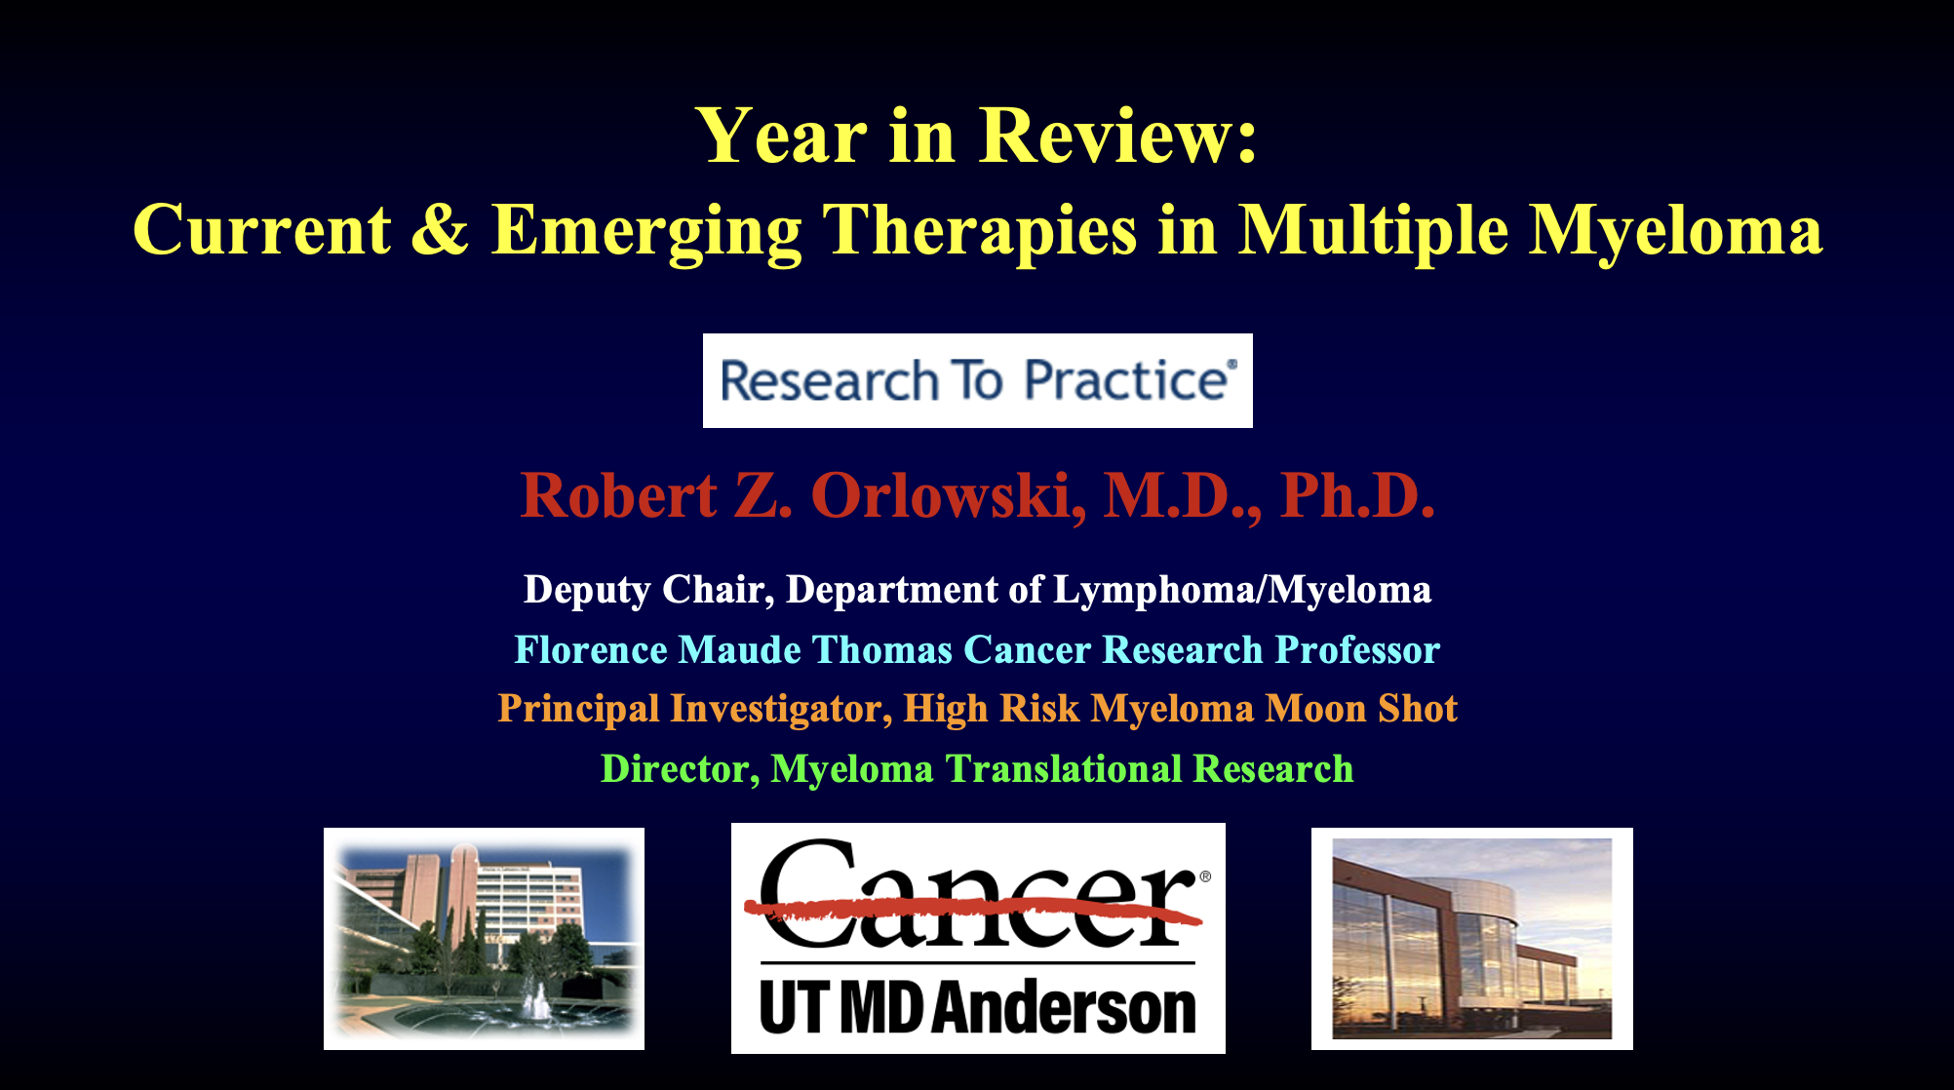
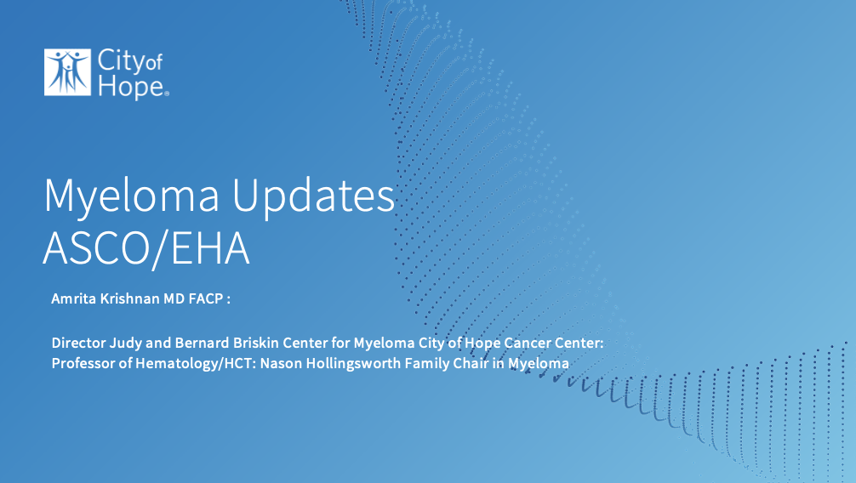

Slide 33
Key Datasets
Robert Z Orlowski, MD, PhD
Dimopoulos MA et al. Daratumumab or active monitoring for high-risk smoldering multiple myeloma.
N Engl J Med 2025;392(18):1777-88.
Bertamini L et al. New IMS/IMWG risk criteria by next-generation sequencing (NGS): Analysis of daratumumab benefit in both high- and standard-risk patients (pts) in the PERSEUS study. ASCO 2026;Abstract 7505.
Gay F et al. Isatuximab, carfilzomib, lenalidomide and dexamethasone in newly diagnosed multiple myeloma: A randomized phase 3 trial. Nat Med 2026;32(5):1773-82.
Usmani S et al. Daratumumab plus bortezomib, lenalidomide, and dexamethasone (DVRd) in patients (pts) with newly diagnosed multiple myeloma (NDMM): Final analysis of transplant-ineligible (TIE) pts in the phase 3 CEPHEUS study. ASCO 2026;Abstract 7513.
Orlowski RZ et al. Isatuximab, bortezomib, lenalidomide, dexamethasone for multiple myeloma: Dynamics of MRD negativity in the IMROZ study. Blood 147(23):2760-9.

Slide 34
Key Datasets
Robert Z Orlowski, MD, PhD (continued)
Bobin A et al. Sustained minimal residual disease (sMRD) negativity in transplant ineligible newly diagnosed multiple myeloma treated with isatuximab plus lenalidomide and dexamethasone with bortezomib (Isa-VRd) versus Isa-Rd: 12-24-month data from the phase 3 benefit trial (IFM 2020-05). ASH 2025;Abstract 368.
Ailawadhi S et al. Isatuximab subcutaneous by on-body injector versus isatuximab intravenous plus pomalidomide and dexamethasone in relapsed/refractory multiple myeloma: Phase III IRAKLIA study.
J Clin Oncol 2025;43(22):2527-37.
Anderson LD et al. Updated efficacy and safety results of subcutaneous daratumumab plus lenalidomide versus lenalidomide alone as maintenance therapy in newly diagnosed multiple myeloma after transplant: AURIGA study. International Myeloma Society (IMS) 2025;Abstract OA-47.
Richardson P et al. Mezigdomide, carfilzomib, and dexamethasone (MeziKd) vs carfilzomib and dexamethasone (Kd) in relapsed/refractory multiple myeloma (RRMM): Results from the phase 3 SUCCESSOR-2 trial. ASCO 2026;Abstract LBA7506.
Kapoor P et al. Safety and efficacy of iberdomide-based quadruplet for patients with newly diagnosed multiple myeloma: The IDEAL phase I/II trial results. EHA 2026;Abstract S199.

Slide 35
Key Datasets
Amrita Krishnan, MD
Jagannath S et al. Long-term (≥5-year) remission and survival after treatment with ciltacabtagene autoleucel in CARTITUDE-1 patients with relapsed/refractory multiple myeloma. J Clin Oncol 2025;43(25):2766-71.
Einsele H et al. Cilta-cel in lenalidomide-refractory multiple myeloma (CARTITUDE-4): An updated analysis including overall survival from an open-label, multicentre, randomised, phase 3 trial. Lancet Oncol 2026;27(2):254-68.
Costa L J et al. Teclistamab plus daratumumab in relapsed or refractory multiple myeloma. N Engl J Med 2026;394(8):739-52.
Mina R et al. MajesTEC-9: A phase 3 randomized study of teclistamab monotherapy vs investigator’s choice of pomalidomide, bortezomib, and dexamethasone or carfilzomib and dexamethasone (PVd/Kd) in patients (pts) with relapsed refractory multiple myeloma (RRMM). ASCO 2026;Abstract 7507.
Lee HC et al. Linvoseltamab in patients with relapsed/refractory multiple myeloma in the LINKER-MM1 study: Longer follow-up and subgroup analyses. Clin Lymphoma Myeloma Leuk 2026;26(2):e201-12.
Wechalekar A et al. First results from the phase 1/2 LINKER-AL2 trial of linvoseltamab (LINVO) in patients (pts) with relapsed or refractory (RR) systemic light chain (AL) amyloidosis. ASCO 2026;Abstract 7502.

Slide 36
Key Datasets
Amrita Krishnan, MD (continued)
Chari A et al. Safety and activity of talquetamab in patients with relapsed or refractory multiple myeloma (MonumenTAL-1): A multicentre, open-label, phase 1-2 study. Lancet Haematol 2025;12(4):e269-81.
Voorhees P et al. Phase 3, randomized study of talquetamab (tal) plus daratumumab (dara) ± pomalidomide (pom) vs dara plus pom and dexamethasone (DPd) in relapsed/refractory multiple myeloma (RRMM): MonumenTAL-3. EHA 2026;Abstract S100.
Hungria V et al. Belantamab mafodotin plus bortezomib and dexamethasone in patients with relapsed or refractory multiple myeloma (DREAMM-7): Updated overall survival analysis from a global, randomised, open-label, phase 3 trial. Lancet Oncol 2025;26(8):1067-80.
Trudel S et al. Long-term outcomes with sustained minimal residual disease (MRD) negativity in belantamab mafodotin–treated patients (pts) with relapsed/refractory multiple myeloma (RRMM): An update from DREAMM-8. ASCO 2026;Abstract 7515.

Slide 37
Year in Review:
Multiple Myeloma
INTRODUCTION: Up-Front PFS for Standard-Risk Disease — 2006, 2016
MODULE 1: Current and Emerging Therapeutic Approaches — Dr Orlowski
MODULE 2: Chimeric Antigen Receptor T-Cell Therapy, Bispecific Antibodies and Antibody-Drug Conjugates — Dr Krishnan
MODULE 3: ASCO and EHA 2026

Slide 38
Year in Review:
Multiple Myeloma
INTRODUCTION: Up-Front PFS for Standard-Risk Disease — 2006, 2016
MODULE 1: Current and Emerging Therapeutic Approaches — Dr Orlowski
MODULE 2: Chimeric Antigen Receptor T-Cell Therapy, Bispecific Antibodies and Antibody-Drug Conjugates — Dr Krishnan
MODULE 3: ASCO and EHA 2026

Slide 39
Year in Review:
Multiple Myeloma
INTRODUCTION: Up-Front PFS for Standard-Risk Disease — 2006, 2016
MODULE 1: Current and Emerging Therapeutic Approaches — Dr Orlowski
MODULE 2: Chimeric Antigen Receptor T-Cell Therapy, Bispecific Antibodies and Antibody-Drug Conjugates — Dr Krishnan
MODULE 3: ASCO and EHA 2026

Slide 40

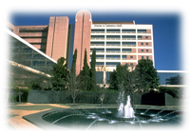

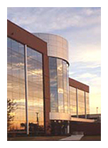
Year in Review:
Current & Emerging Therapies in Multiple Myeloma
Robert Z. Orlowski, M.D., Ph.D.
Deputy Chair, Department of Lymphoma/Myeloma
Florence Maude Thomas Cancer Research Professor
Principal Investigator, High Risk Myeloma Moon Shot
Director, Myeloma Translational Research

Slide 41
Daratumumab for Smoldering Myeloma

Slide 42
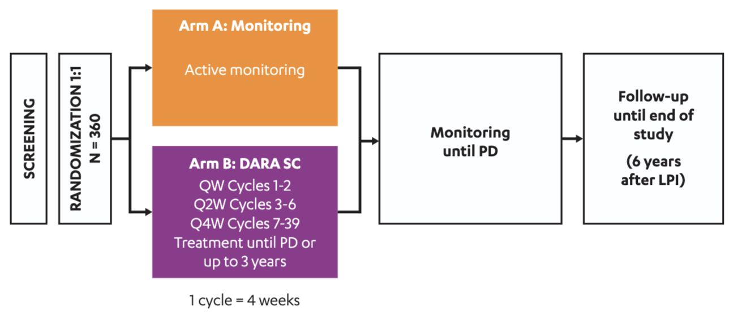
AQUILA : Daratumumab for HR SMM
M-protein >2 g/dL
BM PC >20%
i/u FLC ratio >20
Mateos, M-V et al. Blood Cancer J. 2020 Oct 16;10(10):102.
Dimopoulos, MA et al. N Engl J Med. 2025 May 8;392(18):1777-1788.

Slide 43
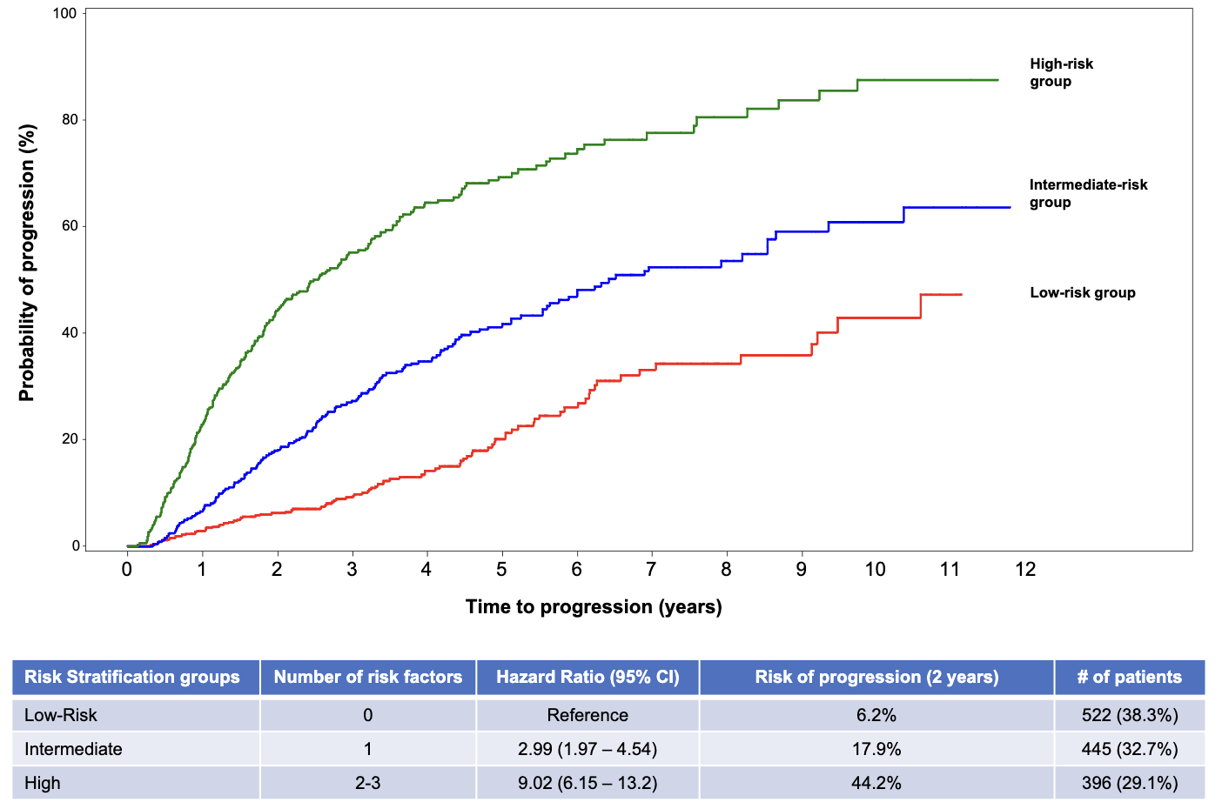
AQUILA : Daratumumab for HR SMM
M-protein >2 g/dL
BM PC >20%
i/u FLC ratio >20
Mateos, M-V et al. Blood Cancer J. 2020 Oct 16;10(10):102.
Dimopoulos, MA et al. N Engl J Med. 2025 May 8;392(18):1777-1788.

Slide 44
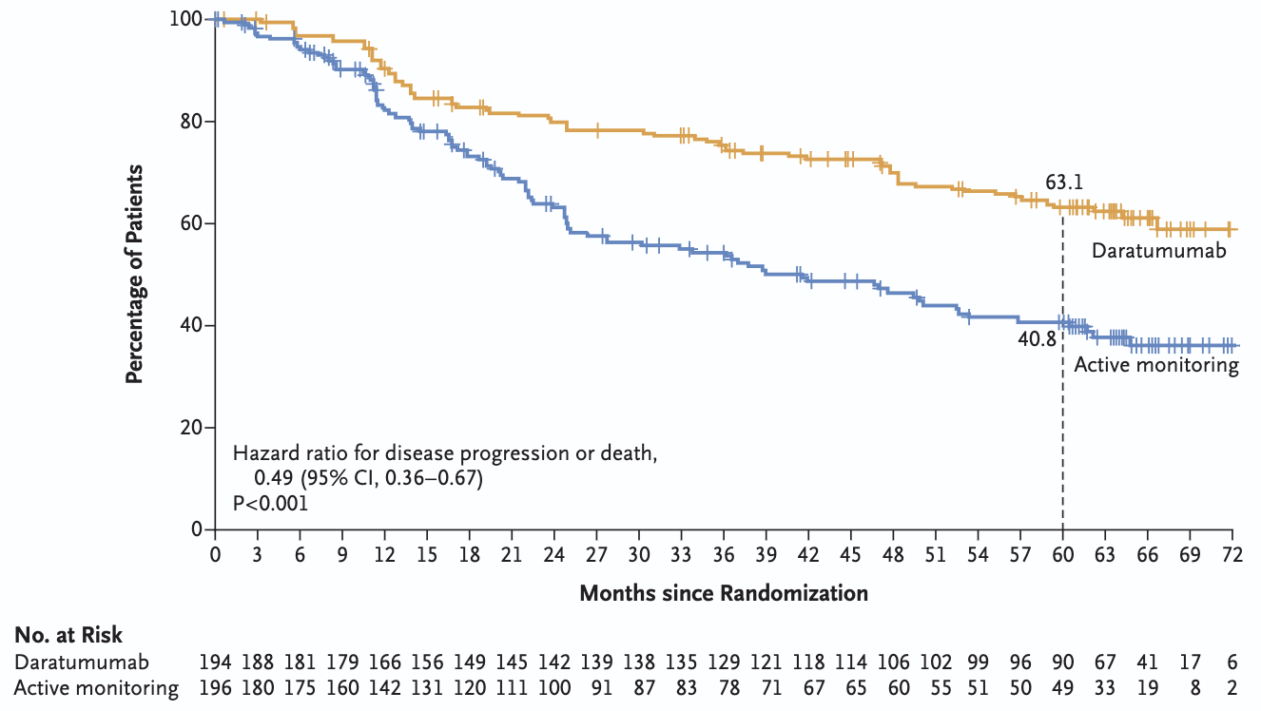
AQUILA : Outcomes
Lower risk of progression & trend towards better survival
Dimopoulos, MA et al. N Engl J Med. 2025 May 8;392(18):1777-1788.

Slide 45
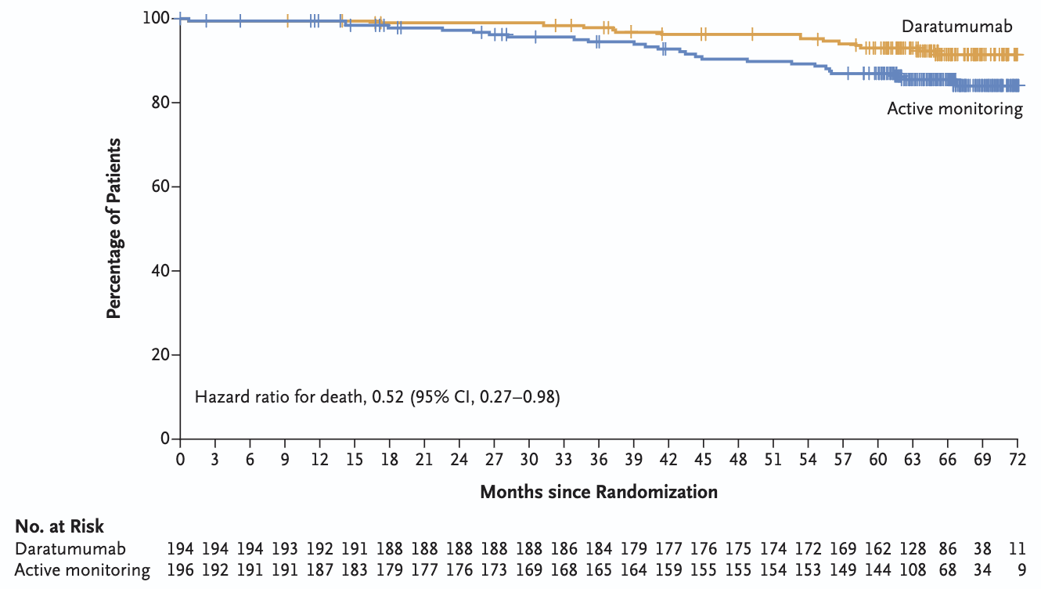
AQUILA : Outcomes
Lower risk of progression & trend towards better survival
Dimopoulos, MA et al. N Engl J Med. 2025 May 8;392(18):1777-1788.

Slide 46
Quadruplet Therapy for Transplant-Eligible Newly Diagnosed MM

Slide 47
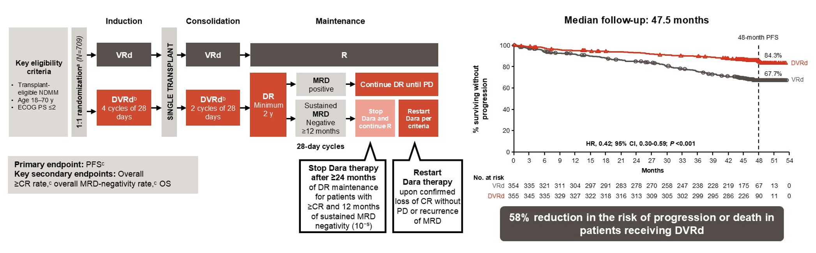
PERSEUS : Risk by New IMS/IMWG
Bertamini, L et al. ASCO 2026;Abstract 7505.

Slide 48
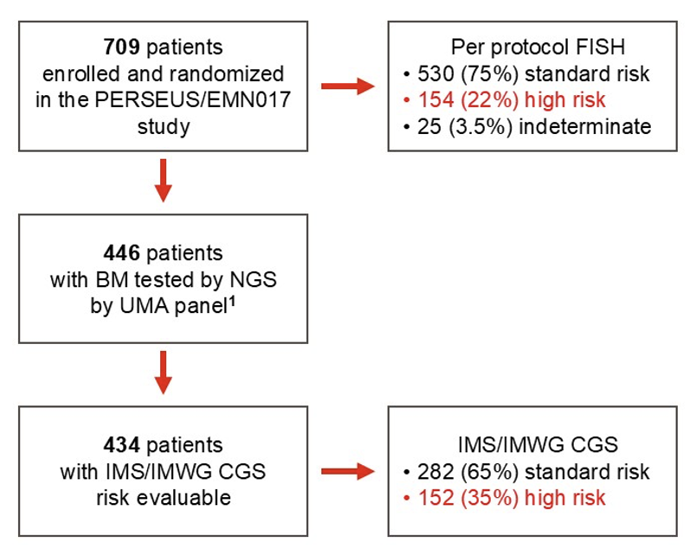
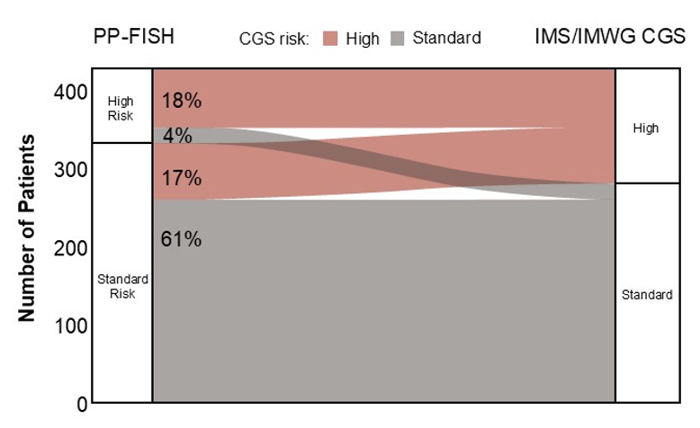
PERSEUS : Risk by New IMS/IMWG
Bertamini, L et al. ASCO 2026;Abstract 7505.

Slide 49
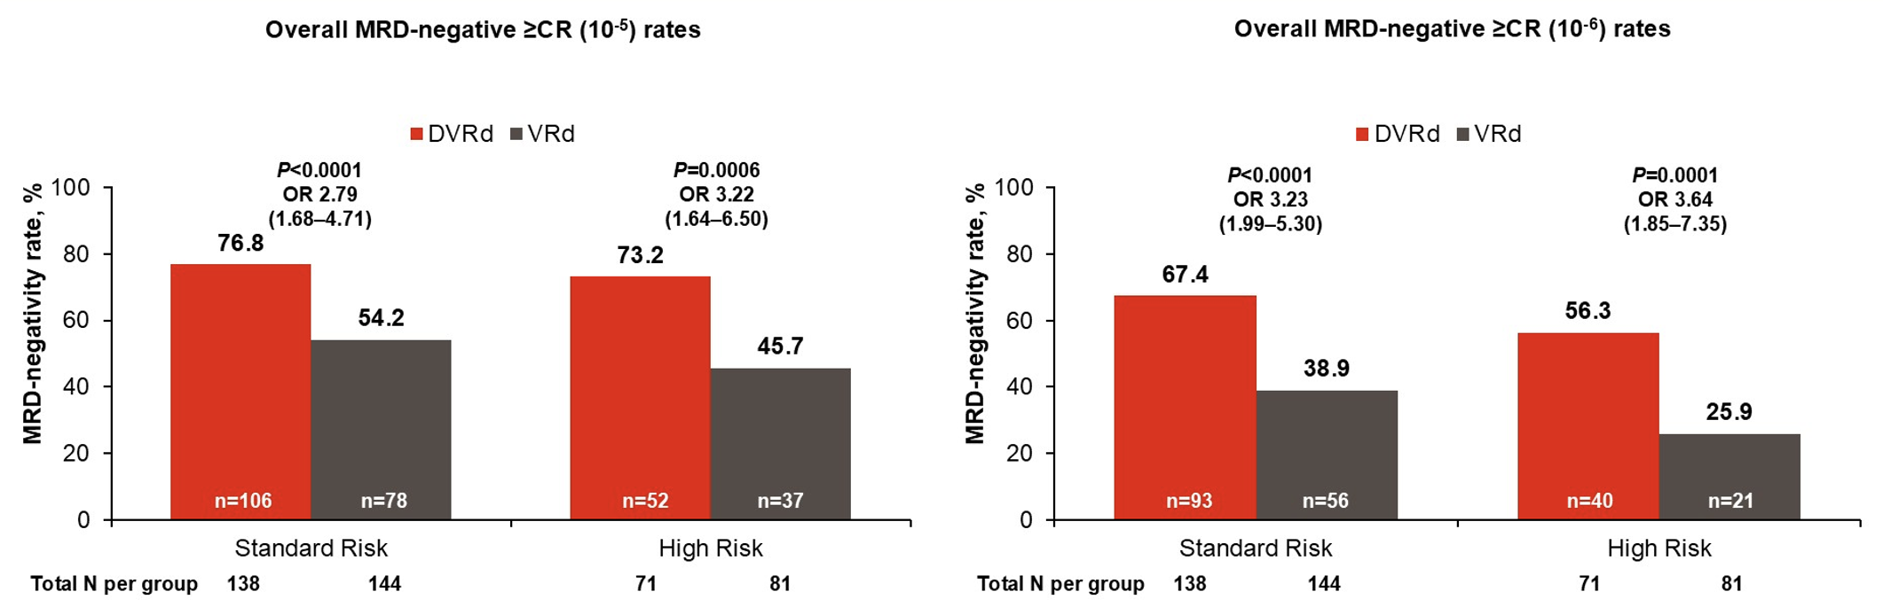
MRD & Outcomes Data
Dara improves outcomes in both SR & HR MM, but HRMM still doesn’t do as well
Bertamini, L et al. ASCO 2026;Abstract 7505.

Slide 50
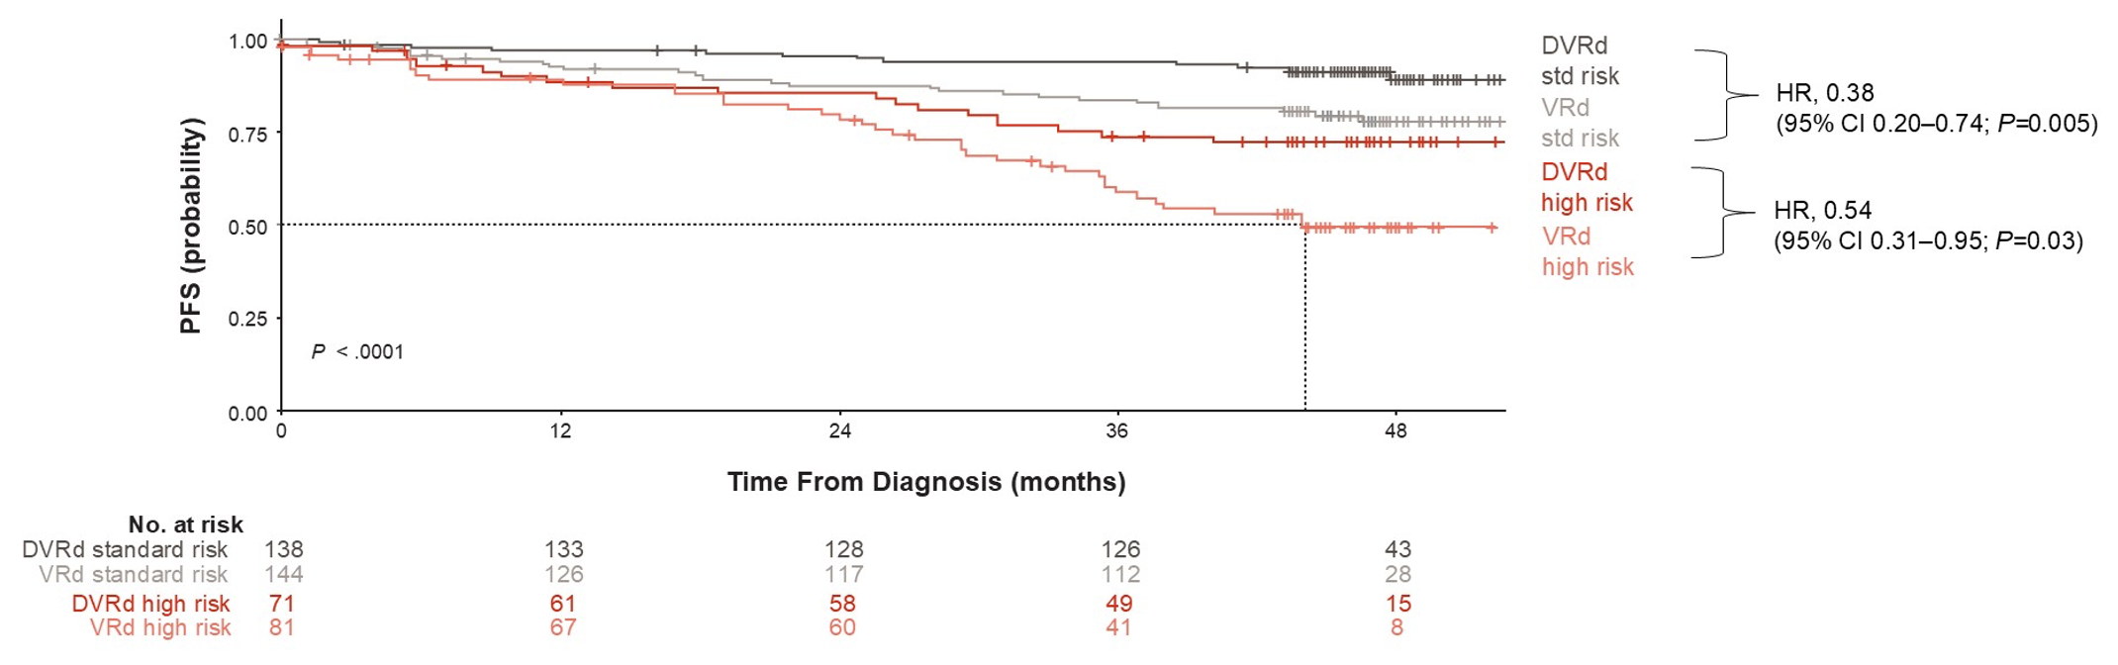
MRD & Outcomes Data
Dara improves outcomes in both SR & HR MM, but HRMM still doesn’t do as well
Bertamini, L et al. ASCO 2026;Abstract 7505.

Slide 51
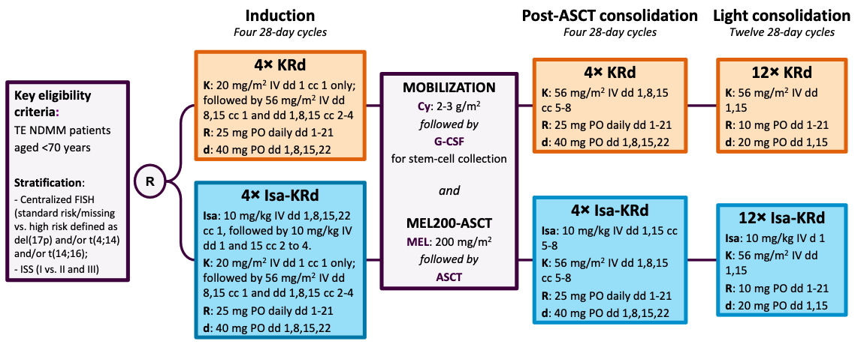
IsKia : Isa-KRd vs. KRd in TE NDMM
M-protein >2 g/dL
BM PC >20%
i/u FLC ratio >20
Randomized 302 patients ≤70 years 1:1 to Isa-KRd versus KRd pre-transplant induction and post-transplant consolidation
Primary endpoint was rate of MRD negativity (10⁻⁵ or better) by NGS after consolidation
Gay, F et al. Nat Med. 2026 May;32(5):1773-1782.

Slide 52
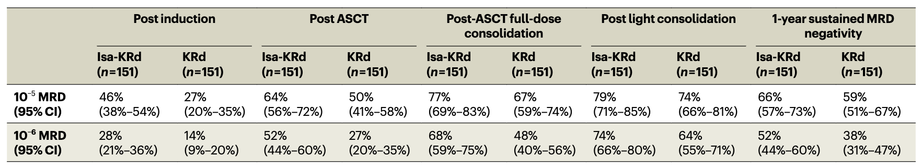
Outcomes : IsaKRd Better
Isa-KRd produced higher rates of MRD-negativity at every timepoint studied
Gay, F et al. Nat Med. 2026 May;32(5):1773-1782.

Slide 53
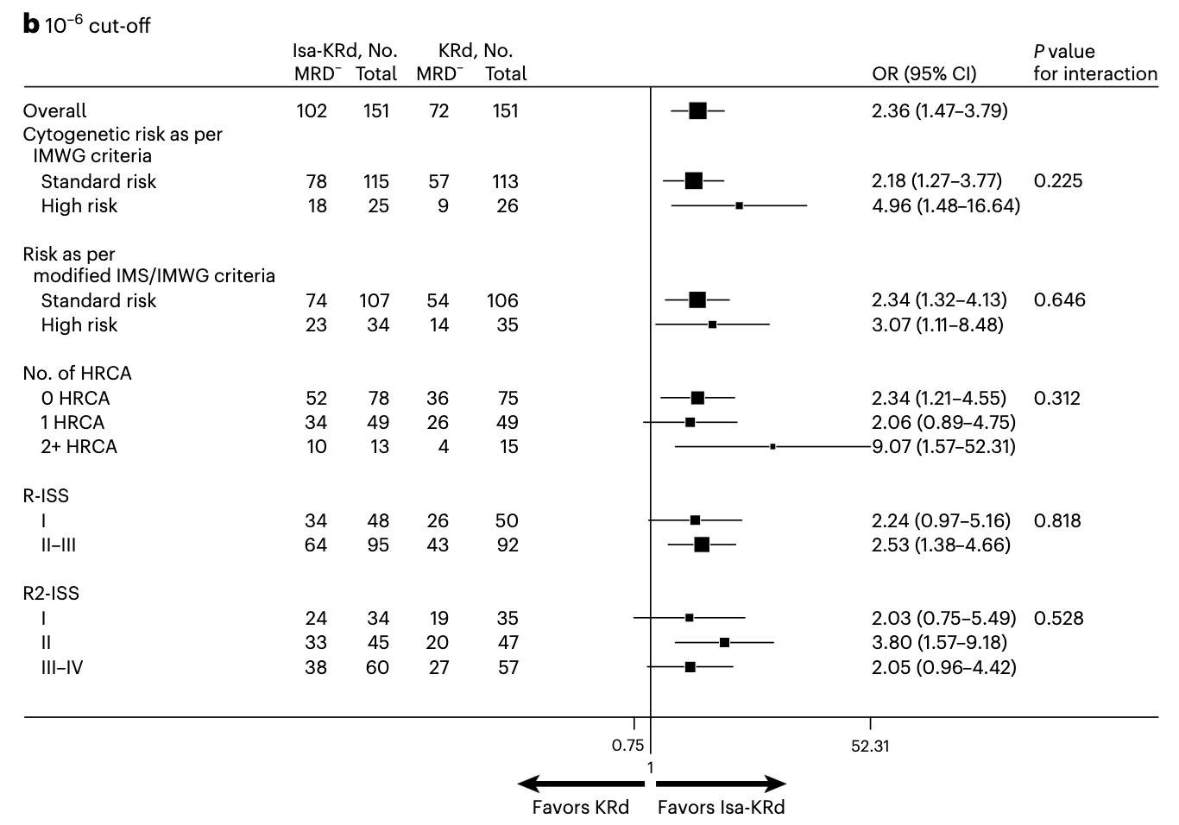
Outcomes : IsaKRd Better
Gay, F et al. Nat Med. 2026 May;32(5):1773-1782.

Slide 54
Quadruplet Therapy for Transplant-Ineligible Newly Diagnosed MM

Slide 55
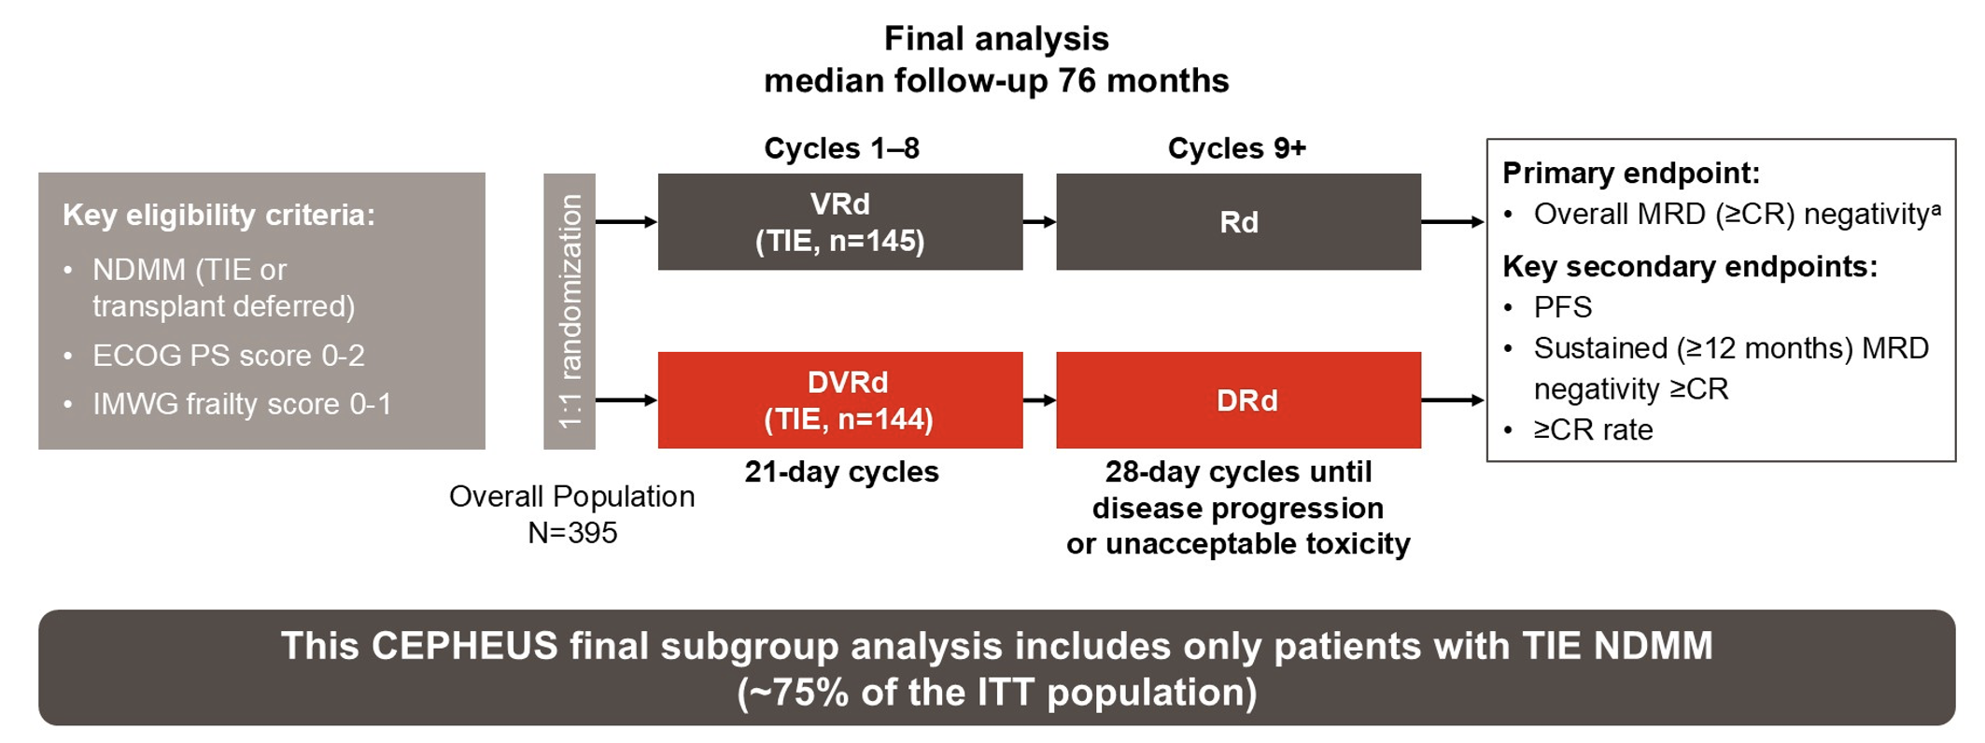
CEPHEUS Update : DVRd in TIE NDMM
Usmani, SZ et al. ASCO 2026;Abstract 7513.

Slide 56
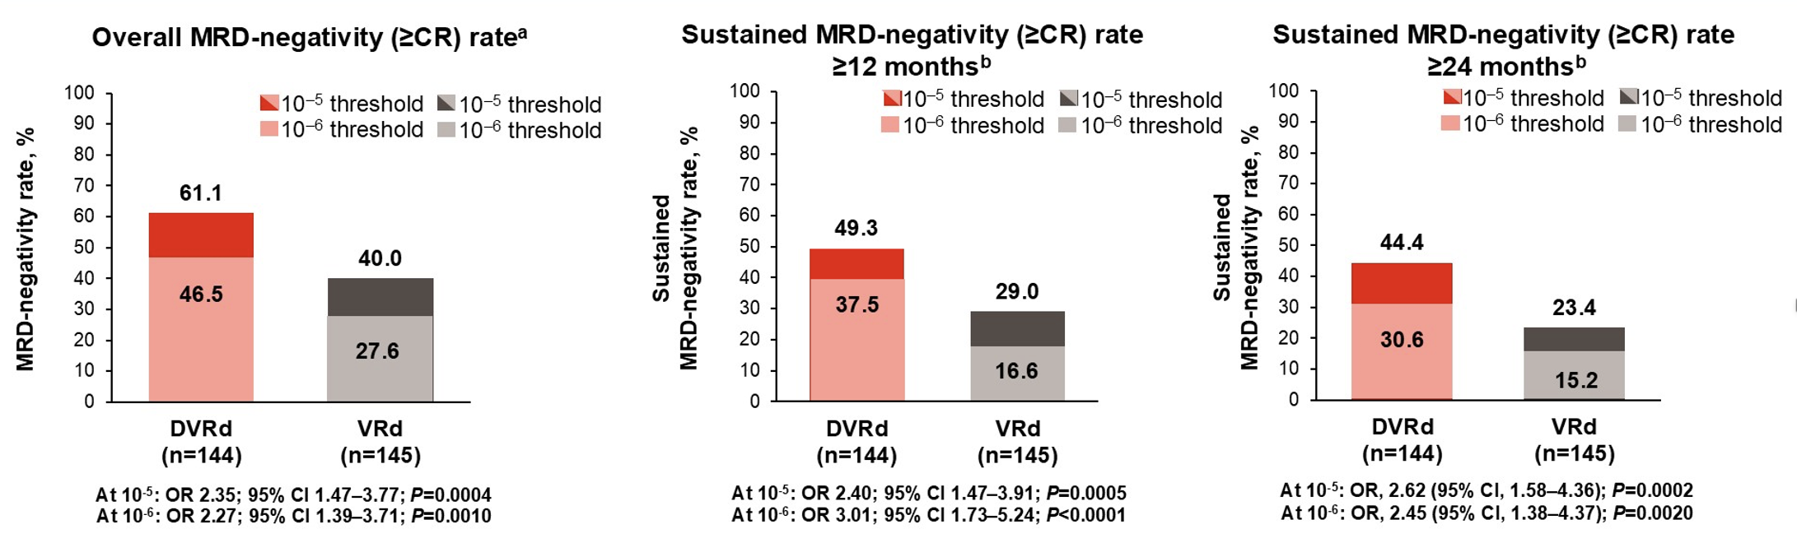
CEPHEUS Update : DVRd in TIE NDMM
Better MRD-negative CR rate overall, and at 12 & 24 months
Usmani, SZ et al. ASCO 2026;Abstract 7513.

Slide 57
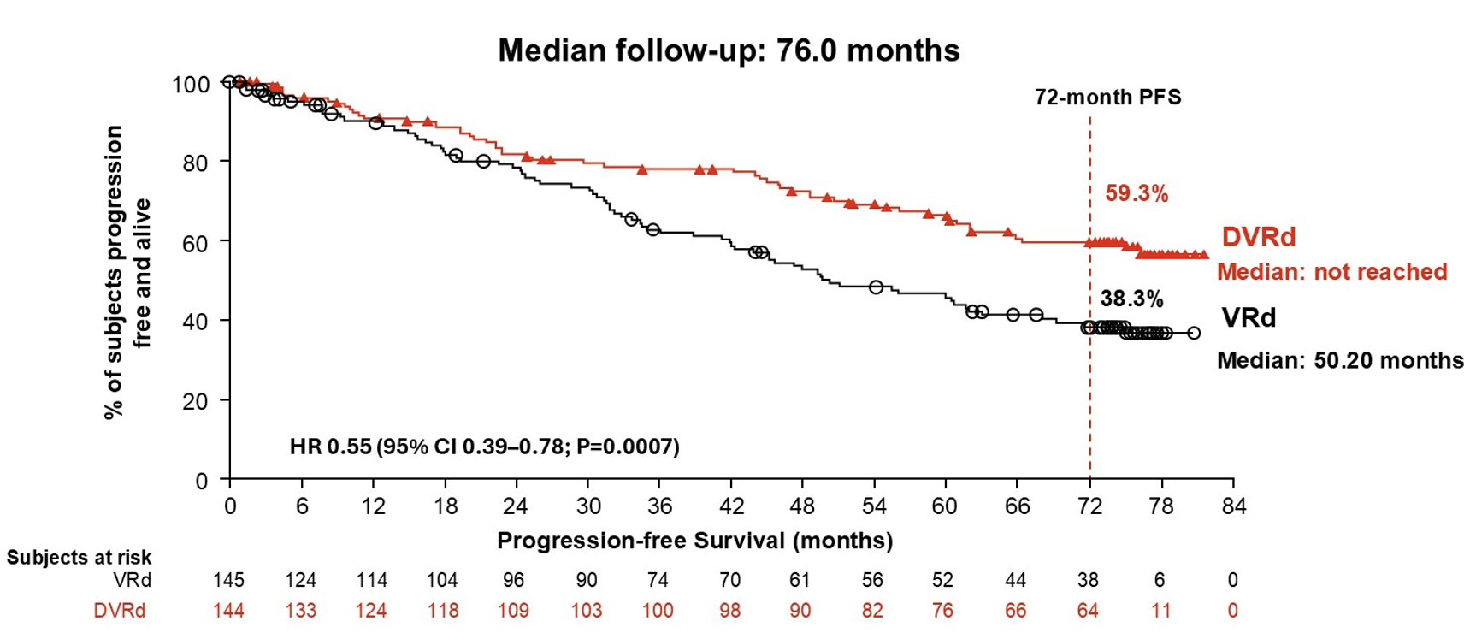
Final PFS & Subgroup Data
Usmani, SZ et al. ASCO 2026;Abstract 7513.

Slide 58
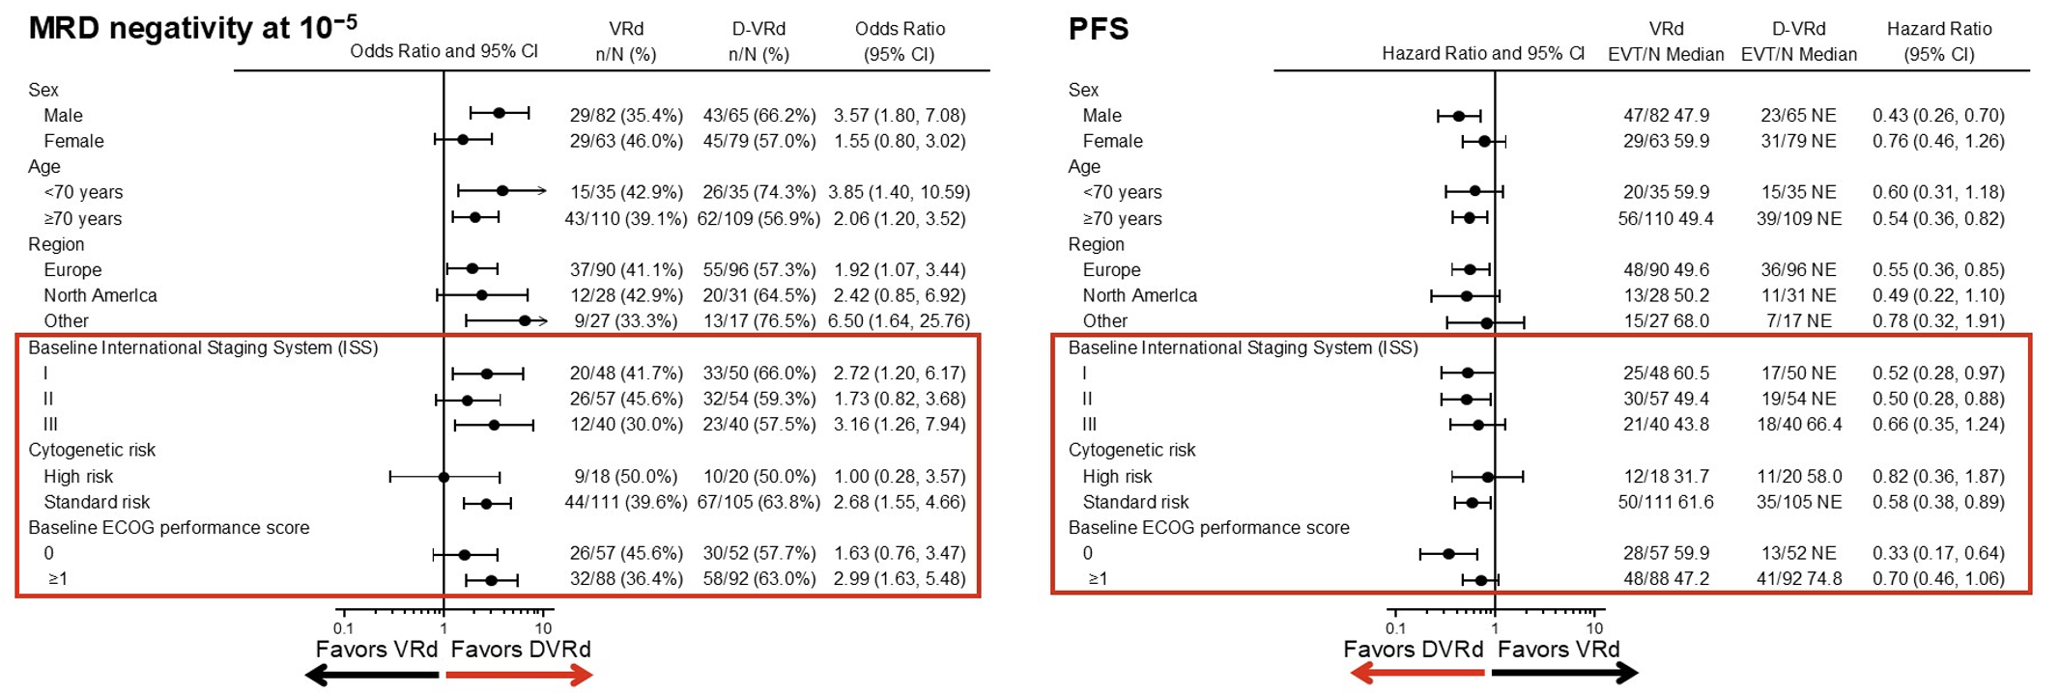
Final PFS & Subgroup Data
Treatment effect consistent across most subgroups except a few where N was too small
Usmani, SZ et al. ASCO 2026;Abstract 7513.

Slide 59
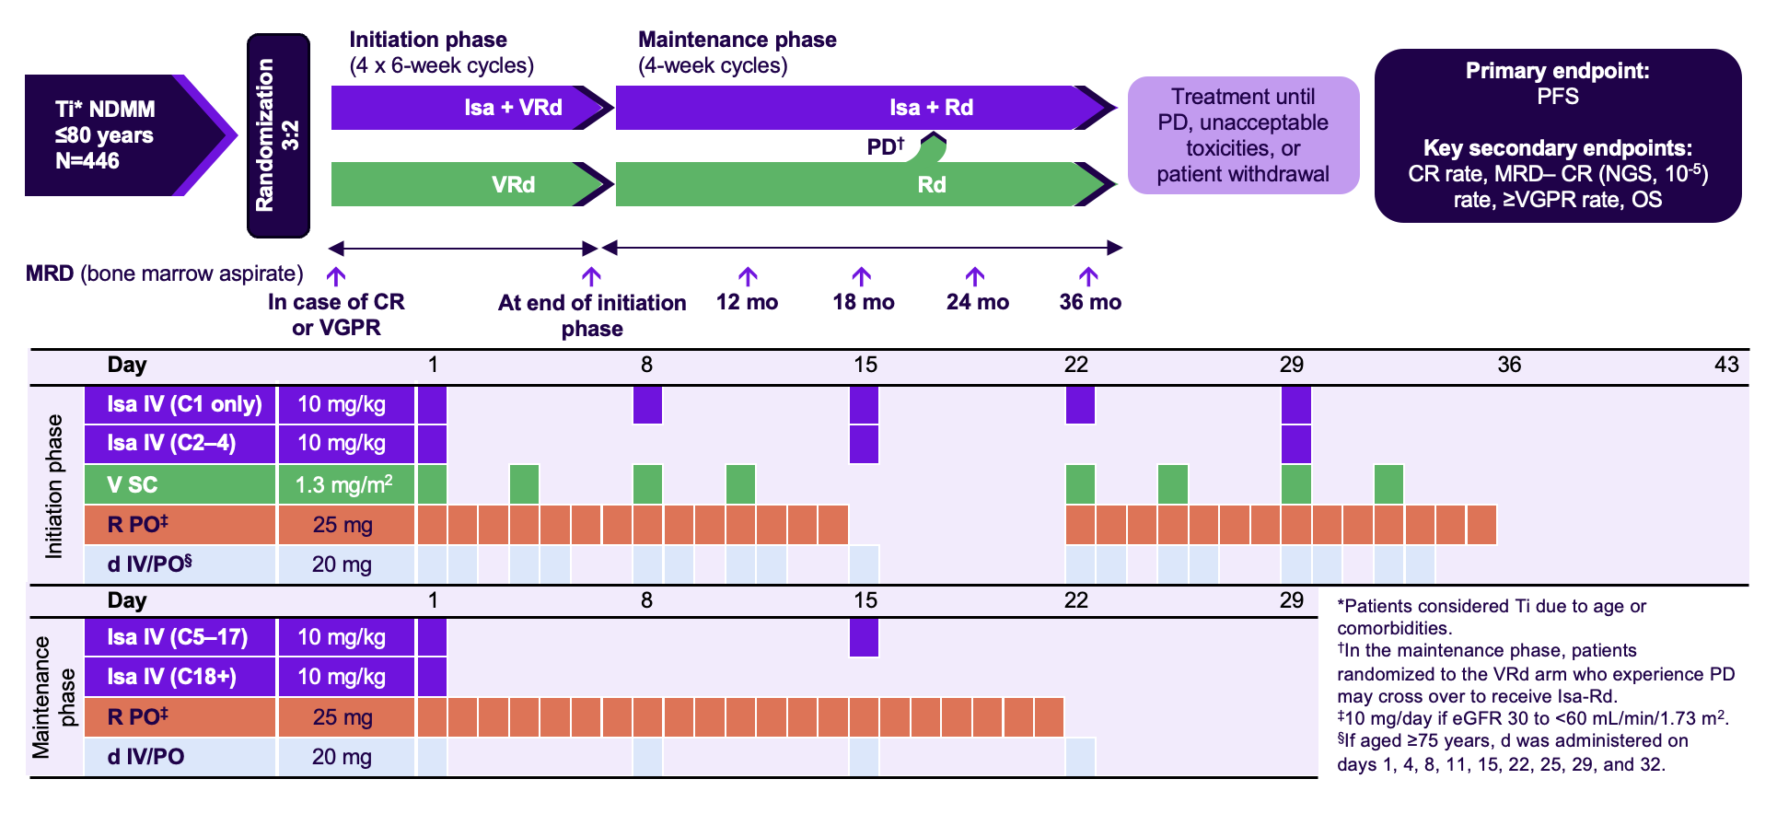
IMROZ : Isa-VRd Better During Induction
M-protein >2 g/dL
BM PC >20%
i/u FLC ratio >20
Orlowski, RZ et al. Blood. 2026 Jun 4;147(23):2760-2769.

Slide 60
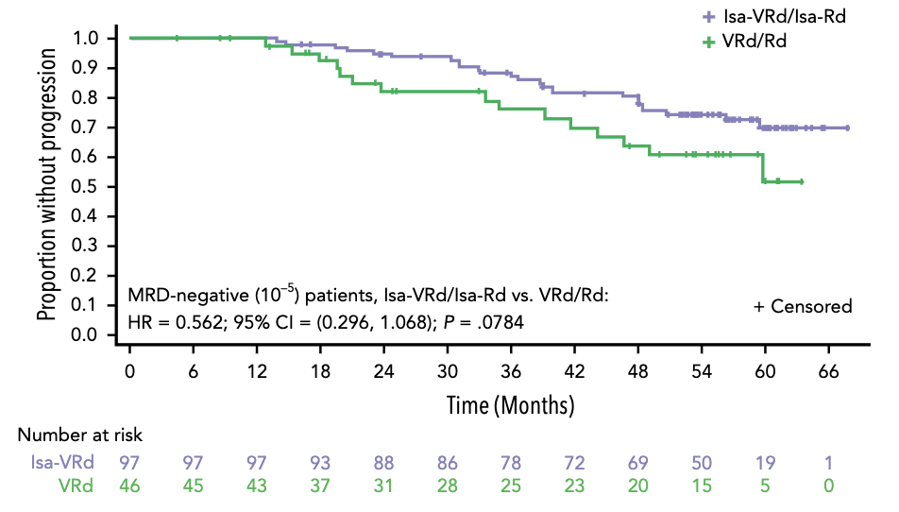
IMROZ : Isa-VRd Better During Induction
M-protein >2 g/dL
BM PC >20%
i/u FLC ratio >20
PFS in patients by MRD-negativity (10⁻⁵) @ 6 months
Orlowski, RZ et al. Blood. 2026 Jun 4;147(23):2760-2769.

Slide 61
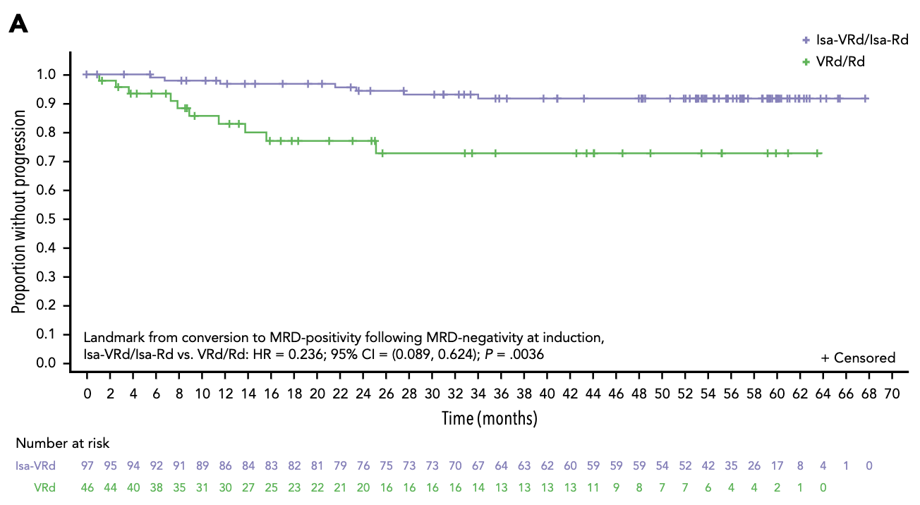
Isa-VRd Better Even After MRD⁺
M-protein >2 g/dL
BM PC >20%
i/u FLC ratio >20
Group that converts from MRD⁻ to MRD⁺ still does better if they had prior Isa-VRd
Orlowski, RZ et al. Blood. 2026 Jun 4;147(23):2760-2769.

Slide 62
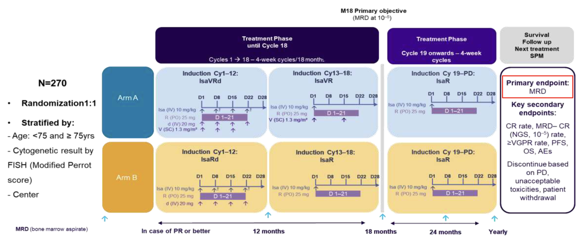
BENEFIT Trial Update
M-protein >2 g/dL
BM PC >20%
i/u FLC ratio >20
Bobin, A et al. ASH 2025;Abstract 368.

Slide 63
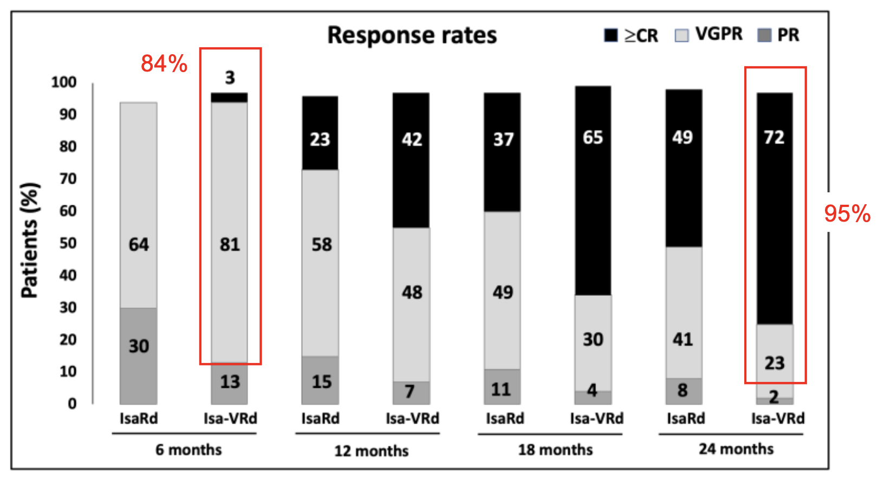
BENEFIT Trial Update
M-protein >2 g/dL
BM PC >20%
i/u FLC ratio >20
Bobin, A et al. ASH 2025;Abstract 368.

Slide 64
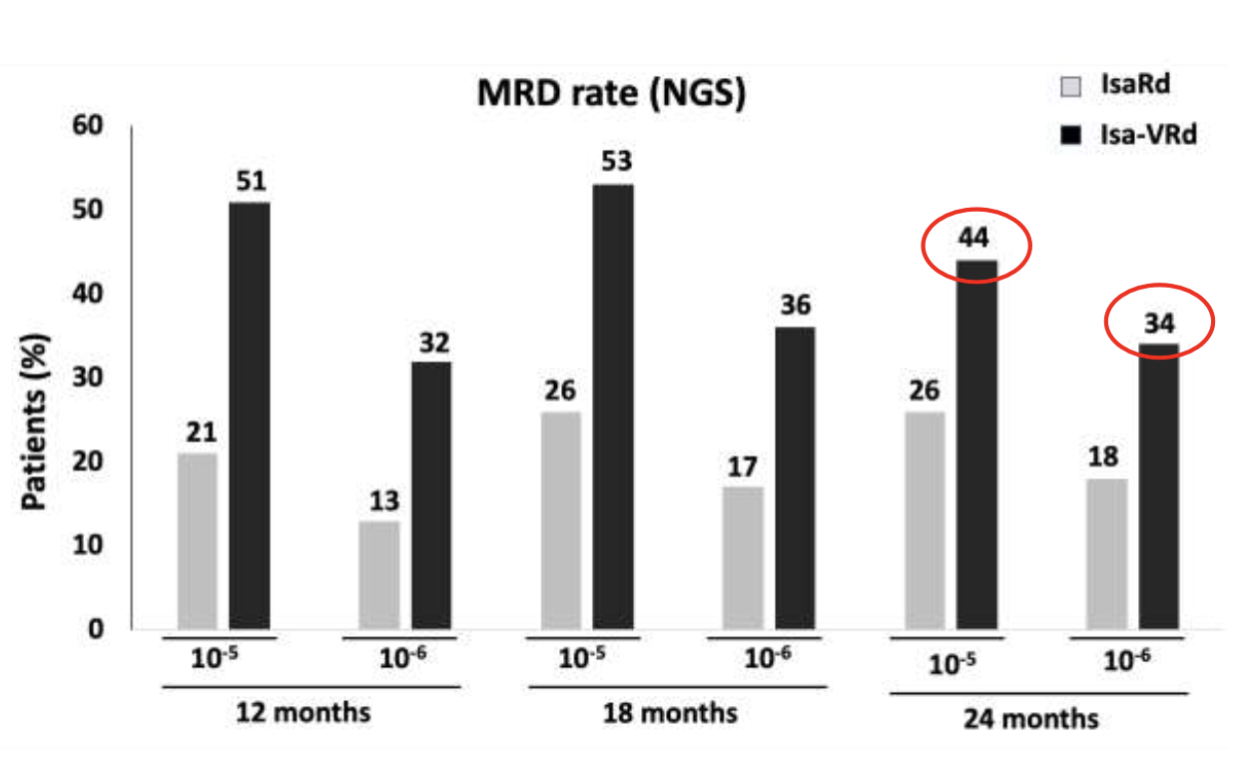
MRD & Sustained MRD⁻
M-protein >2 g/dL
BM PC >20%
i/u FLC ratio >20
Bobin, A et al. ASH 2025;Abstract 368.

Slide 65
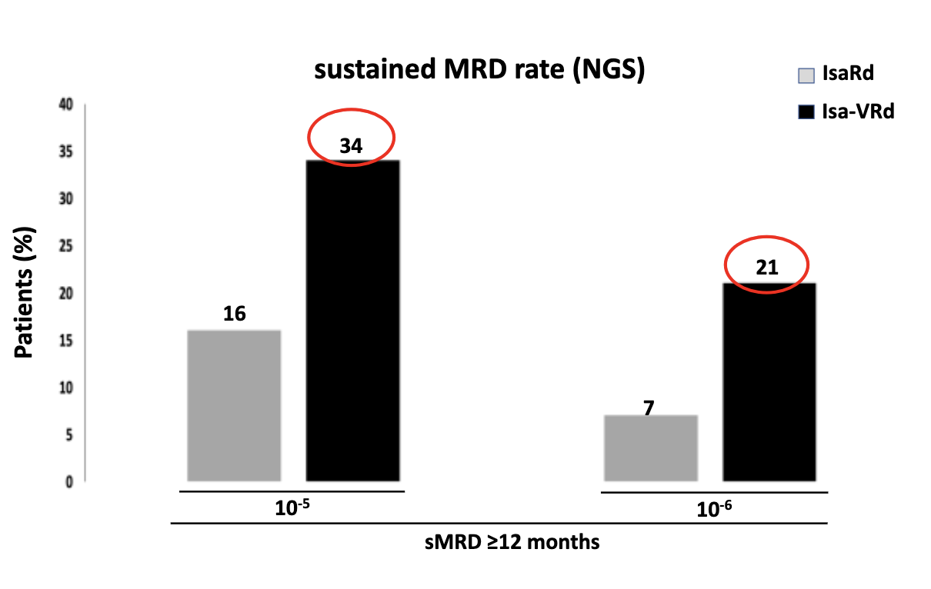
MRD & Sustained MRD⁻
M-protein >2 g/dL
BM PC >20%
i/u FLC ratio >20
Bobin, A et al. ASH 2025;Abstract 368.

Slide 66
Subcutaneous Isatuximab

Slide 67
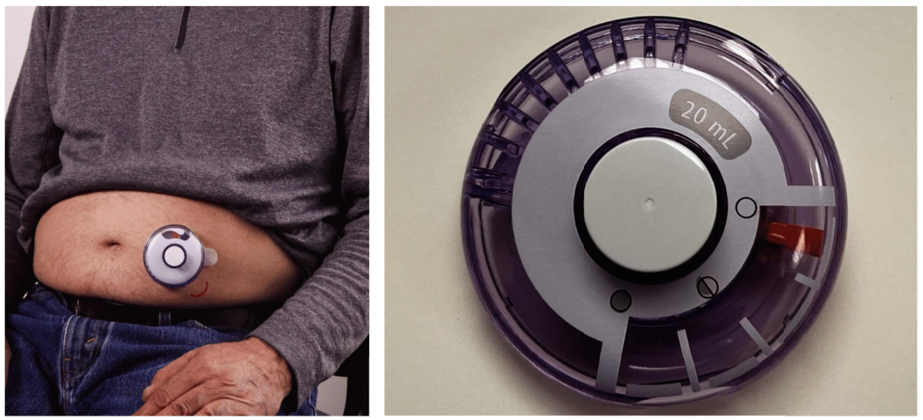
IRAKLIA : Isatuximab OBI
M-protein >2 g/dL
BM PC >20%
i/u FLC ratio >20
Ailawadhi, S et al. J Clin Oncol. 2025 Aug;43(22):2527-2537.

Slide 68
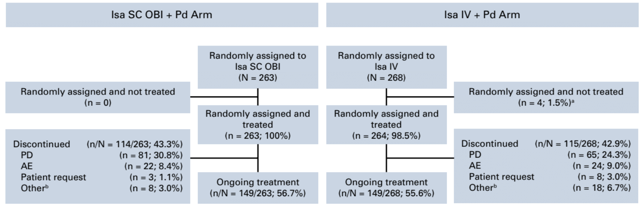
IRAKLIA : Isatuximab OBI
M-protein >2 g/dL
BM PC >20%
i/u FLC ratio >20
Phase III study comparing Isa^{IV}Pd to Isa^{SC}Pd in patients with 1 or more prior lines, including lenalidomide and a PI
Ailawadhi, S et al. J Clin Oncol. 2025 Aug;43(22):2527-2537.

Slide 69
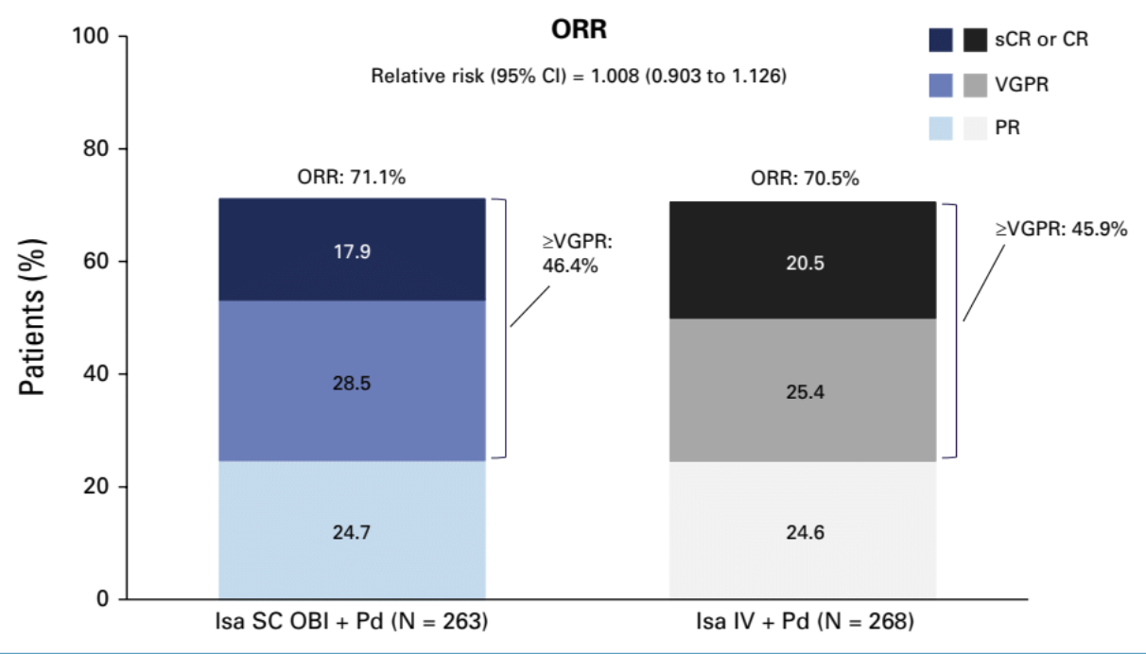
Results : Non-inferiority
M-protein >2 g/dL
BM PC >20%
i/u FLC ratio >20
Ailawadhi, S et al. J Clin Oncol. 2025 Aug;43(22):2527-2537.

Slide 70
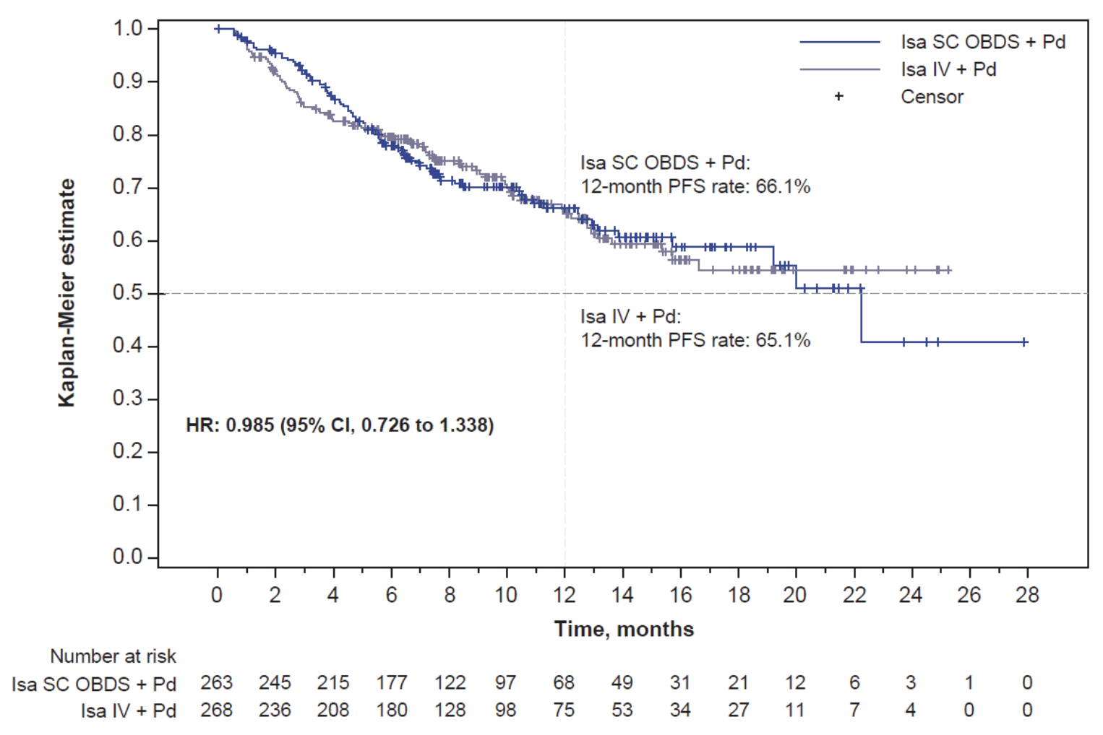
Results : Non-inferiority
M-protein >2 g/dL
BM PC >20%
i/u FLC ratio >20
Ailawadhi, S et al. J Clin Oncol. 2025 Aug;43(22):2527-2537.

Slide 71
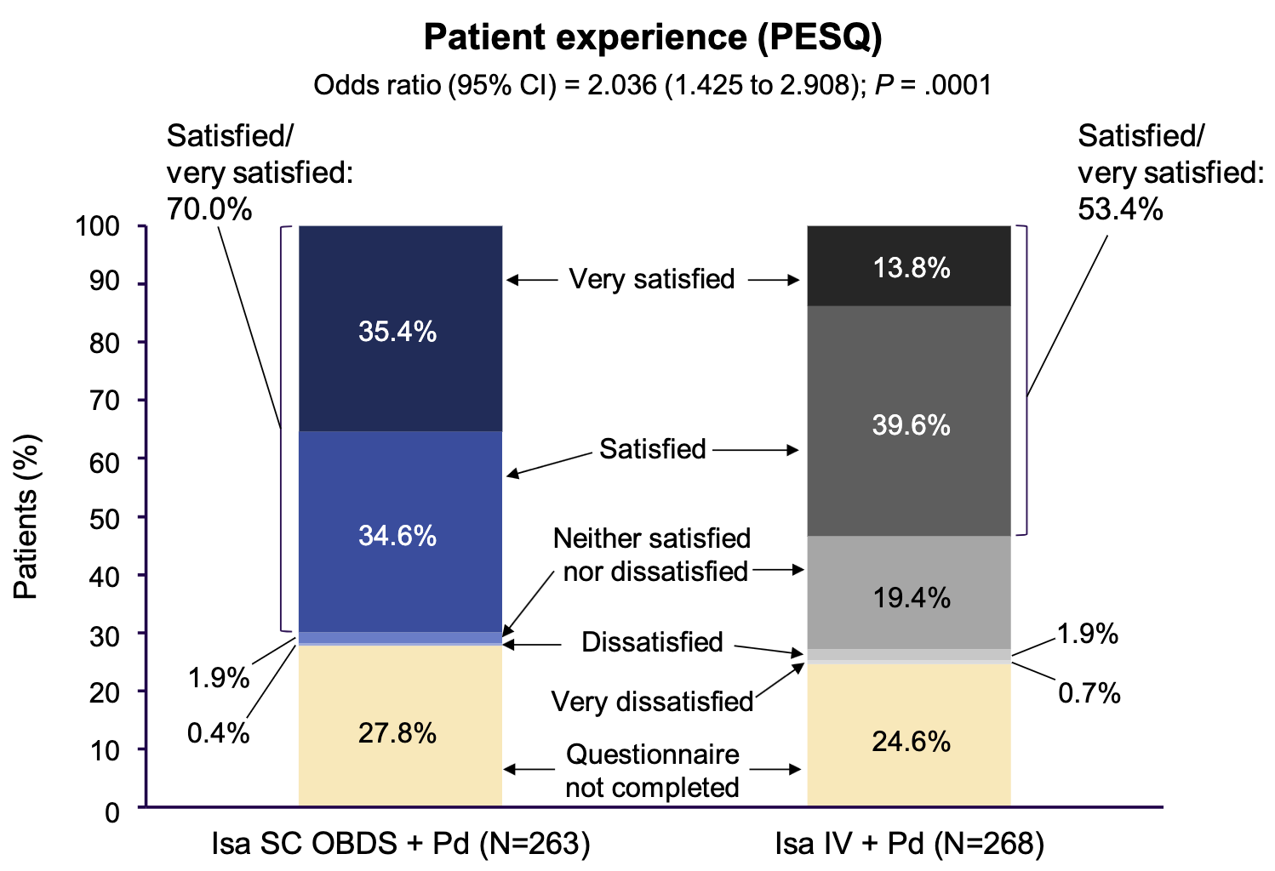
Results : Non-inferiority
M-protein >2 g/dL
BM PC >20%
i/u FLC ratio >20
Improved patient experience
Ailawadhi, S et al. J Clin Oncol. 2025 Aug;43(22):2527-2537.

Slide 72
Addition of Daratumumab to Maintenance Therapy

Slide 73
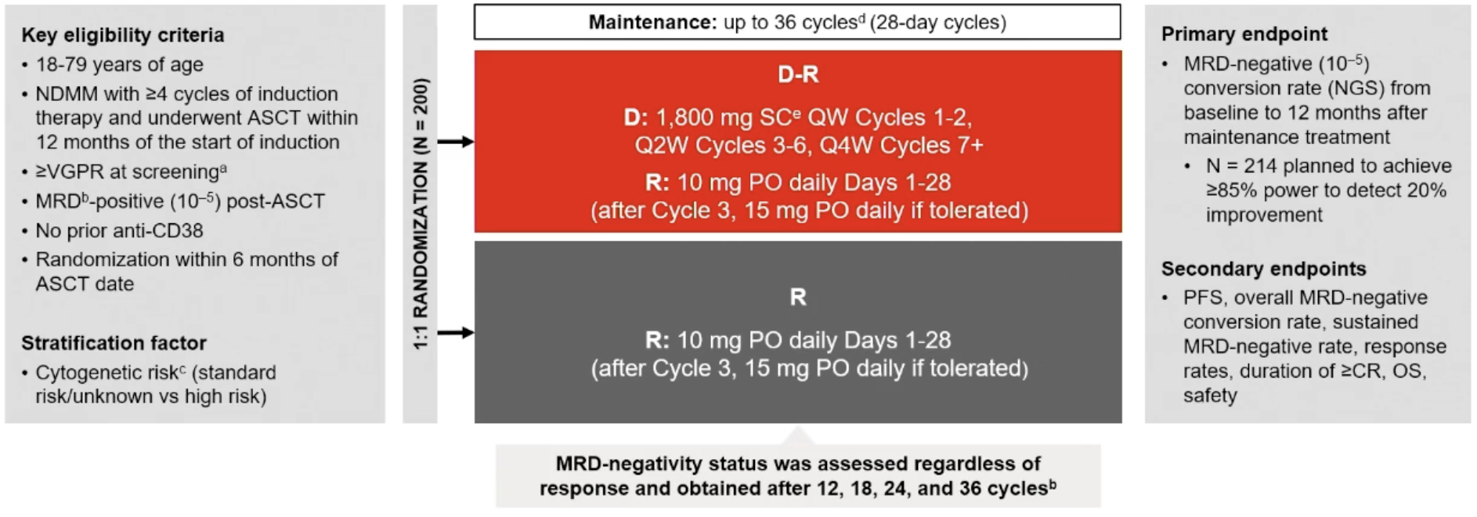
AURIGA Study Update
M-protein >2 g/dL
BM PC >20%
i/u FLC ratio >20
Badros, A et al. Blood. 2025 Jan 16;145(3):300-310.

Slide 74
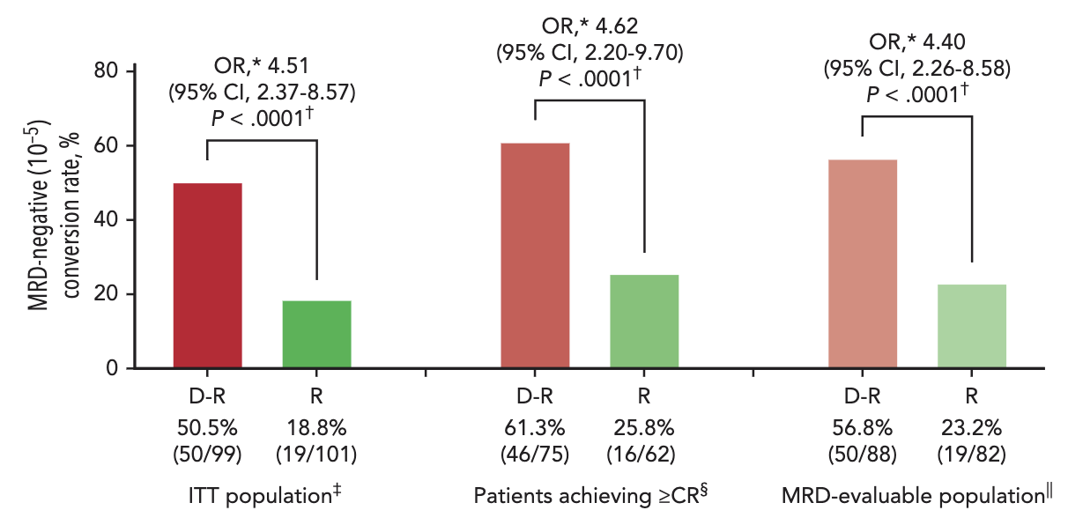
AURIGA Study Update
M-protein >2 g/dL
BM PC >20%
i/u FLC ratio >20
Badros, A et al. Blood. 2025 Jan 16;145(3):300-310.

Slide 75
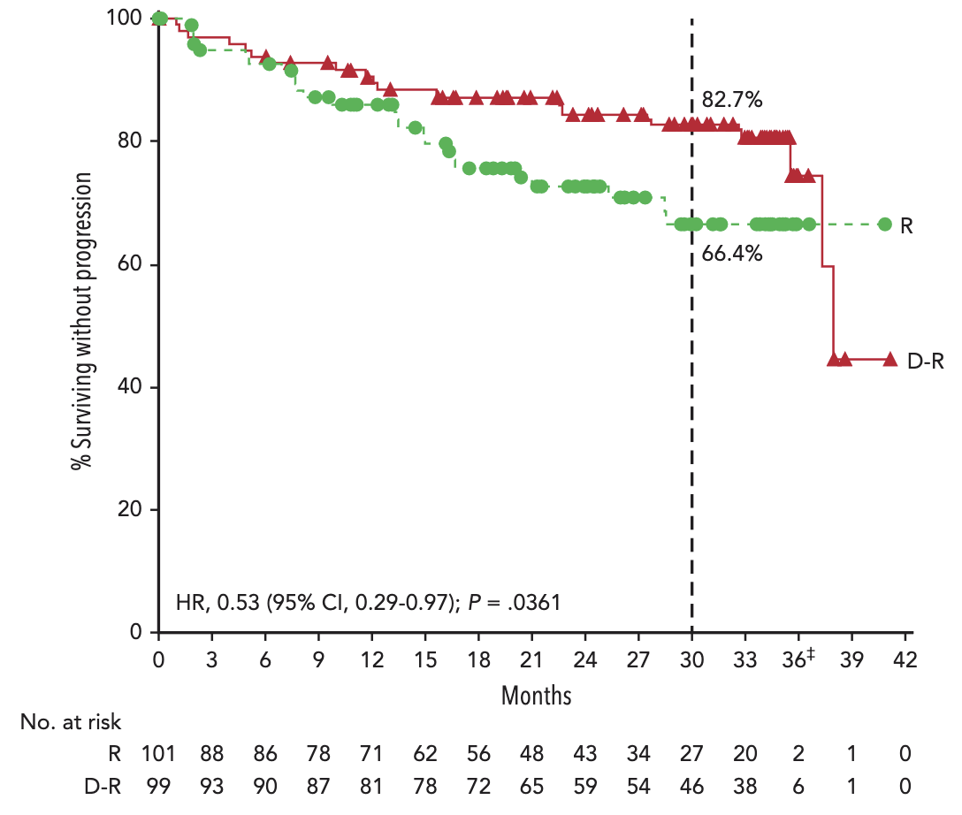
AURIGA Study Update
M-protein >2 g/dL
BM PC >20%
i/u FLC ratio >20
Badros, A et al. Blood. 2025 Jan 16;145(3):300-310.

Slide 76
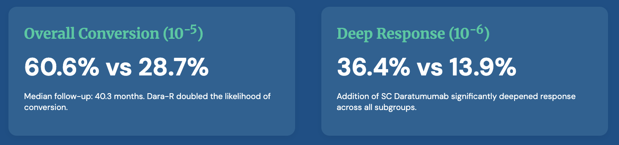
Updated Data From IMS
M-protein >2 g/dL
BM PC >20%
i/u FLC ratio >20
Per investigator assessment, a 45% reduction in the risk of PD or death was seen with D-R versus R, with estimated 36-mo PFS rates of 76.8% for D-R and 61.4% for R
Anderson, L et al. IMS 2025;Abstract OA-47.

Slide 77
CELMoDs for Relapsed/Refractory MM

Slide 78
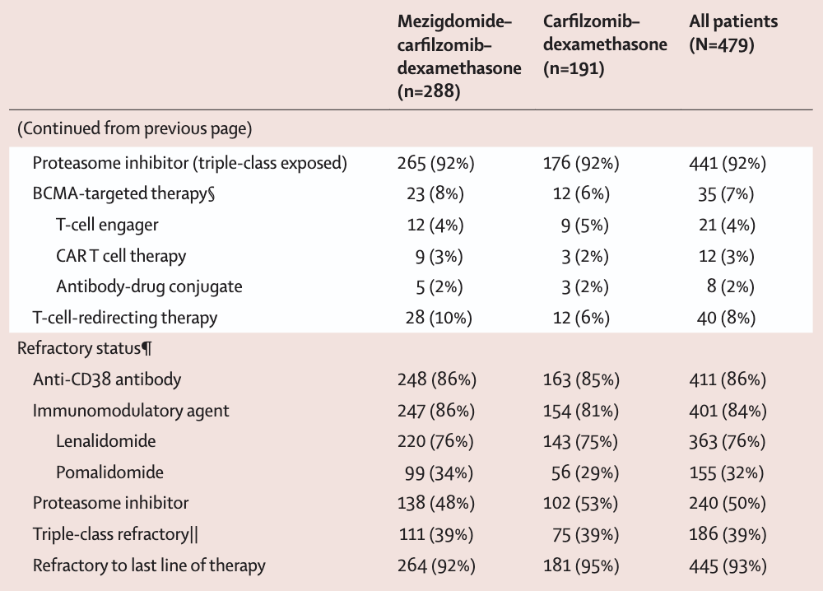
SUCCESSOR-2 : MeziKD vs. Kd
M-protein >2 g/dL
BM PC >20%
i/u FLC ratio >20
1 or more prior lines (including anti-CD38 antibodies and lenalidomide) on which they had MR or better
Dimopoulos, MA et al. Lancet. 2026 Jun 14:S0140-6736(26)01088-3.

Slide 79
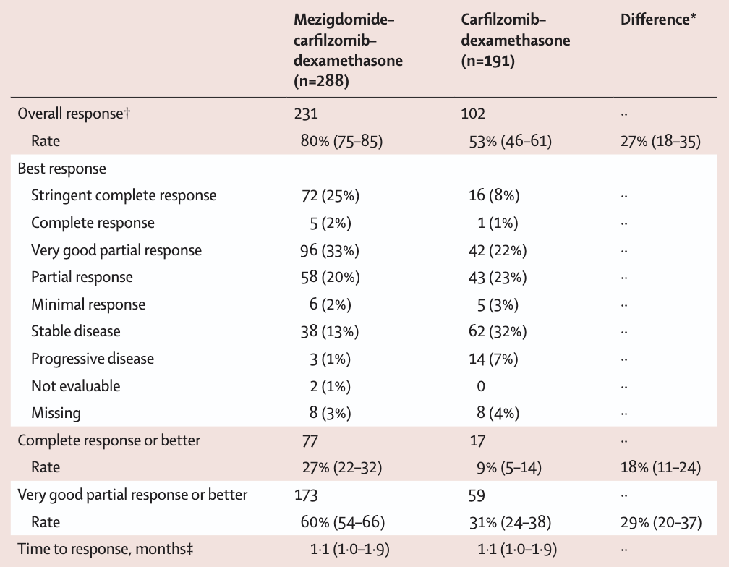
Outcomes & AE Data
M-protein >2 g/dL
BM PC >20%
i/u FLC ratio >20
Dimopoulos, MA et al. Lancet. 2026 Jun 14:S0140-6736(26)01088-3.

Slide 80
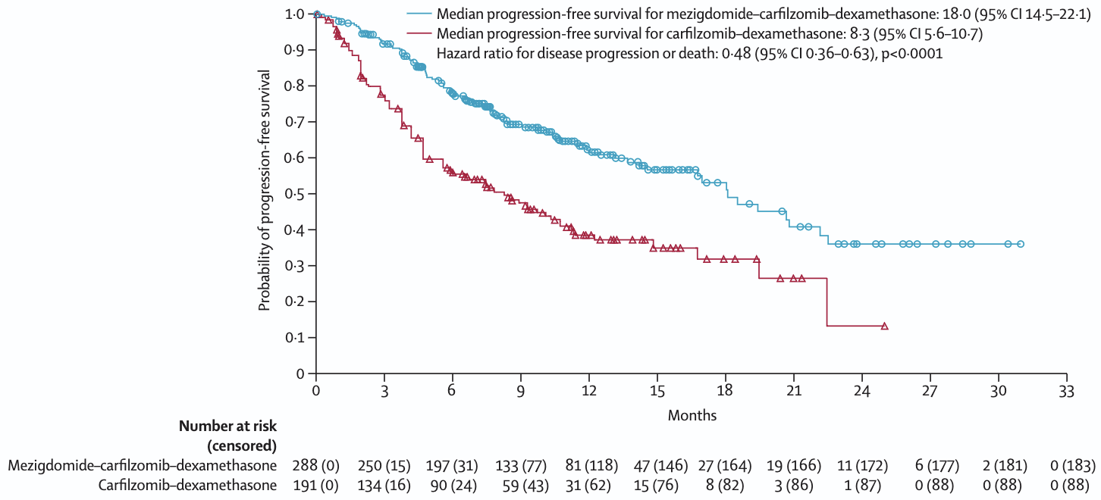
Outcomes & AE Data
M-protein >2 g/dL
BM PC >20%
i/u FLC ratio >20
Dimopoulos, MA et al. Lancet. 2026 Jun 14:S0140-6736(26)01088-3.

Slide 81
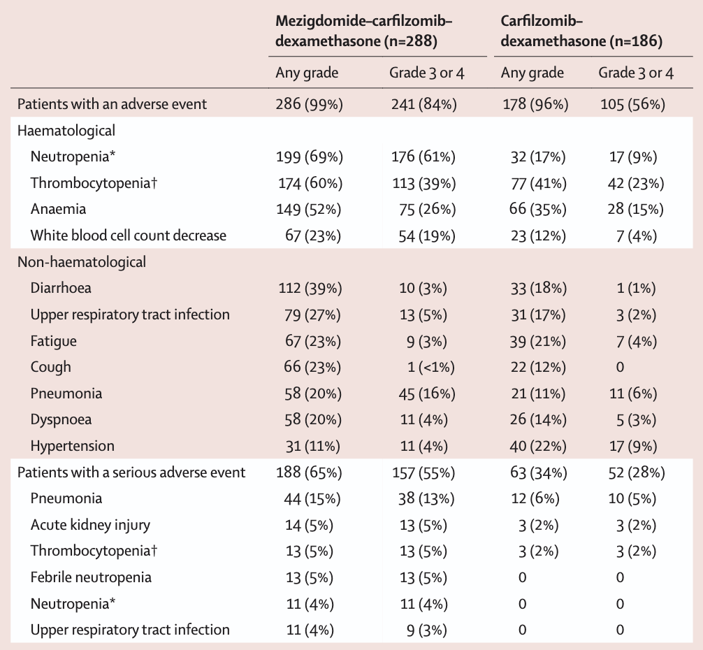
Outcomes & AE Data
M-protein >2 g/dL
BM PC >20%
i/u FLC ratio >20
Dimopoulos, MA et al. Lancet. 2026 Jun 14:S0140-6736(26)01088-3.

Slide 82
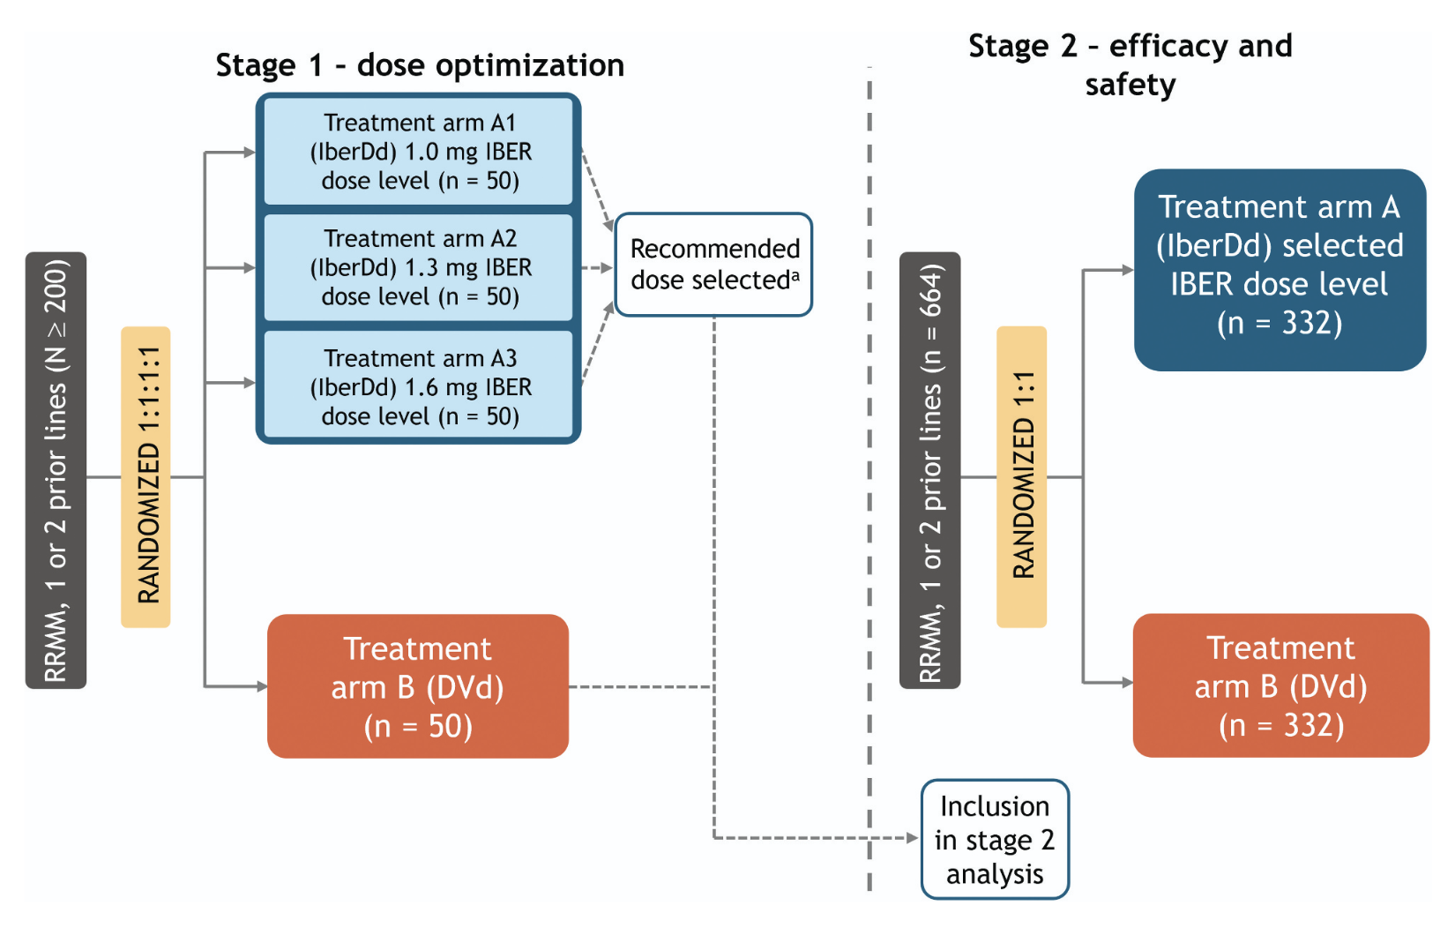
EXCALIBER-RRMM Study
M-protein >2 g/dL
BM PC >20%
i/u FLC ratio >20
Lonial, S et al. Future Oncol. 2025 Jun;21(14):1761-1769.

Slide 83
Phase III EXCALIBER-RRMM Study Evaluating Iberdomide in Combination with Standard Therapies Demonstrated a Significant Improvement in Minimal Residual Disease Negativity Rates in Relapsed or Refractory Multiple Myeloma
Press Release: September 23, 2025
“[The manufacturer] today announced that the Phase 3 EXCALIBER-RRMM study evaluating iberdomide, an investigational cereblon E3 ligase modulator (CELMoD™), combined with standard therapies (daratumumab + dexamethasone) in patients with relapsed or refractory multiple myeloma (RRMM) demonstrated a statistically significant improvement in minimal residual disease (MRD) negativity rates, compared with the control arm, in a planned interim analysis of the MRD endpoint. In accordance with the trial design and based on the recommendation from the Data Monitoring Committee, the trial will continue without changes to evaluate the other dual-primary endpoint of progression-free survival (PFS), and the key secondary endpoint of overall survival and safety. The safety profile of iberdomide in combination with daratumumab and dexamethasone in this study is generally consistent with previous studies.
The company plans to discuss these results with health authorities.”
https://news.bms.com/news/corporate-financial/2025/Bristol-Myers-Squibb-Announces-Phase-3-EXCALIBER-RRMM-Study-Evaluating-Iberdomide-in-Combination-with-Standard-Therapies-Demonstrated-a-Significant-Improvement-in-Minimal-Residual-Disease-Negativity-Rates-in-Relapsed-or-Refractory-Multiple-Myeloma/default.aspx

Slide 84
CELMoDs for Newly Diagnosed MM

Slide 85
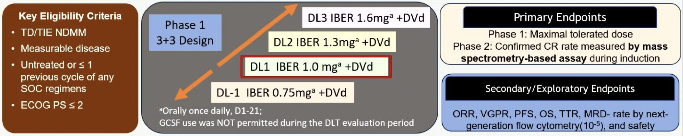
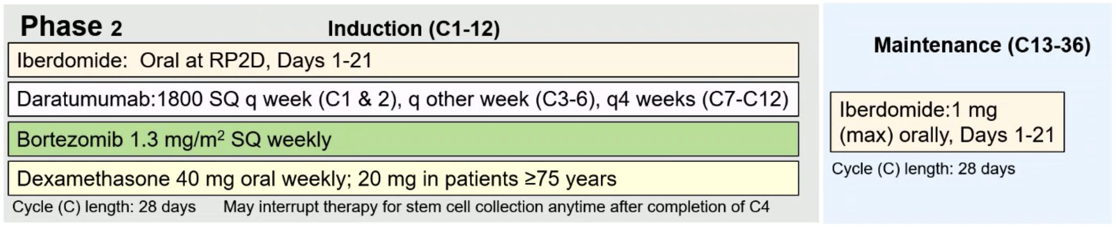
Phase I/II IDEAL Study : Iber-DVd
M-protein >2 g/dL
BM PC >20%
i/u FLC ratio >20
Kapoor, P et al. EHA 2026;Abstract S199.

Slide 86
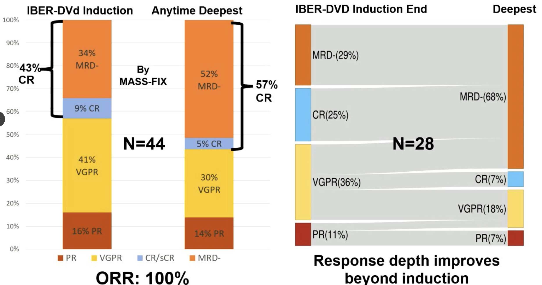
Phase I/II IDEAL Study : Iber-DVd
M-protein >2 g/dL
BM PC >20%
i/u FLC ratio >20
Kapoor, P et al. EHA 2026;Abstract S199.

Slide 87
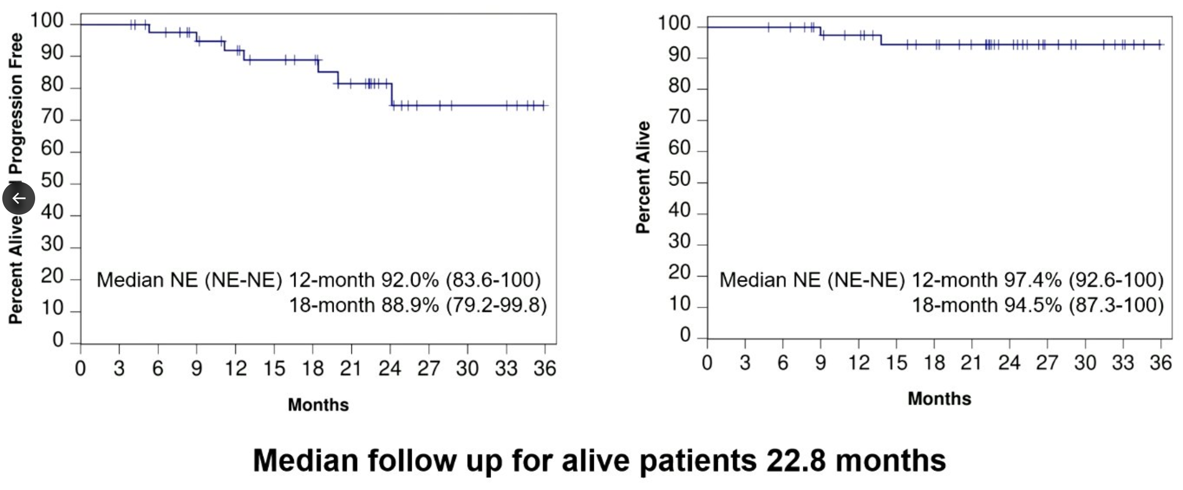


Long-term Data & AEs
M-protein >2 g/dL
BM PC >20%
i/u FLC ratio >20
Kapoor, P et al. EHA 2026;Abstract S199.

Slide 88
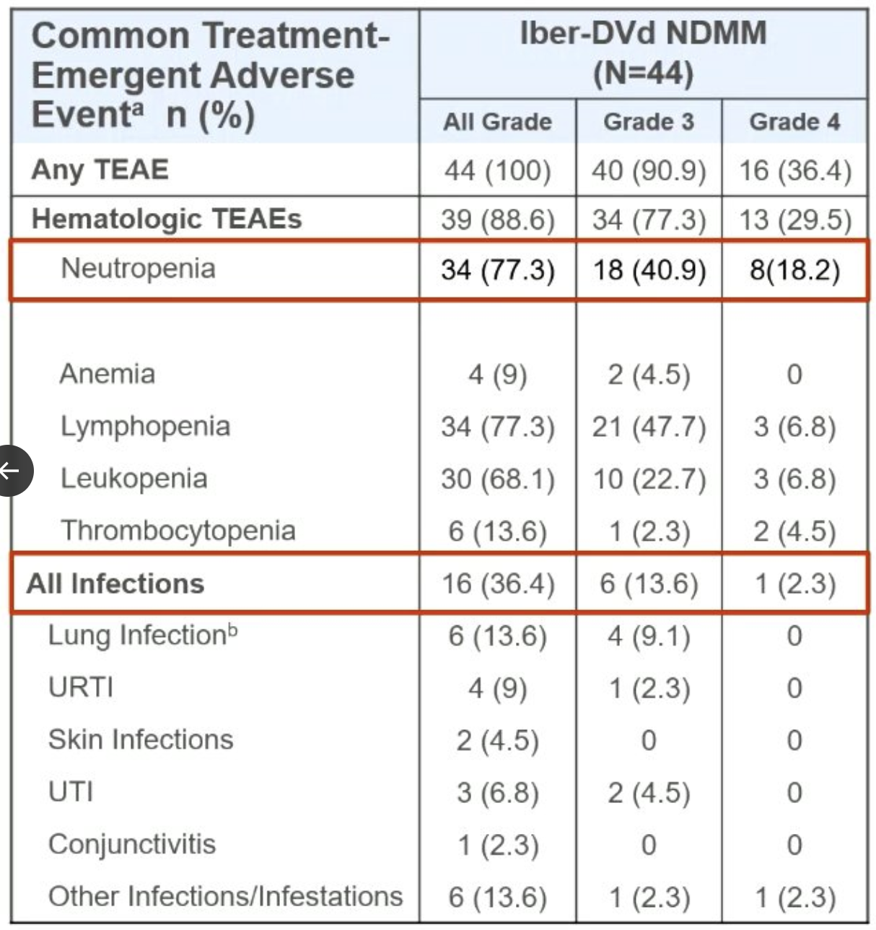
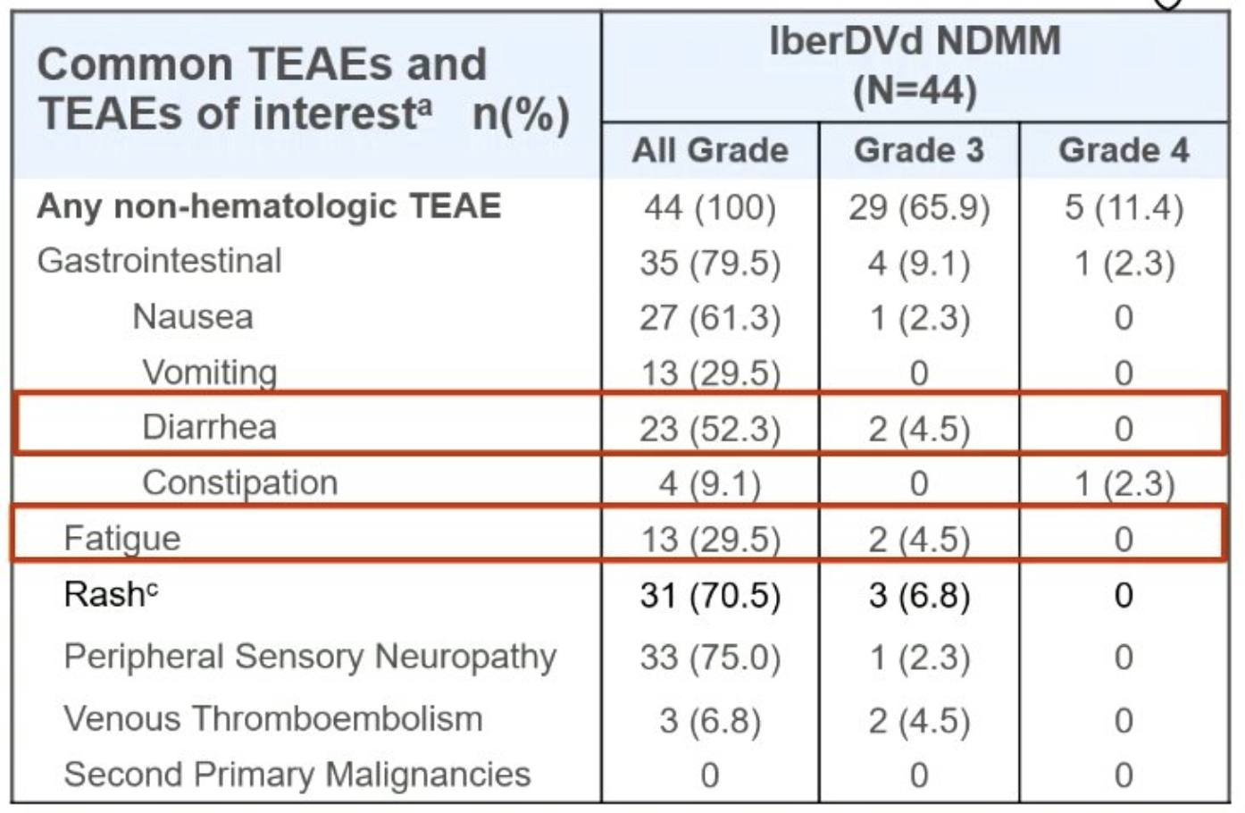


Long-term Data & AEs
M-protein >2 g/dL
BM PC >20%
i/u FLC ratio >20
Kapoor, P et al. EHA 2026;Abstract S199.

Slide 89

DETERMINATION 2 Schema (Revised for N = 720 Patients)
Courtesy of Paul G Richardson, MD

Slide 90
DETERMINATION 2
Discussion Points
Isatuximab-iberdomide Vd backbone
MRD guided
Linvoseltamab versus autologous stem cell transplant

Slide 91
Year in Review:
Multiple Myeloma
INTRODUCTION: Up-Front PFS for Standard-Risk Disease — 2006, 2016
MODULE 1: Current and Emerging Therapeutic Approaches — Dr Orlowski
MODULE 2: Chimeric Antigen Receptor T-Cell Therapy, Bispecific Antibodies and Antibody-Drug Conjugates — Dr Krishnan
MODULE 3: ASCO and EHA 2026

Slide 92



Myeloma Updates ASCO/EHA
Amrita Krishnan MD FACP :
Director Judy and Bernard Briskin Center for Myeloma City of Hope Cancer Center: Professor of Hematology/HCT: Nason Hollingsworth Family Chair in Myeloma

Slide 93
Long-Term Outcomes with Ciltacabtagene Autoleucel (Cilta-cel) CAR T-Cell Therapy

Slide 94

CAR T CELLS

Slide 95

Long Term Remission after Cilta-cel
Clinical implication: Cilta-cel demonstrates durable remission supporting earlier use in treatment sequencing.
FIG 2. (A) OS. (B) Progression-free survival. Cilta-cel, ciltacabtagene autoleucel; OS, overall survival.
Published in: Sundar Jagannath; Thomas G. Martin; Yi Lin; Adam D. Cohen; Noopur Raje; Myo Htut; Abhinav Deol; Mounzer Agha; Jesus G. Berdeja; Alexander M. Lesokhin; Jessica J. Liegel; Adriana Rossi; Alex Lieberman-Cribbin; Saad Z. Usmani; Binod Dhakal; Samir Parekh; Hui Li; Feng Wang; Rocio Montes de Oca; Vicki Plaks; Huabin Sun; Arnob Banerjee; Jordan M. Schecter; Nikoletta Lendvai; Deepu Madduri; Tamar Lengil; Jieqing Zhu; Mythili Koneru; Muhammad Akram; Nitin Patel; Octavio Costa Filho; Andrzej J. Jakubowiak; Peter M. Voorhees J Clin Oncol 2025 06-3
DOI: 10.1200/JCO-25-00760

Slide 96

Cilta-cel Shows an Overall Survival
Benefit over SOC
Einsele Lancet 2026

Slide 97
MajesTEC-3 Trial versus CARTITUDE-4 Trial

Slide 98


MajesTEC-3 suggests that bsAb and CAR T cells are similarly effective (comparing to CARTITUDE-4)
Key eligibility criteria for both:
1-3 prior lines of therapy including PI/imid
Lenalidomide-refractory
Refractory to last line of therapy
MajesTEC-3
CARTITUDE-4
Clinical implication: Bispecific antibodies provide a practical alternative to CAR-T with comparable efficacy signals.

Slide 99
MajesTEC-3 suggests that bsAb and CAR T cells are similarly effective (comparing to CARTITUDE-4)
Key eligibility criteria for both:
1-3 prior lines of therapy including PI/imid
Lenalidomide-refractory
Refractory to last line of therapy
 | MajesTEC-3 | CARTITUDE-4
Median prior lines | 2 (1-3) | 1: 32% 2: 40% 3: 27%
Time from diagnosis (yr) | 3.7 | 3.0
HR Cytogenetics | 36.5% | 33.6%
ISS stage 3 | 8.0% | 6.2%
Anti-CD38 exposed | 5.2% | 25%
Costa et al. NEJM 2025
Mateos et al. IMS 2024

Slide 100


MajesTEC-3 suggests that bsAb and CAR T cells are similarly effective (comparing to CARTITUDE-4)
Clinical implication: Treatment choice between CAR-T and bsAb may be guided by access, logistics, and patient factors.
Earlier analysis at ODAC:
PFS
Sources
Costa et al. NEJM 2025
Mateos et al. IMS 2024
FDA ODAC materials (https://www.fda.gov/media/176988/download)

Slide 101
Similar eligibility populations between MajesTEC-3 and CARTITUDE-4 CAR-T trials may reflect selection bias and exclusion of non-infused patients
Fixed-duration teclistamab strategies are emerging (e.g., Limi-Tec)
Bispecifics: Easier to deliver
No manufacturing delay
Potential for outpatient initiation
CAR-T: One-time therapy but toxicity and access limitations remain

Slide 102
MajesTEC-9 Trial

Slide 103
MajesTEC-9: Phase 3 Study Design
Tec
n=296
Primary endpoint
PFS per IRC^{b}
Key inclusion criteria
RRMM
1–3 prior LOTs including an anti-CD38 mAb and lenalidomide
ECOG PS score of 0–2
Key exclusion criteria
Prior BCMA-directed therapy
Key secondary endpoints
≥CR^{b}
OS
MySIm-Q Total Symptom score
Other secondary endpoints
ORR
Safety
PK and immunogenicity
Exploratory endpoints
MRD negativity
1:1
randomization
N=593
PVd/Kdª
by investigator’s choice
n=297 (69% Kd)
April 28, 2023–
April 3, 2025
SUD^{c}
Tec 1.5 mg/kg
Tec 3 mg/kg
28-day cycles
C1 QW
C2 QW
C3–C6 Q2W^{d}
C7+ Q4W
D1
D3
D5
D12
D19
D1
D8
D15
D22
D1
D8
D15
D22
D1
D8
D15
D22
Tec SC
Dex (pre-med)^{e}
Monthly Tec dosing from C7 (earlier if ≥VGPR); steroid free after C1D5
Mina R et al. ASCO 2026;Abstract 7507

Slide 104
MajesTEC-9: Baseline Demographic and
Disease Characteristics
Characteristic | Tec (n=296) | PVd/Kd (n=297)
Age
Median (range), years | 70 (34–85) | 70 (36–86)
≥75 years, n (%) | 84 (28.4) | 89 (30.0)
Sex, n (%)
Male | 150 (50.7) | 153 (51.5)
Female | 146 (49.3) | 144 (48.5)
Race, n (%)
White | 190 (64.2) | 198 (66.7)
Asian | 62 (20.9) | 56 (18.9)
Black or African American | 10 (3.4) | 10 (3.4)
Otherª | 34 (11.5) | 33 (11.1)
Characteristic | Tec (n=296) | PVd/Kd (n=297)
Baseline ECOG PS score, n (%)
0 | 156 (52.7) | 135 (45.5)
1 | 121 (40.9) | 137 (46.1)
2 | 19 (6.4) | 24 (8.1)
3 | 0 | 1 (0.3)
ISS stage, n (%)
I | 168 (56.8) | 170 (57.2)
II | 86 (29.1) | 82 (27.6)
III | 42 (14.2) | 45 (15.2)
BMPCs ≥60%,^{b} n/N (%) | 31/292 (10.6) | 40/295 (13.6)
Soft-tissue plasmacytomas, n (%) | 54 (18.2) | 65 (21.9)
Extramedullary plasmacytomas^{b} | 19 (6.4) | 22 (7.4)
Paraskeletal plasmacytomas^{b} | 43 (14.5) | 52 (17.5)
High-risk cytogenetics,^{c} n/N (%) | 105/294 (35.7) | 104/296 (35.1)
Balanced baseline characteristics are reflective of a RRMM population, including high‑risk disease
Mina R et al. ASCO 2026;Abstract 7507

Slide 105
MajesTEC-9: Prior LOTs
Characteristic | Tec (n=296) | PVd/Kd (n=297)
Prior LOTs
Median (range), n | 2 (1–3) | 2 (1–3)
1 prior LOT | 64 (21.6) | 64 (21.5)
2 prior LOTs | 131 (44.3) | 137 (46.1)
3 prior LOTs | 101 (34.1) | 96 (32.3)
Prior transplantation, n (%) | 145 (49.0) | 147 (49.5)
Autologous | 145 (49.0) | 146 (49.2)
Prior therapy exposure, n (%)
PI | 256 (86.5) | 254 (85.5)
IMiD | 296 (100) | 297 (100)
Anti-CD38, n (%) | 296 (100) | 297 (100)
Characteristic | Tec (n=296) | PVd/Kd (n=297)
Refractory status, n (%)
To last prior LOT | 274 (92.6) | 273 (91.9)
Any PI | 122 (41.2) | 128 (43.1)
Any IMiD | 245 (82.8) | 251 (84.5)
Lenalidomide | 234 (79.1) | 240 (80.8)
Any anti-CD38 | 253 (85.5) | 252 (84.8)
Double refractory (IMiD and anti-CD38) | 218 (73.6) | 221 (74.4)
Triple refractory (IMiD, anti-CD38, and PI) | 102 (34.5) | 98 (33.0)
Clinical implication: Optimized dosing strategies enable safer outpatient bispecific administration.
Approximately 75% of patients were double refractory to an IMiD and anti-CD38 mAb
Mina R et al. ASCO 2026;Abstract 7507

Slide 106

MajesTEC-9: Tec Significantly Improved PFS
(Primary Endpoint)
Estimated 18-mo PFS
69.8%
Tec
Median, NR
Surviving without progression, %
26.9%
HR, 0.29 (95% CI, 0.23–0.38); P<0.0001ª
Median follow-up: 17.3 months
PVd/Kd
Median, 8.2 months
296
297
258
199
239
162
206
112
172
74
141
51
92
33
57
16
27
6
6
1
0
0
No. at risk
Tec
PVd/Kd
Clinical implication: Bispecific sequencing after prior BCMA therapy remains feasible
in heavily pretreated patients.
Tec significantly improved PFS, with a 71% reduction in the risk of
disease progression or death in a highly refractory population
Mina R et al. ASCO 2026;Abstract 7507

Slide 107
Linvoseltamab for R/R MM and Systemic Amyloidosis

Slide 108
LINKER-MM1 (NCT03761108)
Phase 1/2 study of linvoseltamab (BCMA × CD3 bispecific antibody) in patients with relapsed/refractory multiple myeloma
Lee et al. Clin Lymphoma Myeloma Leuk. 2025
Patient population
Study design
Endpoints
Triple-class exposed or double refractory multiple myeloma
≥3 prior lines of therapy (PI, IMiD, anti-CD38 mAb)
ECOG PS ≤2
Phase 1: Dose escalation
Linvoseltamab 50 mg and 200 mg IV
Phase 2: Dose optimization
Linvoseltamab 200 mg IV
N=117 at 200 mg dose
Dosing schedule
IV linvoseltamab QW through Wk 14–16
Then Q2W thereafter
Primary endpoint
Overall response rate (ORR)
Key secondary endpoints
Duration of response (DOR)
Progression-free survival (PFS)
Overall survival (OS)
MRD negativity rate

Slide 109
LINKER-MM1: Efficacy at 21.3 Months Median Follow-up
Linvoseltamab 200 mg (N=117) | Lee et al. Clin Lymphoma Myeloma Leuk. 2025 | Data cutoff: July 23, 2024
Endpoint | Linvoseltamab 200 mg
ORR | 71%
≥CR rate | 52%
MRD negativity (10⁻⁵) Among evaluable ≥CR patients | 94%
Median DOR | 29.4 months
Median PFS | Not reached
Median OS | 31.4 months
Key Safety Findings
CRS: 46% (Grade 3: 1%); most events during step-up dosing
Neutropenia: 44% (Grade ≥3: 43%)
Infections: 75% (Grade ≥3: 48%); rate decreasing after 6 months
No new safety signals with longer follow-up
Subgroup Highlights
ORR ≥50% across all subgroups assessed
Consistent responses across age, race, penta-refractory status
Favorable outcomes in high disease burden and difficult-to-treat RRMM (EMP, ISS stage 3, high-risk cytogenetics)
Long-term linvoseltamab 200 mg provided deep and durable responses with no new safety signals in RRMM

Slide 110

LINKER-MM1: Efficacy in Patients Across Key Subgroups
Presented at COMy 2025 by Manshi Shah, MD
Lee H et al. ASCO 2023;Abstract 8006

Slide 111
LINKER-AL2 (NCT06292780)
An open-label, Phase 1/2 study evaluating linvoseltamab monotherapy in patients with RR systemic AL amyloidosis
Here we report results from Phase 1 of LINKER-AL2
Patient population
Phase 1:
Dose escalation
Phase 2:
Dose expansion
Key eligibility criteria
Confirmed diagnosis of AL amyloidosis (stage I-IIIa)
Measurable disease (dFLC ≥20 mg/L)
ECOG PS ≤2
≥1 prior therapy
Phase 1 objective:
To evaluate the safety and tolerability, and to determine the RP2DRs of LINVO
(Current enrollment n=20;
up to 60 patients)
Primary endpoint
  Incidence of DLTs through Day 28
  Selected secondary endpoints
  Safety (TEAEs, AESIs, and SAEs)
  IRC-assessed CR, ≥VGPR
  Time to response, DoR, PFS
Low-dose LINVO (80 mg)
Low-dose LINVO (80 mg)
R 1:1
High-dose LINVO (240 mg)
High-dose LINVO (240 mg)
Phase 2 objective:
To evaluate the effect of LINVO on hematologic CR
(Currently recruiting)
Primary endpoint
  IRC-assessed hematologic CR
Treatment schedule
N≈220
Phase 1: Dose escalation
Phase 2: Randomized expansion
Step-up
(IV)
Full dose (SC)
5 mg: Week 1/Day 1
25 mg: Week 2/Day 8
Cycles 1–2: Q1W
Cycle 3–12: Q4W, up to 24 cycles
(28-day cycles)
Wechalekar A al. ASCO 2026;Abstract 7502

Slide 112
RESULTS: Efficacy—Hematological response rate and depth
Hematologic response per ISA criteria
Footnote here
High rate of deep hematologic responses at 9.5 months of follow-up:
  ≥VGPR: 100%
  CR: 90%
≥VGPR
(100%)
≥VGPR
(100%)
≥VGPR
(100%)
LINVO dose groups
Time to CR, median (range) | 1.0 (0.5–4.2) months | 1.6 (0.2–7.9) months | 1.5 (0.2-7.9) months
Study follow up, median (range) | 10.6 (1.6–13.3) months | 9.0 (6.6–11.7) months | 9.5 (1.6–13.3) months
Wechalekar A al. ASCO 2026;Abstract 7502

Slide 113
RESULTS: Efficacy—Organ responses
Investigator-assessed organ response per ISA criteria*
At median follow up of 9.5 months†:
Renal response: 73% (8/11)
  Median time to response: 6.2 weeks (1.1–15.3)
Cardiac response: 38% (3/8)
  Response at Cycle 1 (n=1) and Cycle 4 (n=2)
Patients with organ
response (%)
  High rate of deep hematologic responses (100% ≥VGPR; 90% CR)
  Rapid iFLC level normalization by Day 15; no hematologic progression events
  Cardiac and renal responses observed, even with short treatment duration
  No DLTs observed and generally manageable safety
Wechalekar A al. ASCO 2026;Abstract 7502

Slide 114
Talquetamab: GPRC5D Bispecific Antibody Therapy

Slide 115
MonumenTAL-1: Study Design
Multicenter, open-label phase I/II trial
Primary endpoint (phase II): ORR
Secondary endpoints (phase II): DoR, ≥ VGPR rate, ≥ CR, sCR rate, TTR, PFS, OS, MRD, safety
Talquetamab 0.4 mg/kg SC QW*
(n = 143)
Adults with measurable MM
Phase I: progression on or intolerance to all established therapies; ECOG PS 0-1
Phase II: ≥3 prior lines of therapy that included a PI, an IMiD, and an anti-CD38 antibody; ECOG PS 0–2
Talquetamab 0.8 mg/kg SC Q2W*
(n = 145)
Prior T-Cell Redirection Group: Talquetamab
Either 0.4 mg/kg SC QW or 0.8 mg/kg SC Q2W
(n = 51)
*Previous anti-BCMA therapy allowed; T-cell redirection therapy naive.
Chari. ASH 2022. Abstr 157. NCT03399799. NCT04634552.

Slide 116
MonumenTAL-1: ORR
ORR (%)
Similar ORR among all subgroups examined, including refractory status, except for patients with BL plasmacytoma
ORR was similar for both dosing schedules
  Triple-class refractory: 72.6% (63.1-80.9) QW and 71.0% (61.1–79.6) Q2W
  Penta-drug refractory: 71.4% (55.4–84.3) QW and 70.6% (52.5–84.9) Q2W
PR
VGPR
CR
sCR
100
80
60
40
Timing | 0.4 mg/kg SC QW (n = 143) | 0.8 mg/kg SC Q2W (n = 145)
Median follow-up for efficacy, mo (range) | 14.9 (0.5-29.0) | 8.6 (0.2-22.5)
Median time to first response, mo (range) (n = 106 in each group) | 1.2 (0.2-10.9) | 1.3 (0.2-9.2)
Median time to best response, mo (range) (n = 106 in each group) | 2.2 (0.8-12.7) | 2.7 (0.3-12.5)
20
0
Chari. ASH 2022. Abstr 157. Reproduced with permission.

Slide 117

MonumenTAL 1 ( Chari Lancet Hem 2025)

Slide 118
MONUMENTAL-3: Tal + Dara + Pom vs. Tal + Dara vs. Dara + Pom + Dex
Talquetamab + Daratumumab + Pomalidomide
(N=287)
Relapsed/Refractory Myeloma
≥ 1 line of prior therapy
lenalidomide and proteasome inhibitor exposed
R
Talquetamab + Daratumumab
(N=287)
Len refractory: 85%
anti-CD38 exposed: 12%
Daratumumab + Pomalidomide + Dexamethasone
(N=290)
Efficacy: Tal/Dara/Pom vs. Tal/Dara vs. Dara/Pom/Dex
MRD neg ≥ CR rate: 52.3% vs. 46.3% vs. 15.9%
Significant PFS benefit of Tal/Dara/Pom and Tal/Dara vs Dara/Pom/Dex; HRs 0.28 and 0.33, respectively
24-month PFS: 81.3% vs 77.6% vs. 51.2%.
Voorhees et al. EHA. 2026.

Slide 119

Tal shows PFS benefit

Slide 120
Belantamab Mafodotin

Slide 121
DREAMM-7: study design
Recruitment period
≈13 months from FPI (May 7, 2020) to LPI (June 28, 2021)
Treatment period
Until end of study, withdrawal of consent, PD, death, or
unacceptable toxicity
Follow-up period
Cycles 1-8
Cycle 9+
Eligibility criteria
Arm A (BVd)
Belamaf
2.5 mg/kg IV q3w
+
Belamaf monotherapy
2.5 mg/kg IV q3w
End-of-treatment visit
Follow-up for PFS
q3w
(for patients who discontinue due to reasons other than PD)
Disease assessments q3w
Follow-up for OS q12w
(for patients who discontinue due to PD or other reasons)
Adults with MM
≥1 prior line of MM therapy and documented PD during or after most recent therapy
No prior treatment with anti-BCMA
Not refractory to or intolerant of daratumumab or bortezomib
1:1 randomization
bortezomib 1.3 mg/m² SC on days 1, 4, 8, and 11 of cycles 1-8
(21-day cycles)
+
dexamethasone 20 mg on the day of and day after bortezomibª in cycles 1-8
Arm B (DVd)
Daratumumab
16 mg/kg IV qw in cycles 1-3; and q3w in cycles 4-8
+
Daratumumab monotherapy
16 mg/kg IV q4w in cycle 9+
bortezomib 1.3 mg/m² SC on days 1, 4, 8, and 11 of cycles 1-8
(21-day cycles)
+
dexamethasone 20 mg on the day of and day after bortezomibª in cycles 1-8
Median follow-up (ITT)
28.2 months (range, 0.10-40.02 months)
Stratification:
Prior lines of treatment (1 vs 2 or 3 vs ≥4)
R-ISS stage (I vs II/III)
Prior bortezomib (yes vs no)
Disease assessment visits: q3w from cycle 1 day 1 until PD
Primary endpoint:
PFS (IRC assessed)
Key secondary endpoints:
OS, DOR, and MRD
Additional secondary endpoints:
CRR, ORR, CBR, TTR, TTP, PFS2, AEs, ocular findings, and QOL
AE, adverse event; BCMA, B-cell maturation antigen; CBR, clinical benefit rate; CRR, complete response rate; DOR, duration of response; FPI, first patient in; IRC, independent review committee; ITT, intent-to-treat; IV, intravenous; LPI, last patient in; MM, multiple myeloma; MRD, minimal residual disease; ORR, overall response rate; OS, overall survival; PD, progressive disease; PFS, progression-free survival; q3w, every 3 weeks; q4w, every 4 weeks; q12w, every 12 weeks; QOL, quality of life; qw, once weekly; R-ISS, Revised International Staging System; SC, subcutaneous; TTP, time to progression; TTR, time to response.
ª Reduce starting dose of dexamethasone to 10 mg for patients aged >75 years who have a body mass index of <18.5, previous unacceptable side effects associated with glucocorticoid therapy, or inability to tolerate the starting dose.
María Victoria Mateos, MD, PhD

Slide 122
DREAMM-7: ITT population
Prior treatments
Prior treatments, n (%) | ITT population
 | BVd (N=243) | DVd (N=251)
Prior LOT
1 | 125 (51) | 125 (50)
2 or 3 | 88 (36) | 99 (39)
4+ | 30 (12) | 27 (11)
Prior proteasome inhibitor | 218 (90) | 216 (86)
Prior bortezomib | 210 (86) | 211 (84)
Prior carfilzomib | 31 (13) | 35 (14)
Prior immunomodulatory drugs | 198 (81) | 216 (86)
Prior thalidomide | 121 (50) | 144 (57)
Prior pomalidomide | 25 (10) | 19 (8)
Prior lenalidomide | 127 (52) | 130 (52)
Refractory to lenalidomide | 79 (33) | 87 (35)
Prior daratumumab | 3 (1) | 4 (2)
Prior ASCT | 164 (67) | 173 (69)
In both arms, approximately one-third of patients had disease that was refractory to prior lenalidomide; refractoriness to lenalidomide has been previously associated with a poor prognosis
ASCT, autologous stem cell transplant; ITT, intent to treat; LOT, line of therapy.
María Victoria Mateos, MD, PhD

Slide 123
DREAMM-7: Updated Overall Survival (OS)
BVd showed a significant overall survival benefit vs DVd
36 months
1.0
74%
OSª | BVd (N=243) | DVd (N=251)
Deaths, n (%) | 63 (26) | 100 (40)
OS, median (95% CI), months^{b} | NR (NR-NR) | NR (NR-NR)
HR (95% CI)^{c} | 0.58 (0.43-0.79)
P value^{d} | .00023
0.8
Median
Proj. 84 mo
0.6
OS probability, %
0.4
Median
Proj. 51 mo
0.2
BVd
60%
DVd
0.0
No. at risk
0
1
2
3
4
5
6
7
8
9
10
11
12
13
14
15
16
17
18
19
20
21
22
23
24
25
26
27
28
29
30
31
32
33
34
35
36
37
38
39
40
41
Time since randomization, months
BVd
243
230
220
211
205
200
192
183
175
171
163
158
155
150
147
140
137
131
128
127
125
122
120
118
115
110
105
94
79
72
56
41
31
25
15
11
8
6
3
2
1
0
DVd
251
230
214
205
194
183
176
155
148
141
132
124
115
107
103
99
94
91
87
80
78
73
68
67
65
61
59
52
39
33
22
19
12
11
5
2
1
1
1
1
0
0
BVd demonstrated a statistically significant 42% reduction in the risk of death vs DVd
3-year OS rate: 74% (BVd) vs 60% (DVd); median follow-up 39.4 months
HR, hazard ratio; ITT, intent to treat; NR, not reached; OS, overall survival; R-ISS, Revised International Staging System.
ª Two patients in the ITT population were randomized, not treated, rescreened, and rerandomized. They are counted as 4 unique patients in this output. ^{b} CIs were estimated using the Brookmeyer-Crowley method. ^{c} HRs were estimated using a Cox proportional hazards model stratified by the number of lines of prior therapy (1 vs 2 or 3 vs ≥4), prior bortezomib, and R-ISS stage at screening (I vs II/III), with a covariate of treatment. ^{d} P value from 1-sided stratified log-rank test.
Hungria V et al. Lancet Oncol 2025;26(8):1067-80

Slide 124
Study Design DreaMM8
Recruitment period
October 2020 to December 2022
Treatment period
Until PD, death, unacceptable toxicity, end of study, or
withdrawal of consent
Eligibility criteria
BPd (Q4W)
Belantamab mafodotin
2.5 mg/kg IV (cycle 1) then 1.9 mg/kg IV Q4W from cycle 2 onward
+
Pomalidomide 4 mg orally on days 1-21 (28-day cycles)
+
Dexamethasone 40 mgª on days 1, 8, 15, and 22
End-of-treatment visit
N=302
Primary endpoint:
PFS (IRC assessed per IMWG)
Key secondary endpoints:
OS, MRD negativity, DOR
Additional secondary endpoints include:
ORR, CRR, ≥VGPR,TTBR, TTR, TTP, PFS2, AEs, ocular findings, HRQOL, and PROs
Adults with MM
≥1 prior line of MM therapy including LEN
Documented PD during or after their most recent therapy
No prior treatment with anti-BCMA or pomalidomide; not refractory/intolerant to bortezomib
1:1 randomization
PVd (Q3W)
Bortezomib
1.3 mg/m² SC on days 1, 4, 8, and 11 of cycles 1-8 then days 1 and 8 (21-day cycles)
+
Pomalidomide 4 mg orally on days 1-14 (21-day cycles)
+
Dexamethasone 20 mgª on the day of and day after bortezomib
Stratification^{b}:
Prior lines of treatment (1 vs 2 or 3 vs ≥4)
Prior bortezomib (yes vs no)
Prior anti-CD38 therapy (yes vs no)
AE, adverse event; BCMA, B-cell maturation antigen; BPd, belamaf, pomalidomide, and dexamethasone; CD, cluster of differentiation; CRR, complete response rate; DOR, duration of response; HRQOL, health-related quality of life; IMWG, International Myeloma Working Group; IRC, independent review committee; ISS, International Staging System; IV, intravenous; LEN, lenalidomide; MM, multiple myeloma; MRD, minimal residual disease; ORR, objective response rate; OS, overall survival; PD, progressive disease; PFS, progression-free survival; PFS2, progression-free survival on subsequent line of therapy; PRO, patient-reported outcome; PVd, pomalidomide, bortezomib, and dexamethasone; Q3W, every 3 weeks; Q4W, every 4 weeks; SC, subcutaneous; TTBR, time to best response; TTP, time to progression; TTR, time to response; VGPR, very good partial response.
ª Patients aged >75 years, with comorbidities, or intolerant to 40 mg dose in Arm A or 20 mg dose in Arm B could have dose level reduced to half per investigator discretion. ^{b} Some patients were stratified by ISS status (I vs II/III); the protocol was amended on 20 April 2021 to replace this randomization factor with prior anti-CD38 treatment (yes vs no).
Suzanne Trudel, MD

Slide 125
BPd Led to a Significant PFS Benefit vs PVd
PFS | BPd (N=155) | PVd (N=147)
Events, n (%) | 62 (40) | 80 (54)
Median PFS (95% CI), months | NR (20.6-NR) | 12.7 (9.1-18.5)
HR (95% CI); P value | 0.52 (0.37-0.73); <.001
1.0
12 months
0.8
71%
0.6
Proportion alive and progression free
0.4
51%
BPd
0.2
PVd
0.0
0
1
2
3
4
5
6
7
8
9
10
11
12
13
14
15
16
17
18
19
20
21
22
23
24
25
26
27
28
29
30
31
32
33
34
35
36
37
38
39
No. at risk
(no. of events)
Time since randomization, months
BPd
155
143
135
130
125
122
117
113
111
109
107
102
97
93
82
80
77
75
72
67
64
59
50
45
38
36
28
23
21
16
13
8
4
2
1
0
0
0
0
0
(0)
(5)
(10)
(15)
(19)
(21)
(26)
(28)
(30)
(32)
(34)
(37)
(41)
(42)
(47)
(47)
(49)
(50)
(52)
(53)
(54)
(56)
(58)
(59)
(61)
(61)
(62)
(62)
(62)
(62)
(62)
(62)
(62)
(62)
(62)
(62)
(62)
(62)
(62)
(62)
PVd
147
138
123
111
102
96
92
83
75
68
59
56
54
51
47
43
40
39
37
30
25
22
22
19
18
18
17
13
11
7
5
4
3
2
2
1
1
1
1
0
(0)
(4)
(14)
(23)
(27)
(33)
(37)
(45)
(49)
(52)
(59)
(62)
(62)
(64)
(66)
(68)
(68)
(68)
(70)
(73)
(76)
(77)
(77)
(77)
(77)
(77)
(78)
(78)
(79)
(80)
(80)
(80)
(80)
(80)
(80)
(80)
(80)
(80)
(80)
(80)
BPd led to a statistically significant and clinically meaningful reduction in risk of
disease progression or death vs PVd (HR, 0.52; 95% CI, 0.37-0.73; P<.001)
Median follow-up, 21.8 months (range, 0.03-39.23 months)
The treatment effect (HR and corresponding 95% CIs) was estimated using the stratified Cox proportional hazards model, and the P value was produced based on the 1-sided stratified log-rank test. Stratified analyses were adjusted for number of prior lines of therapy and prior bortezomib use.
BPd, belamaf, pomalidomide, and dexamethasone; HR, hazard ratio; NR, not reported; PFS, progression-free survival; PVd, pomalidomide, bortezomib, and dexamethasone.
Suzanne Trudel, MD

Slide 126
DREAMM-8: MRD Negativity Favors BPd Over PVd
MRD Negativity Rates (10⁻⁵ by NGS) BPd (n=155) PVd (n=147)
≥CR-based MRD neg (ITT) 28% 6%
≥VGPR-based MRD neg (ITT) 35% 7%
≥CR-based MRD neg (among ≥CR responders) 64% 36%
≥VGPR-based MRD neg (among ≥VGPR responders) 56% 19%
Sustained MRD neg ≥12 months (≥CR-based, ITT) 15% 3%
Key Findings
BPd achieved 5–7x higher MRD-negativity rates vs PVd in the ITT population and across key subgroups
CR-based MRD neg associated with 86% lower risk of progression or death (PFS HR 0.14; 95% CI, 0.06–0.32)
MRD negativity correlated with improved PFS and OS outcomes regardless of treatment arm
Among patients who did not achieve MRD neg, BPd still showed clinically meaningful PFS benefit vs PVd
BPd, belantamab mafodotin, pomalidomide, and dexamethasone; CR, complete response; HR, hazard ratio; ITT, intent-to-treat; MM, multiple myeloma; MRD, minimal residual disease; neg, negativity; NGS, next-generation sequencing; OS, overall survival; PFS, progression-free survival; PVd, pomalidomide, bortezomib, and dexamethasone; RRMM, relapsed/refractory multiple myeloma; VGPR, very good partial response.
Trudel S, Dimopoulos MA, et al. ASCO 2025; Abstract 7515

Slide 127
Conclusions
Myeloma is evolving quickly
Bispecifics conclusively show benefits in early relapse (tec3/tec9)
Dara refractory vs Dara Exposed (Tec Dara vs Dara )
Bispecifics will be easier to use in community (Monviso ppx toci)
Talquetamab combinations
CART cells have also shown OS benefit in early relapse (Cartitude4)
Belantamab also shown OS benefit in early relapse(Dreamm7/8)
Akrishnan MD

Slide 128
Year in Review:
Multiple Myeloma
INTRODUCTION: Up-Front PFS for Standard-Risk Disease — 2006, 2016
MODULE 1: Current and Emerging Therapeutic Approaches — Dr Orlowski
MODULE 2: Chimeric Antigen Receptor T-Cell Therapy, Bispecific Antibodies and Antibody-Drug Conjugates — Dr Krishnan
MODULE 3: ASCO and EHA 2026

Slide 129

Highlights of the Year

Slide 130

Education Session

Slide 131

Education Session

Slide 132

Education Session

Slide 133

Am Soc Clin Oncol Educ Book 46:e517488 (2026).

Slide 134

Am Soc Clin Oncol Educ Book 46:e517494 (2026).

Slide 135

Am Soc Clin Oncol Educ Book 46:e517460 (2026).

Slide 136
Elranatamab Significantly Improves PFS for Double-Class-Exposed Relapsed or Refractory Multiple Myeloma
Press Release: April 29, 2026
“[On April 29, 2026, the manufacturer] announced positive topline results from the Phase 3 MagnetisMM-5 study evaluating elranatamab as monotherapy in adults with relapsed or refractory multiple myeloma (RRMM) who received at least one prior line of treatment. The study demonstrated a statistically significant and clinically meaningful improvement in the primary endpoint of progression‑free survival (PFS), as assessed by blinded independent central review (BICR), versus standard-of-care daratumumab plus pomalidomide and dexamethasone (DPd). The safety and tolerability of elranatamab was consistent with its known safety profile.
The PFS results exceeded the pre-specified interim analysis target hazard ratio for efficacy, with most elranatamab-treated patients remaining progression-free. The trial remains ongoing to assess overall survival, a key secondary endpoint, which was not yet mature at the time of this interim analysis. These data will be discussed with global health authorities, and detailed results from MagnetisMM-5 will be submitted for presentation at a future medical congress.”
https://www.pfizer.com/NEWS/PRESS-RELEASE/PRESS-RELEASE-DETAIL/PFIZERS-ELREXFIO-SIGNIFICANTLY-IMPROVES-PROGRESSION-FREE

Slide 137

Abstract 7500

Slide 138
Etentamig: A Novel BCMA Bispecific Antibody

Slide 139
MONVISO (NCT05650632): multicenter, open-label, Phase 1b study
Treatment
arms
Arm A:
Etentamig with SUD
Arm B:
Etentamig after prior BCMA exposure
(no SUD)
Arm C:
Outpatient etentamig with SUD
Arm D:
Outpatient etentamig with SUD in US community sites
Key eligibility criteria
Etentamig monthly dosing
Endpoints
Adults (aged ≥18 years) with RRMM; ECOG PS ≤2
Cycle 1
Cycle 2+
Primary safety:
  Arm A: Grade ≥2 CRS (Cycle 1)
  Arm B: CRS and ICANS
Exploratory efficacy:
  ORR^{b}
  DoR and PFS
 | Arm A | Arm B
Prior LoT | ≥3 | ≥2
Prior exposure to:
PI, IMiD, and anti-CD38 mAb | Required | Required
BCMA (CAR-T and/or ADC) | Not allowed | Requiredª
Outpatient administration | Allowed | Allowed
D1
D4
D1
SUD
60 mg
60 mg Q4W
Arm A
D1
D1
60 mg
60 mg Q4W
Arm B
MONVISO defined the OPTIMAL ETENTAMIG INITIATION SCHEDULE to reduce CRS and
enable safe outpatient administration for ALL PATIENTS
ªPrior BCMA CAR-T or BCMA ADC must be completed >6 months or >30 days prior to first dose of study treatment, respectively. Prior BCMA-directed therapies included CAR-T preferred terms: CAR-T cells not otherwise specified, idecabtagene vicleucel, ciltacabtagene autoleucel, or ADC preferred terms: belantamab mafodotin and belantamab. Prior BCMA bispecific or trispecific antibody therapy is not permitted. ^{b}IMWG 2016 criteria. ADC, antibody-drug conjugate; BCMA, B-cell maturation antigen; CAR-T, chimeric antigen receptor T cell; CRS, cytokine release syndrome; D, day; DoR, duration of response; ECOG PS, Eastern Cooperative Oncology Group performance status; ICANS, immune effector cell-associated neurotoxicity syndrome; IMiD, immunomodulatory drug; IMWG, International Myeloma Working Group; LoT, line of therapy; mAb, monoclonal antibody; ORR, objective response rate; PFS, progression-free survival; PI, proteasome inhibitor; Q4W, every 4 weeks; RRMM, relapsed/refractory multiple myeloma; SUD, step-up dose.
Chhabra S et al. ASCO 2026;Abstract 7508

Slide 140
Baseline characteristics demonstrate a heavily pretreated patient population with difficult-to-treat disease
Characteristics | Prior BCMA CAR-T n=24 | Any prior BCMA N=41
Median age, years (range) ≥75 years, n (%) | 68 (43–79) 2 (8.3) | 68 (43–89) 8 (19.0)
Sex, n (%) Female Male | 7 (29.2) 17 (70.8) | 18 (42.9) 24 (57.1)
Race, n (%) White Black/African American | 22 (91.7) 2 (8.3) | 38 (92.7) 3 (7.3)
Ethnicity, n (%) Hispanic or Latino Not Hispanic or Latino | 0 24 (100) | 2 (4.8) 40 (95.2)
ECOG PS [at entry], n (%) 0 1 2 | 11 (45.8) 12 (50.0) 1 (4.2) | 14 (34.1) 23 (56.1) 4 (9.8)
R-ISS [at entry],ª n (%) I II III | 8 (33.3) 9 (37.5) 5 (20.8) | 12 (30.0) 17 (42.5) 8 (20.0)
Characteristics | Prior BCMA CAR-T n=24 | Any prior BCMA N=41
Cytogenetic risk,^{a,b} n (%) Standard High risk | 13 (54.2) 7 (29.2) | 19 (46.3) 10 (24.4)
Plasmacytomas,^{c} n (%) Presence Absence | 5 (20.8) 19 (79.2) | 11 (26.8) 30 (73.2)
Number of prior LoT, median (range) ≥6 prior LoT, n (%) | 6 (3–9) 14 (58.3) | 6 (3–15) 25 (61.0)
BCMA-directed therapy as last LoT, n (%) | 12 (50.0) | 21 (51.2)
Median time from last prior BCMA-directed therapy to first dose of etentamig, months (range) | 16.4 (7.1–29.9) | 14.9 (1.4–45.2)
Non-responder to prior BCMA CAR-T/ADC,^{d} n (%) | 6 (25.0) | 17 (41.5)
61% received ≥6 pLoT and 42% were non-responders to prior BCMA-directed therapy
Note: Percentages calculated on nonmissing values. Baseline demographics for age, sex, race, and ethnicity were calculated using N=42, as one patient who did not meet eligibility criteria was inadvertently enrolled. ªR-ISS unknown for 2 patients with prior CAR-T and 3 patients with any prior BCMA and missing for 1 patient in any prior BCMA. Cytogenetic risk unknown for 4 patients with prior CAR-T and 12 patients with any prior BCMA. ^{b}High risk: ≥1 of the following genetic abnormalities detected: t(4;14), t(14;16), or del(17p). Standard risk: None of the following genetic abnormalities detected: t(4;14), t(14;16), or del(17p). ^{c}CT, PET-CT, or MRI was used to assess for the presence of extramedullary or paramedullary/paraskeletal plasmacytoma. ^{d}Patients who did not achieve a PR or better. ADC, antibody-drug conjugate; BCMA, B-cell maturation antigen; CAR-T, chimeric antigen receptor T cell; CT, computed tomography; ECOG PS, Eastern Cooperative Oncology Group performance status; LOT, line of therapy; PR, partial response; MRI, magnetic resonance imaging; PET, positron emission tomography; R-ISS, Revised International Staging System.
Data cutoff: March 31, 2026
Arm B
Chhabra S et al. ASCO 2026;Abstract 7508

Slide 141
Etentamig showed clinically meaningful outcomes immediately after receiving BCMA CAR-T as last LoT
DoRª
PFS
100
BCMA CAR-T as last LoT
100
BCMA CAR-T as last LoT
90
57%
90
52%
80
80
70
70
60
60
50
50
Probability, %
Probability, %
40
mDoR: 13.0 months
40
30
30
mPFS: 12.7 months
20
20
10
Censored
10
Censored
0
0
21
0
3
6
9
12
15
18
21
24
0
3
6
9
12
15
18
24
No. at Risk
Time from first dose (months)
No. at Risk
Time from first dose (months)
Total (N=7)
7
7
7
5
4
2
1
0
Total (N=12)
12
8
7
6
5
3
2
6
Clinical implication: Linvoseltamab shows strong early efficacy with high complete response rates in AL amyloidosis.
Etentamig use immediately following BCMA CAR-T therapy is feasible without compromising efficacy
Median (range) follow-up^{b}: 14.3 (0.2–26.1) months
ªAmong patients who achieved a PR or better. ^{b}Full analysis set. BCMA, B-cell maturation antigen; CAR-T, chimeric antigen receptor T cell; DoR, duration of response; LoT, line of therapy;
m, median; No., number; PR, partial response; PFS, progression-free survival.
Arm B
Data cutoff: March 31, 2026
Chhabra S et al. ASCO 2026;Abstract 7508

Slide 142
MONVISO (NCT05650632): multicenter, open-label, Phase 1b study
Treatment
arms
Arm A:
Etentamig with SUD
Arm B:
Etentamig after prior BCMA exposure
(no SUD)
Arm C:
Outpatient etentamig with SUD
Arm D:
Outpatient etentamig with SUD in US community sites
Key eligibility criteria
Etentamig monthly dosing
Endpoints
Adults (aged ≥18 years) with RRMM; ECOG PS ≤1
Cycle 1
Cycle 2+
Primary safety:
  Arm C and Arm D: Grade ≥2 CRS (Cycle 1)
Exploratory efficacy:
  ORR^{c}
  DoR and PFS
 | Arm C | Arm D
Prior LoT | ≥2 | 1–3
Prior exposure to:
PI, IMiD, and anti-CD38 mAb | Required | Requiredª
BCMA (CAR-T and/or ADC) | Allowed^{b} | Allowed^{b}
Outpatient administration | Required | Required
D1
D4
D1
SUD
60 mg
60 mg Q4W
Arm C
D1
D4
D1
SUD
60 mg
60 mg Q4W
Arm D
Clinical implication: Early organ responses suggest meaningful clinical benefit even with short follow-up.
Here we present initial etentamig safety data in the outpatient treatment setting
ªPrior exposure to at least one of the following drug classes (PI, IMiD, and anti-CD38 mAb) is sufficient. ^{b}Prior BCMA CAR-T or BCMA ADC must be completed >6 months or >30 days prior to first dose of study treatment, respectively. Prior BCMA-directed therapies included CAR-T preferred terms: CAR-T cells not otherwise specified, idecabtagene vicleucel, ciltacabtagene autoleucel, or ADC preferred terms: belantamab mafodotin and belantamab. Prior BCMA bispecific or trispecific antibody therapy is not permitted. ^{c}IMWG 2016 criteria. ADC, antibody-drug conjugate; BCMA, B-cell maturation antigen; CAR-T, chimeric antigen receptor T cell; CRS, cytokine release syndrome; D, day; DoR, duration of response; ECOG PS, Eastern Cooperative Oncology Group performance status; IMiD, immunomodulatory drug; IMWG, International Myeloma Working Group; LoT, line of therapy; mAb, monoclonal antibody; ORR, objective response rate; PFS, progression-free survival; PI, proteasome inhibitor; Q4W, every 4 weeks; RRMM, relapsed/refractory multiple myeloma; SUD, step-up dose.
Chhabra S et al. ASCO 2026;Abstract 7508

Slide 143
Prophylactic tocilizumab use with etentamig resulted in a 0% CRS incidence
No SUD
1 SUD
1 SUD
Arm B
Arm A
Arm C
+ Prophylactic tocilizumabª
Grade 1
Grade 2
57%
Incidence of CRS (%)
30%
27%
0%
N=42
N=23
N=60
n=16
Etentamig’s safety profile can overcome bispecific antibody implementation barriers and improve accessibility across treatment settings
ªProphylactic tocilizumab given per investigator discretion. CRS, cytokine release syndrome; dex, dexamethasone; mod, modified; SUD, step-up dose.
Arm A data cutoff: July 12, 2024; Arm B data cutoff: March 31, 2026; Arm C data cutoff: March 31, 2026.
Chhabra S et al. ASCO 2026;Abstract 7508

Slide 144

Abstract 7503

Slide 145

Abstract 7510

Slide 146


Abstract 7512
EHA 2026; Abstract S204

Slide 147

Abstract TPS7577

Slide 148

EHA 2026; Abstract LB5008

Slide 149

EHA 2026; Abstract S187

Slide 150

EHA 2026; Abstract S197

Slide 151

EHA 2026; Abstract S198

Slide 152
Year in Review: Clinical Investigator Perspectives on the
Most Relevant New Datasets and Advances in Oncology
Therapeutic Targets Beyond
EGFR for Non-Small Cell Lung Cancer
A CME/MOC-Accredited Live Webinar
Tuesday, June 30, 2026
5:00 PM – 6:00 PM ET
Faculty
John V Heymach, MD, PhD
Maurice Pérol, MD
Moderator
Neil Love, MD

Slide 153
Thank you for joining us!
Please take a moment to complete the survey currently up on Zoom.
Your feedback is very important to us. The survey will remain open for 5 minutes after the meeting ends.
Information on how to obtain CME and ABIM MOC credit will be provided in the Zoom chat room. Attendees will also receive an email in
1 to 3 business days with these instructions.

