Slide 1
Year in Review: Clinical Investigator Perspectives on the
Most Relevant New Datasets and Advances in Oncology
Gastroesophageal Cancers
A CME/MOC-Accredited Live Webinar
Tuesday, June 23, 2026
5:00 PM – 6:00 PM ET
Faculty
David H Ilson, MD, PhD
Kohei Shitara, MD
Moderator
Neil Love, MD

Slide 2



Faculty
David H Ilson, MD, PhD
Attending Physician, Member
Memorial Sloan Kettering Cancer Center
Professor of Medicine
Weill Cornell Medical College
New York, New York
MODERATOR
Neil Love, MD
Research To Practice
Miami, Florida
Kohei Shitara, MD
Chief of the Department of Gastrointestinal Oncology
National Cancer Center Hospital East
Kashiwa, Japan

Slide 3
Commercial Support
This activity is supported by educational grants from AstraZeneca Pharmaceuticals LP, BeOne, and Daiichi Sankyo Inc.
Research To Practice CME Planning Committee Members,
Staff and Reviewers
Planners, scientific staff and independent reviewers for Research To Practice have no relevant financial relationships to disclose.

Slide 4
Dr Love — Disclosures
Dr Love is president and CEO of Research To Practice. Research To Practice receives funds in the form of educational grants to develop CME activities from the following companies: Aadi Bioscience, AbbVie Inc, ADC Therapeutics, Agendia Inc, Alexion Pharmaceuticals, Amgen Inc, Array BioPharma Inc, a subsidiary of Pfizer Inc, Arvinas, Astellas, AstraZeneca Pharmaceuticals LP, Aveo Pharmaceuticals, Bayer HealthCare Pharmaceuticals, BeOne, Biotheranostics Inc, A Hologic Company, Black Diamond Therapeutics Inc, Blueprint Medicines, Boehringer Ingelheim Pharmaceuticals Inc, Bristol Myers Squibb, Catalyst Pharmaceuticals Inc, Celcuity, Clovis Oncology, Coherus BioSciences, Corcept Therapeutics Inc, CTI BioPharma, a Sobi Company, Daiichi Sankyo Inc, Eisai Inc, Elevation Oncology Inc, Exact Sciences Corporation, Exelixis Inc, Genentech, a member of the Roche Group, Genmab US Inc, Geron Corporation, Gilead Sciences Inc, GSK, Helsinn Therapeutics (US) Inc, ImmunoGen Inc, Incyte Corporation, Ipsen Biopharmaceuticals Inc, Jazz Pharmaceuticals Inc, Johnson & Johnson, Karyopharm Therapeutics, Kite, A Gilead Company, Kura Oncology, Legend Biotech, Lilly, MEI Pharma Inc, Merck, Mersana Therapeutics Inc, Mirati Therapeutics Inc, Mural Oncology Inc, Natera Inc, Novartis, Novartis Pharmaceuticals Corporation on behalf of Advanced Accelerator Applications, Novocure Inc, Nuvalent, Nuvation Bio Inc, Pfizer Inc, Pharmacyclics LLC, an AbbVie Company, Puma Biotechnology Inc, Regeneron Pharmaceuticals Inc, Revolution Medicines Inc, Rigel Pharmaceuticals Inc, R-Pharm US, Sanofi, Seagen Inc, Servier Pharmaceuticals LLC, SpringWorks Therapeutics Inc, Stemline Therapeutics Inc, Sumitomo Pharma America, Summit Therapeutics, Syndax Pharmaceuticals, Taiho Oncology Inc, Takeda Pharmaceuticals USA Inc, TerSera Therapeutics LLC, Tesaro, A GSK Company, and Verastem Inc.

Slide 5
Dr Ilson — Disclosures
Advisory Committees | Amgen Inc, Astellas, AstraZeneca Pharmaceuticals LP, Bayer HealthCare Pharmaceuticals, Bristol Myers Squibb, Daiichi Sankyo Inc, Lilly, Merck, Oncolys BioPharma, Roche Laboratories Inc, Taiho Oncology Inc
Consulting Agreements | Astellas

Slide 6
Dr Shitara — Disclosures
No relevant financial relationships to disclose.

Slide 7
This educational activity contains discussion of
non-FDA-approved uses of agents and regimens. Please refer to official prescribing information for each product for approved indications.

Slide 8

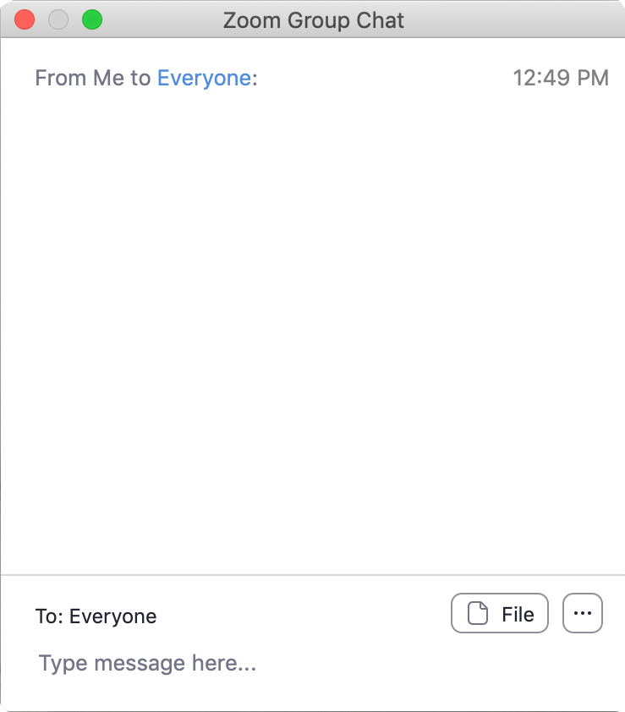
We Encourage Clinicians in Practice to Submit Questions
Feel free to submit questions now before the program begins and throughout the program.

Slide 9

Familiarizing Yourself with the Zoom Interface
Expand chat submission box
Drag the white line above the submission box up to create
more space for your message.

Slide 10

Familiarizing Yourself with the Zoom Interface
Increase chat font size
Press Command (for Mac) or Control (for PC) and the + symbol.
You may do this as many times as you need for readability.

Slide 11


Clinicians in the Audience, Please Complete the Pre- and Postmeeting Surveys
Quick Survey
Quick Poll

Slide 12
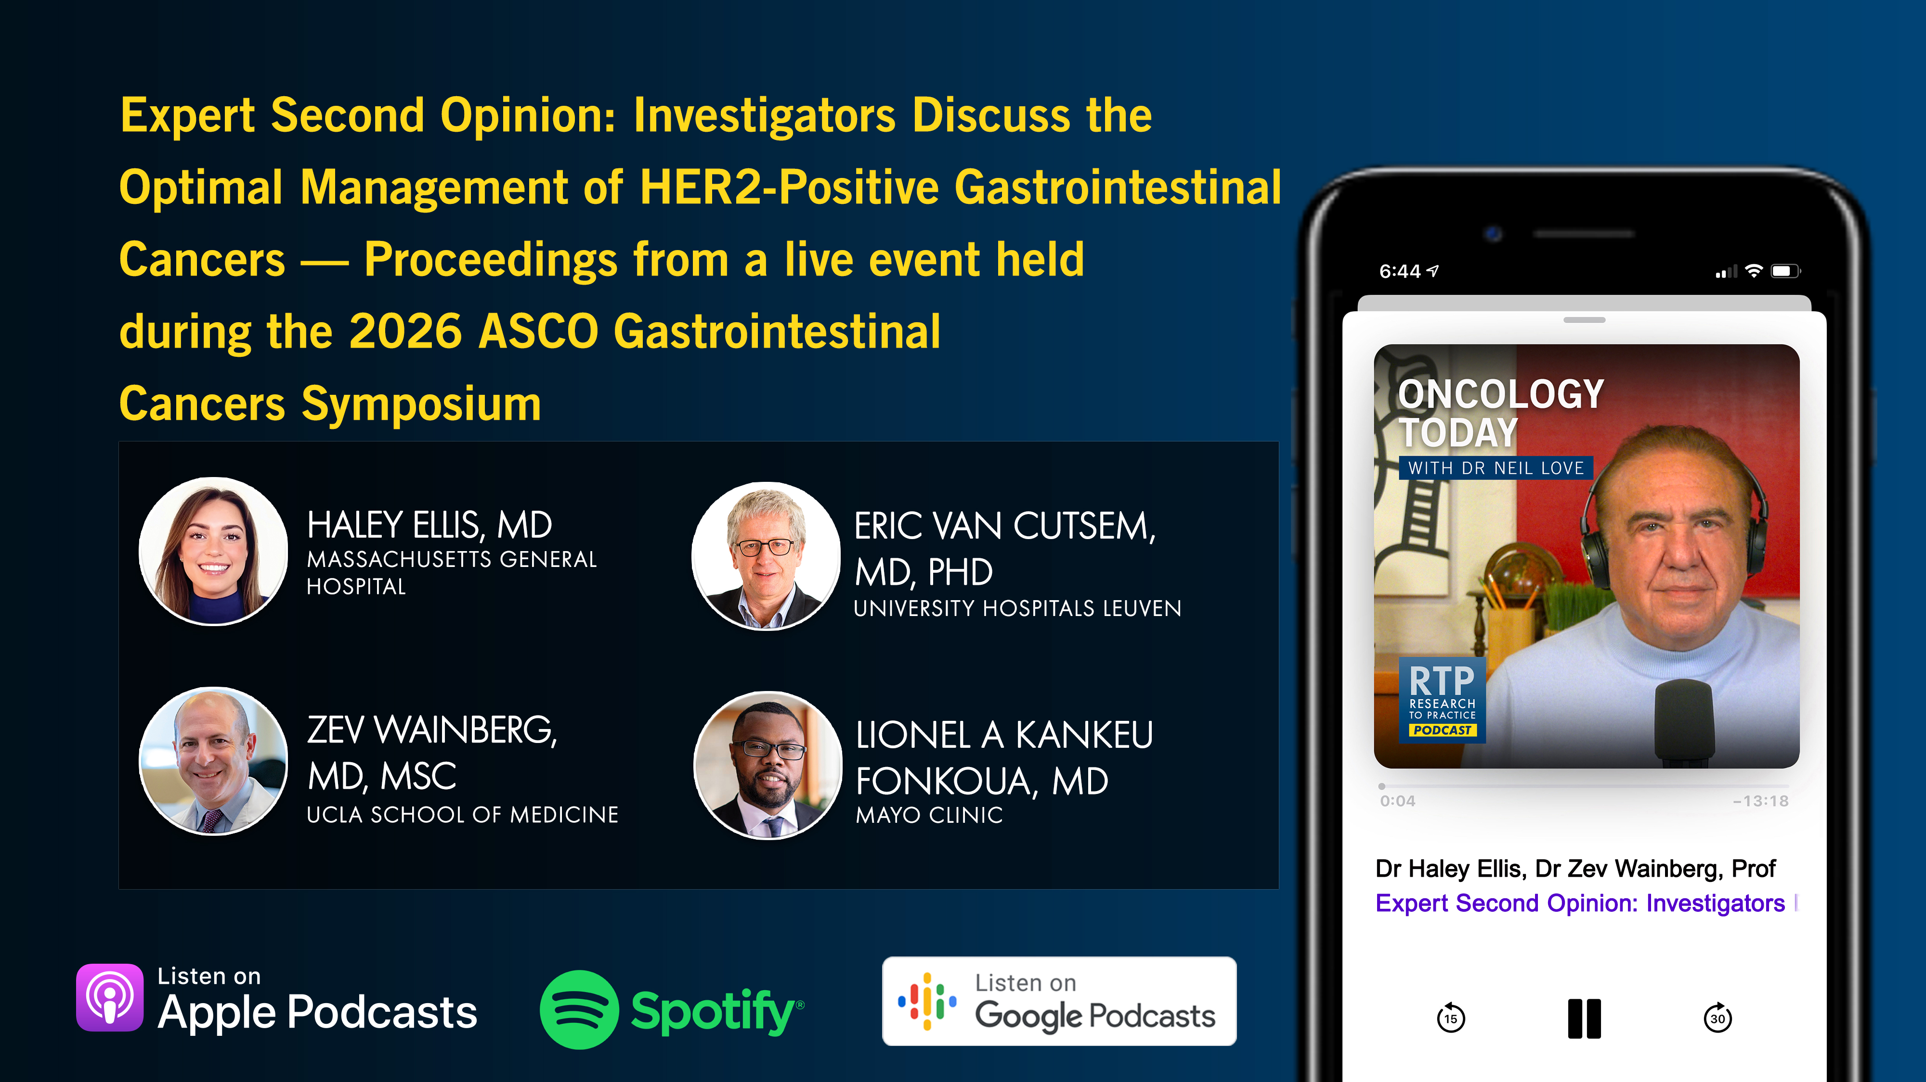

Slide 13
Year in Review: Clinical Investigator Perspectives on the
Most Relevant New Datasets and Advances in Oncology
Multiple Myeloma
A CME/MOC-Accredited Live Webinar
Thursday, June 25, 2026
5:00 PM – 6:00 PM ET
Faculty
Amrita Krishnan, MD
Robert Z Orlowski, MD, PhD
Moderator
Neil Love, MD

Slide 14
Year in Review: Clinical Investigator Perspectives on the
Most Relevant New Datasets and Advances in Oncology
Therapeutic Targets Beyond
EGFR for Non-Small Cell Lung Cancer
A CME/MOC-Accredited Live Webinar
Tuesday, June 30, 2026
5:00 PM – 6:00 PM ET
Faculty
John V Heymach, MD, PhD
Maurice Pérol, MD
Moderator
Neil Love, MD

Slide 15
Patterns of Care: Exploring How
Community Oncologists Manage HR-Positive,
HER2-Positive Metastatic Breast Cancer
A CME/MOC-Accredited Live Webinar
Wednesday, July 1, 2026
5:00 PM – 6:00 PM ET
Faculty
Lisa A Carey, MD, ScM, FASCO
Reshma L Mahtani, DO
Moderator
Neil Love, MD

Slide 16
Grand Rounds
CME/MOC-Accredited Interactive Series
Regional Activities
Two Series
Optimizing the Use of
Novel Therapies for Patients with Diffuse Large B-Cell Lymphoma
Optimizing Therapy for Patients with Hormone Receptor-Positive
Localized Breast Cancer
Host a 1-hour session at your institution:
Email Meetings@ResearchToPractice.com
or call (800) 233-6153

Slide 17
Year in Review:
Gastroesophageal Cancers
INTRODUCTION
MODULE 1: Role of Immune Checkpoint Inhibitors in the Management of Gastroesophageal Cancers — Dr Ilson
MODULE 2: Other Available Therapeutic Approaches — Dr Shitara

Slide 18
Thank you for joining us!
Please take a moment to complete the survey currently up on Zoom.
Your feedback is very important to us.
Information on how to obtain CME, ABIM MOC and ABS credit will be provided in the Zoom chat room. Attendees will also receive an email in
1 to 3 business days with these instructions.

Slide 19
Year in Review: Clinical Investigator Perspectives on the
Most Relevant New Datasets and Advances in Oncology
Gastroesophageal Cancers
A CME/MOC-Accredited Live Webinar
Tuesday, June 23, 2026
5:00 PM – 6:00 PM ET
Faculty
David H Ilson, MD, PhD
Kohei Shitara, MD
Moderator
Neil Love, MD

Slide 20
Faculty
David H Ilson, MD, PhD
Attending Physician, Member
Memorial Sloan Kettering Cancer Center
Professor of Medicine
Weill Cornell Medical College
New York, New York
MODERATOR
Neil Love, MD
Research To Practice
Miami, Florida
Kohei Shitara, MD
Chief of the Department of Gastrointestinal Oncology
National Cancer Center Hospital East
Kashiwa, Japan

Slide 21
We Encourage Clinicians in Practice to Submit Questions
Feel free to submit questions now before the program begins and throughout the program.

Slide 22
Clinicians in the Audience, Please Complete the Pre- and Postmeeting Surveys
Quick Survey
Quick Poll

Slide 24
Year in Review: Clinical Investigator Perspectives on the
Most Relevant New Datasets and Advances in Oncology
Multiple Myeloma
A CME/MOC-Accredited Live Webinar
Thursday, June 25, 2026
5:00 PM – 6:00 PM ET
Faculty
Amrita Krishnan, MD
Robert Z Orlowski, MD, PhD
Moderator
Neil Love, MD

Slide 25
Year in Review: Clinical Investigator Perspectives on the
Most Relevant New Datasets and Advances in Oncology
Therapeutic Targets Beyond
EGFR for Non-Small Cell Lung Cancer
A CME/MOC-Accredited Live Webinar
Tuesday, June 30, 2026
5:00 PM – 6:00 PM ET
Faculty
John V Heymach, MD, PhD
Maurice Pérol, MD
Moderator
Neil Love, MD

Slide 26
Patterns of Care: Exploring How
Community Oncologists Manage HR-Positive,
HER2-Positive Metastatic Breast Cancer
A CME/MOC-Accredited Live Webinar
Wednesday, July 1, 2026
5:00 PM – 6:00 PM ET
Faculty
Lisa A Carey, MD, ScM, FASCO
Reshma L Mahtani, DO
Moderator
Neil Love, MD

Slide 27
Grand Rounds
CME/MOC-Accredited Interactive Series
Regional Activities
Two Series
Optimizing the Use of
Novel Therapies for Patients with Diffuse Large B-Cell Lymphoma
Optimizing Therapy for Patients with Hormone Receptor-Positive
Localized Breast Cancer
Host a 1-hour session at your institution:
Email Meetings@ResearchToPractice.com
or call (800) 233-6153

Slide 28
Year in Review: Clinical Investigator Perspectives on the
Most Relevant New Datasets and Advances in Oncology
Gastroesophageal Cancers
A CME/MOC-Accredited Live Webinar
Tuesday, June 23, 2026
5:00 PM – 6:00 PM ET
Faculty
David H Ilson, MD, PhD
Kohei Shitara, MD
Moderator
Neil Love, MD

Slide 29
Commercial Support
This activity is supported by educational grants from AstraZeneca Pharmaceuticals LP, BeOne, and Daiichi Sankyo Inc.
Research To Practice CME Planning Committee Members,
Staff and Reviewers
Planners, scientific staff and independent reviewers for Research To Practice have no relevant financial relationships to disclose.

Slide 30
Dr Ilson — Disclosures
Advisory Committees | Amgen Inc, Astellas, AstraZeneca Pharmaceuticals LP, Bayer HealthCare Pharmaceuticals, Bristol Myers Squibb, Daiichi Sankyo Inc, Lilly, Merck, Oncolys BioPharma, Roche Laboratories Inc, Taiho Oncology Inc
Consulting Agreements | Astellas

Slide 31
Dr Shitara — Disclosures
No relevant financial relationships to disclose.

Slide 32
Dr Love — Disclosures
Dr Love is president and CEO of Research To Practice. Research To Practice receives funds in the form of educational grants to develop CME activities from the following companies: Aadi Bioscience, AbbVie Inc, ADC Therapeutics, Agendia Inc, Alexion Pharmaceuticals, Amgen Inc, Array BioPharma Inc, a subsidiary of Pfizer Inc, Arvinas, Astellas, AstraZeneca Pharmaceuticals LP, Aveo Pharmaceuticals, Bayer HealthCare Pharmaceuticals, BeOne, Biotheranostics Inc, A Hologic Company, Black Diamond Therapeutics Inc, Blueprint Medicines, Boehringer Ingelheim Pharmaceuticals Inc, Bristol Myers Squibb, Catalyst Pharmaceuticals Inc, Celcuity, Clovis Oncology, Coherus BioSciences, Corcept Therapeutics Inc, CTI BioPharma, a Sobi Company, Daiichi Sankyo Inc, Eisai Inc, Elevation Oncology Inc, Exact Sciences Corporation, Exelixis Inc, Genentech, a member of the Roche Group, Genmab US Inc, Geron Corporation, Gilead Sciences Inc, GSK, Helsinn Therapeutics (US) Inc, ImmunoGen Inc, Incyte Corporation, Ipsen Biopharmaceuticals Inc, Jazz Pharmaceuticals Inc, Johnson & Johnson, Karyopharm Therapeutics, Kite, A Gilead Company, Kura Oncology, Legend Biotech, Lilly, MEI Pharma Inc, Merck, Mersana Therapeutics Inc, Mirati Therapeutics Inc, Mural Oncology Inc, Natera Inc, Novartis, Novartis Pharmaceuticals Corporation on behalf of Advanced Accelerator Applications, Novocure Inc, Nuvalent, Nuvation Bio Inc, Pfizer Inc, Pharmacyclics LLC, an AbbVie Company, Puma Biotechnology Inc, Regeneron Pharmaceuticals Inc, Revolution Medicines Inc, Rigel Pharmaceuticals Inc, R-Pharm US, Sanofi, Seagen Inc, Servier Pharmaceuticals LLC, SpringWorks Therapeutics Inc, Stemline Therapeutics Inc, Sumitomo Pharma America, Summit Therapeutics, Syndax Pharmaceuticals, Taiho Oncology Inc, Takeda Pharmaceuticals USA Inc, TerSera Therapeutics LLC, Tesaro, A GSK Company, and Verastem Inc.

Slide 33
This educational activity contains discussion of
non-FDA-approved uses of agents and regimens. Please refer to official prescribing information for each product for approved indications.

Slide 34
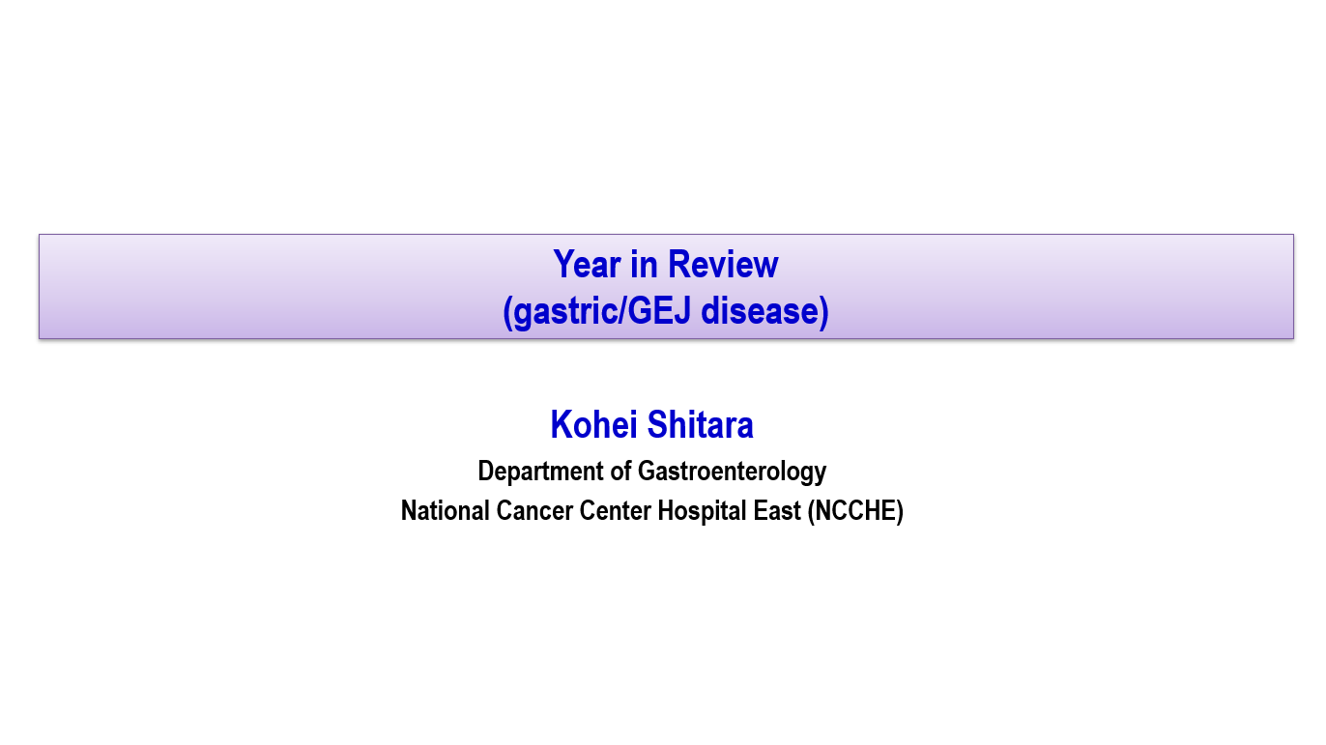
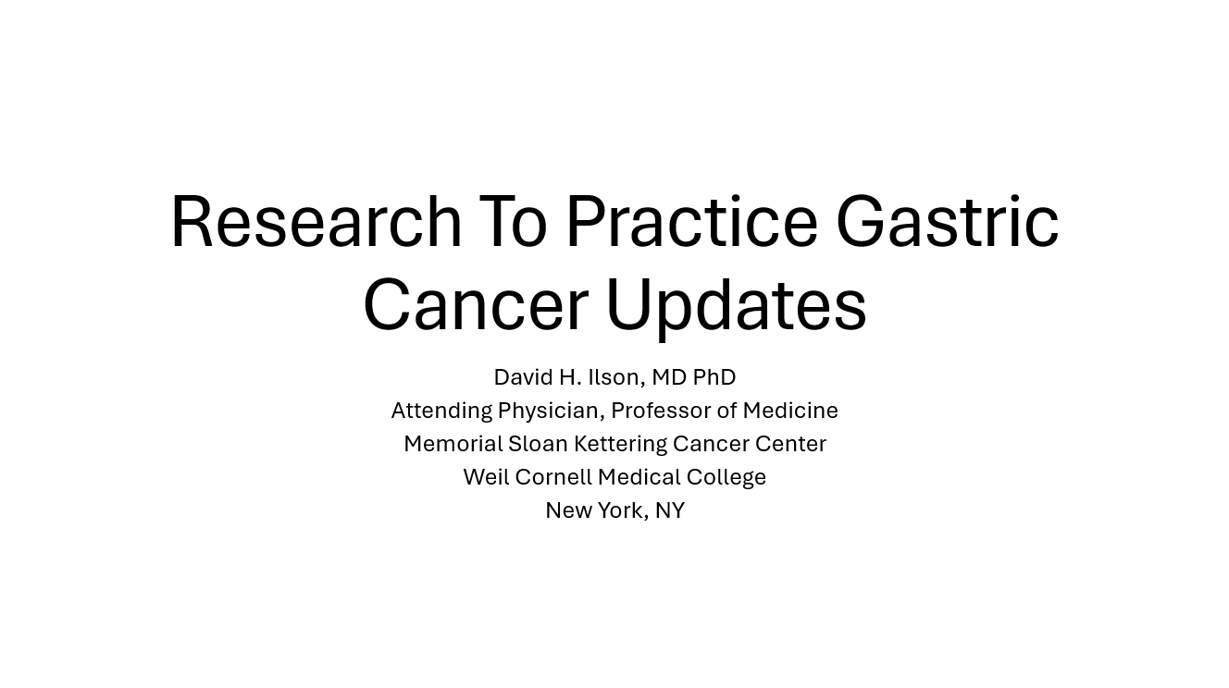

Slide 35
Key Datasets
David Ilson, MD, PhD
Samaille T et al. Neoadjuvant nivolumab plus ipilimumab and adjuvant nivolumab in patients with localized microsatellite instability-high (MSI)/mismatch repair deficient (dMMR) oeso-gastric adenocarcinoma: Long-term follow-up of the GERCOR NEONIPIGA phase II study. ASCO 2026;Abstract 4099.
Leone AG et al. STRIDE regimen of tremelimumab and durvalumab as non-operative management strategy of microsatellite instability-high (MSI-H) resectable gastric or gastroesophageal junction adenocarcinoma (GAC/GEJAC): Final results of the cohort 2 of INFINITY study by GONO GI. AACR 2026;Abstract CT230.
Stein A et al. Perioperative pembrolizumab, trastuzumab and FLOT in HER2-positive localized esophagogastric adenocarcinoma: A phase 2 trial. Nat Med 2025;31(12):4197-204.
Tabernero J et al. Final overall survival (OS) and the association of pathological outcomes with event-free survival (EFS) in MATTERHORN: A randomised, phase III study of durvalumab (D) plus 5-fluorouracil, leucovorin, oxaliplatin and docetaxel (FLOT) in resectable gastric/gastroesophageal (G/GEJ) adenocarcinoma. ESMO 2025;Abstract LBA81.
Wainberg ZA et al. Efficacy of durvalumab and safety by treatment period in MATTERHORN: A randomized, phase 3 study of durvalumab plus 5-fluorouracil, leucovorin, oxaliplatin and docetaxel (FLOT) in resectable gastric/gastroesophageal junction (G/GEJ) adenocarcinoma. ASCO 2026;Abstract 4070.

Slide 36
Key Datasets
David Ilson, MD, PhD (continued)
Shitara K et al. Pembrolizumab plus chemotherapy versus chemotherapy as perioperative therapy in locally advanced gastric and gastroesophageal junction cancer: Final analysis of the randomized, phase 3 KEYNOTE-585 study. J Clin Oncol 2025;43(29):3152-9.
Janjigian YY et al. Nivolumab plus chemotherapy as first-line treatment for advanced gastric, gastroesophageal junction, and esophageal adenocarcinoma: 5-year follow-up results from CheckMate 649. Ann Oncol 2026;37(6):787-97.
Cruz-Correa M et al. Tislelizumab + chemotherapy in gastric cancer: Long-term RATIONALE-305 randomized trial follow-up. Adv Ther 2026;43(1):165-83.
Oh D-Y et al. Nivolumab plus ipilimumab combined with chemotherapy as first-line treatment for HER2-negative unresectable advanced or recurrent gastric/gastroesophageal junction cancer: A randomized phase 3 trial (ATTRACTION-6). ASCO 2026;Abstract 4006.
Metges J-P et al. Pembrolizumab plus chemotherapy versus chemotherapy for advanced esophageal cancer: 5-year extended follow-up for the randomized phase III KEYNOTE-590 study. ESMO Open 2025;10(12):105854.
Kawazoe A et al. KEYNOTE-811: 6-year median follow-up of pembrolizumab plus trastuzumab and chemotherapy for previously untreated advanced HER2-positive gastric or gastroesophageal junction adenocarcinoma. ASCO 2026;Abstract 4040.

Slide 37
Key Datasets
Kohei Shitara, MD
Elimova E et al. Zanidatamab + chemotherapy (CT) ± tislelizumab for first-line (1L) HER2-positive (HER2+) locally advanced, unresectable, or metastatic gastroesophageal adenocarcinoma (mGEA): Primary analysis from HERIZON-GEA-01. Gastrointestinal Cancers Symposium 2026;Abstract LBA285.
Rha SY et al. Zanidatamab + chemotherapy (CT) ± tislelizumab for first-line (1L) HER2-positive (HER2+) locally advanced or metastatic gastroesophageal adenocarcinoma (mGEA): PD-L1 subgroup analysis from HERIZON-GEA-01. ASCO 2026;Abstract 4010.
Shitara K et al. Trastuzumab deruxtecan or ramucirumab plus paclitaxel in gastric cancer. N Engl J Med 2025;393(4):336-48.
Janjigian YY et al. First line (1L) trastuzumab deruxtecan (T-DXd)-based regimens in advanced HER2-expressing gastric cancer (GC), gastroesophageal junction adenocarcinoma (GEJA), or esophageal adenocarcinoma (EA): Safety results from DESTINY-Gastric03 (DG-03) Part 2 arms D and F, and Part 4. ASCO 2026;Abstract 4022.
Shah M et al. ARTEMIDE-Gastric01: A phase 3 randomized study of rilvegostomig with fluoropyrimidine and trastuzumab deruxtecan (T-DXd) as first-line (1L) treatment for locally advanced or metastatic HER2-positive gastric or gastroesophageal junction cancer (GC/GEJC). Gastrointestinal Cancers Symposium 2026;Abstract TPS460.

Slide 38
Key Datasets
Kohei Shitara, MD (continued)
Shitara K et al. Phase 2 ILUSTRO trial of 1L zolbetuximab plus mFOLFOX6 and nivolumab in patients with CLDN18.2+ locally advanced (LA) unresectable or metastatic gastric or gastroesophageal junction (mG/GEJ adenocarcinoma. Gastrointestinal Cancers Symposium 2026;Abstract LBA284.
Shitara K et al. Zolbetuximab + pembrolizumab and chemotherapy as first-line treatment for patients with CLDN18.2-positive, HER2-negative, PD-L1-positive locally advanced unresectable or metastatic G/GEJ adenocarcinoma: Phase 3, double-blind, randomized trial (LUCERNA). Gastrointestinal Cancers Symposium 2026;Abstract TPS473.
Shitara K et al. Sonesitatug vedotin (Sone-Ve) monotherapy in patients (pts) with claudin 18.2-positive (CLDN18.2+) advanced or metastatic gastric or gastroesophageal junction (GEJ) cancers: Data from CLARITY-PanTumor01. ASCO 2026;Abstract 4023.
Shitara K et al. CLARITY-Gastric01: A randomized phase 3 study of sonesitatug vedotin (sone ve), a claudin 18.2 (CLDN18.2)-targeted antibody-drug conjugate, in second- or later-line (2L+) advanced gastric or gastroesophageal junction cancer (GJ/GEJC). Gastrointestinal Cancers Symposium 2026;Abstract TPS462.
Lu Z et al. Izalontamab brengitecan (iza-bren) versus chemotherapy in patients with recurrent or metastatic esophageal squamous cell carcinoma (ESCC): A multicenter, randomized, open-label, phase III study. ASCO 2026;Abstract 4008.

Slide 39
Year in Review:
Gastroesophageal Cancers
INTRODUCTION: Biomarker Evaluation in Localized and Metastatic Disease
MODULE 1: Role of Immune Checkpoint Inhibitors in the Management of Gastroesophageal Cancers — Dr Ilson
MODULE 2: Other Available Therapeutic Approaches — Dr Shitara

Slide 40
Year in Review:
Gastroesophageal Cancers
INTRODUCTION: Biomarker Evaluation in Localized and Metastatic Disease
MODULE 1: Role of Immune Checkpoint Inhibitors in the Management of Gastroesophageal Cancers — Dr Ilson
MODULE 2: Other Available Therapeutic Approaches — Dr Shitara

Slide 41
Year in Review:
Gastroesophageal Cancers
INTRODUCTION: Biomarker Evaluation in Localized and Metastatic Disease
MODULE 1: Role of Immune Checkpoint Inhibitors in the Management of Gastroesophageal Cancers — Dr Ilson
MODULE 2: Other Available Therapeutic Approaches — Dr Shitara

Slide 42
Research To Practice Gastric Cancer Updates
David H. Ilson, MD PhD
Attending Physician, Professor of Medicine
Memorial Sloan Kettering Cancer Center
Weil Cornell Medical College
New York, NY

Slide 43
Microsatellite Instability (MSI)-High Locally Advanced Esophagogastric Adenocarcinoma

Slide 44
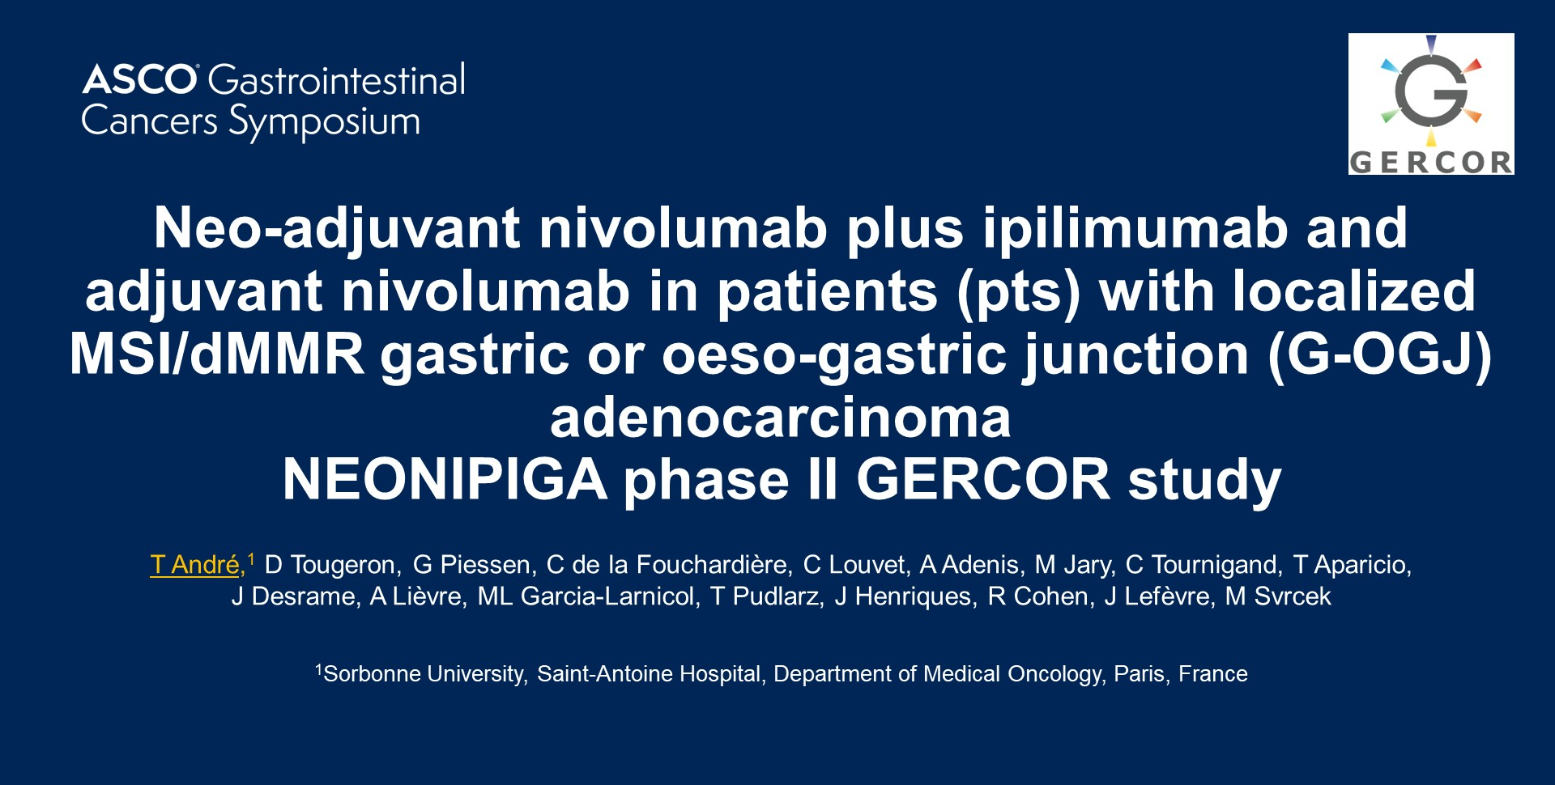
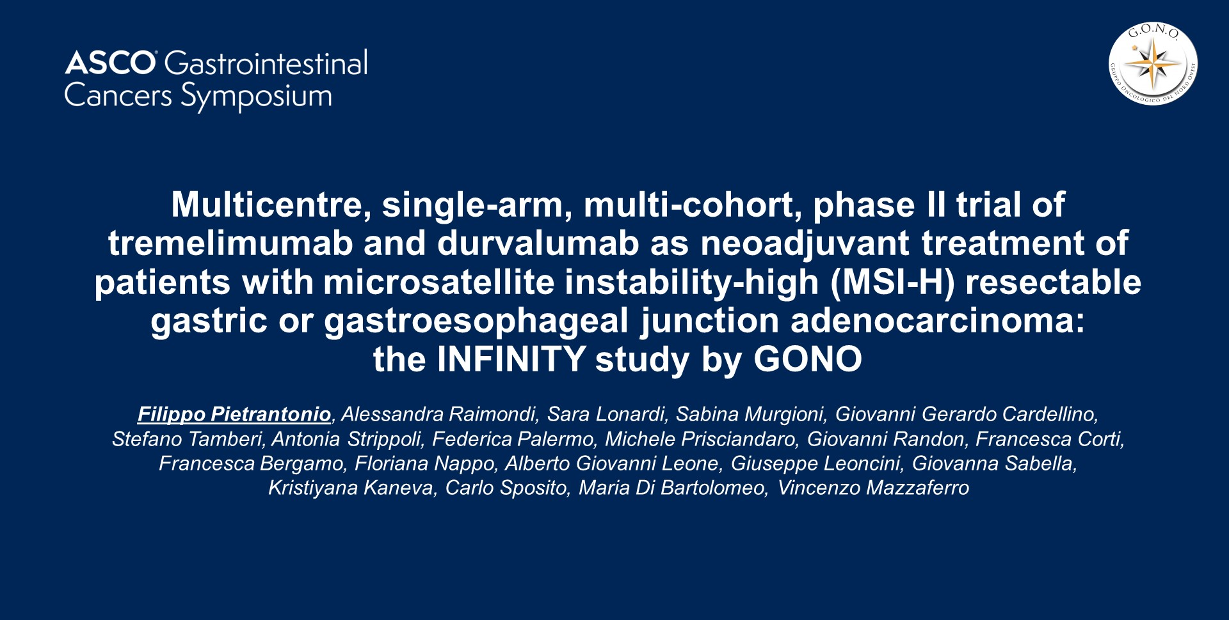
Preoperative CPI therapy in MSI High Gastric Cancer
Andre, JCO. 2023;41: 255-265
ASCO GI 2022;Abstract 244
Pietrantonio, JCO. 2023;41(suppl 4; abstr 358)
ASCO GI 2023;Abstract 358

Slide 45
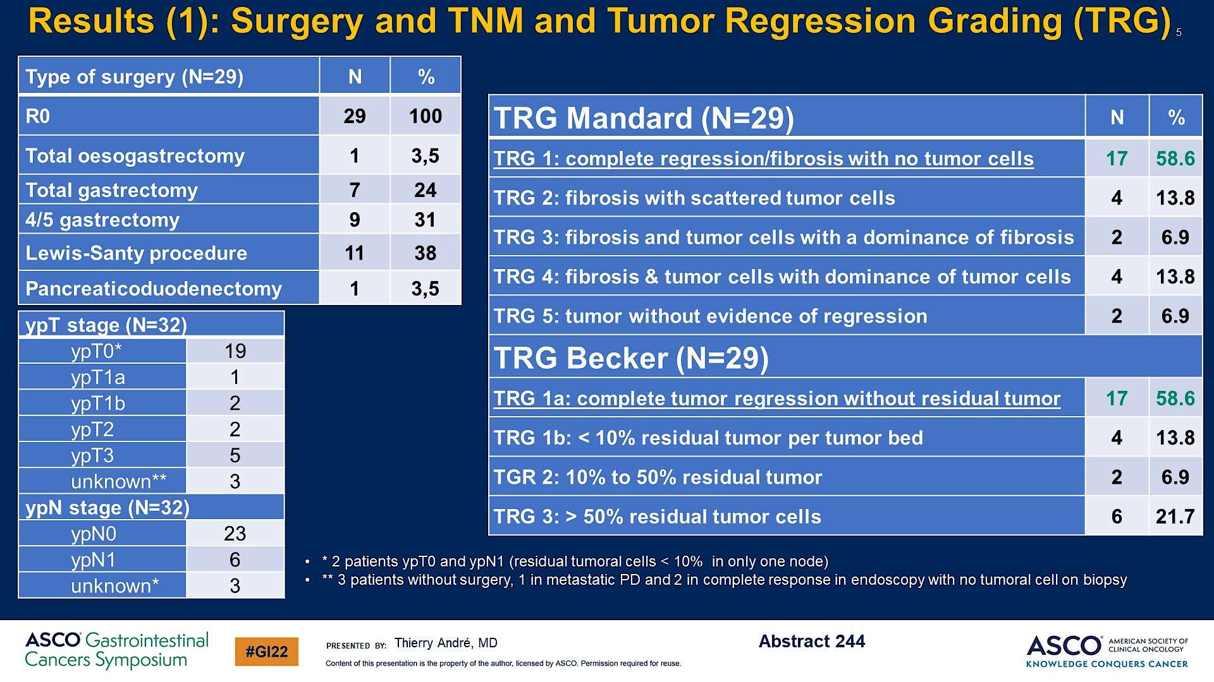
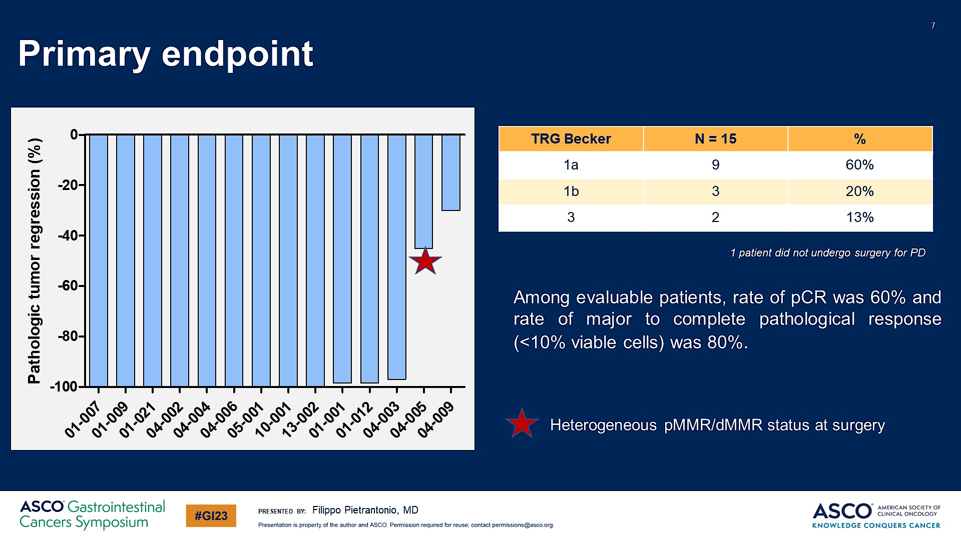
Preoperative CPI therapy in MSI High Gastric Cancer
Andre, JCO. 2023;41: 255-265
Pietrantonio, JCO. 2023;41(suppl 4; abstr 358)
Pathologic CR 59%-60%, Near pCR 14-20%

Slide 46
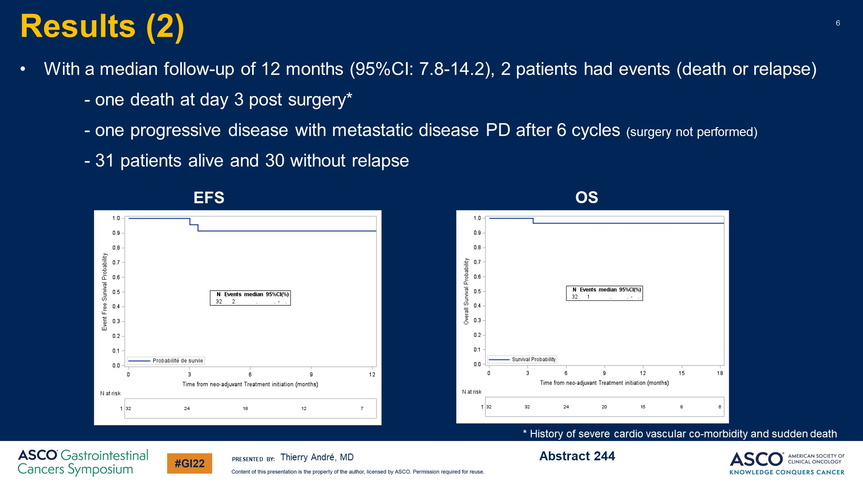
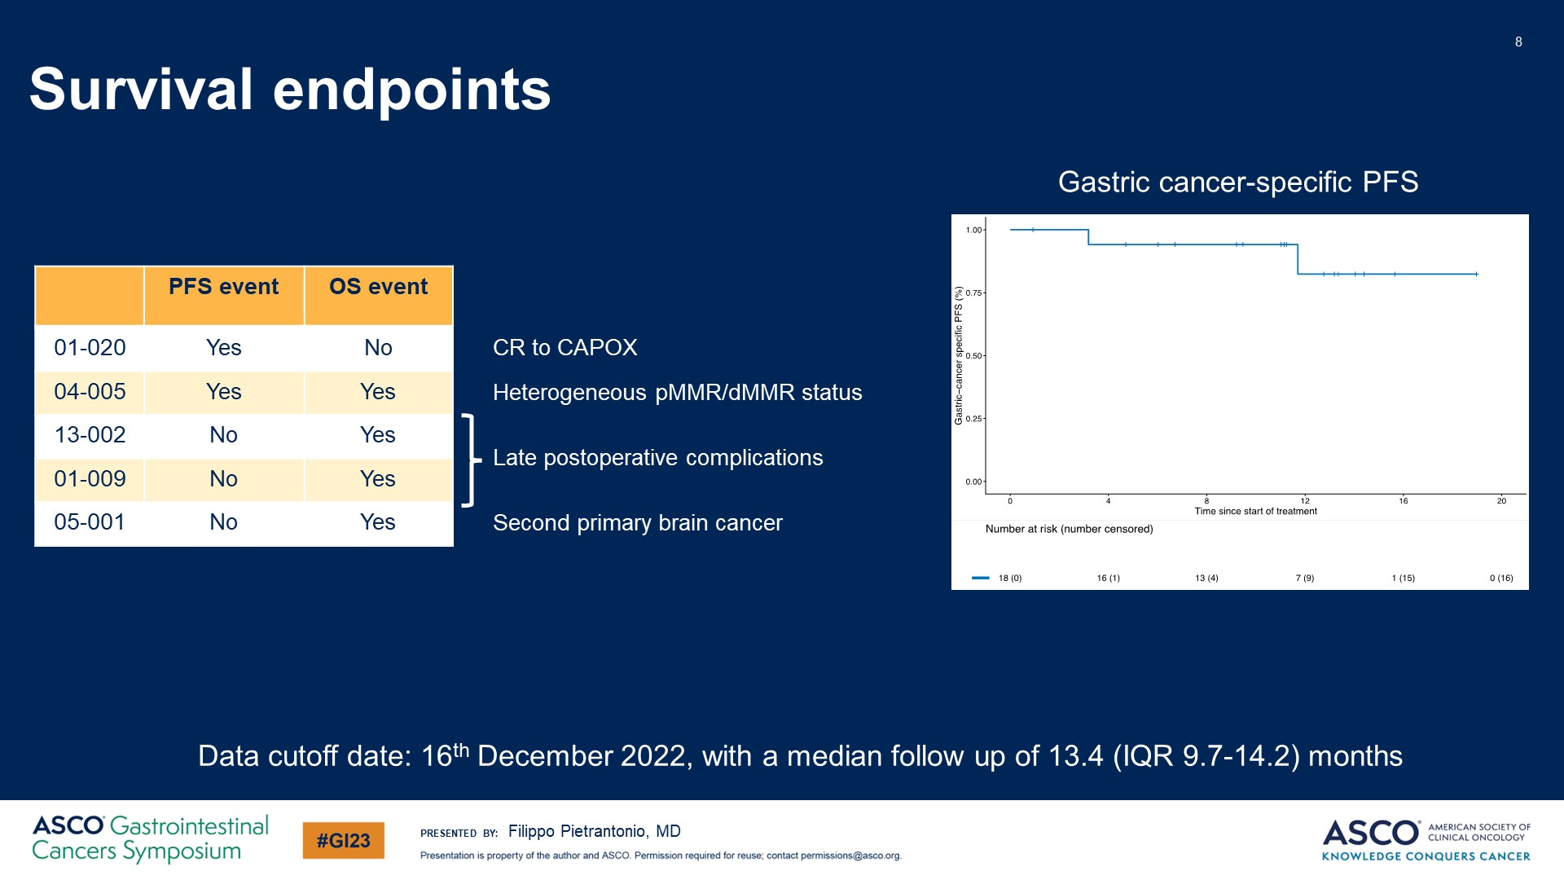
Preoperative CPI therapy in MSI High Gastric Cancer
Andre JCO 41: 255-265, 2023
Pietrantonio JCO 41: 2023 (suppl 4; abstr 358)
High Rates of pCR: Nonoperative Management?

Slide 47
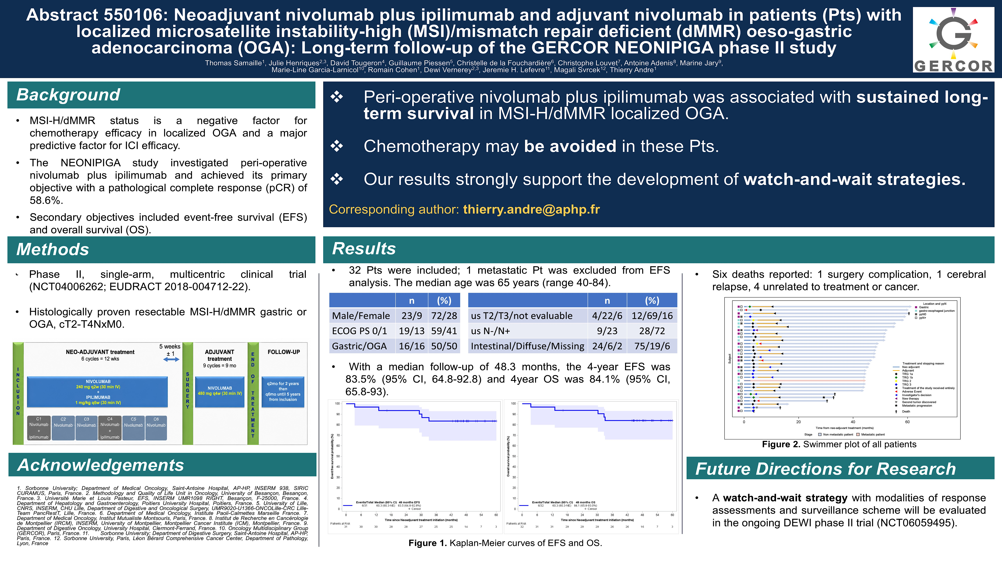
NEONIPIGA: ASCO 2026 Update at 48 months

Slide 48
INFINITY AACR 2026 UPDATE
Cohort of 17 evaluable patients with MSI esophagogastric cancers, treated with 3 months of one dose tremelimumab and monthly durvalumab
Primary endpoint gastrectomy free survival
13 clinical CR, one required salvage surgery, 4 non-CR patients underwent surgery
At median 27.1 months fu
  PFS 94.1%
  OS 100%
  GFS 70.6%
Leone AACR 2026; Abstract CT230

Slide 49
Takeaway Messages: MSI high locally advanced esophagogastric adenocarcinoma
From the Infinity and NEONIPIGA trials, combination anti CTLA-4 and PD-1/PD-L1 therapy achieves a high rate of pathologic and clinical complete response which appears durable in most patients.
Consideration for treating these patients with combination checkpoint inhibitor therapy up front should be considered, with non operative management for patients achieving a clinical CR. Chemotherapy and surgery may be avoided altogether.

Slide 50
MATTERHORN and KEYNOTE-585 Trial Updates

Slide 51
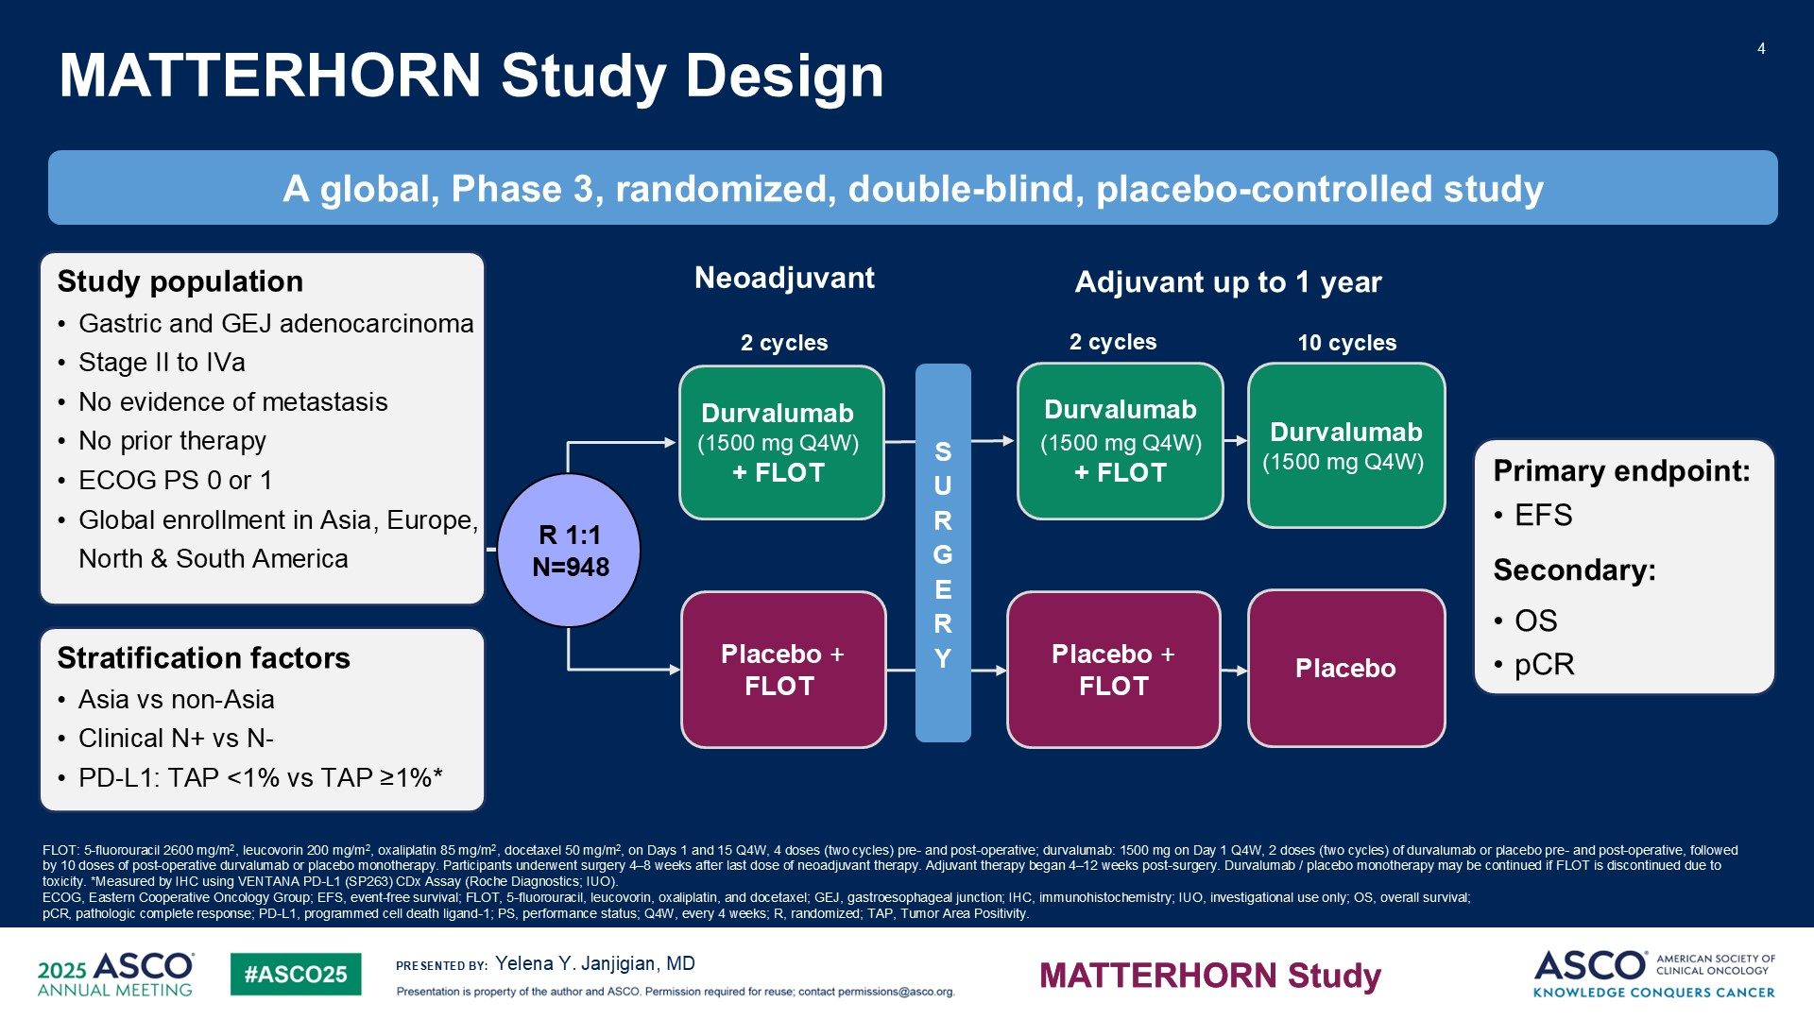
MATTERHORN Study Design
Janjigian NEJM 393: 217; 2025
Janjigian ASCO 2025;Abstract LBA5

Slide 52
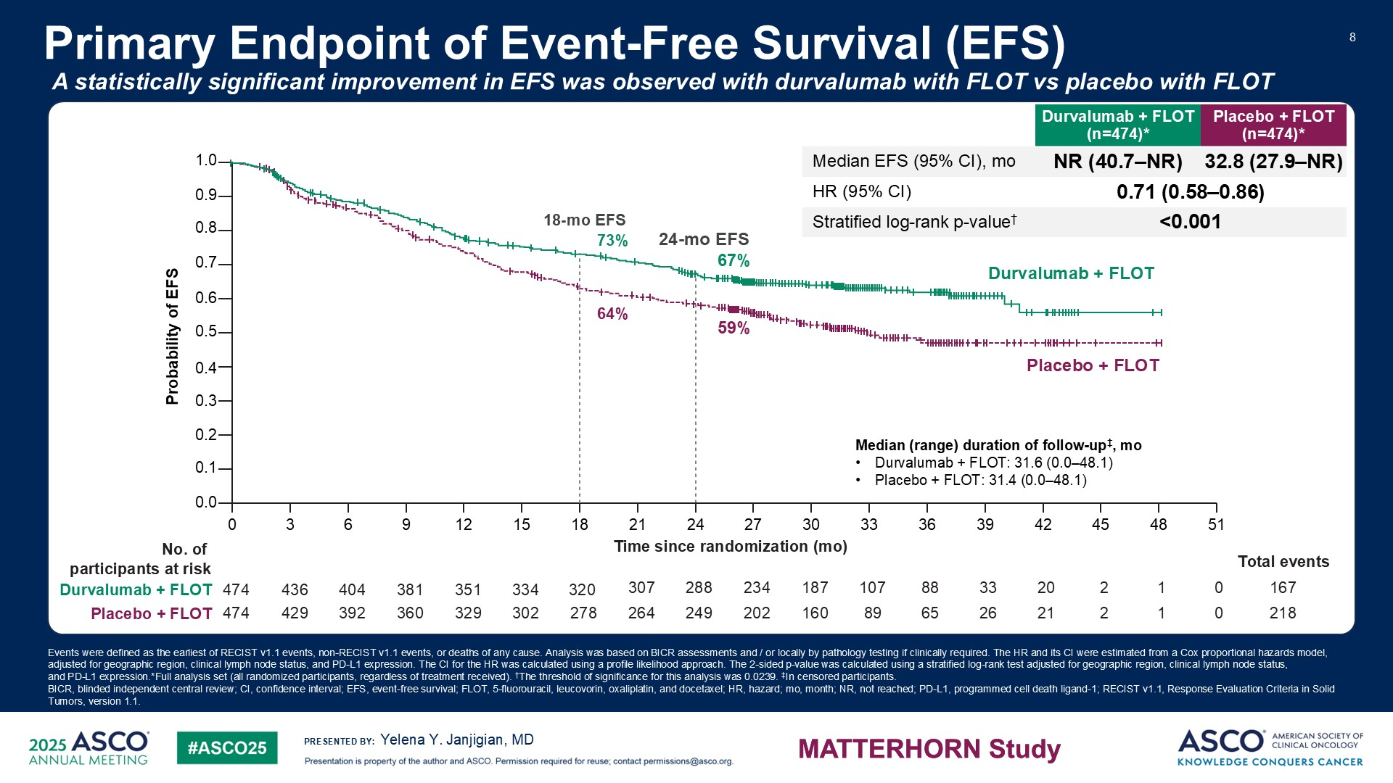
Primary Endpoint of Event-Free Survival (EFS)
Janjigian NEJM 393: 217; 2025
Janjigian ASCO 2025;Abstract LBA5

Slide 53
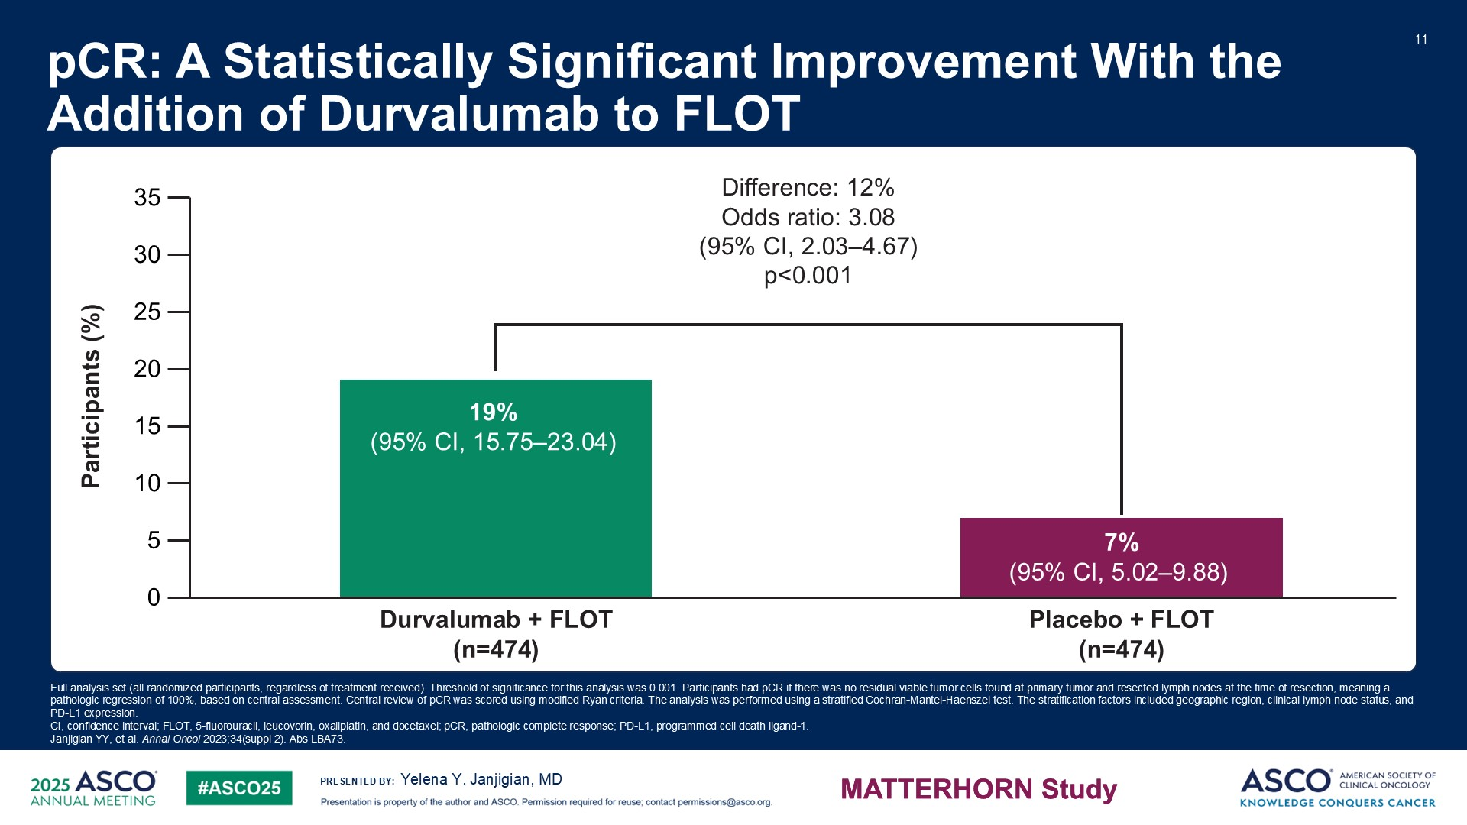
Slide 11
Janjigian NEJM 393: 217; 2025
Janjigian ASCO 2025;Abstract LBA5

Slide 54
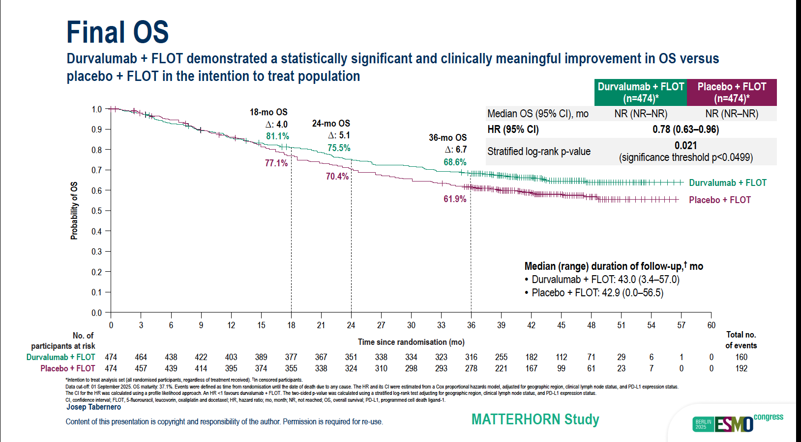
Tabernero ESMO 2025: LBA81

Slide 55
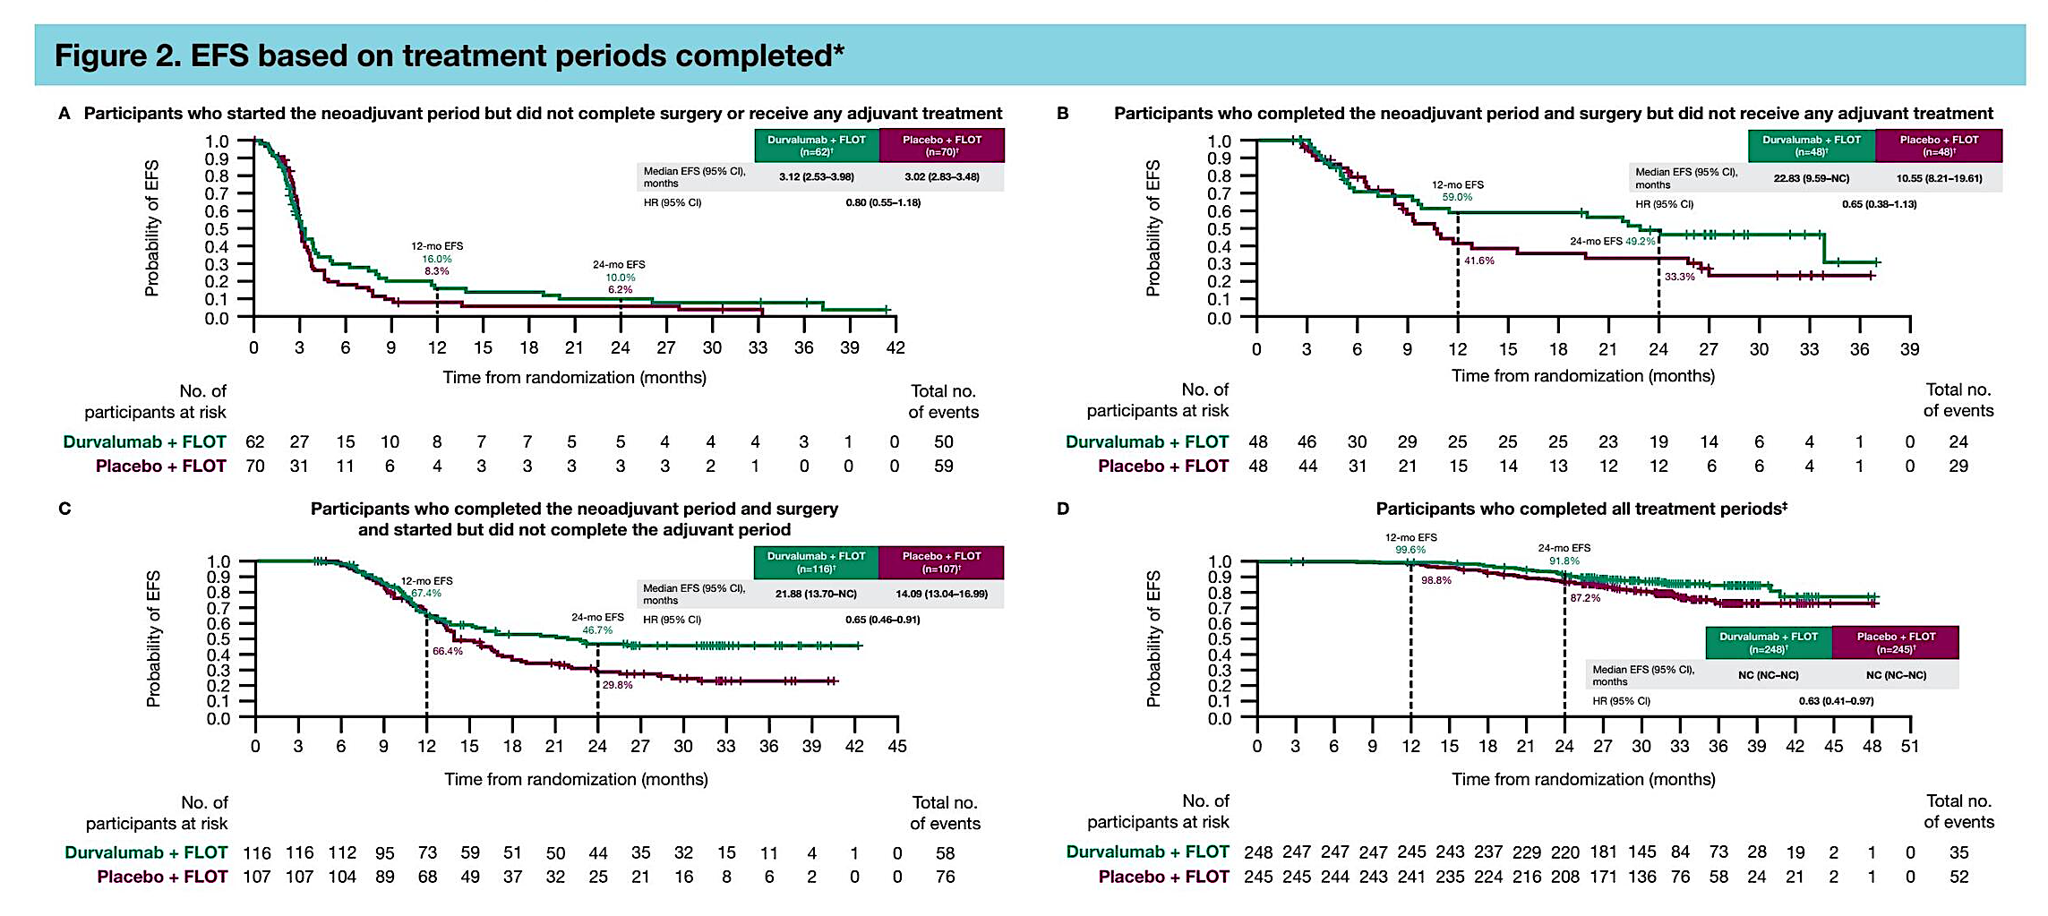
MATTERHORN UPDATE ASCO 2026: Abstract 470
No Surgery
No Adjuvant
Greatest EFS in patients completing all planned pre and postoperative therapy
Inferior EFS in patients receiving no or some adjuvant therapy
Durvalumab EFS superior to placebo all patient groups
Some Adjuvant
All Adjuvant
Wainberg Z et al. ASCO 2026;Abstract 4070

Slide 56
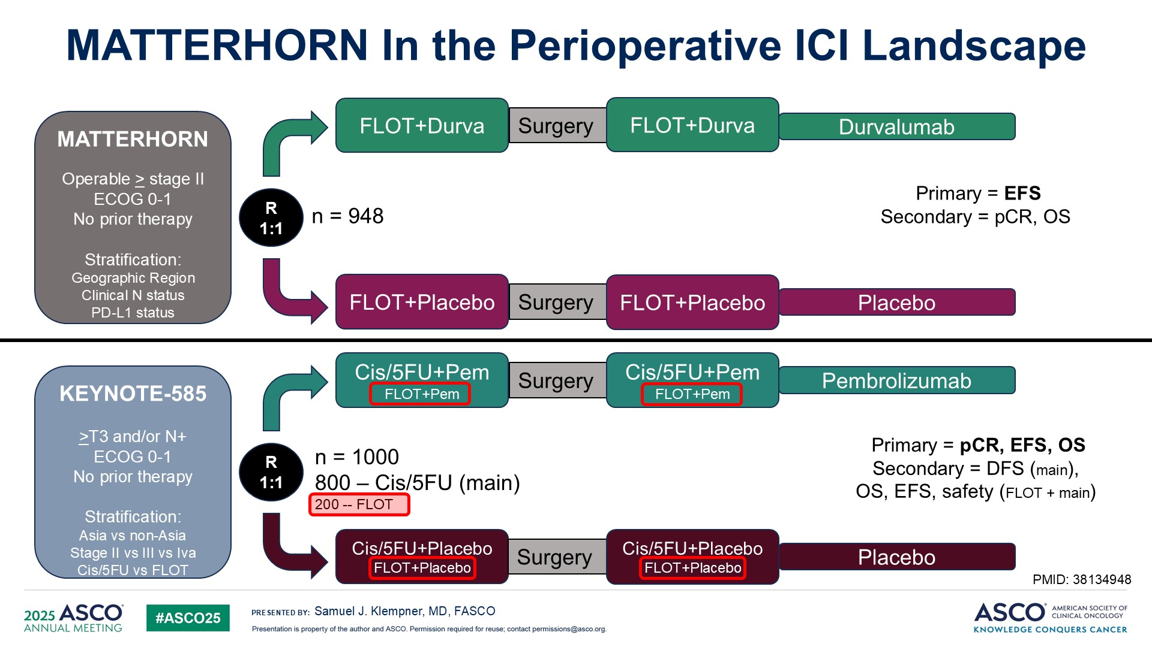
MATTERHORN In the Perioperative ICI Landscape

Slide 57
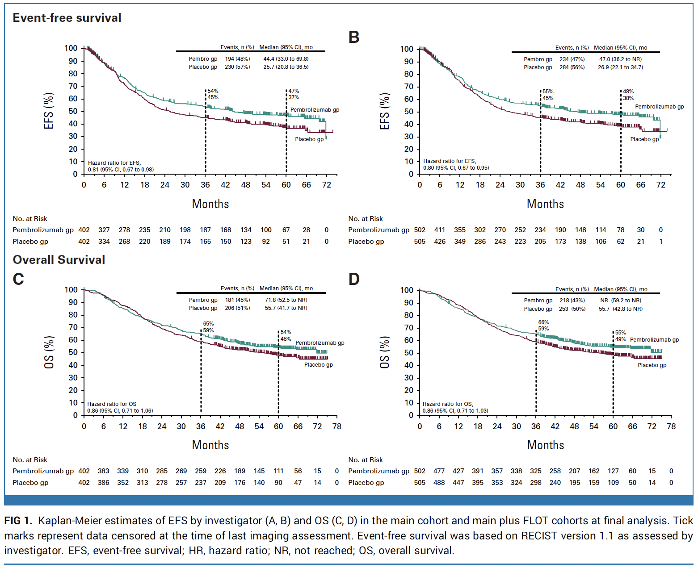
KEYNOTE 585: EFS and OS: Main Cohort (FP) and Combined Cohort (+ FLOT)
FP
FP + FLOT
EFS numerically superior for pembro + FP (25.7-44.4 months), NS (HR 0.81)
OS numerically superior for pembro + FP (55.7-71.8 months), NS (HR 0.86
FLOT + CF: EFS (HR 0.80) and OS (HR 0.86) not changed
Shitara JCO 43: 3152; 2025

Slide 58
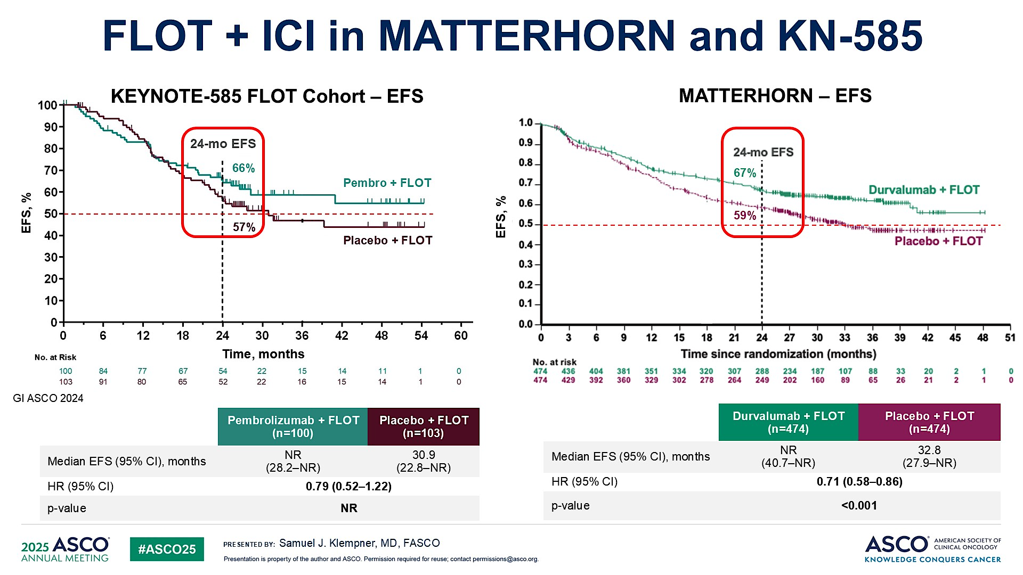
FLOT + ICI in MATTERHORN and KN-585

Slide 59
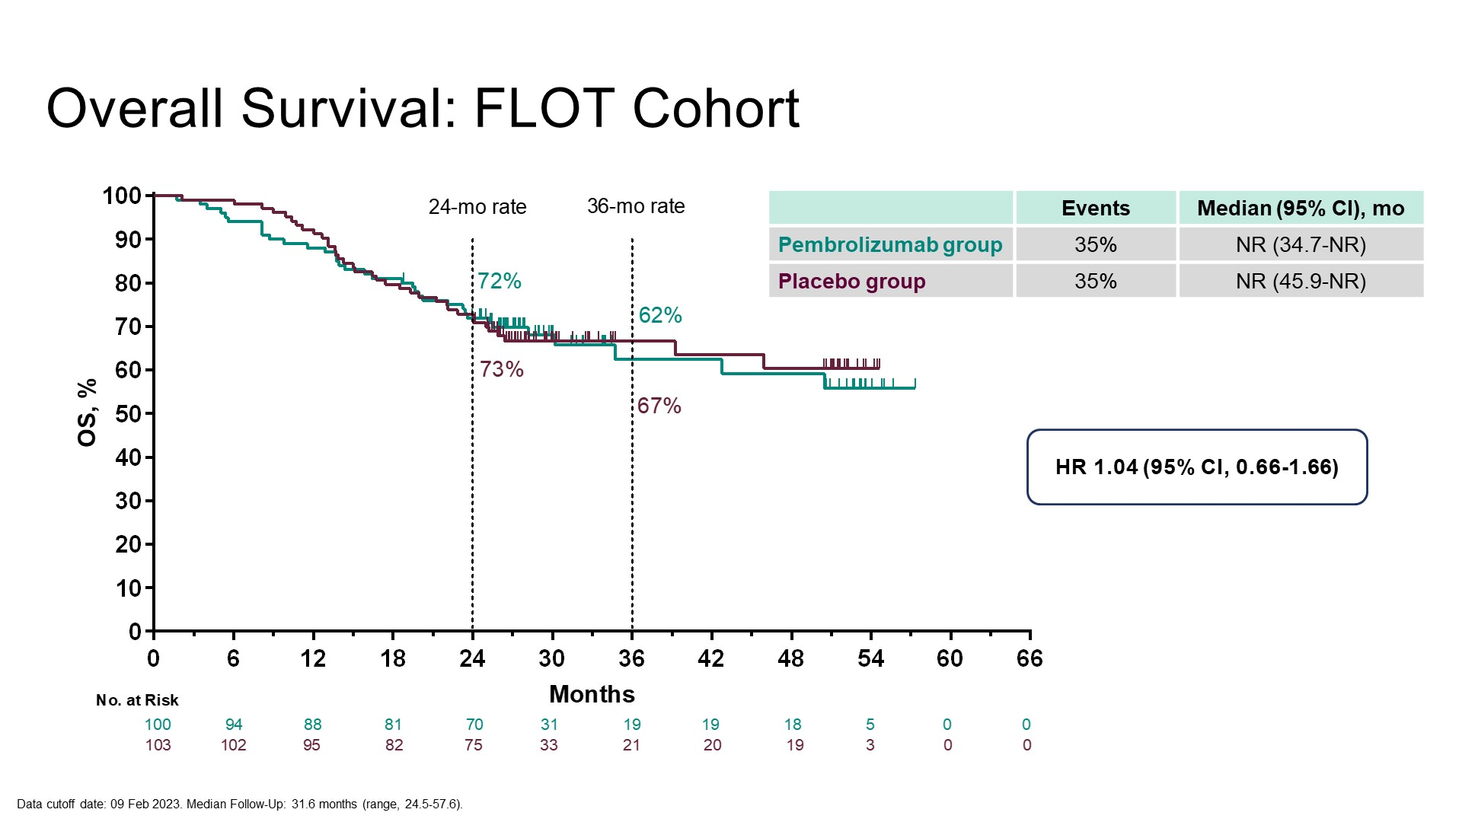
Overall Survival: FLOT Cohort
KEYNOTE 585, Al-Batran JCO GI ASCO 2024

Slide 60
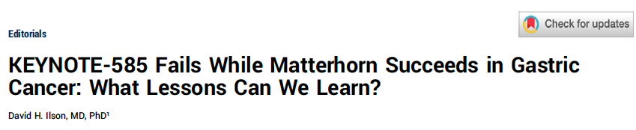
J Clin Oncol 2025;43:3141-3.

Slide 61
“The potential superiority of preoperative and postoperative chemotherapy over adjuvant chemotherapy alone was recently evidenced from updated results from the RESOLVE trial from China and the PRODIGY trial from Japan and Korea. Therefore, perioperative FLOT, now with the addition of durvalumab, should and will be embraced globally as the standard of care in the management of operable esophagogastric cancer.”
Ilson DH. J Clin Oncol 2025;43:3141-43.

Slide 62
MATTERHORN AND KEYNOTE 585 UPDATES
For esophagogastric adenocarcinoma, pre- and postoperative FLOT + durvalumab is the preferred standard of care treatment.
Completing all planned therapy if possible achieves the highest event free survival.
Two drug perioperative 5-FU/cisplatin plus pembrolizumab failed to improve survival over chemotherapy alone despite higher rates of pathologic complete response and numeric improvements in PFS and OS.

Slide 63
Perioperative Therapy for HER2-Positive
Esophagogastric Adenocarcinoma

Slide 64
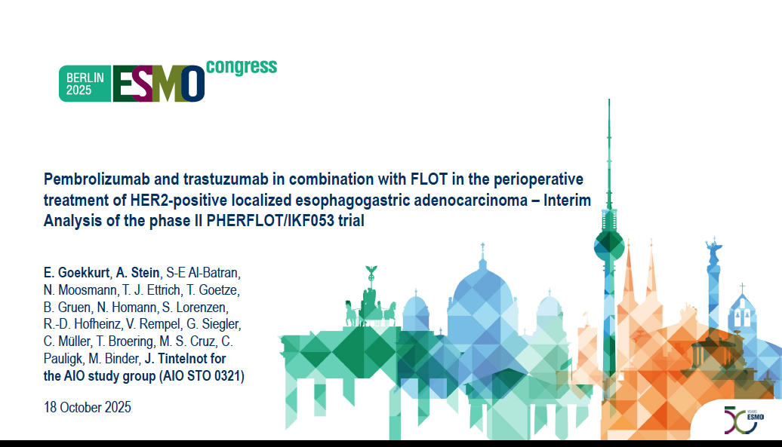
Stein Nature Med 31:4197; 2025

Slide 65
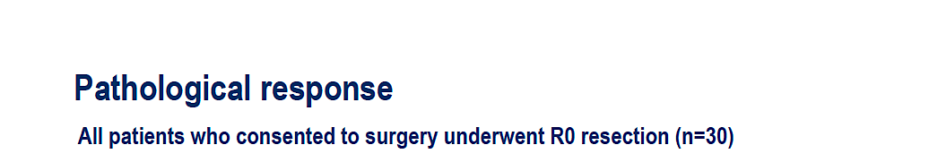
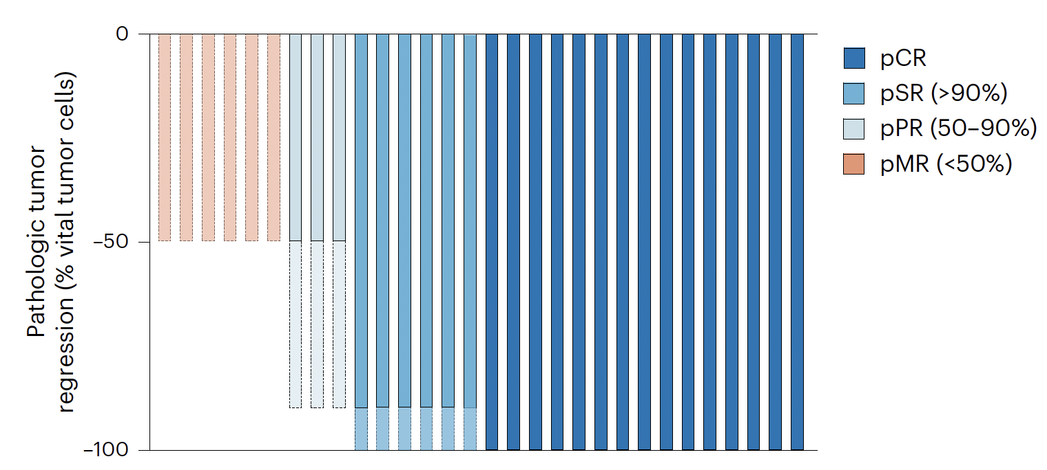
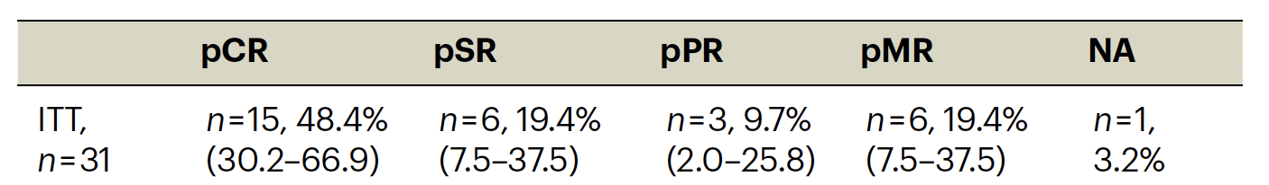
Stein Nature Med 31:4197; 2025

Slide 66
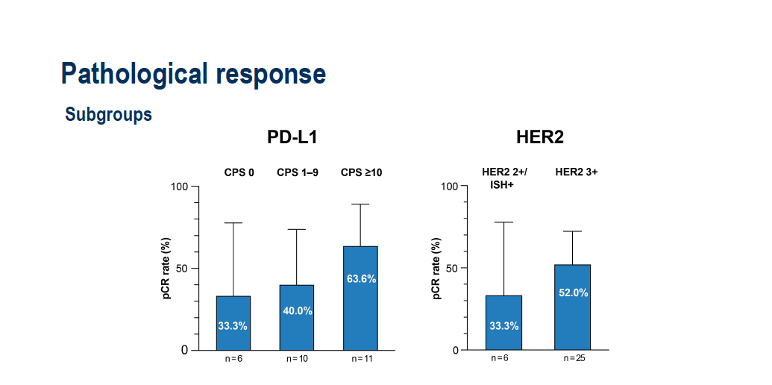
Stein Nature Med 31:4197; 2025

Slide 67
PERIOPERATIVE THERAPY OF HER2 + ESOPHAGOGASTRIC ADENOCARCINOMA
The combination of FLOT, pembrolizumab and trastuzumab achieves a remarkably high rate of pathologic complete response.
Trials may consider nonoperative management in clinical complete responders to this or similar regimens.
Evaluation of perioperative therapy with novel and potentially more effective HER2 agents, including zanidatamab and trastuzumab deruxtecan, combined with immunotherapy, is warranted.

Slide 68
Long-Term Follow-Up of M1 Trials of
Immunotherapy + Chemotherapy

Slide 69
Nivolumab plus ipilimumab combined with chemotherapy as first-line treatment for HER2-negative unresectable advanced or recurrent gastric/gastroesophageal junction cancer: A randomized phase 3 trial (ATTRACTION-6)
Do-Youn Oh^{1*}, Yoon-Koo Kang², Kohei Shitara³, Li-Tzong Chen⁴, Narikazu Boku⁵, Min-Hee Ryu², Sun Young Rha⁶, Jong Gwang Kim⁷,
Jin Young Kim⁸, Sang Cheul Oh⁹, Keun-Wook Lee¹⁰, Jeeyun Lee¹¹, Akihito Kawazoe³, Hirokazu Shoji¹², Kensei Yamaguchi¹³,
Sung Yong Oh¹⁴, Li-Yuan Bai¹⁵, Ming-Huang Chen¹⁶, Jen-Shi Chen¹⁷, Kun-Huei Yeh¹⁸, ATTRACTION-6 Study Group
¹Seoul National University College of Medicine, Seoul, Republic of Korea, ²Asan Medical Center, University of Ulsan College of Medicine, Seoul, Republic of Korea, ³National Cancer Center Hospital East, Kashiwa, Japan, ⁴Kaohsiung Medical University Hospital, Kaohsiung, Taiwan, ⁵Institute of Medical Science Hospital, University of Tokyo, Tokyo, Japan, ⁶Yonsei Cancer Center, Yonsei University College of Medicine, Seoul, Republic of Korea, ⁷Kyungpook National University, Daegu, Republic of Korea, ⁸Keimyung University Dongsan Medical Center, Daegu, Republic of Korea, ⁹Korea University Guro Hospital, Korea University College of Medicine, Seoul, Republic of Korea, ¹⁰Seoul National University College of Medicine, Seoul, South Korea; Seoul National University Bundang Hospital, Seongnam, Republic of Korea, ¹¹Samsung Medical Center, Seoul, Republic of Korea, ¹²National Cancer Center Hospital, Tokyo, Japan, ¹³Cancer Institute Hospital of the Japanese Foundation for Cancer Research, Tokyo, Japan, ¹⁴Dong-A University Hospital, Busan, Republic of Korea, ¹⁵China Medical University Hospital, Taichung, Taiwan, ¹⁶Taipei Veterans General Hospital, Taipei, Taiwan, ¹⁷Chang Gung Memorial Hospital at Linkou and Chang Gung University, Tao-Yuan, Taiwan, ¹⁸National Taiwan University Hospital, Taipei, Taiwan.
*Presenting
Do-Youn Oh, MD, PhD

Slide 70
ATTRACTION 6
Combined ipilimumab and nivolumab added to chemotherapy failed to improve overall survival over chemotherapy alone.
Adding single agent checkpoint inhibitors (pembrolizumab, nivolumab, or tislelizumab) remains the standard of care
Treatment with immune checkpoint inhibitors should be limited to tumors testing CPS or TAP > = 1%.

Slide 71
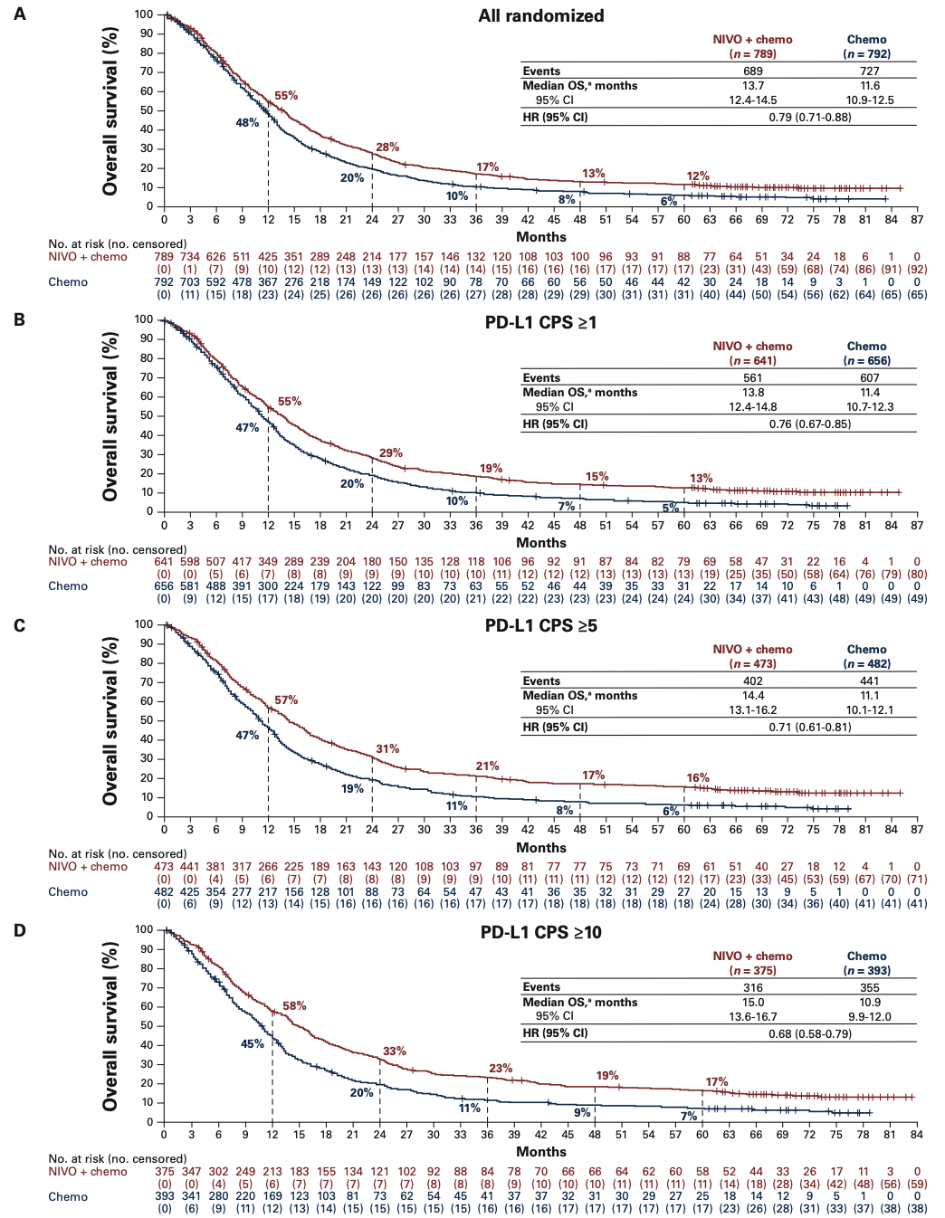
CHECKMATE 649 Long Term Follow up
Improved long term survival with Nivolumab + Chemo
Chemo alone 5-year OS 5%
+ Nivolumab
  All patients: 12%
  CPS > = 1% 13%
  CPS > = 5% 18%
  CPS > = 10% 17%
Janjigian Ann Oncol 37: 787; 2026

Slide 72
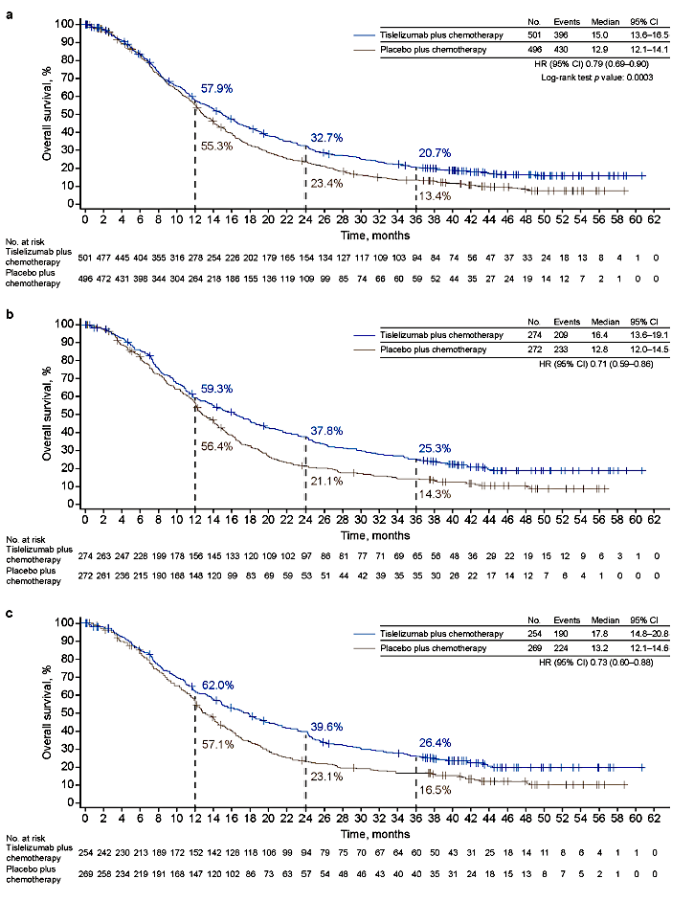
RATIONALE-305 Long Term Follow Up
Improved long term overall survival with Tislelizumab + Chemo
Chemo alone 3-year OS 14.3%
+ Tislelizumab
  All patients: 20.7%
  TAP > = 5% 25.3%
  CPS > = 5% 26.4 %
Cruz-Correa Adv Ther 43: 165: 2026

Slide 73
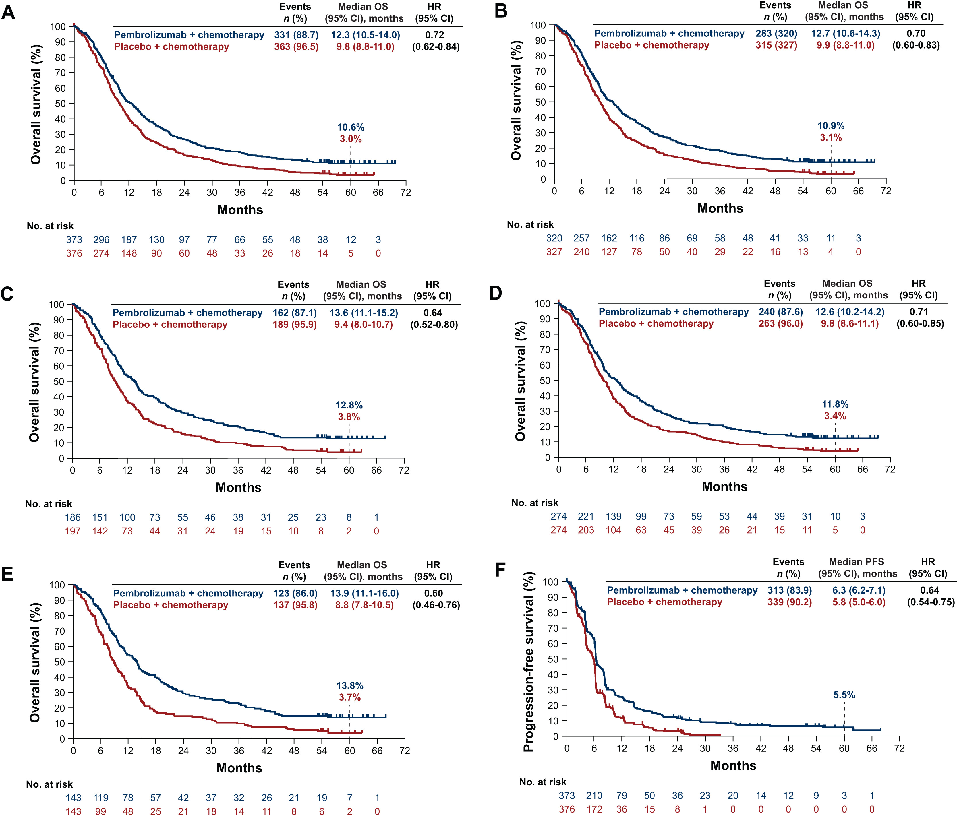
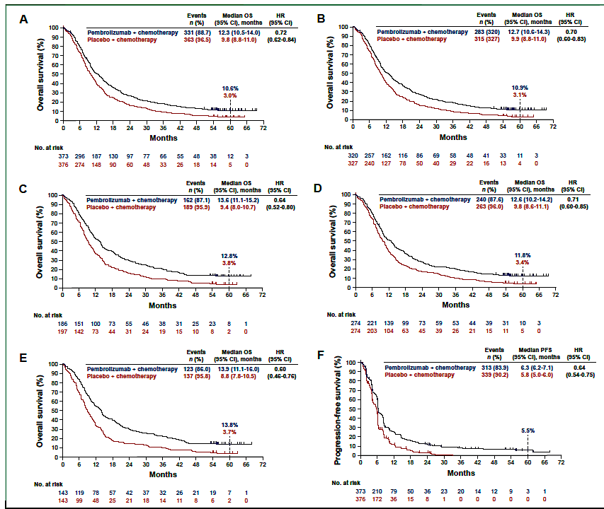
KEYNOTE 590 Long Term Follow Up: Esophageal Adenocarcinoma and SCC
Improved long term overall survival with Pembrolizumab + Chemo
Chemo alone 5-year OS 3.0%
+ Pembrolizumab
  All patients: 10.6%
  CPS > = 1%, 10.9%
  CPS > = 10%, 12.8 %
Figure 2 Efficacy outcomes. (A-E) Kaplan–Meier estimates of overall survival in (A) all randomly assigned participants in the intention-to-treat population, (B) participants with PD-L1 CPS ≥1, (C) participants with PD-L1 CPS ≥10, (D) participants with ESCC, and (E) participants with ESCC PD-L1 CPS ≥10. (F-I) Kaplan–Meier estimates of progression-free survival in (F) all randomly assigned participants in the intention-to-treat population, (G) participants with PD-L1 CPS ≥1, (H) participants with PD-L1 CPS ≥10, and (I) participants with ESCC. The intention-to-treat population included all randomly assigned participants. CI, confidence interval; CPS, combined positive score; ESCC, esophageal squamous-cell carcinoma; HR, hazard ratio; OS, overall survival; PD-L1, programmed death-ligand 1; PFS, progression-free survival.
Metges ESMO Open 10: 1; 2025

Slide 74
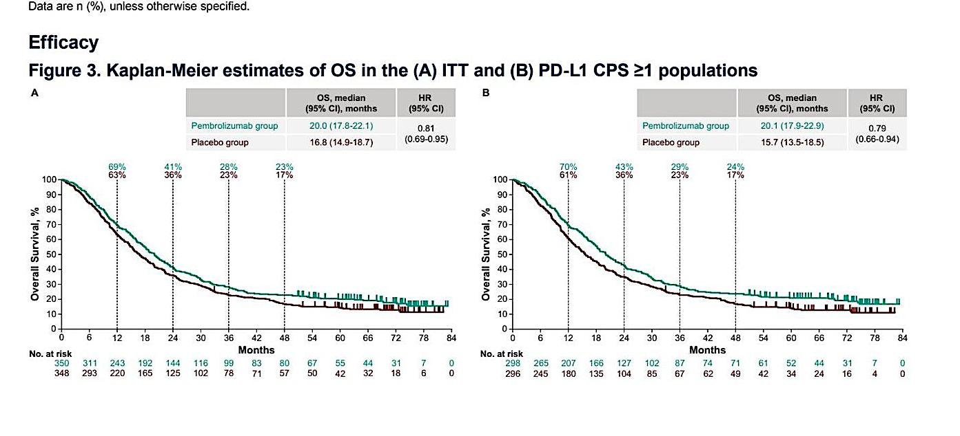
KEYNOTE 811 Long Term Follow Up; ASCO 2026
Improved long term overall survival with Pembrolizumab + Chemo/Tras
Chemo/Tras alone 4-year OS 17.0%
+ Pembrolizumab
  All patients: 23.0%
  CPS > = 1%, 24.0%
  CPS < 1%: survival detriment
Kawazoe ASCO 2026 Abstract 4040

Slide 75
LONG TERM FU OF M1 TRIALS OF IMMUNOTHERAPY + CHEMOTHERAPY
All trials indicate a significant improvement in long term survival with front line addition of immunotherapy (tislelizumab, pembrolizumab, or nivolumab) to chemotherapy
Benefits are limited to cancers testing CPS positive with regulators stipulating a cutoff of 1% or higher for positive scores.

Slide 76
Year in Review:
Gastroesophageal Cancers
INTRODUCTION: Biomarker Evaluation in Localized and Metastatic Disease
MODULE 1: Role of Immune Checkpoint Inhibitors in the Management of Gastroesophageal Cancers — Dr Ilson
MODULE 2: Other Available Therapeutic Approaches — Dr Shitara

Slide 77
Year in Review
(gastric/GEJ disease)
Kohei Shitara
Department of Gastroenterology
National Cancer Center Hospital East (NCCHE)

Slide 78
What we will cover today
Section A · HER2-positive G/GEJ
Section B · CLDN18.2-positive G/GEJ
Section C · ESCC & synthesis
From "trastuzumab + chemo" to dual-epitope + ADC
Antibody vs. ADC: two ways to drug claudin 18.2
A new bispecific ADC in ESCC, and the cross-cutting themes
1L
HERIZON-GEA-01 primary + PD-L1 subgroup
Elimova ASCO GI 2026 · Rha ASCO 2026 · Shitara NEJM 2026
1L
SPOTLIGHT & GLOW pivotal context
(zolbetuximab + chemo)
Shitara Lancet 2023 · Shah Nat Med 2023
2L+
Iza-bren in r/m ESCC
Lu Z, ASCO 2026 abs 4008 · BL-B01D1-305
2L
DESTINY-Gastric04 T-DXd vs ram/pac
Shitara NEJM 2025 / ASCO GI 2026 update
1L
ILUSTRO zolb + mFOLFOX6 + nivo, Cohort 4
Shitara ASCO GI 2026 · Nat Med 2026
1L
DESTINY-Gastric03 safety (Arms D, F, Part 4)
Janjigian ASCO 2025 poster 4022
TiP
LUCERNA zolb + pembro + chemo (CPS ≥1)
Shitara ASCO GI 2026
TiP
DESTINY-Gastric05 (T-DXd+Pembro+Cape)
Shitara ASCO 2025 poster
ARTEMIDE-Gastric01 (rilvegostomig + T-DXd)
Xu ASCO 2025 poster
ADC
CLARITY-PanTumor01 & CLARITY-Gastric01
Sonesitatug vedotin (Sone-Ve / AZD0901)

Slide 79
Resistance to Trastuzumab in Gastric Cancer
Why HER2-targeted therapy fails in gastric cancer: multiple escape routes
Intratumoral heterogeneity/HER2 Loss
HER2 heterogeneity is more common in gastric cancer than breast cancer
Around 50% of patients have reduced or lost HER2 expression after chemotherapy plus trastuzumab
Heterodimer formation between HER2 and EGFR or HER3
Single-agent trastuzumab cannot completely block these pairings

Slide 80
Trial 1: HERIZON-GEA-01 Phase III Trial of Zanidatamab + Chemotherapy ± Tislelizumab

Slide 81
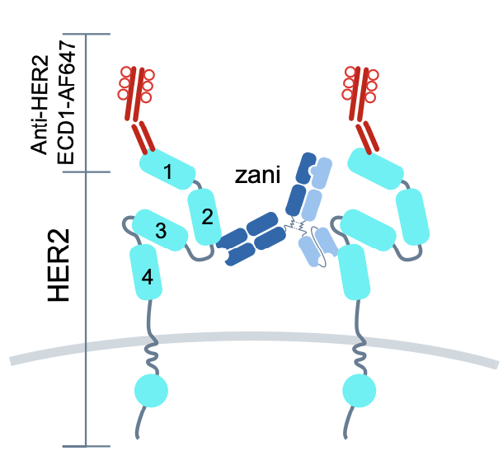
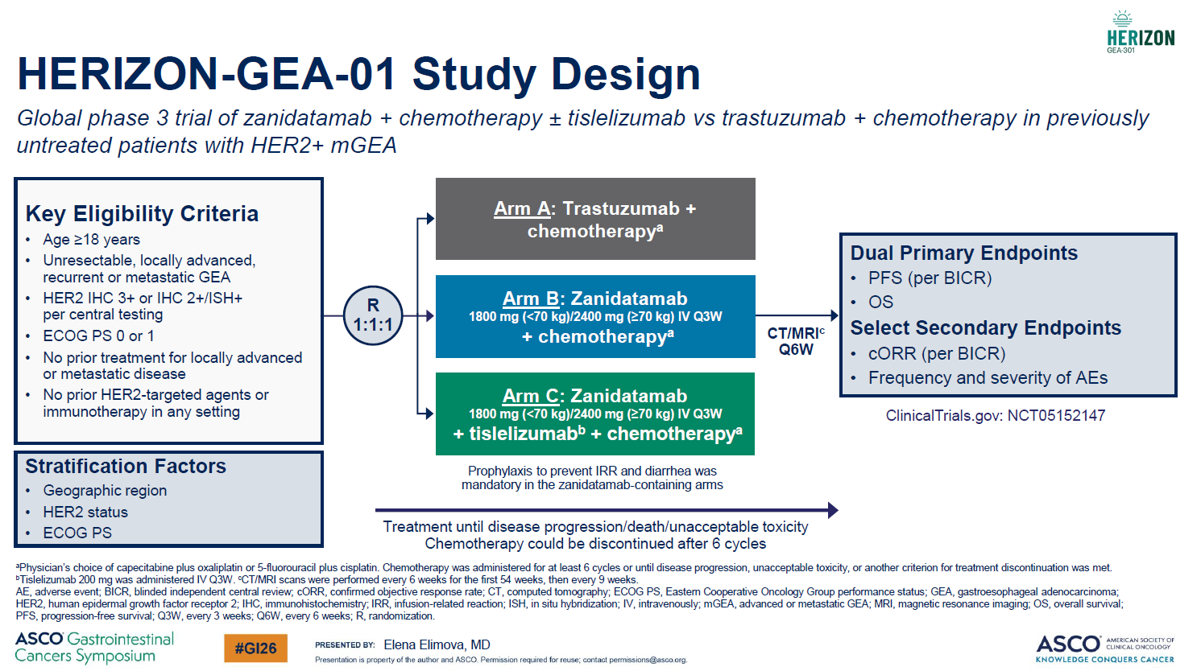
Trial 1: HERIZON-GEA-01 Phase 3 of zanidatamab ± tisle + chemo
Forms trans-bridging HER2 clusters with topology disruption
Heterodimer blockade
Complement dependent cytotoxicity
N=914 pts (Dec 2021-Feb 2025)
Comparison with ToGA regimen
KN 811 approval by FDA in May 2021 and EMA in Aug 2023
Asia 53%, IHC3+ 83%, TAP>1% 60%, CapeOX 90%
Ongoing treatment: 29% (triplet), 23% (doublet) vs 12% (control)
Shitara K, et al. NEJM 2026; Elimova E, et al. ASCO-GI 2026

Slide 82
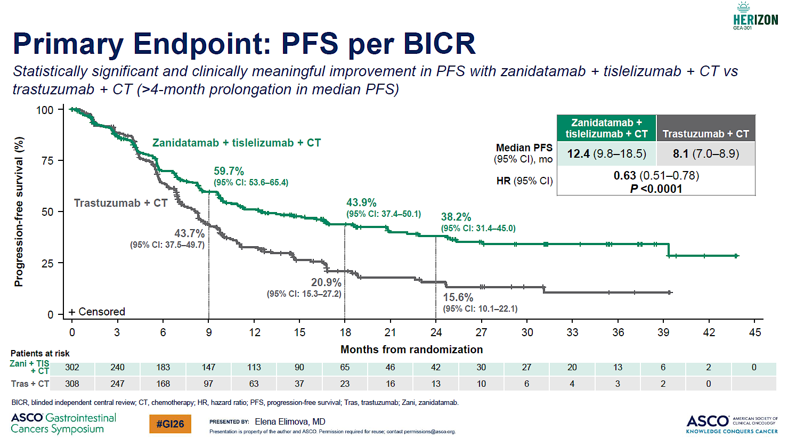
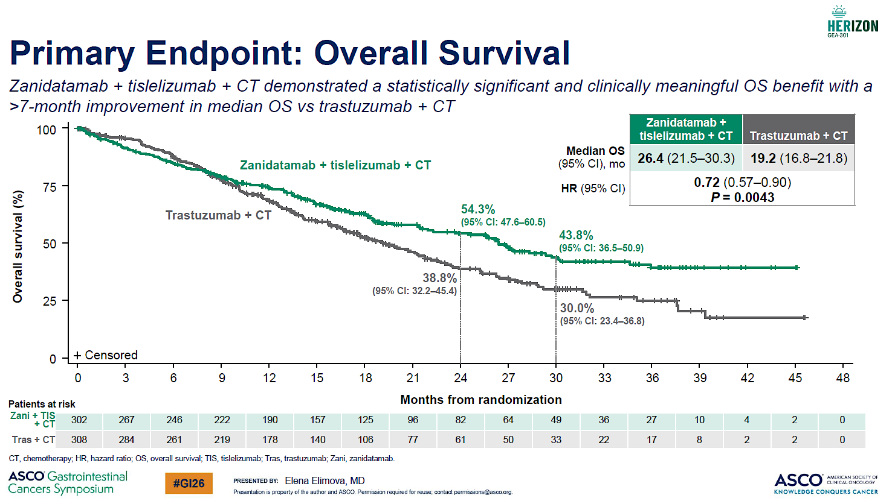
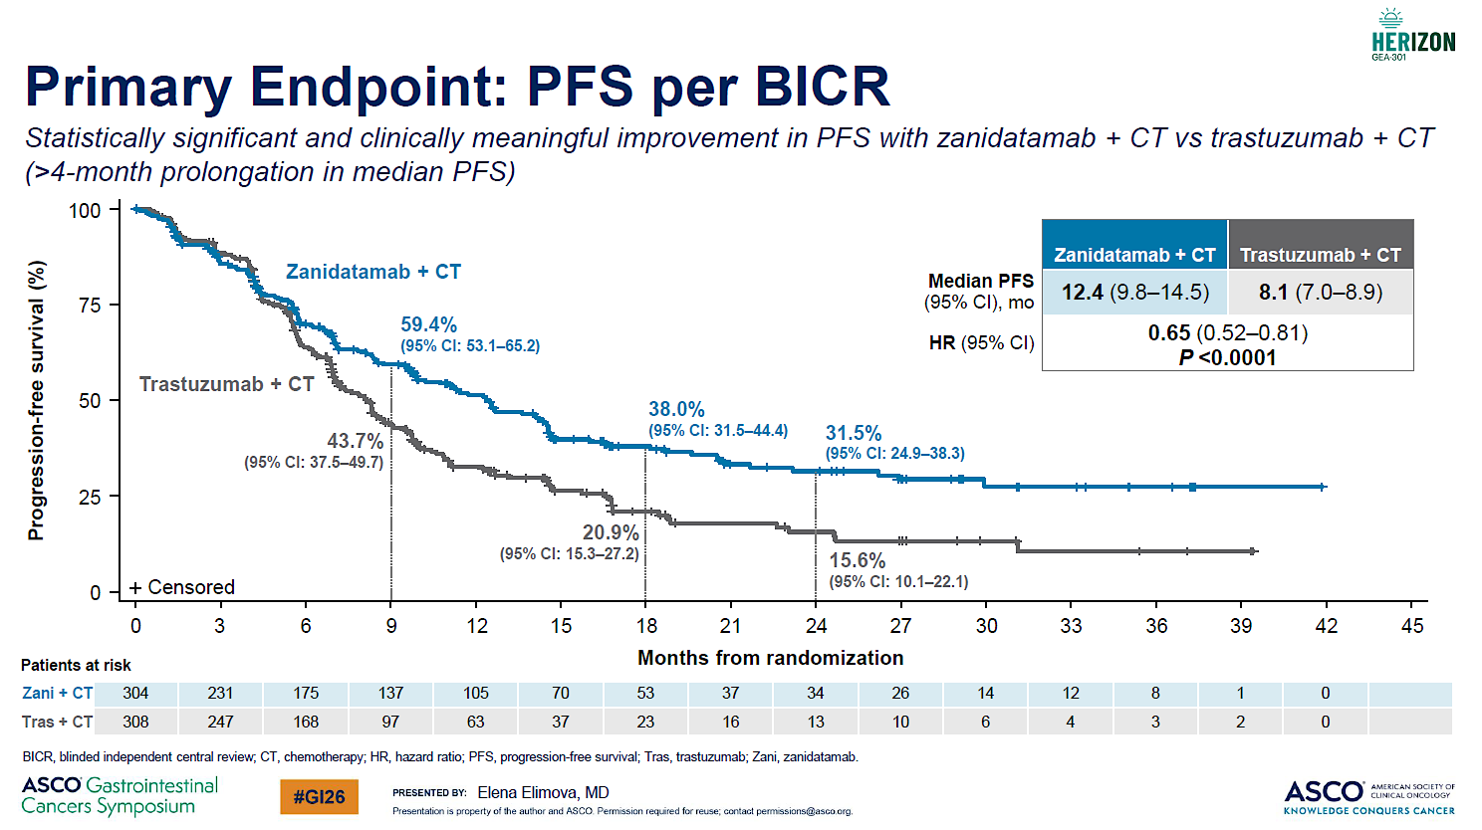
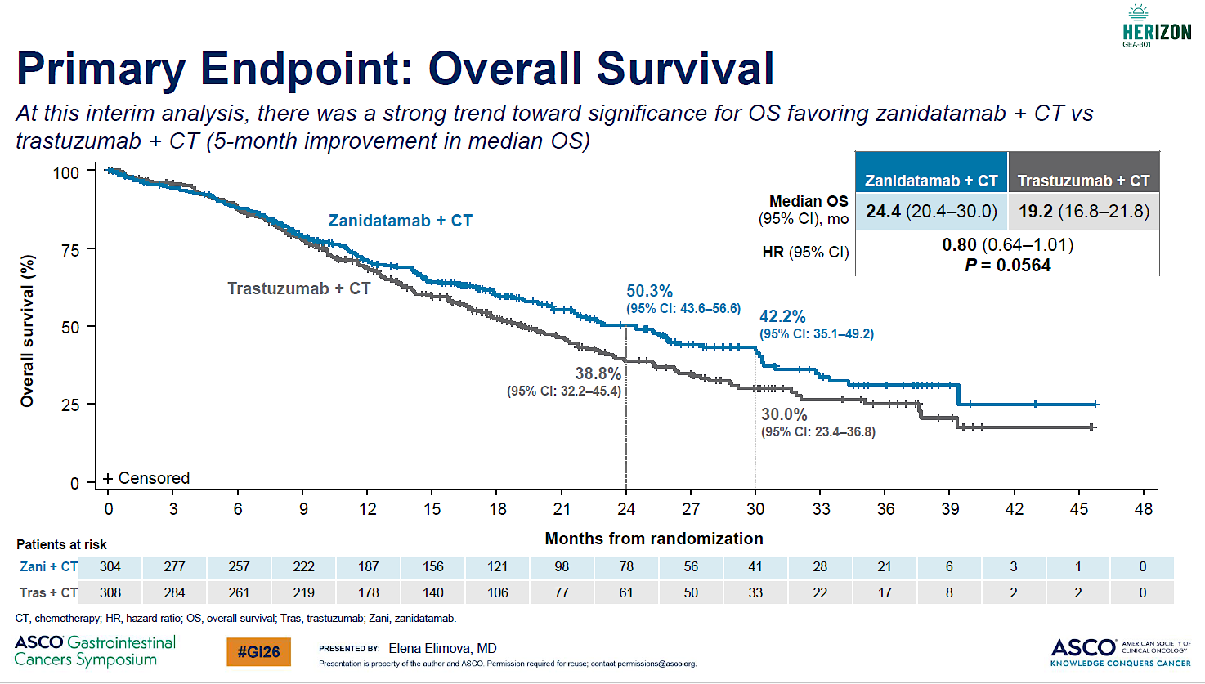
Trial 1: HERIZON-GEA-01 Phase 3 of zanidatamab ± tisle + chemo
PFS improved with both chemo+Zani+Tisle and chemo+Zani
mPFS+4.3 ms (HR 0.63 with triplet and 0.65 with doublet)
ORR 70.7%/69.6%/65.7%
mDOR 20.7 / 14.3 / 8.3 ms
OS improved by chemo+Zani+Tisle: mOS 26.4 (+7.2ms, HR 0.72)
OS not conclusive by chemo+Zani; mOS 24.4 (+5.2ms, HR 0.80)
Follow up still ongoing for next analysis
Shitara K, et al. NEJM 2026; Elimova E, et al. ASCO-GI 2026

Slide 83
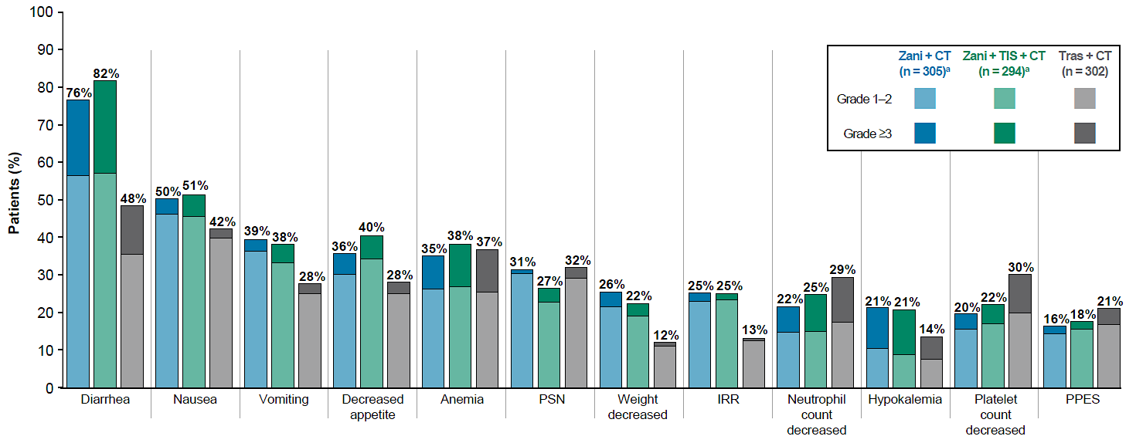
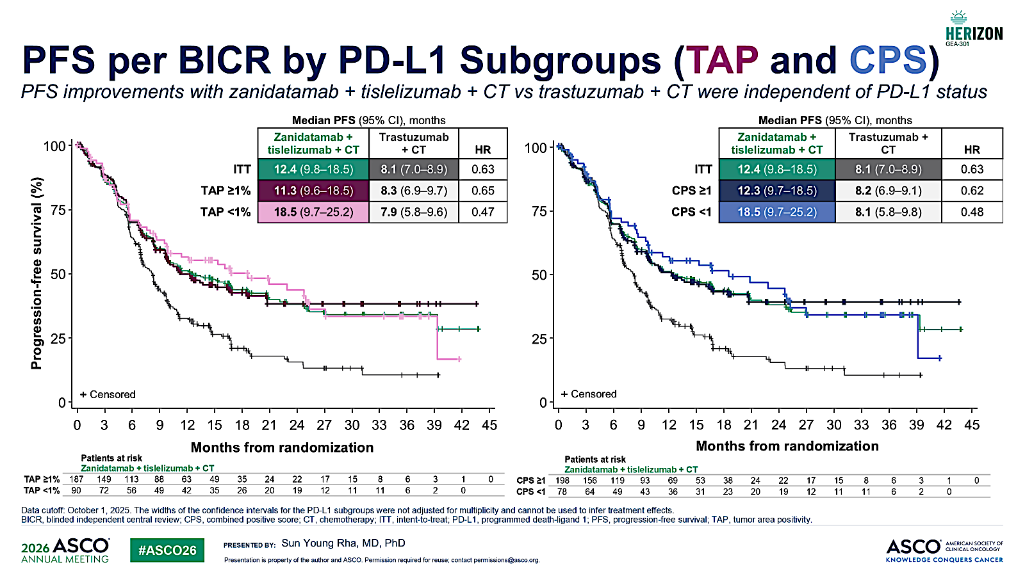
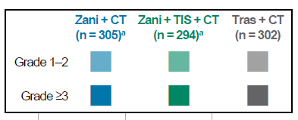
Trial 1: HERIZON-GEA-01 Phase 3 of zanidatamab ± tisle + chemo
Common TRAEs
PFS subgroup by PDL1 TAP
Diarrhea: +30% increase (+10% ≥Grade3)
Occurred early: 7 days
Loperamide prophylaxis mandatory for 7days in cycle 1
Zani discontinuation by diarrhea: 4%
Consistent benefit in most of the subgroups
Benefit regardless of PD-L1 status
Shitara K, et al. NEJM 2026; Elimova E, et al. ASCO-GI 2026; Rha SY, et al. ASCO 2026 #4010

Slide 84
Trial 1: HERIZON-GEA-01 Phase 3 of zanidatamab ± tislelizumab + chemo
Implications
Phase 3 study to demonstrate PFS and OS superiority of a zanidatamab-based regimen in 1L HER2+ G/GEJ.
Zanidatamab + chemotherapy improved PFS, supporting the biological advantage of biparatopic HER2 targeting.
Addition of tislelizumab further improved OS, with more durable response
Benefit appeared consistent across PD-L1 subgroups, including TAP or CPS<1%.
Diarrhea management is essential
Comparator caveat: the control arm did not include pembrolizumab.
Bottom line
Practice-changing
Likely to become a new first-line standard, pending regulatory approval.

Slide 85
Trial 2: DESTINY-Gastric04 Phase III Trial Comparing Trastuzumab Deruxtecan (T-DXd) to Ramucirumab + Paclitaxel

Slide 86
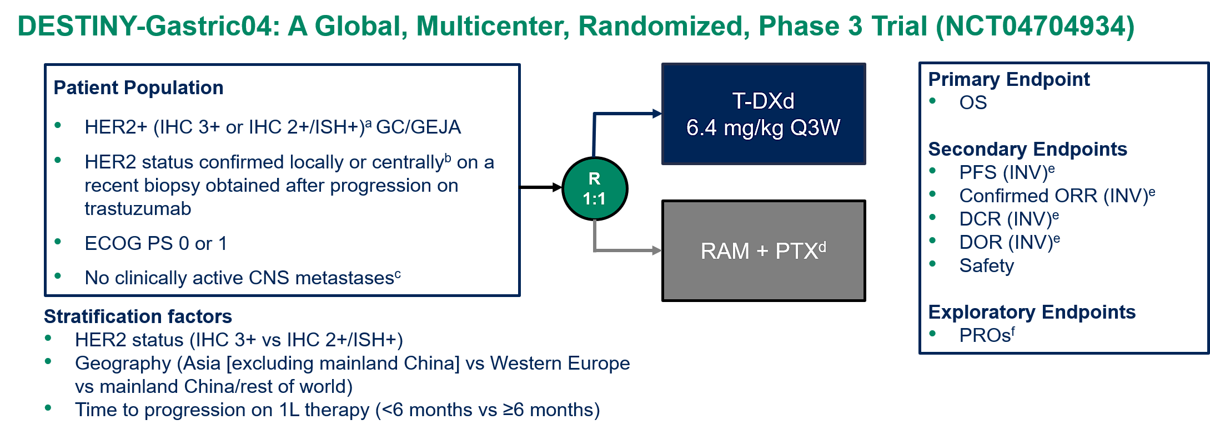
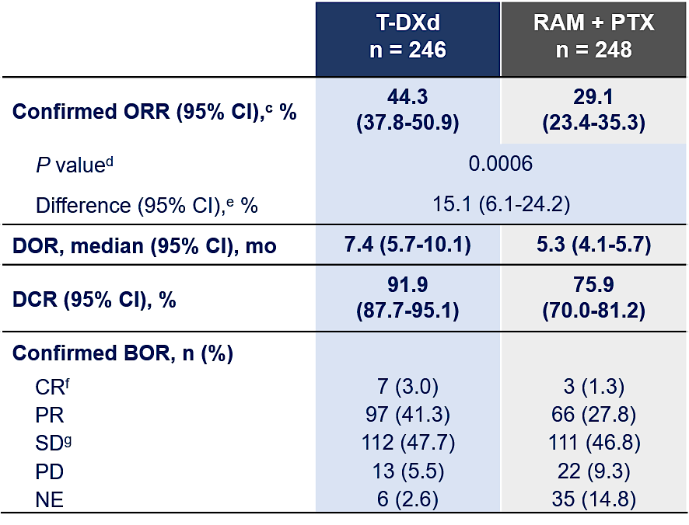
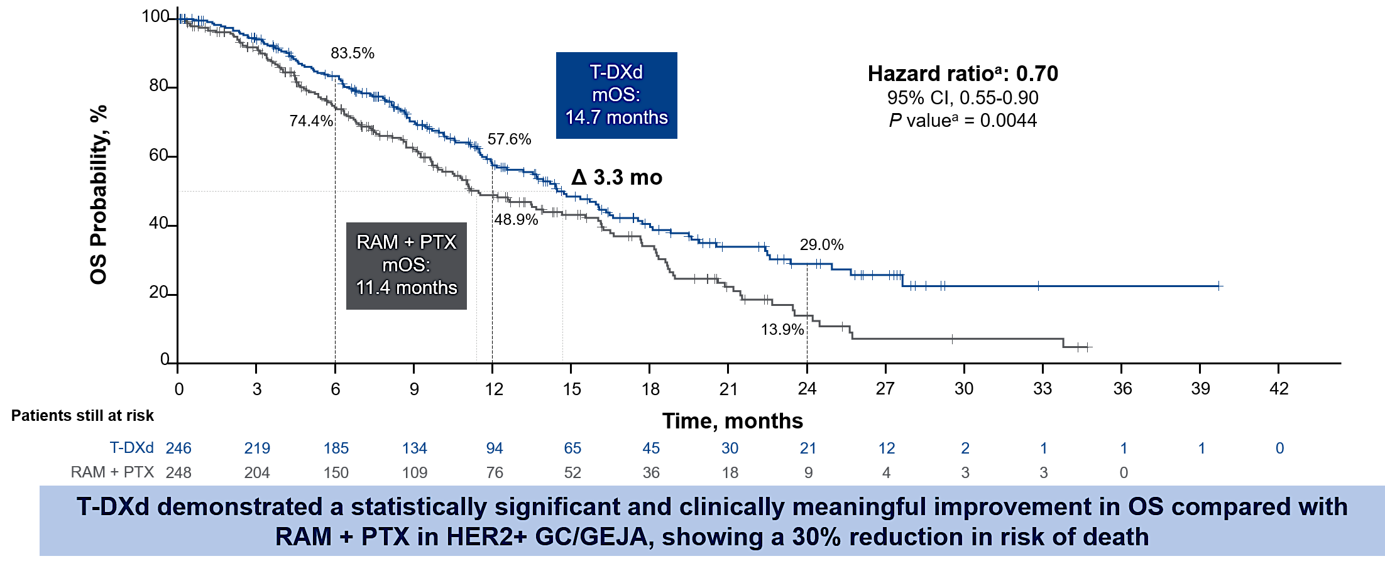
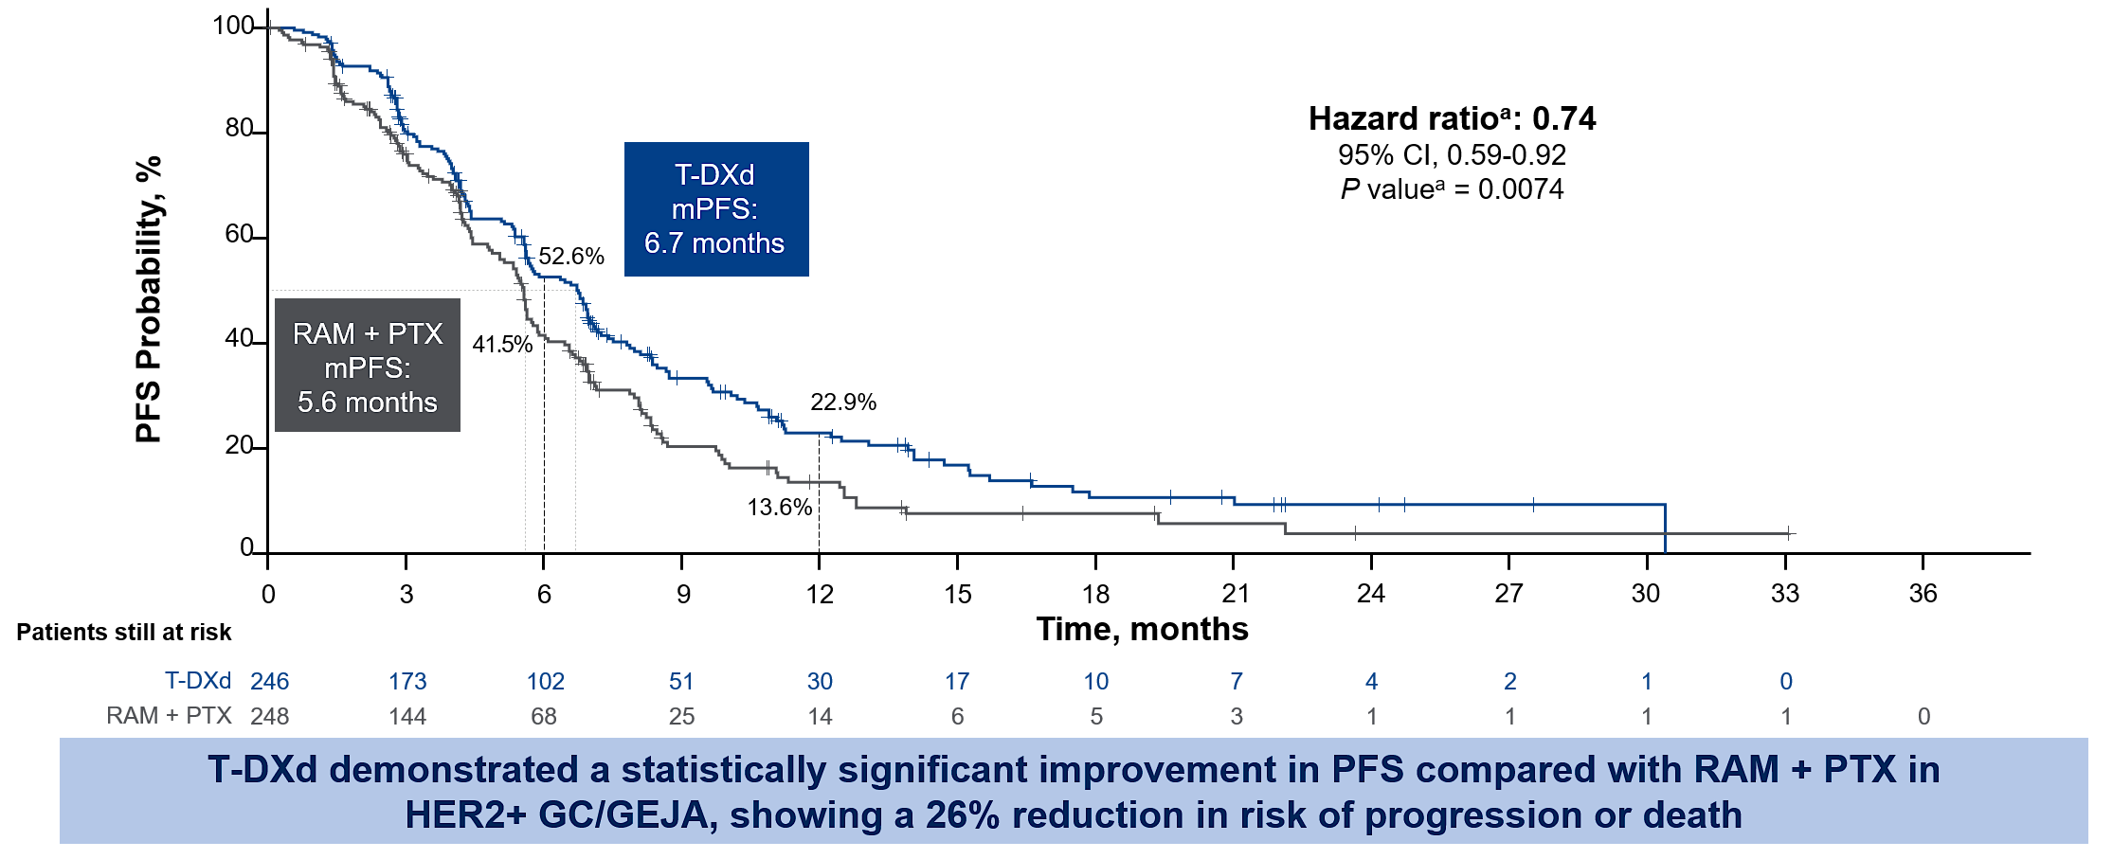
Trial 2: DESTINY-GC04 phase 3 comparing T-DXd vs. Ram + PTX
Shitara K, et al. ASCO 2025: NEJM 2025

Slide 87
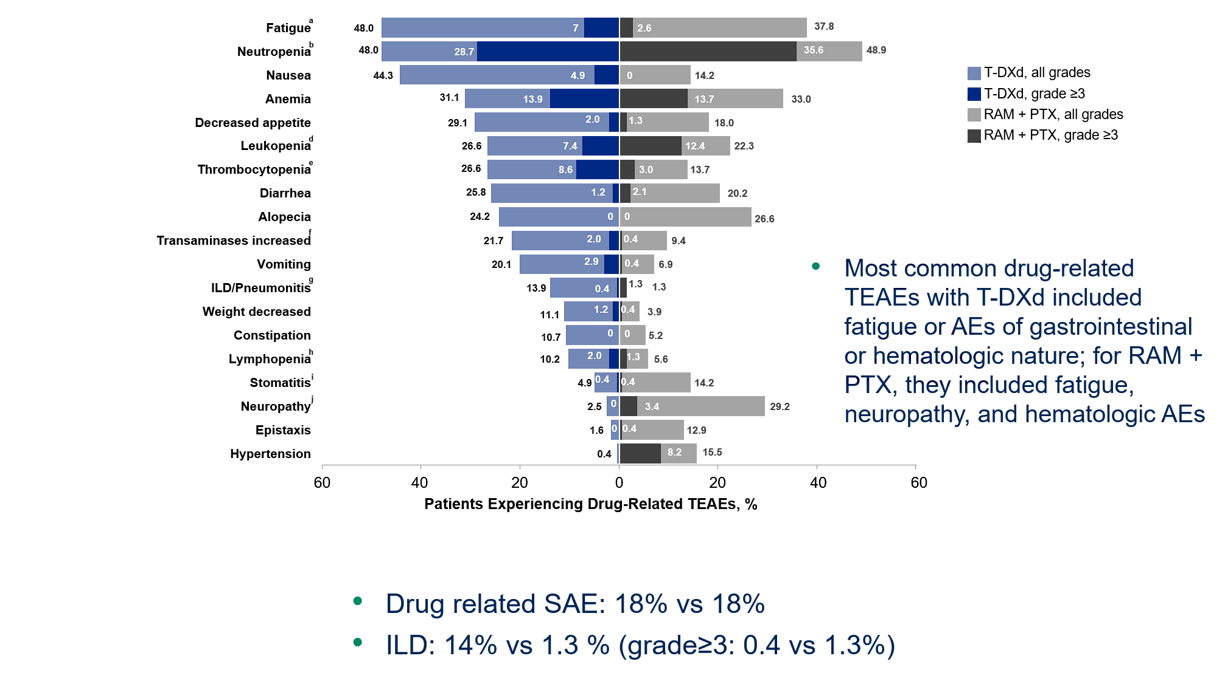
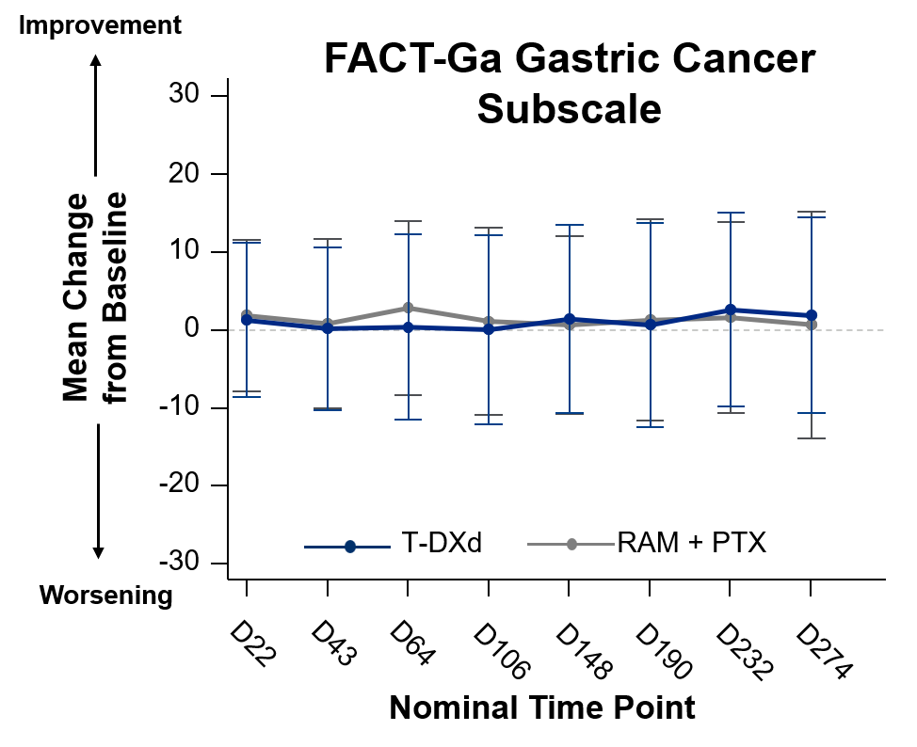
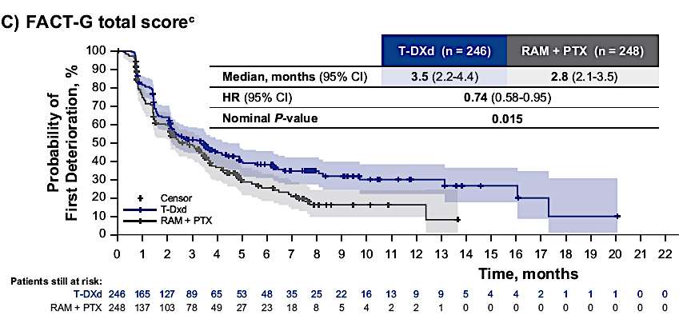
Trial 2: DESTINY-GC04 phase 3 comparing T-DXd vs. Ram + PTX
Drug related SAE: 18% vs 18%
ILD: 14% vs 1.3 % (grade≥3: 0.4 vs 1.3%)
Patient reported outcomes: comparable
Time to function deterioration; Favored T-DXd
Shitara K, et al. ASCO 2025, 2026: NEJM 2025

Slide 88
Trial 2: DESTINY-GC04 phase 3 comparing T-DXd vs. Ram + PTX
Implications
First global randomized phase 3 confirmation of 2nd-line T-DXd in HER2-positive gastric cancer.
T-DXd significantly improved OS, PFS, and ORR versus ramucirumab plus paclitaxel.
HER2 re-confirmation at progression should be considered whenever feasible.
ILD remains the key toxicity requiring proactive monitoring.
Bottom line
Practice-changing
Re-biopsy HER2 at progression and use T-DXd as preferred 2L therapy if HER2 is retained.

Slide 89
Trial 3: DESTINY-Gastric03 — T-DXd +
Chemotherapy ± Anti-PD-1 Antibody

Slide 90
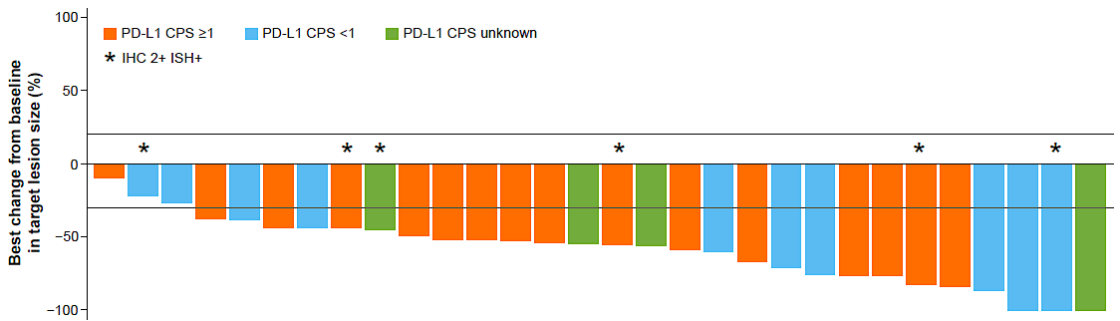
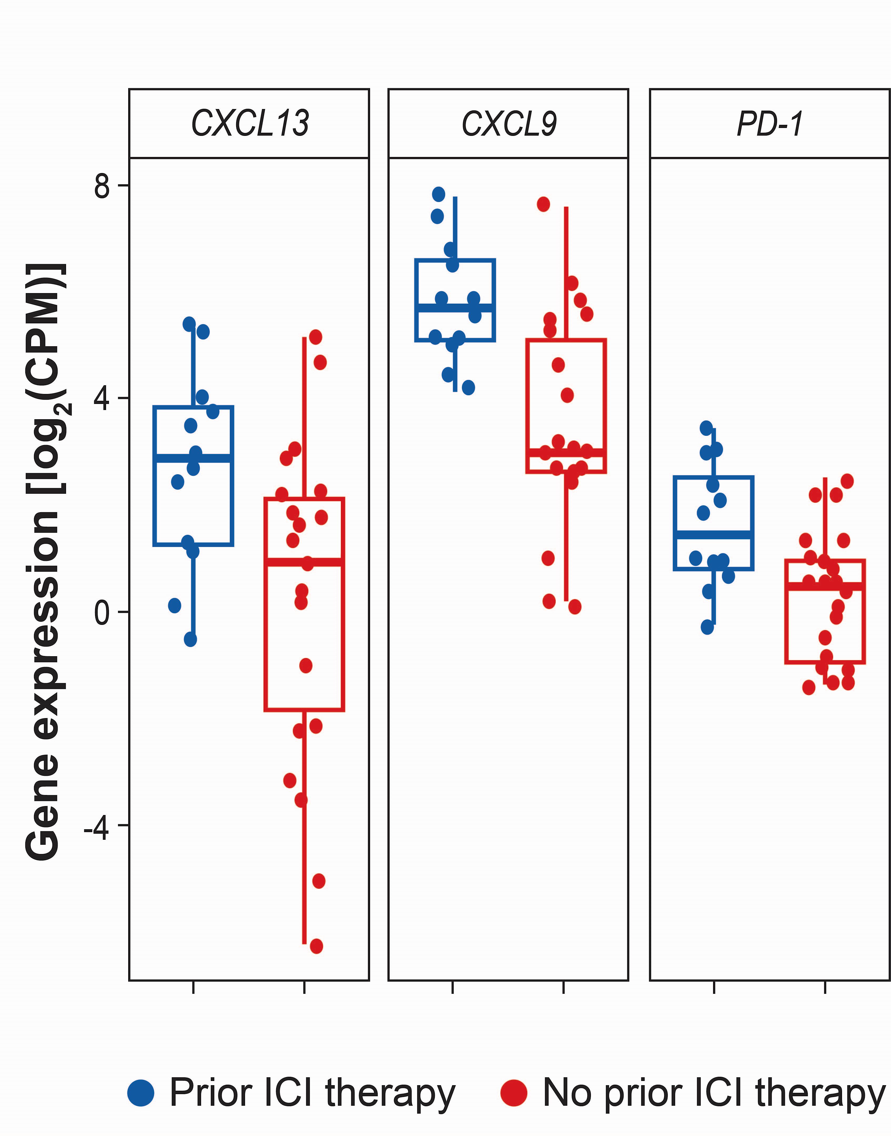
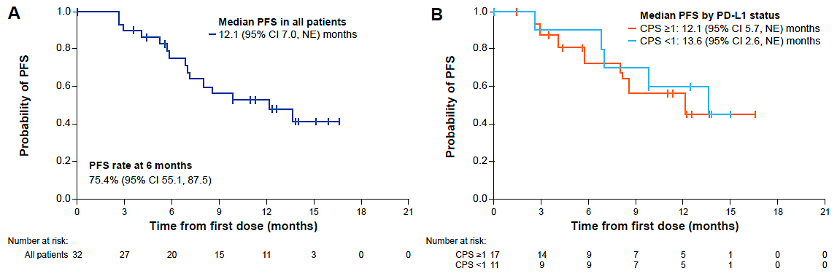

Trial 3: DESTINY-Gastric03: T-DXd plus chemo +/- anti-PD1
Rationales: analysis from DG-01 study
DESTINY-Gastric03: T-DXd5.4mg/kg+reduced FU/cape (750mg/bid)+pembro
 | Prior ICI |  | No Prior ICI
Efficacy | T-DXd n = 44 | Chemo n = 17 | T-DXd n = 81 | Chemo n = 45
Confirmed ORR, % | 56.8 | 18.5 | 34.7 | 10.0
Median OS, months | 16.6 | 8.6 | 10.3 | 8.4
 | HR, 0.31 |  | HR, 0.83
Combination activity
Reduced T-DXd+Capecitabine+pembro was feasible
ORR 75%, median PFS 12.1 ms and median DOR 12.3 ms
No increase T-DXd incidence compared with T-DXd monotherapy
T-DXd+with bispecific (PD-1xCTLA4, PD-1xTIGIT) also showed acceptable safeties and promising activities
T-DXd showed trend of higher ORR after anti-PD1
CXCL13, CXCL9, and PD-1 showed higher expression in pts after prior ICI such as
T-DXd activated DC and ↑ MHC-I, resulted in combination activity
Shitara K, et al. ASCO-GI 2022; Iwata et al, Mol Cancer Ther. 2018; Jajigian Y, et al. ESMO Asia 2025: ASCO 2026 #4022

Slide 91



DESTINY-Gastric03 Safety Results
Janjigian Y et al ASCO 2026;Abstract 4022

Slide 92
Trial 3: DESTINY-Gastric03: T-DXd plus chemo +/- anti-PD1
Implications
Demonstrated feasibility of combining T-DXd with immunotherapy and chemotherapy in 1L.
Dose reduction of both T-DXd and fluoropyrimidine substantially improved tolerability.
Safety profiles were generally consistent with those of the individual components
No unexpected safety signals emerged beyond known ADC toxicities.
Bottom line
Evidence tier: Signal-seeking / dose-selection
Provides the rationale for phase 3 development of T-DXd-based first-line combinations.

Slide 93
Trials 4 and 5: Phase III DESTINY-Gastric05 and ARTEMIDE-Gastric01

Slide 94


Trials 4 and 5: Phase 3 DESTINY-Gastric05 and ARTEMIDE-Gastric01
Phase 3 DESTINY-Gastric05
Phase 3 ARTEMIDE-Gastric01
Shitara K, Jajigian Y, et al. ASCO 2025; Shah M, et al. ASCO GI 2026 TPS460

Slide 95
Trials 6 and 7: Zolbetuximab + Chemotherapy in the Phase III SPOTLIGHT and GLOW Trials

Slide 96
CLDN18.2: Non-Oncogenic Targets and Tumor-Specific Vulnerability
Tight junction protein usually located at the apical site of normal epithelial gastric stomach cells
During malignant transformation it is exposed to the tumor cell surface with the disruption of the tight junction – becomes an accessible target for cancer treatment
Around 40% of patients maintain high expression of claudin 18.2, so it is a relatively prevalent biomarker for this disease

Slide 97


Trials 6 and 7: Zolbetuximab + chemotherapy in phase 3 SPOTLIGHT + GLOW
PFS of combined population
OS of combined population
Enrolled pts with CLDN18.2 IHC 2+/3+ in ≥75%
PFS and OS improved
No increase of response rate, suggesting a mechanism beyond direct cytotoxicity
Approval in Japan, UK, EU and US (FDA) etc.
Shitara K, et al. Lancet 2023, Shah M, et al. Nature Med 2023; Shitara K, et al. NEJM 2024

Slide 98


GI toxicities with zolbetuximab
All occurrences of nausea or vomiting in SPOTLIGHT and GLOW
Nausea/Vomiting common in pts without gastrectomy
Incidence was high in 1st cycle and decreased later
Infusion rate adjustment and anti-emetics were needed
Use of NK1, 5-HT3 and steroid was associated with less vomiting
Shitara K, et al. ASCO-GI 2024; ESMO open 2026

Slide 99
Trials 6 and 7: Zolbetuximab + chemotherapy in phase 3 SPOTLIGHT + GLOW
Implications
Established CLDN18.2 as a validated therapeutic target in gastric cancer.
Zolbetuximab plus chemo is now a standard first-line option for CLDN18.2-high disease.
Two independent phase 3 trials consistently demonstrated PFS and OS benefit.
Nausea and vomiting remain the major treatment-limiting toxicities.
Bottom line
Practice-changing
Test CLDN18.2 routinely at diagnosis and proactively manage nausea/vomiting.

Slide 100
Trial 8: Phase II ILUSTRO Trial Cohort 4 —
FOLFOX + Zolbetuximab + Nivolumab

Slide 101



Trial 8: Phase 2 ILUSTRO Cohort 4: FOLFOX + Zolbe + Nivo
N=71 pts for cohort B (dose expansion)
mOS 18ms in CLDN high and 23ms in CLDN high+CPS≥1
ORR 62% in all pts / 68% in CLDN high
Discontinue by AE: Zolbe 5% Nivo 9%
Nausea 81% (no G3) Vomiting 38% (G3: 4%)
Phase 3 LUCERNA is ongoing
Shitara K, et al. ASCO-GI 2026 LBA284, Nature Med 2026

Slide 102
Trial 8: Phase 2 ILUSTRO Cohort 4: FOLFOX + Zolbe + Nivo
Implications
First substantial dataset combining zolbetuximab, chemotherapy, and PD-1 blockade.
Demonstrated encouraging efficacy, particularly in CLDN18.2-high tumors
Supports the hypothesis that CLDN18.2 targeting and PD-1 inhibition may be complementary.
Manageable safety profiles
Bottom line
Evidence tier: Signal-seeking
Supports ongoing phase 3 evaluation of zolbetuximab plus chemo-immunotherapy.

Slide 103
Trial 9: Ongoing Phase III LUCERNA Trial (NCT06901531)

Slide 104

Trial 9: Phase 3 LUCERNA (NCT0690151) is ongoing
Key question: Does zolbetuximab add benefit beyond pembrolizumab + chemotherapy?
Shitara K, et al. ASCO-GI 2026 TPS473

Slide 105
Trial 10: Phase II CLARITY-PanTumor01 Trial with AZD0901 (Sonesitatug Vedotin)

Slide 106


Emerging CLDN18.2 Targeted treatments
>30 agents have been tested in clinical trials
ADCs, T-cell engager, CAR-T may expand indication of CLDN targeted agents
Nakayama I, Shitara K. et al. Nature Revise Clinical Oncol. 2024

Slide 107




Trial 10: Phase 2 CLARITY-Pan tumor 01 trial with AZD0901 (Sone-Ve)
ORR 28.4%
CLDN18.2 >25% with any intensity, 2nd or later line
Premedication for Nausea is essential
Shitara K, et al. ASCO 2026 #4023

Slide 108
Trial 10: Phase 2 CLARITY-Pan tumor 01 trial with AZD0901 (Sone-Ve)
Implications
Represents the next generation of CLDN18.2-directed therapy using an ADC approach.
Early studies demonstrate substantial activity in heavily pretreated patients.
May provide deeper and more durable responses than antibody-based approaches.
Nausea and vomiting remain important but manageable toxicities.
Bottom line
Evidence tier: Early signal
Support the ongoing phase 3 study

Slide 109
Trial 11: Ongoing CLARITY-Gastric01 Phase III Study

Slide 110

Trial 11: ongoing CLARITY-Gastric 01 phase 3 study
CLARITY-Gastric01: Phase 3 AZD0901 vs 2nd or 3rd line chemo (NCT06346392)
Key question: Can ADCs outperform antibodies in CLDN18.2-positive disease?
Shitara K, et al. ESMO-GI 2024; ASCO-GI 2026 TPS462

Slide 111
Trial 12: Izalontamab Brengitecan versus Chemotherapy for Recurrent/Metastatic Esophageal Squamous Cell Carcinoma (ESCC)

Slide 112




Trial 12: Izalontamab brengitecan vs. chemotherapy in recurrent/metastatic ESCC
PFS and OS improved
ORR by BICR 35.3 vs 13.1%
Grade 3 related AEs 85% vs 60%
AEs leading to discontinuation 2% vs 3.3%
ILD 1.6% with Iza-Bren
Lu et al. ASCO 2026 #4008

Slide 113
Trial 12: Izalontamab brengitecan vs. chemotherapy in recurrent/metastatic ESCC
Implications
Demonstrates meaningful activity of EGFR×HER3 bispecific ADC therapy in ESCC
Responses appear durable and clinically relevant in refractory disease.
Safety profile is manageable and consistent with prior BL-B01D1 experience.
A promising new ADC option that may expand treatment choices in ESCC
Bottom line
Potentially practice-changing
Warrants confirmation in global cohorts

Slide 114
Year in Review: Clinical Investigator Perspectives on the
Most Relevant New Datasets and Advances in Oncology
Multiple Myeloma
A CME/MOC-Accredited Live Webinar
Thursday, June 25, 2026
5:00 PM – 6:00 PM ET
Faculty
Amrita Krishnan, MD
Robert Z Orlowski, MD, PhD
Moderator
Neil Love, MD

Slide 115
Thank you for joining us!
Please take a moment to complete the survey currently up on Zoom. Your feedback is very important to us. The survey will remain open for 5 minutes after the meeting ends.
Information on how to obtain CME, ABIM MOC and ABS credit is provided in the Zoom chat room. Attendees will also receive an email in
1 to 3 business days with these instructions.

