Slide 1
Year in Review: Clinical Investigator Perspectives on the Most Relevant New Datasets and Advances in Oncology
Colorectal Cancer
A CME/MOC-Accredited Live Webinar
Thursday, April 16, 2026 5:00 PM – 6:00 PM ET
Faculty
Arvind Dasari, MD, MS
Anwaar Saeed, MD
Moderator
Neil Love, MD

Slide 2


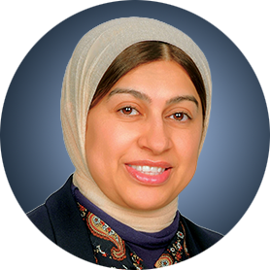
Faculty
Arvind Dasari, MD, MS
Professor
Department of Gastrointestinal Medical Oncology
The University of Texas MD Anderson Cancer Center
Houston, Texas
MODERATOR
Neil Love, MD Research To Practice
Miami, Florida
Anwaar Saeed, MD
Associate Professor
University of Pittsburgh School of Medicine
Section Chief, Gastrointestinal Oncology
Director, Gastrointestinal Disease Center
Co-Leader, Cancer Therapeutics Program
UPMC Hillman Cancer Center
Pittsburgh, Pennsylvania

Slide 3
Commercial Support
This activity is supported by educational grants from Exelixis Inc, GSK, and Natera Inc.

Slide 4
Dr Love — Disclosures
Dr Love is president and CEO of Research To Practice. Research To Practice receives funds in the form of educational grants to develop CME activities from the following companies: Aadi Bioscience, AbbVie Inc, ADC Therapeutics, Agendia Inc, Alexion Pharmaceuticals, Amgen Inc, Array BioPharma Inc, a subsidiary of Pfizer Inc, Arvinas, Astellas, AstraZeneca Pharmaceuticals LP, Aveo Pharmaceuticals, Bayer HealthCare Pharmaceuticals, BeOne, Biotheranostics Inc, A Hologic Company, Black Diamond Therapeutics Inc, Blueprint Medicines, Boehringer Ingelheim Pharmaceuticals Inc, Bristol Myers Squibb, Celcuity, Clovis Oncology, Coherus BioSciences, Corcept Therapeutics Inc, CTI BioPharma, a Sobi Company, Daiichi Sankyo Inc, Eisai Inc, Elevation Oncology Inc, Exact Sciences Corporation, Exelixis Inc, Genentech, a member of the Roche Group, Genmab US Inc, Geron Corporation, Gilead Sciences Inc, GSK, Helsinn Therapeutics (US) Inc, ImmunoGen Inc, Incyte Corporation, Ipsen Biopharmaceuticals Inc, Jazz Pharmaceuticals Inc, Johnson & Johnson, Karyopharm Therapeutics, Kite, A Gilead Company, Kura Oncology, Legend Biotech, Lilly, MEI Pharma Inc, Merck, Mersana Therapeutics Inc, Mirati Therapeutics Inc, Mural Oncology Inc, Natera Inc, Novartis, Novartis Pharmaceuticals Corporation on behalf of Advanced Accelerator Applications, Novocure Inc, Nuvalent, Nuvation Bio Inc, Pfizer Inc, Pharmacyclics LLC, an AbbVie Company, Puma Biotechnology Inc, Regeneron Pharmaceuticals Inc, Revolution Medicines Inc, Rigel Pharmaceuticals Inc, R-Pharm US, Sanofi, Seagen Inc, Servier Pharmaceuticals LLC, SpringWorks Therapeutics Inc, Stemline Therapeutics Inc, Sumitomo Pharma America, Summit Therapeutics, Syndax Pharmaceuticals, Taiho Oncology Inc, Takeda Pharmaceuticals USA Inc, TerSera Therapeutics LLC, and Tesaro, A GSK Company.

Slide 5
Research To Practice CME Planning Committee Members, Staff and Reviewers
Planners, scientific staff and independent reviewers for Research To Practice have no relevant financial relationships to disclose.

Slide 6
Dr Dasari — Disclosures
Advisory Committees | Agenus Inc, Bristol Myers Squibb, Exelixis Inc, Illumina, Lantheus, Personalis, Sanofi, Taiho Oncology Inc, Takeda Pharmaceuticals USA Inc
Contracted Research | Bristol Myers Squibb, Crinetics Pharmaceuticals, Eisai Inc, Enterome, Guardant Health, Hutchison MediPharma, Natera Inc, NeoGenomics, Personalis, RayzeBio, Taiho Oncology Inc, Xencor

Slide 7
Dr Saeed — Disclosures
Advisory Committees and Consulting Agreements | Amgen Inc, AstraZeneca Pharmaceuticals LP, Autem Therapeutics, BeOne, Bristol Myers Squibb, Exact Sciences Corporation, Exelixis Inc, KAHR Medical, Merck, Pfizer Inc, Regeneron Pharmaceuticals Inc, Replimune, Taiho Oncology Inc, Xilio Therapeutics
Contracted Research | Actuate Therapeutics, Arcus Biosciences, AstraZeneca Pharmaceuticals LP, Bristol Myers Squibb, Coherus BioSciences, Exelixis Inc, Henlius, Incyte Corporation, KAHR Medical, Merck, Oxford BioTherapeutics, Phanes Therapeutics Inc, Regeneron Pharmaceuticals Inc, Replimune
Data and Safety Monitoring Boards/Committees | Arcus Biosciences

Slide 8
This educational activity contains discussion of non-FDA-approved uses of agents and regimens. Please refer to official prescribing information for each product for approved indications.

Slide 9
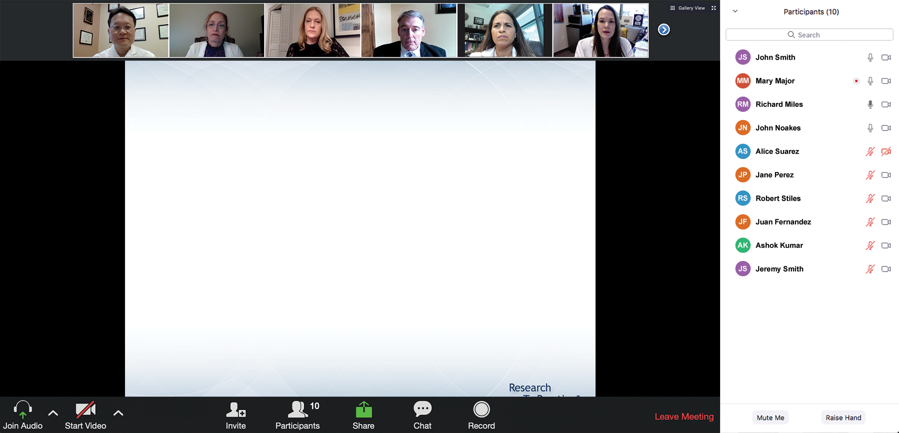

We Encourage Clinicians in Practice to Submit Questions
Feel free to submit questions now before the program begins and throughout the program.

Slide 10
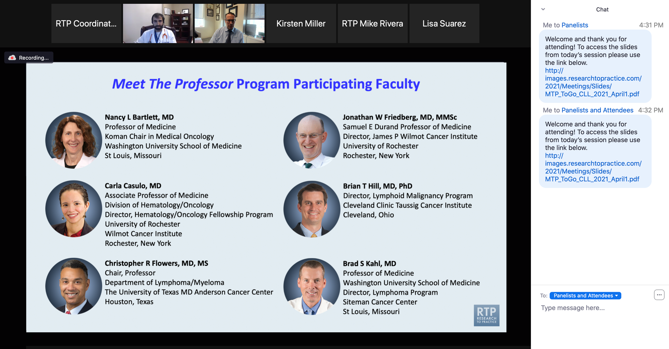
Familiarizing Yourself with the Zoom Interface
Expand chat submission box
Drag the white line above the submission box up to create more space for your message.

Slide 11
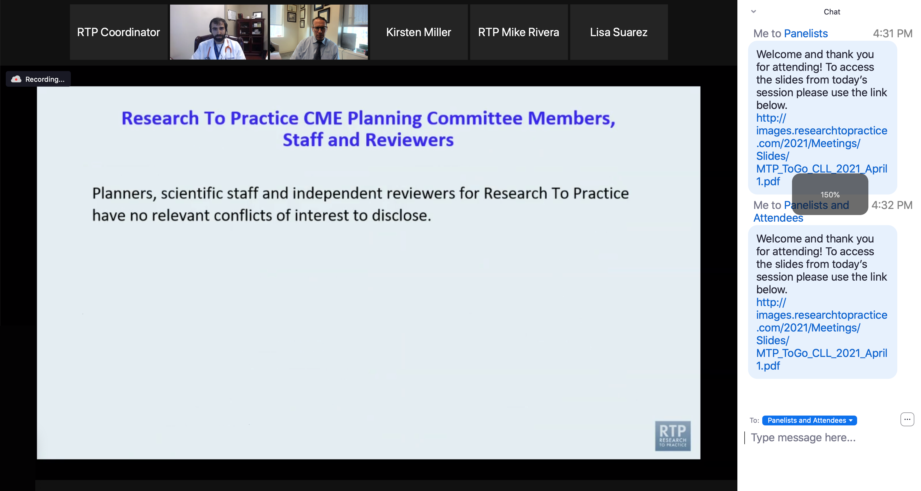
Familiarizing Yourself with the Zoom Interface
Increase chat font size
Press Command (for Mac) or Control (for PC) and the + symbol. You may do this as many times as you need for readability.

Slide 12
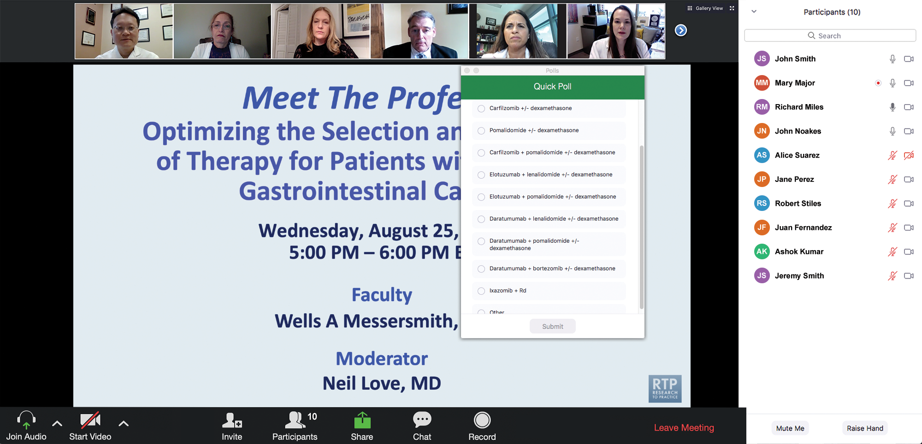
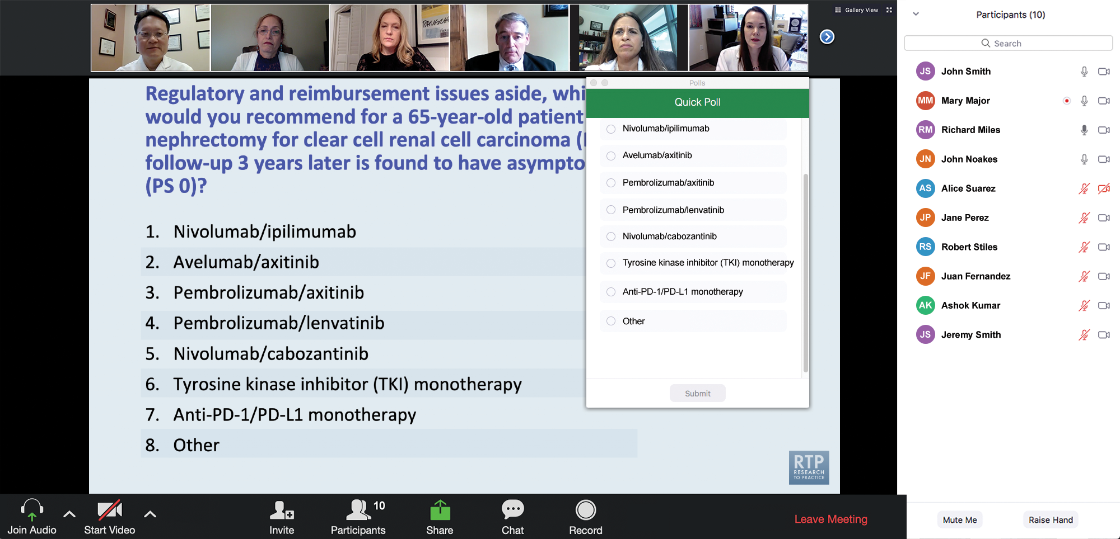
Clinicians in the Audience, Please Complete the Pre- and Postmeeting Surveys
Quick Survey
Quick Poll

Slide 13
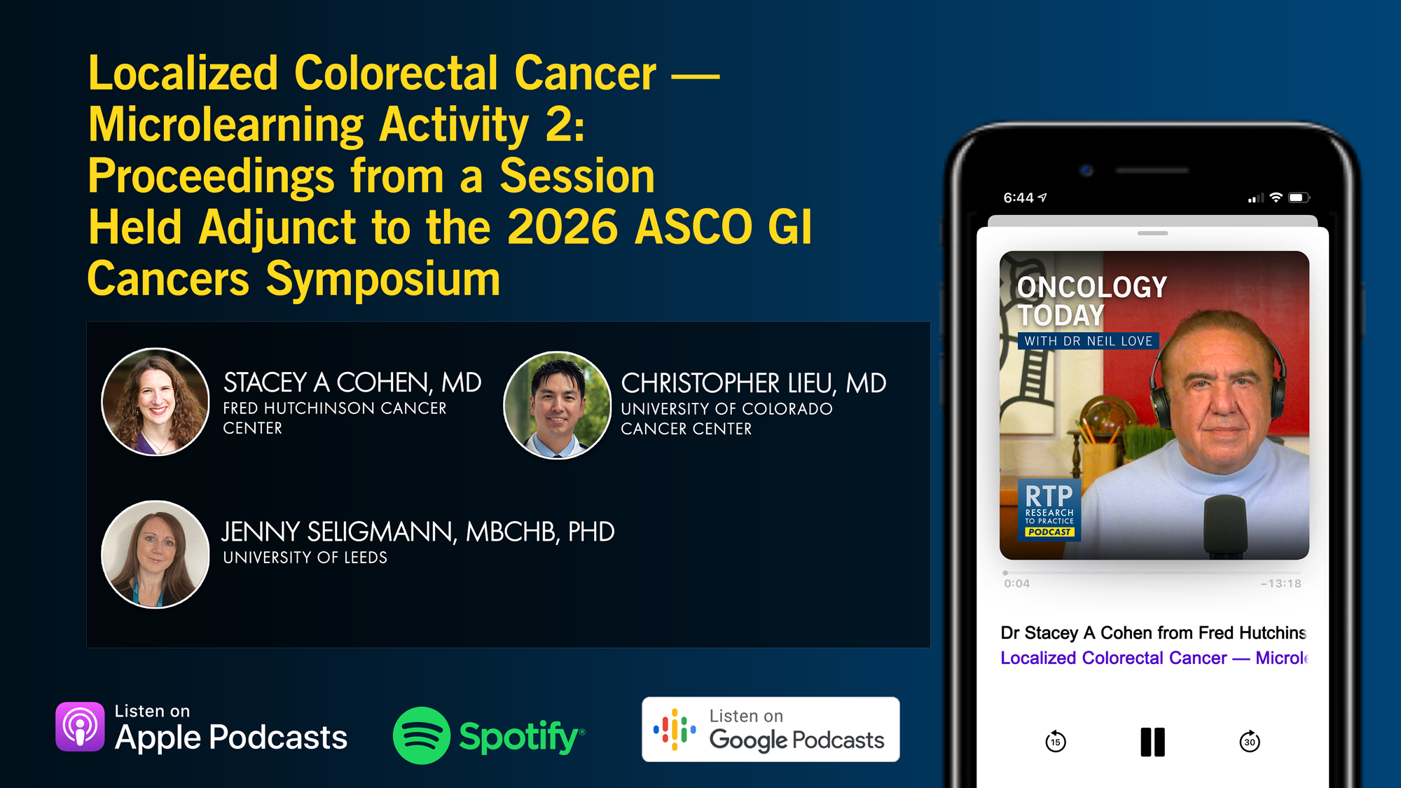

Slide 14
Fifth Annual National General Medical Oncology Summit
A Multitumor CME/MOC-, NCPD- and ACPE-Accredited Educational Conference
Developed in Partnership with Florida Cancer Specialists & Research Institute
The Ritz-Carlton Orlando, Grande Lakes | Orlando, Florida
Friday, April 24, 2026
Fellows Welcome!
7:00 PM – 9:00 PM
Keynote Session: Diffuse Large B-Cell Lymphoma and Follicular Lymphoma
Manali Kamdar, MD, MBBS Krish Patel, MD Gilles Salles, MD, PhD

Slide 15
Fifth Annual National General Medical Oncology Summit
Saturday, April 25, 2026
8:00 AM – 8:50 AM
Chronic Lymphocytic Leukemia
John N Allan, MD Adam Kittai, MD
8:50 AM – 9:40 AM
Pancreatic Cancer
Eileen M O’Reilly, MD Philip A Philip, MD, PhD
10:00 AM – 10:50 AM
Ovarian Cancer
Deborah K Armstrong, MD David M O’Malley, MD
10:50 AM – 11:40 AM
Relapsed/Refractory Multiple Myeloma
Hans Lee, MD Noopur Raje, MD
11:40 AM – 12:30 PM
Gastroesophageal Cancers
Yelena Y Janjigian, MD Samuel J Klempner, MD
1:20 PM – 2:10 PM
Desmoid Tumors and Soft Tissue Sarcoma
Mrinal Gounder, MD Richard F Riedel, MD

Slide 16
Fifth Annual National General Medical Oncology Summit
Saturday, April 25, 2026
Sunday, April 26, 2026
2:10 PM – 3:00 PM
Urothelial Bladder Cancer
Terence Friedlander, MD
Daniel P Petrylak, MD
3:20 PM – 4:10 PM
Triple-Negative Breast Cancer
Adam M Brufsky, MD, PhD
Kevin Kalinsky, MD, MS, FASCO
4:10 PM – 5:00 PM
HER2-Positive Breast Cancer
Erika Hamilton, MD Shanu Modi, MD
8:00 AM – 9:40 AM
HR-Positive Breast Cancer
Erika Hamilton, MD
Jane Lowe Meisel, MD
Joyce O’Shaughnessy, MD
Seth Wander, MD, PhD
9:40 AM – 10:30 AM
Colorectal Cancer
Kristen K Ciombor, MD, MSCI
John Strickler, MD

Slide 17
Fifth Annual National General Medical Oncology Summit
Sunday, April 26, 2026
10:50 AM – 11:40 AM
EGFR-Mutated Non-Small Cell Lung Cancer
Jonathan Goldman, MD
Zofia Piotrowska, MD, MHS
11:40 AM – 12:30 PM
Prostate Cancer
Neeraj Agarwal, MD, FASCO Alan H Bryce, MD
1:15 PM – 2:05 PM
Myelofibrosis and Systemic Mastocytosis
Anthony M Hunter, MD Abdulraheem Yacoub, MD
2:05 PM – 2:55 PM
Targeted Therapies for Non-Small Cell Lung Cancer
Lyudmila Bazhenova, MD
Corey J Langer, MD
2:55 PM – 3:45 PM
Acute Myeloid Leukemia
Courtney D DiNardo, MD, MSCE
Harry Paul Erba, MD, PhD

Slide 18
What Clinicians Want to Know: Optimizing the Management of Metastatic Triple-Negative Breast Cancer
A CME/MOC-Accredited Live Webinar
Thursday, April 30, 2026 5:00 PM – 6:00 PM ET
Faculty
Kevin Punie, MD
Tiffany A Traina, MD, FASCO
Moderator
Neil Love, MD

Slide 19
Recent Advances in Cancer Care — New Paradigms, Novel Agents and What It Means for the Oncology Nurse
A Complimentary NCPD Symposium Series Held During the 51st Annual ONS Congress May 13-16
San Antonio Marriott Rivercenter | San Antonio, Texas
Antibody-Drug Conjugates Wednesday, May 13, 2026 | 12:15 PM – 1:45 PM CT
Prostate Cancer Thursday, May 14, 2026 | 12:15 PM – 1:45 PM CT
Ovarian Cancer Wednesday, May 13, 2026 | 6:00 PM – 7:30 PM CT
Non-Muscle-Invasive and Muscle-Invasive Bladder Cancer Thursday, May 14, 2026 | 6:00 PM – 7:30 PM CT
Endometrial Cancer Thursday, May 14, 2026 | 6:00 AM – 7:30 AM CT
Pancreatic Cancer Friday, May 15, 2026 | 6:00 AM – 7:30 AM CT

Slide 20
Recent Advances in Cancer Care — New Paradigms, Novel Agents and What It Means for the Oncology Nurse
A Complimentary NCPD Symposium Series Held During the 51st Annual ONS Congress May 13-16
San Antonio Marriott Rivercenter | San Antonio, Texas
Targeting the PI3K/AKT/mTOR Pathway in HR-Positive Metastatic Breast Cancer Friday, May 15, 2026 | 12:15 PM – 1:45 PM CT
Relapsed/Refractory Multiple Myeloma Saturday, May 16, 2026 | 12:15 PM – 1:45 PM CT
Non-Hodgkin Lymphoma and Chronic Lymphocytic Leukemia Friday, May 15, 2026 | 6:00 PM – 8:00 PM CT
Oral SERDs for Breast Cancer Saturday, May 16, 2026 | 6:00 PM – 7:30 PM CT
CDK4/6 Inhibitors for HR-Positive Breast Cancer Saturday, May 16, 2026 | 6:00 AM – 7:30 AM CT

Slide 21
Grand Rounds
CME/MOC-Accredited Interactive Series
Regional Activities
Three Series
Optimizing Treatment for Patients with Relapsed/Refractory Chronic Lymphocytic Leukemia
Optimizing the Use of Novel Therapies for Patients with Diffuse Large B-Cell Lymphoma
Optimizing Therapy for Patients with Hormone Receptor-Positive Localized Breast Cancer
Host a 1-hour session at your institution: Email Meetings@ResearchToPractice.com or call (800) 233-6153

Slide 22
Year in Review: Colorectal Cancer
INTRODUCTION: RTP Paper of the Year!
MODULE 1: Checkpoint Inhibitors for Localized MSI-High Tumors
MODULE 2: Circulating Tumor DNA Assays
MODULE 3: Checkpoint Inhibitors for Metastatic Disease
MODULE 4: Other Important Papers

Slide 23
Thank you for joining us! Please take a moment to complete the survey currently up on Zoom. Your feedback is very important to us. Information on how to obtain CME, ABIM MOC and ABS credit will be provided in the Zoom chat room. Attendees will also receive an email in 1 to 3 business days with these instructions.

Slide 24
Year in Review: Clinical Investigator Perspectives on the Most Relevant New Datasets and Advances in Oncology
Colorectal Cancer
A CME/MOC-Accredited Live Webinar
Thursday, April 16, 2026 5:00 PM – 6:00 PM ET
Faculty
Arvind Dasari, MD, MS
Anwaar Saeed, MD
Moderator
Neil Love, MD

Slide 25
Faculty
Arvind Dasari, MD, MS
Professor
Department of Gastrointestinal Medical Oncology
The University of Texas MD Anderson Cancer Center
Houston, Texas
MODERATOR
Neil Love, MD Research To Practice
Miami, Florida
Anwaar Saeed, MD
Associate Professor
University of Pittsburgh School of Medicine
Section Chief, Gastrointestinal Oncology
Director, Gastrointestinal Disease Center
Co-Leader, Cancer Therapeutics Program
UPMC Hillman Cancer Center
Pittsburgh, Pennsylvania

Slide 26
We Encourage Clinicians in Practice to Submit Questions
Feel free to submit questions now before the program begins and throughout the program.

Slide 27
Clinicians in the Audience, Please Complete the Pre- and Postmeeting Surveys
Quick Survey
Quick Poll

Slide 29
Fifth Annual National General Medical Oncology Summit
A Multitumor CME/MOC-, NCPD- and ACPE-Accredited Educational Conference
Developed in Partnership with Florida Cancer Specialists & Research Institute
The Ritz-Carlton Orlando, Grande Lakes | Orlando, Florida
Friday, April 24, 2026
Fellows Welcome!
7:00 PM – 9:00 PM
Keynote Session: Diffuse Large B-Cell Lymphoma and Follicular Lymphoma
Manali Kamdar, MD, MBBS Krish Patel, MD Gilles Salles, MD, PhD

Slide 30
Fifth Annual National General Medical Oncology Summit
Saturday, April 25, 2026
8:00 AM – 8:50 AM
Chronic Lymphocytic Leukemia
John N Allan, MD Adam Kittai, MD
8:50 AM – 9:40 AM
Pancreatic Cancer
Eileen M O’Reilly, MD Philip A Philip, MD, PhD
10:00 AM – 10:50 AM
Ovarian Cancer
Deborah K Armstrong, MD David M O’Malley, MD
10:50 AM – 11:40 AM
Relapsed/Refractory Multiple Myeloma
Hans Lee, MD Noopur Raje, MD
11:40 AM – 12:30 PM
Gastroesophageal Cancers
Yelena Y Janjigian, MD Samuel J Klempner, MD
1:20 PM – 2:10 PM
Desmoid Tumors and Soft Tissue Sarcoma
Mrinal Gounder, MD Richard F Riedel, MD

Slide 31
Fifth Annual National General Medical Oncology Summit
Saturday, April 25, 2026
Sunday, April 26, 2026
2:10 PM – 3:00 PM
Urothelial Bladder Cancer
Terence Friedlander, MD
Daniel P Petrylak, MD
3:20 PM – 4:10 PM
Triple-Negative Breast Cancer
Adam M Brufsky, MD, PhD
Kevin Kalinsky, MD, MS, FASCO
4:10 PM – 5:00 PM
HER2-Positive Breast Cancer
Erika Hamilton, MD Shanu Modi, MD
8:00 AM – 9:40 AM
HR-Positive Breast Cancer
Erika Hamilton, MD
Jane Lowe Meisel, MD
Joyce O’Shaughnessy, MD
Seth Wander, MD, PhD
9:40 AM – 10:30 AM
Colorectal Cancer
Kristen K Ciombor, MD, MSCI
John Strickler, MD

Slide 32
Fifth Annual National General Medical Oncology Summit
Sunday, April 26, 2026
10:50 AM – 11:40 AM
EGFR-Mutated Non-Small Cell Lung Cancer
Jonathan Goldman, MD
Zofia Piotrowska, MD, MHS
11:40 AM – 12:30 PM
Prostate Cancer
Neeraj Agarwal, MD, FASCO Alan H Bryce, MD
1:15 PM – 2:05 PM
Myelofibrosis and Systemic Mastocytosis
Anthony M Hunter, MD Abdulraheem Yacoub, MD
2:05 PM – 2:55 PM
Targeted Therapies for Non-Small Cell Lung Cancer
Lyudmila Bazhenova, MD
Corey J Langer, MD
2:55 PM – 3:45 PM
Acute Myeloid Leukemia
Courtney D DiNardo, MD, MSCE
Harry Paul Erba, MD, PhD

Slide 33
What Clinicians Want to Know: Optimizing the Management of Metastatic Triple-Negative Breast Cancer
A CME/MOC-Accredited Live Webinar
Thursday, April 30, 2026 5:00 PM – 6:00 PM ET
Faculty
Kevin Punie, MD
Tiffany A Traina, MD, FASCO
Moderator
Neil Love, MD

Slide 34
Recent Advances in Cancer Care — New Paradigms, Novel Agents and What It Means for the Oncology Nurse
A Complimentary NCPD Symposium Series Held During the 51st Annual ONS Congress May 13-16
San Antonio Marriott Rivercenter | San Antonio, Texas
Antibody-Drug Conjugates Wednesday, May 13, 2026 | 12:15 PM – 1:45 PM CT
Prostate Cancer Thursday, May 14, 2026 | 12:15 PM – 1:45 PM CT
Ovarian Cancer Wednesday, May 13, 2026 | 6:00 PM – 7:30 PM CT
Non-Muscle-Invasive and Muscle-Invasive Bladder Cancer Thursday, May 14, 2026 | 6:00 PM – 7:30 PM CT
Endometrial Cancer Thursday, May 14, 2026 | 6:00 AM – 7:30 AM CT
Pancreatic Cancer Friday, May 15, 2026 | 6:00 AM – 7:30 AM CT

Slide 35
Recent Advances in Cancer Care — New Paradigms, Novel Agents and What It Means for the Oncology Nurse
A Complimentary NCPD Symposium Series Held During the 51st Annual ONS Congress May 13-16
San Antonio Marriott Rivercenter | San Antonio, Texas
Targeting the PI3K/AKT/mTOR Pathway in HR-Positive Metastatic Breast Cancer Friday, May 15, 2026 | 12:15 PM – 1:45 PM CT
Relapsed/Refractory Multiple Myeloma Saturday, May 16, 2026 | 12:15 PM – 1:45 PM CT
Non-Hodgkin Lymphoma and Chronic Lymphocytic Leukemia Friday, May 15, 2026 | 6:00 PM – 8:00 PM CT
Oral SERDs for Breast Cancer Saturday, May 16, 2026 | 6:00 PM – 7:30 PM CT
CDK4/6 Inhibitors for HR-Positive Breast Cancer Saturday, May 16, 2026 | 6:00 AM – 7:30 AM CT

Slide 36
Grand Rounds
CME/MOC-Accredited Interactive Series
Regional Activities
Three Series
Optimizing Treatment for Patients with Relapsed/Refractory Chronic Lymphocytic Leukemia
Optimizing the Use of Novel Therapies for Patients with Diffuse Large B-Cell Lymphoma
Optimizing Therapy for Patients with Hormone Receptor-Positive Localized Breast Cancer
Host a 1-hour session at your institution: Email Meetings@ResearchToPractice.com or call (800) 233-6153

Slide 37
Year in Review: Clinical Investigator Perspectives on the Most Relevant New Datasets and Advances in Oncology
Colorectal Cancer
A CME/MOC-Accredited Live Webinar
Thursday, April 16, 2026 5:00 PM – 6:00 PM ET
Faculty
Arvind Dasari, MD, MS
Anwaar Saeed, MD
Moderator
Neil Love, MD

Slide 38
Commercial Support
This activity is supported by educational grants from Exelixis Inc, GSK, and Natera Inc.
Research To Practice CME Planning Committee Members, Staff and Reviewers
Planners, scientific staff and independent reviewers for Research To Practice have no relevant financial relationships to disclose.

Slide 39
Dr Dasari — Disclosures
Advisory Committees | Agenus Inc, Bristol Myers Squibb, Exelixis Inc, Illumina, Lantheus, Personalis, Sanofi, Taiho Oncology Inc, Takeda Pharmaceuticals USA Inc
Contracted Research | Bristol Myers Squibb, Crinetics Pharmaceuticals, Eisai Inc, Enterome, Guardant Health, Hutchison MediPharma, Natera Inc, NeoGenomics, Personalis, RayzeBio, Taiho Oncology Inc, Xencor

Slide 40
Dr Saeed — Disclosures
Advisory Committees and Consulting Agreements | Amgen Inc, AstraZeneca Pharmaceuticals LP, Autem Therapeutics, BeOne, Bristol Myers Squibb, Exact Sciences Corporation, Exelixis Inc, KAHR Medical, Merck, Pfizer Inc, Regeneron Pharmaceuticals Inc, Replimune, Taiho Oncology Inc, Xilio Therapeutics
Contracted Research | Actuate Therapeutics, Arcus Biosciences, AstraZeneca Pharmaceuticals LP, Bristol Myers Squibb, Coherus BioSciences, Exelixis Inc, Henlius, Incyte Corporation, KAHR Medical, Merck, Oxford BioTherapeutics, Phanes Therapeutics Inc, Regeneron Pharmaceuticals Inc, Replimune
Data and Safety Monitoring Boards/Committees | Arcus Biosciences

Slide 41
Dr Love — Disclosures
Dr Love is president and CEO of Research To Practice. Research To Practice receives funds in the form of educational grants to develop CME activities from the following companies: Aadi Bioscience, AbbVie Inc, ADC Therapeutics, Agendia Inc, Alexion Pharmaceuticals, Amgen Inc, Array BioPharma Inc, a subsidiary of Pfizer Inc, Arvinas, Astellas, AstraZeneca Pharmaceuticals LP, Aveo Pharmaceuticals, Bayer HealthCare Pharmaceuticals, BeOne, Biotheranostics Inc, A Hologic Company, Black Diamond Therapeutics Inc, Blueprint Medicines, Boehringer Ingelheim Pharmaceuticals Inc, Bristol Myers Squibb, Celcuity, Clovis Oncology, Coherus BioSciences, Corcept Therapeutics Inc, CTI BioPharma, a Sobi Company, Daiichi Sankyo Inc, Eisai Inc, Elevation Oncology Inc, Exact Sciences Corporation, Exelixis Inc, Genentech, a member of the Roche Group, Genmab US Inc, Geron Corporation, Gilead Sciences Inc, GSK, Helsinn Therapeutics (US) Inc, ImmunoGen Inc, Incyte Corporation, Ipsen Biopharmaceuticals Inc, Jazz Pharmaceuticals Inc, Johnson & Johnson, Karyopharm Therapeutics, Kite, A Gilead Company, Kura Oncology, Legend Biotech, Lilly, MEI Pharma Inc, Merck, Mersana Therapeutics Inc, Mirati Therapeutics Inc, Mural Oncology Inc, Natera Inc, Novartis, Novartis Pharmaceuticals Corporation on behalf of Advanced Accelerator Applications, Novocure Inc, Nuvalent, Nuvation Bio Inc, Pfizer Inc, Pharmacyclics LLC, an AbbVie Company, Puma Biotechnology Inc, Regeneron Pharmaceuticals Inc, Revolution Medicines Inc, Rigel Pharmaceuticals Inc, R-Pharm US, Sanofi, Seagen Inc, Servier Pharmaceuticals LLC, SpringWorks Therapeutics Inc, Stemline Therapeutics Inc, Sumitomo Pharma America, Summit Therapeutics, Syndax Pharmaceuticals, Taiho Oncology Inc, Takeda Pharmaceuticals USA Inc, TerSera Therapeutics LLC, and Tesaro, A GSK Company.

Slide 42
This educational activity contains discussion of non-FDA-approved uses of agents and regimens. Please refer to official prescribing information for each product for approved indications.

Slide 43
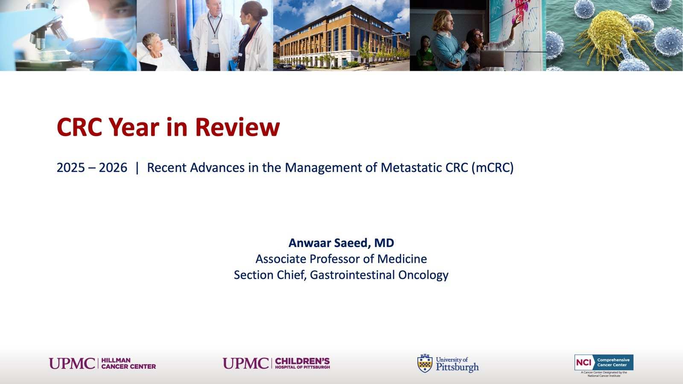
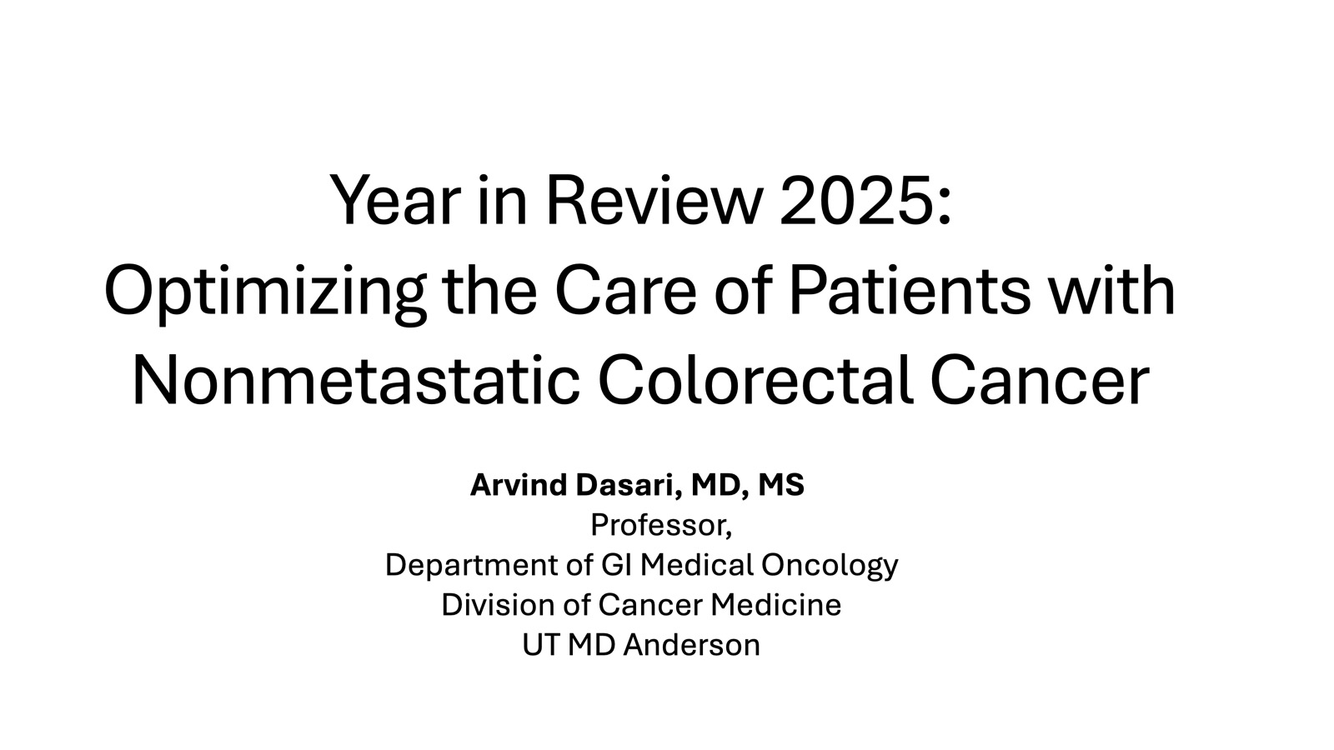

Slide 44
Key Datasets
Arvind Dasari, MD, MS
Shi Q et al. Proposed changes to the pathologic staging for colon cancer (CC): AJCC Colon Cancer Expert Panel (AJCCCCEP). ASCO 2025;Abstract 3520.
Ando K et al. Correlation between the timing of recurrence and circulating tumor DNA (ctDNA) doubling time in patients (pts) with resected colon cancer. Gastrointestinal Cancers Symposium 2026;Abstract 220.
Tie J et al. Circulating tumor DNA analysis guiding adjuvant therapy in stage II colon cancer: 5-year outcomes of the randomized DYNAMIC trial. Nat Med 2025;31(5):1509-18.
Tie J et al. Circulating tumor DNA-guided adjuvant therapy in locally advanced colon cancer: The randomized phase 2/3 DYNAMIC-III trial. Nat Med 2025;31(12):4291-300.
Cohen SA et al. Real-world monitoring of ctDNA reliably predicts cancer recurrence and treatment efficacy in patients with resected stages I-III colon cancer. Ann Surg 2025;[Online ahead of print].
Bando H et al. Impact of postoperative ctDNA dynamics on eligibility for the ALTAIR randomized trial in patients with colorectal cancer: Implications for clinical trial enrollment. Gastrointestinal Cancers Symposium 2026;Abstract 12.

Slide 45
Key Datasets
Arvind Dasari, MD, MS (continued)
Zhang GQ et al. Predictive role of circulating tumor DNA in stage III colon cancer treated with celecoxib: A post hoc analysis of the CALGB (Alliance)/SWOG 80702 phase 3 randomized cinical trial. JAMA Oncol 2026;12(2):149-58.
Martling A et al. Low-dose aspirin for PI3K-altered localized colorectal cancer. N Engl J Med 2025;393(11):1051-64.
Courneya KS et al. Structured exercise after adjuvant chemotherapy for colon cancer. N Engl J Med 2025;393(1):13-25.
Cercek A et al. Nonoperative management of mismatch repair-deficient tumors. N Engl J Med 2025;392(23):2297-308.
Rasschaert G et al. AZUR-4, a phase 2, open label, randomized study of neoadjuvant dostarlimab plus capecitabine plus oxaliplatin (CAPEOX) versus CAPEOX alone in previously untreated T4N0 or stage III mismatch repair proficient/microsatellite stable resectable colon cancer. ASCO 2025;Abstract TPS3649.
Sinicrope FA et al. Randomized trial of standard chemotherapy alone or combined with atezolizumab as adjuvant therapy for patients with stage III deficient DNA mismatch repair (dMMR) colon cancer (Alliance A021502; ATOMIC). ASCO 2025;Abstract LBA1.

Slide 46
Key Datasets
Anwaar Saeed, MD
André T et al. Pembrolizumab versus chemotherapy in microsatellite instability-high or mismatch repair-deficient metastatic colorectal cancer: 5-year follow-up from the randomized phase III KEYNOTE-177 study. Ann Oncol 2025;36(3):277-84.
Lonardi S et al. Nivolumab plus ipilimumab vs nivolumab monotherapy for microsatellite instability-high/mismatch repair-deficient (MSI-H/dMMR) metastatic colorectal cancer (mCRC): New results from CheckMate 8HW. ESMO 2025;Abstract LBA29.
Rocha Lima CM et al. Colorectal Cancer Metastatic dMMR Immunotherapy (COMMIT) study: A randomized phase III study of atezolizumab (atezo) monotherapy versus mFOLFOX6/bevacizumab/atezo (FFX/bev) in the first-line treatment of patients (pts) with deficient DNA mismatch repair (dMMR) or microsatellite instability-high (MSI-H) metastatic colorectal cancer (mCRC) — NRG-GI004/SWOG-S1610. Gastrointestinal Cancers Symposium 2026;Abstract 14.
Hecht JR et al. Zanzalintinib plus atezolizumab versus regorafenib in refractory colorectal cancer (STELLAR-303): A randomised, open-label, phase 3 trial. Lancet 2025;406(10517):2360-70.
Elez E et al. Encorafenib, cetuximab, and mFOLFOX6 in BRAF-mutated colorectal cancer. N Engl J Med 2025;392(24):2425-37.
Kopetz S et al. BREAKWATER: Primary analysis of first-line (1L) encorafenib + cetuximab (EC) + FOLFIRI in BRAF V600E-mutant metastatic colorectal cancer (mCRC). Gastrointestinal Cancers Symposium 2026;Abstract 13.

Slide 47
Key Datasets
Anwaar Saeed, MD (continued)
Strickler JH et al. Tucatinib plus trastuzumab for chemotherapy-refractory, HER2+, RAS wild-type metastatic colorectal cancer (MOUNTAINEER): Final analysis. Nat Commun 2026;17(1):1068.
Raghav K et al. Trastuzumab deruxtecan (T-DXd) in patients (pts) with HER2-positive (HER2+) metastatic colorectal cancer (mCRC): Final analysis of DESTINY-CRC02, a randomized, phase II trial. ESMO 2025;Abstract 737MO.
Pietrantonio F et al. Overall survival analysis of the phase III CodeBreaK 300 study of sotorasib plus panitumumab versus investigator’s choice in chemorefractory KRAS G12C colorectal cancer. J Clin Oncol 2025;43(19):2147-54.
Hollebecque A et al. Efficacy and safety of olomorasib, a second-generation KRAS G12C inhibitor, plus cetuximab in KRAS G12C-mutant advanced colorectal cancer. ASCO 2025;Abstract 3507.
Lugowska IA et al. The KRAS G12C inhibitor MK-1084 for KRAS G12C–mutated advanced colorectal cancer (CRC): Results from KANDLELIT-001. ASCO 2025;Abstract 3508.
Chen E et al. Amivantamab plus FOLFOX or FOLFIRI in RAS/BRAF wild-type metastatic colorectal cancer: Long-term follow-up from the phase 1b/2 OrigAMI-1 study. Gastrointestinal Cancers Symposium 2026;Abstract 166.

Slide 48
Year in Review: Colorectal Cancer
INTRODUCTION: RTP Paper of the Year!
MODULE 1: Checkpoint Inhibitors for Localized MSI-High Tumors
MODULE 2: Circulating Tumor DNA Assays
MODULE 3: Checkpoint Inhibitors for Metastatic Disease
MODULE 4: Other Important Papers

Slide 49
Year in Review: Colorectal Cancer
INTRODUCTION: RTP Paper of the Year!
MODULE 1: Checkpoint Inhibitors for Localized MSI-High Tumors
MODULE 2: Circulating Tumor DNA Assays
MODULE 3: Checkpoint Inhibitors for Metastatic Disease
MODULE 4: Other Important Papers

Slide 50
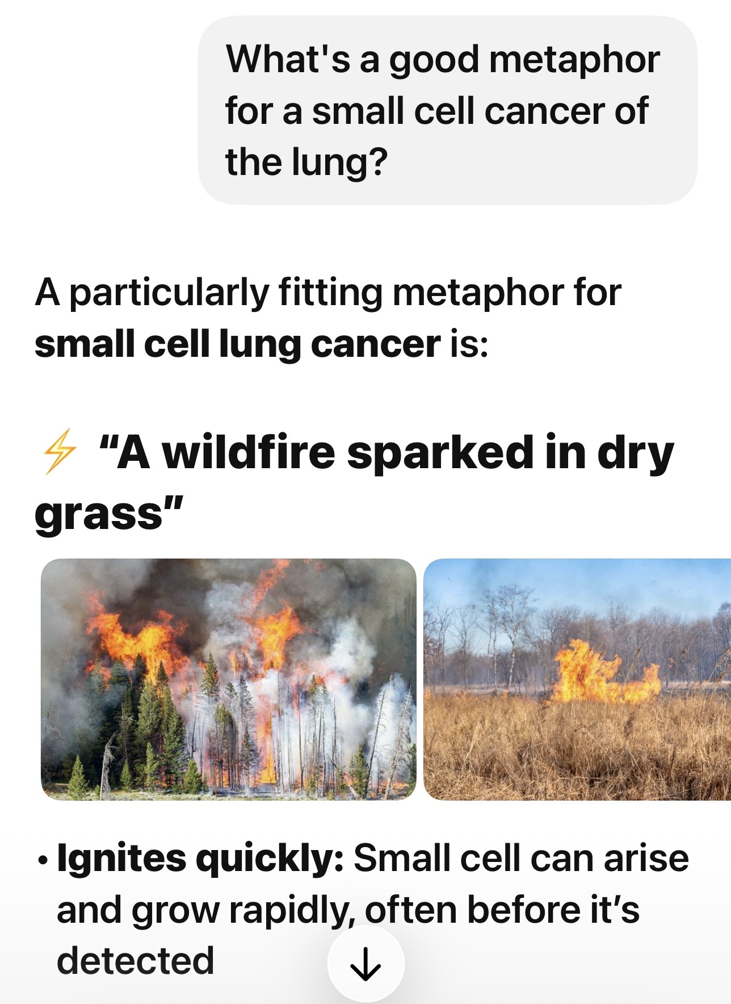

Slide 51


Slide 52
If I had to shrink that to the single most important shortlist, I would probably choose: BREAKWATER, MATTERHORN, FLAURA2 OS, DeLLphi-304, SERENA-6, INAVO120 OS, AMPLIFY/CLL17, and MajesTEC-3. Those are the studies I think are most likely to be remembered as the ones that actually changed treatment patterns or treatment philosophy.

Slide 53
If this was a drug, we’d be giving it Thomas Lynch, MD June 3, 2010

Slide 54
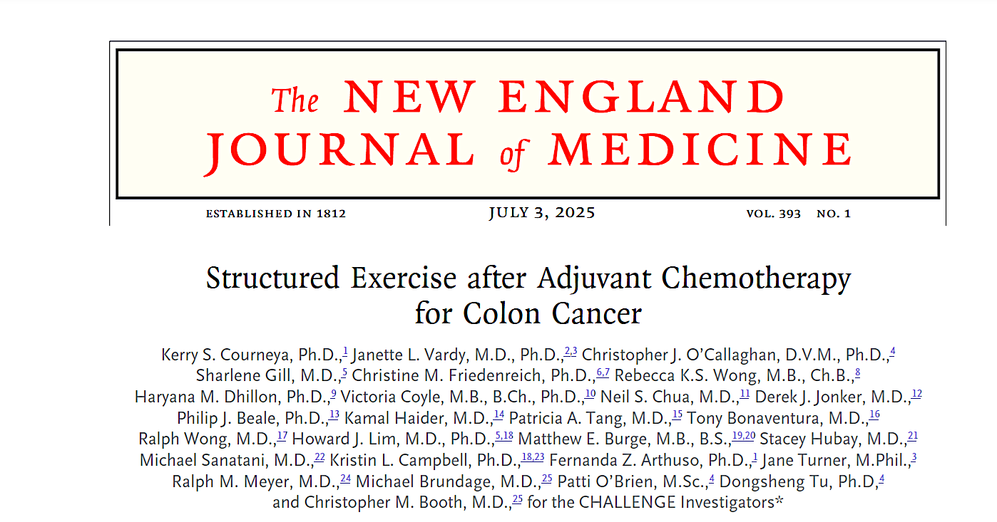

Slide 55
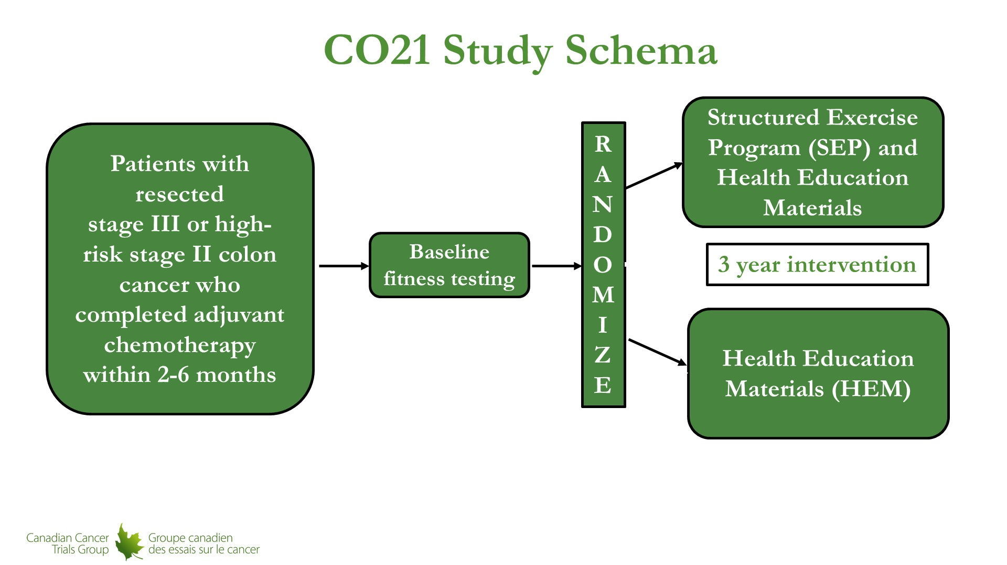
Primary Endpoint: PFS
Courneya. ESMO 2025.

Slide 56
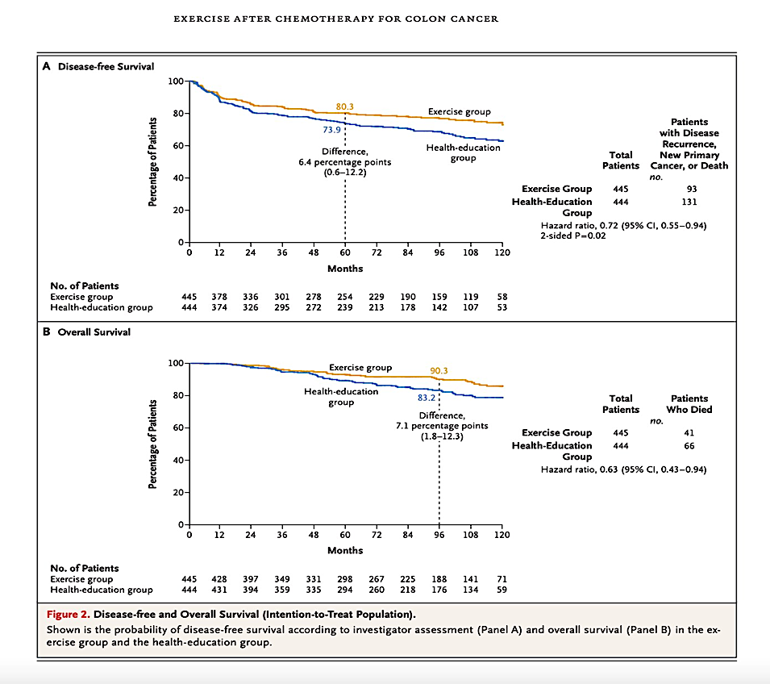
DFS
HR 0.72
OS
HR 0.63
Courneya. NEJM 2025.

Slide 57
Discussion
Practice changing and must be considered standard of care
We can apply these findings immediately in clinic
Cost effective and safe

Slide 58
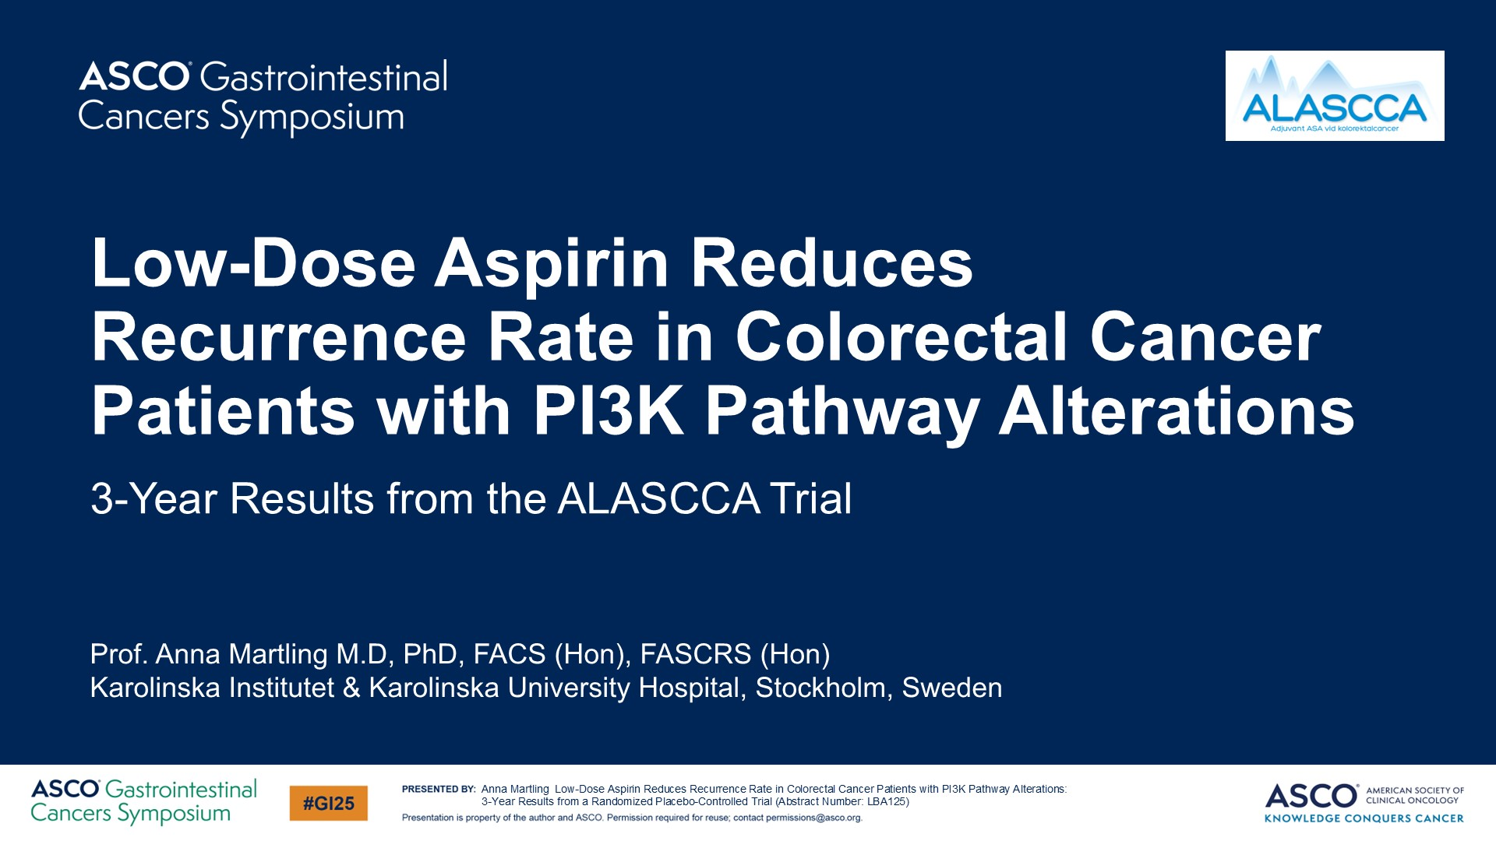

Slide 59
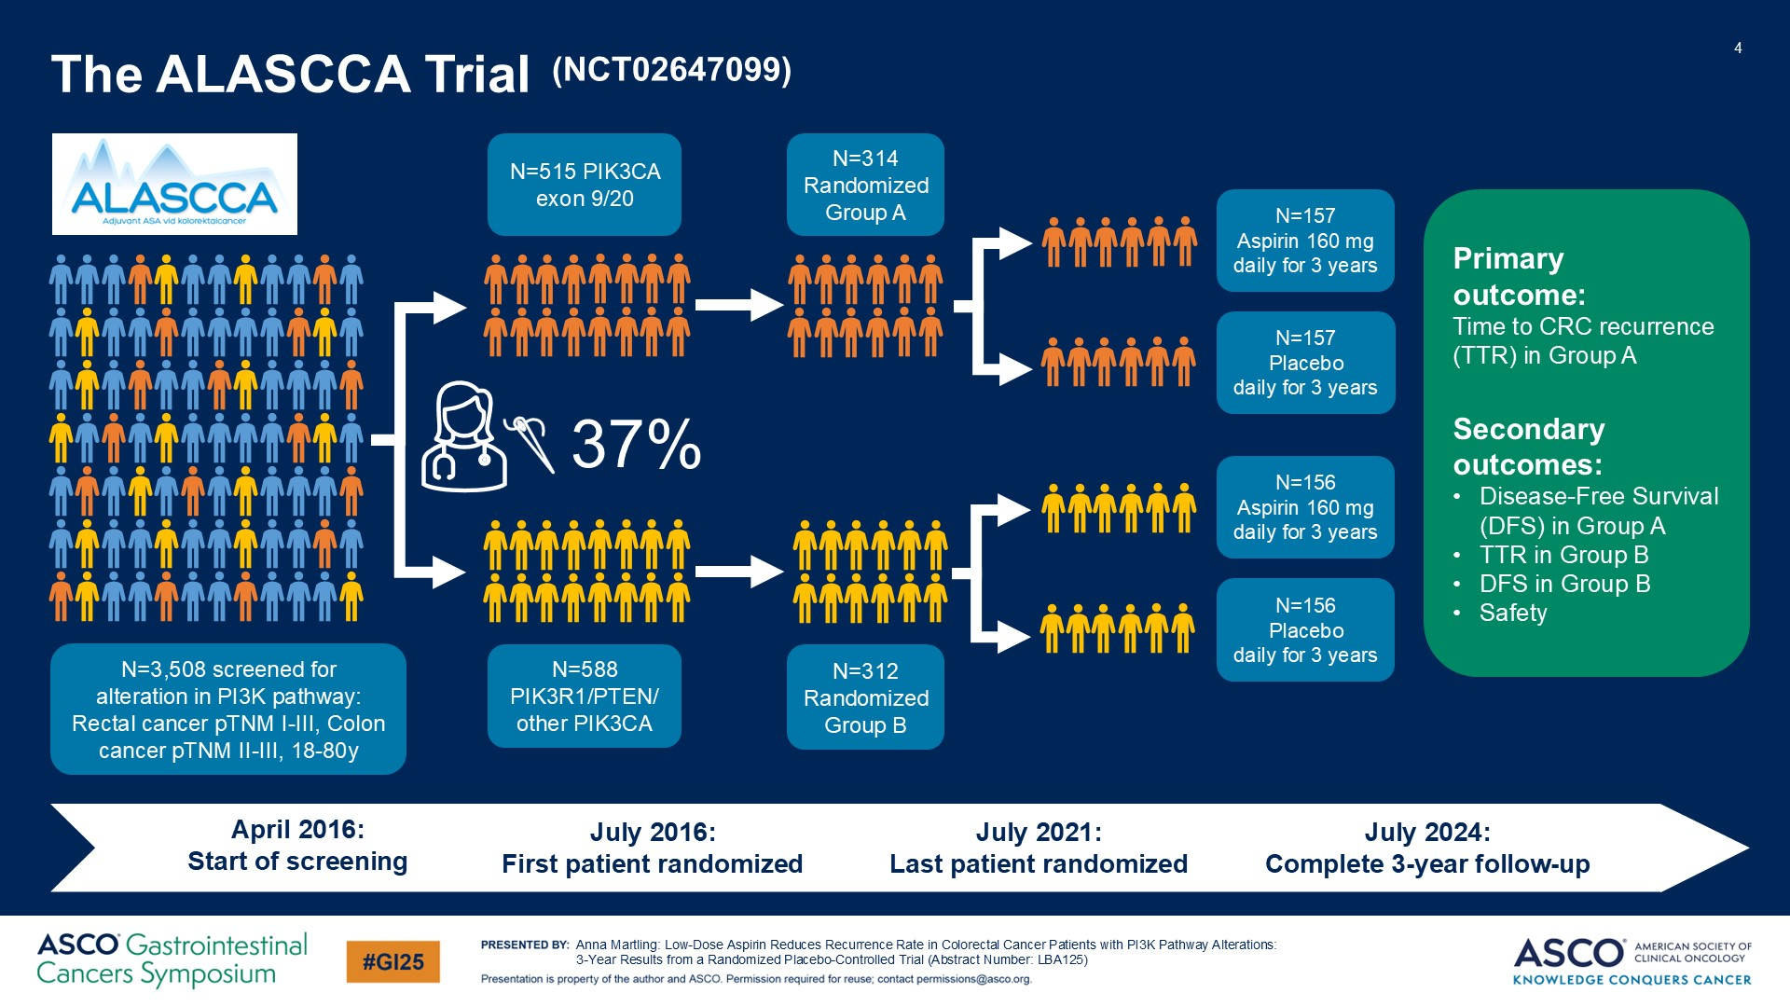

Slide 60
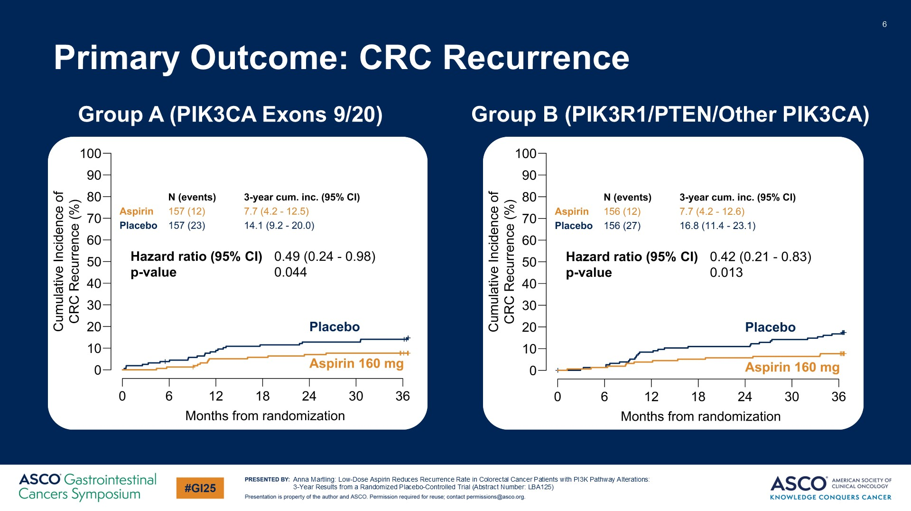

Slide 61
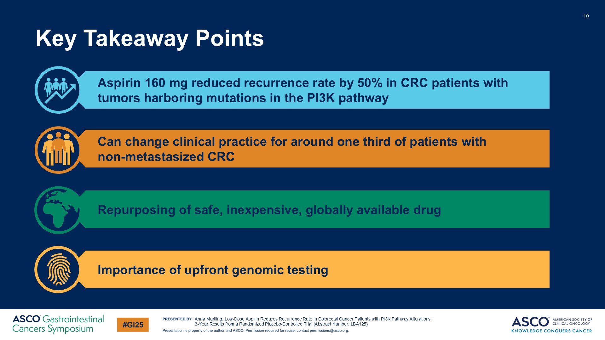

Slide 62
Year in Review: Colorectal Cancer
INTRODUCTION: RTP Paper of the Year!
MODULE 1: Checkpoint Inhibitors for Localized MSI-High Tumors
MODULE 2: Circulating Tumor DNA Assays
MODULE 3: Checkpoint Inhibitors for Metastatic Disease
MODULE 4: Other Important Papers

Slide 63
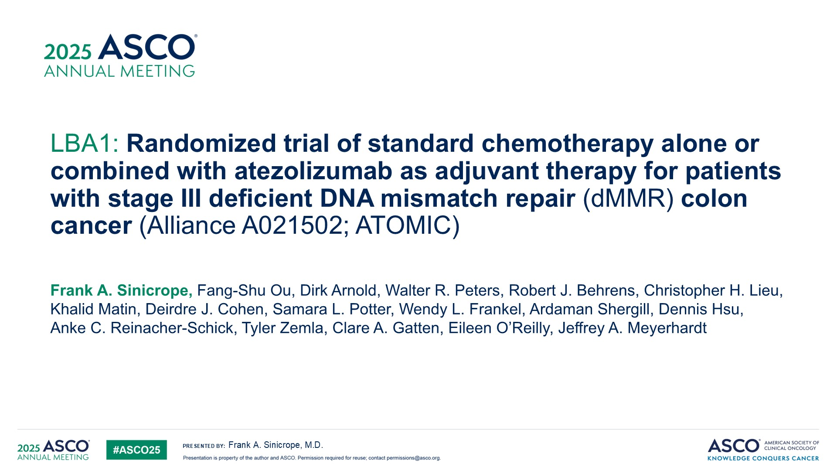

Slide 64
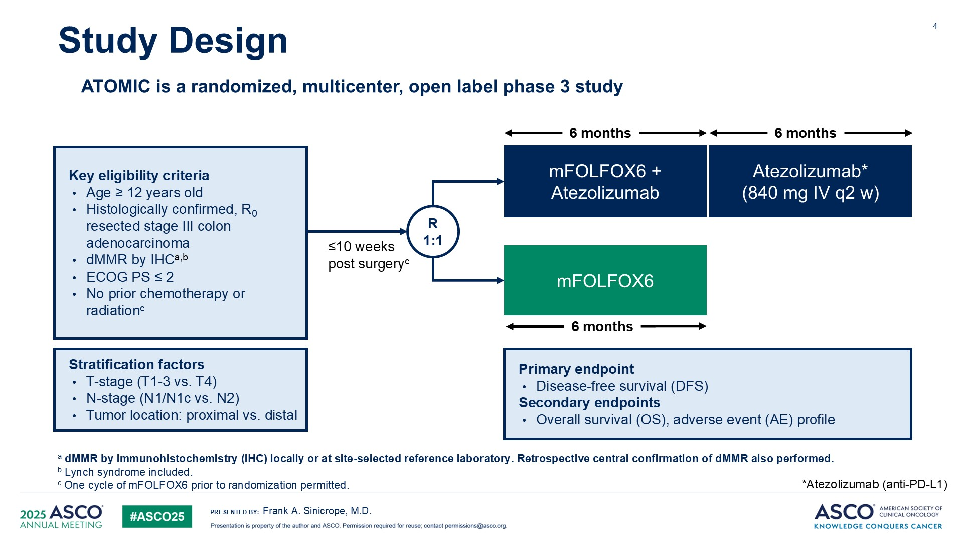

Slide 65
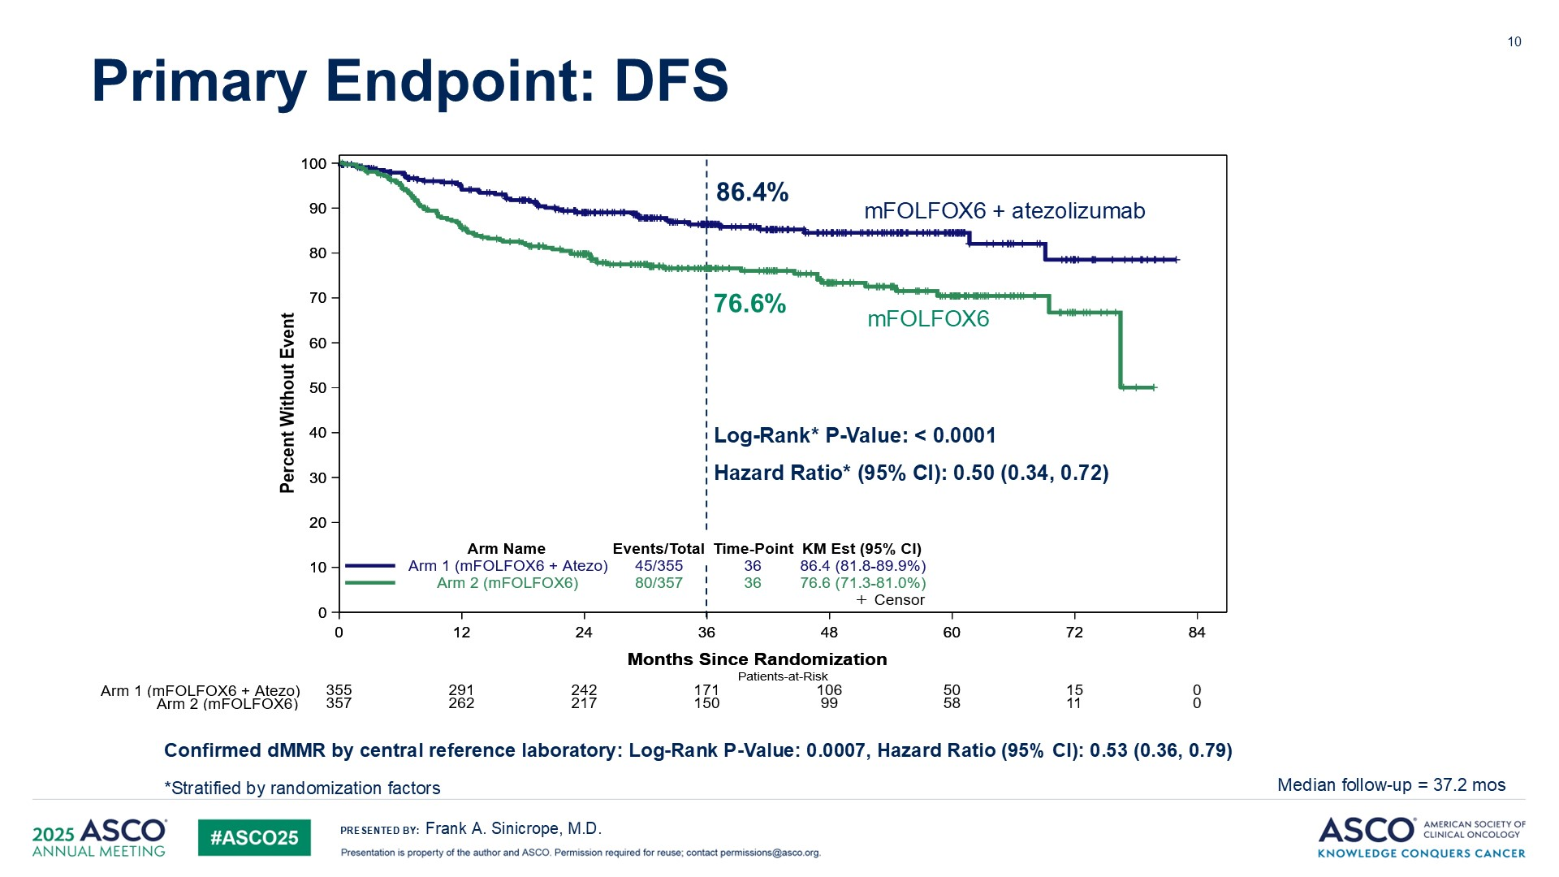

Slide 66
Discussion
Practice changing and must be considered standard of care for stage III colon cancer patients
Reasonable to extrapolate to the minority of stage II colon cancer patients who receive adjuvant therapy
Future trials must look at duration & intensity of adjuvant immunotherapy:
Is 12-months required in all patients?
Approximately 15% still with recurrence. Can these patients be identified and be offered dual checkpoint inhibitors?

Slide 67
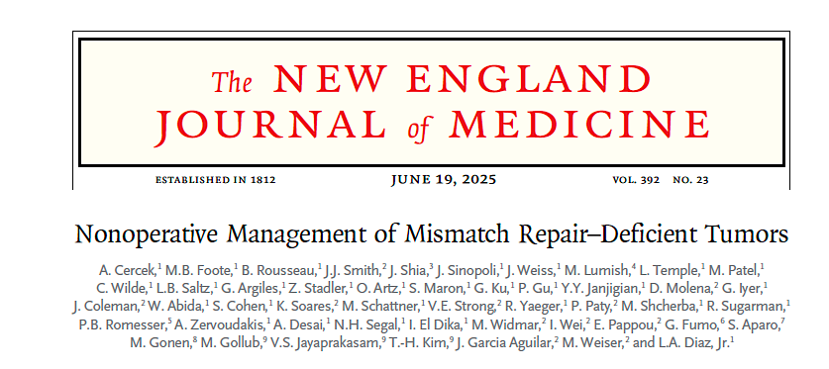
Notes:
Cercek. NEJM 2025

Slide 68
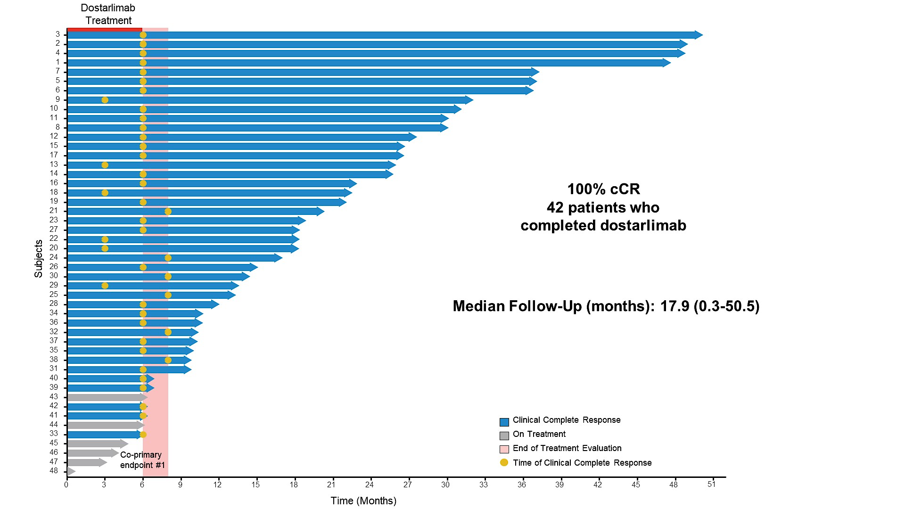
Cercek A. ASCO 2024.

Slide 69
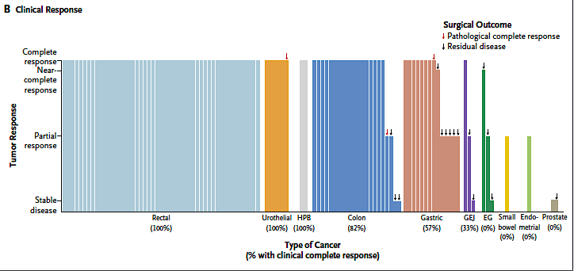
- All pts underwent NOM
-5 pts with local recurrence (4/ 4 responded to IO re-challenge)
- 96% without recurrence at 2-years
- 65% underwent NOM
- 85% without recurrence at 2-years
Cercek A. NEJM 2025.

Slide 70
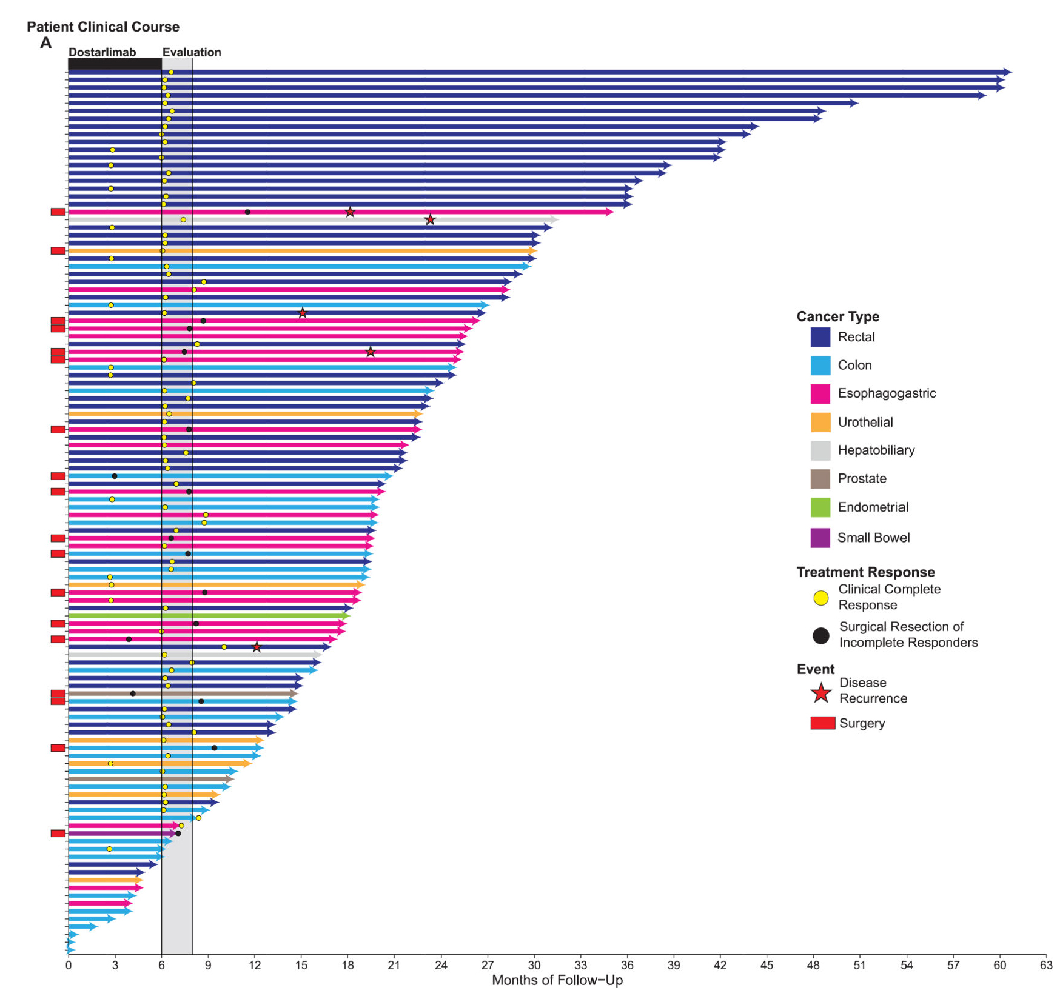
Clinical Outcomes by Tumor Type
Cercek A. NEJM 2025.

Slide 71
Discussion
Practice changing and must be considered standard of care for MSI-H / dMMR rectal cancer.
Should neoadjuvant IO be considered for MSI-H / dMMR colon cancer outside of a clinical trial?
In certain circumstances such as bulky tumors or high risk for surgical complications.
Should neoadjuvant IO be considered for MSS / pMMR colon or rectal cancer?
Only as part of clinical trials

Slide 72
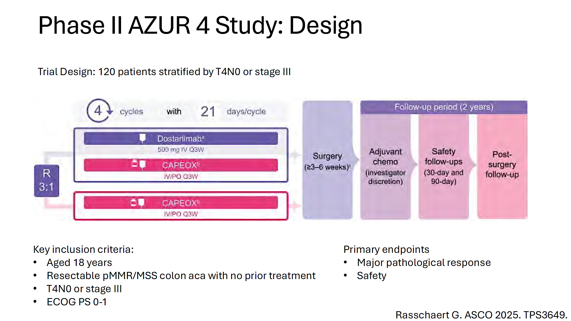

Slide 73
Year in Review: Colorectal Cancer
INTRODUCTION: RTP Paper of the Year!
MODULE 1: Checkpoint Inhibitors for Localized MSI-High Tumors
MODULE 2: Circulating Tumor DNA Assays
MODULE 3: Checkpoint Inhibitors for Metastatic Disease
MODULE 4: Other Important Papers

Slide 74
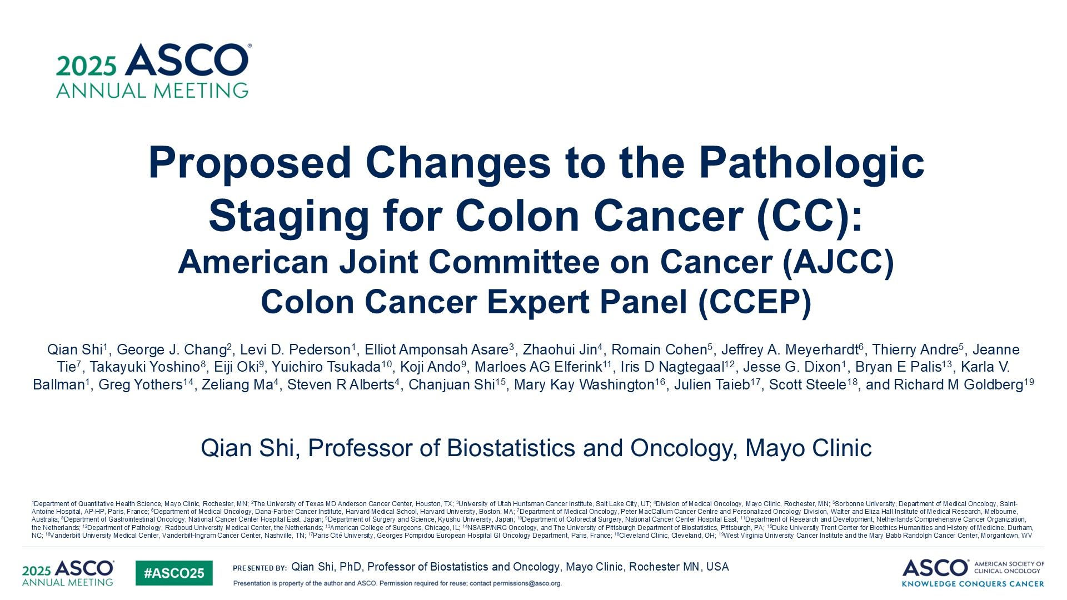

Slide 75
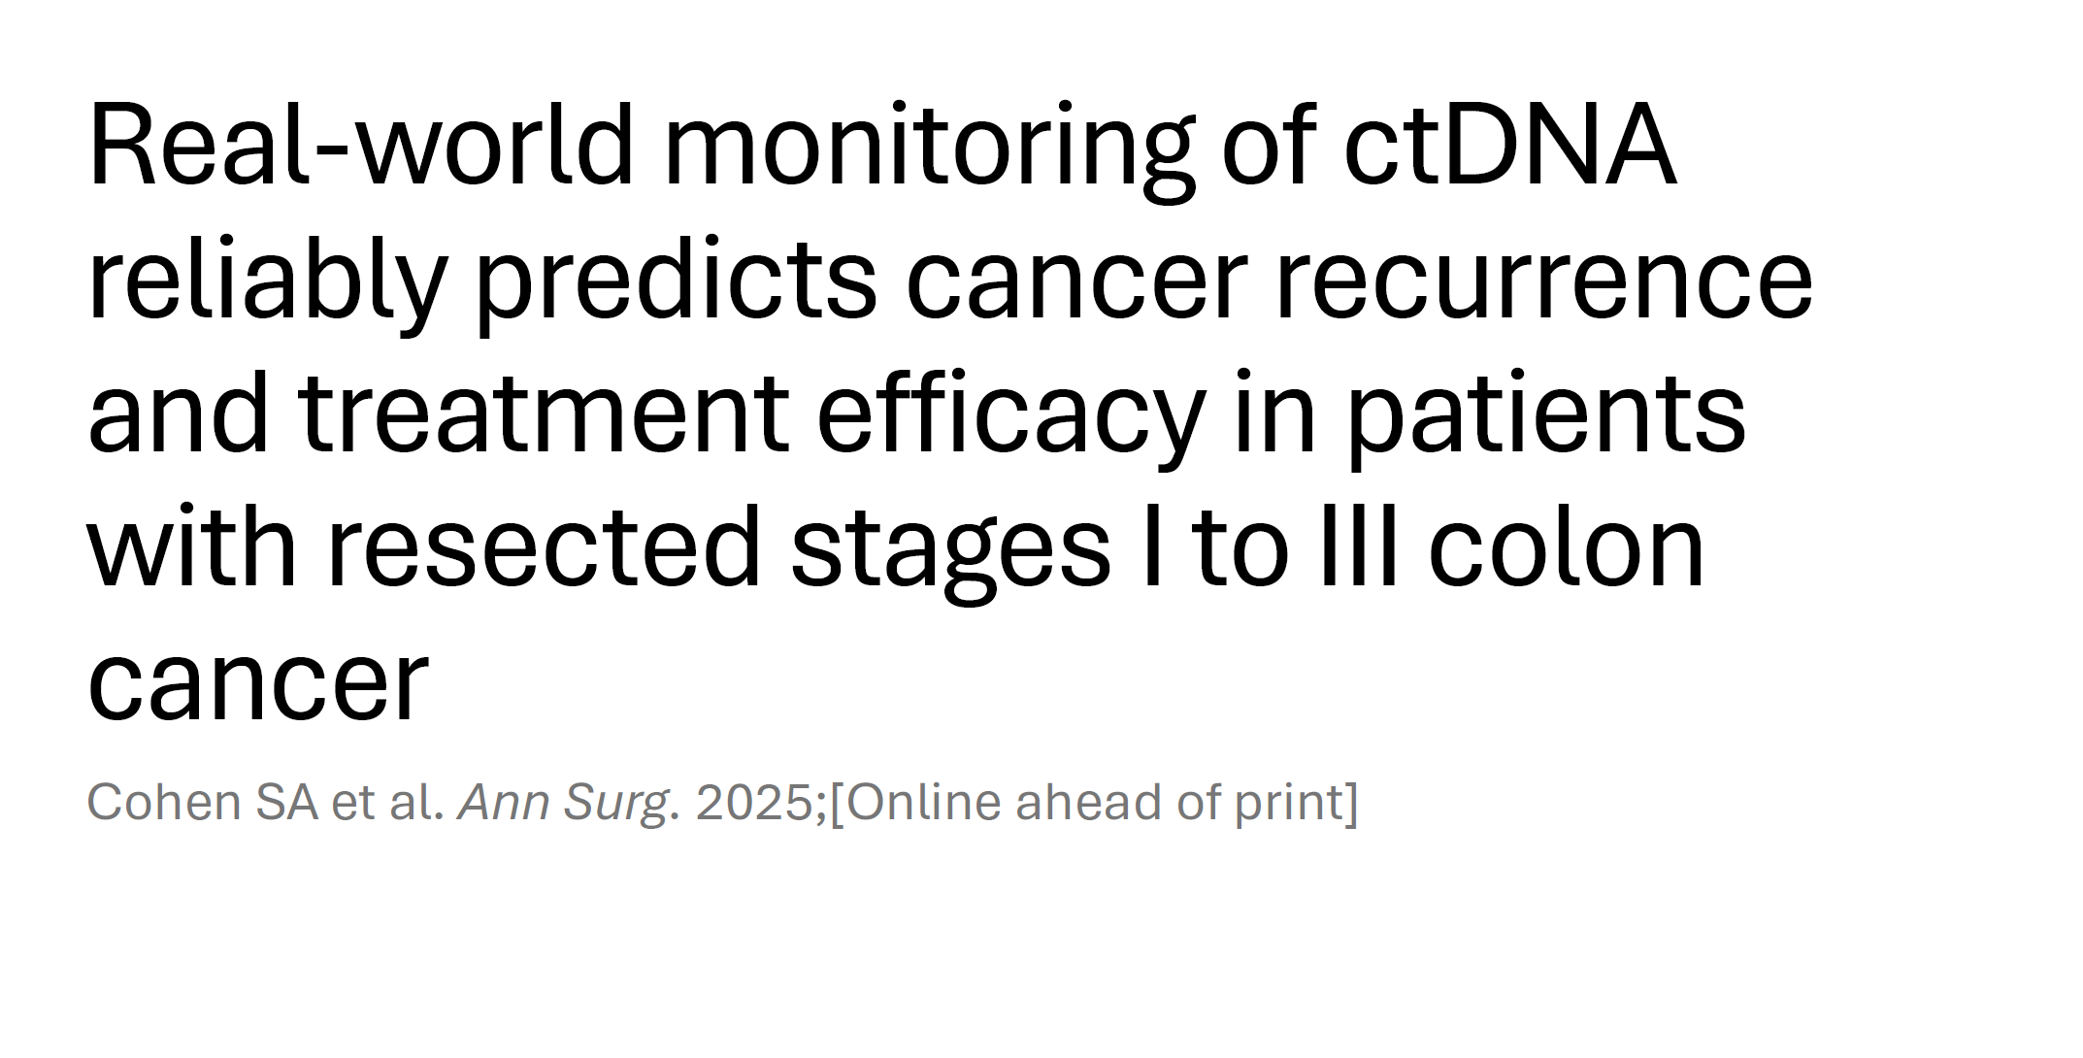
Notes:
Cohen SA. Ann Surg. 2025

Slide 76
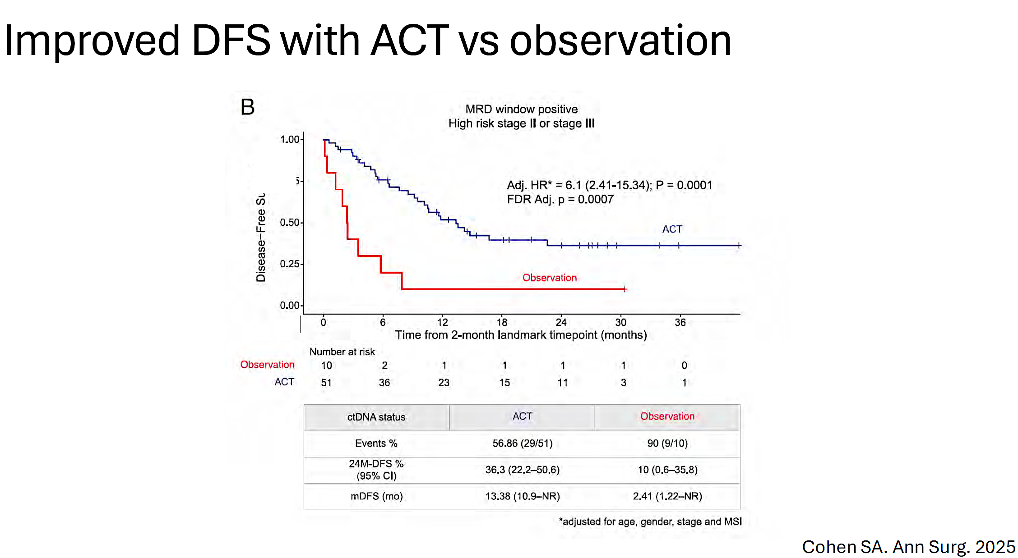
Disease-Free Survival

Slide 77
Conclusions: Postsurgical ctDNA detection is prognostic of relapse and potentially predictive of ACT benefit in patients with resectable colon cancer, which may enable personalized surveillance, intervention, and/or trial options, ultimately improving patient outcomes.
Cohen SA. Ann Surg. 2025

Slide 78


Slide 79
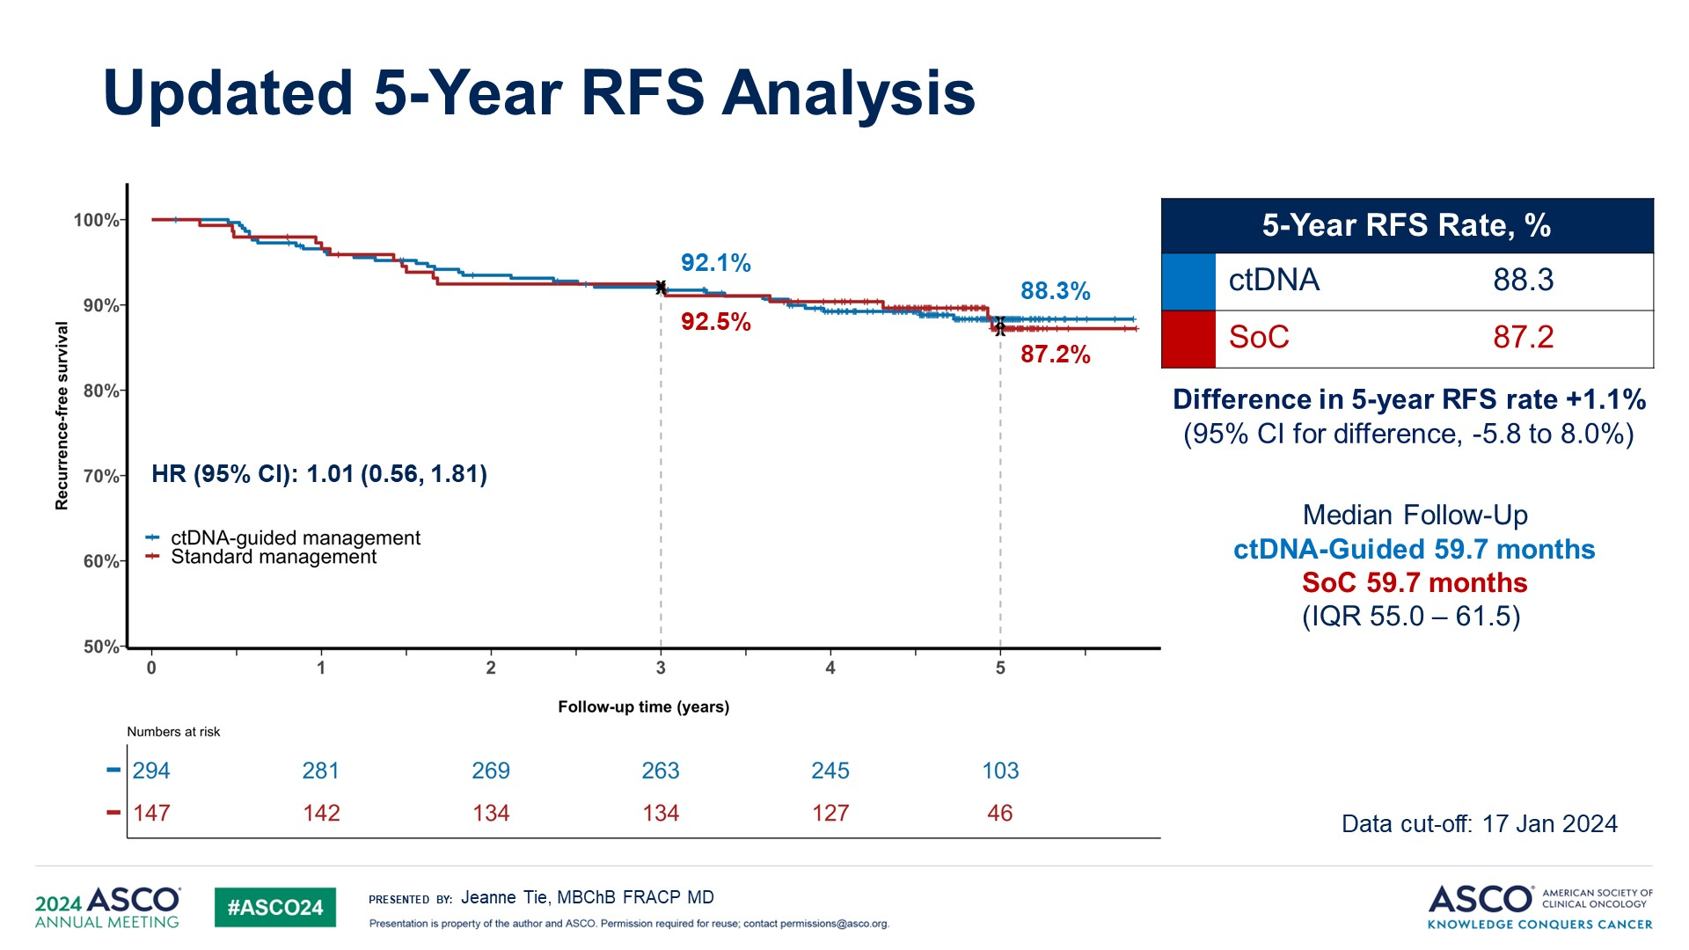

Slide 80
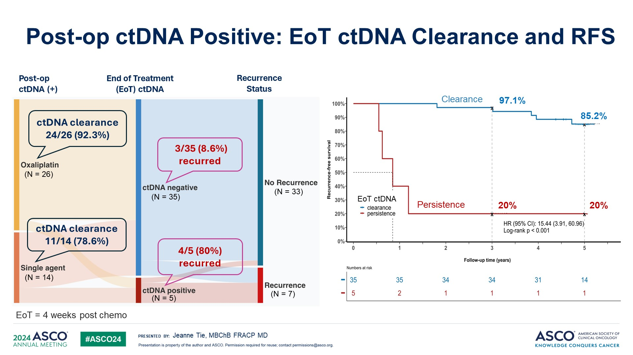

Slide 81
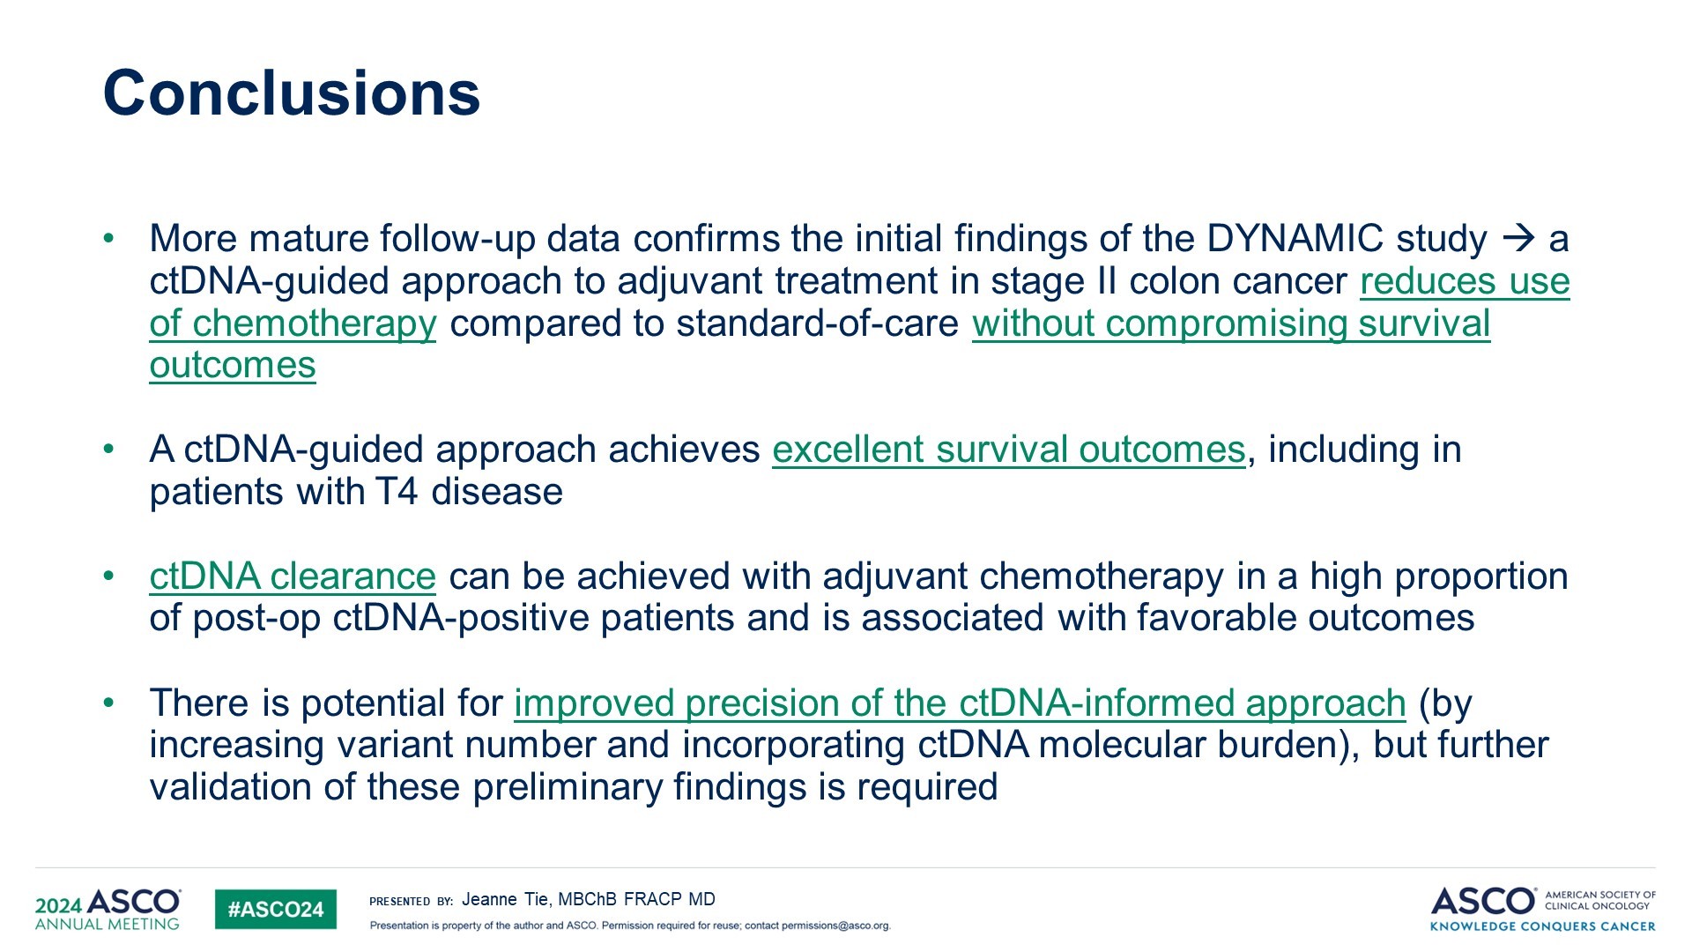

Slide 82
Discussion
Compelling data confirming earlier observations
NCCN guidelines currently do not recommend using MRD assays to make treatment decisions BUT….
Reasonable to consider after thorough discussion with patients and their families in low-risk stage II (or when adjuvant therapy may be high risk and / or not in line with patient preferences)

Slide 83


Slide 84
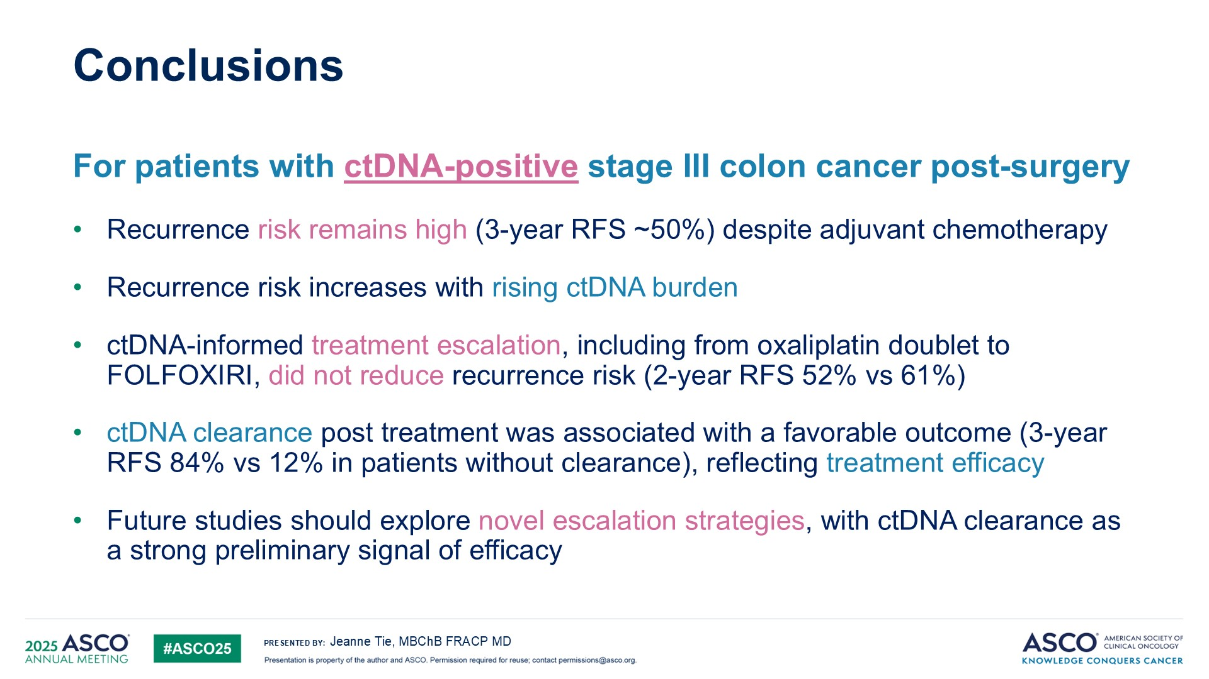

Slide 85
Conclusions
For patients with ctDNA-negative stage III colon cancer post-surgery
Recurrence risk is low, with 3-year RFS of 87%
ctDNA-informed treatment de-escalation was feasible with high adherence (90%)
Markedly reduced oxaliplatin exposure (88.6% → 34.8%)
Better safety profile: fewer treatment-related hospitalisations and grade ≥3 adverse events
Non-inferiority versus SoC was not confirmed, though outcomes were close (3-yr RFS 85.3% vs 88.1%), particularly in low-risk (T1-3N1) disease (3-yr RFS 91.0% vs 93.2%)
Could inform risk-benefit discussions for individual patients
ctDNA-informed de-escalation strategies warrant further investigation
Jeanne Tie

Slide 86
Discussion
Trial used an older generation assay and treatment escalation decisions were not consistent
Will need to await results of ongoing trials such as CIRCULATE-North America
No role for treating ctDNA+ patients outside of clinical trials with systemic chemotherapy

Slide 87
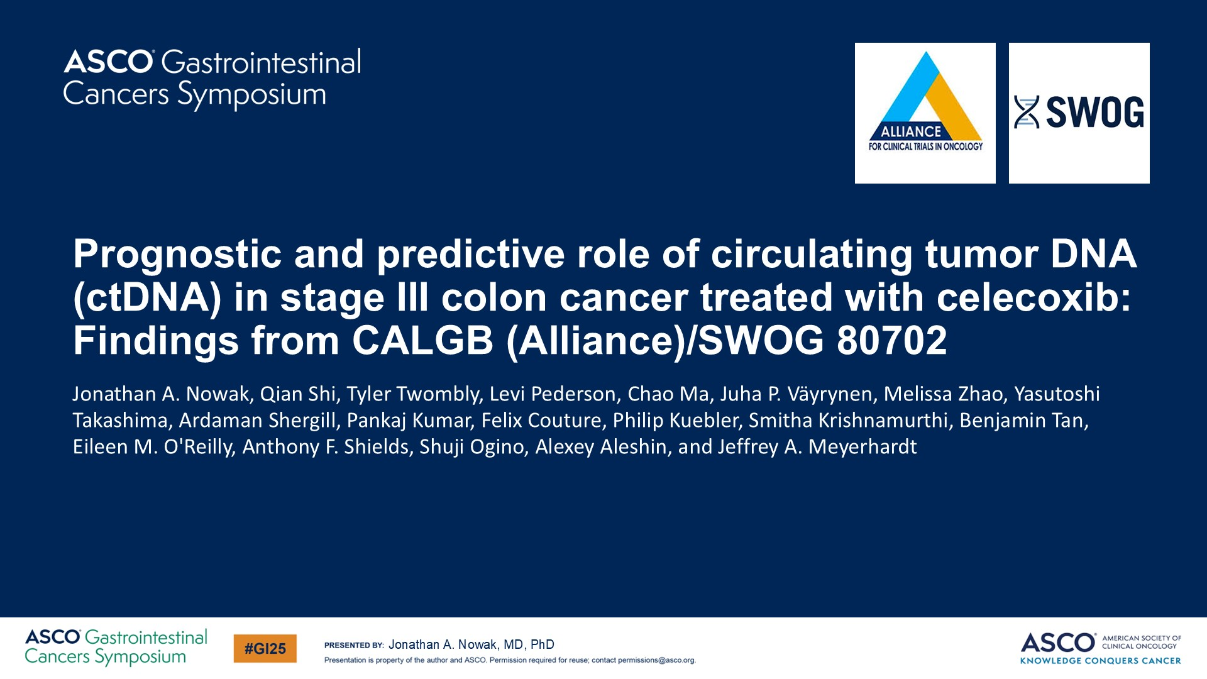

Slide 88
Discussion
Compelling hypothesis generating data
Reminiscent of atezolizumab in muscle invasive bladder cancer development and approval (Powles et al, NEJM, 2025)
Need further validation prior to use in clinic; should enroll patients onto trials

Slide 89
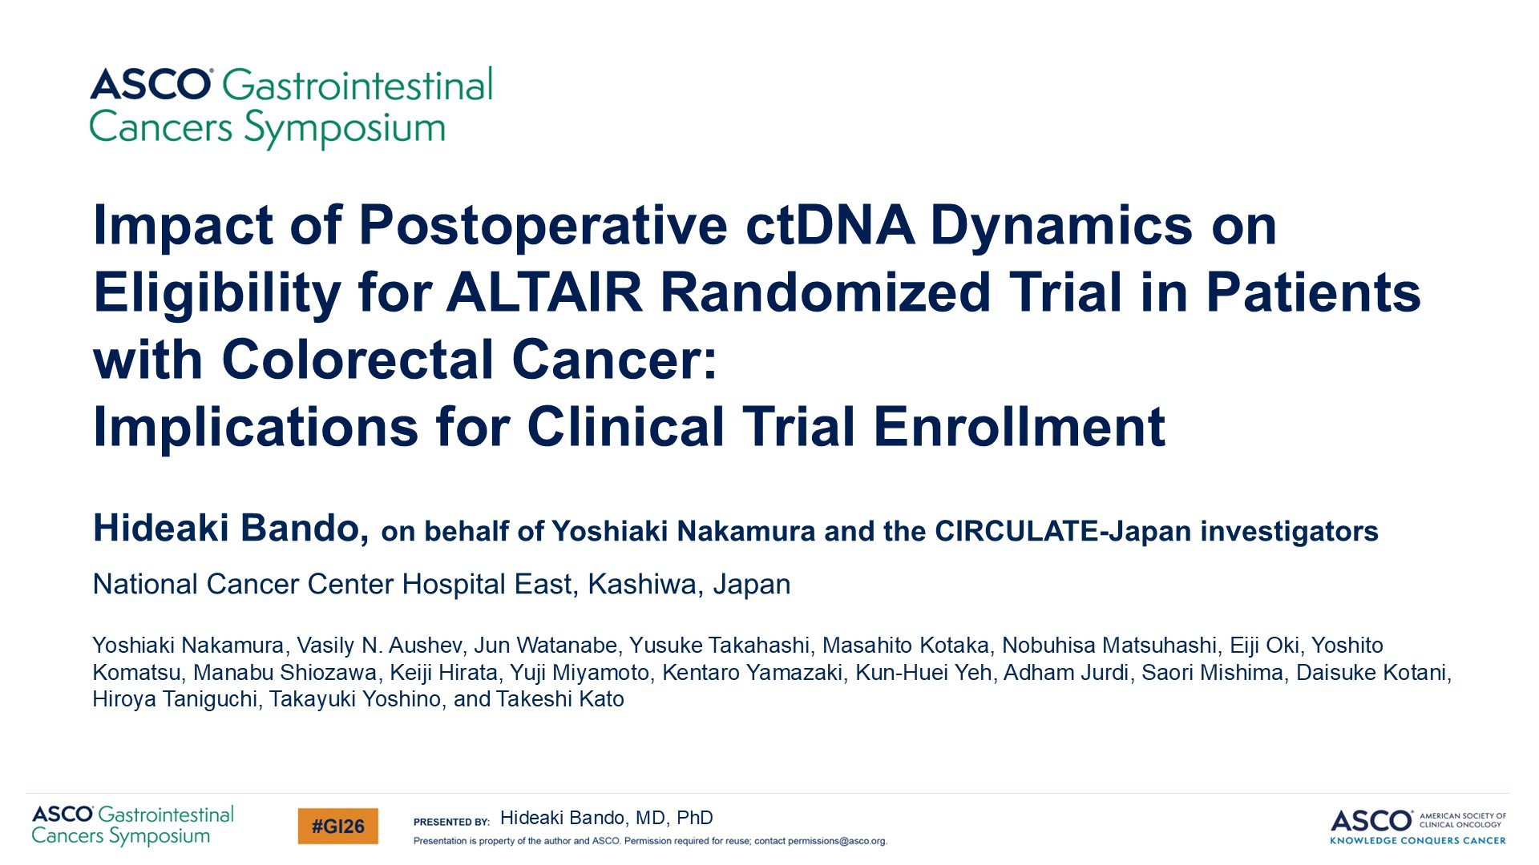

Slide 90
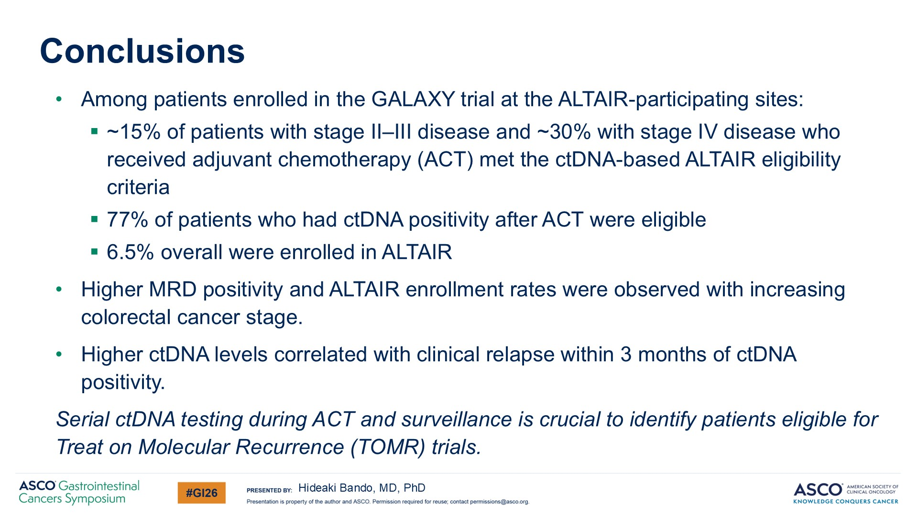

Slide 91
Year in Review: Colorectal Cancer
INTRODUCTION: RTP Paper of the Year!
MODULE 1: Checkpoint Inhibitors for Localized MSI-High Tumors
MODULE 2: Circulating Tumor DNA Assays
MODULE 3: Checkpoint Inhibitors for Metastatic Disease
MODULE 4: Other Important Papers

Slide 92
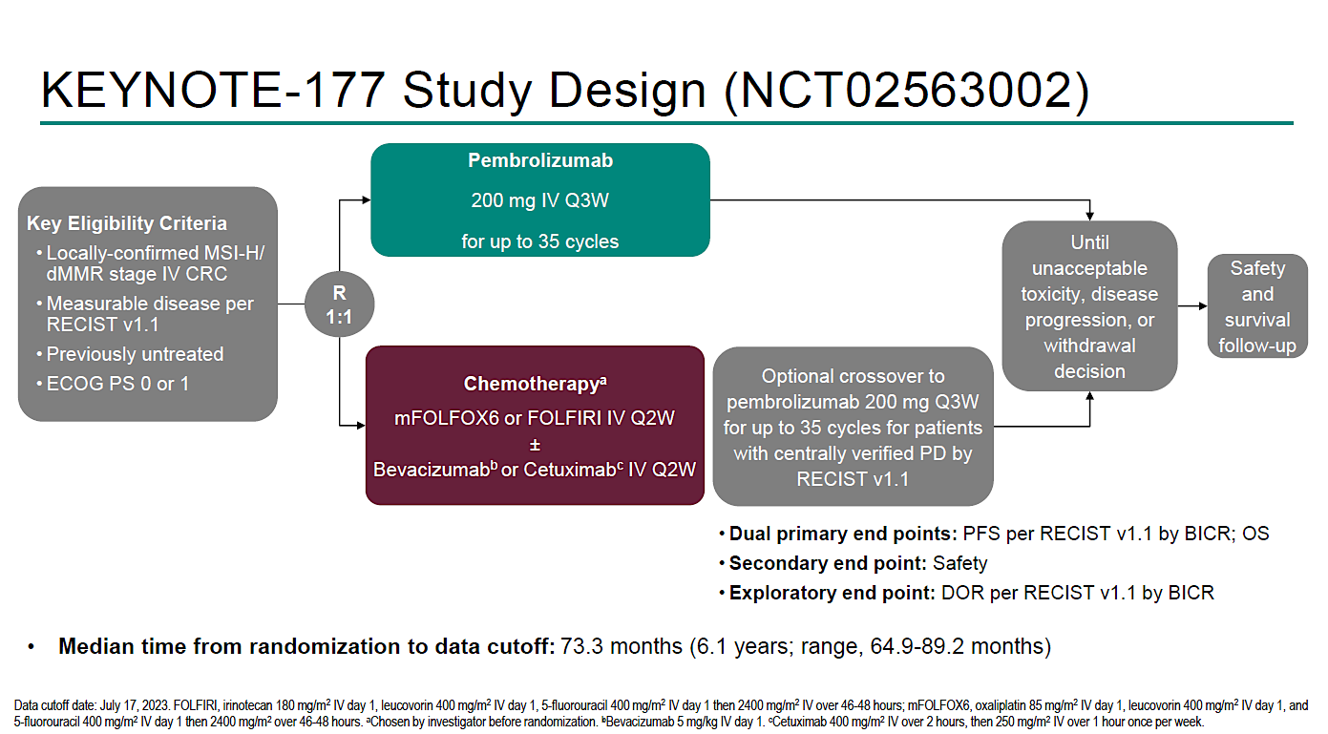
Trial 1 | KEYNOTE-177 5yr
André et al. Ann Oncol 2025;36:277-284.

Slide 93
Trial 1 | KEYNOTE-177 5yr
IMPLICATIONS
1
Cements pembrolizumab as 1L SOC for MSI-H/dMMR mCRC
2
OS > 6 years with IO-first — transformative
3
Durable responses (mDOR > 6 yrs) support IO biology
4
Crossover-adjusted benefit likely even greater (mOS doubled: 77.5 vs 36.7 mo despite 62% crossover)
5
Benchmark for dual IO comparisons (CM8HW, COMMIT)
CRC Year in Review 2025–2026 | mCRC | A. Saeed
André et al. Ann Oncol 2025;36:277-284.

Slide 94
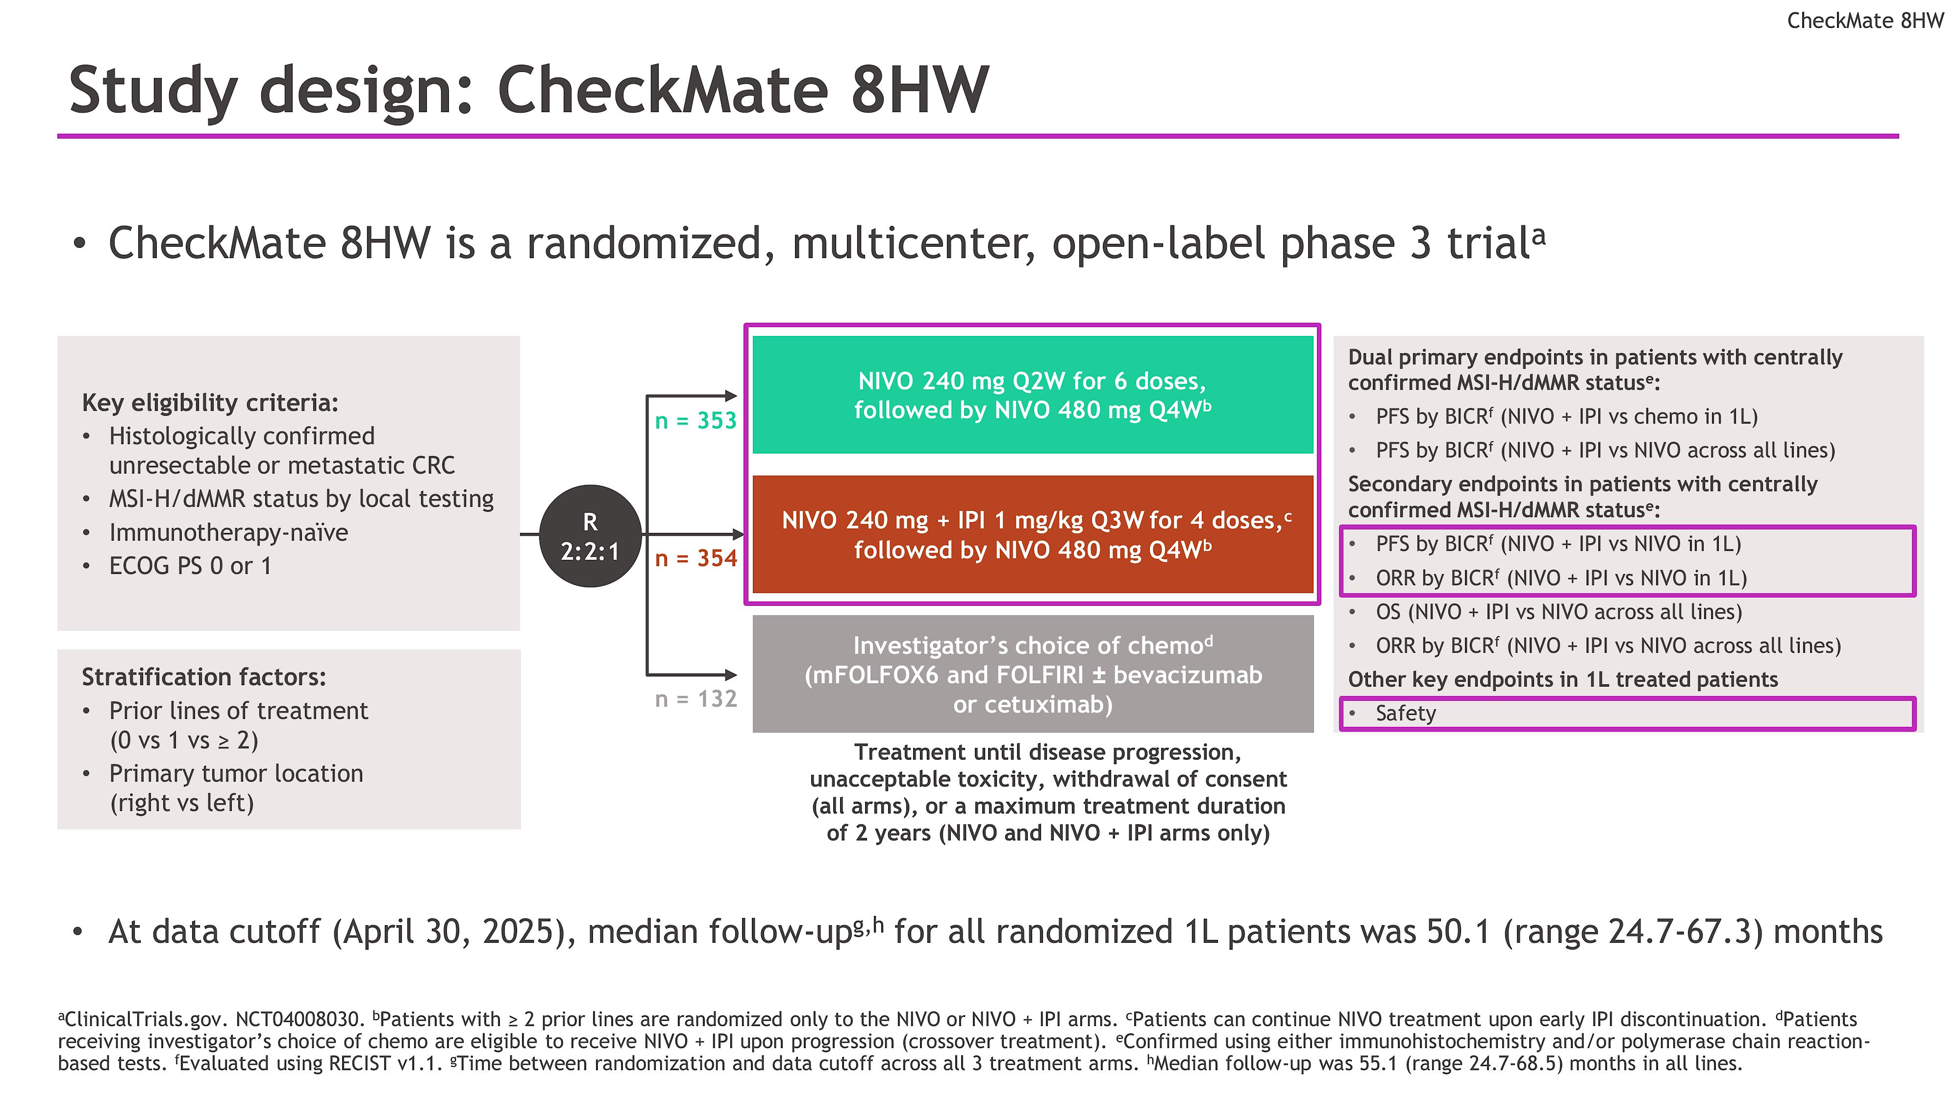
Trial 2 | CheckMate 8HW
Crossover from chemo allowed at PD
Lonardi S et al ESMO 2025; Abstract LBA49

Slide 95
Trial 2 | CheckMate 8HW
IMPLICATIONS
1
First phase 3: dual IO > chemo AND mono IO in MSI-H
2
PFS HR 0.21 vs chemo — unprecedented in mCRC
3
Led to FDA approval nivo+ipi for MSI-H/dMMR
4
Nivo mono viable — PFS > 3 years
5
Key Q: which patients need dual vs mono?
CRC Year in Review 2025–2026 | mCRC | A. Saeed
Lonardi S et al ESMO 2025; Abstract LBA49

Slide 96
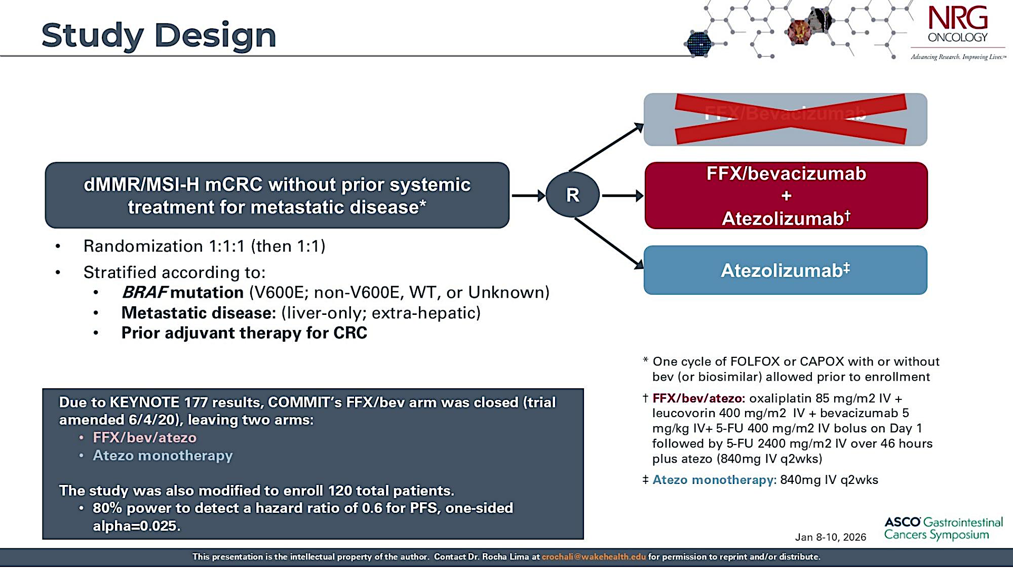
Trial 3 | COMMIT
Primary endpoint: PFS
Key secondary: ORR, DCR, OS, safety
N=102 (41 combo vs 41 atezo mono)
Rocha Lima et al. ASCO GI 2026; Abstract 14.

Slide 97
Trial 3 | COMMIT
IMPLICATIONS
1
Chemo+Bev+IO combo superior to IO mono in dMMR mCRC
2
Nearly eliminates early PD (2.8% vs 32.4%)
3
Challenges IO-mono paradigm from KN-177
4
BRAF V600E benefit: PFS HR 0.23 — key subgroup
5
Complementary to CM8HW dual-IO; defines IO+chemo role
CRC Year in Review 2025–2026 | mCRC | A. Saeed
Rocha Lima et al. ASCO GI 2026; Abstract 14.

Slide 98
The Manufacturer Announces US FDA Accepted the New Drug Application for Zanzalintinib in Combination with an Immune Checkpoint Inhibitor for Patients with Metastatic Colorectal Cancer Press Release: February 2, 2026
“[The manufacturer] today announced that its New Drug Application (NDA) for zanzalintinib, in combination with atezolizumab, has been accepted for review in the U.S. for the treatment of adult patients with metastatic colorectal cancer (mCRC) who have been previously treated with fluoropyrimidine-, oxaliplatin- and irinotecan-based chemotherapy, and, if RAS wild-type, an anti-epidermal growth factor receptor (EGFR) therapy. The Food and Drug Administration(FDA) assigned a standard review with a Prescription Drug User Fee Act target action date of December 3, 2026.
The NDA is based on the results of the phase 3 STELLAR-303 pivotal trial, in which zanzalintinib in combination with atezolizumab demonstrated a statistically significant improvement in overall survival (OS) versus regorafenib in the intention-to-treat (ITT) population of patients with previously treated CRC. Detailed results, including OS and progression-free survival (PFS) in the ITT population and in the subset of patients without liver metastases (non-liver metastases, NLM), were presented at the 2025 European Society for Medical Oncology (ESMO) Congress and published in The Lancet. Data pertaining to the other dual primary endpoint, OS inpatients without active liver metastases, were immature at the data cutoff, and the trial is proceeding to the planned final analysis for this endpoint, which is expected in mid-2026, based on current event rates.”
https://ir.exelixis.com/news-releases/news-release-details/exelixis-announces-us-fda-accepted-new-drug-application

Slide 99
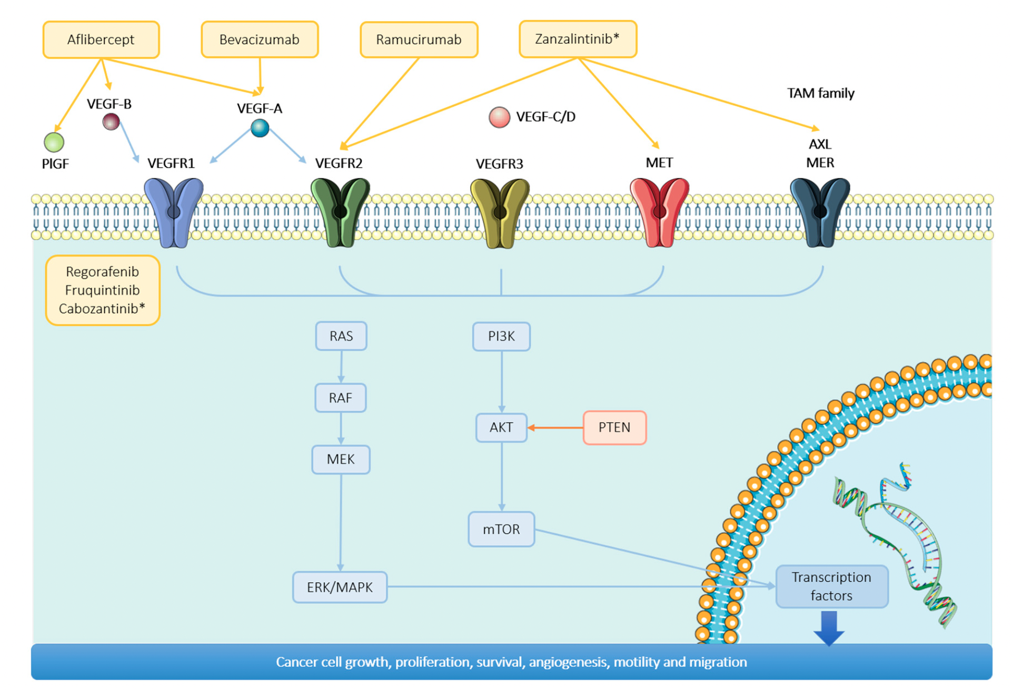
Zanzalintinib Mechanism of Action
* Not FDA approved
de Torres CS et al. Int J Mol Sci 2024;25,6967.

Slide 100
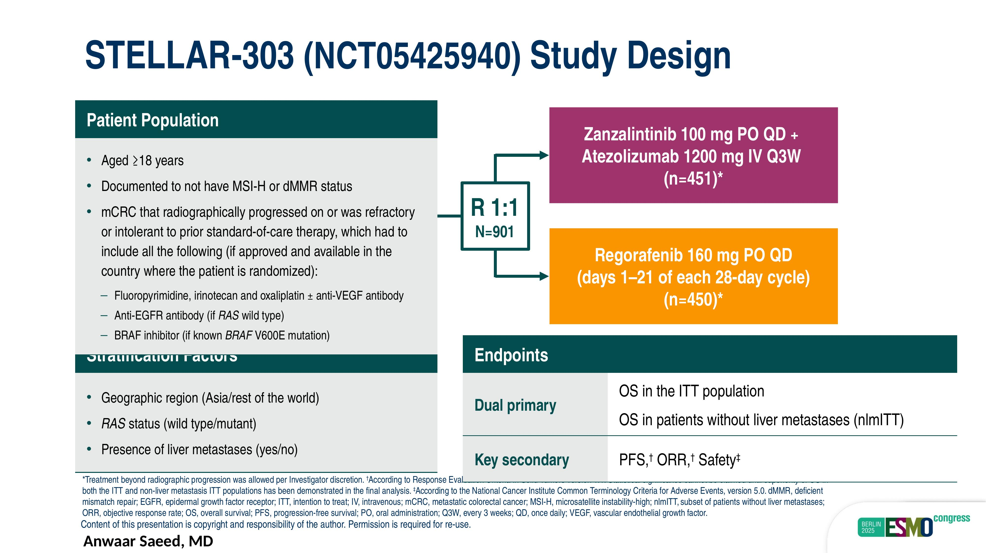
Trial 4 | STELLAR-303
Stratification Factors
Hecht et al. Lancet 2025; 406: 2360–70.

Slide 101
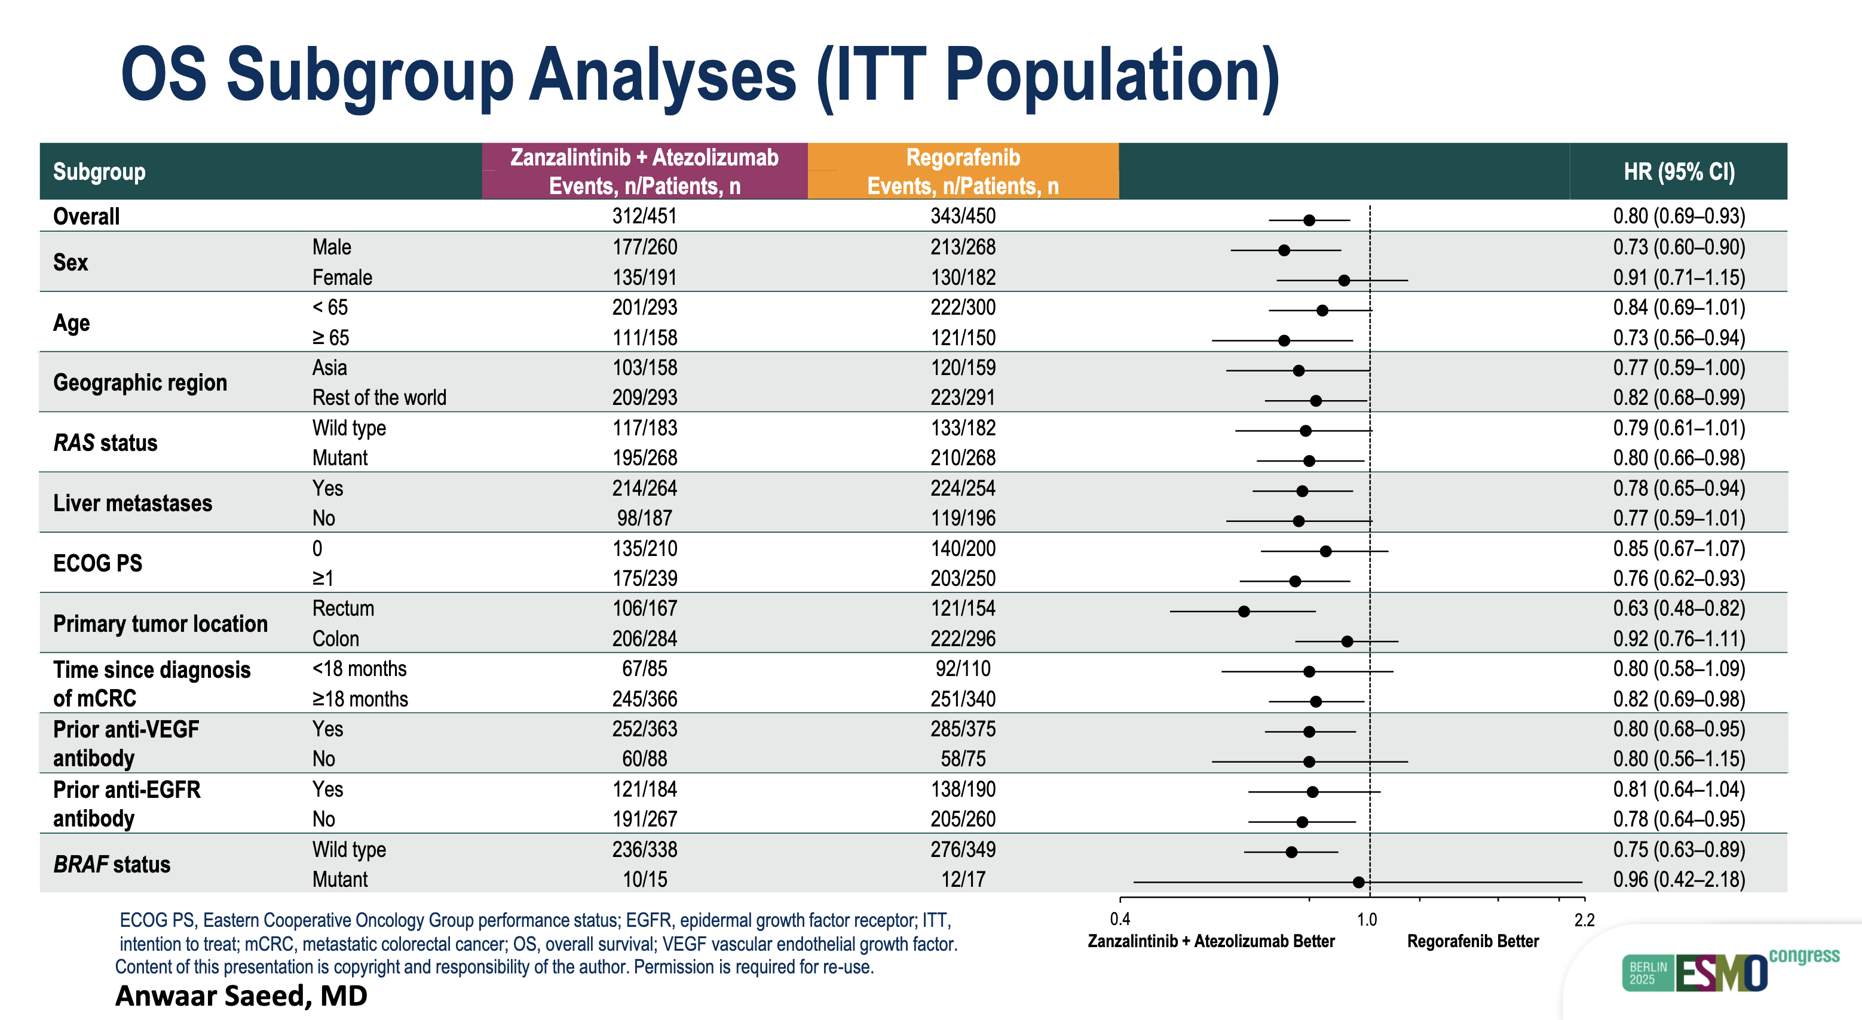
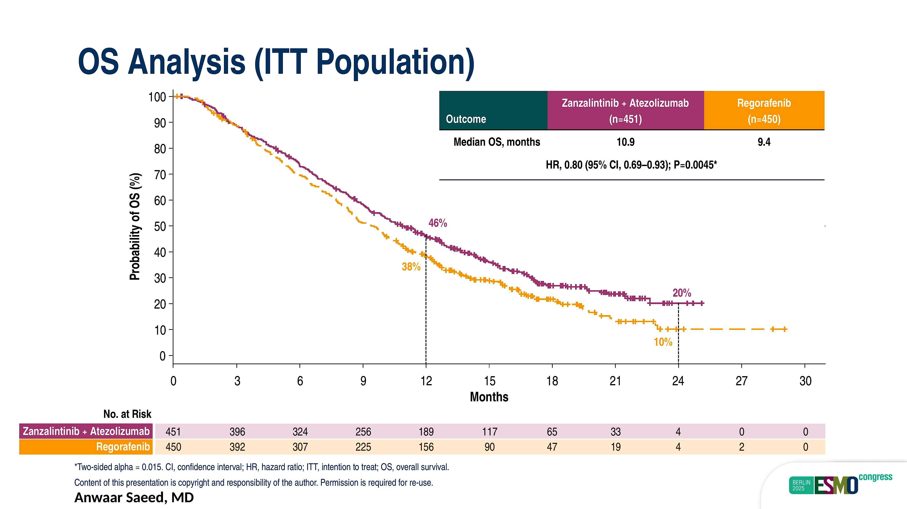
Trial 4 | STELLAR-303
RESULTS
CRC Year in Review 2025–2026 | mCRC | A. Saeed
Hecht et al. Lancet 2025; 406: 2360–70.

Slide 102
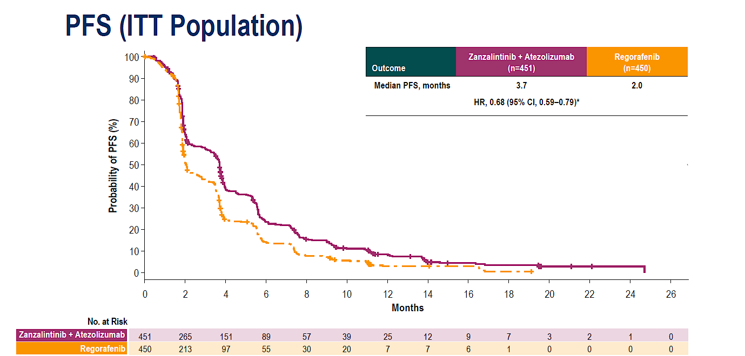
Trial 4 | STELLAR-303
RESULTS
CRC Year in Review 2025–2026 | mCRC | A. Saeed
Hecht et al. Lancet 2025; 406: 2360–70.

Slide 103
Trial 4 | STELLAR-303
RESULTS
CRC Year in Review 2025–2026 | mCRC | A. Saeed
Hecht et al. Lancet 2025; 406: 2360–70.

Slide 104
Trial 4 | STELLAR-303
IMPLICATIONS
1
First IO-based OS benefit in non-MSI-H/dMMR mCRC
2
TKI+ICI approach: TAM/MET/VEGFR + anti-PD-L1
3
Chemo free option for heavily pretreated patients
4
Consistent benefit across subgroups incl. liver mets
5
Head-to-head vs TFD+bev needed (unmet need)
CRC Year in Review 2025–2026 | mCRC | A. Saeed
Hecht et al. Lancet 2025; 406: 2360–70.

Slide 105
Year in Review: Colorectal Cancer
INTRODUCTION: RTP Paper of the Year!
MODULE 1: Checkpoint Inhibitors for Localized MSI-High Tumors
MODULE 2: Circulating Tumor DNA Assays
MODULE 3: Checkpoint Inhibitors for Metastatic Disease
MODULE 4: Other Important Papers

Slide 106
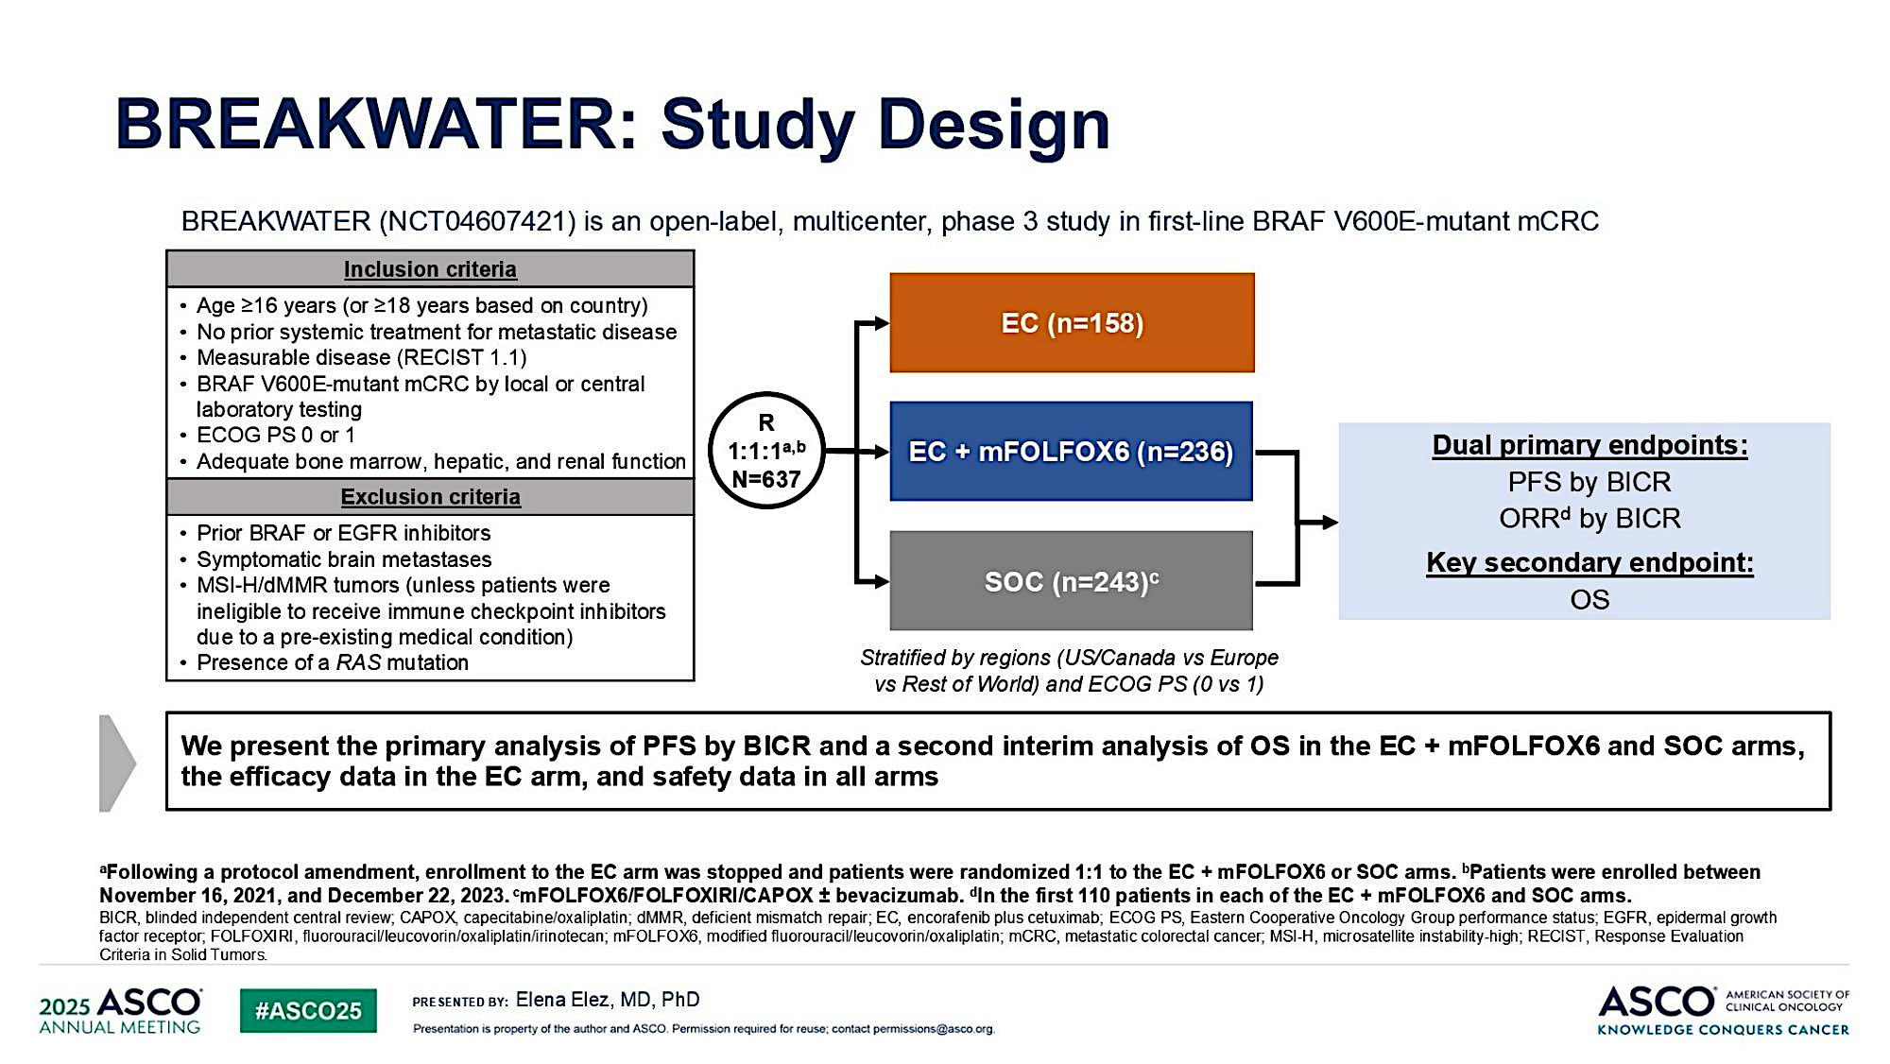
Trial 5 | BREAKWATER mFOLFOX6
Elez et al. NEJM 2025;392:2425-2437.

Slide 107
Trial 5 | BREAKWATER mFOLFOX6
IMPLICATIONS
1
Paradigm shift: 1L targeted Tx for BRAF V600E
2
mOS 30.3 mo ≈ BRAF-WT — transformative
3
EC+mFOLFOX6 = new global SOC
4
EC alone (19.5 mo): chemo-ineligible option
CRC Year in Review 2025–2026 | mCRC | A. Saeed
Elez et al. NEJM 2025;392:2425-2437.

Slide 108
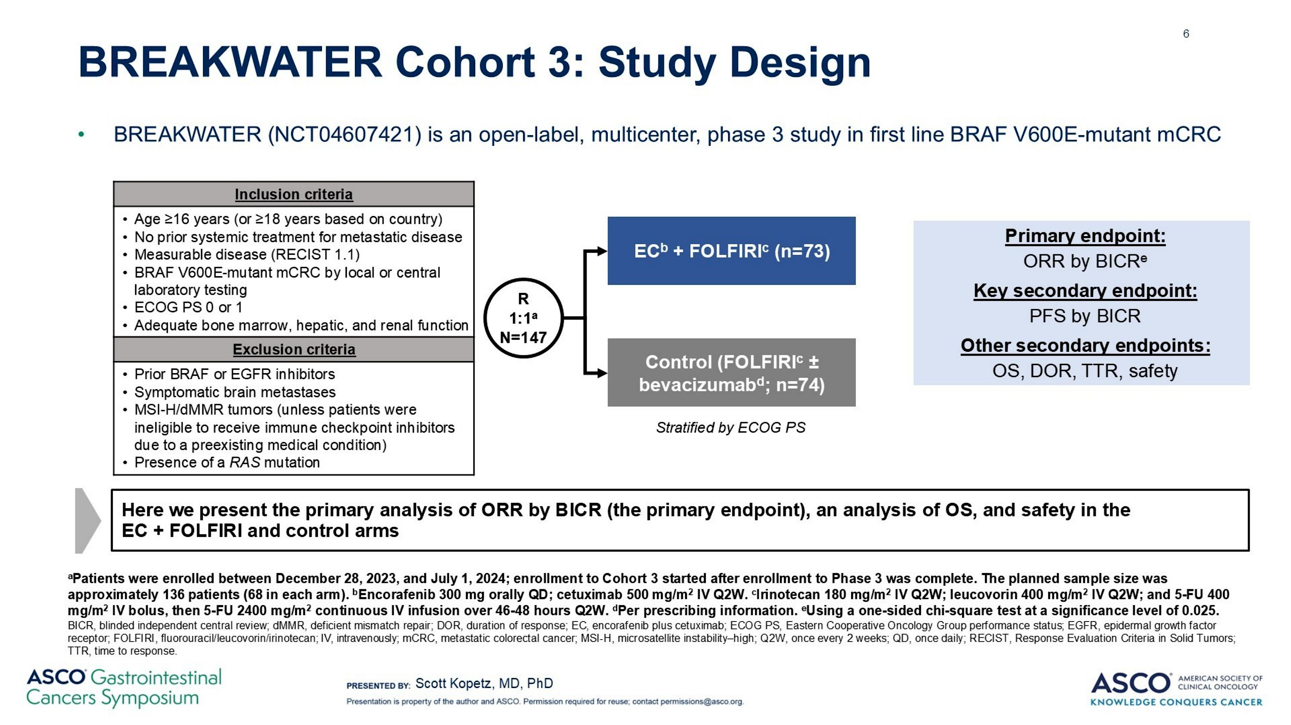
Trial 6 | BREAKWATER FOLFIRI
Kopetz Proc ASCO GI 2026;Abstract 13

Slide 109
Trial 6 | BREAKWATER FOLFIRI
IMPLICATIONS
1
Irinotecan-based alt to EC+mFOLFOX6
2
For oxaliplatin contraindication/intolerance
3
Comparable ORR to FOLFOX arm
4
Awaiting randomized PFS/OS
5
Expands BRAF-targeted options
CRC Year in Review 2025–2026 | mCRC | A. Saeed
Kopetz Proc ASCO GI 2026;Abstract 13

Slide 110
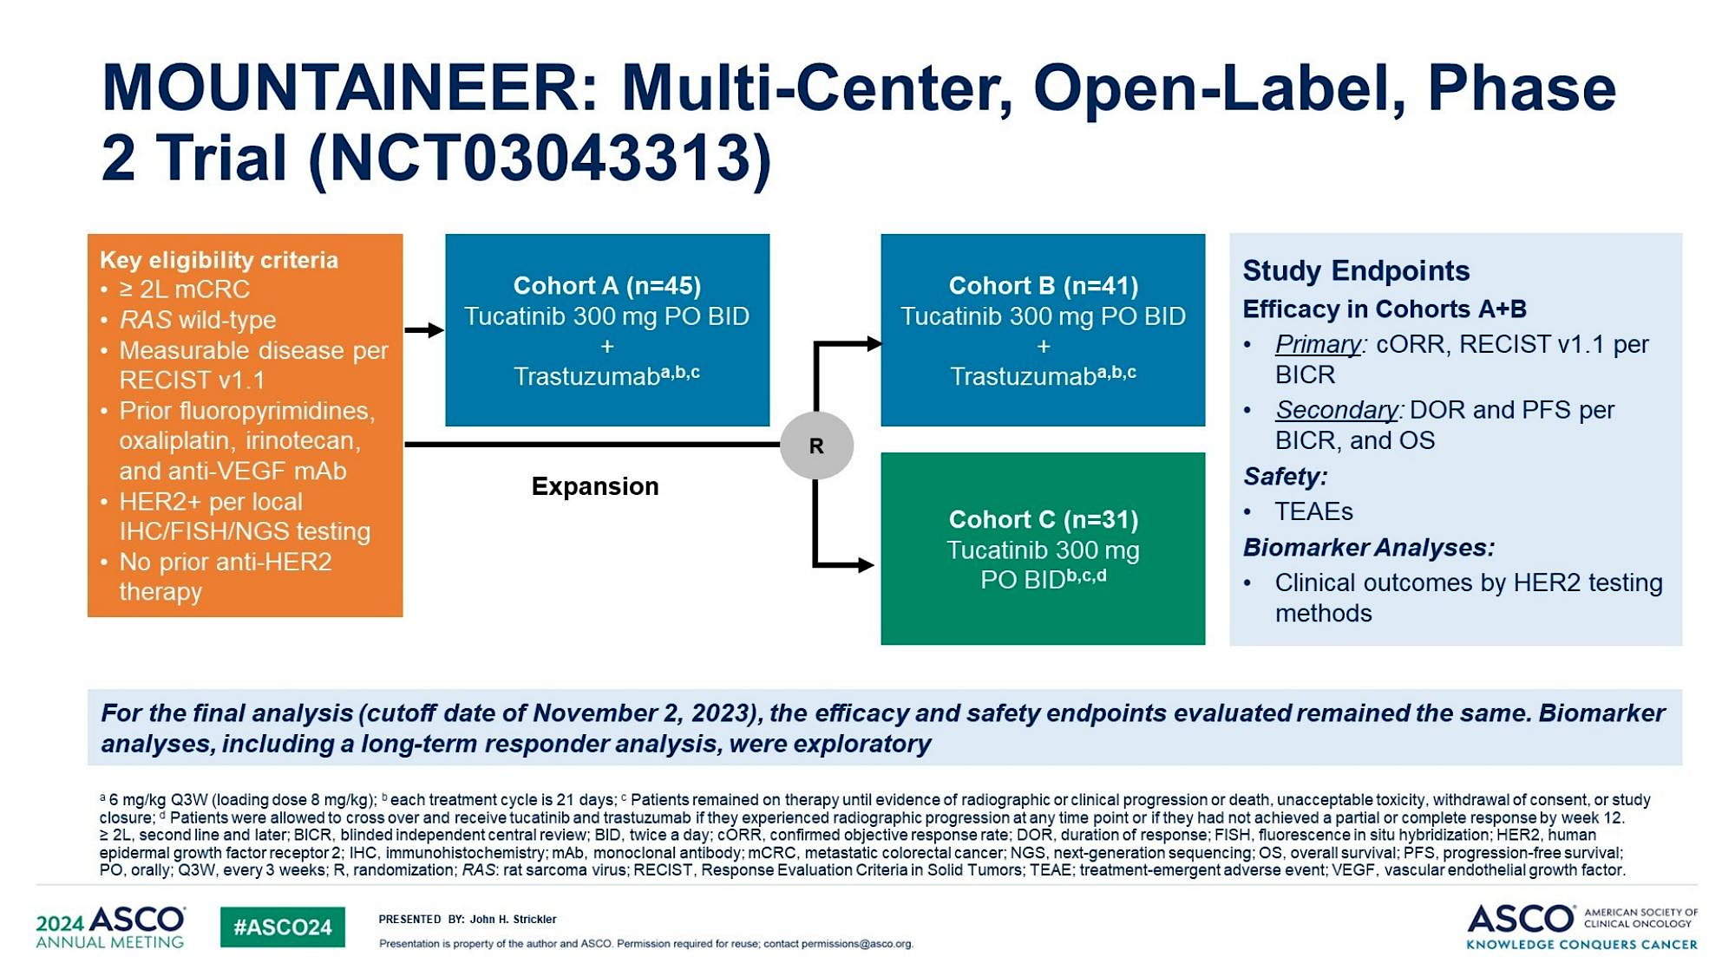
Trial 7 | MOUNTAINEER
Strickler JH et al Nat Commun 2026

Slide 111
Trial 7 | MOUNTAINEER
IMPLICATIONS
1
First FDA HER2-targeted therapy for mCRC
2
Validates dual HER2 blockade (mAb+TKI)
3
mOS 23.9 mo — exceptional in pretreated
4
MOUNTAINEER-03 ongoing (phase 3)
5
Universal HER2 testing warranted
CRC Year in Review 2025–2026 | mCRC | A. Saeed
Strickler et al. Lancet 2023;401:609-619.

Slide 112
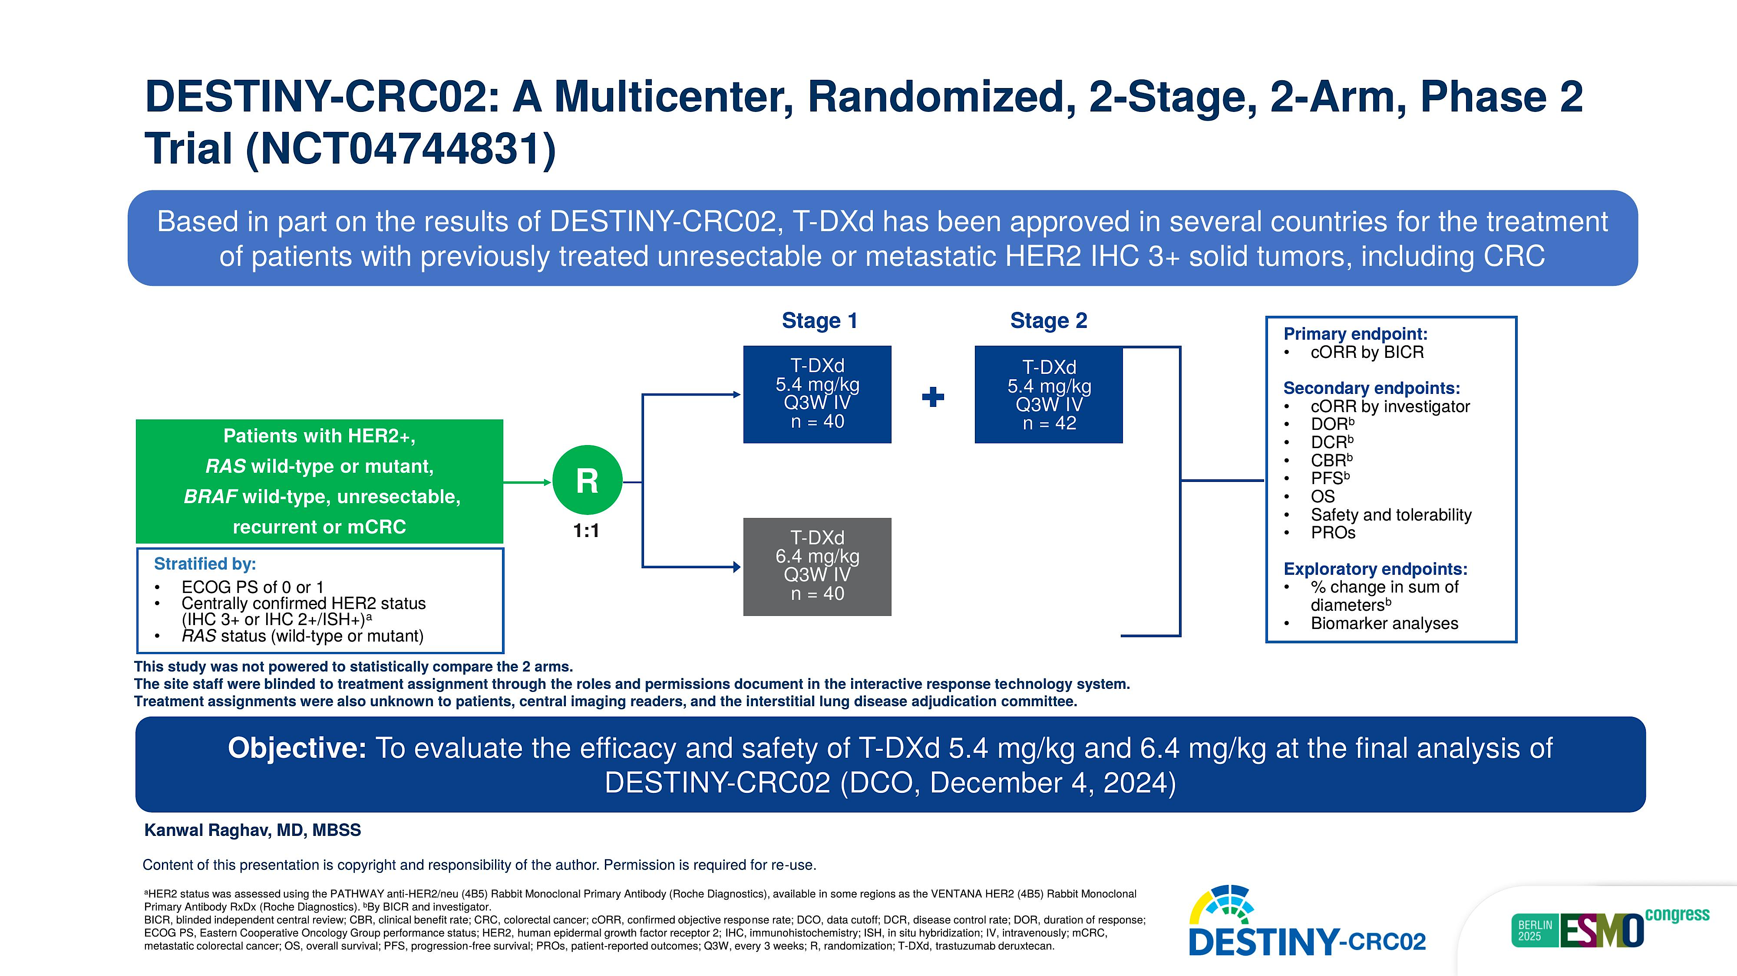
Trial 8 | DESTINY-CRC02
Raghav et al. ESMO 2025;Abstract 737MO

Slide 113
Trial 8 | DESTINY-CRC02
IMPLICATIONS
1
Confirms ADC viable in HER2+ mCRC
2
5.4 mg/kg: best benefit-risk — selected
3
Active in RAS-mutant HER2+ (vs MOUNTAINEER)
4
Complementary MOA to tras+tucatinib
5
Supports biomarker-driven sequencing
CRC Year in Review 2025–2026 | mCRC | A. Saeed
Raghav et al. ESMO 2025;Abstract 737MO

Slide 114
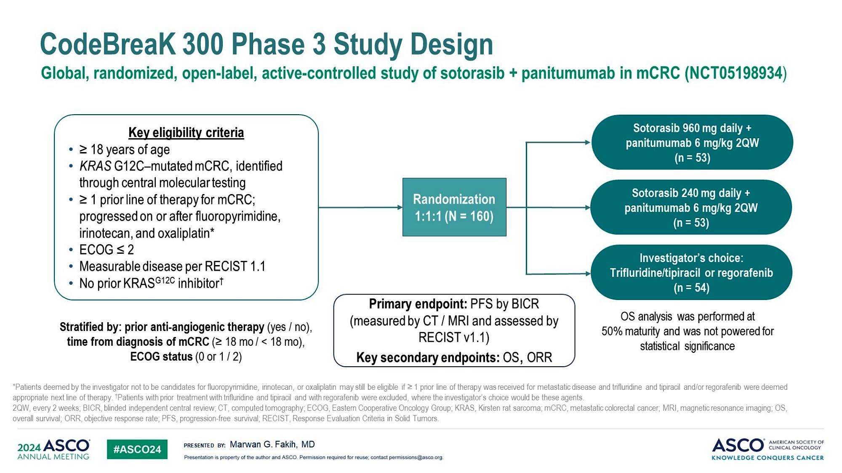
Trial 9 | CodeBreaK 300 OS
Pietrantonio et al. JCO 2025;43:2147-2154.

Slide 115
Trial 9 | CodeBreaK 300 OS
IMPLICATIONS
1
First phase 3 G12Ci with PFS benefit in mCRC
2
OS trend supports soto960+pani as SOC
3
Confounded by 28% crossover
4
30.2% ORR clinically meaningful
5
FDA approved — validates approach
CRC Year in Review 2025–2026 | mCRC | A. Saeed
Pietrantonio et al. JCO 2025;43:2147-2154.

Slide 116
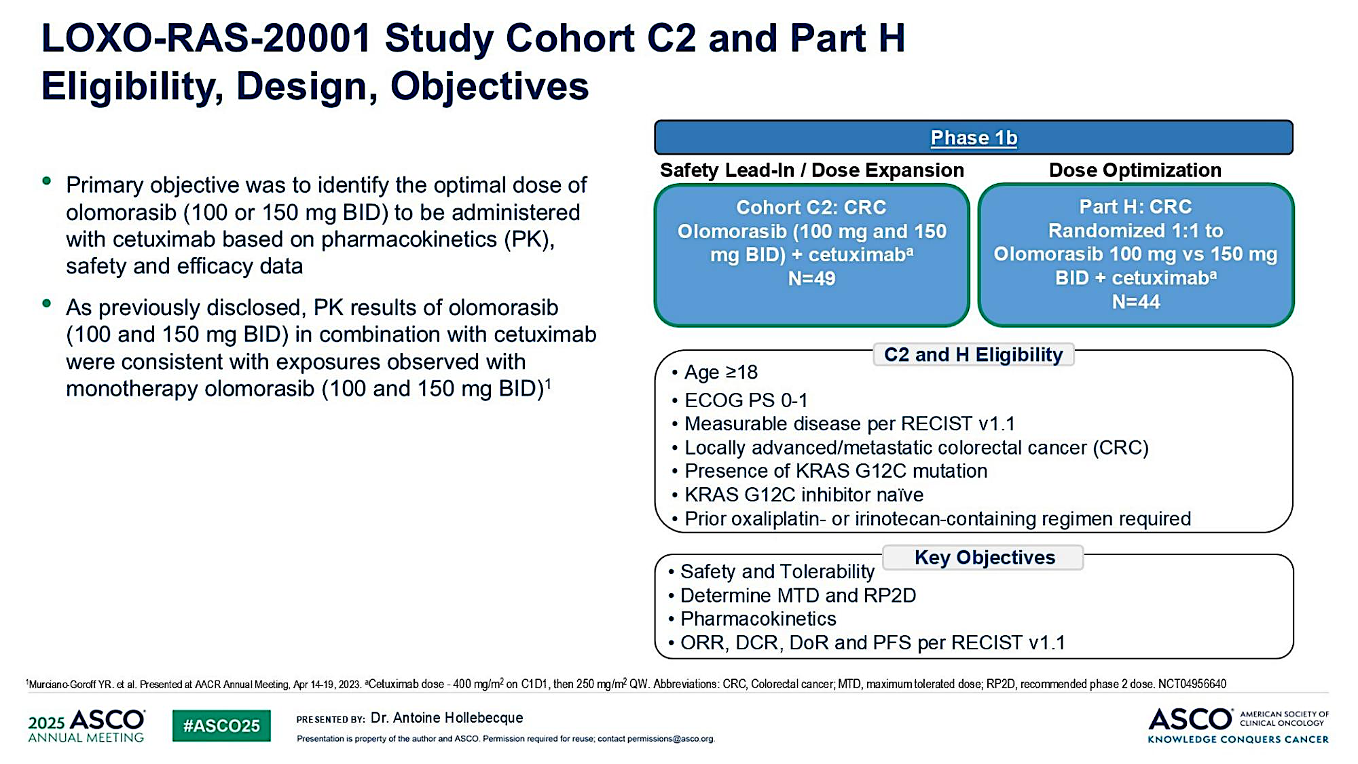
Trial 10 | Olomorasib
Hollebecque Proc ASCO 2025;Abstract 3507

Slide 117
Trial 10 | Olomorasib
IMPLICATIONS
1
Next-gen G12Ci with superior efficacy potential
2
47% ORR > CodeBreaK 300 benchmark
3
Room for improvement in G12C therapy
4
Phase 3 randomized data needed
5
Expanding KRAS toolkit
CRC Year in Review 2025–2026 | mCRC | A. Saeed
Hollebecque Proc ASCO 2025;Abstract 3507

Slide 118
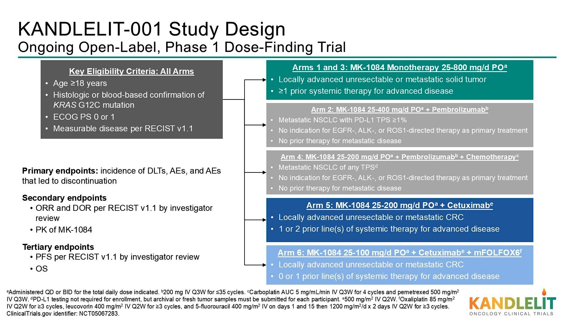
Trial 11 | MK-1084
Lugowska Proc ASCO 2025;Abstract 3508 Slides

Slide 119
Trial 11 | MK-1084
IMPLICATIONS
1
First G12C degrader — paradigm shift
2
50% ORR+cetux: highest in G12C mCRC
3
May overcome adaptive resistance
4
Early data — needs confirmation
5
Could redefine G12C treatment
CRC Year in Review 2025–2026 | mCRC | A. Saeed
Lugowska Proc ASCO 2025;Abstract 3508 Slides

Slide 120

Trial 12 | OrigAMI-1
STUDY SCHEMA & BIOMARKERS
Study Design
Phase 1b/2, open-label (NCT05379595)
RAS/BRAF WT mCRC, anti-EGFR naïve
Amivantamab: EGFR-MET bispecific
Multiple cohorts: mono + chemo combos
Endpoints & Treatment
Primary: Safety/RP2D (combo); ORR (mono)
Ami 1050mg + FOLFOX or FOLFIRI
1L or 2L (anti-EGFR naïve)
Phase 3 OrigAMI-2/3 enrolling
Chen EX et al. ASCO GI 2026; Abstract 166

Slide 121
Trial 12 | OrigAMI-1
IMPLICATIONS
1
EGFR-MET bispecific: novel beyond anti-EGFR mAbs
2
49% ORR competitive with cetux/pani
3
Intrahepatic ORR 53% — unmet need
4
Phase 3 OrigAMI-2/3 pivotal
5
Could shift 1L RAS WT paradigm
CRC Year in Review 2025–2026 | mCRC | A. Saeed
Chen EX et al. ASCO GI 2026; Abstract 166

Slide 122

Join Us
A Multitumor CME/MOC-, NCPD- and ACPE-Accredited Educational Conference Developed in Partnership with Florida Cancer Specialists & Research Institute
Friday to Sunday, April 24 to 26, 2026
The Ritz-Carlton Orlando, Grande Lakes | Orlando, Florida
Moderated by Neil Love, MD

Slide 123
Thank you for joining us! Please take a moment to complete the survey currently up on Zoom. Your feedback is very important to us. The survey will remain open for 5 minutes after the meeting ends. Information on how to obtain CME, ABIM MOC and ABS credit is provided in the Zoom chat room. Attendees will also receive an email in 1 to 3 business days with these instructions.

