Slide 1
Year in Review: Clinical Investigator Perspectives on the
Most Relevant New Datasets and Advances in Oncology
Menin Inhibitors in Acute Myeloid Leukemia
A CME/MOC-Accredited Live Webinar
Thursday, March 26, 2026
5:00 PM – 6:00 PM ET
Faculty
Amir Fathi, MD
Eunice S Wang, MD
Moderator
Neil Love, MD

Slide 2
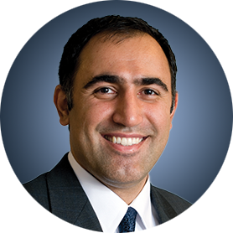

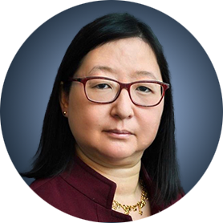
Faculty
Amir Fathi, MD
Director, Leukemia Program
Massachusetts General Hospital
Associate Professor of Medicine
Harvard Medical School
Boston, Massachusetts
MODERATOR
Neil Love, MD
Research To Practice
Miami, Florida
Eunice S Wang, MD
Chief, Leukemia/Benign Hematology Service
Professor of Oncology, Department of Medicine
Roswell Park Comprehensive Cancer Center
Buffalo, New York

Slide 3
Commercial Support
This activity is supported by educational grants from Johnson & Johnson, Kura Oncology, and Syndax Pharmaceuticals.

Slide 4
Dr Love — Disclosures
Dr Love is president and CEO of Research To Practice. Research To Practice receives funds in the form of educational grants to develop CME activities from the following companies: Aadi Bioscience, AbbVie Inc, ADC Therapeutics, Agendia Inc, Alexion Pharmaceuticals, Amgen Inc, Array BioPharma Inc, a subsidiary of Pfizer Inc, Arvinas, Astellas, AstraZeneca Pharmaceuticals LP, Aveo Pharmaceuticals, Bayer HealthCare Pharmaceuticals, BeOne, Biotheranostics Inc, A Hologic Company, Black Diamond Therapeutics Inc, Blueprint Medicines, Boehringer Ingelheim Pharmaceuticals Inc, Bristol Myers Squibb, Celcuity, Clovis Oncology, Coherus BioSciences, Corcept Therapeutics Inc, CTI BioPharma, a Sobi Company, Daiichi Sankyo Inc, Eisai Inc, Elevation Oncology Inc, Exact Sciences Corporation, Exelixis Inc, Genentech, a member of the Roche Group, Genmab US Inc, Geron Corporation, Gilead Sciences Inc, GSK, Helsinn Therapeutics (US) Inc, ImmunoGen Inc, Incyte Corporation, Ipsen Biopharmaceuticals Inc, Jazz Pharmaceuticals Inc, Johnson & Johnson, Karyopharm Therapeutics, Kite, A Gilead Company, Kura Oncology, Legend Biotech, Lilly, MEI Pharma Inc, Merck, Mersana Therapeutics Inc, Mirati Therapeutics Inc, Mural Oncology Inc, Natera Inc, Novartis, Novartis Pharmaceuticals Corporation on behalf of Advanced Accelerator Applications, Novocure Inc, Nuvalent, Nuvation Bio Inc, Pfizer Inc, Pharmacyclics LLC, an AbbVie Company, Puma Biotechnology Inc, Regeneron Pharmaceuticals Inc, Revolution Medicines Inc, Rigel Pharmaceuticals Inc, R-Pharm US, Sanofi, Seagen Inc, Servier Pharmaceuticals LLC, SpringWorks Therapeutics Inc, Stemline Therapeutics Inc, Sumitomo Pharma America, Summit Therapeutics, Syndax Pharmaceuticals, Taiho Oncology Inc, Takeda Pharmaceuticals USA Inc, TerSera Therapeutics LLC, and Tesaro, A GSK Company.

Slide 5
Research To Practice CME Planning Committee Members,
Staff and Reviewers
Planners, scientific staff and independent reviewers for Research To Practice have no relevant financial relationships to disclose.

Slide 6
Dr Fathi — Disclosures
Consulting Agreements | AbbVie Inc, Astellas, AstraZeneca Pharmaceuticals LP, Autolus, Bristol Myers Squibb, Daiichi Sankyo Inc, Genentech, a member of the Roche Group, Genmab US Inc, Gilead Sciences Inc, Kura Oncology, Pfizer Inc, Prelude Therapeutics, Remix Therapeutics, Rigel Pharmaceuticals Inc, Schrödinger, Servier Pharmaceuticals LLC, Syndax Pharmaceuticals, Takeda Pharmaceuticals USA Inc, Thermo Fisher Scientific
Contracted Research | AbbVie Inc, Bristol Myers Squibb, Kura Oncology, Servier Pharmaceuticals LLC

Slide 7
Dr Wang — Disclosures
Advisory Boards | AbbVie Inc, Blueprint Medicines, Cullinan Therapeutics, Daiichi Sankyo Inc, Dark Blue Therapeutics, Johnson & Johnson, Kite, A Gilead Company, Kura Oncology, Novartis, QIAGEN, Rigel Pharmaceuticals Inc, Ryvu Therapeutics, Schrödinger, Servier Pharmaceuticals LLC, Syndax Pharmaceuticals, Takeda Pharmaceuticals USA Inc
Consulting Agreements | Kura Oncology, Menarini Group
Data and Safety Monitoring Boards/Committees | AbbVie Inc, Gilead Sciences Inc
Speakers Bureaus | Astellas, Pfizer Inc
Nonrelevant Financial Relationships | UpToDate

Slide 8
This educational activity contains discussion of
non-FDA-approved uses of agents and regimens. Please refer to official prescribing information for each product for approved indications.

Slide 9
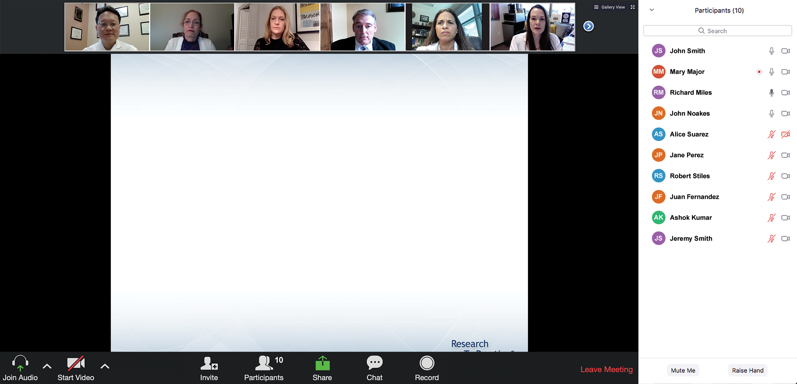
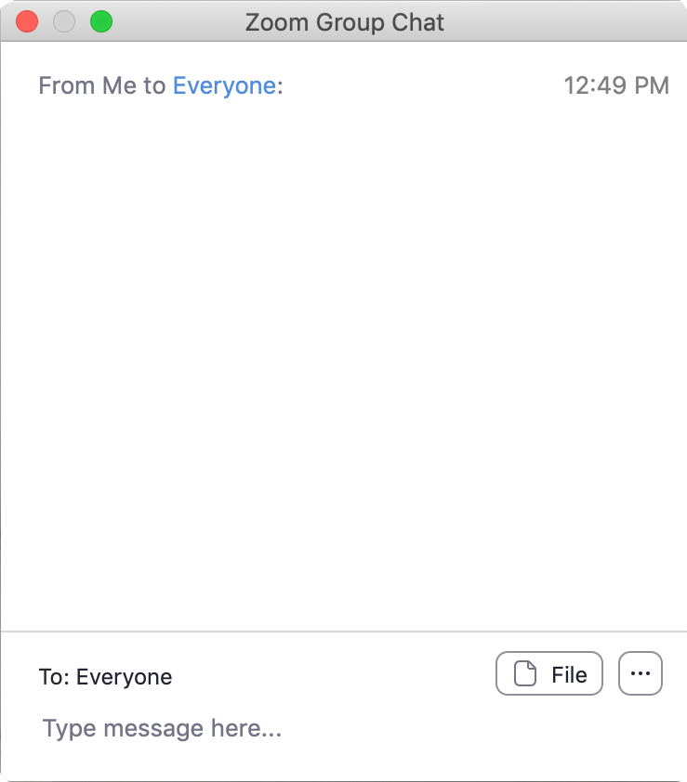
We Encourage Clinicians in Practice to Submit Questions
Feel free to submit questions now before the program begins and throughout the program.

Slide 10
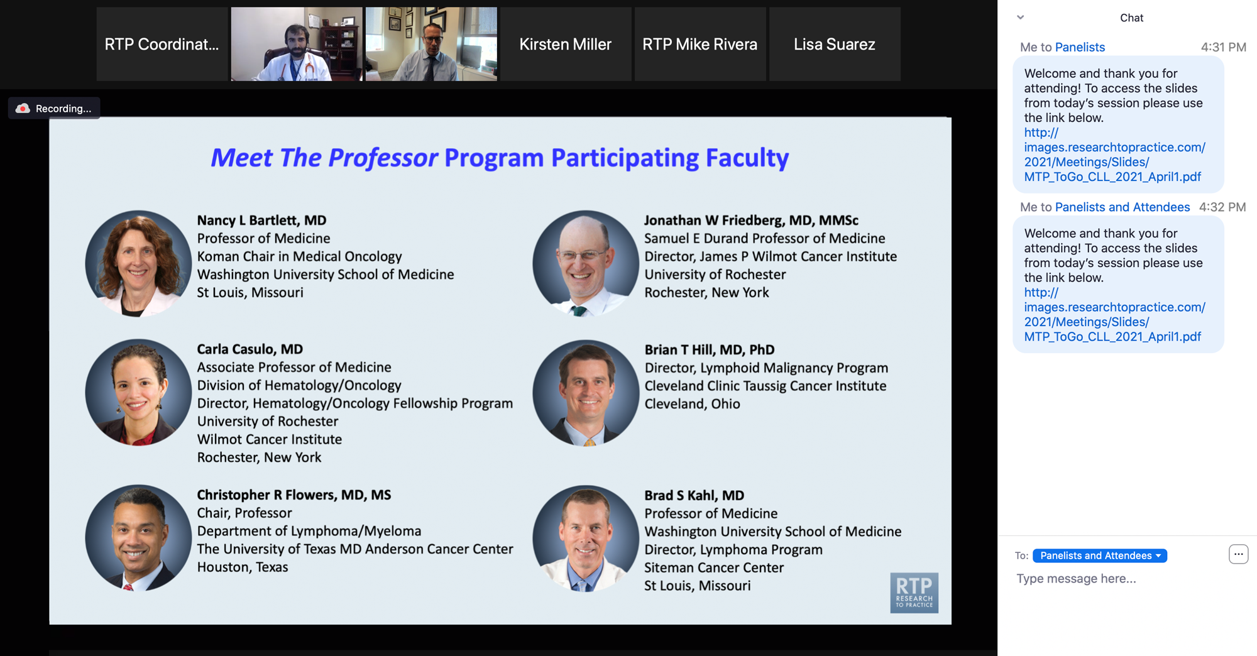
Familiarizing Yourself with the Zoom Interface
Expand chat submission box
Drag the white line above the submission box up to create
more space for your message.

Slide 11
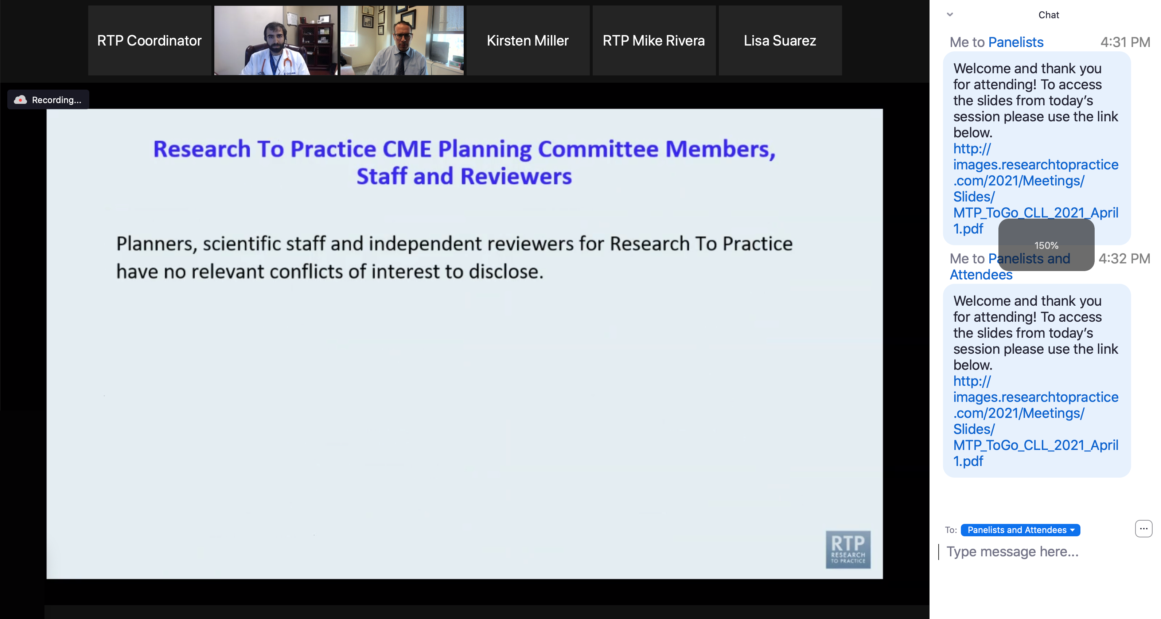
Familiarizing Yourself with the Zoom Interface
Increase chat font size
Press Command (for Mac) or Control (for PC) and the + symbol.
You may do this as many times as you need for readability.

Slide 12
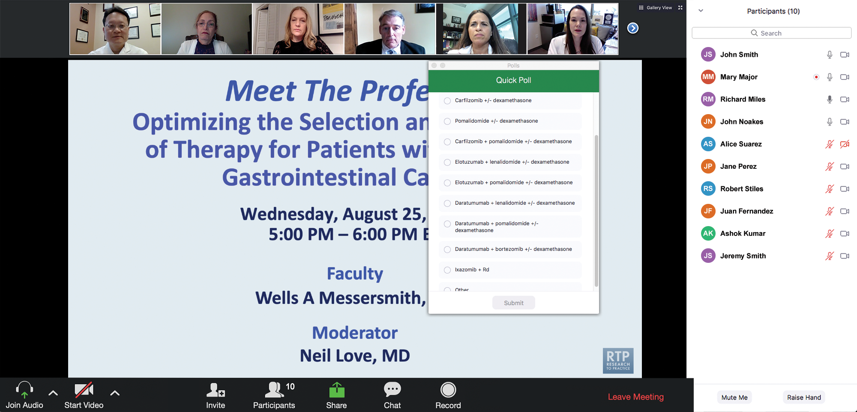
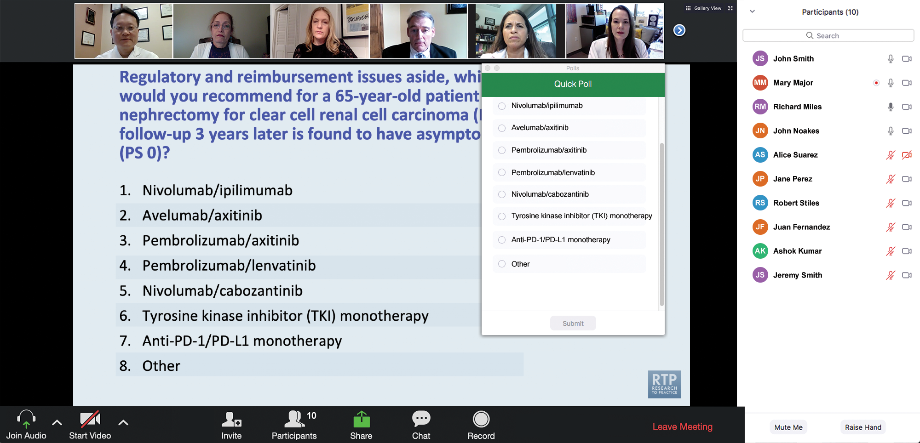
Clinicians in the Audience, Please Complete the Pre- and Postmeeting Surveys
Quick Survey
Quick Poll

Slide 13
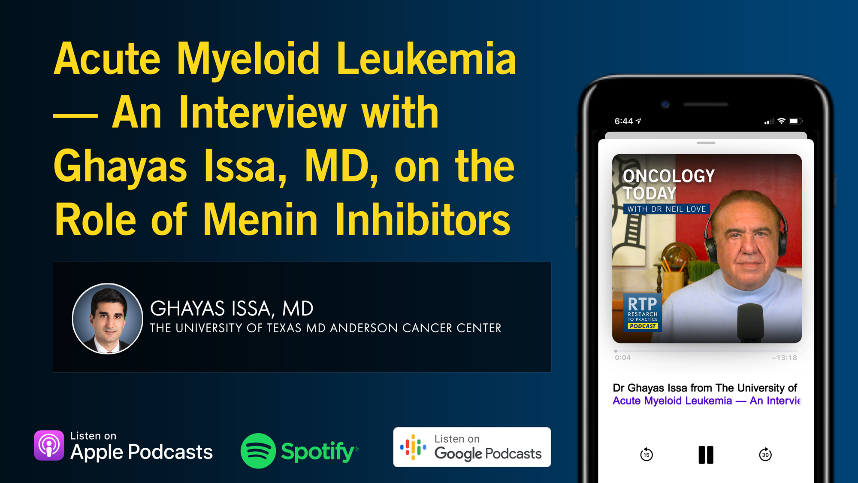

Slide 14
Year in Review: Clinical Investigator Perspectives on the
Most Relevant New Datasets and Advances in Oncology
Oral SERDs for Breast Cancer
A CME/MOC-Accredited Live Webinar
Tuesday, March 31, 2026
5:00 PM – 6:00 PM ET
Faculty
Aditya Bardia, MD, MPH
Erica Mayer, MD, MPH, FASCO
Moderator
Neil Love, MD

Slide 15
Year in Review: Clinical Investigator Perspectives on the
Most Relevant New Datasets and Advances in Oncology
EGFR-Mutant Non-Small Cell Lung Cancer
A CME/MOC-Accredited Live Webinar
Tuesday, April 7, 2026
5:00 PM – 6:00 PM ET
Faculty
Suresh S Ramalingam, MD
Helena Yu, MD
Moderator
Neil Love, MD

Slide 16
Grand Rounds
CME/MOC-Accredited Interactive Series
Regional Activities
Three Series
Optimizing Treatment
for Patients with Relapsed/Refractory Chronic Lymphocytic Leukemia
Optimizing the Use of
Novel Therapies for Patients with Diffuse
Large B-Cell Lymphoma
Optimizing Therapy for Patients with Hormone Receptor-Positive
Localized Breast Cancer
Host a 1-hour session at your institution:
Email Meetings@ResearchToPractice.com
or call (800) 233-6153

Slide 17
Four Exciting Programs on the
Management of Gynecologic Cancers
An Independent CME Symposium Series During the 2026 Society of
Gynecologic Oncology (SGO) Annual Meeting on Women’s Cancer®
HER2-Positive
Gynecologic Cancers
Saturday, April 11, 2026
12:45 PM – 2:15 PM AST
Ovarian Cancer
Sunday, April 12, 2026
1:30 PM – 3:00 PM AST
Immunotherapy for
Endometrial Cancer
Saturday, April 11, 2026
12:45 PM – 2:15 PM AST
Antibody-Drug Conjugates
in Gynecologic Cancers
Sunday, April 12, 2026
1:30 PM – 3:00 PM AST

Slide 18
Fifth Annual National General Medical Oncology Summit
A Multitumor CME/MOC-, NCPD- and ACPE-Accredited Educational Conference
Developed in Partnership with Florida Cancer Specialists & Research Institute
The Ritz-Carlton Orlando, Grande Lakes | Orlando, Florida
Friday, April 24, 2026
Fellows Welcome!
7:00 PM – 9:00 PM
Keynote Session: Diffuse Large B-Cell Lymphoma and Follicular Lymphoma
Manali Kamdar, MD, MBBS
Krish Patel, MD
Gilles Salles, MD, PhD

Slide 19
Fifth Annual National General Medical Oncology Summit
Saturday, April 25, 2026
8:00 AM – 8:50 AM
Chronic Lymphocytic Leukemia
John N Allan, MD
Additional faculty to be announced.
8:50 AM – 9:40 AM
Pancreatic Cancer
Eileen M O’Reilly, MD
Philip A Philip, MD, PhD
10:00 AM – 10:50 AM
Ovarian Cancer
Deborah K Armstrong, MD
David M O’Malley, MD
10:50 AM – 11:40 AM
Relapsed/Refractory Multiple Myeloma
Hans Lee, MD
Noopur Raje, MD
11:40 AM – 12:30 PM
Gastroesophageal Cancers
Yelena Y Janjigian, MD
Samuel J Klempner, MD
1:20 PM – 2:10 PM
Desmoid Tumors and Soft Tissue Sarcoma
Mrinal Gounder, MD
Richard F Riedel, MD

Slide 20
Fifth Annual National General Medical Oncology Summit
Saturday, April 25, 2026
Sunday, April 26, 2026
2:10 PM – 3:00 PM
Urothelial Bladder Cancer
Terence Friedlander, MD
Daniel P Petrylak, MD
3:20 PM – 4:10 PM
Triple-Negative Breast Cancer
Adam M Brufsky, MD, PhD
Kevin Kalinsky, MD, MS, FASCO
4:10 PM – 5:00 PM
HER2-Positive Breast Cancer
Shanu Modi, MD
Additional faculty to be announced.
8:00 AM – 9:40 AM
HR-Positive Breast Cancer
Erika Hamilton, MD
Jane Lowe Meisel, MD
Joyce O’Shaughnessy, MD
Seth Wander, MD, PhD
9:40 AM – 10:30 AM
Colorectal Cancer
Kristen K Ciombor, MD, MSCI
John Strickler, MD

Slide 21
Fifth Annual National General Medical Oncology Summit
Sunday, April 26, 2026
10:50 AM – 11:40 AM
EGFR-Mutated Non-Small Cell
Lung Cancer
Jonathan Goldman, MD
Zofia Piotrowska, MD, MHS
11:40 AM – 12:30 PM
Prostate Cancer
Neeraj Agarwal, MD, FASCO
Additional faculty to be announced.
1:15 PM – 2:05 PM
Myelofibrosis and Systemic Mastocytosis
Anthony M Hunter, MD
Additional faculty to be announced.
2:05 PM – 2:55 PM
Targeted Therapies for Non-Small Cell Lung Cancer
Lyudmila Bazhenova, MD
Corey J Langer, MD
2:55 PM – 3:45 PM
Acute Myeloid Leukemia
Courtney D DiNardo, MD, MSCE
Harry Paul Erba, MD, PhD

Slide 22
Year in Review:
Menin Inhibitors in Acute Myeloid Leukemia
INTRODUCTION: Overview — Biopharmacologic Considerations
MODULE 1: Menin Inhibitor Monotherapy
MODULE 2: Differentiation Syndrome
MODULE 3: Menin Inhibitor Combination Approaches
MODULE 4: Future Directions
MODULE 5: PARADIGM — Randomized Phase II Trial

Slide 23
Thank you for joining us!
Please take a moment to complete the survey currently up on Zoom.
Your feedback is very important to us.
Information on how to obtain CME and ABIM MOC credit will be provided in the Zoom chat room. Attendees will also receive an email in
1 to 3 business days with these instructions.

Slide 24
Year in Review: Clinical Investigator Perspectives on the
Most Relevant New Datasets and Advances in Oncology
Menin Inhibitors in Acute Myeloid Leukemia
A CME/MOC-Accredited Live Webinar
Thursday, March 26, 2026
5:00 PM – 6:00 PM ET
Faculty
Amir Fathi, MD
Eunice S Wang, MD
Moderator
Neil Love, MD

Slide 25
Faculty
Amir Fathi, MD
Director, Leukemia Program
Massachusetts General Hospital
Associate Professor of Medicine
Harvard Medical School
Boston, Massachusetts
MODERATOR
Neil Love, MD
Research To Practice
Miami, Florida
Eunice S Wang, MD
Chief, Leukemia/Benign Hematology Service
Professor of Oncology, Department of Medicine
Roswell Park Comprehensive Cancer Center
Buffalo, New York

Slide 26
We Encourage Clinicians in Practice to Submit Questions
Feel free to submit questions now before the program begins and throughout the program.

Slide 27
Clinicians in the Audience, Please Complete the Pre- and Postmeeting Surveys
Quick Survey
Quick Poll

Slide 29
Year in Review: Clinical Investigator Perspectives on the
Most Relevant New Datasets and Advances in Oncology
Oral SERDs for Breast Cancer
A CME/MOC-Accredited Live Webinar
Tuesday, March 31, 2026
5:00 PM – 6:00 PM ET
Faculty
Aditya Bardia, MD, MPH
Erica Mayer, MD, MPH, FASCO
Moderator
Neil Love, MD

Slide 30
Year in Review: Clinical Investigator Perspectives on the
Most Relevant New Datasets and Advances in Oncology
EGFR-Mutant Non-Small Cell Lung Cancer
A CME/MOC-Accredited Live Webinar
Tuesday, April 7, 2026
5:00 PM – 6:00 PM ET
Faculty
Suresh S Ramalingam, MD
Helena Yu, MD
Moderator
Neil Love, MD

Slide 31
Grand Rounds
CME/MOC-Accredited Interactive Series
Regional Activities
Three Series
Optimizing Treatment
for Patients with Relapsed/Refractory Chronic Lymphocytic Leukemia
Optimizing the Use of
Novel Therapies for Patients with Diffuse
Large B-Cell Lymphoma
Optimizing Therapy for Patients with Hormone Receptor-Positive
Localized Breast Cancer
Host a 1-hour session at your institution:
Email Meetings@ResearchToPractice.com
or call (800) 233-6153

Slide 32
Four Exciting Programs on the
Management of Gynecologic Cancers
An Independent CME Symposium Series During the 2026 Society of
Gynecologic Oncology (SGO) Annual Meeting on Women’s Cancer®
HER2-Positive
Gynecologic Cancers
Saturday, April 11, 2026
12:45 PM – 2:15 PM AST
Ovarian Cancer
Sunday, April 12, 2026
1:30 PM – 3:00 PM AST
Immunotherapy for
Endometrial Cancer
Saturday, April 11, 2026
12:45 PM – 2:15 PM AST
Antibody-Drug Conjugates
in Gynecologic Cancers
Sunday, April 12, 2026
1:30 PM – 3:00 PM AST

Slide 33
Fifth Annual National General Medical Oncology Summit
A Multitumor CME/MOC-, NCPD- and ACPE-Accredited Educational Conference
Developed in Partnership with Florida Cancer Specialists & Research Institute
The Ritz-Carlton Orlando, Grande Lakes | Orlando, Florida
Friday, April 24, 2026
Fellows Welcome!
7:00 PM – 9:00 PM
Keynote Session: Diffuse Large B-Cell Lymphoma and Follicular Lymphoma
Manali Kamdar, MD, MBBS
Krish Patel, MD
Gilles Salles, MD, PhD

Slide 34
Fifth Annual National General Medical Oncology Summit
Saturday, April 25, 2026
8:00 AM – 8:50 AM
Chronic Lymphocytic Leukemia
John N Allan, MD
Additional faculty to be announced.
8:50 AM – 9:40 AM
Pancreatic Cancer
Eileen M O’Reilly, MD
Philip A Philip, MD, PhD
10:00 AM – 10:50 AM
Ovarian Cancer
Deborah K Armstrong, MD
David M O’Malley, MD
10:50 AM – 11:40 AM
Relapsed/Refractory Multiple Myeloma
Hans Lee, MD
Noopur Raje, MD
11:40 AM – 12:30 PM
Gastroesophageal Cancers
Yelena Y Janjigian, MD
Samuel J Klempner, MD
1:20 PM – 2:10 PM
Desmoid Tumors and Soft Tissue Sarcoma
Mrinal Gounder, MD
Richard F Riedel, MD

Slide 35
Fifth Annual National General Medical Oncology Summit
Saturday, April 25, 2026
Sunday, April 26, 2026
2:10 PM – 3:00 PM
Urothelial Bladder Cancer
Terence Friedlander, MD
Daniel P Petrylak, MD
3:20 PM – 4:10 PM
Triple-Negative Breast Cancer
Adam M Brufsky, MD, PhD
Kevin Kalinsky, MD, MS, FASCO
4:10 PM – 5:00 PM
HER2-Positive Breast Cancer
Shanu Modi, MD
Additional faculty to be announced.
8:00 AM – 9:40 AM
HR-Positive Breast Cancer
Erika Hamilton, MD
Jane Lowe Meisel, MD
Joyce O’Shaughnessy, MD
Seth Wander, MD, PhD
9:40 AM – 10:30 AM
Colorectal Cancer
Kristen K Ciombor, MD, MSCI
John Strickler, MD

Slide 36
Fifth Annual National General Medical Oncology Summit
Sunday, April 26, 2026
10:50 AM – 11:40 AM
EGFR-Mutated Non-Small Cell
Lung Cancer
Jonathan Goldman, MD
Zofia Piotrowska, MD, MHS
11:40 AM – 12:30 PM
Prostate Cancer
Neeraj Agarwal, MD, FASCO
Additional faculty to be announced.
1:15 PM – 2:05 PM
Myelofibrosis and Systemic Mastocytosis
Anthony M Hunter, MD
Additional faculty to be announced.
2:05 PM – 2:55 PM
Targeted Therapies for Non-Small Cell Lung Cancer
Lyudmila Bazhenova, MD
Corey J Langer, MD
2:55 PM – 3:45 PM
Acute Myeloid Leukemia
Courtney D DiNardo, MD, MSCE
Harry Paul Erba, MD, PhD

Slide 37
Year in Review: Clinical Investigator Perspectives on the
Most Relevant New Datasets and Advances in Oncology
Menin Inhibitors in Acute Myeloid Leukemia
A CME/MOC-Accredited Live Webinar
Thursday, March 26, 2026
5:00 PM – 6:00 PM ET
Faculty
Amir Fathi, MD
Eunice S Wang, MD
Moderator
Neil Love, MD

Slide 38
Commercial Support
This activity is supported by educational grants from Johnson & Johnson,
Kura Oncology, and Syndax Pharmaceuticals.
Research To Practice CME Planning Committee Members,
Staff and Reviewers
Planners, scientific staff and independent reviewers for Research To Practice have no relevant financial relationships to disclose.

Slide 39
Dr Fathi — Disclosures
Consulting Agreements | AbbVie Inc, Astellas, AstraZeneca Pharmaceuticals LP, Autolus, Bristol Myers Squibb, Daiichi Sankyo Inc, Genentech, a member of the Roche Group, Genmab US Inc, Gilead Sciences Inc, Kura Oncology, Pfizer Inc, Prelude Therapeutics, Remix Therapeutics, Rigel Pharmaceuticals Inc, Schrödinger, Servier Pharmaceuticals LLC, Syndax Pharmaceuticals, Takeda Pharmaceuticals USA Inc, Thermo Fisher Scientific
Contracted Research | AbbVie Inc, Bristol Myers Squibb, Kura Oncology, Servier Pharmaceuticals LLC

Slide 40
Dr Wang — Disclosures
Advisory Boards | AbbVie Inc, Blueprint Medicines, Cullinan Therapeutics, Daiichi Sankyo Inc, Dark Blue Therapeutics, Johnson & Johnson, Kite, A Gilead Company, Kura Oncology, Novartis, QIAGEN, Rigel Pharmaceuticals Inc, Ryvu Therapeutics, Schrödinger, Servier Pharmaceuticals LLC, Syndax Pharmaceuticals, Takeda Pharmaceuticals USA Inc
Consulting Agreements | Kura Oncology, Menarini Group
Data and Safety Monitoring Boards/Committees | AbbVie Inc, Gilead Sciences Inc
Speakers Bureaus | Astellas, Pfizer Inc
Nonrelevant Financial Relationships | UpToDate

Slide 41
Dr Love — Disclosures
Dr Love is president and CEO of Research To Practice. Research To Practice receives funds in the form of educational grants to develop CME activities from the following companies: Aadi Bioscience, AbbVie Inc, ADC Therapeutics, Agendia Inc, Alexion Pharmaceuticals, Amgen Inc, Array BioPharma Inc, a subsidiary of Pfizer Inc, Arvinas, Astellas, AstraZeneca Pharmaceuticals LP, Aveo Pharmaceuticals, Bayer HealthCare Pharmaceuticals, BeOne, Biotheranostics Inc, A Hologic Company, Black Diamond Therapeutics Inc, Blueprint Medicines, Boehringer Ingelheim Pharmaceuticals Inc, Bristol Myers Squibb, Celcuity, Clovis Oncology, Coherus BioSciences, Corcept Therapeutics Inc, CTI BioPharma, a Sobi Company, Daiichi Sankyo Inc, Eisai Inc, Elevation Oncology Inc, Exact Sciences Corporation, Exelixis Inc, Genentech, a member of the Roche Group, Genmab US Inc, Geron Corporation, Gilead Sciences Inc, GSK, Helsinn Therapeutics (US) Inc, ImmunoGen Inc, Incyte Corporation, Ipsen Biopharmaceuticals Inc, Jazz Pharmaceuticals Inc, Johnson & Johnson, Karyopharm Therapeutics, Kite, A Gilead Company, Kura Oncology, Legend Biotech, Lilly, MEI Pharma Inc, Merck, Mersana Therapeutics Inc, Mirati Therapeutics Inc, Mural Oncology Inc, Natera Inc, Novartis, Novartis Pharmaceuticals Corporation on behalf of Advanced Accelerator Applications, Novocure Inc, Nuvalent, Nuvation Bio Inc, Pfizer Inc, Pharmacyclics LLC, an AbbVie Company, Puma Biotechnology Inc, Regeneron Pharmaceuticals Inc, Revolution Medicines Inc, Rigel Pharmaceuticals Inc, R-Pharm US, Sanofi, Seagen Inc, Servier Pharmaceuticals LLC, SpringWorks Therapeutics Inc, Stemline Therapeutics Inc, Sumitomo Pharma America, Summit Therapeutics, Syndax Pharmaceuticals, Taiho Oncology Inc, Takeda Pharmaceuticals USA Inc, TerSera Therapeutics LLC, and Tesaro, A GSK Company.

Slide 42
This educational activity contains discussion of
non-FDA-approved uses of agents and regimens. Please refer to official prescribing information for each product for approved indications.

Slide 43
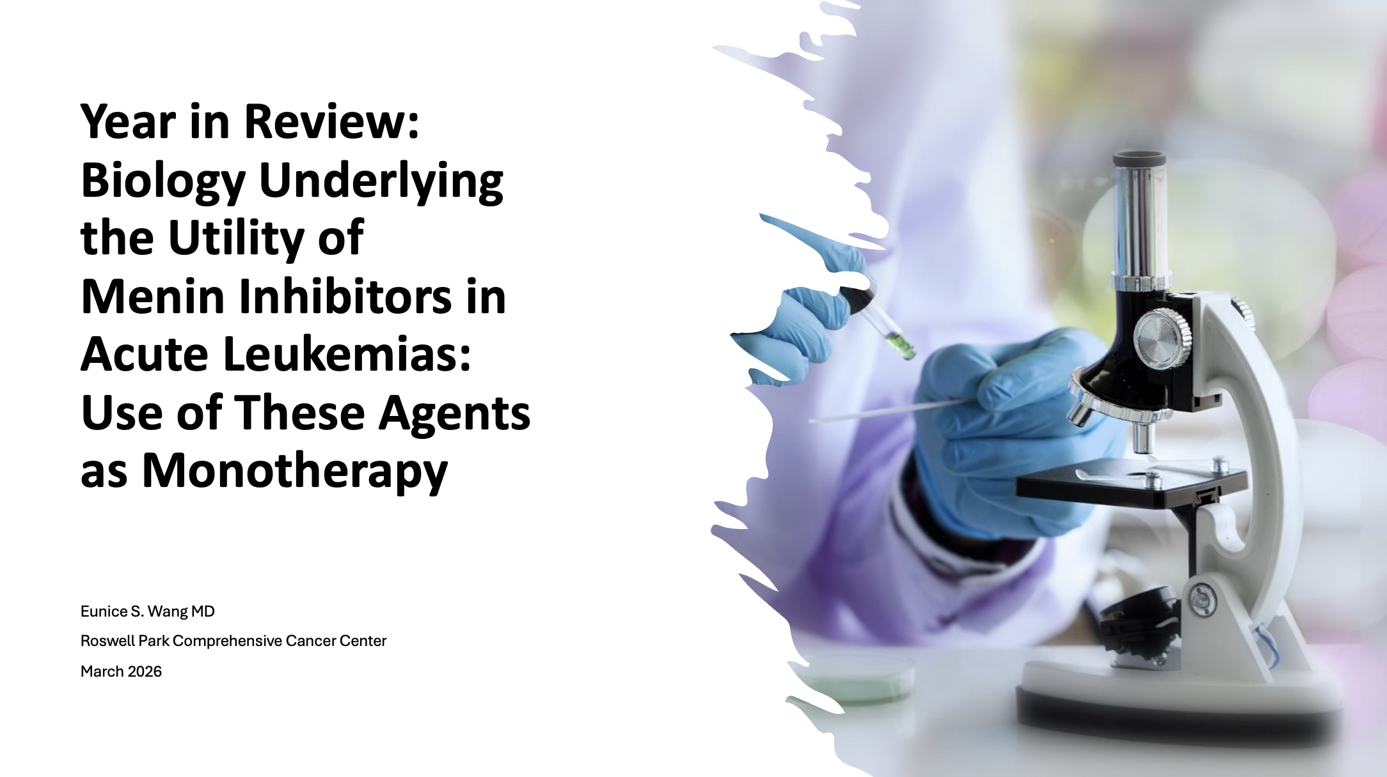
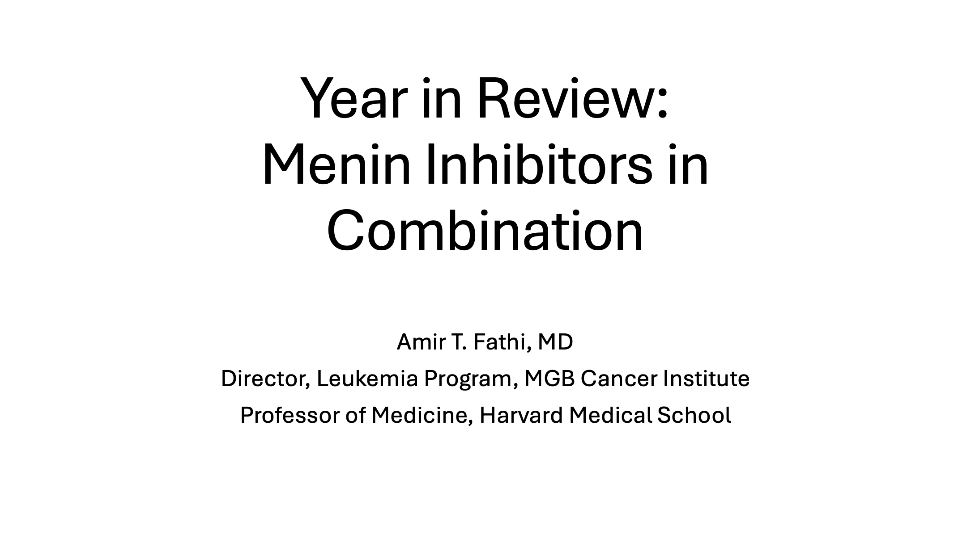

Slide 44
Key Datasets
Eunice S Wang, MD
Navarro-Vicente I et al. Real world outcomes in a series of 417 adult patients with KMT2A (MLL) gene rearranged acute myeloid leukemia. EHA 2025;Abstract S147.
Huether R et al. Detection of KMT2A partial tandem duplication (PTD) in AML by whole genome sequencing (WGS): Addressing limitations of traditional techniques in the era of revumenib approval. ASCO 2025;Abstract 6532.
Wang E at al. Ziftomenib in relapsed or refractory NPM1-mutated AML. J Clin Oncol 2025;43(31):3381-90.
Aldoss I et al. Updated results and longer follow-up from the AUGMENT-101 phase 2 study of revumenib in patients with relapsed or refractory (R/R) KMT2Ar acute leukemia. EHA 2025;Abstract PS1473.
Arellano ML et al. Patients with relapsed or refractory R/R) nucleophosmin 1-mutated (NPM1m) acute myeloid leukemia (AML): Updated results from the phase 2 AUGMENT-101 study. EHA 2025;Abstract PS1467.
Issa G et al. Revumenib activity in patients with acute leukemia with NUP98r: Results from the AUGMENT-101 phase 1 study. EHA 2025;Abstract PS1501.
Daver N et al. Monotherapy update from phase 1 portion in phase1/2 trial of the menin-MLL inhibitor enzomenib (DSP-5336) in patients with relapsed or refractory acute leukemia. ASH 2025;Abstract 763.
Shukla N et al. Detection of MEN1 resistance mutations in cell-free DNA from acute leukemia patients treated with menin inhibitors. ASH 2025;Abstract 938.

Slide 45
Key Datasets
Amir Fathi, MD
Issa G et al. Ziftomenib in combination with venetoclax and azacitidine in relapsed/refractory NPM1-m or KMT2A-r acute myeloid leukemia: Updated phase 1a/b safety and clinical activity results from KOMET-007. ASH 2025;Abstract 764.
Roboz G et al. Ziftomenib in combination with venetoclax and azacitidine in newly diagnosed NPM1-m acute myeloid leukemia: Phase 1b results from KOMET-007. ASH 2025;Abstract 766.
Erba H et al. Ziftomenib combined with intensive induction chemotherapy (7+3) in newly diagnosed NPM1-M or KMT2A-R acute myeloid leukemia (AML): Updated phase 1a/b results from KOMET-007. EHA 2025;Abstract S136.
Zeidner JF et al. Azacitidine, venetoclax, and revumenib for newly diagnosed NPM1-mutated or KMT2A-rearranged AML. J Clin Oncol 2025;43(23):2606-15.
Jen W-Y et al. Phase II study of the all-oral combination of revumenib (SNDX-5613) with decitabine/cedazuridine (ASTX727) and venetoclax (SAVE) in newly diagnosed AML. ASH 2025;Abstract 47.
Wei AH et al. RP2D determination of bleximenib in combination with VEN + AZA: phase 1b study in ND & R/R AML with KMT2A/NPM1 alterations. EHA 2025;Abstract S137.

Slide 46
Key Datasets
Amir Fathi, MD (continued)
Döhner H et al. Bleximenib in combination with intensive chemotherapy: A Phase 1b study in newly diagnosed acute myeloid leukemia with KMT2A or NPM1 alterations. ASH 2025;Abstract 5199.
Watts J et al. Preliminary data from the ongoing phase 1 study of the menin-MLL inhibitor enzomenib (DSP-5336) in combination with venetoclax and azacitidine in patients with relapsed or refractory acute myeloid leukemia. ASH 2025;Abstract 765.

Slide 47
Year in Review:
Menin Inhibitors in Acute Myeloid Leukemia
INTRODUCTION: Overview — Biopharmacologic Considerations
MODULE 1: Menin Inhibitor Monotherapy
MODULE 2: Differentiation Syndrome
MODULE 3: Menin Inhibitor Combination Approaches
MODULE 4: Future Directions
MODULE 5: PARADIGM — Randomized Phase II Trial

Slide 48
Year in Review:
Menin Inhibitors in Acute Myeloid Leukemia
INTRODUCTION: Overview — Biopharmacologic Considerations
Biomarker evaluation in first-line therapy
Biology of KMT2A rearrangements (KMT2Ar) and NPM1 mutations (NPM1m)
Mechanism of action of menin inhibitors
Efficacy indirectly compared to other targetable mutations
Other alterations (NUP98R)
Mechanism of resistance

Slide 49
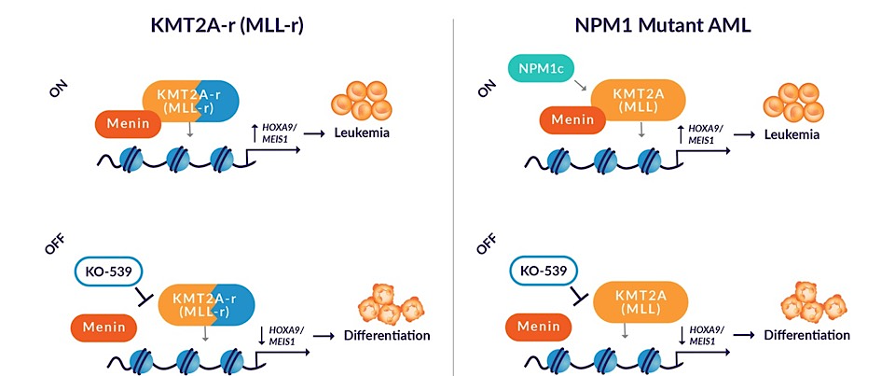
Menin Inhibitor Induced Differentiation: On target effect
Inhibitor
Inhibitor
Targeting the menin-KMT2A(MLL) interaction to reverse epigenetic dysregulation in MLL-rearranged AML
A central role for menin-KMT2A(MLL) interaction in epigenetic dysregulation in NPM1-mutant AML
Kühn MW, et al. Cancer Discov. 2016;6(10):1166-1181 | Thorsteinsdottir U, et al. Mol Cell Biol. 2001;21(1):224-234 | Patel SS, et al. Curr Hematol Malig Rep. 2020;15(4):350-359 | Brunetti L, et al. Cancer Cell. 2018;34(3):499-512

Slide 50
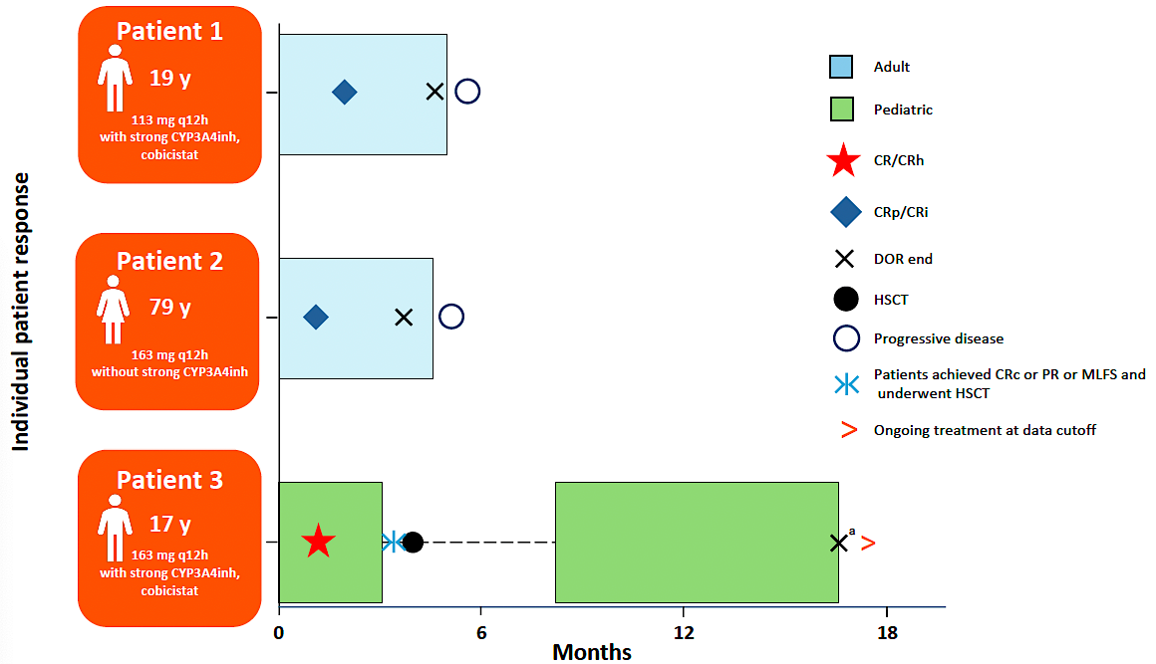
Issa G et al. REVUMENIB ACTIVITY IN PATIENTS WITH ACUTE LEUKEMIA WITH NUP98R: RESULTS FROM THE AUGMENT-101 PHASE 1 STUDY. EHA 2025;Abstract PS1501.
Three out of five patients with R/R NUP98r AML achieved morphological remission on revumenib monotherapy
(113-163 mg BID-TID)
Duration of response
was 2.8, 2.8 and 15.6 months (underwent HSCT)
Adverse events:
Gr 3 decreased LVEF
Gr 2 paresthesia
Gr 1 dysgeusia, alopecia

Slide 51
Shukla N et al. Detection of MEN1 resistance mutations in cell-free DNA from acute leukemia patients treated with menin inhibitors. ASH 2025;Abstract 938.
High-sensitivity research NGS assay MSK-ACCESS-MEN1 includes probes to all MEN1 exons for cell-free DNA interrogation in hematologic cancers
MSK-ACCESS-MEN1 identified:
  an emerging MEN1 M322I mutation in cfDNA from a patient with KMT2A-rearranged AML who had received 14 cycles of revumenib with an MRD-negative BM remission. At the time of cfDNA collection, she remained transfusion independent without evidence of relapse. She subsequently relapsed 3 months later with identification of the MEN1 M322I mutation.
Incorporation of cfDNA monitoring for MEN1 resistance mutations into clinical protocols for menin inhibitor therapy is warranted

Slide 52
Year in Review:
Menin Inhibitors in Acute Myeloid Leukemia
MODULE 1: Menin Inhibitor Monotherapy
Approved agents: Revumenib, ziftomenib
Agents in development: Bleximenib, enzomenib
Toxicity: QTc prolongation

Slide 53
Conclusions
The emergence of menin inhibitors:
Effective, safe agents with activity in multiply R/R NPM1-m, KMT2A-r AML
Differentiation syndrome as a class effect – requires close vigilance.
Limited durability of response as monotherapy.
The promise of combinations:
Studies reveal promise in combination with HMA-ven and induction chemotherapy
High response rates and promising durability of response, particularly in the frontline setting.
Will likely mitigate risk of DS.
Potential for all-oral regimens
Multiple phase 3 studies under way:
KOMET-017
REVEAL / EVOLVE-2
cAMeLOt
Courtesy of Amir Fathi, MD

Slide 54
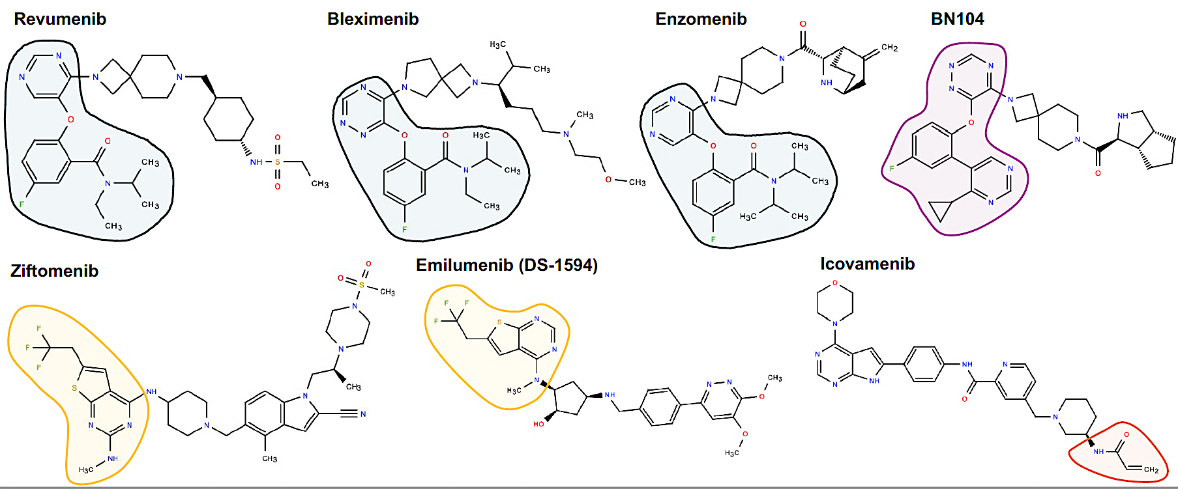
Menin Inhibitor Structures
Issa G et al. Blood Cancer Discov 2025;6(6):547-60.

Slide 55
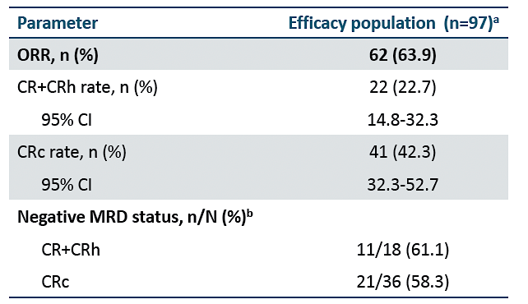
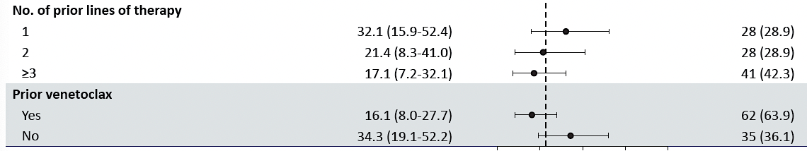
Aldoss I et al. UPDATED RESULTS AND LONGER FOLLOW-UP FROM THE AUGMENT-101 PHASE 2 STUDY OF REVUMENIB IN PATIENTS WITH RELAPSED OR REFRACTORY (R/R) KMT2AR ACUTE LEUKEMIA. EHA 2025; Abstract PS1473.
Median duration of CR/CRh = 6.4 mos 1.9-NR)
Time to first response = 1 month (0.9-3.1 mos)
Time to CR/CRh= 2 months (0.9-4.6 mos)
Out of 62 responders, 21 (34%) proceeded to HSCT
Decreased responses associated with prior lines
of therapy and prior venetoclax

Slide 56
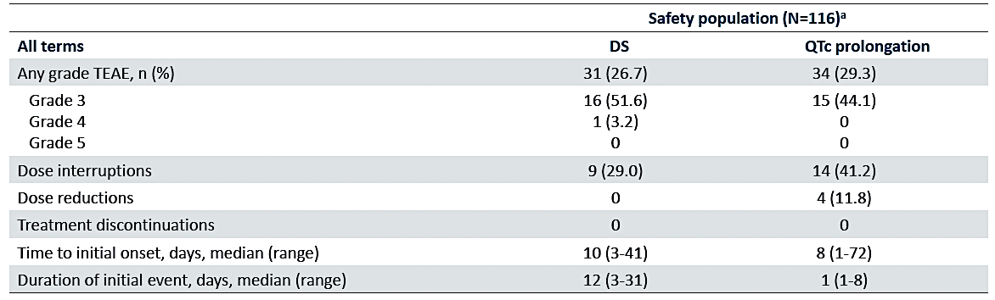
Aldoss I et al. UPDATED RESULTS AND LONGER FOLLOW-UP FROM THE AUGMENT-101 PHASE 2 STUDY OF REVUMENIB IN PATIENTS WITH RELAPSED OR REFRACTORY (R/R) KMT2AR ACUTE LEUKEMIA. EHA 2025; Abstract PS1473.

Slide 57
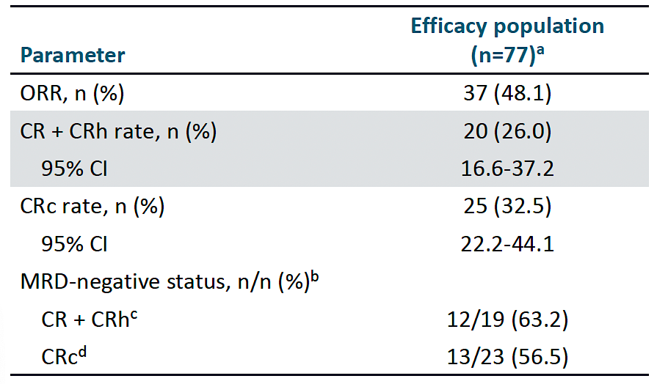
Arellano ML et al. PATIENTS WITH RELAPSED OR REFRACTORY (R/R) NUCLEOPHOSMIN 1-MUTATED (NPM1M) ACUTE MYELOID LEUKEMIA (AML): UPDATED RESULTS FROM THE PHASE 2 AUGMENT-101 STUDY. EHA 2025;Abstract PS1467.
Median time to first CR/CRh = 2.8 (0.9-8.8) months
Median duration of CR/CRh = 4.7 (2.1-8.2) months
Median OS= 4.8 (3.4-8.4) months
Five patients out of 77 proceeded to HSCT

Slide 58
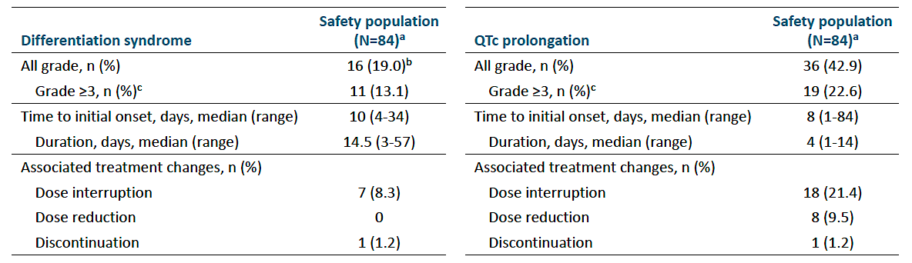
Arellano ML et al. PATIENTS WITH RELAPSED OR REFRACTORY (R/R) NUCLEOPHOSMIN 1-MUTATED (NPM1M) ACUTE MYELOID LEUKEMIA (AML): UPDATED RESULTS FROM THE PHASE 2 AUGMENT-101 STUDY. EHA 2025;Abstract PS1467.

Slide 59
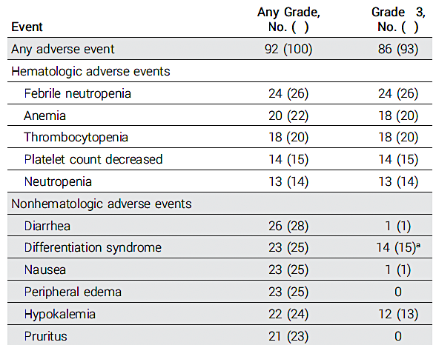
Wang E at al. Ziftomenib in Relapsed or Refractory NPM1-Mutated AML. J Clin Oncol 2025;43(31):3381-90.
Response Rate Adverse events/Safety
Response | Ziftomenib 600 mg QD (N=92)
ORR | 30 (33%)
CR/CRh | 20 (22%)
CR | 13 (14%)
CRh | 7 (8%)
Med Time to ORR | 1.9 (0.8-3.7 mos)
Med DOR | 4.6 (2.8-7.4 mos)
MRD negativity | 14/25 (56%)

Slide 60
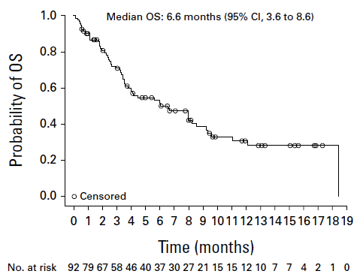
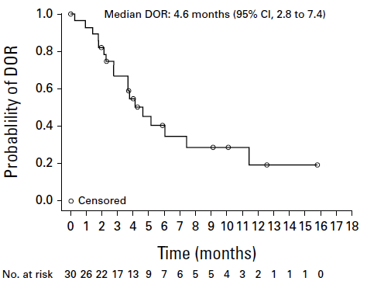
Wang E at al. Ziftomenib in Relapsed or Refractory NPM1-Mutated AML. J Clin Oncol 2025;43(31):3381-90.
Overall survival Duration of Response

Slide 61
Daver N et al. Monotherapy update from Phase 1 portion in Phase1/2 trial of the menin-MLL inhibitor enzomenib (DSP-5336) in patients with relapsed or refractory acute leukemia. ASH 2025;Abstract 763.
Each menin inhibitor has a different chemical structure and different physiochemical properties such as polar surface area, lipophilicity, and basicity that may impact safety and efficacy^{1,2}
Enzomenib was specifically and intentionally designed to have low lipophilicity and basicity, which preliminary clinical data from the ongoing phase 1 trial has shown results in rapid clearance and minimal to no accumulation³
1. Hughes J et al. Bioorg Med Chem Lett. 2008 Sep 1;18(17):4872-5.
2. Yukawa T, Naven R. ACS Med Chem Lett. 2020 Jan 29;11(2):203–209.
3. Zeidner et al. ASH 2024;Abstract 213

Slide 62
Enzomenib Monotherapy: Response Rates in R/R AML
KMT2Ar AL (n = 39)
Dose optimization is complete evaluating 200, 300 and 400 mg po bid
Optimal RP2D as monotherapy is 300 mg po bid (n=15)
At RP2D
  Overall Response rate (CR/CRh/CRi/MLFS) 73.3%
  Composite CR rate (CR/CRh/CRi) 60%
  CR + CRh rate 40%
NPM1m AML (n = 25)
Dose optimization is ongoing at 200, 300 and 400 mg po bid and initial activity is similar across dose levels
Response Category* | NPM1m
 | 200 mg BID (n = 10) | 300 mg BID (n = 7) | 400 mg BID (n = 8)
Overall Response rate (CR/CRh/CRi/MLFS) | 60% (6/10) | 57.1% (4/7) | 37.5% (3/8)
Composite CR rate (CR/CRh/CRi) | 50% (5/10) | 42.9% (3/7) | 37.5% (3/8)
CR/CRh rate | 50% (5/10) | 42.9% (3/7) | 37.5% (3/8)
* Pts who achieved CRh and CRi or MLFS were counted as CRh
Of 95 total patients with KMT2Ar or NPM1m, the efficacy analysis population (n = 64) did not include those who received < 200 mg BID enzomenib (n = 16), had prior menin inhibitor treatment (n = 11), and who had bone marrow blasts < 5% (n = 4)
Daver N et al. ASH 2025;Abstract 763
Study ongoing, data cutoff 04 OCT 2025

Slide 63
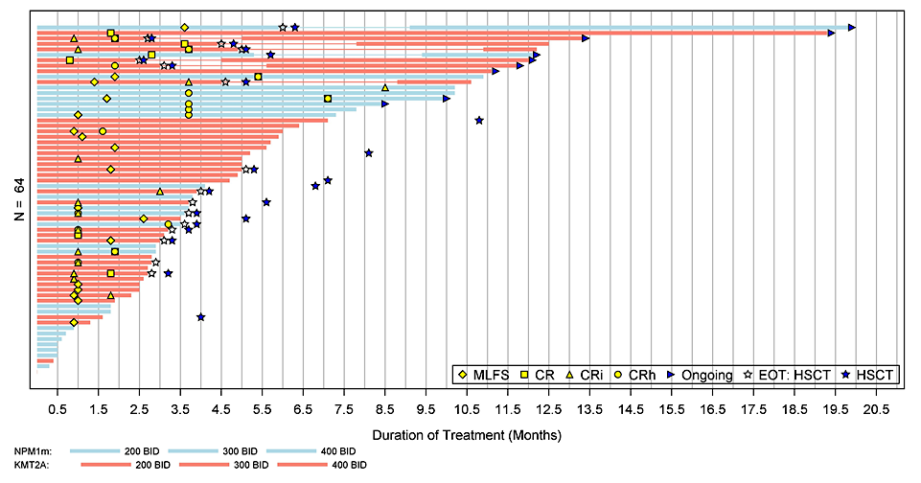
Enzomenib: Responses in R/R AML are Durable
 | KMT2Ar | NPM1m
 | N = 39 | N = 25
Median Time to first response, months | 1.0 | 1.8
Median Time to CR/CRh, months | 1.6 | 3.7
Duration of CR/CRh, months | 12.5 (n=11) | 5.7 (n=11)
Patients with allo-HSCT on study, n (%) | 13 (33%) | 3 (12%)
Transfusion Independence, RBC+PLT, %* | 27% | 38%
KMT2Ar:
NPM1m:
*Proportion of patients with documented transfusion dependence for
RBC or PLT at baseline that had transfusion independence for both RBC and PLT on study prior to HSCT
Daver N et al. ASH 2025;Abstract 763
Study ongoing, data cutoff 04 OCT 2025

Slide 64
Year in Review:
Menin Inhibitors in Acute Myeloid Leukemia
MODULE 2: Differentiation Syndrome
Distinguishing characteristics
Clinical presentation, grading and timing
Prevention and management
Correlation with tumor burden, type of alteration and type of menin inhibitor

Slide 65
Case: Revumenib induced DS in KMT2Ar AML patient
WBC >30K
Less common in C2
Cycle 1
First 10-14 days
Issa G et al ASH 2022;Abstract 376

Slide 66
Revumenib: Black Box warning for Differentiation Syndrome
Differentiation Syndrome: Revumenib can cause fatal or life-threatening differentiation syndrome (DS). Symptoms of DS, including those seen in patients treated with revumenib, include fever, dyspnea, hypoxia, peripheral edema, pleuropericardial effusion, acute renal failure, rash, and/or hypotension.
In clinical trials, DS occurred in 60 (25%) of 241 patients treated with revumenib at the recommended dosage for relapsed or refractory acute leukemia. Among those with a KMT2A translocation, DS occurred in 33% of patients with acute myeloid leukemia (AML), 33% of patients with mixed-phenotype acute leukemia (MPAL), and 9% of patients with acute lymphoblastic leukemia (ALL); DS occurred in 18% of patients with NPM1m AML. DS was Grade 3 or 4 in 12% of patients and fatal in 2 patients. The median time to initial onset was 9 days (range 3-41 days). Some patients experienced more than 1 DS event. Treatment interruption was required for 7% of patients, and treatment was withdrawn for 1%.
Revumenib product insert (2025)

Slide 67
Ziftomenib-induced DS (23%) in NPM1m R/R AML
Ziftomenib-Related AEs in ≥ 5% of All Patients
Event, n (%) | Ziftomenib RP2D 600 mg QD
 | Phase 2 (N = 92) |  | Pooled Phase 1b/2 (N = 112)
 | Any Grade | Grade ≥ 3 | Any Grade | Grade ≥ 3
Any ziftomenib-related AE | 64 (70) | 37 (40) | 77 (69) | 45 (40)
Hematologic AEs
Anemia | 5 (5) | 5 (5) | 6 (5) | 6 (5)
Neutropenia | 6 (7) | 6 (7) | 6 (5) | 6 (5)
Nonhematologic AEs
Differentiation syndrome | 22 (24) | 14 (15)ª | 26 (23) | 15 (13)ª
Pruritus | 15 (16) | 0 | 16 (14) | 0
Nausea | 8 (9) | 0 | 13 (12) | 0
Diarrhea | 8 (9) | 0 | 10 (9) | 2 (2)
Alanine aminotransferase increased | 6 (7) | 2 (2) | 7 (6) | 2 (2)
Decreased appetite | 5 (5) | 0 | 6 (5) | 0
Ziftomenib was well tolerated, with a safety profile consistent with previous studies, including:
Differentiation syndrome: Overall 26 pts (23%)
15 (13%) Grade 3 DS
No Grade 4–5 DS events
3% pts discontinued due to ziftomenib-related AEs
ªNo patients had Grade 4–5 differentiation syndrome.
*All 3 patients were on additional medications associated with QTc prolongation: 2 patients had electrolyte abnormalities and 1 patient had prior diagnosis of atrial fibrillation.
Wang ES et al JCO 2025

Slide 68
Ziftomenib: Black Box Warning for Differentiation Syndrome
Differentiation syndrome is associated with rapid proliferation and differentiation of myeloid cells. Symptoms of differentiation syndrome, including those seen in patients treated with ziftomenib, may include fever, hypoxia, joint pain, hypotension, dyspnea, rapid weight gain or peripheral edema, pleural or pericardial effusions, acute kidney injury, and rashes.
In the clinical trial, differentiation syndrome occurred in 29 (26%) of 112 patients with relapsed or refractory AML with an NPM1 mutation who were treated with ziftomenib at the recommended dosage. Differentiation syndrome was Grade 3 in 13% and fatal in two patients. In broader evaluation of all patients with any genetic form of AML treated with ziftomenib monotherapy in clinical trials, differentiation syndrome occurred in 25% of patients. Four fatal cases of differentiation syndrome occurred out of 39 patients with KMT2A-rearranged AML treated with ziftomenib. ziftomenib is not approved for use in patients with KMT2A-rearranged AML.
In the 112 patients with an NPM1 mutation, differentiation syndrome was observed with and without concomitant hyperleukocytosis, in as early as 3 days and up to 46 days after ziftomenib initiation. The median time to onset was 15 days. Two patients experienced more than one differentiation syndrome event. Treatment was interrupted and resumed in 15 (13%) patients, while it was permanently discontinued in 2 (2%) patients.
Ziftomenib prescribing information, November 2025.

Slide 69
Year in Review:
Menin Inhibitors in Acute Myeloid Leukemia
MODULE 3: Menin Inhibitor Combination Approaches
Intensive chemotherapy (7 + 3)
HMA/venetoclax:
  All oral

Slide 70
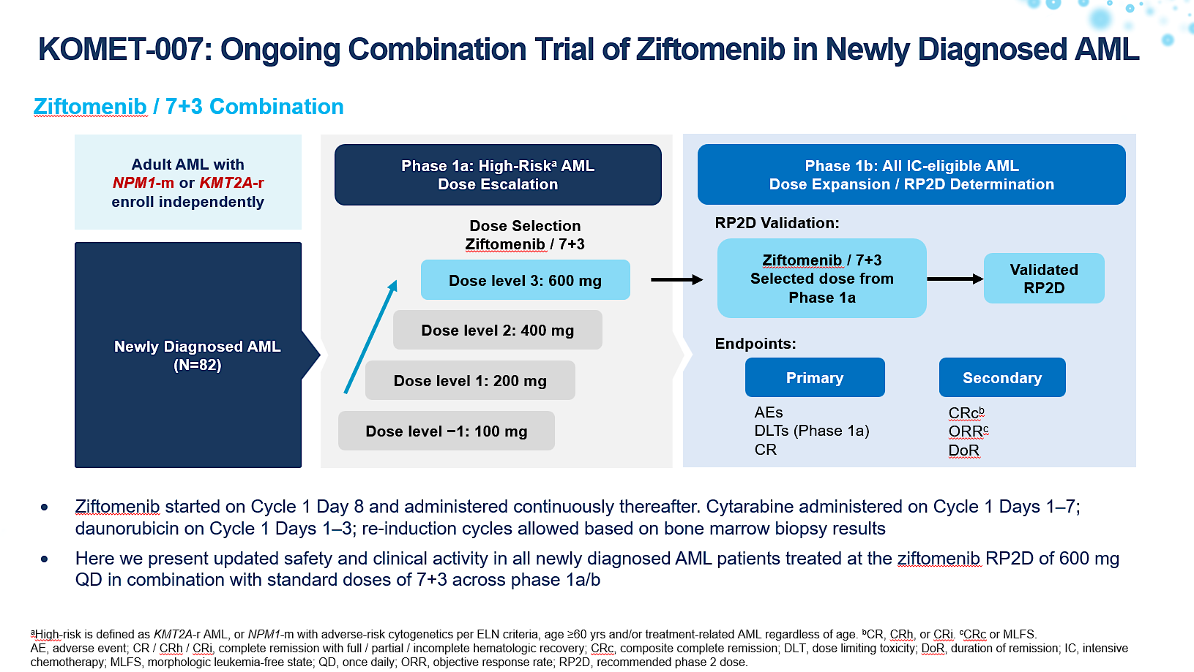
Erba H, et al. EHA, 2025;Abstract S136.

Slide 71
KOMET-007: Clinical Activity in All Response-Evaluableª 1L Patients (N=71)
n (%) | NPM1-m | KMT2A-r | All Patients
 | 600 mg (n=44) | 600 mg (n=27) | 600 mg (N=71)
CRc | 41 (93) | 24 (89) | 65 (92)
ORR CR CRh CRi MLFS PR NR NE | 43 (98) 37 (84) 1 (2) 3 (7) 2 (5) 0 1 (2) 0 | 24 (89) 20 (74) 0 4 (15) 0 0 2 (7) 1 (4) | 67 (94) 57 (80) 1 (1) 7 (10) 2 (3) 0 3 (4) 1 (1)
CR MRD-negativity, n/N (%)^{b} CRc MRD-negativity, n/N (%)^{b} | 24/34 (71) 26/38 (68) | 14/16 (88) 15/18 (83) | 38/50 (76) 41/56 (73)
Median time to CR MRD-negativity, weeks (range) Median time to CRc MRD-negativity, weeks (range) | 4.7 (2–17) 4.7 (2–17) | 4.4 (3–12) 4.1 (3–12) | 4.5 (2–17) 4.3 (2–17)
ªPatients who had ≥1 response assessment or who had died.
^{b}Among evaluable responders tested for MRD per local assay (NGS, RT-qPCR, FISH, flow cytometry). Preliminary central testing also shows concordance with local MRD-negative rates.
Data cutoff: Mar 21, 2025.
Per ELN 2022: CR / CRh / CRi, complete remission with full / partial / incomplete hematologic recovery; CRc, composite complete remission; FISH, fluorescence in situ hybridization; MLFS, morphologic leukemia-free state; MRD, measurable residual disease; NE, not evaluable; NGS, next-generation sequencing; NR, no response; ORR, objective response rate; PR, partial remission; RT-qPCR, quantitative reverse transcription polymerase chain reaction.
Erba H, et al. EHA, 2025; Abstract S136.
Notes:
Note: There is the potential for intra-patient improvement for both response and MRD-negativity.

Slide 72
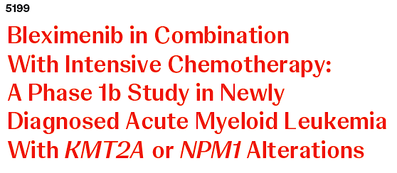
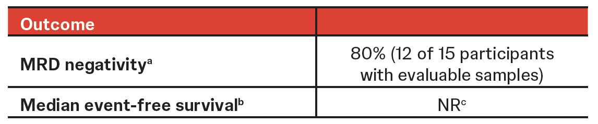
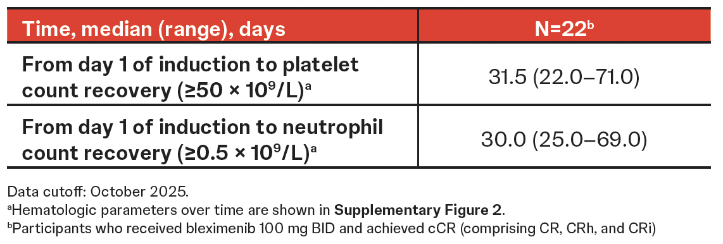
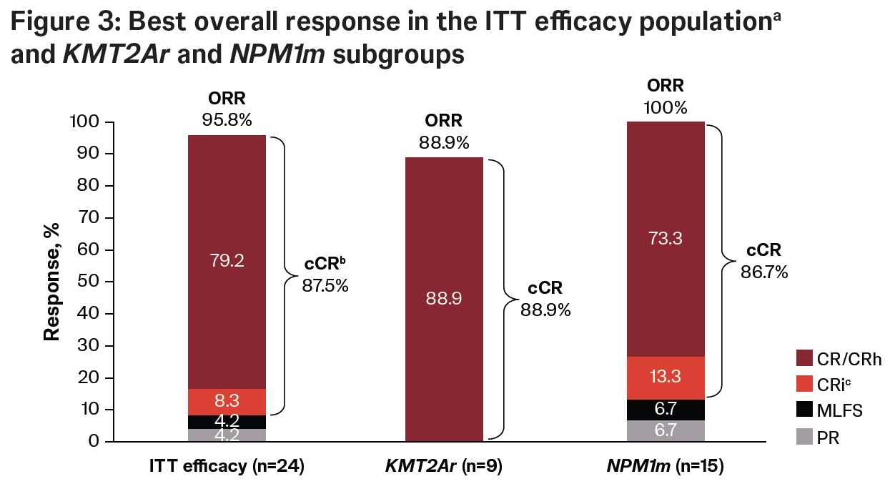
Dohner H, et al. ASH, 2025;Abstract 5199.

Slide 73
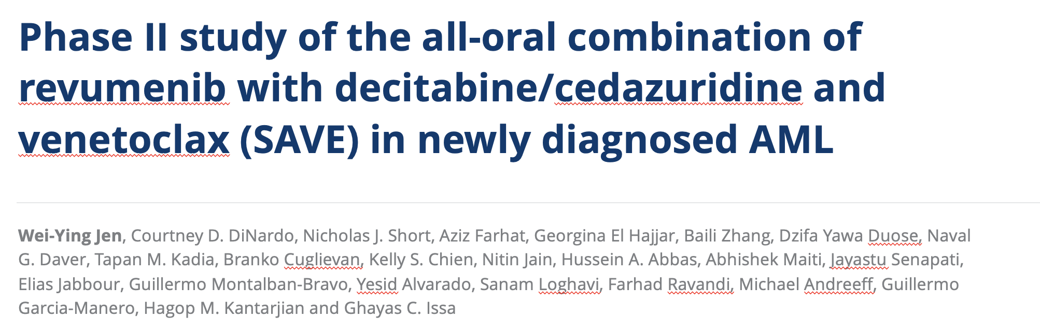
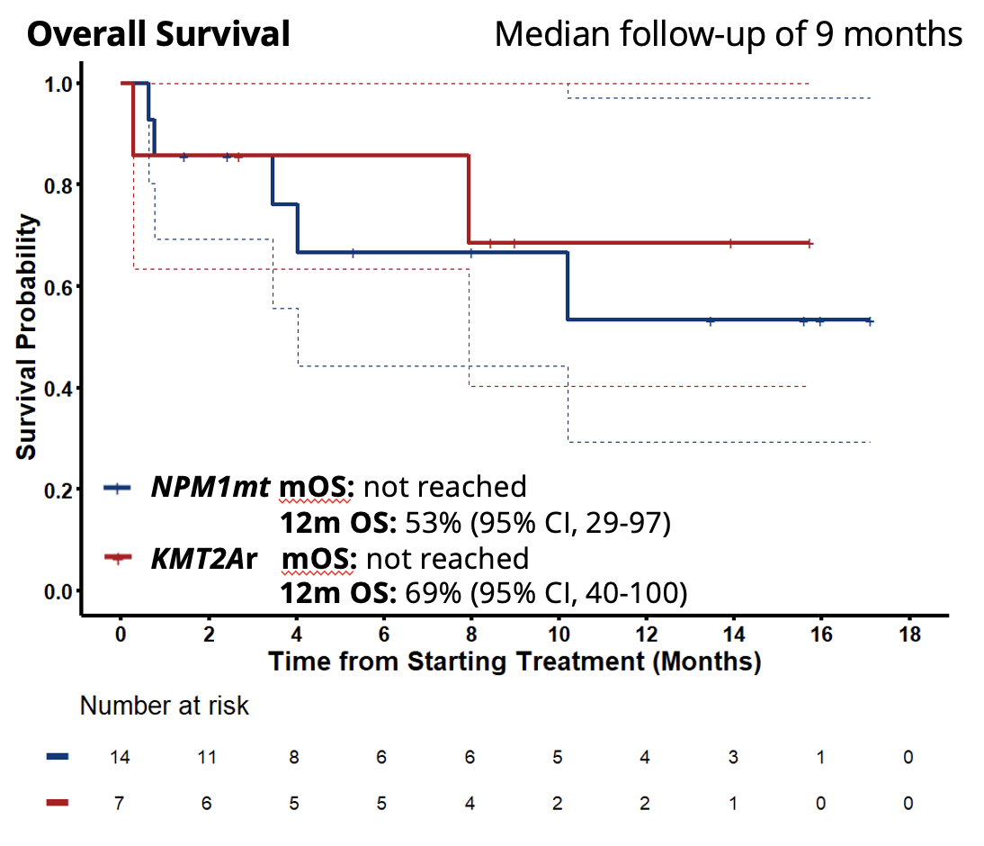
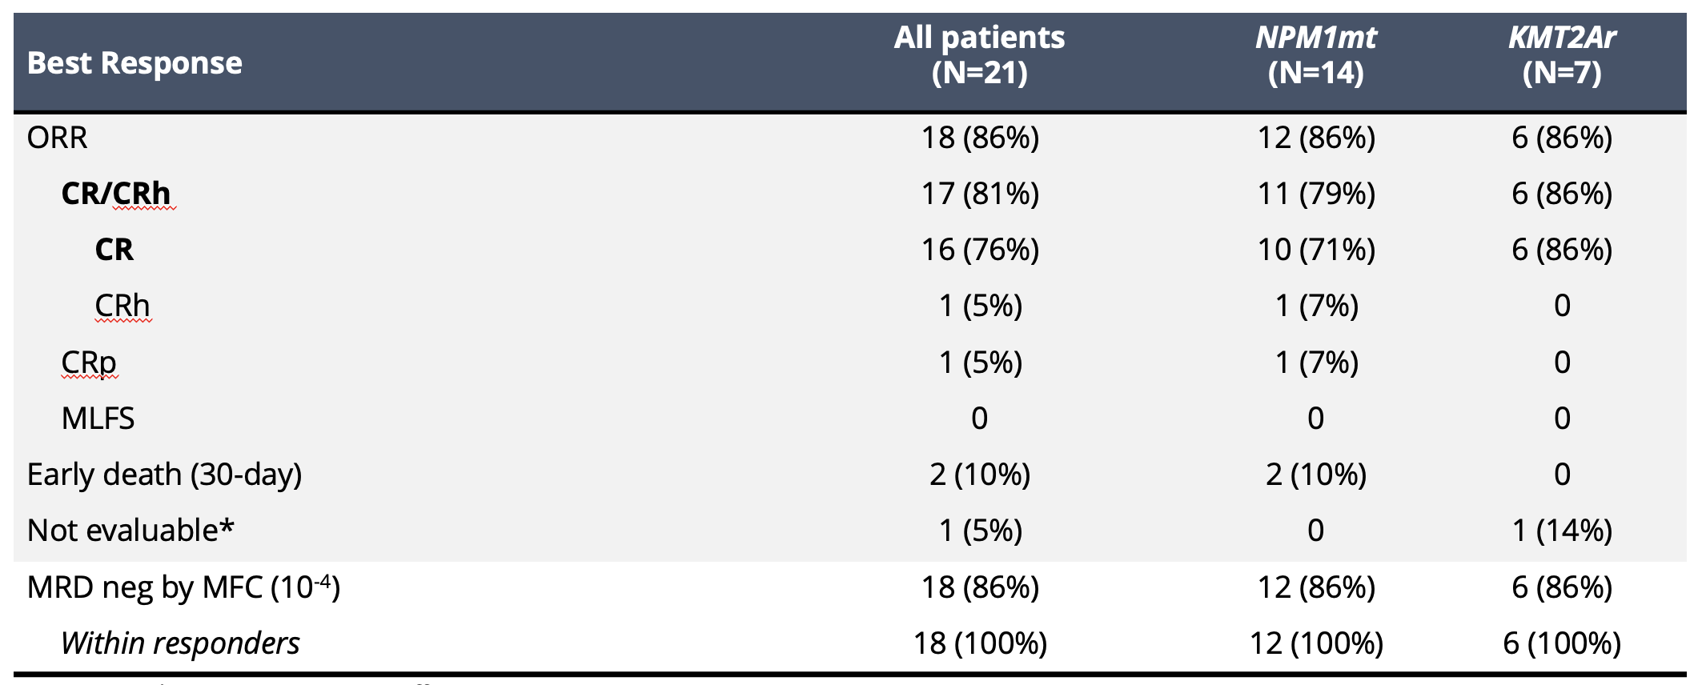
All Oral Triplet Regimens
Jen W, et al. ASH, 2025;Abstract 47.

Slide 74
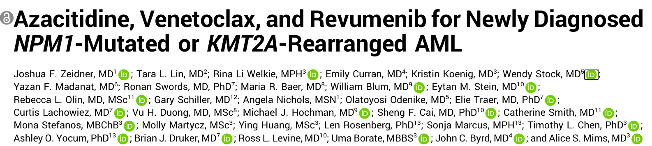
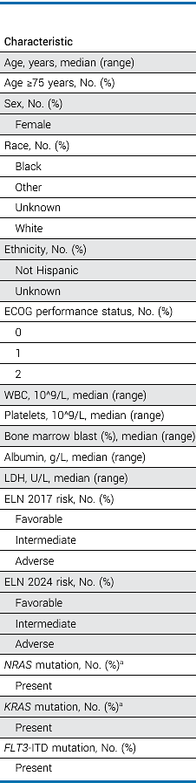
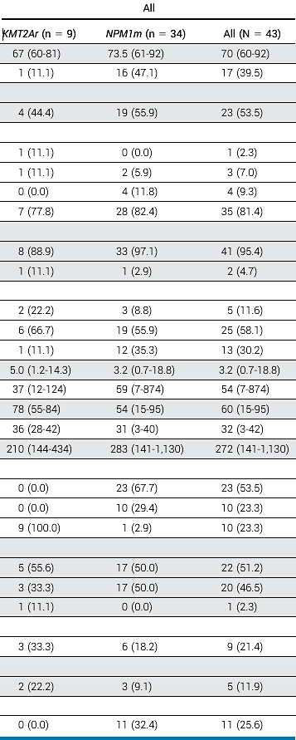
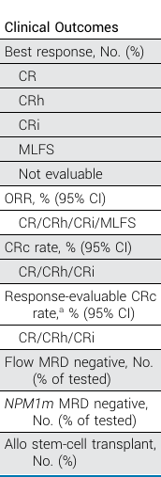
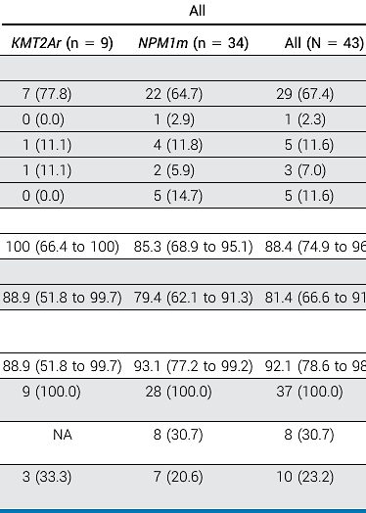
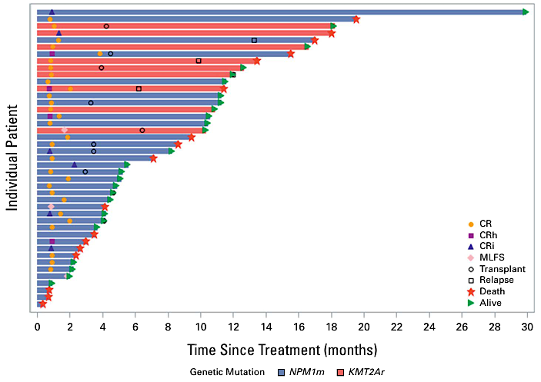
MENi-Triplet (Revumenib)
Zeidner JF, et al. J Clin Oncol, 2025.

Slide 75
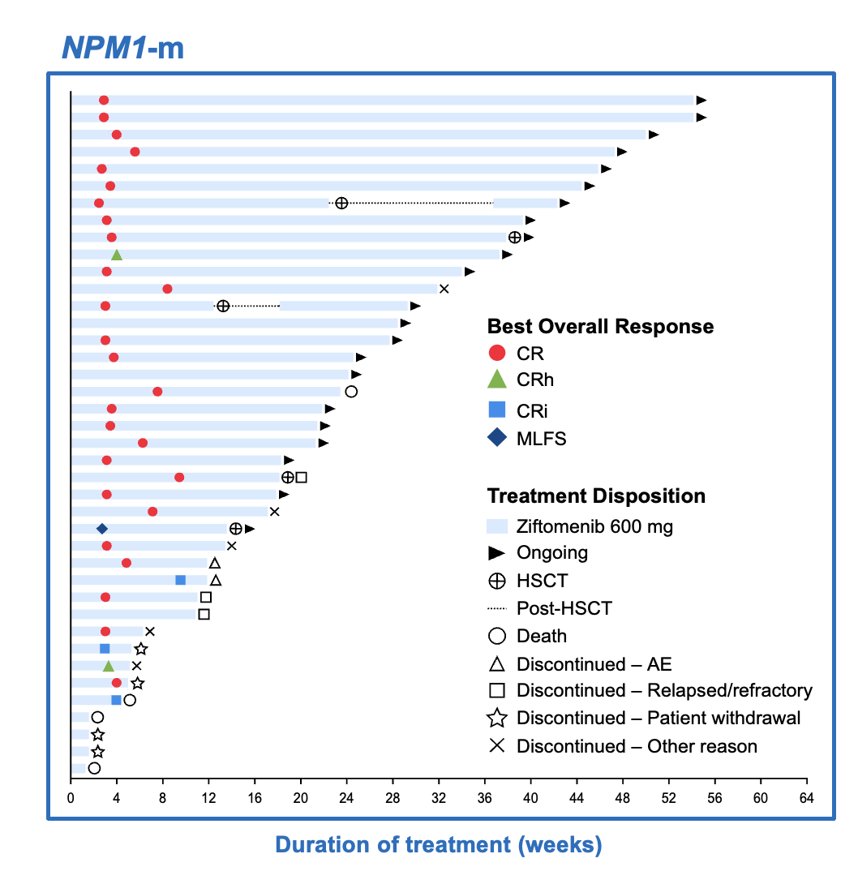
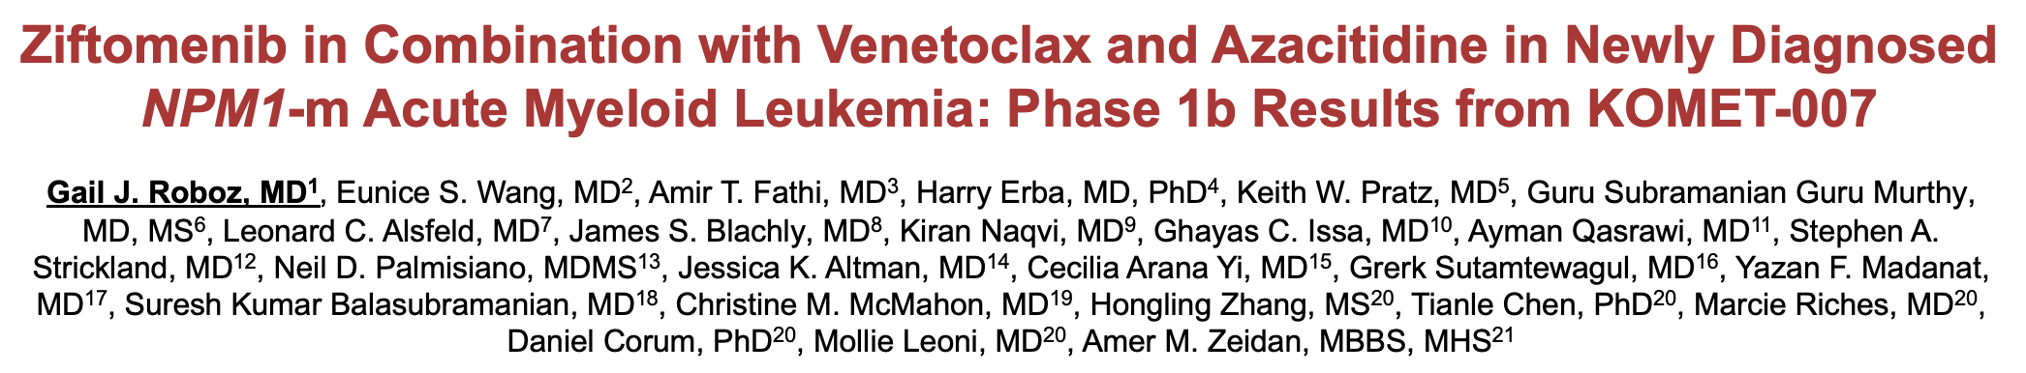
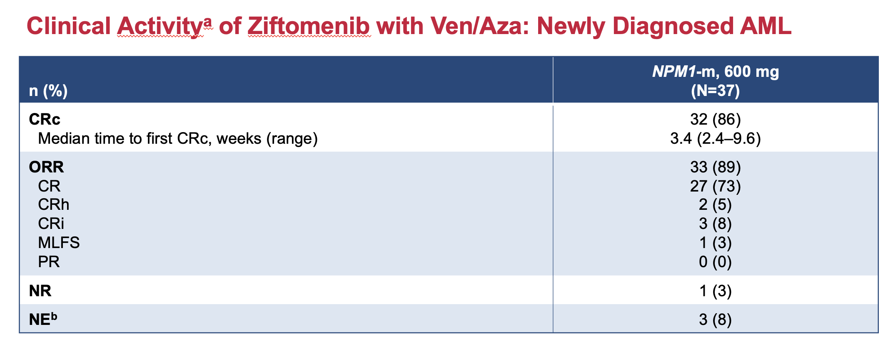
MENi-Triplet (Ziftomenib)
Roboz GJ, et al. ASH, 2025;Abstract 766.

Slide 76
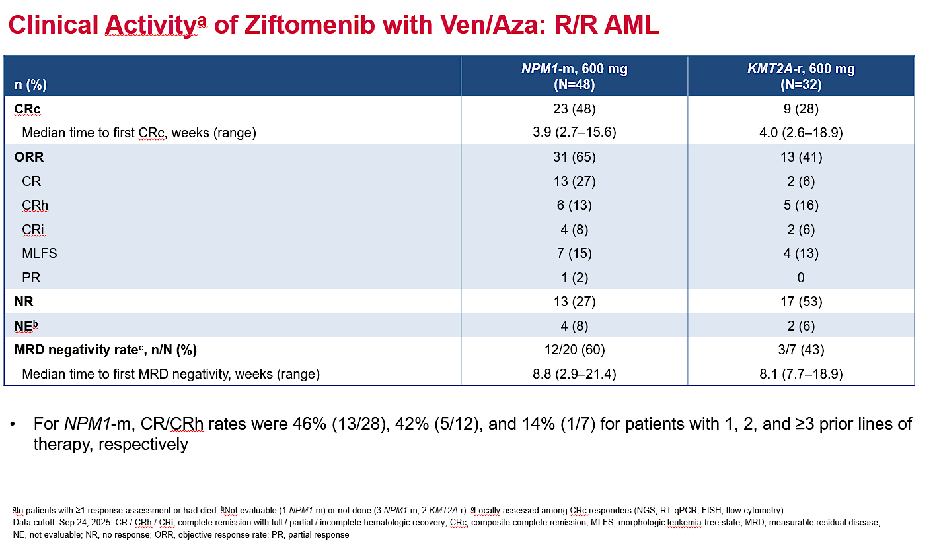
Issa G, et al. ASH, 2025;Abstract 764.

Slide 77
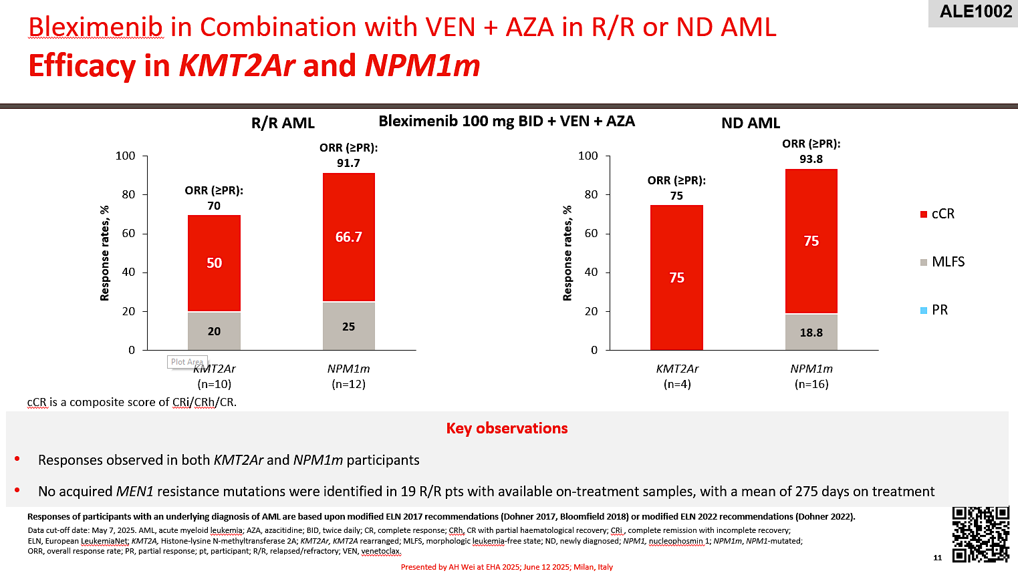
Wei A, et al. EHA, 2025;Abstract S137.

Slide 78
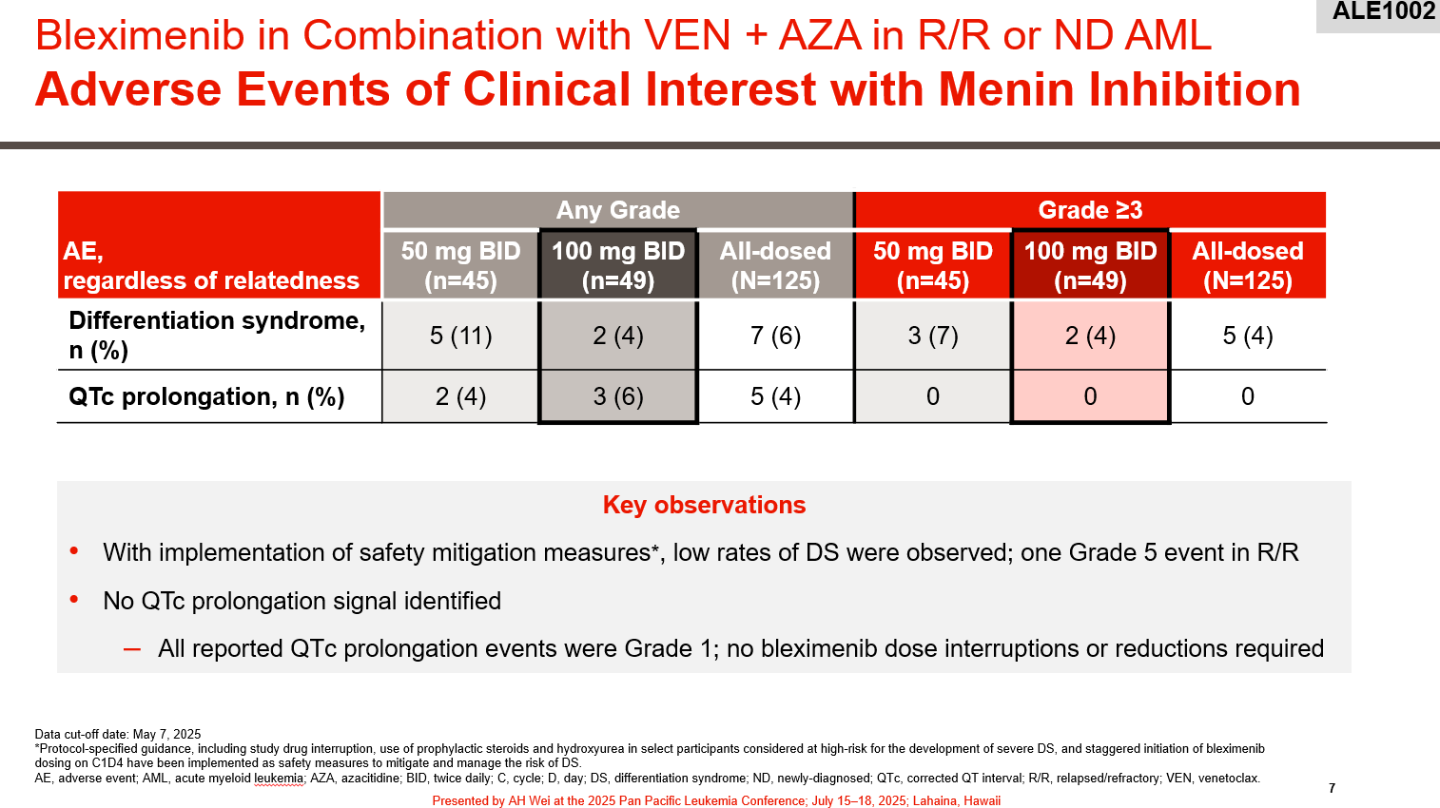
Wei A, et al. EHA, 2025;Abstract S137.

Slide 79
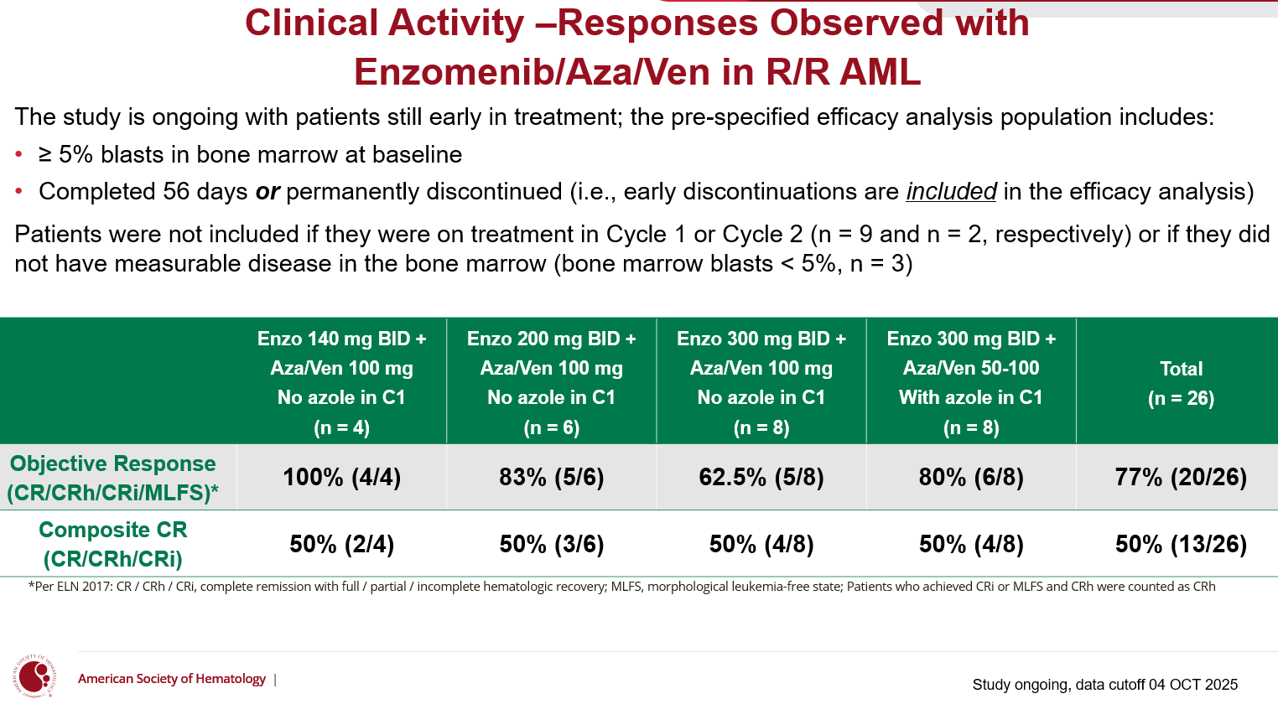
Watts J, et al. ASH, 2025;Abstract 765.

Slide 80
Year in Review:
Menin Inhibitors in Acute Myeloid Leukemia
MODULE 4: Future Directions
Ongoing trials:
  KOMET-017
  REVEAL/EVOLVE-2
  cAMeLot
  HOVON 181

Slide 81
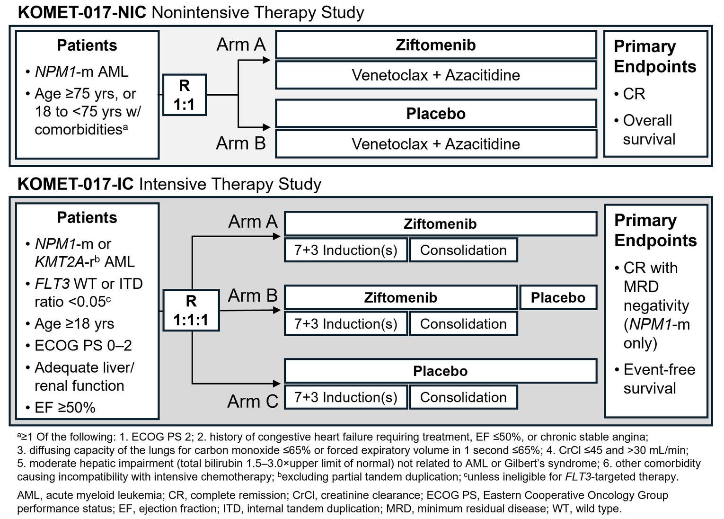
KOMET-017: Ongoing Phase III Trial Designs
Zeidan AM et al. EHA 2025;Abstract PB2573.

Slide 82
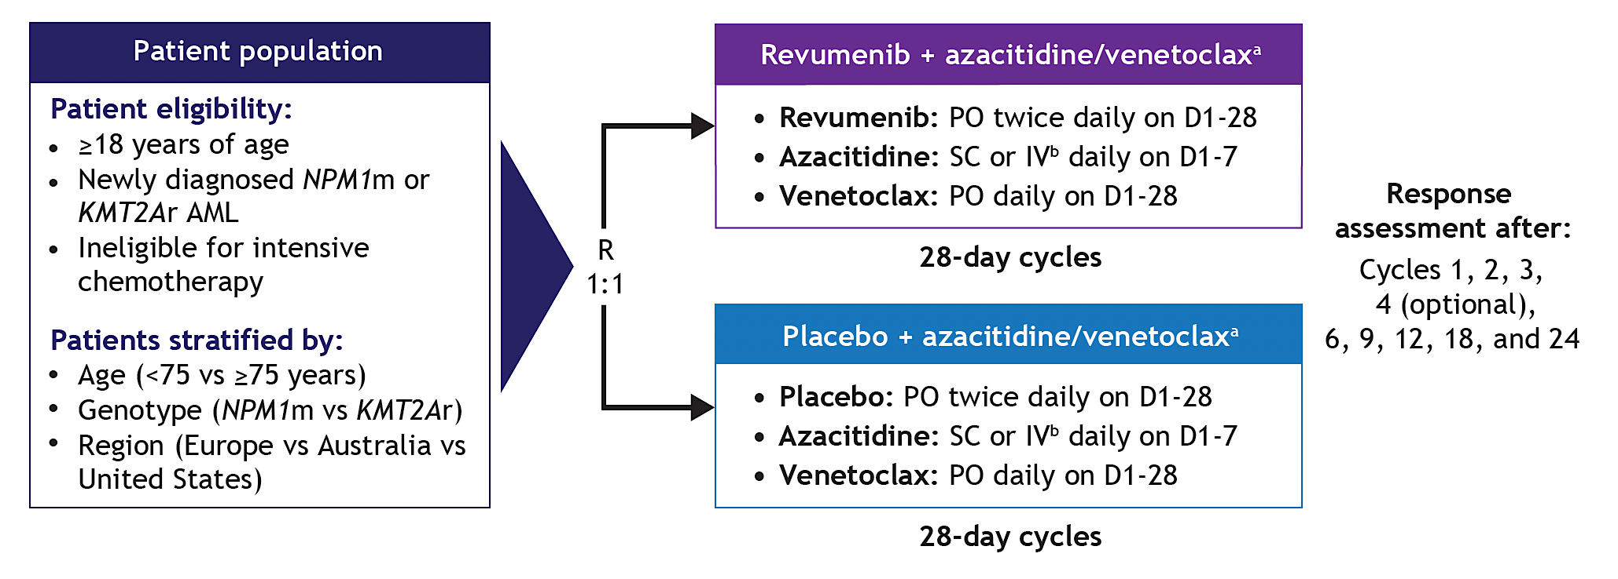
EVOLVE-2: Ongoing Phase III Trial Design
Huls G et al. European School of Hematology International Conference on Acute Myeloid Leukemia 2025; Poster.

Slide 83
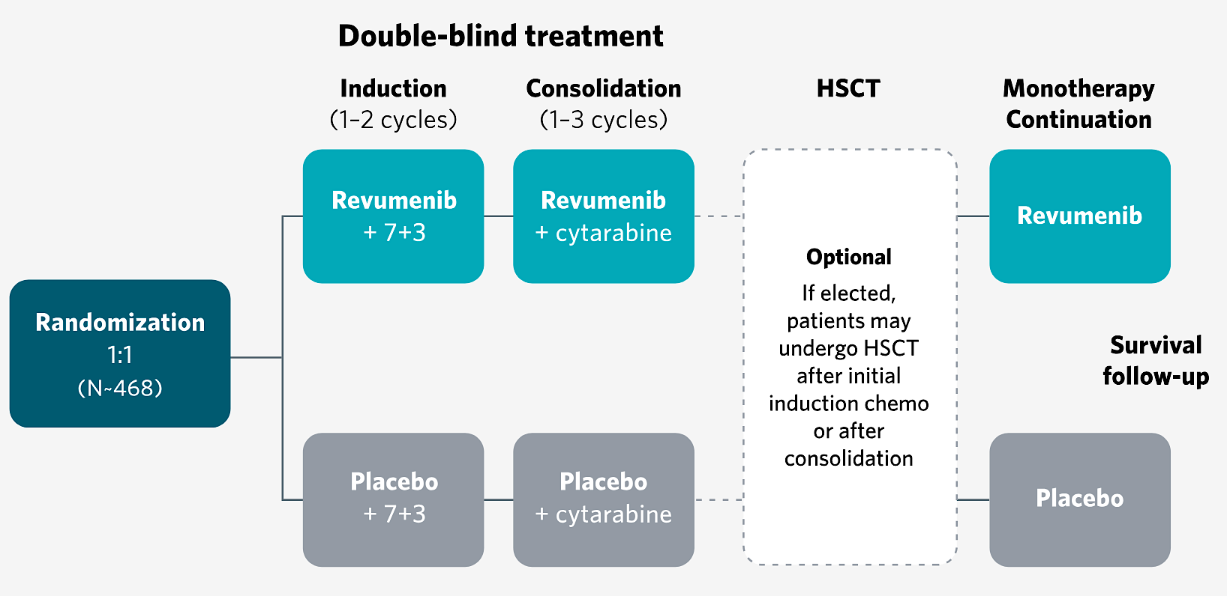
REVEAL-ND NPM1: Ongoing Phase III Trial Design
Eligibility: Newly diagnosed, previously untreated NPM1-mutated AML
Primary endpoints: Event-free survival, MRD complete remission rate
https://revealtrialaml.com

Slide 84
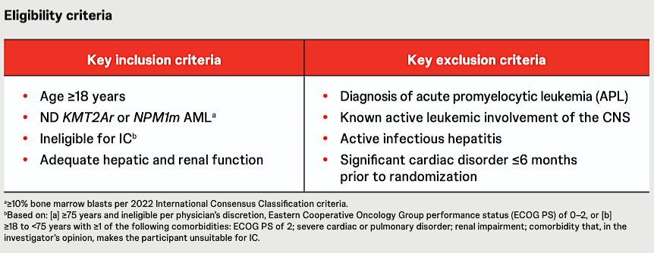
cAMeLot-2: Ongoing Phase III Trial Design
Bleximenib PO + VEN PO + AZA IV/SC
R
Placebo PO + VEN PO + AZA IV/SC
Primary Endpoints: % complete remission and OS
Jabbour E et al. ASH 2025;Abstract 3429.

Slide 85
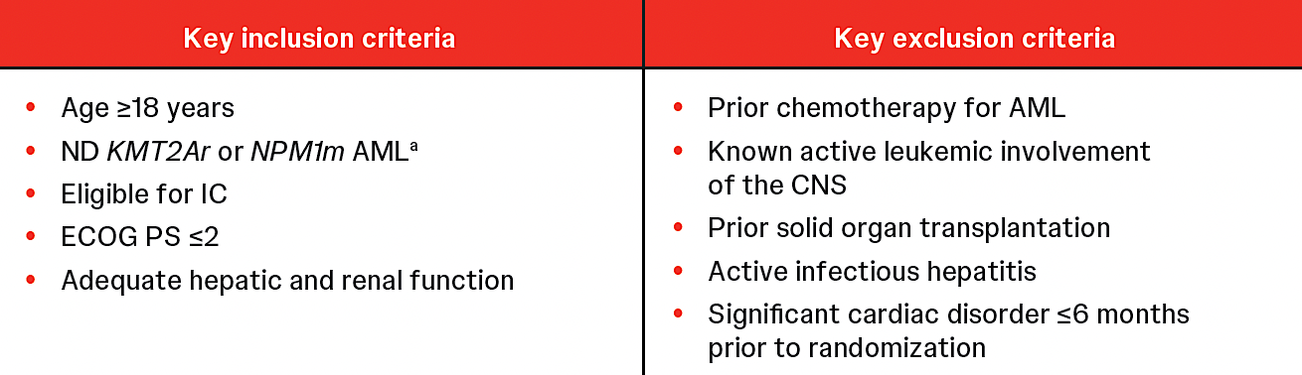
HOVON 181 AML/AMLSG 37-25: Ongoing Phase III Trial Design
Induction (2 cycles)
Consolidation
Maintenance
Bleximenib + 7+3
Bleximenib + IDAC/allo-HSCT
Bleximenib
R
Bleximenib + 7+3
Bleximenib + IDAC/allo-HSCT
Placebo
Placebo + 7+3
Placebo +
IDAC/allo-HSCT
Placebo
Primary endpoint: Event-free survival
Raajmakers M et al. ASH 2025;Abstract 1654.

Slide 86
Conclusions
The emergence of menin inhibitors:
Effective, safe agents with activity in multiply R/R NPM1-m, KMT2A-r AML
Differentiation syndrome as a class effect – requires close vigilance.
Limited durability of response as monotherapy.
The promise of combinations:
Studies reveal promise in combination with HMA-ven and induction chemotherapy
High response rates and promising durability of response, particularly in the frontline setting.
Will likely mitigate risk of DS.
Potential for all-oral regimens
Multiple phase 3 studies under way:
KOMET-017
REVEAL / EVOLVE-2
cAMeLOt
Courtesy of Amir Fathi, MD

Slide 87
Year in Review:
Menin Inhibitors in Acute Myeloid Leukemia
INTRODUCTION: Overview — Biopharmacologic Considerations
MODULE 1: Menin Inhibitor Monotherapy
MODULE 2: Differentiation Syndrome
MODULE 3: Menin Inhibitor Combination Approaches
MODULE 4: Future Directions
MODULE 5: PARADIGM — Randomized Phase II Trial

Slide 88
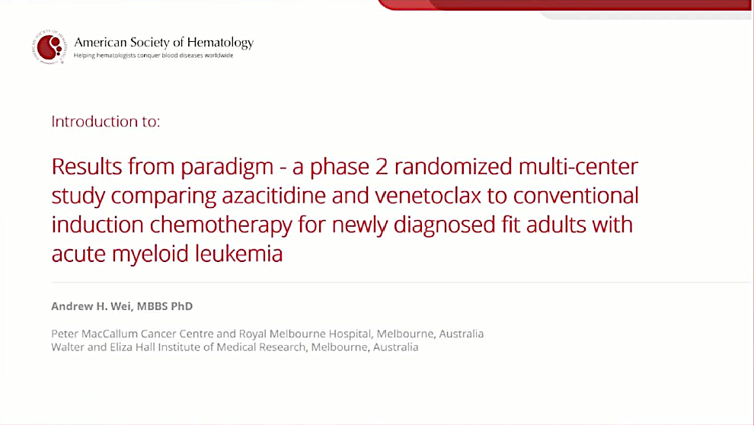
Wei AL et al. ASH 2025.

Slide 89

Evolution of Approved AML Therapies
Wei AL et al. ASH 2025.

Slide 90

Evolution of Approved AML Therapies (Continued)
Olutasidenib
Wei AL et al. ASH 2025.

Slide 91

Established AML Dogma
Wei AL et al. ASH 2025.

Slide 92

Could a Fit Patient Receive Less-Intensive AML Therapy?
Wei AL et al. ASH 2025.

Slide 93

PARADIGM Trial
Wei AL et al. ASH 2025.

Slide 94

Fathi AT et al. ASH 2025;Abstract 6.

Slide 95

IC = induction chemotherapy; HCT = hematopoietic cell transplant
Fathi AT et al. ASH 2025;Abstract 6.

Slide 96
Outcomes with IC vary significantly based on AML biology
EUROPEAN LEUKEMIA NET 2022¹
Favorable | t(8;21)(q22;q22.1)/RUNX1::RUNX1T1 inv(16)(p13.1q22) or t(16;16)(p13.1;q22)/CBFB::MYH11 Mut NPM1 w/o FLT3-ITD bZIP in-frame mut CEBPA
Intermediate | Mut NPM1 with FLT3-ITD Wt NPM1 with FLT3-ITD t(9;11)(p21.3;q23.3)/ MLLT3::KMT2A Cytogenetic and/or molecular
Adverse | t(6;9)(p23.3;q34.1)/DEK::NUP214 t(v;11q23.3)/KMT2A-rearr t(9;22)(q34.1;q11.2)/BCR::ABL1 t(8;16)(p11.2;p13.3)/KAT6A::CREBBP inv(3)(q21.3q26.2) or t(3;3)(q21.3;q26.2)/GATA2,MECOM(EVI1) t(3q26.2;v)/MECOM(EVI1)-rearr –5 or del(5q); –7; –17/abn(17p) Complex/monosomal karyotype Mut ASXL1, BCOR, EZH2, RUNX1, SF3B1, SRSF2, STAG2, U2AF1, or ZRSR2 Mut TP53
OS in Patients Aged < 60 Years With de Novo AML*
(N = 867)²
100
PML-RARA
80
CEBPAdm
RUNX1-RUNX1T1/
CBFB-MYH11
60
Overall survival (%)
NPM1^{mut}/FLT3-ITD–
40
Interm./adv., no mutation
in ASXL1, TP53, or FLT3-ITD
NPM1^{mut}/FLT3-ITD+
20
Interm./adv. with ≥ 1 mutation
in ASXL1, TP53, or FLT3-ITD
Complex karyotype,
KMT2A or MECOM rearrangement
0
0
1
2
3
4
5
6
7
8
9
10
Time (years)
* This population of patients had been treated with standard intensive chemotherapy. ELN, European LeukemiaNet. 1. Döhner H et al. Blood. 2022;144(12):1345-1377. 2. Adapted from Haferlach C et al. Blood. 2016;128:286.

Slide 97

PARADIGM Primary Endpoint: Event-Free Survival (EFS)
Fathi AT et al. ASH 2025;Abstract 6.

Slide 98

PARADIGM Secondary Endpoint: Overall Survival (OS)
Fathi AT et al. ASH 2025;Abstract 6.

Slide 99



PARADIGM: Clinical Activity and Transplant
Fathi AT et al. ASH 2025;Abstract 6.

Slide 100

PARADIGM: Safety and Tolerability
Grade ≥3 treatment-emergent adverse events in ≥10% of patients
Fathi AT et al. ASH 2025;Abstract 6.

Slide 101

PARADIGM: Patient-Reported Outcomes (PROs)
FACT = Functional assessment of cancer treatment
HADS = Hospital anxiety and depression scale
ESAS = Edmonton symptom assessment system
Fathi AT et al. ASH 2025;Abstract 6.

Slide 102

Healthcare Utilization
Wei AL et al. ASH 2025; Discussant.

Slide 103

PARADIGM: Conclusions
Fathi AT et al. ASH 2025;Abstract 6.

Slide 104
Year in Review: Clinical Investigator Perspectives on the
Most Relevant New Datasets and Advances in Oncology
Oral SERDs for Breast Cancer
A CME/MOC-Accredited Live Webinar
Tuesday, March 31, 2026
5:00 PM – 6:00 PM ET
Faculty
Aditya Bardia, MD, MPH
Erica Mayer, MD, MPH, FASCO
Moderator
Neil Love, MD

Slide 105
Thank you for joining us!
Please take a moment to complete the survey currently up on Zoom. Your feedback is very important to us. The survey will remain open for 5 minutes after the meeting ends.
Information on how to obtain CME and ABIM
MOC credit is provided in the Zoom chat room.
Attendees will also receive an email in
1 to 3 business days with these instructions.

