Slide 1
Optimal Use of Hormonal Therapy in the
Care of Patients with Prostate Cancer
A CME/MOC-Accredited Live Webinar
Wednesday, July 29, 2026
5:00 PM – 6:00 PM ET
Faculty
William K Oh, MD
Mary-Ellen Taplin, MD
Moderator
Neil Love, MD

Slide 2



Faculty
William K Oh, MD
Director of Precision Medicine
Yale Cancer Center and Smilow Cancer Hospital
Professor of Medicine, Section of Medical Oncology
Yale School of Medicine
New Haven, Connecticut
MODERATOR
Neil Love, MD
Research To Practice
Miami, Florida
Mary-Ellen Taplin, MD
Professor of Medicine
Harvard School of Medicine
Dana-Farber Cancer Institute
Boston, Massachusetts

Slide 3
Commercial Support
This activity is supported by an educational grant from Johnson & Johnson.

Slide 4
Dr Love — Disclosures
Dr Love is president and CEO of Research To Practice. Research To Practice receives funds in the form of educational grants to develop CME activities from the following companies: Aadi Bioscience, AbbVie Inc, ADC Therapeutics, Agendia Inc, Alexion Pharmaceuticals, Amgen Inc, Array BioPharma Inc, a subsidiary of Pfizer Inc, Arvinas, Astellas, AstraZeneca Pharmaceuticals LP, Aveo Pharmaceuticals, Bayer HealthCare Pharmaceuticals, BeOne, Biotheranostics Inc, A Hologic Company, Black Diamond Therapeutics Inc, Blueprint Medicines, Boehringer Ingelheim Pharmaceuticals Inc, Bristol Myers Squibb, Catalyst Pharmaceuticals Inc, Celcuity, Clovis Oncology, Coherus BioSciences, Corcept Therapeutics Inc, CTI BioPharma, a Sobi Company, Daiichi Sankyo Inc, Eisai Inc, Elevation Oncology Inc, Exact Sciences Corporation, Exelixis Inc, Genentech, a member of the Roche Group, Genmab US Inc, Geron Corporation, Gilead Sciences Inc, GSK, Helsinn Therapeutics (US) Inc, ImmunoGen Inc, Incyte Corporation, Ipsen Biopharmaceuticals Inc, Jazz Pharmaceuticals Inc, Johnson & Johnson, Karyopharm Therapeutics, Kite, A Gilead Company, Kura Oncology, Legend Biotech, Lilly, MEI Pharma Inc, Merck, Mersana Therapeutics Inc, Mirati Therapeutics Inc, Mural Oncology Inc, Natera Inc, Novartis, Novartis Pharmaceuticals Corporation on behalf of Advanced Accelerator Applications, Novocure Inc, Nuvalent, Nuvation Bio Inc, Pfizer Inc, Pharmacyclics LLC, an AbbVie Company, Puma Biotechnology Inc, Regeneron Pharmaceuticals Inc, Revolution Medicines Inc, Rigel Pharmaceuticals Inc, R-Pharm US, Sanofi, Seagen Inc, Servier Pharmaceuticals LLC, SpringWorks Therapeutics Inc, Stemline Therapeutics Inc, Sumitomo Pharma America, Summit Therapeutics, Syndax Pharmaceuticals, Taiho Oncology Inc, Takeda Pharmaceuticals USA Inc, TerSera Therapeutics LLC, Tesaro, A GSK Company, and Verastem Inc.

Slide 5
Research To Practice CME Planning Committee Members,
Staff and Reviewers
Planners, scientific staff and independent reviewers for Research To Practice have no relevant financial relationships to disclose.

Slide 6
Dr Oh — Disclosures
Advisory Committees | Analysis Group, AstraZeneca Pharmaceuticals LP, Biocartis, Novartis, Pfizer Inc
Stock Options/Stock — Public Companies | GeneDx

Slide 7
Dr Taplin — Disclosures
Advisory Committees | AstraZeneca Pharmaceuticals LP, BioNTech SE, Delphia Therapeutics, Flare Therapeutics, GSK, Johnson & Johnson, Novartis
Consulting Agreements | Johnson & Johnson
Data and Safety Monitoring Boards/ Committees | Amgen Inc
Education | Curio Science, DAVA Oncology
Nonrelevant Financial Relationships | AXIS Medical Education Inc, MJH Life Sciences, Reach MD, UpToDate

Slide 8
This educational activity contains discussion of
non-FDA-approved uses of agents and regimens. Please refer to official prescribing information for each product for approved indications.

Slide 9
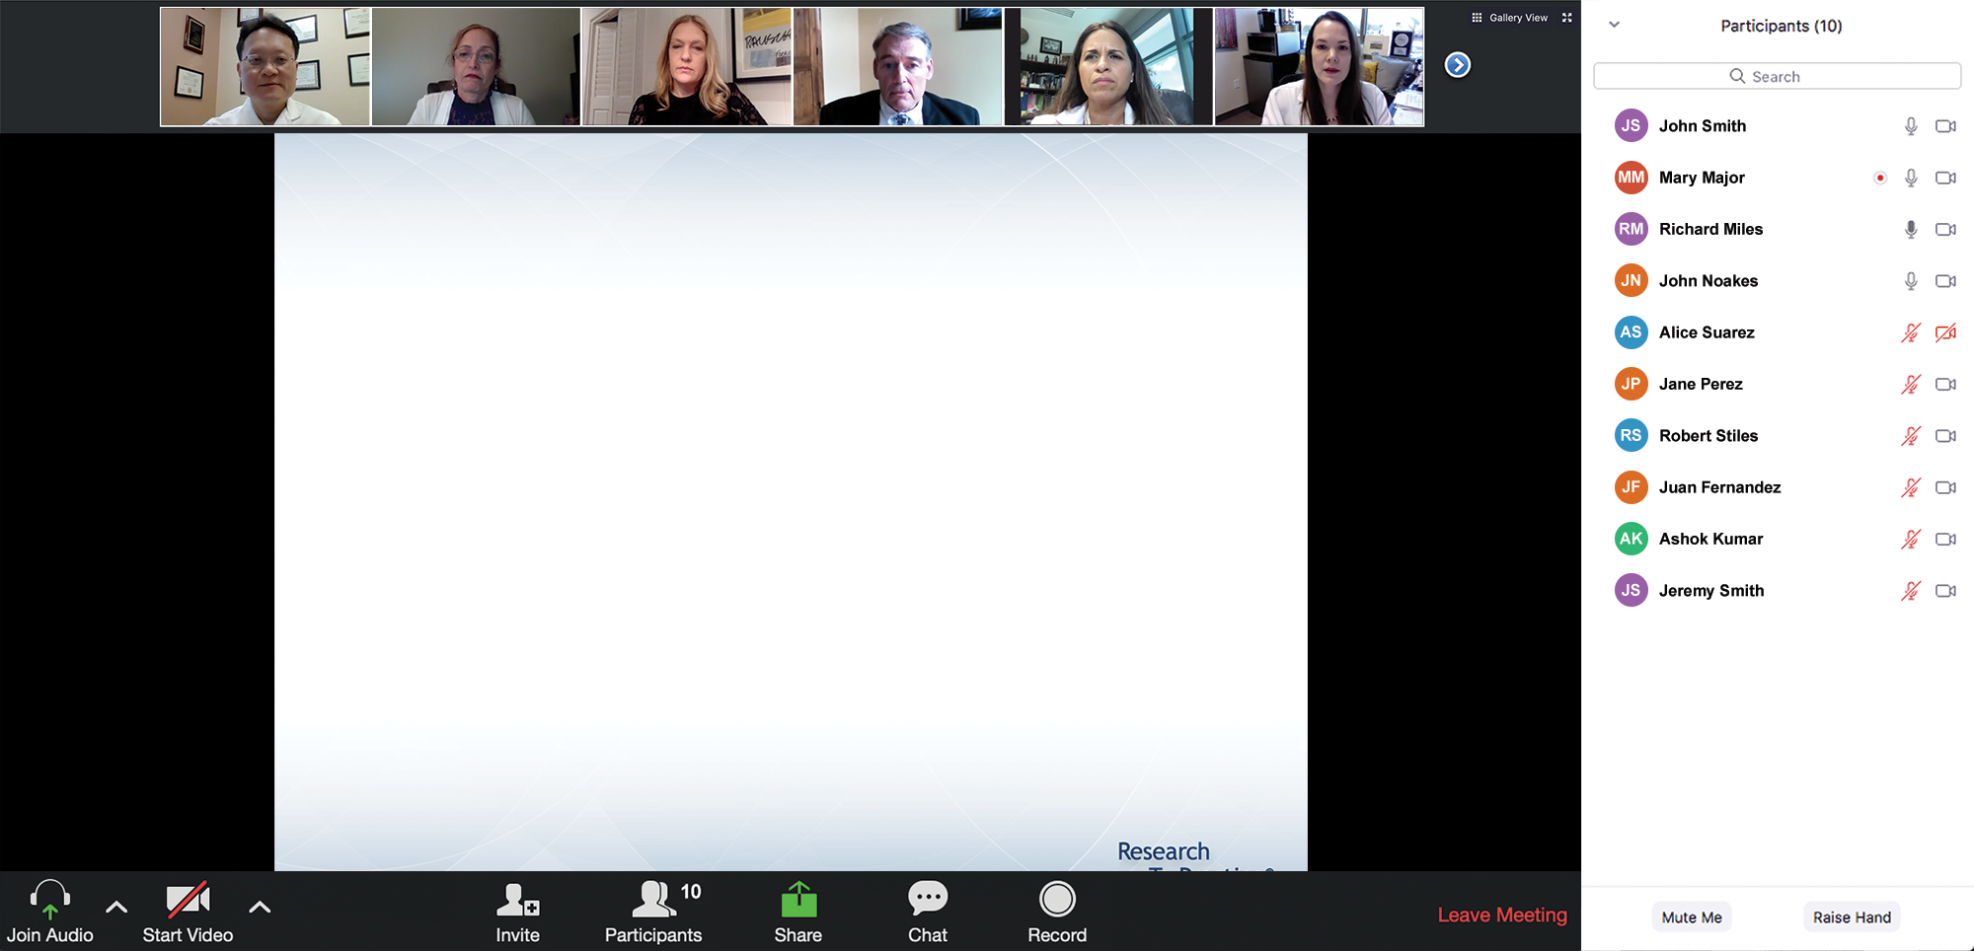

We Encourage Clinicians in Practice to Submit Questions
Feel free to submit questions now before the program begins and throughout the program.

Slide 10
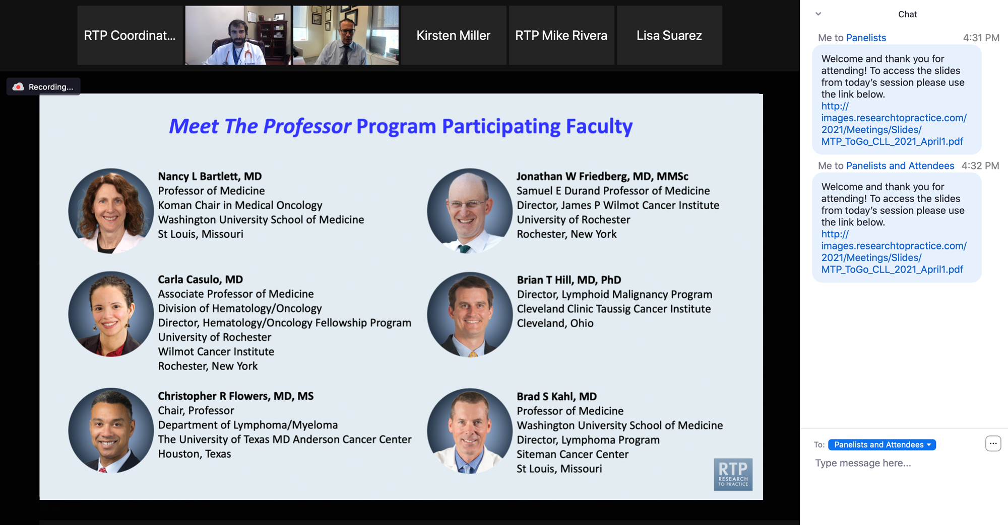
Familiarizing Yourself with the Zoom Interface
Expand chat submission box
Drag the white line above the submission box up to create
more space for your message.

Slide 11
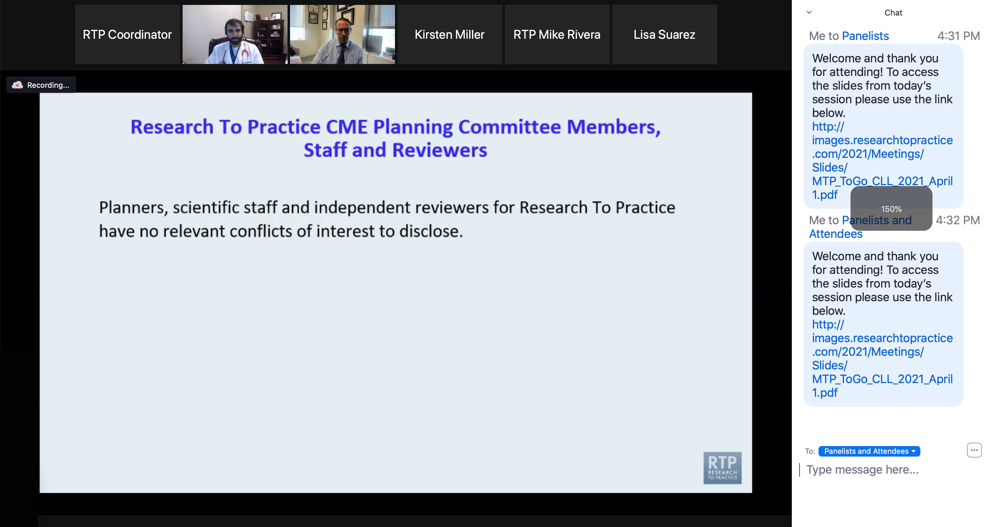
Familiarizing Yourself with the Zoom Interface
Increase chat font size
Press Command (for Mac) or Control (for PC) and the + symbol.
You may do this as many times as you need for readability.

Slide 12
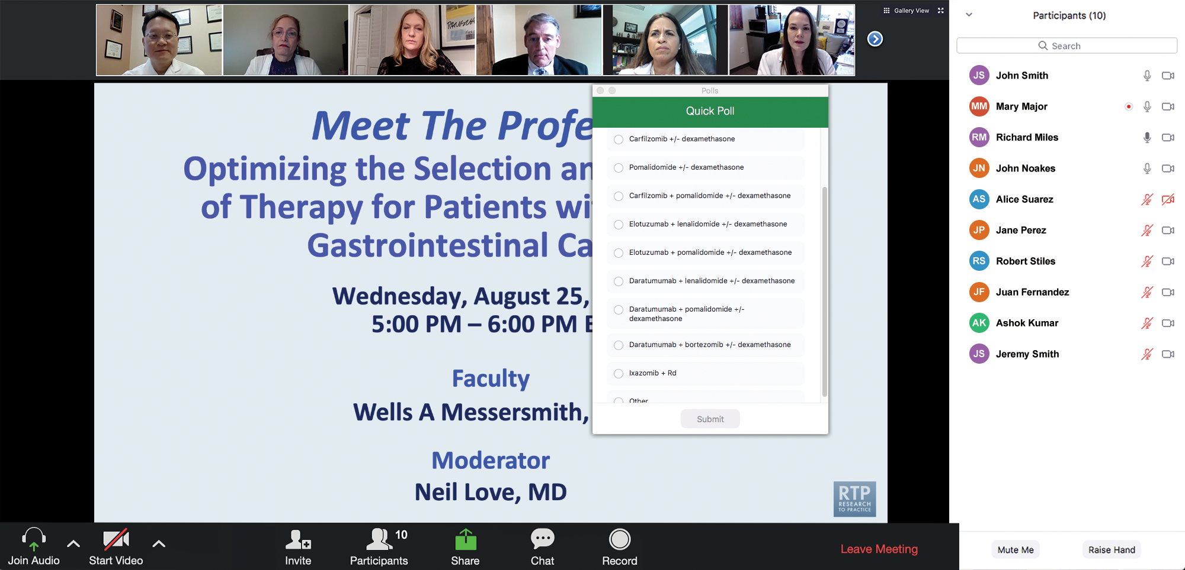
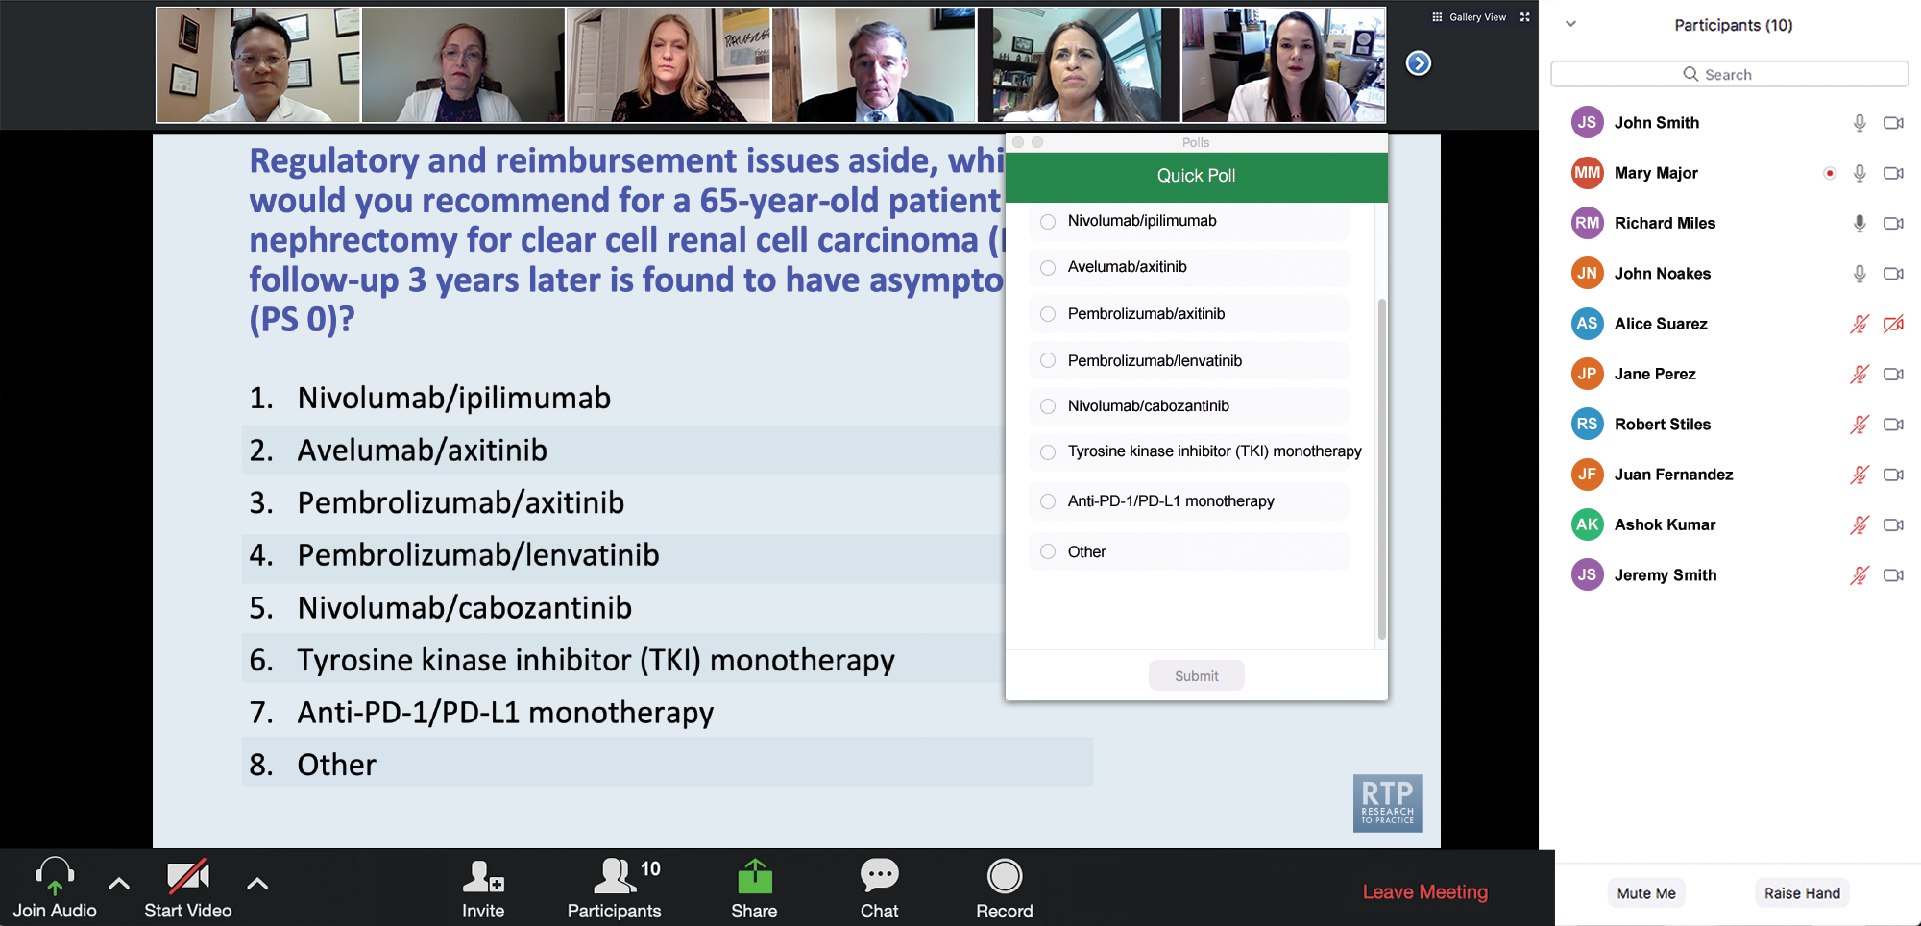
Clinicians in the Audience, Please Complete the Pre- and Postmeeting Surveys
Quick Survey
Quick Poll

Slide 13


Slide 14
The Implications of Recent Datasets for the Current and Future Management of Breast Cancer — An ASCO 2026 Review
A CME/MOC-Accredited Live Webinar
Thursday, July 30, 2026
5:00 PM – 6:30 PM ET
Faculty
Aditya Bardia, MD, MPH
Kevin Kalinsky, MD, MS, FASCO
Joyce O’Shaughnessy, MD
Moderator
Neil Love, MD

Slide 15
Integrating New Advances into
Community Oncology Practice
A Multitumor Symposium Hosted in Conjunction with the American Oncology Network
Join Us In Person or Virtually
Saturday, August 22, 2026
JW Marriott Nashville | Nashville, Tennessee
Chronic Lymphocytic Leukemia
9:05 AM – 9:55 AM CT
Diffuse Large B-Cell Lymphoma
12:40 PM – 1:30 PM CT
Gastroesophageal Cancers
9:55 AM – 10:45 AM CT
Lung Cancer
1:30 PM – 2:20 PM CT
Gynecologic Cancers
11:00 AM – 11:50 AM CT
Moderator
Stephen “Fred” Divers, MD

Slide 16
The Implications of Recent Datasets for the Current and Future Management of
Gynecologic Cancers — An ASCO 2026 Review
A CME/MOC-Accredited Live Webinar
Wednesday, August 26, 2026
5:00 PM – 6:00 PM ET
Faculty
Faculty to be announced
Moderator
Neil Love, MD

Slide 17
Data + Perspectives: Investigators
Discuss the Optimal Management of
Relapsed/Refractory Multiple Myeloma
A CME-Accredited Satellite Symposium During the
Society of Hematologic Oncology 2026 Annual Meeting
Wednesday, September 9, 2026
11:56 AM – 12:56 PM CT
Faculty
Noopur Raje, MD
Paul G Richardson, MD
Moderator
Robert Z Orlowski, MD, PhD

Slide 18
Grand Rounds
CME/MOC-Accredited Interactive Series
Regional Activities
Three Series
Integrating Recent Advances into the Management of Gastroesophageal Cancers
Optimizing the Use of
Novel Therapies for Patients with Diffuse Large B-Cell Lymphoma
Optimizing Therapy for Patients with Hormone Receptor-Positive
Localized Breast Cancer
Host a 1-hour session at your institution:
Email Meetings@ResearchToPractice.com
or call (800) 233-6153

Slide 19
Thank you for joining us! Please take a moment to complete the survey currently up on Zoom.
Your feedback is very important to us.
Information on how to obtain CME, ABIM MOC and ABS credit will be provided at the conclusion of the activity in the Zoom chat room. Attendees will also receive an email in 1 to 3 business days with these instructions.

Slide 20
Optimal Use of Hormonal Therapy in the
Care of Patients with Prostate Cancer
A CME/MOC-Accredited Live Webinar
Wednesday, July 29, 2026
5:00 PM – 6:00 PM ET
Faculty
William K Oh, MD
Mary-Ellen Taplin, MD
Moderator
Neil Love, MD

Slide 21
Faculty
William K Oh, MD
Director of Precision Medicine
Yale Cancer Center and Smilow Cancer Hospital
Professor of Medicine, Section of Medical Oncology
Yale School of Medicine
New Haven, Connecticut
MODERATOR
Neil Love, MD
Research To Practice
Miami, Florida
Mary-Ellen Taplin, MD
Professor of Medicine
Harvard School of Medicine
Dana-Farber Cancer Institute
Boston, Massachusetts

Slide 22
We Encourage Clinicians in Practice to Submit Questions
Feel free to submit questions now before the program begins and throughout the program.

Slide 23
Clinicians in the Audience, Please Complete the Pre- and Postmeeting Surveys
Quick Survey
Quick Poll

Slide 25
The Implications of Recent Datasets for the Current and Future Management of Breast Cancer — An ASCO 2026 Review
A CME/MOC-Accredited Live Webinar
Thursday, July 30, 2026
5:00 PM – 6:30 PM ET
Faculty
Aditya Bardia, MD, MPH
Kevin Kalinsky, MD, MS, FASCO
Joyce O’Shaughnessy, MD
Moderator
Neil Love, MD

Slide 26
Integrating New Advances into
Community Oncology Practice
A Multitumor Symposium Hosted in Conjunction with the American Oncology Network
Join Us In Person or Virtually
Saturday, August 22, 2026
JW Marriott Nashville | Nashville, Tennessee
Chronic Lymphocytic Leukemia
9:05 AM – 9:55 AM CT
Diffuse Large B-Cell Lymphoma
12:40 PM – 1:30 PM CT
Gastroesophageal Cancers
9:55 AM – 10:45 AM CT
Lung Cancer
1:30 PM – 2:20 PM CT
Gynecologic Cancers
11:00 AM – 11:50 AM CT
Moderator
Stephen “Fred” Divers, MD

Slide 27
The Implications of Recent Datasets for the Current and Future Management of
Gynecologic Cancers — An ASCO 2026 Review
A CME/MOC-Accredited Live Webinar
Wednesday, August 26, 2026
5:00 PM – 6:00 PM ET
Faculty
Faculty to be announced
Moderator
Neil Love, MD

Slide 28
Data + Perspectives: Investigators
Discuss the Optimal Management of
Relapsed/Refractory Multiple Myeloma
A CME-Accredited Satellite Symposium During the
Society of Hematologic Oncology 2026 Annual Meeting
Wednesday, September 9, 2026
11:56 AM – 12:56 PM CT
Faculty
Noopur Raje, MD
Paul G Richardson, MD
Moderator
Robert Z Orlowski, MD, PhD

Slide 29
Grand Rounds
CME/MOC-Accredited Interactive Series
Regional Activities
Three Series
Integrating Recent Advances into the Management of Gastroesophageal Cancers
Optimizing the Use of
Novel Therapies for Patients with Diffuse Large B-Cell Lymphoma
Optimizing Therapy for Patients with Hormone Receptor-Positive
Localized Breast Cancer
Host a 1-hour session at your institution:
Email Meetings@ResearchToPractice.com
or call (800) 233-6153

Slide 30
Optimal Use of Hormonal Therapy in the
Care of Patients with Prostate Cancer
A CME/MOC-Accredited Live Webinar
Wednesday, July 29, 2026
5:00 PM – 6:00 PM ET
Faculty
William K Oh, MD
Mary-Ellen Taplin, MD
Moderator
Neil Love, MD

Slide 31
Dr Oh — Disclosures
Advisory Committees | Analysis Group, AstraZeneca Pharmaceuticals LP, Biocartis, Novartis, Pfizer Inc
Stock Options/Stock — Public Companies | GeneDx

Slide 32
Dr Taplin — Disclosures
Advisory Committees | AstraZeneca Pharmaceuticals LP, BioNTech SE, Delphia Therapeutics, Flare Therapeutics, GSK, Johnson & Johnson, Novartis
Consulting Agreements | Johnson & Johnson
Data and Safety Monitoring Boards/ Committees | Amgen Inc
Education | Curio Science, DAVA Oncology
Nonrelevant Financial Relationships | AXIS Medical Education Inc, MJH Life Sciences, Reach MD, UpToDate

Slide 33
Dr Love — Disclosures
Dr Love is president and CEO of Research To Practice. Research To Practice receives funds in the form of educational grants to develop CME activities from the following companies: Aadi Bioscience, AbbVie Inc, ADC Therapeutics, Agendia Inc, Alexion Pharmaceuticals, Amgen Inc, Array BioPharma Inc, a subsidiary of Pfizer Inc, Arvinas, Astellas, AstraZeneca Pharmaceuticals LP, Aveo Pharmaceuticals, Bayer HealthCare Pharmaceuticals, BeOne, Biotheranostics Inc, A Hologic Company, Black Diamond Therapeutics Inc, Blueprint Medicines, Boehringer Ingelheim Pharmaceuticals Inc, Bristol Myers Squibb, Catalyst Pharmaceuticals Inc, Celcuity, Clovis Oncology, Coherus BioSciences, Corcept Therapeutics Inc, CTI BioPharma, a Sobi Company, Daiichi Sankyo Inc, Eisai Inc, Elevation Oncology Inc, Exact Sciences Corporation, Exelixis Inc, Genentech, a member of the Roche Group, Genmab US Inc, Geron Corporation, Gilead Sciences Inc, GSK, Helsinn Therapeutics (US) Inc, ImmunoGen Inc, Incyte Corporation, Ipsen Biopharmaceuticals Inc, Jazz Pharmaceuticals Inc, Johnson & Johnson, Karyopharm Therapeutics, Kite, A Gilead Company, Kura Oncology, Legend Biotech, Lilly, MEI Pharma Inc, Merck, Mersana Therapeutics Inc, Mirati Therapeutics Inc, Mural Oncology Inc, Natera Inc, Novartis, Novartis Pharmaceuticals Corporation on behalf of Advanced Accelerator Applications, Novocure Inc, Nuvalent, Nuvation Bio Inc, Pfizer Inc, Pharmacyclics LLC, an AbbVie Company, Puma Biotechnology Inc, Regeneron Pharmaceuticals Inc, Revolution Medicines Inc, Rigel Pharmaceuticals Inc, R-Pharm US, Sanofi, Seagen Inc, Servier Pharmaceuticals LLC, SpringWorks Therapeutics Inc, Stemline Therapeutics Inc, Sumitomo Pharma America, Summit Therapeutics, Syndax Pharmaceuticals, Taiho Oncology Inc, Takeda Pharmaceuticals USA Inc, TerSera Therapeutics LLC, Tesaro, A GSK Company, and Verastem Inc.

Slide 34
Commercial Support
This activity is supported by an educational grant from Johnson & Johnson.
Research To Practice CME Planning Committee Members,
Staff and Reviewers
Planners, scientific staff and independent reviewers for Research To Practice have no relevant financial relationships to disclose.

Slide 35
This educational activity contains discussion of
non-FDA-approved uses of agents and regimens. Please refer to official prescribing information for each product for approved indications.

Slide 36
Agenda
Introduction: Another Perspective on the Treatment of Localized Prostate Cancer
Module 1: Nonmetastatic Disease
Module 2: Metastatic Androgen Pathway Modulation-Naïve and Androgen Pathway Modulation-Sensitive Disease

Slide 37
Agenda
Introduction: Another Perspective on the Treatment of Localized Prostate Cancer
Module 1: Nonmetastatic Disease
Module 2: Metastatic Androgen Pathway Modulation-Naïve and Androgen Pathway Modulation-Sensitive Disease

Slide 38
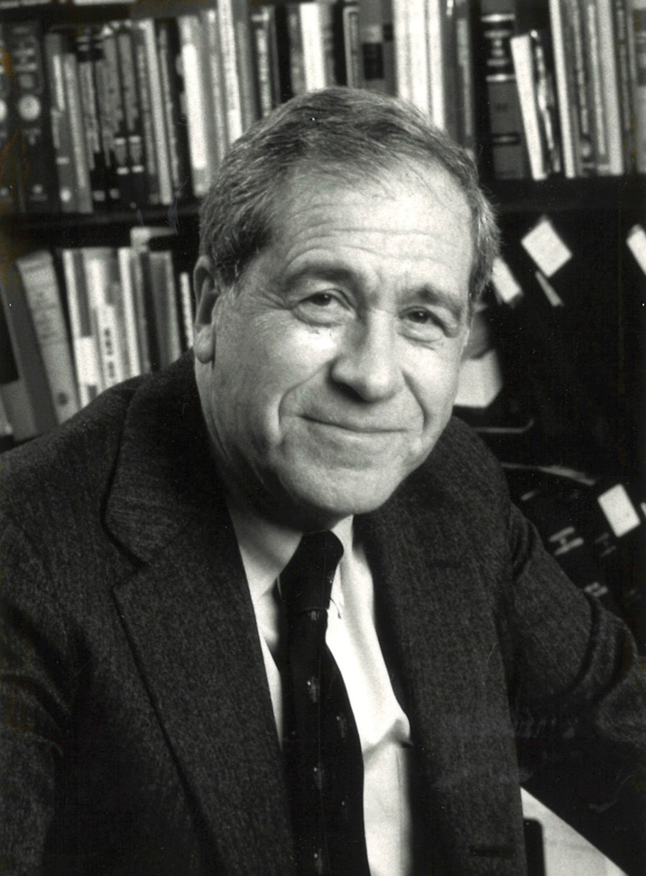
Bernard Fisher, MD

Slide 39
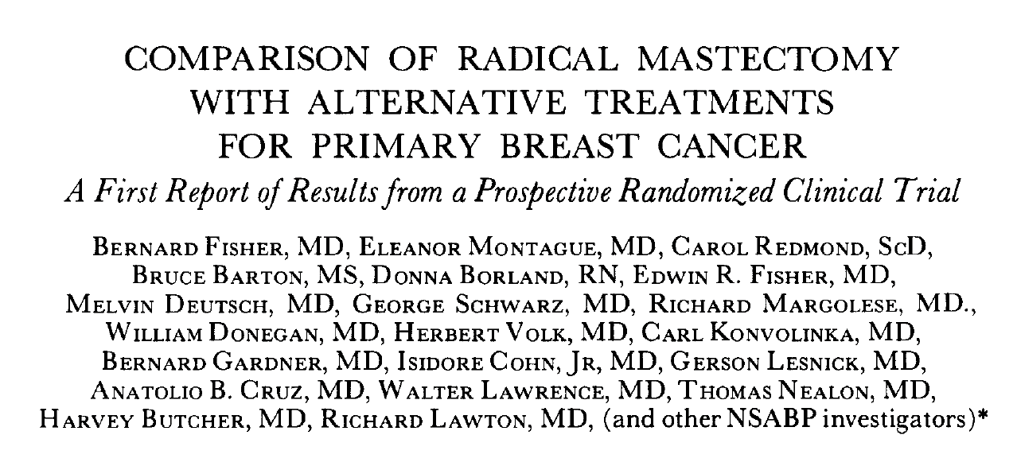
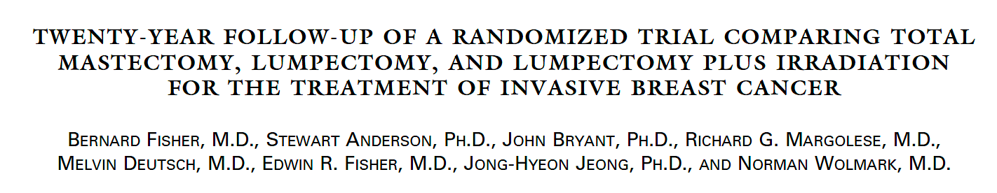
Fisher B et al. Cancer 1977;39(6 Suppl):2827-39.
Fisher B et al. N Engl J Med 2002;347(16):1233-41.

Slide 40
Is there a patient age at which you generally discourage RP?
75 years
About 75 years
80 years
70 years
75 years
80 years

Slide 41
Agenda
Introduction: Another Perspective on the Treatment of Localized Prostate Cancer
Module 1: Nonmetastatic Disease
Module 2: Metastatic Androgen Pathway Modulation-Naïve and Androgen Pathway Modulation-Sensitive Disease

Slide 42
Recent Data Defining the Optimal Use of Hormonal Therapy for Patients with Non-metastatic Prostate Cancer
Mary-Ellen Taplin, MD
Professor of Medicine
Dana-Farber Cancer Institute
Boston, MA

Slide 43
Topics
Risk Stratification and selection of initial therapy for localized high-risk prostate cancer
Major efficacy and safety results
  PROTEUS – Apalutamide
  EMBARK – Enzalutamide
  PRESTO – abiraterone/apalutamide
Ongoing phase III trials investigating ARPIs for nmHSPCa
Cases
  Localized high-risk candidate for neoadjuvant ADT/Apalutamide
  nmHSPCa and high-risk biochemical recurrence

Slide 44
Clinical States of Prostate Cancer
Clinically
localized
“Rising PSA”
state
Non-metastatic,
hormone-
sensitive
Non-metastatic
CRPC
Metastatic,
hormone-sensitive
Metastatic
CRPC
Death from prostate cancer
Death from other causes
10-15 years +
Notes:
44

Slide 45
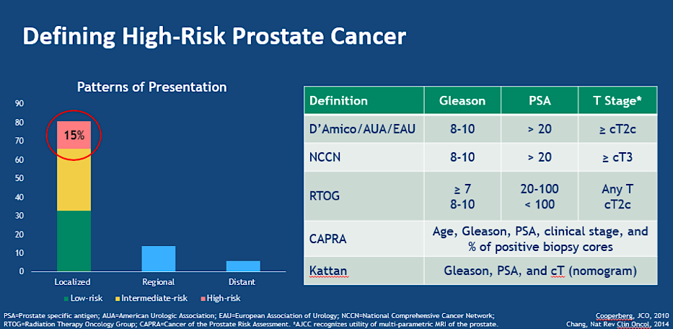
NCCN – Very High-Risk (at least one): T3b, T4, Primary Gleason pattern 5, 5 or more biopsy cores containing Grade Group 4 or 5, two or three NCCN high-risk features
McKay R et al. ASCO 2020

Slide 46
PROTEUS: A Randomized, Double-Blind, Placebo-Controlled Phase 3 Study in HR-LPC
Post treatment
N=2109
R
A
N
D
O
M
I
Z
E
D
1:1
Neoadjuvant
(C1 through C6)
Adjuvant
(C7 through C12)
Patients With HR-LPC
APA
(240 mg QD) + ADT
2
wks
4
wks
APA
(240 mg QD) + ADT
RPª
+
ADT
PSMA-PET (3 months after EOT)
PSA every 3 months
Conventional and PSMA-PET imaging at BCF (PSA ≥0.2 ng/mL); every 6 months thereafter
PBO + ADT
PBO + ADT
Stratification:
cN0 vs N1
Gleason score (7 vs 8-10)
Region (North America, Europe, ROW)
Adjuvant or salvage RT post-RP at investigator’s discretion
To complement these data, a substudy is ongoing to further inform on the role of APA + ADT + RP versus RP alone
Patients randomized from July 15, 2019, to June 30, 2022.
Protocol Amendment 7 for including PSMA-PET into MFS assessment (April 14, 2022).
APA, apalutamide; BCF, biochemical failure; C, cycle; EOT, end of treatment; PBO, placebo; PSA, prostate-specific antigen; PSMA-PET, prostate-specific membrane antigen positron emission tomography; QD, daily; ROW, rest of the world; RT, radiation therapy.
ªAPA/PBO is stopped 2 weeks prior to planned RP and then resumed 4 weeks after RP. Cardiovascular risk prophylaxis and venous thromboembolism prophylaxis given based on risk.
Taplin ME et al. ASCO 2026;Abstract LBA1

Slide 47
End Points and Hierarchical Testing:
Dual primary, assessed by BICR
Secondary (in hierarchical testing order)
pCR/MRD (ypT0 or ≤ypT2;
≤5 mm tumor)
MFS (metastasis by conventional
or PSMA-PETª imaging or histopathology, or death)
EFS
Time to first subsequent therapy
TTDM by conventional or PSMA-PET imaging
NED at 4 years
MFS (by conventional imaging)
Time to PSA-free survival with testosterone recovery^{b}
Additionally, exploratory end points included RCB, OS for no detriment of treatment, and testosterone recovery >200 ng/dL
BICR, blinded independent central review; MRD, minimal residual disease; NED, no evidence of disease; pCR, pathological complete response; OS, overall survival; RCB, residual cancer burden; TTDM, time to distant metastasis.
ªImaging was assessed by BICR. ^{b}Not formally tested after MFS by conventional imaging was insignificant.
Taplin ME et al. ASCO 2026;Abstract LBA1

Slide 48
Dual Primary End Point Met: pCR/MRD
PRIMARY END POINT
9-fold improvement in pCR/MRD at RP after
6-cycle neoadjuvant
APA + ADT
vs PBO + ADT
12
8.9%
OR, 10.17
95% CI, 5.27-19.64
p<0.0001ª
10
8
Exploratory end point of RCB (≤ypT2, N0, ≤0.25 cm³) corroborates pCR/MRD:
APA + ADT vs PBO + ADT, 30.6% vs 11.7%
OR, 3.36;
95% CI, 2.67-4.23; p<0.0001
pCR/MRD (%) by Pathology-BICR
6
4
5.1% ypT0
2
1.0%
0.4% ypT0
0
APA + ADT
94/1057
PBO + ADT
10/1052
pCR/MRD: Minimal residual tumor ≤5 mm (greatest dimension of largest tumor lesion) in prostate-confined disease (≤ypT2, N0) or no tumor identified (ypT0)
RCB: Residual cancer burden ≤0.25 cm³ in prostate-confined disease (≤ypT2, N0)
Error bars indicate 95% confidence intervals (CIs). Odds ratio (OR) is from a logistic regression adjusted for stratification factor; OR >1 favors APA + ADT.
ªp Value is based on Cochran-Mantel-Haenszel test stratified by Gleason score (7, ≥8), nodal status (N0, N1), geographic region (North America, Europe, and rest of the world).
Taplin ME et al. ASCO 2026;Abstract LBA1
Notes:
Here is the primary end-point of pCR/MRD. The Odds Ratio was 10.17, statistically significant and a 9-fold improvement in pCR/MRD with apalutamide/ADT compared to placebo/ADT. More than half of the responses in the apalutamide cohort were pCR.
The exploratory endpoint of residual cancer burden was 30% for apalutamide/ADT and 11% for placebo/ADT - a 3.4-fold difference. Both pCR/MRD and RCB support better tumor response for apalutamide/ADT compared to placebo/ADT.

Slide 49
Dual Primary End Point Met:
MFS by Conventional or PSMA-PET Imaging
PRIMARY END POINT
100
APA + ADT
20% reduction in the risk of metastasis or death after 1 year
of perioperative APA + ADT with RP by BICR
80
PBO + ADT
60
MFS (%) Assessed by BICR
40
HR, 0.80ª
95% CI, 0.67-0.96
p=0.02^{b}
20
Investigator-assessed
MFS was consistent
HR, 0.74;
95% CI, 0.62-0.87;
p=0.0004
0
0
12
24
36
48
60
72
84
No. at risk
Months Since Randomization
APA + ADT
1057
992
922
837
659
382
62
0
PBO + ADT
1052
1000
924
812
634
385
61
0
MFS: Time to first occurrence of radiographic distant metastasis based on conventional imaging or PSMA-PET imaging, pathologic finding of distant metastasis,
or death from any cause
ªHazard ratio (HR) is from stratified proportional hazards model. HR <1 favors APA + ADT.
^{b}p Value is from a log-rank test stratified by Gleason score (7, ≥8), nodal status (N0, N1), geographic region (North America, Europe, and rest of the world).
Taplin ME et al. ASCO 2026;Abstract LBA1

Slide 50
Treatment-Emergent Adverse Events of Special Interest
Special Interest Category, n (%) | APA + ADT (n=1050) |  | PBO + ADT (n=1050)
 | All Grades | Grade ≥3 | All Grades | Grade ≥3
≥1 TEAE of special interest | 398 (37.9) | 90 (8.6) | 214 (20.4) | 23 (2.2)
Skin rash | 346 (33.0) | 62 (5.9) | 161 (15.3) | 3 (0.3)
Fall | 34 (3.2) | 6 (0.6) | 29 (2.8) | 5 (0.5)
Ischemic heart disease | 25 (2.4) | 13 (1.2) | 22 (2.1) | 9 (0.9)
Nonpathological fracture | 22 (2.1) | 6 (0.6) | 19 (1.8) | 5 (0.5)
Cerebrovascular disorders | 8 (0.8) | 5 (0.5) | 13 (1.2) | 6 (0.6)
Seizure | 2 (0.2) | 2 (0.2) | 1 (0.1) | 0
Fatigue | 291 (27.7) | 4 (0.4) | 281 (26.8) | 1 (0.1)
TEAEs are those that occurred on or after the first dose of study drug through the last dose of study treatment plus 30 days or prior to the start of subsequent therapy, whichever is earlier, or any AE that is considered treatment related regardless of the start date of the event. Patients are counted only once for any given event, regardless of the number of times they actually experienced the event. The event with the worst toxicity grade is used. If a patient has all adverse events with missing toxicity grades, the patient is only counted in the total column.
Taplin ME et al. ASCO 2026;Abstract LBA1

Slide 51
Case 1: Localized high-risk candidate for neoadjuvant ADT/Apalutamide
55 year old man who presents with a PSA 22, prostate MRI with 3 cm PIRAD 5 lesions, Prostate biopsy with Gleason 8 (4+4) in 6 cores and Gleason 7 (4+3) in 2 cores, +PNI, - cribriform, bone scan NED, PSMA-PET/CT with low volume pelvic nodes with SUV slightly over blood pool (indeterminate). Patient had treated hypertension and states that he “wants aggressive treatment”.
  What are the SOC treatment options?
  What are the pros and cons of the PROTEUS regimen compared to RP (+/- salvage RT/ADT) and RT/ADT
  If patient chooses RT/ADT, should an ARPI be added to the ADT?
  Is there a cohort of patients with localized high-risk prostate cancer who should not be considered for ARPI/ADT and RP?

Slide 52
Do you anticipate that the PROTEUS trial strategy of perioperative apalutamide/androgen deprivation therapy (ADT) will receive FDA approval for patients with high-risk localized or locally advanced prostate cancer undergoing RP?
Yes
Yes
Yes
No
Yes
Yes

Slide 53
For which patients, if any, would you use the PROTEUS strategy?
Younger fit patients with NCCN VHR, urinary symptoms, interested in surgery, locally advanced
High risk, high volume, up to N1 nodes by conventional imaging
Younger patients with high-risk disease and patients with a lot of urinary symptoms that might worsen with RT
I do not expect to use the ‘PROTEUS strategy’. The small effect on an intermediate endpoint of uncertain clinical importance is not compelling
Young, large prostate, high grade, bulky disease who are contemplating surgery as primary therapy
Only for the very high-risk patients who are young (eg.,<65) and who want to be very aggressive

Slide 54
For a patient who received the PROTEUS strategy and attained a pathologic complete response, would you offer the option of forgoing postoperative treatment?
No
Yes
No, I’d want at least a year of postoperative treatment
Yes, although from the data, that is a rare outcome
No
Yes

Slide 55
Otherwise healthy patient presents with PSA of 9 ng/mL; Gleason 5 + 4 in 3 out of 20 cores; MRI: Extracapsular extension; clinical T2. Local and systemic therapy?
55-year-old
70-year-old
80-year-old
RP or RT; PROTEUS or ADT/ARPI for 2 years
RP or RT; PROTEUS or ADT/ARPI for 2 years
RT; ADT for 2 years
RP; PROTEUS
RP; PROTEUS
RT; ADT for
18-24 months
RP; PROTEUS
RT; ADT for
18-24 months
RT; ADT for
18-24 months
RP or RT; None or long-term ADT
RT; Long-term ADT
RT; Long-term ADT
RP; PROTEUS
RT; ADT for 18 months
RT; ADT for 18 months
RT; ADT/abiraterone for 2 years
RT; ADT/abiraterone for 2 years
RT; ADT/abiraterone for 2 years
RP = radical prostatectomy; RT = radiation therapy; PROTEUS = perioperative apalutamide/androgen deprivation therapy; ADT = androgen deprivation therapy; ARPI = androgen receptor pathway inhibitor

Slide 56
Otherwise healthy patient presents with urinary symptoms; large prostate
(100 cm³); 10 out of 12 cores with Gleason 8 cancer; PSMA PET with suspicious nodes, pelvic nodes. Local and systemic therapy?
55-year-old
70-year-old
80-year-old
RP or RT; PROTEUS or ADT/ARPI for 2 years
RP or RT; PROTEUS or ADT/ARPI for 2 years
RT; ADT for 2 years
RP; PROTEUS
RP; PROTEUS
RT; ADT for
18-24 months
RP; PROTEUS or ADT/abiraterone
RP; PROTEUS or ADT/abiraterone
RT; ADT/abiraterone for 2 years
RP or RT; None or ADT/ARPI for 24 months
RT; ADT/ARPI for 24 months
RT; ADT/ARPI for 24 months
RT; ADT/abiraterone for 18-24 months
RT; ADT/abiraterone for 18-24 months
RT; ADT/darolutamide for 18-24 months
RT; ADT/abiraterone for 2 years
RT; ADT/abiraterone for 2 years
RT; ADT/abiraterone for 2 years

Slide 57
Otherwise healthy patient presents with urinary symptoms; prostate 35 cm³;
10 out of 12 cores with Gleason 8 cancer; PSMA PET with suspicious nodes, pelvic nodes. Local and systemic therapy?
55-year-old
70-year-old
80-year-old
RP or RT; PROTEUS or ADT/ARPI for 2 years
RT; ADT/ARPI for 2 years
RT; ADT for 2 years
RP; PROTEUS
RP; PROTEUS
RT; ADT for
18-24 months
RP; PROTEUS
RT; ADT/abiraterone for 2 years
RT; ADT/abiraterone for 2 years
RP or RT; None or ADT/ARPI for 24 months
RT; ADT/ARPI for 24 months
RT; ADT/ARPI for 24 months
RT; ADT/abiraterone for 18-24 months
RT; ADT/abiraterone for 18-24 months
RT; ADT/darolutamide for 18-24 months
RT; ADT/abiraterone for 2 years
RT; ADT/abiraterone for 2 years
RT; ADT/abiraterone for 2 years

Slide 58
Patient is otherwise healthy; Gleason 7 (4 + 3 in multiple cores); negative PSMA PET, but MRI suggests seminal vesicle invasion and extracapsular extension (T3 disease). Local and systemic therapy?
55-year-old
70-year-old
80-year-old
RP or RT; None or ADT
for 6-24 months
RP or RT; None or ADT
for 6-24 months
RT; ADT for 6-24 months
RP; None
RP; None
RT; ADT for
18-24 months
RP; Neoadjuvant ADT, ARPI doublet for downstaging
RT; ADT for
18-24 months
RT; ADT (duration based
on Decipher score)
RP or RT; None or long-term ADT
RP or RT; None or long-term ADT
RT; Long-term ADT
RP; None
RP; None
RT; ADT for 6 months
RP; PROTEUS
RT; ADT for 2 years
RT; ADT/abiraterone for 2 years

Slide 59
PSA recurrence after local therapy
Primary radiation +/- ADT
Definition of recurrence = PSA 2.0
Staging PSMA-PET
Some consideration of salvage RP or salvage RT (HDR brachytherapy)
SOC = ADT
  Timing of ADT per clinical judgment
  Trials EMBARK, PRESTO
Prostatectomy
Definition of recurrence = PSA 0.2
Practical definition of recurrence PSA 0.1-0.2
Staging with PSMA-PET
SOC = salvage RT +/- ADT

Slide 60
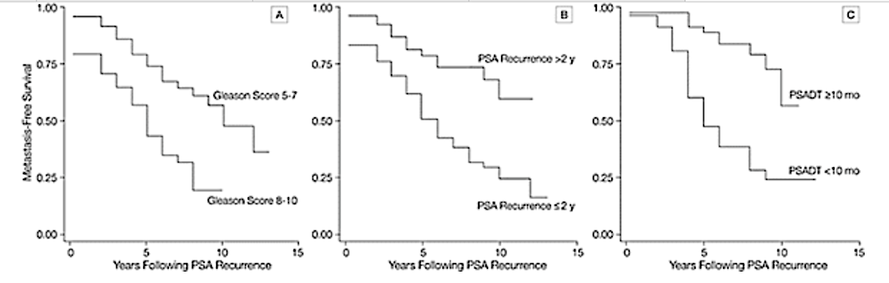
Actuarial likelihood of MFS with PSA Elevation after radical prostatectomy
A, Based on Gleason scores in the radical prostatectomy specimen (P<.001).
B, Based on years until initial biochemical recurrence (P<.001).
C, Based on prostate-specific antigen doubling time (PSADT) (P<.001).
Pound CR et al. JAMA. 1999 May 5;281(17):1591-7.

Slide 61
Patients with a Rising PSA-Importance of PSADT
Freedland SJ, et al. JAMA. 2005

Slide 62
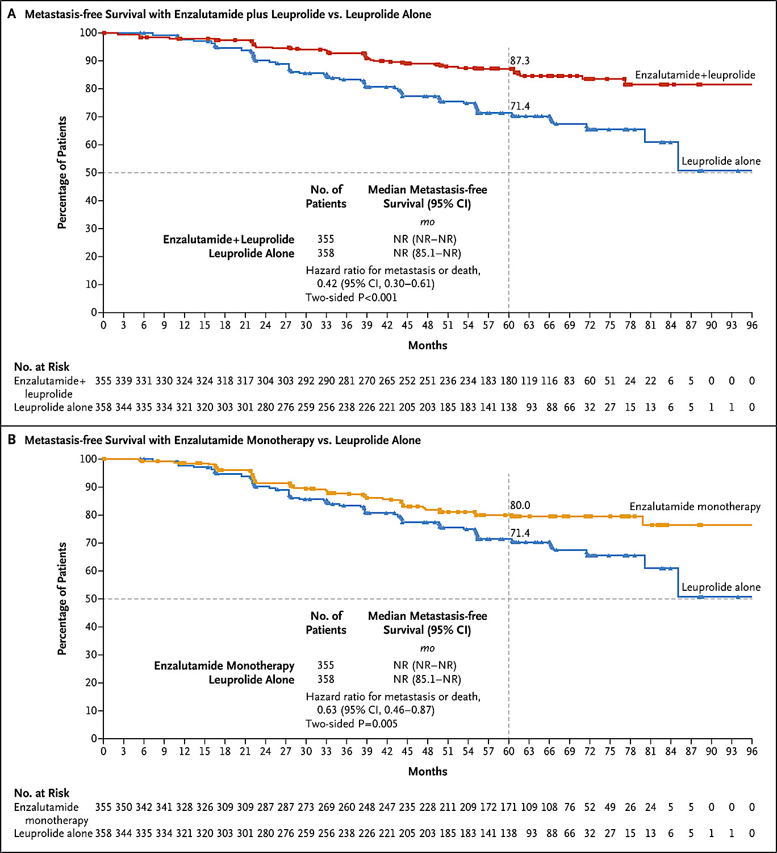
EMBARK trial
ADT vs ADT/ENZA
ADT vs ENZA monotherapy
Med f/u = 5 yr
Med PSAdt 4.9 mo
Med PSA 5.2
HR 0.42
HR 0.63
Freedland SJ et al. N Engl J Med. 2023 Oct 19;389(16):1453-1465.

Slide 63
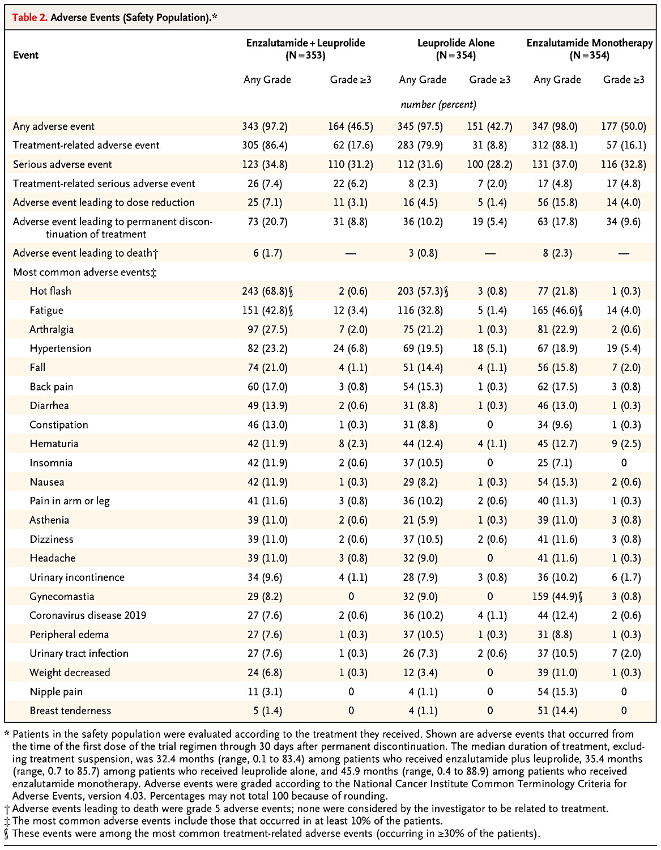
Permanent discontinuation Enza/ADT: 20%
Enza: 18%
ADT: 10%
Gynecomastia
Enza: 45%
Enza/ADT: 8%
ADT: 9%
Freedland SJ et al.
N Engl J Med. 2023 Oct 19;389(16):1453-1465.

Slide 64
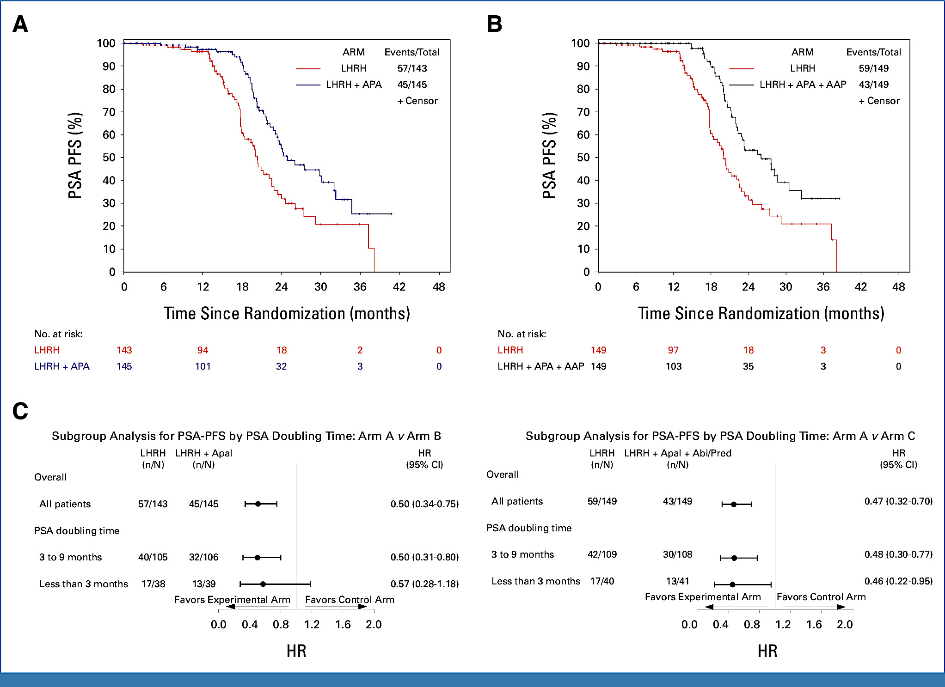
PRESTO trial
ADT vs ADT/Apa
ADT vs ADT/Apa/
Abi
PSAdt < 9 mo
PSA progression-
free end point
Aggarwal R et al. J Clin Oncol. 2024 Apr 1;42(10):1114-1123.

Slide 65
Phase III trials of ARPI in non-metastatic prostate cancer
Trial | Drug | Disease Setting | Local Rx | Key Result
STAMPEDE (g) | Abi +/- Enza | High-risk non-metastatic | RT | Pos OS and MFS, Enza no benefit
ENZARAD | Enzalutamide | High-risk localized | RT | Neg 8-year MFS
EMBARK | Enzalutamide | High-risk biochemical recurrence | Prior RP and/or RT | Pos
PROTEUS | Apalutamide | Localized high-risk/N1 | RP | Pos major path response and MFS
ATLAS | Apalutamide | Localized high-risk/N1 | RT | Pending
DASL-HiCaP | Darolutamide | Localized very high-risk | RT | MFS, Pending
ARASTEP | Darolutamide | High-risk biochemical recurrence | Prior RP and/or RT | RPFS (PET), Pending
ALADDIN (French) | Darolutamide | Localized, N1 by PET | RT | FFS, Pending

Slide 66
Summary
Benefit for ARPIs in localized, high-risk and Biochemical recurrence
ARPIs have known toxicities
When making treatment decisions need careful attention to patients baseline co-morbidities, age, goals

Slide 67
Case 2: non-metastatic biochemical recurrence
72 year old man s/p RP (age 65) and salvage RT/ADT (age 67) who has a PSA of 5 and PSAdt of 7 months. A PSMA-PET/CT = NED. He has baseline treated hypercholesterolemia and is fit. He notes that he wants to be aggressive and live as long as possible.
  What is the significance of the PSAdt?
  What treatment options are available?
  If he chooses treatment with ADT/Enzalutamide per EMBARK, how should he be followed and how long should he be treated?
  What was the average time off therapy in EMBARK for each cohort – ADT, ADT/ENZA and ENZA monotherapy?

Slide 68
For patients with a rising PSA after primary RT or RP and salvage RT, what factors would lead you to initiate systemic treatment, and which systemic treatment do you generally recommend?
PSA doubling time, absolute PSA, initial Gleason and stage — EMBARK regimen: ADT/enzalutamide
PSA doubling time < 10 months — ADT/enzalutamide
Combination of PSA level + kinetics, and PSMA PET findings. If SBRT to oligomet can be done, I use 6 months relugolix. If not, I recommend EMBARK
Gleason score, interval from completion of primary treatment to PSA failure, PSA doubling time, and PSMA PET CT findings — ADT alone or ADT/ARPI
PSMA PET findings, Decipher assay, PSA number, PSA doubling time — ADT alone or ADT/abiraterone
Absolute PSA value and PSA doubling time. I prefer to just do intermittent ADT, unless the patient is very high risk with PSA doubling <3 months. Then I would offer ADT plus enzalutamide but I would consider intermittent with breaks, if PSA reaches undetectable

Slide 69
In which situations, if any, are you recommending enzalutamide monotherapy?
History of poor tolerance of ADT, frail patients where I may even start lower-dose enzalutamide
Select rising PSA after local therapy per EMBARK
Only the patients who absolutely refuse castration
Patients who were intolerant of ADT or refuse ADT
Patient preference; those who do not like side effects
of low testosterone
Essentially never

Slide 70
In which situations do you use intermittent endocrine treatment, and how do you generally approach it?
BCR frequently is IADT, repeatedly based on PSA and tolerance. Oligomets, esp if only on PSMA PET. Some patients with more mets who are in remission
mHSPC low vol after 2 years of ADT/ARPI if NED by PSA/PET will offer
to stop all Rx and non-metastatic rising PSA after local therapy
Generally use for BCR, repeatedly. Discontinue after minimum 6 months, when PSA undetectable ideally. Resume when PSMA PET shows new activity or rapid rising PSA >1-2. For mHSPC I consider treatment holiday but when specific criteria met
Patients with lower risk of prostate cancer-specific mortality; treat for 12 months,
hard stop, restart at PSA threshold similar to the value that prompted treatment initiation; repeat holiday for those with reasonable treatment holiday
Patient preference; discontinue after undetectable PSA for 12-18 months; follow the A-DREAM approach rather than EMBARK
Biochemical recurrence. I do this repeatedly and restart with PSA level between 5 to 10

Slide 71
In which situations, if any, do you prefer relugolix?
Distance, no high copay, patient preference (AEs from degarelix)
Most situations
For intermittent therapy. Also for short course with definitive RT or salvage. For metastatic, I prefer when CV comorbidities are significant
Patients who require short-term (6 months) ADT or patients with higher CVD risk
Patient preference
In patients very, very concerned about cardiac risk
AEs = adverse events; CV = cardiovascular; CVD = CV disease

Slide 72
How would you manage mHSPC in a patient with inadequate response to ADT, an ARPI and docetaxel?
BRCA wild type Not PTEN deficient
BRCA2 mutant Not PTEN deficient
BRCA wild type PTEN deficient
Follow closely
Consider PARPi
Consider capivasertib
Restage and consider SBRT or prostate RT
Restage, only add PARPi upon clear PD
Restage, only add new therapy upon clear PD
No change
No change, would not add PARPi until PD
No change
Consider cabazitaxel + carboplatin
Consider cabazitaxel + carboplatin
Consider cabazitaxel + carboplatin
No change
Consider a PARPi
No change
No change
Add a PARPi
Consider capivasertib
PD = progressive disease

Slide 73
Agenda
Introduction: Another Perspective on the Treatment of Localized Prostate Cancer
Module 1: Nonmetastatic Disease
Module 2: Metastatic Androgen Pathway Modulation-Naïve and Androgen Pathway Modulation-Sensitive Disease

Slide 74
Updates in Metastatic HSPC
William K. Oh, MD
Director, Precision Medicine
Yale Cancer Center and Smilow Cancer Hospital
Jean and David W. Wallace Medical Director
Smilow Cancer Hospital at Greenwich Hospital
Chair, National Prostate Cancer Roundtable
American Cancer Society

Slide 75
Clinical States of Prostate Cancer
Clinically
localized
Biochemical
Recurrence
Non-metastatic,
hormone-
sensitive
Non-metastatic
CRPC
Metastatic,
hormone-sensitive
Metastatic
CRPC
Death from prostate cancer
Death from other causes
10-15 years +
Notes:
75

Slide 76
FDA- Approved Treatments in Metastatic HSPC
Multiple ADT + ARPI combinations are approved for mHSPC
allowing tailored treatment based on patient and disease characteristics
2015 2018 2019 2022 2025 2026
ADT + Docetaxel CHAARTED and STAMPEDE (Arm C)
ADT + Abiraterone
LATITUDE
ADT + Abiraterone
+ Docetaxel
PEACE-1
ADT + Darolutamide ARANOTE
ADT + Abiraterone + Niraparib AMPLITUDE
ADT + Enzalutamide
ARCHES
ADT + Darolutamide
+ Docetaxel
ARASENS
ADT + Abiraterone
+ Capivasertib
CAPItello-281
ADT + Apalutamide
TITAN
Fizazi K et al. Lancet Oncology. 2019; 20(5):686-700.; Fizazi K et al. ESMO 2021.; Chi KN et al. JCO. 2021; 39(20):2294-2303.; Andrew Armstrong, ASCO 2025; Smith MR et al. NEJM. 2022; 386:1132-1142.; Saad F et al. J Clin Oncol. 2024;42(36):4271-4281.; Gerhardt Attard, ASCO 2025; Karim Fizazi, ESMO 2025

Slide 77
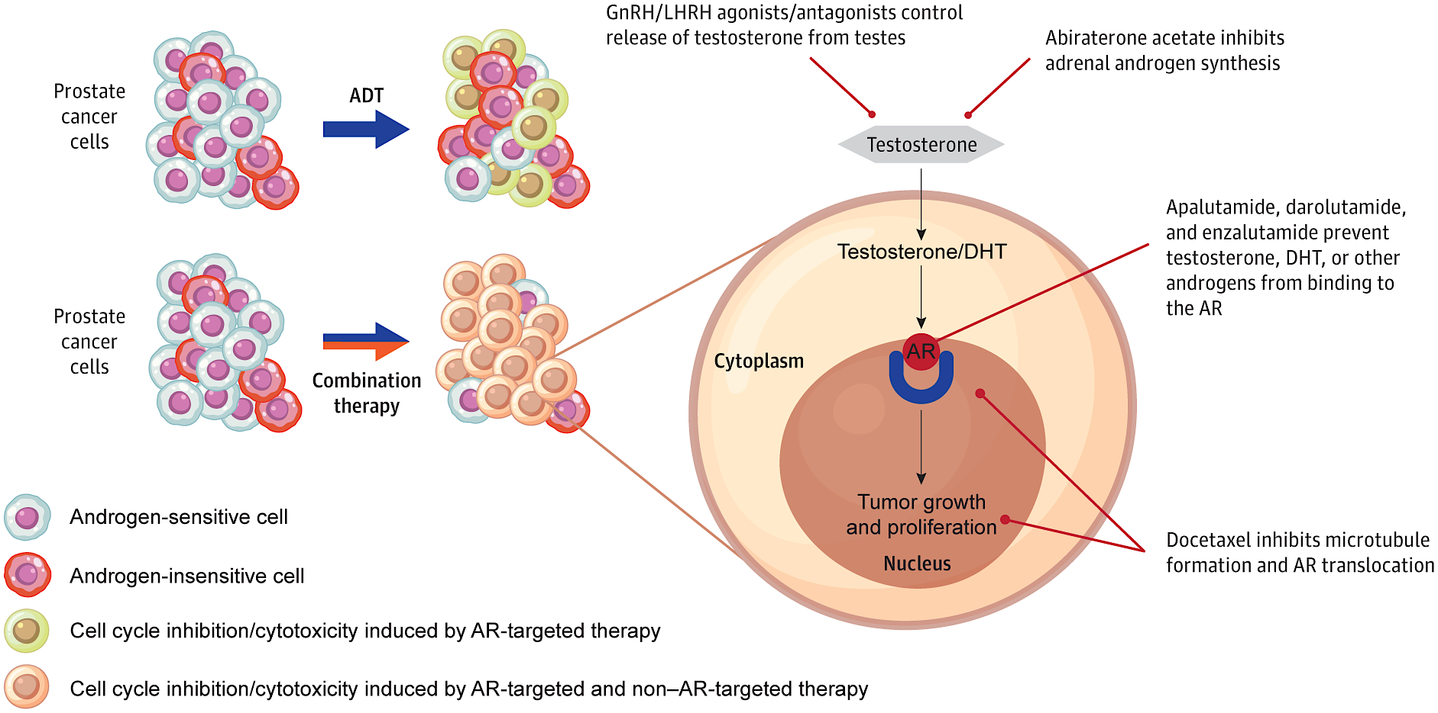
Combination Therapy Targets Tumor Heterogeneity in mHSPC
ARPI:
Abiraterone
ARPI:
Apalutamide Darolutamide
Enzalutamide
Chemo:
Docetaxel
Hussain. JAMA Onc 10:807, 2024

Slide 78
Fizazi K et al. Lancet Oncol. 2019 May;20(5):686-700.

Slide 79
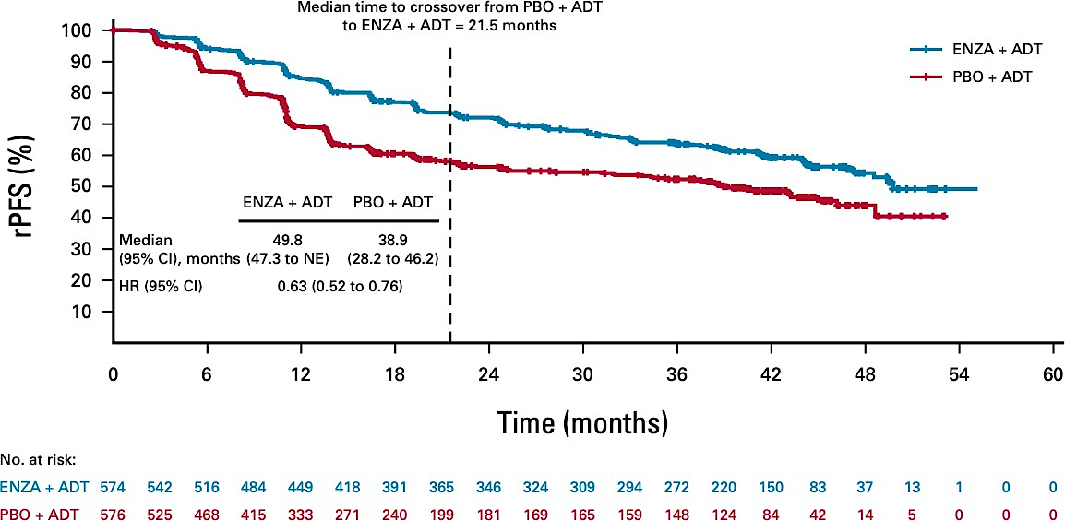
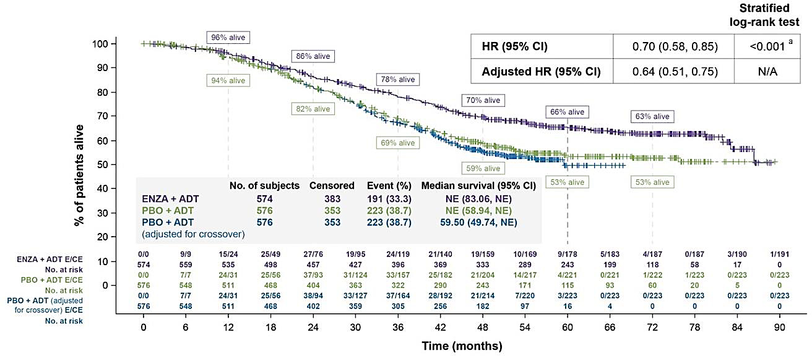
ARCHES: Key Endpoints for Enzalutamide in mHSPC
5-Year Overall Survival (Adjusted for Crossover)
Radiographic Progression Free Survival
Armstrong AJ et al. J Clin Oncol. 2022; 40:1616-1622.
Armstrong AJ et al. Eur Urol. 2026 May;89(5):396-403.

Slide 80
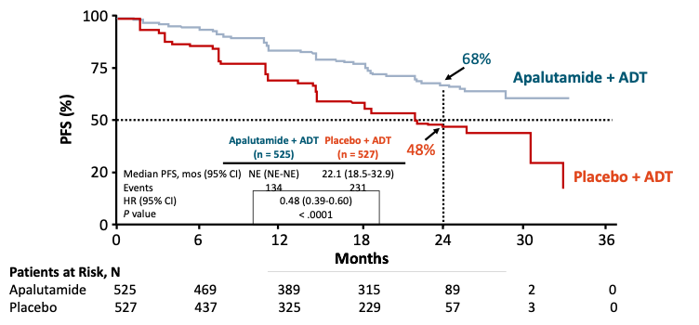
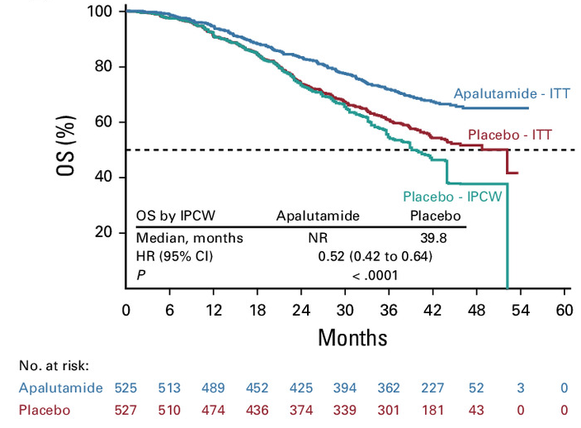
TITAN: Key Endpoints for Apalutamide in mHSPC
Overall Survival (Adjusted for Crossover)
Radiographic Progression Free Survival
Chi KN et al. JCO. 2021; 39(20):2294-2303.

Slide 81
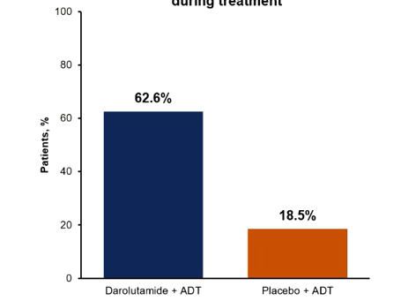
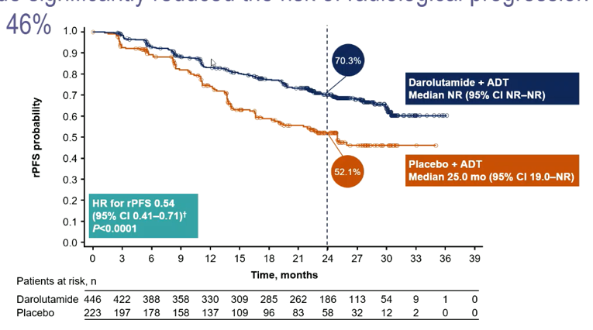
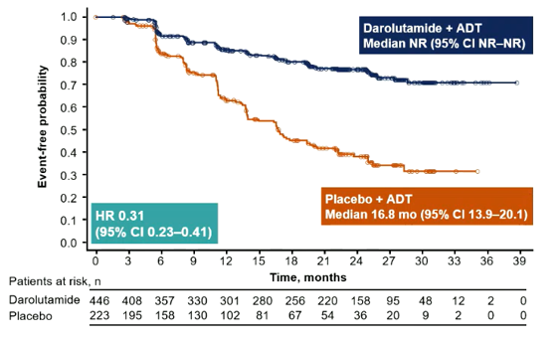
ARANOTE (Phase 3): Radiological PFS and PSA
Primary endpoint: Radiological PFS
PSA <0.2 ng/mL at any time during treatment
Time to PSA progression
Benefit of darolutamide was consistent across all subgroups
ADT, androgen-deprivation therapy.
Saad F, et al. ESMO 2024. Abstract LBA68

Slide 82
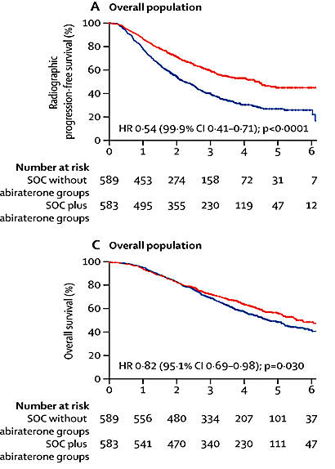
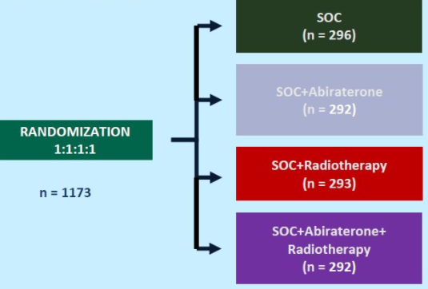
Phase 3 PEACE-1 Study (2x2):
Abiraterone + ADT + Docetaxel ± RT for mHSPC
Coprimary Endpoints (Overall Population)
Median follow-up: 3.5 y
SOC + Abi
4.5y
≥ 1 distant lesion on bone and/or CT scan), ECOG PS 0-2
SOC
2.2y
Median follow-up: 4.4 y
SOC + Abi
5.7y
SOC
4.1y
Grade 3-5 AEs (>5%, ABI vs control):
neutropenic fever (5% vs 5%), neutropenia (10% vs 9%), liver toxicity (6% vs 1%) and HTN (21% vs 13%)
Fizazi K, et al. Lancet. 2022 Apr 30;399(10336):1695-1707.

Slide 83
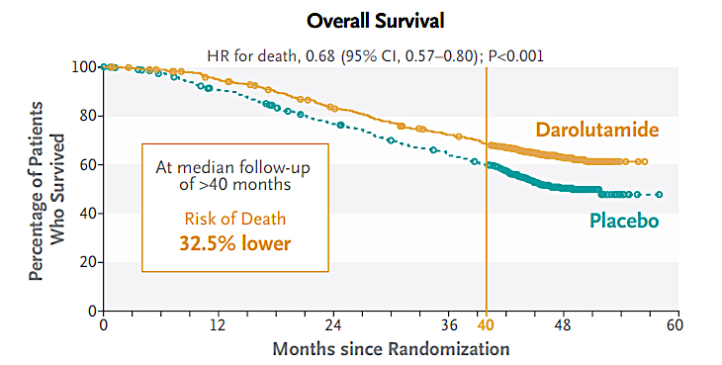
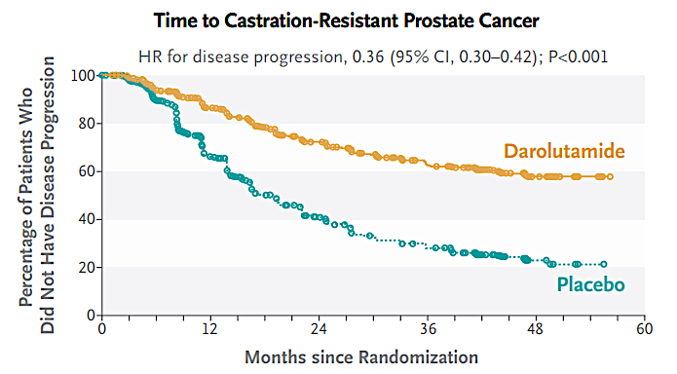
Phase 3 ARASENS Study of Darolutamide + ADT + Docetaxel for Advanced HSPC
N=1306
Primary Endpoint
mHSPC, ECOG PS 0-1, candidates for ADT and docetaxel
Safety
AE incidence: similar in the 2 groups
Incidences of most common AEs (≥ 10%) highest during overlapping docetaxel treatment period in both groups
Grade 3/4 AEs: 66.1% (daro) vs 63.5% (pbo)
  Neutropenia: 33.7% vs 34.2%
Serious AEs: 45% vs 42%
Median OS: NR daro vs 48.9 mo PBO
Smith MR, et al. N Engl J Med. 2022;386:1132-1142.

Slide 84

Metastatic Hormone Sensitive Prostate Cancer
ADT + Docetaxel
ADT + ARPI
ADT + Docetaxel + Abiraterone
ADT + Docetaxel + Darolutamide
ADT alone

Slide 85
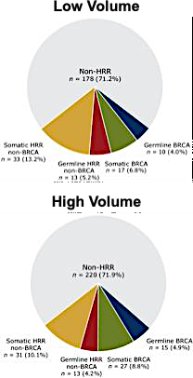
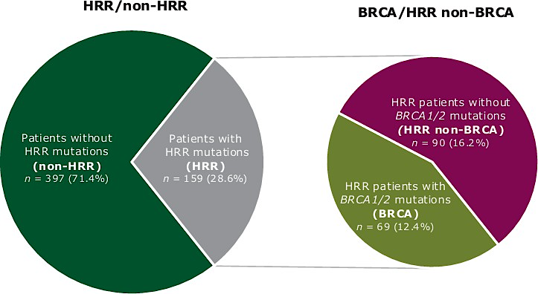
BRCA1/2 and HRR Alterations are Common in the Metastatic Hormone Sensitive Setting
Approximately one-third of mHSPC patients will present with an HRR mutation, with just under half of those patients harboring BRCA mutations; no difference in prevalence is seen in high versus low volume disease, highlighting the need to test all patients regardless of volume status
Olmos D et al. Annals of Oncology. 2025;36(10):1190-1202.

Slide 86
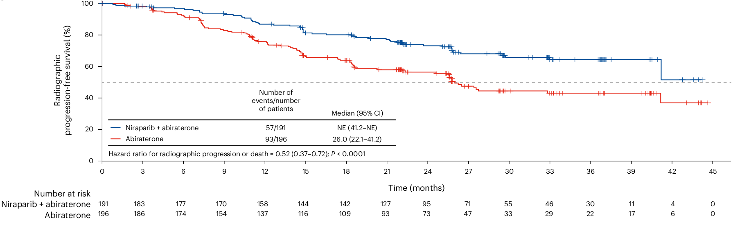
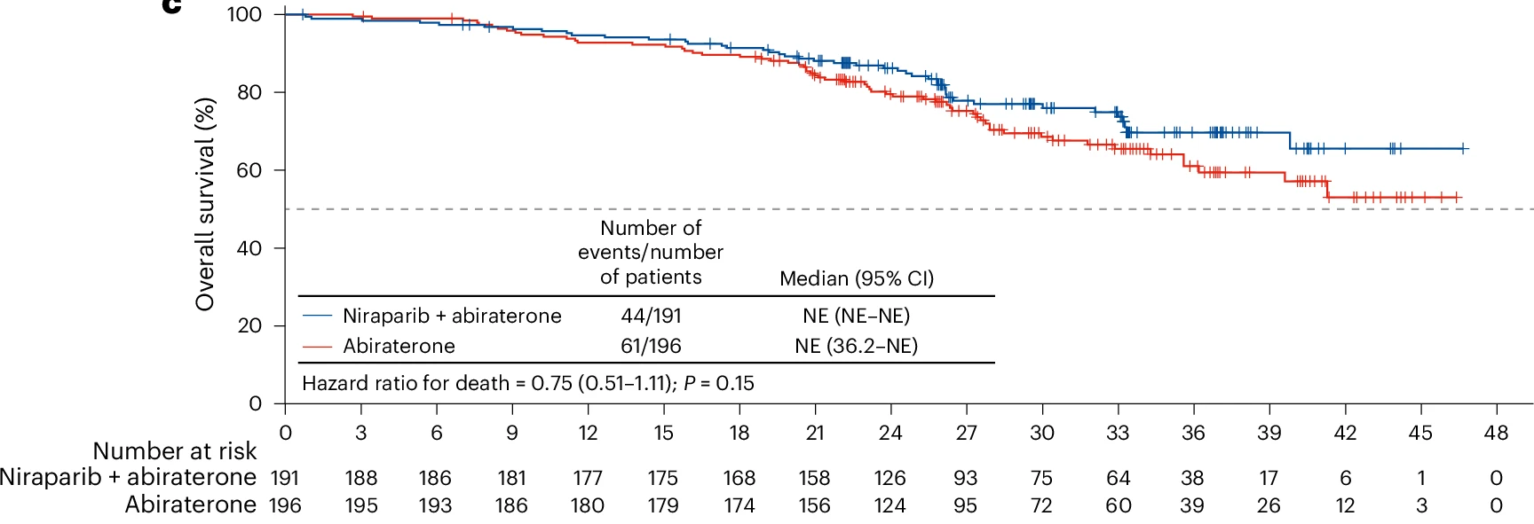
AMPLITUDE: Abiraterone +/- Niraparib, rPFS and OS in BRCA Subgroup
AMPLITUDE met the primary endpoint: Nira + AAP significantly reduced the risk of radiographic progression or death by 48% in BRCAm group (HR 0.52, 95% CI
0.37–0.72)
At the first interim analysis (~50% of total needed events) estimates show Nira + AAP reduced the risk of death by 25% in the BRCAm subgroup (HR 0.75, 95% CI 0.51–
1.11)
Attard G et al. ASCO 2025; Attard G et al. Nature. 2025;31:4109-4118.

Slide 87
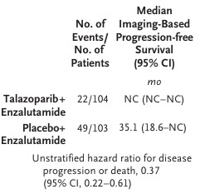
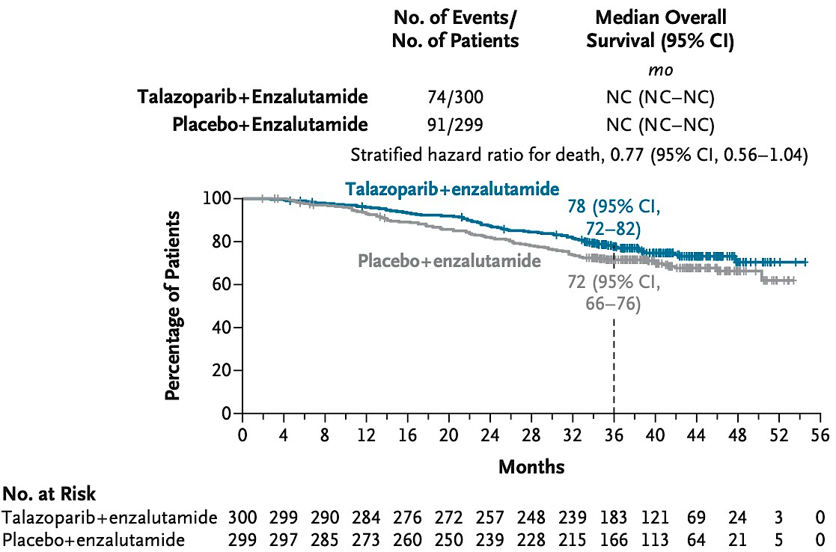
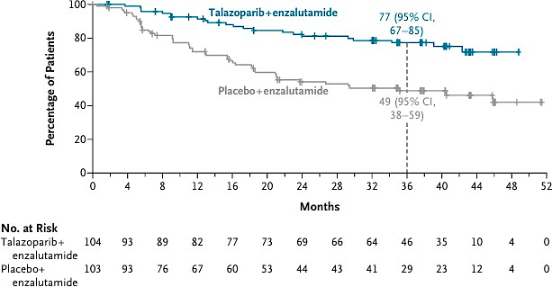
TALAPRO-3: rPFS in BRCAm and Interim OS in All Patients
rPFS in Patients with BRCA Mutations
HR 0.37 (95% CI, 0.22–0.61)
Overall Survival in All Patients
HR 0.77 (95% CI, 0.56–1.04)
Agarwal N et al. N Engl J Med. 2026 May 30;doi:10.1056/NEJMoa2604126

Slide 88
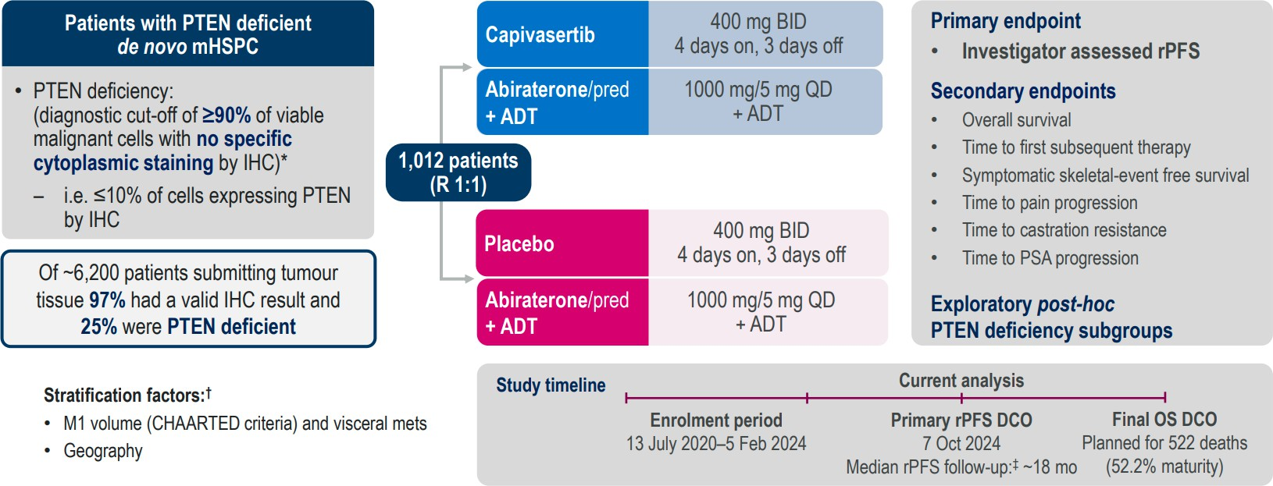
CAPItello-281: Trial Design
Karim Fizazi, ESMO 2025

Slide 89
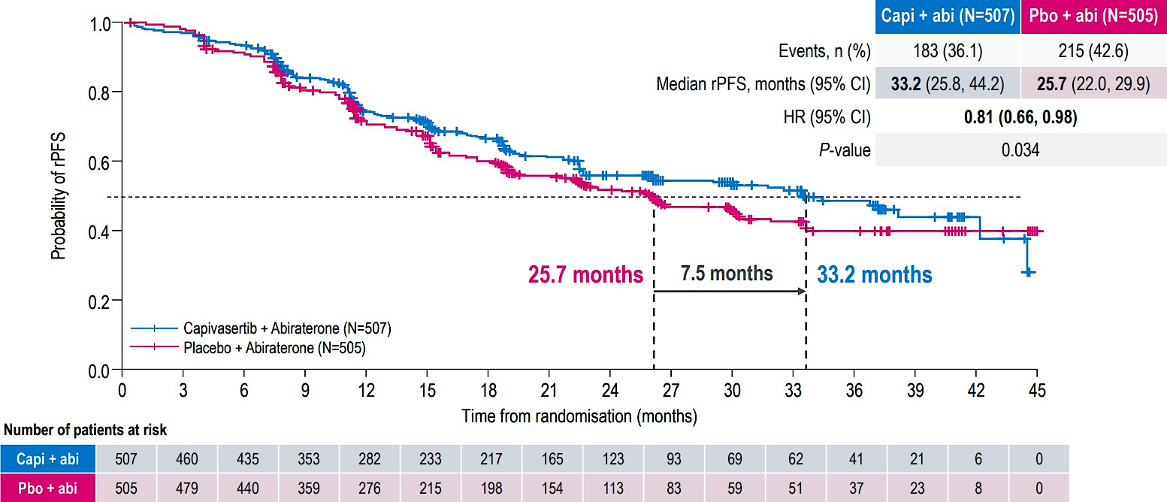
CAPItello-281: Primary Endpoint rPFS
Karim Fizazi, ESMO 2025

Slide 90
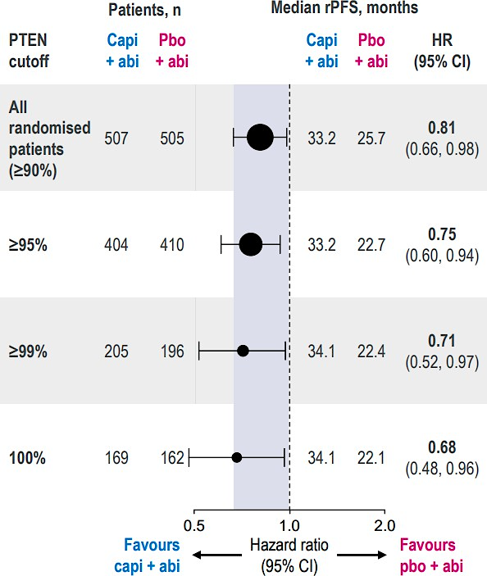
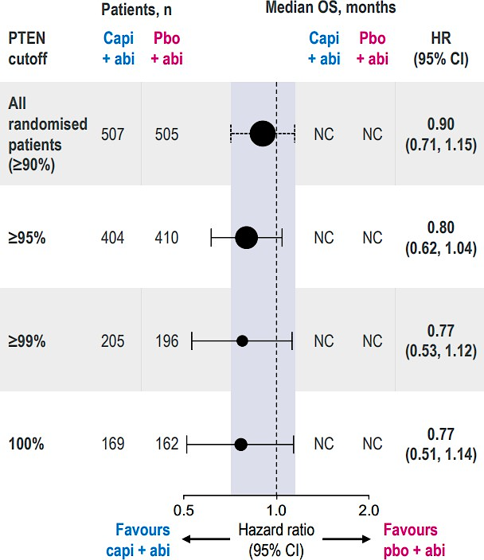
CAPItello-281: rPFS and OS by PTEN Cutoff
Radiographic PFS
Overall Survival
Karim Fizazi, ESMO 2025

Slide 91
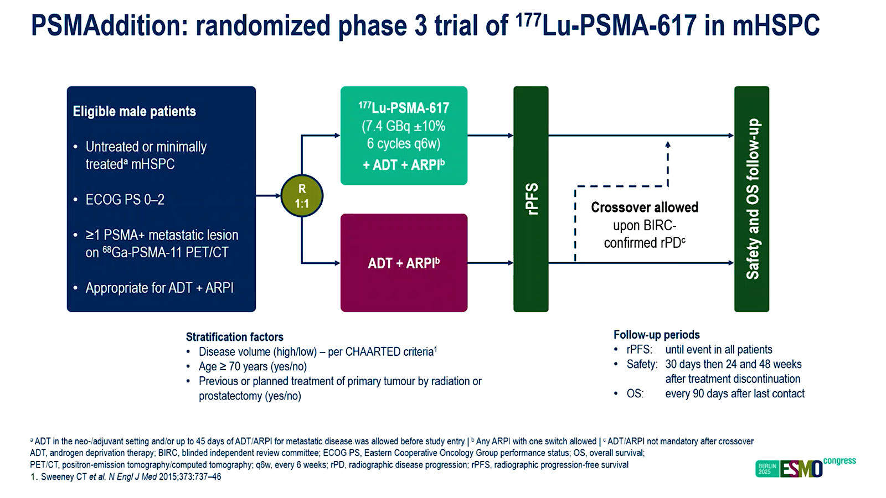
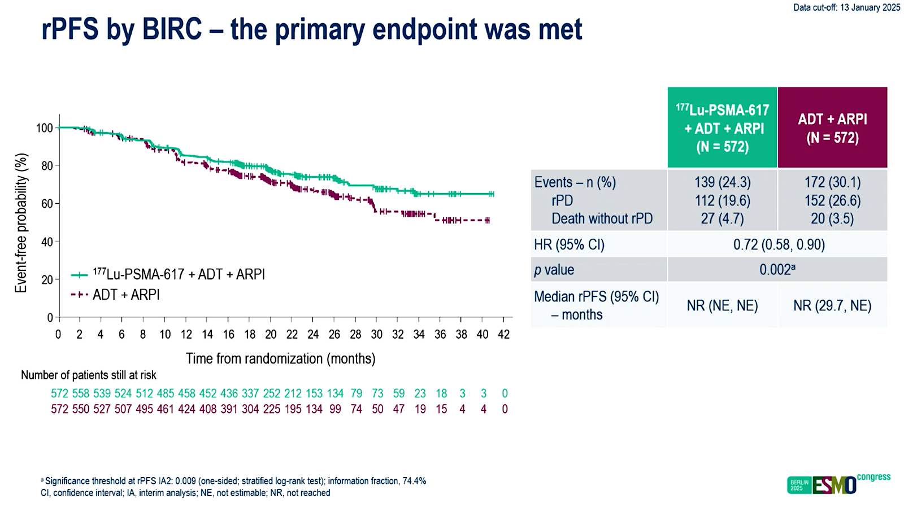
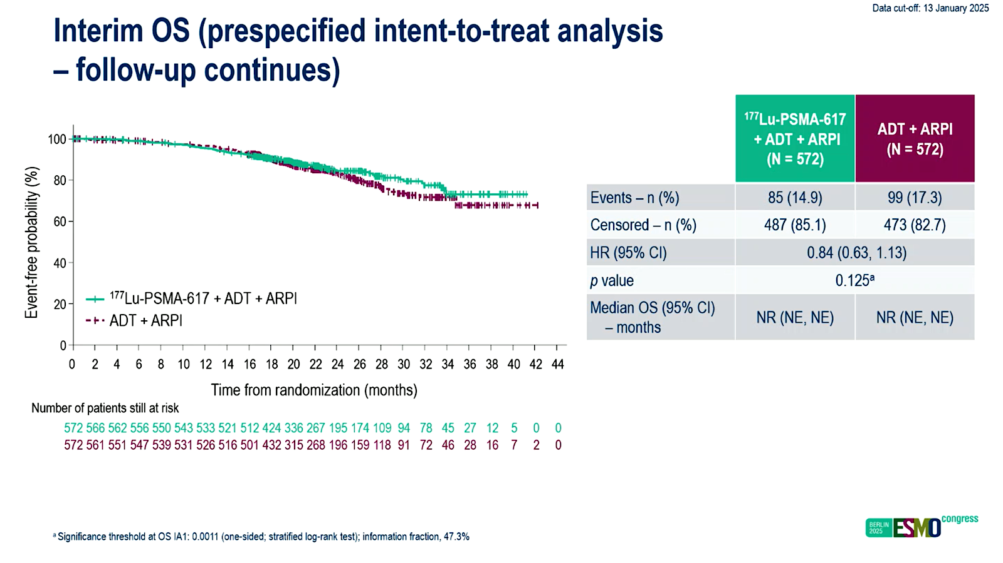
PSMAddition (Phase 3): [177Lu]Lu-PSMA-617 + ADT + ARPI for PSMA-positive metastatic HSPC
Insights
6 cycles of Lu177-PSMA in mHSPC had rPFS benefit—met primary endpoint!
Are 6 cycles too many? PSMA signal is gone
What are the long-term toxicities?
Should PSMA PET guide total # cycles?
Tagawa ST, et al. ESMO 2025. Abstract LBA6

Slide 92
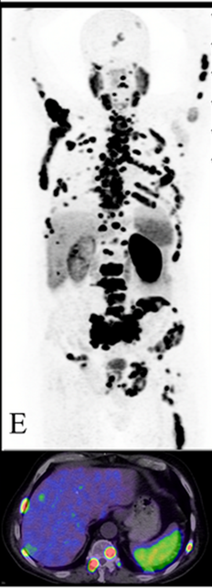
Patient 1: A 60 year old Man with Liver Mets
A 60-year-old man presents with urinary retention, fatigue and poor appetite
Initial PSA 150 ng/mL (none prior)
TRUS biopsy: adenocarcinoma of the prostate, Gleason score 8
PSMA PET/CT shows multiple metastatic bone lesions in the pelvis, spine, ribs as well as diffuse liver lesions
No family history of prostate or other cancers
Germline and somatic genetic testing is negative
PMH: HTN

Slide 93
Patient 1
Therapeutic options available were reviewed with the patient
ADT was started immediately with leuprolide
Darolutamide + docetaxel x 6 cycles was recommended given his young age and aggressive recurrence
Chemotherapy was complicated by fatigue, but he actually gained weight as his tumor regressed
His PSA responded, dropping to 0.4 after 6 months
He continues on leuprolide and darolutamide
PSA, labs and visits are conducted every 3 months

Slide 94
Patient 2: mHSPC in a healthy 82 yo
82 yo man presents to the ER with acute back and hip pain: admitted for workup and pain control
CT CAP with bone metastases but no soft tissue disease
Bone scan with widespread metastases of the spine, ribs, pelvis, and femur
No other past medical history
FH: mother died of ovarian cancer at age 65
PSA 590 ng/mL

Slide 95
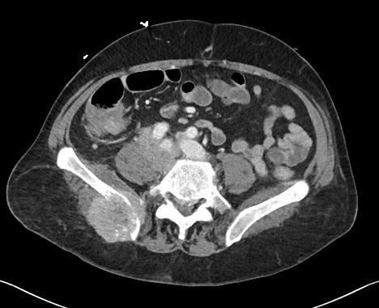
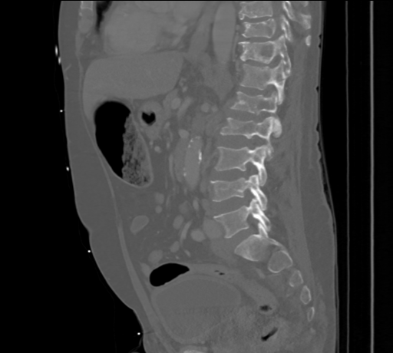
Patient 2

Slide 96
Patient 2
Biopsy of the iliac mass shows high grade adenocarcinoma, consistent with prostate primary
PSA (+), synaptophysin and chromogranin A (-)
Somatic testing shows: SPOP mutation, MSS, TMB low
Germline testing negative
He starts ADT and apalutamide and his PSA declines after 1 mo to 25 ng/ml and pain resolves
He develops an itchy maculopapular rash over arms and back
  He is prescribed topical steroids and antihistamine and his rash improves over several weeks
His PSA becomes undetectable within 4 mo and he continues on therapy after 2 years

Slide 97
65-year-old man; Presenting de novo with Gleason 8 prostate cancer; 3 minimally symptomatic bone metastases. What systemic therapy would you recommend?
BRCA wild type Not PTEN deficient
BRCA2 mutant Not PTEN deficient
BRCA wild type PTEN deficient
ADT/ARPI
ADT/ARPI ± PARPi
ADT/ARPI
ADT/ARPI
ADT/ARPI + PARPi
ADT/abiraterone + capivasertib
ADT/ARPI
ADT/enzalutamide + talazoparib
ADT/ARPI
ADT/ARPI
ADT/ARPI
ADT/ARPI
ADT/abiraterone
ADT/abiraterone
ADT/abiraterone + docetaxel
ADT/abiraterone
ADT/abiraterone + niraparib
ADT/abiraterone

Slide 98
65-year-old man; Presenting de novo with Gleason 8 prostate cancer; 6 moderately symptomatic bone metastases. What systemic therapy would you recommend?
BRCA wild type Not PTEN deficient
BRCA2 mutant Not PTEN deficient
BRCA wild type PTEN deficient
ADT/ARPI ± docetaxel
ADT/ARPI + PARPi
ADT/ARPI ± capivasertib
ADT/ARPI + docetaxel
ADT/ARPI + PARPi
ADT/abiraterone + capivasertib
ADT/ARPI + docetaxel
ADT/ARPI + PARPi
ADT/abiraterone + capivasertib
ADT/ARPI
ADT/ARPI
ADT/ARPI
ADT/abiraterone
ADT/enzalutamide + talazoparib
ADT/abiraterone
ADT/abiraterone
ADT/abiraterone + niraparib
ADT/abiraterone + capivasertib

Slide 99
65-year-old man; Presenting de novo with Gleason 8 prostate cancer; 3 bone and liver metastases. What systemic therapy would you recommend?
BRCA wild type Not PTEN deficient
BRCA2 mutant Not PTEN deficient
BRCA wild type PTEN deficient
ADT/ARPI + docetaxel
ADT/ARPI + docetaxel (consider adding PARPi)
ADT/ARPI + docetaxel (consider adding capi)
ADT/ARPI + docetaxel
ADT/ARPI + docetaxel (consider adding carbo)
ADT/ARPI + docetaxel (consider adding carbo)
ADT/ARPI + docetaxel
ADT/enzalutamide + talazoparib
ADT/abiraterone + (capivasertib or docetaxel)
ADT/darolutamide + docetaxel
ADT/darolutamide + docetaxel
ADT/darolutamide + docetaxel
ADT/abiraterone + docetaxel
ADT/abiraterone + docetaxel
ADT/abiraterone
ADT/darolutamide + docetaxel
ADT/abiraterone + niraparib
ADT/darolutamide + docetaxel

Slide 100
How do you manage non-oligometastatic disease observed on PSMA PET only?
Treat similar to conventional imaging
SBRT ± ADT or ADT/ARPI
ADT/enzalutamide for 9 months/intermittent (EMBARK)
Treat as metastatic disease
ADT, preferentially intermittent if there is nothing on conventional imaging

Slide 101
Is there a patient age at which you generally withhold the use of abiraterone?
75 years
About 75 years
I prefer AR antagonist for >75 years but will use abiraterone in patients >75 when appropriate
I prefer darolutamide (or enzalutamide) for all age groups
80 years
No

Slide 102
In which situations, if any, do you order a bone scan for patients with prostate cancer?
Rarely to never
I do not order bone scans outside a clinical trial
When insurance requires, when considering radium-223, or for equivocal PET findings with high suspicion
Screening for radium-223, or if required for a clinical trial
Clinical trials
Right now, I’m still doing bone scan most of the time, unless I have a negative PSMA PET. Then it isn’t needed

Slide 103
What are your usual criteria for using ADT with docetaxel and darolutamide for patients with metastatic hormone-sensitive prostate cancer (mHSPC)?
Fit for chemo, high Gleason, extensive/symptomatic mets, liver mets
High volume, more than 4 metastases
De novo presentation, high volume. Or symptomatic bone mets or high-risk features but not technically high volume
De novo metastatic disease with ‘high volume’ or other criteria
(ie tumor suppressor gene loss) consistent with particularly poor
expected cancer-specific survival. Also age and comorbidities
High volume, chemo fit, not an abiraterone candidate
De novo and high volume disease by CHAARTED criteria

Slide 104
Do you use the Decipher Prostate genomic classifier assay in deciding when to administer docetaxel for patients with mHSPC?
Yes
Not yet, but probably will
No
No
Yes
No

Slide 105
The Implications of Recent Datasets for the Current and Future Management of Breast Cancer — An ASCO 2026 Review
A CME/MOC-Accredited Live Webinar
Thursday, July 30, 2026
5:00 PM – 6:30 PM ET
Faculty
Aditya Bardia, MD, MPH
Kevin Kalinsky, MD, MS, FASCO
Joyce O’Shaughnessy, MD
Moderator
Neil Love, MD

Slide 106
Thank you for joining us!
Please take a moment to complete the survey currently up on Zoom. Your feedback is very important to us.
The survey will remain open for
5 minutes after the meeting ends.
Information on how to obtain CME, ABIM MOC and ABS credit is provided in the Zoom chat room.
Attendees will also receive an email in 1 to 3 business days with these instructions.

