Slide 1
Data + Perspectives: Investigators
Discuss the Optimal Management of
Relapsed/Refractory Multiple Myeloma
A CME-Accredited Satellite Symposium During the
Society of Hematologic Oncology 2026 Annual Meeting
Wednesday, September 9, 2026
11:56 AM – 12:56 PM
Faculty
Meletios-Athanasios (Thanos) C Dimopoulos, MD
Noopur Raje, MD
Moderator
Robert Z Orlowski, MD, PhD

Slide 2
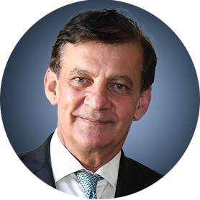
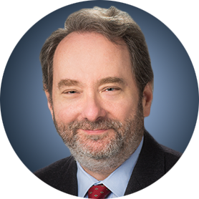

Faculty
Meletios-Athanasios (Thanos) C Dimopoulos, MD
Professor and Chairman
Plasma Cell Dyscrasias Unit
Section of Hematology and Medical Oncology
Department of Clinical Therapeutics
School of Medicine
National and Kapodistrian University of Athens
Alexandra Hospital
Athens, Greece
Moderator
Robert Z Orlowski, MD, PhD
Florence Maude Thomas Cancer Research Professor
Department of Lymphoma and Myeloma
Professor, Department of Experimental Therapeutics
Vice Chair, Myeloma Translational Research
Division of Cancer Medicine
The University of Texas MD Anderson Cancer Center
Houston, Texas
Noopur Raje, MD
Director, Center for Multiple Myeloma and Plasma Cell Disorders
Mass General Brigham Cancer Institute
Rita Kelley Chair in Oncology
Professor of Medicine
Harvard Medical School
Boston, Massachusetts

Slide 3
Prof Dimopoulos — Disclosures
Faculty
Advisory Committees and Consulting Agreements | Amgen Inc, AstraZeneca Pharmaceuticals LP, BeOne, Bristol Myers Squibb, GSK, Janssen Biotech Inc, Menarini Group, Regeneron Pharmaceuticals Inc, Sanofi, Swixx Biopharma, Takeda Pharmaceutical Company Limited

Slide 4
Dr Raje — Disclosures
Faculty
Advisory Boards and Consulting Agreements | AbbVie Inc, Bristol Myers Squibb, Caribou Biosciences Inc, GSK, Immuneel Therapeutics, Johnson & Johnson, Kelonia Therapeutics, Pfizer Inc, Sanofi
Contracted Research | Pfizer Inc
Data and Safety MonitoringBoards/ Committees | Bristol Myers Squibb

Slide 5
Dr Orlowski — Disclosures
Moderator
Advisory Committees and Consulting Agreements | AbbVie Inc, Adaptive Biotechnologies Corporation, Asylia Therapeutics Inc, Biotheryx, Bristol Myers Squibb, DEM BioPharma, GSK, IASO Bio, Karyopharm Therapeutics, Lytica Therapeutics, Meridian Therapeutics, Monte Rosa Therapeutics, MYELOMA360, Neurogene Inc, Oncopeptides, Pfizer Inc, Regeneron Pharmaceuticals Inc, Sanofi, Sporos Bioventures, Takeda Pharmaceuticals USA Inc
Contracted Research | Asylia Therapeutics Inc, Biotheryx, Heidelberg Pharma, Regeneron Pharmaceuticals Inc
Data and Safety Monitoring Boards/Committees | Sanofi

Slide 6
Research To Practice President Neil Love, MD — Disclosures
Dr Love is president and CEO of Research To Practice. Research To Practice receives funds in the form of educational grants to develop CME activities from the following companies: Aadi Bioscience, AbbVie Inc, ADC Therapeutics, Agendia Inc, Alexion Pharmaceuticals, Amgen Inc, Array BioPharma Inc, a subsidiary of Pfizer Inc, Arvinas, Astellas, AstraZeneca Pharmaceuticals LP, Aveo Pharmaceuticals, Bayer HealthCare Pharmaceuticals, BeOne, Biotheranostics Inc, A Hologic Company, Black Diamond Therapeutics Inc, Blueprint Medicines, Boehringer Ingelheim Pharmaceuticals Inc, Bristol Myers Squibb, Catalyst Pharmaceuticals Inc, Celcuity, Clovis Oncology, Coherus BioSciences, Corcept Therapeutics Inc, CTI BioPharma, a Sobi Company, Daiichi Sankyo Inc, Eisai Inc, Elevation Oncology Inc, Exact Sciences Corporation, Exelixis Inc, Genentech, a member of the Roche Group, Genmab US Inc, Geron Corporation, Gilead Sciences Inc, GSK, Helsinn Therapeutics (US) Inc, ImmunoGen Inc, Incyte Corporation, Ipsen Biopharmaceuticals Inc, Jazz Pharmaceuticals Inc, Johnson & Johnson, Karyopharm Therapeutics, Kite, A Gilead Company, Kura Oncology, Legend Biotech, Lilly, MEI Pharma Inc, Merck, Mersana Therapeutics Inc, Mirati Therapeutics Inc, Mural Oncology Inc, Natera Inc, Novartis, Novartis Pharmaceuticals Corporation on behalf of Advanced Accelerator Applications, Novocure Inc, Nuvalent, Nuvation Bio Inc, Pfizer Inc, Pharmacyclics LLC, an AbbVie Company, Puma Biotechnology Inc, Regeneron Pharmaceuticals Inc, Revolution Medicines Inc, Rigel Pharmaceuticals Inc, R-Pharm US, Sanofi, Seagen Inc, Servier Pharmaceuticals LLC, SpringWorks Therapeutics Inc, Stemline Therapeutics Inc, Sumitomo Pharma America, Summit Therapeutics, Syndax Pharmaceuticals, Taiho Oncology Inc, Takeda Pharmaceuticals USA Inc, TerSera Therapeutics LLC, Tesaro, A GSK Company, and Verastem Inc.

Slide 7
Commercial Support
This activity is supported by educational grants from Bristol Myers Squibb, Genentech, a member of the Roche Group, and GSK.
Research To Practice CME Planning Committee Members,
Staff and Reviewers
Planners, scientific staff and independent reviewers for Research To Practice have no relevant financial relationships to disclose.

Slide 8
This educational activity contains discussion of
non-FDA-approved uses of agents and regimens. Please refer to official prescribing information for each product for approved indications.

Slide 9
Have a Case or Question for the Faculty?
In-Person Attendees: Download our RTPLive app or email DrNeilLove@ResearchToPractice.com to submit challenging cases or questions for discussion. Links for instructions on how to download the app are included on the back cover of the program syllabus.
Virtual/Zoom Attendees: Submit challenging cases or questions for discussion using the Zoom chat room.
The program moderator will address as many cases or questions as possible with the faculty panel during the program.

Slide 10

Download Program Slides Here
https://asset.researchtopractice.com/
2026/Webinar/SOHO/RR_MM_Sep9.pdf
Slides are also available on our RTPLive app.
For Zoom attendees, the slides link is posted in the chat room.

Slide 11
About the Enduring Program
The live meeting is being video
and audio recorded.
The proceedings from today will
be edited and developed into
an enduring web-based program.
An email will be sent to all attendees
when the activity is available.
To learn more about our education programs, visit our website, www.ResearchToPractice.com
Notes:
11
11

Slide 12
Data + Perspectives: Investigators
Discuss the Optimal Management of
Relapsed/Refractory Multiple Myeloma
A CME-Accredited Satellite Symposium During the
Society of Hematologic Oncology 2026 Annual Meeting
Wednesday, September 9, 2026
11:56 AM – 12:56 PM
Faculty
Meletios-Athanasios (Thanos) C Dimopoulos, MD
Noopur Raje, MD
Moderator
Robert Z Orlowski, MD, PhD

Slide 13
Agenda
Module 1 – New and Emerging Strategies with Bispecific Antibodies in Multiple Myeloma (MM) – Dr Raje
Module 2 – Utility of Antibody-Drug Conjugates for Relapsed/Refractory (R/R) MM – Dr Orlowski
Module 3 – Potential Role of Cereblon E3 Ligase Modulators
and Other Promising Novel Agents and Strategies for R/R MM –
Prof Dimopoulos

Slide 14
Agenda
Module 1 – New and Emerging Strategies with Bispecific Antibodies in Multiple Myeloma (MM) – Dr Raje
Module 2 – Utility of Antibody-Drug Conjugates for Relapsed/Refractory (R/R) MM – Dr Orlowski
Module 3 – Potential Role of Cereblon E3 Ligase Modulators
and Other Promising Novel Agents and Strategies for R/R MM –
Prof Dimopoulos

Slide 15

New and Emerging Strategies with Bispecific Antibodies in Multiple Myeloma
Noopur Raje, MD
Center for Multiple Myeloma
MGH Cancer Center
Professor of Medicine
Harvard Medical School

Slide 16
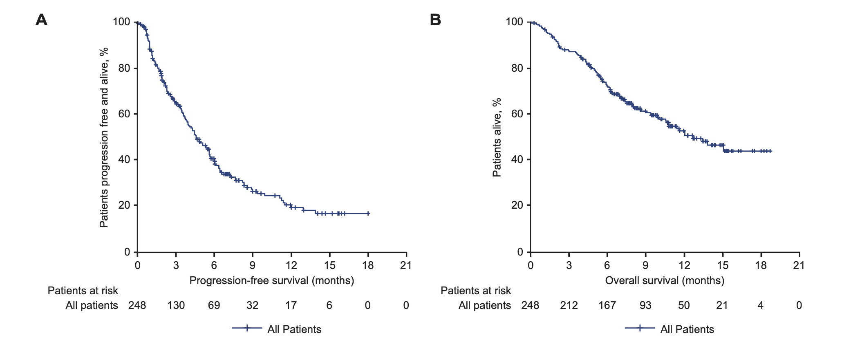
Triple-class-exposed disease has historically had poor outcomes
LocoMMotion: prospective study of real life standard of care of triple-class exposed RRMM patients
Proteasome inhibitor, immunomodulatory drug, anti-CD38 monoclonal antibody
Data cut off: May 2021
PFS 4.6 months
OS 12.4 months
Mateos MV et al, Leukemia 2022

Slide 17
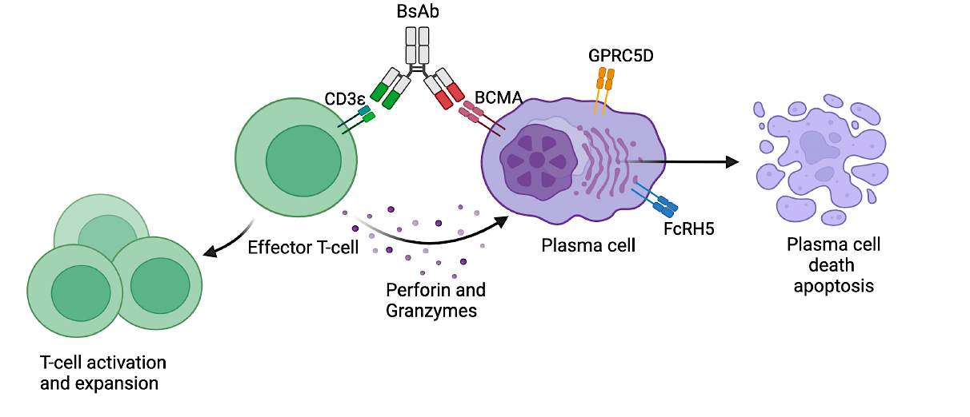
Bispecific Antibody Targets and Mechanism of Action
 | BCMA | GPRC5D | FcRH5
Expression | Plasma cells, Plasmablasts | Plasma cells, hair follicle, eccrine glands, filiform papillae of tongue | B-cell lineage cells including plasma cells
Biologic Significance | Survival/growth of plasma cells | Unclear | Unclear
Location | 16p13 | 12p13 | 1q21
Extracellular Shedding? | Yes | No | Yes
Reese et al, Frontiers in Immunology, 2024; Yu et al, Journal of Hematology & Oncology; Rodriguez-Otero et al, Blood Cancer Journal, 2024; Li et al, Cancer Cell, 2017;
Ise et al, Leukemia 2007

Slide 18
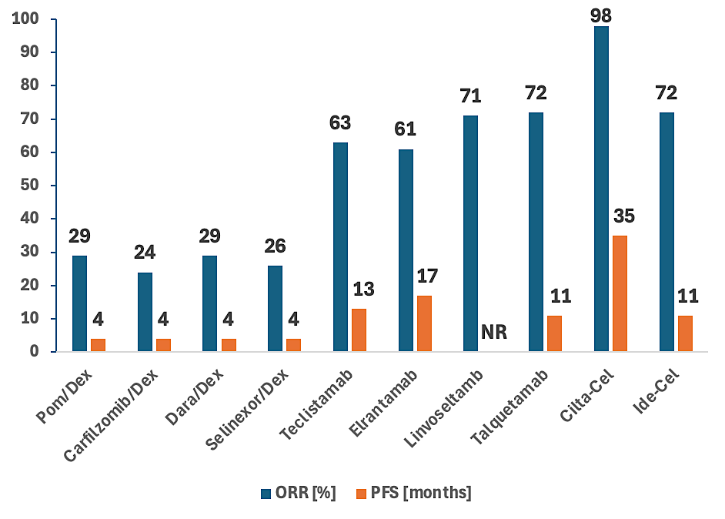
PFS and ORR of Recently Approved
Myeloma Drugs in RRMM
Elranatamab
San Miguel et al, Lancet Oncology, 2013; Siegel et al, Blood, 2012; Lonial et al, Lancet, 2016; Chari et al, NEJM 2019; Moreau et al, NEJM, 2022; Lesokhin et al, Nature Medicine, 2023; Bumma et al, JCO, 2024; Chari et al, NEJM, 2022; Berdeja et al, Lancet, 2021; Munshi et al, NEJM, 2021

Slide 19
Moving anti-BCMA bispecific antibody monotherapy to earlier lines of therapy

Slide 20
MajesTEC-9 Study Design
1-3 prior lines of therapy, including lenalidomide and anti-CD38 antibody therapy
Teclistamab
R
Pomalidomide
Bortezomib
Dexamethasone
N = 614
Carfilzomib
Dexamethasone
or
Primary endpoint: PFS
Touzeau C et al. N Engl J Med 2026;395:440-53.

Slide 21
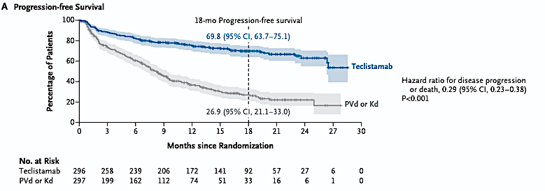
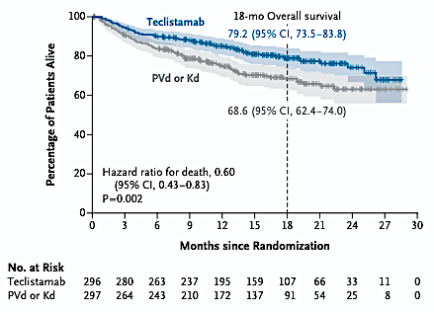
MajesTEC-9: Teclistamab in Multiple Myeloma with One to Three Previous Lines of Therapy
Touzeau C et al. N Engl J Med 2026;395:440-53.

Slide 22
Randomized phase III studies of anti-BCMA bispecific antibody in progress in relapsed myeloma
MagnetisMM-5
LINKER-MM3
CERVINO
Etentamig
Elranatamab
Linvoseltamab
R
Carfilzomib
Dexamethasone
R
Elotuzumab
Pomalidomide
Dexamethasone
R
Elranatamab
Daratumumab
~300 patients
Elotuzumab
Pomalidomide
Dexamethasone
555 patients
Daratumumab
Pomalidomide
Dexamethasone
380 patients
Selinexor
Bortezomib
Dexamethasone
Primary endpoint: PFS
Primary endpoint: PFS
Primary endpoints: PFS and ORR
1-4 prior lines of therapy, including lenalidomide and PI
Prior anti-CD38 allowed if > 6 months
1-4 prior lines of therapy, including lenalidomide and PI
Prior anti-CD38 antibody allowed
Patients in the EU and the UK must have had 2-4 prior lines of therapy, including an anti-CD38 antibody
≥ 2 prior lines of therapy, including lenalidomide, PI, and anti-CD38 antibody
Grosicki S et al., ASCO 2022; Weisel K et al., IMS 2023; Costa LJ et al., IMS 2024

Slide 23
Elranatamab Significantly Improves Progression-Free Survival for Double-Class Exposed Patients with Relapsed or Refractory MM
Press Release: April 29, 2026
“[The manufacturer] announced positive topline results from the Phase 3 MagnetisMM-5 study evaluating elranatamab as monotherapy in adults with relapsed or refractory multiple myeloma (RRMM) who received at least one prior line of treatment.
The study demonstrated a statistically significant and clinically meaningful improvement in the primary endpoint of progression‑free survival (PFS), as assessed by blinded independent central review (BICR), versus standard-of-care daratumumab plus pomalidomide and dexamethasone (DPd). The safety and tolerability of elranatamab was consistent with its known safety profile.
The PFS results exceeded the pre-specified interim analysis target hazard ratio for efficacy, with most elranatamab-treated patients remaining progression-free. The trial remains ongoing to assess overall survival, a key secondary endpoint, which was not yet mature at the time of this interim analysis. These data will be discussed with global health authorities, and detailed results from MagnetisMM-5 will be submitted for presentation at a future medical congress.”
https://www.pfizer.com/news/press-release/press-release-detail/pfizers-elrexfio-significantly-improves-progression-free

Slide 24
Positive Topline Results from the Phase III CERVINO Trial of Etentamig versus Standard Available Therapies (SAT) for Triple-Class Exposed Relapsed/Refractory Multiple Myeloma
Press Release: September 3, 2026
“The study met its dual primary endpoints of objective response rate (ORR) and progression-free survival (PFS). Full results will be presented in a plenary session at the 23rd International Myeloma Society Annual Meeting, taking place September 23-26, 2026, in Glasgow, Scotland. At the data cutoff, the Phase 3 CERVINO trial included 393 patients who had received a median of three prior lines of therapy. At the median follow-up of 11.4 months, etentamig demonstrated statistically significant and clinically meaningful efficacy with a manageable safety profile:
Significantly higher ORR with etentamig vs. SAT (74.0% [95% CI, 67.25–79.97] vs. 45.7% [95% CI, 38.59–52.91]; P<0.0001).
Significantly improved PFS with etentamig vs. SAT (HR, 0.40; 95% CI, 0.29–0.54; P<0.0001). The PFS benefit was observed across all pre-specified subgroups evaluated.
12-month overall survival (OS) was 87.9% for etentamig vs. 72.0% for SAT (HR, 0.48; 95% CI: 0.29–0.77; nominal P=0.0012); prespecified efficacy boundary for OS was not crossed at data cutoff.
This was the first planned efficacy interim analysis of the CERVINO study and, based on the significant benefit, the Independent Data Monitoring Committee (IDMC) recommended unblinding the study.”
https://news.abbvie.com/2026-09-03-AbbVie-Announces-Positive-Topline-Results-from-the-Phase-3-CERVINO-Trial-Showing-Etentamig-Significantly-Improved-Response-Rate-and-Progression-Free-Survival-in-Patients-with-Relapsed-Refractory-Multiple-Myeloma

Slide 25
Combining bispecific antibodies with other systemic therapies

Slide 26
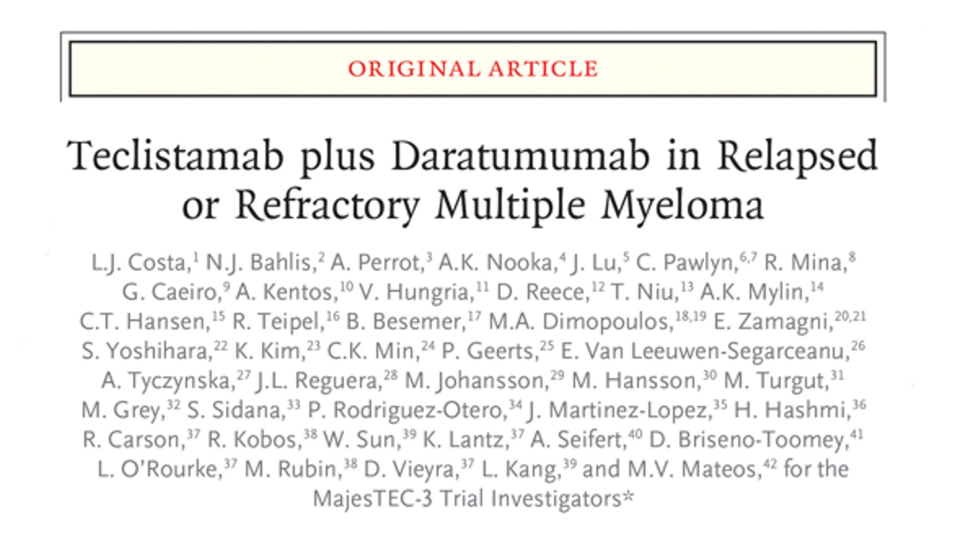
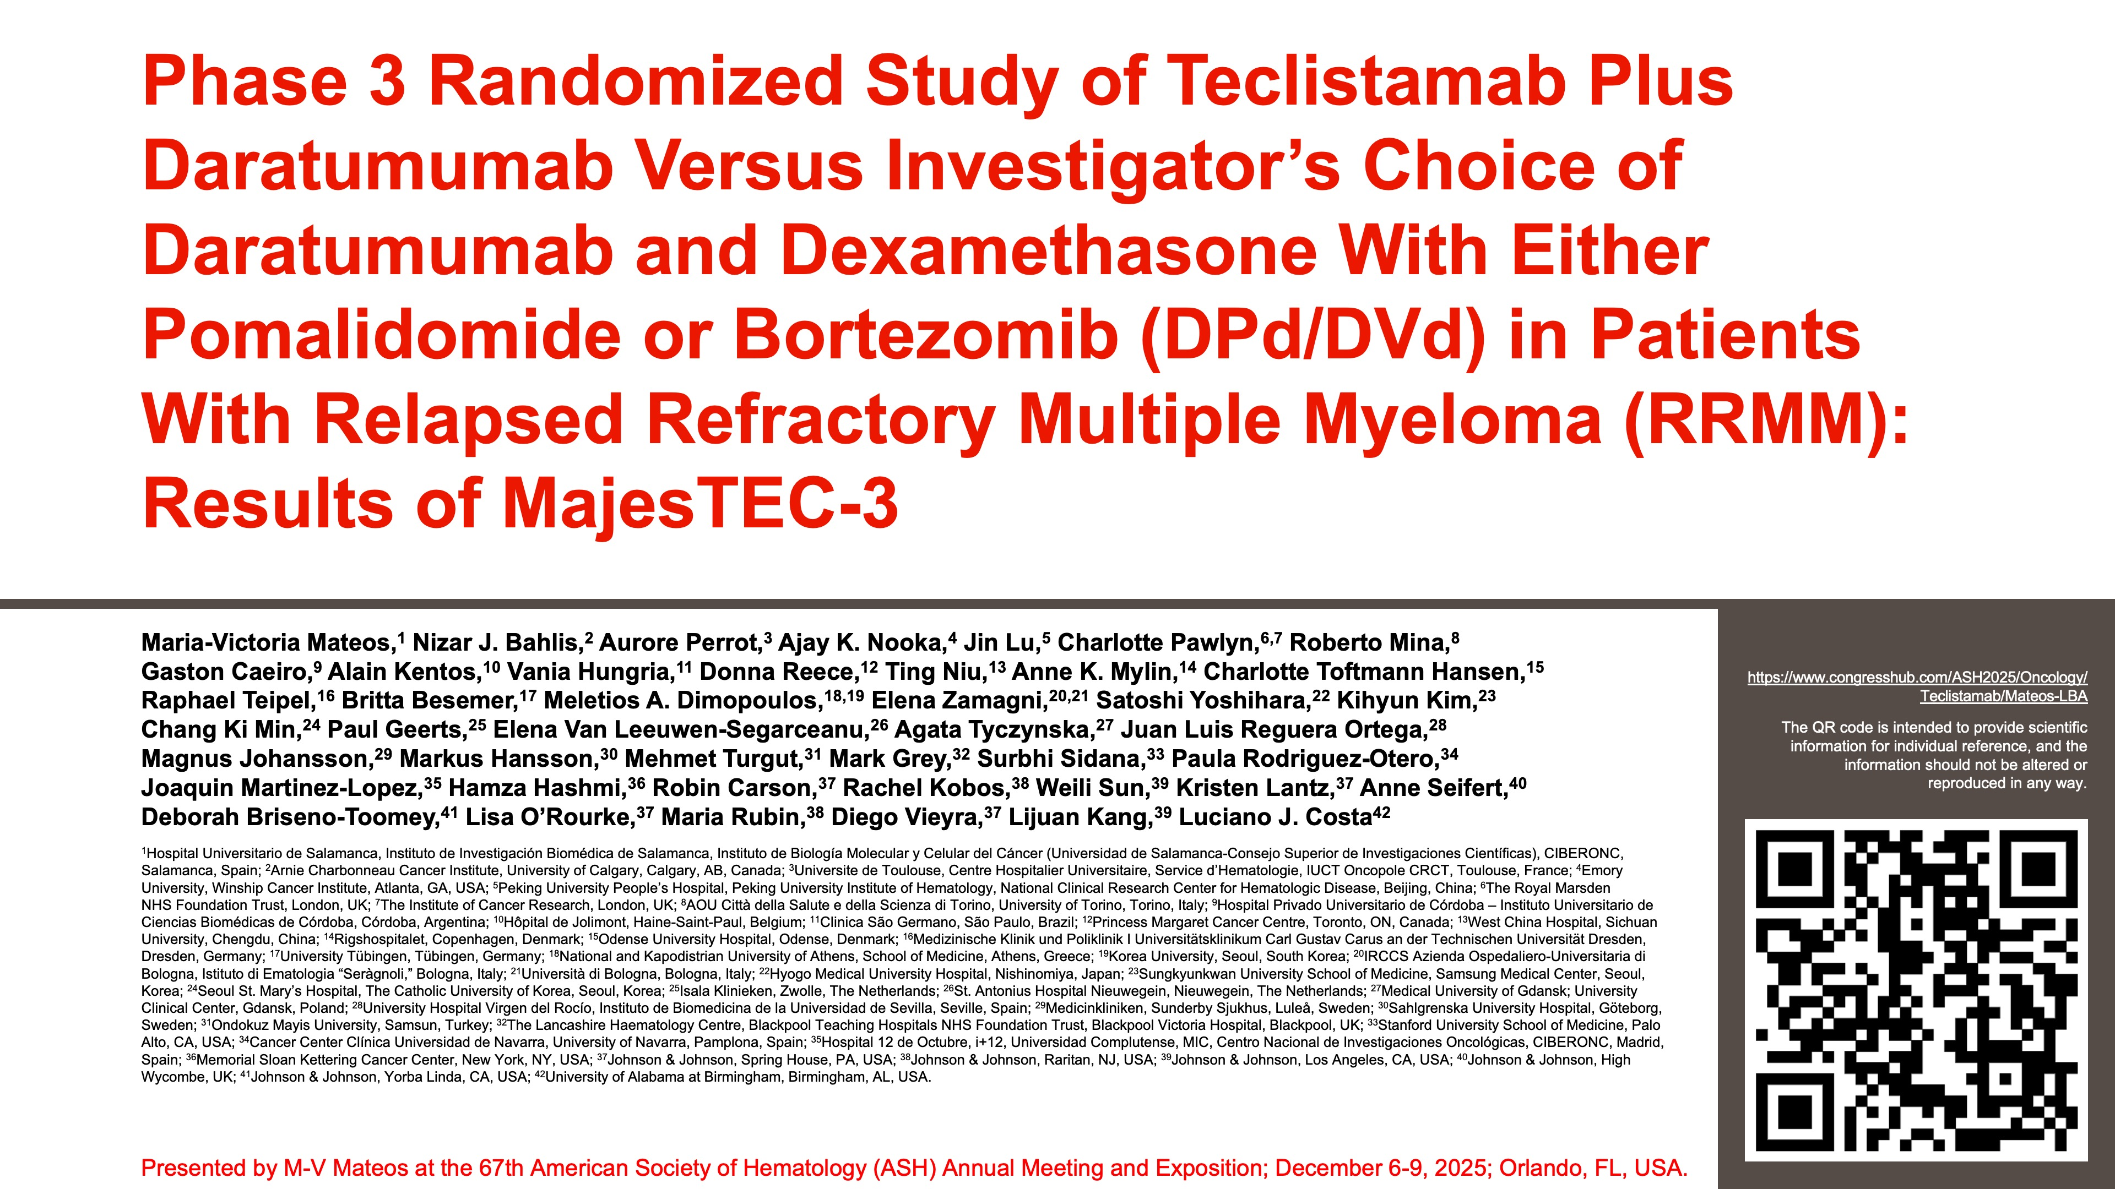
2025
Mateos M-V et al., ASH 2025, LBA-6
Rationale for combining daratumumab with teclistamab
Direct anti-myeloma effect of daratumumab
Daratumumab depletes immunosuppressive T-cells
Daratumumab enhances CD8+ T-cell cytotoxicity
Above creates a synergy between the two drugs

Slide 27
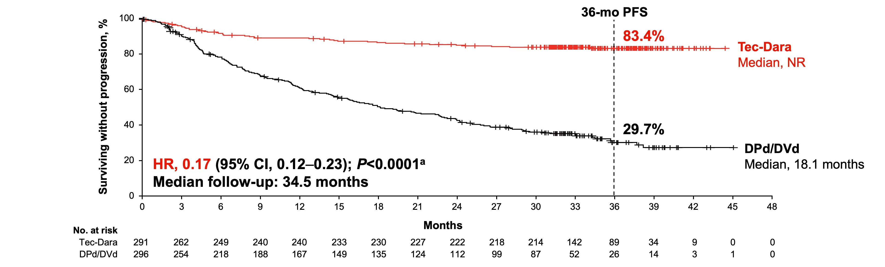
MajesTEC-3: Teclistamab and daratumumab v. SOC
Dara Pd = 269 (91%)
Dara Vd = 27 (9%)
1-3 prior lines of therapy, including PI and lenalidomide
Sensitive to anti-CD38 antibody (i.e., naïve or not refractory)
Daratumumab exposure: 5.3% overall
Higher dose of teclistamab, 3 mg/kg (starting with cycle 3)
No dexamethasone after C1D8
APOLLO dara Pd median PFS 12.4 months
CASTOR dara Vd median PFS 16.7 months
Approved by FDA in March 2026 for relapse after 1 prior line of therapy including a proteasome inhibitor and an immunomodulatory drug
Dramatic improvement in PFS with HR 0.17 with potential plateau in PFS
Mateos MV et al., ASH 2025; Dimopoulos MA et al., Lancet Oncol 2021; Spencer A et al., Haematologica 2018

Slide 28
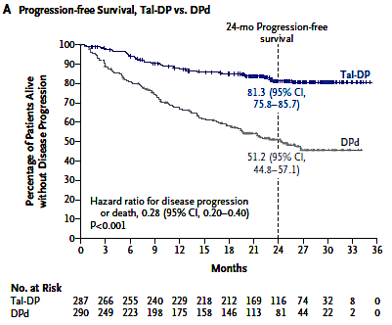
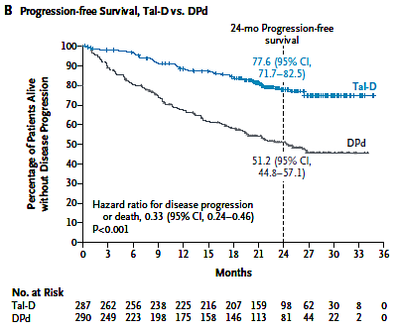
MonumenTAL-3: Phase III Trial of Talquetamab with Daratumumab in Relapsed or Refractory Myeloma
24-month OS (HR 0.47):
Tal-DP 89.2%
DPd 79.1%
24-month OS (HR 0.51):
Tal-D 87.9%
DPd 79.1%
Mina R et al. N Engl J Med 2026;395:671-83.

Slide 29
Randomized phase III anti-BCMA bispecific antibody trials in progress
Newly diagnosed, transplant not eligible or not intended
MajesTEC-7
MagnetisMM-6
LINKER-MM6/EMN39
ENTRUST (IFM/PETHEMA)
Teclistamab
Daratumumab
Lenalidomide
Elranatamab
Daratumumab
Lenalidomide
Daratumumab
Lenalidomide
Dexamethasone
× 4 cycles
Etentamig*
Daratumumab
Linvoseltamab
R
R
R
Talquetamab
Daratumumab
Lenalidomide
Daratumumab
Lenalidomide
Dexamethasone
Daratumumab
Lenalidomide
Dexamethasone
R
N = 870
N = 1000
Daratumumab
Lenalidomide
Dexamethasone
N = 1590
Daratumumab
Lenalidomide
Dexamethasone
*Dose will be based on ongoing phase 2
Tec and talq arms, dex given cycles 2-4
Transplant ineligible or
transplant not intended
Transplant ineligible
Transplant ineligible
Transplant ineligible
IMWG Frailty Index ≥1
Dual primary endpoint: PFS and sustained MRD negative (10⁻⁵) CR duration ≥ 12 months
Dual primary endpoint: PFS and
sustained MRD-negative (10⁻⁵) duration ≥ 12 months
Dual primary endpoint: PFS and MRD-negative (10⁻⁵)
Dual primary endpoint: PFS and MRD-negative (10⁻⁵)
Touzeau C, et al., ASCO 2024. Grosicki S, et al., ASCO 2023. Manier S et al., ASH 2025

Slide 30
Combining bispecific antibodies with other bispecific antibodies

Slide 31
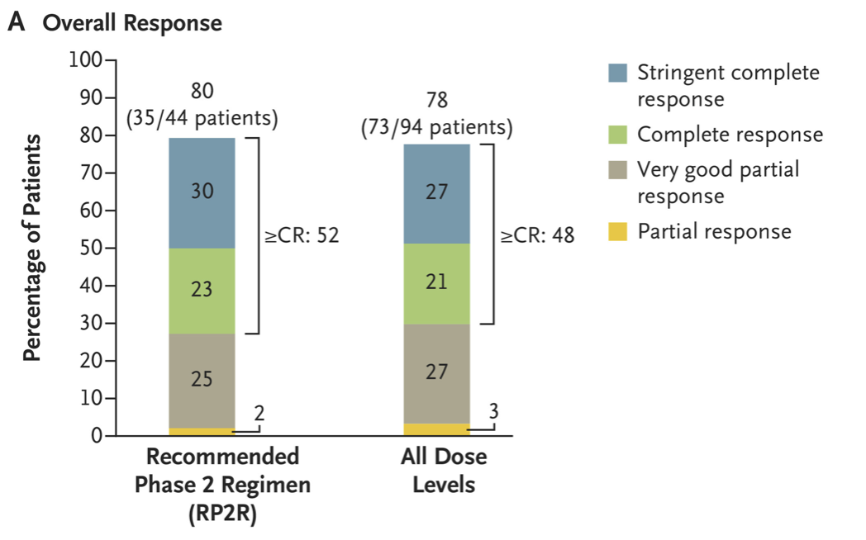
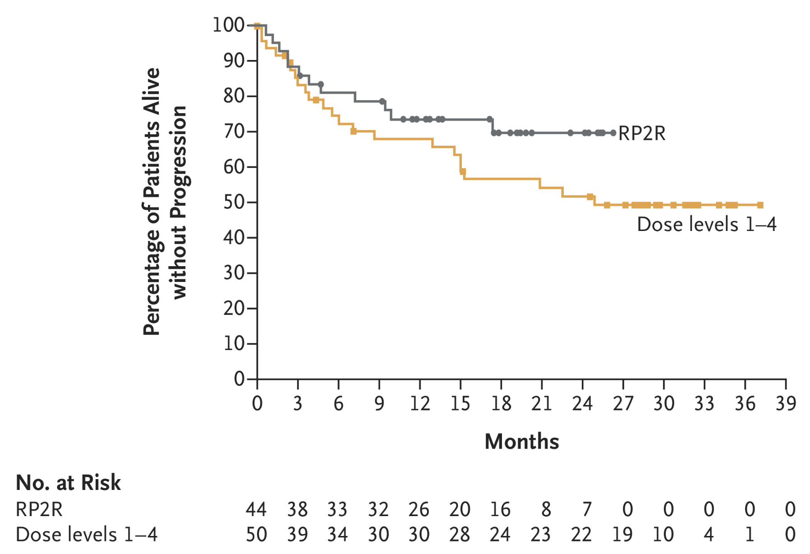
RedirecTT-1: Talquetamab + Teclistamab in R/R MM
With the recommended phase 2 regimen:
12-month PFS: 74%
18-month PFS: 70%
Cohen YC et al. N Engl J Med 2025;392(2):138-149.

Slide 32
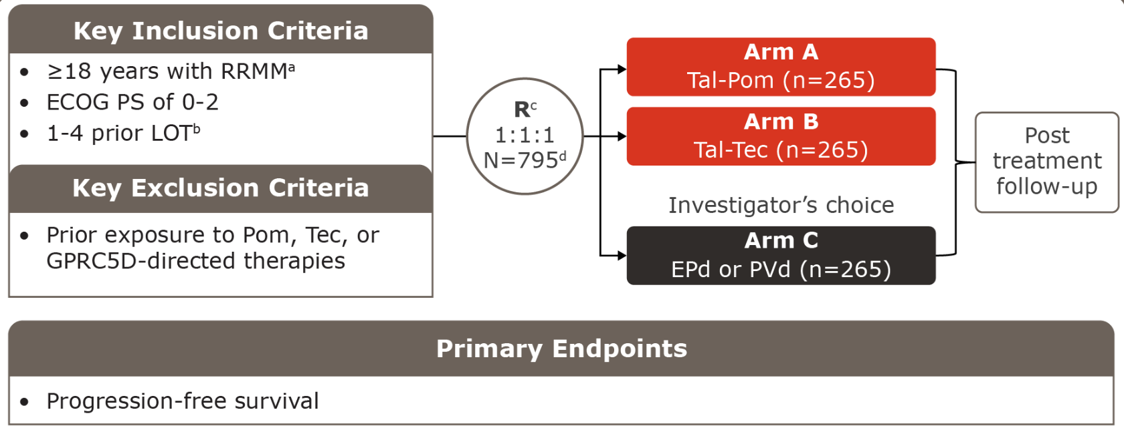
MonumenTAL-6: Phase III Trial of Talquetamab-Based Combinations in Early Relapsed R/R MM
Nooka AK et al. ASH 2024;Abstract 4757.

Slide 33
Positive Topline Results from the MonumenTAL-6 Phase III Trial of Teclistamab with Talquetamab for Relapsed/Refractory Multiple Myeloma in Earlier Lines of Therapy
Press Release: July 23, 2026
“[The manufacturer] announced positive topline results from the three-arm investigational Phase III MonumenTAL-6 study evaluating teclistamab-cqyv + talquetamab-tgvs, a BCMA and GPRC5D dual antigen targeting regimen, and talquetamab-tgvs + pomalidomide in adult patients with relapsed or refractory multiple myeloma (RRMM) who received 1 to 4 prior lines of therapy, including an anti-CD38 antibody and lenalidomide.
The study demonstrated statistically significant and clinically meaningful improvements in progression-free survival and overall survival for both investigational arms compared with investigator’s choice standard of care. Teclistamab-cqyv + talquetamab-tgvs delivered the greatest benefit, reducing the risk of disease progression or death by 89% (HR, 0.11) and the risk of death by 62% (HR, 0.38).
Based on the strength of the data, the Independent Data Monitoring Committee recommended unblinding the study at the first interim analysis. The full results of the Phase 3 MonumenTAL-6 study will be presented at a future major medical meeting and shared with global health authorities.”
https://www.jnj.com/media-center/press-releases/tecvayli-talvey-reduced-the-risk-of-disease-progression-or-death-by-89-and-the-risk-of-death-by-62-in-earlier-line-relapsed-refractory-multiple-myeloma.

Slide 34
Novel bispecific antibody targets in MM

Slide 35
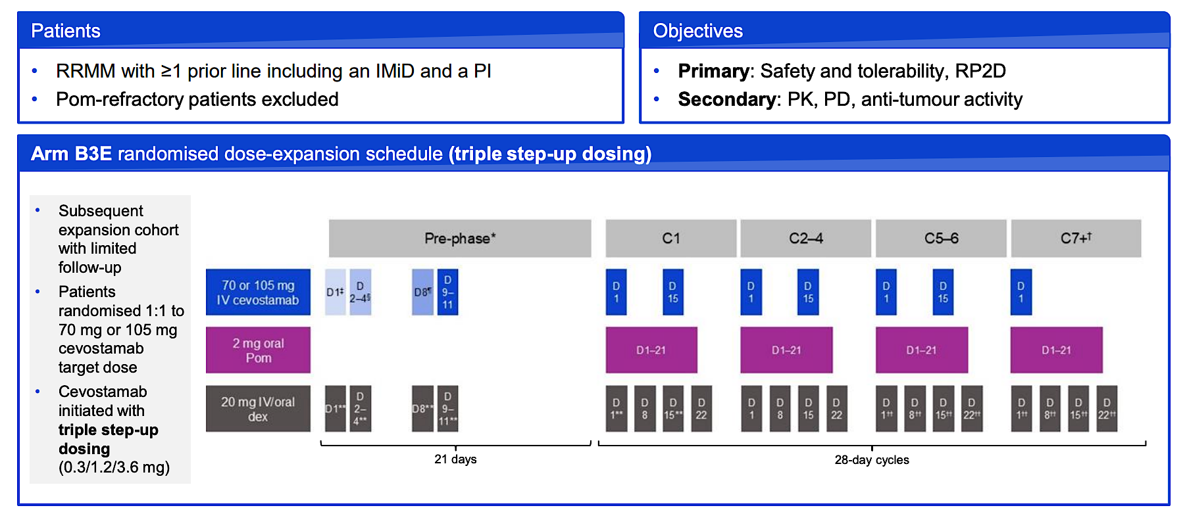
CAMMA 1: Randomized dose-expansion of FcRH5 x CD3 bispecific antibody cevostamab with pomalidomide, and dexamethasone
Courtesy of Hans Lee, MD
Mian et al, IMS 2025

Slide 36
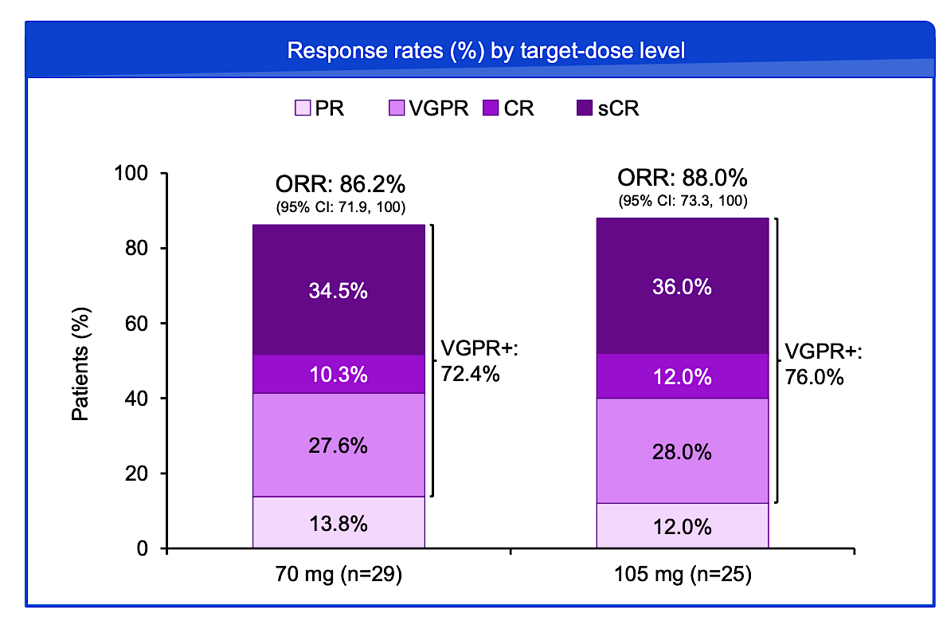
CAMMA 1: Randomized dose-expansion of cevostamab, pomalidomide, and dexamethasone
Courtesy of Hans Lee, MD
Mian et al, IMS 2025

Slide 37
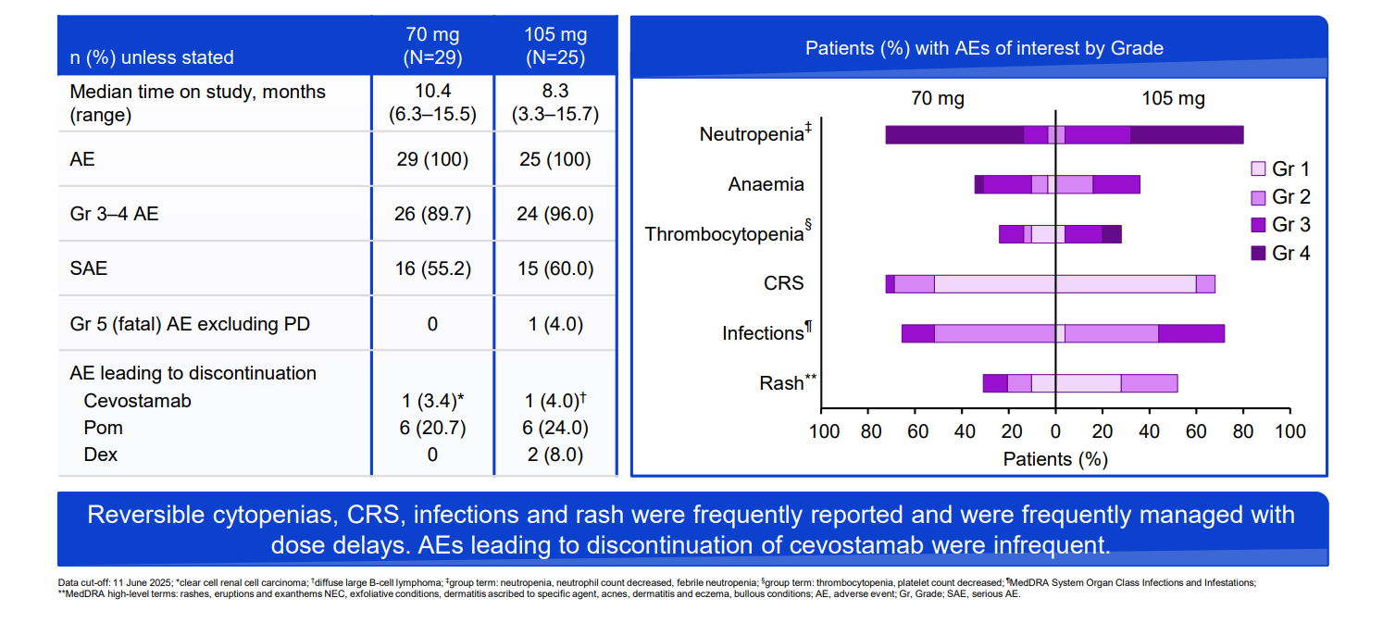
CAMMA 1: Safety summary by target dose level
Courtesy of Hans Lee, MD
Mian et al, IMS 2025

Slide 38
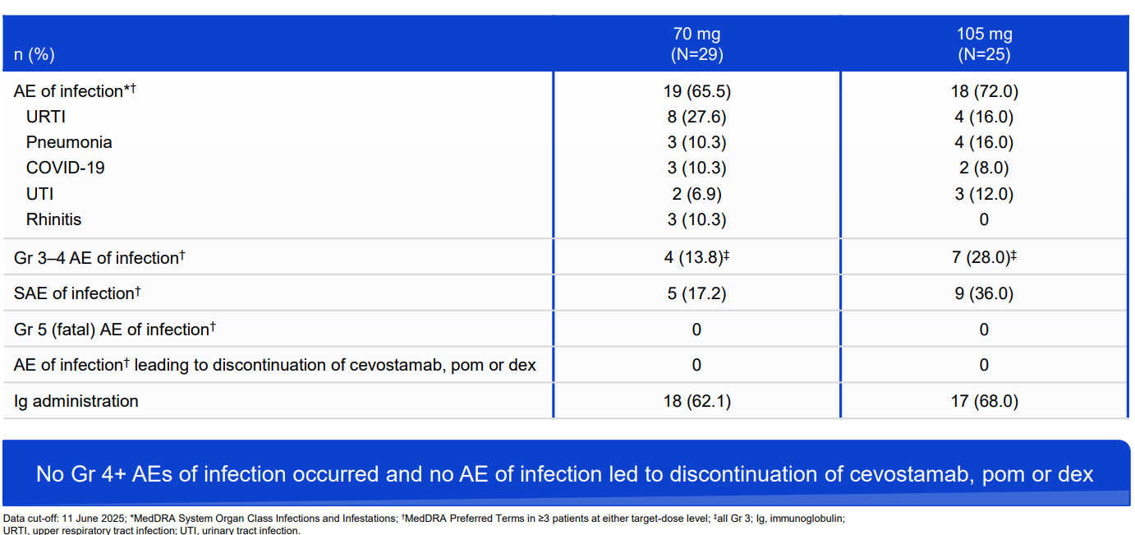
CAMMA 1: Infection summary by target dose level
Courtesy of Hans Lee, MD
Mian et al, IMS 2025

Slide 39
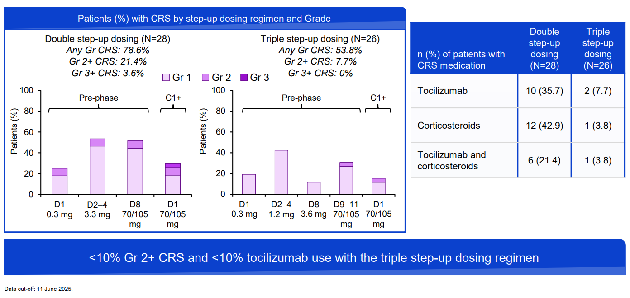
CAMMA 1: CRS by step-up dosing regimen
Courtesy of Hans Lee, MD
Mian et al, IMS 2025

Slide 40
CAMMA 1: Randomized dose-expansion of cevostamab, pomalidomide, and dexamethasone
Randomized Phase 3 “CEVOLUTION” study to start in 2026 (NCT07555938)
RRMM with 1-3 prior lines of therapy and prior anti-CD38 & lenalidomide exposure
Cevostamab, pomalidomide, dexamethasone vs. SOC investigator’s choice (dara/pom/dex, elo/pom/dex or carfilzomib/dex)
Primary end points: MRD neg CR at 9 months and PFS
Courtesy of Hans Lee, MD
Mian et al, IMS 2025

Slide 41
Faculty Case Presentations

Slide 42
Prof Dimopoulos: Case Presentation
Diagnosis | 67y, male, IgG-κ MM, diagnosed 6 years ago
 | R-ISS II, 1q21 addition, no other high-risk cytogenetics Anemia and multiple lytic bone lesions; no extramedullary disease
1L | Dara-VRd → ASCT → lenalidomide maintenance
First relapse | Biochemical progression while receiving lenalidomide
2L | KPd (carfilzomib/pomalidomide/dexamethasone) → VGPR; progression after ~2 years
Current relapse | Rising M-protein, anemia; ECOG PS 1

Slide 43
Prof Dimopoulos: Case Presentation (cont’d) Lab Values at Relapse
Hb | 9.8 g/dL
Platelets | 142 ×10⁹/L
Creatinine | 1.1 mg/dL
Calcium | 9.5 mg/dL
IgG M-protein | 2.1 g/dL
κ FLC | 325 mg/L
λ FLC | 7 mg/L
Bone marrow plasma cells | ~35%
Imaging: PET/CT shows several FDG-avid skeletal lesions but no extramedullary disease.

Slide 44
Prof Dimopoulos: Case Presentation (cont’d) Treatment Selection and Course
Current therapy | Teclistamab + daratumumab + IVIG regardless IgG levels
Early toxicity | Grade 1 CRS during step-up dosing; no ICANS; subsequently managed as outpatient
Response | Rapid decline in M-protein → VGPR by cycle 2 → CR/MRD-negative response
Current status | Remains on therapy with ongoing response; receives IVIG and antiviral/PJP prophylaxis; no infection

Slide 45
QUESTIONS FOR THE FACULTY
For which patients are you prioritizing teclistamab/daratumumab, and for which do you still prefer bispecific antibody monotherapy? How are you generally sequencing each of these relative to other options?
How comfortable are you employing teclistamab/daratumumab for a patient like this who has previously received daratumumab?

Slide 46
QUESTIONS FOR THE FACULTY
How are you currently sequencing talquetamab relative to BCMA-targeted bispecific antibodies for patients with and without prior exposure to BCMA-targeted therapy?
Where do you see emerging talquetamab-containing combinations, such as talquetamab/daratumumab with or without pomalidomide and talquetamab/pomalidomide, fitting in? What about the dual antigen-targeting regimen of teclistamab/talquetamab?

Slide 47

Dr Orlowski: Patient Case
A now 82 yo F who presented with SMM diagnosed in 2015 and followed w/ watchful waiting until developing anemia and a rising paraprotein in 2019
  BM showed 70% PCs & t(11;14), -13, biallelic del 17p
Started on Dara-Rd producing a VGPR by cycle 6 but declined ASCT and had progression after 18 months
Switched to Dara-CyBorD with a PR by cycle 6 but then progressed by cycle 9
Collected T cells for ide-cel and received talquetamab bridging but PD noted on talq

Slide 48
Dr Orlowski: Patient Case (Continued)
Received hyper-fractionated Cyclo-dex with response and then had ide-cel which produced a CR
Relapse noted after 18 months, which was treated with Ven-dex after confirming persistence of t(11;14), which also showed no BCMA expression
After an initial PR that lasted 6 months, disease progression as noted with hyperviscosity symptoms
? Cevostamab

Slide 49
QUESTIONS FOR THE FACULTY
How often do your patients lose BCMA expression after exposure to BCMA-targeted therapy?
What would you recommend next for this patient outside of a clinical trial?
How would you indirectly compare the efficacy of cevostamab to that of BCMA-targeted bispecific antibodies? What about to that of talquetamab? How would you indirectly compare the tolerability of cevostamab to that of BCMA-targeted bispecific antibodies and of talquetamab?

Slide 50
QUESTIONS FOR THE FACULTY
If cevostamab/pomalidomide/dexamethasone were available, how would you most likely sequence it relative to available and emerging BCMA- and/or GPRC5D-targeted bispecific antibody-containing regimens? Which patients might represent ideal candidates for cevostamab?
With 3 BCMA-targeted bispecific antibodies already available, what role do you foresee for etentamig in R/R MM?

Slide 51
Agenda
Module 1 – New and Emerging Strategies with Bispecific Antibodies in MM – Dr Raje
Module 2 – Utility of Antibody-Drug Conjugates for R/R MM –
Dr Orlowski
Module 3 – Potential Role of Cereblon E3 Ligase Modulators
and Other Promising Novel Agents and Strategies for R/R MM –
Prof Dimopoulos

Slide 52
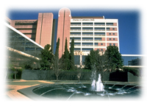
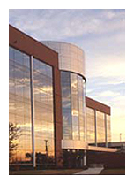
Utility of Antibody Drug Conjugates for Relapsed/ Refractory Multiple Myeloma
Robert Z. Orlowski, M.D., Ph.D.
Deputy Chair, Department of Lymphoma/Myeloma
Florence Maude Thomas Cancer Research Professor
Director, Myeloma Translational Research

Slide 53
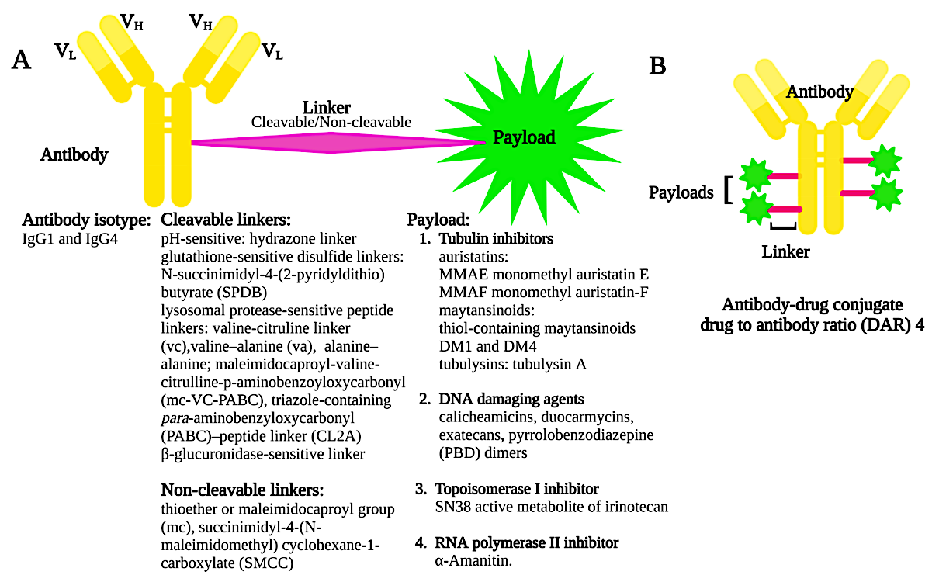
ADC Design
M-protein >2 g/dL
BM PC >20%
i/u FLC ratio >20
Ray, U & Orlowski, RZ. https://pubmed.ncbi.nlm.nih.gov/37111346/

Slide 54
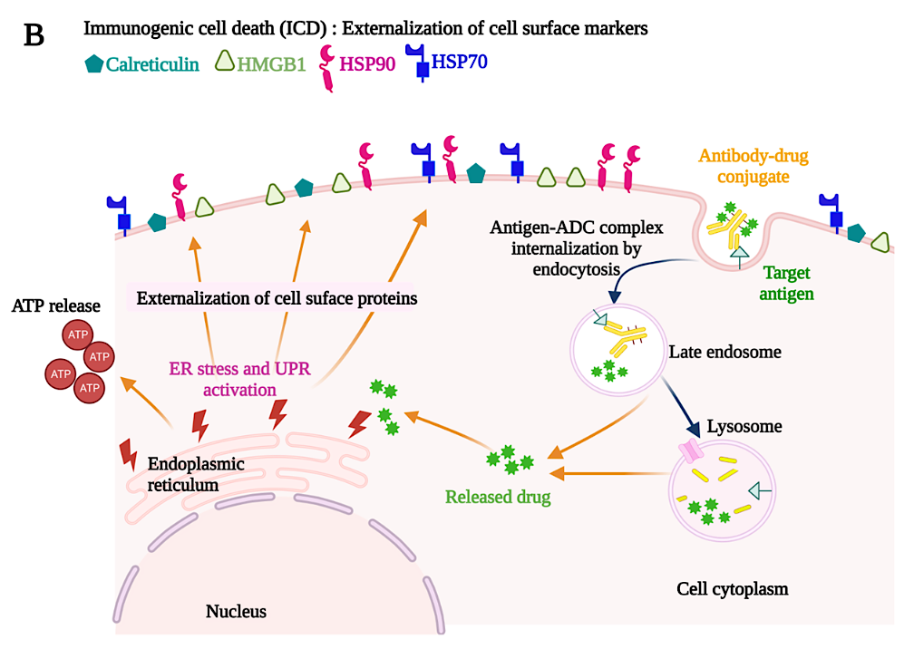
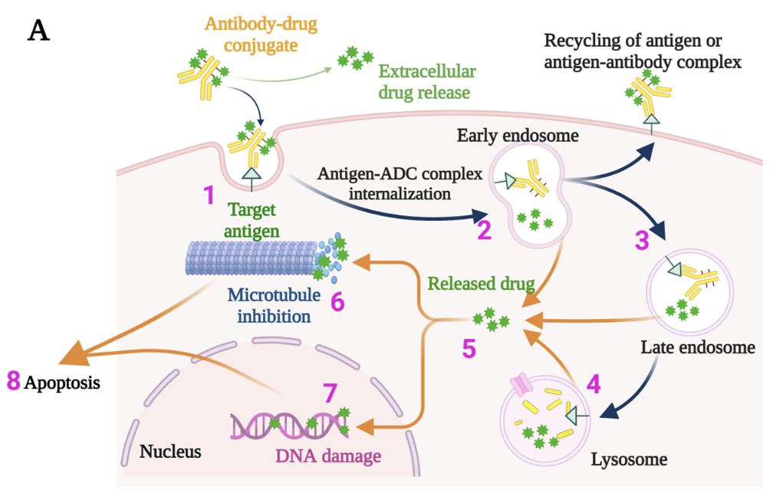
MOA: Direct Cytotoxicity & ICD
M-protein >2 g/dL
BM PC >20%
i/u FLC ratio >20
Ray, U & Orlowski, RZ. https://pubmed.ncbi.nlm.nih.gov/37111346/

Slide 55
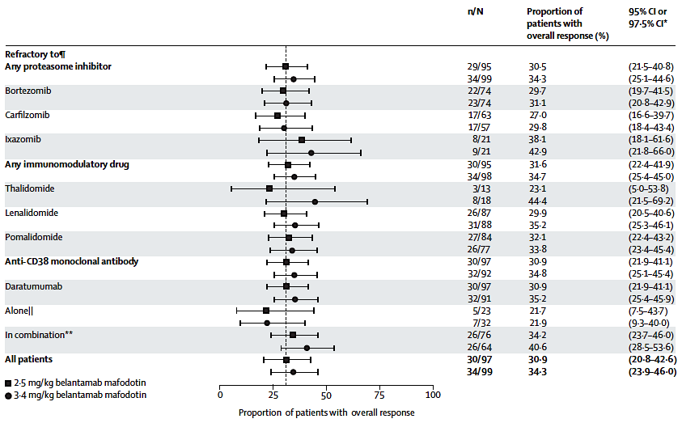
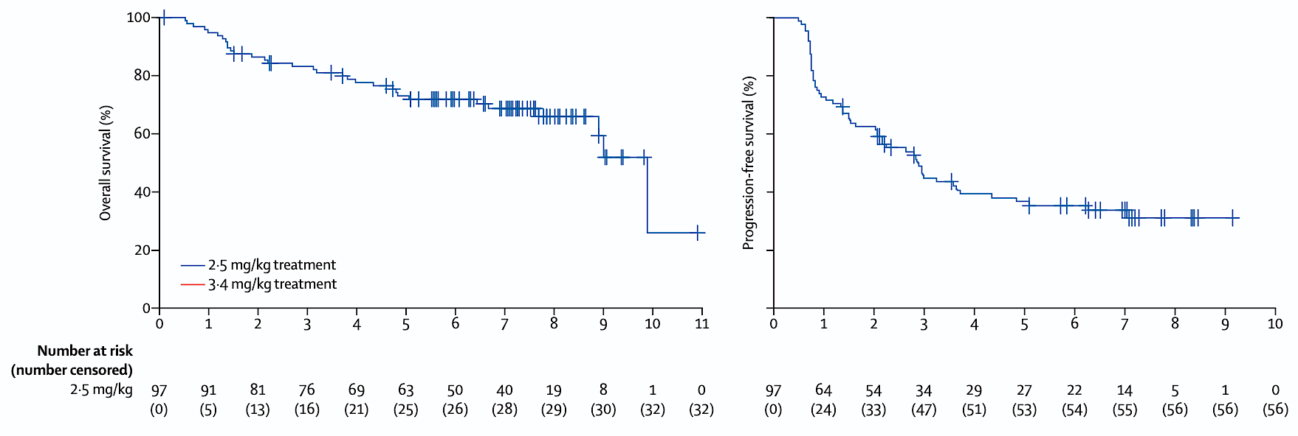
BelaMaf Single-agent: DREAMM-2
Lonial, S et al. https://pubmed.ncbi.nlm.nih.gov/31859245/

Slide 56
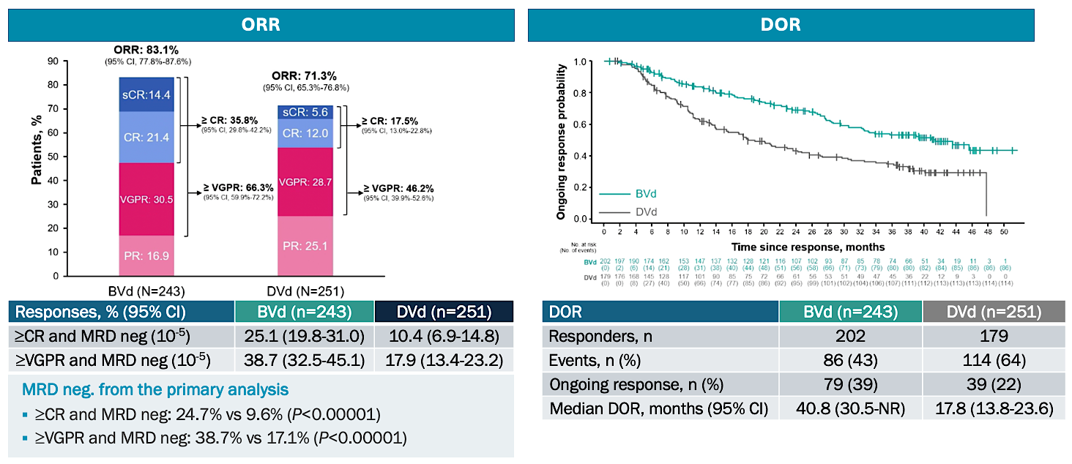
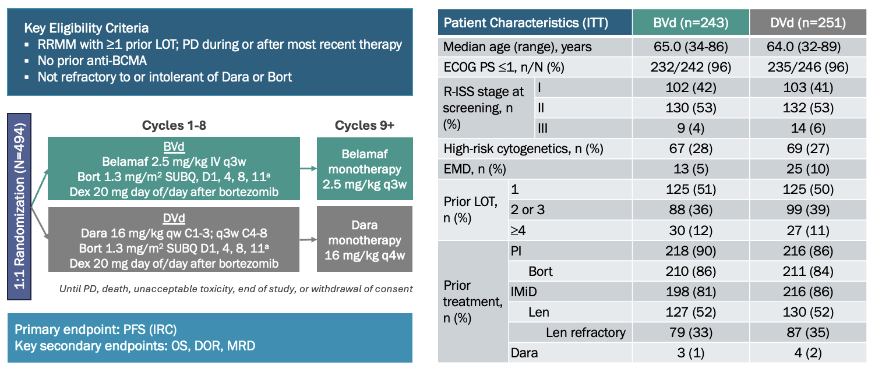
Bela-Vd: DREAMM-7
Hungria, V et al. https://pubmed.ncbi.nlm.nih.gov/40680754/

Slide 57
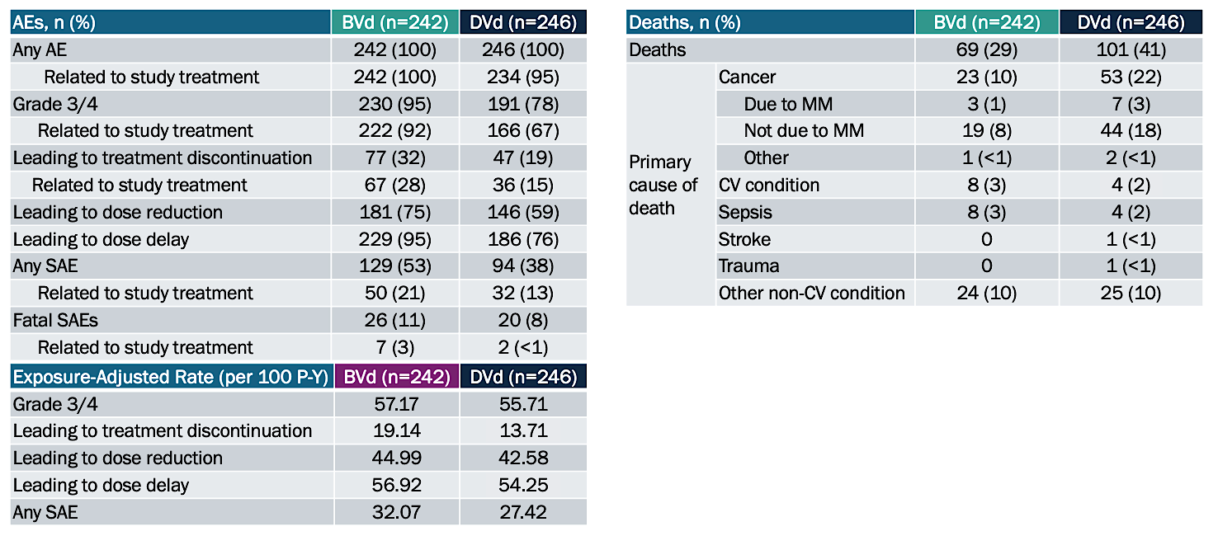
Safety
Hungria, V et al. https://pubmed.ncbi.nlm.nih.gov/38828933/

Slide 58
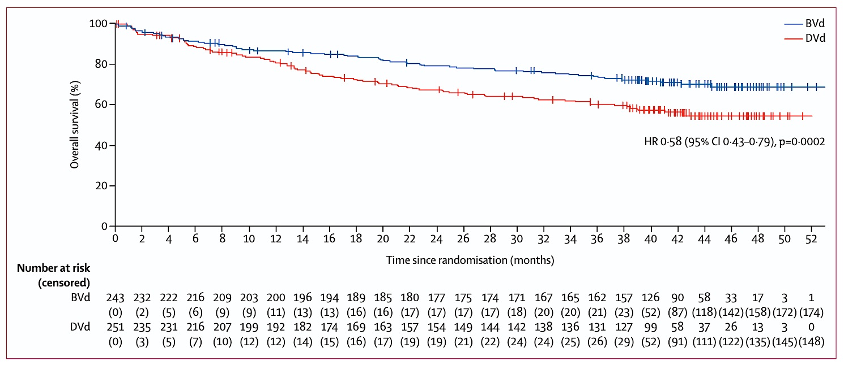
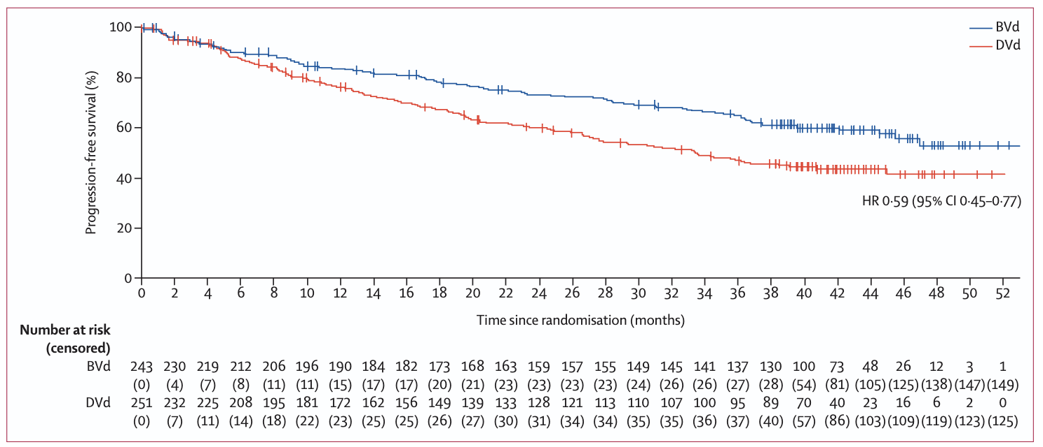
Latest DREAMM-7 Updates
PFS2
OS
Hungria, V et al. https://pubmed.ncbi.nlm.nih.gov/38828933/

Slide 59
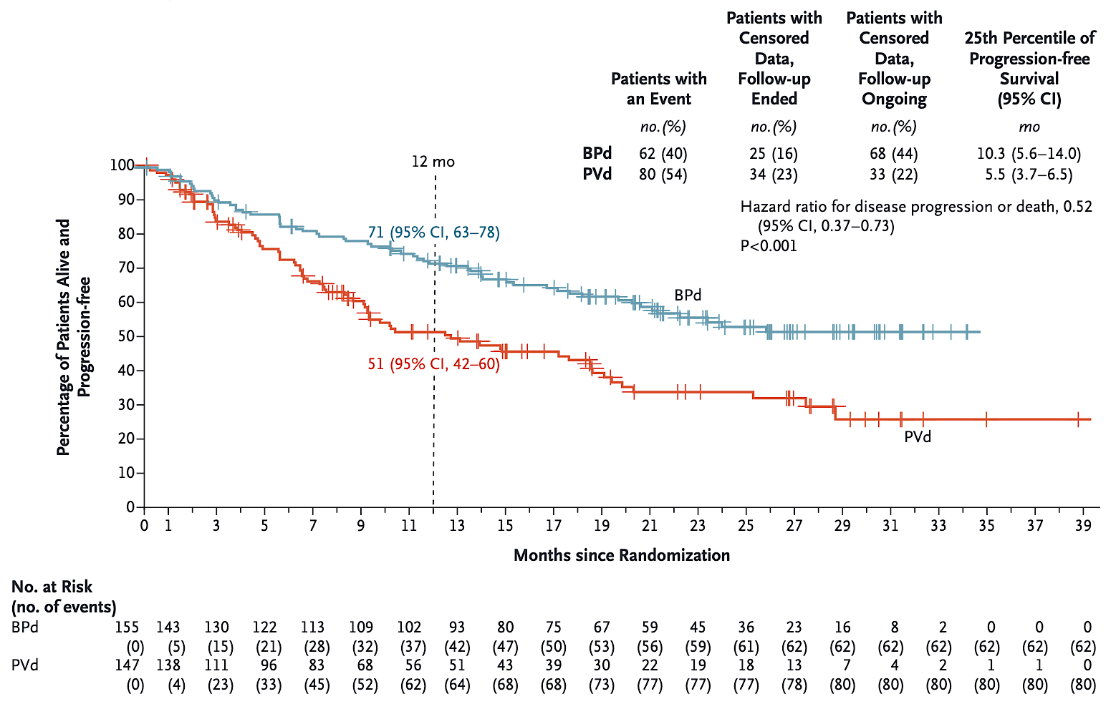
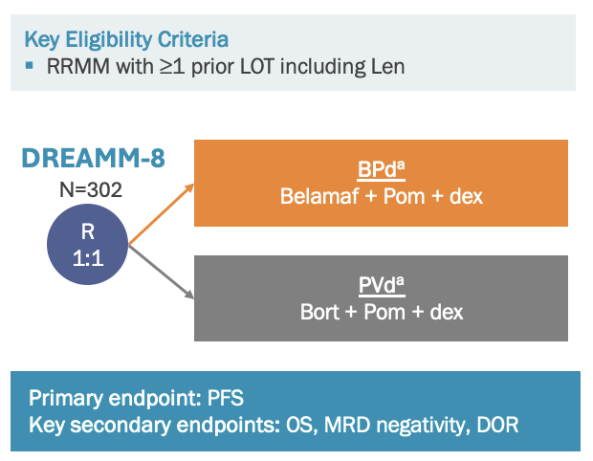
BelaMaf-Pd: DREAMM-8
Dimopoulos, MA et al. https://pubmed.ncbi.nlm.nih.gov/38828951/

Slide 60
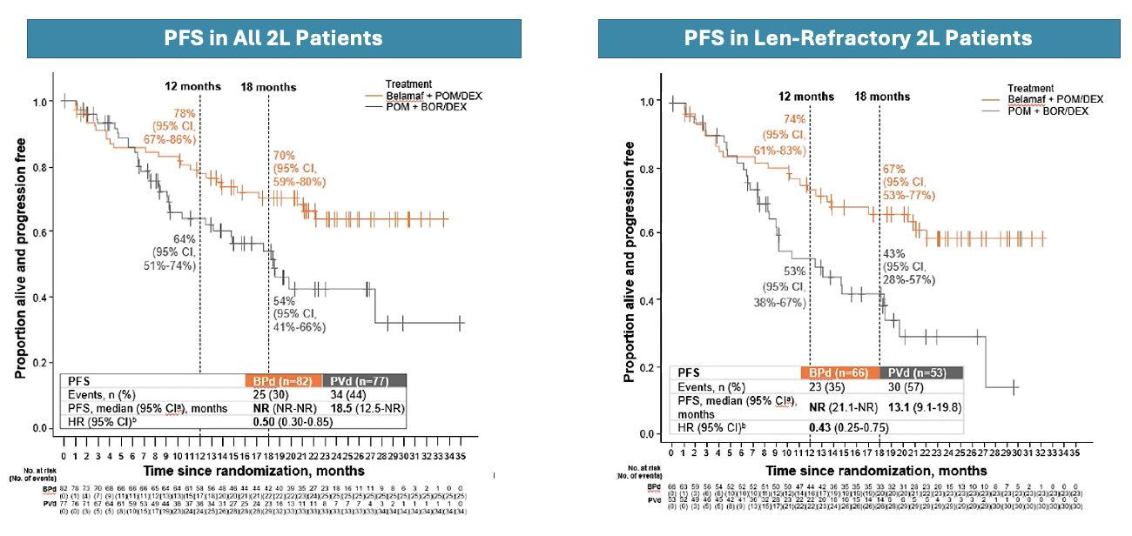
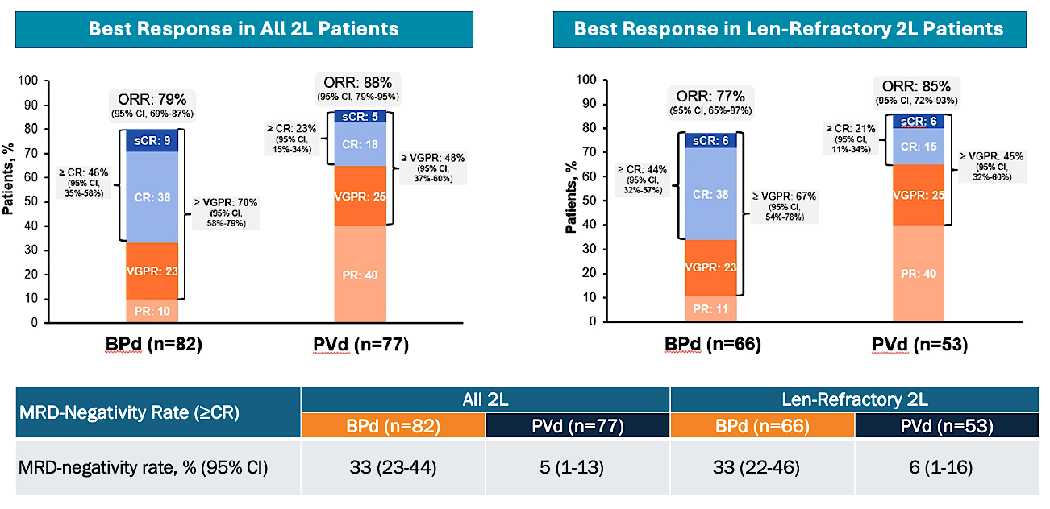
Focus on 2nd Line & MRD
Beksac, M et al. ASH 2024. Abstract 4731.

Slide 61
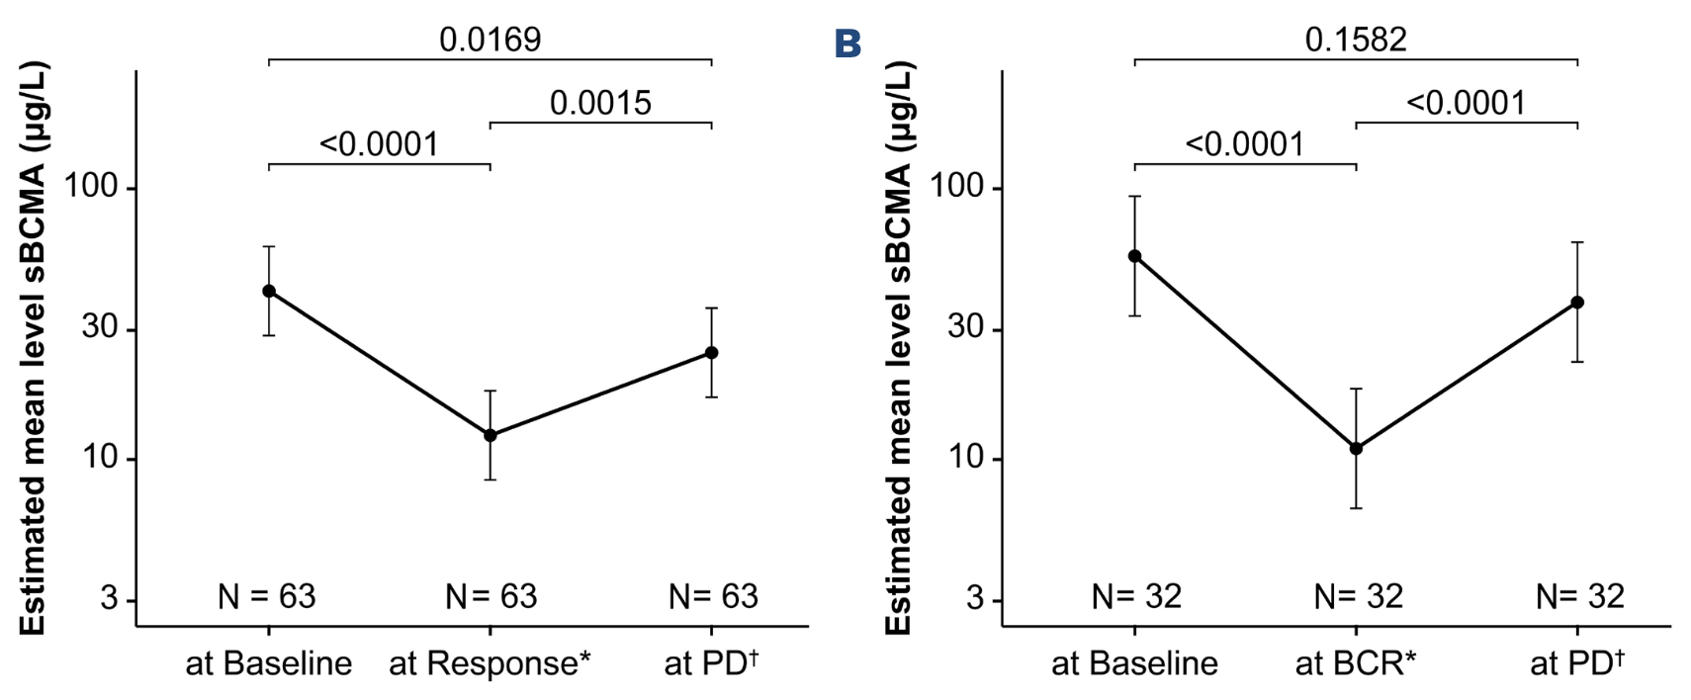
BelaMaf Doesn’t Impact sBCMA
DREAMM-2 DREAMM-7
Musa, H et al. https://pubmed.ncbi.nlm.nih.gov/40874339/

Slide 62
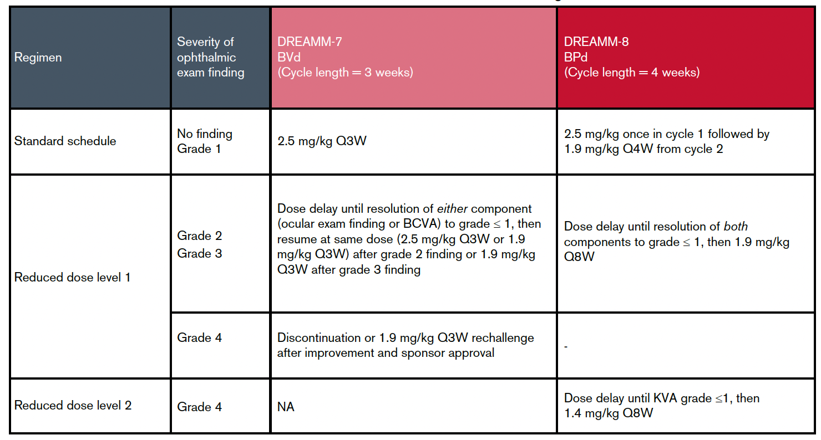
Ocular Toxicity & Dosing Changes
Mateos, M-V. et al. https://pubmed.ncbi.nlm.nih.gov/40763276/

Slide 63
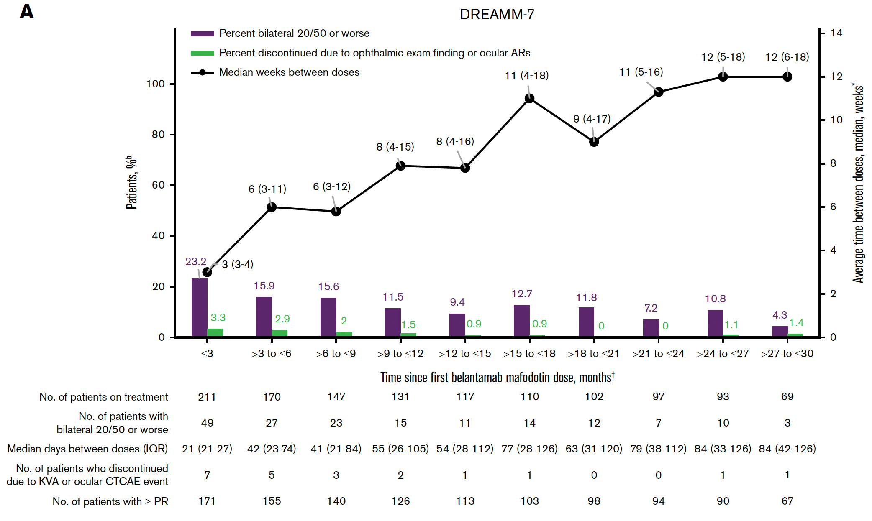
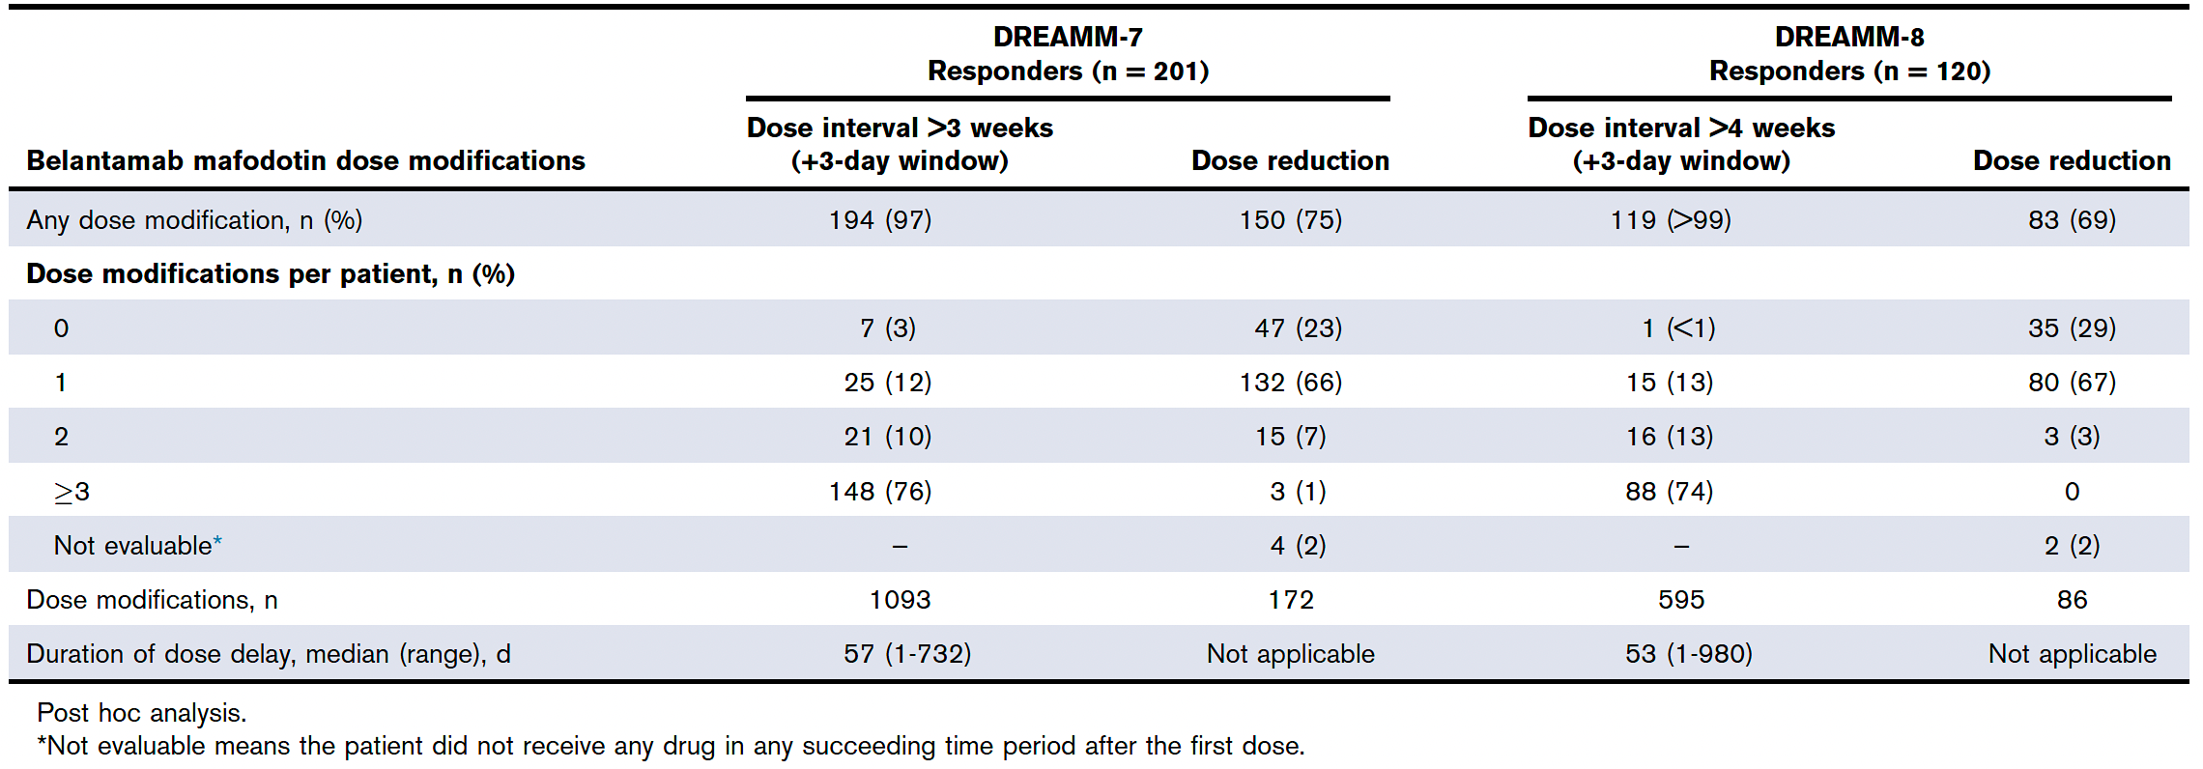
Dosing Interval & Ocular Events
Mateos, M-V. et al. https://pubmed.ncbi.nlm.nih.gov/40763276/

Slide 64
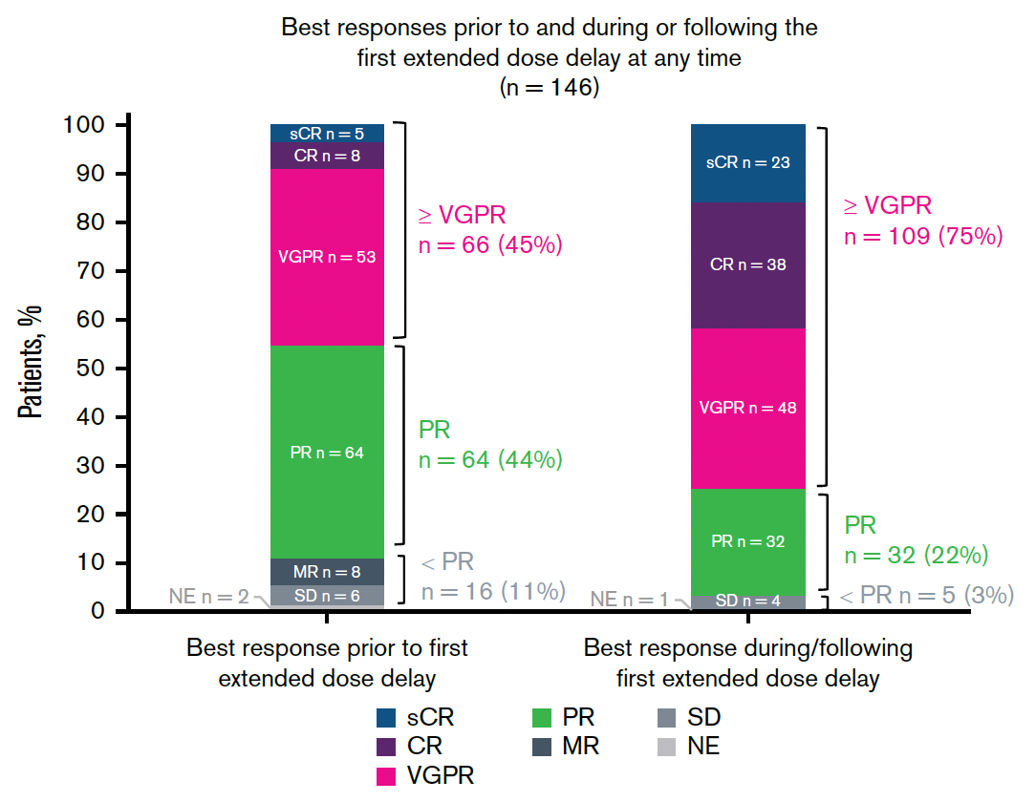
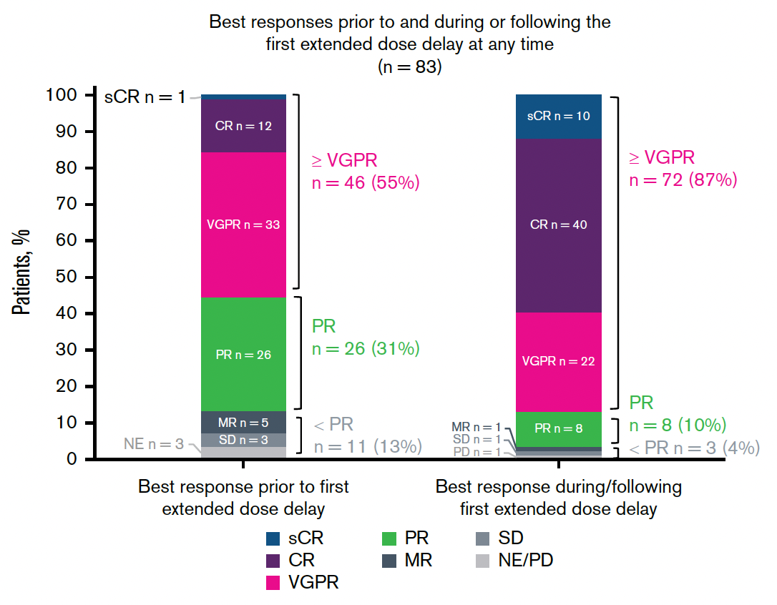
Responses Improve Despite Delays
DREAMM-7
DREAMM-8
Mateos, M-V. et al. https://pubmed.ncbi.nlm.nih.gov/40763276/

Slide 65
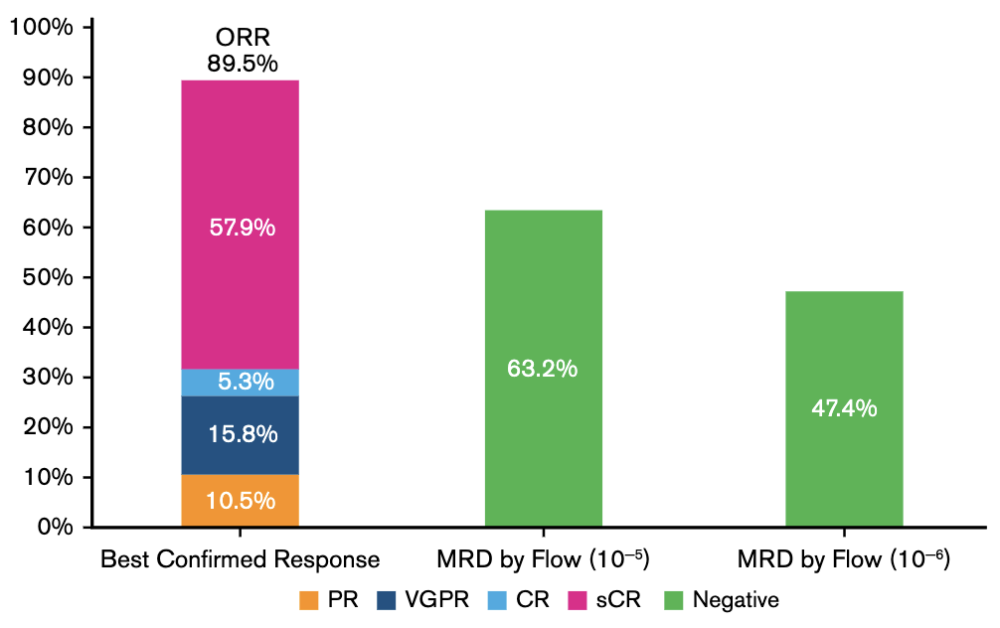
Selected Other Trials: Bela-KRd in RRMM
Atrash, S et al. https://pubmed.ncbi.nlm.nih.gov/41719502/

Slide 66
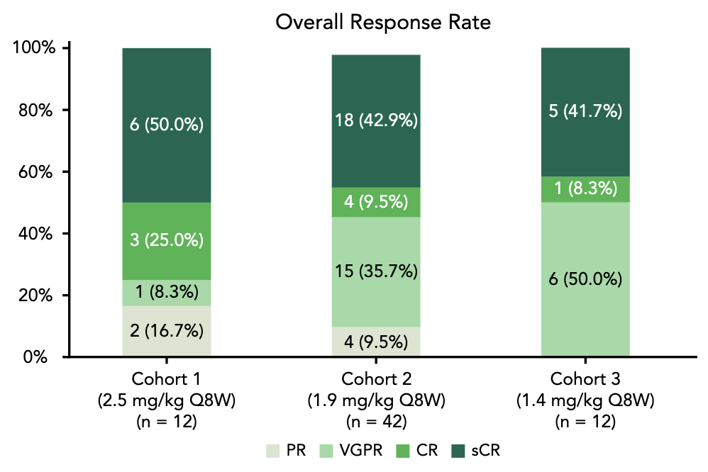
Bela-Rd in IF/F NDMM
Terpos, E et al. https://pubmed.ncbi.nlm.nih.gov/41346230/

Slide 67
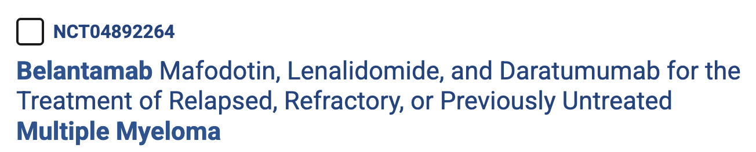

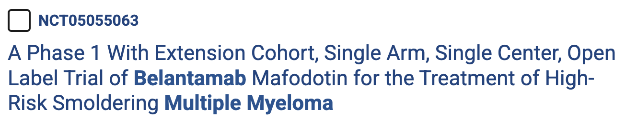
Selected Ongoing Studies
https://clinicaltrials.gov/

Slide 68
Conclusions
BelaMaf-based combos provide effective options in the early RRMM setting
Multiple mechanisms of action, including direct cytotoxic and ICD-based effects
Toxicities are predictable & manageable by adjustments that do not impact benefit
? Minimal impact on antigen expression and immune TME to enable repeat targeting of BCMA
Other ADCs are in development, including agents targeting BCMA, GPRC5D, and other cell surface proteins

Slide 69
Faculty Case Presentations

Slide 70
Dr Raje: A patient with R/R MM
67-year-old female diagnosed with lambda light chain multiple myeloma, normal FISH
Presented 13 years back with cord compression requiring decompression surgery
Received RVd, refused transplant and placed on Len maintenance
Received KPd at first relapse, 5 years into her diagnosis
Received investigational BCMA CAR T cells—had short lived response on 4 months
Relapsed and then received Belamaf in combination with isatuximab and Pom on a clinical trial—is in remission now for 18 months and is on ongoing therapy

Slide 71
QUESTIONS FOR THE FACULTY
For which patients are you prioritizing belantamab mafodotin/bortezomib/dexamethasone (Bela-Vd)? What is the earliest point that you would administer it? When do you opt for Bela-Vd rather than CAR T-cell therapy or a bispecific antibody?
Are you comfortable recommending Bela-Vd for patients who have previously received BCMA-directed CAR T-cell therapy, a BCMA-directed bispecific antibody or both?
Would you consider combining belantamab mafodotin with agents other than bortezomib/dexamethasone? If so, under what circumstances and which ones?

Slide 72
Prof Dimopoulos: Case Presentation
Diagnosis | 72y, woman IgA-λ MM, diagnosed 4 years ago
 | R-ISS II; no high-risk cytogenetics, anemia and vertebral compression fracture
1L | Dara-VRd x 4 → ASCT → DaraVRD x 2 → Dara-Len maintenance 2y (sustained MRD negative) → Lenalidomide maintenance
Relapse | Biochemical followed by symptomatic progression on lenalidomide; new focal bone lesion
Status at relapse | Lenalidomide refractory; prior PI and anti-CD38 exposed; ECOG PS 1

Slide 73
Prof Dimopoulos: Case Presentation (cont’d) Lab Values at Relapse
Hb | 10.2 g/dL
Platelets | 178 ×10⁹/L
Creatinine | 0.9 mg/dL
Calcium | 9.8 mg/dL
IgA | 2,850 mg/dL
M-protein | 1.8 g/dL
λ FLC | 280 mg/L
Bone marrow plasma cells | ~25%
PET/CT: new FDG-avid lesion involving the left iliac bone; no soft-tissue EMD.

Slide 74
Prof Dimopoulos: Case Presentation (cont’d) Treatment Selection and Course
Current therapy | Belantamab mafodotin + bortezomib + dexamethasone (BVd)
Response | M-protein falls rapidly → VGPR, at C3D1 subsequently deepening
At cycle 4, the patient reports: | “My vision is blurry when I read.”
Ophthalmologic examination: | Punctuate keratopathy/corneal epithelial changes with reduction in visual acuity, grade 2, belamaf-related

Slide 75
Prof Dimopoulos: Case Presentation (cont’d) Management of Ophthalmic Toxicity
Management | Belantamab dose held; intensified artificial tear administration; ophthalmologic monitoring; bortezomib/dexamethasone continued
Outcome | Vision improved; belantamab restarted with modified interval from Q8W to Q12W
Current status | Ongoing disease control without new skeletal lesions, now patient in CR, MRD negative

Slide 76
QUESTIONS FOR THE FACULTY
In terms of safety and tolerability, how would you rate your experience with belantamab mafodotin? In your experience, how often do ocular events affect visual acuity versus presenting subclinically on routine screening?
How do you approach screening for and management of belantamab mafodotin-associated ocular toxicity? What dosing interval of belantamab mafodotin do you typically employ?

Slide 77
Agenda
Module 1 – New and Emerging Strategies with Bispecific Antibodies in MM – Dr Raje
Module 2 – Utility of Antibody-Drug Conjugates for R/R MM –
Dr Orlowski
Module 3 – Potential Role of Cereblon E3 Ligase Modulators
and Other Promising Novel Agents and Strategies for R/R MM –
Prof Dimopoulos

Slide 78




SOHO 2026 Symposium on the
Management of Relapsed/Refractory Multiple Myeloma
Potential Role of Cereblon E3 Ligase Modulators (CELMoDs) and Other Promising Novel Agents and Strategies for R/R MM
Meletios (Thanos) Dimopoulos, MD
Professor of Hematology/Oncology, Director
Plasma Cell Dyscrasias Unit, Department of Clinical Therapeutics,
National and Kapodistrian University of Athens
School of Medicine, Athens, Greece

Slide 79
Protein Degradation in MM
The ubiquitin-proteasome system forms a primary means for cellular protein degradation
The ubiquitin ligase enzyme complex is a component of this system and tags proteins for proteasomal degradation with ubiquitin
CELMoDs bring ligase and target proteins into proximity to start protein degradation by the ubiquitin-proteasome system
CELMoDs are derived from the TPD (targeted protein degradation) platform
and represent a novel class of targeted protein degraders with a unique
mechanism of action
CELMoD
Ub
CRBN
Ub
Ub
Ikaros/Aiolos
Ub
Cell Membrane
Cereblon E3 ubiquitin ligase complex
Proteasome degradation
Cytoplasm
Immune modulation
Cell proliferation
Apoptosis
Mitochondria
Nucleus
DNA
CELMoDs in development with clinical data
Iberdomide (CC-220)
Mezigdomide (CC-92480)
Charlinski et al. Cancers 2021;13:4666; Ito et al. Int J Hematol 2016;104:293.

Slide 80
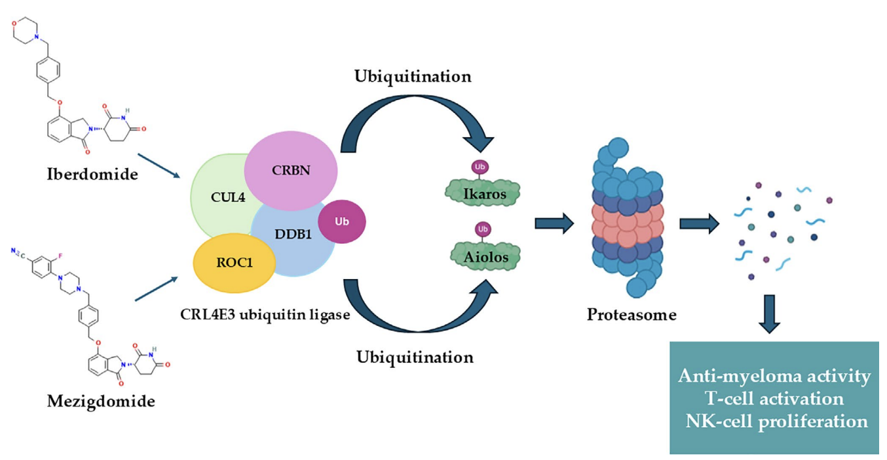
Mechanism of action mezigdomide - iberdomide
Iberdomide and mezigdomide bind to cereblon within the CRL4 E3 ubiquitin ligase complex,
They enhance recruitment and ubiquitination of the transcription factors Ikaros (IKZF1) and Aiolos (IKZF3).
Polyubiquitinated substrates are subsequently degraded by the proteasome, resulting in
suppression of IRF4/MYC-dependent survival pathways and
promoting down-stream immunomodulatory effects, including augmented T-cell activation, NK-cell expansion, and anti-myeloma activity.
Alvaro ME et al. Eur J Haematol. 2026; 116:697–708

Slide 81
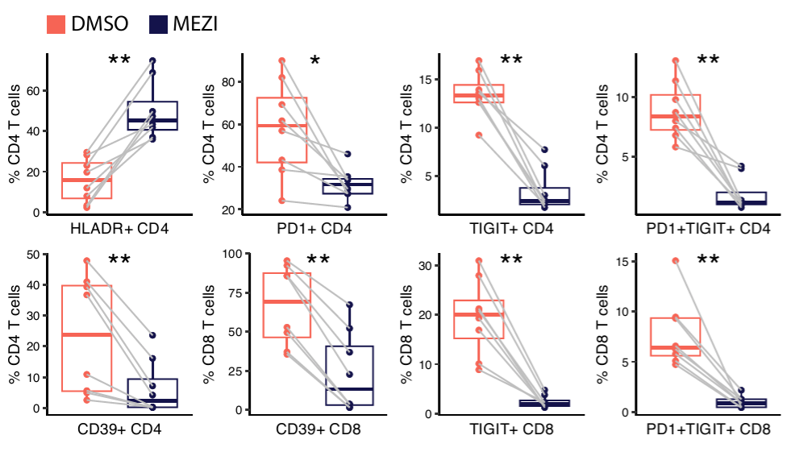
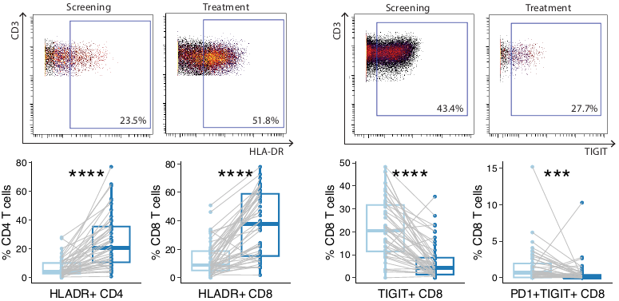
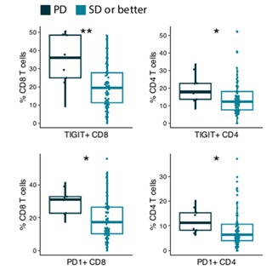
Mezigdomide stimulates T-cell activation and reduces T-cell exhaustion markers both pre-clinically and clinically
Core question: Can CELMoDs rescue dysfunctional immune responses in late-line disease?
  Clinical response correlated with reduced exhaustion features
Chen LY et al., Blood 2026

Slide 82

Hartley-Brown MA, et al. Cancers (Basel). 2024;16(6):1166.

Slide 83

EXCALIBER-RRMM phase III study - design
Primary endpoint:
MRD negative CR
Lonial S et al. Future Oncol 2025

Slide 84

Iberdomide. Package Insert. 2026

Slide 85

On August 13, 2026, the Food and Drug Administration granted accelerated approval to iberdomide in combination with daratumumab and hyaluronidase-fihj and dexamethasone for adults with multiple myeloma who have received at least one prior line of therapy including a proteasome inhibitor and an immunomodulatory agent.
https://www.fda.gov/drugs/resources-information-approved-drugs/fda-grants-accelerated-approval-iberdomide-daratumumab-and-hyaluronidase-fihj-and-dexamethasone

Slide 86
SUCCESSOR-2: Study Design
SUCCESSOR-2
Stage 1 (dose optimization)ª
Stage 2 (efficacy and safety)
Key eligibility criteria
Adult participants who received ≥1 prior line of antimyeloma therapy with progressive disease
    Prior treatment with LEN and an anti-CD38 mAb
Confirmatory analysis group (N = 479)
Primary endpoint
PFS per IRC
Key secondary endpoint
OS
Selected secondary endpoints
Recommended Mezi dose (stage 1)
ORR, VGPR, CR
TTR, DoR
PFS2
Safety
MeziKd at
1.0 mg Mezi
(N = 63)^{b}
Selected Mezi dose
MeziKd^{c}
1.0 mg Mezi +
QW 56 mg/m² K
(N = 225)
MeziKd at
0.6 mg Mezi
(N = 63)
Randomization 3:3:3:2
(N = 235)
Randomization 3:2
(N = 371)
MeziKd at
0.3 mg Mezi
(N = 64)
Kd^{c,d}
BW 56 mg/m² or
QW 70 mg/m² K
(N = 146)
Kd
(N = 45)^{b}
In the MeziKd arm, patients received:
Mezi 1.0 mg orally once daily on D1–21 of each 28-day cycle
K^{e} 56 mg/m² IV on D1, 8, and 15 in C1-12 and on D1 and 15 in C ≥ 13
DEX^{c} 40 mg orally/IV on D1, 8, 15, and 22
Dimopoulos MA et al. EHA 2026;Abstract LB5004

Slide 87
SUCCESSOR-2: Prior Therapy
SUCCESSOR-2
 | MeziKd (N = 288) | Kd (N = 191)
Prior LOTs, median (range) | 2.0 (1–9) | 2.0 (1–8)
No. of prior LOTs, n (%)
1 prior LOT | 43 (14.9) | 33 (17.3)
2 prior LOTs | 109 (37.8) | 68 (35.6)
3 prior LOTs | 64 (22.2) | 35 (18.3)
4+ prior LOTs | 72 (25.0) | 55 (28.8)
 | MeziKd (N = 288) | Kd (N = 191)
Prior therapy exposure, n (%)
Anti-CD38 mAb | 288 (100) | 191 (100)
LEN | 288 (100) | 191 (100)
Triple-class exposed | 265 (92.0) | 176 (92.1)
POM | 114 (39.6) | 64 (33.5)
BCMA-targeted therapy | 23 (8.0) | 12 (6.3)
T cell-redirecting therapy | 28 (9.7) | 12 (6.3)
Refractory status, n (%)ª
To last prior LOT | 264 (91.7) | 181 (94.8)
Anti-CD38 mAb | 248 (86.1) | 163 (85.3)
LEN | 220 (76.4) | 143 (74.9)
POM | 99 (34.4) | 56 (29.3)
PI | 138 (47.9) | 102 (53.4)
Anti-CD38 mAb and LEN | 199 (69.1) | 127 (66.5)
Triple-class refractory^{b} | 111 (38.5) | 75 (39.3)
With a median of 2 prior LOTs,
86% of patients were refractory to
anti-CD38 mAbs and 93% to their last LOT
Dimopoulos MA et al. EHA 2026;Abstract LB5004

Slide 88
SUCCESSOR-2: PFS (Primary Endpoint)
SUCCESSOR-2
1.0
Median PFS
Hazard ratio
0.9
18.0 months
HR 0.48
0.8
8.3 months
(95% CI, 0.36–0.63)
P < 0.0001
0.7
0.6
Probability of PFS
0.5
0.4
MeziKd
0.3
0.2
Median follow-up: 10.6 months
Kd
0.1
0
0
3
6
9
12
15
18
21
24
27
30
33
No. at risk
Time (months)
MeziKd
288
250
197
133
81
47
27
19
11
6
2
0
Kd
191
134
90
59
31
15
8
3
1
0
0
0
In anti-CD38 mAb- and LEN-exposed patients who had received ≥ 1 prior LOT (range 1–9),
MeziKd significantly reduced the risk of progression or death by 52%
Dimopoulos MA et al. EHA 2026;Abstract LB5004

Slide 89
SUCCESSOR-2: Treatment Response
SUCCESSOR-2
ORR
80.2%
 | MeziKd (N = 288) | Kd (N = 191)
Time to response, median (range), monthsª | 1.1 (0.7–7.4) | 1.1 (0.9–7.9)
12-month DoR, % (95% CI) | 72 (65–78) | 54 (41–66)
≥ CR
26.7
ORR
53.4%
≥ CR
8.9
≥ VGPR
60.1
≥ VGPR
30.9
  Minimal residual disease analysis is ongoing, and results will be reported in future presentations
With a median follow up of 10.6 months, the addition of Mezi to Kd deepened response,
doubling the rate of VGPR or better and tripling the rate of CR or better
Dimopoulos MA et al. EHA 2026;Abstract LB5004

Slide 90
SUCCESSOR-2: Overall Survival
SUCCESSOR-2
1.0
0.9
0.8
0.7
MeziKd
0.6
Probability of OS
Kd
0.5
No. of events
Hazard ratio
0.4
62/288 (21.5%)
HR 0.79
0.3
51/191 (26.7%)
(95% CI, 0.54–1.15)
0.2
Median follow-up: 10.6 months
0.1
0
0
3
6
9
12
15
18
21
24
27
30
33
No. at risk
Time (months)
MeziKd
288
273
244
180
122
79
45
35
25
12
5
0
Kd
191
175
157
118
84
44
31
24
12
5
0
0
Planned futility analysis demonstrates a positive OS trend favoring MeziKd with no cross over of the curves
Dimopoulos MA et al. EHA 2026;Abstract LB5004

Slide 91
SUCCESSOR-2: Most Common TEAEs
SUCCESSOR-2
TEAE,ª n (%) | MeziKd (N = 288) |  | Kd (N = 186)^{b}
 | Any grade | Grade 3/4 | Any grade | Grade 3/4
Any TEAE | 286 (99.3) | 241 (83.7) | 178 (95.7) | 105 (56.5)
Hematological
Neutropenia^{c} | 199 (69.1) | 176 (61.1) | 32 (17.2) | 17 (9.1)
Febrile neutropenia | 24 (8.3) | 23 (8.0) | 0 | 0
Thrombocytopenia^{d} | 174 (60.4) | 113 (39.2) | 77 (41.4) | 42 (22.6)
Anemia | 149 (51.7) | 75 (26.0) | 66 (35.5) | 28 (15.1)
White blood cell count decrease | 67 (23.3) | 54 (18.8) | 23 (12.4) | 7 (3.8)
Nonhematological
Diarrhea | 112 (38.9) | 10 (3.5) | 33 (17.7) | 1 (0.5)
URTI | 79 (27.4) | 13 (4.5) | 31 (16.7) | 3 (1.6)
Fatigue | 67 (23.3) | 9 (3.1) | 39 (21.0) | 7 (3.8)
Cough | 66 (22.9) | 1 (0.3) | 22 (11.8) | 0
Pneumonia | 58 (20.1) | 45 (15.6) | 21 (11.3) | 11 (5.9)
Dyspnea | 58 (20.1) | 11 (3.8) | 26 (14.0) | 5 (2.7)
Hypertension | 31 (10.8) | 11 (3.8) | 40 (21.5) | 17 (9.1)
  Neutropenia is an on-target reversible AE; only 1 patient discontinued treatment due to neutropenia with MeziKd (none with Kd)
  A reduction in grade 3/4 hypertension was observed with MeziKd, potentially associated with the lower K dose
  Grade 3/4 VTE^{e} occurred in 2.8% (MeziKd) and 0.5% (Kd) of patients
  Grade 5 TEAEs were observed in 7.3% (MeziKd) and 4.3% (Kd) of patients
    The majority were in the context of myeloma progression
Neutropenia was the most common grade 3/4 AE and was managed effectively with dose interruptions/modifications and/or G-CSF ​
Dimopoulos MA et al. EHA 2026;Abstract LB5004

Slide 92
SUCCESSOR-2: Summary of Infections
SUCCESSOR-2
TEAE,ª n (%) | MeziKd (N = 288) |  |  | Kd (N = 186)^{b}
 | Any grade | Grade3 | Grade 4 | Any grade | Grade 3 | Grade 4
Any infection | 210 (72.9) | 82 (28.5) | 16 (5.6) | 100 (53.8) | 28 (15.1) | 1 (0.5)
URTI | 79 (27.4) | 13 (4.5) | 0 | 31 (16.7) | 3 (1.6) | 0
Pneumonia | 58 (20.1) | 39 (13.5) | 6 (2.1) | 21 (11.3) | 10 (5.4) | 1 (0.5)
Influenza | 30 (10.4) | 9 (3.1) | 0 | 18 (9.7) | 2 (1.1) | 0
COVID-19 | 29 (10.1) | 5 (1.7) | 0 | 11 (5.9) | 0 | 0
RTI | 29 (10.1) | 7 (2.4) | 0 | 8 (4.3) | 0 | 0
UTI | 26 (9.0) | 8 (2.8) | 0 | 9 (4.8) | 1 (0.5) | 0
Nasopharyngitis | 17 (5.9) | 0 | 0 | 18 (9.7) | 0 | 0
Bronchitis | 17 (5.9) | 6 (2.1) | 0 | 7 (3.8) | 0 | 0
Most infections (68.6% MeziKd; 98.0% Kd) were not associated with
grade 3/4 neutropenia
Incidence of hypogammaglobulinemia
was low
  10.1% (MeziKd) versus 6.5% (Kd)
  31.6% (MeziKd) versus 21.0% (Kd) of patients received ≥1 dose of IGRT
Incidence of fatal infections was low
(2.4% MeziKd; 1.1% Kd)
Infections were mostly well managed following standard clinical practice and supportive care,
with low incidence of grade 4 events
Dimopoulos MA et al. EHA 2026;Abstract LB5004

Slide 93
Expanding Clinical Development of CELMoD-Based Therapy
Study | Phase | Setting / population | CELMoD-containing regimen | Comparator / design
EMN26 | II | NDMM, post-ASCT maintenance | Iberdomide maintenance at different dose levels | Single-arm/dose-finding maintenance strategy
IBEX — NCT06107738 | II | NDMM, post-ASCT maintenance | Iberdomide + daratumumab | Single-arm
CADMIUM / Alliance A062102 — NCT06179888 | II | R/R MM after ide-cel | Iberdomide maintenance after ide-cel | Iberdomide vs usual monitoring
Post–CAR-T mezigdomide study — NCT06048250 | I | R/R MM after BCMA CAR-T | Mezigdomide maintenance | Early-phase feasibility/safety study
SUCCESSOR-1 — NCT05519085 | III | R/R MM | Mezigdomide + bortezomib + dexamethasone (MeziVd) | Pomalidomide + bortezomib + dexamethasone (PVd)
ICON | I/II | R/R MM | Iberdomide + low-dose cyclophosphamide + dexamethasone | Single-arm
Iberdomide + ixazomib + dexamethasone | II | R/R MM | Iberdomide + ixazomib + dexamethasone | Single-arm
Iberdomide + belantamab mafodotin ± dexamethasone | II | R/R MM | Belantamab mafodotin + iberdomide ± dexamethasone | Combination study

Slide 94
Next-generation CAR-T platforms to overcome antigen escape, improve T-cell fitness and persistence, and eliminate the logistical vulnerabilities
Current challenges | Rationale for next-generation platform
BCMA loss/downregulation | Novel targets: GPRC5D, FcRH5, etc.
Antigen heterogeneity | Dual/multitarget CAR-T
T-cell exhaustion | Improved CAR design / fitter T-cell phenotype
Limited persistence | Optimized constructs/manufacturing
Manufacturing failure | Allogeneic/off-the-shelf platforms
Progression while awaiting CAR-T | Shorter manufacturing time
Relapse after BCMA CAR-T | Non-BCMA CAR-T / target switching

Slide 95
Arlocabtagene autoleucel-a GPRC5D-targeted CAR T-cell therapy
Phase 1, dose-escalation/expansion study (NCT04674813)
RRMM ≥3 prior antimyeloma treatment regimens (IMiD, PI, antiCD38)
Arlo-cel was administered as a one-time intravenous infusion
Primary endpoints: safety and maximum tolerated dose (MTD)
N=84, median of 5 prior regimens
49% prior BCMA-targeted therapy, of whom 38% received CAR T-cell therapy.
Bal S et al. Blood. 2026. doi:10.1182/blood.2025030750

Slide 96
Arlocabtagene autoleucel-a GPRC5D-targeted CAR T-cell therapy
CRS: 82%; one death at highest dose level
ICANS: 10%
Other neurotoxicities:12%
Most grade 1/2 and frequency appeared dose-dependent.
On-target/off-tumor skin (30%), nail (19%), and oral (32%) adverse events were transient, grade 1/2; most resolved without intervention.
MTD was not reached.
Bal S et al. Blood. 2026. doi:10.1182/blood.2025030750

Slide 97



Arlocabtagene autoleucel-a GPRC5D-targeted CAR T-cell therapy
Median follow-up: 16.1 months
ORR: 87% (CR 53%)
Median DoR: 18.0 months
Median PFS: 18.3 months (95% CI, 11.8-21.9)
1-year OS rate: 90%
Bal S et al. Blood. 2026. doi:10.1182/blood.2025030750

Slide 98
Ongoing Arlo-cel trials
Study | Phase | Population | Treatment arms / regimen
QUINTESSENTIAL NCT06297226 | Phase II | Adults with heavily pretreated R/R MM | Arlocabtagene autoleucel (arlo-cel; BMS-986393)
QUINTESSENTIAL-2 NCT06615479 | Phase III, randomized, open-label | Adults with R/R MM | Arlo-cel vs investigator-selected standard-of-care regimen

Slide 99
Positive Topline Results Announced from the Registrational
Phase II QUINTESSENTIAL Trial of Arlocabtagene Autoleucel
Press Release: September 8, 2026
“[The manufacturer] announced positive Phase 2 results from the registrational QUINTESSENTIAL trial (NCT06297226) of arlocabtagene autoleucel (arlo-cel; BMS-986393) in adult patients with quadruple-class exposed relapsed and refractory multiple myeloma (RRMM).
Results show the study met its primary endpoint with arlo-cel demonstrating a statistically significant and clinically meaningful overall response rate (ORR) in patients with quadruple-class exposed RRMM who had received four or more prior lines of therapy. Quadruple-class exposed consists of those who had been treated with an immunomodulatory inhibitor (IMiD), a proteasome inhibitor (PI), an anti-CD38 therapy and a BCMA-targeted therapy.
The study also met the key secondary endpoint of complete response rate (CRR) in patients with RRMM who had been quadruple-class exposed after four or more prior lines of therapy, and the key secondary endpoints of ORR and CRR after three or more prior lines of therapy. The safety profile of arlo-cel was consistent with that of other CAR T cell therapies and other GPRC5D-targeting therapies in multiple myeloma.”
https://news.bms.com/news/corporate-financial/2026/Bristol-Myers-Squibb-Announces-Positive-Topline-Results-from-Registrational-Phase-2-QUINTESSENTIAL-Trial-of-the-Potential-First-in-Class-GPRC5D-Directed-CAR-T-Cell-Therapy-Arlocabtagene-Autoleucel----/default.aspx

Slide 100
Faculty Case Presentations

Slide 101
Dr Orlowski: Patient Case
A now 59 yo M who presented with leg pain due to lytic lesions leading to a diagnosis of myeloma
  BM had 95% PCs with t(4;14) and +1q
Initial therapy with Dara-VRd produced a CR. Collected stem cells but declined ASCT due to his work schedule and was maintained on VR
Progressed after 2.5 years and received Elo-Pd followed by ASCT and Elo-P maintenance
Relapsed after 2 years: Collected T cells followed by talquetamab bridging, which produced cytoreduction

Slide 102
Dr Orlowski: Patient Case (Continued)
Received cilta-cel complicated by transient cranial nerve palsy
Relapse noted after 9 months with persistent lymphopenia and CD4⁺/CD8⁺ counts
? Iberdomide/dara-dex

Slide 103
QUESTIONS FOR THE FACULTY – CELMoDs
What are your thoughts on iberdomide/daratumumab/dexamethasone (IberDd) as the next line of therapy for this patient? Given its recent FDA approval, how do you foresee using IberDd relative to other options in the R/R setting?
Do you have any qualms about the use of MRD negativity as an endpoint in the pivotal study of IberDd?
How comfortable would you be employing IberDd for a patient like this who had previously received daratumumab? What about for a patient whose disease was refractory to one or more standard IMiDs?

Slide 104
QUESTIONS FOR THE FACULTY – CELMoDs
Would you currently consider combining iberdomide with agents other than daratumumab/dexamethasone? If so, under what circumstances and which ones? Can CELMoDs be substituted for standard IMiDs in any IMiD-containing regimen?
If iberdomide- and mezigdomide-containing triplets were to be approved, how would you select between them? Are there specific types of patients for whom you would prefer IberDd over mezigdomide/carfilzomib/dexamethasone or vice versa? Would you use these regimens in sequence?

Slide 105
QUESTIONS FOR THE FACULTY – CELMoDs
How should CBC monitoring and growth factor support be approached for patients receiving iberdomide? What about mezigdomide? How do CELMoDs compare to standard IMiDs in terms of gastrointestinal toxicities and rates of second cancer?

Slide 106
Dr Raje: A patient with R/R MM
64-year-old male who was initially treated with RVd transplant and Len maintenance
Received Dara-Pd at relapse
Received Cilta-cel and remission lasted 24 months
Liked the idea of a treatment-free interval and wanted to explore CAR T-cell therapy options
Was consented and treated with Arlo-cel—continues in remission 12 months into Arlo-cel

Slide 107
QUESTIONS FOR THE FACULTY – GPRC5D-Targeted CAR T-Cell Therapy
How would you indirectly compare the global efficacy of arlocabtagene autoleucel (arlo-cel) to that of BCMA-targeted CAR T-cell therapy? How would you indirectly compare their tolerability?
If arlo-cel were to reach the clinic, how do you see it fitting in? Would you prioritize arlo-cel over currently available BCMA-targeted CAR T-cell therapies in any circumstances? Would you be comfortable administering BCMA- and GPRC5D-targeted CAR T-cell therapy to the same patient in sequence?

Slide 108
QUESTIONS FOR THE FACULTY – GPRC5D-Targeted CAR T-Cell Therapy
Would you administer arlo-cel to a patient who had already received talquetamab? Can GPRC5D expression be lost?
How do nail, skin and oral toxicities with arlo-cel compare to those with GPRC5D-targeting bispecific antibodies? Is there any difference in severity/persistence given the one-time versus continuous administration of arlo-cel?

Slide 109
Thank you for joining us!
Your feedback is very important to us.
For those attending virtually please complete the survey currently on Zoom. The survey will remain open up to 5 minutes after the meeting ends.
How to Obtain CME Credit
In-person attendees: Please refer to the program syllabus for the CME credit link or QR code.
Virtual/Zoom attendees:
The CME credit link is posted in the chat room.

