Slide 1
Data + Perspectives: Investigators Discuss the Optimal Management of Chronic Lymphocytic Leukemia
A CME/MOC-Accredited Live Webinar
Thursday, September 17, 2026
5:00 PM – 6:00 PM ET
Faculty
Catherine C Coombs, MD
Matthew S Davids, MD, MMSc
Moderator
Neil Love, MD

Slide 2

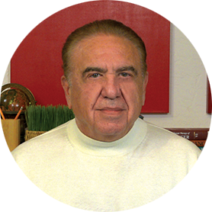
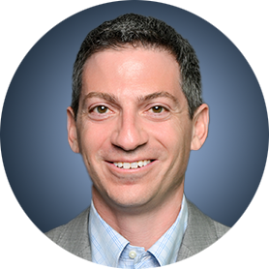
Faculty
Catherine C Coombs, MD
Associate Clinical Professor
Division of Hematology/Oncology
Department of Medicine
UCI Health
Orange County, California
MODERATOR
Neil Love, MD
Research To Practice
Miami, Florida
Matthew S Davids, MD, MMSc
Chief, Division of Lymphoma
Harold and Virginia Lash Endowed Chair in Lymphoma Research
Dana-Farber Cancer Institute
Leader, Lymphoma Program
Harvard Cancer Consortium
Associate Professor of Medicine
Harvard Medical School
Boston, Massachusetts

Slide 3
Commercial Support
This activity is supported by an educational grant from Lilly.

Slide 4
Dr Love — Disclosures
Dr Love is president and CEO of Research To Practice. Research To Practice receives funds in the form of educational grants to develop CME activities from the following companies: Aadi Bioscience, AbbVie Inc, ADC Therapeutics, Agendia Inc, Alexion Pharmaceuticals, Amgen Inc, Array BioPharma Inc, a subsidiary of Pfizer Inc, Arvinas, Astellas, AstraZeneca Pharmaceuticals LP, Aveo Pharmaceuticals, Bayer HealthCare Pharmaceuticals, BeOne, Biotheranostics Inc, A Hologic Company, Black Diamond Therapeutics Inc, Blueprint Medicines, Boehringer Ingelheim Pharmaceuticals Inc, Bristol Myers Squibb, Catalyst Pharmaceuticals Inc, Celcuity, Clovis Oncology, Coherus BioSciences, Corcept Therapeutics Inc, CTI BioPharma, a Sobi Company, Daiichi Sankyo Inc, Eisai Inc, Elevation Oncology Inc, Exact Sciences Corporation, Exelixis Inc, Genentech, a member of the Roche Group, Genmab US Inc, Geron Corporation, Gilead Sciences Inc, GSK, Helsinn Therapeutics (US) Inc, ImmunoGen Inc, Incyte Corporation, Ipsen Biopharmaceuticals Inc, Jazz Pharmaceuticals Inc, Johnson & Johnson, Karyopharm Therapeutics, Kite, A Gilead Company, Kura Oncology, Legend Biotech, Lilly, MEI Pharma Inc, Merck, Mersana Therapeutics Inc, Mirati Therapeutics Inc, Mural Oncology Inc, Natera Inc, Novartis, Novartis Pharmaceuticals Corporation on behalf of Advanced Accelerator Applications, Novocure Inc, Nuvalent, Nuvation Bio Inc, Pfizer Inc, Pharmacyclics LLC, an AbbVie Company, Puma Biotechnology Inc, Regeneron Pharmaceuticals Inc, Revolution Medicines Inc, Rigel Pharmaceuticals Inc, R-Pharm US, Sanofi, Seagen Inc, Servier Pharmaceuticals LLC, SpringWorks Therapeutics Inc, Stemline Therapeutics Inc, Sumitomo Pharma America, Summit Therapeutics, Syndax Pharmaceuticals, Taiho Oncology Inc, Takeda Pharmaceuticals USA Inc, TerSera Therapeutics LLC, Tesaro, A GSK Company, and Verastem Inc.

Slide 5
Research To Practice CME Planning Committee Members,
Staff and Reviewers
Planners, scientific staff and independent reviewers for Research To Practice have no relevant financial relationships to disclose.

Slide 6
Dr Coombs — Disclosures
Advisory Committees | AbbVie Inc, Allogene Therapeutics, AstraZeneca Pharmaceuticals LP, BeOne, Bristol Myers Squibb, Genentech, a member of the Roche Group, Invivyd, Janssen Biotech Inc, Johnson & Johnson, Lilly, Octapharma, Pharmacyclics LLC, an AbbVie Company
Contracted Research | AbbVie Inc, AstraZeneca Pharmaceuticals LP, BeOne, Carna Biosciences, Lilly
Speakers Bureaus | AstraZeneca Pharmaceuticals LP, BeOne, Lilly
Stock Options/Stock — Public Companies | Geron Corporation

Slide 7
Dr Davids — Disclosures
Consulting Agreements | AbbVie Inc, Ascentage Pharma, AstraZeneca Pharmaceuticals LP, BeOne, Bristol Myers Squibb, Galapagos NV, Genentech, a member of the Roche Group, Genmab US Inc, Janssen Scientific Affairs LLC, Lilly, MEI Pharma Inc, Merck, Nuvalent, Schrödinger
Contracted Research | Ascentage Pharma, AstraZeneca Pharmaceuticals LP, Flindr Therapeutics, MEI Pharma Inc
Nonrelevant Financial Relationships | UpToDate

Slide 8
This educational activity contains discussion of
non-FDA-approved uses of agents and regimens. Please refer to official prescribing information for each product for approved indications.

Slide 9
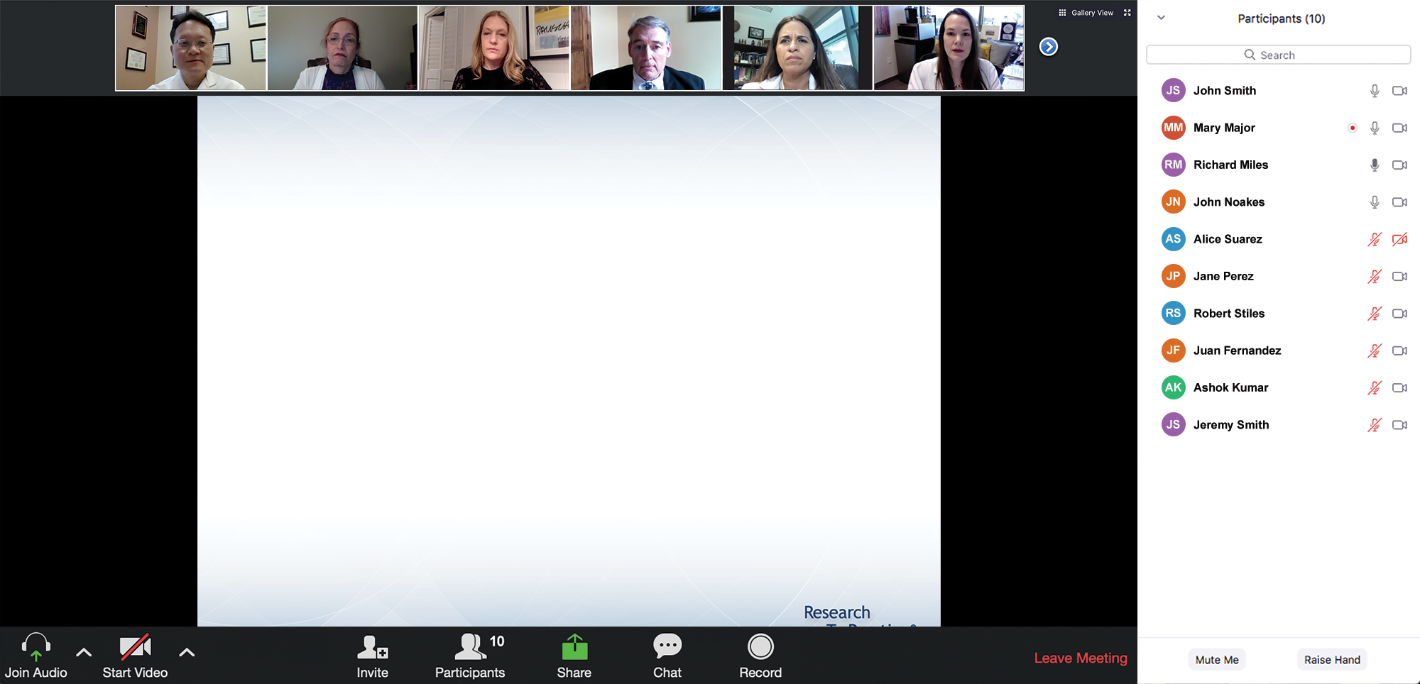
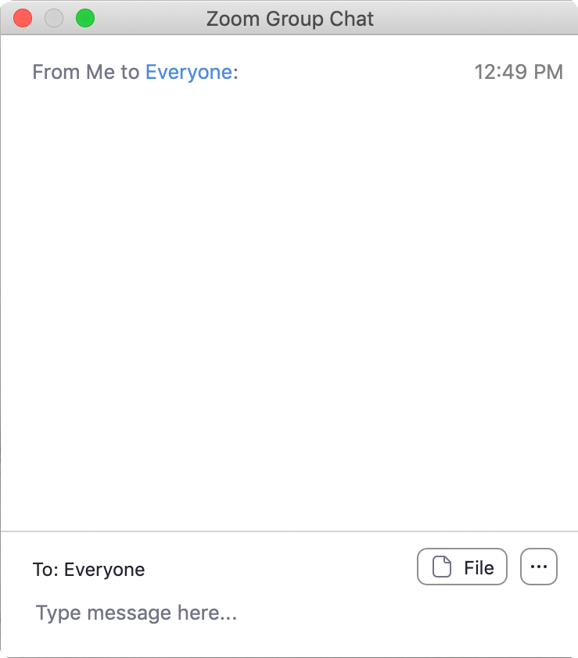
We Encourage Clinicians in Practice to Submit Questions
Feel free to submit questions now before the program begins and throughout the program.

Slide 10
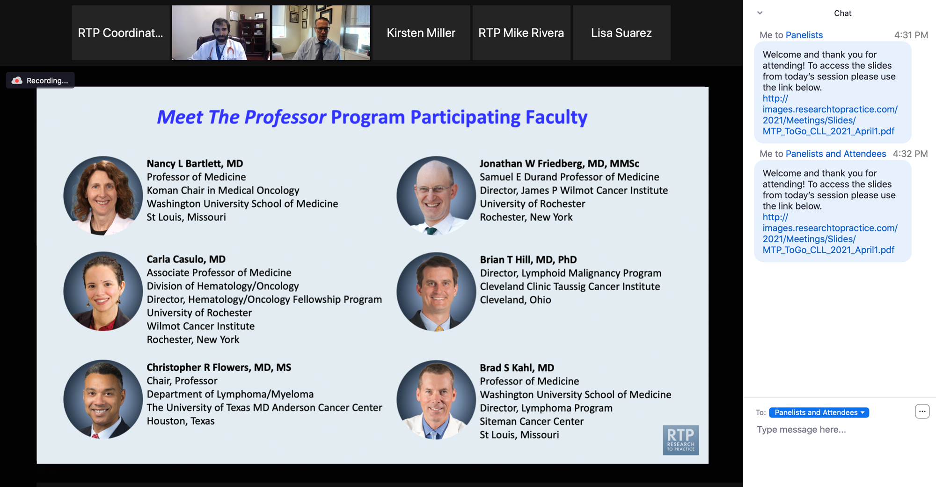
Familiarizing Yourself with the Zoom Interface
Expand chat submission box
Drag the white line above the submission box up to create
more space for your message.

Slide 11
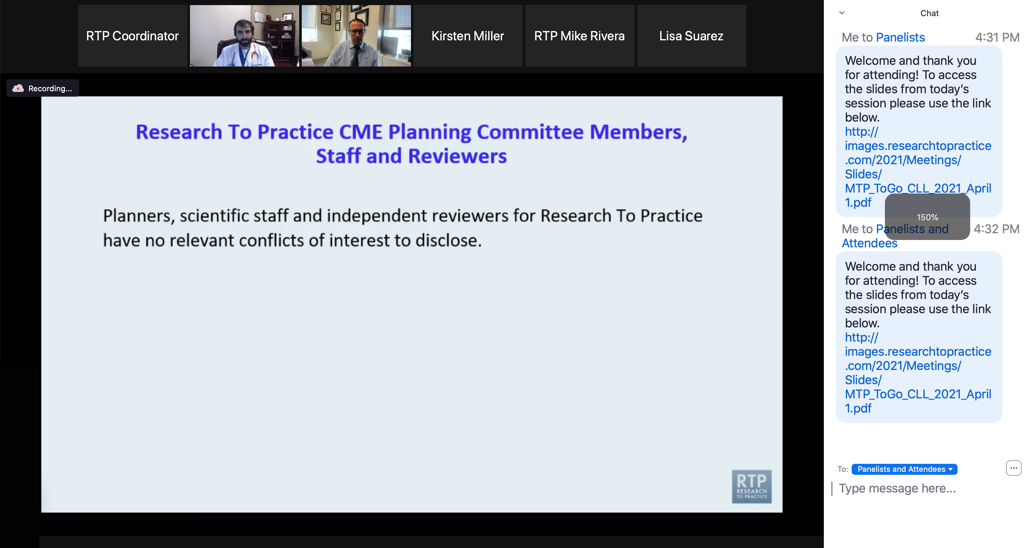
Familiarizing Yourself with the Zoom Interface
Increase chat font size
Press Command (for Mac) or Control (for PC) and the + symbol.
You may do this as many times as you need for readability.

Slide 12
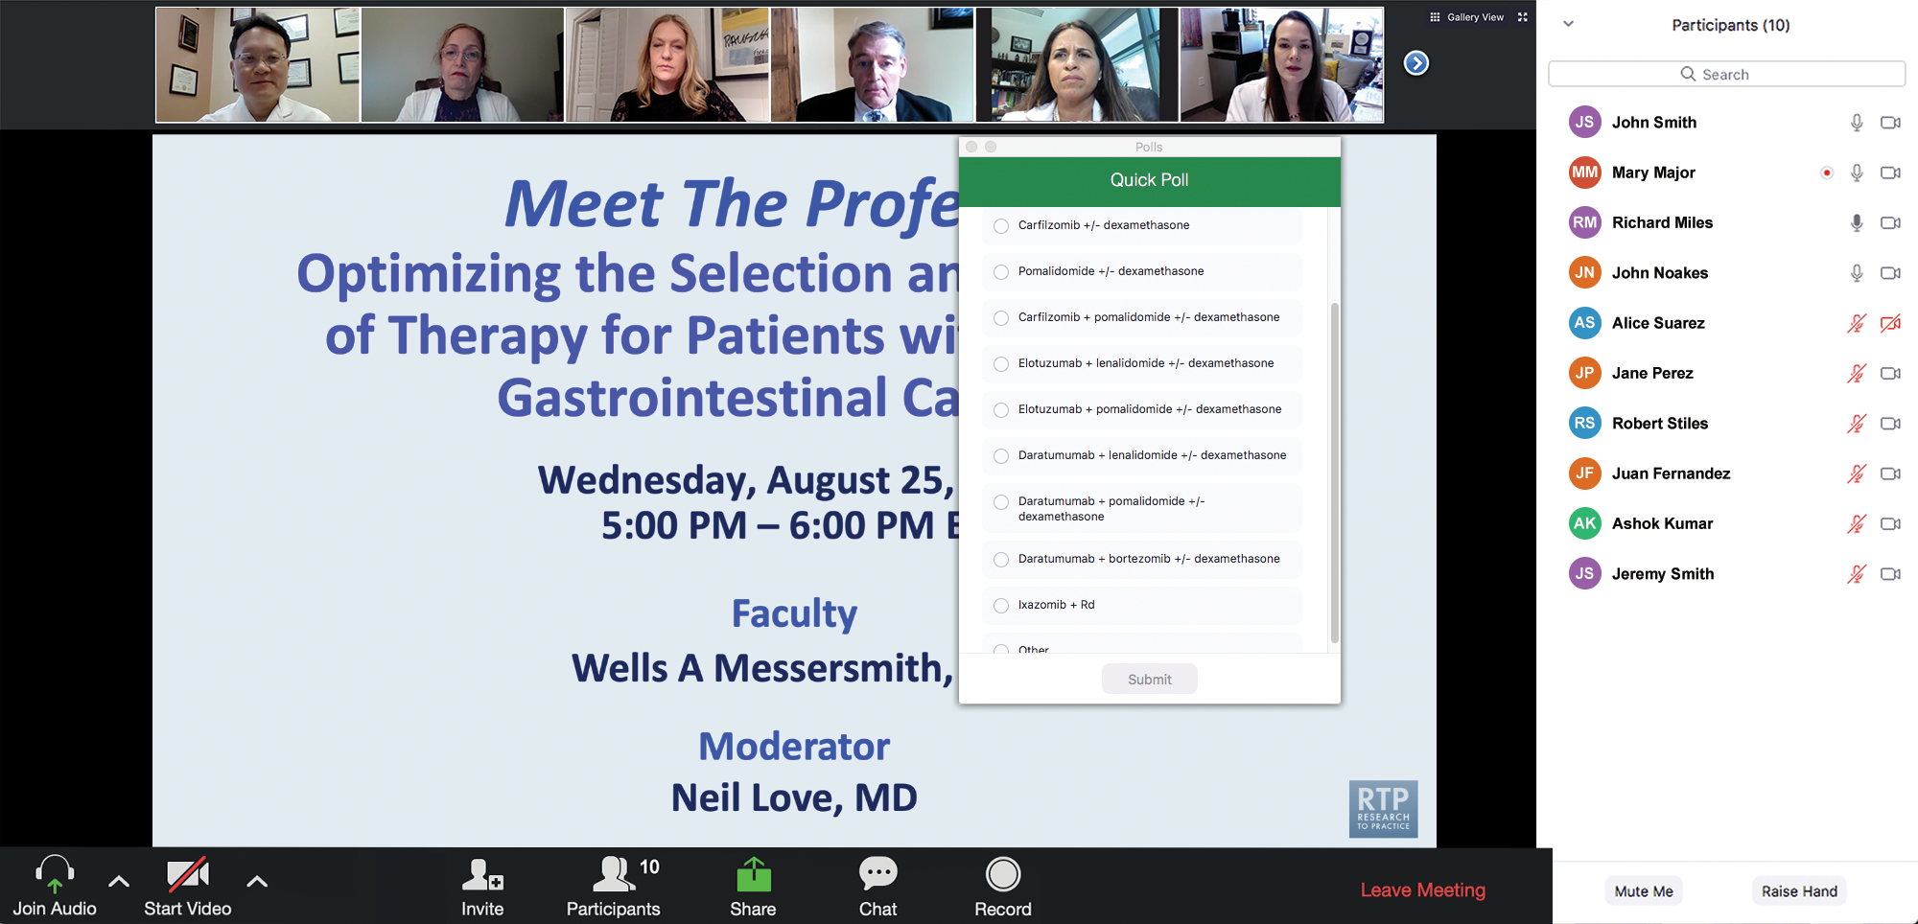
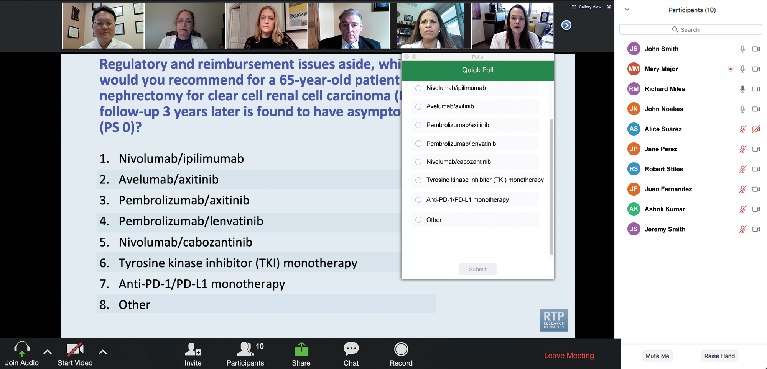
Clinicians in the Audience, Please Complete the Pre- and Postmeeting Surveys
Quick Survey
Quick Poll

Slide 13
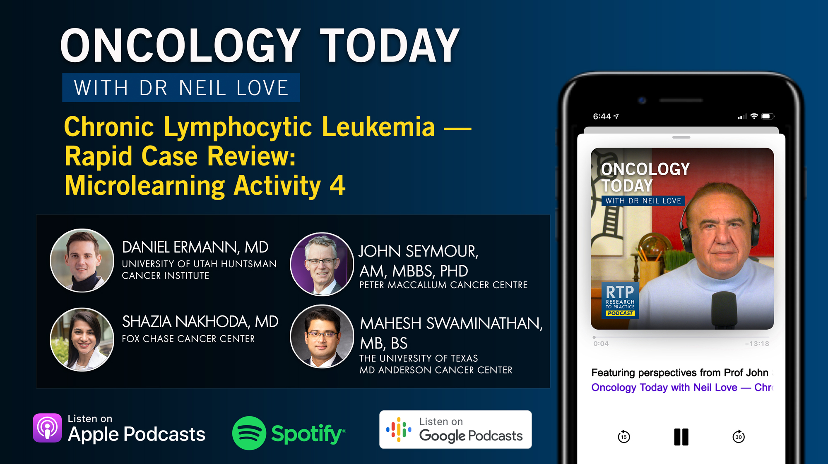

Slide 14
Integrating New Advances into
Community Oncology Practice
A Multitumor Symposium in Partnership with
Florida Cancer Specialists & Research Institute
Saturday, October 17, 2026
7:15 AM – 12:00 PM ET
The Ritz-Carlton Orlando Grande Lakes | Orlando, Florida
Moderator
Neil Love, MD

Slide 15
Second Opinion: A Case-Based Exploration of Clinical Investigator Best Practices Related to the Management of Breast Cancer
A CME Satellite Symposium Series
HER2-Positive Breast Cancer
Tuesday, December 8, 2026
7:00 PM – 9:00 PM CT
Localized HR-Positive
Breast Cancer
Thursday, December 10, 2026
7:00 PM – 9:00 PM CT
PI3K/AKT/mTOR Inhibitors for HR-Positive Breast Cancer
Tuesday, December 8, 2026
7:00 PM – 9:00 PM CT
Oral SERDs for HR-Positive Breast Cancer
Thursday, December 10, 2026
7:00 PM – 9:00 PM CT
Triple-Negative Breast Cancer
Wednesday, December 9, 2026
7:00 PM – 9:00 PM CT

Slide 16
A Friday Satellite Symposium Series
Preceding the 68th ASH Annual Meeting
Friday, December 11, 2026
Acute Myeloid Leukemia
7:30 AM – 9:30 AM CT
Myelofibrosis
3:15 PM – 5:15 PM CT
Chronic Lymphocytic Leukemia
7:30 AM – 9:30 AM CT
BCMA ADCs and Bispecific Antibodies for Multiple Myeloma
7:00 PM – 9:00 PM CT
Non-Hodgkin Lymphoma
11:30 AM – 1:30 PM CT
Novel Therapies for
Non-Hodgkin Lymphoma
7:00 PM – 9:00 PM CT
Multiple Myeloma
11:30 AM – 1:30 PM CT

Slide 17
Grand Rounds
CME/MOC-Accredited Interactive Series
Regional Activities
Four Series
Gastroesophageal Cancers
Diffuse Large
B-Cell Lymphoma
HR-Positive
Breast Cancer
Squamous Cell Carcinoma of the Head and Neck
Host a 1-hour session at your institution:
Email Meetings@ResearchToPractice.com
or call (800) 233-6153

Slide 18
Thank you for joining us! Please take a moment to complete the survey currently up on Zoom.
Your feedback is very important to us.
Information on how to obtain CME and ABIM MOC credit will be provided at the conclusion of the activity in the Zoom chat room. Attendees will also receive an email in 1 to 3 business days with these instructions.

Slide 19
Data + Perspectives: Investigators Discuss the Optimal Management of Chronic Lymphocytic Leukemia
A CME/MOC-Accredited Live Webinar
Thursday, September 17, 2026
5:00 PM – 6:00 PM ET
Faculty
Catherine C Coombs, MD
Matthew S Davids, MD, MMSc
Moderator
Neil Love, MD

Slide 20
Faculty
Catherine C Coombs, MD
Associate Clinical Professor
Division of Hematology/Oncology
Department of Medicine
UCI Health
Orange County, California
MODERATOR
Neil Love, MD
Research To Practice
Miami, Florida
Matthew S Davids, MD, MMSc
Chief, Division of Lymphoma
Harold and Virginia Lash Endowed Chair in Lymphoma Research
Dana-Farber Cancer Institute
Leader, Lymphoma Program
Harvard Cancer Consortium
Associate Professor of Medicine
Harvard Medical School
Boston, Massachusetts

Slide 21
We Encourage Clinicians in Practice to Submit Questions
Feel free to submit questions now before the program begins and throughout the program.

Slide 22
Clinicians in the Audience, Please Complete the Pre- and Postmeeting Surveys
Quick Survey
Quick Poll

Slide 24
Integrating New Advances into
Community Oncology Practice
A Multitumor Symposium in Partnership with
Florida Cancer Specialists & Research Institute
Saturday, October 17, 2026
7:15 AM – 12:00 PM ET
The Ritz-Carlton Orlando Grande Lakes | Orlando, Florida
Moderator
Neil Love, MD

Slide 25
Second Opinion: A Case-Based Exploration of Clinical Investigator Best Practices Related to the Management of Breast Cancer
A CME Satellite Symposium Series
HER2-Positive Breast Cancer
Tuesday, December 8, 2026
7:00 PM – 9:00 PM CT
Localized HR-Positive
Breast Cancer
Thursday, December 10, 2026
7:00 PM – 9:00 PM CT
PI3K/AKT/mTOR Inhibitors for HR-Positive Breast Cancer
Tuesday, December 8, 2026
7:00 PM – 9:00 PM CT
Oral SERDs for HR-Positive Breast Cancer
Thursday, December 10, 2026
7:00 PM – 9:00 PM CT
Triple-Negative Breast Cancer
Wednesday, December 9, 2026
7:00 PM – 9:00 PM CT

Slide 26
A Friday Satellite Symposium Series
Preceding the 68th ASH Annual Meeting
Friday, December 11, 2026
Acute Myeloid Leukemia
7:30 AM – 9:30 AM CT
Myelofibrosis
3:15 PM – 5:15 PM CT
Chronic Lymphocytic Leukemia
7:30 AM – 9:30 AM CT
BCMA ADCs and Bispecific Antibodies for Multiple Myeloma
7:00 PM – 9:00 PM CT
Non-Hodgkin Lymphoma
11:30 AM – 1:30 PM CT
Novel Therapies for
Non-Hodgkin Lymphoma
7:00 PM – 9:00 PM CT
Multiple Myeloma
11:30 AM – 1:30 PM CT

Slide 27
Grand Rounds
CME/MOC-Accredited Interactive Series
Regional Activities
Four Series
Gastroesophageal Cancers
Diffuse Large
B-Cell Lymphoma
HR-Positive
Breast Cancer
Squamous Cell Carcinoma of the Head and Neck
Host a 1-hour session at your institution:
Email Meetings@ResearchToPractice.com
or call (800) 233-6153

Slide 28
Data + Perspectives: Investigators Discuss the Optimal Management of Chronic Lymphocytic Leukemia
A CME/MOC-Accredited Live Webinar
Thursday, September 17, 2026
5:00 PM – 6:00 PM ET
Faculty
Catherine C Coombs, MD
Matthew S Davids, MD, MMSc
Moderator
Neil Love, MD

Slide 29
Dr Coombs — Disclosures
Advisory Committees | AbbVie Inc, Allogene Therapeutics, AstraZeneca Pharmaceuticals LP, BeOne, Bristol Myers Squibb, Genentech, a member of the Roche Group, Invivyd, Janssen Biotech Inc, Johnson & Johnson, Lilly, Octapharma, Pharmacyclics LLC, an AbbVie Company
Contracted Research | AbbVie Inc, AstraZeneca Pharmaceuticals LP, BeOne, Carna Biosciences, Lilly
Speakers Bureaus | AstraZeneca Pharmaceuticals LP, BeOne, Lilly
Stock Options/Stock — Public Companies | Geron Corporation

Slide 30
Dr Davids — Disclosures
Consulting Agreements | AbbVie Inc, Ascentage Pharma, AstraZeneca Pharmaceuticals LP, BeOne, Bristol Myers Squibb, Galapagos NV, Genentech, a member of the Roche Group, Genmab US Inc, Janssen Scientific Affairs LLC, Lilly, MEI Pharma Inc, Merck, Nuvalent, Schrödinger
Contracted Research | Ascentage Pharma, AstraZeneca Pharmaceuticals LP, Flindr Therapeutics, MEI Pharma Inc
Nonrelevant Financial Relationships | UpToDate

Slide 31
Dr Love — Disclosures
Dr Love is president and CEO of Research To Practice. Research To Practice receives funds in the form of educational grants to develop CME activities from the following companies: Aadi Bioscience, AbbVie Inc, ADC Therapeutics, Agendia Inc, Alexion Pharmaceuticals, Amgen Inc, Array BioPharma Inc, a subsidiary of Pfizer Inc, Arvinas, Astellas, AstraZeneca Pharmaceuticals LP, Aveo Pharmaceuticals, Bayer HealthCare Pharmaceuticals, BeOne, Biotheranostics Inc, A Hologic Company, Black Diamond Therapeutics Inc, Blueprint Medicines, Boehringer Ingelheim Pharmaceuticals Inc, Bristol Myers Squibb, Catalyst Pharmaceuticals Inc, Celcuity, Clovis Oncology, Coherus BioSciences, Corcept Therapeutics Inc, CTI BioPharma, a Sobi Company, Daiichi Sankyo Inc, Eisai Inc, Elevation Oncology Inc, Exact Sciences Corporation, Exelixis Inc, Genentech, a member of the Roche Group, Genmab US Inc, Geron Corporation, Gilead Sciences Inc, GSK, Helsinn Therapeutics (US) Inc, ImmunoGen Inc, Incyte Corporation, Ipsen Biopharmaceuticals Inc, Jazz Pharmaceuticals Inc, Johnson & Johnson, Karyopharm Therapeutics, Kite, A Gilead Company, Kura Oncology, Legend Biotech, Lilly, MEI Pharma Inc, Merck, Mersana Therapeutics Inc, Mirati Therapeutics Inc, Mural Oncology Inc, Natera Inc, Novartis, Novartis Pharmaceuticals Corporation on behalf of Advanced Accelerator Applications, Novocure Inc, Nuvalent, Nuvation Bio Inc, Pfizer Inc, Pharmacyclics LLC, an AbbVie Company, Puma Biotechnology Inc, Regeneron Pharmaceuticals Inc, Revolution Medicines Inc, Rigel Pharmaceuticals Inc, R-Pharm US, Sanofi, Seagen Inc, Servier Pharmaceuticals LLC, SpringWorks Therapeutics Inc, Stemline Therapeutics Inc, Sumitomo Pharma America, Summit Therapeutics, Syndax Pharmaceuticals, Taiho Oncology Inc, Takeda Pharmaceuticals USA Inc, TerSera Therapeutics LLC, Tesaro, A GSK Company, and Verastem Inc.

Slide 32
Commercial Support
This activity is supported by an educational grant from Lilly.
Research To Practice CME Planning Committee Members,
Staff and Reviewers
Planners, scientific staff and independent reviewers for Research To Practice have no relevant financial relationships to disclose.

Slide 33
This educational activity contains discussion of
non-FDA-approved uses of agents and regimens. Please refer to official prescribing information for each product for approved indications.

Slide 34
Agenda
Introduction: Minimal Residual Disease Assays in Community-Based Practice
Module 1: New Developments in Previously Untreated Chronic Lymphocytic Leukemia (CLL)
Module 2: Richter Transformation
Module 3: Selection and Sequencing of Therapies for Relapsed/Refractory CLL

Slide 35
Agenda
Introduction: Minimal Residual Disease Assays in Community-Based Practice
Module 1: New Developments in Previously Untreated Chronic Lymphocytic Leukemia (CLL)
Module 2: Richter Transformation
Module 3: Selection and Sequencing of Therapies for Relapsed/Refractory CLL

Slide 36
Agenda
Introduction: Minimal Residual Disease Assays in Community-Based Practice
Module 1: New Developments in Previously Untreated Chronic Lymphocytic Leukemia (CLL)
Module 2: Richter Transformation
Module 3: Selection and Sequencing of Therapies for Relapsed/Refractory CLL

Slide 37
New Developments in Previously Untreated
Chronic Lymphocytic Leukemia (CLL)
Matthew S Davids, MD, MMSc
Chief, Division of Lymphoma
Harold and Virginia Lash Endowed Chair in Lymphoma Research
Dana-Farber Cancer Institute
Leader, Lymphoma Program
Harvard Cancer Consortium
Associate Professor of Medicine
Harvard Medical School
Boston, Massachusetts

Slide 38
Key Datasets — BTK (Bruton Tyrosine Kinase) and Bcl-2 Inhibitor Combinations
Brown JR et al. Fixed-Duration Acalabrutinib Combinations in Untreated Chronic Lymphocytic Leukemia. N Engl J Med 2025;392(8):748-62.
Davids MS et al. Majic: A Phase 3 Prospective, Multicenter, Randomized, Open-Label Trial of Acalabrutinib plus Venetoclax versus Venetoclax plus Obinutuzumab in Previously Untreated Chronic Lymphocytic Leukemia or Small Lymphocytic Lymphoma. ASH 2021;Abstract 1553.
Shadman M et al. Zanubrutinib and Venetoclax for Patients with Treatment-Naïve Chronic Lymphocytic Leukemia/Small Lymphocytic Lymphoma with and without Del(17p)/TP53 Mutation: SEQUOIA Arm D Results. J Clin Oncol 2025;43(21):2409-17.

Slide 39

Dr Davids: Case Presentation
76 y/o man was diagnosed 3 years ago with del(11q), IGHV unmutated, TP53 wildtype CLL and observed for 3 years but now progressing with bulky lymph nodes and cytopenias and needs treatment. Co-morbidities include hypertension and well-controlled type 2 DM. He prefers time-limited therapy and is able to travel for clinic visits but this is somewhat challenging logistically for him.
How would you treat this patient?

Slide 40
AMPLIFY
TN CLL (N=867)
Key inclusion criteria
Age ≥18 years
TN CLL requiring treatment per iwCLL 2018 criteria¹
Without del(17p) or TP53ª
ECOG PS ≤2
Key exclusion criteria
CIRS-Geriatric >6
Significant cardiovascular disease
Stratification
Age (>65 vs ≤65 years)
IGHV mutational status
Rai stage (≥3 vs <3)
Geographic region
AMPLIFY: randomized, multicenter, open-label, Ph 3 trial
AV (14 cycles)
Primary endpoint: IRC-assessed PFS (AV vs FCR/BR)
If primary endpoint met, secondary endpoints tested in fixed sequential hierarchy:
IRC-PFS (AVO vs FCR/BR)
uMRD (AV vs FCR/BR)
uMRD (AVO vs FCR/BR)
OS (AV vs FCR/BR)
OS (AVO vs FCR/BR)
AVO (14 cycles)
RANDOMIZE 1:1:1
FCR/BR (6 cycles)
Crossover not built into protocol
AV and AVO dosing schedule
Acalabrutinib 100 mg PO BID (Cycles 1–14)
Venetoclax 400 mg PO QD (Cycles 3–14)
Obinutuzumab (AVO only) 1000 mg (Cycles 2–7)
Cycles (28 days each)
1
2
3
4
5
6
7
8
9
10
11
12
13
14
NCT03836261. Data cutoff: April 30, 2024.
ªAssayed by central lab.
AV, acalabrutinib-venetoclax; AVO, acalabrutinib-venetoclax-obinutuzumab; BR, bendamustine-rituximab; CIRS-Geriatric, Cumulative Illness Rating Scale-Geriatric; CLL, chronic lymphocytic leukemia; ECOG PS, Eastern Cooperative Oncology Group performance status; FCR, fludarabine-cyclophosphamide-rituximab; IGHV, immunoglobulin heavy-chain variable region gene; iwCLL, International Working Group on CLL; OS, overall survival; PFS, progression-free survival; TN, treatment-naive; uMRD, undetectable measurable residual disease.
Brown et al., NEJM, 2025

Slide 41
AMPLIFY: uMRD Rates (Flow Cytometry [<10⁻⁴] in PB)
AV
AVO
FCR/BR
Evaluable Patients†
uMRD Rate (%)
No. patients:
244
202
190
222
202
181
229
197
190
Same Timepoint as Key Secondary Endpoint
EOT
EOT+3
Key secondary endpoint timing: cycle 9, day 1 (AV arm), cycle 10, day 1 (AVO arm), and cycle 6, day 1 plus 12 weeks (FCR/BR)
Key secondary endpoint (ITT population): AV vs FCR/BR: P<0.0001 (favoring FCR/BR); AVO vs FCR/BR: P=0.0003 (favoring AVO).
*ITT population: all randomized patients regardless of whether MRD assessment was performed at the specified time point (missing assessments considered MRD+).
†Evaluable patients: those with MRD assessment at the specified timepoint.
EOT: cycle 14 day 28 for AV (± obinutuzumab); cycle 6 day 1 (±28-day window) (FCR/BR).
Brown et al., NEJM, 2025

Slide 42
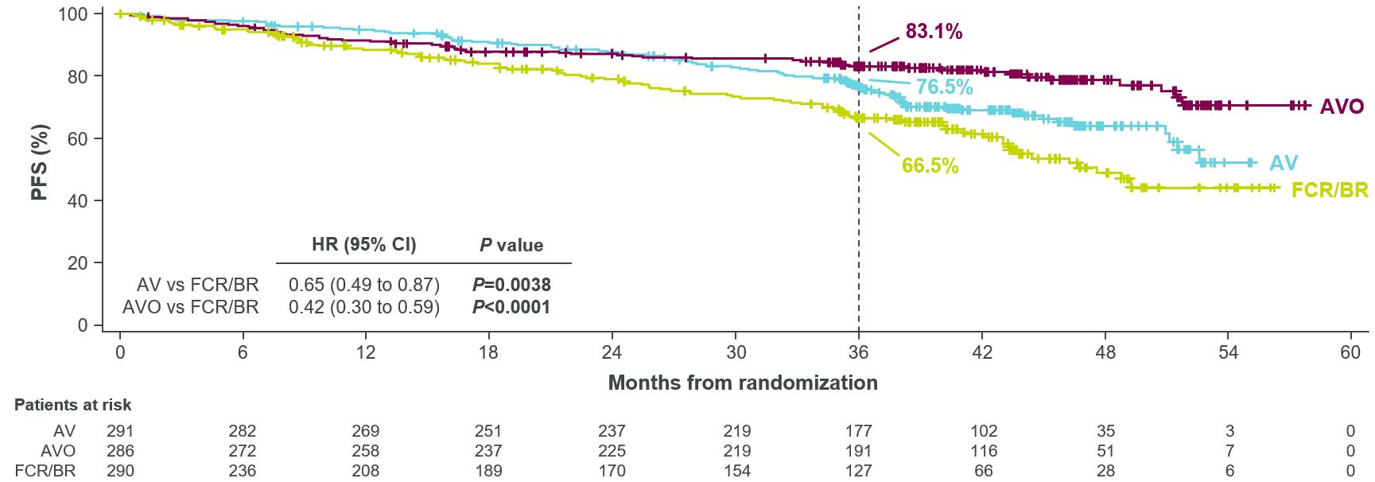
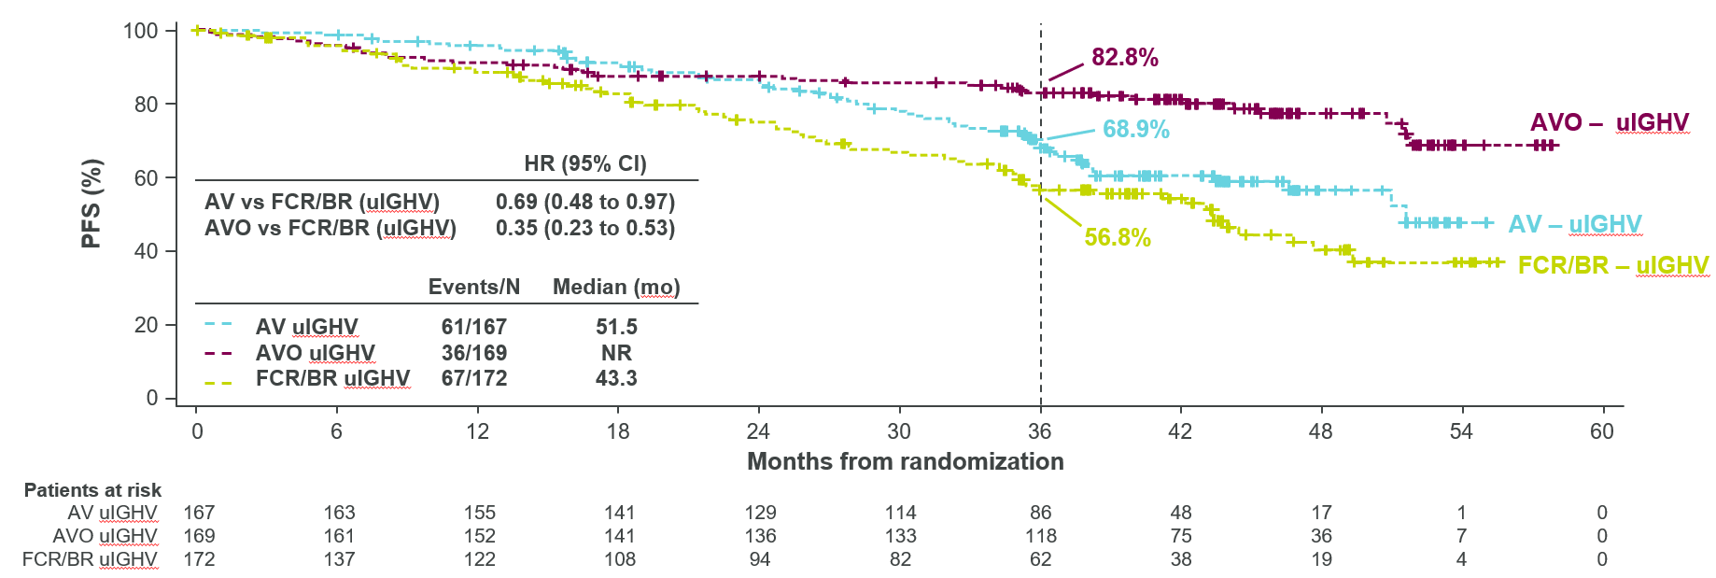
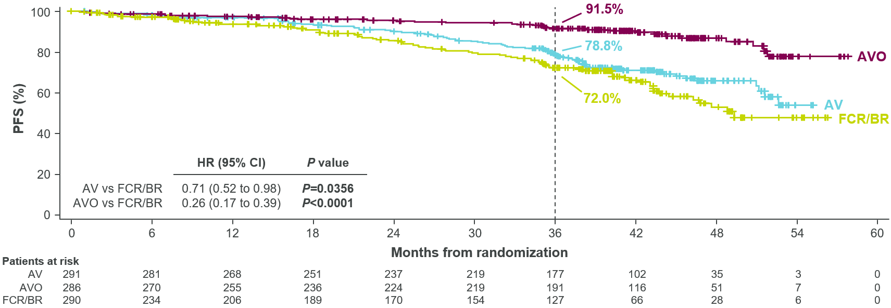
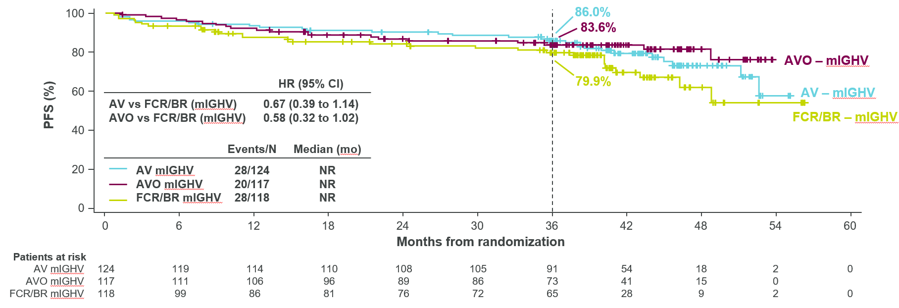
AMPLIFY: PFS
IRC-assessed (primary endpoint)
PFS - uIGHV
IRC-assessed (censoring COVID-19 deaths)
PFS - mIGHV
ITT population. Median follow-up from randomization: 40.8 months (range, 0–59 months).
Hazard ratio (95% CI) computed using a Cox proportional-hazards model stratified by the randomization strata. P-value based on stratified log-rank test.
AV, acalabrutinib-venetoclax; AVO, acalabrutinib-venetoclax-obinutuzumab; BR, bendamustine-rituximab; CI, confidence interval; FCR, fludarabine-cyclophosphamide-rituximab; HR, hazard ratio; IRC, independent review committee; ITT, intent-to-treat; NR, not reached; PFS, progression-free survival.
Brown et al., NEJM, 2025

Slide 43
AMPLIFY: Safety / Events of Clinical Interest
 | AV (n=291) |  | AVO (n=284) |  | FCR/BR (n=259)
 | Any Grade | Grade ≥3 | Any Grade | Grade ≥3 | Any Grade | Grade ≥3
Any ECI | 222 (76.3) | 136 (46.7) | 242 (85.2) | 188 (66.2) | 185 (71.4) | 141 (54.4)
Cardiac events | 27 (9.3) | 5 (1.7) | 34 (12.0) | 7 (2.5) | 9 (3.5) | 3 (1.2)
Atrial fibrillation | 2 (0.7) | 1 (0.3) | 6 (2.1) | 2 (0.7) | 2 (0.8) | 2 (0.8)
Ventricular tachyarrhythmiasª | 2 (0.7) | 0 | 3 (1.1) | 0 | 0 | 0
Hypertension | 12 (4.1) | 8 (2.7) | 11 (3.9) | 6 (2.1) | 7 (2.7) | 2 (0.8)
Hemorrhage | 94 (32.3) | 3 (1.0) | 86 (30.3) | 6 (2.1) | 11 (4.2) | 1 (0.4)
Major hemorrhage | 3 (1.0) | 3 (1.0) | 8 (2.8) | 6 (2.1) | 2 (0.8) | 1 (0.4)
Neutropenia (any)^{b} | 108 (37.1) | 94 (32.3) | 143 (50.4) | 131 (46.1) | 132 (51.0) | 112 (43.2)
Infections (any) | 148 (50.9) | 36 (12.4) | 153 (53.9) | 67 (23.6) | 82 (31.7) | 26 (10.0)
Second primary malignancies | 15 (5.2) | 5 (1.7) | 12 (4.2) | 5 (1.8) | 2 (0.8) | 0
Excl. non-melanoma skin | 8 (2.7) | 5 (1.7) | 7 (2.5) | 4 (1.4) | 1 (0.4) | 0
Tumor lysis syndrome | 1 (0.3) | 1 (0.3) | 1 (0.4) | 1 (0.4) | 8 (3.1) | 8 (3.1)
Data are n (%). ECIs listed by category and sub-category.
ªVentricular tachyarrhythmias consisted of ventricular extrasystoles (n=1 in AV arm; n=2 in AVO arm) and ventricular tachycardia (n=1 each in AV and AVO arms).
^{b}Includes neutropenia, neutrophil count decreased, and febrile neutropenia.
AEs with an onset date or that worsen on or after the date of first dose and up to and including 30 days following the date of last dose of treatment or up to the day prior to start of subsequent anti-CLL therapy, whichever comes first.
AE, adverse event; AV, acalabrutinib-venetoclax; AVO, acalabrutinib-venetoclax-obinutuzumab; BR, bendamustine-rituximab; ECI, event of clinical interest; FCR, fludarabine-cyclophosphamide-rituximab.
Brown et al., NEJM, 2025

Slide 44
Dr Davids: Case Presentation
76 y/o man was diagnosed 3 years ago with del(11q), IGHV unmutated, TP53 wildtype CLL and observed for 3 years but now progressing with bulky lymph nodes and cytopenias and needs treatment. Co-morbidities include hypertension and well-controlled type 2 DM. He prefers time-limited therapy and is able to travel for clinic visits but this is somewhat challenging logistically for him.
AMPLIFY: AV
The patient decides to start on AV, and is now about 7 months into treatment with excellent response and tolerability to date

Slide 45
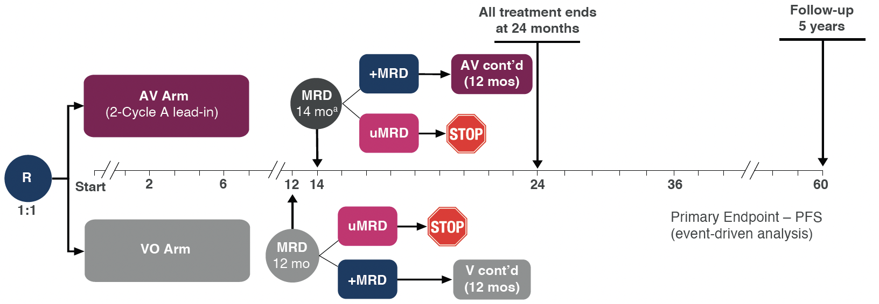
The global MAJIC phase 3 study seeks to define the optimal MRD-guided venetoclax doublet for frontline CLL treatment
N=~600 patients recruited
Global study with ~40 sites
FPI: Sept 2022
Accrual completed: March 2024
Key Eligibility Criteria
TN CLL/SLL requiring treatment per 2018 iwCLL guidelines
ECOG PS 0-2
Anti-thrombotic agents permitted except for warfarin or equivalent vitamin K antagonists
Primary endpoint: INV-assessed PFS
Davids et al., ASH, 2021. Abstract 1553

Slide 46
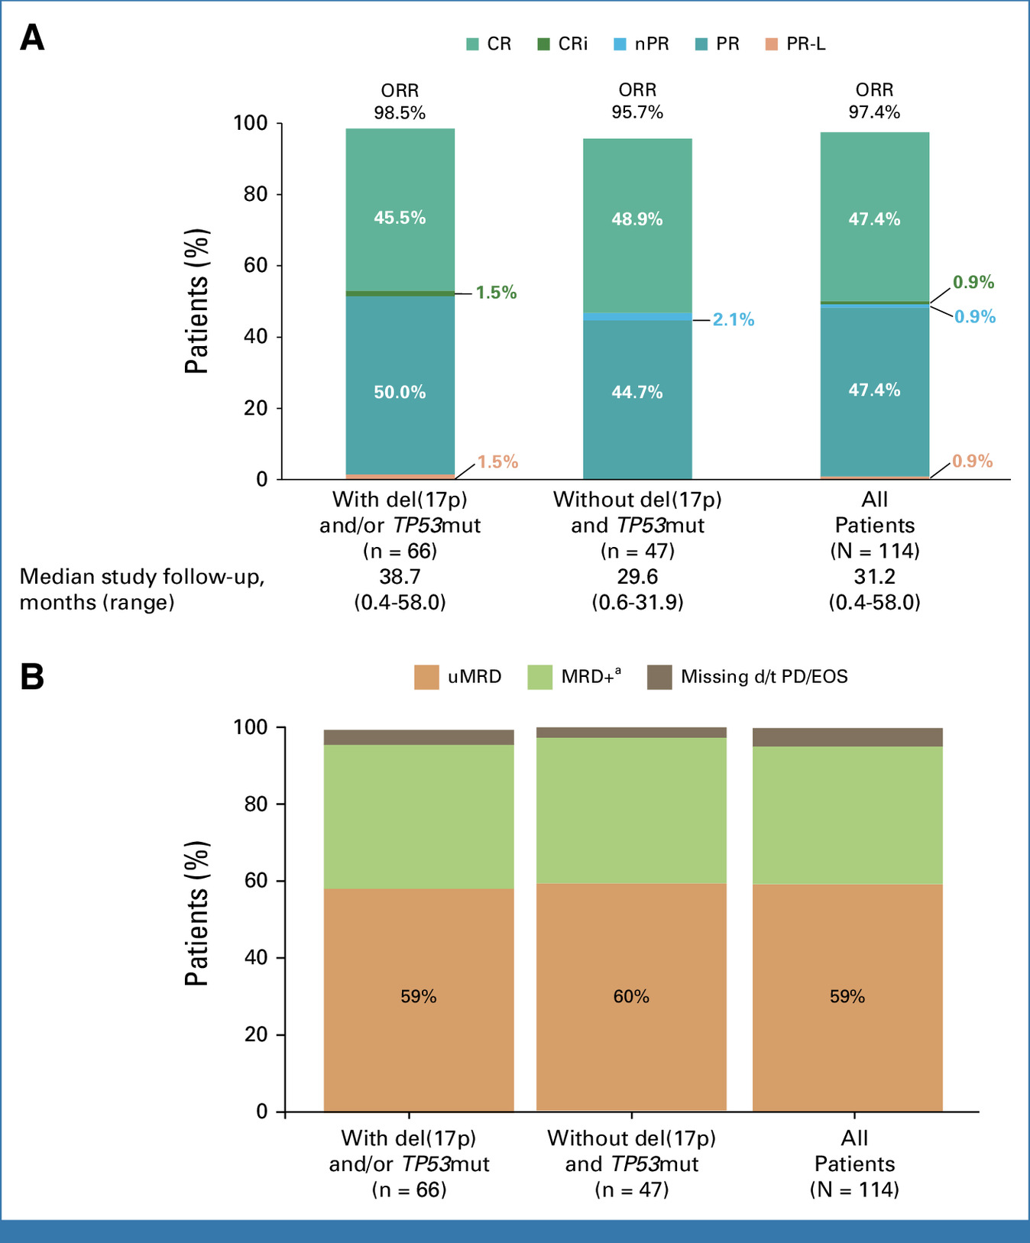
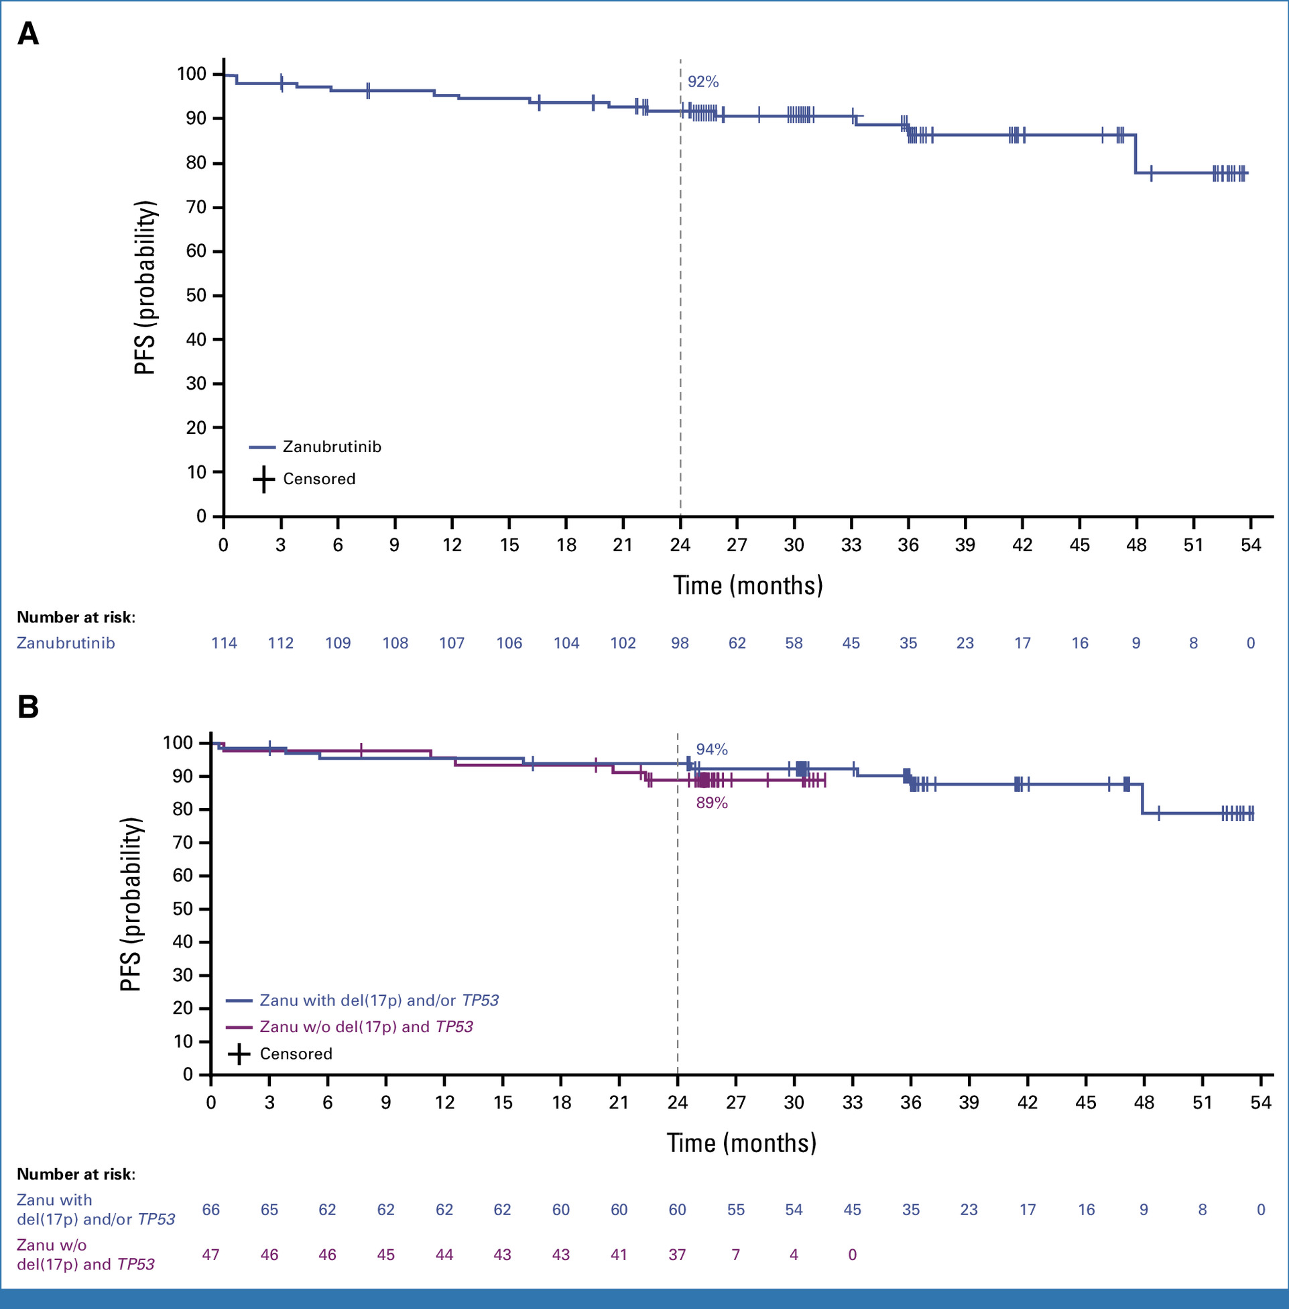
Zanubrutinib + venetoclax is an alternative BTKi/BCL-2i frontline regimen for CLL
Patients received zanu 160 mg bid starting at cycle 1 and ven qd from cycle 4-28 followed by zanu monotherapy until PD, uMRD-guided stopping criteria were met, or unacceptable toxicity
Shadman et al., J Clin Oncol, 2025

Slide 47
Faculty Discussion
BTK and Bcl-2 Inhibitor Combinations
Brown JR et al. Fixed-Duration Acalabrutinib Combinations in Untreated Chronic Lymphocytic Leukemia. N Engl J Med 2025;392(8):748-62.
Davids MS et al. Majic: A Phase 3 Prospective, Multicenter, Randomized, Open-Label Trial of Acalabrutinib plus Venetoclax versus Venetoclax plus Obinutuzumab in Previously Untreated Chronic Lymphocytic Leukemia or Small Lymphocytic Lymphoma. ASH 2021;Abstract 1553.
Shadman M et al. Zanubrutinib and Venetoclax for Patients with Treatment-Naïve Chronic Lymphocytic Leukemia/Small Lymphocytic Lymphoma with and without Del(17p)/TP53 Mutation: SEQUOIA Arm D Results. J Clin Oncol 2025;43(21):2409-17.

Slide 48
Key Datasets — First-Line Noncovalent BTK Inhibitors
Jurczak W et al. BRUIN CLL-313: Randomized Phase III Trial of Pirtobrutinib versus Bendamustine plus Rituximab in Untreated Patients with Chronic Lymphocytic Leukemia/Small Lymphocytic Lymphoma. J Clin Oncol 2026;44(6):466-75.
Woyach JA et al. Pirtobrutinib versus Ibrutinib in Treatment-Naïve and Relapsed/Refractory Chronic Lymphocytic Leukemia/Small Lymphocytic Lymphoma. J Clin Oncol 2026;44(6):476-85.

Slide 49

Dr Davids: Case Presentation
89 y/o man with del(11q) on FISH, IGHV unmutated, TP53 wildtype observed for the past 3 years but now progressing with bulky lymph nodes and cytopenias and needs treatment. Co-morbidities include CAD s/p stents, mild CHF, stage 3 CKD, impaired mobility. He finds it difficult logistically to make it to clinic visits, and is becoming increasingly forgetful.
How would you treat this patient?

Slide 50
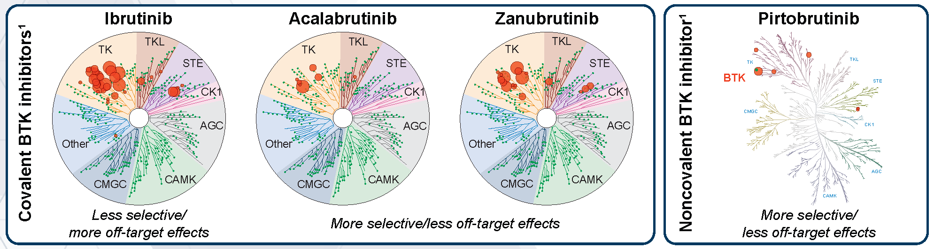
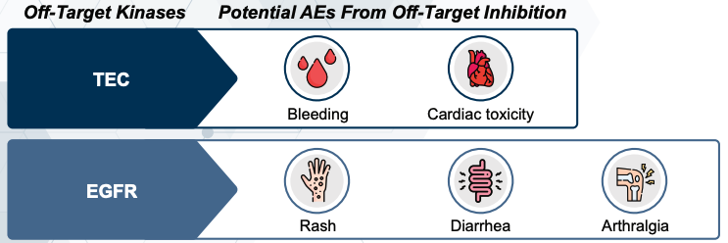
What are the Implications of Covalent BTKi Selectivity for Off-Target Effects?
Less selective BTK inhibitors (eg, ibrutinib) have more off-target effects,
which contribute to more toxicity compared with more selective agents
Potential off-target effects include:
Notes:
Kaptein A, de Bruin G, Emmelot-van Hoek M, et al. Potency and selectivity of BTK inhibitors in clinical development for B-cell malignancies. Blood. 2018;132(suppl 1):1871.

Slide 51
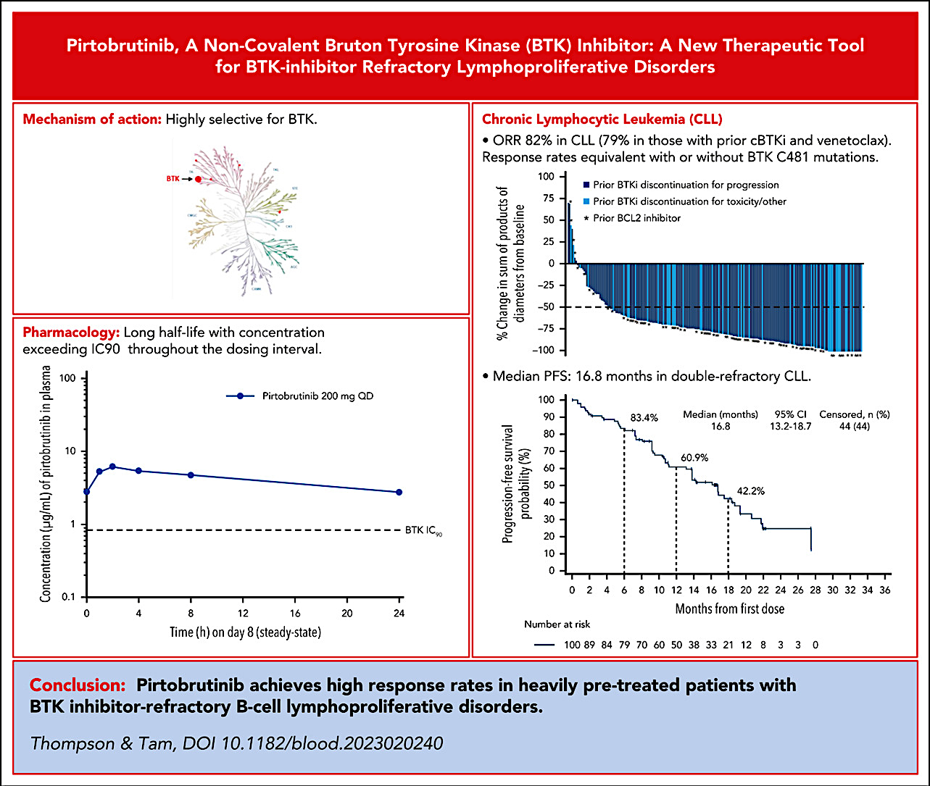
Pirtobrutinib is highly selective for BTKi with favorable PK/PD properties leading to a high level of efficacy in R/R CLL
Thompson and Tam, Blood, 2023

Slide 52
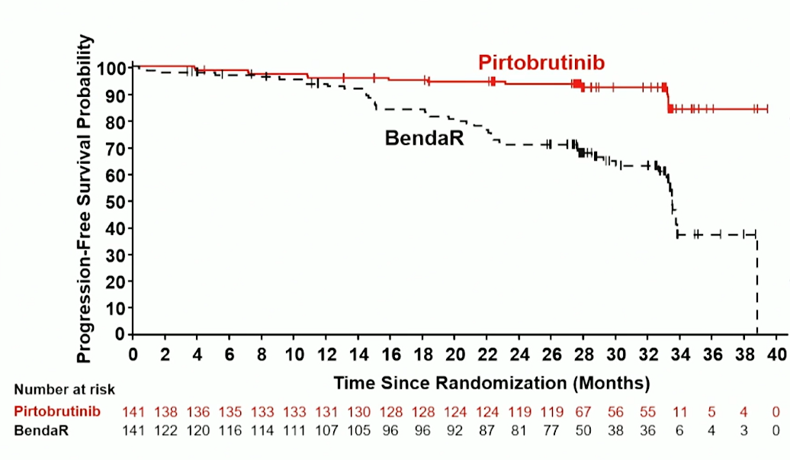
First Results From the BRUIN CLL-313 Randomized Phase 3 Study of Pirtobrutinib vs BR in Patients With TN CLL/SLL
Key Eligibility Criteria
Confirmed TN CLL/SLL, with requirement for therapy
ECOG PS 0-2
No del(17p)
Primary Endpoint:
PFS (by IRC)
RANDOMIZED 1:1
Pirto
Pirtobrutinib 200 mg po qd
(28-day cycles)
Optional Crossover
(PD by IRC)
PFS | Pirto (n=141) | BR (n=141)
Events, n (%) | 13 (9.2) | 48 (34.0)
24-month rate (95% CI), % | 93.4 (87.6-96.5) | 70.7 (61.5-78.1)
HR (95% CI); P-value | 0.20 (0.11-0.37); P<0.0001
Median follow-up, months | 28.1 | 28.3
BR
Bendamustine 90 mg/m² IV, D1-2
Rituximab 375 mg/m² IV C1,
then 500 mg /m² IV D1 C2-6
(28-day cycles)
Primary endpoint: PFS (by IRC)
Key secondary endpoint: OS
Secondary endpoints: ORR, safety
PFS Subgroup Analysis
PFS favored Pirto across all prespecified subgroups (age at enrollment, disease type, Rai stage, β2M, del[11q], IGHV mutation status, complex karyotype, TP53 mutation)
Jurczak W, et al. J Clin Oncol., 2026

Slide 53
First Results From the BRUIN CLL-313 Randomized Phase 3 Study of Pirtobrutinib vs BR in Patients With TN CLL/SLL: Safety
AEs of Interest, n (%) | Pirto (n=140) |  | BR (n=132) |  | Any Grade AEs, EAIR per 100 Person-Years
 | Any grade | Grade ≥3 | Any grade | Grade ≥3 | Pirto | BR | EAIR ratio (95% CI)
Infection | 80 (57.1) | 19 (13.6) | 44 (33.3) | 11 (8.3) | 38.3 | 89.7 | 0.43 (0.30-0.62)
Without COVID-19 | 72 (51.4) | 19 (13.6) | 38 (28.8) | 9 (6.8) | 30.9 | 74.9 | 0.41 (0.28-0.61)
Bleeding | 36 (25.7) | 1 (0.7) | 2 (1.5) | 0 | 12.5 | 3.3 | 3.73 (0.90-15.50)
Hemorrhage | 17 (12.1) | 1 (0.7) | 2 (1.5) | 0 | 5.2 | 3.3 | 1.55 (0.36-6.69)
Bruising | 16 (11.4) | 0 | 0 | 0 | 4.8 | 0 | NE
Petechiae and purpura | 8 (5.7) | 0 | 0 | 0 | 2.3 | 0 | NE
Neutropenia | 21 (15.0) | 13 (9.3) | 68 (51.5) | 60 (45.5) | 6.5 | 169.5 | 0.04 (0.02-0.06)
Anemia | 14 (10.0) | 6 (4.3) | 21 (15.9) | 10 (7.6) | 4.1 | 37.7 | 0.11 (0.06-0.21)
Thrombocytopenia | 12 (8.6) | 4 (2.9) | 23 (17.4) | 9 (6.8) | 3.5 | 43.1 | 0.08 (0.04-0.16)
AFib and AFlutter | 2 (1.4) | 1 (0.7) | 2 (1.5) | 1 (0.8) | 0.5 | 3.3 | 0.17 (0.02-1.17)
≥75 years old | 1 (5.0) | 0 | 1 (4.3) | 0 | 2.2 | 10.0 | 0.22 (0.01-3.46)
Hypertension | 11 (7.9) | 4 (2.9) | 6 (4.5) | 4 (3.0) | 3.2 | 10.2 | 0.31 (0.11-0.84)
Jurczak W, et al., J Clin Oncol., 2026

Slide 54
BRUIN CLL-314 Phase 3 Study of Pirtobrutinib vs Ibrutinib in Patients With TN and R/R CLL/SLL
Key Eligibility Criteria
Confirmed CLL/SLL
BTKi naïve (1L or R/R)
del(17p)
ECOG PS 0-2
AESIs (in ≥10%), n (%) | Pirto (n=330) |  | Ibr (n=325)
 | Any grade | Grade ≥3 | Any grade | Grade ≥3
≥1 AESI | 288 (87.3) | 127 (38.5) | 288 (88.6) | 117 (36.0)
Infections | 226 (68.5) | 56 (17.0) | 241 (74.2) | 54 (16.6)
Bleeding | 115 (34.8) | 11 (3.3) | 118 (36.3) | 9 (2.8)
Hemorrhage | 78 (23.6) | 11 (3.3) | 81 (24.9) | 9 (2.8)
Bruising | 45 (13.6) | 0 | 39 (12.0) | 0
Petechiae, purpura | 17 (5.2) | 0 | 25 (7.7) | 0
Neutropenia | 103 (31.2) | 83 (25.2) | 76 (23.4) | 57 (17.5)
Anemia | 51 (15.5) | 20 (6.1) | 51 (15.7) | 12 (3.7)
Thrombocytopenia | 39 (11.8) | 12 (3.6) | 57 (17.5) | 13 (4.0)
AFib | 8 (2.4) | 3 (0.9) | 44 (13.5) | 13 (4.0)
≥75 years old | 3 (4.5) | 1 (1.5) | 15 (21.4) | 5 (7.1)
RANDOMIZED 1:1
Pirto
Pirtobrutinib 200 mg po qd
Until PD or unacceptable toxicity
Ibr
Ibrutinib 420 mg po qd
Until PD or unacceptable toxicity
N=662
Primary endpoint: ORR noninferiority (BICR)
Secondary endpoints: PFS superiority (BICR)
ª Most discontinued for finishing treatment (67.6% and 64.7%); ”other” not listed in table (7.3% each).
Woyach J, et al., J Clin Oncol., 2025

Slide 55
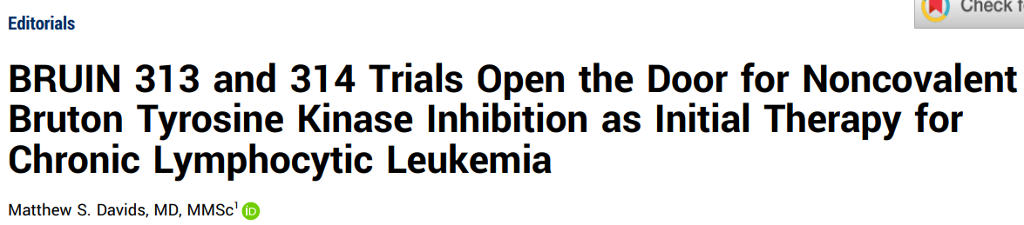
First Results From the BRUIN CLL-314 Phase 3 Study of Pirtobrutinib vs Ibrutinib in Patients With TN and R/R CLL/SLL: ORR
Response by BICR |  | ITT |  | TN |  | R/R
 |  | Pirto (n=331) | Ibr (n=331) | Pirto (n=112) | Ibr (n=113) | Pirto (n=219) | Ibr (n=218)
ORR, % (95% CI) |  | 87.0 (82.90-90.44) | 78.5 (73.73-82.85) | 92.9 (86.41-96.87) | 85.8 (78.03-91.68) | 84.0 (78.48-88.61) | 74.8 (68.46-80.39)
Nominal P-value |  | 0.0035 |  | 0.0886 |  | 0.0175
ORR ratio (95% CI) P-value for noninferiority |  | 1.1080 (1.034-1.187) <0.0001 |  | 1.0797 (0.989-1.179) - |  | 1.1233 (1.020-1.237) <0.0001
Best overall response, % | CR/CRi | 4.8 | 2.4 | 7.1 | 3.5 | 3.7 | 1.8
 | PR/nPR | 82.2 | 76.1 | 85.7 | 82.3 | 80.4 | 72.9
 | PR-L | 2.4 | 3.9 | 0.9 | 2.7 | 3.2 | 4.6
 | SD | 5.4 | 10.9 | 2.7 | 4.4 | 6.8 | 14.2
 | PD | 1.5 | 1.2 | 0 | 0 | 2.3 | 1.8
ORR including PR-L, % (95% CI) |  | 89.4 (85.60-92.52) | 82.5 (77.95-86.42) | 93.8 (87.55-97.45) | 88.5 (81.93-93.73) | 87.2 (82.05-91.33) | 79.4 (73.37-84.53)
Nominal P value |  | 0.0093 |  | 0.1692 |  | 0.0286
“Overall, the results of these two phase III BRUIN studies are favorable for pirtobrutinib and are supportive of regulatory approval of the drug as initial therapy for CLL.”
Woyach J, et al. J Clin Oncol., 2025 and Davids, J Clin Oncol, 2025

Slide 56
Dr Davids: Case Presentation
89 y/o man with del(11q) on FISH, IGHV unmutated, TP53 wildtype observed for the past 3 years but now progressing with bulky lymph nodes and cytopenias and needs treatment. Co-morbidities include CAD s/p stents, mild CHF, stage 3 CKD, impaired mobility. He finds it difficult logistically to make it to clinic visits, and is becoming increasingly forgetful.
BRUIN-313: Pirtobrutinib
The patient elects to start on pirto, and is now about 6 weeks into treatment already with smaller lymph nodes and improving cytopenias with minimal side effects

Slide 57
Faculty Discussion
First-Line Noncovalent BTK Inhibitors
Jurczak W et al. BRUIN CLL-313: Randomized Phase III Trial of Pirtobrutinib versus Bendamustine plus Rituximab in Untreated Patients with Chronic Lymphocytic Leukemia/Small Lymphocytic Lymphoma. J Clin Oncol 2026;44(6):466-75.
Woyach JA et al. Pirtobrutinib versus Ibrutinib in Treatment-Naïve and Relapsed/Refractory Chronic Lymphocytic Leukemia/Small Lymphocytic Lymphoma. J Clin Oncol 2026;44(6):476-85.

Slide 58
Agenda
Introduction: Minimal Residual Disease Assays in Community-Based Practice
Module 1: New Developments in Previously Untreated Chronic Lymphocytic Leukemia (CLL)
Module 2: Richter Transformation
Module 3: Selection and Sequencing of Therapies for Relapsed/Refractory CLL

Slide 59
Key Datasets — Richter Transformation
Wierda WG et al. Pirtobrutinib, a Highly Selective, Non-Covalent (Reversible) BTK Inhibitor in Patients with B-Cell Malignancies: Analysis of the Richter Transformation Subgroup from the Multicentre, Open-Label, Phase 1/2 BRUIN Study. Lancet Haematol 2024;11(9):e682-92.
A Randomized Phase III Study of Pirtobrutinib plus R-CHOP vs R-CHOP for Participants with Previously Untreated Richter Transformation (PIRAMID). NCT07220187.
CLL-RT2: A Prospective, Open-Label, Randomized, Multicenter Phase-III Trial to Evaluate the Efficacy of Pirtobrutinib and Epcoritamab Compared with R-(Mini)-CHOP for Treatment of Patients with Richter Transformation. https://www.dcllsg.com/cll-rt2/

Slide 60
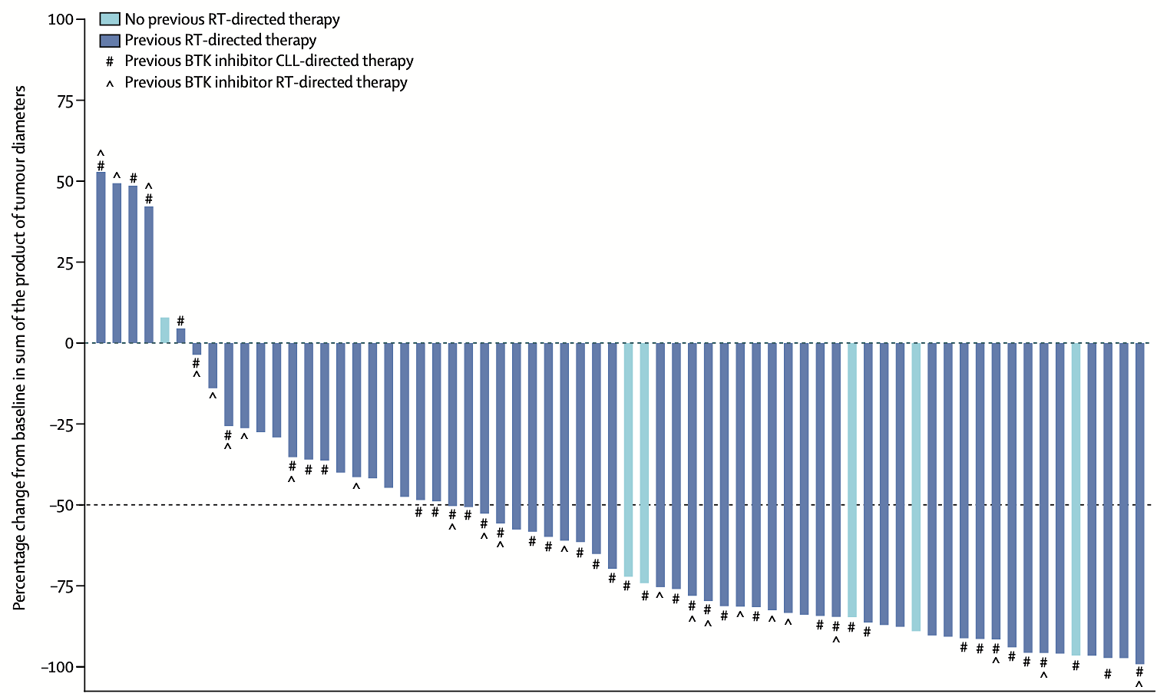
Pirtobrutinib for Richter Transformation
N = 82
ORR: 50%
CR rate: 13%
PR rate: 37%
Median PFS: 3.7 months
Median OS: 12.5 months
18-month OS rate: 44.3%
RT = Richter transformation; ORR = overall response rate; CR = complete response; PR = partial response
Wierda WG et al. Lancet Haematol 2024;11(9):e682-92.

Slide 61
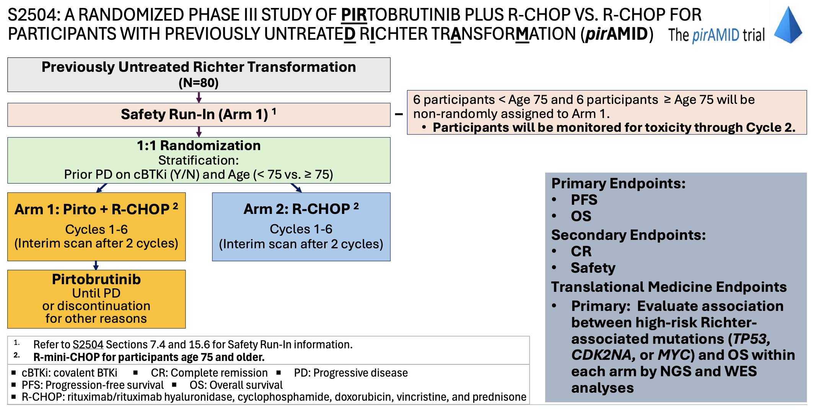
pirAMID (SWOG-S2504) Trial: Adding Pirtobrutinib to R-CHOP for Richter Transformation
www.clinicaltrials.gov. NCT07220187. Accessed September 2026.

Slide 62
CLL-RT2: A Phase III Study of Pirtobrutinib with Epcoritamab versus R-mini-CHOP for Richter Transformation
Pirtobrutinib + epcoritamab
R
1:1
Previously untreated Richter transformation
R-mini-CHOP
Primary endpoint:
Investigator-assessed progression-free survival (PFS) according to Lugano criteria
https://www.dcllsg.com/cll-rt2/

Slide 63
Faculty Discussion
Richter Transformation
Wierda WG et al. Pirtobrutinib, a Highly Selective, Non-Covalent (Reversible) BTK Inhibitor in Patients with B-Cell Malignancies: Analysis of the Richter Transformation Subgroup from the Multicentre, Open-Label, Phase 1/2 BRUIN Study. Lancet Haematol 2024;11(9):e682-92.
A Randomized Phase III Study of Pirtobrutinib plus R-CHOP vs R-CHOP for Participants with Previously Untreated Richter Transformation (PIRAMID). NCT07220187.
CLL-RT2: A Prospective, Open-Label, Randomized, Multicenter Phase-III Trial to Evaluate the Efficacy of Pirtobrutinib and Epcoritamab Compared with R-(Mini)-CHOP for Treatment of Patients with Richter Transformation. https://www.dcllsg.com/cll-rt2/

Slide 64
Agenda
Introduction: Minimal Residual Disease Assays in Community-Based Practice
Module 1: New Developments in Previously Untreated Chronic Lymphocytic Leukemia (CLL)
Module 2: Richter Transformation
Module 3: Selection and Sequencing of Therapies for Relapsed/Refractory CLL

Slide 65
Research To Practice:
Relapsed Chronic
Lymphocytic Leukemia
Catherine Coombs, MD
Associate Clinical Professor
University of California Irvine

Slide 66
Key Datasets — Treatment After a Covalent BTK Inhibitor
Kater AP et al. The MURANO Study: Final Analysis and Retreatment/Crossover Substudy Results of VenR for Patients with Relapsed/Refractory CLL. Blood 2025;145(23):2733-45.
Woyach JA et al. Pirtobrutinib in Post-cBTKi CLL/SLL: ~30 Months Follow-Up and Subgroup Analysis with/without Prior BCL2i from the Phase 1/2 BRUIN Study. ASH 2023;Abstract 325.
Sharman JP et al. Phase III Trial of Pirtobrutinib versus Idelalisib/Rituximab or Bendamustine/Rituximab in Covalent Bruton Tyrosine Kinase Inhibitor-Pretreated Chronic Lymphocytic Leukemia/Small Lymphocytic Lymphoma (BRUIN CLL-321). J Clin Oncol 2025;43(22):2538-49.
Davids MS et al. Fixed Duration Pirtobrutinib plus Venetoclax-Rituximab versus Venetoclax-Rituximab for Patients with Previously Treated CLL/SLL: A Phase 3, Randomized Trial (BRUIN CLL-322). EHA 2026;Abstract LB5001.

Slide 67
PD on cBTKi: Evidence for Venetoclax
MURANO trial leading to venR approval included only 2% post cBTKi pts
Prospective studies including post-cBTKi cohorts used venetoclax monotherapy leading to ~24 months median PFS
Limited prospective data for use of ven-obi post-cBTKi though this is NCCN preferred regimen

Slide 68
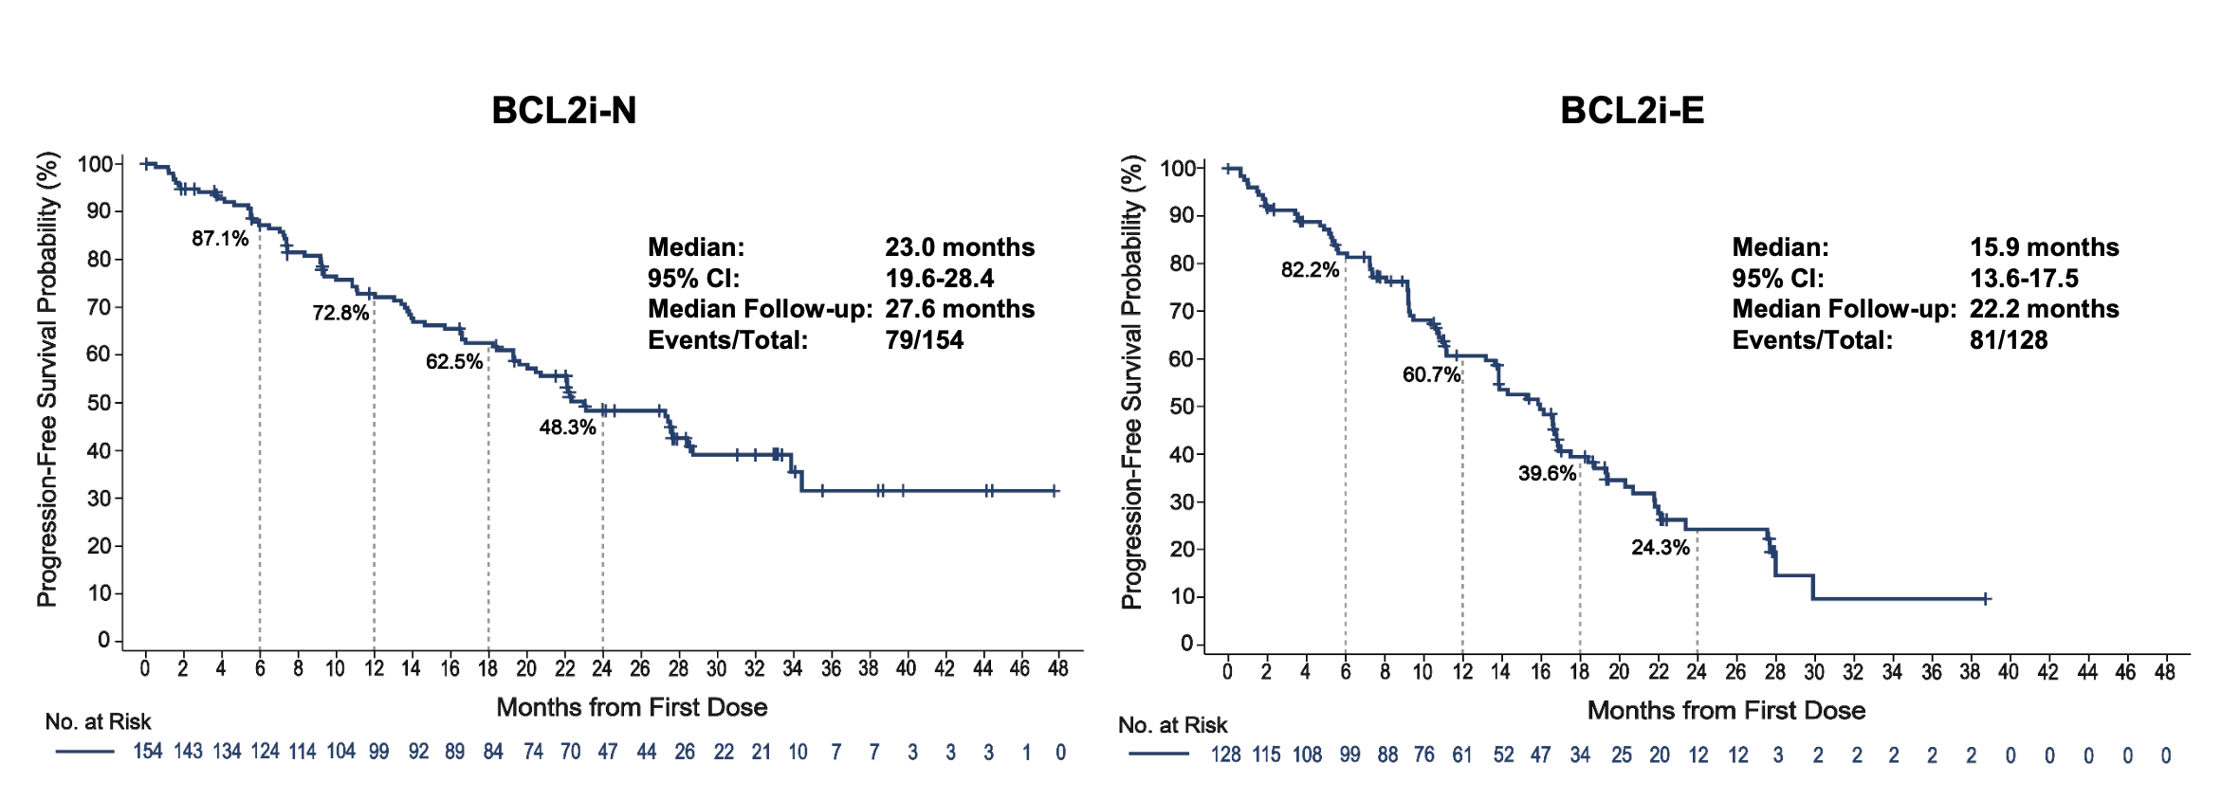
Pirtobrutinib post-BTKi
Rationale is pirto, a ncBTKi, does not interact with C481 residue so effective in both WT BTK and C481S mutated
First studied in phase I/II BRUIN trial:
Woyach JA et al. ASH 2023;Abstract 325

Slide 69
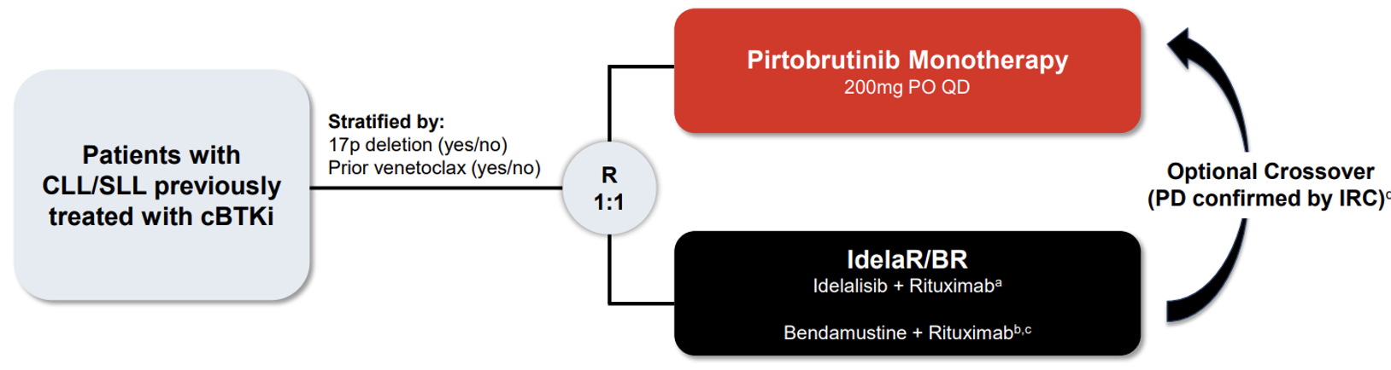
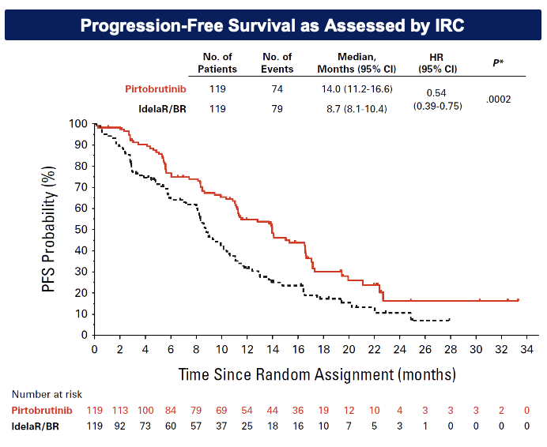
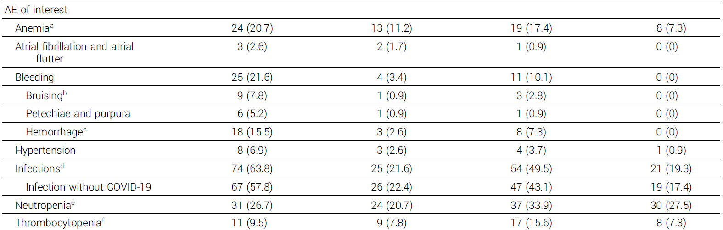
BRUIN CLL-321 trial
AE of Special Interest
Sharman J et al JCO 2025

Slide 70
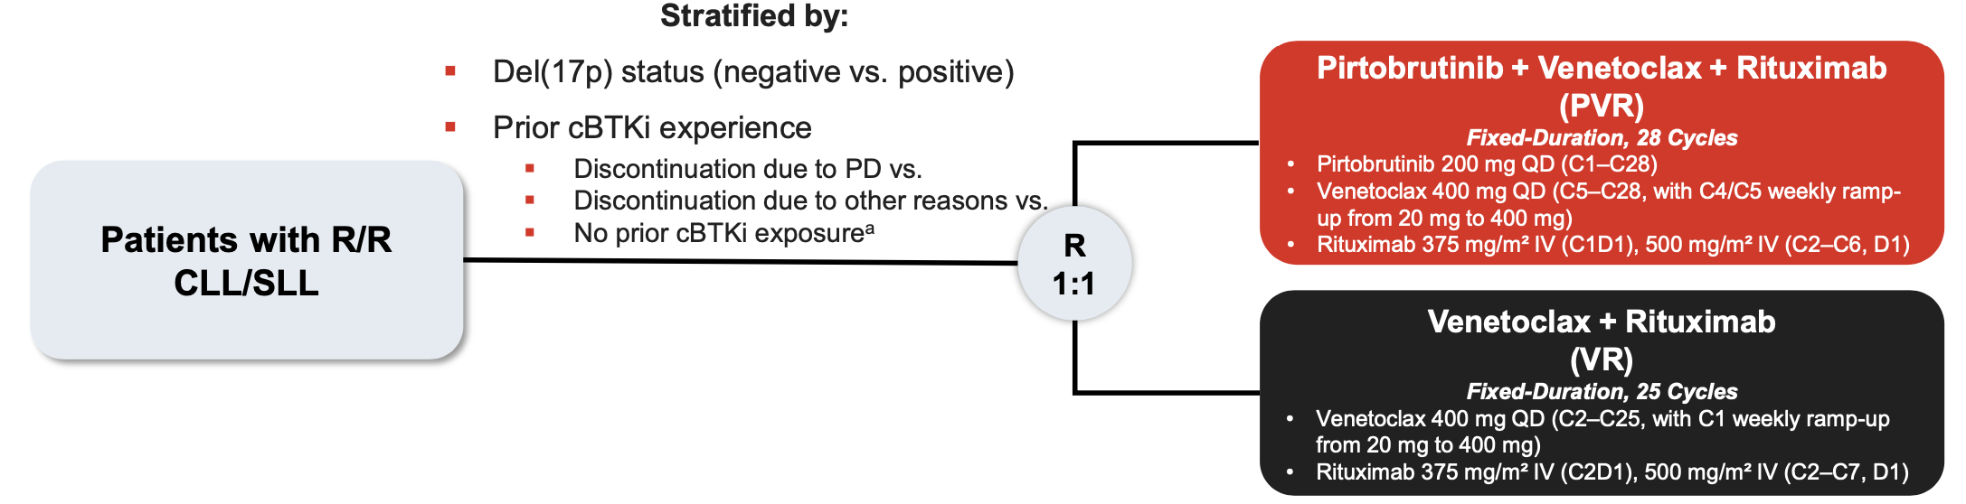
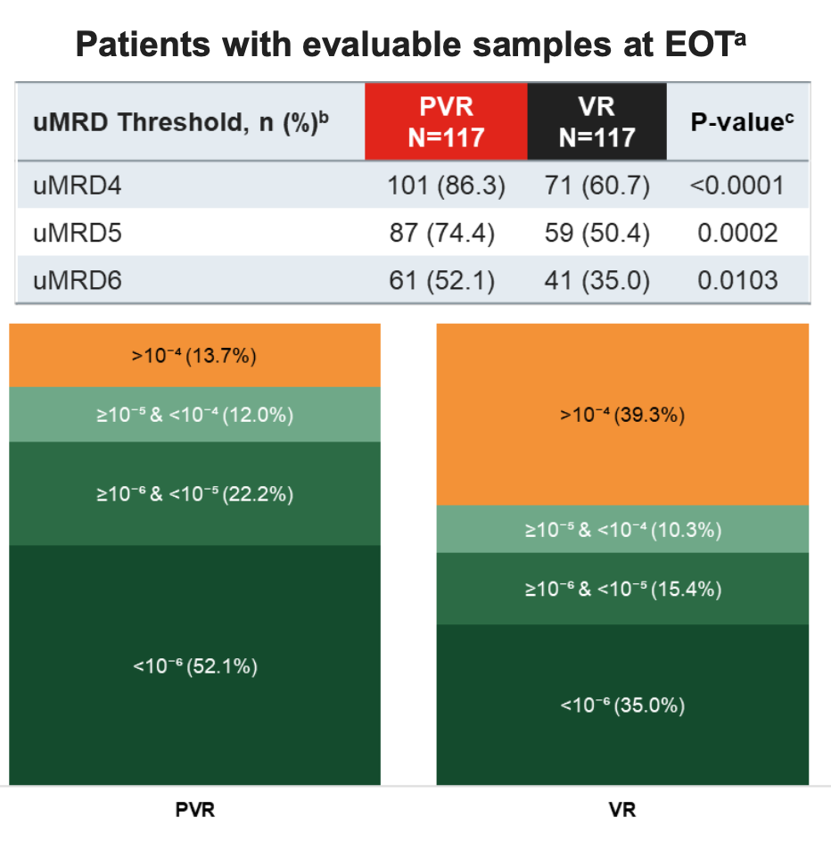
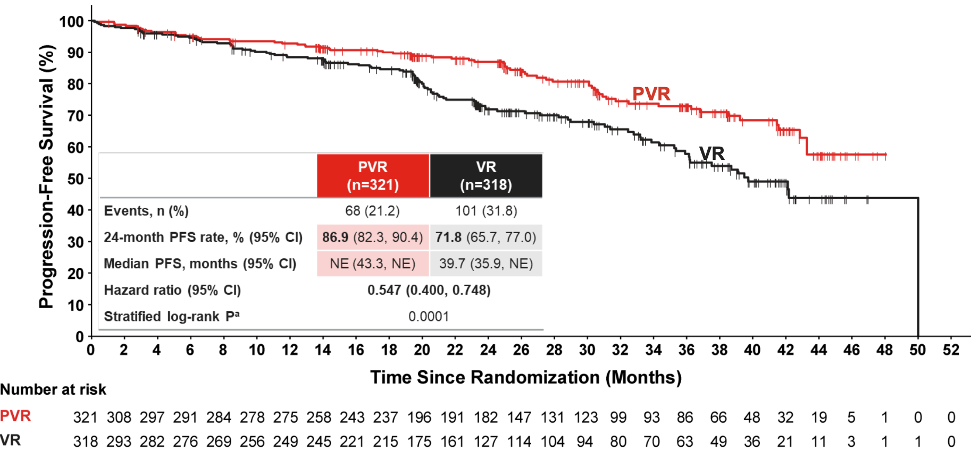
BRUIN CLL-322 trial, PVR regimen – not yet FDA approved
Median follow up 27.3 months
Davids M et al EHA 2026, Lancet 2026

Slide 71
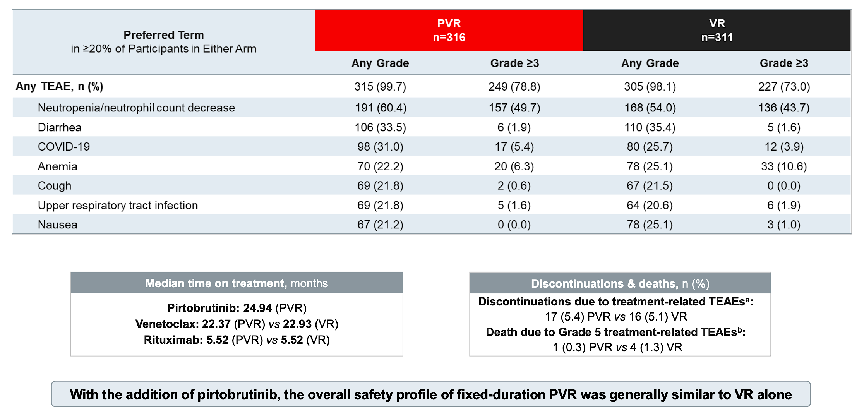
BRUIN CLL-322 safety
Davids M et al EHA 2026, Lancet 2026

Slide 72
Faculty Discussion
Treatment After a Covalent BTK Inhibitor
Kater AP et al. The MURANO Study: Final Analysis and Retreatment/Crossover Substudy Results of VenR for Patients with Relapsed/Refractory CLL. Blood 2025;145(23):2733-45.
Woyach JA et al. Pirtobrutinib in Post-cBTKi CLL/SLL: ~30 Months Follow-Up and Subgroup Analysis with/without Prior BCL2i from the Phase 1/2 BRUIN Study. ASH 2023;Abstract 325.
Sharman JP et al. Phase III Trial of Pirtobrutinib versus Idelalisib/Rituximab or Bendamustine/Rituximab in Covalent Bruton Tyrosine Kinase Inhibitor-Pretreated Chronic Lymphocytic Leukemia/Small Lymphocytic Lymphoma (BRUIN CLL-321). J Clin Oncol 2025;43(22):2538-2549.
Davids MS et al. Fixed Duration Pirtobrutinib plus Venetoclax-Rituximab versus Venetoclax-Rituximab for Patients with Previously Treated CLL/SLL: A Phase 3, Randomized Trial (BRUIN CLL-322). EHA 2026;Abstract LB5001.

Slide 73
Key Datasets — CAR (Chimeric Antigen Receptor) T-Cell Therapy
Wierda WG et al. Characteristics Associated with Response to Lisocabtagene Maraleucel (Liso‑cel) in Patients (pts) with R/R CLL/SLL: Exploratory Analyses from TRANSCEND CLL 004. EHA 2024;Abstract S158.
Siddiqi T et al. Lisocabtagene Maraleucel (Liso-cel) in Patients (pts) with Relapsed or Refractory (R/R) Chronic Lymphocytic Leukemia (CLL)/Small Lymphocytic Lymphoma (SLL): Updated Follow-Up of Transcend CLL 004. ASH 2024;Abstract 4633.

Slide 74
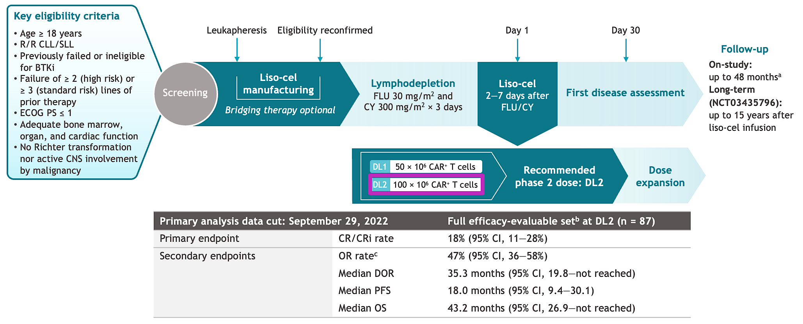
Double exposed/refractory CLL: Lisocabtagene-maraleucel
Wierda WG et al. EHA 2024;Abstract S158

Slide 75

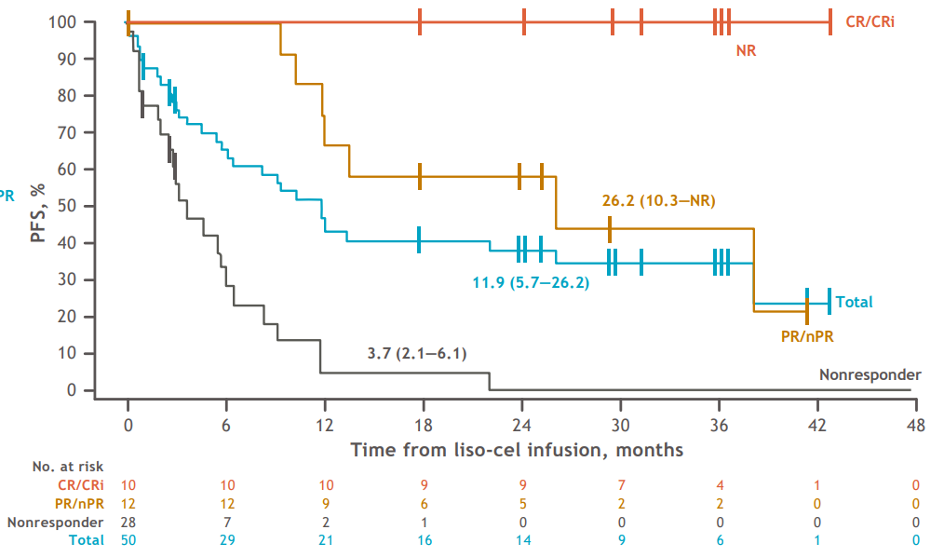
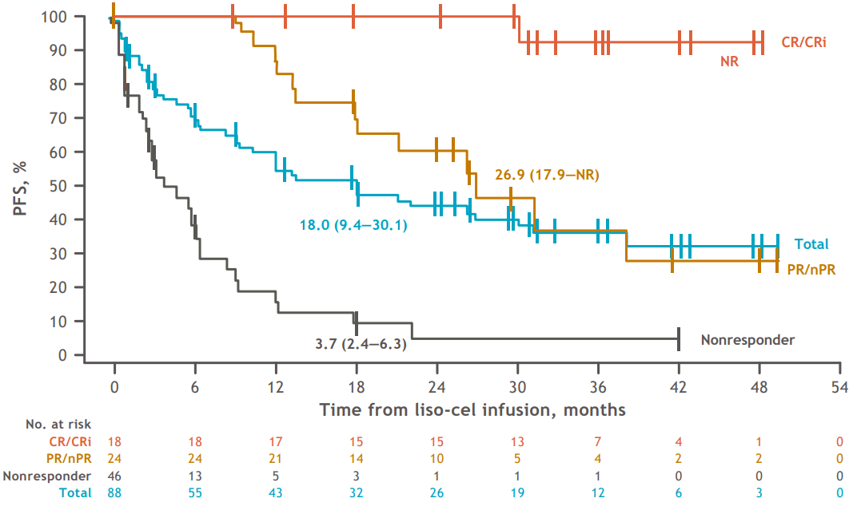
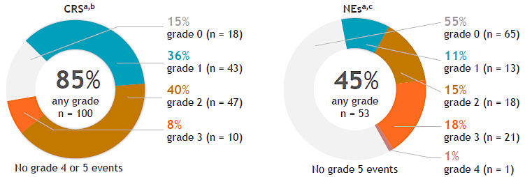
Liso-cel in CLL
CR/CRi = 20%
ORR = 44%
PFS in Full Population at DL2
PFS in PEAS at DL2
Cytokine Release Syndrome and Neurological Events
References: Siddiqi T, et al. Poster presented at ASH Annual Meeting & Exposition; December 7-10, 2024; San Diego, CA. Abstract 4633.

Slide 76
Faculty Discussion
CAR T-Cell Therapy
Wierda WG et al. Characteristics Associated with Response to Lisocabtagene Maraleucel (Liso‑cel) in Patients (pts) with R/R CLL/SLL: Exploratory Analyses from TRANSCEND CLL 004. EHA 2024;Abstract S158.
Siddiqi T et al. Lisocabtagene Maraleucel (Liso-cel) in Patients (pts) with Relapsed or Refractory (R/R) Chronic Lymphocytic Leukemia (CLL)/Small Lymphocytic Lymphoma (SLL): Updated Follow-Up of Transcend CLL 004. ASH 2024;Abstract 4633.

Slide 77
Key Datasets — BTK Degraders
Stilgenbauer S et al. BGB-16673, a Bruton Tyrosine Kinase (BTK) Degrader, in Patients with Relapsed/Refractory (R/R) Chronic Lymphocytic Leukemia/Small Lymphocytic Lymphoma (CLL/SLL): A Phase 1 CADANCE-101 Study Update. EHA 2026;Abstract S152.
Munir T et al. Updated Efficacy and Safety Data from an Ongoing Phase 1a/b Trial of the BTK Degrader Bexobrutideg (NX-5948) in Patients with CLL Across Lines of Therapy. EHA 2026;Abstract S150.
Woyach JA et al. Updates of R/R CLL with Prior Exposure to Bruton’s Tyrosine Kinase (BTK) Inhibitor and/or Bcl-2 Inhibitor in the Phase 1 Trial of LP-168 (Rocbrutinib), a Novel Covalent and Non-Covalent BTK Inhibitor. ASH 2025;Abstract 87.

Slide 78
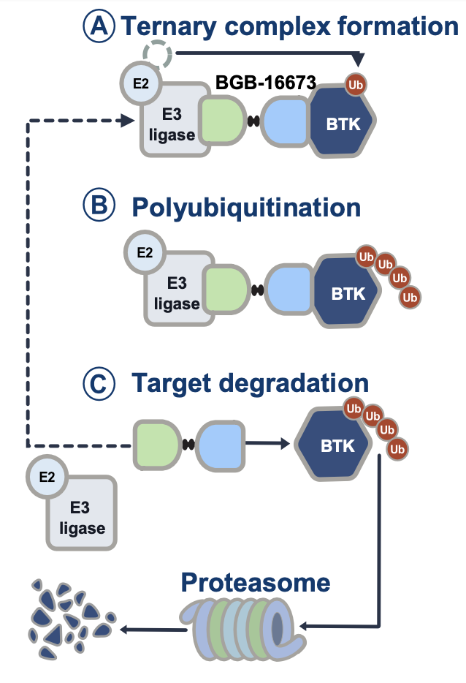
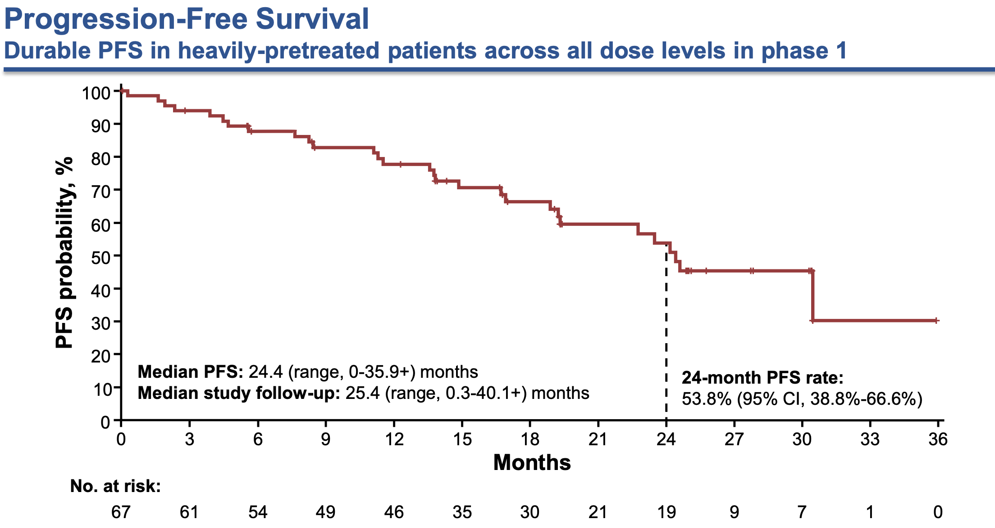
BTK degrader: Tacabrutideg (BGB-16673)
Stilgenbauer et al EHA 2026;Abstract S152

Slide 79
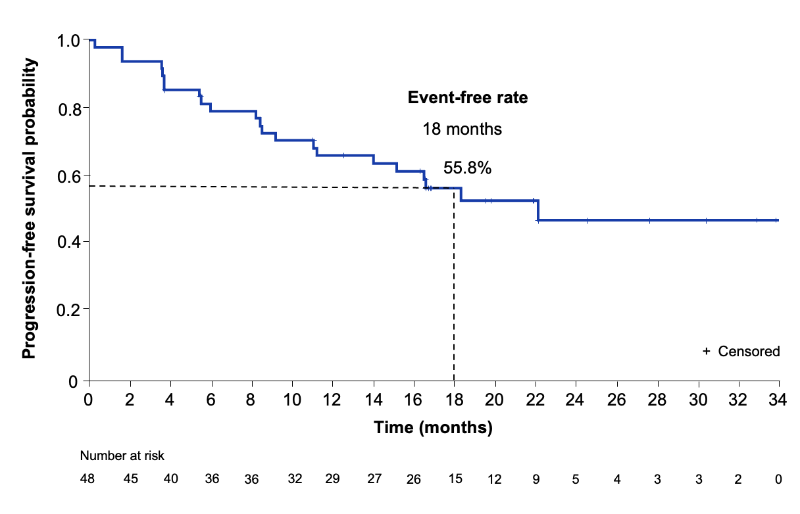
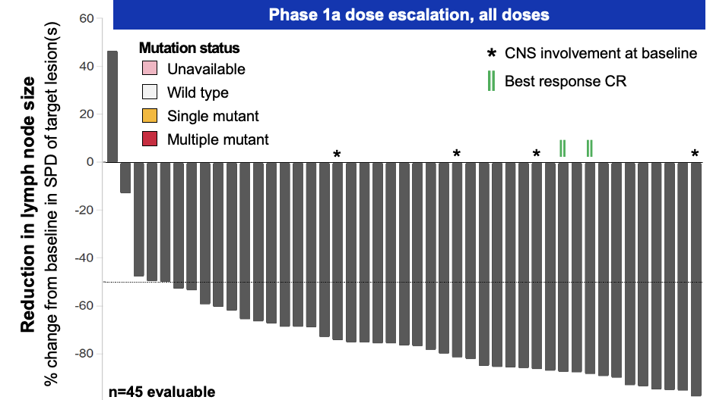
Bexobrutideg (NX-5948)
Median PFS 22.1 months among phase 1b treated CLL patients
Munir T et al. EHA 2026;Abstract S150

Slide 80
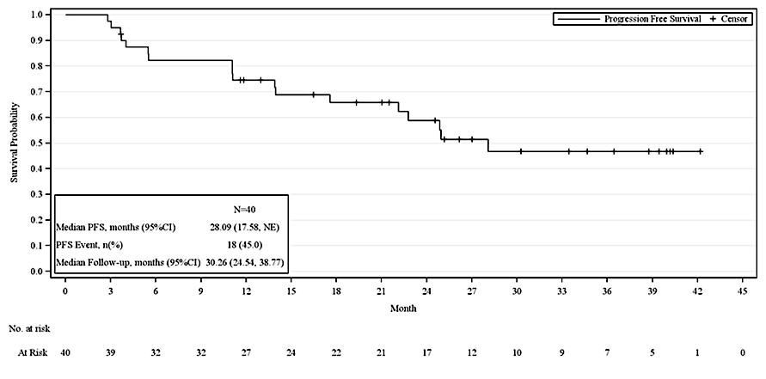
Rocbrutinib – dual covalent and ncBTKi
Woyach JA et al. ASH 2025

Slide 81
Faculty Discussion
BTK Degraders
Stilgenbauer S et al. BGB-16673, a Bruton Tyrosine Kinase (BTK) Degrader, in Patients with Relapsed/Refractory (R/R) Chronic Lymphocytic Leukemia/Small Lymphocytic Lymphoma (CLL/SLL): A Phase 1 CADANCE-101 Study Update. EHA 2026;Abstract S152.
Munir T et al. Updated Efficacy and Safety Data from an Ongoing Phase 1a/b Trial of the BTK Degrader Bexobrutideg (NX-5948) in Patients with CLL Across Lines of Therapy. EHA 2026;Abstract S150.
Woyach JA et al. Updates of R/R CLL with Prior Exposure to Bruton’s Tyrosine Kinase (BTK) Inhibitor and/or Bcl-2 Inhibitor in the Phase 1 Trial of LP-168 (Rocbrutinib), a Novel Covalent and Non-covalent BTK Inhibitor. ASH 2025;Abstract 87.

Slide 82
Dr Coombs - Case 1: PD on 1L cBTKi
84 yo M with 17p-deleted CLL who was treated with frontline ibrutinib following approximately 1 year of watch and wait
Indication for therapy was anemia with w/u negative for other causes in setting of progressive rise in WBC/ALC, also mild thrombocytopenia
Due to myalgias that did not improve after dose reduction to 280 mg ibrutinib, the patient was switched to acalabrutinib which he tolerated well
After 6 cumulative years on cBTKi, pt with rising WBC ct and worsening anemia suggestive of progression

Slide 83
Dr Coombs - Case 1: Review of options
Reviewed both ven-based and cBTKi-based regimens with patient – he expressed desire to minimize visits to clinic so that he can maintain quality of life and without disruption to hobbies/travel
He began pirtobrutinib 200 mg daily and has tolerated well without AE

Slide 84
Faculty Discussion

Slide 85
Dr Coombs - Case 2: Teaching case
72 yo M with CLL, afib who presents to transfer care from his oncologist who is retiring
Labs: WBC ct 32.7, ALC is 27.6, Hb 13.0, Platelet 103
Exam notable for splenomegaly 8 cm below L costal margin
B2m 4.1 (creatinine 1.4), mutated IGHV, 13q del on FISH, no TP53 mutation but DNMT3A mutation (G543A) at VAF 8.6%
Patient expressed desire to avoid treatment unless “absolutely necessary” – is asymptomatic

Slide 86
Dr Coombs - Case 2
Further w/u revealed intermittently elevated total protein, Ig levels revealed IgG 3,201 but depressed IgA, IgM with kappa 222, lambda 15.2 with K/L ratio of 14.66. SPEP with IgG kappa monoclonal protein of 2.3 g/dL
BM bx performed to r/o concurrent myeloma, revealed 70% involvement with CLL with focal plasmacytic differentiation (immunophenotype: CD5+, CD19+, CD20 (moderate), CD22+, CD23 (dim), also surface Ig kappa (dim to moderate), negative for SOX11, LEF1, BCL6, P53, cyclin D1

Slide 87
Dr Coombs - Case 2
Patient was observed for approximately 1 year. He underwent Watchman procedure for his atrial fibrillation and no longer needs anticoagulation. With increase in spleen size (up to 10 cm below L costal margin), he ultimately elected to begin therapy with BTKi + BCL2 doublet (acala + ven). He has started acalabrutinib without issue with plan to introduce ven around C3.

Slide 88
Faculty Discussion

Slide 89
Integrating New Advances into
Community Oncology Practice
A Multitumor Symposium in Partnership with
Florida Cancer Specialists & Research Institute
Saturday, October 17, 2026
7:15 AM – 12:00 PM ET
The Ritz-Carlton Orlando Grande Lakes | Orlando, Florida
Moderator
Neil Love, MD

Slide 90
Thank you for joining us!
Please take a moment to complete the survey currently up on Zoom. Your feedback is very important to us.
The survey will remain open for
5 minutes after the meeting ends.
Information on how to obtain CME and ABIM MOC credit is provided in the Zoom chat room.
Attendees will also receive an email in 1 to 3 business days with these instructions.

