Slide 1
Expert Second Opinion: Investigators Provide Perspectives on the Management of HER2-Positive Gynecologic Cancers
An Independent CME Symposium During the
SGO 2026 Annual Meeting on Women’s Cancer®
Saturday, April 11, 2026
12:45 PM – 2:15 PM AST
Faculty
Joyce F Liu, MD, MPH
Brian M Slomovitz, MD
Moderator
David M O’Malley, MD

Slide 2



Faculty
Joyce F Liu, MD, MPH
Associate Chief and Director of Clinical Research
Division of Gynecologic Oncology
Dana-Farber Cancer Institute
Boston, Massachusetts
Moderator
David M O’Malley, MD
Director and Professor
Division of Gynecologic Oncology in Obstetrics and Gynecology
John G Boutselis Chair in Gynecologic Oncology
The Ohio State University and The James Comprehensive Cancer Center
Columbus, Ohio
Brian M Slomovitz, MD
Professor, OB-GYN, Florida International University
Director, Gynecologic Oncology
Co-Chair, Cancer Research Committee
Mount Sinai Medical Center
Miami, Florida

Slide 3
Dr Liu — Disclosures
Faculty
Consulting Agreements | AbbVie Inc, AstraZeneca Pharmaceuticals LP, Bristol Myers Squibb, Cullinan Therapeutics, Daiichi Sankyo Inc, Eisai Inc, Genmab US Inc, GSK, Loxo Oncology Inc, a wholly owned subsidiary of Eli Lilly & Company, Merck, Revolution Medicines Inc, SystImmune Inc

Slide 4
Dr Slomovitz — Disclosures
Faculty
Advisory Committees | Aadi Bioscience, AstraZeneca Pharmaceuticals LP, BeOne, Daiichi Sankyo Inc, Eisai Inc, Genmab US Inc, Gilead Sciences Inc, GSK, Immunocore, Incyte Corporation, Karyopharm Therapeutics, Merck, Novocure Inc, Regeneron Pharmaceuticals Inc, Seagen Inc
Consulting Agreements | Aadi Bioscience, AstraZeneca Pharmaceuticals LP, Genmab US Inc, GSK, Karyopharm Therapeutics, Seagen Inc
Data and Safety Monitoring Boards/Committees | Genelux

Slide 5
Dr O’Malley — Disclosures
Moderator
Consulting Agreements — Personal Fees (Consult and/or Advisory Boards) | AbbVie Inc, AstraZeneca Pharmaceuticals LP, BeOne, Corcept Therapeutics Inc, Daiichi Sankyo Inc, Duality Biologics, Genmab US Inc, GSK, Lilly, Merck, MSD, Novocure Inc, Pfizer Inc, Regeneron Pharmaceuticals Inc, Verastem Inc, Zentalis Pharmaceuticals
Contracted Research (Institution Received Funds for Research) | AbbVie Inc, Advaxis Inc, Agenus Inc, Alkermes, Aravive Inc, Arcus Biosciences, AstraZeneca Pharmaceuticals LP, BeOne, Bristol Myers Squibb, Deciphera Pharmaceuticals Inc, Eisai Inc, EMD Serono Inc, Exelixis Inc, F Hoffmann-La Roche Ltd, Genentech, a member of the Roche Group, Genmab US Inc, GSK, ImmunoGen Inc, Incyte Corporation, Iovance Biotherapeutics, Karyopharm Therapeutics, Leap Therapeutics Inc, Merck, Mersana Therapeutics Inc, MSD, Novartis, Novocure Inc, OncoC4, OncoQuest Inc, Pfizer Inc, pharmaand GmbH, Predictive Oncology Inc, Prelude Therapeutics, Regeneron Pharmaceuticals Inc, Seagen Inc, Sumitomo Pharma America, Sutro Biopharma, Tesaro, A GSK Company, Verastem Inc
Data and Safety Monitoring Boards/Committees | Frantz Viral Therapeutics

Slide 6
Prof Ledermann — Disclosures
Consulting Clinical Investigator
Financial-relationship disclosures have been requested.

Slide 7
Dr Matulonis — Disclosures
Consulting Clinical Investigator
Advisory Committees | AbbVie Inc, AstraZeneca Pharmaceuticals LP, Daiichi Sankyo Inc, Day One Biopharmaceuticals, GSK, NextCure, Novartis, Tango Therapeutics
Consulting Agreements | Whitehawk Therapeutics
Data and Safety Monitoring Boards/Committees | Daiichi Sankyo Inc, MacroGenics Inc, Mural Oncology Inc, Symphogen A/S

Slide 8
Dr Secord — Disclosures
Consulting Clinical Investigator
Advisory Committees | AbbVie Inc, AstraZeneca Pharmaceuticals LP, Daiichi Sankyo Inc, Foundation Medicine, Genmab US Inc, Gilead Sciences Inc, GSK, HistoSonics, Medtronic Inc, Merck
Clinical Trial Steering Committees | Genmab US Inc, OncoQuest Inc
Consulting Agreements | GSK, Merck
Contracted Research | AbbVie Inc, Aravive Inc, AstraZeneca Pharmaceuticals LP, Canaria Bio Inc, Daiichi Sankyo Inc, Ellipses Pharma, Genentech, a member of the Roche Group, Genmab US Inc, GSK, ImmunoGen Inc, Karyopharm Therapeutics, Merck, Mersana Therapeutics Inc, Myriad Genetic Laboratories Inc, OncoQuest Inc, TORL BioTherapeutics, Zentalis Pharmaceuticals
Stock Options/Stock — Public Companies | Stock in Amgen Inc and Johnson & Johnson, divested in June 2024

Slide 9
Commercial Support
This activity is supported by educational grants from AstraZeneca Pharmaceuticals LP and Daiichi Sankyo Inc.
Research To Practice CME Planning Committee Members,
Staff and Reviewers
Planners, scientific staff and independent reviewers for Research To Practice have no relevant financial relationships to disclose.

Slide 10
This educational activity contains discussion of
non-FDA-approved uses of agents and regimens. Please refer to official prescribing information for each product for approved indications.

Slide 11
Expert Second Opinion: Investigators Provide Perspectives on the Best-Practice Management of Ovarian Cancer
An Independent CME Symposium During the
SGO 2026 Annual Meeting on Women’s Cancer®
Sunday, April 12, 2026
1:30 PM – 3:00 PM AST
Faculty
Nicoletta Colombo, MD
Gottfried E Konecny, MD
Alexander B Olawaiye, MD
Moderator
Shannon N Westin, MD, MPH, FASCO, FACOG

Slide 12
Data + Perspectives: The Potential Role of TROP2- and CDH6-Directed Antibody-Drug
Conjugates in Gynecologic Cancers
An Independent CME Symposium During the
SGO 2026 Annual Meeting on Women’s Cancer®
Sunday, April 12, 2026
1:30 PM – 3:00 PM AST
Faculty
Ramez N Eskander, MD
Bradley J Monk, MD
Moderator
Kathleen N Moore, MD, MS

Slide 13

Save The Date
A Multitumor CME/MOC-, NCPD- and ACPE-Accredited Educational Conference Developed in Partnership with Florida Cancer Specialists & Research Institute
Friday to Sunday, April 24 to 26, 2026
The Ritz-Carlton Orlando, Grande Lakes | Orlando, Florida
Moderated by Neil Love, MD

Slide 14
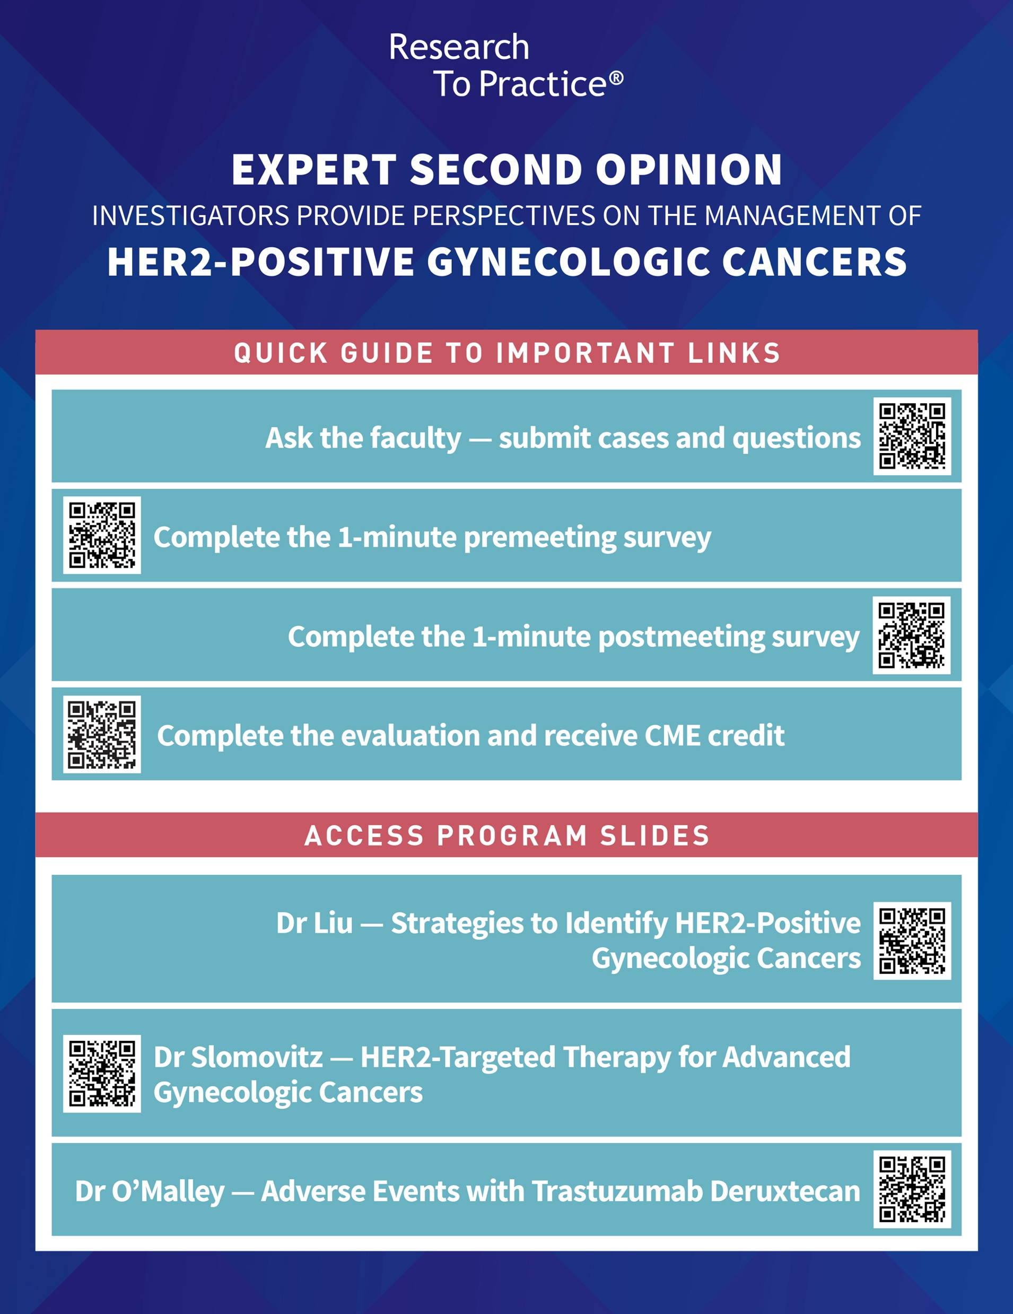




Clinicians in the Meeting Room
Please refer to the printed handout provided with your meeting syllabus, and scan the corresponding QR code to
Review and Download Program Slides.
Answer Survey Questions: Complete the pre-
and postmeeting surveys.
Ask a Question: We will aim to address as many questions as possible during the program.
Get CME Credit: Complete the course evaluation.
Notes:
14

Slide 15
Clinicians Attending via Zoom
Review Program Slides: A link to the program slides will be posted in the chat room at the start of the program.
Answer Survey Questions: Complete the pre- and postmeeting surveys.
Ask a Question: Submit a challenging case or question for discussion using the Zoom chat room.
Get CME Credit: A credit link will be provided in the chat room at the conclusion of the program.
Notes:
15

Slide 16
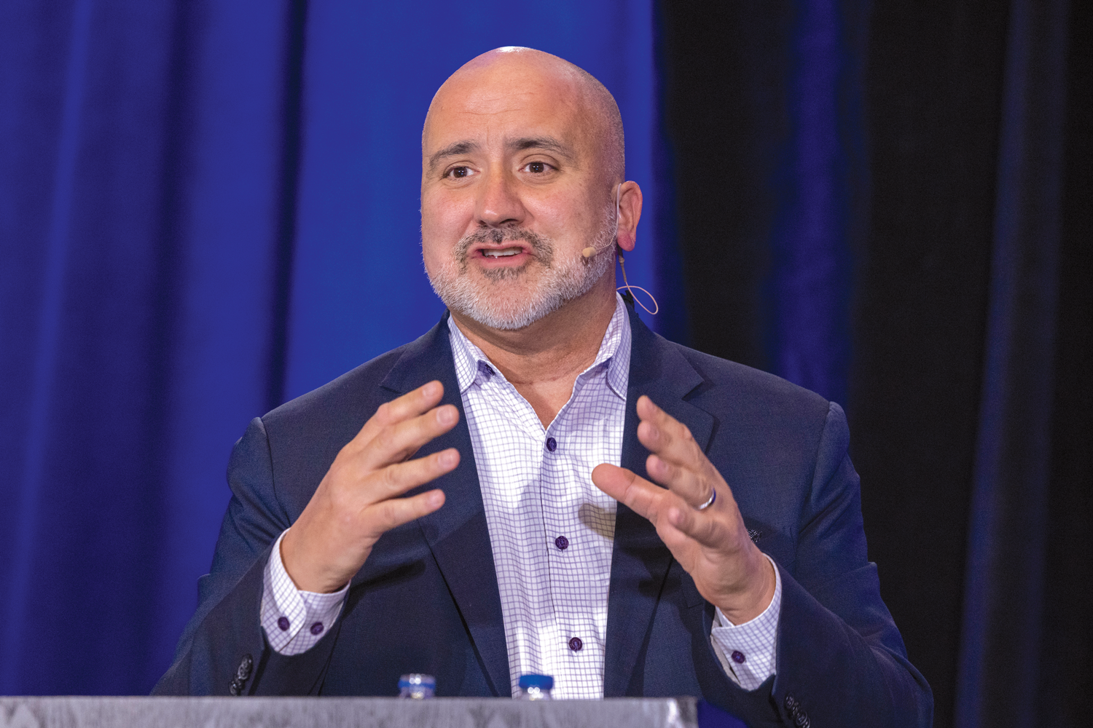
About the Enduring Program
The live meeting is being video
and audio recorded.
The proceedings from today will
be edited and developed into
an enduring web-based
program.
An email will be sent to all attendees when the activity is available.
To learn more about our education programs, visit our website, www.ResearchToPractice.com
Notes:
16
16

Slide 17
Expert Second Opinion: Investigators Provide Perspectives on the Management of HER2-Positive Gynecologic Cancers
An Independent CME Symposium During the
SGO 2026 Annual Meeting on Women’s Cancer®
Saturday, April 11, 2026
12:45 PM – 2:15 PM AST
Faculty
Joyce F Liu, MD, MPH
Brian M Slomovitz, MD
Moderator
David M O’Malley, MD

Slide 18




Second Opinion
Professor Jonathan A Ledermann
Professor of Medical Oncology
UCL Cancer Institute
London, United Kingdom
Angeles Alvarez Secord, MD, MHSc
Director of Gynecologic Oncology Clinical Trials
Associate Director, Clinical Research, Gynecologic Oncology Program
Duke Cancer Institute
Division of Gynecologic Oncology
Department of Obstetrics and Gynecology
Duke University School of Medicine
Durham, North Carolina
Ursula Matulonis, MD
Chief, Division of Gynecologic Oncology
Brock-Wilson Family Chair
Dana-Farber Cancer Institute
Professor of Medicine
Harvard Medical School
Boston, Massachusetts
Neil Love, MD
Research To Practice
Miami, Florida

Slide 19
Agenda
Module 1: Strategies to Identify Patients with HER2-Positive Gynecologic Cancers — Dr Liu
Module 2: Available Data with and Practical Application of HER2-Targeted Therapy in Advanced Gynecologic Cancers — Dr Slomovitz
Module 3: Identification and Management of Adverse Events with T-DXd — Dr O’Malley

Slide 20
Agenda
Module 1: Strategies to Identify Patients with HER2-Positive Gynecologic Cancers — Dr Liu
Module 2: Available Data with and Practical Application of HER2-Targeted Therapy in Advanced Gynecologic Cancers — Dr Slomovitz
Module 3: Identification and Management of Adverse Events with T-DXd — Dr O’Malley

Slide 21
Identifying Patients with HER2-“Positive” Gynecologic Cancers
Joyce Liu, MD, MPH
Associate Chief and Director of Clinical Research
Division of Gynecologic Oncology
Dana-Farber Cancer Institute, Boston, MA

Slide 22
Agenda
HER2 biology and the significance of HER2 addiction
What does it mean to be HER2-“positive”?
HER2 expression in gynecologic cancers
Considerations for HER2 testing in gynecologic cancers in the ADC era

Slide 23
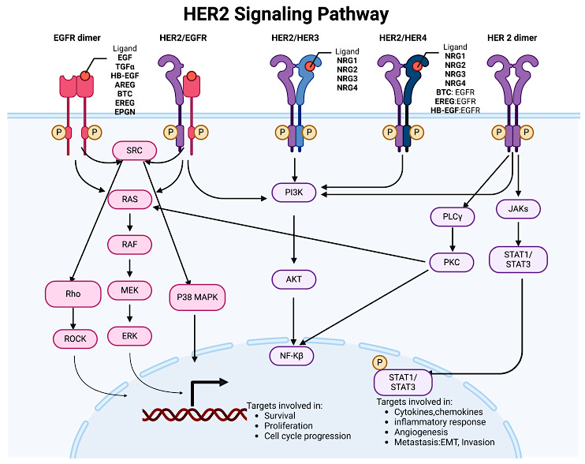
Biology of HER2
Encoded by gene ERBB2
Member of the EGFR family
Does not have a known direct ligand
Activates through dimerization and cross-phosphorylation
  With other EGFR family members in presence of their ligands
  With self or other EGFR family members in setting of high receptor density
Cheng in Genes (Basel) 2024

Slide 24
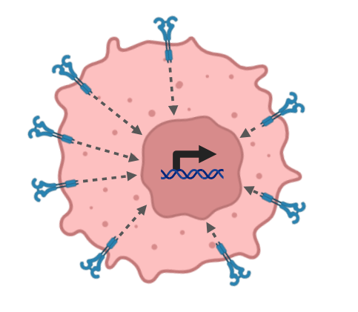
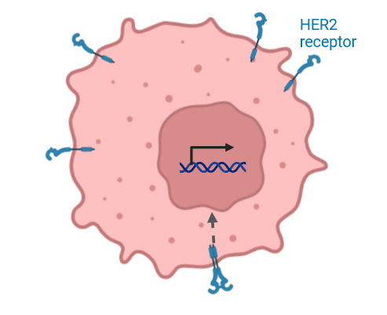
HER2 amplification and the concept of HER2 addiction
HER2-non-amplified
cancer cell
HER2-amplified
cancer cell
HER2-directed monoclonal antibody
HER2-non-addicted
Cell growth and survival are independent of HER2 signaling
HER2-addicted
Cell growth and survival are dependent on HER2 signaling
Images created with BioRender.com

Slide 25
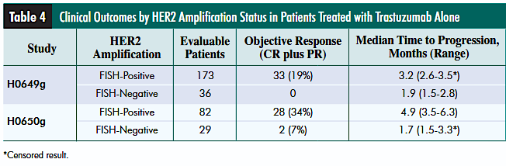
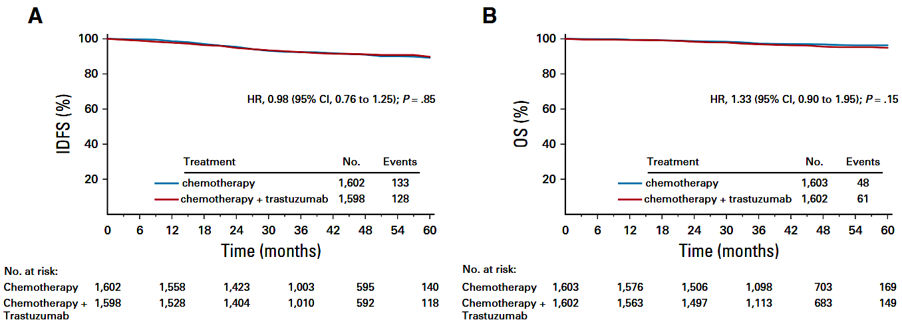
Trastuzumab inactive in HER2-non-amplified tumors
Trastuzumab monotherapy with limited to no activity in HER2 non-amplified breast cancer
Trastuzumab + chemotherapy with no PFS or OS benefit in adjuvant setting for HER2 IHC 1+ or 2+ breast cancer (NSABP-47)
Conclusion: HER2 non-amplified breast cancers not “addicted” to HER2 signaling and therefore insensitive to HER2-directed therapies
Mass et al., Clin Breast Cancer 2005
PFS and OS for chemotherapy + trastuzumab in NSABP-47
HER2-“positive” as HER2-amplified (IHC 3+ or 2+ and positive by FISH) as the biomarker for trastuzumab activity
Fehrenbacher et al., J Clin Oncol 2019

Slide 26


HER2 expression as a vulnerability for antibody-drug conjugates, independent of HER2 addiction/amplification
HER2-non-amplified
cancer cell
HER2-amplified
cancer cell
HER2-directed ADC
HER2-non-addicted
Cell growth and survival are independent of HER2 signaling
HER2-addicted
Cell growth and survival are dependent on HER2 signaling
Images adapted from BioRender.com

Slide 27
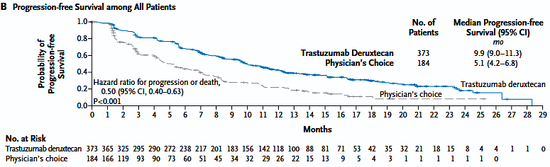
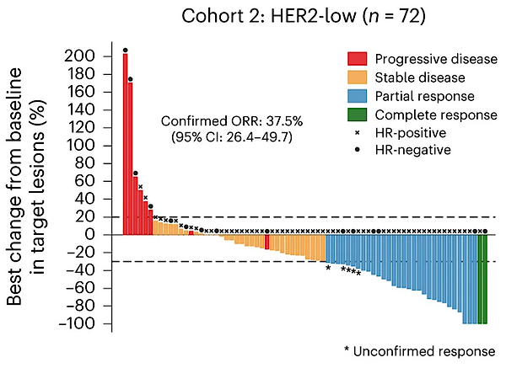
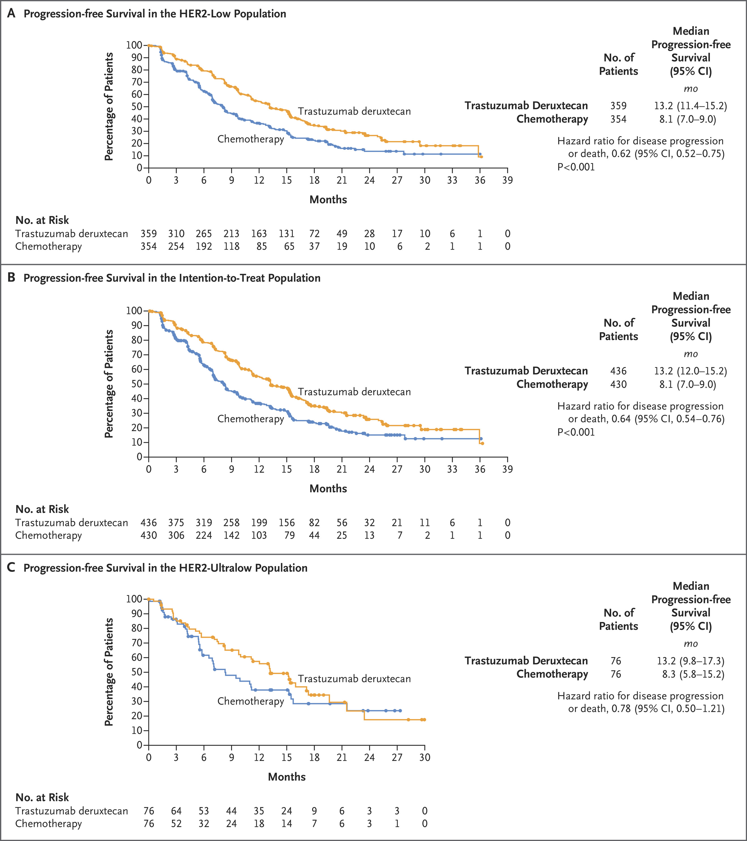
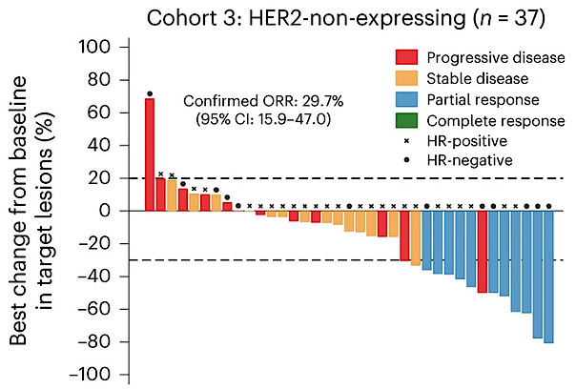
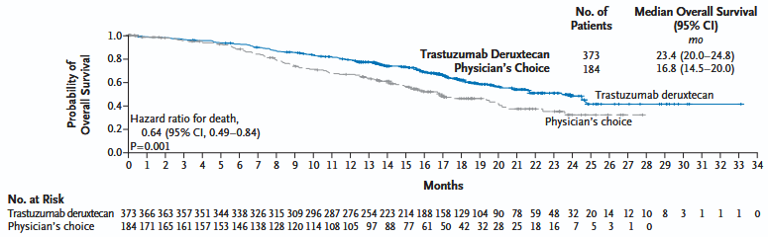
Re-visiting HER2 as a biomarker: Trastuzumab deruxtecan
DESTINY-Breast04
2/3L HER2 low met breast cancer
DAISY
2L+ met breast cancer
DESTINY-Breast06
1L HER2 low met breast cancer
PFS
IHC 1+/2+
HER2 low
T-DXd
T-DXd
ORR 37.5%
OS
T-DXd
IHC 0
HER2 ultralow
T-DXd
ADCs leverage HER2 as a delivery mechanism independent of biological HER2-dependency/addiction
ORR 29.7%
Modi et al., N Engl J Med 2022
Mosele et al., Nat Med 2023
Bardia et al., N Engl J Med 2024

Slide 28
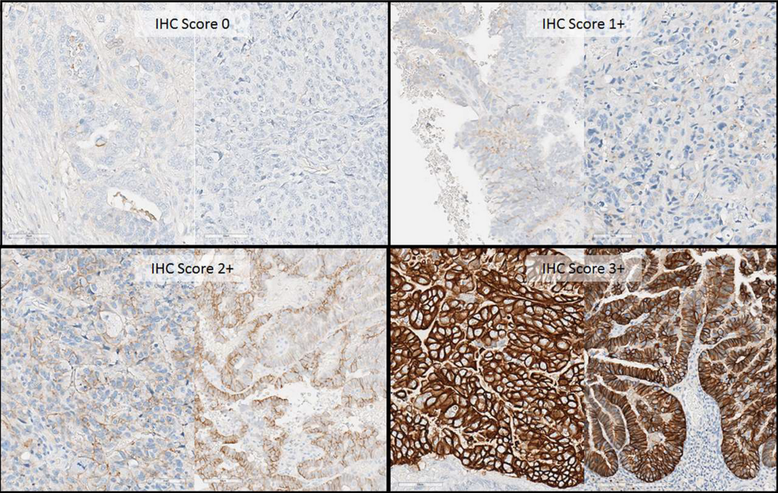
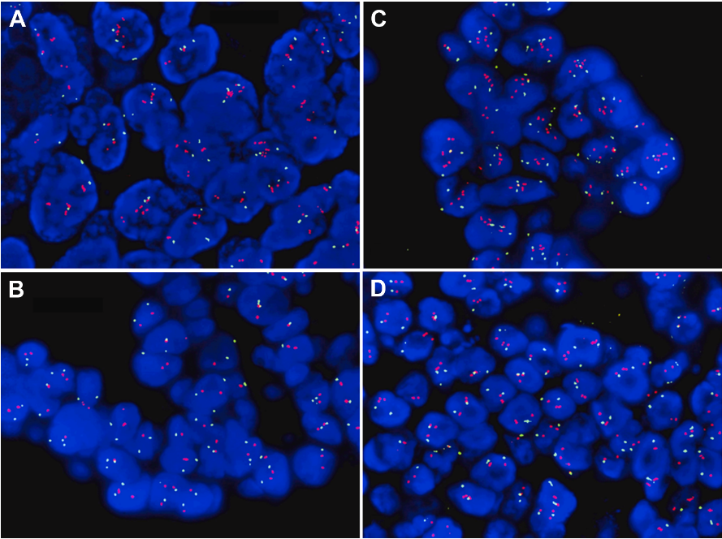
HER2 expression evaluation by ASCO/CAP guidelines: two components
Immunohistochemistry (IHC)
In situ hybridization (ISH)
HER2:CEP17 4.5
Mean HER2 12.4
HER2:CEP17 2.6
Mean HER2 6.4
Green: CEP17
Red: HER2
HER2:CEP17 1.5
Mean HER2 3.3
HER2:CEP17 1.7
Mean HER2 3.6
Definitions for 0, 1+, 2+, and 3+ scoring differ based upon tumor type
Definitions for ISH amplification differ based upon tumor type
Plotkin et al., Cancers 2024
Menshikova et al., Lab Invest 2025

Slide 29
Current HER2 scoring guidelines
Criteria | Endometrial-specific | Breast ASCO/CAP (2018/2023) | Gastric ASCO/CAP
IHC 3+ | Strong, complete circumferential or basolateral membranous staining in ≥30% of tumor cells | Intense, complete circumferential staining in ≥10% of tumor cells | Strong basolateral or complete membranous staining in ≥10% of tumor cells (resections) or in clusters of ≥5 cells (biopsies)
IHC 2+ | Incomplete or weak-to-moderate membranous staining in ≥10% but ≤30% of tumor cells | Weak-to-moderate staining in ≥10% of tumor cells | Weak-to-moderate basolateral or complete staining in ≥10% of tumor cells (resections) or in clusters of ≥5 cells (biopsies)
IHC 1+ | Faint/incomplete membranous staining in any proportion of tumor cells | Faint membranous staining in ≤10% of tumor cells | Faint or barely perceptible membranous reactivity in ≥10% of tumor cells (resections) or in clusters of ≥5 cells (biopsies)
IHC 0 | No staining | No staining | No reactivity or membranous staining in <10 % of tumor cells (resections) or no reactivity in any tumor cell (biopsies)
ISH amplification | HER2/CEP17 signal ratio ≥2.0 or HER2 copy number ≥6 per nucleus | 5-tier system; all HER2/CEP ratio ≥2.0 with average HER2 copy number ≥4.0 positive. Other categories require additional evaluation | HER2/CEP17 signal ratio ≥2.0
Adapted from Zannoni Crit Rev in Oncol/Hem 2026; Wolff et al. Arch Pathol Lab Med 2023; Bartley et al., J Clin Oncol 2016

Slide 30
NRG-GY026
2018 ASCO CAP Breast Criteria
DESTINY-PanTumor02
IHC only
Current HER2 scoring guidelines
Criteria | Endometrial-specific | Breast ASCO/CAP (2018/2023) | Gastric ASCO/CAP
IHC 3+ | Strong, complete circumferential or basolateral membranous staining in ≥30% of tumor cells | Intense, complete circumferential staining in ≥10% of tumor cells | Strong basolateral or complete membranous staining in ≥10% of tumor cells (resections) or in clusters of ≥5 cells (biopsies)
IHC 2+ | Incomplete or weak-to-moderate membranous staining in ≥10% but ≤30% of tumor cells | Weak-to-moderate staining in ≥10% of tumor cells | Weak-to-moderate basolateral or complete staining in ≥10% of tumor cells (resections) or in clusters of ≥5 cells (biopsies)
IHC 1+ | Faint/incomplete membranous staining in any proportion of tumor cells | Faint membranous staining in ≤10% of tumor cells | Faint or barely perceptible membranous reactivity in ≥10% of tumor cells (resections) or in clusters of ≥5 cells (biopsies)
IHC 0 | No staining | No staining | No reactivity or membranous staining in <10% of tumor cells (resections) or no reactivity in any tumor cell (biopsies)
ISH amplification | HER2/CEP17 signal ratio ≥2.0 or HER2 copy number ≥6 per nucleus | 5-tier system; all HER2/CEP ratio ≥2.0 with average HER2 copy number ≥4.0 positive. Other categories require additional evaluation | HER2/CEP17 signal ratio ≥2.0
Fader et al.
2007 ASCO CAP Breast Criteria
Adapted from Zannoni Crit Rev in Oncol/Hem 2026; Wolff et al. Arch Pathol Lab Med 2023; Bartley et al., J Clin Oncol 2016

Slide 31
HER2 “positive” is context-dependent
Historically, referred to HER2-amplified tumors by IHC and ISH criteria
Sometimes now used interchangeably to mean HER2 2+/3+ IHC expression (DESTINY PanTumor02 definition)
HER2 status (positive vs negative) can vary depending upon the definition used
  Tumor that is HER2-“positive” for trastuzumab deruxtecan per PanTumor02 criteria might have been HER2-“negative” when evaluated as candidate for 1L therapy with carboplatin/paclitaxel/trastuzumab

Slide 32
HER2 expression in gyn cancers: ovarian cancer
Most historical series do not distinguish between HER2 IHC 0 and 1+ cancers
HER2 amplification rare in high-grade serous ovarian cancer
  Single-digit percentage range
Highest levels of HER2 expression in mucinous and clear cell histologies
Adapted from Park et al., Gynecol Oncol 2025

Slide 33
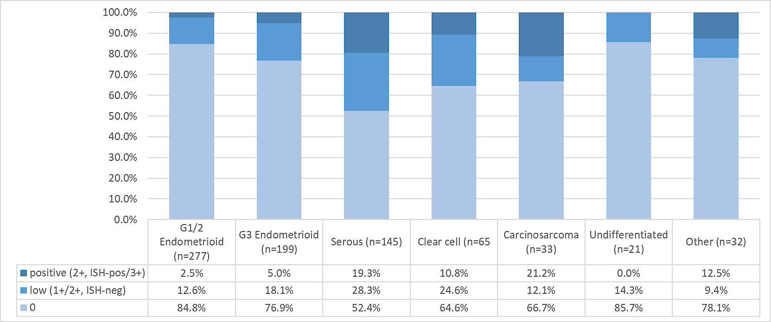
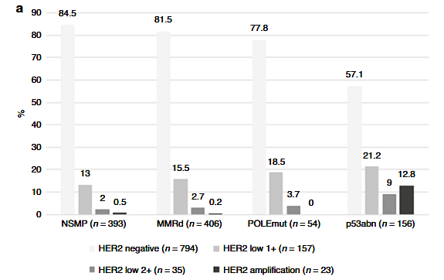
HER2 expression in gyn cancers: endometrial cancer
HER2 amplification and expression rate highest in uterine serous carcinomas
HER2-low expression seen across histologies and molecular subtypes
HER2 amplification reported to be associated with poorer prognosis
Adapted from van Dijk et al., J Clin Oncol 2024
Aro et al., BJC Reports 2025

Slide 34
HER2 expression in gyn cancers: cervical cancer
Limited data currently available on prevalence of HER2 expression by IHC
HER2 overexpression in ~4-12%, with higher rates in certain histological subtypes
  HER2 amplification most common in gastric-type cervical cancer
HER2
Liu W et al. NPJ Precis Oncol 2025

Slide 35
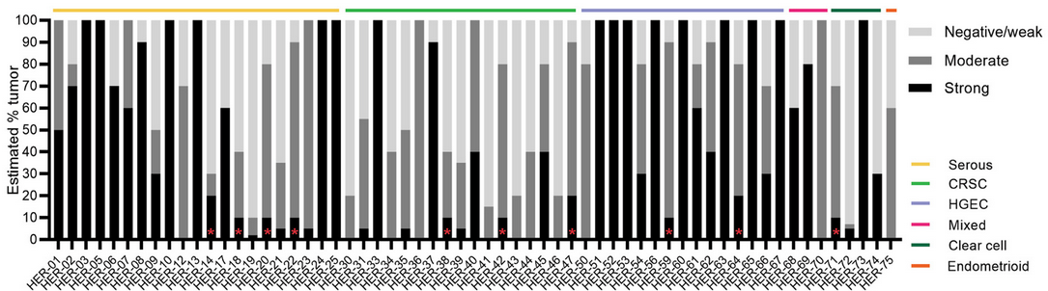
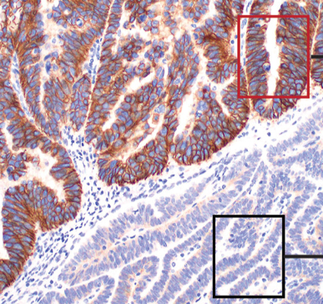
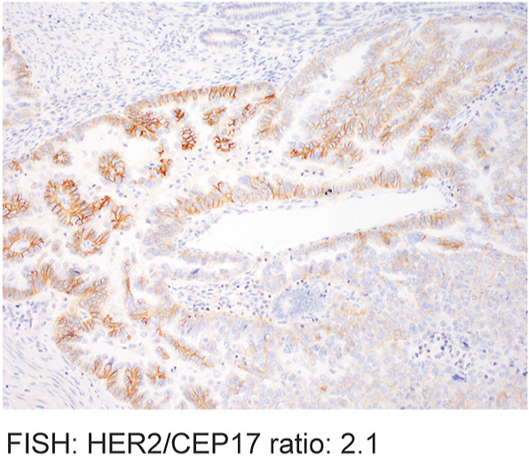
Challenges in HER2 testing in gyn cancers: Intratumoral heterogeneity
Ross et al., Modern Pathology 2022
“Cluster” pattern
“Mosaic” pattern
Shen et al., Modern Pathology 2023
Shen et al., Modern Pathology 2023

Slide 36
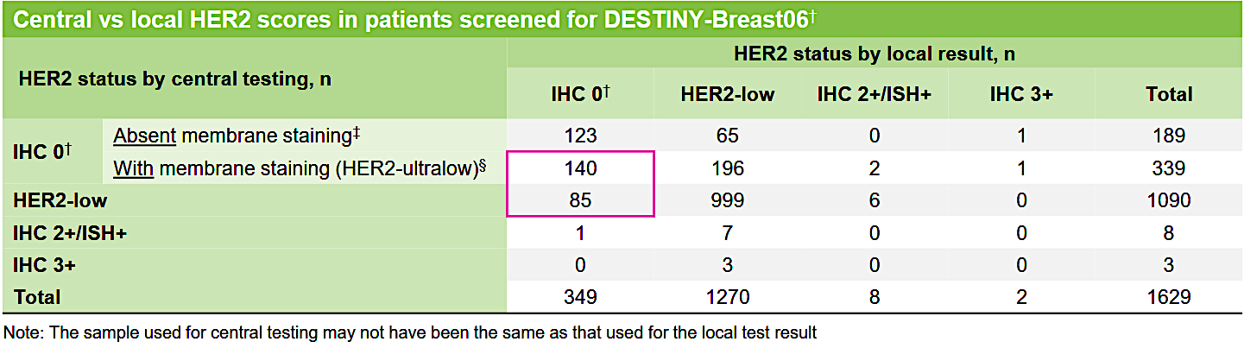
Challenges in HER2 testing in gyn cancers: Intra-test variability
Significant variability between central and local HER2 testing in DESTINY-Breast06 samples
Viale et al., 2024 ESMO Congress

Slide 37
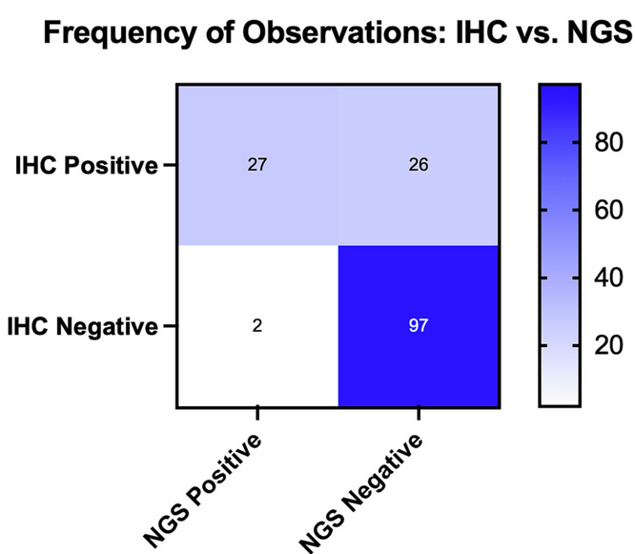
Alternative testing approaches: Next generation sequencing
NGS can identify copy number amplifications or mutations in ERBB2
Almost all ERBB2-amplified tumors demonstrate high HER2 expression by IHC
HER2 high-expressing cancers may not have detectable amplification by NGS
NGS cannot detect low/moderate IHC 1+/2+ HER2 expression levels
Ettorre et al., Gyn Oncol 2025

Slide 38
Considerations for clinical HER2 testing in Gyn cancers: current state
Consider HER2 testing for all recurrent gynecologic cancers, given T-DXd FDA approval in HER2 IHC 3+ solid tumors and NCCN listing in HER2 IHC 2+/3+ gyn cancers
  For potential T-DXd use, DESTINY-PanTumor02 utilized gastric HER2 IHC criteria
Test for HER2 in newly diagnosed advanced/recurrent p53-mutated endometrial cancer
  Addition of trastuzumab to chemotherapy in HER2-positive cancers by modified ASCO CAP 2007 breast guidelines
  Eligibility for NRG-GY026 in HER2-positive tumors by ASCO CAP 2018 breast guidelines
Consider HER2 re-testing for recurrent disease if feasible, recognizing intratumoral heterogeneity and intra-test variability.

Slide 39
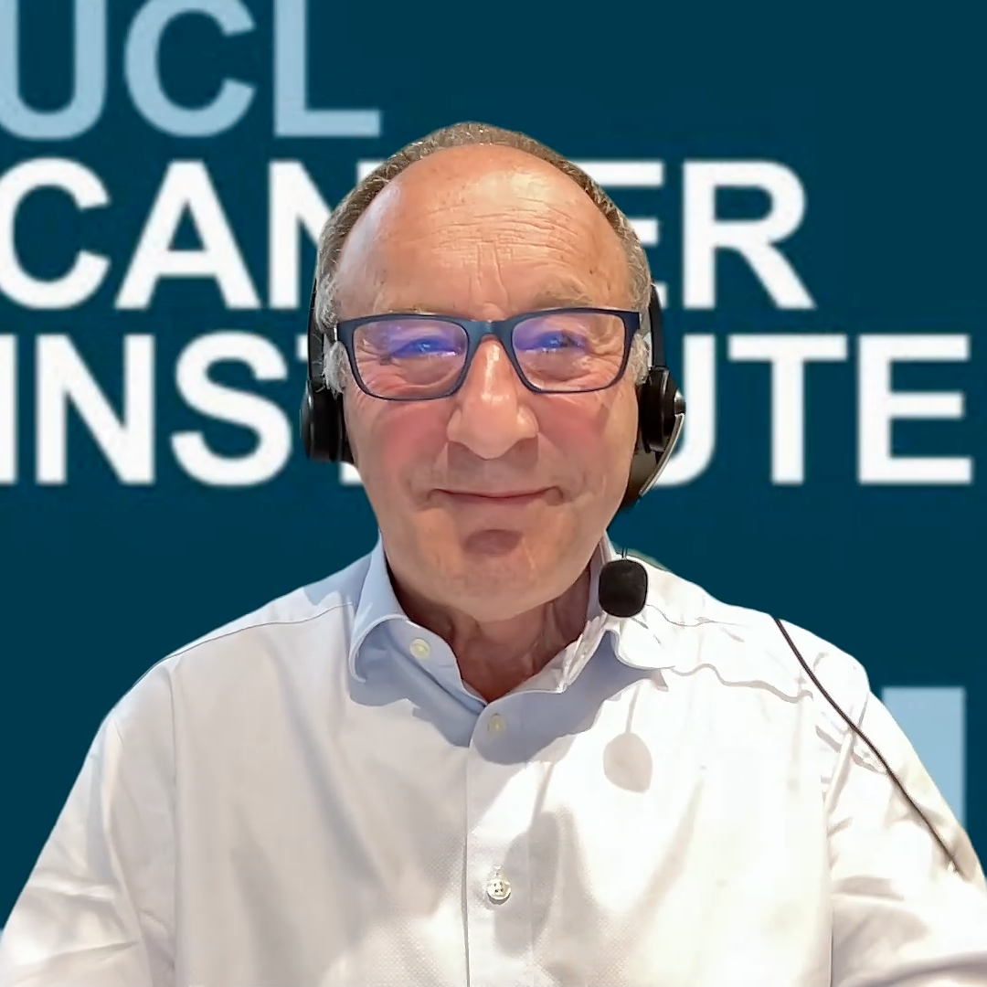


Second Opinion
Professor Jonathan A Ledermann
Angeles Alvarez Secord, MD, MHSc
Neil Love, MD

Slide 40
QUESTIONS FOR THE FACULTY
In which situations do you conduct HER2 testing for patients with gynecologic cancers? Do you test all patients regardless of tumor type, histology or stage? Or only patients with metastatic disease, certain histologies, etc? What criteria do you use to decide whether to test?
To what extent do you believe HER2 testing is being done in the “real-world” community-based setting?
What type of HER2 testing do you employ? Do you recommend HER2 testing using IHC staining in all cases? Do your pathologists employ the IHC scoring criteria for breast cancer or gastric cancer?

Slide 41
QUESTIONS FOR THE FACULTY
For a patient like Prof Ledermann’s with an IHC score of 1+ (or 2+), would you order ISH or NGS testing and treat as if HER2-positive if amplification were seen? What is the correlation between IHC, ISH and NGS when determining HER2 status?
How, if at all, does the benefit of T-DXd vary based on level of HER2 expression in gynecologic cancers? Would you anticipate an antitumor effect in HER2-ultralow disease (ie, with incomplete, faint membrane staining in <10% of tumor cells), as is seen in breast cancer?

Slide 42
QUESTIONS FOR THE FACULTY
Where does liquid biopsy fit into HER2 assessment? Can HER2 status be accurately assessed using liquid biopsy?
How important is having recent versus archival tissue for the purposes of HER2 testing? Does HER2 testing need to be repeated after disease progression?
How often do you see HER2 mutations in gynecologic cancers? For a patient with a HER2 mutation, are there any specific TKIs or other targeted therapies you would recommend? Is there any experience with sevabertinib or zongertinib — TKIs targeting HER2 TKD mutations, including exon 20 insertion mutations, in non-small cell lung cancer — in patients with gynecologic cancers?

Slide 43
Agenda
Module 1: Strategies to Identify Patients with HER2-Positive Gynecologic Cancers — Dr Liu
Module 2: Available Data with and Practical Application of HER2-Targeted Therapy in Advanced Gynecologic Cancers — Dr Slomovitz
Module 3: Identification and Management of Adverse Events with T-DXd — Dr O’Malley

Slide 44


Practical Application of
HER2-Targeted Therapy in
Advanced Gynecologic Cancers
Brian M. Slomovitz, MD, FACOG
Director, Gynecologic Oncology, Mount Sinai Medical Center
Professor, Obstetrics and Gynecology, Florida International University
Member, Board of Directors, GOG Foundation
Uterine Cancer Clinical Trial Lead, GOG Partners
Miami Beach, FL

Slide 45
History of Approvals for HER2-Targeted Therapies for Cancer
HER2 protein expression, gene amplification, and gene mutation are therapeutic targets in several types of tumors
HER2-directed therapy is the standard of care for HER2-expressing unresectable or metastatic breast cancer, HER2-positive locally advanced or metastatic gastric cancers, CRC and GEJ adenocarcinomas, and HER2-mutant NSCLC
Tucatinib +
Approval of anti-HER2 therapeutics in the USA
Lapatinib (MBC)
Neratinib (MBC)
Trastuzumab (RASwt mCRC)
Trastuzumab (mG/GEJ)
Neratinib (adj BC)
Tucatinib (MBC)
T-DXd (mG/GEJ)
Sevabertinib (NSCLC)
1998 1999 2000 2001 2002 2003 2004 2005 2006 2007 2008 2009 2010 2011 2012 2013 2014 2015 2016 2017 2018 2019 2020 2021 2022 2023 2024 2025 2026
Trastuzumab (MBC)
Trastuzumab (adj BC)
Pertuzumab (MBC)
Pertuzumab (adj BC)
Margetuximab (MBC)
Zongertinib (NSCLC)
Pertuzumab–
trastuzumab–
hyaluronidase-zzxf (MBC, adj BC)
Pertuzumab (neoadj BC)
Zanidatamab
(2L mBTC)
T-DM1 (MBC)
T-DM1 (adj BC)
T-DXd (2L MBC)
T-DXd (HER2 mNSCLC)
TKI
mAb
ADC
Bispecific HER2 Ab
T-DXd (3L MBC)
T-DXd (HER2-low)
2L = second line; 3L = third line; ADC = antibody-drug conjugate; adj = adjuvant; BC = breast cancer; BTC = biliary tract cancer; MBC = metastatic breast cancer; mG/GEJ = metastatic gastric/gastroesophageal junction cancer; mAb = monoclonal antibody; mCRC = metastatic colorectal cancer; neoadj = neoadjuvant; mNSCLC = metastatic non-small cell lung cancer; RASwt = RAS wild type; T-DM1 = trastuzumab emtansine; T-DXd = trastuzumab deruxtecan; TKI = tyrosine kinase inhibitor.

Slide 46
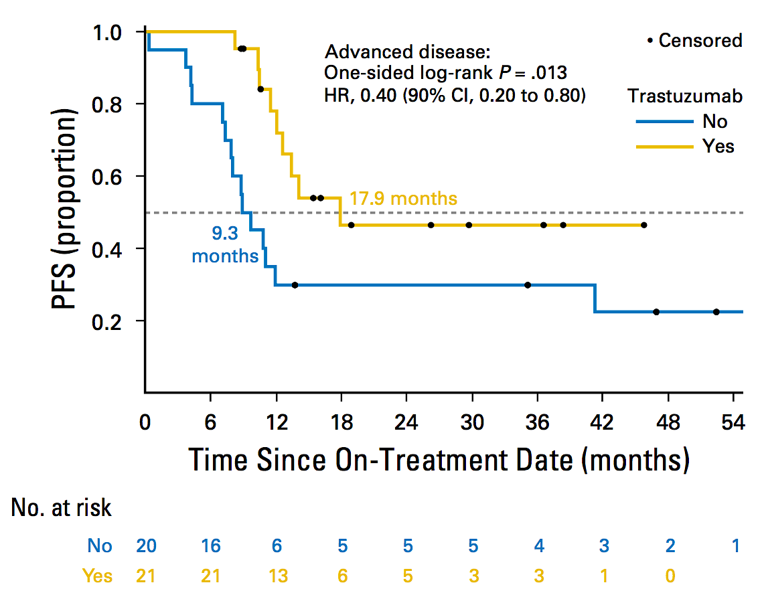
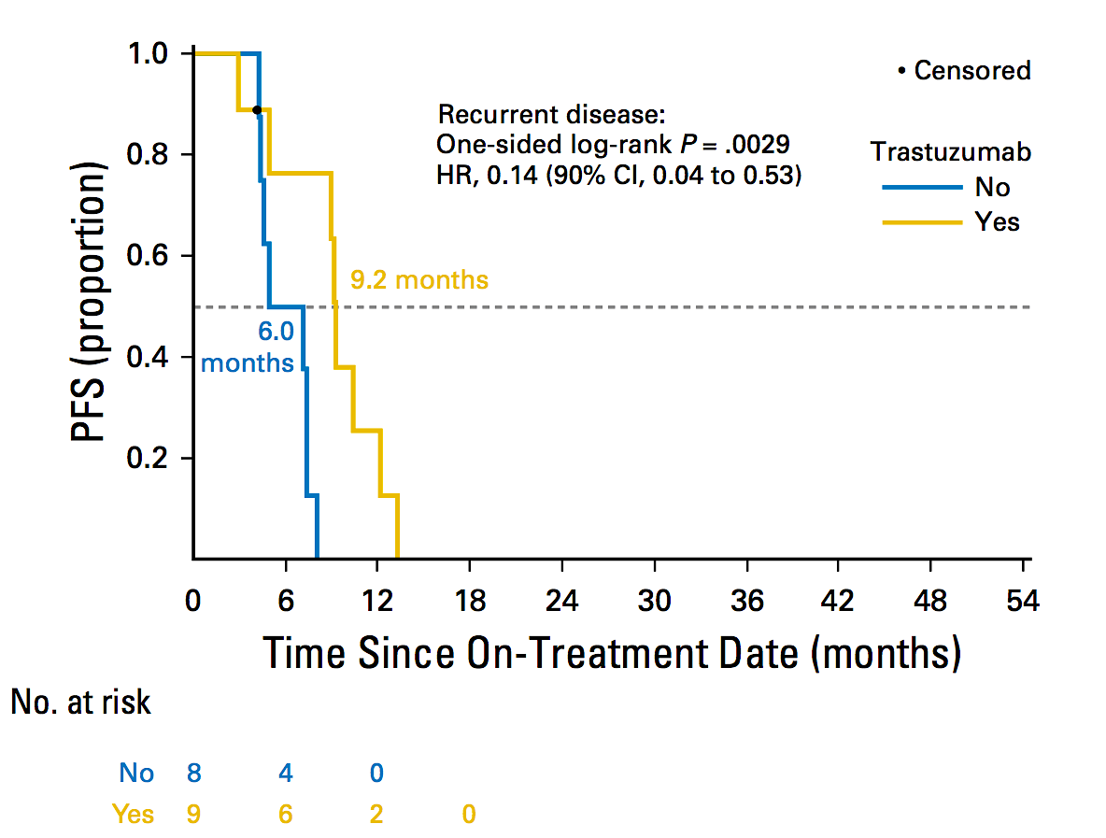
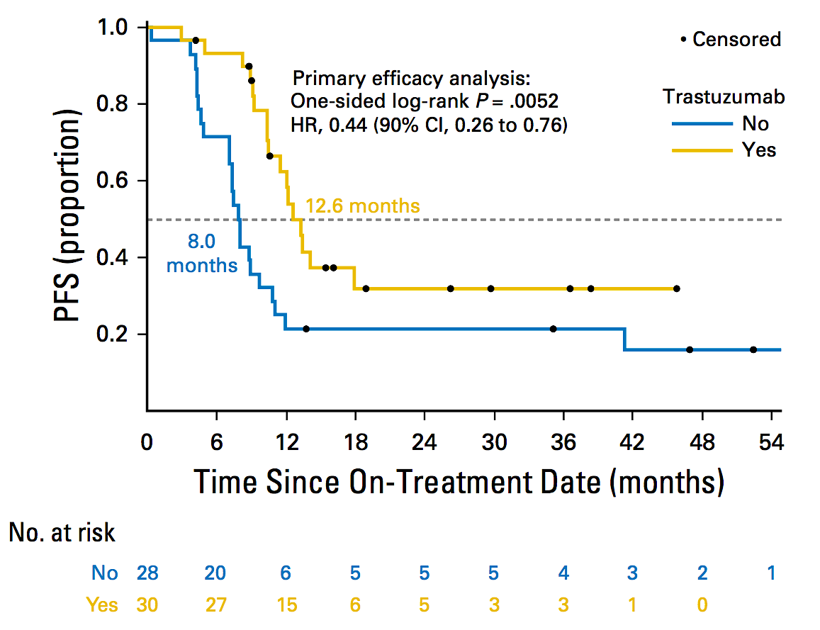
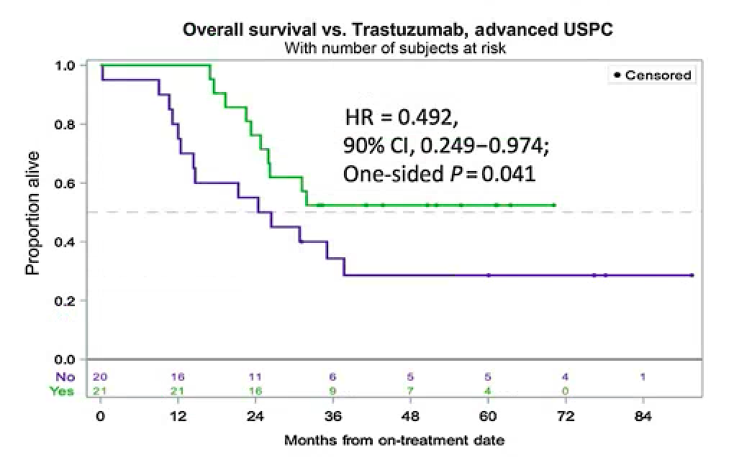
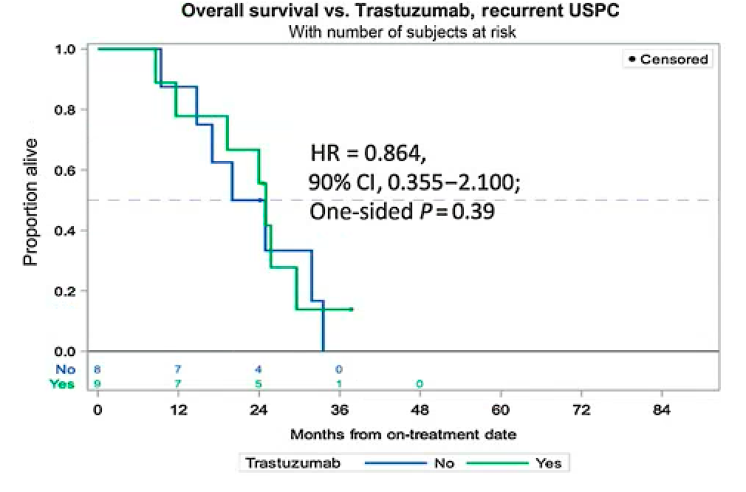
Incorporation of anti-HER2 treatment: Trastuzumab with Chemotherapy in Uterine Serous Carcinomas
Key eligibility criteria
  Primary stage III or IV or recurrent HER2/neu-positive USC: IHC score 3+, or 2+ with + FISH
  ECOG 0-2
  ≤3 prior lines of therapy
  “platinum sensitive” recurrence (6 mo)
OS benefit particularly striking in stage III–IV patients, OS median of 25.4 months (control) versus NR (p = 0.041, HR = 0.49, 90% CI 0.25–0.97).
Fader J Clin Oncol 2018; Fader Clin Cancer Res 2020.

Slide 47
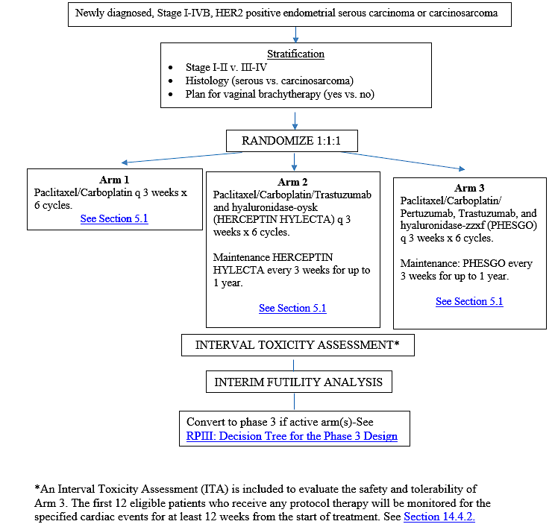
NRG-GY026
Activation Date: 8/12/22
Accrual goal 326
N= 259
q 3 weeks x 6 cycles.
Maintenance every 3 weeks for up to 1 year.
Maintenance: every 3 weeks for up to 1 year.
Issues:
Fear of PC alone
New TDxD
Study Chair: Britt Erickson, MD

Slide 48
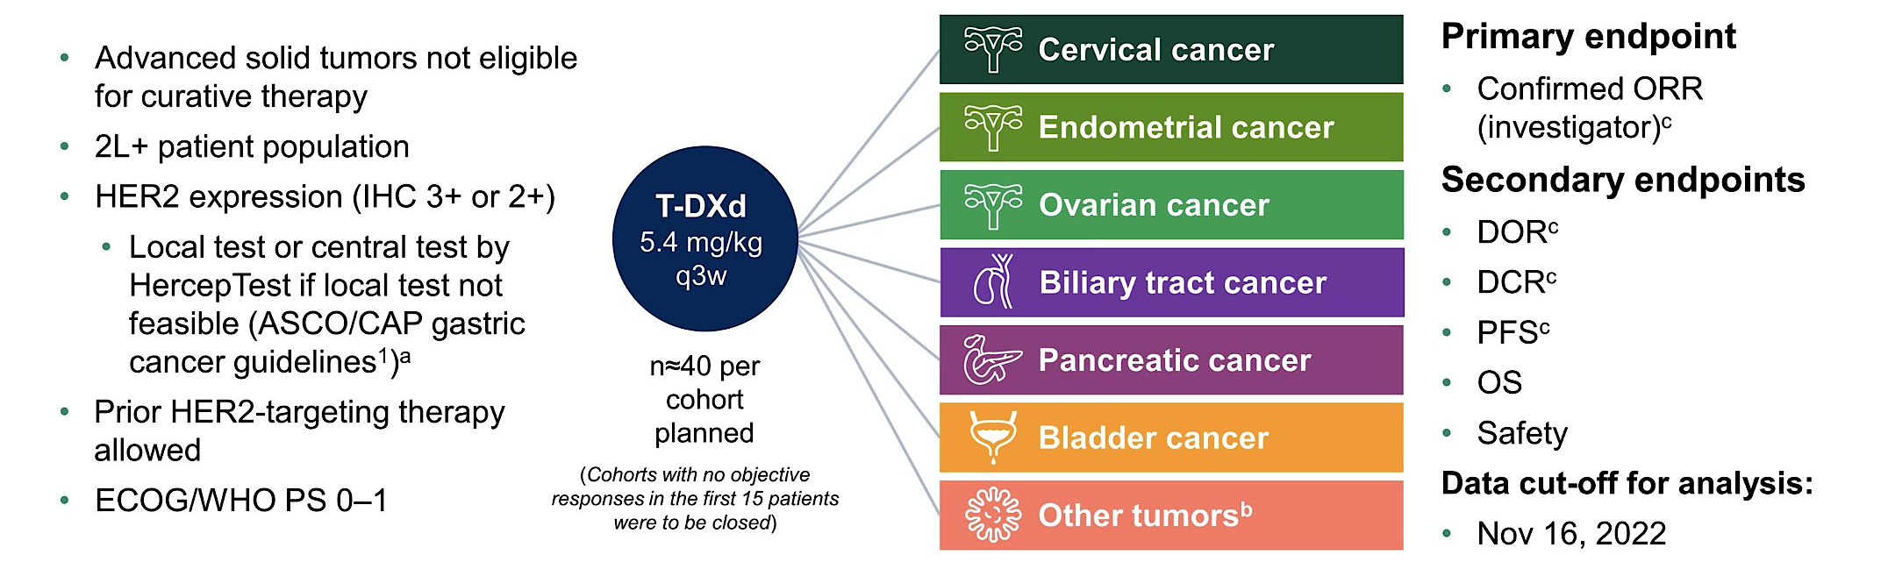
Phase 2 DESTINY-PanTumor02 Study of T-DXd for HER2-Expressing Solid Tumors: Design
Tumor types were selected based on epidemiological frequency, prevalence of HER2 expression, and unmet medical need
ª
ªOther tumors cohort: salivary gland cancer (n = 19), malignant neoplasm of unknown primary site (n = 5), extramammary Paget disease (n = 3), cutaneous melanoma (n = 2), oropharyngeal neoplasm (n = 2), adenoid cystic carcinoma, head and neck cancer, lip and/or oral cavity cancer, esophageal adenocarcinoma, intestinal adenocarcinoma, appendiceal adenocarcinoma, esophageal squamous cell carcinoma, testicular cancer, and vulvar carcinoma (all n = 1).
2L+ = second-line or beyond; DCR = disease control rate; DOR = duration of response; ECOG = Eastern Cooperative Oncology Group; PS = performance status; WHO = World Health Organization.
Meric-Bernstam F, et al. J Clin Oncol. October 23, 2023. DOI: 10.1200/JCO.23.02005. NCTID: NCT04482309.

Slide 49
DESTINY-PanTumor02 – Design and Analysis
Phase 2, open label multi-center study (NCT04482309)
Patient Group
  Advanced solid tumors not eligible for curative therapy
  2L+ patient populationª
  HER2 expression (by ASCO/CAP gastric cancer guidelines)
  Part 1: IHC 3+ or IHC 2+ Local test or central test^{b}
  Part 2: IHC and ISH (cohort B only) results by central assessment as pre-defined for each cohort
  Prior HER2-targeting therapy allowed
  ECOG/WHO PS 0–1
Primary analysis (DCO June 08, 2023) has been published (Meric-Bernstein F, et al. J Clin Oncol. 2024; 42: 47-48)
Final analysis– DCO October 10, 2024
Part 1
Part 2^{g}
Cohort 1 (n = 41) Biliary tract cancer
Cohort A HER2 IHC 3+ Metastatic Solid Tumors^{h}
Cohort 2 (n = 41) Bladder cancer
Primary endpoint
Confirmed ORR (investigator)*
Secondary endpoints
DoR^{i}
DCR^{i}
PFS^{i}
OS
Safety
Exploratory endpoint
Subgroup analyses by HER2 status^{j}
Subgroup analyses by biomarkers^{j}
Cohort B HER2 IHC 2+/ISH+ Metastatic Solid Tumors^{h}
HER2- expressing solid tumors^{c}
T-DXd 5.4 mg/kg Q3w
Cohort 3 (n = 40) Cervical cancer^{e}
Cohort 4 (n = 40) Endometrial cancer
Cohort C HER2 IHC 2+ or 1+ Endometrial cancer
Cohort 5 (n = 40) Ovarian cancer
Cohort D HER2 IHC 2+ or 1+ Ovarian cancer
n = 267^{d}
(75 IHC3+)
Note: HER2 subgroup analyses by central testing
Cohort 6 (n = 25) Pancreatic cancer
Cohort E HER2 IHC 2+ or 1+ Cervical cancer
Cohort 7 (n = 40) Other tumors^{f}
*Confirmed ORR per RECIST 1.1 is the percentage of patients with CR or PR that is subsequently confirmed
ªPatients with no satisfactory treatment options were also included; ^{b}Patients were eligible for either test. All patients were centrally confirmed; ^{c}Excluding breast, gastric, colorectal cancer; ^{d}Cohorts with no objective response in the first 15 patients were closed; ^{e}Cervical cohort was expanded to include five IHC1+ patients; ^{f}Patients with tumors that express HER2, excluding tumors in the tumor-specific cohorts, and breast cancer, non-small cell lung cancer, gastric cancer, and colorectal cancer; ^{g}Enrollment started in 2024; ^{h}Excluding breast, gastric cancer, and colorectal cancer. Patients with non-small cell lung cancer can be included; ^{i}Investigator-assessed per Response Evaluation Criteria In Solid Tumors version 1.1; j Subgroup analyses were based on central HER2 testing.
ASCO/CAP, American Society of Clinical Oncology and the College of American Pathologists; DCO, data cut off; DCR, duration of complete response; DoR, duration of response; ECOG, Eastern Cooperative Oncology Group; IHC, immunohistochemistry; ORR, objective response rate; OS, overall survival; PFS, progression-free survival; PS, performance score; T-DXd, trastuzumab deruxtecan; WHO, World Health Organization.

Slide 50
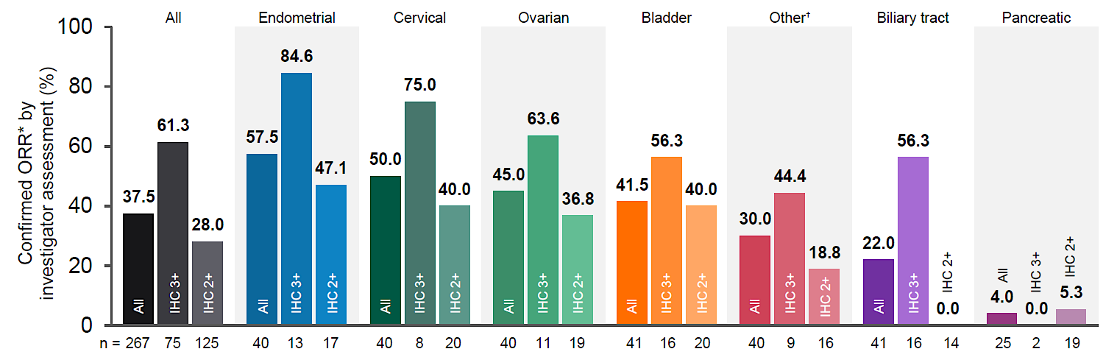
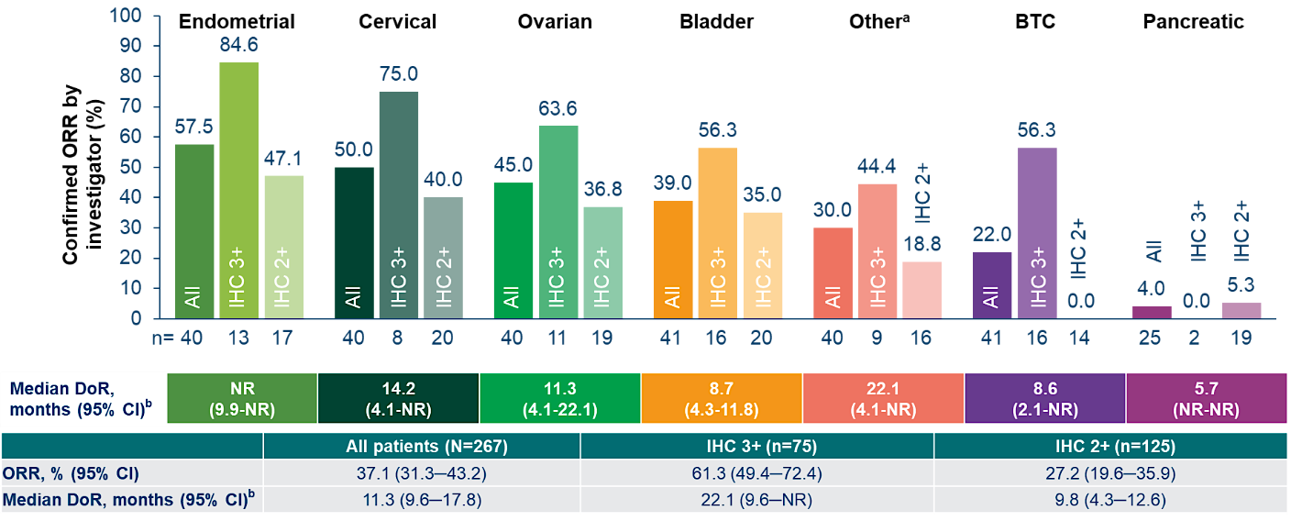
DESTINY-PanTumor02 ‒ Final Analysis (confirmed ORR)
Gynecological cohort
FINAL ANALYSIS
Median (range) follow up
(all cohorts) – 12.98 (0.4‒47.4) months
PRIMARY ANALYSIS
Median (range) follow up
(all cohorts) – 12.75 (0.4‒31.6) months
*Confirmed ORR per RECIST 1.1
Meric-Bernstam F, et al. J Clin Oncol. October 23, 2023; Makker V, et al. ESMO 2025;Abstract 957P.

Slide 51
DESTINY-PanTumor02 ‒ Final Analysis (PFS & OS)
Progression-free survival
Median PFS, months (95% CI) | All patients | HER2 status by central testing
 |  | IHC 3+ | IHC 2+
Endometrial | 11.1 (7.1, 25.8) 11.1 (7.1, NE) | 28.1 (7.3, NE) NE (7.3, NE) | 8.5 (4.6, 15.1) 8.5 (4.6, 15.1)
Cervical | 7.0 (4.2, 11.1) 7.0 (4.2, 11.1) | NE (3.9, NE) NE (3.9, NE) | 4.8 (2.7, 5.7) 4.8 (2.7, 5.7)
Ovarian | 5.9 (4.0, 8.3) 5.9 (4.0, 8.3) | 12.5 (3.1, NE) 12.5 (3.1, NE) | 4.1 (2.3, 12.6) 4.1 (2.3, 12.6)
Final analysis
Primary analysis
PFS and OS data were consistent across primary and final analyses
PFS and OS data were consistent regardless of how HER2 testing was performed (whether central testing was applied or not)
Gynecological cohorts
Overall survival
Median OS, months (95% CI) | All patients | HER2 status by central testing
 |  | IHC 3+ | IHC 2+
Endometrial | 24.2 (12.8, 33.7) 26.0 (12.8, NE) | 33.7 (18.9, NE) 26.0 (18.9, NE) | 16.4 (8.0, 34.7) 16.4 (8.0, NE)
Cervical | 13.6 (11.1, 19.7) 13.6 (11.1, NE) | 35.8 (3.9, NE) NE (3.9, NE) | 11.6 (5.1, 18.0) 11.5 (5,1, NE)
Ovarian | 13.2 (8.0, 17.7) 13.2 (8.0, 17.7) | 20.0 (3.8, NE) 20.0 (3.8, NE) | 13.0 (4.7, 21.9) 13.0 (4.7, 21.9)
Meric-Bernstam F, et al. J Clin Oncol. October 23, 2023; Makker V, et al. ESMO 2025;Abstract 957P.

Slide 52
DESTINY-PanTumor02 – Design and Analysis
Phase 2, open label multi-center study (NCT04482309)
Patient Group
  Advanced solid tumors not eligible for curative therapy
  2L+ patient populationª
  HER2 expression (by ASCO/CAP gastric cancer guidelines)
  Part 1: IHC 3+ or IHC 2+ Local test or central test^{b}
  Part 2: IHC and ISH (cohort B only) results by central assessment as pre-defined for each cohort
  Prior HER2-targeting therapy allowed
  ECOG/WHO PS 0–1
Primary analysis (DCO June 08, 2023) has been published (Meric-Bernstein F, et al. J Clin Oncol. 2024; 42: 47-48)
Final analysis– DCO October 10, 2024
Part 1
Part 2^{g}
Cohort 1 (n = 41) Biliary tract cancer
Cohort A HER2 IHC 3+ Metastatic Solid Tumors^{h}
Cohort 2 (n = 41) Bladder cancer
Primary endpoint
Confirmed ORR (investigator)*
Secondary endpoints
DoR^{i}
DCR^{i}
PFS^{i}
OS
Safety
Exploratory endpoint
Subgroup analyses by HER2 status^{j}
Subgroup analyses by biomarkers^{j}
Cohort B HER2 IHC 2+/ISH+ Metastatic Solid Tumors^{h}
HER2- expressing solid tumors^{c}
T-DXd 5.4 mg/kg Q3w
Cohort 3 (n = 40) Cervical cancer^{e}
Cohort 4 (n = 40) Endometrial cancer
Cohort C HER2 IHC 2+ or 1+ Endometrial cancer
Cohort 5 (n = 40) Ovarian cancer
Cohort D HER2 IHC 2+ or 1+ Ovarian cancer
n = 267^{d}
(75 IHC3+)
Note: HER2 subgroup analyses by central testing
Cohort 6 (n = 25) Pancreatic cancer
Cohort E HER2 IHC 2+ or 1+ Cervical cancer
Cohort 7 (n = 40) Other tumors^{f}
*Confirmed ORR per RECIST 1.1 is the percentage of patients with CR or PR that is subsequently confirmed
ªPatients with no satisfactory treatment options were also included; ^{b}Patients were eligible for either test. All patients were centrally confirmed; ^{c}Excluding breast, gastric, colorectal cancer; ^{d}Cohorts with no objective response in the first 15 patients were closed; ^{e}Cervical cohort was expanded to include five IHC1+ patients; ^{f}Patients with tumors that express HER2, excluding tumors in the tumor-specific cohorts, and breast cancer, non-small cell lung cancer, gastric cancer, and colorectal cancer; ^{g}Enrollment started in 2024; ^{h}Excluding breast, gastric cancer, and colorectal cancer. Patients with non-small cell lung cancer can be included; ^{i}Investigator-assessed per Response Evaluation Criteria In Solid Tumors version 1.1; j Subgroup analyses were based on central HER2 testing.
ASCO/CAP, American Society of Clinical Oncology and the College of American Pathologists; DCO, data cut off; DCR, duration of complete response; DOR, duration of response; ECOG, Eastern Cooperative Oncology Group; IHC, immunohistochemistry; ORR, objective response rate; OS, overall survival; PS, performance score; T-DXd, trastuzumab deruxtecan; WHO, World Health Organization.

Slide 53
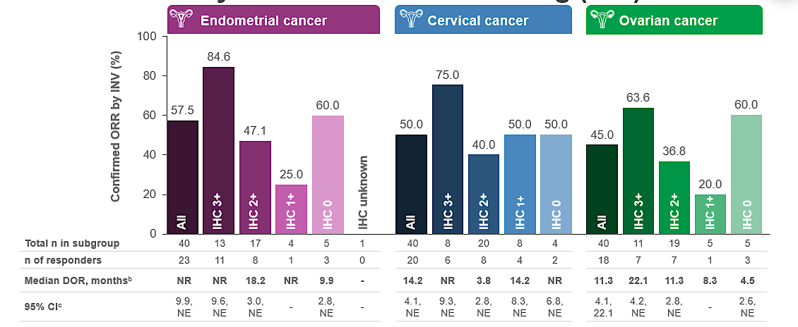
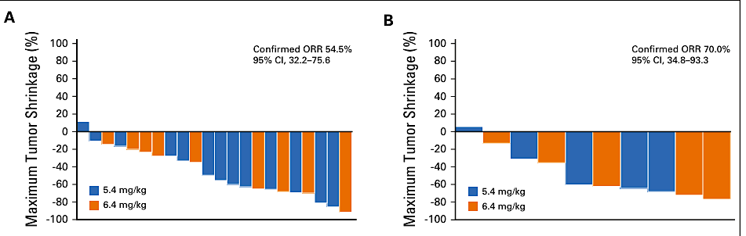
Destiny-PanTumor02 ‒ IHC 2+ and IHC 1+ cohorts
DESTINY-PanTumor02¹
(primary analysis of gynecological cancer cohorts)
STATICE²
(Phase 2 T-DXd vs historical chemo in advanced/recurrent uterine carcinosarcoma)
HER2 high (IHC 2+/3+) n = 22
HER2 low (IHC1+) n = 10
1. Meric-Bernstam, F, et al. Efficacy and Safety of Trastuzumab Deruxtecan in Patients With HER2-Expressing Solid Tumors: Primary Results From the DESTINY-PanTumor02 Phase II Trial. J Clin Oncol; 2024; 47-58; 2. Nishikawa T, et al. Trastuzumab Deruxtecan for Human Epidermal Growth Factor Receptor 2–Expressing Advanced or Recurrent Uterine Carcinosarcoma (NCCH1615): The STATICE Trial. J Clin Oncol 2023 41(15):2789-2799.
CI, confidence interval; DOR, duration of response; IHC, immunohistochemistry; INV, investigator; NR, not reached; ORR, objective response rate; T-DXd, trastuzumab deruxtecan.

Slide 54
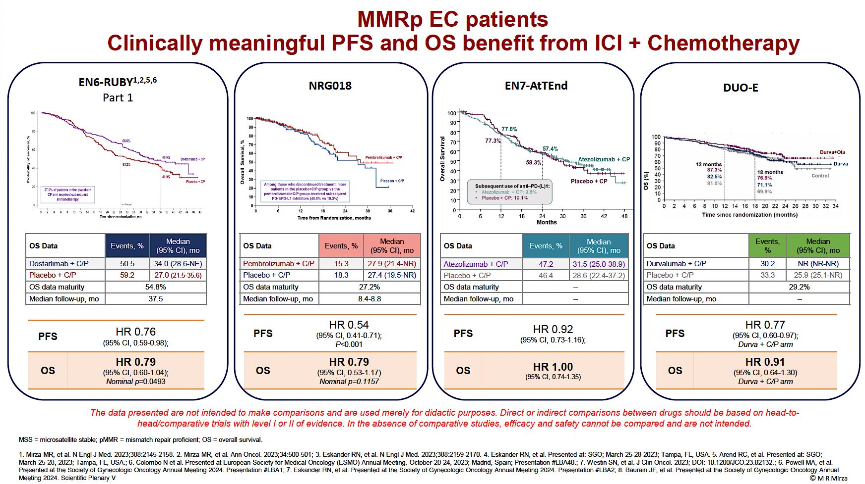
Adding to the Marginal Benefit of Immunotherapy in Advanced and Recurrent EC

Slide 55
DESTINY-Endometrial01 ‒ Study Design
Patient Population
Endpoints
IHC 3+ 25%; IHC 2+ 75% (capped)
Stage III (with m.d.), Stage IV, or first recurrent, histologically-confirmed epithelial endometrial cancer
HER2 expressing (IHC 3+/2+) EC by central test
pMMR EC by central test
Stage III must have measurable disease
Any histological subtype except for sarcomas
≤ 1 prior line of adjuvant/ neoadjuvant chemotherapy (chemotherapy and/ or chemoradiation) if recurrence ≥ 6 months after last dose of chemo
No prior exposure to ADCs or ICIs
ECOG PS 0 or 1
A: T-DXd 5.4 mg/kg +
Rilvegostomig 750mg Q3Wª
Primary:
PFS (BICR) in ITT
Secondary:
OS
PFS (INV)
PFS2
ORR by BICR and INV
DoR
HRQoL (PRO)
Safety and tolerability
Pharmacokinetics and immunogenicity
Futility analysis at 40% IF
N = 600
R
1:1:1
B: T-DXd 5.4 mg/kg + Pembrolizumab 200mg Q3Wª
C: Carboplatin/Paclitaxel + Pembrolizumab^{a,b}
Stratification factors:
HER2 IHC 3+ vs 2+
PD-L1 TAP ≥1% vs TAP <1%
Asia vs Non-Asia
Inclusion/exclusion criteria
NCT06989112
ª Treatment will continue until objective disease progression according to RECIST v1.1 as assessed by the Investigator and confirmed by BICR or until other discontinuation criteria is met, whichever occurs first.
^{b} Carboplatin AUC5, paclitaxel 175 mg/m², and pembrolizumab 200 mg IV once Q3W x 6 cycles*, followed by maintenance with pembrolizumab 400 mg IV Q6W. Treatment with pembrolizumab will continue for up to 20 total cycles (approximately 24 months, accounting for combination and maintenance phases) or until other discontinuation criteria is met, whichever occurs first.
*At the discretion of the treating Investigator, participants may continue to receive carboplatin, paclitaxel and pembrolizumab Q3W for up to 10 cycles.
ADC, antibody-drug conjugate; DoR, duration of response; ICI, immune checkpoint inhibitor; IF, information fraction (of planned); IHC, immunohistochemistry; EC, endometrial cancer; ECOG PS, Eastern Cooperative Oncology Group Performance Status; HRQoL, health-related quality of life; ITT, intention-to-treat; m.d., measurable disease; ORR, objective response rate; OS, overall survival; PFS, progression-free survival; PFS2, time from randomization to progression on second line therapy; pMMR, proficient mismatch repair; PRO, patient reported outcome; Q3W, every three weeks; Q6W, every six weeks; TAP, tumor area positivity; T-DXd, Trastuzumab deruxtecan; OS, overall survival.
Slomovitz B, et al. ESMO 2025;Abstract 1223TiP.

Slide 56

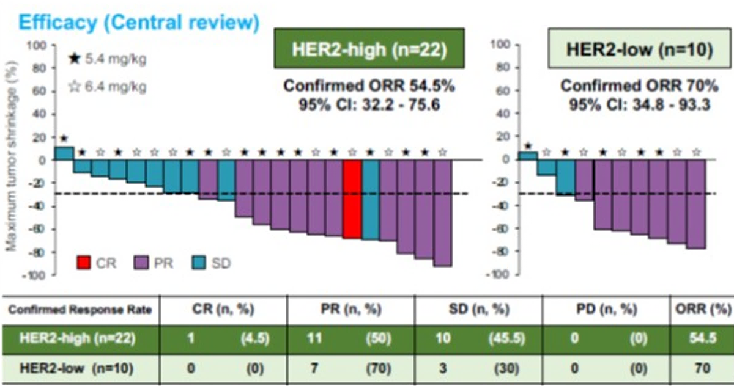


Rationale for adjuvant trial using T-Dxd
DESTINY-PanTumor02⁵
High-risk early endometrial cancer has a high rate of relapse.¹⁻³
The addition of pembrolizumab to adjuvant chemotherapy in KEYNOTE-B21 did not improve patient outcomes (for the majority pMMR disease)⁴
The efficacy of T-DXd in the advanced setting,^{5,6} and data on HER2 prevalence,^{7,8} together support studying T-DXd in the high risk HER2-expressing adjuvant setting
STATICE⁶
HER2 – RWE⁷
DESTINY-PanTumor02 and STATICE trials provide substantial evidence of the activity of T-DXd in HER2 expressing endometrial cancer. Notably, STATICE showed significant efficacy in carcinosarcomas, a histology subtype with a poor prognosis.
1. de Boer SM, et al. Lancet Oncol 2019; 20: 1273-1285; 2. Post CCB, et al. Lancet Oncol 2025; online first; 3. Matei E, et al. J Clin Oncol 2025; 43: 1055-1060; 4. Van Gorp T et al. Ann Oncol 2024;35(11):968–980; 5. Makker A, et al. Poster 957P, ESMO 2025; 6. Nishikawa T, et al. J Clin Oncol 2023 41(15):2789-2799; 7. Krakstad C, et al. JAMA Oncol 2024; 10: 1587-1588; 8. Halle MK, et al. BJC 2018; 118: 378-387.
CI, confidence interval; CR, complete response; IHC, immunohistochemistry; ORR, objective response rate; pMMR, proficient mismatch repair; PD, progressive disease; PR, partial response; RWE, real world evidence; SD, stable disease; T-DXd, trastuzumab deruxtecan.

Slide 57

DESTINY-Endometrial02 – Study Design
Tissue Screening
Main Screening
Treatment
Follow-up
Endpoints
Key Patient Population
Histologically confirmed diagnosis of endometrial cancer
FIGO2023 Stage IIC or III
NO evidence of disease post-surgery as per investigator and confirmed by BICR
Treatment naïve (systemic therapy) in any setting including the neoadjuvant setting for endometrial cancer
T-DXd Q3W 5.4 mg/kg
× 17 cycles +/- concomitant or subsequent VCB
Primary
DFS ITT (BICR or pathology)
Key Secondary
OS ITT
Other Secondary
DFS ITT by investigator
DDFS
HRQoL
Safety
Timelines
FSI Nov 2025, Recruitment 35 months
230 sites
HER2 expression (IHC 3+ / 2+) per 2016 ASCO CAP gastric cancer IHC scoring guidelines by central confirmation
Post-Systemic Therapy
40-day Visit 1
LTSFU
N = 710
Optional Predetermined RT
Post-RT 40-day Visit 2
SoC Chemotherapy* +/- concomitant or subsequent VCB
Full inclusion/exclusion criteria
Stratification Factors
MMR status by local IHC status: pMMR vs dMMR
Within the pMMR stratum, patients will be further stratified by:
HER2 expression by central testing: IHC 3+ vs 2+
FIGO 2023 stage: IIC vs III
Region: Region 1 vs Region 2 vs Region 3
  Region 1: North America, Western EU, Australia
  Region 2: Asia
  Region 3: Rest of the World
*SoC Chemotherapy +/- EBRT Options
6 cycles of carboplatin AUC 5 or 6 and paclitaxel 175 mg/m² Q3W followed by EBRT
4 cycles carboplatin AUC 5 or 6 and paclitaxel 175 mg/m2 Q3W followed by chemoradiotherapy (EBRT plus cisplatin 50 mg/m² on days 1 and 29
6 cycles of carboplatin AUC 5 or 6 and paclitaxel 175 mg/m2 Q3W
Stage IIC includes the following aggressive histotypes: high-grade endometrioid (grade 3), serous, clear cell, undifferentiated, mixed, mesonephric-like, gastrointestinal mucinous type carcinomas, and carcinosarcomas.
ASCO-CAP, American Society of Clinical Oncology and College of American Pathologists; AUC, area under curve; BICR, blinded independent central review; DDFS, Distant disease-free survival; DFS, disease-free survival; dMMR, deficient mismatch repair; EBRT, external beam radiotherapy; EU, European Union; FIGO, International Federation of Gynecology and Obstetrics; FSI, first subject in; IHC, immunohistochemistry; ITT, intention-to-treat; LTSFU, long-term safety follow up; OS, overall survival; pMMR, proficient mismatch repair; Q3W, every 3 weeks; RT, radiotherapy; SoC, standard of care; T-DXd, Trastuzumab deruxtecan; VCB: vaginal cuff brachytherapy.

Slide 58
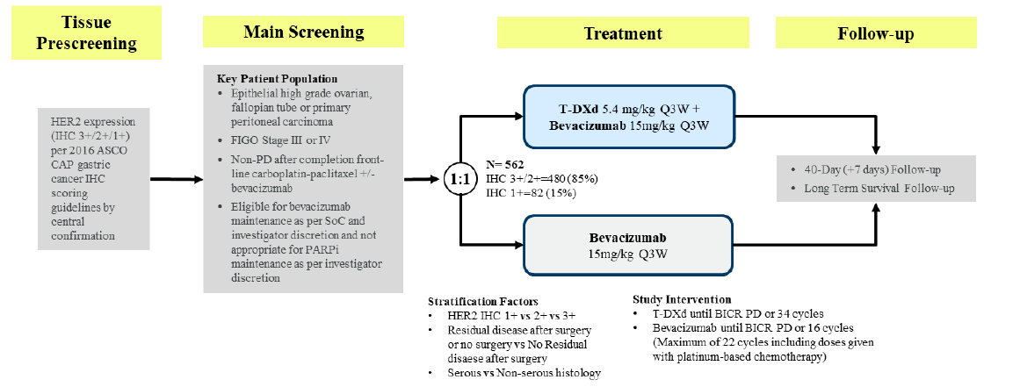
DESTINY Ovarian-01
Redraw batch 2/3 - done
Adjusted formatting slightly. Should the light blue beva box be orange?
YES
Changed “Key Patient Population” to “Key Eligibility Criteria” to make things consistent
Tissue prescreening
Main screening
Treatment
Follow-up
Key Eligibility Criteria
Epithelial high-grade ovarian, fallopian tube,
or primary peritoneal carcinoma
FIGO stage III or IV
Non-PD after completion front-line carboplatin-paclitaxel ± bevacizumab
Eligible for bevacizumab maintenance as per SOC and investigator discretion and not appropriate for PARPi maintenance as per investigator discretion
N = 562
IHC 3+/2+ = 480 (85%)
IHC 1+ = 82 (15%)
T-DXd
5.4 mg/kg Q3W + bevacizumab
15 mg/kg Q3W
HER2 expression
(IHC 3+/2+/1+) per 2016 ASCO CAP gastric cancer IHC scoring guidelines by central confirmation
Stratification
HER2 IHC 1+ vs 2+ vs 3+
Residual disease after surgery or no surgery vs no residual disease after surgery
Serous vs nonserous histology
40-d (+7 d) follow-up
Long-term survival
follow-up
R
1:1
Bevacizumab
15 mg/kg Q3W
Study intervention
T-DXd until BICR PD or 34 cycles
Bevacizumab until BICR PD or 16 cycles (maximum of 22 cycles including doses given with platinum-based chemotherapy)

Slide 59
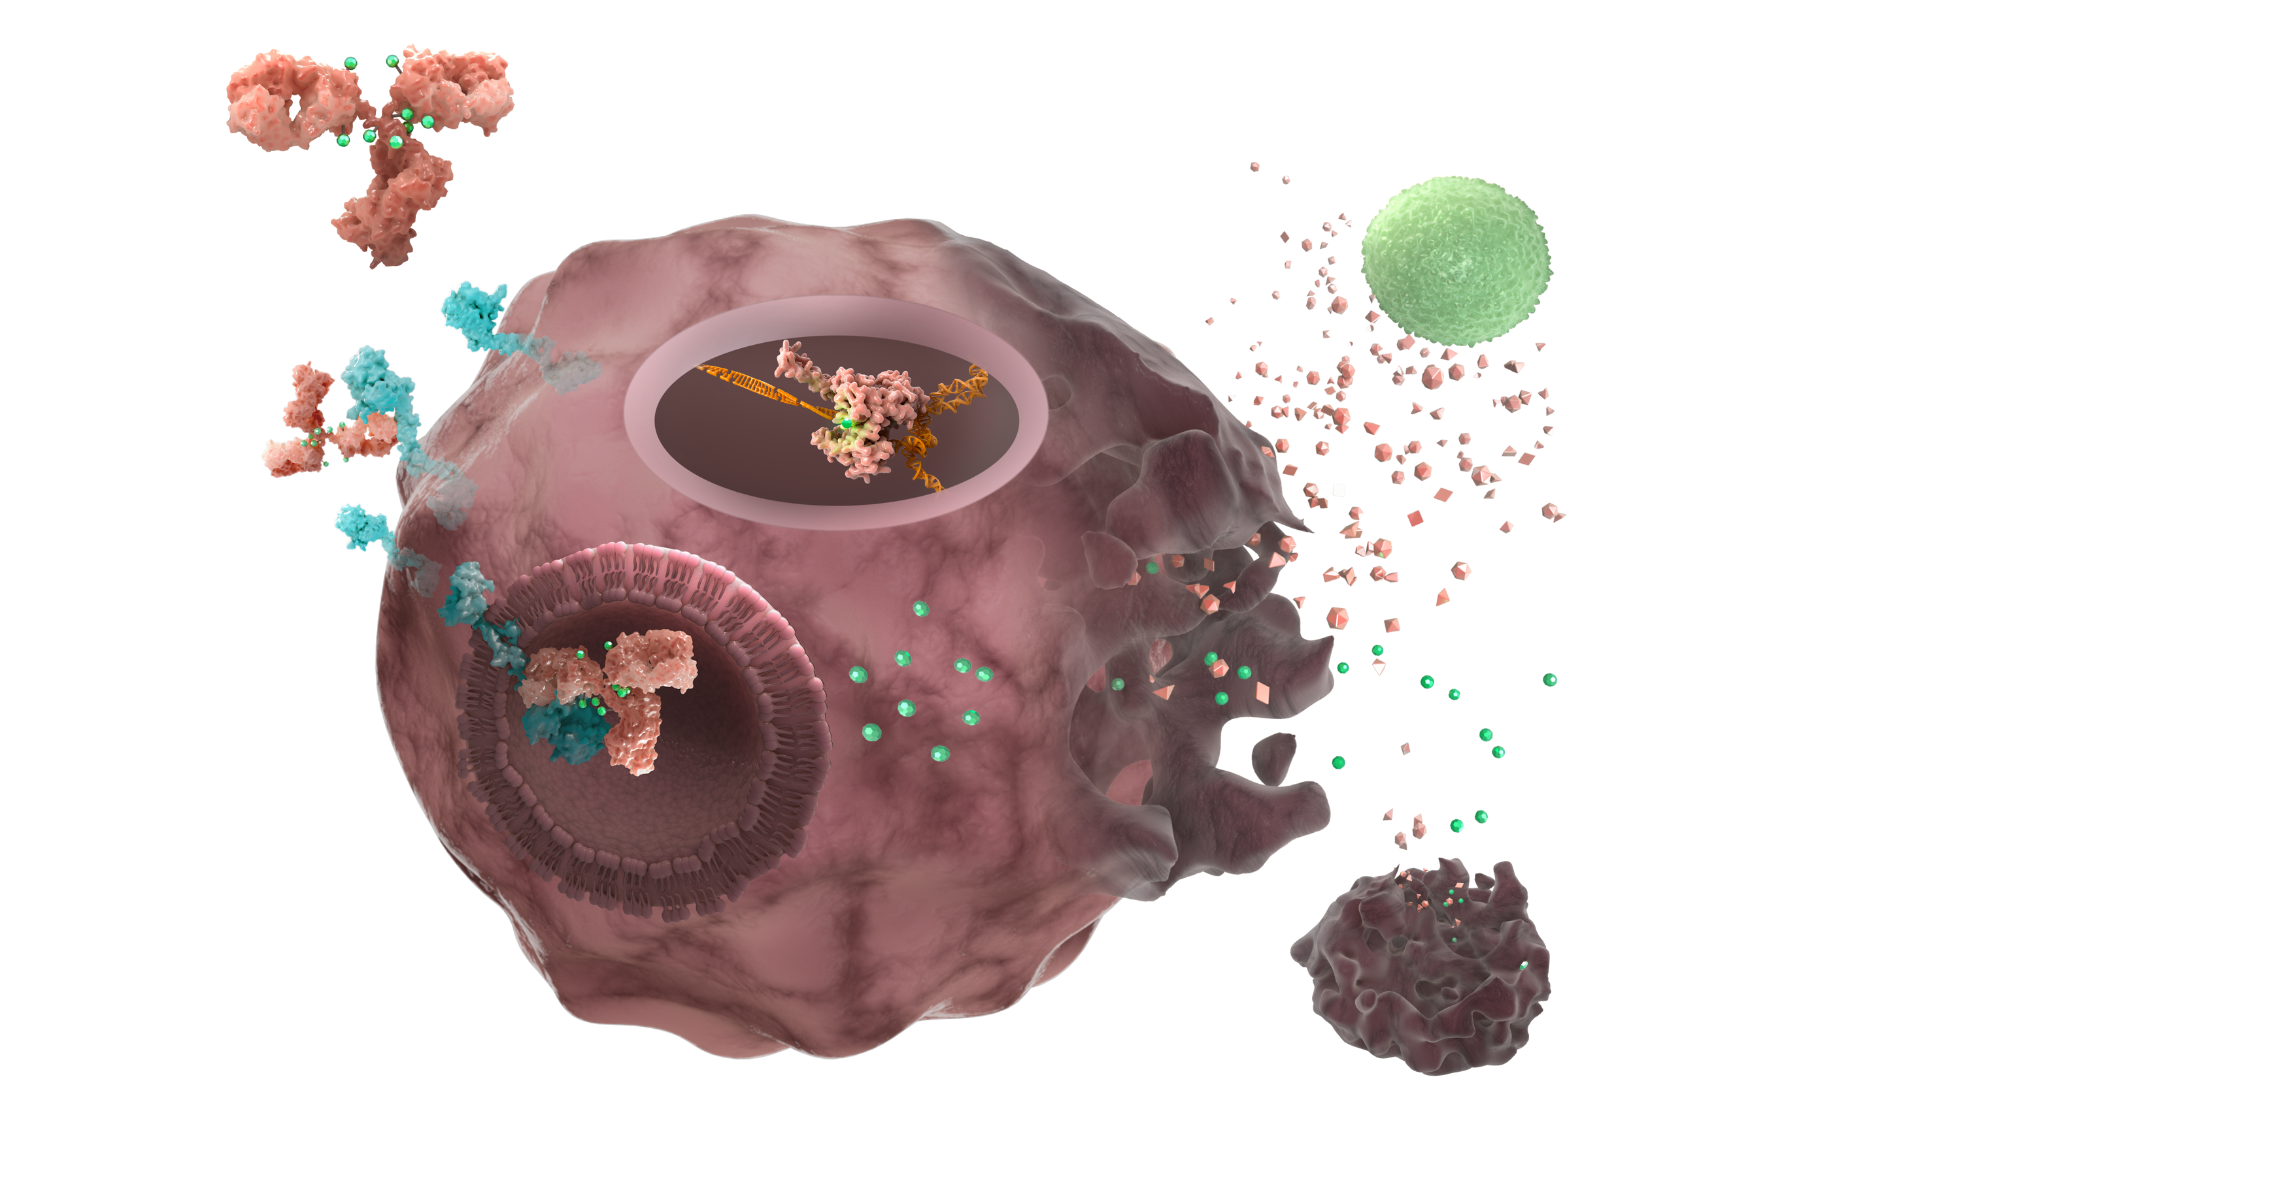
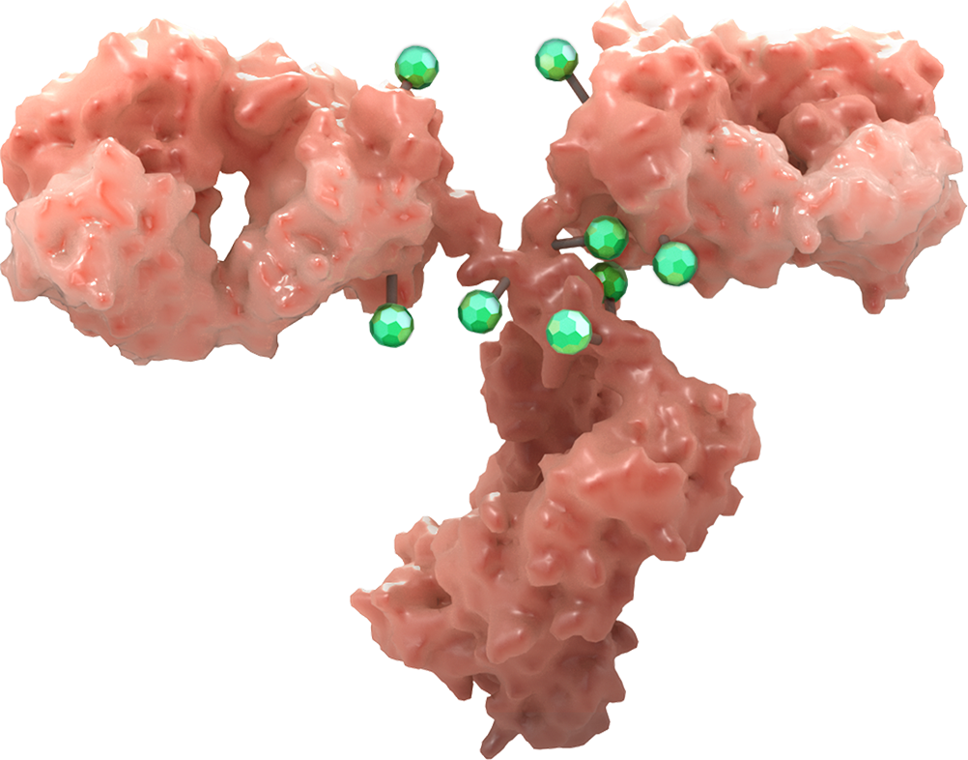
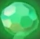
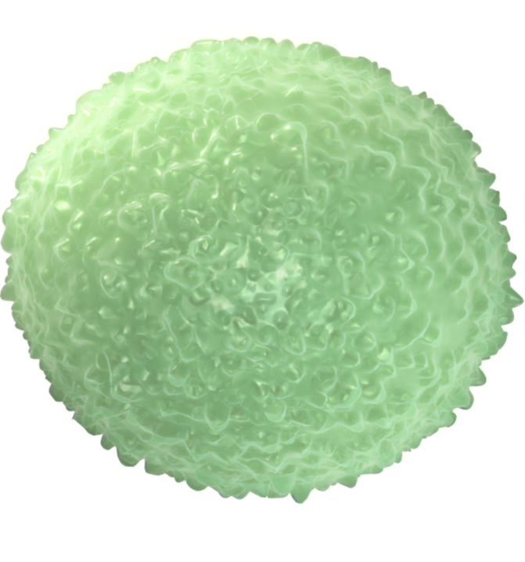
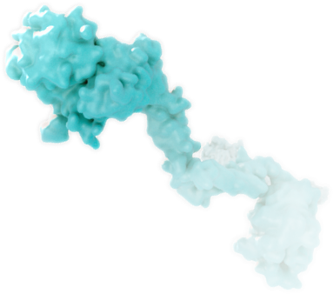

Trastuzumab Pamirtecan (BNT323/DB-1303): MoA
MoA:
Trastuzumab pamirtecan binds to
HER2-expressing tumor cell¹
Internalization into lysosome and cleavage
of linkers^{1,2}
Release of proprietary topoisomerase-1
inhibitors into the cell¹
Topoisomerase-1 inhibitors travel to nucleus preventing resealing of replicating DNA²
Tumor cell death releases both topoisomerase-1 inhibitors and DAMPs into the TME¹
Topoisomerase-1 inhibitors exhibit a bystander effect on neighboring tumor cells¹
DAMPs may activate innate immune response³
Topoisomerase-1 inhibitor with cleavable linker
Anti-HER2 antibody
4
Trastuzumab pamirtecan
DNA
7
1
Nucleus
5
2
6
Lysosome
3
Trastuzumab pamirtecan
HER2 receptor
Topoisomerase-1 inhibitor
DAMPs
T cell
Tumor cell
Jointly developed by BioNTech and DualityBio.
Trastuzumab pamirtecan (BNT323/DB-1303) is an investigational drug and has not been approved for marketed use by any regulatory agency.
For a comprehensive list of all clinical trials investigating trastuzumab pamirtecan (BNT323/DB-1303), please refer to ClinicalTrials.gov.
1. Lin S, et al. Eur J Cancer. 2022;174(suppl 1):S91. 2. Li TK, Liu LF. Annu Rev Pharmacol Toxicol. 2001;41:53-77. 3. Garg AD, et al. Front Immunol. 2015;6:588.
59
Notes:
Steps 1-3,5,6: [Lin Eur J Can/ Pg S91/ Col 2/ Results/ lines 1-3; lines 6-8; Para 2/ lines 4-6] [Li 2001/Pg 1/abstract/lines 6-8]
Step 4: [Li 2001/ Pg 3/ Para 3/ lines 6-9]
Step 7 (DAMP Release): Garg 2015/ Pg 3/ Col 1/ Para 2/ lines 1-18]

Slide 60

Phase 1/2a, global, open-label, first in human study evaluating Trastuzumab Pamirtecan (IV, Q3W) in previously treated patients with solid tumors (NCT05150691)
Dose escalation part adopts an accelerated titration at first dose followed with classic “3+3” design
Phase 1 (Dose Escalation)
(HER2 IHC 3+, IHC 2+, IHC 1+ or ISH +, or HER2 amplification by NGS, or HER2 mutation by NGS)
Phase 2a (Dose Expansion)
Objectives
12.0 mg/kg, n=3-6
Additional dose finding cohorts
(A total of up to 20 participants)
Cohort 2a Trastuzumab-treated HER2+ (IHC3+, IHC2+/ISH positive) gastric or gastroesophageal junction adenocarcinoma (N=30), HER2+ esophageal carcinoma (N=10), and HER2+ CRC (N=15)
Dose Escalation
Primary: safety and tolerability, MTD or RP2D
Secondary: efficacy, PK, and immunogenicity
Exploratory: biomarker and ER relationship
10.0 mg/kg, n=3-6
RP2D/MTD
Cohort 2b Both HER2 overexpression and HER2 low (IHC3+,2+,1+ or ISH positive) endometrial carcinoma, including UC and USC (N=30-60)
(RP2D=8 mg/kg)
Cohort 2b Both HER2 overexpression and HER2 low (IHC3+,2+,1+ or ISH positive) endometrial carcinoma, including UC and USC (N=30-60)
8.0 mg/kg, n=3-6
8.0 mg/kg, n=3-6
Dose extension
If a dose is confirmed to have a tolerable safety profile by the SMC, the cohort size may be backfilled to a maximum of 15-21 at any dose level ≥4.4mg/kg. Up to 57 additional participants (HER2 low BC, HER2+ BC, HER2+/low endometrial carcinoma, and HER2 activation mutation NSCLC) will be enrolled.
7.0 mg/kg, n=3-6
Cohort 2c HR+/HER2 Low (IHC2+ /ISH negative, or IHC1+) BC (N=30-50)
Dose Expansion
Primary: safety and tolerability, efficacy
Secondary: PK, antidrug antibodies, efficacy
Exploratory: biomarker, ER relationship, population PK, neutralizing antibody, efficacy
6.0 mg/kg, n=3-6
Cohort 2d HER2+ (IHC3+, IHC2+/ISH positive) BC (N=20-40)
4.4 mg/kg, n=3-6
Cohort 2e NSCLC with activating HER2 mutation (N=15-30)
2.2 mg/kg, n=1
Cohort 2f HER2+ or HR+/HER2-low BC with treatment failure of trastuzumab deruxtecan (N=10, HER2+ BC; N=10, HR+/HER2-low BC)
Data cutoff: May 8, 2023.
ATD=Accelerated titration design; BC=Breast cancer; CRC=Colorectal cancer; ER=Exposure response; HER2=Human epidermal growth factor receptor 2; HR=Hormone receptor; IHC=Immunohistochemistry; ISH=In situ hybridization; IV=Intravenous; MTD=Maximum tolerated dose; NGS=Next generation sequencing; NSCLC=Non-small cell lung cancer; PK=Pharmacokinetic; Q3W=Once every 3 weeks; RP2D=Recommended phase 2 dose; SMC=Safety monitoring committee; UC=Uterine carcinosarcoma; USC=Uterine serous carcinoma.
Moore K, et al. ESGO 2023;Abstract 430.

Slide 61
Trastuzumab Pamirtecan - Antitumor Activity
Response ª | Dose Escalation |  | Dose Expansion | Pooled 8 mg/kg (n=13) | Total (n=17) ^{b}
 | 7 mg/kg (n=4) ^{b} | 8 mg/kg (n=4) ^{b} | 8 mg/kg (n=9) ^{b}
Best overall response, n (%)
PR | 2 (50.0) | 4 (100) | 4 (44.4) | 8 (61.5) | 10 (58.8)
SD | 2 (50.0) | 0 | 4 (44.4) | 4 (30.8) | 6 (35.3)
PD | 0 | 0 | 1 (11.1) | 1 (7.7) | 1 (5.9)
Unconfirmed ORR, n (%) | 2 (50.0) | 4 (100) | 4 (44.4) | 8 (61.5) | 10 (58.8)
Confirmed ORR, n (%) | 1 (25.0) | 3 (75.0) | 0 | 3 (23.1) | 4 (23.5)
Pending confirmation ORR, n (%) | 1 (25.0) | 1 (25.0) | 4 (44.4) | 5 (38.5) | 6 (35.3) *
Unconfirmed ORR by histology, n/N (%)
Serous carcinoma | 1/1 (100) | 4/4 (100) | 2/3 (66.7) | 6/7 (85.7) | 7/8 (87.5)
Adenocarcinoma | 1/2 (50.0) | -- ^{c} | 0/1 | 0/1 | 1/3 (33.3)
Carcinosarcoma | -- ^{c} | -- ^{c} | 1/2 (50.0) | 1/2 (50.0) | 1/2 (50.0)
Mixed adenocarcinoma | -- ^{c} | -- ^{c} | 1/2 (50.0) | 1/2 (50.0) | 1/2 (50.0)
Unconfirmed DCR, n (%) | 4 (100) | 4 (100) | 8 (88.9) | 12 (92.3) | 16 (94.1)
Among all participants, the unconfirmed ORR was 58.8%, including 23.5%
confirmed and 35.3%
pending confirmation
The unconfirmed ORR was 61.5% (8/13) in 8 mg/kg group and 50.0% (2/4) in
7 mg/kg group
The unconfirmed DCR was 94.1%
Moore K, et al. ESGO 2023;Abstract 430.
Data cutoff: May 8, 2023.
* Up to now, of these 6 pending confirmation PRs, all were confirmed.
DCR=Disease control rate; ORR=Objective response rate; PD=Progressive disease; PR=Partial response; SD=Stable disease.
ª By investigator. ^{b} Response-evaluable participants, which includes participants with ≥1 postbaseline overall response. ^{c} No efficacy-evaluable participants.

Slide 62
FERN-EC-01 (BNT323-01): Phase 3 Study of Trastuzumab Pamirtecan in
HER2-Expressing Recurrent Endometrial Cancer
Cohort 1: HER2 IHC 1+/2+
Study Population
(selected criteria)*
N=504 (estimated)
Recurrent endometrial cancer (HER2 1+, 2+, or 3+ on IHC by central testing)
Prior anti–PD-1/anti–PD-L1 therapy
Recurrence of endometrial cancer <12 months from completing platinum-based chemotherapy in the adjuvant setting for stage I to III, or recurrence after platinum-based chemotherapy in the recurrent/metastatic setting
Up to 3 lines of prior therapy†
Measurable disease per RECIST v1.1
ECOG PS 0, 1, or 2
trastuzumab pamirtecan monotherapy
R
2:1
investigator's choice single-agent chemotherapy
(doxorubicin or paclitaxel)‡
Cohort 2: HER2 IHC 3+
trastuzumab pamirtecan monotherapy
Primary Endpoints:
Cohort 1: PFS (BICR assessed)
Cohort 2: ORR (BICR assessed)
Secondary Endpoints:
Cohort 1: OS, PFS (investigator assessed), ORR, DoR, safety
Cohort 2: ORR (investigator assessed), DoR, PFS, OS, safety
Cohort 1Stratification Factors:
HER2 expression (IHC 1+ vs 2+) by central laboratory
Number of prior lines of treatment (1 vs ≥2)
Note: Unless specific treatment discontinuation criteria are met or the participant withdraws consent, all participants will continue to receive treatment until PD defined by RECIST 1.1. Long-term survival follow-up will be performed every 3 months (±14 days).
ClinicalTrials.gov identifier: NCT06340568. Accessed January 26, 2026. https://clinicaltrials.gov/study/NCT06340568
Notes:
[NCT06340568/ Pg 3/ enrollment; Pg10/Inclusion Criteria/ Bullets 1-6 with sub bullets]
[NCT06340568/ pg2/detailed description/para2; Pg 12-13/ Primary Outcome Measures/ Rows (all)/ Col 1; pg13-15/secondary outcome measures/rows (all)/col1]
[NCT06340568/ pg2/detailed description/para2; Pg 12/ Arms and intervention/ Rows (all)/ Col 1
[NCT06340568 / pg1/para 1 (title: Fern-EC-01);Pg 2/ Detailed description/ Para 1/ entire; pg2/official title/entire]
[NCT06340568/ pg10/inclusion criteria/main bullet 5

Slide 63
Trastuzumab Pamirtecan (DB-1303/BNT323) in Patients with Previously Treated HER2-Expressing Advanced/Metastatic Endometrial Cancer: First Global Clinical Phase 2 Data
Pothuri B et al.
SGO 2026.
SCIENTIFIC PLENARY II
SATURDAY, APRIL 11, 2026
EXHIBIT HALL A
7:47 AM – 7:54 AM CDT

Slide 64
Trastuzumab Deruxtecan (T-DXd) for Pretreated Patients (pts) with HER2-Expressing Solid Tumors: DESTINY-PanTumor02 (DP-02) Part 1 Final Analysis
Makker V et al.
SGO 2026.
FOCUSED FORUM IX: PRECISION STRIKE, THE RISE OF ADCS
MONDAY, APRIL 13, 2026
BALLROOM B
8:52 AM – 8:58 AM CDT

Slide 65
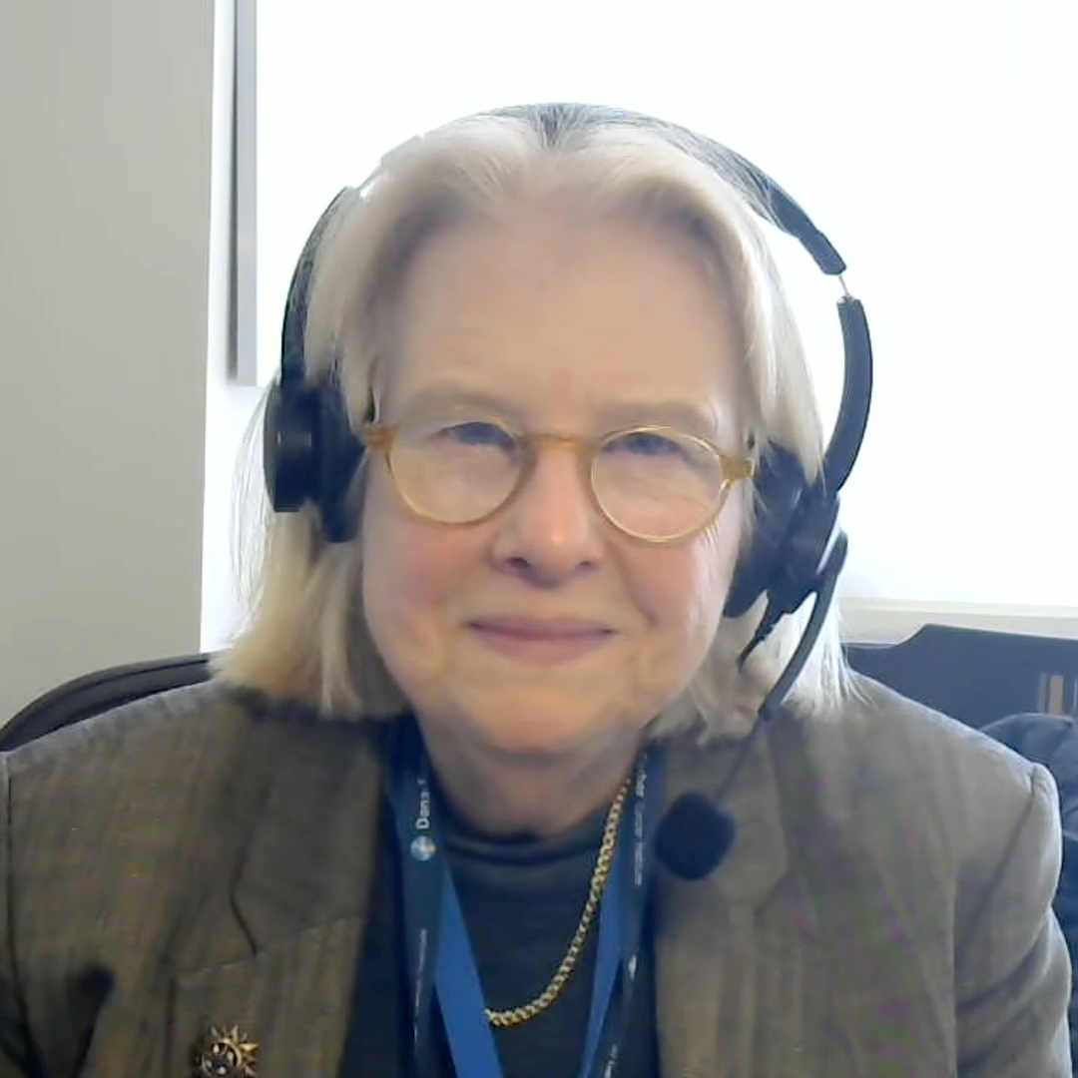
Second Opinion
Ursula Matulonis, MD
Neil Love, MD

Slide 66
QUESTIONS FOR THE FACULTY
How do you think through first-line therapy for patients with HER2-positive advanced endometrial cancer? How do you decide whether to add trastuzumab or an anti-PD-1/PD-L1 antibody to up-front chemotherapy? Do you ever add both?
What is your usual second-line therapy for a patient with HER2-positive advanced endometrial cancer who received chemotherapy/trastuzumab in the first-line setting? What about chemotherapy in combination with an anti-PD-1/PD-L1 antibody? Do you have any hesitation about using T-DXd for a patient who has experienced disease progression on a trastuzumab-containing regimen?

Slide 67
QUESTIONS FOR THE FACULTY
Where in the treatment course are you employing T-DXd for patients with HER2-positive advanced ovarian cancer? How does the presence of biomarkers beyond HER2 (eg, folate receptor alpha or PD-L1 expression) affect this decision? What about comorbidities and patient preferences/the desire to avoid certain side effects (eg, peripheral neuropathy)?
Where in the treatment course are you employing T-DXd for patients with HER2-positive advanced cervical cancer? How do response rates with T-DXd and tisotumab vedotin compare for patients who are eligible to receive both strategies, and which would you prefer in the second-line setting?

Slide 68
QUESTIONS FOR THE FACULTY
If a patient with a HER2-positive advanced gynecologic cancer were to ask you the likelihood that they would experience a significant response, including relief of cancer-related symptoms, with T-DXd, how would you reply? Would this differ at all for endometrial versus ovarian versus cervical cancer?
What would you recommend next for Dr Matulonis’s patient? What future role do you see for WEE1 inhibitors for advanced endometrial cancer?

Slide 69
Second Opinion
Professor Jonathan A Ledermann
Neil Love, MD

Slide 70
QUESTIONS FOR THE FACULTY
How do you currently approach first-line maintenance therapy for patients with BRCA wild-type, HRD-negative advanced ovarian cancer? For a patient with HER2-positive (IHC 3+) disease, would you consider any type of anti-HER2 therapy in this space? How enthusiastic are you about clinical trials addressing the use of anti-HER2 therapy in that setting?
If T-DXd were to become available in the up-front maintenance setting for patients with HER2-positive advanced ovarian cancer, how long do you envision continuing it?

Slide 71
QUESTIONS FOR THE FACULTY
How enthusiastic are you about clinical trials evaluating T-DXd earlier in the treatment course in endometrial cancer? Do you think it will eventually be available in the first-line setting? What about as a component of adjuvant therapy? Are there any situations in which you would use adjuvant anti-HER2 treatment for a patient with endometrial cancer today?
Have you learned any clinical pearls from breast cancer investigators or general medical oncologists about the prevention and management of side effects with T-DXd? What, if anything, do you think gynecologic oncologists could learn about the optimal use of this agent from these other clinicians?

Slide 72
QUESTIONS FOR THE FACULTY
What other novel agents/strategies are you excited about for patients with HER2-positive gynecologic cancers? Do you see a future for the HER2-targeted bispecific antibody zanidatamab, which has proven effective in gastroesophageal and biliary tract cancers, in these diseases?

Slide 73
Agenda
Module 1: Strategies to Identify Patients with HER2-Positive Gynecologic Cancers — Dr Liu
Module 2: Available Data with and Practical Application of HER2-Targeted Therapy in Advanced Gynecologic Cancers — Dr Slomovitz
Module 3: Identification and Management of Adverse Events with T-DXd — Dr O’Malley

Slide 74
Identification and Management of Adverse Events with T-DXd
David O’Malley, M.D.
Professor & Division Director, Gynecologic Oncology
John G. Boutselis Chair in Gynecologic Oncology
Co-Director, Gyn Oncology Phase I Program
James Cancer Center, Ohio State University
Columbus, Ohio US
Member, Board of Directors, GOG Foundation
Ovarian Cancer Clinical Trial Lead, GOG Partners

Slide 75
Objectives
Spectrum and incidence of common (eg, GI toxicities, myelosuppression) and more serious (eg, ILD, cardiac toxicities) treatment-emergent AEs observed with T-DXd
Recommendations for monitoring and immediate reporting of symptoms of ILD and cardiac toxicities with T-DXd
Strategies to manage T-DXd-associated ILD and cardiac toxicities; indications for restarting T-DXd after resolution of symptoms
Recommended algorithms for mitigating and managing cytopenias, GI side effects and other complications of T-DXd

Slide 76
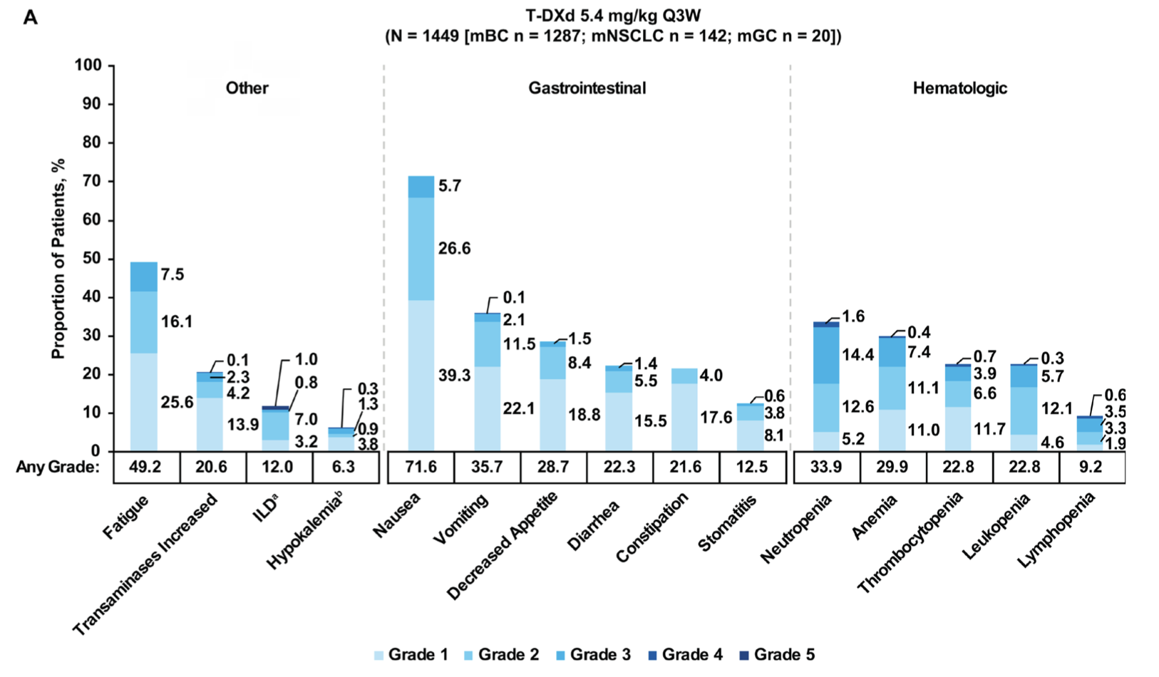
Drug-Related TEAEs Reported in a Pooled Analysis
Park YH, Cortes J, Modi S, Hurvitz SA, Bianchini G, Iwata H, Shitara K, Siena S, Goto Y, Ku GY, Powell CA, Swain SM, Arunachalam M, Janek M, Cheng Y, Chu C, Verma P, Kuptsova-Clarkson N, Mathias E, Goodman E, Rugo HS. Characterization of the safety profile of trastuzumab deruxtecan by dose: a pooled analysis across DESTINY studies. Oncologist. 2025 Dec 27;31(1):oyaf396. doi: 10.1093/oncolo/oyaf396. PMID: 41330717; PMCID: PMC12743619.

Slide 77
Phase 2 DESTINY-PanTumor02 Study: Safety Summary
n (%) | All patients (N = 267)
Any drug-related TEAEs | 226 (84.6)
Drug-related TEAEs Grade ≥3 | 109 (40.8)
Serious drug-related TEAEs | 36 (13.5)
Drug-related TEAEs associated with dose discontinuations | 23 (8.6)
Drug-related TEAEs associated with dose interruptions | 54 (20.2)
Drug-related TEAEs associated with dose reductions | 54 (20.2)
Drug-related TEAEs associated with deaths | 4 (1.5)ª
Most common drug-related TEAEs (>10%)
Nausea
Fatigue^{b}
Neutropenia^{c}​
Anemia​
Diarrhea​
Vomiting​
Decreased appetite
Thrombocytopenia^{d}​
Alopecia​
Increased transaminases^{e}
Leukopenia^{f}
3.7
55.1
7.1
40.1
19.1
32.6
10.9
27.7
3.7
25.8
1.5
24.7
1.5
17.6
5.6
17.2
16.9
Grade ≥3
Any grade
0.4
10.1
2.6
10.1
Patients experiencing drug-related TEAEs (%)
ILD/pneumonitis adjudicated as T-DXd related, n (%) | Grade 1 | Grade 2 | Grade 3 | Grade 4 | Grade 5 | Any grade
All patients​ (N = 267) | 7 (2.6) | 17 (6.4) | 1 (0.4) | 0 | 3 (1.1) | 28 (10.5)
Analyses were performed in patients who received ≥1 dose of T-DXd (N = 267); median total treatment duration 5.6 months (range 0.4–31.1).
ªIncluded pneumonia (n = 1), organizing pneumonia (n = 1), pneumonitis (n = 1), and neutropenic sepsis (n = 1). ^{b}Category includes the preferred terms fatigue, asthenia, and malaise. ^{c}Category includes the preferred terms neutrophil count decreased and neutropenia. ^{d}Category includes the preferred terms platelet count decreased and thrombocytopenia. ^{e}Category includes the preferred terms aspartate aminotransferase increased, alanine aminotransferase increased, gamma-glutamyltransferase increased, hypertransaminasemia. ^{f}Category includes the preferred terms white blood cell count decreased and leukopenia.
ILD = interstitial lung disease; T-DXd = trastuzumab deruxtecan; TEAE = treatment-emergent adverse event.
Meric-Bernstam F, et al. European Society for Medical Oncology (ESMO) 2023; Abstract LBA34.

Slide 78
ADC related Neutropenia – Management
ASCO Guidelines
Patient Risk Factors for Febrile Neutropenia
Age > 65 years | Poor performance status
Advanced Stage Disease | Poor nutritional status
Previous chemotherapy or Radiation | Poor renal/liver function
Preexisting neutropenia or Bone Marrow involvement with tumor | Cardiovascular disease
Infections, or open wounds | HIV infection
Recent Surgery | Multiple comorbid conditions
Use of prophylactic growth factors should be strongly considered
Smith et al. J Clin Oncol 2015

Slide 79
ADC related Neutropenia
ADC related AEs principally driven by the payload (Off-target, Off-site toxicity)¹
In a meta-analysis of 169 clinical trials inclusive of 22,492 patients, the most common grade ≥3 treatment related adverse event was neutropenia (31%)²
ADC associated neutropenia correlates with cumulative plasma exposure of the payload
T-DXd neutropenia (all grades) 35-43% and > Grade 3 ~20% based on studies in breast cancer
  Grade 3: Hold T-DXd until resolved to < grade 2, then maintain dose
  Grade 4: Hold T-DXd until resolved to < grade 2 then reduce 1 dose level³
1Zhu et al. Cancer 2023; 2Nguyen et al. Cancers 2023; 3Rugo et al. ESMO Open 2022

Slide 80

Cardio-Pulmonary Toxicity

Slide 81
Decreased Left Ventricular Dysfunction Management on PanTumor Study of T-DXd
LVEF measurements via echocardiogram (ECHO) or multigated acquisition (MUGA) scan
Baseline troponin-T and as needed
Standard management for abnormal 12-lead electrocardiogram (ECG), perform ECG in triplicate
Standard ECG parameters (including RR, PR, QT intervals, and QRS duration)
Meric-Bernstam F, et al. J Clin Oncol. 2024;42:47-58 including supplementary materials.

Slide 82
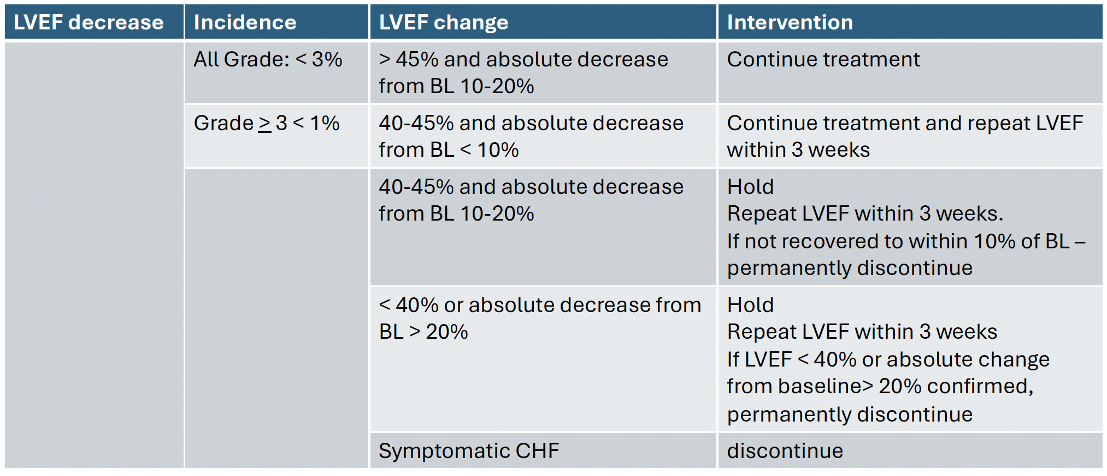
Cardiac Toxicity
Rugo H et al. ESMO Open 7(4) 2022

Slide 83
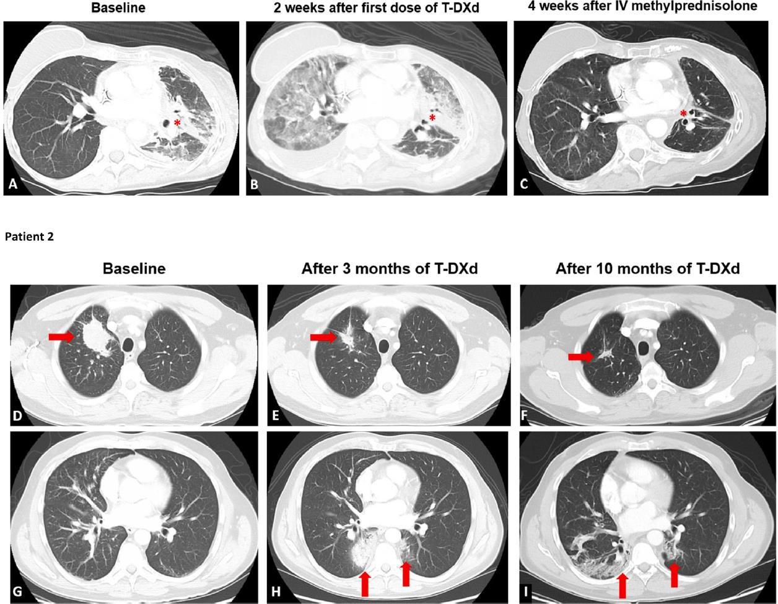
Interstitial Lung Disease (ILD)
T-DXd was localized primarily in alveolar macrophages and not pulmonary epithelial cells, suggesting target-independent T-DXd uptake by alveolar macrophages and release of payload as a mechanism of off-target toxicity
T-DXd–related ILD/pneumonitis may result from cytotoxic lung injury
Diffuse alveolar damage (DAD) is a pulmonary damage pattern associated with poor prognosis that can result from ILD
Can be fulminant from the outset, resulting in life-threatening DAD and acute respiratory distress syndrome
Swain, CTR 2022

Slide 84
Pneumonitis/ILD
Patients who received T-DXd across nine studies were included (1150 patients)
Adjudicated drug-related ILD/pneumonitis was found to be 15.4% patients receiving T-DXd
87.0% had their first event within 12 months
  median, 5.4 months (7-8 cycles)
  Range: <0.1- 46.8 months
Median time to onset of 5-6 months
Most patients with ILD/pneumonitis experienced low-grade events (grade 1 or 2, 77.4%)
Overall rate of fatal events of 2.2%
Powell CA, Modi S, Iwata H, etal: Pooled analysis of drug related interstitial lung disease and/or pneumonitis in nine trastuzumab deruxtecan monotherapy studies. ESMO Open7:100554,2022

Slide 85
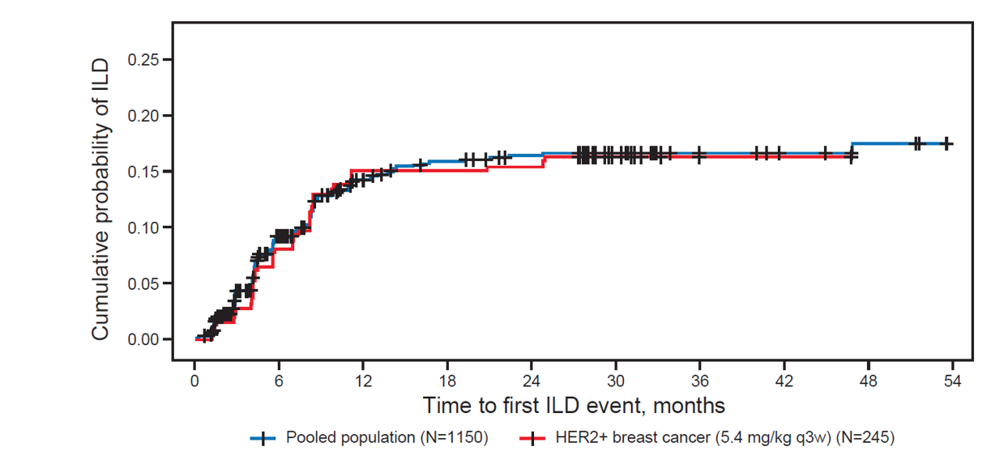
Time to first ILD event
The risk of all-grade ILD decreased after 12 months, as the cumulative probability of adjudicated drug-related ILD began to plateau at this point.
Most ILD events (87%) occurred in the first 12 months of treatment
Powell CA, et al. ESMO Open 2022; 7:4.

Slide 86
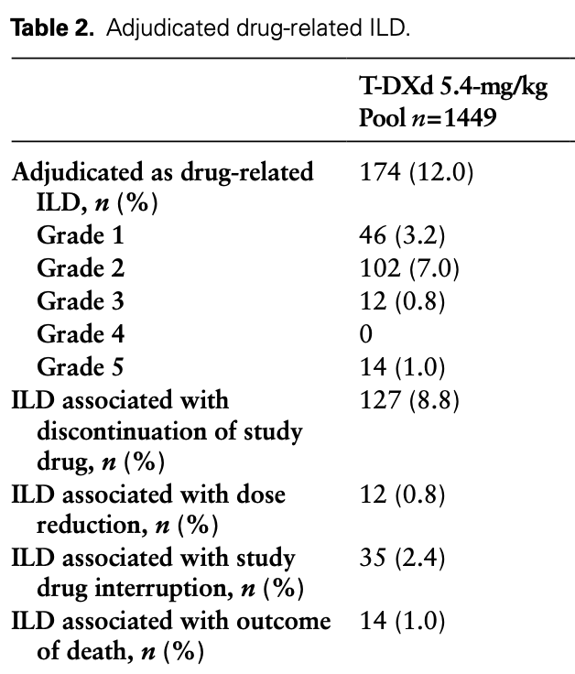
Adjudicated Drug Related in a Pooled Analysis
Park YH, Cortes J, Modi S, Hurvitz SA, Bianchini G, Iwata H, Shitara K, Siena S, Goto Y, Ku GY, Powell CA, Swain SM, Arunachalam M, Janek M, Cheng Y, Chu C, Verma P, Kuptsova-Clarkson N, Mathias E, Goodman E, Rugo HS. Characterization of the safety profile of trastuzumab deruxtecan by dose: a pooled analysis across DESTINY studies. Oncologist. 2025 Dec 27;31(1):oyaf396. doi: 10.1093/oncolo/oyaf396. PMID: 41330717; PMCID: PMC12743619.

Slide 87
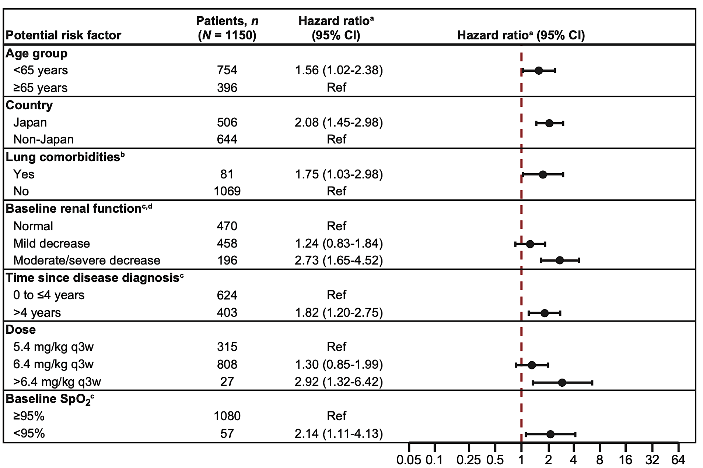
Pneumonitis/ILD – Who’s Highest Risk of Trouble?
Stepwise Cox regression identified several baseline factors potentially associated with increased risk of adjudicated drug-related ILD/pneumonitis:
  age <65 years
  enrollment in Japan
  T-DXd dose >6.4 mg/kg
  oxygen saturation <95%
  moderate/severe renal impairment
  presence of lung comorbidities
  time since initial diagnosis >4 years.
Powell CA, Modi S, Iwata H, et al: Pooled analysis of drug related interstitial lung disease and/or pneumonitis in nine trastuzumab deruxtecan monotherapy studies. ESMO Open7:100554,2022

Slide 88
Variable (N = 203) | Univariable HR (95% CI) | p-value
Age | 1.02 (0.99–1.06) | 0.216
Asian ethnicity | 0.67 (0.09–4.99) | 0.692
People who formerly smoked | 2.08 (0.82–5.29) | 0.123
Cough* | 1.79 (0.41–7.74) | 0.438
Shortness of Breath* | 3.89 (1.40–10.83) | 0.009
Respiratory Infection* | 1.51 (0.20–11.34) | 0.686
History of Lung Disease | 0.72 (0.17–3.12) | 0.662
History of Autoimmune Disease | 3.36 (1.32–8.54) | 0.011
Baseline Interstitial Lung Abnormalities | 17.28 (6.54–45.65) | < 0.0001
HER2/neu Receptor Positive (2+FISH/3+) | 0.25 (0.09–0.70) | 0.009
Retrospective Metastatic breast cancer treated with T-DXd as SOC
2020 and 2024
19/203 patients (9.4%)
*prior to Trastuzumab deruxtecan
Azhar et al, Breast Cancer Res. 2025

Slide 89
Variable (N = 203) | Univariable HR (95% CI) | p-value
Lung Metastasis at Baseline | 1.45 (0.58–3.67) | 0.428
Prior Lines of Treatment | 1.20 (1.03–1.40) | 0.023
Use of ICI* | 3.86 (1.28–11.65) | 0.016
ICI within 6 months of T-DXd | 3.01 (0.4–22) | 0.28
ICI within 3 months of T-DXd | 4.57 (0.6–34) | 0.14
Chest Radiation Prior to T-DXd-All | 1.71 (0.61–4.74) | 0.306
Total Lung V20 (%)-All | 1.05 (1.00–1.10) | 0.073
Mean Lung Dose (Gy)-All | 1.03 (0.98–1.07) | 0.284
Lung Metastasis at Baseline | 1.45 (0.58–3.67) | 0.428
*prior to Trastuzumab deruxtecan
Azhar et al, Breast Cancer Res. 2025

Slide 90
Multivariable predictors for pneumonitis
.
.
Variable (N = 203) | Hazard Ratio (HR) | 95% Confidence Interval | p-value
HER2 positive | 0.30 | 0.09–0.96 | 0.042
Interstitial Lung Abnormalities (ILA) | 10.56 | 3.80–29.31 | < 0.0001
V20 (lung volume receiving ≥ 20 G) | 1.04 | 0.99–1.09 | 0.081
Who needs extra caution?
Pretreatment ILAs
Poor Kidney Function
Underlying Lung Disease
Prior IO/Immune Disease?
Long Treatment History?
Older Age?
HR, hazard ratio; CI, confidence interval; IQR, interquartile range; HER2, human epidermal growth factor receptor 2;ILA, interstitial lung abnormalities; V20, lung volume receiving ≥ 20 G
Azhar et al, Breast Cancer Res. 2025

Slide 91
Strategies to Manage ILD/Pneumonitis
Monitor
Confirm
Manage
Suspected ILD
Assessments should include
High-resolution CT
Pulmonologist consult; if indicated, ID consult
Blood culture and CBC; other blood tests
as needed
Consider bronchoscopy and BAL if indicated and feasible
PFTs and pulse oximetry
Arterial blood gases, if indicated
As soon as ILD suspected, collect 1 blood sample for PK assessment, if feasible
Rule out other causes of ILD (eg, progression, infection, other drugs, radiotherapy)
All ILD events should be followed until resolution and after drug discontinuation
Grade 1 T-DXd: Hold until resolved to
grade 0; consider corticosteroids
(0.5 mg/kg/day prednisolone), then
  If resolved ≤28 days from onset:
  Maintain dose
  If resolved >28 days after onset:
  Reduce dose by 1 level
  -Taper steroid over at least 4 weeks
Grades 2–4: Permanently discontinue treatment and promptly initiate systemic corticosteroid treatment (eg, ≥1 mg/kg/ day prednisolone or equivalent) for ≥14 days followed by taper for ≥4 weeks
Urge patients to immediately report cough, dyspnea, fever, and/or new or worsening pulmonary symptoms
Monitor patients for signs/symptoms of ILD
Promptly investigate
evidence of ILD
Evaluate patients with suspected ILD by radiographic imaging and assess as follows
BAL = bronchoalveolar lavage; ID = infectious disease; PFTs = pulmonary function tests; PK = pharmcokinetics.
Ado-trastuzumab emtansine (Kadcyla®) PI 2022 (https://www.kadcyla.com/). Fam-trastuzumab deruxtecan-nxki (Enhertu®) PI 2024 (https://daiichisankyo.us/prescribing-information-portlet/getPIContent?productName=Enhertu& inline=true). URLs accessed 11/8/2024. Tarantino P, et al. JAMA Oncol. 2021;7:1873-1881.
Notes:
49

Slide 92
Strategies to Manage Grade 2 to 4 ILD/Pneumonitis
Grade 2
Grade 3 or 4
Promptly start systemic glucocorticoids (eg, ≥1 mg/kg/d prednisone or equivalent) for ≥2 weeks or to complete resolution of clinical and chest CT findings, then gradual taper over ≥4 weeks
Monitor symptoms closely
Re-image as indicated
If clinical or diagnostic observations worsen or do not improve in 5 days
  Consider increase in steroid dose (eg, 2 mg/kg/day prednisone or equivalent) or switch to intravenous (IV)
  Reconsider additional workup for alternative etiologies
  Escalate care as needed
Hospitalization required
Promptly initiate empirical high-dose methylprednisolone IV (eg, 500–1000 mg/day for 3 days), followed by ≥1 mg/kg/ day prednisone (or equivalent) for ≥2 weeks until resolution of clinical and chest CT findings, then gradual taper over ≥4 weeks
Re-image as clinically indicated
If still no improvement with 3 to 5 days
  Reconsider additional workup for alternative etiologies
  Consider other immunosuppressants and/or treat per local practice
Li BT, et al. N Engl J Med. 2022;386:241-251 (Protocol).
Notes:
50

Slide 93
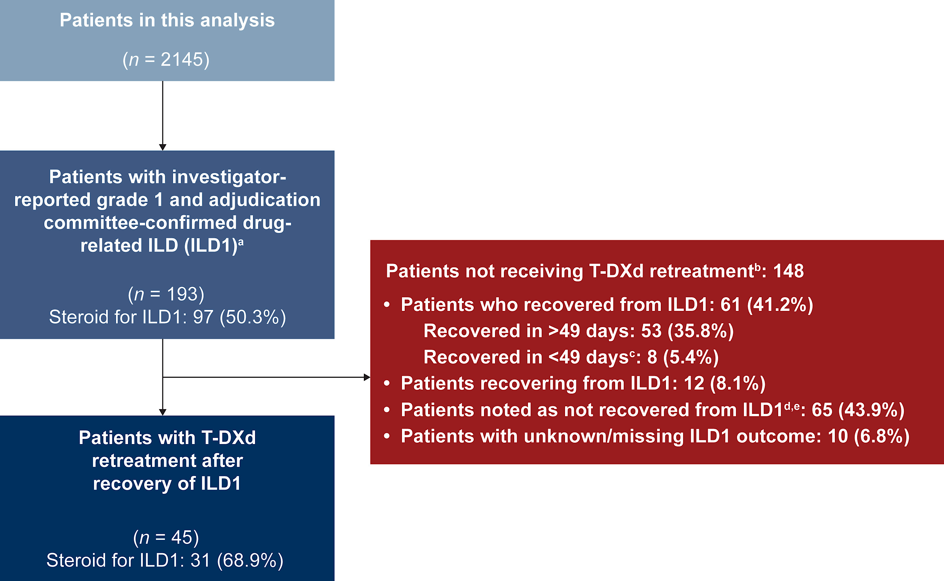
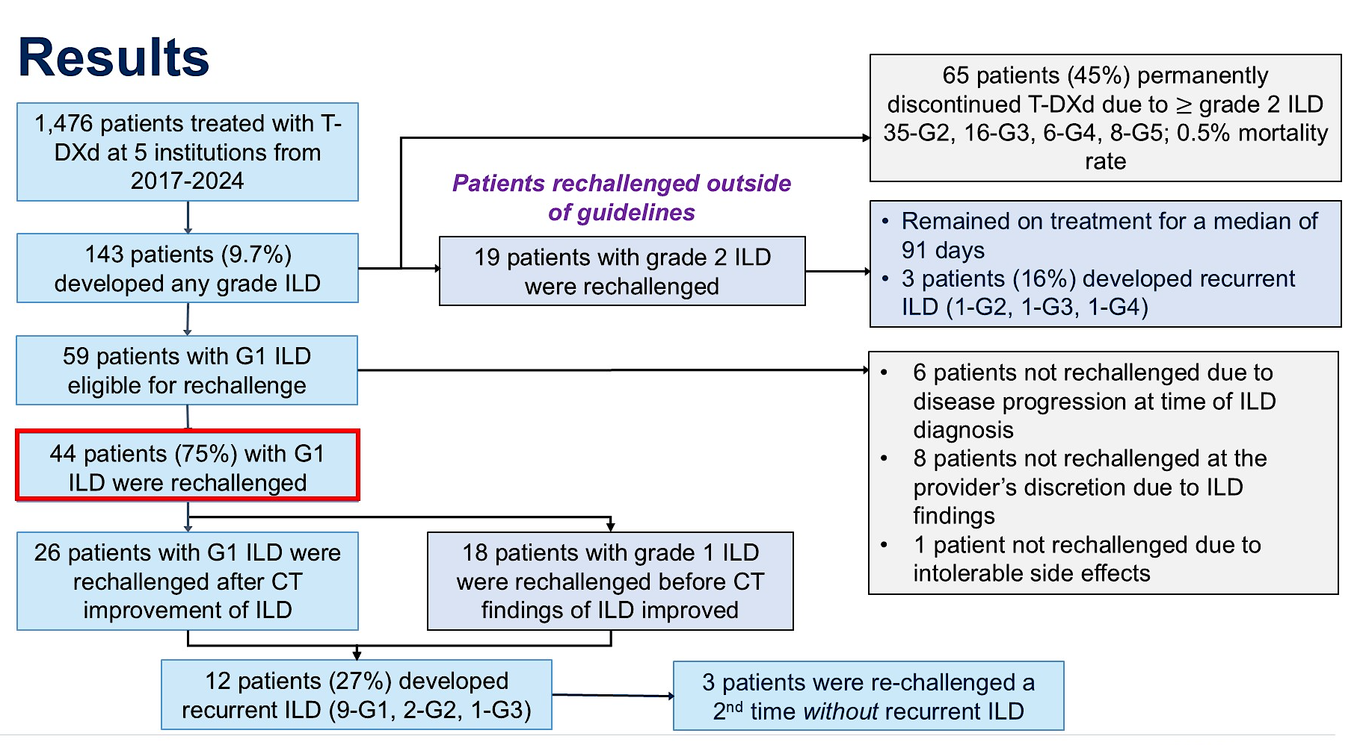
How About Re-Treatment after ILD? 2 Recent Reports
H.S. Rugo, …..C.A. Powell, et al. Pooled analysis of trastuzumab deruxtecan retreatment after recovery from grade 1 interstitial lung disease/pneumonitis, Annals of Oncology (36 (11); 2025
Natsuhara K, Blum K, LeVee A,….Rugo et al. Treatment rechallenge after trastuzumab-deruxtecan–related interstitial lung disease: A multi-institution cohort study. ASCO. 2025.

Slide 94


How About Re-Treatment after ILD? Pooled Analysis
Patients with ILD who showed improvement on CT scans but had residual fibrosis were noted as recovered with sequelae
H.S. Rugo, …..C.A. Powell, et al. Pooled analysis of trastuzumab deruxtecan retreatment after recovery from grade 1 interstitial lung disease/pneumonitis, Annals of Oncology (36 (11); 2025

Slide 95


How About Re-Treatment after ILD? Multi-Institution Cohort Study
treated
Natsuhara K, Blum K, LeVee A,….Rugo et al. Treatment rechallenge after trastuzumab-deruxtecan–related interstitial lung disease: A multi-institution cohort study. ASCO. 2025.

Slide 96

How About Re-Treatment after ILD? Even in Grade 2?
This is outside of guideline therapy and this limited data should be interpreted with caution
Natsuhara K, Blum K, LeVee A,….Rugo et al. Treatment rechallenge after trastuzumab-deruxtecan–related interstitial lung disease: A multi-institution cohort study. ASCO. 2025.

Slide 97


GI Toxicities

Slide 98
Example of Nausea/Vomiting Management Strategy
NCCN guidelines now classify T-DXd as highly emetogenic
Day | Medication protocols
Day 1 Before infusion | Cycle 1: Dexamethasone (8–12 mg PO or IV) + 5-HT₃ RA
 | Subsequent cycles For optimal control: Repeat above For suboptimal control (eg, grade ≥1 for ≥3 days): Dexamethasone (12 mg IV) + NK1 RA + 5-HT₃ RA
Day 1 After infusion | Consider ondansetron (8 mg PO or IV/IM) for 3 doses after infusion
Days 2 to 4 | Cycle 1: Dexamethasone (4 mg PO or 8 mg PO or IV/IM QD) ± metoclopramide (10 mg PO) TID or 5-HT₃ RA
 | Subsequent cycles Adequate control: Repeat above Inadequate control (eg, grade ≥1 for ≥3 days): Aprepitant (80 mg PO) + 5-HT₃ RA ± dexamethasone (8 mg PO or IV) or dexamethasone (8 mg PO or IV/IM QD) ± metoclopramide (10 mg PO TID)
Other considerations
Anticipatory N/V Consider anxiolytic therapy [eg, lorazepam (0.5–1.0 mg PO)] the night before infusion and 1 to 2 hours before infusion begins Behavioral therapy (eg, relaxation exercises, hypnosis) and/or acupuncture/acupressure may help with prevention
For subsequent infusions Estimate individual risk of emesis to determine whether past regimen was adequate or if escalation is necessary
If N/V occurs despite 3-drug regimen Days 1 to 4: Olanzapine (2.5 mg PO; increase to 5-10 mg if needed) OR Days 2 to 4: Increase dexamethasone on subsequent cycles
For delayed nausea (after Day 4) give 1 of the following to resolution Olanzapine (5–10 mg PO at bedtime QD) OR Metoclopramide (10 mg PO TID) ± dexamethasone (4 mg PO QD)
5-HT3 = serotonin type 3; IM = intramuscular; IV = intravenous; NK1 = neurokinin-1; N/V = nausea and/or vomiting; PO = by mouth; QD = once daily; RA = receptor antagonist; SC = subcutaneously; TID = 3 times daily.
Rugo HS, et al. ESMO Open. 2022;7:100553.

Slide 99
T-DXd and R-DXd Dose Modifications
Toxicities treated maximum supportive care (including withholding agent as needed)
At resolution of toxicity with supportive care, consider continuing the same dose with appropriate supportive care
Dose modifications as needed
After dose reduction, subsequent cycles should be given at lower dose level unless further dose reduction is required
Discontinue therapy if unacceptable toxicity occurs after 2 dose reductions
Starting dose | First reduction | Second reduction
T- DXd 5.4 mg/kg | 4.4 mg/kg | 3.2 mg/kg
Meric-Bernstam F, et al. J Clin Oncol. 2024;42:47-58 including supplementary materials.

Slide 100
T-DXd Pneumonitis: What Matters – when it happens, who is at risk, and what you do next.
Incidence 10–15%; fatal 1–2%
Median onset: 5–6 months (~cycle 7–8)
Most events occur within 12 months
High risk: ILAs, prior IO, renal dysfunction
Early steroids change outcomes
Rechallenge only after Grade 1 and with caution
Grade ≥2 → permanently discontinue
T-DXd Toxicities: Supportive Care Still Matters
Highly emetogenic → use full prophylaxis
Consider growth factor support in high-risk patients

Slide 101
Second Opinion
Angeles Alvarez Secord, MD, MHSc
Neil Love, MD

Slide 102
QUESTIONS FOR THE FACULTY
What screening techniques do you employ for early detection of ILD in patients receiving T-DXd? How frequently should patients receiving T-DXd undergo radiographic scans to monitor for ILD? How do you manage Grade 1 (asymptomatic) ILD, and what are your criteria for restarting the drug after radiographic evidence of ILD has resolved? How do you manage Grade 2 (symptomatic) ILD? Are there any situations in which you would rechallenge after resolution of symptoms?

Slide 103
QUESTIONS FOR THE FACULTY
What preemptive antiemetic strategies do you use for patients about to start T-DXd? What has been your experience with acute GI toxicity with the drug? What would you most likely recommend for a patient experiencing breakthrough nausea and vomiting with T-DXd despite antiemetic prophylaxis?
What screening techniques do you use to monitor cardiac function in patients receiving T-DXd? How often do you monitor LVEF?

Slide 104
QUESTIONS FOR THE FACULTY
What other side effects of interest (eg, cytopenias) have you observed in patients receiving T-DXd? Do you employ G-CSF prophylaxis for any patients receiving this agent?
Are there any patients for whom you preemptively start at a lower dose of T-DXd?
What experience do you have with strategies targeting both PD-1/PD-1 and VEGF — like the atezolizumab/bevacizumab regimen used for Dr Secord’s patient — in advanced endometrial cancer? Is the PD-1 x VEGF-A bispecific antibody ivonescimab being looked at in gynecologic cancers?

Slide 105
Second Opinion
Ursula Matulonis, MD
Neil Love, MD

Slide 106
QUESTIONS FOR THE FACULTY
In what situations would you use T-DXd for a patient with a history of cardiomyopathy? Is there a minimum LVEF that you require?
How do you approach patients with drops in LVEF on T-DXd? In patients for whom treatment has been withheld, are there any circumstances in which you would reintroduce T-DXd after normalization of LVEF?
Would you have any qualms about employing T-DXd before or after another antibody-drug conjugate, such as mirvetuximab soravtansine in ovarian cancer or tisotumab vedotin in cervical cancer? How do you generally sequence these strategies?

Slide 107
Second Opinion
Professor Jonathan A Ledermann
Professor of Medical Oncology
UCL Cancer Institute
London, United Kingdom
Angeles Alvarez Secord, MD, MHSc
Director of Gynecologic Oncology Clinical Trials
Associate Director, Clinical Research, Gynecologic Oncology Program
Duke Cancer Institute
Division of Gynecologic Oncology
Department of Obstetrics and Gynecology
Duke University School of Medicine
Durham, North Carolina
Ursula Matulonis, MD
Chief, Division of Gynecologic Oncology
Brock-Wilson Family Chair
Dana-Farber Cancer Institute
Professor of Medicine
Harvard Medical School
Boston, Massachusetts
Neil Love, MD
Research To Practice
Miami, Florida

Slide 108
Expert Second Opinion: Investigators Provide Perspectives on the Best-Practice Management of Ovarian Cancer
An Independent CME Symposium During the
SGO 2026 Annual Meeting on Women’s Cancer®
Sunday, April 12, 2026
1:30 PM – 3:00 PM AST
Faculty
Nicoletta Colombo, MD
Gottfried E Konecny, MD
Alexander B Olawaiye, MD
Moderator
Shannon N Westin, MD, MPH, FASCO, FACOG

Slide 109
Data + Perspectives: The Potential Role of TROP2- and CDH6-Directed Antibody-Drug
Conjugates in Gynecologic Cancers
An Independent CME Symposium During the
SGO 2026 Annual Meeting on Women’s Cancer®
Sunday, April 12, 2026
1:30 PM – 3:00 PM AST
Faculty
Ramez N Eskander, MD
Bradley J Monk, MD
Moderator
Kathleen N Moore, MD, MS

Slide 110
Thank you for joining us!
Your feedback is very important to us.
Please complete the postmeeting survey currently available via the corresponding QR code on the printed handout for attendees in the room and on Zoom for those attending virtually. The survey will remain open up to 5 minutes after the meeting ends.
How to Obtain CME Credit
In-person attendees: Please refer to the program syllabus for the CME credit link or QR code. Online/Zoom attendees:
The CME credit link is posted in the chat room.

