Slide 1
Data + Perspectives: The Potential Role of TROP2- and CDH6-Directed Antibody-Drug
Conjugates in Gynecologic Cancers
An Independent CME Symposium During the
SGO 2026 Annual Meeting on Women’s Cancer®
Sunday, April 12, 2026
1:30 PM – 3:00 PM AST
Faculty
Ramez N Eskander, MD
Bradley J Monk, MD
Moderator
Kathleen N Moore, MD, MS

Slide 2



Faculty
Ramez N Eskander, MD
Julie St John Endowed Chair
in Gynecologic Oncology
Professor, Department of Obstetrics, Gynecology and Reproductive Sciences
Clinical Trials Office Medical Director
Fellowship Director – Gynecologic Oncology
UC San Diego Health
Rebecca and John Moores NCI-Designated Comprehensive Cancer Center
San Diego, California
Moderator
Kathleen N Moore, MD, MS
Deputy Director and
Director, Phase 1 Clinical Trials
Fred and Pamela Buffett Cancer Center
at the University of Nebraska
Omaha, Nebraska
Bradley J Monk, MD
Medical Director, Late-Phase Research Program
Florida Cancer Specialists & Research Institute
Professor at the University of Central Florida College of Medicine
Vice President and Member, Board of Directors
GOG Foundation
Co-Director, GOG Partners
West Palm Beach, Florida

Slide 3
Prof Eskander — Disclosures
Faculty
Advisory Committees and Consulting Agreements | AbbVie Inc, AstraZeneca Pharmaceuticals LP, BeOne, Bristol Myers Squibb, Daiichi Sankyo Inc, Eisai Inc, Foundation Medicine, Gilead Sciences Inc, GSK, ImmunoGen Inc, Loxo Oncology Inc, a wholly owned subsidiary of Eli Lilly & Company, Merck, MSD, Myriad Genetic Laboratories Inc, Natera Inc, Novocure Inc, Pfizer Inc, pharmaand GmbH, PMV Pharma, Regeneron Pharmaceuticals Inc, Tesaro, A GSK Company
Data and Safety Monitoring Boards/Committees | Xencor

Slide 4
Dr Monk — Disclosures
Faculty
Consulting Agreements | AbbVie Inc, Alkermes, AstraZeneca Pharmaceuticals LP, BioNTech SE, Corcept Therapeutics Inc, Daiichi Sankyo Inc, Eisai Inc, Genentech, a member of the Roche Group, Genmab US Inc, GSK, ImmunoGen Inc, Incyte Corporation, Karyopharm Therapeutics, Lilly, Merck, Mersana Therapeutics Inc, Mural Oncology Inc, Myriad Genetic Laboratories Inc, Natera Inc, Novartis, Novocure Inc, OncoC4, Panavance Therapeutics, Pfizer Inc, pharmaand GmbH, ProfoundBio, Regeneron Pharmaceuticals Inc, Seagen Inc, Sutro Biopharma, Takeda Pharmaceuticals USA Inc, Tubulis, Verastem Inc, Zai Lab, Zentalis Pharmaceuticals, Zymeworks Inc
Speakers Bureaus | AbbVie Inc, AstraZeneca Pharmaceuticals LP, Daiichi Sankyo Inc, Eisai Inc, GSK, ImmunoGen Inc, Merck, Takeda Pharmaceuticals USA Inc, Zai Lab

Slide 5
Dr Moore — Disclosures
Moderator
Advisory Committees | AstraZeneca Pharmaceuticals LP, Corcept Therapeutics Inc, GSK, Mersana Therapeutics Inc
Consulting Agreements | Aadi Bioscience, AbbVie Inc, AstraZeneca Pharmaceuticals LP, BioNTech SE, Caris Life Sciences, Corcept Therapeutics Inc, Daiichi Sankyo Inc, Duality Biologics, GSK, ImmunoGen Inc, Janssen Biotech Inc, Merck, Regeneron Pharmaceuticals Inc, Schrödinger, Takeda Pharmaceuticals USA Inc, Verastem Inc, Whitehawk Therapeutics, Zentalis Pharmaceuticals, Zymeworks Inc
Contracted Research | Accent Therapeutics, Advaxis Inc, Allarity Therapeutics, AstraZeneca Pharmaceuticals LP, Daiichi Sankyo Inc, GSK, Immunocore, Iovance Biotherapeutics, Regeneron Pharmaceuticals Inc, Schrödinger, Verastem Inc
Data and Safety Monitoring Boards/Committees | Bicycle Therapeutics
Nonrelevant Financial Relationships | ASCO, GOG Partners, NRG Oncology

Slide 6
Commercial Support
This activity is supported by educational grants from Daiichi Sankyo Inc, Gilead Sciences Inc, and Merck.
Research To Practice CME Planning Committee Members,
Staff and Reviewers
Planners, scientific staff and independent reviewers for Research To Practice have no relevant financial relationships to disclose.

Slide 7
This educational activity contains discussion of
non-FDA-approved uses of agents and regimens. Please refer to official prescribing information for each product for approved indications.

Slide 8

Save The Date
A Multitumor CME/MOC-, NCPD- and ACPE-Accredited Educational Conference Developed in Partnership with Florida Cancer Specialists & Research Institute
Friday to Sunday, April 24 to 26, 2026
The Ritz-Carlton Orlando, Grande Lakes | Orlando, Florida
Moderated by Neil Love, MD

Slide 9
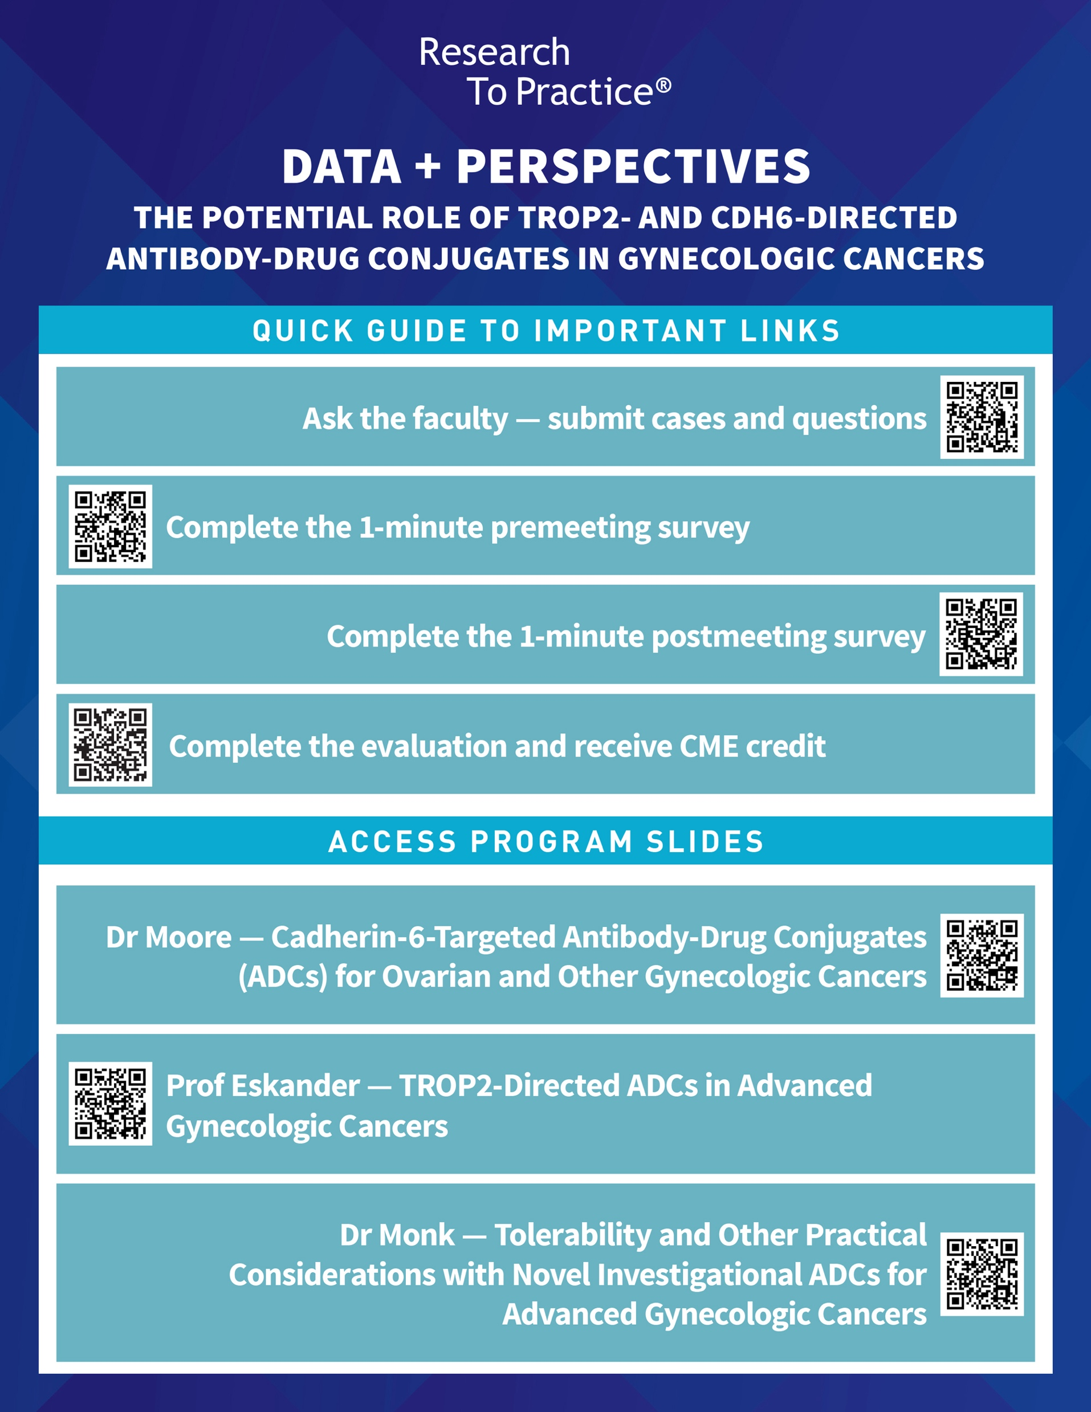




Clinicians in the Meeting Room
Please refer to the printed handout provided with your meeting syllabus, and scan the corresponding QR code to
Review and Download Program Slides.
Answer Survey Questions: Complete the pre-
and postmeeting surveys.
Ask a Question: We will aim to address as many questions as possible during the program.
Get CME Credit: Complete the course evaluation.
Notes:
9

Slide 10
Clinicians Attending via Zoom
Review Program Slides: A link to the program slides will be posted in the chat room at the start of the program.
Answer Survey Questions: Complete the pre- and postmeeting surveys.
Ask a Question: Submit a challenging case or question for discussion using the Zoom chat room.
Get CME Credit: A credit link will be provided in the chat room at the conclusion of the program.
Notes:
10

Slide 11
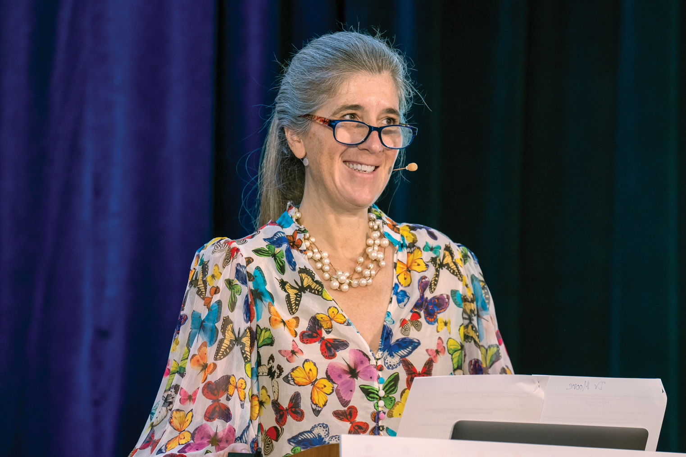
About the Enduring Program
The live meeting is being video
and audio recorded.
The proceedings from today will
be edited and developed into
an enduring web-based
program.
An email will be sent to all attendees when the activity is available.
To learn more about our education programs, visit our website, www.ResearchToPractice.com
Notes:
11
11

Slide 12
Data + Perspectives: The Potential Role of TROP2- and CDH6-Directed Antibody-Drug
Conjugates in Gynecologic Cancers
An Independent CME Symposium During the
SGO 2026 Annual Meeting on Women’s Cancer®
Sunday, April 12, 2026
1:30 PM – 3:00 PM AST
Faculty
Ramez N Eskander, MD
Bradley J Monk, MD
Moderator
Kathleen N Moore, MD, MS

Slide 13
Agenda
Module 1: Advances in Human Cadherin-6-Targeted Antibody-Drug Conjugates (ADCs) in Ovarian and Other Gynecologic Cancers — Dr Moore
Module 2: Leveraging TROP2-Directed ADCs in Advanced Gynecologic Cancers — Prof Eskander
Module 3: Tolerability and Other Practical Considerations with Novel Investigational ADCs in Advanced Gynecologic Cancers — Dr Monk

Slide 14
Agenda
Module 1: Advances in Human Cadherin-6-Targeted Antibody-Drug Conjugates (ADCs) in Ovarian and Other Gynecologic Cancers — Dr Moore
Module 2: Leveraging TROP2-Directed ADCs in Advanced Gynecologic Cancers — Prof Eskander
Module 3: Tolerability and Other Practical Considerations with Novel Investigational ADCs in Advanced Gynecologic Cancers — Dr Monk

Slide 15

Antibody Drug Conjugate in Ovarian Cancer: Selection, Sequencing and Strategy
Tumor Associated Antigens Including CDH6, TROP2 and FRα
Kathleen N. Moore, MD, MS, FASCO
Deputy Director, Buffett Cancer Center at the University of Nebraska Medical Center
Professor, Gynecologic Oncology
ASCO BOD
GOG F BOD

Slide 16
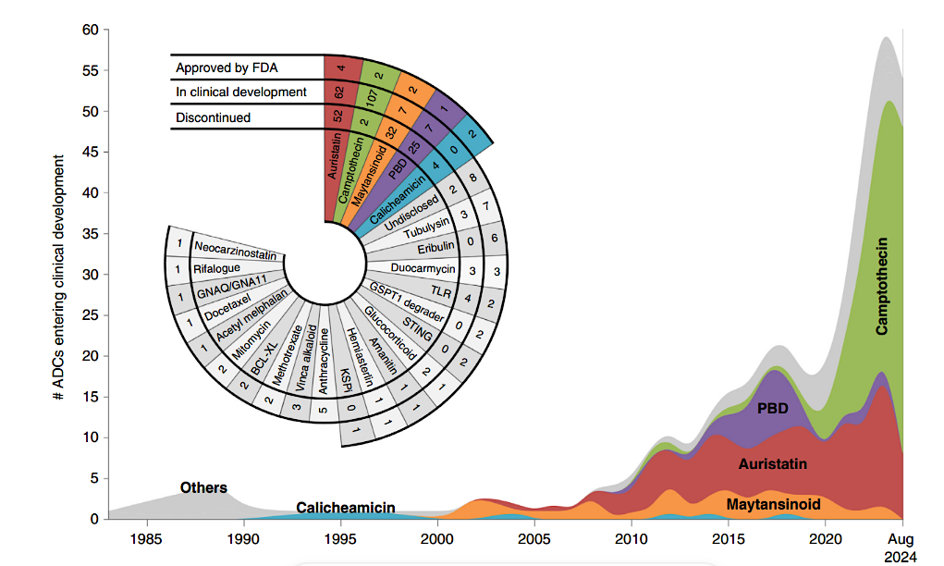
With almost 190 ADCS in development, the opportunity for improving outcomes in gynecologic cancer is here
In gynecology, the payloads mainly fall into 2 classes:
Camptothecins
Microtubule Toxins
Colombo R et al. Cancer Discovery 2024; 14:2089-108

Slide 17
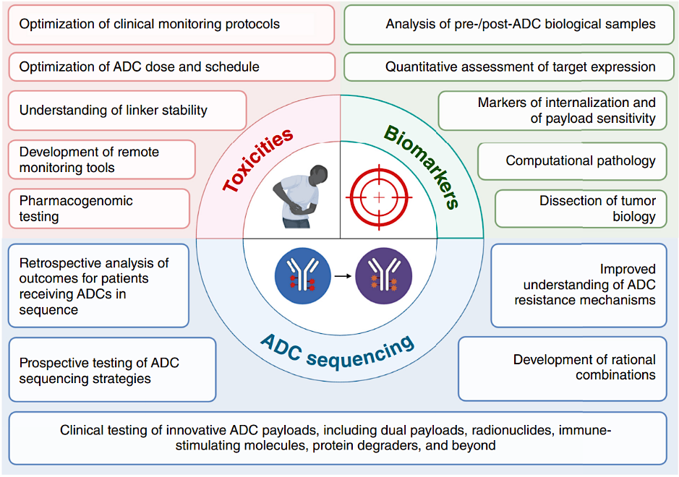
Opportunities for ADCs across a variety of targets and expanding considerations for the treatment setting demands focus on
Selection, Sequencing, Safety and Strategy
Colombo R et al. Cancer Discovery 2024; 14:2089-108

Slide 18
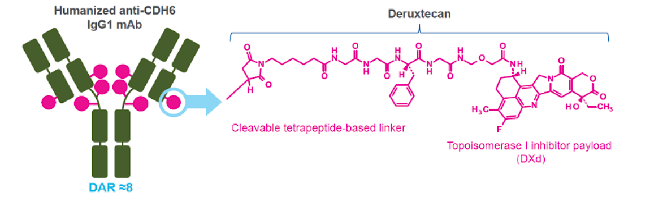
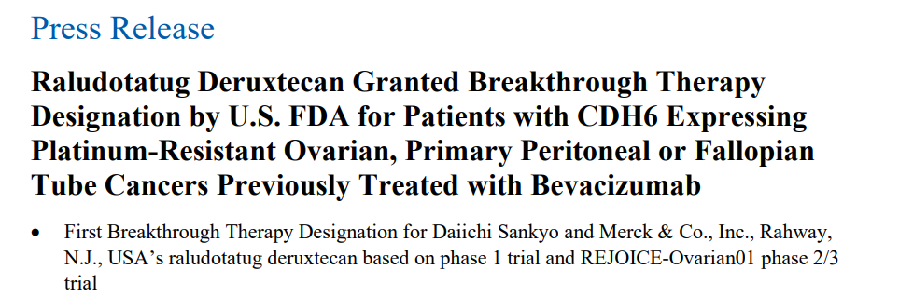
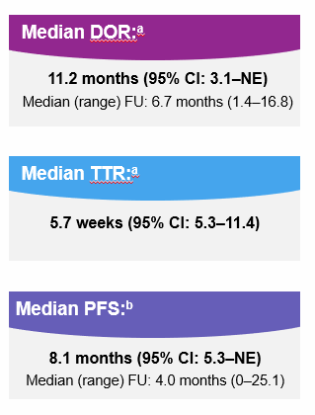
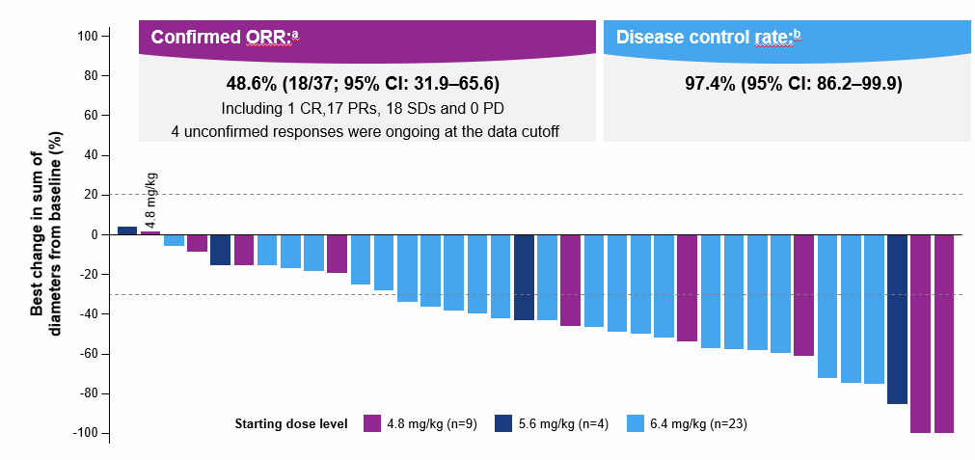
Targeting Cadherin 6 (CDH6): Raludotatug deruxtecan
 | Raludotatug deruxtecan (DS-6000)^{1,2}
Payload | Topoisomerase 1 inhibitor (DXd)
DAR | 8
Linker | Cleavable tetrapeptide based linker
Trial | NCT04707248
1. Moore K, et al. Presented at European Society for Medical Oncology (ESMO) Annual Meeting; 20-24 October 2023; Madrid, Spain.;
2. NCT04707248. Accessed from: https://clinicaltrials.gov/study/NCT04707248?cond=NCT04707248&rank=1.

Slide 19
REJOICE-Ovarian01/GOG-3096: Phase 2/3 Randomized Study of R-DXd in Platinum-Resistant EOC
Key eligibility criteria:
High-grade serous or endometrioid ovarian, primary peritoneal, or fallopian tube cancer
1−3 prior LOT (inc. bevacizumab)
Platinum-resistant disease
Prior MIRV if high FRαª
ECOG PS 0−1
No prior CDH6-targeting agents or ADCs with linked TOPO I inhibitor
Patients with primary platinum-refractory disease are not eligible
40D
LTSFU Q3M
40D
LTSFU Q3M
Phase 2
Follow-up
Phase 3
Follow-up
R-DXd IV Q3W
R-DXd IV Q3W
4.8 mg/kg
R-DXd at RP3D
R
1:1:1
5.6 mg/kg
R
1:1
TPC
(gemcitabine, PLD, topotecan, paclitaxel)
6.4 mg/kg
Until PD,^{b} death, lost to FU, other reason
Until PD,^{b} death, lost to FU, other reason
R
1:1
Stratification:
Number of prior LOT (1 vs 2/3)
CDH6 expression (high vs low)
TPC (paclitaxel vs others; Ph 3 only)
Primary endpoints:
ORR per BICR^{b}
Key secondary endpoints:
ORR per inv^{b}
DOR
Primary endpoints:
ORR per BICR^{b}
PFS per BICR^{b}
Key secondary endpoints:
OS
QOL
NCT06161025
NCT06161025. Accessed from: https://clinicaltrials.gov/study/NCT06161025?term=NCT06161025&rank=1.

Slide 20
REJOICE 01: Phase 2
Raludotatug deruxtecan
R-DXd 4.8 mg/kg, n=36
R-DXd 5.6 mg/kg, n=36
R-DXd 6.4 mg/kg, n=35
ORR: 44.4% (95% CI, 27.9–61.9)
DCR: 75.0% (95% CI, 57.8–87.9)^{b}
ORR: 50.0% (95% CI, 32.9–67.1)
DCR: 80.6% (95% CI, 64.0–91.8)^{b}
ORR: 57.1% (95% CI, 39.4–73.7)
DCR: 77.1% (95% CI, 59.9–89.6)^{b}
Best change in sum of diameters from baseline (%)
Ray Couquad et al. ESMO 2025;Abstract LBA42

Slide 21
R-DXd treatment was associated with rapid responses at all doses
R-DXd 4.8 mg/kg
n=31ª
R-DXd 5.6 mg/kg
n=35ª
R-DXd 6.4 mg/kg
n=34ª
Change from baseline in sum of diameters in target lesions (%)
0
6
12
18
24
30
36
0
6
12
18
24
30
36
0
6
12
18
24
30
36
Time from enrollment (weeks)
Time from enrollment (weeks)
Time from enrollment (weeks)
Median TTR:^{b} 7.1 weeks (range, 5.4–18.7)
Median TTR:^{b} 6.6 weeks (range, 5.1–18.3)
Median TTR:^{b} 7.2 weeks (range, 5.3–19.1)
Ray Couquad et al. ESMO 2025;Abstract LBA42

Slide 22
REJOICE-Ovarian01: Most common TEAEs (≥10%)
R-DXd 4.8 mg/kg (n=36)^{b}
R-DXd 5.6 mg/kg (n=36)^{b}
R-DXd 6.4 mg/kg (n=35)^{b}
CTCAE gr 1–2
CTCAE gr ≥3
Total (%) / gr ≥3 (%)
CTCAE gr 1–2
CTCAE gr ≥3
Total (%) / gr ≥3 (%)
CTCAE gr 1–2
CTCAE gr ≥3
Total (%) / gr ≥3 (%)
Nausea
Anemia
Asthenia
Neutropenia^{c}
Vomiting
Constipation
Decreased appetite
AST increased
Diarrhea
Thrombocytopenia^{d}
Leukopenia^{e}
ALT increased
Pyrexia
GGT increased
Fatigue
Cough
Abdominal pain
66.7 / 2.8
69.4 / 5.6
71.4 / 0
52.8 / 19.4
58.3 / 13.9
60.0 / 17.1
36.1 / 0
50.0 / 11.1
54.3 / 5.7
33.3 / 11.1
44.4 / 16.7
51.4 / 28.6
25.0 / 0
33.3 / 0
28.6 / 0
25.0 / 0
27.8 / 0
34.3 / 0
13.9 / 0
25.0 / 5.6
25.7 / 0
19.4 / 0
16.7 / 0
22.9 / 0
11.1 / 0
16.7/0
28.6 / 2.9
8.3 / 2.8
19.4 / 5.6
25.7 / 8.6
16.7 / 5.6
13.9 / 2.8
14.3 / 8.6
19.4 / 0
8.3 / 0
11.4 / 2.9
13.9 / 0
13.9 / 0
8.6 / 0
5.6 / 0
16.7 / 2.8
11.4 / 5.7
8.3 / 2.8
16.7 / 2.8
5.7 / 2.9
5.6 / 0
11.1 / 0
14.3 / 0
5.6 / 0
13.9 / 2.8
11.4 / 2.9
Patients (%)
Patients (%)
Patients (%)
Nausea, anemia, asthenia and neutropenia were the most common TEAEs across all doses.
ªTEAEs reported in ≥10% of all patients who received R-DXd 4.8–6.4 mg/kg. Reported safety events are defined by MedDRA preferred terminology. ^{b}Grade 4 hematologic TEAEs reported at 4.8 mg/kg: neutropenia^{c} (n=2), thrombocytopenia^{d} (n=1); at 5.6 mg/kg: neutropenia^{c} (n=2), thrombocytopenia^{d} (n=1), leukopenia^{e} (n=1); at 6.4 mg/kg: neutropenia^{c} (n=3), thrombocytopenia^{d} (n=1), lymphopenia (n=1). No grade 5 hematologic TEAEs were reported at any dose. Grade 3 febrile neutropenia was reported in 2 patients, one each in the R-DXd 5.6 and 6.4 mg/kg cohorts. ^{c}Neutropenia was defined as the grouped incidence of events reported under the preferred terms ‘neutropenia’ and ‘neutrophil count decreased’, with a maximum of one event per patient per grouped preferred term. ^{d}Thrombocytopenia was defined as the grouped incidence of events reported under the preferred terms ‘thrombocytopenia’ and ‘platelet count decreased’, with a maximum of one event per patient per grouped preferred term. ^{e}Leukopenia was defined as the preferred term ‘white blood cell count decreased.’
ALT, alanine aminotransferase; AST, aspartate aminotransferase; CTCAE, Common Terminology Criteria for Adverse Events; GGT, gamma-glutamyltransferase; MedDRA, Medical Dictionary for Regulatory Activities; TEAE, treatment-emergent adverse event.
1. Ray-Coquard I et al. Presented at ESMO Congress 2025; October 17–21, 2025; Berlin, Germany; Oral LBA42

Slide 23
REJOICE-Ovarian01: The 5.6-mg/kg dose provided the optimal benefit-risk profile
 | R-DXd 4.8 mg/kg n=36 | R-DXd 5.6 mg/kg n=36 | R-DXd 6.4 mg/kg n=35 | R-DXd 4.8–6.4 mg/kg N=107
Any TEAE, n (%) Grade ≥3 | 35 (97.2) 16 (44.4) | 36 (100) 20 (55.6) | 35 (100) 20 (57.1) | 106 (99.1) 56 (52.3)
Any treatment-related TEAE, n (%) Grade ≥3 Grade 5 | 32 (88.9) 10 (27.8) 0 | 34 (94.4) 11 (30.6) 0 | 34 (97.1) 17 (48.6) 0 | 100 (93.5) 38 (35.5) 0
Any SAE, n (%) Grade ≥3 Grade 5 | 14 (38.9) 13 (36.1) 3 (8.3)ª | 12 (33.3) 10 (27.8) 2 (5.6)^{b} | 14 (40.0) 11 (31.4) 1 (2.9)^{c} | 40 (37.4) 34 (31.8) 6 (5.6)
Any treatment-related SAE, n (%) Grade ≥3 Grade 5 | 3 (8.3) 3 (8.3) 0 | 3 (8.3) 3 (8.3) 0 | 7 (20.0) 5 (14.3) 0 | 13 (12.1) 11 (10.3) 0
Dose modifications associated with treatment-related TEAEs,^{d} n (%) Drug discontinuation Dose reduction Dose delay | 3 (8.3) 5 (13.9) 8 (22.2) | 0 4 (11.1) 7 (19.4) | 3 (8.6) 11 (31.4) 10 (28.6) | 6 (5.6) 20 (18.7) 25 (23.4)
ILD/pneumonitis adjudicated as treatment related,^{e} n (%) Any grade Grade ≥3 Grade 5 | 1 (2.8) 1 (2.8)^{f} 0 | 1 (2.8) 0 0 | 2 (5.7) 0 0 | 4 (3.7) 1 (0.9) 0
The safety profile of the 4.8 and 5.6 mg/kg cohorts were similar.
Treatment-related TEAEs occurred more frequently in the 6.4 mg/kg cohort (vs 4.8 and 5.6 mg/kg cohorts)
.
Reported safety events are defined using MedDRA Preferred Terms and CTCAE criteria.
ªGrade 5 events were hepatic failure, ovarian cancer, and malignant neoplasm progression. ^{b}Grade 5 events were ovarian cancer and aspiration. ^{c}Grade 5 event was influenza infection. ^{d}Dose modifications associated with treatment-related TEAEs defined as: dose discontinuation, no subsequent administration of R-DXd; dose reduction, R-DXd dose was reduced at next administration; dose delay, study drug was not administered at the next scheduled cycle but was administered at a later date. ^{e}ILD/pneumonitis events were adjudicated by an independent ILD adjudication committee. ^{f}ILD/pneumonitis Grade ≥3 event (adjudicated as treatment related) was grade 3.
CTCAE, Common Terminology Criteria for Adverse Events; ILD, interstitial lung disease; MedDRA, Medical Dictionary for Regulatory Activities; SAE, serious adverse event; TEAE, treatment-emergent adverse event.
1. Ray-Coquard I et al. Presented at ESMO Congress 2025; October 17–21, 2025; Berlin, Germany; Oral LBA42

Slide 24
Clinically meaningful tumor responses were observed across a range of CDH6 expression levels
R-DXd 4.8 mg/kg
R-DXd 5.6 mg/kg
R-DXd 6.4 mg/kg
Best change in sum of diameters from baseline (%)
PD
PR
SD
CR
Baseline tumor CDH6 membrane positivity at any intensity (%)
Ray Couquad et al. ESMO 2025;Abstract LBA42

Slide 25
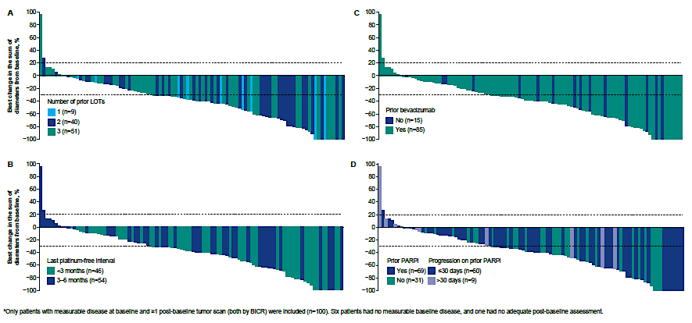
Exploratory Analysis of ORR based on LOT & Prior Therapy Demonstrates No Difference

Slide 26
Nausea and Vomiting Are Among the Most Common TEAEs Reported In Clinical Trials of R-DXd; Most Events are Grade 1 and 2
 | DS6000-A-U101 (Phase 1) (NCT04707248) |  | REJOICE-Ovarian01 (Phase 2/3) (NCT06161025)
 | Patients with heavily pretreated advanced OCª who had received prior platinum and taxane therapy |  | Patients with PROC^{b} who had received 1–3 prior lines of systemic therapy, including bevacizumab (if eligible) and mirvetuximab (unless ineligible, not approved or not available locally)³
TEAE, % | Total OC cohort 4.8–6.4 mg/kg (N=45)¹ | PSOC subgroup 4.8–6.4 mg/kg (n=18)^{2,c} | 4.8 mg/kg (n=36) | 5.6 mg/kg (n=36) | 6.4 mg/kg (n=35)
Nausea, any grade | 57.8 | 50.0 | 66.7 | 69.4 | 71.4
Grade ≥3 | 2.2 | 0 | 2.8 | 5.6 | 0
Vomiting, any grade | 40.0 | 22.2 | 25.0 | 33.0 | 28.6
Grade ≥3 | 2.2 | 0 | 0 | 0 | 0
 | Interim analysis Data cutoff: July 14, 2023 | Interim subgroup analysis Data cutoff: January 10, 2025 | Ph 2 dose-optimization analysis in which patients have completed >18 weeks FU. Data cutoff: Feb 26, 2025 R-DXd 5.6 mg/kg is considered the optimal dose to be further evaluated in the Ph 3 study
ªHigh-grade serous ovarian, primary peritoneal, or fallopian tube cancer. ^{b}High-grade serous or endometroid ovarian, primary peritoneal, or fallopian tube cancer. ^{c}Please note that the PSOC subgroup includes patients also captured in the 4.8–6.4 mg/kg cohorts, therefore the cases of nausea and vomiting could represent the same events.
FU, follow-up; OC, ovarian cancer; Ph, Phase; OC, ovarian cancer; PROC, platinum-resistant ovarian cancer; PSOC, platinum-sensitive ovarian cancer; R-DXd, raludotatug deruxtecan; TEAE, treatment-emergent adverse event.
1. Moore K, et al. Presented at SGO Annual Meeting; March 16–18, 2024; San Diego, CA. 2. Moore K, et al. Presented at ESMO Gynaecolgical Cancers Congress; June 18–20, 2025; Vienna, Austria; Oral 77MO. 3. Ray-Coquard I, et al. Presented at ESMO Congress 2025; October 17–21, 2025; Berlin, Germany; Oral LBA42.

Slide 27
Diarrhea (Any Grade) Is a Common TEAE Reported In Clinical Trials of
R-DXd; Most Events Have Been Grade 1 or 2
 | DS6000-A-U101 (Phase 1) (NCT04707248) |  | REJOICE-Ovarian01 (Phase 2/3) (NCT06161025)
 | Patients with heavily pretreated advanced OCª who had received prior platinum and taxane therapy |  | Patients with PROC^{b} who had received 1–3 prior lines of systemic therapy, including bevacizumab (if eligible) and mirvetuximab (unless ineligible, not approved or not available locally)³
TEAE, % | Total OC cohort 4.8–6.4 mg/kg (N=45)¹ | PSOC subgroup 4.8–6.4 mg/kg (n=18)^{2,c} | 4.8 mg/kg (n=36) | 5.6 mg/kg (n=36) | 6.4 mg/kg (n=35)
Diarrhea, any grade | 31.1 | 16.7 | 11.1 | 16.7 | 28.6
Grade ≥3 | 0 | 0 | 0 | 0 | 2.9
 | Interim analysis Data cutoff: Jul 14, 2023 | Interim subgroup analysis Data cutoff: Jan 10, 2025 | Ph 2 dose-optimization analysis in which patients have completed >18 weeks FU. Data cutoff: Feb 26, 2025 R-DXd 5.6 mg/kg is considered the optimal dose to be further evaluated in the Ph 3 study
ªHigh-grade serous ovarian, primary peritoneal, or fallopian tube cancer. ^{b}High-grade serous or endometroid ovarian, primary peritoneal, or fallopian tube cancer. ^{c}Please note that the PSOC subgroup includes patients also captured in the 4.8–6.4 mg/kg cohorts, therefore the cases of diarrhea could represent the same events.
FU, follow-up; OC, ovarian cancer; Ph, Phase; PROC, platinum-resistant ovarian cancer; PSOC, platinum-sensitive ovarian cancer; R-DXd, raludotatug deruxtecan; TEAE, treatment-emergent adverse event.
1. Moore K, et al. Presented at SGO Annual Meeting; March 16–18, 2024; San Diego, CA. 2. Moore K, et al. Presented at ESMO Gynaecolgical Cancers Congress; June 18–20, 2025; Vienna, Austria; Oral 77MO. 3. Ray-Coquard I, et al. Presented at ESMO Congress; October 17–21, 2025; Berlin, Germany; Oral LBA42.

Slide 28
Hematologic Toxicities Were the Most Common Grade ≥3 TEAEs Reported In Clinical Trials of R-DXd
 | DS6000-A-U101 (Phase 1) (NCT04707248) |  | REJOICE-Ovarian01 (Phase 2/3) (NCT06161025)
 | Patients with heavily pretreated advanced OCª who had received prior platinum and taxane therapy |  | Patients with PROC^{b} who had received 1–3 prior lines of systemic therapy, including bevacizumab (if eligible) and mirvetuximab (unless ineligible, not approved or not available locally)³
TEAE, % | Total OC cohort 4.8–6.4 mg/kg (N=45)^{1,c} | PSOC subgroup 4.8–6.4 mg/kg (n=18)^{2,c,d} | 4.8 mg/kg (n=36)^{e} | 5.6 mg/kg (n=36)^{e} | 6.4 mg/kg (n=35)^{e}
Anemia, any grade | 26.7 | 38.9 | 52.8 | 58.3 | 60.0
Grade ≥3 | 15.6 | 22.2 | 19.4 | 13.9 | 17.1
Neutrophil count decreased, any grade | 24.4 | 22.2 | 33.3^{f} | 44.4^{f} | 51.4^{f}
Grade ≥3 | 11.1 | 16.7 | 11.1^{f} | 16.7^{f} | 28.6^{f}
Platelet count decreased, any grade | 13.3 | 16.7 | 8.3^{g} | 19.4^{g} | 25.7^{g}
Grade ≥3 | 4.4 | 5.6 | 2.8^{g} | 5.6^{g} | 8.6^{g}
 | Interim analysis Data cutoff: Jul 14, 2023 | Interim subgroup analysis Data cutoff: Jan 10, 2025 | Ph 2 dose-optimization analysis in which patients have completed >18 weeks FU. Data cutoff: Feb 26, 2025 R-DXd 5.6 mg/kg is considered the optimal dose to be further evaluated in the Ph 3 study
ªHigh-grade serous ovarian, primary peritoneal, or fallopian tube cancer. ^{b}High-grade serous or endometroid ovarian, primary peritoneal, or fallopian tube cancer. ^{c}No treatment-related Grade 5 hematologic TEAEs were reported. ^{d}Please note that the PSOC subgroup includes patients also captured in the 4.8–6.4 mg/kg cohorts, therefore the cases of hematologic toxicity could represent the same events. ^{e}Grade 4 hematologic TEAEs reported at 4.8 mg/kg: neutropenia^{f} (n=2), thrombocytopenia^{g} (n=1); at 5.6 mg/kg: neutropenia^{f} (n=2), thrombocytopenia^{g} (n=1); at 6.4 mg/kg: neutropenia^{f} (n=3), thrombocytopenia^{g} (n=1). No Grade 5 hematologic TEAEs were reported at any dose. Grade 3 febrile neutropenia was reported in 2 patients, one each in the R-DXd 5.6 and 6.4 mg/kg cohorts. ^{f}Grouped incidence of events reported under the preferred terms ‘neutropenia’ and ‘neutrophil count decreased’, with a maximum of one event per patient per grouped preferred term. ^{g}Grouped incidence of events reported under the preferred terms ‘thrombocytopenia’ and ‘platelet count decreased’, with a maximum of one event per patient per grouped preferred term.
FU, follow-up; OC, ovarian cancer; Ph, Phase; PROC, platinum-resistant ovarian cancer; PSOC, platinum-sensitive ovarian cancer; R-DXd, raludotatug deruxtecan; TEAE, treatment-emergent adverse event.
1. Moore K, et al. Presented at SGO Annual Meeting; March 16–18, 2024; San Diego, CA. 2. Moore K, et al. Presented at ESMO Gynaecolgical Cancers Congress; June 18–20, 2025; Vienna, Austria; Oral 77MO. 3. Ray-Coquard I, et al. Presented at ESMO Congress; October 17–21, 2025; Berlin, Germany; Oral LBA42.

Slide 29
ILD/Pneumonitis Has Been Reported In Clinical Trials of R-DXd
 | DS6000-A-U101 (Phase 1) (NCT04707248) |  | REJOICE-Ovarian01 (Phase 2/3) (NCT06161025)
 | Patients with heavily pretreated advanced OCª who had received prior platinum and taxane therapy |  | Patients with PROC^{b} who had received 1–3 prior lines of systemic therapy, including bevacizumab (if eligible) and mirvetuximab (unless ineligible, not approved or not available locally)³
Adjudicated as treatment-related ILD/pneumonitis, n (%) | Total OC cohort 4.8–6.4 mg/kg (N=45)¹ | PSOC subgroup 4.8–6.4 mg/kg (n=18)^{2,c} | 4.8 mg/kg (n=36) | 5.6 mg/kg (n=36) | 6.4 mg/kg (n=35) | 4.8–6.4 mg/kg (N=107)
Any-grade | 2 (4.4)^{d} | 1 (5.6)^{d} | 1 (2.8) | 1 (2.8) | 2 (5.7) | 4 (3.7)
Grade ≥3 | 0 | 0 | 1 (2.8)^{e} | 0 | 0 | 1 (0.9)
 | Interim analysis Data cutoff: Jul 14, 2023 | Interim subgroup analysis Data cutoff: Jan 10, 2025 | Ph 2 dose-optimization analysis in which patients have completed >18 weeks FU. Data cutoff: Feb 26, 2025 R-DXd 5.6 mg/kg is considered the optimal dose to be further evaluated in the Ph 3 study
In the Phase 1 study, two Grade 5 drug-related ILD events occurred in the 8.0 mg/kg cohort (n=15), which was closed in October 2022 due to a higher incidence of serious and Grade ≥3 TEAEs, and lack of a favorable benefit–risk ratio⁴
ªHigh-grade serous ovarian, primary peritoneal, or fallopian tube cancer. ^{b}High-grade serous ovarian or endometroid ovarian, primary peritoneal, or fallopian tube cancer. ^{c}Please note that the platinum-sensitive OC subgroup includes patients also captured in the 4.8–6.4 mg/kg cohorts, therefore the ILD/pneumonitis case could represent the same event; ^{d}ILD/pneumonitis Grade 2 with starting dose of 6.4 mg/kg. ^{e}ILD/pneumonitis Grade ≥3 event (adjudicated as treatment related) was CTCAE Grade 3.
CTCAE, Common Terminology Criteria for Adverse Events; FU, follow-up; ILD, interstitial lung disease; OC, ovarian cancer; Ph, Phase; PROC, platinum-resistant ovarian cancer; PSOC, platinum-sensitive ovarian cancer; R-DXd, raludotatug deruxtecan; TEAE, treatment-emergent adverse event.
1. Moore K, et al. Presented at SGO Annual Meeting; March 16–18, 2024; San Diego, CA. 2. Moore K, et al. Presented at ESMO Gynaecolgical Cancers Congress; June 18–20, 2025; Vienna, Austria; Oral 77MO. 3. Ray-Coquard I, et al. Presented at ESMO Congress; October 17–21, 2025; Berlin, Germany; Oral LBA42. 4. Moore K, et al. Presented at ESMO Congress 2023; October 20–24, 2023; Madrid, Spain; Abstract 745MO.

Slide 30
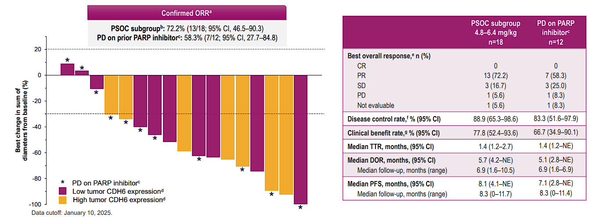
Moving ADCs into PSOC:
RDXd ESMO Gyne 2025

Slide 31
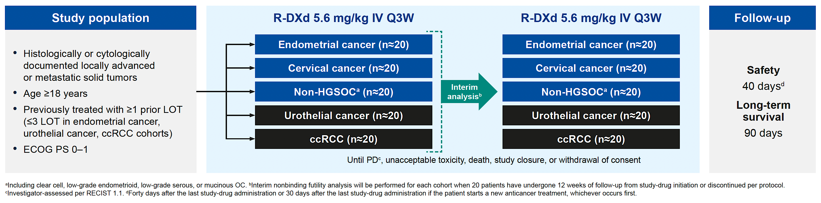
Phase II REJOICE-PanTumor01 Study Design
Primary endpoints: ORR (all except ccRCC cohort), DCR (ccRCC cohort only), Safety
Secondary endpoints: ORR (ccRCC cohort only), DCR (all except ccRCC cohort), PFS, DoR
R-DXd = raludotatug deruxtecan; HGSOC = high-grade serous ovarian cancer; ccRCC = clear cell renal cell carcinoma
Albiges L et al. ASCO 2025;Abstract TPS3158.

Slide 32
Data for ADCs in PSOC is starting to emerge…..
 | Sacituzumab tirumotecan 5mg/kg D1, D15 N=5 (PSOC) | Datopotamab deruxtecan N=9 (PSOC) | Mirvetuximab soravtansine N=79 (PICCOLO) | Raludotatug deruxtecan N=18
Payload | Belotecan derivative Topoisomerase I | Topoisomerase 1- deruxtecan | DM4 | Topoisomerase 1 –deruxtecan
DAR | 7.4 | 4 | 4 | 8
Linker | Sulfonyl pyrimidine CL2A-carbonate linker | Cleavable tetrapeptide based linker | Cleavable linker | Tetrapeptide-based cleavable linker
Trial | NCT06049212 | NCT05489211 | NCT05041257 | NCT04707248
ORR | 60% (PSOC N=5) | 66.7% (PSOC N=9) | 51.9% (95%CI 40.4-63.3) 45.8% (95% CI 32.7-59.2) | 72.2% (9% CI 46.5-90.3) ITT 58.3% (95% CI 27.7-84.8) Post Pi
DOR | ND | ND | 8.25 (95% CI 5.55-10.78) ITT 7.33 (95% CI 5.03-10.78) Post Pi | 5.7 (4.2-NE) ITT 5.1 (2.8- NE) Post Pi
mPFS | ND | ND | 6.93 (95% CI 5.85-9.59) ITT 6.18 (95% CI 5.55-8.41) post Pi | 8.1 (4.1-NE) ITT 7.1 (2.8-NE) Post Pi

Slide 33
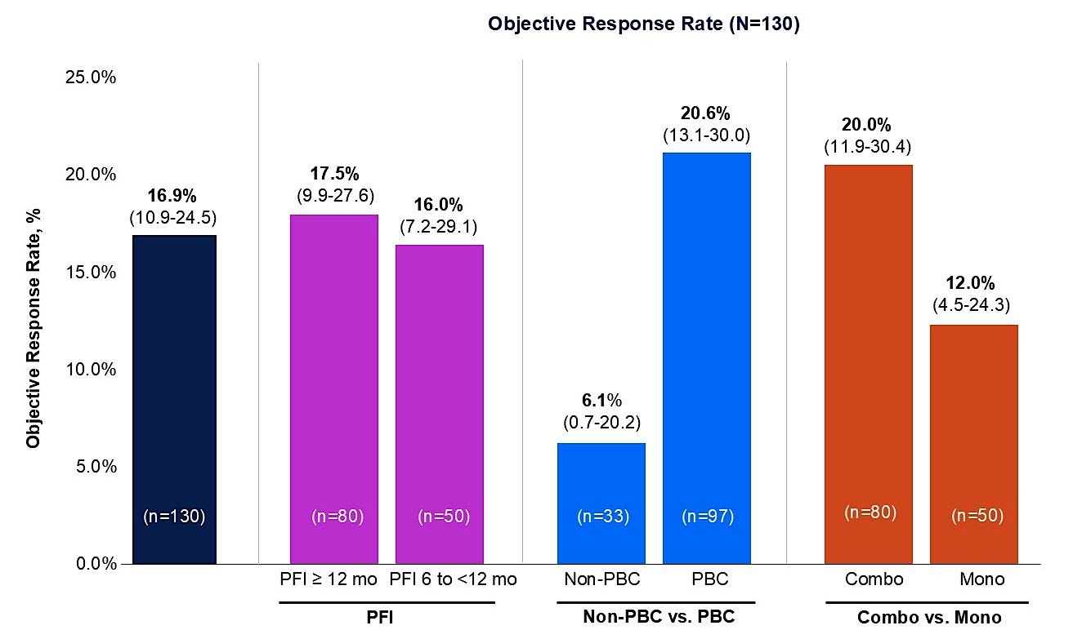
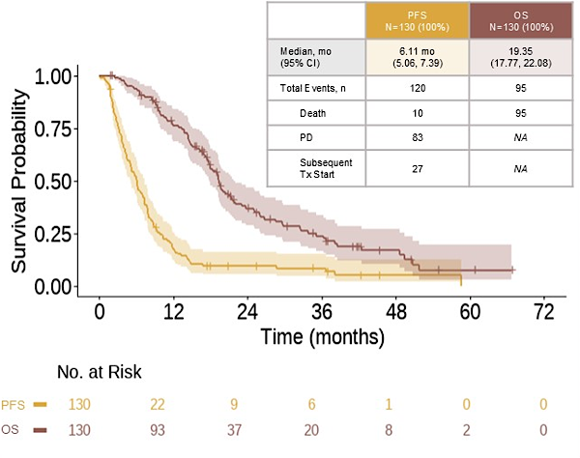

If progression on PARPi is the new “high risk” marker for poor anticipated response to platinum, what do we know about expectations for platinum in this setting?
Coleman et al. ASCO 2025
ORR is 20% at highest and mPFI is around 6-7 months

Slide 34
Data for ADCs in PSOC is starting to emerge….. Will they be better than platinum even in high risk tumors?
 | Sacituzumab tirumotecan 5mg/kg D1, D15 N=5 (PSOC) | Datopotamab deruxtecan N=9 (PSOC) | Mirvetuximab soravtansine N=79 (PICCOLO) | Raludotatug deruxtecan N=18 | Coleman et al. PSOC post PARPi PD Platinum
Payload | Belotecan derivative Topoisomerase I | Topoisomerase 1- deruxtecan | DM4 | Topoisomerase 1 –deruxtecan | Platinum
DAR | 7.4 | 4 | 4 | 8 | NA
Linker | Sulfonyl pyrimidine CL2A-carbonate linker | Cleavable tetrapeptide based linker | Cleavable linker | Tetrapeptide-based cleavable linker | NA
Trial | NCT06049212 | NCT05489211 | NCT05041257 | NCT04707248 | ASCO 2025
ORR | 60% (PSOC N=5) | 66.7% (PSOC N=9) | 51.9% (95%CI 40.4-63.3) 45.8% (95% CI 32.7-59.2) | 72.2% (9% CI 46.5-90.3) ITT 58.3% (95% CI 27.7-84.8) Post Pi | 20.6%
DOR | ND | ND | 8.25 (95% CI 5.55-10.78) ITT 7.33 (95% CI 5.03-10.78) Post Pi | 5.7 (4.2-NE) ITT 5.1 (2.8- NE) Post Pi | NR
mPFS | ND | ND | 6.93 (95% CI 5.85-9.59) ITT 6.18 (95% CI 5.55-8.41) post Pi | 8.1 (4.1-NE) ITT 7.1 (2.8-NE) Post Pi | 7.39 (combo data)

Slide 35
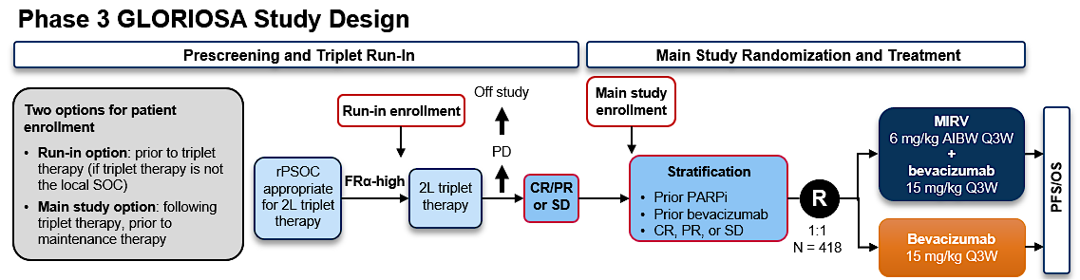
Or for those tumors deemed not high risk for platinum failure do we use ADCs as maintenance? Aka GLORIOSA

Slide 36
Conclusions
In the past 1-2 years we have seen a panoply of new ADCs – many with very promising efficacy signals in patients with limited options. Now the hard work begins
  Dose Optimization will be key for each disease type and agent - how much and how often to maximize benefit and minimize toxicity
  Regimen Optimization is upon us – where do we use these assets? All in R/M? or moving up to PSOC, maintenance – what data do we need to get the timing right?
  Sequencing is a huge opportunity for our patients. The biomarkers have to be evaluated and validated and built into trials.
  New constructs will have to be evaluated carefully – all comer studies may not give us the information we need to really craft scientifically based directions for drug development with these exciting agents.

Slide 37
Faculty Case Presentations

Slide 38
Dr Monk: OC PROC Case
Every patient should have an opportunity to enroll on an ADC protocol.
  Numerous clinical trial options:
    Must account for most active and approved agents in this space:
      Weekly paclitaxel
      Bevacizumab
      mirvetuximab soravtansine if FRα high
      Pembrolizumab if weekly paclitaxel eligible and PD-L1 positive

Slide 39
Dr Monk: OC PROC Case: My Approach
Outside of a clinical trial, my approach is:
  Is she appropriate for weekly taxane?
    Does not have grade 2 or worse neuropathy
    Has not failed weekly paclitaxel in the recurrent setting
    Accepts the inconvenience and increased toxicity of weekly paclitaxel
    Line of therapy (B-96 1-2; Rosella 1-3)
    PD-L1 status
  Is she appropriate for bevacizumab?
    No contraindications
    Did not recently progress on bevacizumab
  Can she tolerate oral anti-cancer therapies?
  Additional biomarkers?
    FRα and HER2

Slide 40
QUESTIONS FOR THE FACULTY
To what extent does your approach to the selection and sequencing of therapies for patients with platinum-resistant advanced ovarian cancer align with Dr Monk’s? Is there anything that you do fundamentally differently or any clinical pearls you would like to add?
Which ongoing clinical trials of novel investigational therapies, including ADCs, are you prioritizing for your patients with platinum-resistant advanced ovarian cancer? To what extent do you think clinical trial participation is potentially advantageous for these patients?

Slide 41
QUESTIONS FOR THE FACULTY
What are the most common barriers to clinical trial participation that you encounter in your patients with ovarian and other gynecologic cancers, and what, if any, measures have you found useful in overcoming them?

Slide 42
Prof Eskander: Case Presentation
62 yo who presented to an outside hospital with progressive R sided flank pain, abdominal pain, bloating with intermittent nausea and emesis
  PMHx: Low grade stage 1A adenocarcinoma of lung, RA, depression, sleep apnea, obesity, GERD
  PSHx: Tonsillectomy, appendectomy, cervical and lumbar spine fusion, right lung lobectomy
Imaging at the time of that hospitalization was notable for widely metastatic disease, large volume ascites, peritoneal carcinomatosis and concern for small volume malignant pleural effusion
IR image guided biopsy: high-grade serous carcinoma of Mullerian origin
  Pathology: grade 3 nuclear features, strongly and diffusely positive for CK7 and PAX8
Started on NACT with carboplatin and paclitaxel by outside medical oncologist

Slide 43
Prof Eskander: Case Presentation
Treatment (NACT carboplatin and paclitaxel x 3 cycles)
  Tolerated her NACT well with excellent clinical, radiographic and biochemical response
Interval CRS: TAH, BSO, with en bloc resection of portion of rectum and sigmoid with primary anastomosis, pan pelvic peritonectomy, omentectomy, R diaphragm peritonectomy, HIPEC (cisplatin total dose 188 mg). R0 surgical resection with no visible residual disease
Surgical pathology:
  All resected specimens involved by high grade serous carcinoma – primary site confirmed to be left fallopian tube
Molecular testing:
  Germline negative; HRD test negative; HER2 1+; FOLR1 80%; PD-L1 CPS score 5; TP53 mutation p.G154fs; TMB 3 mut/Mb; CCNE1 amplification not detected
After interval CRS:
  Resumed systemic chemotherapy, with addition of bevacizumab beginning with cycle 5
  Required 1 level dose reduction of her carboplatin due to thrombocytopenia

Slide 44
Prof Eskander: Case Presentation
Treatment (maintenance bevacizumab)
  While on maintenance bevacizumab she began to demonstrate a progressive increase in her
  CA 125 values
  Interval CT and PET CT imaging concerning for peritoneal based disease recurrence and retroperitoneal nodal recurrence, but not amenable to image guided biopsy
  Post-op developed multiple large ventral abdominal wall hernias
Based on imaging, and rising CA 125 she was diagnosed with platinum resistant recurrent high grade serous fallopian tube carcinoma (platinum free interval of 4 months)
After counseling and discussion the patient was started in single agent mirvetuximab which she started in May 2024

Slide 45
Prof Eskander: Case Presentation
Treatment (single agent mirvetuximab)
  She tolerated her treatment reasonably well
  Treatment related AEs:
    Grade 1 fatigue
    Grade 1 neuropathy – did have period of grade 2 neuropathy that required dose delay as well as one level dose reduction
    Intermittent Grade 1 nausea
She received a total of ~31 cycle of mirvetuximab
April 2026 (~24 months of treatment), imaging was notable for disease progression with rising CA 125

Slide 46
Prof Eskander: Case Presentation
Treatment considerations:
  Excellent ECOG PS of 1
  Prior carboplatin + paclitaxel + bevacizumab
  Prior FRalpha targeting ADC with MMAE payload
  FOLR1 80% 2+
  PD-L1 CPS score 5
  HER2 IHC 1+
What next???

Slide 47
QUESTIONS FOR THE FACULTY
What would you most likely recommend next for this patient outside of a clinical trial, and what outcomes would you expect? Would you have any hesitation about offering pembrolizumab/chemotherapy to her given her history of rheumatoid arthritis? Given her HER2 IHC score of 1+, would you ever consider treatment with trastuzumab deruxtecan?
What ongoing clinical trials would be a good match for this patient if she were interested in participation?

Slide 48
QUESTIONS FOR THE FACULTY
How do response rates and other efficacy outcomes documented with R-DXd thus far compare to those with currently available therapies that this patient might receive? If R-DXd were available today, where in the therapeutic sequence do you envision it fitting for a patient like this?
How does the rapidity of response with R-DXd compare to conventional chemotherapy and other strategies used in the platinum-resistant setting? For a patient who was in need of symptom relief, would you be comfortable administering R-DXd?

Slide 49
QUESTIONS FOR THE FACULTY
Is there any evidence indicating that multiple ADCs with the same or a similar payload are or are not effective when given in sequence? What about multiple ADCs with the same target? Would the fact that this patient has previously received an ADC with an MMAE payload dissuade you from attempting to administer one like R-DXd with a topoisomerase I inhibitor payload?
Would you be concerned about the potential for ILD with the use of an ADC with a topoisomerase I inhibitor payload such as R-DXd for this patient, given her history of lung cancer/right lung lobectomy?

Slide 50
Agenda
Module 1: Advances in Human Cadherin-6-Targeted Antibody-Drug Conjugates (ADCs) in Ovarian and Other Gynecologic Cancers — Dr Moore
Module 2: Leveraging TROP2-Directed ADCs in Advanced Gynecologic Cancers — Prof Eskander
Module 3: Tolerability and Other Practical Considerations with Novel Investigational ADCs in Advanced Gynecologic Cancers — Dr Monk

Slide 51
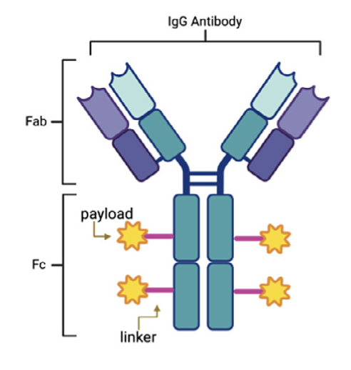
Leveraging TROP2-Directed ADCs in Advanced Gynecologic Cancers
Ramez N. Eskander
Julie St. John Endowed Chair in Gynecologic Oncology
Professor of Obstetrics, Gynecology and Reproductive Sciences
Medical Director, Clinical Trials Office
Fellowship program Director, Gynecologic Oncology
UC San Diego Health
Rebecca & John Moores NCI Designated Comprehensive Cancer Center
La Jolla, CA

Slide 52
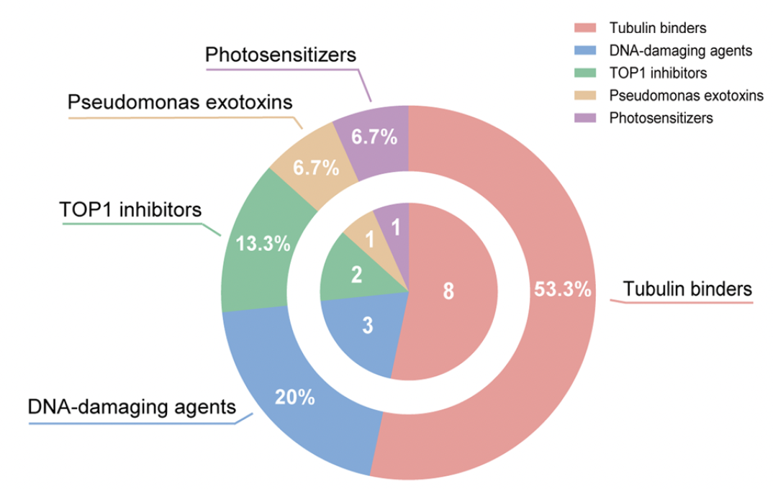
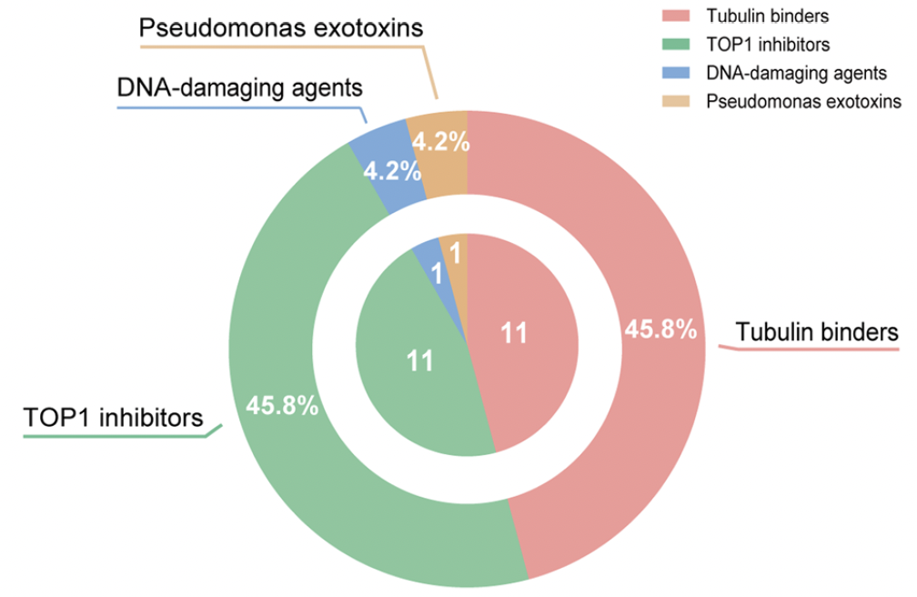
Antibody Drug Conjugates: Over 400 in development…
Marketed ADC Payloads
Ph3 ADC Payloads
Tubulin binders and Top1 inhibitors are the most prevalent payloads
Ruan et al. Cancer Communications 2024; Wang et al. Journal of Hematology & Oncology 2025

Slide 53
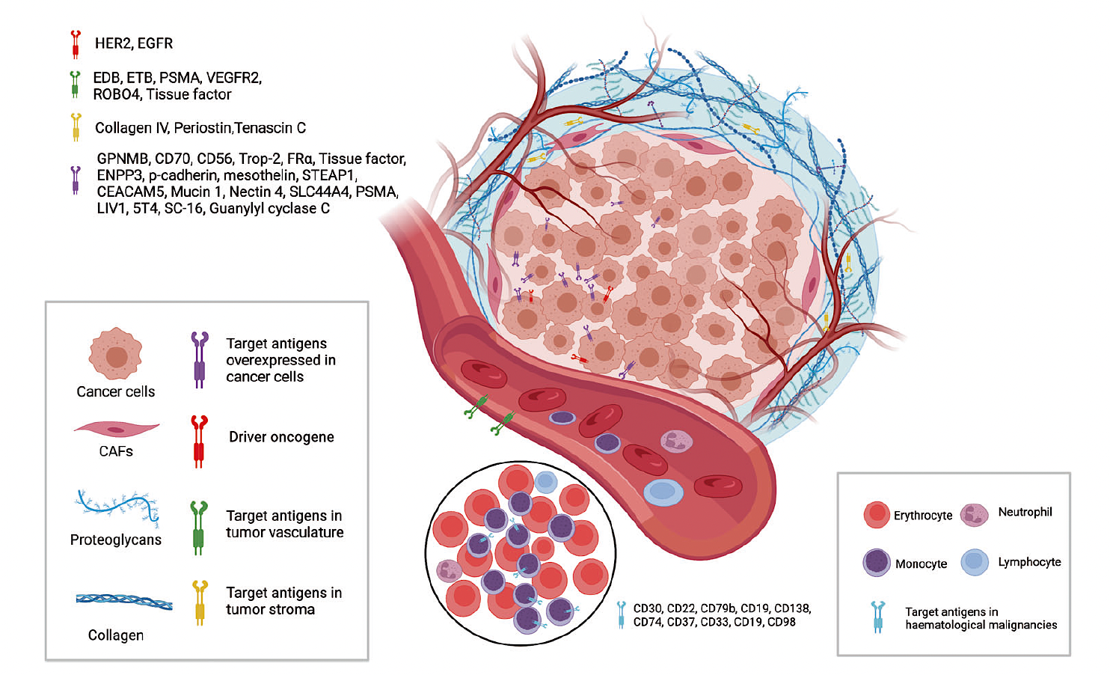
Antigen Targets: Tumor Cells & Tumor Microenvironment
Fu et al. Signal Transduction and Targeted Therapy. 2022

Slide 54
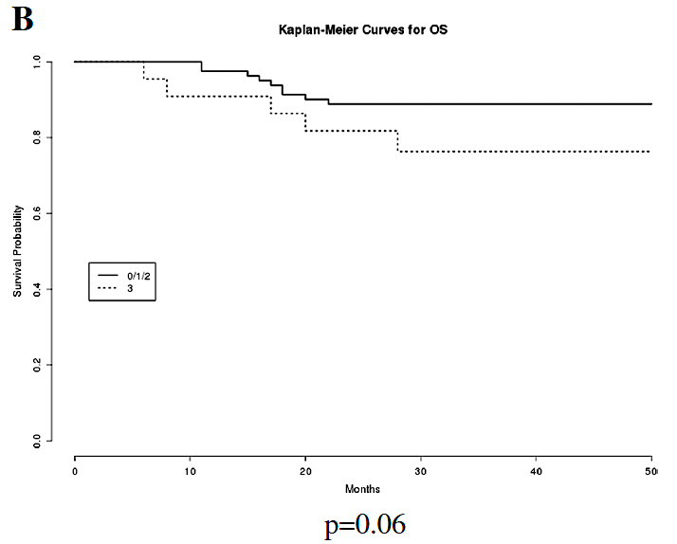
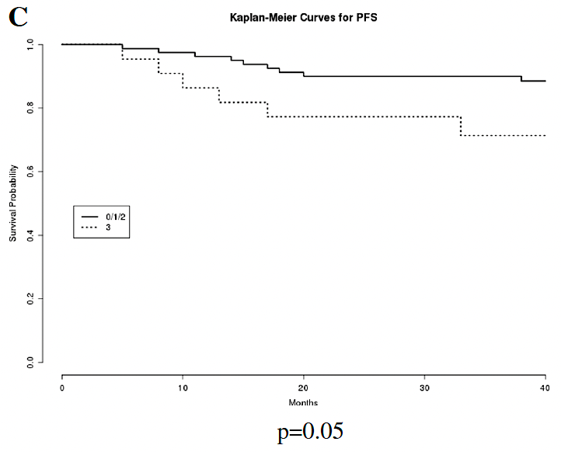
Why TROP2? Biologic Rationale
TROP2 is a transmembrane glycoprotein (discovered in trophoblasts) overexpressed in many solid tumors including:
  Endometrial, ovarian and cervical cancer
TROP2 expression is associated with:
  Tumor proliferation
  Invasion/metastases
  Negative prognostic indicator
Biomarker + Possible functional driver
N=103
OS & PFS by TROP2 expression
Wen et al. Annals of Translational Medicine. 2022; Bignotti et al. BMC Clinical Pathology 2012

Slide 55
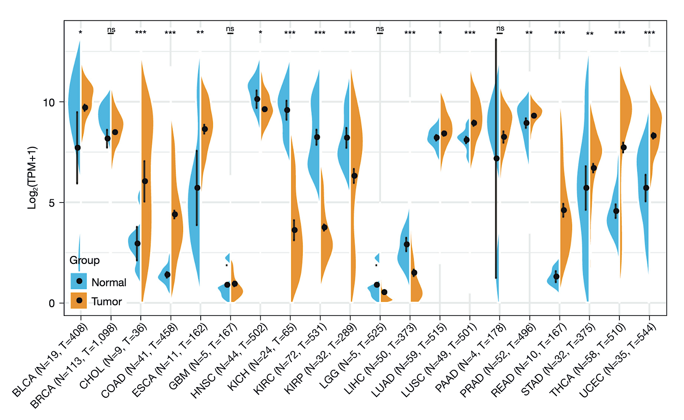
Why TROP2? Biologic Rationale
TROP2 is expressed in up to 92% of EnCa:
  96.2% EEC
  95.1% Serous EnCa
  35% Carcinosarcoma
Wen et al. Annals of Translational Medicine. 2022; Bujnak et al. Gynecologic Oncology 2025

Slide 56
TROP2 ADC Platform and Mechanistic Comparisons
All current agents in study share:
  Anti-TROP2 monoclonal antibody
  Cleavable linker
  Topoisomerase 1 payload
Key differences:
  Payload type
  DAR
  Linker stability
  Adverse event profile
Same Target
Different Engineering
Different Clinical Behavior
Tolerability?
Efficacy?

Slide 57
TROP2 ADC Platform and Mechanistic Comparisons
Agent/Drug | Payload | Key Features | Common AEs
Sacituzumab Govitecan (SG) | SN-38 (topoisomerase 1 inhibitor) | DAR 7.6:1 Bystandard affect Hydrolysable linker | Neutropenia, diarrhea
Datopotamab Deruxtecan (Dato-DXd) | DXd (topoisomerase 1 inhibitor) | DAR 4:1 Lower affinity for target than SG and sac-TMT Tetrapeptide based linker | Stomatitis, ILD
Sacituzumab Tirumotecan (sac-TMT) | Belotecan-derived topoisomerase 1 inhibitor | DAR 7.4:1 Bystandard effect Kthiol linker | Stomatitis, neutropenia
SG + sac-TMT utilize the same humanized TROP2 IgG1 monoclonal antibody hRS7
Zhou et al. Cancer Chemotherapy and Pharmacology. 2025

Slide 58
TROP2 ADCs in Development
Endometrial Cancer

Slide 59
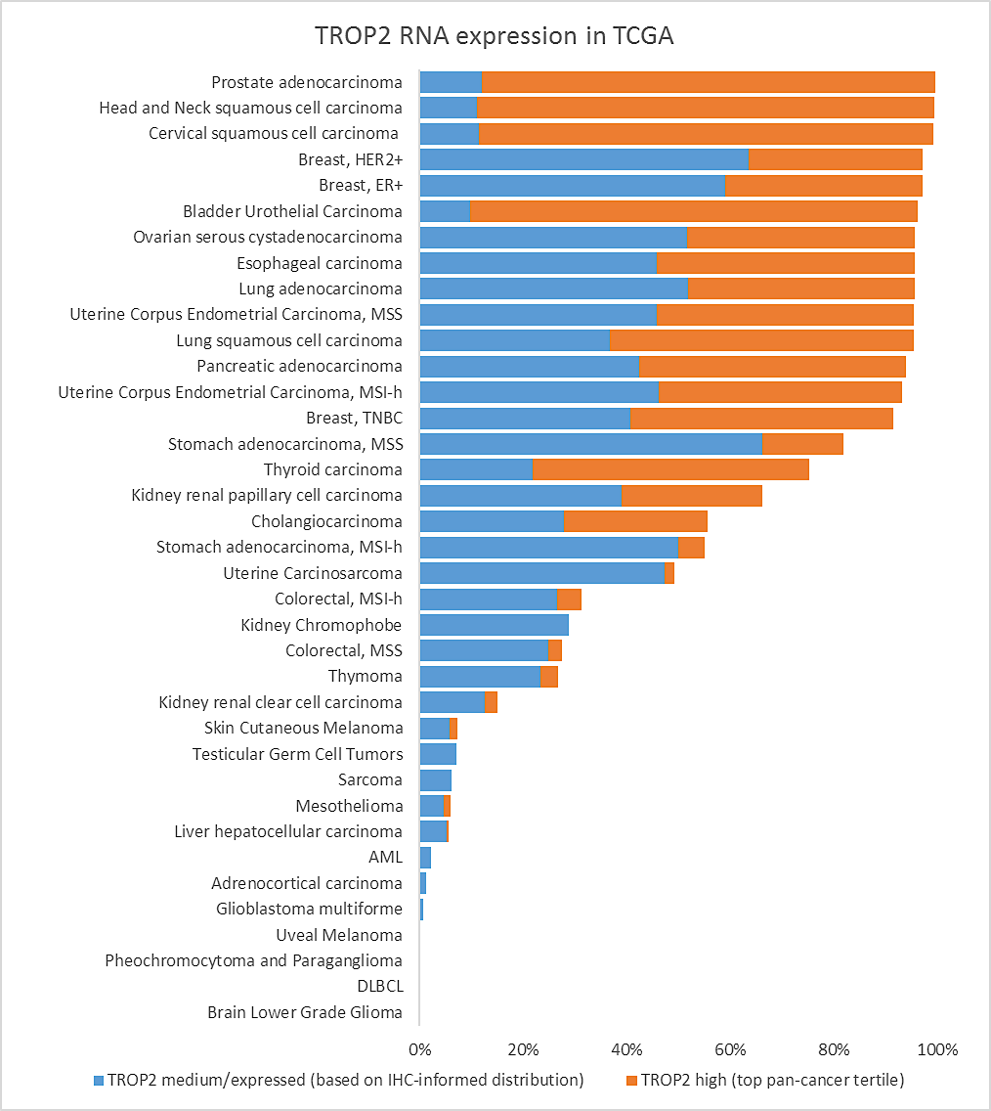
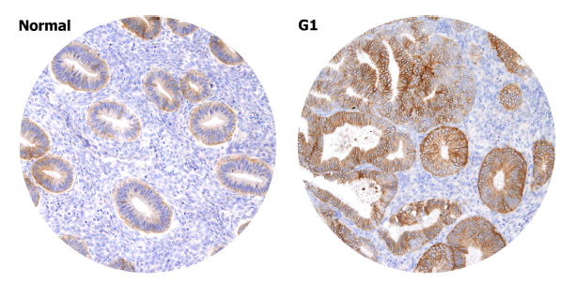
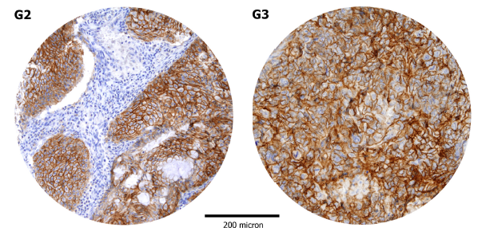
TROP2 Expression and EnCa
TROP2 Expression in Endometroid Histology is inversely correlated with differentiation.

Slide 60
Preliminary TROP2 ADC Efficacy in EnCa
 | Sacituzumab Govitecan (SG) TROPiCS-03 | Datopotamab Deruxtecan (Dato-DXd) TROPION-PanTumor03 | Sacituzumab Tirumotecan (sac-TMT)
Target | Trop-2 | Trop-2 | Trop-2
Study Size | N=41 | N=40 | N=44
Patient Population | 61% with ≥3 prior lines 85% prior IO | 73% with 1 prior line 22.5% prior IO | 48% with 1 prior line 36% prior IO
Region Trial conducted | - United States | EU (45%) Asia (45%) | - Almost entirely China
Efficacy | ORR 22% | ORR 27.5% | ORR 27.3% (41.7% H-score>200)
SAEs | Neutropenia Diarrhea | Stomatitis Anemia Amylase Increase | Stomatitis Anemia Neutropenia
Santin A et al J Clin Oncol 2024,A Oaknin et al ESMO 2024, Wang et al. ESMO 2024, Lee et al ESMO 2024; Winer et al ASCO 2025

Slide 61
Phase 3 TROP2 ADC Clinical Trials in Recurrent EnCa
ASCENT-GYN-01/GOG-3104/ENGOT-en26: A Phase 3 Study of SG vs TPC in Patients With Endometrial Cancer Who Have Received Prior Platinum-Based Chemotherapy and Anti-PD-1/PD-L1 Immunotherapy
Trofuse ENGOT-en23/GOG-3095/SAC-TMT: A Phase 3 Study of SG vs TPC in Patients With Endometrial Cancer Who Have Received Prior Platinum-Based Chemotherapy and Anti-PD-1/PD-L1 Immunotherapy
NCT06486441
NCT06132958

Slide 62
Phase 3 TROP2 ADC Clinical Trials in Advanced Stage, Metastatic and Recurrent EnCa
MK-2870-033/​TroFuse-033/​GOG-3119/​ENGOT-en29) (TroFuse-033): A Phase 3 Study to Compare Sacituzumab Tirumotecan in Combination With Pembrolizumab Vs Pembrolizumab Alone as Treatment in Participants With pMMR Endometrial Cancer (NCT06952504)

Slide 63
TROP2 ADCs in Development
Ovarian Cancer

Slide 64
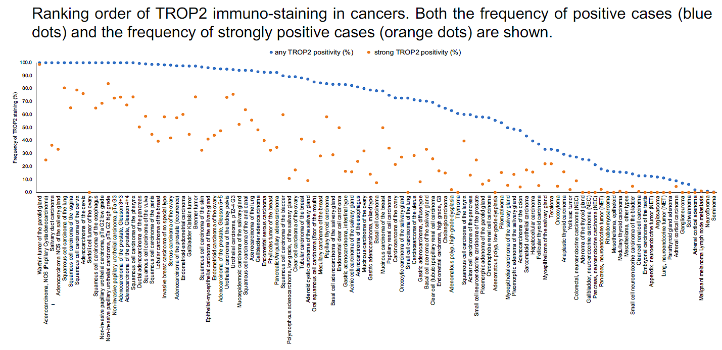
Is TROP2 a Relevant Target in Ovarian Cancer
Endometrioid ovary ~40% strong positivity
Mucinous ovary ~30% strong positivity
Clear cell ovary ~20% strong positivity
Serous ovarian >40% strong positivity
Carcinosarcoma of ovary >20% strong positivity
Dum D, et al. Ann Oncol. (2022);33(suppl_7):S27-S54.

Slide 65
Preliminary TROP2 ADC Efficacy in OvCa
 | Sacituzumab Govitecan (SG) | Datopotamab Deruxtecan (Dato-DXd) TROPION-PanTumor03 | Sacituzumab Tirumotecan (sac-TMT)
Study Size | N/A | N=35 | N=40
Patient Population |  | Median of 2 prior lines of therapy Range 1-4 74% PROS 26% PSOC (n-9) | All with ≥ 2 prior lines of treatment 80% with ≥3 prior lines 87.5% PROC
Region Trial conducted |  | White (63%) Asia (23%) | - Almost entirely China
Efficacy |  | cORR 42.9% (67% PSOC) 1 CR and 14 PR DoR 5.7 months Median PFS 5.6 months | ORR 40% (61.5% H-score>200) - Median PFS 6 months
SAEs |  | Stomatitis Nausea Alopecia | Stomatitis Neutropenia Anemia
A Oaknin et al ESMO 2024, Wang et al. ESMO 2024, Greenman et al. Gynecol Oncol Rep 2024

Slide 66
Phase 3 TROP2 ADC maintenance trial in PSOC
TroFuse-022/​GOG-3101/​ENGOT-ov84 (NCT06824467): A Phase 3, Randomized, Open-label, Multicenter Study to Evaluate the Efficacy and Safety of Sacituzumab Tirumotecan Maintenance Treatment With or Without Bevacizumab Versus Standard of Care After Second-line Platinum-based Doublet Chemotherapy in Participants With Platinum-sensitive Recurrent Ovarian Cancer
Part 1 (Safety Run-In)
Key eligibility criteria:
Histologically confirmed epithelial ovarian, fallopian tube, or primary peritoneal cancer
PSROC with progression >180d after last dose of 1L platinum doublet chemotherapy
Must have received 6 cycles of 2L carboplatin-based doublet chemotherapy (± bevacizumab)
Patients with SD must be receiving bevacizumab in combination with chemo and be eligible to continue treatment with bev
Sacituzumab tirumotecan
(4 mg/kg IV q2w) + bevacizumab (15 mg/kg IV q3w)
Objective:
Safety and tolerability after 1 cycle
of therapy (3 doses of sacituzumab
tirumotecan and 2 doses of bevacizumab)
NED/CR/PR /SD at screening
N=20
Part 2 (Phase 3)
Arm 1:
Sacituzumab tirumotecan (± bevacizumab)
PD by BICR
Primary Endpoint:
PFS per RECIST 1.1 by BICR
Secondary Endpoints:
OS
Safety/Tolerability
QoL
In NED, CR, PR or SD* at screening
Randomize 1:1
N=750
Arm 2:
SOC
(observation
± bevacizumab)
PD by BICR
*Will be randomized to sac-TmT + bev or bev alone

Slide 67
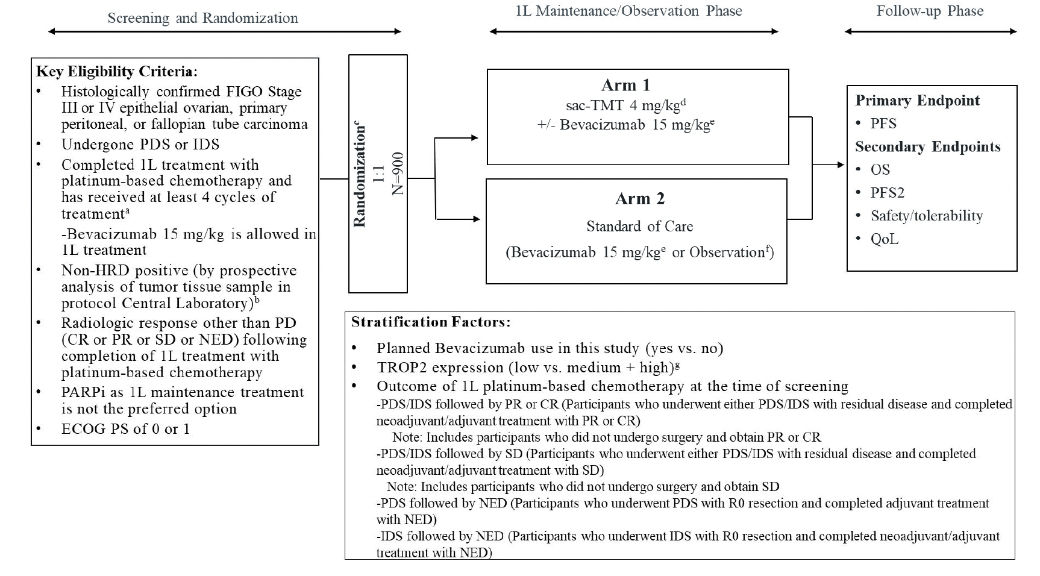
Phase 3 TROP2 ADC maintenance trial in Newly Diagnosed OvCa
TroFuse-021/​GOG-3102/​ENGOT-ov85 (NCT07318558): A clinical trial of sac-TMT in people with non-HRD positive advanced ovarian cancer

Slide 68
TROP2 ADCs in Development
Cervical Cancer

Slide 69
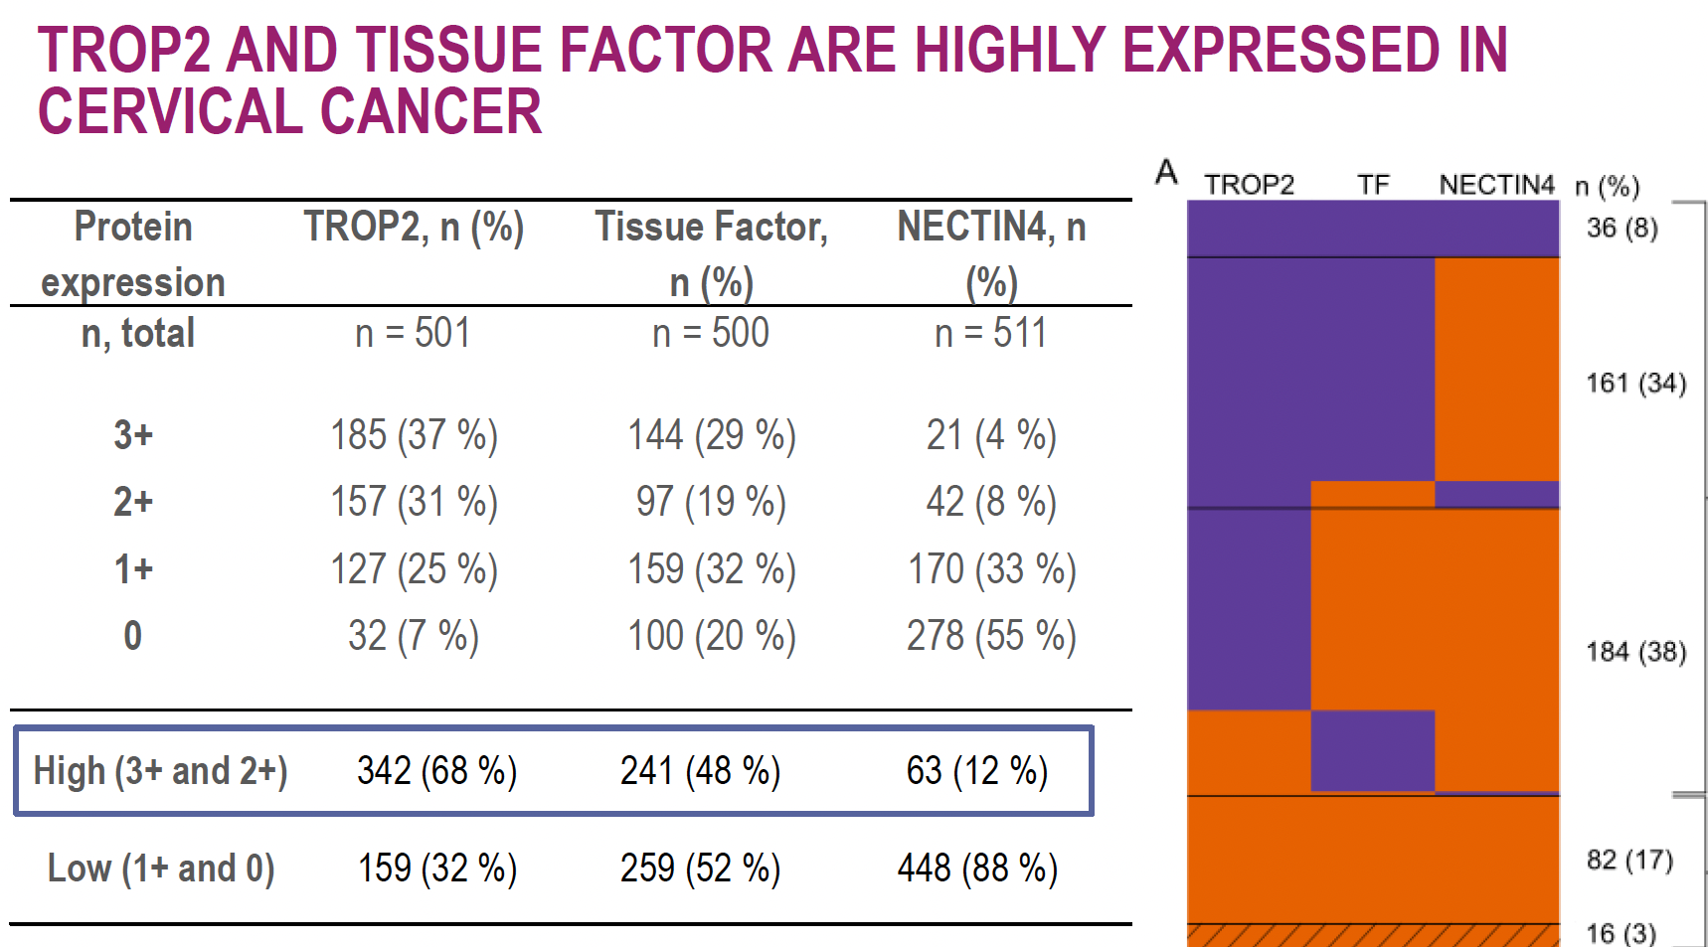
Target Antigen Expression in Cervical Cancer
PRIMARY AND MATCHED RECURRENT LESIONS
Level of high (2+, 3+) recurrent lesion expression:
•TROP2: 56%
•Tissue Factor: 46%
•NECTIN4: 35%
Level of concordance (low versus high) between primary and matched recurrent lesion:
•TROP2: 15/22 (68%)
•Tissue Factor: 20/22 (91%)
•NECTIN4: 15/22 (68%)
Halle et al. ESMO 2024

Slide 70
Preliminary TROP2 Targeting ADC Efficacy in Cervical Cancer
 | N | Trial | Prior Bevacizumab | Prior ICI | ORR | mDOR
SacTMT +pembrolizumab | 38 | NCT05642780 | 53% | 42% | 58% | NR
Sacituzumab govitecan | 18 | NCT05838521 | 61% | 78% | 50% | 9.2 mo
Considerations:
Relative contribution of pembrolizumab?
Context - Tisotumab vedotin:
ORR 17.8%
Prior Bev: 65% and Prior ICI: 28%

Slide 71
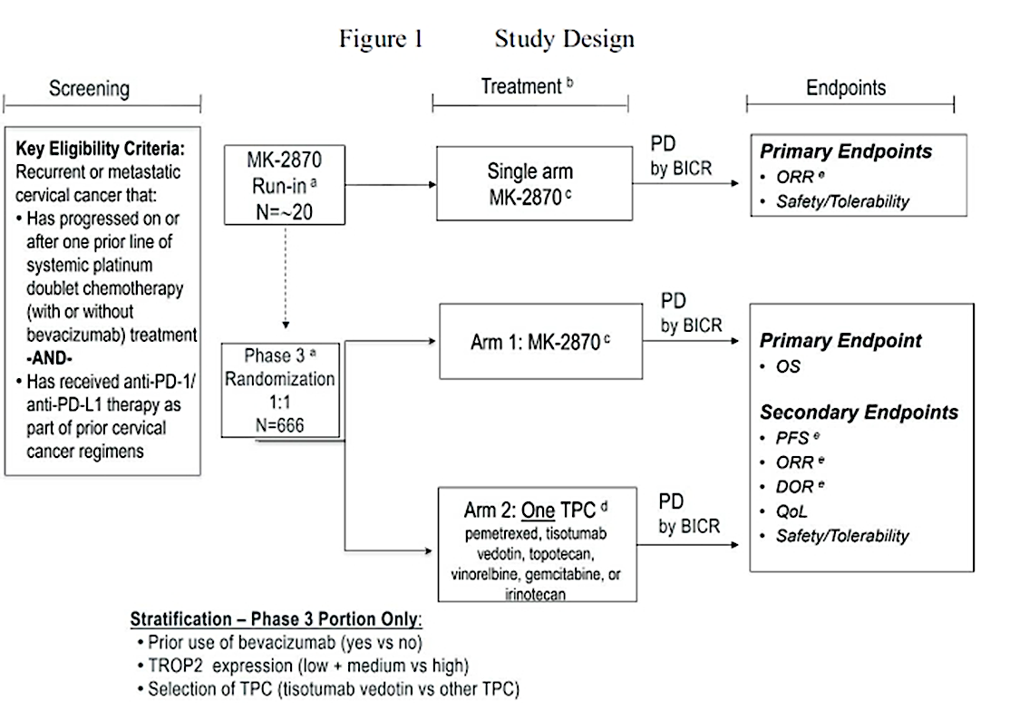
Phase 3 TROP2 ADC Trial in Recurrent Cervical Cancer
TroFuse-020/​GOG-3101/​ENGOT-cx20: A Phase 3 randomized , active-controlled, open-label, multicenter study to compare the efficacy and safety of MK-2870 monotherapy versus treatment of physician choice as second-line treatment for participants with recurrent or metastatic cervical cancer (NCT06459180).

Slide 72
Phase 3 TROP2 ADC Trial in Newly Diagnosed Advanced Stage, Metastatic and Recurrent Cervical Cancer
TroFuse-036/​GOG-3123/​ENGOT-cx22 (NCT07216703). Part 2
Screening for Enrollment
Key Eligibility Criteria for Enrollment:
Persistent, recurrent, or newly diagnosed metastatic cervical cancer that is not amenable to curative treatment
Histologically confirmed diagnosis of squamous cell carcinoma, adenosquamous carcinoma, or adenocarcinoma of cervix
Measurable disease
No prior systemic treatment, including prior IO
Prior radiation + radiosensitizing chemotherapy is allowed
PD-L1 CPS >1 per Central Laboratory
ECOG PS 0 to 1
Excluded if have received prior systemic anticancer therapy other than what is specified in this protocol
Induction ( 6 x 3-weeks cycles)
Arm A
Sac-TMT 4 mg/kg Q2W +
Pembrolizumab 400 mg Q6W
+/- Bevacizumab 15 mg/kg Q3W per investigator
Cisplatin 50 mg/m2 or Carboplatin AUC 5 mg/mL/min,
Paclitaxel 175 mg/m2,
Pembrolizumab 200 mg
+/- Bevacizumab 15 mg/kg per investigator
Q3W
Randomize
Arm B
Pembrolizumab 400 mg Q6W
+/- Bevacizumab 15 mg/kg Q3W per investigator

Slide 73
Sacituzumab Tirumotecan (Sac-TMT) plus Pembrolizumab Maintenance Therapy in Ovarian Cancer: Results from the Phase 2 2870-002/SKB264-II-06 Study
Wu X et al.
SGO 2026.
FOCUSED FORUM IX
MONDAY, APRIL 13, 2026
BALLROOM B
8:38 AM – 8:44 AM CDT

Slide 74
Sacituzumab Tirumotecan (Sac-TMT) plus Pembrolizumab in Participants with Recurrent or Metastatic Cervical Cancer: Results from the Phase 2 2870-002/SKB264-II-06 Study
Wu X et al.
SGO 2026.
SCIENTIFIC PLENARY V
MONDAY, APRIL 13, 2026
EXHIBIT HALL A
10:19 AM – 10:27 AM CDT

Slide 75
Remaining Questions/Considerations….
Optimal Sequencing
Duration of Therapy
TROP2 expression levels
  Predictive of response and what assay?
Is ADC after ADC viable in the gynecologic space?
  Relevance of antigenic target and payload
  Cross-resistance
AE education and mitigation strategies
Novel combinations

Slide 76
Conclusions
TROP2 is a validated and actionable target
ADC design informs efficacy and tolerability
The largest data set, currently, for TROP2 ADCs is in the endometrial cancer space
  2 completed phase 3 trials, in the recurrent setting, with results pending
Promising early signals in ovarian cancer and cervical cancer
Ongoing Phase 3 trials will define the future standard of care
Enroll!

Slide 77
Faculty Case Presentations

Slide 78
Dr Monk: EC After 1-L Immunotherapy
66 year old black American with stage 4B (no residual) uterine serous cancer (pMMR, HER2 1+, TP53 mut, ER -, POLE not tested)
Treated with carboplatin + paclitaxel + pembrolizumab (KN-868, GY-018) and recurred in the peritoneum 9 months into maintenance.
Is this pt appropriate for a TROP2 targeted ADC?

Slide 79
QUESTIONS FOR THE FACULTY
What would you most likely recommend next for this patient outside of a clinical trial, and what outcomes would you expect? Is this patient an appropriate candidate for a clinical trial of a TROP2-targeted ADC?

Slide 80
QUESTIONS FOR THE FACULTY
Have any of the TROP2-targeted ADCs that have been evaluated in endometrial cancer — sacituzumab govitecan, datopotamab deruxtecan (Dato-DXd) or sacituzumab tirumotecan (sac-TMT) — stood out as relatively efficacious compared to the others? If this patient were interested in a clinical trial of a TROP2-targeted ADC and asked you to estimate the likelihood that she would experience a meaningful response to treatment, how would you respond?

Slide 81
QUESTIONS FOR THE FACULTY
Do you believe TROP2-directed ADCs will eventually have a role in the management of advanced endometrial cancer? If so, where will they most likely fall in the treatment sequence? Do you anticipate that they’ll be reserved for later-line use after disease progression on up-front chemoimmunotherapy? Based on the experience in breast cancer, do you think that TROP2-directed ADCs might eventually replace standard chemotherapy as the partner for anti-PD-1/PD-L1 antibodies in the up-front setting?

Slide 82
QUESTIONS FOR THE FACULTY
If multiple TROP2-directed ADCs were to reach the clinic in advanced endometrial cancer, would you attempt to administer more than one of them to the same patient in sequence?
Do you believe TROP2-directed ADCs will eventually have a role in the management of advanced cervical cancer and, if so, in what setting(s)? Given the relatively low response rates with tisotumab vedotin, do you think TROP2-targeted ADCs have the potential to supplant it as second-line therapy?

Slide 83
Dr Moore: Patient presentation
72 year-old female h/o Stage IIIC high grade serous ovarian cancer in 2019
Treated with NACT with paclitaxel and carboplatin and bevacizumab followed by bevacizumab maintenance x 1 year
BRCAwt/HRD test +
Recurred 24 months after last platinum with liver mets
Carboplatin and PLD x 6 cycles with PR. Maintenance Olaparib x 12 months with PD
Carboplatin x 4 with PD
Biomarkers: BRCAwt/HRD+/FRα med/ HER2 2+/ TP53 Y220C/HLA 0201
SOC: No biomarker linked FDA approved medications
NCCN: FRα expression links to MIRV + BEV, HER2 2+ links to TDXd
Trials: TP53 Y220C links to rezatapopt
Work up
Imaging with liver metastases, no bowel obstruction, no ascites
PS = 1
  What additional testing do you order? What are you looking for?

Slide 84
Dr Moore: Patient presentation
72 year-old female h/o Stage IIIC high grade serous ovarian cancer in 2019
Treated with NACT with paclitaxel and carboplatin and bevacizumab followed by bevacizumab maintenance x 1 year
BRCAwt/HRD test +
Recurred 24 months after last platinum with liver mets
Carboplatin and PLD x 6 cycles with PR. Maintenance Olaparib x 12 months with PD
Carboplatin x 4 with PD
Biomarkers: BRCAwt/HRD+/FRα med/ HER2 2+/ TP53 Y220C/HLA 0201
SOC: No biomarker linked FDA approved medications
NCCN: FRα expression links to MIRV + BEV, HER2 2+ links to TDXd
Trials: TP53 Y220C links to rezatapopt
Work up
Imaging with liver metastases, no bowel obstruction, no ascites
PS = 1
What are your considerations for therapy?
3 prior lines
Prior Bevacizumab & PARPi
Progressed on platinum and on PARPi
  What additional testing do you order? What are you looking for?

Slide 85
QUESTIONS FOR THE FACULTY
Do you believe TROP2-directed ADCs will eventually have a role in the management of advanced ovarian cancer? In your experience, are these agents more or less effective in any particular histologic subtypes (serous, clear cell, mucinous, etc)? Where do you think they are most likely to be used, and how might this vary based on biomarker profile and eligibility for other targeted treatments?

Slide 86
QUESTIONS FOR THE FACULTY
If TROP2-targeted ADCs were to become available in the maintenance setting for patients with newly diagnosed or platinum-sensitive recurrent ovarian cancer, how long do you envision continuing them — until disease progression or unacceptable toxicity or for a finite duration?
If ADCs with four different targets — FRα, HER2, CDH6 and TROP2 — were to eventually become available in advanced ovarian cancer, would you have any hesitation about administering them all in sequence to a patient who was eligible?

Slide 87
QUESTIONS FOR THE FACULTY
Given that sacituzumab govitecan and Dato-DXd are already available in other tumor types, would you try to access either one of them outside of a clinical trial for a patient with advanced endometrial, ovarian or cervical cancer who had exhausted other available therapies? If so, in which specific scenarios would you be most likely to attempt this?
Beyond CDH6 and TROP2, what other novel targets for ADCs are you excited about in advanced gynecologic cancers?

Slide 88
Agenda
Module 1: Advances in Human Cadherin-6-Targeted Antibody-Drug Conjugates (ADCs) in Ovarian and Other Gynecologic Cancers — Dr Moore
Module 2: Leveraging TROP2-Directed ADCs in Advanced Gynecologic Cancers — Prof Eskander
Module 3: Tolerability and Other Practical Considerations with Novel Investigational ADCs in Advanced Gynecologic Cancers — Dr Monk

Slide 89
ADCs in Gynecologic Cancers
HOPE VERSUS HYPE
Bradley J. Monk, MD FACOG FACS
Florida Cancer Specialists and Research Institute
West Palm Beach, FL 33401 USA
Professor at University of Central Florida College of Medicine
Vice President and Member Board of Directors GOG-Foundation
Director GOG-Partners

Slide 90
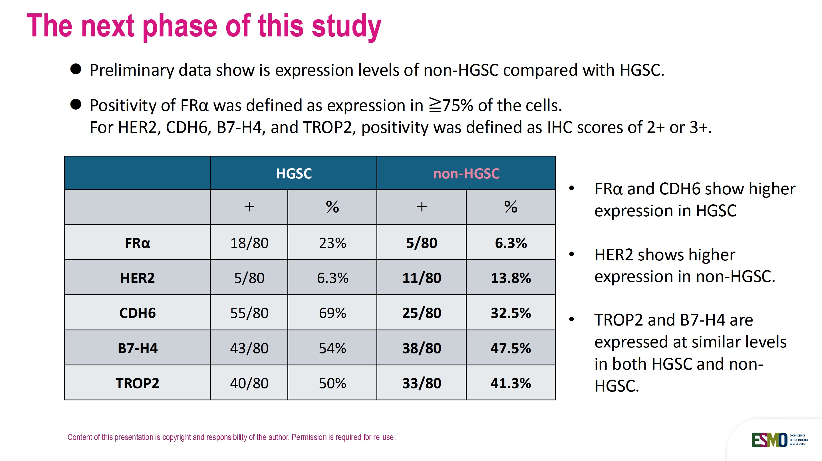
Biomarker Expression Differences Between HGSC and Non-HGSC
HGSC = high-grade serous carcinoma
Hamagawa K et al. ESMO Gyn 2025;Abstract 71O.

Slide 91
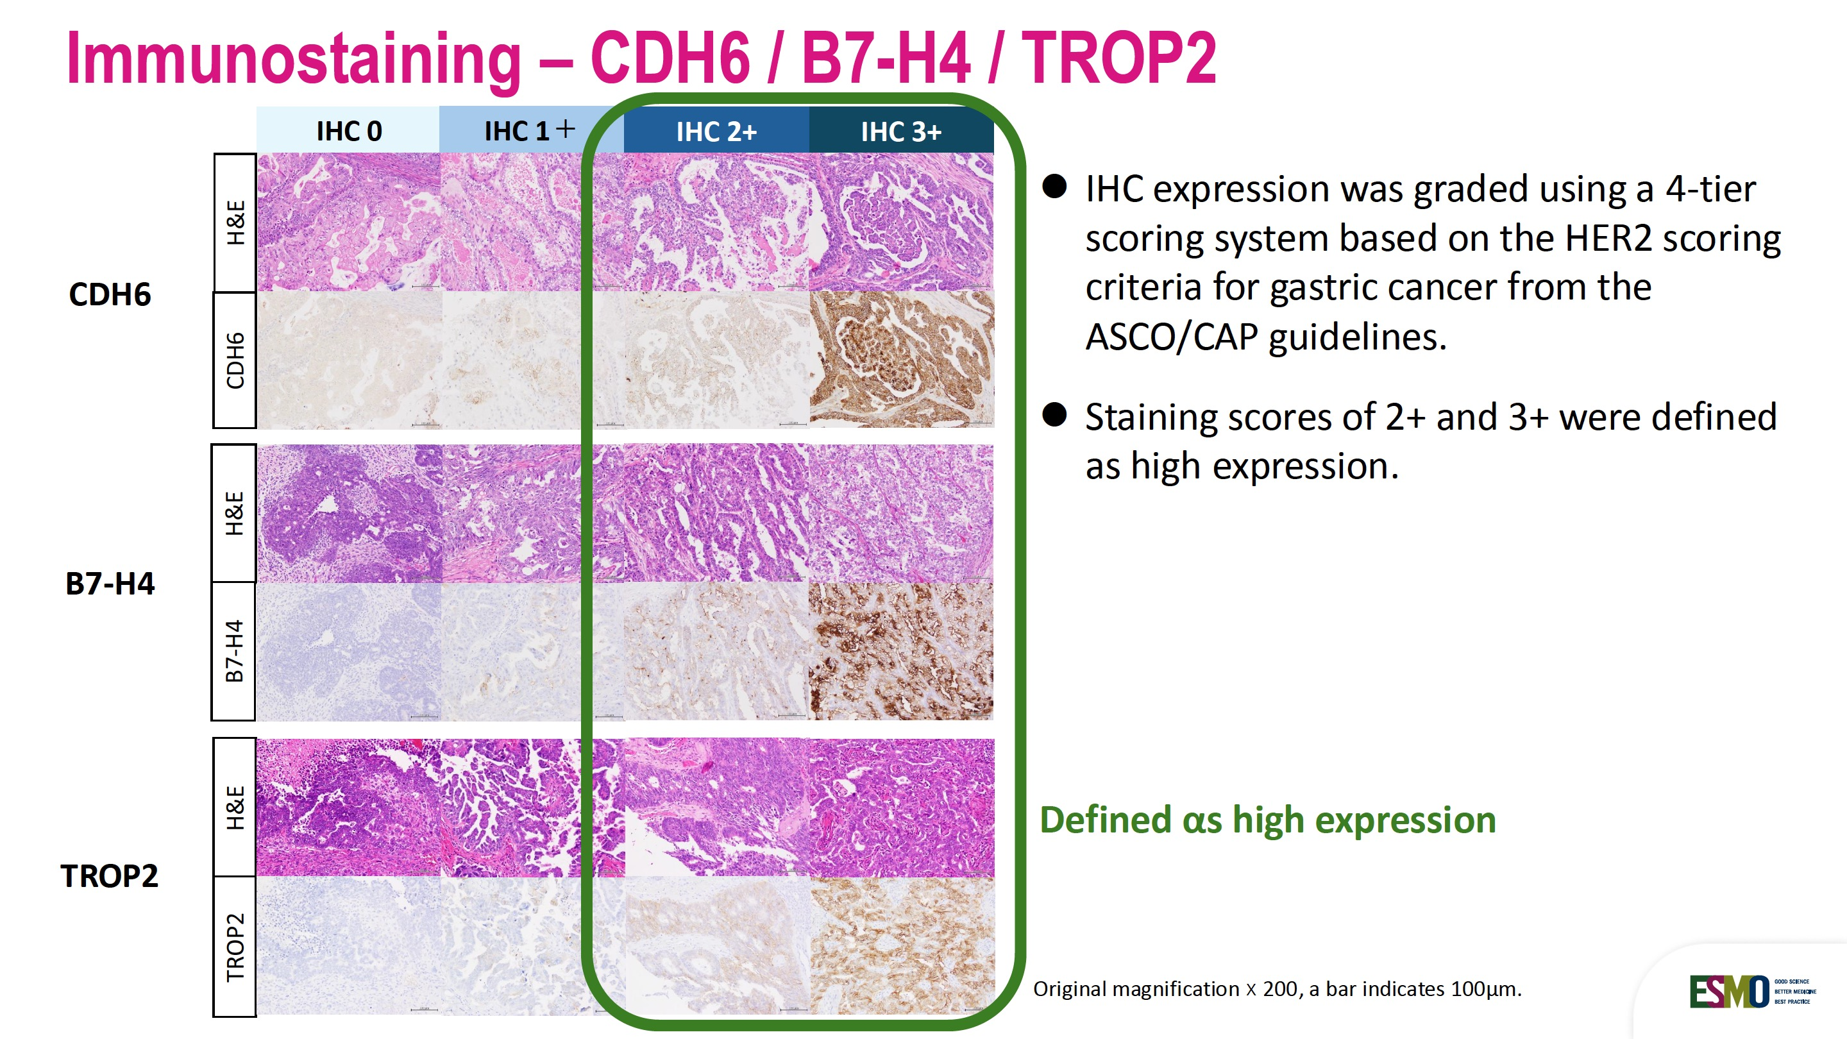
CDH6, B7-H4 and TROP2 in High-Grade Serous Carcinoma
For CDH6, B7-H4, and TROP2, there is no standardized method to evaluate target expression.
Hamagawa K et al. ESMO Gyn 2025;Abstract 71O.

Slide 92
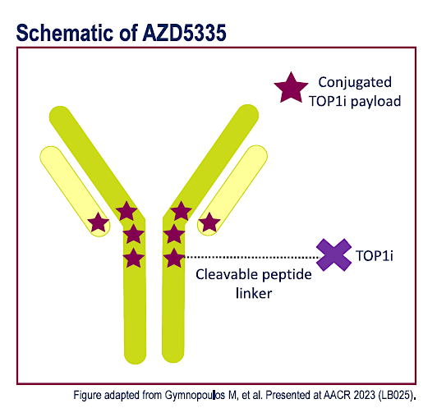
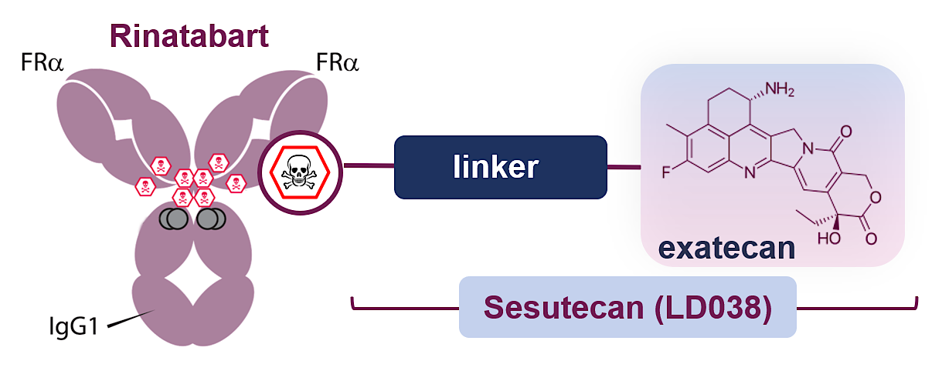
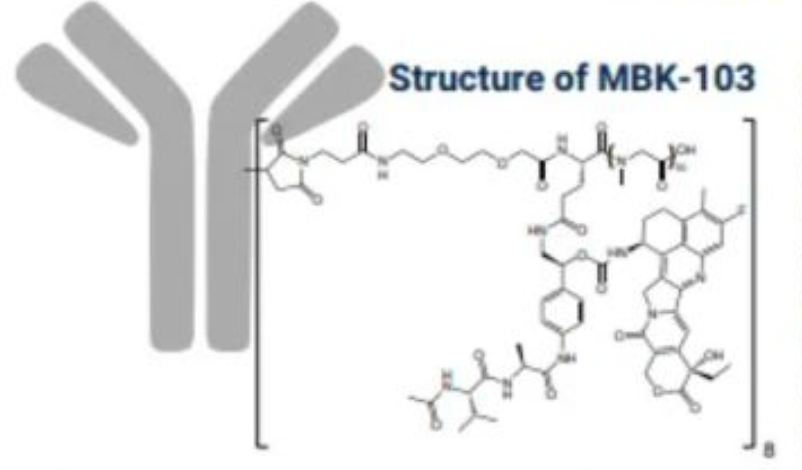
Targeting the Folate Receptor
Rinatabart sesutecan (Rina-S) #
Sofetabart mipitecan *
(LY4170156 / MBK-102)
Torvutatug samrotecan (AZD5335)
Fc-silenced FRα IgG1 that binds at low nm affinities
Polysaccharide hydrophobic linker with a high DAR (8) Cleavable linker
Proprietary orthogonally embedded dipeptide (VAL-Ala)
Exatecan payload (topoisomerase inhibitor)
A human monoclonal antibody directed at FRα
A novel hydrophilic protease-cleavable linker
DNA-damaging agents: Exatecan payload (topoisomerase inhibitor)
Rina-S features a high, homogenous DAR=8
Targeted ADC with a potent TOP1i payload
The cleavable peptide linker is
bystander-capable and serum-stable.
AZD5335 has an average DAR of 8.
* Breakthrough Therapy designation for the treatment of certain patients with platinum-resistant ovarian
# Breakthrough Therapy designation in advanced endometrial cancer
FDA.gov

Slide 93
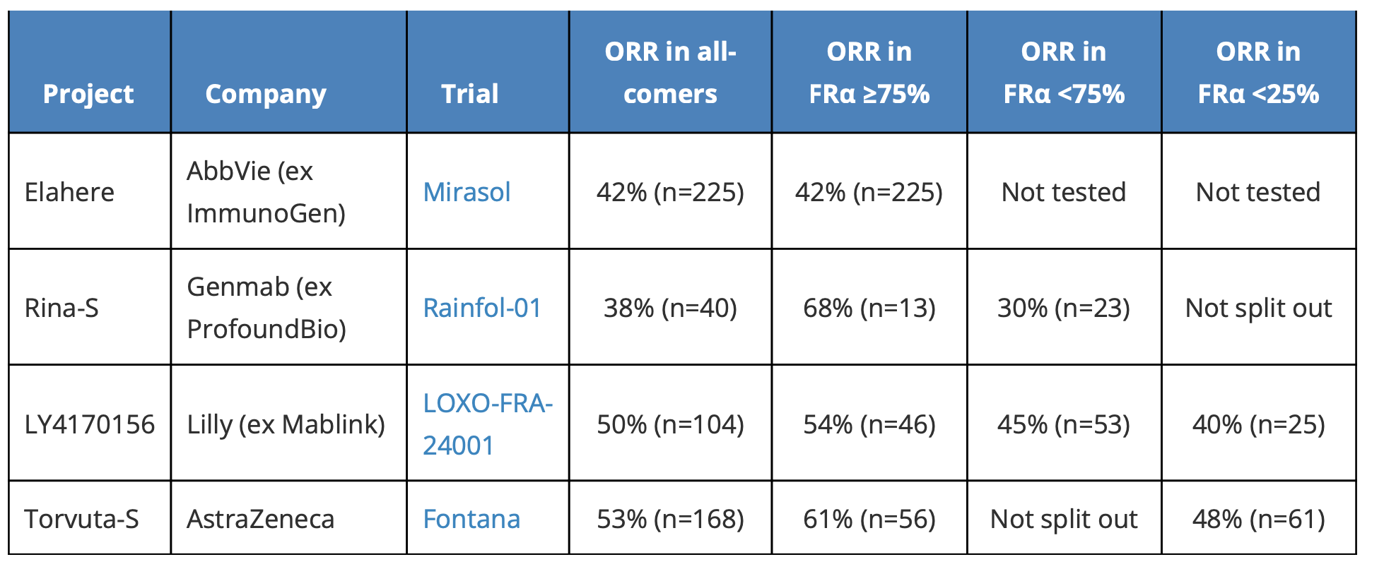
Inferential Cross-trial Comparisons for
Anti-FRα ADCs in OC
Mirv
Sofe-M
Source: OncologyPipeline.

Slide 94
Trastuzumab Deruxtecan (T-DXd): ADC targeting Her2
T-DXd is an ADC with three components:
A humanized anti-HER2 IgG1 mAb with the same amino acid sequence as trastuzumab
A topoisomerase I inhibitor payload, an exatecan derivative
A tetrapeptide-based cleavable linker
Seven Key Attributes^{a,1–5}
Payload mechanism of action: topoisomerase I inhibitor
High potency of payload
High drug-to-antibody ratio ≈8
Payload with short systemic half-life
Stable linker payload
Tumor-selective cleavable linker
Bystander antitumor effect
Humanized anti-HER2
IgG1 mAb^{1–3}
Deruxtecan^{1,2}
Cleavable tetrapeptide-based linker
Topoisomerase I inhibitor payload
(DXd=DX-8951f derivative)
ªThe clinical relevance of these features is under investigation.
ADC, antibody–drug conjugate; HER2, human epidermal growth factor receptor 2; IgG1, immunoglobulin G1; mAb, monoclonal antibody; T-DXd, trastuzumab deruxtecan.
1. Nakada T, et al. Chem Pharm Bull (Tokyo). 2019;67(3):173–185. 2. Ogitani Y, et al. Clin Cancer Res. 2016;22(20):5097–5108. 3. Trail PA, et al. Pharmacol Ther. 2018;181:126–142.
4. Okamoto H, et al. Xenobiotica. 2020;50(10):1242–1250. 5. Nagai Y, et al. Xenobiotica. 2019;49(9):1086–1096.

Slide 95
DESTINY-PanTumor02:
T-DXd for HER2-expressing solid tumors
A Phase 2, open-label, multicenter study (NCT04482309)
Key eligibility criteria
T-DXd 5.4 mg/kg Q3W
Endometrial
Advanced solid tumors not eligible for
curative therapy
Second-line plus patient population
HER2 expression (IHC 3+ or 2+)
  Local test or central test by HercepTest
  if local test not feasible (ASCO/CAP gastric cancer scoring¹)*
  Cervical cohort was expanded to include
  five IHC 1+ patients
Prior HER2-targeting therapy allowed
ECOG/WHO PS 0–1
n≈40 per cohort†
Cervical
Primary endpoint
Confirmed ORR (investigator)
Secondary endpoints
DOR, DCR, PFS, OS
Safety
Exploratory analysis
Subgroup analyses by HER2 status
Primary analysis DCO:
June 8, 2023
Ovarian
Bladder
Other tumors‡
Biliary tract
Pancreatic
*Patients were eligible for either test. All patients were centrally tested; †planned recruitment; cohorts with no objective responses in the first 15 patients were to be closed; ‡patients with tumors that express HER2, excluding tumors in the tumor-specific cohorts, and breast cancer, non-small cell lung cancer, gastric cancer, and colorectal cancer
ASCO, American Society of Clinical Oncology; CAP, College of American Pathologists; DCO, data cutoff; DCR, disease control rate; DOR, duration of response; ECOG, Eastern Cooperative Oncology Group; HER2, human epidermal growth factor receptor 2; IHC, immunohistochemistry; ORR, objective response rate; OS, overall survival; PFS, progression-free survival; PS, performance status;
Q3W, every 3 weeks; T-DXd, trastuzumab deruxtecan; WHO, World Health Organization
1. Hofmann M, et al. Histopathology. 2008;52:797–805
Presented by Funda Meric-Bernstam et al at ASCO Meeting 2023 and ESMO 2023; Presented by JungYun Lee et al at IGCS 2023

Slide 96
ORR and DOR (INV)*
Endometrial cancer
Cervical cancer
Ovarian cancer
Confirmed ORR by INV (%)
All
IHC 3+
IHC 2+
IHC 1+
IHC 0
IHC unknown
All
IHC 3+
IHC 2+
IHC 1+
IHC 0
All
IHC 3+
IHC 2+
IHC 1+
IHC 0
Total n in subgroup | 40 | 13 | 17 | 4 | 5 | 1
n of responders | 23 | 11 | 8 | 1 | 3 | 0
Median DOR, months† | NR | NR | 18.2 | NR | 9.9 | -
95% CI‡ | 9.9, NE | 9.6, NE | 3.0, NE | - | 2.8, NE | -
40 | 8 | 20 | 8 | 4
20 | 6 | 8 | 4 | 2
14.2 | NR | 3.8 | 14.2 | NR
4.1, NE | 9.3, NE | 2.8, NE | 8.3, NE | 6.8, NE
40 | 11 | 19 | 5 | 5
18 | 7 | 7 | 1 | 3
11.3 | 22.1 | 11.3 | 8.3 | 4.5
4.1, 22.1 | 4.2, NE | 2.8, NE | - | 2.6, NE
HER2 status by central testing
*Similar ORR and DOR results were reported by retrospective independent central review; †median DOR reported for patients with a confirmed and objective response only; ‡CI not shown where n=1 responder
CI, confidence interval; DOR, duration of response; HER2, human epidermal growth factor receptor 2; IHC, immunohistochemistry; INV, investigator; NE, not evaluable; NR, not reached; ORR, objective response rate
Presented by Jung-Yun Lee et al at IGCS 2023

Slide 97
Toxicities Associated with ADCs: Approaches to Monitor and Manage
General principles:
TRAEs are mostly related to linker-payload and independent of target (e.g. Vedotin and Deruxtecan)
  Distinct differences between tubulin inhibitor payloads (Peripheral neuropathy) versus topoisomerase inhibitor payloads (Gastrointestinal and Heme)
  Exception: Some targets have unique expression in normal tissue (TROP2 and oral mucosa)
  Unique TRAEs include ocular and pneumonitis
TRAEs: Treatment Related Adverse Events
Cross trial comparisons are misleading and inappropriate

Slide 98
AE Profiles of ADCs Using Deruxtecan Linker-Payload
Approved HER2-directed ADC | Common adverse events (any grades) | Common grade ≥3 adverse events
Trastuzumab deruxtecan | GI (nausea, vomiting, diarrhea, constipation) Cytopenia (neutropenia, anemia, leukopenia, thrombocytopenia) Fatigue Alopecia Decreased appetite | Neutropenia Anemia Nausea Leukopenia Lymphopenia Fatigue
ADC = antibody-drug conjugate; AE = adverse event; GI = gastrointestinal.
Adapted from Nguyen TD, et al. Cancers (Basel). 2023;15:713.

Slide 99
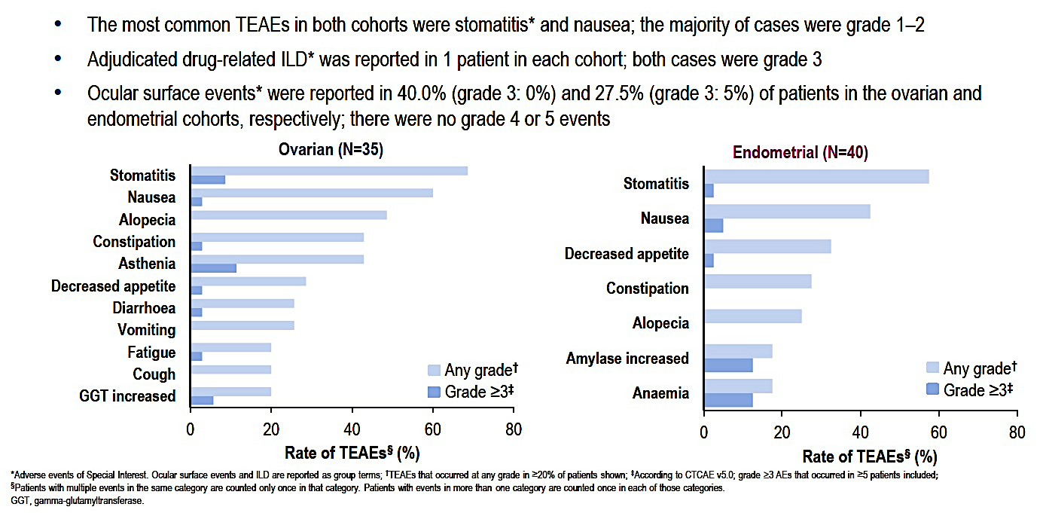
TROPION-PanTumor03 Trial: Safety Data with Datopotamab Deruxtecan
Oaknin A et al. ESMO 2024;Abstract 714MO.

Slide 100



Deruxtecan Linker-Payload Related Adverse Events Management
Anemia/neutropenia/thrombocytopenia
  Dose reductions or delays
  Transfusion
  G-CSF for prevention and/or management of neutropenia
Left ventricular dysfunction
  Only for T-DXd
Nausea/vomiting
  High emetic risk
  Initiate tailored prophylactic antiemetic regimens (3 agents) before T-DXd infusion
Diarrhea
  Infectious workup
  Loperamide/fluid/electrolyte
  Atropine for severe diarrhea with cholinergic syndrome
Fatigue
  Listen/ask/counsel
  Consider holds/reductions
  Rule out other causes
  Encourage exercise/staying active
Alopecia
  Patient counseling/education
  Wig prescription
  Scalp cooling clinical trials ongoing (eg, NCT04986579)
G-CSF = granulocyte colony-stimulating factor; LVEF = left ventricular ejection fraction; RBC = red blood cell; T-DXd = trastuzumab deruxtecan.
Rugo HS, et al. ESMO Open. 2022;7:100553. NCCN Guidelines. Antiemesis v2.2024 (https://www.nccn.org/professionals/physician_gls/pdf/antiemesis.pdf). Accessed 11/8/2024.

Slide 101
T-DXd and R-DXd Dose Modifications
Toxicities treated maximum supportive care (including withholding agent as needed)
At resolution of toxicity with supportive care, consider continuing the same dose with appropriate supportive care
Dose modifications as needed
After dose reduction, subsequent cycles should be given at lower dose level unless further dose reduction is required
Discontinue therapy if unacceptable toxicity occurs after 2 dose reductions
Starting dose | First reduction | Second reduction
T- DXd 5.4 mg/kg | 4.4 mg/kg | 3.2 mg/kg
R- DXd 6.4 mg/kg | 5.6 mg/kg | 4.8 mg/kg
Meric-Bernstam F, et al. J Clin Oncol. 2024;42:47-58 including supplementary materials.

Slide 102
Interstitial Lung Disease: Recognition and Management
Advise patients of risks of ILD prior to start of treatment, as well as signs/symptoms of ILD
Monitor for new or worsening cough, dyspnea, or fever
If ILD is suspected…
Exclude other etiologies, including infectious etiologies
Initiate evaluation without delay, which may include
  High-resolution CT
  Consultation with pulmonologist
  Blood culture and CBC
  Additional tests,
  as clinically indicated
Grade 1 (asymptomatic)
Hold T-DXd until resolved
May resume treatment once fully resolved
Consider starting systemic steroids (eg, 0.5 mg/kg/day of prednisone or equivalent) until improvement, followed by gradual taper over 4 weeks
If >28 days to resolve, reduce dose by
1 dose level
Grade 2+ (symptomatic)
Discontinue T-DXd permanently
Begin steroid treatment (eg, prednisone
≥1 mg/kg daily) with gradual taper
Incidental findings on routine scan
Symptomatic findings
CBC = complete blood (cell) count; CT = computed tomography; ILD = interstitial lung disease; T-DXd = fam-trastuzumab deruxtecan-nxki.
Fam-trastuzumab deruxtecan-nxki (Enhertu®) prescribing information (PI) 2024 (https://daiichisankyo.us/prescribing-information-portlet/getPIContent?productName=Enhertu&inline=true). Accessed 11/8/2024. Swain SM, et al. Cancer Treat Rev. 2022;106:102378.

Slide 103
Strategies to Manage ILD/Pneumonitis
Monitor
Confirm
Manage
Suspected ILD
Assessments should include
High-resolution CT
Pulmonologist consult; if indicated, ID consult
Blood culture and CBC; other blood tests
as needed
Consider bronchoscopy and BAL if indicated and feasible
PFTs and pulse oximetry
Arterial blood gases, if indicated
As soon as ILD suspected, collect 1 blood sample for PK assessment, if feasible
Rule out other causes of ILD (eg, progression, infection, other drugs, radiotherapy)
All ILD events should be followed until resolution and after drug discontinuation
Grade 1 T-DXd: Hold until resolved to
grade 0; consider corticosteroids
(0.5 mg/kg/day prednisolone), then
  If resolved ≤28 days from onset:
  Maintain dose
  If resolved >28 days after onset:
  Reduce dose by 1 level
  -Taper steroid over at least 4 weeks
Grades 2–4: Permanently discontinue treatment and promptly initiate systemic corticosteroid treatment (eg, ≥1 mg/kg/ day prednisolone or equivalent) for ≥14 days followed by taper for ≥4 weeks
Urge patients to immediately report cough, dyspnea, fever, and/or new or worsening pulmonary symptoms
Monitor patients for signs/symptoms of ILD
Promptly investigate
evidence of ILD
Evaluate patients with suspected ILD by radiographic imaging and assess as follows
BAL = bronchoalveolar lavage; ID = infectious disease; PFTs = pulmonary function tests; PK = pharmcokinetics.
Ado-trastuzumab emtansine (Kadcyla®) PI 2022 (https://www.kadcyla.com/). Fam-trastuzumab deruxtecan-nxki (Enhertu®) PI 2024 (https://daiichisankyo.us/prescribing-information-portlet/getPIContent?productName=Enhertu& inline=true). URLs accessed 11/8/2024. Tarantino P, et al. JAMA Oncol. 2021;7:1873-1881.
Notes:
49

Slide 104
Strategies to Manage Grade 2 to 4 ILD/Pneumonitis
Grade 2
Grade 3 or 4
Promptly start systemic glucocorticoids (eg, ≥1 mg/kg/d prednisone or equivalent) for ≥2 weeks or to complete resolution of clinical and chest CT findings, then gradual taper over ≥4 weeks
Monitor symptoms closely
Re-image as indicated
If clinical or diagnostic observations worsen or do not improve in 5 days
  Consider increase in steroid dose (eg, 2 mg/kg/day prednisone or equivalent) or switch to intravenous (IV)
  Reconsider additional workup for alternative etiologies
  Escalate care as needed
Hospitalization required
Promptly initiate empirical high-dose methylprednisolone IV (eg, 500–1000 mg/day for 3 days), followed by ≥1 mg/kg/ day prednisone (or equivalent) for ≥2 weeks until resolution of clinical and chest CT findings, then gradual taper over ≥4 weeks
Re-image as clinically indicated
If still no improvement with 3 to 5 days
  Reconsider additional workup for alternative etiologies
  Consider other immunosuppressants and/or treat per local practice
Li BT, et al. N Engl J Med. 2022;386:241-251 (Protocol).
Notes:
50

Slide 105
ILD/Pneumonitis Associated With T-DXd
Adjudicated drug-related
ILD/pneumonitis
87.0% had their first event within 12 months
  Median: 5.4 months
  Range: <0.1–46.8 months
Median time to onset
Most patients with ILD/pneumonitis experienced low-grade events (grade 1 or 2, 77.4%)
Overall rate of fatal events: 2.2%
10-15% of patients receiving T-DXd
5 to 6 months
Powell CA, et al. ESMO Open. 2022;7:100554.

Slide 106






5 “S” Rules
Screen
Scan
Synergy
Suspend treatment
Steroids
Careful patient selection before initiating T-DXd to optimize the monitoring strategies based on the baseline risk; screening continues during treatment, with regular assessments to exclude signs/symptoms
of ILD
Increased knowledge is needed on the impact of prior ILD with other treatments (eg, everolimus, CDK4/6 inhibitors)
The fundamental diagnostic tools for ILD remain radiological scans, with preference for high-resolution CT scans of the chest; a baseline scan is recommended, with repeat scans to be performed every 6 to 12 weeks
Minimizing the risk of ILD involves teamwork, which includes educating patients and all the care team, as well as multidisciplinary management once ILD is suspected
  Improved synergy with pulmonologists during T-DXd treatment is being explored in several studies
  Evaluate the predictive/ prognostic role of monitoring pulmonary function tests
T-DXd should always be interrupted if ILD is suspected; it can only be restarted in the case of asymptomatic ILD that fully resolves
The mainstay for treating
T-DXd–induced ILD remains corticosteroids, with the dose to be adapted to the toxicity grade
Tarantino P, Tolaney SM. J Oncol Practice. 2023;19:526-527.

Slide 107

T-DXd: Infusion-Related Reactions
Infusion-related reactions are a clinically relevant risk that can be effectively managed with proper preparation!
Prompt recognition and treatment are important for reducing the risk of severe symptoms
  Signs of T-DXd-related IRRs include fever and chills, N/V, pain, headache, dizziness, dyspnea, and/or hypotension
Keep resources to treat IRR readily on hand
Suspected anaphylaxis: Follow local management guidelines (eg, epinephrine (1 mg/mL IM every 5–15 minutes); normal saline (1–2 L at 5–10 ml/kg for first 5 minutes IV); H1/H2 antagonists
Infusion 1
90 minutes
Subsequent infusions
30 minutes
1% to 3% of patients
receiving T-DXd
experience an
IRR with
T-DXd 5.4 mg/kg.
If well tolerated
Grade 1: ⬇ Reduce infusion rate to 50%
Grade 2:  Temporarily stop infusion
Grade 3 or 4: Permanently stop
IRR
Rugo HS, et al. ESMO Open. 2022;7:100553. Fam-trastuzumab deruxtecan-nxki (Enhertu®) PI 2024 (https://daiichisankyo.us/prescribing-information-portlet/getPIContent?productName=Enhertu&inline=true). Accessed 11/8/2024.
IRR = infusion-related reaction; N/V = nausea and/or vomiting.

Slide 108
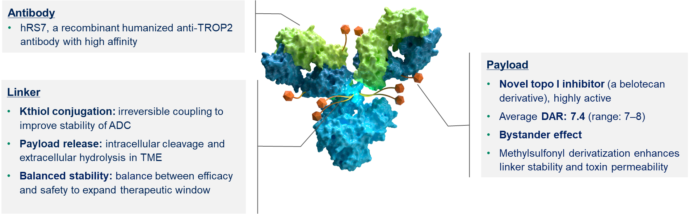
Targeting TROP2
Sacituzumab tirumotecan (sac-TMT)
Sacituzumab Govitecan (sac-G)
HO
N
O
N
O
O
Xu B et al. Presented at: American Society of Clinical Oncology Annual Meeting; 31 May – 4 June 2024; Chicago, IL. Abstract 104
H
H
O
O
(1)
O
[
O
]
N
O
Lys-N
CH₂O
7
O
O
N
N
Linker for SN-38
High drug-to-antibody ratio (7.6:1)
pH-sensitive linker for rapid release of payload at or inside tumor
N
O
H
O
N
N
S
Anti-Trop-2 IgG
O
Irinotecan (Topoisomerase Inhibitor)
Humanized RS7 Antibody
Targets Trop-2, an antigen expressed in many epithelial cancers, including mTNBC (88%)
Antibody type: h-IgG1
O
OH
SN-38 Payload
Targets 136-fold more than parent compound irinotecan
Unique chemistry improves solubility, selectively delivers
SN-38 to tumor
O
N
(2)
O
N
O
O
N
(1)
N
SN-38
Khoury. ASCO 2019. Abstr e14651. Bardia. JCO. 2017;35:2141.

Slide 109
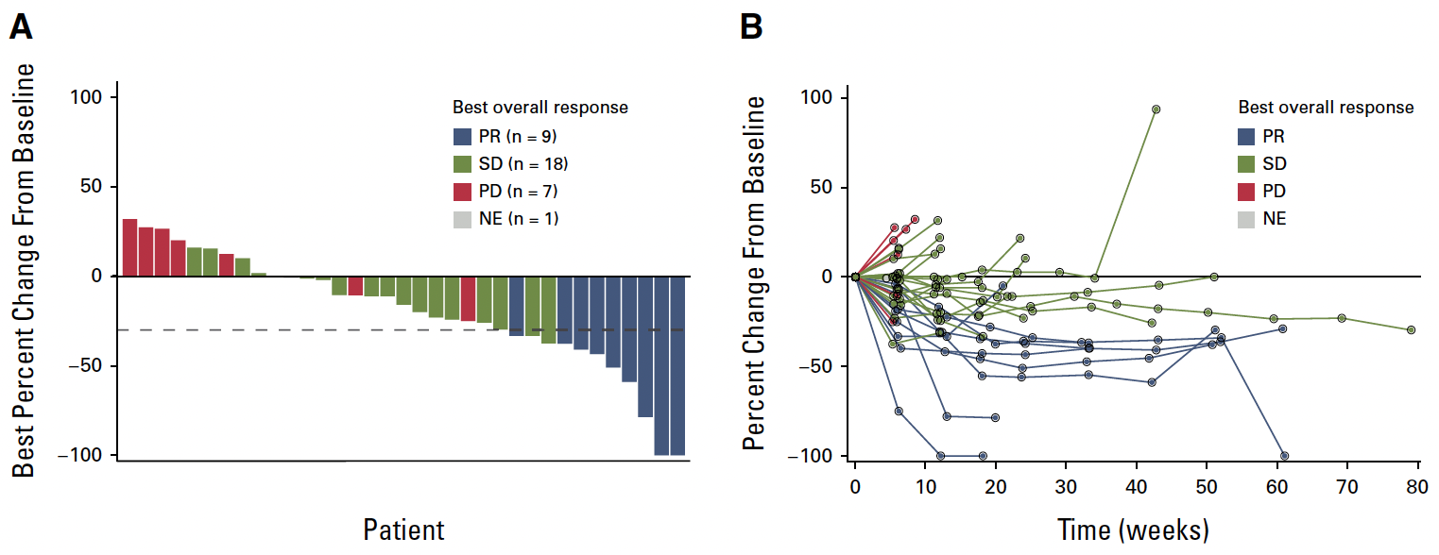
Efficacy and Safety of Sacituzumab Govitecan in Patients With Advanced Solid Tumors (TROPiCS-03): Analysis in Patients With Advanced Endometrial Cancer
10 mg/kg of SG via intravenous infusion once on day 1 and day 8 of a 21-day cycle
Not NCCN recommended
Santin AD et al J Clin Oncol . 2024 Oct 10;42(29):3421-3429.

Slide 110
Sacituzumab tirumotecan (sac-TMT)
Components of sac-TMT²
Sac-TMT employs the same anti–TROP2 antibody as SG, hRS7^{1,2}
Linker was designed to have higher stability than SG¹
Novel Topo 1 inhibitor payload (belotecan) with similar activity to SN-38 (the payload for SG) ¹
Figure used with permission from: Xu et al. 2024.
Sac-TMT is an investigational ADC being evaluated in late-stage clinical trials for various cancers^{3–8}
Sac-TMT showed encouraging antitumor activity and manageable toxicity in phase 1/2 studies of patients with solid tumors,^{9,10} and demonstrated statistically significant and clinically meaningful improvements in both PFS and OS vs chemotherapy in the phase 3 OptiTROP-Breast01 study in recurrent or metastatic TNBC² and in the phase 3 OptiTROP-Lung04 in EGFRm lung cancer¹¹
ADC, antibody–drug conjugate; DAR, drug-to-antibody ratio; OS, overall survival; PFS, progression-free survival; sac-TMT, sacituzumab tirumotecan; SG, sacituzumab govitecan; Topo I, topoisomerase I; TME, tumor microenvironment; TNBC, triple-negative breast cancer;
TROP2, trophoblast cell-surface antigen 2.
1. Cheng Y et al. Front Oncol. 2022;12:951589. 2. Xu B et al. Presented at: American Society of Clinical Oncology Annual Meeting; 31 May – 4 June 2024; Chicago, IL. Abstract 104. 3. ClinicalTrials.gov. https://clinicaltrials.gov/study/NCT06074588. Accessed: 5 July 2024. 4. Clinicaltrials.gov. https://clinicaltrials.gov/study/NCT06132958. Accessed: 5 July 2024. 5. Clinicaltrials.gov. https://clinicaltrials.gov/study/NCT06356311. Accessed: 5 July 2024. 6. Clinicaltrials.gov. https://clinicaltrials.gov/study/NCT06312176. Accessed: 5 July 2024. 7. Clinicaltrials.gov. https://clinicaltrials.gov/study/NCT06393374. Accessed: 5 July 2024. 8. Clinicaltrials.gov. https://clinicaltrials.gov/study/NCT06459180. Accessed: 5 July 2024. 9. Yin Y et al. Presented at: San Antonio Breast Cancer Symposium; 5–9 December 2023; San Antonio, TX.
Abstract PSO8-08. 10. Fang W et al. Presented at: American Society of Clinical Oncology Annual Meeting; 2–6 June 2023; Chicago, IL. Abstract 8520. ¹¹ Fang et al NEJM 2025; DOI: 10.1056/NEJMoa2512071

Slide 111
sac-TMT – Basket Study Including EC Cohort
Preliminary efficacy and safety results for endometrial cancer is available from the sac-TMT Phase 2 basket study (MK2870-001, NCT04152499).
In the EC cohort, patients with advanced EC were enrolled:
  Initial cohort was treated at 5 mg/kg monotherapy
  Additional pts were treated at 4 mg/kg monotherapy
Cohort 8: Advanced EC (n=100)
Key inclusion criteria
Received at least 1 prior line of platinum-based therapy
Prior anti-PD-1/L1 therapy required for MSI-H/dMMR patients
ECOG PS 0 or 1
sac-TMT monotherapy
5 mg/kg, Q2W (n=44)
4 mg/kg, Q2W (n=114)
Until disease progression, unacceptable toxicity or withdrawal of consent
Primary endpoints
ORR (RECIST v1.1 by investigator)
Secondary endpoints
PFS, DoR, OS
Safety
Data presented at ESMO 2025 (DCO May 2025)
Tumor assessment:
Once every 8 weeks for the first 12 months, and every 12 weeks thereafter.
ADC, antibody-drug conjugate; dMMR, deficient mismatch repair; DoR, duration of response; EC, endometrial cancer; ECOG PS, Eastern Cooperative Oncology Group performance status; MSI-H, microsatellite instability high; ORR, objective response rate; OS, overall survival; PD-1, programmed cell death protein 1; PD-L1, programmed cell death ligand 1; PFS, progression-free survival; pts, patients; Q2W, every 2 weeks; RECIST, Response Evaluation Criteria in Solid Tumors.

Slide 112
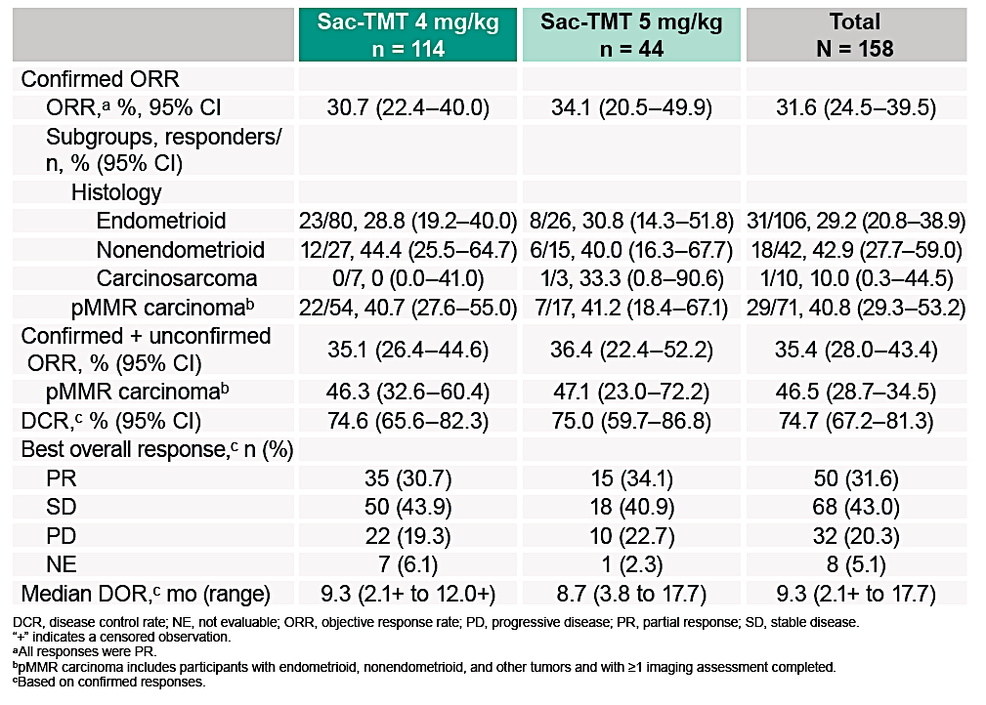
Updated data presented at IGCS
(Wang et al.
IGCS 2025)
TF-033
Population

Slide 113
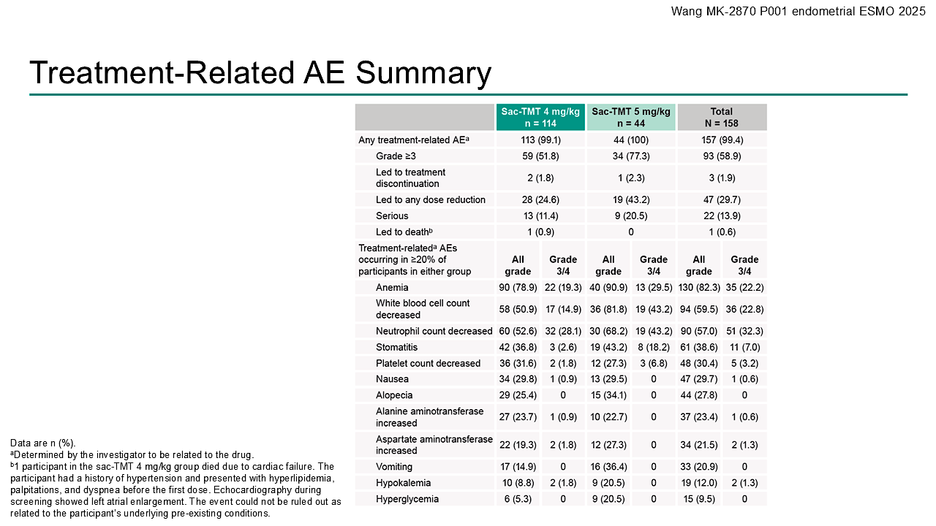
Wang et al. ESMO 2025

Slide 114
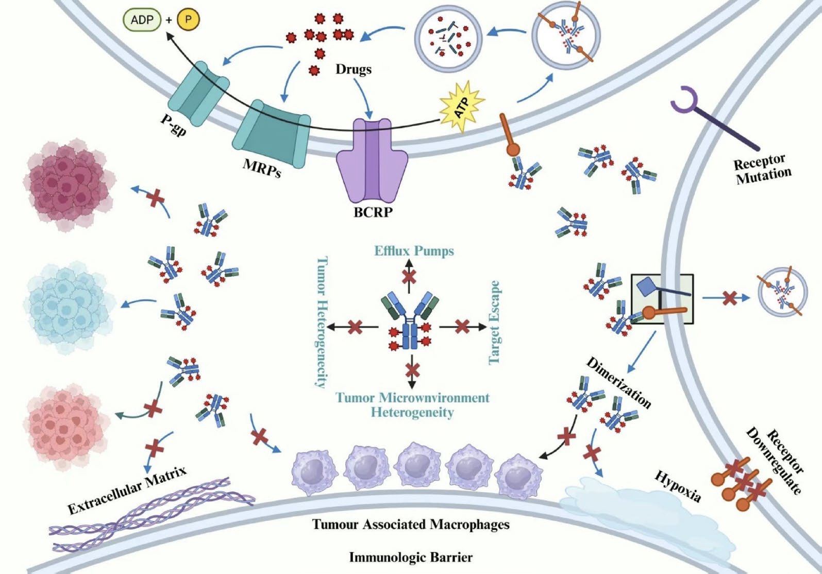
Multifaceted Mechanisms of ADC Resistance
Tumor Microenvironment
Heterogeneity
Zhou K et al. J Hematol Oncol 2025 November 3;18:96.

Slide 115
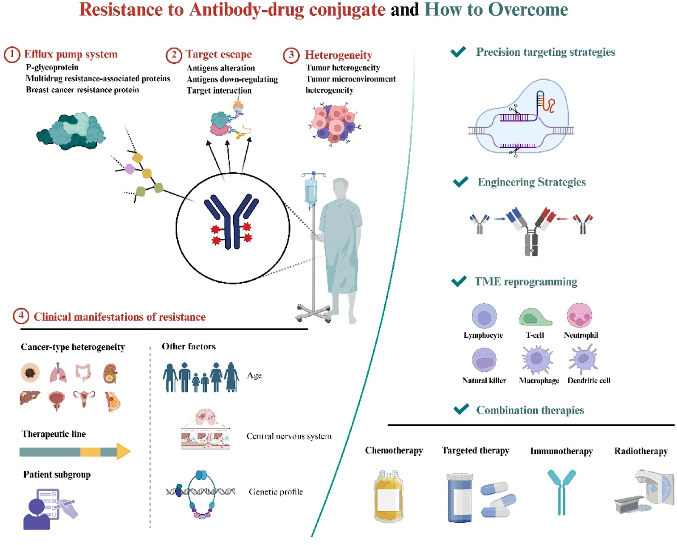
Techniques for Overcoming Resistance to ADCs
Zhou K et al. J Hematol Oncol 2025 November 3;18:96.

Slide 116
B-96: OS in CPS ≥1 Population at Final Analysis
100
12-mo
69.1%
59.3%
18-mo
51.5%
38.9%
 | Events | Median, mo (95% CI) | HR (95% CI)
Pembro Arm | 74.4% | 18.2 (15.3–21.3) | 0.76 (0.62–0.93)
Placebo Arm | 82.8% | 14.0 (12.5–16.1)
90
80
70
60
Overall Survival, %
50
40
30
20
Median follow-up:
32.7 months
10
0
0
6
12
18
24
30
36
42
48
Time, months
ªHazard ratio (CI) analyzed based on a Cox regression model with treatment as a covariate stratified by the randomization stratification factors. Data cutoff date: September 5, 2025.
No. at risk
234
207
161
120
83
35
11
1
0
232
200
137
89
61
29
6
1
0
Monk BJ et al

Slide 117

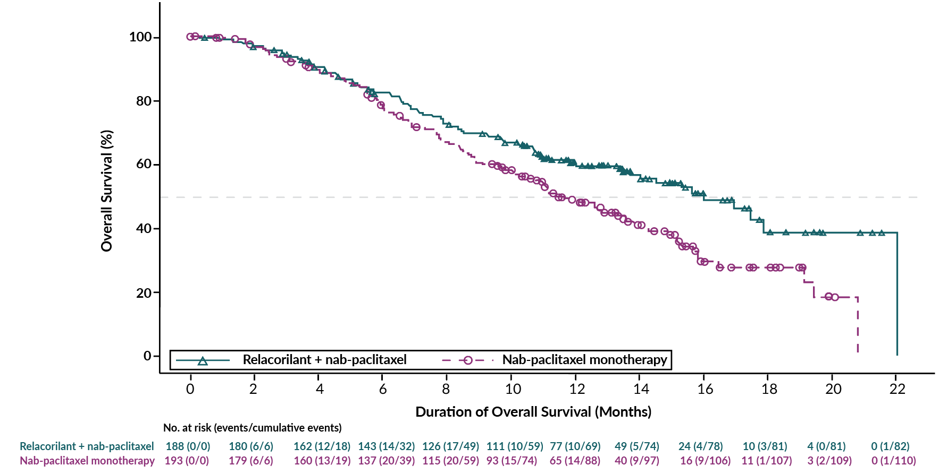
ROSELLA | Relacorilant Improved Overall Survival at this Interim Analysis (all comer)
 | Relacorilant + Nab-paclitaxel N=188 | Nab-paclitaxel N=193
Events, n (%) | 82 (43.6) | 110 (57.0)
Median OS, m (95% CI) | 15.97 (13.47–NR) | 11.50 (10.02–13.57)
HR (95% CI) | 0.69 (0.52–0.92)
Nominal P=0.0121 (Log-rank Test)
12m OS
60%
49%
Median follow-up time: 13.9 months; statistical significance threshold at the interim analysis: P≤0.0001; statistical significance threshold at the final analysis: P≤0.0499. The Kaplan–Meier method was used to estimate the curves, median estimates and the 95% confidence intervals (CI) for overall survival in each treatment arm. The HR and the associated 95% CI were estimated using a Cox regression model with treatment group as the main effect and stratification factors at randomization as covariates. CI, confidence interval; HR, hazard ratio; m, months; NR, not reached; OS, overall survival.
Data cutoff: Feb 24, 2025
Alexander Olawaiye et al. Lancet. 2025 Jun 21;405(10496)

Slide 118
Faculty Case Presentations

Slide 119
Dr Moore: Patient presentation
75-year-old female h/o Stage IV high grade endometrioid ovarian cancer in 2020
Treated with NACT paclitaxel and carboplatin x 3, iCRS to NGR and then 3 additional cycles of paclitaxel and carboplatin
BRCAwt
Received niraparib maintenance x 1 year with PD.
Carboplatin and PLD and bevacizumab x 3 cycles with PD.
Now platinum resistant
Work up
Imaging with peritoneal disease, no bowel obstruction, no ascites, but enlarged lymph nodes in the mediastinum
PS = 1
  What additional testing do you order? What are you looking for?

Slide 120
Dr Moore: Patient presentation
75-year-old female h/o Stage IV high grade endometrioid ovarian cancer in 2020
Treated with NACT paclitaxel and carboplatin x 3, iCRS to NGR and then 3 additional cycles of paclitaxel and carboplatin
BRCAwt
Received niraparib maintenance x 1 year with PD.
Carboplatin and PLD and bevacizumab x 3 cycles with PD.
Now platinum resistant
Biomarkers: BRCAwt/HRD neg/FRα low
SOC: no biomarkers currently link to FDA approved therapies
NCCN: FRα expression links to MIRV + BEV
Trials: No clear biomarker direction
Work up
Imaging with peritoneal disease, no bowel obstruction, no ascites, but enlarged lymph nodes in the mediastinum
PS = 1
What happened?
Patient was offered weekly paclitaxel vs a novel ADC
Selected clinical trial with Raludotatug deruxtecan – has a deep PR after 4 cycles
Presents for cycle 6 with some ground glass opacities on her chest CT, otherwise feels great
  What additional testing do
  you order? What are you
  looking for?

Slide 121
Dr Moore: Patient presentation
75-year-old female h/o Stage IV high grade endometrioid ovarian cancer in 2020
Treated with NACT paclitaxel and carboplatin x 3, iCRS to NGR and then 3 additional cycles of paclitaxel and carboplatin
BRCAwt
Received niraparib maintenance x 1 year with PD.
Carboplatin and PLD and bevacizumab x 3 cycles with PD.
Now platinum resistant
Biomarkers: BRCAwt/HRD neg/FRα low
SOC: no biomarkers currently link to FDA approved therapies
NCCN: FRα expression links to MIRV + BEV
Trials: No clear biomarker direction
Work up
Imaging with peritoneal disease, no bowel obstruction, no ascites, but enlarged lymph nodes in the mediastinum
PS = 1
What happened?
Presents for cycle 6 with some ground glass opacities on her chest CT, otherwise feels great
Seen by pulmonology, steroids started and GGO resolve within 4 weeks
RDxD restarted at a dose modification and is ongoing at cycle 12 with continued PR
  What additional testing do
  you order? What are you
  looking for?

Slide 122
QUESTIONS FOR THE FACULTY
How does the incidence and severity of ILD with R-DXd compare to that with other ADCs employed in gynecologic cancers, particularly trastuzumab deruxtecan?
If R-DXd were to reach the clinic, what screening techniques would you employ for early detection of ILD in patients receiving the drug? How would you manage ILD based on grade, and would this differ at all from the paradigm employed with T-DXd? At what grade of ILD would you permanently discontinue R-DXd?

Slide 123
QUESTIONS FOR THE FACULTY
Is there any reason to believe that ILD would be more likely
and/or more severe with one of the novel ADCs — R-DXd or a TROP2-targeted agent — in a patient who had developed this AE on prior T-DXd treatment? What about in a patient who had developed immune-related ILD/pneumonitis on prior immune checkpoint inhibition?

Slide 124
QUESTIONS FOR THE FACULTY
What has been your experience with other toxicity issues with R-DXd? How do you anticipate approaching antiemetic and/or antidiarrheal prophylaxis with this agent? What about monitoring of CBCs and use of growth factors? Have you encountered any AEs with R-DXd that haven’t been reported with any of the other ADCs that are currently employed in gynecologic cancers?

Slide 125
QUESTIONS FOR THE FACULTY
How is CDH6 expression measured (ie, what platform is employed and how are various levels of expression categorized)? If R-DXd were available, would you test for CDH6 expression and use the results as the basis for identifying appropriate candidates? How would you respond to the same questions vis-à-vis TROP2 expression and TROP2-targeted ADCs? Is there any practical reason that clinicians in community-based practice should be testing for these proteins now?

Slide 126
Prof Eskander: Case Presentation
70 yo otherwise healthy female, who presented with progressive symptoms of abdominal bloating, pain and decreased oral intake as well as postmenopausal vaginal bleeding
EMB 12-2023:
  High grade mixed carcinoma with predominantly serous (85%) features
  Molecular testing: TP53mut; pMMR; HER2 IHC 2+; ER/PR negative
CT C/A/P 1-5-23:
  Peritoneal carcinomatosis with small volume ascites. Mass-like enlargement of the bilateral adnexa measuring 3.9 cm on the left and 4.7 cm on the right. Endometrial thickening measuring 2.2 cm. Peritoneal and omental nodularity. For example, a left anterior omental nodule measures 1.3 cm
  Subcentimeter but mildly prominent enhancing anterior pericardiophrenic, pericaval and AP window lymph nodes are suspicious for intrathoracic lymph nodal metastases
Image guided biopsy of intrathoracic lymph nodes confirmed metastatic high grade endometrial carcinoma

Slide 127
Prof Eskander: Case Presentation
In the context of stage 4B disease, patient was counseled and started on neoadjuvant systemic therapy
Treatment (carboplatin, paclitaxel, pembrolizumab)
  Treated with 3 cycles of neoadjuvant therapy
  CT C/A/P after cycle 3: Decreased conspicuity of peritoneal and omental nodularity. No enlarging soft tissue nodules. Small volume pelvic ascites has decreased in amount from prior. Persistent endometrial thickening, decreased in thickness from prior. Bilateral adnexal masses have mildly decreased in size noting also changed in morphology and differences in measuring technique. Resolution of her intrathoracic nodal disease
Interval surgery:
  RATLH, BSO, infra-colic omentectomy

Slide 128
Prof Eskander: Case Presentation
Surgical pathology and molecular testing:
  TMB low 5 Muts/Mb
  MSS
  PD-L1 negative by TPS score
  PIK3R1 mutation
  TP53 mutation
  PPP2R1A mutation
Pathology
  Final pathology: uterine carcinosarcoma (epithelial component predominantly serous with small clear cell features). Sigmoid colon epiploic nodule, omentum, and peritoneal noudle all involved by disease
Following surgery:
  Completed 3 additional cycles of therapy and transitioned onto maintenance pembrolizumab

Slide 129
Prof Eskander: Case Presentation
6 months after initiation of maintenance pembrolizumab, interval imaging was notable for:
  CT C/A/P: Findings concerning for disease progression with new peritoneal carcinomatosis and serosal deposits along the distal transverse colon, splenic flexure and omentum abutting the ascending colon as described above. Additional small volume pelvic ascites and peritoneal enhancement in the pelvis is also visualized.
  A few serosal deposits on bowel loops are now visualized for example the subsequently described new peritoneal conglomerate in the left midabdomen measuring up to 3.2 cm on the splenic flexure and other serosal deposits on the distal transverse colon on series 13, image 55
Image guided biopsy of serosal deposit: confirmed recurrent metastatic carcinosarcoma
Treatment considerations:
  Excellent ECOG PS of 0
  Prior carboplatin + paclitaxel with prior checkpoint exposure
  HER2 IHC 0+

Slide 130
Prof Eskander: Case Presentation
After counseling and discussion, this patient was interested in enrollment and treatment on a TROP2 ADC phase 3 clinical trial.
ASCENT-GYN-01/GOG-3104: A Randomized, Open-label, Phase 3 Study of Sacituzumab Govitecan Versus Treatment of Physician's Choice in Participants With Endometrial Cancer Who Have Received Prior Platinum-based Chemotherapy and Anti-PD-1/PD-L1 Immunotherapy

Slide 131
Prof Eskander: Case Presentation
ASCENT-GYN-01/GOG-3104: A Randomized, Open-label, Phase 3 Study of Sacituzumab Govitecan Versus Treatment of Physician's Choice in Participants With Endometrial Cancer Who Have Received Prior Platinum-based Chemotherapy and Anti-PD-1/PD-L1 Immunotherapy
Started on study directed therapy in Feb 2025
She remains on treatment, most recently receiving cycle 30, with radiographic imaging showing RECIST v1.1 complete response (14 months after start of treatment)
On treatment side effects:
  Grade 1 fatigue
  Grade 1 constipation
  Preserved ECOG PS 0

Slide 132
QUESTIONS FOR THE FACULTY
Thus far, has the tolerability profile of TROP2-targeted ADCs in patients with advanced gynecologic cancers been consistent with what has been observed with these drugs in other tumor types? Globally, would you say that any one of the TROP2-directed ADCs is better tolerated than the others?

Slide 133
QUESTIONS FOR THE FACULTY
How typical or atypical is this patient’s experience with sacituzumab govitecan from a tolerability perspective? With proper supportive care, how likely are patients to tolerate this drug without significant issues? What prophylactic measures (eg, antidiarrheals, G-CSF) do you think are most appropriate to mitigate the risk of GI toxicities and cytopenias with sacituzumab govitecan? Do you apply the same approach for Dato-DXd and sac-TMT?

Slide 134
QUESTIONS FOR THE FACULTY
Do you test for homozygous for the UGT1A1*28 allele in your patients about to begin treatment with sacituzumab govitecan? Would you approach AE mitigation, monitoring and/or management any differently in a patient with known reduced UGT1A1 activity?
What is your experience with the tolerability of Dato-DXd and sac-TMT? What prophylactic measures, if any, do you recommend to prevent oral mucositis/stomatitis with these drugs?

Slide 135
QUESTIONS FOR THE FACULTY
How do ocular toxicities in patients receiving Dato-DXd and sac-TMT compare to those with other ADCs used in gynecologic cancers, such as mirvetuximab soravtansine and tisotumab vedotin, in terms of type(s) and severity? How do you generally screen for ocular toxicities in patients receiving Dato-DXd and sac-TMT? How often do you recommend consultation with an ophthalmologist? How are ocular toxicities best managed when they occur? What is your threshold for dose reducing or holding TROP2-targeted ADCs due to ocular toxicities?

Slide 136
QUESTIONS FOR THE FACULTY
How do you monitor for pneumonitis in patients receiving Dato-DXd and sac-TMT? How do you manage Grade 1 versus Grade 2 pneumonitis? In which situations will you rechallenge after resolution of symptoms?

Slide 137
Data + Perspectives: The Potential Role of TROP2- and CDH6-Directed Antibody-Drug
Conjugates in Gynecologic Cancers
An Independent CME Symposium During the
SGO 2026 Annual Meeting on Women’s Cancer®
Sunday, April 12, 2026
1:30 PM – 3:00 PM AST
Faculty
Ramez N Eskander, MD
Bradley J Monk, MD
Moderator
Kathleen N Moore, MD, MS

Slide 138
Thank you for joining us!
Your feedback is very important to us.
Please complete the postmeeting survey currently available via the corresponding QR code on the printed handout for attendees in the room and on Zoom for those attending virtually. The survey will remain open up to 5 minutes after the meeting ends.
How to Obtain CME Credit
In-person attendees: Please refer to the program syllabus for the CME credit link or QR code. Online/Zoom attendees:
The CME credit link is posted in the chat room.

