Slide 1
Cancer Conference Update: ESMO Congress 2025 Review — Gynecologic Cancers
A CME/MOC-Accredited Live Webinar
Thursday, January 22, 2026
5:00 PM – 6:00 PM ET
Faculty
Ritu Salani, MD, MBA
Moderator
Neil Love, MD

Slide 2


Faculty
Ritu Salani, MD, MBA
Director, Division of Gynecologic Oncology
Professor, Department of Obstetrics and Gynecology
David Geffen School of Medicine at UCLA
Los Angeles, California
MODERATOR
Neil Love, MD
Research To Practice
Miami, Florida

Slide 3
Commercial Support
This activity is supported by educational grants from AstraZeneca Pharmaceuticals LP, GSK, and Merck.

Slide 4
Dr Love — Disclosures
Dr Love is president and CEO of Research To Practice. Research To Practice receives funds in the form of educational grants to develop CME activities from the following companies: Aadi Bioscience, AbbVie Inc, ADC Therapeutics, Agendia Inc, Alexion Pharmaceuticals, Amgen Inc, Array BioPharma Inc, a subsidiary of Pfizer Inc, Arvinas, Astellas, AstraZeneca Pharmaceuticals LP, Aveo Pharmaceuticals, Bayer HealthCare Pharmaceuticals, BeOne, Biotheranostics Inc, A Hologic Company, Black Diamond Therapeutics Inc, Blueprint Medicines, Boehringer Ingelheim Pharmaceuticals Inc, Bristol Myers Squibb, Celcuity, Clovis Oncology, Coherus BioSciences, Corcept Therapeutics Inc, CTI BioPharma, a Sobi Company, Daiichi Sankyo Inc, Eisai Inc, Elevation Oncology Inc, Exact Sciences Corporation, Exelixis Inc, Genentech, a member of the Roche Group, Genmab US Inc, Geron Corporation, Gilead Sciences Inc, GSK, Helsinn Therapeutics (US) Inc, ImmunoGen Inc, Incyte Corporation, Ipsen Biopharmaceuticals Inc, Jazz Pharmaceuticals Inc, Johnson & Johnson, Karyopharm Therapeutics, Kite, A Gilead Company, Kura Oncology, Legend Biotech, Lilly, MEI Pharma Inc, Merck, Mersana Therapeutics Inc, Mirati Therapeutics Inc, Mural Oncology Inc, Natera Inc, Novartis, Novartis Pharmaceuticals Corporation on behalf of Advanced Accelerator Applications, Novocure Inc, Nuvalent, Nuvation Bio Inc, Pfizer Inc, Pharmacyclics LLC, an AbbVie Company, Puma Biotechnology Inc, Regeneron Pharmaceuticals Inc, Rigel Pharmaceuticals Inc, R-Pharm US, Sanofi, Seagen Inc, Servier Pharmaceuticals LLC, SpringWorks Therapeutics Inc, Stemline Therapeutics Inc, Sumitomo Pharma America, Syndax Pharmaceuticals, Taiho Oncology Inc, Takeda Pharmaceuticals USA Inc, TerSera Therapeutics LLC, and Tesaro, A GSK Company.

Slide 5
Research To Practice CME Planning Committee Members,
Staff and Reviewers
Planners, scientific staff and independent reviewers for Research To Practice have no relevant conflicts of interest to disclose.

Slide 6
Dr Salani — Disclosures
Advisory Committees | AbbVie Inc, Corcept Therapeutics Inc, Daiichi Sankyo Inc, Eisai Inc, Genmab US Inc, GSK, Merck, Pfizer Inc, Whitehawk Therapeutics
Nonrelevant Financial Relationships | UpToDate

Slide 7
This educational activity contains discussion of
non-FDA-approved uses of agents and regimens. Please refer to official prescribing information for each product for approved indications.

Slide 8
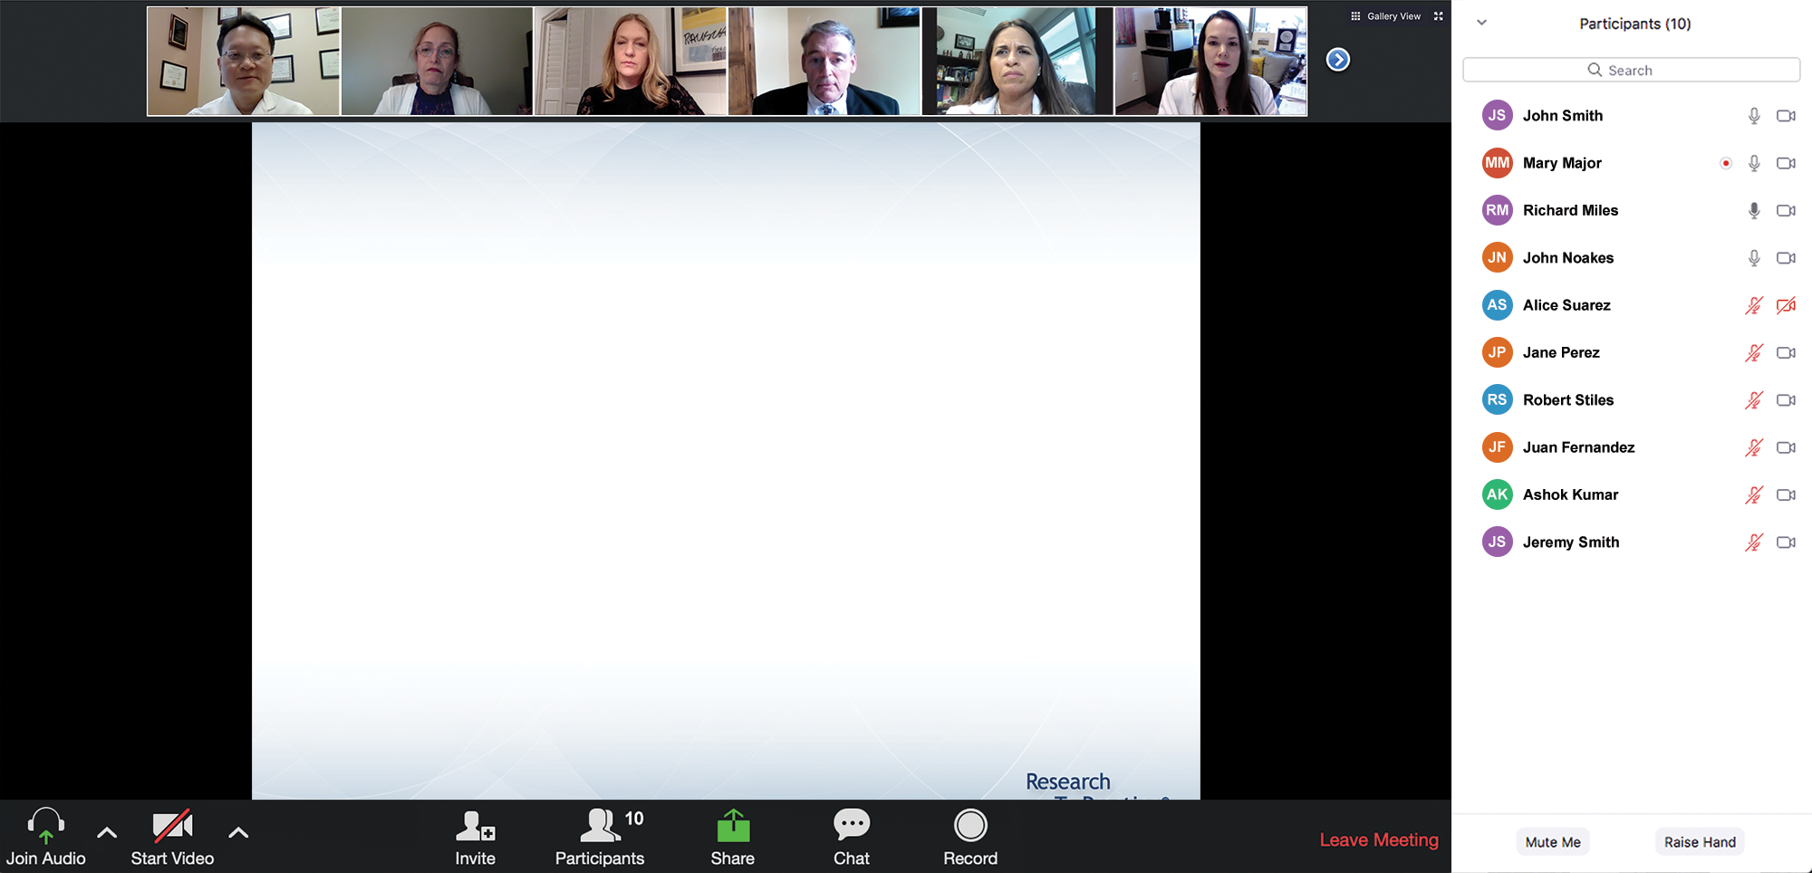

We Encourage Clinicians in Practice to Submit Questions
Feel free to submit questions now before the program begins and throughout the program.

Slide 9
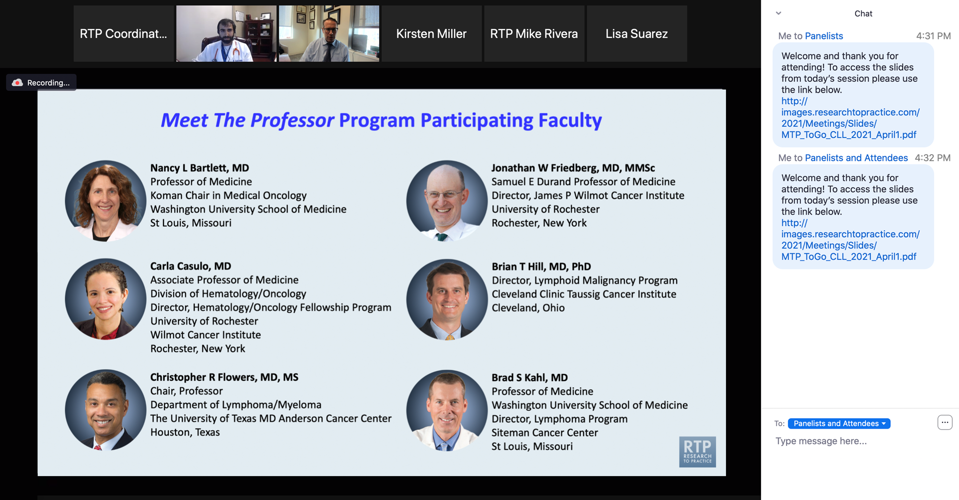
Familiarizing Yourself with the Zoom Interface
Expand chat submission box
Drag the white line above the submission box up to create
more space for your message.

Slide 10
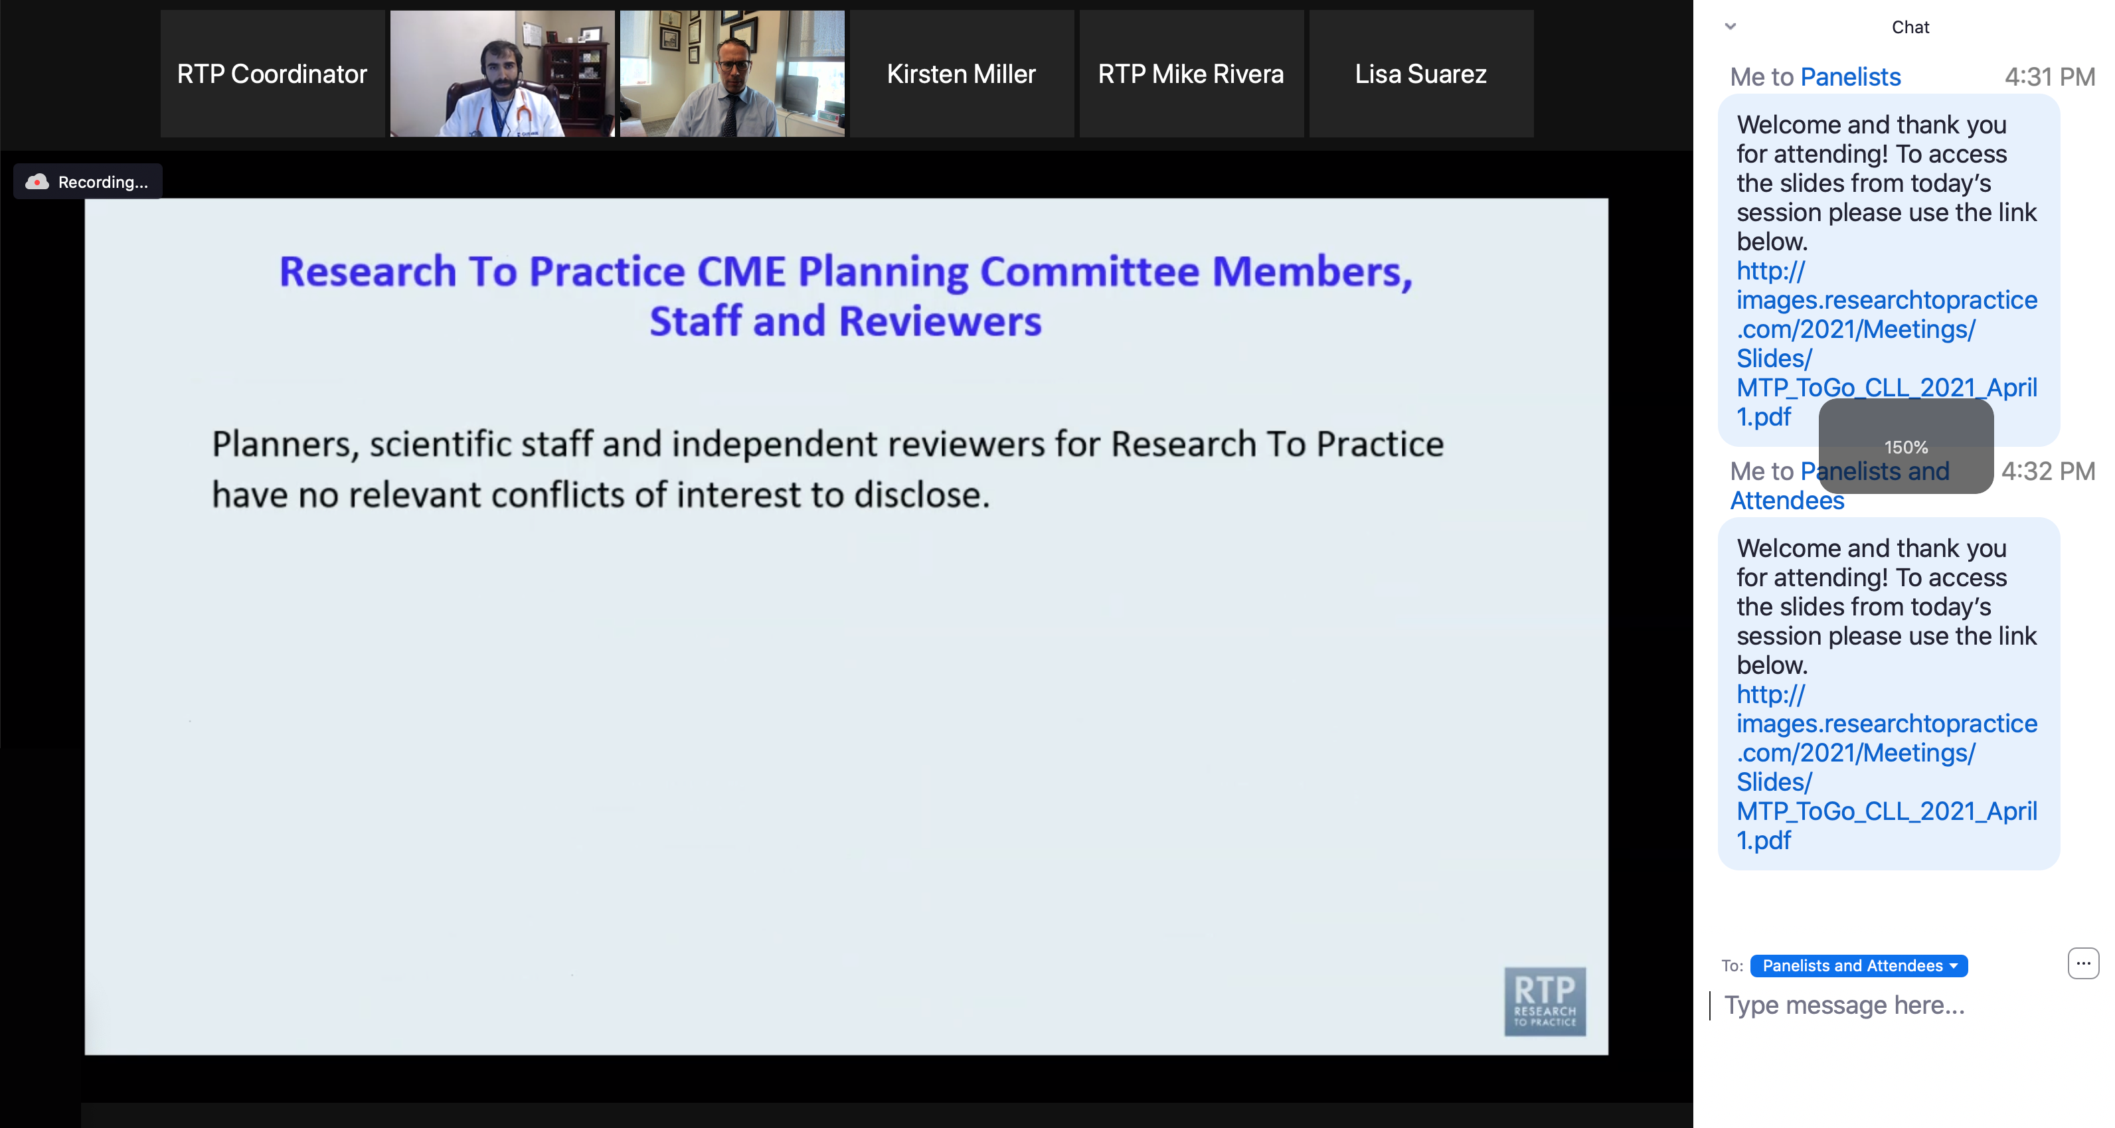
Familiarizing Yourself with the Zoom Interface
Increase chat font size
Press Command (for Mac) or Control (for PC) and the + symbol.
You may do this as many times as you need for readability.

Slide 11
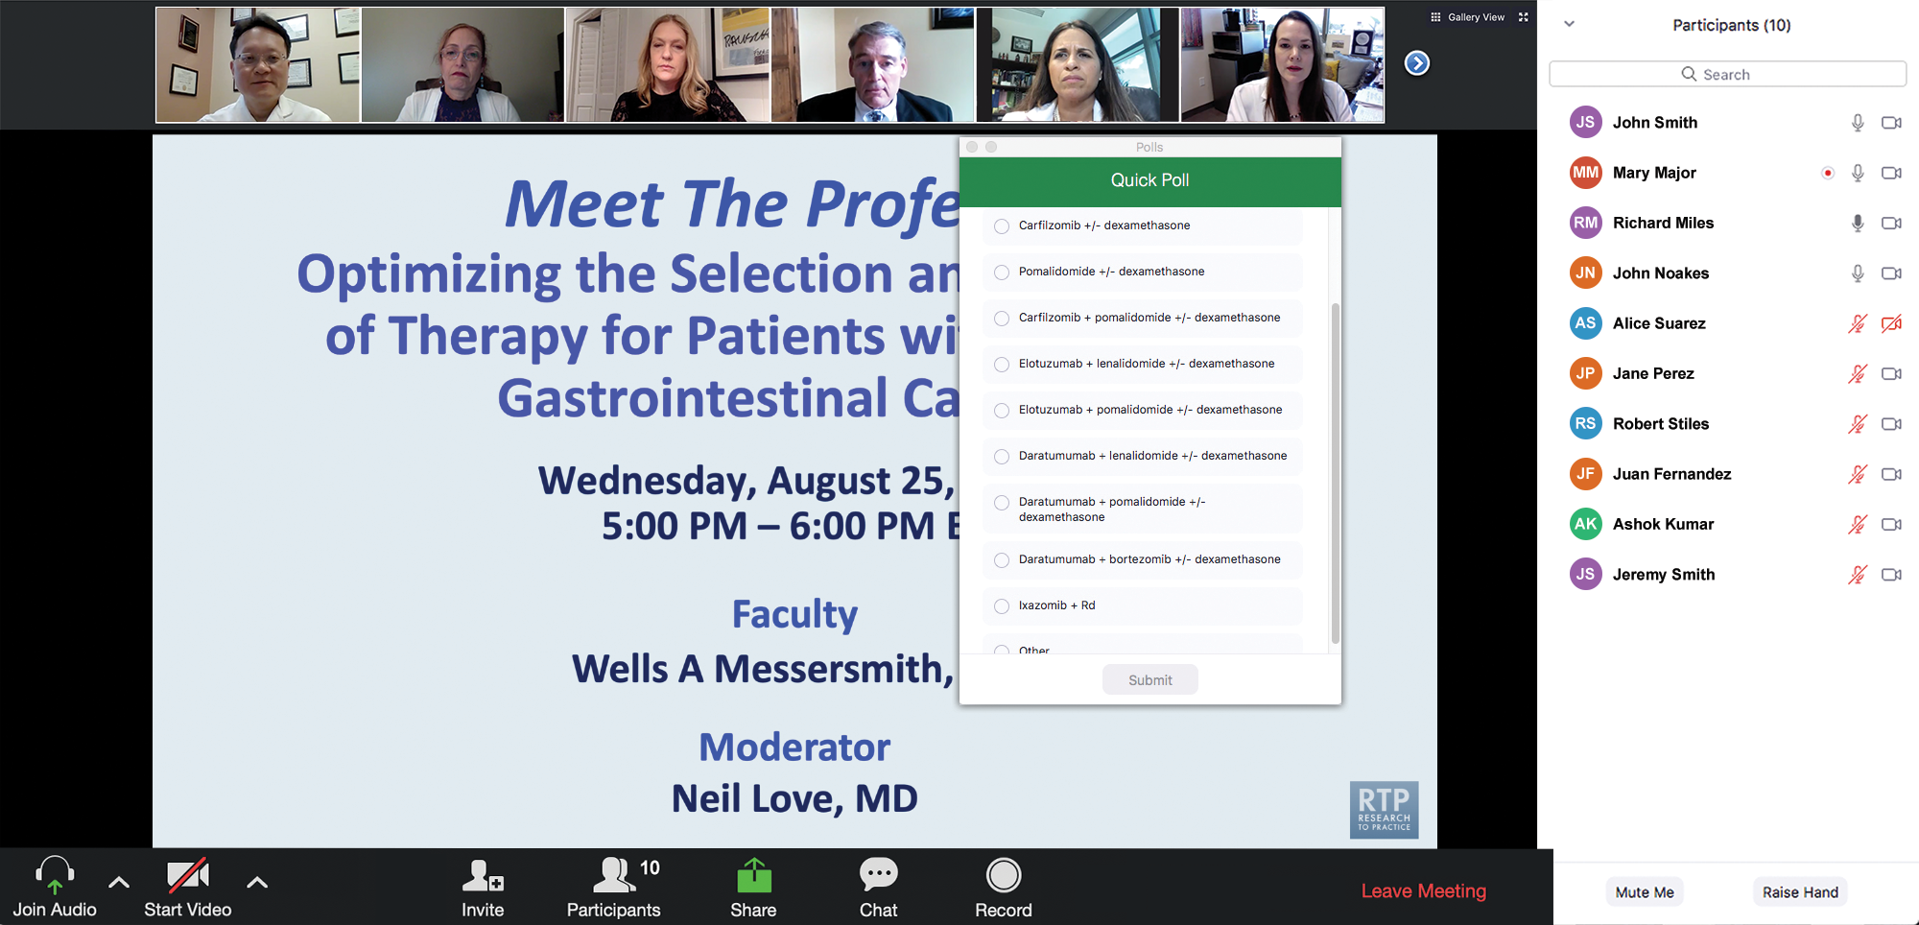
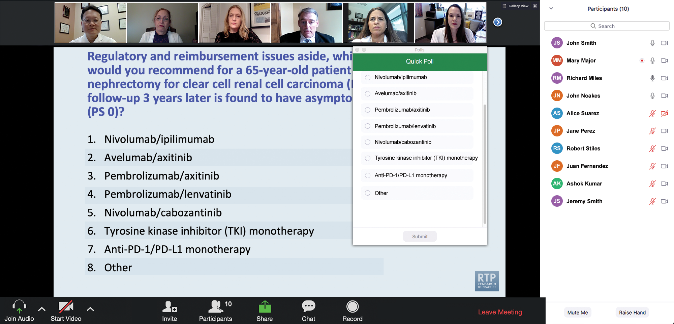
Clinicians in the Audience, Please Complete the Pre- and Postmeeting Surveys
Quick Survey
Quick Poll

Slide 12


Slide 13
Inside the Issue: The Emerging Role of
Cereblon E3 Ligase Modulators in Multiple Myeloma
A CME/MOC-Accredited Live Webinar
Wednesday, January 28, 2026
5:00 PM – 6:00 PM ET
Faculty
Natalie S Callander, MD
Paul G Richardson, MD
Moderator
Neil Love, MD

Slide 14
Exploring Current Patterns of Care in the Community:
Selection of First-Line and Maintenance Therapy for
Patients with Extensive-Stage Small Cell Lung Cancer
A CME/MOC-Accredited Live Webinar
Wednesday, February 4, 2026
5:00 PM – 6:00 PM ET
Faculty
Hossein Borghaei, DO, MS
Anne Chiang, MD, PhD
Moderator
Neil Love, MD

Slide 15
Year in Review: Clinical Investigator Perspectives on the
Most Relevant New Datasets and Advances in Oncology
Antibody-Drug Conjugates for Breast Cancer
A CME/MOC-Accredited Live Webinar
Wednesday, February 18, 2026
5:00 PM – 6:00 PM ET
Faculty
Hope S Rugo, MD
Sara M Tolaney, MD, MPH
Moderator
Neil Love, MD

Slide 16
Expert Second Opinion: Investigators Provide
Perspectives on the Future Role of AKT Inhibition in the Management of Prostate Cancer
A CME Symposium Held Adjunct to the
2026 ASCO® Genitourinary Cancers Symposium
Friday, February 27, 2026
6:00 PM – 7:30 PM PT (9:00 PM – 10:30 PM ET)
Faculty
Professor Karim Fizazi, MD, PhD
Daniel George, MD
Moderator
Elisabeth I Heath, MD

Slide 17
Grand Rounds
CME/MOC-Accredited Interactive Series
Through April 2026
Three Series
Optimizing Treatment
for Patients with Relapsed/Refractory Chronic Lymphocytic Leukemia
Optimizing the Use of
Novel Therapies for Patients with Diffuse
Large B-Cell Lymphoma
Optimizing Therapy for Patients with Hormone Receptor-Positive
Localized Breast Cancer
Host a 1-hour session at your institution:
Email Meetings@ResearchToPractice.com
or call (800) 233-6153

Slide 18

Save The Date
A Multitumor CME/MOC-, NCPD- and ACPE-Accredited Educational Conference Developed in Partnership with Florida Cancer Specialists & Research Institute
Friday to Sunday, April 24 to 26, 2026
The Ritz-Carlton Orlando, Grande Lakes | Orlando, Florida
Moderated by Neil Love, MD

Slide 19
Thank you for joining us! Please take a moment to complete the survey currently up on Zoom.
Your feedback is very important to us.
Information on how to obtain CME, ABIM MOC and ABS credit will be provided at the conclusion of the activity in the Zoom chat room. Attendees will also receive an email in 1 to 3 business days with these instructions.

Slide 20
Cancer Conference Update: ESMO Congress 2025 Review — Gynecologic Cancers
A CME/MOC-Accredited Live Webinar
Thursday, January 22, 2026
5:00 PM – 6:00 PM ET
Faculty
Ritu Salani, MD, MBA
Moderator
Neil Love, MD

Slide 21
Faculty
Ritu Salani, MD, MBA
Director, Division of Gynecologic Oncology
Professor, Department of Obstetrics and Gynecology
David Geffen School of Medicine at UCLA
Los Angeles, California
MODERATOR
Neil Love, MD
Research To Practice
Miami, Florida

Slide 22
We Encourage Clinicians in Practice to Submit Questions
Feel free to submit questions now before the program begins and throughout the program.

Slide 23
Clinicians in the Audience, Please Complete the Pre- and Postmeeting Surveys
Quick Survey
Quick Poll

Slide 25
Inside the Issue: The Emerging Role of
Cereblon E3 Ligase Modulators in Multiple Myeloma
A CME/MOC-Accredited Live Webinar
Wednesday, January 28, 2026
5:00 PM – 6:00 PM ET
Faculty
Natalie S Callander, MD
Paul G Richardson, MD
Moderator
Neil Love, MD

Slide 26
Exploring Current Patterns of Care in the Community:
Selection of First-Line and Maintenance Therapy for
Patients with Extensive-Stage Small Cell Lung Cancer
A CME/MOC-Accredited Live Webinar
Wednesday, February 4, 2026
5:00 PM – 6:00 PM ET
Faculty
Hossein Borghaei, DO, MS
Anne Chiang, MD, PhD
Moderator
Neil Love, MD

Slide 27
Year in Review: Clinical Investigator Perspectives on the
Most Relevant New Datasets and Advances in Oncology
Antibody-Drug Conjugates for Breast Cancer
A CME/MOC-Accredited Live Webinar
Wednesday, February 18, 2026
5:00 PM – 6:00 PM ET
Faculty
Hope S Rugo, MD
Sara M Tolaney, MD, MPH
Moderator
Neil Love, MD

Slide 28
Grand Rounds
CME/MOC-Accredited Interactive Series
Through April 2026
Three Series
Optimizing Treatment
for Patients with Relapsed/Refractory Chronic Lymphocytic Leukemia
Optimizing the Use of
Novel Therapies for Patients with Diffuse
Large B-Cell Lymphoma
Optimizing Therapy for Patients with Hormone Receptor-Positive
Localized Breast Cancer
Host a 1-hour session at your institution:
Email Meetings@ResearchToPractice.com
or call (800) 233-6153

Slide 29
Save The Date
A Multitumor CME/MOC-, NCPD- and ACPE-Accredited Educational Conference Developed in Partnership with Florida Cancer Specialists & Research Institute
Friday to Sunday, April 24 to 26, 2026
The Ritz-Carlton Orlando, Grande Lakes | Orlando, Florida
Moderated by Neil Love, MD

Slide 30
Cancer Conference Update: ESMO Congress 2025 Review — Gynecologic Cancers
A CME/MOC-Accredited Live Webinar
Thursday, January 22, 2026
5:00 PM – 6:00 PM ET
Faculty
Ritu Salani, MD, MBA
Moderator
Neil Love, MD

Slide 31
Dr Salani — Disclosures
Advisory Committees | AbbVie Inc, Corcept Therapeutics Inc, Daiichi Sankyo Inc, Eisai Inc, Genmab US Inc, GSK, Merck, Pfizer Inc, Whitehawk Therapeutics
Nonrelevant Financial Relationships | UpToDate

Slide 32
Dr Love — Disclosures
Dr Love is president and CEO of Research To Practice. Research To Practice receives funds in the form of educational grants to develop CME activities from the following companies: Aadi Bioscience, AbbVie Inc, ADC Therapeutics, Agendia Inc, Alexion Pharmaceuticals, Amgen Inc, Array BioPharma Inc, a subsidiary of Pfizer Inc, Arvinas, Astellas, AstraZeneca Pharmaceuticals LP, Aveo Pharmaceuticals, Bayer HealthCare Pharmaceuticals, BeOne, Biotheranostics Inc, A Hologic Company, Black Diamond Therapeutics Inc, Blueprint Medicines, Boehringer Ingelheim Pharmaceuticals Inc, Bristol Myers Squibb, Celcuity, Clovis Oncology, Coherus BioSciences, Corcept Therapeutics Inc, CTI BioPharma, a Sobi Company, Daiichi Sankyo Inc, Eisai Inc, Elevation Oncology Inc, Exact Sciences Corporation, Exelixis Inc, Genentech, a member of the Roche Group, Genmab US Inc, Geron Corporation, Gilead Sciences Inc, GSK, Helsinn Therapeutics (US) Inc, ImmunoGen Inc, Incyte Corporation, Ipsen Biopharmaceuticals Inc, Jazz Pharmaceuticals Inc, Johnson & Johnson, Karyopharm Therapeutics, Kite, A Gilead Company, Kura Oncology, Legend Biotech, Lilly, MEI Pharma Inc, Merck, Mersana Therapeutics Inc, Mirati Therapeutics Inc, Mural Oncology Inc, Natera Inc, Novartis, Novartis Pharmaceuticals Corporation on behalf of Advanced Accelerator Applications, Novocure Inc, Nuvalent, Nuvation Bio Inc, Pfizer Inc, Pharmacyclics LLC, an AbbVie Company, Puma Biotechnology Inc, Regeneron Pharmaceuticals Inc, Rigel Pharmaceuticals Inc, R-Pharm US, Sanofi, Seagen Inc, Servier Pharmaceuticals LLC, SpringWorks Therapeutics Inc, Stemline Therapeutics Inc, Sumitomo Pharma America, Syndax Pharmaceuticals, Taiho Oncology Inc, Takeda Pharmaceuticals USA Inc, TerSera Therapeutics LLC, and Tesaro, A GSK Company.

Slide 33
Commercial Support
This activity is supported by educational grants from AstraZeneca Pharmaceuticals LP, GSK, and Merck.
Research To Practice CME Planning Committee Members,
Staff and Reviewers
Planners, scientific staff and independent reviewers for Research To Practice have no relevant conflicts of interest to disclose.

Slide 34
This educational activity contains discussion of
non-FDA-approved uses of agents and regimens. Please refer to official prescribing information for each product for approved indications.

Slide 35
Agenda
Module 1: Up-Front Treatment of Ovarian Cancer (OC)
Module 2: Management of Platinum-Resistant OC
Module 3: Up-Front Management of Metastatic Endometrial Cancer
Module 4: Management of HER2-Positive Gynecologic Cancers
Module 5: Management of Cervical Cancer

Slide 36
Agenda
Module 1: Up-Front Treatment of Ovarian Cancer (OC)
Module 2: Management of Platinum-Resistant OC
Module 3: Up-Front Management of Metastatic Endometrial Cancer
Module 4: Management of HER2-Positive Gynecologic Cancers
Module 5: Management of Cervical Cancer

Slide 37
Case Presentation: Dr Salani
39-year-old patient.
1/16/24: CT chest/abdomen/pelvis: Moderate to large ascites, low density liver lesions and capsular attenuation, possible carcinomatosis/endometriosis/hemorrhagic clots. Small, shotty retroperitoneal lymph nodes; no groin adenopathy. Bilateral pleural effusions.
1/17/24: Pelvic ultrasound: Uterus measures 6.7 x 3.3 x 3.0 cm with a 0.7 cm endometrium and surrounded by ill-defined soft tissue concerning for extensive peritoneal or omental neoplasm. Right complex adnexal mass, 4.2 x 3.3 x 3.2 cm, with septations and nodularity. Pelvic ascites.
1/29/24: PET CT: Large hypermetabolic pelvic masses and extensive hypermetabolic peritoneal disease. There is diffuse ascites. There is peritoneal disease along the liver surface and liver hila. There are moderate bilateral pleural effusions with mildly increased FDG uptake. There are no hypermetabolic pulmonary mass lesions.
2/5/24: Diagnostic laparoscopy, total abdominal hysterectomy, bilateral salpingo-oophorectomy, right pelvic lymph node debulking, omentectomy, appendectomy, splenectomy, cystotomy repair, and extensive tumor reductive surgery with optimal cytoreduction: High grade serous carcinoma (Stage IIIC).

Slide 38
Case Presentation: Dr Salani (Continued)
3/4/24 – 6/18/24: Carboplatin, paclitaxel and bevacizumab (added cycle 2) x 6 cycles.
3/5/24: Genomic tumor testing: P53m, TMB low, MSS, HRD positive (22.6% LOH).
7/8/24: CT chest/abdomen/pelvis: No intrathoracic disease. Thickening/scalloping (13 mm) at the right liver dome, no other evidence of disease.
7/9/24: Bevacizumab maintenance started.
8/2/24: Olaparib maintenance started.
1/22/25: CT chest/abdomen/pelvis: Resolution of nodules by liver; no evidence of disease.
7/9/25: CT chest/abdomen/pelvis: Decrease in perihepatic nodule; no new evidence of disease.
10/21/25: Bevacizumab cycle 22.
11/12/25: CT abdomen/pelvis: Stable perihepatic implant at the right hepatic dome measuring; no new metastatic disease in the abdomen or pelvis.
Current status: She is doing well, plans to continue olaparib maintenance until 8/2026 (2 years).

Slide 39
Tumor Markers
 | CA-125
2/29/2024 | 349
3/22/2024 | 175
4/12/2024 | 105
5/3/2024 | 61
5/24/2024 | 29
6/17/2024 | 19
7/9/2024 | 14
7/30/2024 | 12
8/20/2024 | 10
9/10/2024 | 10
10/1/2024 | 8
10/22/2024 | 7
11/12/2024 | 6
12/4/2024 | 6

Slide 40
Tumor Markers (Continued)
 | CA-125
12/27/2024 | 6
1/17/2025 | 6
2/7/2025 | 7
3/1/2025 | 17
3/12/2025 | 12
4/11/2025 | 9
5/2/2025 | 6
6/17/2025 | 5
7/8/2025 | 5
7/29/2025 | 6
8/19/2025 | 5
9/9/2025 | 7
10/1/2025 | 6
10/21/2025 | 6

Slide 41
Key Datasets
Clamp A et al. ICON8B: GCIG phase III randomized trial comparing first-line weekly dose-dense chemotherapy + bevacizumab to three-weekly chemotherapy + bevacizumab in high-risk Stage III-IV epithelial ovarian cancer (EOC): Final overall survival (OS) analysis. ESMO 2025;Abstract 1064O.
Li N et al. Fuzuloparib (FZPL) monotherapy or in combination with apatinib as first-line maintenance therapy in advanced ovarian cancer: Final analysis of the FZOCUS-1 trial. ESMO 2025;Abstract 1063O.
Kim SI et al. First-line niraparib maintenance therapy in BRCA wild-type, low-risk advanced ovarian cancer: The POLO trial. ESMO 2025;Abstract 1084P.
Denys H et al. Quality-adjusted progression-free survival (QA-PFS) and quality-adjusted time without symptoms of disease or toxicity (Q-TWIST) results from the PRIMA/ENGOT-OV26/GOG-3012 final analysis. ESMO 2025;Abstract 1070P.

Slide 42
Key Datasets (Continued)
Moore KN et al. FIRST/ENGOT-OV44 trial: Does the addition of dostarlimab impact niraparib tolerability, exposure, or dose modification? ESMO 2025;Abstract 1101P.
Aghajanian C et al. Durvalumab + paclitaxel/carboplatin + bevacizumab followed by durvalumab, bevacizumab + olaparib maintenance in patients with newly diagnosed
non-tBRCA-mutated advanced ovarian cancer: Final overall survival from DUO-O/
ENGOT-ov46/GOG-3025. ESMO 2025;Abstract LBA44.
Cibula D et al. Phase 3, randomized, double-blind, placebo (Pbo)-controlled ENGOT-ov43/GOG-3036/KEYLYNK-001 study of 1L chemotherapy (CT) ± pembrolizumab (Pembro) then maintenance (Maint) pembro ± olaparib (Ola) for advanced BRCA-nonmutated epithelial ovarian cancer (EOC): Analysis by HRD status. ESMO 2025; Abstract 1071P.

Slide 43
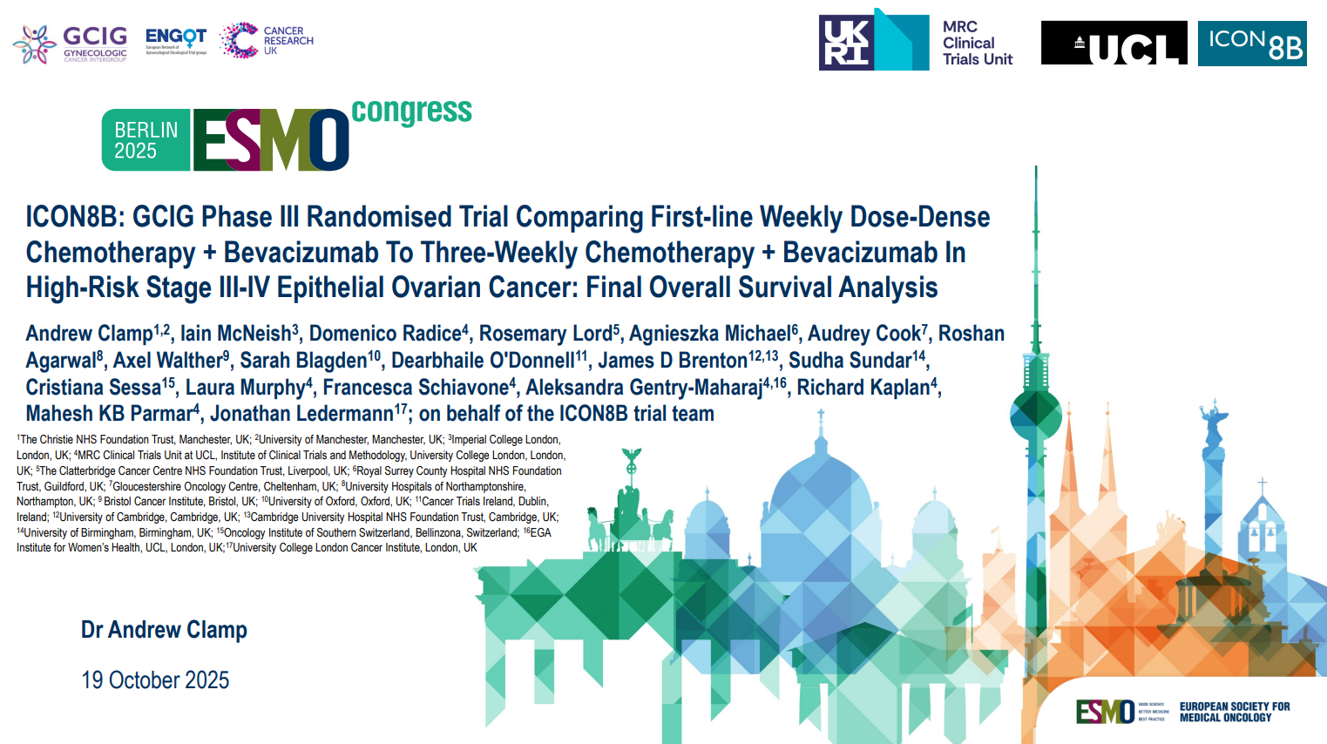
Abstract 1064O

Slide 44
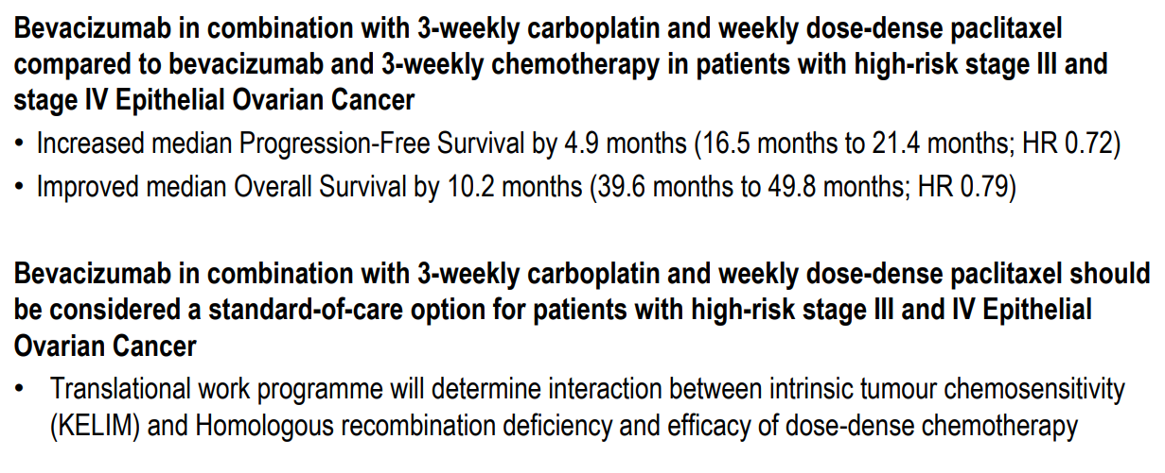
ICON8B Study Conclusions
Clamp A et al. ESMO 2025;Abstract 1064O.

Slide 45
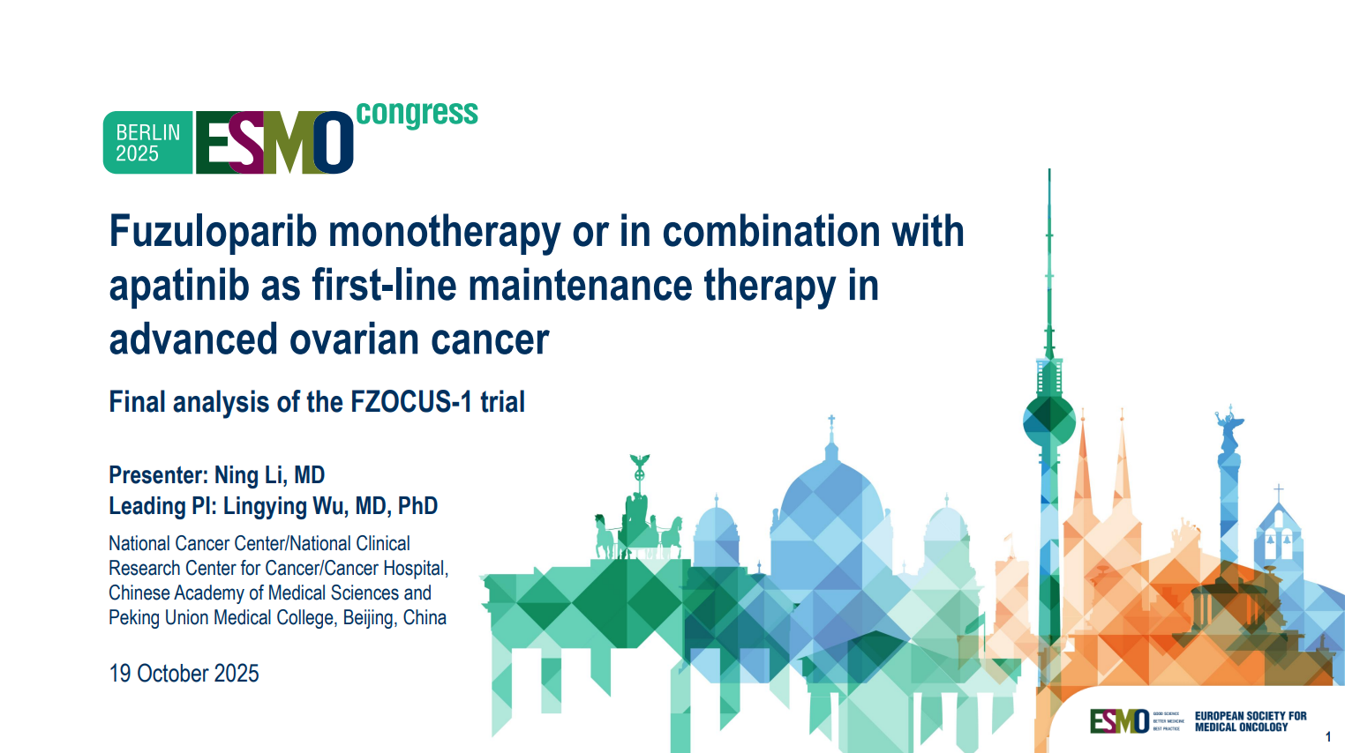
Abstract 1063O

Slide 46
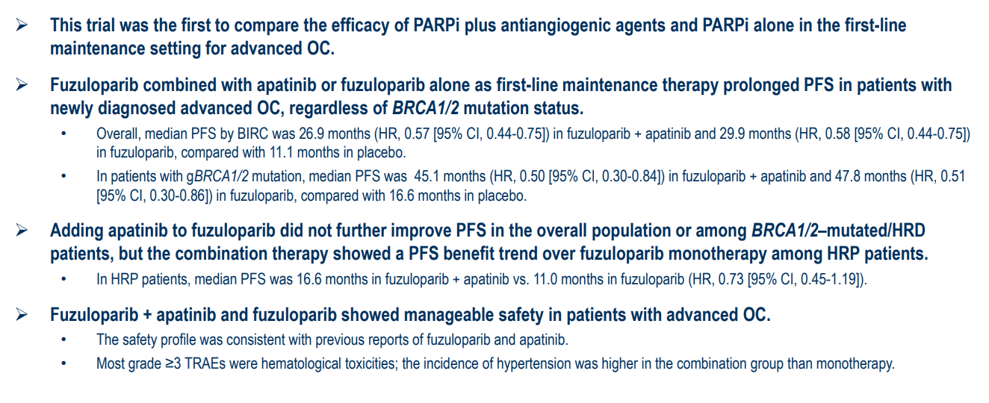
FZOCUS-1 Study Conclusions
PARPi = PARP inhibitor; PFS = progression-free survival; BIRC = blinded independent central review; OC = ovarian cancer; TRAE = treatment-related adverse event
Li N et al. ESMO 2025;Abstract 1063O.

Slide 47
First-Line Niraparib Maintenance Therapy in BRCA Wild-Type, Low-Risk Advanced Ovarian Cancer: The POLO Trial
Kim SI et al.
ESMO 2025;Abstract 1084P.

Slide 48
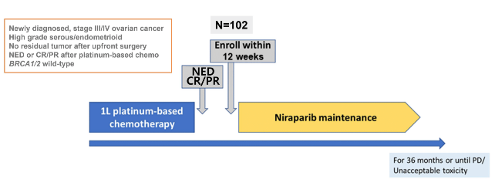
The POLO Trial Study Design
NED = no evidence of disease; CR = complete response; PR = partial response
Kim SI et al. ESMO 2025;Abstract 1084P.

Slide 49
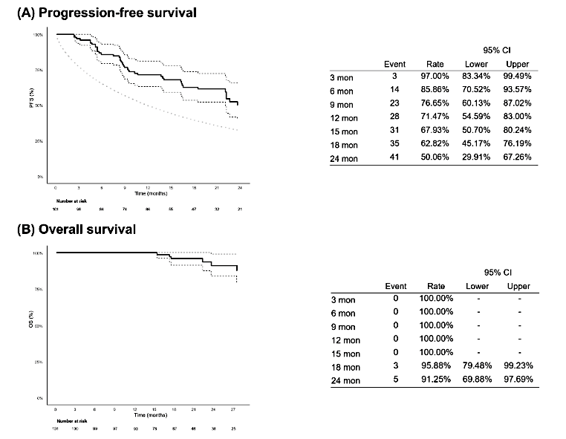
The POLO Trial: PFS and Overall Survival (OS) in the Intent-to-Treat Population
Kim SI et al. ESMO 2025;Abstract 1084P.

Slide 50

The POLO Trial: Conclusions
Kim SI et al. ESMO 2025;Abstract 1084P.

Slide 51
Quality-Adjusted Progression-Free Survival (QA-PFS) and Quality-Adjusted Time without Symptoms of Disease or Toxicity (Q-TWiST) Results from the PRIMA/ENGOT-OV26/GOG-3012 Final Analysis
Denys H et al.
ESMO 2025;Abstract 1070P.

Slide 52
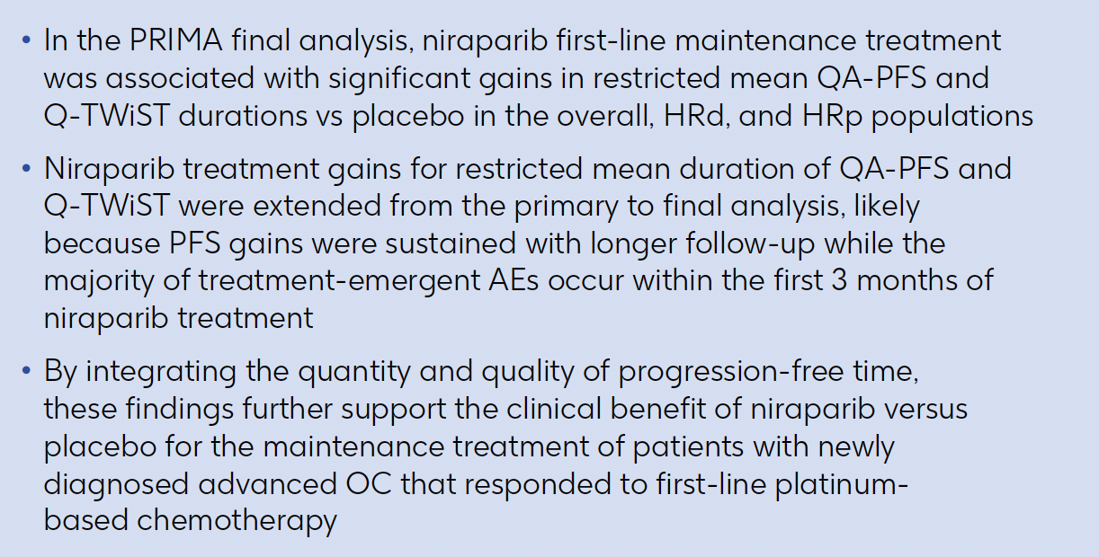
PRIMA Study Conclusions
QA-PFS = quality-adjusted progression-free survival; Q-TWiST = quality-adjusted time without symptoms of disease or toxicity; HRd = homologous recominbation-deficient; HRp = homologous recombination-proficient; AEs = adverse events
Denys H et al. ESMO 2025;Abstract 1070P.

Slide 53
FIRST/ENGOT-OV44 Trial: Does the Addition of Dostarlimab Impact Niraparib Tolerability, Exposure, or Dose Modification?
Moore KN et al.
ESMO 2025;Abstract 1101P.

Slide 54
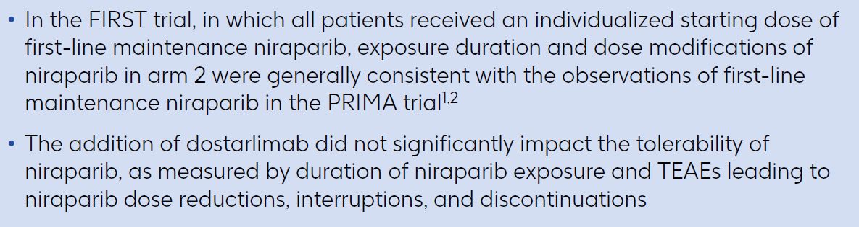
FIRST/ENGOT-OV44 Study Conclusions
Moore KN et al. ESMO 2025;Abstract 1101P.

Slide 55
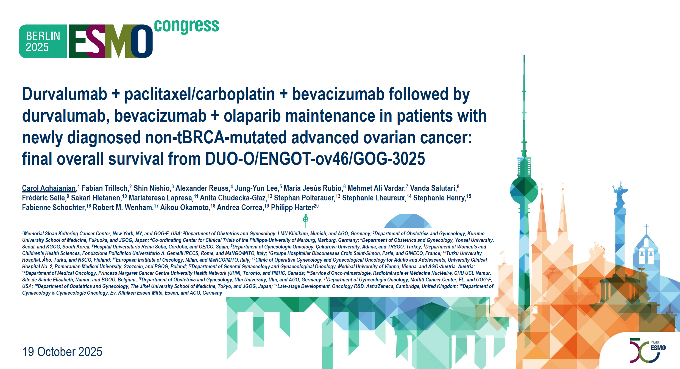
Abstract LBA44

Slide 56
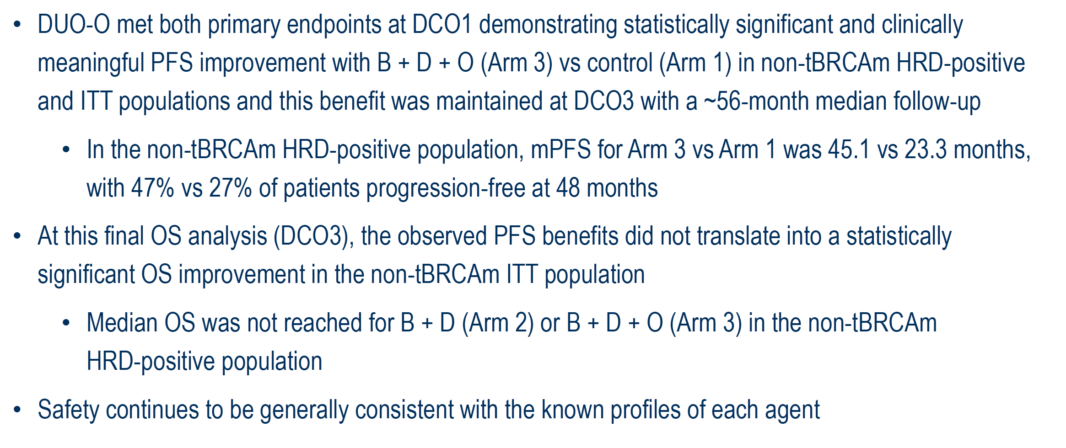
DUO-O Study Conclusions
tBRCAm = tumor BRCA mutation/mutated
Aghajanian C et al. ESMO 2025;Abstract LBA44.

Slide 57
Phase 3, Randomized, Double-Blind, Placebo (Pbo)-Controlled ENGOT-ov43/GOG-3036/KEYLYNK-001 Study of 1L Chemotherapy (CT) + Pembrolizumab (Pembro) Then Maintenance (Maint) Pembro + Olaparib (Ola) for Advanced BRCA-Nonmutated Epithelial Ovarian Cancer (EOC): Analysis by HRD Status
Cibula D et al.
ESMO 2025;Abstract 1071P.

Slide 58
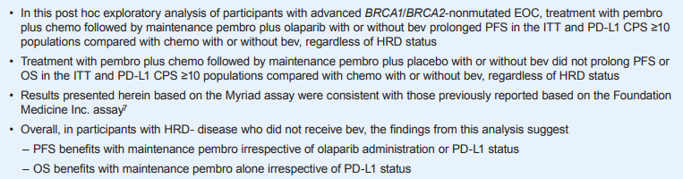
ENGOT-ov43/GOG-3036/KEYLYNK-001 Study Conclusions
Cibula D et al. ESMO 2025;Abstract 1071P.

Slide 59
Agenda
Module 1: Up-Front Treatment of Ovarian Cancer (OC)
Module 2: Management of Platinum-Resistant OC
Module 3: Up-Front Management of Metastatic Endometrial Cancer
Module 4: Management of HER2-Positive Gynecologic Cancers
Module 5: Management of Cervical Cancer

Slide 60
Case Presentation: Dr Salani
61 year old (diagnosed at age 58); healthy patient; musician.
11/21/22: CT abdomen/pelvis: Subcapsular liver and splenic deposits; numerous mesenteric nodules throughout the abdomen and pelvis (largest measuring 4.0 x 3.0 cm and invades the spleen). Right adnexal mass measuring 4.9 x 4.2 cm. Mild ascites and enlarged bilateral groin nodes.
11/23/22: Inguinal lymph node biopsy: Metastatic high grade serous carcinoma, favors tubo-ovarian origin consistent with stage IVb high grade serous ovarian cancer.
Testing: HRD positive, FOLR1 positive, TP53 (exon 4 p.P87fs); MSS, TMB 9 muts/MB.
12/1/22 – 1/12/23: Neoadjuvant carboplatin and paclitaxel (1L) x 3 cycles.
2/15/23: Total abdominal hysterectomy, bilateral salpingo-oophorectomy, omentectomy, tumor reductive surgery with complete cytoreduction: Microscopic high grade serous carcinoma (CRS3).
3/16/23 – 4/27/23: Carboplatin and paclitaxel resumed (1L); bevacizumab (cycle 5 and 6) x 6 cycles; olaparib/bevacizumab maintenance started 5/30/23.

Slide 61
Case Presentation: Dr Salani (Continued)
12/17/23: CT chest/abdomen/pelvis: New left internal mammary artery chain lymph node measuring
5 x 9 mm; stable perisplenic deposit, no evidence of new metastatic disease.
1/16/24: Olaparib and bevacizumab maintenance discontinued (disease progression).
1/18/24: Mammary lymph node biopsy: Metastatic carcinoma consistent with clinical history. HER2 2+.
1/30/24 – 4/23/24: Carboplatin and liposomal doxorubicin (2L) x 4 cycles (liposomal doxorubicin held cycle 4).
5/6/24 – 5/13/24: SBRT to mammary node (4000 cGy).
7/11/24: PET CT: Decrease in size of left internal mammary lymph node (5 x 11 mm, no SUV uptake) and decrease in splenic deposits. Low pelvic mesenteric lymph node measuring 8 x 11 mm (SUV 3.2) and borderline enlarged left inguinal lymph node measuring 10 x 14 mm (SUV 3.6).
8/12/24 – 12/30/24: Mirvetuximab (3L) x 7 cycles; disease progression.
1/27/25 – 5/5/25: Cisplatin, gemcitabine and bevacizumab x 4 cycles (delays due to hematologic toxicities).

Slide 62
Case Presentation: Dr Salani (Continued)
6/3/25: PET CT: Increased FDG avid peritoneal disease (left upper quadrant, hepatic capsular nodule, right lower quadrant), new nodal disease in right common iliac, pericaval, cardiophrenic nodes; stable inguinal and mammary nodes. T11 FDG uptake without correlate.
6/17/25 – 9/26/25: Trastuzumab deruxtecan (5L) X 5 cycles.
10/4/25: CT chest/abdomen/pelvis: Increase size of right mammary node (5 mm), diaphragm and cardiophrenic nodes. Decrease in pulmonary nodule. Slightly increased burden of peritoneal disease, stable hepatic capsular implant and inguinal node, slight increased ascites. Increased size of a necrotic right common iliac node (13 x 17 mm, previously 9 x 10 mm). No new sites of metastatic disease in the abdomen or pelvis.
10/17/25: Pembrolizumab, bevacizumab, and cyclophosphamide (11/5/25) (6L) started.
Current status: She has received 3 cycles and is tolerating therapy well. CA-125 started plateauing and clinically feeling better but has some GI symptoms. Scan with some slight increase, possible pseudoprogression. Plan is to continue with this regimen and rescan after 2-3 cycles; pre-screening for clinical trial options.

Slide 63
Tumor Markers
 | CA-125
1/17/2025 | 539
2/10/2025 | 439
2/24/2025 | 318
3/11/2025 | 212
3/24/2025 | 162
4/7/2025 | 159
4/21/2025 | 176
5/5/2025 | 196
5/19/2025 | 198
6/5/2025 | 363
6/16/2025 | 446
7/7/2025 | 399

Slide 64
Tumor Markers (Continued)
 | CA-125
7/7/2025 | 399
7/25/2025 | 500
8/15/2025 | 685
9/5/2025 | 1,318
9/26/2025 | 1,850
10/17/2025 | 2,651
11/6/2025 | 4,708
12/1/2025 | 4,704

Slide 65
Key Datasets
Colombo N et al. Pembrolizumab vs placebo plus weekly paclitaxel ± bevacizumab in platinum-resistant recurrent ovarian cancer: Results from the randomized double-blind phase III ENGOT-ov65/KEYNOTE-B96 study. ESMO 2025;Abstract LBA3.
Olawaiye AB et al. Relacorilant and nab-paclitaxel in patients with platinum-resistant ovarian cancer (ROSELLA): An open-label, randomised, controlled, phase 3 trial. Lancet 2025;405(10496):2205-16.
Ray-Coquard IL et al. Raludotatug deruxtecan (R-DXd) in patients (pts) with platinum-resistant ovarian cancer (PROC): Primary analysis of the phase II dose-optimization part of REJOICE-Ovarian01. ESMO 2025;Abstract LBA42.
Oaknin A et al. First-in-human study of AZD5335, a folate receptor α (FRα)-targeted antibody-drug conjugate, in patients with platinum-resistant recurrent ovarian cancer. ESMO 2025;Abstract 1065MO.

Slide 66
Phase III KEYNOTE-B96 Trial Met Secondary Endpoint of Overall Survival in All-Comer Population of Patients with Platinum-Resistant Recurrent Ovarian Cancer
Press Release: October 16, 2025
“The Phase 3 KEYNOTE-B96 trial, also known as ENGOT-ov65, met its secondary endpoint of overall survival (OS) for the treatment of patients with platinum-resistant recurrent ovarian cancer in all comers. The trial studied pembrolizumab in combination with chemotherapy (paclitaxel) with or without bevacizumab for these patients.
As previously announced, KEYNOTE-B96 met its primary endpoint of progression-free survival PFS in patients with platinum-resistant recurrent ovarian cancer whose tumors express PD-L1 and in all comers, as well as its secondary endpoint of OS for patients whose tumors express PD-L1, at previous interim analyses.
Findings from these prior analyses will be presented in a Presidential Symposium at the upcoming European Society for Medical Oncology (ESMO) Congress 2025.”
https://www.merck.com/news/merck-announces-phase-3-keynote-b96-trial-met-secondary-endpoint-of-overall-survival-os-in-all-comers-population-of-patients-with-platinum-resistant-recurrent-ovarian-cancer/

Slide 67
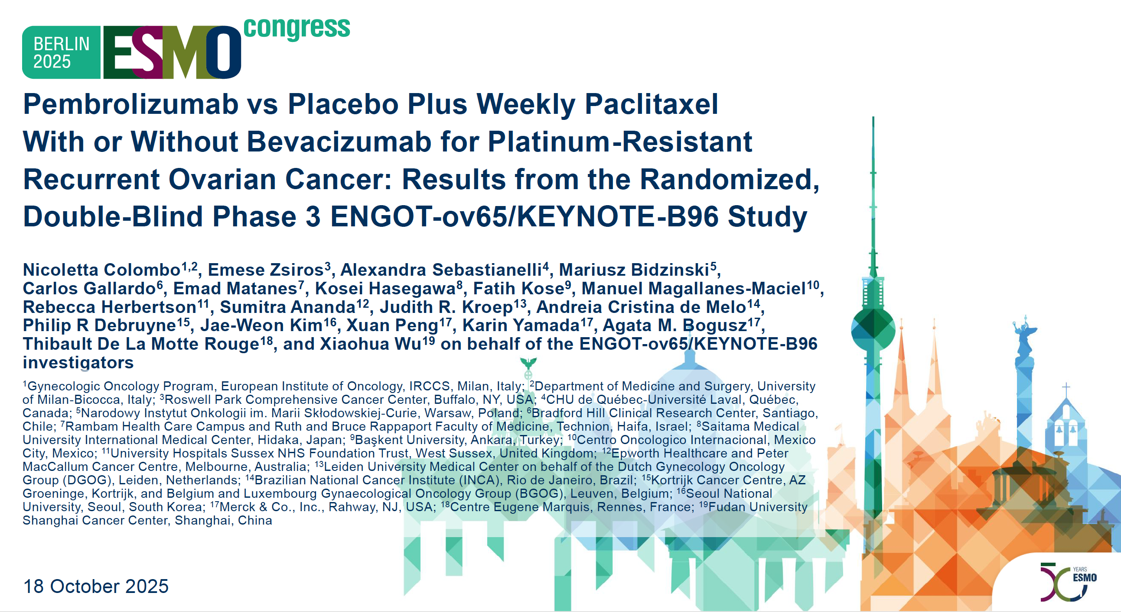
Abstract LBA3

Slide 68
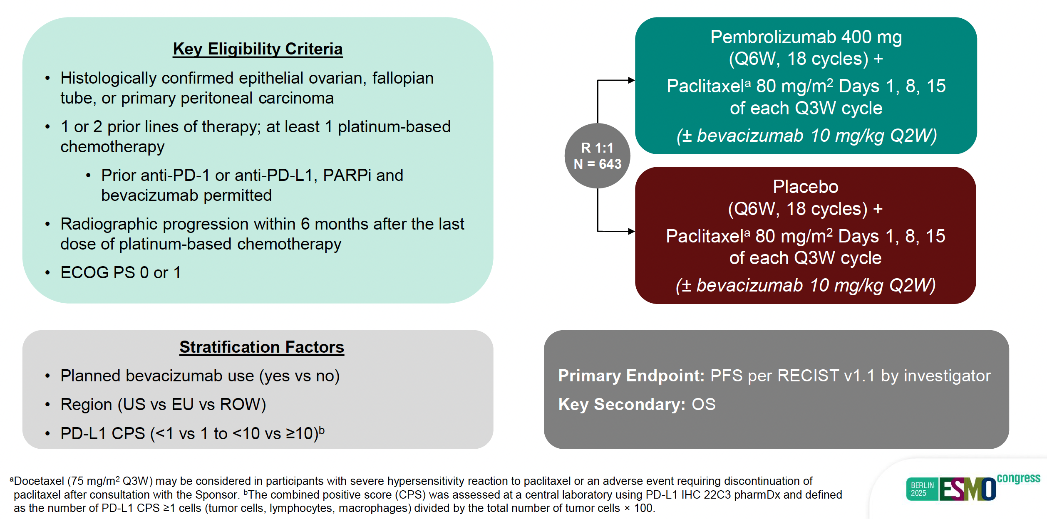
KEYNOTE-B96 Study Design
Colombo N et al. ESMO 2025;Abstract LBA3.

Slide 69
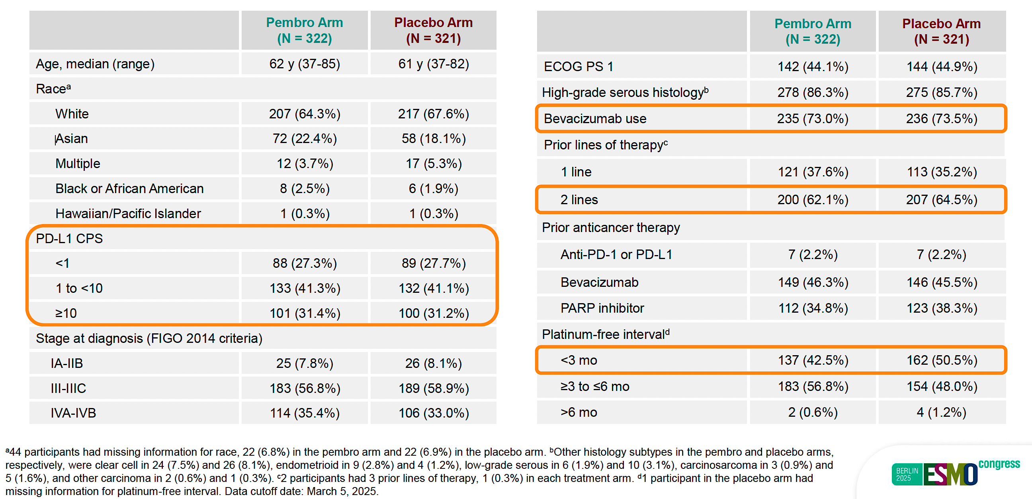
KEYNOTE-B96: Baseline Characteristics
Colombo N et al. ESMO 2025;Abstract LBA3.

Slide 70
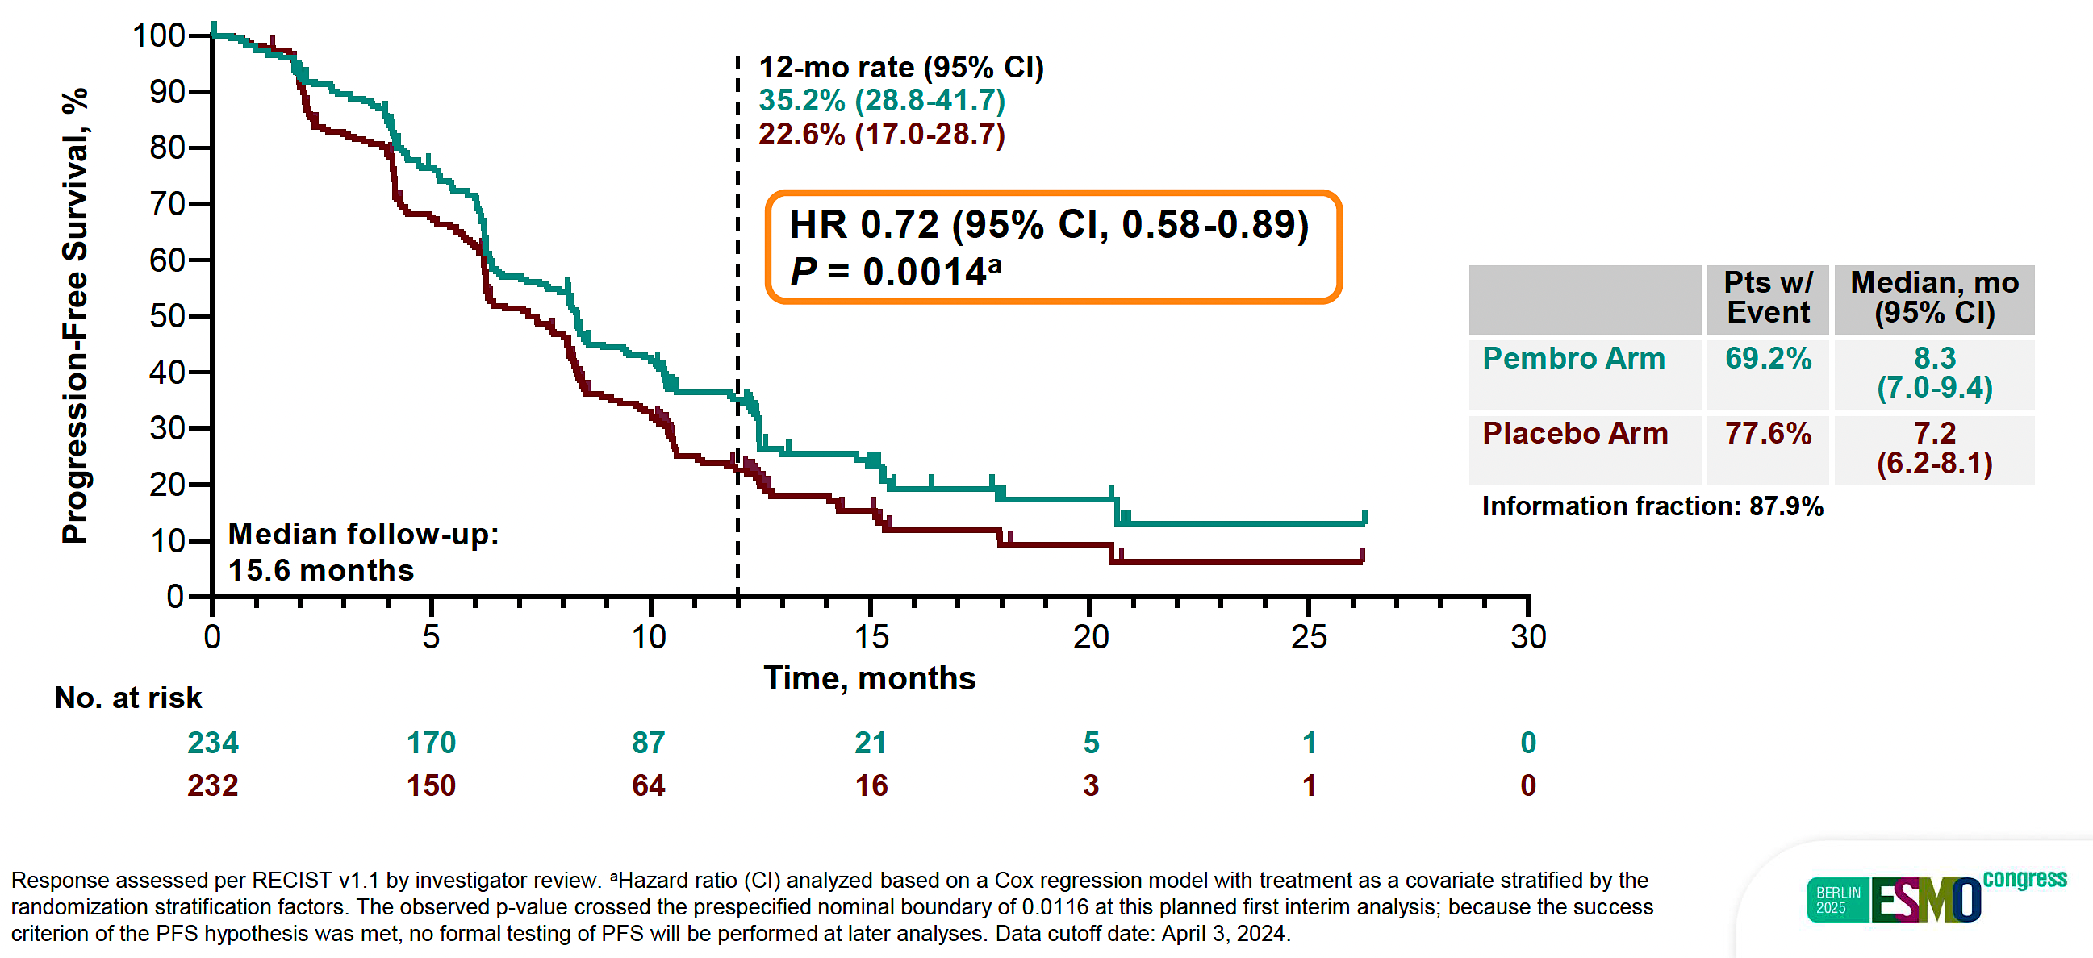
KEYNOTE-B96: PFS in the CPS ≥1 Population at Interim Analysis 1 (IA1)
Colombo N et al. ESMO 2025;Abstract LBA3.

Slide 71
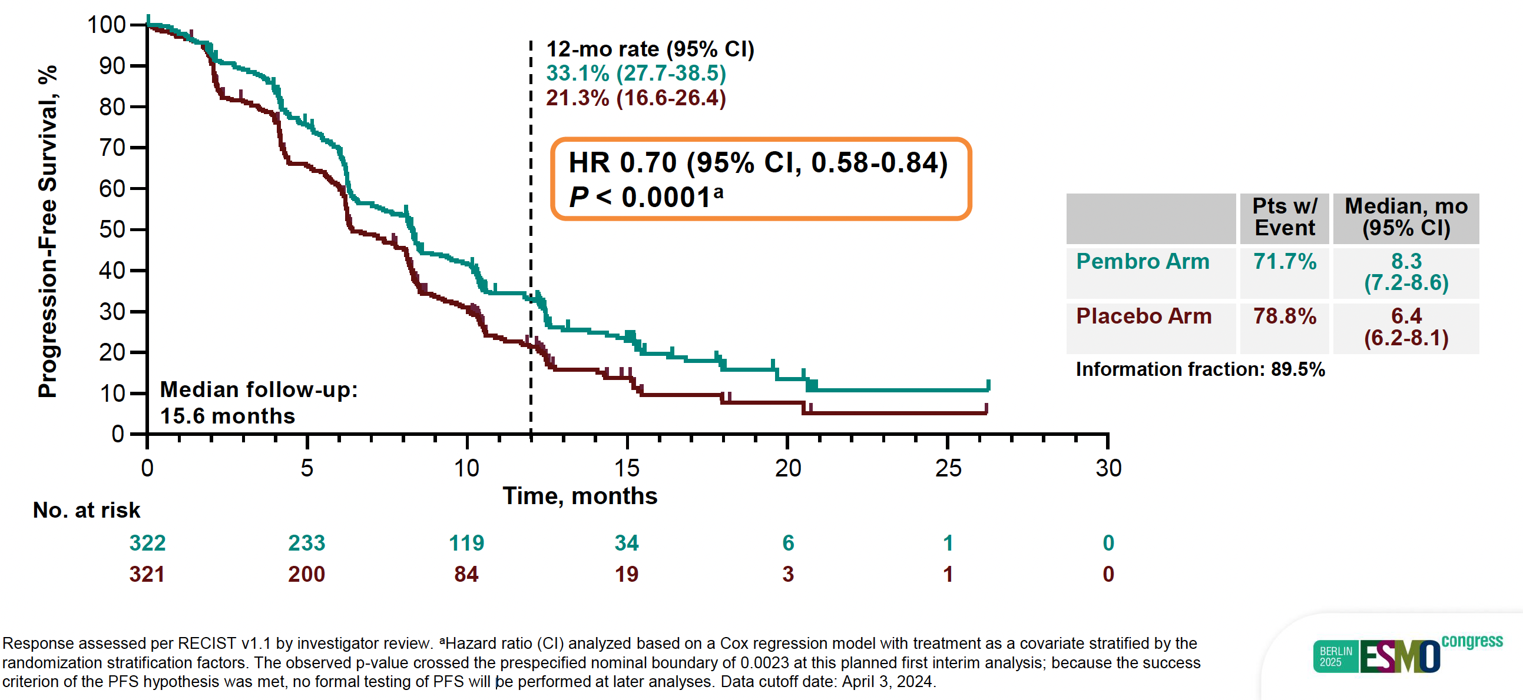
KEYNOTE-B96: PFS in the Intent-to-Treat Population at IA1
Colombo N et al. ESMO 2025;Abstract LBA3.

Slide 72
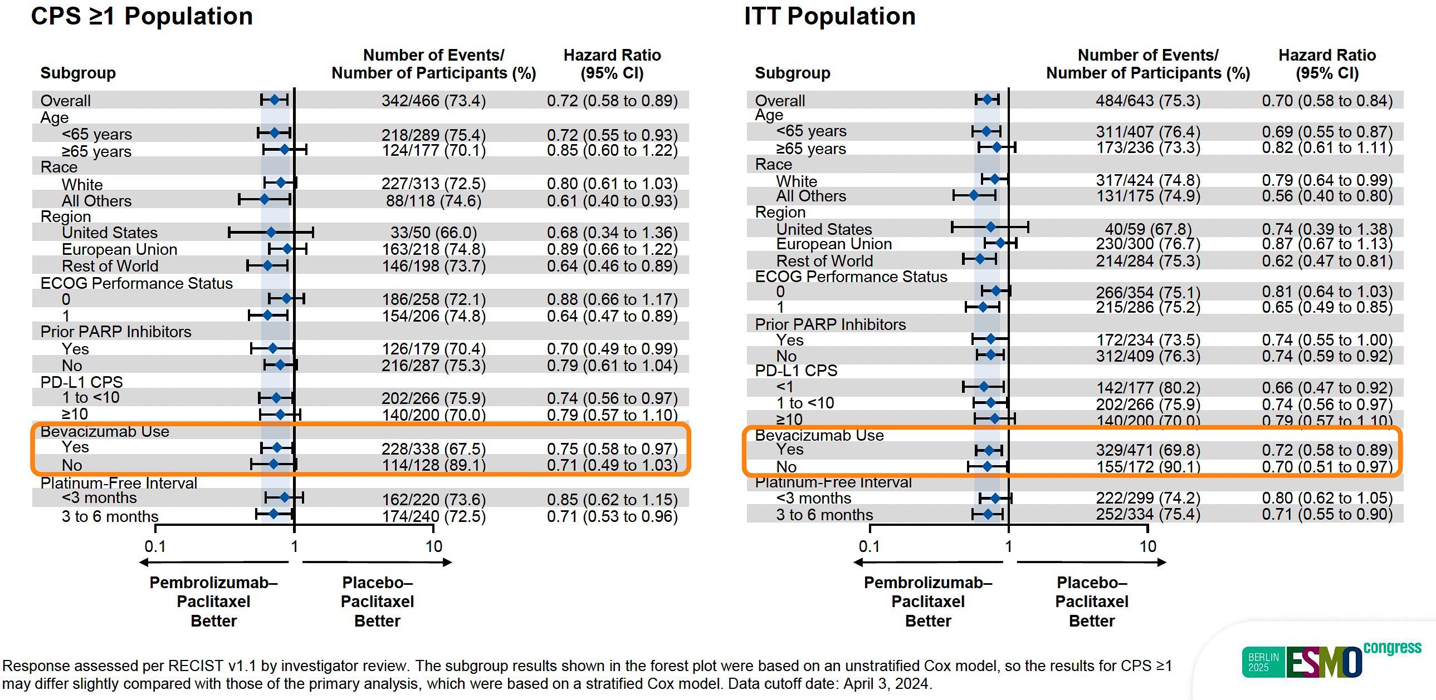
KEYNOTE-B96: PFS in Subgroups in the CPS ≥1 and Intent-to-Treat (ITT) Populations at IA1
Colombo N et al. ESMO 2025;Abstract LBA3.

Slide 73
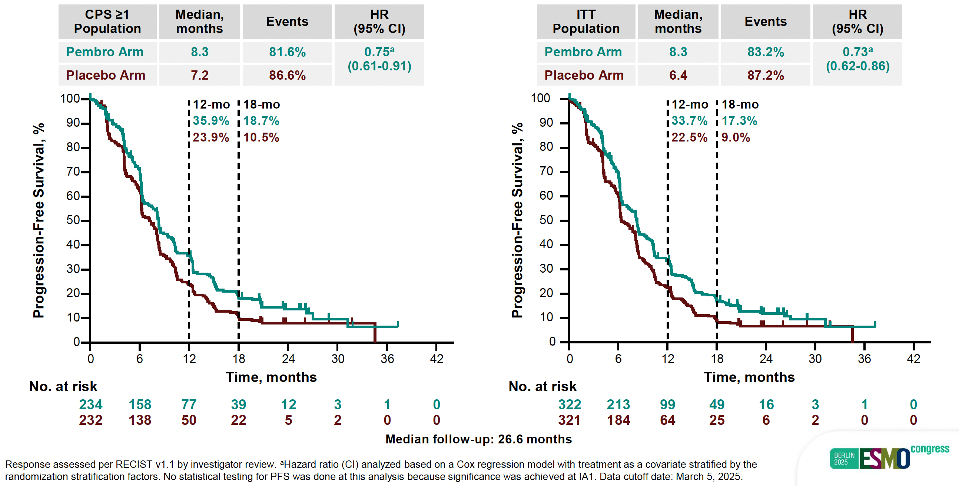
KEYNOTE-B96: PFS in the CPS ≥1 and ITT Populations at Interim Analysis 2 (IA2)
Colombo N et al. ESMO 2025;Abstract LBA3.

Slide 74
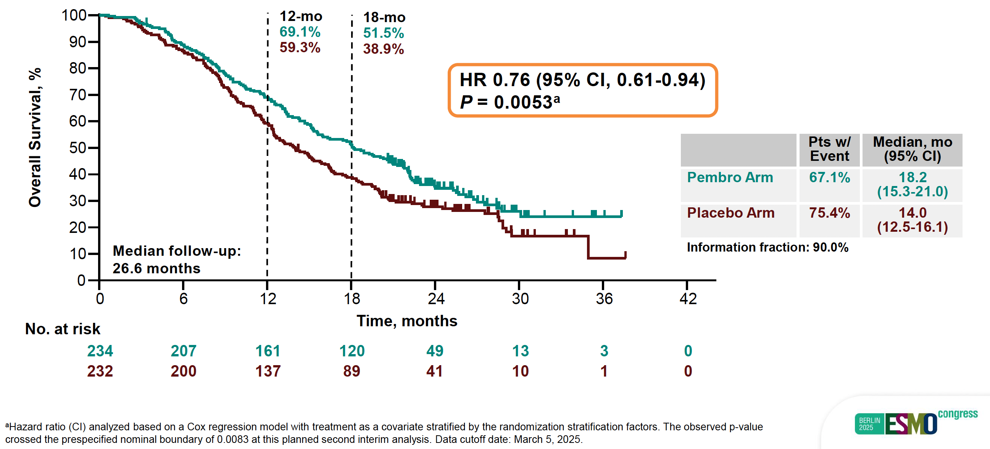
KEYNOTE-B96: OS in the PD-L1 CPS ≥1 Population at IA2
Colombo N et al. ESMO 2025;Abstract LBA3.

Slide 75
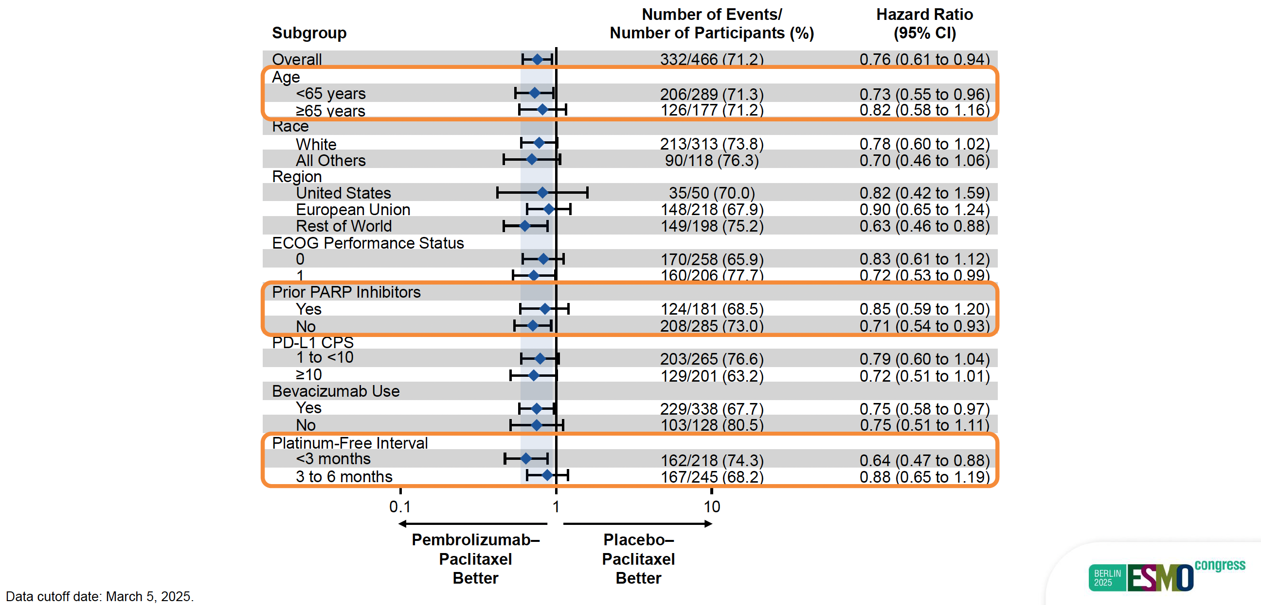
KEYNOTE-B96: OS in Subgroups in the PD-L1 CPS ≥1 Population at IA2
Colombo N et al. ESMO 2025;Abstract LBA3.

Slide 76
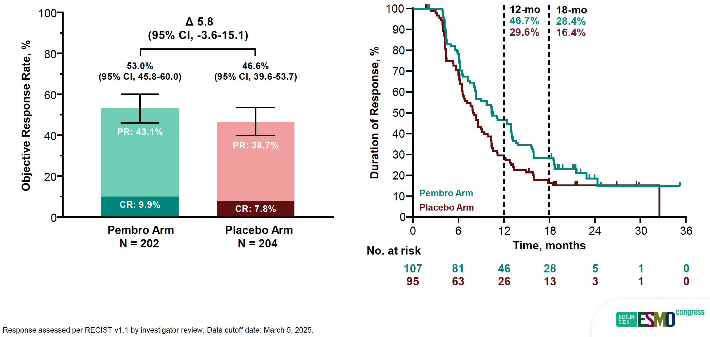
KEYNOTE-B96: Objective Response Rate and Response Duration in the PD-L1 CPS ≥1 Population at IA2
Colombo N et al. ESMO 2025;Abstract LBA3.

Slide 77
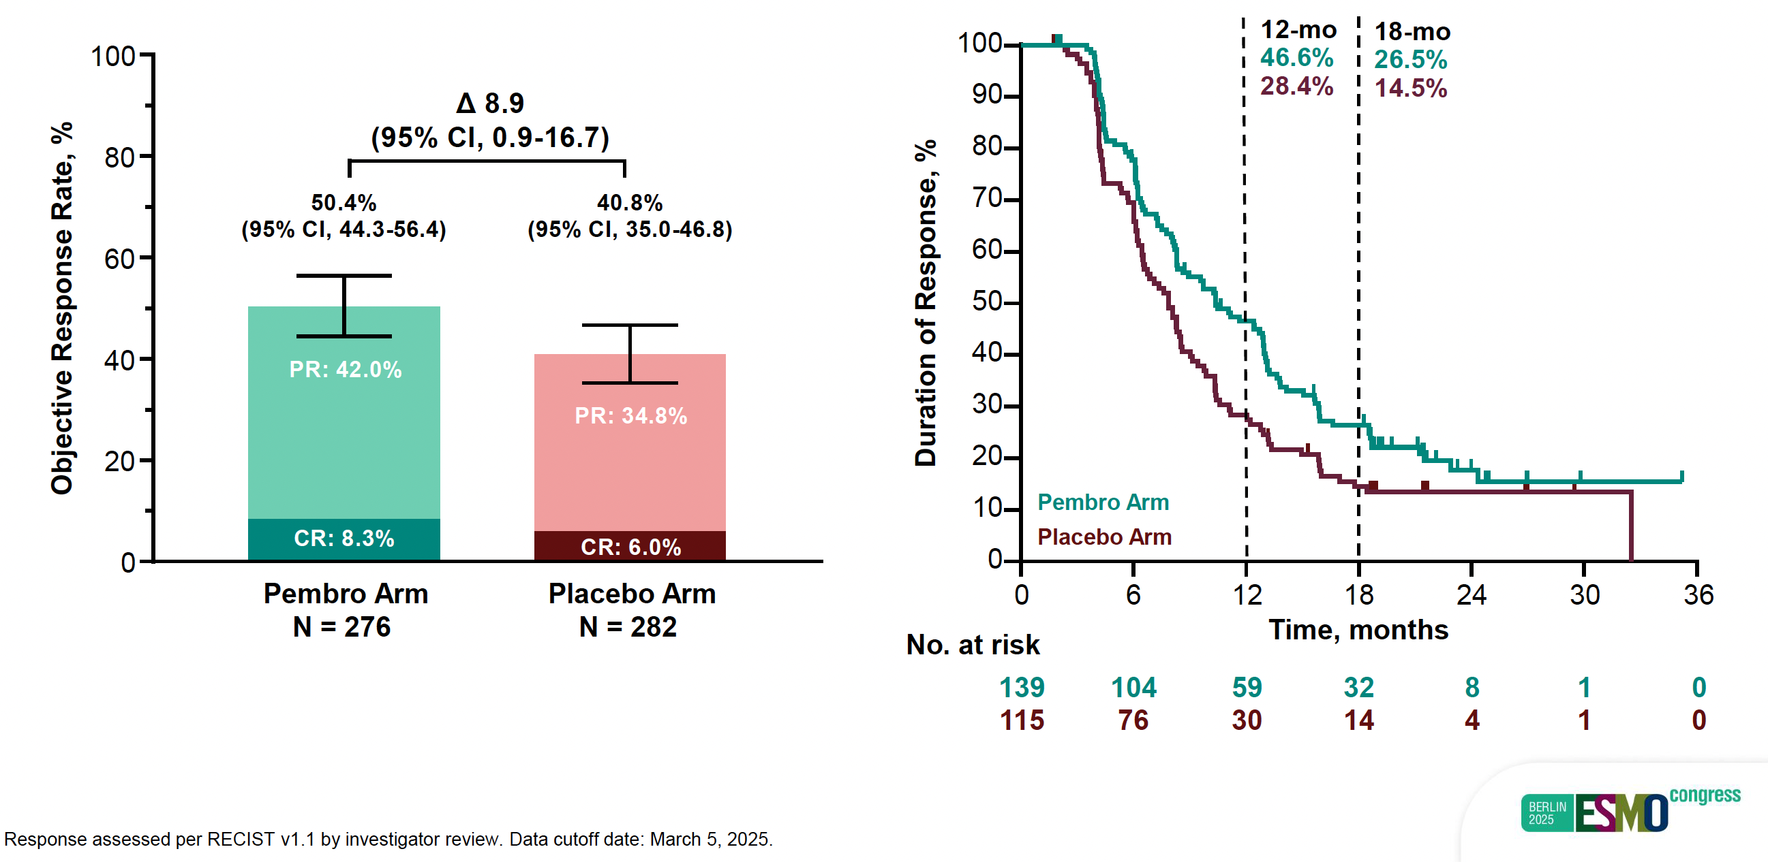
KEYNOTE-B96: Objective Response Rate and Response Duration in the ITT Population at IA2
Colombo N et al. ESMO 2025;Abstract LBA3.

Slide 78
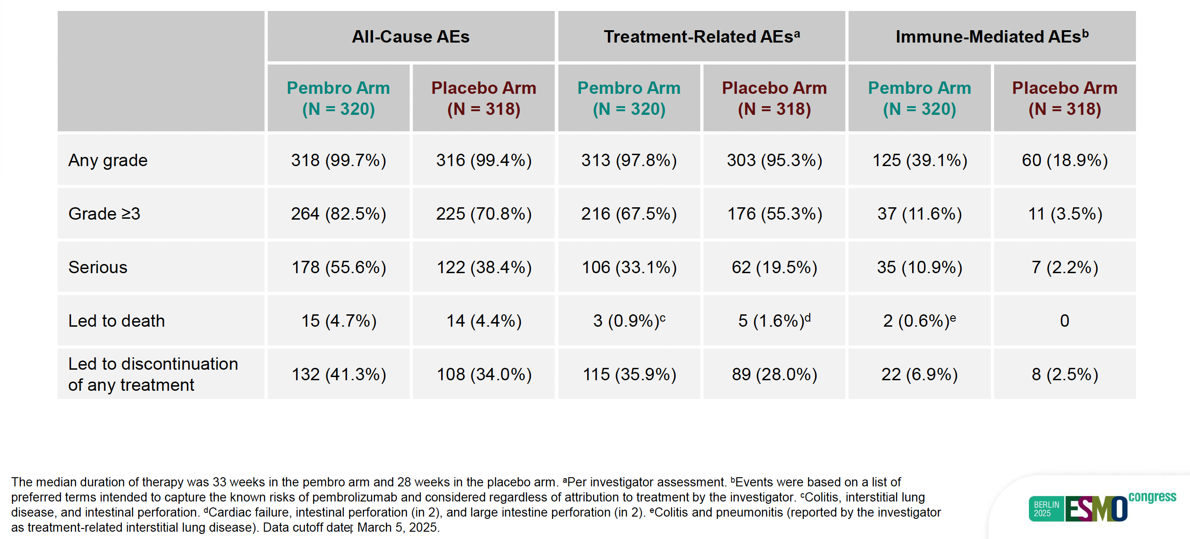
KEYNOTE-B96: Summary of Adverse Events at IA2
Colombo N et al. ESMO 2025;Abstract LBA3.

Slide 79
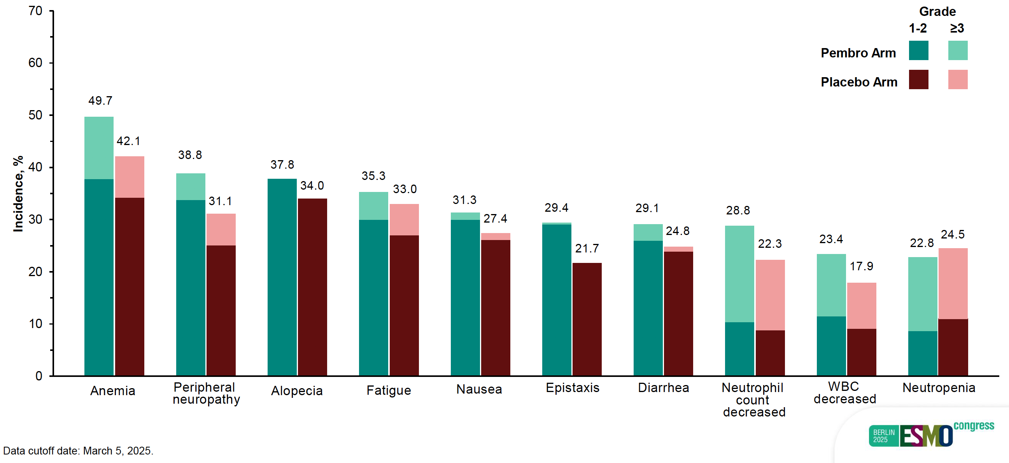
KEYNOTE-B96: Treatment-Related Adverse Events at IA2
Colombo N et al. ESMO 2025;Abstract LBA3.

Slide 80
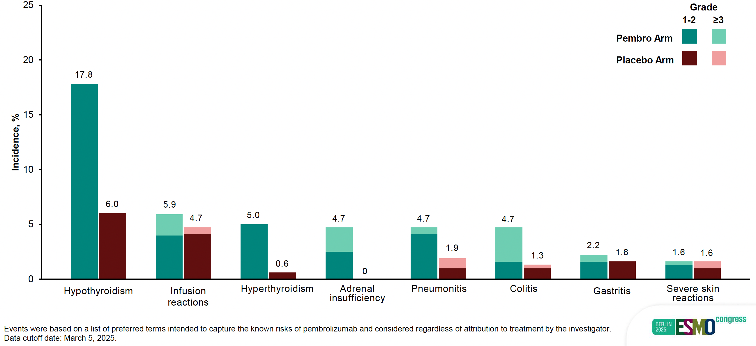
KEYNOTE-B96: Immune-Mediated Adverse Events and Infusion Reactions at IA2
Colombo N et al. ESMO 2025;Abstract LBA3.

Slide 81
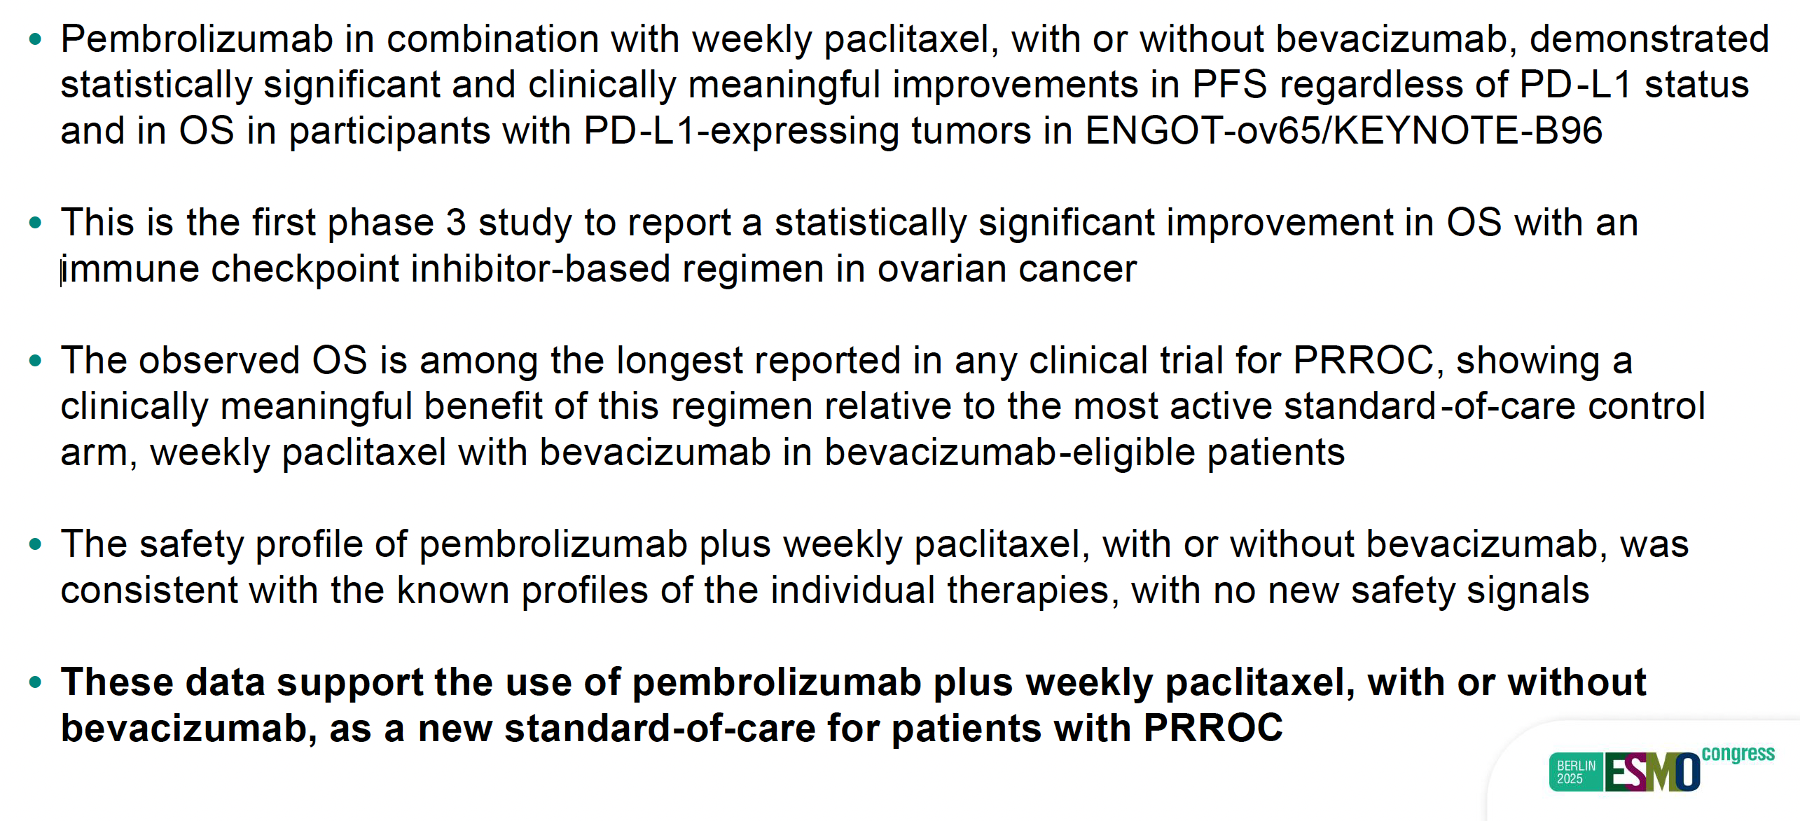
KEYNOTE-B96 Study Conclusions
PRROC = platinum-resistant recurrent ovarian cancer
Colombo N et al. ESMO 2025;Abstract LBA3.

Slide 82
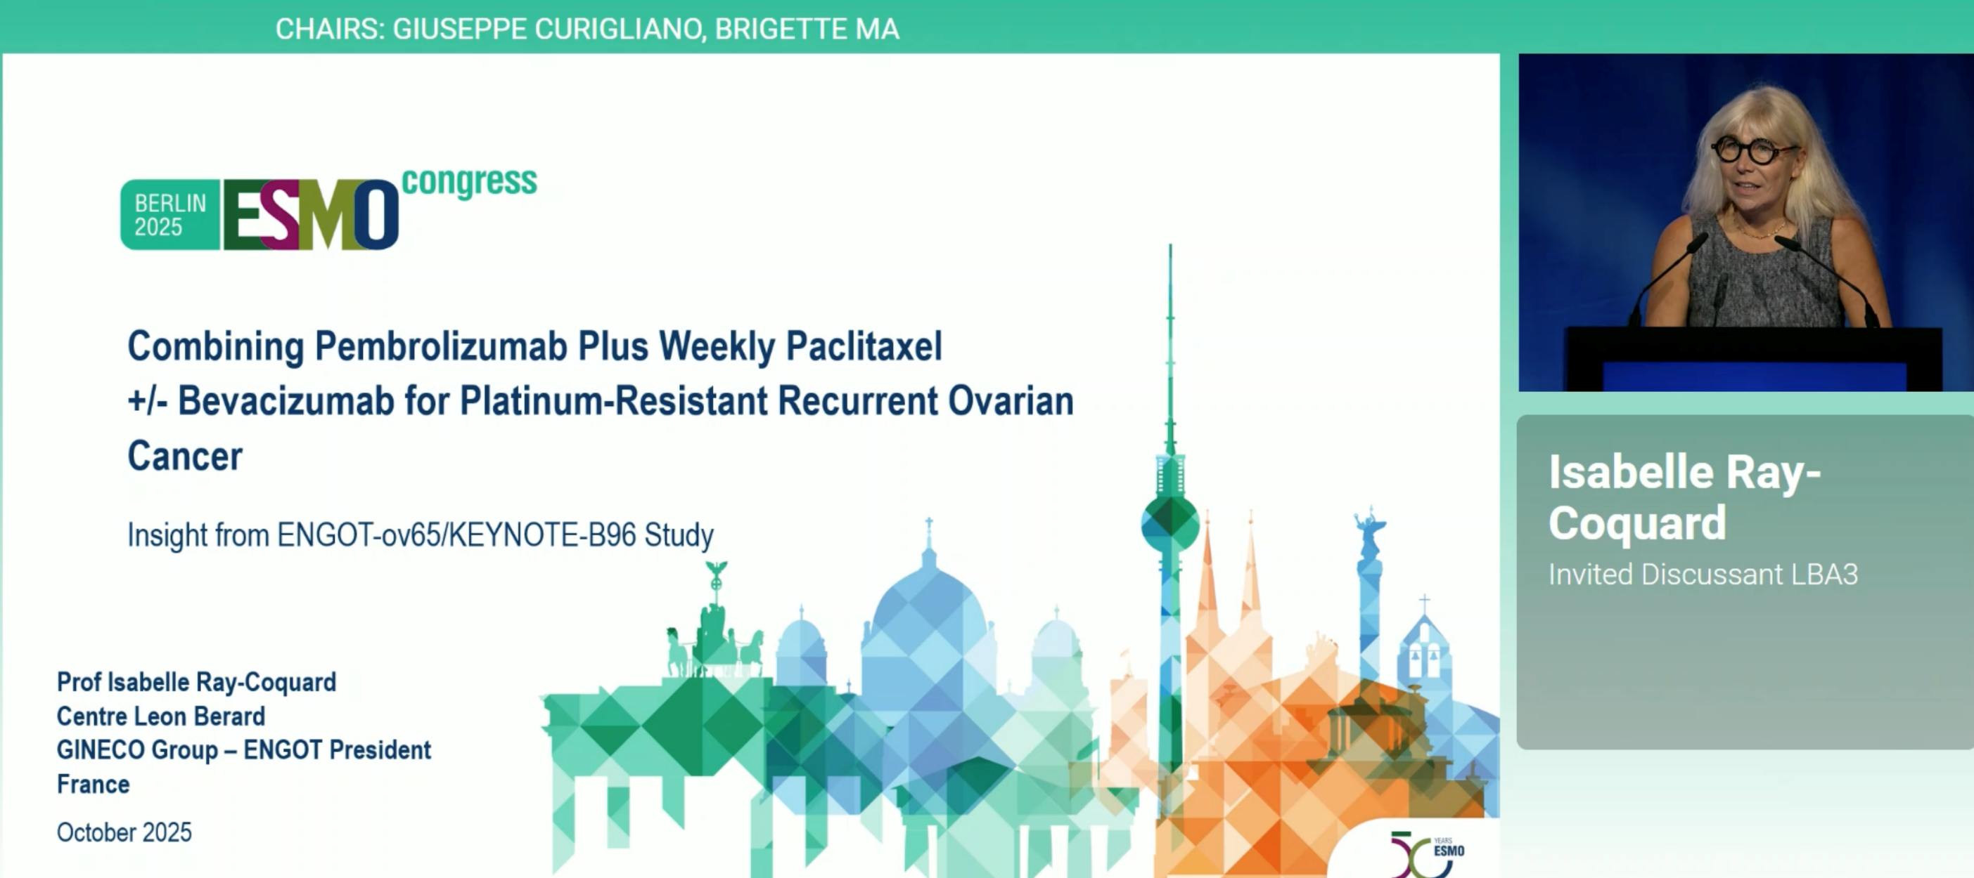

Slide 83
Overall Survival Primary Endpoint Met in Phase III ROSELLA Trial of Relacorilant for Patients with Platinum-Resistant Ovarian Cancer
Press Release: January 22, 2026
It was announced today that ROSELLA, a pivotal Phase III trial of relacorilant with nab-paclitaxel to treat patients with platinum-resistant ovarian cancer, met its overall survival (OS) primary endpoint.
“In ROSELLA, patients treated with relacorilant in addition to nab-paclitaxel chemotherapy experienced a 35 percent reduction in the risk of death compared to patients treated with nab-paclitaxel alone (hazard ratio: 0.65; p-value: 0.0004). The median OS for patients receiving relacorilant was 16.0 months, compared to 11.9 months for patients receiving nab-paclitaxel alone, a difference of 4.1 months. Relacorilant in combination with nab-paclitaxel was well-tolerated, consistent with its known safety profile. Importantly, the type, frequency and severity of adverse events in the combination arm were comparable to those in the nab-paclitaxel monotherapy arm. Relacorilant conferred its benefit without increasing the safety burden of the patients who received it.”
Complete results from ROSELLA will be presented at an upcoming medical conference.
https://ir.corcept.com/news-releases/news-release-details/overall-survival-primary-endpoint-met-corcepts-pivotal-phase-3

Slide 84
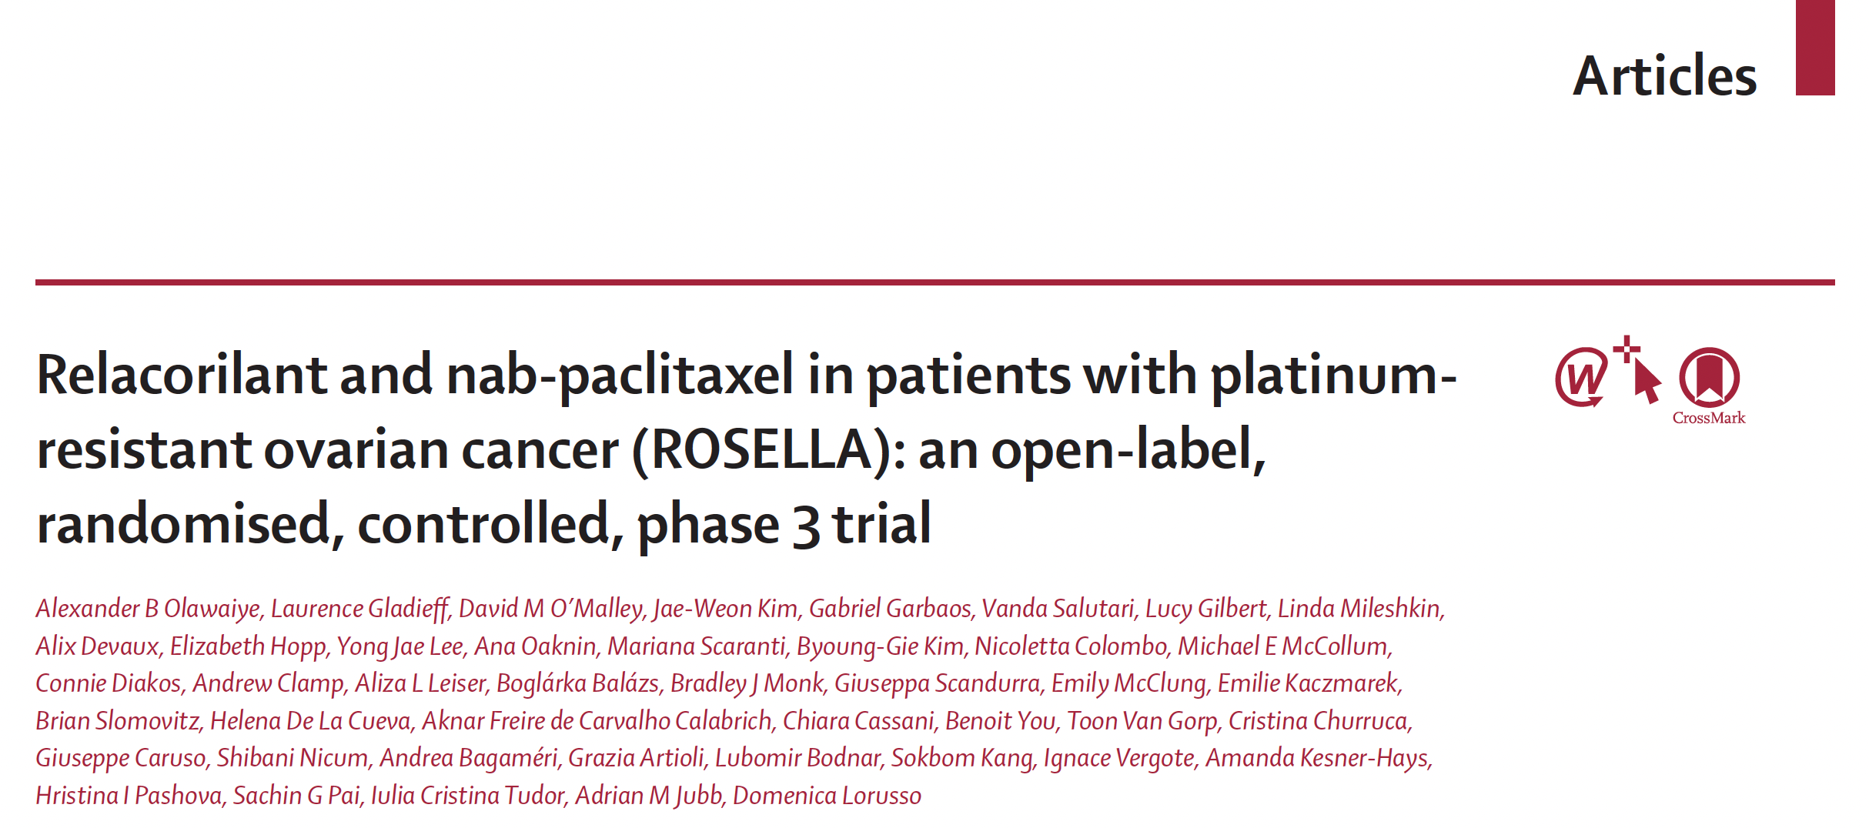
Lancet 2025;405(10496):2205-16.

Slide 85
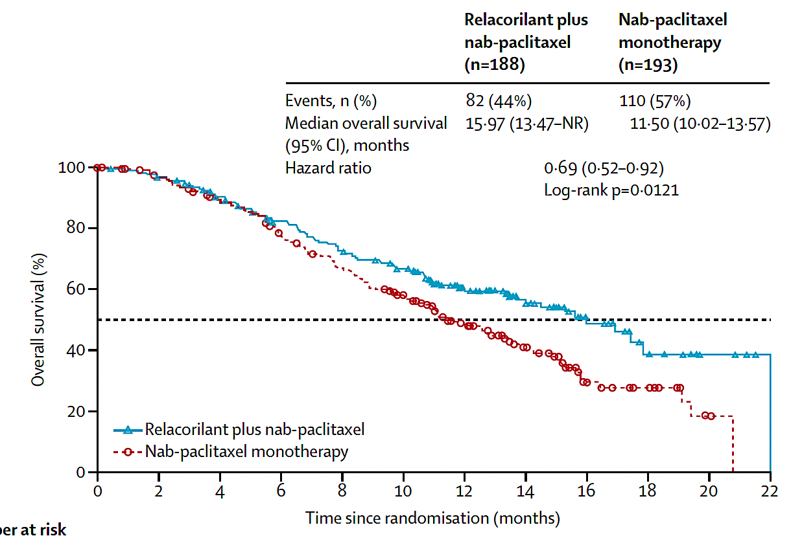
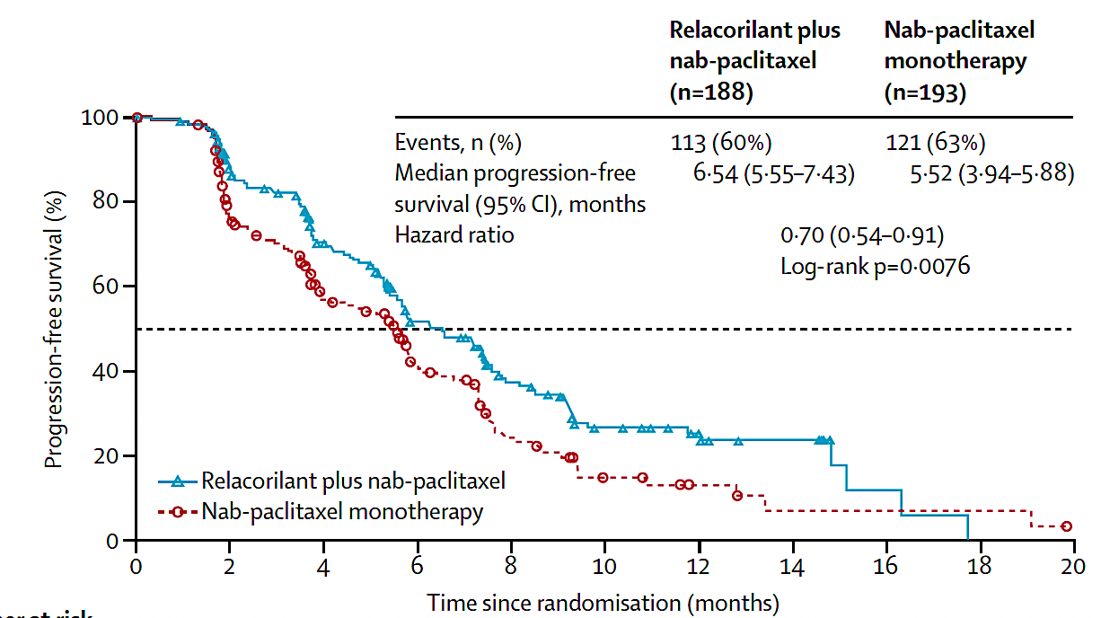
ROSELLA: PFS and Interim OS Analysis with Relacorilant and nab Paclitaxel
Olawaiye AB et al. Lancet 2025;405(10496):2205-16.

Slide 86
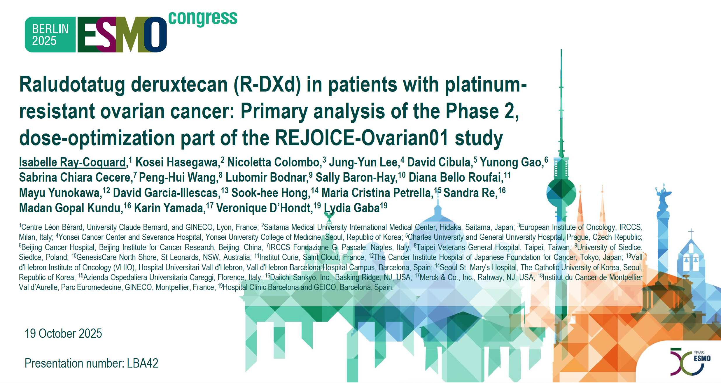

Slide 87
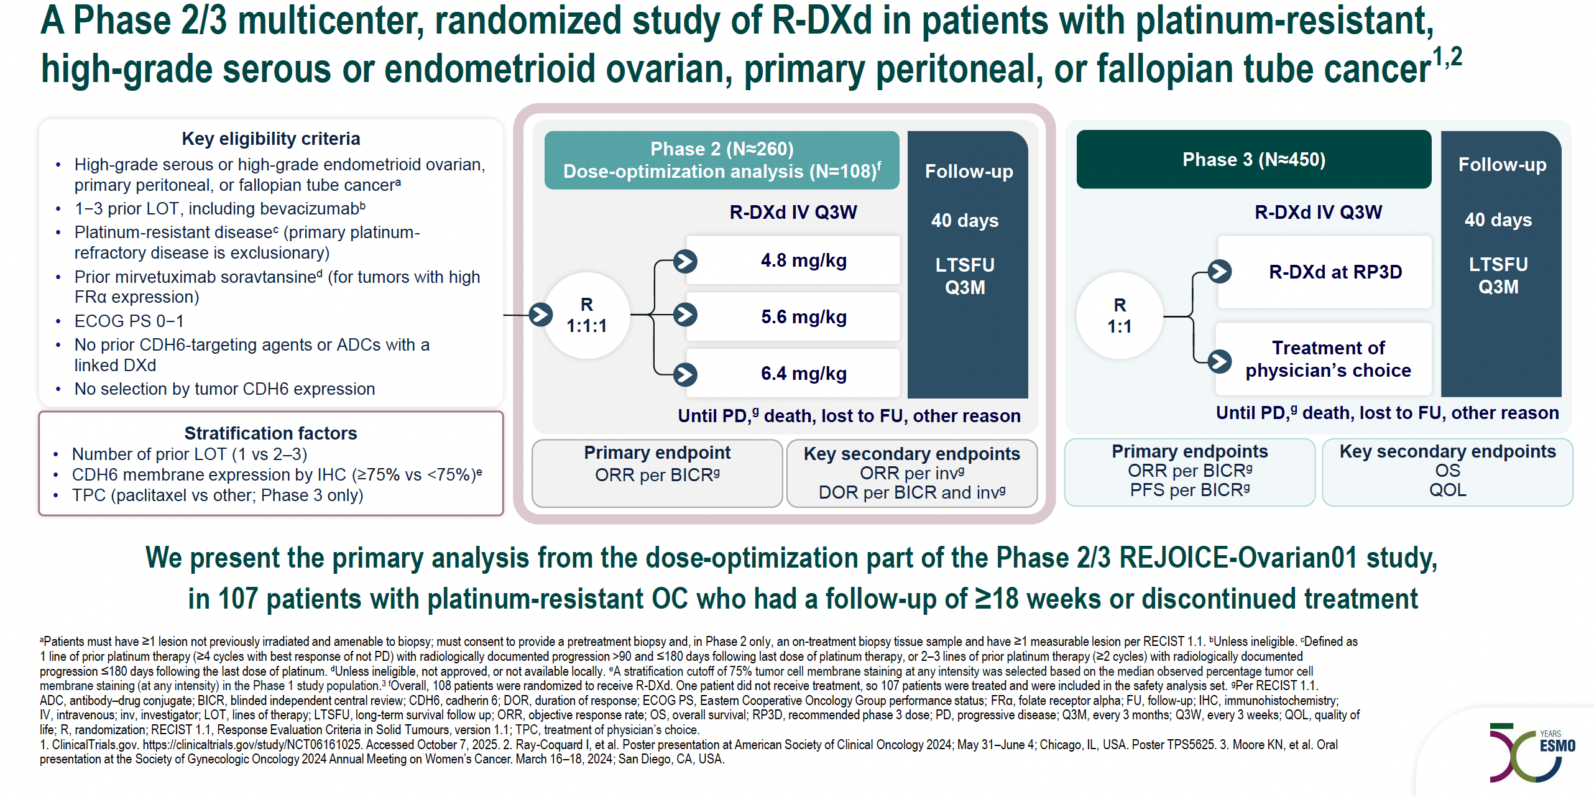
REJOICE-Ovarian01 Phase II/III Study Design
Ray-Coquard IL et al. ESMO 2025;Abstract LBA42.

Slide 88
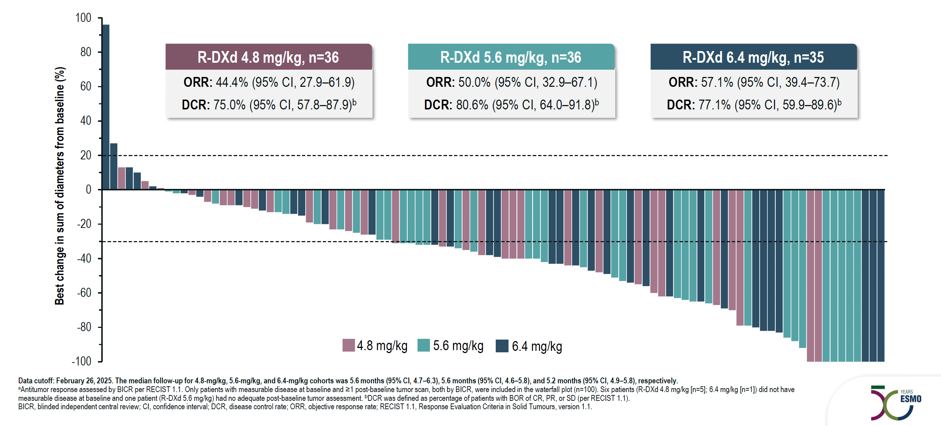
REJOICE-Ovarian01: Antitumor Activity Across Doses
Ray-Coquard IL et al. ESMO 2025;Abstract LBA42.

Slide 89
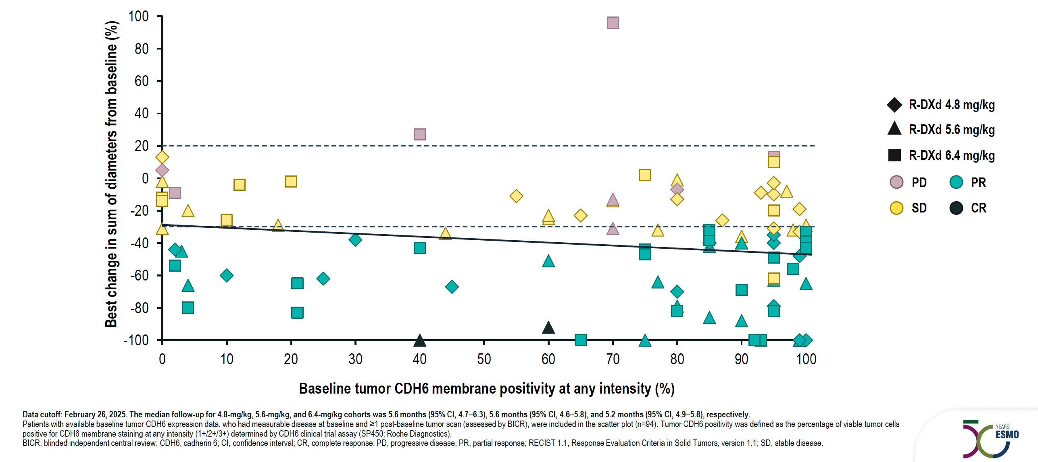
REJOICE-Ovarian01: Antitumor Responses Across CDH6 Expression Levels
Ray-Coquard IL et al. ESMO 2025;Abstract LBA42.

Slide 90
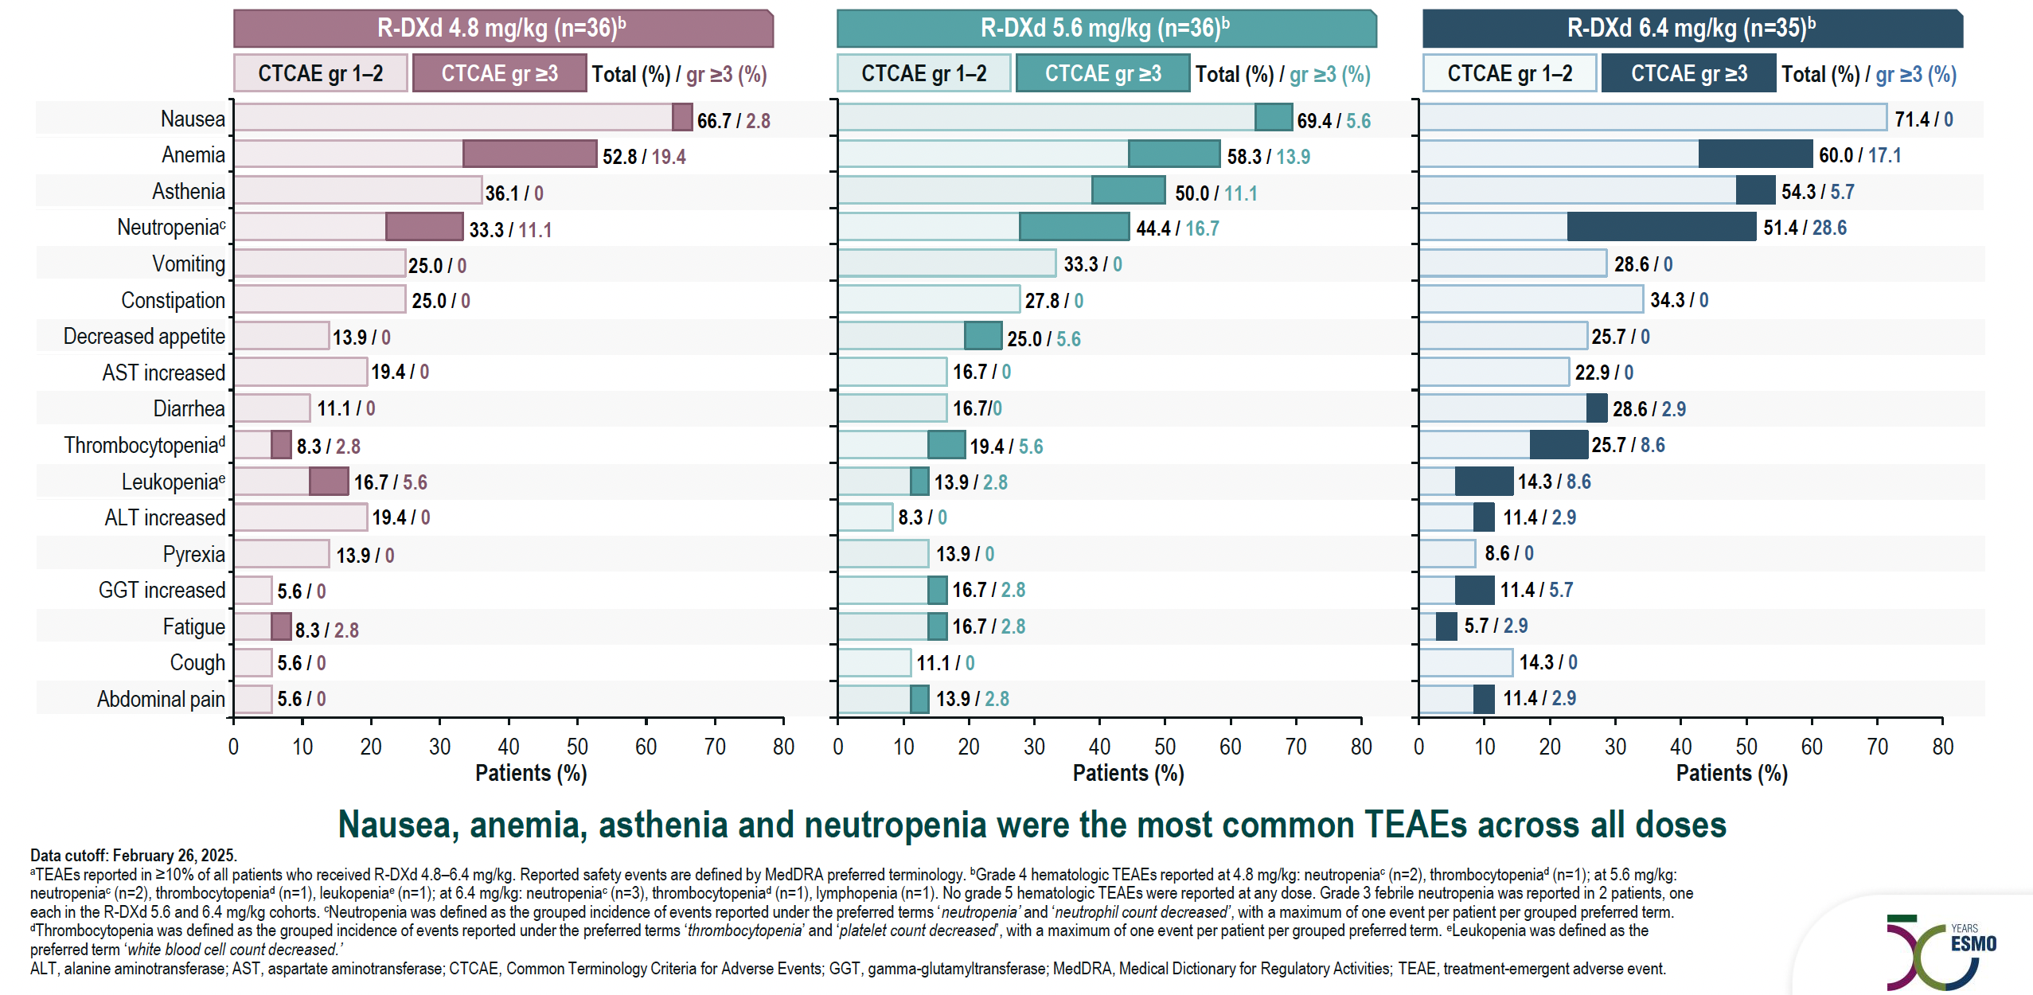
REJOICE-Ovarian01: Most Common Treatment-Emergent Adverse Events
Ray-Coquard IL et al. ESMO 2025;Abstract LBA42.

Slide 91
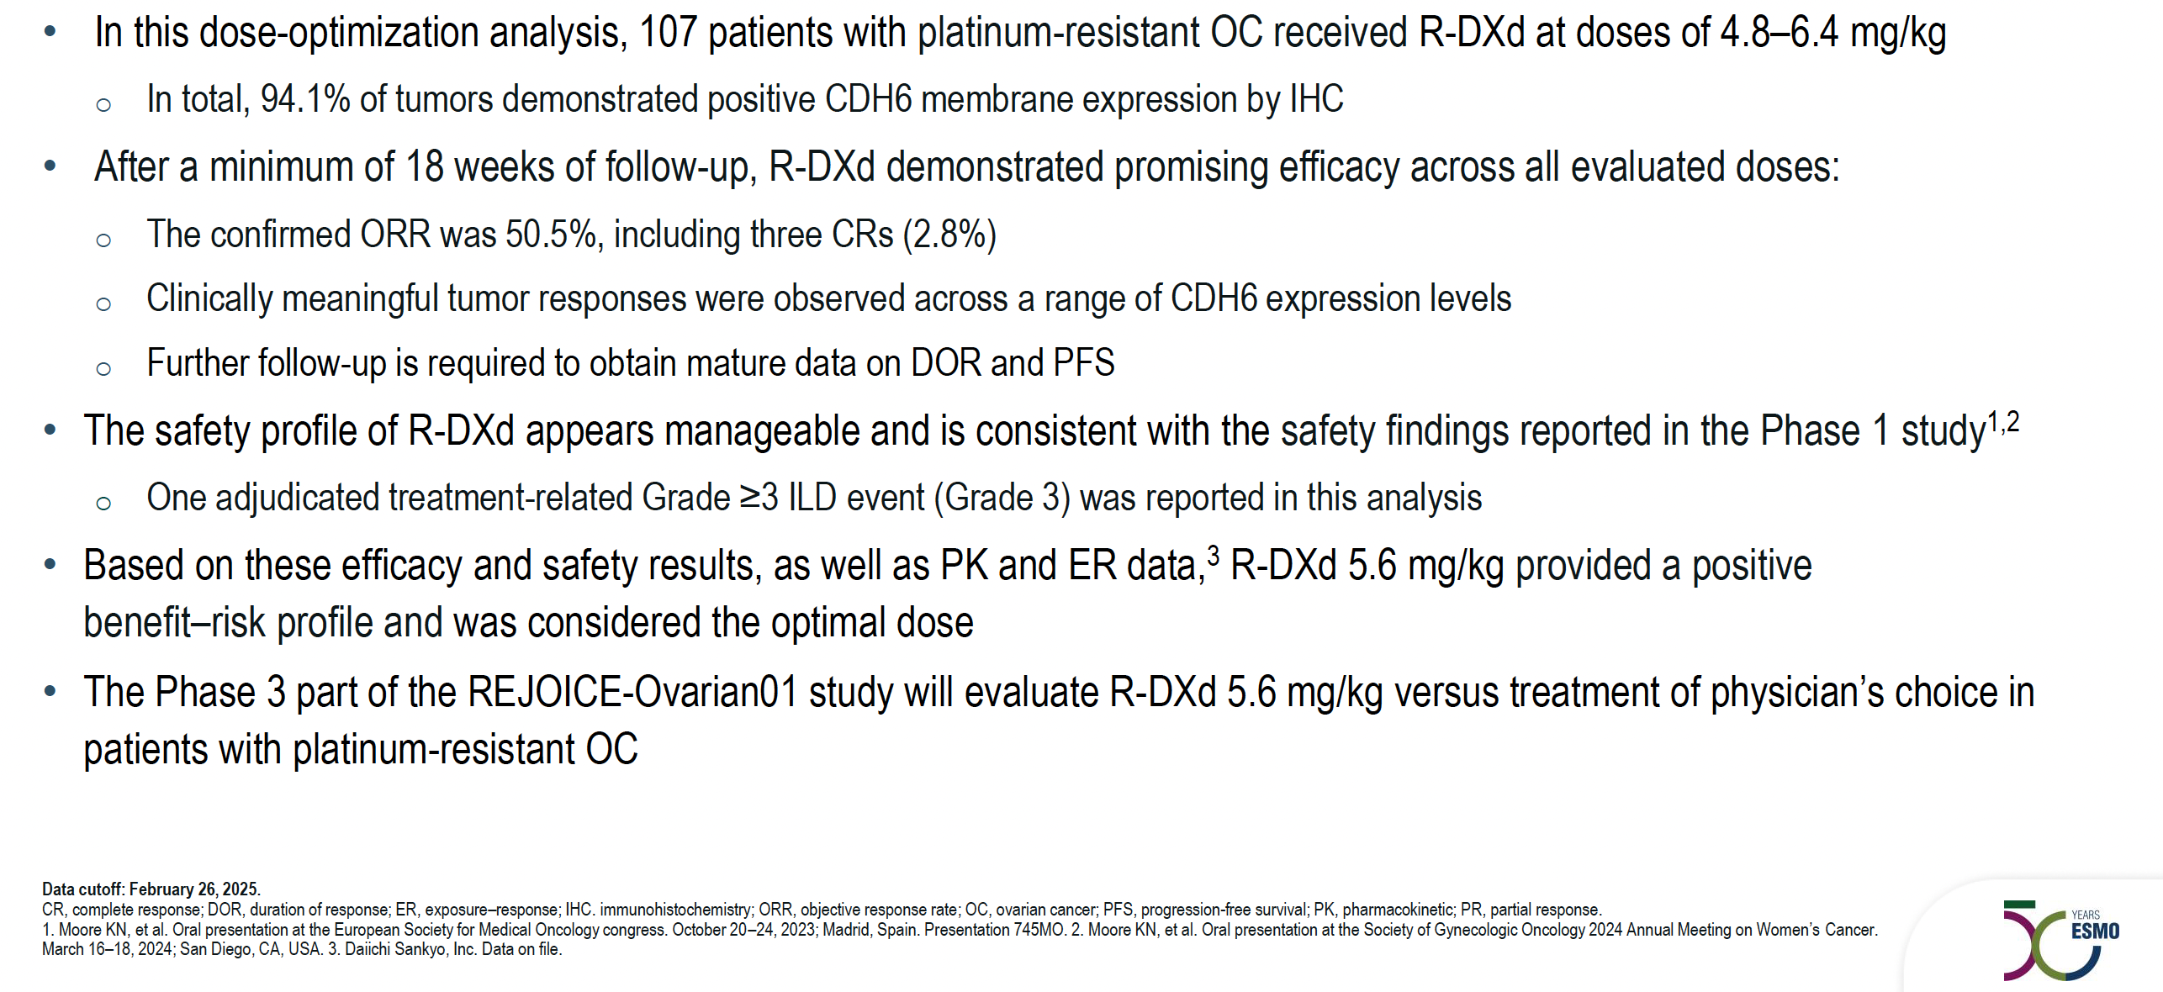
REJOICE-Ovarian01 Study Conclusions
Ray-Coquard IL et al. ESMO 2025;Abstract LBA42.

Slide 92
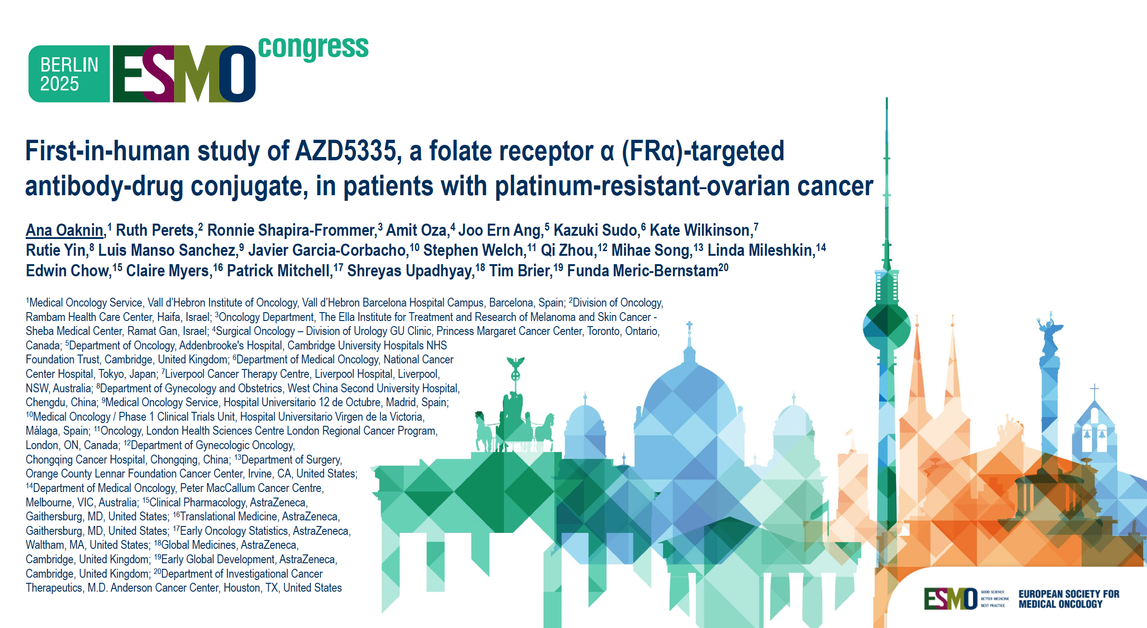
Abstract 1065MO

Slide 93
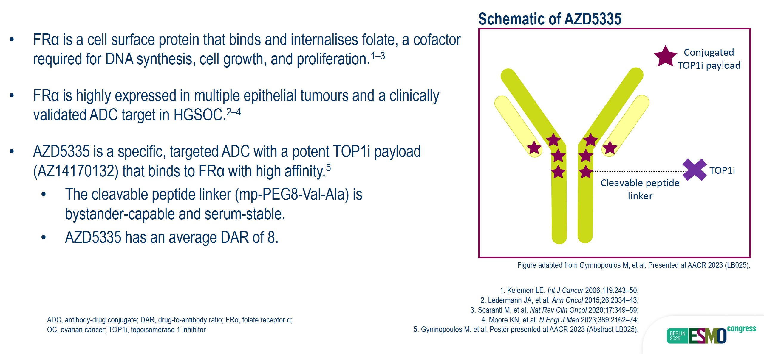
AZD5335 Background
Oaknin A et al. ESMO 2025;Abstract 1065MO.

Slide 94
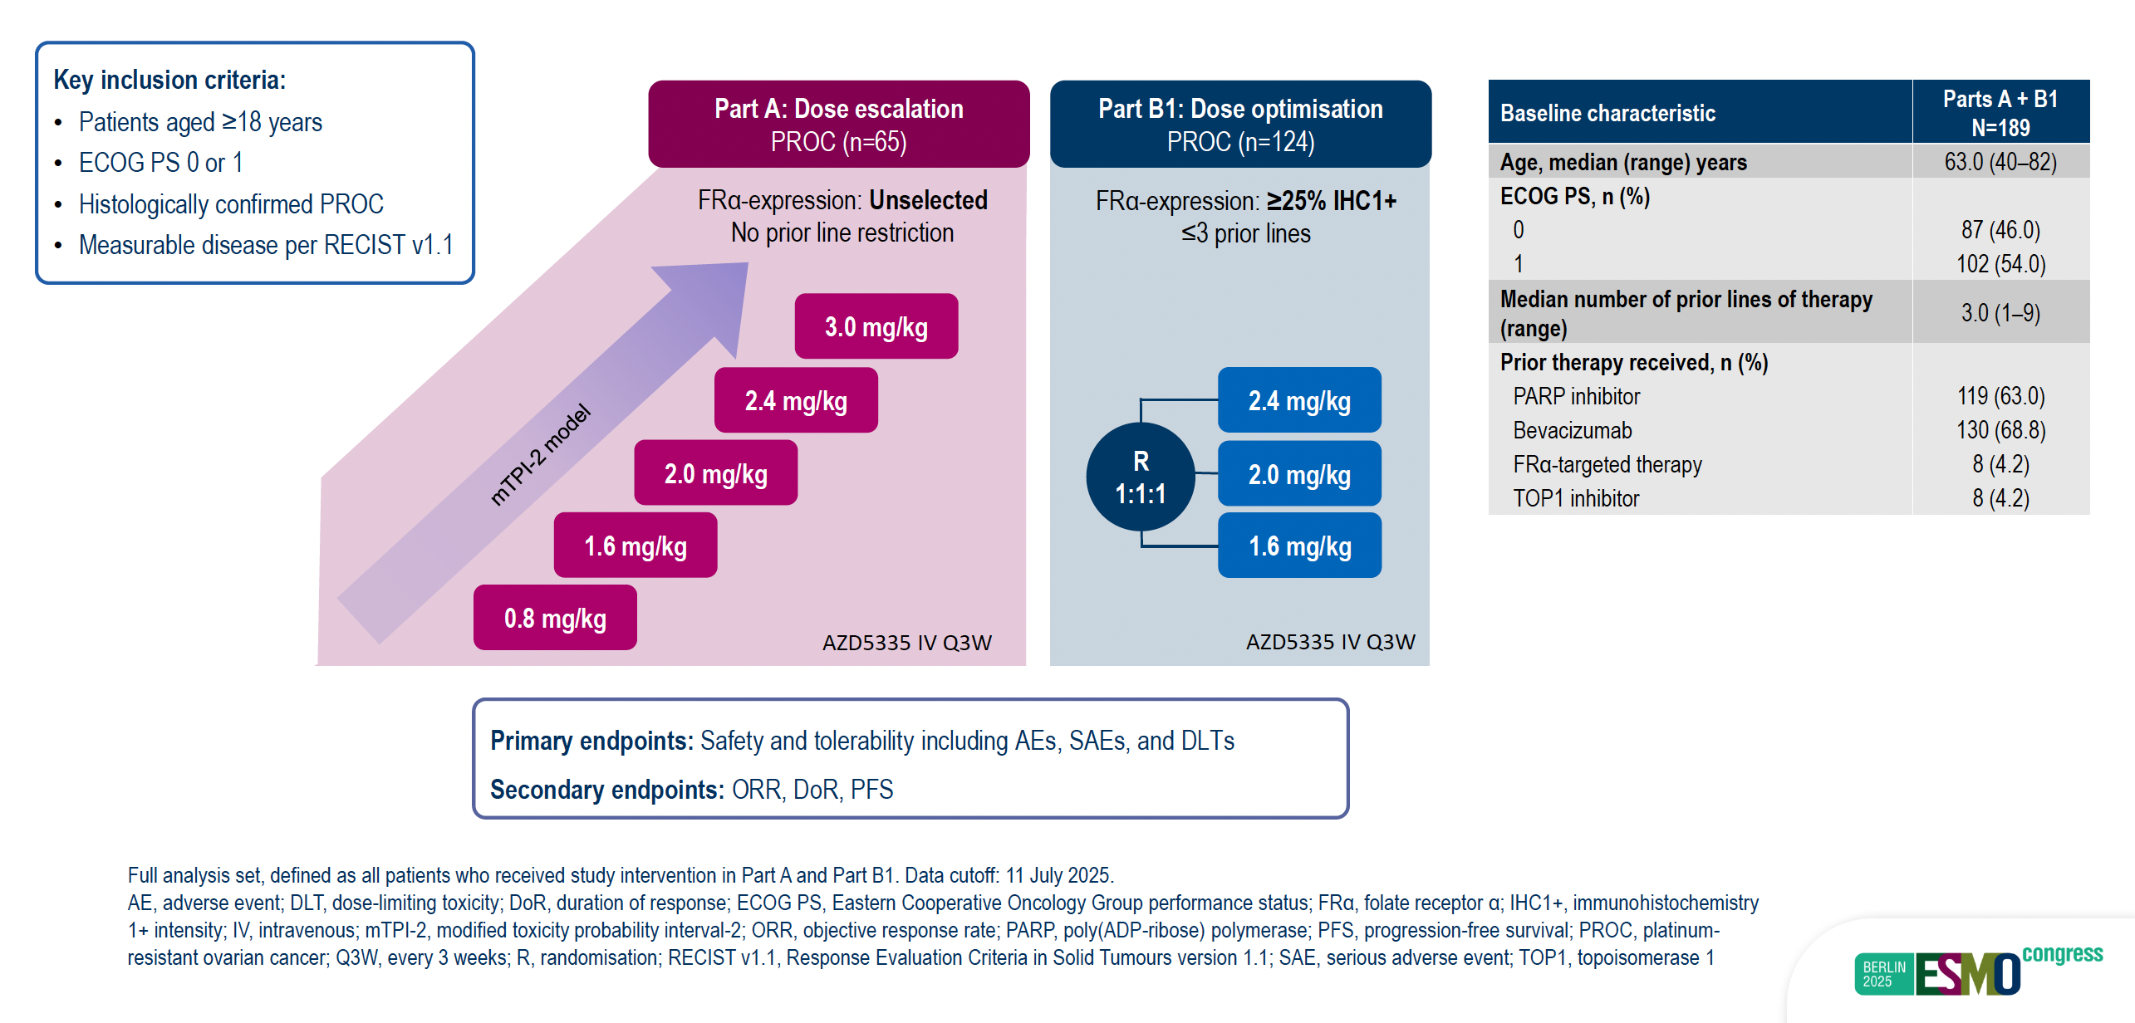
FONTANA Module 1: Phase I/IIa Study Design
Oaknin A et al. ESMO 2025;Abstract 1065MO.

Slide 95
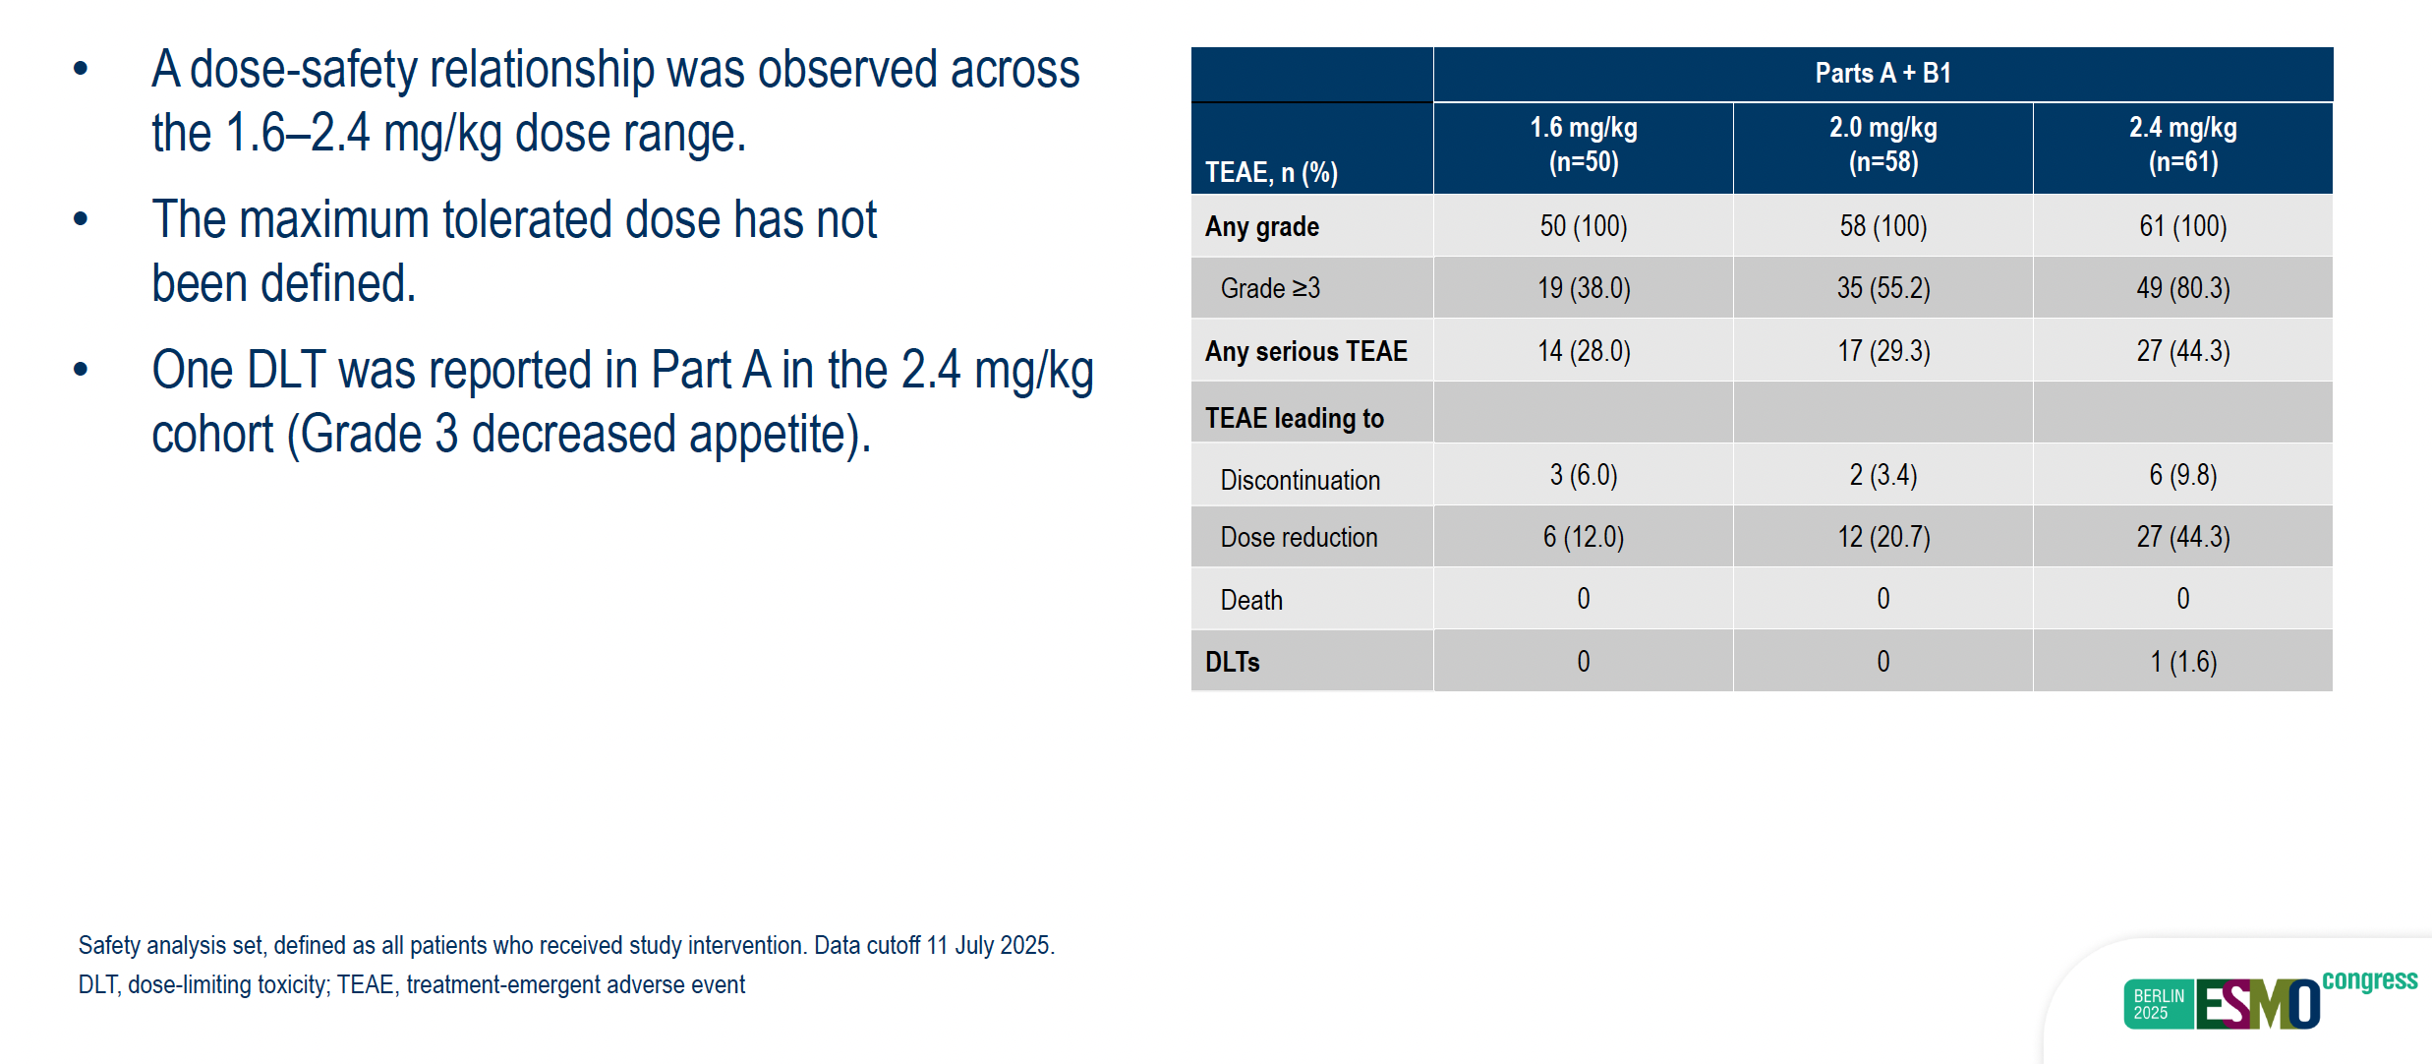
FONTANA: AZD5335 Safety Summary Across Dosing Range
Oaknin A et al. ESMO 2025;Abstract 1065MO.

Slide 96
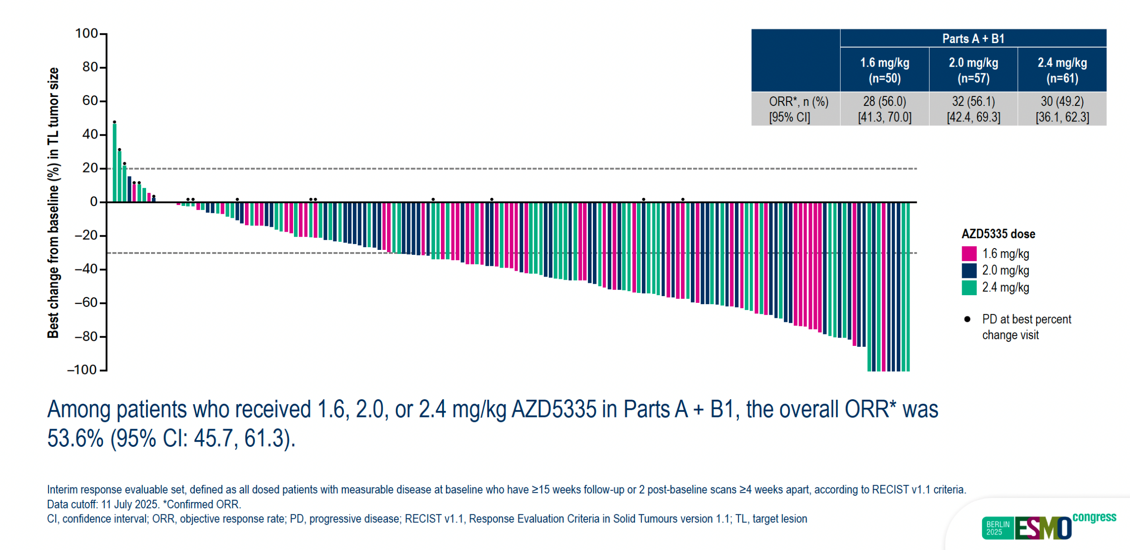
FONTANA: AZD5335 Tumor Responses Across Dosing Range
Oaknin A et al. ESMO 2025;Abstract 1065MO.

Slide 97
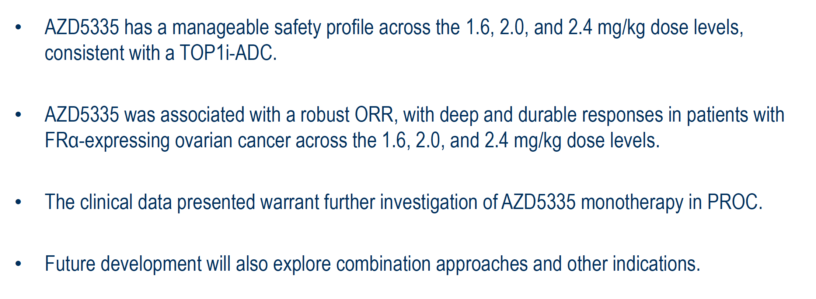
FONTANA Study Conclusions
Oaknin A et al. ESMO 2025;Abstract 1065MO.

Slide 98
Agenda
Module 1: Up-Front Treatment of Ovarian Cancer (OC)
Module 2: Management of Platinum-Resistant OC
Module 3: Up-Front Management of Metastatic Endometrial Cancer
Module 4: Management of HER2-Positive Gynecologic Cancers
Module 5: Management of Cervical Cancer

Slide 99
Case Presentation: Dr Salani
68-year-old (diagnosed at age 64).
3/2/21: Endometrial biopsy: Grade 1 endometrial cancer; Pelvic ultrasound: Uterus measures 7.5 x 3.6 x 4.7 cm with a 15 mm stripe.
3/18/21: Robotic hysterectomy, bilateral salpingo-oophorectomy, sentinel lymph node dissection: Stage IB (75% myometrial invasion, lymphovascular space invasion), grade 2 endometrial cancer (loss of PMS2 and MLH1-methylated).
4/29/21 – 5/11/21: Vaginal brachytherapy (30 Gy) enrolled on GY020 (VB +/- pembrolizumab) to control arm.
10/27/21: CT chest/abdomen/pelvis: Subtle liver hypodensity; no evidence of disease.
4/22/22: CT chest/abdomen/pelvis: Borderline enlarged left para-aortic lymph node; no other findings.
10/22/24: CT abdomen/pelvis: Stable left para-aortic node (9 x 9 mm); interval enlargement of other para-aortic lymph nodes, largest measuring 16 x 21 mm.

Slide 100
Case Presentation: Dr Salani (Continued)
11/6/24: Lymph node biopsy: Carcinoma, consistent with history.
12/5/24 – 3/13/25: Carboplatin, paclitaxel and dostarlimab x 5 cycles (last cycle held due to side effects).
4/3/25: Dostarlimab maintenance started.
5/22/25: PET CT: Decrease in left para-aortic lymph node without FDG uptake; no evidence of recurrent or metastatic disease.
12/16/25: CT chest/abdomen/pelvis: Interval decreased size of left para-aortic lymph node measuring 6 x 9 mm; no new enlarged lymph nodes. No definite evidence for local recurrence or new distant metastatic disease.
Current status: Clinically doing well. Traveling the world and plans to continue dostarlimab maintenance.

Slide 101
Key Datasets
Garcia LG et al. Neoadjuvant dostarlimab in mismatch repair deficient (MMRd) stage II-III endometrioid endometrial cancer (EC): The GEICO137-E/NADIA study. ESMO 2025;Abstract 1224TiP.
Powell MA et al. Post-hoc survival outcomes based on initial and subsequent treatment in patients with mismatch repair proficient/microsatellite stable (MMRp/MSS) primary advanced or recurrent endometrial cancer (pA/R EC) in the ENGOT-EN6-NSGO/GOG-3031/RUBY trial. ESMO 2025;Abstract 1113P.
Ginesta MPB et al. Final overall survival (OS) results from the randomized double-blind phase III AtTEND/ENGOT-EN7 trial evaluating atezolizumab in combination with paclitaxel and carboplatin in women with advanced/recurrent endometrial cancer. ESMO 2025;Abstract LBA39.
Westin S et al. Durvalumab plus carboplatin/paclitaxel followed by durvalumab for endometrial cancer: Tumour mutational burden-high subpopulation efficacy analyses from the DUO-E trial. ESMO 2025;Abstract 1117P.

Slide 102
Key Datasets
Makker V et al. Lenvatinib plus pembrolizumab (L + P) vs treatment of physician’s choice (TPC) for advanced endometrial cancer (EC): 5-year outcomes from study 309/KEYNOTE-775. ESMO 2025;Abstract 1119P.
Akilli H et al. First-line lenvatinib + pembrolizumab (L + P) vs chemotherapy (CT) for advanced or recurrent endometrial cancer (EC): Additional 1-year follow-up results from ENGOT-en9/LEAP-001. ESMO 2025;Abstract 1114P.
Eminowicz G et al. GOG-3119/ENGOT-en29/TroFuse-033: A phase III, randomized study of sacituzumab tirumotecan (sac-TMT) + pembrolizumab (pembro) vs pembro alone as first-line (1L) maintenance therapy for mismatch repair-proficient (pMMR) endometrial cancer (EC). ESMO 2025;Abstract 1221TiP.

Slide 103
Neoadjuvant Dostarlimab in Mismatch Repair
Deficient (MMRd) Stage II-III Endometrioid Endometrial Cancer (EC): The GEICO137-E/NADIA Study
Garcia LG et al.
ESMO 2025;Abstract 1224TiP.

Slide 104
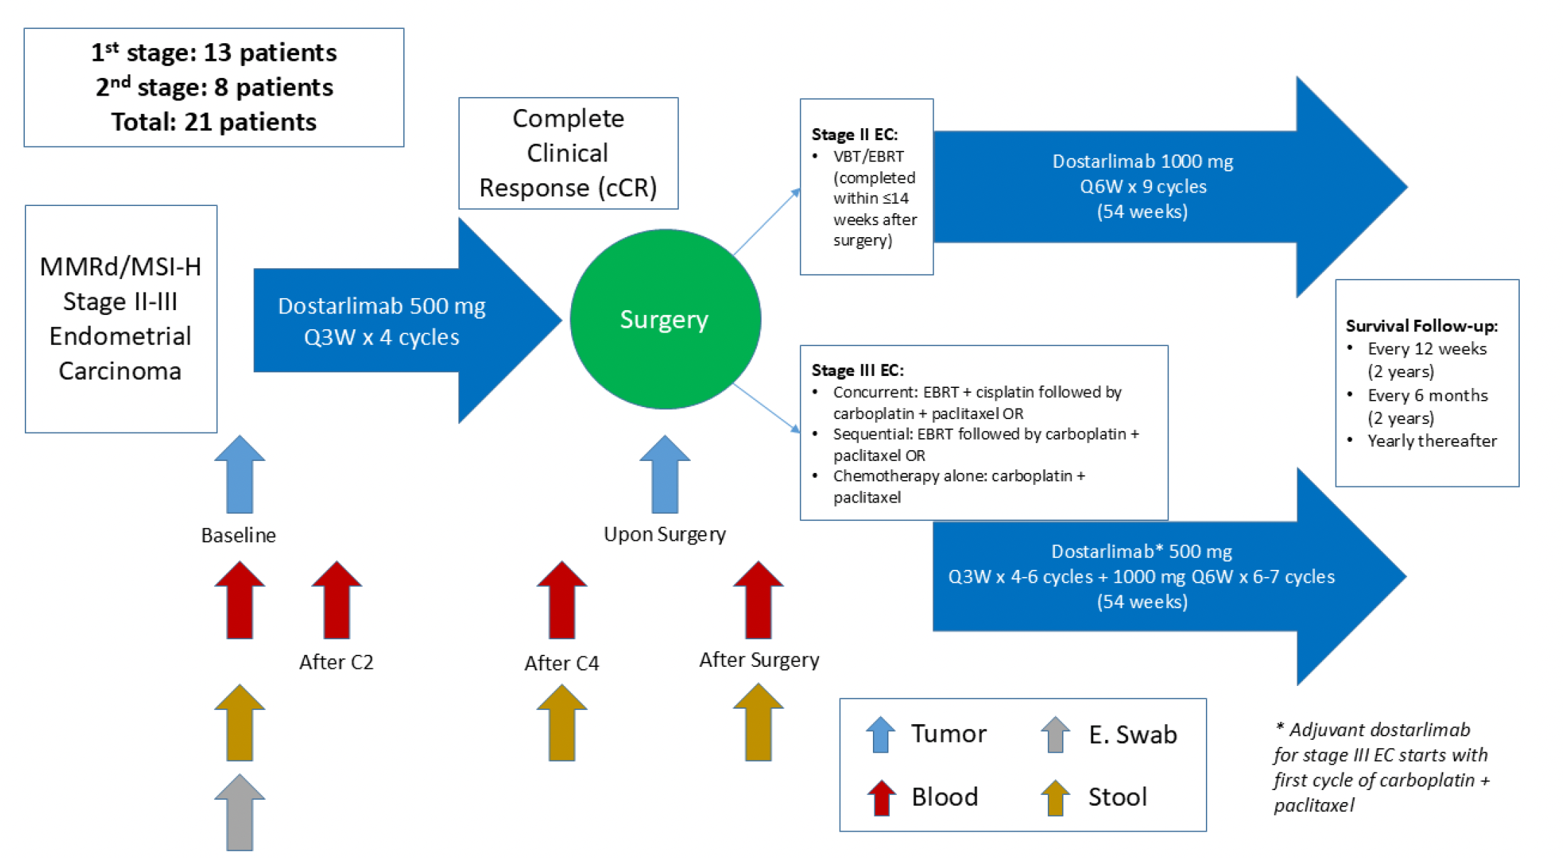
GEICO137-E/NADIA Study Design
Garcia LG et al. ESMO 2025;Abstract 1224TiP.

Slide 105
Post Hoc Survival Outcomes Based on Initial and Subsequent Treatment in Patients (pts) with Mismatch Repair Proficient/Microsatellite Stable (MMRp/MSS) Primary Advanced or Recurrent Endometrial Cancer
(pA/R EC) in the ENGOT-EN6-NSGO/GOG-3031/RUBY Trial
Powell MA et al.
ESMO 2025;Abstract 1113P.

Slide 106
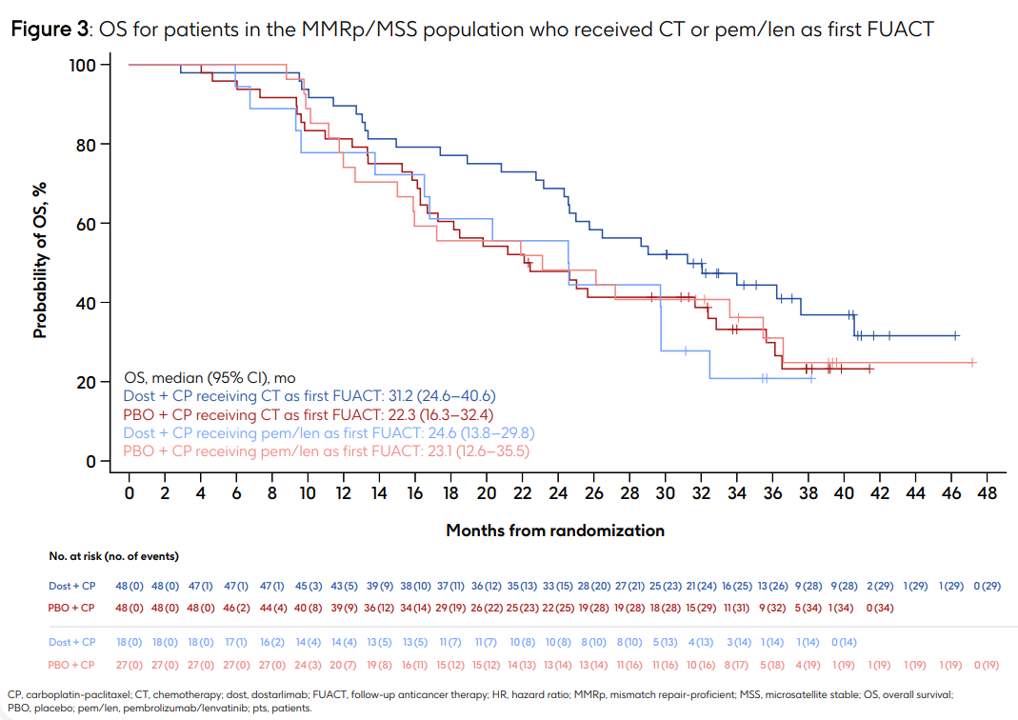
ENGOT-EN6-GOG-3031/RUBY: OS for Patients with MMRp/MSS Primary Advanced or Recurrent Endometrial Cancer
Powell MA et al. ESMO 2025;Abstract 1113P.

Slide 107
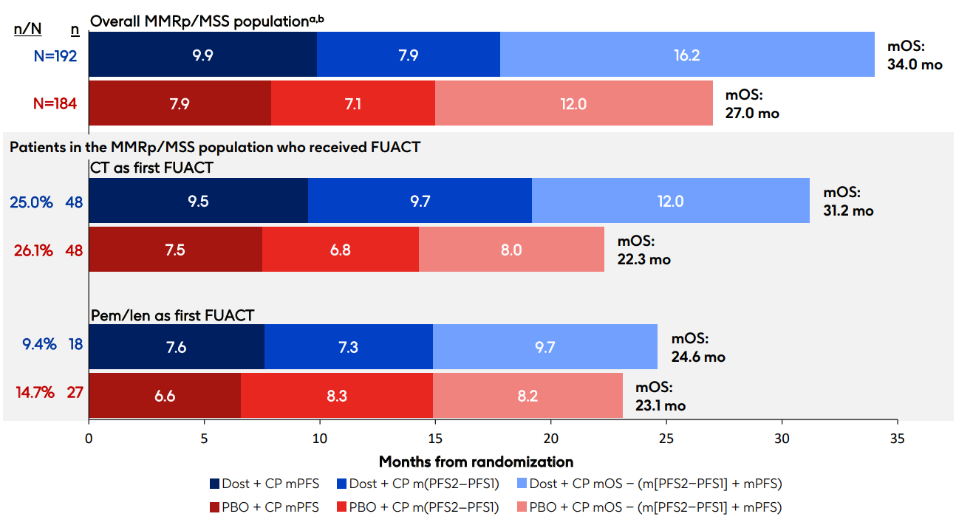
ENGOT-EN6-GOG-3031/RUBY: Long-Term Outcomes
Powell MA et al. ESMO 2025;Abstract 1113P.

Slide 108

ENGOT-EN6-GOG-3031/RUBY Study Conclusions
Powell MA et al. ESMO 2025;Abstract 1113P.

Slide 109

Abstract LBA39

Slide 110

AtTEnd/ENGOT-EN7: Analysis of OS in the Mismatch Repair-Deficient (MMRd) and Non-MMRd Subgroups
MMRd tumors
Non-MMRd tumors
Ginesta MPB et al. ESMO 2025;Abstract LBA39.

Slide 111

AtTEnd/ENGOT-EN7: Updated PFS for All Patients
Ginesta MPB et al. ESMO 2025;Abstract LBA39.

Slide 112

AtTEnd/ENGOT-EN7: Analysis of PFS in the MMRd and Non-MMRd Subgroups
MMRd tumors
Non-MMRd tumors
Ginesta MPB et al. ESMO 2025;Abstract LBA39.

Slide 113

AtTEnd/ENGOT-EN7 Study Conclusions
Ginesta MPB et al. ESMO 2025;Abstract LBA39.

Slide 114

ESMO 2025

Slide 115

Tumor Mutational Burden (TMB) Efficacy Analysis in DUO-E: Concordance Between MMR and TMB Status
H = high; L = low
Westin SN et al. ESMO 2025;Abstract 1117P.

Slide 116



TMB Efficacy Analysis in DUO-E: Post-Hoc PFS Exploratory Analysis
Westin SN et al. ESMO 2025;Abstract 1117P.

Slide 117

TMB Efficacy Analysis in DUO-E: Authors’ Conclusions
Westin SN et al. ESMO 2025;Abstract 1117P.

Slide 118


ESMO 2025

Slide 119

KEYNOTE-775 Study Conclusions
Makker V et al. ESMO 2025;Abstract 1119P.

Slide 120


ESMO 2025

Slide 121

LEAP-001 Study Conclusions
Akilli H et al. ESMO 2025;Abstract 1114P.

Slide 122
GOG-3119/ENGOT-en29/TroFuse-033: A Phase 3, Randomized Study of Sacituzumab Tirumotecan (Sac-TMT) + Pembrolizumab (Pembro) vs Pembro Alone as First-Line (1L) Maintenance Therapy for Mismatch Repair-Proficient (pMMR) Endometrial Cancer (EC)
Eminowicz G et al.
ESMO 2025;Abstract 1221TiP.

Slide 123
Agenda
Module 1: Up-Front Treatment of Ovarian Cancer (OC)
Module 2: Management of Platinum-Resistant OC
Module 3: Up-Front Management of Metastatic Endometrial Cancer
Module 4: Management of HER2-Positive Gynecologic Cancers
Module 5: Management of Cervical Cancer

Slide 124
Case Presentation: Dr Salani
84 yo (83 at diagnosis) with PMH of hypertension and hypothyroidism.
12/2/24: Robotic hysterectomy, bilateral salpingo-oophorectomy, bilateral pelvic sentinel lymph node dissection, and omental biopsy: FIGO 2023 Stage IIC high grade serous endometrial cancer; pMMR, HER2 2+, p53m.
1/13/25 – 4/8/25: Carboplatin and paclitaxel (1L) x 6 cycles.
5/14/25: CT chest/abdomen/pelvis: No evidence of disease; positive for pulmonary embolism.
9/9/25: CT abdomen/pelvis: New ascites and omental carcinomatosis.
10/7/25: Trastuzumab deruxtecan (2L) started (declined lenvatinib and pembrolizumab due to hypertension).
12/4/25: CT chest/abdomen/pelvis: No intrathoracic disease. Improved peritoneal and omental nodularity, resolution of ascites.
Current status: Tolerating therapy well. Plan to continue current therapy and reassessment after cycle 6 (currently on cycle 4).

Slide 125
Key Datasets
Makker V et al. Trastuzumab deruxtecan (T-DXd) for pretreated patients (pts) with HER2-expressing solid tumors: DESTINY-PanTumor02 (DP-02) part 1 final analysis. ESMO 2025;Abstract 957P.
Lee J-Y et al. Trastuzumab deruxtecan (T-DXd) in pretreated patients (pts) with HER2-expressing solid tumors: Exploratory biomarker analysis of DESTINY-PanTumor02 (DP-02) Part 1. ESMO 2025;Abstract 145P.
Slomovitz BM et al. A randomized phase 3 study of first-line (1L) trastuzumab deruxtecan (T-DXd) with rilvegostomig or pembrolizumab in patients with HER2-expressing, mismatch repair proficient (pMMR), primary advanced or recurrent endometrial cancer (EC): DESTINY Endometrial 01/GOG-3098/ENGOT-EN24. ESMO 2025;Abstract 1223TiP.
González-Martín A et al. An open-label, randomized, multicenter, phase III study of trastuzumab deruxtecan (T-DXd) with bevacizumab (BEV) vs BEV monotherapy as first-line (1L) maintenance therapy in HER2-expressing ovarian cancer: DESTINY-Ovarian01 (DO 01). ESMO 2025;Abstract 127TiP.

Slide 126

ESMO 2025

Slide 127

DESTINY-PanTumor02 Part 1 Final Analysis: Investigator-Assessed Confirmed ORR by Tumor Cohort and Central HER2 IHC Status
Makker V et al. ESMO 2025;Abstract 957P.

Slide 128

DESTINY-PanTumor02 Part 1 Final Analysis: Investigator-Assessed Median PFS by Tumor Cohort and HER2 IHC Status
Makker V et al. ESMO 2025;Abstract 957P.

Slide 129

DESTINY-PanTumor02 Part 1 Final Analysis: Median OS by Tumor Cohort and HER2 IHC Status
Makker V et al. ESMO 2025;Abstract 957P.

Slide 130

DESTINY-PanTumor02 Part 1 Conclusions
Makker V et al. ESMO 2025;Abstract 957P.

Slide 131

ESMO 2025

Slide 132

DESTINY-PanTumor02 Part 1 Biomarker Analysis Conclusions
Lee J-Y et al. ESMO 2025;Abstract 145P.

Slide 133
A Randomized Phase 3 Study of First-Line (1L) Trastuzumab Deruxtecan (T-DXd) with Rilvegostomig or Pembrolizumab in Patients with HER2-Expressing, Mismatch Repair Proficient (pMMR), Primary Advanced or Recurrent Endometrial Cancer (EC): DESTINY-Endometrial 01/GOG-3-98/ENGOT-EN24
Slomovitz BM et al.
ESMO 2025;Abstract 1223TiP.

Slide 134
An Open-Label, Randomized, Multicenter, Phase III Study of Trastuzumab Deruxtecan (T-DXd) with Bevacizumab (BEV) vs BEV Monotherapy as First-Line (1L) Maintenance Therapy in HER2-Overexpressing Ovarian Cancer: DESTINY-Ovarian01 (DO-01)
González-Martín A et al.
ESMO Gynaecological Cancers Congress 2025;Abstract 127TiP.

Slide 135
Agenda
Module 1: Up-Front Treatment of Ovarian Cancer (OC)
Module 2: Management of Platinum-Resistant OC
Module 3: Up-Front Management of Metastatic Endometrial Cancer
Module 4: Management of HER2-Positive Gynecologic Cancers
Module 5: Management of Cervical Cancer

Slide 136
Case Presentation: Dr Salani
75 year old patient, PMH of hypertension and well controlled diabetes.
6/13/24: Cervical biopsy: Detached fragments of at least high-grade squamous intraepithelial lesion (HSIL/CIN 3) with papillary features.
6/17/24: PET CT: Cervical mass (6.3 x 4.1 x 4.7 cm) with SUV 15.8, intense FDG avid right iliac lymph node and several mild FDG uptake in bilateral pelvic nodes. Concern for pulmonary embolism.
6/18/24: Cervical biopsy: Papillary squamous cell carcinoma; CPS>1; consistent with Stage IIIC1r cervical cancer.
6/18/24: MRI abdomen/pelvis: Cervical mass measuring 6.5 x 3.5 x 4.7 cm with parametrial extension on the right and uppermost vagina; suspicious pelvic and common iliac lymph nodes.

Slide 137
Case Presentation: Dr Salani (Continued)
7/8/24 – 8/9/24: External beam radiation (4500 cGy) with cisplatin and pembrolizumab.
8/12/24 – 8/16/24: Cervical brachytherapy (2550 cGy).
8/19/24: Pembrolizumab maintenance started.
11/1/24: PET CT: Resolution of cervical mass and lymph nodes; stable 4 mm right pulmonary nodules.
5/3/25: CT chest/abdomen/pelvis: No evidence of intrathoracic or abdominal disease.
10/25/25: CT abdomen/pelvis: No evidence of disease, sustained treatment response.
Current status: Doing well, plan to receive pembrolizumab maintenance for a total of 15 cycles.

Slide 138
Key Datasets
Wu X et al. Phase III study of camrelizumab plus famitinib versus platinum-based chemotherapy as first-line therapy for recurrent or metastatic cervical cancer. ESMO 2025;Abstract LBA38.

Slide 139

Abstract LBA38

Slide 140

Study Conclusions
Wu X et al. ESMO 2025;Abstract LBA38.

Slide 141
Inside the Issue: The Emerging Role of
Cereblon E3 Ligase Modulators in Multiple Myeloma
A CME/MOC-Accredited Live Webinar
Wednesday, January 28, 2026
5:00 PM – 6:00 PM ET
Faculty
Natalie S Callander, MD
Paul G Richardson, MD
Moderator
Neil Love, MD

Slide 142
Thank you for joining us!
Please take a moment to complete the survey currently up on Zoom. Your feedback is very important to us.
The survey will remain open for
5 minutes after the meeting ends.
Information on how to obtain CME, ABIM MOC and ABS credit is provided in the Zoom chat room.
Attendees will also receive an email in 1 to 3 business days with these instructions.

