Slide 1
The Implications of Recent Datasets for the Current and
Future Management of Non-Hodgkin Lymphoma and Chronic Lymphocytic Leukemia — An ASCO/EHA 2026 Review
A CME/MOC-Accredited Live Webinar
Wednesday, September 2, 2026
5:00 PM – 6:30 PM ET
Faculty
Brad S Kahl, MD
Jeff Sharman, MD
Tanya Siddiqi, MD
Moderator
Neil Love, MD

Slide 2



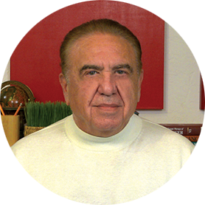
Faculty
Brad S Kahl, MD
Professor of Medicine
Washington University School of Medicine
Director, Lymphoma Program
Siteman Cancer Center
St Louis, Missouri
Tanya Siddiqi, MD
Medical Director of Lymphoma and IEC Programs
City of Hope OC
Director, CLL Program
Professor, Department of Hematology/HCT
City of Hope
Duarte, California
Jeff Sharman, MD
Medical Director of Hematology Research
Sarah Cannon Research Institute at
Willamette Valley Cancer Center
Eugene, Oregon
MODERATOR
Neil Love, MD
Research To Practice
Miami, Florida

Slide 3
Commercial Support
This activity is supported by educational grants from Genmab US Inc and Lilly.

Slide 4
Dr Love — Disclosures
Dr Love is president and CEO of Research To Practice. Research To Practice receives funds in the form of educational grants to develop CME activities from the following companies: Aadi Bioscience, AbbVie Inc, ADC Therapeutics, Agendia Inc, Alexion Pharmaceuticals, Amgen Inc, Array BioPharma Inc, a subsidiary of Pfizer Inc, Arvinas, Astellas, AstraZeneca Pharmaceuticals LP, Aveo Pharmaceuticals, Bayer HealthCare Pharmaceuticals, BeOne, Biotheranostics Inc, A Hologic Company, Black Diamond Therapeutics Inc, Blueprint Medicines, Boehringer Ingelheim Pharmaceuticals Inc, Bristol Myers Squibb, Catalyst Pharmaceuticals Inc, Celcuity, Clovis Oncology, Coherus BioSciences, Corcept Therapeutics Inc, CTI BioPharma, a Sobi Company, Daiichi Sankyo Inc, Eisai Inc, Elevation Oncology Inc, Exact Sciences Corporation, Exelixis Inc, Genentech, a member of the Roche Group, Genmab US Inc, Geron Corporation, Gilead Sciences Inc, GSK, Helsinn Therapeutics (US) Inc, ImmunoGen Inc, Incyte Corporation, Ipsen Biopharmaceuticals Inc, Jazz Pharmaceuticals Inc, Johnson & Johnson, Karyopharm Therapeutics, Kite, A Gilead Company, Kura Oncology, Legend Biotech, Lilly, MEI Pharma Inc, Merck, Mersana Therapeutics Inc, Mirati Therapeutics Inc, Mural Oncology Inc, Natera Inc, Novartis, Novartis Pharmaceuticals Corporation on behalf of Advanced Accelerator Applications, Novocure Inc, Nuvalent, Nuvation Bio Inc, Pfizer Inc, Pharmacyclics LLC, an AbbVie Company, Puma Biotechnology Inc, Regeneron Pharmaceuticals Inc, Revolution Medicines Inc, Rigel Pharmaceuticals Inc, R-Pharm US, Sanofi, Seagen Inc, Servier Pharmaceuticals LLC, SpringWorks Therapeutics Inc, Stemline Therapeutics Inc, Sumitomo Pharma America, Summit Therapeutics, Syndax Pharmaceuticals, Taiho Oncology Inc, Takeda Pharmaceuticals USA Inc, TerSera Therapeutics LLC, Tesaro, A GSK Company, and Verastem Inc.

Slide 5
Research To Practice CME Planning Committee Members,
Staff and Reviewers
Planners, scientific staff and independent reviewers for Research To Practice have no relevant financial relationships to disclose.

Slide 6
Dr Kahl — Disclosures
Consulting Agreements | AbbVie Inc, ADC Therapeutics, AstraZeneca Pharmaceuticals LP, BeOne, Genentech, a member of the Roche Group, Genmab US Inc, Incyte Corporation, Lilly, Octapharma, Roche Laboratories Inc
Data and Safety Monitoring Boards/Committees | Acrotech Biopharma, Bristol Myers Squibb, Foresight Diagnostics, a wholly-owned subsidiary of Natera Inc, Nurix Therapeutics Inc, PeproMene Bio Inc

Slide 7
Dr Sharman — Disclosures
Consulting Agreements | AbbVie Inc, AstraZeneca Pharmaceuticals LP, BeOne, Bristol Myers Squibb, Genentech, a member of the Roche Group, Lilly, Merck, Roche Laboratories Inc
Data and Safety Monitoring Boards/Committees | BeOne

Slide 8
Dr Siddiqi — Disclosures
Advisory Committees | AbbVie Inc, AstraZeneca Pharmaceuticals LP, BeOne, Bristol Myers Squibb, Genentech, a member of the Roche Group, Gilead Sciences Inc, Merck, Pfizer Inc
Contracted Research | Bristol Myers Squibb

Slide 9
This educational activity contains discussion of
non-FDA-approved uses of agents and regimens. Please refer to official prescribing information for each product for approved indications.

Slide 10
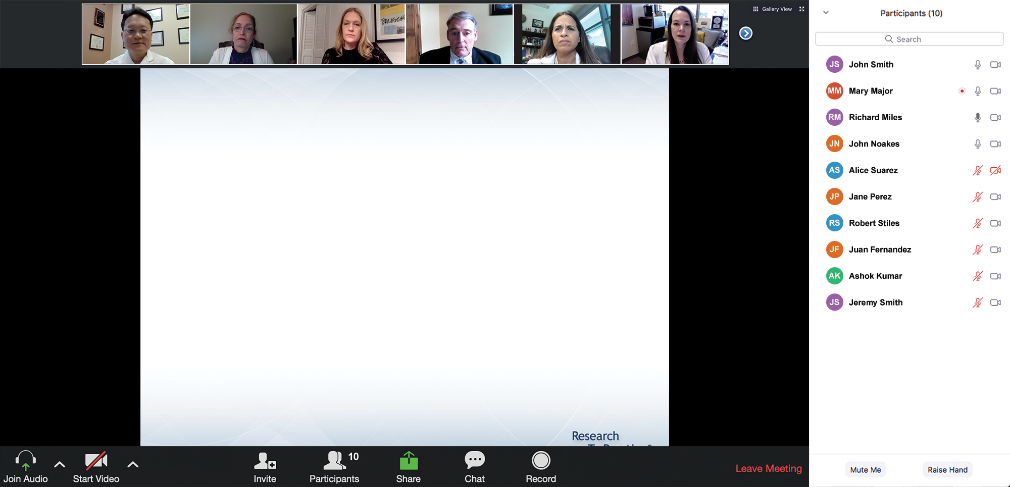
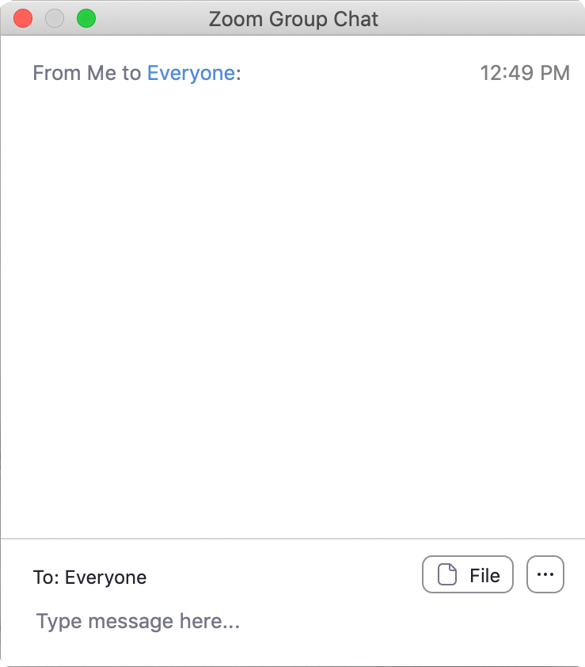
We Encourage Clinicians in Practice to Submit Questions
Feel free to submit questions now before the program begins and throughout the program.

Slide 11
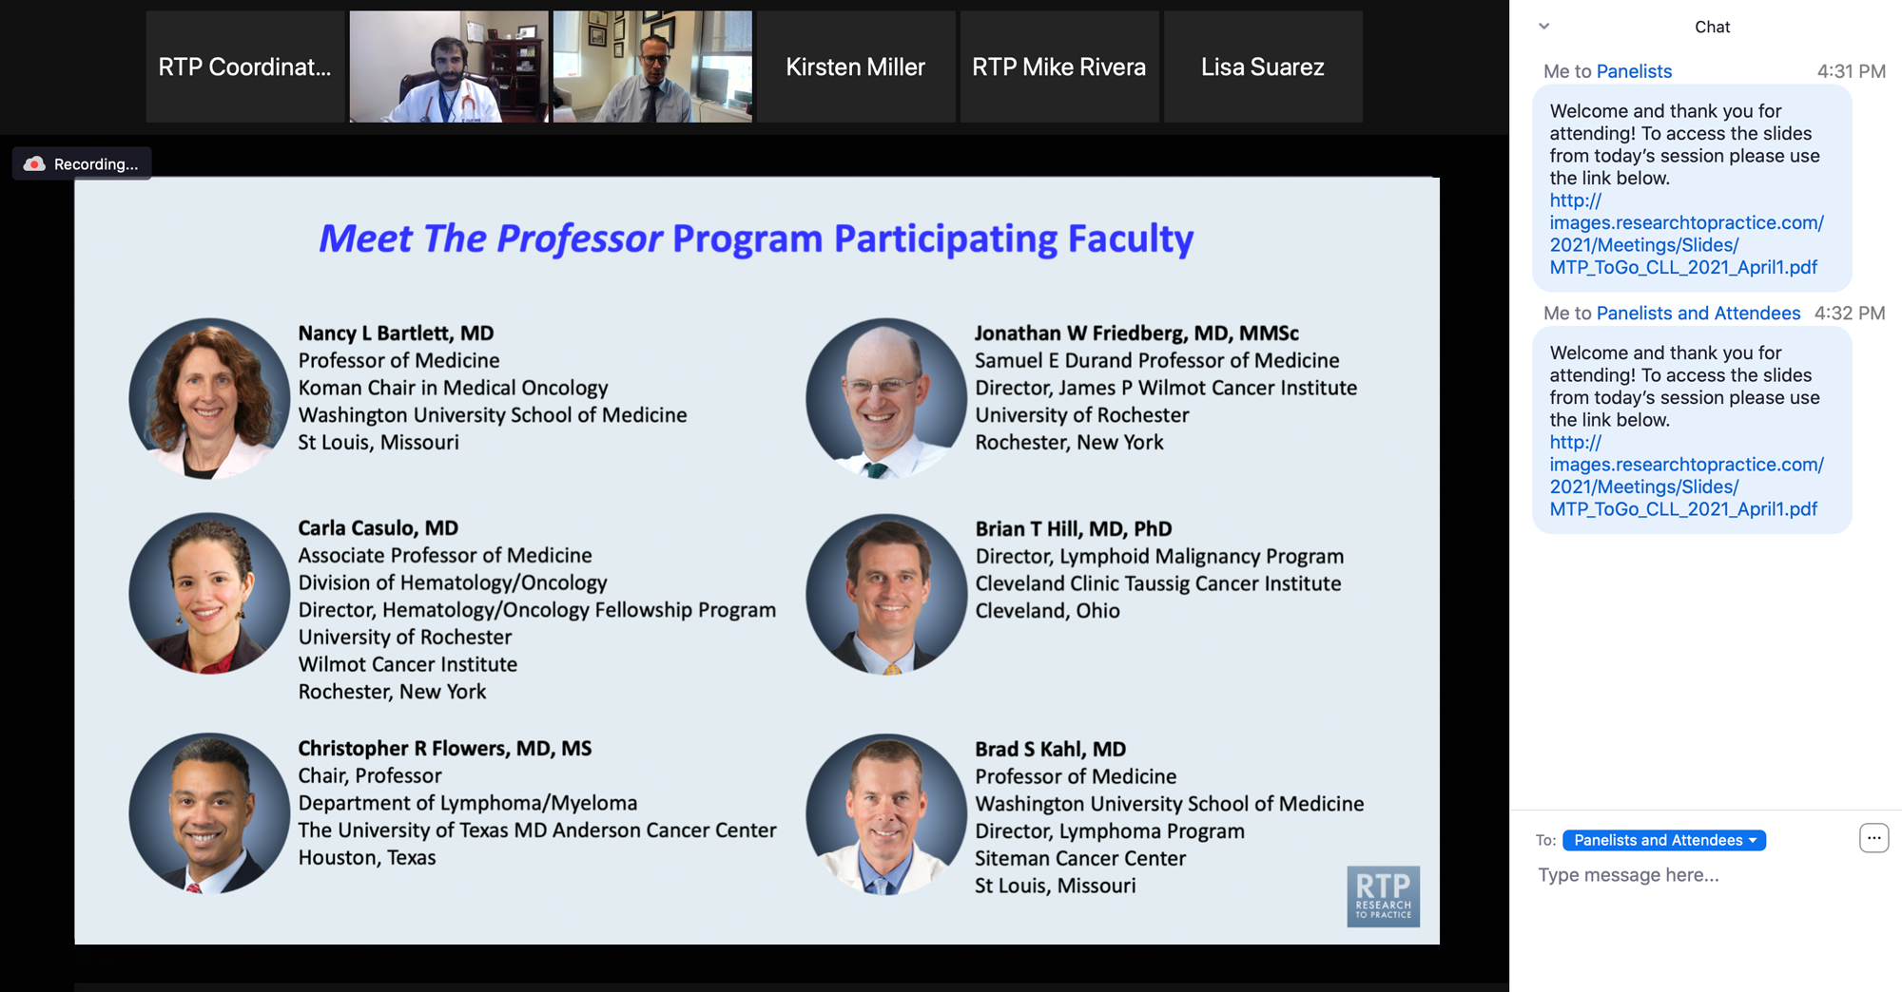
Familiarizing Yourself with the Zoom Interface
Expand chat submission box
Drag the white line above the submission box up to create
more space for your message.

Slide 12
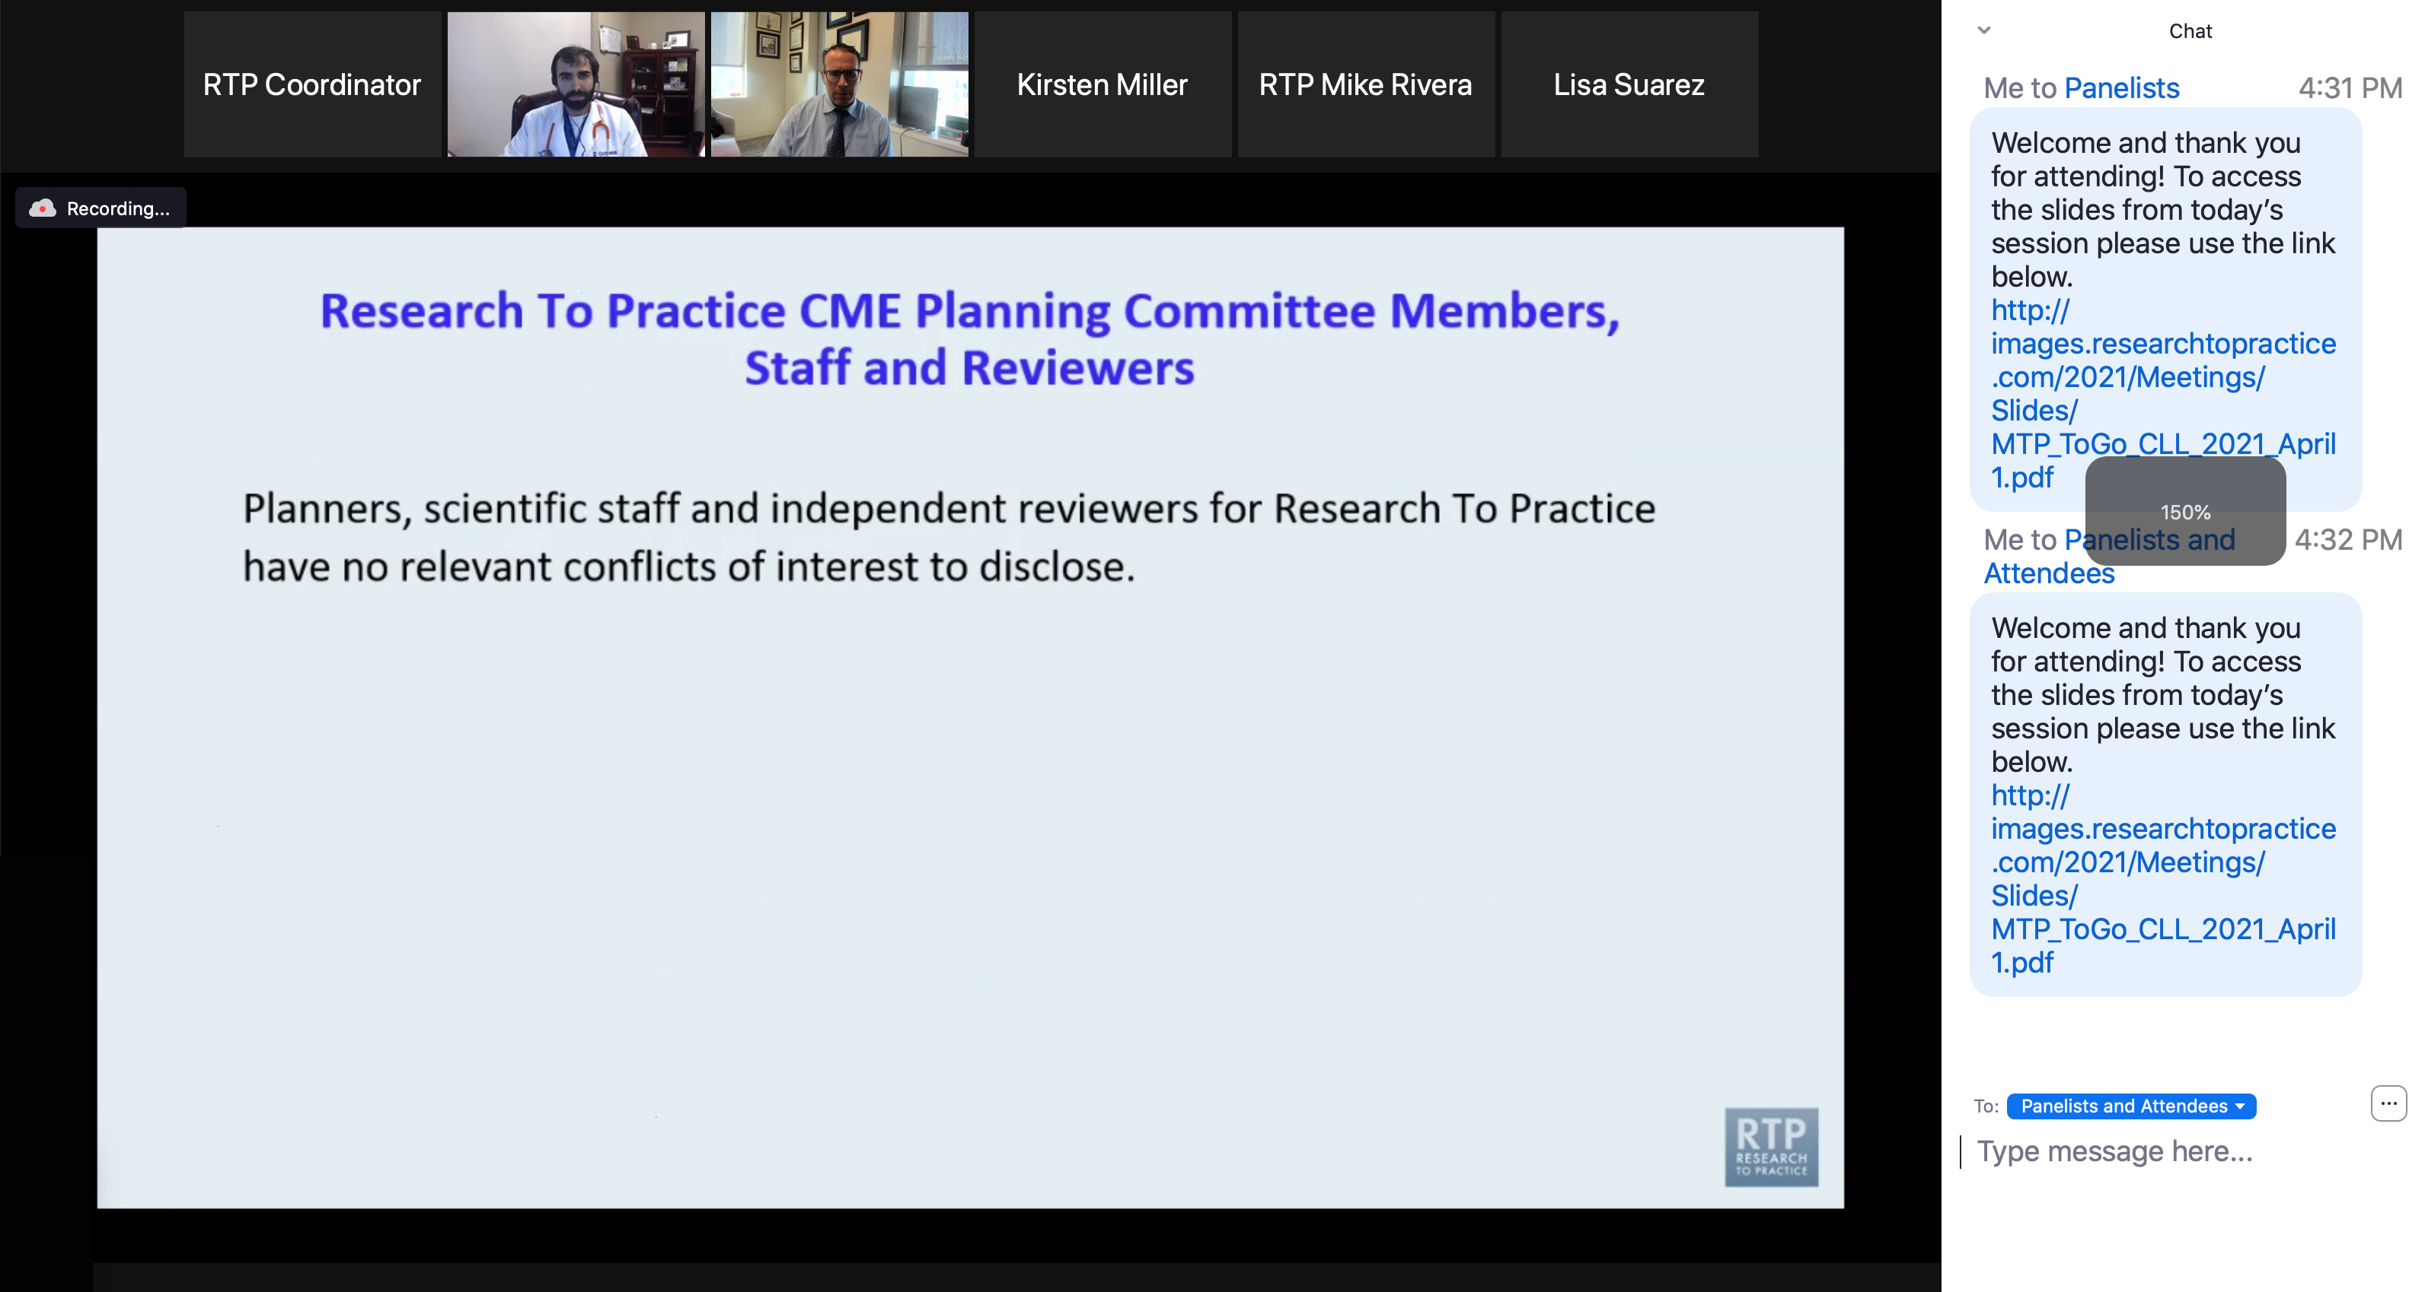
Familiarizing Yourself with the Zoom Interface
Increase chat font size
Press Command (for Mac) or Control (for PC) and the + symbol.
You may do this as many times as you need for readability.

Slide 13
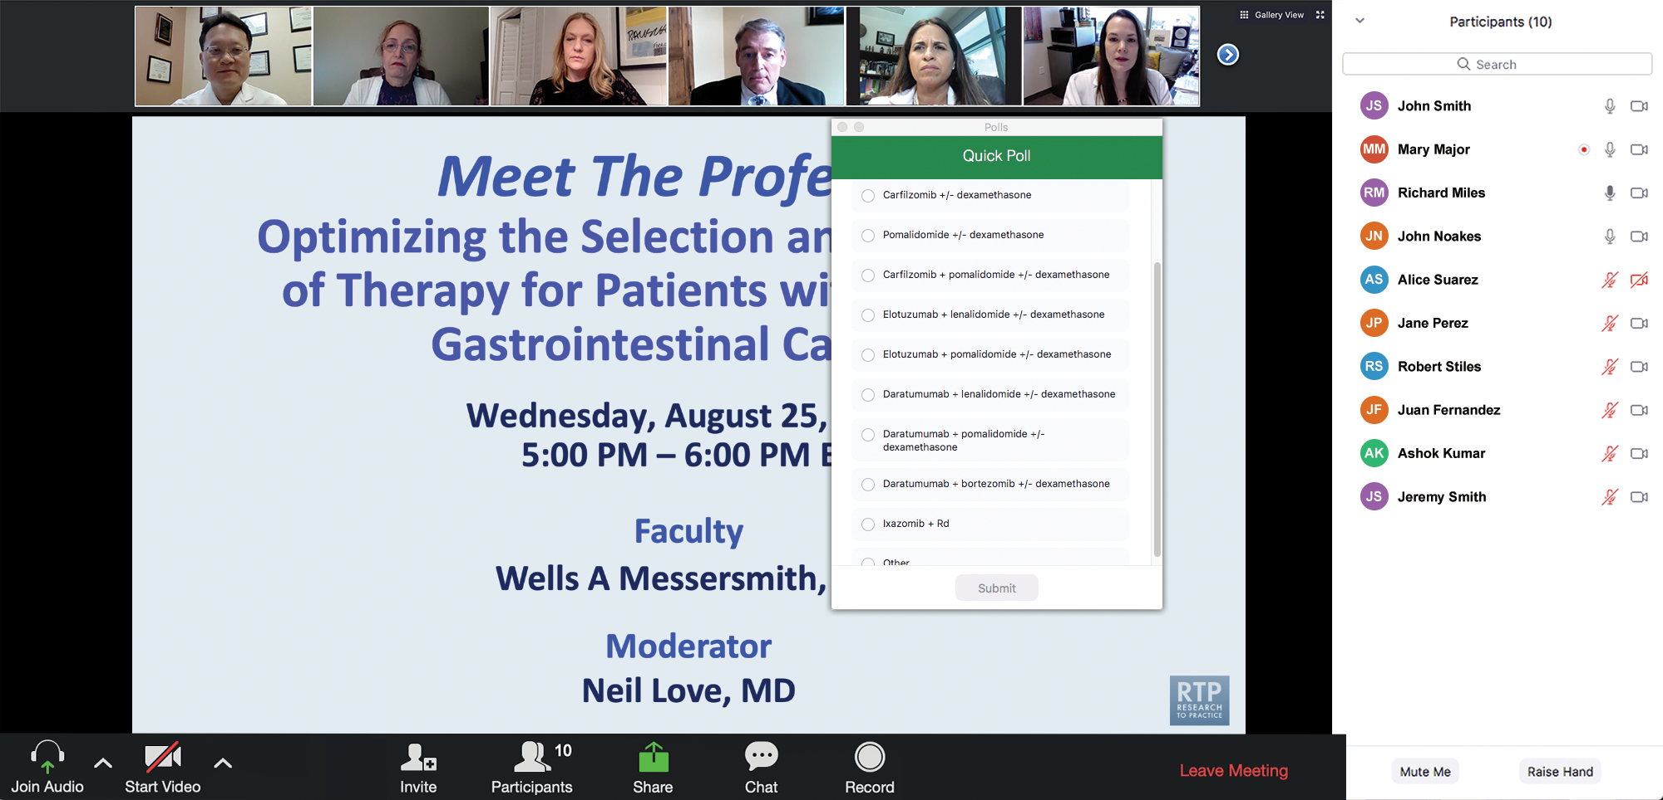
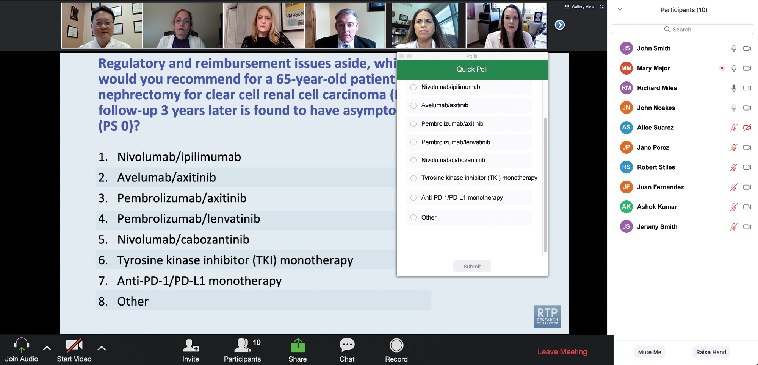
Clinicians in the Audience, Please Complete the Pre- and Postmeeting Surveys
Quick Survey
Quick Poll

Slide 14
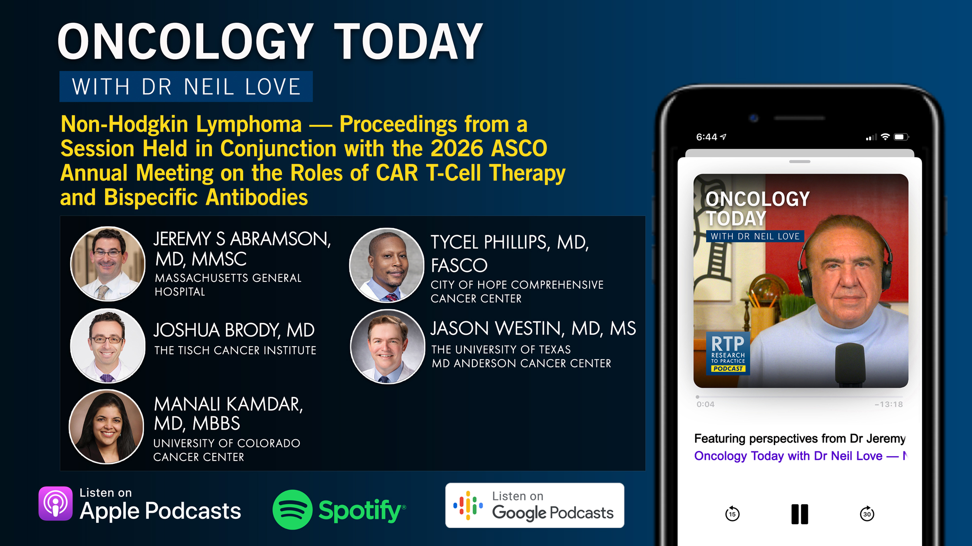

Slide 15
Data + Perspectives: Investigators
Discuss the Optimal Management of
Relapsed/Refractory Multiple Myeloma
A CME-Accredited Satellite Symposium During the
Society of Hematologic Oncology 2026 Annual Meeting
Wednesday, September 9, 2026
11:56 AM – 12:56 PM CT
Faculty
Meletios-Athanasios (Thanos) C Dimopoulos, MD
Noopur Raje, MD
Moderator
Robert Z Orlowski, MD, PhD

Slide 16
Data + Perspectives: Investigators Discuss the Optimal Management of Chronic Lymphocytic Leukemia
A CME/MOC-Accredited Live Webinar
Thursday, September 17, 2026
5:00 PM – 6:00 PM ET
Faculty
Catherine C Coombs, MD
Matthew S Davids, MD, MMSc
Moderator
Neil Love, MD

Slide 17
Integrating New Advances into
Community Oncology Practice
A Multitumor Symposium in Partnership with Florida Cancer Specialists & Research Institute
Saturday, October 17, 2026
7:15 AM – 12:00 PM ET
The Ritz-Carlton Orlando Grande Lakes | Orlando, Florida
Faculty
Faculty to be announced.
Moderator
Neil Love, MD

Slide 18
Second Opinion: A Case-Based Exploration of Clinical Investigator Best Practices Related to the Management of Breast Cancer
A CME Satellite Symposium Series
HER2-Positive Breast Cancer
Tuesday, December 8, 2026
7:00 PM – 9:00 PM CT
Localized HR-Positive
Breast Cancer
Thursday, December 10, 2026
7:00 PM – 9:00 PM CT
PI3K/AKT/mTOR Inhibitors for HR-Positive Breast Cancer
Tuesday, December 8, 2026
7:00 PM – 9:00 PM CT
Oral SERDs for HR-Positive Breast Cancer
Thursday, December 10, 2026
7:00 PM – 9:00 PM CT
Triple-Negative Breast Cancer
Wednesday, December 9, 2026
7:00 PM – 9:00 PM CT

Slide 19
A Friday Satellite Symposium Series
Preceding the 68th ASH Annual Meeting
Friday, December 11, 2026
Acute Myeloid Leukemia
7:30 AM – 9:30 AM CT
Myelofibrosis
3:15 PM – 5:15 PM CT
Chronic Lymphocytic Leukemia
7:30 AM – 9:30 AM CT
BCMA ADCs and Bispecific Antibodies for Multiple Myeloma
7:00 PM – 9:00 PM CT
Non-Hodgkin Lymphoma
11:30 AM – 1:30 PM CT
Novel Therapies for
Non-Hodgkin Lymphoma
7:00 PM – 9:00 PM CT
Multiple Myeloma
11:30 AM – 1:30 PM CT

Slide 20
Grand Rounds
CME/MOC-Accredited Interactive Series
Regional Activities
Three Series
Integrating Recent Advances into the Management of Gastroesophageal Cancers
Optimizing the Use of
Novel Therapies for Patients with Diffuse Large B-Cell Lymphoma
Optimizing Therapy for Patients with Hormone Receptor-Positive
Localized Breast Cancer
Host a 1-hour session at your institution:
Email Meetings@ResearchToPractice.com
or call (800) 233-6153

Slide 21
Thank you for joining us! Please take a moment to complete the survey currently up on Zoom.
Your feedback is very important to us.
Information on how to obtain CME, ABIM MOC and ABS credit will be provided at the conclusion of the activity in the Zoom chat room. Attendees will also receive an email in 1 to 3 business days with these instructions.

Slide 22
The Implications of Recent Datasets for the Current and
Future Management of Non-Hodgkin Lymphoma and Chronic Lymphocytic Leukemia — An ASCO/EHA 2026 Review
A CME/MOC-Accredited Live Webinar
Wednesday, September 2, 2026
5:00 PM – 6:30 PM ET
Faculty
Brad S Kahl, MD
Jeff Sharman, MD
Tanya Siddiqi, MD
Moderator
Neil Love, MD

Slide 23
Faculty
Brad S Kahl, MD
Professor of Medicine
Washington University School of Medicine
Director, Lymphoma Program
Siteman Cancer Center
St Louis, Missouri
Tanya Siddiqi, MD
Medical Director of Lymphoma and IEC Programs
City of Hope OC
Director, CLL Program
Professor, Department of Hematology/HCT
City of Hope
Duarte, California
Jeff Sharman, MD
Medical Director of Hematology Research
Sarah Cannon Research Institute at
Willamette Valley Cancer Center
Eugene, Oregon
MODERATOR
Neil Love, MD
Research To Practice
Miami, Florida

Slide 24
We Encourage Clinicians in Practice to Submit Questions
Feel free to submit questions now before the program begins and throughout the program.

Slide 25
Clinicians in the Audience, Please Complete the Pre- and Postmeeting Surveys
Quick Survey
Quick Poll

Slide 27
Data + Perspectives: Investigators
Discuss the Optimal Management of
Relapsed/Refractory Multiple Myeloma
A CME-Accredited Satellite Symposium During the
Society of Hematologic Oncology 2026 Annual Meeting
Wednesday, September 9, 2026
11:56 AM – 12:56 PM CT
Faculty
Meletios-Athanasios (Thanos) C Dimopoulos, MD
Noopur Raje, MD
Moderator
Robert Z Orlowski, MD, PhD

Slide 28
Data + Perspectives: Investigators Discuss the Optimal Management of Chronic Lymphocytic Leukemia
A CME/MOC-Accredited Live Webinar
Thursday, September 17, 2026
5:00 PM – 6:00 PM ET
Faculty
Catherine C Coombs, MD
Matthew S Davids, MD, MMSc
Moderator
Neil Love, MD

Slide 29
Integrating New Advances into
Community Oncology Practice
A Multitumor Symposium in Partnership with Florida Cancer Specialists & Research Institute
Saturday, October 17, 2026
7:15 AM – 12:00 PM ET
The Ritz-Carlton Orlando Grande Lakes | Orlando, Florida
Faculty
Faculty to be announced.
Moderator
Neil Love, MD

Slide 30
Second Opinion: A Case-Based Exploration of Clinical Investigator Best Practices Related to the Management of Breast Cancer
A CME Satellite Symposium Series
HER2-Positive Breast Cancer
Tuesday, December 8, 2026
7:00 PM – 9:00 PM CT
Localized HR-Positive
Breast Cancer
Thursday, December 10, 2026
7:00 PM – 9:00 PM CT
PI3K/AKT/mTOR Inhibitors for HR-Positive Breast Cancer
Tuesday, December 8, 2026
7:00 PM – 9:00 PM CT
Oral SERDs for HR-Positive Breast Cancer
Thursday, December 10, 2026
7:00 PM – 9:00 PM CT
Triple-Negative Breast Cancer
Wednesday, December 9, 2026
7:00 PM – 9:00 PM CT

Slide 31
A Friday Satellite Symposium Series
Preceding the 68th ASH Annual Meeting
Friday, December 11, 2026
Acute Myeloid Leukemia
7:30 AM – 9:30 AM CT
Myelofibrosis
3:15 PM – 5:15 PM CT
Chronic Lymphocytic Leukemia
7:30 AM – 9:30 AM CT
BCMA ADCs and Bispecific Antibodies for Multiple Myeloma
7:00 PM – 9:00 PM CT
Non-Hodgkin Lymphoma
11:30 AM – 1:30 PM CT
Novel Therapies for
Non-Hodgkin Lymphoma
7:00 PM – 9:00 PM CT
Multiple Myeloma
11:30 AM – 1:30 PM CT

Slide 32
Grand Rounds
CME/MOC-Accredited Interactive Series
Regional Activities
Three Series
Integrating Recent Advances into the Management of Gastroesophageal Cancers
Optimizing the Use of
Novel Therapies for Patients with Diffuse Large B-Cell Lymphoma
Optimizing Therapy for Patients with Hormone Receptor-Positive
Localized Breast Cancer
Host a 1-hour session at your institution:
Email Meetings@ResearchToPractice.com
or call (800) 233-6153

Slide 33
The Implications of Recent Datasets for the Current and
Future Management of Non-Hodgkin Lymphoma and Chronic Lymphocytic Leukemia — An ASCO/EHA 2026 Review
A CME/MOC-Accredited Live Webinar
Wednesday, September 2, 2026
5:00 PM – 6:30 PM ET
Faculty
Brad S Kahl, MD
Jeff Sharman, MD
Tanya Siddiqi, MD
Moderator
Neil Love, MD

Slide 34
Dr Kahl — Disclosures
Consulting Agreements | AbbVie Inc, ADC Therapeutics, AstraZeneca Pharmaceuticals LP, BeOne, Genentech, a member of the Roche Group, Genmab US Inc, Incyte Corporation, Lilly, Octapharma, Roche Laboratories Inc
Data and Safety Monitoring Boards/Committees | Acrotech Biopharma, Bristol Myers Squibb, Foresight Diagnostics, a wholly-owned subsidiary of Natera Inc, Nurix Therapeutics Inc, PeproMene Bio Inc

Slide 35
Dr Sharman — Disclosures
Consulting Agreements | AbbVie Inc, AstraZeneca Pharmaceuticals LP, BeOne, Bristol Myers Squibb, Genentech, a member of the Roche Group, Lilly, Merck, Roche Laboratories Inc
Data and Safety Monitoring Boards/Committees | BeOne

Slide 36
Dr Siddiqi — Disclosures
Advisory Committees | AbbVie Inc, AstraZeneca Pharmaceuticals LP, BeOne, Bristol Myers Squibb, Genentech, a member of the Roche Group, Gilead Sciences Inc, Merck, Pfizer Inc
Contracted Research | Bristol Myers Squibb

Slide 37
Dr Love — Disclosures
Dr Love is president and CEO of Research To Practice. Research To Practice receives funds in the form of educational grants to develop CME activities from the following companies: Aadi Bioscience, AbbVie Inc, ADC Therapeutics, Agendia Inc, Alexion Pharmaceuticals, Amgen Inc, Array BioPharma Inc, a subsidiary of Pfizer Inc, Arvinas, Astellas, AstraZeneca Pharmaceuticals LP, Aveo Pharmaceuticals, Bayer HealthCare Pharmaceuticals, BeOne, Biotheranostics Inc, A Hologic Company, Black Diamond Therapeutics Inc, Blueprint Medicines, Boehringer Ingelheim Pharmaceuticals Inc, Bristol Myers Squibb, Catalyst Pharmaceuticals Inc, Celcuity, Clovis Oncology, Coherus BioSciences, Corcept Therapeutics Inc, CTI BioPharma, a Sobi Company, Daiichi Sankyo Inc, Eisai Inc, Elevation Oncology Inc, Exact Sciences Corporation, Exelixis Inc, Genentech, a member of the Roche Group, Genmab US Inc, Geron Corporation, Gilead Sciences Inc, GSK, Helsinn Therapeutics (US) Inc, ImmunoGen Inc, Incyte Corporation, Ipsen Biopharmaceuticals Inc, Jazz Pharmaceuticals Inc, Johnson & Johnson, Karyopharm Therapeutics, Kite, A Gilead Company, Kura Oncology, Legend Biotech, Lilly, MEI Pharma Inc, Merck, Mersana Therapeutics Inc, Mirati Therapeutics Inc, Mural Oncology Inc, Natera Inc, Novartis, Novartis Pharmaceuticals Corporation on behalf of Advanced Accelerator Applications, Novocure Inc, Nuvalent, Nuvation Bio Inc, Pfizer Inc, Pharmacyclics LLC, an AbbVie Company, Puma Biotechnology Inc, Regeneron Pharmaceuticals Inc, Revolution Medicines Inc, Rigel Pharmaceuticals Inc, R-Pharm US, Sanofi, Seagen Inc, Servier Pharmaceuticals LLC, SpringWorks Therapeutics Inc, Stemline Therapeutics Inc, Sumitomo Pharma America, Summit Therapeutics, Syndax Pharmaceuticals, Taiho Oncology Inc, Takeda Pharmaceuticals USA Inc, TerSera Therapeutics LLC, Tesaro, A GSK Company, and Verastem Inc.

Slide 38
Commercial Support
This activity is supported by educational grants from Genmab US Inc and Lilly.
Research To Practice CME Planning Committee Members,
Staff and Reviewers
Planners, scientific staff and independent reviewers for Research To Practice have no relevant financial relationships to disclose.

Slide 39
This educational activity contains discussion of
non-FDA-approved uses of agents and regimens. Please refer to official prescribing information for each product for approved indications.

Slide 40
Agenda
Introduction: Trials in Progress
Module 1: Chronic Lymphocytic Leukemia
Module 2: Diffuse Large B-Cell Lymphoma
Module 3: Mantle Cell Lymphoma
Module 4: Follicular Lymphoma

Slide 41
Agenda
Introduction: Trials in Progress
Module 1: Chronic Lymphocytic Leukemia
Module 2: Diffuse Large B-Cell Lymphoma
Module 3: Mantle Cell Lymphoma
Module 4: Follicular Lymphoma

Slide 42
Agenda
Introduction: Trials in Progress
Module 1: Chronic Lymphocytic Leukemia
First-Line Therapy
BRUIN CLL-322 (Pirtobrutinib/Venetoclax/Rituximab for Relapsed Disease)
Bispecific Antibodies (Epcoritamab)
BTK Degraders
Module 2: Diffuse Large B-Cell Lymphoma
Module 3: Mantle Cell Lymphoma
Module 4: Follicular Lymphoma

Slide 43
Key Datasets
Fischer K et al. Venetoclax-obinutuzumab for previously untreated chronic lymphocytic leukemia: Final results of the randomized CLL14 study. EHA 2026;Abstract S146.
Seymour JF et al. Safety of fixed-duration (FD) acalabrutinib-venetoclax combinations in patients (pts) with chronic lymphocytic leukemia (CLL) stratified by age: Post hoc analysis of the phase 3 AMPLIFY trial. EHA 2026;Abstract PF614.
Cheah CY et al. First-line treatment of CLL/SLL with the all-oral combination of sonrotoclax and zanubrutinib achieves undetectable minimal residual disease rates of >90%, including in patients with del(17p)/TP53. EHA 2026;Abstract S145.
Ahn I et al. A phase 2 study of fixed-duration pirtobrutinib and obinutuzumab in previously untreated CLL. EHA 2026;Abstract S148.
Wierda W et al. Pirtobrutinib in treatment-naïve patients with CLL/SLL: Pooled results from BRUIN CLL-313 and BRUIN CLL-314. ASCO 2026;Abstract 7044.

Slide 44
Key Datasets (Continued)
Davids MS et al. Fixed duration pirtobrutinib plus venetoclax–rituximab versus venetoclax–rituximab for patients with previously treated CLL/SLL: A phase 3, randomized trial (BRUIN CLL-322). EHA 2026;Abstract LB5001.
Kater AP et al. Fixed duration venetoclax plus epcoritamab shows favorable tolerability and high response rates with early molecular responses in R/R CLL/SLL: Interim analysis of the randomized HOVON 165/AETHER trial. EHA 2026;Abstract S153.
Stilgenbauer S et al. BGB-16673, a Bruton tyrosine kinase (BTK) degrader, in patients with relapsed/refractory (R/R) chronic lymphocytic leukemia/small lymphocytic lymphoma (CLL/SLL): A phase 1 CADANCE-101 study update. EHA 2026;Abstract S152.
Munir T et al. Updated efficacy and safety data from an ongoing phase 1a/b trial of the BTK degrader bexobrutideg (NX-5948) in patients with CLL across lines of therapy. EHA 2026;Abstract S150.

Slide 45
Updates in CLL
Jeff Sharman M.D.
Medical Director of Hematology Research SCRI

Slide 46
Key Datasets — First-Line Therapy
Fischer K et al. Venetoclax-obinutuzumab for previously untreated chronic lymphocytic leukemia: Final results of the randomized CLL14 study. EHA 2026;Abstract S146.
Seymour JF et al. Safety of fixed-duration (FD) acalabrutinib-venetoclax combinations in patients (pts) with chronic lymphocytic leukemia (CLL) stratified by age: Post hoc analysis of the phase 3 AMPLIFY trial. EHA 2026;Abstract PF614.
Cheah CY et al. First-line treatment of CLL/SLL with the all-oral combination of sonrotoclax and zanubrutinib achieves undetectable minimal residual disease rates of >90%, including in patients with del(17p)/TP53. EHA 2026;Abstract S145.
Ahn I et al. A phase 2 study of fixed-duration pirtobrutinib and obinutuzumab in previously untreated CLL. EHA 2026;Abstract S148.
Wierda W et al. Pirtobrutinib in treatment-naïve patients with CLL/SLL: Pooled results from BRUIN CLL-313 and BRUIN CLL-314. ASCO 2026;Abstract 7044.

Slide 47
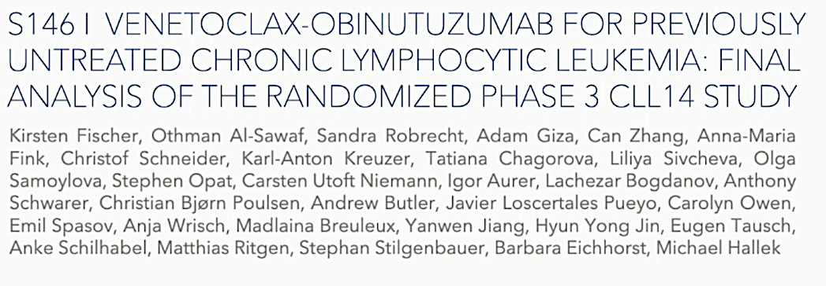
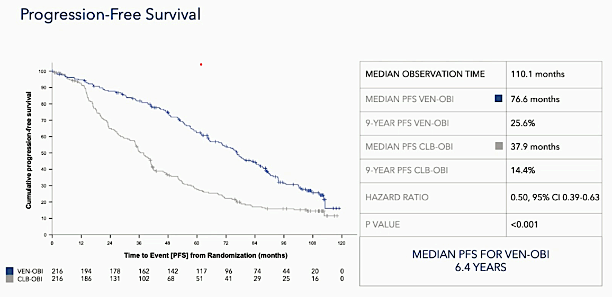
Fischer K et al. EHA 2026;Abstract S146

Slide 48
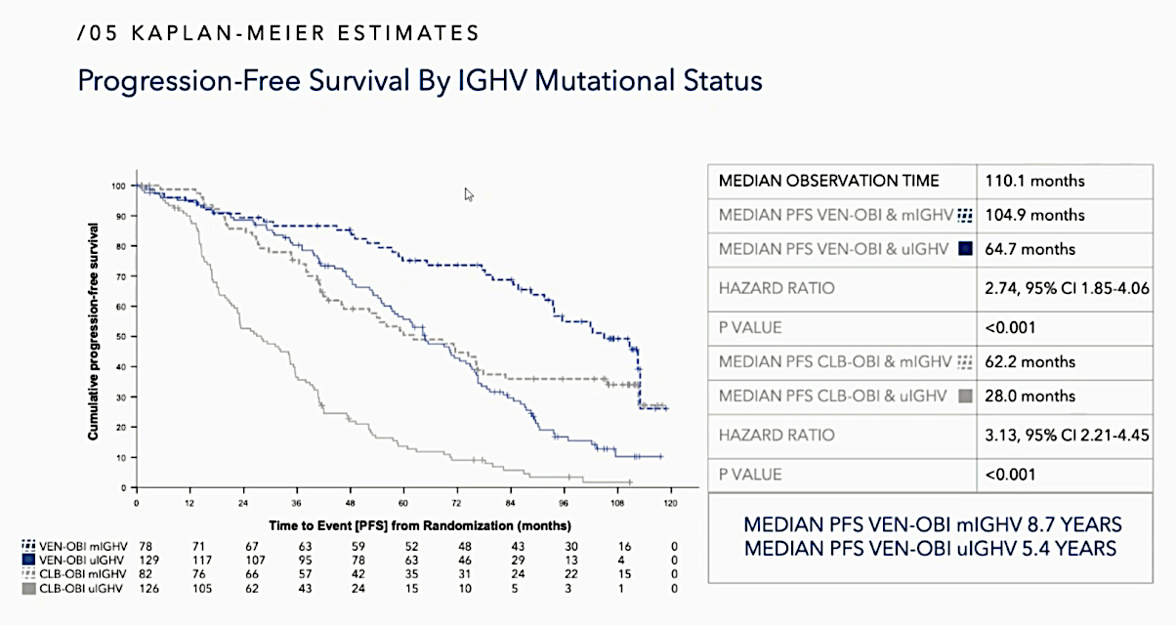
Fischer K et al. EHA 2026;Abstract S146

Slide 49

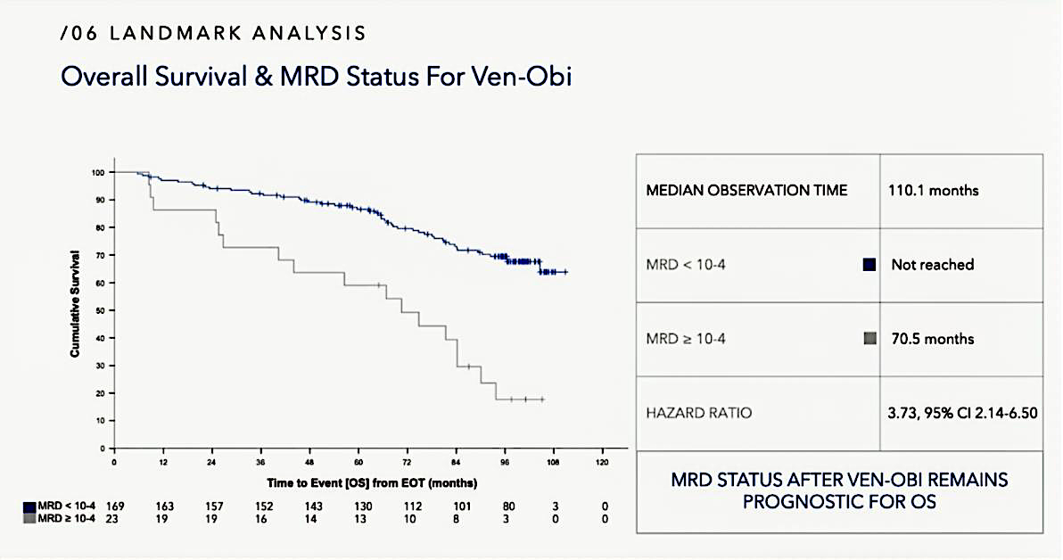
Fischer K et al. EHA 2026;Abstract S146

Slide 50
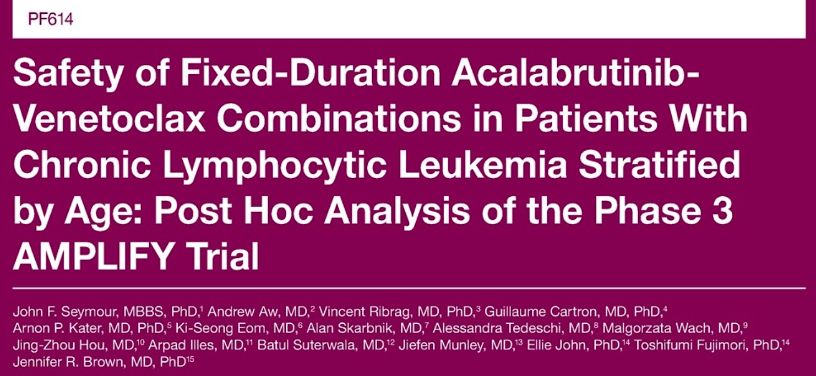
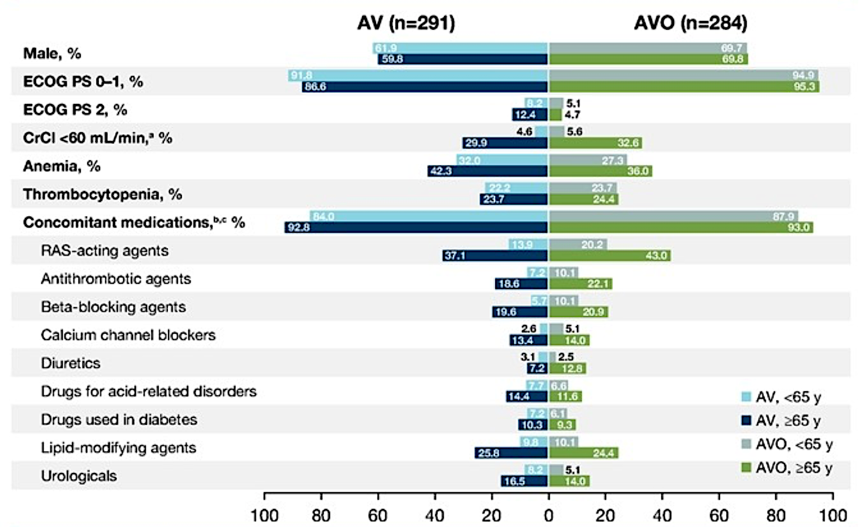
Seymour JF et al. EHA 2026;Abstract PF614.

Slide 51
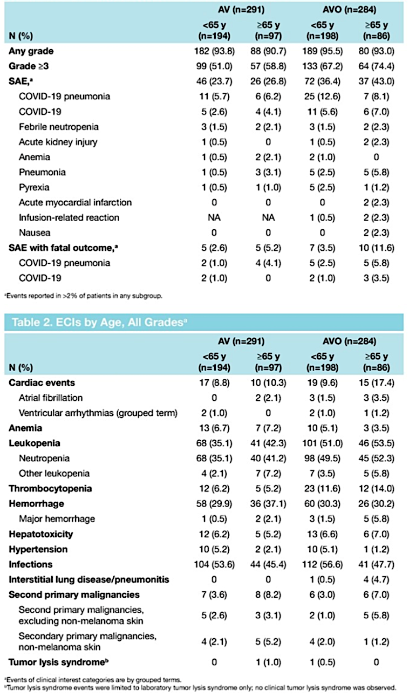
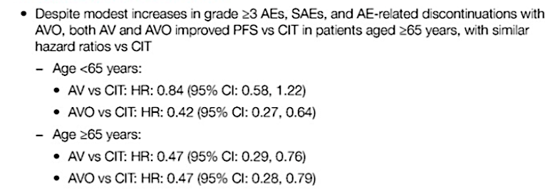
Phase III AMPLIFY:
Post-Hoc Safety Analysis
Seymour JF et al. EHA 2026;Abstract PF614.

Slide 52
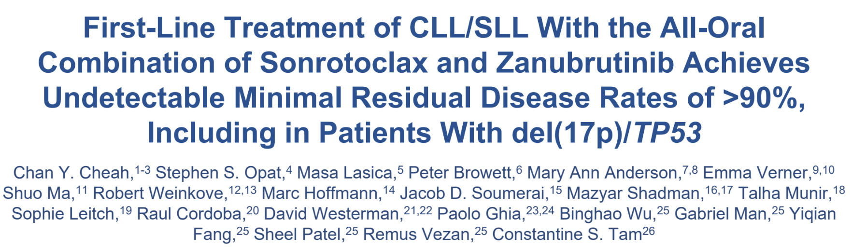
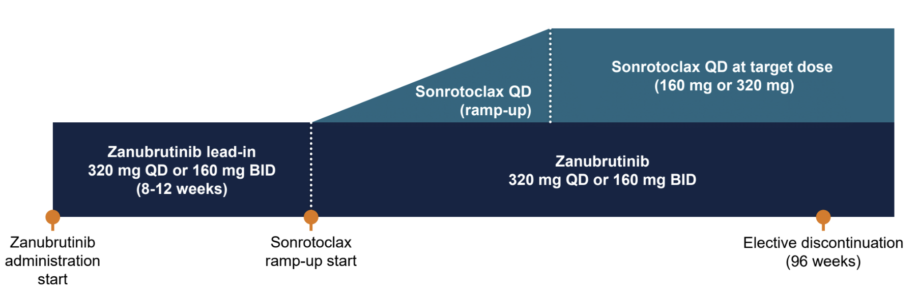
Cheah CY et al. EHA 2026;Abstract S145

Slide 53
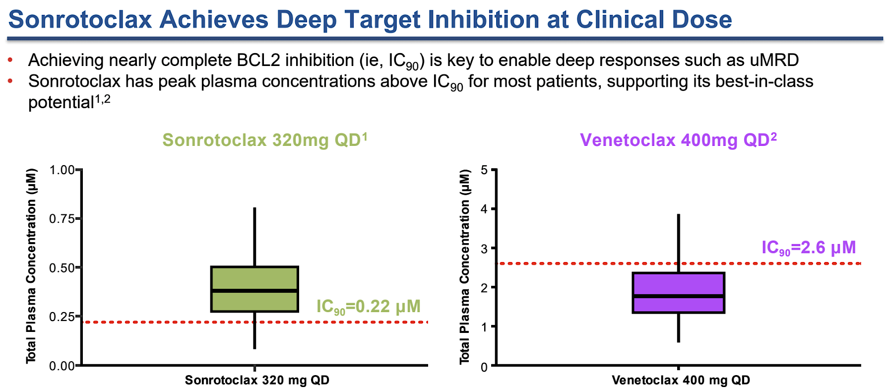
Cheah CY et al. EHA 2026;Abstract S145

Slide 54
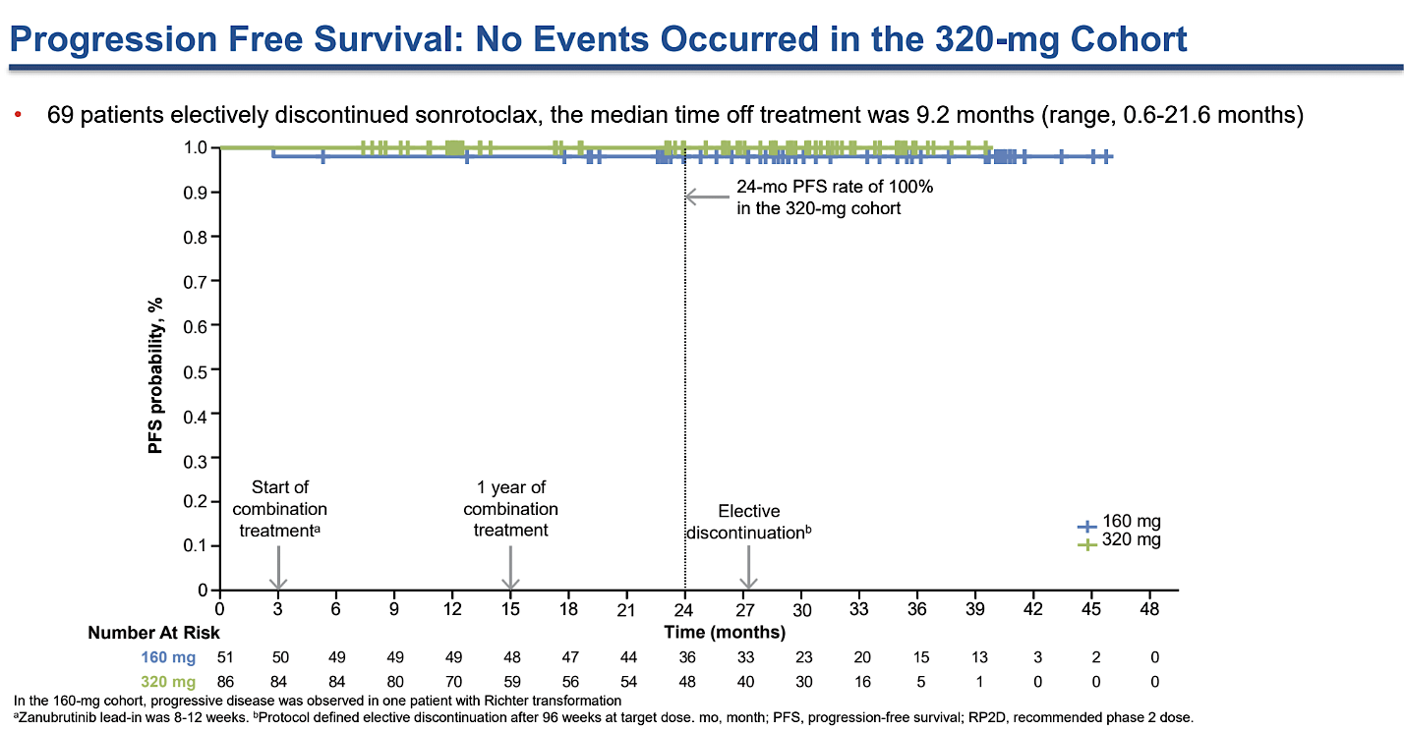
Cheah CY et al. EHA 2026;Abstract S145

Slide 55
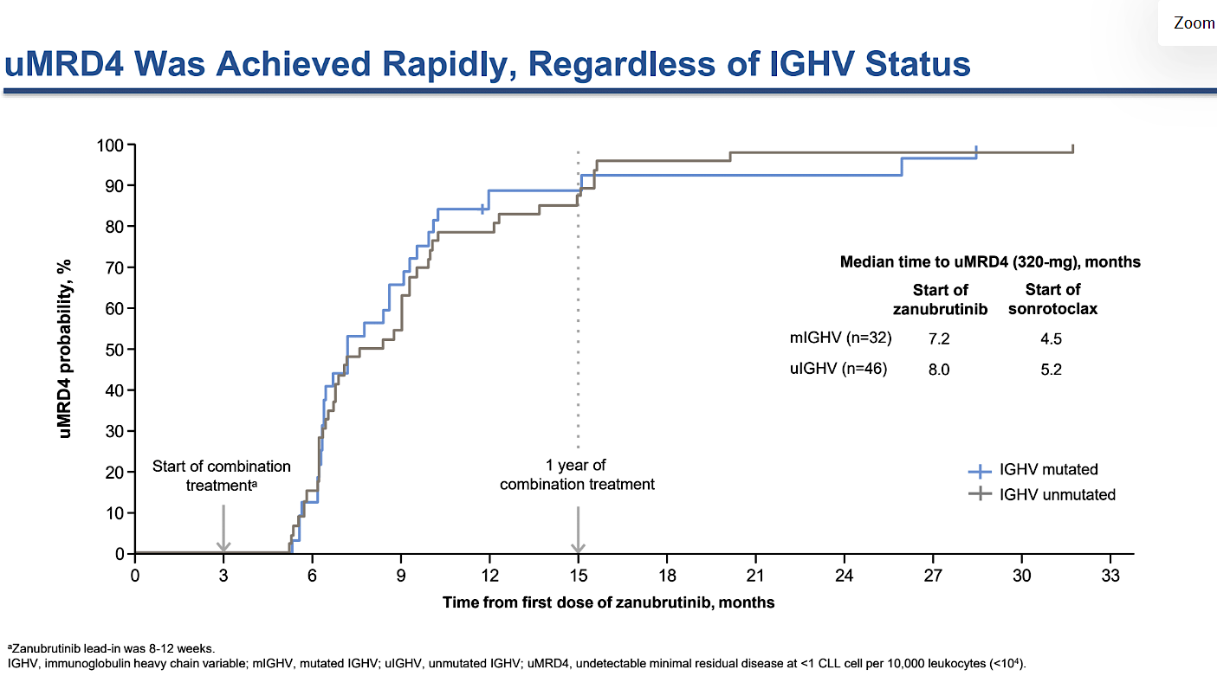
Cheah CY et al. EHA 2026;Abstract S145

Slide 56
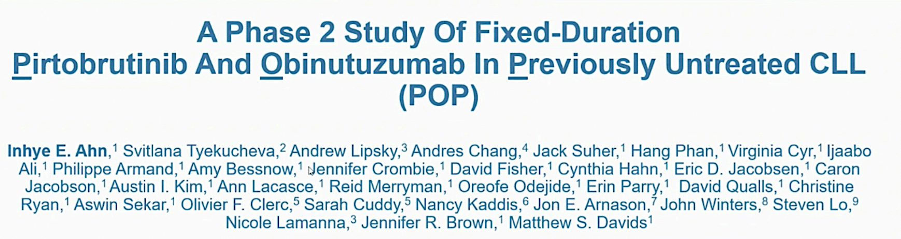
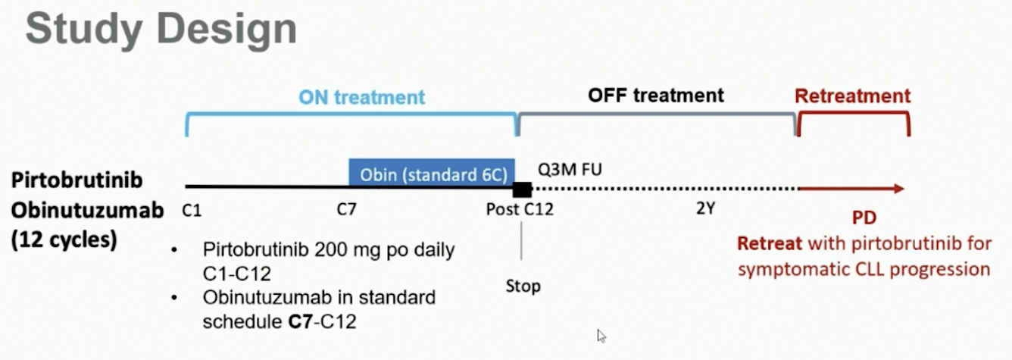
Ahn I et al. EHA 2026;Abstract S148

Slide 57
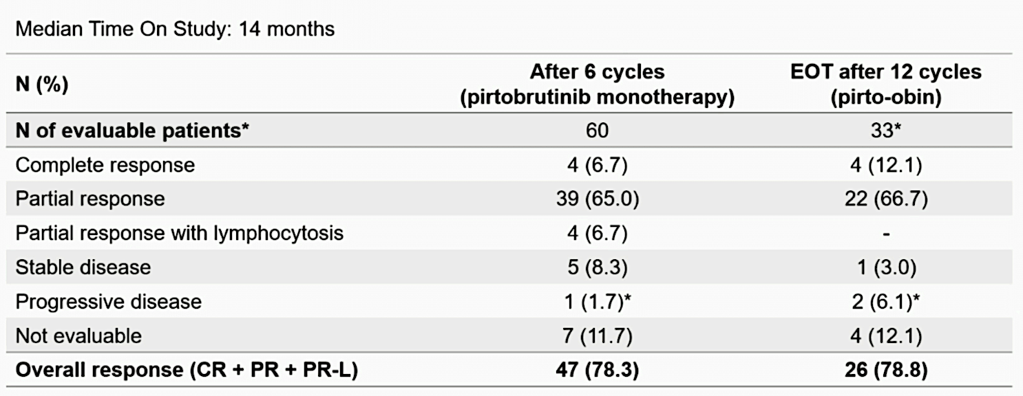
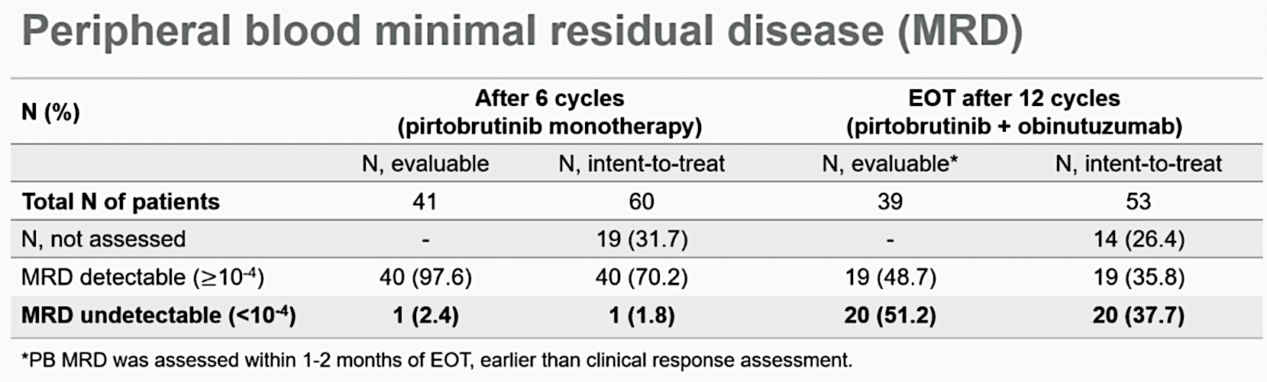
Ahn I et al. EHA 2026;Abstract S148

Slide 58
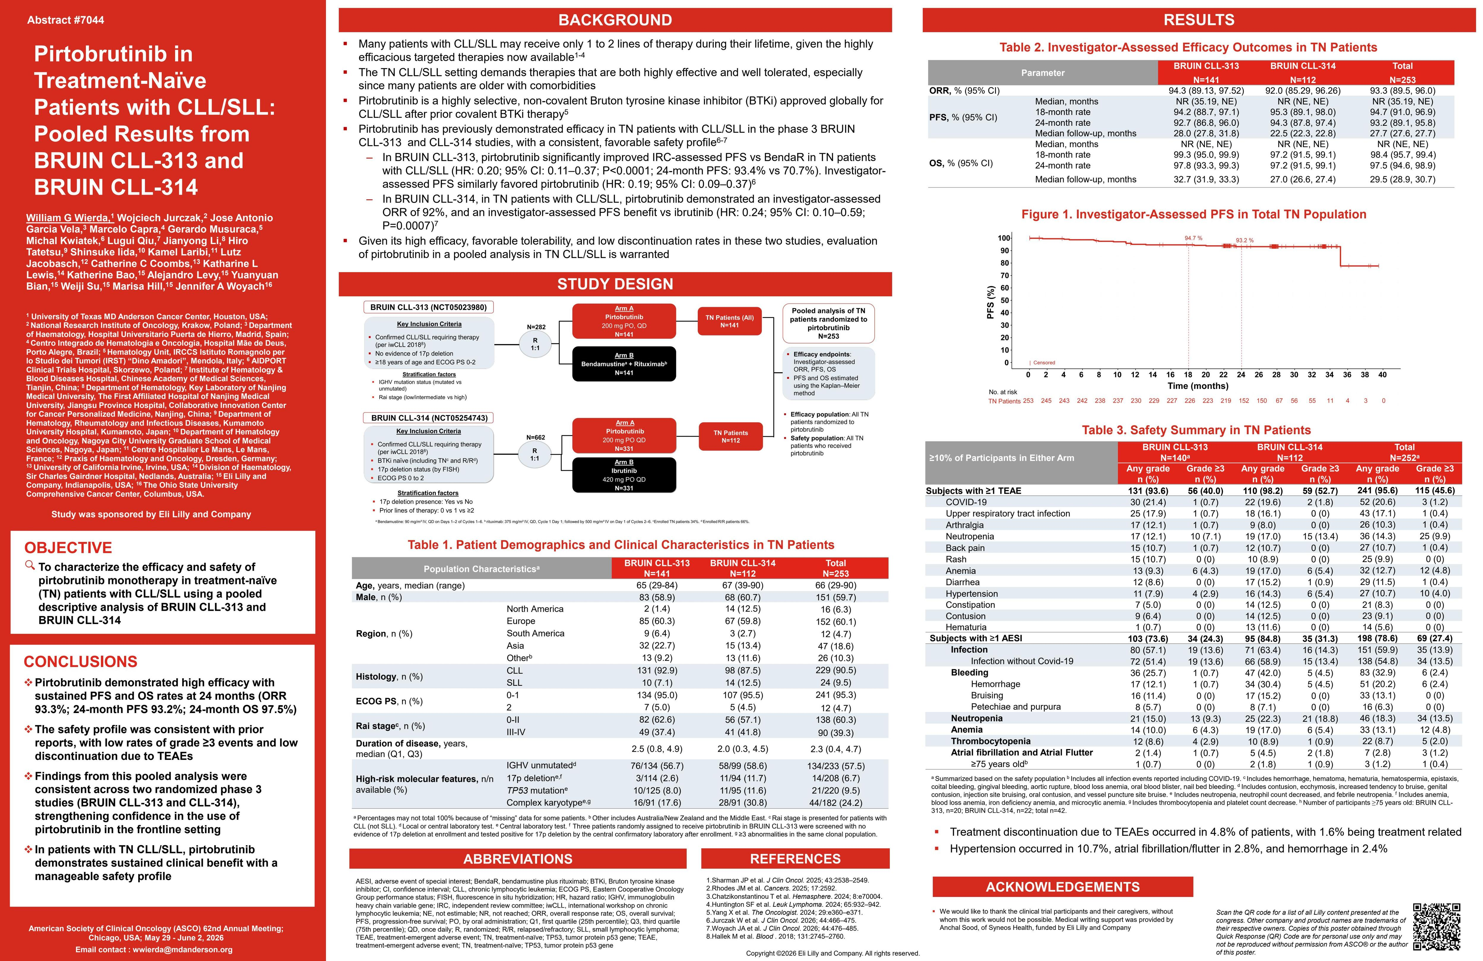
Wierda W et al. ASCO 2026;Abstract 7044

Slide 59
Wierda W et al. ASCO 2026;Abstract 7044

Slide 60
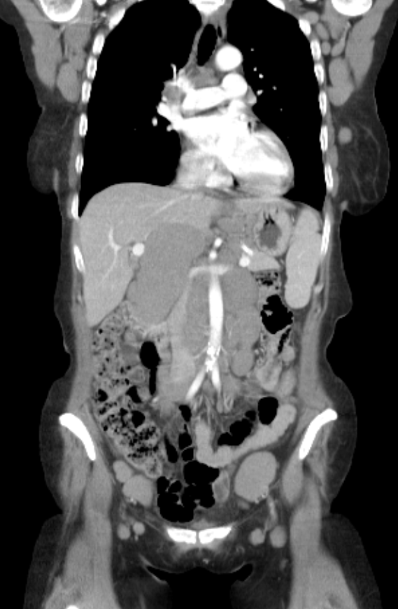
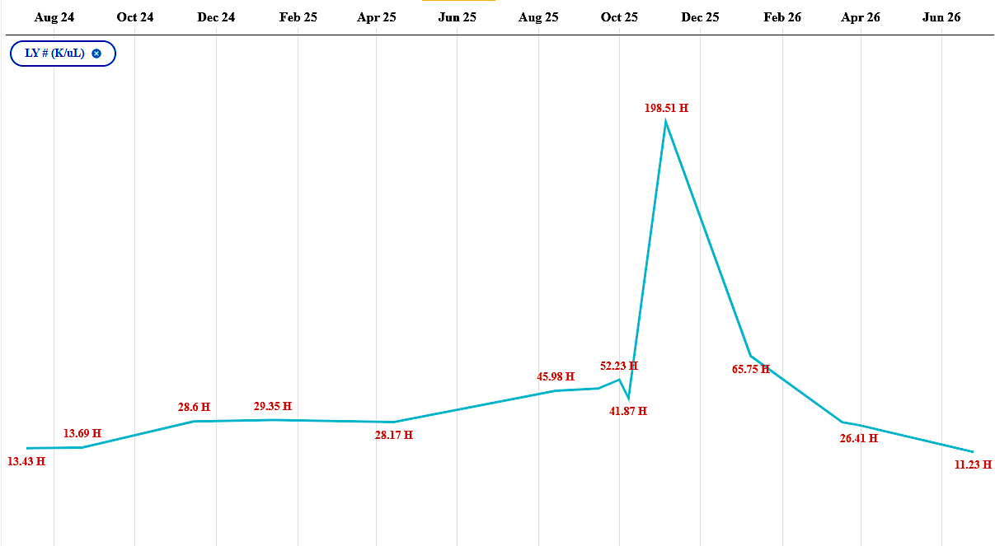
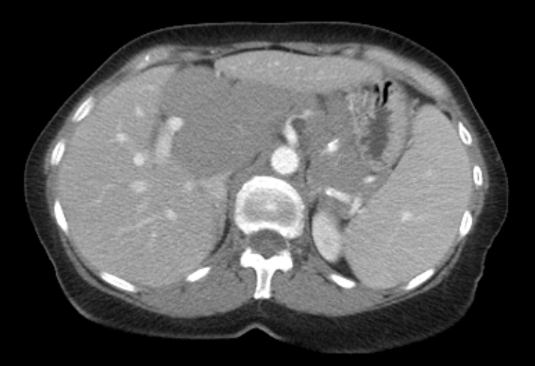
Dr. Sharman Case Presentation
68-year-old woman who presents initially with substantial lymphadenopathy but relatively modest absolute lymphocytosis. Found to have IgHV unmutated disease, with FISH showing deletion of 11Q
Imaging revealed adenopathy considerably larger than appreciated on physical exam. Started initially on BTK monotherapy, with venetoclax to be added.

Slide 61
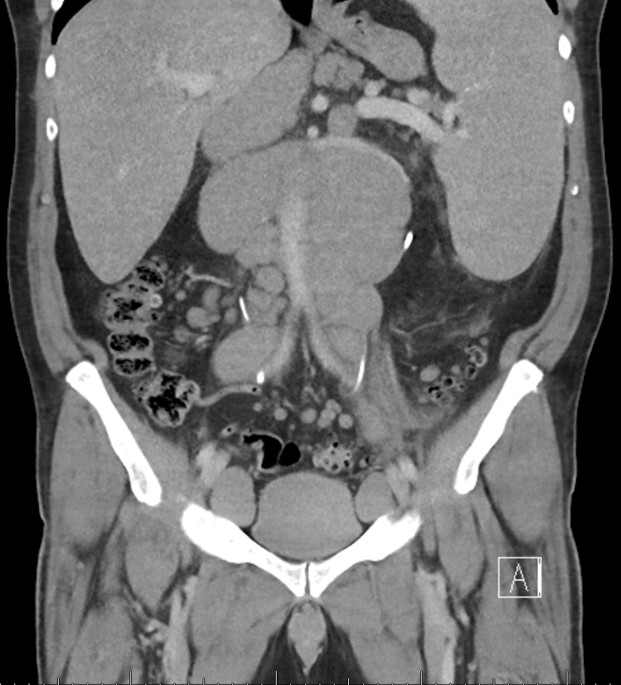
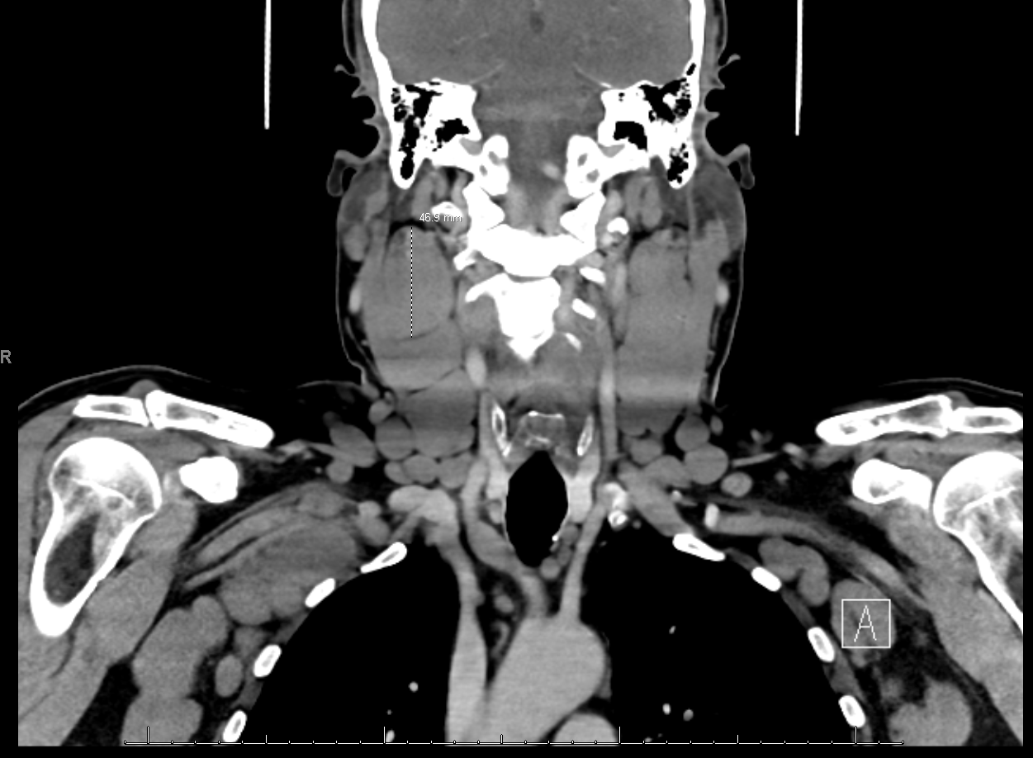
Dr. Sharman Case Presentation
64 year-old otherwise healthy male, rarely goes to doctor. Aware of adenopathy in his neck but does not really recall when it started. Wife suspects longer than he does.
IgHV unmutated, Del 13Q, TP53 wildtype.
Started on AVO regimen – only just began A for one month and now adding Obinutuzumab. Venetoclax to follow.

Slide 62
Questions?
First-Line Therapy
Fischer K et al. Venetoclax-obinutuzumab for previously untreated chronic lymphocytic leukemia: Final results of the randomized CLL14 study. EHA 2026;Abstract S146.
Seymour JF et al. Safety of fixed-duration (FD) acalabrutinib-venetoclax combinations in patients (pts) with chronic lymphocytic leukemia (CLL) stratified by age: Post hoc analysis of the phase 3 AMPLIFY trial. EHA 2026;Abstract PF614.
Cheah CY et al. First-line treatment of CLL/SLL with the all-oral combination of sonrotoclax and zanubrutinib achieves undetectable minimal residual disease rates of >90%, including in patients with del(17p)/TP53. EHA 2026;Abstract S145.
Ahn I et al. A phase 2 study of fixed-duration pirtobrutinib and obinutuzumab in previously untreated CLL. EHA 2026;Abstract S148.
Wierda W et al. Pirtobrutinib in treatment-naïve patients with CLL/SLL: Pooled results from BRUIN
CLL-313 and BRUIN CLL-314. ASCO 2026;Abstract 7044.

Slide 63
Key Datasets — BRUIN CLL-322 (Pirtobrutinib/Venetoclax/Rituximab for Relapsed Disease)
Davids MS et al. Fixed duration pirtobrutinib plus venetoclax–rituximab versus venetoclax–rituximab for patients with previously treated CLL/SLL: A phase 3, randomized trial (BRUIN CLL-322). EHA 2026;Abstract LB5001.

Slide 64
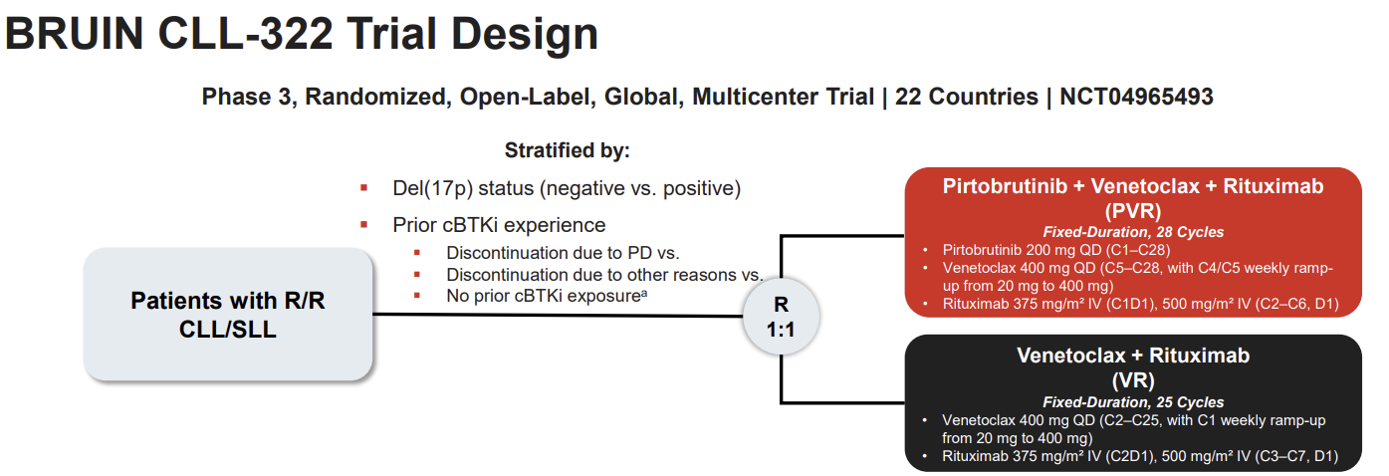
Davids MS et al. EHA 2026;Abstract LB5001

Slide 65
Davids MS et al. EHA 2026;Abstract LB5001

Slide 66
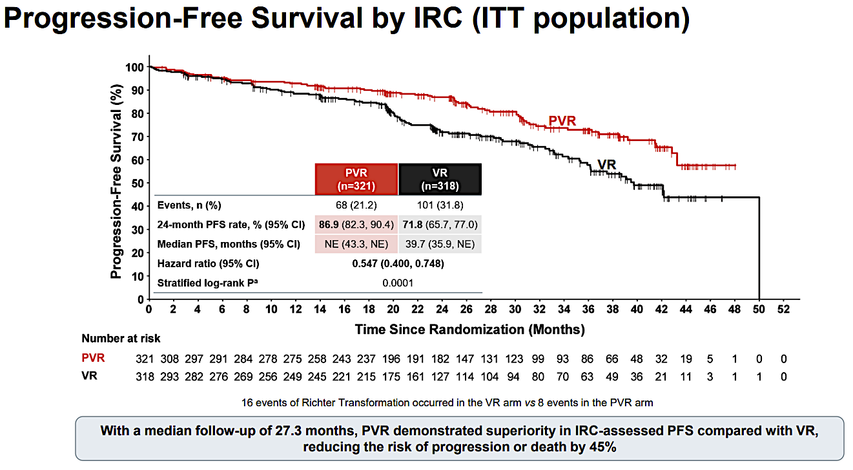
Davids MS et al. EHA 2026;Abstract LB5001

Slide 67
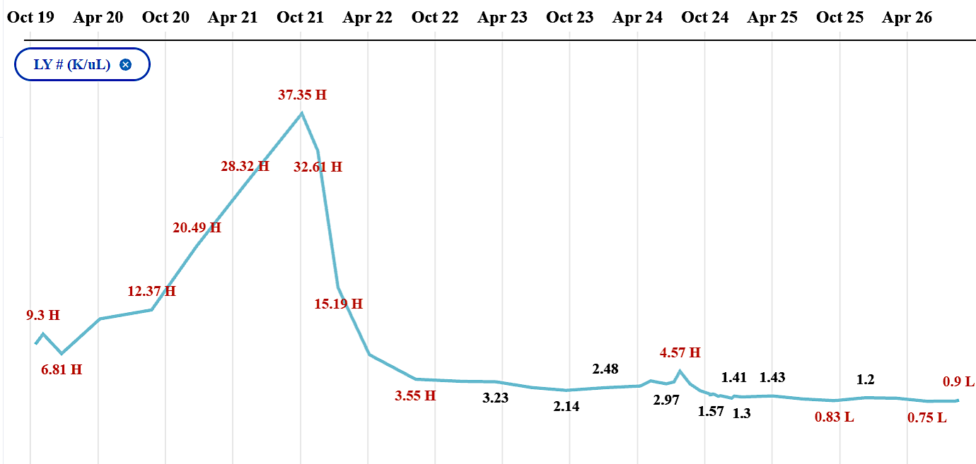
Dr. Sharman Case Presentation
Mid 70’s woman - recently retired nurse who initially presented with IgHV unmutated CLL. FISH testing had revealed Del17P. Started on BTK monotherapy in 2021.
Did well for 4 years but developed progressive / recurrent adenopathy and slight bump in lymphocyte count. Enrolled on a clinical trial of Ven/R versus pirto/ven/R receiving the triplet

Slide 68
Questions?
BRUIN CLL-322 (Pirtobrutinib/Venetoclax/Rituximab for Relapsed Disease)
Davids MS et al. Fixed duration pirtobrutinib plus venetoclax–rituximab versus venetoclax–rituximab for patients with previously treated CLL/SLL: A phase 3, randomized trial (BRUIN CLL-322). EHA 2026;Abstract LB5001.

Slide 69
Key Datasets — Bispecific Antibodies (Epcoritamab)
Kater AP et al. Fixed duration venetoclax plus epcoritamab shows favorable tolerability and high response rates with early molecular responses in R/R CLL/SLL: Interim analysis of the randomized HOVON 165/AETHER trial. EHA 2026;Abstract S153.

Slide 70
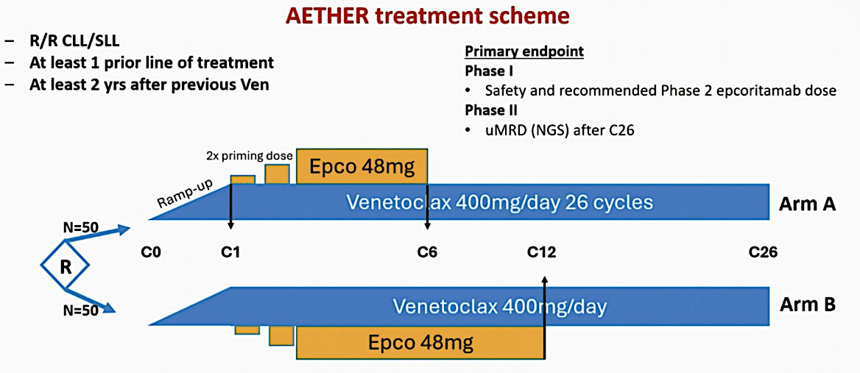
Kater AP et al. EHA 2026;Abstract S153

Slide 71
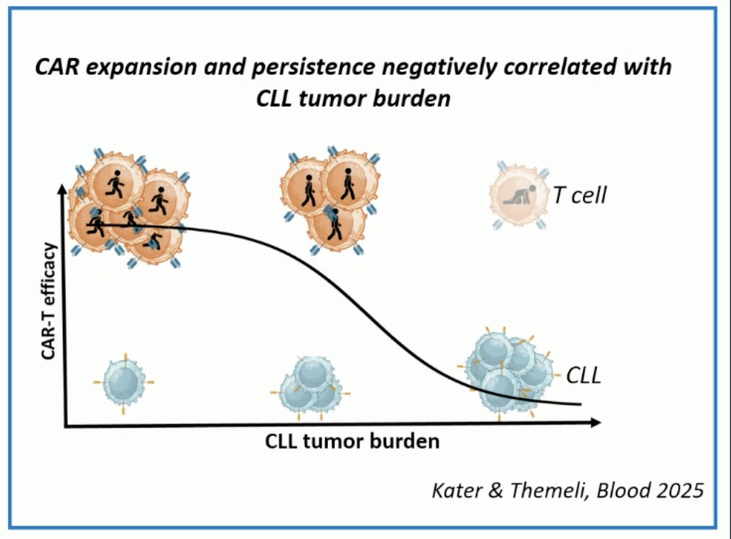
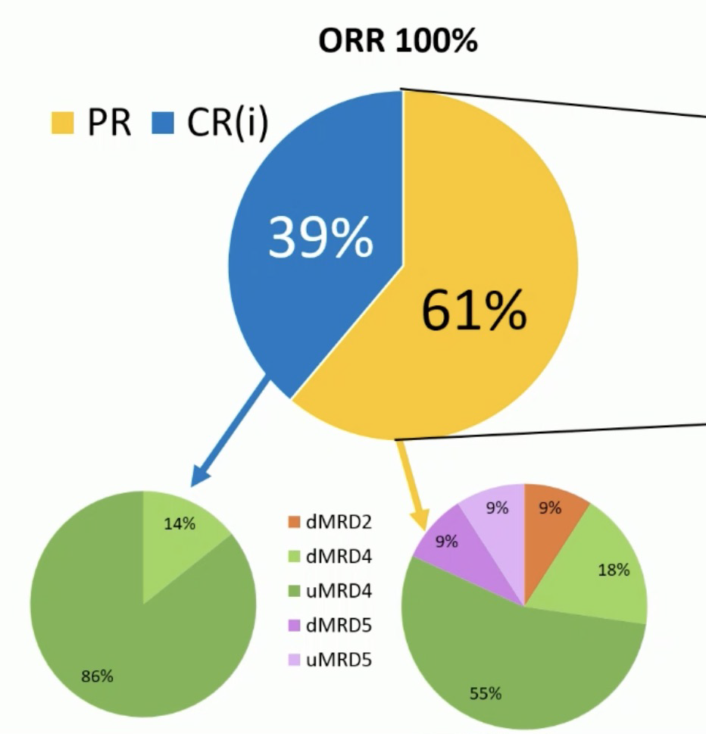
Kater AP et al. EHA 2026;Abstract S153

Slide 72
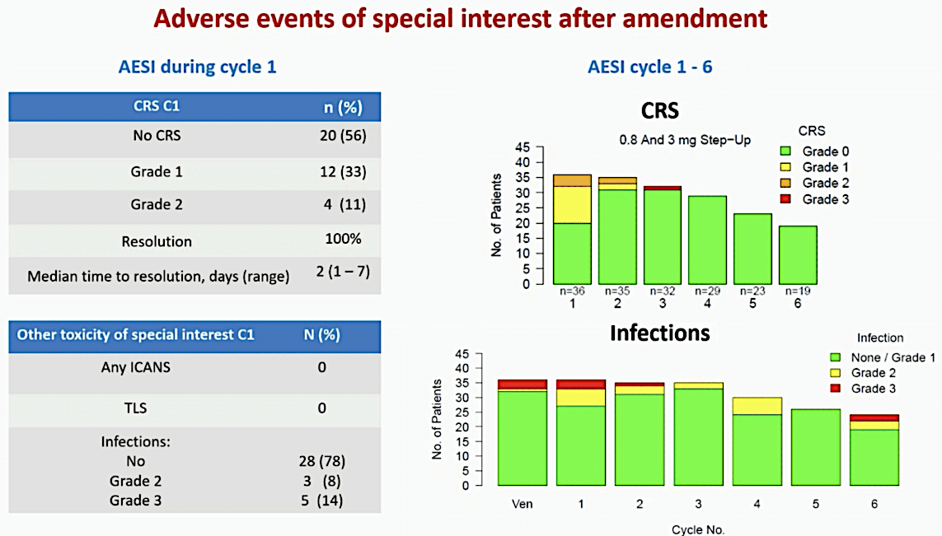
Kater AP et al. EHA 2026;Abstract S153

Slide 73
Questions?
Bispecific Antibodies (Epcoritamab)
Kater AP et al. Fixed duration venetoclax plus epcoritamab shows favorable tolerability and high response rates with early molecular responses in R/R CLL/SLL: Interim analysis of the randomized HOVON 165/AETHER trial. EHA 2026;Abstract S153.

Slide 74
Key Datasets — BTK Degraders
Stilgenbauer S et al. BGB-16673, a Bruton tyrosine kinase (BTK) degrader, in patients with relapsed/refractory (R/R) chronic lymphocytic leukemia/small lymphocytic lymphoma (CLL/SLL): A phase 1 CADANCE-101 study update. EHA 2026;Abstract S152.
Munir T et al. Updated efficacy and safety data from an ongoing phase 1a/b trial of the BTK degrader bexobrutideg (NX-5948) in patients with CLL across lines of therapy. EHA 2026;Abstract S150.

Slide 75
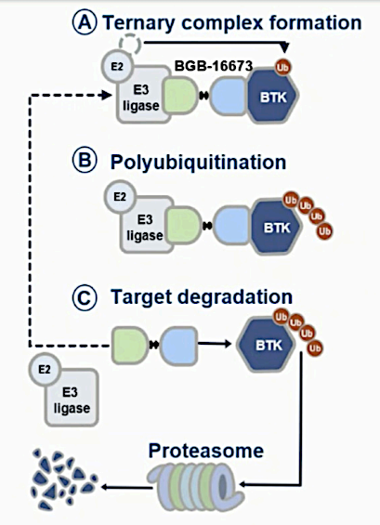
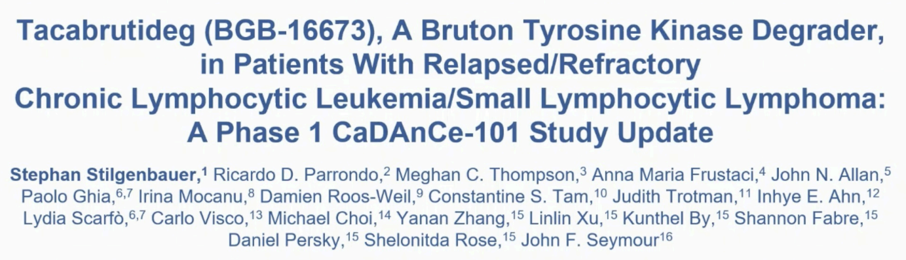
Stilgenbauer S et al. EHA 2026;Abstract S152

Slide 76
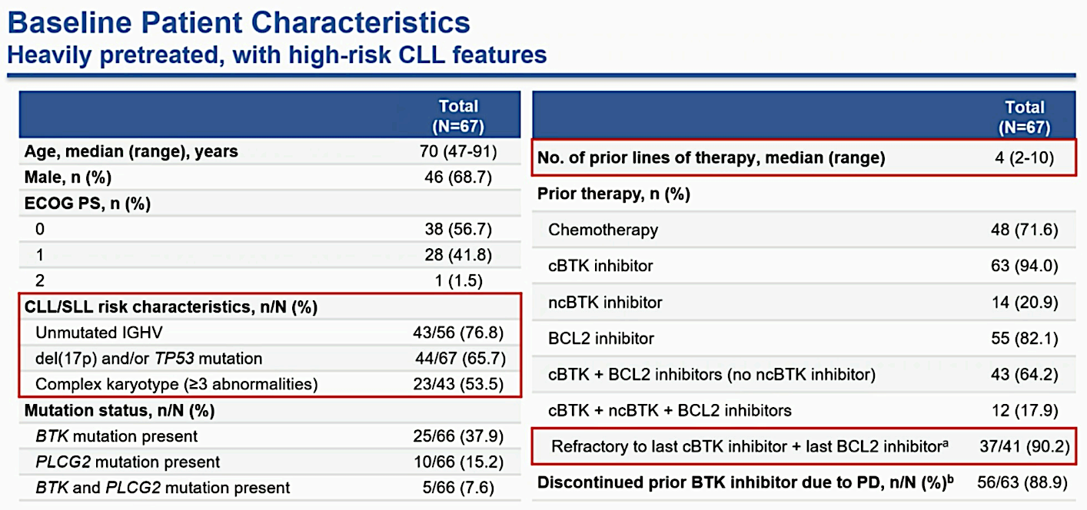
Stilgenbauer S et al. EHA 2026;Abstract S152

Slide 77
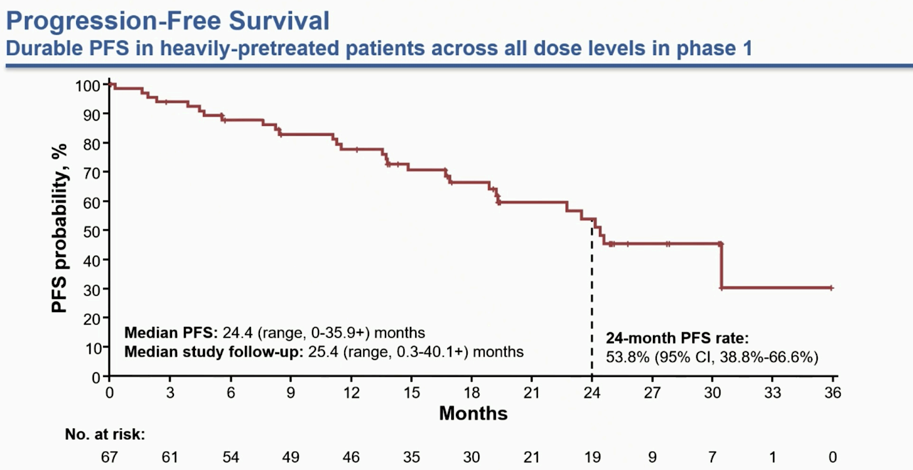
Stilgenbauer S et al. EHA 2026;Abstract S152

Slide 78
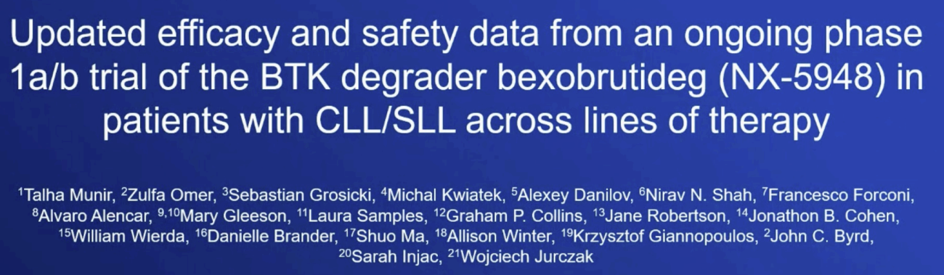
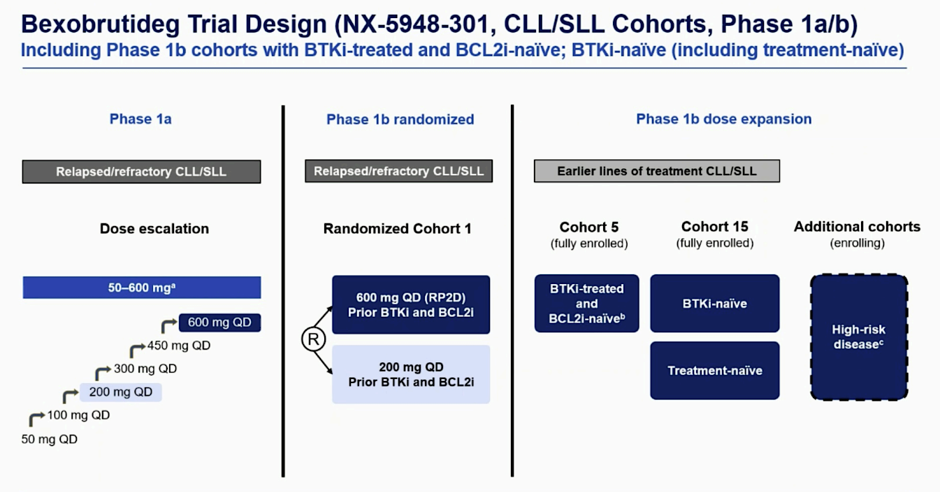
Munir T et al. EHA 2026;Abstract S150

Slide 79
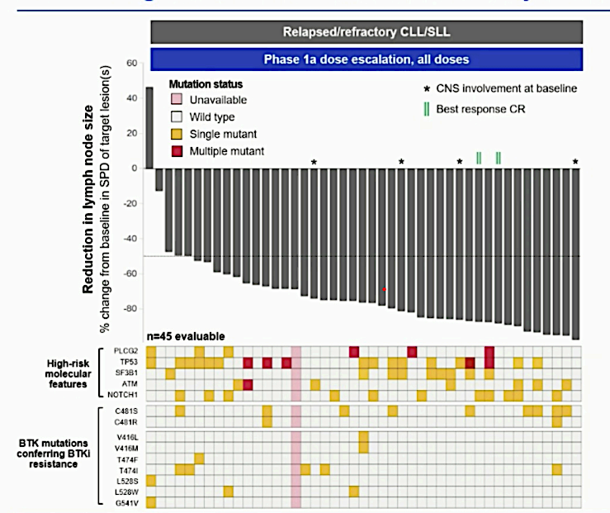
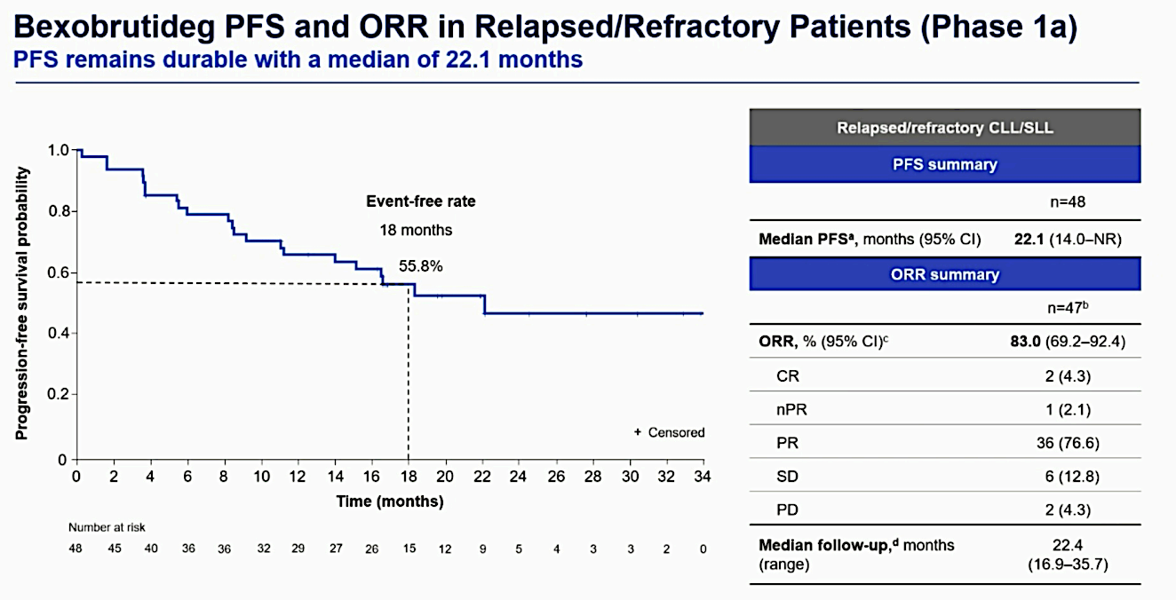
Munir T et al. EHA 2026;Abstract S150

Slide 80
Questions?
BTK Degraders
Stilgenbauer S et al. BGB-16673, a Bruton tyrosine kinase (BTK) degrader, in patients with relapsed/refractory (R/R) chronic lymphocytic leukemia/small lymphocytic lymphoma (CLL/SLL): A phase 1 CADANCE-101 study update. EHA 2026;Abstract S152.
Munir T et al. Updated efficacy and safety data from an ongoing phase 1a/b trial of the BTK degrader bexobrutideg (NX-5948) in patients with CLL across lines of therapy. EHA 2026;Abstract S150.

Slide 81
Agenda
Introduction: Trials in Progress
Module 1: Chronic Lymphocytic Leukemia
Module 2: Diffuse Large B-Cell Lymphoma
First-Line Therapy
Bispecific Antibodies (Epcoritamab, Mosunetuzumab)
Antibody-Drug Conjugates (Polatuzumab Vedotin)
CELMoDs (Golcadomide)
Module 3: Mantle Cell Lymphoma
Module 4: Follicular Lymphoma

Slide 82
Key Datasets
Harkins RA et al. Outcomes by LymphoMAP archetypes in untreated diffuse large B-cell lymphoma from the POLARIX trial. ASCO 2026;Abstract 7017.
Jerkeman M et al. Safety data and initial pooled efficacy data from the Nordic Lymphoma Group phase 3 POLAR BEAR trial in elderly or frail patients with diffuse large cell lymphoma - R-Pola-mini-CHP vs R-mini-CHOP. EHA 2026;Abstract S238.
Lenz G et al. Tafasitamab plus lenalidomide and R-CHOP for patients with previously untreated diffuse large B-cell lymphoma (DLBCL): Results from the phase 3 frontMIND study. ASCO 2026;Abstract LBA7000.
Thieblemont C et al. Sustained remissions beyond 4 years with epcoritamab monotherapy: Long-term follow-up results from the pivotal EPCORE NHL-1 trial in patients with relapsed or refractory large B-cell lymphoma. EHA 2026;Abstract PF977.

Slide 83
Key Datasets (Continued)
Fox CP et al. Results from EPCORE DLBCL-1: Randomized Phase 3 study of epcoritamab (epcor) vs investigator’s choice chemoimmunotherapy (CIT) in patients with relapsed/refractory large B-cell lymphoma (R/R LBCL). EHA 2026;Abstract S235.
[Manufacturer] announces positive phase 3 results for epcoritamab plus lenalidomide in patients with relapsed/refractory diffuse large B-cell lymphoma, demonstrating statistically significant improvement in progression-free survival [press release]. June 29, 2026. https://www.us.genmab.com/company/news/press-releases/genmab-announces-positive-phase-3-results-for-epcoritamab-plus-lenalidomide-in-patients-with-relapsed-refractory-diffuse-large-b-cell-lymphoma-demonstrating-statistically-significant-improvement-in-progression-free-survival-2026-06.
Chihara D et al. Phase 2 trial of epcoritamab in combination with rituximab-mini CVP for older unfit/frail or anthracycline-ineligible adult patients with newly diagnosed diffuse large B-cell lymphoma: Interim futility analysis. ASCO 2026;Abstract 7002.

Slide 84
Key Datasets (Continued)
Flinn I et al. Fixed-duration subcutaneous (SC) mosunetuzumab (Mosun) in elderly/unfit patients with previously untreated diffuse large B-cell lymphoma (DLBCL): Interim analysis and patient-reported outcomes (PROs) from the phase 2 MorningSun study. ASCO 2026;Abstract 7029.
Matasar M et al. Multivariable analyses (MVAs) of overall survival (OS) in the phase 3 SUNMO, STARGLO, and POLARGO trials in relapsed/refractory large B-cell lymphoma (LBCL). ASCO 2026;Abstract 7093.
Glass B et al. Polatuzumab vedotin plus rituximab, ifosfamide, carboplatin, etoposide
(Pola-R-ICE) vs R-ICE as second line treatment in large B cell lymphoma (LBCL). Final analysis
of a randomized phase 3 study. EHA 2026;Abstract S237.
Budde LE et al. Mosunetuzumab plus polatuzumab vedotin versus rituximab, gemcitabine and oxaliplatin in large B-cell lymphoma: Updated efficacy and safety from the phase 3 SUNMO study including in patient subgroups. EHA 2026;Abstract PF968.
Hoffmann M et al. Golcadomide (GOLCA), a potential, first-in-class, oral CELMoD, +
Pola-RCHP in patients (pts) with newly diagnosed aggressive B-cell lymphoma (a-BCL):
Safety and 12-month (mo) efficacy results. ASCO 2026;Abstract 7011.

Slide 85

Post-ASCO/EHA 2026:
Diffuse Large B-Cell Lymphoma
Tanya Siddiqi, MD
City of Hope Orange County, CA
Research To Practice webinar
9/2/26

Slide 86
Key Datasets — First-Line Therapy
Harkins RA et al. Outcomes by LymphoMAP archetypes in untreated diffuse large B-cell lymphoma from the POLARIX trial. ASCO 2026;Abstract 7017.
Jerkeman M et al. Safety data and initial pooled efficacy data from the Nordic Lymphoma Group phase 3 POLAR BEAR trial in elderly or frail patients with diffuse large cell lymphoma - R-Pola-mini-CHP vs R-mini-CHOP. EHA 2026;Abstract S238.
Lenz G et al. Tafasitamab plus lenalidomide and R-CHOP for patients with previously untreated diffuse large B-cell lymphoma (DLBCL): Results from the phase 3 frontMIND study. ASCO 2026;Abstract LBA7000.

Slide 87
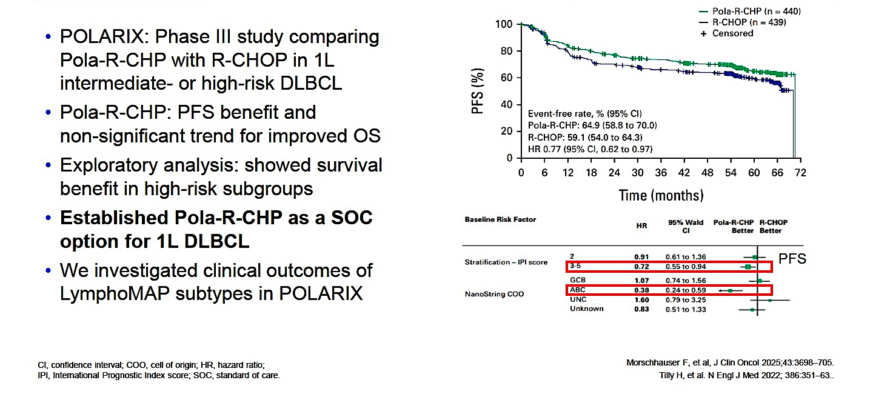
POLARIX Established Pola-R-CHP as a SOC 1L Therapy for DLBCL
Harkins RA et al. ASCO 2026;Abstract 7017

Slide 88
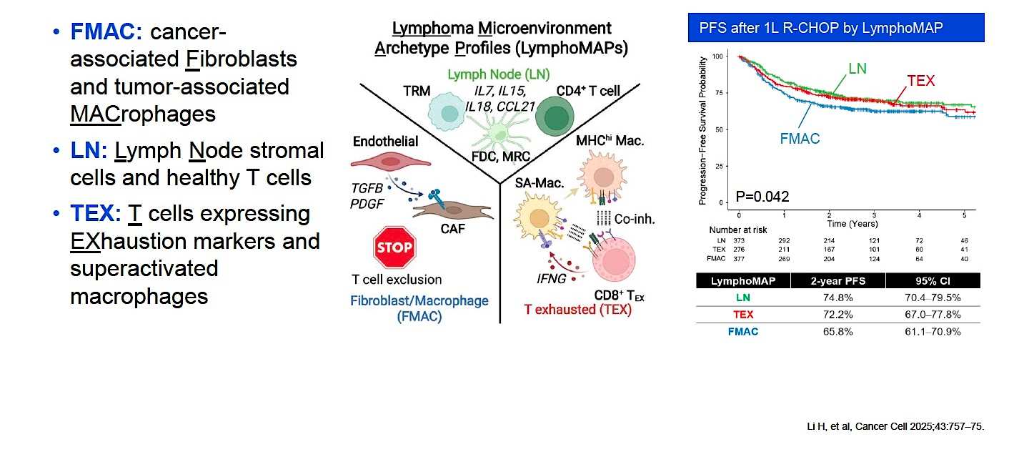
Lymphoma Microenvironment Archetype Profiles (LymphoMAPs)
Harkins RA et al. ASCO 2026;Abstract 7017

Slide 89
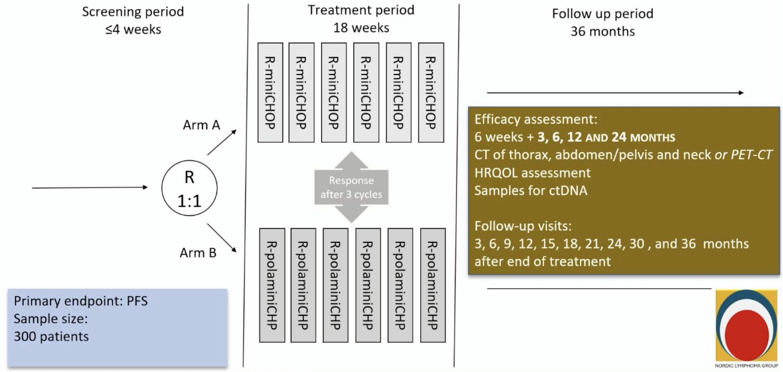
R-Pola-mini-CHP for Frail/Elderly Patients:
Phase III POLAR BEAR Study
Jerkeman M et al. EHA 2026;Abstract S238

Slide 90
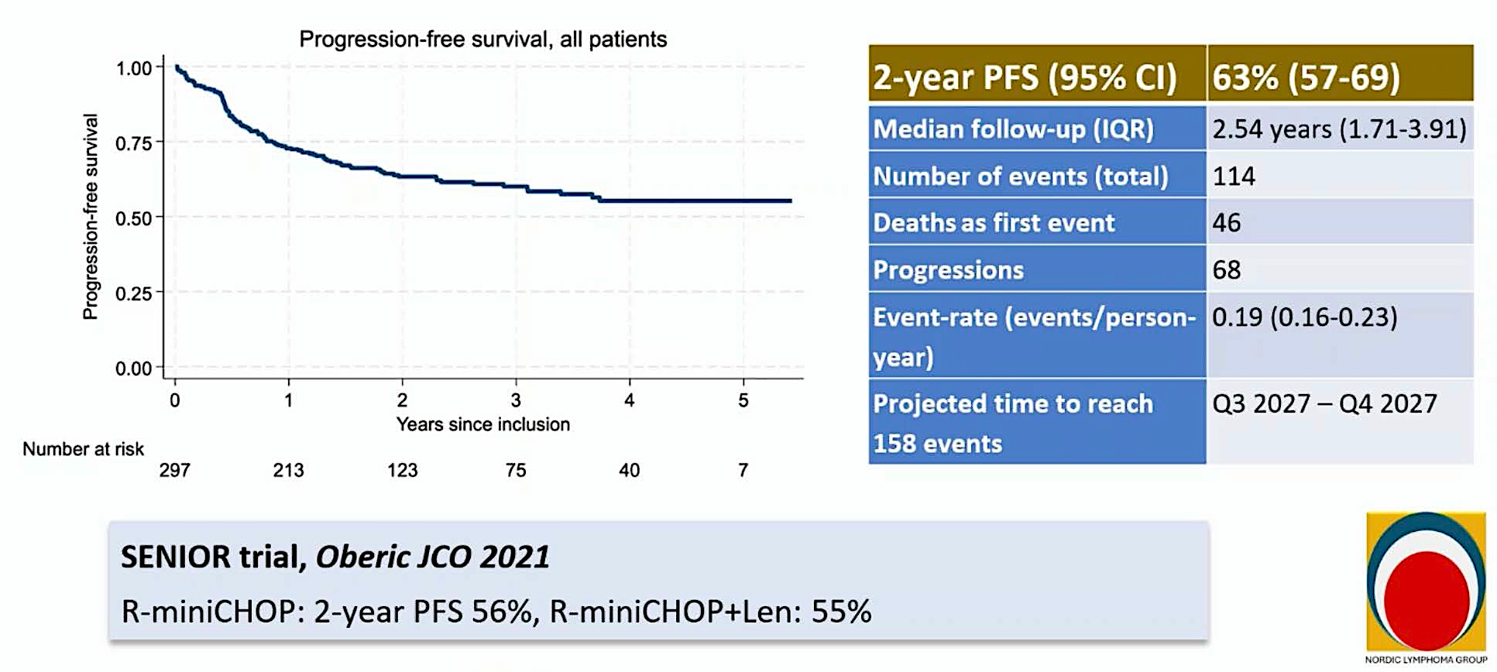
Phase III POLAR BEAR: Pooled PFS
Jerkeman M et al. EHA 2026;Abstract S238

Slide 91

Phase III frontMIND Study Design
Lenz G et al. ASCO 2026;Abstract LBA7000; Lenz G et al. Lancet 2026 June 20;407(10547):2528-41.

Slide 92

Phase III frontMIND Primary Endpoint: Investigator-Assessed Progression-Free Survival
In key prespecified subgroup analyses, there are trends toward PFS advantage with Tafa-Len-R-CHOP
Lenz G et al. ASCO 2026;Abstract LBA7000; Lenz G et al. Lancet 2026 June 20;407(10547):2528-41.

Slide 93

Phase III frontMIND: Most Frequent Treatment-Emergent Adverse Events
Safety events with Tafa-Len-R-CHOP were manageable and did not affect the delivery of the
R-CHOP backbone
Lenz G et al. ASCO 2026;Abstract LBA7000; Lenz G et al. Lancet 2026 June 20;407(10547):2528-41.

Slide 94
Dr. Siddiqi: DLBCL Case 1 – 1L
43 y.o. female hospital worker who initially presented with abdominal pain and distention x 5 days, which prompted an ED visit on 2/5/24. CT Abdomen done in the ER on 2/6/24 showed extensive mesenteric lymphadenopathy with a partially visualized left paracentral mesenteric mass measuring at least 6.7 x 6.3 cm. Diffuse omental infiltration with a small amount of ascites suspicious for peritoneal carcinomatosis and trace right pleural effusion were also seen.
She underwent abdominal peritoneum core needle biopsy on 2/7/24. Pathology reported High grade lymphoma, CD10+ but on our pathology review it was confirmed to be Diffuse large B-cell lymphoma, germinal center subtype, with IHC showing CD20+/CD10+/BCL2+ disease with Ki67 at ~70%. FISH was negative for MYC (Rearrangement and Amplification). Flow cytometry: CD10 positive B-cell lymphoproliferative disorder, kappa restricted, without CD5 or CD11c. Paracentesis was performed on 2/9/24 and showed lymphoma as well. Bone marrow biopsy on 2/20/24 was negative.
Staging PET CT on 2/15/24 showed extensive hypermetabolic peritoneal and omental carcinomatosis with bulky hypermetabolic mesenteric adenopathy. Hypermetabolic cervical and thoracic adenopathy and evidence of right pleural metastases. (IPI 2-3)
Started treatment with Pola-R-CHP on 2/27/24 and achieved CR which is durable thus far.

Slide 95
Questions?
First-Line Therapy
Harkins RA et al. Outcomes by LymphoMAP archetypes in untreated diffuse large B-cell lymphoma from the POLARIX trial. ASCO 2026;Abstract 7017.
Jerkeman M et al. Safety data and initial pooled efficacy data from the Nordic Lymphoma Group phase 3 POLAR BEAR trial in elderly or frail patients with diffuse large cell lymphoma - R-Pola-mini-CHP vs R-mini-CHOP. EHA 2026;Abstract S238.
Lenz G et al. Tafasitamab plus lenalidomide and R-CHOP for patients with previously untreated diffuse large B-cell lymphoma (DLBCL): Results from the phase 3 frontMIND study. ASCO 2026;Abstract LBA7000.

Slide 96
Key Datasets — Bispecific Antibodies
(Epcoritamab, Mosunetuzumab)
Thieblemont C et al. Sustained remissions beyond 4 years with epcoritamab monotherapy: Long-term follow-up results from the pivotal EPCORE NHL-1 trial in patients with relapsed or refractory large B-cell lymphoma. EHA 2026;Abstract PF977.
Fox CP et al. Results from EPCORE DLBCL-1: Randomized phase 3 study of epcoritamab (epcor) vs investigator’s choice chemoimmunotherapy (CIT) in patients with relapsed/refractory large B-cell lymphoma (R/R LBCL). EHA 2026;Abstract S235.
[Manufacturer] announces positive phase 3 results for epcoritamab plus lenalidomide in patients with relapsed/refractory diffuse large B-cell lymphoma, demonstrating statistically significant improvement in progression-free survival [press release]. June 29, 2026. https://www.us.genmab.com/company/news/press-releases/genmab-announces-positive-phase-3-results-for-epcoritamab-plus-lenalidomide-in-patients-with-relapsed-refractory-diffuse-large-b-cell-lymphoma-demonstrating-statistically-significant-improvement-in-progression-free-survival-2026-06.
Chihara D et al. Phase 2 trial of epcoritamab in combination with rituximab-mini CVP for older unfit/frail or anthracycline-ineligible adult patients with newly diagnosed diffuse large B-cell lymphoma: Interim futility analysis. ASCO 2026;Abstract 7002.
Flinn I et al. Fixed-duration subcutaneous (SC) mosunetuzumab (Mosun) in elderly/unfit patients with previously untreated diffuse large B-cell lymphoma (DLBCL): Interim analysis and patient-reported outcomes (PROs) from the phase 2 MorningSun study. ASCO 2026;Abstract 7029.
Matasar M et al. Multivariable analyses (MVAs) of overall survival (OS) in the phase 3 SUNMO, STARGLO, and POLARGO trials in relapsed/refractory large B-cell lymphoma (LBCL). ASCO 2026;Abstract 7093.

Slide 97

Phase II EPCORE NHL-1 Trial Long-Term Follow-Up
Thieblemont C et al. EHA 2026;Abstract PF977

Slide 98



Phase II EPCORE NHL-1 Trial Long-Term Follow-Up: Responses
LBCL = large B-cell lymphoma; HGBCL = high-grade B-cell lymphoma;
ORR = overall response rate; PR = partial response; DOR = duration of response
Thieblemont C et al. EHA 2026;Abstract PF977

Slide 99

Phase III EPCORE DLBCL-1: Epcoritamab versus Investigator’s Choice Chemoimmunotherapy (CIT) for R/R LBCL
Fox CP et al. EHA 2026;Abstract S235

Slide 100

Phase III EPCORE DLBCL-1: Efficacy Summary
Epcoritamab resulted in clinically meaningful improvement in CR, DOR and duration of complete response
OS was not significantly different; confounded by COVID-19 mortality and higher use of effective subsequent treatments in the CIT arm
Fox CP et al. EHA 2026;Abstract S235

Slide 101

Phase III EPCORE DLBCL-1:
Most Common Treatment-Emergent Adverse Events
Fox CP et al. EHA 2026;Abstract S235

Slide 102
Phase III EPCORE DLBCL-4 Study Design
Trial identifier: NCT06508658 (closed)
Eligibility
Histologically confirmed CD20+ DLBCL
Relapsed/refractory disease previously treated with at least 1 line of systemic antineoplastic therapy, including anti-CD20 mAb-containing combination chemotherapy
Failure of prior ASCT or ASCT ineligible
CAR T-cell therapy ineligible
Arm A
Subcutaneous epcoritamab + oral lenalidomide
Arm B
IV R-GemOx (rituximab/gemcitabine/
oxaliplatin)
R
Arm C
Subcutaneous epcoritamab
Primary endpoint (Arm A vs Arm B): Progression-free survival
Secondary endpoints (Arm A vs Arm B): Complete response, overall survival, minimal residual disease negativity rate
www.clinicaltrials.gov. Accessed August 2026.

Slide 103
Positive Phase III Results Announced for Epcoritamab with Lenalidomide for Patients with Relapsed or Refractory DLBCL
Press Release: June 29, 2026
“[The manufacturers] today announced topline results from the Phase 3 EPCORE DLBCL-4 trial evaluating the combination of fixed duration epcoritamab, a T-cell engaging bispecific antibody administered subcutaneously, and lenalidomide, compared to standard-of-care, rituximab plus gemcitabine plus oxaliplatin (R-GemOx), in adult patients with relapsed or refractory (R/R) diffuse large B-cell lymphoma (DLBCL) who received at least one prior line of treatment. Based on topline results, the trial met its primary objective, demonstrating statistically significant and clinically meaningful improvement in progression-free survival (PFS). The risk of disease progression and death was reduced by 60% (HR 0.40 [95% CI 0.30, 0.55]; p value < 0.0001) and 56% (HR 0.44 [95% CI 0.33, 0.60]; p value < 0.0001), based on different censoring rules in the U.S. and outside the U.S., respectively.
The safety profile of epcoritamab when administered in combination with lenalidomide was consistent with the previously reported safety profiles of the individual agents (epcoritamab or lenalidomide).
Data will be submitted for presentation at a future medical meeting.”
https://www.us.genmab.com/company/news/press-releases/genmab-announces-positive-phase-3-results-for-epcoritamab-plus-lenalidomide-in-patients-with-relapsed-refractory-diffuse-large-b-cell-lymphoma-demonstrating-statistically-significant-improvement-in-progression-free-survival-2026-06

Slide 104

Phase II Epco-R-mini CVP Study Design:
Epcoritamab Combination Therapy for Older Unfit/Frail Patients
Chihara D et al. ASCO 2026;Abstract LBA7002

Slide 105

Phase II Epco-R-mini CVP: Overall Safety
Chihara D et al. ASCO 2026;Abstract LBA7002

Slide 106

Phase II Epco-R-mini CVP: Survival
Chihara D et al. ASCO 2026;Abstract LBA7002

Slide 107

ASCO 2026;Abstract 7029.

Slide 108

Phase II MorningSun: Subcutaneous Mosunetuzumab for Older or Unfit Patients with Previously Untreated DLBCL – Objective Response Rate
DOCR = duration of complete response; COO = cell of origin; DH/TH = double-hit/triple-hit
Flinn I et al. ASCO 2026;Abstract 7029.

Slide 109

Phase II MorningSun: Subcutaneous Mosunetuzumab for Older or Unfit Patients with Previously Untreated DLBCL – Survival
NR (NE–NE)
73.8 (58.4–84.2)
67.3 (50.5–79.5)
Flinn I et al. ASCO 2026;Abstract 7029.

Slide 110

ASCO 2026;Abstract 7093.

Slide 111


Analysis of OS in the Phase III SUNMO, STARGLO, and POLARGO Trials
BMI = body mass index; trFL = transformed follicular lymphoma
Matasar M et al. ASCO 2026;Abstract 7093.

Slide 112

Pooled Analysis of OS with Mosunetuzumab/Polatuzumab Vedotin
Matasar M et al. ASCO 2026;Abstract 7093.

Slide 113
Dr. Siddiqi: DLBCL Case 2 – R/R
55 y.o. female who developed abdominal pain around March 2024. Her internist sent her for work-up with endoscopy which was reportedly normal. She started pantoprazole and traveled to Vietnam. There her pain worsened significantly and she had a CT scan done which showed lymphadenopathy. She returned to US and CT AP from 4/4/24 showed matted group of lymph nodes measuring 8.4 x 4.3 cm in axial plane and 4.8 cm in height in the mesenteric area; superior to this group of matted lymph nodes, there was another vertically oriented group of matted lymph nodes measuring 4.9 x 5.4 cm in axial plane and 9.3 cm in height extending to the peripancreatic region. Patient underwent abdominal mass biopsy on 4/9/24 and pathology showed diffuse large b-cell lymphoma, activated B-cell subtype. MYC rearrangement not detected. She also had a BMBx on 4/10/24 which showed no evidence of lymphoma. B symptoms were present.
Patient started RCHOP chemotherapy on 5/1/24. Her mid-treatment scan showed excellent response to chemotherapy, with mesenteric mass SUV down to 2.6 from 17. She completed 6 cycles on 8/21/24. Unfortunately, restaging scan at the end of treatment now showed some disease progression. Due to primary refractory disease, she was started on RICE chemo and referred for ASCT vs. CAR T cell therapy. However, she did not respond to this and was consented for a CD19 CAR T cell trial at our institution. She failed to respond to this as well, with disease progression soon after her day 28 response assessment.
CD20 bispecific antibody was the next treatment option for her to try: epcoritamab was tried.

Slide 114
Questions?
Bispecific Antibodies (Epcoritamab, Mosunetuzumab)
Thieblemont C et al. Sustained remissions beyond 4 years with epcoritamab monotherapy: Long-term follow-up results from the pivotal EPCORE NHL-1 trial in patients with relapsed or refractory large B-cell lymphoma. EHA 2026;Abstract PF977.
Fox CP et al. Results from EPCORE DLBCL-1: Randomized phase 3 study of epcoritamab (epcor) vs investigator’s choice chemoimmunotherapy (CIT) in patients with relapsed/refractory large B-cell lymphoma (R/R LBCL). EHA 2026;Abstract S235.
[Manufacturer] announces positive phase 3 results for epcoritamab plus lenalidomide in patients with relapsed/refractory diffuse large B-cell lymphoma, demonstrating statistically significant improvement in progression-free survival [press release]. June 29, 2026. https://www.us.genmab.com/company/news/press-releases/genmab-announces-positive-phase-3-results-for-epcoritamab-plus-lenalidomide-in-patients-with-relapsed-refractory-diffuse-large-b-cell-lymphoma-demonstrating-statistically-significant-improvement-in-progression-free-survival-2026-06.
Chihara D et al. Phase 2 trial of epcoritamab in combination with rituximab-mini CVP for older unfit/frail or anthracycline-ineligible adult patients with newly diagnosed diffuse large B-cell lymphoma: Interim futility analysis. ASCO 2026;Abstract 7002.
Flinn I et al. Fixed-duration subcutaneous (SC) mosunetuzumab (Mosun) in elderly/unfit patients with previously untreated diffuse large B-cell lymphoma (DLBCL): Interim analysis and patient-reported outcomes (PROs) from the phase 2 MorningSun study. ASCO 2026;Abstract 7029.
Matasar M et al. Multivariable analyses (MVAs) of overall survival (OS) in the phase 3 SUNMO, STARGLO, and POLARGO trials in relapsed/refractory large B-cell lymphoma (LBCL). ASCO 2026;Abstract 7093.

Slide 115
Key Datasets — Antibody-Drug Conjugates (Polatuzumab Vedotin)
Glass B et al. Polatuzumab vedotin plus rituximab, ifosfamide, carboplatin, etoposide (Pola-R-ICE) vs R-ICE as second line treatment in large B cell lymphoma (LBCL). Final analysis of a randomized phase 3 study. EHA 2026;Abstract S237.
Budde LE et al. Mosunetuzumab plus polatuzumab vedotin versus rituximab, gemcitabine and oxaliplatin in large B-cell lymphoma: Updated efficacy and safety from the phase 3 SUNMO study including in patient subgroups. EHA 2026;Abstract PF968.

Slide 116


Phase III Study of Pola-R-Ice or R-Ice as 2L Salvage Therapy for LBCL
Pola-R-Ice = Polatuzumab vedotin plus rituximab, ifosfamide, carboplatin, etoposide
Ifosfamide 5000 mg/m2
d1
Ifosfamide 5000 mg/m2
d1
Ifosfamide 5000 mg/m2
d1
Ifosfamide 3000 mg/m2
d1
Glass B et al. EHA 2026;Abstract S237

Slide 117

Phase III Study of Pola-R-Ice: Grade ≥3 Adverse Events
Glass B et al. EHA 2026;Abstract S237

Slide 118



Phase III Study of Pola-R-Ice: EFS (Primary Endpoint)
Glass B et al. EHA 2026;Abstract S237

Slide 119

Phase III SUNMO Study Design
Budde LE et al. EHA 2026;Abstract PF968

Slide 120


Phase III SUNMO: PFS, ORR (Dual Primary Endpoints)
Budde LE et al. EHA 2026;Abstract PF968
ORR = objective response rate

Slide 121
Dr. Siddiqi: DLBCL Case 3
77 y.o. male with enlarged left inguinal lymph node noted in 1/2024. He brought it to his doctor’s attention who order CT for 3/1/2024. CT chest showed some enlarged mediastinal and left inguinal lymph nodes. 3/11/2024 US-guided left inguinal lymph node biopsy was performed and pathology revealed follicular lymphoma, grade 1-2/3 (and focally grade 3A). There was no immediate indication for treatment (no GELF criteria and FLIPI score 1-2) as the nodes remained stable.
However, PET CT from 1/30/25 showed overall progression of disease compared to 9/30/24. He subsequently began treatment with rituximab + lenalidomide on 2/26/25. He had a partial response on the next scan but the left inguinal node worsened in uptake so another biopsy was performed on 6/26/25. Pathology now revealed DLBCL with a high Ki67 (>80%) focally involving the node.
Given his age and frailty, zanubrutinib was added to the regimen first to see if a non-chemo approach would work. However, there was significant disease progression with the subsequent scan showing new and intensely FDG avid retroperitoneal left external iliac lymph nodes along with persistent left inguinal disease.
He was started on Mosun + Pola on 12/16/25, tolerated it well, and achieved a CR which is durable thus far.

Slide 122
Questions?
Antibody-Drug Conjugates (Polatuzumab Vedotin)
Glass B et al. Polatuzumab vedotin plus rituximab, ifosfamide, carboplatin, etoposide (Pola-R-ICE) vs R-ICE as second line treatment in large B cell lymphoma (LBCL). Final analysis of a randomized phase 3 study. EHA 2026;Abstract S237.
Budde LE et al. Mosunetuzumab plus polatuzumab vedotin versus rituximab, gemcitabine and oxaliplatin in large B-cell lymphoma: Updated efficacy and safety from the phase 3 SUNMO study including in patient subgroups. EHA 2026;Abstract PF968.

Slide 123
Key Datasets — CELMoDs (Golcadomide)
Hoffmann M et al. Golcadomide (GOLCA), a potential, first-in-class, oral CELMoD, + Pola-RCHP in patients (pts) with newly diagnosed aggressive B-cell lymphoma (a-BCL): Safety and 12-month (mo) efficacy results. ASCO 2026;Abstract 7011.
CELMoD = cereblon E3 ligase modulator

Slide 124

Phase Ib CC-220-DLBCL-001: Study Design
Hoffman M et al. ASCO 2026;Abstract 7011

Slide 125

Phase Ib CC-220-DLBCL-001: High-Grade AEs
Hoffman M et al. ASCO 2026;Abstract 7011

Slide 126

Phase Ib CC-220-DLBCL-001: Responses
Hoffman M et al. ASCO 2026;Abstract 7011

Slide 127
Questions?
CELMoDs (Golcadomide)
Hoffmann M et al. Golcadomide (GOLCA), a potential, first-in-class, oral CELMoD, + Pola-RCHP in patients (pts) with newly diagnosed aggressive B-cell lymphoma (a-BCL): Safety and 12-month (mo) efficacy results. ASCO 2026;Abstract 7011.

Slide 128
Agenda
Introduction: Trials in Progress
Module 1: Chronic Lymphocytic Leukemia
Module 2: Diffuse Large B-Cell Lymphoma
Module 3: Mantle Cell Lymphoma
BTK Inhibitors
Bcl-2 Inhibitors
Bispecific Antibodies
Module 4: Follicular Lymphoma

Slide 129
Key Datasets
[Manufacturer] announces positive phase 3 results for [zanubrutinib] in frontline mantle cell lymphoma [press release]. June 30, 2026. https://ir.beonemedicines.com/news/beone-medicines-announces-positive-phase-3-results-for-brukinsa-in-frontline-mantle-cell-lymphoma/44597eac-a44b-451f-a021-48d345cdb85e.
Testing continuous versus intermittent treatment with the study drug zanubrutinib for older patients with previously untreated mantle cell lymphoma. NCT05976763
Wang ML et al. Pirtobrutinib in covalent Bruton tyrosine kinase inhibitor pretreated mantle-cell lymphoma. J Clin Oncol 2023;41(24):3988-97.

Slide 130
Key Datasets (Continued)
Eyre TA et al. Phase I/II study of sonrotoclax (BGB-11417) monotherapy in patients with mantle cell lymphoma previously treated with anti-CD20 therapy and a Bruton tyrosine kinase inhibitor. J Clin Oncol 2026;44(23):2233-43.
A study to investigate the efficacy and safety of sonrotoclax plus zanubrutinib compared with placebo plus zanubrutinib in adults with relapsed/refractory mantle cell lymphoma (CELESTIAL-RRMCL). NCT06742996
Karimi Y et al. Fixed-duration glofitamab monotherapy in relapsed/refractory (R/R) mantle cell lymphoma (MCL) with/without prior Bruton’s tyrosine kinase inhibitor (BTKi) exposure: Updated data after a 3.5-year follow-up. ASCO 2026;Abstract 7006.
Budde LE et al. Mosunetuzumab plus polatuzumab vedotin for relapsed/refractory MCL after BTK inhibitor therapy: A phase 2 study. Blood 2026;148(6):682-692.

Slide 131
Post ASCO/EHA NHL Updates
Brad Kahl, MD,
September 2, 2026

Slide 132
Key Datasets — BTK Inhibitors
[Manufacturer] announces positive phase 3 results for [zanubrutinib] in frontline mantle cell lymphoma [press release]. June 30, 2026. https://ir.beonemedicines.com/news/beone-medicines-announces-positive-phase-3-results-for-brukinsa-in-frontline-mantle-cell-lymphoma/44597eac-a44b-451f-a021-48d345cdb85e.
Testing continuous versus intermittent treatment with the study drug zanubrutinib for older patients with previously untreated mantle cell lymphoma. NCT05976763
Wang ML et al. Pirtobrutinib in covalent Bruton tyrosine kinase inhibitor pretreated mantle-cell lymphoma. J Clin Oncol 2023;41(24):3988-97.

Slide 133
Press Release
The Manufacturer Announces Positive Phase 3
Results for Zanubrutinib in Frontline Mantle Cell
Lymphoma
Jun 30, 2026 6:00 AM
Foundational BTKi zanubrutinib plus rituximab reduced the risk of progression or death by 43% versus bendamustine plus rituximab (HR=0.57; p<0.0001), meeting the primary endpoint of PFS
MANGROVE is the first Phase 3 trial to advance a new chemotherapy-free standard in frontline MCL, potentially allowing patients freedom from the burden of years of infusions
Full results from MANGROVE, including efficacy and safety, will be presented at an upcoming medical meeting; global regulatory submissions are planned for 2H 2026
https://ir.beonemedicines.com/news/beone-medicines-announces-positive-phase-3-results-for-brukinsa-in-frontline-mantle-cell-lymphoma/44597eac-a44b-451f-a021-48d345cdb85e

Slide 134
A case from my practice: MCL receiving chemo-free regimen
74 yo female presents with worsening fatigue.
Labs reveal HgB 8.2 and WBC 22k
Flow cytometry and FISH confirm MCL.
Marrow 60% involved. Ki67 30%.
PET shows widespread involvement of marrow and spleen. Some adenopathy.
Agrees to participate in AO52101

Slide 135

A052101- A Randomized Phase 3 Trial Of Continuous vs. Intermittent Maintenance Therapy With Zanubrutinib As Upfront Treatment In Older Patients With Mantle Cell Lymphoma
Receives 6 months of Zanubrutinib plus Rituximab
Well tolerated except for some HTN and easy bruising
EOT PET shows complete metabolic response
EOT marrow confirms complete response
On 8/26/26 she is randomized to Arm B
Arm A: Continuous
Zanubrutinib
indefinitely
Arm B: Re-treatment
Observation →
zanubrutinib re-initiated
upon clinical progression

Slide 136



Wang ML et al. JCO 2023

Slide 137
A case from my practice: R/R MCL on Pirtobrutinib
55 yo man dx with MCL in 2014. presented with painless adenopathy. Stage IV. Ki67 20%.
Received R-CHOP/R-DHAP plus ASCT. Achieves CR.
Maintenance Rituximab x 2 years.
Relapses in January 2021. Receives ibrutinib for 4 months but dc’s due to HTN, rash, severe muscle cramping.
Zanubrutinib started 5/21. Dose reduced to 80 mg BID due to severe muscle cramps in 8/22. Progressive Disease 10/23.
Pirtobrutinib 200 mg day started 11/23. Achieves CR.
Now age 67. Remains on Pirto in CR. Well tolerated.

Slide 138
Questions?
BTK Inhibitors
[Manufacturer] announces positive phase 3 results for [zanubrutinib] in frontline mantle cell lymphoma [press release]. June 30, 2026. https://ir.beonemedicines.com/news/beone-medicines-announces-positive-phase-3-results-for-brukinsa-in-frontline-mantle-cell-lymphoma/44597eac-a44b-451f-a021-48d345cdb85e.
Testing continuous versus intermittent treatment with the study drug zanubrutinib for older patients with previously untreated mantle cell lymphoma. NCT05976763
Wang ML et al. Pirtobrutinib in covalent Bruton tyrosine kinase inhibitor pretreated mantle-cell lymphoma. J Clin Oncol 2023;41(24):3988-97.

Slide 139
Key Datasets — Bcl-2 Inhibitors
Eyre TA et al. Phase I/II study of sonrotoclax (BGB-11417) monotherapy in patients with mantle cell lymphoma previously treated with anti-CD20 therapy and a Bruton tyrosine kinase inhibitor. J Clin Oncol 2026;44(23):2233-43.
A study to investigate the efficacy and safety of sonrotoclax plus zanubrutinib compared with placebo plus zanubrutinib in adults with relapsed/​refractory mantle cell lymphoma (CELESTIAL-RRMCL). NCT06742996

Slide 140



Eyre TA et al. JCO 2026

Slide 141

Important Ongoing Global Study

Slide 142
Questions?
Bcl-2 Inhibitors
Eyre TA et al. Phase I/II study of sonrotoclax (BGB-11417) monotherapy in patients with mantle cell lymphoma previously treated with anti-CD20 therapy and a Bruton tyrosine kinase inhibitor. J Clin Oncol 2026;44(23):2233-43.
A study to investigate the efficacy and safety of sonrotoclax plus zanubrutinib compared with placebo plus zanubrutinib in adults with relapsed/​refractory mantle cell lymphoma (CELESTIAL-RRMCL). NCT06742996

Slide 143
Key Datasets — Bispecific Antibodies
Karimi Y et al. Fixed-duration glofitamab monotherapy in relapsed/refractory (R/R) mantle cell lymphoma (MCL) with/without prior Bruton’s tyrosine kinase inhibitor (BTKi) exposure: Updated data after a 3.5-year follow-up. ASCO 2026;Abstract 7006.
Budde LE et al. Mosunetuzumab plus polatuzumab vedotin for relapsed/refractory MCL after BTK inhibitor therapy: A phase 2 study. Blood 2026;148(6):682-692.

Slide 144


Slide 145

Karimi Y et al. ASCO 2026;Abstract 7006

Slide 146

Karimi Y et al. ASCO 2026;Abstract 7006

Slide 147

Karimi Y et al. ASCO 2026;Abstract 7006

Slide 148

Karimi Y et al. ASCO 2026;Abstract 7006

Slide 149

Karimi Y et al. ASCO 2026;Abstract 7006

Slide 150

Blood 2026;148(6):682-92.

Slide 151

Mosunetuzumab with Polatuzumab Vedotin for Relapsed/Refractory MCL After Prior BTK Inhibitor
ORR = objective response rate; CRS = cytokine release syndrome
Budde LE et al. Blood 2026;148(6):682-92.

Slide 152
Questions?
Bispecific Antibodies
Karimi Y et al. Fixed-duration glofitamab monotherapy in relapsed/refractory (R/R) mantle cell lymphoma (MCL) with/without prior Bruton’s tyrosine kinase inhibitor (BTKi) exposure: Updated data after a 3.5-year follow-up. ASCO 2026;Abstract 7006.
Budde LE et al. Mosunetuzumab plus polatuzumab vedotin for relapsed/refractory MCL after BTK inhibitor therapy: A phase 2 study. Blood 2026;148(6):682-692.

Slide 153
Agenda
Introduction: Trials in Progress
Module 1: Chronic Lymphocytic Leukemia
Module 2: Diffuse Large B-Cell Lymphoma
Module 3: Mantle Cell Lymphoma
Module 4: Follicular Lymphoma
inMIND
Epcoritamab
Mosunetuzumab/Lenalidomide
Surovatamig
Golcadomide

Slide 154
Key Datasets
Scholz CW et al. Phase 3 inMIND study of tafasitamab (tafa) plus lenalidomide (len) and rituximab (R) for relapsed or refractory follicular lymphoma (R/R FL): Outcomes in patients with or without high-risk factors. EHA 2026;Abstract PS2048.
Tessoulin B et al. Clinically relevant subgroup analysis from the randomized phase 3 EPCORE FL-1 trial: Treatment (tx) effect of epcoritamab with lenalidomide and rituximab (R²) in R/R follicular lymphoma (FL). EHA 2026;Abstract S229.
Budde LE at al. CELESTIMO single arm extension: Safety and efficacy of mosunetuzumab plus lenalidomide in patients with R/R follicular lymphoma. EHA 2026;Abstract PS2043.
Cheah CY et al. Surovatamig (AZD0486) plus rituximab in previously untreated follicular lymphoma (FL): Initial safety data from the phase 3 SOUNDTRACK-F1 trial. EHA 2026;Abstract S228.
Morillo D et al. Golcadomide (GOLCA), a potential, first-in-class, oral CELMoD ± rituximab (R) in patients (pts) with relapsed/refractory (R/R) follicular lymphoma (FL): Phase (Ph) 1/2 study long-term follow-up (f/u). EHA 2026;Abstract S227.

Slide 155
Key Datasets — inMIND
Scholz CW et al. Phase 3 inMIND study of tafasitamab (tafa) plus lenalidomide (len) and rituximab (R) for relapsed or refractory follicular lymphoma (R/R FL): Outcomes in patients with or without high-risk factors. EHA 2026;Abstract PS2048.

Slide 156


Scholz CW et al. EHA 2026;Abstract PS2048

Slide 157

Efficacy demonstrated in high-risk subgroups
Scholz CW et al. EHA 2026;Abstract PS2048

Slide 158
Questions? inMIND
Scholz CW et al. Phase 3 inMIND study of tafasitamab (tafa) plus lenalidomide (len) and rituximab (R) for relapsed or refractory follicular lymphoma (R/R FL): Outcomes in patients with or without high-risk factors. EHA 2026;Abstract PS2048.

Slide 159
Key Datasets — Epcoritamab
Tessoulin B et al. Clinically relevant subgroup analysis from the randomized phase 3 EPCORE FL-1 trial: Treatment (tx) effect of epcoritamab with lenalidomide and rituximab (R²) in R/R follicular lymphoma (FL). EHA 2026;Abstract S229.

Slide 160

Tessoulin B et al. EHA 2026;Abstract S229

Slide 161

Tessoulin B et al. EHA 2026;Abstract S229

Slide 162
A case from my practice: Epco plus R2 for R/R FL
69 yo man dx’d with FL in 3/24. High tumor burden.
BR x 6 from 4/24 – 9/24.
Starts maintenance rituximab but PD in fall of 2025.
So now POD 24 and R refractory.
Epco – R2 starts 1/26. Responds initially but PD by 5/26.
Repeat bx: Grade 1-2 FL
CAR-T planned for 9/26.

Slide 163
Questions?
Epcoritamab
Tessoulin B et al. Clinically relevant subgroup analysis from the randomized phase 3 EPCORE FL-1 trial: Treatment (tx) effect of epcoritamab with lenalidomide and rituximab (R²) in R/R follicular lymphoma (FL). EHA 2026;Abstract S229.

Slide 164
Key Datasets — Mosunetuzumab/Lenalidomide
Budde LE at al. CELESTIMO single arm extension: Safety and efficacy of mosunetuzumab plus lenalidomide in patients with R/R follicular lymphoma. EHA 2026;Abstract PS2043.

Slide 165


Mosunetuzumab plus Lenalidomide
Budde LE et al. EHA 2026;Abstract PS2043

Slide 166


Efficacy of Mosun plus Lenalidomide
Budde LE et al. EHA 2026;Abstract PS2043

Slide 167
Questions?
Mosunetuzumab/Lenalidomide
Budde LE at al. CELESTIMO single arm extension: Safety and efficacy of mosunetuzumab plus lenalidomide in patients with R/R follicular lymphoma. EHA 2026;Abstract PS2043.

Slide 168
Key Datasets — Surovatamig
Cheah CY et al. Surovatamig (AZD0486) plus rituximab in previously untreated follicular lymphoma (FL): Initial safety data from the phase 3 SOUNDTRACK-F1 trial. EHA 2026;Abstract S228.

Slide 169

Surovatamig
Cheah CY et al. EHA 2026;Abstract S228

Slide 170

Surovatamig
Cheah CY et al. EHA 2026;Abstract S228

Slide 171


Cheah CY et al. EHA 2026;Abstract S228

Slide 172
Surovatamig Toxicity
 | 2.4 mg | 7.2 mg
Infections (any grade) | 68% | 71%
CRS (any grade) | 36% | 38%
ICANs | 5% (grade 1) | 5% (grade 3)
Cheah CY et al. EHA 2026;Abstract S228

Slide 173
Questions?
Surovatamig
Cheah CY et al. Surovatamig (AZD0486) plus rituximab in previously untreated follicular lymphoma (FL): Initial safety data from the phase 3 SOUNDTRACK-F1 trial. EHA 2026;Abstract S228.

Slide 174
Key Datasets — Golcadomide
Morillo D et al. Golcadomide (GOLCA), a potential, first-in-class, oral CELMoD ± rituximab (R) in patients (pts) with relapsed/refractory (R/R) follicular lymphoma (FL): Phase (Ph) 1/2 study long-term follow-up (f/u). EHA 2026;Abstract S227.

Slide 175

Golcadomide Overview
Morillo D et al. EHA 2026;Abstract S227

Slide 176

Golcadomide plus Rituximab in R/R FL
Morillo D et al. EHA 2026;Abstract S227

Slide 177

Golcadomide Toxicity
Morillo D et al. EHA 2026;Abstract S227

Slide 178

Golcadomide Efficacy
Morillo D et al. EHA 2026;Abstract S227

Slide 179
Questions?
Golcadomide
Morillo D et al. Golcadomide (GOLCA), a potential, first-in-class, oral CELMoD ± rituximab (R) in patients (pts) with relapsed/refractory (R/R) follicular lymphoma (FL): Phase (Ph) 1/2 study long-term follow-up (f/u). EHA 2026;Abstract S227.

Slide 180
Data + Perspectives: Investigators
Discuss the Optimal Management of
Relapsed/Refractory Multiple Myeloma
A CME-Accredited Satellite Symposium During the
Society of Hematologic Oncology 2026 Annual Meeting
Wednesday, September 9, 2026
11:56 AM – 12:56 PM CT
Faculty
Noopur Raje, MD
Paul G Richardson, MD
Moderator
Robert Z Orlowski, MD, PhD

Slide 181
Thank you for joining us!
Please take a moment to complete the survey currently up on Zoom. Your feedback is very important to us.
The survey will remain open for
5 minutes after the meeting ends.
Information on how to obtain CME, ABIM MOC and ABS credit is provided in the Zoom chat room.
Attendees will also receive an email in 1 to 3 business days with these instructions.

