Slide 1
The Implications of Recent Datasets for the Current and Future Management of Breast Cancer — An ASCO 2026 Review
A CME/MOC-Accredited Live Webinar
Thursday, July 30, 2026
5:00 PM – 6:30 PM ET
Faculty
Aditya Bardia, MD, MPH
Kevin Kalinsky, MD, MS, FASCO
Joyce O’Shaughnessy, MD
Moderator
Neil Love, MD

Slide 2



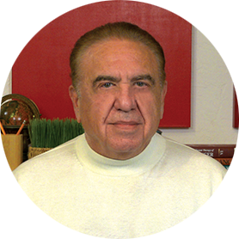
Faculty
Aditya Bardia, MD, MPH
Program Director, Breast Medical Oncology
Assistant Chief (Translational Research)
Division of Hematology-Oncology
Director of Translational Research Integration
UCLA Health Jonsson Comprehensive Cancer Center
Professor of Medicine, Geffen School of Medicine
University of California Los Angeles
Los Angeles, California
Joyce O’Shaughnessy, MD
Celebrating Women Chair in Breast
Cancer Research
Baylor University Medical Center
Director, Breast Cancer Research Program
Texas Oncology
Sarah Cannon Research Institute
Dallas, Texas
Kevin Kalinsky, MD, MS, FASCO
Professor of Medicine
Director, Division of Medical Oncology
Louisa and Rand Glenn Family Chair in Breast Cancer Research
Winship Cancer Institute at Emory University
Atlanta, Georgia
MODERATOR
Neil Love, MD
Research To Practice
Miami, Florida

Slide 3
Commercial Support
This activity is supported by educational grants from AstraZeneca Pharmaceuticals LP, Celcuity, Daiichi Sankyo Inc, Novartis, and Stemline Therapeutics Inc.

Slide 4
Dr Love — Disclosures
Dr Love is president and CEO of Research To Practice. Research To Practice receives funds in the form of educational grants to develop CME activities from the following companies: Aadi Bioscience, AbbVie Inc, ADC Therapeutics, Agendia Inc, Alexion Pharmaceuticals, Amgen Inc, Array BioPharma Inc, a subsidiary of Pfizer Inc, Arvinas, Astellas, AstraZeneca Pharmaceuticals LP, Aveo Pharmaceuticals, Bayer HealthCare Pharmaceuticals, BeOne, Biotheranostics Inc, A Hologic Company, Black Diamond Therapeutics Inc, Blueprint Medicines, Boehringer Ingelheim Pharmaceuticals Inc, Bristol Myers Squibb, Catalyst Pharmaceuticals Inc, Celcuity, Clovis Oncology, Coherus BioSciences, Corcept Therapeutics Inc, CTI BioPharma, a Sobi Company, Daiichi Sankyo Inc, Eisai Inc, Elevation Oncology Inc, Exact Sciences Corporation, Exelixis Inc, Genentech, a member of the Roche Group, Genmab US Inc, Geron Corporation, Gilead Sciences Inc, GSK, Helsinn Therapeutics (US) Inc, ImmunoGen Inc, Incyte Corporation, Ipsen Biopharmaceuticals Inc, Jazz Pharmaceuticals Inc, Johnson & Johnson, Karyopharm Therapeutics, Kite, A Gilead Company, Kura Oncology, Legend Biotech, Lilly, MEI Pharma Inc, Merck, Mersana Therapeutics Inc, Mirati Therapeutics Inc, Mural Oncology Inc, Natera Inc, Novartis, Novartis Pharmaceuticals Corporation on behalf of Advanced Accelerator Applications, Novocure Inc, Nuvalent, Nuvation Bio Inc, Pfizer Inc, Pharmacyclics LLC, an AbbVie Company, Puma Biotechnology Inc, Regeneron Pharmaceuticals Inc, Revolution Medicines Inc, Rigel Pharmaceuticals Inc, R-Pharm US, Sanofi, Seagen Inc, Servier Pharmaceuticals LLC, SpringWorks Therapeutics Inc, Stemline Therapeutics Inc, Sumitomo Pharma America, Summit Therapeutics, Syndax Pharmaceuticals, Taiho Oncology Inc, Takeda Pharmaceuticals USA Inc, TerSera Therapeutics LLC, Tesaro, A GSK Company, and Verastem Inc.

Slide 5
Research To Practice CME Planning Committee Members,
Staff and Reviewers
Planners, scientific staff and independent reviewers for Research To Practice have no relevant financial relationships to disclose.

Slide 6
Dr Bardia — Disclosures
Consulting Agreements | Alyssum Therapeutics, AstraZeneca Pharmaceuticals LP, Daiichi Sankyo Inc, Genentech, a member of the Roche Group, Gilead Sciences Inc, Lilly, Menarini Group, Merck, Novartis, Pfizer Inc, Vyome
Contracted Research (Support to Institution) | AstraZeneca Pharmaceuticals LP, Daiichi Sankyo Inc, Genentech, a member of the Roche Group, Gilead Sciences Inc, Lilly, Menarini Group, Merck, Novartis, OnKure Therapeutics, Pfizer Inc

Slide 7
Dr Kalinsky — Disclosures
Consulting Agreements | AstraZeneca Pharmaceuticals LP, Bicycle Therapeutics, Biotheranostics Inc, A Hologic Company, Daiichi Sankyo Inc, Genentech, a member of the Roche Group, Gilead Sciences Inc, Jazz Pharmaceuticals Inc, Lilly, Menarini Silicon Biosystems, Merck, Mersana Therapeutics Inc, Myovant Sciences, Novartis, Pfizer Inc, ProteinQure, Puma Biotechnology Inc, RayzeBio, Regor Therapeutics, Relay Therapeutics, Seagen Inc
Nonrelevant Financial Relationships (Spouse) | Stock Options/Stock, Public Companies — Revolution Medicines Inc (prior employee of EQRx), ADC Therapeutics

Slide 8
Dr O’Shaughnessy — Disclosures
Advisory Committees and Consulting Agreements | Aadi Bioscience, Agendia Inc, Amgen Inc, Aptitude Health, AstraZeneca Pharmaceuticals LP, BioNTech SE, Bristol Myers Squibb, Daiichi Sankyo Inc, Duality Biologics, Eisai Inc, Ellipses Pharma, Exact Sciences Corporation, G1 Therapeutics Inc, Genentech, a member of the Roche Group, Gilead Sciences Inc, Guardant Health, HiberCell, Jazz Pharmaceuticals Inc, Johnson & Johnson, Lilly, Menarini Group, Merck, Mersana Therapeutics Inc, Natera Inc, Novartis, Pfizer Inc, Pierre Fabre, Puma Biotechnology Inc, RayzeBio, Roche Laboratories Inc, Sanofi, Seagen Inc, Stemline Therapeutics Inc, Summit Therapeutics, Tempus, TerSera Therapeutics LLC

Slide 9
This educational activity contains discussion of
non-FDA-approved uses of agents and regimens. Please refer to official prescribing information for each product for approved indications.

Slide 10
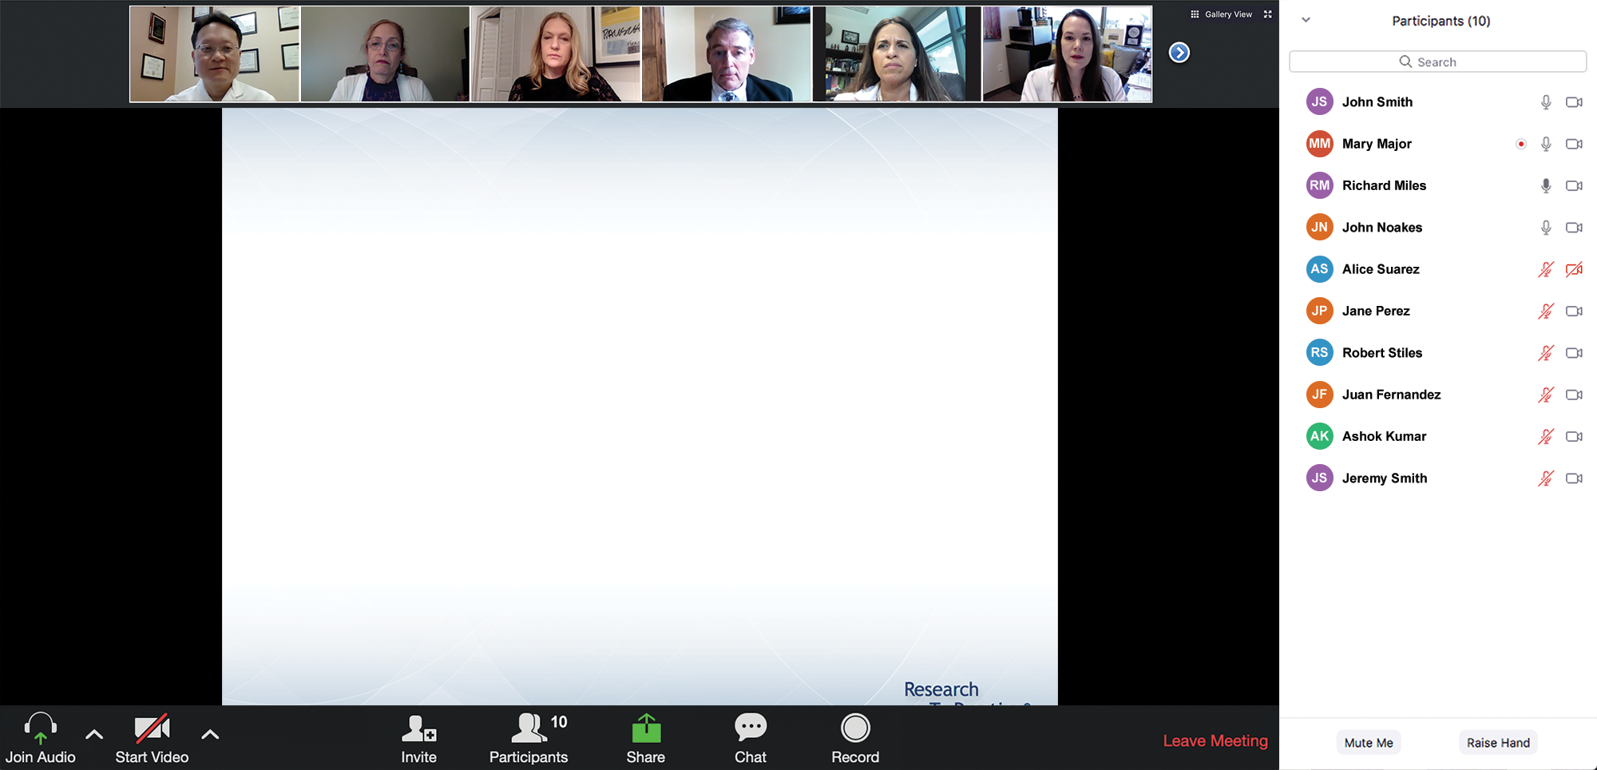

We Encourage Clinicians in Practice to Submit Questions
Feel free to submit questions now before the program begins and throughout the program.

Slide 11
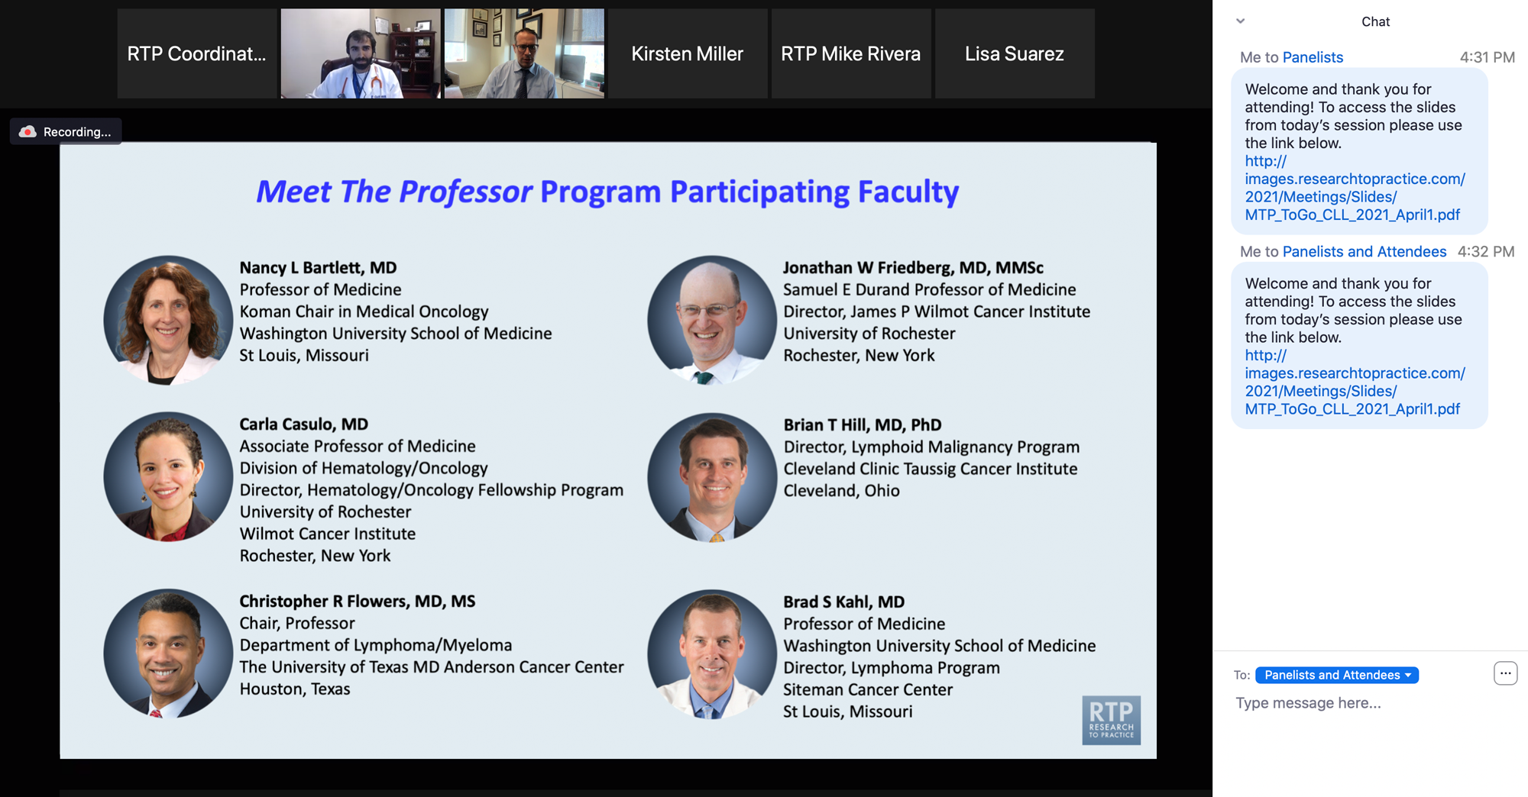
Familiarizing Yourself with the Zoom Interface
Expand chat submission box
Drag the white line above the submission box up to create
more space for your message.

Slide 12
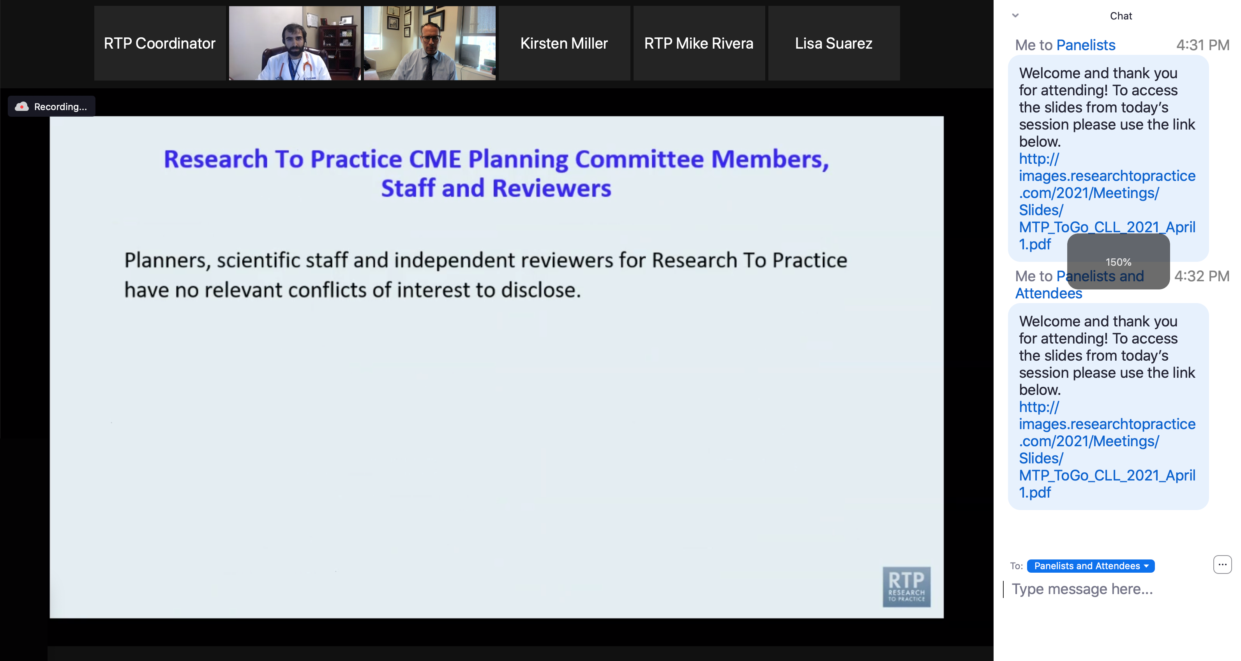
Familiarizing Yourself with the Zoom Interface
Increase chat font size
Press Command (for Mac) or Control (for PC) and the + symbol.
You may do this as many times as you need for readability.

Slide 13
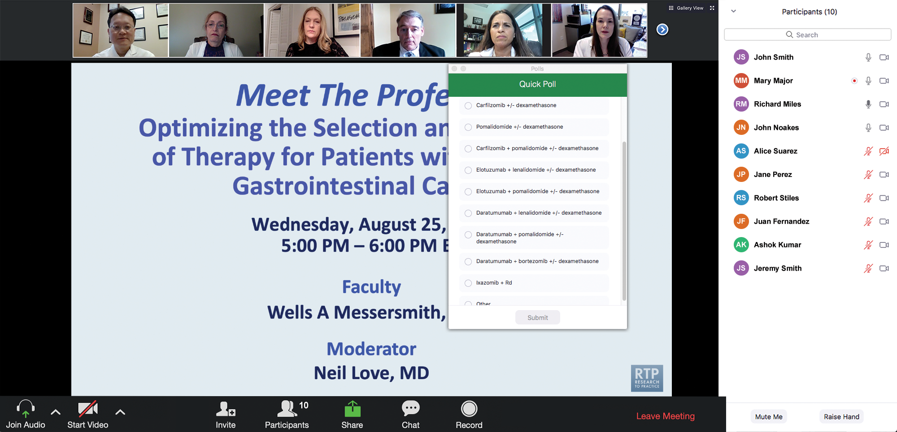
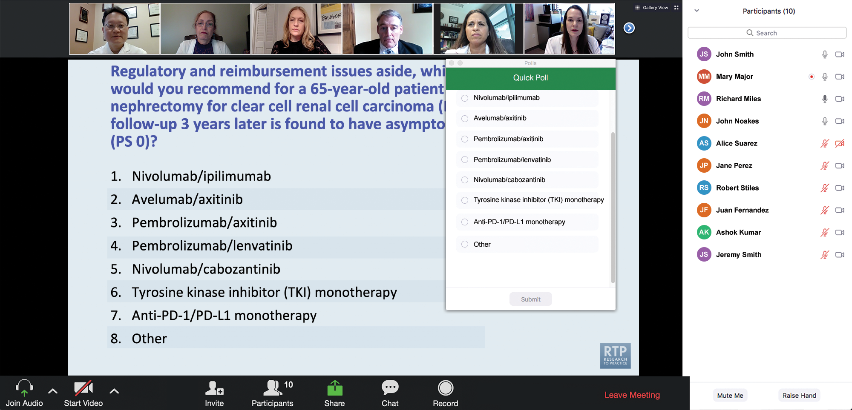
Clinicians in the Audience, Please Complete the Pre- and Postmeeting Surveys
Quick Survey
Quick Poll

Slide 14
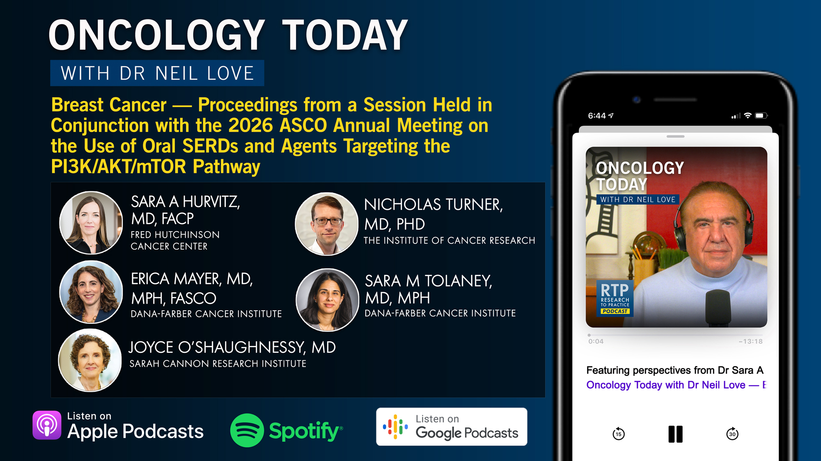

Slide 15
Integrating New Advances into
Community Oncology Practice
A Multitumor Symposium Hosted in Conjunction with the American Oncology Network
Join Us In Person or Virtually
Saturday, August 22, 2026
JW Marriott Nashville | Nashville, Tennessee
Chronic Lymphocytic Leukemia
9:05 AM – 9:55 AM CT
Diffuse Large B-Cell Lymphoma
12:40 PM – 1:30 PM CT
Gastroesophageal Cancers
9:55 AM – 10:45 AM CT
Lung Cancer
1:30 PM – 2:20 PM CT
Gynecologic Cancers
11:00 AM – 11:50 AM CT
Moderator
Stephen “Fred” Divers, MD

Slide 16
The Implications of Recent Datasets for the Current and Future Management of
Gynecologic Cancers — An ASCO 2026 Review
A CME/MOC-Accredited Live Webinar
Wednesday, August 26, 2026
5:00 PM – 6:00 PM ET
Faculty
Faculty to be announced
Moderator
Neil Love, MD

Slide 17
Data + Perspectives: Investigators
Discuss the Optimal Management of
Relapsed/Refractory Multiple Myeloma
A CME-Accredited Satellite Symposium During the
Society of Hematologic Oncology 2026 Annual Meeting
Wednesday, September 9, 2026
11:56 AM – 12:56 PM CT
Faculty
Noopur Raje, MD
Paul G Richardson, MD
Moderator
Robert Z Orlowski, MD, PhD

Slide 18
Grand Rounds
CME/MOC-Accredited Interactive Series
Regional Activities
Three Series
Integrating Recent Advances into the Management of Gastroesophageal Cancers
Optimizing the Use of
Novel Therapies for Patients with Diffuse Large B-Cell Lymphoma
Optimizing Therapy for Patients with Hormone Receptor-Positive
Localized Breast Cancer
Host a 1-hour session at your institution:
Email Meetings@ResearchToPractice.com
or call (800) 233-6153

Slide 19
Thank you for joining us! Please take a moment to complete the survey currently up on Zoom.
Your feedback is very important to us.
Information on how to obtain CME, ABIM MOC and ABS credit will be provided at the conclusion of the activity in the Zoom chat room. Attendees will also receive an email in 1 to 3 business days with these instructions.

Slide 20
The Implications of Recent Datasets for the Current and Future Management of Breast Cancer — An ASCO 2026 Review
A CME/MOC-Accredited Live Webinar
Thursday, July 30, 2026
5:00 PM – 6:30 PM ET
Faculty
Aditya Bardia, MD, MPH
Kevin Kalinsky, MD, MS, FASCO
Joyce O’Shaughnessy, MD
Moderator
Neil Love, MD

Slide 21
Faculty
Aditya Bardia, MD, MPH
Program Director, Breast Medical Oncology
Assistant Chief (Translational Research)
Division of Hematology-Oncology
Director of Translational Research Integration
UCLA Health Jonsson Comprehensive Cancer Center
Professor of Medicine, Geffen School of Medicine
University of California Los Angeles
Los Angeles, California
Joyce O’Shaughnessy, MD
Celebrating Women Chair in Breast
Cancer Research
Baylor University Medical Center
Director, Breast Cancer Research Program
Texas Oncology
Sarah Cannon Research Institute
Dallas, Texas
Kevin Kalinsky, MD, MS, FASCO
Professor of Medicine
Director, Division of Medical Oncology
Louisa and Rand Glenn Family Chair in Breast Cancer Research
Winship Cancer Institute at Emory University
Atlanta, Georgia
MODERATOR
Neil Love, MD
Research To Practice
Miami, Florida

Slide 22
We Encourage Clinicians in Practice to Submit Questions
Feel free to submit questions now before the program begins and throughout the program.

Slide 23
Clinicians in the Audience, Please Complete the Pre- and Postmeeting Surveys
Quick Survey
Quick Poll

Slide 25
Integrating New Advances into
Community Oncology Practice
A Multitumor Symposium Hosted in Conjunction with the American Oncology Network
Join Us In Person or Virtually
Saturday, August 22, 2026
JW Marriott Nashville | Nashville, Tennessee
Chronic Lymphocytic Leukemia
9:05 AM – 9:55 AM CT
Diffuse Large B-Cell Lymphoma
12:40 PM – 1:30 PM CT
Gastroesophageal Cancers
9:55 AM – 10:45 AM CT
Lung Cancer
1:30 PM – 2:20 PM CT
Gynecologic Cancers
11:00 AM – 11:50 AM CT
Moderator
Stephen “Fred” Divers, MD

Slide 26
Data + Perspectives: Investigators
Discuss the Optimal Management of
Relapsed/Refractory Multiple Myeloma
A CME-Accredited Satellite Symposium During the
Society of Hematologic Oncology 2026 Annual Meeting
Wednesday, September 9, 2026
11:56 AM – 12:56 PM CT
Faculty
Noopur Raje, MD
Paul G Richardson, MD
Moderator
Robert Z Orlowski, MD, PhD

Slide 27
Grand Rounds
CME/MOC-Accredited Interactive Series
Regional Activities
Three Series
Integrating Recent Advances into the Management of Gastroesophageal Cancers
Optimizing the Use of
Novel Therapies for Patients with Diffuse Large B-Cell Lymphoma
Optimizing Therapy for Patients with Hormone Receptor-Positive
Localized Breast Cancer
Host a 1-hour session at your institution:
Email Meetings@ResearchToPractice.com
or call (800) 233-6153

Slide 28
The Implications of Recent Datasets for the Current and Future Management of Breast Cancer — An ASCO 2026 Review
A CME/MOC-Accredited Live Webinar
Thursday, July 30, 2026
5:00 PM – 6:30 PM ET
Faculty
Aditya Bardia, MD, MPH
Kevin Kalinsky, MD, MS, FASCO
Joyce O’Shaughnessy, MD
Moderator
Neil Love, MD

Slide 29
Dr Bardia — Disclosures
Consulting Agreements | Alyssum Therapeutics, AstraZeneca Pharmaceuticals LP, Daiichi Sankyo Inc, Genentech, a member of the Roche Group, Gilead Sciences Inc, Lilly, Menarini Group, Merck, Novartis, Pfizer Inc, Vyome
Contracted Research (Support to Institution) | AstraZeneca Pharmaceuticals LP, Daiichi Sankyo Inc, Genentech, a member of the Roche Group, Gilead Sciences Inc, Lilly, Menarini Group, Merck, Novartis, OnKure Therapeutics, Pfizer Inc

Slide 30
Dr Kalinsky — Disclosures
Consulting Agreements | AstraZeneca Pharmaceuticals LP, Bicycle Therapeutics, Biotheranostics Inc, A Hologic Company, Daiichi Sankyo Inc, Genentech, a member of the Roche Group, Gilead Sciences Inc, Jazz Pharmaceuticals Inc, Lilly, Menarini Silicon Biosystems, Merck, Mersana Therapeutics Inc, Myovant Sciences, Novartis, Pfizer Inc, ProteinQure, Puma Biotechnology Inc, RayzeBio, Regor Therapeutics, Relay Therapeutics, Seagen Inc
Nonrelevant Financial Relationships (Spouse) | Stock Options/Stock, Public Companies — Revolution Medicines Inc (prior employee of EQRx), ADC Therapeutics

Slide 31
Dr O’Shaughnessy — Disclosures
Advisory Committees and Consulting Agreements | Aadi Bioscience, Agendia Inc, Amgen Inc, Aptitude Health, AstraZeneca Pharmaceuticals LP, BioNTech SE, Bristol Myers Squibb, Daiichi Sankyo Inc, Duality Biologics, Eisai Inc, Ellipses Pharma, Exact Sciences Corporation, G1 Therapeutics Inc, Genentech, a member of the Roche Group, Gilead Sciences Inc, Guardant Health, HiberCell, Jazz Pharmaceuticals Inc, Johnson & Johnson, Lilly, Menarini Group, Merck, Mersana Therapeutics Inc, Natera Inc, Novartis, Pfizer Inc, Pierre Fabre, Puma Biotechnology Inc, RayzeBio, Roche Laboratories Inc, Sanofi, Seagen Inc, Stemline Therapeutics Inc, Summit Therapeutics, Tempus, TerSera Therapeutics LLC

Slide 32
Dr Love — Disclosures
Dr Love is president and CEO of Research To Practice. Research To Practice receives funds in the form of educational grants to develop CME activities from the following companies: Aadi Bioscience, AbbVie Inc, ADC Therapeutics, Agendia Inc, Alexion Pharmaceuticals, Amgen Inc, Array BioPharma Inc, a subsidiary of Pfizer Inc, Arvinas, Astellas, AstraZeneca Pharmaceuticals LP, Aveo Pharmaceuticals, Bayer HealthCare Pharmaceuticals, BeOne, Biotheranostics Inc, A Hologic Company, Black Diamond Therapeutics Inc, Blueprint Medicines, Boehringer Ingelheim Pharmaceuticals Inc, Bristol Myers Squibb, Catalyst Pharmaceuticals Inc, Celcuity, Clovis Oncology, Coherus BioSciences, Corcept Therapeutics Inc, CTI BioPharma, a Sobi Company, Daiichi Sankyo Inc, Eisai Inc, Elevation Oncology Inc, Exact Sciences Corporation, Exelixis Inc, Genentech, a member of the Roche Group, Genmab US Inc, Geron Corporation, Gilead Sciences Inc, GSK, Helsinn Therapeutics (US) Inc, ImmunoGen Inc, Incyte Corporation, Ipsen Biopharmaceuticals Inc, Jazz Pharmaceuticals Inc, Johnson & Johnson, Karyopharm Therapeutics, Kite, A Gilead Company, Kura Oncology, Legend Biotech, Lilly, MEI Pharma Inc, Merck, Mersana Therapeutics Inc, Mirati Therapeutics Inc, Mural Oncology Inc, Natera Inc, Novartis, Novartis Pharmaceuticals Corporation on behalf of Advanced Accelerator Applications, Novocure Inc, Nuvalent, Nuvation Bio Inc, Pfizer Inc, Pharmacyclics LLC, an AbbVie Company, Puma Biotechnology Inc, Regeneron Pharmaceuticals Inc, Revolution Medicines Inc, Rigel Pharmaceuticals Inc, R-Pharm US, Sanofi, Seagen Inc, Servier Pharmaceuticals LLC, SpringWorks Therapeutics Inc, Stemline Therapeutics Inc, Sumitomo Pharma America, Summit Therapeutics, Syndax Pharmaceuticals, Taiho Oncology Inc, Takeda Pharmaceuticals USA Inc, TerSera Therapeutics LLC, Tesaro, A GSK Company, and Verastem Inc.

Slide 33
Commercial Support
This activity is supported by educational grants from AstraZeneca Pharmaceuticals LP, Celcuity, Daiichi Sankyo Inc, Novartis, and Stemline Therapeutics Inc.
Research To Practice CME Planning Committee Members,
Staff and Reviewers
Planners, scientific staff and independent reviewers for Research To Practice have no relevant financial relationships to disclose.

Slide 34
This educational activity contains discussion of
non-FDA-approved uses of agents and regimens. Please refer to official prescribing information for each product for approved indications.

Slide 35
Agenda
Module 1: Hormone Receptor (HR)-Positive Breast Cancer
— Dr Kalinsky
Module 2: HER2-Positive Breast Cancer — Dr Bardia
Module 3: Triple-Negative Breast Cancer — Dr O’Shaughnessy

Slide 36
Agenda
Module 1: Hormone Receptor (HR)-Positive Breast Cancer
— Dr Kalinsky
Module 2: HER2-Positive Breast Cancer — Dr Bardia
Module 3: Triple-Negative Breast Cancer — Dr O’Shaughnessy

Slide 37
Advances in Hormone Receptor-Positive Breast Cancer
Kevin Kalinsky, MD, MS, FASCO
Professor of Medicine
Director, Division of Medical Oncology
Louisa and Rand Glenn Family Chair in Breast Cancer Research
Winship Cancer Institute at Emory University
Atlanta, Georgia

Slide 38
OPTIMA Trial Design
Main eligibility criteria
Women & men age ≥40 with excised breast cancer
ER-pos (IHC>10%) & HER2-neg
Nodes: ▸0-9N+,
▸minimum T-size requirement if N0/ N1mi
Neoadjuvant chemotherapy prohibited
Prosigna*
Control arm
chemo.
endocrine
informed consent
1
blinded to randomisation
R
1
Prosigna
high score
chemo.
endocrine
ROR>60
Test-directed
ROR
endocrine
low score
ET includes OFS for premenopausal patients
All other treatment SoC
*Control arm Prosigna testing used for analysis only. U.K. control arm testing performed following recruitment completion
Stein R et al. ASCO 2026;Abstract 500

Slide 39
Invasive Breast Cancer Free Survival (IBCFS)
Complete Per Protocol
ROR ≤ 60 (2/3rd)
Adjusted HR 1.03; 90% CI 0.85-1.25, p(3%noninferiority) = 0.006
 | No. events | %IBCFS (95% CI) at 5 years
Control arm | 148 | 91.8 (90.1- 93.2)
Test-directed arm | 153 | 90.3 (88.5- 91.8)
Adjusted HR 1.06; 90% CI 0.80-1.40, p(3.5%noninferiority) = 0.003
 | No. events | %IBCFS (95% CI) at 5 years
Control arm | 68 | 94.8 (93.1- 96.1)
Test-directed arm | 76 | 93.6 (91.7- 95.0)
Median follow-up 4.0 years: IQR 2.0-6.0 years
Stein R et al. ASCO 2026;Abstract 500

Slide 40
IBCFS vs menopausal status: low ROR score
Premenopausal (40%)
Postmenopausal (60%)
HR 1.04; 95% CI 0.60-1.80
 | No. events | %IBCFS (95% CI) at 5 years
Control arm | 25 | 95.5 (92.6- 97.3)
Test-directed arm | 26 | 94.2 (91.0- 96.2)
HR 1.14; 95% CI 0.76-1.71
 | No. events | %IBCFS (95% CI) at 5 years
Control arm | 42 | 94.5 (92.2- 96.2)
Test-directed arm | 50 | 93.2 (90.6- 95.0)
Postmenopausal: age > 45 and LMP > 12 months; BSO; or estradiol and FSH in postmenopausal range
Stein R et al. ASCO 2026;Abstract 500

Slide 41
IBCFS vs menopausal status: low ROR score
N1 (1-3 LN+) (80%)
N2 (4-9 LN+) (20%)
HR 1.11; 95% CI 0.76-1.64
 | No. events | %IBCFS (95% CI) at 5 years
Control arm | 48 | 95.2 (93.3- 96.6)
Test-directed arm | 56 | 93.6 (91.4- 95.3)
HR 1.19; 95% CI 0.62-2.29
 | No. events | %IBCFS (95% CI) at 5 years
Control arm | 17 | 93.1 (87.2- 96.4)
Test-directed arm | 20 | 91.5 (86.0- 94.9)
Stein R et al. ASCO 2026;Abstract 500

Slide 42
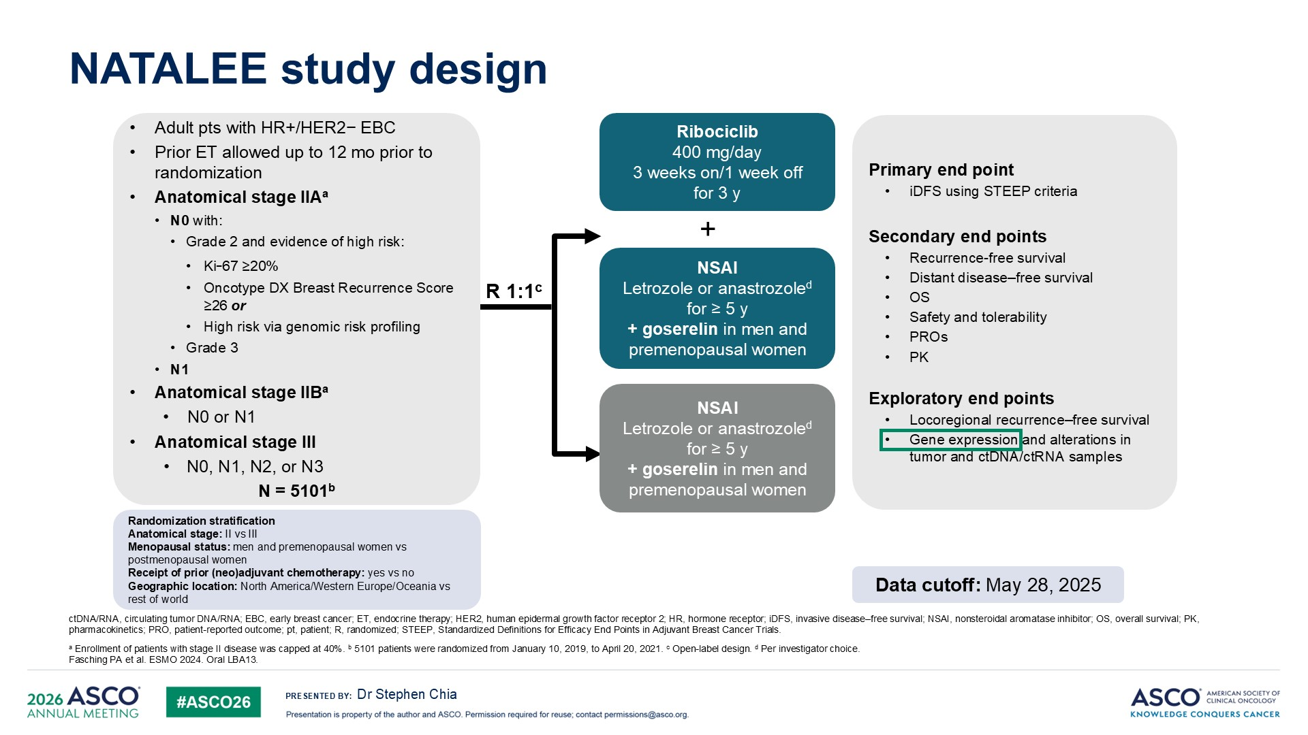
Chia S et al. ASCO 2026;Abstract 501

Slide 43
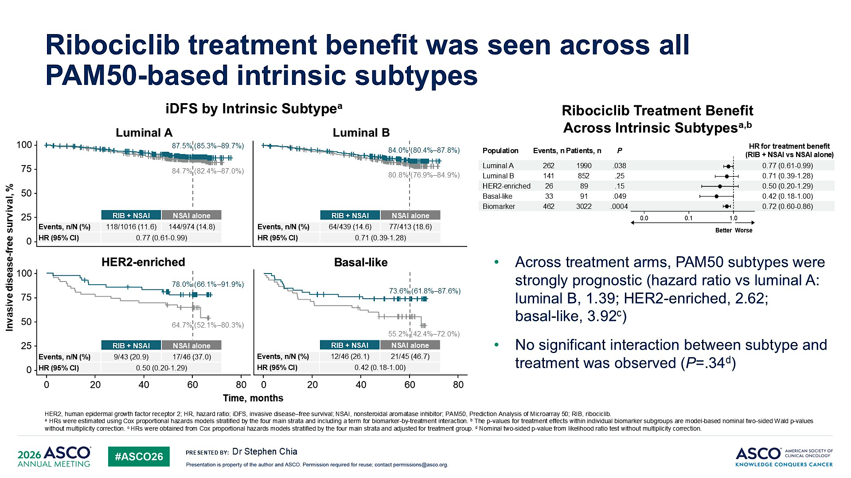
Chia S et al. ASCO 2026;Abstract 501

Slide 44
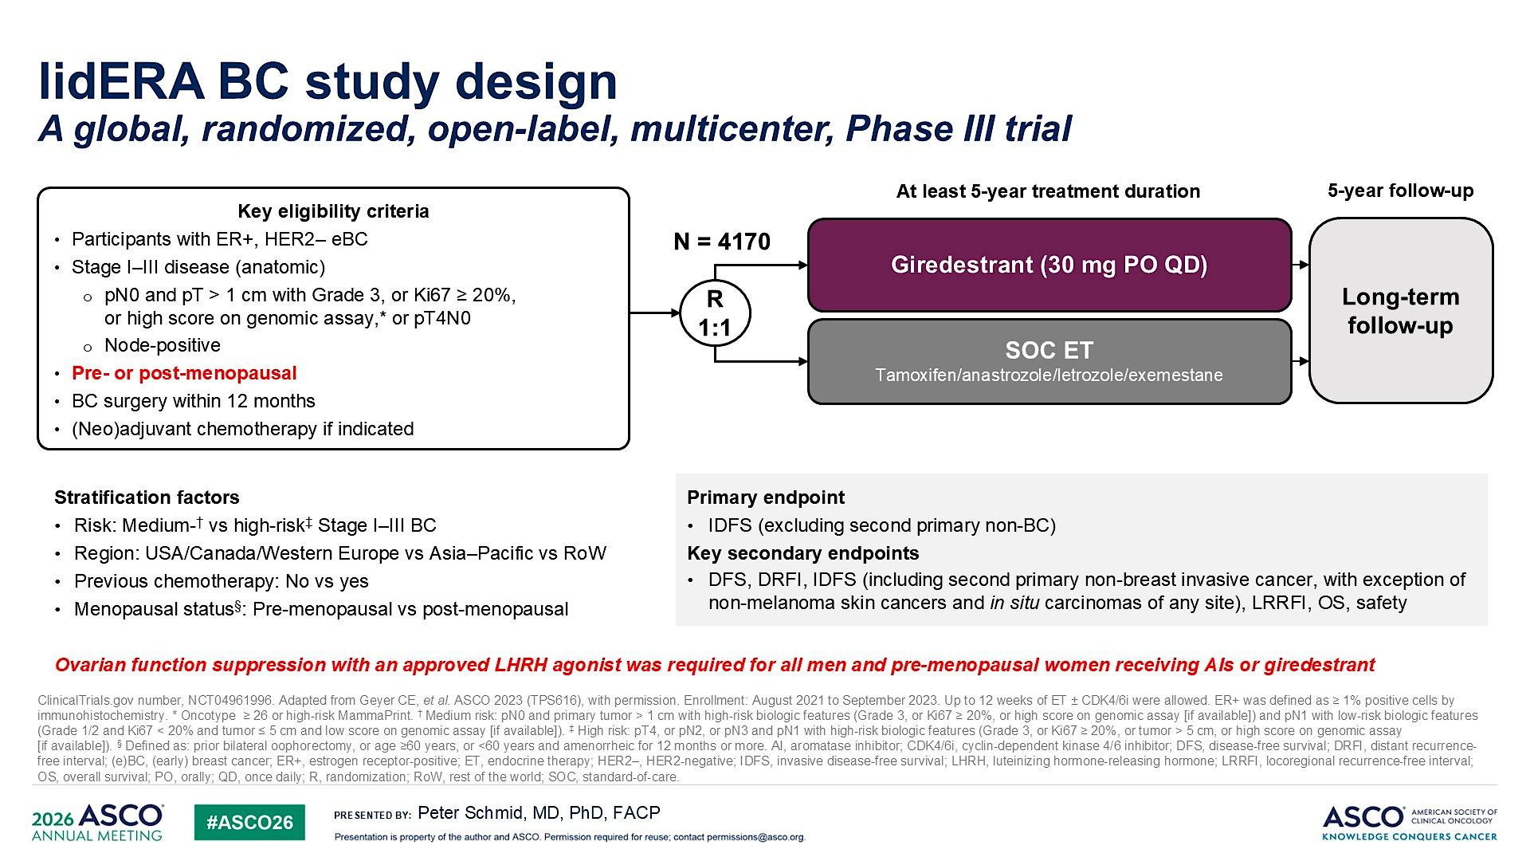
Schmid P et al. ASCO 2026;Abstract 502

Slide 45
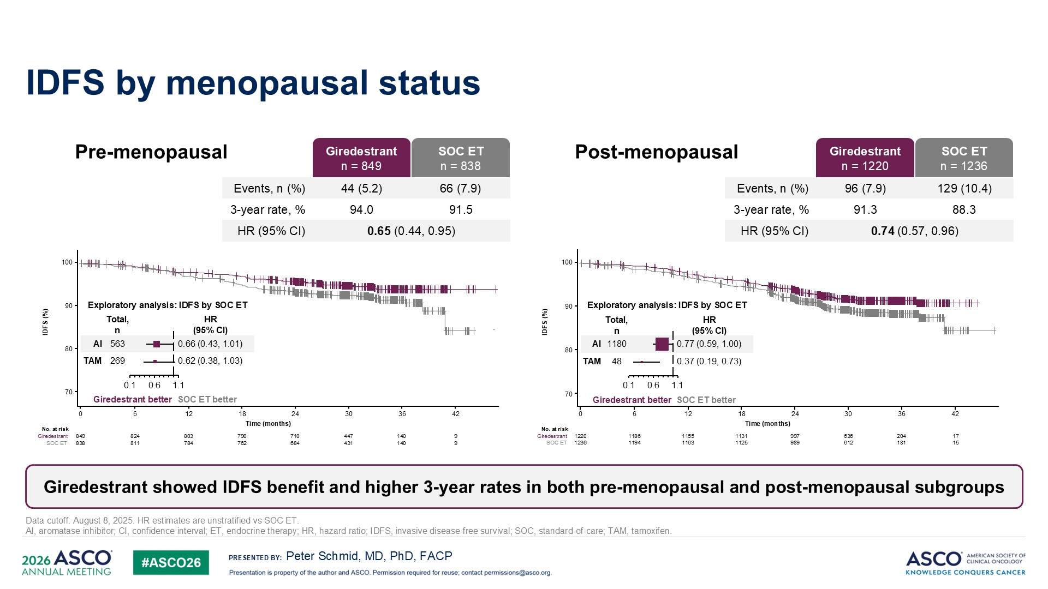
Schmid P et al. ASCO 2026;Abstract 502

Slide 46
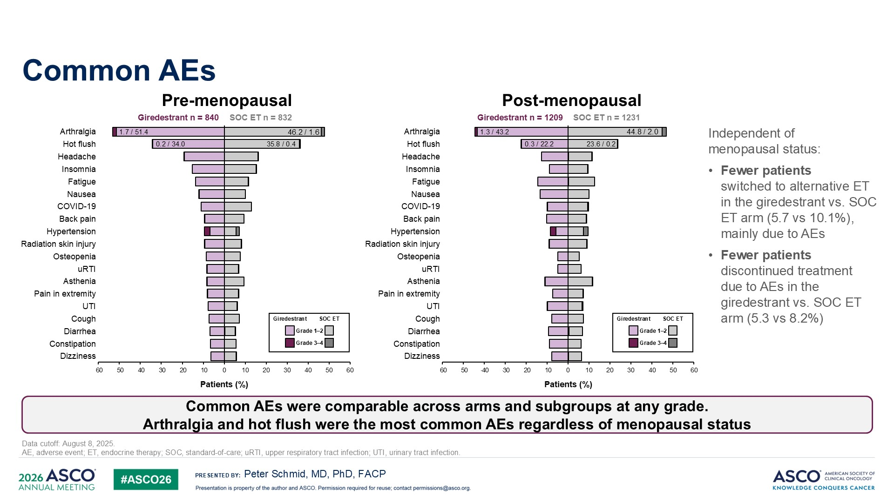
Schmid P et al. ASCO 2026;Abstract 502

Slide 47
Dr Kalinsky Case Presentation #1
53 year old premenopausal F
Right breast mastectomy, SLNB:
  grade I 1.7 cm strongly HR+/HER2- IDC, 0/1 LN. oncotype 13
Left breast mastectomy, SLNB
  Grade II 3.2 cm, 1.7 cm strongly HR+/HER2- IDC, 1/3 LN. oncotype 13
s/p CMF x 8
s/p XRT
Hx of pulmonary embolus. Concern with tamoxifen
On leuprolide acetate + ribo/letrozole since 6/6/24

Slide 48
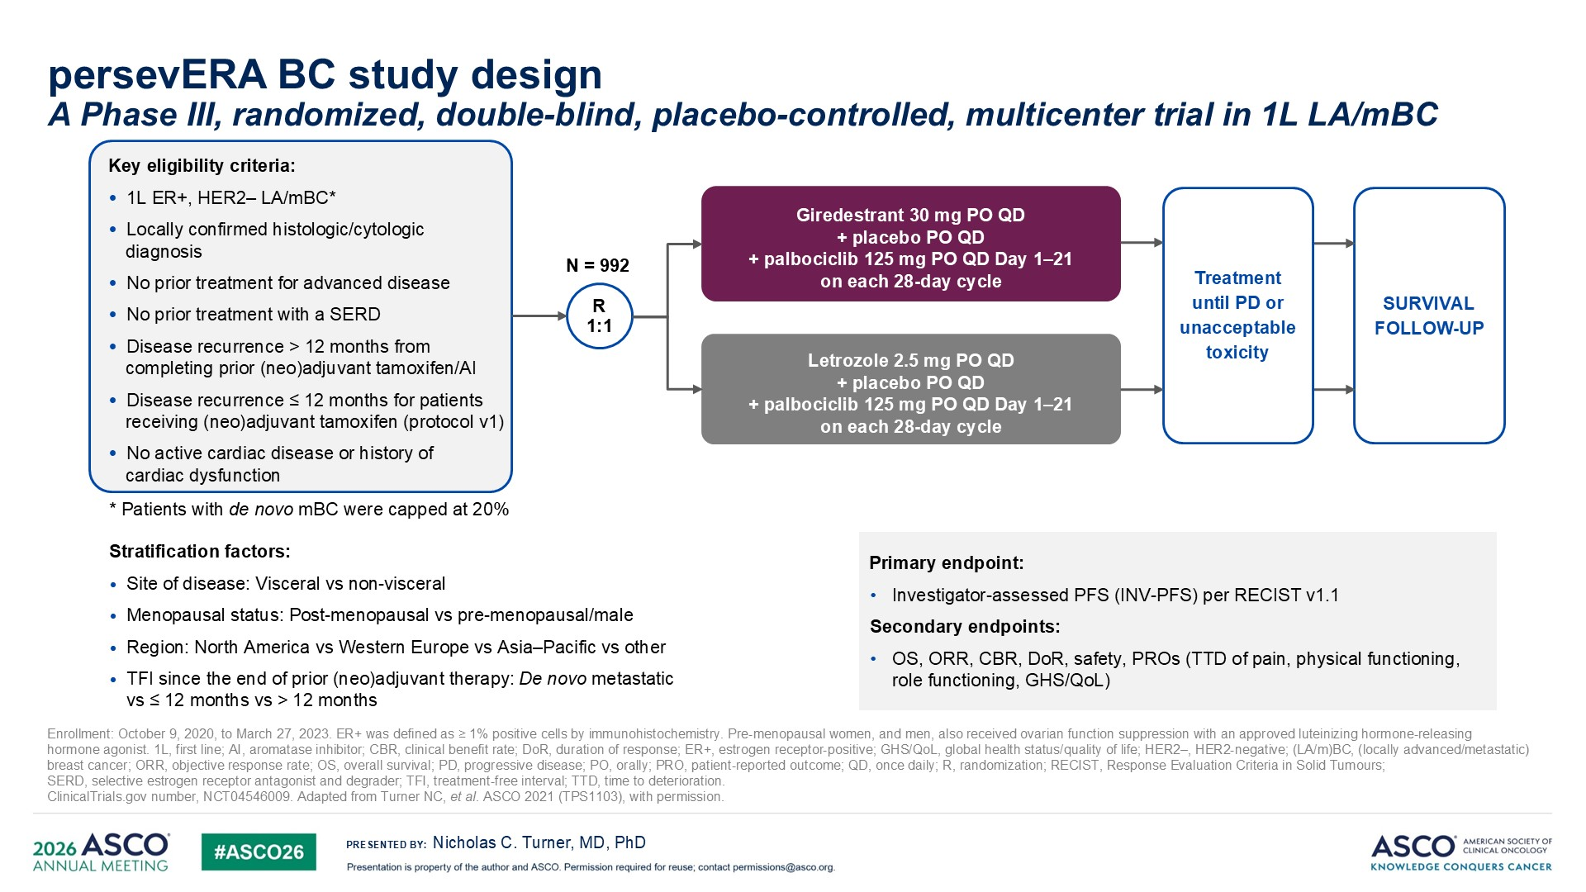
Turner NC et al. ASCO 2026;Abstract LBA1006

Slide 49
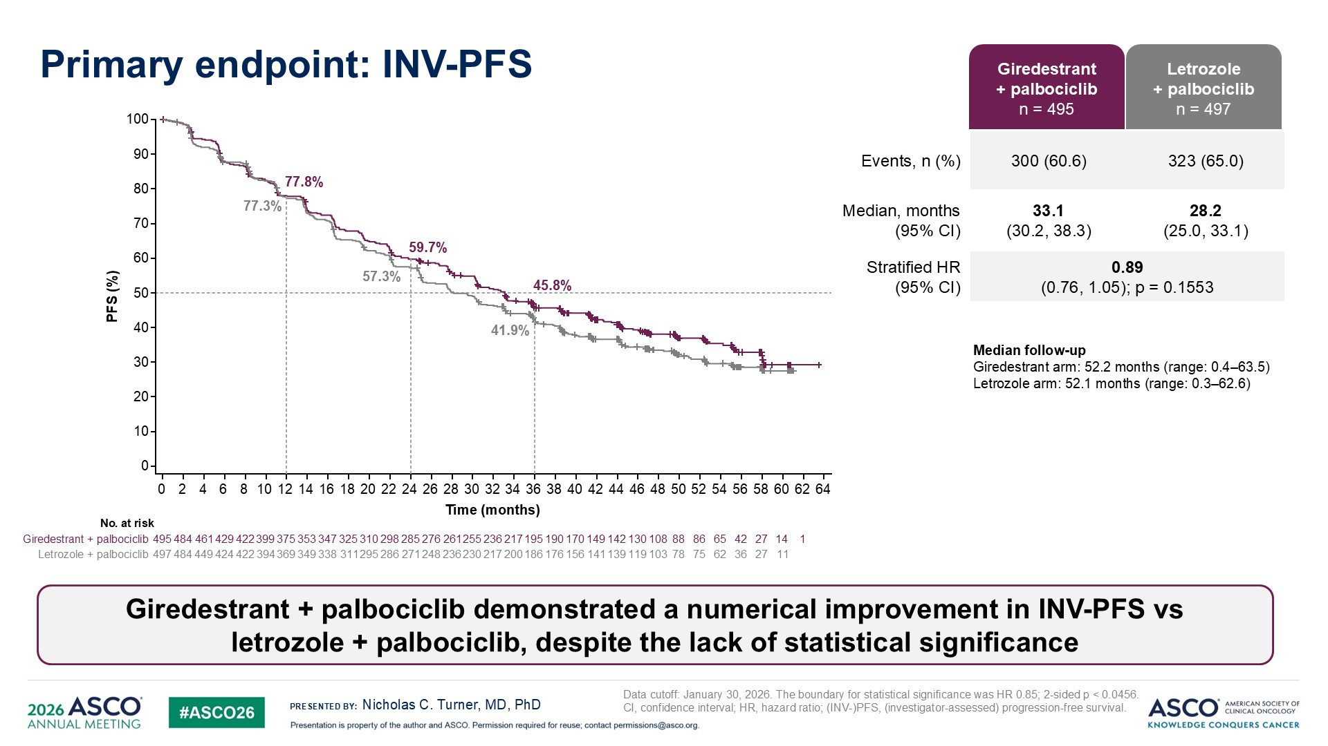
Turner NC et al.
ASCO 2026;Abstract LBA1006

Slide 50
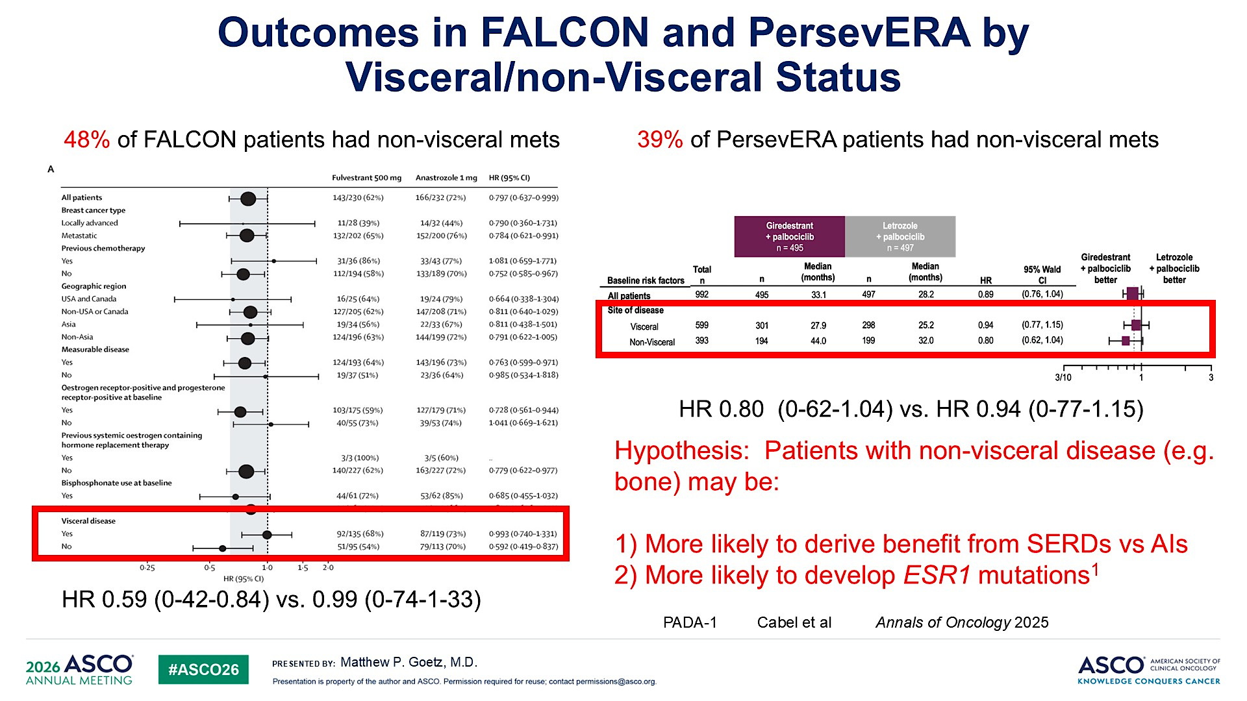
Goetz MP. ASCO 2026

Slide 51
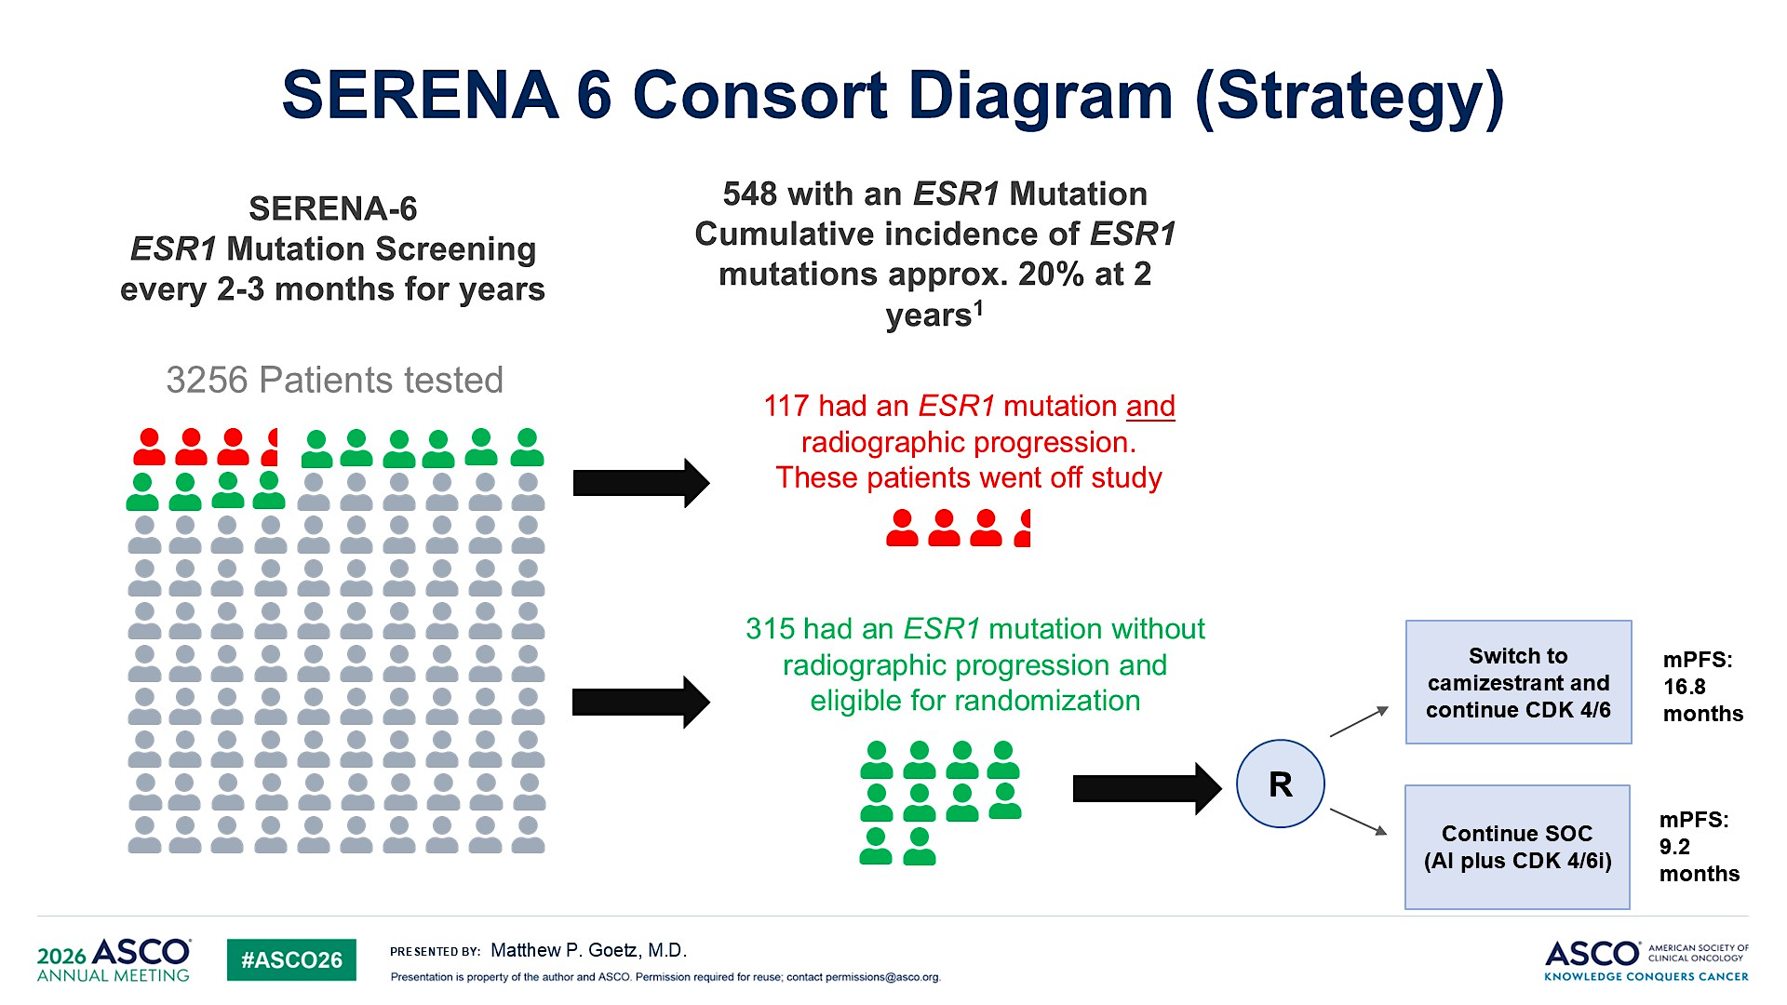
Goetz MP. ASCO 2026

Slide 52
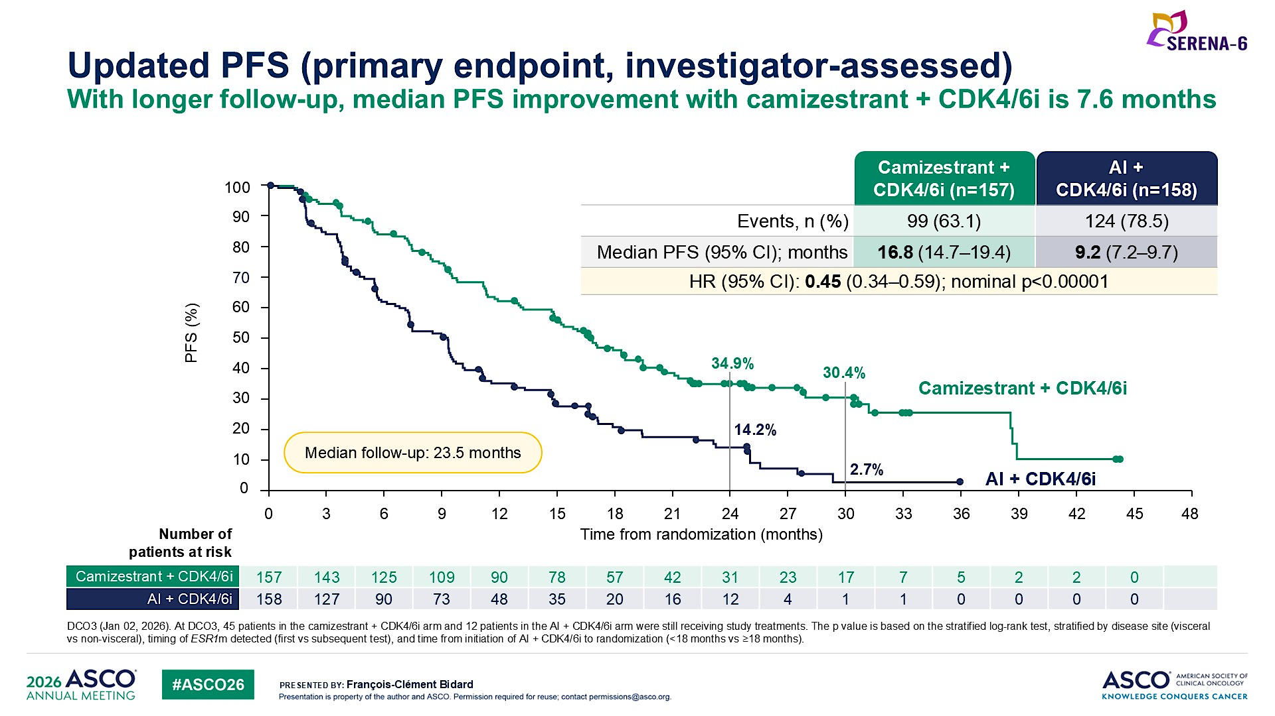
Bidard FC et al. ASCO 2026;Abstract LBA1007

Slide 53
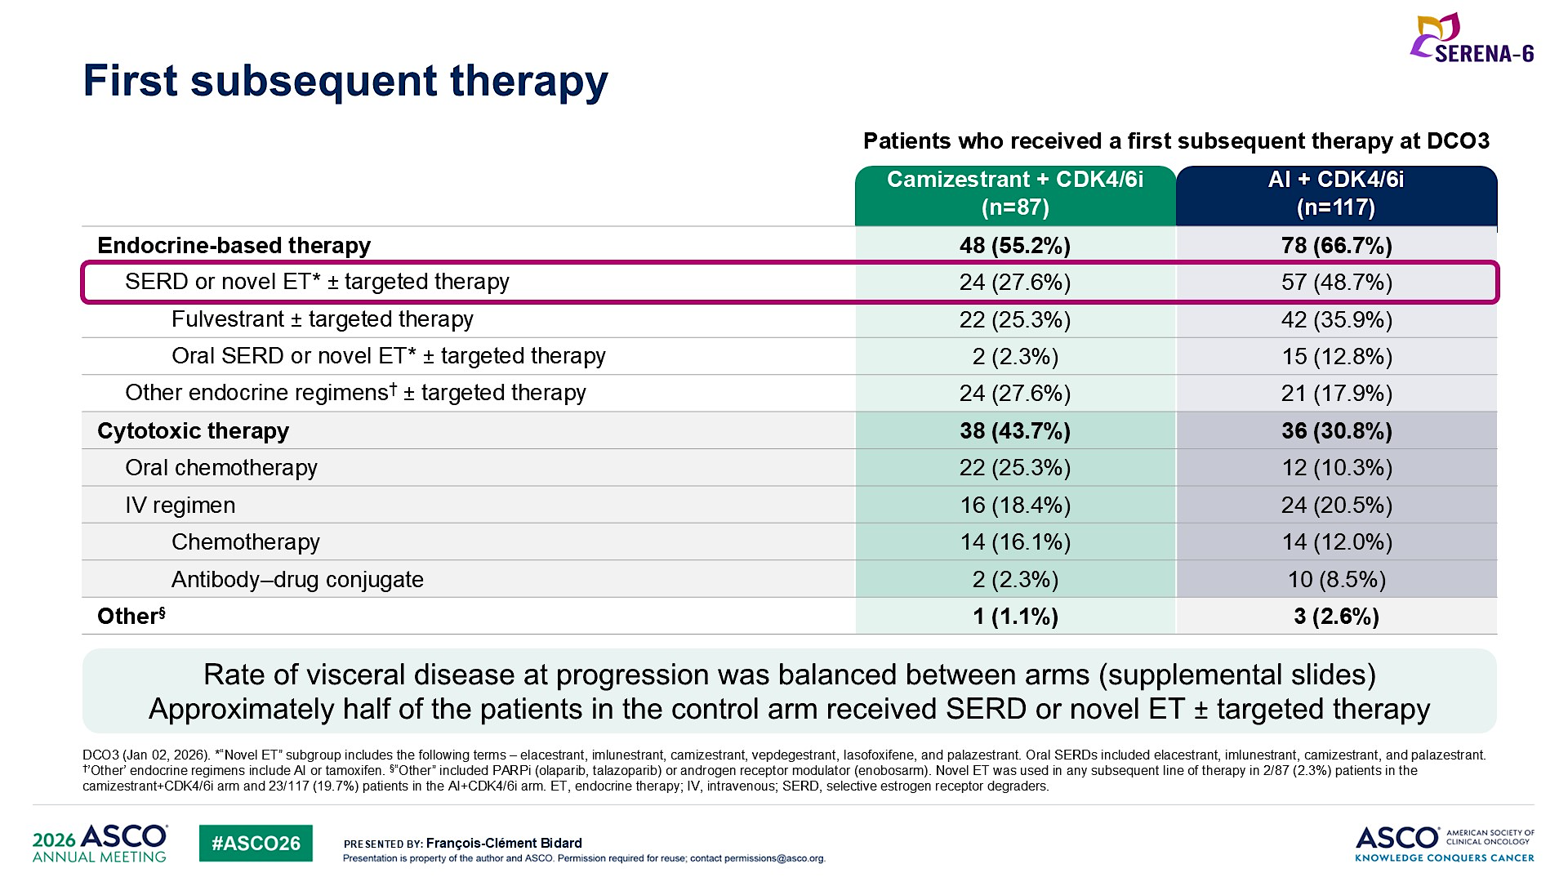
Bidard FC et al. ASCO 2026;Abstract LBA1007

Slide 54
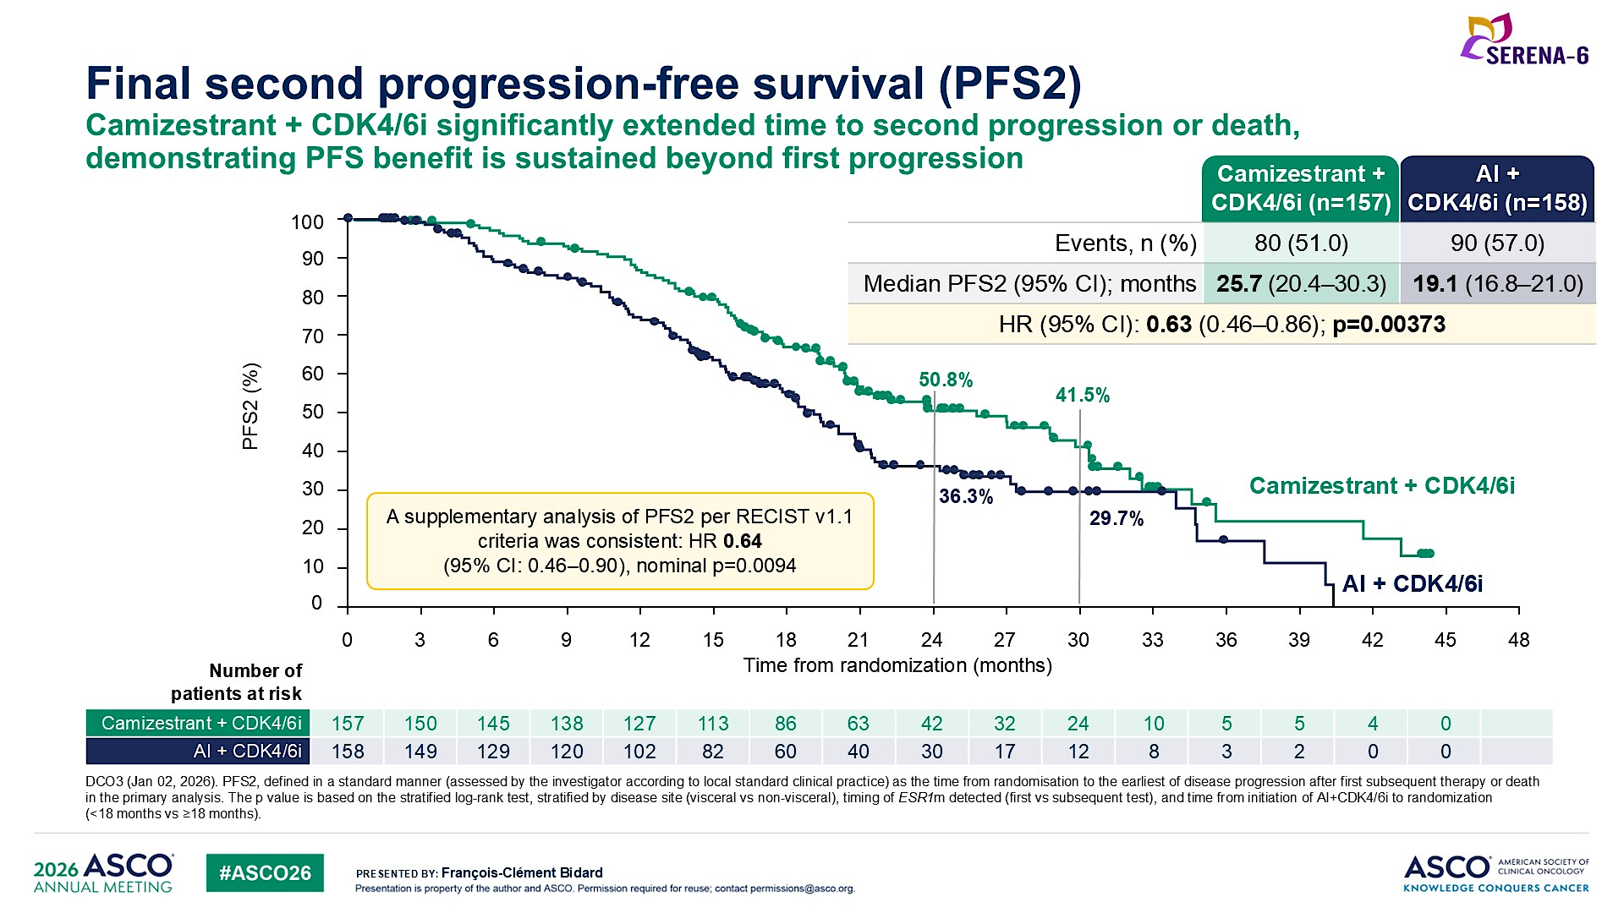
Bidard FC et al. ASCO 2026;Abstract LBA1007

Slide 55
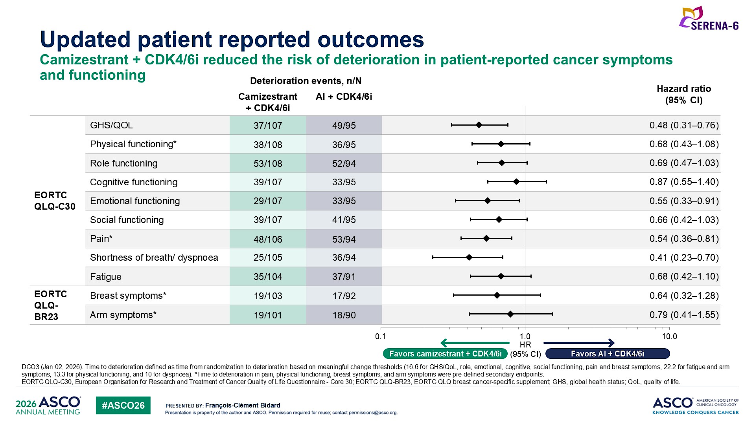
Bidard FC et al. ASCO 2026;Abstract LBA1007

Slide 56
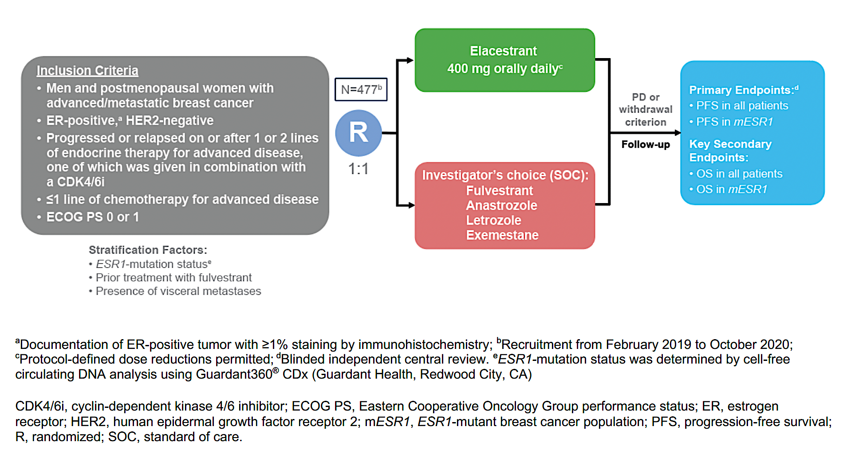
Phase III EMERALD Study Design
Bidard FC et al. J Clin Oncol 2022 October 1;40(28):3246-56.

Slide 57
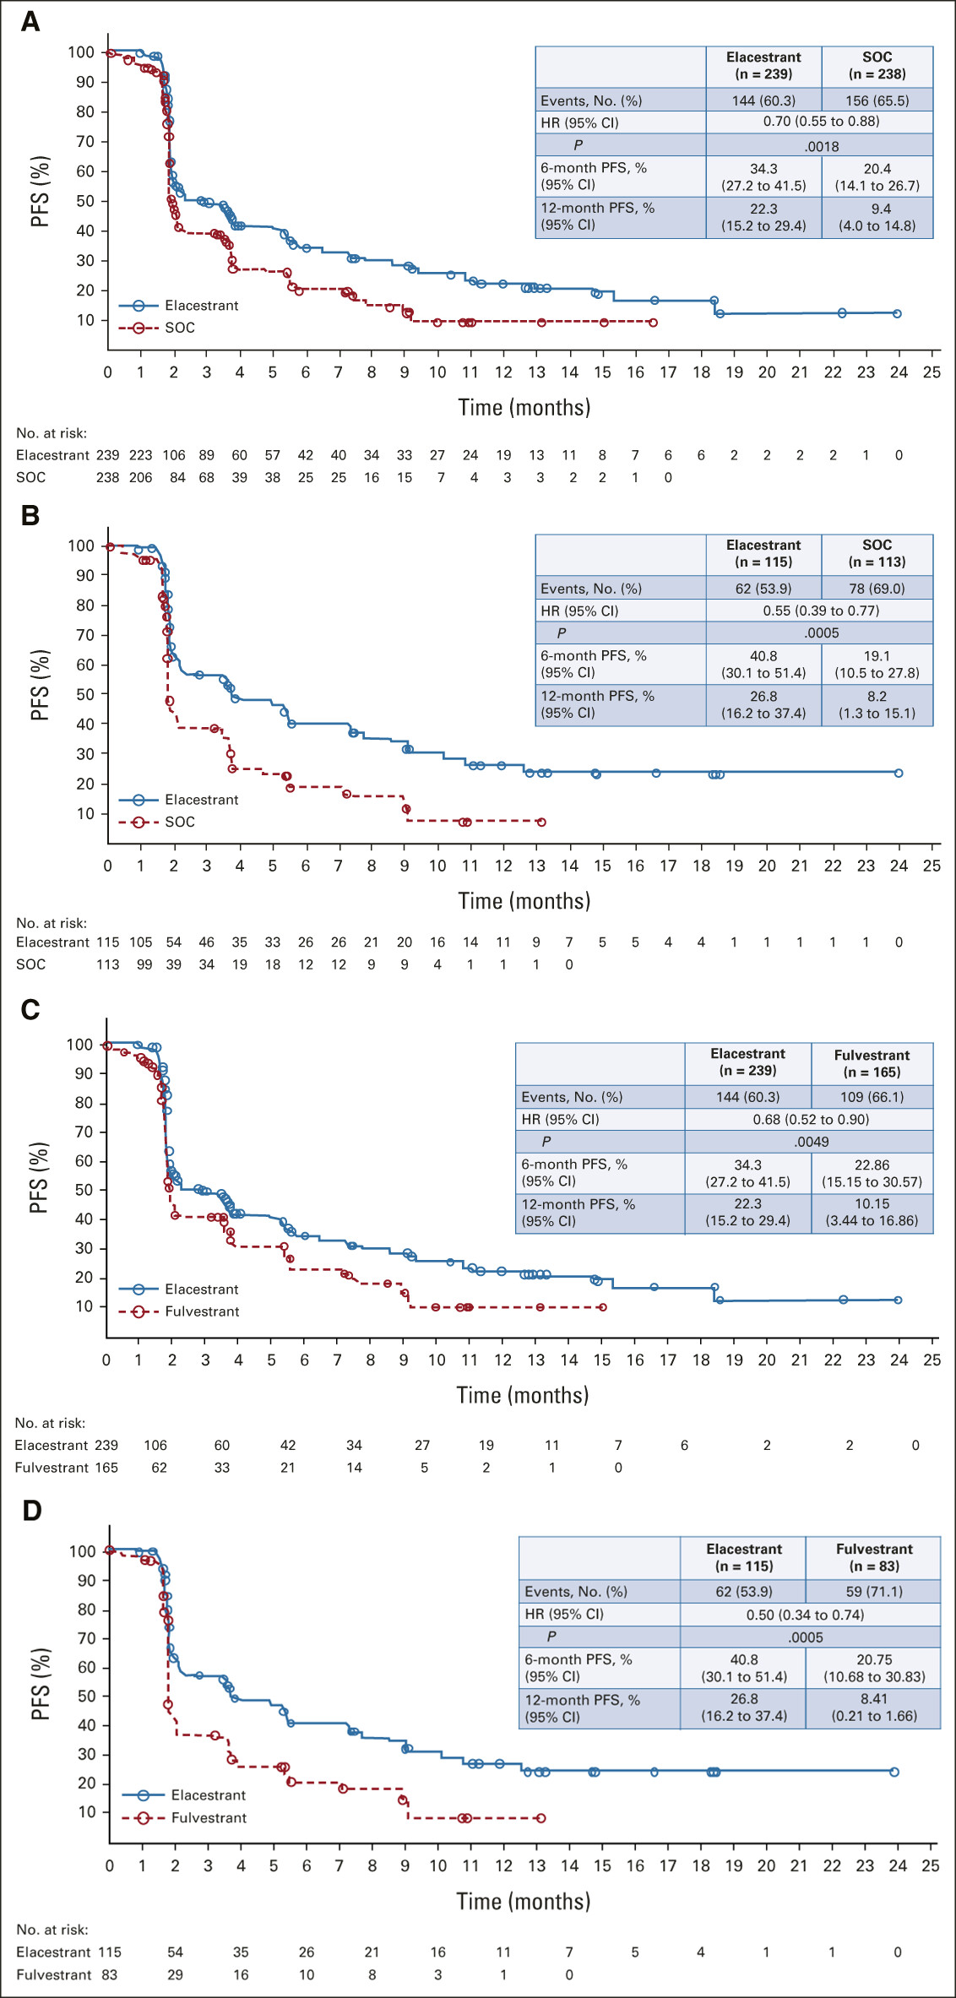
Phase III EMERALD: PFS (Primary Endpoint)
All patients
Pts with ESR1 mut
PFS = progression-free survival; SOC = standard of care
Bidard FC et al. J Clin Oncol 2022 October 1;40(28):3246-56.

Slide 58
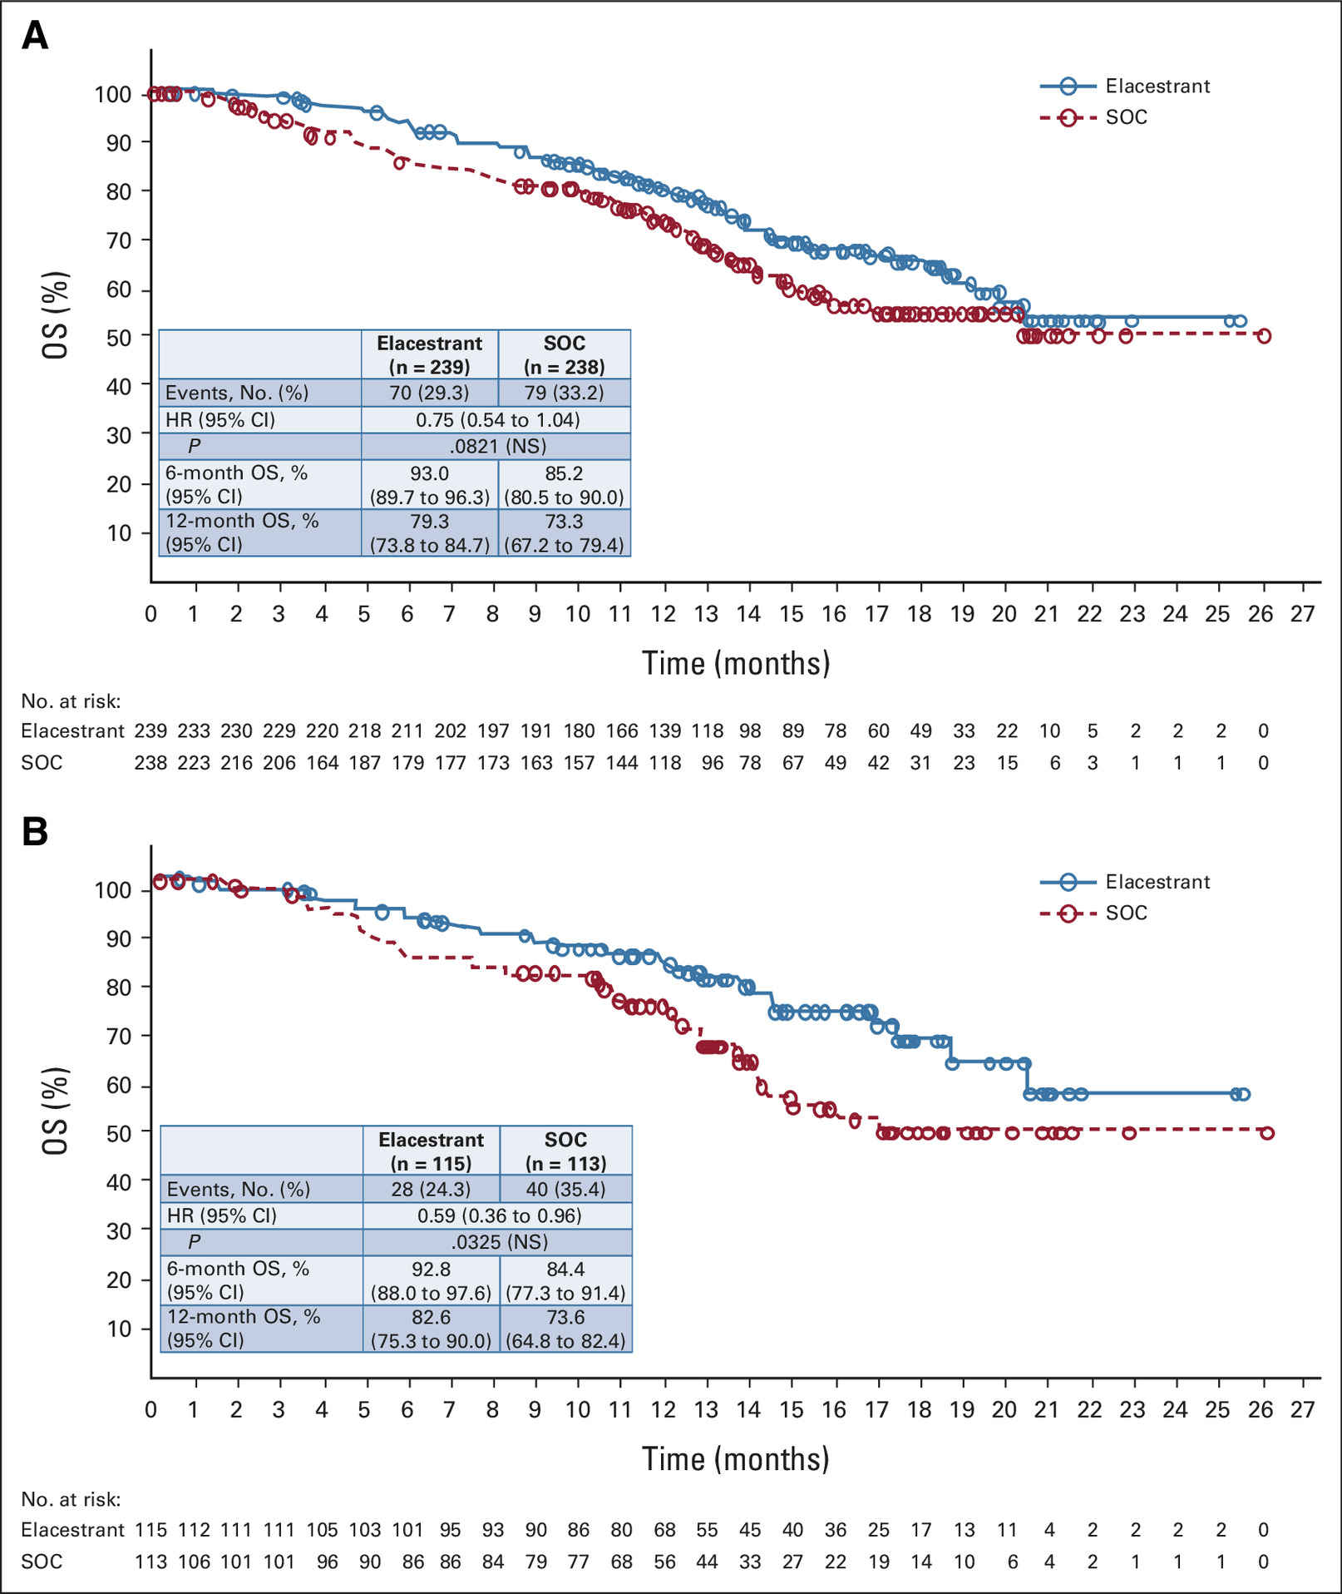
Phase III EMERALD: OS (Secondary Endpoint)
All patients
Pts with ESR1 mut
Bidard FC et al. J Clin Oncol 2022 October 1;40(28):3246-56.
OS = overall survival

Slide 59
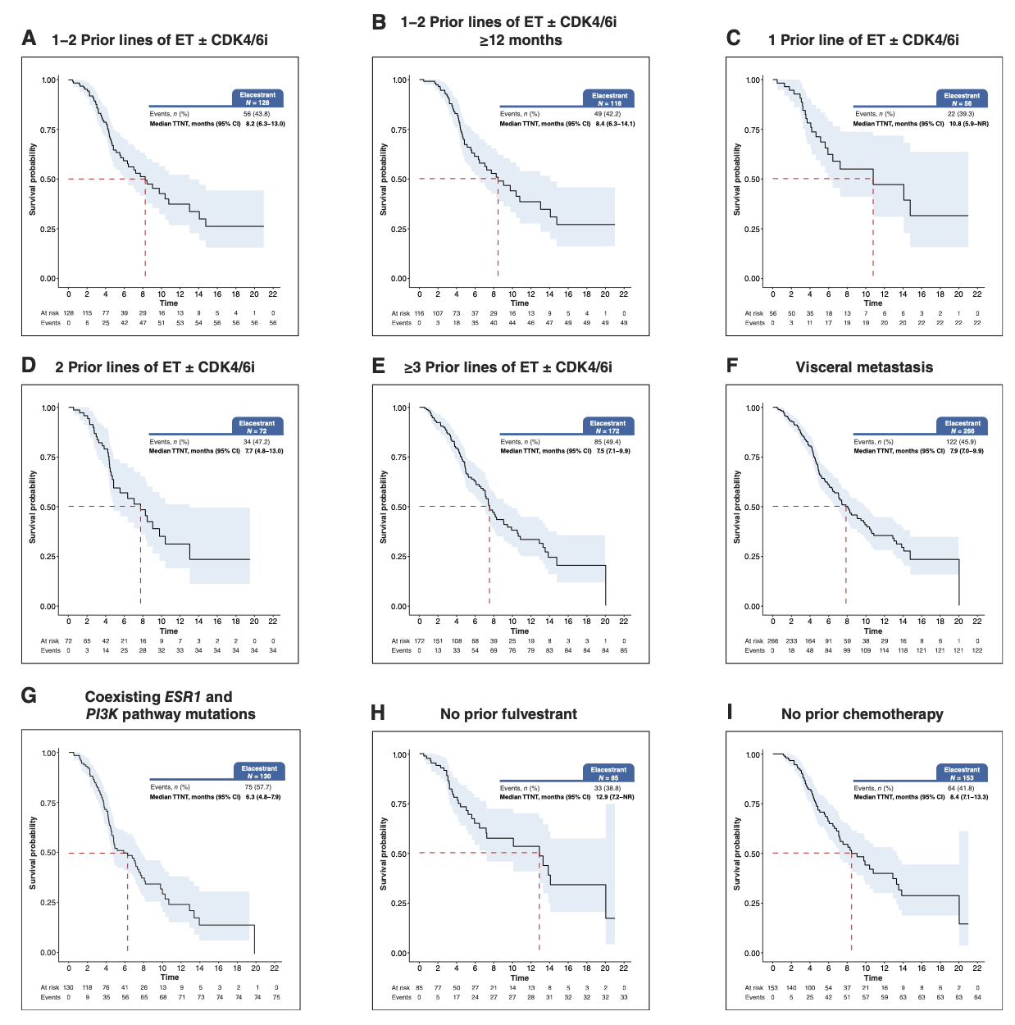
Real-World Outcomes with Elacestrant: Median Time to Next Treatment
Rugo HS et al. Clin Cancer Res 2026 January 6;32(1):179-87.

Slide 60
ASCO 2026 Abstracts of Interest: Elacestrant
Bardia A et al. ELEGANT: Elacestrant versus standard endocrine therapy (ET) in women and men with node-positive, estrogen receptor–positive (ER+), HER2-negative (HER2−), early breast cancer (eBC) with high risk of recurrence in a global, multicenter, randomized, open-label phase 3 study. ASCO 2026;Abstract TPS1153.
Llombart-Cussac A et al. ADELA: A double-blind, placebo-controlled, randomized phase 3 trial of elacestrant (Ela) + everolimus (EVE) versus elacestrant + placebo in ER+/HER2− advanced breast cancer (aBC) patients with ESR1-mutated tumors progressing on endocrine therapy (ET) + CDK4/6i. ASCO 2026;Abstract TPS1154.
Ibrahim N et al. ELECTRA: An open-label, multicenter, phase 1b/2 study of elacestrant in combination with abemaciclib in patients with brain metastasis from ER+/HER2− breast cancer. ASCO 2026;Abstract TPS1155.
CAPELA: A phase II multicenter open-label randomized study of capecitabine in combination with elacestrant versus capecitabine alone in advanced estrogen receptor (ER)-positive breast cancer (TBCRC 070). ASCO 2026;Abstract TPS1156.
McHayleh W et al. Elacestrant in combination with capivasertib in patients with ER+/HER2− advanced breast cancer: Update from ELEVATE, a phase 1b/2, open-label, umbrella study. ASCO 2026;Abstract 1098.

Slide 61
EMBER-3 Study Design
Imlunestrant
400 mg QD
n=331
ER+, HER2- ABC
Primary Endpoints
Investigator-assessed PFS for^{f}:
A vs B in patients with ESR1m^{g}
A vs B in all patients
C vs A in all patients^{h}
A
Men and pre-ª/post-menopausal women
Prior therapy:
Adjuvant: Recurrence on
or within 12 months of completion of AI ± CDK4/6i
ABC: Progression on first-line AI ± CDK4/6i
No other therapy for ABC
SOC ET^{c,d}
Fulvestrant or
Exemestane
n=330
R 1:1:1
N=874
B
Key Secondary Endpoints
OS, PFS by BICR, and ORR
Safety
Imlunestrant
400 mg QD +
abemaciclib^{d}
n=213
Stratification Factors:
Prior CDK4/6i therapy (Y/N)
Visceral metastases (Y/N)
Region^{b}
Exploratory Endpoints
TTC^{i}, CFS^{j}, PFS2^{k}
Ce
Jhaveri K et al. SABCS 2025;Abstract GS3-08

Slide 62
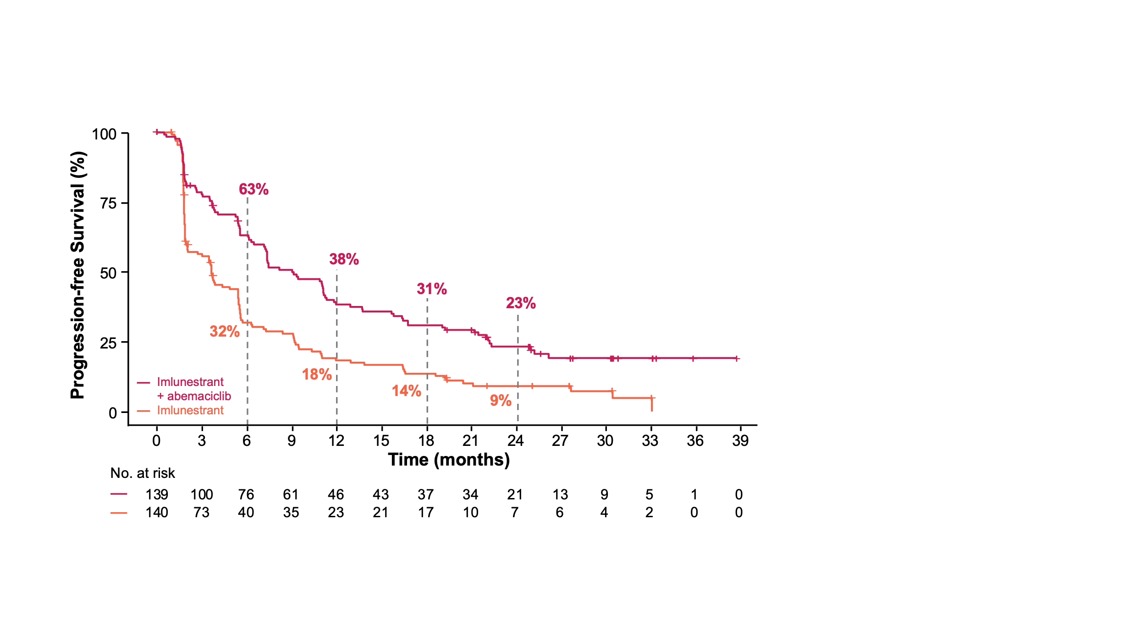
Subgroup Analysis: PFS of Imlunestrant + Abemaciclib vs Imlunestrant in CDK4/6i Pretreated Patients
Imlunestrant + abemaciclib
n=139
Imlunestrant
n=140
No. of events |  | 97 | 120
Median (95% CI) |  | 9.1 (7.2-11.3) | 3.7 (2.1-5.5)
HR (95% CI) |  | 0.53 (0.40-0.69)
 |  | Nominal p-value < 0.0001
Consistent benefit of imlunestrant + abemaciclib maintained in patients previously treated with a CDK4/6i
Jhaveri K et al. SABCS 2025;Abstract GS3-08

Slide 63
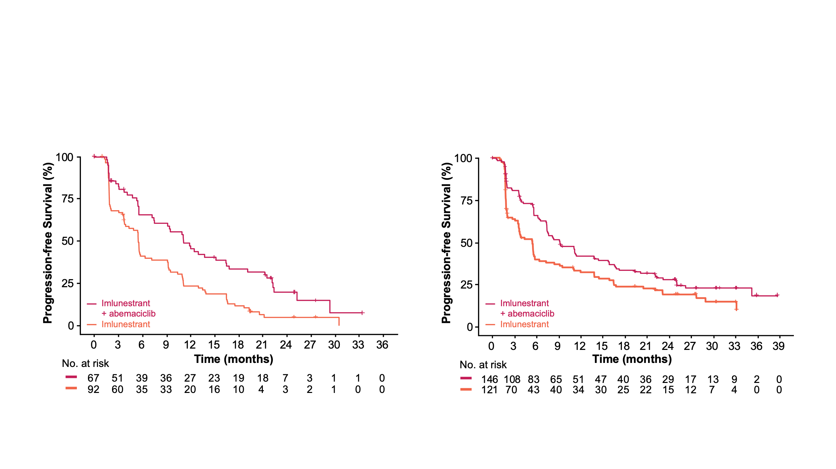
Subgroup Analysis: PFS of Imlunestrant + Abemaciclib vs Imlunestrant by ESR1m Status
Patients With ESR1m
Patients Without ESR1m
Imlunestrant
+ abemaciclib
n=67
Imlunestrant
n=92
Imlunestrant
+ abemaciclib
n=146
Imlunestrant
n=121
No. of events |  | 48 | 82
Median (95% CI) |  | 11.1 (7.4-16.4) | 5.5 (3.8-7.2)
HR (95% CI) |  | 0.49 (0.33-0.71)
 |  | Nominal p-value = 0.0002
No. of events |  | 96 | 92
Median (95% CI) |  | 9.2 (7.4-13.8) | 5.5 (3.6-5.8)
HR (95% CI) |  | 0.64 (0.47-0.85)
 |  | Nominal p-value = 0.0023
Consistent benefit of imlunestrant + abemaciclib maintained regardless of ESR1m status
Jhaveri K et al. SABCS 2025;Abstract GS3-08

Slide 64
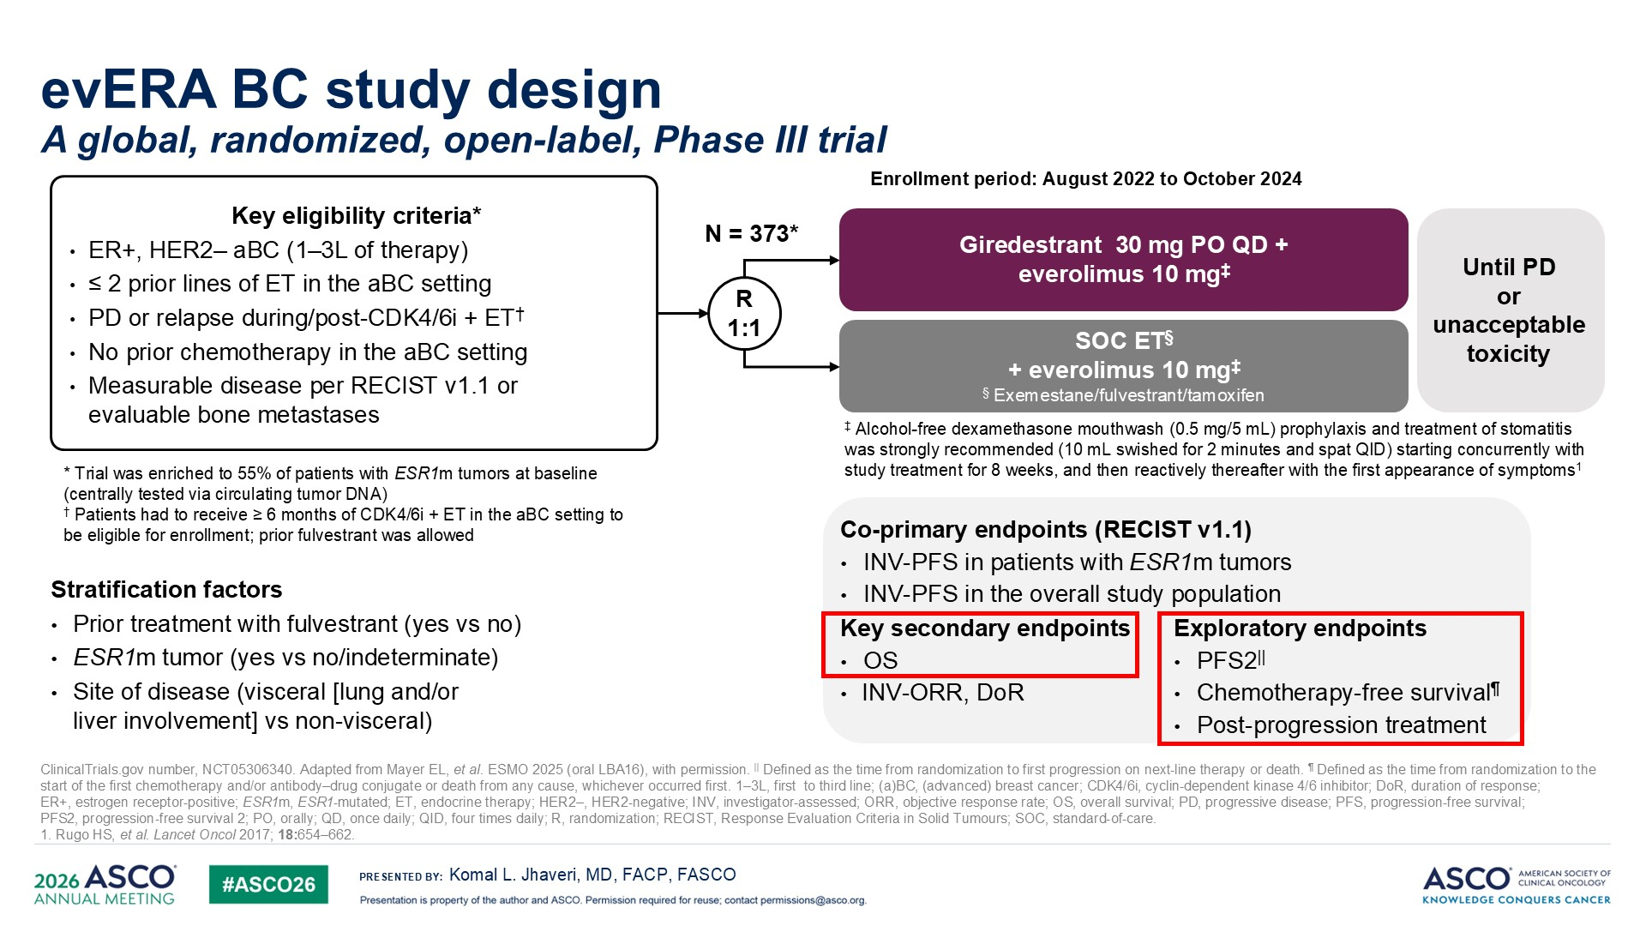
Jhaveri KL et al. ASCO 2026;Abstract 1016

Slide 65
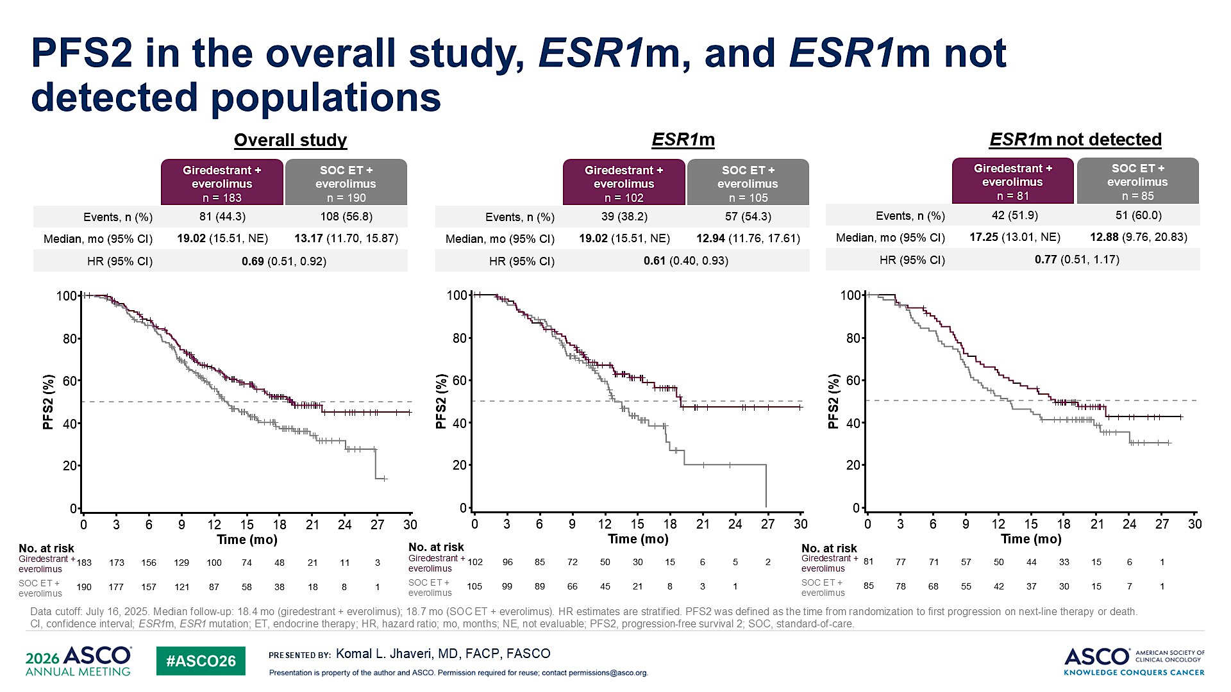
Jhaveri KL et al. ASCO 2026;Abstract 1016

Slide 66
Dr Kalinsky Case Presentation #2
69 yo F, biopsy of left mass showed atypical papillary proliferation with DCIS, and Invasive ductal carcinoma at 8 o’clock. , ER 100% positive, PR 80% positive, Her -2 negative, Ki67 20%
Excisional biopsy with sentinel node biopsy: 0.8cm invasive ductal carcinoma, no lymph node involved ( 0/4 positive)
Left mastectomy, pathology no invasive component. No chemotherapy, No XRT
Anastrozole: 12/31/21: Completed endocrine therapy x 10
11/9/22 Repeat R ilium biopsy confirmed +mets, ER 94%, PR 33%, HER2 equivocal 2+, HER2 FISH neg
Guardant testing: +ESR1 mutation, no PIK3CA mutation
Palbociclib/Fulvestrant x 2 years
Switched to Elacestrant x 1 yr, tolerated therapy well

Slide 67
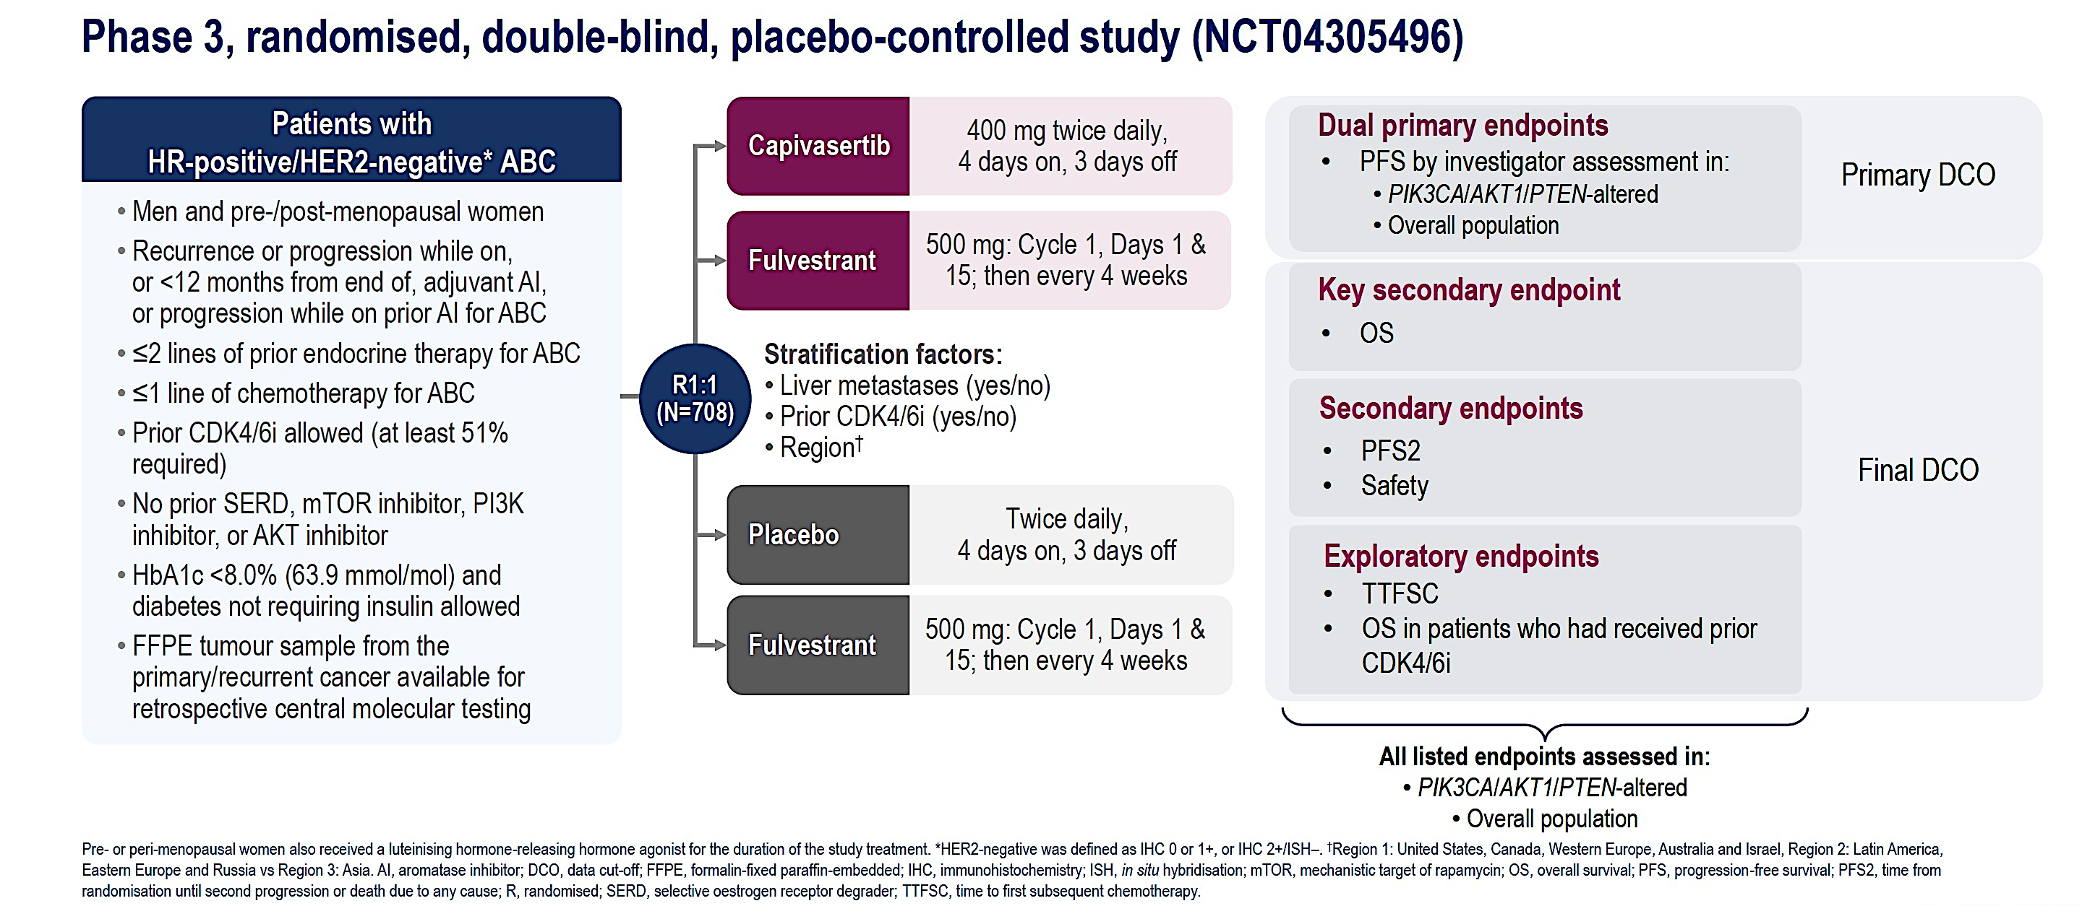
Phase III CAPItello-291 Study Design
Rugo HS et al. ESMO Breast 2026;Abstract 417O.

Slide 68
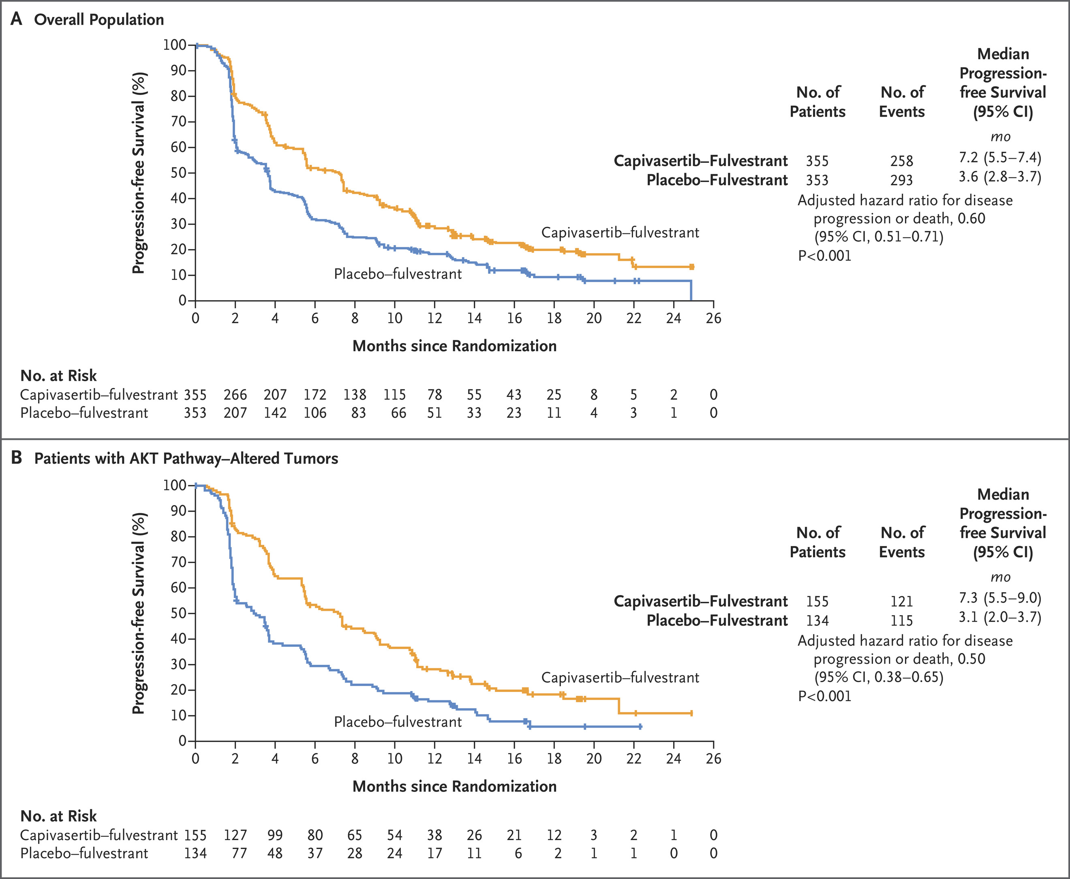
Phase III CAPItello-291: Progression-Free Survival (Dual Primary Endpoints)
Overall population
AKT pathway-altered tumors
Turner NC et al. N Engl J Med 2023 June 1;388(22):2058-70.

Slide 69
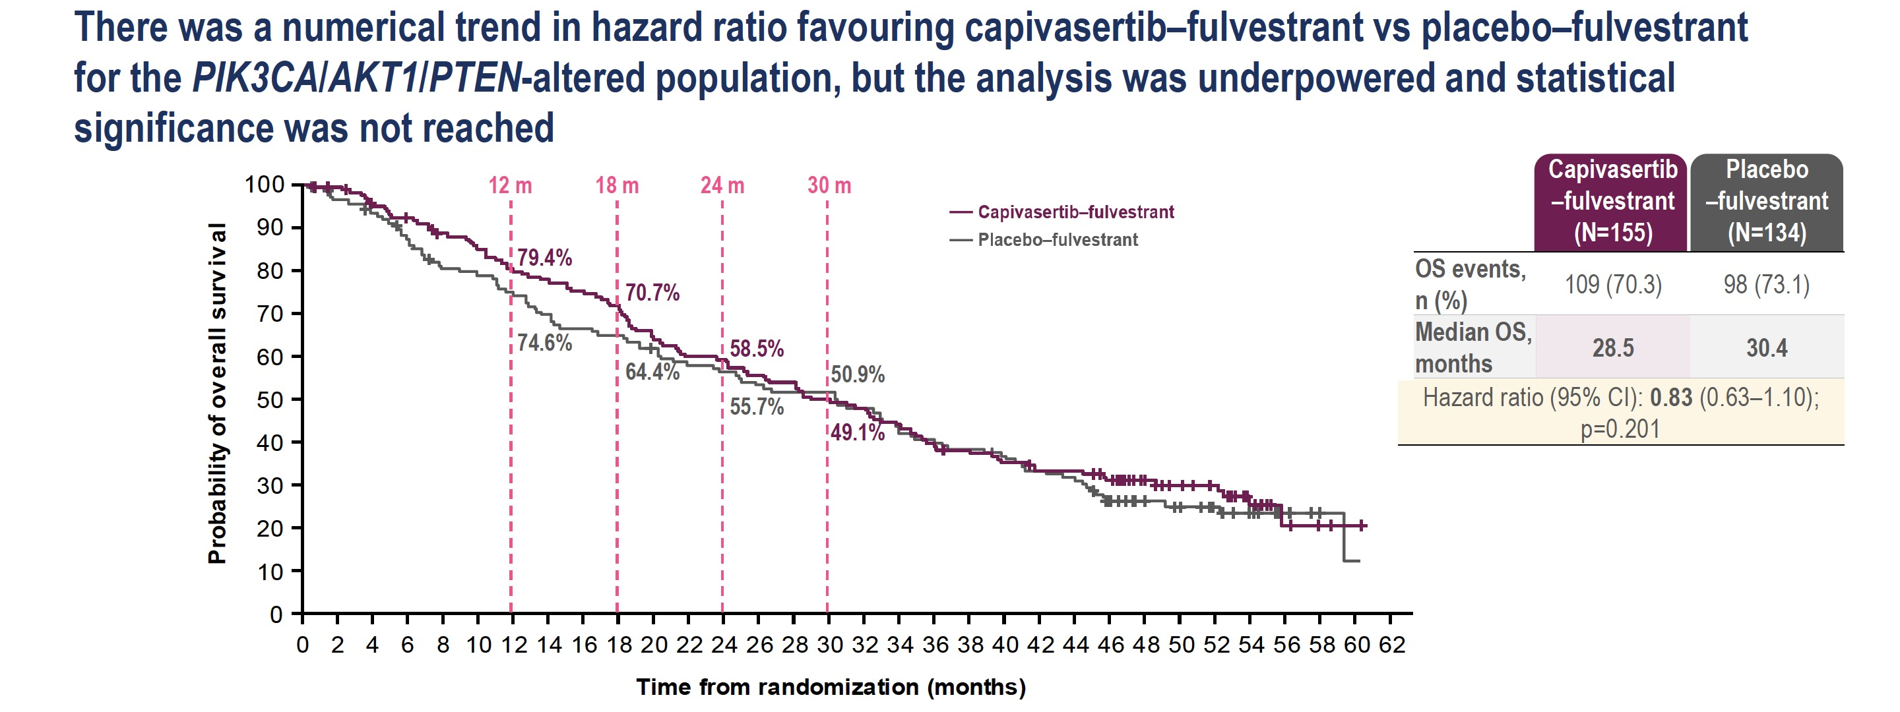
Phase III CAPItello-291: Overall Survival (Altered Population)
Rugo HS et al. ESMO Breast 2026;Abstract 417O.

Slide 70
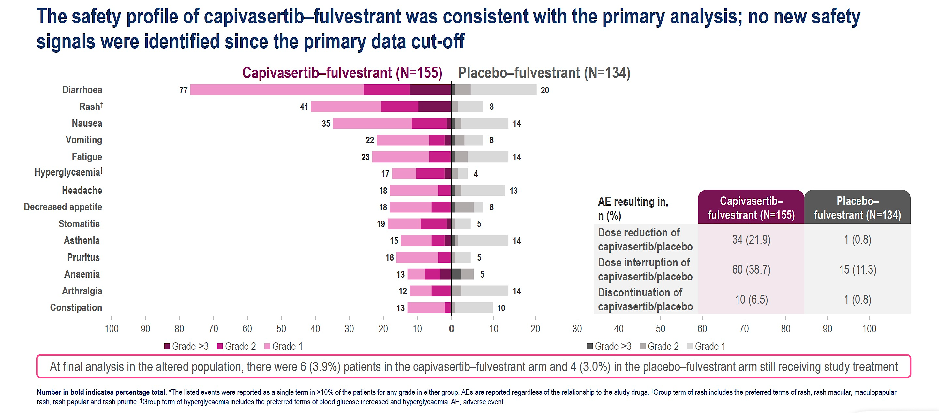
Phase III CAPItello-291: Safety
Rugo HS et al. ESMO Breast 2026;Abstract 417O.

Slide 71
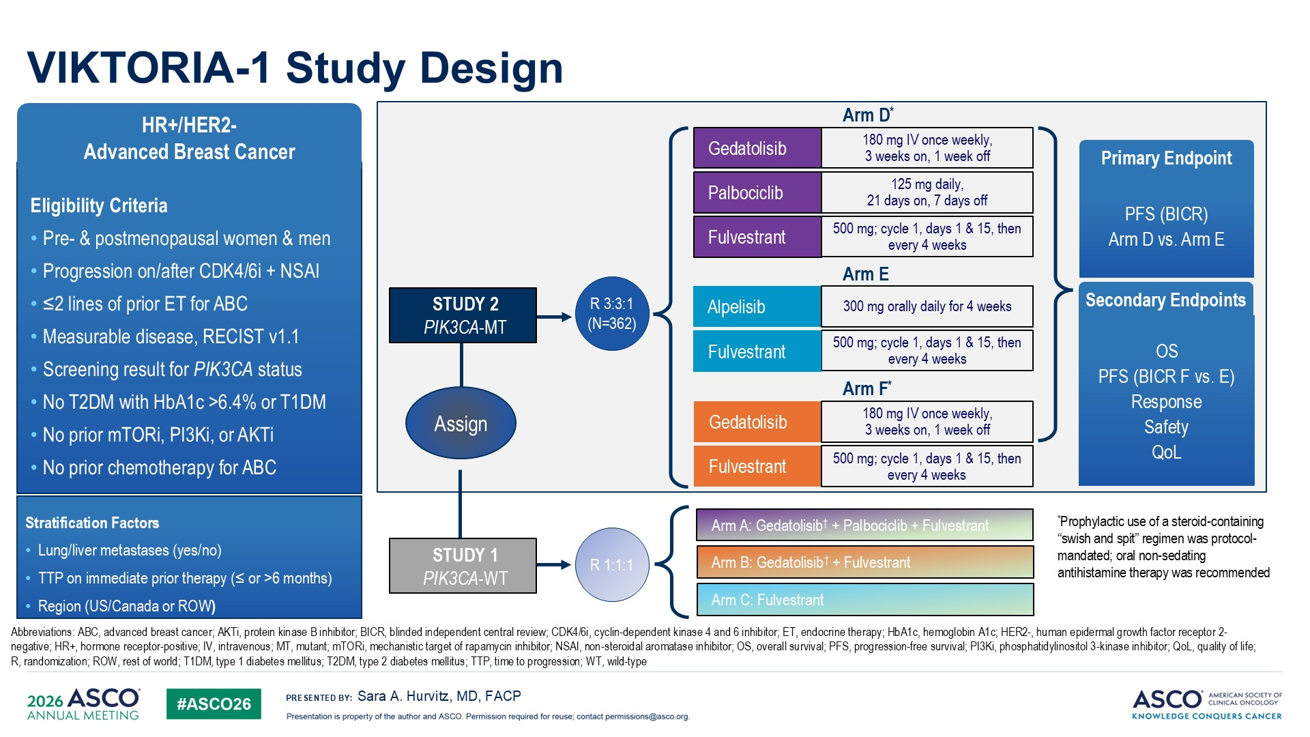
Hurvitz SA et al. ASCO 2026;Abstract LBA1008

Slide 72
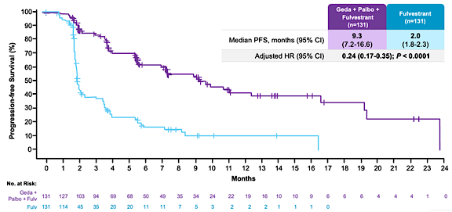
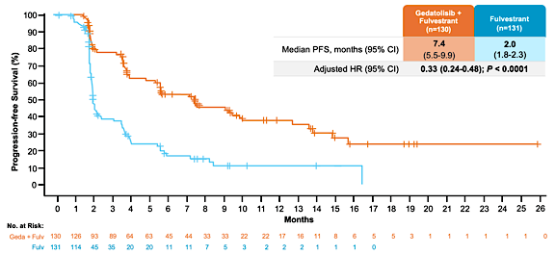
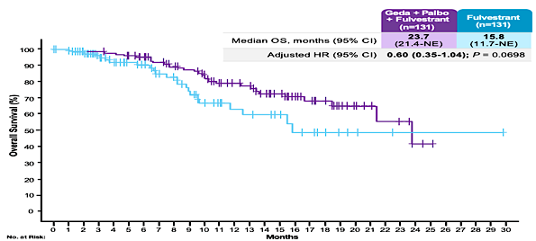


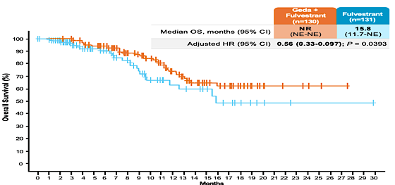
VIKTORIA-1 Study 1 results for PI3K WT
PFS Gedatolisib Triplet vs. Fulvestrant
PFS Gedatolisib Doublet vs. Fulvestrant
Interim OS Censored at Cross-Over
Gedatolisib Triplet vs. Fulvestrant
Interim OS Censored at Cross-Over
Gedatolisib Doublet vs. Fulvestrant
A Gennari
Hurvitz SA et al, ESMO 2025.

Slide 73
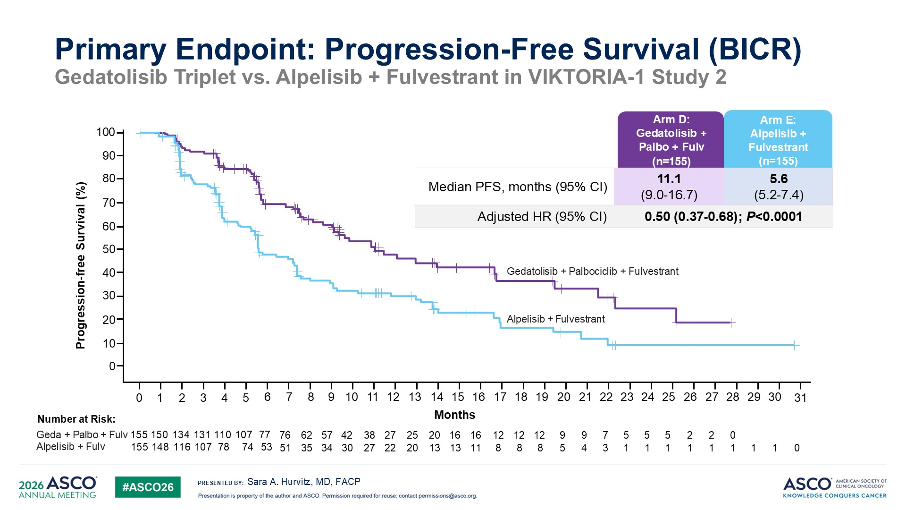
Hurvitz SA et al. ASCO 2026;Abstract LBA1008

Slide 74
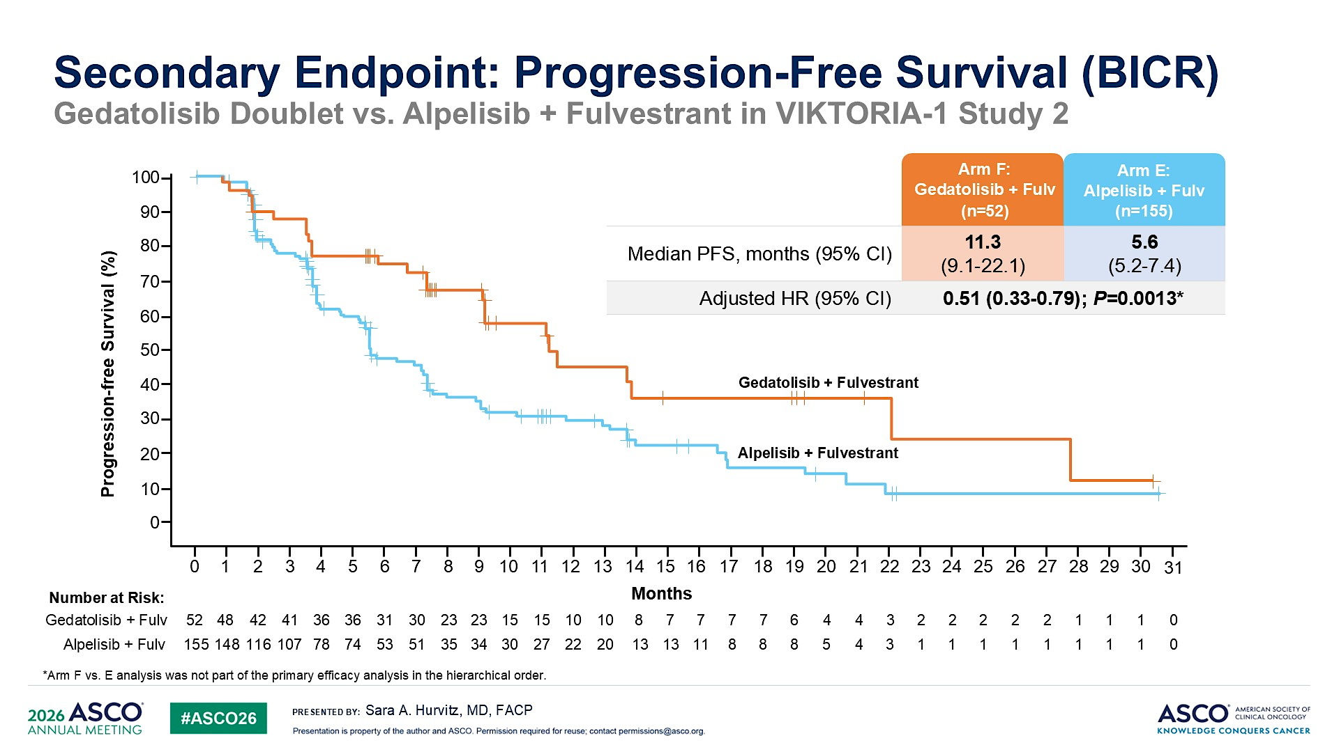
Hurvitz SA et al. ASCO 2026;Abstract LBA1008

Slide 75
Dr Kalinsky Case Presentation #3
60 yo F
2/17/05: s/p right lumpectomy + SLNB: IDC, grade 2 (0.5 cm in greatest dimension), 1/7 LNs, ER+/PR+/HER2 2+, FISH negative.
Received adjuvant chemotherapy with FEC x3 cycles followed by docetaxel x3 cycles, s/p XRT and endocrine therapy x 11 years (Tam, AI)
5/27/21: CT-biopsy of left iliac bone lesion confirmed metastatic carcinoma consistent with breast primary, ER+/PR-/HER2 2+, FISH negative. Ki-67 24%.
Anastrozole + Abemaciclib x 2 years
Fulvestrant + everolimus x 1.5 years
Carbo x 6 months (somatic BRCA, no other mutations)
Capecitabine x 1 year
Recently started T-DXD

Slide 76
Agenda
Module 1: Hormone Receptor (HR)-Positive Breast Cancer
— Dr Kalinsky
Module 2: HER2-Positive Breast Cancer — Dr Bardia
Module 3: Triple-Negative Breast Cancer — Dr O’Shaughnessy

Slide 77
Updates from ASCO 2026:
HER2-Positive Breast Cancer
Aditya Bardia, MD, MPH
UCLA Health Jonsson Comprehensive Cancer Center
Los Angeles, California

Slide 78
HER2-Positive Breast Cancer
EBC:
Stage II-III (high risk)
Neoadjuvant (DESTINY-B 11)
Adjuvant (DESTINY-B05)
MBC:
  T-DXd upfront (DESTINY-B09)
  T-DXd and Durvalumab (DESTINY-B07)

Slide 79
Dr Bardia – Case #1: 35F
Noted palpable mass in left breast. Diagnostic US demonstrated irregular mass measuring 29 * 13 mm seen in the left breast at 3 o’clock located 1 centimeter from the nipple, and prominent axillary lymph node measuring 3.9 mm in the left axilla. Biopsy confirmed IDC, poorly differentiated grade 3, ER+/PR-/HER2+ (both breast and LN), Ki67 = 40%.
What would you consider next?
  Taxane + Carboplatin + Trastuzumab + Pertuzumab (TCHP)
  Trastuzumab and Pertuzumab and Taxane (THP)
  Trastuzumab deruxtecan (T-DXd) followed by THP
  Doxorubicin + Cyclophosphamide (AC) followed by THP

Slide 80
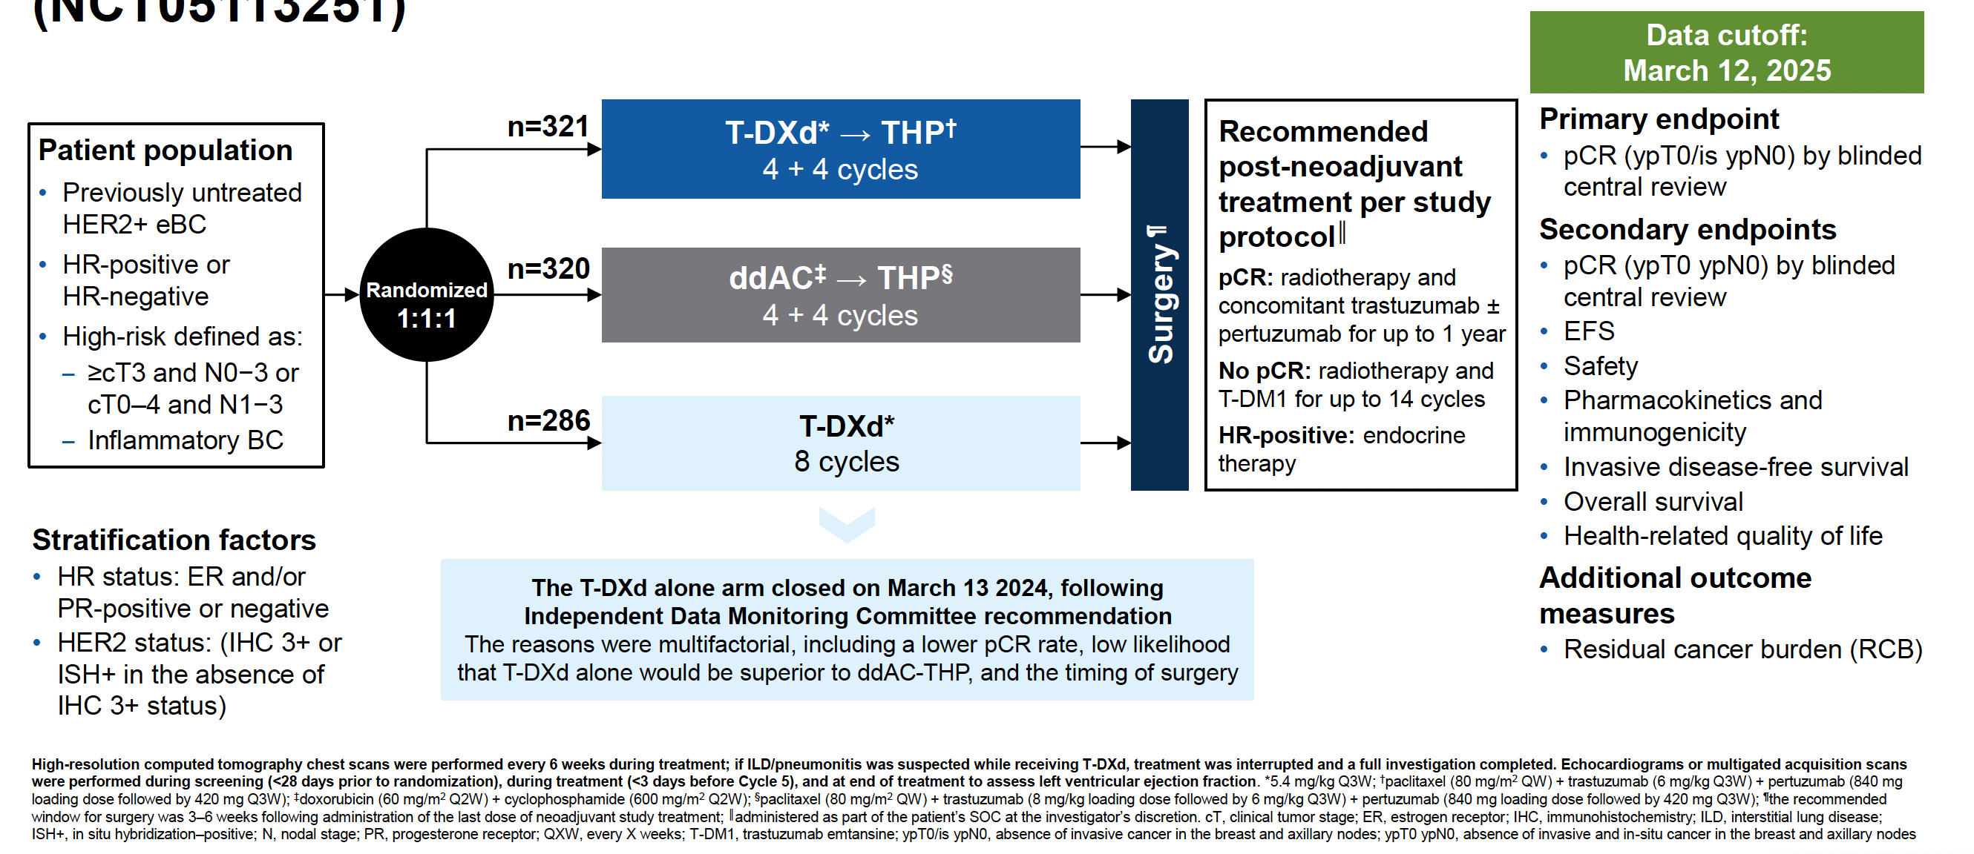
Phase III DESTINY-Breast11 Study Design
eBC = early breast cancer; THP = paclitaxel with trastuzumab and pertuzumab; ddAC = dose-dense doxorubicin and cyclophosphamide; pCR = pathologic complete response; EFS = event-free survival
Harbeck N et al. ESMO 2025;Abstract 291O.

Slide 81
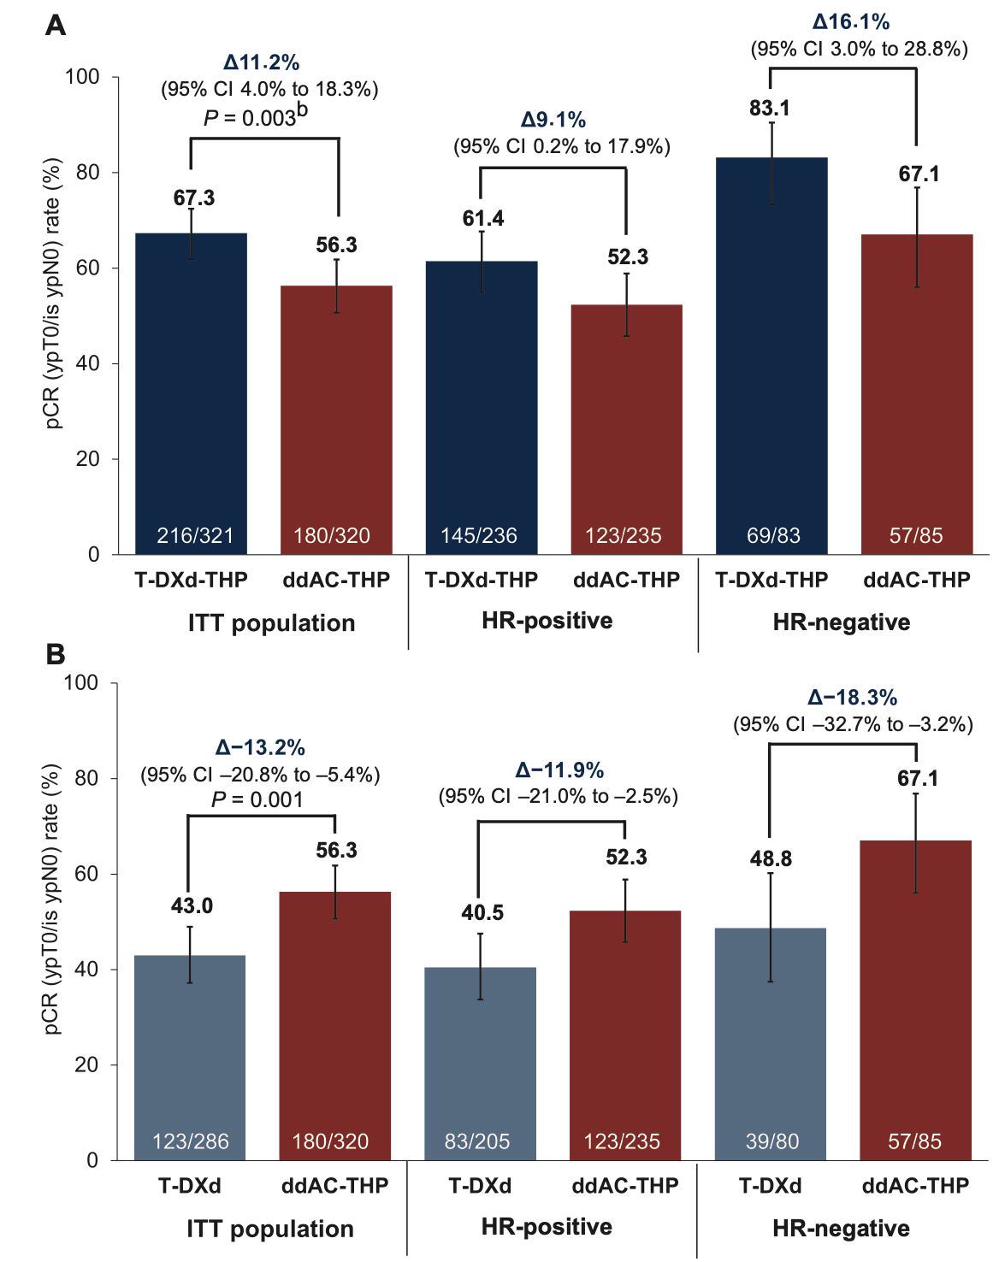
Phase III DESTINY-Breast11: pCR (Primary Endpoint)
ITT = intention-to-treat
Harbeck N et al. Ann Oncol 2026 February;37(2):166-79.

Slide 82
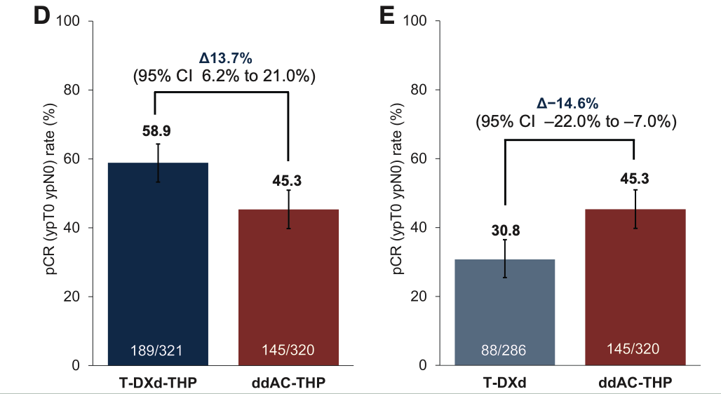
Phase III DESTINY-Breast11: pCR (Secondary Endpoint)
Harbeck N et al. Ann Oncol 2026 February;37(2):166-79.

Slide 83
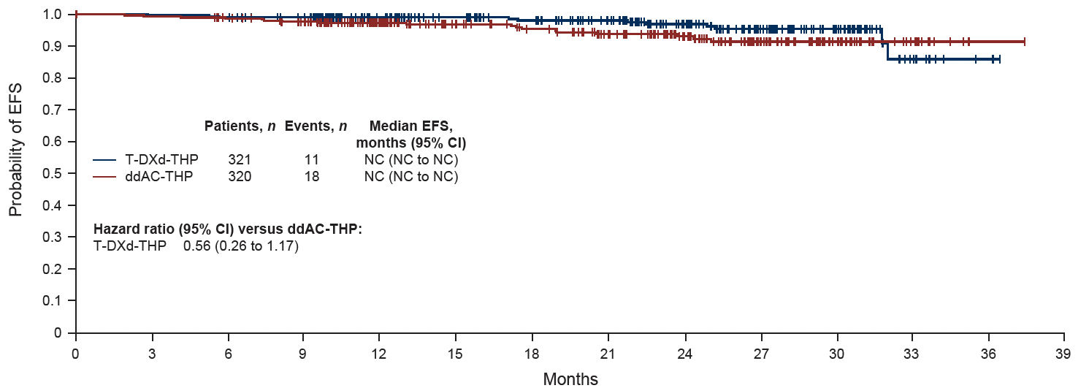

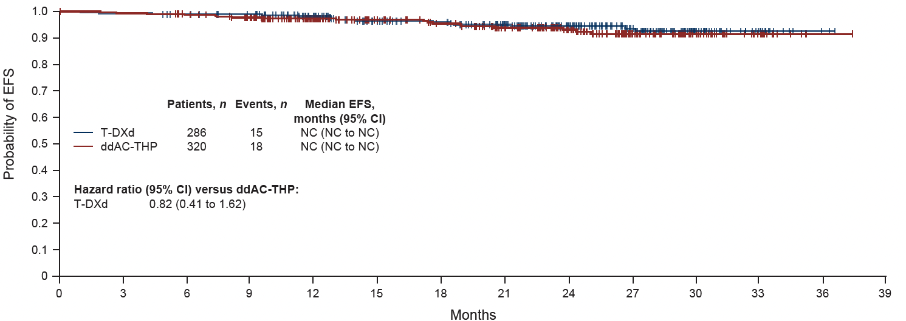

Phase III DESTINY-Breast11: EFS (Secondary Endpoint)
Harbeck N et al. Ann Oncol 2026 February;37(2):166-79.

Slide 84
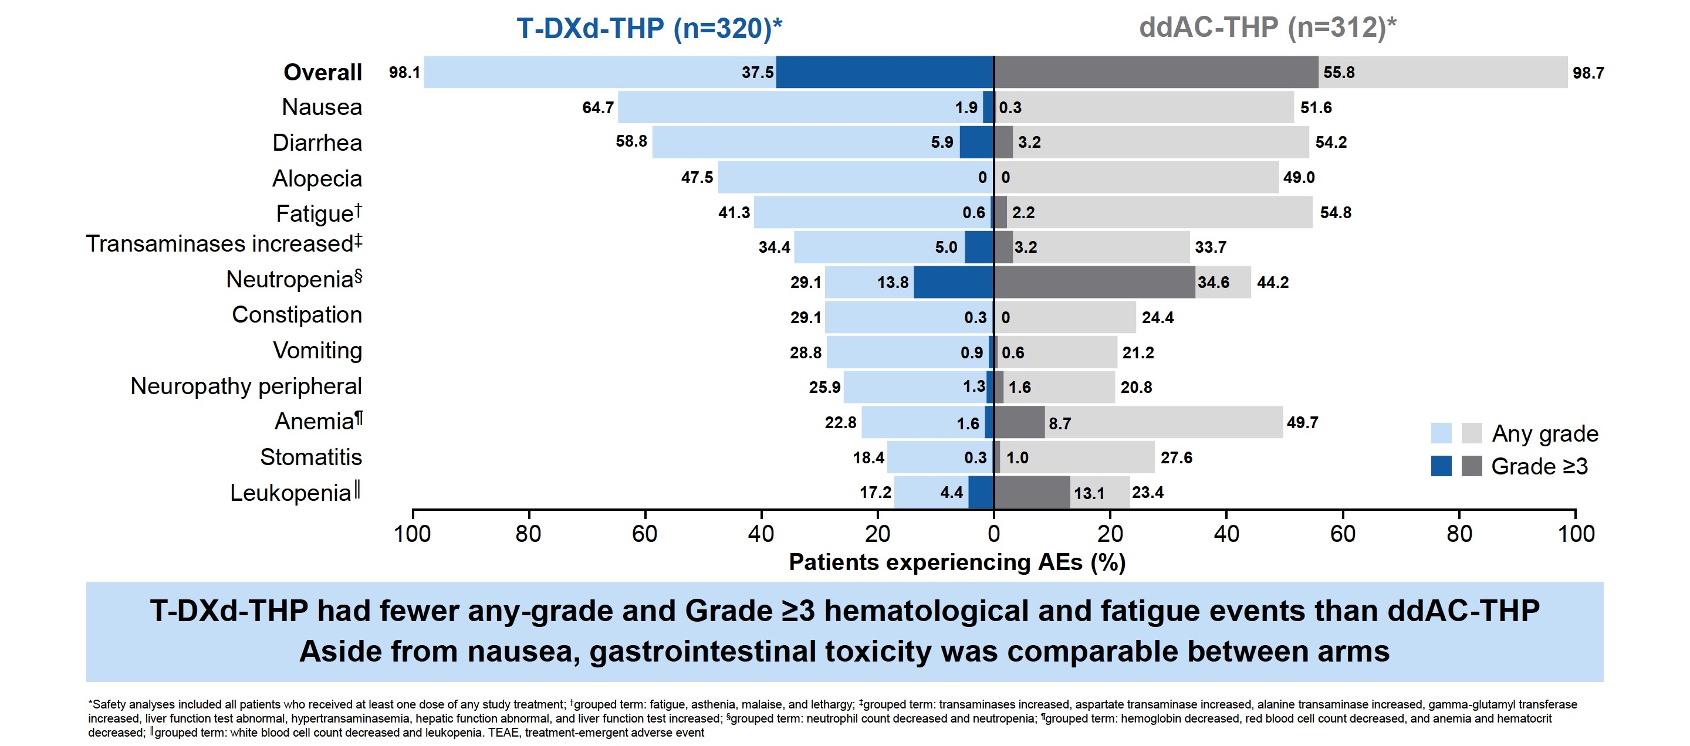
Phase III DESTINY-Breast11: Common AEs
Harbeck N et al. ESMO 2025;Abstract 291O.

Slide 85
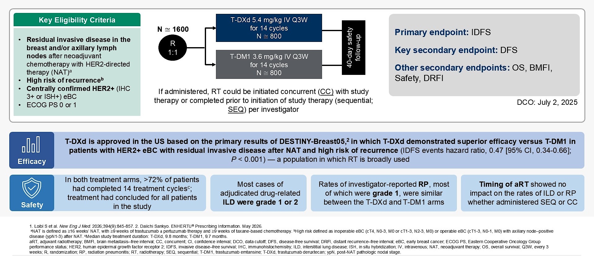
Phase III DESTINY-Breast05: Study Design and Summary
Untch M et al. ASCO 2026;Abstract 516.

Slide 86
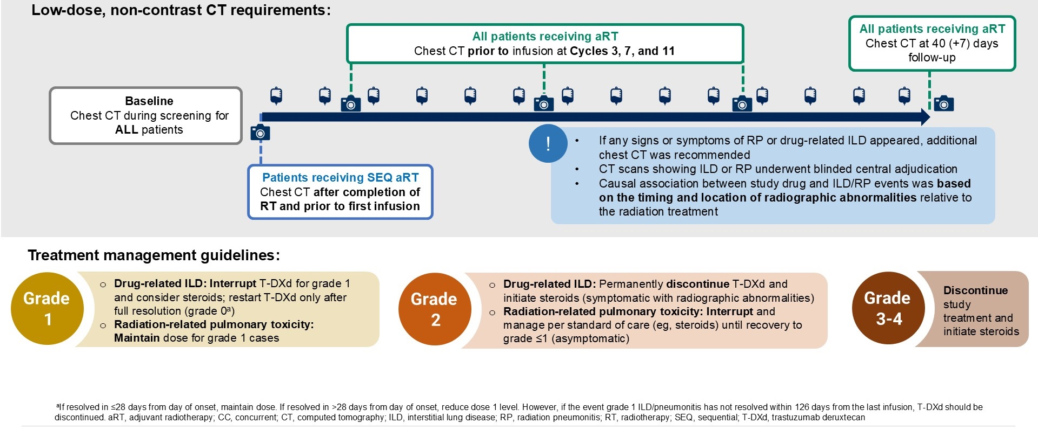
Phase III DESTINY-Breast05 Secondary Safety Analysis:
Guidance on CT Requirements for Identifying ILD and RP
Untch M et al. ASCO 2026;Abstract 516.

Slide 87
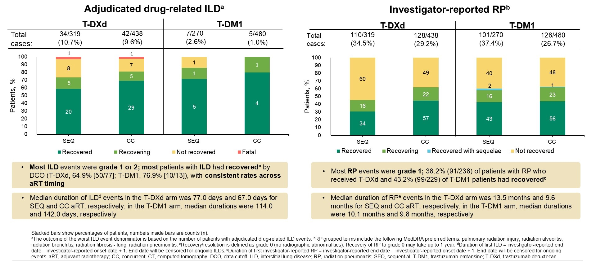
Phase III DESTINY-Breast05 Secondary Safety Analysis:
Drug-Related ILD and Investigator-Reported RP (Outcomes at DCO)
Untch M et al. ASCO 2026;Abstract 516.

Slide 88
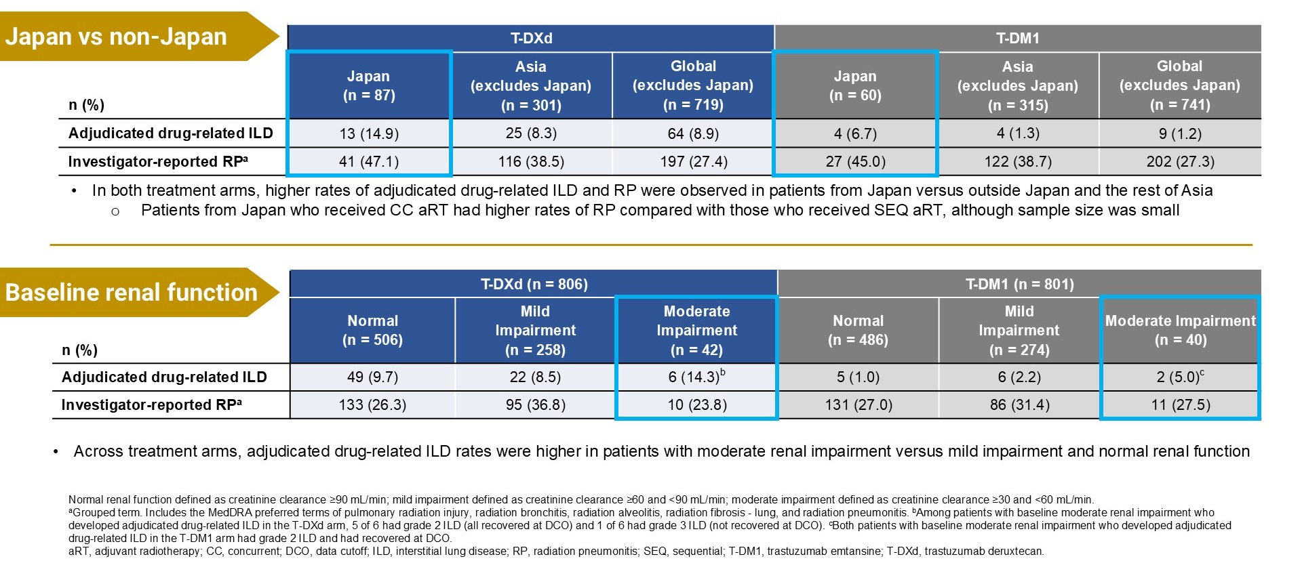
Phase III DESTINY-Breast05 Secondary Safety Analysis:
Drug-Related ILD and Investigator-Reported RP by Subgroup
Untch M et al. ASCO 2026;Abstract 516.

Slide 89
HER2-Positive Breast Cancer
EBC:
Stage II-III (high risk)
– Neoadjuvant T-DXd (DESTINY-B 11)
– Adjuvant T-DXd (DESTINY-B05)
MBC:
  – T-DXd upfront (DESTINY-B09)
  – T-DXd and Durvalumab (DESTINY-B07)

Slide 90
Dr Bardia – Case #2: 45F
Received neoadjuvant TCHP (*6 cycles) for cT2N1Mx HR+/HER2+ Breast Cancer Underwent lumpectomy. Surgical path yT1aN0MX.
Received adjuvant T-DM1 (and radiation therapy)
3 years later diagnosed with hepatic metastasis, HR+/HER2+
What would you consider next?
  Trastuzumab and Pertuzumab and Taxane (THP) for 6 cycles followed by HP + ET + Palbociclib
  Trastuzumab and Pertuzumab and Taxane (THP) for 6 cycles followed by HP + Tucatinib
  Trastuzumab deruxtecan (T-DXd)
  Tucatinib with capecitabine and trastuzumab
  T-DM1

Slide 91
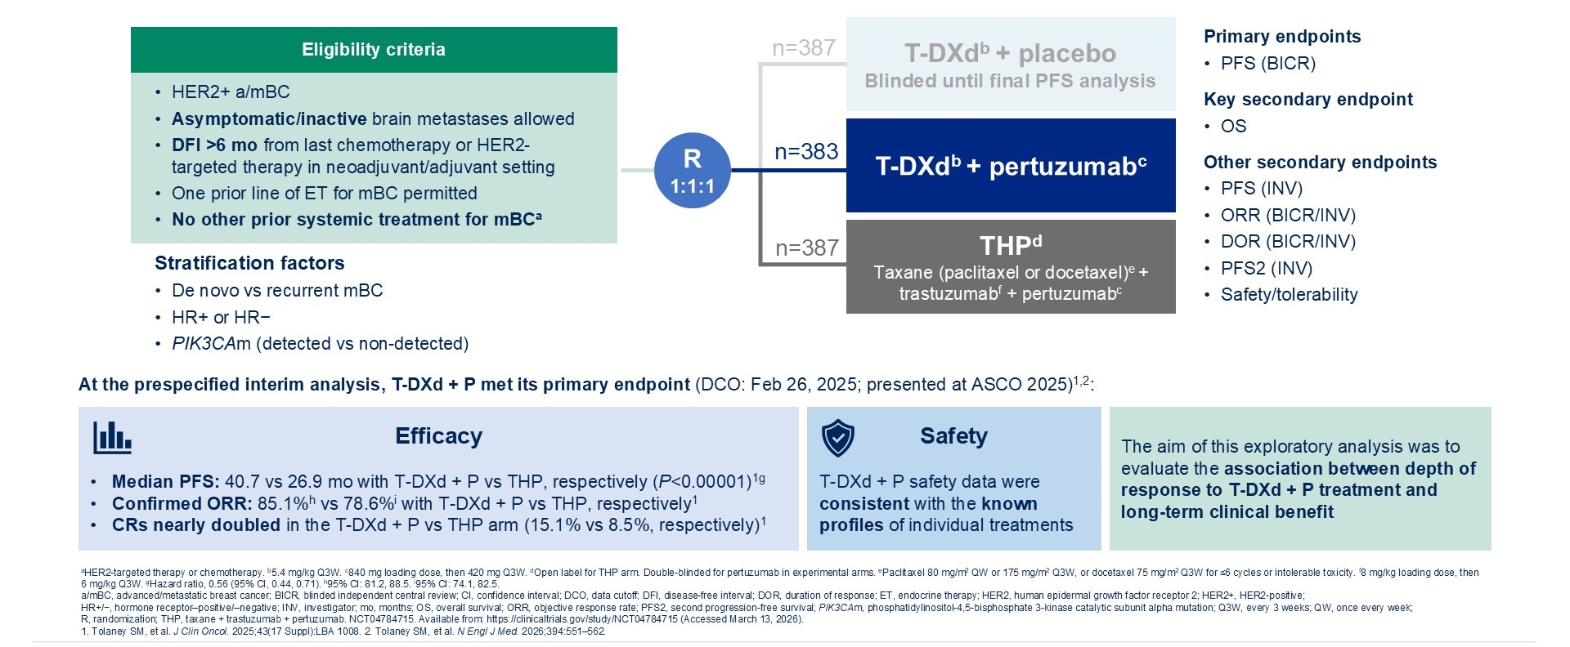
Phase III DESTINY-Breast09: Study Design
Park YH et al. ASCO 2026;Abstract 1021.

Slide 92

Phase III DESTINY-Breast09: Exploratory Analysis of Response
Park YH et al. ASCO 2026;Abstract 1021.

Slide 93

Phase III DESTINY-Breast09:
PFS by Response Subgroup (T-DXd with Pertuzumab Arm)
Park YH et al. ASCO 2026;Abstract 1021.

Slide 94

Phase III DESTINY-Breast09:
Response Characteristics (T-DXd with Pertuzumab Arm)
Park YH et al. ASCO 2026;Abstract 1021.

Slide 95

Phase III DESTINY-Breast09: Safety Summary (T-DXd with Pertuzumab Arm)
Park YH et al. ASCO 2026;Abstract 1021.

Slide 96

Phase Ib/II DESTINY-Breast07 Study Design
Loi S et al. ASCO 2026;Abstract 1012.

Slide 97

Phase Ib/II DESTINY-Breast07: Responses
Loi S et al. ASCO 2026;Abstract 1012.

Slide 98

Phase Ib/II DESTINY-Breast07: PFS
Loi S et al. ASCO 2026;Abstract 1012.

Slide 99

Phase Ib/II DESTINY-Breast07: Biomarker Analysis
Loi S et al. ASCO 2026;Abstract 1012.

Slide 100

Phase Ib/II DESTINY-Breast07: Common AEs
Loi S et al. ASCO 2026;Abstract 1012.

Slide 101
HER2-Positive Breast Cancer
EBC:
Stage II-III (high risk):
– Neoadjuvant (DESTINY-B 11)
– Adjuvant (DESTINY-B05)
MBC
  – T-DXd upfront (DESTINY-B09)
  – T-DXd and Durvalumab (DESTINY-B07)

Slide 102
Agenda
Module 1: Hormone Receptor (HR)-Positive Breast Cancer
— Dr Kalinsky
Module 2: HER2-Positive Breast Cancer — Dr Bardia
Module 3: Triple-Negative Breast Cancer — Dr O’Shaughnessy

Slide 103
Advances in Metastatic Triple Negative Breast Cancer
ASCO 2026
Joyce O’Shaughnessy, MD
Baylor University Medical Center
Texas Oncology
Sarah Cannon Research Institute
Dallas TX

Slide 104
KEYNOTE-522 Study Design (NCT03036488)
Neoadjuvant Phase
Adjuvant Phase
Stratification Factors:
Nodal status (+ vs -)
Tumor size (T1/T2 vs T3/T4)
Carboplatin schedule (QW vs Q3W)
Neoadjuvant Treatment 1
(cycles 1-4; 12 weeks)
Neoadjuvant Treatment 2
(cycles 5-8; 12 weeks)
Adjuvant Treatment
(cycles 1-9; 27 weeks)
Carboplatin^{b} + Paclitaxel^{c}
Doxo^{d}/Epirubicin^{e} + Cyclophosphamide^{f}
S
U
R
G
E
R
Y
Key Eligibility Criteria
Age ≥18 years
Newly diagnosed TNBC of either T1c N1-2 or T2-4 N0-2
ECOG PS 0-1
Tissue sample for PD-L1 assessmentª
Pembrolizumab 200 mg Q3W
Pembrolizumab 200 mg Q3W
R
2:1
N = 1174
Carboplatin^{b} + Paclitaxel^{c}
Doxo^{d}/Epirubicin^{e} + Cyclophosphamide^{f}
Placebo
Placebo
Primary Endpoints
pCR (ypT0/Tis ypN0)
EFS
Key Secondary Endpoint
OS
Neoadjuvant phase: starts from the first neoadjuvant treatment and ends after definitive surgery (post-treatment included)
Adjuvant phase: starts from the first adjuvant treatment and includes radiation therapy as indicated (post-treatment included)
ªMust consist of at least 2 separate tumor cores from the primary tumor. ^{b}Carboplatin dose was AUC 5 Q3W or AUC 1.5 QW. ^{c}Paclitaxel dose was 80 mg/m² QW. ^{d}Doxorubicin dose was 60 mg/m² Q3W. ^{e}Epirubicin dose was 90 mg/m² Q3W. ^{f}Cyclophosphamide dose was 600 mg/m² Q3W.
Schmid P, et al. ASCO 2026; Abstract 507

Slide 105
Event-Free Survival
IA4 | Events | HR (95% CI) | P-value
Pembro + Chemo/Pembro | 15.7% | 0.63ª (0.48-0.82) | 0.00031^{b}
Placebo + Chemo/Placebo | 23.8%
FA | Events | HR (95% CI)
Pembro + Chemo/Pembro | 21.9% | 0.68ª (0.54-0.86)
Placebo + Chemo/Placebo | 30.3%
100
90
84.5%
78.3%
80
70
76.8%
60
69.8%
Percentage of Participants
50
40
30
20
10
Median follow-up^{c}: 39.1 months
Median follow-up^{d}: 93.8 months
0
0
3
6
9
12
15
18
21
24
27
30
33
36
39
42
45
48
51
Time, months
No. at risk
784
781
769
751
728
718
702
692
681
671
652
551
433
303
165
28
0
0
390
386
382
368
358
342
328
319
310
304
297
250
195
140
83
17
0
0
Schmid P, et al. ASCO 2026; Abstract 507

Slide 106
Event-Free Survival by Pathological Complete Response (ypT0/Tis ypN0) at FA
90.4%
pCR Yes
HR (95% CI)
0.68 (0.44-1.07)
85.9%
57.6%
pCR No
HR (95% CI)
0.78 (0.59-1.03)
Pembro + Chemo/Pembro Responder
Placebo + Chemo/Placebo Responder
Pembro + Chemo/Pembro Non-responder
Placebo + Chemo/Placebo Non-responder
49.7%
Median follow-up: 93.8 months
Schmid P, et al. ASCO 2026; Abstract 507

Slide 107
Overall Survival
IA7 | Events | HR (95% CI) | P-value
Pembro + Chemo/Pembro | 14.7% | 0.66ª (0.50-0.87) | 0.00150^{b}
Placebo + Chemo/Placebo | 21.8%
FA | Events | HR (95% CI)
Pembro + Chemo/Pembro | 15.3% | 0.64ª (0.49-0.85)
Placebo + Chemo/Placebo | 23.1%
86.6%
85.1%
81.7%
77.2%
Median follow-up^{c}: 75.1 months
Median follow-up^{d}: 93.8 months
Schmid P, et al. ASCO 2026; Abstract 507

Slide 108
Overall Survival by Pathological Complete Response (ypT0/Tis ypN0) at FA
94.5%
pCR Yes
HR (95% CI)
0.64 (0.37-1.14)
91.1%
69.0%
pCR No
HR (95% CI)
0.76 (0.55-1.03)
59.8%
Pembro + Chemo/Pembro Responder
Placebo + Chemo/Placebo Responder
Pembro + Chemo/Pembro Non-responder
Placebo + Chemo/Placebo Non-responder
Median follow-up: 93.8 months
Schmid P, et al. ASCO 2026; Abstract 507

Slide 109
Dr O’Shaughnessy Case Presentation #1
48 yo physician presented with a 4 cm left breast mass and palpable axillary LN
Biopsies showed grade 3 TNBC
PET CT showed 1 axillary LN only and no other metastases
She was treated with KN-522 regimen with rapid clinical CR
Her psoriasis flared requiring treatment with anti-IL-23 MAb
At mastectomy she had pCR in breast and LNs
PMRT was not recommended
She did not receive adjuvant pembrolizumab due to psoriasis which returned to her baseline post-op
She proceeded with DIEP reconstruction

Slide 110
Novel and Emerging Therapies in mTNBC
FDA-Approved
Pembrolizumab + CT (1L)‡
Sacituzumab govitecan +
pembrolizumab
(1L PD-L1 positive, cat 1 preferred)
Talazoparib†
Trastuzumab deruxtecan (2L+)¶
Sacituzumab govitecan (2L+)§
Datopotamab deruxtecan (1L)¥
Sacituzumab govitecan
(1L PD-L1 negative, cat 1 preferred)
Olaparib*
1/2018
10/2018
11/2020
4/2020
5/2022
5/2026
6/2026
PARPi
Immunotherapy
ADC
*FDA-approved for patients with deleterious or suspected deleterious germline BRCA-mutated, HER2-negative metastatic breast cancer who have been treated with CT in the neoadjuvant, adjuvant, or metastatic setting
†FDA-approved for patients with deleterious or suspected deleterious germline BRCA-mutated, HER2-negative locally advanced or metastatic breast cancer
‡FDA-approved for patients with locally recurrent unresectable or metastatic TNBC whose tumors express PD-L1 (CPS ≥10). See appendix for subcutaneous formulations.
§FDA-approved for patients with unresectable locally advanced or metastatic HR+/HER2- breast cancer who have received endocrine-based therapy and ≥2 additional systemic therapies in metastatic setting
¶FDA-approved for patients with unresectable/metastatic HER2-low BC who have received prior CT in the metastatic setting or developed disease recurrence during or within 6 months of completing adjuvant CT
¥ FDA-approved for patients with unresectable/metastatic HR+/HER2- breast cancer who have received prior ET and CT; patients with unresectable/metastatic TNBC who are not candidates for PD-1/PD-L1 inhibitor therapy.
mTNBC = metastatic Triple-Negative Breast Cancer; ADC = Antibody-Drug Conjugate; PARPi = Poly (ADP-Ribose) Polymerase Inhibitors; 1L = First-Line Therapy; 2L = Subsequent-Line Therapy; Cat = Category.
FDA website. https://www.fda.gov/drugs/resources-information-approved-drugs/oncology-cancerhematologic-malignancies-approval-notifications. Accessed 05/26;
Xiao T et al. Curr Oncol. 2023;30(7):6447-6461. NCCN Clinical Practice Guidelines. Breast Cancer. Version 3.2026. www.nccn.org. Accessed 5/13/26.

Slide 111

ASCENT-04: Untreated PD-L1+ metastatic TNBC treated with sacituzumab govitecan + pembrolizumab vs chemo + pembro
Key eligibility
Previously untreated, locally advanced unresectable or metastatic TNBC
PD-L1 positive (CPS ≥10 by 22C3 assay)
≥6 months since treatment in curative setting (prior anti-PD-[L]1 use allowed)
Local SOC
Sacituzumab govitecanª + pembrolizumab^{b} (n=221)
Primary endpoint:
PFS by BICR
Secondary endpoints:
OS, ORR, DOR by BICR, AEs, QoL
Exploratory endpoints:
PFS2, TFST, TSST
R
1:1
Treatment continued until BICR-verified progression or unacceptable toxicity
N=443
Chemotherapy^{c} + pembrolizumab^{b} (n=222)
Offered 2L SG monotherapy provided through study following BICR-verified disease progression
Data cut-off: March 3, 2025
At data cut-off, median follow-up (range): 14.0 mo (0.1–28.6)
PFS2: Time from randomization to first documented progression on next-line therapy per investigator assessment, or death due to any cause, whichever occurred first
ª10mg/kg IV, Days 1, 8 of 21-day cycles. ^{b}200mg, Day 1 of 21-day cycles. ^{c}Paclitaxel or nab-paclitaxel or gemcitabine + carboplatin.
Kalinsky K, et al. ASCO 2026; Abstract LBA1000

Slide 112


ASCENT-04: Efficacy, PFS, and PFS2
PFS by BICR
PFS2
Kalinsky K, et al. ASCO 2026; Abstract LBA1000

Slide 113
PFS by Trop-2 H-Score Quartilesª
Q1
Q2
 | SG + Pembro (n = 48) | Chemo + Pembro (n = 47)
Events | 29 | 28
Median PFS by BICR, (95% CI), mo | 9.3 (7.4-19.4) | 9.0 (6.0-10.9)
Unstratified HR (95% CI) | 0.81 (0.48-1.36)
 | SG + Pembro (n = 50) | Chemo + Pembro (n = 50)
Events | 27 | 33
Median PFS by BICR, (95% CI), mo | 9.6 (7.3-16.7) | 7.4 (6.9-9.7)
Unstratified HR (95% CI) | 0.73 (0.44-1.22)
100
100
80
80
60
60
PFS Probability (%)
PFS Probability (%)
40
40
20
20
0
0
2
4
6
8
10
12
14
16
18
20
22
24
26
28
30
0
0
2
4
6
8
10
12
14
16
18
20
22
24
26
28
30
Time (months)
Time (months)
No. at risk (events)
SG + pembro | 48 (0) | 43 (3) | 36 (9) | 31 (13) | 26 (17) | 19 (22) | 17 (22) | 13 (22) | 12 (22) | 11 (23) | 5 (26) | 2 (29) | 0 (29)
Chemo + pembro | 47 (0) | 42 (2) | 37 (5) | 26 (14) | 19 (20) | 13 (24) | 11 (26) | 8 (27) | 5 (28) | 4 (28) | 2 (28) | 0 (28)
No. at risk (events)
SG + pembro | 50 (0) | 42 (5) | 37 (10) | 31 (15) | 20 (21) | 13 (23) | 8 (25) | 7 (25) | 6 (26) | 5 (27) | 3 (27) | 3 (27) | 1 (27) | 0 (27)
Chemo + pembro | 50 (0) | 45 (3) | 37 (10) | 29 (16) | 19 (25) | 10 (30) | 7 (32) | 5 (32) | 4 (32) | 0 (33)
Q3
Q4
 | SG + Pembro (n = 55) | Chemo + Pembro (n = 50)
Events | 21 | 34
Median PFS by BICR, (95% CI), mo | 13.5 (9.3-NE) | 8.4 (5.6-10.8)
Unstratified HR (95% CI) | 0.46 (0.27-0.80)
 | SG + Pembro (n = 51) | Chemo + Pembro (n = 49)
Events | 22 | 30
Median PFS by BICR, (95% CI), mo | 16.6 (8.1-NE) | 9.2 (5.5-11.3)
Unstratified HR (95% CI) | 0.57 (0.33-0.99)
100
100
80
80
60
60
PFS Probability (%)
PFS Probability (%)
40
40
20
20
0
0
2
4
6
8
10
12
14
16
18
20
22
24
26
28
30
0
0
2
4
6
8
10
12
14
16
18
20
22
24
26
28
30
Time (months)
Time (months)
No. at risk (events)
SG + pembro | 55 (0) | 52 (0) | 46 (4) | 38 (12) | 28 (14) | 24 (16) | 17 (19) | 10 (21) | 7 (21) | 2 (21) | 1 (21) | 0 (21)
Chemo + pembro | 50 (0) | 44 (6) | 37 (13) | 27 (20) | 22 (24) | 15 (29) | 8 (30) | 6 (32) | 4 (32) | 2 (33) | 1 (34) | 0 (34)
No. at risk (events)
SG + pembro | 51 (0) | 49 (2) | 42 (7) | 33 (13) | 25 (16) | 18 (20) | 13 (21) | 10 (21) | 8 (21) | 4 (22) | 2 (22) | 1 (22) | 1 (22) | 0 (22)
Chemo + pembro | 49 (0) | 41 (5) | 34 (11) | 29 (16) | 19 (21) | 15 (24) | 8 (27) | 4 (30) | 3 (30) | 2 (30) | 2 (30) | 2 (30) | 0 (30)
SG + pembro treatment was associated with consistently improved PFS vs chemo + pembro
across Trop-2 expression quartiles, with trends toward greater separation of KM curves in Q3 and Q4
ªTrop-2 H-score quartiles: Q1, 0-224; Q2, 225-279; Q3, 280-298; Q4, 299-300.
BICR, blinded independent central review; chemo, chemotherapy; HR, hazard ratio; KM, Kaplan-Meier; mo, months; NE, not estimable; pembro, pembrolizumab; PFS, progression-free survival; Q, quartile; SG, sacituzumab govitecan.
Sara M Tolaney, MD, MPH, FASCO
Abstract 1013

Slide 114
PFS by tBRCA Subgroups
 | Mut
 | SG + Pembro (n = 39) | Chemo + Pembro (n = 32)
Events | 18 | 16
Median PFS by BICR (95% CI), mo | 16.6 (7.5-NE) | 12.9 (7.1-NE)
Unstratified HR (95% CI) | 0.88 (0.45-1.74)
 | WT
 | SG + Pembro (n = 130) | Chemo + Pembro (n = 131)
Events | 69 | 90
Median PFS by BICR (95% CI), mo | 9.6 (7.6-16.7) | 7.4 (6.9-9.2)
Unstratified HR (95% CI) | 0.67 (0.49-0.91)
100
100
80
80
60
60
PFS Probability (%)
PFS Probability (%)
40
40
20
20
0
0
0 | 2 | 4 | 6 | 8 | 10 | 12 | 14 | 16 | 18 | 20 | 22 | 24 | 26
0 | 2 | 4 | 6 | 8 | 10 | 12 | 14 | 16 | 18 | 20 | 22 | 24 | 26
Time (months)
Time (months)
No. at risk
WT, SG + pembro | 130 | 119 | 100 | 78 | 58 | 42 | 30 | 19 | 17 | 11 | 7 | 3 | 0 | 0
WT, Chemo + pembro | 131 | 113 | 92 | 71 | 47 | 30 | 21 | 15 | 13 | 8 | 4 | 2 | 1 | 0
No. at risk
Mut, SG + pembro | 39 | 36 | 33 | 28 | 21 | 16 | 11 | 10 | 8 | 6 | 2 | 1 | 1 | 0
Mut, Chemo + pembro | 32 | 30 | 29 | 22 | 19 | 14 | 9 | 6 | 2 | 0 | 0 | 0 | 0 | 0
PFS improvement with SG + pembro vs chemo + pembro was observed across tBRCA subgroups
BICR, blinded independent central review; chemo, chemotherapy; HR, hazard ratio; mBC, metastatic breast cancer; mo, months; mut, mutant; NE, not estimable; pembro, pembrolizumab; PFS, progression-free survival; SG, sacituzumab govitecan; tBRCA, tumor BRCA; WT, wild-type.
Sara M Tolaney, MD, MPH, FASCO
Abstract 1013

Slide 115
PFS by HER2 Subgroups
 | HER2 Low
 | SG + Pembro (n = 133) | Chemo + Pembro (n = 136)
Events | 65 | 83
Median PFS by BICR, (95% CI), mo | 11.2 (9.1-16.6) | 7.7 (7.0-9.4)
Unstratified HR (95% CI) | 0.67 (0.48-0.92)
 | HER2 IHC 0
 | SG + Pembro (n = 84) | Chemo + Pembro (n = 82)
Events | 42 | 54
Median PFS by BICR, (95% CI), mo | 16.6 (9.1-21.2) | 9.0 (7.2-10.8)
Unstratified HR (95% CI) | 0.69 (0.46-1.04)
100
100
80
80
60
60
PFS Probability (%)
PFS Probability (%)
40
40
20
20
0
0
0 | 2 | 4 | 6 | 8 | 10 | 12 | 14 | 16 | 18 | 20 | 22 | 24 | 26
0 | 2 | 4 | 6 | 8 | 10 | 12 | 14 | 16 | 18 | 20 | 22 | 24 | 26
Time (months)
Time (months)
No. at risk
HER2 IHC 0, SG + pembro | 84 | 76 | 64 | 54 | 42 | 32 | 26 | 20 | 17 | 11 | 6 | 1 | 0 | 0
HER2 IHC 0, Chemo + pembro | 82 | 70 | 58 | 50 | 37 | 25 | 17 | 13 | 7 | 5 | 4 | 3 | 1 | 0
No. at risk
HER2 Low, SG + pembro | 133 | 122 | 106 | 84 | 60 | 46 | 32 | 22 | 17 | 11 | 5 | 5 | 2 | 0
HER2 Low, Chemo + pembro | 136 | 118 | 98 | 71 | 50 | 33 | 23 | 16 | 14 | 8 | 3 | 1 | 0 | 0
Favors SG
Favors Chemo
PFS curves showed benefit with SG + pembro compared to chemo + pembro,
regardless of HER2 expression status
Sara M Tolaney, MD, MPH, FASCO
Abstract 1013

Slide 116

ASCENT-03: PFS2 and subsequent therapies of patients with previously untreated metastatic TNBC treated with SG vs chemo
Sacituzumab govitecan + (n=279)ª
Local SOC
Primary endpoint:
PFS by BICR
Secondary endpoints:
OS, ORR, DOR by BICR, AEs, QoL
Exploratory endpoints:
PFS2, TFST, TSST
Key eligibility
Previously untreated, locally advanced unresectable or metastatic TNBC
Who are candidates for PD-L(1) inhibitors
R
1:1
Treatment continued until BICR-verified progression or unacceptable toxicity
N=558
Chemotherapy^{b}
(n=279)
Offered 2L SG provided through study following BICR-verified disease progression
Data cut-off: April 2, 2025
At data cut-off, median follow-up (range): 13.2 months (<0.1–29.2)
PFS2: Time from randomization to first documented progression on next-line therapy per investigator assessment, or death due to any cause, whichever occurred first
ª10mg/kg IV, Days 1, 8 of 21-day cycles. ^{b}Paclitaxel or nab-paclitaxel or gemcitabine + carboplatin.
Hurvitz S, et al. ASCO 2026; Abstract 1001

Slide 117




ASCENT-03: Efficacy, PFS and PFS2
PFS by BICR
PFS2
Hurvitz S, et al. ASCO 2026; Abstract 1001

Slide 118
PFS by Trop-2 H-Score Quartilesª
Q1
Q2
100
 | SG (n = 68) | Chemo (n = 55)
Events | 39 | 43
Median PFS by BICR, (95% CI), mo | 8.5 (5.6-12.7) | 5.5 (4.2-8.1)
Unstratified HR (95% CI) | 0.54 (0.35-0.84)
100
 | SG (n = 60) | Chemo (n = 62)
Events | 37 | 43
Median PFS by BICR, (95% CI), mo | 8.3 (5.6-12.4) | 6.8 (4.2-9.0)
Unstratified HR (95% CI) | 0.62 (0.40-0.97)
80
80
60
60
PFS Probability (%)
PFS Probability (%)
40
40
20
20
0
0
2
4
6
8
10
12
14
16
18
20
22
24
26
28
30
0
0
2
4
6
8
10
12
14
16
18
20
22
24
26
28
30
Time (months)
Time (months)
No. at risk (events)
SG | 68 (0) | 55 (7) | 45 (14) | 34 (23) | 28 (28) | 17 (33) | 13 (34) | 7 (37) | 3 (39) | 3 (39) | 1 (39) | 1 (39) | 0 (39)
Chemo | 55 (0) | 46 (8) | 34 (15) | 19 (30) | 18 (31) | 5 (41) | 3 (42) | 2 (43) | 1 (43) | 1 (43) | 0 (43)
No. at risk (events)
SG | 60 (0) | 52 (6) | 42 (15) | 33 (22) | 27 (27) | 20 (32) | 15 (33) | 6 (36) | 4 (36) | 3 (36) | 1 (37) | 1 (37) | 1 (37) | 1 (37) | 1 (37) | 0 (37)
Chemo | 62 (0) | 47 (9) | 37 (18) | 25 (27) | 22 (30) | 9 (39) | 6 (40) | 4 (40) | 1 (42) | 0 (43)
Q3
Q4
100
 | SG (n = 50) | Chemo (n = 74)
Events | 35 | 48
Median PFS by BICR, (95% CI), mo | 9.7 (7.6-11.3) | 7.0 (5.3-8.5)
Unstratified HR (95% CI) | 0.84 (0.54-1.31)
100
 | SG (n = 74) | Chemo (n = 56)
Events | 35 | 37
Median PFS by BICR, (95% CI), mo | 9.9 (6.9-NE) | 8.1 (4.4-8.5)
Unstratified HR (95% CI) | 0.60 (0.38-0.95)
80
80
60
60
PFS Probability (%)
PFS Probability (%)
40
40
20
20
0
0
2
4
6
8
10
12
14
16
18
20
22
24
26
28
30
0
0
2
4
6
8
10
12
14
16
18
20
22
24
26
28
30
Time (months)
Time (months)
No. at risk (events)
SG | 50 (0) | 44 (2) | 36 (8) | 31 (11) | 24 (17) | 16 (23) | 11 (27) | 9 (28) | 4 (32) | 4 (32) | 2 (34) | 2 (34) | 0 (35)
Chemo | 74 (0) | 58 (12) | 51 (19) | 38 (31) | 25 (39) | 12 (45) | 12 (45) | 7 (45) | 7 (45) | 3 (47) | 1 (47) | 1 (47) | 0 (48)
No. at risk (events)
SG | 74 (0) | 64 (5) | 54 (13) | 41 (23) | 36 (26) | 21 (32) | 13 (33) | 9 (34) | 7 (34) | 6 (34) | 4 (35) | 1 (35) | 0 (35)
Chemo | 56 (0) | 48 (6) | 40 (10) | 27 (22) | 22 (25) | 9 (35) | 6 (37) | 4 (37) | 1 (37) | 1 (37) | 1 (37) | 0 (37)
PFS curves separated early in all Trop-2 quartiles
Favors SG
Favors Chemo
ªTrop-2 H-score quartiles: Q1, 0-184; Q2, 185-239; Q3, 240-283; Q4, 284-300.
BICR, blinded independent central review; chemo, chemotherapy; HR, hazard ratio; mo, months; NE, not estimable; PFS, progression-free survival; Q, quartile; SG, sacituzumab govitecan.
Carlos Barrios, MD

Slide 119
PFS by tBRCA Subgroups
 | WT
 | SG (n = 177) | Chemo (n = 169)
Events | 105 | 115
Median PFS by BICR (95% CI), mo | 8.8 (7.2-9.9) | 6.9 (5.4-8.3)
Unstratified HR (95% CI) | 0.70 (0.54-0.92)
 | Mut
 | SG (n = 40) | Chemo (n = 37)
Events | 19 | 24
Median PFS by BICR (95% CI), mo | 12.7 (7.2-18.7) | 8.3 (5.6-11.2)
Unstratified HR (95% CI) | 0.59 (0.32-1.09)
100
100
80
80
60
60
PFS Probability (%)
PFS Probability (%)
40
40
20
20
0
0
0 | 2 | 4 | 6 | 8 | 10 | 12 | 14 | 16 | 18 | 20 | 22 | 24 | 26 | 28 | 30
0 | 2 | 4 | 6 | 8 | 10 | 12 | 14 | 16 | 18 | 20 | 22 | 24 | 26 | 28 | 30
Time (months)
Time (months)
No. at risk
WT, SG | 177 | 148 | 124 | 93 | 80 | 46 | 32 | 19 | 11 | 9 | 6 | 4 | 1 | 1 | 1 | 0
WT, Chemo | 169 | 132 | 113 | 75 | 58 | 26 | 21 | 14 | 7 | 4 | 2 | 1 | 0 | 0 | 0 | 0
No. at risk
Mut, SG | 40 | 38 | 32 | 25 | 21 | 15 | 9 | 6 | 2 | 2 | 1 | 0 | 0 | 0 | 0 | 0
Mut, Chemo | 37 | 33 | 26 | 19 | 17 | 7 | 6 | 4 | 3 | 2 | 0 | 0 | 0 | 0 | 0 | 0
The SG and chemotherapy PFS curves separated early within the tBRCA WT and tBRCA mut subgroups and show PFS improvement with SG vs chemo regardless of tBRCA status
BICR, blinded independent central review; chemo, chemotherapy; HR, hazard ratio; mo, months; mPFS, median progression-free survival; mut, mutant; PFS, progression-free survival; SG, sacituzumab govitecan; tBRCA, tumor BRCA; WT, wild-type.
Carlos Barrios, MD

Slide 120
PFS by HER2 Subgroups
 | HER2 IHC 0
 | SG (n = 115) | Chemo (n = 138)
Events | 75 | 103
Median PFS by BICR (95% CI), mo | 8.3 (6.9-10.3) | 5.6 (4.3-7.0)
Unstratified HR (95% CI) | 0.63 (0.46-0.85)
 | HER2 Low
 | SG (n = 159) | Chemo (n = 139)
Events | 85 | 83
Median PFS by BICR (95% CI), mo | 9.8 (8.3-12.4) | 8.3 (5.7-9.7)
Unstratified HR (95% CI) | 0.74 (0.55-1.01)
100
100
80
80
60
60
PFS Probability (%)
PFS Probability (%)
40
40
20
20
0
0
0 | 2 | 4 | 6 | 8 | 10 | 12 | 14 | 16 | 18 | 20 | 22 | 24 | 26 | 28 | 30
0 | 2 | 4 | 6 | 8 | 10 | 12 | 14 | 16 | 18 | 20 | 22 | 24 | 26 | 28 | 30
Time (months)
Time (months)
No. at risk
HER2 IHC 0, SG | 115 | 93 | 78 | 62 | 50 | 34 | 25 | 17 | 11 | 9 | 5 | 3 | 1 | 1 | 1 | 0
HER2 IHC 0, Chemo | 138 | 108 | 87 | 56 | 42 | 16 | 13 | 8 | 6 | 3 | 1 | 0 | 0 | 0 | 0 | 0
No. at risk
HER2 Low, SG | 159 | 142 | 118 | 89 | 76 | 49 | 34 | 21 | 12 | 11 | 5 | 4 | 1 | 1 | 1 | 0
HER2 Low, Chemo | 139 | 117 | 98 | 69 | 57 | 28 | 22 | 13 | 6 | 4 | 2 | 1 | 0 | 0 | 0 | 0
PFS curves separated early and remained separated during the study period,
showing PFS benefit with SG over chemo across HER2 subgroups
BAS, biomarker analysis set; BICR, blinded independent central review; chemo, chemotherapy; HR, hazard ratio; mo, months; mPFS, median progression-free survival; mut, mutant; PFS, progression-free survival; SG, sacituzumab govitecan; tBRCA, tumor BRCA; WT, wild-type.
Carlos Barrios, MD

Slide 121



TROPION-Breast02: 1L Dato-DXd vs chemo in locally recurrent inoperable or metastatic TNBC for whom immunotherapy was not an option
Cescon D, et al. ASCO 2026; Abstract 1002

Slide 122





TROPION-Breast02: TFST, PFS2, and TSST
TFST
PFS2
TSST
Summary of outcomes
Cescon D, et al. ASCO 2026; Abstract 1002

Slide 123

TROPION-Breast02: Subsequent ADC therapy
Cescon D, et al. ASCO 2026; Abstract 1002

Slide 124
Dr O’Shaughnessy Case Presentation #2
44 yo woman presented with T3N2M0 TNBC. Germline - no PV
She received KN-522 regimen with clinical CR and at mastectomy had 2+ axillary LNs and no residual disease in her breast
She underwent PMRT and adjuvant pembrolizumab and 6 mos of capecitabine therapy
1 year later she presented with mediastinal LNs and no other disease on PET CT
Transbronchial biopsy showed PDL1- TNBC
She was treated with datopotamab and had CR on repeat PET after 4 cycles
She developed grade 2 stomatitis in spite of steroid mouth rinse treated with dose reduction
After 6 cycles she received proton radiation to mediastinal LNs and then resumed reduced-dose datopotamab – monitoring blood ctDNA

Slide 125
PANKU-Breast02 Study Design
A multicenter, randomized, open-label, phase III study conducted at 81 study centers across China.
Key eligibility criteria:
Unresectable locally advanced or metastatic TNBC
Progressed after 1–2 prior lines of systemic therapy for advanced disease—including prior taxanes
Measurable lesion per RECIST v1.1
ECOG PS 0-1
Treatment until
Disease progression per RECIST v1.1 or intolerable toxicity
Dual primary endpoints
Iza-bren
2.5 mg/kg D1D8 Q3W
PFS (BICR) & OS
H_{PFS}
α=0.025
H_{OS}
α=0
R 1:1
N=406
Chemotherapy
Eribulin, D1D8 Q3W
Capecitabine, BID, Q3W
Gemcitabine, D1D8 Q3W
Vinorelbine, D1D8 Q3W
Secondary endpoints
ORR (BICR)
PFS (INV)
DCR, DoR, Safety, PK,
Immunogenicity
Stratified by
Previous lines of chemotherapy (1 line vs 2 lines)
Prior anti-PD(L)-1 (yes vs no)
HER2 expression (IHC 0 vs IHC 1+/2+ ISH-)
Note: The planned enrollment was 406 subjects. Iza-bren was dosed with 10% compensation per protocol; eribulin 1.4 mg/m² on days 1 and 8 Q3W; capecitabine 1000-1250 mg/m², BID from days 1 to 14 Q3W; gemcitabine 1000 mg/m² on days 1 and 8 Q3W; vinorelbine 25 mg/m² on days 1 and 8 Q3W.
ECOG PS, Eastern Cooperative Oncology Group performance status; Q3W, every 3 weeks; D, day; BICR, blinded independent central review; INV, investigator assessed;
PFS, progression-free survival; OS, overall survival; ORR, objective response rate (confirmed); PK, pharmacokinetics; DCR, disease control rate; DoR, duration of response.
Jiong Wu, MD, PhD.
Abstract LBA1003

Slide 126

PFS (BICR): Dual Primary Endpoint
 | Iza-bren (N=207) | Chemotherapy (N=205)
Number of events, % | 103 (49.8) | 158 (77.1)
Median, mo (95% CI) | 8.5 (6.9, 9.8) | 3.1 (2.7, 4.1)
HR (95% CI) | 0.29 (0.22, 0.38)†
P-value | <0.0001*
Probability of PFS at 6-mo,
% (95% CI)
62.0% (54.3, 68.8)
Probability of PFS at 9-mo,
% (95% CI)
47.7% (39.4, 55.6)
17.6% (12.0, 24.0)
7.7% (3.8, 13.4)
Iza-bren showed statistically significant and clinically meaningful improvement in PFS vs chemotherapy (median Δ 5.4 mo).
PFS (BICR) was evaluated in the mITT population. The median duration of follow-up for PFS was 8.5 months.
Similar results were observed for PFS (BICR) in the ITT population, with 103 events in the iza-bren arm and 158 events in the chemotherapy arm. The hazard ratio (95% CI) was 0.29 (0.22,0.38).
†Based on a stratified Cox regression model. *One-sided, based on a stratified log-rank test.
Jiong Wu, MD. PhD.
Abstract LBA1003

Slide 127

OS: Dual Primary Endpoint
 | Iza-bren (N=207) | Chemotherapy (N=205)
Number of events, % | 56 (27.1) | 77 (37.6)
Median, mo (95% CI) | 15.9 (13.3, NR) | 12.5 (11.4, NR)
HR (95% CI) | 0.60 (0.42, 0.85)†
P-value | 0.0019*
79.9% (73.1, 85.2)
67.5% (58.7, 74.8)
68.7% (61.0, 75.2)
Probability of OS at 9-mo,
% (95% CI)
53.5% (44.4, 61.7)
Probability of OS at 12-mo,
% (95% CI)
Iza-bren showed statistically significant and clinically meaningful improvement in OS vs chemotherapy (median Δ 3.4 mo) at pre-specified interim analysis.
OS was evaluated in the mITT population, with a median follow-up duration of 11.0 months. The pre-specified interim analysis was planned upon the observation of 255 BICR-confirmed PFS events, with approximately 175 OS events (70% information fraction) expected at the same time. At the analysis, the actual information fraction was 53.2%. A P-value of 0.0021 was required for interim analysis superiority.
Similar results were observed for OS in the ITT population, with 56 events in the iza-bren arm and 77 events in the chemotherapy arm. The hazard ratio (95% CI) was 0.60 (0.42, 0.85).
†Based on a stratified Cox regression model. *One-sided, based on a stratified log-rank test.
Jiong Wu, MD. PhD.
Abstract LBA1003

Slide 128

TEAEs in >25% of Patients
The most frequent Grade ≥3 TEAEs in the iza-bren arm were hematologic and were effectively managed by standard supportive care.
In the iza-bren arm, median time to resolution of Grade 3 or 4 neutropenia was 4 days. Most patients had only 1 episode. G-CSF was not mandatory in this study.
Febrile neutropenia occurred in 5.3% (n=11) of patients in the iza-bren arm vs. 0.5% in the control arm. Grade ≥ 3 infection rates were 6.8% in the iza-bren arm vs. 5.4% in the control arm.
Per investigator’s assessment, all-grade ILD were reported in 3 (1.4%) patients in the iza-bren arm, including 1 case of Grade 1 and 2 cases of Grade 2.
Per independent ILD adjudication committee, only 1 (0.5%) case of Grade 2 ILD occurred in the iza-bren arm.
No new safety signals were observed.
46.9
50.2
57.1
3.9
56.0
35.7
48.3
33.2
52.7
33.3
18.5
2.4
58.0
26.6
30.7
46.8
2.9
53.6
16.6
47.8
27.8
1.9
43.0
45.4
2.4
1.0
40.6
49.3
2.9
6.3
35.3
19.0
1.5
1.4
38.6
14.6
3.4
34.8
12.2
1.0
1.4
32.7
28.8
2.0
7.2
26.6
15.6
2.4
Jiong Wu, MD. PhD.
Abstract LBA1003

Slide 129


Slide 130

McDonald E et al. JCO Oncol Pract. 2026 Jul;22(7):1341-1348.

Slide 131

McDonald E et al. ASCO 2026; Abstract 10506

Slide 132
SG +/- pembro is more effective in prolonging PFS1 and PFS2 as 1L vs 2L Rx
Dato-DXd prolongs PFS1 and PFS2 and OS (no X-over to 2L Dato-DXd)
SG +/- pembro is more effective than chemotherapy +/- pembro regardless of TROP2 and HER2 expression and tBRCA status
KEY TAKEAWAYS TNBC. ASCO 2026
Iza-Bren has impressive activity vs SOC chemotherapy in unselected, pretreated mTNBC with myelosuppression as main toxicity – has moved in 1L mTNBC trial
Preop pembrolizumab with chemotherapy improves OS in TNBC
GLP1 RAs may decrease breast cancer incidence (and recurrence)

Slide 133
Dr O’Shaughnessy Case Presentation #3
61 yo woman presented with a 6cm N+ grade 3 IDC
PET CT showed axillary and subpectoral LNs and no metastases
ER 20% PR- HER2 0 with Ki-67 80%
Blueprint showed basal breast cancer
She was treated with preop KN-522 with excellent clinical response
Mastectomy showed pCR in breast and LNs
She received PMRT and adjuvant pembrolizumab
Repeat ER IHC at reference lab on biopsy showed 1-10% ER+
She was not treated with adjuvant endocrine therapy and remains NED

Slide 134
Integrating New Advances into
Community Oncology Practice
A Multitumor Symposium Hosted in Conjunction with the American Oncology Network
Join Us In Person or Virtually
Saturday, August 22, 2026
JW Marriott Nashville | Nashville, Tennessee
Chronic Lymphocytic Leukemia
9:05 AM – 9:55 AM CT
Diffuse Large B-Cell Lymphoma
12:40 PM – 1:30 PM CT
Gastroesophageal Cancers
9:55 AM – 10:45 AM CT
Lung Cancer
1:30 PM – 2:20 PM CT
Gynecologic Cancers
11:00 AM – 11:50 AM CT
Moderator
Stephen “Fred” Divers, MD

Slide 135
Thank you for joining us!
Please take a moment to complete the survey currently up on Zoom. Your feedback is very important to us.
The survey will remain open for
5 minutes after the meeting ends.
Information on how to obtain CME, ABIM MOC and ABS credit is provided in the Zoom chat room.
Attendees will also receive an email in 1 to 3 business days with these instructions.

Slide 136
Questions?

