Slide 1
Relapsed/Refractory Multiple Myeloma
Recent Advances in Cancer Care — New Paradigms,
Novel Agents and What It Means for the Oncology Nurse
A Complimentary NCPD Symposium Series Held During the 51st Annual ONS Congress
Saturday, May 16, 2026
12:15 PM – 1:45 PM
Faculty
Beth Faiman, PhD, MSN, APN-BC, AOCN, BMTCN, FAAN, FAPO
Hans Lee, MD
Mary Steinbach, PhD-c, DNP, FNP-C, APRN
Moderator
Natalie S Callander, MD

Slide 2

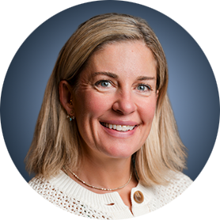
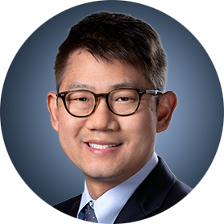
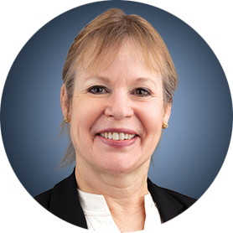
Faculty
Beth Faiman, PhD, MSN, APN-BC, AOCN, BMTCN, FAAN, FAPO
Adult Nurse Practitioner
Department of Hematology and Medical Oncology
Cleveland Clinic Taussig Cancer Institute
Member, Population and Cancer
Prevention Program
Case Comprehensive Cancer Center
Cleveland, Ohio
Mary Steinbach, PhD-c, DNP, FNP-C, APRN
Lead Ambulatory Advanced Practice Clinician
Division of Hematology
Huntsman Cancer Institute at the
University of Utah
Salt Lake City, Utah
Hans Lee, MD
Director, Multiple Myeloma Research
Sarah Cannon Research Institute
Nashville, Tennessee
Moderator
Natalie S Callander, MD
Professor of Medicine
Director, Myeloma Clinical and Cellular Therapy Program
University of Wisconsin Carbone
Cancer Center
Madison, Wisconsin

Slide 3
Dr Faiman — Disclosures
Advisory Committees and Consulting Agreements | Janssen Biotech Inc, Sanofi

Slide 4
Dr Lee — Disclosures
Consulting Agreements (Paid to Institution) | AbbVie Inc, Alexion Pharmaceuticals, Allogene Therapeutics, AstraZeneca Pharmaceuticals LP, Bristol Myers Squibb, GSK, Janssen Biotech Inc, Legend Biotech, Medline, Pfizer Inc, Predicta Biosciences, Regeneron Pharmaceuticals Inc, Sanofi, Takeda Pharmaceuticals USA Inc
Consulting Agreements (Paid to Self) | Alexion Pharmaceuticals, Allogene Therapeutics, Bristol Myers Squibb, GSK, Janssen Biotech Inc, Menarini Group, Pfizer Inc, Regeneron Pharmaceuticals Inc, Sanofi, Takeda Pharmaceuticals USA Inc
Contracted Research | AbbVie Inc, Alexion Pharmaceuticals, Amgen Inc, AstraZeneca Pharmaceuticals LP, Bristol Myers Squibb, GSK, Janssen Biotech Inc, Menarini Group, Moderna, Regeneron Pharmaceuticals Inc, Takeda Pharmaceuticals USA Inc
Data and Safety Monitoring Boards/Committees | Allogene Therapeutics, Takeda Pharmaceuticals USA Inc

Slide 5
Ms Steinbach — Disclosures
Advisory Committees | Bristol Myers Squibb, Johnson & Johnson, Pfizer Inc, Regeneron Pharmaceuticals Inc
Contracted Research and Speakers Bureaus | Johnson & Johnson, Pfizer Inc, Regeneron Pharmaceuticals Inc

Slide 6
Dr Callander — Disclosures
No relevant financial relationships to disclose.

Slide 7
Commercial Support
This activity is supported by educational grants from Bristol Myers Squibb, GSK, and Regeneron Pharmaceuticals Inc.
Research To Practice NCPD Planning Committee Members,
Staff and Reviewers
Planners, scientific staff and independent reviewers for Research To Practice have no relevant financial relationships to disclose.

Slide 8
This educational activity contains discussion of
non-FDA-approved uses of agents and regimens. Please refer to official prescribing information for each product for approved indications.

Slide 9



Clinicians in the Meeting Room
Networked iPads are available.
Review Program Slides: Tap the Program Slides button to review speaker presentations and other program content.
Answer Survey Questions: Complete the pre- and postmeeting surveys. Survey questions will be discussed throughout the meeting.
Ask a Question: Tap Ask a Question to submit a challenging case or question for discussion. We will aim to address as many questions as possible during the program.
For assistance, please raise your hand. Devices will be collected at the conclusion of the activity.
Notes:
9

Slide 10

Clinicians Attending via Zoom
Review Program Slides: A link to the program slides will be posted in the chat room at the start of the program.
Answer Survey Questions: Complete the pre- and postmeeting surveys. Survey questions will be discussed throughout the meeting.
Ask a Question: Submit a challenging case or question for discussion using the Zoom chat room.
Get NCPD Credit: An NCPD credit link will be provided in the chat room at the conclusion of the program.
Notes:
10

Slide 11
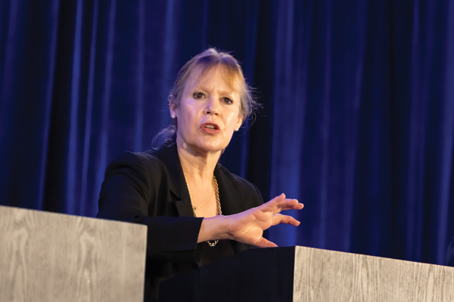
About the Enduring Program
The live meeting is being video
and audio recorded.
The proceedings from today will
be edited and developed into
an enduring web-based program.
An email will be sent to all attendees
when the activity is available.
To learn more about our education programs, visit our website, www.ResearchToPractice.com
Notes:
11
11

Slide 12



Slide 13

“Recent Advances in Cancer Care — New Paradigms,
Novel Agents and What It Means for the Oncology Nurse”
Eighteenth Annual RTP-ONS NCPD Symposium Series

Slide 14


New Agents, Therapies and Regimens
Recent Advances in Cancer Care — New Paradigms,
Novel Agents and What It Means for the Oncology Nurse
When should it be used, for whom and why?
How to prevent and manage side effects:
dose holds and reductions
  Kaplan Meier curves —
  HR and absolute benefit
  Waterfall plots

Slide 15
Relapsed/Refractory Multiple Myeloma
Recent Advances in Cancer Care — New Paradigms,
Novel Agents and What It Means for the Oncology Nurse
A Complimentary NCPD Symposium Series Held During the 51st Annual ONS Congress
Saturday, May 16, 2026
12:15 PM – 1:45 PM
Faculty
Beth Faiman, PhD, MSN, APN-BC, AOCN, BMTCN, FAAN, FAPO
Hans Lee, MD
Mary Steinbach, PhD-c, DNP, FNP-C, APRN
Moderator
Natalie S Callander, MD

Slide 16
Agenda
Introduction: The Multiple Myeloma (MM) Treatment Journey
Module 1: Role of Chimeric Antigen Receptor T-Cell Therapy in Relapsed/
Refractory (R/R) MM
Module 2: Role of BCMA- and Non-BCMA-Targeted Bispecific Antibodies in
R/R MM
Module 3: Utility of Belantamab Mafodotin in R/R MM
Module 4: Potential Role of Cereblon E3 Ligase Modulators in MM

Slide 17
Agenda
Introduction: The Multiple Myeloma (MM) Treatment Journey
Module 1: Role of Chimeric Antigen Receptor T-Cell Therapy in Relapsed/
Refractory (R/R) MM
Module 2: Role of BCMA- and Non-BCMA-Targeted Bispecific Antibodies in
R/R MM
Module 3: Utility of Belantamab Mafodotin in R/R MM
Module 4: Potential Role of Cereblon E3 Ligase Modulators in MM

Slide 18
Discussion Questions
At a very basic level, how do you counsel your patients with MM about the nature of their disease and what their treatment journey might look like?
What sorts of discussions do you typically have with your patients at the time of disease relapse, and how do they typically react?

Slide 19
Agenda
Introduction: The Multiple Myeloma (MM) Treatment Journey
Module 1: Role of Chimeric Antigen Receptor T-Cell Therapy in Relapsed/
Refractory (R/R) MM
Module 2: Role of BCMA- and Non-BCMA-Targeted Bispecific Antibodies in
R/R MM
Module 3: Utility of Belantamab Mafodotin in R/R MM
Module 4: Potential Role of Cereblon E3 Ligase Modulators in MM

Slide 20
Role of Chimeric Antigen Receptor (CAR) T-Cell Therapy in Relapsed/Refractory (R/R) Multiple Myeloma (MM)
Natalie S Callander, MD
Professor of Medicine
Director, Myeloma Clinical and Cellular Therapy Program
University of Wisconsin Carbone Cancer Center
Madison, Wisconsin

Slide 21
What makes a good CAR-T target
Target should be essential for the growth and development of the (tumor) cell
Expression of target should be stable and highly expressed on cell of interest
Target should be absent from normal cells

Slide 22
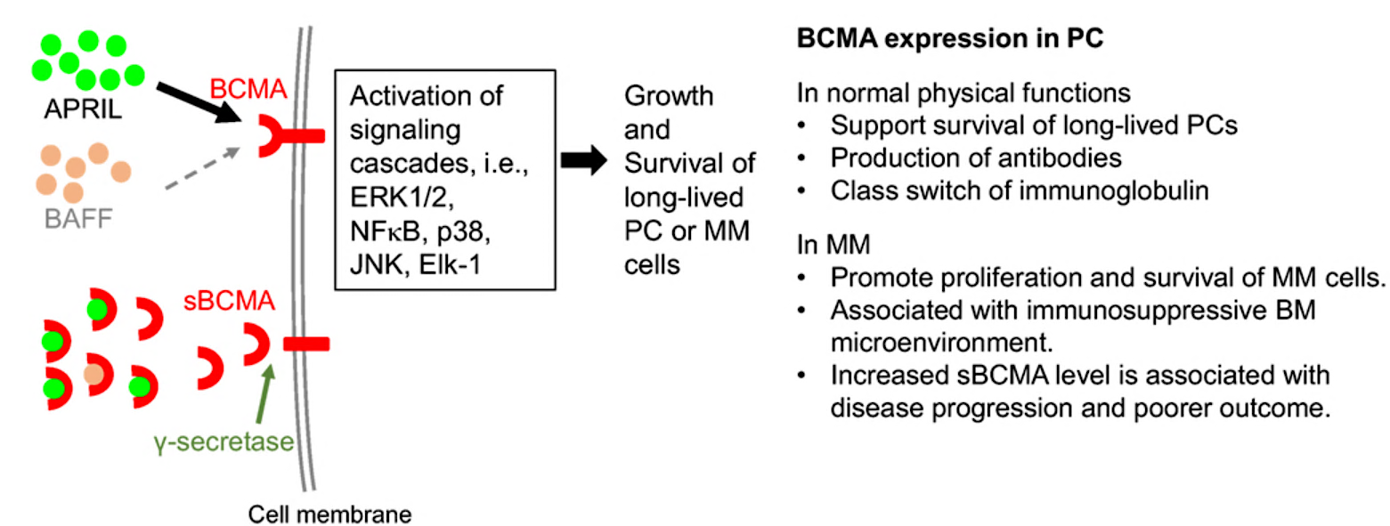
DOMINANCE OF BCMA AS BiSPECIFIC/CAR-T TARGET IN MYELOMA
Cho Front Immunol 2018

Slide 23
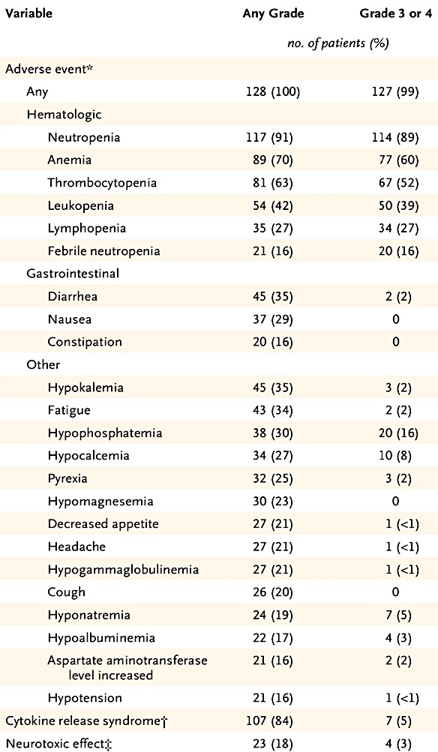
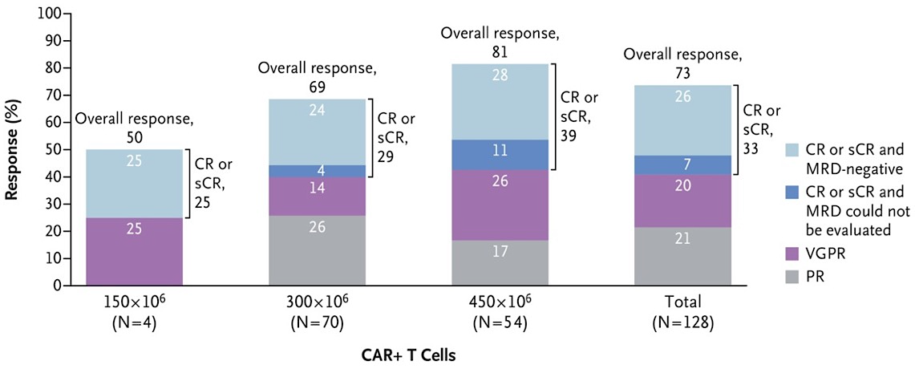
KarMMa: idecabtagene vicleucel, the “OG”
Munshi NC et al. N Engl J Med 2021;384:705-716

Slide 24
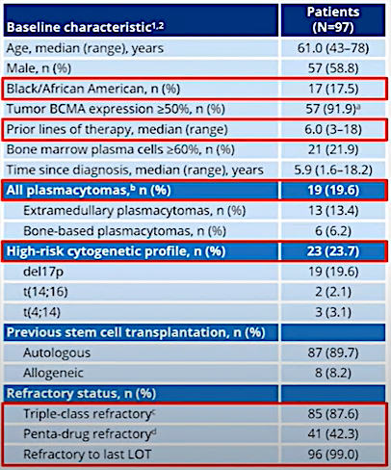
CARTITUDE-1: A Phase 1b/2
Primary objectives
  Phase 1b: Characterize the safety of cilta-cel and confirm the recommended phase 2 dose
  Phase 2: Evaluate the efficacy of cilta-cel
Key eligibility criteria
  Progressive MM per IMWG criteria
  ECOG PS ≤1
  Measurable disease
  ≥3 prior therapies or double refractory
  Prior PI, IMiD, anti-CD38 antibody exposure
Median administered dose:
0.71x10⁶ (range 0.51–0.95x10⁶) CAR+ viable T cells/kg
Martin et al, ASH 2021

Slide 25
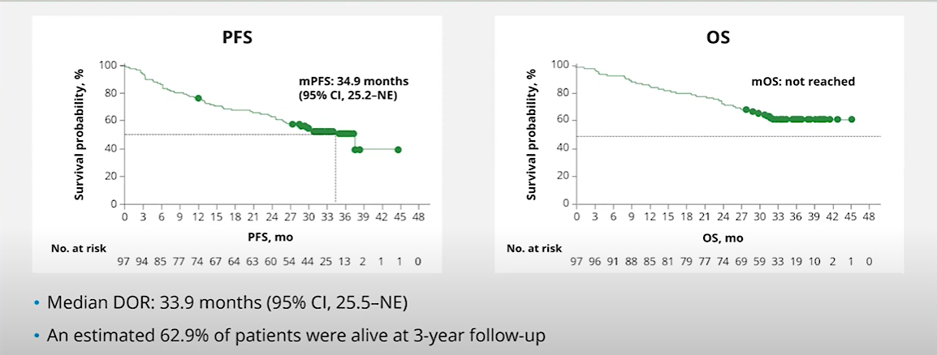
CARTITUDE-1: Efficacy Response
Responses deepened over time from the 1-year follow-up
sCR: 82.5%
≥VGPR: 94.9%
  Median time to first response was 1 month (range, 0.9–10.7)
  Median time to best response was 2.6 months (range, 0.9–17.8)
  Median time to CR or better was 2.9 months (range, 0.9–17.8)
  Median duration of response: 33.9 MO
  After 5 yr follow up, 33% had not progressed
  Obtaining CR and/or sustained MRD associated with best PFS
Best response =
sCR
VGPR
PR
Munshi, EHA 2023; Vorhees P ASCO 2025, Abstract 7507

Slide 26
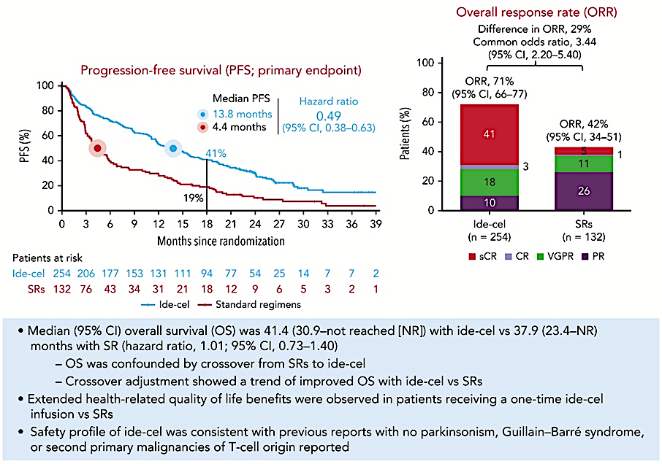
Ide-cel vs. SOC –KarMMa 3
Ailawadhi S et al. Blood. 2024 Dec 5;144(23):2389-2401.

Slide 27
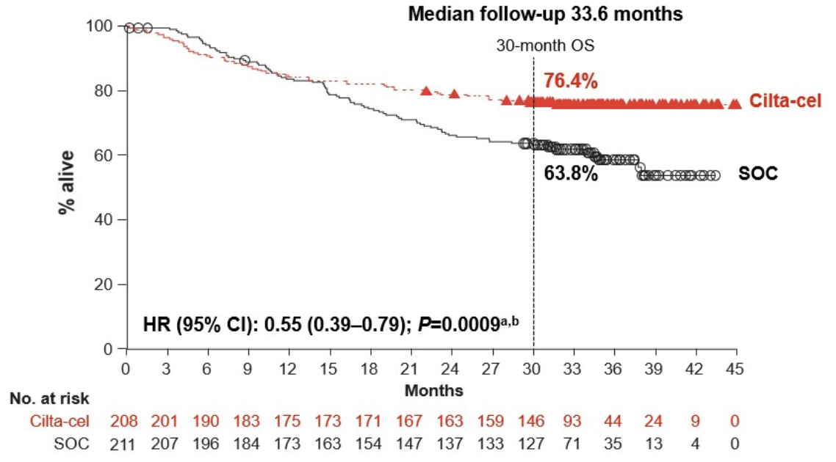
CARTITUDE-4: Cilta-cel vs. SOC: approved for “2nd line”
Wk 8 End of Bridging Phase
 | Cilta-Cel (n = 208) | SoC (n = 211)
mPFS, mo (95% CI) | NR (22.8-NE) | 11.8 (9.7-13.8)
 | HR: 0.26 (95% CI: 0.18-0.38; P <.0001)
12-mo PFS, % | 76 | 49
PR or better | NR | 16.6 mo
100
80
Cilta-cel group
60
Progression-free Survival (%)
40
20
Standard-care group
0
0
3
6
9
12
15
18
21
24
27
30
Patients at Risk, n
Cilta-cel group
Standard-care group
Mo
208
211
177
176
172
133
166
116
146
88
94
46
45
20
22
4
9
1
1
0
0
0
San-Miguel. NEJM. 2023;389:355.
Mateos IMS Brazil 2024

Slide 28
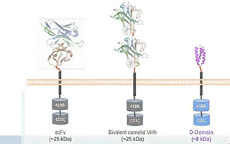
iMMagine-1: Phase 2 Study Design
Lymphodepleting chemotherapy
Cyclophosphamide 300 mg/m²
Fludarabine 30 mg/m²
Day -5, -4, -3
Leukapheresis
Screening
Anitocabtagene autoleucel manufacturing
Anitocabtagene autoleucel
infusion
Day 0
Response and safety assessments
(up to 24 months)
Long term safety follow-up
Bridging therapy if necessary
Key Eligibility Criteria
Prior IMiD, PI, and CD38-targeted therapy
Received ≥3 prior lines of therapy
Refractory to the last line of therapy
ECOG PS of 0 or 1
Evidence of measurable disease
Target Dose of 115 x 10⁶ CAR+ T cells
Primary Endpoint:
ORR, per 2016 IMWG criteria
Key Secondary Endpoints:
CR/sCR rate, per 2016 IMWG criteria
ORR in patients limited to 3 prior LOT, per 2016 IMWG criteria
Primary and key secondary endpoints to be assessed per Independent Review Committee (IRC); Investigator assessment of response per IMWG also permitted per protocol.
CR, complete response; ECOG PS, Eastern Cooperative Oncology Group Performance Status Scale; IMiD, immunomodulatory drug; IMWG, International Myeloma Working Group; LOT, line of therapy; ORR, overall response rate; PI, proteasome inhibitor; sCR, stringent complete response.
Freeman CL et al, ASH 2024, Abstract 1031

Slide 29
iMMagine-1: Overall Response Rate and MRD Negativity
Efficacy Evaluable Patients (N=86)
At a median follow-up of 9.5 months, responses were ongoing in 80.2% of 86 patients
93.1% (n=54/58) of evaluable* patients MRD negative at minimum of 10⁻⁵ sensitivity
 | Evaluable Patients | Months (min - max)
Median time to first response | 84 | 1 (0.9 - 7.3)
Median time to MRD negativity of 10⁻⁵ or lower | 58 | 1.0 (0.9 - 6.4)
No late neurotoxicity observed
PDUFA date Dec 2026
Best Response:
Responses are investigator assessed, ORR defined as partial response or better; *Evaluable patients had identifiable malignant clone in the baseline bone marrow aspirate
CR, complete response; MRD, minimal residual disease; ORR, overall response rate; PR, partial response; sCR, stringent complete response; VGPR, very good partial response
Freeman CL et al, ASH 2024, Abstract 1031

Slide 30
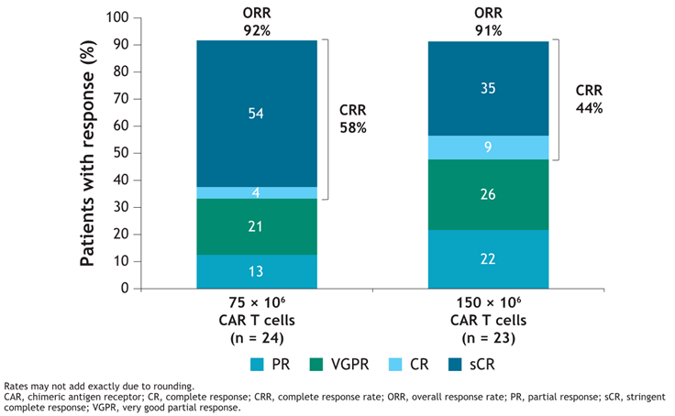
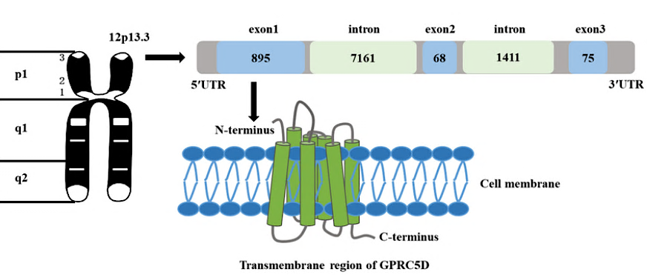
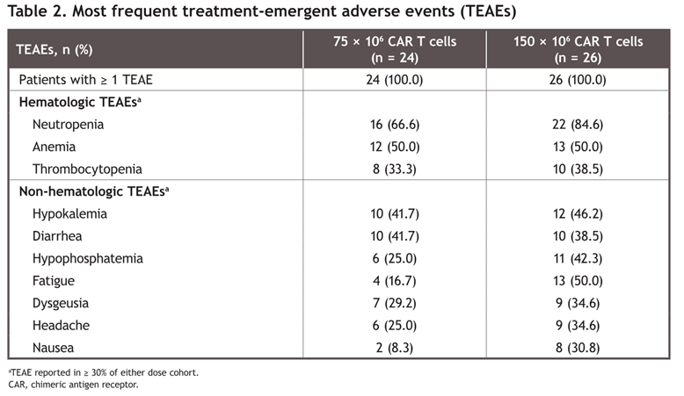
ARLOCABTAGENE targets GPRC5D: phase 2 trial underway
GPRC5D complex
Arlo-cel CAR-T targets GPRC5D
Study includes pts who have received previous
BCMA directed therapies
Patel K et al. ASCO 2025;Abstract TPS7563
Bal S et al. IMS 2025;Abstract PA-076

Slide 31




BETTER RESPONSE BY TARGETING 2 RECEPTORS:
AZD0120: A Novel BCMA/CD19 Dual CAR T
Dual Target
BCMA/CD19 Dual CAR T
\
Next-Generation Manufacturing
Faster to Patients Better T Cells
Manufactured in
<3 days
Younger, fitter naive T cells
α-CD19
Safety profile enabling outpatient administration and monitoring
BCMA
α-BCMA
CD19 (low expression)
CD19
\
\
Making cell therapy available to more patients
MM cell
MM progenitor
AZD0120 was formerly named GC012F, and next-generation manufacturing refers to the FasTCAR platform. BCMA, B-cell maturation antigen; CAR T, chimeric antigen receptor T-cell therapy; MM, multiple myeloma.
OVER COME RESISTANCE BY DUAL TARGETING

Slide 32
Study Design
Study Schema
AZD0120 infusion
DL1: 1×10⁵ cells/kg
DL2: 3×10⁵ cells/kg
Apheresis
Flu/Cy
Days −5, −4, −3
Follow-up
Bridging/ debulking tx
(as needed)
Key inclusion criteria
Phase 1b primary objectives
≥3 prior LOT (exposure to PI, IMiD, and anti-CD38 Ab required)
Documented evidence of PD with most recent LOT
Prior exposure to BCMA-directed therapy permittedª
Safety/tolerability
RP2D determination
ªIf prior BCMA-directed therapy occurred >6 months before the study.
Ab, antibody; BCMA, B-cell maturation antigen; DL, dose level; Flu/Cy, fludarabine/cyclophosphamide; IMiD, immunomodulatory drug; LOT, line(s) of therapy; PD, progressive disease; PI, proteasome inhibitor; RP2D, recommended phase 2 dose; tx, therapy.

Slide 33
Case Presentation

Slide 34
58 y.o. female presented with knee pain 6/2013; kappa LC 304 mg/dl, BMBX 83% PCs,
  XRT, lenalidomide/dex
  Auto PBSCT 2/2014, len maintenance
  4/2018 new lytic lesions, Icd,
  IxaPomD, Ikd, XPd
  5/2022 referred for CAR-T-idecabtagene-no CRS, ICANS
  Currently in CR

Slide 35
Discussion Questions
How do you choose patients for anti-BCMA CAR T-cell therapy, and when do you typically employ it?
Do you have a preference for ide-cel over cilta-cel or vice versa for any specific types of patients or in any particular clinical situations?
In your experience, how long do responses with anti-BCMA CAR T-cell therapy typically last? How much of an advantage do your patients who have been administered CAR T-cell therapy find it to not receive ongoing treatment for a period of time?

Slide 36
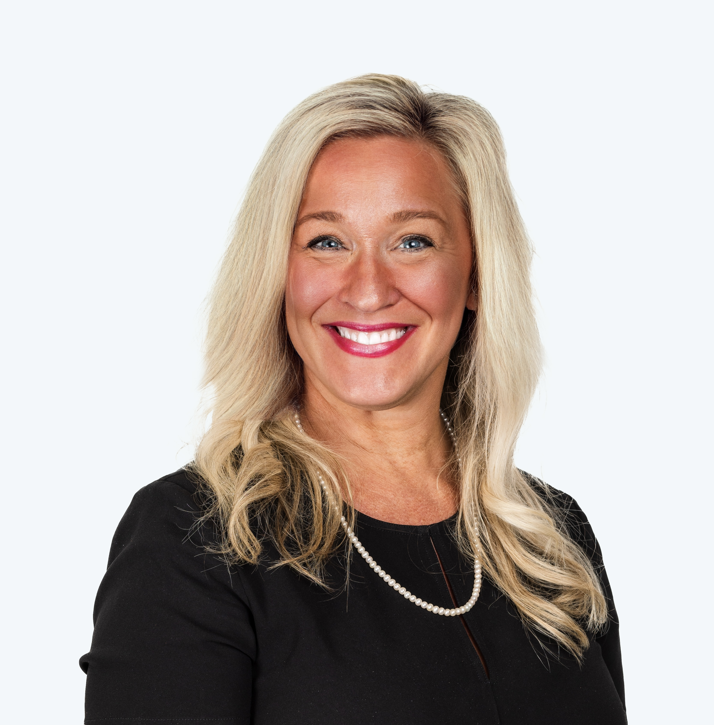
Tolerability and Other Practical Considerations with CAR T-Cell Therapy
Beth Faiman PHD, MSN, APN-BC, AOCN, TCTCN, FAAN, FAPO
Nurse Practitioner and Clinical Researcher
Department of Hematology and Medical Oncology, Cleveland Clinic
Member, Cancer Population and Health, Case Western Reserve University
Cleveland, OH

Slide 37
Overview of the CAR T-cell manufacturing and delivery processes
Patient Identification
(meets FDA label)
Referral to
CAR T Specialist
T-Cell Collection via Apheresis
Close Monitoring
± Bridging Therapy
No age cutoff
1 prior LOT for ciltacel; 2LOT ide cel
CAR centers will have variable eligibility criteria, so best to refer and let them decide
Patients can be CAR candidates who are not auto-transplant candidates
The earlier the referral, the better!
Eligibility evaluation
Insurance authorization
Consent and education
LD Chemotherapy
and T-Cell Infusion
Is the patient experiencing significant symptoms or at risk for organ function impairment?
Bridging could include steroids, palliative RT, chemotherapy, and/or newer targeted agents (e.g talquetamab)
LD chemo mostly outpatient
(ie, Flu/Cy x 3 days)
CAR T-cell infusion can be inpatient or outpatient
Postinfusion monitoring involves daily labs, close vital sign monitoring, and exams for at least 7 days to assess for CRS/NT
Can be outpatient or inpatient depending on the center
Patient remains within 2 hr of CAR center for 4 wk from infusion
Monitor for late CRS/NT and/or ongoing cytopenias
First response assessment often at 4-wk mark
Assessment of toxicities and response is critical in the acute and delayed Post–CAR T stages

Slide 38



Three main considerations: Acute and delayed
Cytokine Release
Syndrome (CRS)
Immune effector cell–associated neurotoxicity syndrome (ICANS)
Infection
Neuro Toxicity
Cilta-cel (~7–8 days)
ide-cel (~1–2 days)
Incidence less in earlier LOT (4.5%)
Range 45–69% and highest cause of non-relapse mortality

Slide 39
Understanding CRS and Neurologic Events
CRS Symptoms
Common | Potentially Serious
Fever Hypotension Tachycardia Hypoxia Chills | Atrial fibrillation Ventricular tachycardia Cardiac arrest Cardiac failure Renal insufficiency Capillary leak syndrome Hypotension Hypoxia HLH/MAS
CAR-T cell infusion
Neurologic event median onset Day 4
CRS median resolution Day 8
CRS
median onset
Day 2
Neurologic event median resolution Day 17
CAR T-cells in the blood
Neurologic Event Symptoms
Common | Potentially Serious
Encephalopathy Tremor Dizziness Delirium Confusion Agitation | Seizures Leukoencephalopathy Cerebral edema Aphasia Obtundation
CRS
Neurologic events
0
7
14
28
DAY

Slide 40
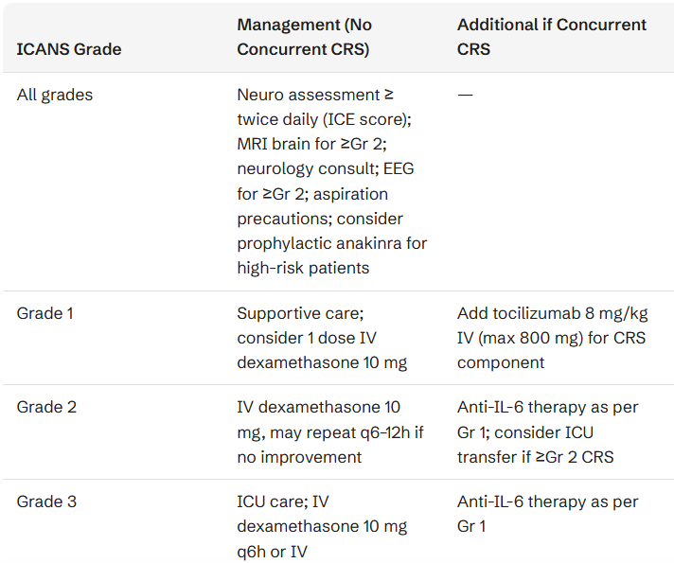
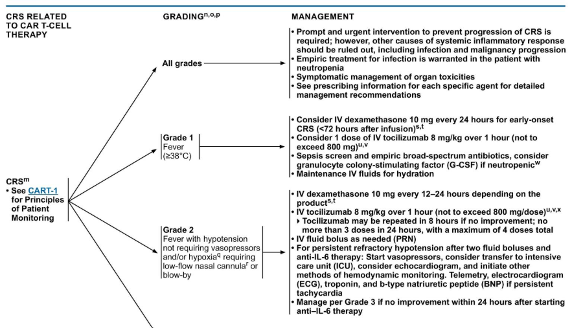
Guideline-endorsed approaches for mitigation and management of CRS, neurotoxicity/ICANS and other AEs with CAR T-cell therapy

Slide 41
Domain | Recommendation
Cardiac | Baseline echocardiogram; cardiology consult if prior cardiac history
Vascular access | Central venous access (double/triple lumen) for IV fluids and vasopressors
Seizure prophylaxis | Levetiracetam 500–750 mg PO q12h × 30 days if high ICANS risk based on patient factors or product type
Neurologic baseline | ICE score (adults), baseline brain MRI consideration
Labs | Baseline CRP and ferritin (pre-lymphodepletion) to calculate CAR-HEMATOTOX score; HIV, HBV, HCV screening; consider CMV
Tumor lysis prophylaxis | Per institutional guidelines for patients with large tumor burden
Infection prophylaxis | PJP prophylaxis (TMP-SMX or alternatives) ≥6 months; VZV/HSV prophylaxis ≥1 year (indefinite preferred); antibacterial/antifungal prophylaxis while neutropenic
Immunoglobulin | In myeloma, IVIG should be considered if IgG 400 mg/dL prior to BCMA-directed CAR T-cell therapy

Slide 42
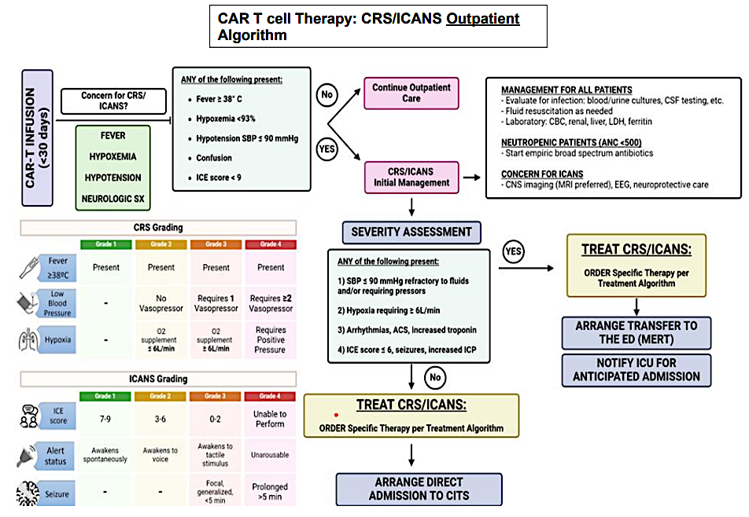
Outpatient considerations
Other Considerations
Routine lab and disease monitoring (CBC, CMP, Cytokines)
Regular assessments by Advanced practitioner or Physician

Slide 43
Medications to minimize infection risk
Type of Infection Risk | Medication Recommendation(s) for Healthcare Team Consideration
Viral: Herpes Simplex (HSV/VZV); CMV | Acyclovir prophylaxis
Bacterial: blood, pneumonia, and urinary tract infection | Consider prophylaxis with levofloxacin
PJP (P. jirovecii pneumonia) | Consider prophylaxis with trimethoprim-sulfamethoxazole
Fungal infections | Consider prophylaxis with fluconazole
COVID-19 and Influenza | Antiviral therapy if exposed or positive for covid per institution recommendations
IgG < 400 mg/dL (general infection risk) | IVIg recommended
ANC < 1000 cells/μL (general infection risk) | Consider GCSF 2 or 3 times/wk (or as frequently as needed) to maintain ANC > 1000 cells/μL and maintain treatment dose intensity
Some people receiving CART therapies have experienced infections that are less common like CMV, PJP and fungal infections
ANC = absolute neutrophil count; BCMA = B-cell maturation antigen; CAR = chimeric antigen receptor; CMV, cytomegalovirus; GCSF = granulocyte colony-stimulating factor; HSV = herpes simplex virus; IVIg = intravenous immunoglobulin; PJP = Pneumocystis jirovecii pneumonia; VZV = varicella zoster virus.
Raje NS, et al. Lancet Haematol.2022;9(2):143–161; NCCN v 5.2026; Shahid Z, et al., Transplant Cell Ther. 2024;30(10):955-969.

Slide 44
Adverse Event | Incidence | Key Features | Management
Delayed Neurotoxicity (Non-ICANS) | IEC-Parkinsonism: ~5% (CARTITUDE-1) Cranial nerve palsy: 2.5–9% with cilta-cel; rare with ide-cel. | Onset 11–108 days post-infusion (later than ICANS). Parkinsonism: bradykinesia, rigidity, tremor, micrographia, personality change; levodopa-unresponsive. Cranial nerve palsy: facial paralysis, peripheral neuropathy. Risk factors: high tumor burden, grade ≥2 CRS, prior ICANS, high CAR T-cell expansion | Parkinsonism — Variable strategies from dexamethasone 10 mg 2–4×/day × 3–5 days; Severe/refractory: high-dose cyclophosphamide (2 g/m²) to ablate CAR T cells; alternatives include intrathecal chemotherapy or ruxolitinib. No consensus
Prolonged Cytopenias (ICAHT) | Grade ≥3 cytopenias at day 28: ~30–52%; persistent grade ≥3 at day 100: ~19%; may persist >1 year in 64% of those with day-100 cytopenias | Neutropenia, thrombocytopenia, anemia persisting weeks to months. Associated w/ worse PFS and OS. Risk factors: baseline inflammation, clonal hematopoiesis (CH), CRS severity, prior therapy burden. CAR-HEMATOTOX score can predict risk | First-line: transfusion support + G-CSF Refractory: consider autologous stem cell boost if available. Evaluate for MDS if cytopenias persist. Monitor CBC closely for months post-infusion
Hypogamma-globulinemia | Post-BCMA CAR T: 68–80% develop hypogammaglobulinemia; 42–68% persist >12 months | BCMA-directed therapy targets plasma cells, impacting pre-existing pathogen-specific immunity while preserving naïve/memory B cells (unlike CD19 CAR T). Lower IgG and greater IgG decline post-CAR T associated with increased infection risk and mortality | In myeloma: IVIG should be considered if IgG 400 mg/dL prior to BCMA-directed CAR T (not guided by presence of infections
Infections | Any grade: 45–69%; Grade ≥3: 20–27%. Bacterial: first 30 days; viral infections (especially respiratory) 30 days and up to >1 year. Invasive fungal infections: ~8%. **leading cause of non-relapse mortality | Risk factors: CRS severity, prolonged neutropenia, hypogammaglobulinemia, prior therapies, lymphopenia. CRS may mimic sepsis | See previous chart; — empiric antibiotics recommended if neutropenic with fever
Secondary Malignancies | Overall SPM: ~6% (meta-analysis, median follow-up 22 months); 2–10% within 5 years. Hematologic SPM most common T-cell malignancies extremely rare. Solid tumors and NMSC also reported | Hematologic SPMs (MDS/AML) associated with clonal hematopoiesis, especially TP53-mutated CH (67% MDS incidence if baseline TP53 CH). -(pre-existing mutations, viral infections, possible insertional mutagenesis). Randomized trial data show similar SPM risk vs. standard-of-care | Survivorship monitoring, health maintenance

Slide 45
Case Presentation

Slide 46
Case Presentation
78 YO PMHx HTN, DM2, hyperlipidemia diagnosed in 2018 with high risk, IgA Lambda MM (gain 1q; t(4;14), 80% bone marrow plasmacytosis
LOT1: Induction KRd – ASCT – Kd maintenance (FORTE trial) until March 2022; PD with progression on surveillance PET scan
LOT2: Dara + Pom + dex , March 2022-April 2023; PD biochemical (doubling lambda light chains)
LOT3: Cilta-cel May 2023. Admitted Day +7 for CRS management until day +11. On day 28, admitted after onset of L-sided facial droop w/ progressive lip numbness.
High dose dexamethasone given for 7 day course w/ taper for delayed cranial nerve VII palsy
MRI no significant findings. Completed 7day course of dexamethasone, and Palsy resolved within 10 days. Continues to be MRD negative.

Slide 47
Discussion Questions
What steps can nurses in community-based practice take to ensure a smooth transition for patients who receive CAR
T-cell therapy at tertiary care centers and then return to them for routine care? What clinical pearls would you offer nurses in this situation?

Slide 48
Agenda
Introduction: The Multiple Myeloma (MM) Treatment Journey
Module 1: Role of Chimeric Antigen Receptor T-Cell Therapy in Relapsed/
Refractory (R/R) MM
Module 2: Role of BCMA- and Non-BCMA-Targeted Bispecific Antibodies in
R/R MM
Module 3: Utility of Belantamab Mafodotin in R/R MM
Module 4: Potential Role of Cereblon E3 Ligase Modulators in MM

Slide 49
Role of BCMA- and Non-BCMA-Targeted Bispecific Antibodies in Multiple Myeloma
May 16, 2026
Hans Lee, MD
Director, Multiple Myeloma Research
Sarah Cannon Research Institute
Notes:
I. DIAGNOSIS, STAGING, AND PROGNOSIS
Chronic Lymphocytic Leukemia

Slide 50
What is a Bispecific T-cell Antibody?
T-cell
CD3
Myeloma
Cell
Myeloma Cell Death
BCMA
Bispecific T-cell antibody

Slide 51
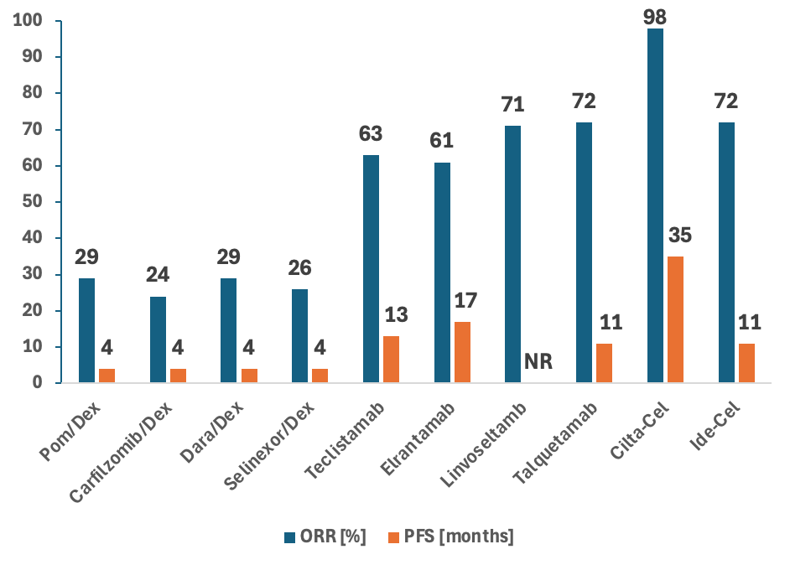
Overall Response Rate (ORR) and Progression Free Survival (PFS) of Recently Approved Drugs in Relapsed/Refractory Myeloma
Moreau P, et al. N Engl J Med. 2022;387:495-505; Lesokhin AM, et al. Nat Med. 2023;29:2259-2267; Bumma N, et al. J Clin Oncol. 2024;42:2702-2712; Chari A, et al. N Engl J Med. 2022;12:e269-e281.
Notes:
San Miguel et al, 2013, Lancet Oncology; Siegel et al, Blood, 2012; Lonial et al, Lancet, 2016; Chari et al, NEJM 2019; Moreau et al, NEJM, 2022; Lesokhin et al, NatureMedicine, 2023; Bumma et al, JCO, 2024; Chari et al, NEJM, 2022; Berdeja et al, Lancet, 2021; Munshi et al, NEJM, 2021

Slide 52
Bispecific T-Cell Antibodies Summary
Drug | Target | Administration Route | Which Patients Can Receive?
Teclistamab FDA approved, 2022 | BCMA | Subcutaneous | ≥ 4 lines of therapy OR ≥ 1 line of therapy in combination with daratumumab
Elranatamab FDA approved, 2023 | BCMA | Subcutaneous | ≥ 4 lines of therapy
Linvoseltamab FDA approved, 2025 | BCMA | Intravenous | ≥ 4 lines of therapy
Talquetamb FDA approved, 2023 | GPRC5D | Subcutaneous | ≥ 4 lines of therapy
Etentamig (in clinical development) | BCMA | Intravenous | Clinical trial only
Cevostamab (in clinical development) | FCRH5 | Intravenous | Clinical trial only

Slide 53
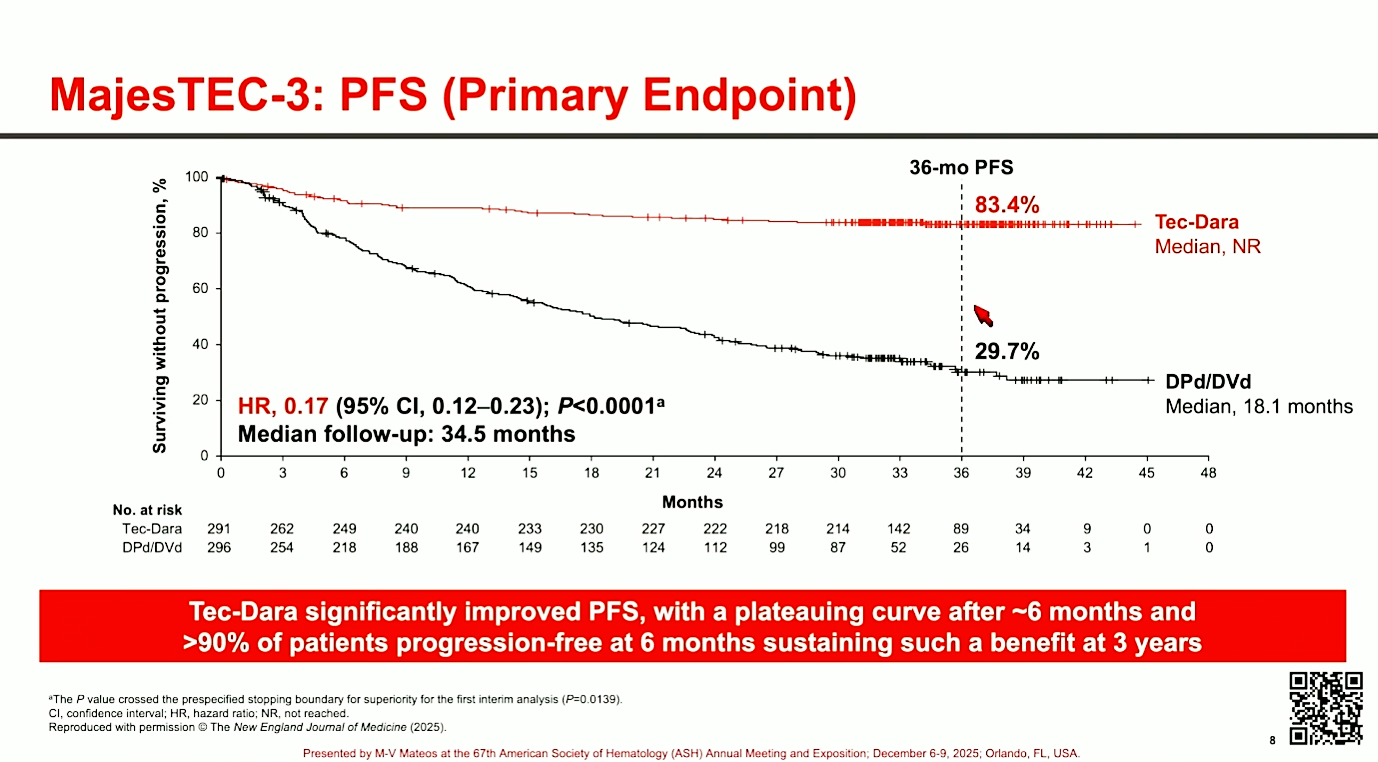
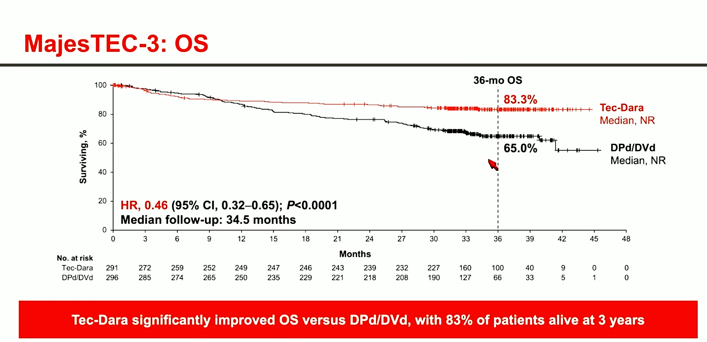
MajesTEC-3: Teclistamab + Daratumumab vs. Standard Therapies (1-3 prior lines of therapy)
Teclistamab + Daratumumab combination significant longer survival compared to conventional therapies!
FDA Approved on March 5, 2026
Costa et al. NEJM. 2025.

Slide 54
MajesTEC-9 Phase III Trial Design
Teclistamab
Screening (28 days)
≥18 years of age RRMM per IMWG criteria with evidence of progressive disease or failure to achieve a response to the last LOT ECOG PS 0-2 1-3 prior LOT, including ≥2 consecutive days of an anti-CD38 mAB and ≥2 consecutive cycles of lenalidomide No prior BCMA targeted therapy
January 14, 2026 – “[A] worldwide leader in multiple myeloma therapies, today announced positive topline results from the investigational Phase 3 MajesTEC-9 study of teclistamab-cqyv monotherapy, showing a 71% reduction in the risk of disease progression or death and a 40% reduction in the risk of death in a patient population that was predominantly refractory to anti-CD38 therapy and lenalidomide. Data confirm superior progression-free survival (PFS) and overall survival (OS) with teclistamab-cqyv compared to standard of care as early as second line.”
https://www.jnj.com/media-center/press-releases/tecvayli-monotherapy-demonstrates-superior-progression-free-and-overall-survival-versus-standard-of-care-as-early-as-first-relapse-in-patients-with-multiple-myeloma-predominantly-refractory-to-anti-cd38-therapy-and-lenalidomide
R
PVd or Kd
Primary endpoint: Progression-free survival per IMWG 2016 criteria
https://clinicaltrials.gov/ct2/show/NCT05572515. Accessed April 2026.

Slide 55
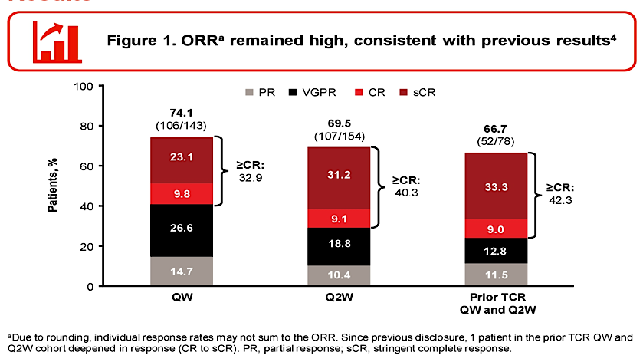
Phase I/II MonumenTAL-1 Study: ORR
Rasche L et al. ASCO 2025

Slide 56
Myeloma Bispecific Antibody Summary
  Bispecific antibodies represent major therapeutic advance for patients with myeloma
    Very strong efficacy
    Accessible (“off-the-shelf”)
    Side effect profile manageable so that most patients can receive them
  Future directions
    Will form backbone for newly diagnosed myeloma treatment in future
    Fixed duration therapy approaches
    Multi-antigen targeting (multiple bispecifics or trispecifics)

Slide 57
Case Presentation

Slide 58
Patient Case
82 yo male with relapsed/refractory multiple myeloma
Diagnosed in 2022, high-risk disease with del 17p. Presented with renal failure and bone lesions
Line 1: -CyBorD x 1 cycle, then Dara-VRd induction x 5 cycles (stopped bortezomib due to
neuropathy), then DRd maintenance with very good partial response (VGPR)
-Disease progression in May, 2024
Line 2: -Carfilzomib, Cyclophosphamide, Dexamethasone x 5 cycles, then carfilzomib QOW + dexamethasone maintenance with VGPR
-Rapid disease progression in October, 2025 with M-protein 2.8 g/dL, serum free kappa light chain 1004 g/dL, FLC ratio 225

Slide 59
Patient Case (Cont)
82 yo male with relapsed/refractory multiple myeloma
Discussed treatment options with patient. Very functionally independent, lives alone, has adult son/family that lives locally with strong support system.
Comorbidities include
  Residual intermittent grade 1 peripheral neuropathy
  Chronic kidney disease (baseline creatinine 1.5)
  Hypertension
  Prostate cancer that is being observed
Discussed CART; however given rapidly progressing disease, high-disease burden, and advanced age, decided to proceed with BCMA bispecific antibody option with linvoseltamab as the best next treatment course

Slide 60
Patient Case (Cont)
82 yo male with relapsed/refractory multiple myeloma
Linvoseltamab initiated in October, 2025
  Prophylactic tocilizumab given prior to first step-up dose of linvoseltamab
  Grade 1 CRS (single fever) on cycle 1, day 2 (1 day after first step-up dose); managed with acetaminophen, resolved.
  No recurrent CRS. No ICANS.
Best response VGPR (deepest response patient has attained to-date for his myeloma).
Linvoseltamab was de-escalated to q4 week dosing after 6 cycles
Supportive care: valacyclovir for VZV prophylaxis, sulfamethoxazole/trimethoprim for PJP prophylaxis, monthly IVIG

Slide 61
Discussion Questions
How are you currently sequencing bispecific antibodies relative to other currently available therapies for R/R MM?
How do you choose among the available BCMA-targeted bispecific antibodies — teclistamab, elranatamab and linvoseltamab — as monotherapy? When are you more likely to opt for teclistamab/daratumumab? What about talquetamab?

Slide 62
ONS 2026 SYMPOSIUM · PRESENTATION 4
Toxicities & Practical Issues with
Bispecific Antibodies in Multiple Myeloma
Mary Steinbach, DNP, APRN
Huntsman Cancer Institute · University of Utah
Saturday, May 16, 2026

Slide 63
WHAT WE'RE TALKING ABOUT
Bispecific antibodies: the MM landscape today
How they work — in plain language
Teclistamab
SC
A bispecific is a single Y-shaped antibody with two grips. One grip grabs a marker on the myeloma cell (BCMA or GPRC5D). The other grip grabs the patient's own T-cells. Pulling the two together tells the T-cell to kill the cancer cell.
BCMA × CD3
Elranatamab
SC
BCMA × CD3
Linvoseltamab
IV
BCMA × CD3
All four are FDA-approved after ≥4 prior lines (PI, IMiD, anti-CD38).
Talquetamab
SC
GPRC5D × CD3
Bispecific Antibody Toxicities · M. Steinbach · ONS 2026

Slide 64
ROUTES & SCHEDULES
Step-up dosing: the on-ramp matters
Agent | Step-up doses | Target dose | Frequency at target
Teclistamab (SC) | 0.06 → 0.3 mg/kg | 1.5 mg/kg | Weekly; q2wk option after ≥6 mo CR
Elranatamab (SC) | 12 mg → 32 mg | 76 mg | Weekly × 24 wk → q2wk
Linvoseltamab (IV) | 5 mg → 25 mg | 200 mg | Weekly → q2wk → q4wk by response
Talquetamab (SC) | 0.01 → 0.06 → 0.4 mg/kg (or to 0.8 for q2wk) | 0.4 mg/kg wkly or 0.8 mg/kg q2wk | Weekly or q2wk schedule
Why it matters: Step-up doses are intentionally small to lower the cytokine surge — the patient's first full dose is the highest-risk window for CRS.
Bispecific Antibody Toxicities · M. Steinbach · ONS 2026

Slide 65
BEFORE EACH STEP-UP
Premedications & where the patient stays
Premedications (each step-up + first full dose)
Hospitalization during step-up
Acetaminophen 650–1000 mg PO
Diphenhydramine 25–50 mg PO/IV
Dexamethasone 16 mg IV/PO (20 mg elranatamab; 40 mg linvoseltamab)
Consider tocilizumab 8 mg/kg prophylactically before first full dose at high-volume centers
Anti-infective prophylaxis: HSV/VZV, PJP, IVIG when IgG <400 mg/dL
Inpatient (per label):
Teclistamab — 48 h after each step-up + first full dose
Elranatamab — 48 h after dose 1, 24 h after dose 2
Linvoseltamab — 24 h after each step-up
Outpatient pathways (institution-specific):
24/7 access to non-ED clinical contact
Dedicated caregiver × 48 h, no driving
Patient stays within 30 min of hospital
Wallet card + rescue meds at home
Bispecific Antibody Toxicities · M. Steinbach · ONS 2026

Slide 66
MOST-COMMON TOXICITY
Cytokine release syndrome (CRS): what to expect
~60-75%
<3%
1–3 d
<2 d
any-grade CRS
(tec, elra, linvo)
Grade ≥3 CRS
across BCMA agents
typical onset
after step-up dose
typical duration
(once tx started)
What it looks like at the bedside
Fever ≥38°C is almost always the first sign — treat empirically until proven otherwise
Hypotension: tachycardia first, then BP drop — watch trends, not single readings
Hypoxia: subtle desat on ambulation often precedes resting hypoxia
Rigors, headache, fatigue — patients describe it as “the worst flu I’ve ever had”
Bispecific Antibody Toxicities · M. Steinbach · ONS 2026

Slide 67
ASTCT GRADING + TOCILIZUMAB ALGORITHM
Grading & treating CRS
Grade | What you see | First moves
1 | Fever ≥38°C only | Acetaminophen, IV fluids, blood cultures, tocilizumab 8 mg/kg
2 | Fever + hypotension responsive to fluids, or O₂ by NC ≤6 L/min | Tocilizumab ± dexamethasone 10 mg IV q6h; vasopressor if no response
3 | Fever + hypotension on ≥1 pressor, or O₂ >6 L/min | ICU; tocilizumab + high-dose dex; consider anakinra if refractory
4 | Multiple pressors, mechanical ventilation | ICU; methylprednisolone 1000 mg/day; anakinra; siltuximab
Pearls: max 4 toc doses in 24 h (3 max in label). Don’t hold antibiotics waiting for cultures. Most CRS resolves in 24–48 h once treated.
Bispecific Antibody Toxicities · M. Steinbach · ONS 2026

Slide 68
LESS COMMON
Neurotoxicity (ICANS): catch it early
Lower incidence than CAR-T — ICANS in ~3–10% on bispecifics (≤3% Grade ≥3)
Onset within 1–2 weeks — often during or just after CRS
Tremor, dysgraphia, expressive aphasia, confusion — often subtle first
Talquetamab also causes a distinct, non-ICANS neuro picture (cranial-nerve palsies, paresthesias)
First-line: dexamethasone 10 mg IV q6h — it crosses the BBB. Anakinra if refractory.
ICE Score (10 points)
Use BID during peak risk
Orientation × 4 (year, month, city, hospital)
Naming × 3 (name 3 objects)
Following commands × 1
Writing × 1 (write a standard sentence)
Attention × 1 (count 100 backwards by 10s)
10 = normal 0–2 = G4 3–6 = G2/3 7–9 = G1
Bispecific Antibody Toxicities · M. Steinbach · ONS 2026

Slide 69
BEYOND THE FIRST CYCLE
Persisting toxicities: infections & cytopenias
Infections
Cytopenias
Hepatic & other
~70%
~60%
<5%
any-grade with BCMA bispecifics
neutropenia (G3/4) on label
Grade ≥3 LFT elevations
Any-grade ~50% with talquetamab; Grade ≥3 ~25% with BCMA agents
Hypogammaglobulinemia is the rule — IgG <400 mg/dL or recurrent infections → IVIG
PJP, HSV/VZV prophylaxis; CMV PCR if febrile or unexplained cytopenias
Vaccinate ahead of therapy: COVID, flu, RSV (≥60 y), pneumococcal
Neutropenia, anemia, thrombocytopenia are common in cycles 1–3
G-CSF support; transfusions per institutional thresholds
Re-check CBC before each dose during weekly schedule
Hold dose for ANC <1.0 or platelets <50
Transaminitis usually mild and self-limited — monitor each cycle
Talquetamab: dysgeusia, weight loss, nail/skin (next slide)
Rare: PML, hepatic failure (case-level reports with teclistamab)
Injection-site reactions — rotate sites, cool compresses
Bispecific Antibody Toxicities · M. Steinbach · ONS 2026

Slide 70
GPRC5D: ON-TARGET, OFF-TUMOR
Talquetamab’s signature: skin, nails, taste
Why it happens
What helps the patient
GPRC5D lives on myeloma cells — but also on healthy tissues that make keratin (skin, nails, tongue). Hitting GPRC5D shrinks the tumor and irritates those tissues at the same time.
Skin: thick fragrance-free moisturizers BID; antihistamines for itch; topical steroid for persistent rash; gentle exfoliation of peeling palms/soles
Nails: keep short, file edges; dimethicone; avoid acrylics; protect with gloves for cleaning
Mouth & taste: frequent sips of water, sugar-free gum, saliva substitutes; nutrition referral if ≥5% wt loss; dose-reduce or extend interval to q4wk after ≥PR
62%
52%
48%
skin AEs
(rash, peeling)
nail AEs
dysgeusia
Bispecific Antibody Toxicities · M. Steinbach · ONS 2026

Slide 71
TAKE-HOME POINTS
What I want you to remember
1
The first full dose is the riskiest dose.
CRS shows up in 60–75% of patients during step-up. Watch the temperature curve, treat ≥38°C aggressively, and have toc at the bedside.
2
Tocilizumab is your friend, don’t wait.
Early, low-grade CRS treated promptly almost always resolves quickly and prevents escalation.
3
Neuro changes are subtle. Use ICE.
Tremor, hesitant speech, or trouble writing a sentence are early signs. BID ICE during peak risk catches it.
4
Infections are the long game.
Vaccinate ahead. Trend IgG. Replace with IVIG. Counsel patients to call for any fever, even months in.
5
Talquetamab needs proactive skin/mouth care.
Set patients up with moisturizer, saliva substitute, and a nutrition plan before cycle 1 , not after they’re struggling.
Bispecific Antibody Toxicities · M. Steinbach · ONS 2026

Slide 72
Case Presentation

Slide 73
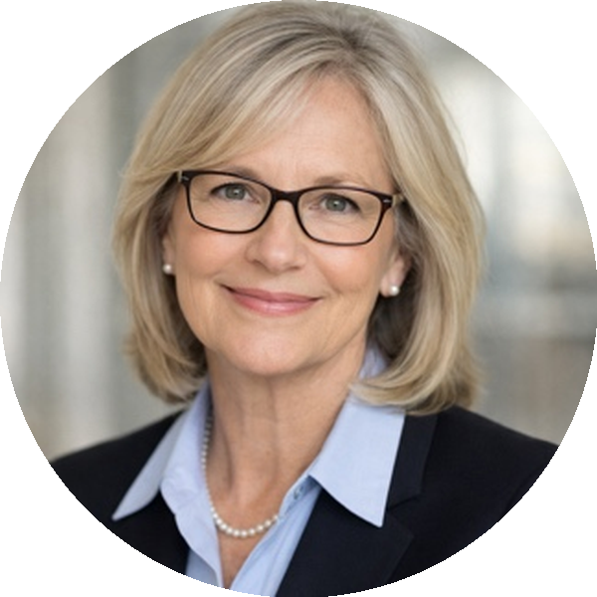
CASE PRESENTATION
62-year-old woman with R-ISS II IgA Lambda Multiple Myeloma
On talquetamab + pomalidomide (MonumenTAL-6)
Diagnosis · 4/22/24
Toxicities
IgA λ MM · R-ISS II · ISS I
Advanced bone disease
FISH: 1q gain (40%), 16q23 gain (61%)
Hgb 13.1, Ca 9.3, Cr 0.7, β2M 2.7
EARLY
CRS G1 × 2
Fevers after day 1 (2/11) and day 4 (2/14) doses; recurrent G1 fevers 2/22 & 2/25 with ↑ CRP → tocilizumab 2/26; no fevers since.
Skin G2 rash (~12% BSA, arms + chest)
Triamcinolone BID; ointment for hands. CeraVe + Aquaphor. Derm consult if worsening.
Dysgeusia G2
Miracle-berry lozenges, sour candies.
Dry mouth & dry/peeling skin
Dex + nystatin swish-and-spit; CeraVe, AmLactin, triamcinolone.
Patient
Treatment course
Line 1 (4/29/24 – 1/15/26) → CR/MRD+, then relapse
DKRd → Auto-HSCT (mel 200)
RAMP-Up trial: isatuximab + lenalidomide
LATE
Infections
Non-neutropenic fevers; recent Gemella bacteremia.
Fungal concern — BDG > 500.
Line 2 (2/9/26 – ongoing) · current
Talquetamab → pomalidomide added cycle 2 · MonumenTAL-6
Case · Bispecific Antibody Toxicities · M. Steinbach · ONS 2026

Slide 74
Discussion Questions
Can bispecific antibodies be safely delivered in a community oncology setting, and what role can nurses play in helping this happen?
Do any of the available BCMA-targeted bispecific antibodies — teclistamab, elranatamab or linvoseltamab — offer any advantages over the others in terms of global tolerability or convenience and ease of administration? How, if at all, do these factors affect your selection among them?

Slide 75
Agenda
Introduction: The Multiple Myeloma (MM) Treatment Journey
Module 1: Role of Chimeric Antigen Receptor T-Cell Therapy in Relapsed/
Refractory (R/R) MM
Module 2: Role of BCMA- and Non-BCMA-Targeted Bispecific Antibodies in
R/R MM
Module 3: Utility of Belantamab Mafodotin in R/R MM
Module 4: Potential Role of Cereblon E3 Ligase Modulators in MM

Slide 76
Utility of Belantamab Mafodotin in Relapsed/Refractory Multiple Myeloma
May 16, 2026
Hans Lee, MD
Director, Multiple Myeloma Research
Sarah Cannon Research Institute
Notes:
I. DIAGNOSIS, STAGING, AND PROGNOSIS
Chronic Lymphocytic Leukemia

Slide 77
Belantamab Mafodotin (Belamaf)
ADC
BCMA
Antibody: BCMA afucosylated monoclonal IgG1
Conjugate: monomethyl auristatin F (anti-microtubulin drug)
Noncleavable linker
Lysosome
Belamaf
Myeloma
Cell
ADCP
ADCC
CD16
NK Cell
Macrophage
Cell Death
Immunogenic cell death
Calereticulin
HSP60
HMGB1
Tai YT et al Blood, 2014; de Oca RM et al, Mol Cancer Ther, 2021

Slide 78
Belamaf Efficacy (DREAMM-2)
Relapsed/Refractory Myeloma
≥ 3 lines of therapy
PI & IMiD refractory
Anti-CD38 refractory and/or intolerant
Belamaf 2.5 mg/kg q3 weeks
(n = 97)
FDA Accelerated Approval (2020)
EMA Approval (2020)
Relapsed or refractory multiple myeloma ≥ 4 prior therapies including an anti-CD38 monoclonal antibody, a proteasome inhibitor, and an immunomodulatory agent
R
Belamaf 3.4 mg/kg q3 weeks
(n = 99)
 | 2.5 mg/kg* | 3.4 mg/kg
ORR | 31% | 34%
≥ VGPR | 19% | 20%
Median PFS | 2.9 mo | 3.9 mo
Median DOR | 11 mo | 6.2 mo
Median OS | 13.7 mo | 13.8 mo
Unique Toxicity: Ocular Adverse Events
Grade 1-2: 43%
Grade 3: 27%
Lonial S, et al, Lancet Oncology 2019; Lonial S et al, ASCO Abstract # 8536, 2020

Slide 79
Belamaf vs Pomalidomide/Dexamethasone (DREAMM-3)
Belamaf 2.5 mg/kg q3 weeks
(n = 214)
Relapsed/Refractory Myeloma
≥ 2 lines of therapy
PI & lenalidomide exposed
R
Pomalidomide + Dexamethasone
(n = 106)
Belamaf withdrawn by FDA in February, 2023 based on negative DREAMM-3 study
…but that’s not the end of the story
 | Belamaf | Pom/Dex
ORR | 41% | 36%
≥ VGPR | 25% | 8%
Median PFS* | 11.2 mo | 7 mo
Median OS | 21.2 mo | 21.2 mo
*Not statistically significant
Dimopoulos et al, Lancet Haematology, 2023

Slide 80
DREAMM-7: BelaVd vs. DVd
Primary endpoint: PFS
Key secondary endpoints: OS, DoR, MRD negativity
Cycle 1-8
Cycle 9+
Belantamab Mafodotin +
Bortezomib + Dexamethasone
21-day cycles
(n = 243)
Belantamab Mafodotin
2.5 mg/kg IV Q3W
Tx continued until PD, unacceptable toxicity, end of study, or consent withdrawal
RRMM, ≥1 line of therapy; with PD on/after most recent therapy;
(N = 494)
Daratumumab +
Bortezomib + Dexamethasone
21-day cycles
(n = 251)
Daratumumab
16 mg/kg IV Q4W
Stratified by prior lines of tx (1 vs 2-3 vs ≥4),
prior bortezomib (yes vs no), R-ISS (I vs II/III)
Belantamab mafodotin: 2.5 mg/kg IV Q3W cycle 1-8.
Bortezomib: 1.3 mg/m² SC Days 1, 4, 8, 11 cycles 1-8 (21-day cycle).
Daratumumab: 16 mg/kg IV cycle 1-3 QW and 16 mg/kg IV Cycle 4-8 Q3W.
Dexamethasone: 20 mg on day of and day after bortezomib in cycle 1-8 in BVd and DVd regimens.
Hungria V. et al., NEJM, 2024.
80

Slide 81
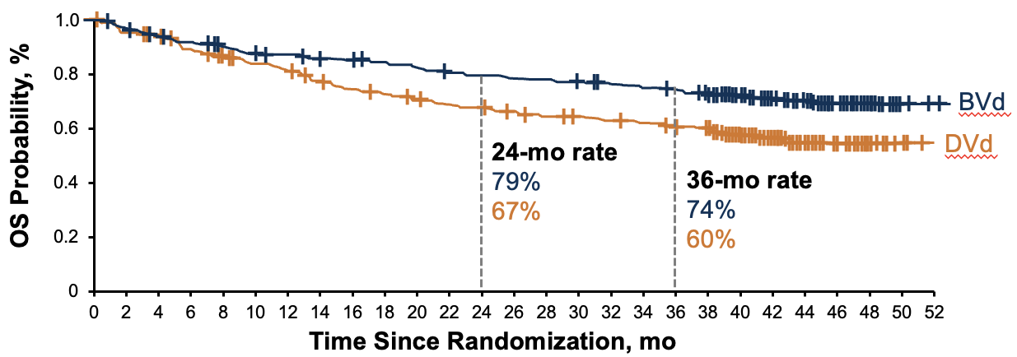
DREAMM-7: PFS and OS
 | BVd (N = 243) | DVd (N = 251)
ORR, % | 83% | 71%
≥CR, % | 36% | 18%
Median PFS, mo | 36.6 | 13.4
Median OS, mo | NR, HR = 0.58; P = .0002
Median follow-up: 39.4 mo
BelaVd with significant PFS and OS benefit vs DVd
BelaVd approved now in ≥2 prior lines of therapy in US (October, 2025)
Hungria V. et al., NEJM, 2024.
Hungria V. et al, Lancet Oncology, 2025

Slide 82
DREAMM-8: BelaPd versus PVd
Recruitment period
October 2020 to December 2022
Treatment period
Until PD, death, unacceptable toxicity, end of study, or
withdrawal of consent
Eligibility criteria
BPd (Q4W)
Belantamab mafodotin
2.5 mg/kg IV (cycle 1) then 1.9 mg/kg IV Q4W from cycle 2 onward
+
Pomalidomide 4 mg orally on days 1-21 (28-day cycles)
+
Dexamethasone 40 mgª on days 1, 8, 15, and 22
N=302
Primary endpoint:
PFS (IRC assessed per IMWG)
Key secondary endpoints:
OS, MRD negativity, DOR
Additional secondary endpoints include:
ORR, CRR, ≥VGPR,TTBR, TTR, TTP, PFS2, AEs, ocular findings, HRQOL, and PROs
Adults with MM
≥1 prior line of MM therapy including LEN
Documented PD during or after their most recent therapy
No prior treatment with anti-BCMA or pomalidomide; not refractory/intolerant to bortezomib
1:1 randomization
End-of-treatment visit
PVd (Q3W)
Bortezomib
1.3 mg/m² SC on days 1, 4, 8, and 11 of cycles 1-8 then days 1 and 8 (21-day cycles)
+
Pomalidomide 4 mg orally on days 1-14 (21-day cycles)
+
Dexamethasone 20 mgª on the day of and day after bortezomib
Stratification^{b}:
Prior lines of treatment (1 vs 2 or 3 vs ≥4)
Prior bortezomib (yes vs no)
Prior anti-CD38 therapy (yes vs no)
In the BPd group:
53% had received 1 prior LOT
90% received prior PI
81% were Lenalidomide refractory
23% were anti-CD38 refractory
Dimopoulos MA, et al. N Engl J Med. 2024 Aug 1;391(5):408-421

Slide 83
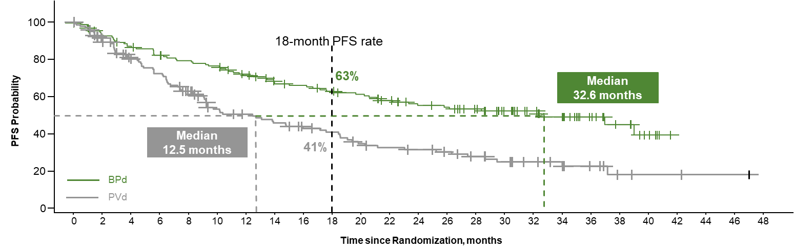
DREAMM-8: PFS and OS
Progression-free Survival
Overall Survival
12 months
OS probability
1.0
83%
0.8
76%
0.6
0.4
0.2
BPd
PVd
0.0
0
2
4
6
8
10
12
14
16
18
20
22
24
26
28
30
32
36
38
40
42
Time since randomization, months
 |  | BPd (N=155) | PVd (N=147)
PFS | PFS, median (95% CI), months | 32.6 (21.1, NR) | 12.5 (9.1, 17.6)
 | HR (95% CI) | 0.49 (0.35-0.68)
OS | OS, median (95% CI), months | NR (33.0, NR) | NR (25.2, NR)
 | HR (95% CI)‡ | 0.77 (0.53, 1.14)
BelaPd with significant PFS benefit versus PVd
BelaPd approved now in European Commission (EC) ≥ 1 line of therapy + lenalidomide exposed (2025)
Dimopoulos MA, et al. N Engl J Med. 2024 Aug 1;391(5):408-421

Slide 84
Belantamab Mafodotin Summary
Belamaf generally well tolerated off-the-shelf approach with no CRS/ICANS monitoring
  Therapeutic option in frail/elderly patients.
  Can be given in community oncology setting
Belamaf in combination with bortezomib/dexamethasone (Bela-Vd) approved in US for RRMM ≥2 prior lines of therapy (October, 2025)
  Significant PFS and OS benefit of BelaVd vs. daratumumab, bortezomib, dexamethasone in DREAMM-7 study

Slide 85
Case Presentation

Slide 86
Patient Case
79 y.o. woman with relapsed/refractory myeloma.
Diagnosed in 2019. Standard risk disease. Initial presentation with bone lesions and anemia.
  Line 1: VRd induction. Declines transplant. Continues on lenalidomide maintenance until disease progression in 2024. Best response very good partial response (VGPR).
  Line 2: Daratumumab, pomalidomide, dexamethasone. Disease progression in January, 2026 with slowly rising M-protein of 1.1 g/dL from nadir of 0.4 g/dL.

Slide 87
Patient Case (Cont)
79 y.o. woman with relapsed/refractory myeloma.
Discussed treatment options with patient
    Lives alone about 45 minutes from local oncology office. Has a pet dog that she cares for.
    Has 2 adult children that live out-of-state
    Other medical history includes type 2 diabetes, hypertension, osteoarthritis of bilateral knees
CART discussed, not feasible due to lack of caregiver support. Lives 3 hours from nearest CART center.
Bispecific also discussed (although not yet approved at the time with 3rd line therapy). Still needs caregiver support during step-up dosing period which she doesn’t have.

Slide 88
Patient Case (Cont)
79 y.o. woman with relapsed/refractory myeloma.
Patient decides to proceed with belantamab mafodotin, bortezomib, dexamethasone
  Dosing started at 1.9 mg/kg (lower dose than 2.5 mg/kg in label) q4 weeks
  Pre-C2 evaluation
    M-protein downtrending from 1.1 g/dL to 0.7 g/dL
    Grade 1 keratopathy (no visual acuity changes pre-Cycle 2)
    Belamaf 1.9 mg/kg given for cycle 2, but dosing interval preemptively changed to q8 week thereafter
  Best response VGPR. Continues on q8 week dosing with maximum grade 1 keratopathy. No visual acuity changes.

Slide 89
Discussion Questions
How are you sequencing belantamab mafodotin/bortezomib/
dexamethasone relative to other treatment strategies for R/R MM, and how does this vary for individual patients?
Does belantamab mafodotin still have activity after BCMA-targeted CAR T-cell therapy and/or bispecific antibodies?
Can belantamab mafodotin be combined with agents other than bortezomib/dexamethasone?

Slide 90
ONS 2026 SYMPOSIUM · PRESENTATION 6
Tolerability Considerations with
Belantamab Mafodotin
Mary Steinbach, DNP, APRN
Huntsman Cancer Institute · University of Utah
Saturday, May 16, 2026

Slide 91
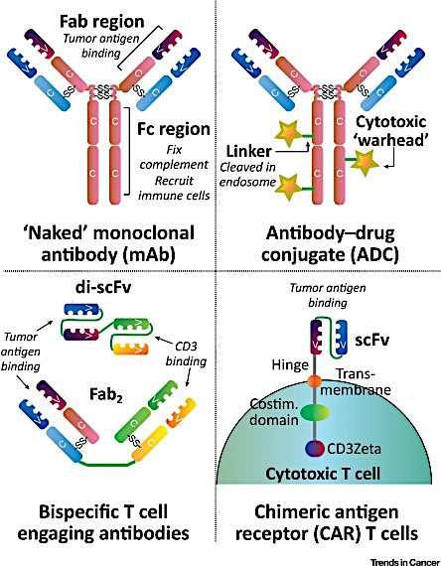
WHAT IT IS
Belantamab mafodotin: an Antibody Drug Conjugate
How I explain it to patients
How it works
Belantamab is an antibody-drug conjugate — a “smart bomb.” An antibody finds BCMA on the myeloma cell, and a tiny chemo payload (MMAF) is delivered directly inside. It also recruits the immune system. Given as a 30–60 minute IV infusion, every 3 to 8 weeks depending on regimen.
The same payload also reaches corneal cells — that’s where ocular AEs come from.
No step-up dosing. No mandatory hospitalization. Outpatient infusion.
Belantamab Mafodotin Tolerability · M. Steinbach · ONS 2026

Slide 92
PHASE 3 EVIDENCE — KEY TAKEAWAYS ONLY
Where belantamab fits today: DREAMM-7 & DREAMM-8
DREAMM-7
DREAMM-8
Bela + Vd vs Dara + Vd
Bela + Pd vs Bortezomib + Pd
≥1 prior line of therapy
≥1 prior line incl. lenalidomide
Median PFS: 36.6 vs 13.4 mo
Median PFS: NR vs 12.7 mo
HR 0.41 · OS at 36 mo: 74% vs 60%
HR 0.52 · ≥CR rate: 40% vs 16%
Belantamab arm doubled PFS.
Belantamab arm doubled PFS.
Bottom line: Both phase-3 trials show meaningful PFS gains over standard triplets — the trade-off is ocular toxicity, which is what the rest of this talk is about.
Belantamab Mafodotin Tolerability · M. Steinbach · ONS 2026

Slide 93
INCIDENCE & SEVERITY
Ocular adverse events - how often and how bad?
~70-80%
~30-45%
~25%
~95%
any-grade ocular AE
(DREAMM-2, -7, -8)
Grade 3+ ocular AE
at label dose
best-corrected vision
decline ≥2 lines
events that resolve
with dose modification
What patients describe
Blurry or fluctuating vision — “like looking through wax paper”
Dry, gritty eyes; foreign-body sensation; light sensitivity
Trouble reading or driving — usually 1–2 cycles in
Nearly all symptoms reverse with dose hold/reduction; permanent visual loss is rare
Belantamab Mafodotin Tolerability · M. Steinbach · ONS 2026

Slide 94
EXAM FINDINGS + SYMPTOMS
How ocular AEs are graded — the KVA scale
Grade | Corneal exam (MEC) | Best-corrected visual acuity (BCVA) | Action
1 | Mild superficial keratopathy | Decline 1 line from baseline | Continue at current dose
2 | Moderate superficial keratopathy | Decline 2–3 lines (no worse than 20/200) | Hold until ≤G1; resume at reduced dose
3 | Severe superficial keratopathy | Decline >3 lines (worse than 20/200, better than 20/2000) | Hold; resume at reduced dose when ≤G1
4 | Corneal epithelial defect | Worse than 20/2000 in better eye | Discontinue
Document at every visit: BCVA in each eye, slit-lamp findings (MEC grade), and any patient-reported visual symptoms. Always grade by the worst eye.
Belantamab Mafodotin Tolerability · M. Steinbach · ONS 2026

Slide 95
BASELINE OPHTHALMOLOGY EVALUATION
Set up the eye care plan before cycle 1
1
Refer everyone — before the first dose
Send every patient to ophthalmology before cycle 1. Don’t wait for symptoms. Establish baseline so you can compare later.
2
Document baseline exam
Visual acuity (best corrected, both eyes); slit-lamp; corneal exam. Treat any pre-existing dry eye, blepharitis, or contact-lens damage now.
3
Counsel & equip
Preservative-free lubricating drops 4–8×/day, starting before cycle 1. Pause contact lens wear during therapy. Sunglasses for photosensitivity.
Belantamab Mafodotin Tolerability · M. Steinbach · ONS 2026

Slide 96
ONGOING MONITORING
On treatment: who looks at the eyes, and when?
When | Eye assessment | Done by
Before every dose | BCVA (Snellen / hand-held card), symptom check, dry-eye review | Infusion-clinic RN or APP
Before each dose (per label) | Slit-lamp + corneal exam (MEC grading) | Ophthalmology
Anytime symptoms change | Same-day or next-day ophthalmology re-evaluation | Ophthalmology
After dose hold/reduction | Re-grade KVA before resuming; confirm ≤G1 | Ophthalmology
Patient action plan: Call same-day for any new blurry vision, eye pain, foreign-body sensation, or sensitivity to light. Don’t wait for the next infusion.
Belantamab Mafodotin Tolerability · M. Steinbach · ONS 2026

Slide 97
MANAGEMENT FRAMEWORK
When ocular AEs happen: hold, reduce, restart
G1: keep going
Continue full dose. Reinforce lubricating drops. Re-check at the next visit.
G2: hold the dose
Hold belantamab. Continue lubricating drops. Re-evaluate q3wk. Resume at one dose level lower (1.9 → 1.4 mg/kg) once ≤G1.
G3: hold longer, reduce more
Hold; co-manage with ophthalmology. Resume at the next reduced dose (1.4 → 0.95 mg/kg) once ≤G1. Some regimens extend interval to q8wk.
G4: discontinue
Permanent discontinuation. Refer to ophthalmology for ongoing care.
Belantamab Mafodotin Tolerability · M. Steinbach · ONS 2026

Slide 98
OTHER COMMON & UNCOMMON AES
Beyond the eyes: other toxicities to watch
Thrombocytopenia
Infusion reactions
Infections & misc.
55%
~20%
varies
any-grade · ~25% G3+
mostly first infusion
URTI, pneumonia, herpes
Most common hematologic AE
Check CBC before each dose
Hold for platelets <50; transfuse <10 or per institutional threshold
Resolves with dose hold/modification
Fever, chills, rash, hypotension during/within hours
Premedicate at first sign or with prior reaction
Slow rate, hold, treat with steroids/antihistamines
Most patients can continue therapy
URI/pneumonia — flu, COVID, RSV vaccines beforehand
Pyrexia, fatigue, nausea — supportive care
Mild LFT elevations — monitor each cycle
Less infection risk than BCMA bispecifics
Belantamab Mafodotin Tolerability · M. Steinbach · ONS 2026

Slide 99
TAKE-HOME PEARLS FOR THE INFUSION NURSE
What I want you to remember
1
Set up ophthalmology BEFORE cycle 1.
A baseline exam, lubricating drops, and patient counseling done up front prevents most surprises later.
2
Eye AEs are the price of efficacy — but they’re reversible.
DREAMM-7 and -8 doubled PFS over standard triplets. ~95% of ocular events resolve with dose modification.
3
Grade by the worst eye. Hold early, restart slow.
Symptoms + BCVA + slit-lamp. Don’t push through G2 — a brief hold with dose reduction usually fixes it.
4
Lubricating drops are mandatory, not optional.
Preservative-free, 4–8×/day, starting before cycle 1. Counsel patients to keep them in pocket and purse.
5
Empower the patient to call early.
Any new blur, dryness, pain, or light sensitivity → call. This is the single biggest predictor of a good ocular outcome.
Belantamab Mafodotin Tolerability · M. Steinbach · ONS 2026

Slide 100
Case Presentation

Slide 101
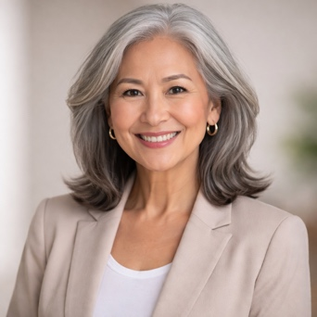
CASE PRESENTATION
67-year-old woman, IgA κ MM — sequencing after CAR-T
≥4th line, post BCMA-directed therapy · considering belantamab mafodotin
Diagnosis
Why belantamab — and why now?
IgA κ multiple myeloma
R-ISS Stage 1
Complex karyotype
WHY ADC, NOT ANOTHER T-CELL ENGAGER
Avoids T-cell redirection.
After CAR-T, T-cell fitness is a real concern: an ADC sidesteps it.
Different mechanism, same target.
Belantamab still hits BCMA, but via a payload: not via T cells.
Outpatient infusion every 3–8 weeks.
No step-up, no hospitalization: protects QoL and independence.
Treatment course
L1
Induction (DRd / VRd) → Auto-HSCT → maintenance
DISCUSSION · WHAT MATTERS TO HER
L2
1st relapse — anti-CD38–based triplet
L3
Anito-cel (CAR-T) · ARC-112A — remarkable response
Values QoL and independence above all.
Drove herself to every CAR-T visit; living independently: protect both.
Rural vs academic care setting.
Frequency of ophthalmology + slit-lamp visits may be the deciding factor.
L4 (next line) · belantamab mafodotin
Regimen: BVd or BPd
Case #4 Belantamab Mafodotin Tolerability · M. Steinbach · ONS 2026

Slide 102
Agenda
Introduction: The Multiple Myeloma (MM) Treatment Journey
Module 1: Role of Chimeric Antigen Receptor T-Cell Therapy in Relapsed/
Refractory (R/R) MM
Module 2: Role of BCMA- and Non-BCMA-Targeted Bispecific Antibodies in
R/R MM
Module 3: Utility of Belantamab Mafodotin in R/R MM
Module 4: Potential Role of Cereblon E3 Ligase Modulators in MM

Slide 103
Potential Role of Cereblon E3 Ligase Modulators (CELMoDs) in MM
Natalie S Callander, MD
Professor of Medicine
Director, Myeloma Clinical and Cellular Therapy Program
University of Wisconsin Carbone Cancer Center
Madison, Wisconsin

Slide 104
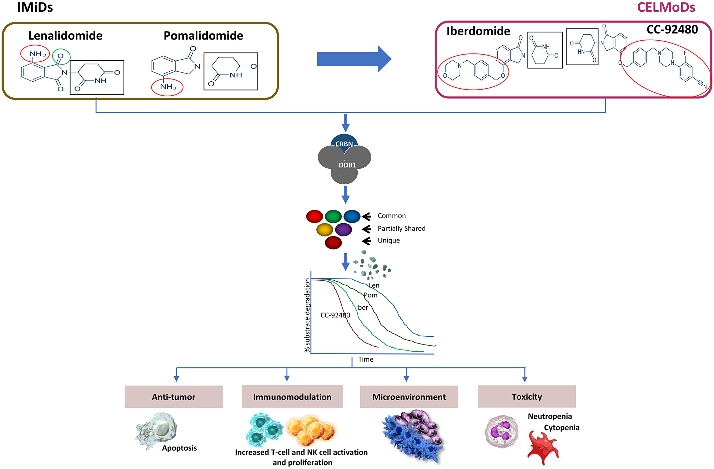
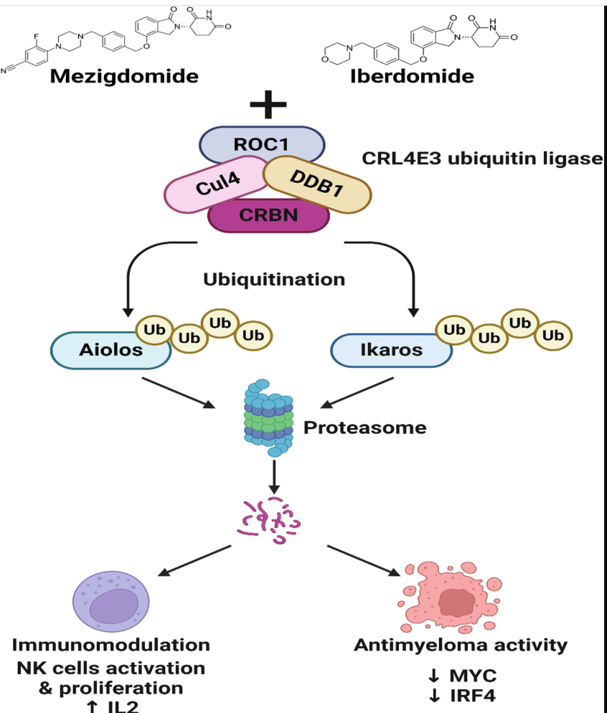
Celmods bind to cereblon, keeping it active so that targets like Aiolos and Ikaros can be degraded
CELMoDs are much more
Potent but no more toxic
Oral dosing schedule comparable
To Lenalidomide or pomalidomide
Patel T Clin Lym Mye 2024 24:762

Slide 105
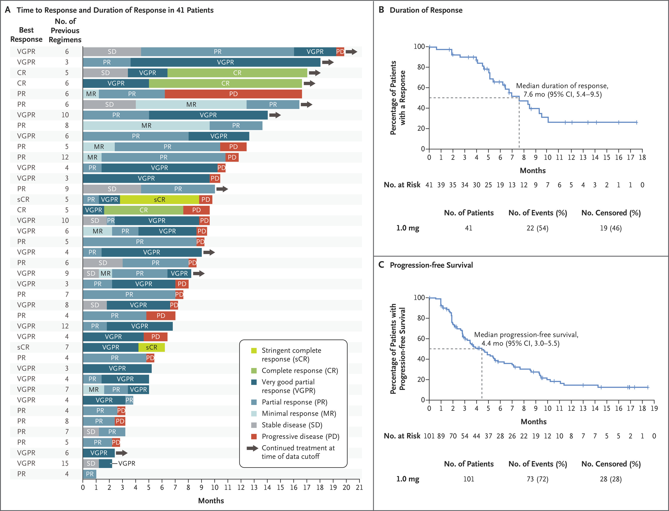
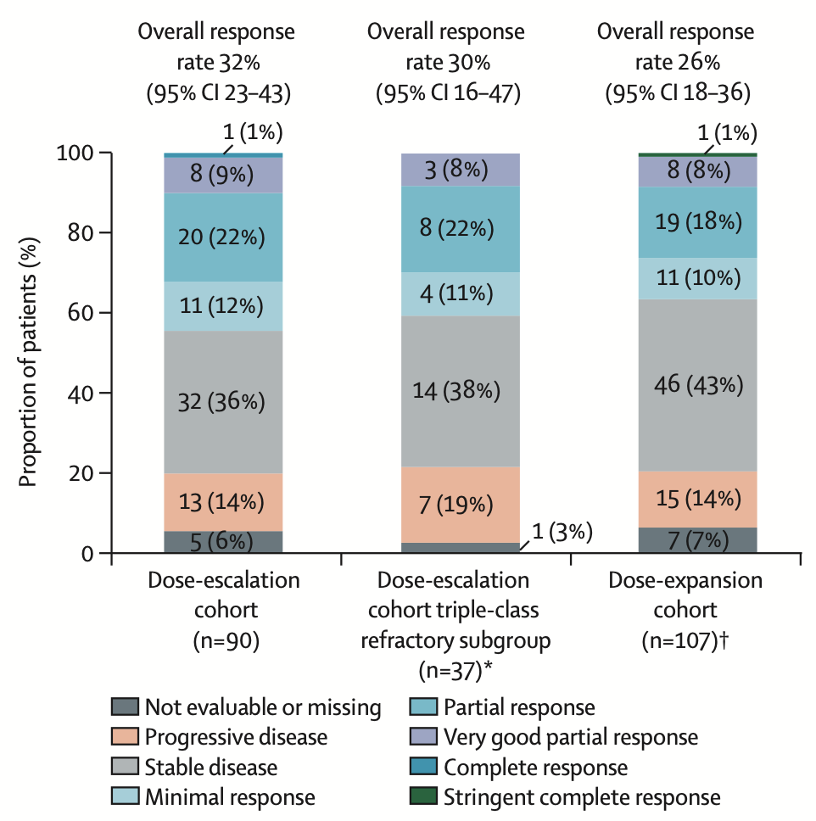
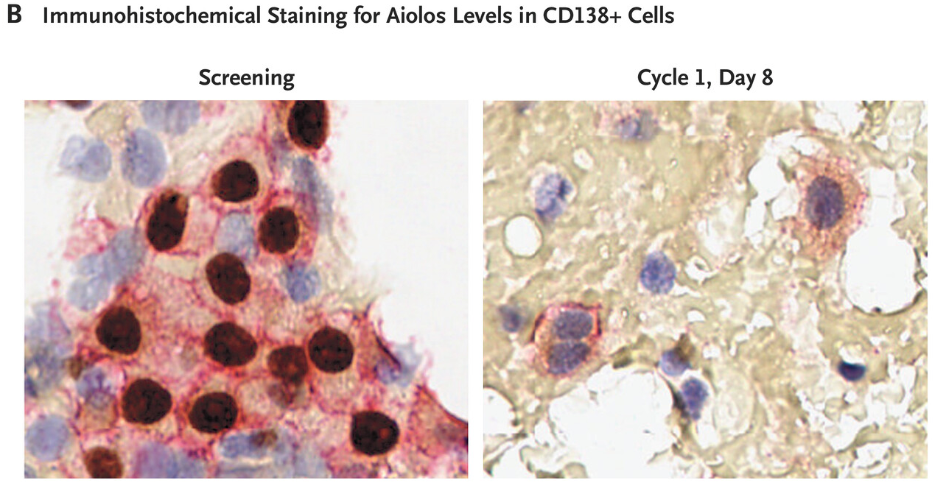
Both IBERDOMIDE AND MEZIGDOMIDE HAVE ACTIVITY
In VERY HEAVILY PRETREATED MM PTS
ORR 55% at RP2D
Lonial S Lancet 2022 e822
Richardson P NEJM 2023

Slide 106
Mezigdomide Plus Vd or Kd in R/R MM: Study Design
Multicenter, open-label phase I/II dose-finding and expansion trial
Coprimary endpoints: recommended dose, safety, ORR
Phase I: Dose escalation
Phase II: Dose expansion
Cohort A*
Mezigdomide† 0.3, 0.6, or 1.0 mg +
Bortezomib‡ 1.3 mg/m² +
Dexamethasone¶ 20 or 10 mg
(n = 28)
Cohort D*
Mezigdomide 0.6 or 1.0 mg + Vd
(n = 49)
Patients with MM and measurable disease; PD during or after most recent antimyeloma tx; MR or better to ≥1 prior tx; prior LEN for
≥2 consecutive cycles; 2-4 prior tx for cohorts A, C;
1-3 prior tx for cohort D
*21-day cycle. †D1-14. ‡D1, 4, 8, 11 of C1-8; D1, 8 of C≥9. ¶20 mg PO; 10 mg if aged >75 yr.
Cohort C§
Mezigdomide^{ǁ} 0.3, 0.6, or 1.0 mg +
Carfilzomib# 20 mg/m² C1D1; 56 mg/m² +
Dexamethasone¶ 40 or 20 mg
(n = 27)
Other Phase I Cohorts Not Reported Here
Cohort B
MEZI + DARA + DEX
§28-day cycle. ^{ǁ}D1-21. #20 mg/m² IV D1C1; 56 mg/m² IV D8, 15 (C1);
D1, 8, 15 (C2-12); D1, 15 C≥13. ¶40 mg PO or IV; 20 mg if aged >75 yr.
Cohort H
MEZI + ELO + DEX
Sandhu. ASH 2024. Abstr 1025.

Slide 107
Mezigdomide Plus Vd or Kd in R/R MM:
PFS and Response
Efficacy Measure | Cohort A: MEZI-Vd (n = 28) |  |  | Cohort D: MEZI-Vd (n = 49) |  | Cohort C: MEZI-Kd (n = 27)
Overall mPFS, mo | 12.3 |  |  | 17.5 |  | 13.5
ORR, % (95% CI) | 75.0 (55.1-89.3) |  |  | 85.7 (72.8-94.1) |  | 85.2 (66.3-95.8)
Median DoR, mo (95% CI) | 10.9 (8.8-18.7) |  |  | 19.4 (9.7-NA) |  | 11.9 (6.4-35.9)
Efficacy Measure | Cohort A: MEZI-Vd (n = 28) |  |  | Cohort D: MEZI-Vd (n = 49) |  | Cohort C: MEZI-Kd (n = 27)
 | 0.3 mg (n = 9) | 0.6 mg (n = 9) | 1.0 mg (n = 10) | 0.6 mg (n = 11) | 1.0 mg (n = 38) | 0.3 mg (n = 9) | 0.6 mg (n = 9) | 1.0 mg (n = 9)
mPFS, mo | 13.4 | 11.2 | 12.3 | 20.8 | 16.6 | 11.7 | 13.5 | 13.8
ORR, % (95% CI) | NR | NR | 60.0 (55.1-89.3) | NR | 84.2 (68.7-94.0) | NR | NR | 77.8 (40.0-97.2)
Median DoR, mo (95% CI) | NR | NR | 11.6 (5.3-NA) | NR | 19.4 (7.0-NA) | NR | NR | 11.9 (0.2-NA)
MEZI-Vd and MEZI-Kd showed efficacy at all doses tested
Pharmacodynamic activity was observed with MEZI-Vd and MEZI-Kd at all doses, as measured by Aiolos degradation in T-cells and within tumors
Sandhu. ASH 2024. Abstr 1025.

Slide 108
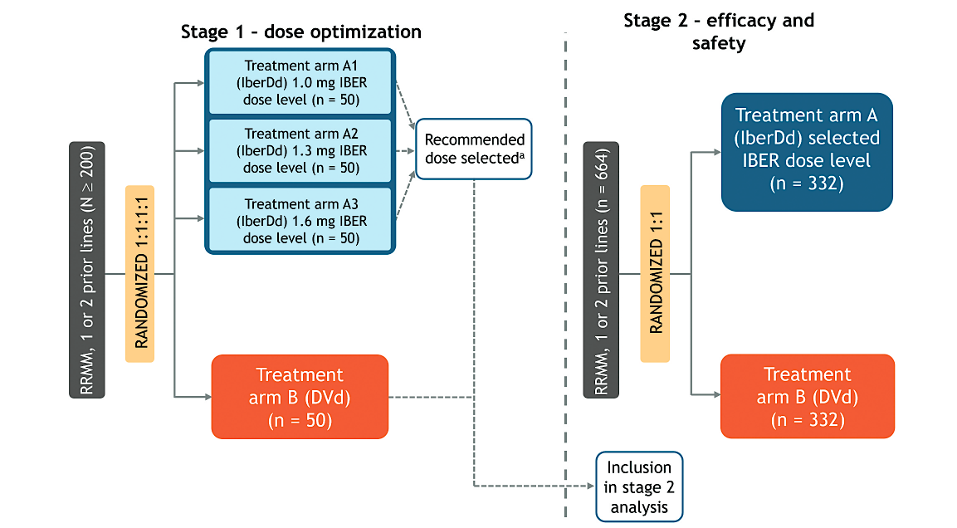
EXCALIBER Phase III trial: coprimary endpoints of MRD negativity and PFS: met endpoint!
Expected accelerated FDA approval 8/2026
NCT04975997

Slide 109
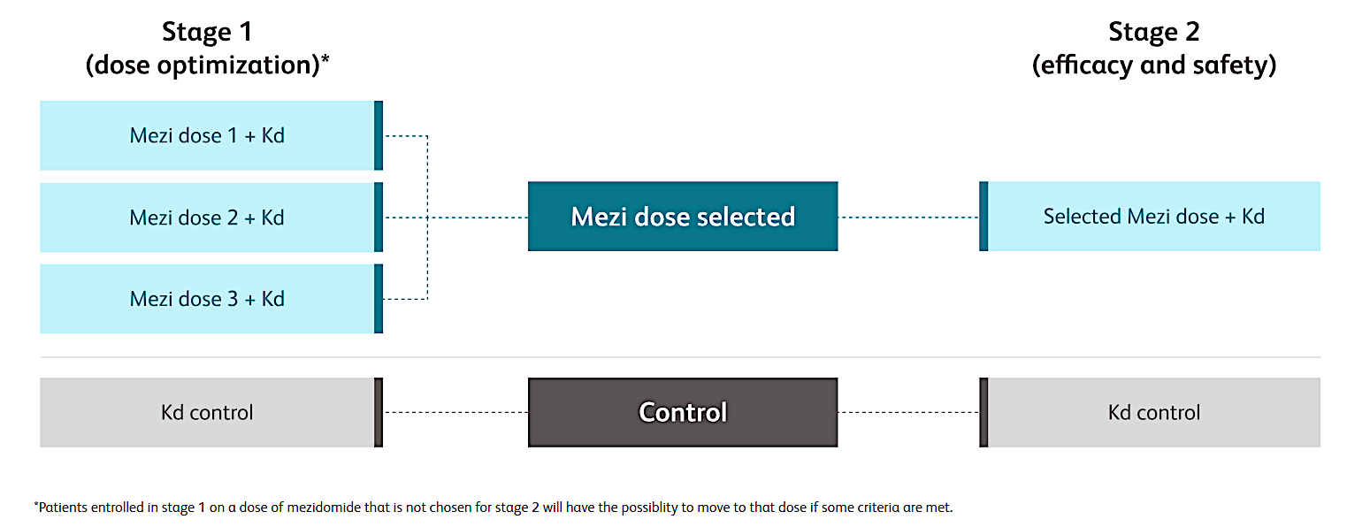
SUCCESSOR-2: phase III study met primary endpoint of improved PFS
Eligibility:
At least 1 line of Rx
Exposure to len and
At least 2 cycles of
Anti CD38 Ab
Richardson P et al. ASCO 2026;Abstract LBA7506

Slide 110
Stay tuned for many CELMoDs combinations: drugs may enhance the activity of T cell redirecting therapies
Mezigdomide plus elranatamab (MELT trial)¹
Magnetismm 30 trial: elranatamab and iberdomide, 22 pts, refractory population: with 7.8mo of follow up the ORR 95.5% ²
Iberdomide post CAR-T
Teclistamab/Iberdomide
¹Byun ASH 2025;Abstract 5835, ²Suvannasankha ASH 2025;Abstract 100

Slide 111
Case Presentation

Slide 112
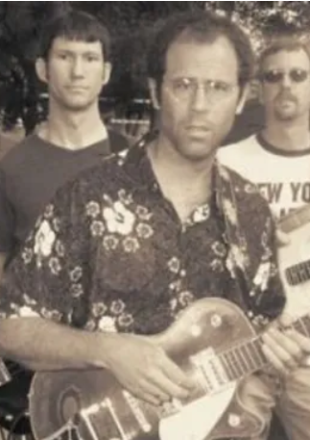
68 year old male with IgG kappa myeloma, R-ISS III on basis of Beta-2 mg 5.6mg/L, high LDH 1/2018
VRD induction, stem cell transplant, lenalidomide maintenance
New bone pain, rising kappa light chains in 2/2023
6/2023 started iberdomide, daratumumab, dexamethasone. MRD negative in 4 cycles, remains on treatment at this time.
Side effects: developed pneumocystis pneumonia in 11/2023
Performs regularly with his band

Slide 113
Discussion Questions
How do you see CELMoDs fitting into the treatment of
R/R MM?
Are iberdomide and mezigdomide essentially interchangeable, or are there scenarios in which one would be more appropriate than the other should they eventually reach the clinic?

Slide 114
Tolerability/Toxicity Considerations with the Use of CELMoDs in MM
Beth Faiman PHD, MSN, APN-BC, AOCN, TCTCN, FAAN, FAPO
Nurse Practitioner and Clinical Researcher
Department of Hematology and Medical Oncology, Cleveland Clinic
Member, Cancer Population and Health, Case Western Reserve University
Cleveland, OH

Slide 115
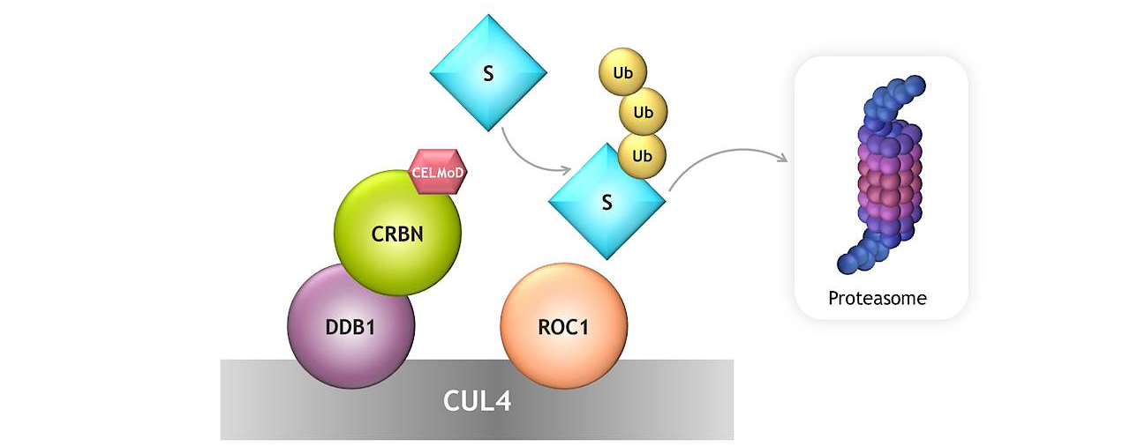
CELMoDs induce degradation of the transcription factors Ikaros and Aiolos, promoting immune-modulatory activity in MM cells. They may mitigate T-cell exhaustion, improving efficacy of T cell–engaging therapy.
Iberdomide
Oral CELMoD (new drug class)
Phase 3 EXCALIBER-RRMM (NCT04975997: IberDd vs DVd) met primary MRD-negativity endpoint in pts with RRMM (Sept 2025).
FDA NDA accepted Feb 17, 2026; PDUFA August 17, 2026.
Mezigdomide
Oral CELMoD targeting Ikaros/Aiolos.
SUCCESSOR-2 (NCT05552976: MeziKd vs Kd) met primary PFS endpoint in pts with RRMM March 2026.
Approval expected after NDA submission
CELMoD = cereblon E3 ligase modulator; Dd = daratumumab, dexamethasone; FDA = US Food and Drug Administration; IberDd = iberdomide, daratumumab, dexamethasone; IMiD = immunomodulatory drug; Kd = carfilzomib, dexamethasone; MeziKd = mezigdomide, carfilzomib, dexamethasone; MRD = minimal residual disease; NDA – new drug application; PDUFA = Prescription Drug User Fee Act; PFS = progression-free survival; RRMM = relapsed/refractory multiple myeloma; SMM = smoldering multiple myeloma; TEAE = treatment-emergent adverse event; Vd = bortezomib, dexamethasone; VGPR = very good partial response.
The Manufacturer Announces Phase 3 EXCALIBER-RRMM Study Evaluating Iberdomide in Combination with Standard Therapies Demonstrated a Significant Improvement in Minimal Residual Disease Negativity Rates in Relapsed or Refractory Multiple Myeloma. https://news.bms.com/news/details/2025/Bristol-Myers-Squibb-Announces-Phase-3-EXCALIBER-RRMM-Study-Evaluating-Iberdomide-in-Combination-with-Standard-Therapies-Demonstrated-a-Significant-Improvement-in-Minimal-Residual-Disease-Negativity-Rates-in-Relapsed-or-Refractory-Multiple-Myeloma/default.aspx Accessed March 26, 2026. The Manufacturer Announces Positive Phase 3 Results from the SUCCESSOR-2 Study of Oral Mezigdomide in Relapsed or Refractory Multiple Myeloma. https://news.bms.com/news/details/2026/Bristol-Myers-Squibb-Announces-Positive-Phase-3-Results-from-the-SUCCESSOR-2-Study-of-Oral-Mezigdomide-in-Relapsed-or-Refractory-Multiple-Myeloma/default.aspx Accessed March 26, 2026.

Slide 116
Trial | Agent | Experimental Arm | Comparator | Population | Primary Endpoint | Status | NCT ID | References
SUCCESSOR-1 | Mezigdomide | MeziVd | Vd | RRMM, ≥1 prior line (incl. len + anti-CD38) | PFS | Enrolling | NCT05519085 | [1]
SUCCESSOR-2 | Mezigdomide | MeziKd | Kd | RRMM, ≥1 prior line (incl. len + anti-CD38), no prior CFZ | PFS (HR 0.667) | Enrolling (since Oct 2022) | NCT05552976 | [2]
EXCALIBER-RRMM | Iberdomide | IberDd | DVd | RRMM, 1–2 prior lines | PFS (HR 0.75) | Enrolling (since Jun 2022) | NCT04975997 | [3-4]
EXCALIBER-Maintenance | Iberdomide | Iber maintenance | Standard maintenance | NDMM, post-transplant | Not reported | Enrolling | NCT04564703 | [5]

Slide 117
Non-Hematologic AE | Mezigdomide + Dex (Ph 2, N=101) Any Grade | Mezigdomide + Dex (Ph 2, N=101) Gr 3–4 | Mezigdomide + Dex (Ph 2, N=101) Estimated Gr 1–2 | Iberdomide + Dex (Ph 2, N=107) Gr 3–4 | Iberdomide + Dex (Ph 1, N=90) Gr 3–4 | IberCd (ICON, N=61) Gr ≥3
Infections (all) | 65% | 35% | ~30% | 27% | 26% | 34%
Fatigue | 36% | 5% | ~31% | 3% | 2% | 3%
Diarrhea | 31% | 3% | ~28% | 1% | 1% | NR
Nausea | 21% | 1% | ~20% | 1% | 0% | NR
Constipation | 24% | 0% | ~24% | NR | NR | NR
Decreased appetite | 21% | 2% | ~19% | NR | NR | NR
Dyspnea | 22% | 5% | ~17% | NR | NR | NR
Arthralgia | 21% | 2% | ~19% | NR | NR | NR
Insomnia | 20% | 1% | ~19% | NR | NR | NR
Pyrexia | 15% | 3% | ~12% | NR | NR | NR
Peripheral edema | 8% | 0% | ~8% | NR | NR | NR
Rash | NR | NR | NR | 3% | 0% | NR
Peripheral neuropathy | 7% | 1% | ~6% | 0% | 1% | 3% (Gr 3)
GI disorders (combined) | — | — | — | 6% | 3% | NR
DVT/VTE | 3% | 1% | ~2% | 0% | 0% | 2%

Slide 118
Case Presentation

Slide 119
Case Presentation
81 year old, IgG Kappa MM diagnosed 2014
LOT1 – lenalidomide+ dexamethasone on a clinical trial until 2017
LOT2- carfilzomib, pom + dex 2017-2020
LOT3- clinical trial with daratumumab, iberdomide and dexamethasone
Side effects: neutropenia grade 2; dose reduce iberdomide
Hypogammaglobulinemia – IVIg started with IgG level 280 (700-1400 range)
Best response: Complete remission

Slide 120
Discussion Questions
How do you currently counsel your patients with MM who are going to receive standard IMiDs, such as lenalidomide, about how these agents work and what to expect in terms of tolerability?
How do these conversations play out with CELMoDs? How, if at all, do they differ for iberdomide versus mezigdomide?
What has been your personal experience with cytopenias with CELMoDs? What about GI toxicities? What advice about management of these toxicities would you offer a nurse who was about to enroll a patient on a clinical trial evaluating a CELMoD?

Slide 121
Discussion Questions
If CELMoDs were to be approved, are there any comorbidities that might dissuade you from using them?
Do you anticipate that iberdomide and mezigdomide can be safely offered to older or frail patients?
What is the route of administration of CELMoDs? What dosing schedules of iberdomide and mezigdomide are being employed in the emerging and ongoing Phase III clinical trials in the R/R setting?

Slide 122
Oral Selective Estrogen Receptor Degraders in Breast Cancer
Recent Advances in Cancer Care — New Paradigms,
Novel Agents and What It Means for the Oncology Nurse
A Complimentary NCPD Symposium Series Held During the 51st Annual ONS Congress
Saturday, May 16, 2026
6:00 PM – 7:30 PM
Faculty
Blanca Ledezma, MSN, NP, AOCNP
Marissa Marti-Smith, DNP, APRN, AGNP-C, AOCNP
Ruth M O’Regan, MD
Moderator
Heather McArthur, MD, MPH, FASCO

Slide 123
Thank you for joining us! Please take a moment to complete the survey currently up on Zoom. Your feedback is very important to us. The survey will remain open up to 5 minutes after the meeting ends.
To Claim NCPD Credit
In-person attendees: Please refer to the program syllabus for the NCPD credit link or QR code.
Virtual attendees: The NCPD credit link is posted in the chat room.
NCPD/ONCC credit information will be emailed to each participant within 1 to 2 business days.

