Slide 1
Prostate Cancer
Recent Advances in Cancer Care — New Paradigms,
Novel Agents and What It Means for the Oncology Nurse
A Complimentary NCPD Symposium Series Held During the 51st Annual ONS Congress
Thursday, May 14, 2026
12:15 PM – 1:45 PM
Faculty
Michael Lai, MSN, ARNP, FNP-C
Stacy E Walker, FNP-BC
Evan Y Yu, MD
Moderator
Scott T Tagawa, MD, MS

Slide 2




Faculty
Michael Lai, MSN, ARNP, FNP-C
Advanced Practice Provider
Fred Hutchinson Cancer Center
Teaching Associate
University of Washington School of Medicine
Seattle, Washington
Evan Y Yu, MD
Section Head, Medical Oncology, Clinical Research Division
Fred Hutchinson Cancer Center
Medical Director, Clinical Research Support
Fred Hutchinson Cancer Research Consortium
Professor of Medicine
Division of Hematology and Oncology, Department
of Medicine
University of Washington School of Medicine
Seattle, Washington
Stacy E Walker, FNP-BC
Nurse Practitioner
Dana-Farber Cancer Institute
Boston, Massachusetts
Moderator
Scott T Tagawa, MD, MS
Professor of Medicine and Urology
Weill Cornell Medicine
Leader, GU Disease Management Team
Meyer Cancer Center
New York, New York

Slide 3
Mr Lai — Disclosures
No relevant financial relationships to disclose.

Slide 4
Ms Walker — Disclosures
No relevant financial relationships to disclose.

Slide 5
Dr Yu — Disclosures
Consulting Agreements | Astellas, AstraZeneca Pharmaceuticals LP, Bayer HealthCare Pharmaceuticals, Johnson & Johnson, Lantheus, Merck, Novartis, Samsung Bioepis, Tolmar
Contracted Research | Bayer HealthCare Pharmaceuticals, Blue Earth Diagnostics, Dendreon Pharmaceuticals Inc, Lantheus, Merck, Pfizer Inc, Tyra Biosciences Inc

Slide 6
Dr Tagawa — Disclosures
Consulting Agreements | AbbVie Inc, Abdera Therapeutics, Bayer HealthCare Pharmaceuticals, Biohaven, Blue Earth Diagnostics, Boston Scientific Corporation, Clarity Pharmaceuticals, Convergent Therapeutics Inc, Daiichi Sankyo Inc, EMD Serono Inc, GE Healthcare, Gilead Sciences Inc, Johnson & Johnson, Lantheus, Lilly, Merck, Myovant Sciences, Novartis, Pfizer Inc, Regeneron Pharmaceuticals Inc, Telix Pharmaceuticals Limited
Contracted Research | AIQ Solutions, Bayer HealthCare Pharmaceuticals, Clarity Pharmaceuticals, Gilead Sciences Inc, Janux Therapeutics, Johnson & Johnson, Lilly, Merck, Novartis, Pfizer Inc, Telix Pharmaceuticals Limited
Data and Safety Monitoring Boards/Committees | Boston Scientific Corporation
Stock OPTIONS — Private Companies | Convergent Therapeutics

Slide 7
Commercial Support
This activity is supported by educational grants from Astellas and Pfizer Inc, AstraZeneca Pharmaceuticals LP, Merck, and Novartis.
Research To Practice NCPD Planning Committee Members,
Staff and Reviewers
Planners, scientific staff and independent reviewers for Research To Practice have no relevant financial relationships to disclose.

Slide 8
This educational activity contains discussion of
non-FDA-approved uses of agents and regimens. Please refer to official prescribing information for each product for approved indications.

Slide 9



Clinicians in the Meeting Room
Networked iPads are available.
Review Program Slides: Tap the Program Slides button to review speaker presentations and other program content.
Answer Survey Questions: Complete the pre- and postmeeting surveys. Survey questions will be discussed throughout the meeting.
Ask a Question: Tap Ask a Question to submit a challenging case or question for discussion. We will aim to address as many questions as possible during the program.
For assistance, please raise your hand. Devices will be collected at the conclusion of the activity.
Notes:
9

Slide 10

Clinicians Attending via Zoom
Review Program Slides: A link to the program slides will be posted in the chat room at the start of the program.
Answer Survey Questions: Complete the pre- and postmeeting surveys. Survey questions will be discussed throughout the meeting.
Ask a Question: Submit a challenging case or question for discussion using the Zoom chat room.
Get NCPD Credit: An NCPD credit link will be provided in the chat room at the conclusion of the program.
Notes:
10

Slide 11
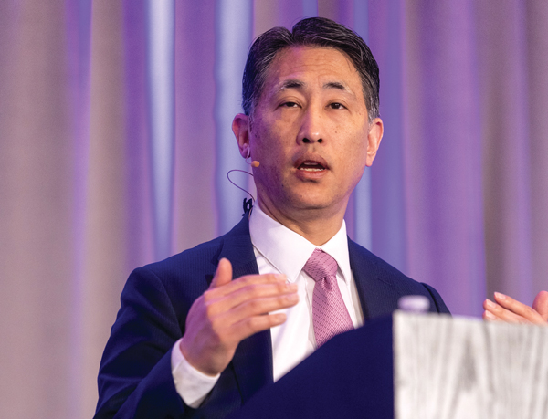
About the Enduring Program
The live meeting is being video
and audio recorded.
The proceedings from today will
be edited and developed into
an enduring web-based program.
An email will be sent to all attendees
when the activity is available.
To learn more about our education programs, visit our website, www.ResearchToPractice.com
Notes:
11
11

Slide 12



Slide 13

“Recent Advances in Cancer Care — New Paradigms,
Novel Agents and What It Means for the Oncology Nurse”
Eighteenth Annual RTP-ONS NCPD Symposium Series

Slide 14


New Agents, Therapies and Regimens
Recent Advances in Cancer Care — New Paradigms,
Novel Agents and What It Means for the Oncology Nurse
When should it be used, for whom and why?
How to prevent and manage side effects:
dose holds and reductions
  Kaplan Meier curves —
  HR and absolute benefit
  Waterfall plots

Slide 15
Prostate Cancer
Recent Advances in Cancer Care — New Paradigms,
Novel Agents and What It Means for the Oncology Nurse
A Complimentary NCPD Symposium Series Held During the 51st Annual ONS Congress
Thursday, May 14, 2026
12:15 PM – 1:45 PM
Faculty
Michael Lai, MSN, ARNP, FNP-C
Stacy E Walker, FNP-BC
Evan Y Yu, MD
Moderator
Scott T Tagawa, MD, MS

Slide 16
Agenda
Module 1: Overview of Prostate Cancer
Module 2: Hormonal Therapy for Nonmetastatic and Metastatic Hormone-Sensitive Prostate Cancer (HSPC)
Module 3: Potential Role of Capivasertib in Metastatic HSPC
Module 4: Current and Potential Future Role of PARP Inhibitors in Metastatic PC
Module 5: Current and Future Role of Lutetium Lu 177 Vipivotide Tetraxetan for Patients with Metastatic PC

Slide 17
Agenda
Module 1: Overview of Prostate Cancer
Module 2: Hormonal Therapy for Nonmetastatic and Metastatic Hormone-Sensitive Prostate Cancer (HSPC)
Module 3: Potential Role of Capivasertib in Metastatic HSPC
Module 4: Current and Potential Future Role of PARP Inhibitors in Metastatic PC
Module 5: Current and Future Role of Lutetium Lu 177 Vipivotide Tetraxetan for Patients with Metastatic PC

Slide 18
Clinical Disease States Model of Prostate Cancer
Death from
other causes
Noncastrate prostate cancer
Castrate prostate cancer
Clinical Metastases
Clinically
localized disease
Rising PSA:
noncastrate
Clinical metastases:
noncastrate
Clinical metastases:
castrate
Rising PSA:
castrate
Death from
disease
Two defining criteria
Rising PSA in the setting of castrate testosterone levels (<50 ng/dL)
No radiographically identifiable metastasis

Slide 19
Agenda
Module 1: Overview of Prostate Cancer
Module 2: Hormonal Therapy for Nonmetastatic and Metastatic Hormone-Sensitive Prostate Cancer (HSPC)
Module 3: Potential Role of Capivasertib in Metastatic HSPC
Module 4: Current and Potential Future Role of PARP Inhibitors in Metastatic PC
Module 5: Current and Future Role of Lutetium Lu 177 Vipivotide Tetraxetan for Patients with Metastatic PC

Slide 20


FRED HUTCH / UNIVERSITY OF WASHINGTON / SEATTLE CHILDREN’S
CANCER CONSORTIUM
Hormonal Therapy for Nonmetastatic and Metastatic Hormone Sensitive Prostate Cancer
Evan Y. Yu, M.D
Section Head, Medical Oncology, Clinical Research Division
Medical Director, Clinical Research Support
Research To Practice at ONS
San Antonio, TX
May 14, 2026

Slide 21
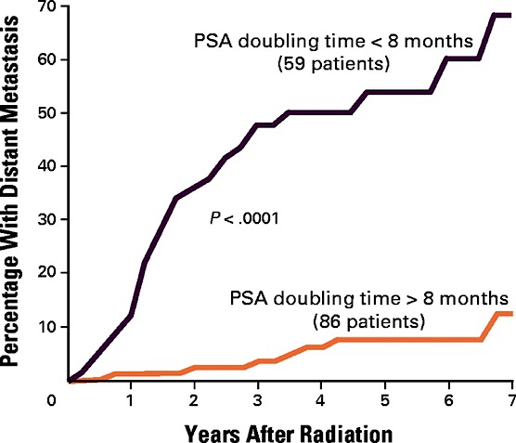
Most Important Prognostic Factor for
Biochemical Recurrence: PSA Doubling Time
Period of time it takes for PSA to double over multiple measurements
  Most often expressed in terms of months
  Longer is better!
After surgery, PSADT >10 months associated with longer time to distant metastasis¹ and survival²
After radiation, PSADT >8 months was better³
  7 year metastatic disease rates 7% vs. 54%
Pound CR et al. JAMA. 1999; 281:1591-7.
Freedland SJ et al. JAMA. 2005; 294:433-9.
Zagars GK et al. Radiother Oncol. 1997; 44:213-21.

Slide 22
EMBARK Trial for High-Risk Biochemically-Recurrent
Prostate Cancer (PSAdt <9 months)
Eligibility criteria
Screening PSA ≥ 1 ng/mL after RP and at least 2 ng/mL above the nadir for primary EBRT
No mets on bone scan or CT/MRI
Testosterone ≥ 150 ng/mL
Prior hormonal therapy ≥ 9 months prior to randomization (neoadjuvant/adjuvant for ≤ 36 mos or ≤ 6 mos for rising PSA)
Stratified:
Screening PSA
PSADT
Prior hormonal therapy
Primary endpoints: MFS
Secondary endpoints: OS, safety
Enzalutamide (160 mg oral qd) +
leuprolide acetate (22.5 mg IM, q12w)
n = 355, blinded
Suspend treatment at week 37, monitor PSA (reinstate if PSA rises)
Yes
R 1:1:1
Placebo + leuprolide acetate
(22.5 mg IM, q12w)
n = 358, blinded
PSA < 0.2 ng/mL at week 36
Enzalutamide monotherapy
(160 mg oral qd)
n = 355, unblinded
No
Remain on treatment

Slide 23
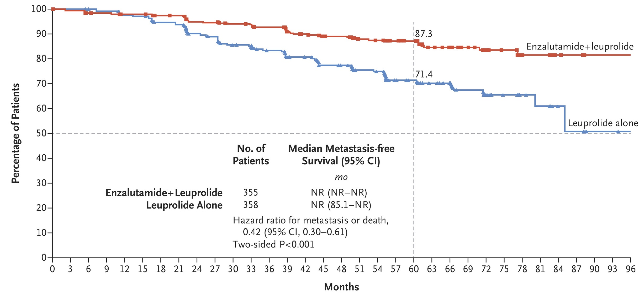
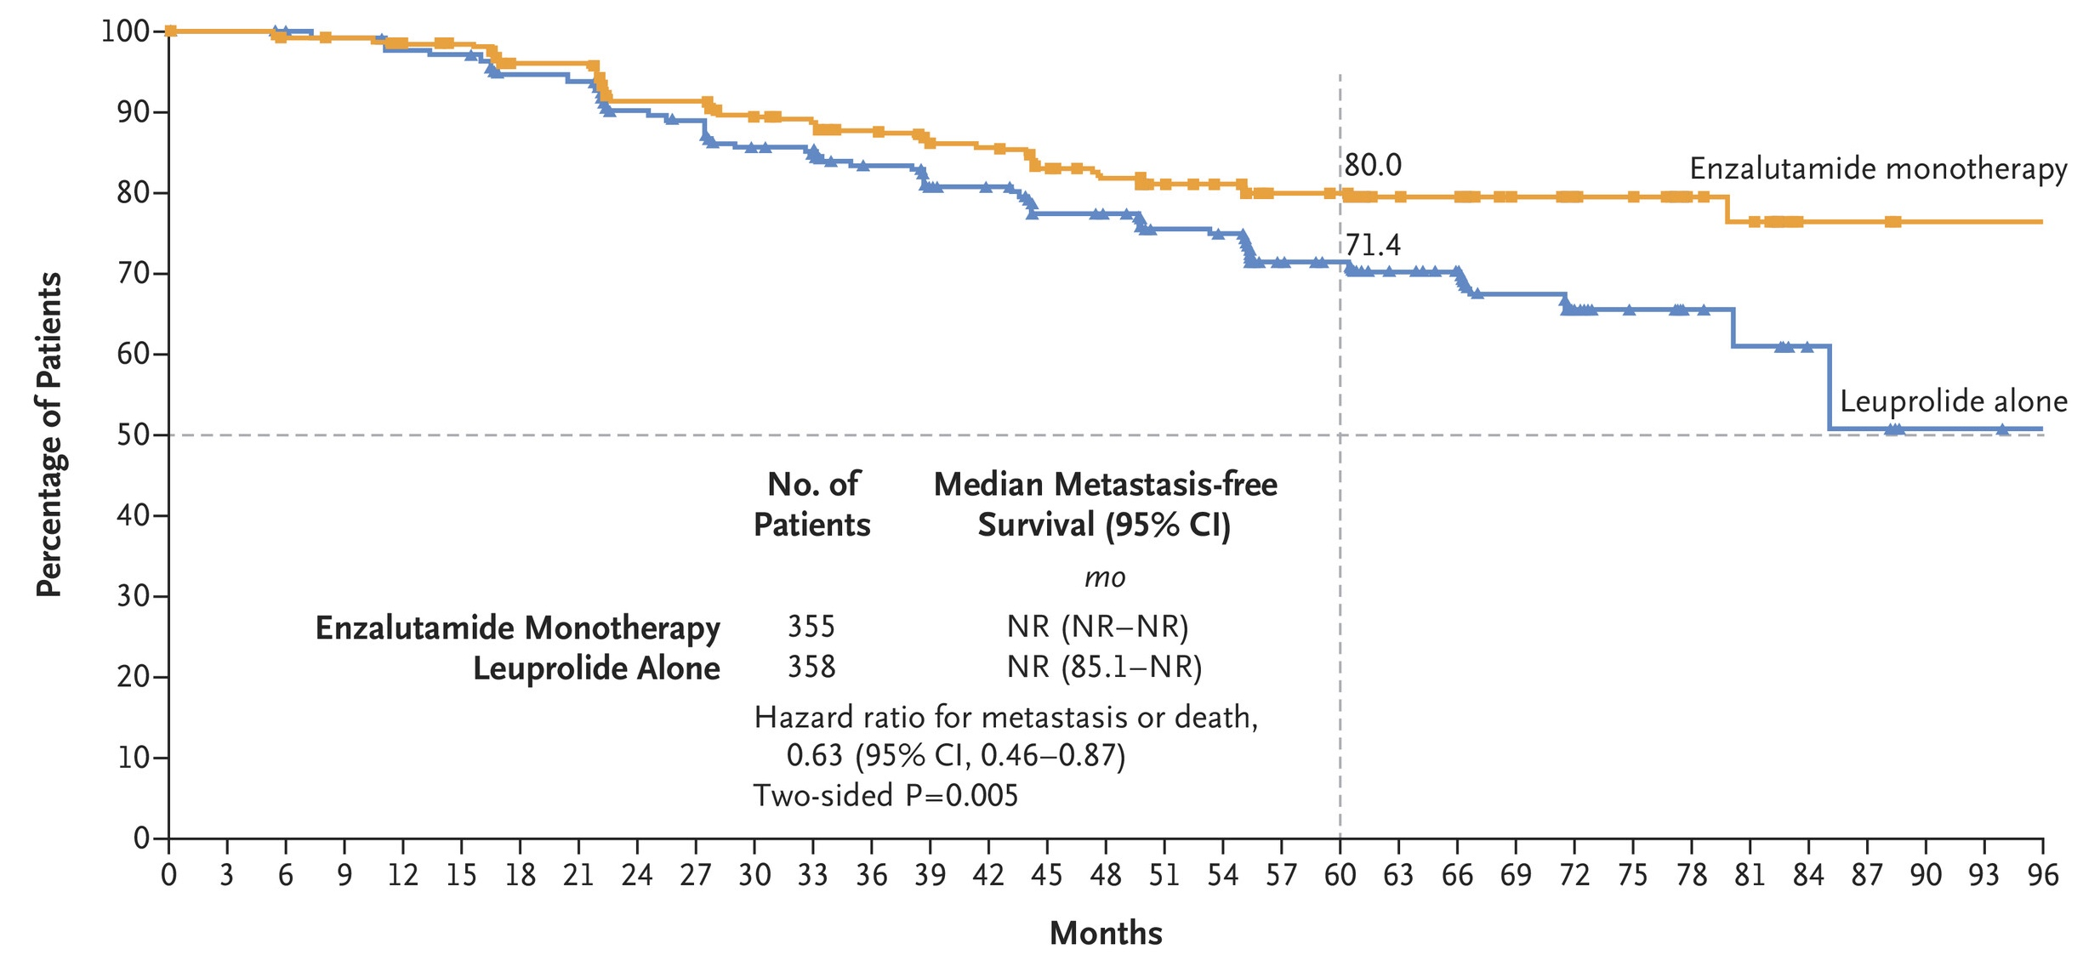
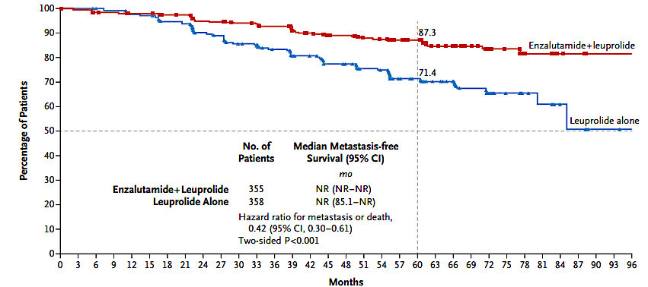
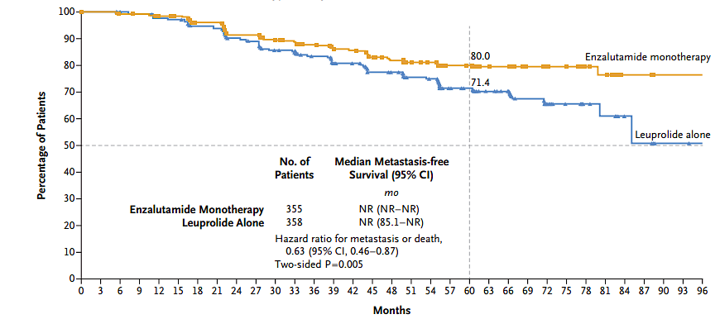
EMBARK Metastasis-Free Survival
MFS for Enzalutamide Combination vs Leuprolide Alone
MFS for Enzalutamide Monotherapy vs Leuprolide Alone
Interim OS trended in favor of enzalutamide + leuprolide alone (HR 0.59; 95% CI: 0.38, 0.91; P = .02 [did not cross interim efficacy boundary P < .0001]) and enzalutamide monotherapy (HR 0.78; 95% CI: 0.52, 1.17; P = .23)
MFS, metastasis free survival; NR, not reported.
Freedland SJ, et al. N Engl J Med. 2023;389:1453-1465.

Slide 24
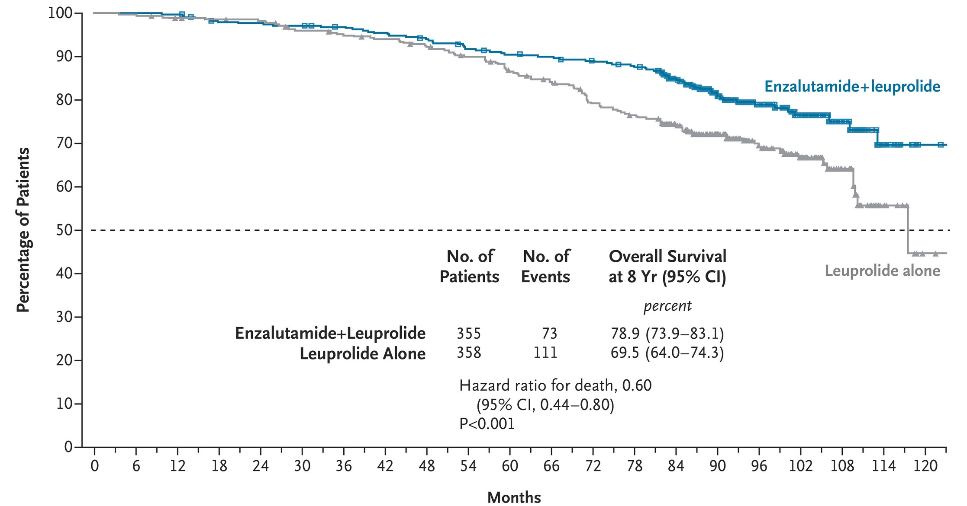
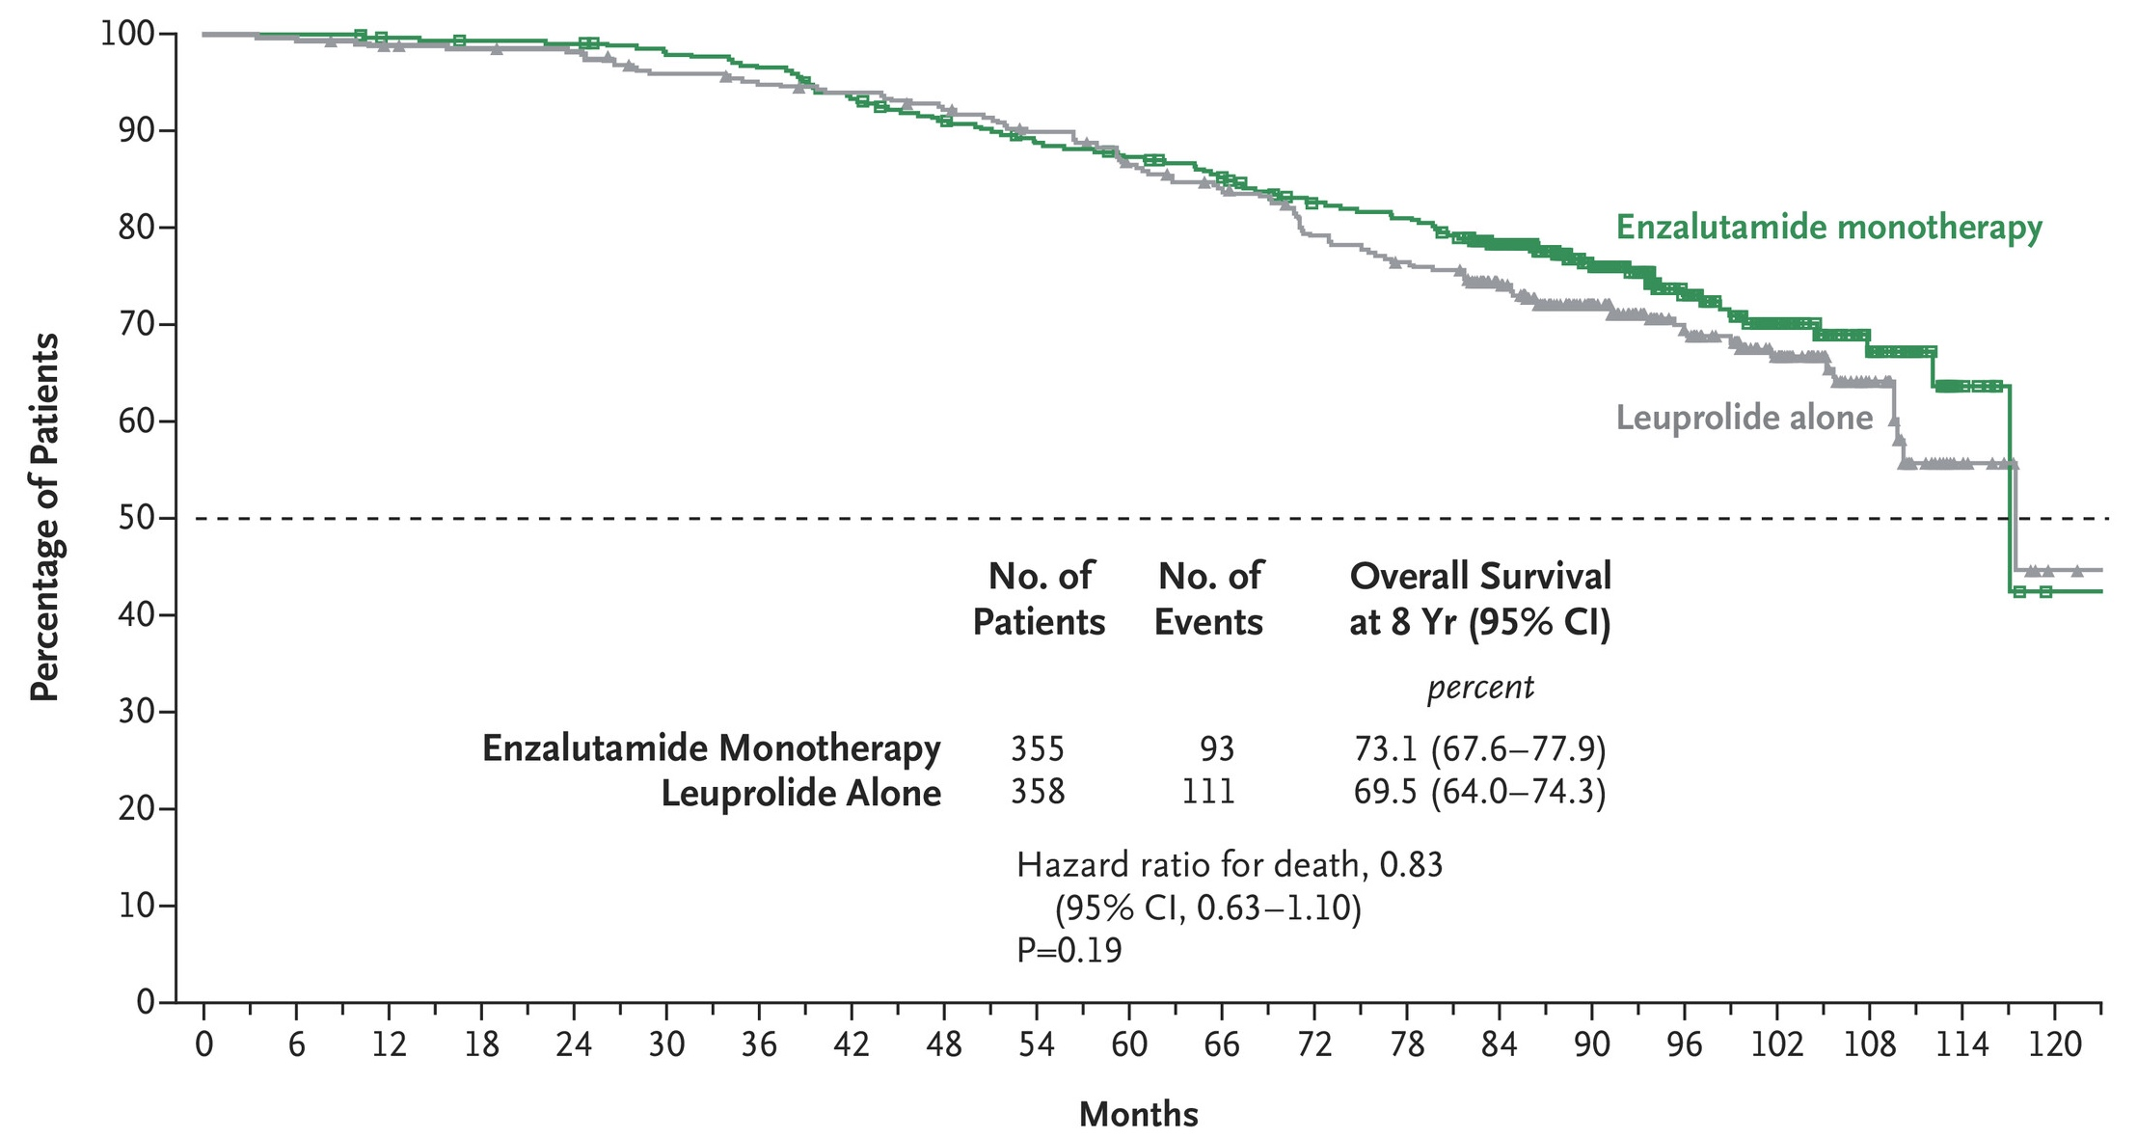
EMBARK Overall Survival
Enzalutamide Combination vs Leuprolide Alone
Enzalutamide Monotherapy vs Leuprolide Alone
Shore ND, et al. N Engl J Med. 2026;394:563-575.

Slide 25
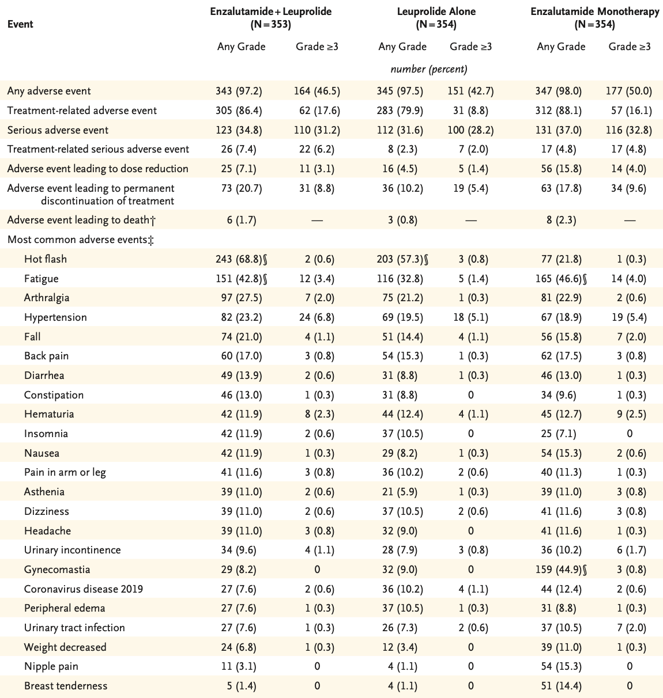
EMBARK Safety Data
No new safety signals were reported
Most common AEs (≥ 10%) and TRAEs (≥ 30%) for ENZA + LA were hot flashes and fatigue
Most common AE for ENZA monotherapy were gynecomastia, hot flashes and fatigue
Sexual activity appears better preserved with ENZA monotherapy than with LA alone
Freedland SJ, et al. N Engl J Med. 2023;389:1453-1465.

Slide 26
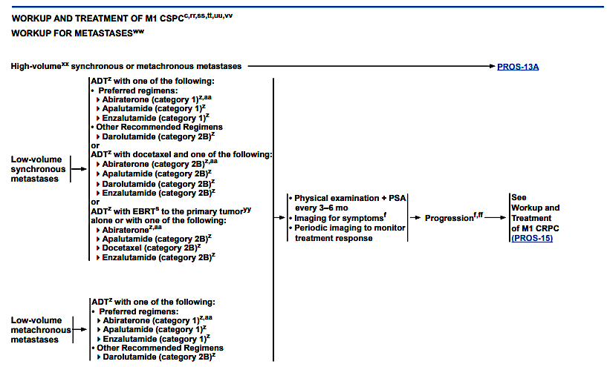
NCCN Guidelines for mHSPC

Slide 27
Timeline of FDA Approvals in
Metastatic Hormone Sensitive Prostate Cancer
Multiple ADT + ARPI combinations are now approved for mHSPC
allowing treatment to be tailored to the individual patient and disease characteristics
2015 2018 2019 2022 2025
ADT + Docetaxel
CHAARTED and STAMPEDE (Arm C)
ADT + Abiraterone
LATITUDE
ADT + Abiraterone + Docetaxel
PEACE-1
ADT + Darolutamide
ARANOTE
ADT + Enzalutamide
ARCHES
ADT + Darolutamide + Docetaxel
ARASENS
ADT + Abiraterone + Niraparib
AMPLITUDE
ADT + Apalutamide
TITAN
Fizazi K et al. Lancet Oncology. 2019; 20(5):686-700.; Fizazi K et al. ESMO 2021.; Chi KN et al. JCO. 2021; 39(20):2294-2303.; Andrew Armstrong, ASCO 2025; Smith MR et al. NEJM. 2022; 386:1132-1142.; Saad F et al. J Clin Oncol. 2024;42(36):4271-4281.; Gerhardt Attard, ASCO 2025

Slide 28
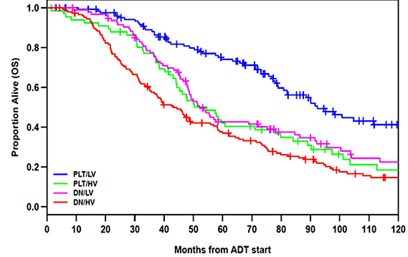
Prognosis by Volume and Presentation at Diagnosis
High-volume de novo metastatic disease is associated with the poorest prognosis
Overall Survival
Groups | N (% events) | mOS, years (95% CI)
Metachronous/ low volume | 125 (50) | 7.7 (6.7-10.6)
Metachronous/ high volume | 67 (75) | 4.6 (3.7-6.7)
De novo/ low volume | 96 (70) | 4.3 (4.0-6.5)
De novo/ high volume | 148 (84) | 3.6 (3.1-4.7)
Metachronous/low volume
Metachronous/high volume
De novo/low volume
De novo/high volume
Francini E, et al. Prostate. 2018;78(12):889-895.

Slide 29
Summary
Enzalutamide with or without ADT is a newer option for patients with high-risk biochemical recurrence
Short PSA doubling time should help identify patients with high-risk disease who are more likely to benefit from treatment intensification with enzalutamide
Doublet therapy with ADT and ARPI should be the foundation of treatment for patients with metastatic hormone-sensitive prostate cancer
For patients fit for docetaxel with metastatic hormone sensitive prostate cancer, consideration should be given to add either darolutamide or abiraterone to ADT + docetaxel, especially for patients with de novo, high-volume prostate cancer

Slide 30
Case Presentation

Slide 31
Case 1 – A Modern Day Scenario
A 55-year-old gentleman has a history of PSA 12 ng/dL, Grade Group 5, and T3b adenocarcinoma of the prostate
He is s/p radical prostatectomy 9 months ago
His PSA nadired to undetectable after surgery, however, 3 months later his PSA was detectable at 0.28 ng/dL
Every 3 months, he has had his PSA rechecked and it increased to 0.97 and now it is 4.9 ng/dL
He has no past medical history and is extremely active with ECOG performance status of 0
He undergoes imaging with CAP CT and bone scan and there is no evidence of metastatic disease
His goal is to live as long as possible, given his young age and outstanding quality of life

Slide 32
Case – Treatment Options
What treatment(s) should we consider for this patient?
PSMA PET to identify oligometastatic disease for potential metastasis directed therapy
ADT alone
ADT + enzalutamide
Enzalutamide alone
ADT + enzalutamide + docetaxel

Slide 33
Case – Evan’s Thoughts
This patient has extremely high-risk biochemical recurrence given a PSA doubling time of clearly <3 months
He is young and wishes for aggressive treatment
His PSMA PET would highly likely be positive for multiple metastases and likely metastasis directed therapy will not be successful, given the systemic nature of his disease
ADT + enzalutamide offers overall survival benefit in this setting

Slide 34
Discussion Questions
For which patients with nonmetastatic hormone-sensitive PC (nmHSPC) with high-risk biochemical recurrence after definitive therapy do you employ either enzalutamide alone or combined
with leuprolide?
How are the various androgen receptor pathway inhibitors — abiraterone, enzalutamide, apalutamide and darolutamide — similar and how are they different? How do you select which one to use
for a patient with mHSPC?

Slide 35
Tolerability of Hormonal Therapy Used in Treatment of Prostate Cancer
Stacy Walker, NP

Slide 36
GnRH Agonists vs Antagonists
Leuprolide, Degarelix, Relugolix
GnRH antagonists (degarelix, relugolix) may have fewer cardiovascular risks than GnRH agonists (leuprolide)
HERO trial - 54% lower risk of major adverse cardiovascular events with relugolix compared to leuprolide (2.9% vs 6.2%).
Risk reduction more pronounced in men with pre-existing conditions (3.6% vs 17.8%)
Zhang KW, Reimers MA, Calaway AC, Fradley MG, Ponsky L, Garcia JA, Cullen J, Baumann BC, Addison D, Campbell CM, Ghosh AK, Lenihan DJ, Desai NR, Weintraub N, Guha A. Cardiovascular Events in Men with Prostate Cancer Receiving Hormone Therapy: An Analysis of the FDA Adverse Event Reporting System (FAERS). J Urol. 2021 Sep;206(3):613-622. doi: 10.1097/JU.0000000000001785. Epub 2021 Apr 19. PMID: 33872049; PMCID: PMC10243352.

Slide 37
CV Toxicity in ARPIs
Hypertension is most common CV toxicity across all ARPIs
ARPI therapy doubles risk of grade 3 or higher CV events (with significant agent-level variation)
Agent | Predominant CV Toxicity | Reference
Abiraterone | Hypertension, Heart Failure (r/t mineralocorticoid excess mechanism) | LATITUDE
Enzalutamide | Hypertension, atrial fibrillation, ischemic heart disease | ARCHES
Apalutamide | Myocardial Infarction, Hypertension | TITAN
Darolutamide | Hypertension (modest increase) | ARASENS
Courtesy of Stacy Walker, NP

Slide 38
Cardiovascular Assessment and Management
Pre-Treatment Assessment
  Pre-existing and emerging CVD -
    CAD, PVD, CHF, arrhythmias including a-fib)
  ASCVD (AtheroSclerotic CardioVascular Disease) risk calculation
    The 10-year ASCVD risk estimate is used to guide decision-making for many preventive interventions, including lipid and blood pressure management
    While all individuals should be encouraged to follow a heart-healthy lifestyle, estimating an individual’s 10-year absolute ASCVD risk helps guide the intensity of medical management to maximize anticipated benefit and minimize potential harm from overtreatment
    ASCVD Risk - https://tools.acc.org/ldl/ascvd_risk_estimator/index.html#!/calulate/estimator/
On Treatment Monitoring
  Routine monitoring of clinical symptoms - BP, weight, blood sugar
  Lifestyle management - diet, tobacco, exercise
Managing Cardiovascular Risk - ABCDE
Steps | Risk Modification
A | Assess cardiovascular risk Consider aspirin
B | Blood pressure management
C | Cholesterol management Cigarette/tobacco cessation
D | Diabetes management Dietary recommendations
E | Exercise recommendations
Arnett DK et al. 2019 ACC/AHA Guideline on the Primary Prevention of Cardiovascular Disease: A Report of the American College of Cardiology/American Heart Association Task Force on Clinical Practice Guidelines. Circulation. 2019;140:e596–e646. DOI: 10.1161/CIR.0000000000000678.

Slide 39
CNS Side effects
CNS AE | Enzalutamide | Abiraterone | Apalutamide | Darolutamide
Mental Impairment
Cognitive Impairment
Seizure
Fatigue
Matsukawa A, Yanagisawa T, Rajwa P, Fazekas T, Miszczyk M, Tsuboi I, Parizi MK, Laukhtina E, Klemm J, Chiujdea S, Mancon S, Mori K, Kimura S, Karakiewicz PI, Miki J, Kimura T, Shariat SF. Central Nervous System Toxicity in Prostate Cancer Patients Treated with Androgen Receptor Signaling Inhibitors: A Systematic Review, Meta-analysis, and Network Meta-analysis. Clin Genitourin Cancer. 2025 Feb;23(1):102251. doi: 10.1016/j.clgc.2024.102251. Epub 2024 Oct 24. PMID: 39571519.

Slide 40
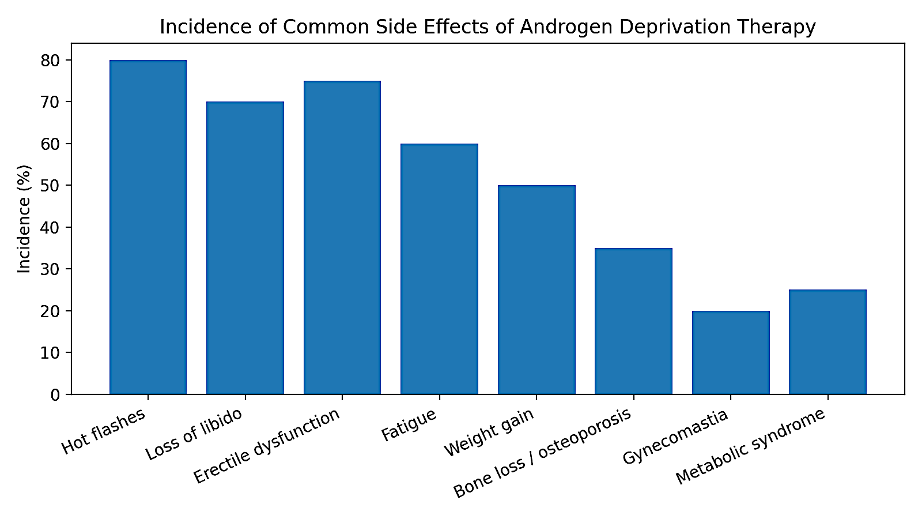
Courtesy of Stacy Walker, NP

Slide 41
ADT Side Effect Management
Fatigue | Remain active, regular exercise
Hot Flashes | SSRI (venlafaxine commonly), Gabapentin, Oxybutynin, Acupuncture
Gynecomastia/ Breast Tenderness | Weight management, some may consider surgical intervention or radiation
Erectile Dysfunction / Loss of Libido | PDE 5 Inhibitors (Cialis, Viagra), Injections (BiMix), Sexual health counseling
Low Bone Density | DEXA monitoring, Calcium/Vit D supplementation, weight- bearing exercises, bisphosphonates
Depression/ Mood Swings | Antidepressant medication, counseling
Courtesy of Stacy Walker, NP

Slide 42
Discussion Questions
How do you monitor for and manage common ADT-associated toxicities? How, if at all, does this differ based on patient age/performance status and medical history?
What are the most common toxicities observed with enzalutamide monotherapy and in combination with ADT?
What do you tell your patients who are about to start an AR pathway inhibitor about potential toxicities? How does this vary according to the specific agent?

Slide 43
Agenda
Module 1: Overview of Prostate Cancer
Module 2: Hormonal Therapy for Nonmetastatic and Metastatic Hormone-Sensitive Prostate Cancer (HSPC)
Module 3: Potential Role of Capivasertib in Metastatic HSPC
Module 4: Current and Potential Future Role of PARP Inhibitors in Metastatic PC
Module 5: Current and Future Role of Lutetium Lu 177 Vipivotide Tetraxetan for Patients with Metastatic PC

Slide 44
FRED HUTCH / UNIVERSITY OF WASHINGTON / SEATTLE CHILDREN’S
CANCER CONSORTIUM
Potential Role of Capivasertib in Metastatic
Hormone-Sensitive Prostate Cancer
Research To Practice - ONS
Evan Y. Yu, M.D
Section Head, Medical Oncology, Clinical Research Division
Medical Director, Clinical Research Support
Fred Hutchinson Cancer Center
Professor of Medicine, Division of Hematology & Oncology
University of Washington, Seattle, WA
April 26, 2025

Slide 45
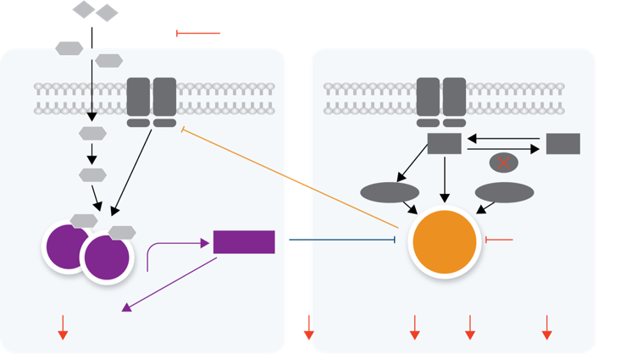
Overview of PTEN-PI3K-AKT and Intersection with AR Pathway
Rationale for Dual Pathway Inhibition
Androgen precursors
Cross talk between P13K/AKT
and AR pathways leads to reciprocal activation when one of the pathways is inhibited, providing an alternative mechanism for tumor growth and survival
Androgen
synthesis
Abiraterone
T
T
Receptor tyrosine kinases
Receptor tyrosine kinases
Cross talk between PI3K/AKT and AR pathways leads to reciprocal activation when one of the pathways is inhibited, providing an alternative mechanism for tumor growth and survival
T
PIP₃
PIP₂
PTEN
DHT
PDK1
mTORC2
Dual targeting of both pathways may increase antitumor activity
DHT
AR
DHT
AR target
genes
AKT
AKT Inhibitor
AR
eg, PHLPP, FKBP5
Ipatasertib and Capivasertib are potent AKT Inhibitors
Cell growth
and proliferation
Cell growth
and proliferation
Cell
survival
Glucose
metabolism
Protein
synthesis
Cellular process
decreased
de Bono J et al ESMO 2021;Abstract LBA4.

Slide 46
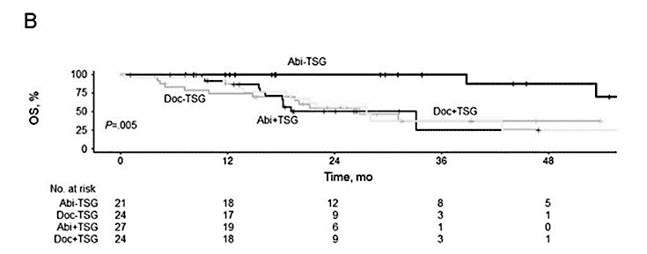
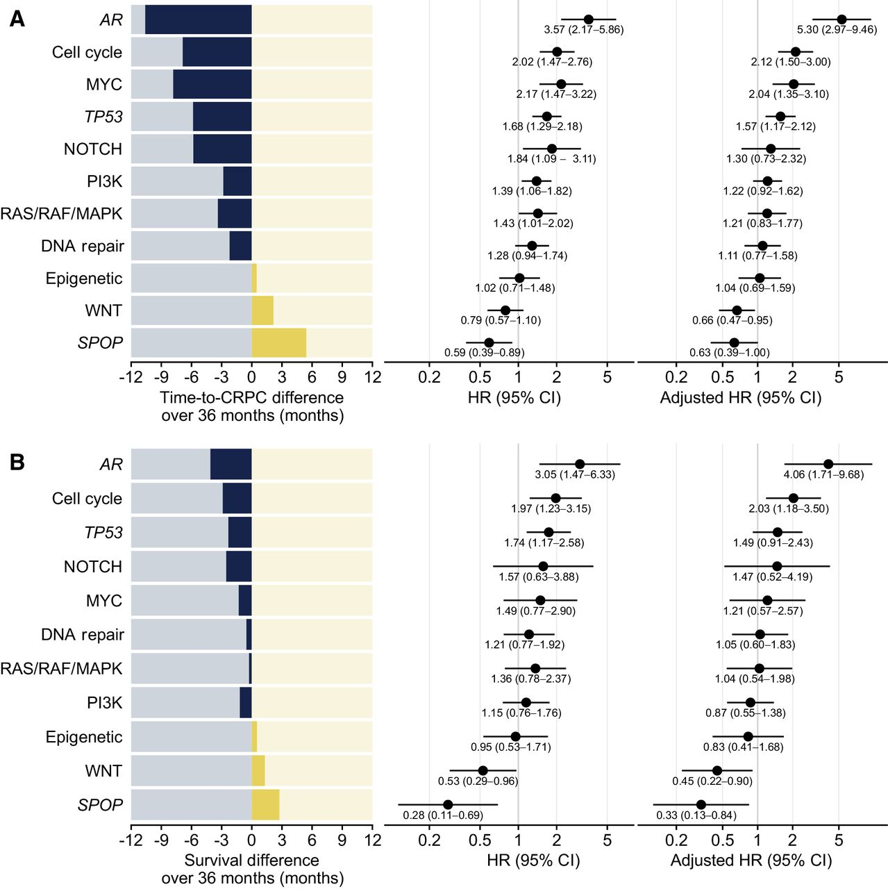
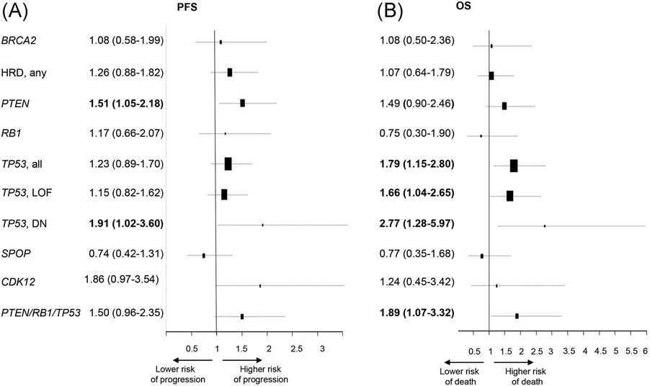
Outcomes Based on Tumor Suppressor Gene (TSG) Alterations in Metastatic Hormone-Sensitive Prostate Cancer
Radiographic PFS and OS Worse with TSG alteration
Stopsack et al. CCR 2020.
Ramirez-Velez et al. J Strength Cond Res 2020
Nizialek et al. Prostate 2020.

Slide 47
CAPItello-281: Capivasertib + Abiraterone vs. Placebo + Abiraterone in De Novo Metastatic Hormone Sensitive Prostate Cancer with PTEN Deficiency
Eligible patients:
Newly diagnosed, previously untreated mHSPC
IHC-confirmed PTEN deficiency
ECOG PS 0 or 1
Phase 3, Randomized, Double-Blind, Placebo-Controlled Trial
Primary endpoint: rPFS
Secondary endpoints: OS, time to start of first subsequent anticancer therapy, SSE-FS, TTPP
Capivasertib + abiraterone
(n = ~ 500)
R 1:1
All patients to receive continuous ADT
Placebo + abiraterone
(n = ~ 500)
ECOG, Eastern Cooperative Oncology Group; mHSPC, metastatic hormone-sensitive prostate cancer; OS, overall survival; PS, performance score; SSE-FS, symptomatic skeletal event-free survival; TTPP, time to pain progression.
Fizazi K, et al. J Clin Oncol. 2021;39(suppl_6): TPS178; ClinicalTrials.gov. Accessed April 4, 2024. https://clinicaltrials.gov/study/NCT04493853

Slide 48
What is PTEN Deficiency in the Capitello-281 Trial?
Previous trial with another AKT inhibitor using >50% of cells with no viable PTEN IHC staining was positive for rPFS but negative for overall survival
In Capitello-281, diagnostic cutoff of >90% of viable malignant cells with no specific cytoplasmic staining by IHC
  Of ~6200 patients submitting tumor tissue, 97% had a valid IHC result and 25% were PTEN deficient by this above definition

Slide 49
Capitello-281 rPFS
 | Capi+abi (N=507) | Pbo+abi (N=505)
Events, n (%) | 183 (36.1) | 215 (42.6)
Median rPFS, months (95% CI) | 33.2 (25.8, 44.2) | 25.7 (22.0, 29.9)
HR (95% CI) | 0.81 (0.66, 0.98)
P value | 0.034
1.0
0.8
0.6
Probability of rPFS
0.4
25.7 months
7.5 months
33.2 months
0.2
Capivasertib+abiraterone (N=507)
Placebo+abiraterone (N=505)
0.0
0
3
6
9
12
15
18
21
24
27
30
33
36
39
42
45
Number of patients at risk
Time from randomization (months)
Capi+abi | 507 | 460 | 435 | 353 | 282 | 233 | 217 | 165 | 123 | 93 | 69 | 62 | 41 | 21 | 6 | 0
Pbo+abi | 505 | 479 | 440 | 359 | 276 | 215 | 198 | 154 | 113 | 83 | 59 | 51 | 37 | 23 | 8 | 0
A stratified log-rank test was used to calculate two-sided P values. HRs and 95% CIs were calculated using a stratified Cox proportional-hazards model. Median follow-up: 18.4 months (capi+abi), 18.5 months (pbo+abi)
abi, abiraterone; capi, capivasertib; CI, confidence interval; HR, hazard ratio; pbo, placebo; rPFS, radiographic progression-free survival
Fizazi K et al. Ann Oncol 2026;37:53–68

Slide 50
CAPItello-281 PTEN subgroups:
investigator-assessed rPFS
1.0
PTEN cutoff | Capi+abi | Pbo+abi |  | Capi+abi | Pbo+abi | HR (95% CI)
All randomized patients (≥90%) | 507 | 505 |  | 33.2 | 25.7 | 0.81 (0.66, 0.98)
≥95% | 404 | 410 |  | 33.2 | 22.7 | 0.75 (0.60, 0.94)
≥99% | 205 | 196 |  | 34.1 | 22.4 | 0.71 (0.52, 0.97)
100% | 169 | 162 |  | 34.1 | 22.1 | 0.68 (0.48, 0.96)
0.8
0.6
Probability of rPFS
0.4
PTEN cutoff: 100%
0.2
Capivasertib+abiraterone
Placebo+abiraterone
0.0
0
3
6
9
12
15
18
21
24
27
30
33
36
39
42
45
Time from randomization (months)
Favors
capi+abi
0.5
1.0
2.0
Favors pbo+abi
HR (95% CI)

Slide 51
CAPItello-281 PTEN subgroups: OS
1.0
PTEN cutoff | Capi+abi | Pbo+abi |  | Capi+abi | Pbo+abi | HR (95% CI)
All randomized patients (≥90%) | 507 | 505 |  | NC | NC | 0.90 (0.71, 1.15)
≥95% | 404 | 410 |  | NC | NC | 0.80 (0.62, 1.04)
≥99% | 205 | 196 |  | NC | NC | 0.77 (0.53, 1.12)
100% | 169 | 162 |  | NC | NC | 0.77 (0.51, 1.14)
0.8
0.6
Probability of OS
0.4
0.2
0.0
0
3
6
9
12
15
18
21
24
27
30
33
36
39
42
45
48
Time from randomisation (months)

Slide 52
Summary
Current treatment for metastatic hormone sensitive prostate cancer includes doublet therapy with ADT + ARPI, at a minimum
PTEN, p53 and Rb are tumor suppressor genes that confer a poor prognosis
It is unclear whether PTEN deficiency predisposes to better outcomes with docetaxel
Capitello-281 with Capivasertib offers rPFS benefit for patients with PTEN deficiency

Slide 53
Case Presentation

Slide 54
Case 2 – A Modern Day Scenario
A 65-year-old gentleman presents asymptomatically with his initial screening PSA with a new PCP found to be 28 ng/mL
He has a h/o obesity and hyperlipidemia, but no known cardiac disease
ECOG performance status is 0
Labs are all WNL
CT and bone scan imaging confirm 6 osteoblastic lesions in the thoracic and lumbar spine and 1 in the R femur; PSMA PET is obtained and all lesions are PSMA PET positive with SUVs between 4 and 9
NGS reveals no alterations in BRCA1 or 2 or any other homologous recombination repair genes
PTEN by IHC reveals no tumor cells with PTEN immunostaining

Slide 55
Case – Treatment Options
What treatment(s) should we consider for this patient?
ADT alone
ADT + abiraterone
ADT + abiraterone + capivasertib
ADT + docetaxel
ADT + darolutamide + docetaxel

Slide 56
Case – Evan’s Thoughts
This patient has de novo, high volume disease (7 total bone metastases with 1 in the appendicular skeleton)
He has multiple comorbidities that are not ideal for ADT, but none of which preclude him from any of the treatment intensification options
Although ADT + abiraterone or ADT + docetaxel could be administered, he is a decent candidate for ADT + darolutamide + docetaxel
Given his PTEN deficiency, ADT + abiraterone + capivasertib is something to watch out for in the future

Slide 57
Discussion Questions
What is the optimal method to assess PTEN status, and when should testing be done?
How, if at all, does PTEN deficiency influence your treatment decision-making today?
If capivasertib were to become available, for which patients with mHSPC and PTEN deficiency would you prioritize its use?

Slide 58
FRED HUTCH / UNIVERSITY OF WASHINGTON / SEATTLE CHILDREN’S
CANCER CONSORTIUM
Tolerability Profile of Capivasertib
Research to Practice - ONS
Michael Lai, MSN, ARNP, NP-C
Advanced Practice Provider
Fred Hutchinson Cancer Center
Teaching Associate
University of Washington, Seattle, WA
April 26, 2025

Slide 59
CAPItello-281: common AEs associated with
AKT inhibition
Rash*
Diarrhea
Hyperglycemia†
 | Capi+abi (N=503) | Pbo+abi (N=503)
Any grade AE, n (%) | 178 (35.4) | 35 (7.0)
Grade ≥3 AE,‡ n (%) | 62 (12.3) | 1 (0.2)
Median (IQR) time to onset, days | 13 (11–43) | 78 (37–195)
AE leading to, n (%)
Interruption of capi/pbo | 85 (16.9) | 3 (0.6)
Reduction of capi/pbo | 43 (8.5) | 2 (0.4)
Discontinuation of capi/pbo | 24 (4.8) | 0
Supportive treatment given, n (%) | 146 (29.0) | 20 (4.0)
Outcome at time of DCO, n (%) Recovered/recovering Not recovered | 164 (32.6) 24 (4.8) | 28 (5.6) 8 (1.6)
Capi+abi (N=503) | Pbo+abi (N=503)
261 (51.9) | 40 (8.0)
31 (6.2) | 2 (0.4)
12 (3–43) | 142 (28–339)
63 (12.5) | 1 (0.2)
22 (4.4) | 0
5 (1.0) | 0
167 (33.2) | 19 (3.8)
238 (47.3) 45 (8.9) | 36 (7.2) 4 (0.8)
Capi+abi (N=503) | Pbo+abi (N=503)
191 (38.0) | 65 (12.9)
52 (10.3) | 3 (0.6)
54 (15–114) | 114 (71–326)
55 (10.9) | 4 (0.8)
33 (6.6) | 1 (0.2)
5 (1.0) | 0
127 (25.2) | 23 (4.6)
140 (27.8) 65 (12.9) | 43 (8.5) 25 (5.0)
*Grouped term including the preferred terms of erythema, rash, rash erythematous, rash macular, rash maculopapular, rash papular, rash pruritic. †Grouped term including the preferred terms of blood glucose increased, hyperglycemia. ‡A diarrhea AE of Grade 4 was reported for one patient (0.2%) in the capi+abi arm only, hyperglycemia AEs of Grade 4 and Grade 5 were reported for one patient (0.2%) each in the capi+abi arm only, no Grade 4–5 AEs of rash were reported. No primary prophylaxis interventions were used during the CAPItello-281 trial for prospective AE management. Additional data on supportive treatment received are available via QR code.
abi, abiraterone; AE, adverse event; capi, capivasertib; DCO, data cutoff; IQR, interquartile range; pbo, placebo
Courtesy of Michael Lai, MSN, ARNP, NP-C.

Slide 60
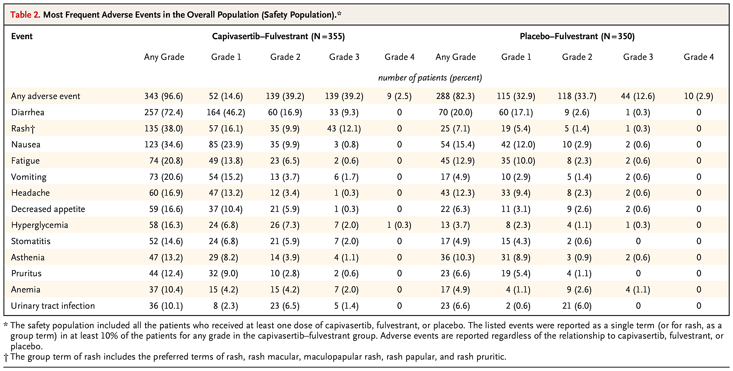
Table
CAPitello-291: most frequent AEs in the overall population
Turner et al N Engl J Med 2023;388: 2058-2070

Slide 61
Capivasertib: Diarrhea management
Dose Level | Capivasertib Dose | Schedule
Starting dose | 400 mg twice daily | 4 days on, 3 days off
First dose reduction | 320 mg twice daily | 4 days on, 3 days off
Second dose reduction | 200 mg twice daily | 4 days on, 3 days off
Grade 2: Withhold until ≤ Grade 1. Resume at same dose or one lower dose if recovery ≤ 28 days; reduce by one level if > 28 days. For recurrence, reduce by one dose level.
Grade 3: Withhold until ≤ Grade 1. Resume at same dose or one lower dose if recovery ≤ 28 days; permanently discontinue if > 28 days.
Grade 4: Permanently discontinue.
Patients should be advised to increase oral fluids and start antidiarrheal treatment (e.g., loperamide) at the first sign of diarrhea.
Consider secondary prophylaxis with loperamide for patients who experienced diarrhea in prior cycles.
Capivasertib. FDA Drug Label.

Slide 62
Capivasertib: Hyperglycemia management
Monitor fasting glucose at frequent intervals (baseline, then weekly during the first cycle is reasonable, regularly during first several cycles). Initiate or intensify oral anti-diabetic therapy (metformin preferred) early when glucose trends upward. HbA1c should be checked at baseline
FG > ULN–160 mg/dL (or HbA1c > 7%): Consider initiation or intensification of oral anti-diabetic treatment; no dose hold required.
FG 161–250 mg/dL: Withhold until FG ≤ 160 mg/dL. Resume at same dose if recovery ≤ 28 days; reduce by one level if > 28 days.
FG 251–500 mg/dL: Withhold until FG ≤ 160 mg/dL. Resume at one lower dose if recovery ≤ 28 days; permanently discontinue if > 28 days.
FG > 500 mg/dL or life-threatening sequelae: Withhold. Permanently discontinue if FG persists ≥ 500 mg/dL after 24 hours or life-threatening sequelae occur. If FG falls to ≤ 500 mg/dL within 24 hours, follow guidance for the relevant grade.
Capivasertib. FDA Drug Label.

Slide 63
Capivasertib: Cutaneous AE management
Monitor closely during the first 2–4 weeks. Initiate antihistamines and/or topical corticosteroids promptly. For severe or widespread rash, systemic corticosteroids may be needed.
Grade 2: Withhold until ≤ Grade 1, then resume at same dose. For persistent or recurrent Grade 2, reduce by one dose level.
Grade 3: Withhold until ≤ Grade 1. Resume at same dose if recovery ≤ 28 days; reduce by one level if > 28 days. Permanently discontinue for recurrent Grade 3.
Grade 4: Permanently discontinue.
Capivasertib. FDA Drug Label.

Slide 64
Capivasertib: Cytopenias monitoring and management
Laboratory Abnormality | Capivasertib + Fulvestrant | Placebo + Fulvestrant
 | All Grades (%) | All Grades (%)
Decreased lymphocytes | 49 | 14
Decreased hemoglobin | 47 | 22
Decreased leukocytes | 35 | 23
Decreased neutrophils | 25 | 16
Decreased platelets | 12 | 6
In clinical practice, following the CAPItello-291 monitoring schedule (hematologic tests on days 1 and 15 of cycles 1–2, then day 1 of each subsequent cycle) is reasonable and evidence-based. More frequent monitoring may be warranted in patients with baseline cytopenias, heavy prior treatment, or concurrent myelosuppressive therapies
Grade 2: Withhold capivasertib until recovery to ≤ Grade 1, then resume at the same dose.
Grade 3: Withhold until recovery to ≤ Grade 1. Resume at the same dose if recovery occurs within 28 days; reduce by one dose level if recovery takes > 28 days.
Grade 4: Permanently discontinue capivasertib.
Capivasertib. FDA Drug Label.
Turner et al N Engl J Med 2023;388: 2058-2070

Slide 65
Case Presentation

Slide 66
Case 1 – A Modern Day Scenario .. Enrolled onto CAPItello-281
A 60-year-old gentleman presents asymptomatically with an initial screening PSA found to be 21 ng/mL
He has a h/o obesity, hypertension, and hyperlipidemia, but no known cardiac disease
ECOG performance status is 0
Labs are all WNL
CT and bone scan imaging confirm 4 osteoblastic lesions in the thoracic and lumbar spine and 1 in the R acetabulum
NGS reveals no alterations in BRCA or any other homologous recombination repair genes; however, the patient is labeled as having PTEN loss
  This is confirmed on IHC with 90% of prostate tumor cells lacking PTEN immunostaining

Slide 67
Case 1 – A Modern Day Scenario .. Enrolled onto CAPItello-281
Enrolled on CAPItello-281 trial, randomized to the experimental arm: capivasertib 400 mg PO BID (4 days on, 3 days off) + abiraterone 1,000 mg QD, prednisone 5 mg QD and ADT with leuprolide.
C1D10 (during his second "on" period of capivasertib): he contacts the clinic reporting 5–6 loose, watery bowel movements/day over the past 2 days, an increase of 4–5 stools above his baseline of 1/day. He reports mild abdominal cramping but no fever, blood in stool, or signs of dehydration. He is tolerating oral fluids. He has not yet started any antidiarrheal medication
Meets CTCAE v5.0 criteria for Grade 2 diarrhea: increase of 4–6 stools/day over baseline, not interfering with ADLs but limiting instrumental ADLs. This timing is consistent with the expected onset of capivasertib-associated diarrhea.

Slide 68
Case 1 – A Modern Day Scenario .. Enrolled onto CAPItello-281
Step 1: Withhold capivasertib.
Per the FDA-approved dose modification table for capivasertib, Grade 2 diarrhea requires withholding capivasertib until recovery to ≤ Grade 1 (≤3 stools above baseline per day).
Step 2: Initiate antidiarrheal therapy.
loperamide 4 mg loading dose, then 2 mg after each loose stool, max 16 mg/day.
consider adding diphenoxylate/atropine 1–2 tablets every 6 hours PRN (max 8 tablets/day).

Slide 69
Case 1 – A Modern Day Scenario .. Enrolled onto CAPItello-281
Step 3: Supportive care.
Advise PO fluid intake with electrolyte-containing solutions.
Recommend dietary modifications: low-fiber, lactose-free diet; BRAT diet
Assess for signs of dehydration (orthostatic HoTN, decreased UOP, dry mucous membranes). If unable to tolerate PO fluids, arrange IVF.
Step 4: Rule out alternative etiologies.
Assess for infectious causes. Review concomitant medications
Step 5: Continue abiraterone, prednisone, and ADT.
Capivasertib is the causative agent

Slide 70
Discussion Questions
In your experience, what is the most common toxicity that affects adherence to capivasertib?
How should clinicians approach prophylaxis and early intervention for diarrhea? At what point do you hold versus dose reduce versus discontinue capivasertib for diarrhea?
Should clinicians assess baseline hemoglobin A1C in all patients before administering capivasertib? How frequently are endocrinology referrals necessary for patients receiving this drug?

Slide 71
Agenda
Module 1: Overview of Prostate Cancer
Module 2: Hormonal Therapy for Nonmetastatic and Metastatic Hormone-Sensitive Prostate Cancer (HSPC)
Module 3: Potential Role of Capivasertib in Metastatic HSPC
Module 4: Current and Potential Future Role of PARP Inhibitors in Metastatic PC
Module 5: Current and Future Role of Lutetium Lu 177 Vipivotide Tetraxetan for Patients with Metastatic PC

Slide 72


Current and potential use of PARP inhibitors for advanced prostate cancer
Scott T. Tagawa, MD, MS, FASCO, FACP
Professor of Medicine & Urology
weillcornellgucancer.org
@DrScottTagawa

Slide 73









Germline vs Somatic Mutations
GERMLINE MUTATIONS
SOMATIC MUTATIONS
Parental Gametes
Germline mutation
Inherited mutations can be detected in all cells
Embryo
Somatic/acquired mutations can be detected in tumor cells
Somatic mutation
Patch of affected area
Entire organism carries the mutation
Organism
Half of gametes carry mutation
Gametes of Offspring
None of gametes carry mutation
Bioninja. Accessed August 26, 2024. https://ib.bioninja.com.au/mutation-outcomes/

Slide 74



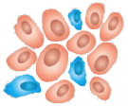


Rationale for PARP Inhibitors as PC Therapy
Poly (ADP-ribose) polymerase (PARP) inhibitors block the enzyme PARP in cells
PARP enzymes help with DNA repair
Tumor cells that have alterations in homologous recombination repair (HRR) will die when PARP enzyme is blocked (synthetic lethality)
About 20–25% of patients with mPC have tumor cells with alterations in HRR^{1,2}
Accumulation of DSBs in homologous recombination-deficient cells
Persistent unrepaired SSBs
PARPi
PARP
Unaffected normal cell
1. Inhibition of PARP enzyme activity
1
PARP inhibitor
Tumor cells
SSBs
2
Targeted tumor cell death
2. PARP trapping
PARPi
PARP
Trapping of PARP-DNA complexes
Replication fork instability Inhibition of transcription
SSBs, single strand break; DSBs, double strand breaks
1. Robinson. Cell, 2015;161(5):1215-1228. 2. Chung. JCO Precis Oncol. 2019:3:PO.18.002839. ; 3. Agarwal. Future Oncol. 2022;18(4):425-436.

Slide 75
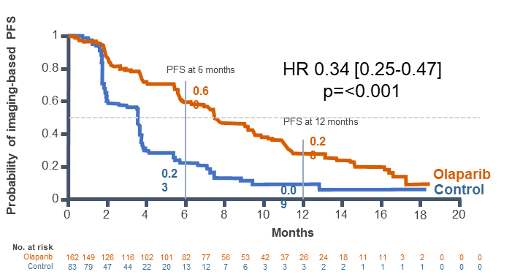
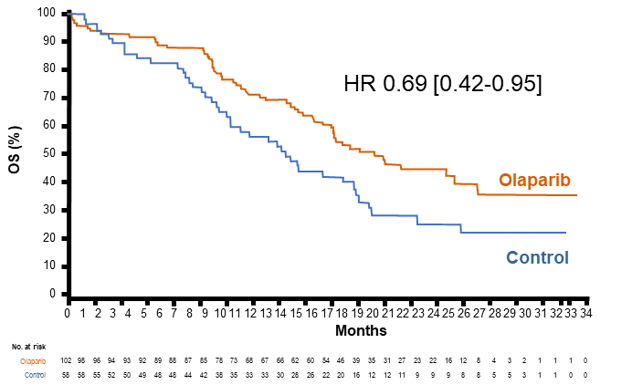
Phase 3 PROfound* in mAPMR With HRR Gene Alterations^{1,2}
Olaparib vs Enzalutamide or Abiraterone
Primary Endpoint
rPFS in Cohort A (RECIST 1.1 & PCWG3 by BICR)
Key Secondary Endpoints
rPFS in Cohorts A+B Confirmed radiographic objective response rate in Cohort A Time to pain progression in Cohort A OS in Cohort A
Key eligibility criteria
mAPMR PC with disease progression on prior ARPI; eg, abiraterone or enzalutamide
Alterations in ≥ 1 of any qualifying gene with a direct or indirect role in HRR*
Stratification factors
Previous taxane
Measurable disease
Olaparib, 300 mg bid
n = 162
Cohort A
BRCA1, BRCA2, or ATM
n = 245
Choice Abi/Enza‡
n = 83
R 2:1
Open-label
Upon BICR progression, physician's choice patients were allowed to cross over to olaparib
N = 387
Olaparib, 300 mg bid
n = 94
Cohort B
Other alterations
n = 142
Choice Abi/Enza‡
n = 48
‡Physician’s choice of either enzalutamide (160 mg qd) or abiraterone (1000 mg qd + prednisone [5 mg bid]); BICR, blinded independent central review
HRR, homologous recombination repair.
1. Hussain. N Engl J Med. 2020; 383:2345-2357. 2. de Bono. N Engl J Med. 2020; 382:2091-2102.

Slide 76
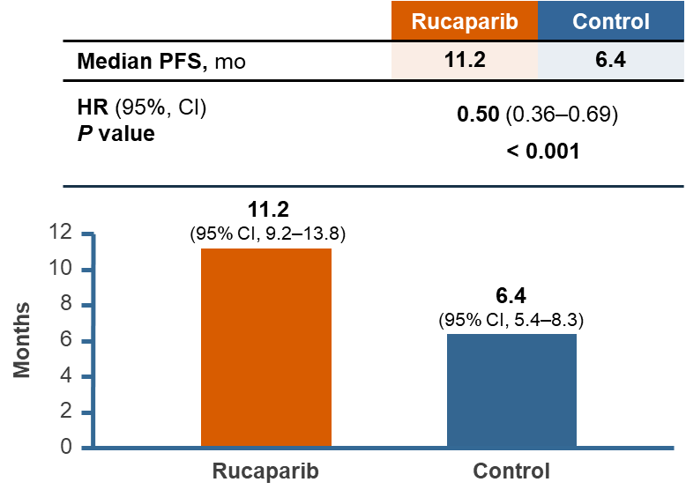
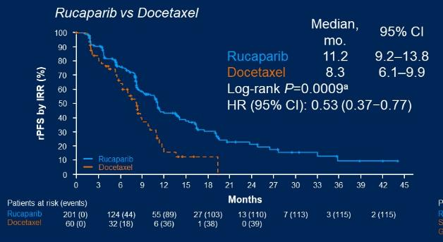
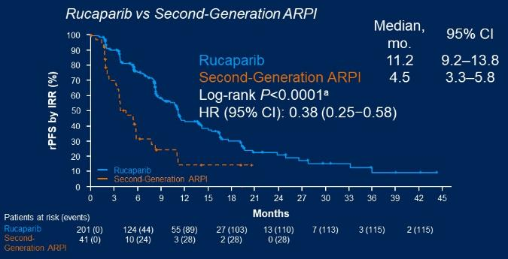
Phase 3 TRITON3 Trial mAPMR PC with BRCA/ATM Mutation
Rucaparib vs Physician’s Choice (abi/enza or docetaxel)
Patient population
ARPI-resistant mAPMR PC
BRCA1/2 or ATM mutation
ECOG 0-1
No prior chemotherapy
Primary endpoint
Radiographic PFS
Secondary end points
ORR and DoR OS Clinical benefit rate PSA response Time to PSA progression Patient-reported outcome Safety/tolerability
Rucaparib 600 mg BID
n = 270
Radiographic progression or Tx discontinuation
R
2:1
Docetaxel OR abiraterone OR enzalutamide
n = 135
Optional crossover to rucaparib if progression on comparator
Rucaparib with regular FDA approval for BRCA+ mAPMR PC after ARPI
*ATM included in trial
Fizazi K. N Engl J Med. 2023; 388(8):719-732. FDA grants regular approval to rucaparib for metastatic castration-resistant prostate cancer | FDA

Slide 77
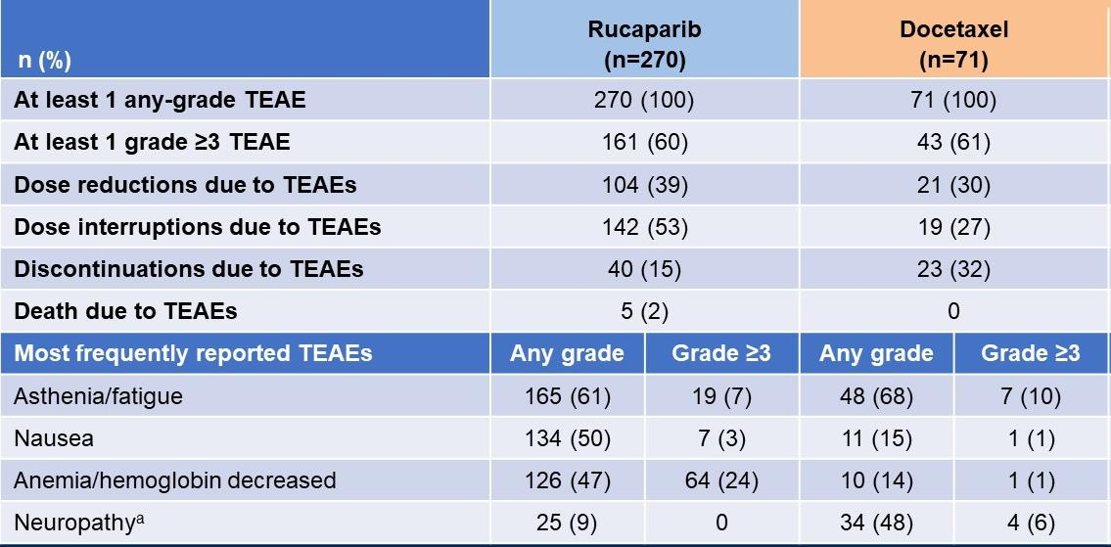
Phase 3 TRITON3 Trial in patients with mAPMR PC and BRCA/ATM
Rucaparib vs Physician’s Choice: Docetaxel subset
Fizazi K. N Engl J Med. 2023; 388(8):719-732

Slide 78
PARP Inhibitor + AR Pathway Inhibitor
Rationale: Pre-clinical synergy
  PARP is a transcriptional co-activator of AR
  AR induces expression of PARP
Olaparib + AAP¹
Niraparib + AAP²
Talazoparib + enzalutamide³
First-line therapy for patients with ARPI-naïve mAPMR PC and known or suspected BRCA alterations
Prior docetaxel for mCSPC permitted
First-line therapy for patients with mAPMR PC and BRCA alterations
No prior systemic therapy for mAPMR PC, except up to 4 months of AAP and ongoing ADT; Prior docetaxel and ARPIs received in mAPMN/S PC permitted
First-line therapy for patients with ARPI-naïve mAPMR PC and HRR alterations
1. US FDA. https://www.fda.gov/drugs/drug-approvals-and-databases/fda-approves-olaparib-abiraterone-and-prednisone-or-prednisolone-brca-mutated-metastatic-castration. 2. US FDA. https://www.fda.gov/drugs/resources-information-approved-drugs/fda-approves-niraparib-and-abiraterone-acetate-plus-prednisone-brca-mutated-metastatic-castration. 3. US FDA. https://www.fda.gov/drugs/drug-approvals-and-databases/fda-approves-talazoparib-enzalutamide-hrr-gene-mutated-metastatic-castration-resistant-prostate.

Slide 79
Summary of Combination PARPi Regimens
PARPi + ARPI combinations for mAPMR PC: Data for reference
 | Olaparib + AAP^{1,2} | Niraparib + AAP^{3,4} | Talazoparib + Enzalutamide⁵⁻⁷
PC Approvals | BRCA-mutated mAPMR PC | BRCA-mutated mAPMR PC | HRR-gene mutated mAPMR PC
Dose | 300 mg olaparib BID plus 1,000 mg abiraterone acetate qday with 5mg prednisone BID | 200 mg niraparib qday combined with 1,000 mg abiraterone acetate qday with 10 mg of prednisone daily | Talazoparib 0.5 mg qday plus Enzalutamide 160 mg qday
Most frequent AEs (≥ 20%), All Grades | Anemia (50%), fatigue (39%), nausea (31%), Back pain (22%), diarrhea (21%) | Decreased hemoglobin (67%), decreased lymphocytes (55%), decreased white blood cells (48%), musculoskeletal pain (44%), fatigue (43%), decreased platelets (37%), increased alkaline phosphatase (34%), constipation (34%), hypertension (33%), nausea (33%), decreased neutrophils (32%), increased creatinine (30%), increased potassium (25%), decreased potassium (20%) and increased AST (20%) | Anemia (66%), neutropenia (36%), fatigue (34%), thrombocytopenia (25%), back pain (22%), leukopenia (22%), decreased appetite (22%), nausea (21%)
Clinical Benefit | 34% reduced risk for radiographic progression (overall) In exploratory BRCAm mCRPC subgroup: HR for rPFS: 0.24 (95% CI, 0.12–0.45) HR for OS: 0.29 (95% CI, 0.14–0.56) | In the BRCA1/2 subgroup: HR for rPFS: 0.55 (95% CI, 0.39–0.78); P = 0.0007 HR for OS: 0.788 (95% CI 0.554-1.120); nominal p = 0.183 | HR for rPFS: (HR 0.67; 95% CI 0.55–0.81; P<.0001) In the HRR subgroup: HR for rPFS: 0.46 (0.30–0.70; P = 0.0003) HR for mOS: 0.55 (0.36–0.83; P = 0.0035) In the BRCA1/2 m subgroup HR for mOS: 0.497 (0.318-0.776); P=0.0017
1. Clarke. N Eng J Med Evid. 2022;1(9):EVIDoa2200043. 2. Saad. Lancet Oncol. 2023 Oct;24(10):1094-1108. 3. Chi. Ann Oncol. 2023;34: 772-782. 4. Chi. Eur Urol Oncol. 2025; 8(4):986-998. 5. Agarwal. Lancet. 2023;402(10398):291-303. 6. Agarwal. Lancet. 2025;406:447.460. 7. Agarwal. ASCO GU 2025, LBA18.

Slide 80

Phase 3 AMPLITUDE Trial in HRRm mAPMN/S PC
Niraparib + AAP +ADT vs placebo + AAP +ADT
1,2
3
Niraparib + abiraterone acetate (1,000 mg) + prednisone (5 mg)
Continuous administration, 28-day C (n = 348)
Adverse Events
Eligibility Criteria:
Prostate adenocarcinoma
HRR gene alteration
ADT started <6 mo prior to R and continued through study
Prior doce allowed; up to 45 days abi/pred allowed
No prior PARPi treatment
Primary Endpoint rPFS
Secondary Endpoint
OS
Niraparib + AAP
Placebo + AAP
1:1
75%
25%
69%
31%
R
696
Placebo + abiraterone acetate (1,000 mg) + prednisone (5 mg)
Continuous administration, 28-day C (n = 348)
This regimen was FDA-approved December 12, 2025 for those with known or suspected deleterious BRCA2m mAPMN/S PC.
Anemia (25% needed blood transfusion) and hypertension
 | Nira + AAP vs Placebo + APP (N = 696)
Endpoints | Niraparib + AAP (n = 348) | Placebo + AAP (n = 348) | Placebo + AAP (n = 398)
Median rPFS (mos) | NE | 29.5 | 29.5
HR (95% CI) | 0.63 (0.49, 0.8)
P | .0001
Median OS (mos) | NE |  | NE
HR (95% CI) | 0.75 (0.51, 1.11)
P | .15
BRCA Subgroup Analysis
HRR Effector Subgroup Analysis
Nira + AAP
n = 191
Placebo + AAP
n = 196
Nira + AAP
n = 230
Placebo + AAP
n = 226
Median
rPFS
NR
26 mos
Median
rPFS
NR
27.6 mos
Median
rPFS
rPFS HR: 0.52
95% CO: 0.37, 0.72; P < .0001
rPFS HR: 0.57
95% CO: 0.42, 0.77; P < .0003
AAP, abiraterone acetate + prednisone; ADT, androgen deprivation therapy; BRCA2m, BRCA2-mutated; C, cycles; HRR, homologous recombination repair; mCSPC, metastatic castration-sensitive prostate cancer; NE, not evaluable; Nira, niraparib; rPFS, radiographic progression-free survival. 1. ClinicalTrials.gov. NCT04497844. 2. Food and Drug Administration. https://www.fda.gov/drugs/resources-information-approved-drugs/fda-approves-niraparib-and-abiraterone-acetate-plus-prednisone-brca2-mutated-metastatic-castration. Accessed Feb 19, 2026. 3. Attard. Nat Med. 2025;31(12):4109-4118.

Slide 81
PARP inhibitor summary
mAPMN/S
  ADT/Abi/pred + niraparib FDA approved for BRCA2
    Need longer follow up for other groups
  ADT/Enza/talazoparib with positive trial (press release → ASCO 2026)
ARPI-naïve mAPMR
  ARPI + PARPi better than ARPI alone in molecularly selected
    Abi/pred/olaparib, Abi/pred/niraparib, Enza/talazoparib
ARPI-resistant mAPMR
  Rucaparib > doce/ARPI in BRCA2/1
  Olaparib > ARPI in molecularly selected
Additional combinations being studied
PARP1 selective?

Slide 82
Case Presentation

Slide 83
At age 68, pt presented with PSA 11, Gleason grade group 4, cT3N0 prostate adenocarcinoma
  Family history of breast and prostate cancer
  History of diet-controlled hyperlipidemia, no other co-morbidities
Started ADT and received radiation to prostate and pelvic lymph nodes. PSA declined to 0.5.
  Complains of fatigue and weakness with occasional stumbling
Towards the end of year 2 of ADT, PSA begins rising
  0.5 → 0.9 → 2.1 (doubling time 2.5 months) without new symptoms
  Scans c/w multifocal lymph node and bone metastases
  Biopsy confirms prostate adenocarcinoma
  Germline assessment = pathogenic BRCA2 alteration
  Biopsy genomics = BRCA2 and TMPRSS2-Erg fusion
How would you treat this patient?

Slide 84
Discussion Questions
What is the incidence of BRCA1/2 and other homologous recombination repair abnormalities in PC? Who should be tested for them, when and how?
When do you use PARP inhibitor monotherapy and when do you recommend a PARP inhibitor/AR pathway inhibitor combination for individual patients?

Slide 85
FRED HUTCH / UNIVERSITY OF WASHINGTON / SEATTLE CHILDREN’S
CANCER CONSORTIUM
Tolerability of PARP Inhibitors Used in the Treatment of PC
Research to Practice - ONS
Michael Lai, MSN, ARNP, NP-C
Advanced Practice Provider
Fred Hutchinson Cancer Center
Teaching Associate
University of Washington, Seattle, WA
April 26, 2025
Notes:
Spectrum and incidence of common class-effect and agent-specific toxicities associated with PARP inhibitors in patients with mPC
Optimal monitoring and management paradigms for PARP inhibitor-related toxicities
Impact on the tolerability of PARP inhibitors when administered in combination with secondary hormonal therapy
Strategies for identifying the root cause of toxicities that may be attributable to either agent in patients receiving PARP inhibitor/secondary hormonal therapy combinations

Slide 86
Comparative Toxicity Across PARP Inhibitors
Class effect toxicities seen across all PARPi
  GI disturbances
  Fatigue
  Anemia
Care team should be proactive in management of AEs
  Consider prescribing antiemetics and antidiarrheals prior to first dose
  Consider initiating treatment at reduced dose based on patient profile
Close laboratory and clinical monitoring for initial 3 months.
Other AE considerations
  Hypertension and cardiovascular events
  Pneumonitis
  Myelodysplastic Syndrome / Acute Myeloid Leukemia

Slide 87
Comparative Toxicity Across PARP Inhibitors
Adverse Event | Olaparib (PROfound, n=256) | Rucaparib (TRITON3, n=270) | Niraparib (GALAHAD, n=289) | Talazoparib (TALAPRO-1, n=127)
Anemia (any grade) | 50% | 49% | 54% | 49%
Anemia (Grade ≥3) | 23% | 23% | 33% | 31%
Neutropenia (any grade) | 9% | 17% | 14% | 17%
Neutropenia (Grade ≥3) | 4% | 9% | 10% | 8%
Thrombocytopenia (any grade) | 12% | 14% | 24% | 19%
Thrombocytopenia (Grade ≥3) | 4% | 6% | 16% | 9%
Nausea (any grade) | 43% | 49% | 58% | 33%
Fatigue/Asthenia (any grade) | 42% | 55% | 33% | 24%/20%
Decreased appetite (any grade) | 31% | 29% | 25% | 28%
Discontinuation due to AE | 18% | 15% | 15% | 12%

Slide 88
Optimal Monitoring and Management of PARP Inhibitors
At PARP initiation:
CBC + differential, monitor monthly
For Niraparib:
FDA label recommends weekly CBC during first month (high incidence thrombocytopenia)
Then convert to monthly monitoring
  May be reasonable to apply this principle to all PARPs
La Fargue et al Lancet Oncol 2019 Jan; 20(1) e15-e28 Niraparib PI

Slide 89
Optimal Monitoring and Management of PARP Inhibitors
Hematologic toxicities tend to occur early
PROfound (Olaparib): all 4 most common AEs peaked within first 2 months
  Managed with dose modifications
TALAPRO1 (Talazoparib): median time to onset …
  >G3 anemia was first 56 days
  >G3 neutropenia 48 days
  >G3 thrombocytopenia 17 days
For Niraparib:
FDA label recommends weekly CBC during first month (high incidence thrombocytopenia)
Then convert to monthly monitoring
  May be reasonable to apply this principle to all PARPs
Roubaud et al Eur J Cancer 2022 Jul: 170: 73-84
Mehra et al J Clin Oncol 39, 5047 (2021) Niraparib PI

Slide 90
Optimal Monitoring and Management of PARP Inhibitors
Anemia – the most clinically impactful toxicity
Dose interruptions, dose reductions
Transfusions
  TALAPRO1: 34% received this, most when Hgb 7.0-10.0g/dL
Nausea/Vomiting
Generally G1-2 tends to peak early, then improve with continued tx
Standard antiemetics
Thrombocytopenia
Niraparib: decreases occur predominantly during C1, stabilize by C2-3
Dose modifications, primary strategy
Olaparib PI
Mehra et al J Clin Oncol 39, 5047 (2021)

Slide 91
Optimal Monitoring and Management of PARP Inhibitors
VTE
Routine thromboprophylaxis not currently recommended, but awareness prudent.
PROpel (Olaparib): most PEs were incidental findings on imaging
MDS/AML surveillance
If unexplained pancytopenia develops, nutritional deficiencies and viral infections should be excluded
Persistent issue should prompt bone marrow aspirate to evaluate for dysplasia
Must discontinue the PARP if MDS/AML confirmed.
Yazgan et al Crit Rev Oncol Hematol 2024 Jun:98:104376
La Fargue et al Lancet Oncol 2019 Jan; 20(1) e15-e28

Slide 92
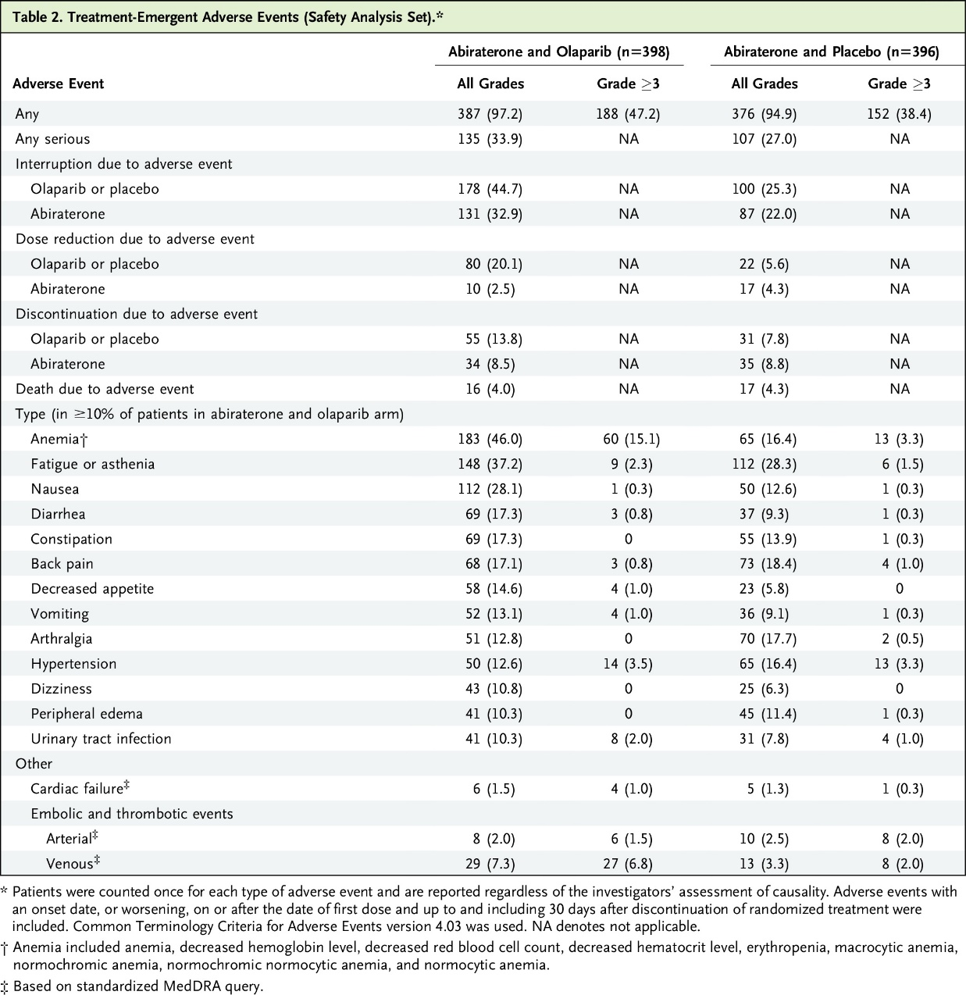
Combo Therapy Impacts on Tolerability
Three phase III combination trials in 1st line mCRPC
PROpel (Olaparib + abiraterone)
TALAPRO2 (Talazoparib + enzalutamide)
MAGNITUDE (Niraparib + abiraterone)
The rate of ≥G3 AEs is 10-30% higher with PARP inhibitor/ARPI combinations compared to ARPI alone
Clarke et al NEJM Evid 2022; 1(9):EVIDoa2200043

Slide 93
PROpel: Most Common Adverse Events
Olaparib + abiraterone (n=399)
Placebo + abiraterone (n=399)
Grade ≥3
All grade
Grade ≥3
All grade
Safety was assessed through the reporting of AEs according to the National Cancer Institute Common Terminology Criteria for Adverse Events (NCI CTCAE v4.03) and laboratory assessments.
*Anemia category includes anemia, decreased hemoglobin level, decreased red-cell count, decreased hematocrit level, erythropenia, macrocytic anemia, normochromic anemia, normochromic normocytic anemia, and normocytic anemia.
Saad F, et al. GU ASCO 2022.

Slide 94
Case Presentation

Slide 95
Identifying Toxicity Cause in PARP/ARPI Combos – Case Discussion
Toxicities Predominantly Attributable to the PARPi
Myelosuppression In PROpel, Grade ≥3 anemia was 15.1% with olaparib-abiraterone vs. 3.3% with placebo-abiraterone, clearly attributable to olaparib. Similarly, in TALAPRO-2, Grade ≥3 anemia was 43% vs. 2%. ARPIs alone cause minimal myelosuppression.
Nausea, vomiting, decreased appetite: GI toxicities are well-established PARP inhibitor class effects and occur at much lower rates with ARPIs alone.
MDS/AML: Exclusively attributable to PARP inhibition.
Toxicities Predominantly Attributable to the ARPI:
Hypertension: known abiraterone effect (mineralocorticoid excess) and, to a lesser extent, enzalutamide. In PROpel, hypertension rates were similar between arms (12.6% vs. 16.4%), confirming this is an abiraterone-driven effect
Hepatotoxicity (elevated transaminases): Primarily an abiraterone effect (though rucaparib also causes ALT/AST elevations independently)
Fatigue: Shared by both drug classes, making attribution difficult. However, fatigue rates in PROpel were modestly higher with the combination (37.2% vs. 28.3%), suggesting an additive effect
Cognitive effects, seizure risk: Enzalutamide-specific.
Peripheral edema, hypokalemia: Abiraterone-specific (mineralocorticoid pathway)
Clarke et al NEJM Evid 2022; 1(9):EVIDoa2200043
Roubaud et al Eur J Cancer 2022 Jul: 170: 73-84
Prostate Cancer. NCCN Guidelines
Fizazi et al Lancet 2025 Aug 2; 406 (10502): 461-474
La Fargue et al Lancet Oncol 2019 Jan; 20(1) e15-e28

Slide 96
Identifying Toxicity Cause in PARP/ARPI Combos – Case Discussion
72-year-old man with BRCA2-mutated metastatic castration resistant prostate cancer with bone metastases to the pelvis, lumbar spine, and ribs. PMhx well controlled HTN (on lisinopril 10 mg), T2 DM (on metformin 1000 mg BID), and mild CKD (baseline eGFR 55 mL/min). He was started on first-line Olaparib 300 mg BID + abiraterone 1000 mg QD + prednisone 5 mg BID, with ongoing ADT (leuprolide depot injections). Baseline Hgb 11.8 g/dL, otherwise CBC and CMP largely unremarkable.
At his routine 8-week follow-up, he reports progressive fatigue over past 3 weeks now limiting instrumental ADLs, intermittent nausea (3-4 episodes/week), bilateral ankle swelling, mild dizziness on standing. No chest pain, dyspnea, melena, or hematuria.

Slide 97
Identifying Toxicity Cause in PARP/ARPI Combos – Case Discussion
VS:
BP 162/96, HR 88 bpm, wt 92 kg (up 3.5 kg)
Labs:
Hgb 8.4 (down from 11.8)
MCV 102
Reticulocyte count 1.8% (inappropriately low)
K 3.1 (down from normal range)
AST 78 (~2x ULN)
ALT 62 (~1.5x ULN)
Fasting glucose 198 mg/dL

Slide 98
Discussion Questions
How do you counsel patients with germline BRCA and other germline homologous recombination repair abnormalities about the potential utility of genetic testing for children or grandchildren?
What are the common side effects associated with PARP inhibitors? What do you tell your patients about to start one of these agents about potential toxicities? How does this vary according to the specific agent and whether it is used alone or in combination with an AR pathway inhibitor?
How would you alleviate the concern of a patient who expressed fear about the potential development of AML/MDS on a PARP inhibitor?

Slide 99
Agenda
Module 1: Overview of Prostate Cancer
Module 2: Hormonal Therapy for Nonmetastatic and Metastatic Hormone-Sensitive Prostate Cancer (HSPC)
Module 3: Potential Role of Capivasertib in Metastatic HSPC
Module 4: Current and Potential Future Role of PARP Inhibitors in Metastatic PC
Module 5: Current and Future Role of Lutetium Lu 177 Vipivotide Tetraxetan for Patients with Metastatic PC

Slide 100
Current and future role of Lu-177 vipivotide tetraxetan for advanced prostate cancer
Scott T. Tagawa, MD, MS, FASCO, FACP
Professor of Medicine & Urology
weillcornellgucancer.org
@DrScottTagawa

Slide 101
Targeted Radionuclide Therapy (TRT)
TRT = preferred term for targeted delivery of therapeutic radionuclide
  Radiopharmaceutical therapy (RPT)
    RLT = small molecule ligand; PRRT = peptide; RIT = antibody
Examples (with typical “theranostic” pair), partial list
  Iodine-131 (¹²³I / ¹³¹I)
  Strontium-89, samarium-153 (^{99Tm}-MDP)
  Radium-223 dichloride (^{99Tm}-MDP)
  Lutetium-177 dotatate (⁶⁸Ga/⁶⁴Cu-dotatate)
  Lutetium-177 vipivotide tetraxetan (⁶⁸Ga-PSMA-11 / ¹⁸F-DCFPyL / ¹⁸F-PSMA-7.3)
Al-Ibraheem A et al. J Nucl Med. 2025;66(5):757-763..

Slide 102

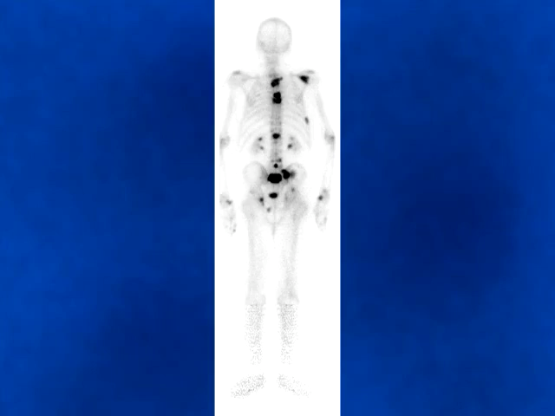
Targeted Diagnostics & Therapeutics
PSMA = a very specific lock present on most prostate cancers
also salivary/lacrimal glands, small intestine, proximal renal tubules, solid tumor neovasculature
We have engineered specific “keys” that only target PSMA “locks”
  and we can attach cancer killers or other molecules to keys that enter via locks

Slide 103
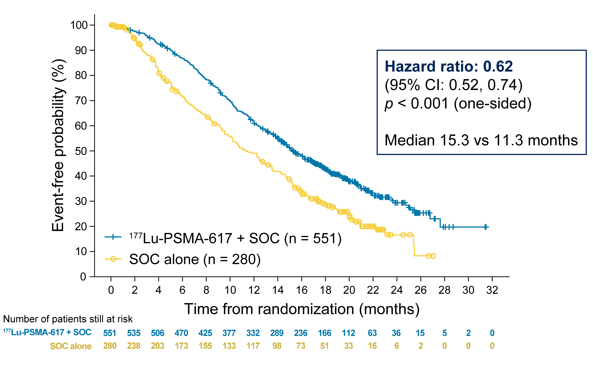
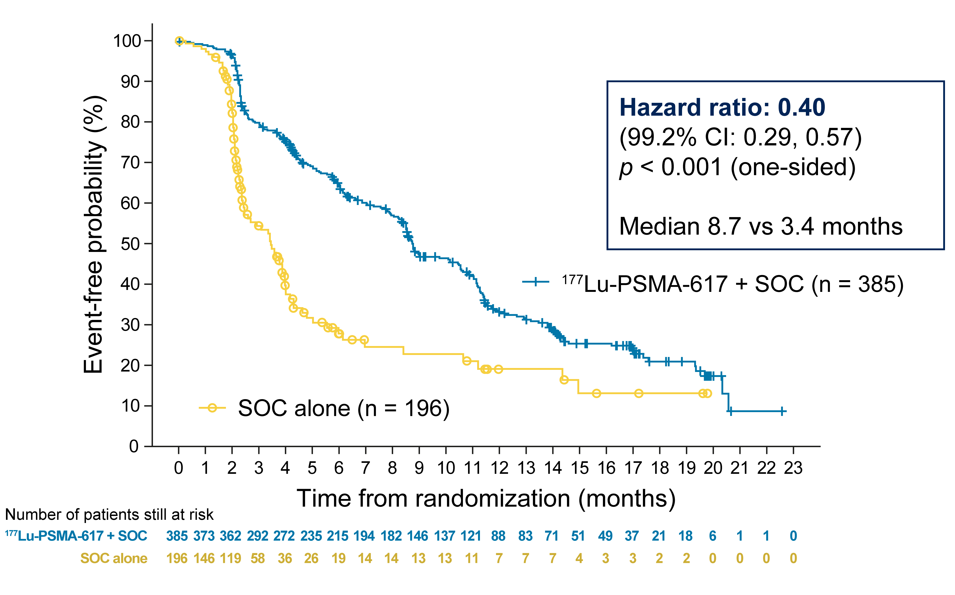
VISION: pre-treated mAPMR PC
N=814
Alternative 1º endpoint:
rPFS or OS acceptable with FDA
Best standard care
¹⁷⁷Lu-PSMA-617
  7.4 GBq q6 wks x4-6
Stratification Factors
mAPMR PC
at least 1 prior ARPI
at least 1 prior taxane
PS = 0-2
PSMA PET+
LDH (above/below 260)
Liver mets (Y/N)
PS (0-1 vs 2)
ARPI as BSC (Y/N)
2:1 Randomization
Best standard care
OS
rPFS
Sartor et al. N Engl J Med. 2021; 385:1091-1103.

Slide 104
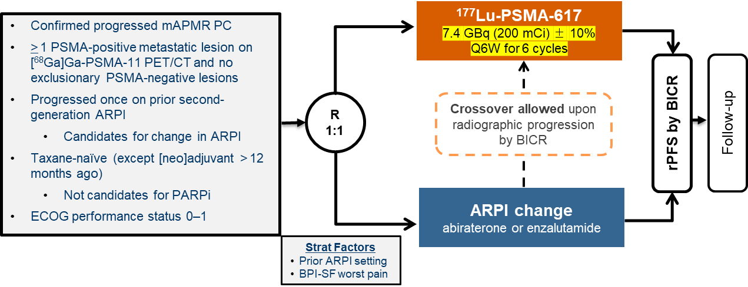
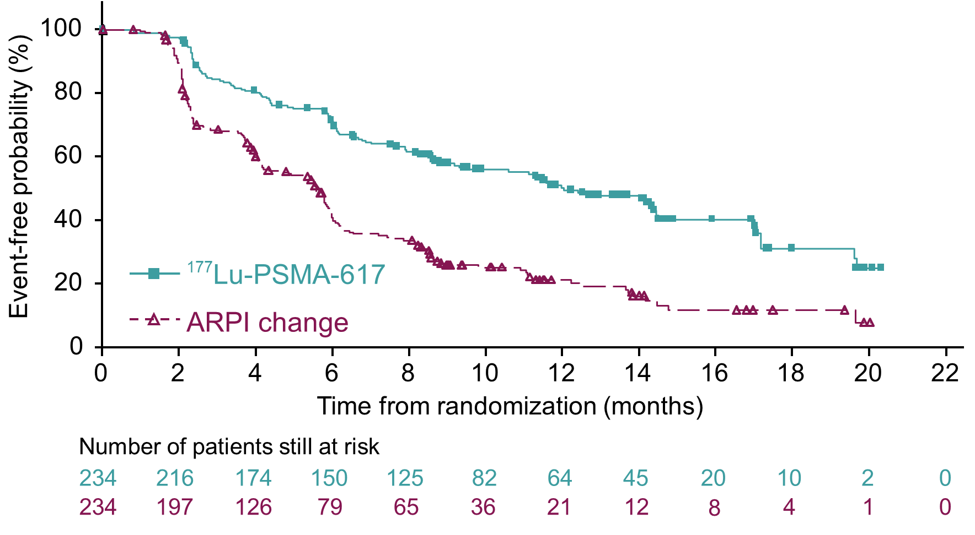
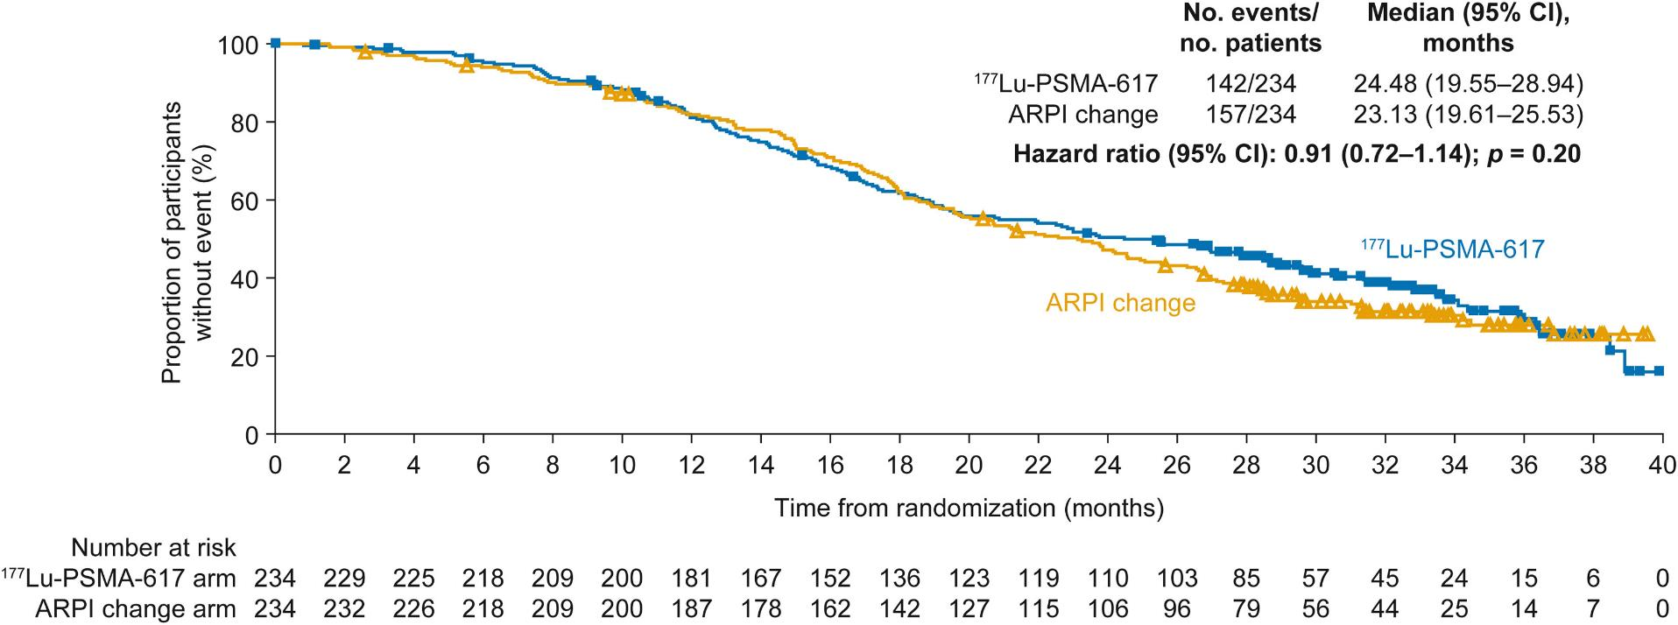
PSMAfore: ARPI-resistant, chemo-naïve mAPMR PC
rPFS
Morris et al. Lancet. 2024; 404:1227-1239.
Fizazi et al, Ann Oncol 2025

Slide 105
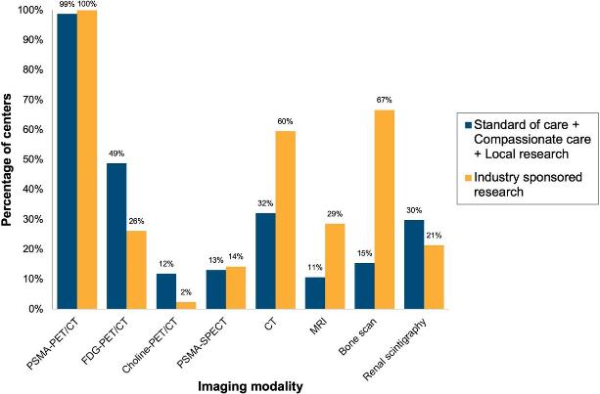
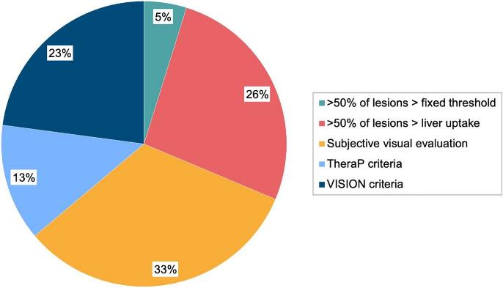
VISION: ¹⁷⁷Lu-PSMA-617: Patient Selection With PSMA PET
1003 patients received
⁶⁸Ga-PSMA-11 PET/CT
869/1003 patients (~87%)
met PSMA criteria
(95% at least 1 PSMA+ lesion > liver)
Pre-Specified Criteria for PSMA Positivity
PSMA-positive metastatic lesion
  PSMA PET positivity defined as visual uptake > liver
No size criteria for PSMA-positive lesions
No PSMA < liver visceral or lytic bone lesions > 1 cm
No PSMA < liver lymph node lesions > 2.5 cm
⁶⁸Ga-PSMA-11 PET/CT, Gallium-68 prostate-specific membrane antigen-11 positron emission tomography/computed tomography; PSMA, prostate-specific membrane antigen
Sartor O et al. N Engl J Med. 2021;385:1091-1103. Farolfi A et al. J Nucl Med. 2024;65:438-45.

Slide 106
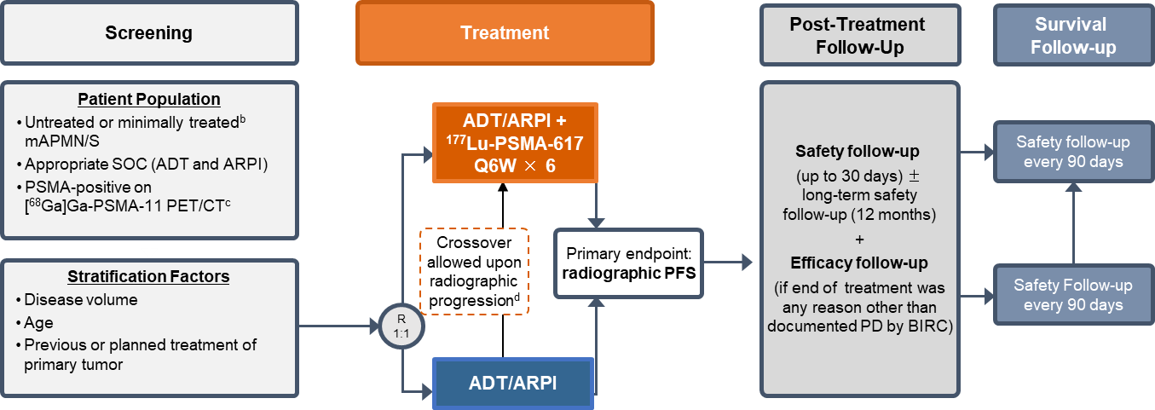
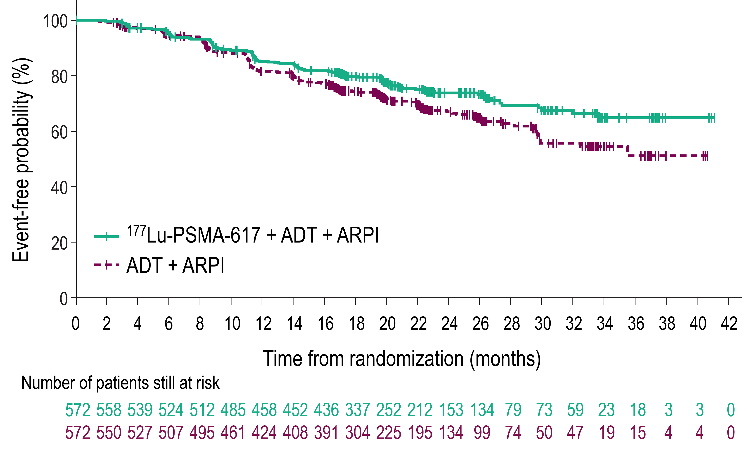
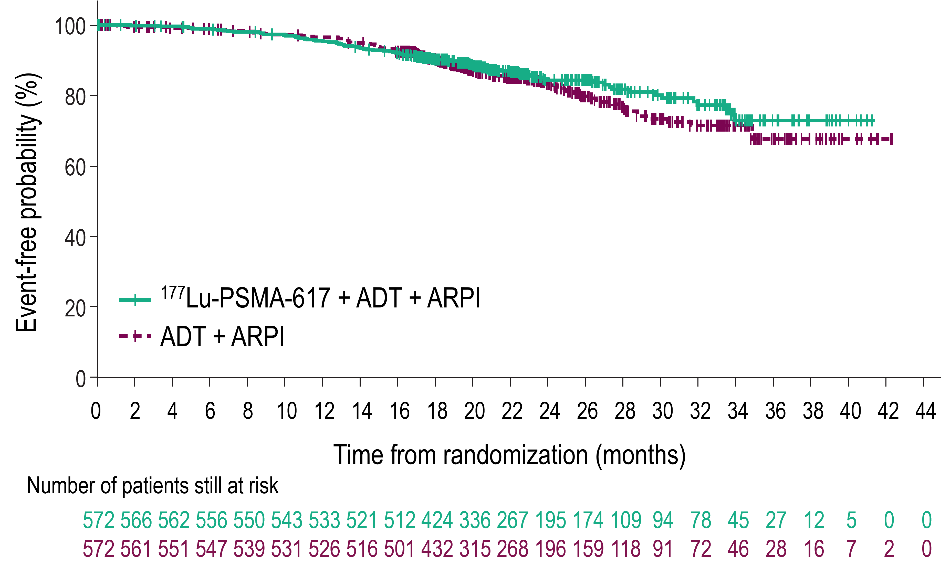
PSMAddition
OS
rPFS
HR 0.84
95%CI 0.63-1.13
P=0.125
HR 0.72
95%CI 0.58-0.90
P=0.002
Other endpoints favoring ¹⁷⁷Lu-PSMA-617
PSA<0.2
RECIST
Time to SSE, PSA progression, hormone resistance
Tagawa S et al. ESMO 2025;Abstract LBA6

Slide 107
PSMAddition safety findings (ADT/ARPI +/- ¹⁷⁷Lu-PSMA-617)
Data cut-off: 13 January 2025
AEs in ≥10% of patients in the ¹⁷⁷Lu-PSMA-617 arm – n (%) | ¹⁷⁷Lu-PSMA-617 + ADT + ARPI (N = 564) |  | ADT + ARPI (N = 565)
 | Any grade | Grade ≥3 | Any grade | Grade ≥3
Dry mouthª | 258 (45.7) | 0 | 21 (3.7) | 0
Fatigue | 196 (34.8) | 6 (1.1) | 158 (28.0) | 6 (1.1)
Nausea | 193 (34.2) | 1 (0.2) | 53 (9.4) | 0
Hot flush | 164 (29.1) | 0 | 205 (36.3) | 0
Anaemia | 153 (27.1) | 28 (5.0) | 75 (13.3) | 15 (2.7)
Arthralgia | 111 (19.7) | 5 (0.9) | 130 (23.0) | 9 (1.6)
Back pain | 101 (17.9) | 8 (1.4) | 110 (19.5) | 16 (2.8)
Constipation | 101 (17.9) | 0 | 91 (16.1) | 0
Asthenia | 92 (16.3) | 2 (0.4) | 73 (12.9) | 5 (0.9)
Decreased appetite | 81 (14.4) | 5 (0.9) | 37 (6.5) | 1 (0.2)
Vomiting | 78 (13.8) | 4 (0.7) | 21 (3.7) | 0
COVID-19 | 76 (13.5) | 5 (0.9) | 60 (10.6) | 2 (0.4)
Hypertension | 76 (13.5) | 34 (6.0) | 95 (16.8) | 35 (6.2)
Diarrhoea | 69 (12.2) | 1 (0.2) | 56 (9.9) | 0
Headache | 69 (12.2) | 0 | 51 (9.0) | 2 (0.4)
Alanine aminotransferase increased | 68 (12.1) | 19 (3.4) | 73 (12.9) | 14 (2.5)
Dysgeusia | 67 (11.9) | 0 | 23 (4.1) | 0
White blood cell count decreased | 63 (11.2) | 12 (2.1) | 18 (3.2) | 3 (0.5)
Aspartate aminotransferase increased | 61 (10.8) | 10 (1.8) | 65 (11.5) | 11 (1.9)
Lymphocyte count decreased | 60 (10.6) | 28 (5.0) | 21 (3.7) | 7 (1.2)
Tagawa S et al.
ESMO 2025;Abstract LBA6
ª Grade 1 in 231 (41.0%) and grade 2 in 27 (4.8%) in the ¹⁷⁷Lu-PSMA-617 + ADT + ARPI arm; grade 1 in 19 (3.4) and grade 2 in 2 (0.4%) in the ADT + ARPI arm

Slide 108

Multidisciplinary
Care
Surgeon
Radiation
Oncologist
Treatment Team
Surgeon
Radiation Oncologist
Medical Oncologist
Pathologist, Radiologist
(nuc med, physicist, rad safety)
Primary Care
Physician
Parents
Children
Advanced Practice
Provider
Psychiatrist
Medical
Oncologist
Physical Therapist
Dietician
Clergy
Dog
Social Worker

Slide 109
Pre-existing renal dysfunction
  Slower renal clearance → monitor closely for marrow toxicity
Pre-existing low blood counts
  If due to bone marrow infiltration, treat promptly and monitor
On-/post- treatment monitoring
  At least CBC and chemistry following treatment / before next cycle; interim contrast CT
Supportive care
  Anti-emetics: not mandatory for prophylaxis in all, but have available prn
  Pain meds / steroids: not mandatory for pain flare prophylaxis, but be aware of pain flares
  Blood growth factors: occasionally indicated, involve heme; cautious use of WBC growth factors close to TRT dosing; transfusions prn
Holding / discontinuing therapy
  Discuss hold for exceptional responders
  Discontinue if not tolerated despite adjustments or progression of cancer (esp PSMA low) with additional treatment options
Hope TA et al. J Nucl Med. 2023;64(9):1417-1423.

Slide 110
PSMA-TRT (risks) for the PCP*
Main categories of toxicity
  Constitutional, myelosuppression, PSMA+ organs
Dry mouth (and dry eye)
  Typically mild, reversible (with beta)
  Dry eye less common, but be mindful
Myelosuppression
  Timing different than chemo
Fatigue, nausea, pain flare
? Long-term
  Most worry about kidney, bone marrow, additional malignancy
  Baseline organ function appears important
Radioactivity to others
  Particularly gamma
  Early urine; body exposure esp first 2-3 days
*Primary care providers or primary cancer providers (oncologists, urologists, etc.)

Slide 111
Case Presentation

Slide 112
Pt with controlled DM and HTN presents with multiple bone and lymph node metastases
  No known family history of cancer
  Biopsy reveals Gleason grade group 3
  Germline testing without pathologic alterations
Treated with ADT and enzalutamide. PSA declines from 45 to 1 and he feels OK.
  With hot flashes, low libido, erectile dysfunction
  Enrolls in S1802 and gets radiation to prostate
After 20 months, PSA begins increasing and continues to increase
  PSA 4.1, Hgb 11, alk phos 210, LDH 90
Plasma DNA with low TMB, microsatellite stable, no pathogenic alterations
Repeat imaging ordered

Slide 113
⁶⁸Ga-PSMA-11 PET/CT
  SUVmax 81.1; SUVmean 9.3; TTV 161.9
Wishes to avoid chemo
Receives 3 cycles of ¹⁷⁷Lu-PSMA-617
PSA 4.1 → <0.02; Hgb 9.8
Feels OK with mild dry mouth and fatigue
Repeat PSMA PET with resolution of most lesions; residual bone lesions with SUVmax 2.1 – 2.9 (liver = 5.4)
Elect to stop / pause treatment

Slide 114
Discussion Questions
How common is PSMA expression in mCRPC, and how do you
test for it?
For which patients with PSMA-positive mCRPC do you use lutetium Lu 177 vipivotide tetraxetan? Are you generally using this before chemotherapy?
What other radioligand therapies are available for PC, and how do they compare in terms of their effectiveness?

Slide 115
Tolerability and Other Practical Considerations with the Use of Lutetium Lu 177 Vipivotide Tetraxetan in Prostate Cancer
Stacy Walker, NP

Slide 116
Lutetium - administration and indication
Lu-177 – PSMA-617 (lutetium Lu 177 vipivotide tetraxetan)
IV administration Q6 weeks x6 cycles
  If good response and significant decrease in PSMA avidity, can consider pausing and resuming with additional progression
Approved for patients with mCRPC who have progressed with ARPI
Emits gamma radiation and therefore higher risk of radioactive exposure to others than Radium-223 – consideration for patients who are caregivers or require caregivers

Slide 117
Hygiene and Contact Considerations
Contact Restrictions
No close contact (less than 3 feet) with people in household for 3 days
Sleep in separate bed at least 3 feet away for at least 3 days
No close contact (less than 3 feet) with children less than 10 years of age for at least 7 days
Stay away from public spaces for 3 days
Hygiene Considerations
Wash soiled laundry separate from other household laundry (when possible patient should wash their own laundry to minimize exposure)
Separate toilets encouraged

Slide 118
Lutetium Side effects
Decreased blood cell counts - consider mid cycle safety checks
Fatigue
Dry mouth (salivary glands express PSMA)
  Moisturizing mouth rinse, xylitol gum, hard candies
Nausea
Anorexia
Joint pain
Constipation
Back pain

Slide 119
Lutetium Availability
Not all oncology locations offer Lutetium -
  May need to consider referral to another location for duration of treatment
  us.pluvicto.com/treatment-center-locator
  Treatment centers may have different eligibility requirements
  May require management and coordination of care between two different locations

Slide 120
Case Presentation

Slide 121
Case Study - Lutetium
49 y/o male with metastatic hormone resistant prostate cancer. Treatment history includes leuprolide + abi/pred, docetaxel x10 cycles.
After completion of 10 cycles of docetaxel he had 2 consecutive PSA rises, PSMA PET 4/2025 showed new and increasing, now extensive, PSMA avid osseous metastatic lesions compared to November 2024
PMH: None
Social History - married, two children ages 6 and 8. Raised in France, works remotely for company in France, parents retired in Portugal

Slide 122
Case Study - Lutetium
Clinical trial considered, however patient’s family opted to spend summer in Portugal near patient’s parents.
To minimize visits - opted for lutetium (Q6 week dosing). Cycle 1 5/2025, PSA 18.86
PSA with good response
Mild dry mouth managed with moisturizing mouth rinse and hard candies; Nausea for a few days after treatment each cycle - managed with ondansetron. Mild neutropenia.
Special considerations given to children in the household (no close contact to his children for 3 days after treatment)
Carrying card with radioactive explanation for airport travel
Schedule alterations to support being with his children (ex: delayed dose so not radioactive for Christmas/school break)

Slide 123
Discussion Questions
What do you tell your patients about to start lutetium Lu 177 vipivotide tetraxetan about potential toxicities?
How do you attempt to prevent or ameliorate dry mouth associated with lutetium Lu 177 vipivotide tetraxetan?
How bothersome is this toxicity to patients?
How do you educate your patients receiving radiopharmaceuticals regarding radiation risks and appropriate precautions to protect their loved ones?

Slide 124
Non-Muscle-Invasive and Muscle-Invasive Bladder Cancer
Recent Advances in Cancer Care — New Paradigms,
Novel Agents and What It Means for the Oncology Nurse
A Complimentary NCPD Symposium Series Held During the 51st Annual ONS Congress
Thursday, May 14, 2026
6:00 PM – 7:30 PM
Faculty
Alexandra Drakaki, MD, PhD
Krisztina Emodi, NP-C, MPH, CNS
Margarita Huober, MS, AGNP-C, AOCNP
Moderator
Terence Friedlander, MD

Slide 125
Thank you for joining us! Please take a moment to complete the survey currently up on Zoom. Your feedback is very important to us. The survey will remain open up to 5 minutes after the meeting ends.
To Claim NCPD Credit
In-person attendees: Please refer to the program syllabus for the NCPD credit link or QR code.
Virtual attendees: The NCPD credit link is posted in the chat room.
NCPD/ONCC credit information will be emailed to each participant within 1 to 2 business days.

