Slide 1
Pancreatic Cancer
Recent Advances in Cancer Care — New Paradigms, Novel Agents and What It Means for the Oncology Nurse
A Complimentary NCPD Symposium Series Held During the 51st Annual ONS Congress
Friday, May 15, 2026
6:00 AM – 7:30 AM
Faculty
Caroline Kuhlman, MSN, APRN-BC
Philip A Philip, MD, PhD
Amanda K Wagner, APRN-CNP, AOCNP
Moderator
Eileen M O’Reilly, MD

Slide 2


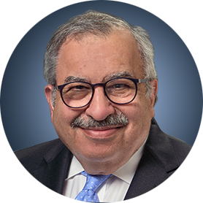

Faculty
Caroline Kuhlman, MSN, APRN-BC
Nurse Practitioner
Tucker Gosnell Center for Gastrointestinal Cancers
Massachusetts General Brigham Cancer Institute
Boston, Massachusetts
Amanda K Wagner, APRN-CNP, AOCNP
GI Malignancies
The James Cancer Hospital
The Ohio State University
Columbus, Ohio
Philip A Philip, MD, PhD
Chair, Hematology and Oncology
Professor of Oncology and Pharmacology
Co-Leader, Pancreatic Cancer Program
Medical Director, Cancer Clinical and Translational Research Office
Chair, GI Cancer, SWOG
Henry Ford Cancer Institute
Wayne State University Department of Oncology
Detroit, Michigan
Moderator Eileen M O’Reilly, MD
Winthrop Rockefeller Endowed Chair in Medical Oncology
Section Head, Hepatopancreaticobiliary and Neuroendocrine Cancers
Co-Director, Medical Initiatives
David M Rubenstein Center for Pancreatic Cancer Research
Chair, Human Research Protection Program
and IRB
Attending Physician, Member
Memorial Sloan Kettering Cancer Center
Professor of Medicine, Weill Cornell Medical College
New York, New York

Slide 3
Ms Kuhlman — Disclosures
No relevant financial relationships to disclose.

Slide 4
Dr Philip — Disclosures
Advisory Committees | Corcept Therapeutics Inc, Ipsen Biopharmaceuticals Inc, Jazz Pharmaceuticals Inc, Novocure Inc, Revolution Medicines Inc
Consulting Agreements | Novocure Inc
Contracted Research | Bristol Myers Squibb, Novartis, Revolution Medicines Inc, Taiho Oncology Inc
Data and Safety Monitoring Boards/Committees | J-Pharma Co Ltd, Oncolytics Biotech Inc

Slide 5
Ms Wagner — Disclosures
No relevant financial relationships to disclose.

Slide 6
Dr O’Reilly — Disclosures
Advisory Committees and Consulting Agreements (Uncompensated) | Agenus Inc, Alligator Bioscience, Amgen Inc, Arcus Biosciences, Astellas, AstraZeneca Pharmaceuticals LP, BioNTech SE, Bristol Myers Squibb, Ikena Oncology, Immuneering Corporation, Ipsen Biopharmaceuticals Inc, Merck, MOMA Therapeutics, Novartis, Pfizer Inc, Regeneron Pharmaceuticals Inc, Revolution Medicines Inc, Tango Therapeutics
Contracted Research | Agenus Inc, Amgen Inc, Arcus Biosciences, AstraZeneca Pharmaceuticals LP, BioNTech SE, Digestive Care Inc, Elicio Therapeutics, Genentech, a member of the Roche Group, Incyte Corporation, Revolution Medicines Inc, Tango Therapeutics
Nonrelevant Financial Relationships | American Association of Cancer Research (Editor), American Society of Clinical Oncology (Editor), Break Through Cancer, Imedex, National Cancer Institute (Cancer Center Support Grant/Core Grant), National Institutes of Health (research grant), Stand Up 2 Cancer

Slide 7
Commercial Support
This activity is supported by educational grants from Ipsen Biopharmaceuticals Inc and Revolution Medicines Inc.
Research To Practice NCPD Planning Committee Members, Staff and Reviewers
Planners, scientific staff and independent reviewers for Research To Practice have no relevant financial relationships to disclose.

Slide 8
This educational activity contains discussion of non-FDA-approved uses of agents and regimens. Please refer to official prescribing information for each product for approved indications.

Slide 9



Clinicians in the Meeting Room
Networked iPads are available.
Review Program Slides: Tap the Program Slides button to review speaker presentations and other program content.
Answer Survey Questions: Complete the pre- and postmeeting surveys. Survey questions will be discussed throughout the meeting.
Ask a Question: Tap Ask a Question to submit a challenging case or question for discussion. We will aim to address as many questions as possible during the program.
For assistance, please raise your hand. Devices will be collected at the conclusion of the activity.
Notes:
9

Slide 10

Clinicians Attending via Zoom
Review Program Slides: A link to the program slides will be posted in the chat room at the start of the program.
Answer Survey Questions: Complete the pre- and postmeeting surveys. Survey questions will be discussed throughout the meeting.
Ask a Question: Submit a challenging case or question for discussion using the Zoom chat room.
Get NCPD Credit: An NCPD credit link will be provided in the chat room at the conclusion of the program.
Notes:
10

Slide 11
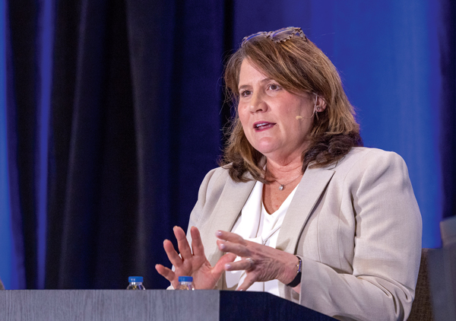
About the Enduring Program
The live meeting is being video and audio recorded.
The proceedings from today will be edited and developed into an enduring web-based program. An email will be sent to all attendees when the activity is available.
To learn more about our education programs, visit our website, www.ResearchToPractice.com
Notes:
11
11

Slide 12
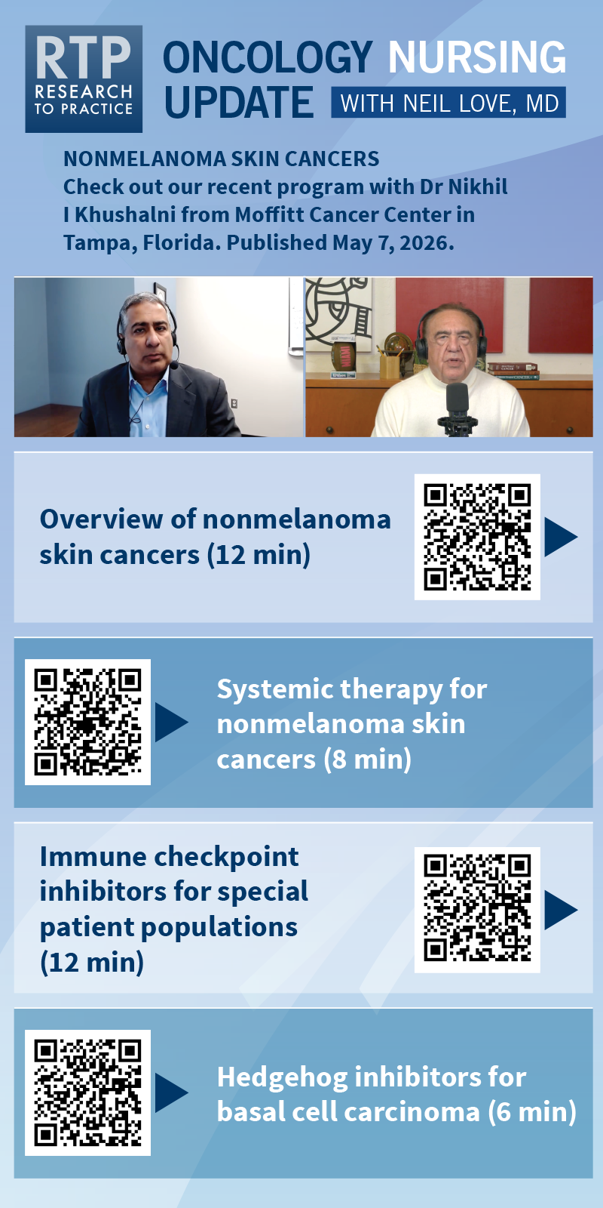
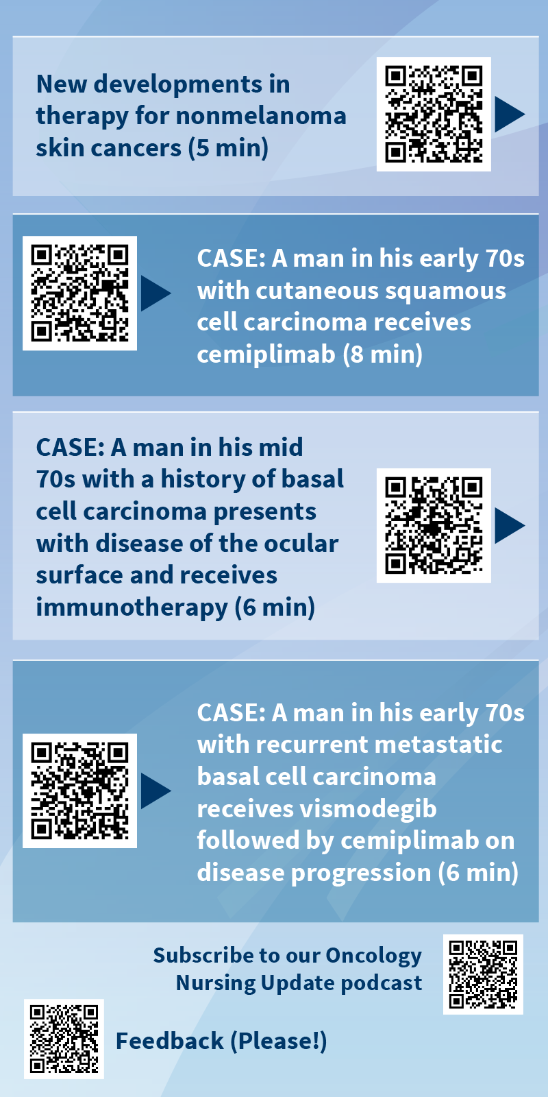

Slide 13
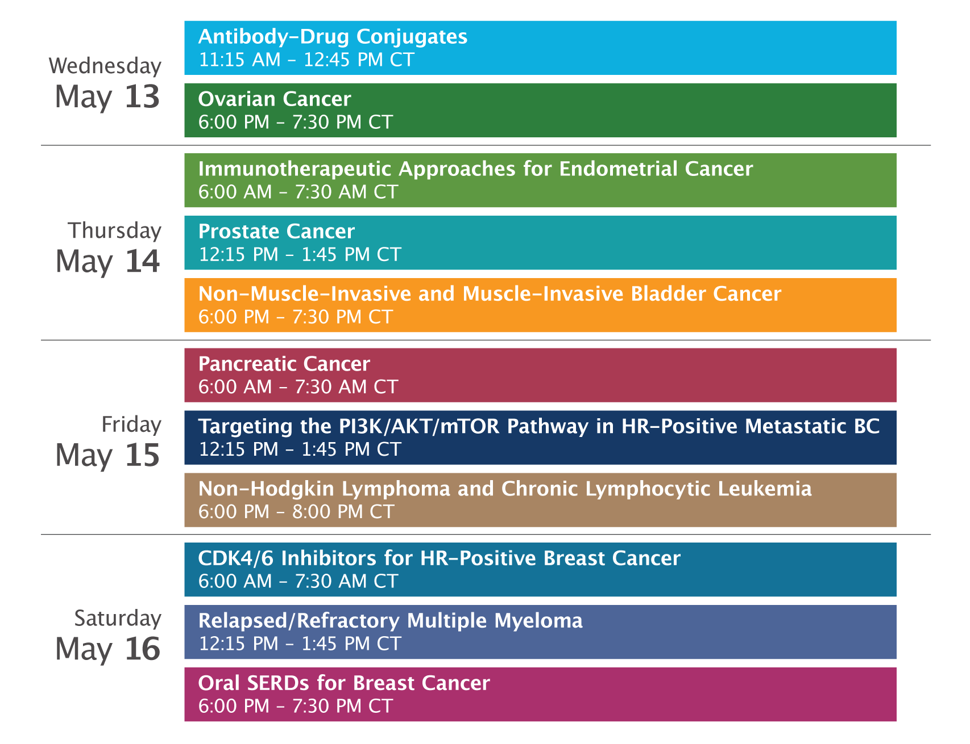
“Recent Advances in Cancer Care — New Paradigms, Novel Agents and What It Means for the Oncology Nurse” Eighteenth Annual RTP-ONS NCPD Symposium Series

Slide 14
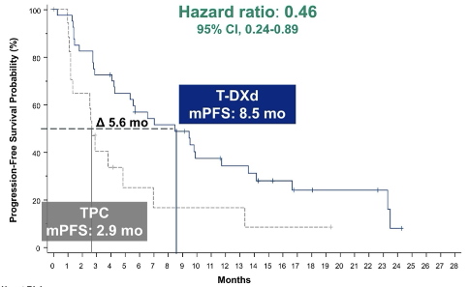
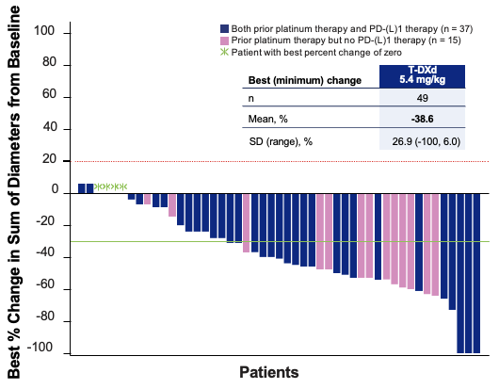
New Agents, Therapies and Regimens
Recent Advances in Cancer Care — New Paradigms, Novel Agents and What It Means for the Oncology Nurse
When should it be used, for whom and why?
How to prevent and manage side effects: dose holds and reductions
Kaplan Meier curves — HR and absolute benefit
Waterfall plots

Slide 15
Pancreatic Cancer
Recent Advances in Cancer Care — New Paradigms, Novel Agents and What It Means for the Oncology Nurse
A Complimentary NCPD Symposium Series Held During the 51st Annual ONS Congress
Friday, May 15, 2026
6:00 AM – 7:30 AM
Faculty
Caroline Kuhlman, MSN, APRN-BC
Philip A Philip, MD, PhD
Amanda K Wagner, APRN-CNP, AOCNP
Moderator
Eileen M O’Reilly, MD

Slide 16
Agenda
Introduction: Clinical Presentation and Prognosis of Pancreatic Adenocarcinoma (PAD)
Module 1: Recent Advances in Up-Front Treatment for Metastatic PAD
Module 2: Selection and Sequencing of Therapy for Relapsed/Refractory Metastatic PAD
Module 3: Novel Strategies Targeting RAS Mutations in Advanced PAD
Module 4: Utility of Tumor Treating Fields in PAD Management

Slide 17
Agenda
Introduction: Clinical Presentation and Prognosis of Pancreatic Adenocarcinoma (PAD)
Module 1: Recent Advances in Up-Front Treatment for Metastatic PAD
Module 2: Selection and Sequencing of Therapy for Relapsed/Refractory Metastatic PAD
Module 3: Novel Strategies Targeting RAS Mutations in Advanced PAD
Module 4: Utility of Tumor Treating Fields in PAD Management

Slide 18
Clinical Presentation and Prognosis of Pancreatic Cancer
Caroline Kuhlman, MSN, APRN-BC
Tucker Gosnell Center for Gastrointestinal Cancer
Mass General Brigham Cancer Institute
May, 2026

Slide 19

5-Year Relative Survival by SEER Summary Stage (U.S.)
Stage at Diagnosis | % of Cases | 5-Year Survival
Localized (confined to pancreas) | ~14% | 44–46%
Regional (spread to regional lymph nodes/adjacent structures) | ~29% | 16%
Distant (metastatic) | ~53% | 3%

Slide 20
Key Trends (2004–2015, SEER Data)
Overall 5-year survival doubled: 6% → 12%
Localized disease survival nearly doubled: 24% → 46%
Distant disease survival essentially unchanged: 2% → 3%
1-year survival for metastatic disease improved: 14% → 22%

Slide 21
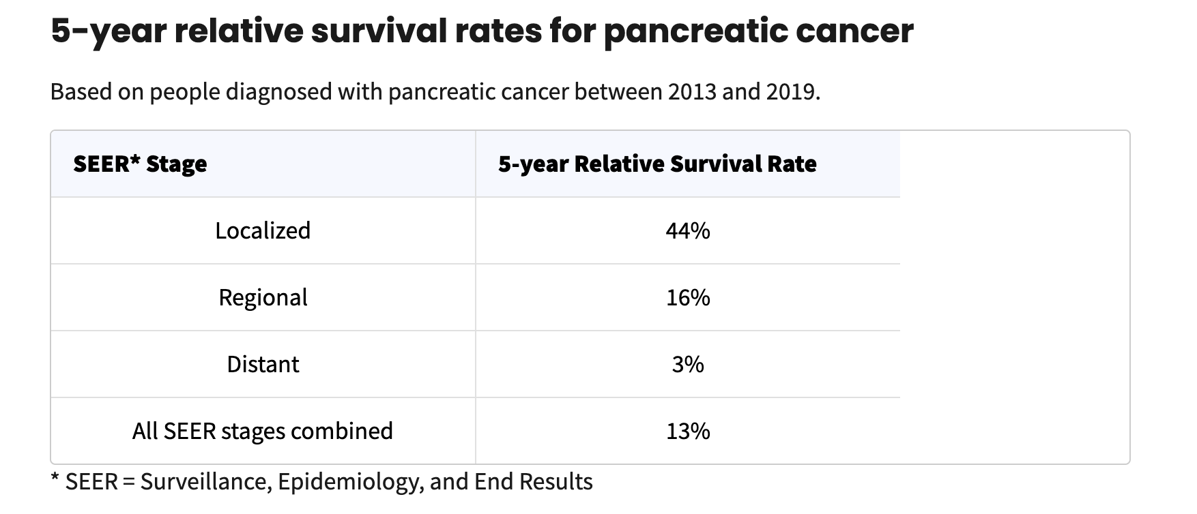
Pancreatic cancer by the numbers
Pancreatic cancer accounts for about 3% of all cancers in the US and about 7% of all cancer deaths.
The average lifetime risk of pancreatic cancer is about 1 in 58 in men and about 1 in 60 in women
American Cancer Society

Slide 22
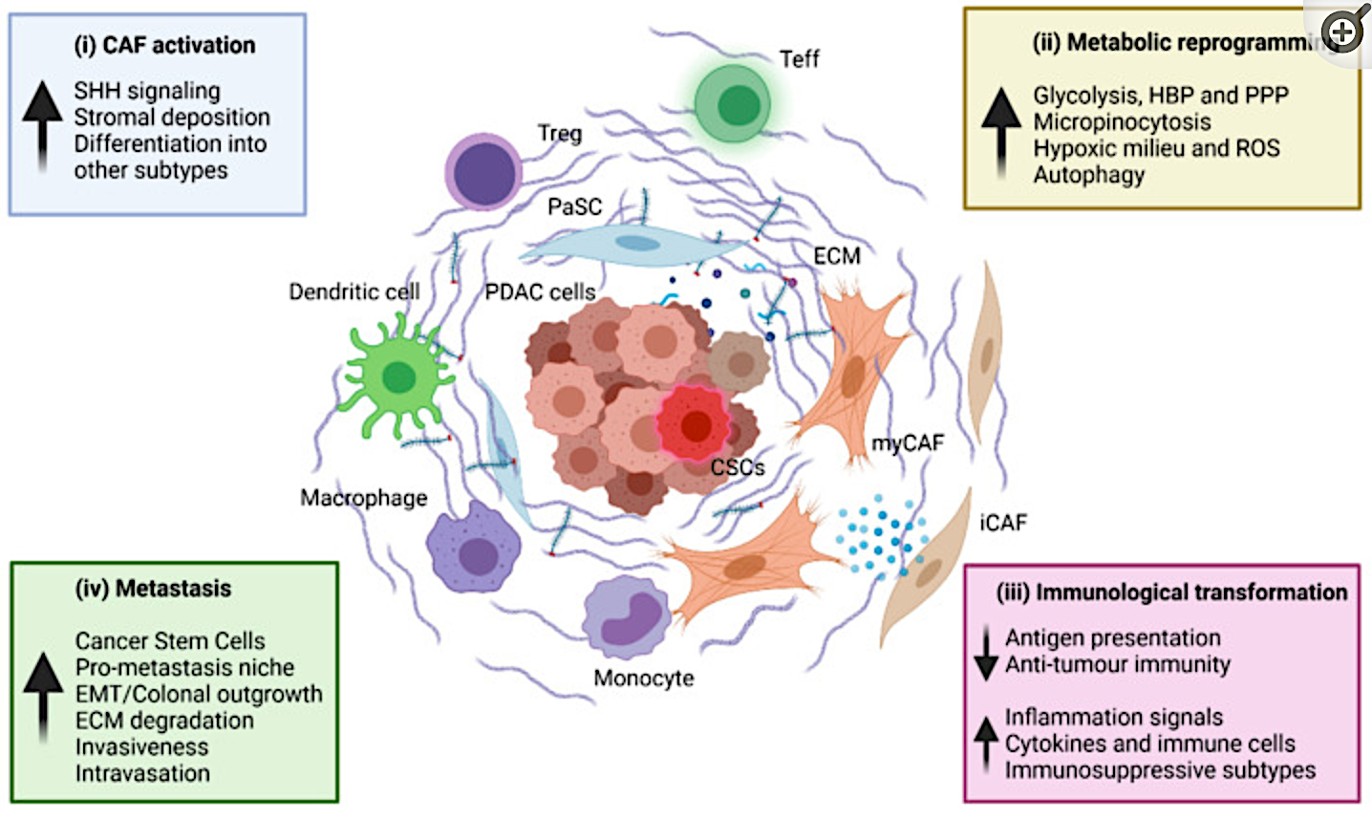
Why is pancreatic cancer so challenging?
Lack of easy, accurate screening tests for early detection
Infiltrative growth around blood vessels – unresectable
Spreads early – not visible on imaging. ‘Biologically stage IV at diagnosis’
Desmoplastic and immunosuppressive microenvironment – resistant to current immunotherapies
Lack of targetable mutations
(ii) Metabolic reprogramming
Truong et al, Cancers (Basel) 2021

Slide 23
Risk factors
Tobacco use
- Smoking one of the most important risk factors
- risk twice as high in smokers vs never smoker
-cigars, smokeless tobacco products also increase risk
Obesity
-BMI>30 20% more likely to develop panc ca
Diabetes
-More common in people with DM, esp type 2
- ?Cause or effect
Chronic pancreatitis
-often seen with heavy alcohol use and smoking

Slide 24
Risk factors
IPMN
- 2-9% develop invasive cancer
Inherited genetic syndromes (~10-15% PDAC)
Hereditary breast and ovarian cancer syndrome - BRCA1, BRCA2, PALB2
Familial atypical multiple mole melanoma (FAMMM) syndrome - p16/CDKN2A
Familial pancreatitis - PRSS1, SPINK1, CFTR
Lynch syndrome - MLH1, MSH2, MSH6, PMS2 genes
Peutz-Jeghers syndrome - STK11
Familial Pancreatic Cancer - unknown gene. ≥2 first-degree relatives with pancreatic cancer. Median age at dx 40-60 yrs (vs 60-80 yrs sporadic)

Slide 25
Risk factors: Unclear effect on risk
Diet
- Red processed meats, saturated fats, sugary drinks
Physical Inactivity
Alcohol
Coffee - conflicting
Aspirin, NSAID use - conflicting
H pylori - conflicting

Slide 26
Clinical Presentation:
Jaundice, dark urine
Progressive back pain radiating around the abdomen
Anorexia, weight loss, nausea, vomiting
Gastric outlet / duodenal obstruction
Diarrhea
Worsening diabetes mellitus
VTE

Slide 27
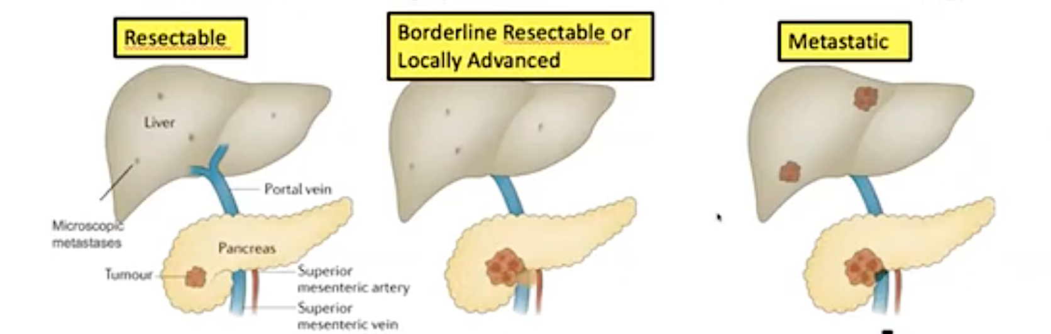

Staging: Resectability
20%
25% -30%
50% - 55%
Assaad Endosc Ultrasound 2017

Slide 28
Importance of Palliative Care in Advanced PDAC
Caroline Kuhlman, MSN, APRN-BC

Slide 29
Patient Case
69 yo man presented with abdominal pain, weight loss. CT demonstrates pancreatic head mass, left adrenal mass, multiple liver lesions and bilateral pulmonary nodules. Biopsy c/w invasive ductal adenocarcinoma. CA 19-9 1024
He is married with 2 adult children. Retired as a high school English teacher. Lives in New Hampshire. Enjoys working on the land, being outdoors, gardening, tending to chickens and dogs. Loves to cook and entertain.
9/2024 started FOLFIRINOX. Abdominal pain, makes moving around, eating and sleeping difficult. Loose stools, difficulty gaining weight. Expressed feelings of depression, lost interest in activities, avoids seeing family and friends. Moody and angry at home. Tearful during initial visits.

Slide 30
Supportive interventions: A team approach
Referral to social work
Referral nutrition
Referral to Palliative care team- pain management, goal setting symptom management
Interventional Radiology for para/thoracentesis
GI- stent changes

Slide 31
Early involvement with palliative care
2010 NEJM paper from MGH supportive oncology group.
Randomized study- randomized patients with newly diagnosed met lung cancer to standard management vs. early intervention with palliative care.
QOL and mood assessed at baseline and at 12 weeks
151 patients randomized.
JS Temel, et al NEJM 2010; 363: 733-742

Slide 32
Results of Early Palliative Care
Palliative care group reported better QOL and less depressive symptoms
Fewer patients in the pall care group received aggressive end of life care, despite this the median survival in this group was longer (11.6 months vs. 8.9 months p=0.02)
Subsequent studies have validated this outcome

Slide 33
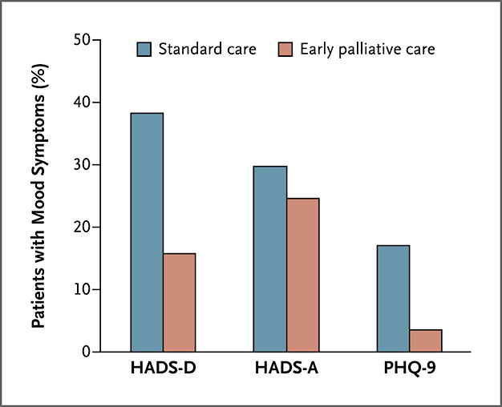
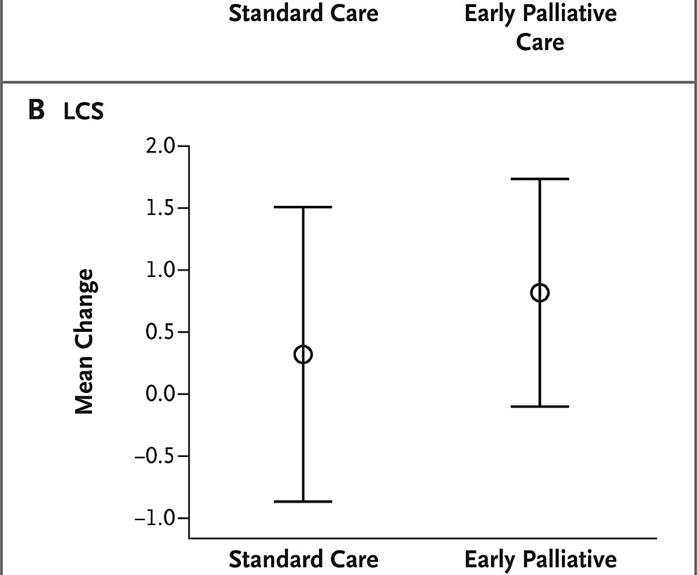
QOL and Depression Scores

Slide 34
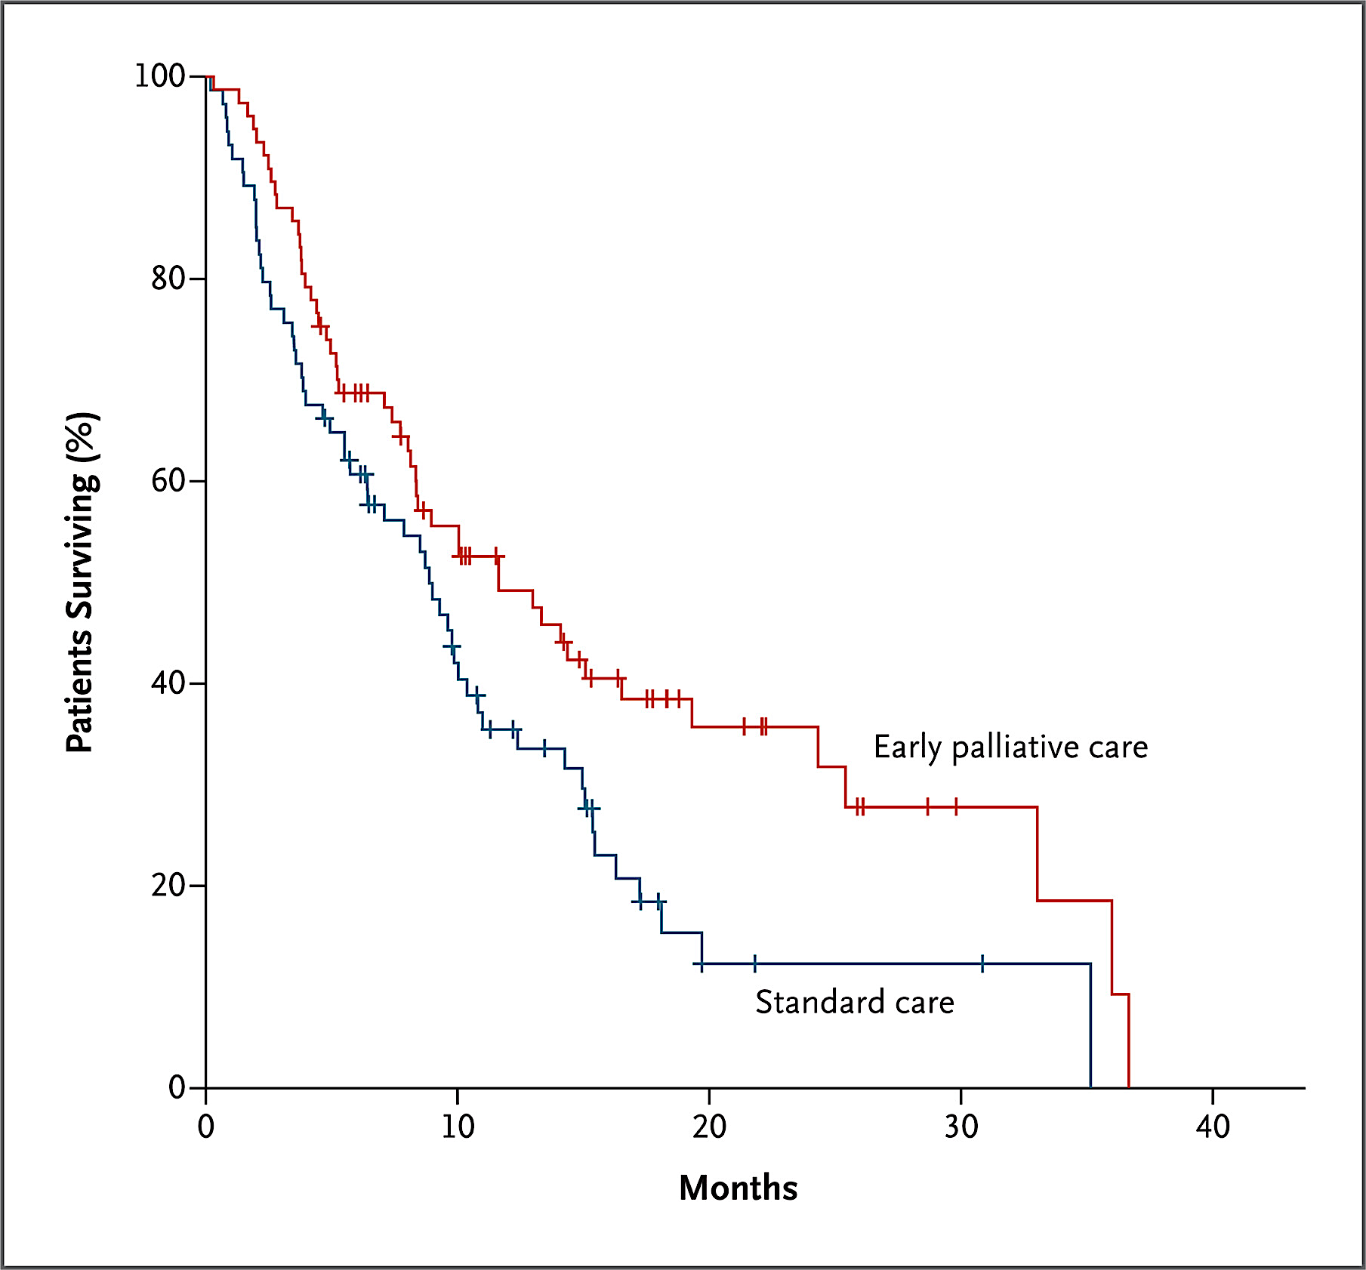
Survival Data

Slide 35
Serious Illness Conversation
Assess “what are your goals”
Sharing our hopes and worries
"Tell me what is important to you"
"If you know your time is limited - how do you want to spend this time?"

Slide 36
Supportive care: The hardest work we do
Aggressive pain management with LA opioids, breakthrough, thoughtful about delivery mode
Coordination with GI/IR for management of biliary stents and drains, paracentesis, thoracentesis
Delayed gastric emptying: metoclopramide, erythromycin
Weight loss- small, frequent, protein rich, calorie dense meals and snacks. Supplements - commercial shakes and drinks
Manage pancreatic insufficiency with pancreatic enzymes to address chronic diarrhea, gas and bloating with meals

Slide 37
Case Study Outcomes
Involvement with palliative care to assist in pain management
Start pancreatic enzymes to help with diarrhea, gas, bloating and weight loss
With improved supportive care able to work in his garden, get out to see friends, entertain at his home
Initiate antidepressant that improved mood and engagement with others

Slide 38
Conclusions
Supportive care, with chemotherapy or without, is the hardest work we do.
In metastatic PDAC supportive care is as important as any treatment we give patients.
Early involvement of supportive care in patients with metastatic PDAC, can not only alleviate suffering, help patients live better, it can help people live longer.

Slide 39
Agenda
Introduction: Clinical Presentation and Prognosis of Pancreatic Adenocarcinoma (PAD)
Module 1: Recent Advances in Up-Front Treatment for Metastatic PAD
Module 2: Selection and Sequencing of Therapy for Relapsed/Refractory Metastatic PAD
Module 3: Novel Strategies Targeting RAS Mutations in Advanced PAD
Module 4: Utility of Tumor Treating Fields in PAD Management

Slide 40
Pancreas Adenocarcinoma Current Standards
Research To Practice: Oncology Nursing Society
Eileen M. O’Reilly, MD, FASCO
Winthrop Rockefeller Endowed Chair, Memorial Sloan Kettering Cancer Center
Chair, Human Research Protection Program and IRB
Professor of Medicine, Weill Cornell Medicine
May 15th, 2026

Slide 41
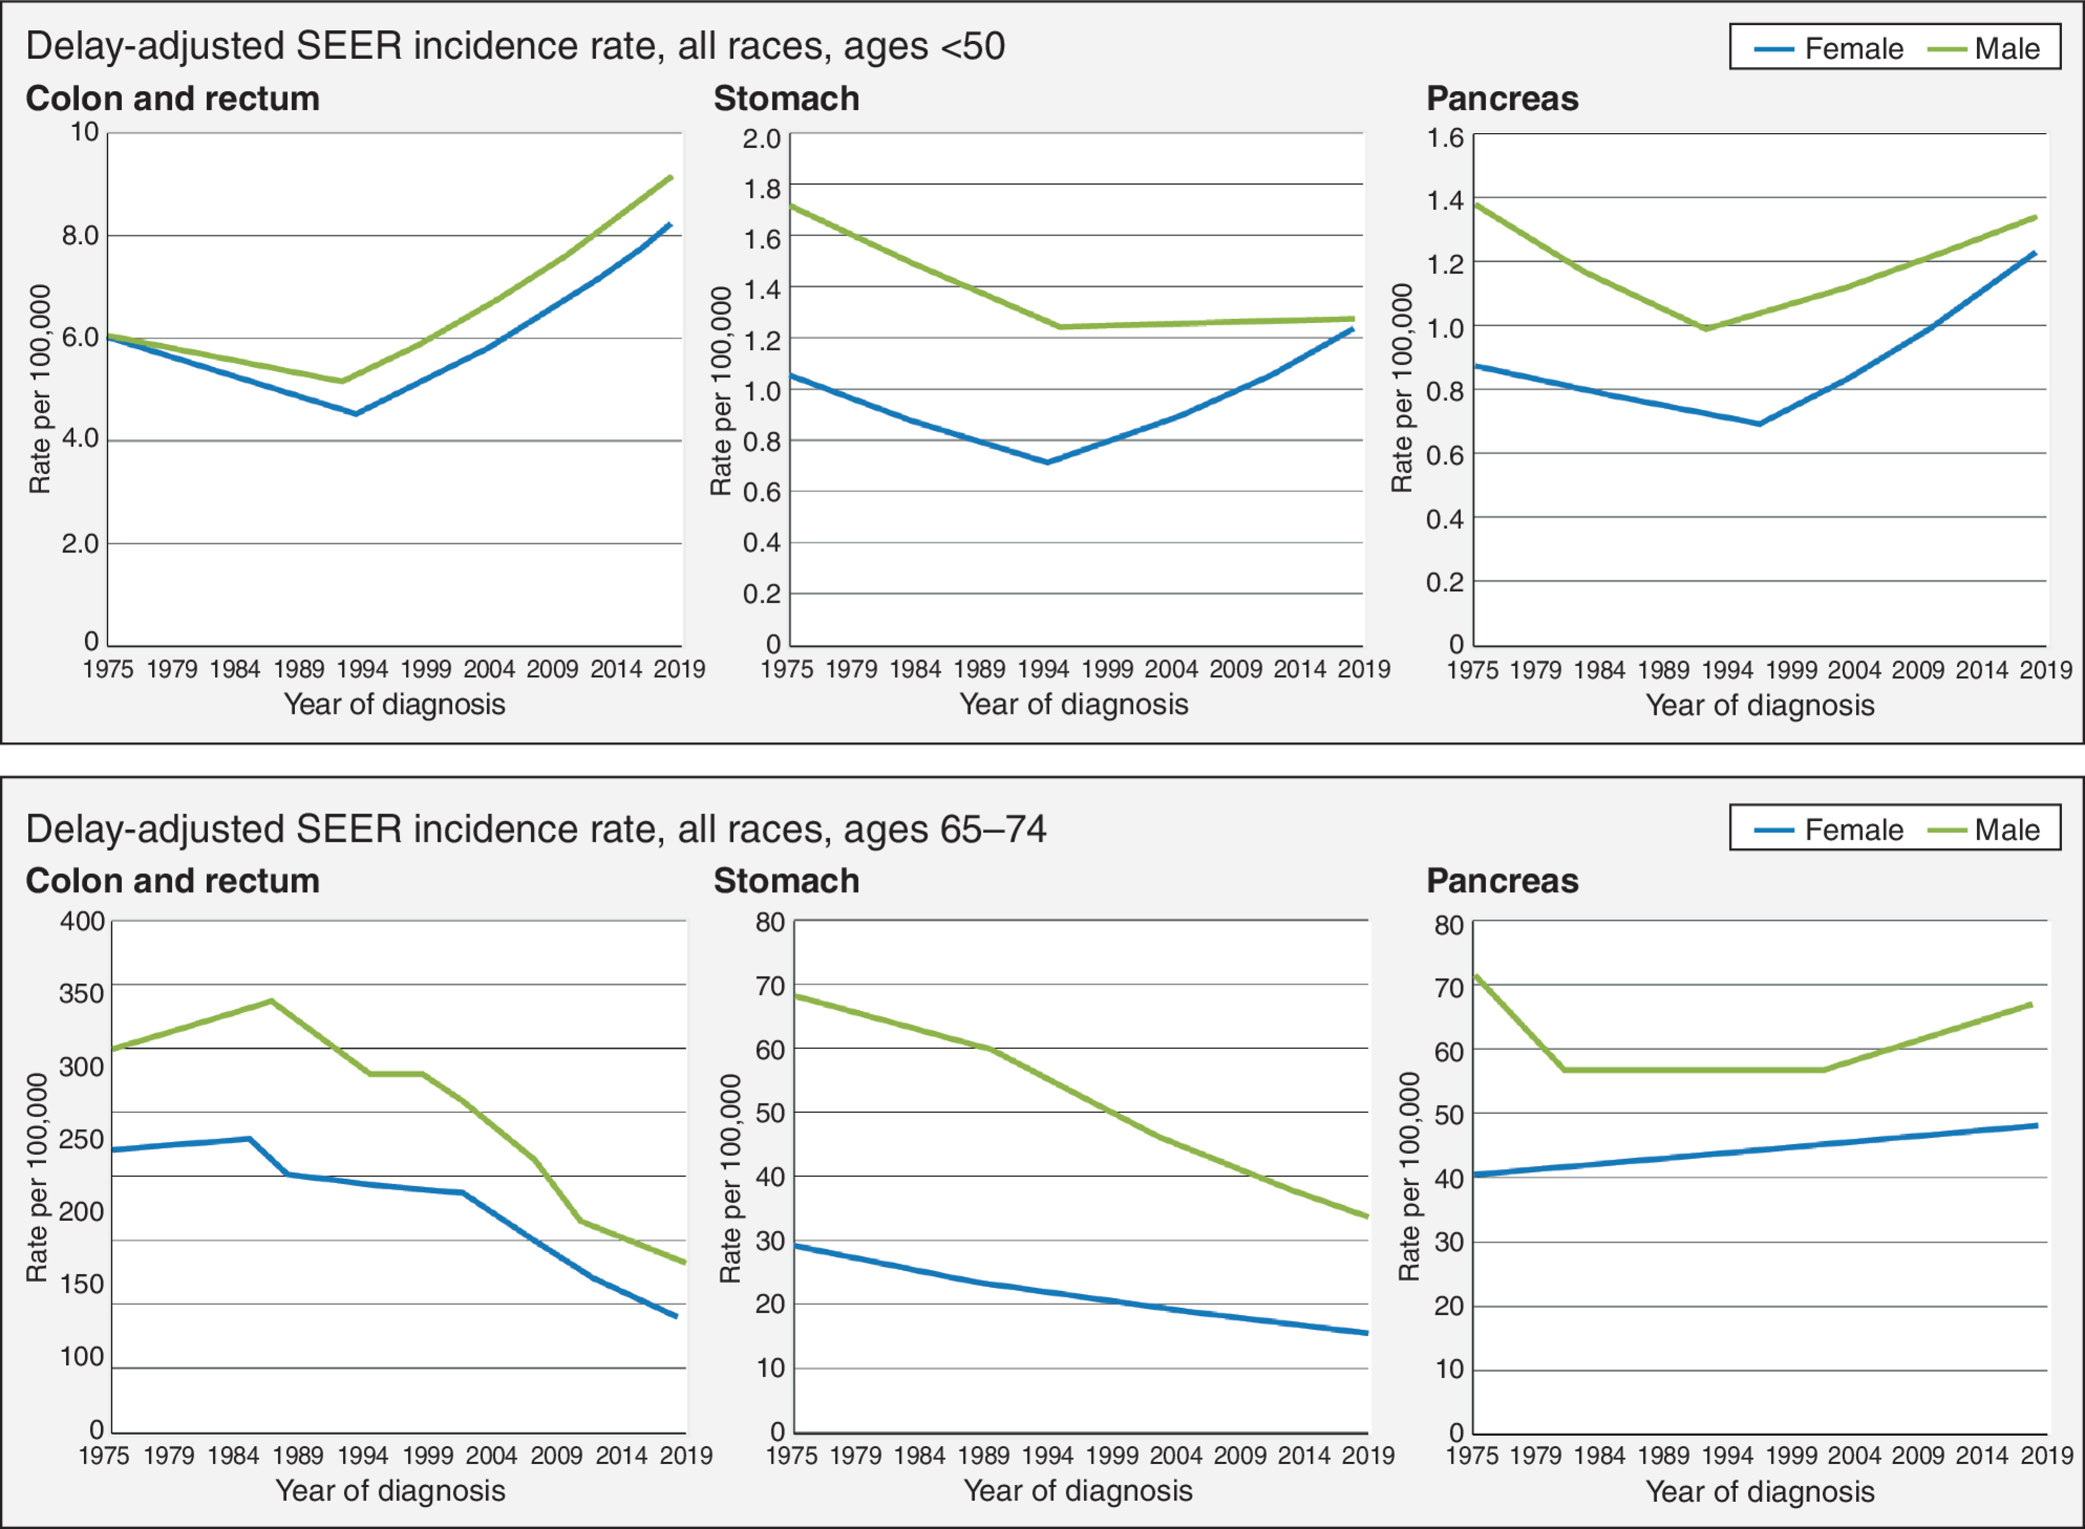
Early Onset Pancreas Cancer (5-10%) on the Rise Trends More Pronounced in Younger Women – Reasons Unclear
Pancreas Cancer: Epidemiology
Ages < 50
Ages > 50
Ben-Aharon I et al. Cancer Discovery, 2023

Slide 42
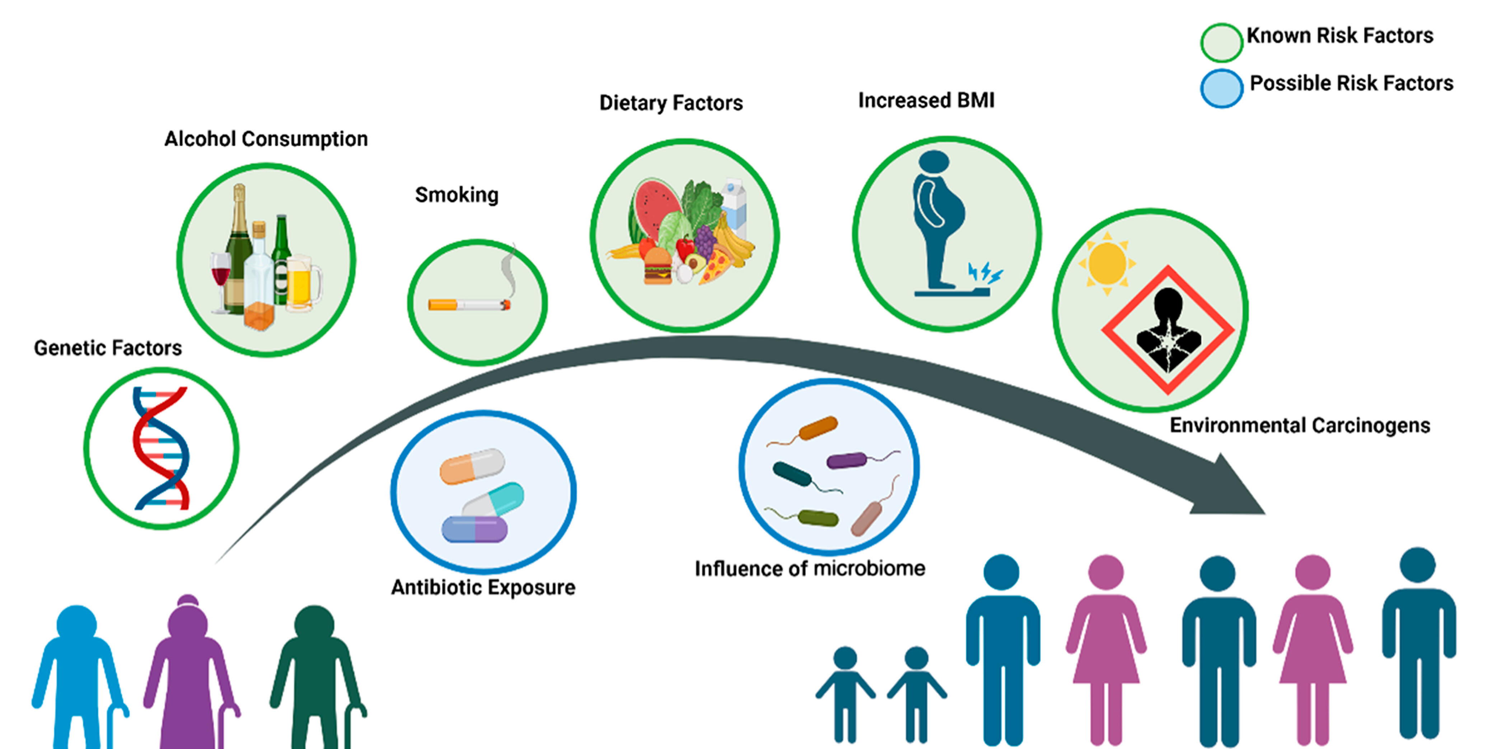
Factors Associated with Early Onset Cancers
Pancreas Cancer: Epidemiology
Harrold et al. ASCO Educational Book. 2023

Slide 43
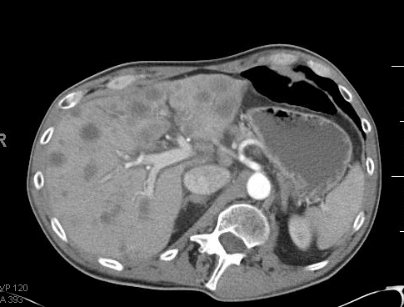
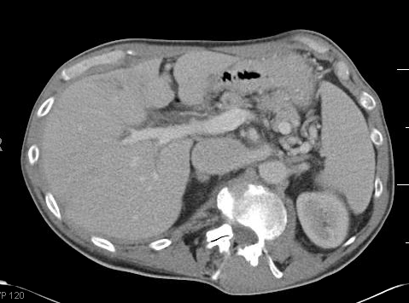
Metastatic Pancreas Cancer: NALIRIFOX 67-Year-old Male; Retired Electrician; 20-Pack Year Cigarettes
Pancreas Cancer: Systemic Therapy
Pre-treatment
6 months later
NALIRIFOX: Liposomal irinotecan/ leucovorin/ 5-FU
Dose #1
Diarrhea
Dehydration
Electrolytes abnormal
Dose reduction #2
Excellent tolerance
Excellent cancer control
Ca 19-9 13,652
Ca 19-9 349

Slide 44
Factors for Treatment Selection in Metastatic PDAC
Pancreas Cancer: Therapy Selection
Performance status, co-morbidities, age, major organ function
Patient preferences
Comparative efficacy, toxicity, cost
Logistics
Treatment sequencing
Genomic context

Slide 45
Current State of Therapy Advanced PDAC 2026 First & Second-Line Practice-Changing Phase III Trials for Unselected Disease
Pancreas Cancer: Current Standards
 | N | Median OS | Overall RR | Reference
First-Line
mFOLFIRINOX (vs Gem) PRODIGE/ ACCORD 11 | 171 | 11.1 m | 31.6% | 2011
Gemcitabine, nab-Paclitaxel (vs Gem) MPACT | 431 | 8.5 m | 23% | 2013
NALIRIFOX (vs Gem/Nab-P) NAPOLI-3 | 383 | 11.1m | 41.8% | 2023
Second-Line
Liposomal irinotecan/5-FU vs 5-FU NAPOLI-1 | 117 | 6.1 m | 16% | 2016
Conroy T et al. N Engl J Med. 2011
Von Hoff DD et al. N Engl J Med. 2013
Wainberg ZA et al. Lancet. 2023
Wang-Gillam A et al. Lancet Oncol. 2016

Slide 46
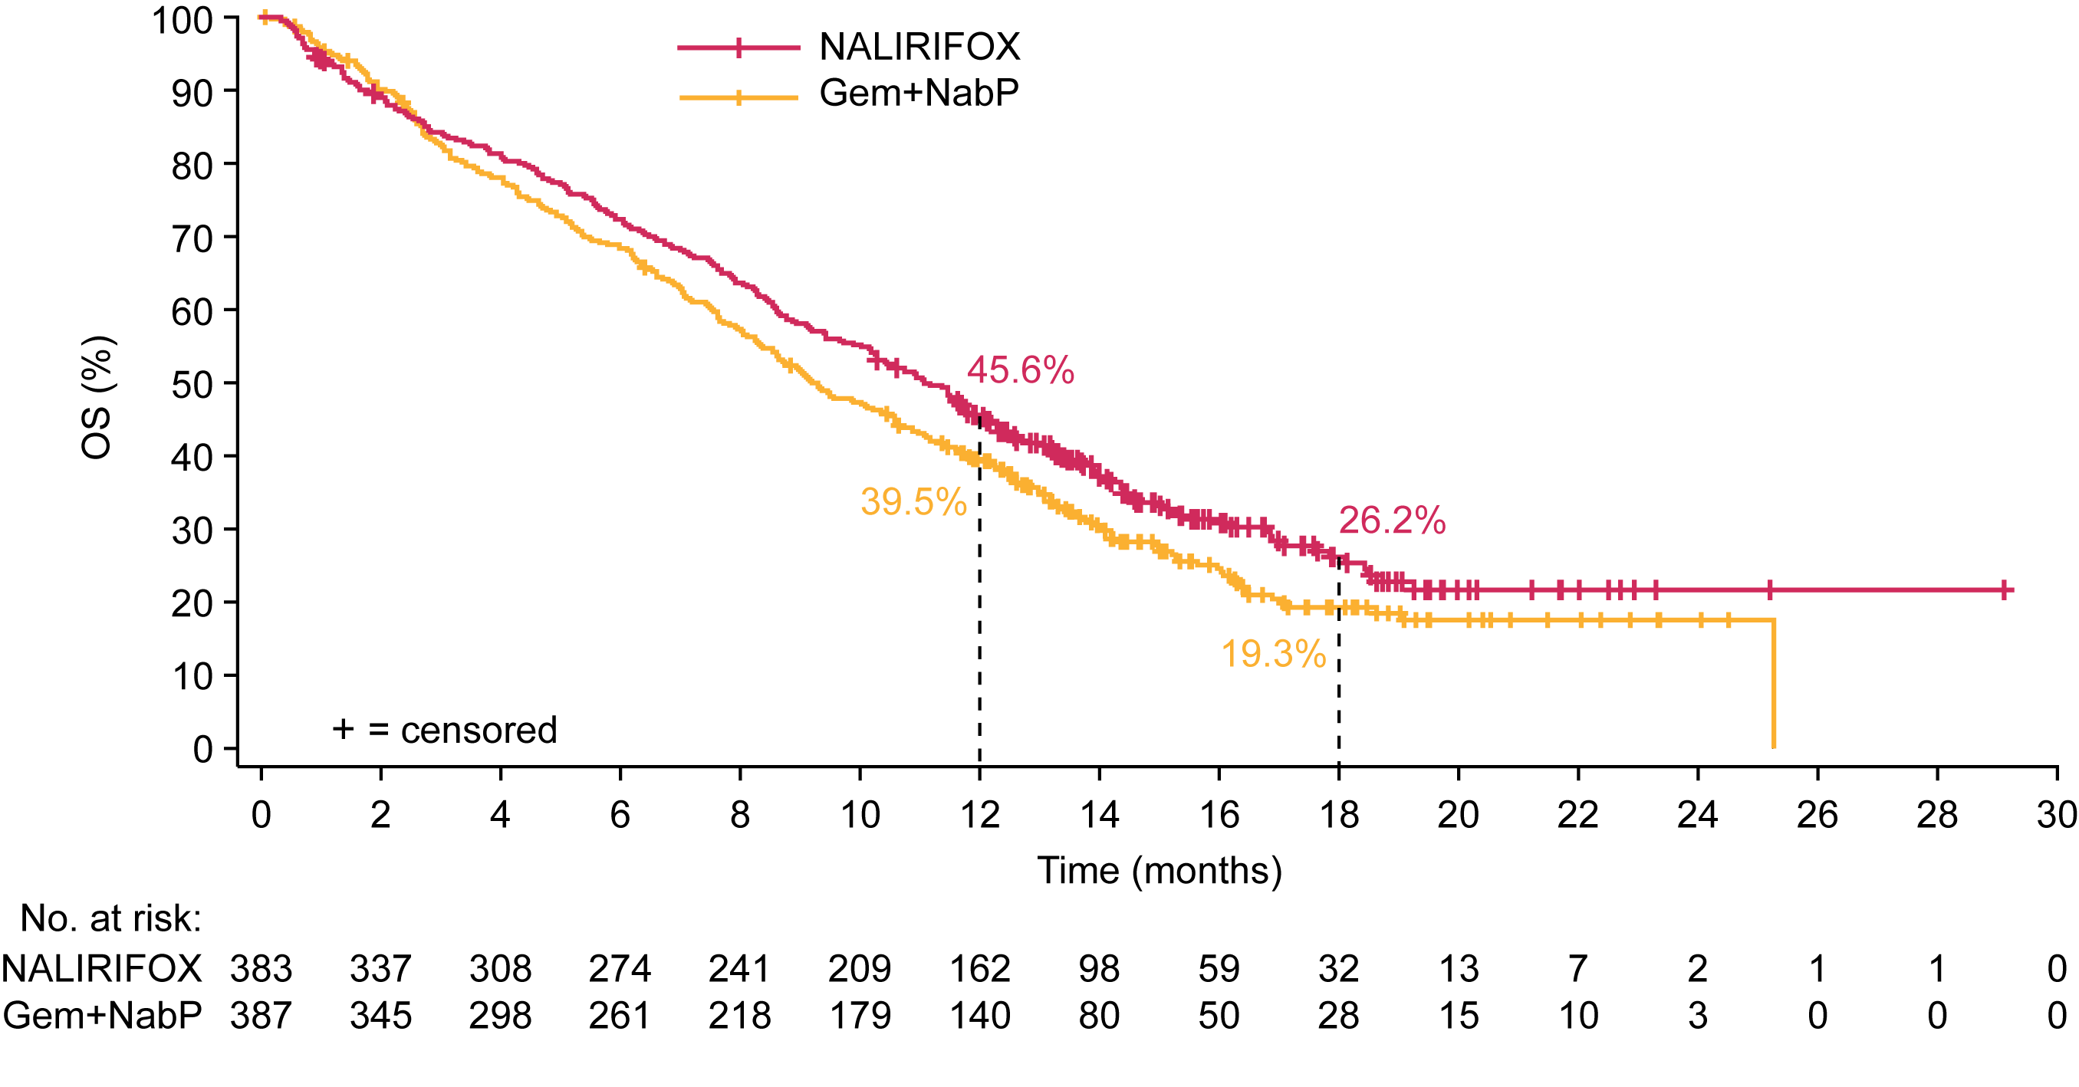
NAPOLI 3: NALIRIFOX vs Gemcitabine/Nab-Paclitaxel Triplet Superior to Doublet Chemotherapy
Pancreas Cancer: First-Line Therapy
Characteristic | NALIRIFOX N= 383 | Gem/Nab-P N= 387
Median OS (HR 0.83, p= 0.04) | 11.1 m | 9.2 m
Median PFS (HR 0.69, p <.0001) | 7.4 m | 5.6 m
Objective RR (95% CI) | 41.8% | 36.2%
Practice implication: NALIRIFOX (vs mFOLFIRINOX) over Gem/nab-P for ECOG 0-1
Wainberg, Z….O’Reilly, EM. Gastrointestinal Cancers Symposium, 2023
Wainberg, Z…O’Reilly, EM. Lancet, 2023

Slide 47
Sequencing Therapy in Advanced PDAC 2026
Pancreas Cancer: Treatment Sequence
1st Line
2nd line
3rd line
Gemcitabine
nab-Paclitaxel
Nanoliposomal irinotecan/5-FU
FOLFOX
mFOLFIRINOX NALIRIFOX
Nanoliposomal irinotecan/5-FU
Gemcitabine +/- nab-Paclitaxel
Germline/ Somatic Testing
Maintenance therapy
2nd line
Adapted NCCN Guidelines 2026

Slide 48
Select Second-Line Negative Trials in PDAC (Control Arms) Response Rates < 10%; Median OS 6-7 m: Outcomes Poor
Pancreas Cancer: Second-Line Therapy
Study | Regimen | N | ORR (%) | Median OS (m)
NAPOLI 1 | Nal-IRI + 5-FU/LV | 117 | 8 | 6.1
SWOG S1513 | FOLFIRI | 58 | 10 | 6.5
SWOG S1115 | FOLFOX | 62 | 7 | 6.7
SEQUOIA | FOLFOX | 284 | 6 | 6.3
QUILT-3.010 | Gem + nab-paclitaxel | 40 | 3 | 6.6
Trybeca-1 | Gem + nab-paclitaxel | 148 | NA | 6.9
GEMPAX | Gem + paclitaxel | 140 | 17 | 6.4
Wang-Gillam, A. Lancet, 2016
Chiorean, EG. Clin Can Res, 2021
Chung, V. JAMA Oncol, 2017
Hecht, JR. J Clin Oncol, 2021
Huffman, BM. JAMA Network Open, 2024
Hammel, P. J Clin Oncol, 2025
Fouchardiere, C. J Clin Oncol, 2024
Experimental agents:
Veliparib, selumetinib/MK-2206, peg-IL10, ensituximab (NPC1C), eryaspase

Slide 49
Biomarker Selection & Therapy

Slide 50
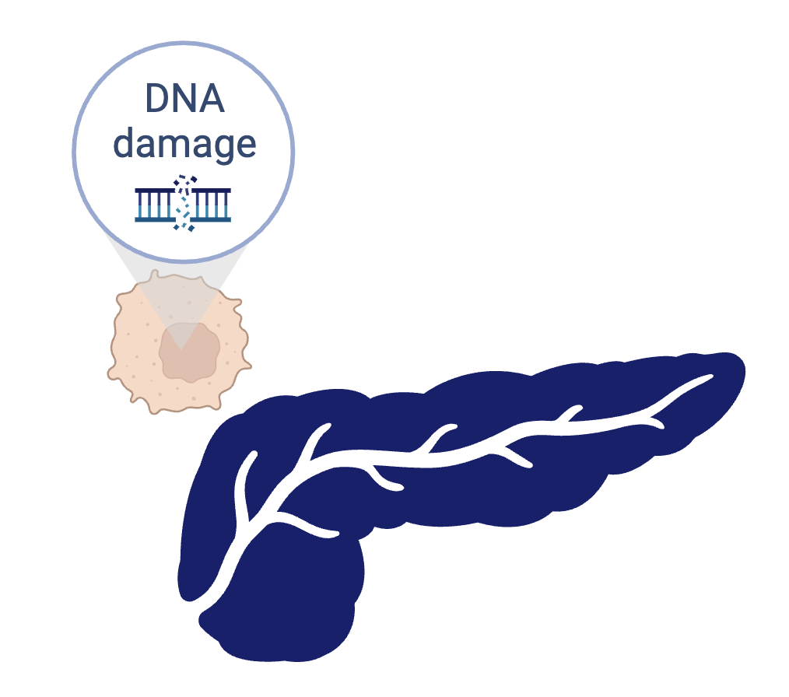
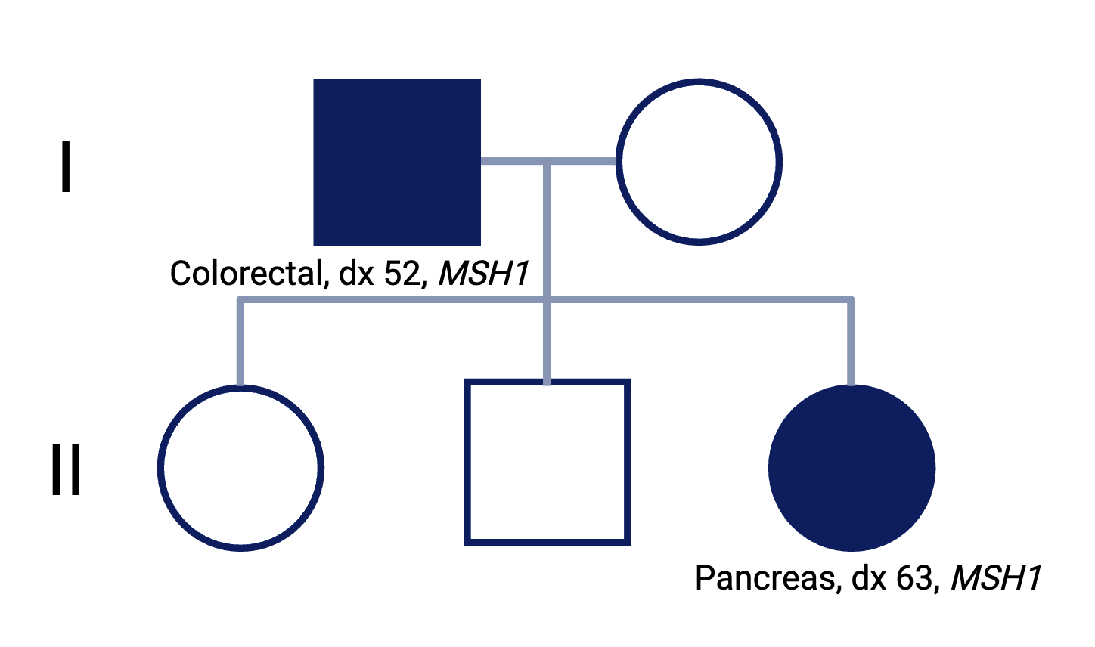
Germline and Somatic Variants
Genetics
Germline variants inherited
Present in all cells
Somatic variants arise sporadically
Present only in affected areas
Adapted Catherine O’Connor

Slide 51
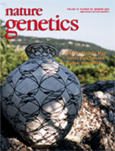

Models of Genetic Testing
Genomics
Somatic & Germline Testing
N= 505+ somatic genes
N= 90+ germline genes
Pre-test Educational Video tool
In clinic counseling
Results communicated by MD
Genetics referral if germline(+)
Rainone, M…Stadler, ZK, O’Reilly, EM. JAMA Onc, 2020. Lincoln, S, et al. JAMA Open Netw. 2020

Slide 52
Genomic Subsets for Therapeutic Actionability: Today Increasing Biomarker Selected Options for PDAC
Pancreas Cancer: Genomic Testing
KRAS^{MUT} PDAC (~95%)
Chemotherapy mFOLFIRINOX
NALIRIFOX
Gemcitabine, nab-Paclitaxel
Gemcitabine, erlotinib
KRAS Therapies
G12C Sotorasib, Adagrasib
KRAS^{WT} PDAC (~5%)
Fusions
RET* ALK, ROS, NTRK FGFR2/3, MET, NRG-1, MET, RAF1 Selpercatinib, Entrectinib, Larotrectinib, Zenocutuzumab
BRAF V600E^{MUT}
Dabrafenib, Encorafenib KRAS^{WT}
Gem +/- Erlotinib (Nimotuzumab)
BRCA1/2, PALB2
Platinum therapy
PARPi: Olaparib, Rucaparib Immunotherapy
HRD, MSI-H
Mismatch Repair Deficiency
TMB >10
Nivolumab, Pembrolizumab, Dostarlimab
Other Targets, Descriptors
Surface Tropisms
Claudin 18.2, TROP2
Other Genomics MTAPdel
Classical, Basal
GATA6 GEMPRED
PurIST
HER2/ERBB2(+) Trastuzumab deruxtecan
BRCA1/2, PALB2, RAD51B/C/D
Platinum therapy
PARPi: Olaparib, Rucaparib Acinar cancer
Germline (multigene), Somatic (±ctDNA) testing
All referenced drugs either FDA approved, guideline endorsed

Slide 53
Germline Variants Pan-Cancer Cohort (N= 11,974) Multiple Cancers Germline Alterations – Germline Testing in all Cancers?
Pan Cancer: Germline Genetics
PDAC Germline BRCA2
BRCA1
ATM CDKN2A
PALB2
MLH1 MSH2
MSH6
PMS2
TP53
Stadler, ZK. J Clin Oncol, 2021; ASCO, 2020

Slide 54
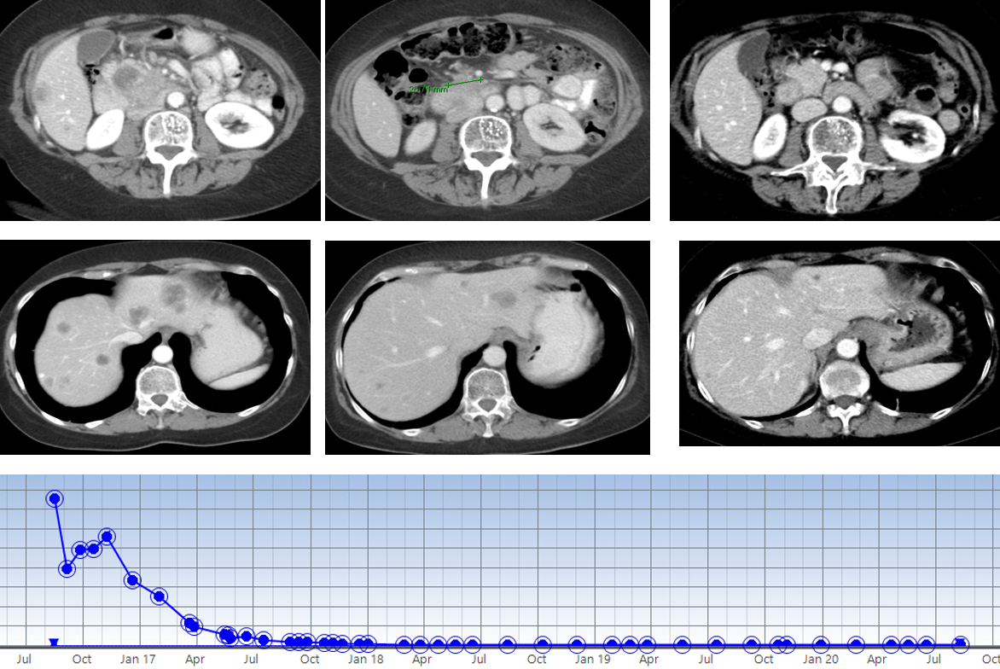
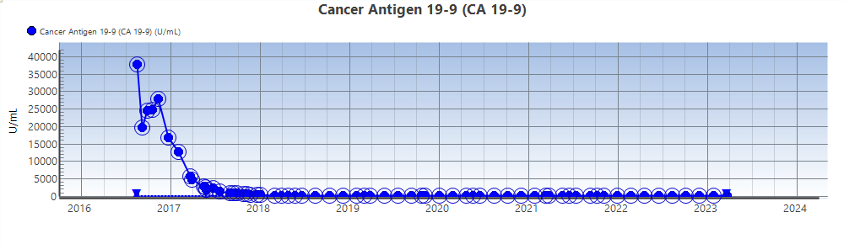
Platinum → PARPi gBRCA2 Metastatic PDAC 62-Year-old Woman: Excellent Cancer Control on Platinum – PARP Inhibitor
Pancreas Cancer: BRCA Targeting
Platinum
PARP Inhibitor
Ca 19-9 37,500+
Ca 19-9 <ULN

Slide 55
Pancreas Cancer & Therapy 2026 – Changing….
Pancreas Cancer: Advanced Disease
Pancreas Cancer
Changing epidemiology
RAS
RAS – new 2L 2026; rapidly moving to 1L
Current Therapies
Targeted therapy: BRCA/HRD, RAS-wild-type – fusions
Germline, somatic testing for all at diagnosis
Cytotoxic-based 3 vs 2 drug combinations for most

Slide 56
Discussion Questions
For which patients are you currently prioritizing the use of first-line NALIRIFOX?
Would you consider front-line NALIRIFOX for a patient who has received FOLFIRINOX in the localized setting and then progressed? What about for a patient who had tolerability issues on prior mFOLFIRINOX?

Slide 57

Comparisons in tolerability/toxicity profiles of treatment regimens used in mPDAC
Amanda K Wagner, APRN-CNP, AOCNP
GI Malignancies
The James Cancer Hospital
The Ohio State University
Columbus, Ohio

Slide 58
Gemcitabine/Nab-Paclitaxel
MPACT Trial (vs Gemcitabine alone)
Grade 3 Toxicities
Neutropenia: 38%
Febrile Neutropenia: 3%
Peripheral Neuropathy: 17%
Fatigue: 17%
Diarrhea: 6%
Nausea/vomiting: <10%
In Practice, consider bi-weekly dosing for patients with advanced disease to decrease risk of toxicity (specifically myelosuppression and peripheral neuropathy)
MPACT Trial (Von Hoff, D., Ervin, T., Arena F., et al, The New England Journal of Medicine, 2013)
Ahn, D., Krishna, K., Blazer, M. et.al, Therapeutic advances in medical oncology, 2017

Slide 59
FOLFIRINOX
ACCORD 11 Trial (vs Gemcitabine alone)
Grade 3 Toxicities
Neutropenia: 45-50%
Febrile Neutropenia: 5-6%
Diarrhea: 12-13%
Peripheral Neuropathy: 9%
Fatigue: 23%
Vomiting: 15%
modified FOLFIRINOX is commonly used in practice (no 5FU Bolus and irinotecan at 150 mg/m2 vs 180 mg/m2, per PRODIGE 24 Trial)
ACCORD 11 trial (Conroy T, Desseigne, F, Ychou, M. et.al, The New England Journal of Medicine, 2011)
PRODIGE 24 Trial (Conroy T., Hammel, P., Hebbar, M., et. al, The New England Journal of Medicine, 2018)

Slide 60
NALIRIFOX
NAPOLI-3 Trial (compared to Gem/Nab-paclitaxel)
Grade 3 Toxicities
Neutropenia: 14-20%
Febrile Neutropenia: 2-3%
Diarrhea: 10-13%
Nausea: 10-12%
Vomiting: 6-8%
Peripheral neuropathy: 1-3%
Fatigue: 10-14%
NAPOLI-3 trial (Wainberg Z, Melisi D, Macarulla T et. Al, The Lancet, 2023)

Slide 61
Key Takeaways
If neuropathy risk matters most:
-consider NALIRIFOX or mFOLFIRINOX (with early oxaliplatin drop) over Gemcitabine/nab-paclitaxel
If GI toxicity (especially diarrhea) would be hard to manage:
-Gemcitabine/nab-paclitaxel would be easier
If marrow reserve is limited:
-consider NALIRIFOX, mFOLFIRINOX over Gemcitabine/nab-paclitaxel
Older, frail patients with decreased PS
-Gemcitabine/nab-paclitaxel tends to be tolerated better

Slide 62
Nal-IRI side effects
Monitoring, mitigation, and management
DIARRHEA
ASSESS-timing (early vs late onset), stool frequency over baseline, monitor electrolytes, creatinine. Watch for symptoms of dehydration
MITIGATION-atropine (0.25-1 mg IV/SC) PRN or pre-med, consider low soluble diet, patient EDUCATION (loperamide IN HAND and clear instructions for use, call with fever >/=104, diarrhea >24 hours, unable to keep fluids down)
MANAGEMENT-loperamide (4 mg at first loose stool, then 2 mg q2 hrs until diarrhea free x 12 hours), add diphenoxylate/atropine. IV fluids, electrolyte replacement as needed
NCCN Guidelines Palliative Care Version 2.2026; Irinotecan liposome injection Prescribing Information; available via FDA: https://www.accessdata.fda.gov
.
Notes:
Withhold ONIVYDE for Grade 2-4 diarrhea. Initiate loperamide for late onset diarrhea of any severity. Administer intravenous or subcutaneous atropine 0.25 to 1 mg (unless clinically contraindicated) for early onset diarrhea of any severity. Following recovery to Grade 1 diarrhea, resume ONIVYDE at a reduced dose

Slide 63
Nal-IRI side effects, cont.
Monitoring, mitigation, and management
NAUSEA/VOMITING
ASSESS-timing, impact on weight/PO intake, risk (moderately to highly emetogenic in combination regimens)
MITIGATION-pre-medicate with 5-HT3 antagonist, dexamethasone, NK1 antagonist. Consider delayed dexamethasone vs olanzapine. Patient education (ondansetron, prochlorperazine rx PRN, call if uncontrolled, unable to maintain hydration)
MANAGEMENT-PRN anti-emetics, IV hydration if needed
ASCO Antiemetic Guidelines (Hesketh PJ, JCO, 2020)

Slide 64
Nal-IRI side effects, cont.
Monitoring, mitigation, and management
NEUTROPENIA
ASSESS-CBC d/p prior to each cycle, risk factors (age, prior treatment, UGT1A1 *28 homozygosity)
MITIGATION-consider G-CSF in older patients, prior neutropenia. Start at lower dose in known UGT1A1 *28 homozygotes.
MANAGEMENT- hold treatment if ANC <1500. Add G-CSF if recurrent grade 3 or 4 neutropenia or febrile neutropenia
FATIGUE
ASSESS-Pattern (post infusion vs cumulative), other causes (anemia, dehydration, sleep disruption, pain)
MITIGATION/MANAGEMENT-treat reversible causes, add IV hydration, encourage activity, PT referrals. Dose adjustments if needed
ASCO G-CSF Guidelines (Gyawali B, JCO, 2026)
Irinotecan liposome injection Prescribing Information; available via FDA: https://www.accessdata.fda.gov
.

Slide 65
Nal-IRI Dosing
NALIRIFOX -1st Line metastatic pancreatic cancer
Nanoliposomal Irinotecan 50 mg/m2
Oxaliplatin 60 mg/m2
Fluorouracil (5-FU) 2400 mg/m2
Leucovorin 400 mg/m2
Nal-IRI with 5-FU-2nd line after progression following Gemcitabine-based therapy
Nanoliposomal Irinotecan 70 mg/m2
Irinotecan liposome injection Prescribing Information; available via FDA: https://www.accessdata.fda.gov

Slide 66
Do dose reductions impact efficacy?
NAPOLI-3 Trial reported high rates of dose delays and reductions (in both arms); despite this, NALIRIFOX improved OS, PFS, and ORR
No convincing evidence that clinically appropriate dose reductions compromised efficacy as long as patients maintain adequate treatment exposure
Key takeaway—in practice, dose adjustments is often what preserves efficacy by preventing early discontinuation
NAPOLI-3 trial (Wainberg Z, Melisi D, Macarulla T et. Al, The Lancet, 2023)

Slide 67
NALIRIFOX Dose Modification Strategies
Implications for practice
Medically fit patients, PS O-1, no co-morbidities
Start with full dose→ assess patients after 1st treatment to monitor for toxicity, dose adjust as necessary
Borderline Performance status, frailty, baseline neuropathy
Pre-emptively start with dose reductions (20-25%) and consider escalating as tolerated
Stepwise adjustments based on side effects
After initial disease control, consider de-escalating treatment to maintenance

Slide 68
Case Presentation

Slide 69
Case Study
54 yo female hx of HLD, HTN, DM2 (no neuropathy)
Presented with abdominal pain; found to have a pancreatic head mass with numerous pulmonary and chest lymph node metastases. Biopsy showed adenocarcinoma
PS 0; UGT1A1 *28 INDETERMINATE
Treatment with NALIRIFOX recommended; nal-IRI dose reduced to 40 mg/m2
Significant n/v with C1; improved with addition of PRN Haloperidol
Imaging after 3 cycles showed interval improvement in pulmonary nodules and pancreatic mass
C4-oxaliplatin dose reduced by 20% d/t neuropathy; eventually discontinued after 6 months d/t stable disease and worsening neuropathy
Patient continues on 5FU/nal-IRI with ongoing disease control

Slide 70
Discussion Questions
How do the tolerability profiles of first-line gemcitabine/nab paclitaxel versus FOLFIRINOX versus NALIRIFOX affect your selection among them for individual patients? Do you find that one of these regimens is fundamentally better tolerated than the others?
Do you proactively test for homozygosity for UGT1A1*28 in patients about to begin treatment with irinotecan-containing regimens, including NALIRIFOX? Do you approach dosing of nal-IRI any differently in patients homozygous for UGT1A1*28? Do you approach AE mitigation, monitoring and/or management any differently?

Slide 71
Agenda
Introduction: Clinical Presentation and Prognosis of Pancreatic Adenocarcinoma (PAD)
Module 1: Recent Advances in Up-Front Treatment for Metastatic PAD
Module 2: Selection and Sequencing of Therapy for Relapsed/Refractory Metastatic PAD
Module 3: Novel Strategies Targeting RAS Mutations in Advanced PAD
Module 4: Utility of Tumor Treating Fields in PAD Management

Slide 72



Selection and Sequencing of Therapy for Relapsed/Refractory (R/R) Metastatic PAD
Philip Agop Philip, MD, PhD, FRCP
Henry Ford Health Wayne State University School of Medicine
Detroit, Michigan
USA

Slide 73
Key factors that determine the selection of therapy in patients who fail initial treatment
Age
Performance status (0-2)
Organ function
Liver
Bone marrow
Nervous system
Access to clinical trials
Patient/caregiver preferences
Understanding treatment goals and benefit vs. risks

Slide 74
NAPOLI-1 clinical trial established the benefit of liposomal irinotecan plus 5-FU and got FDA approval
Global Phase 3 trial
Unresectable or metastatic pancreatic cancer
Progression or intolerance to previous chemotherapy
Favorable performance status (0-1)
Adequate organ function
Bilirubin < 1.5 x upper limit of normal for the lab
No major comorbidities
No age limit!

Slide 75
NAPOLI-1: design of the trial
Nal-IRI 70 mg/m²/
5-FU/LCV
Randomization
Nal-IRI
Overall Survival
N = 417
5-FU/LCV
Wang-Gillam et al, Lancet, 2015

Slide 76
NAPOLI-1: Nal-IRI/5FU/LCV significantly improved overall survival compared to 5FU/LCV and delayed worsening of disease
 | Nal-IRI/5-FU/LCV | 5-FU/LCV
Median overall survival in months | 6.1 | 4.2
Median progression free survival in months | 3.1 | 1.5
Wang-Gillam et al, Lancet, 2015; Wang-Gillam et al, ASCO, 2016

Slide 77
NAPOLI-1: Side effects of Nal-IRI/5FU/LCV
 | Grade 3 or 4 toxicities %
 | Nal/5FU/LCV | 5FU/LCV
Diarrhea | 13 | 4
Vomiting | 11 | 3
Nausea | 8 | 3
Appetite | 4 | 2
Fatigue | 14 | 4
Neutropenia | 27 | 1
Anemia | 9 | 7
Hypokalemia | 3 | 2
Gastro-intestinal
General
Hematological
Wang-Gillam et al, Lancet, 2015; Wang-Gillam et al, ASCO, 2016

Slide 78
Mitigating side effects of Nal-IRI plus 5-FU
Proper patient selection
Performance status
Organ function (e.g., liver)
Pre-treatment genetic testing
DYPD – predicts 5-FU side effects
UGT1A1 – predicts Nal-IRI side effects
Close clinical monitoring first and second cycles
Apply dose reductions if
Necessary!

Slide 79
I do not start all patients with same 70 mg/m² dose of Nal-IRI that was used in the trial
Older patients
Patients who are frail with performance status of 2
UGT1A1 intermediate or poor metabolizers
Borderline liver function
REDUCED DOSES BETTER THAN MISSED DOSES!

Slide 80
Treatment Sequencing Approach For mPDAC In 2026:
A Clinical Trial Must Always Be Considered Before Starting Therapy
1st line
2nd line
3rd line
Nab-paclitaxel + Gemcitabine
NaI-RI-398 + 5-FU/LV
Platinum-based tx (depending on prior exposure)
Daraxonrasib
mFOLFOX6 or CAPOX
Nal-IRI + 5-FU/LV (depending on prior exposure)
FOLFIRINOX
NALIRIFOX
BRCA/PALB^{mut}
Capecitabine or 5-FU
Olaparib
Gemcitabine+
Cisplatin
Gemcitabine
Nab-paclitaxel + gemcitabine (if no neuropathy)
Supported by RCT data
Supported by retrospective data or small, single arm trials

Slide 81
Development of drugs in pancreatic cancer
NTRK
RET
Gemcitabine
Gem + Erlotinib
FOLFIRINOX
Nal-IRI/5FU
Larotrectinib
Selpercatinib
NALIRIFOX
?Daraxonrasib
1997 2007 2010 2013 2016 2018 2020 2022 2023 2024 ?2026
BRCA
Gemcitabine
Nab paclitaxel
Pembrolizumab
Olaparib
Dabrafenib
Trametinib
Zenocutuzumab
MSI-high
BRAF
NRG1
Entrectinib
NTRK
Conventional cytotoxic chemotherapy
Targeted therapies
Biomarker

Slide 82
Case Presentation

Slide 83
Case:
72-year-old grandmother
3/2024 - diagnosed with diabetes
8/2025-
Epigastric and back pain
Weight loss of 18 pounds
CT Scan
Pancreatic body mass 3.1 x 4.1 cm involving the SMA and SMV
Multiple lesions in the liver >6, both lobes

Slide 84
Case:
Liver biopsy = adenocarcinoma, pancreaticobiliary type
CA19-9 = 2,239
NGS = KRAS^{G12D} and p53 mutations
Germline testing = no BRCA/PALB mutations
Liquid biopsy = KRAS^{G12D} and p53 mutations
DYPD and UGT1A1 normal alleles
Performance status 1

Slide 85
Case:
9/2025
Started on gemcitabine nab-paclitaxel
11/2025
CT scan = partial response
CA19-9 down to less than 1,000
2/2026
CT scan = disease worsening
CA19-9 trending up
Grandson graduating from college in May 2026
3/2026
Started on Nal-IRI/5-FU/LCV at reduced dose of Nal-IRI 50 mg/m²
Well tolerated
CT scan after the graduation

Slide 86
Discussion Questions
Do you employ nal-IRI as second-line therapy for all patients who did not receive the agent in the first-line setting?
For patients with advanced PAD who have received nal-IRI as a component of first-line NALIRIFOX, how is the therapeutic algorithm for R/R disease impacted?

Slide 87
Agenda
Introduction: Clinical Presentation and Prognosis of Pancreatic Adenocarcinoma (PAD)
Module 1: Recent Advances in Up-Front Treatment for Metastatic PAD
Module 2: Selection and Sequencing of Therapy for Relapsed/Refractory Metastatic PAD
Module 3: Novel Strategies Targeting RAS Mutations in Advanced PAD
Module 4: Utility of Tumor Treating Fields in PAD Management

Slide 88
Pancreas Adenocarcinoma The Coming Future!
Research To Practice: Oncology Nursing Society
Eileen M. O’Reilly, MD, FASCO
Winthrop Rockefeller Endowed Chair, Memorial Sloan Kettering Cancer Center
Chair, Human Research Protection Program and IRB
Professor of Medicine, Weill Cornell Medicine
May 15th, 2026

Slide 89


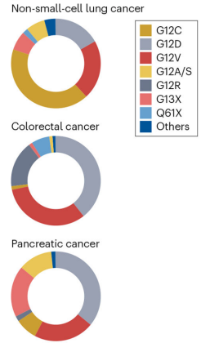








RAS Mutations in ~20% of All Cancers
KRAS Genomics
RAS Mutations Across
Cancer Types
KRAS Alleles in NSCLC, CRC,
and Pancreatic Cancers
Melanoma
KRAS 1%, HRAS 2%, NRAS 17%
Head and neck
KRAS 2%, HRAS 5%, NRAS 2%
Pancreas
KRAS 88%
Non-small cell lung cancer
KRAS 32%
Esophagogastric
KRAS 3%, KRAS-amp 6%
Gallbladder, cholangiocarcinoma
KRAS 21%, NRAS 2%
Colorectal
KRAS 42%, NRAS 4%
Endometrial
KRAS 17%, NRAS 3%
Ovarian
KRAS 9%, NRAS 2%
Leukemia
KRAS 5%, NRAS 14%
Yang, X. J Haematol Oncol, 2024
Singhal, A… O’Reilly, EM. Nat Med, 2024

Slide 90
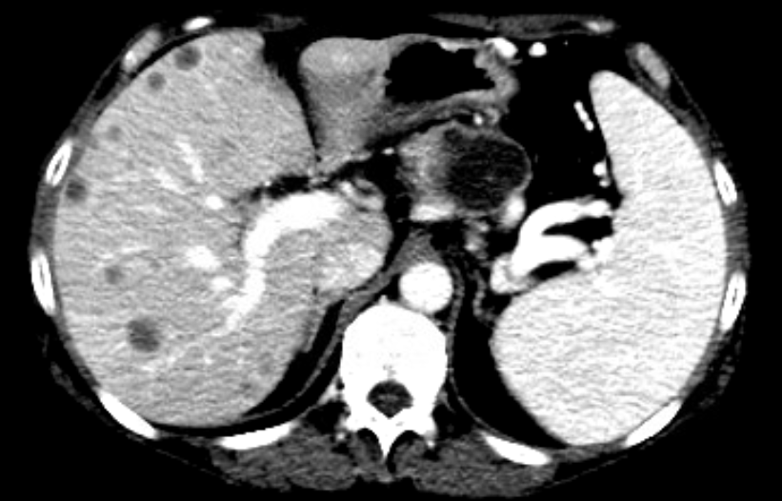
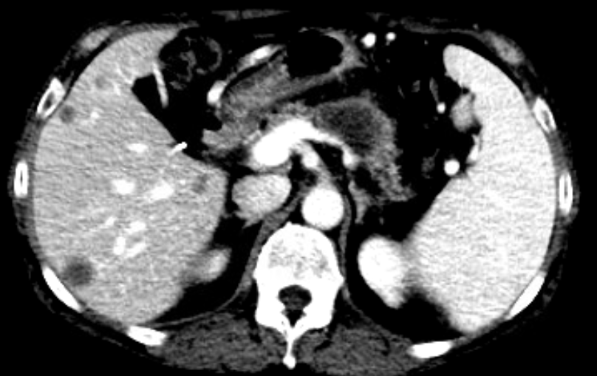
Case: RASi Targeting in Metastatic Pancreas Cancer
Pancreas Cancer: Targeted Therapy
Ms. XY, 63 years, human resources manager, non-smoker; occasional alcohol
Metastatic pancreas adenoca(+); Germline NEG
Somatic: MICROSATELLITE STABLE (MSS). MSIsensor score 1.14; TMB 4.1 mt/Mb. 1. KRAS (NM_004985) exon2 p.G12V (c.35G>T)
2. NOTCH2 (NM_024408 - 1p11.2) Amplification (Fold Change: 4.2)
3. RAC2 (NM_002872 - 22q13.1) Amplification (Fold Change: 2.2)
4. NF2 (NM_000268 - 22q12.2) Amplification (Fold Change: 2.0)
5. KMT2A (MLL1) (NM_001197104) exon12 p.N1513Tfs*16 (c.4533_4555delinsCCCAAC)
6. PHOX2B (NM_003924) exon3 p.A254_A260del (c.741_761delCGCGGCAGCGGCGGCGGCGGC)
7. SMAD4 (NM_005359) exon11 p.Q455* (c.1363C>T)
8. TP53 (NM_000546) exon11 p.M384Ffs*38 (c.1150_1152delinsTT)
9. CDKN2A (NM_058195) rearrangement: c.194-3832:CDKN2A_chr9:g.30910251inv
4 lines systemic therapy
#1: 10 m Gemcitabine, nab-paclitaxel, ipilimumab, nivolumab (trial) PR
#2: 5 m mFOLFIRINOX + mAb Ca 19-9 (trial) – SD
#3: 2 m Cisplatin/gemcitabine/nab-paclitaxel – PD
#4: 1 m Nano-liposomal irinotecan/5-FU – PD

Slide 91
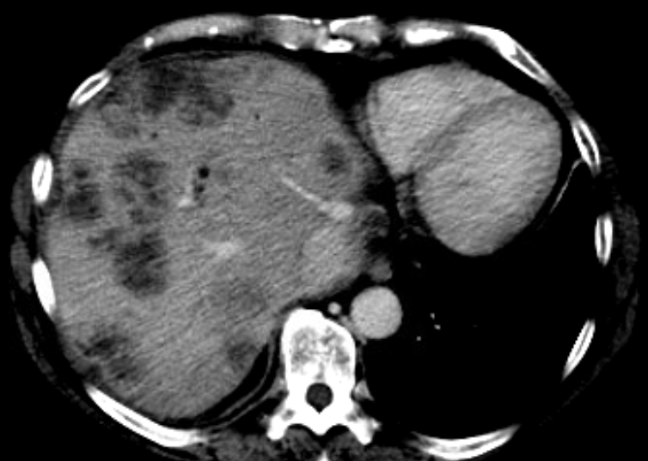
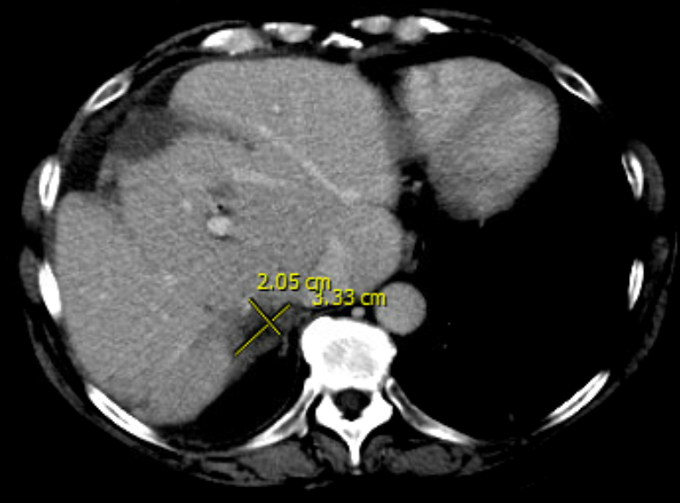
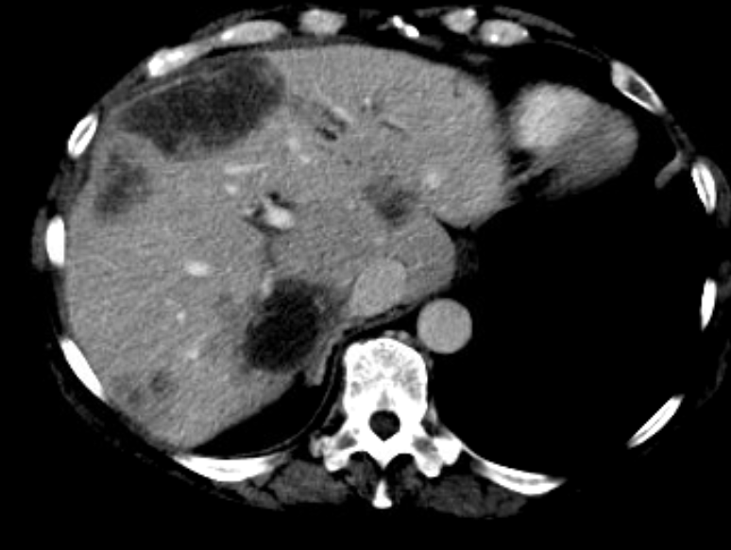
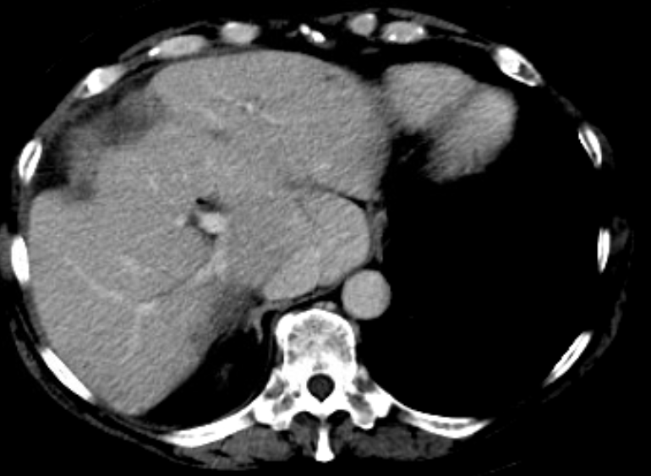
Pre-RAS Targeting
Pancreas Cancer: Targeted Therapy
Post-RAS Targeting
Marked symptom improvement
Decreased pain
Off narcotics
Weight gain 5 kg
Ca 19-9 320,362 U/ml
Ca 19-9 22,956 U/ml

Slide 92
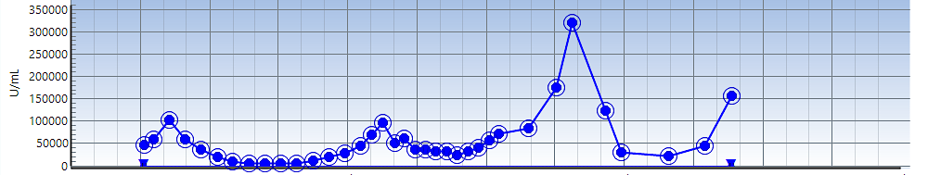
Case: Tumor Marker Profile and Outcome
Pancreas Cancer: Targeted Therapy
T0
4 lines systemic therapy (2 trials) 18 m
5th line therapy
RAS agent
RIP
Subsequent course
Ras agent (5th line): 6 m excellent clinical, radiologic (SD), biomarker, symptom control
Response as 5th line; disease control > prior 3 lines
RIP 27 m post diagnosis

Slide 93
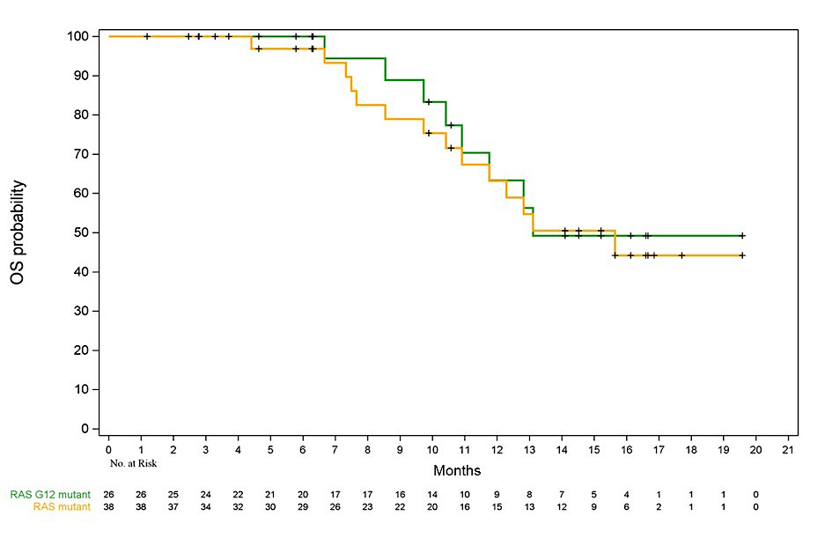
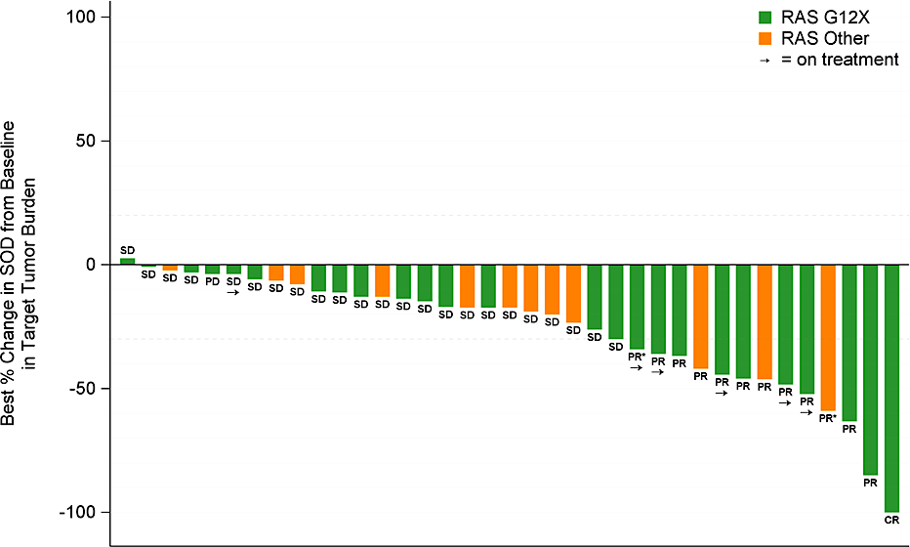

Daraxonrasib: Early Outcomes in 2L PDAC 300 mg PO Multi-RAS(ON) Tri-Complex Inhibitor (KRAS H, N, Wild-Type)
RAS Therapeutics: PanRas Inhibitor
Response Rate (N= 38)
Overall Survival (N= 38)
 | Overall RR | DCR Rate | PFS (m) | OS (m)
RAS G12X (N= 26) | 35% | 92% | 8.5 (6.7- 10.5) | 13.1 (10.9- NE)
RAS mutant (N= 38) | 29% | 29% | 8.1 (5.9- 10.1) | 15.6 (10.9- NE)
*RAS mutant: G12X, G13X, Q61X; Median f/up > 16 m
Data cut off 06-30-2025
Courtesy Revolution Medicine website 09 2025

Slide 94
Daraxonrasib 300 mg: Safety, Adjustments 2L+ (N= 83) Toxicity: Primarily Cutaneous/GI
Pancreas Cancer: PanRAS Inhibitor
Toxicity | Any Grade | Grade > 3
Rash | 75 (90%) | 6 (7%)
Mucositis | 45 (54%) | 3 (4%)
Diarrhea | 43 (52%) | 3 (4%)
Nausea/Vomiting | ~39%/ 26% | -
Paronychia | 15 (18%) | --
Fatigue | 14 (17%) | 1 (1%)
Platelets | 8 (10%) | 3 (4%)
Anemia | 7 (8%) | 6 (7%)
AST/ALT | 10%/ 7% | 4%/ 2%
Dose Adjustments | N= 83
Dose modifications | 40 (48%)
Dose interruption | 36 (43%)
Dose reduction | 25 (30%)
Discontinuation AE | -
Data cut off 06-30-2025
Courtesy Revolution Medicine website 09 2025

Slide 95
RASolute 302: Phase III PDAC 2L Daraxonrasib vs Chemo ASCO 2026 Plenary Session
Pancreas Cancer: PanRAS Inhibitor
Daraxonrasib 300 mg PO Daily
N= 230
Metastatic PDAC
Second-Line ECOG 0-1
RAS G12X (K,H,N), WT
N= 460
1:1
Investigator Choice Chemo
N= 230
Co-primary endpoints: Progression-free survival; OS (G12X)
Secondary endpoints: PFS, OS (all), Overall response rate, duration of response, safety, QoL
HR 0.7 OS (G12X 7.1 → 10.1 m)
HR 0.54 PFS (G12X 3.5 → 6.5 m)
NCT06625320

Slide 96
RASolute 302: Phase III PDAC 2L Daraxonrasib vs Chemo
Pancreas Cancer: PanRAS Inhibitor
Trial met all primary and key secondary endpoints
In overall (intent-to-treat) study population: Daraxonrasib median OS 13.2 vs 6.7 m for chemotherapy Hazard ratio 0.40, p < 0.0001
https://ir.revmed.com/news-releases/news-release-details/daraxonrasib-demonstrates-unprecedented-overall-survival-benefit

Slide 97
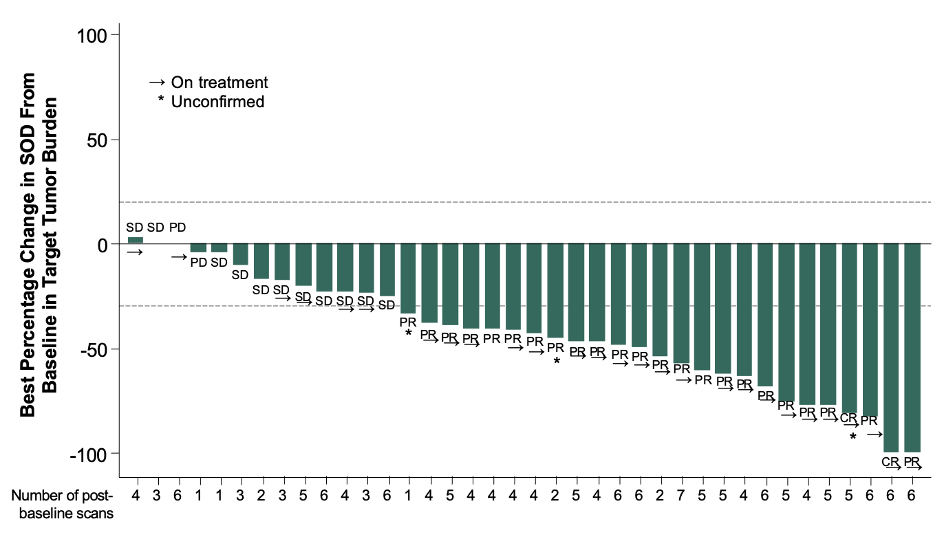
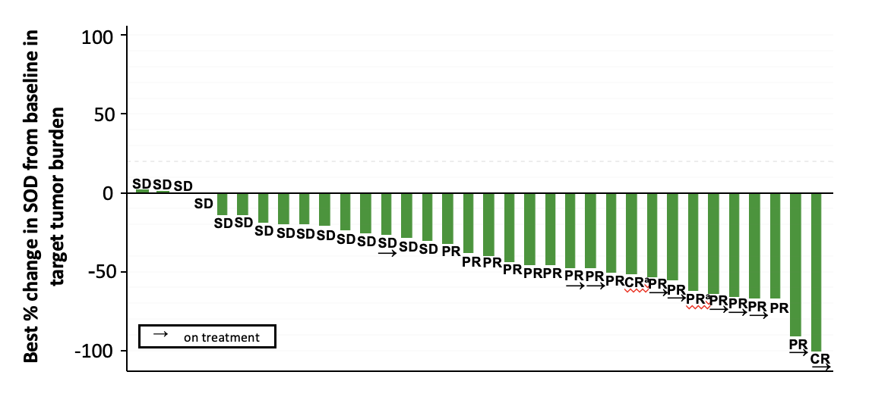
Daraxonrasib +/- Gem/nab-Paclitaxel: 1L Pancreas Cancer Promising Single Agent, Combination Signals in First Line PDAC (AACR 2026)
RAS Therapeutics: PanRAS Inhibitor
Daraxonrasib | N= 38
Overall RR | 47% (31, 64)
Disease control Rate | 89% (79, 98)
6-month OS | 83% (67, 92)
Daraxonrasib+Gem/nab-P | N= 40
Overall RR | 58% (41, 73)
Disease control Rate | 90% (76, 97)
6-month OS | 90% (76, 96)
O’Reilly, EM…Garrido-Laguna, I. AACR, 2026
Wolpin, B….Sohal, D. AACR, 2026

Slide 98
RASolute 303: Phase III 1L Metastatic PDAC Accruing
Pancreas Cancer: PanRAS Inhibitor
Daraxonrasib 300 mg Daily
1L Metastatic PDAC ECOG 0-1
RAS G12X (K,H,N), WT
N~ 900
1:1:1 Randomization
Daraxonrasib 200 mg + Gem/nabP
→ Daraxonrasib 300 mg
SOC Gemcitabine/nab-Paclitaxel
Co-primary endpoints: Progression-free survival; OS
Secondary endpoints: PFS, OS, Overall response rate, duration of response, safety, QoL
NCT07491445

Slide 99
Selected Phase III Trials Activated / Announced in PDAC
RAS/MAPK Inhibitors: Pancreas Cancer
Trial Name | Therapeutic | Target | N | Disease Setting | Status
RASolute 302 | Daraxonrasib vs Chemo | PanRAS | 460 | 2nd line metastatic | ASCO 2026
RASolute 303 | Gem/nabP +/- Daraxonrasib, D | PanRAS | ~900 | 1st line metastatic | Activated Q1 2026
RASolute 304 | Daraxonrasib | PanRAS | 500 | Adjuvant | Activated Q4 2025
RASolute 305 | Zoldonrasib + chemo/Z | KRAS G12D |  | 1st line metastatic | Activated Q1 2026
RASolute 309 | Zoldonrasib + Daraxonrasib | KRAS G12D, panRAS |  | 1st line metastatic | Pending 2026
Pending | mFOLFIRINOX +/- Setigrasib | KRAS G12D |  | 1st line metastatic | Activated Q1 2026
DAWN 303 | Chemo +/- INCB161734 | KRAS G12D |  | 1st line metastatic | Activated Q2 2026
MAPKeeper 301 | Gem/nabP +/- Atebimetinib | MEK |  | 1st line metastatic | Pending 2026
HRS-4642-302 China | Chemo +/- HRS-4642 | KRAS G12D |  | 1st line metastatic | Activated Q4 2025
GFH375-X1301 China | VS-7375 vs Chemo | KRAS G12D |  | 2nd line metastatic | Activated Q4 2025

Slide 100
Pancreas Cancer & Therapy 2026 – Changing….
Pancreas Cancer: Advanced Disease
Pancreas Cancer Current 2026
Cytotoxic-based 3 or 2 drug combinations for most
Other Targets
MTAP-loss: PRMT5 inhibitors, Claudin
Immunotherapy: Adenosine modulation, CD40
RAS Therapies
RAS inhibitors – new 2L standard 2026 - daraxonrasib
Targeted: BRCA/HRD, RAS-wild-type – fusions
Rapidly moving to 1L, Adjuvant
Vaccines: Personalized neoantigen, RAS immunotherapy
Multiple agents, multiple mechanisms in development

Slide 101
Discussion Questions
Do you actively assess for RAS mutations in patients with metastatic PAD in your current practice? If so, when in the course of the disease do you typically test, and what testing platform(s) do you employ?
Do you believe daraxonrasib will soon enter clinical practice? Would you like to have access to it at the current time? For which patients would you prioritize its use?

Slide 102
Tolerability of RAS-Targeted Therapies in Advanced PDAC
Caroline Kuhlman, MSN, APRN-BC
Tucker Gosnell Center for Gastrointestinal Cancer
Mass General Brigham Cancer Institute
May, 2026

Slide 103
Precision Medicine Targeting KRAS – Holy Grail in Pancreatic Cancer
KRAS mutations present in >90% of pancreatic cancer - key ‘driver mutation’
Traditionally considered ‘undruggable’ due to intrinsic characteristics of KRAS protein
Discovery of new allosteric site of KRAS G12C led to irreversible covalently binding inhibitors of G12C
Multiple new KRASG12D (MRTX1133, ASP3082 etc) and other KRAS inhibitors in clinical trials
Notes:
. KRAS is a small protein that has a relatively smooth surface with few potential inhibitor-binding regions and a very high binding affinity to GTP
KRYSTAL 1 trial – adagrasib 21 pts PDAC mPFS 5.4, mOS 8
CODEBREAK sotorasib 38 pts PDAC mPFS 4, mOS 6.9 mos

Slide 104
Case Study
Presented to the ED with a few weeks of left flank and abdominal pain
CT abdomen/pelvis: 3.5 cm hypodense lesion in pancreatic tail, consistent with primary pancreatic cancer. Multiple liver metastases, up to 1.7 cm. Mild hepatic steatosis. Liver biopsy demonstrates Adenocarcinoma, moderately differentiated, consistent with primary pancreatic biliary tumor. Mismatch repair proteins are intact.
24-325 subprotocol A (FOLFIRINOX + RMC 6236 (daraxonrasib) start 2/6/2025
Best response after 11 cycles with significant improvement in hepatic metastasis. RECIST - 83.22% compared to baseline
Various holds and adjustments for rash, mucositis and thrombocytopenia
3/17/2026 CT CAP: POD TIMC

Slide 105

Daraxonrasib
Daraxonrasib is an investigational oral RAS(ON) inhibitor for RAS-mutant cancers (NSCLC, PDAC) .
Not yet FDA-approved; in Phase 3 trials showing significant survival benefit in PDAC .
May 2026 UPDATE: Revolution Medicines has opened expanded access to drug
Safety profile differs from chemotherapy — less myelosuppression, but notable dermatologic and GI toxicities

Slide 106
Common Adverse Events (AEs)
Dermatologic: Rash (≥90% of patients) — most common
Gastrointestinal: Diarrhea, nausea, vomiting, stomatitis.
Other: Fatigue, taste changes, elevated liver enzymes
Most AEs are Grade 1–2; discontinuations due to AEs are relatively low

Slide 107
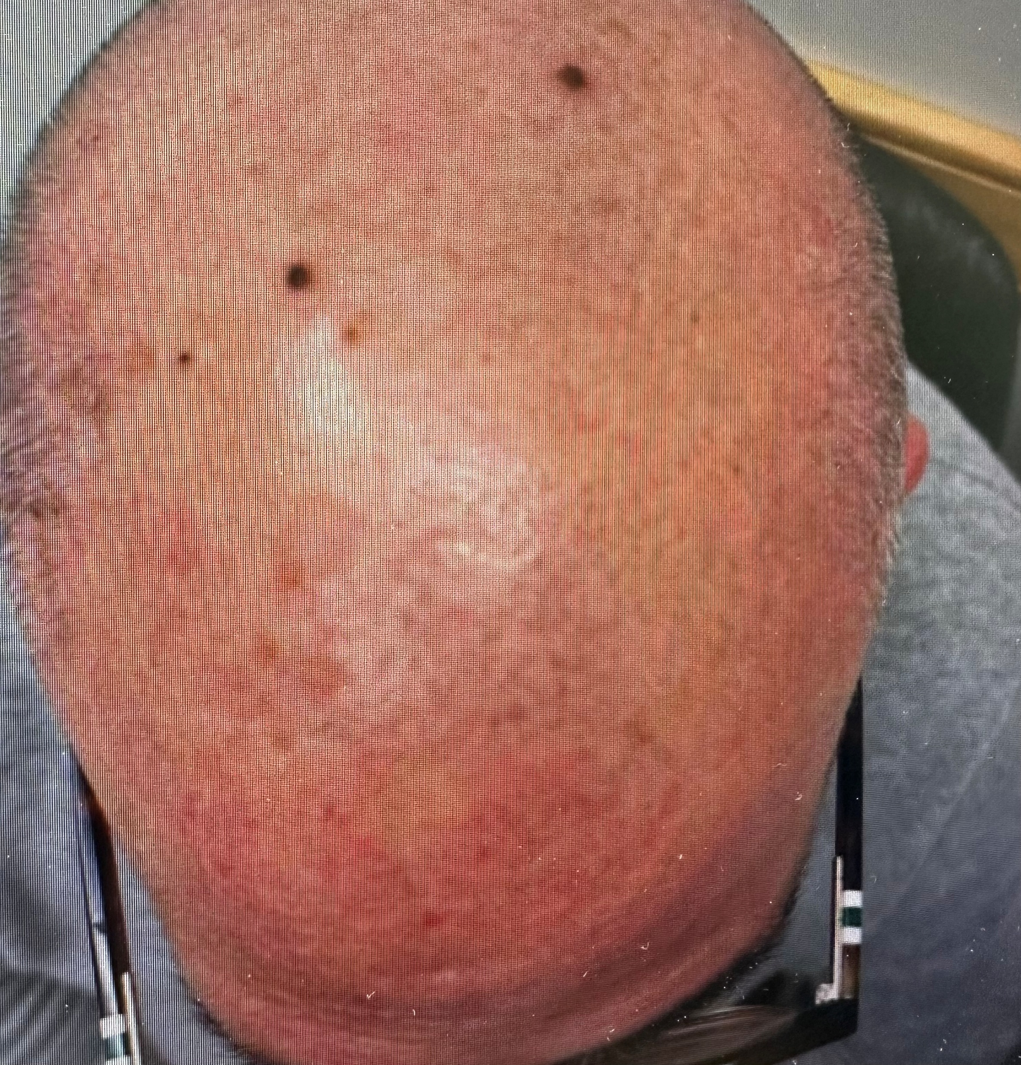
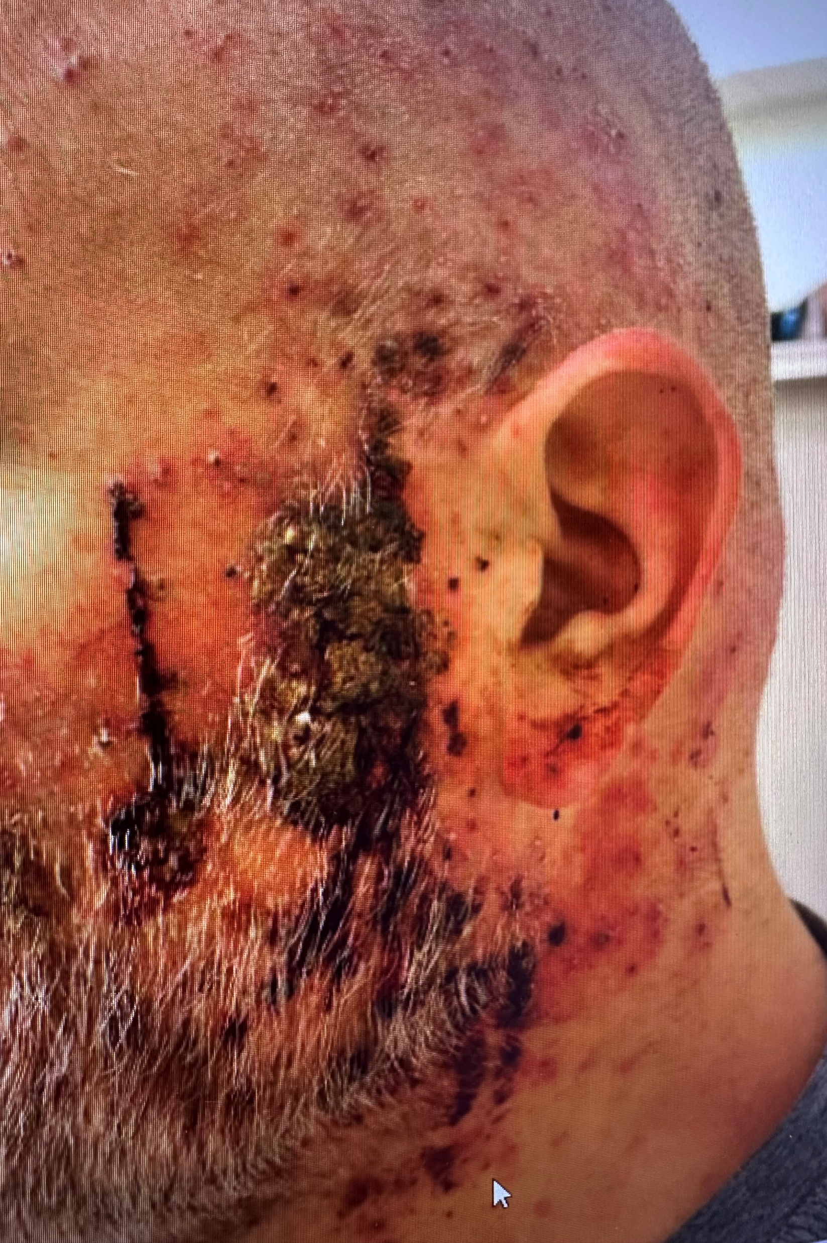

Rash Management

Slide 108
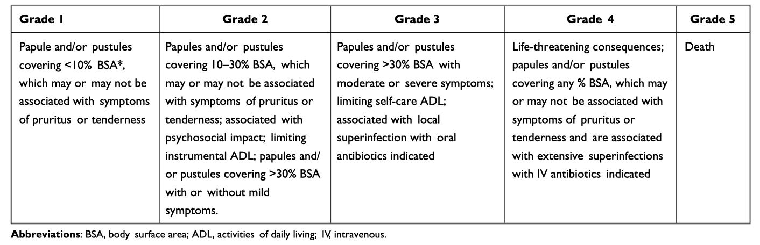
Grading acneiform skin rash
NCI CTCAE Guidelines V.5.0

Slide 109

Rash management
Oral antibiotics ppx: Doxycycline 100-200mg/day or Minocycline 100mg/day prior to first dose of Dara continue at least 8 weeks
Topical steroids Start hydrocortisone 1%, clobetasol or triamcinolone, oral steroids
Perfume-free moisturizing creams/lotions
Sun protection > 30SPF at least 30minutes prior to sun exposure
Dose hold and adjustment along with referral to dermatology for grade 2-4 rash for management-resistant to standard treatment

Slide 110
Mucositis
Warm salt water/baking soda water rinses
“Magic/ Miracle” mouthwash
E.g. diphenhydramine, viscous lidocaine, Maalox
Dexamethasone oral solution

Slide 111
Diarrhea
At first sign of diarrhea: Loperamide 4mg, then 2 mg every 2 hours, 4mg prior to bedtime (Overnight dosing) Continue regimen as long as diarrhea persists. STOP if no BM for >= 12 hrs
Diphenoxylate-Atropine: IF not controlled with loperamide after 4 hours, initiate 1 pill every 6 hours, continue if diarrhea persists. STOP if no BM for >= 8hrs.
Encourage fluids (Gatorade, lemonade, ginger ale)
Assess for signs of BRB, black stools, etc.

Slide 112
Nausea
Day 1: PREMEDICATION: Palonosetron, Dexamethasone, Olanzapine
Days 2,3: dexamethasone 8mg in am with olanzapine 5mg at HS
Day 4 Dexamethasone 4mg in am, olanzapine 5mg at HS
Day 5 Dexamethasone 4mg in am
PRN nausea prochlorperazine 10mg, q 6PRN, ondansetron 8mg q 8PRN, olanzapine 5mg at HS

Slide 113
Conclusion: Daraxonrasib
Generally well tolerated with a manageable safety profile across several clinical trials. As of early 2026, data from Phase 1/2 and Phase 3 trials
Grade ≥3 Events: In first-line monotherapy trials, Grade 3 or higher TRAEs occurred in approximately 38% of patients. The most frequent Grade 3 events were rash, diarrhea, and stomatitis.
Comparison to Chemotherapy: The incidence of Grade ≥3 TRAEs was significantly lower with daraxonrasib monotherapy (38%) compared to standard chemotherapy (73%) in comparative studies.
Discontinuations: Permanent discontinuation due to toxicity is relatively rare; one first-line study reported only a 3% discontinuation rate.
Dose Modifications: To manage toxicities, dose interruptions and reductions are common, with modifications required in 60-70% of patients in some trial arms. The mean relative dose intensity remained favorable at approximately 84-89%.
Fatalities: No Grade 4 or Grade 5 (fatal) TRAEs were reported at the standard 300 mg daily dose in several clinical updates.
Safety in Combination Therapy: When combined with chemotherapy (such as gemcitabine/nab-paclitaxel), the safety profile was consistent with the known toxicities of each individual agent, with no new safety signals identified for the combination regimen

Slide 114
Agenda
Introduction: Clinical Presentation and Prognosis of Pancreatic Adenocarcinoma (PAD)
Module 1: Recent Advances in Up-Front Treatment for Metastatic PAD
Module 2: Selection and Sequencing of Therapy for Relapsed/Refractory Metastatic PAD
Module 3: Novel Strategies Targeting RAS Mutations in Advanced PAD
Module 4: Utility of Tumor Treating Fields in PAD Management

Slide 115
Utility of Tumor Treating Fields (TTFields) in PAD Management
Philip Agop Philip, MD, PhD, FRCP
Henry Ford Health Wayne State University School of Medicine
Detroit, Michigan
USA

Slide 116
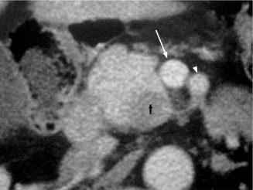
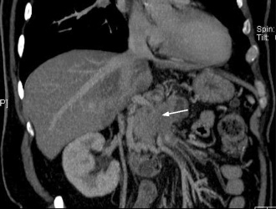
Most patients are diagnosed with advanced
non-curable disease
Resectable
R0/R1
Surgically
explored
20
100
Pancreatic
Cancer
35
Localized
unresectable
Metastatic
37
End stage
8

Slide 117
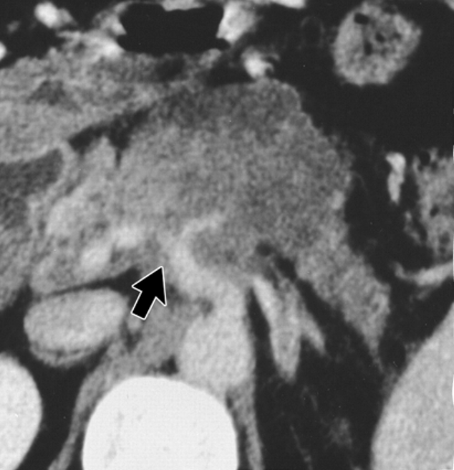
Extensive involvement of blood vessels by tumor in LAPC

Slide 118
Locally advanced unresectable pancreatic cancer
Unlikely to undergo curative surgery
Suffer from local effects of an expanding and invasive tumor
Abdominal +/- back pain
Bile duct blockage
Chemotherapy with or without radiation has been the only treatment option for palliation
Radiation therapy produces modest local benefit but does not improve survival

Slide 119

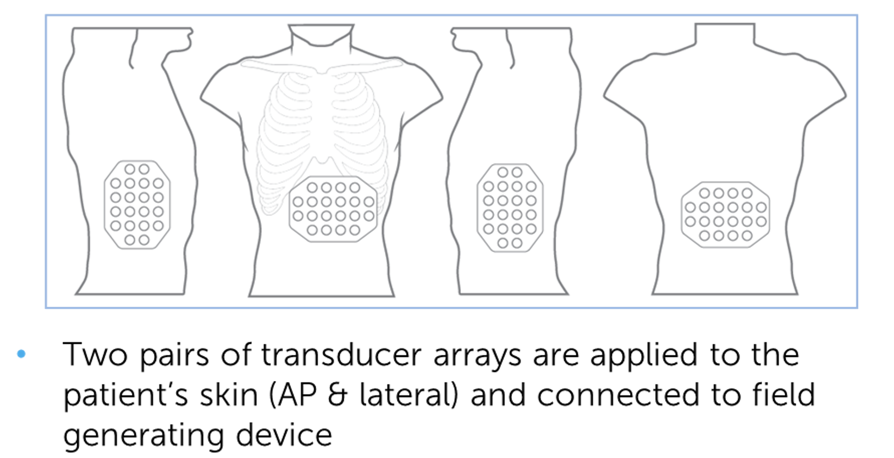
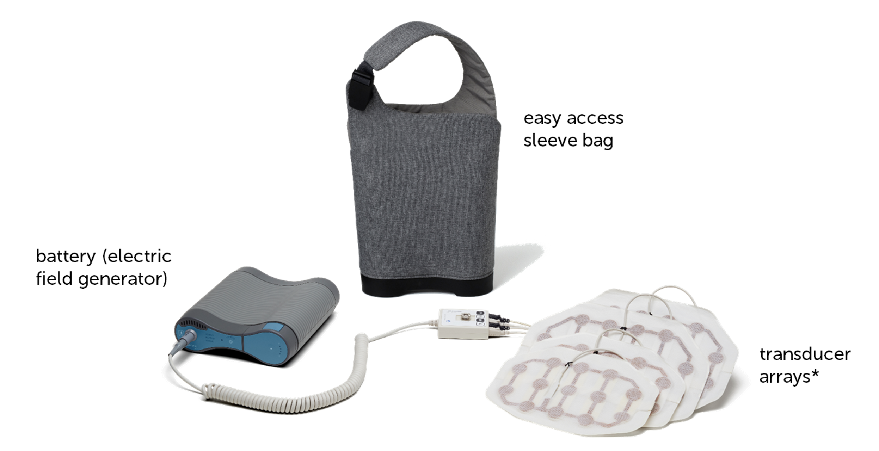
Tumor Treating Fields (TTFields) is a non-invasive application of alternating electric fields in treating pancreatic cancer
Courtesy of Philip A Philip, MD, FACP

Slide 120
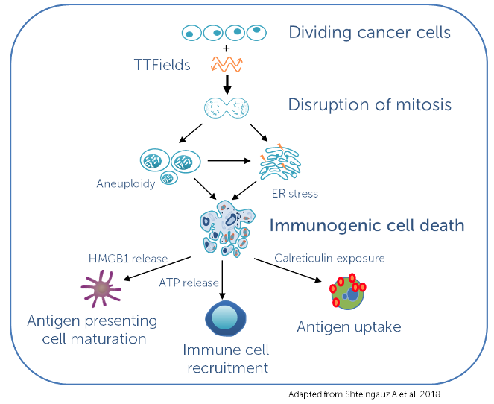
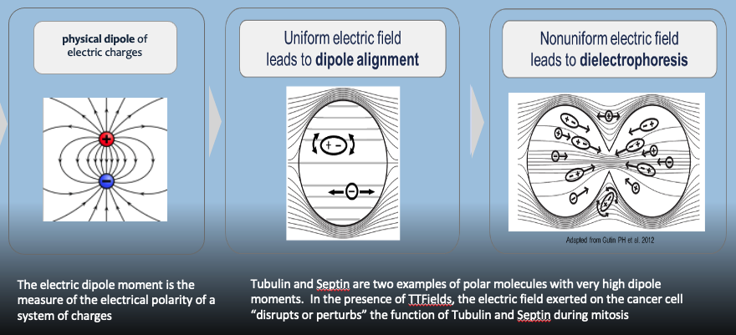
TTFields disrupts internal structures in cancer cells and leads to cell death and arresting cell multiplication
Courtesy of Philip A Philip, MD, FACP

Slide 121
PANOVA-3: Phase 3 International Study of TTFields plus Chemotherapy in Locally Advanced Pancreatic Cancer
R
A
N
D
O
M
I
Z
E
TTFields
+
Gemcitabine/nab-paclitaxel
1
571 patients
Overall survival
1
Gemcitabine/
nab-paclitaxel
NCT03377491
Babiker et al, JCO, 2025

Slide 122
PANOVA-3: eligible patients
Patients with locally advanced unresectable pancreatic cancer
ECOG performance status of 0, 1, or 2
Able to receive gemcitabine plus nab paclitaxel
Able to operate the device or have help
No upper age limit
NCT03377491
Babiker et al, JCO, 2025

Slide 123
PANOVA-3: Patients on TTF added to chemotherapy did better
 | TTF + Chemo | Chemo alone
Median overall survival in months | 16.2 | 14.2
Median pain-free survival in months | 15.2 | 9.1
Median distant progressive free survival in months | 13.9 | 11.5
Babiker et al, JCO, 2025

Slide 124
PANOVA-3: patients on TTF added to chemotherapy did better
 | TTF + Chemo | Chemo alone
Median overall survival in months | 16.2 | 14.2
Median pain-free survival in months | 15.2 | 9.1
Median distant progressive free survival in months | 13.9 | 11.5
Babiker et al, JCO, 2025

Slide 125
TTF-related side effects were mainly skin related (mild to moderate)
 | %
Skin reactions | 76.3
Dermatitis | 27.7
Rash | 17.5
Pruritus | 15.0
Maculopapular rash | 12.0
Erythema | 10.6
TTFields discontinuations | 8.4
Babiker et al, JCO, 2025

Slide 126
FDA Approves Tumor Treating Fields to Treat Pancreatic Cancer Press Release: February 12, 2026
“The US Food and Drug Administration has approved a first-of-its-kind device for the treatment of adult patients with locally advanced pancreatic cancer. Optune Pax is a portable, non-invasive device that delivers alternating electrical fields, known as tumor treating fields (TTFields), to the abdomen. TTFields work by physically disrupting the rapid cell division that is characteristic of cancer cells, while minimizing damage to healthy tissue.
The FDA’s approval of Optune Pax is based on data from a pivotal clinical study conducted under an Investigational Device Exemption. The randomized and controlled study followed adult patients with locally advanced pancreatic cancer for up to five years. The results showed that the addition of TTFields to standard of care chemotherapies gemcitabine and nab-paclitaxel (GnP) improved Overall Survival by approximately two months compared to GnP alone. Localized skin reactions were the most common device-related risks observed in the study.”
https://www.fda.gov/news-events/press-announcements/fda-approves-first-its-kind-device-treat-pancreatic-cancer

Slide 127
Case Presentation

Slide 128
Case
69 year old male – retired engineer
Well controlled hypertension and diabetes
Abdominal pain (7/10), unintentional weight loss 20 lb.
CT scan = pancreatic head mass, 4.1 x 3.9 cm, full circumference involvement of the superior mesenteric artery and superior mesenteric vein, no distant metastases
Endoscopic ultrasound and biopsy = adenocarcinoma
Germline testing for BRCA/PALB mutations was negative
Tumor NGS = KRAS^{G12V} and SMAD4 mutations
CA19-9 = 865

Slide 129
Case
Wants to stay active as long as possible!
Referred to palliative/supportive care
Experienced opioid side effects - constipation and mild drowsiness
Started treatment with TTF and gemcitabine and nab paclitaxel
Reduction in requirement of opiates
CT scan after 2 months showed 15% reduction
Mild skin irritation
CA19-9 trending down
Will continue treatment until disease progression and/or intolerable side effects

Slide 130
Discussion Questions
Given the recent FDA approval of TTFields in combination with gemcitabine/nab paclitaxel for unresectable locally advanced PAD, to which specific patients will you offer this strategy?

Slide 131
Tolerability and Other Practical Considerations with TTFields
Amanda K Wagner, APRN-CNP, AOCNP
GI Malignancies
The James Cancer Hospital
The Ohio State University
Columbus, Ohio

Slide 132

TTF Device
Electric Field Generator
Transducer Arrays; total of 4 (to be replaced q3-4 days)
Portable power supply, batteries, charger
Slide courtesy of Ashish Manne MD; images reused with permission from Novocure GmbH. Actor portrayal

Slide 133
TTF Device Logistical considerations
Device is to be worn at least 12 hours daily
Comes with a provided bag that is designed to allow for proper air flow; do not use a different bag
If the patient is away from home for more than 1 hour, should carry an extra battery and/or power supply. Provided with 4 rechargeable batteries, device uses 1 at a time
Should have 12 extra transducer arrays at all times (available in 2 sizes to accommodate different body sizes)
Device will activate metal detectors
Arrays should not get wet (take them off completely for a shower vs wrap abdomen with a towel and sponge bathe)
Should not be used by patients with electrical implants or a known sensitivity to gels used on ECGs stickers or TENS electrodes or patients who are pregnant or plan to become pregnant
Summary of Safety and Effectiveness Data. https://www.accessdata.fda.gov/cdrh_docs/pdf25/P250034B.pdf; Patient Information and Operation Manual. https://www.accessdata.fda.gov/cdrh_docs/pdf25/P250034C.pdf; Physician Instructions for Use. https://www.accessdata.fda.gov/cdrh_docs/pdf25/P250034D.pdf
Notes:
https://www.accessdata.fda.gov/cdrh_docs/pdf25/P250034C.pdf

Slide 134
Skin Preparation Instructions
Array Placement
Wash hands before handling arrays/skin
Shave the abdomen using a clean electric shaver
Wash the skin with mild, fragrance-free soap and pat the skin dry
Apply topical skin products (moisturizing cream, skin barrier film, corticosteroid, antibiotic cream) and leave on for 20 min before placing arrays
Patient may need assistance with array that goes on the back
Array Removal
Avoid pulling or rubbing the skin
Thoroughly wet the arrays until fully saturated while showering, apply even tension and slowly pull back
Evaluate the skin for signs/symptoms of skin breakdown
Summary of Safety and Effectiveness Data. https://www.accessdata.fda.gov/cdrh_docs/pdf25/P250034B.pdf; Patient Information and Operation Manual. https://www.accessdata.fda.gov/cdrh_docs/pdf25/P250034C.pdf; Physician Instructions for Use. https://www.accessdata.fda.gov/cdrh_docs/pdf25/P250034D.pdf

Slide 135
TTF Dermatologic Toxicities
Management and Mitigation Strategies
76% of patients experienced mild to moderate skin irritation on PANOVA-3 trial
7% of patients on study experienced more severe skin toxicity requiring break from treatment
Prevention
Cleanse skin daily with lukewarm water and mild fragrance-free soap
Avoid skin products containing alcohol, fragrances, solvents, petroleum-based products
Moisturize daily with water-based lotions
Wear loose fitting clothing
Avoid sun exposure; wear SPF/sun protective clothing when outdoors
Shift arrays by ~2 cm at each array change
Summary of Safety and Effectiveness Data. https://www.accessdata.fda.gov/cdrh_docs/pdf25/P250034B.pdf; Patient Information and Operation Manual. https://www.accessdata.fda.gov/cdrh_docs/pdf25/P250034C.pdf; Physician Instructions for Use. https://www.accessdata.fda.gov/cdrh_docs/pdf25/P250034D.pdf

Slide 136
TTF Dermatologic Toxicities
Management and Mitigation Strategies, cont.
Monitor patient closely for skin issues within the first 4 weeks of treatment
Consider prescribing prophylactic water or silicone based wipes, skin barrier films, and low potency topical corticosteroids
If patient develops skin toxicity:
Grade 1 (asymptomatic or mild, no impact on ADLs) -moisturizing creams, topical corticosteroids, continue treatment
Grade 2 (symptomatic redness, localized erosions, or pruritis interfering with ADLs) -add moderate-potency topical steroids (triamcinolone 0.1%), consider adding topical antibiotics if secondary infection, antihistamines. Continue treatment if tolerated, consider 2-7 day treatment break
Grade 3 (skin ulceration, bleeding, widespread erosions)-add wound care, topical/systemic antibiotics based on culture, systemic corticosteroids, derm consult. Interrupt treatment, may resume once re-epithelialized and resolves to </=Grade 1
Grade 4 (full thickness ulceration, infection, necrosis)-hospitalization, permanently discontinue
Anadkat et al. Frontiers of Oncology. 2023; Summary of Safety and Effectiveness Data. https://www.accessdata.fda.gov/cdrh_docs/pdf25/P250034B.pdf; Patient Information and Operation Manual. https://www.accessdata.fda.gov/cdrh_docs/pdf25/P250034C.pdf; Physician Instructions for Use. https://www.accessdata.fda.gov/cdrh_docs/pdf25/P250034D.pdf

Slide 137
Case Presentation

Slide 138
Case Study
59 yo male presented with abdominal pain, n/v. found to have acute cholecystitis and incidental finding of a pancreatic head mass (resectable). Medical management attempted for treatment of cholecystitis, but ultimately required surgery. Upfront chemo recommended before surgery for pancreatic cancer once recovered
Enrolled on a clinical trial using gem/nab-paclitaxel with TTF device
C1D15 skipped d/t neutropenia; required dose reduction with C2
C2D15 developed thrombocytopenia, required 2nd dose reduction
Developed mild skin reaction to TTF device which improved with barrier wipes and hydrocortisone cream
Developed significant fatigue despite dose reductions and ultimately chose to stop treatment on trial after 3 months.
Received bi-weekly Gem/nab-paclitaxel with prior dose reductions for another 2 months, followed by chemoRT and then surgical resection. R0 resection
Now on surveillance

Slide 139
Targeting the PI3K/AKT/mTOR Pathway in HR-Positive Metastatic Breast Cancer
Recent Advances in Cancer Care — New Paradigms, Novel Agents and What It Means for the Oncology Nurse
A Complimentary NCPD Symposium Series Held During the 51st Annual ONS Congress
Friday, May 15, 2026
12:15 PM – 1:45 PM
Faculty
Reva Basho, MD
Kelly Fischer, MSN, FNP-BC
Melissa Rikal, FNP-BC, AOCNP
Moderator
Seth Wander, MD, PhD

Slide 140
Thank you for joining us! Please take a moment to complete the survey currently up on Zoom. Your feedback is very important to us. The survey will remain open up to 5 minutes after the meeting ends. To Claim NCPD Credit In-person attendees: Please refer to the program syllabus for the NCPD credit link or QR code. Virtual attendees: The NCPD credit link is posted in the chat room. NCPD/ONCC credit information will be emailed to each participant within 1 to 2 business days.

