Slide 1
Targeting the PI3K/AKT/mTOR Pathway in HR-Positive
Metastatic Breast Cancer
Recent Advances in Cancer Care — New Paradigms,
Novel Agents and What It Means for the Oncology Nurse
A Complimentary NCPD Symposium Series Held During the 51st Annual ONS Congress
Friday, May 15, 2026
12:15 PM – 1:45 PM
Faculty
Reva Basho, MD
Kelly Fischer, MSN, FNP-BC
Melissa Rikal, FNP-BC, AOCNP
Moderator
Seth Wander, MD, PhD

Slide 2




Faculty
Reva Basho, MD
Breast Medical Oncology
Chief Medical Officer
Ellison Medical Institute
Los Angeles, California
Melissa Rikal, FNP-BC, AOCNP
Nurse Practitioner
Sarah Cannon Research Institute
Nashville, Tennessee
Kelly Fischer, MSN, FNP-BC
Family Nurse Practitioner
Dana-Farber Cancer Institute
Boston, Massachusetts
Moderator
Seth Wander, MD, PhD
Director of Precision Medicine
Termeer Center for Targeted Therapies
Director of Translational Research
Breast Oncology Program
Massachusetts General Hospital
Assistant Professor of Medicine
Harvard Medical School
Boston, Massachusetts

Slide 3
Dr Basho — Disclosures
Advisory Committees | AstraZeneca Pharmaceuticals LP, Celcuity, Novartis, Pfizer Inc
Consulting Agreements | AstraZeneca Pharmaceuticals LP, Celcuity, Daiichi Sankyo Inc, Genentech, a member of the Roche Group, Pfizer Inc
Contracted Research | AstraZeneca Pharmaceuticals LP, Boehringer Ingelheim Pharmaceuticals Inc, Genentech, a member of the Roche Group, Scorpion Therapeutics
Data and Safety Monitoring Boards/Committees | Pfizer Inc
Speakers Bureaus | DAVA Oncology, MDOutlook
Nonrelevant Financial Relationships | Community Health Media, OncLive, Targeted Oncology

Slide 4
Ms Fischer — Disclosures
No relevant financial relationships to disclose.

Slide 5
Ms Rikal — Disclosures
Advisory Committees | Stemline Therapeutics Inc
Consulting Agreements and Speakers Bureaus | AstraZeneca Pharmaceuticals LP, Daiichi Sankyo Inc

Slide 6
Dr Wander — Disclosures
Consulting Agreements | Arvinas, AstraZeneca Pharmaceuticals LP, Biotheranostics Inc, A Hologic Company, Biovica International AB, Foundation Medicine, Genentech, a member of the Roche Group, Gilead Sciences Inc, Lilly, Menarini Group, Novartis, Pfizer Inc, Puma Biotechnology Inc, Regor Therapeutics, Stemline Therapeutics Inc, Veracyte Inc
Contracted Research | Arvinas, Genentech, a member of the Roche Group, Lilly, Menarini Group, Nuvation Bio Inc, Pfizer Inc, Phoenix Molecular Designs, Puma Biotechnology Inc, Regor Therapeutics, Sermonix Pharmaceuticals, Stemline Therapeutics Inc

Slide 7
Commercial Support
This activity is supported by educational grants from AstraZeneca Pharmaceuticals LP, Celcuity, and Genentech, a member of the Roche Group.
Research To Practice NCPD Planning Committee Members,
Staff and Reviewers
Planners, scientific staff and independent reviewers for Research To Practice have no relevant financial relationships to disclose.

Slide 8
This educational activity contains discussion of
non-FDA-approved uses of agents and regimens. Please refer to official prescribing information for each product for approved indications.

Slide 9



Clinicians in the Meeting Room
Networked iPads are available.
Review Program Slides: Tap the Program Slides button to review speaker presentations and other program content.
Answer Survey Questions: Complete the pre- and postmeeting surveys. Survey questions will be discussed throughout the meeting.
Ask a Question: Tap Ask a Question to submit a challenging case or question for discussion. We will aim to address as many questions as possible during the program.
For assistance, please raise your hand. Devices will be collected at the conclusion of the activity.
Notes:
9

Slide 10

Clinicians Attending via Zoom
Review Program Slides: A link to the program slides will be posted in the chat room at the start of the program.
Answer Survey Questions: Complete the pre- and postmeeting surveys. Survey questions will be discussed throughout the meeting.
Ask a Question: Submit a challenging case or question for discussion using the Zoom chat room.
Get NCPD Credit: An NCPD credit link will be provided in the chat room at the conclusion of the program.
Notes:
10

Slide 11

About the Enduring Program
The live meeting is being video
and audio recorded.
The proceedings from today will
be edited and developed into
an enduring web-based program.
An email will be sent to all attendees
when the activity is available.
To learn more about our education programs, visit our website, www.ResearchToPractice.com
Notes:
11
11

Slide 12



Slide 13

“Recent Advances in Cancer Care — New Paradigms,
Novel Agents and What It Means for the Oncology Nurse”
Eighteenth Annual RTP-ONS NCPD Symposium Series

Slide 14


New Agents, Therapies and Regimens
Recent Advances in Cancer Care — New Paradigms,
Novel Agents and What It Means for the Oncology Nurse
When should it be used, for whom and why?
How to prevent and manage side effects:
dose holds and reductions
  Kaplan Meier curves —
  HR and absolute benefit
  Waterfall plots

Slide 15
Targeting the PI3K/AKT/mTOR Pathway in HR-Positive
Metastatic Breast Cancer
Recent Advances in Cancer Care — New Paradigms,
Novel Agents and What It Means for the Oncology Nurse
A Complimentary NCPD Symposium Series Held During the 51st Annual ONS Congress
Friday, May 15, 2026
12:15 PM – 1:45 PM
Faculty
Reva Basho, MD
Kelly Fischer, MSN, FNP-BC
Melissa Rikal, FNP-BC, AOCNP
Moderator
Seth Wander, MD, PhD

Slide 16
Agenda
Introduction: Identification of Appropriate Candidates for Agents Targeting the PI3K/AKT/mTOR Pathway
Module 1: Role of Inavolisib in HR-Positive Metastatic Breast Cancer (mBC)
Module 2: Strategies to Prevent and Manage Hyperglycemia
Module 3: Clinical Utility of Capivasertib for HR-Positive mBC
Module 4: Mitigation and Management of Gastrointestinal Adverse Events
Module 5: Management of Dermatologic Adverse Events
Module 6: Potential Role of Gedatolisib in the Management of HR-Positive mBC
Module 7: Monitoring and Management of Cytopenias

Slide 17
Agenda
Introduction: Identification of Appropriate Candidates for Agents Targeting the PI3K/AKT/mTOR Pathway
Module 1: Role of Inavolisib in HR-Positive Metastatic Breast Cancer (mBC)
Module 2: Strategies to Prevent and Manage Hyperglycemia
Module 3: Clinical Utility of Capivasertib for HR-Positive mBC
Module 4: Mitigation and Management of Gastrointestinal Adverse Events
Module 5: Management of Dermatologic Adverse Events
Module 6: Potential Role of Gedatolisib in the Management of HR-Positive mBC
Module 7: Monitoring and Management of Cytopenias

Slide 18
The Role of the PI3K Pathway in HR+ Breast Cancer
Reva Basho, MD
Associate Professor of Medicine
Chief Medical Officer
Ellison Medical Institute

Slide 19
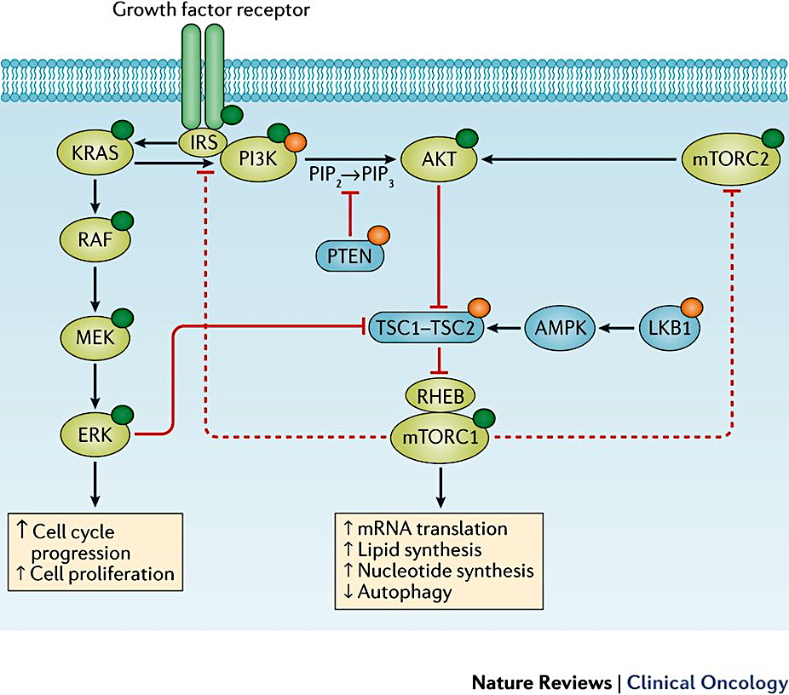
The PI3K-AKT Pathway
PI3K$α$
p110$α$
p85
Gene | HR+ HER2-
PIK3CA mut | 40%
PTEN mut/loss | 2-4%
PIK3R1 mut | 3%
AKT1 mut | 2-3%
Janku. Nat Rev Clin Oncol 2018.
TCGA. Nature 2012.
Bareche. Annals of Oncology 2018.

Slide 20
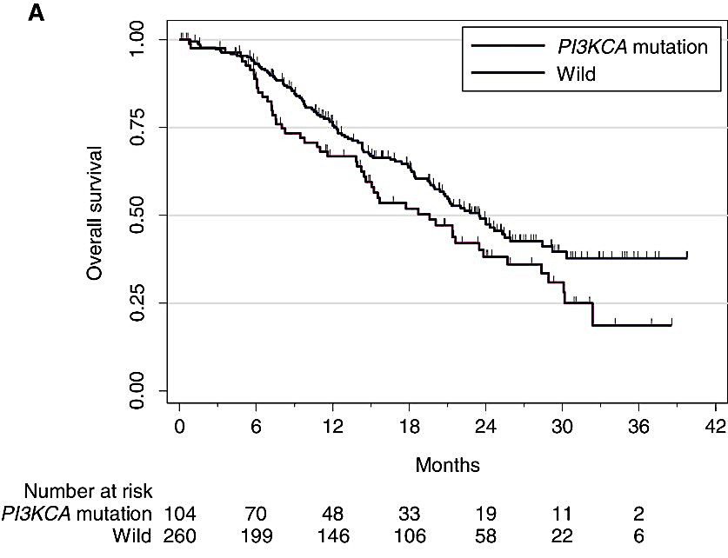
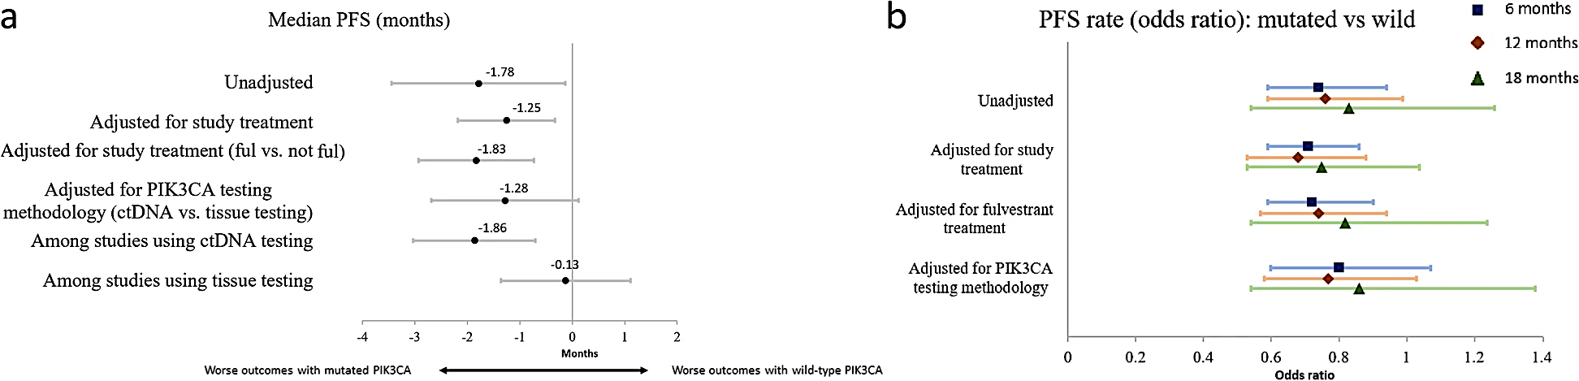
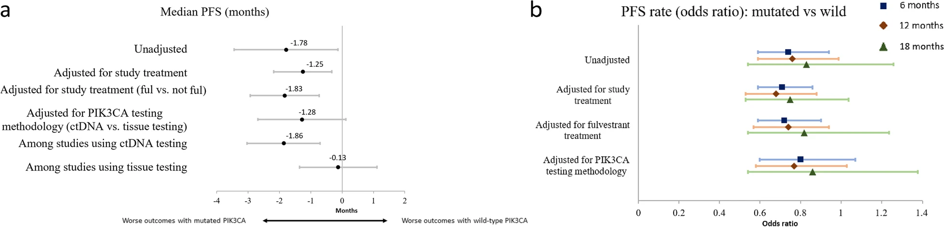
PIK3CA Mutation is Associated with Worse Outcomes
SAFIR02
Meta-Analysis of Published Trials in HR+ ABC
Mosele. Annals of Oncology 2020.
Fillbrunn. BMC Cancer 2022.

Slide 21
AI + CDK4/6 Inhibition 1st Line
Study | Agents | PFS (months) | OS (months)
PALOMA-2 | Palbociclib + letrozole | 24.8 vs 14.5 HR 0.58 (0.46-0.72) | 53.9 vs 51.2 HR 0.96 (0.78-1.18)
MONALEESA-2 | Ribociclib + letrozole | 25.3 vs 16.0 HR 0.57 (0.46-0.70) | 63.9 vs 51.4 HR 0.76 (0.63-0.93)
MONARCH-3 | Abemaciclib + letrozole/ anastrozole | 28.2 vs 14.8 HR 0.54 (0.42-0.70) | 66.8 vs 53.7 HR 0.80 (0.64-1.02)

Slide 22
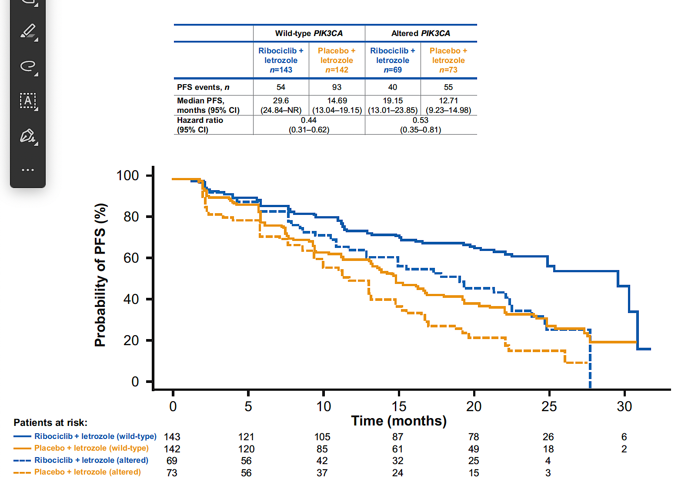
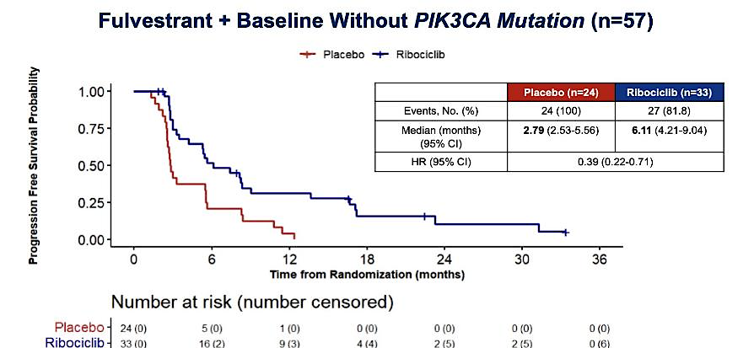
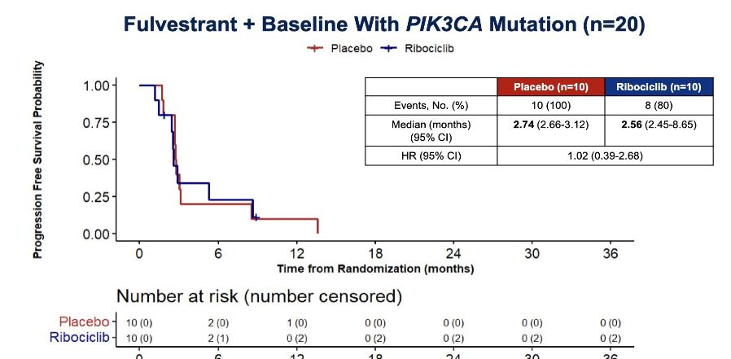
PI3K-Altered Tumors:
Inferior Response to CDK4/6 Inhibition
MONALEESA-2
MAINTAIN
Hortobagyi. Annals of Oncology 2018. Kalinsky. J Clin Oncol 2023.

Slide 23

Treatment after Progression on 1L CDK4/6i
Targetable Mutations
Progression on 1L CDK4/6i
NGS Testing
No Targetable Mutations

Slide 24
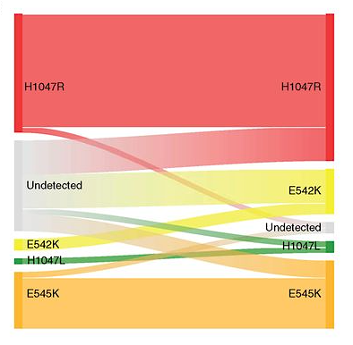
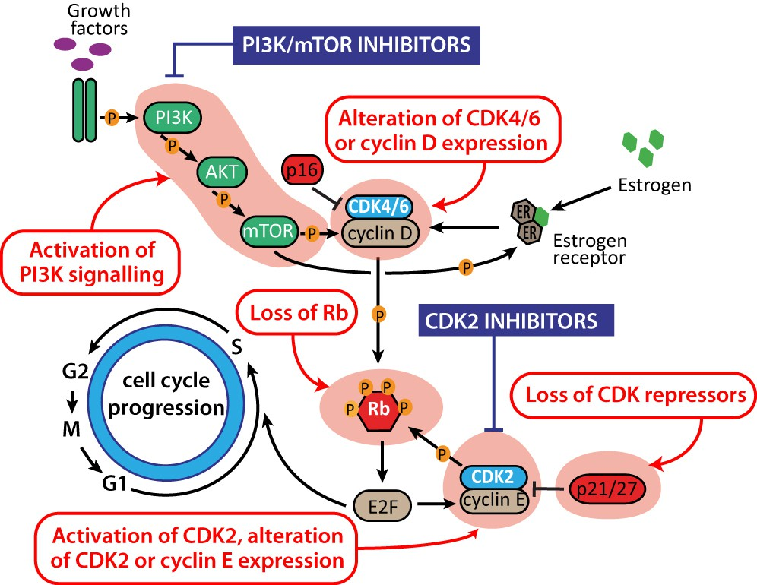
PI3K Pathway
Through the Course of CDK4/6i Treatment
MONALEESA-2 PIK3CA Mutations
Portman. Endocr Relat Cancer 2019.
O’Leary. Cancer Discov 2018.

Slide 25
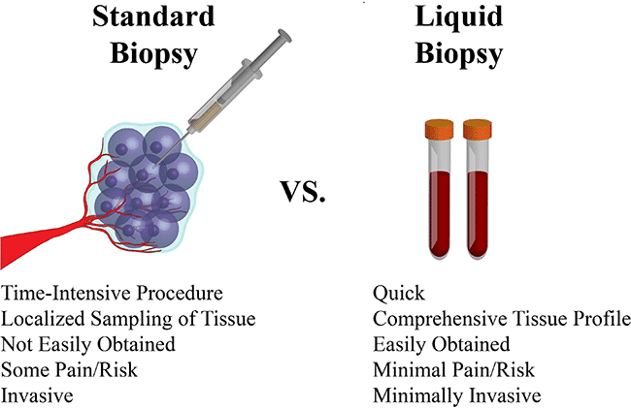
NGS Testing to Guide 2L Therapy
Tissue Biopsy
Liquid Biopsy
Pros
- Can use archival samples - Histology/molecular profiling
Cons
- Invasive - Limited insights into tumor heterogeneity
Pros
- Non-invasive blood test - Reflects tumor heterogeneity - Real-time sequencing
Cons
- False positives from clonal hematopoiesis - Lower sensitivity

Slide 26
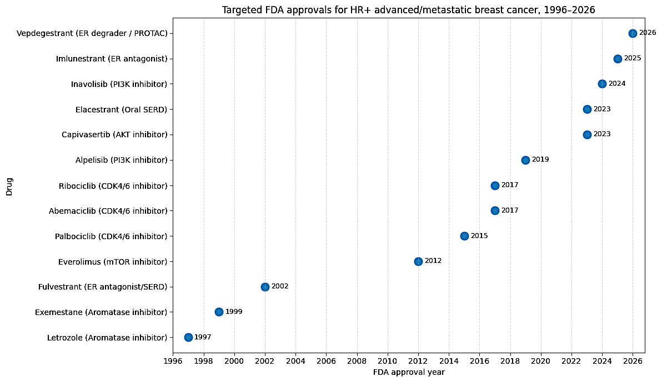
FDA Approvals of Targeted Therapies for HR+ Advanced Breast Cancer over the Years

Slide 27
Case Presentation

Slide 28
Case Presentation
Patient is a 62 yo F with no significant PMH who presents with L breast mass and worsening R hip pain
She is diagnosed with HR+/HER2- MBC with disease in the hip and spine
She is started on 1L therapy with letrozole + ribociclib + denosumab
She does well for approximately 2 years
Recently, she was found to have progression of her disease with new liver metastases
Change in therapy is planned
What should you do to guide 2L therapy?
NGS testing to guide next-line therapy. Can test archival tissue biopsy (if not already done) and/or send liquid biopsy.

Slide 29
Take Home Points
Alterations in the PI3K pathway are prevalent in HR+ metastatic breast cancer
  ~40% have PIK3CA mutation
PI3K pathway activation is associated with worse clinical outcomes
There are a growing number of agents targeting the PI3K pathway
Timely sequencing for identification of patients for pathway-directed therapy is important

Slide 30
Discussion Questions
How do you approach testing for alterations in the PI3K/AKT/mTOR pathway in your own practice? What role can oncology nurses play in facilitating appropriate testing?

Slide 31
Agenda
Introduction: Identification of Appropriate Candidates for Agents Targeting the PI3K/AKT/mTOR Pathway
Module 1: Role of Inavolisib in HR-Positive Metastatic Breast Cancer (mBC)
Module 2: Strategies to Prevent and Manage Hyperglycemia
Module 3: Clinical Utility of Capivasertib for HR-Positive mBC
Module 4: Mitigation and Management of Gastrointestinal Adverse Events
Module 5: Management of Dermatologic Adverse Events
Module 6: Potential Role of Gedatolisib in the Management of HR-Positive mBC
Module 7: Monitoring and Management of Cytopenias

Slide 32
Role of Inavolisib in HR+ Metastatic Breast Cancer
Oncology Nursing Society Annual Meeting – May 2026
PI3K/AKT/mTOR Pathway in HR+ Metastatic Breast Cancer Symposium
Research to Practice
Seth A. Wander, MD, PhD
Director of Precision Medicine, Termeer Center for Targeted Therapies
Director of Translational Research, Breast Oncology Program
Assistant Professor of Medicine, Harvard Medical School
Massachusetts General Hospital
swander@mgh.harvard.edu

Slide 33
Regional Targets for Various PI3K Inhibitors
Pan-Mutant Selective
Bind novel allosteric site
Inhibits multiple mutant PI3Ka
Non-Mutant Selective
Bind orthosteric (active) site
Inhibit WT and mutant PI3Ka
Single Mutant Selective
Bind hotspot mutant site
Inhibits only one mutant PI3Ka
Downstream Inhibitors
Block pathway elements
AKTi, mTORi, etc
Slide modified courtesy of Dr. A Varkaris

Slide 34
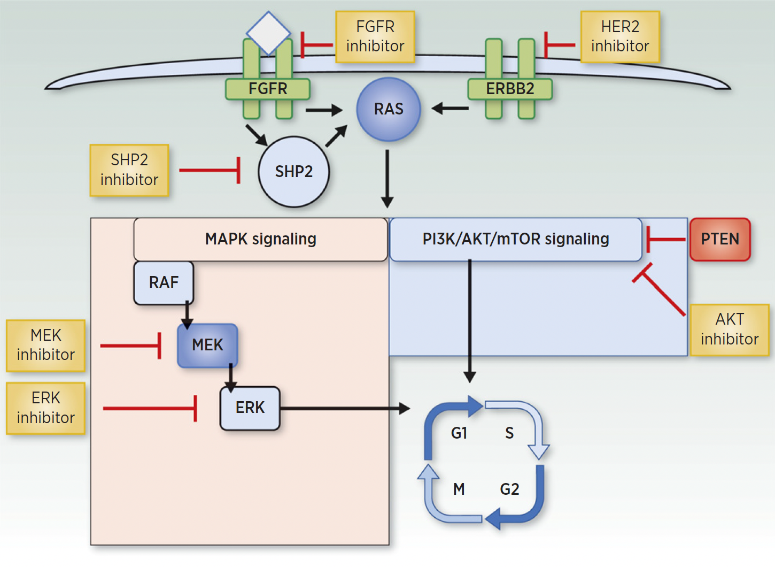
Resistance Drivers Define New Therapeutic Targets
Oncogenic growth signaling mediators
Receptor tyrosine kinases
RAS / MAPK pathway
PI3K/AKT/mTOR pathway
RTKs @ cell surface + external ligands
PI3K >>>>>> Activated PI3K
Alpelisib
Inavolisib
Gedatolisib
AKT
Capivasertib
Everolimus
mTOR::
Cellular Growth
Survival + Division
Motility + Metastasis
Lloyd MR et al CCR 2022

Slide 35
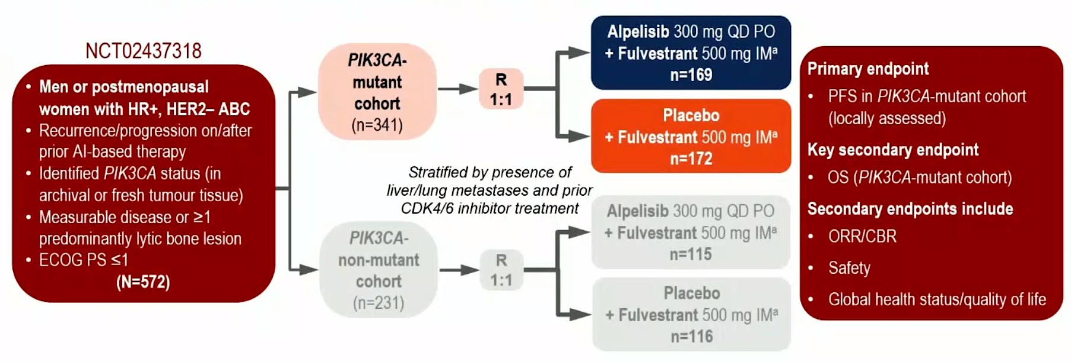
SOLAR-1: 1st Generation PI3K inhibition in HR+ MBC
Andre F et al NEJM 2019

Slide 36
SOLAR-1: Alpelisib Clinical Outcomes
Andre F et al NEJM 2019; Andre F et al Ann Onc 2020

Slide 37
SOLAR-1: Alpelisib Clinical Outcomes
Andre F et al NEJM 2019; Andre F et al Ann Onc 2020

Slide 38
SOLAR-1: Alpelisib Toxicity
A1c < 6.4%
Discontinuation Rate: 25%
Andre F et al NEJM 2019

Slide 39
INAVO120: Inavolisib Triplet in ET-Refractory HR+ MBC
Turner NC et al NEJM 2024

Slide 40
INAVO120: Inavolisib Clinical Outcomes
Jhaveri KL et al NEJM 2025

Slide 41
INAVO120: Inavolisib Clinical Outcomes
Jhaveri KL et al NEJM 2025

Slide 42
INAVO120: Toxicity Experience
A1c < 6%
Discontinuation Rate: 6.8%
Turner NC et al NEJM 2024

Slide 43
Key Toxicity Experience Across PAM Pathway Inhibitors
Andre F et al NEJM 2019
Turner NC et al NEJM 2024
Turner NC et al NEJM 2023
Hurvitz SA et al ESMO 2025

Slide 44
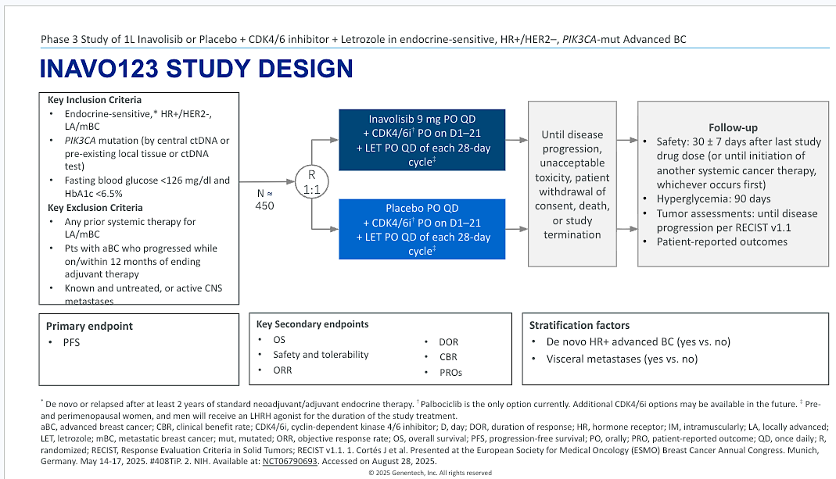
INAVO123: Triplet Therapy in the 1L Metastatic Setting
NCT06790693

Slide 45
Case Presentation

Slide 46
Case Presentation: Inavolisib
52yo post-menopausal woman with HTN and HLD (A1c WNL)
Prior pT2N1 HR+/HER2- breast cancer diagnosed 4 years prior: treated with bilateral mastectomy (BRCA-WT), adjuvant TC, ovarian suppression and letrozole (good adherence)
New back and hip pain > imaging concerning for multifocal lytic osseous disease and several liver lesions up to 2.3cm (normal LFTs)
Liver biopsy: metastatic breast cancer, ER/PR+, HER2 IHC 1+
NGS (MGH Snapshot): PIK3CA H1047R (VAF 35%), TP53 SNV, TMB 7, MSS
ctDNA (Guardant): PIK3CA H1047R (VAF 26%), TP53 SNV, TMB 4
1st line therapy initiated with fulvestrant, palbociclib and inavolisib > ongoing response x14m

Slide 47
Discussion Questions
For which patients are you prioritizing the triplet regimen of inavolisib/palbociclib/fulvestrant in the front-line setting?
What side effects can occur with inavolisib? What are the top things that you would tell a patient who is to going receive inavolisib/palbociclib/fulvestrant about potential toxicities?

Slide 48
Agenda
Introduction: Identification of Appropriate Candidates for Agents Targeting the PI3K/AKT/mTOR Pathway
Module 1: Role of Inavolisib in HR-Positive Metastatic Breast Cancer (mBC)
Module 2: Strategies to Prevent and Manage Hyperglycemia
Module 3: Clinical Utility of Capivasertib for HR-Positive mBC
Module 4: Mitigation and Management of Gastrointestinal Adverse Events
Module 5: Management of Dermatologic Adverse Events
Module 6: Potential Role of Gedatolisib in the Management of HR-Positive mBC
Module 7: Monitoring and Management of Cytopenias

Slide 49
Hyperglycemia Associated with Agents Targeting the PI3K/AKT/mTOR Pathway
Melissa Rikal, FNP-BC, AOCNP
Nurse Practitioner
Sarah Cannon Research Institute
Nashville, Tennessee

Slide 50
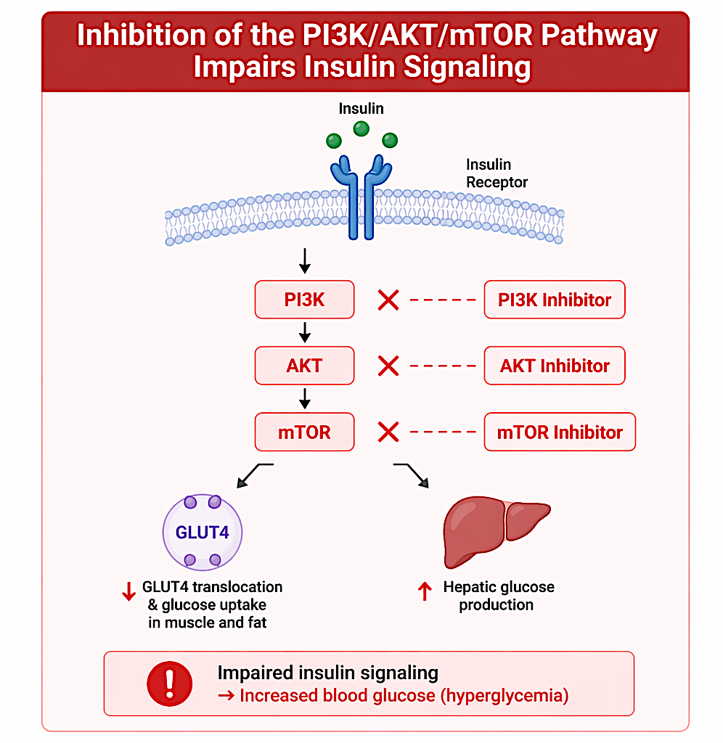
Mechanism of hyperglycemia with PI3K/AKT/mTOR pathway inhibitors
Inhibition of the PI3K/AKT/mTOR pathway impairs insulin signaling
↓ Glucose uptake in muscle and adipose tissue
↑ Hepatic glucose production→ elevated blood glucose

Slide 51
Risk Factors for Hyperglycemia with PI3K/AKT/mTOR Inhibitors
Patient-Related Risk Factors:
  Pre-existing Type 2 Diabetes or prediabetes
  Obesity (↑ insulin resistance)
  Advanced age
  Family history of diabetes
  Sedentary lifestyle
Treatment-Related Risk Factors:
  Use of potent PI3K inhibitors (e.g., Alpelisib)
  Higher drug doses or combination regimens
  Concurrent use of corticosteroids
  Longer duration of therapy
Laboratory/Clinical Risk Indicators:
  Elevated baseline fasting plasma glucose
  High HbA1c prior to treatment
  Insulin resistance markers (e.g., high fasting insulin)

Slide 52
Comparative Hyperglycemia with PI3K/AKT/mTOR Pathway Inhibitors
1. Incidence (All-grade hyperglycemia)
  Inavolisib: ~58–85% (highest among approved agents)
  Alpelisib: ~60–65%
  Capivasertib: ~16–37% (lower vs PI3K inhibitors)
  Gedatolisib (investigational): ~9-11%
*Key pattern: PI3Kα inhibitors > AKT inhibitors in frequency
2. Severity (Grade ≥3 hyperglycemia)
  Alpelisib: ~33–37% (highest severity burden)
  Inavolisib: ~5–6% (lower severe rate despite high incidence)
  Capivasertib: ~2–3%
  Gedatolisib: ~2%
*Key pattern: Severity highest with alpelisib
3. Timing of Onset
  Alpelisib: rapid onset; median ~15 days (often within 1–2 weeks)
  Inavolisib: early onset
  Capivasertib: generally later and less abrupt
  Gedatolisib: limited published timing; likely early but variable
*Key pattern:
PI3K inhibitors → early, rapid onset
AKT inhibitors → less abrupt, less frequent

Slide 53
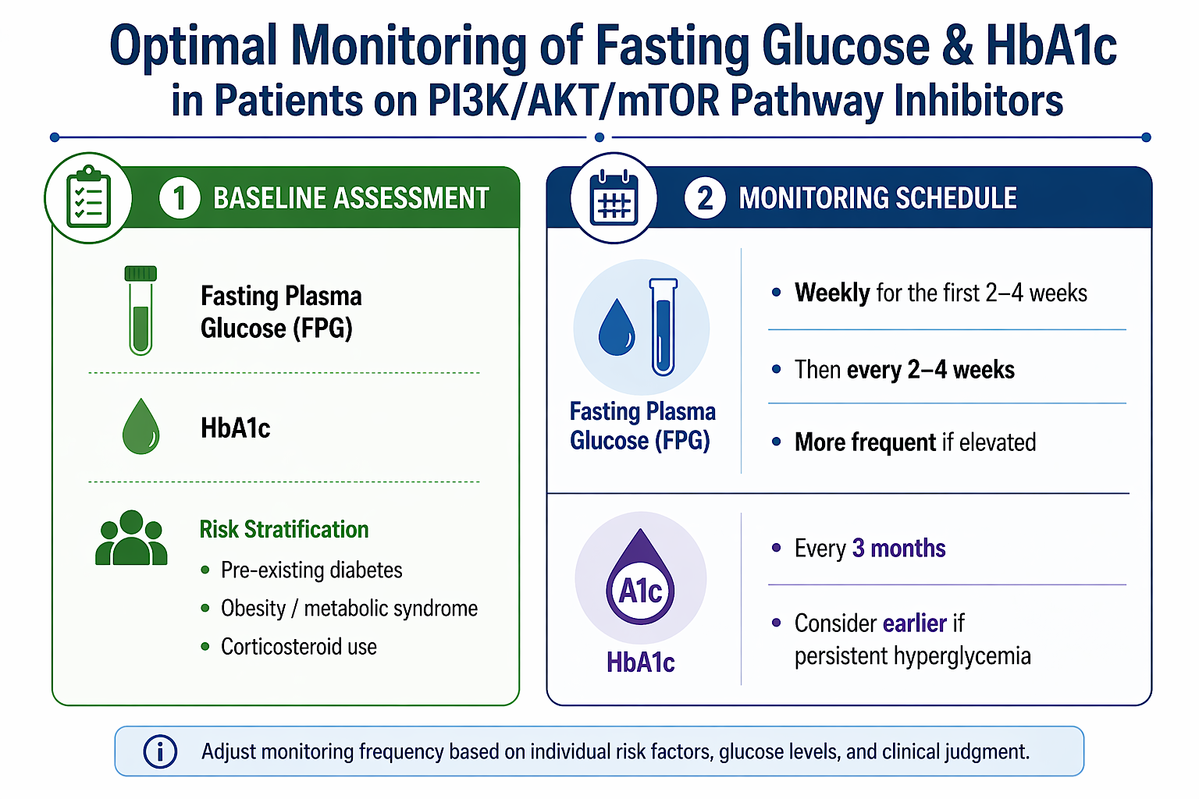

Slide 54
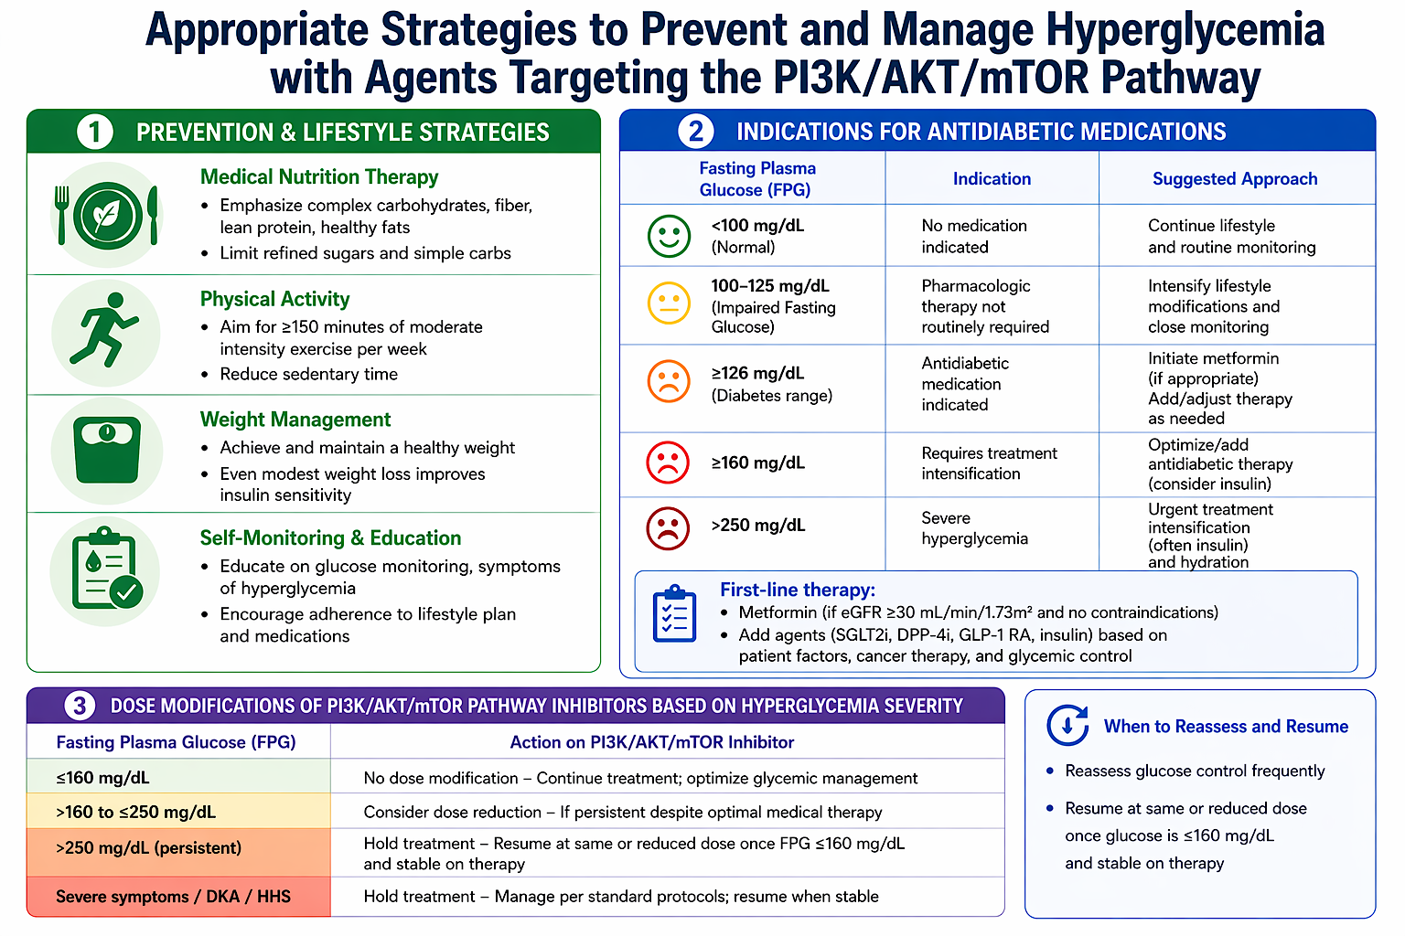

Slide 55
Case Presentation

Slide 56
Case Study: Metastatic ER+ / HER2-Negative Breast Cancer Complicated by Alpelisib-Induced Hyperglycemia
Patient: 58-year old Caucasian female with HR+ HER2- metastatic breast cancer. She works as a high school art teacher, lives alone in a suburban area. Divorced, one adult daughter living out of state. Actively involved in a local community theater group where she designs costumes. The patient has a strong creative identity and values independence. She is hesitant to “burden” her daughter and often underreports symptoms to avoid worrying others. She also relies heavily on comfort foods during periods of stress and is overweight as a result.
History: Prior early breast cancer, ER-positive, PR-positive, HER2-negative; s/p lumpectomy, adjuvant chemo and radiation. Completed 5 years of adjuvant AI, 2 years later develops back pain and imaging revealed bone metastases (spine, pelvis); Biopsy confirmed metastatic ER+/HER2-negative disease. 1st line CDK4/6 inhibitor + letrozole with zoledronic acid, Achieved stable disease for ~18 months, then surveillance scans show PD to liver. NGS liquid biopsy performed showing PIK3CA mutation.
Current Treatment: alpelisib + fulvestrant

Slide 57
Case continued
Risk Factors Identified prior to starting Alpelisib.
  Overweight (BMI ~29)
  Sedentary periods during grading seasons
  Stress-related dietary habits (high refined carbohydrate intake)
  Possible baseline insulin resistance- fasting glucose 110 mg/dL and Hgb A1c 5.6% pre-diabetes (though not previously diagnosed)

Slide 58
Case continued
Approximately 3 weeks after initiating alpelisib, the patient reports:
  Increased thirst
  Frequent urination
  Fatigue (which she initially attributes to work stress)
  She delayed reporting symptoms for a week, assuming they were “just side effects” she should tolerate.
  You bring her in for evaluation and lab check, fasting glucose is 198 mg/dL.
Management:
  Initiate metformin 500mg BID
  Discuss lifestyle changes w/ practical, low-effort meals due to her schedule but with a focus on reduction in refined sugars, short walks after work or during planning periods.
  Lay out clear plan to monitor glucose weekly until consistently well controlled

Slide 59
Case continued
2 week follow up: Fasting glucose remains elevated at 165 mg/dL. Decision to keep metformin at same dose to avoid diarrhea w/ work schedule and lack of home support. Dapagliflozin 5mg once daily added. Endocrinology consult ordered. Discussion of treatment hold if remains >160 mg/dL in one week.
3 week follow up: Fasting glucose improving at 125 mg/dL, home glucose monitoring initiated to reduce frequent clinic lab checks moving forward. Recommend she keep record of levels in her sketch book which she always has with her.
4 week follow up: Fasting glucose maintains at 120mg/dL and consistently in 110-130mg/dL range with home monitoring. Transition to 2 week monitoring given stability, upcoming endocrinologist visit

Slide 60
Case continued
Week 6 update: Reports her endocrinologist visit went well. No changes were made given current glucose control. She reports improved sense of control. Opens up more to her daughter after a care team discussion about support systems. Continues working and participating in theater, which remains a major protective factor for her mental health.
Key Takeaways:
  Alpelisib-associated hyperglycemia is common
  Early monitoring (especially in first 2–4 weeks) is critical
  Management requires a multidisciplinary approach (oncology + endocrinology + nutrition)
  Psychosocial factors strongly influence symptom reporting and adherence
  Treatment can often be continued successfully with proactive glucose control

Slide 61
Agenda
Introduction: Identification of Appropriate Candidates for Agents Targeting the PI3K/AKT/mTOR Pathway
Module 1: Role of Inavolisib in HR-Positive Metastatic Breast Cancer (mBC)
Module 2: Strategies to Prevent and Manage Hyperglycemia
Module 3: Clinical Utility of Capivasertib for HR-Positive mBC
Module 4: Mitigation and Management of Gastrointestinal Adverse Events
Module 5: Management of Dermatologic Adverse Events
Module 6: Potential Role of Gedatolisib in the Management of HR-Positive mBC
Module 7: Monitoring and Management of Cytopenias

Slide 62
The Role of Capivasertib in
HR-Positive mBC
Reva Basho, MD
Associate Professor of Medicine
Chief Medical Officer
Ellison Medical Institute

Slide 63
Sequencing Therapy in HR+ Metastatic Breast Cancer
CDK4/6 Inh
PI3K Inh
ET
ET
PI3K Inh
ET
CDK4/6 Inh
ET
PI3K Inh
Alternative Agents
CDK4/6 Inh
ET
ET

Slide 64
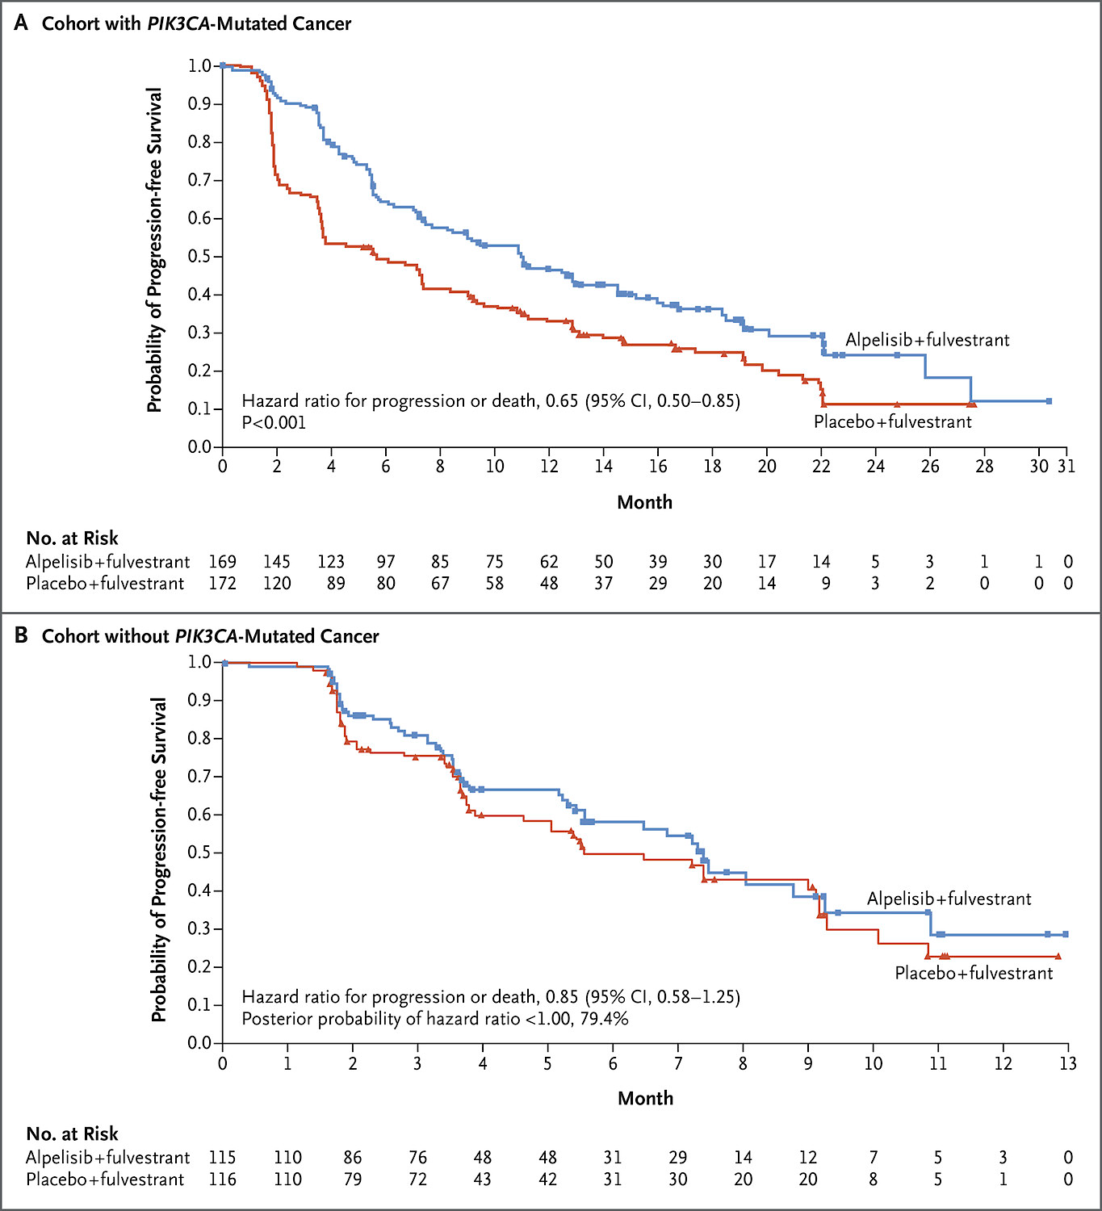

SOLAR-1: Alpelisib + Fulvestrant in HR+ MBC After AI
Alpelisib is an $α$-specific PI3K inhibitor
PIK3CA Mutant
Treatment Arm | Alpelisib N=169 | Placebo N=172
Median PFS, months (95% CI) | 11.0 (7.5-14.5) | 5.7 (3.7-7.4)
HR 0.65 (95% CI 0.50-0.85) P<0.001
Men and postmenopausal women with HR+ ABC; prior AI
PIK3CA Mutant
PIK3CA WT
Randomization (1:1)
Stratification Factors:
Presence of liver and/or lung metastases
Prior treatment with CDK 4/6 inhibitors
PIK3CA WT
Treatment Arm | Alpelisib N=115 | Placebo N=116
Median PFS, months (95% CI) | 7.4 (5.4-9.3) | 5.6 (3.9-9.1)
HR 0.85 (95% CI 0.58-1.25) Posterior probability of true HR < 1.00, 79.4%
Alpelisib + Fulvestrant
N=169
Placebo + Fulvestrant
N=172
Alpelisib + Fulvestrant
N=115
Placebo + Fulvestrant
N=116
Andre NEJM 2019.

Slide 65
SOLAR-1: AEs
Grade 3/4 AEs ≥ 5% N (%) | Alpelisib + Fulvestrant N=284 | Placebo + Fulvestrant N=287
Any | 216 (76.0) | 102 (35.5)
Hyperglycemia | 104 (36.6) | 2 (0.7)
Rash | 57 (20.1) | 1 (0.3)
Diarrhea | 19 (6.7) | 1 (0.3)
Alpelisib discontinued in 25% Most frequent AEs leading to the discontinuation: hyperglycemia (6.3%) & rash (3.2%)
Andre NEJM 2019.

Slide 66
Efficacy
Toxicity

Slide 67
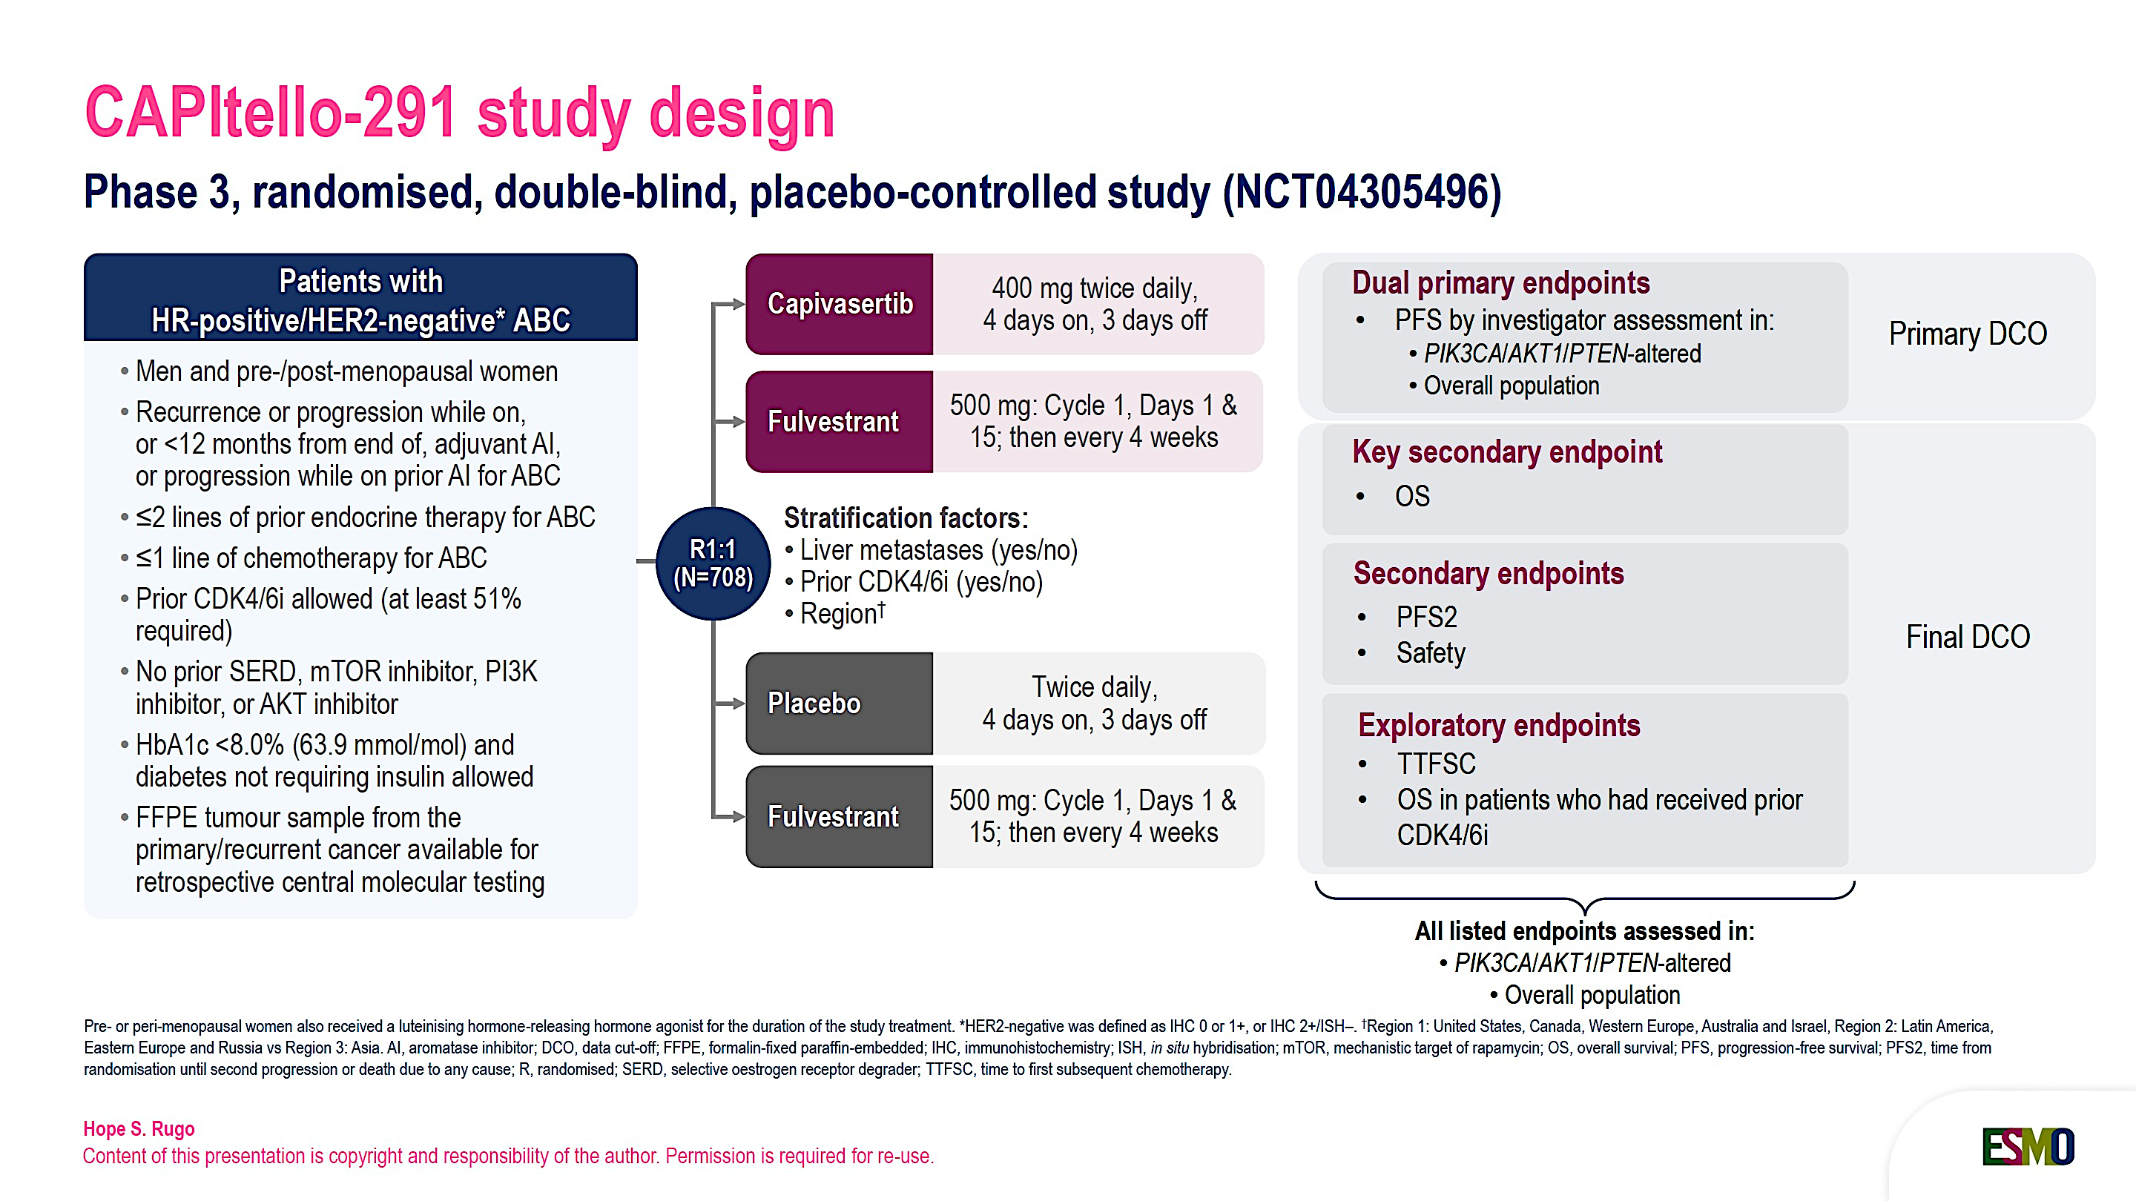
CAPItello-291: Capivasertib + Fulvestrant
After an Aromatase Inhibitor
Rugo ESMO Breast 2026. Turner NEJM 2023.

Slide 68
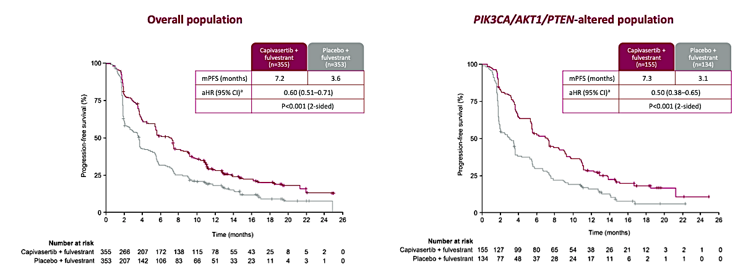
CAPItello-291: PFS
Turner SABCS 2022. Turner NEJM 2023.

Slide 69
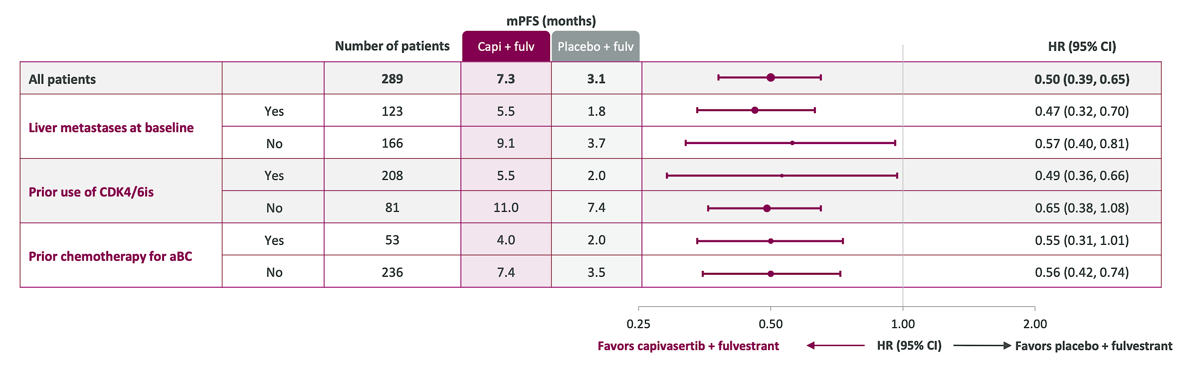
CAPItello-291: PFS in Key PIK3CA/AKT1/PTEN-Altered Subgroups
Oliveira ESMO Breast 2023.

Slide 70
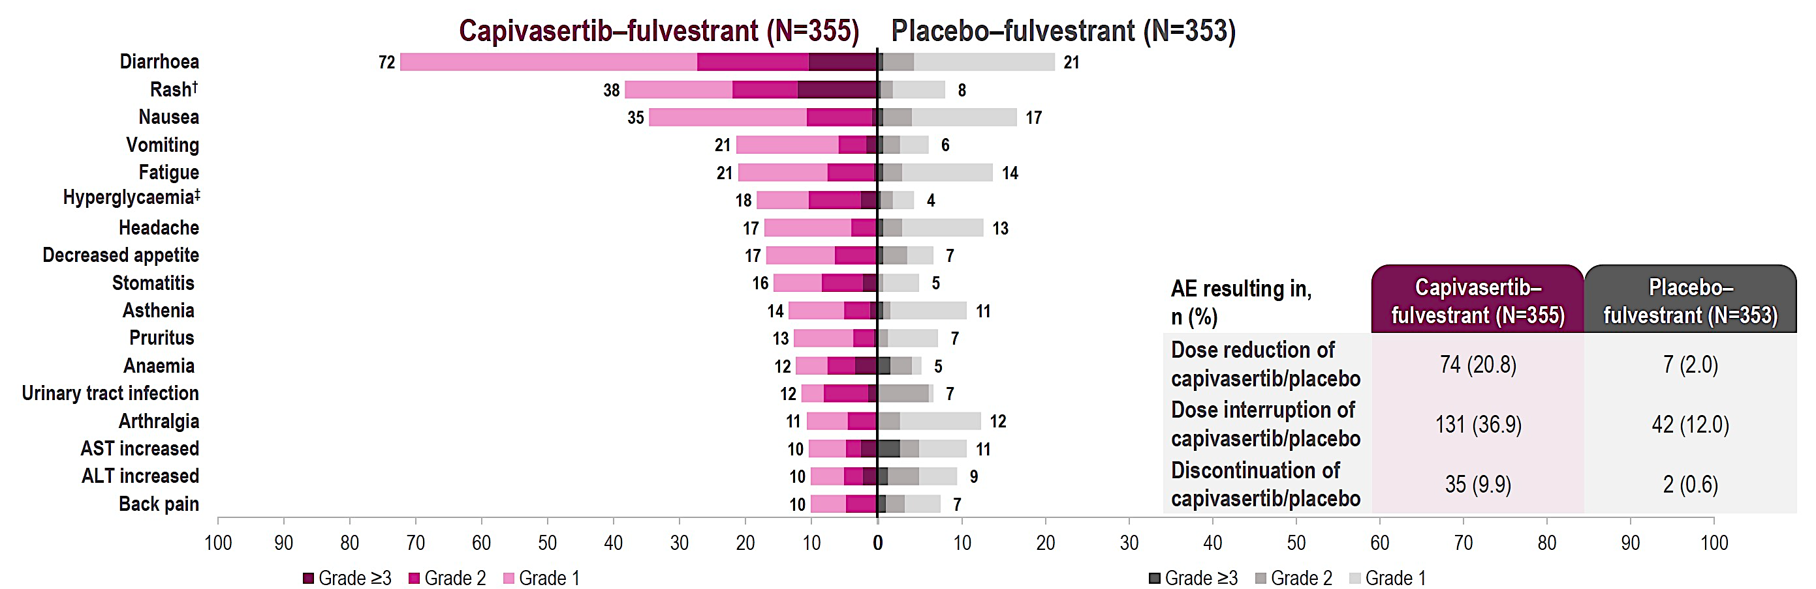
CAPItello-291: Safety
Turner SABCS 2022. Rugo ESMO Breast 2026.

Slide 71
Targeting the PI3K Pathway in the 2nd Line
CAPItello-291
SOLAR-1
HR+/HER2- ABC
Progressed on prior AI
N=289 PIK3CA/AKT1/PTEN-altered subset
Capivasertib + Fulvestrant
N=155
HR+/HER2- ABC
Progressed on prior AI
N=341 PIK3CA-mutant subset
Alpelisib + Fulvestrant
N=169
R
1:1
R
1:1
Placebo + Fulvestrant
N=134
Placebo +
Fulvestrant
N=172
 | CAPItello-291 |  | SOLAR-1
 | PIK3CA/AKT1/PTEN-Altered |  | PIK3CA-Mutant
 | Capivasertib (N=155) | Placebo (N=134) | Alpelisib (N=169) | Placebo (N=172)
Median PFS, Months | 7.3 | 3.1 | 11.0 | 5.7
HR (95% CI) | HR 0.50 (0.38-0.65) |  | HR 0.65 (0.50-0.85)
P-value | P<0.001 |  | P<0.001
Turner NEJM 2023. Andre NEJM 2019.

Slide 72
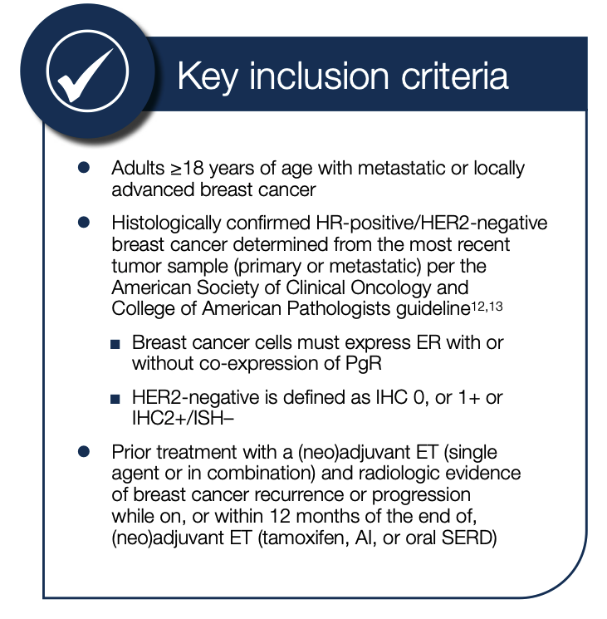
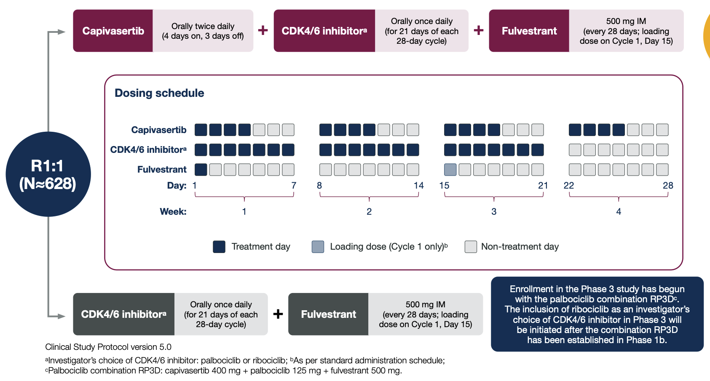
CAPItello-292: Capivasertib + CDK4/6i + Fulvestrant after AI
Rugo. SABCS 2023.

Slide 73
Case Presentation

Slide 74
Case Presentation
Patient is a 53 yo F with a history of previously treated HR+/HER2- breast cancer. She presents with new onset cough. Imaging is suspicious for metastatic disease in the lungs + bones. Lung biopsy confirms HR+/HER2- metastatic breast cancer; PIK3CA H1047R mutation is found
She is started on 1L therapy with letrozole + ribociclib + denosumab
She does well for approximately 1.5 years
Recently, she was found to have progression of her disease in her lungs
Liquid biopsy again demonstrates PIK3CA H1047R mutation
What therapies are available to this patient?
  What would you choose and why?
Fulvestrant + alpelisib and fulvestrant + capivasertib are both options
-Toxicity profiles differ

Slide 75
Take Home Points
Alterations in the PI3K pathway are prevalent in HR+ metastatic breast cancer
  ~40% have PIK3CA mutation
Alpelisib is an alpha-specific inhibitor of PI3K
  SOLAR-1: Addition of alpelisib to fulvestrant resulted in a significant improvement in PFS in the 2nd line setting in patients with PIK3CA-mutated disease
  Grade 3+ AEs in > 75% of patients; 25% discontinued alpelisib
Capivasertib is an AKT inhibitor
  CAPItello-291: The addition of capivasertib to fulvestrant resulted in a significant improvement in PFS in the 2nd line setting in patients with PIK3CA/AKT1/PTEN-altered disease
  Lower rates of grade 3+ AEs

Slide 76
Discussion Questions
Are you now prioritizing capivasertib/fulvestrant over alpelisib/fulvestrant for all patients with HR-positive,
HER2-negative mBC and a PIK3CA mutation who have experienced disease progression after a CDK4/6 inhibitor and endocrine therapy?
Can capivasertib safely be partnered with endocrine agents other than fulvestrant and, if so, which one(s)?
What unique pretreatment counseling/education do you offer patients who are going to receive capivasertib versus other agents targeting the PI3K/AKT/mTOR pathway?

Slide 77
Agenda
Introduction: Identification of Appropriate Candidates for Agents Targeting the PI3K/AKT/mTOR Pathway
Module 1: Role of Inavolisib in HR-Positive Metastatic Breast Cancer (mBC)
Module 2: Strategies to Prevent and Manage Hyperglycemia
Module 3: Clinical Utility of Capivasertib for HR-Positive mBC
Module 4: Mitigation and Management of Gastrointestinal Adverse Events
Module 5: Management of Dermatologic Adverse Events
Module 6: Potential Role of Gedatolisib in the Management of HR-Positive mBC
Module 7: Monitoring and Management of Cytopenias

Slide 78
Gastrointestinal Adverse Events Documented with Agents Targeting the PI3K/AKT/mTOR Pathway
Kelly Fischer, MSN, FNP-BC
Family Nurse Practitioner
Dana-Farber Cancer Institute
Boston, Massachusetts

Slide 79
Adverse Reaction: GI | Capivasertib | Alpelisib | Inavolisib | Gedatolisib
Diarrhea | 72% | 57% | 48% | 17%
Nausea | 35% | 44% | 28% | 44%
Vomiting | 20% | 27% | 15% | 27%
Stomatitis | 15% | 25% | 51% | 69%
Notes:
Rates of various GI issues (ALL GRADES) (eg, diarrhea, nausea/vomiting, stomatitis) documented with approved (capivasertib, alpelisib, inavolisib) and investigational (eg, gedatolisib) agents targeting the PI3K/AKT/mTOR pathway
- In CAPItello-291 (capibasertib plus fulvestrant), diarrhea events were generally grade 1 or 2, occurred early in treatment, and were associated with lower rates of dose reductions or discontinuations
REFERENCES
Turner NC et al NEJM 2024
Andre et al., NEJM 2019
Hurvitz et al., JCO 2026

Slide 80
Strategies to mitigate and manage treatment-related GI AEs with agents targeting the PI3K/AKT/mTOR pathway: Diarrhea
Start over-the-counter loperamide at first sign of diarrhea and take as needed
Stay hydrated and drink 8-10 glasses of water/clear liquids daily
Modify diet if needed – limit alcohol and caffeine intake, avoid spicy foods, refrain from lactose-containing food or drink
Notes:
We will sometimes prescribe diphenoxylate hydrochloride + atropine sulfate if diarrhea is not managed with loperamide alone
We offer IV hydration in clinic if patients are unable to keep up with PO fluids and are becoming dehydrated. We also check CMP as needed and replete electrolytes like potassium and magnesium if needed

Slide 81
Strategies to mitigate and manage treatment-related GI AEs with agents targeting the PI3K/AKT/mTOR pathway: Nausea/Vomiting
Start antiemetic like ondansetron or prochlorperazine at the first sign of nausea
Ondansetron can be a bit constipating, so that may be a good first option if patient is also struggling with diarrhea
Increase fluid intake
Avoid spicy foods, caffeine, alcohol

Slide 82
Strategies to mitigate and manage treatment-related GI AEs with agents targeting the PI3K/AKT/mTOR pathway: Stomatitis
Rinse mouth with warm salt water as needed
Avoid mouthwash containing alcohol
Brush teeth with soft bristle toothbrush and floss
Keep lips moisturized
Suck on hard candies
A compounded alcohol-free mouthwash of dexamethasone (0.5 mg in 5 mL) is recommended for prophylaxis or treatment of stomatitis with Inavolisib
Notes:
- It’s important to educate patients that if they develop oral sores that are affecting their ability to eat or drink, they need to reach out to their provider so a prescription mouthwash like Magic Mouthwash or dexamethasone mouth wash can be prescribed. The concern is that oral mucositis and sores can become so painful it impacts the ability to stay hydrated and drink adequate amount of fluids

Slide 83
Role of nutritional counseling and diet modifications during treatment with agents targeting the PI3K/AKT/mTOR pathway
Referral to nutrition
All of these agents may cause hyperglycemia, so nutritional counseling should focus on following a low carbohydrate, high fiber diet
Avoid simple carbs (white breads, white pastas), sweetened beverages/juices
Focus more on lean proteins, fish, non-starchy vegetables, nuts
Eat small, frequent meals as opposed to large meals
For patients experiencing diarrhea, follow a bland diet and eat foods with more soluble fiber (bananas, applesauce)
Hydration is important

Slide 84
Case Presentation

Slide 85
Case Presentation: A 63 y/o female with HR-positive, HER2-negative metastatic breast cancer
2000. R breast cancer. BCS for 1.2 cm and 0.8 cm multifocal tumors, grade 2 of 3, with DCIS. 2 of 9 axillary nodes positive.
  Adjuvant AC x 4, then tamoxifen x 5 years
  Adjuvant radiation
February 2022 – Developed new back pain. Scans showed several suspicious vertebral lesions.
3/17/2022 – Bone biopsy shows metastatic ER+, PR -, HER2 – breast cancer.
3/28/2022 – Starts letrozole/palbociclib/zoledronic acid.
9/2022 – Hospitalized with neutropenic sepsis and cholecystitis. Stent placed. Palbo held.
3/2023 – Scans show PD in bones. Switch to fulvestrant/palbo (palbo at DR of 75 mg 3 weeks on, 1 week off post-hospitalization in 9/2022).
3/2026 – Scans show PD in bones. Switch to capivasertib/fulvestrant. Start capivasertib at dose reduction of 320 mg BID for 4 days on, 3 days off.
  Genomic testing shows PIK3CA mutation
Notes:
She is married and was a homemaker, she has two children and four grandchildren. Her kids are very involved in her care and accompany her to visits.
The biggest concern for her throughout her treatment course for her metastatic breast cancer has been tolerability. When she was admitted with neutropenic sepsis in 2022, she was extremely hesitant to resume palbo, but eventually we did have her resume it at a dose reduction and she did well. She really had minimal side effects when she resumed the palbo at the dose reduction, then had progression in the bones in 2023. We switched the letrozole to fulvestrant and kept her on palbo, and she actually did very well for ~3 years until she had further progression in the bones (luckily, her disease is largely asymptomatic and she really does not have much pain at all).
It took about a month to actually switch over to capivasertib because she was very hesitant about switching to a new regimen. She was so used to being on the palbo for 4 years and was happy to have tolerated it as well as she did.
Thus far, she is actually tolerating the capivasertib very well. She has had some mild diarrhea, but this is well-controlled with loperamide. She has RX’s for antiemetics but has not needed to use them. We also had her start prophylactic cetirizine to prevent rash, and she has not had a rash so far.
Her tumor markers have been very indicative of how her disease is responding to treatment over the years, and she has already had a nice decrease after just a couple months of being on capivasertib/fulvestrant.

Slide 86
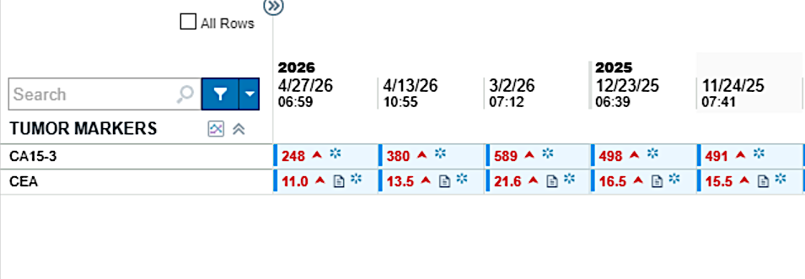
Notes:
- This is a trend of her CEA and CA15-3 over a 6 month period. You can see how really in March 2026 this is where both markers significantly increased, and around that time is when she switched over to capivasertib/fulvestrant. Her markers have already quickly come down nicely in just about a month or two of being on this new regimen.

Slide 87
Agenda
Introduction: Identification of Appropriate Candidates for Agents Targeting the PI3K/AKT/mTOR Pathway
Module 1: Role of Inavolisib in HR-Positive Metastatic Breast Cancer (mBC)
Module 2: Strategies to Prevent and Manage Hyperglycemia
Module 3: Clinical Utility of Capivasertib for HR-Positive mBC
Module 4: Mitigation and Management of Gastrointestinal Adverse Events
Module 5: Management of Dermatologic Adverse Events
Module 6: Potential Role of Gedatolisib in the Management of HR-Positive mBC
Module 7: Monitoring and Management of Cytopenias

Slide 88
Dermatologic Adverse Events Associated with Agents Targeting the PI3K/AKT/mTOR Pathway
Melissa Rikal, FNP-BC, AOCNP
Nurse Practitioner
Sarah Cannon Research Institute
Nashville, Tennessee

Slide 89
Dermatologic Adverse Events Associated with Agents Targeting the PI3K/AKT/mTOR Pathway
Most frequent dermatologic AEs across all agents
  Maculopapular rash
  Pruritus
  Dry skin
Alpelisib (PI3Kα inhibitor)
  Rash: ~45–64% all grades
  Grade ≥3 rash: ~2–20% depending on prophylaxis
Capivasertib (AKT inhibitor)
  Broad cutaneous AEs: 35% all grades
  Grade ≥3 rash: ~12%
Inavolisib (PI3Kα inhibitor)
  Rash ~25% all grades
  Grade ≥ 3: rare
Gedatolisib (dual PI3K/mTOR inhibitor)
  Eczematous and morbilliform eruptions most common ~27-32% all grades
  Grade ≥ 3: ~3-4%

Slide 90
Role of Prophylactic Antihistamines to Mitigate Dermatologic AEs with PI3K/AKT/mTOR Inhibitors
Rationale for antihistamine use
  Dermatologic AEs are common and often early-onset (within 2–4 weeks)
  Likely mediated by immune and inflammatory pathways (histamine release, cytokines)
Antihistamines help reduce pruritus and rash severity
Strongest data with alpelisib
  Prophylactic antihistamines ↓ incidence of all grade rash by 50%
  Reduction in Grade ≥3 rash by 40% and reduced treatment interruptions
Recommended Approach
  Initiate at start of therapy (Day 1)
  Continue for first 4–8 weeks (highest risk period)
  Consider longer duration if prior rash
  Use non-sedating antihistamines when able- fexofenadine, cetirizine, loratadine

Slide 91
Topical Management of Dermatologic AEs
1. Emollients
  Start at treatment initiation and continue throughout therapy
  Thick creams/ointments (ceramide-based preferred)
  ↓ Xerosis and pruritus and supports skin barrier integrity
2. Topical Corticosteroids
  At first sign of rash
  Low–moderate potency (e.g., hydrocortisone, triamcinolone) for most areas
  Avoid high potency on face/intertriginous areas
  ↓ Inflammation and erythema,↓ progression to Grade ≥2 rash
3. Topical Antibiotics
  Use if signs of secondary infection: crusting, pustules, oozing
  Options: mupirocin, topical clindamycin
4. Systemic/Oral Corticosteroids
  Use if Grade 3/Severe Rash in addition to holding treatment and referral to dermatology.

Slide 92
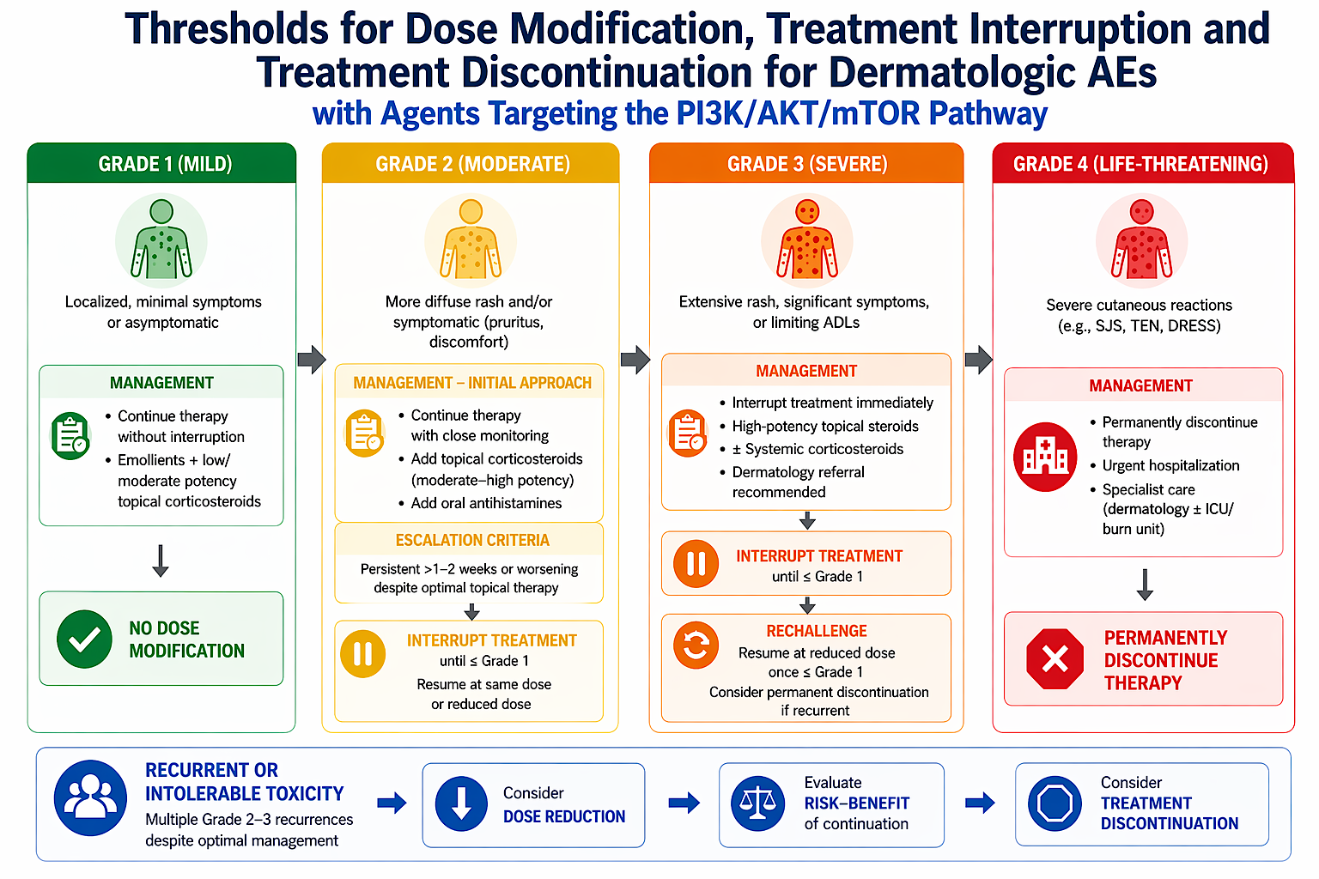

Slide 93
Case Presentation

Slide 94
Case: Managing Rash on Capivasertib
Patient: 42-year-old female with HR+/HER2- metastatic breast cancer. She is a single parent w/ limited support. She holds an hourly paid job and cannot miss work easily. She has ongoing body image concerns that were initially triggered by alopecia that occurred during adjuvant chemotherapy. She lives far from the outpatient oncology clinic.
History:
  Prior early-stage breast cancer (treated with surgery, chemo, endocrine therapy)
  Progressed on first line CDK4/6 inhibitor + AI
  NGS liquid biopsy shows PTEN mutation
Current Therapy: Capivasertib + Fulvestrant

Slide 95
Case continued
Week 3 on Therapy
  Patient calls into clinic reporting diffuse pruritic rash (trunk + arms), sleep disruption due to itching.
  Exam reveals maculopapular rash, grade 2
  Management
    Add medium–high potency topical corticosteroids
    Continue topical emollient
    Ensure she is taking a non-sedating antihistamine for daytime function
    Ensure she is scheduled for her week 4 in-person visit for fulvestrant injection, labs and to assess rash in person.

Slide 96
Case continued
Week 4 Update
  Rash persists and worsens slightly
  Still Grade 2 but more symptomatic
  Patient distressed about her appearance + limited sleep due to pruritus
Management
  Temporarily interrupt capivasertib
  Start short course oral corticosteroids
  Continue topical therapy + antihistamines
  Add diphenhydramine at bedtime to promote sleep and reduce pruritus
  Arrange a telehealth follow-up due to work expectations and distance from the clinic.
Week 5 Update During Telehealth Visit
  Rash has improved to Grade 1
  Restart capivasertib at dose reduction, continue topical corticosteroids, emollient and oral antihistamines
Week 6 Update via telehealth Visit
  Rash remains very mild and slowly improving. Patient is happy to have minimal impact on physical appearance. She is sleeping better and reports less pruritus. She is grateful to have not missed any work shifts since this was managed so promptly and follow ups were accommodated with telehealth visits.

Slide 97
Agenda
Introduction: Identification of Appropriate Candidates for Agents Targeting the PI3K/AKT/mTOR Pathway
Module 1: Role of Inavolisib in HR-Positive Metastatic Breast Cancer (mBC)
Module 2: Strategies to Prevent and Manage Hyperglycemia
Module 3: Clinical Utility of Capivasertib for HR-Positive mBC
Module 4: Mitigation and Management of Gastrointestinal Adverse Events
Module 5: Management of Dermatologic Adverse Events
Module 6: Potential Role of Gedatolisib in the Management of HR-Positive mBC
Module 7: Monitoring and Management of Cytopenias

Slide 98
Potential Role of Gedatolisib in the Management of HR+ Metastatic Breast Cancer
Oncology Nursing Society Annual Meeting – May 2026
PI3K/AKT/mTOR Pathway in HR+ Metastatic Breast Cancer Symposium
Research to Practice
Seth A. Wander, MD, PhD
Director of Precision Medicine, Termeer Center for Targeted Therapies
Director of Translational Research, Breast Oncology Program
Assistant Professor of Medicine, Harvard Medical School
Massachusetts General Hospital
swander@mgh.harvard.edu

Slide 99
Resistance Drivers Define New Therapeutic Targets
Oncogenic growth signaling mediators
Receptor tyrosine kinases
RAS / MAPK pathway
PI3K/AKT/mTOR pathway
RTKs @ cell surface + external ligands
PI3K >>>>>> Activated PI3K
Alpelisib
Inavolisib
Gedatolisib
AKT
Capivasertib
Everolimus
mTOR::
Cellular Growth
Survival + Division
Motility + Metastasis
Lloyd MR et al CCR 2022

Slide 100
Gedatolisib: Phase 1, 1L HR+ MBC Experience
N= 41 patients; HR+ MBC, treatment naïve
22% PIK3CAm
ORR 79% overall, similar +/- PIK3CA mutations
Median PFS 48.4 months
Median OS 77.3 months
Wesolowski et al CCR 2025

Slide 101
VIKTORIA-1: Gedatolisib PAM Pathway Inhibitor
Hurvitz SA et al ESMO 2025

Slide 102
VIKTORIA-1: Doublet Efficacy
Hurvitz SA et al ESMO 2025; J Clin Oncol 2026;44:1108-19.

Slide 103
VIKTORIA-1: Triplet Efficacy
Hurvitz SA et al ESMO 2025; J Clin Oncol 2026;44:1108-19.

Slide 104
VIKTORIA-1: Gedatolisib Toxicity
A1c < 6.4%
Discontinuation Rate:
2.3% Triplet
3.1% Doublet
SAE and discontinuation, n (%) | Gedatolisib + palbociclib + fulvestrant (n=130) |  |  | Gedatolisib + fulvestrant (n=130) |  |  | Fulvestrant (n=123)
Pts with ≥1 SAE | 14 (10.8) |  |  | 12 (9.2) |  |  | 1 (0.8)
Study treatment D/C due to TRAE | 3 (2.3) |  |  | 4 (3.1) |  |  | 0
Deaths due to TRAE† | 2 (1.5) |  |  | 0 |  |  | 0
Adverse events, n (%) | Gedatolisib + palbociclib + fulvestrant (n=130) |  |  | Gedatolisib + fulvestrant (n=130) |  |  | Fulvestrant (n=123)
 | Any Grade | Grade 3 | Grade 4 | Any Grade | Grade 3 | Grade 4 | Any Grade | Grade 3 | Grade 4
Stomatitis‡ | 90 (69.2) | 25 (19.2) | 0 | 74 (56.9) | 16 (12.3) | 0 | 0 | 0 | 0
Neutropenia‡ | 85 (65.4) | 68 (52.3) | 13 (10.0) | 2 (1.5) | 0 | 1 (0.8) | 1 (0.8) | 1 (0.8) | 0
Nausea | 57 (43.8) | 5 (3.8) | 0 | 56 (43.1) | 1 (0.8) | 0 | 4 (3.3) | 0 | 0
Rash‡ | 36 (27.7) | 6 (4.6) | 0 | 42 (32.3) | 7 (5.4) | 0 | 0 | 0 | 0
Vomiting | 36 (27.7) | 2 (1.5) | 0 | 30 (23.1) | 0 | 0 | 1 (0.8) | 0 | 0
Fatigue | 29 (22.3) | 2 (1.5) | 0 | 27 (20.8) | 1 (0.8) | 0 | 5 (4.1) | 0 | 0
Diarrhea§ | 22 (16.9) | 2 (1.5) | 0 | 16 (12.3) | 1 (0.8) | 0 | 0 | 0 | 0
Hyperglycemia‡,§ | 12 (9.2) | 3 (2.3) | 0 | 15 (11.5) | 3 (2.3) | 0 | 0 | 0 | 0
Hurvitz SA et al ESMO 2025; J Clin Oncol 2026;44:1108-19.

Slide 105
Toxicity Experience Across Current PAM Inhibitors
Andre F et al NEJM 2019
Turner NC et al NEJM 2024
Turner NC et al NEJM 2023
Hurvitz SA et al ESMO 2025

Slide 106
VIKTORIA1: Gedatolisib PAM Pathway Inhibitor
Hurvitz SA et al ESMO 2025

Slide 107
VIKTORIA1: Gedatolisib PAM Pathway Inhibitor
Phase 3 VIKTORIA-1 Trial Achieves Primary Endpoint With Improvement
in Progression-Free Survival in PIK3CA Mutant Cohort

Slide 108
1st Line::
AI/OS + CDK4/6i
(Ribociclib)
Fulvestrant + Palbo
+ Inavolisib
(PIK3CAm,
ET refractory)
2nd Line::
Fulvestrant +/- Abemaciclib
Antiestrogen + Everolimus
(NGS Negative)
Fulvestrant + Alpelisib
(PIK3CAm)
Fulvestrant + Capivasertib
(PIK3CAm, AKTm, PTENm)
Elacestrant, Imlunestrant, or Vepdegestrant
(ESR1m)
Olaparib
(BRCAm)
3rd Line (and beyond)::
Trastuzumab Deruxtecan (ADC, HER2-low)
Chemotherapy (many choices)
Sacituzumab Govitecan (ADC)
Datopotamab Deruxtecan (ADC)
NGS
Biopsy/ctDNA @ baseline
ctDNA @ progression

Slide 109
(+) Phase III Data (not yet approved)
Camizestrant Switch via ESR1 ctDNA?
1st Line::
AI/OS + CDK4/6i
(Ribociclib)
Fulvestrant + Palbo
+ Inavolisib
(PIK3CAm,
ET refractory)
2nd Line::
Fulvestrant +/- Abemaciclib
Antiestrogen + Everolimus
(NGS Negative)
Fulvestrant + Alpelisib
(PIK3CAm)
Fulvestrant + Capivasertib
(PIK3CAm, AKTm, PTENm)
Elacestrant, Imlunestrant, or Vepdegestrant
(ESR1m)
Olaparib
(BRCAm)
3rd Line (and beyond)::
Trastuzumab Deruxtecan (ADC, HER2-low)
Chemotherapy (many choices)
Sacituzumab Govitecan (ADC)
Datopotamab Deruxtecan (ADC)
**Ongoing clinical trials exploring:
New antiestrogens (KAT6i) and doublets/triplets
New CDK4/2 inhibitors
New targeted agents (PI3K, RAS pathway)
New ADCs
NGS
Biopsy/ctDNA @ baseline
ctDNA @ progression
(+) Phase III Data (not yet approved)
Doublet/Triplet:
Imlunestrant + Abemaciclib? NGS agnostic or ESR1m?
Giredestrant + Everolimus? ESR1m?
Gedatolisib + Fulvestrant +/- Palbociclib? NGS agnostic?

Slide 110
Case Presentation

Slide 111
Case Presentation: Gedatolisib
61yo woman with DMII (no insulin, A1c <6%) and HLD
No mammograms >5y; presented with progressive fatigue and abdominal discomfort
Imaging with multifocal liver lesions, peritoneal deposits, >4cm R breast mass and regional adenopathy
Liver biopsy > metastatic breast cancer, ER/PR positive, HER2 IHC 0/null
NGS (MGH Snapshot): GATA3 mutation, TP53 mutation, TMB 2, MSS
ctDNA (Guardant): no actionable alterations
1st line therapy with letrozole + ribociclib > stable disease x10 months
New progression in liver and lung (normal LFTs)
Repeat ctDNA again negative
Current options: Fulvestrant vs Fulvestrant/Everolimus vs Fulvestrant/Abemaciclib vs Chemo
Future option: Fulvestrant/Gedatolisib +/- Palbociclib?

Slide 112
Discussion Questions
In which line of therapy do you envisage using gedatolisib opposite current options for patients with PIK3CA wild-type and PIK3CA-mutant disease?
Which patients do you see as the optimal candidates
for gedatolisib/fulvestrant/palbociclib versus gedatolisib/
fulvestrant?
If gedatolisib were to become available, how would your pretreatment counseling/education differ for patients who are going to receive that agent versus others targeting the PI3K/AKT/mTOR pathway?

Slide 113
Agenda
Introduction: Identification of Appropriate Candidates for Agents Targeting the PI3K/AKT/mTOR Pathway
Module 1: Role of Inavolisib in HR-Positive Metastatic Breast Cancer (mBC)
Module 2: Strategies to Prevent and Manage Hyperglycemia
Module 3: Clinical Utility of Capivasertib for HR-Positive mBC
Module 4: Mitigation and Management of Gastrointestinal Adverse Events
Module 5: Management of Dermatologic Adverse Events
Module 6: Potential Role of Gedatolisib in the Management of HR-Positive mBC
Module 7: Monitoring and Management of Cytopenias

Slide 114
Cytopenias Documented with Agents Targeting the PI3K/AKT/mTOR Pathway
Kelly Fischer, MSN, FNP-BC
Family Nurse Practitioner
Dana-Farber Cancer Institute
Boston, Massachusetts

Slide 115
Adverse Reaction: Cytopenias | Capivasertib | Alpelisib | Inavolisib | Gedatolisib
Neutropenia | 23% | - | 89% | 65%
Anemia | 45% | 42% | 37% | 42%
Thrombocytopenia | 12% | 14% | 48% | 4%

Slide 116
Appropriate monitoring of complete blood counts in patients receiving agents targeting the PI3K/AKT/mTOR pathway
More frequent lab monitoring initially is recommended
once every week for the first 4 weeks, then once every 2 weeks for the next 8 weeks, then once every 4 weeks thereafter, and as clinically indicated

Slide 117
Thresholds for dose modification, treatment interruption and treatment discontinuation in patients experiencing cytopenias: Inavolisib
Severity | Dose Modification
Grade 1, 2, or 3 | None required
Grade 4 | Hold until recover to less than or equal to grade 2 Resume at same dose or reduce one dose level

Slide 118
Thresholds for dose modification, treatment interruption and treatment discontinuation in patients experiencing cytopenias: Capivasertib
Severity | Dose Modification
Grade 2 | Withhold Capivaertib until recovery to less than or equal to Grade 1 Resume Capivasertib at same dose
Grade 3 | Withhold Capivasertib until recovery to less than or equal to Grade 1 If recovery occurs in less than or equal to 28 days, resume at same dose. If recovery occurs in greater than 28 days, resume at one lower dose
Grade 4 | Permanently discontinue

Slide 119
Role of other supportive care strategies to manage cytopenias with agents targeting the PI3K/AKT/mTOR pathway
Usually, first step in managing cytopenias is to interrupt therapy and/or modify dose if needed
Growth factor support (ie filgrastim) is not usually recommended as a prophylactic measure when starting these therapies
Can consider transfusions as needed for anemia, thrombocytopenia

Slide 120
Case Presentation

Slide 121
Case Presentation: A 54-year-old female with hormone positive, HER2 negative metastatic breast cancer
March 2023: Diagnosed with left invasive ductal carcinoma, ER+, PR+, HER2- (IHC 1+).
April 2023: Underwent left mastectomy and SLNB, showed IDC, grade 3, 4 cm, multifocal LVI, 0/3 SLNs involved by malignancy though one with ITCs → pT2N0(i+)(sn). Oncotype 33.
May-August 2023: ddAC-T (taxol DR for neuropathy).
October-November 2023: PMRT.
December 2023: Start anastrozole. Then switch to exemestane in June 2024.
March 2025: Develops left groin pain.
June 2025: PET CT shows diffuse avid lytic bone lesions, and a large 9.6 cm lesion in left iliac with non-displaced pathologic fracture.
June 2025: Bone biopsy confirms metastatic ER+, PR low, HER2- (IHC 0+ aka ultralow) breast cancer.

Slide 122
Case Presentation: A 54-year-old female with hormone positive, HER2 negative metastatic breast cancer
June 2025: Palliative RT to left hip.
July 2025: Started fulvestrant + palbociclib. Also monthly denosumab.
August 2025: Found to have PIK3CA mutation on NGS. Inavolisib added to regimen.
September 2025: Admitted with hyperglycemia (blood sugar > 600). Inavolisib held for several weeks.
October-November 2025: RT to cervical spine (pain due to lytic lesion and fracture). Palbo and inavo held during RT.
October 2025: New baseline re-staging scans show similar mixed sclerotic/lytic osseous lesions.
December 2025: Re-staging scans show increased sclerosis of osseous lesions, likely treatment effect.
February 2025: Scans stable.

Slide 123
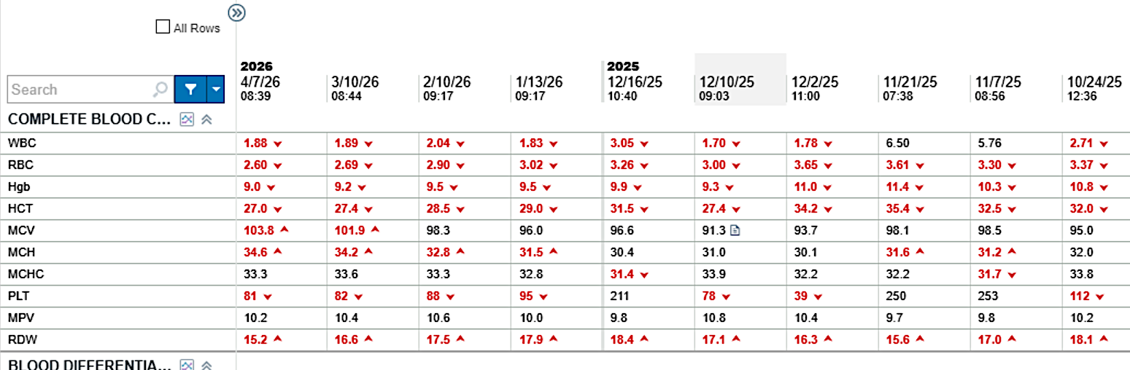

Slide 124
Bispecific Antibodies and Antibody-Drug Conjugates for
Non-Hodgkin Lymphoma and Chronic Lymphocytic Leukemia
Recent Advances in Cancer Care — New Paradigms,
Novel Agents and What It Means for the Oncology Nurse
A Complimentary NCPD Symposium Series Held During the 51st Annual ONS Congress
Friday, May 15, 2026
6:00 PM – 8:00 PM
Faculty
Farrukh T Awan, MD, MS, MBA
Robin Klebig, MSN, APRN, CNP, AOCNP
Mollie Moran, APRN-CNP, AOCNP
Moderator
Brad S Kahl, MD

Slide 125
Thank you for joining us! Please take a moment to complete the survey currently up on Zoom. Your feedback is very important to us. The survey will remain open up to 5 minutes after the meeting ends.
To Claim NCPD Credit
In-person attendees: Please refer to the program syllabus for the NCPD credit link or QR code.
Virtual attendees: The NCPD credit link is posted in the chat room.
NCPD/ONCC credit information will be emailed to each participant within 1 to 2 business days.

