Slide 1
Oral Selective Estrogen Receptor Degraders in Breast Cancer
Recent Advances in Cancer Care — New Paradigms,
Novel Agents and What It Means for the Oncology Nurse
A Complimentary NCPD Symposium Series Held During the 51st Annual ONS Congress
Saturday, May 16, 2026
6:00 PM – 7:30 PM
Faculty
Blanca Ledezma, MSN, NP, AOCNP
Marissa Marti-Smith, DNP, APRN, AGNP-C, AOCNP
Ruth M O’Regan, MD
Moderator
Heather McArthur, MD, MPH, FASCO

Slide 2




Faculty
Blanca Ledezma, MSN, NP, AOCNP
UCLA Health
Department of Hematology Oncology
Santa Monica, California
Ruth M O’Regan, MD
Charles A Dewey Professor of Medicine and Oncology
Chair, Department of Medicine
University of Rochester Medical Center
Physician-in-Chief
Strong Memorial Hospital
Associate Director of Education and Mentoring
Wilmot Cancer Institute
Rochester, New York
Marissa Marti-Smith, DNP, APRN,
AGNP-C, AOCNP
Nurse Practitioner
Texas Oncology-Baylor Charles A Sammons Cancer Center
Dallas, Texas
Moderator
Heather McArthur, MD, MPH, FASCO
Professor, Department of Internal Medicine
Clinical Director, Breast Cancer Program
Komen Distinguished Chair in Clinical Breast Cancer Research
UT Southwestern Medical Center
Dallas, Texas

Slide 3
Ms Ledezma — Disclosures
Speakers Bureaus | AstraZeneca Pharmaceuticals LP, Daiichi Sankyo Inc, Lilly, Pfizer Inc
Steering Committees | AstraZeneca Pharmaceuticals LP

Slide 4
Ms Marti-Smith — Disclosures
Consulting Agreements | Amplity
Speakers Bureaus | AstraZeneca Pharmaceuticals LP, Biotheranostics Inc, A Hologic Company, Daiichi Sankyo Inc, Stemline Therapeutics Inc
Nonrelevant Financial Relationships | ASCO Quality Care Symposium, Clinical Care Options, Kaplan, OncLive, Oncology Nursing News

Slide 5
Dr O’Regan — Disclosures
Advisory Committees | Biotheranostics Inc, A Hologic Company
Consulting Agreements | Biotheranostics Inc, A Hologic Company, Gilead Sciences Inc, Lilly, Puma Biotechnology Inc, Regor Therapeutics
Contracted Research | Novartis, Puma Biotechnology Inc
Data and Safety Monitoring Boards/Committees | Gilead Sciences Inc

Slide 6
Dr McArthur — Disclosures
Advisory Committees | Arvinas, AstraZeneca Pharmaceuticals LP, Boston Scientific Corporation, Celcuity, Daiichi Sankyo Inc, Delcath Systems Inc, Genentech, a member of the Roche Group, Gilead Sciences Inc, Lilly, Merck, Novartis, Pfizer Inc
Consulting Agreements | ALX Oncology

Slide 7
Commercial Support
This activity is supported by educational grants from AstraZeneca Pharmaceuticals LP, Lilly, and Stemline Therapeutics Inc.
Research To Practice NCPD Planning Committee Members,
Staff and Reviewers
Planners, scientific staff and independent reviewers for Research To Practice have no relevant financial relationships to disclose.

Slide 8
This educational activity contains discussion of
non-FDA-approved uses of agents and regimens. Please refer to official prescribing information for each product for approved indications.

Slide 9



Clinicians in the Meeting Room
Networked iPads are available.
Review Program Slides: Tap the Program Slides button to review speaker presentations and other program content.
Answer Survey Questions: Complete the pre- and postmeeting surveys. Survey questions will be discussed throughout the meeting.
Ask a Question: Tap Ask a Question to submit a challenging case or question for discussion. We will aim to address as many questions as possible during the program.
For assistance, please raise your hand. Devices will be collected at the conclusion of the activity.
Notes:
9

Slide 10

Clinicians Attending via Zoom
Review Program Slides: A link to the program slides will be posted in the chat room at the start of the program.
Answer Survey Questions: Complete the pre- and postmeeting surveys. Survey questions will be discussed throughout the meeting.
Ask a Question: Submit a challenging case or question for discussion using the Zoom chat room.
Get NCPD Credit: An NCPD credit link will be provided in the chat room at the conclusion of the program.
Notes:
10

Slide 11
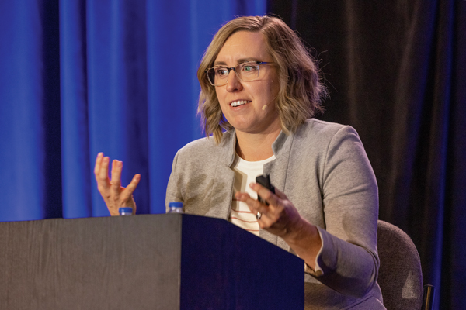
About the Enduring Program
The live meeting is being video
and audio recorded.
The proceedings from today will
be edited and developed into
an enduring web-based program.
An email will be sent to all attendees
when the activity is available.
To learn more about our education programs, visit our website, www.ResearchToPractice.com
Notes:
11
11

Slide 12



Slide 13

“Recent Advances in Cancer Care — New Paradigms,
Novel Agents and What It Means for the Oncology Nurse”
Eighteenth Annual RTP-ONS NCPD Symposium Series

Slide 14


New Agents, Therapies and Regimens
Recent Advances in Cancer Care — New Paradigms,
Novel Agents and What It Means for the Oncology Nurse
When should it be used, for whom and why?
How to prevent and manage side effects:
dose holds and reductions
  Kaplan Meier curves —
  HR and absolute benefit
  Waterfall plots

Slide 15
Agenda
Module 1: Current Clinical Role of Oral Selective Estrogen Receptor Degraders (SERDs) in HR-Positive Metastatic Breast Cancer
Module 2: Practical Considerations with Oral SERDs
Module 3: Potential Role of Combination Approaches with Oral SERDs
Module 4: Gastrointestinal Adverse Events Documented with Oral SERDs
Module 5: Potential Role of Early Therapeutic Switching After Detection of an Emergent ESR1 Mutation
Module 6: Other Class-Effect Toxicities Associated with Oral SERDs
Module 7: Emerging Utility of Adjuvant Oral SERDs
Module 8: Unique Toxicities Associated with 1 or More Oral SERDs

Slide 16
Agenda
Module 1: Current Clinical Role of Oral Selective Estrogen Receptor Degraders (SERDs) in HR-Positive Metastatic Breast Cancer
Module 2: Practical Considerations with Oral SERDs
Module 3: Potential Role of Combination Approaches with Oral SERDs
Module 4: Gastrointestinal Adverse Events Documented with Oral SERDs
Module 5: Potential Role of Early Therapeutic Switching After Detection of an Emergent ESR1 Mutation
Module 6: Other Class-Effect Toxicities Associated with Oral SERDs
Module 7: Emerging Utility of Adjuvant Oral SERDs
Module 8: Unique Toxicities Associated with 1 or More Oral SERDs

Slide 17
Current Clinical Role of Oral Selective Estrogen Receptor Degraders (SERDs) in HR-Positive mBC
Ruth M O’Regan, MD
Charles A Dewey Professor of Medicine and Oncology
Chair, Department of Medicine
University of Rochester Medical Center
Physician-in-Chief
Strong Memorial Hospital
Associate Director of Education and Mentoring
Wilmot Cancer Institute
Rochester, New York

Slide 18
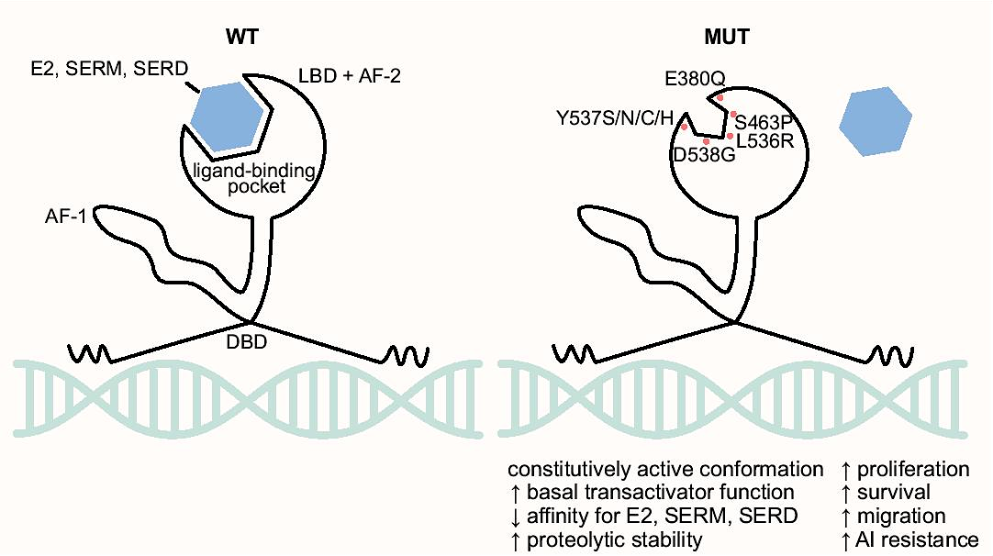
ESR1 Mutations
PIK3CA mutations are early events, present at baseline (~40%)
ESR1 mutations are rare in primary/untreated HR+ breast cancer (<5%)
Arise after exposure to aromatase inhibitors = Acquired
  25%-40% frequency in second-/third-line metastatic setting
ESR1 mutations are enriched in the ligand-binding domain
Constitutive signaling in the absence of ligand
Jeselsohn R et al. Nat Rev Clin Onc 2015; Brett JO et al. Breast Cancer Res 2021.

Slide 19
ESR1 Mutation Testing — ASCO Recommendations
Routine testing for emergence of ESR1 mutations at recurrence or progression on ET in patients with ER-positive, HER2-negative mBC
Testing should be performed on blood or tissue obtained at the time of progression, with a CLIA-certified assay
Blood-based ctDNA is preferred owing to greater sensitivity
Patients whose tumor or ctDNA tests remain ESR1 wild-type may warrant retesting at subsequent progression(s) to determine if an ESR1 mutation has arisen
Burstein H et al. J Clin Oncol 2023;41(18):3423-25.

Slide 20
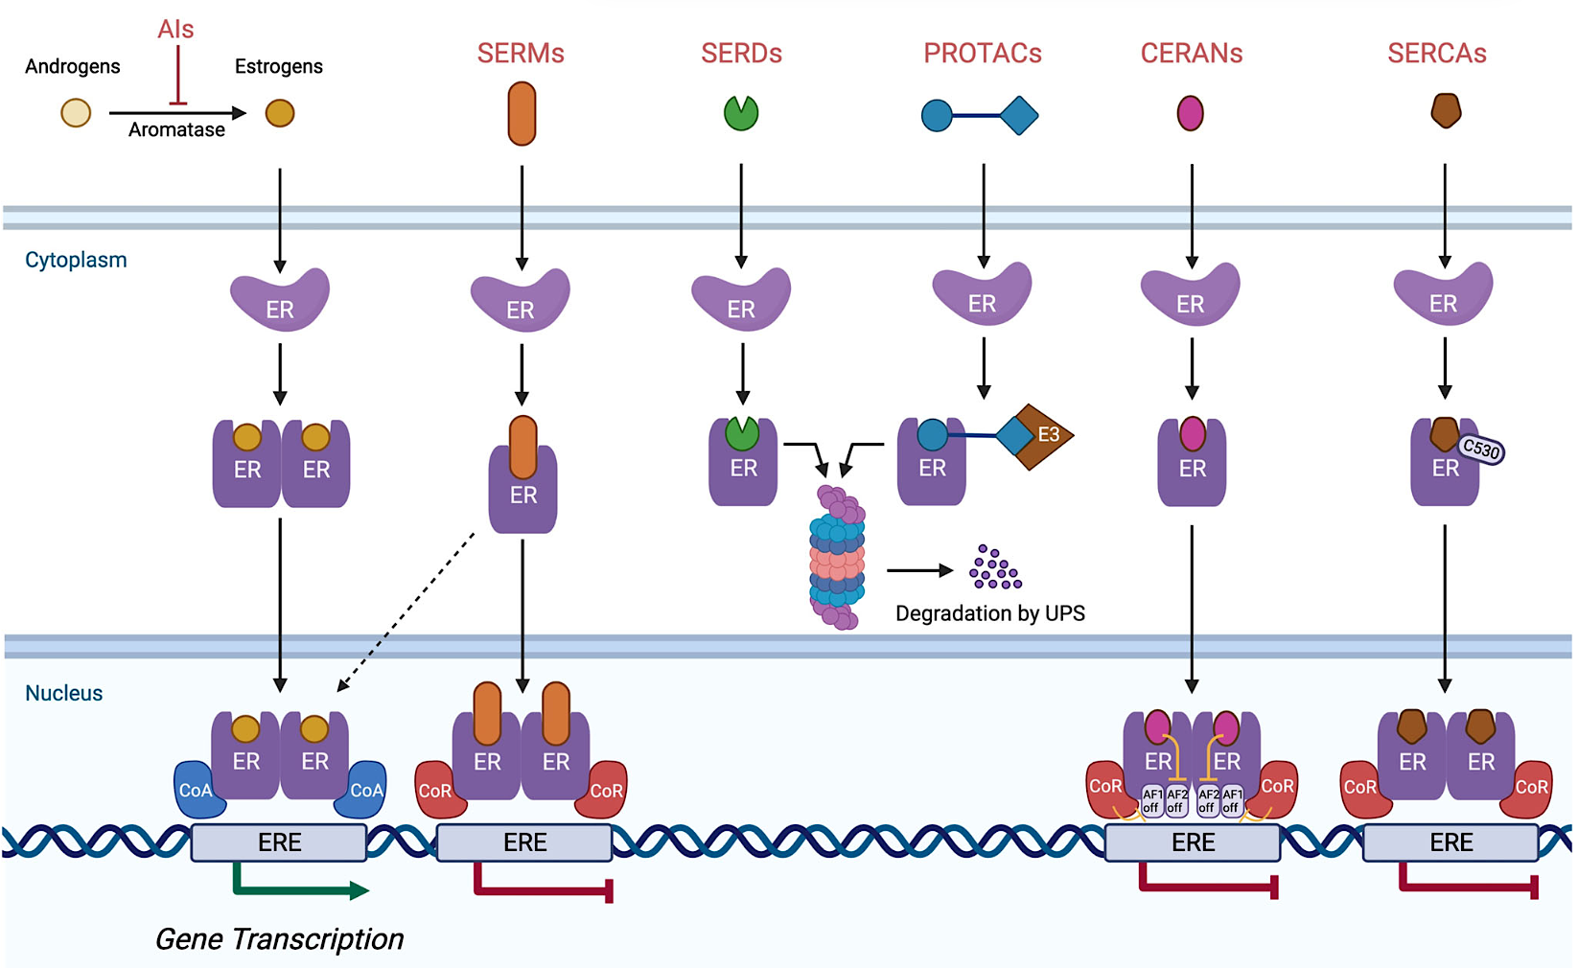
Mechanism of Action of Oral SERDs and Other Antiestrogen Therapies
Patel R et al. npj Breast Cancer 2023;9:20.

Slide 21
EMERALD Phase III Study
Elacestrant
400 mg daily^{c}
Co-Primary Endpoints:^{d}
PFS in all pts
PFS in mESR1
Key Secondary Endpoint:
Overall Survival
Inclusion Criteria
Men and postmenopausal women with advanced/metastatic breast cancer
ER-positive,ª HER2-negative
Progressed or relapsed on or after 1 or 2 lines of endocrine therapy for advanced disease, one of which was given in combination with a CDK4/6i
≤1 line of chemotherapy for advanced disease
ECOG PS 0 or 1
N = 477^{b}
PD or withdrawal criterion^{f}
R
Follow Up
1:1
Investigator’s choice (SOC):
Fulvestrant
Anastrozole
Letrozole
Exemestane
Stratification Factors:
ESR1 mutation status^{e}
Prior treatment with fulvestrant
Presence of visceral metastases
ªDocumentation of ER-positive tumor with ≥1% staining by immunohistochemistry; ^{b}Recruitment from February 2019 to October 2020; ^{c}Protocol-defined dose reductions permitted;
^{d}Blinded Independent Central Review. ^{e}ESR1 mutation status was determined by ctDNA analysis using the Guardant360® assay (Guardant Health, Redwood City, CA). ^{f}Restaging CT scans every 8 weeks.
ECOG PS = Eastern Cooperative Oncology Group performance status; R = randomized; SOC = standard of care; PFS = progression-free survival; pts = patients
Bardia A. SABCS 2021; Bidard FC. J Clin Oncol 2022.

Slide 22
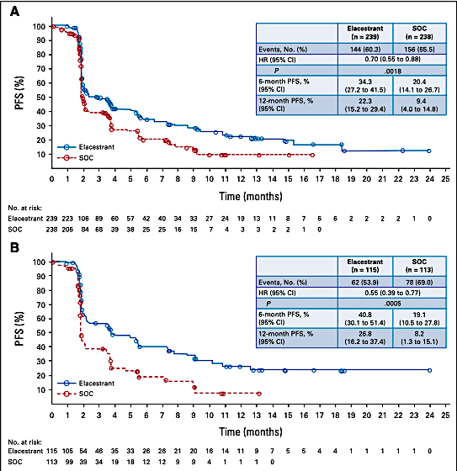
EMERALD Primary Endpoint: PFS in All and mESR1 Patients
All patients (ITT)
Patients with tumors harboring mESR1
mPFS (months)
3.8
1.9
mPFS (months): 2.8 versus 1.9
mPFS (months): 3.8 versus 1.9
Bardia A. SABCS 2021; Bidard FC. J Clin Oncol 2022.

Slide 23
EMERALD: Efficacy Subgroups
Bardia A et al. CCR 2024.

Slide 24
EMBER-3 Study Design
Imlunestrant
400 mg QD
ER+, HER2- ABC
Primary Endpoints
Investigator-assessed PFS for^{f}:
A vs B in patients with ESR1m^{g}
A vs B in all patients
C vs A in all^{h} patients
A
Men and Pre-ª/Post-menopausal women
Prior therapy:
Adjuvant: Recurrence on or within 12 months of completion of AI ± CDK4/6i
ABC: Progression on first-line AI ± CDK4/6i
No other therapy for ABC
SOC ET^{d,e}
Fulvestrant or
Exemestane
R 1:1:1^{b}
N=874
B
Key Secondary Endpoints
OS, PFS by BICR, and ORR
Safety
Imlunestrant
400 mg QD +
abemaciclib^{e}
Stratification Factors:
Prior CDK4/6i therapy (Y/N)
Visceral metastases (Y/N)
Region^{c}
C^{b}
Exploratory Endpoints
PFS and OS for C vs B in all^{h} patients
ABC = advanced breast cancer; AI = aromatase inhibitor; SOC = standard of care; PFS = progression-free survival; OS = overall survival; BICR = blinded independent central review; ORR = objective response rate
Jhaveri KL et al. SABCS 2024; Jhaveri KL et al. NEJM 2025.

Slide 25
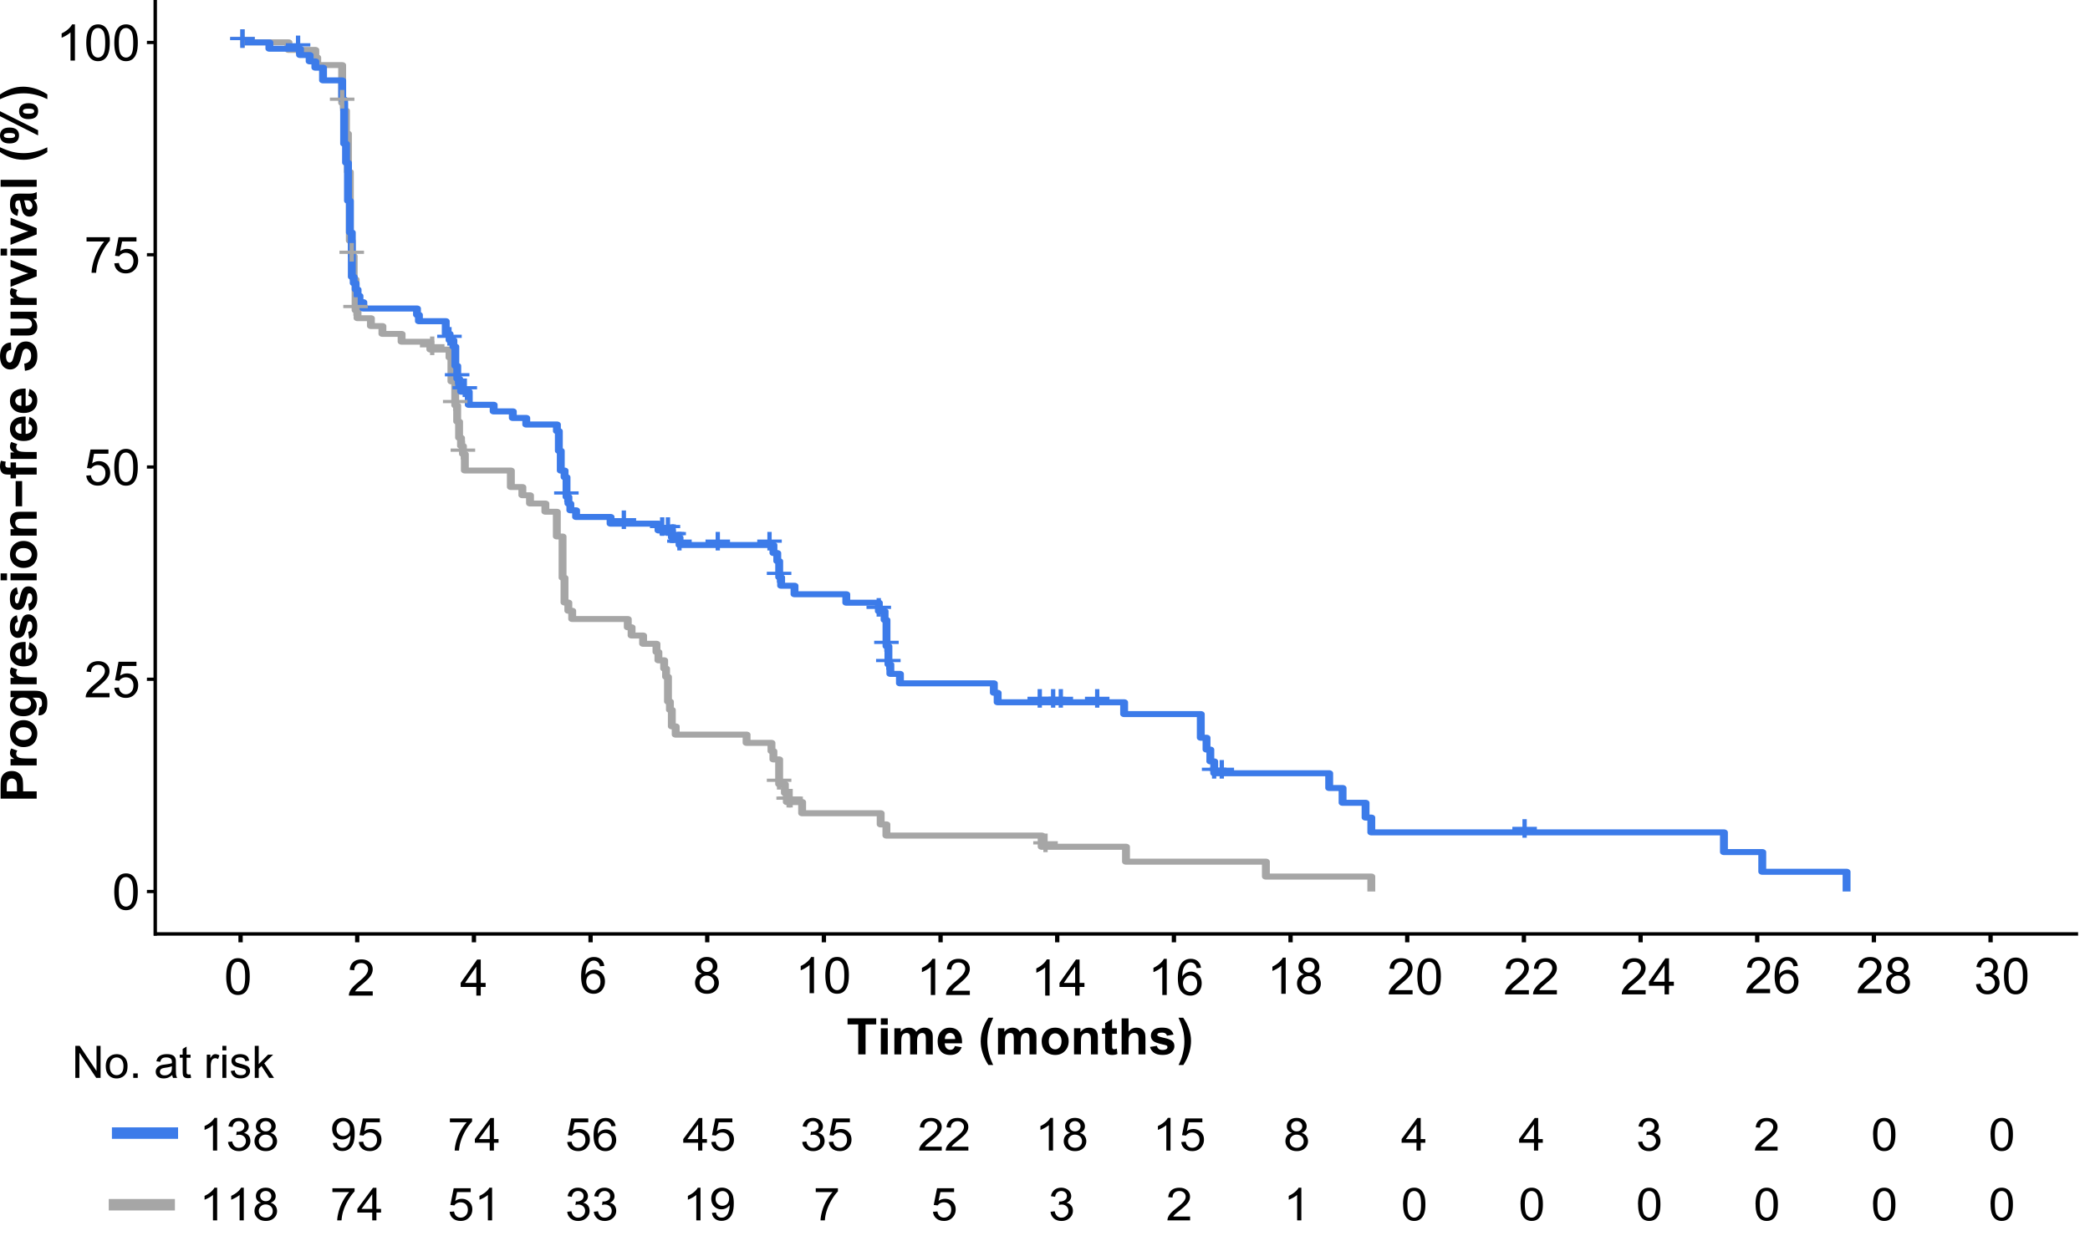
EMBER-3 Primary Endpoint: PFS in Patients with ESR1m
Imlunestrant
n=138
SOC ET
n=118
No. of events | 109 | 102
Median (95% CI); Months | 5.5 (3.9-7.4) | 3.8 (3.7-5.5)
HR (95% CI) | 0.62 (0.46-0.82)ª p-value<0.001
44%
25%
32%
7%
Jhaveri KL et al. SABCS 2024; Jhaveri KL et al. NEJM 2025.

Slide 26
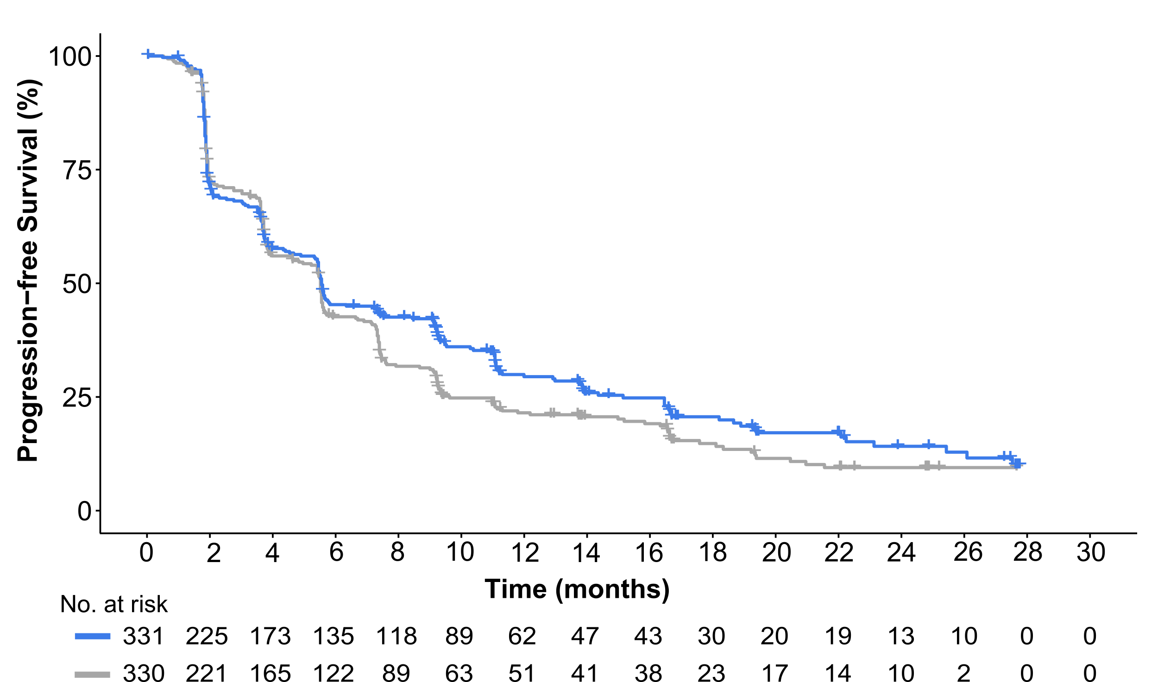
EMBER-3 Primary Endpoint: PFS in All Patients
Imlunestrant
n=331
SOC ET
n=330
No. of events | 237 | 253
Median (95% CI); Months | 5.6 (5.3-7.3) | 5.5 (4.6-5.6)
HR (95% CI) | 0.87 (0.72-1.04) p-value 0.12
45%
30%
43%
22%
Prespecified Critical HR < 0.84ª
The majority subgroup of patients without ESR1m showed no difference in PFS (HR=1.00; 95% CI, 0.79-1.27)
Jhaveri KL et al. SABCS 2024; Jhaveri KL et al. NEJM 2025.

Slide 27
Discussion Questions
In which line of therapy are you using an oral SERD for patients with ESR1 mutations only? How do you sequence oral SERDs relative to other options for patients with ESR1 and PTEN/PI3K/AKT pathway alterations, and what factors influence your choice?
How do you choose between elacestrant and imlunestrant? Are any toxicities noted with one of these that have not been documented with other, and how does this influence your choice?
How do the tolerability profiles of camizestrant and giredestrant differ from those of elacestrant and imlunestrant?

Slide 28
Agenda
Module 1: Current Clinical Role of Oral Selective Estrogen Receptor Degraders (SERDs) in HR-Positive Metastatic Breast Cancer
Module 2: Practical Considerations with Oral SERDs
Module 3: Potential Role of Combination Approaches with Oral SERDs
Module 4: Gastrointestinal Adverse Events Documented with Oral SERDs
Module 5: Potential Role of Early Therapeutic Switching After Detection of an Emergent ESR1 Mutation
Module 6: Other Class-Effect Toxicities Associated with Oral SERDs
Module 7: Emerging Utility of Adjuvant Oral SERDs
Module 8: Unique Toxicities Associated with 1 or More Oral SERDs

Slide 29
Practical Considerations with the Use of Oral SERDs
Blanca Ledezma, MSN, NP, AOCNP

Slide 30
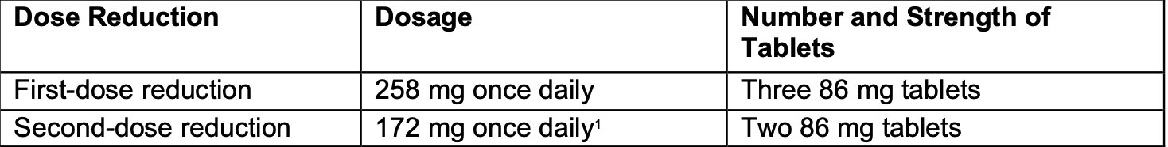
Elacestrant
Dosing
345 mg (1tab) taken orally with food once daily
Take at approximately the same time every day.
Take with food to reduce symptoms of nausea and vomiting
Swallow whole
Dosage forms:
345mg tablets and 86mg tablets
Elacestrant, PI 2023

Slide 31
Imlunestrant
Dosing
400 mg (2 tab) orally once daily
Take on an empty stomach 2 hours before or 1 hour after food
Take at approximately the same time every day.
Swallow whole
Pre/perimenopausal women and men should receive a gonadotropin-releasing hormone agonist (GnRH) according to current clinical practice standards
Dosage forms:
200mg tablets
Dose Reduction:
First dose reduction:200mg 1 tablet
Unable to tolerate 200 mg, permanently discontinue
Imlunestrant, PI 2025

Slide 32
Dose Modification: Elacestrant
Grade 1 Continue at current dose
Grade 2 consider hold until recovers to ≤1 or baseline, resume at same dose
Grade 3 hold until recovers to ≤1 or baseline, resume at next lower dose
if grade 3 recurs hold until recovers to ≤1 or baseline, resume and reduce by another dose
Grade 4 hold until recovers to ≤1 or baseline, resume at next lower dose
Intolerable grade 4 permanently discontinue
Elacestrant, PI 2023

Slide 33
Dose Modification: Imlunestrant
General Modifications
Grade 2 persistent or recurrent that does not recover in 7 days with maximal supportive measures to baseline or grade 1
hold until recovers to ≤1 or baseline, resume at same dose
Grade 3 or 4 (except non-hepatic asymptomatic lab changes)
hold until recovers to ≤1 or baseline, resume at next lower dose
Hepatoxicity
Grade 2 hold until recovers to ≤1 or baseline, resume at same dose
Grade 3 OR AST/ALT ≥ 3x at baseline, AST/ALT ≥ 1.5x at baseline OR AST/ALT ≥ 8x ULN (whichever is lower)
hold until recovers to baseline or > 3x ULN, resume at next lower dose
or discontinue if at 200mg dose
Grade 4 OR AST/ALT ≥ 3x + bili 2x ULN, (AST/ALT < 1.5x ULN),in the absence of cholestasis at OR AST/ALT ≥ 2x at baseline + bili 2x ULN,( AST/ALT ≥ 1.5x at baseline), in the absence of cholestasis
Discontinue treatment
Imlunestrant, PI 2025

Slide 34
Unique considerations within specific patient populations
Geriatric Population
Elacestrant
43% were 65 years of age or older of the 237 patients who received elacestrant in the EMERALD trial
17% were 75 years of age or older.
No overall differences in safety or effectiveness were observed between patients 65 years or older of age compared to younger patients.
There was insufficient number of patients 75 years of age or older to assess differences in safety or effectiveness
Imlunestrant
118 patients were ≥ 65 years of age and 37 patients were ≥ 75 years of age of 327 patients who received imlunestrant in the EMBER-3 study
No overall differences in safety or effectiveness observed between patients 65 years of age and older and younger adult patients.
Bidard, F.C.,J Clin Oncol. 2022 May
Jhaveri, L.K., N Engl J Med 2025

Slide 35
Unique considerations within specific patient populations
Hepatic Impairment
Elacestrant
Patients with mild hepatic impairment (Child-Pugh A) no dosage adjustment
Patients with moderate hepatic impairment (Child-Pugh B) reduce the dose (258 mg)
Avoid use in patients with severe hepatic impairment (Child-Pugh C)
Imlunestrant
Patients with mild hepatic impairment (Child-Pugh A) no dosage adjustment
Patients with moderate to severe hepatic impairment (Child-Pugh B or Child-Pugh C ) reduce the dose (200mg)
Imlunestrant, PI 2025
Elacestrant, PI 2023

Slide 36
Adherence with oral SERDs
Understanding Key Barriers:
  Side effects
  Financial
  Mental health (anxiety)
  Level of education
Ongoing follow-up and Engagement:
  Regular follow-up visits
  Clinical pharmacist adherence monitoring
  Written instructions at an accessible reading level and using teach-back methods
  Expectations of possible side effects to avoid self-discontinuation
Simplifying medication logistics;
  90 day prescription refill is associated with higher adherence
  Medication reminders (apps, pill organizers, text messages) showed improvement in some studies, particularly technology-based interventions
Neuner JM., Breast Cancer Res Treat. 2023
Ganna S., J Cancer Surviv. 2025 Jun;19(3):930-939
Franzoi MA, Lancet Oncol. 2021 Jul;22(7)

Slide 37
Drug-drug interactions
Elacestrant
Strong and Moderate CYP3A4 Inhibitors: Avoid, increases elacestrant exposure
Strong and Moderate CYP3A4 Inducers: Avoid, decreases elacestrant exposure
P-gp inhibition (digoxin): reduce the dosage of P-gp substrates
BCRP inhibition (rosuvastatin): reduce the dosage of BCRP substrates
Imlunestrant
Strong CYP3A4 inhibitor: Avoid; if unavoidable, reduce dose
Strong CYP3A4 inducer: Avoid; if unavoidable, increase dose
CYP3A substrate: decreases imlunestrant exposure
P-gp inhibition (digoxin): avoid, increases exposure
BCRP inhibition (rosuvastatin): avoid, increases exposure
Imlunestrant, PI 2025
Elacestrant, PI 2023

Slide 38
Clinical Summary of Oral SERDs
Elacestrant (345mg) must be taken with food daily; Imlunestrant (400mg) requires an empty stomach. Dosage must be swallowed whole.
Imlunestrant utilizes specific LFT thresholds for hepatotoxicity management.
Dose adjustments are required for Child-Pugh B/C hepatic impairment. Geriatric patients (≥65) show comparable safety profiles to younger cohorts.
Avoid concomitant strong CYP3A4 inhibitors/inducers. Closely monitor P-gp substrates (e.g., digoxin) and BCRP substrates during co-administration.
Leverage 90-day refills, simplified logistics, and teach-back methods to mitigate barriers like cost, education levels, and therapy anxiety.

Slide 39
Case Presentation
Blanca Ledezma, MSN, NP, AOCNP

Slide 40
Case Presentation
78-year-old retired female who lives with her husband and has 2 daughters
Diagnosis: ER-positive, HER2-negative, ESR1-mutated (D538G) metastatic breast cancer with bone (thoracic spine, right iliac crest) and solitary liver metastasis
Treatment history:
  Adjuvant radiation
  Adjuvant letrozole x 4 yrs → PD with imaging revealing new bone metastases in the thoracic spine and right iliac crest. liquid biopsy (ctDNA) confirmed an ESR1 D538G mutation
  Abemaciclib / letrozole x 16 months + denosumab → PD current sites of disease and solitary liver lesion, liquid biopsy confirmed an ESR1 D538G mutation
  Elacestrant started x 6 weeks + denosumab
Comorbidities:
  Mild CKD
  Hyperlipidemia on rosuvastatin
  HTN well controlled
  Reflux
  Mild forgetfulness

Slide 41
Case Presentation
Approaches for Encouraging and Assessing Adherence:
  Pill organization: smart pill box with alarms
  Proactive side effect engagement: phone calls, video visits (when possible) and in person visits
  Diary of symptoms
  Medication review at every visit
  Written information on treatment and plan of action of possible adverse effects
Current status:
  Scans 3 months after treatment start
  Mild nausea (grade 1) managed with dietary modifications and occasional ondansetron
  Musculoskeletal discomfort (grade 1) managed with acetaminophen
  She is tolerating the oral regimen well

Slide 42
Agenda
Module 1: Current Clinical Role of Oral Selective Estrogen Receptor Degraders (SERDs) in HR-Positive Metastatic Breast Cancer
Module 2: Practical Considerations with Oral SERDs
Module 3: Potential Role of Combination Approaches with Oral SERDs
Module 4: Gastrointestinal Adverse Events Documented with Oral SERDs
Module 5: Potential Role of Early Therapeutic Switching After Detection of an Emergent ESR1 Mutation
Module 6: Other Class-Effect Toxicities Associated with Oral SERDs
Module 7: Emerging Utility of Adjuvant Oral SERDs
Module 8: Unique Toxicities Associated with 1 or More Oral SERDs

Slide 43
Potential Role of Combination Approaches with Oral SERDs in HR-Positive, HER2-Negative MBC
Heather McArthur, MD, MPH, FASCO
Professor, Department of Internal Medicine
Clinical Director, Breast Cancer Program
Komen Distinguished Chair in Clinical Breast Cancer Research
UT Southwestern Medical Center
Dallas, Texas

Slide 44
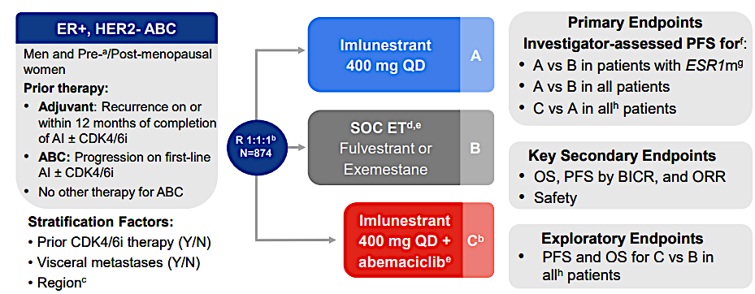
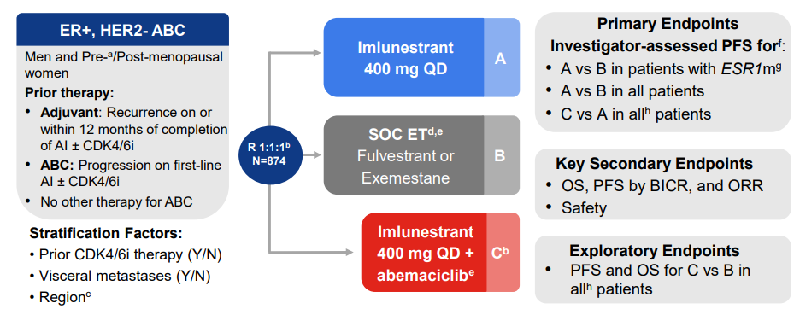
EMBER-3 Study of Imlunestrant: Design
n = 331
n = 330
n = 213
No prior CT (except for neoadjuvant/ adjuvant), FULV, or any investigational-ER-directed therapy (including SERDs and non-SERDs), any PI3K/mTOR/AKT inhibitor
Jhaveri K, et al. SABCS 2024. Abstract GS1-01.
Jhaveri K, et al. N Engl J Med. 2025;392:1189-1202.

Slide 45
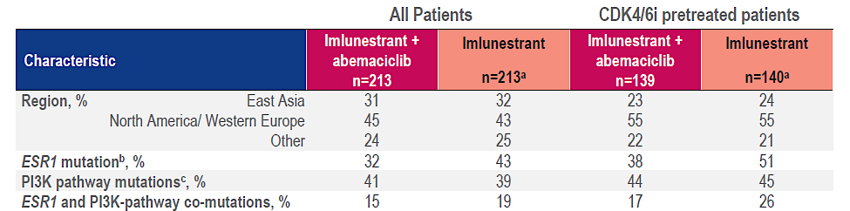
EMBER-3: Imlunestrant + Abemaciclib + Imlunestrant—Baseline Characteristics
Saura C, et al. ESMO Br Cancer 2025.

Slide 46
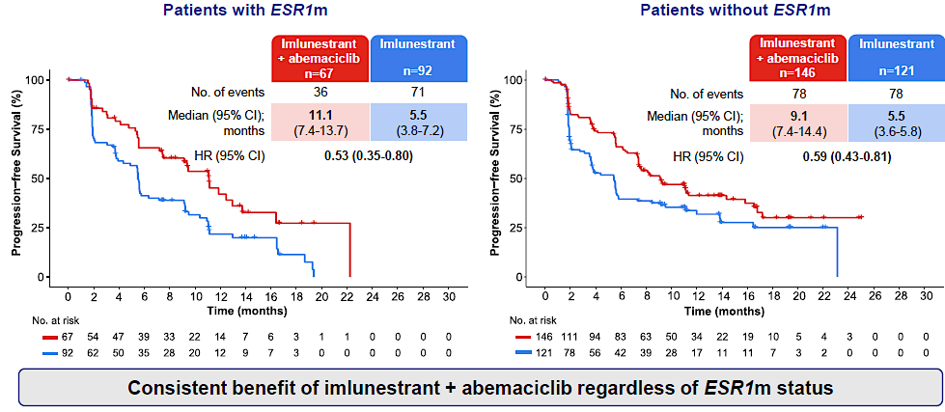
EMBER-3: Imlunestrant + Abema vs Imlunestrant—PFS by ESR1m Status
Saura C, et al. ESMO Br Cancer 2025.

Slide 47
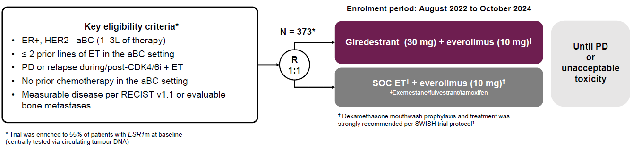
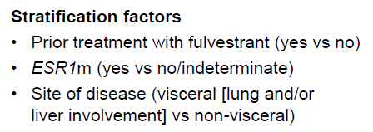
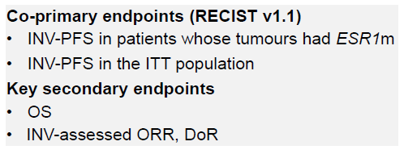
Phase 3 evERA Study of Giredestrant + Everolimus
141 exemestane
39 fulvestrant
6 tamoxifen
Mayer E, et al. ESMO 2025. LBA16.

Slide 48
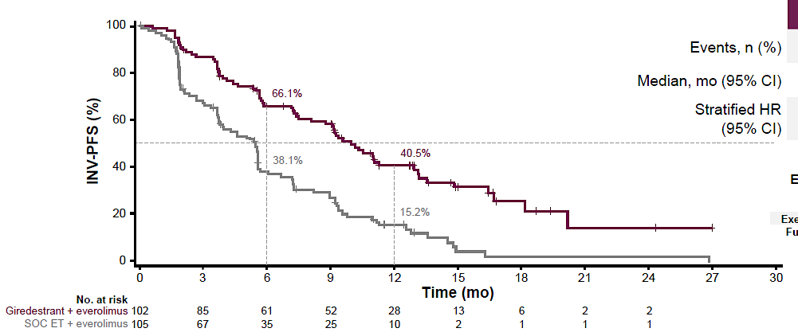
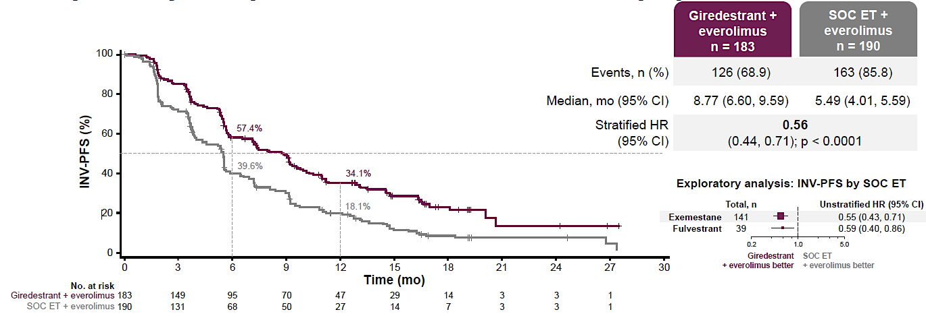
Phase 3 evERA Study
ESR1m Population
ITT Population
 | G + EVE (n = 102) | SOC + EVE (n = 105)
Events, n (%) | 63 (62) | 89 (85)
mPFS, mo | 9.99 | 5.45
HR (95% CI) | 0.38 (0.27-0.54); P <.0001
 | G + EVE (n = 183) | SOC + EVE (n = 190)
Events, n (%) | 126 (69) | 163 (86)
mPFS, mo | 8.77 | 5.49
HR (95% CI) | 0.56 (0.44-0.71); P <.0001
FDA decision expected by December 2026
Mayer E, et al. ESMO 2025. LBA16.

Slide 49
Interim analysis of OS in the ESR1m patients
ESR1 mutation (59% mature)
100
HR 0.62 (0.38-1.02)
80
60
OS (%)
40
Giredestrant + everolimus
n = 102
SOC ET + everolimus
n = 105
 | Giredestrant + everolimus (n = 102) | SOC ET + everolimus (n = 105)
Events, n (%) | 26 (25.5) | 41 (39.0)
Median, mo (95% CI) | NE (20.17, NE) | 21.03 (14.78, 26.87)
Stratified HR (95% CI) | 0.62 (0.38, 1.02); p = 0.0566
20
0
0
3
6
9
12
15
18
21
24
27
30
33
36
No. at risk
Time (mo)
Giredestrant + everolimus
SOC ET + everolimus
102
105
96
100
87
93
81
79
57
57
37
33
19
18
8
10
6
3
2
1
Mayer E, et al. ESMO 2025. LBA16.

Slide 50
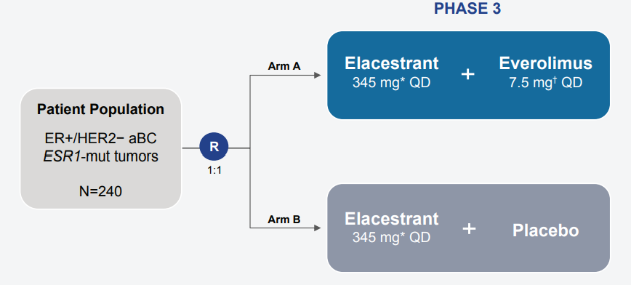
Phase 3 ADELA Study of Elacestrant ± Everolimus for ESR1mut, ER+/HER2− aBC After ET + CDK4/6i
ER+/HER2− unresectable locally recurrent or metastatic disease
Confirmed ESR1m
PD on prior CDK4/6i + ET for aBC after ≥6 mo
  Patients receiving CDK4/6i-based therapy in adj setting are eligible if PD is confirmed after ≥12 mo of treatment but < 12 mo following CDK4/6i treatment completion
Previously received 1-2 lines of ET for aBC
  PD during or within 12 mo of adj ET considered as a line of ET for aBC
No prior CT for aBC
No prior elacestrant, novel ET, and/or PI3K/AKT/mTOR inhibitors*
ECOG PS 0 or 1
Adequate BM and organ function
N = 240
Stratification:
Presence of visceral metastases (Y/N)
Duration of prior CDK4/6i tx (≥12 vs <12 mo)
Endpoints
Primary: PFS by BICR
Secondary: PFS INV, OS, response, safety and HRQoL
☑ Recruiting (NCT06382948)
*including everolimus.
Llombart-Cussac A, et al. ASCO 2025. Abstract TPS1129.

Slide 51
First line oral SERD vs AI (+ CDK4/6i)
SERENA4
persevERA
Camizestrant + palbociclib
(+ placebo)
Giredestrant + palbociclib
(+ placebo)
R
1:1
R
1:1
N=1370
N=992
Anastrozole + palbociclib
(+ placebo)
Letrozole + palbociclib
(+ placebo)

Slide 52
First line oral SERD vs AI (+ CDK4/6i)
SERENA4
persevERA
Camizestrant + palbociclib
(+ placebo)
Giredestrant + palbociclib
(+ placebo)
R
1:1
R
1:1
N=1370
N=992
Anastrozole + palbociclib
(+ placebo)
Letrozole + palbociclib
(+ placebo)
March 8, 2026: persevERA did not meet the primary objective of a statistically significant improvement in PFS
Despite this setback, giredestrant recently showed success in the Phase III lidERA trial in early-stage breast cancer, which may still support its adoption in other settings.

Slide 53
Case Presentation

Slide 54
Patient Case
54-year-old postmenopausal woman:
BMI = 25.5 kg/m²
ECOG PS 0
Work-up:
Bone scan shows lytic bone lesions in thoracic spine and ribs
CT CAP also shows 4 lung lesions (largest 1.8 cm in diameter)
Liver biopsy: Grade 3, ER+, PR+, HER2 IHC 1
Labs: WNL
Genetic testing shows no pathogenic variants
Treatment and response:
She receives AI + ribociclib for 2 years (tolerates well)
Slight growth in largest lung lesion noted on last 2 follow up CT scans; one new 1 cm lesion on latest scan
Presents with persistent, worsening rib pain
PMH: otherwise, healthy;
ctDNA shows an ESR1 mutation and a PIK3CA mutation, no other actionable alterations
Lung tissue NGS shows a PIK3CA mutation, no other actionable alterations

Slide 55
Discussion Questions
Would you like to have access to imlunestrant/
abemaciclib for any of your patients with HR-positive, HER2-negative mBC? What about giredestrant/everolimus? If so, which ones?
In your experience, how problematic are the toxicities associated with oral SERD-containing combinations relative to oral SERD monotherapy?

Slide 56
Agenda
Module 1: Current Clinical Role of Oral Selective Estrogen Receptor Degraders (SERDs) in HR-Positive Metastatic Breast Cancer
Module 2: Practical Considerations with Oral SERDs
Module 3: Potential Role of Combination Approaches with Oral SERDs
Module 4: Gastrointestinal Adverse Events Documented with Oral SERDs
Module 5: Potential Role of Early Therapeutic Switching After Detection of an Emergent ESR1 Mutation
Module 6: Other Class-Effect Toxicities Associated with Oral SERDs
Module 7: Emerging Utility of Adjuvant Oral SERDs
Module 8: Unique Toxicities Associated with 1 or More Oral SERDs

Slide 57
Gastrointestinal Adverse Events with oral SERDs
Marissa Marti-Smith
DNP, APRN, AGNP-C, AOCNP

Slide 58
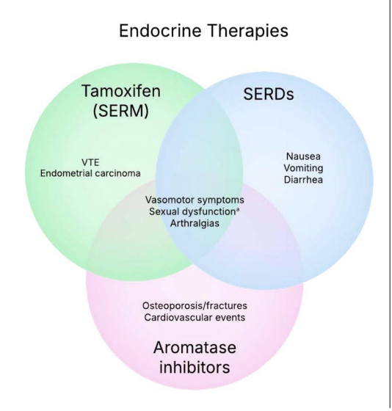
Oral SERDs overview
Rates of GI side effects
Mitigation strategies for GI AE’s
Nutritional counseling / diet modifications
Image from ASCO ebook (2025)

Slide 59

Rates of GI side effects
Elacestrant
  Well tolerated
  Phase 3 trial -- any grade nausea (35%), vomiting (19%), diarrhea (14%)
Imlunestrant
  Very similar AE’s, predominantly GI, but studied with Abemaciclib
Camizestrant
  Slightly higher rates hepatoxicity
  Less GI toxicity observed in phase 2 & 3 trials
  (LeVee et al., 2025 ASCO eBook)

Slide 60

Mitigation Strategies for GI related AE’s
Elacestrant
  Take with food
Imlunestrant
  Empty stomach (2hrs before food) or (1hr after food)
Camizestrant
  With or without food
(Sykes et al., 2026)

Slide 61

Educate & Empower Patients
Take med (if able to) with light meal to help with nausea prevention
Pre-medicate with anti-nausea med
Imodium PRN
Stool softeners
Laxative if necessary

Slide 62

Counseling / Diet Modifications
BRAT diet
Small meals
Avoid triggers (greasy food, spicy, high fat)
Room temperature foods
Protein shakes
Fluids w/ electrolytes
Notify clinic with uncontrolled symptoms
        Nausea
        Vomiting
        Diarrhea

Slide 63
Case Presentation

Slide 64

Case Study
39 yo female
Recurrent metastatic breast CA to right lung
3rd line Elacestrant 345mg PO QD
Diagnosed metastatic at age 26, chest wall recurrence w/2 pleural mets
No children, BSO at age 26 + AI
Changed jobs @ same time this therapy started
Positive outlook

Slide 65

Management & Takeaway
Nausea
Pt initiated > PPI QD and probiotic
MD initiated > Olanzapine 2.5mg @HS
@ next f/u
    pt declined need for Olanzapine
    Ativan “a few days”
Balance treatment & QOL

Slide 66
Agenda
Module 1: Current Clinical Role of Oral Selective Estrogen Receptor Degraders (SERDs) in HR-Positive Metastatic Breast Cancer
Module 2: Practical Considerations with Oral SERDs
Module 3: Potential Role of Combination Approaches with Oral SERDs
Module 4: Gastrointestinal Adverse Events Documented with Oral SERDs
Module 5: Potential Role of Early Therapeutic Switching After Detection of an Emergent ESR1 Mutation
Module 6: Other Class-Effect Toxicities Associated with Oral SERDs
Module 7: Emerging Utility of Adjuvant Oral SERDs
Module 8: Unique Toxicities Associated with 1 or More Oral SERDs

Slide 67
Potential Role of Early Therapeutic Switching After Detection of an Emergent ESR1 Mutation
Ruth M O’Regan, MD
Charles A Dewey Professor of Medicine and Oncology
Chair, Department of Medicine
University of Rochester Medical Center
Physician-in-Chief
Strong Memorial Hospital
Associate Director of Education and Mentoring
Wilmot Cancer Institute
Rochester, New York

Slide 68
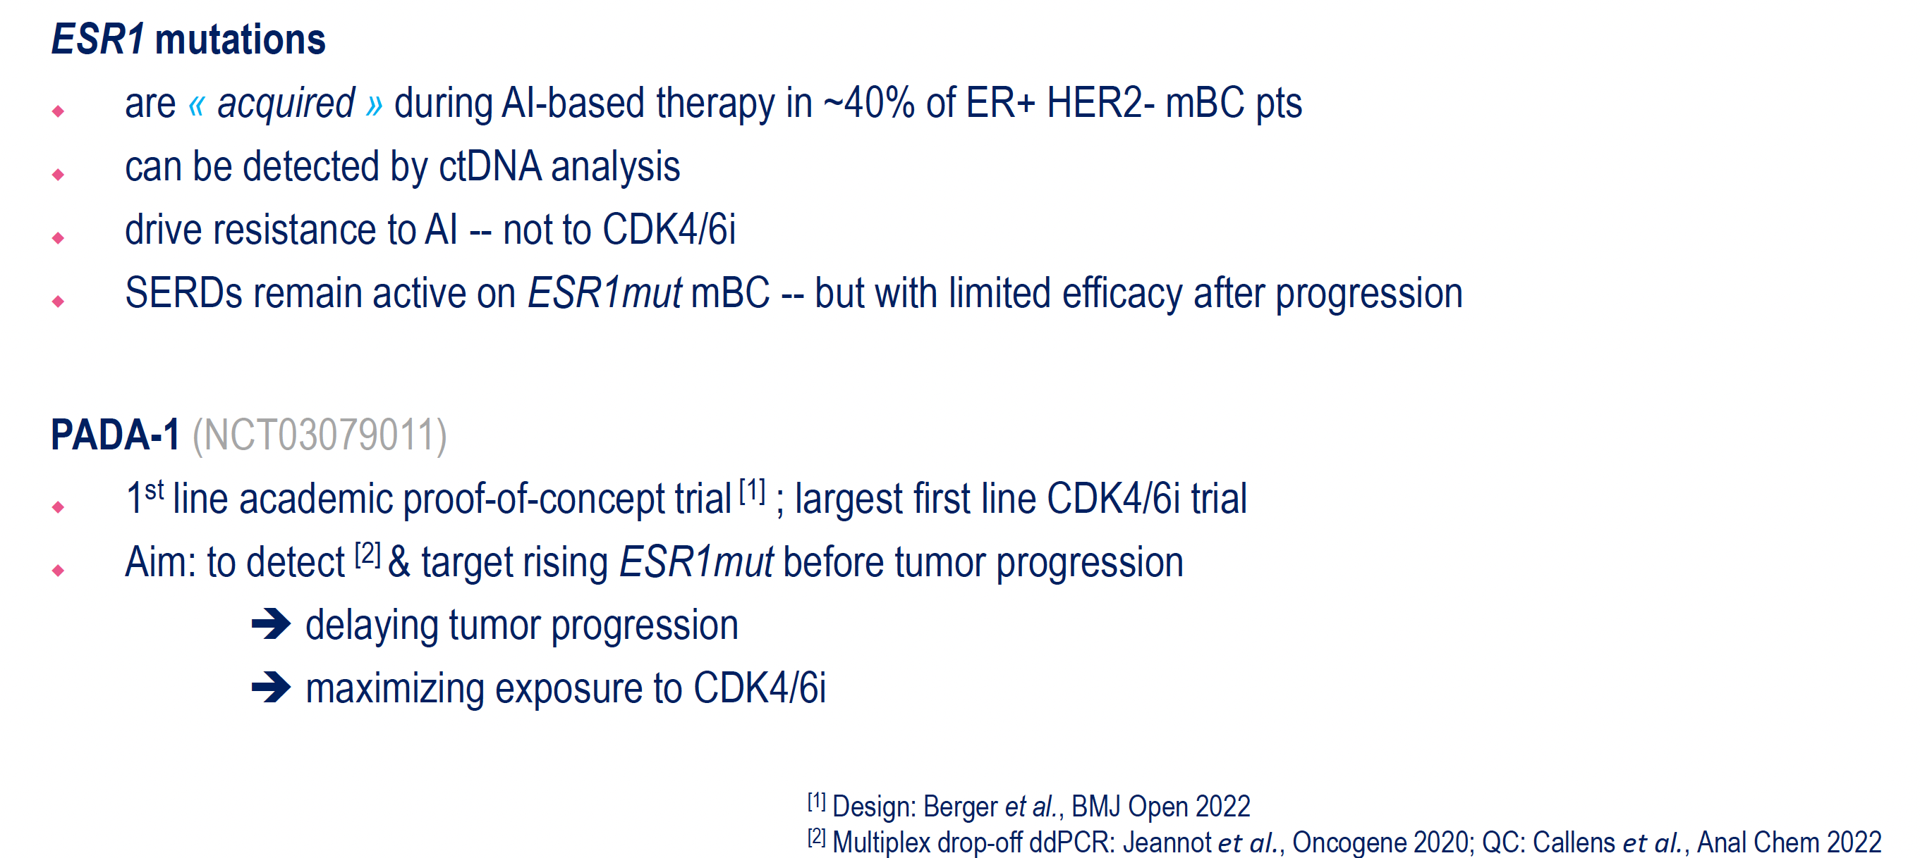
PADA-1 Study: Monitoring ESR1 Mutations During First-Line Therapy
Bidard FC et al. ESMO Breast 2025;Abstract 10.

Slide 69
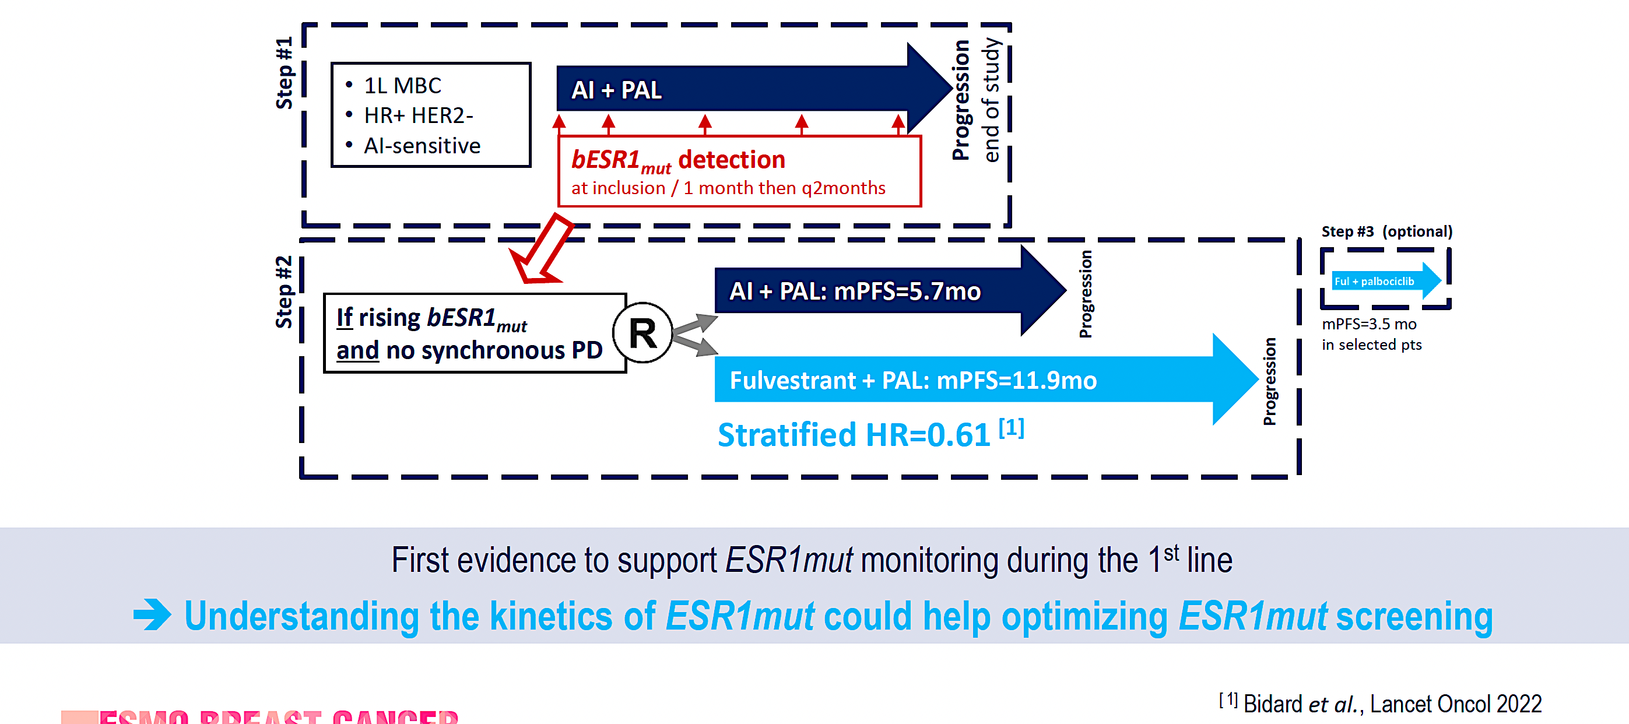
PADA-1 Design
Bidard FC et al. ESMO Breast 2025;Abstract 10.

Slide 70
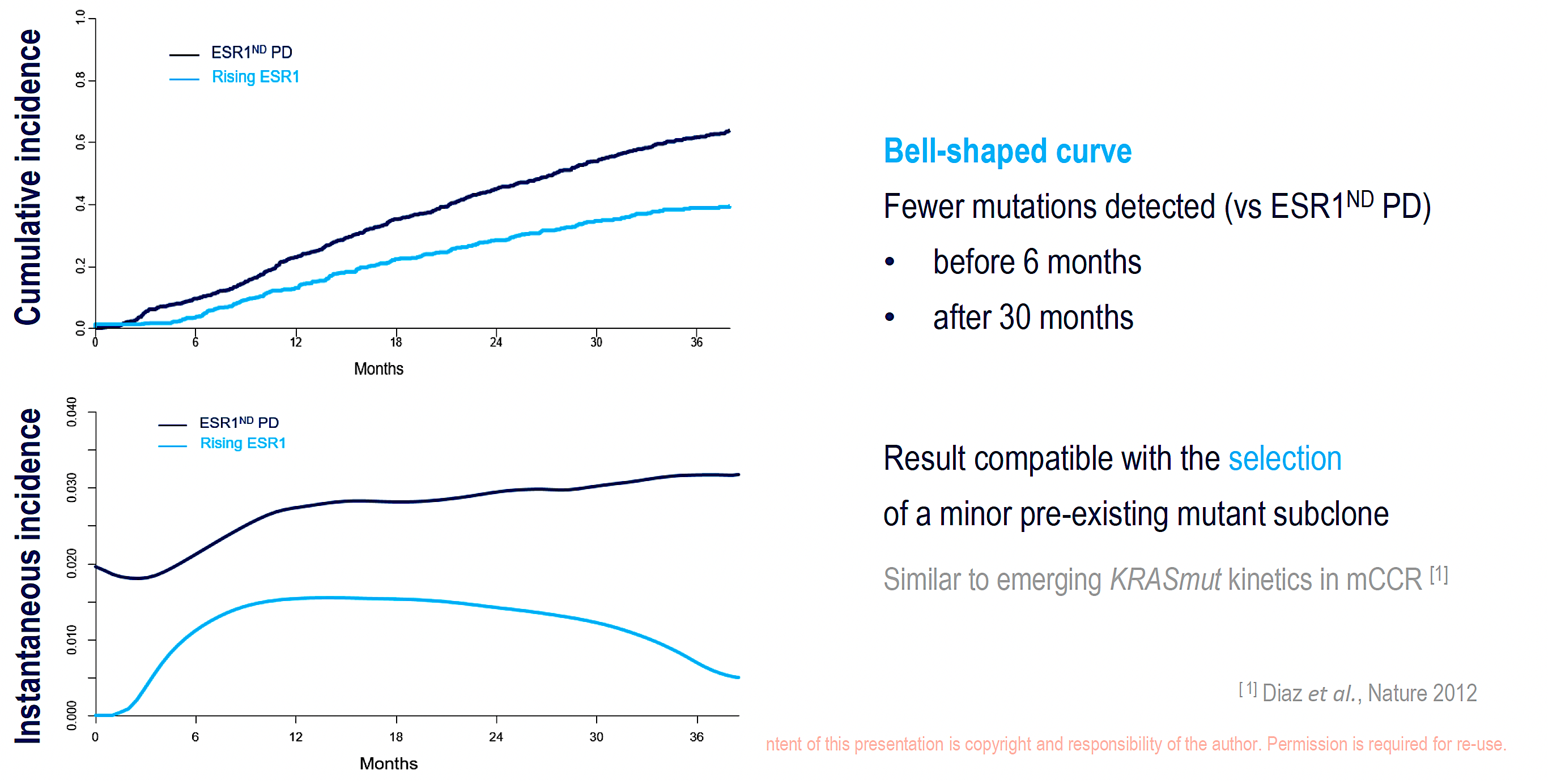
PADA-1: Cumulative and Instantaneous Incidence of ESR1 Mutation
Bidard FC et al. ESMO Breast 2025;Abstract 10.

Slide 71
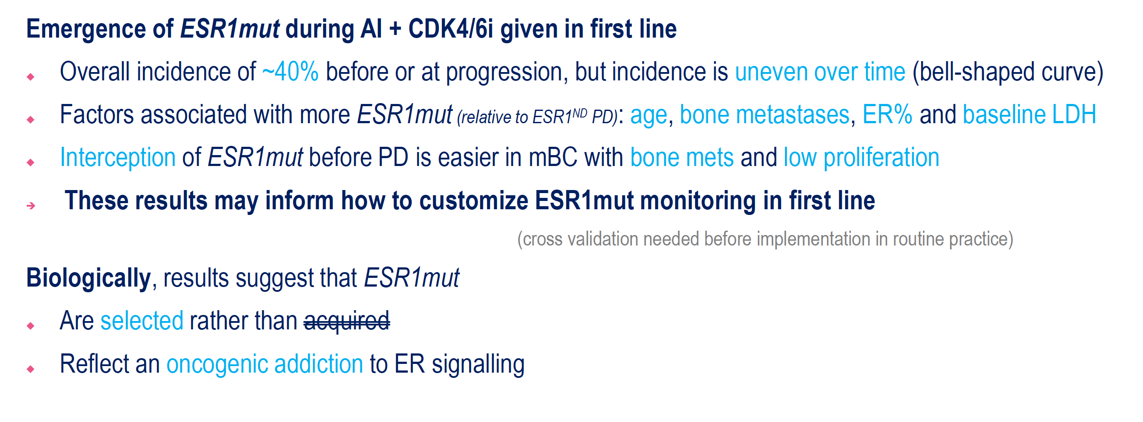
PADA-1: Conclusions
Bidard FC et al. ESMO Breast 2025;Abstract 10.

Slide 72
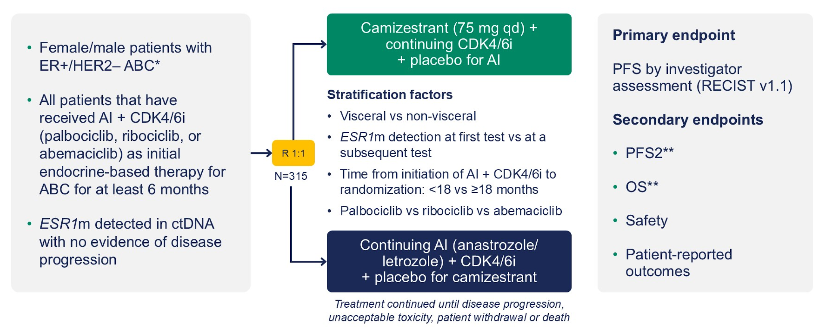
SERENA-6 Study Design
Bidard F-C et al. N Engl J Med June 1, 2025;[Online ahead of print]. Turner N et al. ASCO 2025;Abstract LBA4.

Slide 73
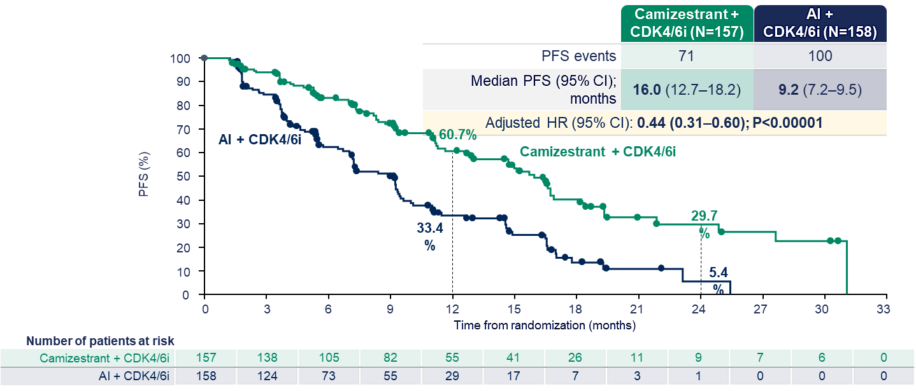
SERENA-6 Primary Endpoint: Investigator-Assessed PFS
Bidard F-C et al. N Engl J Med June 1, 2025;[Online ahead of print]. Turner N et al. ASCO 2025;Abstract LBA4.

Slide 74
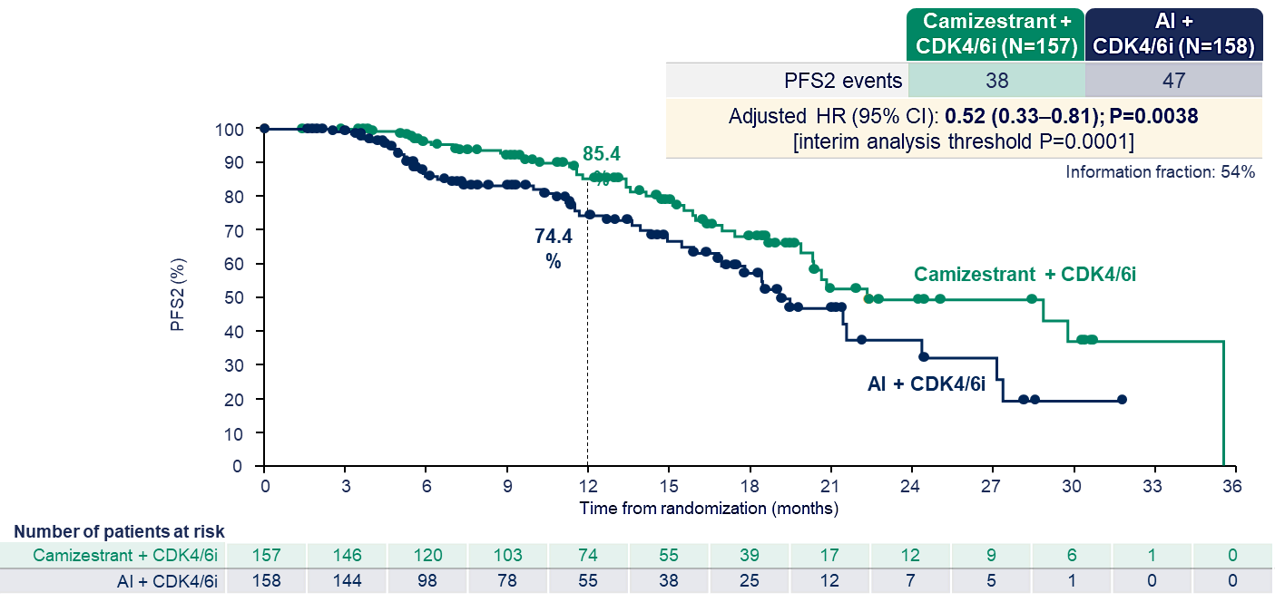
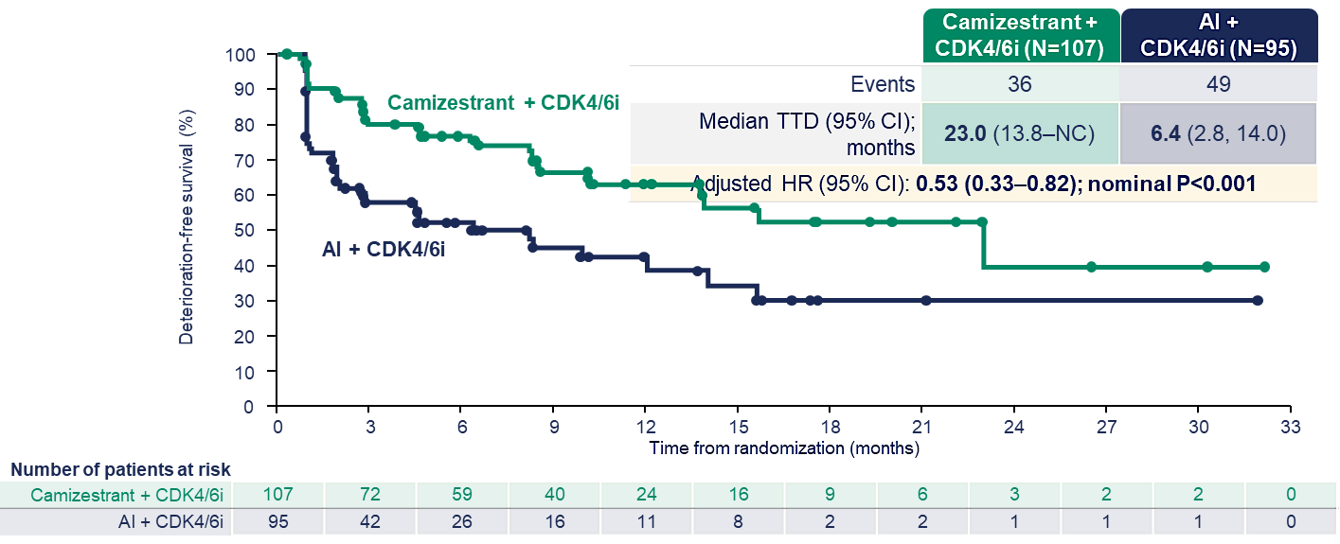
SERENA-6 Secondary Endpoints
PFS-2
Time to deterioration in global health status/quality of life
Bidard F-C et al. N Engl J Med June 1, 2025;[Online ahead of print]. Turner N et al. ASCO 2025;Abstract LBA4.

Slide 75
Oncologic Drugs Advisory Committee (ODAC) Meeting:
April 30, 2026
“The morning session focused on the results of the SERENA-6 trial, which was intended to support a new drug application (NDA) for camizestrant, an oral selective estrogen receptor degrader (SERD), for the treatment of patients with HR+/HER2- metastatic breast cancer. The committee evaluated whether a novel treatment-switching paradigm—where patients receiving an aromatase inhibitor (AI) and CDK4/6 inhibitor switched to camizestrant upon detection of an ESR1 mutation, rather than at radiographic progression—provided adequate evidence of clinically meaningful benefit on camizestrant.”
“The committee voted 6-3 that the SERENA-6 trial did not demonstrate clinically meaningful benefit for camizestrant treatment. Those in favor cited the magnitude of PFS improvement, the favorable early OS trend, and plausibility of the early treatment switching approach. Those opposed pointed to the trial’s inability to determine whether earlier treatment switching improves patient outcomes, particularly in the absence of a statistically significant OS benefit or a crossover design to isolate treatment timing. Thus, the committee concluded that, although camizestrant appears active, the trial design could note establish whether the observed PFS gain represents a real, clinically meaningful benefit from the earlier treatment switching.”
https://friendsofcancerresearch.org/blog/stakeholder-connect-insights-from-the-april-30-odac-meeting/

Slide 76
Discussion Questions
If the strategy evaluated in SERENA-6 were to be approved, would you use it in your own practice, and if, so for whom? How would you counsel an interested patient about the potential pros and cons of this approach?

Slide 77
Agenda
Module 1: Current Clinical Role of Oral Selective Estrogen Receptor Degraders (SERDs) in HR-Positive Metastatic Breast Cancer
Module 2: Practical Considerations with Oral SERDs
Module 3: Potential Role of Combination Approaches with Oral SERDs
Module 4: Gastrointestinal Adverse Events Documented with Oral SERDs
Module 5: Potential Role of Early Therapeutic Switching After Detection of an Emergent ESR1 Mutation
Module 6: Other Class-Effect Toxicities Associated with Oral SERDs
Module 7: Emerging Utility of Adjuvant Oral SERDs
Module 8: Unique Toxicities Associated with 1 or More Oral SERDs

Slide 78
Class-Effect Toxicities Associated with Oral SERDs
Blanca Ledezma, MSN, NP, AOCNP

Slide 79
Class-Effect Toxicities Associated with Oral SERDs
Common Adverse effects
Nausea / Vomiting
Diarrhea
Musculoskeletal pain
Fatigue
Myelosuppression: anemia, neutropenia, thrombocytopenia
Dyslipidemia
Other Side Effects
headache, dizziness, hot flashes, elevated liver enzymes
Elacestrant, PI 2023
Imlunestrant,PI 2025

Slide 80
Elacestrant: Adverse Effects & Lab Abnormalities Monotherapy
Frequency of Most Common Toxicities
All Grades (%) Grade 3/4 (%)
Musculoskeletal Pain 41 7
Nausea 35 2.5
Cholesterol increased 30 1
ALT increased 29 0
Triglycerides increased 27 2
Hemoglobin decreased 26 1
Fatigue 26 2
Vomiting 19 0.8
ALT increased 17 0
Elacestrant, PI 2023

Slide 81
Imlunestrant: Adverse Effects & Lab Abnormalities Monotherapy
Frequency of Most Common Toxicities
All Grades (%) Grade 3/4 (%)
Musculoskeletal Pain 30 3.7
Hemoglobin decrease 30 1.2
Neutrophils decrease 26 4
AST increased 25 1.9
Triglycerides increased 21 0
ALT increased 21 1.3
Fatigue 23 0.3
Diarrhea 22 0.6
Nausea 17 0.3
Platelet decreased 16 1.8
Cholesterol increased 10 0
Imlunestrant, PI 2025

Slide 82
Management of Cytopenias
Obtain baseline CBC prior to oral SERD initiation
Repeat CBC every 4–12 weeks during early therapy or per institutional guidelines
Dose interruption or dose reduction for clinically significant cytopenias (rare)
Resume therapy after hematologic recovery (rare)
Growth factor support may be considered for severe neutropenia (rare)
Transfusion support may be appropriate for symptomatic anemia or thrombocytopenia (rare)
Evaluate for marrow infiltration, nutritional deficiencies, or concomitant medications
Elacestrant, PI 2023
Imlunestrant,PI 2025

Slide 83
Management of Musculoskeletal Pain
Encourage physical activity, stretching, and low-impact exercise
  Yoga
Use acetaminophen or NSAIDs when clinically appropriate
Consider physical therapy, massage, or acupuncture
Evaluate for metastatic disease causes if symptoms worsen
Dose hold and dose modification may be required for persistent Grade ≥2 symptoms
Franzoi MA.,Lancet Oncol. 2021
NCCN (2026) Survivorship Pain

Slide 84
Management of Fatigue
Assess contributing causes: anemia, sleep disturbance, depression, endocrine dysfunction
Nutritional deficits: electrolyte imbalance
Promote sleep hygiene and energy conservation strategies
Recommend structured exercise programs when feasible
Optimize management of pain and concurrent medications
Consider dose hold or dose reduction for severe fatigue
NCCN (2026) Cancer Related Fatigue

Slide 85
Dyslipidemia
Elacestrant has a boxed-level warning for dyslipidemia in its label
Elacestrant / Imlunestrant
  Obtain baseline lipid levels
  Periodically evaluate while on treatment or as clinically indicated
Baseline: | Fasting lipid panel before initiating the oral SERD
Early follow-up: | Repeat at 4–8 weeks
Ongoing: | Every 3–6 months while on therapy, or more frequently if abnormalities are detected
Elacestrant, PI 2023
Imlunestrant, PI 2025

Slide 86
Key Takeaways
Oral SERDs are associated with manageable toxicities
Toxicities are predominately grade 1/2
Routine CBC monitoring supports early identification of cytopenias and other lab abnormalities
Dose modifications and supportive interventions are central to toxicity management
Comprehensive supportive care improves tolerability and treatment continuation
Nurses / APP’s are the frontline for early symptom detection and patient education to maintain treatment adherence and patient quality of life
Elacestrant, PI 2023

Slide 87
Case Presentation
Blanca Ledezma, MSN, NP, AOCNP

Slide 88
Case Presentation
Age: 42 years old single female, no children, has a dog and sister is main support
Diagnosis: stage IIA (T2N0M0) ER-positive, PR-positive, HER2-negative (IHC 1+), ESR1 D538G mutated, with bone and liver metastasis.
Treatment History:
  Adjuvant radiation
  Tamoxifen with goserelin – Patient started treatment and then stopped after 3 months as she she felt well and did not need to be on treatment
  Follow-up scans 9 months after tx d/c, demonstrate multiple osseous metastases (thoracic and lumbar spine, bilateral iliac bones) and two small hepatic lesions (1.2 cm and 0.8 cm)
  Biopsy of liver confirmed metastatic disease
  Tamoxifen / abemaciclib + goserelin & zoledronic acid→ PD after 14 months at current sites of disease with enlargement of existing bone metastases. Liquid biopsy confirmed ESR1 D538G mutation. No PIK3CA
  Imlunestrant + goserelin & zoledronic acid
Comorbidities:
  No significant PMH

Slide 89
Case Presentation
Supportive care strategies
  Diarrhea (grade 1) managed with loperamide
  Musculoskeletal discomfort (grade 2) NSAIDs help control discomfort but does not like taking medications
    Started yoga
    At home stretching videos
  She is tolerating the oral regimen well and has been compliant and not missed a dose
  Using phone alarm for treatment reminder
Current status:
  3 months after treatment start CT shows stable disease with slight reduction in hepatic lesions. Bone scan is stable

Slide 90
Agenda
Module 1: Current Clinical Role of Oral Selective Estrogen Receptor Degraders (SERDs) in HR-Positive Metastatic Breast Cancer
Module 2: Practical Considerations with Oral SERDs
Module 3: Potential Role of Combination Approaches with Oral SERDs
Module 4: Gastrointestinal Adverse Events Documented with Oral SERDs
Module 5: Potential Role of Early Therapeutic Switching After Detection of an Emergent ESR1 Mutation
Module 6: Other Class-Effect Toxicities Associated with Oral SERDs
Module 7: Emerging Utility of Adjuvant Oral SERDs
Module 8: Unique Toxicities Associated with 1 or More Oral SERDs

Slide 91
Emerging Utility of
Adjuvant Oral SERDs
Heather McArthur, MD, MPH, FASCO
Professor, Department of Internal Medicine
Clinical Director, Breast Cancer Program
Komen Distinguished Chair in Clinical Breast Cancer Research
UT Southwestern Medical Center
Dallas, Texas

Slide 92
Oral SERD Adjuvant Trials
Trial Name | N | Arms | Patient Population | Adjuvant CDK4/6i allowed | Trial Identifier
CAMBRIA-2 | 5500 | Camizestrant vs ET | High-risk ER+/HER2-, first adjuvant therapy | Yes | NCT05952557
lidERA | 4200 | Giredestrant vs ET | Medium to high-risk ER+/HER2-, first adjuvant therapy | No | NCT04961996
ELEGANT | 4220 | Elacestrant vs SoC | ER+/HER2-, Early Breast Cancer With High Risk of Recurrence; 2-5y of prior ET | Prior to trial entry | NCT06492616
EMBER-4 | 6000 | Imlunestrant vs ET | High-risk ER+/HER2-, 2-5 yr of adjuvant ET | Prior to trial entry | NCT05514054
CAMBRIA-1 | 4300 | Camizestrant vs ET | Intermediate to high-risk ER+/HER2-, 2-5 yr of adjuvant ET | Prior to trial entry | NCT05774951
TREAT ctDNA | 220 | Elacestrant vs ET | ↑ risk ER+/HER2-, ctDNA relapse, 2-7 yr adjuvant ET | ≥12 mo prior to trial entry | NCT05512364

Slide 93
lidERA Trial Design
Key eligibility criteria
Participants with ER+, HER2− early breast cancer
Stage I–III disease
        pN0 and pT > 1 cm with Grade 3, or Ki67 ≥ 20%,
        or high score on genomic assay*, or pT4N0
        Node-positive
Pre- or post-menopausal†
Breast cancer surgery < 12 months
(Neo)adjuvant chemotherapy if indicated
At least 5-year treatment duration
5-year follow-up
N = 4170
Giredestrant (30 mg PO QD)
Long-term follow-up
R
1:1
SOC ET
Tamoxifen/anastrozole/letrozole/exemestane
Bardia A et al. SABCS 2025;Abstract GS1-10

Slide 94
lidERA Trial Design
Key eligibility criteria
Participants with ER+, HER2− early breast cancer
Stage I–III disease
        pN0 and pT > 1 cm with Grade 3, or Ki67 ≥ 20%,
        or high score on genomic assay*, or pT4N0
        Node-positive
Pre- or post-menopausal†
Breast cancer surgery < 12 months
(Neo)adjuvant chemotherapy if indicated
At least 5-year treatment duration
5-year follow-up
N = 4170
Giredestrant (30 mg PO QD)
Long-term follow-up
R
1:1
SOC ET
Tamoxifen/anastrozole/letrozole/exemestane
Stage I allowed (high risk)
Premenopausal: giredestrant + OFS
  SOC = AI (+ OFS) or tamoxifen (OFS not required)
Prior ET including CDK4/6i x 12 weeks allowed
No combination with CDK4/6i during trial
Bardia A et al. SABCS 2025;Abstract GS1-10

Slide 95
Participant Characteristics
 | Giredestrant n = 2084 | SOC ET n = 2086
Median age, years (range) | 54.0 (22–91) | 54.0 (25–89)
Female sex, n (%) | 2073 (99.5) | 2075 (99.5)
Race, n (%)
American Indian or Alaska Native | 77 (3.7) | 62 (3.0)
Asian | 461 (22.1) | 467 (22.4)
Black or African American | 50 (2.4) | 50 (2.4)
Other* | 263 (12.6) | 232 (11.1)
White | 1233 (59.2) | 1275 (61.1)
Region, n (%)
Asia–Pacific | 544 (26.1) | 544 (26.1)
USA/Canada/Western Europe | 860 (41.3) | 905 (43.4)
Latin America/Africa/Eastern Europe | 680 (32.6) | 637 (30.5)
Menopausal status, n (%)
Pre-menopausal | 849 (41.0) | 838 (40.4)
Post-menopausal | 1220 (59.0) | 1236 (59.6)
 | Giredestrant n = 2084 | SOC ET n = 2086
ER status, n (%) | n = 2075 | n = 2083
Low positive (1–10% of cells positive) | 45 (2.2) | 52 (2.5)
Positive (> 10% of cells positive) | 2030 (97.8) | 2031 (97.5)
AJCC stage at surgery, n (%)† | n = 2066 | n = 2078
I | 254 (12.3) | 283 (13.6)
II | 1013 (49.0) | 950 (45.7)
III | 799 (38.7) | 844 (40.6)
Nodal status, n (%) on surgical specimen‡ | n = 2079 | n = 2085
pN0 | 449 (21.6) | 441 (21.2)
pN1 | 968 (46.6) | 953 (45.7)
pN2–3 | 662 (31.8) | 691 (33.1)
Risk, n (%)
High | 1448 (69.5) | 1447 (69.4)
Medium | 636 (30.5) | 639 (30.6)
Prior chemotherapy, n (%)
No | 396 (19.0) | 450 (21.6)
Yes | 1688 (81.0) | 1636 (78.4)
Baseline demographics and characteristics were balanced
Bardia A et al. SABCS 2025;Abstract GS1-10

Slide 96
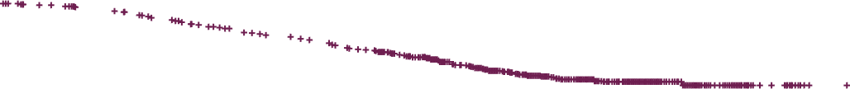
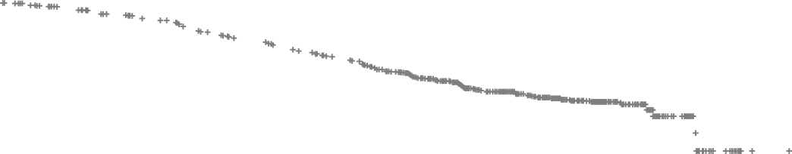

IDFS (randomized patients)
 | Giredestrant + everolimus (n = 102) | SOC ET + everolimus (n = 105)
Events, n (%) | 140 (6.7) | 196 (9.4)
Median, mo (range) | NE (0.0,* 46.5*) | NE (0.0,* 46.3*)
Stratified HR (95% CI) | 0.70 (0.57, 0.87); p = 0.0014†
Giredestrant
n = 2084
SOC ET
n = 2086
100
80
100
97.7%
94.6%
60
96.9%
92.4%
IDFS (%)
92.3%
89.6%
40
80
Note separation of curves (although few data at 3y)
20
0
0
0
6
12
18
24
30
36
42
0
6
12
18
24
30
36
42
Time (mo)
Giredestrant
SOC ET
2084
2086
2021
2016
1969
1958
1932
1898
1716
1683
1088
1048
345
325
26
25
No. at risk
Bardia A et al. SABCS 2025;Abstract GS1-10

Slide 97
IDFS (randomized patients)
 | Giredestrant + everolimus (n = 102) | SOC ET + everolimus (n = 105)
Events, n (%) | 140 (6.7) | 196 (9.4)
Median, mo (range) | NE (0.0,* 46.5*) | NE (0.0,* 46.3*)
Stratified HR (95% CI) | 0.70 (0.57, 0.87); p = 0.0014†
Giredestrant
n = 2084
SOC ET
n = 2086
100
80
100
97.7%
94.6%
60
96.9%
92.4%
IDFS (%)
92.3%
89.6%
40
80
Note separation of curves (although few data at 3y)
20
0
0
0
6
12
18
24
30
36
42
0
6
12
18
24
30
36
42
Time (mo)
Giredestrant
SOC ET
2084
2086
2021
2016
1969
1958
1932
1898
1716
1683
1088
1048
345
325
26
25
No. at risk
Absolute difference 2.8% @ 2.75y
Same direction for clinically important endpoints (e.g. DRFS 2.1% difference)
Medium risk group has few events (HR 0.74, 0.42-1.31)
Bardia A et al. SABCS 2025;Abstract GS1-10

Slide 98
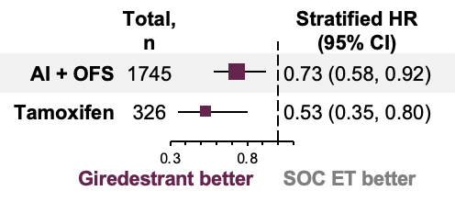
lidERA Control ET Was Not Modern Therapy
Giredestrant IDFS vs
SOC ET type*
(16% Rx tamoxifen)
(
)
*exploratory analysis
Bardia A, SABCS 2025
Nearly 80% were node-positive, >30% N2-3
None received CDK4/6 inhibition
Carey L. SABCS 2025. Discussant;GS1-10

Slide 99
lidERA in Context of Other Adjuvant Advances
 | absolute △ | HR
lidERA (2.75y) | 2.8% | 0.70
ATAC (3y) | 2.0% | 0.83
MonarchE (2y) | 2.8% | 0.75
MonarchE (4y) | 6.4% | 0.66
MonarchE (7y) | 6.5% | 0.73
NATALEE (3y) | 2.7% | 0.75
NATALEE (4y) | 4.4% | 0.72
NATALEE (5y) | 4.5% | 0.72
Bardia A, SABCS2025; ATAC Trialists, Lancet 2005; Johnston S, JCO2020; Lancet Oncol 2023; ESMO2025; Hortobagyi G, Ann Oncol2025; Fasching PA, JAMA Oncol 2025; Crown J, ESMO2025
Carey L. SABCS 2025. Discussant;GS1-10

Slide 100
Oral SERD Adjuvant Trials
Trial Name | N | Arms | Patient Population | Adjuvant CDK4/6i allowed | Trial Identifier
CAMBRIA-2 | 5500 | Camizestrant vs ET | High-risk ER+/HER2-, first adjuvant therapy | Yes | NCT05952557
lidERA | 4200 | Giredestrant vs ET | Medium to high-risk ER+/HER2-, first adjuvant therapy | No | NCT04961996
ELEGANT | 4220 | Elacestrant vs SoC | ER+/HER2-, Early Breast Cancer With High Risk of Recurrence; 2-5y of prior ET | Prior to trial entry | NCT06492616
EMBER-4 | 6000 | Imlunestrant vs ET | High-risk ER+/HER2-, 2-5 yr of adjuvant ET | Prior to trial entry | NCT05514054
CAMBRIA-1 | 4300 | Camizestrant vs ET | Intermediate to high-risk ER+/HER2-, 2-5 yr of adjuvant ET | Prior to trial entry | NCT05774951
TREAT ctDNA | 220 | Elacestrant vs ET | ↑ risk ER+/HER2-, ctDNA relapse, 2-7 yr adjuvant ET | ≥12 mo prior to trial entry | NCT05512364

Slide 101

Summary
First improvement in adjuvant endocrine therapy in 20 years!
  ~ 30% proportional improvement in IDFS and other endpoints
  Absolute IDFS differences < 3% at 32m, likely to grow
Combination data with CDK4/6i not yet available.
  Given benefit in high-risk patients, continue AI + CDK4/6i during initial 2-3y
  Need to determine if giredestrant benefit is additive to CDK4/6i benefit
No predictive biomarkers to tailor therapy (besides ER) so lidERA has broad clinical implications
  Biomarkers and models to guide decision-making will be crucial

Slide 102
Discussion Questions
If adjuvant giredestrant were available, for which patients would you prioritize its use? How would you select between giredestrant monotherapy and CDK4/6 inhibitor/endocrine therapy combinations for patients eligible to receive both?
How is adjuvant giredestrant tolerated compared to standard adjuvant endocrine therapy? Would your approach to counseling/education for patients receiving an oral SERD in the adjuvant setting differ from that for metastatic disease?

Slide 103
Agenda
Module 1: Current Clinical Role of Oral Selective Estrogen Receptor Degraders (SERDs) in HR-Positive Metastatic Breast Cancer
Module 2: Practical Considerations with Oral SERDs
Module 3: Potential Role of Combination Approaches with Oral SERDs
Module 4: Gastrointestinal Adverse Events Documented with Oral SERDs
Module 5: Potential Role of Early Therapeutic Switching After Detection of an Emergent ESR1 Mutation
Module 6: Other Class-Effect Toxicities Associated with Oral SERDs
Module 7: Emerging Utility of Adjuvant Oral SERDs
Module 8: Unique Toxicities Associated with 1 or More Oral SERDs

Slide 104
Unique Toxicities Associated with One or More Oral SERDs
Marissa Marti-Smith
DNP, APRN, AGNP-C, AOCNP

Slide 105

SERD overview
Hyperlipidemia
Other lab abnormalities
Cardiac AE’s
Visual disturbances

Slide 106

Lipid monitoring
Elacestrant, EMERALD 3 trial
Hypercholesterolemia (30%), Grade 3/4 (0.9%)
Hypertriglyceridemia (27%), Grade 3/4 (2.2%)
Other SERDs (such as Camizestrant, Giredestrant, and Imlunestrant)
  comparable or slightly elevated risks of dyslipidemia in early trial data, consistent with the broader class effect
Baseline & “Periodic” monitoring
Prevention, patient education on diet, exercise
(Shah et al., 2024), (Elacestrant PI, 2026).

Slide 107

Lab monitoring
Elacestrant
  LFTs , AST (29%), ALT (17%)
  CBC ~ decreased hgb (26%)
  CMP ( creatinine, low Na+) (16%)
Imlunestrant
  LFTs, AST (25%), ALT (21%)
  CBC ~ decreased hgb (30%), ANC (26%), Plts (16%)
  CMP ~ low Ca+ (26%)
(Imlunestrant PI, 2025), (Elacestrant PI, 2026)

Slide 108

Cardiac AE’s
Camizestrant (not yet approved)
Bradycardia: SERENA-6, sinus bradycardia was ~7.7% Severity:
The vast majority of these events are Grade 1 or 2 (asymptomatic or mildly symptomatic).
Median HR ~ 14 beats per minute.
Concern combo therapy w/ QT prolonging drugs, synergistic risk
ECGs (frequent w/trials), CMP, Mg+
(U.S. FDA, 2026).

Slide 109

AE’s
Giredestrant (not yet approved)
Bradycardia: evERA trial:
bradycardia Grade 1/2 (mild to moderate) was observed in 3.8% of patients receiving the giredestrant combination, compared to 0.5% in the SOC arm.
No reports of Grade 3 or 4 (severe) bradycardia.
No photopsia (visual disturbances)
(Mayer et al., 2025)

Slide 110

Visual Disturbances
Incidence: 32% of patients taking camizestrant in combination with a CDK4/6 inhibitor.
Photopsia 12% to 20% of patients, depending on the trial and dose
SERENA-6 trial, 90% Grade 1, and 8% were Grade 2.
Onset and Duration: median time to onset is roughly 8 days
Symptoms: transient, reversible
Eyelid
(Brufsky et al., 2026).

Slide 111

Visual Disturbances
Education re: photopsia
Often transient and tend to occur when transitioning from dark to bright environments.
When to seek medical attention
  Severe, continuous vision changes or blurring.
  If symptoms progress, unsafe completing daily tasks.

Slide 112
Case Presentation

Slide 113

Case Study
76 yo female
MBC, extensive bone only disease
2nd line, Phase 1/2 Study, q2 week checks
Elacestrant 345mg PO QD + EP0062 (Vosilasarm) 5mg PO BID
Selective Androgen Receptor Modulator
~4 months into therapy
Responding well, tolerating well
LDL 271 (298 month prior), HDL 37
Trigs normal, LFTs mildly elevated

Slide 114
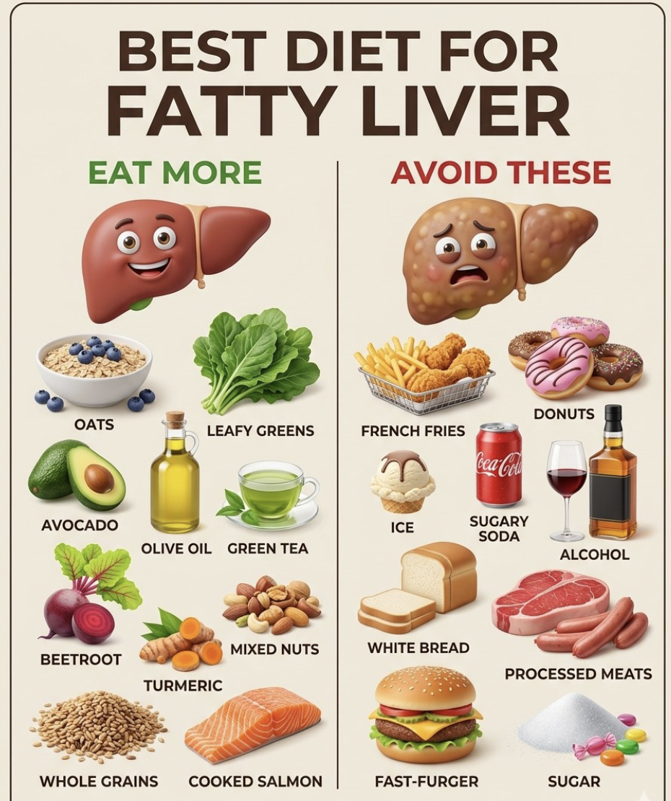
Management & Takeaway
Atorvastatin 10mg PO QD
Dietary changes
Exercise
Communion wine, ”sip” daily
Avoiding hepatotoxic medications
2 mo later, LDL 90, HDL 36
AST 54, ALT 72, Alk phos normal
FAST-FOOD BURGER

Slide 115

Thanks for
all you
do as
Oncology
nurses!

Slide 116
Thank you for joining us! Please take a moment to complete the survey currently up on Zoom. Your feedback is very important to us. The survey will remain open up to 5 minutes after the meeting ends.
To Claim NCPD Credit
In-person attendees: Please refer to the program syllabus for the NCPD credit link or QR code.
Virtual attendees: The NCPD credit link is posted in the chat room.
NCPD/ONCC credit information will be emailed to each participant within 1 to 2 business days.

