Slide 1
Non-Muscle-Invasive and Muscle-Invasive Bladder Cancer
Recent Advances in Cancer Care — New Paradigms,
Novel Agents and What It Means for the Oncology Nurse
A Complimentary NCPD Symposium Series Held During the 51st Annual ONS Congress
Thursday, May 14, 2026
6:00 PM – 7:30 PM
Faculty
Alexandra Drakaki, MD, PhD
Krisztina Emodi, NP-C, MPH, CNS
Margarita Huober, MS, AGNP-C, AOCNP
Moderator
Terence Friedlander, MD

Slide 2




Faculty
Alexandra Drakaki, MD, PhD
Associate Professor of Medicine
Hematology/Oncology and Urology
Medical Director of the Genitourinary Oncology Program
Leader of the Genitourinary Research Program
University of California, Los Angeles
Los Angeles, California
Margarita Huober, MS, AGNP-C, AOCNP
Nurse Practitioner
Genitourinary Medical Oncology
Stanford Health Care
Palo Alto, California
Krisztina Emodi, NP-C, MPH, CNS
GU Surgical Oncology
UCSF Helen Diller Family Comprehensive Cancer Center
San Francisco, California
Moderator
Terence Friedlander, MD
Professor of Medicine and Robert and Virginia O’Reilly Family Endowed Chair
Chief, Division of Hematology/Oncology
Zuckerberg San Francisco General Hospital
Helen Diller Family Comprehensive
Cancer Center
University of California, San Francisco
San Francisco, California

Slide 3
Dr Drakaki — Disclosures
Advisory Committees | AstraZeneca Pharmaceuticals LP, Bristol Myers Squibb, Daiichi Sankyo Inc, Janssen Biotech Inc, Loxo Oncology Inc, a wholly owned subsidiary of Eli Lilly & Company, Pfizer Inc
Consulting Agreements | AstraZeneca Pharmaceuticals LP, Daiichi Sankyo Inc, Loxo Oncology Inc, a wholly owned subsidiary of Eli Lilly & Company, Pfizer Inc
Contracted Research | Acrivon Therapeutics, Adcentrx Therapeutics, Allogene Therapeutics, Arcus Biosciences, AstraZeneca Pharmaceuticals LP, Daiichi Sankyo Inc, Genentech, a member of the Roche Group, Infinity Pharmaceuticals Inc, Kite, A Gilead Company, Loxo Oncology Inc, a wholly owned subsidiary of Eli Lilly & Company, Merck, Pfizer Inc
Data and Safety Monitoring Boards/Committees | Nektar Therapeutics
Speakers Bureaus | AstraZeneca Pharmaceuticals LP
Stock OPTIONS — Private Companies | Athos Therapeutics
Nonrelevant Financial Relationships | Dyania Health

Slide 4
Ms Emodi — Disclosures
No relevant financial relationships to disclose.

Slide 5
Ms Huober — Disclosures
No relevant financial relationships to disclose.

Slide 6
Dr Friedlander — Disclosures
Advisory Committees | Aadi Bioscience, AbbVie Inc, Adaptimmune, Aktis Oncology, Astellas, Bicycle Therapeutics, Bristol Myers Squibb, Gilead Sciences Inc, Merck, Pfizer Inc, Samsung Bioepis
Consulting Agreements | Astellas, EMD Serono Inc, Genentech, a member of the Roche Group
Contracted Research | AbbVie Inc, Bicycle Therapeutics, Flare Therapeutics, Genentech, a member of the Roche Group, Johnson & Johnson, Pfizer Inc

Slide 7
Commercial Support
This activity is supported by educational grants from AstraZeneca Pharmaceuticals LP, Johnson & Johnson, and Merck.
Research To Practice NCPD Planning Committee Members,
Staff and Reviewers
Planners, scientific staff and independent reviewers for Research To Practice have no relevant financial relationships to disclose.

Slide 8
This educational activity contains discussion of
non-FDA-approved uses of agents and regimens. Please refer to official prescribing information for each product for approved indications.

Slide 9



Clinicians in the Meeting Room
Networked iPads are available.
Review Program Slides: Tap the Program Slides button to review speaker presentations and other program content.
Answer Survey Questions: Complete the pre- and postmeeting surveys. Survey questions will be discussed throughout the meeting.
Ask a Question: Tap Ask a Question to submit a challenging case or question for discussion. We will aim to address as many questions as possible during the program.
For assistance, please raise your hand. Devices will be collected at the conclusion of the activity.
Notes:
9

Slide 10

Clinicians Attending via Zoom
Review Program Slides: A link to the program slides will be posted in the chat room at the start of the program.
Answer Survey Questions: Complete the pre- and postmeeting surveys. Survey questions will be discussed throughout the meeting.
Ask a Question: Submit a challenging case or question for discussion using the Zoom chat room.
Get NCPD Credit: An NCPD credit link will be provided in the chat room at the conclusion of the program.
Notes:
10

Slide 11
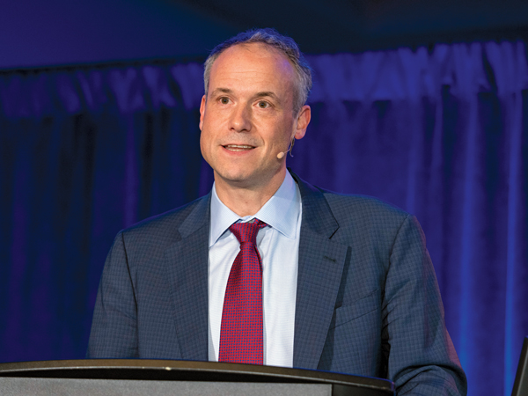
About the Enduring Program
The live meeting is being video
and audio recorded.
The proceedings from today will
be edited and developed into
an enduring web-based program.
An email will be sent to all attendees
when the activity is available.
To learn more about our education programs, visit our website, www.ResearchToPractice.com
Notes:
11
11

Slide 12



Slide 13

“Recent Advances in Cancer Care — New Paradigms,
Novel Agents and What It Means for the Oncology Nurse”
Eighteenth Annual RTP-ONS NCPD Symposium Series

Slide 14


New Agents, Therapies and Regimens
Recent Advances in Cancer Care — New Paradigms,
Novel Agents and What It Means for the Oncology Nurse
When should it be used, for whom and why?
How to prevent and manage side effects:
dose holds and reductions
  Kaplan Meier curves —
  HR and absolute benefit
  Waterfall plots

Slide 15
Non-Muscle-Invasive and Muscle-Invasive Bladder Cancer
Recent Advances in Cancer Care — New Paradigms,
Novel Agents and What It Means for the Oncology Nurse
A Complimentary NCPD Symposium Series Held During the 51st Annual ONS Congress
Thursday, May 14, 2026
6:00 PM – 7:30 PM
Faculty
Alexandra Drakaki, MD, PhD
Krisztina Emodi, NP-C, MPH, CNS
Margarita Huober, MS, AGNP-C, AOCNP
Moderator
Terence Friedlander, MD

Slide 16
Agenda
Introduction: Basic Biology of Nonmetastatic Urothelial Bladder Cancer (UBC)
Module 1: Systemic Therapy for Cisplatin-Eligible Patients with Muscle-Invasive Bladder Cancer (MIBC)
Module 2: Evolving Approach to Systemic Therapy for Cisplatin-Ineligible Patients with MIBC
Module 3: Immune Checkpoint Inhibitors in Non-Muscle-Invasive Bladder Cancer
Module 4: Novel Intravesical Therapies for Nonmetastatic UBC

Slide 17
Agenda
Introduction: Basic Biology of Nonmetastatic Urothelial Bladder Cancer (UBC)
Module 1: Systemic Therapy for Cisplatin-Eligible Patients with Muscle-Invasive Bladder Cancer (MIBC)
Module 2: Evolving Approach to Systemic Therapy for Cisplatin-Ineligible Patients with MIBC
Module 3: Immune Checkpoint Inhibitors in Non-Muscle-Invasive Bladder Cancer
Module 4: Novel Intravesical Therapies for Nonmetastatic UBC

Slide 18
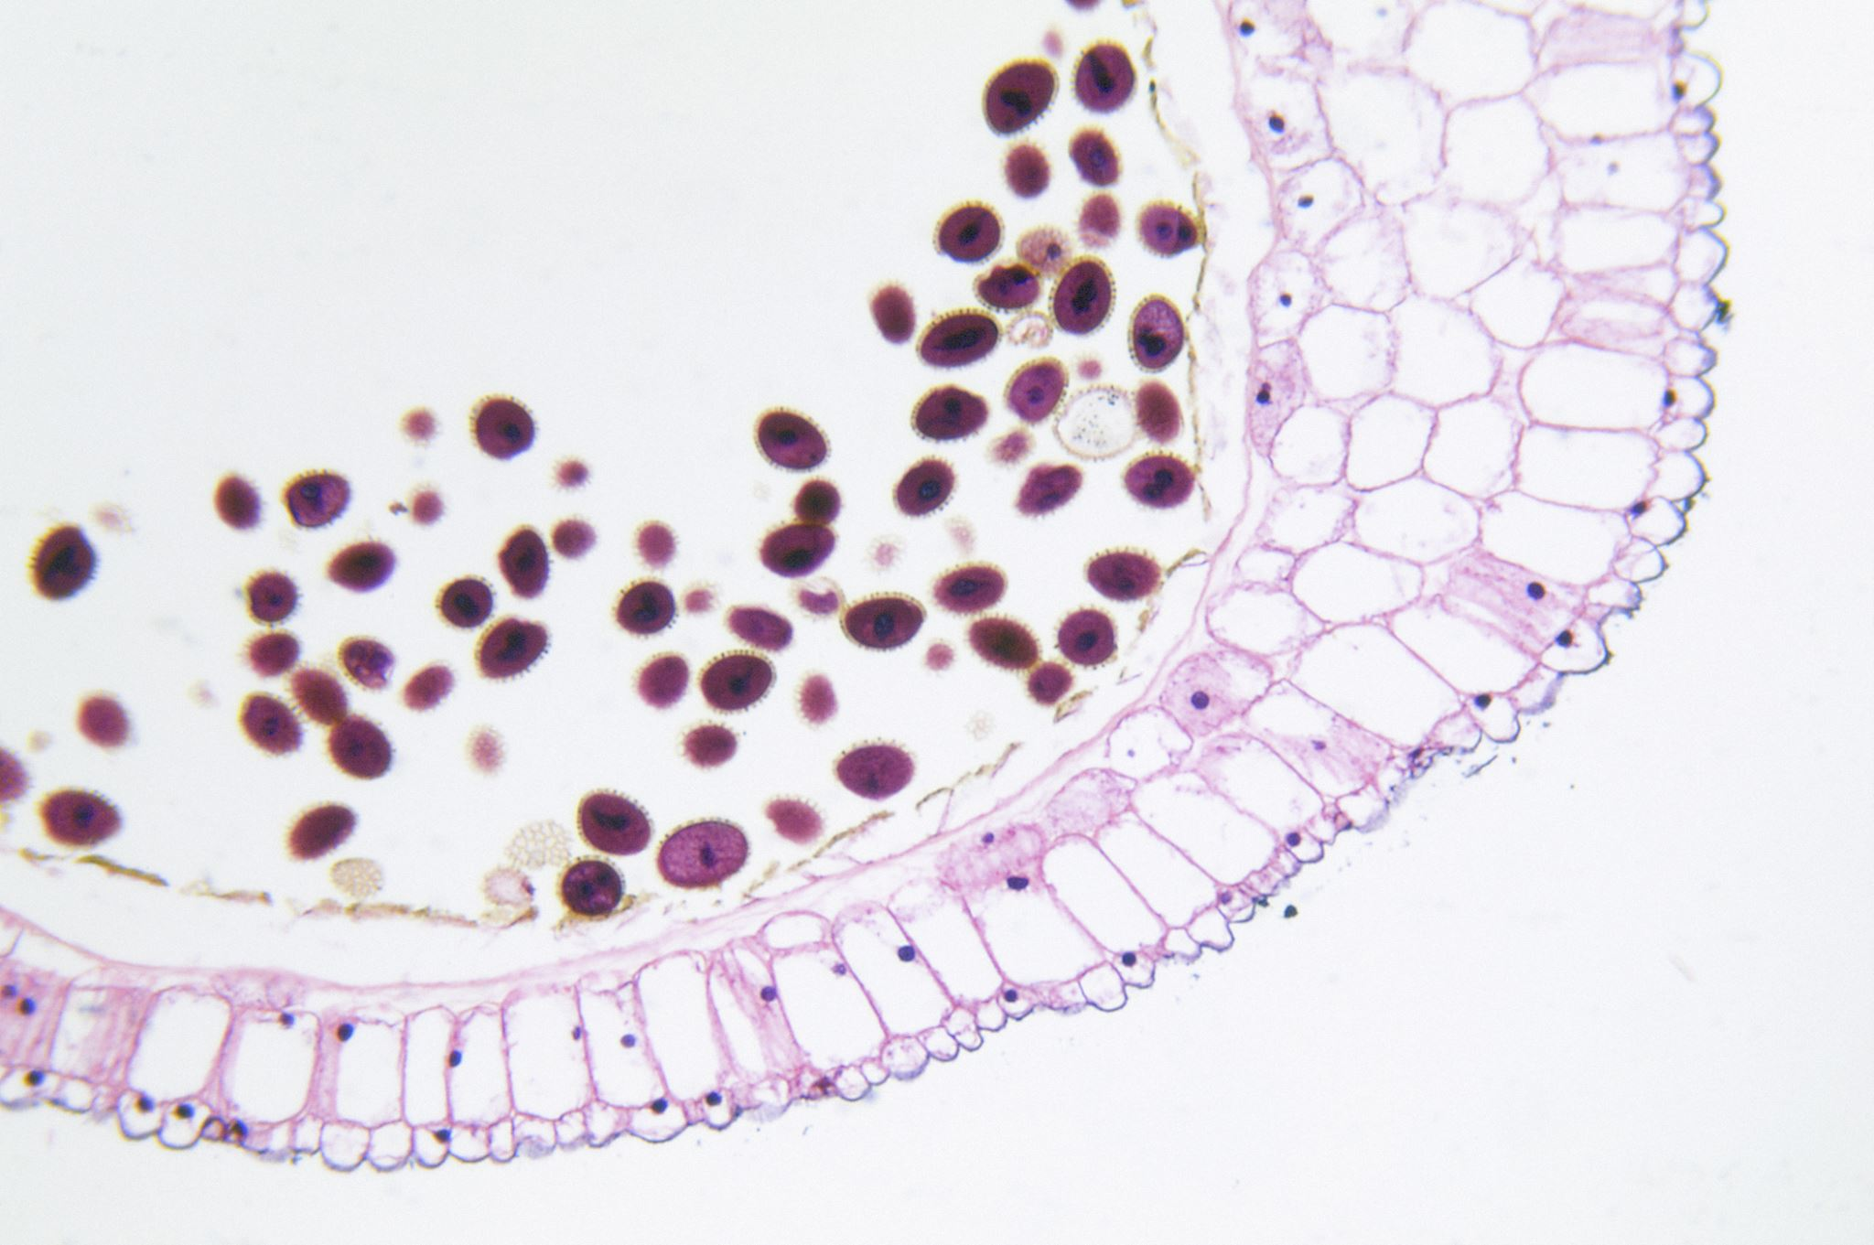
Basic Biology of
Nonmetastatic Urothelial Bladder Cancer (UBC)
Krisztina Emodi NP-C, MPH, CNS
Nurse Practitioner III
UCSF GU Surgical Oncology
Bladder Cancer Survivorship Program Lead

Slide 19
Agenda
Staging of nonmetastatic UBC; difference between non-muscle-invasive bladder cancer (NMIBC) and muscle-invasive bladder cancer (MIBC)
Role of various treatment strategies that have historically been employed in nonmetastatic UBC
Educating patients regarding expectations surrounding radical cystectomy
Criteria used to determine platinum eligibility in patients with MIBC
Case study

Slide 20
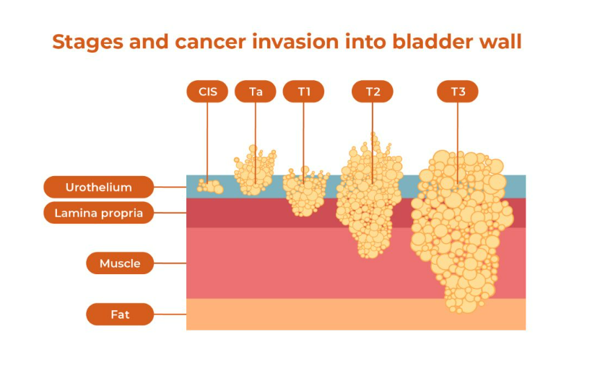
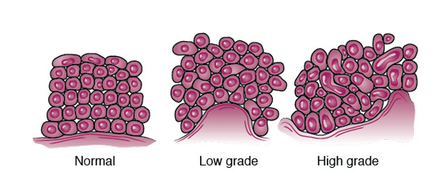
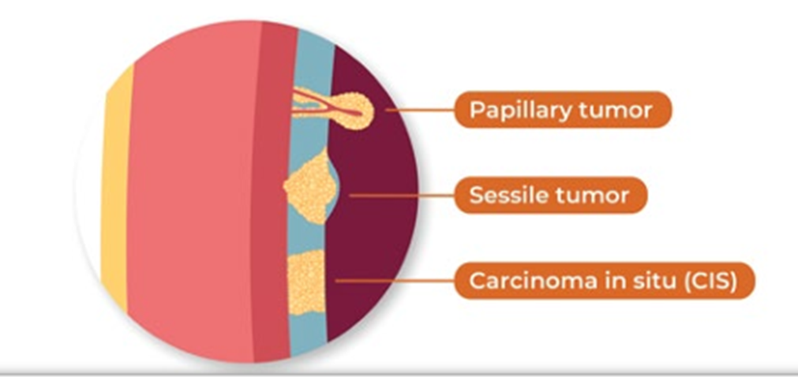
Bladder Cancer Staging
The Urothelium:
-basal cells​
-intermediate cells​
-umbrella cells. ​
The urothelium is the most impermeable of all human epithelia
Notes:
CIS (Carcinoma in situ): This is a flat tumor on the surface of the bladder lining. Non-invasive (Ta): The tumor is only on the inner lining of the bladder, not going deeper into the bladder walls. Superficially invasive (T1): The tumor has spread to the layer of tissue under the bladder lining, the lamina propria, but not yet into the bladder muscles. Muscle invasive (T2 or higher): The tumor has grown into or through the bladder wall and involves the muscle layer.

Slide 21
AUA guidelines for risk stratification
Low Risk | Intermediate Risk | High Risk
LGª solitary Ta ≤ 3cm | Recurrence within 1 year, LG Ta | HG T1
PUNLMP^{b} | Solitary LG Ta > 3cm | Any recurrent, HG Ta
 | LG Ta, multifocal | HG Ta, >3cm (or multifocal)
 | HG^{c} Ta, ≤ 3cm | Any CIS^{d}
 | LG T1 | Any BCG failure in HG patient
 |  | Any variant histology
 |  | Any LVIe
 |  | Any HG prostatic urethral involvement
ªLG = low grade; ^{b}PUNLMP = papillary urothelial neoplasm of low malignant potential; ^{c}HG = high grade; ^{d}CIS=carcinoma in situ; ^{e}LVI = lymphovascular invasion

Slide 22
Diagnostic Tests (Cystoscopy, Cytology, CTU)
Initial evaluation: Office cystoscopy for hematuria or symptoms
Limitations: WL cystoscopy may miss tumors; CIS can resemble normal or inflamed mucosa
Next step: CTU, OR biopsy/resection for diagnosis and treatment (TURBT)
Cytology: detects malignant cells in urine
Low sensitivity for low-grade tumors (true +)

Slide 23
Case Presentation

Slide 24
Patient Case: NMIBC
He is a 54 yo male who initially presented for evaluation of gross hematuria on 11/29/2022. Former smoker, quit in 2000s, no work or chemical exposures.
PMH: former smoker (quit 2000s), anxiety, childhood asthma, claustrophobia, HLD, IBS, allergies
Meds: finasteride, semaglutide
All: NKDA
Mother with hx of bladder cancer
Widowed and lost husband d/t leukemia. Now raising 12-yo twins alone

Slide 25

Transurethral resection of the bladder tumor (TURBT)
Cytology on 11/29/22 was AUC (PARIS III, classified from I-IV)
12/22/22: CTU: 2.8 cm bladder mass at left wall. No hydronephrosis, renal masses or filling defects. L renal cyst 1 cm.
Cysto Findings: no bladder stones, no foreign bodies, no diverticula, no active bleeding. At left bladder dome, one ~2 cm bladder tumor with wide-based stalk. Adjacent 0.5 cm papillary tumor.
TURBT: 1/10/22 TURBT #1
- bladder tumor #1: HG T1 UC, muscle present uninvolved
- bladder tumor #2: HG UC
- bladder tumor #3: HG Ta
High risk NMIBC

Slide 26
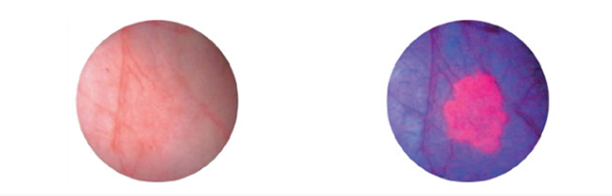
3/1/2023, the patient underwent a re-resection TURBT per guidelines for T1 with blue light and urethral dilation at UCSF to confirm stage + maximal TUR
Findings: Tight proximal penile urethral stricture, NED

Slide 27
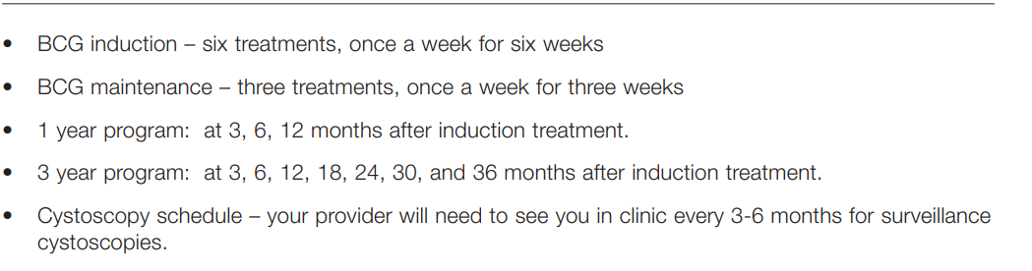
BCG: The Gold Standard to treat HG NMIBC
BCG with a maintenance protocol
  BCG is administered as a 6-week induction 3-6 weeks after TUR
  Followed by 3-week maintenance boosters at 3, 6, 12, 18, 24, 30 and 36 months. Strict cystoscopic and upper tract surveillance must be maintained throughout this period.

Slide 28
BCG Journey: Induction to Maintenance
BCG #1-6 3/23/2023-4/26/2023
BCG #7-9 with catheter in place: 7/5/2023-7/19/2023
BCG #10-12 (3/20/24-3/27/24)
BCG #13-15 (10/8/24-10/29/24)
BCG #16-18 (4/11/25-4/25/25)
BCG # 19-21 (July to Nov 2025)
5 mm L bladder wall lesion on Cystoscopy Jan 2026
OR/TURBT HG T1 into LP
CTU irregular mural thickening and urothelial hyperenhancement of the left lateral bladder wall

Slide 29
What is next after BCG unresponsive HG T1?
Treatment options for BCG-unresponsive high-grade T1 disease
-Pembrolizumab systemic immunotherapy with approximately 20% response rate at 1 year, generally reserved for older patients who cannot tolerate additional intravesical therapy
-Nadofaragene firadenovec-vncg gene-based viral vector therapy administered every 3 months with approximately 40-50% complete response rate at one year for papillary disease, but high-grade recurrence-free survival at 5 years is only 33% in the TA/T1 cohort
-Nogapendekin alfa inbakicept-pmln, which is the preferred bladder preservation option given the patient's prior good response to BCG (QUILT-3.032 Study)
58% (n=28) ≥12 months; 40% (n=19) ≥24 months

Slide 30
Radical Cystectomy as Definitive Treatment
High-grade T1 recurrence after BCG is one of the situations where bladder preservation carries significant risk of disease progression. It offers a 95% cure rate
If MIBC patients usually get NAC
Pre-op RC pathway, needs high volume cancer center
  Complex surgeries w/ high readmission rates
  Pre op materials include 22 page PDF document created by RN team
  Ostomy practice kits, video x 30 min
  Pre op meeting w/ NP x 60 min individually or in group visit
March 27, 2026- Radical Cystectomy w/ Neobladder, final pathology HG papillary tumor, pTaN0, no invasion

Slide 31
Criteria used to Determine Platinum Eligibility in
Patients with MIBC

Slide 32
Cisplatin Eligibility
GUMO uses the Galsky criteria (widely used in urothelial cancer to answer the question if a patient can get cisplatin therapy, typically gemcitabine/cisplatin or ddMVAC)
A patient is considered cisplatin-ineligible if they have any one of the following:
  Poor performance status
  ECOG performance status ≥ 2
  Renal dysfunction
Creatinine clearance < 60 mL/min
  Hearing loss
  Grade ≥ 2 audiometric hearing loss (clinically significant hearing impairment)
  Neuropathy
  Grade ≥ 2 peripheral neuropathy

Slide 33

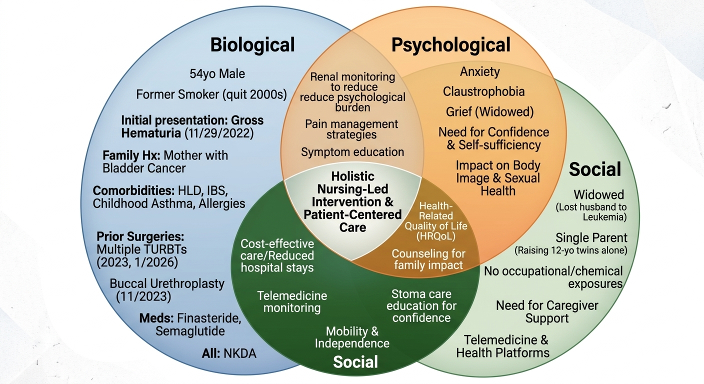

Slide 34
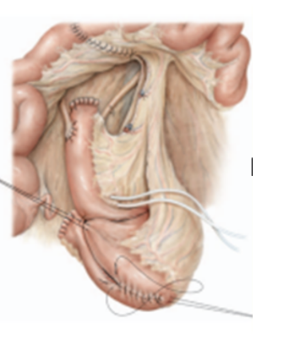
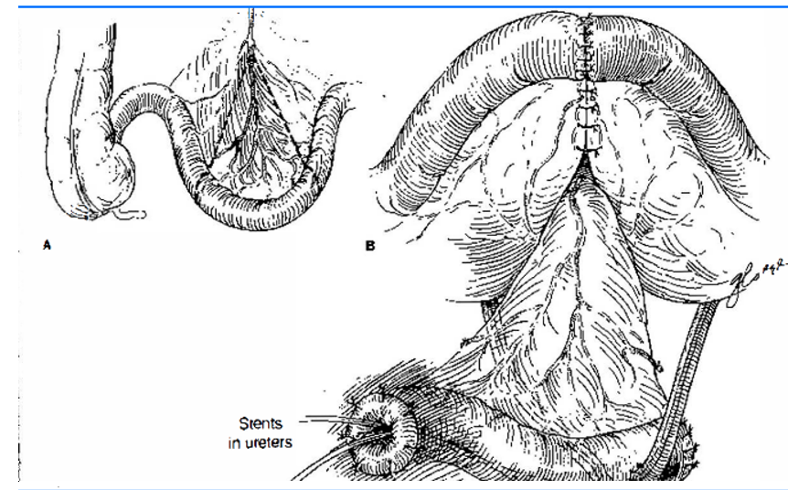
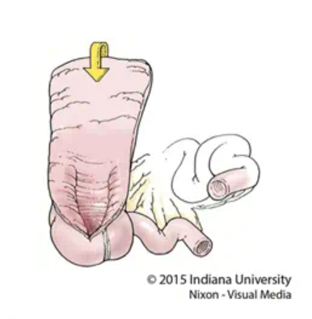
Urinary Diversion Options

Slide 35
Efficacy of Nursing-Led Interventions in Bladder Cancer Care
Specialized nursing care is more efficacious and cost-effective than usual care, primarily by reducing complications and hospital length of stay (LOS) + readmissions post RC
High-level urological nursing catches complications before they become costly emergencies
Stoma Care post op and long term/WOCN
Long term survivorship care/holistic approach w/ biopsychosocial model
Sexual health/support groups led by RNs/SW
Continence/pelvic floor
Improvement in QoL
Algaisi et al, Medicina 2026 PMID: 41597472

Slide 36
Agenda
Introduction: Basic Biology of Nonmetastatic Urothelial Bladder Cancer (UBC)
Module 1: Systemic Therapy for Cisplatin-Eligible Patients with Muscle-Invasive Bladder Cancer (MIBC)
Module 2: Evolving Approach to Systemic Therapy for Cisplatin-Ineligible Patients with MIBC
Module 3: Immune Checkpoint Inhibitors in Non-Muscle-Invasive Bladder Cancer
Module 4: Novel Intravesical Therapies for Nonmetastatic UBC

Slide 37

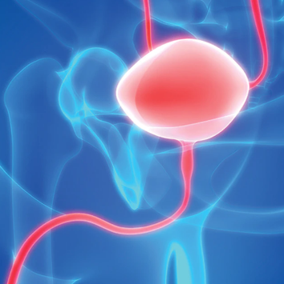
Perioperative Systemic Therapy for
Cisplatin-Eligible Patients with MIBC
Alexandra Drakaki, MD, PhD
Associate Professor of Medicine, Hematology/Oncology and Urology
Medical Director of the Genitourinary Oncology Program
Leader of the Genitourinary Research Program
University of California, Los Angeles
05/14/2026

Slide 38
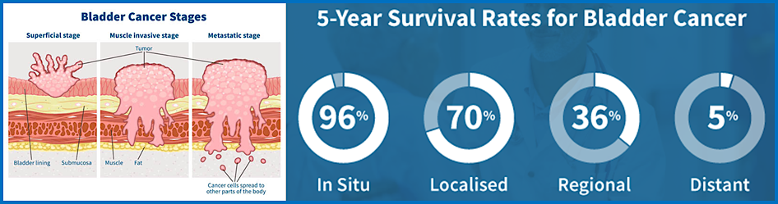
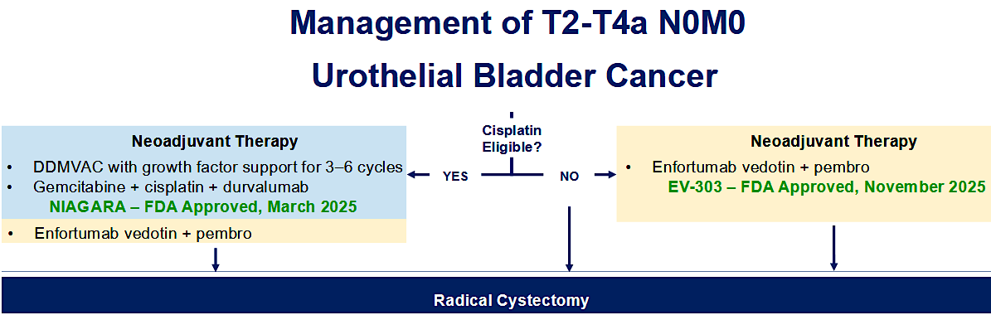
EV-304

Slide 39
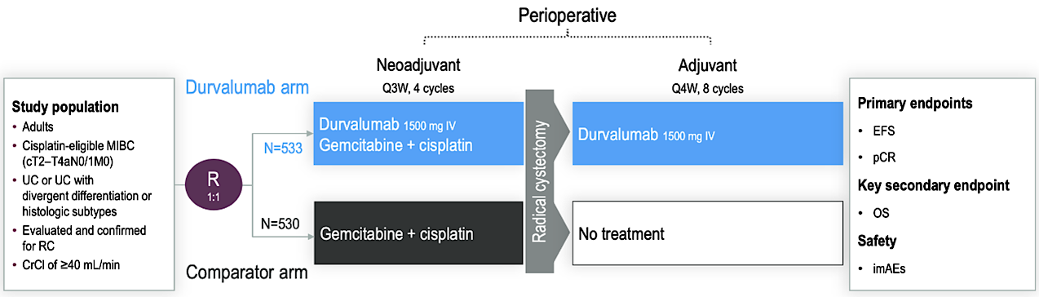
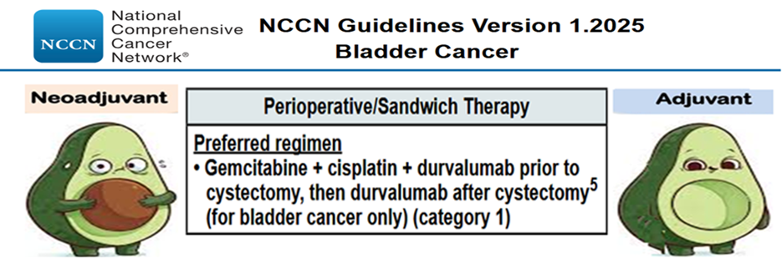

Slide 40
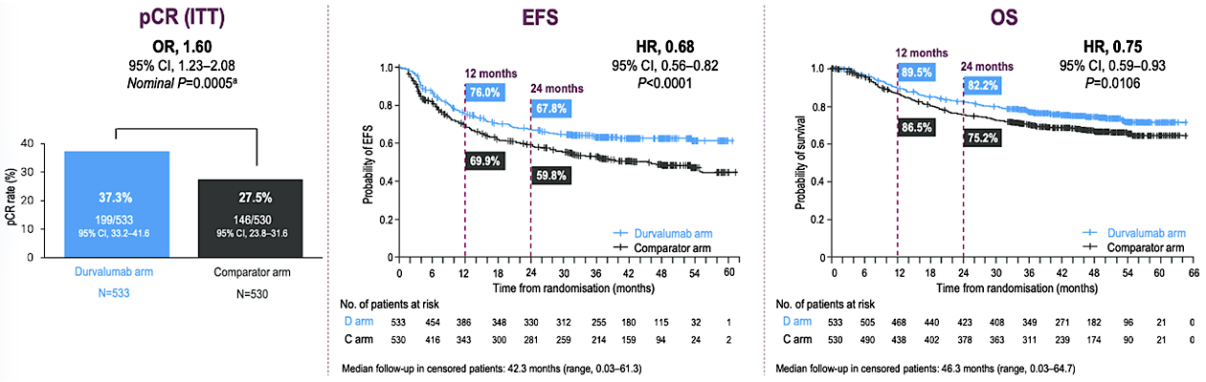
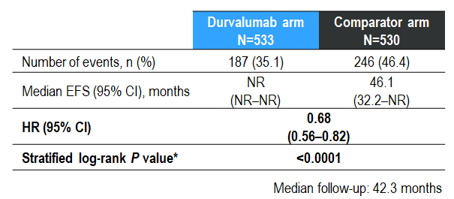
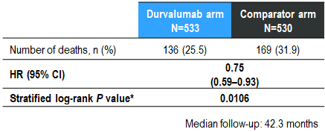
Powles T et al. ESMO 2024;Abstract LBA5; Meeks JJ et al. AUA 2025; Abstract PD39-09.

Slide 41
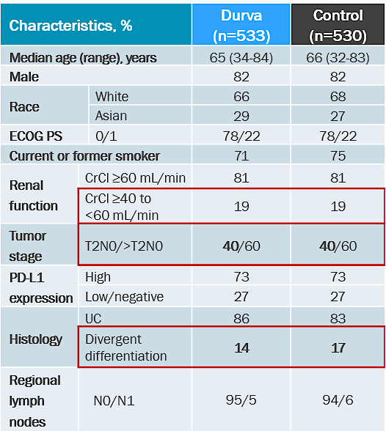
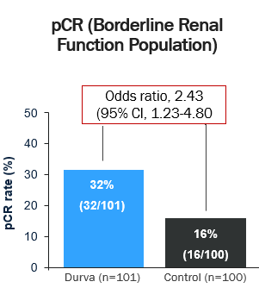
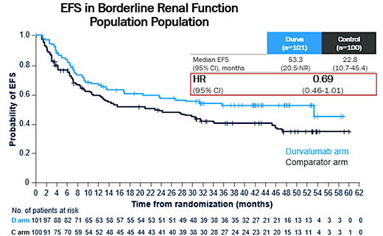
NIAGARA: pCR and EFS in Borderline Renal Function (CrCl ≥40 to <60 mL/min)
Meeks JJ et al. AUA 2025; Abstract PD39-09.

Slide 42
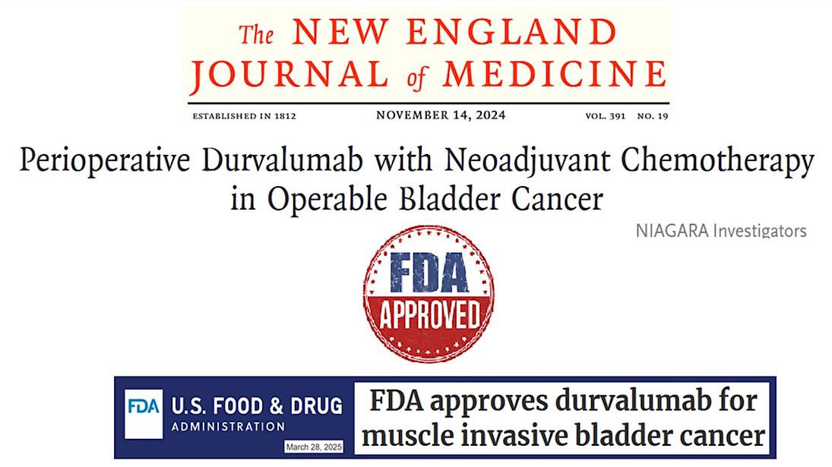

Slide 43
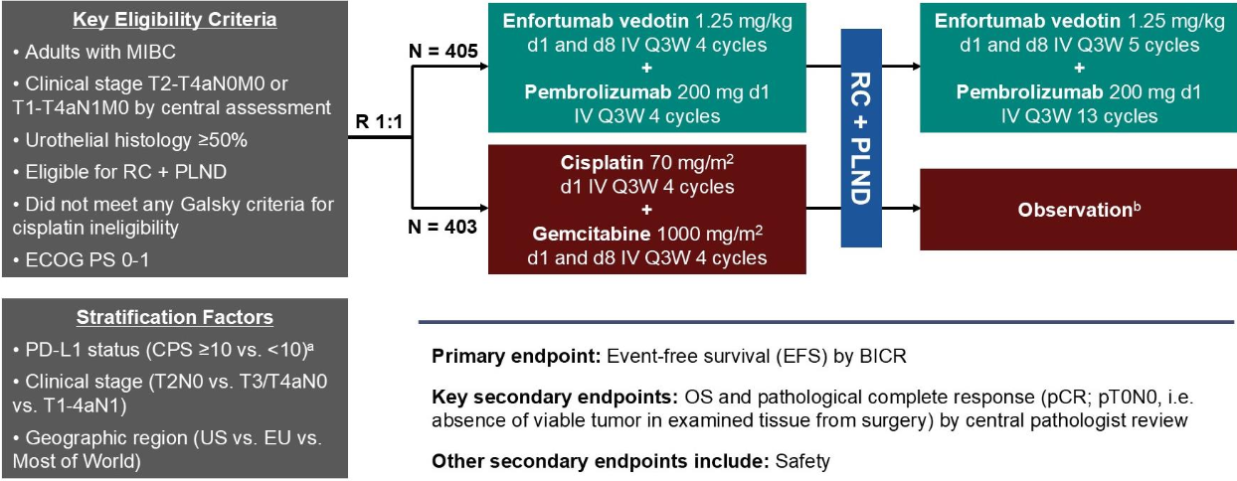

Slide 44
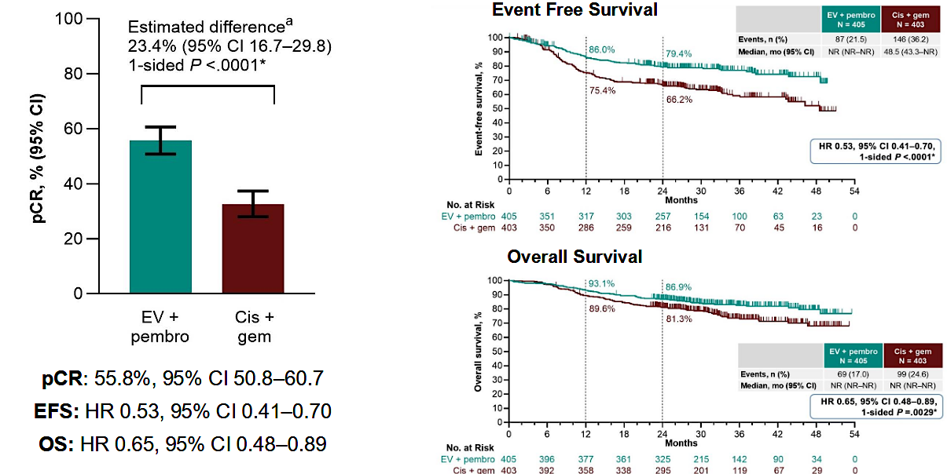

Slide 45
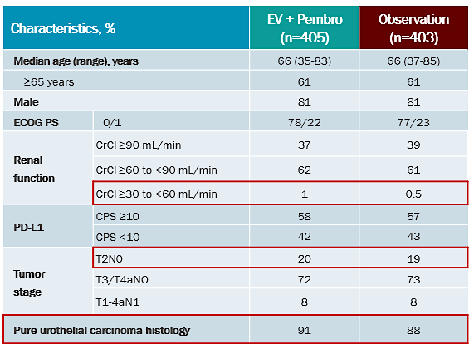
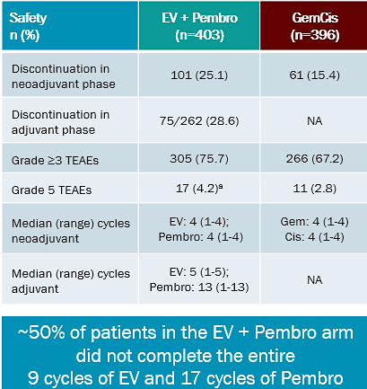
KEYNOTE B15/EV304 : Patient Characteristics & Safety

Slide 46
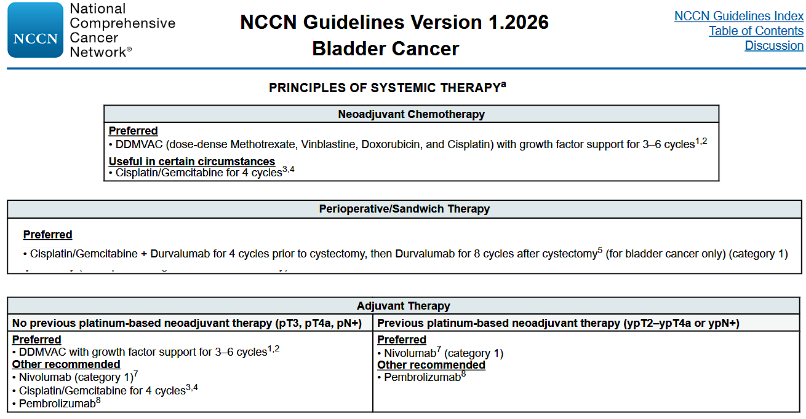
Conclusions

Slide 47
Case Presentation

Slide 48
48-year-old female with new diagnosis of Muscle Invasive Bladder Cancer
History of Present Illness:
48-year-old female is seen in urology clinic for stress incontinence. She has been having chronic UTIs since she started being sexually active in her early 20s, however more recently is having dysuria and irregular bleeding that is felt to be due to being perimenopausal. She has 4 children, two pairs of twins, age 20 and 16. Both deliveries were normal but prolonged and the second was an assisted vaginal delivery. She is having pelvic floor weakening and therefore stress incontinence. Given her recent complaints of intermittent hematuria, she was seen by her Ob/Gyn who did not identify any abnormalities during the exam and therefore referred to Urology for urodynamic studies and cystoscopy to evaluate the intermittent hematuria.

Slide 49
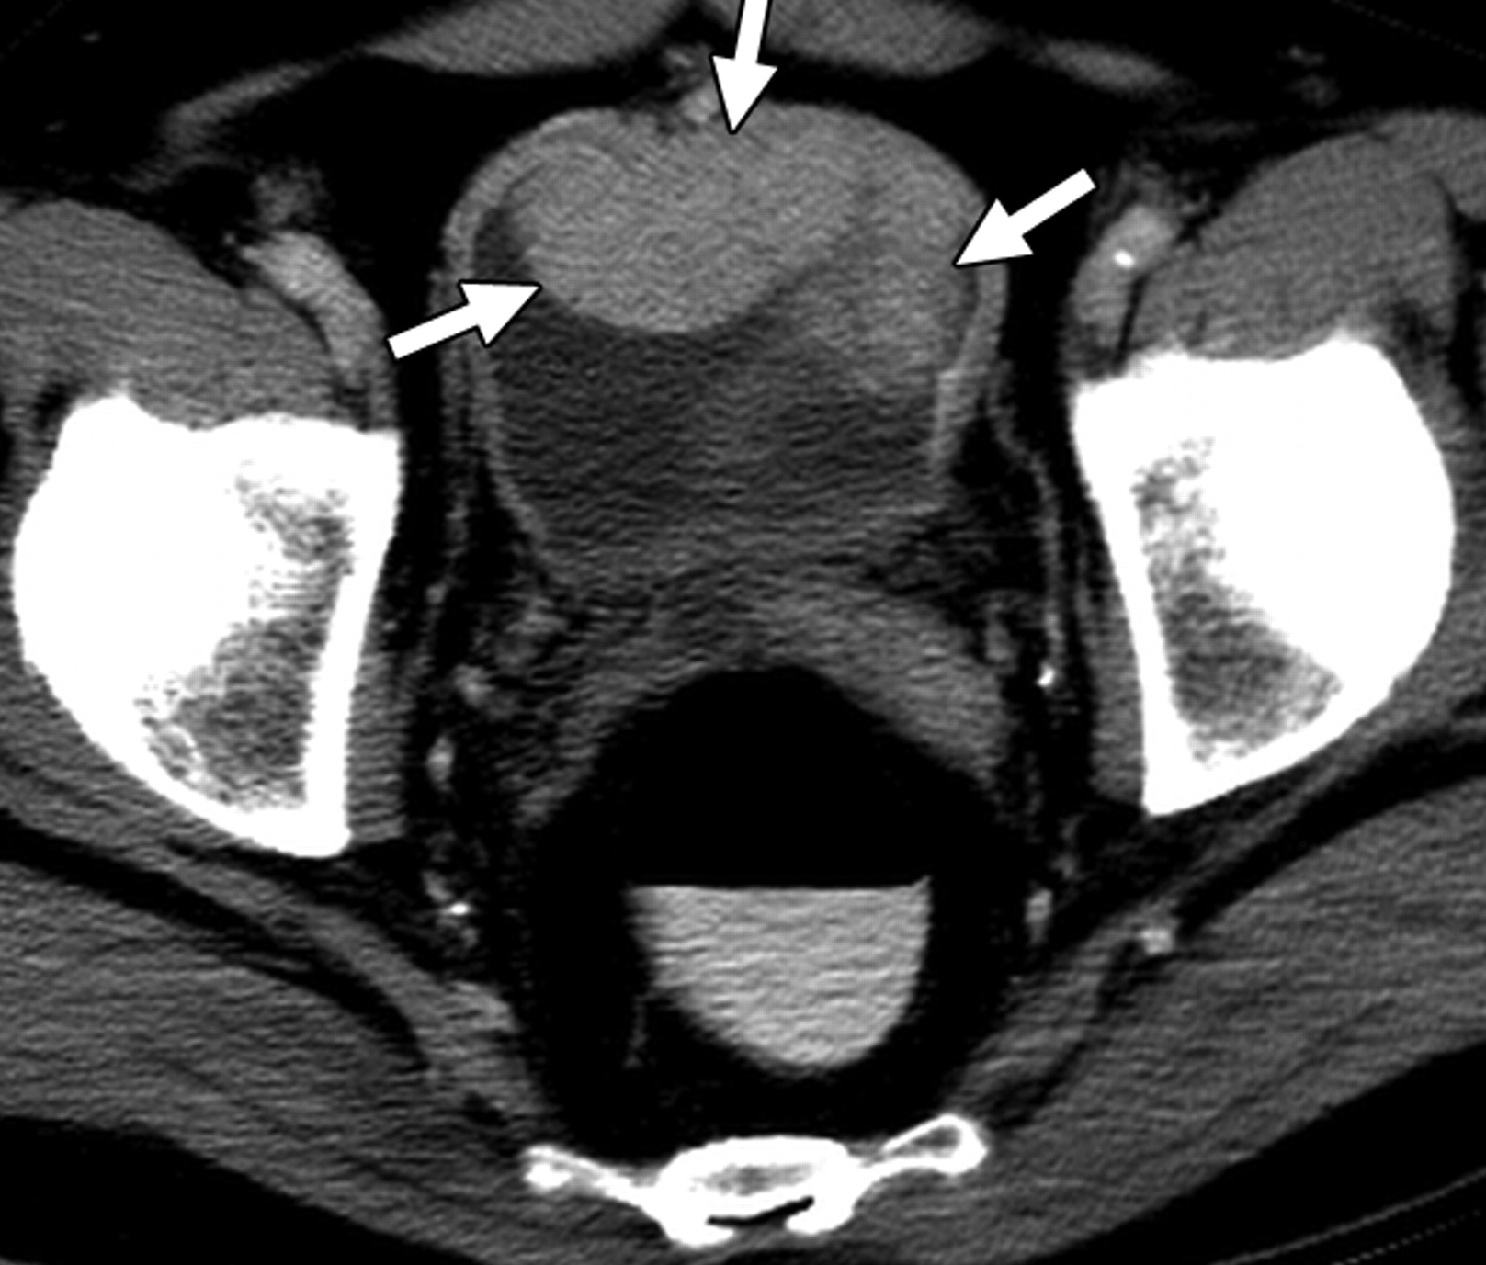
Patient underwent CT chest/abdomen/pelvis that revealed
the tumor mass but no metastatic disease
Patient had TURBT with maximum resection of the tumor.
Pathology was consistent with High Grade Urothelial carcinoma, with micropapillary features, invasion into the muscularis propria and perivesical fat.
Given new diagnosis of T3N0M0, she was referred to medical oncology for evaluation and management.

Slide 50
Past Medical History:
Gestational Diabetes, osteopenia
Past Surgical History:
None
Family History:
Mother: Ovarian Cancer, Father:Stroke, Brother: Prostate Cancer on active surveillance
Social History:
Works as a kindergarten teacher, does not smoke or drink, exercises 5 days a week and is vegan

Slide 51
Current Medications:
Calcium and Vitamin D, Multivitamin
She wants to be as aggressive as possible given her young age and her young kids and is asking about combination therapies.
Treatment Approach:
Given that she was very healthy otherwise, she was offered full dose Cisplatin/Gemcitabine/Durvalumab in the neoadjuvant setting. Underwent radical cystectomy with lymph node dissection and total abdominal hysterectomy and bilateral salpingo-oophorectomy with ileal conduit. Her pathology revealed yT1N0M0 with CIS and negative margins. She completed the 8 cycles of adjuvant durvalumab and currently is cancer free.

Slide 52
Discussion Questions
For which patients with MIBC are you prioritizing the use of perioperative durvalumab?
If perioperative pembrolizumab/enfortumab vedotin were to receive FDA approval for cisplatin-eligible patients with MIBC, how would you choose between these strategies? How would their individual side-effect profiles affect this decision?

Slide 53


Tolerability with the Use of Immune Checkpoint Inhibitors in Urothelial Bladder Cancer
Margarita Huober, AGNP, AOCNP
Stanford Health Care

Slide 54

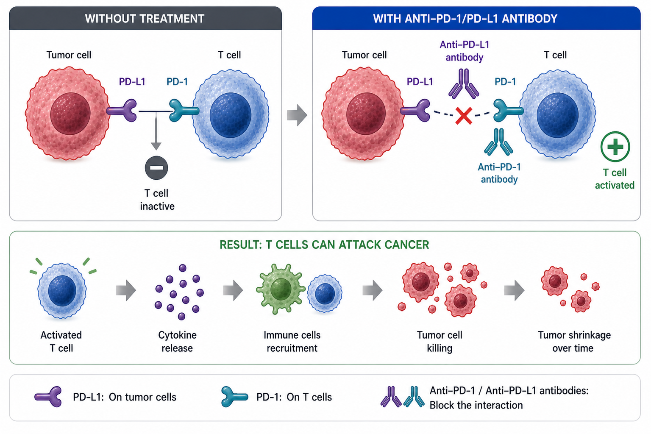


MECHANISM OF ACTION: PD-1 / PD-L1 CHECKPOINT
PD-1: Receptor on T cells → "off switch"
PD-L1: On tumor cells → turns T cells OFF
Tumors use this to escape the immune system
Drugs block PD-1 / PD-L1 interaction
→ T cells turn back ON and attack cancer
BLADDER CANCER AGENTS:
Anti–PD-1: Pembrolizumab, Nivolumab
Anti–PD-L1: Avelumab, Durvalumab
Atezolizumab UC indication withdrawn 2021
PD-1: programmed cell death 1; PD-L1: programmed cell death ligand 1; ICI: immune checkpoint inhibitor
Notes:
Immunotherapy works by:
Tumor has PD-L1 signal
T cells have PD-1 receptor
When they connect → T cell turns off and does not fight cancer
Immunotherapy blocks this connection → T cell stays on and attacks cancer
In Bladder Ca; most used Pembro, Durva.

Slide 55
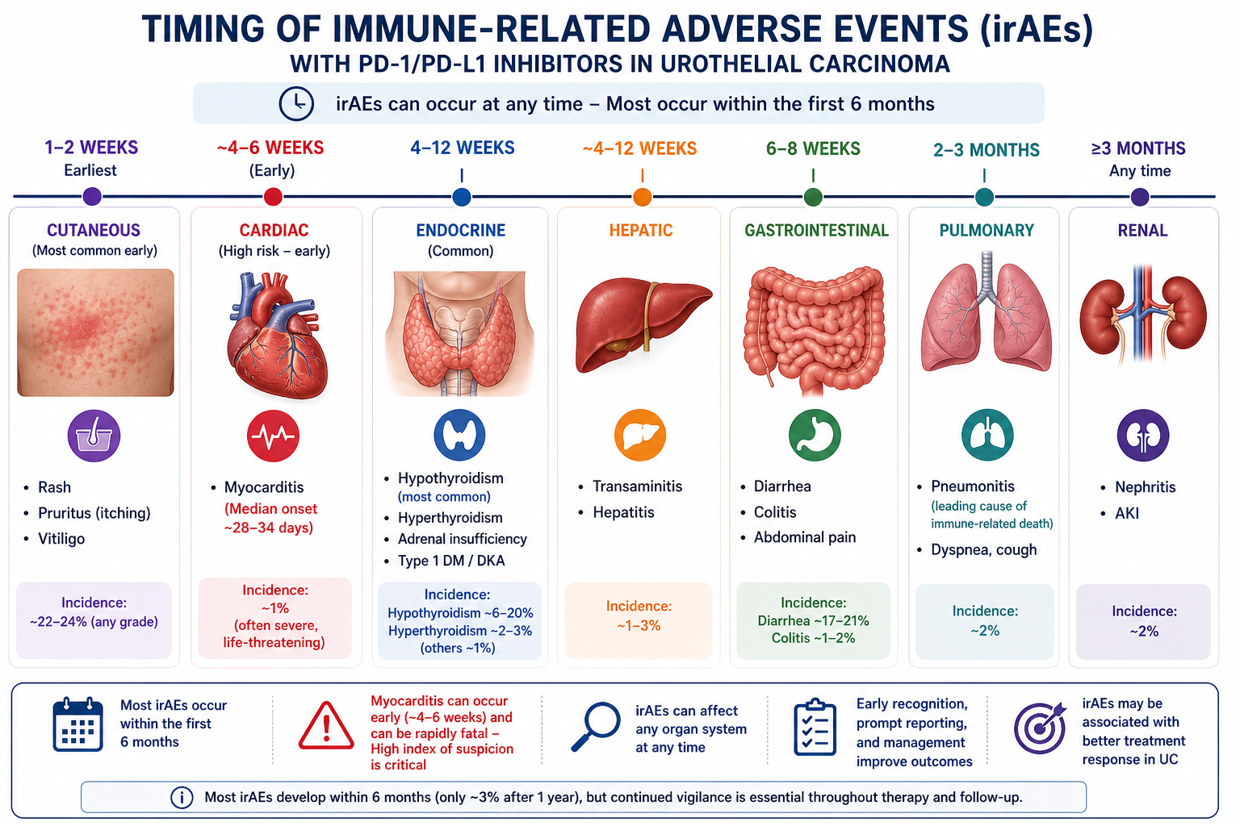
Schneider BJ et al. J Clin Oncol. 2021;39(36):4073-4126. Postow MA, et al. N Engl J Med. 2018;378(2):158-168. Daetwyler E, et al. J Immunother Cancer. 2024;12(1):e007409.

Slide 56



MONITORING FOR IMMUNE-RELATED ADVERSE EVENTS
BASELINE (BEFORE C1)
EVERY CYCLE
Labs: CBC, CMP
Endocrine: TSH, free T4, AM Cortisol, ACTH
History: Screen for Autoimmune History (Risk vs. Contraindication)
Labs: CBC, CMP, TSH (6–12 wk)
Symptom Check: Fatigue, Rash, GI, Cough, Joint Pain, Vision, Numbness, Polyuria
Ask directly — patients underreport mild symptoms
Red Flag Labs: Act Immediately
Trop/BNP ↑ → Myocarditis workup
AST/ALT >5x ULN → Hold ICI, start steroids
Cr Rise >1.5x → Nephritis workup
ICI: immune checkpoint inhibitor; ULN: upper limit of normal
Schneider BJ et al. J Clin Oncol. 2021;39(36):4073-4126. Brahmer JR, et al. J Immunother Cancer. 2021;9(6):e002435. Postow MA, et al. N Engl J Med. 2018;378(2):158-168. Chan KK, Bass AR. BMJ. 2020;369:m736. Daetwyler E, et al. J Immunother Cancer. 2024;12(1):e007409.
Notes:
baseline labs and exam before starting
check labs and symptoms every cycle
red flags to act on: lab abnormalities; shortness of breath or cough; chest pain or palpitations; diarrhea ≥4 stools/day; jaundice or dark urine; severe fatigue, headache, vision changes
any of these → evaluate and escalate immediately

Slide 57




IRAE MANAGEMENT — GRADES 1 & 2
GRADE 1 (MILD)
GRADE 2 (MODERATE)
•
Maintain ICI + close clinical monitoring
•
Oral Prednisone 0.5–1 mg/kg/day
•
Symptomatic treatment only (topicals, etc.)
•
Prompt subspecialty referral
•
Taper steroids slowly over 4+ weeks
⚠️ EXCEPTIONS: Myocarditis, Guillain-Barré, or Myasthenia → Hold/Discontinue even at Grade 1
Endocrinopathies: Hormone replacement, NOT steroids
irAE: immune-related adverse event; ICI: immune checkpoint inhibitor
Schneider BJ et al. J Clin Oncol. 2021;39(36):4073-4126. Brahmer JR, et al. J Immunother Cancer. 2021;9(6):e002435. Postow MA, et al. N Engl J Med. 2018;378(2):158-168. Puzanov I, et al. J Immunother Cancer. 2017;5(1):95.
Notes:
Grade 1 → continue ICI, monitor, treat symptoms; exception: cardiac/neuro (Myasthenia, Gullian Barre) → hold
Grade 2 → hold ICI, start steroids, involve specialists
Endocrine → hormone replacement; usually continue IO (no steroids)

Slide 58




IRAE MANAGEMENT — GRADES 3 & 4
GRADE 3 (SEVERE)
GRADE 4
(LIFE-THREATENING)
•
IV Methylprednisolone 1–2 mg/kg/day
•
IV Pulse Steroids ± Critical Care (ICU)
•
Consider permanent ICI discontinuation
•
Refractory at 48–72h: Add 2nd line (Infliximab, etc.)
Hospitalization often required for IV management
Stable Endocrinopathies on replacement: may continue ICI
irAE: immune-related adverse event
Schneider BJ et al. J Clin Oncol. 2021;39(36):4073-4126. Brahmer JR, et al. J Immunother Cancer. 2021;9(6):e002435. Postow MA, et al. N Engl J Med. 2018;378(2):158-168. Puzanov I, et al. J Immunother Cancer. 2017;5(1):95.
Notes:
severe irAEs → start high-dose IV steroids
often requires hospitalization
hold immunotherapy
some cases require permanent discontinuation

Slide 59


PROMPT REPORTING CHANGES OUTCOMES
THE CLINICAL IMPACT
THE "BIG 5" SYMPTOMS
Pneumonitis: #1 cause of immune-related death; early steroids improve outcomes
Myocarditis: Early aggressive treatment ↓ mortality from ~50% to <15%
Colitis: Rapid intervention reduces perforation risk and surgical needs
Hepatitis: Early (G2) = Hold & Monitor; Late (G3) = Prolonged Steroid Tapers
New shortness of breath or cough → Pneumonitis
Chest pain, palpitations, or swelling → Myocarditis
Severe diarrhea (≥4 stools/day above baseline) → Colitis
Yellowing of skin/eyes or dark urine → Hepatitis
Polyuria/polydipsia, severe headache, vision changes, or fatigue → Endocrinopathy
irAE: immune-related adverse event; G: grades 1-4 (1=mild, 2=moderate, 3=severe, 4=life-threatening)
Schneider BJ et al. J Clin Oncol. 2021;39(36):4073-4126. Brahmer JR, et al. J Immunother Cancer. 2021;9(6):e002435. Postow MA, et al. N Engl J Med. 2018;378(2):158-168. Puzanov I, et al. J Immunother Cancer. 2017;5(1):95.
Notes:
Early recognition changes outcomes; pneumonitis and myocarditis are the of the most dangerous and require immediate action
Colitis and hepatitis respond well to early treatment and prevent complications
Focus on the “Big 5” symptoms: SOB/cough, chest pain/palpitations, diarrhea, jaundice/dark urine

Slide 60







FINAL TAKEAWAYS: IRAE MANAGEMENT
Detect Early
Monitor Always
Act Fast
Taper Safely
Any organ can be affected at any time
Baseline labs + assessment every cycle
Treat Myocarditis/ Neurological IRAE aggressively
Reduce steroids slowly (≥4–6 wks) Endocrinopathy = Hormones, NOT steroids
irAE: Immune-Related Adverse Event; Neuro: Neurological toxicity
Notes:
Any organ can be affected on IO
Monitor every cycle → labs + symptom check
Act fast → myocarditis & neuro (MG/GBS) treat aggressively
Taper steroids slowly (≥4–6 wks)
Endocrine → hormone replacement, not steroids
Bottom line → detect early, help to stay on therapy and avoid delays and discontinuation

Slide 61
CASE PRESENTATION: IMMUNOTHERAPY — RESPONSE & TOXICITY

Slide 62





CASE STUDY: MEET THE PATIENT
CLINICAL HISTORY
•
DS, 71: Retired long-haul trucker; former smoker (40 pk-yr)
•
PMH: Hypertension and mild COPD
•
Status: Cisplatin-ineligible (CrCl 47 mL/min)
SOCIAL & FAMILY SUPPORT
DIAGNOSIS & TREATMENT PLAN
•
Diagnosis: High-grade urothelial carcinoma, cT3bN0M0 (MIBC)
DS lives with his wife. His daughter is a nurse and calls the clinic frequently for updates regarding his status.
•
Treatment Plan: 3 cycles of perioperative EV + pembrolizumab → radical cystectomy
CrCl: creatinine clearance; EV: enfortumab vedotin; MIBC: muscle-invasive bladder cancer; PMH: past medical history

Slide 63












CASE STUDY: THE PHONE CALL (C2, D14)
DS’s daughter calls the infusion clinic:
"He can barely keep his eyes open — his eyelids are drooping."
"He's having trouble swallowing his pills and choked on water at dinner."
"He says his legs feel heavy and he can't get up from the couch."
"He also mentioned some chest tightness but says it's probably heartburn."
C2, D14: Cycle 2, Day 14

Slide 64








DIAGNOSIS — TRIPLE M SYNDROME
DS was directed to the Emergency Department immediately for urgent evaluation
Myocarditis
Myositis
Myasthenia
Heart Muscle Attack
(Troponin Elevated)
Muscle Inflammation
(CK Elevated, Weakness)
Nerve-Muscle Block
(Ptosis, Dysphagia)
Clinical Urgency: Fatal within days if not caught early. Mortality ~25–40%.
CK: Creatine Kinase

Slide 65
TREATMENT — WHAT HAPPENED NEXT
Pembrolizumab permanently discontinued
High-dose IV steroids (Methylprednisolone pulse dose)
IMMEDIATE ACTIONS
EARLY ESCALATION
Within 48 hrs: Added IVIG (myasthenia component)
ICU CARE REQUIRED
Telemetry | Respiratory monitoring | Serial labs (CK, troponin)
Do not wait for steroids alone to work; Start aggressive, combination immunosuppression early
🔑
IVIG: Intravenous Immunoglobulin

Slide 66




OUTCOME & TAKEAWAYS
PATIENT STATUS
THERAPY UPDATE
FINAL RESULT
Stabilized in ICU → Transferred to floor
Pembro discontinued; Completed with EV alone
Cystectomy → Pathologic Complete Response (pT0)
🔴 REMEMBER “TRIPLE M SYNDROME”
PTOSIS + DYSPHAGIA + WEAKNESS + CHEST SYMPTOMS = EMERGENCY
Do not wait — escalate immediately. Triple M can progress rapidly to respiratory failure
PROACTIVE SCREENING
Droopy eyelids
Trouble swallowing
Ask directly during every assessment. Do not rely on patient self-reporting.
New weakness
Chest discomfort
EV: enfortumab vedotin; Triple M: Myocarditis, Myositis, Myasthenia

Slide 67
Discussion Questions
If a patient with nonmetastatic UBC were to ask you the likelihood that they will experience an immune-related adverse event (irAE) while receiving an anti-PD-1/PD-L1 antibody, how would you respond? What about an irreversible irAE? What about a severe or life-threatening event?

Slide 68
Potential Role of ctDNA in Nonmetastatic UBC

Slide 69
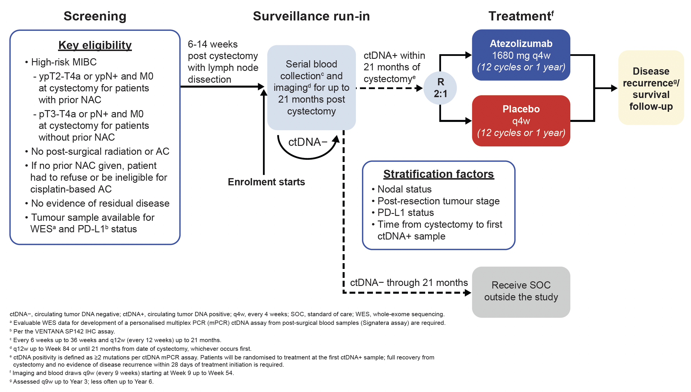
IMvigor011 Study Design
Powles et al. ESMO 2021;Abstract 716TiP.

Slide 70
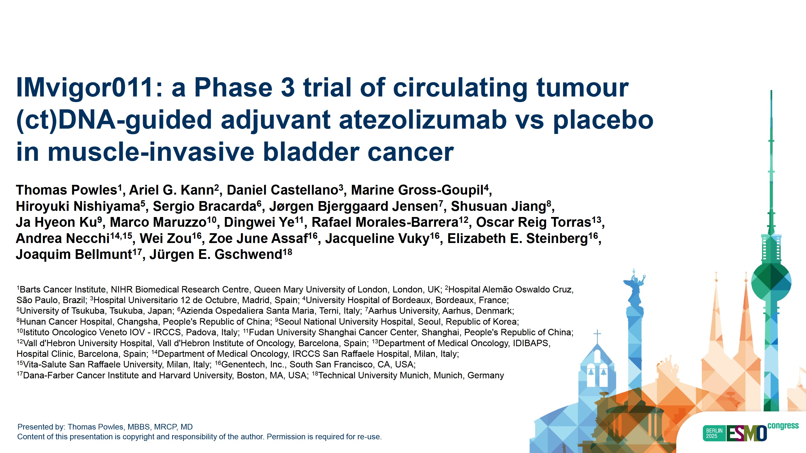
Abstract LBA8

Slide 71
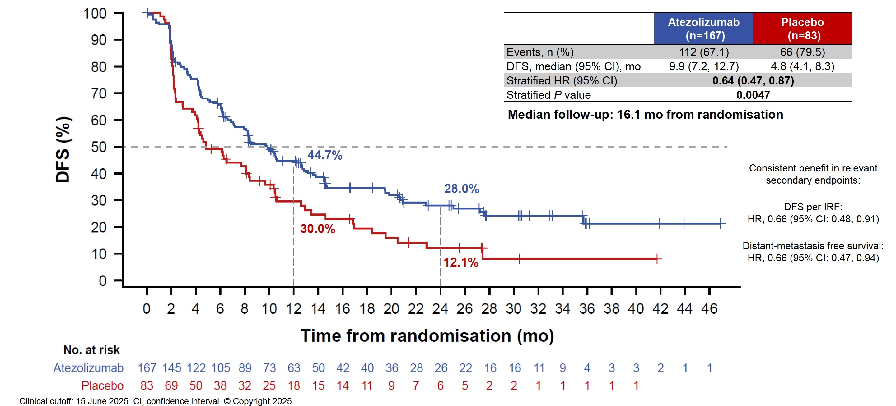
Phase III IMvigor011: Investigator-Assessed Disease-Free Survival for Patients Whose Disease Tested ctDNA Positive
Powles T et al. ESMO 2025;Abstract LBA8.

Slide 72
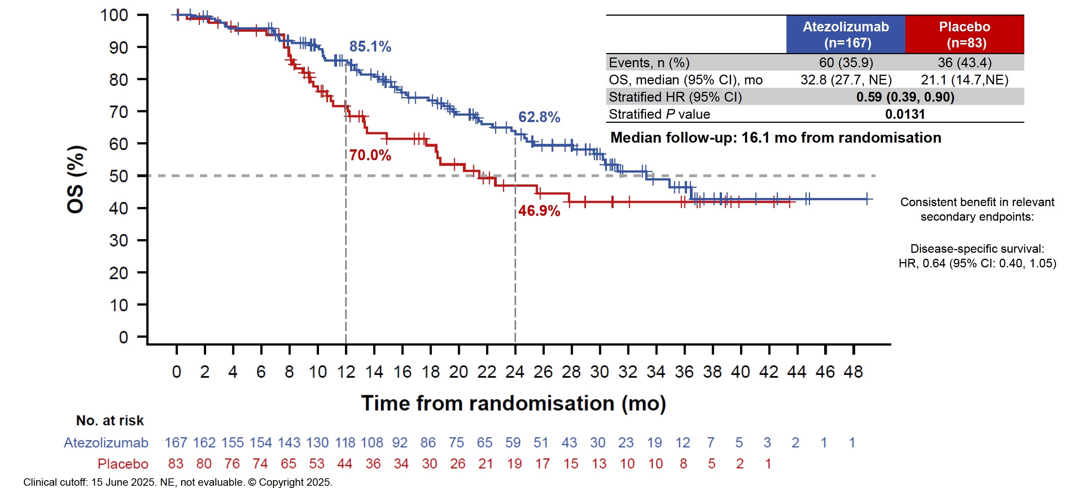
Phase III IMvigor011: OS for Patients Whose Disease Tested ctDNA Positive
Powles T et al. ESMO 2025;Abstract LBA8.

Slide 73
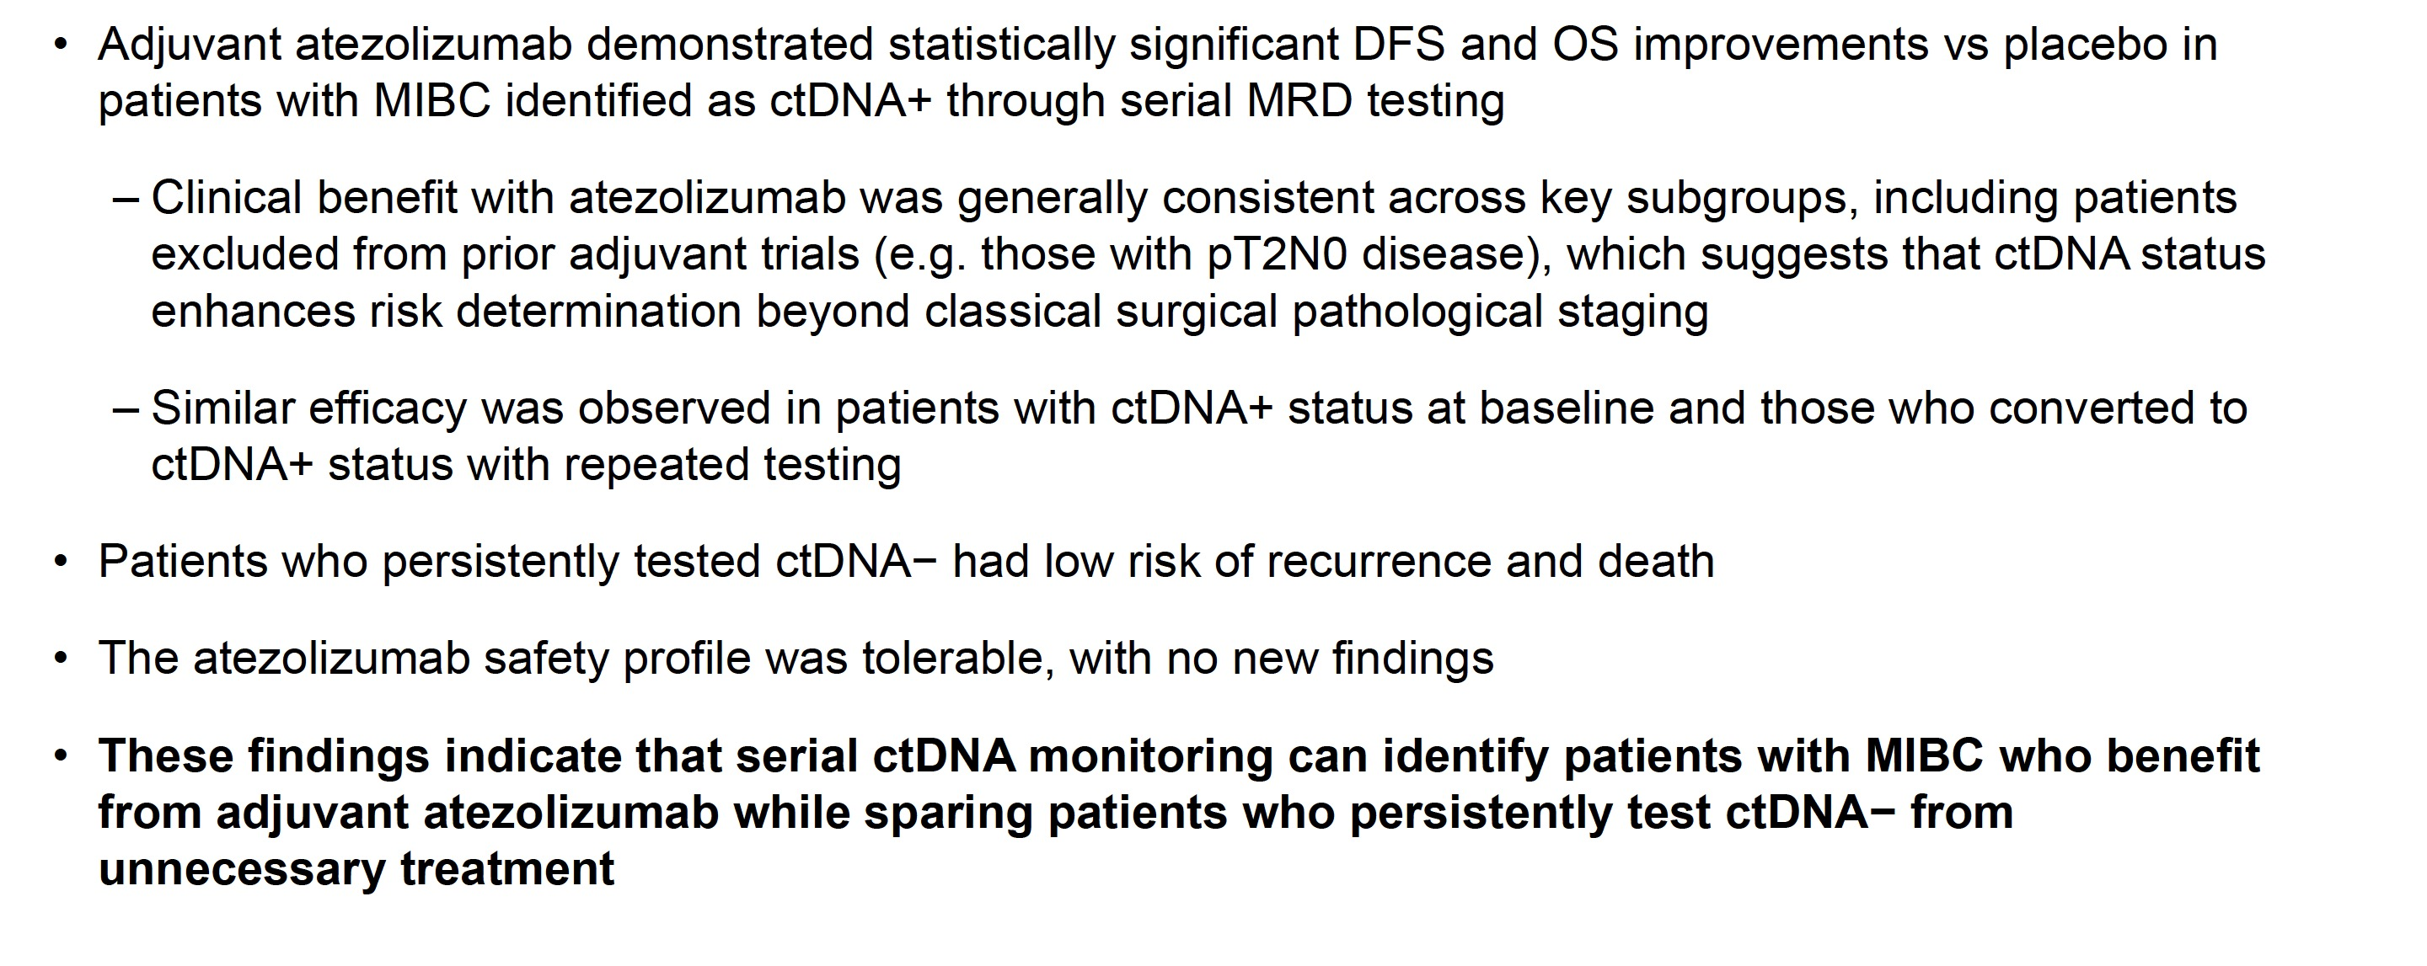
Phase III IMvigor011: Authors’ Conclusions
MRD = molecular residual disease
Powles T et al. ESMO 2025;Abstract LBA8.

Slide 74
Discussion Questions
Do you believe ctDNA will be used to inform treatment decision-making for patients with nonmetastatic UBC in routine practice in the near future? How so?
Are you using ctDNA analysis in your own practice today? What role might oncology nurses play in identifying patients for whom ctDNA analysis might be appropriate and helping them understand their test results?

Slide 75
Agenda
Introduction: Basic Biology of Nonmetastatic Urothelial Bladder Cancer (UBC)
Module 1: Systemic Therapy for Cisplatin-Eligible Patients with Muscle-Invasive Bladder Cancer (MIBC)
Module 2: Evolving Approach to Systemic Therapy for Cisplatin-Ineligible Patients with MIBC
Module 3: Immune Checkpoint Inhibitors in Non-Muscle-Invasive Bladder Cancer
Module 4: Novel Intravesical Therapies for Nonmetastatic UBC

Slide 76
Perioperative Systemic Therapy for
Cisplatin-Ineligible Patients with MIBC
Alexandra Drakaki, MD, PhD
Associate Professor of Medicine, Hematology/Oncology and Urology
Medical Director of the Genitourinary Oncology Program
Leader of the Genitourinary Research Program
University of California, Los Angeles
05/14/2026

Slide 77

How to think in bladder cancer
CISPLATIN ELIGIBLE
CISPLATIN INELIGIBLE
NEOADJUVANT CHEMO
SURGERY
GFR <60
NEUROPATHY
ECOG >2
HEARING PROBLEM
SURGERY
/
TRIALS

Slide 78



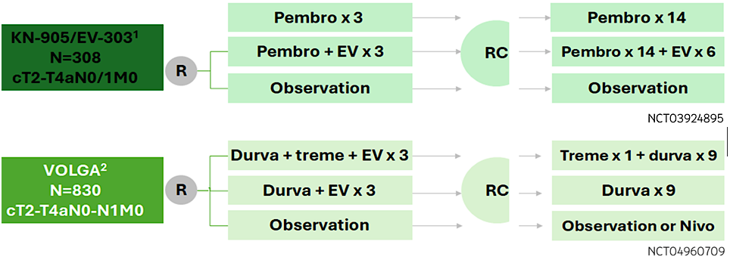
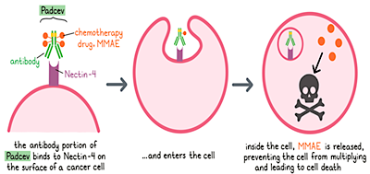
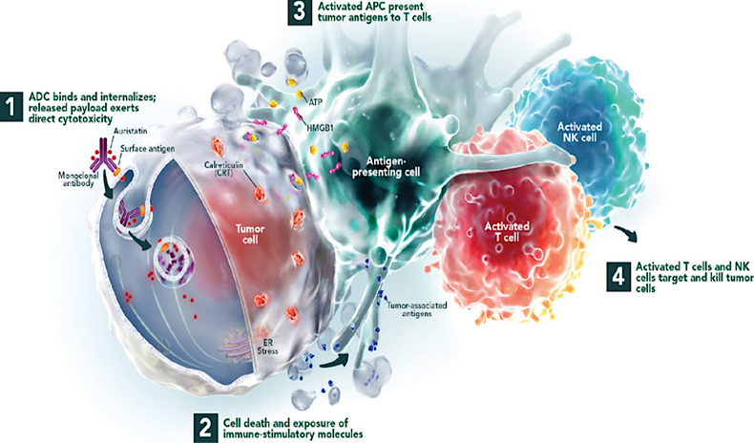
Perioperative Phase 3 Studies in
Cis-Ineligible MIBC
Enfortumab vedotin
the antibody portion
binds to Nectin-4 on
the cancer cell surface

Slide 79
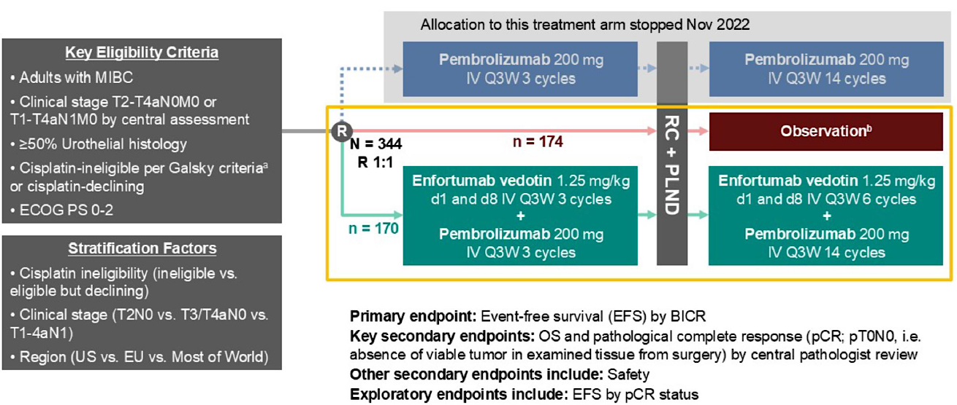


Slide 80
KEYNOTE 905/EV303: Patient Characteristics
Characteristics, % |  | EV + Pembro (n=170) | Observation (n=174)
Median age (range), years |  | 74 (47-87) | 72.5 (46-87)
≥65 to <75 years/≥75 years |  | 37/46 | 44/39
Male (%) |  | 81 | 75
ECOG PS (%) | 0/1/2 | 60/28/12 | 55/31/15
Renal Function (%) | CrCl ≥60 mL/min | 40 | 41
 | CrCl ≥30 to <60 mL/min | 60 | 58
 | CrCl <30 mL/min | 0 | 1
PD-L1 CPS ≥10 |  | 47 | 48
Cisplatin eligibility (%) | Ineligible | 84 | 80
 | Eligible but declining | 17 | 20
Tumor Stage (%) | T2N0 | 18 | 18
 | T3/T4aNO | 78 | 76
 | T1-4aN1 | 4 | 6
Pure urothelial carcinoma histology (%) |  | 89 | 92
Christof Vulsteke, ESMO 2025; N Engl J Med 2026;394(13):1257-69.

Slide 81
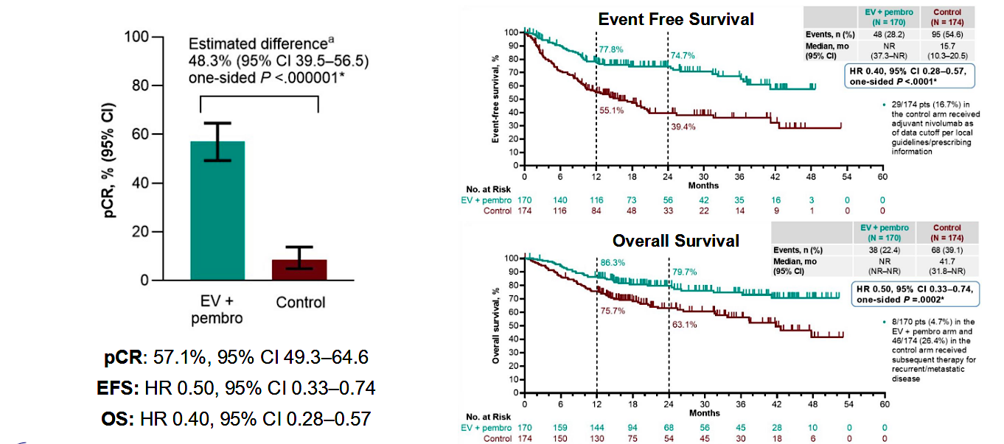
Christof Vulsteke, ESMO 2025; N Engl J Med 2026;394(13):1257-69.

Slide 82
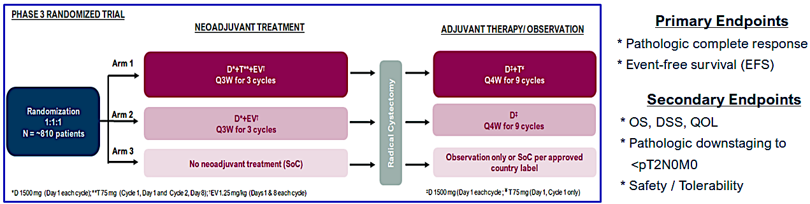

Phase 3 Study of Durvalumab (D) + Tremelimumab (T) +
Enfortumab Vedotin (EV) or D + EV In Neoadjuvant Cisplatin-Ineligible Muscle-Invasive Bladder Cancer (VOLGA)

Slide 83
Interim Analysis of the Phase III VOLGA Trial Demonstrated Significant Improvement in Event-Free and Overall Survival With Perioperative Durvalumab Plus Neoadjuvant EV in Muscle-Invasive Bladder Cancer
Press Release: May 14, 2026
“High-level results from a planned interim analysis of the VOLGA Phase III trial showed perioperative treatment with durvalumab in combination with neoadjuvant enfortumab vedotin (EV) demonstrated statistically significant and clinically meaningful improvements in event-free survival (EFS) and overall survival (OS) in patients with muscle-invasive bladder cancer (MIBC) versus standard of care. Patients were ineligible for or had declined cisplatin-based chemotherapy. Patients in the comparator arm had a radical cystectomy (surgery to remove the bladder) with or without approved adjuvant treatment.
Perioperative durvalumab plus tremelimumab in combination with neoadjuvant EV demonstrated a statistically significant and clinically meaningful improvement in EFS and a favourable trend for OS; however, the OS data were not statistically significant at this planned interim analysis and will be formally reassessed at a subsequent analysis.”
https://www.astrazeneca.com/media-centre/press-releases/2026/imfinzi-ev-improves-efs-os-in-bladder-cancer.html

Slide 84

Conclusions
New Era in management of Cis-Ineligible MIBC

Slide 85
Case Presentation

Slide 86
65-year-old male with new diagnosis of Muscle Invasive Bladder Cancer
History of Present Illness:
65-year-old male presented with a year-long history of left flank pain and hematuria after intense workout.
CT chest did not reveal any evidence of metastatic disease, but the CT urogram was consistent with left sided mild hydronephrosis. Upon evaluation by Urology, he underwent TURBT that showed high grade urothelial cancer with muscularis propria invasion.

Slide 87
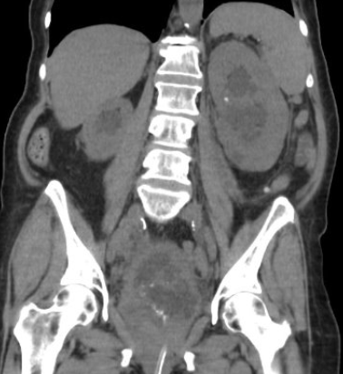
Therefore, patient was referred to medical oncology with the new diagnosis of
T3N0M0 muscle invasive bladder cancer with Left sided hydronephrosis
PreTURBT Image

Slide 88
Past Medical History:
Childhood asthma, mild hypertension, eczema
Past Surgical History:
Knee surgery
Family History:
Mother with uterine cancer, brother with prostate cancer
Social History:
Works as a hairdresser, does not drink alcohol, does not smoke cigarettes but using marijuana occasionally, No IVDU.
Married with a 30-year-old healthy son

Slide 89
Current Medications:
Multivitamin, Albuterol as needed, Cortisone cream as needed
Muscle Invasive Bladder Cancer Treatment Approach:
Patient is Cisplatin Ineligible with creatinine clearance of 45 and therefore started on the Neoadjuvant regimen with
Enfortumab Vedotin/Pembrolizumab, followed by cystoprostatectomy and LN dissection that revealed pathologic complete response and completed the adjuvant therapy with 6 more cycles of enfortumab and 14 cycles of pembrolizumab.
Patient remains cancer free 3 years later

Slide 90
Discussion Questions
Now that perioperative pembrolizumab/enfortumab vedotin is available for cisplatin-ineligible patients with MIBC, are you recommending it in most cases? In which ones, if any, are you not?

Slide 91
Tolerability and Toxicity Profile of Enfortumab Vedotin
Margarita Huober, AGNP, AOCNP
Stanford Health Care

Slide 92
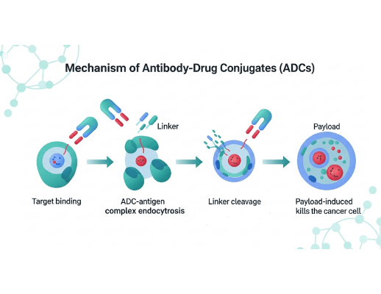

SELECTIVE CYTOTOXIC DELIVERY
How It Works
Enfortumab Vedotin (EV) is a precision-targeted Antibody-Drug Conjugate (ADC)
The Target: High affinity for Nectin-4, a protein found in ~97% of bladder cancers
The Payload: MMAE, a potent chemotherapy-like medicine, is attached to the antibody
The Action: The antibody binds to the cancer cell and releases the payload directly inside
Result: Disrupts cell cycle, leading to the death of the cancer cell
▪
MMAE: monomethyl auristatin E; Nectin-4: cell surface adhesion molecule.
Notes:
EV is like a smart missile. It is antibody-drug conjugate that targets Nectin-4 and delivers chemotherapy into the tumor cell, leading to cell death. Nectin-4 is also present in normal tissues (skin, peripheral nerves), which explains the side effects.

Slide 93





SPECTRUM & INCIDENCE OF EV-RELATED ADVERSE EVENTS
Skin Reactions
Peripheral Neuropathy
Any Grade: ~67% |
Any Grade: ~50% |
Median Onset: 0.6 months (Early)
Median Onset: 6 months (Cumulative)
Hyperglycemia
Ocular Disorders
Any Grade: ~12% |
Any Grade: ~21% |
Median Onset: 0.5 months (Rapid)
Secondary: Fatigue, Dry eye, Blurred vision
All-Cause Grade ≥3 TRAE INCIDENCE: ~56%
EV: enfortumab vedotin; G: grade; TRAE: treatment-related adverse event.
Enfortumab Vedotin Package Insert
Notes:
EV toxicities are predictable — skin is early (after 1st infusion), neuropathy is cumulative, hyperglycemia can be rapid, and ocular is usually mild.

Slide 94

EV TOXICITY VS. PEMBRO IRAE
Toxicity | EV | Pembro | Quick Clinical Tip
Skin Rash | Flexural (groin, axillae); Onset: Days 1–14 | Trunk-first, diffuse; Onset: Weeks–Months | Steroids fix pembro, not EV
Neuropathy | ~50%; Symmetric, sensory, Gradual/Cumulative | ~1%; Asymmetric, motor, Acute onset | Slow over cycles → EV Sudden + weakness → Pembro
Hyperglycemia | Common (6% G≥3); Gradual; No autoantibodies | Rare (1%); New-onset T1DM with DKA; + Antibodies | Check T1DM Antibodies Positive result → Pembro
Ocular | ~21% (Dry eye, blur); Nectin-4 in epithelium | Rare (Uveitis) | Almost always EV Uveitis with pain/photophobia → Pembro
IRAE: immune-related adverse event; DKA: diabetic ketoacidosis | EV: enfortumab vedotin | G: grade | T1DM: type 1 diabetes mellitus
Postow MA, et al. N Engl J Med. 2018;378(2):158-168. Powles T, et al. N Engl J Med. 2024;390(10):875-888. Vulsteke C, et al. N Engl J Med. 2026. Yajima S, et al. JAMA Netw Open. 2025;8(3):e250250.
Notes:
EV is given with Pembo → EV vs Pembro toxicities:
EV → predictable
IO → systemic, immune-mediated, “ITIS” (pneumonitis, hepatitis..)
Highlight Hyperglycemia:
→ EV = gradual
→ IO = rare but autoimmune type 1 diabetes → DKA risk

Slide 95




EV SKIN TOXICITY: CLINICAL MANAGEMENT
DOSE MANAGEMENT
G1: Continue | G2–3: Hold → Resume same dose or reduce| Recurrent G3 or G4: discontinue
Grade 1
Grade 2
Grade 3
Grade 4
<10% BSA
10–30% BSA
>30% BSA / ADL
EMERGENCY
Moderate topical steroids (Triamcinolone)
Emollients
Antihistamines
High-potency topical steroids
Antihistamines
Consider Dermatology referral
High-potency topicals (Clobetasol 0.05%)
Prednisone 0.5–1 mg/kg
Urgent Derm consult / consider inpatient care
Immediate specialized inpatient (Burn Unit/ICU)
Intensive management (SJS/TEN protocols)
BSA: Body Surface Area; G1-4: Toxicity Grade; SJS: Stevens-Johnson syndrome; TEN: Toxic Epidermal Necrolysis
Postow MA, et al. N Engl J Med. 2018;378(2):158-168. Powles T, et al. N Engl J Med. 2024;390(10):875-888. Vulsteke C, et al. N Engl J Med. 2026. Yajima S, et al. JAMA Netw Open. 2025;8(3):e250250.
Notes:
Skin toxicity is common and often early
Mild cases we treat with topical steroids; moderate to severe cases we hold therapy and may need to escalate to PO steroids.
Black Box Warning”: G4 → emergency, Stevens–Johnson syndrome, Toxic epidermal necrolysis admit → (burn unit/ICU). Mucosal involvement, blistering

Slide 96




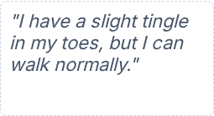
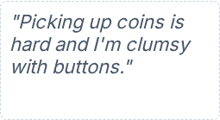
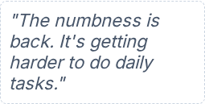





EV PERIPHERAL NEUROPATHY: MANAGEMENT
Dose Reductions: 1.25 mg/kg 1.0 mg/kg 0.75 mg/kg 0.5 mg/kg
G1: MILD
G2: MODERATE
G2: RECURRENT
G3+: SEVERE
CLINICAL DEFINITION
CLINICAL DEFINITION
CLINICAL DEFINITION
CLINICAL DEFINITION
Asymptomatic paresthesia or loss of DTRs; no functional impact
Sensory loss interfering with function (e.g., buttoning clothes)
Functional interference repeating after prior G2 event
Severe symptoms; limiting self-care ADLs (bathing, feeding)
ADL: activities of daily living | DTR: deep tendon reflex | EV: enfortumab vedotin | G: grade
Postow MA, et al. N Engl J Med. 2018;378(2):158-168. Powles T, et al. N Engl J Med. 2024;390(10):875-888. Vulsteke C, et al. N Engl J Med. 2026. Yajima S, et al. JAMA Netw Open. 2025;8(3):e250250.
Notes:
Neuropathy is cumulative
Once it affects function → hold and dose-reduce
Often slow to improve and may be irreversible

Slide 97
















EV HYPERGLYCEMIA MANAGEMENT
SCREENING & MONITORING
Check Baseline HbA1c before C1D1.
Monitor blood glucose before each cycle
Early identification of risk factors is critical
WITHHOLD THRESHOLD
Glucose >250 mg/dL → Withhold EV until glucose improves to ≤250 mg/dL
Resume at Same Dose
(No reduction required)
ADA STANDARDS
Metformin is first-line for drug-induced insulin resistance; some patients may require insulin
Most cases controlled without stopping EV
DKA SAFETY EDUCATION
Educate on thirst, polyuria, nausea, and confusion
Report symptoms immediately
DKA: diabetic ketoacidosis | EV: enfortumab vedotin | HbA1c: hemoglobin A1c
Postow MA, et al. N Engl J Med. 2018;378(2):158-168. Powles T, et al. N Engl J Med. 2024;390(10):875-888. Vulsteke C, et al. N Engl J Med. 2026. Yajima S, et al. JAMA Netw Open. 2025;8(3):e250250.
Notes:
Hyperglycemia with EV:
Check A1c at baseline; monitor glucose each cycle
If glucose >250 → hold EV until controlled
Once improved → resume same dose
Most cases controlled without stopping EV
Educate on DKA symptoms: thirst, polyuria, nausea, confusion

Slide 98








EV OCULAR TOXICITY
Dry eye, blurred vision, irritation
Artificial Tears (4x daily)
Baseline vision exam pre-Cycle 1
Refer to Ophthalmology
Pain or foreign body sensation
Avoid contact lenses
Evaluate for vision changes at every visit
Withhold/Reduce if symptomatic
Warm compresses + lid hygiene
Starting | 1.25 mg/kg
1st Redux | 1.0 mg/kg
2nd Redux | 0.75 mg/kg
3rd Redux | 0.5 mg/kg
EV: enfortumab vedotin
Chen H, et al. Front Immunol. 2024;15:1495137.
Notes:
Ocular toxicity is usually dry eyes.
Start artificial tears early and monitor vision.
Pain or photophobia should raise concern for immunotherapy-related toxicity. .

Slide 99




EV TOXICITY: TAKEAWAYS
RECOGNIZE EARLY
ACT EARLY
•
Skin: Typically early onset
•
Hold or adjust based on severity
•
Neuropathy: Cumulative burden
•
Check glucose each cycle
•
Hyperglycemia: risk for DKA
•
Start artificial tears Day 1
•
Ocular: Corneal surface / dry eye
TOXICITY DRIVERS
WHY THIS MATTERS
•
EV: Skin, neuropathy, hyperglycemia
IO: Systemic (GI, lung, endocrine)
Overlap exists → evaluate carefully
•
Prevent irreversible toxicity (Neuro)
•
•
Maintain treatment intensity
•
•
Avoid delays in curative care
EV: enfortumab vedotin; IO: immunotherapy; DKA: Diabetic Ketoacidosis
Postow MA, et al. N Engl J Med. 2018;378(2):158-168. Powles T, et al. N Engl J Med. 2024;390(10):875-888. Vulsteke C, et al. N Engl J Med. 2026. Yajima S, et al. JAMA Netw Open. 2025;8(3):e250250.
Notes:
EV toxicities follow predictable patterns
Intervene early to prevent irreversible toxicity → Neuropathy
Monitor glucose and educate on DKA symptoms
Distinguish EV vs IO → pattern + timing guide management
RNs and APPs role is to recognize toxicity early + take action → prevent tx delayed and discontinuation

Slide 100
CASE PRESENTATION: BALANCING EFFICACY AND TOXICITY WITH ENFORTUMAB VEDOTIN

Slide 101









INITIAL PRESENTATION
CANCER DIAGNOSIS
cT3aN0M0 Muscle-Invasive Bladder Cancer (High-Grade)
BASELINE RISK
Type 2 Diabetes (HbA1c 7.4%) + Grade 1 Neuropathy
CONTRAINDICATION
Cisplatin-ineligible (CrCl 45 mL/min)
MK is 65 yo Male
MANAGEMENT GOAL
Self-employed Electrician
Deliver Neoadjuvant EV + Pembro → Radical Cystectomy
| Pre-Treatment ctDNA: 1.8 MTM/mL (Positive)

Slide 102



EMERGING TOXICITY WITH FUNCTIONAL IMPACT
Cycle 1: Day 10
Cycle 2: Day 15–21
Flexural Rash (G1): Resolved with emollients + Triamcinolone 0.1% BID.
Neuropathy (G2): Progressive fingertip numbness.
Result: Fully resolved; no dose change.
Functional Impact: Dropping tools; slower motor tasks.
Dilemma: Risk of irreversible injury vs. finishing Cycle 3.
PRE-TX ctDNA:
1.8 MTM/mL
POST-C2 ctDNA:
0.0 MTM/mL
BID: twice daily | G1/G2: Grade 1/2 | EV: enfortumab vedotin | ctDNA: circulating tumor DNA

Slide 103



MANAGEMENT DECISION & PRE-OP REASSESSMENT
DECISION
Stopped Neoadjuvant Therapy early (after 2 cycles) to avoid irreversible neuro-toxicity
PREOPERATIVE RE-ASSESSMENT
NEUROPATHY MANAGEMENT
•
Cystoscopy: No visible tumor; clear bladder wall
•
Gabapentin: Titrated to 300 mg TID
•
Referrals: OT + Diabetes optimization
•
Imaging: No measurable mass; no lymphadenopathy
•
Stability: No rapid reversal; G1–2 stable
OT: occupational therapy; TID: three times daily; G1–2: toxicity grade 1–2

Slide 104







SURGICAL OUTCOME & TEACHING POINTS
FINAL PATHOLOGY
NODAL STATUS
RECOVERY
ypT0N0 (pCR)
0/16 Nodes
Return to Work
CLINICAL TAKEAWAYS
Act Early: Intervene at G1–2 neuro in high-risk (T2DM) patients to preserve livelihood
ctDNA Kinetics: Molecular clearance (1.8 → 0.0) can support an early transition
to surgery
Stability is the Goal: Holding treatment is damage control; do not wait for full
neuro-recovery
Perioperative Priority: Deliver enough therapy to clear disease, but stop before permanent toxicity
ctDNA: circulating tumor DNA; EV: enfortumab vedotin; G1-2: Grade 1-2; pCR: pathological complete response; T2DM: type 2 diabetes

Slide 105
Discussion Questions
If a patient with MIBC experiences tolerability issues during neoadjuvant pembrolizumab/enfortumab vedotin therapy, do you always attempt to continue both agents in the adjuvant setting? What is your threshold for discontinuing one or both?

Slide 106
Agenda
Introduction: Basic Biology of Nonmetastatic Urothelial Bladder Cancer (UBC)
Module 1: Systemic Therapy for Cisplatin-Eligible Patients with Muscle-Invasive Bladder Cancer (MIBC)
Module 2: Evolving Approach to Systemic Therapy for Cisplatin-Ineligible Patients with MIBC
Module 3: Immune Checkpoint Inhibitors in Non-Muscle-Invasive Bladder Cancer
Module 4: Novel Intravesical Therapies for Nonmetastatic UBC

Slide 107

Immune Checkpoint Inhibitors in NMIBC
Terence Friedlander, MD
Clinical Professor
Robert and Virginia O’Reilly Family Endowed Chair
Helen Diller Family Comprehensive Cancer Center
University of California, San Francisco
Chief of Hematology-Oncology
Zuckerberg San Francisco General Hospital and Trauma Center
San Francisco, California

Slide 108
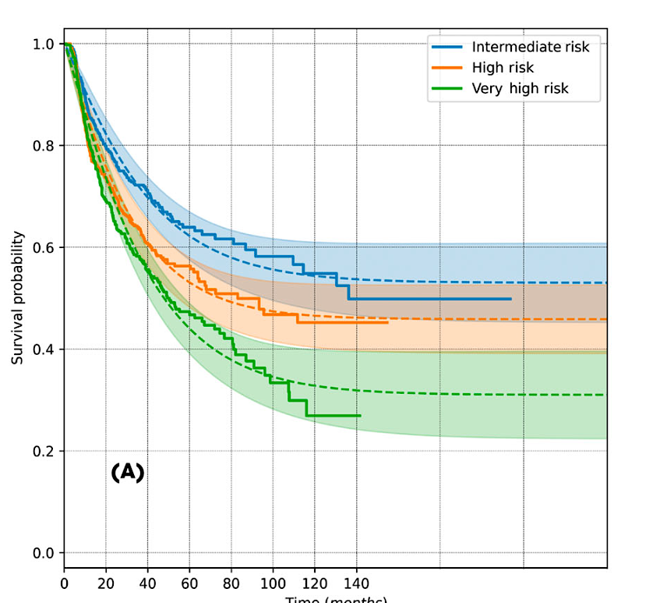
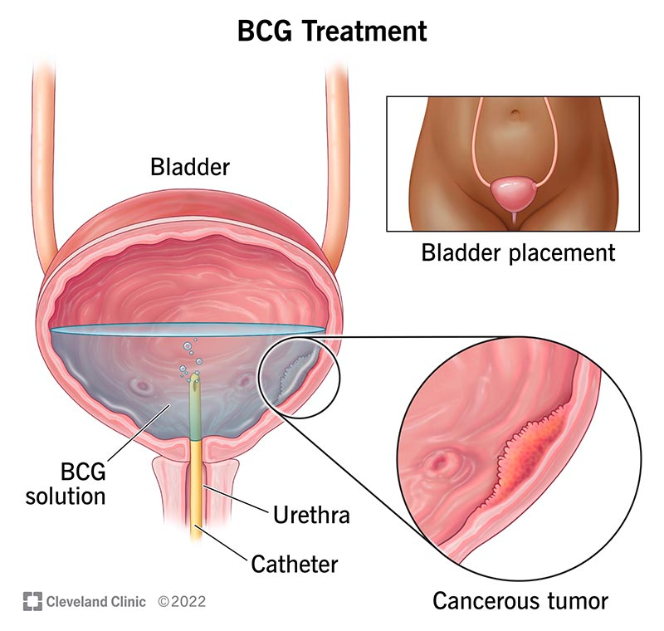
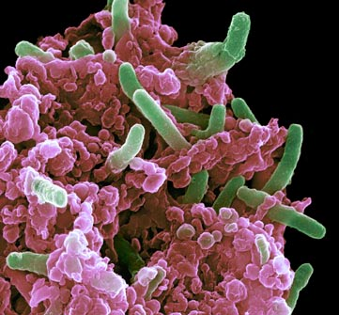
BCG is the Standard of Care for treatment-naïve NMIBC
Recurrence-Free Survival
>50% of patients will not be cured!
Time (months)
Nature Medicine 2011, Subiela et al BJUI 2026

Slide 109

Why add PD-1 immunotherapy to BCG?
Immunologically
  BCG makes cancer cells increase PD-1
    “Shield” against immune cells
    PD-1 therapies “remove the shield”
Clinically
  Avoids cystectomy (potentially!)
  Synergy of 2 immunotherapies
    BCG addresses localized disease
    PD-1 addresses any disease beyond the urothelium
Wang et al OncoTarg and Therapy 2018, Fukumoto Ann Surg Onc 2018, Hashizume et al Oncotarget 2018, Lim et al Front Immunol 2021

Slide 110

The Patient Perspective?
How important is it to keep the bladder and avoid cystectomy?
Kopenhafer L et al, Urol Oncol 2024
Notes:
Importance of keeping bladder and avoiding cystectomy

Slide 111

Studies to discuss today
HR-NMIBC = High-risk Non-muscle invasive bladder cancer; I = Induction; M = Maintenance; EFS = Event-free survival; DFS = Disease-free survival
Hahn GU ASCO 2026, Shore NS et al, AUA 2025 / Nat Med 2025;31:2806-14 / De Santis M et al, ESMO 2025 Lancet 2025;406(10516):2221-2234 / Ann Oncol 2026;37(1):44-52

Slide 112



CREST
POTOMAC
2 years BCG
2 years Sasanlimab
2 years BCG
1-year Durvalumab
EFS HR 0.68
primary endpoint
OS HR 1.13 (0.68-1.87)
Gr 3 TRAE 29% vs 5.4%
EFS HR 0.68
primary endpoint
OS HR 0.8 (0.53-1.20)
Gr 3 TRAE 21% vs 4%
Shore NS et al, AUA 2025 / Nat Med 2025, De Santis M et al, ESMO 2025 / Lancet 2025, Hahn GU ASCO 2026

Slide 113

Impact on Practice
Either Sasanlimab or Durvalumab combined with BCG induction and maintenance may become an option for high-risk BCG-naïve NIMBC
  Benefit mostly in T1 (highest risk) population
  Awaiting KEYNOTE-676 trial in similar population
Are autoimmune side effects worth it?
  How to balance EFS (positive), OS (immature) and Toxicity (real)?
  Likely will allow some patients to avoid cystectomy
  But… multiple later-line therapies available for NMIBC
Who will be giving this therapy? Urologists? Medical Oncologists?

Slide 114

Can we “save” PD-1 for BCG-unresponsive patients?
KEYNOTE 057
Li et al ASCO 2024

Slide 115



KEYNOTE 057: Pembrolizumab for High-risk (HR) BCG-unresponsive NMIBC
HR NMIBC with CIS
HR NMIBC without CIS
41% CR rate at 3 months
  Median duration of CR 16.2 month
  9.3% (n=9) remain in CR at 45 months
12 month DFS: 43%
36 month DFS: 33%
Balar et al Lancet Onc 2021, Necchi et al Lancet Onc 2024
Notes:
Cohort A included 96 participants in the efficacy population; 101 were in the safety population. Median time from first dose to data cutoff (May 25, 2022) in the efficacy population was 60.4 months (range, 50.2-72.5). Ninety-one participants (94.8%) declined RC, 70 (72.9%) had recurrent HR NMIBC, and 26 (27.1%) had persistent HR NMIBC. Thirty-nine participants (40.6%) achieved CR at 3 months. Median duration of CR was 16.2 months (range, 0.0+ to 57.7+); 9 responders (33.3%) experienced CR ≥45 months. Forty-three participants (44.8%) underwent subsequent RC (none with ongoing CR). Median time from last dose to RC was 4.7 months (range, 1.4-28.3) for participants with CR who later progressed and 2.8 months (range, 1.4-38.4) for participants without CR. Five of 42 participants (12%) who underwent RC progressed to muscle-invasive disease (Table). Three participants (7.1%) who delayed RC for ≥1 year after treatment discontinuation progressed to T3/T4. No treatment-related deaths occurred.
Conclusion:
Findings Between April 12, 2016, and June 17, 2021, 132 patients (104 [79%] men and 28 [21%] women) who had received a median of ten (IQR 9–15) previous BCG instillations were enrolled into cohort B of the study. Patients received a median of 10 cycles (IQR 6–27) of pembrolizumab. At data cutoff date, Oct 20, 2022, median follow-up was 45·4 months (IQR 36·4–59·3) and five (4%) of 132 patients remained on treatment. The 12-month disease-free survival was 43·5% (95% CI 34·9–51·9). Treatment-related adverse events occurred in 97 (73%) of 132 patients; 19 (14%) had a grade 3 or 4 treatment-related adverse event; the most common grade 3 or 4 treatment-related adverse events were colitis (in three [2%] patients) and diarrhoea (in two [2%]). 17 (13%) of 132 patients experienced serious treatment-related adverse events, of which colitis (three patients [2%]) was most common. No treatment-related deaths occurred.

Slide 116

Many intravesical options for BCG-unresponsive NMIBC!
Adapted from: Li and International Bladder Cancer Group, Eur Urol, 2024

Slide 117
Case Presentation

Slide 118

Clinical Case
62 yo M with second-hand tobacco exposure as a child, and new hematuria
  Urine cytology suspicious (Paris IV)
Cysto/TURBT: HG T1 NMIBC
SH: Avid outdoorsman, enjoys rock-climbing
  “I do not want to have a cystectomy… ever”

Slide 119

Follow up with Urology
Discusses role of BCG, about a 30-50% chance of relapse
“Isn’t there anything we can do to improve chances of cure?”
Enrolls in the Phase 3 trial of Sasanlimab + BCG

Slide 120

Clinical Case
Tolerates therapy well overall
Course c/b hypothyroidism requiring levothyroxine
  Grade 1 pruritis responsive to antihistamines/topical steroid
Cystoscopy/TURBT negative after induction, and maintains in a CR at present
Still mountaineering!
Steinberg et al Fut Med 2024

Slide 121
Discussion Questions
Which patients with NMIBC represent ideal candidates for anti-PD-1/PD-L1 antibodies in combination with BCG? If this strategy were to reach the clinic, would you prefer it for all patients with high-risk disease, or are there some for whom you would still opt for BCG alone or some other strategy?

Slide 122
Agenda
Introduction: Basic Biology of Nonmetastatic Urothelial Bladder Cancer (UBC)
Module 1: Systemic Therapy for Cisplatin-Eligible Patients with Muscle-Invasive Bladder Cancer (MIBC)
Module 2: Evolving Approach to Systemic Therapy for Cisplatin-Ineligible Patients with MIBC
Module 3: Immune Checkpoint Inhibitors in Non-Muscle-Invasive Bladder Cancer
Module 4: Novel Intravesical Therapies for Nonmetastatic UBC

Slide 123
Novel Intravesical Therapies for Nonmetastatic UBC
Terence Friedlander, MD
Clinical Professor
Robert and Virginia O’Reilly Family Endowed Chair
Helen Diller Family Comprehensive Cancer Center
University of California, San Francisco
Chief of Hematology-Oncology
Zuckerberg San Francisco General Hospital and Trauma Center
San Francisco, California

Slide 124
Many intravesical options for BCG-unresponsive NMIBC!
Adapted from: Li and International Bladder Cancer Group, Eur Urol, 2024

Slide 125

Intravesical Chemotherapy for NMIBC
Pros
  Delivered directly to cancer cells
  High concentration in urine
  Generally well-tolerated
  Years of safety and efficacy data
  Cost is low
Cons
  Short drug exposure (1h)
  Diluted by urine over time
  Repeated catheterizations (weekly x 6 induction)
  Less effective in later lines

Slide 126


Intravesical Gemcitabine Delivery Device (TAR-200)
Silicone tube containing solid gemcitabine
  Continuous release over 3 weeks
  No systemic exposure
  Fewer office visits
  Well tolerated
  But does it work…?
©2023 Digital Science Press Inc., and UroToday.com

Slide 127

Notes:
Importance of keeping bladder and avoiding cystectomy

Slide 128

Most patients respond…

Slide 129

…and some responses are durable!

Slide 130

Treatment is generally well-tolerated

Slide 131


Why gemcitabine? Why not other agents?
FGFR mutations present in 30-60% of NMIBC tumors
TAR-210 – delivers erdafitinib (FGFR–inhibitor) in place of gemcitabine
Phase 1 trial in FGFR-mutated, recurrent NMIBC
Vilaseca A et al. AUA 2024; Clark P et al SESAUA 2025

Slide 132


What’s next?

Slide 133
Case Presentation

Slide 134
Clinical Case
4/2022: New hematuria and dysuria, frequency.
  CT Urogram: 2.9 cm x 4.3cm x 4.1 cm exophytic bladder trigone mass
  TURBT: HG Ta NMIBC
5/2022 – 8/2022: BCG induction and maintenance
8/2022: Bladder bx: HG Ta NMIBC
  Intravesical gemcitabine x 6 doses
11/2022: Persistent HG Ta NMIBC

Slide 135
Clinical Case
3/2023 – 1/2024: Intravesical Gemcitabine + Docetaxel x 15 doses
4/2024 – recurrence in bladder: HG papillary T1
5/2024 – 9/2024: Repeat BCG x 9 doses
11/2024 – Recurrence with 2 papillary HG tumors
1/2025 - Starts monthly TAR-200 (intravesical gemcitabine delivery device)
  Well tolerated, mild dysuria, mild urgency
6/2025 – Cystoscopy/cytology: No recurrence, Paris II
Remains without recurrence now 1.5 years later!

Slide 136
Discussion Questions
Now that the gemcitabine intravesical system has received FDA approval, how are you integrating it into patient care? How do you choose among the gemcitabine intravesical system, pembrolizumab or intravesical vaccine therapy for individual patients with NMIBC after BCG failure?
Are you currently ordering biomarker testing for your patients with nonmetastatic UBC? Do you think TAR-210 is likely to reach the clinic in the near future, and if so, how do you envision using it?

Slide 137

Tolerability/Toxicity Profile and Other Practical Considerations with Novel Intravesical Therapies
Krisztina Emodi NP-C, MPH, CNS
Nurse Practitioner III
UCSF GU Surgical Oncology
Bladder Cancer Survivorship Program Lead

Slide 138
Agenda
Logistics of insertion and removal of the gemcitabine intravesical system and TAR-200
Incidence of urinary issues (eg, urinary frequency, urinary tract infection/pain, dysuria, micturition urgency, hematuria) related to the gemcitabine intravesical system; optimal strategies to mitigate these effects
Spectrum, frequency and severity of systemic toxicities with the gemcitabine intravesical system; appropriate monitoring and management protocols
Incidence, severity and management of local and systemic side effects noted with TAR-200

Slide 139

What is TAR 200 (iDRS )?
SunRISe-1 Trial
Gemcitabine intravesical system is indicated for the treatment of adult patients with Bacillus Calmette-Guérin (BCG)-unresponsive, non-muscle invasive bladder cancer (NMIBC) with carcinoma in situ (CIS), with or without papillary tumors (HG T1/Ta)
Given in 14 doses over 2 years
Inserted q3 weeks x 6 months (8 doses) then once q12 weeks for up to 18 months (6 doses)
Notes:
SunRise: Patients were enrolled between March 2021 and April 2024 at 142 sites in 14 countries.

Slide 140

Gemcitabine Intravesical System Insertion: APP/MD
Pass a urinary catheter via urethra into bladder
Then, pass the gemcitabine intravesical system into the urinary catheter.
The gemcitabine intravesical system will uncurl and straighten as it is passed into the urinary catheter, afterward resuming its curled shape.
The urinary catheter will be removed, and the gemcitabine intravesical system will remain in the bladder.
Gemcitabine Intravesical System Insertion Packet 2026

Slide 141

Treatment-Related Adverse Events (AEs) – TAR-200 Monotherapy (Cohort 2) N=85
Treatment-related AEs leading to TAR-200 interruption occurred in 27 patients (31.8%), with urinary tract pain (5.9%), hematuria (4.7%), and pollakiuria (4.7%) being the most frequent TAR-200–related AEs.
Most interruptions were limited to one to two doses, and most patients resumed treatment.
Three patients (3.5%) discontinued TAR-200 because of treatment-related AEs, including noninfective cystitis (two patients) and pollakiuria and urinary tract disorder
Daneshmand, S et al
J Clin Oncol. 2025;43(33):3578-3588. doi:10.1200/JCO-25-01651

Slide 142

Incidence of ADVERSE SIDE EFFECTS
disorder, hydrnephrosis, and urinary tract disorder
There are detectable levels of gemcitabine in urine 7 days after placement w/o detection in plasma
The toxicity profile of iDRS as reported in published clinical trials is characterized by dysuria, UTI, overactive bladder (OAB) symptoms, and hematuria (generally low grade)
Monitor Hgb, increase Cr/lipase, AST/ALT, Na, K +UA/MICRO REFLEX CX
Notes:
Moreover, in an animal model, gemcitabine metabolites were detected in all layers of bladder tissue 4 days after placement of TAR-200, demonstrating both sustained release and deep penetration of gemcitabine

Slide 143
Clinical Management of iDRS in the Treatment of Bladder Cancer
Asymptomatic bacteriuria
Continue iDRS
UTI without fever
Continue iDRS if clinical improvement is seen on antibiotic treatment
Consider removal/delaying insertion of new iDRS if no clinical improvement 48-72h after antibiotics
Resume iDRS after complete resolution of infection and negative urine culture
UTI without fever
Continue iDRS if clinical improvement is seen on antibiotic treatment
To avoid risk of infection, current iDRS can remain in bladder for at least 48h of antibiotics
Remove/delay insertion of new iDRS if no clinical improvement after 48-72h of antibiotics
Resume iDRS after complete resolution of infection and negative urine culture
Urosepsis
Remove iDRS as soon as patient is clinically stable on broad spectrum antibiotics
Consider resumption of iDRS after complete resolution of infection and negative urine culture
Consider proactive UTI prevention strategy
Pradere B et al. Curr Opin Urol. 2025;36(1):123-133

Slide 144

Expert Panel Recommendations for Managing Toxicity from iDRS
Pradere B et al. Curr Opin Urol. 2025;36(1):123-133

Slide 145
Case Presentation

Slide 146
Case of Roy, 83 yo male for TAR 200
Roy has BCG-unresponsive high-risk non–muscle invasive bladder cancer (NMIBC), specifically recurrent high-grade papillary urothelial carcinoma with prior CIS despite multiple adequate courses of BCG.
PMH: BPH, LUTS, hematuria, bladder cancer, diabetes, arthritis, hypertension, peptic ulcer disease, decreased vision, hearing, low back pain. Former smoker.
Key points from the timeline:
8/1/25 TURBT showed:
  HG Ta disease + CIS
  No muscle invasion identified
Rapid recurrence shortly after BCG is particularly concerning because recurrence within months of BCG strongly suggests treatment resistance rather than undertreatment.
11/5/25 TURBT then showed:
  invasive high-grade papillary urothelial carcinoma with lamina propria invasion (T1)
  No muscle present in specimen, so complete staging was limited
12/17/25 repeat re-resection was reassuring:
  only focal atypia/scar, muscle negative/clear
  no residual T1 identified

Slide 147
Clinical Course
Discussed RC, gem/doce, TAR200/gemcitabine intravesical system (CIS), nogapendekin alfa inbakicept-pmln (given w/ BCG as it induces the proliferation of NK cells and CD8+ T cells to destroy tumor cells), Nadofaragene (vector-based gene therapy to encode for interferon- alpha2b into the bladder wall cells, turning them into factories that produce this protein to fight cancer cells).
Roy chose TAR200/gemcitabine intravesical system and s/p 4 instillation
2/3/26: Cystoscopy: TAR200 #1 inserted without difficulty after prep and drape through UPC device. No evidence of recurrent tumor, TAR200 in correct place confirmed on cystoscopy
02/23/26: TAR200 #2
02/24/26: Cytology Atypical Urothelial Cells (Paris System III)
3/12/2026 TAR200 #3
4/7/2026: TAR200 #4

Slide 148
Induction is 8 doses given every 3 weeks. Full surveillance cystoscopy with cytology will be done at removal of #4, no recurrence seen
Break x 2 weeks d/t TAR200 unavailability
Hydration as best prevention of urinary symptoms.
His schedule:
May 12th cysto: TAR200 #5 insertion
June 2nd cysto: TAR200 removal and insertion of #6
June 23rd cysto: TAR200 removal and insertion of #7
July 14th cysto: TAR200 removal and insertion of #8
August 4th cysto: TAR200 removal only

Slide 149
Approaches to dysuria: Urge, burn, repeat….
Hydration, Hydration!
Skip an insertion or remove sooner
Most pain resolves after a week
ATC Ibuprofen 600 mg x 1 week +/- Tylenol
Mirabegron 50 mg daily for OAB
Oxybutynin for bladder spasms (less incontinence and leakage during sex)
Alpha blocker
Hydroxyzine for bladder pain (blocks mast cells & inflammation)
Timed voiding and eliminating bladder irritants
NMIBC, Hematuria, BPH/LUTS, Diabetes, Hypertension, Arthritis, poor vision
Social: Married/support system,Former smoker, Older adult needs, Healthcare access/follow-up, Possible caregiver dependence
Psychological: Anxiety about recurrence, coping with chronic illness, stress from ongoing treatment, fear of progression, Impact on independence

Slide 150
Discussion Questions
How is the gemcitabine intravesical system tolerated relative to traditional intravesical delivery of gemcitabine? How do the two delivery methods stack up in terms of practical requirements?
What are the most frequently observed adverse events with TAR-210? How is intravesical delivery of erdafitinib tolerated relative to conventional systemic delivery?

Slide 151
Pancreatic Cancer
Recent Advances in Cancer Care — New Paradigms,
Novel Agents and What It Means for the Oncology Nurse
A Complimentary NCPD Symposium Series Held During the 51st Annual ONS Congress
Friday, May 15, 2026
6:00 AM – 7:30 AM
Faculty
Caroline Kuhlman, MSN, APRN-BC
Philip A Philip, MD, PhD
Amanda K Wagner, APRN-CNP, AOCNP
Moderator
Eileen M O’Reilly, MD

Slide 152
Thank you for joining us! Please take a moment to complete the survey currently up on Zoom. Your feedback is very important to us. The survey will remain open up to 5 minutes after the meeting ends.
To Claim NCPD Credit
In-person attendees: Please refer to the program syllabus for the NCPD credit link or QR code.
Virtual attendees: The NCPD credit link is posted in the chat room.
NCPD/ONCC credit information will be emailed to each participant within 1 to 2 business days.

