Slide 1
Bispecific Antibodies and Antibody-Drug Conjugates for
Non-Hodgkin Lymphoma and Chronic Lymphocytic Leukemia
Recent Advances in Cancer Care — New Paradigms,
Novel Agents and What It Means for the Oncology Nurse
A Complimentary NCPD Symposium Series Held During the 51st Annual ONS Congress
Friday, May 15, 2026
6:00 PM – 8:00 PM
Faculty
Farrukh T Awan, MD, MS, MBA
Robin Klebig, MSN, APRN, CNP, AOCNP
Mollie Moran, APRN-CNP, AOCNP
Moderator
Brad S Kahl, MD

Slide 2

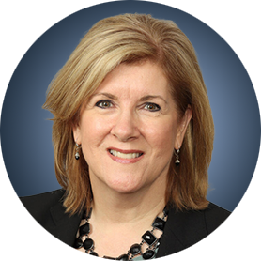


Faculty
Farrukh T Awan, MD, MS, MBA
Professor of Internal Medicine
Associate Director, Section of Hematologic Malignancies/Transplantation and Cellular Therapies
Director of Lymphoid Malignancies Program
Harold C Simmons Comprehensive Cancer Center
University of Texas Southwestern Medical Center
Dallas, Texas
Robin Klebig, MSN, APRN, CNP, AOCNP
Hematology Outpatient APP Supervisor
Assistant Professor of Medicine
Nurse Practitioner, Lymphoma Group
Division of Hematology
Mayo Clinic
Rochester, Minnesota
Mollie Moran, APRN-CNP, AOCNP
Nurse Practitioner
The James Cancer Hospital and Solove Research Institute
The Ohio State University
Columbus, Ohio
Moderator
Brad S Kahl, MD
Professor of Medicine
Washington University School of Medicine
Director, Lymphoma Program
Siteman Cancer Center
St Louis, Missouri

Slide 3
Dr Awan — Disclosures
Consulting Agreements | AbbVie Inc, Adaptive Biotechnologies Corporation, AstraZeneca Pharmaceuticals LP, BeOne, Bristol Myers Squibb, DAVA Oncology, Genmab US Inc, Incyte Corporation, Invivyd, Loxo Oncology Inc, a wholly owned subsidiary of Eli Lilly & Company, Miltenyi Biotec, Pierre Fabre
Contracted Research | Actinium Pharmaceuticals Inc, Pharmacyclics LLC, an AbbVie Company
Data and Safety Monitoring Boards/Committees | Ascentage Pharma, AstraZeneca Pharmaceuticals LP, Caribou Biosciences Inc

Slide 4
Ms Klebig — Disclosures
No relevant financial relationships to disclose.

Slide 5
Ms Moran — Disclosures
No relevant financial relationships to disclose.

Slide 6
Dr Kahl — Disclosures
Advisory Committees | AbbVie Inc, AstraZeneca Pharmaceuticals LP, BeOne, Bristol Myers Squibb, Genentech, a member of the Roche Group, GSK, Incyte Corporation, Lilly, Merck, Pfizer Inc, Roche Laboratories Inc
Contracted Research | BeOne, Roche Laboratories Inc
Data and Safety Monitoring Boards/Committees | BeOne, Bristol Myers Squibb, Roche Laboratories Inc

Slide 7
Commercial Support
This activity is supported by educational grants from ADC Therapeutics, Genentech, a member of the Roche Group, and Lilly.
Research To Practice NCPD Planning Committee Members,
Staff and Reviewers
Planners, scientific staff and independent reviewers for Research To Practice have no relevant financial relationships to disclose.

Slide 8
This educational activity contains discussion of
non-FDA-approved uses of agents and regimens. Please refer to official prescribing information for each product for approved indications.

Slide 9



Clinicians in the Meeting Room
Networked iPads are available.
Review Program Slides: Tap the Program Slides button to review speaker presentations and other program content.
Answer Survey Questions: Complete the pre- and postmeeting surveys. Survey questions will be discussed throughout the meeting.
Ask a Question: Tap Ask a Question to submit a challenging case or question for discussion. We will aim to address as many questions as possible during the program.
For assistance, please raise your hand. Devices will be collected at the conclusion of the activity.
Notes:
9

Slide 10

Clinicians Attending via Zoom
Review Program Slides: A link to the program slides will be posted in the chat room at the start of the program.
Answer Survey Questions: Complete the pre- and postmeeting surveys. Survey questions will be discussed throughout the meeting.
Ask a Question: Submit a challenging case or question for discussion using the Zoom chat room.
Get NCPD Credit: An NCPD credit link will be provided in the chat room at the conclusion of the program.
Notes:
10

Slide 11
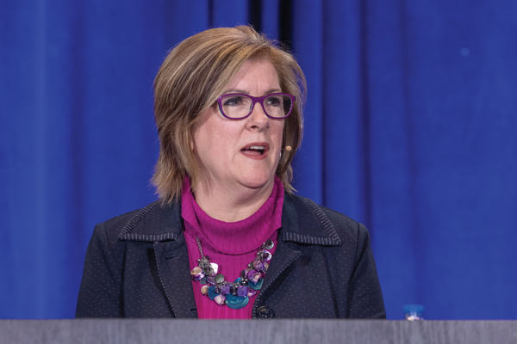
About the Enduring Program
The live meeting is being video
and audio recorded.
The proceedings from today will
be edited and developed into
an enduring web-based program.
An email will be sent to all attendees
when the activity is available.
To learn more about our education programs, visit our website, www.ResearchToPractice.com
Notes:
11
11

Slide 12



Slide 13

“Recent Advances in Cancer Care — New Paradigms,
Novel Agents and What It Means for the Oncology Nurse”
Eighteenth Annual RTP-ONS NCPD Symposium Series

Slide 14


New Agents, Therapies and Regimens
Recent Advances in Cancer Care — New Paradigms,
Novel Agents and What It Means for the Oncology Nurse
When should it be used, for whom and why?
How to prevent and manage side effects:
dose holds and reductions
  Kaplan Meier curves —
  HR and absolute benefit
  Waterfall plots

Slide 15
Bispecific Antibodies and Antibody-Drug Conjugates for
Non-Hodgkin Lymphoma and Chronic Lymphocytic Leukemia
Recent Advances in Cancer Care — New Paradigms,
Novel Agents and What It Means for the Oncology Nurse
A Complimentary NCPD Symposium Series Held During the 51st Annual ONS Congress
Friday, May 15, 2026
6:00 PM – 8:00 PM
Faculty
Farrukh T Awan, MD, MS, MBA
Robin Klebig, MSN, APRN, CNP, AOCNP
Mollie Moran, APRN-CNP, AOCNP
Moderator
Brad S Kahl, MD

Slide 16
Agenda
Introduction: Biology of Non-Hodgkin Lymphoma (NHL)
Module 1: Current Role of CD20 x CD3 Bispecific Antibodies in NHL
Module 2: Role of Polatuzumab Vedotin in Diffuse Large B-Cell Lymphoma (DLBCL)
Module 3: Optimal Application of Loncastuximab Tesirine for Patients with DLBCL and Follicular Lymphoma
Module 4: Role of BTK Inhibitors Alone or with Anti-CD20 Antibodies for Patients with Newly Diagnosed Chronic Lymphocytic Leukemia (CLL)
Module 5: Combining BTK Inhibitors with Bcl-2 Inhibitors
Module 6: Current and Future Role of Noncovalent BTK Inhibitors in CLL

Slide 17
Agenda
Introduction: Biology of Non-Hodgkin Lymphoma (NHL)
Module 1: Current Role of CD20 x CD3 Bispecific Antibodies in NHL
Module 2: Role of Polatuzumab Vedotin in Diffuse Large B-Cell Lymphoma (DLBCL)
Module 3: Optimal Application of Loncastuximab Tesirine for Patients with DLBCL and Follicular Lymphoma
Module 4: Role of BTK Inhibitors Alone or with Anti-CD20 Antibodies for Patients with Newly Diagnosed Chronic Lymphocytic Leukemia (CLL)
Module 5: Combining BTK Inhibitors with Bcl-2 Inhibitors
Module 6: Current and Future Role of Noncovalent BTK Inhibitors in CLL

Slide 18
Discussion Questions
At a very basic level, how do you counsel your patients with newly diagnosed DLBCL about the nature of their disease and what their treatment journey might look like?
How does this conversation differ for patients with newly diagnosed FL?

Slide 19
Agenda
Introduction: Biology of Non-Hodgkin Lymphoma (NHL)
Module 1: Current Role of CD20 x CD3 Bispecific Antibodies in NHL
Module 2: Role of Polatuzumab Vedotin in Diffuse Large B-Cell Lymphoma (DLBCL)
Module 3: Optimal Application of Loncastuximab Tesirine for Patients with DLBCL and Follicular Lymphoma
Module 4: Role of BTK Inhibitors Alone or with Anti-CD20 Antibodies for Patients with Newly Diagnosed Chronic Lymphocytic Leukemia (CLL)
Module 5: Combining BTK Inhibitors with Bcl-2 Inhibitors
Module 6: Current and Future Role of Noncovalent BTK Inhibitors in CLL

Slide 20
Biologic Rationale for and Current Role of CD20 x CD3 Bispecific Antibodies in
Non-Hodgkin Lymphoma (NHL)
Farrukh T. Awan, M.D., M.S., M.B.A.
Professor of Internal Medicine
Associate Director, Section of Hematologic Malignancies/Transplantation and Cellular Therapies
Director of Lymphoid Malignancies Program
Harold C. Simmons Comprehensive Cancer Center
University of Texas Southwestern Medical Center
Dallas, TX

Slide 21
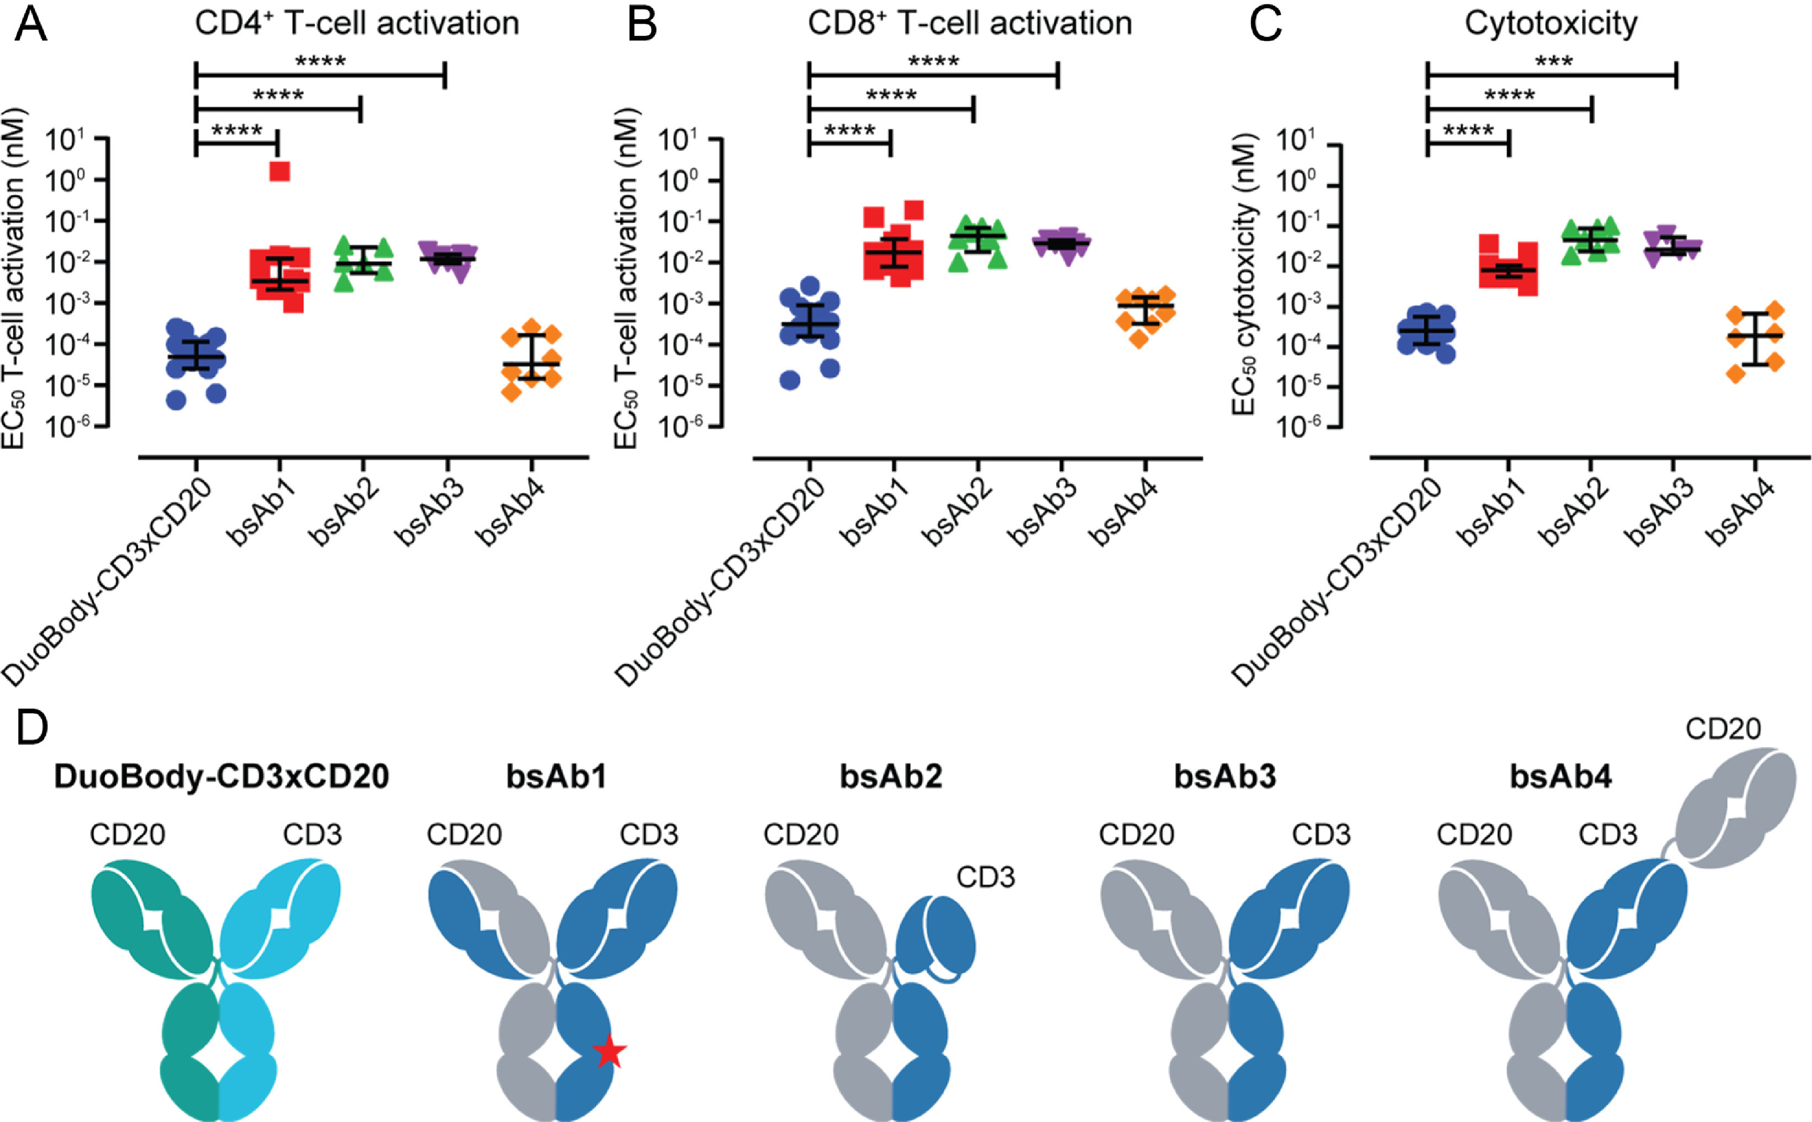
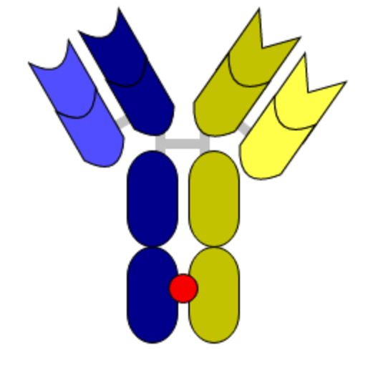
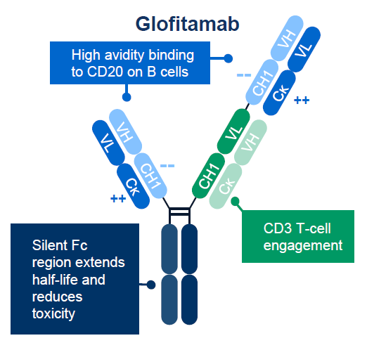
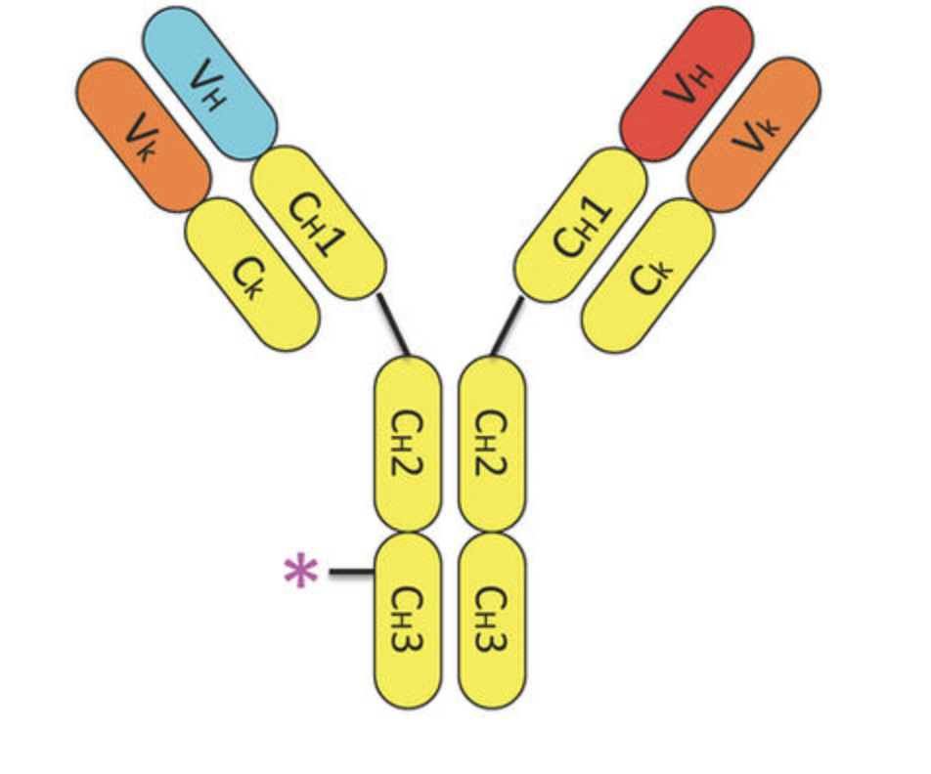
New and Emerging Bispecific Antibodies in Non-Hodgkin Lymphomas
Anti-CD20/CD3 bispecific monoclonal antibodies in the development for B-cell NHL
Epcoritamab¹ | Mosunetuzumab^{2,3} (approved in FL) | Glofitamab⁴ | Odronextamab^{5,6}
DuoBody – CD3 x CD20 BsAb SC | CD3 x CD20 Knobs-into-holes Fc BsAb IV/SC | CD3 (Fab) x CD20 (Fab x2) Fc BsAb IV | CD3 x CD20 common LC Fc BsAb IV
1. Hutchings M, et al. Lancet. 2021;398:1157-1169. 2. Budde LE, et al. J Clin Oncol. 2022;40:481-491. 3. Hosseini I, et al. NPJ Syst Biol Appl. 2020;6:28. 4. Minson A, Dickinson M. Leuk Lymphoma. 2021;62:3098-3108. 5. Zhu M, et al. Clin Transl Sci. 2022;15:954-966. 6. Smith EJ, et al. Sci Rep. 2015;5:17943.
Odronextamab is an investigational therapy for the management of NHL.
Ab = antibody; BsAb = bispecific Ab; Fc = crystallizable fragment; FL = follicular lymphoma; Fab = fragment antigen binding; IV = intravenous; LC = liquid chromatography; SC = subcutaneous.

Slide 22
Approved or Late-Stage Development Bispecifics: Administration Schedules
Bispecific | Route | Schedule | Duration
Glofitamab | IV | Weekly C1, every 3 weeks | 12 cycles
Mosunetuzumab | IV | Weekly C1, every 3 weeks | 8 cycles if complete response (CR); 17 cycles if partial response (PR)
Odronextamab | IV | Twice weekly C1, weekly C2 to C4, every 2 weeks C ≥5 | Until progressive disease (PD)
Epcoritamab | SC | Weekly C1 to C3, every 2 weeks C4 to C9, every 4 weeks C ≥10 | Until PD
Odronextamab is an investigational therapy for the management of NHL.
González Barca E. Front Immunol. 2022;13:909008.

Slide 23
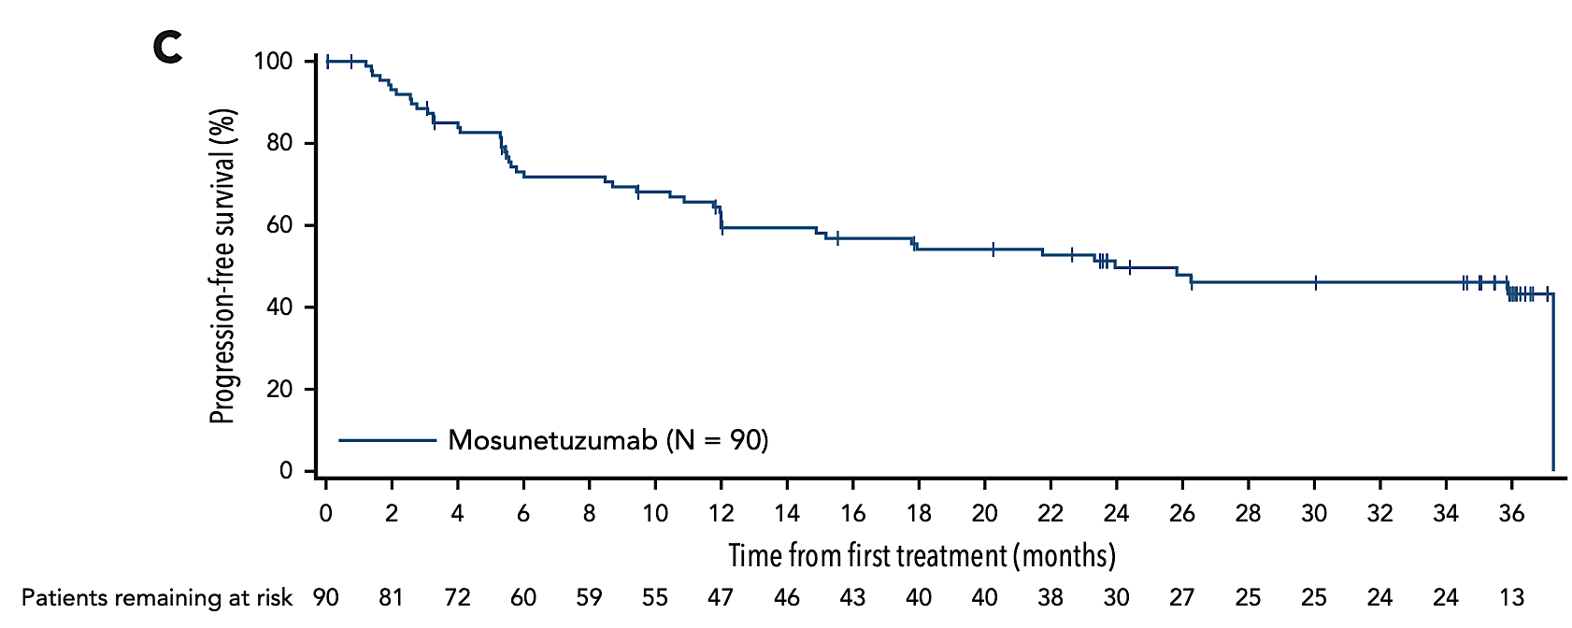
Efficacy of mosunetuzumab in R/R FL
Median PFS: 24 months
ORR: 80%
CR: 60%
Sehn et al., Blood, 2025
Notes:
37.4 months of follow up
Among 70 responders, median DOR was 35.9 months

Slide 24
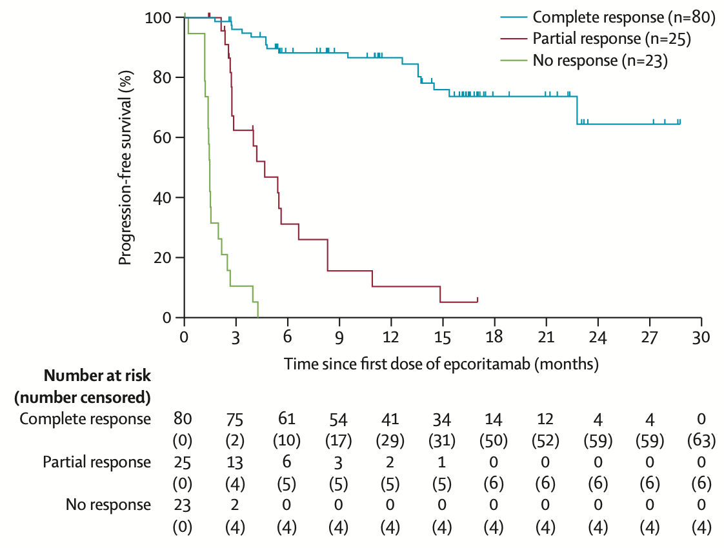
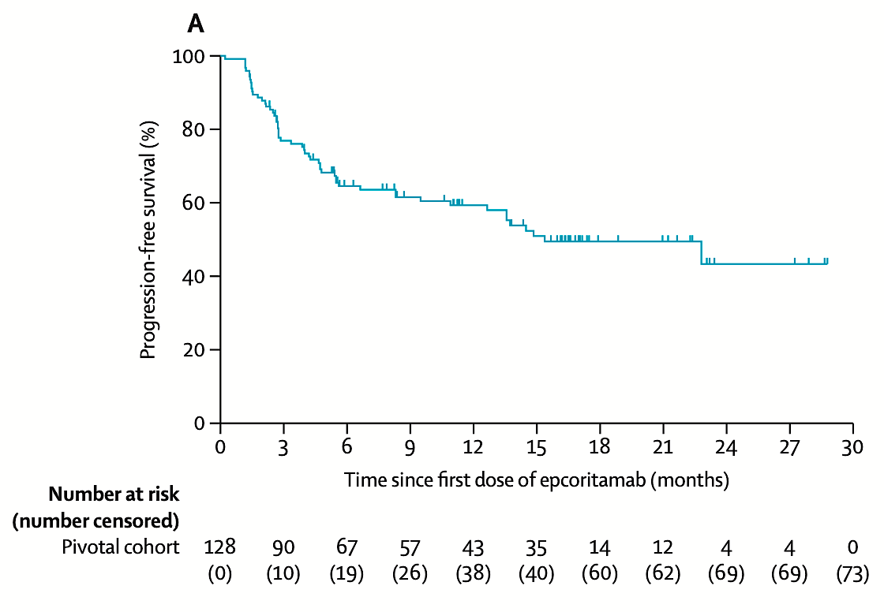
Efficacy of Epcoritamab in R/R FL
ORR: 82%
CR: 62.5%
18m PFS: 49.5%
Linton et al. Lancet Haematol., 2024

Slide 25
Summary of CD20-Directed Bispecifics for R/R FL
Bispecific antibody | Number of patients | ORR % | CR % | Duration of CR (median; months) | PFS months
Glofitamab¹ | 44 | 71 | 48 | NR | 11.8
Mosunetuzumab² | 90 | 79 | 60 | NR | 18
Odronextamab³ | 128 | 80 | 72 | 21.7 | 20.7
Epcoritamab⁴ | 10 | 90 | 50 | NA | NR
1. Hutchings M, et al. J Clin Oncol. 2021;39:1959-1970. 2. Budde LE, et al. Lancet Oncol. 2022;23:1055-1065. 3. Villasboas JC, et al. Blood. 2023;142(suppl 1):3041. 4. Hutchings M, et al. Lancet. 2021;398:1157-1169.
Odronextamab is an investigational therapy for the management of NHL.

Slide 26
Glofitamab Monotherapy at RP2D
Induces Durable Complete Responses
Pivotal phase 2 results
  DLBCL NOS, HGBCL, trFL or PMBCL; ≥2 prior therapies
  Glofitamab 2.5/10/30 mg (N = 155)
  Efficacy
    CR rate: 39.4% (61/155)
    ORR: 51.6% (80/155)
Heavily pretreated,
highly refractory population
Pivotal phase 2 cohort (ASCO 2022) – DoCR* by IRC
100
80
60
Probability
40
20
Median DoCR:
NE (95% CI: 16.8–NE)
0
0
1
2
3
4
5
6
7
8
9
10
11
12
13
14
15
16
17
18
19
20
21
Patients at risk
Time, months
61
57
55
46
45
36
34
33
28
26
25
23
21
16
14
13
12
10
10
3
1
NE
 | N = 61
Median DoCR follow-up, months (range) | 10.6 (0–21)
12-months DoCR, % (95% CI) | 77.6 (64.3–90.8)
CRs ongoing at CCOD, n (%) | 49 (80.3)
Received FDA approval on June 15, 2023, for R/R DLBCL after 2 prior therapy lines
Clinical cutoff date: March 14, 2022. *Time from the initial occurrence of a CR until PD or death due to any cause, whichever occurs first.
RP2D = recommended phase II doseCCOD = clinical cutoff date; CI = confidence interval; CRS = cytokine release syndrome; DoCR = duration of complete response; IRC = independent review committee; PD = progressive disease.
Dickinson M, et al. American Society of Clinical Oncology (ASCO) 2022; Abstract 7500. Dickinson M, et al. N Engl J Med. 2022;387:2220-2231.

Slide 27
Glofitamab: Remission at 12-Month Post-EOT in Patients With CR at EOT
Follow-up period
EOT
(N = 61)
The majority of patients remain in remission
6-month follow-up: 79% (48/61)
12-month follow-up: 61% (37/61)
After 12-month follow-up, 7 patients had discontinued
1 PD
2 deaths (due to lymphoma)
4 discontinued study (2 received allogeneic transplant, 1 due to physician decision, 1 lost to follow-up)
17 patients remained in follow-up but had not yet reached 12 months
6 mo
12 mo
18m
24m
30m
36m
42m
100
80
60
Patients ,%
40
20
0
Response:
Not reached
Discontinued study
Death
PD
Continued remission
The majority of patients remain in remission 12 months after cessation of therapy.
Hutchings M, et al. Presented at ASH 2022. Abstract 441

Slide 28
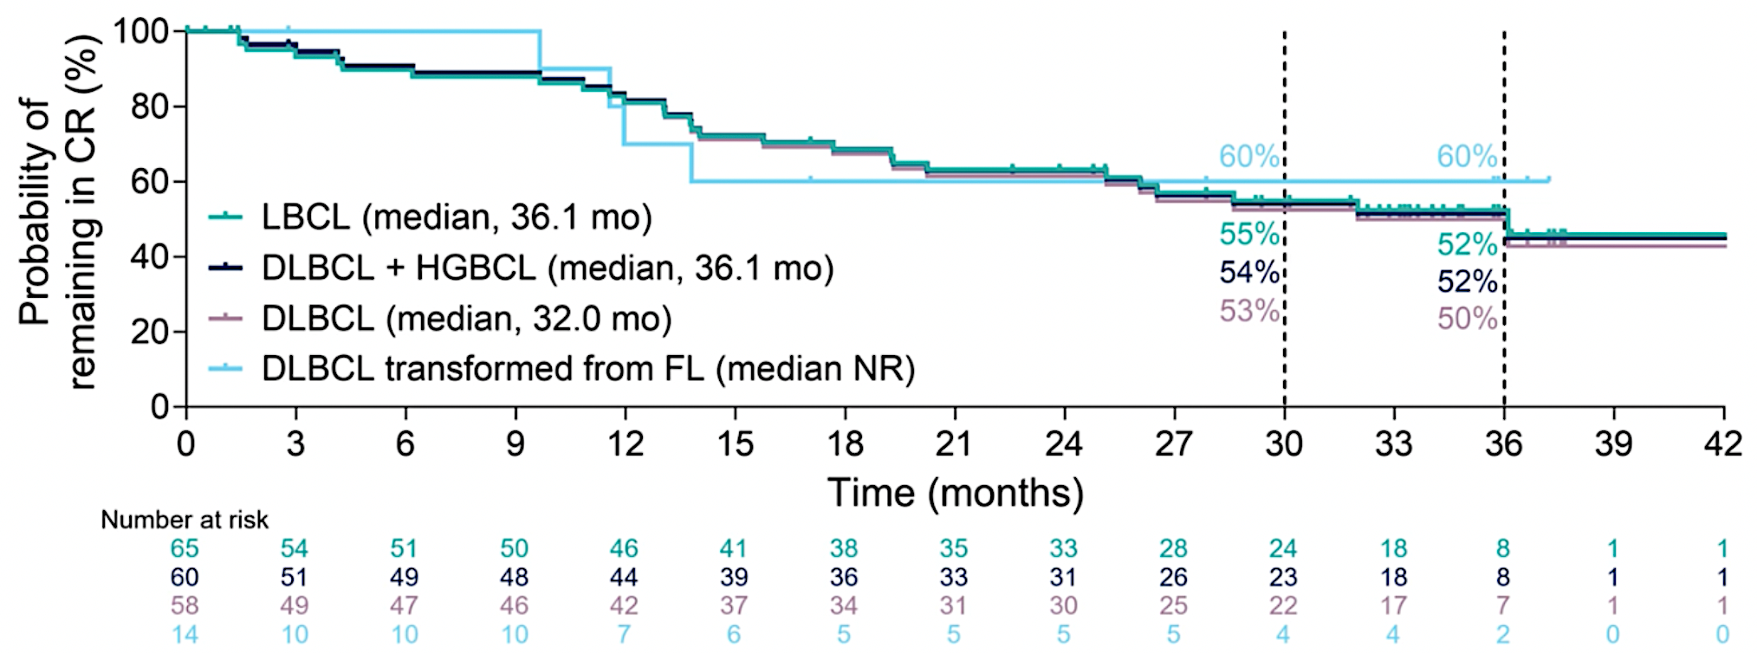
EPCORE NHL-1 Trial: Efficacy
Response and DOR | LBCL (N=157) | DLBCL Transformed From FL (n=32)
ORR, n (%) | 92 (59) | 16 (50)
CR, | 65 (41) | 14 (44)
PR, | 21 (17) | 2 (6)
Median DOR, months (95% CI) | 20.8 (13.0-32.0) | NR (10.6-NR)
36-month estimate, % | 39 | 55
Durable complete responses and overall median DOCR of 36.1 months
(95% CI, 20.2-NR)
Vose JM, et al. ASH 2024. Abstract 4480.

Slide 29
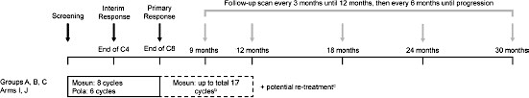
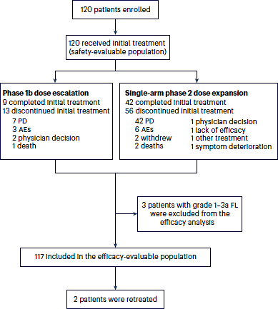
Mosunetuzumab + polatuzumab vedotin for R/R DLBCL
Key baseline characteristics
  56% age >70
  55% elevated LDH
  57-77% refractory
  50% 1 prior LOT
  35% prior CART19
Nat Med. 2024 Jan;30(1):229-239.

Slide 30
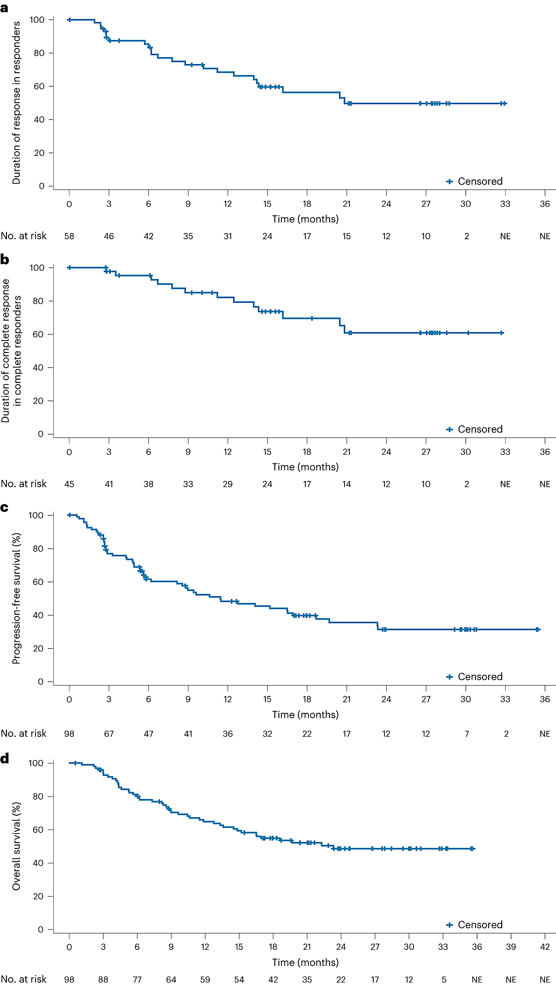
Mosunetuzumab + polatuzumab vedotin for R/R DLBCL
Response
  ORR: 73%
  CRR: 59%
  CRR if 1 prior LOT: 49%
  CRR by prior CART19 vs not: 40% vs 49%
Toxicity
  CRS: 18% any grade, 3% grade ≥3
  Febrile neutropenia: 0%
Mosun/pola is associated with a high response rate and low toxicity in R/R DLBCL
Nat Med. 2024 Jan;30(1):229-239.

Slide 31
Case Presentation

Slide 32
CASE PRESENTATION
89-year-old male diagnosed with triple hit DLBCL
Had primary refractory disease after R-mini-CHOP chemotherapy
Received radiation as a bridge to CAR-T cell therapy
Initially did well after CAR-T cell therapy, but had relapsed disease after 6 months
Performance status is still good, and the patient desires additional treatment
What’s the best next option for treatment

Slide 33
CASE PRESENTATION..cntd
72-year-old female with CLL with cBTKi resistance and needs treatment
Multiple comorbidities
What is the least likely to be an effective treatment option
  Loncastuximab
  Epcoritamab
  Glofitamab
  Tafasitamab + lenalidomide
  Chemotherapy

Slide 34
Discussion Questions
How are you currently sequencing bispecific antibodies relative to other currently available therapies for relapsed/refractory (R/R) DLBCL? How do you decide whether to use glofitamab or epcoritamab?
Which patients with R/R FL represent ideal candidates for bispecific antibody therapy? How do you choose among mosunetuzumab monotherapy, epcoritamab monotherapy and epcoritamab/R²?

Slide 35
Cytokine Release Syndrome (CRS), Neurotoxicity and Other Tolerability Concerns with Bispecific Antibodies in NHL
Robin Klebig, APRN, CNP, AOCNP
May 15, 2026

Slide 36
Cytokine Release Syndrome (CRS), Neurotoxicity and Other Tolerability Concerns with Bispecific Antibodies in NHL
CRS - Cytokine Release Syndrome
  Systemic inflammatory response resulting from massive cytokine release by activated immune cells
  Characterized by fever, hypotension, hypoxia, organ dysfunction
  Managed with corticosteroids (dexamethasone) +/- tocilizumab (IL-6 inhibitor)
ICANS - Immune effector Cell-Associated Neurotoxicity Syndrome
  Neurological toxicities associated with immune cell activation and cytokine release
  Presents as confusion, delirium, aphasia/dysphasia, seizures, encephalopathy or cerebral edema
  Managed with corticosteroids (dexamethasone), Neurology consultation, levetiracetam
ASTCT and NCCN guidelines

Slide 37
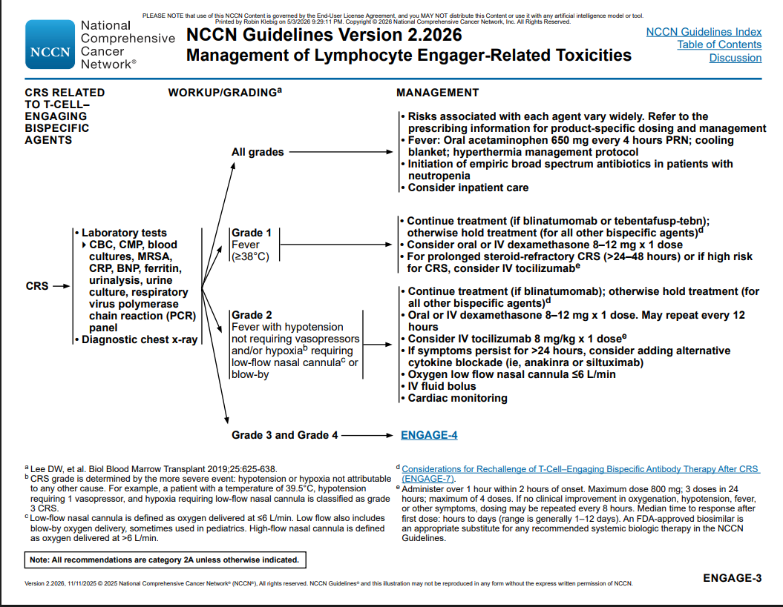

Slide 38
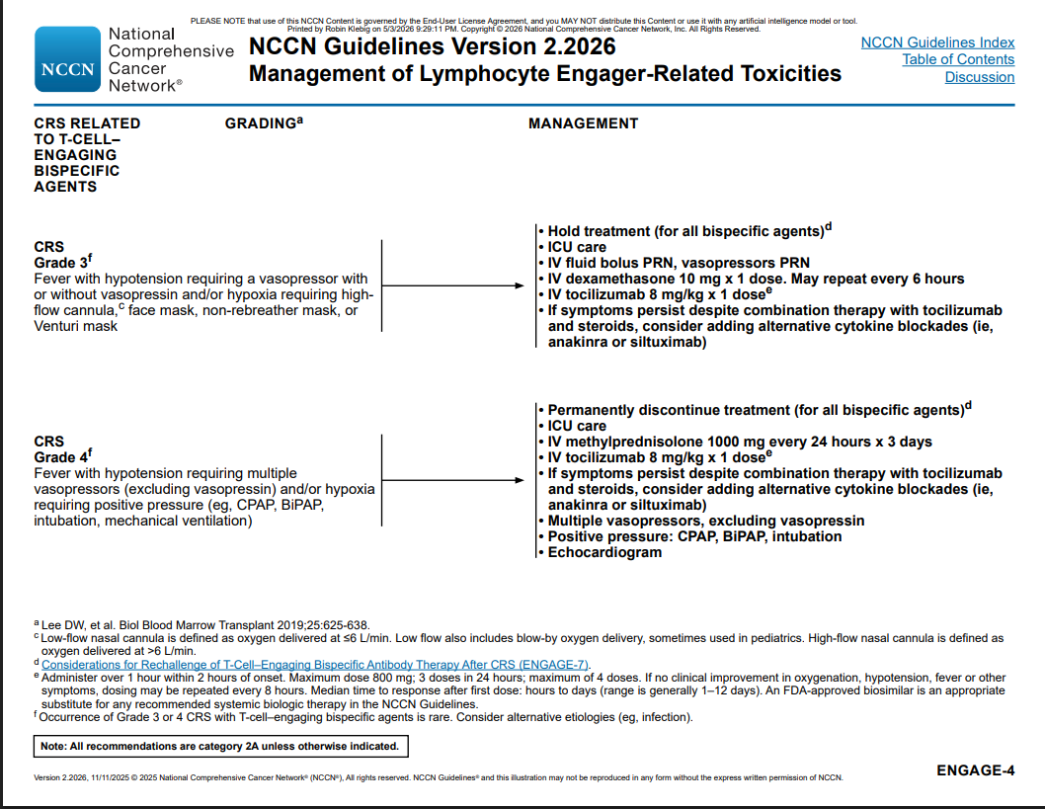

Slide 39
Bispecific antibodies and CRS incidence and time course:
Bispecific | Setting | Treatment Day/Dose/CRS incidence | Overall CRS (≥grade 2) | Median Time to CRS | Median Duration CRS
Epcoritamab | SC in LBCL | C1D1 (0.16 mg) = 6% C1D8 (0.8 mg) = 12% C1D15 ( 48 mg) = 43% C1D22 (48 mg) = 5% C2D1+ (48 mg) = 3% | 51% (19.5%) | 21 hrs (range: 0-7 days) | 2 days (range 1-27 days)
Epcoritamab | SC in FL | C1D1 (0.16 mg) = 12% C1D8 (0.8 mg) = 6% C1D15 (3 mg) = 15% C1D22 (48 mg) = 37% C1D22 (48 mg) = 5% C2D1+ (48 mg) = 3% | 49% (9%) | 61 hrs | 2 days (range 1-27 days)
Glofitamab | IV in LBCL | C1D1 (obinutuzumab) C1D8 (2.5 mg) = 56% C1D15 (10 mg) = 35% C2 (30 mg) = 29% C3+ (30 mg) = 2.8% | 70% (18%) | 14 hrs (range: 5-74 hrs) | 2 days (range: 1-14 days)
Mosunetuzumab | IV in FL | C1D1 (1 mg) = 23% C1D8 (2 mg) = NR C1D15 (60 mg) = 36% C2D1 (60 mg) = 1% C3+ (30 mg) = | 44% (19%) | 5 hrs (C1D1) 27 hrs (C1D15) | 3 days
Mosunetuzumab | SC in FL | C1D1 (5 mg) = 19% C1D8 (45 mg) = 13% C1D15 (45 mg) = 2.1% | 30% (9.1%) | 17 hrs (C1D1) 62 hrs (C1D8) | 2 days (range: 1-15 days)
Courtesy of Robin Klebig, APRN, CNP, AOCNP

Slide 40
ICANS/Neurotoxicity presentations
ICANS
Non ICANS Neurotoxicity
Expressive aphasia; dysgraphia, tremor, confusion/delirium, lethargy, impaired attention, difficulty concentrating, seizures, non-convulsive status epilepticus. LOC may be depressed
Timing typically during step-up dosing during C1
  3-3.5 days from most recent dose
  Median duration 2-4 days
Often concurrent with or shortly after CRS, though can be independent of CRS
ICE score Abnormal (≤9) — this is the defining feature
Management: Corticosteroids (dexamethasone → methylprednisolone); tocilizumab does NOT help
Isolated headache, dizziness, insomnia, peripheral neuropathy, tremor (isolated symptoms without encephalopathy symptoms). LOC typically normal
Timing is variable; headache may occur acutely with infusion; peripheral neuropathy may be delayed
Usually independent of CRS (headache may accompany fever/CRS but is non-specific)
ICE score is Normal (10/10)
Management is symptomatic (analgesics for headache, gabapentin for neuropathy, etc.)
 | Epcoritamab | Glofitamab | Mosunetuzumab
Any grade (Gr3+) | 6% (0.6% in LBCL) | 4.8-8% (2.6%) | 3% grade 1-2 confusion 1% grade 1 disturbance in attention 1% grade 1 cognitive disorder
Key screening test is ICE assessment
ASTCT and NCCN guidelines

Slide 41
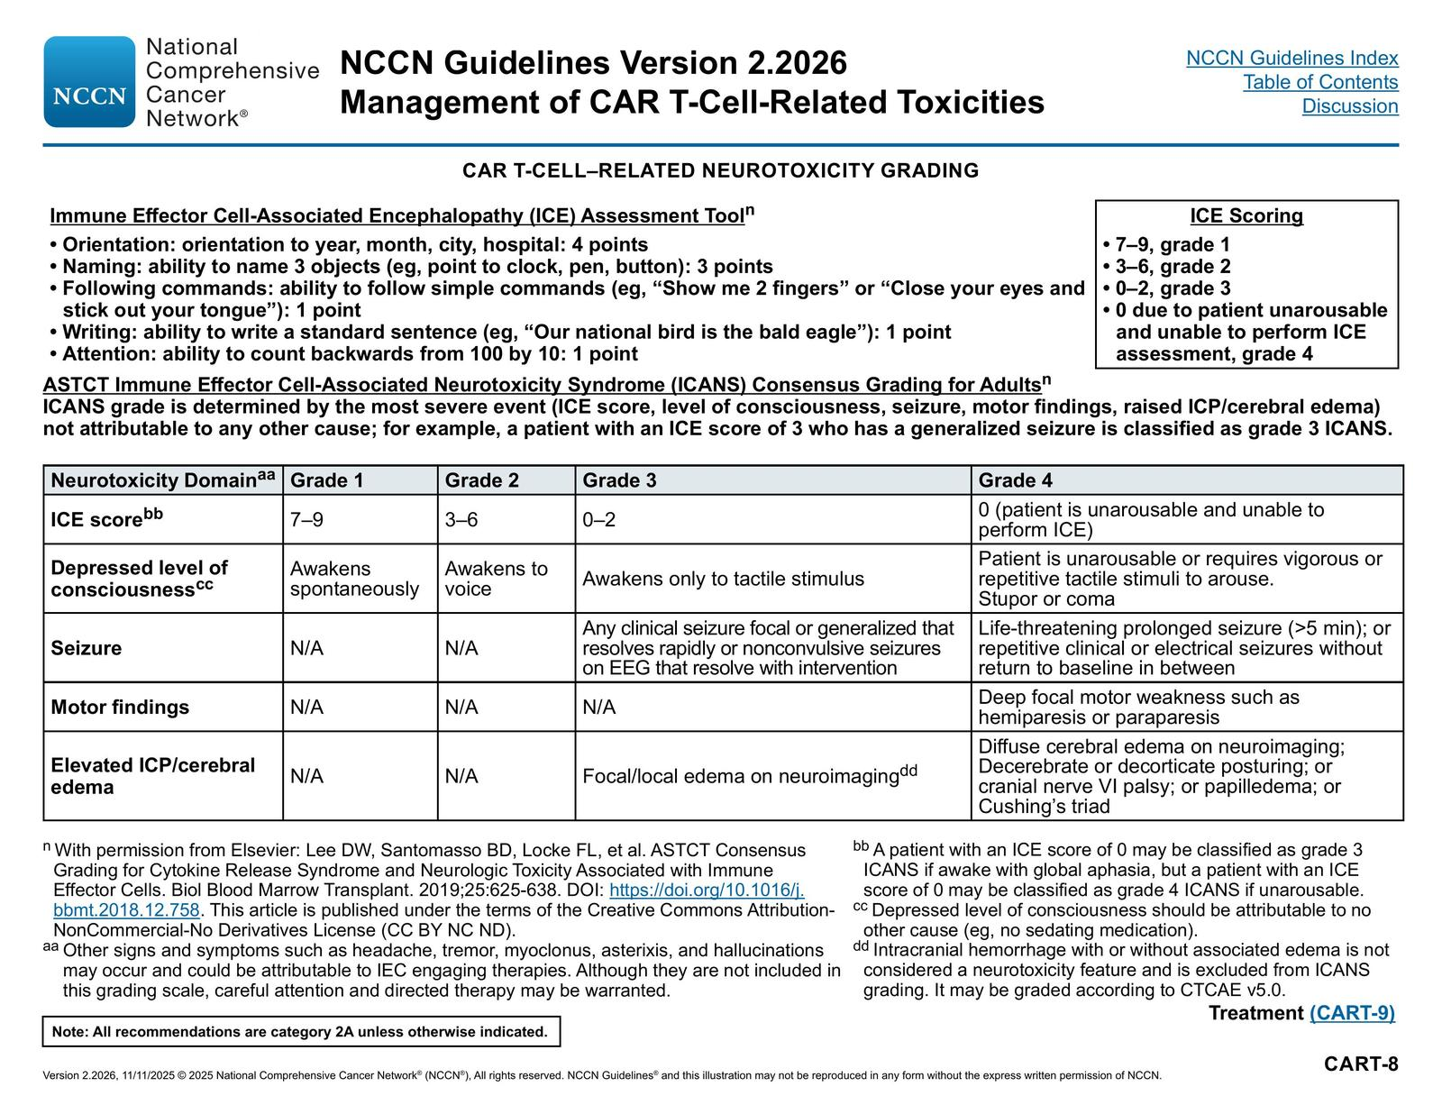

Slide 42
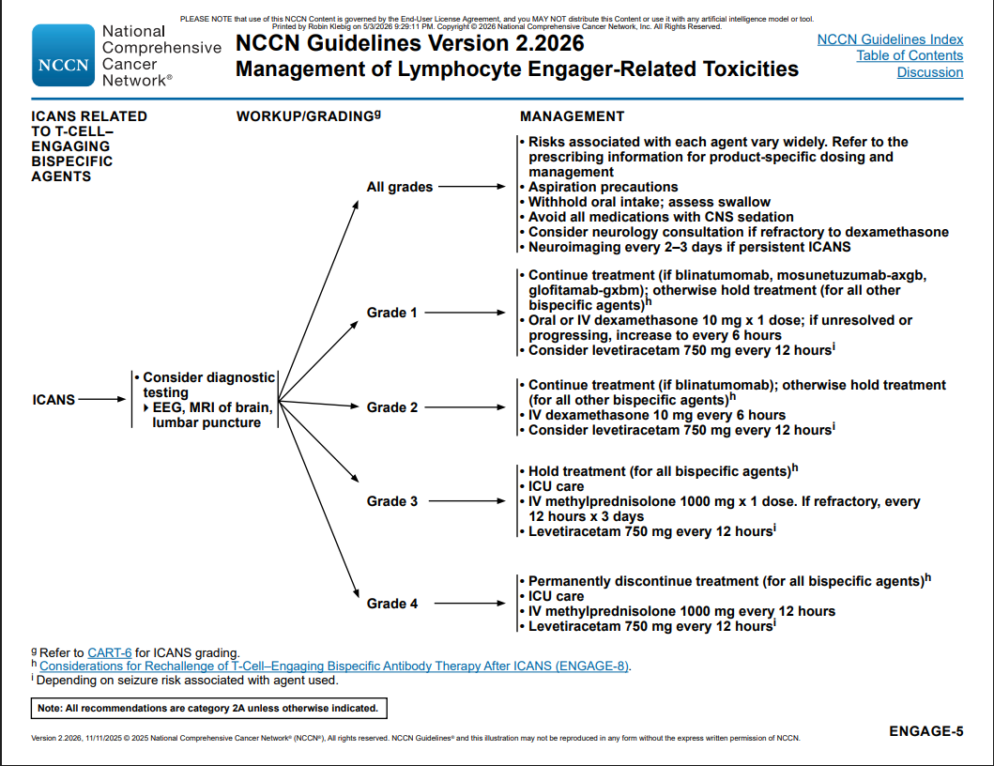

Slide 43
Other Tolerability Concerns with Bispecific Antibodies in NHL
Cytopenias & Infections
 | Neutropenia* | Infections | Thrombocytopenia | Anemia
Mosunetuzumab | 50% (26% gr 3+) *median onset 70 days, duration 8 days | 20% (14% gr 3+) | 33% (6.4% gr 3+) | 60% (10% gr 3+)
Epcoritamab | 21.7% (14.6% gr 3+) | 15% (14% gr 3+) | 13.4% (5.7% gr 3+) | 62% (12% gr 3+)
Glofitamab | 56% (26% gr 3+) | 38% (15% gr 3+) | 56% (8% gr 3+) | 72% (8% gr 3+)
*G-CSF for Neutropenia (ANC <1.0)
Prophylactic antimicrobials (VZV, PJP) until end of therapy and CD4 >200
Monitor IgG – IVIG for hypogammaglobulinemia (IgG <400 mg/dL)
Courtesy of Robin Klebig, APRN, CNP, AOCNP

Slide 44
Other Tolerability Concerns with Bispecific Antibodies in NHL
Fatigue
  Mosunetuzumab SC - highest incidence (39%), followed by epcoritamab in FL (37%), epcoritamab in LBCL (29%), and glofitamab (20%)
Rash
  Generally low-grade, manageable, and rarely treatment-limiting
  Epcoritamab - 15% of patients (grade 3–4 in 0.6%)
    Injection site reactions in 27–47% of patients (nearly all grade 1)
  Glofitamab - 20% of patients (grade 3–4 in 1.4%)
  Mosunetuzumab SC - 35% of patients (grade 3–4 in 3.2%)
    Injection site reactions (69%)
    In IV formulation, rash was not listed among the most common adverse events
  Management: topical corticosteroids, oral antihistamines; po corticosteroids and Dermatology consultation prn
Musculoskeletal pain
  Epcoritamab in LBCL - 28%; glofitamab and mosunetuzumab SC - 20–21%; very low rates of grade 3–4 musculoskeletal pain (0–2.1%)
Courtesy of Robin Klebig, APRN, CNP, AOCNP

Slide 45
Other Tolerability Concerns with Bispecific Antibodies in NHL
Gastrointestinal adverse effects
GI Adverse Reaction | Glofitamab | Epcoritamab | Mosunetuzumab
Nausea | 10% (Gr 3+ 0%) | 17-20% (Gr 3+ 1.3%) | 14% (Gr 3+ 0%)
Vomiting | 10% | 12% (Gr 3+ 0.6%) | NR
Diarrhea | 14% (Gr 3+ 0%) | 20-26% (Gr 3+ 1.6%) | 20% (Gr 3+ 0%)
Constipation | 14% (Gr 3+ 0%) | 16% (Gr 3+ 0%) | 14% (Gr 3+ 0%)
Courtesy of Robin Klebig, APRN, CNP, AOCNP

Slide 46
Case Presentation

Slide 47
A patient with NHL who received a bispecific antibody
45 y/o male ER physician
Lives 17 hours from Mayo Clinic
Presented with urinary pain, concerned about prostatitis, possible abscess
CT performed and showed adenopathy in small bowel area, largest 3.6 cm
CBC, chem panel, LDH all WNL
No B symptoms
PMH: Thyroid nodule
Social:
  Patient and spouse both ER physicians. 2 children, ages 7 and 9
  Never smoker, physically active, healthy diet & lifestyle

Slide 48
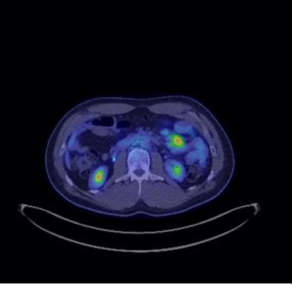
Diagnosis
Lymph node, mesenteric, laparoscopic excisional bx: Follicular lymphoma, grade 1-2.
  Germinal center B-cells
  Positive CD20 and BCL6
  Aberrant BCL2 expression
  Ki-67 10%

Slide 49
A patient with NHL who received a bispecific antibody
No prior therapy
Came to Mayo Clinic to participate in MorningSun clinical trial ML43389 - An Open-Label, Multicenter, Phase II Trial Evaluating the Safety, Efficacy, and Pharmacokinetics of Subcutaneous Mosunetuzumab Monotherapy in Patients With Select B-Cell Malignancies
Treatment
  Mosunetuzumab SQ 5 mg on Day 1
  Mosunetuzumab SQ 45 mg on Days 8 onward
  Plan per protocol – up to 17 cycles, can d/c treatment after 8 cycles if in CR
Premedications
  Diphenhydramine 50 mg po
  Acetaminophen 650 mg po
  Dexamethasone 20 mg po

Slide 50

Treatment course
CRS
  C1D1 – grade 1
    Temp 100.3, headache, malaise
      Dexamethasone 10 mg IV given
  C1D3 – grade 1
    recurrent CRS with fever (temp 101) & rigors
      Dexamethasone 10 mg IV and tocilizumab
  Infectious w/u unremarkable
  No recurrence of CRS
ICANS/Neurotoxicity
  Grade 0?
  “Passed” ICE score but subsequently admitted he could not recall the names of his children, word finding, “in a fog” and “scary”
  [received dexamethasone 10 mg IV for CRS]

Slide 51
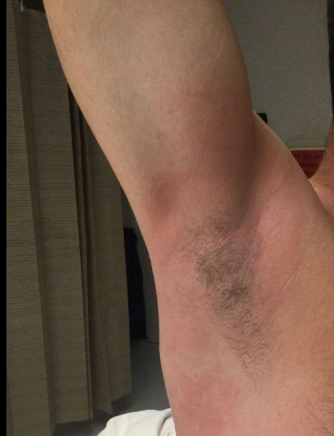
Treatment course
General side effects & management
  Headaches, malaise, myalgias
  Rash
    Derm consult – r/o SJS/TEN
    Topical triamcinolone 0.1% cream BID to affected areas
    Loratadine 20 mg BID
    Famotidine 20 mg BID
    Montelukast 10 mg daily
    With recurrence - Dexamethasone 20 mg 1 day prior to and day of mosunetuzumab, then 10 mg daily x 3 days after injection
  Injection site reactions
  Neutropenia & Lymphopenia
    Antimicrobial prophylaxis (VZV/PJP)
    G-CSF prn (Cycle 10 – ANC = 250)

Slide 52
Treatment course
Per protocol, can d/c treatment after 8 cycles if in CR (he was)
  ClonoSeq ID - had 3 traceable sequences - "trackable tumor"
    PLAN: If negative, consider d/c and observe; if positive, continue
  MRD negative after cycle 10
  Elected to discontinue treatment after cycle 11, entered observation
Recurrent infections for 6 months after completion of treatment
Current status –
  Alive, 16 months out from completion of treatment
  Living a normal active life

Slide 53
Discussion Questions
Can bispecific antibodies be safely delivered in a community oncology setting?
What steps can nurses in community-based practice take to ensure a smooth transition for patients who receive bispecific antibodies at tertiary care centers and then return to them for routine care?
What potential long-term complications are associated with bispecific antibodies? How should patients who receive these agents be followed over time?

Slide 54
Agenda
Introduction: Biology of Non-Hodgkin Lymphoma (NHL)
Module 1: Current Role of CD20 x CD3 Bispecific Antibodies in NHL
Module 2: Role of Polatuzumab Vedotin in Diffuse Large B-Cell Lymphoma (DLBCL)
Module 3: Optimal Application of Loncastuximab Tesirine for Patients with DLBCL and Follicular Lymphoma
Module 4: Role of BTK Inhibitors Alone or with Anti-CD20 Antibodies for Patients with Newly Diagnosed Chronic Lymphocytic Leukemia (CLL)
Module 5: Combining BTK Inhibitors with Bcl-2 Inhibitors
Module 6: Current and Future Role of Noncovalent BTK Inhibitors in CLL

Slide 55
Polatuzumab Vedotin in DLBCL
Brad Kahl, MD
Professor of Medicine

Slide 56
Frontline DLBCL:
R-CHOP had been the standard of care since 2002

Slide 57
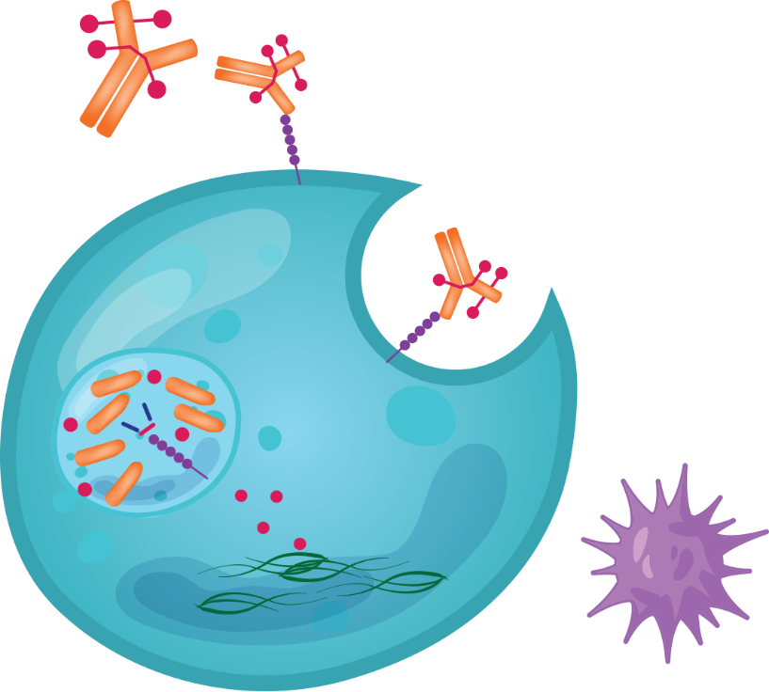
Polatuzumab Vedotin: Mechanism of Action
Microtubule inhibitor MMAE conjugated to CD79b monoclonal antibody via a protease-cleavable peptide linker
Polatuzumab vedotin in combination with rituximab, cyclophosphamide, doxorubicin, and prednisone (R-CHP) as 1L treatment for adults with previously untreated DLBCL not otherwise specified (NOS), or high-grade B-cell lymphoma (HGBL) who have an International Prognostic Index (IPI) score of 2 or greater
Polatuzumab vedotin in combination with bendamustine and rituximab is indicated for adult patients with R/R DLBCL-NOS after ≥2 prior therapies
Current NCCN guidelines list polatuzumab ± bendamustine ± rituximab as a preferred
second-line therapy
Polatuzumab vedotin
Binds to CD79b and is then internalized
Microtubule
disruption
Apoptosis
Sawalha. Oncol Targets Ther. 2020;13:5123. NCCN Clinical Practice Guidelines in Oncology: B-cell lymphomas. v..1.2026.

Slide 58
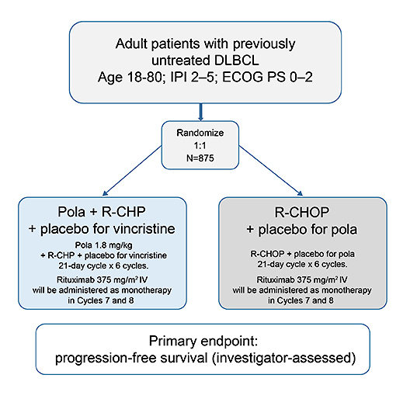
Phase III POLARIX Study Design
Tilly H et al. EHA 2018

Slide 59
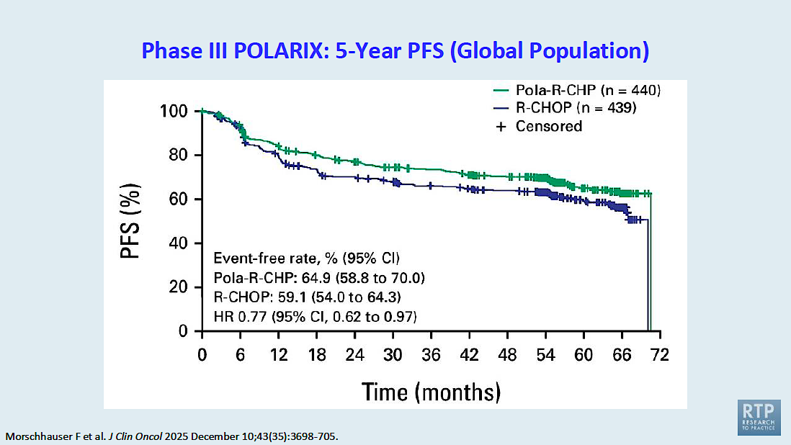

Slide 60
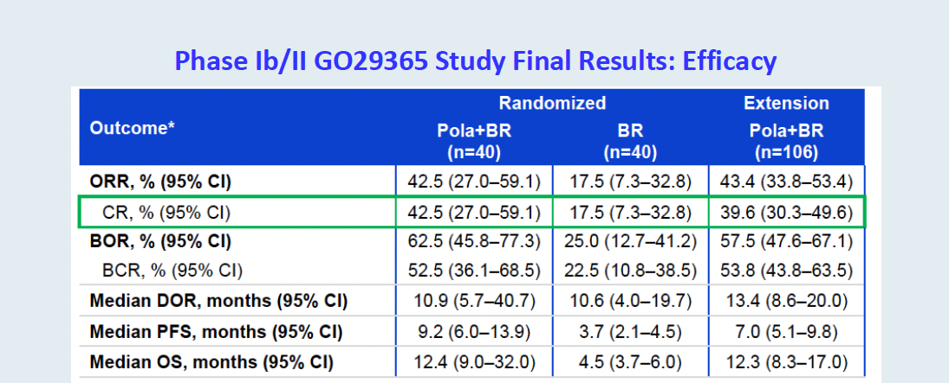
Pola in the relapsed DLBCL setting
Sehn LH et al. Blood. 2022;140 (1_Suppl: 9464-9467)

Slide 61
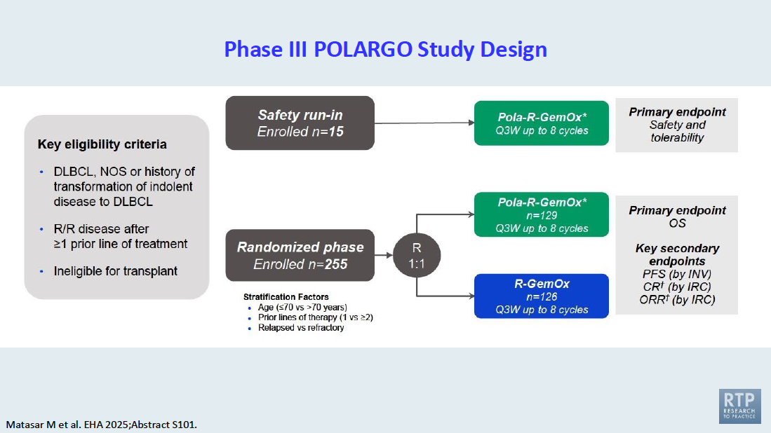

Slide 62
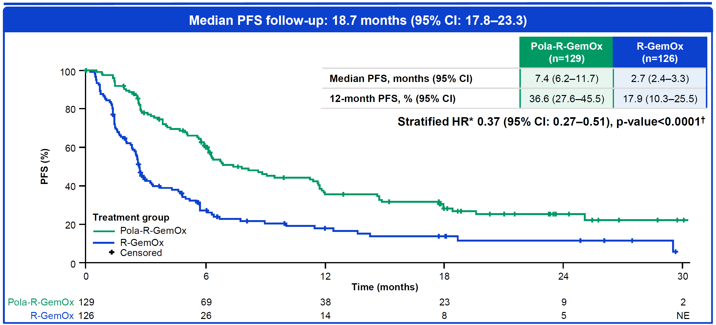
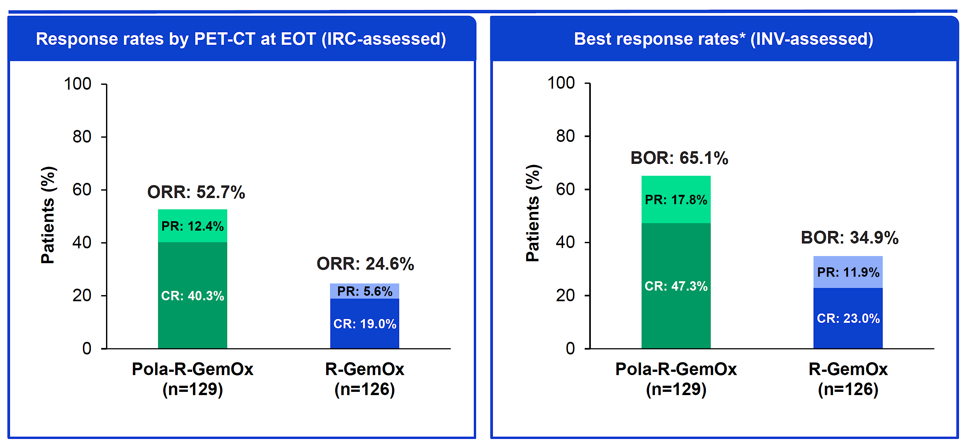
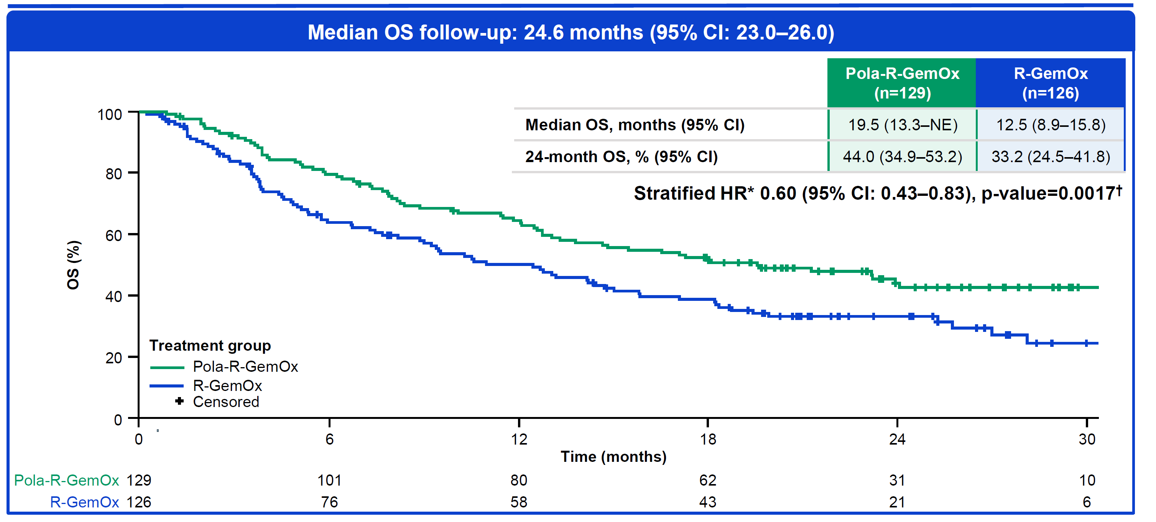
Pola-R-GO
Matasar et al, EHA. Abstract S101.

Slide 63
SUNMO Study design
Key eligibility
R/R LBCL with
≥1 prior therapy and ASCT-ineligible:
DLBCL NOS
Transformed FL
HGBCL
Grade 3B FL
Outpatient Mosun SC (8 cycles) + Pola IV (6 cycles) (21-day cycles)
Mosun
5mg
Mosun
45mg
Mosun
45mg
2:1
Screen
C1
D1 D8 D15
C2
C3
C4
C5
C6
C7
C8
Follow up after
drug completion
Screen | C1 D1 D8 D15 | C2 | C3 | C4 | C5 | C6 | C7 | C8 | Follow up after drug completion
Screening
8
weeks
16
weeks
24
weeks
…
9
months
…
30
months
R-GemOx IV (8 x 14–21-day cycles*)
Stratification factors
1 vs ≥2 prior lines of
systemic therapy
Relapsed vs refractory disease
Screen
C1
C2
C3
C4
C5
C6
C7
C8
Follow up after drug completion
Screen | C1 | C2 | C3 | C4 | C5 | C6 | C7 | C8 | Follow up after drug completion
Screening
8
weeks
16
weeks
24
weeks
…
9
months
…
30
months
Mosun
Pola
R-GemOx
Tumor
assessment
Presented as LBA3 by Westin et al, ICML 2025

Slide 64
Mosun-Pola significantly prolonged progression-free survival versus R-GemOx
Primary endpoint: Progression-free survival by IRC
100
Mosun-Pola (n=138)
12-month PFS, % (95% CI):
Mosun-Pola: 48.5 (39.6–57.4)
R-GemOx: 17.8 (5.4–30.3)
R-GemOx (n=70)
Mosun-Pola demonstrates a 59%
risk reduction for progression or death compared with R-GemOx
80
Censored
60
PFS (%)
40
20
0
0
3
6
9
12
15
18
21
24
27
30
n at risk
Time (months)
Mosun-Pola
138
108
65
54
49
40
34
20
8
5
NE
R-GemOx
70
33
9
6
5
4
4
3
1
NE
NE
Presented as LBA3 by Westin et al, ICML 2025

Slide 65
Three new combinations vs. R-GemOx
 | ORR | CR | 12 month PFS
R-GemOx | 40% | 25% | 18%
Pola-R-GemOx | 65% | 47% | 36%
Glofit-GemOx | 68% | 58% | 50%
Mosun-Pola | 70% | 51% | 48%
What is “preferred” regimen going forward?
Notes:
Appendix

Slide 66
Case Presentation

Slide 67
Case Presentation
80 yo male attorney with several months of failure to thrive, wt loss and urinary retention. Extremely weak and debilitated. PS 3.
PMHx: CHF, CAD, HTN, BPH
Found to have large abdominal mass during evaluation. Hospitalized.
Images show “malignancy” with extensive intra-abdominal adenopathy with peritoneal involvement and prostate involvement.
BX: DLBCL. Non-GCB. Stage IV. IPI score 5. Echo EF 60%.
RX: mini-R-CHP-pola. X 3. PS improving. Interim PET showed PMR with 5 point score of 4. Increased to full dose R-CHP-pola.
EOT PET (4/29/26) show CMR.

Slide 68
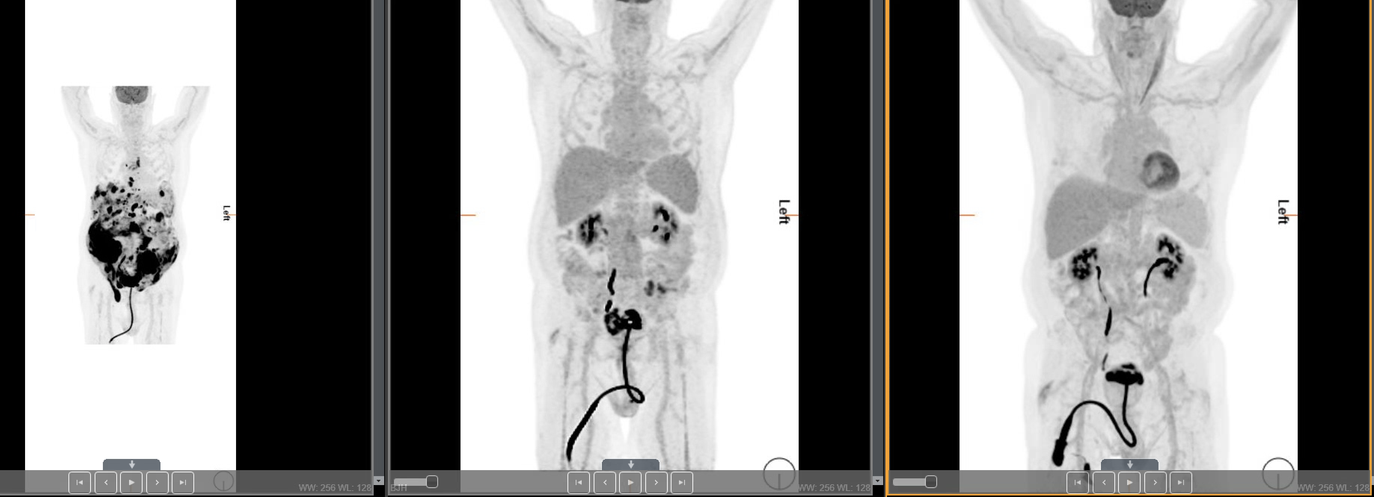
PET images 12/25, 2/26, 4/26

Slide 69
Discussion Questions
For which patients with newly diagnosed DLBCL are you prioritizing the use of polatuzumab vedotin/R-CHP?
For your patients who don’t receive polatuzumab vedotin in the front-line setting, how are you employing this agent in the R/R setting? What are you typically partnering it with?

Slide 70
Tolerability Considerations with Polatuzumab Vedotin
Mollie Moran, APRN-CNP, AOCNP
Nurse Practitioner
The James Cancer Hospital and Solove Research Institute
The Ohio State University
Columbus, Ohio

Slide 71
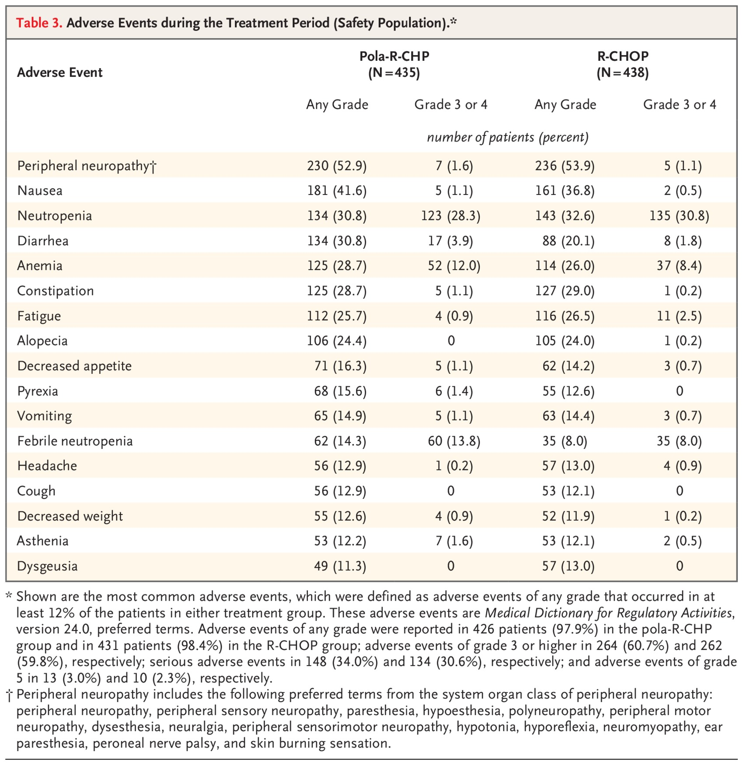

Adverse Events during the Treatment Period (Safety Population).
Tilly H et al. N Engl J Med2022;386:351-363
Notes:
Table 3 Adverse Events during the Treatment Period (Safety Population).

Slide 72
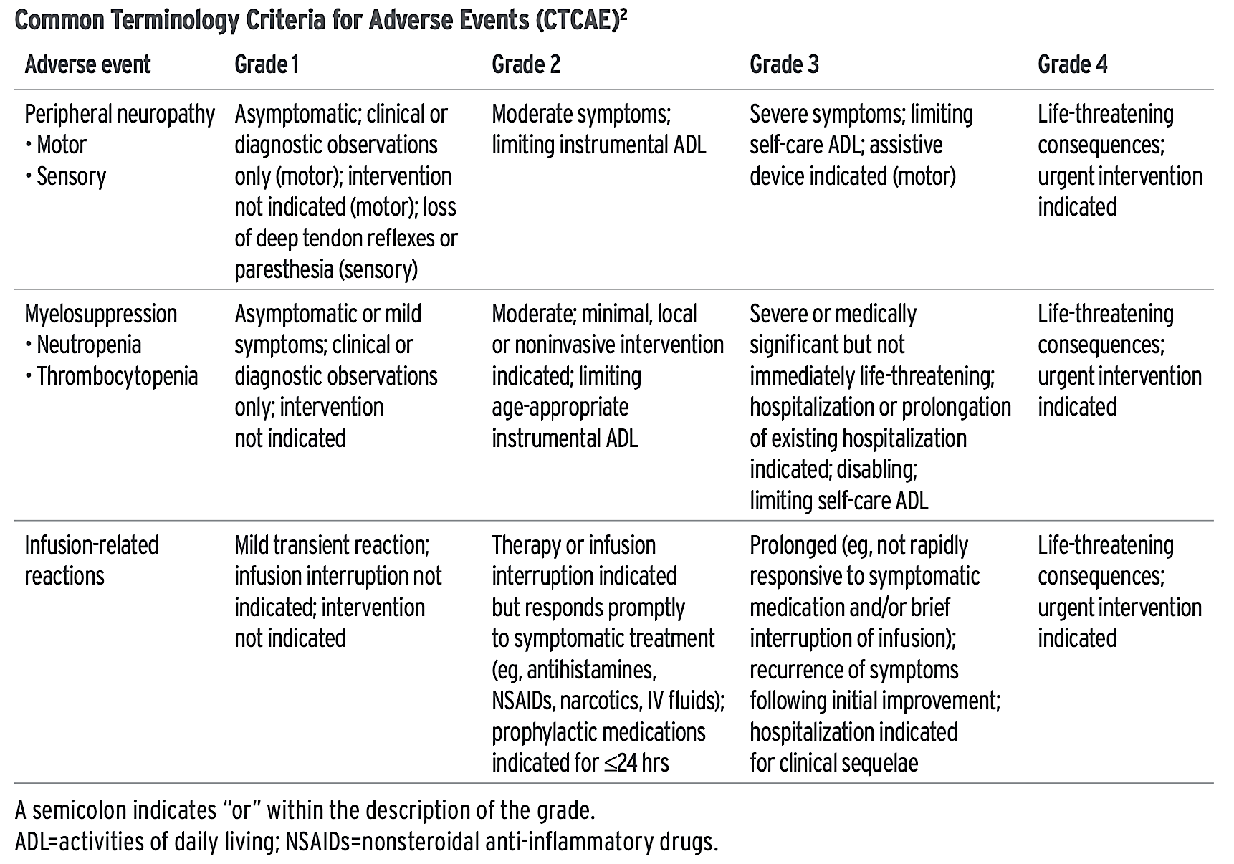
Grading of Common Polatuzumab Vedotin-Associated Adverse Events
Polatuzumab vedotin, Manufacturer’s dosing and administration guide.

Slide 73
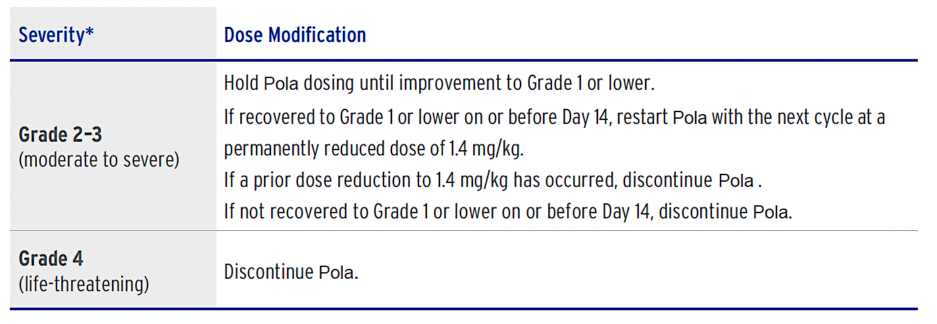
Management of Peripheral Neuropathy
Polatuzumab vedotin, Manufacturer’s dosing and administration guide.

Slide 74
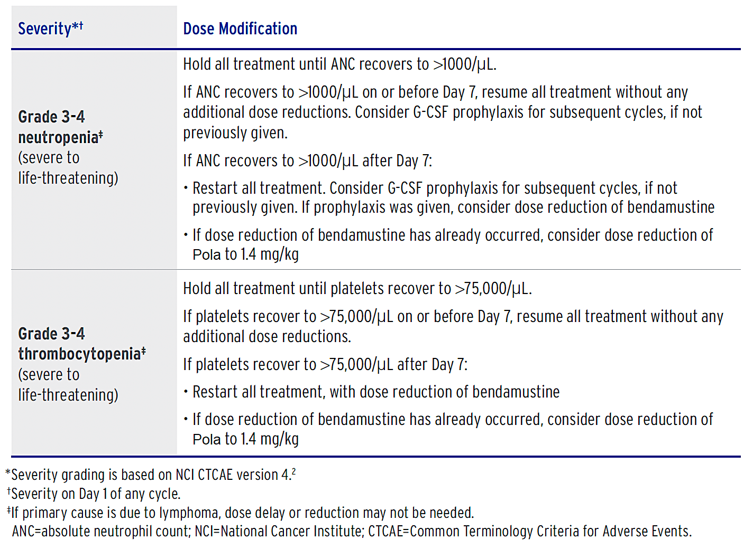
Management of Myelosuppression
Polatuzumab vedotin, Manufacturer’s dosing and administration guide.

Slide 75
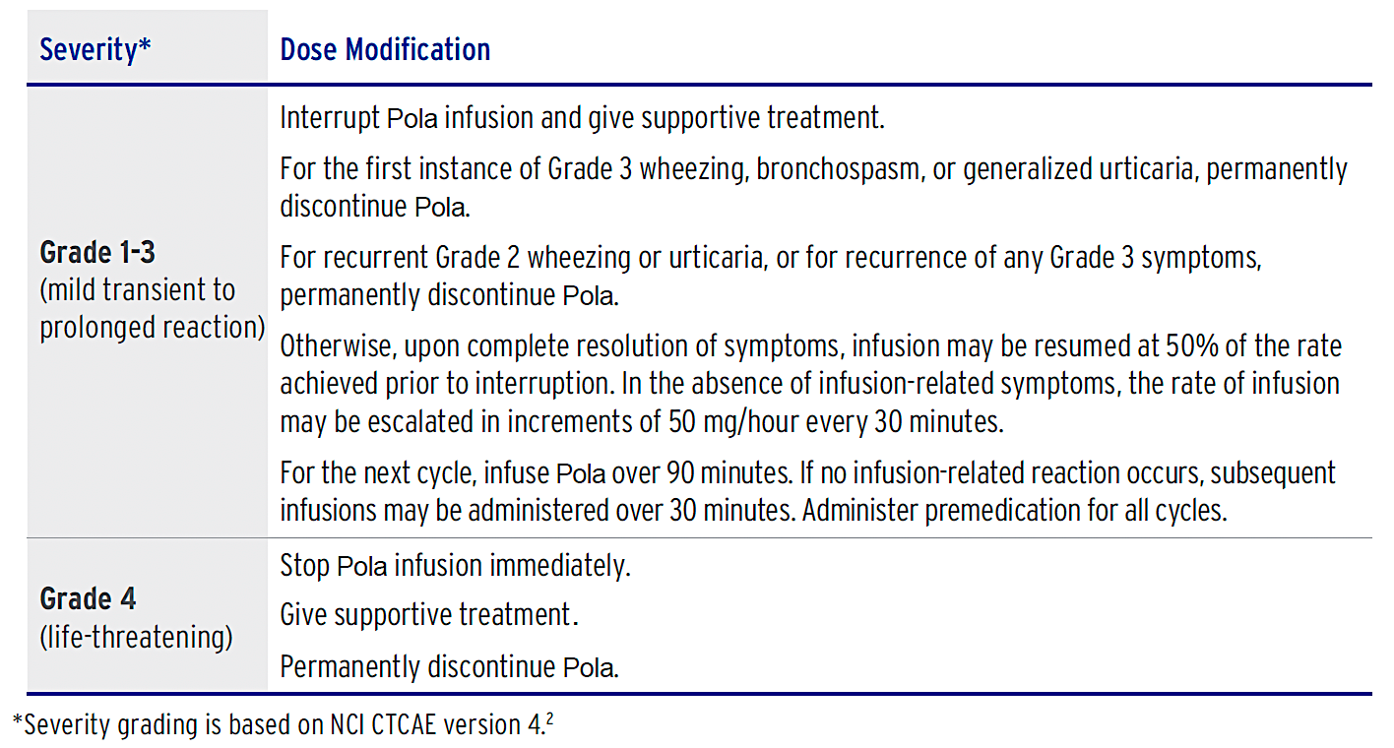
Management of Infusion-Related Reactions
Polatuzumab vedotin, Manufacturer’s dosing and administration guide.

Slide 76
Case Presentation

Slide 77
Case study: Polatuzumab vedotin
Patient is a 65 yo farmer (M). He noticed a mass in his right lower neck that continued to increase in size
  PCP ordered CT scan – >5 cm cervical mass. Refer to ENT.
  Bx showed aggressive B cell lymphoma. Pt referred to OSU.
  Ki6780% on LN bx.
  Stage IV non-GC DLBCL with IPI 2.
  PET scan with large abdominal nodes with max SUV 15.7
  Hx DM and HTN well controlled
  Discussed the standard treatment has been R-CHOP for many years although R-Pola-CHP was recently approved by the FDA based on results of the POLARIX trial which evaluated RCHOP vs RCHP+POLA and showed a benefit in 2 year PFS with the RCHP+Pola. This was maintained at 3 years of follow up. At this time there is no overall survival benefit noted but further follow up required. Discussed this is 6 cycles.

Slide 78
Case Study Continued
Pretreatment he is started on PJP prophylaxis and antiviral
He receives growth factor support with each cycle
He will have weekly labs checked at a local lab and faxed to the office
After C1 he develops N/V and requires IV antiemetics and IV hydration with the addition of oral antiemetics for home.
After C2 he has alopecia and constipation. Use OTC medications for constipation. Cervical mass resolved.
Arrives for C3 with increased numbness and tingling in his feet and hands. He is having difficulty buttoning his shirt. He has to cut back on his duties at the farm.
  Dose of Polatuzumab vedotin is reduced
Gets COVID, took nirmatrelvir/ritonavir
PET scan after #4 with good response to therapy. Neuropathy is improving.
Completes 6 cycles of R-Pola-CHP
PET scan Deauville 2, complete metabolic response
  Rib fx noted. Likely due to a cow incident.

Slide 79
Agenda
Introduction: Biology of Non-Hodgkin Lymphoma (NHL)
Module 1: Current Role of CD20 x CD3 Bispecific Antibodies in NHL
Module 2: Role of Polatuzumab Vedotin in Diffuse Large B-Cell Lymphoma (DLBCL)
Module 3: Optimal Application of Loncastuximab Tesirine for Patients with DLBCL and Follicular Lymphoma
Module 4: Role of BTK Inhibitors Alone or with Anti-CD20 Antibodies for Patients with Newly Diagnosed Chronic Lymphocytic Leukemia (CLL)
Module 5: Combining BTK Inhibitors with Bcl-2 Inhibitors
Module 6: Current and Future Role of Noncovalent BTK Inhibitors in CLL

Slide 80
Loncastuximab Tesirine in DLBCL and FL
Brad Kahl, MD
Professor of Medicine

Slide 81
Loncastuximab Tesirine: Mechanism of Action
Antibody-drug conjugate targeting CD19
Payload: SG3199
    Pyrrolobenzodiazepine dimer cytotoxin causes interstrand DNA crosslinks
    14-day half-life
Val-Ala
Linker
dPEG8
PABA
O
HN
HN
O
HN
S
N
O
O
O
O
O
O
O
O
O
O
O
NH
O
N
O
O
O
H
H
O
O
N
H
N
O
O
O
O
N
Maleimide
SG3199
RB41.2
SG3249
Zammarchi. Blood. 2018;131:1094. Caimi. Lancet Oncol. 2021;22:790.

Slide 82
LOTIS-2: Loncastuximab Tesirine in R/R DLBCL
Single-arm, open-label, phase II study
Primary endpoint: ORR by ICR per Lugano 2014 (up to 21.5 months)
Key secondary endpoints: DoR, RFS, OS, safety
Treat for ≤1 yr
Treat for ≤3 yr
Patients 18-years of age or older with relapsed/refractory DLBCL; (N = 145)
Loncastuximab Tesirine 150 μg/kg Q3W (C1-2)
then 75 μg/kg (C3+); 30-min infusion
Loncastuximab
Tesirine
Q3W
Responders
NCT03589469. Caimi. Lancet Oncol. 2021;22:790. Caimi. Haematologica. 2024; 109:1184.

Slide 83
LOTIS-2: Patient Characteristics and
Efficacy/Safety Summary
ORR: 48.3%
  CR: 24.8%
  PR: 23.5%
Median DoR (n = 145): 13.4 mo
  95% CI: 6.9-NR
Baseline Characteristic | N = 145
Median age, yr (range) | 66 (23-94)
Histology, n (%) DLBCL NOS HGBCL PMBCL | 127 (88) 11 (8) 7 (5)
Median prior tx (IQR) | 3 (2-4)
Relapsed to prior tx, n (%) | 43 (30)
Refractory to prior tx, n (%) | 84 (58)
Prior CAR T-cells, n (%) | 13 (9)
PFS
1.0
Number of events: 6
Median PFS: NR
0.8
0.6
Probability
0.4
Number of events: 73
Median PFS: 4.93 mo (95% CI: 2.89-8.31)
0.2
All-treated population
Subset of patients with CR
Censored
FDA approved for R/R DLBCL who have received 2 prior lines of therapy
0
0
2
4
6
8
10
12
14
16
18
20
22
24
26
28
30
32
34
36
38
40
Mo
145
36
85
35
46
31
34
23
27
20
21
17
18
16
18
16
15
14
15
14
11
11
11
11
11
11
11
11
11
11
7
7
4
4
3
3
3
3
1
1
0
0
Caimi. Lancet Oncol. 2021;22:790. Caimi. Haematologica. 2024; 109:1184.

Slide 84
New ADC Data in R/R DLBCL
Updated safety run in results from Lotis-5: A phase III trial of Lonca-T plus rituximab vs. immunochemotherapy in patients with R/R DLBCL. Carlo-Stella et al, EHA.
Initial Results from LOTIS-7: A phase 1B study of Lonca-T plus Glofitamab in patients with R/R DLBCL. Alderuccio et al, EHA.

Slide 85
LOTIS-5 Safety Run-in: Efficacy Results^{1,a}
The ORR by central review was 80% (16/20)
A total of 50% (10/20) and 30% (6/20) of patients attained CR and PR, respectively
The median DOR was 8.0 months (95% CI, 3.2-NE)
The median PFS was 8.3 months (95% CI, 4.5-NE)
No new safety signals were identified
Trial has progressed to randomization
Efficacy outcomes in safety run-in population (N=20)
ORR (95% CI), % | 80.0 (56.3, 94.3)
CR rate (95% CI), % | 50.0 (27.2-72.8)
Median DOR (95% CI), months | 8.0 (3.2-NE)
Median PFS (95% CI), months | 8.3 (4.5, NE)
Efficacy outcomes in responders (n=16)
Median DOR (95% CI), months | 8.0 (3.19-NE)
Events (%), n | 5 (31.3)
Efficacy outcomes in complete responders (n=10)
Median DOR (95% CI), months | NE (3.19-NE)
Events (%), n | 3 (30.0)
MRD results in patients with ctDNA measurements (n=8)
CR and MRD negative (%), n | 4 (50.0)
MRD negative at end of treatment (%), n | 4 (50.0)
ªOctober 4, 2024, data cutoff.
Abbreviations: CR, complete response; ctDNA, circulating tumor DNA; DOR, duration of response; EOT, end of therapy; MRD, minimal residual disease; NE, not estimable; ORR, overall response rate; PFS, progression-free survival; PR, partial response; SCT, stem cell transplant.
1. Carlo-Stella C, et al. Updated Safety Run-in Results From LOTIS-5: A Phase 3, Randomized Trial of Loncastuximab Tesirine With Rituximab Versus Immunochemotherapy in Patients With R/R DLBCL/HGBL. Poster presented at the European Hematology Association 30th Annual Congress (EHA 2025). June 12-15, 2025. Milan, Italy.

Slide 86
Best Overall Response & Duration of Response
Efficacy Evaluable Population (N=30)ª
Best overall response^{b}
ORR: 93.3
ORR: 93.3
ORR: 93.3
Duration of response
Characteristic, n (%) | Glofit + Lonca, 120 μg/kg^{c} (n=15) | Glofit + Lonca, 150 μg/kg^{c} (n=15) | All dose levels (N=30)
DOR^{d} Median | (n=14) NE | (n=14) NE | (n=28) NE
Time to first response (CR or PR) Median, days | (n=14) 42.0 | (n=14) 42.0 | (n=28) 42.0
Time to first CR Median, days | (n=13) 80.0 | (n=13) 42.0 | (n=26) 70.5
CR
PR
Glofit + Lonca, 120 μg/kg^{c} (n=15)
Glofit + Lonca, 150 μg/kg^{c} (n=15)
All dose levels (N=30)
Data cutoff: April 14, 2025.
CR, complete response; DOR, duration of response; Glofit, glofitamab; Lonca, loncastuximab tesirine; NE, not estimable; ORR, overall response rate; PR, partial response.
ªThe efficacy evaluable population (N=30) included all patients who received ≥1 dose of the study drug with a valid baseline and ≥1 valid postbaseline disease assessment. Patients who did not have a postbaseline assessment owing to early clinical progression or death were also included. ^{b}Percentages do not add up to total due to rounding. ^{c}When the starting dose of Lonca is 120 μg/kg or 150 μg/kg, the dose will be reduced to 75 μg/kg for Cycles ≥3. ^{d}In the efficacy evaluable population, the DOR and probability of maintaining an event-free response were evaluated in responders (n=28), including all patients who had a best response of CR or PR. Alderuccio et al, EHA. 2025

Slide 87
Loncastuximab tesirine with rituximab induces robust and durable complete metabolic responses in high-risk relapsed/refractory follicular lymphoma
Juan Alderuccio, Alvaro Alencar, Jonathan H. Schatz, Russ A. Kuker, David Sicre, Georgios Pongas, Isildinha M. Reis, Jay Spiegel, Laura Medina Andara, Lazaros J. Lekakis, Joseph S. Gyedu, Jose Sandoval-Sus, Amer Beitinjaneh, Michele Stanchina, Asaad Trabolsi, Izidore S. Lossos, Joseph D. Rosenblatt, David Lessen, Craig H. Moskowitz
American Society of Hematology 2024, Abstract 337
Notes:
Good evening, Thanks to the scientific committee for their interest in our study. On behalf of my co-investigators I will be presenting…

Slide 88
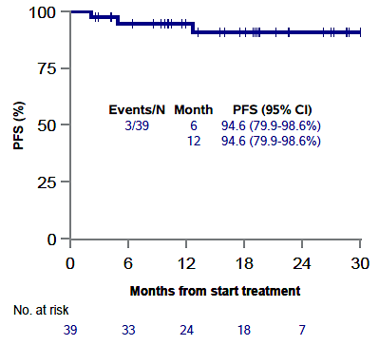
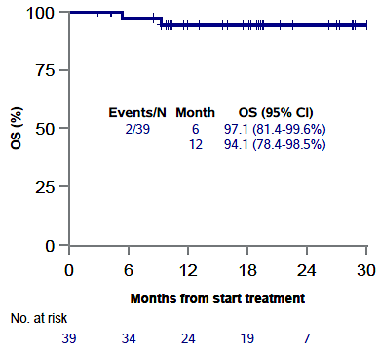
Now listed on NCCN guidelines as option for >3rd line R/R FL

Slide 89
Case Presentation

Slide 90
A patient case
May 2012. 70 yo woman diagnosed with DLBCL. GCB subtype. Stage 3. IPI score 4. Treatment with R-CHOP x 6. Achieves CR.
April 2018. New RP mass. Bx shows DLBCL. Now age 76. Receives R-GemOx for 8 cycles. Achieves PR after cycle 4 but has PD by cycle 8.
Nov 2018. Referred to see me. I recommended Axi-Cel CART therapy.
No bridging therapy required. Day 30 PET shows CR.
June 2019. New mesenteric mass detected by surveillance imaging. Biopsy shows DLBCL. She receives Lonca-T (on a clinical trial) x 8 cycles. Achieves CR. Therapy stopped due to 3rd spacing.
Feb 2021. New mesenteric mass detected by surveillance imaging. Biopsy shows DLBCL. Offered glofitamab (on a clinical trial) x 12 cycles.

Slide 91
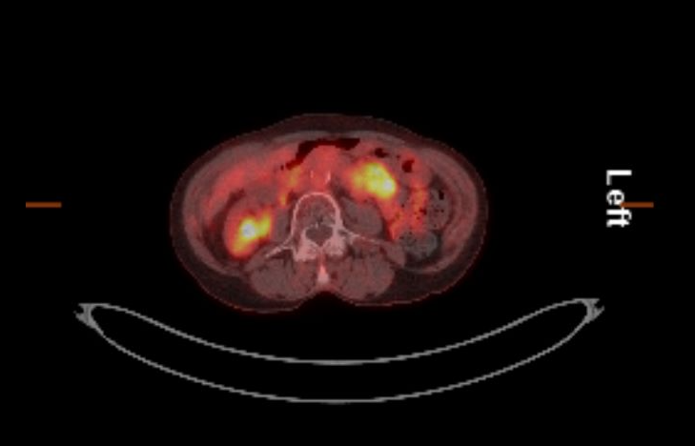
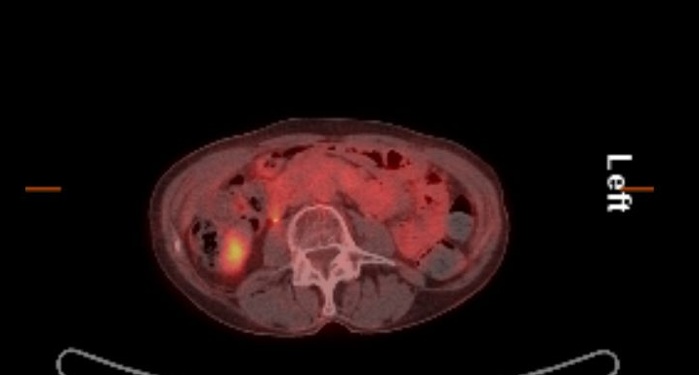
Pre and Post Lonca-T PET images
June 2019 PET Scan
DEC 2019 PET SCAN

Slide 92
Patient Update
Therapy complicated by hypogammaglobulinemia - on IVIg since 2021
MAI/MAC infection requiring Azithromycin/Rifampin/Ethambutol 2021 - 2022
Chronic neutropenia requiring filgrastim 3X/week 2022 – 2023
Now age 82. Patient remains in CR. On IVIg every 6 weeks. Looks fabulous. She and daughter treat themselves to a nice lunch every trip to St. Louis.

Slide 93
Discussion Questions
What advantages and risks do you perceive in the use of loncastuximab tesirine versus other available regimens in R/R DLBCL? How do you typically sequence it relative to other options?
In which specific situations can you envision yourself employing loncastuximab tesirine/rituximab for R/R FL, given its recent NCCN guideline inclusion?

Slide 94
Tolerability Considerations with Loncastuximab Tesirine
Robin Klebig, APRN, CNP, AOCNP
May 15, 2026

Slide 95
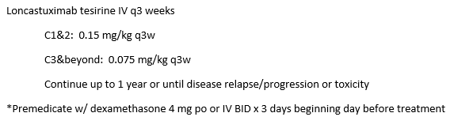
Loncastuximab tesirine
CD19 directed antibody and alkylating drug conjugate
LOTIS-2 (Caimi et al 2021)
  Multicenter open label single arm phase 2 study
145 pts – ORR 48.3%; CR 24%
Most common grade 3+ adverse events:
  Neutropenia (30%)
  Thrombocytopenia (17%)
  Anemia (10%)
  Elevated GGT (21%)
  Most common SAEs: febrile neutropenia (3%), pneumonia, edema (3%), pleural effusion (2%), sepsis
Courtesy of Robin Klebig, APRN, CNP, AOCNP

Slide 96
Loncastuximab tesirine – Edema/Effusions
Edema/effusions
  Edema (peripheral, facial, generalized, ascites) – 28% all grades; 3% grade 3-4
  Pleural effusion (10% all grades; 2-3% grade 3-4)
    HOLD for Grade ≥ 2 until ≤ Grade 1
  Pericardial effusion (3% all grades; 1% grade 3-4)
    Grade 2: HOLD until resolved; DISCONTINUE if recurs or if ≥ Grade 3
    Rare cases of cardiac tamponade with grade 3-4
  Capillary leak syndrome (0.6% grade 3-4)
  Mitigate by administering dexamethasone 4 mg po/IV BID x 3 days beginning day prior to infusion
    if not started the day before – begin at least 2 hours prior to infusion
  Monitor for new/worsening swelling, rapid wt gain, dyspnea, chest pain, abdominal bloating
  CXR, CT chest, echo to evaluate for pleural or pericardial effusion
  Diuretic (e.g., spironolactone standard dose) for pts w/ wt gain >1kg from baseline or with edema/effusions
Courtesy of Robin Klebig, APRN, CNP, AOCNP

Slide 97
Loncastuximab tesirine – Cutaneous reactions
Reaction | All Grades | Grade 3/4
Rash (erythematous, maculopapular, pruritic, pustular, exfoliative, dermatitis, PPE) | 30% | 2%
Pruritus | 12% | 0%
Photosensitivity reaction | 10% | 2%
Hyperpigmentation | 4% | —
Prevention:
  Minimize or AVOID exposure to direct natural or artificial sunlight — including through glass windows
  Wear sun-protective clothing at all times
  Apply broad-spectrum sunscreen regularly
  Avoid tanning beds and prolonged outdoor exposure
Management:
  Monitor for new or worsening rash, erythema, blistering, or photosensitivity at each visit
  Grade 3 cutaneous reactions: HOLD until resolution to ≤ Grade 1
  Consider dermatology referral for persistent or severe skin reactions
  Topical corticosteroids and emollients may be used for symptomatic relief
Courtesy of Robin Klebig, APRN, CNP, AOCNP

Slide 98
Loncastuximab tesirine – Lab abnormalities
Neutropenia (32% grade 3-4; 21% grade 4)
  HOLD until ANC ≥1 × 10⁹/L
  Consider G-CSF
  Febrile neutropenia – 3% all grades; 3% grade 3-4
    Monitor for fevers
  Infections – 10% grade 3-4
Thrombocytopenia (20% grade 3-4; 7% grade 4)
  HOLD until ≥50,000/mcL
Anemia (12% grade 3-4)
Hepatotoxicity
  Elevated GGT (and other LFTs)
    HOLD if ≥ Grade 3 until ≤ Grade 1; DISCONTINUE if DILI confirmed
      Grade 3 (>5.0-20.0 ULN)
  Monitor for dark urine, jaundice; monitor LFTs
  Generally mild-moderate and reversible with dose delays
If treatment is delayed by >3 weeks for any toxicity, decrease dose by 50%
If toxicity recurs following dose reduction, consider discontinuation
Monitor weekly CBC/dif in cycles 1-2, then q3w
Courtesy of Robin Klebig, APRN, CNP, AOCNP

Slide 99
Case Presentation

Slide 100
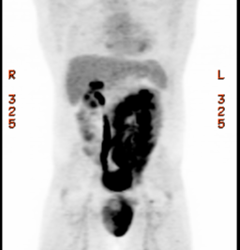
A patient with DLBCL treated with loncastuximab tesirine
43 y/o male correctional officer
  Married, teen daughter; Lives 2 hours from Mayo Clinic
Presented with testicular mass
Left orchiectomy: Large B -cell lymphoma, non-germinal center phenotype. Non double expresser. FISH negative for MYC rearrangement and no fusion of MYC and IGH was observed – not a HGBCL or double/triple hit. CD20+, CD5+, BCL2+, MUM1+; Ki-67 50-75%.
Bone marrow, CSF, MRI brain negative.
Treatment 1:
  Clinical trial with Parsaclisib + R-CHOP (phase Ib) x 6 cycles → CR
  Radiation 3000 cGy to scrotum
  Prophylactic HDMTX 3.5 Gm/m2 x 3 cycles

Slide 101
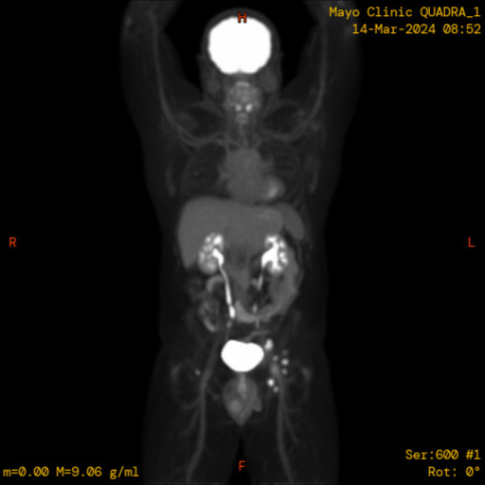
A patient with DLBCL treated with loncastuximab tesirine
8 months later –
  Self-palpated inguinal lymph node
Lymph node, Left Inguinal, FNA and core bx: Large B-cell lymphoma, clinically recurrent.
Treatment 2 (early relapser):
  Axicabtagene ciloleucel → CR

Slide 102
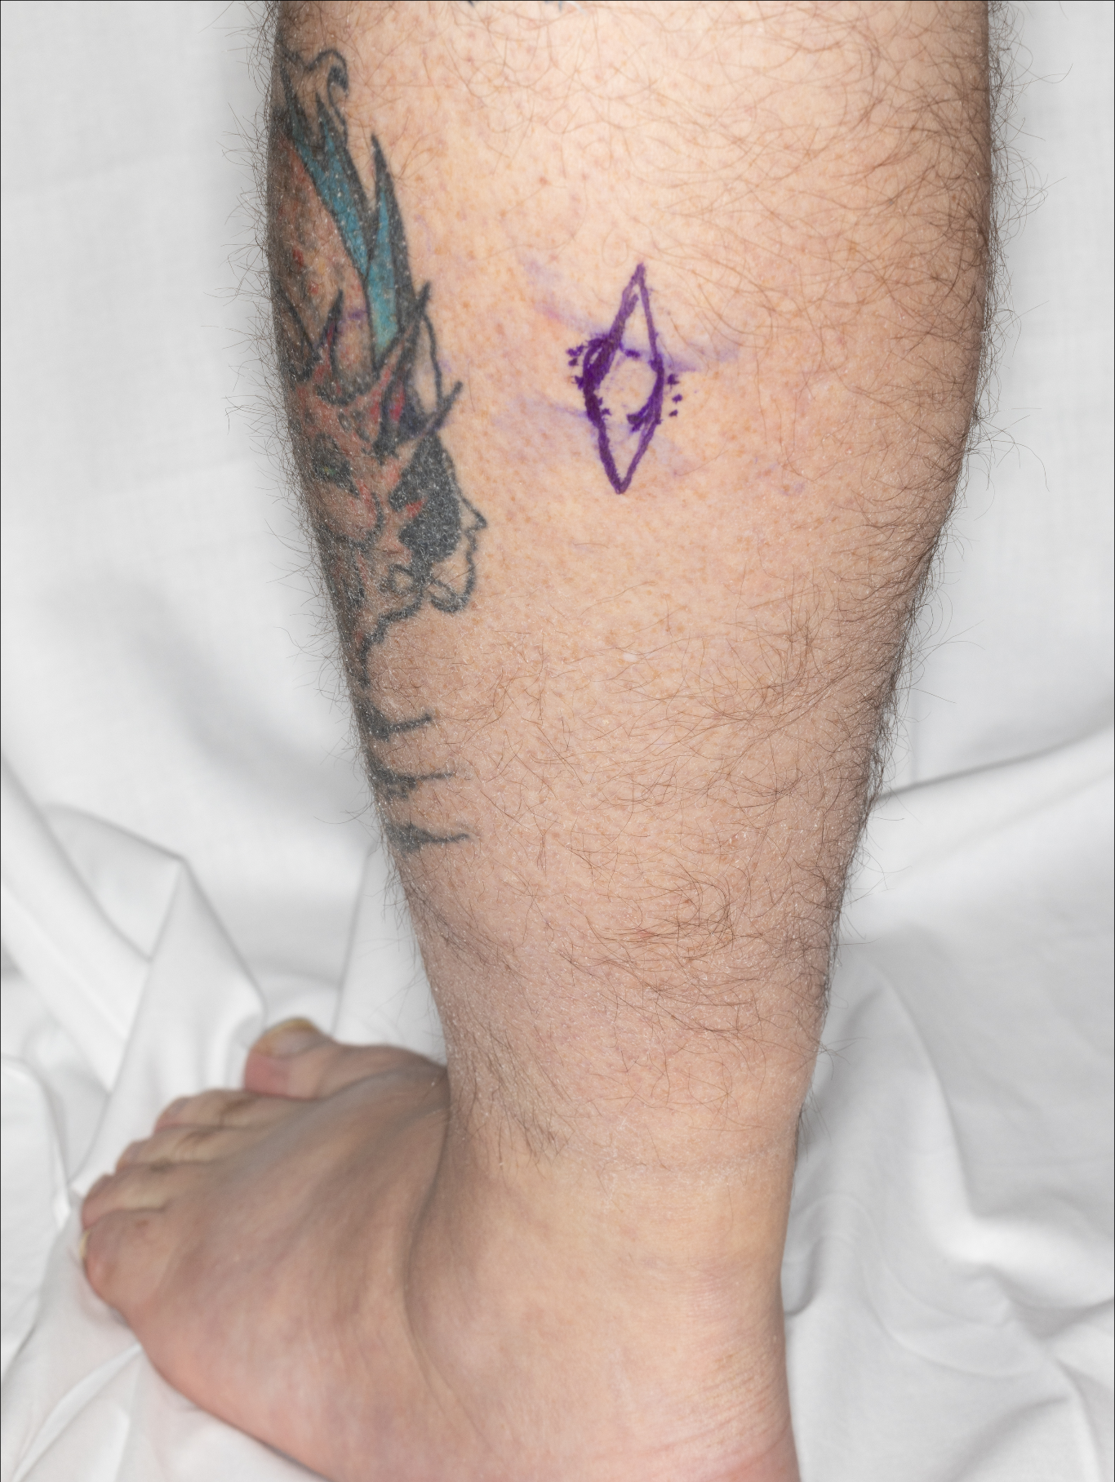
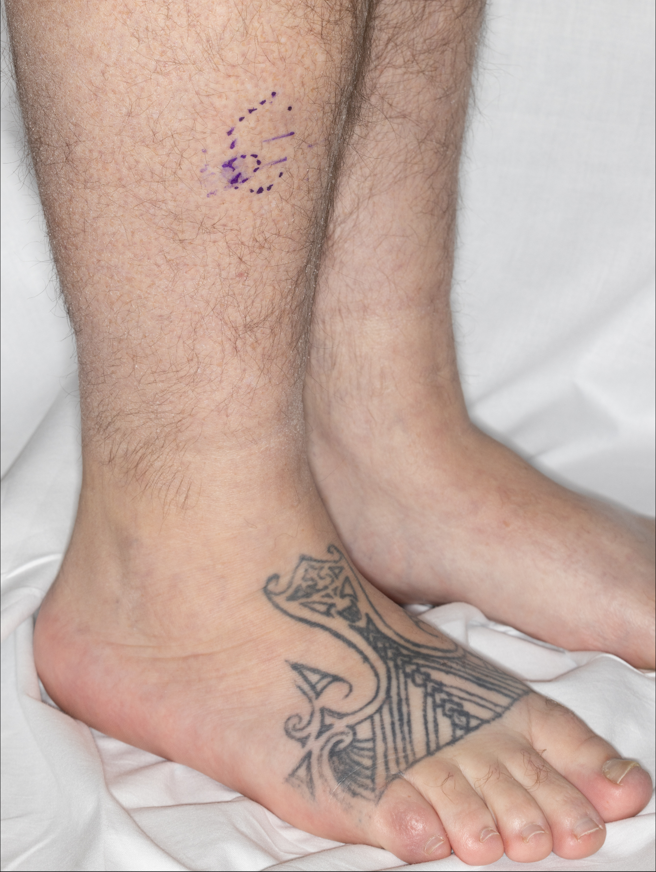
A patient with DLBCL treated with loncastuximab tesirine
7 months later
  SQ nodules lower extremities
Right leg, Skin punch bx: Diffuse large B-cell lymphoma
Left posterior lower leg, Skin excision: Diffuse large B-cell lymphoma
Treatment 3:
  Radiation - 30 Gy each, qod 5 fx utilizing Orthovoltage
Recurrent cutaneous -> more RT
  3600 cGy IMRT BLE

Slide 103
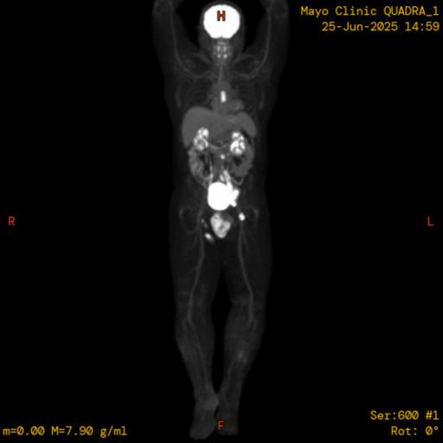
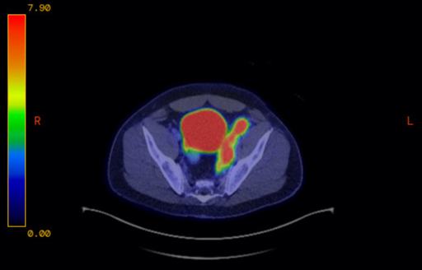
A patient with DLBCL treated with loncastuximab tesirine
2 months later
  PET/CT shows systemic progression
Lymph node, Left Iliac tissue, FNA and core bx: Recurrent diffuse large B-cell lymphoma.
Treatment 4:
  R-ICE x 3
  Autologous SCT

Slide 104
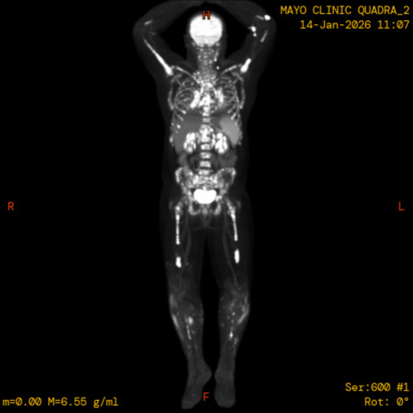
A patient with DLBCL treated with loncastuximab tesirine
Day 100 post auto SCT
  Left calf skin punch bx: Cutaneous
  involvement by DLBCL
  Bone marrow: DLBCL involving approximately 60% of cellularity
Treatment 5:
  Glofi-GemOx (glofitamab/gemcitabine/oxaliplatin – STARGLO)

Slide 105
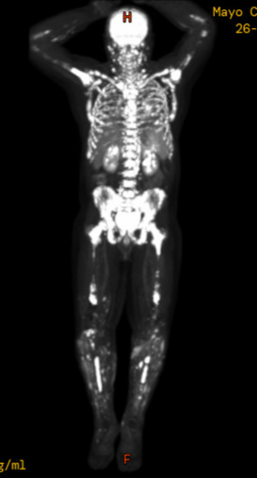
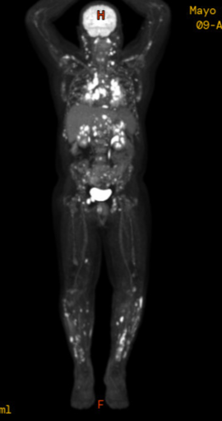
A patient with DLBCL treated with loncastuximab tesirine
Post 2 cycles Glofi-GemOx
Treatment 6:
  Loncastuximab tesirine
    After 3 cycles, mixed response with improvement in bone marrow but increased lymphadenopathy

Slide 106
Agenda
Introduction: Biology of Non-Hodgkin Lymphoma (NHL)
Module 1: Current Role of CD20 x CD3 Bispecific Antibodies in NHL
Module 2: Role of Polatuzumab Vedotin in Diffuse Large B-Cell Lymphoma (DLBCL)
Module 3: Optimal Application of Loncastuximab Tesirine for Patients with DLBCL and Follicular Lymphoma
Module 4: Role of BTK Inhibitors Alone or with Anti-CD20 Antibodies for Patients with Newly Diagnosed Chronic Lymphocytic Leukemia (CLL)
Module 5: Combining BTK Inhibitors with Bcl-2 Inhibitors
Module 6: Current and Future Role of Noncovalent BTK Inhibitors in CLL

Slide 107
Discussion Questions
At a very basic level, how do you counsel your patients with newly diagnosed CLL about the nature of their disease and what their treatment journey might look like?
How do factors such as IGHV mutation status, del(17p) and TP53 mutations affect patient prognosis and treatment selection, and how do you explain these to patients?

Slide 108
Role of BTK Inhibitors Alone or with Anti-CD20 Antibodies in Patients with Newly Diagnosed Chronic Lymphocytic Leukemia (CLL)
Farrukh T. Awan, M.D., M.S., M.B.A.
Professor of Internal Medicine
Associate Director, Section of Hematologic Malignancies/Transplantation and Cellular Therapies
Director of Lymphoid Malignancies Program
Harold C. Simmons Comprehensive Cancer Center
University of Texas Southwestern Medical Center
Dallas, TX

Slide 109
Myth: Doc, I’ve got CLL! I need treatment
        Wrong
Maybe, let’s talk

Slide 110
Signs and Symptoms
Many Patients with CLL have no Early Symptoms.
Those Who do Develop Symptoms May Experience:
FATIGUE
SHORTNESS OF BREATH
SWOLLEN LYMPH NODES OR SPLEEN
INFECTIONS
WEIGHT LOSS

Slide 111
Timing of Therapy
Constitutional symptoms – How does the patient feel?
  Unintentional weight loss of >10% within the previous 6 months
  Significant fatigue (ECOG PS 2 or worse)
  Fevers >100.5°F for >2 weeks without other evidence of infection
  Night sweats for >1 month without evidence of infection
  Worsening or steroid-resistant anemia and/or thrombocytopenia
  Spleen >6cm below the left costal margin
  Lymph Nodes >10cm
IWCLL recommendations, Blood, 2018

Slide 112
Don’t Treat
Hypogammaglobulinemia
Monoclonal or oligoclonal paraproteinemia
Elevated leukocyte count
IWCLL recommendations, Blood, 2018

Slide 113
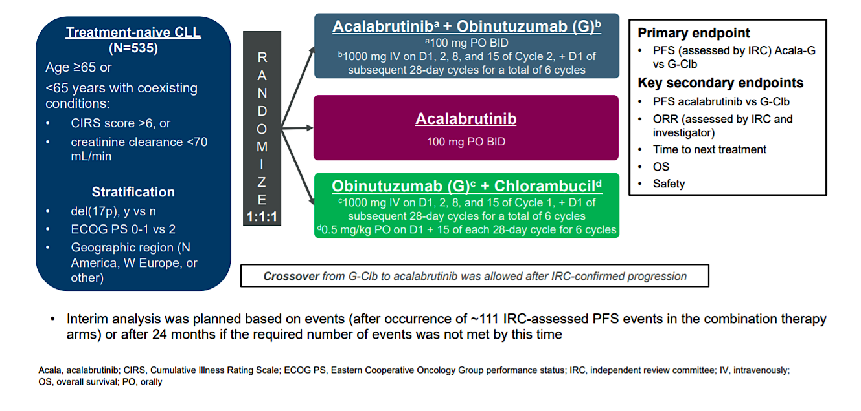
Phase III ELEVATE TN Study Design (ACE-CL-007)
Sharman JP et al. 2019 ASH Annual Meeting. Abstract 31.
Sharman JP, et al. Lancet. 2020;395(10232):1278-1291.

Slide 114
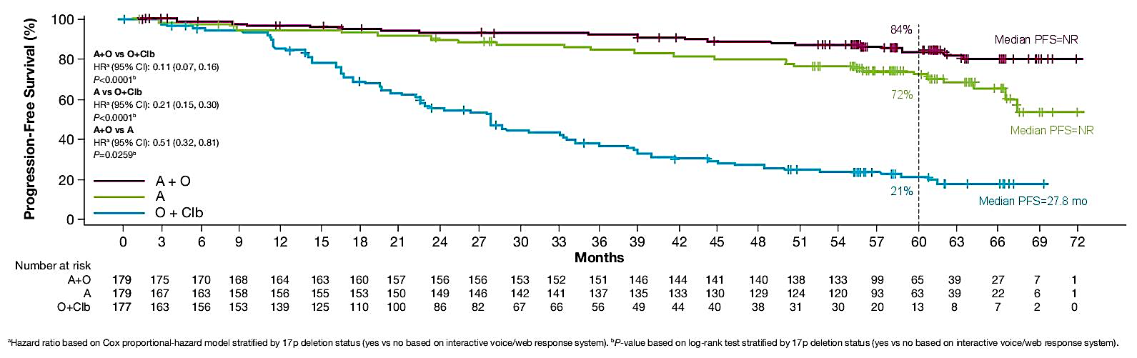
ELEVATE-TN: Investigator-Assessed PFS (ITT)
(Median follow-up 58.2 mo)
Sharman JP, et al. Lancet. 2020;395(10232):1278-1291.
Sharman JP, et al. ASCO 2022. Abstract 7539.

Slide 115
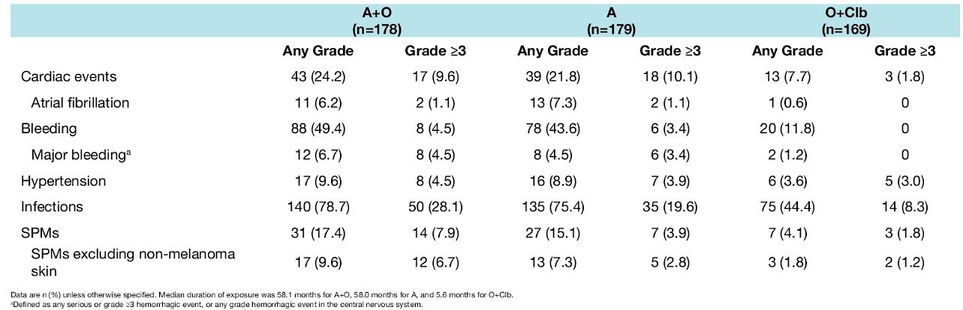
ELEVATE TN: Safety
Most Common Serious AEs¹⁻³ | SAEs (≥2% pts) - n (%) | Acala-G N=178 | Acalabrutinib N=179 | G-Clb N=169
 | Any | 69 (38.8) | 57 (31.8) | 37 (21.9)
 | Pneumonia | 12 (6.7) | 5 (2.8) | 3 (1.8)
 | IRR | 4 (2.2) | 0 | 2 (1.2)
 | Anemia | 3 (1.7) | 4 (2.2) | 0
 | Febrile neutropenia | 3 (1.7) | 2 (1.1) | 7 (4.1)
 | TLS | 1 (0.6) | 0 | 8 (4.7)
Most common AEs (≥ 30%)
Anemia, neutropenia, URTI, thrombocytopenia, headache, diarrhea, musculoskeletal pain^{3,*}
Events of Clinical Interest: 58.2 mo median follow up⁴
n (%)
* At 5-y follow-up, most common AEs were generally unchanged from earlier analyses.⁴
1. Sharman JP et al. 2019 ASH Annual Meeting. Abstract 31.
2. Sharman JP, et al. Lancet. 2020;395(10232):1278-1291. 3. Acalabrutinib. Prescribing Information. 2019. 4. Sharman JP, et al. ASCO 2022. Abstract 7539.

Slide 116

Phase 3 SEQUOIA Study
Tam CS, et al. ASH 2021. Abstract 396.

Slide 117


Phase 3 SEQUOIA: PFS (IRC) —Cohort 1 (Without del[17p])
Median follow-up, 26.2 mo
PFS by IGHV Status
Selected Secondary Outcomes |  | Zanu (n=241) | BR (n=238)
 | ORR (INV), % | 97.5 | 88.7
 | Median OS | NR | NR
PFS benefit with zanubrutinib seen independent of age, sex, or high-risk disease status (Binet stage C, bulky disease, or unmutated IGHV gene status
PFS benefit not seen among patients with mutated IGHV, SLL (n=40), or pathogenic TP53m (n=28)
Tam CS, et al. Lancet Oncol. 2022;23:1031-1043.

Slide 118

Phase 3 SEQUOIA: AEs of Interest—Cohort 1 (Without del[17p])
Median follow up: Arm A, 26.4 mo; Arm B, 25.9 mo
Tam CS, et al. ASH 2021. Abstract 396. Tam CS, et al. Lancet Oncol. 2022;23:1031-1043.

Slide 119

Phase 3 GAIA/CLL13: Study Design
229:
140/79
237
229
231
926 pts
N Engl J Med 2023;388:1739-1754;
Eichorst B, et al. EHA 2022. Abstract LBA2365.

Slide 120


Phase 3 GAIA/CLL13 Study Design: PFS
(Co-Primary Endpoint)
Superior PFS observed for GV vs CIT
HR 0.42, 97.5% CI 0.26-0.68, p<0.0001
3-Y PFS unmutated IGHV vs mutated IGHV
  GIV: 86.6% vs 96.0%
  CIT: 65.5% vs 89.9%
Similar OS rates observed across all treatment arms
N Engl J Med 2023;388:1739-1754;
Eichorst B, et al. EHA 2022. Abstract LBA2365.

Slide 121

Phase 3 GAIA/CLL13 Study Design: Overview of AEs ≥ Grade 3
N Engl J Med 2023;388:1739-1754;
Eichorst B, et al. EHA 2022. Abstract LBA2365.

Slide 122
My Algorithm for Frontline Therapy
del17p or TP53 mutation; unmutated IGHV (any age)
No indication
Acalabrutinib ± obin
Zanubrutinib ± Venetoclax
Observe
CLL or SLL
Treatment?
Indication
present
Acalabrutinib ± obin
Acala+Ven ± obin
Venetoclax + obin
Zanubrutinib
All others

Slide 123
Case Presentation

Slide 124
CASE PRESENTATION
65-year-old female diagnosed with CLL
Has IGHV unmutated del11q, TP53 wildtype CLL
Presents with enlarging, painful lymphadenopathy and anemia.
Patient also has type 2 diabetes, hypertension, and chronic renal failure with baseline Cr 1.8 (not on dialysis)
Imaging shows bulky lymph nodes around 8cm and a spleen of 20cm
Patient desires oral therapy with minimal back and forth to the cancer center
What’s the best next option for treatment

Slide 125
CASE PRESENTATION..cntd
65-year-old female with untreated CLL and needs treatment
Multiple comorbidities
Best treatment option
  Venetoclax
  Venetoclax and rituximab
  Zanubrutinib
  Acalabrutinib +/- Obinutuzumab

Slide 126
Discussion Questions
In which subsets of patients with treatment-naïve CLL are you prioritizing the use of continuous BTK inhibitor monotherapy?
Do you have a preference for a specific covalent BTK inhibitor?
When do you also incorporate an anti-CD20 antibody?

Slide 127
Impact of Comorbid Conditions and Other Practical Considerations on the Choice of First-Line Therapy for Newly Diagnosed CLL
Mollie Moran, APRN-CNP, AOCNP
Nurse Practitioner
The James Cancer Hospital and Solove Research Institute
The Ohio State University
Columbus, Ohio

Slide 128
Case Study: First line therapy for CLL
72 yo male, retired police officer with hx of CLL dx 4 years ago. He has increased lymphocytosis, thrombocytopenia and increased lymph nodes. WBC 58K, ALC 52K, Hgb 9.9, plts 105K.
Prognostic factors at dx 46 XY del11q, FISH del 11q, IGHV unmutated, B2M 3.8
Well controlled HTN and DM. He is the primary caregiver for his wife with early dementia
Time to consider starting therapy

Slide 129
NCCN Guidelines for 1L Treatment of CLL/SLL
Preferred Regimens | Other Recommended Regimens | Useful in Certain Circumstances
Without del(17)p/TP53 mutation
BCL-2i–containing regimens Acalabrutinib + venetoclax ± obinutuzumab (fixed duration) Venetoclax + obinutuzumab (fixed duration) Covalent BTKi-based regimens Acalabrutinib (continuous) ± obinutuzumab Zanubrutinib (continuous) | BCL-2i–containing regimen Ibrutinib + venetoclax (fixed duration or MRD guided) | BCL-2i–containing regimen Zanubrutinib + venetoclax (MRD guided) Covalent BTKi-based regimens Ibrutinib (continuous) Ibrutinib (continuous) + anti-CD20 mAb HDMP + anti-CD20 mAb Consider only when cBTKi and BCL-2i are not available or feasible Bendamustine + anti-CD20 mAb FCR Chlorambucil + obinutuzumab Obinutuzumab
With del(17)p/TP53 mutation
BCL-2i–containing regimens Venetoclax + obinutuzumab (fixed duration) Acalabrutinib + venetoclax ± obinutuzumab (MRD guided) Zanubrutinib + venetoclax (MRD guided) Covalent BTKi-based regimens Acalabrutinib (continuous) ± obinutuzumab Zanubrutinib (continuous) | BCL-2i–containing regimen Ibrutinib + venetoclax (fixed duration) | Covalent BTKi-based regimen Ibrutinib (continuous) HDMP + anti-CD20 mAb Consider only when cBTKi and BCL-2i are not available or feasible Obinutuzumab
In all randomized trials including chemoimmunotherapy compared to novel agents, novel agent arm(s) were superior in overall response rates and progression-free survival leading to the absence of chemoimmunotherapy in preferred regimen options.
NCCN. Clinical practice guidelines in oncology: chronic lymphocytic leukemia/small lymphocytic lymphoma.
v.2.2026. nccn.org.

Slide 130
BTK Inhibitors for CLL/SLL
BTK inhibitors are small-molecule inhibitors of Bruton’s tyrosine kinase (BTK), an integral component of the B-cell receptor signaling pathway
BTKi shared toxicities: atrial fibrillation (uncommon), “ASA-like” antiplatelet effects cause bruising (very common) and major bleeding (uncommon), B-cell suppression with infection risks, hypertension, cytopenias, GI adverse effects
  More bleeding risk with antiplatelet therapy (eg, aspirin) plus BTK inhibitors than with anticoagulants has been suggested
Yosifov. HemaSphere. 2019;3:e175. Byrd. NEJM. 2013;369:32. Woyach. Blood. 2024;143:1616.

Slide 131
Common and Important BTK Inhibitor Toxicities in CLL
Toxicities of Special Interest | Most Common Toxicities | Other Common Toxicities
Atrial fibrillation Ventricular arrhythmia Bleeding Hypertension Infections | Anemia Arthralgia/myalgia Cough Diarrhea Fatigue Headache Neutropenia | Cytopenias Hair/nail changes Lymphocytosis Nausea Rash
Lipsky. Hematology Am Soc Hematol Educ Program. 2020;1:336. Brown. Blood. 2018;131:379.
NCCN. Clinical practice guidelines in oncology: chronic lymphocytic leukemia/small lymphocytic lymphoma. v.2.2026. nccn.org.
Notes:
CLL, chronic lymphocytic leukemia.

Slide 132
BCL-2 Inhibitors for CLL/SLL
BCL-2 inhibitors were originally studied in combination with the anti-CD20 monoclonal antibodies rituximab (MURANO; 2L+ VenR) and obinutuzumab (CLL14; 1L VenO), which require infusions^{1,2}
Newer regimens combine BCL-2i with BTKi as “all oral” options³⁻⁵
  AMPLIFY (AV ± O vs CIT), FLAIR (I+V vs FCR), SEQUOIA Arm D (zanubrutinib + venetoclax)
BCL-2i–based treatments are the backbone for fixed-duration and MRD-guided regimens, with superiority over chemoimmunotherapy and often durable and deep responses measured in years
Side effects include tumor lysis syndrome risk, cytopenias, GI toxicities, fatigue, and arthralgias
1. Kater. Blood. 2025;145:2733. 2. Al-Sawaf. Blood. 2024;144:1924. 3. Brown. NEJM. 2025;392:748. 4. Munir. NEJM. 2024;390:326. 5. Shadman. JCO. 2025;43:2409.

Slide 133





Venetoclax for CLL: TLS Risk Stratification and Prophylaxis
Low Tumor Burden
All LN <5 cm
and
ALC <25 x 10⁹/L
Medium Tumor Burden
Any LN 5 to <10 cm
or
ALC ≥25 x 10⁹/L
High Tumor Burden
Any LN ≥10 cm
or
Any LN ≥5 cm and ALC ≥25 x 10⁹/L
Prophylaxis
Allopurinol 2-3 days prior and
Oral hydration 1.5-2.0 L/day
Consider IV hydration if high risk
Add IV fluids 150-200 mL/hr
Consider rasburicase if hyperuricemic
TLS Monitoring
Consider treating as high burden if CrCl
<80 mL/min
Venetoclax PI.

Slide 134
Case Study: Treatment Begins
Patient starts on acalabrutinib 100 mg po bid.
  After 1 month CBC shows WBC 159K, ALC 148K, Hgb 8.5, plts 85K
    Lymphocytosis is expected side effect of BTKi.
  C/o aching joints
    Treat with acetaminophen prn
  Frequent bruising
    Expected side effect of BTKi
  Hold BTKi prior to and after invasive procedures for 3 days (minor) or 7 days (major)
  After 3 months his BP is elevated and his PCP adjusts antihypertensive medication.
    HTN is a common side effect of BTKi
Weekly labs at start of treatment with monthly visits for first 3 months. Every 3 months for 2 years then every 6 months.
Jurczak. JCO. 2025;25-02380. Woyach. JCO. 2026;44:476. O'Brien. Front Oncol. 2021;11:720704.

Slide 135
Case Study: 12-month visit
Patient is tolerating the acalabrutinib well
  WBC 10K, Hgb 13.1, plts 145K
He sees a dermatologist annually for increased risk of skin cancers (SCC, BCC)
He is current with colonoscopy
He sees his PCP regularly
  Manages HTN, DM
  Checks PSA annually
No live vaccines, annual flu shot

Slide 136
Discussion Questions
What comorbidities and/or concomitant medications do you typically take into account when selecting therapy for patients with CLL?

Slide 137
Tolerability of Covalent BTK Inhibitors
Robin Klebig, APRN, CNP, AOCNP
May 15, 2026

Slide 138
Tolerability of Covalent BTK Inhibitors — Cardiovascular Events
Cardiovascular Toxicity | Ibrutinib | Acalabrutinib | Zanubrutinib
Atrial fibrillation/flutter | 13–16% | 9.4% | 2-5%
Ventricular arrhythmia | 1.9% | 0.4% | 0.2-0.8%
Hypertension | 9-23% | 9.4% | 10-23.5%
Bleeding | 3.9-10% | 4.5% | 2.9-5.9%
Stroke | 2.0% | 1-2.5% | 1.4-1.8%
BTKis should be held 3-7 days before and after any procedure to minimize risk of bleeding
  Colonoscopy, EGD, etc.: 3 days before and after
  Mohs procedure: 3-5 days before and after
  Major surgery, orthopedic surgery, etc.: 7 days before and after
American College of Cardiology, 2022

Slide 139
Monitoring and management of treatment-related cardiovascular events in patients receiving covalent BTK inhibitors
Baseline ECG and echocardiogram for higher-risk individuals e.g., male, >65, h/o HTN, DM, prior cardiac issues
Blood pressure monitoring
ECG q3-6 mo x 1 year, then prn symptoms
Afib screening
Referral to CardioOncology if arrhythmia detected
American College of Cardiology (ACC) recommends switching from ibrutinib to 2nd generation BTKi (acala or zanu) in pts w/ CV toxicities
Atrial fibrillation is not necessarily a contraindication to BTKi use if well controlled
  Warfarin is contraindicated, DOACs are preferred, consider dose reduction of DOAC and/or BTKi

Slide 140
Tolerability of Covalent BTK Inhibitors — Noncardiovascular Events
Fatigue
  Multifactorial, self-limited
Headache (acalabrutinib)
  Transient, resolve within 1st month
  Caffeine
  Hydration
  Acetaminophen (avoid NSAIDs)
Diarrhea
  Loperamide prn
  Evening dosing
Arthralgias/myalgias
  Supportive care
  Acetaminophen
  Avoid NSAIDs
  Stretching/yoga, remain active
  Heat, topical menthol, diclofenac gel
Dermatologic
  Rash
    Topical corticosteroids prn
  Petechiae/bruising
  Nail splitting/cracking
    Biotin 2.5 mg daily
Cytopenias
  Neutropenia
  Lymphopenia
  Anemia
  Thrombocytopenia
Infections
  Vaccinations up to date
  Prophylaxis with acyclovir (HZV/HSV)
  Consider PJP prophylaxis with Bactrim/pentamidine for high risk or heavily pretreated pts
  IVIG if hypogammaglobulinemia

Slide 141
Case Presentation

Slide 142



A patient with CLL treated with a covalent BTK inhibitor
56 y/o female
  Lives 3 hrs from Mayo Clinic
  PMH: Hyperlipidemia, Migraines
  SH: Married, 3 grown daughters. Preschool teacher, works 4-12 hour days/week
Dx CLL 2013; observed until 2020 (age 63)
  WBC 185,000
    ALC 30,150
    ANC 1680
  Hgb 10.5
  Plts 104,000
  Exaggerated insect bite-like reactions
  Progressive lymphadenopathy and splenomegaly
  No B symptoms

Slide 143
Initial treatment
Treatment Protocol: EA9161 - Arm B ( Obinutuzumab / Ibrutinib )
A Study Comparing Ibrutinib and Obinutuzumab With or Without Venetoclax in Treating Patients with Chronic Lymphocytic Leukemia
Diarrhea
  15-20 minutes after ibrutinib dose
  5-6 stools per day (grade 2)
  Took at night, loperamide prn, ensure adequate hydration
  Resolved within a few weeks
Mild arthralgias
Fatigue

Slide 144


Response to obinutuzumab/ibrutinib
Prompt resolution of lymphadenopathy, splenomegaly in 1 week
Normalization of CBC/dif within 6 months
Remains on ibrutinib per protocol since 7/2020
Normal CBC/dif, no LAD, splenomegaly
Living a normal life

Slide 145
Discussion Questions
How, if at all, do the tolerability profile and other practical considerations with individual covalent BTK inhibitors affect your selection among them?

Slide 146
Agenda
Introduction: Biology of Non-Hodgkin Lymphoma (NHL)
Module 1: Current Role of CD20 x CD3 Bispecific Antibodies in NHL
Module 2: Role of Polatuzumab Vedotin in Diffuse Large B-Cell Lymphoma (DLBCL)
Module 3: Optimal Application of Loncastuximab Tesirine for Patients with DLBCL and Follicular Lymphoma
Module 4: Role of BTK Inhibitors Alone or with Anti-CD20 Antibodies for Patients with Newly Diagnosed Chronic Lymphocytic Leukemia (CLL)
Module 5: Combining BTK Inhibitors with Bcl-2 Inhibitors
Module 6: Current and Future Role of Noncovalent BTK Inhibitors in CLL

Slide 147
Combining BTK inhibitors with BCL-2 inhibitors
Brad Kahl, MD

Slide 148
My Thoughts on First-line Treatment: 4 Primary Options
Continuous therapy with covalent BTK inhibitors (cBTKi)
  Acalabrutinib (FDA approved 2019)
  Zanubrutinib (FDA approved 2023)
Time-limited therapy with BCL-2 inhibitor combinations
  Venetoclax + obinutuzumab (FDA approved 2019)
  Venetoclax + acalabrutinib (FDA approval 2026)
Technically, there are 6 options, but I rarely add obinutuzumab to acalabrutinib or to venetoclax + acalabrutinib
NCCN Clinical Practice Guidelines in Oncology (NCCN Guidelines®) for Chronic Lymphocytic Leukemia/Small Lymphocytic Lymphoma v.1.2026. ©National Comprehensive Cancer Network, Inc 2025. All rights reserved. Accessed October 30, 2025. Acalabrutinib PI. Zanubrutinib PI. Venetoclax PI.

Slide 149
Factors guiding therapy
Does your patient prefer time limited therapy
  If yes, then Venetoclax-Obinutuzumab is done in 12 months, Ven-Acala is done in 14 months
Does your patient wish to avoid infusions
  BTKi or Ven-Acala are all oral
Does your patient have an underlying bleeding risk or significant cardiac disease
  Perhaps wish to avoid BTKi
Does your patient have significant underlying renal impairment
  Increases risk for TLS, may wish to avoid VO and opt for BTKi
Does your patient have a 17p del or p53 mutation
  BTKi appears to control disease better than time limited options

Slide 150
Venetoclax
BCL-2 inhibitor
  No lymphocytosis
Highly effective
  Remission “deeper" than with BTKi’s
    More complete responses.
    More MRD undetectable.
Generally well tolerated
  GI side effects, cytopenias
Tumor Lysis Syndrome

Slide 151


Venetoclax
Toxicity profile different from other targeted agents: TLS risks
Blood. 2017;130(9):1081

Slide 152
AMPLIFY: Study Design
Prespecified interim analysis of international, randomized, open-label phase III trial
Stratified by age (> vs ≤65 yr); IGHV mutational status; Rai stage (≥ vs <3); region
AV (n = 291)
Acalabrutinib 100 mg PO BID in cycles 1-14 +
Venetoclax 400 mg PO QD in cycles 3-14
Adults with previously untreated CLL requiring tx according to iwCLL 2008 criteria; no del(17p) or TP53 mutation; ECOG PS 0-2; no CIRS-Geriatric >6; no significant CVD
(N = 867)
AVO (n = 286)
Acalabrutinib 100 mg PO BID in cycles 1-14 +
Venetoclax 400 mg PO QD in cycles 3-14 +
Obinutuzumab 1000 mg IV in cycles 2-7
Crossover
not built into study protocol
FCR/BR (n = 290)
FCR or BR in cycles 1-6
Primary endpoint: PFS per IRC for AV vs FCR/BR
Secondary endpoints*: PFS per IRC for AVO vs FCR/BR; uMRD for AV vs FCR/BR; uMRD for AVO vs FCR/BR; OS for AV vs FCR/BR; OS for AVO vs FCR/BR
*Secondary endpoints tested in the order listed if primary endpoint is met.
Brown. ASH 2024. Abstr 1009. NCT03836261.

Slide 153
AMPLIFY: PFS per IRC
100
83.1%
80
76.5%
AVO
60
PFS (%)
66.5%
AV
40
FCR/BR
 | HR (95% CI) | P Value
AV vs FCR/BR | 0.65 (0.49-0.87) | .0038
AVO vs FCR/BR | 0.42 (0.30-0.59) | <.0001
20
0
0
6
12
18
24
30
36
42
48
54
60
Patients at Risk, n
Mo From Randomization
AV
AVO
FCR/BR
291
288
290
282
272
238
289
258
208
251
237
189
237
225
170
219
219
154
177
191
127
102
118
68
35
51
28
3
7
6
0
0
0
Study met its primary endpoint, demonstrating significantly prolonged PFS per IRC for AV vs FCR/BR after a median follow-up of 48.0 mo
Brown. ASH 2024. Abstr 1009. Reproduced with permission.

Slide 154
AMPLIFY: OS
OS With COVID-19 Deaths Censored
100
80
36-mo OS
94.1%
87.7%
85.9%
AVO
36-mo OS
97.5%
96.2%
93.7%
FCR/BR
60
OS (%)
OS (%)
40
AV
 | HR (95% CI) | P Value
AV vs FCR/BR | 0.33 (0.18-0.56) | <.0001
AVO vs FCR/BR | 0.76 (0.49-1.18) | –
 | HR (95% CI)
AV vs FCR/BR | 0.27 (0.11-0.60)
AVO vs FCR/BR | 0.47 (0.22-0.95)
20
0
0
6
12
18
24
30
36
42
48
54
60
Patients at Risk, n
Mo From Randomization
Patients at Risk, n
Mo From Randomization
AV
AVO
FCR/BR
291
286
290
286
276
247
281
265
236
277
257
228
275
252
223
270
250
217
233
223
182
142
143
98
58
84
45
10
10
13
0
0
0
AV
AVO
FCR/BR
When COVID-19 deaths censored, OS prolonged for AV and AVO vs FCR/BR
  COVID-19 deaths: AV, 10; AVO, 25; FCR/BR, 21
OS prolonged for AV vs FCR/BR
Brown. ASH 2024. Abstr 1009. Reproduced with permission.

Slide 155
What to do with all of these great options?
BTK Inhibitor
TIME LIMITED THERAPY
Recommending to older/frailer CLL
  Simple/Safe
  Indefinite therapy less of an issue
Recommending if p53 aberrant
  Data impressive
Acala vs. Zanu
  Essentially never add obinutuzumab
Recommeding if IgHV mutated
  Results comparable to indefinite BTKi
IgHV unmutated and young age
  Conversation with patient regarding pros and cons
VO vs. AV vs. AVO
  Discuss pros and cons with patient
  Do not see myself recommending AVO at this time

Slide 156


Slide 157


Slide 158


Studies that could influence practice
MAJIC
CELESTIAL

Slide 159
Case Presentation

Slide 160
CLL Case: 63 yo female
Dx’d with CLL 9/24. WBC 66k, HgB 13.4, Plts 225. Modest adenopathy and splenomegaly. IgHV unmutated. Del 13q by FISH. Started on observation.
2nd opinion with me 7/2025. Worsening adenopathy and fatigue. WBC 240K, HgB 10.3, Plts 157.
HTN, obesity, type 2 DM. Lives 4 hours from clinic.
Strongly preferred time limited therapy. We started Acal-Ven.
WBC increase to 414K on Acal. Ven started cycle 3. No TLS.
Very well tolerated.
Labs 4/6/26: WBC 5.6, HgB 12.2, Plts 121. Adenopathy and splenomegaly resolved.
Due to finish treatment early fall 2026

Slide 161
Discussion Questions
What fraction of your patients with newly diagnosed CLL would prefer time-limited therapy versus continuous therapy?
In which subsets of patients are you prioritizing the use of venetoclax/BTK inhibitor therapy?

Slide 162
Agenda
Introduction: Biology of Non-Hodgkin Lymphoma (NHL)
Module 1: Current Role of CD20 x CD3 Bispecific Antibodies in NHL
Module 2: Role of Polatuzumab Vedotin in Diffuse Large B-Cell Lymphoma (DLBCL)
Module 3: Optimal Application of Loncastuximab Tesirine for Patients with DLBCL and Follicular Lymphoma
Module 4: Role of BTK Inhibitors Alone or with Anti-CD20 Antibodies for Patients with Newly Diagnosed Chronic Lymphocytic Leukemia (CLL)
Module 5: Combining BTK Inhibitors with Bcl-2 Inhibitors
Module 6: Current and Future Role of Noncovalent BTK Inhibitors in CLL

Slide 163
Current and Future Role of Noncovalent BTK Inhibitors in CLL
Farrukh T. Awan, M.D., M.S., M.B.A.
Professor of Internal Medicine
Associate Director, Section of Hematologic Malignancies/Transplantation and Cellular Therapies
Director of Lymphoid Malignancies Program
Harold C. Simmons Comprehensive Cancer Center
University of Texas Southwestern Medical Center
Dallas, TX

Slide 164


Targeted Therapy Sequencing for CLL

Slide 165
Targeted Therapy Sequencing for CLL
cBTKi
cBTKi
ncBTKi
CART
BCL2i
BCL2i
cBTKi
cBTKi
BCL2i
+CD20
ncBTKi
CART
BCL2i
+CD20
1
2
3
4
5
6
7
8
9
10
11
12
13
14
Years

Slide 166

Pirtobrutinib is effective in patients with CLL – BRUIN trial
Shah NN et al. Haematologica 2025;110(1):92-102.
SLL = small lymphocytic lymphoma; SPD = sum of product diameters

Slide 167

BRUIN: Pirtobrutinib Safety Profile in the Overall Population
Shah NN et al. Haematologica 2025;110(1):92-102.

Slide 168

BRUIN CLL-314 Study Design
TN = treatment naïve
Woyach J et al. ASH 2025;Abstract 683; Woyach JA et al. J Clin Oncol 2025 December 7;[Online ahead of print].

Slide 169

BRUIN CLL-314: Response Data
ORR = overall response rate; NI = noninferiority; PR-L = partial remission with lymphocytosis
Woyach J et al. ASH 2025;Abstract 683; Woyach JA et al. J Clin Oncol 2025 December 7;[Online ahead of print].

Slide 170

BRUIN CLL-314: PFS in ITT Population
ITT = intent to treat
Woyach J et al. ASH 2025;Abstract 683; Woyach JA et al. J Clin Oncol 2025 December 7;[Online ahead of print].

Slide 171

BRUIN CLL-314: PFS by Prior Treatment Status
Woyach J et al. ASH 2025;Abstract 683; Woyach JA et al. J Clin Oncol 2025 December 7;[Online ahead of print].

Slide 172

BRUIN CLL-314: Safety Profile
Woyach J et al. ASH 2025;Abstract 683; Woyach JA et al. J Clin Oncol 2025 December 7;[Online ahead of print].

Slide 173

BRUIN CLL-314: Adverse Events of Special Interest (AESI)
Woyach J et al. ASH 2025;Abstract 683; Woyach JA et al. J Clin Oncol 2025 December 7;[Online ahead of print].

Slide 174

BRUIN CLL-322: Phase III Trial of Pirtobrutinib and Venetoclax/Rituximab for Relapsed/Refractory CLL
Primary endpoint: Progression-free survival per iwCLL 2018 by IRC
Pirto + VR improved PFS and is trending towards improved overall survival
2-year fixed treatment
N=639
Eyre TA et al. ASCO 2023;Abstract TPS7583. Wierda WG et al. SOHO 2022;Abstract CLL-322.

Slide 175
Case Presentation

Slide 176
CASE PRESENTATION
72-year-old female diagnosed with CLL at the age of 65
Has IGHV unmutated del11q, TP53 wildtype CLL
Initially monitored with active surveillance
Subsequently started on ibrutinib monotherapy and has continued on it for 5 years
Now presents with enlarging, painful lymphadenopathy and anemia.
Patient also has type 2 diabetes, hypertension, and chronic renal failure with baseline Cr 2.2 (not on dialysis)
Imaging shows bulky lymph nodes around 8cm and a spleen of 20cm
She has del11q and BTK c481 mutation
Patient desires oral therapy with minimal back and forth to the cancer center
What’s the best next option for treatment

Slide 177
CASE PRESENTATION..cntd
72-year-old female with CLL with cBTKi resistance and needs treatment
Multiple comorbidities
Best treatment option
  Venetoclax
  Venetoclax and rituximab
  Zanubrutinib
  Acalabrutinib
  Pirtobrutinib

Slide 178
Discussion Questions
In which line of therapy are you currently employing pirtobrutinib for your patients with R/R CLL?
Are you enthusiastic about the potential use of time-limited pirtobrutinib in combination venetoclax/rituximab for R/R CLL, and if so, which patients would you like to offer this regimen to?
Would you consider substituting pirtobrutinib for a first-
or second-generation covalent BTK inhibitor for a patient with BTK inhibitor-naïve disease under any circumstances?

Slide 179
Tolerability of Noncovalent BTK Inhibitors
Mollie Moran, APRN-CNP, AOCNP
Nurse Practitioner
The James Cancer Hospital and Solove Research Institute
The Ohio State University
Columbus, Ohio

Slide 180
BRUIN: Pirtobrutinib Safety Profile
Adverse Event, % | All Doses and Patients (N = 773)
 | TEAEs in ≥15% |  | TRAEs
 | Any Grade | Grade ≥3 | Any Grade | Grade ≥3
Fatigue | 28.7 | 2.1 | 9.3 | 0.8
Diarrhea | 24.2 | 0.9 | 9.3 | 0.4
Contusion | 19.4 | 0 | 12.8 | 0
Cough | 17.5 | 0.1 | 2.3 | 0
COVID-19 | 16.7 | 2.7 | 1.3 | 0
Nausea | 16.5 | 0.1 | 4.7 | 0.1
Dyspnea | 15.5 | 1.0 | 3.0 | 0.1
Anemia | 15.4 | 8.8 | 5.2 | 2.1
AEs of Special Interest, %
Bruising | 23.7 | 0 | 15.1 | 0
Bleeding | 36.0 | 2.2 | 19.3 | 0.8
Infections | 55.6 | 21.3 | 12.0 | 3.1
Hemorrhage | 19.1 | 2.2 | 6.9 | 0.8
Hypertension | 9.2 | 2.3 | 3.4 | 0.6
Atrial fibrillation/flutter | 2.8 | 1.2 | 0.8 | 0.1
Neutropenia | 24.2 | 20.4 | 14.7 | 11.5
Mato. NEJM. 2023;389:33.
Notes:
AE, adverse event; CLL, chronic lymphocytic leukemia; SLL, small lymphocytic lymphoma; TEAE, treatment-emergent adverse event.

Slide 181

Pirtobrutinib Tolerability Compared to Ibrutinib (BRUIN CLL-314) Trial: Overall Safety
Woyach JA et al. ASH 2025;Abstract 683.

Slide 182

Pirtobrutinib Tolerability Compared to Ibrutinib (BRUIN CLL-314):
AEs of Special Interest
Woyach JA et al. ASH 2025;Abstract 683.

Slide 183
Management of Pirtobrutinib-Related Side Effects
Bleeding
  Monitor patient for signs of bleeding, especially if on concurrent anticoagulation
  Instruct patient to inform provider about any upcoming procedures
  Consider benefit-risk of withholding for 3 to 7 days pre- and post-surgery
Atrial fibrillation
  Monitor for and educate patient on signs and symptoms of arrhythmia
  Patients with risk factors such as hypertension or previous arrythmias may be at increased risk
Pirtobrutinib PI, 6/2024

Slide 184
Management of Pirtobrutinib-Related Side Effects
Infection
  Encourage patients to report fever and other signs and symptoms of infection
    Evaluate promptly, treat appropriately
  Consider prophylaxis for patients at high risk
    Vaccinations
    Antimicrobial prophylaxis
Cytopenias
  Monitor CBCs regularly during treatment
  Hold therapy or dose reduce depending on severity
Pirtobrutinib PI, 6/2024

Slide 185

Pirtobrutinib Dose-Modification Strategies
Pirtobrutinib package insert.

Slide 186
Case Presentation

Slide 187
Case Study: Noncovalent BTK
60 yo woman with hx of R/R CLL. She has IGHV unmutated, 46 XY, FISH del 13q disease. She was initially treated with ibrutinib and developed a resistance mutation. She then received venetoclax. She presents with progressing disease.
FISH is now positive for P53. She still has the BTK mutation C481
She has increased lymphocytosis, thrombocytopenia, increased lymph nodes and B symptoms.
She has depression and anxiety due to family issues
She starts therapy with pirtobrutinib.

Slide 188
Tolerating therapy well. Compliant with dosing.
  Diarrhea with the first 2 weeks of dosing controlled with loperamide and it resolved after the first 2 weeks
  Increased fatigue – encouraged increased activity
  Increased bruising – report any bleeding, manage expectantly
Lymph nodes resolved. Counts improved.
Ongoing discussion about potential CAR-T therapy.

Slide 189
Discussion Questions
How would you compare the global tolerability/toxicity of pirtobrutinib to that of the available covalent BTK inhibitors?
How, if at all, does the pretreatment counseling/education that you offer patients who are going to receive pirtobrutinib differ from the counseling/education that you offer patients who are going to receive covalent BTK inhibitors?

Slide 190
CDK4/6 Inhibitors in the Management of HR-Positive Breast Cancer
Recent Advances in Cancer Care — New Paradigms,
Novel Agents and What It Means for the Oncology Nurse
A Complimentary NCPD Symposium Series Held During the 51st Annual ONS Congress
Saturday, May 16, 2026
6:00 AM – 7:30 AM
Faculty
Kelly Fischer, MSN, FNP-BC
Marissa Marti-Smith, DNP, APRN, AGNP-C, AOCNP
Ruth M O’Regan, MD
Moderator
Rita Nanda, MD

Slide 191
Thank you for joining us! Please take a moment to complete the survey currently up on Zoom. Your feedback is very important to us. The survey will remain open up to 5 minutes after the meeting ends.
To Claim NCPD Credit
In-person attendees: Please refer to the program syllabus for the NCPD credit link or QR code.
Virtual attendees: The NCPD credit link is posted in the chat room.
NCPD/ONCC credit information will be emailed to each participant within 1 to 2 business days.

