Slide 1
Immunotherapeutic Approaches for Endometrial Cancer
Recent Advances in Cancer Care — New Paradigms,
Novel Agents and What It Means for the Oncology Nurse
A Complimentary NCPD Symposium Series Held During the 51st Annual ONS Congress
Thursday, May 14, 2026
6:00 AM – 7:30 AM
Faculty
Sarah Karpen, MPAS, PA-C
J Alejandro Rauh-Hain, MD, MPH
Jaclyn Shaver, MS, APRN, CNP, WHNP
Moderator
Dana M Chase, MD

Slide 2




Faculty
Sarah Karpen, MPAS, PA-C
APP Supervisor Medical Oncology
Division of Gynecologic Oncology
Moores Cancer Center
University of California San Diego Health
San Diego, California
Jaclyn Shaver, MS, APRN, CNP, WHNP
Section of Gynecologic Oncology
Stephenson Cancer Center
OU Health
Oklahoma City, Oklahoma
J Alejandro Rauh-Hain, MD, MPH
Associate Professor, Tenure Track
Deputy Division Head for Clinical Research
Division of Surgery
Dept of Gynecologic Oncology and Reproductive Medicine
Dept of Health Services Research
The University of Texas
MD Anderson Cancer Center
Houston, Texas
Moderator
Dana M Chase, MD
Professor
Division of Gynecologic Oncology
David Geffen School of Medicine at UCLA
Los Angeles, California

Slide 3
Ms Karpen — Disclosures
Speakers Bureaus | Amgen Inc

Slide 4
Dr Rauh-Hain — Disclosures
No relevant financial relationships to disclose.

Slide 5
Ms Shaver — Disclosures
No relevant financial relationships to disclose.

Slide 6
Dr Chase — Disclosures
Advisory Committees | AstraZeneca Pharmaceuticals LP, Eisai Inc, GSK, Merck
Consulting Agreements | AbbVie Inc, GSK
Contracted Research | GSK, Merck
Speakers Bureaus | AbbVie Inc, AstraZeneca Pharmaceuticals LP, Eisai Inc, GSK, Pfizer Inc
Nonrelevant Financial Relationships | NRG Oncology

Slide 7
This educational activity contains discussion of
non-FDA-approved uses of agents and regimens. Please refer to official prescribing information for each product for approved indications.

Slide 8
Commercial Support
This activity is supported by educational grants from GSK and Merck.
Research To Practice NCPD Planning Committee Members,
Staff and Reviewers
Planners, scientific staff and independent reviewers for Research To Practice have no relevant financial relationships to disclose.

Slide 9



Clinicians in the Meeting Room
Networked iPads are available.
Review Program Slides: Tap the Program Slides button to review speaker presentations and other program content.
Answer Survey Questions: Complete the pre- and postmeeting surveys. Survey questions will be discussed throughout the meeting.
Ask a Question: Tap Ask a Question to submit a challenging case or question for discussion. We will aim to address as many questions as possible during the program.
For assistance, please raise your hand. Devices will be collected at the conclusion of the activity.
Notes:
9

Slide 10

Clinicians Attending via Zoom
Review Program Slides: A link to the program slides will be posted in the chat room at the start of the program.
Answer Survey Questions: Complete the pre- and postmeeting surveys. Survey questions will be discussed throughout the meeting.
Ask a Question: Submit a challenging case or question for discussion using the Zoom chat room.
Get NCPD Credit: An NCPD credit link will be provided in the chat room at the conclusion of the program.
Notes:
10

Slide 11
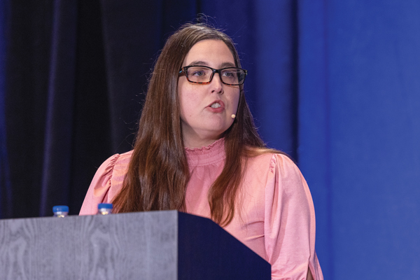
About the Enduring Program
The live meeting is being video
and audio recorded.
The proceedings from today will
be edited and developed into
an enduring web-based program.
An email will be sent to all attendees
when the activity is available.
To learn more about our education programs, visit our website, www.ResearchToPractice.com
Notes:
11
11

Slide 12



Slide 13

“Recent Advances in Cancer Care — New Paradigms,
Novel Agents and What It Means for the Oncology Nurse”
Eighteenth Annual RTP-ONS NCPD Symposium Series

Slide 14


New Agents, Therapies and Regimens
Recent Advances in Cancer Care — New Paradigms,
Novel Agents and What It Means for the Oncology Nurse
When should it be used, for whom and why?
How to prevent and manage side effects:
dose holds and reductions
  Kaplan Meier curves —
  HR and absolute benefit
  Waterfall plots

Slide 15
Immunotherapeutic Approaches for Endometrial Cancer
Recent Advances in Cancer Care — New Paradigms,
Novel Agents and What It Means for the Oncology Nurse
A Complimentary NCPD Symposium Series Held During the 51st Annual ONS Congress
Thursday, May 14, 2026
6:00 AM – 7:30 AM
Faculty
Sarah Karpen, MPAS, PA-C
J Alejandro Rauh-Hain, MD, MPH
Jaclyn Shaver, MS, APRN, CNP, WHNP
Moderator
Dana M Chase, MD

Slide 16
Agenda
Introduction: Biology of Endometrial Cancer (EC)
Module 1: First-Line Therapy for Advanced or Recurrent EC
Module 2: Potential Benefits of PARP Inhibition Combined with Immunotherapy in Advanced EC
Module 3: Role of Lenvatinib/Pembrolizumab in the Management of Progressive Advanced EC
Module 4: Other Nursing Considerations in the Care of Patients with
Advanced EC

Slide 17
Agenda
Introduction: Biology of Endometrial Cancer (EC)
Module 1: First-Line Therapy for Advanced or Recurrent EC
Module 2: Potential Benefits of PARP Inhibition Combined with Immunotherapy in Advanced EC
Module 3: Role of Lenvatinib/Pembrolizumab in the Management of Progressive Advanced EC
Module 4: Other Nursing Considerations in the Care of Patients with
Advanced EC

Slide 18
Biology of Endometrial Cancer; Rationale for the Use of Immune Checkpoint Inhibitors in This Disease
J. Alejandro Rauh-Hain, MD, MPH
MD Anderson Cancer Center

Slide 19
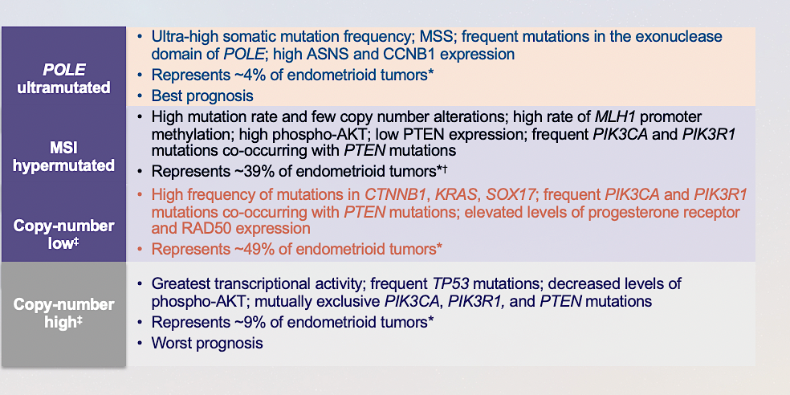
TCGA Molecular Subgroups
Kandoth et al Nature 2013

Slide 20
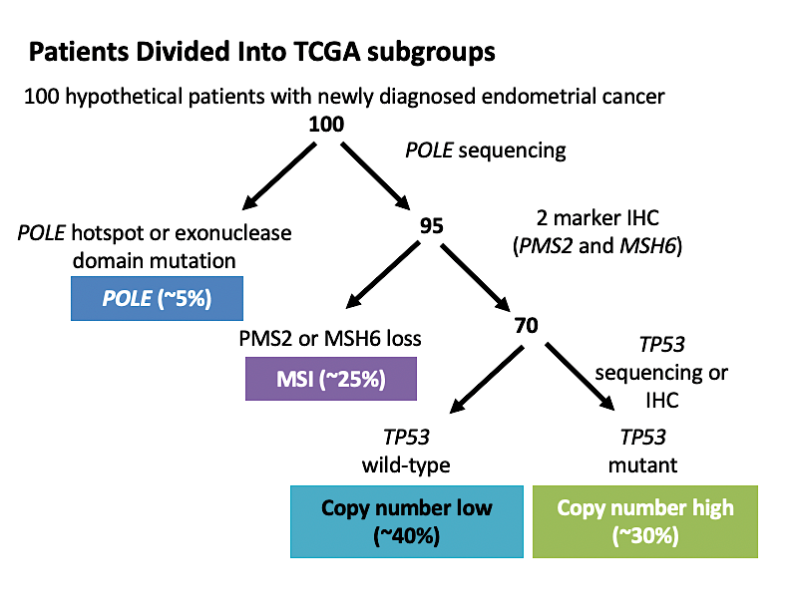
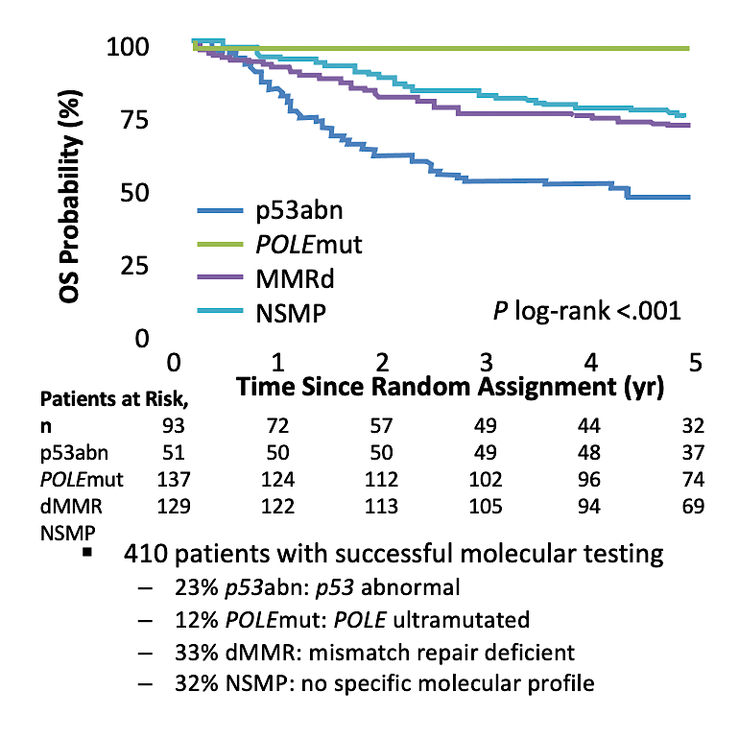
TCGA Molecular Classification and Outcomes
MacKay. Oncotarget. 2017;8:84579. León-Castillo. JCO. 2020;38:3388.

Slide 21
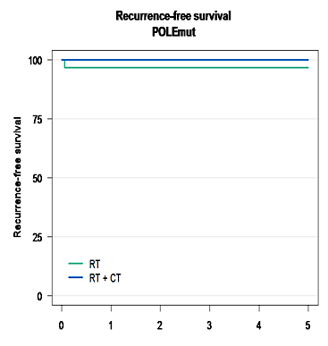

Molecular Classification and
Benefit from Adjuvant Chemotherapy
POLEmut N=51
P53abn
N=93
MMRd
N=137
NSMP
N=129
p=0.015, HR 0.50 (95%CI 0,28-0,88)
P53abn: worst prognosis but greatest benefit from adj Ctx
POLEmut: does not relapse regardless of tx
MSI and NSMP: intermediate prognosis , but little benefit from Adj Ctx
Leon-Castillo et al 2020

Slide 22
GOG 209: Design
Doxorubicin 45 mg/m²
Cisplatin 50 mg/m²
Paclitaxel 160 mg/m² (d2,3h)
Every 21 days
With G-CSF support
I
x7
Adenocarcinoma
Stage III/IV or recurrent
No prior chemotherapy
Measurable disease
Primary Endpoint: Equiv OS
ER/PR status recorded
Carboplatin AUC 6
Paclitaxel 175 mg/m² (3 h) every 21 days
II
x7
Open: 25-Aug-03
Closed: 20-Apr-09
Accrual: 1316 (eligible)
Notes:
22

Slide 23
GOG 209: Survival
Outcome Measure | TAP | TC | HR
Median PFS | 14 mos | 14 mos | 1.03
Median OS | 38 mos | 37 mos | 1.01
OS (90% CI, Test for Non-inferiority) |  | 1.16 | P>0.1

Slide 24
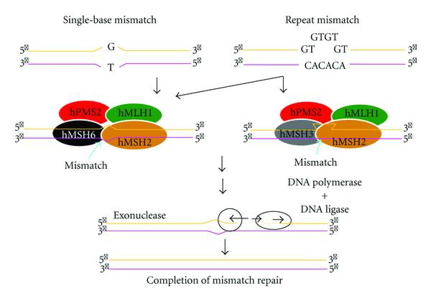
Microsatellite Instability (MSI)
MSI is a condition of genetic hypermutability that is the result of defective DNA mismatch repair (MMR)¹
The MMR pathway corrects DNA replication errors that lead to incorporation of the wrong nucleotides and/or nucleotide insertions or deletions²
Deficient MMR (dMMR) causes accumulations of mutations and can lead to an MSI-high (MSI-H) phenotype²
  A tumor is considered dMMR when ≥1 MMR protein is inactivated
  Germline mutations in MMR genes cause Lynch syndrome²
    Accounts for ~2% of endometrial cancers³
MSI-H/dMMR status is predictive of clinical benefit from checkpoint inhibitor therapy⁴
MMR, mismatch repair; MSI, microsatellite instability; MSI-H, microsatellite instability-high.
1. Luchini C et al. Ann Oncol. 2019;30:1232-1243. 2. Kristeleit RS et al. Am Soc Clin Oncol Educ Book. 2016;35:e259-e268. 3. Hampel H et al. Cancer Res. 2006;66:7810-7817. 4. Le DT et al. Science. 2017;357:409-413.
Notes:
Appendix

Slide 25
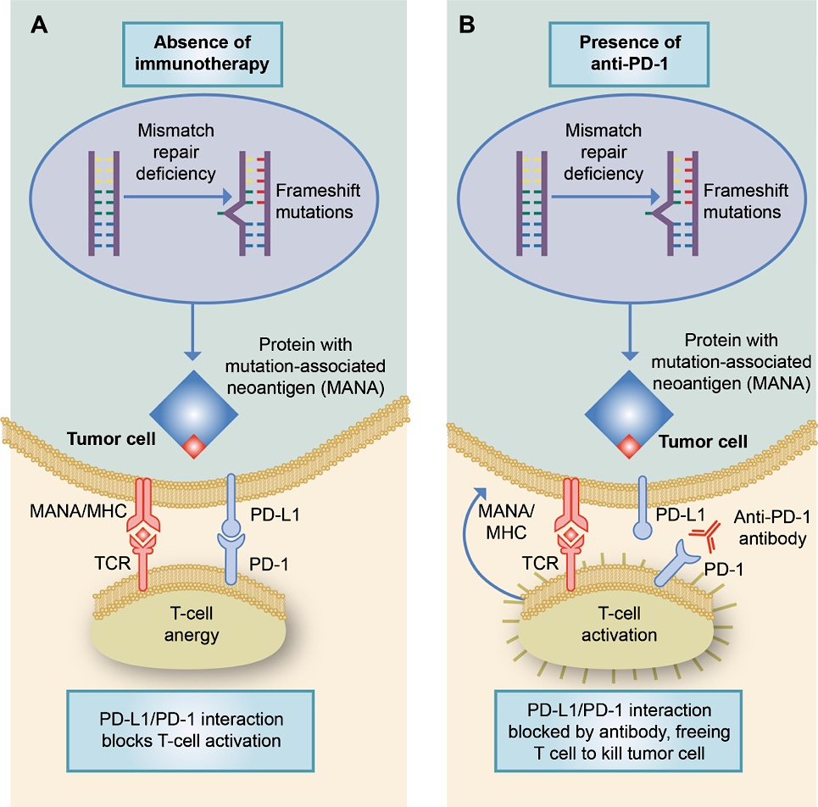
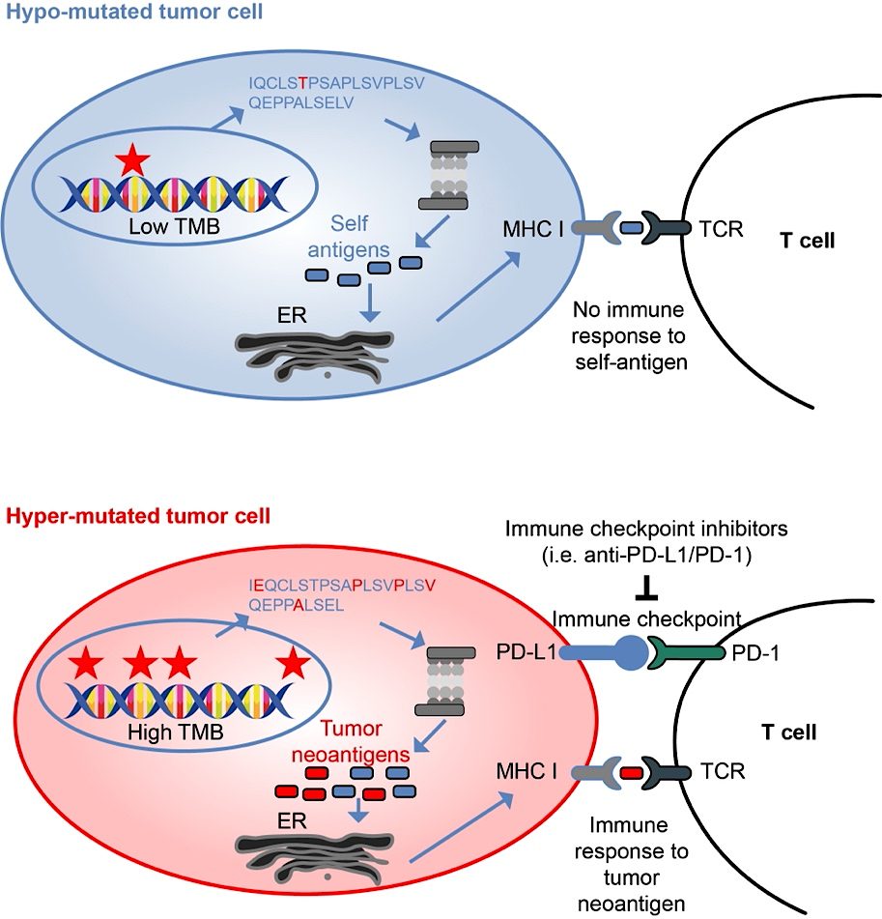
MSI-H/dMMR or TMB-H Tumors and
Response to Checkpoint Blockade
MSI-H/dMMR Tumors¹
TMB-H Tumors²
1. Dudley JC et al. Clin Cancer Res. 2016;22:813-820. 2. Fancello L et al. J Immunother Cancer. 2019;7(1):183.
Notes:
Appendix

Slide 26
Single Agent IO in “biomarker” Selected Endometrial Cancer Populations (dMMR)
Response to single agent IO in dMMR or MSI-high endometrial
Study & Drug | Patient Population | Outcome
Keynote 158: Pembrolizumab (N=49) | Advanced stage or metastatic dMMR endometrial cancer | ORR: 57.1%
PHAEDRA trial: Durvalumab (N=35 dMMR) | Advanced stage or metastatic endometrial cancer | ORR in dMMR: 43%
GARNET study: Dostarlimab (N=70) | Previously treated, recurrent advanced stage endometrial cancer | ORR in dMMR: 45%
Ph II Avelumab study (N= 15 dMMR) | Advanced stage or metastatic endometrial cancer | ORR: 26.7%
Marabelle A, et al. J Clin Oncol, 2019; Antill PSK et al. J Clin Oncol 2019; Oaknin A et al. SGO virtual meeting 2020; Konstantinopoulos PA et al. J Clin Oncol 2019

Slide 27
Case 1
67-year-old new diagnosis of grade 3 endometrial cancer
Initial Workup
Endometrial biopsy: Grade 3 endometrioid endometrial adenocarcinoma
CT imaging: Concern for adrenal metastasis, diffuse lymphadenopathy
Biopsy confirmed adrenal metastasis
Molecular Testing: dMMR tumor

Slide 28
Biopsychosocial Context
Social Context
Husband died from cancer 1 year ago
Lives >2 hours from cancer center
Emotional Concerns
Fear of losing independence
Anxiety regarding chemotherapy toxicity
Concern about burdening family
Medical Comorbidities
Hypertension

Slide 29
Treatment Decision
CT scan 6 months later (Pt declined treatment): Adrenal gland metastasis, bone metastasis, diffuse lymphadenopathy
Treatment Selected
Carboplatin + paclitaxel + pembrolizumab
Rationale
Advanced/recurrent EC
dMMR/MSI-H tumor with high likelihood of response to PD-1 inhibition
Supportive Interventions
Nutrition referral
Early symptom-management planning

Slide 30
Clinical Course
Treatment Course
Significant improvement in pelvic pain after Cycle 3 and excellent response
CT after 6 cycles: Partial response, only area of disease adrenal metastasis
Toxicities: Fatigue, Immune-related hypothyroidism
Management: Levothyroxine initiated, zoledronic acid, dose adjustments and supportive care
Current Status: Continuing maintenance pembrolizumab, Surgery with Endocrine Surg Onc pending

Slide 31
Key Lessons From This Case
Molecular Testing Matters
dMMR/MSI-H status directly influenced frontline therapy selection
Biomarker testing should be performed at diagnosis
Immunotherapy Has Changed the Treatment Landscape
Chemoimmunotherapy can produce meaningful and durable responses
Particularly impactful in dMMR EC
Cancer Care Extends Beyond Tumor Biology
Transportation barriers
Caregiver responsibilities
Emotional distress

Slide 32
Discussion Questions
What is the optimal approach to biomarker assessment for patients with newly diagnosed advanced EC?
Given that first-line chemoimmunotherapy regimens are available regardless of MSI/MMR status, are you still assessing this in all patients?
Do you test for other potential biomarkers of response to immune checkpoint inhibition (eg, POLE mutations, tumor mutational burden, PD-L1 status)? What about other biomarkers, such as BRCA, TP53 and HER2 status?

Slide 33
Agenda
Introduction: Biology of Endometrial Cancer (EC)
Module 1: First-Line Therapy for Advanced or Recurrent EC
Module 2: Potential Benefits of PARP Inhibition Combined with Immunotherapy in Advanced EC
Module 3: Role of Lenvatinib/Pembrolizumab in the Management of Progressive Advanced EC
Module 4: Other Nursing Considerations in the Care of Patients with
Advanced EC

Slide 34
First-Line Therapy for Advanced or Recurrent Endometrial Cancer
Dana M. Chase, MD
Professor and Fellowship Program Director
Division of Gynecologic Oncology
David Geffen School of Medicine at UCLA

Slide 35
Objectives
Key efficacy findings with dostarlimab, pembrolizumab and durvalumab, respectively, in combination with chemotherapy as first-line treatment for advanced or recurrent EC
Impact of MSI/MMR status on outcomes with the addition of anti-PD-1/PD-L1 antibodies to chemotherapy
FDA-approved indications for dostarlimab, pembrolizumab and durvalumab for patients with advanced or recurrent EC; optimal incorporation into up-front therapy

Slide 36
Treatment Options for Metastatic and/or Recurrent Endometrial Cancer—FDA approved
Trials | RUBY | GY018 | DUO-E
Population Included | dMMR and pMMR Advanced metastatic or Recurrent Includes carcinosarcoma Some patients with non-measurable disease 6+ months from last treatment | dMMR and pMMR Advanced metastatic or Recurrent Measurable only 12+ months from last treatment Includes performance status 2 | dMMR only Advanced metastatic or Recurrent 12+ months from last treatment Includes carcinosarcoma
Treatment | Carboplatin AUC5 Paclitaxel 175 mg/m2 Dostarlimab 500 mg + Dostarlimab 1000 mg q6 weeks for up to 3 years | Carboplatin AUC5 Paclitaxel 175 mg/m2 Pembrolizuamb 200 mg + Pembrolizumab 400 mg q6 weeks for up to 14 cycles | Carboplatin AUC5 Paclitaxel 175 mg/m2 Durvalumab 1,120 mg + Durvalumab 1500 mg q4weeks until progression
1. Powell MA, et al. Ann Oncol. 2024;35(8):728-738; 2. Mirza MR, et al. N Engl J Med. 2023;388(23):2145-2158; 3. Eskander RN, et al. Nat Med. 2025;31(5):1539-1546; 4. Westin SN, et al. J Clin Oncol. 2024;42(2):283-299.

Slide 37
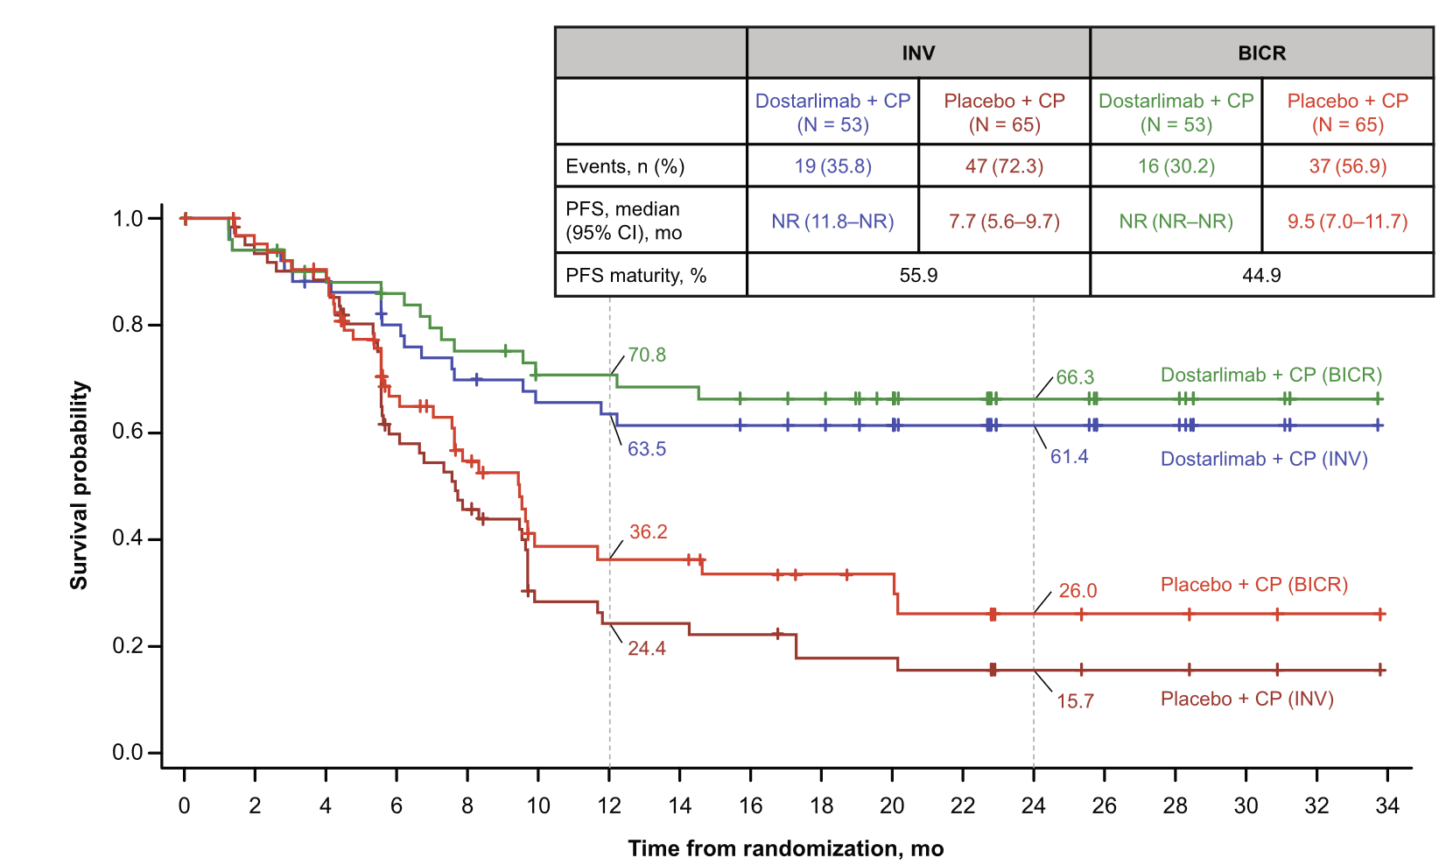
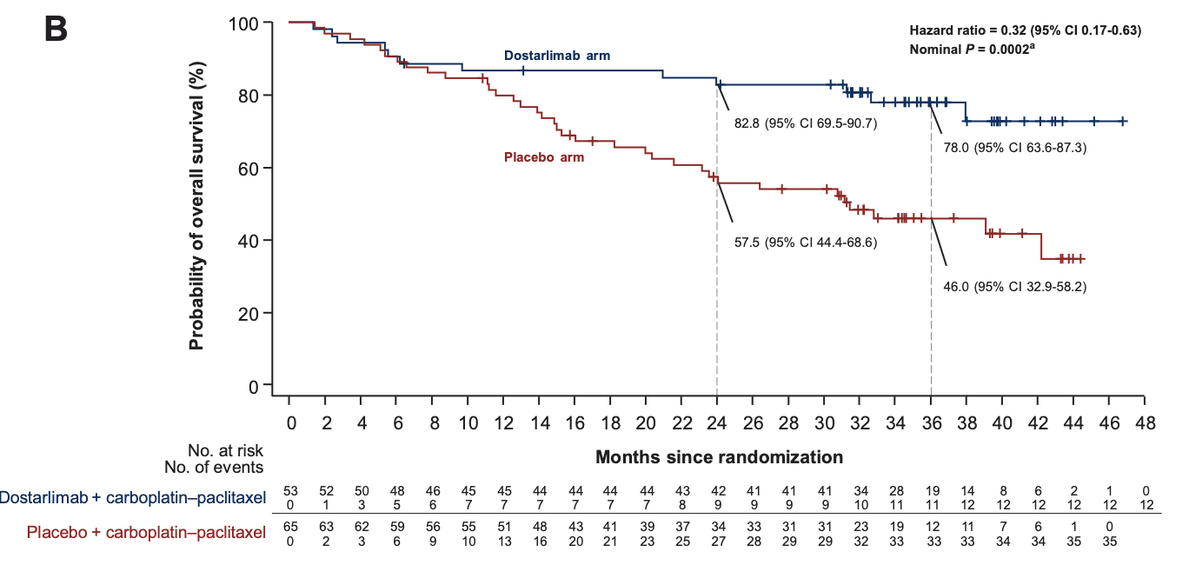
RUBY Trial
Substantial PFS Benefit
in dMMR/MSI-H Population
July 31, 2023: Initial FDA Approval
Dostarlimab + chemo followed by single-agent dostarlimab for patients with dMMR endometrial carcinoma
Substantial OS Benefit
in dMMR/MSI-H Population
Powell MA et al. Gyn Oncol 2025;192:40-49;
Powell MA et al. Ann Oncol 2024;35(8);728-38.

Slide 38
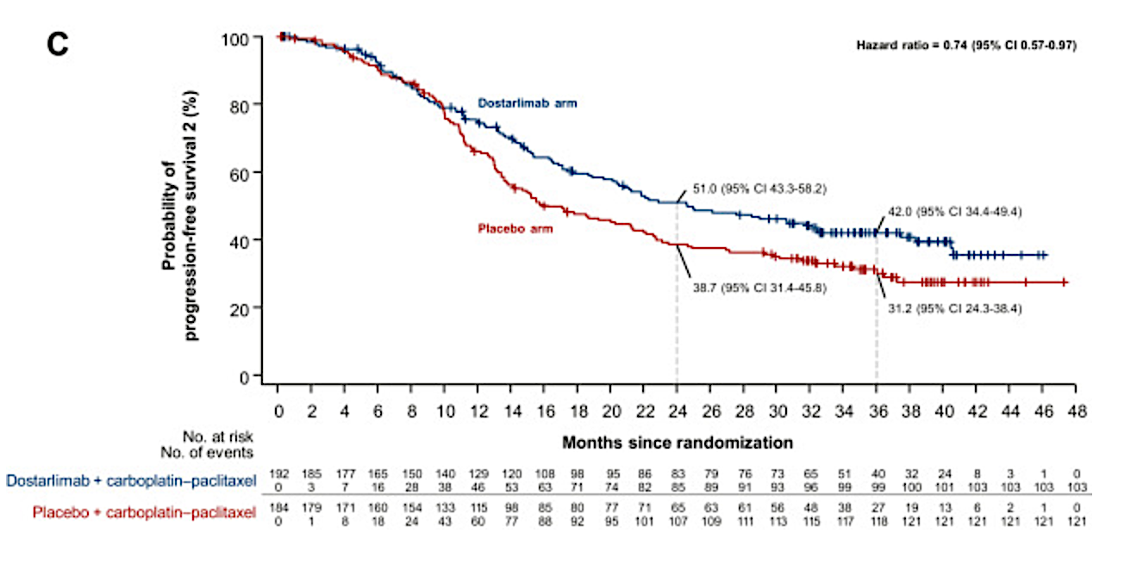
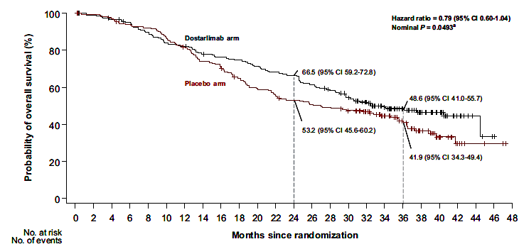
RUBY Trial- pMMR patients
OS Benefit
in pMMR/MSS Population
PFS2 Benefit
in pMMR/MSS Population
August 1, 2024: Expanded FDA Approval
Dostarlimab + chemo followed by single-agent dostarlimab for patients with
either dMMR or pMMR endometrial carcinoma
Powell MA et al. Ann Oncol 2024;35(8);728-38.

Slide 39
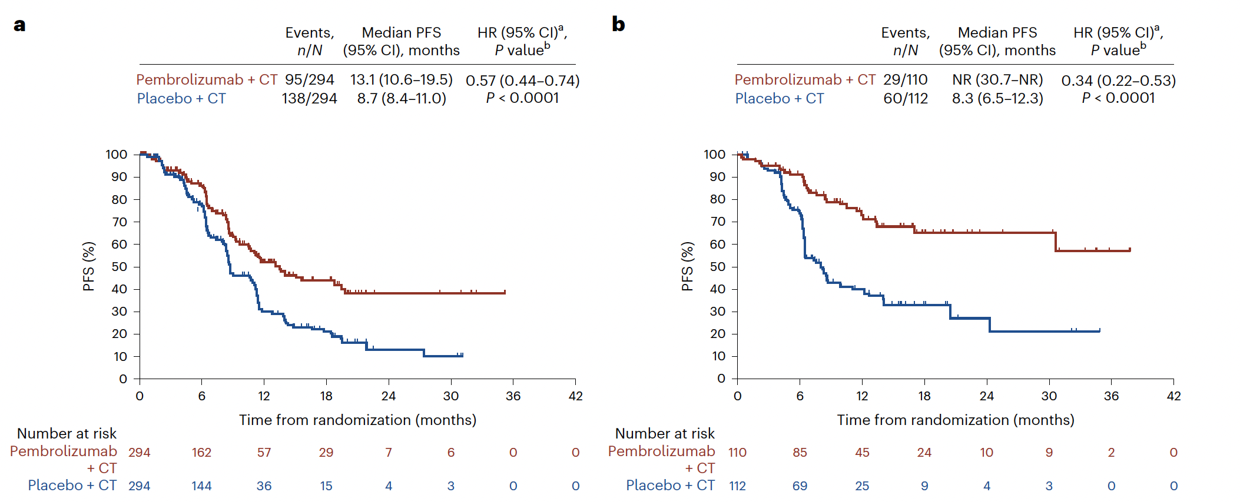
GY018
PFS in pMMR and dMMR
Eskander MN et al. Nat Med 2024;31:1539–46.

Slide 40
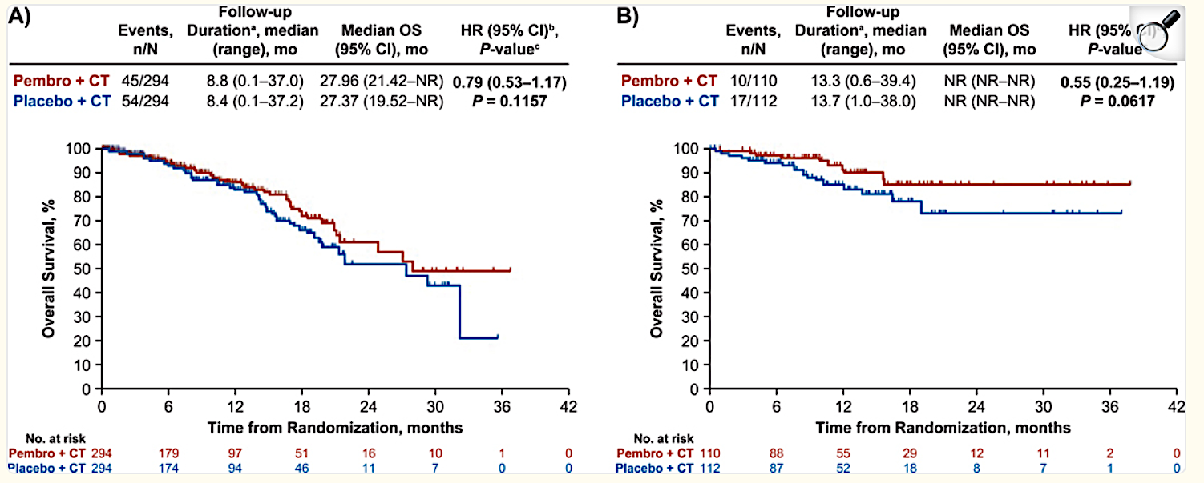
GY018
OS in pMMR and dMMR
HR (95% CI)
P-value
June 17, 2024: FDA Approval
Pembrolizumab + chemo followed by single-agent pembrolizumab
for patients with either dMMR or pMMR endometrial carcinoma
Eskander MN et al. Nat Med 2024;31:1539–46.

Slide 41
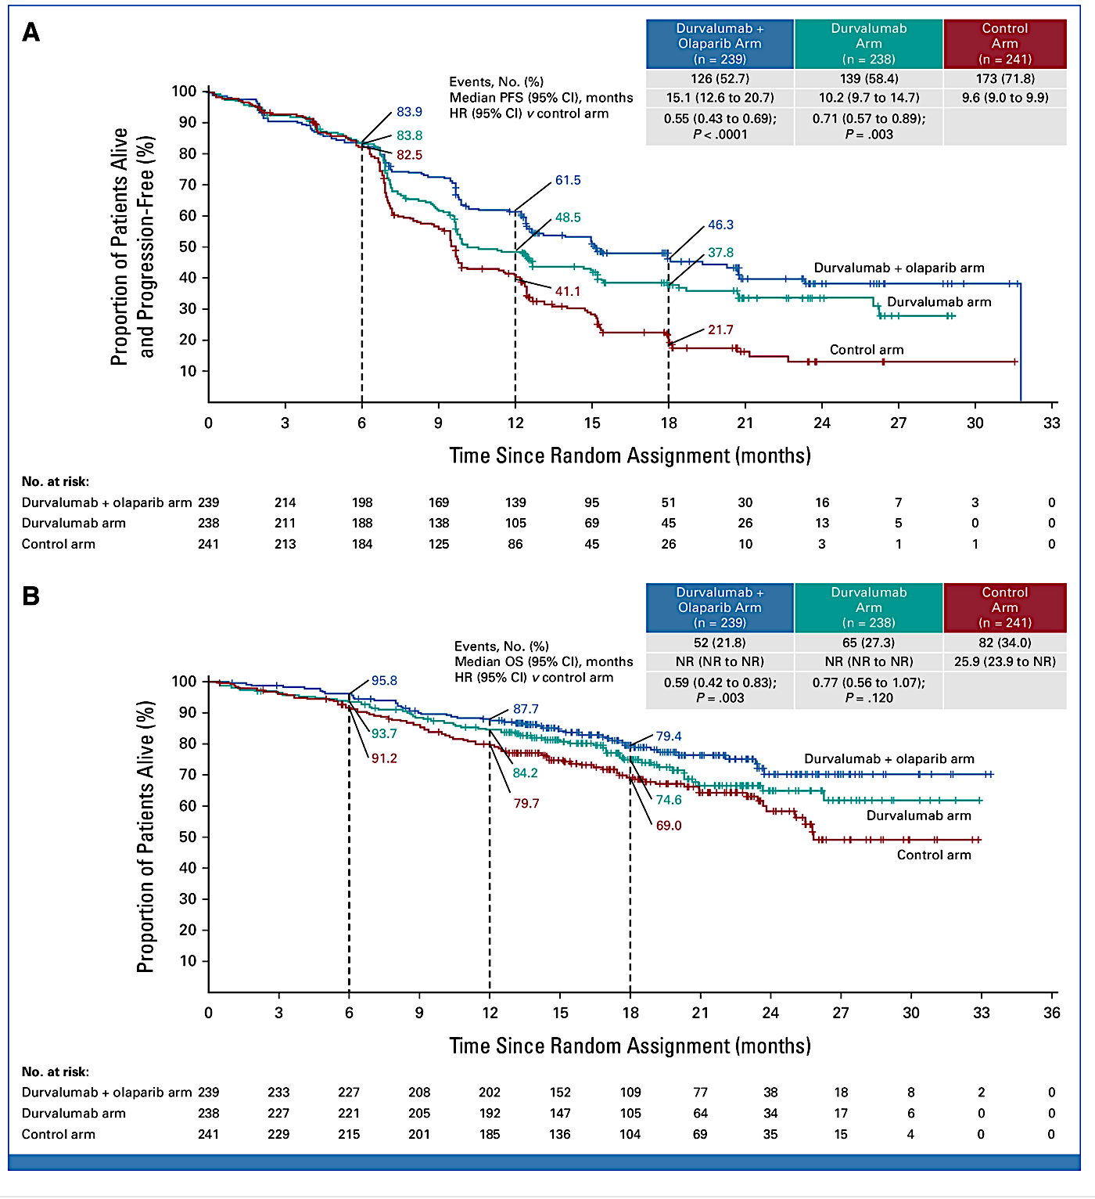
DUO-E
June 14, 2024: FDA Approval
Durvalumab + chemotherapy followed by single-agent durvalumab
for patients with dMMR endometrial carcinoma

Slide 42
Patient Case
64 y.o. female had TLHBSO, BSLN 9/30/2024 at outside hospital, Stage IB G2 endometrioid adenocarcinoma, + LVSI, 71% myometrial invasion, MLH1+PMS2 loss, +MLH1 promoter methylation. Completed brachytherapy in December 2024
Presents 1/20/2026 with abdominal discomfort, worsens with position changes, subsides with passing gas and walking. Occasional rectal bleeding, described as red blood not mixed with stool
PMH: back pain, GERD, Pseudogout
PSH: cholecystectomy, laparoscopic USO, TLHUSO, BSLN 9/2024
SH: divorced, has a baking business, retired case manager, former smoker
POBGYNHX: G3P3, children live nearby
FH: mother with breast cancer in her 50s

Slide 43
Physical Exam
BP 147/77 | Pulse 87 | Temp 37.1 °C (98.7 °F) (Forehead) | Ht 5' 2" (1.575 m) | Wt 190 lb 9.6 oz (86.5 kg) | SpO2 97% | BMI 34.86 kg/m²
ECOG performance status: 0
General: Pleasant female in no apparent distress. AAOx3
HEENT: Mucous membranes: pink and moist. No scleral icterus
Lymph: No supraclavicular or anterior cervical lymphadenopathy.
Pulmonary: Speaks in full sentences, no labored breathing
Abdomen: soft, non tender, slightly distended, no fluid wave, no masses, no hepatosplenomegaly
Pelvic:
EGWNL
Vaginal atrophy and shortening noticed
No palp masses, NT
Rectum: no masses, NT
Extremities: no lower extremity edema, no calf tenderness
Neuro: Grossly intact, no focal deficits
Psych: Appropriate mood and affect, good judgement

Slide 44
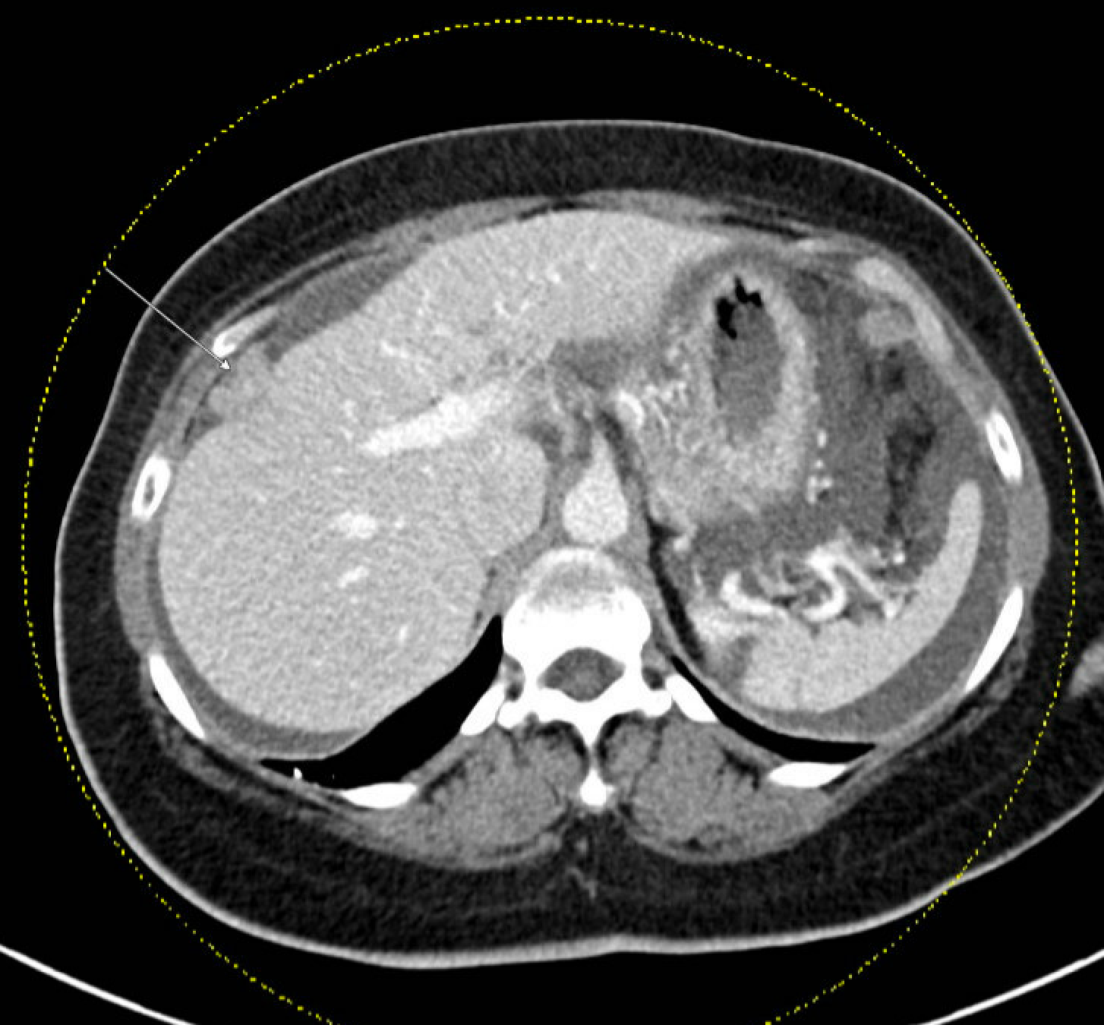
CT 1/27/2026
ONCOLOGIC FINDINGS:
History of endometrial adenocarcinoma status post hysterectomy, bilateral salpingo-oophorectomy, and sentinel lymph node dissection with:
- New moderate volume ascites and multifocal new enhancing peritoneal nodules/masses in the pelvis and right perihepatic space, the largest one measuring up to 6.6 cm along the left pelvic sidewall (3-121), compatible with peritoneal carcinomatosis

Slide 45
Started on carboplatin, paclitaxel, dostarlimab
Now s/p cycle 6 of carboplatin, paclitaxel, dostarlimab on C1 of dostarlimab maintenance
C2 of chemo developed lower extremity rash
  Tried topical Benadryl and hydrocortisone without relief
  Methylprednisolone dose pack with resolution

Slide 46
Discussion Questions
How do you choose among dostarlimab, pembrolizumab and durvalumab in combination with first-line chemotherapy for individual patients with MSI-H/dMMR EC? What about for those with MSS/pMMR disease?
Do you believe these regimens are essentially equivalent in terms of efficacy and tolerability?
Are there any patients with newly diagnosed advanced EC for whom you wouldn’t currently add an anti-PD-1/PD-L1 antibody to up-front chemotherapy?

Slide 47
Tolerability and Other Practical Considerations with the Use of Anti-PD-1/PD-L1 Antibodies in Advanced Endometrial Cancer
Sarah Karpen PA-C
UC San Diego Health
Division of Gynecologic Oncology
Immune Checkpoint Inhibitor Toxicity Management | Advanced Endometrial Cancer

Slide 48
Agenda
01
Incidence and spectrum of immune-mediated adverse events (AEs) with anti-PD-1/PD-L1 antibodies
02
Recommended monitoring and management paradigms for immune-related AEs with immune checkpoint inhibitors
03
Strategies to discern whether toxicities stem from anti-PD-1/PD-L1 antibodies or their therapeutic partners when administered in combination
04
Relative and absolute contraindications to anti-PD-1/PD-L1 antibody therapy; role in patients with preexisting autoimmune conditions or a history of solid organ transplant

Slide 49
Incidence & Spectrum of Immune-Related Adverse Events
40-45%
92%
<1%
of patients have any AE
AEs are mild to moderate (Grade 1-2)
fatal irAE rate with monotherapy (~0.36-0.38%)
Most Common irAEs
High Severity irAEs (Grade ≥3 risk)
Rash / Pruritus (~10% each)
Diarrhea (9.5%)
Hypothyroidism (6.1%)
AST/ALT increase (3.1-3.4%)
Vitiligo (3.3%)
Hyperthyroidism (2.8%)
Pneumonitis (2.8%)
Hepatitis — ~50% of cases are Grade ≥3
Colitis — ~38% of cases are Grade ≥3
Pneumonitis — ~24% of cases are Grade ≥3; most common irAE-related death
Myocarditis, Myasthenia Gravis, GBS — rare but potentially fatal
Stevens-Johnson Syndrome / TEN — rare
Incidence substantially lower with monotherapy vs combination therapy

Slide 50
irAE Incidence by Organ System
Organ System / irAE | All-Grade Incidence | Grade ≥3 Incidence
ENDOCRINE
Hypothyroidism | 6.1% | 0.08%
Hyperthyroidism | 2.8% | —
Adrenal Insufficiency | 0.69% | 0.18%
Type 1 Diabetes | Uncommon | 0.18%
GASTROINTESTINAL
Diarrhea | 9.5% | 0.59%
Colitis | 1.2% | 0.47% (~38% of all colitis)
HEPATIC
Hepatitis (AST/ALT elevation) | 3.1–3.4% | ~50% of cases
PULMONARY
Pneumonitis | 2.8% | 0.67% (~24% of all pneumonitis)
DERMATOLOGIC
Rash / Pruritus | ~10% each | Low
Vitiligo | 3.3% | —
Source: Wang Y et al. JAMA Oncol. 2019

Slide 51
Timing of Immune-Related Adverse Events
Most irAEs occur within the first 10 weeks of therapy
Late-onset events (>1 year) occur in ~30% of patients on long-term therapy
Typical Sequence of irAE Onset
Dermatologic (2–6 wks)
GI / Hepatic (6–12 wks)
Pulmonary (8–14 wks)
Endocrine (8–16+ wks)
0
2
6
8
14
16+
wks
Dostarlimab Clinical Trial Data — Endometrial Cancer
RUBY trial (dostarlimab + carboplatin/paclitaxel): Hypothyroidism in 11.2% of patients
GARNET trial (dostarlimab monotherapy): Hypothyroidism and diarrhea most common at 5.8% | Endocrinopathies predominate — manageable with hormone replacement, rarely leads to discontinuation

Slide 52
Recommended Monitoring for irAEs (NCCN)
Pre-Therapy Assessment
Routine Monitoring During Therapy
Physical exam
Patient/family history of autoimmune disease
Infectious disease screening: HIV, hepatitis A/B/C
CBC with differential
Complete metabolic panel (CMP)
TSH / free T4
Baseline ECG + high-sensitivity troponin + NT-proBNP (consider)
PFTs for high-risk pulmonary patients (prior COPD or lung toxicity)
CBC + CMP prior to each treatment cycle
TSH + free T4 every 4–6 weeks
Serum cortisol every 4–6 weeks
High-risk CV patients: troponin every cycle ×3, then every 3 months
Monitor oxygen saturation at each visit
Clinical Pearl: Endocrinopathies often asymptomatic — routine thyroid and cortisol monitoring is essential for early detection

Slide 53
Management of irAEs — Grade-Based Framework (ASCO/NCCN)
Grade 1
Grade 2
Grade 3
Grade 4
Continue ICI
Hold ICI
Hold ICI
Discontinue ICI
Close monitoring
Symptomatic/supportive care
Exceptions: myocarditis, some neurologic & hematologic toxicities → hold
Resume when symptoms resolve to ≤Grade 1
Prednisone 1–2 mg/kg/day (oral)
Exception: myocarditis → permanent discontinuation
High-dose corticosteroids (IV methylprednisolone 1–2 mg/kg/day)
Consider permanent discontinuation (organ-dependent)
Specialist consultation often required
Permanently discontinue ICI
IV high-dose corticosteroids
Exception: endocrinopathies controlled by hormone replacement may continue
Steroid Tapers: 6–8 weeks (or longer) for pneumonitis, hepatitis, or neuromuscular toxicities | Preferred agents: Prednisone (oral) · Methylprednisolone (IV) | Prophylactic steroids: NOT indicated

Slide 54
Management Example: ICI-Mediated Colitis / Diarrhea
Grade 1
Grade 2
Grade 3
Grade 4
• Continue ICI
• Hydration
• Dietary modification
• Consider loperamide
• Consider holding ICI
• Hold ICI
• Prednisone 1–2 mg/kg/day
• Colonoscopy with biopsy
• If no response in 3 days → IV steroids
• Hold ICI
• IV methylprednisolone 1–2 mg/kg/day
• Inpatient care
• GI consultation
• Discontinue ICI permanently
• IV steroids
• Inpatient care
• Urgent GI consultation
Steroid-Refractory Options
First-line: Infliximab 5 mg/kg or Vedolizumab
If still refractory: Tofacitinib or Ustekinumab | Fecal microbiota transplant may be considered in selected cases
Supportive care: Blood glucose monitoring, PPI/H2 blocker (gastritis prevention), antimicrobial/antifungal prophylaxis, vitamin D/calcium supplementation

Slide 55
Distinguishing ICI vs Chemotherapy/PARP Inhibitor Toxicities
Strongly Suggests ICI
Overlapping AEs
Strongly Suggests Chemo/PARP
Hypothyroidism / Hyperthyroidism
Thyroiditis
Adrenal insufficiency
Pneumonitis
Myocarditis
Inflammatory arthritis
Clinical pearl: any "-itis" is more likely ICI-related
Diarrhea
Hepatotoxicity (AST/ALT elevation)
Fatigue
Rash
Note: Timing and histopathology can help differentiate
Neutropenia / Thrombocytopenia
Myelosuppression
Alopecia
Peripheral neuropathy
Cycle-dependent nausea/vomiting
Note: Chemo may suppress or delay irAEs
Dechallenge Approach
1. Low suspicion for irAE? Hold the non-ICI agent first and monitor before starting immunosuppression | 2. Toxicity resolves? Non-ICI likely causative | 3. Toxicity persists? Suspect irAE → hold ICI and initiate management | 4. Responds to steroids? Diagnostic clue for irAE

Slide 56
Contraindications to Anti-PD-1/PD-L1 Therapy
ABSOLUTE CONTRAINDICATION
Severe hypersensitivity to the drug or its components — ICI is contraindicated regardless of clinical context
RELATIVE CONTRAINDICATIONS — Risk Stratification
Higher Risk
Moderate / Consider With Caution
Uncontrolled autoimmune disease on immunosuppression
Solid organ transplant (rejection risk)
Prior allogeneic HCT
Active myasthenia gravis
Multiple sclerosis
Any autoimmune disorder (even controlled)
Chronic hepatitis B or C
HIV infection
Significant renal or hepatic insufficiency
Preexisting autoimmune neurologic disorders
Risk-benefit assessment required; multidisciplinary consultation recommended for patients with autoimmune conditions or prior transplant history

Slide 57
Case Study: irAE in Advanced Endometrial Cancer
Patient Profile
70-year-old female | PMH: HTN, obesity
Stage IVB endometrial cancer — dMMR (MLH1/PMS2 loss), MSI-high, TP53 wild-type, HER2-negative, ER/PR-positive
Surgery: Robotic hysterectomy, BSO, omentectomy, lymph node sampling
Treatment: Carboplatin + paclitaxel + pembrolizumab every 3 weeks
Cycles 1–4
Treatment
After Cycle 4
Symptoms
irAE Identified
& Managed
6-Week
Follow-Up
Presenting Symptoms & Labs (After Cycle 4)
Management & Outcome
Symptoms: Worsening fatigue, constipation, dry skin
TSH: 18.6 (markedly elevated)
Free T4: Low
Diagnosis: ICI-induced hypothyroidism (Grade 2)
Action: ICI continued; levothyroxine 50 mcg daily initiated
6-Week Follow-up TSH: 5.2 (normalized)
Free T4: Normal
Key Teaching: Endocrinopathies managed with hormone replacement — ICI does not need to be discontinued

Slide 58
Agenda
Introduction: Biology of Endometrial Cancer (EC)
Module 1: First-Line Therapy for Advanced or Recurrent EC
Module 2: Potential Benefits of PARP Inhibition Combined with Immunotherapy in Advanced EC
Module 3: Role of Lenvatinib/Pembrolizumab in the Management of Progressive Advanced EC
Module 4: Other Nursing Considerations in the Care of Patients with
Advanced EC

Slide 59
Potential Benefits of PARP Inhibition Combined with Immunotherapy in Advanced Endometrial Cancer
J. Alejandro Rauh-Hain, MD, MPH
MD Anderson Cancer Center

Slide 60
Landmark Immunotherapy Frontline Trials
 | NRG-GY018 | RUBY 1 | AtTEnd | DUO-E | RUBY 2
dMMR Immuno | NR (31-NR) | NR (12-NR) | NR (12-NR) | NR (NR-NR)
dMMR Control | 8 (6-10) | 8 (6-10) | 7 (6-9) | 7 (7-15) | 8 (5-NR)
dMMR Imm + PARP |  |  |  | 32 (12-NR) | NR (11.8-NR)
d Hazard Ratio | 0.3 (0.2-0.5) | 0.3 (0.2-0.5) | 0.4 (0.2-0.6) | 0.4 (0.2-0.8)
d Hazard Ratio + PARP |  |  |  | 0.4 (0.2-0.7) | 0.5 (0.2-0.9)
pMMR Immuno | 13 (10-19) | 10 (9-13) | 9 (9-10) | 10 (9-12)
pMMR Control | 9 (8-11) | 8 (8-10) | 9 (8-10) | 10 (9-10) | 8 (8-10)
pMMR Imm + PARP |  |  |  | 15 (12-18) | 14 (10-17)
p Hazard Ratio | 0.5 (0.4-0.7) | 0.8 (0.6-1) | 0.9 (0.7-1.2) | 0.8 (0.6-1)
p Hazard Ratio + PARP |  |  |  | 0.6 (0.4-0.7) | 0.6 (0.4-0.9)

Slide 61


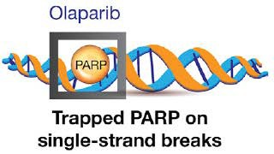



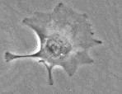
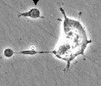
Mechanism of Action of PARP Inhibitors
DNA SSBs occur all the time in cells and PARP detects and repairs them
PARP
PARPi
During the replication process unrepaired SSBs are converted into DSBs
Replicating cells
Normal cell
Cancer cell with HRD
Repair by homologous recombination
No effective repair (No HR pathway)
Survival
Tumor-specific killing by PARP inhibitors
Cell death
DSB, double-strand break; HR, homologous recombination; HRD, homologous recombination deficiency; PARP, poly (ADP-ribose) polymerase; PARPi, PARP inhibitor; SSB, single-strand break.
O’Connor MJ, et al. Mol Cell. 2015;60:547-560.

Slide 62
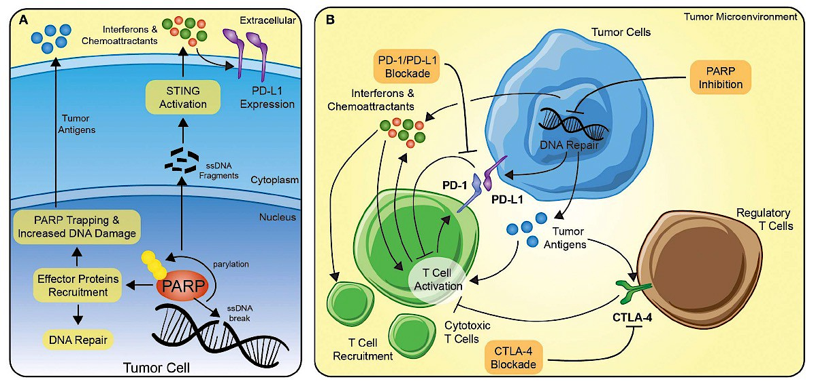

The Potential Synergy Between PARP Inhibition and Immune Checkpoint Blockade
Vikas P et al. Front Oncol 2020;10:570.

Slide 63
DUO-E study design
Patients
Chemotherapy phase
Maintenance phase
Endpoints
Newly diagnosed FIGO 2009 Stage III/IV or recurrent endometrial cancer
Known MMR status
Naïve to first-line systemic anticancer treatment for advanced disease
Naïve to PARP inhibitors and immune-mediated therapy
Adjuvant chemotherapy allowed if ≥12 months from last treatment to relapse
All histologies except sarcomas
Control
CP* (q3w)
+
Durvalumab pbo (IV q3w)
Durvalumab pbo (IV q4w)
+
Olaparib pbo (tablets bid)
Primary
PFS (RECIST per investigator) in:
  Durva vs Control
  Durva+Ola vs Control
  Key secondary
OS (analytical)
Safety
  Exploratory
PFS in Durva+Ola vs Durva
Subgroup analyses of PFS
  Including MMR, PD-L1, and HRRm
N=718
R
1:1:1
Durva
CP* (q3w)
+
Durvalumab (1120 mg IV q3w)
Durvalumab (1500 mg IV q4w)
+
Olaparib pbo (tablets bid)
Patients without disease progression
Stratified by:
MMR status
(proficient vs deficient)
Disease status (recurrent vs
newly diagnosed)
Geographic region (Asia vs non-Asia)
Durva+Ola
CP* (q3w)
+
Durvalumab (1120 mg IV q3w)
Durvalumab (1500 mg IV q4w)
+
Olaparib (300 mg tablets bid)
Treatment until disease progression, unacceptable toxicity
or other discontinuation criteria were met
*Six cycles of carboplatin at an area under the concentration–time curve of 5 or 6 mg per mL/min and paclitaxel 175 mg/m².
bid, twice daily; CP, carboplatin/paclitaxel; Durva, durvalumab; FIGO, International Federation of Gynaecology and Obstetrics; HRRm, homologous recombination repair mutation; IV, intravenously; MMR, mismatch repair; PD-L1, programmed death-ligand 1; PFS, progression-free survival; Ola, olaparib; OS, overall survival; PARP, poly(ADP-ribose) polymerase; pbo, placebo; q3(4)w, every 3(4) weeks; R, randomization; RECIST, Response Evaluation Criteria for Solid Tumours.
Westin SN et al. J Clin Oncol 2023;DOI:10.1200/JCO.23.02132.

Slide 64
DUO-E met its dual primary endpoints
PFS: dual primary endpoints
OS: secondary endpoint; interim analysis
100
100
90
12 months
90
80
61.5%
Overall data maturity: 61.0%
80
Overall data maturity: 27.7%
70
48.5%
18 months
70
87.7%
Durva+Ola
60
41.1%
46.3%
60
84.2%
Durva
37.8%
79.7%
79.4%
PFS, %
21.7%
OS, %
74.6%
50
50
12 months
69.0%
Control
40
Durva+Ola
40
18 months
30
Durva
30
20
20
10
Control
10
0
0
0
3
6
9
12
15
18
21
24
27
30
33
0
3
6
9
12
15
18
21
24
27
30
33
36
Months since randomization
No. at risk
Months since randomization
Durva+Ola
239
214
198
169
139
95
51
30
16
7
3
0
Durva+Ola
239
233
227
208
202
152
109
77
38
18
8
2
0
Durva
238
211
188
138
105
69
45
26
13
5
0
0
Durva
238
227
221
205
192
147
105
64
34
17
6
0
0
Control
241
213
184
125
86
45
26
10
3
1
1
0
Control
241
229
215
201
185
136
104
69
35
15
4
0
0
 | Control (N=241) | Durva (N=238)
Events, n (%) | 173 (71.8) | 139 (58.4)
Median PFS (95% CI),* months | 9.6 (9.0–9.9) | 10.2 (9.7–14.7)
HR (95% CI) vs Control† |  | 0.71 (0.57–0.89); P=0.003
HR (95% CI) vs Durva†
 | Control (N=241) | Durva (N=238) | Durva+Ola (N=239)
Events, n (%) | 173 (71.8) | 139 (58.4) | 126 (52.7)
Median PFS (95% CI),* months | 9.6 (9.0–9.9) | 10.2 (9.7–14.7) | 15.1 (12.6–20.7)
HR (95% CI) vs Control† |  | 0.71 (0.57–0.89); P=0.003 | 0.55 (0.43–0.69); P<0.0001
HR (95% CI) vs Durva† |  |  | 0.78 (0.61–0.99)
 | Control (N=241) | Durva (N=238) | Durva+Ola (N=239)
Events, n (%) | 82 (34.0) | 65 (27.3) | 52 (21.8)
Median OS (95% CI),* months | 25.9 (23.9–NR) | NR (NR–NR) | NR (NR–NR)
HR (95% CI) vs Control‡ |  | 0.77 (0.56–1.07); P=0.120 | 0.59 (0.42–0.83); P=0.003
HR (95% CI) vs Durva‡ |  |  | 0.77 (0.53–1.10)
The median (range) duration of follow-up for PFS was 12.6 (0.0–31.6), 15.4 (0.0–29.1), and 15.4 (0.0–31.7) months in censored patients for the Control, Durva, and Durva+Ola arms, respectively. The median (range) duration of follow-up for OS was 18.6 (0.5–32.9), 18.4 (2.1–33.0), and 18.7 (1.1–33.4) months in censored patients for the Control, Durva, and Durva+Ola arms, respectively. PFS and OS rates were estimated by the KM method.
*CI for median PFS and OS is derived based on the Brookmeyer–Crowley method; †The primary PFS analysis for each comparison was performed separately. The HR and CI were estimated from a Cox proportional hazards model stratified by MMR and disease status. The CI was calculated using a profile likelihood approach. The P value was calculated using a log-rank test stratified by MMR and disease status; ‡The HRs were estimated from an unstratified Cox proportional hazards model. The CI was calculated using a profile likelihood approach. P values failed to reach statistical significance.
CI, confidence interval; HR, hazard ratio; ITT, intent-to-treat; KM, Kaplan–Meier; NR, not reached.
Figure borrowed with permission from Westin SN et al. J Clin Oncol 2023;DOI:10.1200/JCO.23.02132

Slide 65
Subgroup analyses of PFS by MMR status
Prespecified exploratory analyses
dMMR (20% of population)
pMMR (80% of population)
100
12 months
100
90
70.0%
18 months
90
12 months
80
67.9%
62.7%
80
43.3%
67.9%
59.4%
70
31.7%
Durva+Ola
70
44.4%
18 months
60
60
40.8%
42.0%
PFS, %
PFS, %
31.3%
50
50
20.0%
40
Durva
40
30
Control
30
Durva+Ola
20
20
Durva
10
10
Control
0
0
0
2
4
6
8
10
12
14
16
18
20
22
24
26
28
30
32
0
2
4
6
8
10
12
14
16
18
20
22
24
26
28
30
32
No. at risk
Months since randomization
No. at risk
Months since randomization
Durva+Ola
48
46
46
41
38
32
32
23
18
16
16
10
4
3
2
1
0
Durva+Ola
191
183
164
157
134
114
107
75
46
35
31
19
12
10
5
2
0
Durva
46
40
37
36
32
27
26
19
17
14
11
9
5
5
2
0
0
Durva
192
182
169
152
113
83
79
53
36
31
27
15
8
7
2
0
0
Control
49
43
39
28
17
16
13
9
7
5
4
2
2
2
0
0
0
Control
192
178
170
156
113
77
73
40
25
21
13
7
1
1
1
1
0
 | Control (N=49) | Durva (N=46) | Durva+Ola (N=48)
Events, n (%) | 25 (51.0) | 15 (32.6) | 18 (37.5)
Median PFS (95% CI),* months | 7.0 (6.7–14.8) | NR (NR–NR) | 31.8 (12.4–NR)
HR (95% CI) vs Control† |  | 0.42 (0.22–0.80) | 0.41 (0.21–0.75)
HR (95% CI) vs Durva† |  |  | 0.97 (0.49–1.98)
 | Control (N=192) | Durva (N=192) | Durva+Ola (N=191)
Events, n (%) | 148 (77.1) | 124 (64.6) | 108 (56.5)
Median PFS (95% CI),* months | 9.7 (9.2–10.1) | 9.9 (9.4–12.5) | 15.0 (12.4–18.0)
HR (95% CI) vs Control† |  | 0.77 (0.60–0.97) | 0.57 (0.44–0.73)
HR (95% CI) vs Durva† |  |  | 0.76 (0.59–0.99)
Exploratory subgroup analysis. MMR status evaluated using the Ventana immunohistochemistry MMR panel. PFS rates were estimated by the KM method.
*CI for median PFS was derived based on the Brookmeyer–Crowley method; †The HR and CI were estimated from an unstratified Cox proportional hazards model.
dMMR, mismatch repair deficient; pMMR, mismatch repair proficient.
Figure borrowed with permission from Westin SN et al. J Clin Oncol 2023;DOI:10.1200/JCO.23.02132

Slide 66
pMMR subpopulation: PFS by biomarker subgroup
CP + durvalumab + olaparib vs CP
Post hoc exploratory analysis
HR (95% CI)
All pMMR patients |  | 0.57 (0.44–0.73)
PD-L1 expression* | Positive (TAP score ≥1%) | 0.44 (0.31–0.61)
 | Negative (TAP score <1%) | 0.87 (0.59–1.28)
 | Unknown^{ǁ} | NC (NC–NC)**
POLEm and TP53m status†,‡ | POLEm | NC (NC–NC)**
 | TP53m | 0.47 (0.32–0.67)
 | TP53 wild-type | 0.71 (0.47–1.07)
 | Unknown^{ǁ} | 0.74 (0.37–1.45)
HRRm status†,§ | HRRm | 0.47 (0.26–0.86)
 | Non-HRRm | 0.58 (0.43–0.78)
 | Unknown^{ǁ} | 0.74 (0.37–1.45)
BRCAm status† | BRCAm | NC (NC–NC)**
 | Non-BRCAm | 0.57 (0.43–0.75)
 | Unknown^{ǁ} | 0.74 (0.37–1.45)
Histological type at diagnosis | Endometrioid | 0.60 (0.42–0.85)
 | Serous | 0.46 (0.27–0.76)
 | Other¶ | 0.64 (0.38–1.06)
Baseline ctDNA | Detected | 0.36 (0.23–0.56)
 | Not detected | NC (NC–NC)**
 | Unknown^{ǁ} | 0.69 (0.49–0.96)
0.25
0.5 1 2
Favors CP+D+O Favors CP
DCO: April 12, 2023. *PD-L1 expression was evaluated using the VENTANA PD-L1 (SP263) assay. PD-L1 positive defined as TAP ≥1%, PD-L1 negative defined as TAP <1%; †Status determined retrospectively in two ways: from tissue samples (FoundationOne®CDx assay; Foundation Medicine, Inc.), and by molecular profiling of ctDNA (FoundationOne®Liquid CDx; Foundation Medicine, Inc.) from blood samples; ‡TP53m status defined as a sample with a deleterious or suspected deleterious mutation in TP53 excluding samples with a deleterious or suspected deleterious mutation in POLE; TP53 wild-type status defined as a sample with no deleterious or suspected deleterious mutation in TP53 excluding samples with a deleterious or suspected deleterious mutation in POLE; §Positive HRRm status defined as a sample with a deleterious or suspected deleterious mutation in any of the following prespecified genes: ATM, BRCA1, BRCA2, BARD1, BRIP1, CDK12, CHEK1, CHEK2, FANCL, PALB2, RAD51B, RAD51C, RAD51D, and RAD54L; negative HRRm status (non-HRRm) defined as a sample with no deleterious or suspected deleterious mutations in any of the prespecified genes; ^{ǁ}‘Unknown’ status included patients recruited in China (where molecular testing was not performed) and/or patients who withdrew consent and/or those without available samples; ¶‘Other’ includes carcinosarcoma, mixed epithelial, clear cell, undifferentiated, mucinous, and other; **Not calculated due to low event numbers.
NC, not calculable.
Westin SH et al. SGO 2025

Slide 67


ENGOT-EN6-NSGO/GOG-3031/RUBY Part 2
Eligible patients
Stage III/IV disease or first recurrent ECª
Primary endpoint
PFS by INV
per RECIST v1.1
  Overall
  MMRp/MSS
All histologies except sarcomas^{b}
Naive to systemic anticancer therapy or had a recurrence or PD ≥6 months after completing
systemic anticancer therapy
Naive to PARP inhibitor therapy
Dostarlimab (500 mg IV Q3W)
+
CP^{d} (Q3W)
Dostarlimab
1000 mg IV Q6W up to 3 years^{e}
+
Niraparib
200 or 300 mg^{f} QD up to 3 years^{e}
N=192
(6 cycles)
Secondary endpoints
R 2:1
Follow-up
OS
PFS by BICR
ORR
DOR
DCR (BOR of CR, PR, or SD)
PFS2
HRQOL/PRO
PK
Safety
Stratification
MMR/MSI status^{c}
  25% dMMR/MSI-H
  75% MMRp/MSS
Prior external pelvic radiotherapy
Disease status
Placebo IV
(Q3W)
+
CP^{d} (Q3W)
Placebo IV
Q6W up to 3 years^{e}
Placebo PO
QD up to 3 years^{e}
N=99
(6 cycles)
On-study imaging assessments were performed Q6W (±7 days) from the randomization date until week 25 (cycle 8), followed by Q9W (±7 days) until week 52. Subsequent tumor imaging was performed every 12 weeks (±7 days) until radiographic PD was documented by investigator assessment per RECIST v1.1 followed by 1 additional imaging 4–6 weeks later, or subsequent anticancer therapy was started, whichever occurred first. Thereafter, scans were performed per standard of care.
ªHistologically/cytologically proven advanced or recurrent EC; stage III/IV disease or first recurrent EC with low potential for cure by radiation therapy or surgery alone or in combination. ^{b}Carcinosarcoma, clear cell, serous, or mixed histology permitted (mixed histology containing ≥10% carcinosarcoma,
clear cell, or serous histology). ^{c}Patients were randomized based on either local or central MMR/MSI testing results. Central testing was used with local results were not available. For local determination of MMR/MSI status, IHC, next-generation sequencing, and polymerase chain reaction assays were accepted. For central determination of MMR/MSI status IHC per Ventana MMR RxDx panel was used. ^{d}Carboplatin AUC 5 mg/mL/min and paclitaxel 175 mg/m². ^{e}Treatment ends after 3 years, PD, toxicity, withdrawal of consent, investigator’s decision, or death, whichever occurs first. Continued treatment with dostarlimab or placebo beyond 3 years may be considered following discussion between the sponsor and the investigator. ^{f}Dose of 300 mg in patients with body weight ≥77 kg and platelet count ≥150,000/µL and 200 mg in patients with body weight <77 kg or platelet count <150,000/µL or both. AUC, area under the plasma or serum concentration-time curve; BICR, blinded independent central review; BOR, best overall response; CP, carboplatin-paclitaxel; CR, complete response; DCR, disease control rate; dMMR, MMR deficient; DOR, duration of response; EC, endometrial cancer; HRQOL, health-related quality of life; IHC, immunohistochemistry; INV, investigator assessment; MMR, mismatch repair; MMRp, MMR proficient; MSI, microsatellite instability; MSI-H, MSI high; MSS, microsatellite stable; ORR, objective response rate; OS, overall survival; PARP, poly(ADP-ribose) polymerase; PD, progressive disease; PFS, progression-free survival; PK, pharmacokinetic; PO, by mouth; PR, partial response; PRO, patient-reported outcome; Q3W, every 3 weeks; Q6W, every 6 weeks; Q9W, every 9 weeks; QD, once daily; R, randomization; RECIST v1.1, Response Evaluation Criteria in Solid Tumors version 1.1; SD, stable disease.
1. Mirza M, et al. Presented at SGO 2024, San Diego, USA; 2. Westin SH, et al. Presented at ESMO 2023, Madrid, Spain

Slide 68
RUBY Part 2: Maintenance Dostarlimab ± Niraparib on PFS in Overall and pMMR Populations
Overall
pMMR
 | Median (95% CI), mo | Events, n/N (%)
Dosta + nira + CP | 14.5 (11.8–17.4) | 95/192 (49.5)
Placebo + CP | 8.3 (7.6–9.8) | 69/99 (69.7)
PFS maturity |  | 164/291 (56.4)
 | Median (95%CI), mo | Events, n/N (%)
Dosta + nira + CP | 14.3 (9.7–16.9) | 79/142 (55.6)
Placebo + CP | 8.3 (7.6–9.8) | 53/74 (71.6)
PFS maturity |  | 132/216 (61.1)
Median duration of follow-up, 19.0 months*
100
100
80
80
Probability of PFS, %
Probability of PFS, %
54.7%
60
57.0%
60
40
40
HR, 0.60
33.7%
Dosta + nira + CP
HR, 0.63
(95% CI, 0.44–0.91)
31.1%
Dosta + nira + CP
20
(95% CI, 0.43–0.82)
P=.0007
Placebo IV + Placebo oral + CP
20
Placebo IV + Placebo oral + CP
P=.0060
0
0
0 2
4
6
8
10
12
14
16
18
20
22
24
26
28
30
0
2 4
Chemotherapy period
6
8
10
12
14
16
18
20
22
24
26
28
30
Chemotherapy period
Maintenance dostarlimab + niraparib resulted in a statistically significant improvement in PFS in the overall and pMMR populations
*Median expected duration of follow-up. Nira, niraparib.
Mirza MR, et al. Presented at: 2024 ESMO Gynecological Cancers Congress; June 20-22, 2024; Florence, Italy. Oral abstract 38M0.

Slide 69
Selecting Which Patient May Benefit From Addition of PARPi
RUBY Part 2 ITT
Dostarlimab + niraparib + CP N=192
Placebo IV + placebo oral + CP N=99
Dostarlimab + Placebo IV + niraparib + CP placebo oral + CP
N=192 N=99
HR (95% CI)
No. of patients with events/No. of patients
HR (95% CI)
HR (95% CI)
HR (95% CI)
All patients
95/192
69/99
0.59 (0.43–0.81)
0.59 (0.43–0.81)
PD-L1 statusª
All patients
95/192
69/99
PD-L1+
56/123
43/62
0.56 (0.37–0.83)
PD-L1-
37/64
24/31
0.67 (0.40–1.12)
Molecular subgroupª
Not evaluable^{b}
2/5
2/6
NA
POLEmut
0/3
1/2
NA
BRCA mutation status
Positive
1/6
3/4
NA
dMMR/MSI-H
12/37
10/17
0.45 (0.20–1.05)
Negative
75/148
49/71
0.61 (0.43–0.88)
0.29 (0.13–0.63)
Not evaluable^{b}
19/38
17/24
0.71 (0.37–1.37)
TP53mut
27/39
10/10
HRR mutation status^{c}
Positive
3/20
10/14
NA
NSMP
37/75
31/46
0.61 (0.38–0.99)
Negative
73/134
42/62
0.69 (0.47–1.01)
Not evaluable^{b}
19/38
17/24
0.71 (0.37–1.37)
Not evaluable^{b}
19/38
17/24
0.71 (0.37–1.37)
←Dostar + Nira + CP better
0.0156 0.0313 0.0625 0.125 0.25 0.5
Placebo + CP better®
2 4 8
←Dostar + Nira + CP better
0.0156 0.0313 0.0625 0.125 0.25 0.5
Placebo + CP better®
2 4
1
16
1
8
16
Results should be interpreted with caution as the study was not powered to detect a treatment difference in any subgroup, and there were small numbers and low data maturity in some subgroups. Where there were less than 20 events in the subgroup, the HR estimation and 95% CI were not analyzed as there were too few events (“not applicable”). ªBased on available whole exome sequencing results; ^{b}Sample not available. ^{c}Defined by a mutation in 1 or more genes included in the FMI14 panel: BRCA1, BRCA2, ATM, BARD1, BRIP1, PALB2, RAD51B, RAD51C, RAD51D, RAD54L, CDK12, CHEK1, CHEK2, and FANCL BRCA, breast cancer gene; CI, confidence interval; CP, carboplatin-paclitaxel; dMMR, mismatch repair deficient; dostar, dostarlimab; HR, hazard ratio; HRR, homologus recombination repair; ITT, intention to treat; IV, intravenous; MSI-H, microsatellite instability high; mut, mutation; nira, niraparib; NSMP, no specific molecular profile; PARPi, poly (ADP-ribose) polymerase inhibitor; PD-L1, protein death ligand-1; POLE, polymerase epsilon.
Mirza MR, et al. Presented at the Society of Gynecologic Oncology Annual Meeting 2024. Presentation #LBA2.

Slide 70
Case Presentation
72-year-old postmenopausal woman presented with progressive vaginal bleeding, pelvic pressure, fatigue, early satiety, and unintentional 18-lb weight loss over 3 months
PMH: hypertension, obesity, type 2 diabetes, and chronic anemia
ECOG performance status: 1
CT chest/abdomen/pelvis demonstrated a large uterine mass, bulky pelvic and para-aortic adenopathy, omental nodularity, and multiple bilateral pulmonary metastases
Endometrial biopsy confirmed high-grade uterine carcinosarcoma
Final stage: FIGO Stage IVB disease

Slide 71
Pathology and Molecular Profile
Pathology: Biphasic malignant epithelial and sarcomatous components consistent with uterine carcinosarcoma
Immunohistochemistry showed abnormal diffuse p53 staining pattern
Mismatch repair proteins intact (MLH1, PMS2, MSH2, MSH6 retained) consistent with pMMR/MSS disease
HER2 testing negative

Slide 72
Why Consider Frontline Dostarlimab?
RUBY Part 1 and NRG-GY018 established chemoimmunotherapy as a frontline standard in advanced/recurrent EC
RUBY Part 2 further suggested that combining PD-1 blockade with PARP inhibitor maintenance may enhance benefit in pMMR disease
Carcinosarcomas frequently harbor genomic instability, TP53 abnormalities, and high replication stress, potentially increasing sensitivity to combination strategies

Slide 73
Treatment Plan
Initiated carboplatin/paclitaxel plus dostarlimab every 3 weeks
Planned maintenance dostarlimab following completion of chemotherapy
Niraparib maintenance was discussed but deferred because of baseline anemia, frailty concerns, and limited carcinosarcoma-specific prospective data
Supportive interventions included early palliative care involvement, nutrition consultation, neuropathy monitoring, and transportation assistance

Slide 74
Clinical Course and Response
Patient experienced rapid improvement in bleeding, pelvic pain, appetite, and functional status after 2 cycles
Restaging imaging after 3 cycles demonstrated partial response with marked reduction in pulmonary metastases, nodal disease, and omental implants
Toxicities included Grade 1 fatigue, mild sensory neuropathy, and transient neutropenia
No significant immune-related adverse events observed
Patient remained highly motivated to continue therapy because of substantial improvement in quality of life and symptom burden

Slide 75
Educational Discussion Points
Uterine carcinosarcoma remains one of the highest-risk endometrial cancer histologies with historically poor survival outcomes
Molecular classification is increasingly important even in aggressive histologies such as carcinosarcoma
Checkpoint inhibitors combined with chemotherapy are now changing frontline management of advanced EC
Maintenance strategies should be individualized based on patient comorbidities, marrow reserve, toxicity risk, and goals of care

Slide 76
Discussion Questions
Would you like to be able to administer up-front chemoimmunotherapy followed by combined anti-PD-1/
PD-L1 antibody and PARP inhibitor maintenance to any of your patients with newly diagnosed advanced EC? If so, which ones?
Would you be more likely to do so for certain patient subsets (eg, those with MSS/pMMR disease, those with documented HRR mutations) than others?

Slide 77
Side Effects and Other Practical Considerations with PARP Inhibitors
Jaclyn Shaver, MS, APRN, CNP, WHNP
Section of Gynecologic Oncology
Stephenson Cancer Center
OU Health
Oklahoma City, Oklahoma

Slide 78
Side Effects and Other Practical Considerations with PARP Inhibitors
Combining PARP inhibitors with immunotherapy frequently results in manageable safety profile, but with increased toxicity compared to monotherapy
Common adverse events include – Fatigue, nausea, diarrhea and hematologic toxicities

Slide 79
Specific Combinations
Niraparib + immunotherapy
  Increased Nausea and HTN
Olaparib + immunotherapy
  Increased associated diarrhea
Rucaparib + immunotherapy
  GI effects, fatigue, anemia, and liver enzymes elevations

Slide 80
Key Side Effect Profile with combined PARP and Immunotherapy
  Hematologic Toxicity
    Anemia is the most common – 15-41% incidence of grade ≥3
    Thrombocytopenia
    Neutropenia
  Gastrointestinal Effects
    Nausea, vomiting, diarrhea, constipation
  Fatigue
  Immune- Related Adverse Events
    Higher incidence of rash, pneumonitis, colitis

Slide 81
Key Monitoring – PARP Inhibitors
Hematologic Monitoring
  Frequent CBC’s, CMP’s
  Niraparib –weekly for the first month then monthly
  Olaparib/Rucaparib – Monthly monitoring
  Can space out to every 3M once dosage is tolerated
Cardiovascular Monitoring
  Niraparib – Home BP/HR monitoring
Duration
  Most side effects occur shortly after starting treatment, especially in first 3 months
Dose modifications
  Hold vs dose reduce as indicated
Long term safety
  Monitor for MDS/AML – look for persistent cytopenia

Slide 82
Common Side Effects
Olaparib
  Nausea, fatigue, vomiting, anemia, neutropenia, thrombocytopenia
Niraparib (dose based on weight/platelet count and hepatic impairment)
  Thrombocytopenia, anemia, Neutropenia, nausea, vomiting, constipation, fatigue, joint pain, loss of appetite, HTN, headaches, insomnia, dizziness, cough
Rucaparib
  Nausea, vomiting, constipation, diarrhea, abd pain, fatigue, dysgeusia, rash, increased sensitivity to sunlight, increased ALT/AST, creatinine, anemia, and thrombocytopenia

Slide 83
Patient Education
First 3M – side effects are the worse, then improve
Oral medication compliance
Frequency of labs value monitoring and office visits
Anti-emetics prior to taking PARP inhibitor
Home BP/HR monitoring
Reporting symptoms- ie hypertension, uncontrolled nausea/vomiting, worsening fatigue, bruising, abd pain, HTN, fever, diarrhea

Slide 84
Patient Resources
Pill Organizers
Alarms on Phones/Calendars
Ensuring they have clinic phone numbers - day/night to report symptoms
  Adequate clinic staff with triage experience
Ensuring patients have refills on supportive care medication
Blood pressure monitor
Social needs are met
  Transportation, finances, mental health, nutritional
    Refer when appropriate

Slide 85
Case Study – 57 y/o with Recurrent EMCA
57 y/o CF G2P2 Recurrent Stage IIIC1 grade 2 EMCA
Comorbidities: Obesity - BMI 45, Seasonal Allergies
  Initially thought to be endometrioid endometrial cancer vs possible endocervical origin - s/p MRI & PET/CT with 4.8cm lower uterine segment mass invading into cervix with left parametrial involvement
    AUB – IUD was in place 2 years after due to be removed
    MRI/PET CT 4.8cm lower uterine segment tumor with invasion into cervix with parametrial involvement
    AGUS pap, + HPV 18, + ECC adenocarcinoma
Underwent Cisplatin x 6 cycles with external beam pelvic RT and brachy completed 5/18/2019
Robotic hyst, BSO, B/L PALND on 6/24/2019 followed by Carbo/Taxol x4 cycles completed 9/26/2019
Recurrent
  Splenic lesion 7/2021 2.3cm, placed on DUO-E Carbo/Taxol/Durva x 6 cycles completed 12/2021
    CT 1/2022 Splenic lesion 1.2cm
  Completed DUO-E maintenance with Durva/placebo + Olaparib/placebo x 45 cycles 12/2024
  Overall tolerated well with persistent nausea that was controlled with anti-emetics
    CT 1/2025 – splenic lesion 1cm
    PET/CT – Not FGD avid
    Molecular residual disease test - negative

Slide 86
Case Study – 57 y/o with Recurrent EMCA
Currently in surveillance doing well – NED on exam
CT scan 4/17/26 – Stable splenic lesion 0.6cm
5 years from initial diagnosis of recurrence

Slide 87
Discussion Questions
Are there any unexpected side effects when anti-PD-1/
PD-L1 antibodies are administered in combination with PARP inhibitors?
How would you determine the root cause of tolerability issues (eg, gastrointestinal effects, fatigue) that could be attributable to either agent?

Slide 88
Agenda
Introduction: Biology of Endometrial Cancer (EC)
Module 1: First-Line Therapy for Advanced or Recurrent EC
Module 2: Potential Benefits of PARP Inhibition Combined with Immunotherapy in Advanced EC
Module 3: Role of Lenvatinib/Pembrolizumab in the Management of Progressive Advanced EC
Module 4: Other Nursing Considerations in the Care of Patients with
Advanced EC

Slide 89
The Role of Lenvatinib/Pembrolizumab in the Management of Progressive Advanced EC
Dana M. Chase, MD
Professor and Fellowship Program Director
Division of Gynecologic Oncology
David Geffen School of Medicine at UCLA

Slide 90
Objectives
Mechanism of action of Lenvatinib
Rationale for combining immune checkpoint inhibitors with agents targeting the VEGF pathway in EC
Long-term findings, including overall survival data, supporting the use of lenvatinib in combination with pembrolizumab for patients with pMMR advanced EC with disease progression after prior systemic therapy
Optimal integration of lenvatinib/pembrolizumab into current EC management algorithms
Case Presentation: A patient with progressive advanced EC who received Lenvatinib/pembrolizumab

Slide 91
Treatment of Recurrent Endometrial Cancer
Progression on single- agent chemotherapy
or platinum-doublet

Slide 92
Checkpoint Inhibitor Regimens for Endometrial Cancer in the Second-Line Setting
2021:
Full FDA approval for
2L pembrolizumab + lenvatanib (pMMR)
2022:
Full FDA approval for
2L pembrolizumab monotherapy (dMMR)
2023:
Full FDA approval for
2L dostarlimab monotherapy (dMMR)
2021:
Full FDA approval for 2L pembrolizumab + lenvatanib in patients with advanced endometrial carcinoma that is not MSI-H or dMMR who have disease progression following prior systemic therapy

Slide 93
Option: Lenvatinib + Pembrolizumab?
Makker V et al. J Clin Oncol. 2023;41(16):2904-2910.

Slide 94
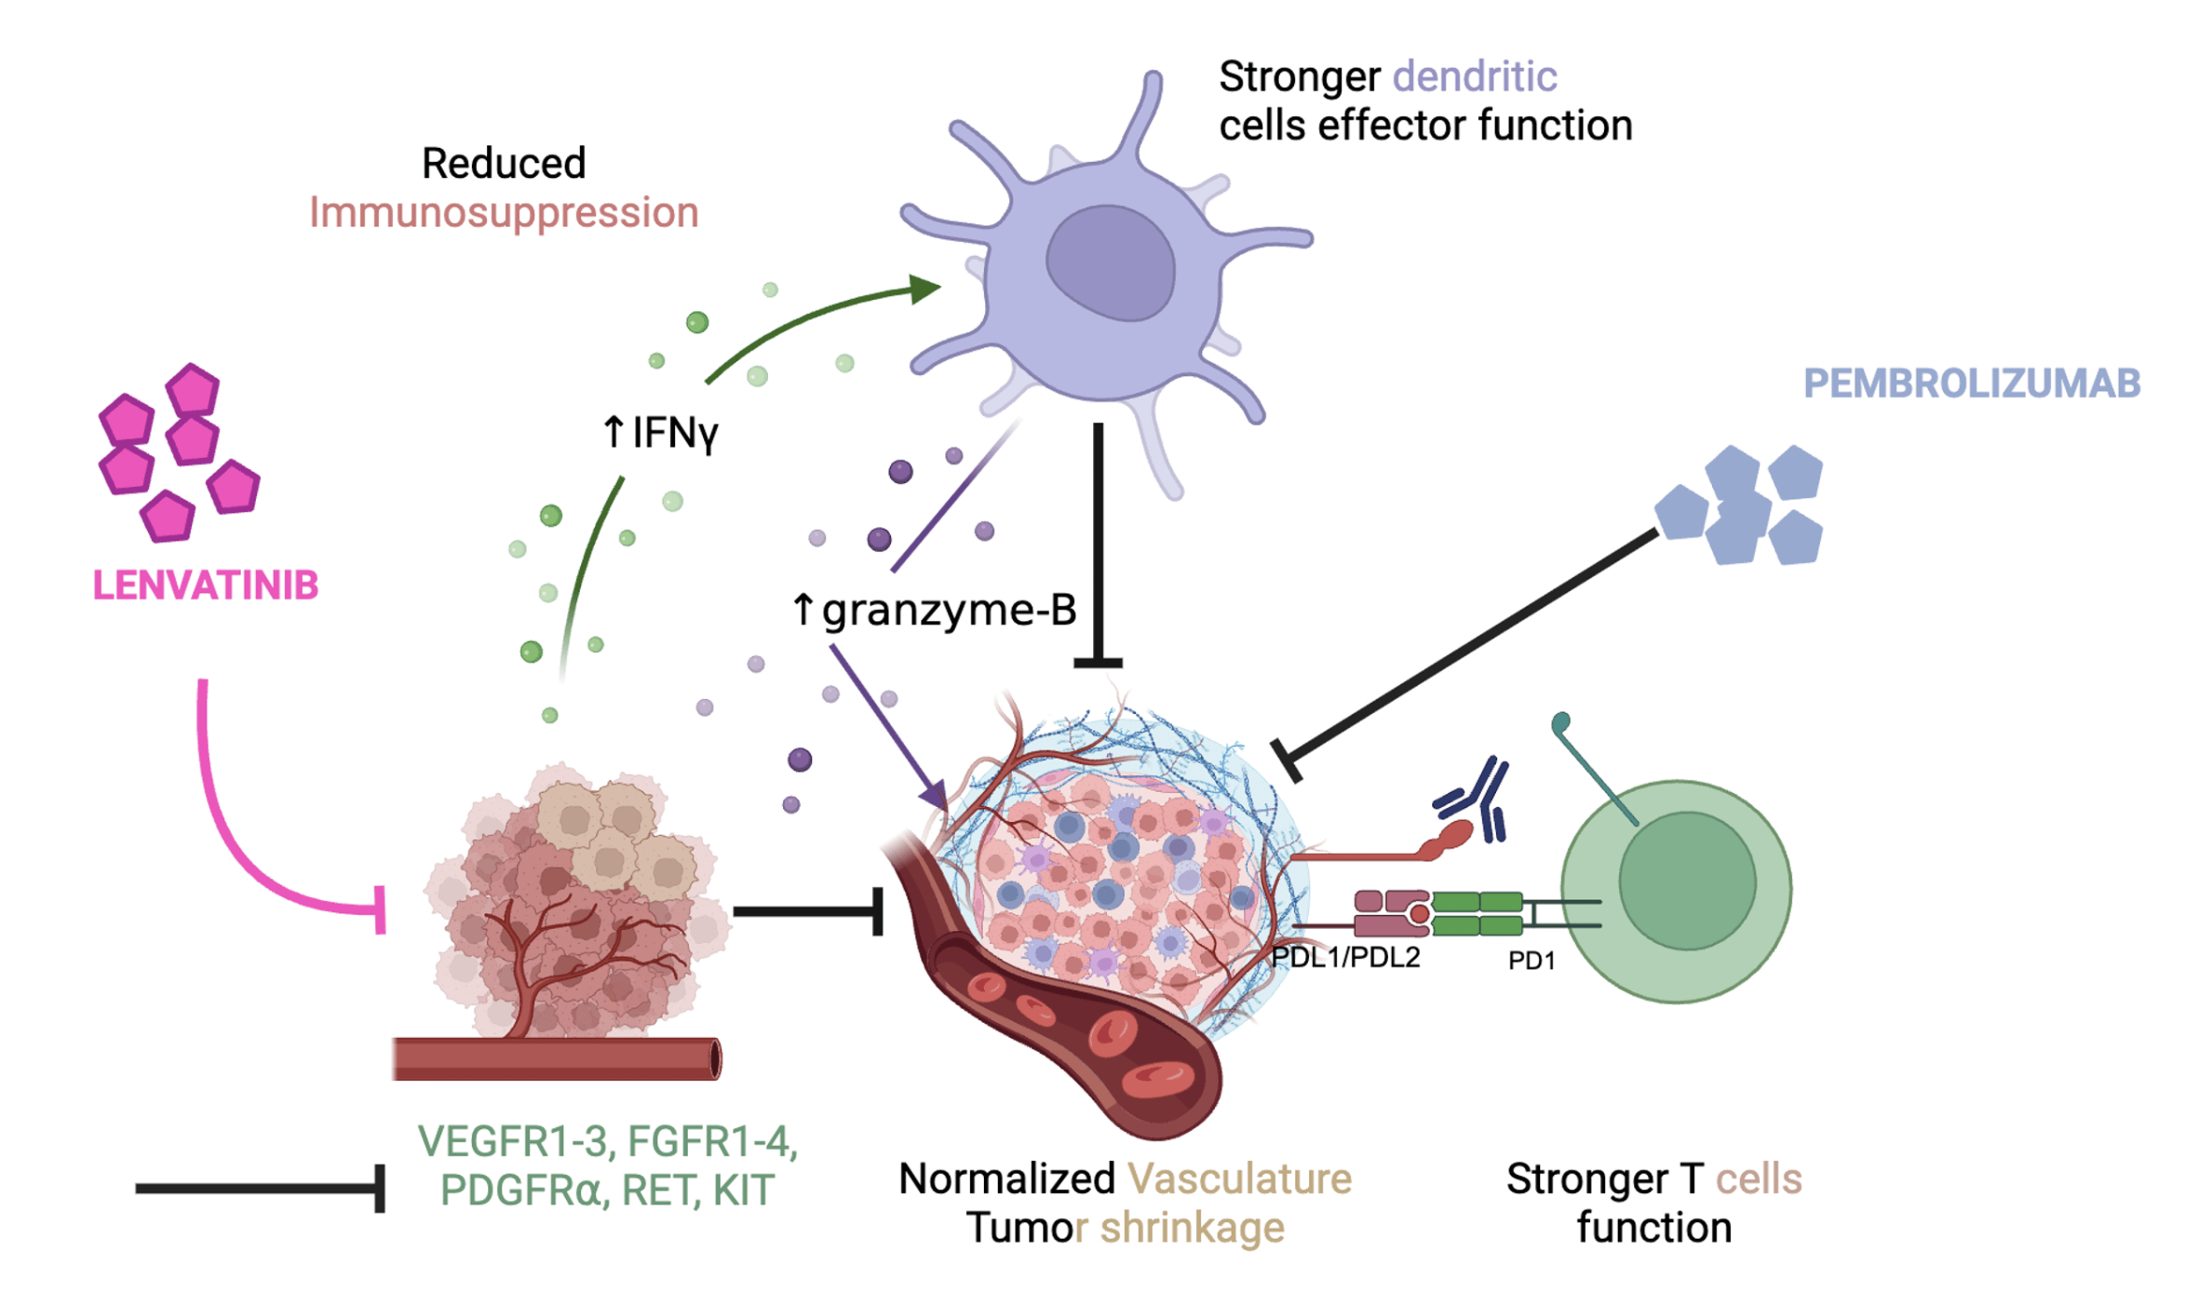
Mechanism of Action of Lenvatinib and Pembrolizumab
Alabi F et al. Cureus 2025;17(7) e89030.

Slide 95
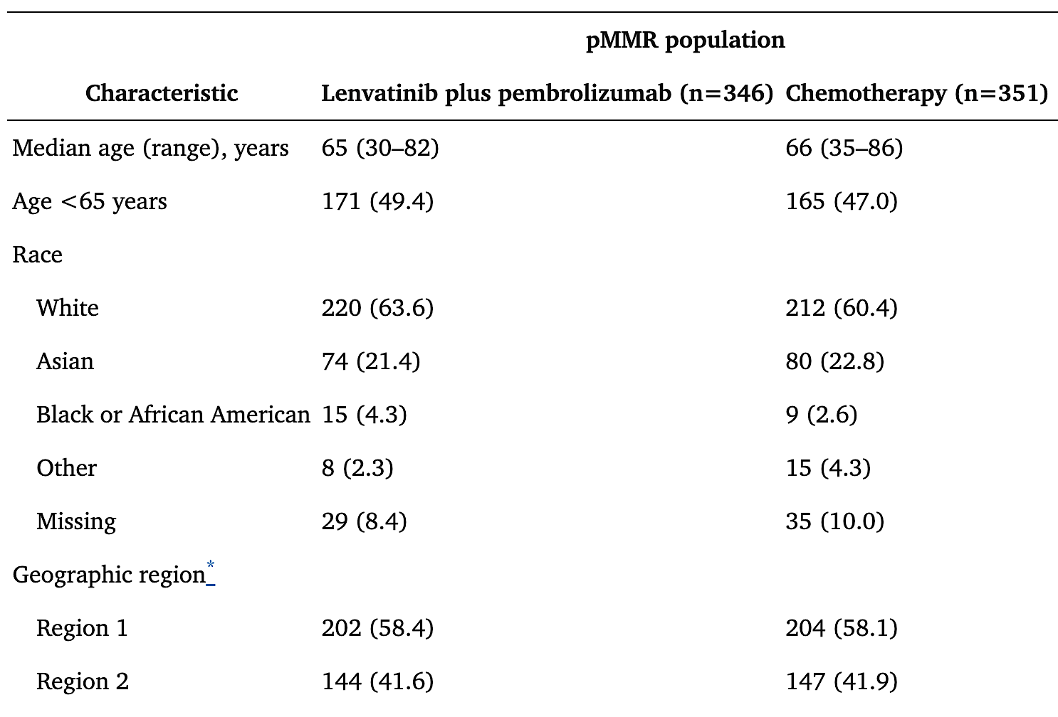
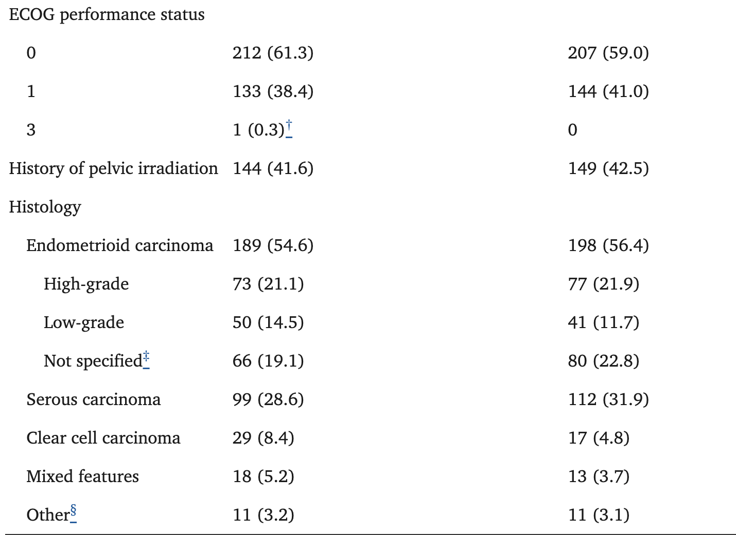
Lenvatinib + Pembrolizumab
Patient Characteristics:
Makker V et al. J Clin Oncol. 2023;41(16):2904-2910.

Slide 96
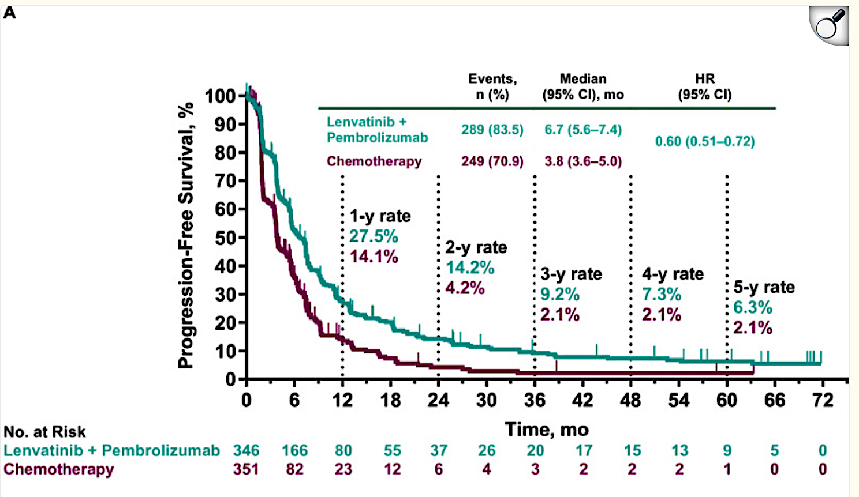
Lenvatinib + Pembrolizumab: pMMR population
Makker V, Colombo N, Casado A, Santin AD, Colomba E, Miller DS, Fujiwara K, Pignata S, Yonemori K, Kim YM, Baron-Hay S, Ray-Coquard I, Shapira-Frommer R, Kristeleit R, Nishio S, Suzuki S, Guerra Alía EM, Sanli UA, Selle F, Shikama A, Martínez Rodríguez JL, Arik Z, Arican A, Sebastianelli A, Yu Z, McKenzie J, Kruger S, Meng R, Okpara CE, Lorusso D. Lenvatinib plus pembrolizumab in previously treated advanced endometrial cancer: 5-year outcomes from the randomized, phase 3 Study 309/KEYNOTE-775. J Immunother Cancer. 2026 Feb 19;14(2):e013713. doi: 10.1136/jitc-2025-013713. PMID: 41714113; PMCID: PMC12927346.

Slide 97
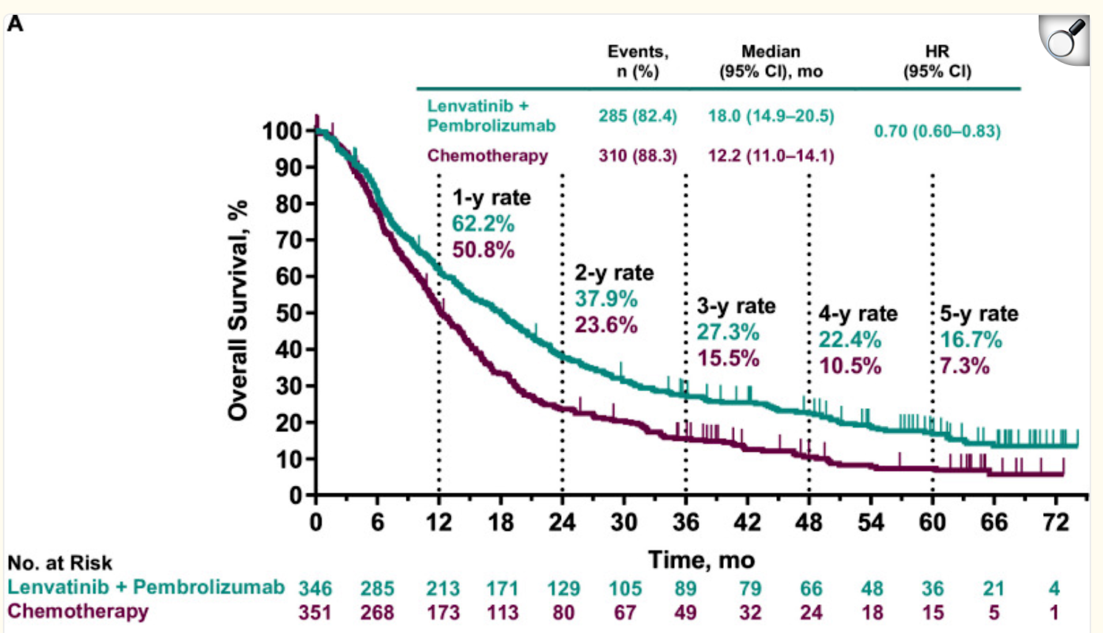
Lenvatinib + Pembrolizumab: pMMR population
Makker V, Colombo N, Casado A, Santin AD, Colomba E, Miller DS, Fujiwara K, Pignata S, Yonemori K, Kim YM, Baron-Hay S, Ray-Coquard I, Shapira-Frommer R, Kristeleit R, Nishio S, Suzuki S, Guerra Alía EM, Sanli UA, Selle F, Shikama A, Martínez Rodríguez JL, Arik Z, Arican A, Sebastianelli A, Yu Z, McKenzie J, Kruger S, Meng R, Okpara CE, Lorusso D. Lenvatinib plus pembrolizumab in previously treated advanced endometrial cancer: 5-year outcomes from the randomized, phase 3 Study 309/KEYNOTE-775. J Immunother Cancer. 2026 Feb 19;14(2):e013713. doi: 10.1136/jitc-2025-013713. PMID: 41714113; PMCID: PMC12927346.

Slide 98
Patient Case
87 yo with recurrent endometrial cancer
2013 Stage IB G2 endometrial cancer, +LVSI, pMMR
Adjuvant RT
2015 hematemesis
Recurrent endometrial cancer to lung
6/2022 Carbo/paclitaxel
Progression in lung
10/2022 Lenvatinib+Pembrolizumab
  Started at Lenvatinib 20 mg + Pembro → Dose reductions due to fatigue, weight loss, hypertension
  6/2023 on lenvatinib 8 mg + Pembro
PMH: Meniere’s disease, osteoporosis, hypertension
  FH: no history of cancer in the family
  POBGYNHX: G2P2, no h/o abnormal pap tests
  SH: Works as professional tennis photographer, still works

Slide 99
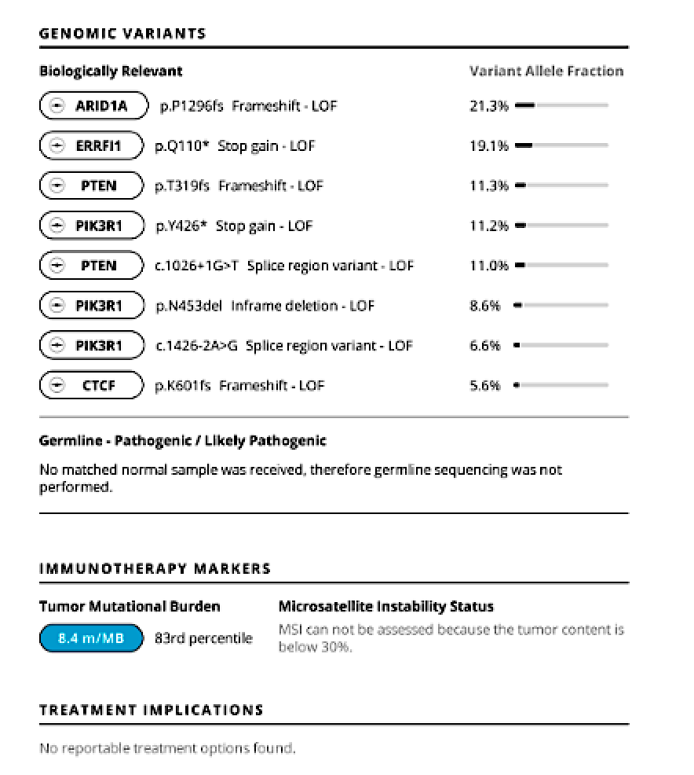
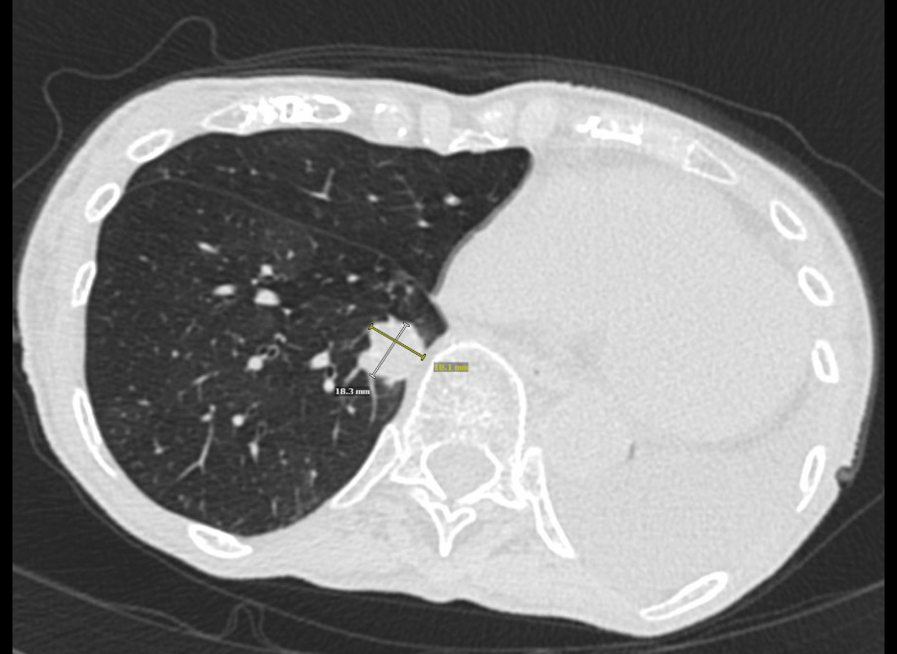
Tumor profiling and imaging

Slide 100
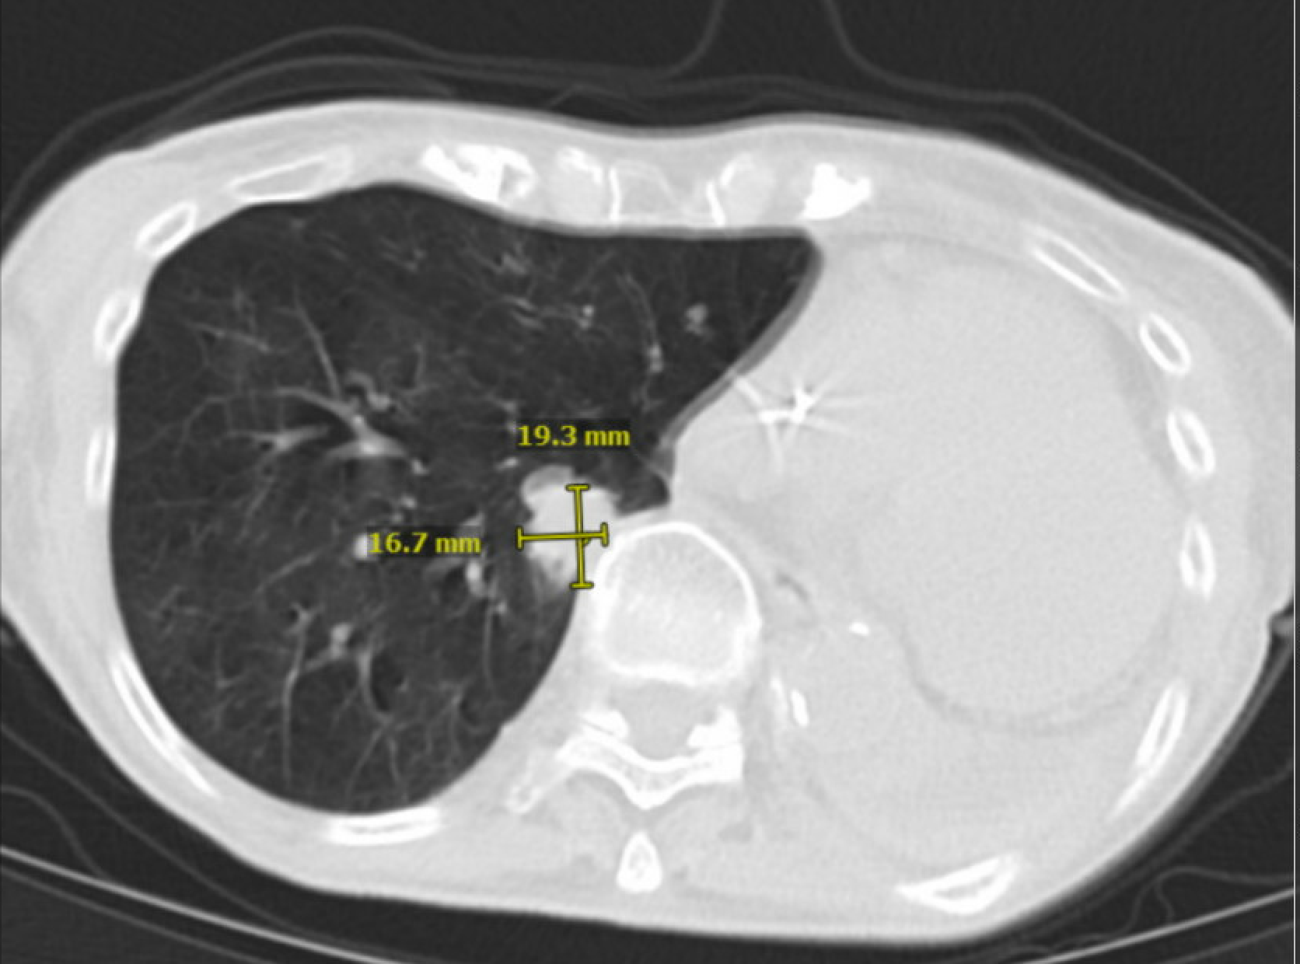
- Progression of disease and discontinued Lenvatinib + Pembrolizumab in 1/2024 (1.5 years)
Started on letrozole, transitioned to megestrol acetate/tamoxifen
9/2024 deceased

Slide 101
Discussion Questions
Is pembrolizumab/lenvatinib your preferred second-line regimen for most patients with relapsed/refractory (R/R) MSS/pMMR EC? Would you currently recommend this combination for patients with R/R MSI-H/dMMR EC under any circumstances?
Would you rechallenge with an immune checkpoint inhibitor-containing regimen, namely pembrolizumab/
lenvatinib, in a patient who has received chemoimmunotherapy in the front-line setting?

Slide 102
Toxicities with
Lenvatinib/Pembrolizumab
Sarah Karpen, PA-C
UC San Diego Health
Division of Gynecologic Oncology

Slide 103
Agenda
1
Incidence, severity, timing, and management of adverse events (AEs) observed in patients with endometrial cancer (EC) receiving lenvatinib/pembrolizumab
2
Approaches to encourage adequate nutrition among patients receiving lenvatinib/pembrolizumab
3
Initial dosing and dose-modification strategies for lenvatinib/pembrolizumab in EC; available data exploring the impact of lenvatinib dose reductions on antitumor activity
4
Strategies to determine the cause of toxicities that could stem from either lenvatinib or pembrolizumab in patients receiving the combination
UC San Diego Health — Division of Gynecologic Oncology

Slide 104
Case Study
70-year-old female | PMH: HTN, HLD, aortic stenosis | Stage IIIC pMMR HER2 3+ papillary serous uterine cancer — platinum refractory
Surgical History
Molecular Profile
Exploratory laparotomy
Total abdominal hysterectomy
Bilateral salpingo-oophorectomy
Tumor debulking & omentectomy
Pelvic and para-aortic lymphadenectomies
p53 abnormal (overexpression)
MMR status: pMMR — MLH1, PMS2, MSH2, MSH6 all intact
Estrogen receptor positive
HER2 positive (3+)
Treatment Course
Carboplatin/paclitaxel/trastuzumab × 9 cycles
Progression on imaging with new metastases to distant lymph nodes in the chest
Started lenvatinib 14 mg daily + pembrolizumab 200mg IV every 3 weeks
UC San Diego Health — Division of Gynecologic Oncology

Slide 105
Considerations for Starting Lenvatinib
This patient presented with progressive aortic stenosis (moderate → severe) identified on routine ECHO during trastuzumab therapy.
Cardiac Evaluation
Cardiovascular Risks
Patient evaluated by cardiology prior to initiating lenvatinib. Dose pre-emptively reduced to 14 mg daily given severe aortic stenosis.
TKIs carry risk for rapid hypertension, which can precipitate cardiac stress, heart failure, pulmonary edema, myocardial infarction, and arrhythmias — particularly with pre-existing valvular disease.
Baseline Medications
CYP3A4 Considerations
Patient was already on atenolol and lisinopril (antihypertensives), atorvastatin, and aspirin — facilitating proactive blood pressure management.
Nondihydropyridine calcium channel blockers (verapamil, diltiazem) should be avoided due to CYP3A4 drug interactions with lenvatinib.
UC San Diego Health — Division of Gynecologic Oncology

Slide 106
Incidence, Severity & Timing of Adverse Events (KEYNOTE-775)
1.9 o
~89%
1.9 mo
had a grade ≥3 adverse event
median time to lenvatinib
dose reduction
Nearly all patients experienced an adverse event, with most AEs occurring within the first 3 months of therapy.
Hypertension Management - most significant AE up to 64% of patients compared to 5.2% with chemo
Monitor blood pressure proactively at baseline and throughout treatment
First-line antihypertensives: ACE inhibitors or ARBs
Avoid nondihydropyridine calcium channel blockers (verapamil, diltiazem) — CYP3A4 interactions
UC San Diego Health — Division of Gynecologic Oncology

Slide 107
Gastrointestinal Toxicities: Within 1-4 Weeks
55% — Diarrhea
49% — Nausea
37% — Vomiting
Diarrhea Grading & Management
Nausea & Vomiting Management
Grade | Definition | Management
Grade 1 | <4 stools/day over baseline | Supportive care: hydration, bland/low-fiber diet, avoid greasy foods, caffeine, alcohol, dairy Loperamide: 4 mg initially, then 2 mg after each loose stool (max 16 mg/day)
Grade 2 | 4–6 stools/day | Continue loperamide; add diphenoxylate/atropine Lomitil (1–2 tabs q6h PRN, max 8/day); consider bulk-forming agents Hold lenvatinib if persistent; resume when resolved to grade 1
Grade 3 | ≥7 stools/day or hospitalization | Hospitalize; hold lenvatinib; resume at reduced dose once improved
Grade 4 | Life-threatening | Discontinue lenvatinib
Standard antiemetics:
ondansetron, prochlorperazine, metoclopramide
General GI Dietary Guidance
BRAT-type foods (bland, low-fiber)
Avoid greasy, spicy, or high-fiber foods
Avoid caffeine, alcohol, and dairy if symptoms worsen
Increase oral hydration and electrolyte intake
UC San Diego Health — Division of Gynecologic Oncology

Slide 108
Nutritional Support & Management of Weight Loss
Prehabilitation
For Decreased Appetite
For Stomatitis / Mucositis
Dietary counseling before therapy begins
Dental evaluation
Psychosocial support
Referral to a registered dietitian
Increase feeding frequency (smaller, more frequent meals)
Limit fluids with food intake
Encourage calorie-dense, nutrient-rich foods
Avocados, nuts, nut butters, plant-based fat sources
Avoid crunchy, spicy, acidic, or hot foods
Encourage soft foods
Gentle tooth brushing; bland rinses with salt water or baking soda
Prescribe dexamethasone rinse or 'magic mouthwash'
Pharmacologic Appetite Stimulants (Severe Cases)
Olanzapine
Corticosteroids
Megestrol acetate (Megace)
These agents may be considered when nutritional support and dietary modifications are insufficient to maintain adequate caloric intake.
UC San Diego Health — Division of Gynecologic Oncology

Slide 109
Distinguishing Lenvatinib vs. Pembrolizumab Toxicities
TKI toxicities are managed with dose reduction/interruption and supportive care, while immune-mediated toxicities require immunosuppression (corticosteroids ± biologics).
Lenvatinib — Half-life: 1–3 days
Pembrolizumab — Half-life: ~22 days
Toxicities typically resolve quickly after dose hold
Toxicities may worsen even after pembrolizumab is discontinued
Clinical Pearls for Attribution
Symptom Pattern | Likely Lenvatinib | Likely Pembrolizumab
Resolution with hold | Resolves quickly after dose hold | Persists or worsens after hold
Diarrhea character | Without blood or mucus | May be associated with colitis (blood/mucus)
Fever | Not typically associated | Often associated
Rash | Less common | More common; immune-mediated
Hypertension | Yes — hallmark TKI toxicity | Not typical
UC San Diego Health — Division of Gynecologic Oncology

Slide 110
Lenvatinib Dose Reductions
In the KEYNOTE-775 trial, 66.5% of patients required a dose reduction. Retrospective data (n=369) showed no significant difference in progression-free survival between patients receiving ≤20 mg vs. the standard 20 mg dose.
Standard Dose Reduction Sequence
20 mg
14 mg
10 mg
8 mg
→
→
→
Starting dose
First reduction
Second reduction
Third reduction
Tablet Formulations Available
Lenvatinib capsules are available in 10 mg and 4 mg strengths
Dose reductions can be achieved using combinations of available capsule sizes
Case patient began at 14 mg daily given pre-existing severe aortic stenosis
UC San Diego Health — Division of Gynecologic Oncology

Slide 111
Agenda
Introduction: Biology of Endometrial Cancer (EC)
Module 1: First-Line Therapy for Advanced or Recurrent EC
Module 2: Potential Benefits of PARP Inhibition Combined with Immunotherapy in Advanced EC
Module 3: Role of Lenvatinib/Pembrolizumab in the Management of Progressive Advanced EC
Module 4: Other Nursing Considerations in the Care of Patients with
Advanced EC

Slide 112
Other Nursing Considerations in the Care of Patients with Advanced Endometrial Cancer
Jaclyn Shaver, MS, APRN, CNP, WHNP
Section of Gynecologic Oncology
Stephenson Cancer Center
OU Health
Oklahoma City, Oklahoma

Slide 113
Assessing Symptom Burden
Crucial for improving patient Quality of Life
Guiding Supportive Care
Optimizing Treatment
Can Directly Impact
  Prognosis
  Functional status
  Treatment Adherence

Slide 114
Importance of Assessment
Improves Quality of Life
  Systematic assessment allows clinicians to identify and manage symptoms such as fatigue, pain, sexual changes, and psychological distress
Guides Treatment Decisions
  Monitoring symptom burden allows for timely interventions, preventing premature treatment termination, and ensures better adherence to therapy
Identifies Recurrence/Progression Early
  Monitoring for and educating patient about signs and symptoms of disease
Tailors Supportive Care
  Enables referral to palliative care or other supportive services

Slide 115
Key Symptom Areas to Monitor
Physical
  Pain, fatigue, sleep disturbances, GI issues
Emotional
  Distress, depression, anxiety
Functional
  Impact on daily activities and overall lifestyle

Slide 116
Early Palliative Care - Advanced Endometrial Cancer
Optimal timing: Within 8 weeks of diagnosis
Particularly effective with high symptom burden at start of treatment
Significantly improves quality of life
  Manage Symptom Burden
  Patients experience better coping skills, improved mood, and in some cases enhanced survival rates

Slide 117
Impact on Quality of Life and Clinical Outcomes
Rapid Symptom Relief
Enhanced Psychological Well-being
Improved Patient Empowerment
Lowered Care Intensity

Slide 118
Depression in Advanced Endometrial Cancer
Prevalence is high exceeding 40%-50% in studies measuring emotional distress coupled with obesity and poor sleep
Advanced disease increases the risk of major depressive episode up to 3.5 times compared to general population.
Often peaking around diagnosis and treatment

Slide 119
Depression and Advanced Endometrial Cancer
47% of endometrial cancer survivors experienced depressed mood and 64% reported anxiety
Risk of mental health disorders increased with stage of cancer
Obesity – higher rates of depression and lower quality of life
Associated with higher risk of mortality
Highest rates occur within 2 months of diagnosis – indicating need for early screening
Treatment disparities: Many patients do not receive appropriate mental health, counseling, or pharmaceutical treatment.
  Referral to palliative/supportive care, social workers, local psychologist, psychiatrist, primary care providers

Slide 120
Clinical Trial Participation – Potential Advantages
Access to cutting-edge therapies
Treatments may be more effective
Treatments may be less toxic
Receive a higher level of personalized care
Contribute to medical advancements that help future patients

Slide 121
Case Study – 66 y/o Woman
66 y/o CF G2P2
Comorbidities: Obesity, HTN, DM
Last seen gyn with birth of her last child
Divorced, lives alone - on Medicare
Reports PMB spotting/bleeding for the last 1-2 years. Reports symptoms to her PCP who referred her to gyn.
TVUS showed an endometrial stripe of 53mm
EMB – showed endometrial adenocarcinoma, high grade
She referred to Gyn/Onc – CT scan revealed a 2.2 cm right pelvic lymph node.

Slide 122
Case Study – 66 y/o Woman
She underwent RATLH/BSO/SLNB – Stage IIIC UPSC
At her first post-op visit – She expressed worsening depression symptoms. She had stopped taking her anti-depressants several years ago. Denies SI/HI. She was restarted on paroxetine.
She was started on chemotherapy – carboplatin/paclitaxel.
At her pre-chemo visit s/p cycle #2 – she reported grade 2 fatigue, insomnia, loss of appetite with weight loss - wasn’t sure if she wanted to continue therapy
  Depression was assessed as possible cause of above symptoms and patient admits restarting paroxetine had not helped.
    She was then referred to our supportive care team for counseling and medication adjustment
    She underwent counseling and her anti-depressant was switched to mirtazapine
    Subsequent cycles were better tolerated – her appetite improved and was now sleeping better. She had more energy and felt like she could complete her 6 cycles of chemotherapy.

Slide 123
Management of Prostate Cancer
Recent Advances in Cancer Care — New Paradigms,
Novel Agents and What It Means for the Oncology Nurse
A Complimentary NCPD Symposium Series Held During the 51st Annual ONS Congress
Thursday, May 14, 2026
12:15 PM – 1:45 PM
Faculty
Michael Lai, MSN, ARNP, FNP-C
Stacy E Walker, FNP-BC
Evan Y Yu, MD
Moderator
Scott T Tagawa, MD, MS

Slide 124
Thank you for joining us! Please take a moment to complete the survey currently up on Zoom. Your feedback is very important to us. The survey will remain open up to 5 minutes after the meeting ends.
To Claim NCPD Credit
In-person attendees: Please refer to the program syllabus for the NCPD credit link or QR code.
Virtual attendees: The NCPD credit link is posted in the chat room.
NCPD/ONCC credit information will be emailed to each participant within 1 to 2 business days.

