Slide 1
Inside the Issue: The Emerging Role of
Cereblon E3 Ligase Modulators in Multiple Myeloma
A CME/MOC-Accredited Live Webinar
Wednesday, January 28, 2026
5:00 PM – 6:00 PM ET
Faculty
Natalie S Callander, MD
Paul G Richardson, MD
Moderator
Neil Love, MD

Slide 2
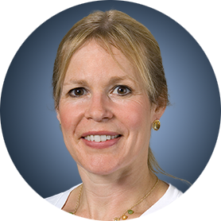
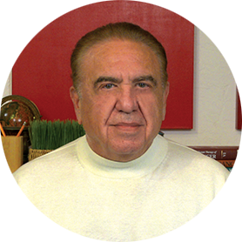
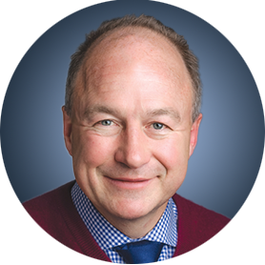
Faculty
Natalie S Callander, MD
Director, Myeloma Clinical Program
University of Wisconsin Carbone Cancer Center
Madison, Wisconsin
MODERATOR
Neil Love, MD
Research To Practice
Miami, Florida
Paul G Richardson, MD
Clinical Program Leader and Director of Clinical Research
Jerome Lipper Multiple Myeloma Center
Dana-Farber Cancer Institute
RJ Corman Professor of Medicine
Harvard Medical School
Boston, Massachusetts

Slide 3
Commercial Support
This activity is supported by an educational grant from Bristol Myers Squibb.

Slide 4
Dr Love — Disclosures
Dr Love is president and CEO of Research To Practice. Research To Practice receives funds in the form of educational grants to develop CME activities from the following companies: Aadi Bioscience, AbbVie Inc, ADC Therapeutics, Agendia Inc, Alexion Pharmaceuticals, Amgen Inc, Array BioPharma Inc, a subsidiary of Pfizer Inc, Arvinas, Astellas, AstraZeneca Pharmaceuticals LP, Aveo Pharmaceuticals, Bayer HealthCare Pharmaceuticals, BeOne, Biotheranostics, A Hologic Company, Black Diamond Therapeutics Inc, Blueprint Medicines, Boehringer Ingelheim Pharmaceuticals Inc, Bristol Myers Squibb, Celcuity, Clovis Oncology, Coherus BioSciences, Corcept Therapeutics Inc, CTI BioPharma, a Sobi Company, Daiichi Sankyo Inc, Eisai Inc, Elevation Oncology Inc, Exact Sciences Corporation, Exelixis Inc, Genentech, a member of the Roche Group, Genmab US Inc, Geron Corporation, Gilead Sciences Inc, GSK, Helsinn Therapeutics (US) Inc, ImmunoGen Inc, Incyte Corporation, Ipsen Biopharmaceuticals Inc, Jazz Pharmaceuticals Inc, Johnson & Johnson, Karyopharm Therapeutics, Kite, A Gilead Company, Kura Oncology, Legend Biotech, Lilly, MEI Pharma Inc, Merck, Mersana Therapeutics Inc, Mirati Therapeutics Inc, Mural Oncology Inc, Natera Inc, Novartis, Novartis Pharmaceuticals Corporation on behalf of Advanced Accelerator Applications, Novocure Inc, Nuvalent, Nuvation Bio Inc, Pfizer Inc, Pharmacyclics LLC, an AbbVie Company, Puma Biotechnology Inc, Regeneron Pharmaceuticals Inc, Rigel Pharmaceuticals Inc, R-Pharm US, Sanofi, Seagen Inc, Servier Pharmaceuticals LLC, SpringWorks Therapeutics Inc, Stemline Therapeutics Inc, Sumitomo Pharma America, Syndax Pharmaceuticals, Taiho Oncology Inc, Takeda Pharmaceuticals USA Inc, TerSera Therapeutics LLC, and Tesaro, A GSK Company.

Slide 5
Research To Practice CME Planning Committee Members,
Staff and Reviewers
Planners, scientific staff and independent reviewers for Research To Practice have no relevant conflicts of interest to disclose.

Slide 6
Dr Callander — Disclosures
No relevant conflicts of interest to disclose

Slide 7
Dr Richardson — Disclosures
Consulting Agreements | Bristol Myers Squibb, Celgene Corporation, GSK, Karyopharm Therapeutics, Oncopeptides, Regeneron Pharmaceuticals Inc, Sanofi
Contracted Research | Oncopeptides

Slide 8
This educational activity contains discussion of
non-FDA-approved uses of agents and regimens. Please refer to official prescribing information for each product for approved indications.

Slide 9
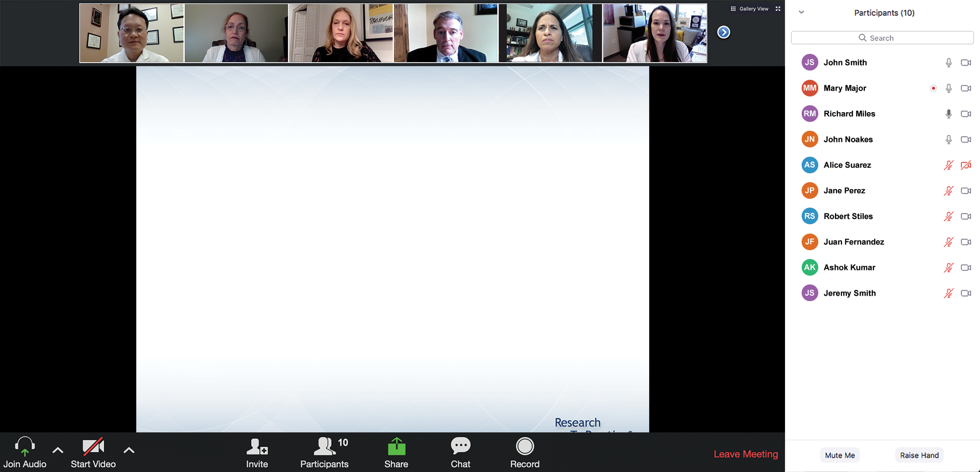

We Encourage Clinicians in Practice to Submit Questions
Feel free to submit questions now before the program begins and throughout the program.

Slide 10
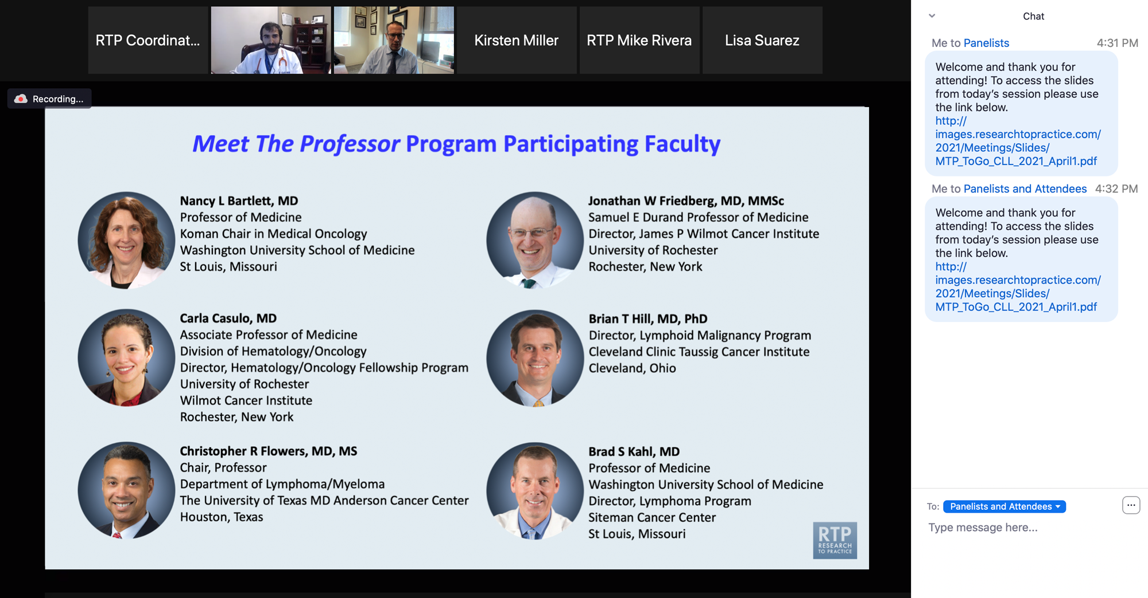
Familiarizing Yourself with the Zoom Interface
Expand chat submission box
Drag the white line above the submission box up to create
more space for your message.

Slide 11
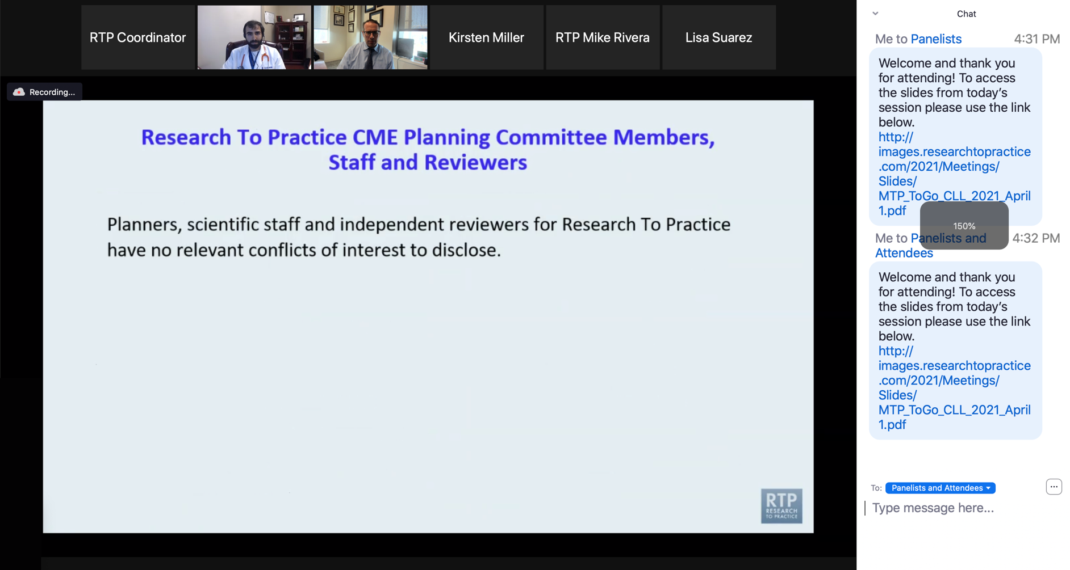
Familiarizing Yourself with the Zoom Interface
Increase chat font size
Press Command (for Mac) or Control (for PC) and the + symbol.
You may do this as many times as you need for readability.

Slide 12
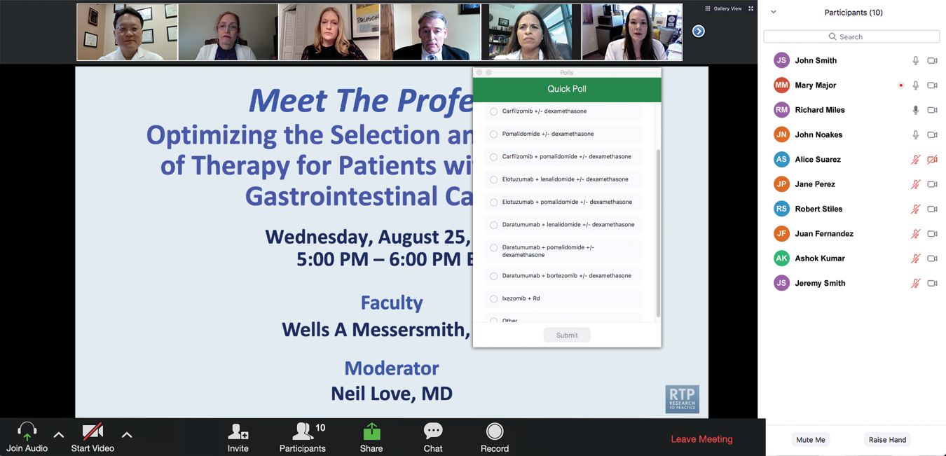
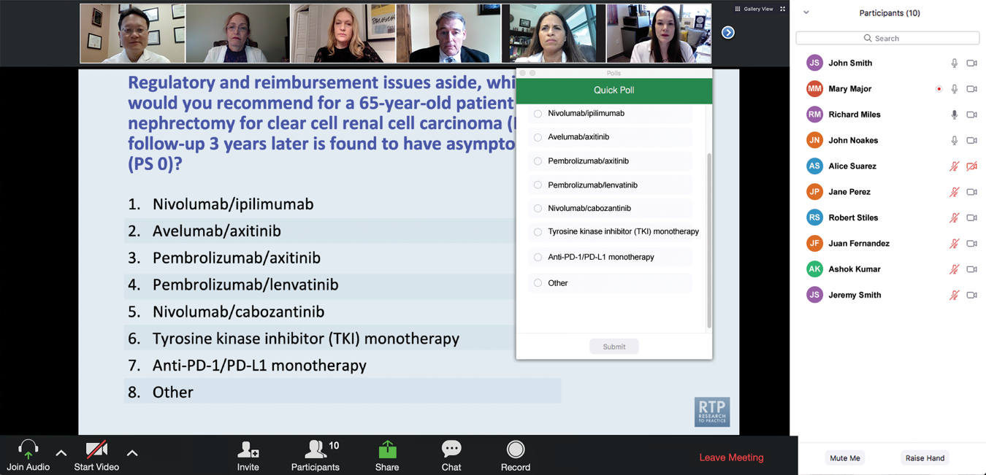
Clinicians in the Audience, Please Complete the Pre- and Postmeeting Surveys
Quick Survey
Quick Poll

Slide 13
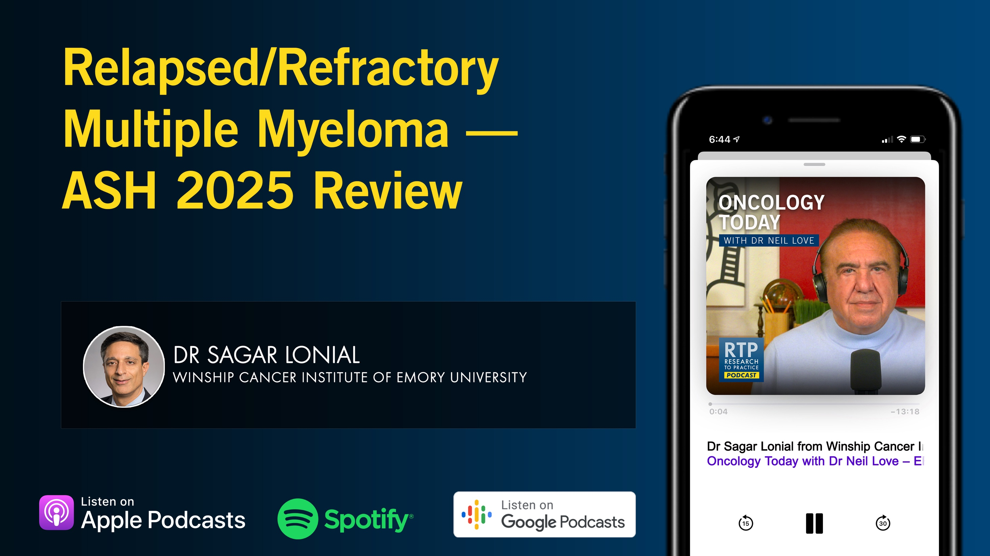

Slide 14
Exploring Current Patterns of Care in the Community:
Selection of First-Line and Maintenance Therapy for
Patients with Extensive-Stage Small Cell Lung Cancer
A CME/MOC-Accredited Live Webinar
Wednesday, February 4, 2026
5:00 PM – 6:00 PM ET
Faculty
Hossein Borghaei, DO, MS
Anne Chiang, MD, PhD
Moderator
Neil Love, MD

Slide 15
Year in Review: Clinical Investigator Perspectives on the
Most Relevant New Datasets and Advances in Oncology
Antibody-Drug Conjugates for Breast Cancer
A CME/MOC-Accredited Live Webinar
Wednesday, February 18, 2026
5:00 PM – 6:00 PM ET
Faculty
Hope S Rugo, MD
Sara M Tolaney, MD, MPH
Moderator
Neil Love, MD

Slide 16
Year in Review: Clinical Investigator Perspectives on the
Most Relevant New Datasets and Advances in Oncology
Ovarian Cancer
A CME/MOC-Accredited Live Webinar
Thursday, February 19, 2026
5:00 PM – 6:00 PM ET
Faculty
Nicoletta Colombo, MD
Angeles Alvarez Secord, MD, MHSc
Moderator
Neil Love, MD

Slide 17
Second Opinion: Clinical Investigators Discuss the
Optimal Management of Genitourinary Cancers
A CME Symposium Series Held Adjunct to the
2026 ASCO® Genitourinary Cancers Symposium
Non-Muscle-Invasive and Muscle-Invasive Bladder Cancer
Thursday, February 26, 2026
7:00 PM – 9:00 PM PT
(10:00 PM – 12:00 AM ET)
AKT Inhibition in
Prostate Cancer
Friday, February 27, 2026
6:00 PM – 7:30 PM PT
(9:00 PM – 10:30 PM ET)

Slide 18
Grand Rounds
CME/MOC-Accredited Interactive Series
Through April 2026
Three Series
Optimizing Treatment
for Patients with Relapsed/Refractory Chronic Lymphocytic Leukemia
Optimizing the Use of
Novel Therapies for Patients with Diffuse
Large B-Cell Lymphoma
Optimizing Therapy for Patients with Hormone Receptor-Positive
Localized Breast Cancer
Host a 1-hour session at your institution:
Email Meetings@ResearchToPractice.com
or call (800) 233-6153

Slide 19

Save The Date
A Multitumor CME/MOC-, NCPD- and ACPE-Accredited Educational Conference Developed in Partnership with Florida Cancer Specialists & Research Institute
Friday to Sunday, April 24 to 26, 2026
The Ritz-Carlton Orlando, Grande Lakes | Orlando, Florida
Moderated by Neil Love, MD

Slide 20
Inside the Issue: The Emerging Role of
Cereblon E3 Ligase Modulators in Multiple Myeloma
A CME/MOC-Accredited Live Webinar
Wednesday, January 28, 2026
5:00 PM – 6:00 PM ET
Faculty
Natalie S Callander, MD
Paul G Richardson, MD
Moderator
Neil Love, MD

Slide 21
Faculty
Natalie S Callander, MD
Professor of Medicine
Director, Myeloma Clinical and Cellular Therapy Program
University of Wisconsin Carbone Cancer Center
Madison, Wisconsin
MODERATOR
Neil Love, MD
Research To Practice
Miami, Florida
Paul G Richardson, MD
Clinical Program Leader and Director of Clinical Research
Jerome Lipper Multiple Myeloma Center
Dana-Farber Cancer Institute
RJ Corman Professor of Medicine
Harvard Medical School
Boston, Massachusetts

Slide 22
We Encourage Clinicians in Practice to Submit Questions
Feel free to submit questions now before the program begins and throughout the program.

Slide 23
Clinicians in the Audience, Please Complete the Pre- and Postmeeting Surveys
Quick Survey
Quick Poll

Slide 25
Exploring Current Patterns of Care in the Community:
Selection of First-Line and Maintenance Therapy for
Patients with Extensive-Stage Small Cell Lung Cancer
A CME/MOC-Accredited Live Webinar
Wednesday, February 4, 2026
5:00 PM – 6:00 PM ET
Faculty
Hossein Borghaei, DO, MS
Anne Chiang, MD, PhD
Moderator
Neil Love, MD

Slide 26
Year in Review: Clinical Investigator Perspectives on the
Most Relevant New Datasets and Advances in Oncology
Antibody-Drug Conjugates for Breast Cancer
A CME/MOC-Accredited Live Webinar
Wednesday, February 18, 2026
5:00 PM – 6:00 PM ET
Faculty
Hope S Rugo, MD
Sara M Tolaney, MD, MPH
Moderator
Neil Love, MD

Slide 27
Year in Review: Clinical Investigator Perspectives on the
Most Relevant New Datasets and Advances in Oncology
Ovarian Cancer
A CME/MOC-Accredited Live Webinar
Thursday, February 19, 2026
5:00 PM – 6:00 PM ET
Faculty
Nicoletta Colombo, MD
Angeles Alvarez Secord, MD, MHSc
Moderator
Neil Love, MD

Slide 28
Second Opinion: Clinical Investigators Discuss the
Optimal Management of Genitourinary Cancers
A CME Symposium Series Held Adjunct to the
2026 ASCO® Genitourinary Cancers Symposium
Non-Muscle-Invasive and Muscle-Invasive Bladder Cancer
Thursday, February 26, 2026
7:00 PM – 9:00 PM PT
(10:00 PM – 12:00 AM ET)
AKT Inhibition in
Prostate Cancer
Friday, February 27, 2026
6:00 PM – 7:30 PM PT
(9:00 PM – 10:30 PM ET)

Slide 29
Grand Rounds
CME/MOC-Accredited Interactive Series
Through April 2026
Three Series
Optimizing Treatment
for Patients with Relapsed/Refractory Chronic Lymphocytic Leukemia
Optimizing the Use of
Novel Therapies for Patients with Diffuse
Large B-Cell Lymphoma
Optimizing Therapy for Patients with Hormone Receptor-Positive
Localized Breast Cancer
Host a 1-hour session at your institution:
Email Meetings@ResearchToPractice.com
or call (800) 233-6153

Slide 30
Save The Date
A Multitumor CME/MOC-, NCPD- and ACPE-Accredited Educational Conference Developed in Partnership with Florida Cancer Specialists & Research Institute
Friday to Sunday, April 24 to 26, 2026
The Ritz-Carlton Orlando, Grande Lakes | Orlando, Florida
Moderated by Neil Love, MD

Slide 31
Inside the Issue: The Emerging Role of
Cereblon E3 Ligase Modulators in Multiple Myeloma
A CME/MOC-Accredited Live Webinar
Wednesday, January 28, 2026
5:00 PM – 6:00 PM ET
Faculty
Natalie S Callander, MD
Paul G Richardson, MD
Moderator
Neil Love, MD

Slide 32
Dr Callander — Disclosures
No relevant conflicts of interest to disclose

Slide 33
Dr Richardson — Disclosures
Consulting Agreements | Bristol Myers Squibb, Celgene Corporation, GSK, Karyopharm Therapeutics, Oncopeptides, Regeneron Pharmaceuticals Inc, Sanofi
Contracted Research | Oncopeptides

Slide 34
Dr Love — Disclosures
Dr Love is president and CEO of Research To Practice. Research To Practice receives funds in the form of educational grants to develop CME activities from the following companies: Aadi Bioscience, AbbVie Inc, ADC Therapeutics, Agendia Inc, Alexion Pharmaceuticals, Amgen Inc, Array BioPharma Inc, a subsidiary of Pfizer Inc, Arvinas, Astellas, AstraZeneca Pharmaceuticals LP, Aveo Pharmaceuticals, Bayer HealthCare Pharmaceuticals, BeOne, Biotheranostics, A Hologic Company, Black Diamond Therapeutics Inc, Blueprint Medicines, Boehringer Ingelheim Pharmaceuticals Inc, Bristol Myers Squibb, Celcuity, Clovis Oncology, Coherus BioSciences, Corcept Therapeutics Inc, CTI BioPharma, a Sobi Company, Daiichi Sankyo Inc, Eisai Inc, Elevation Oncology Inc, Exact Sciences Corporation, Exelixis Inc, Genentech, a member of the Roche Group, Genmab US Inc, Geron Corporation, Gilead Sciences Inc, GSK, Helsinn Therapeutics (US) Inc, ImmunoGen Inc, Incyte Corporation, Ipsen Biopharmaceuticals Inc, Jazz Pharmaceuticals Inc, Johnson & Johnson, Karyopharm Therapeutics, Kite, A Gilead Company, Kura Oncology, Legend Biotech, Lilly, MEI Pharma Inc, Merck, Mersana Therapeutics Inc, Mirati Therapeutics Inc, Mural Oncology Inc, Natera Inc, Novartis, Novartis Pharmaceuticals Corporation on behalf of Advanced Accelerator Applications, Novocure Inc, Nuvalent, Nuvation Bio Inc, Pfizer Inc, Pharmacyclics LLC, an AbbVie Company, Puma Biotechnology Inc, Regeneron Pharmaceuticals Inc, Rigel Pharmaceuticals Inc, R-Pharm US, Sanofi, Seagen Inc, Servier Pharmaceuticals LLC, SpringWorks Therapeutics Inc, Stemline Therapeutics Inc, Sumitomo Pharma America, Syndax Pharmaceuticals, Taiho Oncology Inc, Takeda Pharmaceuticals USA Inc, TerSera Therapeutics LLC, and Tesaro, A GSK Company.

Slide 35
Commercial Support
This activity is supported by an educational grant from Bristol Myers Squibb.
Research To Practice CME Planning Committee Members,
Staff and Reviewers
Planners, scientific staff and independent reviewers for Research To Practice have no relevant conflicts of interest to disclose.

Slide 36
This educational activity contains discussion of
non-FDA-approved uses of agents and regimens. Please refer to official prescribing information for each product for approved indications.

Slide 37
Agenda
Introduction: Clinical Trials We LOVE to Discuss
Module 1: Mechanism of Action of Cereblon E3 Ligase Modulators (CELMoDs)
Module 2: Available Efficacy Data with CELMoDs in the Management of Relapsed/Refractory Multiple Myeloma (MM)
Module 3: Extramedullary Disease
Module 4: Spectrum and Management of CELMoD-Associated Adverse Events
Module 5: Ongoing Phase II and III Trials Evaluating CELMoDs for MM
Module 6: Other Trials in Progress

Slide 38
Agenda
Introduction: Clinical Trials We LOVE to Discuss
Module 1: Mechanism of Action of Cereblon E3 Ligase Modulators (CELMoDs)
Module 2: Available Efficacy Data with CELMoDs in the Management of Relapsed/Refractory Multiple Myeloma (MM)
Module 3: Extramedullary Disease
Module 4: Spectrum and Management of CELMoD-Associated Adverse Events
Module 5: Ongoing Phase II and III Trials Evaluating CELMoDs for MM
Module 6: Other Trials in Progress

Slide 39
Clinical Trials We LOVE to Discuss!
Trial | Cancer Type | Experimental Arm
EMBARK | Prostate | Enzalutamide/leuprolide
VIALE-A | AML | Azacitidine/venetoclax
SOLO1 | Ovarian | Olaparib
ADAURA | Lung | Osimertinib
HERIZON-GEA-01 | Gastroesophageal | Zanidatamab/CT + tislelizumab
ATOMIC | Colon | Atezolizumab/CT
IMvigor011 | Urothelial bladder | Atezolizumab
lidERA | Breast | Giredestrant/LHRH

Slide 40
Clinical Trials We LOVE to Discuss!
Trial | Cancer Type | Experimental Arm
AMPLIFY | CLL | Acalabrutinib/venetoclax
ZUMA-7 | DLBCL | Axicabtagene ciloleucel
GO29781 | Follicular Lymphoma | Mosunetuzumab
ASC4FIRST | CML | Asciminib
VAYHIT2 | ITP | Ianalumab
DeFi | Desmoid | Nirogacestat
TRIANGLE | MCL | ASCT
DETERMINATION | Multiple Myeloma | RVD ± ASCT

Slide 41
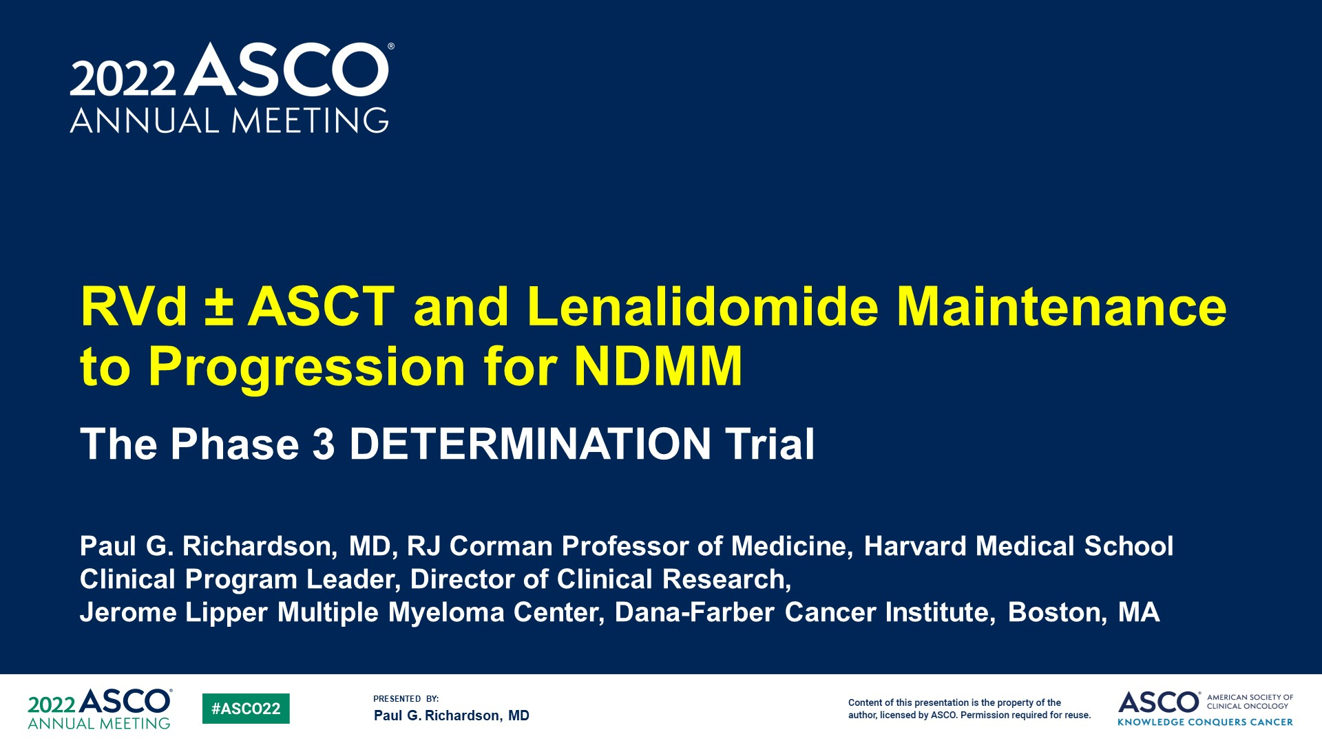

Slide 42
Agenda
Introduction: Clinical Trials We LOVE to Discuss
Module 1: Mechanism of Action of Cereblon E3 Ligase Modulators (CELMoDs)
Module 2: Available Efficacy Data with CELMoDs in the Management of Relapsed/Refractory Multiple Myeloma (MM)
Module 3: Extramedullary Disease
Module 4: Spectrum and Management of CELMoD-Associated Adverse Events
Module 5: Ongoing Phase II and III Trials Evaluating CELMoDs for MM
Module 6: Other Trials in Progress

Slide 43
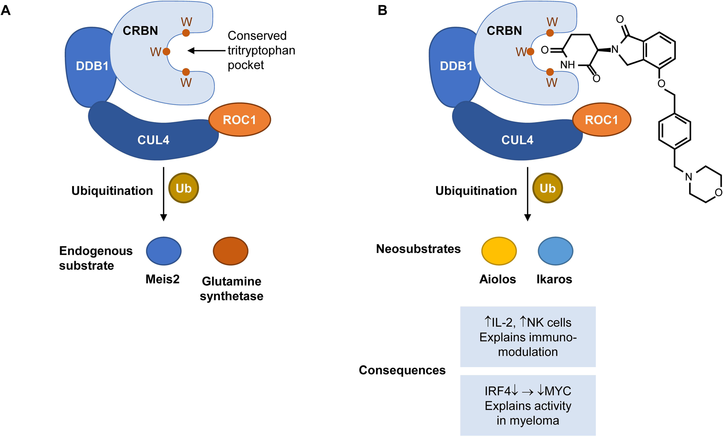
CELMoDs Overview: The Cereblon (CRBN) Pathway
CELMoD
van de donk NWCJ et al. Onco Targets Ther 2025;18:921-33.

Slide 44
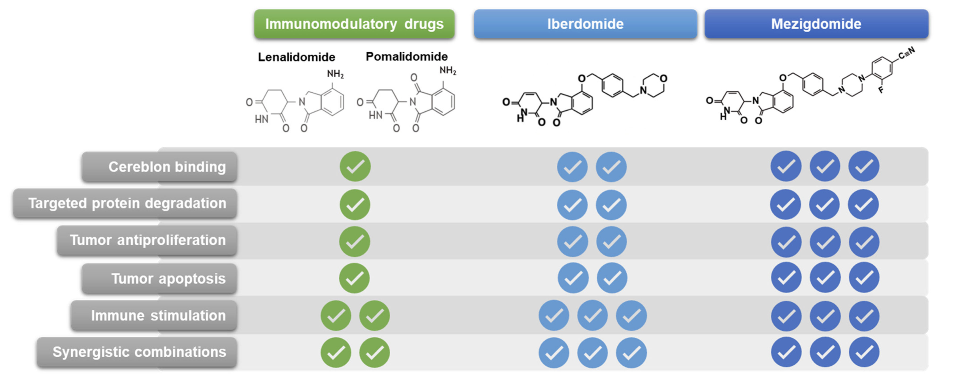
IMiDs and CELMoDs
van de donk NWCJ et al. Onco Targets Ther 2025;18:921-33.
Hartley-Brown MA et al. Cancers (Basel) 2024 ;16(6):1166.

Slide 45
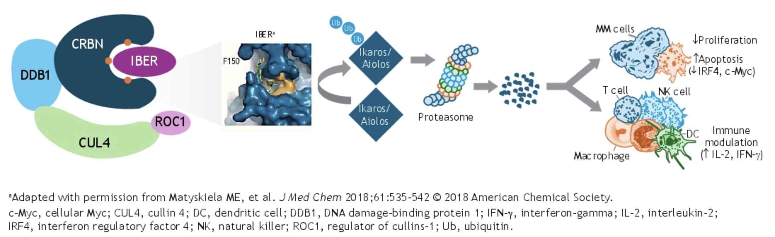
Rationale for Iberdomide in MM
White D et al. ASCO 2025;Abstract 7532

Slide 46
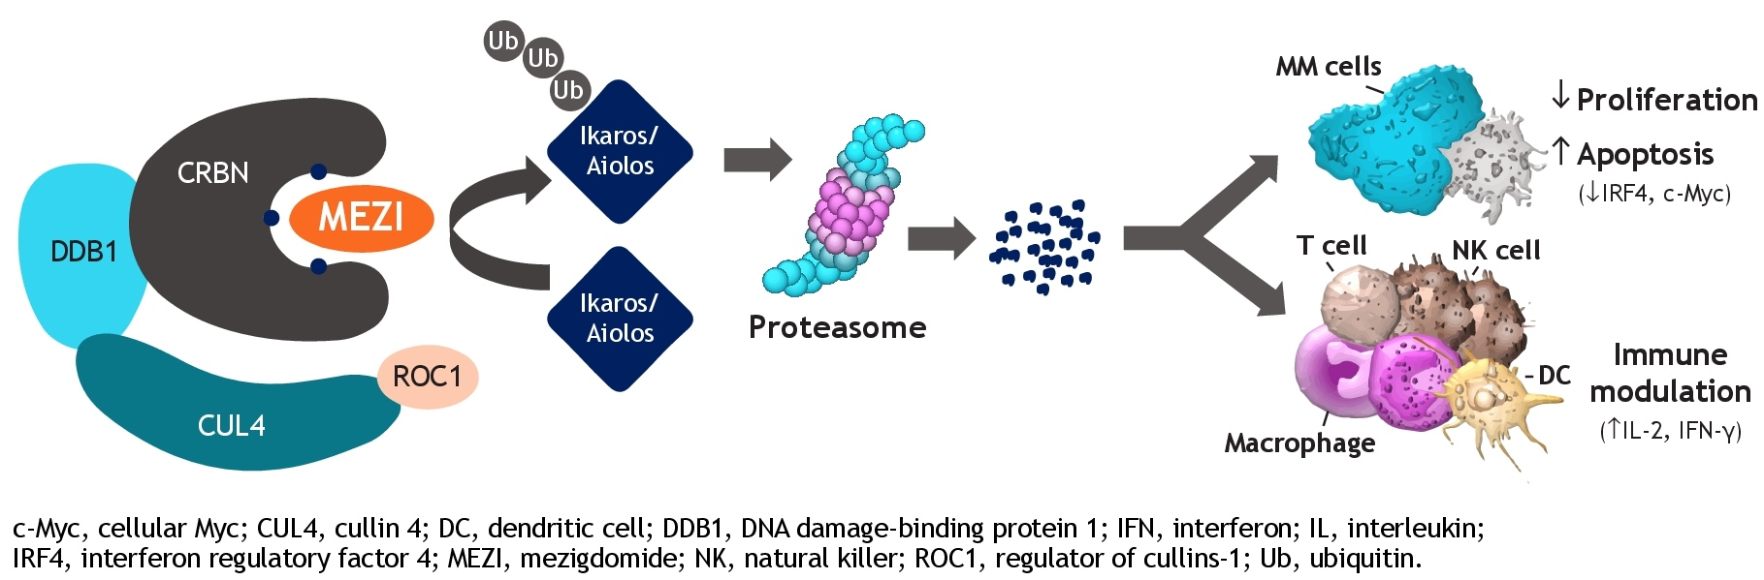
Rationale for Mezigdomide in MM
Richardson PG et al. ASCO 2023;Abstract TPS8070

Slide 47
Agenda
Introduction: Clinical Trials We LOVE to Discuss
Module 1: Mechanism of Action of Cereblon E3 Ligase Modulators (CELMoDs)
Module 2: Available Efficacy Data with CELMoDs in the Management of Relapsed/Refractory Multiple Myeloma (MM)
Module 3: Extramedullary Disease
Module 4: Spectrum and Management of CELMoD-Associated Adverse Events
Module 5: Ongoing Phase II and III Trials Evaluating CELMoDs for MM
Module 6: Other Trials in Progress

Slide 48
Iberdomide Key Datasets
Landgren O et al. A phase 2 trial of iberdomide, carfilzomib, daratumumab and dexamethasone quadruplet therapy for relapsed/refractory multiple myeloma: The ReKinDLE study. ASH 2025;Abstract 251.
Suvannasankha A et al. Safety and efficacy of elranatamab in combination with iberdomide in patients with relapsed or refractory multiple myeloma: Results from the phase 1b MagnetisMM-30 trial. ASH 2025;Abstract 100.
Korst CLBM et al. Iberdomide plus low-dose cyclophosphamide and dexamethasone in patients with relapsed and refractory multiple myeloma (the ICON study): A multicentre, single-arm, phase 2 trial. Lancet Haematol 2026 January;13(1):e30-40.
White D et al. Iberdomide, bortezomib, and dexamethasone (IberVd) in transplant-ineligible (TNE) newly diagnosed multiple myeloma (NDMM): Updated results from the CC-220-MM-001 trial. ASCO 2025;Abstract 7532.

Slide 49
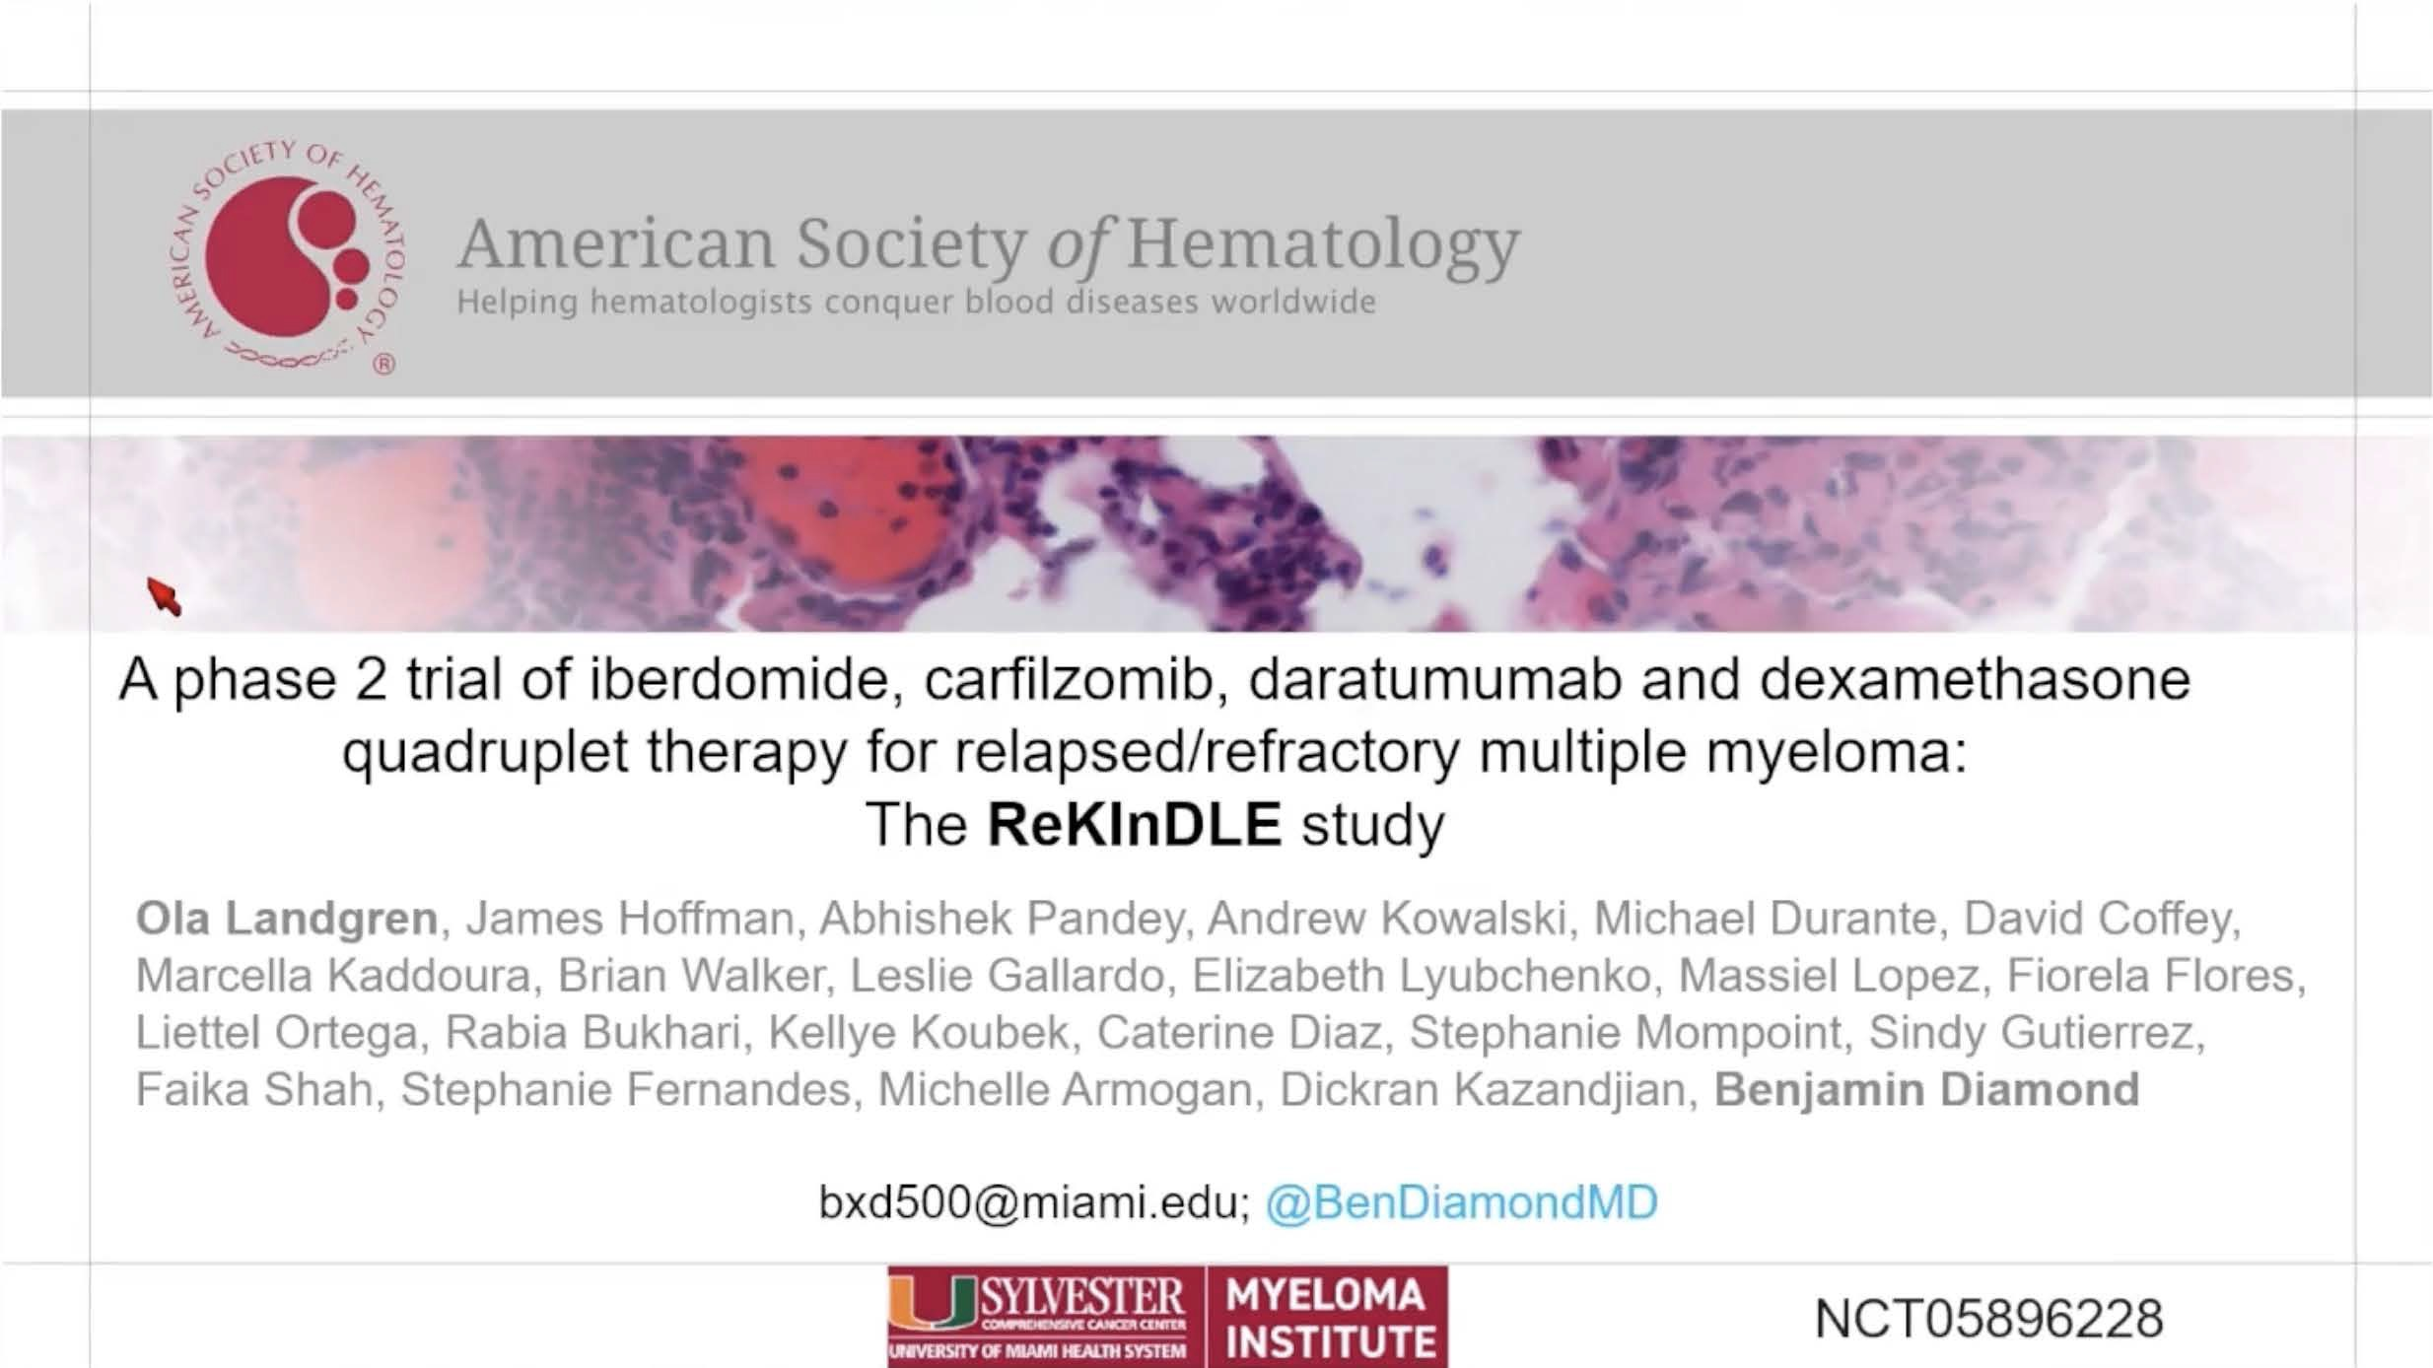
ASH 2025;Abstract 251

Slide 50
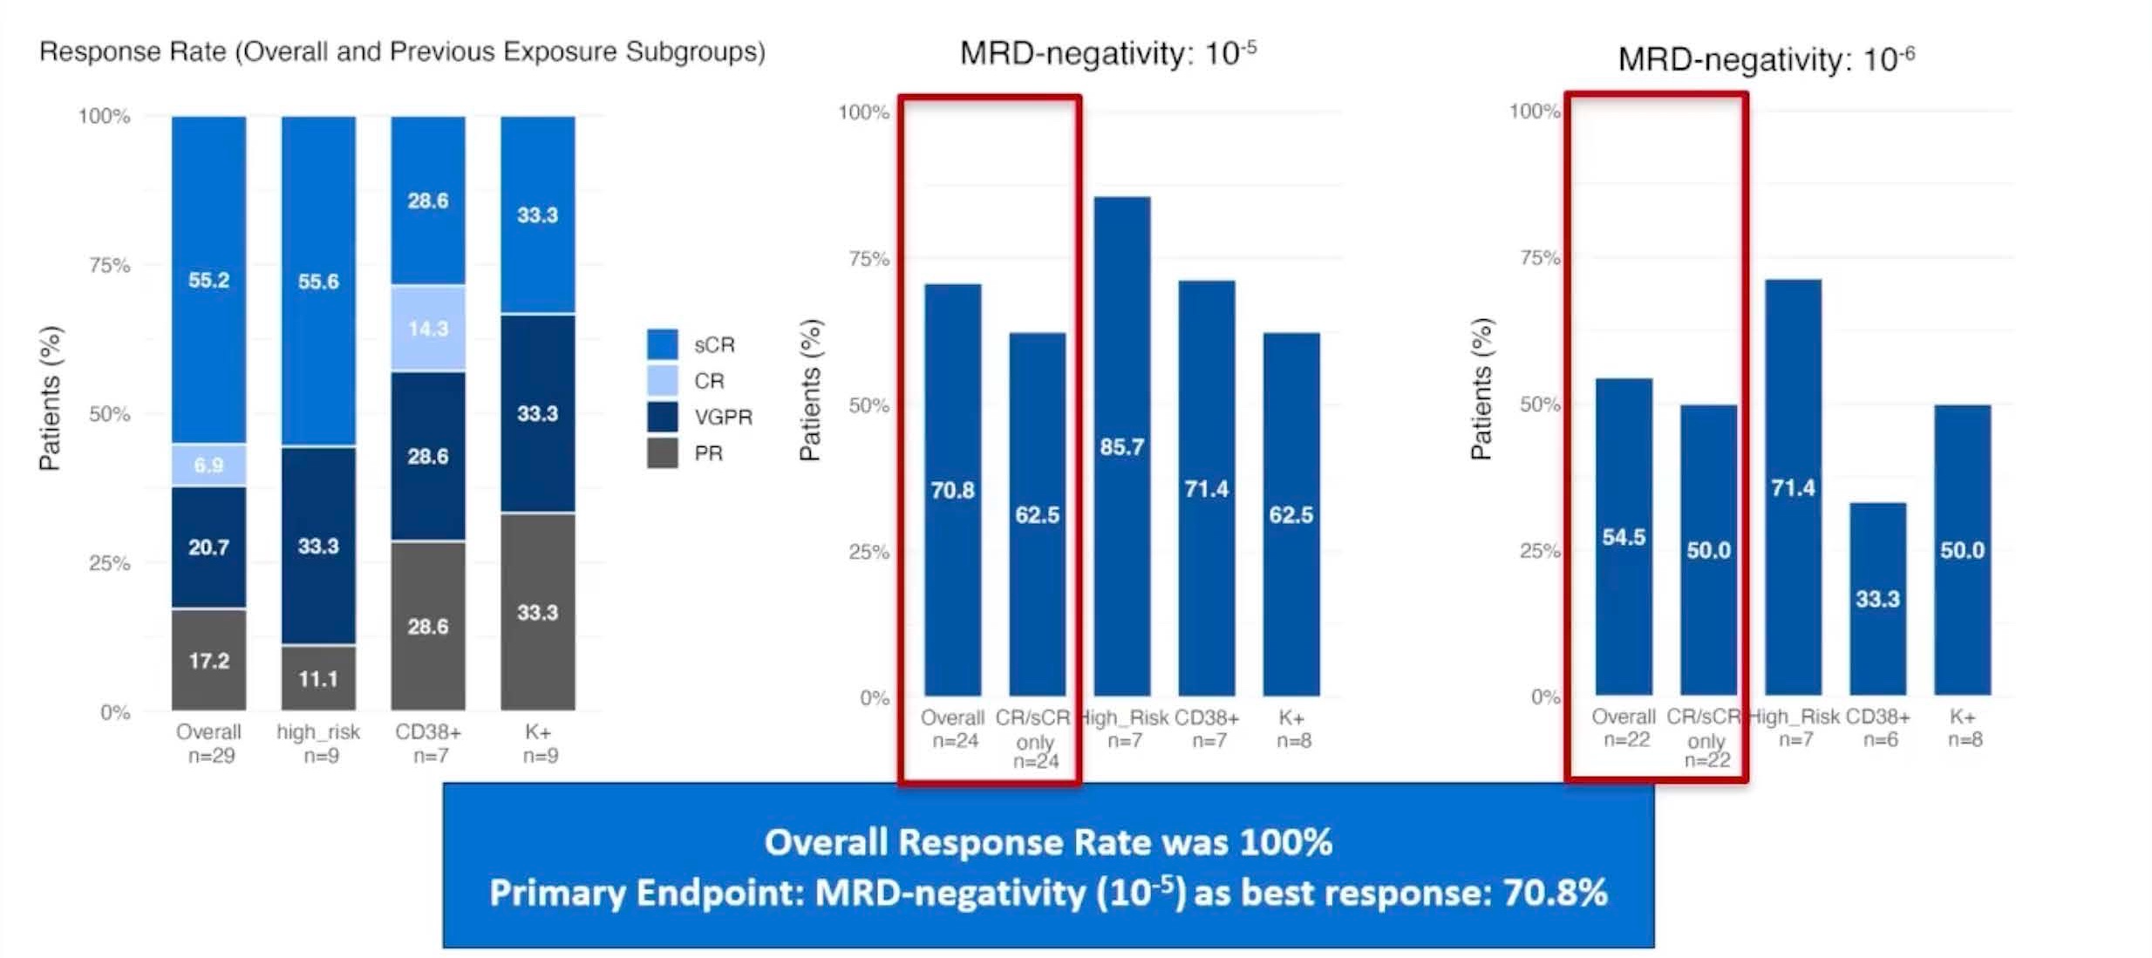
Phase II ReKInDLE: Response Rates, Minimal Residual Disease (MRD) Analysis
sCR = stringent complete response; CR = complete response; VGPR = very good partial response; PR = partial response
Landgren O et al. ASH 2025;Abstract 251.

Slide 51
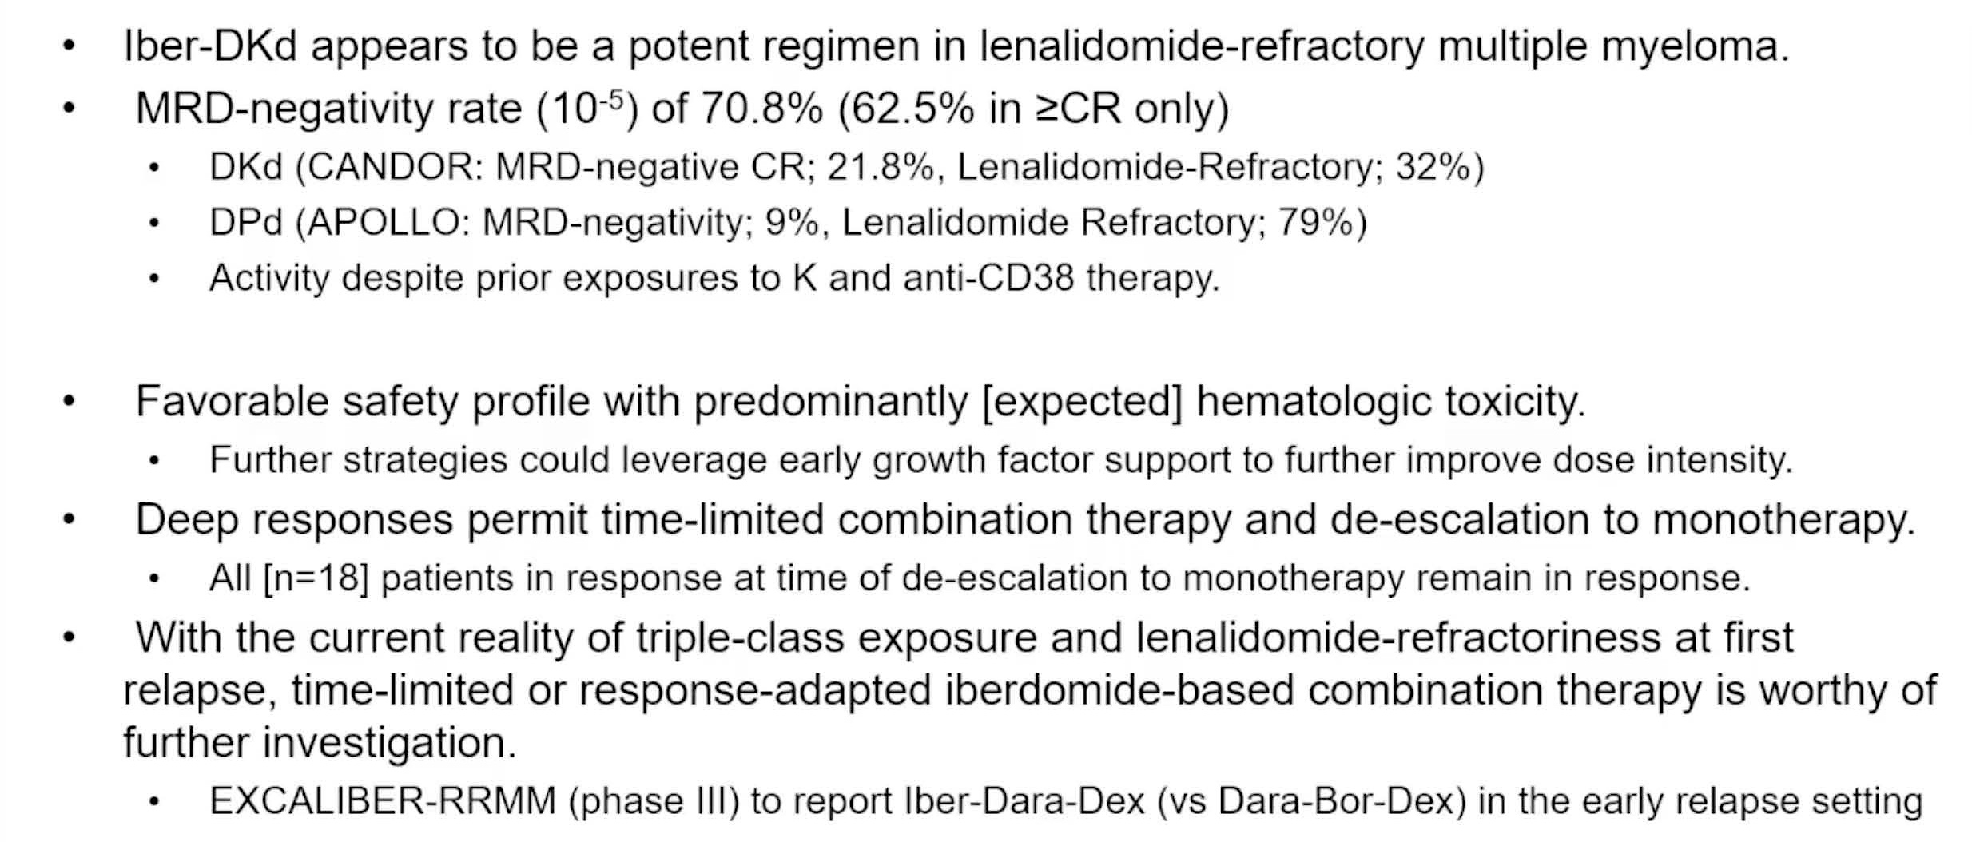
Phase II ReKInDLE: Authors’ Conclusions
Landgren O et al. ASH 2025;Abstract 251.

Slide 52
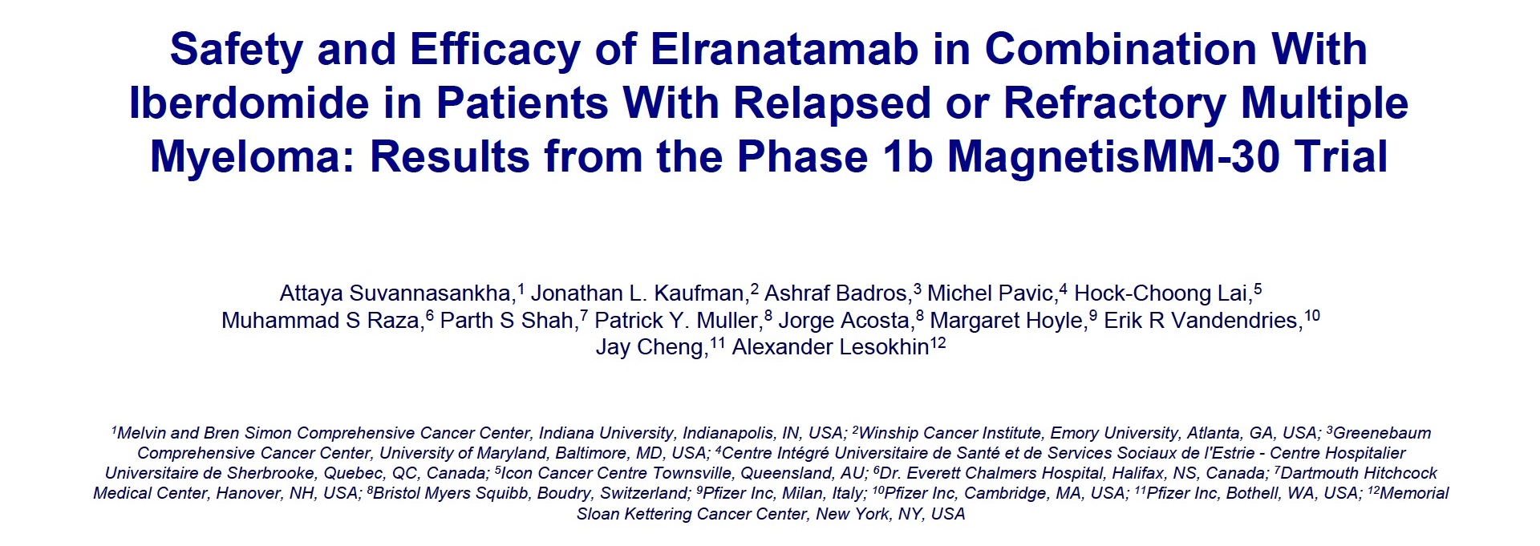
ASH 2025;Abstract 100

Slide 53
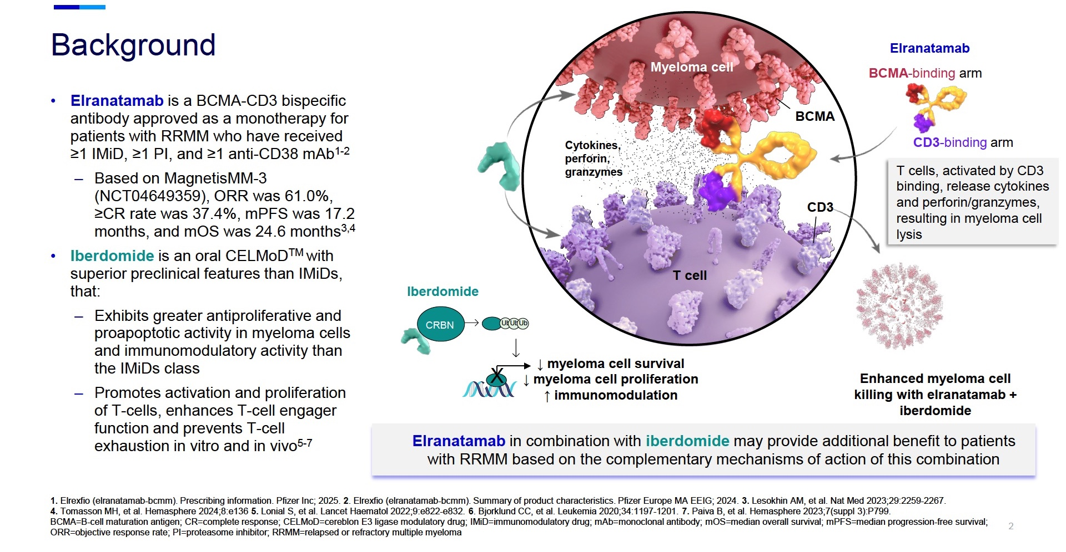
Rationale for Elranatamab/Iberdomide Combination Therapy
Suvannasankha A et al. ASH 2025;Abstract 100.

Slide 54
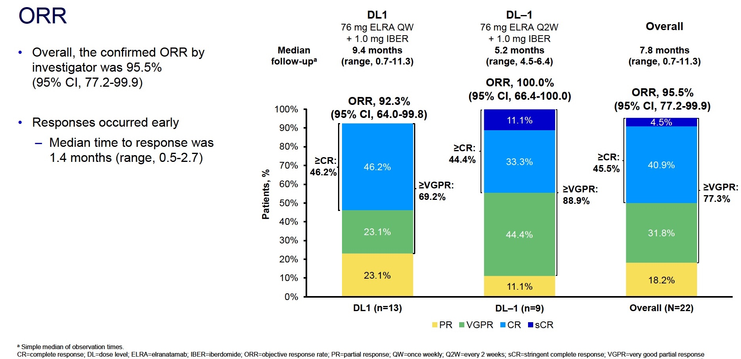
Phase Ib MagnetisMM-30: Objective Response Rate
Suvannasankha A et al. ASH 2025;Abstract 100.

Slide 55
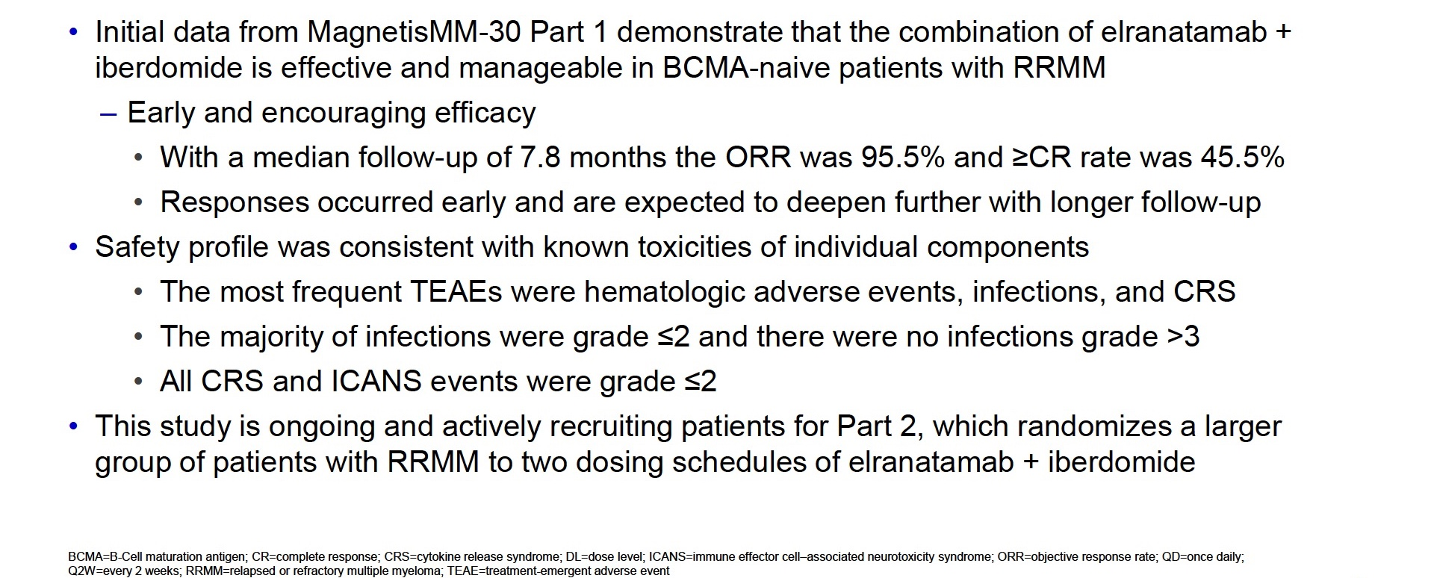
Phase Ib MagnetisMM-30: Authors’ Conclusions
Suvannasankha A et al. ASH 2025;Abstract 100.

Slide 56
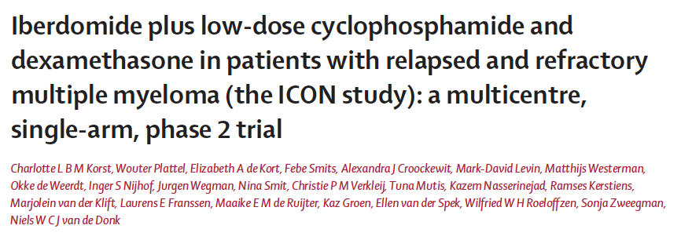
Lancet Haematol 2026; 13:e30-40

Slide 57
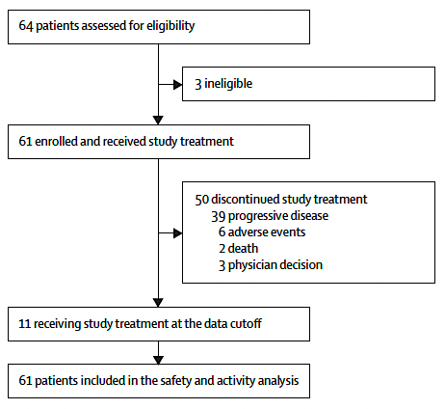
Phase II ICON Trial Profile
Primary endpoint:
PFS
Secondary endpoints:
ORR, Safety, OS, TTR, DoR, PFS2, TTNT
Korst CLBM et al. Lancet Haematol 2026 January;13(1):e30-40.

Slide 58
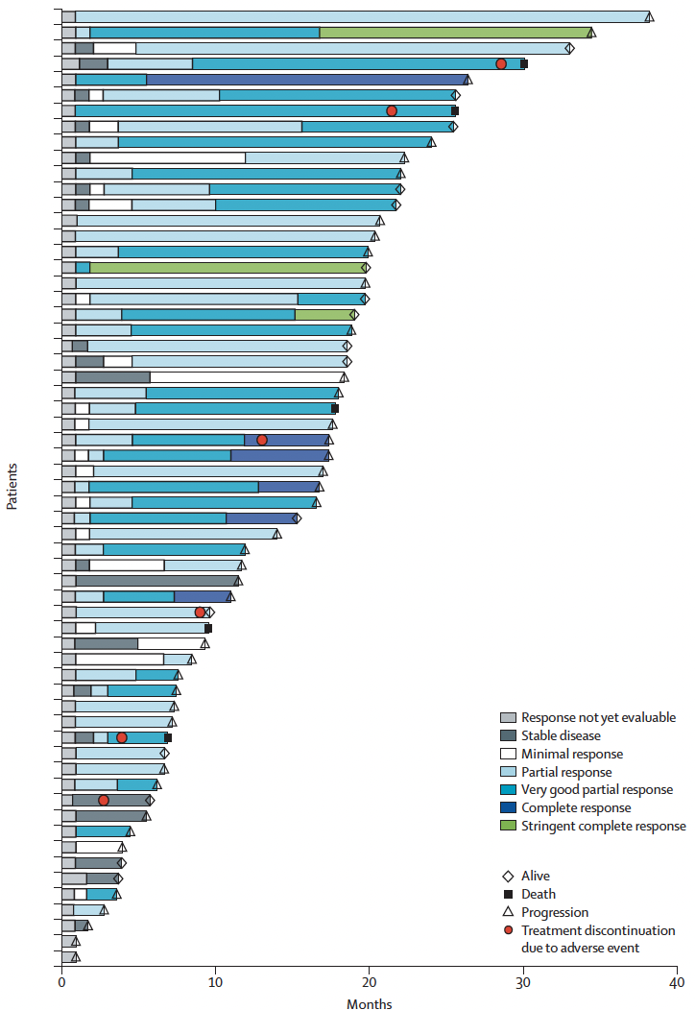
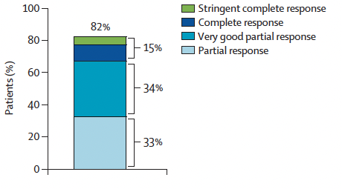
Phase II ICON: Responses with IberCd
Korst CLBM et al. Lancet Haematol 2026 January;13(1):e30-40.

Slide 59
Phase II ICON: Authors’ Conclusions
IberCd induced a high response rate and durable responses in patients with relapsed and refractory multiple myeloma who had received 2 to 4 previous lines of therapy and had lenalidomide-refractory disease.
The main nonhematologic adverse events were infections, mostly respiratory infections.
Most patients enrolled were triple-class exposed, representing a population that is challenging to treat. This regimen could be a valuable alternative alongside new T-cell-redirecting therapies, particularly for patients who are ineligible for these treatments because of frailty or comorbidities.
Korst CLBM et al. Lancet Haematol 2026 January;13(1):e30-40.

Slide 60
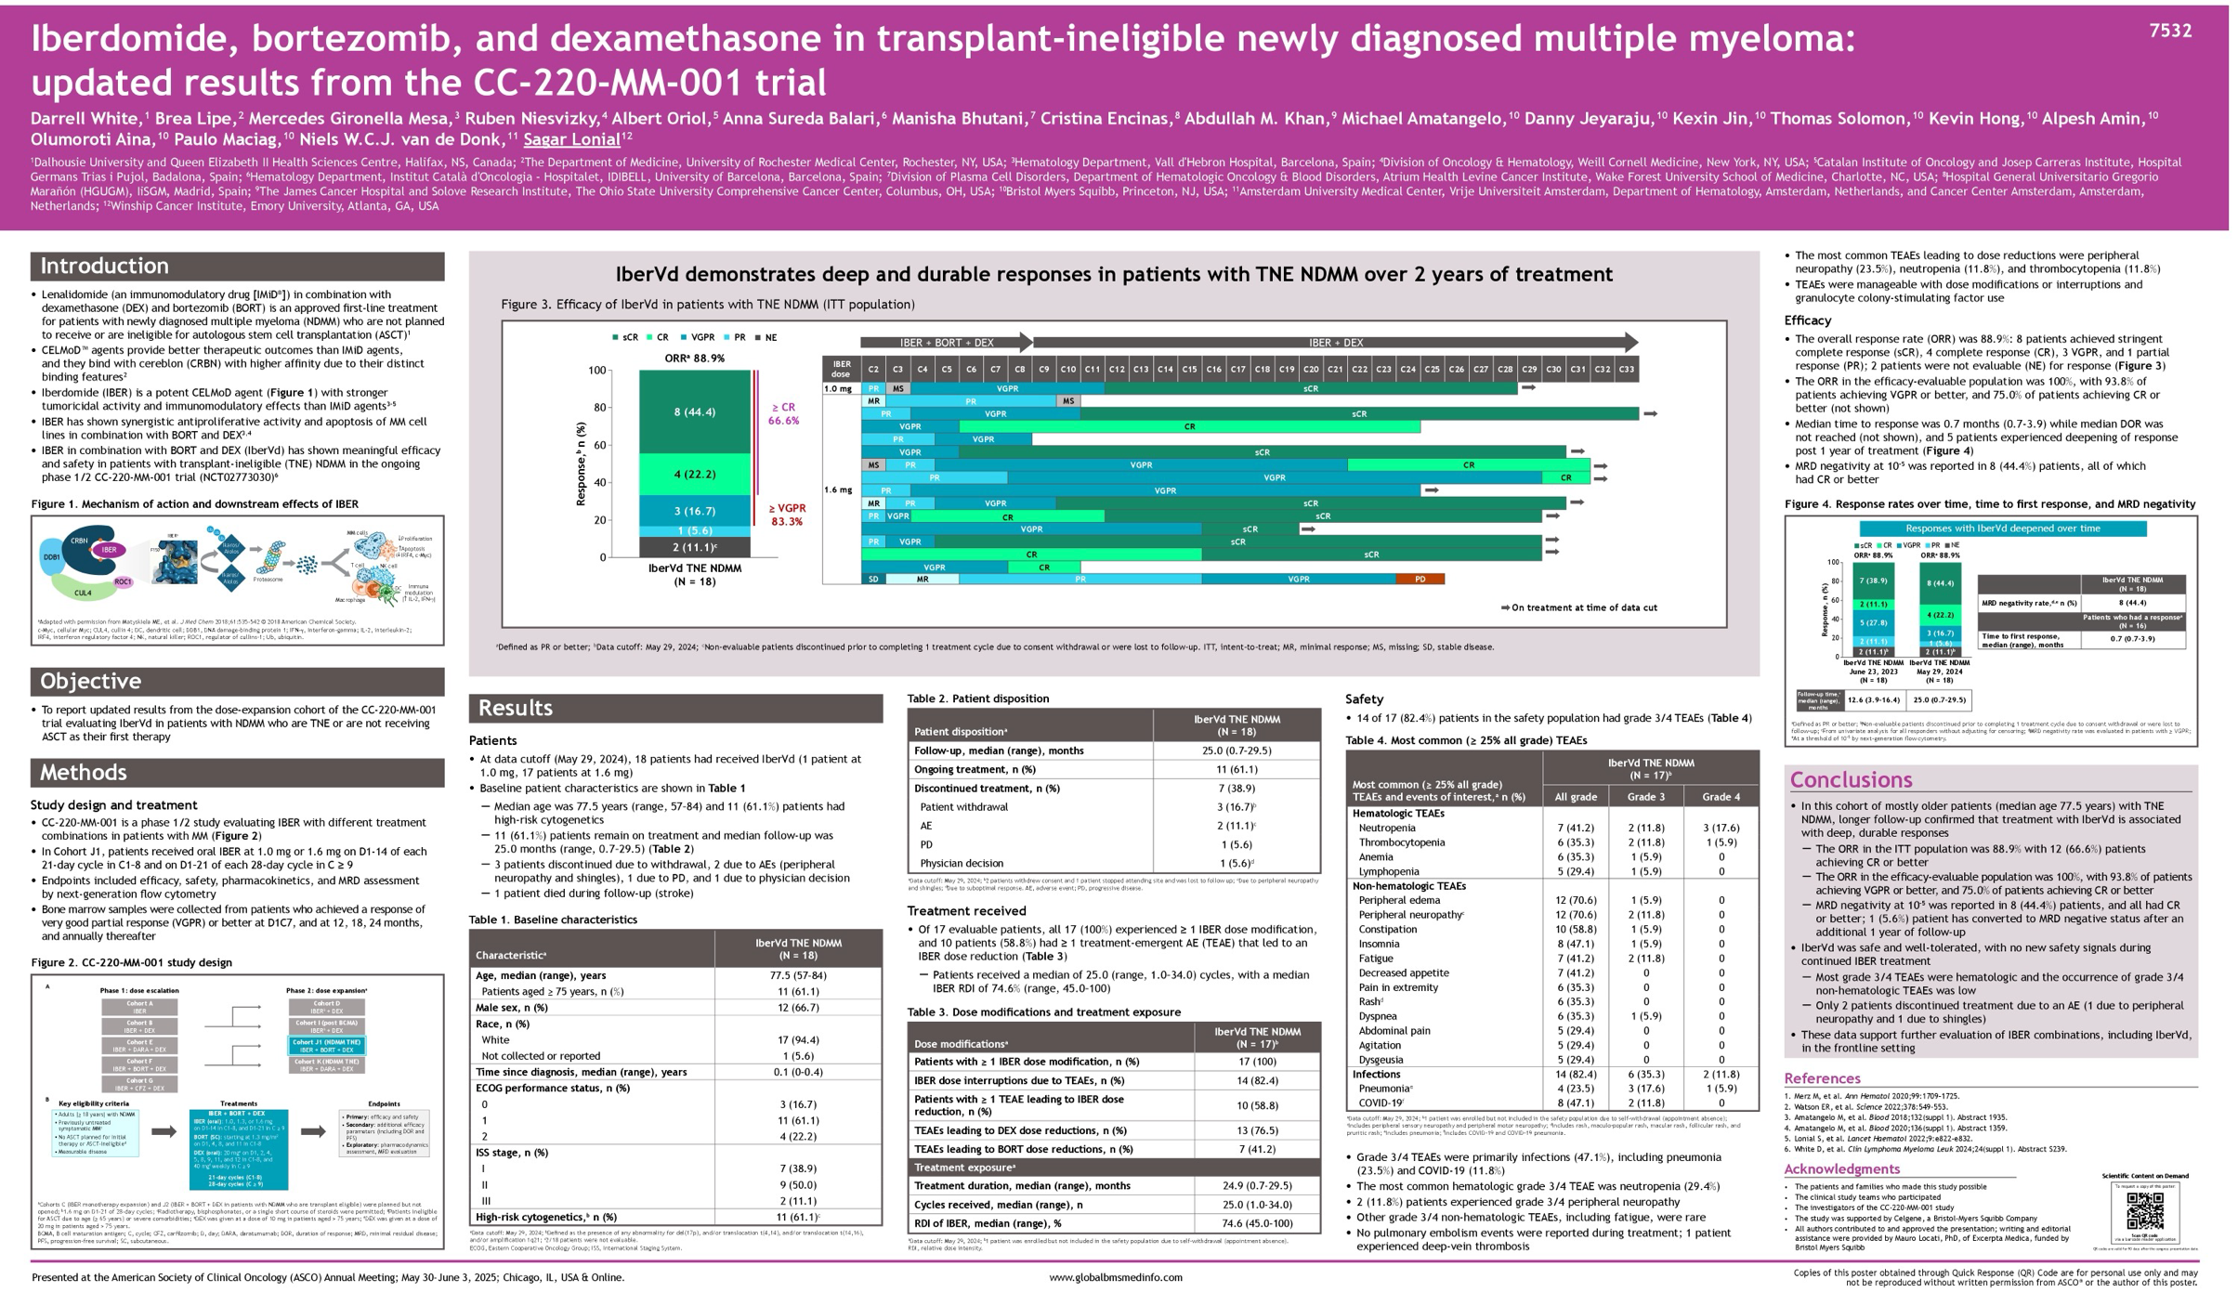
ASCO 2025;Abstract 7532

Slide 61
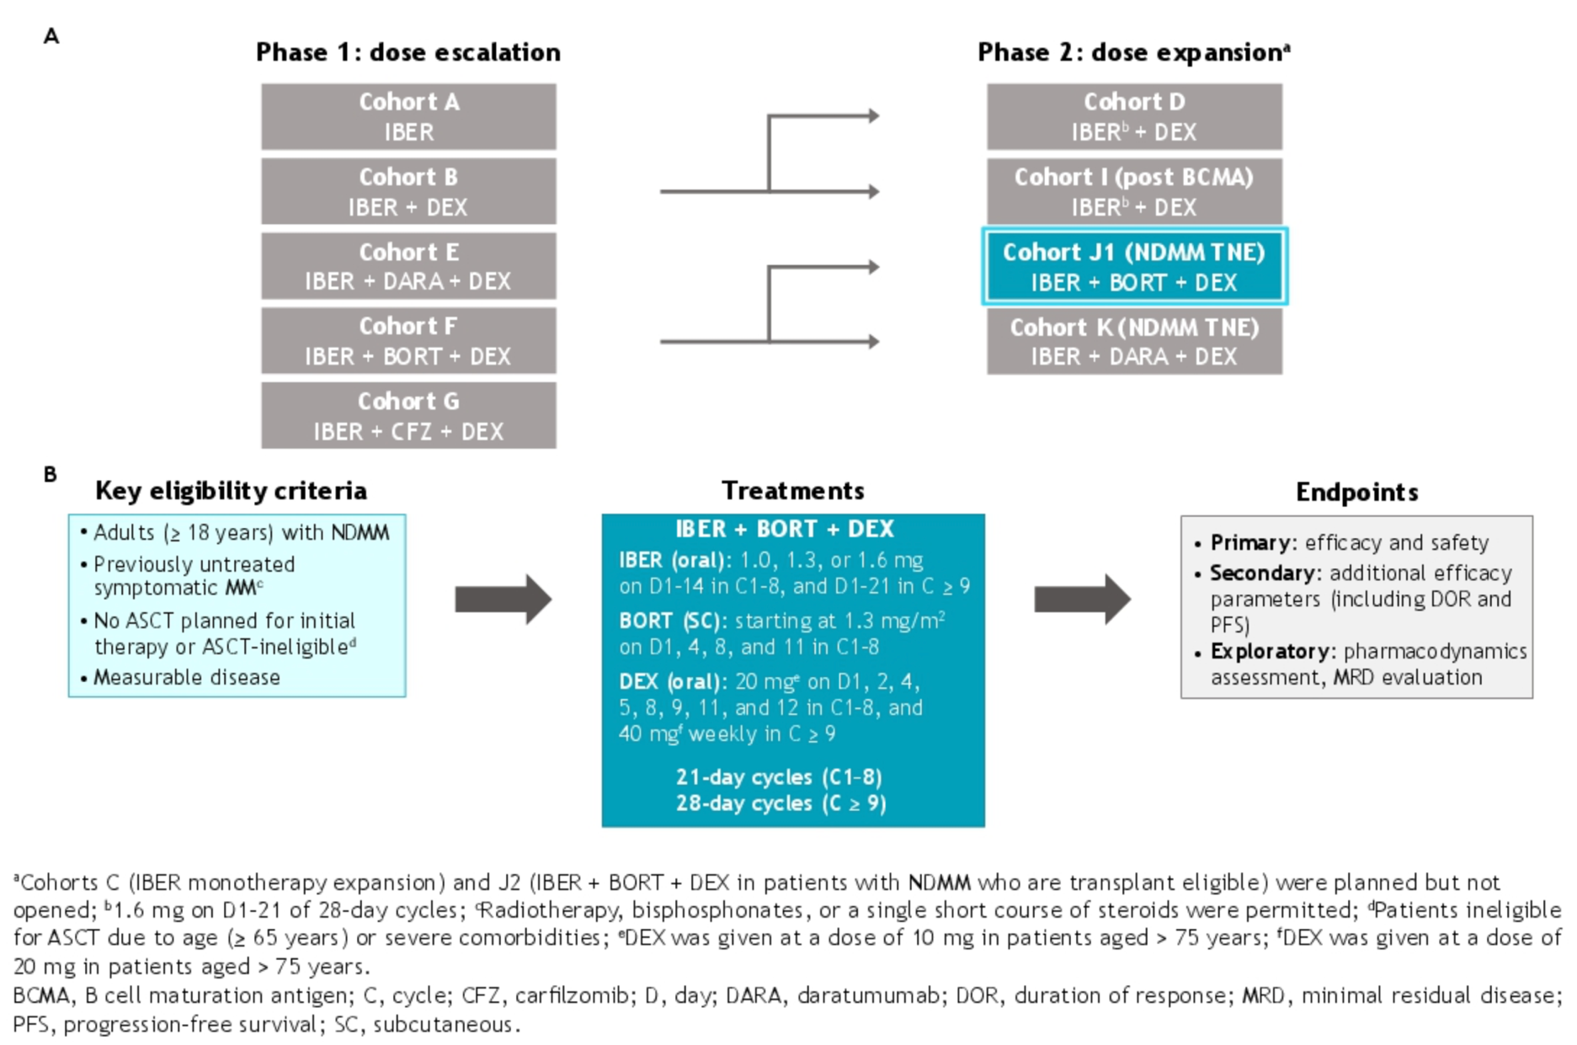
Phase I/II CC-220-MM-001 Study Design
NDMM = newly diagnosed MM; TNE = transplant ineligible
White D et al. ASCO 2025;Abstract 7532.

Slide 62
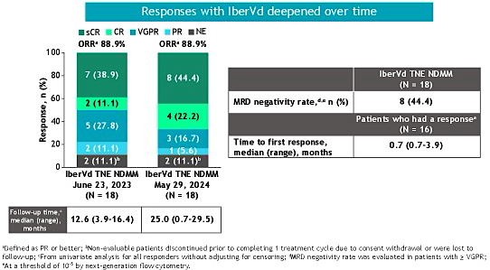
Phase I/II CC-220-MM-001: Responses over Time
ORR = overall response rate
White D et al. ASCO 2025;Abstract 7532.

Slide 63
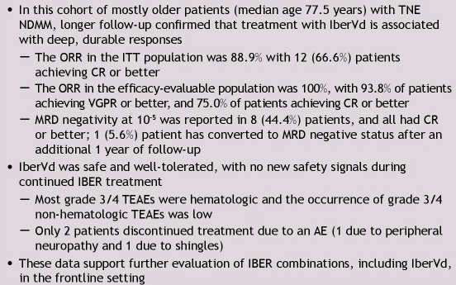
Phase I/II CC-220-MM-001: Authors’ Conclusions
White D et al. ASCO 2025;Abstract 7532.

Slide 64
Mezigdomide Key Datasets
Richardson PG et al. Mezigdomide plus dexamethasone in relapsed and refractory multiple myeloma. N Engl J Med 2023 September 14;389(11):1009-22.
Richardson PG et al. Mezigdomide (MEZI) plus dexamethasone (DEX) and daratumumab (DARA) or elotuzumab (ELO) in patients (pts) with relapsed/refractory multiple myeloma (RRMM): Results from the CC-92480-MM-002 trial. ASH 2023;Abstract 1013.
Byun JM et al. Phase I/II study of mezigdomide and elranatamab for relapsed/refractory multiple myeloma patients (MELT-MM): Initial results from part 1. ASH 2025;Abstract 5835.
Mo C et al. Selinexor, mezigdomide, and dexamethasone in patients with relapsed/refractory multiple myeloma who relapsed or are ineligible for T-cell–redirecting therapy: STOMP Phase 1 results. ASH 2025;Abstract 4010.

Slide 65
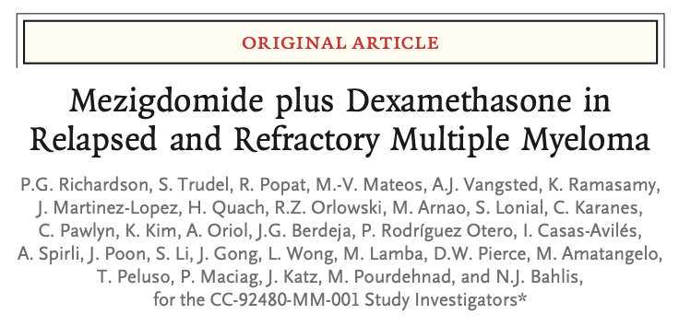
N Engl J Med 2023 September 14;389(11):1009-22.

Slide 66
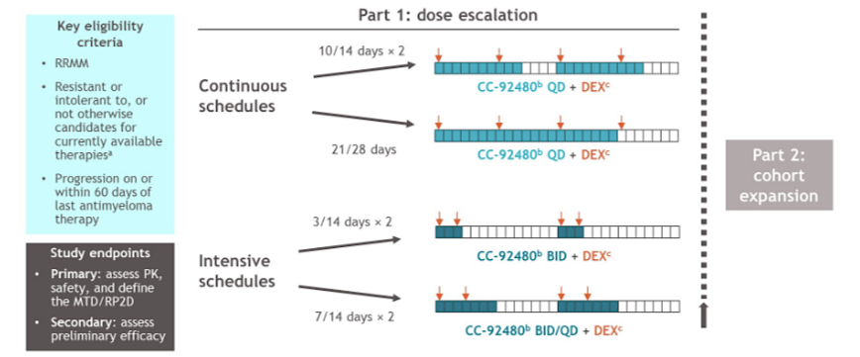
Phase I/II CC-92480-MM-001 Study Design
Richardson PG et al. N Engl J Med 2023 September 14;389(11):1009-22.

Slide 67
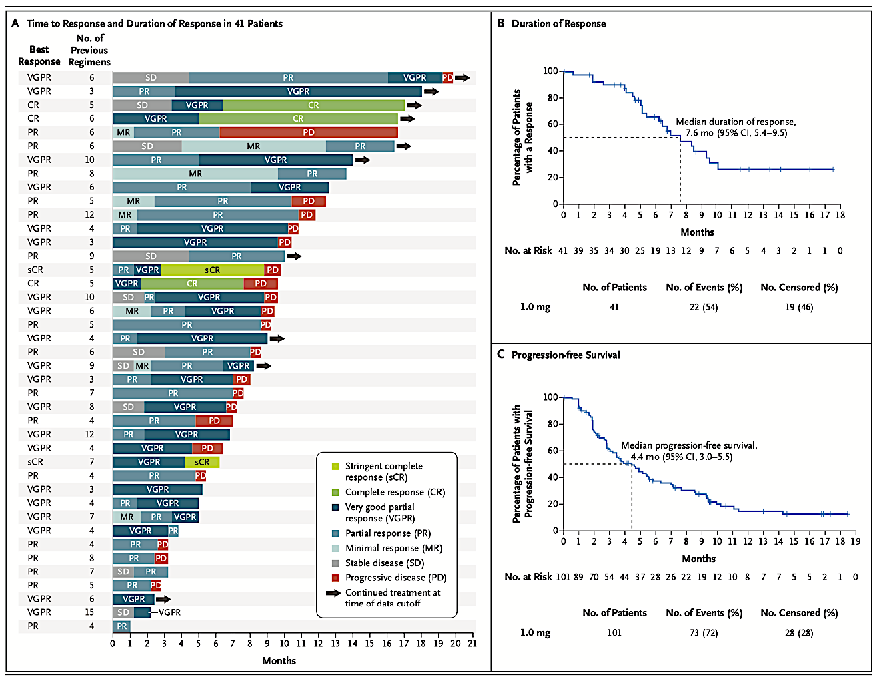
Phase I/II CC-92480-MM-001: Responses, PFS
Richardson PG et al. N Engl J Med 2023 September 14;389(11):1009-22.

Slide 68
Phase I/II CC-92480-MM-001: Authors’ Conclusions
The all-oral combination of mezigdomide and dexamethasone showed promising efficacy in patients with heavily pretreated multiple myeloma, with treatment-related adverse events consisting mainly of myelotoxic effects.
Richardson PG et al. N Engl J Med 2023 September 14;389(11):1009-22.

Slide 69
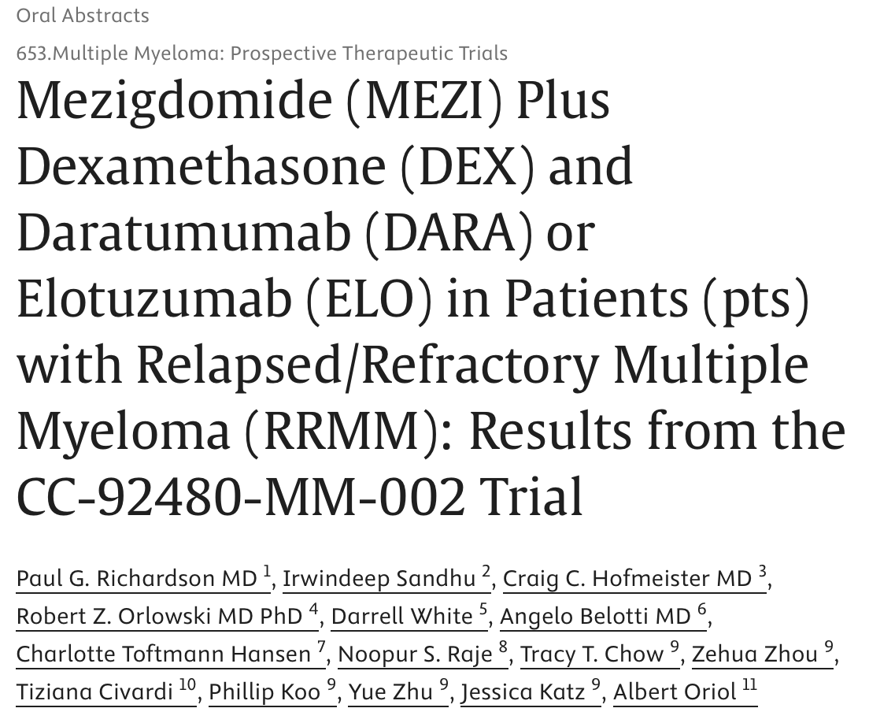
ASH 2023:Abstract 1013.

Slide 70
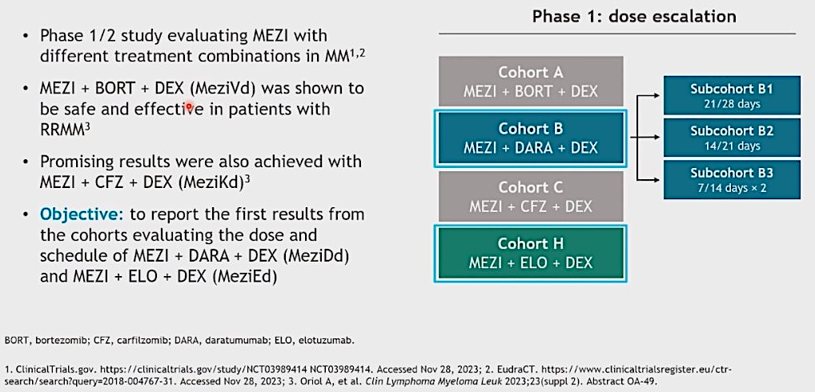
Phase I/II CC-92480-MM-002 Study Design
Richardson PG et al. ASH 2023;Abstract 1013.

Slide 71
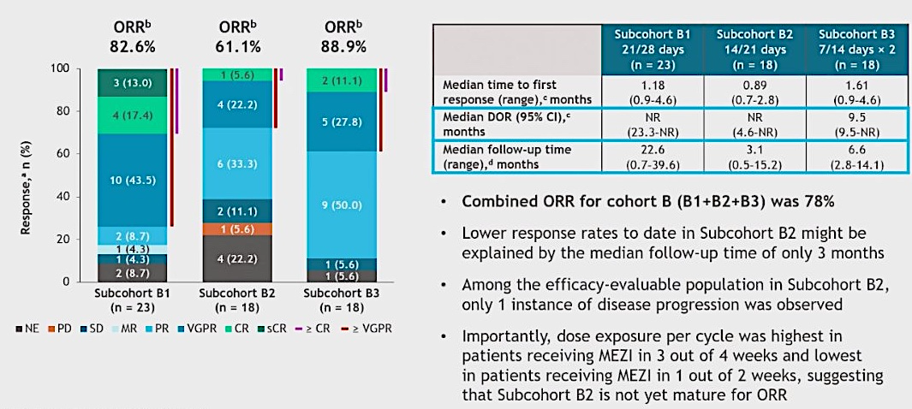
Phase I/II CC-92480-MM-002: Efficacy in Cohort B – MeziDd
ORR = overall response rate
Richardson PG et al. ASH 2023;Abstract 1013.

Slide 72
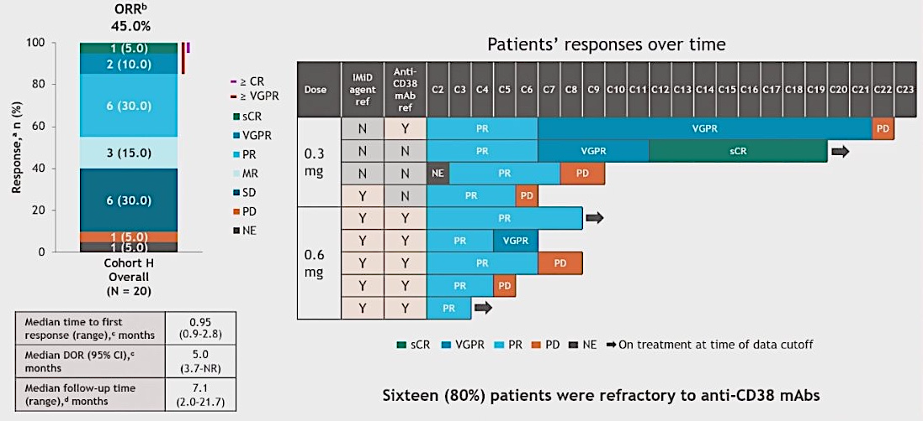
Phase I/II CC-92480-MM-002: Efficacy in Cohort H – MeziEd
ORR = overall response rate; DOR = duration of response; mAbs = monoclonal antibodies
Richardson PG et al. ASH 2023;Abstract 1013.

Slide 73
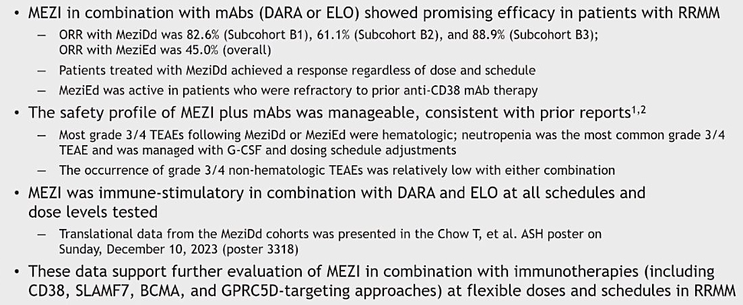
Phase I/II CC-92480-MM-002: Authors’ Conclusions
Richardson PG et al. ASH 2023;Abstract 1013.

Slide 74
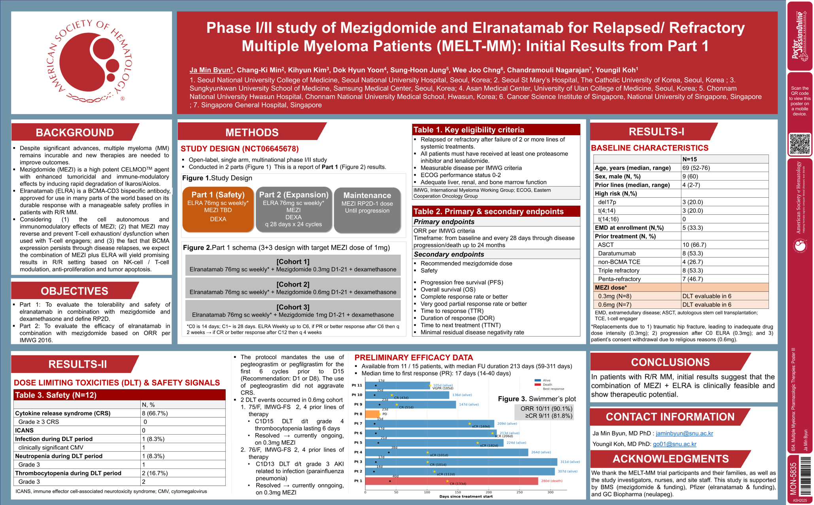
ASH 2025;Abstract 5835.

Slide 75
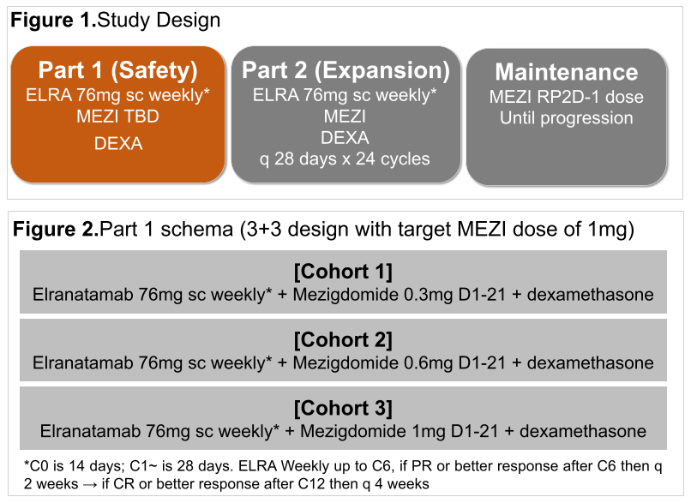
Phase I/II MELT-MM Study Design
Byun JM et al. ASH 2025;Abstract 5835.

Slide 76
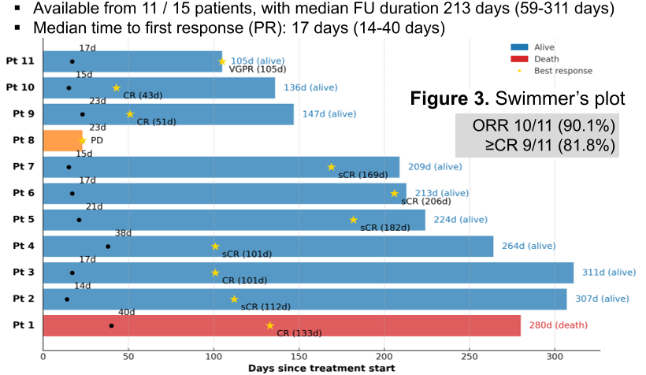
Phase I/II MELT-MM: Preliminary Efficacy Data
ORR = overall response rate
Byun JM et al. ASH 2025;Abstract 5835.

Slide 77
Phase I/II MELT-MM: Authors’ Conclusions
In patients with R/R MM, initial results suggest that the combination of MEZI + ELRA is clinically feasible and shows therapeutic potential.
Byun JM et al. ASH 2025;Abstract 5835.

Slide 78
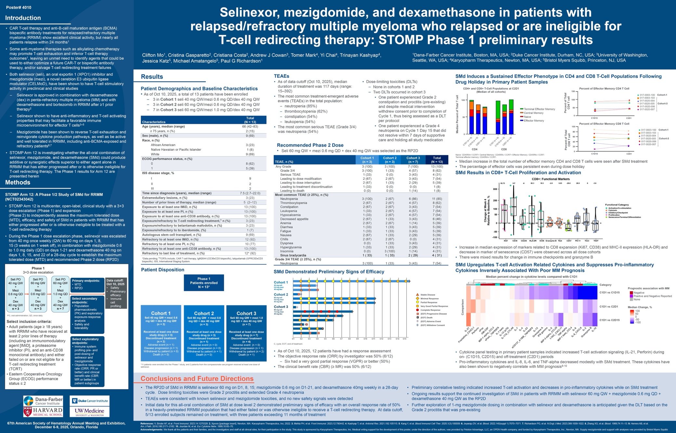
ASH 2025;Abstract 4010.

Slide 79
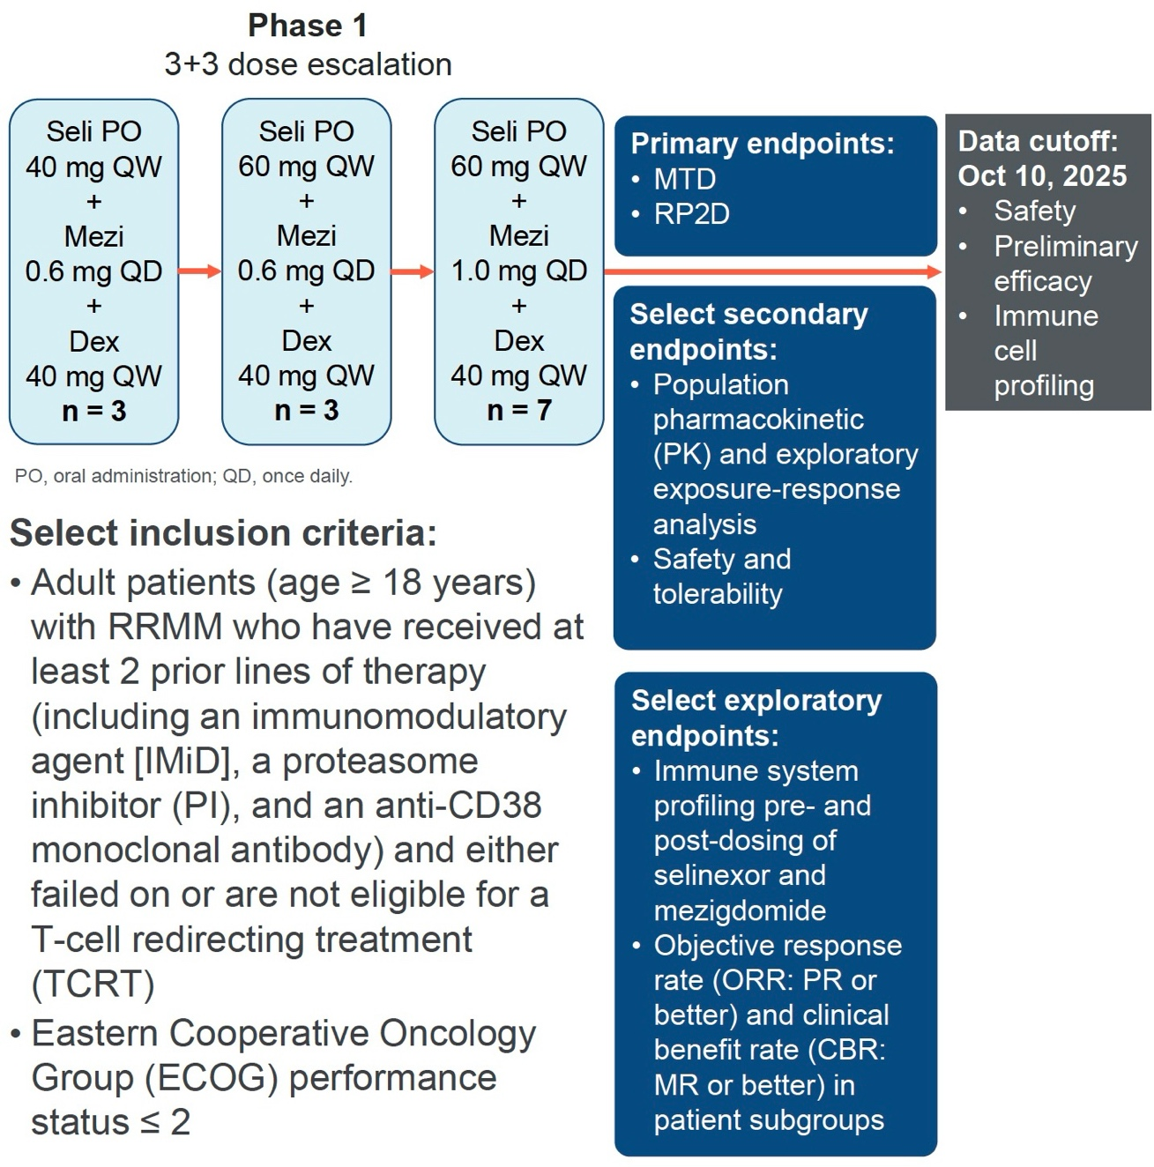
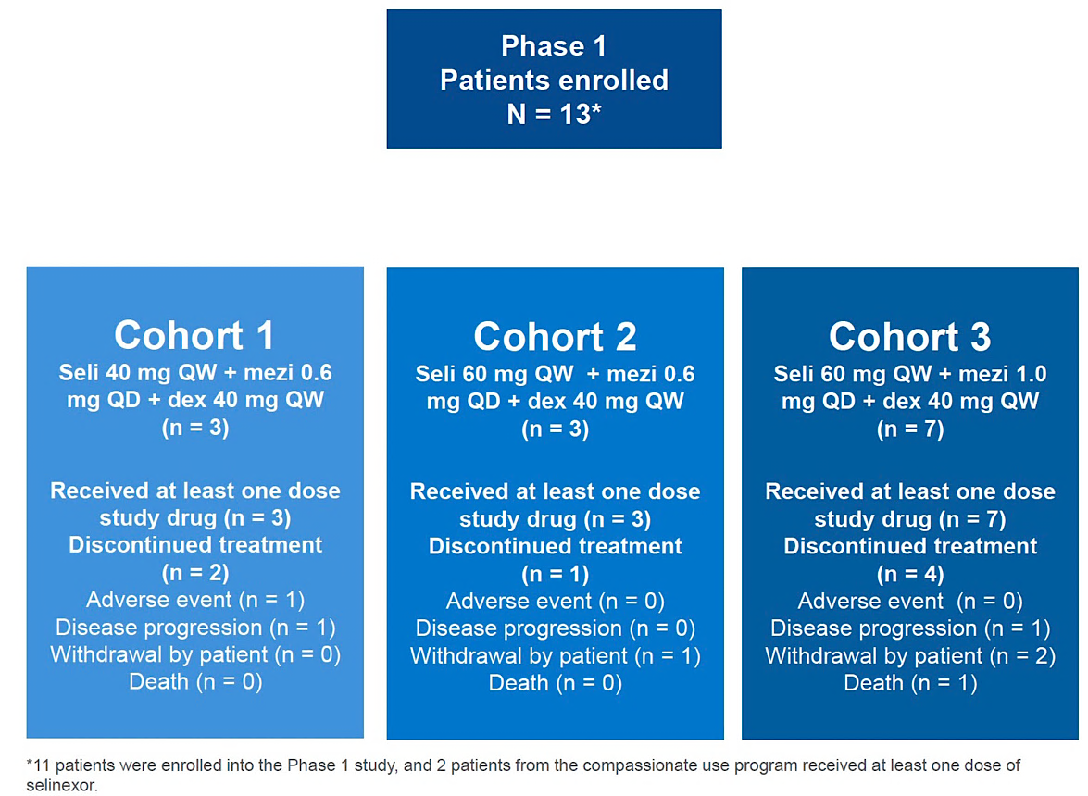
Phase I STOMP Study and Cohort Design
Seli = selinexor
Mo C et al. ASH 2025;Abstract 4010.

Slide 80
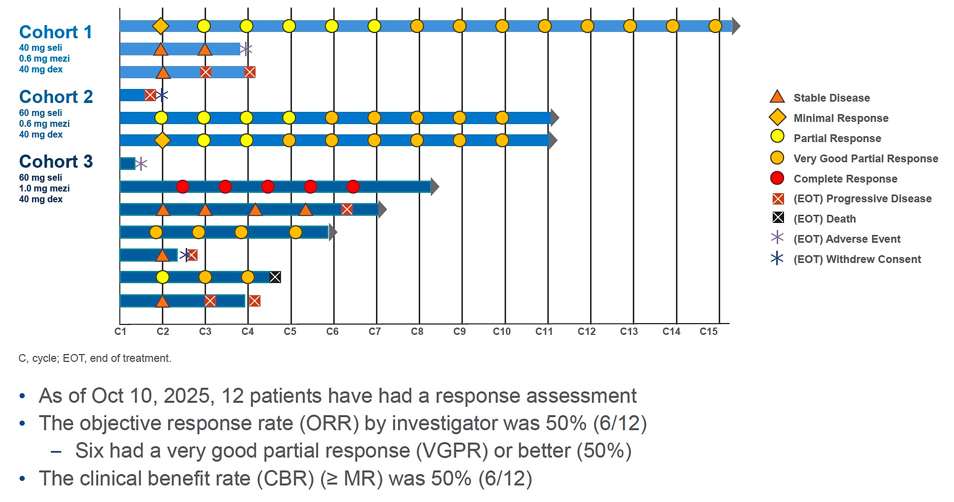
Phase I STOMP: Preliminary Efficacy
Mo C et al. ASH 2025;Abstract 4010.

Slide 81
Phase I STOMP: Authors’ Conclusions
The recommended Phase II dose of selinexor/mezigdomide/dexamethasone (SMd) for RRMM is selinexor 60 mg on D1, 8, 15; mezigdomide 0.6 mg on D1-21, and dexamethasone 40 mg weekly in a 28-day cycle. Dose-limiting toxicities were Grade 2 proctitis and extended Grade 4 neutropenia
TEAEs were consistent with known selinexor and mezigdomide toxicities, and no new safety signals were detected
Initial data for this all-oral combination of SMd at dose level 2 demonstrated preliminary signs of efficacy with an overall response rate of 50% for patients with heavily pretreated RRMM that was refractory to or was otherwise ineligible to receive a T-cell-redirecting therapy. At data cutoff, 5/13 enrolled patients remained on treatment, with 3 exceeding 11 months of treatment
Further exploration of 1-mg mezigdomide dosing in combination with selinexor and dexamethasone is anticipated given the DLT based on the Grade 2 proctitis that was preexisting
Mo C et al. ASH 2025;Abstract 4010.

Slide 82
Agenda
Introduction: Clinical Trials We LOVE to Discuss
Module 1: Mechanism of Action of Cereblon E3 Ligase Modulators (CELMoDs)
Module 2: Available Efficacy Data with CELMoDs in the Management of Relapsed/Refractory Multiple Myeloma (MM)
Module 3: Extramedullary Disease
Module 4: Spectrum and Management of CELMoD-Associated Adverse Events
Module 5: Ongoing Phase II and III Trials Evaluating CELMoDs for MM
Module 6: Other Trials in Progress

Slide 83
Agenda
Introduction: Clinical Trials We LOVE to Discuss
Module 1: Mechanism of Action of Cereblon E3 Ligase Modulators (CELMoDs)
Module 2: Available Efficacy Data with CELMoDs in the Management of Relapsed/Refractory Multiple Myeloma (MM)
Module 3: Extramedullary Disease
Module 4: Spectrum and Management of CELMoD-Associated Adverse Events
Module 5: Ongoing Phase II and III Trials Evaluating CELMoDs for MM
Module 6: Other Trials in Progress

Slide 84
Key Datasets
Iberdomide
Landgren O et al. A phase 2 trial of iberdomide, carfilzomib, daratumumab and dexamethasone quadruplet therapy for relapsed/refractory multiple myeloma: The ReKinDLE study. ASH 2025;Abstract 251.
Korst CLBM et al. Iberdomide plus low-dose cyclophosphamide and dexamethasone in patients with relapsed and refractory multiple myeloma (the ICON study): A multicentre, single-arm, phase 2 trial. Lancet Haematol 2026 January;13(1):e30-40.
Suvannasankha A et al. Safety and efficacy of elranatamab in combination with iberdomide in patients with relapsed or refractory multiple myeloma: Results from the phase 1b MagnetisMM-30 trial. ASH 2025;Abstract 100.
White D et al. Iberdomide, bortezomib, and dexamethasone (IberVd) in transplant-ineligible (TNE) newly diagnosed multiple myeloma (NDMM): Updated results from the CC-220-MM-001 trial. ASCO 2025;Abstract 7532.

Slide 85
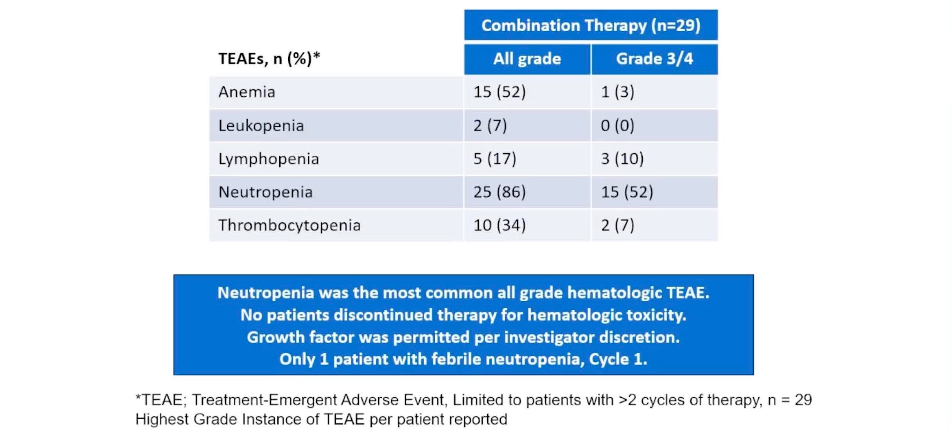
Phase II ReKInDLE: Hematologic Adverse Events
Landgren O et al. ASH 2025;Abstract 251.

Slide 86
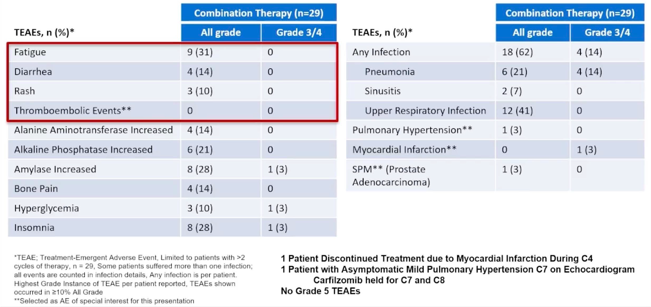
Phase II ReKInDLE: Common and Select Nonhematologic Adverse Events
Landgren O et al. ASH 2025;Abstract 251.

Slide 87

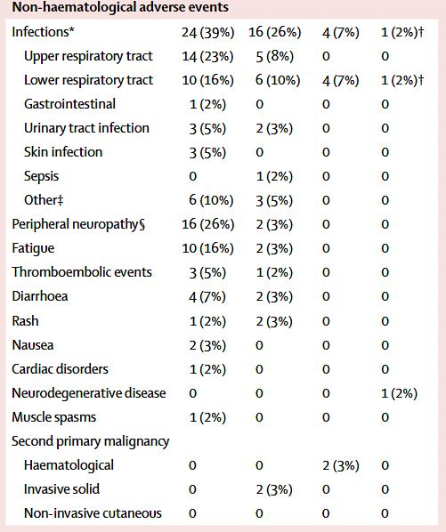
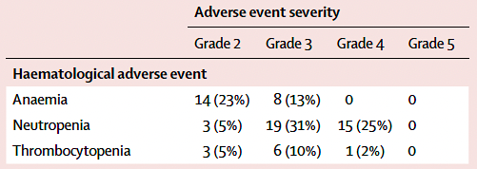
Phase II ICON: Safety
Korst CLBM et al. Lancet Haematol 2026 January;13(1):e30-40.

Slide 88
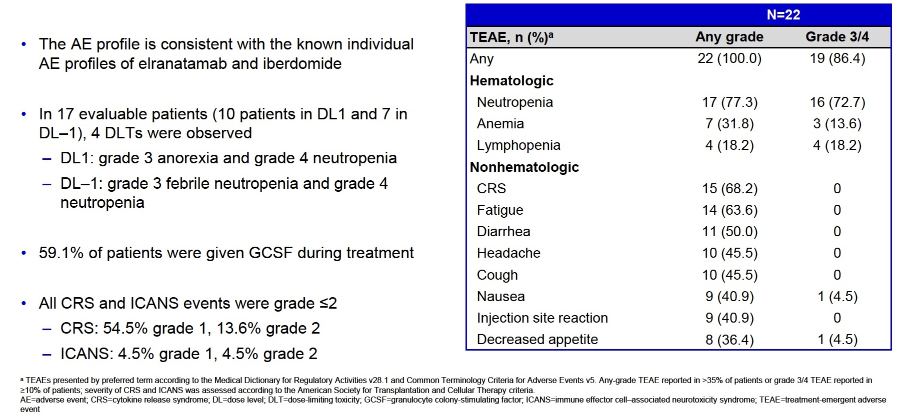
Phase Ib MagnetisMM-30: Safety
Suvannasankha A et al. ASH 2025;Abstract 100.

Slide 89
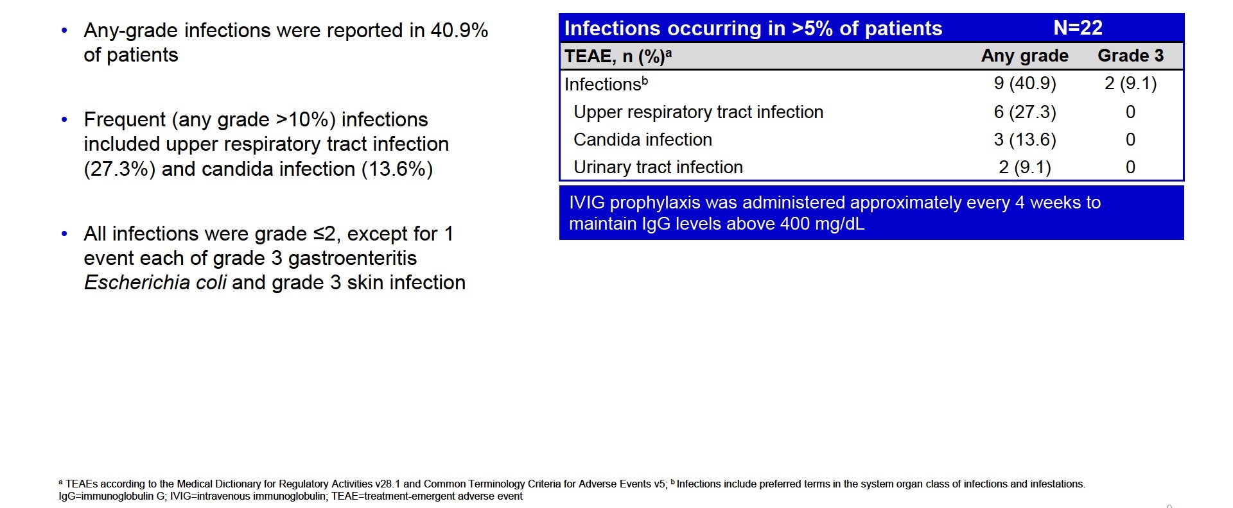
Phase Ib MagnetisMM-30: Infections
Suvannasankha A et al. ASH 2025;Abstract 100.

Slide 90

Phase I/II CC-220-MM-001: Common TEAEs (Any Grade)
White D et al. ASCO 2025;Abstract 7532.

Slide 91
Key Datasets
Mezigdomide
Richardson PG et al. Mezigdomide plus dexamethasone in relapsed and refractory multiple myeloma. N Engl J Med 2023 September 14;389(11):1009-22.
Byun JM et al. Phase I/II study of mezigdomide and elranatamab for relapsed/refractory multiple myeloma patients (MELT-MM): Initial results from part 1. ASH 2025;Abstract 5835.
Mo C et al. Selinexor, mezigdomide, and dexamethasone in patients with relapsed/refractory multiple myeloma who relapsed or are ineligible for T-cell–redirecting therapy: STOMP Phase 1 results. ASH 2025;Abstract 4010.

Slide 92

Phase I/II CC-92480-MM-001: Common Adverse Events
Richardson PG et al. N Engl J Med 2023 September 14;389(11):1009-22.

Slide 93

Phase I/II MELT-MM: Safety
Byun JM et al. ASH 2025;Abstract 5835.

Slide 94

Phase I STOMP: Adverse Events
Mo C et al. ASH 2025;Abstract 4010.

Slide 95
Agenda
Introduction: Clinical Trials We LOVE to Discuss
Module 1: Mechanism of Action of Cereblon E3 Ligase Modulators (CELMoDs)
Module 2: Available Efficacy Data with CELMoDs in the Management of Relapsed/Refractory Multiple Myeloma (MM)
Module 3: Extramedullary Disease
Module 4: Spectrum and Management of CELMoD-Associated Adverse Events
Module 5: Ongoing Phase II and III Trials Evaluating CELMoDs for MM
Module 6: Other Trials in Progress

Slide 96
Key Datasets
Lonial S et al. EXCALIBER-RRMM: A phase III trial of iberdomide, daratumumab, and dexamethasone in relapsed/refractory multiple myeloma. Future Oncol 2025 June;21(14):1761-9.
Richardson PG et al. A Phase III, Two-Stage, Randomized Study of Mezigdomide, Bortezomib, and Dexamethasone (MeziVd) Versus Pomalidomide, Bortezomib, and Dexamethasone (PVd) in Relapsed/Refractory Multiple Myeloma (RRMM): SUCCESSOR-1. SOHO 2023;Abstract MM-372.
Richardson PG et al. A phase 3, two-stage, randomized study of mezigdomide, carfilzomib, and dexamethasone (MeziKd) versus carfilzomib and dexamethasone (Kd) in relapsed/refractory multiple myeloma (RRMM): SUCCESSOR-2. ASCO 2023;Abstract TPS8070.
van de Donk NWCJ et al. Iberdomide maintenance after autologous stem-cell transplantation in newly diagnosed multiple myeloma: An update from the phase 2 EMN26 trial. ASH 2025;Abstract 101.
Merz L et al. The impact of Duffy genotype on progression-free survival (PFS) with lenalidomide, Bortezomib, and dexamethasone (RVd) alone or RVd plus autologous stem cell transplantation (ASCT) and continuous R maintenance in patients (pts) with newly diagnosed multiple myeloma (NDMM): Updated subgroup analysis of the phase 3 DETERMINATION trial. ASH 2025;Abstract 1033.

Slide 97
Minimal Residual Disease and Complete Response in Multiple Myeloma: Use as Endpoints to Support Accelerated Approval
FDA Guidance for Industry Document
January 20, 2026
“On January 20, 2026, the Food and Drug Administration issued a draft guidance for industry that provides recommendations to sponsors about using minimal residual disease (MRD) and complete response (CR) as primary endpoints in trials evaluating drugs and biologics intended to treat patients with multiple myeloma to support approval under the accelerated approval regulations.
The draft guidance, ‘Minimal Residual Disease and Complete Response in Multiple Myeloma: Use as Endpoints to Support Accelerated Approval,’ provides specific recommendations for designing clinical trials using MRD as an endpoint for accelerated approval. These recommendations include general drug development considerations, trial design and statistical considerations, and assay considerations for MRD evaluation. The guidance also includes considerations when proposing CR as an endpoint for accelerated approval as well as other regulatory considerations.
In multiple myeloma, accelerated approval based on an endpoint of overall response rate (ORR) supported by duration of response has expedited the approval of new therapies. However, the ORRs observed with new therapies have surpassed 60-70% in the relapsed or refractory setting and 90% in the newly diagnosed setting. With the improved outcomes observed in this disease area demonstrating statistically significant differences in ORRs may require infeasibly large clinical trials. Additionally, more sensitive response assessments will allow for continued expeditious drug development.”
https://www.fda.gov/regulatory-information/search-fda-guidance-documents/minimal-residual-disease-and-complete-response-multiple-myeloma-use-endpoints-support-accelerated

Slide 98



Slide 99


Slide 100


Phase III EXCALIBER-RRMM Study Design, Endpoints
Lonial S et al. Future Oncol 2025 June;21(14):1761-9.

Slide 101
Phase III EXCALIBER-RRMM: Authors’ Conclusions
EXCALIBER-RRMM is a unique, inferentially seamless, 2-stage, confirmatory, Phase III study supporting dose optimization of iberdomide/daratumumab/dexamethasone (IberDd) and comparing the efficacy and safety of IberDd with daratumumab/bortezomib/dexamethasone for patients with RRMM who had received 1 or 2 prior lines of therapy.
Enrollment began in June 2022 and is ongoing.
The clinical implications of this study are significant, as the need for convenient, accessible and safe drugs remains critical for MM, especially with the advantage of an orally bioavailable agent that facilitates a successful translational process into real-world practice.
Iberdomide is a highly attractive agent for use as a backbone in combination therapies for MM. Therefore, the outcomes of EXCALIBER-RRMM may establish IberDd as a transformative treatment in early-line RRMM and potentially broaden its role in combination regimens across the disease spectrum.
Lonial S et al. Future Oncol 2025 June;21(14):1761-9.

Slide 102
Phase III EXCALIBER-RRMM Study Evaluating Iberdomide with Standard Therapies Demonstrated a Significant Improvement in MRD Negativity Rates for RRMM
Press Release: September 23, 2025
“[The manufacturer] announced that the Phase 3 EXCALIBER-RRMM study evaluating iberdomide, an investigational cereblon E3 ligase modulator, combined with standard therapies (daratumumab + dexamethasone) in patients with relapsed or refractory multiple myeloma (RRMM) demonstrated a statistically significant improvement in minimal residual disease (MRD) negativity rates, compared with the control arm, in a planned interim analysis of the MRD endpoint.”
The company plans to discuss these results with health authorities.
https://news.bms.com/news/corporate-financial/2025/Bristol-Myers-Squibb-Announces-Phase-3-EXCALIBER-RRMM-Study-Evaluating-Iberdomide-in-Combination-with-Standard-Therapies-Demonstrated-a-Significant-Improvement-in-Minimal-Residual-Disease-Negativity-Rates-in-Relapsed-or-Refractory-Multiple-Myeloma/default.aspx

Slide 103

EXCALIBER Maintenance Trial
van de Donk NWCJ et al. ASH 2025;Abstract 101.

Slide 104

Phase III SUCCESSOR-1 Study Design
https://www.bmsclinicaltrials.com/celmodmmtrials/successor-1
Vd = bortezomib/dexamethsone; Pom = pomalidomide

Slide 105


Phase III SUCCESSOR-2 Study Design
Estimated Primary Completion: February 2026
Richardson PG et al. ASCO 2023;Abstract TPS8070.

Slide 106

ASH 2025;Abstract 101

Slide 107

Phase II EMN26 Study Design
van de Donk NWCJ et al. ASH 2025;Abstract 101.

Slide 108

Phase II EMN26: Response Improvement over 24 Cycles
van de Donk NWCJ et al. ASH 2025;Abstract 101.

Slide 109

Phase II EMN26: Progression-Free Survival
van de Donk NWCJ et al. ASH 2025;Abstract 101.

Slide 110

Phase II EMN26: Authors’ Conclusions
PI = proteasome inhibitor
van de Donk NWCJ et al. ASH 2025;Abstract 101.

Slide 111


Slide 112

DETERMINATION 1: Improved PFS with RVd + ASCT vs RVd Alone (Primary Endpoint – Δ 21.3 months between medians)
Median follow-up: 76 months
 | Events* – no. (%) | Median PFS, months (95% CI) | 5-year PFS, % (95% CI)
RVd-alone | 189 (52.9%) | 46.2 (38.1–53.7) | 41.5 (35.7–47.2)
RVd+ASCT | 139 (38.1%) | 67.5 (58.6–NR) | 55.6 (49.4–61.3)
 |  | HR 1.53 (1.23–1.91), p<0.0001
Richardson PG, et al. N Engl J Med 2022;387(2):132–47.
Data cutoff: 12/10/21. *PFS events: disease progression or death.

Slide 113

DETERMINATION: No OS improvement with RVd + ASCT vs RVd Alone (Key Secondary Endpoint)
Median follow-up: 76 months
Only 78 (28.0%) of 279 RVd-alone patients had received ASCT at any time following end of study treatment to date
72% received 2nd-generation novel therapies (PIs, IMiDs, mAbs)
 | Events – no. (%) | 5-year OS, % | HR (adjusted CI*)
RVd-alone | 90 (25.2%) | 79.2 | 1.10 (0.73–1.65) p=0.99*
RVd+ASCT | 88 (24.1%) | 80.7
*CIs and p-value adjusted using Bonferroni’s correction to control overall family-wise error rate for secondary outcomes; therefore, CIs use an α level of 0.05/7.
Richardson PG, et al. N Engl J Med 2022;387(2):132–47.
Data cutoff: 12/10/21.

Slide 114


Slide 115


DETERMINATION: Differential PFS Effect by Race in NDMM
Overall (N=357 vs N=365):
PFS benefit with RVd+ASCT
Overall (N=357 vs N=365):
no OS benefit with RVd+ASCT
1.0
Median follow-up: 76 months
  RVd-alone vs RVd+ASCT
  HR 1.53 (95% CI 1.23–1.91)
  RVd-alone vs RVd+ASCT, 5-yr OS 79.2% vs 80.7%, HR 1.10 (95% CI 0.73–1.65)
0.8
Race is social construct and an inadequate explanatory model for differences in PFS
Socioeconomic: minimized given trial design, access to free medication
→ Genetic: MM pathobiology
White patients
(75.1% vs 74.5% of ITT patients):
PFS benefit with RVd+ASCT
0.6
  RVd-alone vs RVd+ASCT
  HR 1.67 (95% CI 1.29–2.15)
Probability of PFS
Probability of OS
0.4
AA patients | Median PFS, months | HR
RVd-alone | NR | 1.07
RVd+ASCT | 61.4
ITT | Median PFS, months | HR
RVd-alone | 46.2 | 1.53
RVd+ASCT | 67.5
0.2
White patients | Median PFS, months | HR
RVd-alone | 44.3 | 1.67
RVd+ASCT | 67.2
African American patients
(18.5% vs 18.1% of ITT patients):
PFS appeared similar between arms
  RVd-alone vs RVd+ASCT
  HR 1.07 (95% CI 0.61–1.89)
0
0
12
24
36
48
60
72
84
Time from randomization, months
Richardson PG, et al. DETERMINATION Investigators. Triplet Therapy, Transplantation, and Maintenance until Progression in Myeloma. N Engl J Med 2022;387(2):132–47.
Zonder JA, et al. Blood 2023;142(suppl 1):4762.
Notes:
Note: highest % of AA pts in phase 3 trials in this setting

Slide 116

Frequency of the Duffy null Genotype
~66%
of people identifying as Black
<1%
of people identifying as White or Asian
Howes RE, et al. The global distribution of the Duffy blood group. Nat Commun 2011;2:266.
Notes:
.^{13,14} The geographic distribution of the Duffy null phenotype correlates closely with the geographic ancestry typically associated with lower neutrophil counts. In fact, the Duffy null phenotype is seen in 80-100% of people from Sub-Saharan Africa, but in <1% of people of Asian or Caucasian descentInterestingly, ANC reference ranges from African countries—where the majority of the population is Duffy null--are much lower than the ANC reference range in the United States. For example, reference range in Togo is 500-5,400 cells/μL¹⁵and 840-3,370 cells/μL in Uganda¹⁶,

Slide 117





Roles of the Duffy Antigen
DARC/ACKR1 – atypical chemokine receptor
  Ligands:
    CCL1, CCL2, CCL5, CCL6, CCL8, CCL11, CCL12, CCL14, CCL16, CCL17
    CXCL1, CXCL2, CXCL3, CXCL5, CXCL6, CXCL8, CXCL9, CXCL10, CXCL11, CXCL13
Chemokine scavenging
Chemokine presentation
Chemokine reservoir
Cytokine/chemokine homeostasis
Null form is protective against Plasmodium vivax
Chemokine signaling in TME may be regulated by DARC expression
Establishes normal absolute neutrophil reference intervals
  Duffy non-null: 2,000 – 7,500/µL
  Duffy null: 1,200 – 5,500/µL
Crucial decoy receptor ~ including cytokine/chemokine homeostasis
Lack of expression on erythrocytes in Duffy null
Reduced binding to inflammatory cytokines
Exaggerated inflammatory reaction, with increased inflammasome and sequelae
  → Preserved expression of DARC on endothelium and Purkinje cells, with potential for asymmetric dysfunction
  → Potential role in
  MM pathobiology
  → Excess inflammatory response
  → Complex downstream effects (e.g. upregulation of APOBEC; additional tissue injury)
Jinna N, et al. Cells 2022;11(23):3818. Lindsay HG, et al. Int J Mol Sci 2023;24(22):16493. Crawford KS, Volkman BF. Front Immunol. 2023;14:1111960. Rappoport N, et al. Br J Haematol 2019;184:497–7. Morgan G. COMy; 2023. Richardson PG. Korean Society of Hematology, sponsored symposium; 2024. Richardson PG. LLM NYC Annual Meeting; 2025.
Notes:
Purkinje fibers, endothelium, cerebellum

Slide 118
PFS in Duffy non-null Patients
Consistent with ITT Analysis, in Favor of RVd+ASCT
1.0
 | Events / Patients | Median PFS, months (95% CI) | 5-year PFS, % (95% CI)
RVd-alone | 120 / 209 | 46.7 (38.1–53.3) | 38.8 (31.5–45.9)
RVd+ASCT | 85 / 225 | 67.5 (59.8–NE) | 57.6 (49.7–64.8)
HR (95% CI) |  | 1.76 (1.33–2.34) Interaction p-value for Duffy status, p=0.005
0.8
0.6
Probability of PFS
0.4
0.2
0.0
0
12
24
36
48
60
72
84
At risk
RVd-alone | 209 |  | 152 |  | 121 |  | 104 |  | 80 |  | 59 |  | 43 |  | 30
RVd+ASCT | 225 |  | 179 |  | 150 |  | 127 |  | 108 |  | 80 |  | 56 |  | 31
Months

Slide 119
PFS in African American Duffy non-null Patients
Consistent with ITT Analysis, in Favor of RVd+ASCT
1.0
0.8
0.6
Probability of PFS
0.4
Duffy non-null AA patients | Events / Patients | Median PFS, months (95% CI) | 5-year PFS, % (95% CI)
RVd-alone | 6 / 13 | 64.4 (9.2–NE) | 54.5 (22.9–78.0)
RVd+ASCT | 3 / 15 | NE (48.3–NE) | 72.7 (37.1–90.3)
HR (95% CI) |  | 5.29 (1.20–23.4)
0.2
0.0
0
12
24
36
48
60
72
84
At risk
RVd-alone | 13 |  | 9 |  | 8 |  | 6 |  | 5 |  | 3 |  | 1 |  | 1
RVd+ASCT | 15 |  | 12 |  | 12 |  | 11 |  | 11 |  | 6 |  | 5 |  | 3
Months

Slide 120
PFS in Duffy null Patients Longer with RVd-alone,
Opposite of ITT, in Favor of Deferred ASCT
1.0
 | Events / Patients | Median PFS, months (95% CI) | 5-year PFS, % (95% CI)
RVd-alone | 9 / 29 | NE (45.3–NE) | 63.9 (40.0–80.3)
RVd+ASCT | 16 / 30 | 44.0 (23.8–NE) | 39.0 (20.3–57.3)
HR (95% CI) |  | 0.64 (0.27–1.50) Interaction p-value for Duffy status, p=0.005
0.8
0.6
Probability of PFS
0.4
0.2
0.0
0
12
24
36
48
60
72
84
At risk
RVd-alone | 29 |  | 21 |  | 17 |  | 14 |  | 12 |  | 10 |  | 8 |  | 6
RVd+ASCT | 30 |  | 21 |  | 18 |  | 16 |  | 10 |  | 8 |  | 6 |  | 3
Months

Slide 121
PFS in African American Duffy null Patients Longer with RVd-alone, Opposite of ITT, in Favor of Deferred ASCT
1.0
0.8
0.6
Probability of PFS
0.4
Duffy null AA patients | Events / Patients | Median PFS, months (95% CI) | 5-year PFS, % (95% CI)
RVd-alone | 8 / 25 | NE (27.4–NE) | 63.8 (38.1–81.1)
RVd+ASCT | 15 / 28 | 45.4 (21.8–NE) | 40.5 (21.1–59.0)
HR (95% CI) |  | 0.66 (0.27–1.60)
0.2
0.0
0
12
24
36
48
60
72
84
At risk
RVd-alone | 25 |  | 17 |  | 14 |  | 11 |  | 10 |  | 8 |  | 7 |  | 5
RVd+ASCT | 28 |  | 20 |  | 17 |  | 16 |  | 10 |  | 8 |  | 6 |  | 3
Months

Slide 122



DETERMINATION 2
Clifton C. Mo, MD
Assistant Professor of Medicine, Harvard Medical School
Director of Autologous Stem Cell Transplantation
Associate Director of Clinical Research
Paul G. Richardson, MD
RJ Corman Professor of Medicine, Harvard Medical School
Clinical Program Leader, Director of Clinical Research
Susanna Jacobus, MSc MBA; LJ Wei, PhD; Yuxin Liu, MD
Ajantha Nithi, Diane Warren, Catriona Byrne, Shannon Lydon, Taya Salman, Catie O’Connor
Jerome Lipper Multiple Myeloma Center
Dana-Farber Cancer Institute
Boston, MA, USA

Slide 123

NDMM in 2025: A Tale of Two Cities ~ high risk (genetic, functional) versus standard risk

Slide 124

DETERMINATION 2 Schema (Revised for N = 720 Patients)

Slide 125
Agenda
Introduction: Clinical Trials We LOVE to Discuss
Module 1: Mechanism of Action of Cereblon E3 Ligase Modulators (CELMoDs)
Module 2: Available Efficacy Data with CELMoDs in the Management of Relapsed/Refractory Multiple Myeloma (MM)
Module 3: Extramedullary Disease
Module 4: Spectrum and Management of CELMoD-Associated Adverse Events
Module 5: Ongoing Phase II and III Trials Evaluating CELMoDs for MM
Module 6: Other Trials in Progress

Slide 126
Other CELMoD Trials in Progress
GEM21menos65. A Phase III Trial for NDMM Patients Who Are Candidates for ASCT Comparing Extended VRD Plus Early Rescue Intervention vs Isatuximab-VRD vs Isatuximab-V-Iberdomide-D
A Randomized Phase III Trial Assessing Iberdomide Versus Iberdomide Plus Isatuximab Maintenance Therapy Post Autologous Hematopoietic Stem-Cell Transplantation in Patients With Newly Diagnosed Multiple Myeloma
Multicenter, Phase II, National and Open-label Study to Evaluate Iberdomide-dexamethasone Alone or in Combination With Standard MM Treatment Regimens in Transplant Ineligible Newly Diagnosed Patients
IBEX: Phase 2 Trial of Iberdomide + SQ Daratumumab As Post-Autologous Stem Cell Transplant Maintenance Therapy in Multiple Myeloma
A Phase I/II Study of Elotuzumab and Iberdomide and Dexamethasone Post Idecabtagene Vicleucel in Relapsed and Refractory Multiple Myeloma
A Phase 2, Single Arm Multicenter, Study Testing Mezigdomide, Carfilzomib, and Dexamethasone (480Kd) in Participants With Relapsed or Refractory Multiple Myeloma (RRMM)
A Phase 1b/2a, Multicenter, Open-label Study to Determine the Recommended Dose and Schedule, and Evaluate the Safety and Preliminary Efficacy of Mezigdomide in Combination With Elranatamab in Participants with Relapsed and/or Refractory Multiple Myeloma (RRMM)

Slide 127
Exploring Current Patterns of Care in the Community:
Selection of First-Line and Maintenance Therapy for
Patients with Extensive-Stage Small Cell Lung Cancer
A CME/MOC-Accredited Live Webinar
Wednesday, February 4, 2026
5:00 PM – 6:00 PM ET
Faculty
Hossein Borghaei, DO, MS
Anne Chiang, MD, PhD
Moderator
Neil Love, MD

Slide 128
Thank you for joining us!
Please take a moment to complete the survey currently up on Zoom. Your feedback is very important to us.
The survey will remain open for
5 minutes after the meeting ends.
Information on how to obtain CME and ABIM MOC credit is provided in the Zoom chat room.
Attendees will also receive an email in 1 to 3 business days with these instructions.

