Slide 1
Consensus or Controversy? Clinical Investigators Discuss and Debate Current Approaches to First- and Second-Line Therapy for HR-Positive Metastatic Breast Cancer
A CME/MOC-Accredited Live Webinar
Wednesday, April 15, 2026
5:00 PM – 6:00 PM ET
Faculty
Sara A Hurvitz, MD, FACP
Virginia Kaklamani, MD, DSc
Moderator
Neil Love, MD

Slide 2


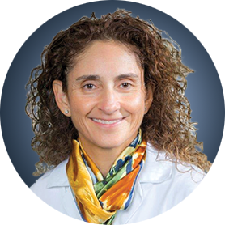
Faculty
Sara A Hurvitz, MD, FACP
Professor of Medicine
Smith Family Endowed Chair in Women’s Health
Senior Vice President, Clinical Research Division
Fred Hutchinson Cancer Center
Head, Division of Hematology/Oncology
Department of Medicine
UW Medicine
Seattle, Washington
MODERATOR
Neil Love, MD
Research To Practice
Miami, Florida
Virginia Kaklamani, MD, DSc
Professor of Medicine
Ruth McLean Bowman Bowers Chair in Breast Cancer Research and Treatment
AB Alexander Distinguished Chair in Oncology
Leader, Breast Oncology Program
UT Health San Antonio MD Anderson Cancer Center
San Antonio, Texas

Slide 3




Contributing Clinical Investigators
Harold J Burstein, MD, PhD
Director of Academic Partnerships
Institute Physician
Dana-Farber Cancer Institute
Professor of Medicine
Harvard Medical School
Boston, Massachusetts
Komal Jhaveri, MD, FACP, FASCO
Patricia and James Cayne Chair for Junior Faculty
Associate Attending Physician
Breast Medicine Service and Early Drug Development Service
Section Head, Endocrine Therapy Research Program
Clinical Director, Early Drug Development Service
Department of Medicine
Memorial Sloan Kettering Cancer Center
Associate Professor of Medicine
Weill Cornell College of Medicine
New York, New York
Professor Giuseppe Curigliano, MD, PhD
Clinical Director
Division of Early Drug Development for Innovative Therapy
Co-Chair, Cancer Experimental Therapeutics Program
Department of Oncology and Hemato-Oncology
University of Milano
European Institute of Oncology
Milano, Italy
Maryam Lustberg, MD, MPH
Professor of Internal Medicine (Medical Oncology)
Director, Center for Breast Cancer
Yale School of Medicine
New Haven, Connecticut

Slide 4
Commercial Support
This activity is supported by educational grants from Novartis and Stemline Therapeutics Inc.

Slide 5
Dr Love — Disclosures
Dr Love is president and CEO of Research To Practice. Research To Practice receives funds in the form of educational grants to develop CME activities from the following companies: Aadi Bioscience, AbbVie Inc, ADC Therapeutics, Agendia Inc, Alexion Pharmaceuticals, Amgen Inc, Array BioPharma Inc, a subsidiary of Pfizer Inc, Arvinas, Astellas, AstraZeneca Pharmaceuticals LP, Aveo Pharmaceuticals, Bayer HealthCare Pharmaceuticals, BeOne, Biotheranostics Inc, A Hologic Company, Black Diamond Therapeutics Inc, Blueprint Medicines, Boehringer Ingelheim Pharmaceuticals Inc, Bristol Myers Squibb, Celcuity, Clovis Oncology, Coherus BioSciences, Corcept Therapeutics Inc, CTI BioPharma, a Sobi Company, Daiichi Sankyo Inc, Eisai Inc, Elevation Oncology Inc, Exact Sciences Corporation, Exelixis Inc, Genentech, a member of the Roche Group, Genmab US Inc, Geron Corporation, Gilead Sciences Inc, GSK, Helsinn Therapeutics (US) Inc, ImmunoGen Inc, Incyte Corporation, Ipsen Biopharmaceuticals Inc, Jazz Pharmaceuticals Inc, Johnson & Johnson, Karyopharm Therapeutics, Kite, A Gilead Company, Kura Oncology, Legend Biotech, Lilly, MEI Pharma Inc, Merck, Mersana Therapeutics Inc, Mirati Therapeutics Inc, Mural Oncology Inc, Natera Inc, Novartis, Novartis Pharmaceuticals Corporation on behalf of Advanced Accelerator Applications, Novocure Inc, Nuvalent, Nuvation Bio Inc, Pfizer Inc, Pharmacyclics LLC, an AbbVie Company, Puma Biotechnology Inc, Regeneron Pharmaceuticals Inc, Revolution Medicines Inc, Rigel Pharmaceuticals Inc, R-Pharm US, Sanofi, Seagen Inc, Servier Pharmaceuticals LLC, SpringWorks Therapeutics Inc, Stemline Therapeutics Inc, Sumitomo Pharma America, Summit Therapeutics, Syndax Pharmaceuticals, Taiho Oncology Inc, Takeda Pharmaceuticals USA Inc, TerSera Therapeutics LLC, and Tesaro, A GSK Company.

Slide 6
Research To Practice CME Planning Committee Members,
Staff and Reviewers
Planners, scientific staff and independent reviewers for Research To Practice have no relevant financial relationships to disclose.

Slide 7
Dr Hurvitz — Disclosures
Faculty
Advisory Committees | Akari Therapeutics, BeOne, Boundless Bio, BriaCell, BridgeBio, Bristol Myers Squibb, Daiichi Sankyo Inc, Gilead Sciences Inc, Jazz Pharmaceuticals Inc, Lilly, Luminate, Mersana Therapeutics Inc, Novartis, Prelude Therapeutics, Roche Laboratories Inc
Consulting Agreements | ALX Oncology, Bayer HealthCare Pharmaceuticals, BeOne, Blueprint Medicines, Ellipses Pharma, EMBioSys, Genentech, a member of the Roche Group, Jazz Pharmaceuticals Inc, Myricx Bio
Contracted Research | AstraZeneca Pharmaceuticals LP, Daiichi Sankyo Inc, Menarini Group, Novartis, Stemline Therapeutics Inc
Data and Safety Monitoring Boards/Committees | Atossa Therapeutics (paid to institution), Roche Laboratories Inc (paid to UW)
Nonrelevant Financial Relationships | Alliance for Clinical Trials in Oncology Foundation, InClin, Quantum Leap Healthcare Collaborative, ROMTech (stocks for orthopedic device for postop pts; not cancer related)

Slide 8
Dr Kaklamani — Disclosures
Faculty
Consulting Agreements | AstraZeneca Pharmaceuticals LP, Daiichi Sankyo Inc, Genentech, a member of the Roche Group, Gilead Sciences Inc, Lilly, Menarini Group, Novartis, Pfizer Inc
Speakers Bureaus | AstraZeneca Pharmaceuticals LP, Gilead Sciences Inc

Slide 9
Dr Burstein — Disclosures
Contributing Clinical Investigator
No relevant financial relationships to disclose.

Slide 10
Prof Curigliano — Disclosures
Contributing Clinical Investigator
Advisory Committees, Consulting Agreements and Speakers Bureaus | AstraZeneca Pharmaceuticals LP, Daiichi Sankyo Inc, Gilead Sciences Inc, Lilly, Menarini Group, Novartis, Pfizer Inc
Data and Safety Monitoring Boards/Committees | Roche Laboratories Inc

Slide 11
Dr Jhaveri — Disclosures
Contributing Clinical Investigator
Advisory Committees and Consulting Agreements | Arvinas, AstraZeneca Pharmaceuticals LP, BeOne, Bicycle Therapeutics, Blueprint Medicines, BridgeBio Oncology Therapeutics, ConcertAI, Daiichi Sankyo Inc, Eisai Inc, Genentech, a member of the Roche Group, Gilead Sciences Inc, Halda Therapeutics, Loxo Oncology Inc, a wholly owned subsidiary of Eli Lilly & Company, Merck, Mersana Therapeutics Inc, Natera Inc, Novartis, Olema Oncology, Pfizer Inc, Precede Biosciences, RayzeBio, Relay Therapeutics, Scorpion Therapeutics, Zymeworks Inc
Contracted Research | AstraZeneca Pharmaceuticals LP, Bicycle Therapeutics, Blueprint Medicines, BridgeBio Oncology Therapeutics, Eisai Inc, Genentech, a member of the Roche Group, Gilead Sciences Inc, Loxo Oncology Inc, a wholly owned subsidiary of Eli Lilly & Company, Merck, Novartis, Pfizer Inc, Puma Biotechnology Inc, RayzeBio Inc, Scorpion Therapeutics, Zymeworks Inc

Slide 12
Dr Lustberg — Disclosures
Contributing Clinical Investigator
Consulting Agreements | Astellas, AstraZeneca Pharmaceuticals LP, Bayer HealthCare Pharmaceuticals, Daiichi Sankyo Inc, Gilead Sciences Inc, Lilly, Menarini Group, Novartis, Pfizer Inc, Sandoz Inc, a Novartis Division
Contracted Research | Astellas, AstraZeneca Pharmaceuticals LP

Slide 13
This educational activity contains discussion of
non-FDA-approved uses of agents and regimens. Please refer to official prescribing information for each product for approved indications.

Slide 14
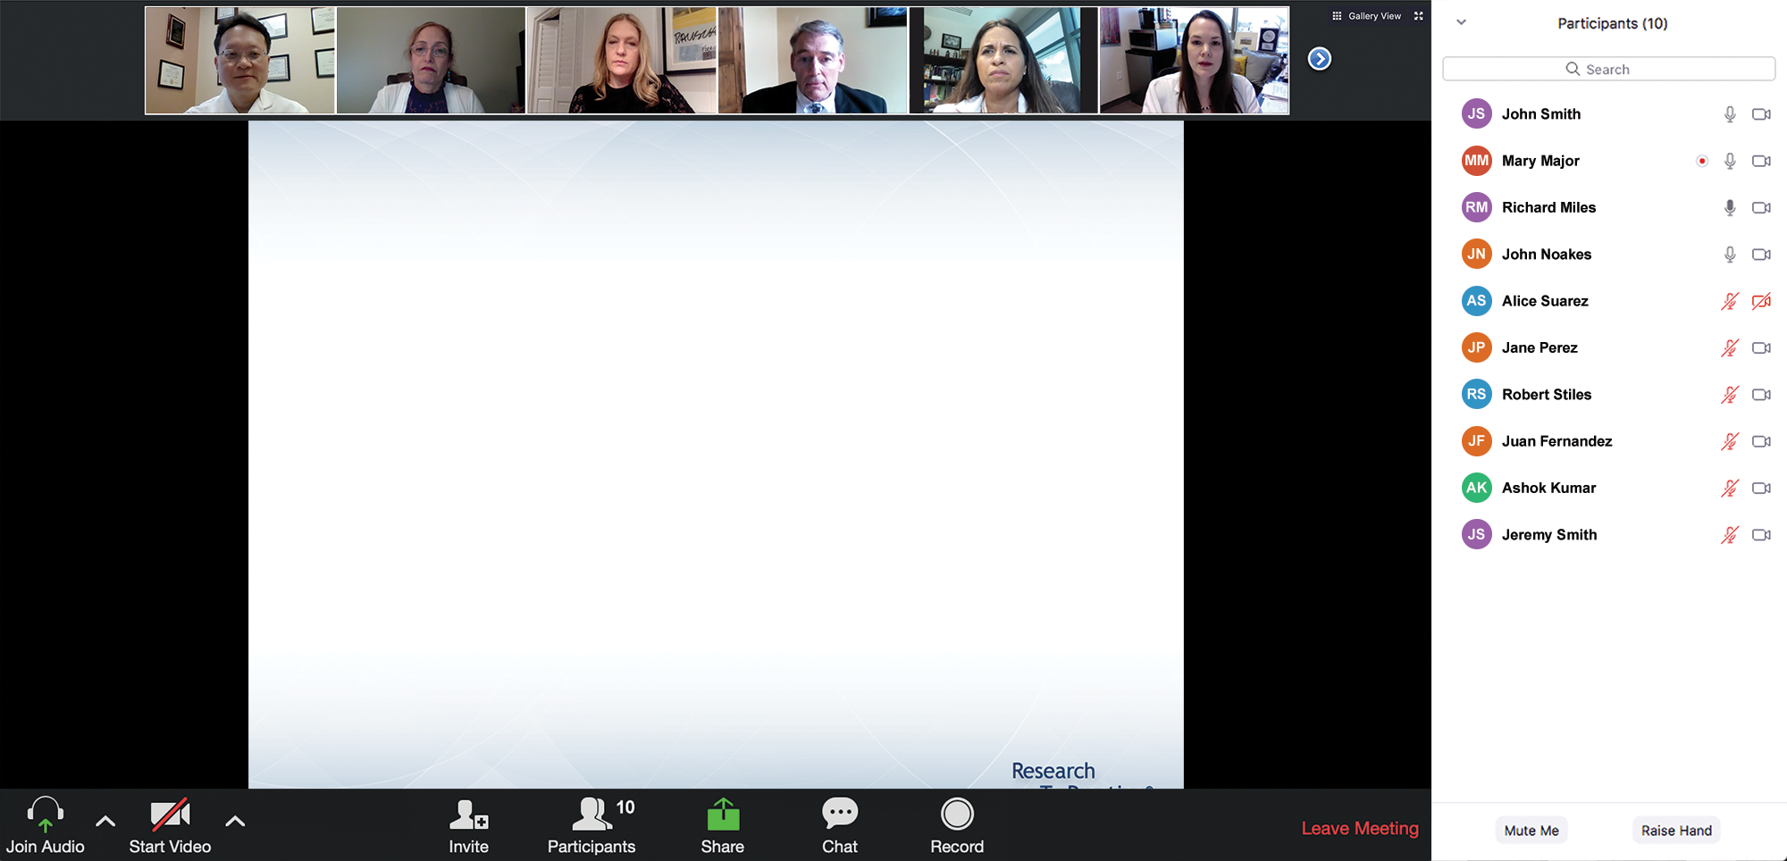

We Encourage Clinicians in Practice to Submit Questions
Feel free to submit questions now before the program begins and throughout the program.

Slide 15
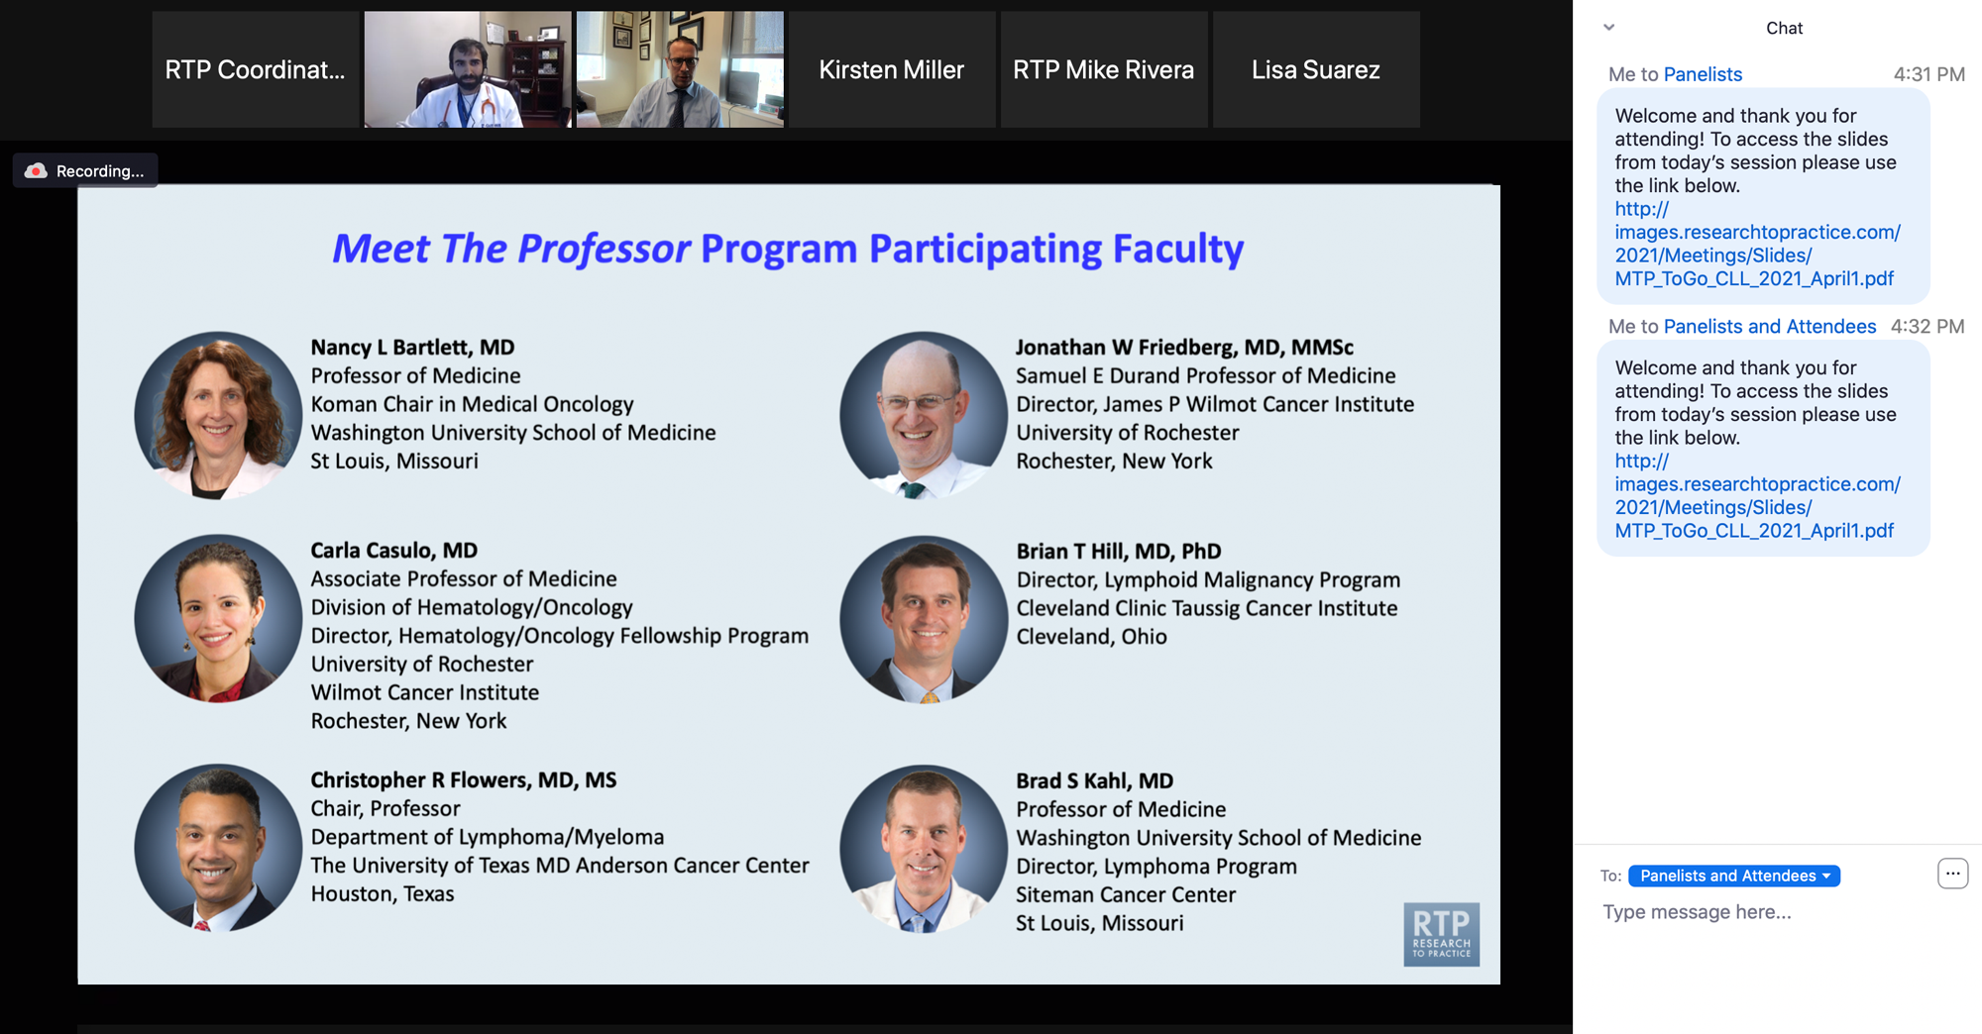
Familiarizing Yourself with the Zoom Interface
Expand chat submission box
Drag the white line above the submission box up to create
more space for your message.

Slide 16
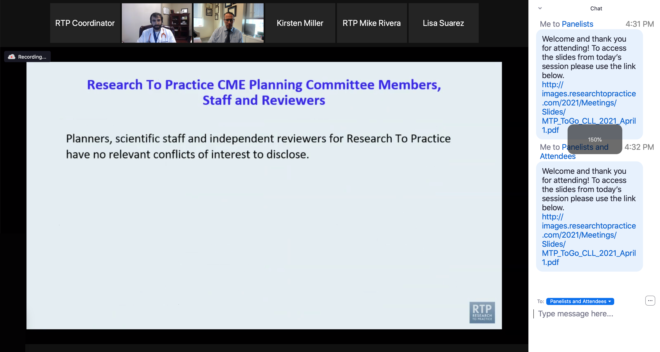
Familiarizing Yourself with the Zoom Interface
Increase chat font size
Press Command (for Mac) or Control (for PC) and the + symbol.
You may do this as many times as you need for readability.

Slide 17
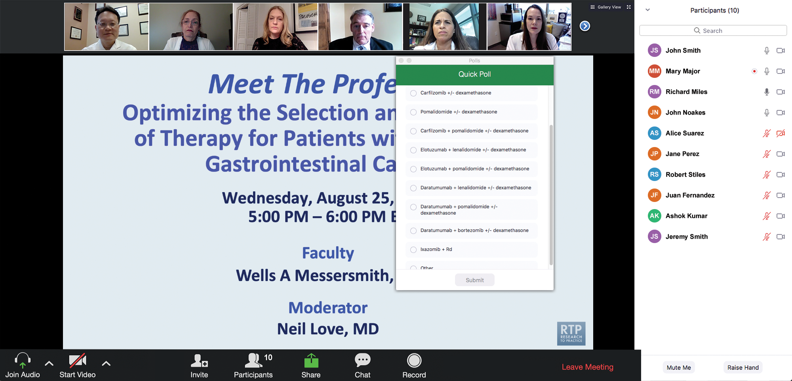
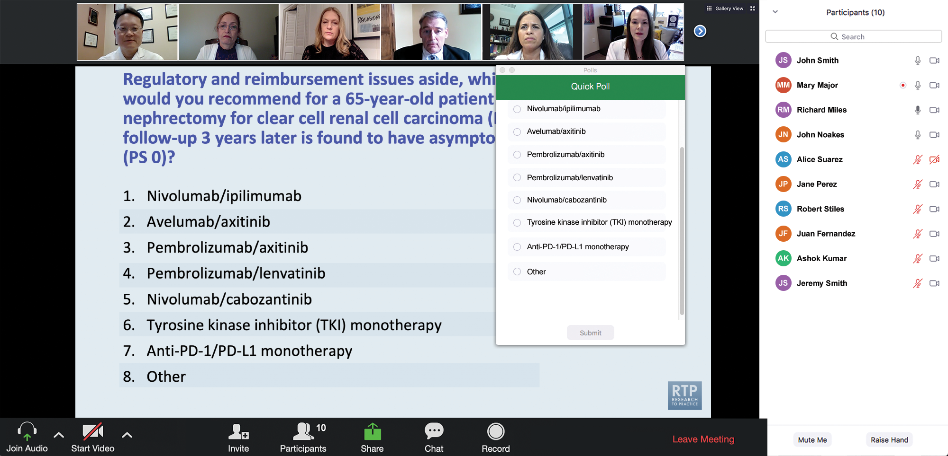
Clinicians in the Audience, Please Complete the Pre- and Postmeeting Surveys
Quick Survey
Quick Poll

Slide 18
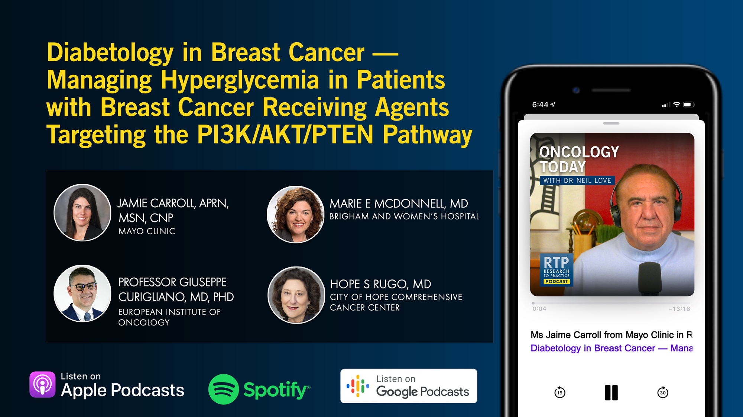

Slide 19
Year in Review: Clinical Investigator Perspectives on the
Most Relevant New Datasets and Advances in Oncology
Colorectal Cancer
A CME/MOC-Accredited Live Webinar
Thursday, April 16, 2026
5:00 PM – 6:00 PM ET
Faculty
Arvind Dasari, MD, MS
Anwaar Saeed, MD
Moderator
Neil Love, MD

Slide 20
Fifth Annual National General Medical Oncology Summit
A Multitumor CME/MOC-, NCPD- and ACPE-Accredited Educational Conference
Developed in Partnership with Florida Cancer Specialists & Research Institute
The Ritz-Carlton Orlando, Grande Lakes | Orlando, Florida
Friday, April 24, 2026
Fellows Welcome!
7:00 PM – 9:00 PM
Keynote Session: Diffuse Large B-Cell Lymphoma and Follicular Lymphoma
Manali Kamdar, MD, MBBS
Krish Patel, MD
Gilles Salles, MD, PhD

Slide 21
Fifth Annual National General Medical Oncology Summit
Saturday, April 25, 2026
8:00 AM – 8:50 AM
Chronic Lymphocytic Leukemia
John N Allan, MD
Adam Kittai, MD
8:50 AM – 9:40 AM
Pancreatic Cancer
Eileen M O’Reilly, MD
Philip A Philip, MD, PhD
10:00 AM – 10:50 AM
Ovarian Cancer
Deborah K Armstrong, MD
David M O’Malley, MD
10:50 AM – 11:40 AM
Relapsed/Refractory Multiple Myeloma
Hans Lee, MD
Noopur Raje, MD
11:40 AM – 12:30 PM
Gastroesophageal Cancers
Yelena Y Janjigian, MD
Samuel J Klempner, MD
1:20 PM – 2:10 PM
Desmoid Tumors and Soft Tissue Sarcoma
Mrinal Gounder, MD
Richard F Riedel, MD

Slide 22
Fifth Annual National General Medical Oncology Summit
Saturday, April 25, 2026
Sunday, April 26, 2026
2:10 PM – 3:00 PM
Urothelial Bladder Cancer
Terence Friedlander, MD
Daniel P Petrylak, MD
3:20 PM – 4:10 PM
Triple-Negative Breast Cancer
Adam M Brufsky, MD, PhD
Kevin Kalinsky, MD, MS, FASCO
4:10 PM – 5:00 PM
HER2-Positive Breast Cancer
Erika Hamilton, MD
Shanu Modi, MD
8:00 AM – 9:40 AM
HR-Positive Breast Cancer
Erika Hamilton, MD
Jane Lowe Meisel, MD
Joyce O’Shaughnessy, MD
Seth Wander, MD, PhD
9:40 AM – 10:30 AM
Colorectal Cancer
Kristen K Ciombor, MD, MSCI
John Strickler, MD

Slide 23
Fifth Annual National General Medical Oncology Summit
Sunday, April 26, 2026
10:50 AM – 11:40 AM
EGFR-Mutated Non-Small Cell
Lung Cancer
Jonathan Goldman, MD
Zofia Piotrowska, MD, MHS
11:40 AM – 12:30 PM
Prostate Cancer
Neeraj Agarwal, MD, FASCO
Alan H Bryce, MD
1:15 PM – 2:05 PM
Myelofibrosis and Systemic Mastocytosis
Anthony M Hunter, MD
Abdulraheem Yacoub, MD
2:05 PM – 2:55 PM
Targeted Therapies for Non-Small Cell Lung Cancer
Lyudmila Bazhenova, MD
Corey J Langer, MD
2:55 PM – 3:45 PM
Acute Myeloid Leukemia
Courtney D DiNardo, MD, MSCE
Harry Paul Erba, MD, PhD

Slide 24
What Clinicians Want to Know: Optimizing the Management of Metastatic Triple-Negative Breast Cancer
A CME/MOC-Accredited Live Webinar
Thursday, April 30, 2026
5:00 PM – 6:00 PM ET
Faculty
Kevin Punie, MD
Tiffany A Traina, MD, FASCO
Moderator
Neil Love, MD

Slide 25
Recent Advances in Cancer Care — New Paradigms,
Novel Agents and What It Means for the Oncology Nurse
A Complimentary NCPD Symposium Series Held During the 51st Annual ONS Congress May 13-16
Antibody-Drug Conjugates
Wednesday, May 13, 2026 | 12:15 PM – 1:45 PM CT
Targeting the PI3K/AKT/mTOR Pathway in
HR-Positive Metastatic Breast Cancer
Friday, May 15, 2026 | 12:15 PM – 1:45 PM CT
Ovarian Cancer
Wednesday, May 13, 2026 | 6:00 PM – 7:30 PM CT
Non-Hodgkin Lymphoma and Chronic
Lymphocytic Leukemia
Friday, May 15, 2026 | 6:00 PM – 8:00 PM CT
Endometrial Cancer
Thursday, May 14, 2026 | 6:00 AM – 7:30 AM CT
CDK4/6 Inhibitors for HR-Positive Breast Cancer
Saturday, May 16, 2026 | 6:00 AM – 7:30 AM CT
Prostate Cancer
Thursday, May 14, 2026 | 12:15 PM – 1:45 PM CT
Non-Muscle-Invasive and Muscle-Invasive Bladder Cancer
Thursday, May 14, 2026 | 6:00 PM – 7:30 PM CT
Relapsed/Refractory Multiple Myeloma
Saturday, May 16, 2026 | 12:15 PM – 1:45 PM CT
Pancreatic Cancer
Friday, May 15, 2026 | 6:00 AM – 7:30 AM CT
Oral SERDs for Breast Cancer
Saturday, May 16, 2026 | 6:00 PM – 7:30 PM CT

Slide 26
Grand Rounds
CME/MOC-Accredited Interactive Series
Regional Activities
Three Series
Optimizing Treatment
for Patients with Relapsed/Refractory Chronic Lymphocytic Leukemia
Optimizing the Use of
Novel Therapies for Patients with Diffuse
Large B-Cell Lymphoma
Optimizing Therapy for Patients with Hormone Receptor-Positive
Localized Breast Cancer
Host a 1-hour session at your institution:
Email Meetings@ResearchToPractice.com
or call (800) 233-6153

Slide 27
Thank you for joining us! Please take a moment to complete the survey currently up on Zoom.
Your feedback is very important to us.
Information on how to obtain CME, ABIM MOC and ABS credit will be provided at the conclusion of the activity in the Zoom chat room. Attendees will also receive an email in 1 to 3 business days with these instructions.

Slide 28
Consensus or Controversy? Clinical Investigators Discuss and Debate Current Approaches to First- and Second-Line Therapy for HR-Positive Metastatic Breast Cancer
A CME/MOC-Accredited Live Webinar
Wednesday, April 15, 2026
5:00 PM – 6:00 PM ET
Faculty
Sara A Hurvitz, MD, FACP
Virginia Kaklamani, MD, DSc
Moderator
Neil Love, MD

Slide 29
Faculty
Sara A Hurvitz, MD, FACP
Professor of Medicine
Smith Family Endowed Chair in Women’s Health
Senior Vice President, Clinical Research Division
Fred Hutchinson Cancer Center
Head, Division of Hematology/Oncology
Department of Medicine
UW Medicine
Seattle, Washington
MODERATOR
Neil Love, MD
Research To Practice
Miami, Florida
Virginia Kaklamani, MD, DSc
Professor of Medicine
Ruth McLean Bowman Bowers Chair in Breast Cancer Research and Treatment
AB Alexander Distinguished Chair in Oncology
Leader, Breast Oncology Program
UT Health San Antonio MD Anderson Cancer Center
San Antonio, Texas

Slide 30
Contributing Clinical Investigators
Harold J Burstein, MD, PhD
Director of Academic Partnerships
Institute Physician
Dana-Farber Cancer Institute
Professor of Medicine
Harvard Medical School
Boston, Massachusetts
Komal Jhaveri, MD, FACP, FASCO
Patricia and James Cayne Chair for Junior Faculty
Associate Attending Physician
Breast Medicine Service and Early Drug Development Service
Section Head, Endocrine Therapy Research Program
Clinical Director, Early Drug Development Service
Department of Medicine
Memorial Sloan Kettering Cancer Center
Associate Professor of Medicine
Weill Cornell College of Medicine
New York, New York
Professor Giuseppe Curigliano, MD, PhD
Clinical Director
Division of Early Drug Development for Innovative Therapy
Co-Chair, Cancer Experimental Therapeutics Program
Department of Oncology and Hemato-Oncology
University of Milano
European Institute of Oncology
Milano, Italy
Maryam Lustberg, MD, MPH
Professor of Internal Medicine (Medical Oncology)
Director, Center for Breast Cancer
Yale School of Medicine
New Haven, Connecticut

Slide 31
We Encourage Clinicians in Practice to Submit Questions
Feel free to submit questions now before the program begins and throughout the program.

Slide 32
Clinicians in the Audience, Please Complete the Pre- and Postmeeting Surveys
Quick Survey
Quick Poll

Slide 34
Year in Review: Clinical Investigator Perspectives on the
Most Relevant New Datasets and Advances in Oncology
Colorectal Cancer
A CME/MOC-Accredited Live Webinar
Thursday, April 16, 2026
5:00 PM – 6:00 PM ET
Faculty
Arvind Dasari, MD, MS
Anwaar Saeed, MD
Moderator
Neil Love, MD

Slide 35
Fifth Annual National General Medical Oncology Summit
A Multitumor CME/MOC-, NCPD- and ACPE-Accredited Educational Conference
Developed in Partnership with Florida Cancer Specialists & Research Institute
The Ritz-Carlton Orlando, Grande Lakes | Orlando, Florida
Friday, April 24, 2026
Fellows Welcome!
7:00 PM – 9:00 PM
Keynote Session: Diffuse Large B-Cell Lymphoma and Follicular Lymphoma
Manali Kamdar, MD, MBBS
Krish Patel, MD
Gilles Salles, MD, PhD

Slide 36
Fifth Annual National General Medical Oncology Summit
Saturday, April 25, 2026
8:00 AM – 8:50 AM
Chronic Lymphocytic Leukemia
John N Allan, MD
Adam Kittai, MD
8:50 AM – 9:40 AM
Pancreatic Cancer
Eileen M O’Reilly, MD
Philip A Philip, MD, PhD
10:00 AM – 10:50 AM
Ovarian Cancer
Deborah K Armstrong, MD
David M O’Malley, MD
10:50 AM – 11:40 AM
Relapsed/Refractory Multiple Myeloma
Hans Lee, MD
Noopur Raje, MD
11:40 AM – 12:30 PM
Gastroesophageal Cancers
Yelena Y Janjigian, MD
Samuel J Klempner, MD
1:20 PM – 2:10 PM
Desmoid Tumors and Soft Tissue Sarcoma
Mrinal Gounder, MD
Richard F Riedel, MD

Slide 37
Fifth Annual National General Medical Oncology Summit
Saturday, April 25, 2026
Sunday, April 26, 2026
2:10 PM – 3:00 PM
Urothelial Bladder Cancer
Terence Friedlander, MD
Daniel P Petrylak, MD
3:20 PM – 4:10 PM
Triple-Negative Breast Cancer
Adam M Brufsky, MD, PhD
Kevin Kalinsky, MD, MS, FASCO
4:10 PM – 5:00 PM
HER2-Positive Breast Cancer
Erika Hamilton, MD
Shanu Modi, MD
8:00 AM – 9:40 AM
HR-Positive Breast Cancer
Erika Hamilton, MD
Jane Lowe Meisel, MD
Joyce O’Shaughnessy, MD
Seth Wander, MD, PhD
9:40 AM – 10:30 AM
Colorectal Cancer
Kristen K Ciombor, MD, MSCI
John Strickler, MD

Slide 38
Fifth Annual National General Medical Oncology Summit
Sunday, April 26, 2026
10:50 AM – 11:40 AM
EGFR-Mutated Non-Small Cell
Lung Cancer
Jonathan Goldman, MD
Zofia Piotrowska, MD, MHS
11:40 AM – 12:30 PM
Prostate Cancer
Neeraj Agarwal, MD, FASCO
Alan H Bryce, MD
1:15 PM – 2:05 PM
Myelofibrosis and Systemic Mastocytosis
Anthony M Hunter, MD
Abdulraheem Yacoub, MD
2:05 PM – 2:55 PM
Targeted Therapies for Non-Small Cell Lung Cancer
Lyudmila Bazhenova, MD
Corey J Langer, MD
2:55 PM – 3:45 PM
Acute Myeloid Leukemia
Courtney D DiNardo, MD, MSCE
Harry Paul Erba, MD, PhD

Slide 39
What Clinicians Want to Know: Optimizing the Management of Metastatic Triple-Negative Breast Cancer
A CME/MOC-Accredited Live Webinar
Thursday, April 30, 2026
5:00 PM – 6:00 PM ET
Faculty
Kevin Punie, MD
Tiffany A Traina, MD, FASCO
Moderator
Neil Love, MD

Slide 40
Recent Advances in Cancer Care — New Paradigms,
Novel Agents and What It Means for the Oncology Nurse
A Complimentary NCPD Symposium Series Held During the 51st Annual ONS Congress May 13-16
Antibody-Drug Conjugates
Wednesday, May 13, 2026 | 12:15 PM – 1:45 PM CT
Targeting the PI3K/AKT/mTOR Pathway in
HR-Positive Metastatic Breast Cancer
Friday, May 15, 2026 | 12:15 PM – 1:45 PM CT
Ovarian Cancer
Wednesday, May 13, 2026 | 6:00 PM – 7:30 PM CT
Non-Hodgkin Lymphoma and Chronic
Lymphocytic Leukemia
Friday, May 15, 2026 | 6:00 PM – 8:00 PM CT
Endometrial Cancer
Thursday, May 14, 2026 | 6:00 AM – 7:30 AM CT
CDK4/6 Inhibitors for HR-Positive Breast Cancer
Saturday, May 16, 2026 | 6:00 AM – 7:30 AM CT
Prostate Cancer
Thursday, May 14, 2026 | 12:15 PM – 1:45 PM CT
Non-Muscle-Invasive and Muscle-Invasive Bladder Cancer
Thursday, May 14, 2026 | 6:00 PM – 7:30 PM CT
Relapsed/Refractory Multiple Myeloma
Saturday, May 16, 2026 | 12:15 PM – 1:45 PM CT
Pancreatic Cancer
Friday, May 15, 2026 | 6:00 AM – 7:30 AM CT
Oral SERDs for Breast Cancer
Saturday, May 16, 2026 | 6:00 PM – 7:30 PM CT

Slide 41
Grand Rounds
CME/MOC-Accredited Interactive Series
Regional Activities
Three Series
Optimizing Treatment
for Patients with Relapsed/Refractory Chronic Lymphocytic Leukemia
Optimizing the Use of
Novel Therapies for Patients with Diffuse
Large B-Cell Lymphoma
Optimizing Therapy for Patients with Hormone Receptor-Positive
Localized Breast Cancer
Host a 1-hour session at your institution:
Email Meetings@ResearchToPractice.com
or call (800) 233-6153

Slide 42
Consensus or Controversy? Clinical Investigators Discuss and Debate Current Approaches to First- and Second-Line Therapy for HR-Positive Metastatic Breast Cancer
A CME/MOC-Accredited Live Webinar
Wednesday, April 15, 2026
5:00 PM – 6:00 PM ET
Faculty
Sara A Hurvitz, MD, FACP
Virginia Kaklamani, MD, DSc
Moderator
Neil Love, MD

Slide 43
Dr Hurvitz — Disclosures
Faculty
Advisory Committees | Akari Therapeutics, BeOne, Boundless Bio, BriaCell, BridgeBio, Bristol Myers Squibb, Daiichi Sankyo Inc, Gilead Sciences Inc, Jazz Pharmaceuticals Inc, Lilly, Luminate, Mersana Therapeutics Inc, Novartis, Prelude Therapeutics, Roche Laboratories Inc
Consulting Agreements | ALX Oncology, Bayer HealthCare Pharmaceuticals, BeOne, Blueprint Medicines, Ellipses Pharma, EMBioSys, Genentech, a member of the Roche Group, Jazz Pharmaceuticals Inc, Myricx Bio
Contracted Research | AstraZeneca Pharmaceuticals LP, Daiichi Sankyo Inc, Menarini Group, Novartis, Stemline Therapeutics Inc
Data and Safety Monitoring Boards/Committees | Atossa Therapeutics (paid to institution), Roche Laboratories Inc (paid to UW)
Nonrelevant Financial Relationships | Alliance for Clinical Trials in Oncology Foundation, InClin, Quantum Leap Healthcare Collaborative, ROMTech (stocks for orthopedic device for postop pts; not cancer related)

Slide 44
Dr Kaklamani — Disclosures
Faculty
Consulting Agreements | AstraZeneca Pharmaceuticals LP, Daiichi Sankyo Inc, Genentech, a member of the Roche Group, Gilead Sciences Inc, Lilly, Menarini Group, Novartis, Pfizer Inc
Speakers Bureaus | AstraZeneca Pharmaceuticals LP, Gilead Sciences Inc

Slide 45
Dr Burstein — Disclosures
Contributing Clinical Investigator
No relevant financial relationships to disclose.

Slide 46
Prof Curigliano — Disclosures
Contributing Clinical Investigator
Advisory Committees, Consulting Agreements and Speakers Bureaus | AstraZeneca Pharmaceuticals LP, Daiichi Sankyo Inc, Gilead Sciences Inc, Lilly, Menarini Group, Novartis, Pfizer Inc
Data and Safety Monitoring Boards/Committees | Roche Laboratories Inc

Slide 47
Dr Jhaveri — Disclosures
Contributing Clinical Investigator
Advisory Committees and Consulting Agreements | Arvinas, AstraZeneca Pharmaceuticals LP, BeOne, Bicycle Therapeutics, Blueprint Medicines, BridgeBio Oncology Therapeutics, ConcertAI, Daiichi Sankyo Inc, Eisai Inc, Genentech, a member of the Roche Group, Gilead Sciences Inc, Halda Therapeutics, Loxo Oncology Inc, a wholly owned subsidiary of Eli Lilly & Company, Merck, Mersana Therapeutics Inc, Natera Inc, Novartis, Olema Oncology, Pfizer Inc, Precede Biosciences, RayzeBio, Relay Therapeutics, Scorpion Therapeutics, Zymeworks Inc
Contracted Research | AstraZeneca Pharmaceuticals LP, Bicycle Therapeutics, Blueprint Medicines, BridgeBio Oncology Therapeutics, Eisai Inc, Genentech, a member of the Roche Group, Gilead Sciences Inc, Loxo Oncology Inc, a wholly owned subsidiary of Eli Lilly & Company, Merck, Novartis, Pfizer Inc, Puma Biotechnology Inc, RayzeBio Inc, Scorpion Therapeutics, Zymeworks Inc

Slide 48
Dr Lustberg — Disclosures
Contributing Clinical Investigator
Consulting Agreements | Astellas, AstraZeneca Pharmaceuticals LP, Bayer HealthCare Pharmaceuticals, Daiichi Sankyo Inc, Gilead Sciences Inc, Lilly, Menarini Group, Novartis, Pfizer Inc, Sandoz Inc, a Novartis Division
Contracted Research | Astellas, AstraZeneca Pharmaceuticals LP

Slide 49
Dr Love — Disclosures
Dr Love is president and CEO of Research To Practice. Research To Practice receives funds in the form of educational grants to develop CME activities from the following companies: Aadi Bioscience, AbbVie Inc, ADC Therapeutics, Agendia Inc, Alexion Pharmaceuticals, Amgen Inc, Array BioPharma Inc, a subsidiary of Pfizer Inc, Arvinas, Astellas, AstraZeneca Pharmaceuticals LP, Aveo Pharmaceuticals, Bayer HealthCare Pharmaceuticals, BeOne, Biotheranostics Inc, A Hologic Company, Black Diamond Therapeutics Inc, Blueprint Medicines, Boehringer Ingelheim Pharmaceuticals Inc, Bristol Myers Squibb, Celcuity, Clovis Oncology, Coherus BioSciences, Corcept Therapeutics Inc, CTI BioPharma, a Sobi Company, Daiichi Sankyo Inc, Eisai Inc, Elevation Oncology Inc, Exact Sciences Corporation, Exelixis Inc, Genentech, a member of the Roche Group, Genmab US Inc, Geron Corporation, Gilead Sciences Inc, GSK, Helsinn Therapeutics (US) Inc, ImmunoGen Inc, Incyte Corporation, Ipsen Biopharmaceuticals Inc, Jazz Pharmaceuticals Inc, Johnson & Johnson, Karyopharm Therapeutics, Kite, A Gilead Company, Kura Oncology, Legend Biotech, Lilly, MEI Pharma Inc, Merck, Mersana Therapeutics Inc, Mirati Therapeutics Inc, Mural Oncology Inc, Natera Inc, Novartis, Novartis Pharmaceuticals Corporation on behalf of Advanced Accelerator Applications, Novocure Inc, Nuvalent, Nuvation Bio Inc, Pfizer Inc, Pharmacyclics LLC, an AbbVie Company, Puma Biotechnology Inc, Regeneron Pharmaceuticals Inc, Revolution Medicines Inc, Rigel Pharmaceuticals Inc, R-Pharm US, Sanofi, Seagen Inc, Servier Pharmaceuticals LLC, SpringWorks Therapeutics Inc, Stemline Therapeutics Inc, Sumitomo Pharma America, Summit Therapeutics, Syndax Pharmaceuticals, Taiho Oncology Inc, Takeda Pharmaceuticals USA Inc, TerSera Therapeutics LLC, and Tesaro, A GSK Company.

Slide 50
Commercial Support
This activity is supported by educational grants from Novartis and Stemline Therapeutics Inc.
Research To Practice CME Planning Committee Members,
Staff and Reviewers
Planners, scientific staff and independent reviewers for Research To Practice have no relevant financial relationships to disclose.

Slide 51
This educational activity contains discussion of
non-FDA-approved uses of agents and regimens. Please refer to official prescribing information for each product for approved indications.

Slide 52
Agenda
Introduction: Which Biomarkers and When
Module 1: Optimizing First-Line Therapy for Patients with Hormone Receptor (HR)-Positive Metastatic Breast Cancer (mBC)
Biomarker-based selection of first-line treatment
Use of SERENA-6 strategy
Use of inavolisib triplet
Module 2: Management of HR-Positive mBC Progressing on a CDK4/6 Inhibitor and Endocrine Therapy
Biomarker-based selection of second-line treatment
Use of selective estrogen receptor degrader (SERD) monotherapy
Use of AKT inhibitors

Slide 53
Agenda
Introduction: Which Biomarkers and When
Module 1: Optimizing First-Line Therapy for Patients with Hormone Receptor (HR)-Positive Metastatic Breast Cancer (mBC)
Biomarker-based selection of first-line treatment
Use of SERENA-6 strategy
Use of inavolisib triplet
Module 2: Management of HR-Positive mBC Progressing on a CDK4/6 Inhibitor and Endocrine Therapy
Biomarker-based selection of second-line treatment
Use of selective estrogen receptor degrader (SERD) monotherapy
Use of AKT inhibitors

Slide 54


Slide 55
At what point do you typically first assess ESR1 mutation status in your patients with ER-positive, HER2-negative breast cancer?
After disease progression on first-line therapy
for metastatic disease
After disease progression as long as pt is
still candidate for hormone therapy
At diagnosis of metastasis
After disease progression on first-line therapy for metastatic disease
After disease progression on first-line therapy for metastatic disease
After disease progression on first-line therapy for metastatic disease

Slide 56
Which ESR1 testing method do you use in your practice?
How would you compare the sensitivity of blood-based circulating tumor DNA (ctDNA) testing to that of tissue testing in assessing for the presence of ESR1 mutations?
Testing method
Sensitivity
ctDNA testing
ctDNA testing is more sensitive
ctDNA testing
ctDNA testing is more sensitive
Both
Tissue testing is more sensitive
ctDNA testing
ctDNA testing is more sensitive
ctDNA testing
ctDNA testing is more sensitive
ctDNA testing
ctDNA testing is more sensitive

Slide 57
Agenda
Introduction: Which Biomarkers and When
Module 1: Optimizing First-Line Therapy for Patients with Hormone Receptor (HR)-Positive Metastatic Breast Cancer (mBC)
Biomarker-based selection of first-line treatment
Use of SERENA-6 strategy
Use of inavolisib triplet
Module 2: Management of HR-Positive mBC Progressing on a CDK4/6 Inhibitor and Endocrine Therapy
Biomarker-based selection of second-line treatment
Use of selective estrogen receptor degrader (SERD) monotherapy
Use of AKT inhibitors

Slide 58
Dr Kaklamani: Case Presentation 1
56 yo postmenopausal patient who was diagnosed with de novo metastatic disease to the liver and bones.
Patient presented to her PCP with back pain. Xrays showed lesions in her T and L spine. Follow-up imaging showed a L breast mass and liver lesions. She had a biopsy of the breast mass and the liver lesion showing IDC ER 90%, PR 80% HER2 1+. NGS testing didn’t show any actionable mutations and genetic testing was negative.
She was started on ribociclib, letrozole and denosumab.
After 1 mo of treatment her back pain subsided and staging scans showed partial response.
She remained on therapy with ribociclib and letrozole for a total of 42 mo until she had disease progression in her bones with new bone lesions.
Liquid biopsy negative. She was started on everolimus/fulvestrant.

Slide 59
Agenda
Introduction: Which Biomarkers and When
Module 1: Optimizing First-Line Therapy for Patients with Hormone Receptor (HR)-Positive Metastatic Breast Cancer (mBC)
Biomarker-based selection of first-line treatment
Use of SERENA-6 strategy
Use of inavolisib triplet
Module 2: Management of HR-Positive mBC Progressing on a CDK4/6 Inhibitor and Endocrine Therapy
Biomarker-based selection of second-line treatment
Use of selective estrogen receptor degrader (SERD) monotherapy
Use of AKT inhibitors

Slide 61
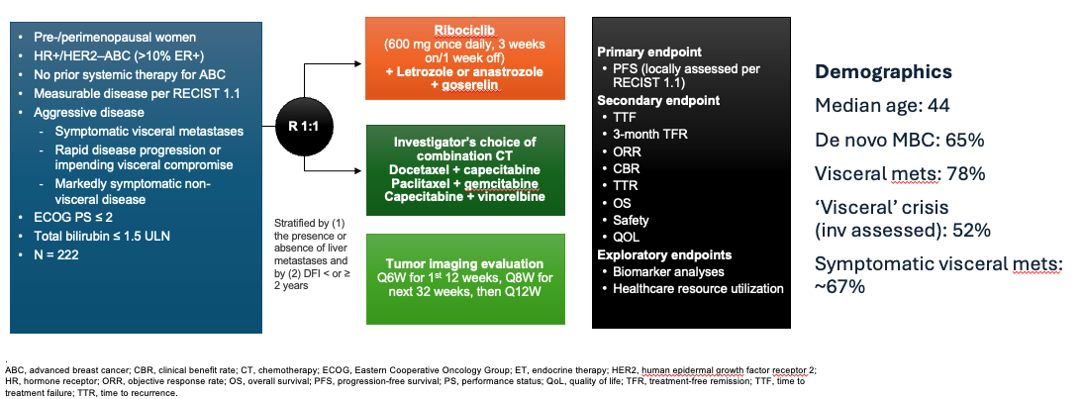
RIGHT Choice Phase II Study of First-Line ET/Ribociclib for Premenopausal Woman with mBC and Visceral Crisis or Symptomatic Disease
Courtesy of Hope S Rugo, MD

Slide 62
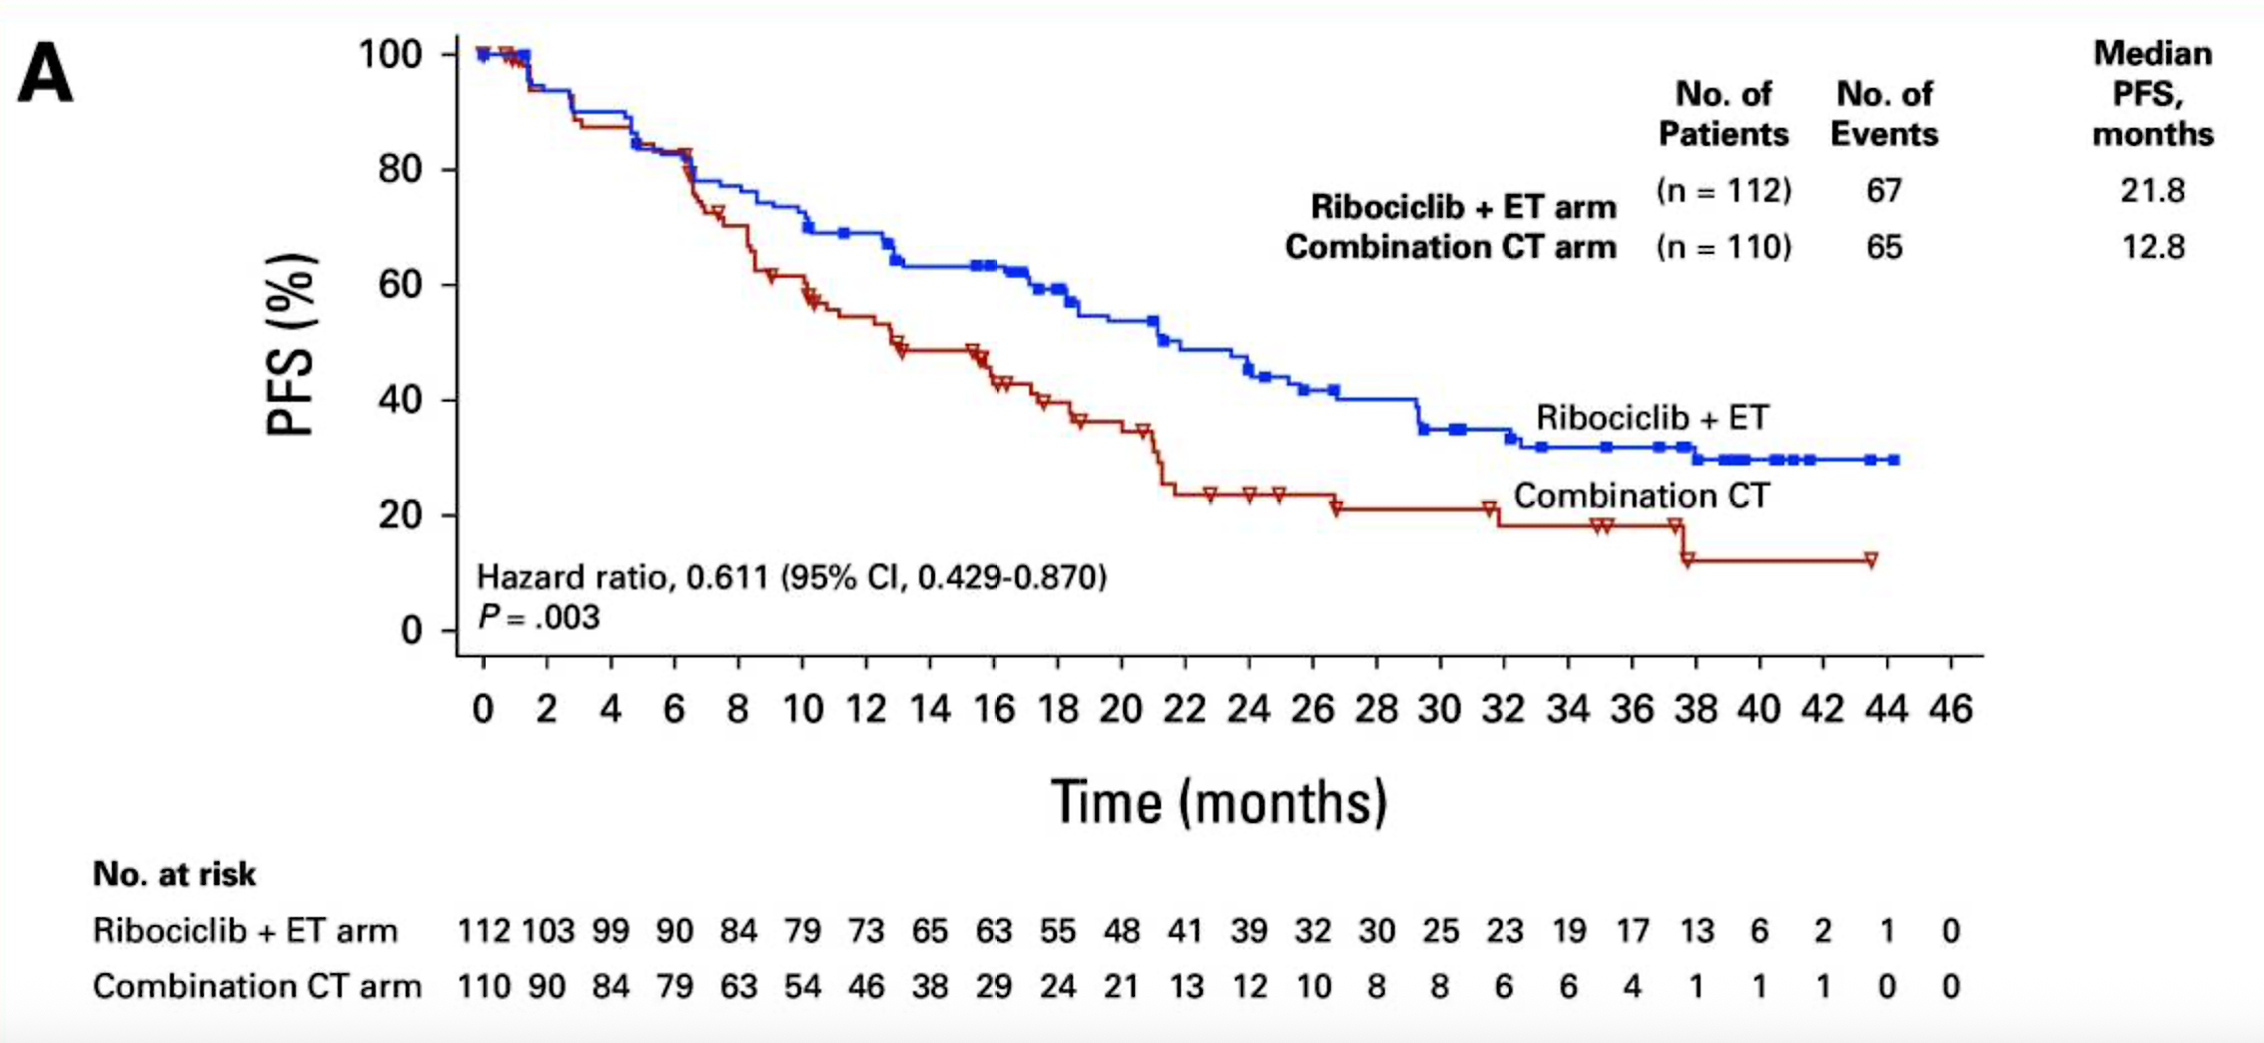
RIGHT Choice Final Results: Efficacy Outcomes
Overall response rate (ET/R vs CT):
66.1% vs 61.8%
CR: 6.3% vs 2.7%
Time to response (ET/R vs CT):
4.9 mo vs 3.2 mo
HR 0.76
PFS = progression-free survival; ET = endocrine therapy; R = ribociclib; CT = combination chemotherapy
Lu Y-S et al. J Clin Oncol 2024;42(23):2812-21.

Slide 63
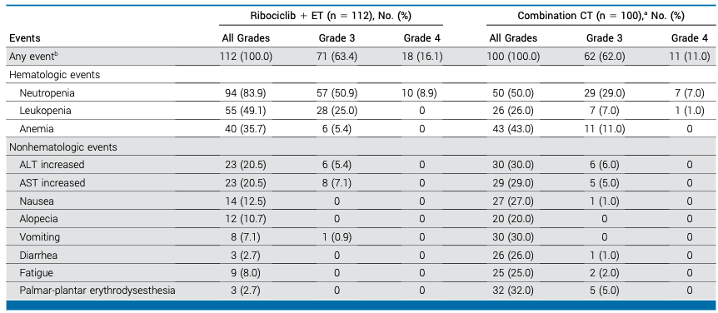
RIGHT CHOICE Final Results: Safety Summary
Lu Y-S et al. J Clin Oncol 2024;42(23):2812-21.

Slide 64
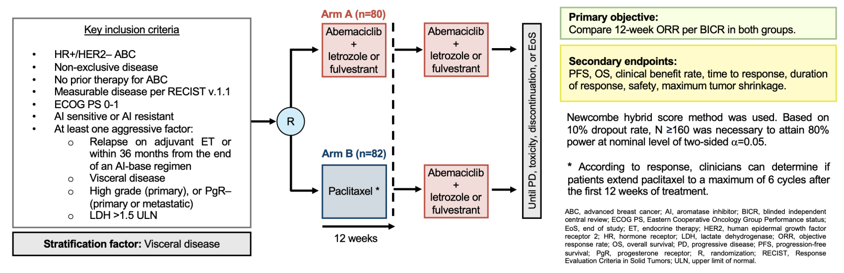
ABIGAIL Phase II Study of Abemaciclib/ET with or without Paclitaxel Induction for Patients with mBC and Aggressive Disease Criteria
de la Haba-Rodriguez J et al. ESMO 2024;Abstract LBA23.

Slide 65
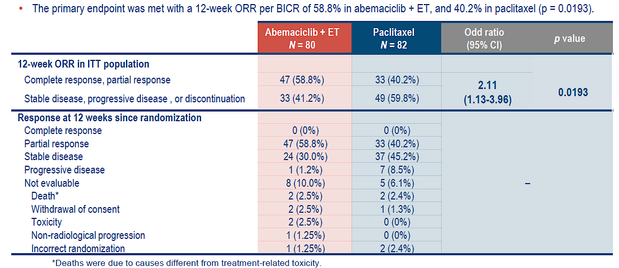
ABIGAIL Primary Endpoint: 12-Week ORR by BICR
ORR = overall response rate; BICR = blinded independent central review; ITT = intention to treat
de la Haba-Rodriguez J et al. ESMO 2024;Abstract LBA23.

Slide 66
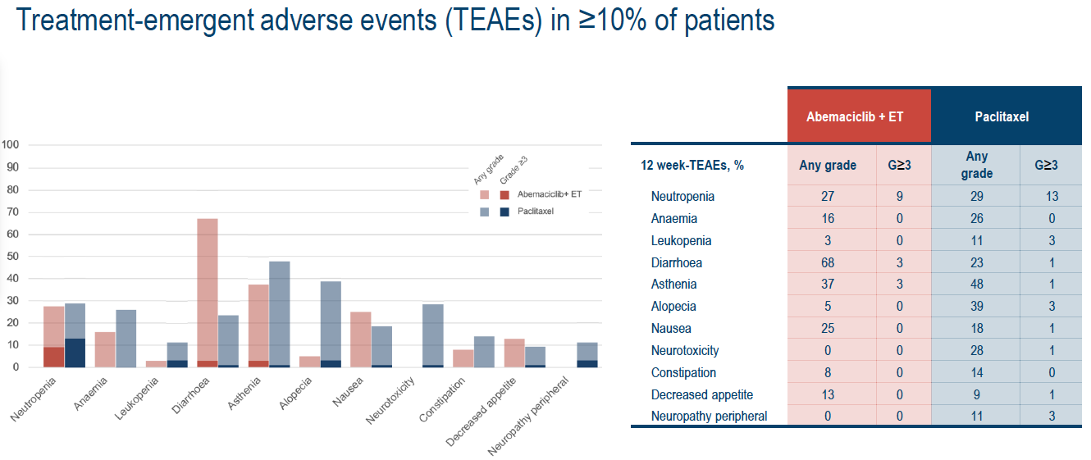
ABIGAIL: Safety Results at 12 Weeks
de la Haba-Rodriguez J et al. ESMO 2024;Abstract LBA23.

Slide 67
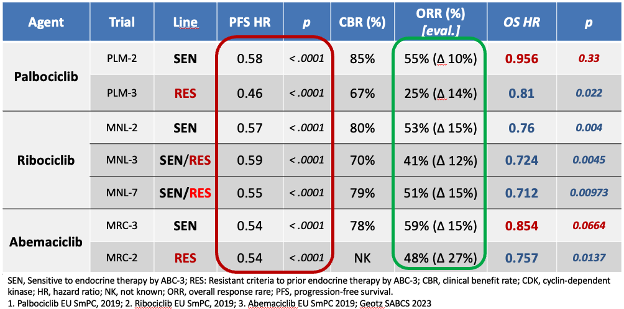
Phase III Registration Studies of CDK4/6 Inhibitors
Courtesy of Hope S Rugo, MD

Slide 68
Age 65, PS 0; de novo metastatic disease; symptomatic liver and bone metastases
HER2 IHC 1+, ESR1-negative, BRCA wild type
PIK3CA-negative
PIK3CA-positive
Ribociclib + AI
Ribociclib + AI
Ribociclib + AI
Ribociclib + AI
Abemaciclib + AI
Abemaciclib + AI
Ribociclib + AI
Ribociclib + AI
Ribociclib + AI vs paclitaxel induction followed by switch*
Ribociclib + AI vs paclitaxel induction followed by switch*
Ribociclib + AI
Ribociclib + AI
*Depends on liver enzymes and bilirubin
AI = aromatase inhibitor

Slide 69
Age 65, PS 0; de novo metastatic disease; asymptomatic bone and/or soft tissue metastases
HER2 IHC 1+, ESR1-negative, BRCA wild type
PIK3CA-negative
PIK3CA-positive
Ribociclib + AI
Ribociclib + AI
Ribociclib + AI
Ribociclib + AI
CDK4/6i + AI
CDK4/6i + AI
Ribociclib + AI
Ribociclib + AI
Ribociclib + AI
Ribociclib + AI
Ribociclib + AI
Ribociclib + AI

Slide 70
Age 65, PS 0; s/p 5 years of adjuvant anastrozole; 2 years later: Symptomatic liver and bone metastases
PIK3CA-negative, ESR1-negative, BRCA wild type
HER2-low (IHC 1+)
HER2-negative (IHC 0)
Ribociclib + AI
Ribociclib + AI
Ribociclib + AI
Ribociclib + AI
Abemaciclib + fulvestrant
Abemaciclib + fulvestrant
Ribociclib + AI
Ribociclib + AI
Ribociclib + AI vs paclitaxel induction followed by switch*
Ribociclib + AI vs paclitaxel induction followed by switch*
Ribociclib + AI
Ribociclib + AI
* Depends on liver enzymes and bilirubin

Slide 71
Age 65, PS 0; s/p 5 years of adjuvant anastrozole; 2 years later: Asymptomatic bone and/or soft tissue metastases
PIK3CA-negative, ESR1-negative, BRCA wild type
HER2-low (IHC 1+)
HER2-negative (IHC 0)
Ribociclib + AI
Ribociclib + AI
Ribociclib + AI
Ribociclib + AI
Abemaciclib + fulvestrant
Abemaciclib + fulvestrant
Ribociclib + AI
Ribociclib + AI
Ribociclib + AI
Ribociclib + AI
Ribociclib + AI
Ribociclib + AI

Slide 72
Age 65, PS 0; s/p 5 years of adjuvant anastrozole and 3 years of adjuvant ribociclib; 2 years later: Symptomatic liver and bone metastases
PIK3CA-negative, ESR1-negative, BRCA wild type
HER2-low (IHC 1+)
HER2-negative (IHC 0)
Abemaciclib + fulvestrant
Abemaciclib + fulvestrant
T-DXd
Abemaciclib + AI
T-DXd or capecitabine
T-DXd or capecitabine
Abemaciclib + AI
Abemaciclib + AI
Abema/Ribo + AI vs Pacl
induction followed by switch*
Abema/Ribo + AI vs Pacl
induction followed by switch*
Abemaciclib + AI
Abemaciclib + AI
*Depends on liver enzymes and bilirubin
T-DXd = trastuzumab deruxtecan

Slide 73
Age 65, PS 0; s/p 5 years of adjuvant anastrozole and 3 years of adjuvant ribociclib; 2 years later: Asymptomatic bone and/or soft tissue metastases
PIK3CA-negative, ESR1-negative, BRCA wild type
HER2-low (IHC 1+)
HER2-negative (IHC 0)
Abemaciclib + fulvestrant
Abemaciclib + fulvestrant
Abemaciclib + AI
Abemaciclib + AI
Capecitabine
Capecitabine
Abemaciclib + AI
Abemaciclib + AI
Abemaciclib or ribociclib + AI
Abemaciclib or ribociclib + AI
Abemaciclib + AI
Abemaciclib + AI

Slide 74
Agenda
Introduction: Which Biomarkers and When
Module 1: Optimizing First-Line Therapy for Patients with Hormone Receptor (HR)-Positive Metastatic Breast Cancer (mBC)
Biomarker-based selection of first-line treatment
Use of SERENA-6 strategy
Use of inavolisib triplet
Module 2: Management of HR-Positive mBC Progressing on a CDK4/6 Inhibitor and Endocrine Therapy
Biomarker-based selection of second-line treatment
Use of selective estrogen receptor degrader (SERD) monotherapy
Use of AKT inhibitors

Slide 76
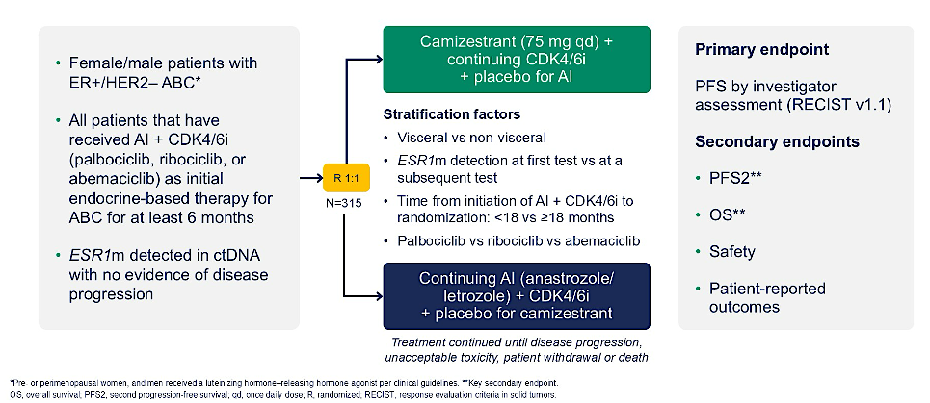
SERENA-6 Phase III Study of First-Line Camizestrant and
CDK4/6 Inhibitor for Emerging ESR1-Mutated Breast Cancer
AI = aromatase inhibitor; CDK4/6i = CDK4/6 inhibitor; ABC = advanced breast cancer
Turner N et al. ASCO 2025;Abstract LBA4.

Slide 77
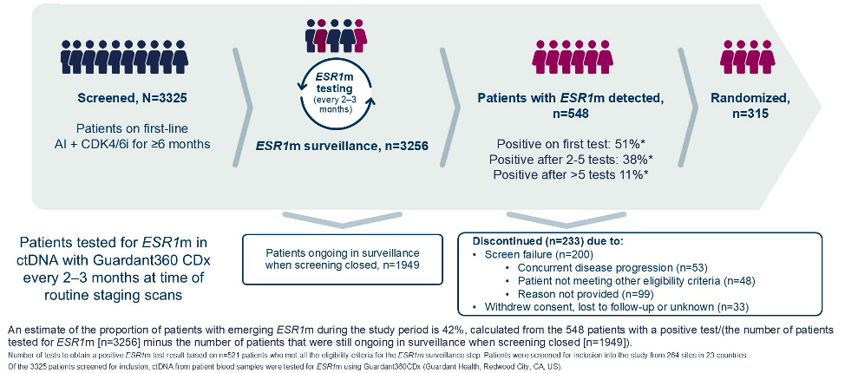
SERENA-6: ESR1m Surveillance
ESR1m = ESR1 mutation
Turner N et al. ASCO 2025;Abstract LBA4; Bidard F-C et al. N Engl J Med 2025;393:569-80.

Slide 78
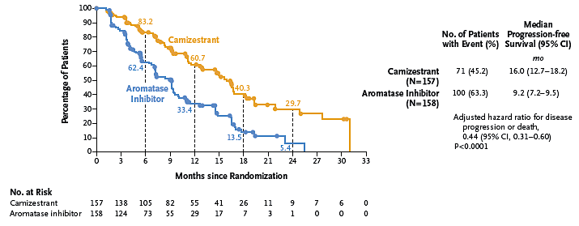
SERENA-6: PFS
Turner N et al. ASCO 2025;Abstract LBA4; Bidard F-C et al. N Engl J Med 2025;393:569-80.

Slide 79
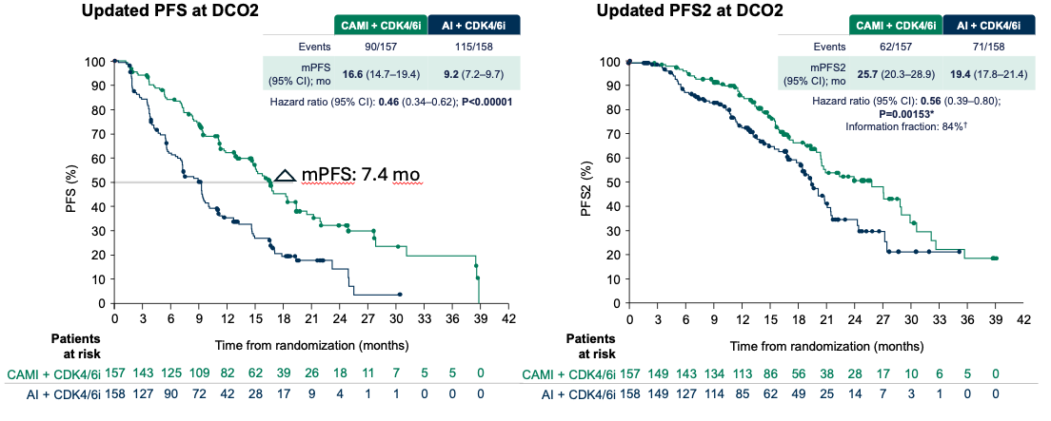
SERENA-6: Updated PFS and PFS2 at Data Cutoff 2
DCO = data cutoff
Bidard F-C et al. SABCS 2025;Abstract RF7-03.

Slide 80
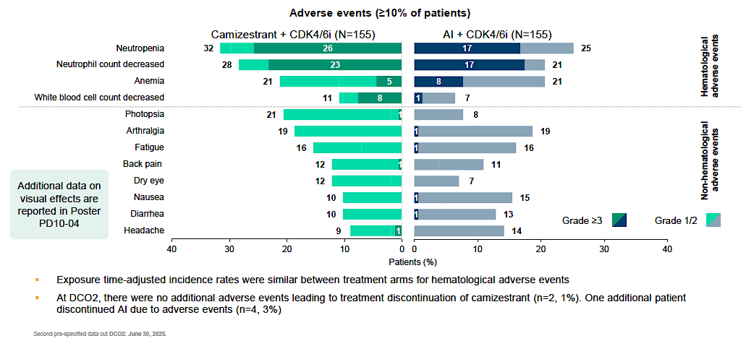
SERENA-6: Updated Safety at Data Cutoff 2
Bidard F-C et al. SABCS 2025;Abstract RF7-03.

Slide 81
Camizestrant + CDK4/6i profoundly reduces ESR1m ctDNA
vs AI + CDK4/6i
In the AI + CDK4/6i arm, ESR1m allele frequency increased >500% from baseline in 24.4% of patients vs 0.8% of patients in the camizestrant + CDK4/6i arm
Camizestrant +
CDK4/6i (n=126)
AI +
CDK4/6i (n=123)
ESR1m allele frequency was profoundly reduced in the camizestrant + CDK4/6i arm vs the AI + CDK4/6i arm (Wilcoxon nominal P<0.00001)
10000
Log scale
1000
100
100
ESR1m sVAF %
change from baseline (%)
50
Median change from baseline
at C3D1 (8 weeks):
+66.7% (IQR: −67.9 to +465.0)
Median change from baseline at C3D1 (8 weeks):
−100% (IQR: −100 to −100)
Linear scale
0
-50
Baseline VAF were balanced across arms.
IQR, interquartile range; (s)VAF, (summed) variant allele fraction.
Second pre-specified data cut DCO2: June 30, 2025.
-100
Bidard F-C et al. SABCS 2025; Abstract RF7-03

Slide 82
A 65-year-old woman presents with de novo ER-positive, HER2-negative (IHC 0/null) mBC with multiple minimally symptomatic bone metastases. Biomarker evaluation is negative for ESR1 mutations and PIK3CA/AKT1/PTEN alterations. She is started on ribociclib with anastrozole and followed with serial ctDNA testing for ESR1 mutations. Regulatory and reimbursement issues aside, what would you most likely recommend if she is found to have an ESR1 mutation without radiographic evidence of disease progression after 1 year? After 3 years?
ESR1 mutation 1 year later
ESR1 mutation 3 years later
Continue ribociclib/anastrozole
until radiographic evidence of PD
Continue ribociclib/anastrozole
until radiographic evidence of PD
Continue ribociclib/anastrozole
until radiographic evidence of PD
Continue ribociclib/anastrozole
until radiographic evidence of PD
Continue ribociclib/anastrozole until radiographic evidence of PD
Continue ribociclib/anastrozole until radiographic evidence of PD
Switch to ribociclib + camizestrant
Switch to ribociclib + camizestrant
SERENA-6 vs imlunestrant + abema/giredestrant + everolimus
SERENA-6 vs imlunestrant + abema/giredestrant + everolimus
Continue ribociclib/anastrozole until radiographic evidence of PD
Continue ribociclib/anastrozole until radiographic evidence of PD
PD = progressive disease

Slide 83
Regulatory and reimbursement issues aside, do you believe that the results from the SERENA-6 study justify the routine use of serial ctDNA monitoring for early detection of ESR1 mutations in patients with ER-positive, HER2-negative mBC receiving first-line therapy? If yes, how often would you conduct ctDNA analysis?
Routine use of ESR1
serial ctDNA monitoring?
How often
No
N/A
No
N/A
No
N/A
Yes
Every 3 months after 18 months
of first-line therapy
No
N/A
No
N/A

Slide 84
Agenda
Introduction: Which Biomarkers and When
Module 1: Optimizing First-Line Therapy for Patients with Hormone Receptor (HR)-Positive Metastatic Breast Cancer (mBC)
Biomarker-based selection of first-line treatment
Use of SERENA-6 strategy
Use of inavolisib triplet
Module 2: Management of HR-Positive mBC Progressing on a CDK4/6 Inhibitor and Endocrine Therapy
Biomarker-based selection of second-line treatment
Use of selective estrogen receptor degrader (SERD) monotherapy
Use of AKT inhibitors

Slide 85
Dr Hurvitz: Case Presentation 1
54 yo woman with pT1N1 grade 2 ER+ PR- HER2 1+ breast cancer with Oncotype DX® RS® of 20 was treated with lumpectomy/SLNB followed by RT
and 2 years of letrozole.
Was in a low impact motor vehicle accident and was seen in ER for severe
mid-back pain. Imaging revealed a T5 burst fracture and several suspicious bone lesions.
Biopsy confirmed ER+ HER2- MBC. ctDNA sent revealing PIK3CA mutation. Two months prior patient had started GLP1 rec agonist for obesity and metformin for hyperglycemia (HbA1c 6.9). Glucose testing now: HbA1c 6.0, FPG 125.

Slide 86
Dr Hurvitz: Case Presentation 1 (Continued)
Decided to start fulvestrant, palbociclib, inavolisib. Glucose monitoring first two weeks, only grade 1 hyperglycemia.
However, she presented on day 15 of cycle 1 for lab work and ANC was 900, K was 2.9 and she was having grade 3 diarrhea (8 BM per day over baseline) for 3 days. She was able to keep up with oral hydration; given IV fluids and potassium in clinic.
Fulvestrant was given, Palbo (held for diarrhea, not ANC) and inavolisib were held and she was started on antidiarrheal regimen.

Slide 87
Dr Hurvitz: Case Presentation 1 (Continued)
Ultimately over the course of the next week, diarrhea resolved; resumed inavolisib (6 mg) and palbociclib (125 mg). ANC on day 1 of cycle 2 was 600.
Held palbociclib - ultimately had to dose reduce to 100 mg. Fatigue prominent. Pt concerned about long term tolerability of this regimen.

Slide 89
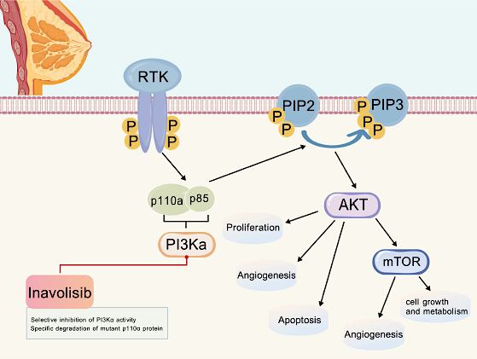
Inavolisib Mechanism of Action
Selective inhibition of PI3Ka activity
Specific degradation of mutant p110a
protein
Zhu R et al. Front Immunol 2025;16:1693927.

Slide 90
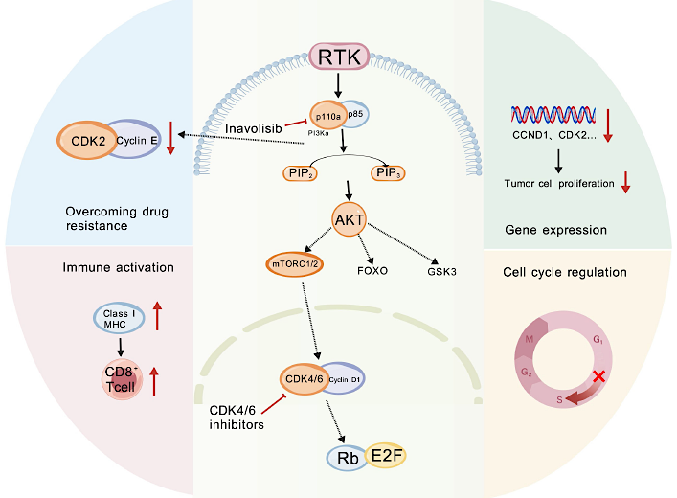
Synergistic Mechanism of Inavolisib with CDK4/6 Inhibitors
Zhu R et al. Front Immunol 2025;16:1693927.

Slide 91
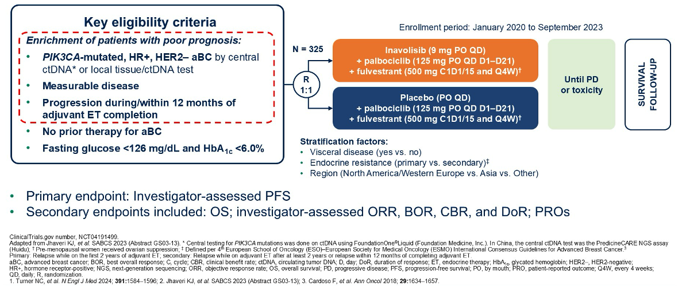
INAVO120 Phase III Trial of First-Line Inavolisib with Palbociclib/Fulvestrant for Patients with PIK3CA-Mutant Localized Relapsing HR-Positive, HER2−Negative mBC
Turner N et al. ASCO 2025;Abstract 1003.

Slide 92
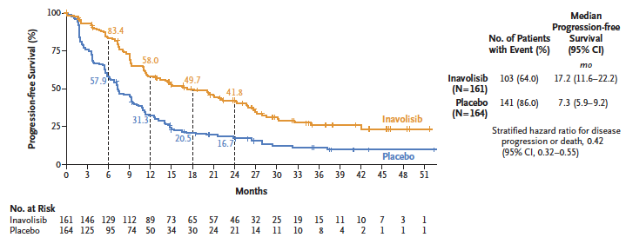
INAVO120: Updated PFS
Turner N et al. ASCO 2025;Abstract 1003; Jhaveri K et al. N Engl J Med 2025;393:151-61.

Slide 93
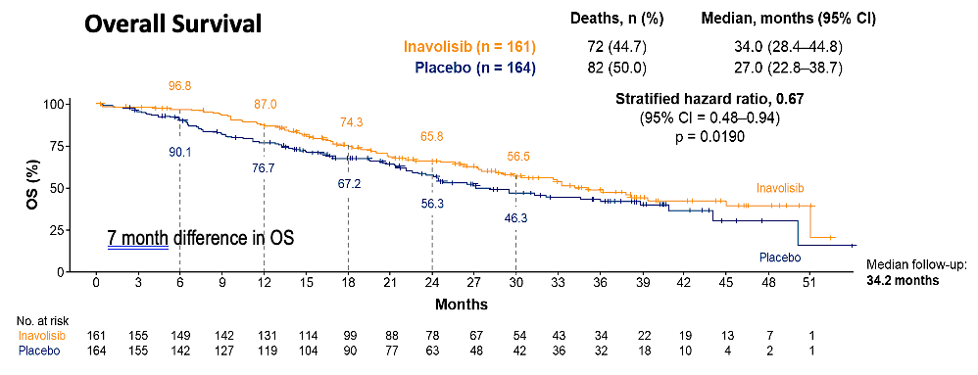
INAVO120: Updated Overall Survival
Turner N et al. ASCO 2025;Abstract 1003; Jhaveri K et al. N Engl J Med 2025;393:151-61.

Slide 94
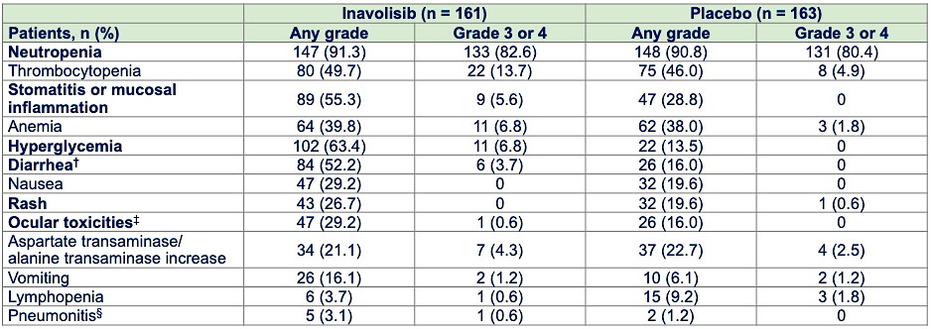
INAVO120: Selected Adverse Events
Turner N et al. ASCO 2025;Abstract 1003; Jhaveri K et al. N Engl J Med 2025;393:151-61.

Slide 95
Age 65, PS 0; metastatic disease after 2 years of planned 5 years of adjuvant AI; symptomatic liver and bone metastases
HER2 IHC 1+, ESR1-negative, BRCA wild type
PIK3CA-negative
PIK3CA-positive
Ribociclib + fulvestrant
Inavolisib + palbociclib + fulvestrant
Ribociclib + fulvestrant
Inavolisib + palbociclib + fulvestrant
Abemaciclib + fulvestrant
OR capecitabine
Inavolisib + palbociclib + fulvestrant OR fulvestrant + capivasertib OR capecitabine
Ribociclib + fulvestrant
Inavolisib + palbociclib + fulvestrant
Ribociclib + fulvestrant
Inavolisib + palbociclib + fulvestrant
Ribociclib + AI
Ribociclib + AI

Slide 96
Age 65, PS 0; metastatic disease after 2 years of planned 5 years of adjuvant AI; asymptomatic bone and/or soft tissue metastases
HER2 IHC 1+, ESR1-negative, BRCA wild type
PIK3CA-negative
PIK3CA-positive
Ribociclib + fulvestrant
Inavolisib + palbociclib + fulvestrant
Ribociclib + fulvestrant
Inavolisib + palbociclib + fulvestrant
Fulvestrant + CDK4/6i
Inavolisib + palbociclib + fulvestrant
Ribociclib + fulvestrant
Inavolisib + palbociclib + fulvestrant
Ribociclib + fulvestrant
Inavolisib + palbociclib + fulvestrant
Ribociclib + AI
Ribociclib + AI
CDK4/6i = CDK4/6 inhibitor

Slide 97
Agenda
Introduction: Which Biomarkers and When
Module 1: Optimizing First-Line Therapy for Patients with Hormone Receptor (HR)-Positive Metastatic Breast Cancer (mBC)
Biomarker-based selection of first-line treatment
Use of SERENA-6 strategy
Use of inavolisib triplet
Module 2: Management of HR-Positive mBC Progressing on a CDK4/6 Inhibitor and Endocrine Therapy
Biomarker-based selection of second-line treatment
Use of selective estrogen receptor degrader (SERD) monotherapy
Use of AKT inhibitors

Slide 98
Dr Kaklamani: Case Presentation 2
48 yo premenopausal woman
She had been diagnosed with a T2N1 R IDC ER 90% PR 80% HER2 0 6 y prior and had received adjuvant chemotherapy with TC and was put on goserelin and anastrozole for 5 y.
14 mo after discontinuing anastrozole she presented with fatigue and workup showed lung and bone lesions. A lung biopsy showed ER 80% PR 80% HER2 1+. NGS testing didn’t show any actionable mutation. Genetic testing was negative.
She was put on denosumab, ribociclib, goserelin and letrozole and after an initial partial response she was found to have disease progression in her bones 35 mo after initiation of 1st line therapy.
She had ctDNA showing an ESR1 mutation and was started on elacestrant.
She is currently on elacestrant for 22 mo having PR on treatment.

Slide 99
Agenda
Introduction: Which Biomarkers and When
Module 1: Optimizing First-Line Therapy for Patients with Hormone Receptor (HR)-Positive Metastatic Breast Cancer (mBC)
Biomarker-based selection of first-line treatment
Use of SERENA-6 strategy
Use of inavolisib triplet
Module 2: Management of HR-Positive mBC Progressing on a CDK4/6 Inhibitor and Endocrine Therapy
Biomarker-based selection of second-line treatment
Use of selective estrogen receptor degrader (SERD) monotherapy
Use of AKT inhibitors

Slide 101
FDA Approves Elacestrant for ER-Positive, HER2-Negative, ESR1-Mutated Advanced or Metastatic Breast Cancer
Press Release: January 27, 2023
“On January 27, 2023, the Food and Drug Administration (FDA) approved elacestrant for postmenopausal women or adult men with ER-positive, HER2-negative, ESR1-mutated advanced or metastatic breast cancer with disease progression following at least one line of endocrine therapy.
FDA also approved the Guardant360 CDx assay as a companion diagnostic device to identify patients with breast cancer for treatment with elacestrant.
Efficacy was evaluated in EMERALD (NCT03778931), a randomized, open-label, active-controlled, multicenter trial that enrolled 478 postmenopausal women and men with ER-positive, HER2-negative advanced or metastatic breast cancer of which 228 patients had ESR1 mutations.”
https://www.fda.gov/drugs/resources-information-approved-drugs/fda-approves-elacestrant-er-positive-her2-negative-esr1-mutated-advanced-or-metastatic-breast-cancer

Slide 102
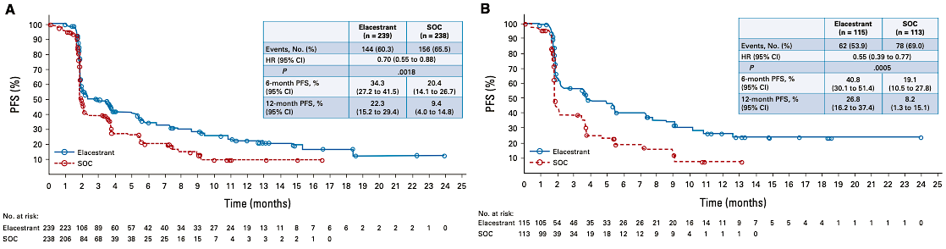
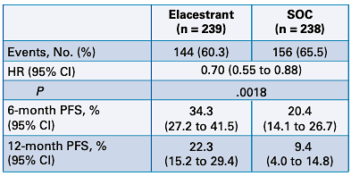
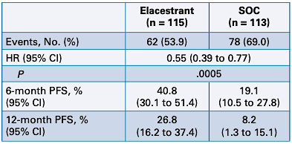
EMERALD: Phase III Trial of Elacestrant versus Standard Endocrine Therapy for ER-Positive, HER2-Negative Advanced Breast Cancer
ITT
ESR1m
SOC = standard of care
Bidard F-C et al. J Clin Oncol 2022;40(28):3246-56.

Slide 103
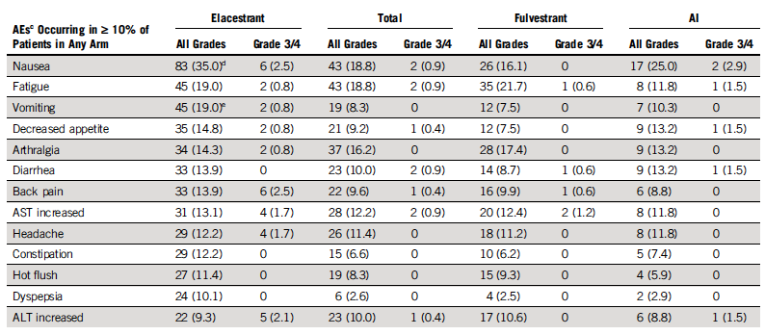
EMERALD: Adverse Events
Bidard F-C et al. J Clin Oncol 2022;40(28):3246-56.

Slide 104
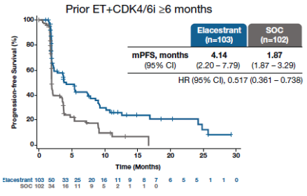
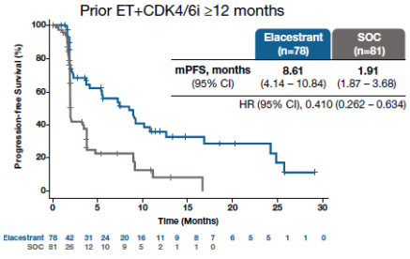
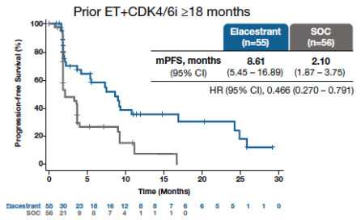
EMERALD: Subgroup Efficacy by Duration of CDK4/6 Inhibitor (ESR1m)
Bardia A et al. Clin Cancer Res 2024;30(19):4299-309.

Slide 105
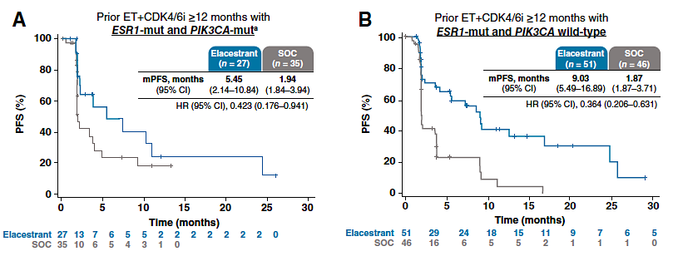
EMERALD: Subgroup Efficacy in Patients with ESR1m and Prior
ET and CDK4/6 Inhibitor ≥12 months
Bardia A et al. Clin Cancer Res 2024;30(19):4299-309.

Slide 106
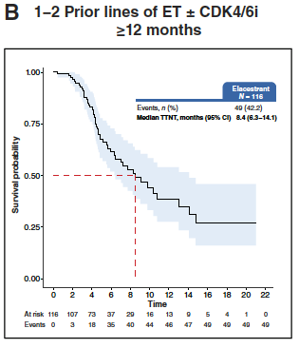
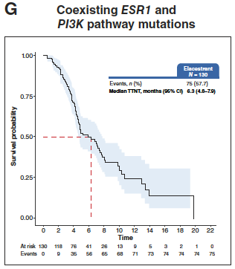
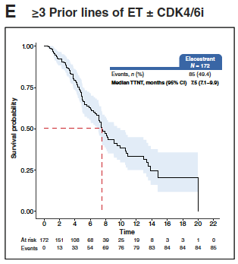



EMERALD: Real-World Data
Rugo HS et al. Clin Cancer Res 2026;32:179-87.

Slide 107
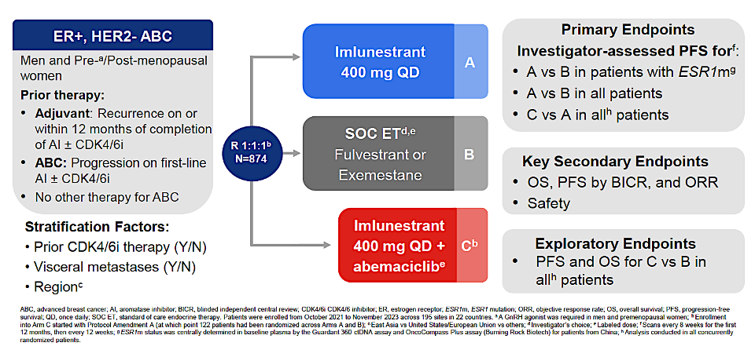
EMBER-3: Phase III Trial of Imlunestrant with or without Abemaciclib for Advanced Breast Cancer
Jhaveri KL et al. SABCS 2024;Abstract GS1-01.

Slide 108
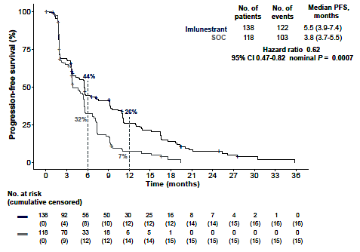
EMBER-3 Updated PFS: Efficacy of Imlunestrant Monotherapy Compared to ET for Patients with ESR1m
Jhaveri KL et al. Ann Oncol 2025;37(4):532-43.

Slide 109
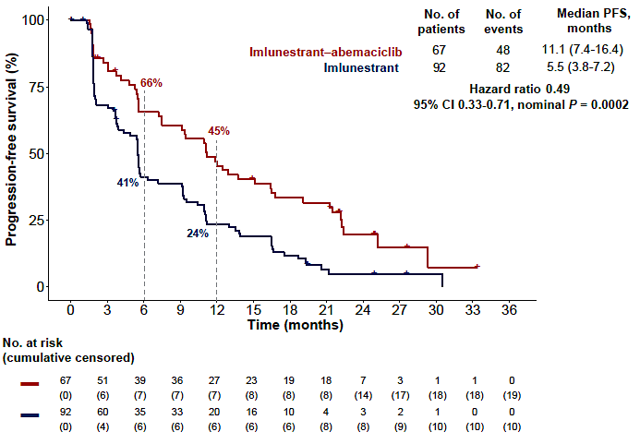
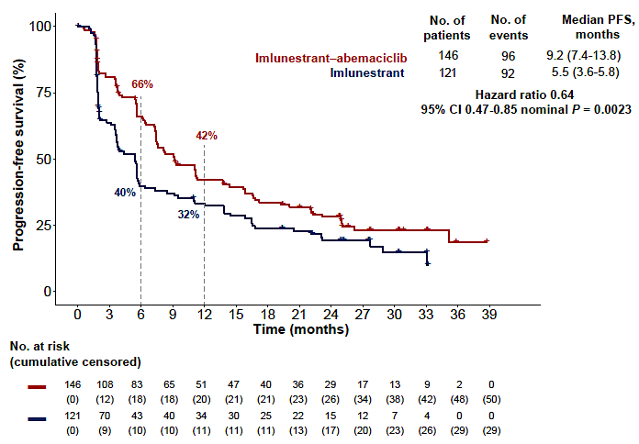
EMBER-3 Updated PFS: Efficacy of Imlunestrant with Abemaciclib Compared to Imlunestant
ESR1m
No ESR1m
In all patients, regardless of ESR1m, the median PFS of imlunestrant with abemaciclib versus imlunestrant was 10.9 versus 5.5 months (HR 0.59, 95% CI 0.47-0.74, nominal p < 0.0001).
Jhaveri KL et al. Ann Oncol 2025;37(4):532-43.

Slide 110
Age 65, PS 0; HER2 IHC 1+, BRCA wild-type mBC
Metastatic PD after ribociclib/letrozole for 2 years
ESR1-negative, PIK3CA/AKT1/PTEN-negative
Symptomatic liver
and bone metastases
Asymptomatic bone metastases
Everolimus + fulvestrant
Everolimus + fulvestrant
Everolimus + fulvestrant
Everolimus + fulvestrant
Abemaciclib + fulvestrant
Abemaciclib + fulvestrant
T-DXd
Capecitabine
Everolimus + fulvestrant or abemaciclib + fulvestrant
Abemaciclib + fulvestrant
Everolimus + fulvestrant
Everolimus + fulvestrant

Slide 111
Age 65, PS 0; HER2 IHC 1+, BRCA wild-type mBC
Metastatic PD after ribociclib/letrozole for 10 months
ESR1-negative, PIK3CA/AKT1/PTEN-negative
Symptomatic liver and bone metastases
Asymptomatic bone metastases
Capecitabine
Everolimus + fulvestrant
T-DXd
Everolimus + fulvestrant
Capecitabine
Abemaciclib + fulvestrant
T-DXd
Capecitabine
T-DXd
Capecitabine
T-DXd
Capecitabine

Slide 112
Which second-line treatment would you recommend for a 65-year-old woman (PS 0) with ER/PR-positive, HER2-low (IHC 1+) breast cancer with the biomarker testing results below who develops symptomatic liver and bone metastases after ribociclib/letrozole for 2 years? After ribociclib/letrozole for 10 months?
ESR1-positive, PIK3CA/AKT1/PTEN-negative
PD after ribociclib/letrozole
2 years
PD after ribociclib/letrozole
10 months
Elacestrant or imlunestant*
T-DXd
Elacestrant
T-DXd
Imlunestrant + abemaciclib
Capecitabine
Elacestrant
Capecitabine
Imlunestrant + abemaciclib
Imlunestrant + abemaciclib
or T-DXd
Elacestrant
T-DXd
* Or imlunestrant/abemaciclib if covered

Slide 113
Agenda
Introduction: Which Biomarkers and When
Module 1: Optimizing First-Line Therapy for Patients with Hormone Receptor (HR)-Positive Metastatic Breast Cancer (mBC)
Biomarker-based selection of first-line treatment
Use of SERENA-6 strategy
Use of inavolisib triplet
Module 2: Management of HR-Positive mBC Progressing on a CDK4/6 Inhibitor and Endocrine Therapy
Biomarker-based selection of second-line treatment
Use of selective estrogen receptor degrader (SERD) monotherapy
Use of AKT inhibitors

Slide 114
Dr Hurvitz: Case Presentation 2
38 yo woman treated for de novo MBC to bones, lungs, LNs treated with first line ribociclib/AI/ovarian suppression (then BSO) with disease control for 3 years. At PD in lungs, ctDNA revealed ESR1mut, switched to elacestrant. Has 5-year-old twins and works as a paralegal.
Prominent nausea with vomiting two to three times a week and fatigue noted at first follow up visit. Had not been taking antiemetic. Teaching re use of ondansetron. At next f/u visit pt notes resolution of vomiting but still with nausea in the morning til past lunch and has lost 8 lbs (6% body weight). Initiated olanzapine 5 mg in the evenings. Next visit, substantially better. Weight stabilized.

Slide 116
If vepdegestrant becomes available for patients with HR-positive, HER2-negative mBC and an ESR1 mutation, will you use it or oral SERD monotherapy first?
Oral SERD monotherapy
Oral SERD monotherapy
Oral SERD monotherapy
Oral SERD monotherapy
Oral SERD monotherapy
Oral SERD monotherapy

Slide 117
Based on published research data and your own clinical experience, how would you indirectly compare the global efficacy and tolerability/toxicity of elacestrant, imlunestrant, camizestrant and giredestrant when administered as monotherapy for endocrine therapy-pretreated ER-positive, HER2-negative mBC with an ESR1 mutation?
Efficacy
Tolerability
Not enough data to tell
About the same
About the same
About the same
About the same
Imlunestrant is most tolerable; Elacestrant is least tolerable
About the same
About the same
About the same
Slightly distinct, but all have
only low-grade toxicities
About the same
Elacestrant is most tolerable

Slide 118
Agenda
Introduction: Which Biomarkers and When
Module 1: Optimizing First-Line Therapy for Patients with Hormone Receptor (HR)-Positive Metastatic Breast Cancer (mBC)
Biomarker-based selection of first-line treatment
Use of SERENA-6 strategy
Use of inavolisib triplet
Module 2: Management of HR-Positive mBC Progressing on a CDK4/6 Inhibitor and Endocrine Therapy
Biomarker-based selection of second-line treatment
Use of selective estrogen receptor degrader (SERD) monotherapy
Use of AKT inhibitors

Slide 119
Dr Kaklamani: Case Presentation 3
65 yo postmenopausal found to have 2.4 cm R IDC, LN- ER 60% PR 50% HER2 0. Her 21 gene Recurrence Score was 21 and she was given adjuvant endocrine therapy with anastrozole.
She discontinued anastrozole due to MS complaints after 1 y and presented 3 y later with back pain.
Imaging showed spinal mets and NGS testing showed a PIK3CA mutation.
She was started on denozumab, palbociclib and exemestane and remained on therapy for 18 mo with stable disease but then was found to have a new liver metastasis.
ctDNA showed the PIK3CA mutation but no other actionable alteration.
She was started on capivasertib and fulvestrant and has been on this treatment for the past 14 mo with partial response to the bones.

Slide 121
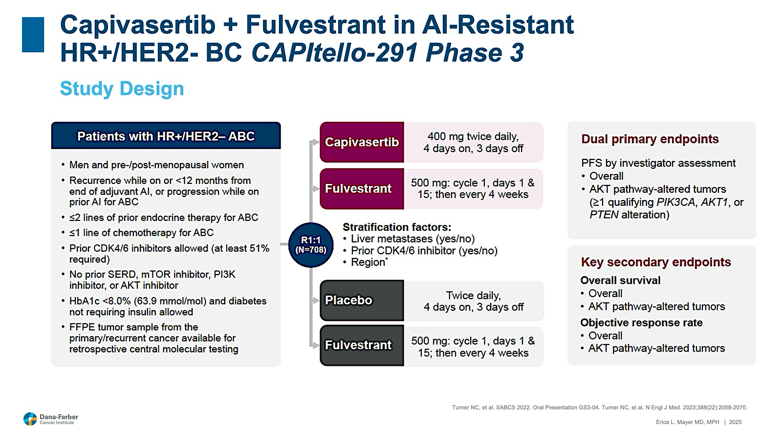
Courtesy of Erica Mayer, MD, MPH

Slide 122
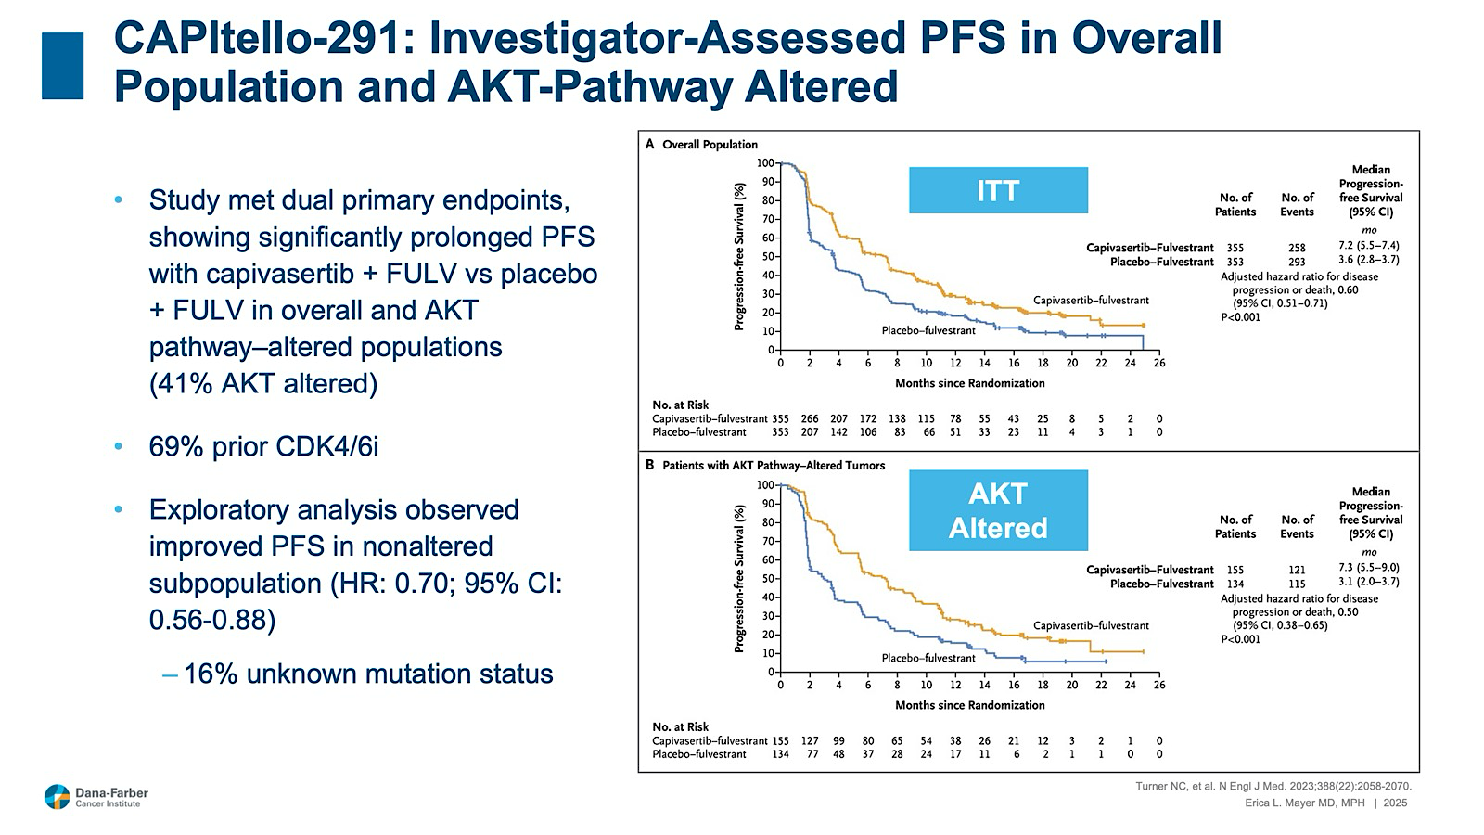
Courtesy of Erica Mayer, MD, MPH

Slide 123
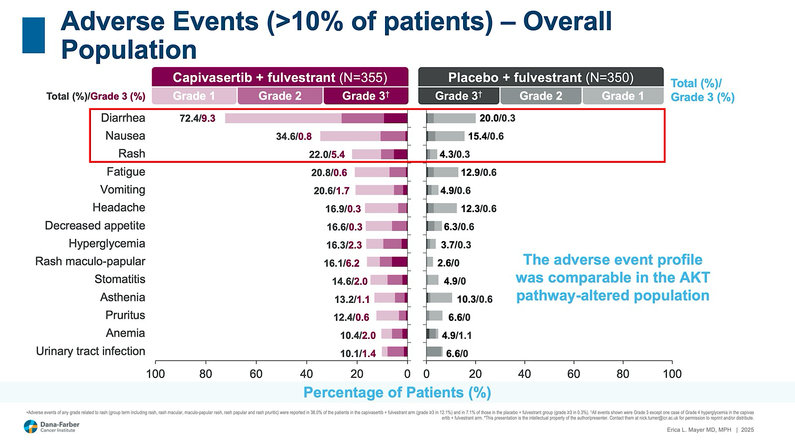
Courtesy of Erica Mayer, MD, MPH

Slide 124
Age 65, PS 0; HER2 IHC 1+, BRCA wild-type mBC
S/p ribociclib/letrozole for 2 years
ESR1-positive, PIK3CA/AKT1/PTEN-positive
Symptomatic liver and
bone metastases
Asymptomatic bone metastases
Capivasertib + fulvestrant*
Capivasertib + fulvestrant
Elacestrant
Elacestrant
Capivasertib + fulvestrant
or capecitabine
Capivasertib + fulvestrant
Capivasertib + fulvestrant
Elacestrant
Imlunestrant + abemaciclib
or capivasertib + fulvestrant
Imlunestrant + abemaciclib
Elacestrant
Elacestrant
* If impending liver failure, would use T-DXd

Slide 125
Age 65, PS 0; HER2 IHC 1+, BRCA wild-type mBC
S/p ribociclib/letrozole for 10 months
ESR1-positive, PIK3CA/AKT1/PTEN-positive
Symptomatic liver and
bone metastases
Asymptomatic bone metastases
Capivasertib + fulvestrant*
Capivasertib + fulvestrant
Capivasertib + fulvestrant
Capivasertib + fulvestrant
Capivasertib + fulvestrant
Capivasertib + fulvestrant
Capivasertib + fulvestrant
Elacestrant
T-DXd
Capecitabine vs imlunestrant + abemaciclib vs capivasertib
T-DXd
Capivasertib + fulvestrant
* If impending liver failure, would use T-DXd

Slide 126
Age 65, PS 0; HER2 IHC 1+, BRCA wild-type mBC
S/p ribociclib/letrozole for 2 years
ESR1-negative, PIK3CA/AKT1/PTEN-positive
Symptomatic liver and
bone metastases
Asymptomatic bone metastases
Capivasertib + fulvestrant
Capivasertib + fulvestrant
Capivasertib + fulvestrant
Capivasertib + fulvestrant
Capivasertib + fulvestrant
Capivasertib + fulvestrant
Capivasertib + fulvestrant
Capivasertib + fulvestrant
Capivasertib + fulvestrant
Capivasertib + fulvestrant
Capivasertib + fulvestrant
Capivasertib + fulvestrant

Slide 127
Age 65, PS 0; HER2 IHC 1+, BRCA wild-type mBC
S/p ribociclib/letrozole for 10 months
ESR1-negative, PIK3CA/AKT1/PTEN-positive
Symptomatic liver and
bone metastases
Asymptomatic bone metastases
Capivasertib + fulvestrant*
Capivasertib + fulvestrant
Capivasertib + fulvestrant
Capivasertib + fulvestrant
T-DXd or capecitabine
Capivasertib + fulvestrant
Capivasertib + fulvestrant
Capivasertib + fulvestrant
Capivasertib + fulvestrant
Capivasertib + fulvestrant
T-DXd
Capivasertib + fulvestrant
* If impending liver failure, would use T-DXd

Slide 128
Dr Hurvitz: Case Presentation 3
67 yo woman with ER+ HER2 1+ MBC with an ESR1 mutation, PIK3CA wild type, previously treated with ribociclib/fulvestrant for 1 year, now with progression in the liver and symptomatic bone metastases.
The patient has a follow-up appointment next week.

Slide 129
Year in Review: Clinical Investigator Perspectives on the
Most Relevant New Datasets and Advances in Oncology
Colorectal Cancer
A CME/MOC-Accredited Live Webinar
Thursday, April 16, 2026
5:00 PM – 6:00 PM ET
Faculty
Arvind Dasari, MD, MS
Anwaar Saeed, MD
Moderator
Neil Love, MD

Slide 130
Thank you for joining us!
Please take a moment to complete the survey currently up on Zoom. Your feedback is very important to us.
The survey will remain open for
5 minutes after the meeting ends.
Information on how to obtain CME, ABIM MOC and ABS credit is provided in the Zoom chat room.
Attendees will also receive an email in 1 to 3 business days with these instructions.

