Slide 1

Welcome!
Please complete the preactivity educational survey by scanning
the QR code below. If you have already completed this survey,
thank you –– please do not respond again.
Your input is greatly appreciated and helps
guide our future educational activities.

Slide 2
Integrating Recent Advances into the
Management of Gastroesophageal Cancers
Rutika Mehta, MD, MPH
Associate Professor
Director for Upper GI Malignancies Progam
Perlmutter Cancer Center
NYU Langone Health
New York, New York

Slide 3
Disclosures
Advisory Committees | Amgen Inc, Astellas, AstraZeneca Pharmaceuticals LP, BeOne, Bristol Myers Squibb, Daiichi Sankyo Inc, Eisai Inc, Gilead Sciences Inc, GSK, Jazz Pharmaceuticals Inc, Legend Biotech
Consulting Agreements | Jazz Pharmaceuticals Inc, Lilly, Replimune
Data and Safety Monitoring Boards/Committees | Arcus Biosciences, Gilead Sciences Inc
Nonrelevant Financial Relationships | Robert A Winn Career Development Award

Slide 4






Program Steering Committee
David H Ilson, MD, PhD
Attending Physician, Member
Memorial Sloan Kettering Cancer Center
Professor of Medicine
Weill Cornell Medical College
New York, New York
Samuel J Klempner, MD
Program Director, Gastroesophageal Cancers
Tobins Family Endowed Chair in Esophagogastric Cancer
Massachusetts General Hospital
Associate Professor, Harvard Medical School
Boston, Massachusetts
Yelena Y Janjigian, MD
Carroll and Milton Petrie Chair
Professor and Chief Attending Gastrointestinal Oncology Service
Memorial Sloan Kettering Cancer Center
New York, New York
Rutika Mehta, MD, MPH
Associate Professor
Director for Upper GI Malignancies Program
Perlmutter Cancer Center
NYU Langone Health
New York, New York
Sunnie Kim, MD
GI Medical Oncologist
Associate Professor
University of Colorado Cancer Center
Aurora, Colorado
Manish A Shah, MD
Professor of Medicine
Bartlett Family Professor of Gastrointestinal Oncology
Chief, Solid Tumor Oncology
Weill Cornell Medicine/NewYork-Presbyterian Hospital
New York, New York

Slide 5



Program Steering Committee
John Strickler, MD
Senior Associate Consultant
Division of Hematology and Oncology
Mayo Clinic
Jacksonville, Florida
PROJECT CHAIR
Neil Love, MD
Research To Practice
Miami, Florida
Zev Wainberg, MD, MSc
Co-Director, GI Oncology Program
Director of Early Phase Clinical Research
Jonsson Comprehensive Cancer Center
UCLA School of Medicine
Los Angeles, California

Slide 6
Agenda
Module 1: Optimizing the Management of HER2-Positive Advanced Gastroesophageal (GE) Cancers
Module 2: Clinician Survey Results
Module 3: Current and Future Strategies to Target CLAUDIN18.2 in Advanced GE Cancers
Module 4: Clinician Survey Results
Module 5: Integration of Immune Checkpoint Inhibitors into the Care of Patients with Resectable and Unresectable Advanced GE Cancers
Module 6: Clinician Survey Results

Slide 7
Agenda
Module 1: Optimizing the Management of HER2-Positive Advanced Gastroesophageal (GE) Cancers
Module 2: Clinician Survey Results
Module 3: Current and Future Strategies to Target CLAUDIN18.2 in Advanced GE Cancers
Module 4: Clinician Survey Results
Module 5: Integration of Immune Checkpoint Inhibitors into the Care of Patients with Resectable and Unresectable Advanced GE Cancers
Module 6: Clinician Survey Results

Slide 8
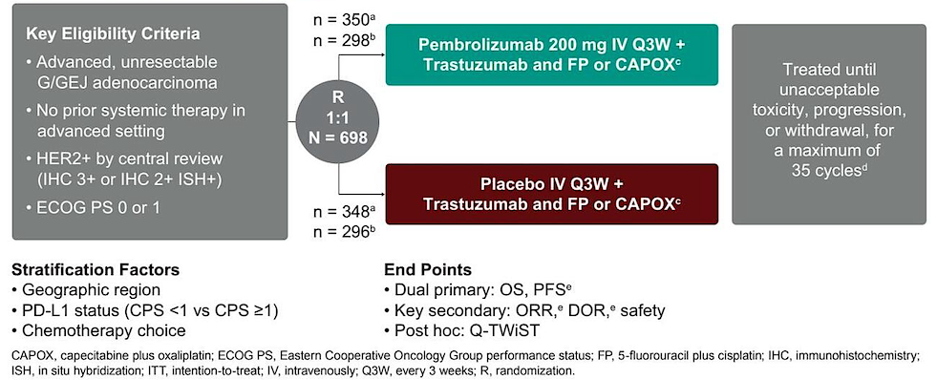
KEYNOTE-811 Phase III Trial of Pembrolizumab with Trastuzumab and Chemotherapy for Previously Untreated Advanced HER2-Positive Gastric or Gastroesophageal Junction (GEJ) Adenocarcinoma
Kawazoe A et al. ASCO 2026;Abstract 4040.

Slide 9
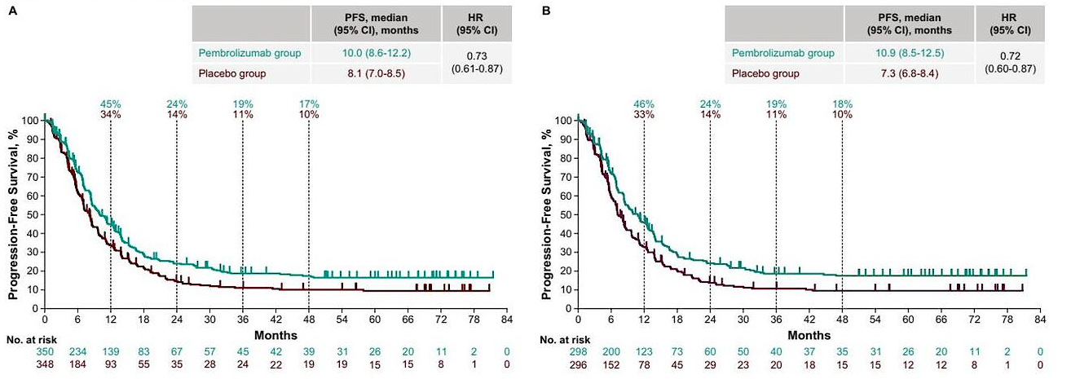
KEYNOTE-811: Progression-Free Survival (PFS) with 6-Year Median Follow-Up
ITT
PD-L1 CPS ≥1
ITT = intention to treat; CPS = combined positive score; HR = hazard ratio; CI = confidence interval
Kawazoe A et al. ASCO 2026;Abstract 4040.

Slide 10
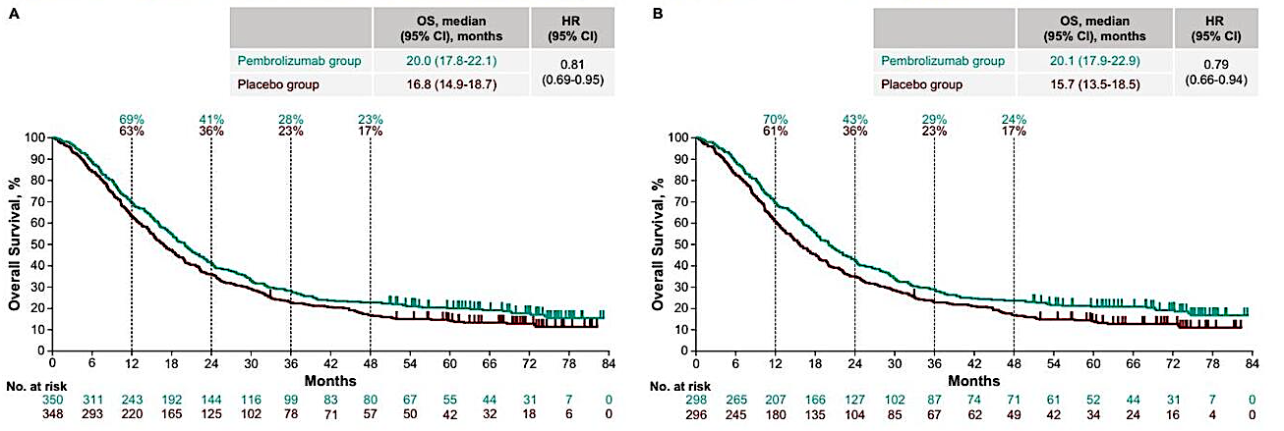
KEYNOTE-811: Overall Survival (OS) with 6-Year Median Follow-Up
ITT
PD-L1 CPS ≥1
Kawazoe A et al. ASCO 2026;Abstract 4040.

Slide 11
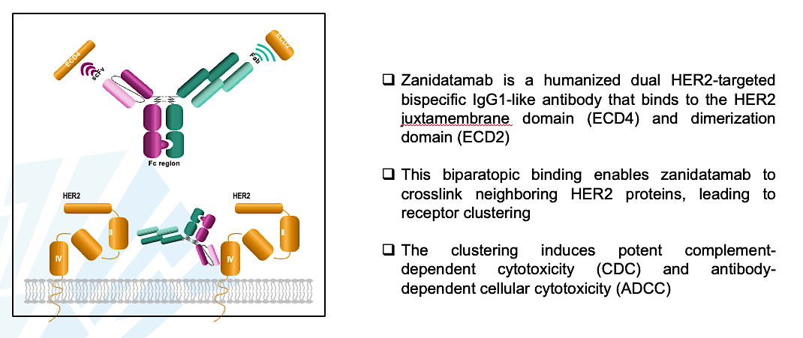
Zanidatamab Mechanism of Action
Weisser N et al. Nat Commun 2023.
Content courtesy of Eric Van Cutsem, MD, PhD

Slide 12
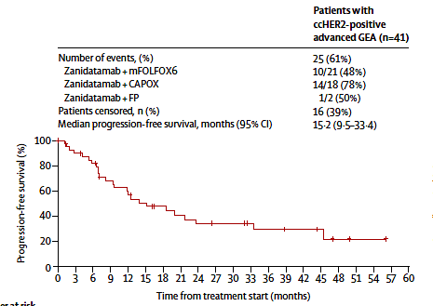
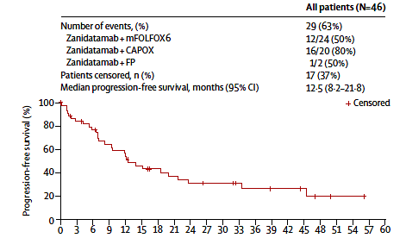
Phase II Study of First-Line Zanidatamab and Chemotherapy for HER2-Positive Advanced GEJ Cancers: PFS
ccHER2+ = centrally confirmed HER2-positive; GEA = gastroesophageal adenocarcinoma
Elimova E et al. ESMO 2024;Abstract 3212; Elimova E et al. Lancet 2025;26:847-59.

Slide 13
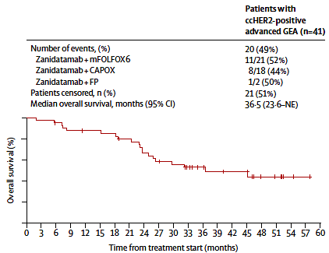
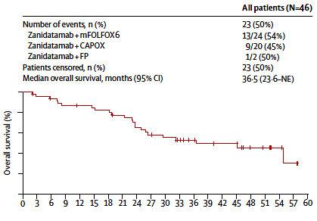
Phase II Study of First-Line Zanidatamab and Chemotherapy for HER2-Positive Advanced GEJ Cancers: OS
Elimova E et al. Lancet 2025;26:847-59.

Slide 14
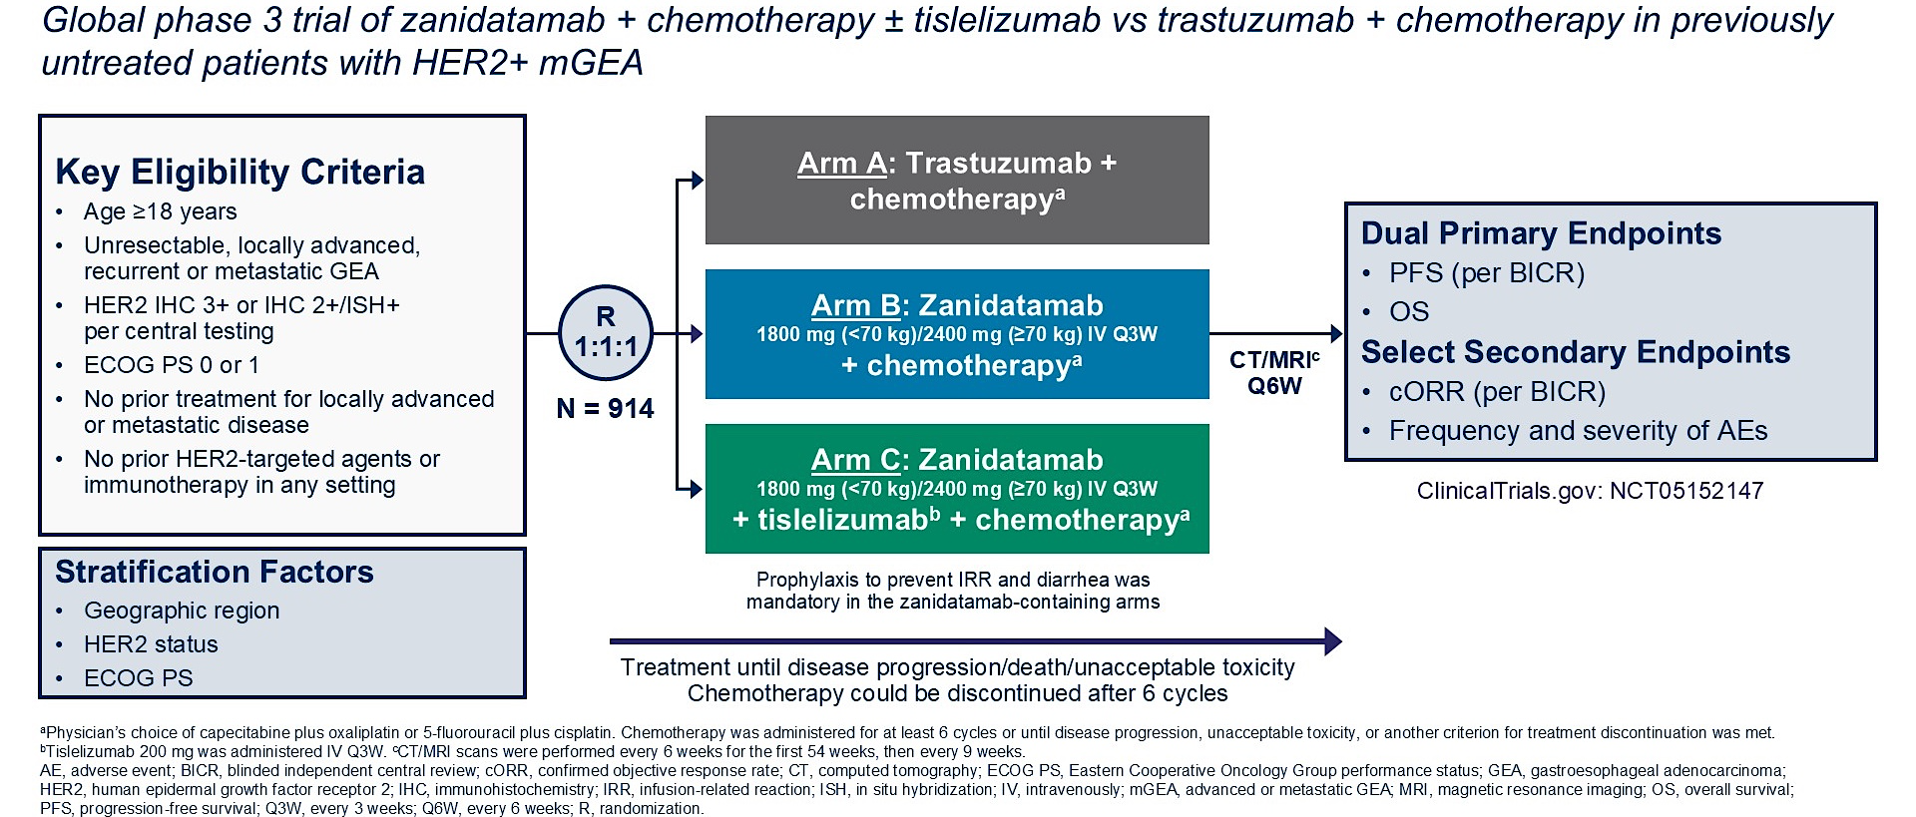
Phase III HERIZON-GEA-01 Trial of Zanidatamab with or without Tislelizumab for HER2-Positive Gastroesophageal Cancer
Elimova E et al. Gastrointestinal Cancers Symposium 2026;Abstract LBA285.

Slide 15
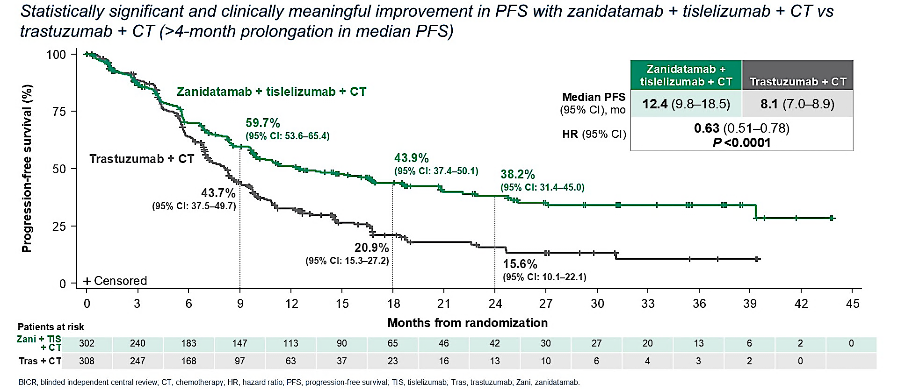
HERIZON-GEA-01 Primary Endpoint: PFS per BICR with Zanidatamab, Tislelizumab and Chemotherapy (CT)
Elimova E et al. Gastrointestinal Cancers Symposium 2026;Abstract LBA285; Shitara K et al. N Engl J Med 2026;394:2002-14.

Slide 16
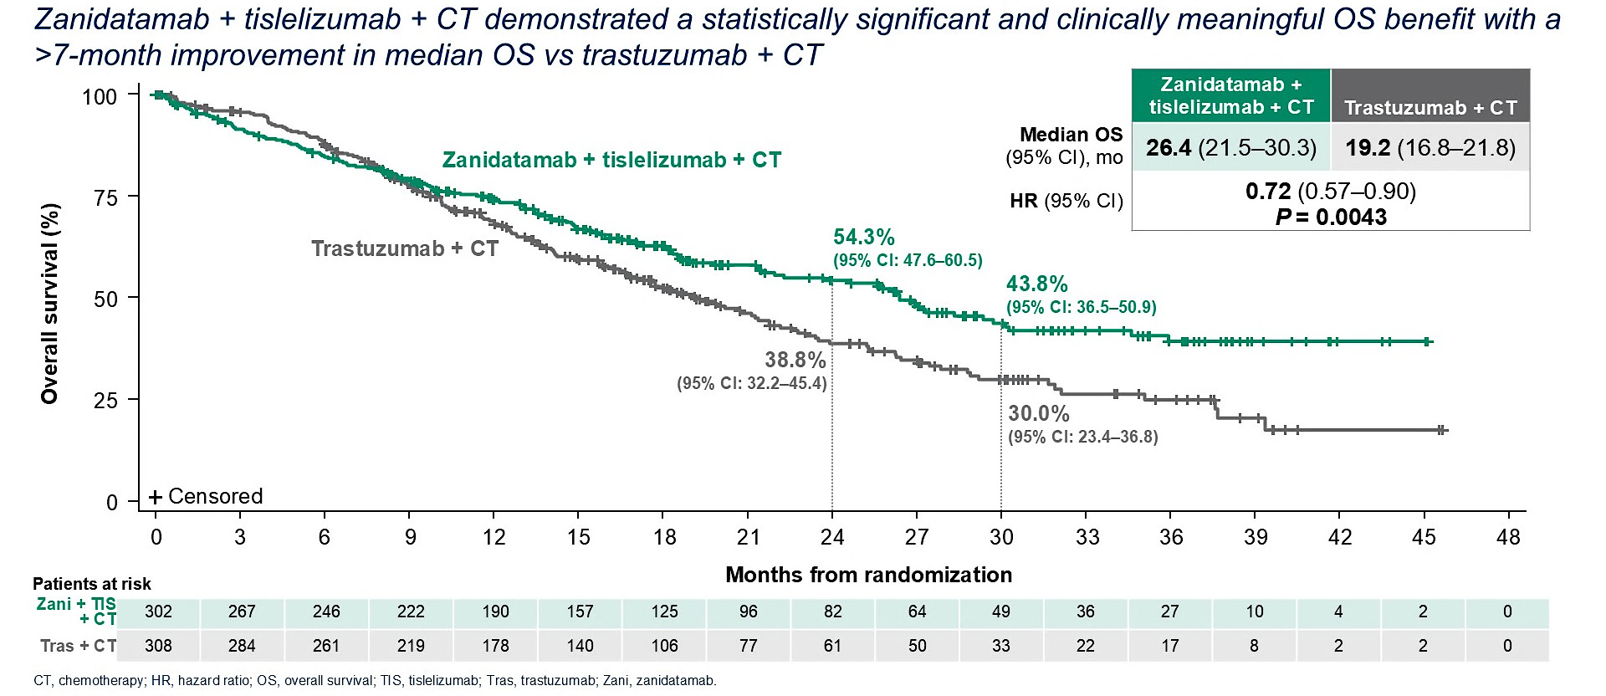
HERIZON-GEA-01 Primary Endpoint: Interim Analysis of OS with Zanidatamab, Tislelizumab and Chemotherapy
Elimova E et al. Gastrointestinal Cancers Symposium 2026;Abstract LBA285; Shitara K et al. N Engl J Med 2026;394:2002-14.

Slide 17
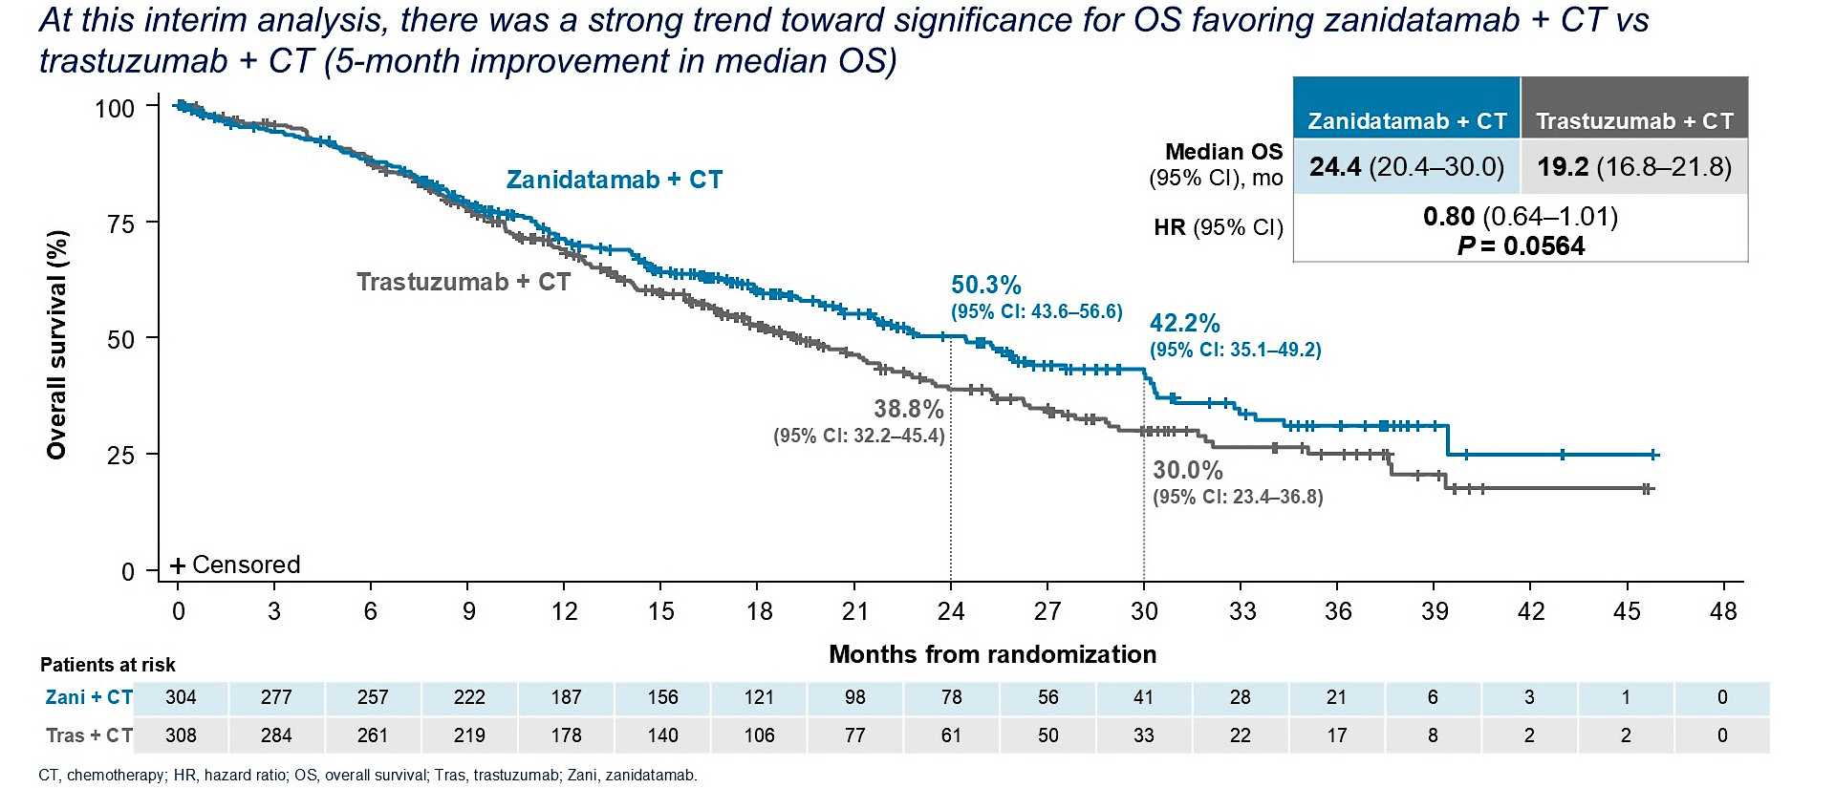
HERIZON-GEA-01: Interim OS Analysis with Zanidatamab and Chemotherapy
Elimova E et al. Gastrointestinal Cancers Symposium 2026;Abstract LBA285; Shitara K et al. N Engl J Med 2026;394:2002-14.

Slide 18
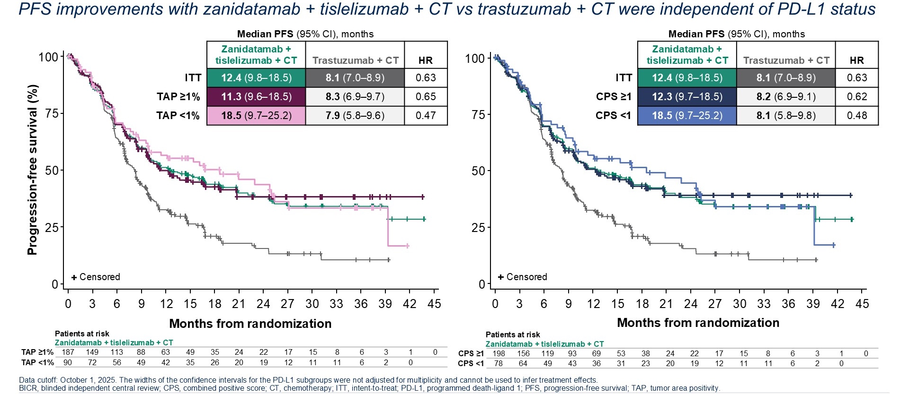
HERIZON-GEA-01 Subgroup Analysis: PFS per BICR by PD-L1 Subgroups
Rha SY et al. ASCO 2026;Abstract 4010.

Slide 19
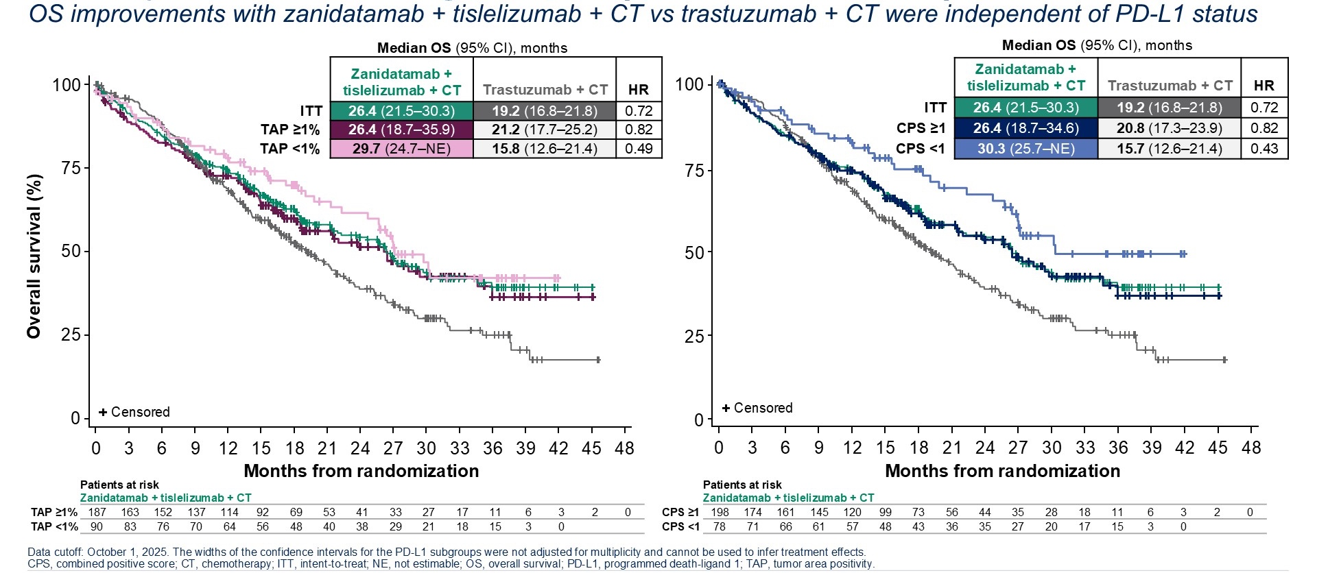
HERIZON-GEA-01 Subgroup Analysis: OS by PD-L1 Subgroups
Rha SY et al. ASCO 2026;Abstract 4010.

Slide 20

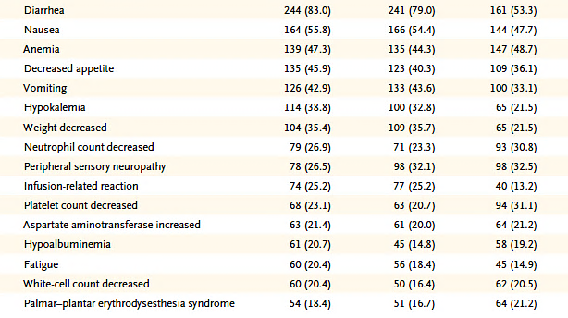
HERIZON-GEA-01: Common Treatment-Related Adverse Events
Shitara K et al. N Engl J Med 2026;394:2002-14.

Slide 21
FDA Approves Zanidatamab and Tislelizumab for HER2-Positive Gastric, Gastroesophageal Junction or Esophageal Adenocarcinoma
Press Release: August 25, 2026
“…the Food and Drug Administration approved zanidatamab-hrii:
In combination with fluoropyrimidine- and platinum-containing chemotherapy and tislelizumab-jsgr, as first-line treatment for adults with HER2-positive (IHC 3+ or IHC 2+/ISH+) unresectable locally advanced or metastatic gastric, gastroesophageal junction, or esophageal adenocarcinoma, as detected by an FDA-approved test, and
in combination with fluoropyrimidine-, and platinum-containing chemotherapy, as first-line treatment for adults with HER2-positive (IHC 3+) unresectable locally advanced or metastatic gastric, gastroesophageal junction, or esophageal adenocarcinoma, as detected by an FDA-approved test.”
The approval is based on data from HERIZON-GEA-01, the global Phase III clinical trial evaluating zanidatamab with chemotherapy, with and without tislelizumab, compared to trastuzumab with chemotherapy as first-line treatment for advanced or metastatic HER2-positive gastroesophageal adenocarcinoma.
https://www.fda.gov/drugs/resources-information-approved-drugs/fda-approves-zanidatamab-hrii-and-tislelizumab-jsgr-her2-positive-gastric-gastroesophageal-junction

Slide 22
Positive Top-Line Results Announced from the Second Interim Analysis of Phase III HERIZON-GEA-01 Trial
Press Release: August 31, 2026
Positive top-line results were announced from the second interim analysis (IA2) of the Phase III HERIZON-GEA-01 trial evaluating zanidatamab, in combination with chemotherapy, with and without tislelizumab, as first-line treatment for HER2-positive locally advanced or metastatic gastroesophageal adenocarcinoma.
“At IA2, zanidatamab plus chemotherapy demonstrated a statistically significant and clinically meaningful improvement in overall survival (OS) compared with trastuzumab plus chemotherapy, meeting the remaining primary endpoint analysis of the study.
IA2 also provided longer follow-up data for the tislelizumab plus zanidatamab and chemotherapy regimen, demonstrating an improved OS hazard ratio, continued durable outcomes, and a generally manageable safety profile. These results reinforce findings from IA1, in which the regimen met the progression-free survival (PFS) and OS endpoints, with the overall survival benefit observed across PD-L1 and HER2+ expression levels.
The safety profile of zanidatamab plus chemotherapy and tislelizumab plus zanidatamab and chemotherapy at IA2 was generally consistent with that of IA1 and the known safety profiles of the individual treatment components, with no new safety signals identified.
The results from IA2 have been submitted for presentation at a major medical meeting in the fourth quarter of 2026.”
.
https://ir.beonemedicines.com/news/beone-medicines-announces-new-phase-3-survival-data-reinforcing-benefit-of-ziihera-containing-regimens-in-first-line/283997ad-826f-4eb5-ad37-323c754de396

Slide 23
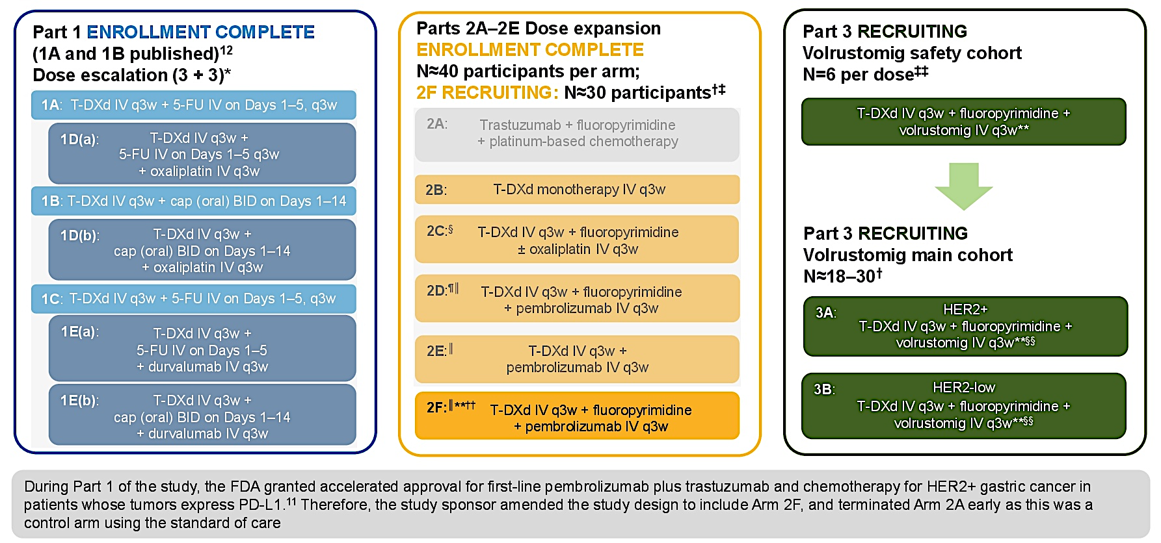
Phase Ib/II DESTINY-Gastric03 Study Design
Janjigian YY et al. ASCO GI 2024;Abstract TPS424.

Slide 24
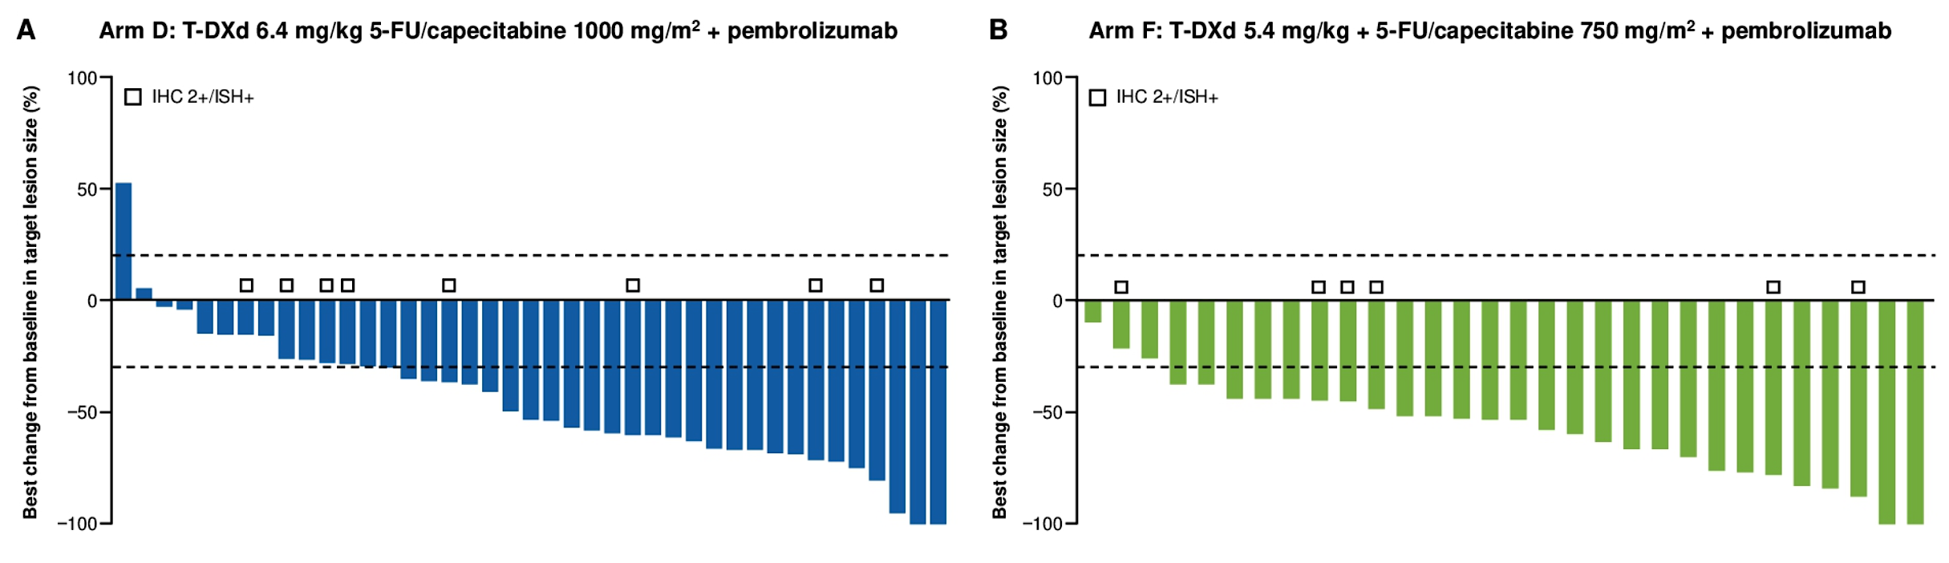
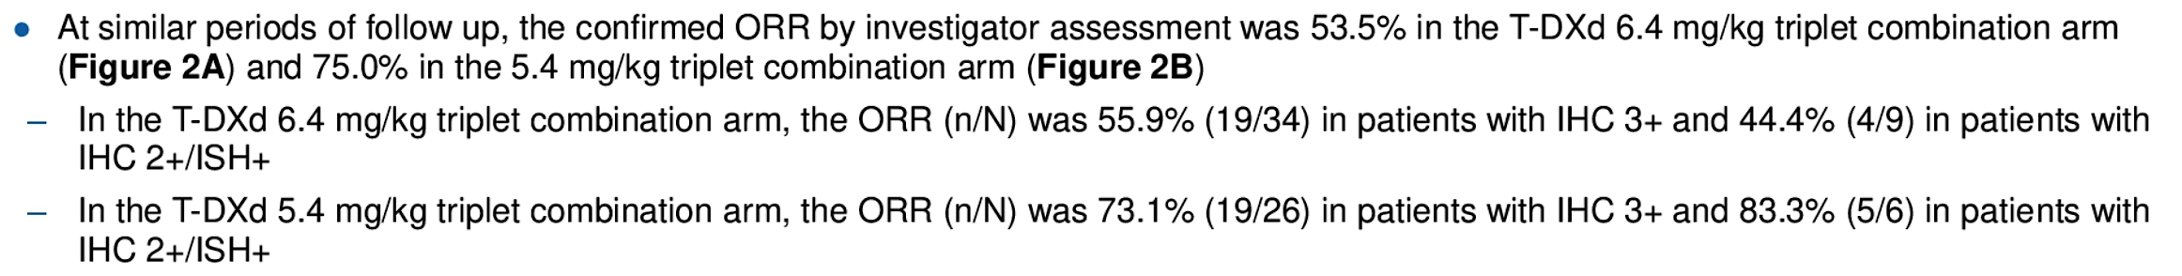
DESTINY-Gastric03: Phase Ib/II Study of First-Line T-DXd with Pembrolizumab and Fluoropyrimidine for HER2-Positive GEJ Cancer (Arms D and F) – Response
6.4 mg/kg
ORR: 53.5%
5.4 mg/kg
ORR: 75%
Janjigian Y et al. Gastrointestinal Cancers Symposium 2025;Abstract 448.

Slide 25
Select Ongoing Phase III Trials of First-Line Therapy for Advanced HER2-Positive Gastroesophageal Adenocarcinoma
Trial identifier | Estimated N | Setting | Treatment arms | Estimated completion date
DESTINY-Gastric05 (NCT06731478) | 726 | Main cohort: Unresectable, locally advanced or metastatic gastric or GEJ cancer, PD-L1 CPS ≥1 Exploratory cohort: Gastric or GEJ cancer, PD-L1 CPS <1 | T-DXd + fluoropyrimidine ± pembrolizumab Standard chemotherapy + trastuzumab ± pembrolizumab | February 2030
ARTEMIDE-Gastric01 (NCT06764875) | 840 | Locally advanced or metastatic gastric or GEJ adenocarcinoma with tumor PD-L1 CPS ≥1 | T-DXd + rilvegostomig + fluoropyrimidine Pembrolizumab + trastuzumab + FP (5-FU + cisplatin) or CAPOX Rilvegostomig + trastuzumab + FP or CAPOX | December 2030
www.clinicaltrials.gov. Accessed September 2026.

Slide 26
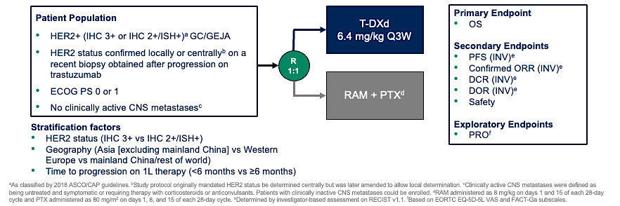
DESTINY-Gastric04 Phase III Trial of Trastuzumab Deruxtecan (T-DXd) Compared to Ramucirumab/Paclitaxel for Gastric Cancer
GC = gastric cancer; GEJA = gastroesophageal junction adenocarcinoma; RAM = ramucirumab; PTX = paclitaxel
Shitara K et al. ASCO 2025;Abstract LBA4002.

Slide 27
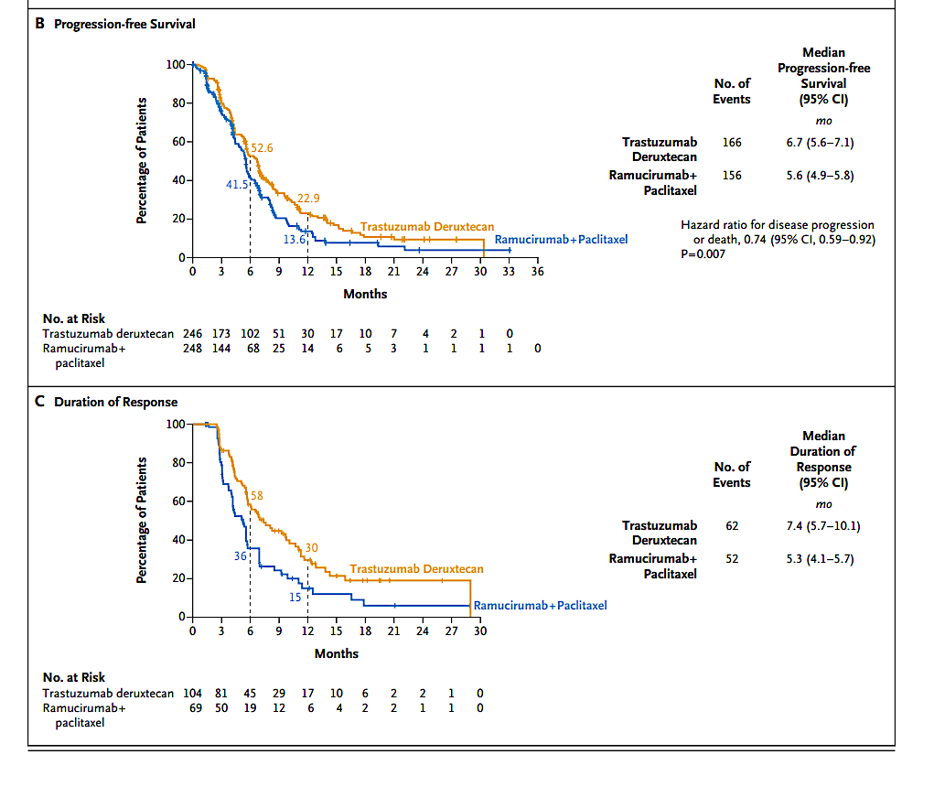
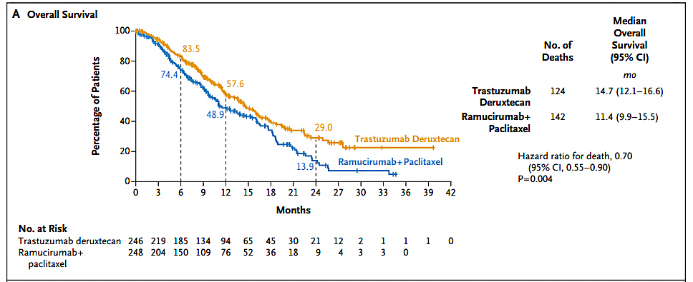
DESTINY-Gastric04: Survival and Duration of Response with T-DXd for
Gastric Cancer
Shitara K et al. ASCO 2025;Abstract LBA4002; Shitara K et al. N Engl J Med 2025;393:336-48.

Slide 28
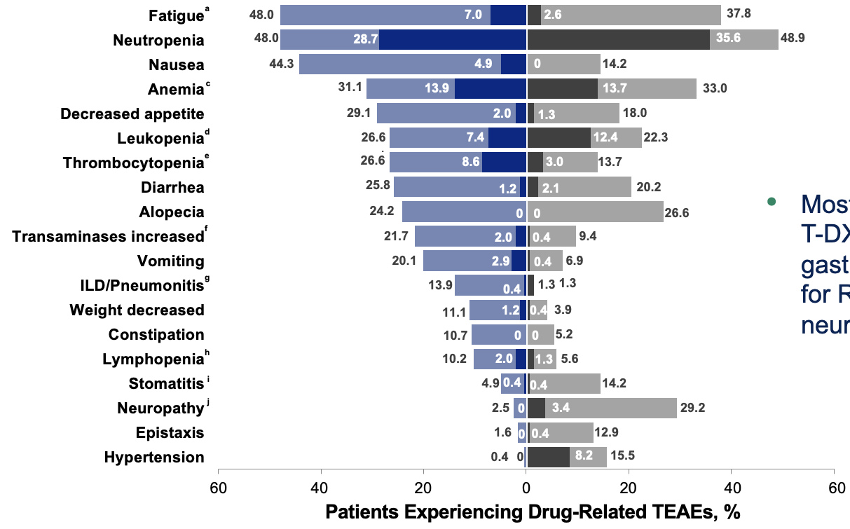
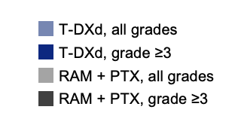
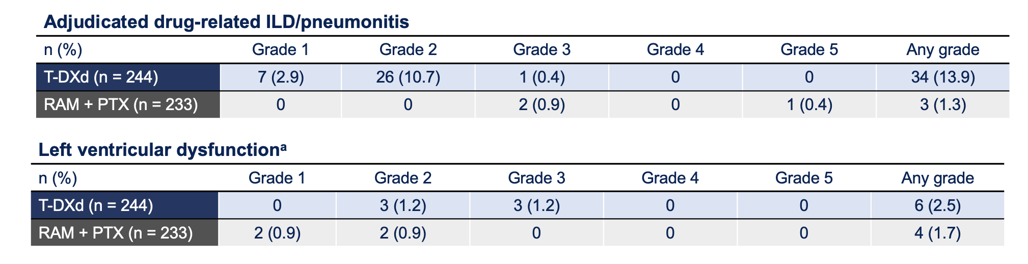
DESTINY-Gastric04: Safety with T-DXd for Gastric Cancer
Drug-related TEAEs in
≥10% of patients
TEAEs = treatment-emergent adverse events; ILD = interstitial lung disease
Shitara K et al. ASCO 2025;Abstract LBA4002; Shitara K et al. N Engl J Med 2025;393:336-48.

Slide 29
Agenda
Module 1: Optimizing the Management of HER2-Positive Advanced Gastroesophageal (GE) Cancers
Module 2: Clinician Survey Results
Module 3: Current and Future Strategies to Target CLAUDIN18.2 in Advanced GE Cancers
Module 4: Clinician Survey Results
Module 5: Integration of Immune Checkpoint Inhibitors into the Care of Patients with Resectable and Unresectable Advanced GE Cancers
Module 6: Clinician Survey Results

Slide 30
Regulatory and reimbursement issues aside, which first-line treatment would you most likely recommend for a 65-year-old patient presenting with metastatic CLDN18.2-negative, HER2-positive, microsatellite-stable (MSS) gastric adenocarcinoma with a PD-L1 combined positive score (CPS) of 0?
Zanidatamab/chemotherapy/tislelizumab
Zanidatamab/chemotherapy/tislelizumab
Zanidatamab/chemotherapy/tislelizumab
Zanidatamab/chemotherapy/tislelizumab
Zanidatamab/chemotherapy/tislelizumab
Zanidatamab/chemotherapy
Zanidatamab/chemotherapy/tislelizumab
Zanidatamab/chemotherapy

Slide 31
Regulatory and reimbursement issues aside, which first-line treatment would you most likely recommend for a 65-year-old patient presenting with metastatic CLDN18.2-negative, HER2-positive, MSS gastric adenocarcinoma with the PD-L1 CPS scores below?
PD-L1 CPS 1
PD-L1 CPS 10
Zanidatamab/chemotherapy/
tislelizumab
Zanidatamab/chemotherapy/
tislelizumab
Zanidatamab/chemotherapy/
tislelizumab
Zanidatamab/chemotherapy/
tislelizumab
Zanidatamab/chemotherapy/
tislelizumab
Zanidatamab/chemotherapy/
tislelizumab
Zanidatamab/chemotherapy/
tislelizumab
Zanidatamab/chemotherapy/
tislelizumab
Zanidatamab/chemotherapy/
tislelizumab
Zanidatamab/chemotherapy/
tislelizumab
Zanidatamab/chemotherapy/
tislelizumab
Zanidatamab/chemotherapy/
tislelizumab
Zanidatamab/chemotherapy/
tislelizumab
Zanidatamab/chemotherapy/
tislelizumab
Zanidatamab/chemotherapy/tislelizumab or trastuzumab/chemotherapy/pembrolizumab
Zanidatamab/chemotherapy/tislelizumab or trastuzumab/chemotherapy/pembrolizumab

Slide 32
For a patient to whom you have elected to administer zanidatamab/chemotherapy in combination with an anti-PD-1 antibody, how will you approach the selection of the anti-PD-1 antibody?
I will use tislelizumab according to the trial
I will use tislelizumab according to the trial
I will use tislelizumab according to the trial
I will use any of the anti-PD-1 antibodies
I will use tislelizumab according to the trial
I will use tislelizumab according to the trial
I will use any of the anti-PD-1 antibodies
I will use any of the anti-PD-1 antibodies

Slide 33
In general, would you prioritize a CLDN18.2-targeted or a HER2-targeted therapy for a patient with newly diagnosed CLDN18.2-positive, HER2-positive metastatic gastric or gastroesophageal junction (GEJ) adenocarcinoma with a PD-L1 CPS of 0?
HER2-targeted therapy
HER2-targeted therapy
HER2-targeted therapy
HER2-targeted therapy
HER2-targeted therapy
HER2-targeted therapy
HER2-targeted therapy
HER2-targeted therapy

Slide 34
In general, do you order repeat biopsies for your patients with HER2-positive gastroesophageal cancers after disease progression on HER2-targeted therapy?
No
Yes
Yes
Yes
Yes
Yes
Yes
Yes

Slide 35
What would you most likely recommend as second-line therapy for a patient with metastatic CLDN18.2-negative, HER2-positive, MSS gastric adenocarcinoma with a PD-L1 CPS of ≥1 who experienced disease progression (PD) on the first-line regimens below?
PD on first-line FOLFOX/trastuzumab/pembrolizumab
PD on first-line zanidatamab/ chemotherapy/tislelizumab
Trastuzumab deruxtecan
Trastuzumab deruxtecan
Trastuzumab deruxtecan
Trastuzumab deruxtecan
Trastuzumab deruxtecan
Trastuzumab deruxtecan
Trastuzumab deruxtecan
Trastuzumab deruxtecan
Trastuzumab deruxtecan
Trastuzumab deruxtecan
Trastuzumab deruxtecan
Trastuzumab deruxtecan
Trastuzumab deruxtecan
Trastuzumab deruxtecan
Trastuzumab deruxtecan
Trastuzumab deruxtecan

Slide 36
For a patient with HER2-positive gastric/GEJ adenocarcinoma who experienced PD on first-line FOLFOX/trastuzumab/pembrolizumab and on second-line trastuzumab deruxtecan, would you offer treatment with zanidatamab?
No
Yes
No
Yes
Yes
No
No
No

Slide 37
Agenda
Module 1: Optimizing the Management of HER2-Positive Advanced Gastroesophageal (GE) Cancers
Module 2: Clinician Survey Results
Module 3: Current and Future Strategies to Target CLAUDIN18.2 in Advanced GE Cancers
Module 4: Clinician Survey Results
Module 5: Integration of Immune Checkpoint Inhibitors into the Care of Patients with Resectable and Unresectable Advanced GE Cancers
Module 6: Clinician Survey Results

Slide 38
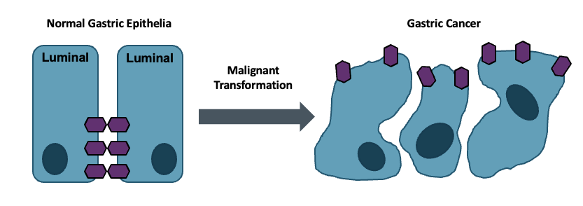
Claudin 18.2: Leveraging Biology
Claudin 18.2 is a major structural component of intercellular tight junctions
Not routinely expressed in any normal tissue outside gastric mucosa (cancer-restricted antigen)
Broadly expressed in several tumor types, including gastric, GEJ, biliary and pancreatic
Baek JH et al. Anticancer Res 2019;39(12):6973-9.
.

Slide 39
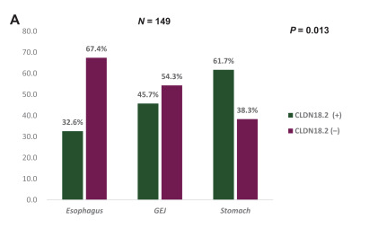
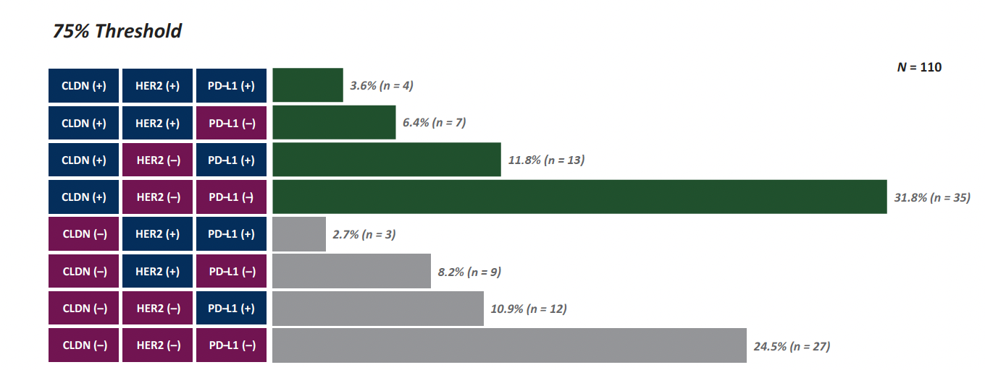
Claudin 18.2 (CLDN18.2): Characteristics and Overlap
CLDN18.2 positivity rates:
  Highest in gastric followed by GEJ and esophagus
  48.3% (75% threshold: ≥75% of tumor cells with 2-3+ staining)
  71.1% (H-score 25; ≥1+ intensity in ≥25% of cells)
  73.8% (H-score 10; ≥1+ intensity in ≥10% of cells)
•
No significant association with HER2, PD-L1 CPS or mismatch repair
~30% sole biomarker
•
Maeng CH et al. ESMO Gastrointest Oncol 2026;11:100278.

Slide 40
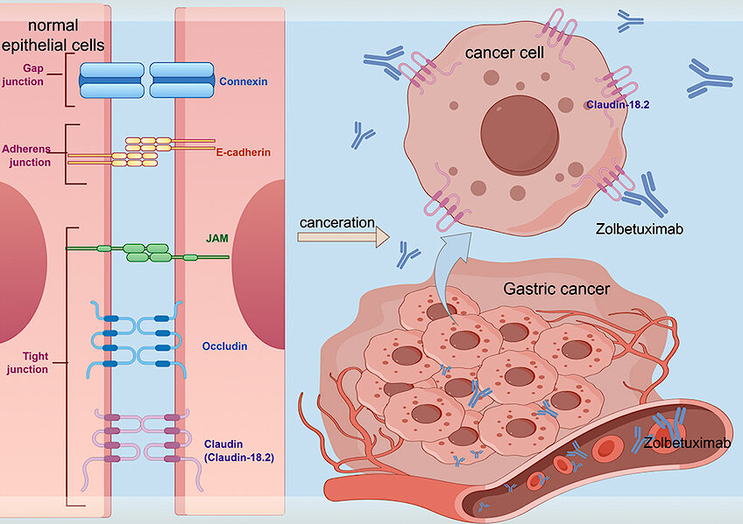
Zolbetuximab Mechanism of Action
Du F et al. J Hepatocell Carcinoma 2024;11:1801-21.

Slide 41
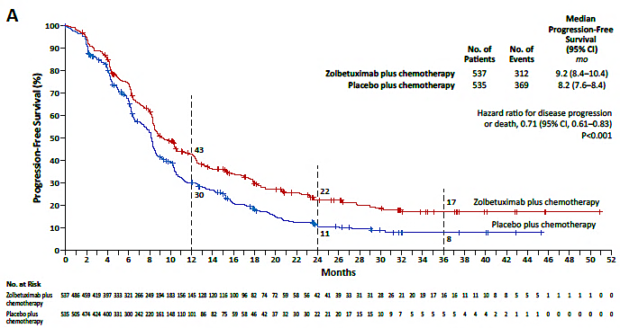
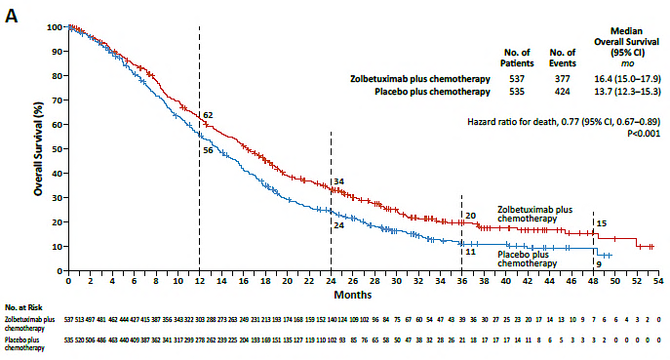
SPOTLIGHT and GLOW Trials Combined Analysis: Survival with First-Line Zolbetuximab and Chemotherapy for Gastric or GEJ Adenocarcinoma
Updated PFS
Final OS Analysis
Shitara K et al. N Engl J Med 2024;391(12):1159-62.

Slide 42
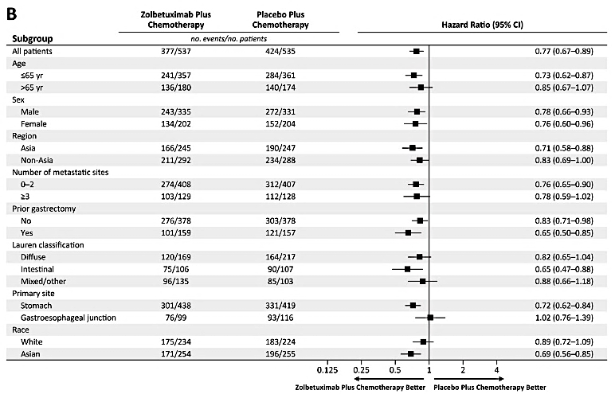
SPOTLIGHT and GLOW Combined Analysis: Overall Survival with First-Line Zolbetuximab and Chemotherapy for Gastric or GEJ Adenocarcinoma
Shitara K et al. N Engl J Med 2024;391(12):1159-62.

Slide 43
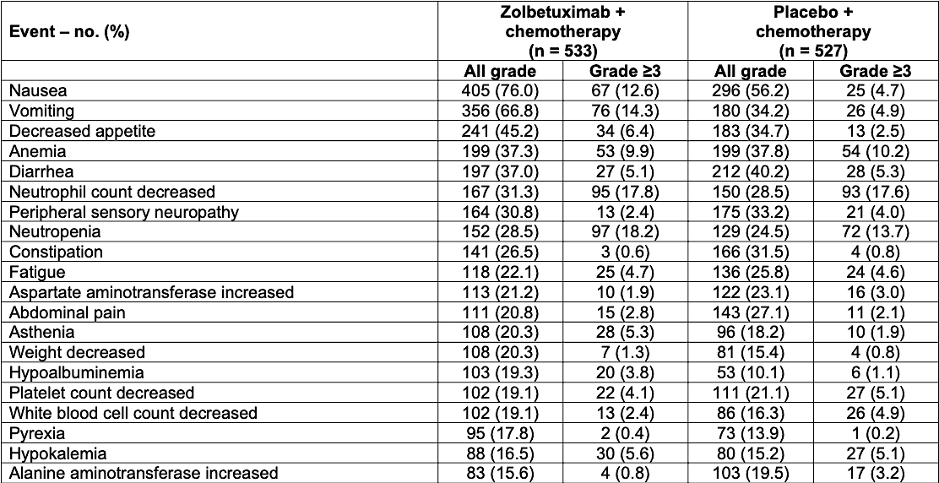
SPOTLIGHT and GLOW Combined Analysis: Treatment-Emergent
Adverse Events
Shitara K et al. N Engl J Med 2024;391(12):1159-62.

Slide 44
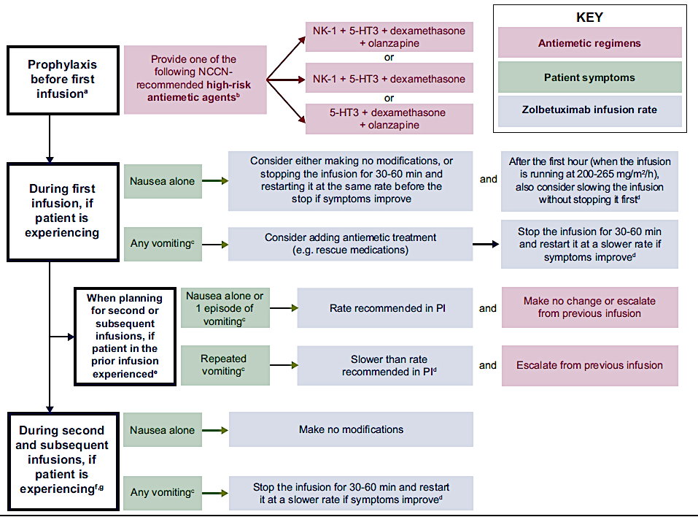
Zolbetuximab: Management of Nausea and Vomiting
Klempner SJ et al. ESMO Gastrointest Oncol 2025;7:100131.

Slide 45
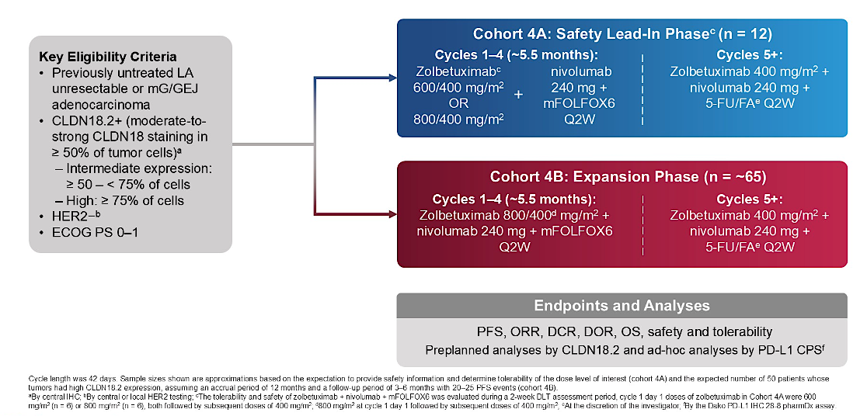
Phase II ILUSTRO Study of First-Line Zolbetuximab with mFOLFOX6 and Nivolumab for CLDN18.2-Positive Locally Advanced Unresectable or Metastatic Gastric or GEJ Adenocarcinoma: Cohort 4
mFOLFOX6 = modified FOLFOX-6; LA = locally advanced
Shitara K et al. Gastrointestinal Cancers Symposium 2026;Abstract LBA284.

Slide 46
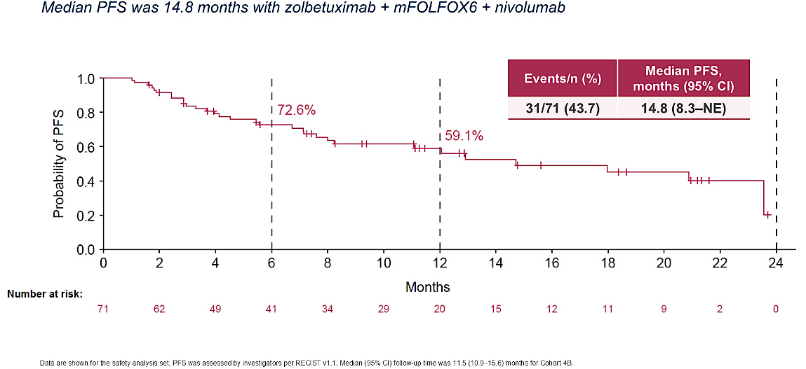
ILUSTRO Cohort 4B: PFS with First-Line Zolbetuximab, Nivolumab and mFOLFOX6
Shitara K et al. Gastrointestinal Cancers Symposium 2026;Abstract LBA284; Shitara K et al. Nat Med 2026;32(6):2182-90.

Slide 47
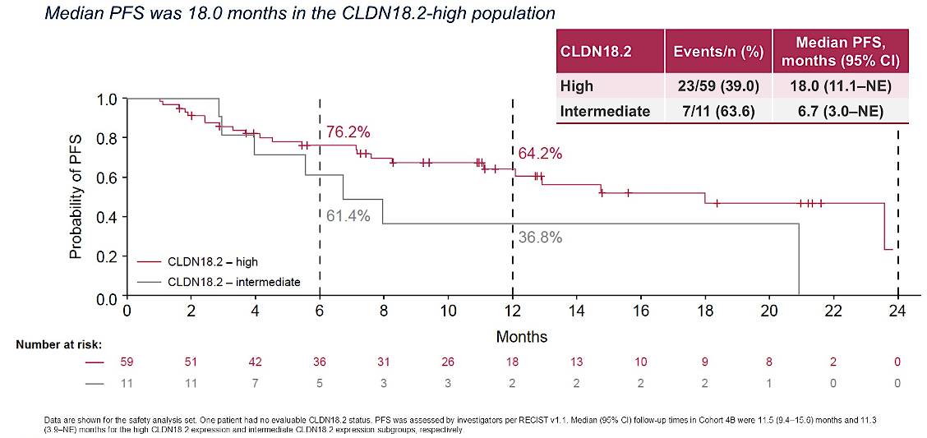
ILUSTRO Cohort 4B: PFS with First-Line Zolbetuximab, Nivolumab and mFOLFOX6, Stratified by CLDN18.2 Expression
Shitara K et al. Gastrointestinal Cancers Symposium 2026;Abstract LBA284; Shitara K et al. Nat Med 2026;32(6):2182-90.

Slide 48
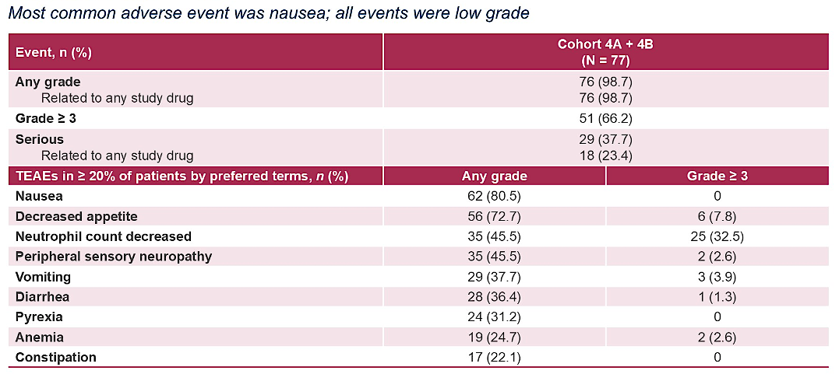
ILUSTRO: Treatment-Emergent Adverse Events with First-Line Zolbetuximab and Nivolumab — Cohorts 4A and 4B
Shitara K et al. Gastrointestinal Cancers Symposium 2026;Abstract LBA284; Shitara K et al. Nat Med 2026;32(6):2182-90.

Slide 49
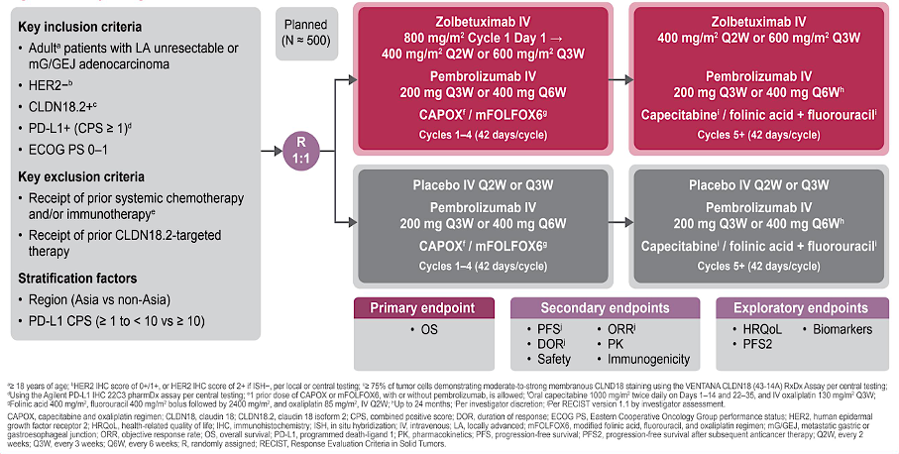
Ongoing Phase III LUCERNA Trial of First-Line Zolbetuximab with Pembrolizumab and Chemotherapy for CLDN18.2-Positive, HER2-Negative, PD-L1-Positive Locally Advanced Unresectable or Metastatic Gastric or GEJ Adenocarcinoma
Shitara K et al. Gastrointestinal Cancers Symposium 2026;Abstract TPS473.

Slide 50
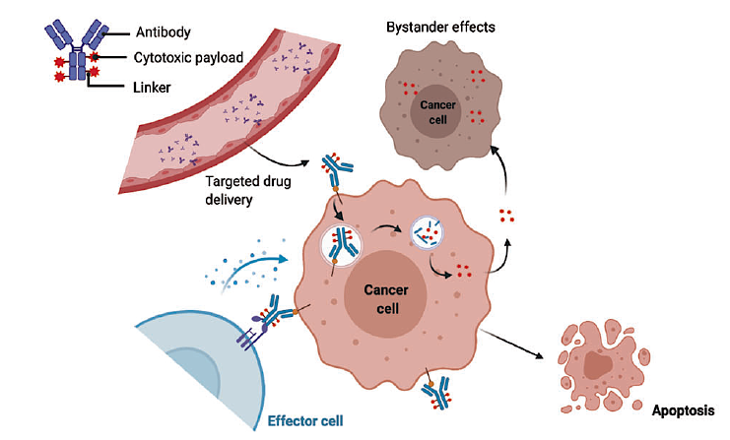
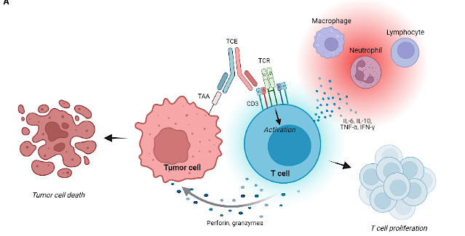
Expanding Therapy Beyond Zolbetuximab
Antibody-drug conjugates (ADCs)
Bispecific antibodies and BiTEs
Spinazzola A et al. Front Immunol 2025:16:1665838.
Fu Z et al. Signal Transduct Target Ther 2022;7(1):93.
Givastomig – CLDN18.2 x 4-1BB bispecific
Spevatamig – CLDN18.2 x CD47 bispecific
ASP2138 – CLDN18.2 x CD3 BiTE
AZD5863 – CLDN18.2 x CD3 BiTE
Sonesitatug vedotin (AZD0901) – CLDN18.2 ADC with MMAE payload
IBI343 – CLDN18.2 ADC with TOPO I payload
SHR-A1904 – CLDN18.2 ADC with TOPO I payload
BiTE = bispecific T-cell engager
Adapted from Samuel J Klempner, MD

Slide 51
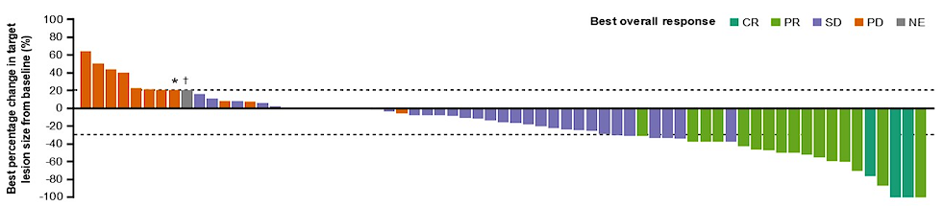
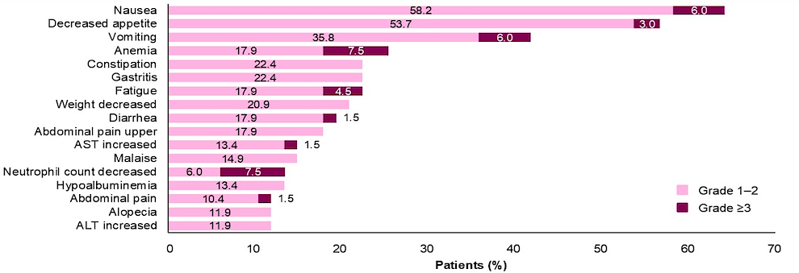
CLARITY-PanTumor01 Substudy 1: Sonesitatug Vedotin Activity in Gastric and GEJ Cancer
ORR 28.4%
TEAs occurring in ≥10% of patients overall
CR = complete response; PR = partial response; SD = stable disease; PD = progressive disease; NE = not evaluable; ORR = objective response rate
Shitara K et al. ASCO 2026;Abstract 4023.

Slide 52
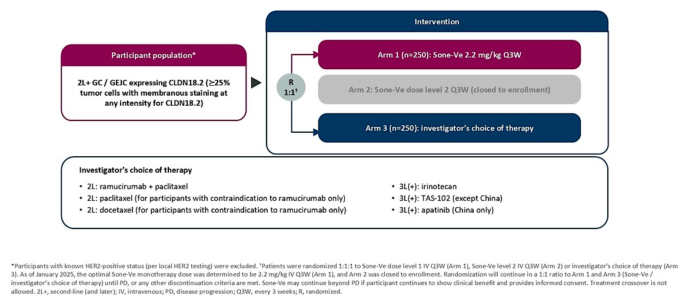
Phase III CLARITY-Gastric 01 Study: Second-or Later-Line Sonesitatug Vedotin for Advanced Gastric/GEJ Cancer
Primary endpoints: PFS for all patients, OS for patients receiving third-line or later treatment
Estimated completion: October 2026
Shitara K et al. Gastrointestinal Cancers Symposium 2026;Abstract TPS462.

Slide 53
Sonesitatug Vedotin Demonstrated a Statistically Significant Improvement in Overall Survival in Second- and Later-Line Therapy for CLDN18.2-Positive Advanced Gastric/GEJ Cancers
Press Release: July 27, 2026
“Positive high-level results from the CLARITY-Gastric01 global Phase III trial showed that sonesitatug vedotin
(Sone-Ve) demonstrated a statistically significant and highly clinically meaningful improvement in overall survival (OS) in 2nd and later-line Claudin 18.2-positive advanced gastric cancers versus investigator’s choice of therapy. The trial included patients with locally advanced or metastatic gastric cancer, gastroesophageal junction (GEJ) cancer, or esophageal adenocarcinoma (EAC) with Claudin 18.2 (CLDN18.2) expression on at least 25% of tumor cells at any staining intensity.
The trial had dual primary endpoints of OS in 3rd and later-line treatment and progression-free survival (PFS) in the overall trial population. The trial met the dual primary endpoint of OS in 3rd and later-line treatment, and a key secondary endpoint of OS in the overall trial population of patients treated in the 2nd and later-line setting, demonstrating a statistically significant and highly clinically meaningful improvement.
For the other dual primary endpoint of PFS as assessed by blinded independent central review (BICR), results showed a trend toward improved PFS in patients treated in the 2nd and later-line setting but did not reach statistical significance.”
https://www.astrazeneca.com/media-centre/press-releases/2026/sone-ve-improved-survival-in-gastric-cancers.html

Slide 54
ESMO 2026 Presidential Symposium II
October 25, 2026
Abstract LBA7
CLARITY-Gastric 01 (CG-01): A Phase 3 study of sonesitatug vedotin (Sone-Ve) in second or later-line (2L+) advanced or metastatic claudin 18.2 (CLDN18.2) positive gastroesophageal carcinoma (GEC)
Rui-Hua Xu

Slide 55
Ongoing Phase III CLARITY-Gastric 02 Study: First-Line Sonesitatug Vedotin in Combination with Capecitabine with or without Rilvegostomig
Cohort 1: CLDN18.2-positive, PD-L1-positive
Sone-Ve + rilvegostomig + capecitabine
Sone-Ve + nivolumab + capecitabine
Standard nivolumab + CAPOX or FOLFOX
1L GC/GEJC expressing CLDN18.2 (≥25% tumor cells with membranous staining at any intensity for CLDN18.2)
N ≈ 2,130
Cohort 2: CLDN18.2-positive, PD-L1-negative
Sone-Ve + capecitabine
CAPOX or FOLFOX with or without zolbetuximab
Primary endpoints: PFS for cohorts 1 and 2, OS for cohort 1
Secondary endpoints: OS (cohort 2), objective response rate, duration of response, safety
Data anticipated: After 2027
Estimated completion: October 2031
www.clinicaltrials.gov. NCT07431281. Accessed August 2026.

Slide 56
Agenda
Module 1: Optimizing the Management of HER2-Positive Advanced Gastroesophageal (GE) Cancers
Module 2: Clinician Survey Results
Module 3: Current and Future Strategies to Target CLAUDIN18.2 in Advanced GE Cancers
Module 4: Clinician Survey Results
Module 5: Integration of Immune Checkpoint Inhibitors into the Care of Patients with Resectable and Unresectable Advanced GE Cancers
Module 6: Clinician Survey Results

Slide 57
Regulatory and reimbursement issues aside, which first-line treatment would you most likely recommend for a 65-year-old patient presenting with metastatic HER2-negative, MSS gastric adenocarcinoma with a PD-L1 CPS of 0 and the CLDN18.2 status below?
CLDN18.2 positive
CLDN18.2 negative
Chemotherapy + zolbetuximab
FOLFOX
Chemotherapy + zolbetuximab
FOLFOX
Chemotherapy + zolbetuximab
FOLFOX
Chemotherapy + zolbetuximab
FOLFOX
Chemotherapy + zolbetuximab
FOLFOX
Chemotherapy + zolbetuximab
FOLFOX
Chemotherapy + zolbetuximab
FOLFOX
Chemotherapy + zolbetuximab
FOLFOX

Slide 58
Regulatory and reimbursement issues aside, which first-line treatment would you most likely recommend for a 65-year-old patient presenting with metastatic HER2-negative, MSS gastric adenocarcinoma with a PD-L1 CPS of 1 and the CLDN18.2 status below?
CLDN18.2 positive
CLDN18.2 negative
Chemotherapy + anti-PD-1/PD-L1 antibody
Nivolumab + FOLFOX
Chemotherapy + zolbetuximab
Nivolumab + FOLFOX
Chemotherapy + zolbetuximab
Nivolumab + FOLFOX
Chemotherapy + zolbetuximab +
anti-PD-1/PD-L1 antibody
Nivolumab + FOLFOX
Chemotherapy + zolbetuximab
Nivolumab + FOLFOX
Chemotherapy + zolbetuximab
IO + FOLFOX
Chemotherapy + zolbetuximab
Nivolumab + FOLFOX
Chemotherapy + zolbetuximab +
anti-PD-1/PD-L1 antibody
Nivolumab + FOLFOX or
pembrolizumab + FOLFOX
IO = immunotherapy

Slide 59
Regulatory and reimbursement issues aside, which first-line treatment would you most likely recommend for a 65-year-old patient presenting with metastatic HER2-negative, MSS gastric adenocarcinoma with a PD-L1 CPS of 10 and the CLDN18.2 status below?
CLDN18.2 positive
CLDN18.2 negative
Chemotherapy + anti-PD-1/PD-L1 antibody
Nivolumab + FOLFOX
Chemotherapy + anti-PD-1/PD-L1 antibody
Nivolumab + FOLFOX
Chemotherapy + anti-PD-1/PD-L1 antibody
Nivolumab + FOLFOX
Chemotherapy + anti-PD-1/PD-L1 antibody or chemotherapy + zolbetuximab and an anti-PD-1/PD-L1 antibody
Nivolumab + FOLFOX
Chemotherapy + zolbetuximab
and an anti-PD-1/PD-L1 antibody
Nivolumab + FOLFOX
Chemotherapy + anti-PD-1/PD-L1 antibody
IO + FOLFOX
Chemotherapy + zolbetuximab
and an anti-PD-1/PD-L1 antibody
Nivolumab + FOLFOX
Chemotherapy + zolbetuximab
and an anti-PD-1/PD-L1 antibody
Nivolumab + FOLFOX or
pembrolizumab + FOLFOX

Slide 60
How would you indirectly compare the global efficacy of zolbetuximab and chemotherapy to that of an anti-PD-1 antibody and chemotherapy for patients with newly diagnosed gastric/GEJ adenocarcinoma who are eligible for both treatments?
An anti-PD-1 antibody with chemotherapy is more efficacious
About the same
About the same
About the same
About the same
About the same
About the same
About the same

Slide 61
Outside of a clinical trial, have you administered or would you administer both zolbetuximab and an anti-PD-1/PD-L1 antibody in combination with first-line chemotherapy for a patient with newly diagnosed gastric/GEJ adenocarcinoma?
I have not and would not
I have not but would for the right patient
I have
I have
I have
I have not but would for the right patient
I have
I have

Slide 62
Based on available information and your own clinical experience, would you currently like to have access to sonesitatug vedotin (Sone-V)?
Yes, but await presentation of Phase III data and approval status
Yes, for patients with CLDN18.2-positive disease and
progression on first-line therapy, including zolbetuximab
Yes
Yes, for CLDN18.2-positive disease (by Sone-V cutoff) in second and third line
Yes, for those patients with progression on first-line zolbetuximab
Yes
Yes, possibly in the second-line setting
I’m not sure

Slide 63
If sonesitatug vedotin becomes clinically available, in which line of therapy do you think you will administer it?
Second line
Second line
Second line
Third line, and second line for some patients
Second line
Second line
Second line
Second or third line

Slide 64
Based on available information and your own clinical experience, would you be inclined to administer sonesitatug vedotin to a patient who received zolbetuximab/chemotherapy and experienced disease progression?
Maybe
Yes
Maybe
Yes
Yes
Maybe
Maybe
No

Slide 65
Agenda
Module 1: Optimizing the Management of HER2-Positive Advanced Gastroesophageal (GE) Cancers
Module 2: Clinician Survey Results
Module 3: Current and Future Strategies to Target CLAUDIN18.2 in Advanced GE Cancers
Module 4: Clinician Survey Results
Module 5: Integration of Immune Checkpoint Inhibitors into the Care of Patients with Resectable and Unresectable Advanced GE Cancers
Module 6: Clinician Survey Results

Slide 66
FDA Revised Indication for Pembrolizumab for Gastroesophageal Cancers – May 22, 2025
Pembrolizumab, in combination with fluoropyrimidine- and platinum-containing chemotherapy, is indicated as first-line treatment for adults with locally advanced unresectable or metastatic HER2-negative gastric or gastroesophageal junction (GEJ) adenocarcinoma whose tumors express PD-L1 (CPS ≥ 1) as determined by an FDA-approved test.
Pembrolizumab is indicated for patients with locally advanced or metastatic esophageal or GEJ (tumors with epicenter 1 to 5 centimeters above the GEJ) carcinoma that is not amenable to surgical resection or definitive chemoradiation therapy either
  In combination with platinum- and fluoropyrimidine-based chemotherapy for patients with tumors that express PD-L1 (CPS ≥ 1), or
  As a single agent after 1 or more prior lines of systemic therapy for patients with tumors of squamous cell histology that express PD-L1 (CPS ≥10) as determined by an FDA-approved test.
https://fda.report/applications/125514/82310. Accessed September 2026.

Slide 67
FDA Revised Indication for Nivolumab for Metastatic Gastroesophageal Cancers – May 23, 2025
Nivolumab, in combination with fluoropyrimidine- and platinum-containing chemotherapy, is indicated as first-line treatment for adult patients with unresectable advanced or metastatic esophageal squamous cell carcinoma (ESCC) whose tumors express PD-L1 (≥1).
Nivolumab, in combination with ipilimumab, is indicated as first-line treatment for adult patients with unresectable advanced or metastatic ESCC whose tumors express PD-L1 (≥1).
Nivolumab, in combination with fluoropyrimidine- and platinum-containing chemotherapy, is indicated as treatment for adult patients with advanced or metastatic gastric cancer, gastroesophageal junction cancer or esophageal adenocarcinoma whose tumors express PD-L1 (≥1).
https://www.accessdata.fda.gov/drugsatfda_docs/appletter/2025/125554Orig1s133ltr.pdf. Accessed September 2026.

Slide 68
Overview of Select Trials of First-Line Immunotherapy for
Gastroesophageal Cancers
Parameter | CheckMate-649¹ | KEYNOTE-859² | Rationale-305³
Disease location | Gastric, GEJ, esophagus | Gastric, GEJ | Gastric, GEJ
Histology | Adenocarcinoma | Adenocarcinoma | Adenocarcinoma
Agent | Nivolumab + chemotherapy vs chemotherapy | Pembrolizumab + chemotherapy vs chemotherapy | Tislelizumab + chemotherapy vs chemo
Setting | First-line advanced | First-line advanced | First-line advanced
ORR, % | 60 vs 46 (CPS ≥1) | 52 vs 43 (CPS ≥1) | 50 vs 43 (TAP ≥5)
PFS HR | 0.71 (CPS ≥5), 0.77 (CPS ≥1), 0.79 (all patients) | 0.62 (CPS ≥10), 0.72 (CPS ≥1), 0.76 (all patients) | 0.67 (TAP ≥5), 0.78 (all patients)
OS ∆, mo | 3.3 (CPS ≥5), 2.4 (CPS ≥1), 2.1 (all patients) | 4.0 (CPS ≥10), 1.6 (CPS ≥1), 1.4 (all patients) | 4.6 (TAP ≥5), 2.1 (all patients)
HR = hazard ratio; CPS = combined positive score; TAP = tumor area positivity
1. Janjigian YY et al. Ann Oncol 2026;37(6):787-97. 2. Rha SY et al. ASCO 2025;Abstract 4036. 3. Qiu M-Z et al. BMJ 2024;385:e078876.

Slide 69
Microsatellite Instability-High (MSI-H) Gastroesophageal Cancers
4% to 24% of GE cancers are MSI-H
  – ~30% of Stage I to Stage II tumors are MSI-H
  – 4% to 12% of metastatic gastric cancers are MSI-H
MSI-H GE cancers by anatomical region:
  – 1% esophagus
  – 5% to 12% cardia or fundus
  – 12% to 16% body
  – 15% to 30% antrum
Cancer Genome Atlas Research Network. Nature 2014;513(7517):202-9.
Cristescu R et al. Nat Med 2015;21(5):449-56.
Zhou KI et al. J Gastrointest Cancer 2024;55(2):483-96.

Slide 70
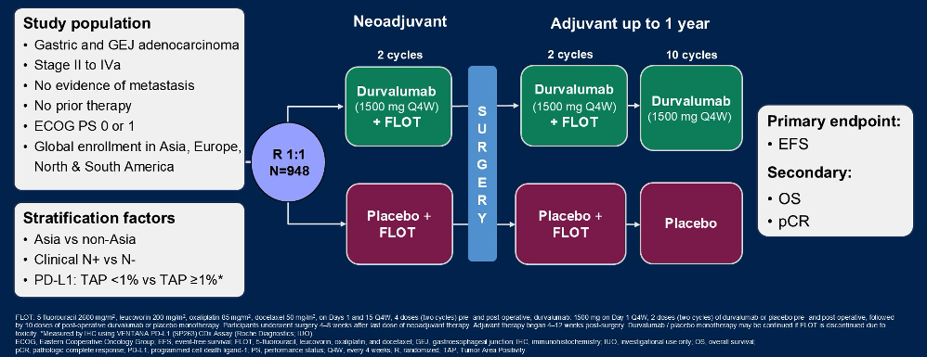
Phase III MATTERHORN Trial of Perioperative Durvalumab for Gastric and Gastroesophageal Junction Cancer
Janjigian YY et al. ASCO 2025;Abstract LBA5.

Slide 71
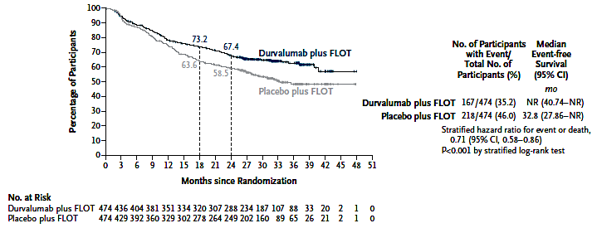
MATTERHORN: Event-Free Survival in the Full-Analysis Population
Janjigian YY et al. N Engl J Med 2025;393(3):217-30.

Slide 72
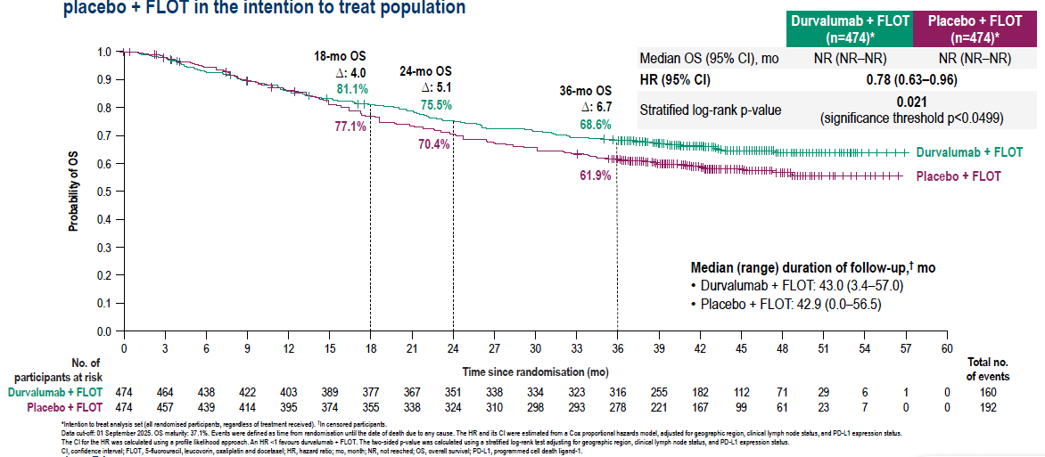
MATTERHORN: Final Overall Survival Analysis
Tabernero J et al. ESMO 2025;Abstract LBA81; Janjigian YY et al. Lancet 2026;408(10560):1114-28.

Slide 73
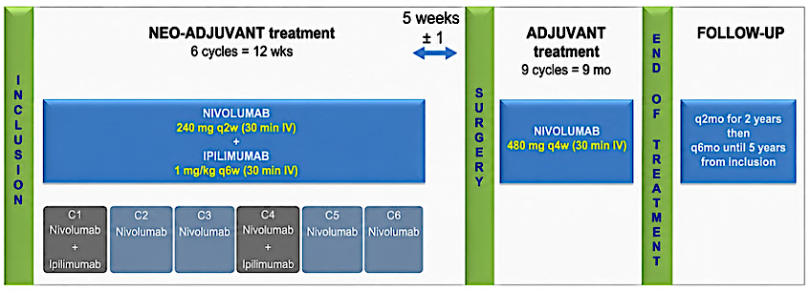
Phase II NEONIPIGA Study of Neoadjuvant Nivolumab with Ipilimumab and Adjuvant Nivolumab for MSI-High/dMMR Esophagogastric Adenocarcinoma
Inclusion criteria: Histologically proven resectable MSI-H/dMMR gastric or esophagogastric adenocarcinoma, cT-T4NxM0
MSI = microstatellite instability; dMMR = mismatch repair deficient
Samaille T et al. ASCO 2026;Abstract 4099.

Slide 74
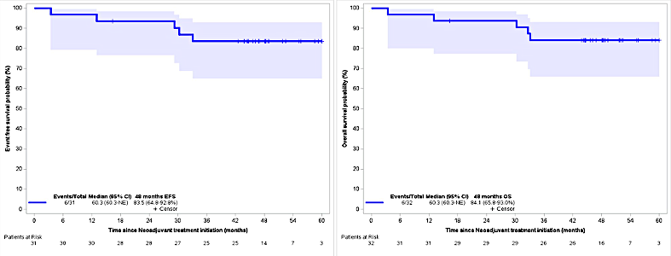
NEONIPIGA Long-Term Follow-Up: Event-Free and Overall Survival
Events/Total | Median EFS | 48-month EFS
6/31 | 60.3 mo | 83.5%
Events/Total | Median EFS | 48-month EFS
6/32 | 60.3 mo | 84.1%
Median follow-up 48.3 months
Samaille T et al. ASCO 2026;Abstract 4099.

Slide 75
Agenda
Module 1: Optimizing the Management of HER2-Positive Advanced Gastroesophageal (GE) Cancers
Module 2: Clinician Survey Results
Module 3: Current and Future Strategies to Target CLAUDIN18.2 in Advanced GE Cancers
Module 4: Clinician Survey Results
Module 5: Integration of Immune Checkpoint Inhibitors into the Care of Patients with Resectable and Unresectable Advanced GE Cancers
Module 6: Clinician Survey Results

Slide 76
Which primary treatment would you most likely recommend for a 65-year-old patient (PS 0) with MSI-high/mismatch repair-deficient, HER2-negative gastric adenocarcinoma, PD-L1 CPS ≥1, that appeared to be amenable to surgical resection, if the patient had T2N1 disease? Would your treatment recommendations change if the patient had node-negative disease?
Tx if T2N1
Tx if node-negative
Neoadjuvant ipi/nivo followed by adjuvant nivo or neoadjuvant durvalumab + tremelimumab
No change
Neoadjuvant ipi/nivo followed
by adjuvant nivo
No change
Neoadjuvant ipi/nivo followed
by adjuvant nivo
No change
Neoadjuvant ipi/nivo followed
by adjuvant nivo
No significant change
Ipi/nivo followed by nivo and if ctDNA clears at 6 wk, would consider NOM
Surgery alone vs definitive
pembrolizumab monotherapy
Neoadjuvant ipi/nivo followed
by adjuvant nivo
No change
Neoadjuvant ipi/nivo followed
by adjuvant nivo
No change; may consider organ preservation if cCR
Neoadjuvant dostarlimab
No change

Slide 77
Given that durvalumab in combination with perioperative FLOT has received regulatory approval, for which patients with resectable gastric adenocarcinoma are you prioritizing this strategy?
All patients with T3 or higher or node-positive disease
Fit patients with resectable Stage II to IV disease who resemble the MATTERHORN population, particularly those with clinically higher-risk T-stage and/or node-positive disease
Nearly all patients who are fit for FLOT-based therapy and surgery
Most patients, unless disease is MSI-H
All patients with T2 or higher or node-positive disease and
no contraindications to immunotherapy
CPS >1
Patients with resectable gastric or GEJ adenocarcinoma (Stage II to IVa),
medically fit, good/excellent PS, and are candidates for surgical resection
Most patients, unless disease is MSI-H
PS = performance status; MSI-H = microsatellite instability high

Slide 78
Which perioperative chemotherapy regimen do you typically use for your patients with resectable gastric/GEJ adenocarcinoma who are unable to tolerate FLOT?
FOLFOX
FOLFOX
I will first dose-reduce all drugs in FLOT before going to FOLFOX
I first tend to start with empiric dose reduction. If patient truly
not a FLOT candidate, I will consider FOLFOX for select patients
FOLFOX
Reduced FLOT
FOLFOX + durvalumab could be considered
Dose-modified FLOT

Slide 79
Questions?

