Slide 1
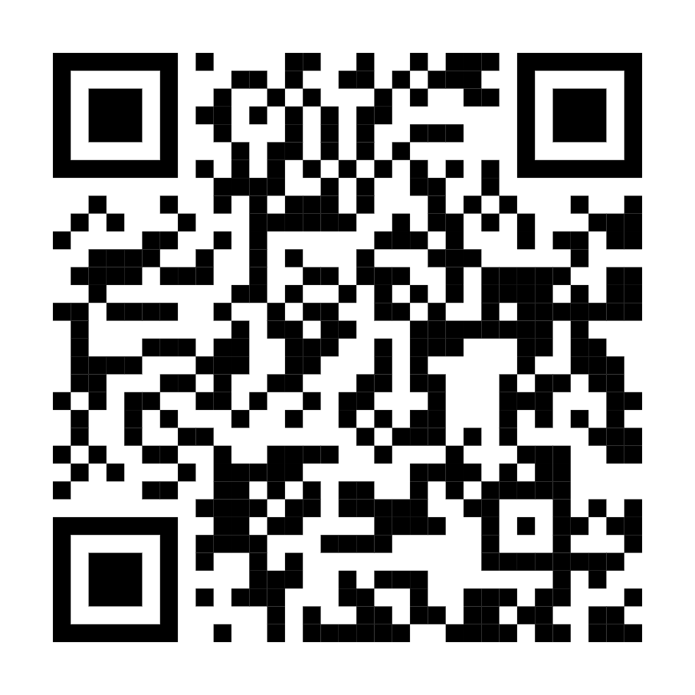
Welcome!
Please complete the preactivity educational survey by scanning
the QR code below. If you have already completed this survey,
thank you –– please do not respond again.
Your input is greatly appreciated and helps
guide our future educational activities.

Slide 2
Optimizing the Use of Novel Therapies for
Patients with Diffuse Large B-Cell Lymphoma
Jason Westin, MD, MS, FACP, FASCO
Director, Lymphoma Clinical Research
Lead, Lymphoma and Myeloma Service Line
Professor, Department of Lymphoma and Myeloma
The University of Texas MD Anderson Cancer Center
Houston, Texas

Slide 3
Disclosures
Advisory Committees | Genentech, a member of the Roche Group, Kite, A Gilead Company, Novartis
Consulting Agreements | AbbVie Inc, ADC Therapeutics, Allogene Therapeutics, AstraZeneca Pharmaceuticals LP, Bristol Myers Squibb, Genentech, a member of the Roche Group, Genmab US Inc, Incyte Corporation, Janssen Biotech Inc, Kite, A Gilead Company, MorphoSys, Novartis, Nurix Therapeutics Inc, Pfizer Inc, Regeneron Pharmaceuticals Inc
Contracted Research | ADC Therapeutics, Allogene Therapeutics, AstraZeneca Pharmaceuticals LP, Bristol Myers Squibb, Genentech, a member of the Roche Group, Incyte Corporation, Janssen Biotech Inc, Kite, A Gilead Company, MorphoSys, Novartis, Nurix Therapeutics Inc, Regeneron Pharmaceuticals Inc

Slide 4
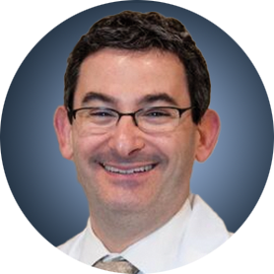
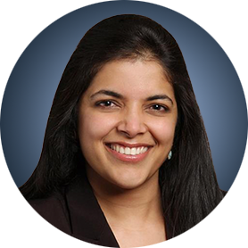
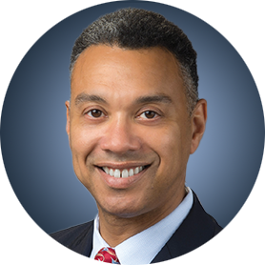



Program Steering Committee
Jeremy S Abramson, MD, MMSc
Director, Center for Lymphoma
Massachusetts General Hospital
Professor of Medicine
Harvard Medical School
Boston, Massachusetts
Manali Kamdar, MD, MBBS
Professor
Clinical Director of Lymphoma Services
Morton and Sandra Saffer Endowed Chair in Hematology Research
Division of Hematology, Hematologic Malignancies
University of Colorado Cancer Center
Aurora, Colorado
Christopher Flowers, MD, MS, FASCO
Division Head, Division of Cancer Medicine
Chair, Professor, Department of Lymphoma/Myeloma
John Brooks Williams and Elizabeth Williams Distinguished
University Chair in Cancer Medicine
The University of Texas
MD Anderson Cancer Center
Houston, Texas
Ann LaCasce, MD, MMSc
Associate Professor, Hematology and Medical Oncology
Program Director, Dana-Farber/MGB Fellowship
in Hematology/Oncology
Dana-Farber Cancer Institute
Harvard Medical School
Boston, Massachusetts
Matthew Lunning, DO
Professor
Chief of Hematology, Interim
Medical Director, Gene and Cellular Therapy
Assistant Vice Chancellor for Clinical Research
Fred and Pamela Buffett Cancer Center
University of Nebraska Medical Center
Omaha, Nebraska
Brad S Kahl, MD
Professor of Medicine
Washington University School of Medicine
Director, Lymphoma Program
Siteman Cancer Center
St Louis, Missouri

Slide 5



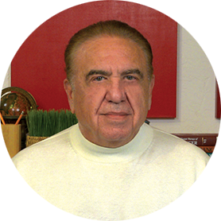

Program Steering Committee
Matthew Matasar, MD
Chief, Division of Blood Disorders
Rutgers Cancer Institute
Hematologist/Oncologist
Professor
Rutgers Robert Wood Johnson Medical School
New Brunswick, New Jersey
Jason Westin, MD, MS, FACP, FASCO
Director, Lymphoma Clinical Research
Lead, Lymphoma and Myeloma Service Line
Professor, Department of Lymphoma
and Myeloma
The University of Texas
MD Anderson Cancer Center
Houston, Texas
Tycel Phillips, MD, FASCO
Associate Professor, Division of Lymphoma
Department of Hematology and Hematopoietic Cell Transplantation
City of Hope Comprehensive Cancer Center
Duarte, California
PROJECT CHAIR
Neil Love, MD
Research To Practice
Miami, Florida
Gilles Salles, MD, PhD
Service Chief, Lymphoma Service
Steven Greenberg Chair
Memorial Sloan Kettering Cancer Center
Weill Cornell Medical College
New York, New York

Slide 6
Optimizing the Use of Novel Therapies for Patients with DLBCL
Module 1: Selection of First-Line Therapy for Patients with Diffuse Large B-Cell Lymphoma (DLBCL)
Module 2: Clinician Survey Results
Module 3: Current and Future Roles of Monoclonal and Bispecific Antibodies in Therapy for Relapsed/Refractory (R/R) DLBCL
Module 4: Clinician Survey Results
Module 5: Evidence-Based Incorporation of Antibody-Drug Conjugates into the Management of R/R DLBCL
Module 6: Clinician Survey Results

Slide 7
Optimizing the Use of Novel Therapies for Patients with DLBCL
Module 1: Selection of First-Line Therapy for Patients with Diffuse Large B-Cell Lymphoma (DLBCL)
Module 2: Clinician Survey Results
Module 3: Current and Future Roles of Monoclonal and Bispecific Antibodies in Therapy for Relapsed/Refractory (R/R) DLBCL
Module 4: Clinician Survey Results
Module 5: Evidence-Based Incorporation of Antibody-Drug Conjugates into the Management of R/R DLBCL
Module 6: Clinician Survey Results

Slide 8
Key Datasets
Morschhauser F et al. Five-year outcomes of the POLARIX study comparing Pola-R-CHP and RCHOP in patients with diffuse large B-cell lymphoma. J Clin Oncol 2025 December 10;43(35):3698-705.
Trněný M et al. Analysis of peripheral neuropathy in the POLARIX study using clinician- and patient-reported outcomes. Blood Adv 2025 July 8;9(13):3263-7.
Lenz G et al. frontMIND: Phase 3 study of tafasitamab (Tafa) plus lenalidomide (Len) and R-CHOP for patients (pts) with newly diagnosed diffuse large B-cell lymphoma (DLBCL). ASCO 2026;Abstract LBA700.
Sehn LH et al. ESCALADE: A phase 3 study of acalabrutinib in combination with rituximab, cyclophosphamide, doxorubicin, vincristine, and prednisone (R-CHOP) for patients ≤65y with untreated non-germinal center B-cell–like (non-GCB) diffuse large B-cell lymphoma (DLBCL). ASCO 2021;Abstract TPS7572.

Slide 9
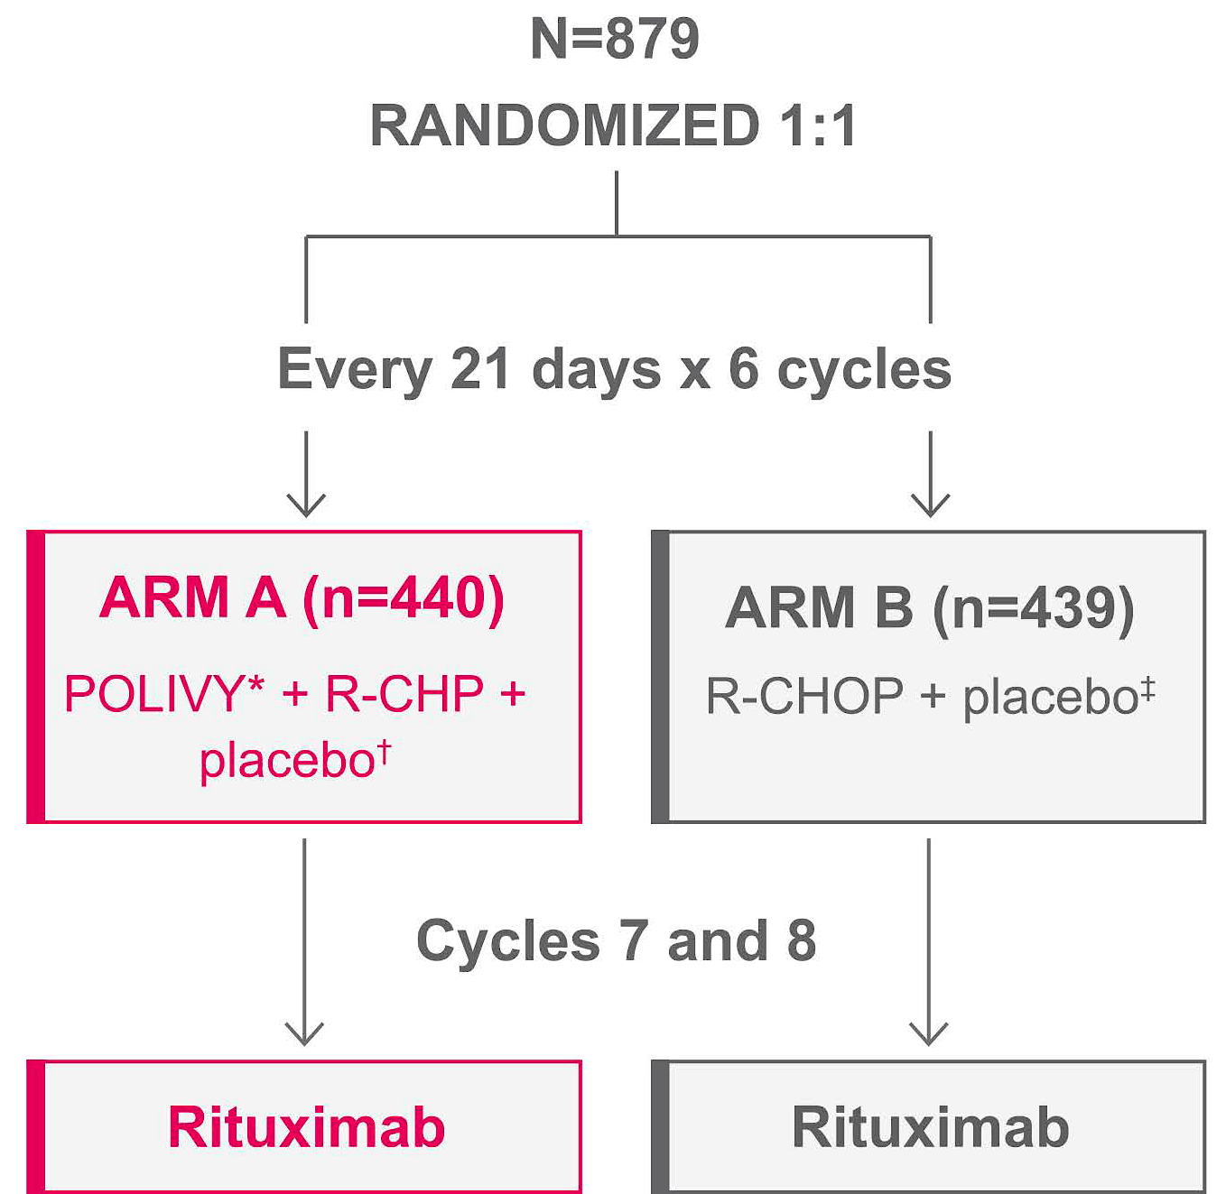
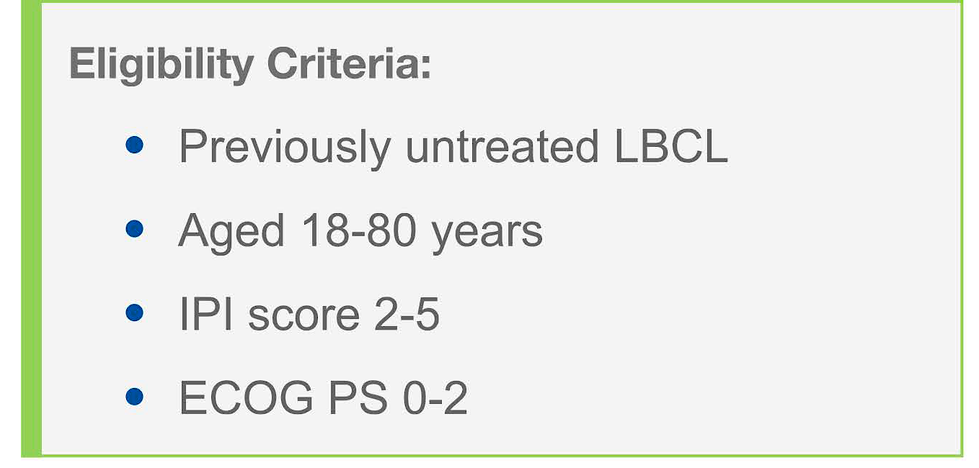
Phase III POLARIX Study Design
Primary endpoint:
Investigator-assessed PFS
Secondary endpoints:
Investigator-assessed EFS, ORR, OS
POLA
LBCL = large B-cell lymphoma; PFS = progression-free survival; EFS = event-free survival; ORR = overall response rate; OS = overall survival
[from the manufacturer’s website]

Slide 10
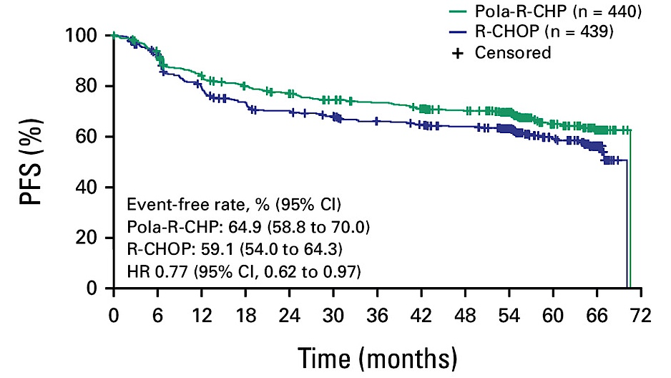
Phase III POLARIX: 5-Year PFS (Global Population)
Morschhauser F et al. J Clin Oncol 2025 December 10;43(35):3698-705.

Slide 11
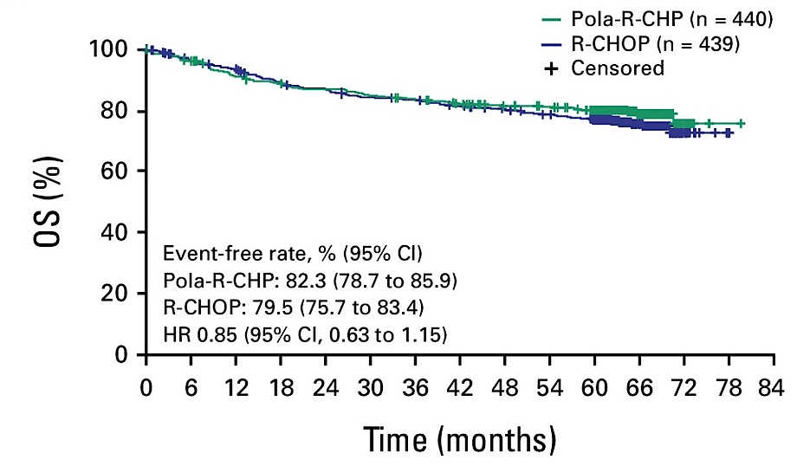
Phase III POLARIX: 5-Year OS (Global Population)
Morschhauser F et al. J Clin Oncol 2025 December 10;43(35):3698-705.

Slide 12
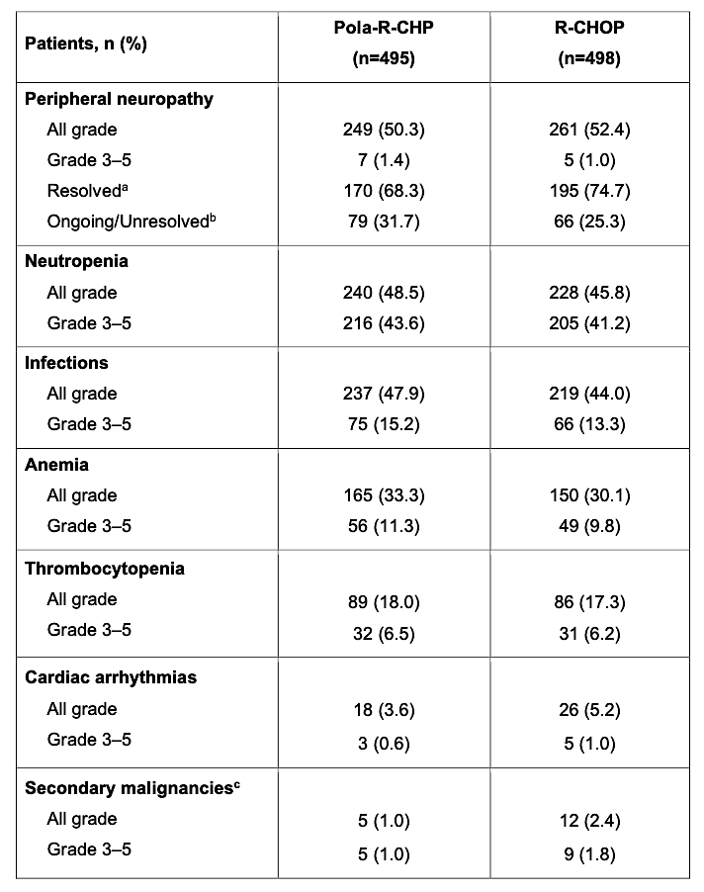
Phase III POLARIX: Adverse Events of Interest
Morschhauser F et al. J Clin Oncol 2025 December 10;43(35):3698-705.

Slide 13
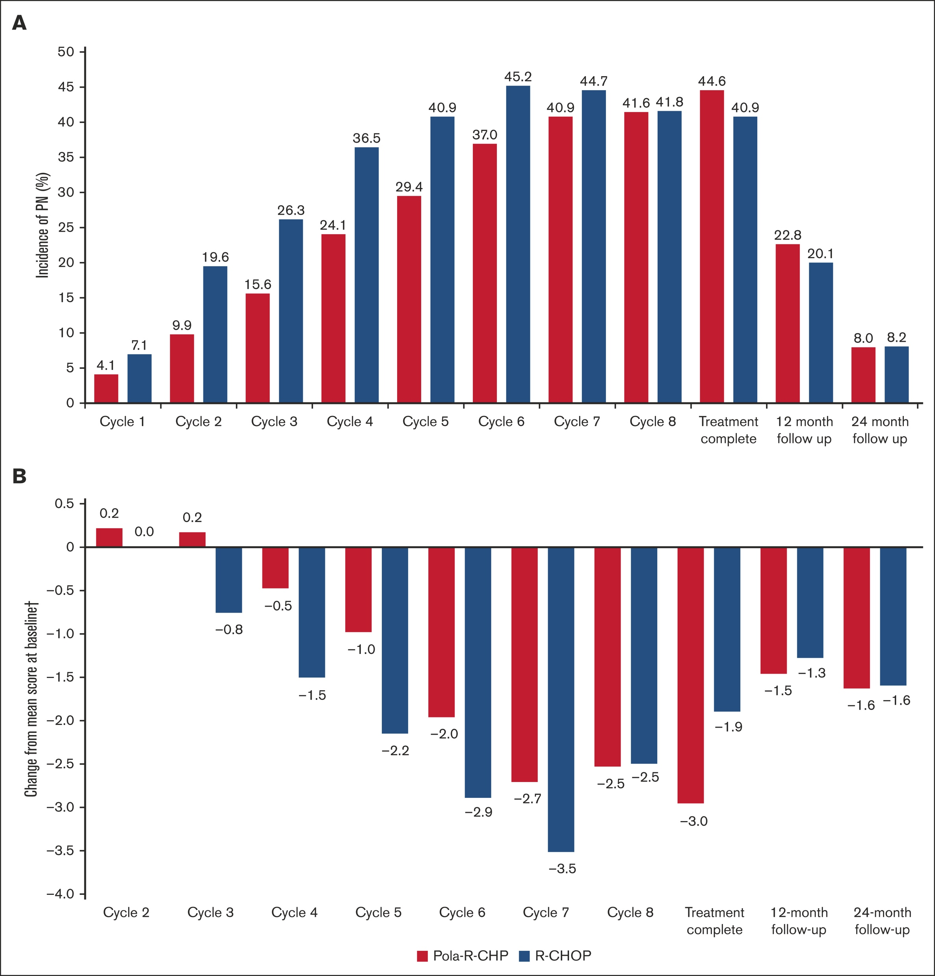
Phase III POLARIX: Peripheral Neuropathy
Trněný M et al. Blood Adv 2025 March 17;9(13):3263-7.

Slide 14
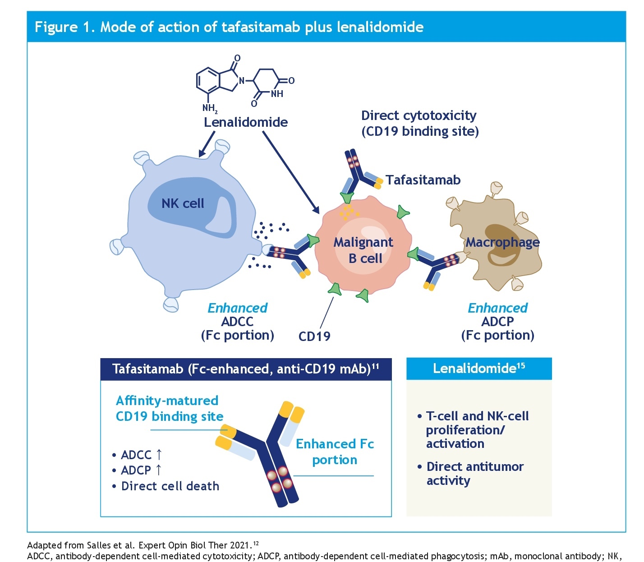
Rationale for Tafasitamab and Lenalidomide Combination Therapy
Vitolo U et al. ASCO 2022;Abstract TPS7590.

Slide 15
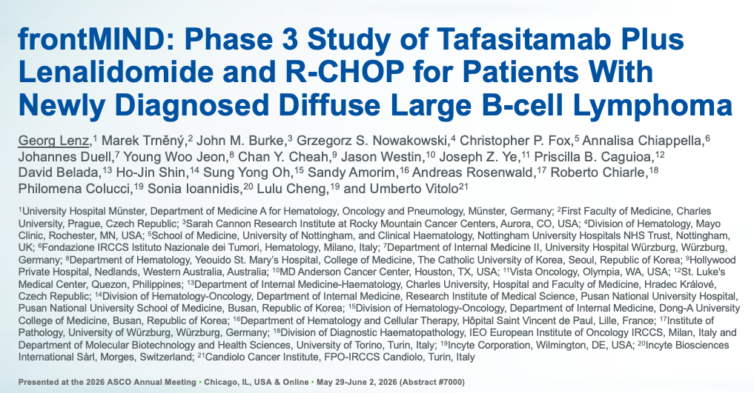
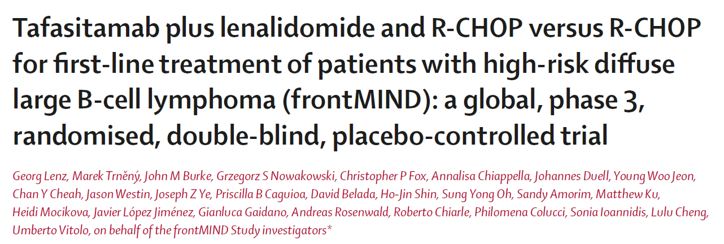
Lancet 2026 May 30;[Online ahead of print].

Slide 16
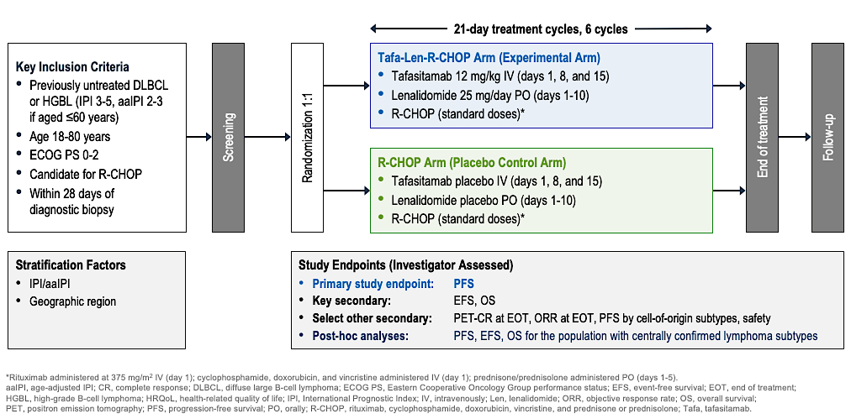
Phase III frontMIND Study Design
Lenz G et al. ASCO 2026;Abstract LBA7000; Lenz G et al. Lancet. 2026 Jun 20;407(10547):2528-2541.

Slide 17
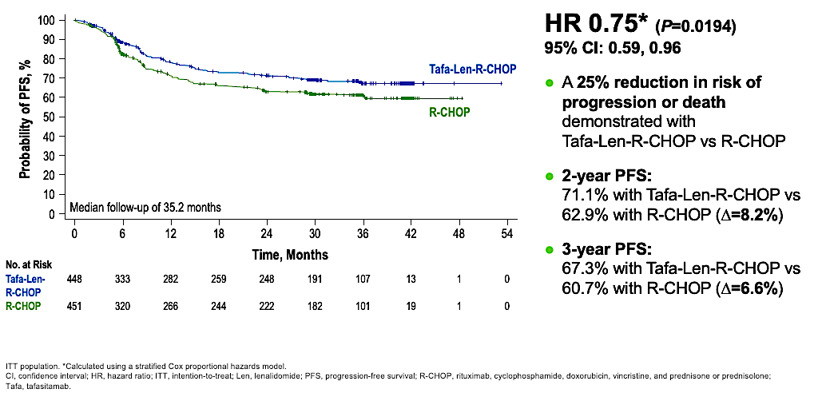
frontMIND Primary Endpoint: Investigator-Assessed
Progression-Free Survival
In key prespecified subgroup analyses, point estimates suggested trends toward PFS advantage with Tafa-Len-R-CHOP
Lenz G et al. ASCO 2026;Abstract LBA7000; Lenz G et al. Lancet 2026 June 20;407(10547):2528-41.

Slide 18
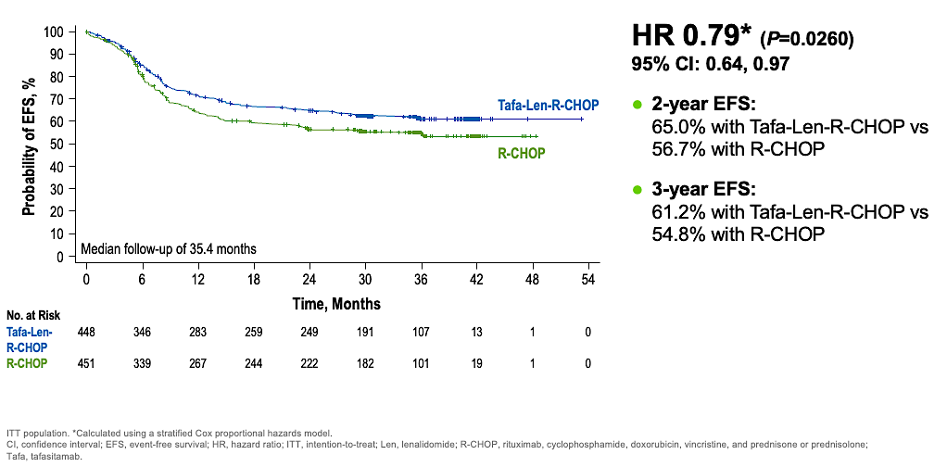
frontMIND Key Secondary Endpoint: Investigator-Assessed
Event-Free Survival
Lenz G et al. ASCO 2026;Abstract LBA7000; Lenz G et al. Lancet 2026 June 20;407(10547):2528-41.

Slide 19
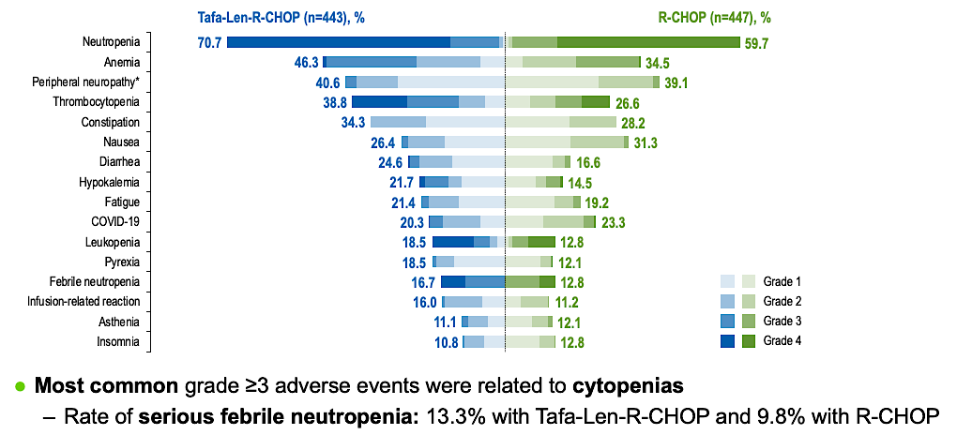
frontMIND: Most Frequent Treatment-Emergent Adverse Events
Safety events with Tafa-Len-R-CHOP were manageable and did not affect the delivery of the
R-CHOP backbone
Lenz G et al. ASCO 2026;Abstract LBA7000; Lenz G et al. Lancet 2026 June 20;407(10547):2528-41.

Slide 20
Studies Supporting the ESCALADE Study
ACCEPT — Davies et al. ASH 2020
  “There is a strong rationale for combining A with R-CHOP in pts with untreated DLBCL, and safety of A + R-CHOP has been shown in a phase 1b/2 study”
PHOENIX — Younes et al. J Clin Oncol 2019;37:1285-9.
  “In untreated non-GCB DLBCL pts, [PHOENIX] showed that addition of the BTKi ibrutinib to R-CHOP (R-CHOP-I) did not improve outcomes in the intent-to-treat population. However, pts age <60y treated with R-CHOP-I had significantly improved progression-free survival (PFS) and overall survival (OS) compared with those receiving R-CHOP alone.”
Sehn LH et al. ASCO 2021;Abstract TPS7572.

Slide 21
Phase III ESCALADE (ACE-LY-312) Study Design
n=661
Patients with newly diagnosed non-GCB DLBCL
Acalabrutinib (100mg BD) + R-CHOP
R-CHOP (cycle 1)
[all pts]
1:1
Placebo + R-CHOP
*All patients will receive primary prophylaxis with
G-CSF accompanying all R-CHOP cycles.
Primary endpoint:
PFS
Secondary endpoints:
EFS, CR rate, OS, pharmacokinetics, safety
GCB = germinal center B-cell-like; CR = complete response; G-CSF = granulocyte-colony stimulating factor
Sehn LH et al. ASCO 2021;Abstract TPS7572.

Slide 22
Optimizing the Use of Novel Therapies for Patients with DLBCL
Module 1: Selection of First-Line Therapy for Patients with Diffuse Large B-Cell Lymphoma (DLBCL)
Module 2: Clinician Survey Results
Module 3: Current and Future Roles of Monoclonal and Bispecific Antibodies in Therapy for Relapsed/Refractory (R/R) DLBCL
Module 4: Clinician Survey Results
Module 5: Evidence-Based Incorporation of Antibody-Drug Conjugates into the Management of R/R DLBCL
Module 6: Clinician Survey Results

Slide 23
Which first-line therapy would you generally recommend for an otherwise healthy patient with Stage IV germinal center B-cell (GCB)-type diffuse large B-cell lymphoma (DLBCL) with an International Prognostic Index (IPI) score of 3?
65-year-old
80-year-old
R-CHP + polatuzumab vedotin
Dose-reduced R-CHP +
polatuzumab vedotin
R-CHP + polatuzumab vedotin
R-CHP + polatuzumab vedotin
R-CHP + polatuzumab vedotin
R-mini-CHOP
R-CHP + polatuzumab vedotin
R-mini-CHP + polatuzumab vedotin
R-CHP + polatuzumab vedotin
R-mini-CHP + polatuzumab vedotin
R-CHP + polatuzumab vedotin
R-mini-CHP + polatuzumab vedotin
R-CHP + polatuzumab vedotin
R-mini-CHP + polatuzumab vedotin
R-CHOP
R-mini-CHOP
R-CHP = rituximab/cyclophosphamide/doxorubicin/prednisone; R-mini-CHOP = rituximab/cyclophosphamide/doxorubicin/vincristine/prednisone (attenuated)

Slide 24
Which first-line therapy would you generally recommend for an otherwise healthy patient with Stage IV activated B-cell (ABC)-type DLBCL with an IPI score of 3?
65-year-old
80-year-old
R-CHP + polatuzumab vedotin
Dose-reduced R-CHP + polatuzumab vedotin
R-CHP + polatuzumab vedotin
R-CHP + polatuzumab vedotin
R-CHP + polatuzumab vedotin
R-mini-CHP + polatuzumab vedotin
R-CHP + polatuzumab vedotin
R-mini-CHP + polatuzumab vedotin
R-CHP + polatuzumab vedotin
R-mini-CHP + polatuzumab vedotin
R-CHP + polatuzumab vedotin
R-mini-CHP + polatuzumab vedotin
R-CHP + polatuzumab vedotin
R-mini-CHP + polatuzumab vedotin
R-CHP + polatuzumab vedotin
R-mini-CHP + polatuzumab vedotin

Slide 25
A 75-year-old woman with a history of congestive heart failure and a LVEF of 45% presents with Stage IV DLBCL with an IPI of 3. Which initial therapy would you most likely recommend if she had the DLBCL molecular subtype below?
GCB-type
ABC-type, high-risk
R-CHOP + dexrazoxane
Pola-R-CHP + dexrazoxane
R-CHP + polatuzumab vedotin (dose adjustments PRN, cardiac monitoring)
R-CHP + polatuzumab vedotin (dose adjustments PRN, cardiac monitoring)
Dose-adjusted R-EPOCH
Pola-R-CHP + dexrazoxane
R-GCVP
Pola-R-CGP
R-GCVP
R-GCVP
Dose-adjusted R-EPOCH
R-CP + Pola + infusional doxorubicin
R-GCVP
R-mini-CGemP-Pola
R-CEOP
RCEP-Pola
R = rituximab; C = cyclophosphamide; E = etoposide; O = vincristine; P = prednisone; G = gemcitabine; V = vincristine; Pola = polatuzumab vedotin

Slide 26
Optimizing the Use of Novel Therapies for Patients with DLBCL
Module 1: Selection of First-Line Therapy for Patients with Diffuse Large B-Cell Lymphoma (DLBCL)
Module 2: Clinician Survey Results
Module 3: Current and Future Roles of Monoclonal and Bispecific Antibodies in Therapy for Relapsed/Refractory (R/R) DLBCL
Module 4: Clinician Survey Results
Module 5: Evidence-Based Incorporation of Antibody-Drug Conjugates into the Management of R/R DLBCL
Module 6: Clinician Survey Results

Slide 27
Key Datasets
Duell J et al. Tafasitamab for patients with relapsed or refractory diffuse large B-cell lymphoma: Final 5-year efficacy and safety findings in the phase II L-MIND study. Haematologica 2024 February 1;109(2):553-66.
Arias DA et al. CD19 expression persists in diffuse large B-cell lymphoma patient biopsies after treatment with tafasitamab. EHA 2024;Abstract P1234.
Kim TM et al. Safety and efficacy of AZD0486, a CD19xCD3 T-cell engager, in relapsed or refractory diffuse large B-cell lymphoma. ASCO 2025;Abstract 7046.
Dickinson MJ et al. Glofitamab for relapsed or refractory diffuse large B-cell lymphoma. N Engl J Med 2022 December 15;387(24):2220-31.
Karimi YH et al. 3-year update from the Epcore NHL-1 trial: Epcoritamab leads to deep and durable responses in relapsed or refractory large B-cell lymphoma.. ASH 2024;Abstract 4480.
Fox CP et al. Results from EPCORE DLBCL-1: Randomized phase 3 study of epcoritamab vs investigator’s choice chemoimmunotherapy in patients with relapsed/refractory large B-cell lymphoma. EHA 2026;Abstract S235.
Abramson JS et al. Glofitamab plus gemcitabine and oxaliplatin (GemOx) versus rituximab-GemOx for relapsed or refractory diffuse large B-cell lymphoma (STARGLO): A global phase 3, randomised, open-label trial. Lancet 2024 November 16;404(10466):1940-54.

Slide 28
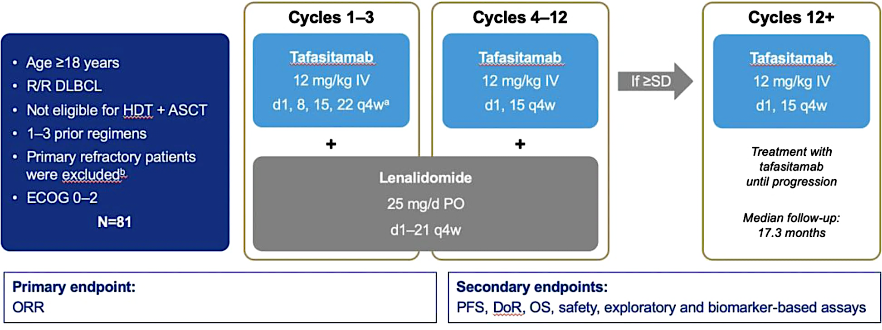
Phase II L-MIND Study Design
HDT = high-dose therapy; ASCT = autologous stem cell transplant; SD = stable disease; DoR = duration of response
Duell J et al. Haematologica 2024 February 1;109(2):553-66.

Slide 29
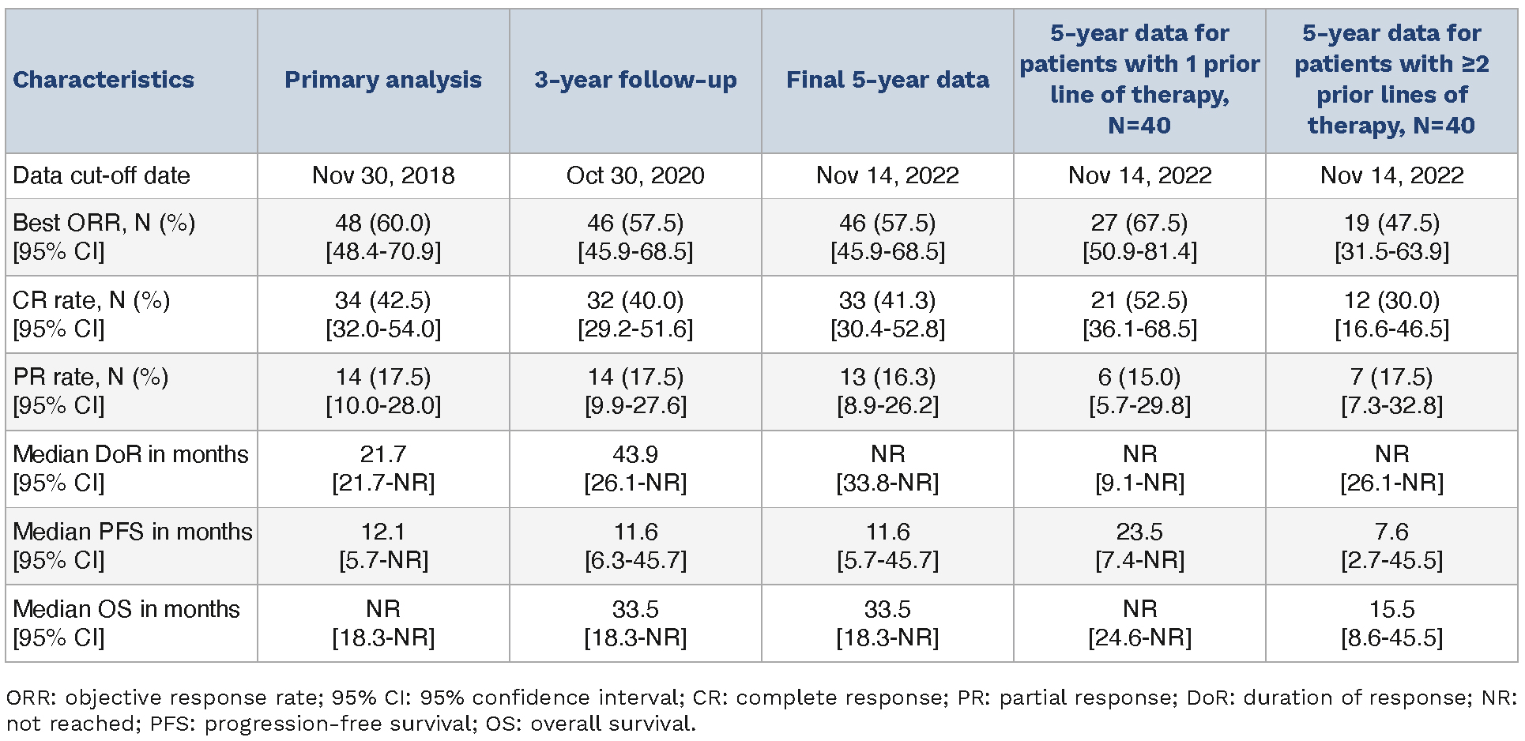
Phase II L-MIND: Efficacy Outcomes (Primary, 3-Year, 5-Year Analyses)
Duell J et al. Haematologica 2024 February 1;109(2):553-66.

Slide 30
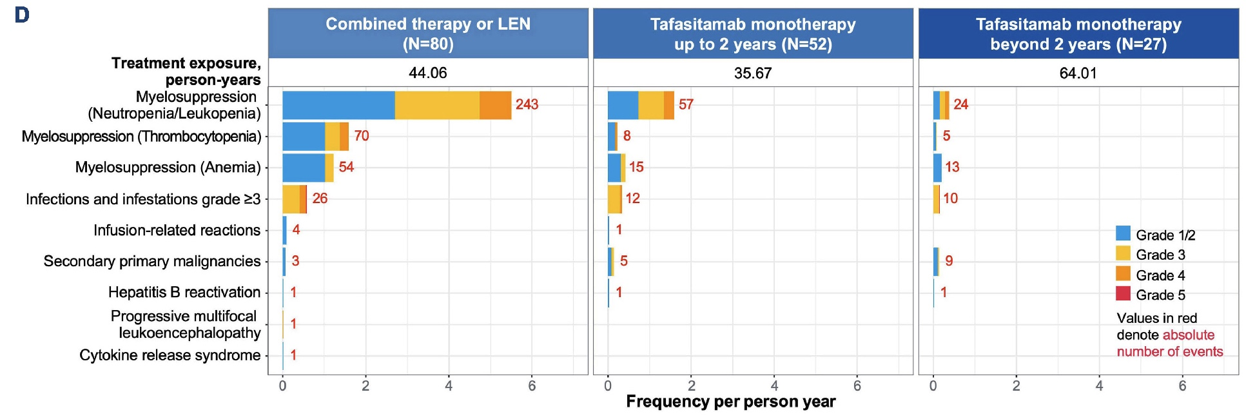
Phase II L-MIND: Adverse Events of Special Interest
Duell J et al. Haematologica 2024 February 1;109(2):553-66.

Slide 31
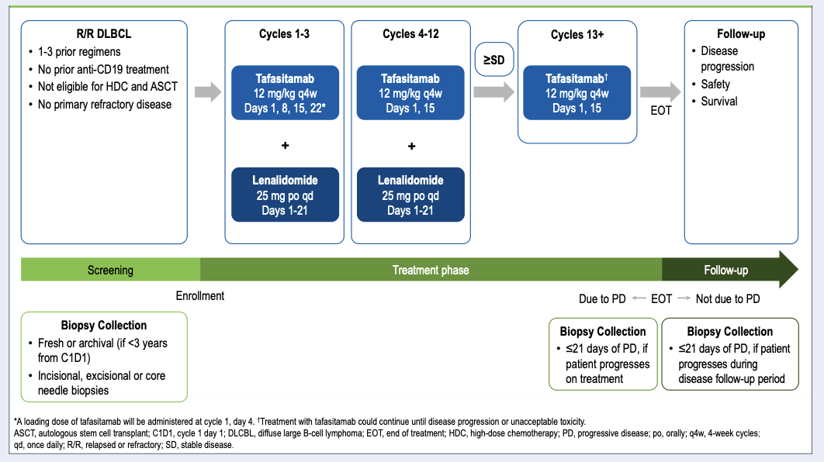
Phase III firmMIND Study Design
Arias DA et al. EHA 2024;Abstract P1234.
Estimated completion (primary): 2026-04-01

Slide 32
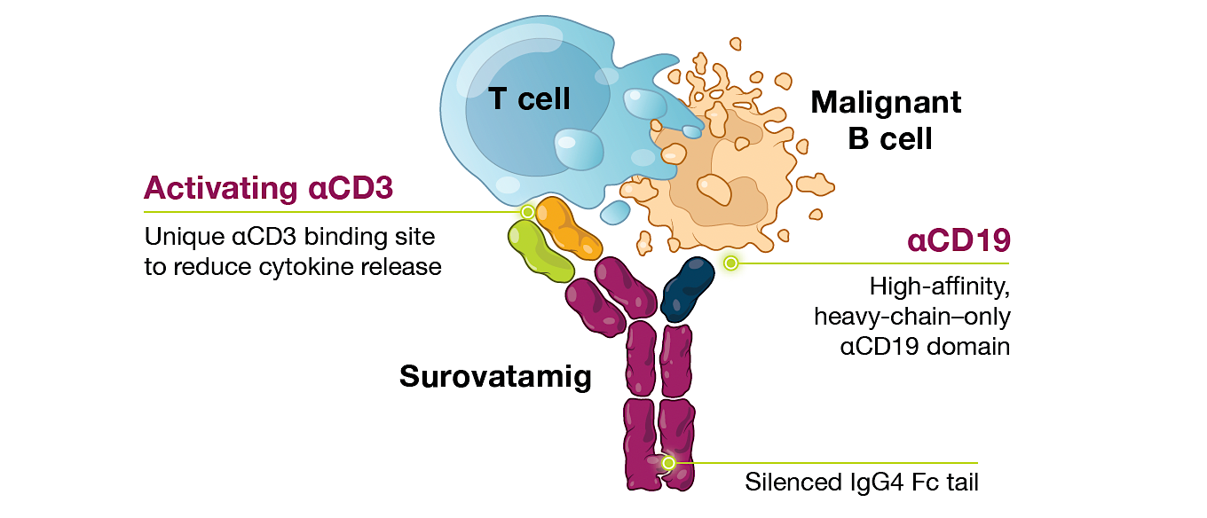
Surovatamig (AZD0486): A CD19 x CD3 Bispecific T-Cell Engager
Cheah C et al. ASH 2025;Abstract 3747.

Slide 33
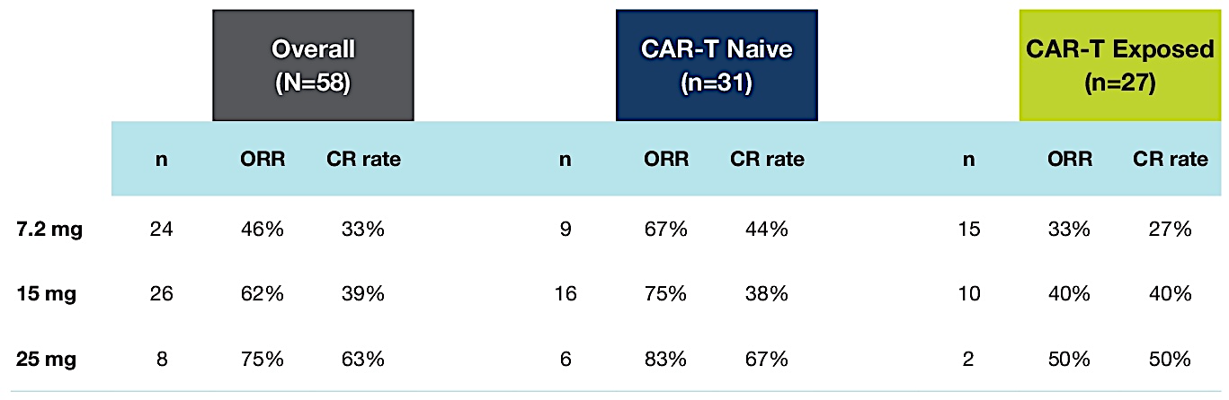
Phase I Surovatamig Study: Responses by Target Dose (≥7.2 mg)
Kim TM et al. ASCO 2025;Abstract 7046.

Slide 34
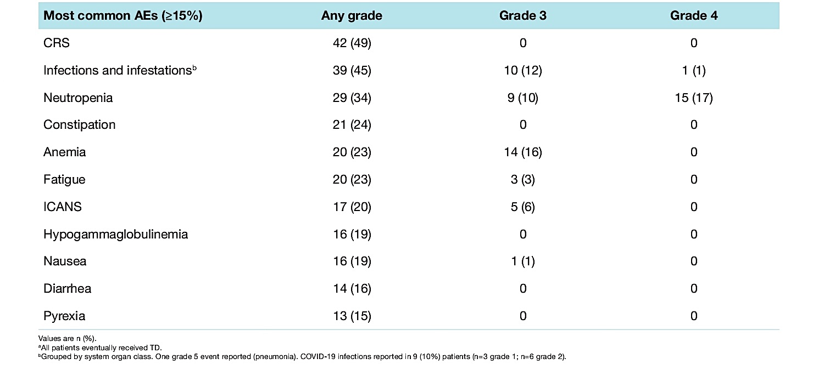
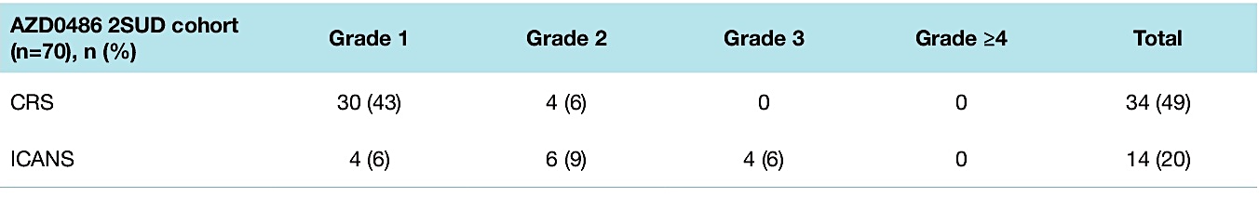
Phase I Surovatamig Study: Safety
AEs = adverse events; CRS = cytokine release syndrome; ICANS = immune effector cell-associated neurotoxicity syndrome
Kim TM et al. ASCO 2025;Abstract 7046.

Slide 35
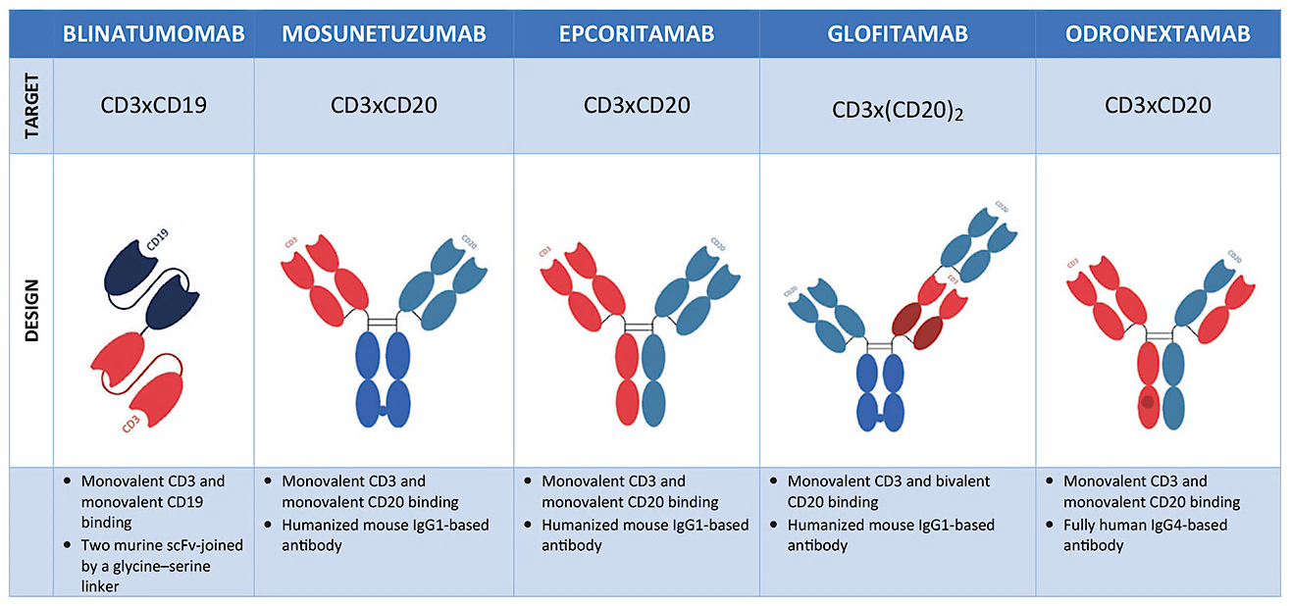
Bispecifics for DLBCL
Brijs J et al. Belg J Hematol 2023;14(2):67-72.

Slide 36
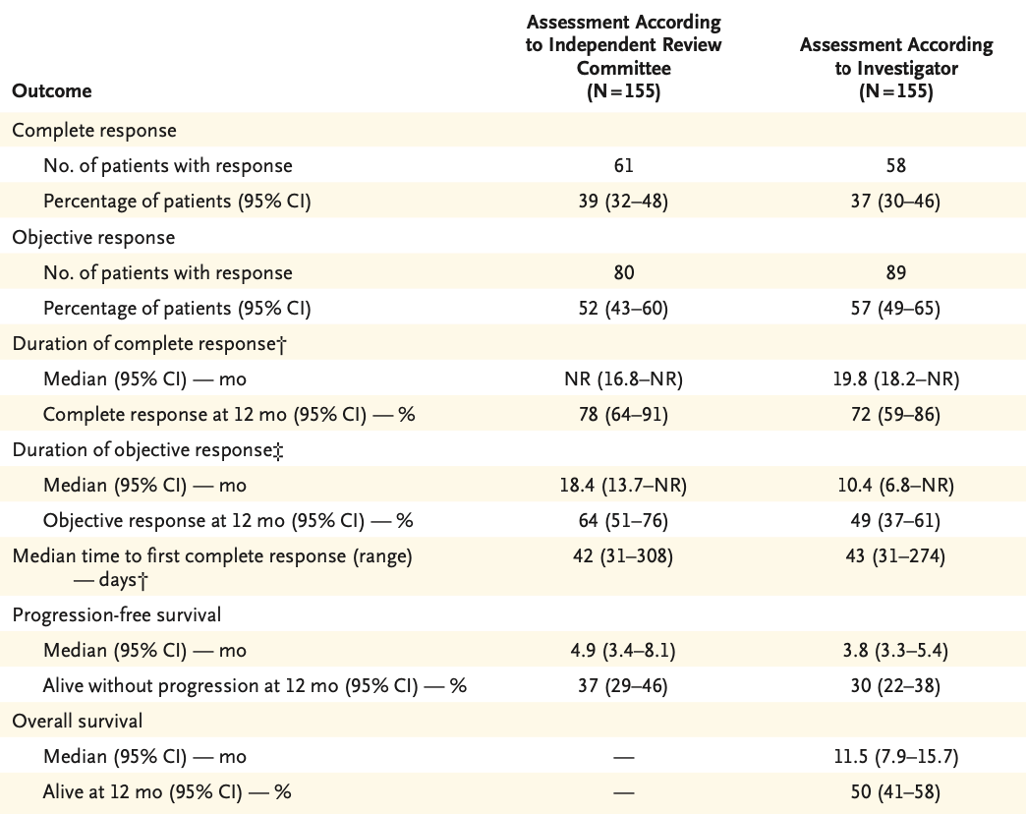
Glofitamab for R/R DLBCL Study: Efficacy (IRC- and Investigator-Assessed)
Dickinson MJ et al. N Engl J Med 2022 December 15;387(24):2220-31.
IRC = independent review committee

Slide 37
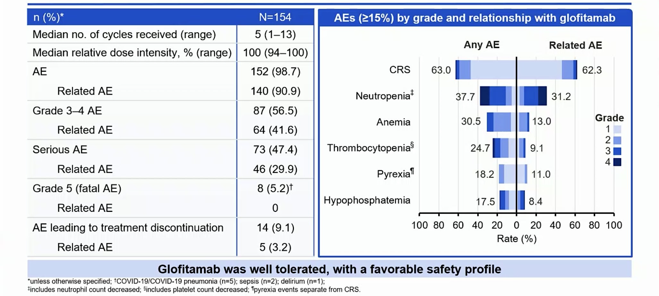
Glofitamab for R/R DLBCL: Safety
Dickinson MJ et al. EHA 2022;Abstract S220.

Slide 38
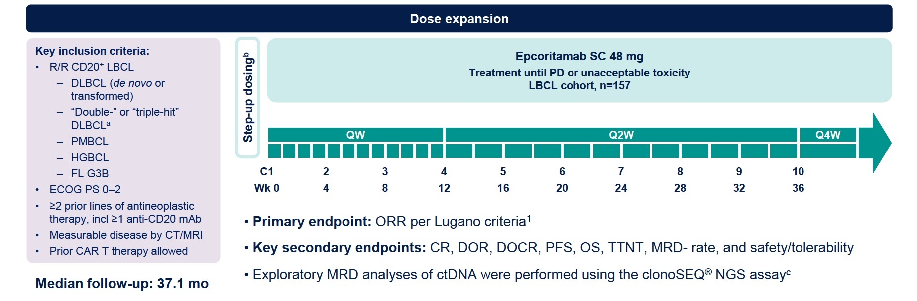
Phase II EPCORE NHL-1 Study Design
PMBCL = primary mediastinal B-cell lymphoma; HGBCL = high-grade B-cell lymphoma; FL = follicular lymphoma; DOCR = duration of complete response; TTNT = time to next treatment; MRD = minimal residual disease; ctDNA = circulating tumor DNA
Karimi YH et al. ASH 2024;Abstract 4480.

Slide 39
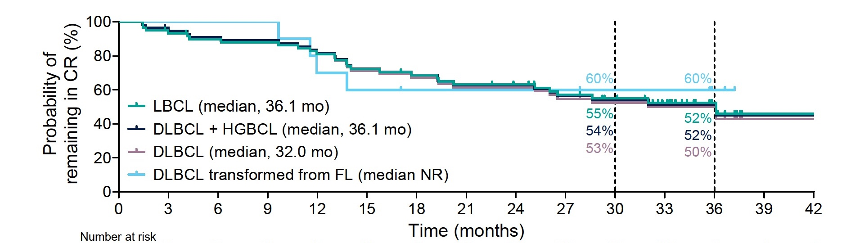
Phase II EPCORE NHL-1: Responses
Karimi YH et al. ASH 2024;Abstract 4480.

Slide 40
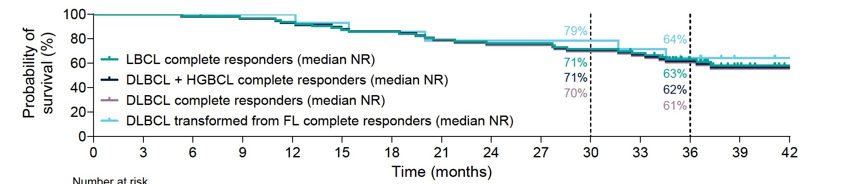
Phase II EPCORE NHL-1: Overall Survival
Karimi YH et al. ASH 2024;Abstract 4480.

Slide 41
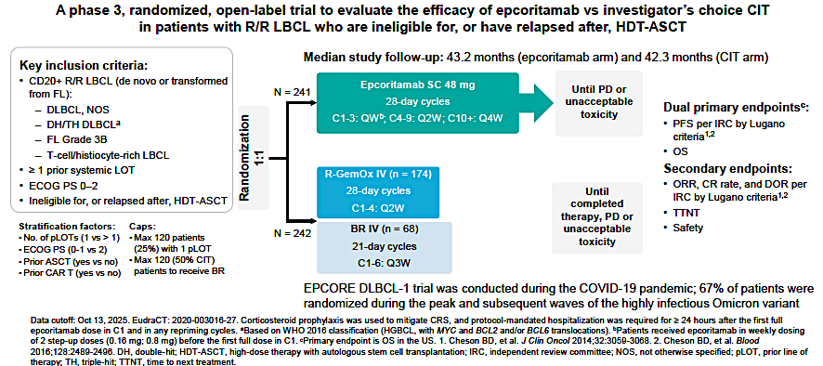
EPCORE DLBCL-1 Phase III Trial of Epcoritamab versus Investigator’s Choice Chemoimmunotherapy (CIT) for R/R LBCL
Fox CP et al. EHA 2026;Abstract S235.

Slide 42
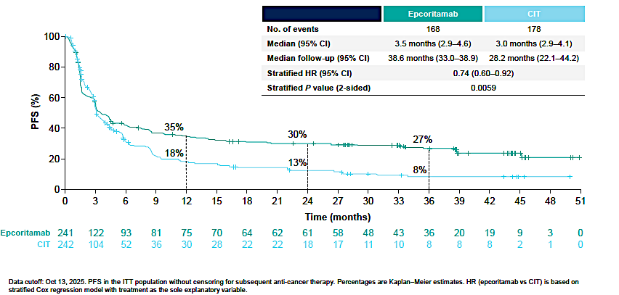
EPCORE DLBCL-1: Efficacy Summary
Epcoritamab resulted in clinically meaningful improvement in CR, DOR and DOCR
OS was not significantly different; confounded by COVID-19 mortality and higher use of effective subsequent treatments in the CIT arm
Fox CP et al. EHA 2026;Abstract S235.

Slide 43
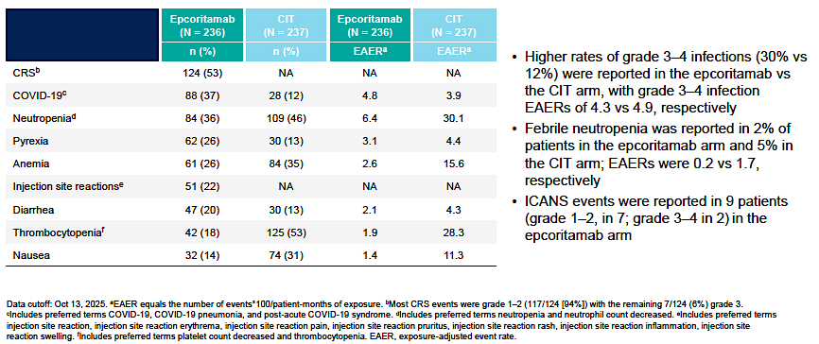
EPCORE DLBCL-1: Most Common Treatment-Emergent Adverse Events
Fox CP et al. EHA 2026;Abstract S235.

Slide 44
Positive Phase III Results Announced for Epcoritamab with Lenalidomide for Patients with Relapsed or Refractory DLBCL
Press Release: June 29, 2026
“[The manufacturer] today announced topline results from the Phase 3 EPCORE DLBCL-4 trial evaluating the combination of epcoritamab, a T-cell engaging bispecific antibody, and lenalidomide, compared to rituximab plus gemcitabine plus oxaliplatin (R-GemOx) in adult patients with relapsed or refractory (R/R) diffuse large B-cell lymphoma (DLBCL) who received at least one prior line of therapy. Based on topline results from the prespecified primary analysis, the trial met its primary endpoint, demonstrating statistically significant and clinically meaningful improvement in progression-free survival (PFS). The risk of disease progression and death was reduced by 60% (HR 0.40 [95% CI 0.30, 0.55]; p-value <0.0001) and 56% (HR 0.44 [95% CI 0.33, 0.60]; p-value <0.0001), based on different censoring rules in the US and outside the US, respectively.
The safety profile of epcoritamab when administered in combination with lenalidomide was consistent with the known safety profiles of the individual agents (epcoritamab and lenalidomide).
Data will be submitted for presentation at a future medical meeting.”
https://news.abbvie.com/2026-06-29-AbbVie-Announces-Positive-Phase-3-Results-for-Epcoritamab-Plus-Lenalidomide-in-Patients-with-Relapsed-or-Refractory-Diffuse-Large-B-Cell-Lymphoma

Slide 45
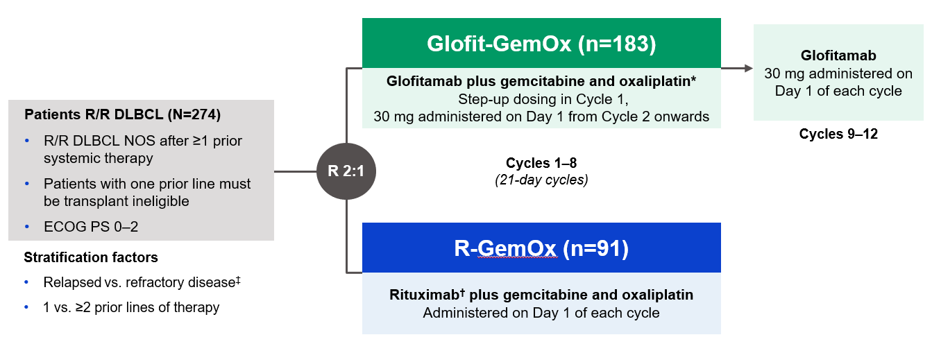
Phase III STARGLO Study Design
Primary endpoint:
Overall survival
Secondary endpoints:
Progression-free survival, ORR, DoR
Abramson JS et al. Lancet 2024 November 16;404(10466):1940-54.

Slide 46
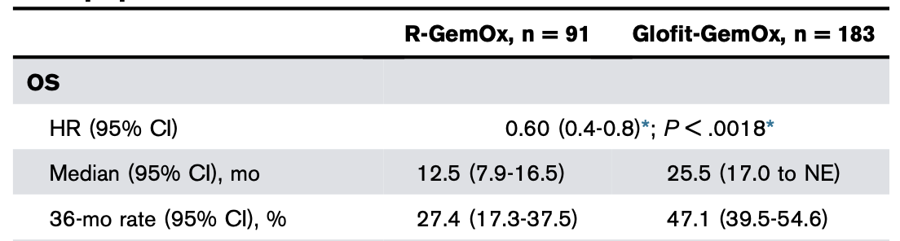
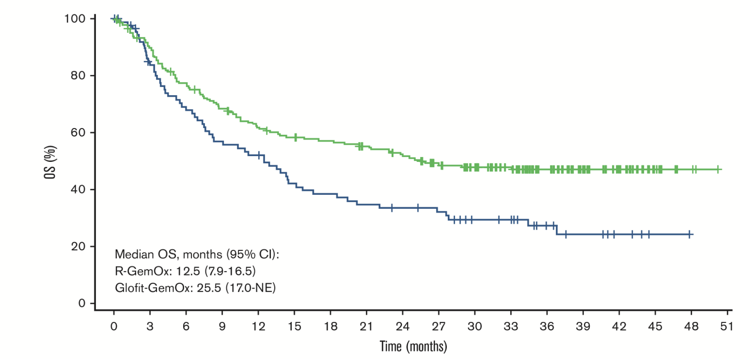
Phase III STARGLO 3-Year Follow-Up: Overall Survival
(OS; Primary Endpoint)
Abramson JS et al. Blood Adv 2026 August 11;10(15):5367-77.

Slide 47
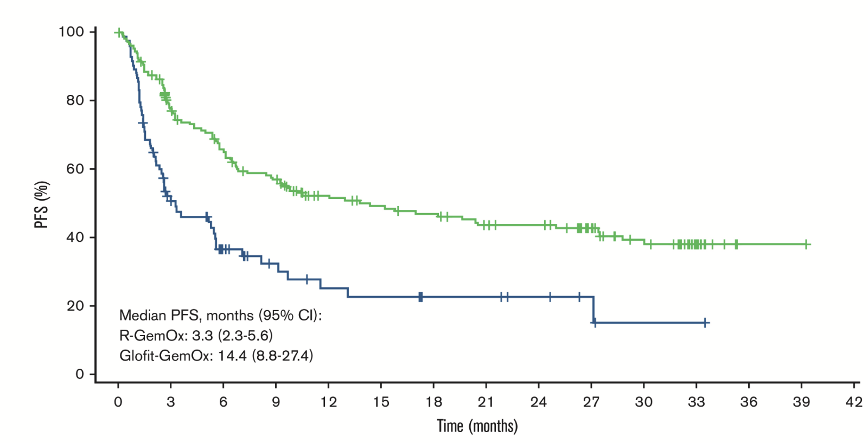
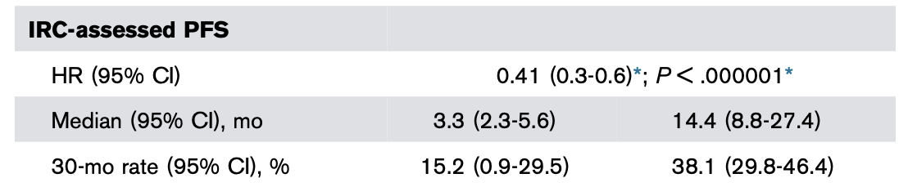
Phase III STARGLO 3-Year Follow-up: Progression-Free Survival (PFS)
Abramson JS et al. Blood Adv 2026 August 11;10(15):5367-77.

Slide 48
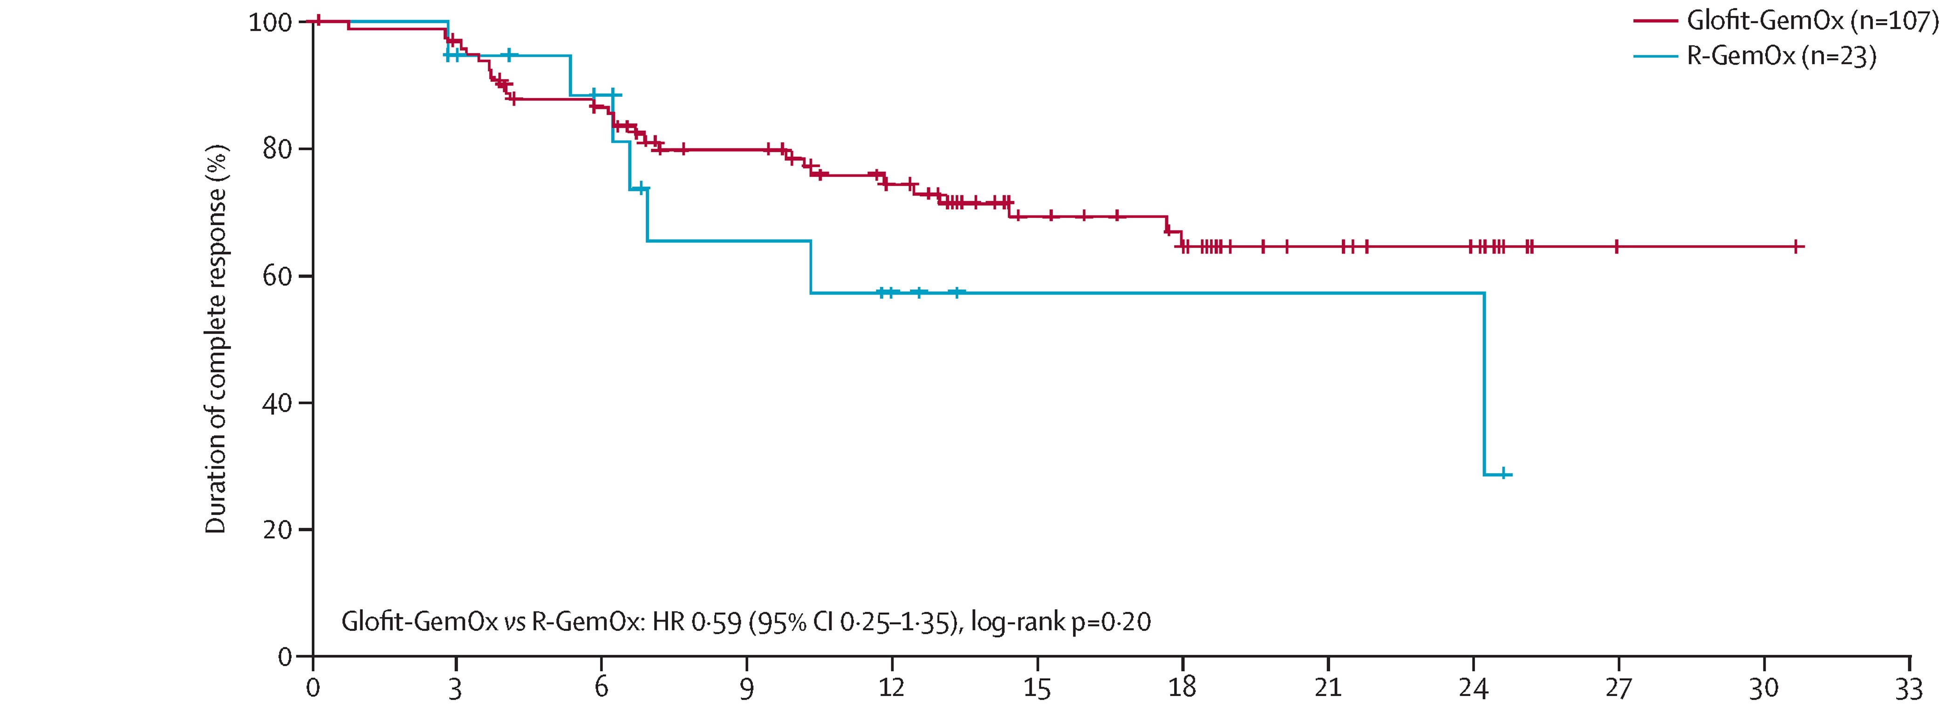
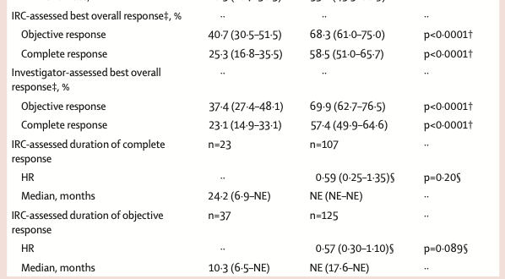
Phase III STARGLO: Responses
Abramson JS et al. Lancet 2024 November 16;404(10466):1940-54.

Slide 49
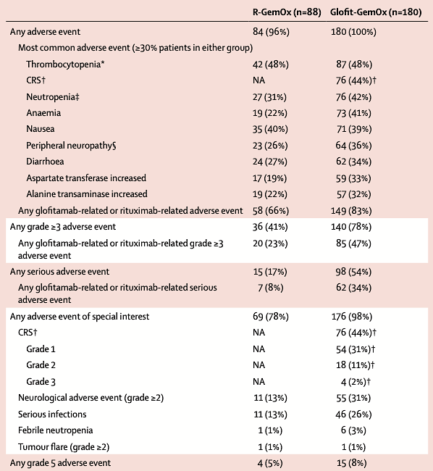
Phase III STARGLO: Safety
Abramson JS et al. Lancet 2024 November 16;404(10466):1940-54.

Slide 50
Optimizing the Use of Novel Therapies for Patients with DLBCL
Module 1: Selection of First-Line Therapy for Patients with Diffuse Large B-Cell Lymphoma (DLBCL)
Module 2: Clinician Survey Results
Module 3: Current and Future Roles of Monoclonal and Bispecific Antibodies in Therapy for Relapsed/Refractory (R/R) DLBCL
Module 4: Clinician Survey Results
Module 5: Evidence-Based Incorporation of Antibody-Drug Conjugates into the Management of R/R DLBCL
Module 6: Clinician Survey Results

Slide 51
Regulatory and reimbursement issues aside, which second-line therapy would you generally recommend for an older (85-year-old) patient with DLBCL who experienced disease relapse 18 months after first-line R-CHOP and who was …
CAR T eligible but
transplant ineligible
Transplant and CAR T ineligible
CAR T-cell therapy
Mosunetuzumab/polatuzumab vedotin
Mosunetuzumab/polatuzumab vedotin
Mosunetuzumab/polatuzumab vedotin
CAR T-cell therapy
Tafasitamab/lenalidomide or glofitamab/GemOx
CAR T-cell therapy
Mosunetuzumab/polatuzumab vedotin
CAR T-cell therapy
Glofitamab/GemOx
Mosunetuzumab/polatuzumab vedotin
Mosunetuzumab/polatuzumab vedotin
Glofitamab/GemOx
Glofitamab/GemOx
CAR T-cell therapy
Tafasitamab/lenalidomide or mosunetuzumab/polatuzumab vedotin
GemOx = gemcitabine/oxaliplatin

Slide 52
Regulatory and reimbursement issues aside, which third-line therapy would you generally recommend for a 65-year-old patient with DLBCL who received first-line R-CHOP and subsequently experienced disease progression on second-line CAR T-cell therapy?
Glofitamab/GemOx
Glofitamab
Glofitamab
Glofitamab
Polatuzumab vedotin/R-GemOx
Glofitamab/polatuzumab vedotin
Glofitamab/GemOx or polatuzumab vedotin/glofitamab
Glofitamab/GemOx or polatuzumab vedotin/glofitamab
R-GemOx = rituximab/gemcitabine/oxaliplatin

Slide 53
Regulatory and reimbursement issues aside, which third-line therapy would you generally recommend for a 65-year-old patient with DLBCL who received first-line polatuzumab vedotin/R-CHP and subsequently experienced disease progression on second-line CAR T-cell therapy?
Glofitamab/GemOx
Glofitamab
Glofitamab
Glofitamab
Loncastuximab tesirine
Glofitamab/GemOx
Glofitamab/GemOx
Glofitamab/GemOx

Slide 54
Regulatory and reimbursement issues aside, which third-line therapy would you generally recommend for an 85-year-old patient with DLBCL who received first-line R-mini-CHOP and subsequently experienced disease progression on second-line polatuzumab vedotin with bendamustine/rituximab (BR)?
Glofitamab
Epcoritamab
Glofitamab
Glofitamab
Glofitamab/GemOx
Glofitamab or epcoritamab
Glofitamab/GemOx
Glofitamab or epcoritamab

Slide 55
Assuming equal access, which bispecific antibody would you prefer to use when administering one of these agents as monotherapy for your patients with R/R DLBCL?
Glofitamab
No preference
Glofitamab
Glofitamab
Glofitamab
No preference
Glofitamab
Glofitamab

Slide 56
Based on the published literature and your clinical experience, would you like to have access to surovatamig for your patients with R/R DLBCL today?
Yes, for patients with CD20-negative disease
Yes, as part of second-line combinations prior to CAR T; third-line+ relapse
Yes, for CAR T-ineligible pts in the second-line setting
Yes, for patients who are ineligible for CD19 CAR T
No
Yes, after CAR T-cell therapy
Yes, for patients with PD on CD3 x CD20 combinations or monotherapy,
and for those with CD20-negative disease
Yes, for patients with CD20 loss and non-CAR T eligible

Slide 57
If surovatamig were granted regulatory approval, would you employ a CD20 x CD3 bispecific antibody and surovatamig in sequence for the same patient with R/R DLBCL?
Yes
Yes
Yes
Maybe
Yes
Yes
Yes
Yes

Slide 58
Optimizing the Use of Novel Therapies for Patients with DLBCL
Module 1: Selection of First-Line Therapy for Patients with Diffuse Large B-Cell Lymphoma (DLBCL)
Module 2: Clinician Survey Results
Module 3: Current and Future Roles of Monoclonal and Bispecific Antibodies in Therapy for Relapsed/Refractory (R/R) DLBCL
Module 4: Clinician Survey Results
Module 5: Evidence-Based Incorporation of Antibody-Drug Conjugates into the Management of R/R DLBCL
Module 6: Clinician Survey Results

Slide 59
Key Datasets
Sehn LH et al. Polatuzumab vedotin plus bendamustine and rituximab in relapsed/refractory diffuse large B-cell lymphoma (R/R DLBCL): Final results of a phase Ib/II randomized study and single-arm extension (ext) study. ASH 2022;Abstract 4260.
Matasar M et al. Polatuzumab vedotin, rituximab, gemcitabine and oxaliplatin (Pola-R-GemOx) for relapsed/refractory (R/R) diffuse large B-cell lymphoma (DLBCL): Results from the randomized phase III POLARGO trial. EHA 2025;Abstract S101.
Kim W et al. Mosunetuzumab plus polatuzumab vedotin (Mosun-Pola) versus rituximab, gemcitabine and oxaliplatin (R-GemOx) in patients with relapsed/refractory large B-cell lymphoma (R/R LBCL): Updated efficacy and safety from the phase 3 SUNMO study including in second-line (2L) versus third-line plus (3L+) patient subgroups. ASCO 2026;Abstract 7007.
Hahn U et al. Brentuximab vedotin combination for relapsed diffuse large B-cell lymphoma: ECHELON-3 final analysis. Pan Pacific Lymphoma Conference 2026.
Caimi PF et al. Loncastuximab tesirine in relapsed/refractory diffuse large B-cell lymphoma: Long-term efficacy and safety from the phase II LOTIS-2 study. Haematologica 2024 April 1;109(4):1184-93.
Carlo-Stella C et al. Updated safety run-in results from LOTIS-5: A phase 3, randomized trial of loncastuximab tesirine with rituximab versus immunochemotherapy in patients with R/R DLBCL/HGBL. EHA 2025;Abstract PS1957.
Alderuccio JP et al. Initial results from LOTIS-7: A phase 1b study of loncastuximab tesirine plus glofitamab in patients with relapsed/refractory (R/R) diffuse large B-cell lymphoma (DLBCL). ICML 2025;Abstract 078.

Slide 60
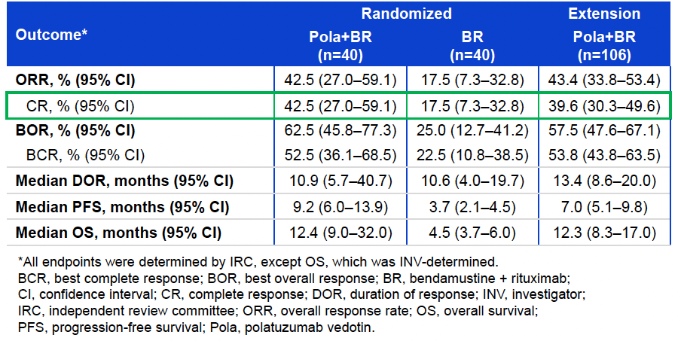
Phase Ib/II GO29365 Study Final Results: Efficacy
Sehn LH et al. ASH 2022;Abstract 4260.

Slide 61
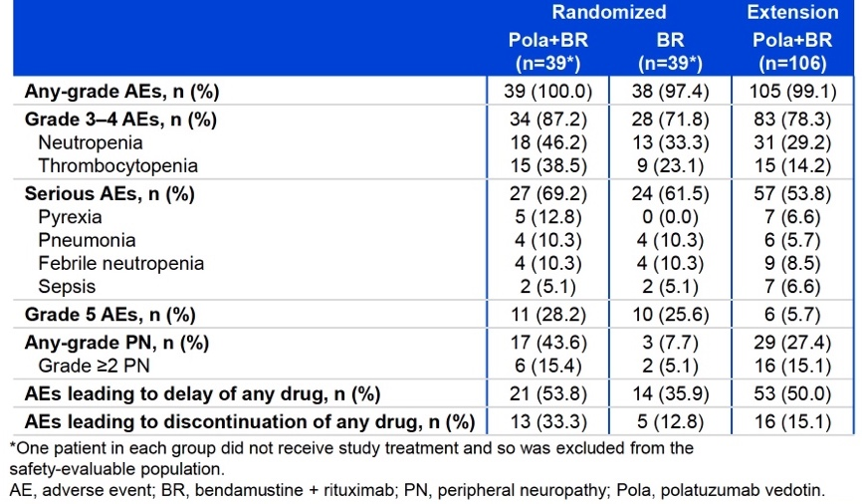
Phase Ib/II GO29365 Final Results: Safety
Sehn LH et al. ASH 2022;Abstract 4260.

Slide 62
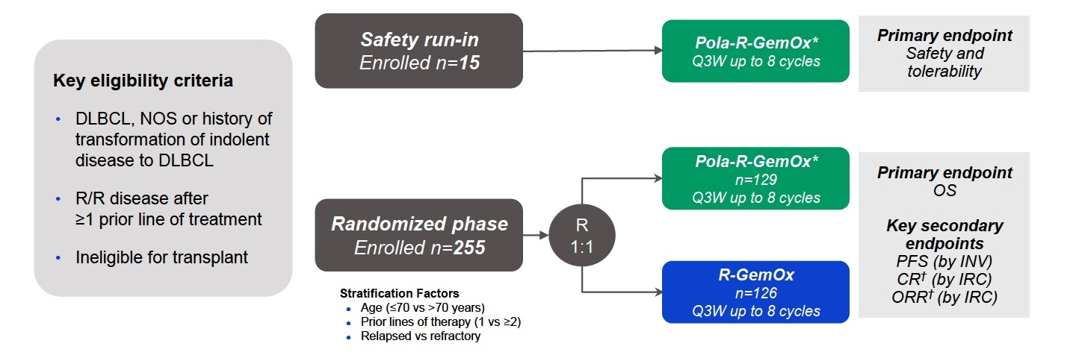
Phase III POLARGO Study Design
Matasar M et al. EHA 2025;Abstract S101.

Slide 63
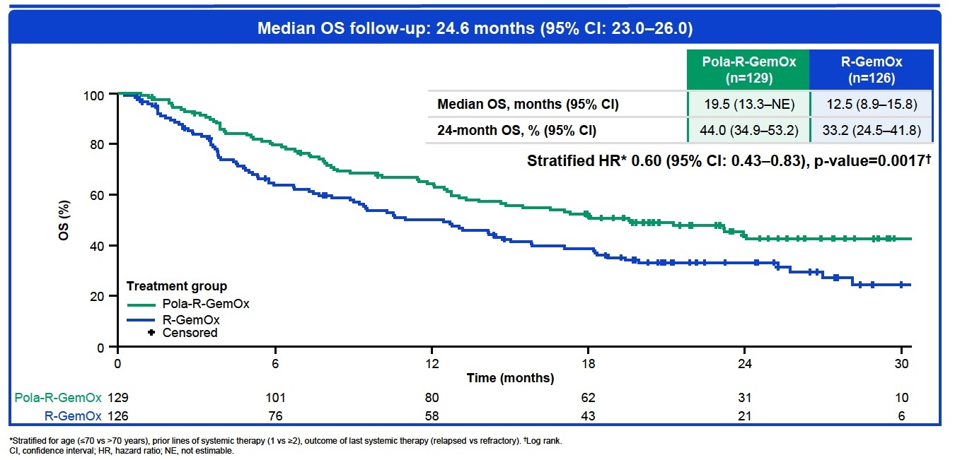
Phase III POLARGO Overall Survival
Matasar M et al. EHA 2025;Abstract S101.

Slide 64
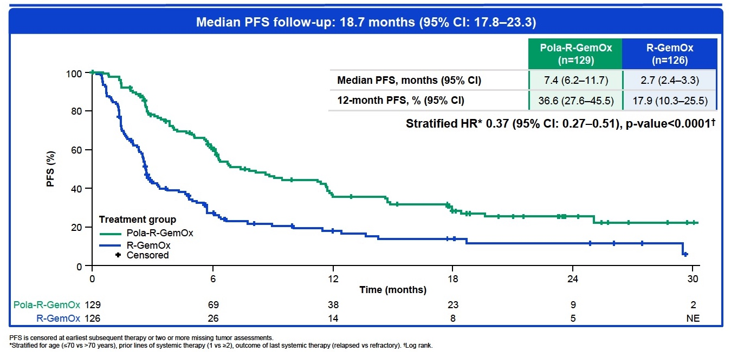
Phase III POLARGO: Progression-Free Survival
Matasar M et al. EHA 2025;Abstract S101.

Slide 65
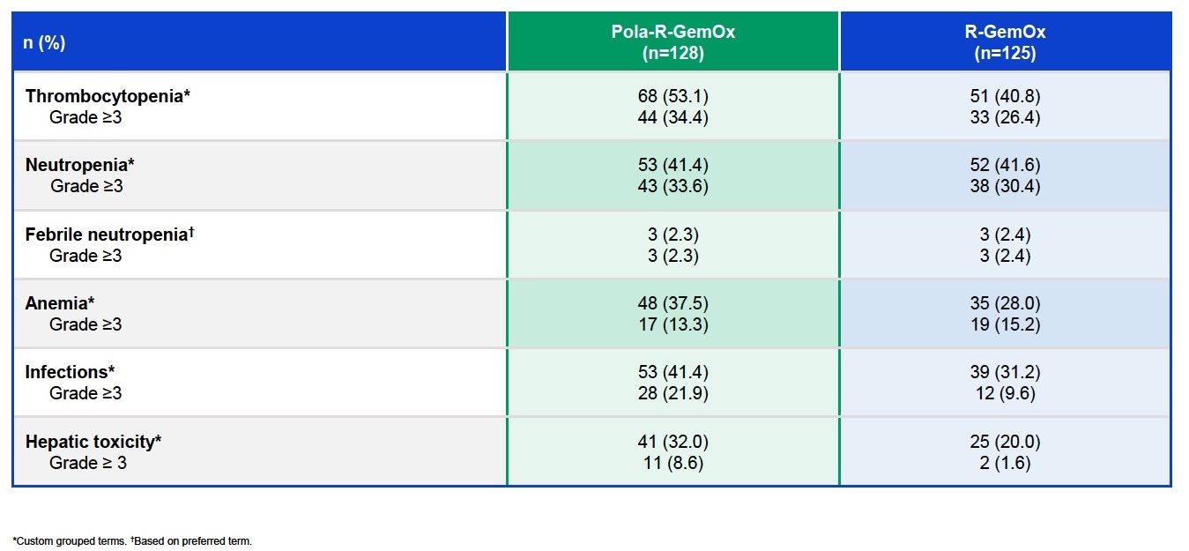
Phase III POLARGO: Select AEs
Matasar M et al. EHA 2025;Abstract S101.

Slide 66
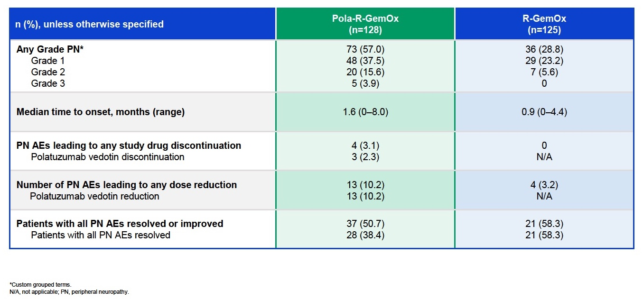
Phase III POLARGO: Peripheral Neuropathy
Matasar M et al. EHA 2025;Abstract S101.

Slide 67

Phase III SUNMO Study Design
Budde LE et al. EHA 2026;Abstract PF968.

Slide 68

Phase III SUNMO Primary Endpoint: PFS by IRC in the Intention-to-Treat Population (28.3-Month Follow-Up)
Efficacy and safety of mosun-pola were comparable across age groups
Budde LE et al. EHA 2026;Abstract PF968.

Slide 69

Phase III SUNMO: Overall Response Rate and Duration of Complete Response
Kim W et al. ASCO 2026;Abstract 7007.

Slide 70

Phase III SUNMO: Efficacy in the Second-Line Setting
ORR = objective response rate; CR = complete response;
DOR = duration of response; DOCR = duration of complete response
Budde LE et al. EHA 2026;Abstract PF968.

Slide 71


Phase III SUNMO: Efficacy in the Third-Line and Beyond Setting
Budde LE et al. EHA 2026;Abstract PF968.
ORR = objective response rate

Slide 72

Phase III ECHELON-3 Study Design
HSCT = hematopoietic stem cell transplantation; FDG = fluorodeoxyglucose; ITT = intent to treat; SCT = stem cell transplant; ORR = objective response rate
Hahn U et al. Pan Pacific Lymphoma Conference 2026.

Slide 73

Phase III ECHELON-3 Final Analysis: OS (Primary Endpoint)
Hahn U et al. Pan Pacific Lymphoma Conference 2026.

Slide 74

Phase III ECHELON-3 Final Analysis: PFS (Key Secondary Endpoint)
Hahn U et al. Pan Pacific Lymphoma Conference 2026.

Slide 75

Phase III ECHELON-3 Final Analysis: Responses
Hahn U et al. Pan Pacific Lymphoma Conference 2026.

Slide 76

Phase III ECHELON-3 Final Analysis: Safety
Hahn U et al. Pan Pacific Lymphoma Conference 2026.

Slide 77


Loncastuximab Tesirine: A CD19-Directed Antibody-Drug Conjugate
[Loncastuximab tesirine manufacturer prescribing information].

Slide 78

Phase II LOTIS-2 Study: Overall Response Rate (ORR) and Long-Term Responses — All-Treated Population
No new safety signals were identified during the long-term follow-up
Caimi PF et al. EHA 2023;Abstract P1132.

Slide 79

Phase II LOTIS-2: Progression-Free Survival
Caimi PF et al. Haematologica 2024 April 1;109(4):1184-93.

Slide 80

Phase II LOTIS-2: Overall Survival
Caimi PF et al. Haematologica 2024 April 1;109(4):1184-93.

Slide 81


Phase III LOTIS-5 Study Design
Carlo-Stella C et al. EHA 2025;Abstract PS1957.

Slide 82

Phase III LOTIS-5: Efficacy
Carlo-Stella C et al. EHA 2025;Abstract PS1957.

Slide 83

Phase III LOTIS-5: Safety
Carlo-Stella C et al. EHA 2025;Abstract PS1957.

Slide 84
Results from LOTIS-5 Phase III Confirmatory Clinical Trial of Loncastuximab Tesirine-lpyl in Combination with Rituximab for R/R DLBCL
Press Release: June 3, 2026
“[The manufacturer] today announced topline data from its Phase 3 LOTIS-5 confirmatory trial evaluating loncastuximab tesirine-lpyl in combination with rituximab in patients with relapsed or refractory diffuse large B-cell lymphoma (r/r DLBCL). Loncastuximab tesirine-lpyl plus rituximab achieved statistical significance on the trial's primary endpoint of progression-free survival (PFS) and demonstrated no detrimental effect on the key secondary efficacy endpoint of overall survival (OS). In addition, a higher complete response (CR) rate and duration of CRs (DoCR) were observed with loncastuximab tesirine-lpyl plus rituximab.
Overall, treatment emergent adverse event (TEAE) rates were similar between arms. Similar rates of overall Grade ≥3 TEAEs greater than 5% were observed across both arms, with hematologic TEAEs higher in the control arm and infection, hepatotoxicity, and edema/effusion higher in the test arm. Serious adverse events (SAEs), TEAEs leading to study drug withdrawal, and Grade 5 events were higher in the test arm, with the majority of Grade 5 TEAEs in the test arm occurring in patients aged 75 years or older.”
https://ir.adctherapeutics.com/2026-06-03-ADC-Therapeutics-Announces-Results-From-LOTIS-5-Phase-3-Confirmatory-Clinical-Trial-of-ZYNLONTA-R-in-Combination-with-Rituximab-in-Relapsed-or-Refractory-Diffuse-Large-B-Cell-Lymphoma

Slide 85

Phase Ib LOTIS-7 Study Design
Alderuccio JP et al. ICML 2025;Abstract 078.

Slide 86

Phase Ib LOTIS-7 Initial Results: Safety Outcomes
Alderuccio JP et al. ICML 2025;Abstract 078.

Slide 87

Phase Ib LOTIS-7 Initial Results: CRS and ICANS
Alderuccio JP et al. ICML 2025;Abstract 078.

Slide 88

Phase Ib LOTIS-7 Initial Results: Best Overall Responses, DoR
Alderuccio JP et al. ICML 2025;Abstract 078.

Slide 89

Phase Ib LOTIS-7 Initial Results: Efficacy over Time
Alderuccio JP et al. ICML 2025;Abstract 078.

Slide 90
Optimizing the Use of Novel Therapies for Patients with DLBCL
Module 1: Selection of First-Line Therapy for Patients with Diffuse Large B-Cell Lymphoma (DLBCL)
Module 2: Clinician Survey Results
Module 3: Current and Future Roles of Monoclonal and Bispecific Antibodies in Therapy for Relapsed/Refractory (R/R) DLBCL
Module 4: Clinician Survey Results
Module 5: Evidence-Based Incorporation of Antibody-Drug Conjugates into the Management of R/R DLBCL
Module 6: Clinician Survey Results

Slide 91
Outside of a clinical trial, would you partner polatuzumab vedotin with other systemic therapies beyond BR for patients with R/R DLBCL under any circumstances?
Yes, mosunetuzumab and glofitamab
Yes, mosunetuzumab
Yes, mosunetuzumab and glofitamab
Yes, mosunetuzumab and glofitamab
Yes, R-GemOx, R-ICE, mosunetuzumab and glofitamab
Yes, mosunetuzumab and glofitamab
Yes, mainly glofitamab
Yes, mosunetuzumab
R-ICE = rituximab/ifosfamide/carboplatin/etoposide

Slide 92
Where in the treatment course do you typically employ loncastuximab tesirine for your patients with R/R DLBCL? Would you administer it to a patient who has experienced disease progression on one or more other CD19-directed approaches?
When
After PD on other
CD19-directed tx?
After CAR T and BsAb therapies
Yes, but only after assessing CD19 expression
Fourth line or later
Yes, but only after assessing CD19 expression
After CAR T and BsAb therapies
Yes, but only after assessing CD19 expression
After CD20 BsAb therapy
Yes, but only after assessing CD19 expression
3L+ especially post-CAR T
with residual CD19+
Yes, but only after assessing CD19 expression
3L+, after PD on CAR T (early relapse)
or BsAb (late relapse after CAR T)
Yes, but only after assessing CD19 expression
When first-line, CAR T and bispecific Ab treatments have failed
Yes, but only after assessing CD19 expression
If CAR T ineligible and unable/ unwilling/relapsed after BsAb
Yes, but only after assessing CD19 expression
PD = disease progression; BsAb = bispecific antibody

Slide 93
Approximately what proportion of your patients with R/R DLBCL receiving loncastuximab tesirine derive meaningful clinical benefit? What is the longest duration of response that you have observed with loncastuximab tesirine in your own practice?
Patients with clinical benefit
Longest duration of response
30%
>1 year
15%
3 months
20%
9 months
10%
3 months
50%
4 years+
30%
>1 year
30%
6 months
45%
>1 year

Slide 94
Approximately what proportion of your patients with DLBCL receiving loncastuximab tesirine develop clinically significant peripheral edema? In general, how do you manage peripheral edema in patients who are receiving loncastuximab tesirine?
Patients with significant
peripheral edema
Management
25%
Dexamethasone prophylaxis, diuretics
40%
Add spironolactone; dose reduce
30%
Dexamethasone prophylaxis, diuretics
20%
Peri-drug dexamethasone
per label, diuretics
25%
Diuretics
50%
Initiate preventative diuretic in most patients, hold/stop drug if AE
20%
Diuretic and prophylactic steroids,
then diuretic alone
33%
Diuretics and steroids
AE = adverse event

Slide 95
Would you administer brentuximab vedotin/R² to a patient with CD30-negative R/R DLBCL?
Yes
No
Yes
No
No
No
No
No
R² = lenalidomide/rituximab

Slide 96
Questions?

