Slide 1

Welcome!
Please complete the preactivity educational survey
by scanning the QR code below.
Your input is greatly appreciated and helps
guide our future educational activities.

Slide 2
Medical Oncology Update
A CME/MOC-Accredited Grand Rounds Event
Friday, August 28, 2026
2:30 PM – 4:45 PM
Faculty
Erica Stringer-Reasor, MD
Gilles Salles, MD, PhD

Slide 3
Agenda
Hormone Receptor (HR)-Positive Localized Breast Cancer —
Dr Stringer-Reasor
Diffuse Large B-Cell Lymphoma (DLBCL) — Prof Salles

Slide 4
Agenda
Hormone Receptor (HR)-Positive Localized Breast Cancer —
Dr Stringer-Reasor
Diffuse Large B-Cell Lymphoma (DLBCL) — Prof Salles

Slide 5
Optimizing Therapy for Patients with Hormone Receptor-Positive Localized Breast Cancer
Erica Stringer-Reasor, MD
Associate Professor of Medicine
UAB O’Neal Comprehensive Cancer Center
Birmingham, Alabama

Slide 6
Disclosures
Advisory Committees and Consulting Agreements | AstraZeneca Pharmaceuticals LP, Daiichi Sankyo Inc, Gilead Sciences Inc, Lilly, Novartis, Pfizer Inc, Seagen Inc, Tesaro, A GSK Company
Contracted Research | Corcept Therapeutics Inc, Daiichi Sankyo Inc, Genentech, a member of the Roche Group, Lilly, Pfizer Inc, Seagen Inc

Slide 7



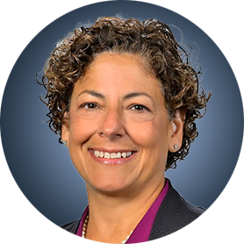

Program Steering Committee
Adam M Brufsky, MD, PhD
Professor of Medicine
UPMC Hillman Cancer Center
Department of Medicine
University of Pittsburgh
Pittsburgh, Pennsylvania
Komal Jhaveri, MD, FACP, FASCO
Patricia and James Cayne Chair for
Junior Faculty
Associate Attending Physician
Breast Medicine Service and Early Drug Development Service
Section Head, Endocrine Therapy
Research Program
Clinical Director, Early Drug
Development Service
Department of Medicine
Memorial Sloan Kettering Cancer Center
Associate Professor of Medicine
Weill Cornell College of Medicine
New York, New York
Nan Chen, MD
Assistant Professor
The University of Chicago
Chicago, Illinois
Angela DeMichele, MD, MSCE
Mariann T and Robert J MacDonald Professor in Breast Cancer
Director, Clinical/Translational Research, Solid Tumor Oncology Hematology/Oncology Division
Co-Leader, Breast Cancer Program
Abramson Cancer Center
Co-Director, 2-PREVENT Breast Cancer Translational Center
of Excellence
Senior Scholar, Center for Clinical Epidemiology and Biostatistics
Perelman School of Medicine
University of Pennsylvania
Philadelphia, Pennsylvania
Kevin Kalinsky, MD, MS, FASCO
Professor of Medicine
Director, Division of Medical Oncology
Louisa and Rand Glenn Family Chair in Breast Cancer Research
Winship Cancer Institute at Emory University
Atlanta, Georgia

Slide 8

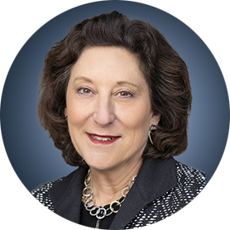

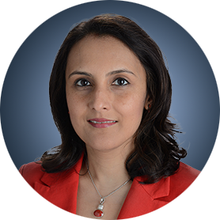

Program Steering Committee
Reshma L Mahtani, DO
Chief of Breast Medical Oncology
Miami Cancer Institute
Baptist Health South Florida
Miami, Florida
Hope S Rugo, MD
Director, Women’s Cancers Program
Division Chief, Breast Medical Oncology
Professor, Department of Medical Oncology and Therapeutics Research
City of Hope Comprehensive Cancer Center
Duarte, California
Professor Emeritus, UCSF
Erica Mayer, MD, MPH, FASCO
Director of Breast Cancer Clinical Research
Breast Oncology Center
Dana-Farber Cancer Institute
Associate Professor of Medicine
Harvard Medical School
Boston, Massachusetts
Priyanka Sharma, MD
Frank B Tyler Professor in Cancer Research
Division of Medical Oncology, Department
of Internal Medicine
Co-Program Leader
Drug Discovery, Delivery and Experimental Therapeutics Program
The University of Kansas Cancer Center
Westwood, Kansas
Jason A Mouabbi, MD
Assistant Professor, Breast Medical Oncology
SAB Chair of the Lobular Breast Cancer Alliance
The University of Texas MD Anderson Cancer Center
Houston, Texas

Slide 9



Program Steering Committee
Rebecca Shatsky, MD
Professor of Clinical Medicine
Breast Medical Oncology Team Leader
Director of Breast Cancer Clinical Trials
Director of Inflammatory and Triple Negative Breast Cancer Program
University of California San Diego
Moores Cancer Center
San Diego, California
PROJECT CHAIR
Neil Love, MD
Research To Practice
Miami, Florida
Erica Stringer-Reasor, MD
Associate Professor of Medicine
UAB O’Neal Comprehensive Cancer Center
Birmingham, Alabama

Slide 10
Key Datasets
Andre F et al. Biomarkers for adjuvant endocrine and chemotherapy in early-stage breast cancer: ASCO Guideline update.
J Clin Oncol 2022;40:1816-37.
Sparano JA et al. Trial Assigning Individualized Options for treatment (TAILORx): An update including 12-year event rates. San Antonio Breast Cancer Symposium 2022;Abstract GS1-05.
Sparano JA et al. Clinical outcomes in early breast cancer with a high 21-gene Recurrence Score of 26 to 100 assigned to adjuvant chemotherapy plus endocrine therapy: A secondary analysis of the TAILORx randomized clinical trial. JAMA Oncol 2020;6(3):367-74.
Chen N et al. Impact of anthracyclines in genomic high-risk, node-negative, HR-positive/HER2-negative breast cancer. Ann Oncol 2025;36(11):1356-65.
O’Shaughnessy J et al. Improved 3-year IDFS with anthracycline-based therapy for patients with 70-gene signature high 2, luminal B, HR+HER2- early-stage breast cancer. San Antonio Breast Cancer Symposium 2025;Abstract PS2-07-03.
Kalinsky K et al. 21-gene assay to inform chemotherapy benefit in node-positive breast cancer. N Engl J Med 2021; 385(25):2336-47.
Piccart M et al. 70-gene signature as an aid for treatment decisions in early breast cancer: Updated results of the phase 3 randomised MINDACT trial with an exploratory analysis by age. Lancet Oncol 2021;22(4):476-88.
Sestak I et al. Comparison of the performance of 6 prognostic signatures for estrogen receptor-positive breast cancer: A secondary analysis of a randomized clinical trial. JAMA Oncol 2018;4(4):545-53.
Noordhoek I et al. Breast Cancer Index predicts extended endocrine benefit to individualize selection of patients with HR+ early-stage breast cancer for 10 years of endocrine therapy. Clin Cancer Res 2021;27(1):311-19.

Slide 11
Key Datasets
Woolpert KM et al. Biomarkers predictive of a response to extended endocrine therapy in breast cancer: A systematic review and meta-analysis. Breast Cancer Res Treat 2024;203(3):407-17.
Johnston S et al. monarchE: Primary overall survival (OS) results of adjuvant abemaciclib + endocrine therapy (ET) for HR+, HER2-, high-risk early breast cancer (EBC). ESMO 2025;Abstract LBA13.
Johnston S et al. Overall survival with abemaciclib in early breast cancer. Ann Oncol 2026;37(2):155-65.
Cortés J et al. monarchE: Subgroup analysis of adjuvant abemaciclib + endocrine therapy for HR+, HER2-, high-risk early breast cancer by nodal status. San Antonio Breast Cancer Symposium 2025;Abstract PS1-08-08.
Crown JP et al. Adjuvant ribociclib (RIB) plus nonsteroidal aromatase inhibitor (NSAI) in patients (pts) with HR+/HER2− early breast cancer (EBC): NATALEE 5-year outcomes. ESMO 2025;Abstract LBA14.
Rugo HS et al. Adjuvant abemaciclib combined with endocrine therapy for high-risk early breast cancer: Safety and patient-reported outcomes from the monarchE study. Ann Oncol 2022;33(6):616-27.
Barrios C et al. NATALEE update: Safety and treatment (tx) duration of ribociclib (RIB) + nonsteroidal aromatase inhibitor (NSAI) in patients (pts) with HR+/HER2− early breast cancer (EBC). ESMO Breast 2024;Abstract 113MO.
Mayer EL et al. TRADE: A phase II trial to assess the tolerability of abemaciclib dose escalation in early-stage HR-positive/HER2-negative breast cancer. Ann Oncol 2025;31(1):117-24.
Bardia A et al. Giredestrant vs standard-of-care endocrine therapy as adjuvant treatment for patients with estrogen receptor-positive, HER2-negative early breast cancer: Results from the global phase III lidERA Breast Cancer trial. San Antonio Breast Cancer Symposium 2025;Abstract GS1-10.

Slide 12
Management of Hormone Receptor (HR)-Positive Localized Breast Cancer
Module 1: Risk Assessment and Genomic Assays for HR-Positive, HER2-Negative Localized Breast Cancer
Module 2: Clinician Survey Results
Module 3: Adjuvant CDK4/6 Inhibitors for High-Risk, HR-Positive, HER2-Negative Localized Breast Cancer
Module 4: Clinician Survey Results
Module 5: Tolerability and Other Practical Considerations with Adjuvant CDK4/6 Inhibitor Therapy
Module 6: Clinician Survey Results
Module 7: Adjuvant Oral SERDs for HR-Positive, HER2-Negative Localized
Breast Cancer

Slide 13
Management of Hormone Receptor (HR)-Positive Localized Breast Cancer
Module 1: Risk Assessment and Genomic Assays for HR-Positive, HER2-Negative Localized Breast Cancer
Module 2: Clinician Survey Results
Module 3: Adjuvant CDK4/6 Inhibitors for High-Risk, HR-Positive, HER2-Negative Localized Breast Cancer
Module 4: Clinician Survey Results
Module 5: Tolerability and Other Practical Considerations with Adjuvant CDK4/6 Inhibitor Therapy
Module 6: Clinician Survey Results
Module 7: Adjuvant Oral SERDs for HR-Positive, HER2-Negative Localized
Breast Cancer

Slide 14
Key Datasets
Andre F et al. Biomarkers for adjuvant endocrine and chemotherapy in early-stage breast cancer: ASCO Guideline update.
J Clin Oncol 2022;40:1816-37.
Sparano JA et al. Trial Assigning Individualized Options for treatment (TAILORx): An update including 12-year event rates. San Antonio Breast Cancer Symposium 2022;Abstract GS1-05.
Sparano JA et al. Clinical outcomes in early breast cancer with a high 21-gene Recurrence Score of 26 to 100 assigned to adjuvant chemotherapy plus endocrine therapy: A secondary analysis of the TAILORx randomized clinical trial. JAMA Oncol 2020;6(3):367-74.
Chen N et al. Impact of anthracyclines in genomic high-risk, node-negative, HR-positive/HER2-negative breast cancer. Ann Oncol 2025;36(11):1356-65.
O’Shaughnessy J et al. Improved 3-year IDFS with anthracycline-based therapy for patients with 70-gene signature high 2, luminal B, HR+HER2- early-stage breast cancer. San Antonio Breast Cancer Symposium 2025;Abstract PS2-07-03.
Kalinsky K et al. 21-gene assay to inform chemotherapy benefit in node-positive breast cancer. N Engl J Med 2021; 385(25):2336-47.
Piccart M et al. 70-gene signature as an aid for treatment decisions in early breast cancer: Updated results of the phase 3 randomised MINDACT trial with an exploratory analysis by age. Lancet Oncol 2021;22(4):476-88.

Slide 15
Key Datasets
Sestak I et al. Comparison of the performance of 6 prognostic signatures for estrogen receptor-positive breast cancer: A secondary analysis of a randomized clinical trial. JAMA Oncol 2018;4(4):545-53.
Noordhoek I et al. Breast Cancer Index predicts extended endocrine benefit to individualize selection of patients with HR+ early-stage breast cancer for 10 years of endocrine therapy. Clin Cancer Res 2021;27(1):311-9.
Woolpert KM et al. Biomarkers predictive of a response to extended endocrine therapy in breast cancer: A systematic review and meta-analysis. Breast Cancer Res Treat 2024;203(3):407-17.

Slide 16
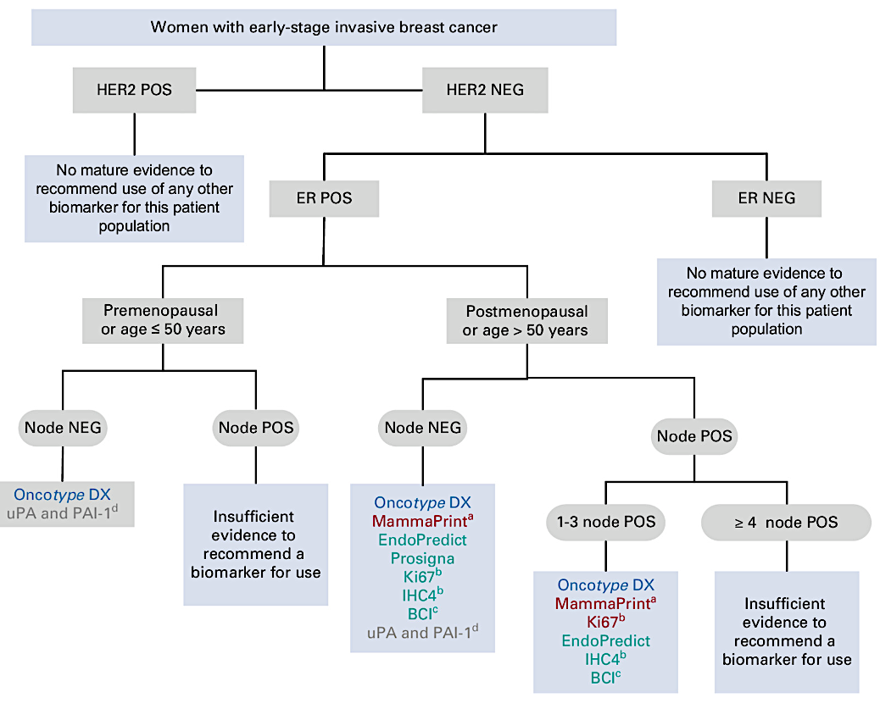
ASCO Guideline
2022
Andre F et al. J Clin Oncol. 2022;40:1816-1837

Slide 17
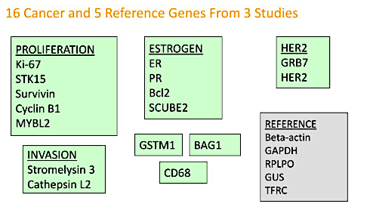
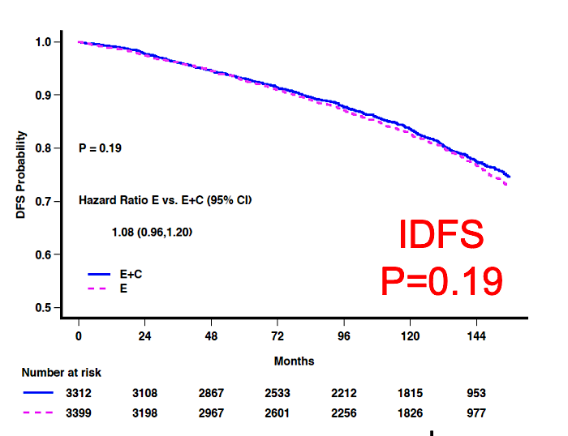
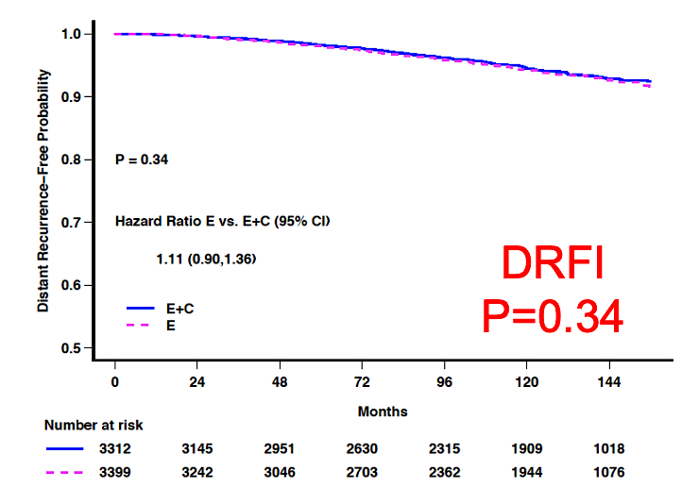
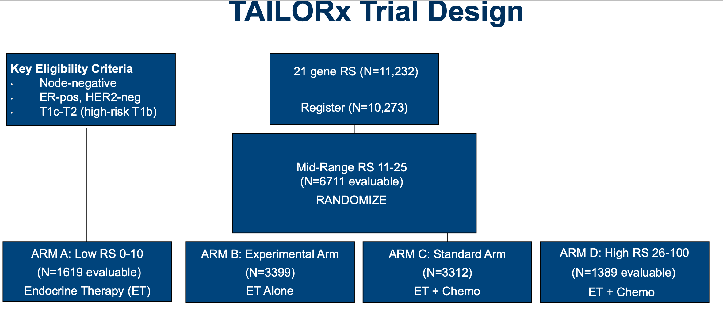
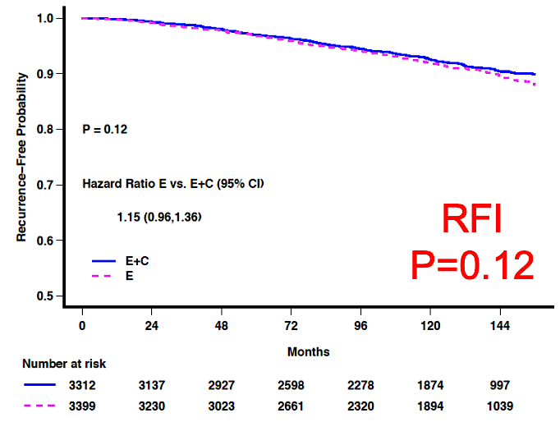
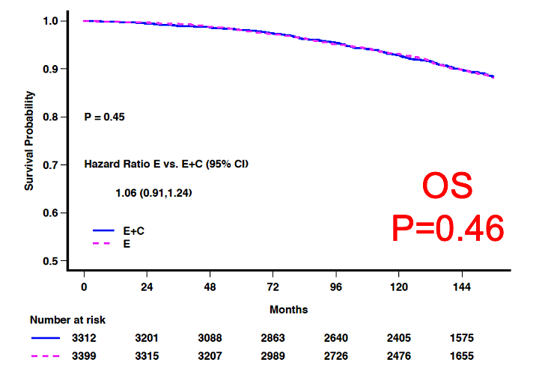
OncotypeDX®: TAILORx Trial Key Results for Node-Negative Disease
Intermediate risk (11-25):
No overall benefit to chemotherapy (2022 update)
Sparano JA et al. SABCS 2022;Abstract GS1-05.
Figures courtesy K. Kalinsky

Slide 18
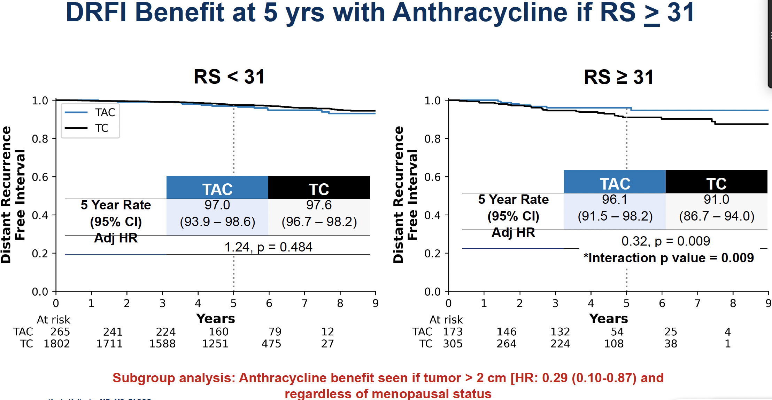
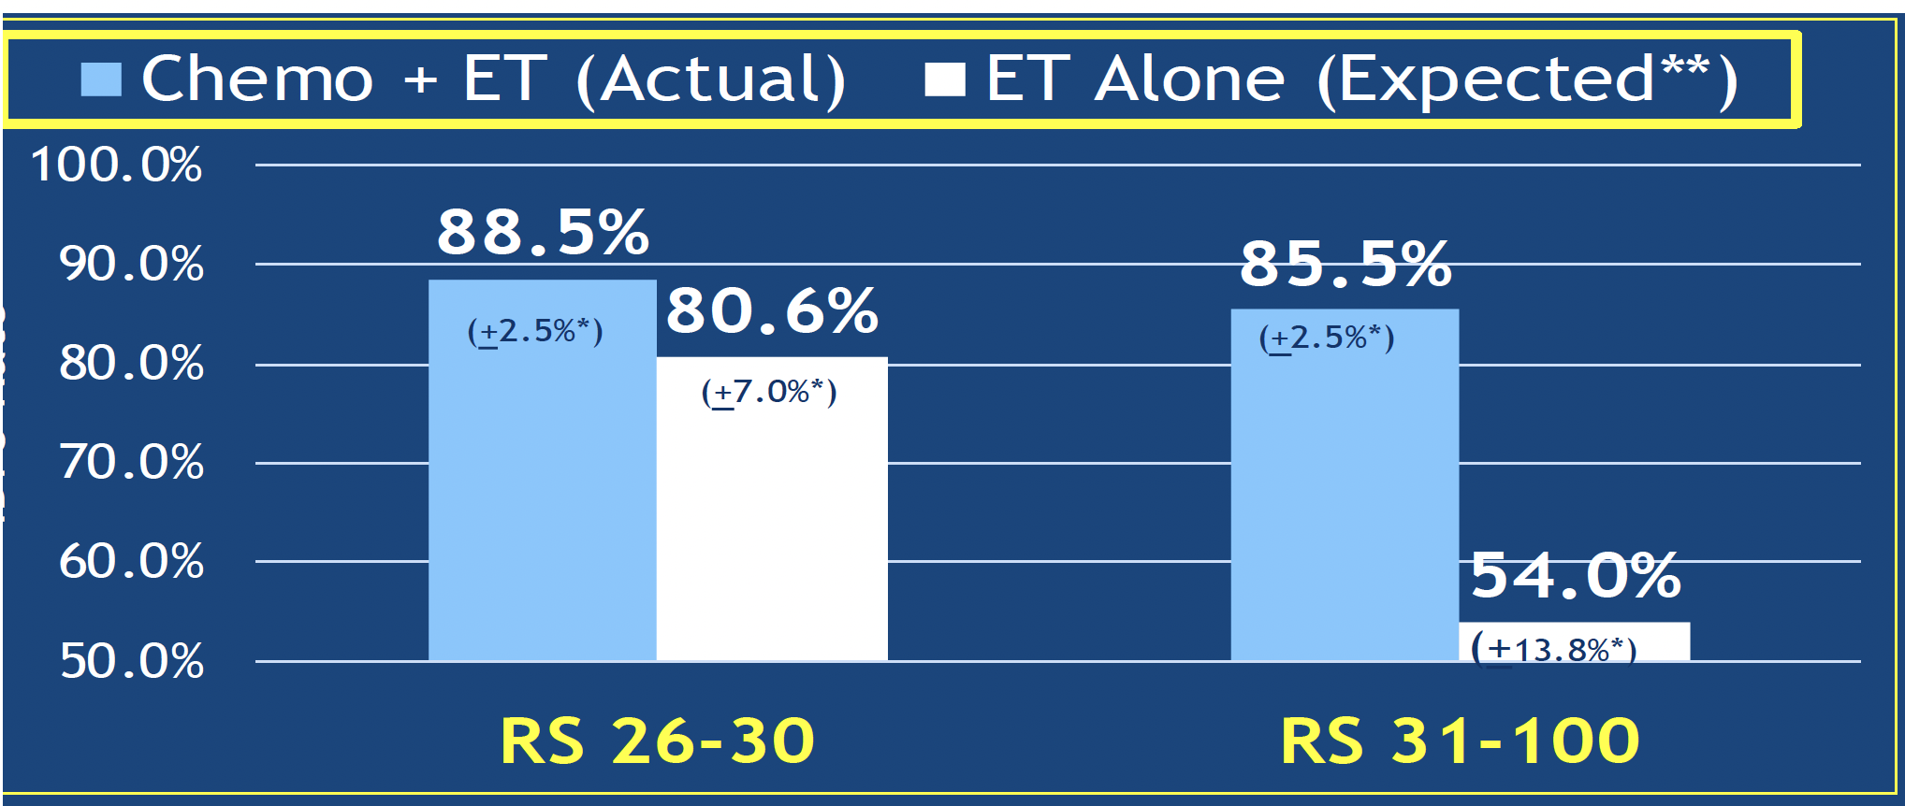
Chemotherapy and Anthracycline Benefits for Patients with High Recurrence Scores® (>25)
DRFI Benefit at 5 y with Anthracycline if RS > 31
High Risk (RS > 25): Expected benefit with chemotherapy
“No chemotherapy” rates estimated by combining
patient-specific distant recurrence risk information with
patient-specific chemotherapy benefit information
from the ERBB2-negative cohort of NSABP B20
TAILORx N = 2,549. T-AC vs TC
5-y DRFI 96.1 vs 91%, HR 0.31, p = 0.006
5-y DRFS 95.4% vs 89.8%, aHR 0.49, p = 0.032
OS NS
Sparano JA et al. JAMA Oncol 2020; Chen N et al. Ann Oncol 2025.

Slide 19
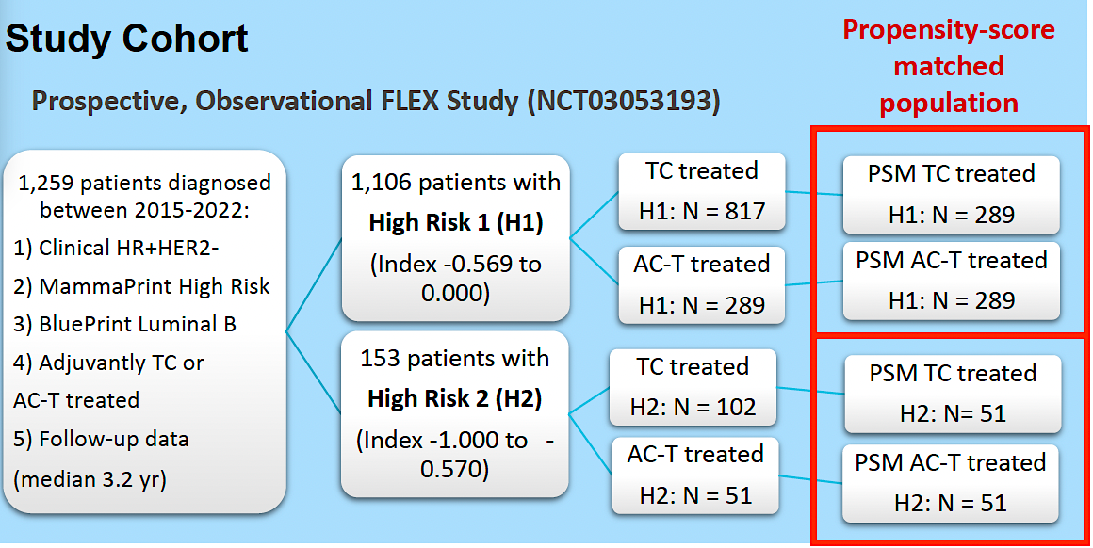
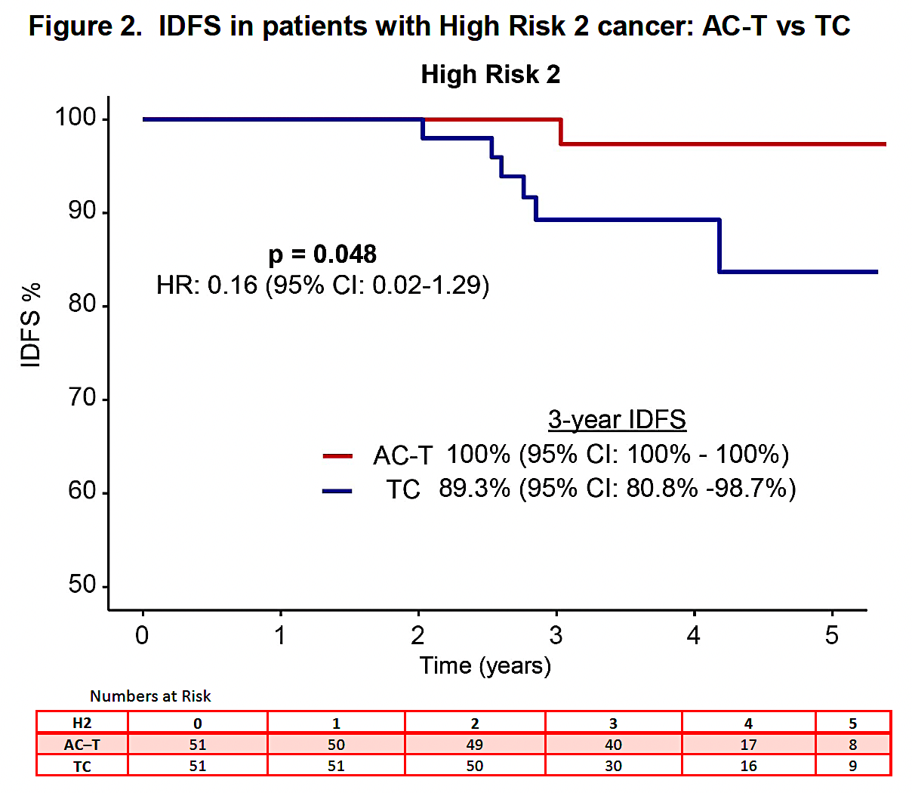
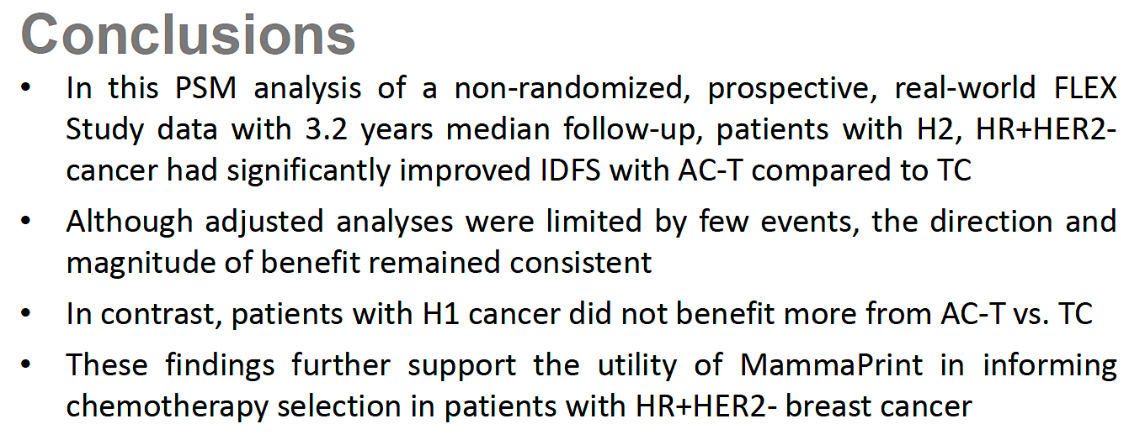
Propensity-Score Matched Analysis of Real-World FLEX Data: IDFS with Anthracycline-Based Therapy for Patients with MammaPrint® High 2, Luminal B, HR-Positive, HER2-Negative Localized Breast Cancer
IDFS = invasive disease-free survival
O’Shaughnessy J et al. SABCS 2025;Abstract PS2-07-03.

Slide 20
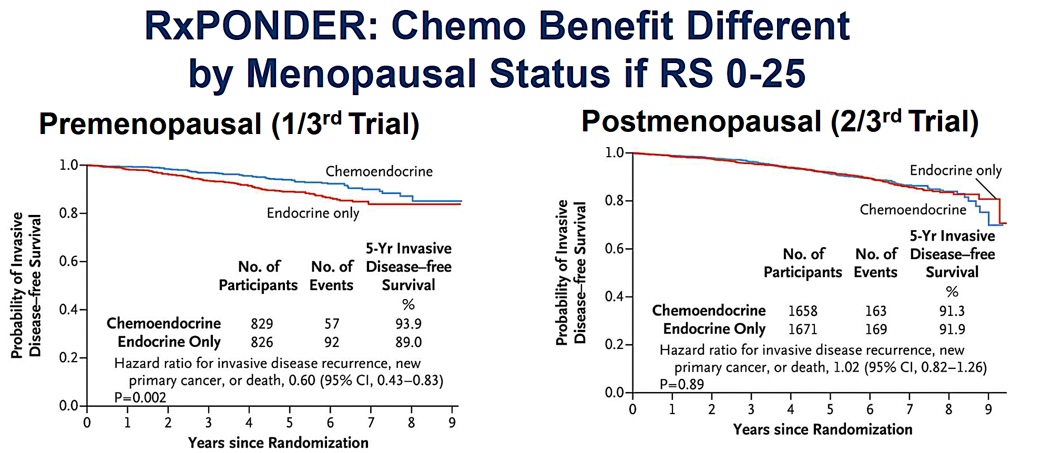
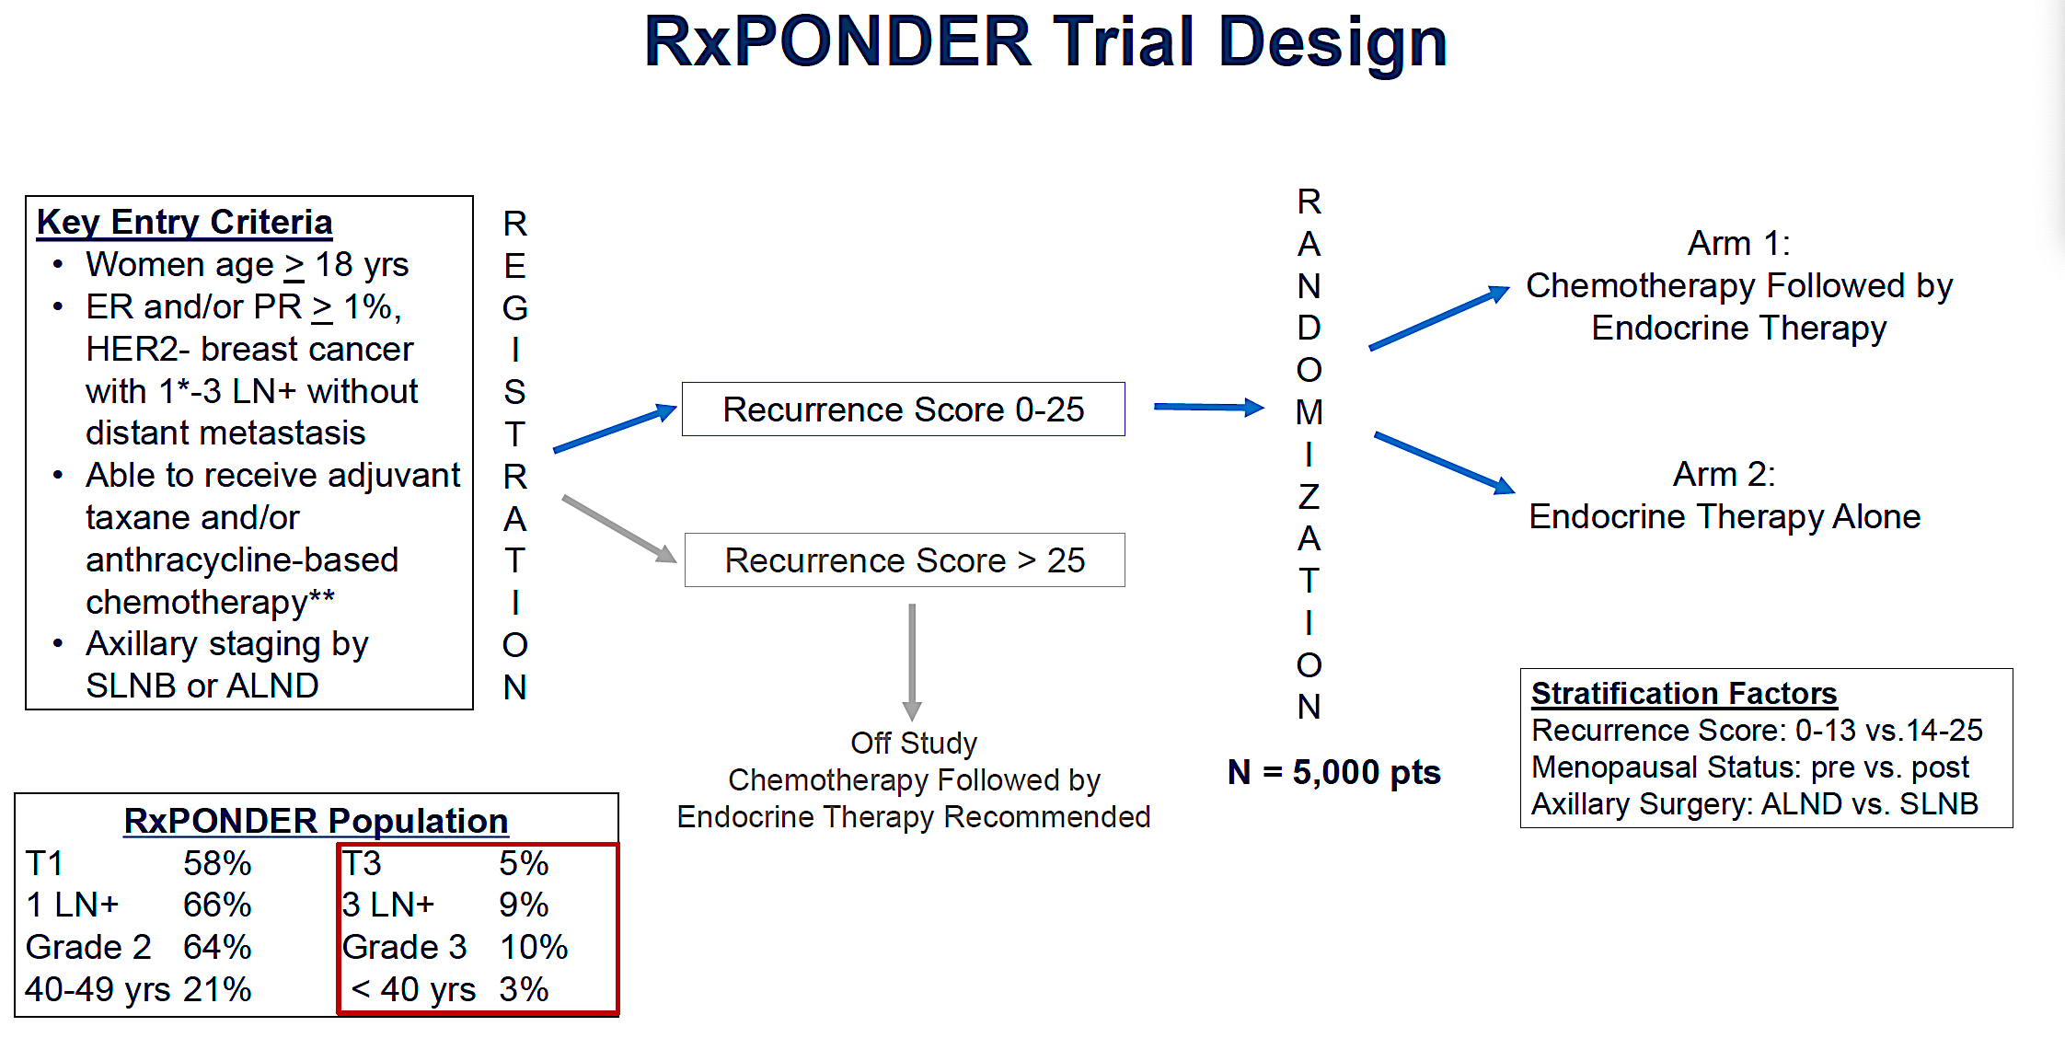
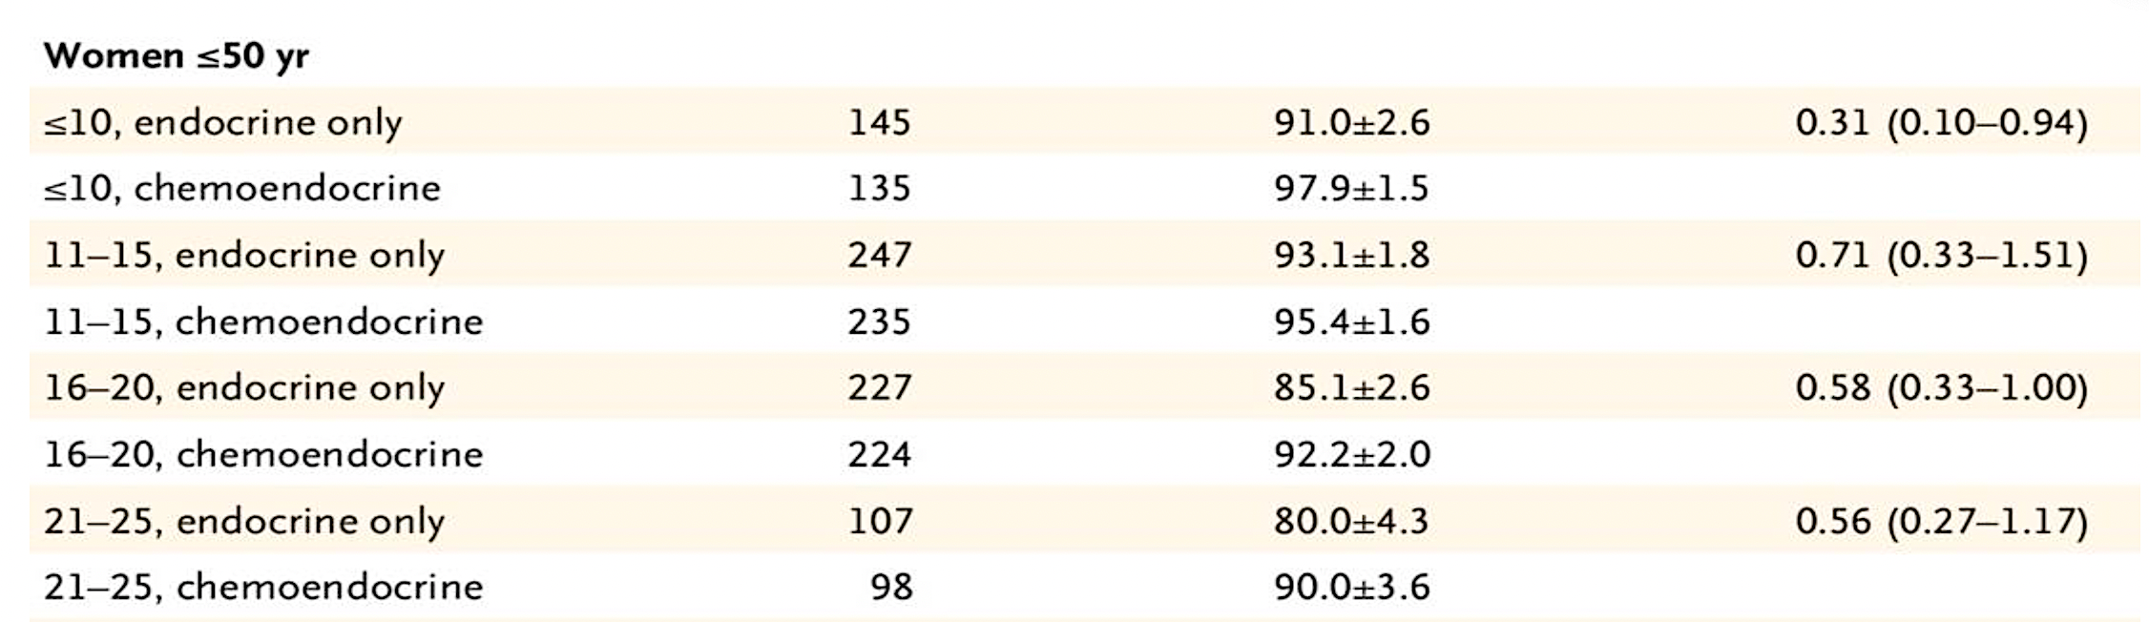
OncotypeDX: RxPONDER Trial
Results Summary
One to Three Positive Lymph Nodes
IDFS Benefit Modified by Score for Women Age ≤50
Sparano JA et al. JAMA Oncol 2020; Chen N et al. Ann Oncol 2025.

Slide 21
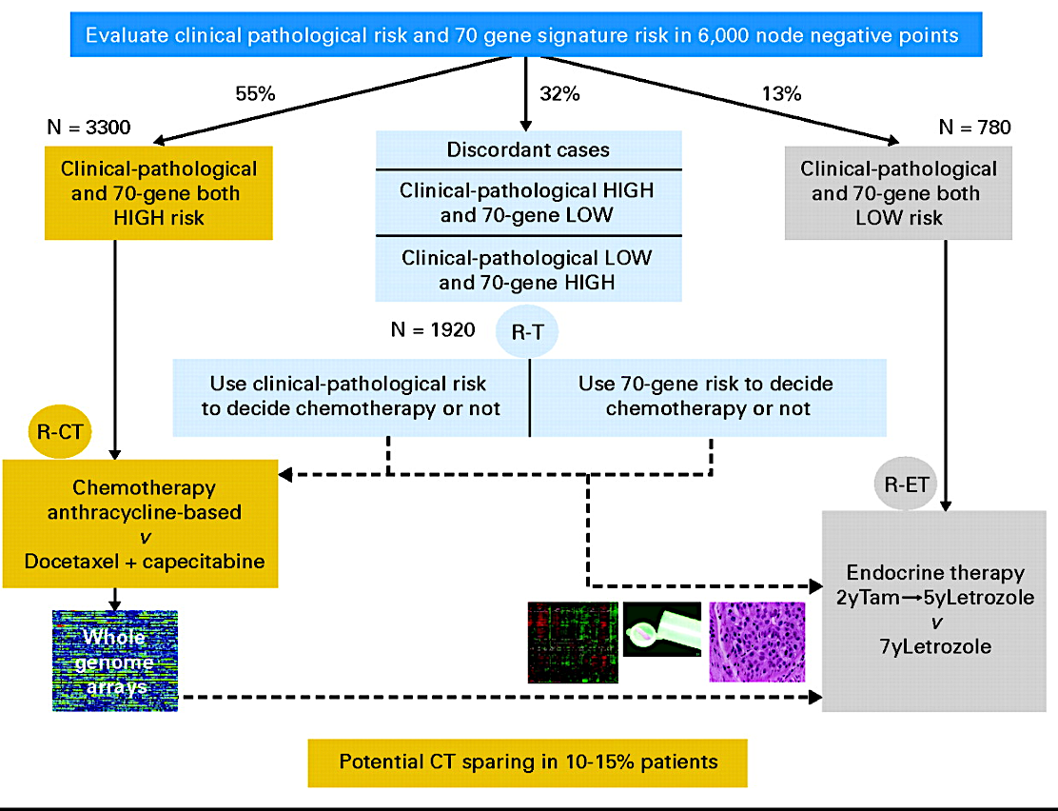
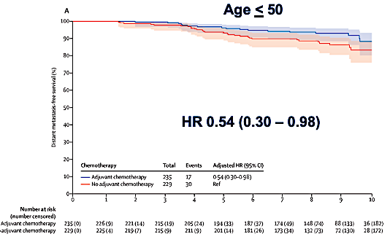
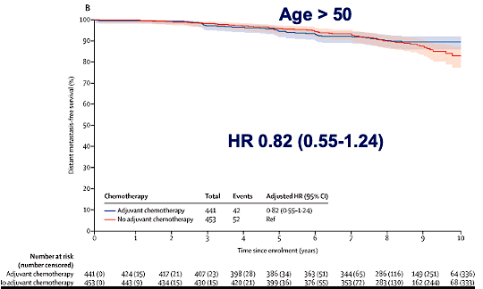
MammaPrint: MindACT Trial Key Results
Chemo benefit increases over time overall. Lost in those age >50, maintained in those age <50
Clinical “high risk”: <88% 10-yr BCSS
Modified Adjuvant! Online to determine
Model included: T size, Node (0-3), grade, ER status, age, comorbidity
 | ET | CET | Absolute diff
5-y DMFS | 94.7% (92.5 – 96.2) | 95.9% (94-97.2) | 1.2%
8-yr DMFS | 89.4% (86.8- 91,5) | 92% (896-93.8) | 2.6%
Met primary outcome: Lower bound of 95% CI >92% 5-y DMFS in the High Clinical/Low Genomic risk group
No adjuvant chemotherapy
No adjuvant chemotherapy
BCSS = breast cancer-specific survival; DMFS = distant metastasis-free survival
Cardoso F et al. N Engl J Med 2016; Piccart M et al. Lancet Oncol 2021.

Slide 22
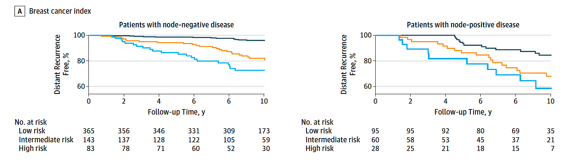
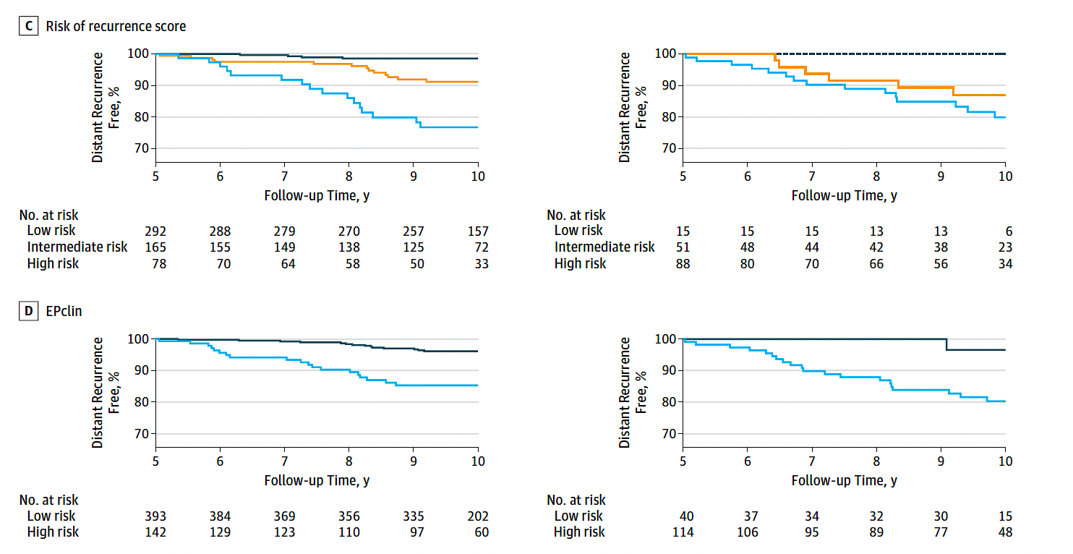
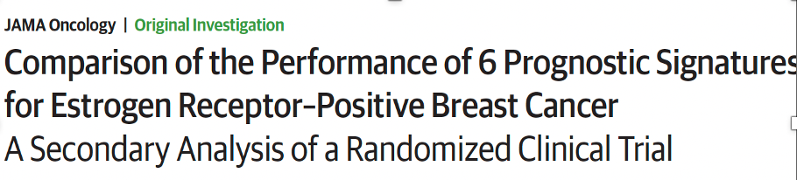
Prosigna® ROR, EndoPredict® EPclin and Breast Cancer Index®
ROR (risk of recurrence, Prosigna)
50-gene RNA-based molecular subtyping assay
ROR available in US; PAM50 not available
EPclin (EndoPredict)
12 genes – Proliferation and hormone receptor
Breast Cancer Index (BCI)
7 genes – Proliferation and hormone receptor (HoxB13/IL17BR)
BCI
ROR
Signatures
Largest retrospective prognostic validation in TransATAC Trial (included Oncotype DX and BCI as well)
N = 535 node-negative, 154 node-positive
Examined risk years 0 to 10
ROR, EPclin and BCI provided most prognostic information
ROR HR 2.56 (1.96-3.35)
EPclin HR 2.14 (1.71-2.68)
BCI HR 2.46 (1.88-3.23)
EPclin
Low risk
Intermediate risk
High risk
Sestak I et al. JAMA Oncol 2018;4(4):545-53.

Slide 23
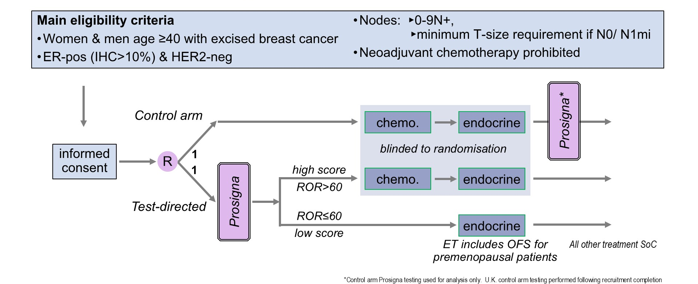
Phase III OPTIMA Study Design
Stein R et al. ASCO 2026;Abstract 500.

Slide 24
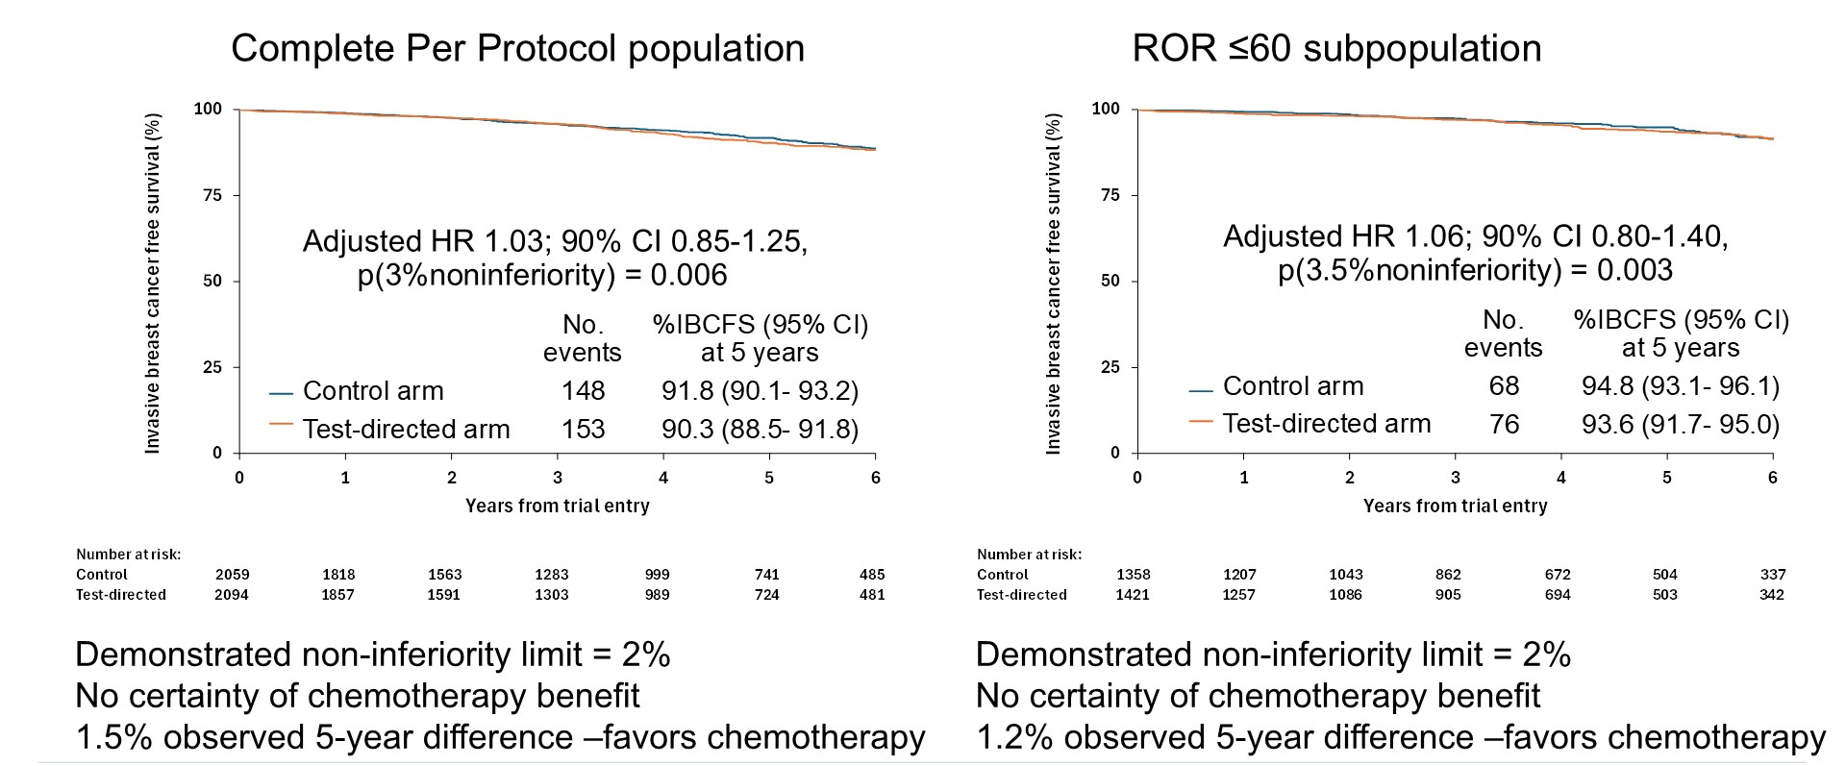
Phase III OPTIMA: Invasive Breast Cancer-Free Survival (IBCFS)
ROR = risk of recurrence
Stein R et al. ASCO 2026;Abstract 500.

Slide 25
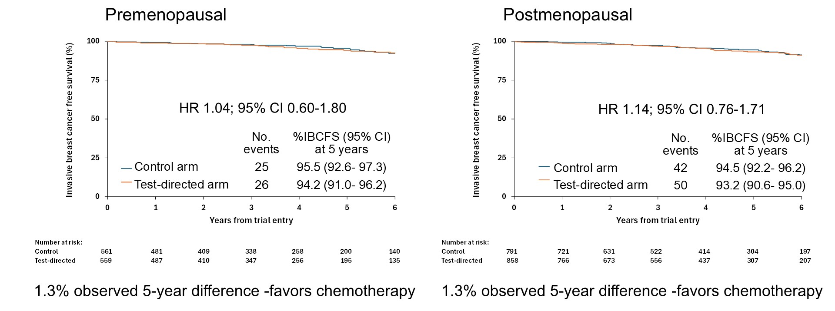
Phase III OPTIMA: IBCFS and Menopausal Status (Low ROR Score)
Stein R et al. ASCO 2026;Abstract 500.

Slide 26
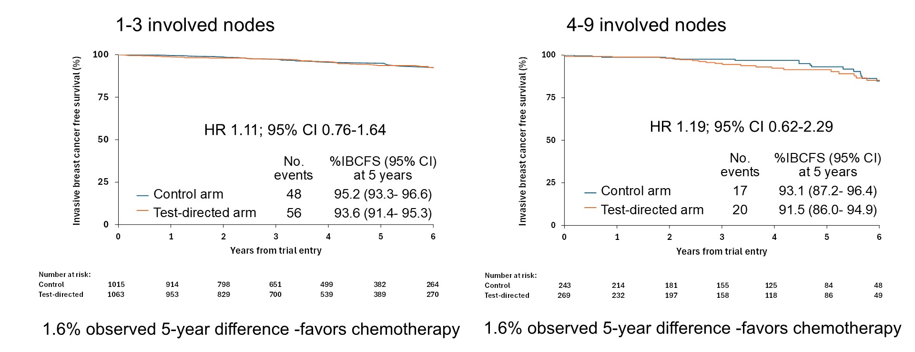
Phase III OPTIMA: IBCFS and Nodal Status (Low ROR Score)
Stein R et al. ASCO 2026;Abstract 500.

Slide 27
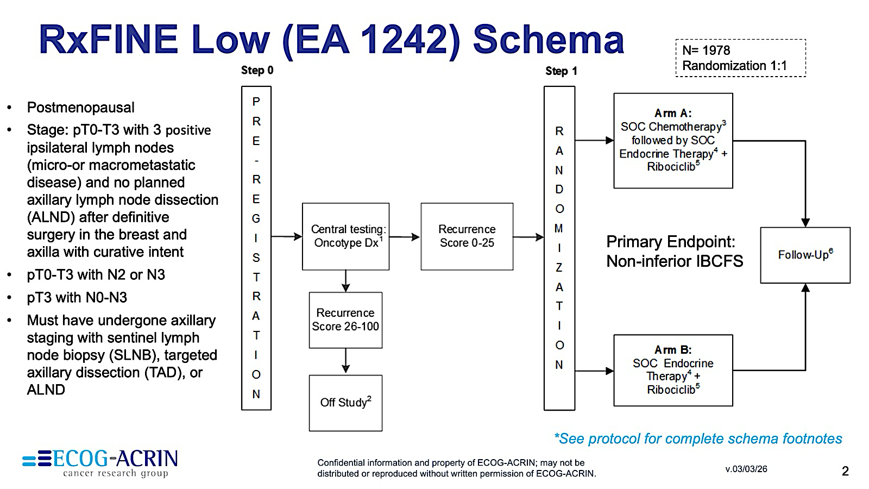
Phase III RxFINE-Low (EA1242) Study Design
https://ecog-acrin.org/clinical-trials/ea1242-rxfine-low-breast-cancer/

Slide 28
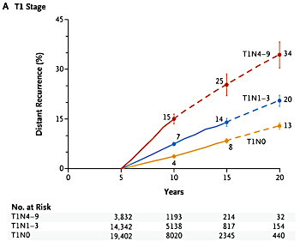
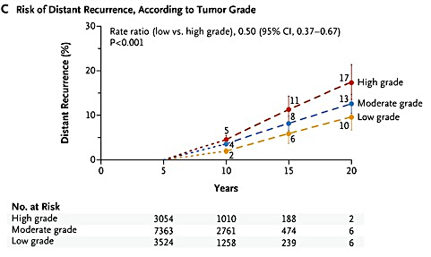
Persistent Long-Term Risk of Distant Recurrence
Risk of late distant recurrence after 5 years of adjuvant endocrine therapy persists across all clinical stages.
Pan H et al. N Engl J Med 2017;377(19):1836-46.

Slide 29
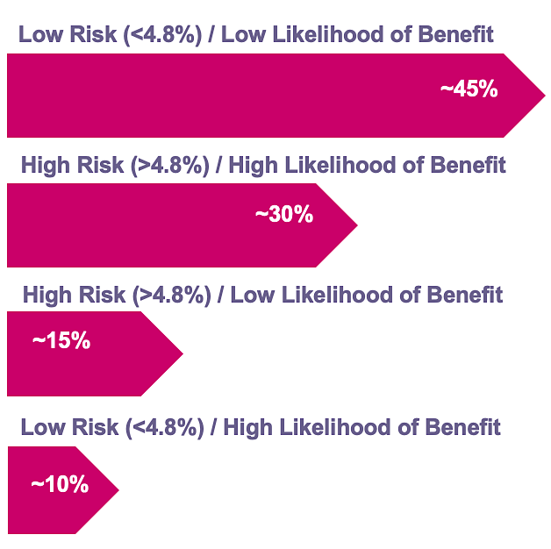
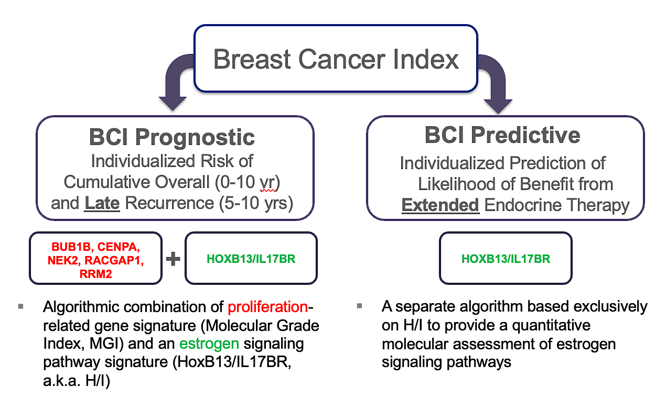
Breast Cancer Index (BCI)
Distribution of BCI scores
BCI Components
Sgroi DC et al. J Natl Cancer Inst 2013;105(14):1036-42.

Slide 30
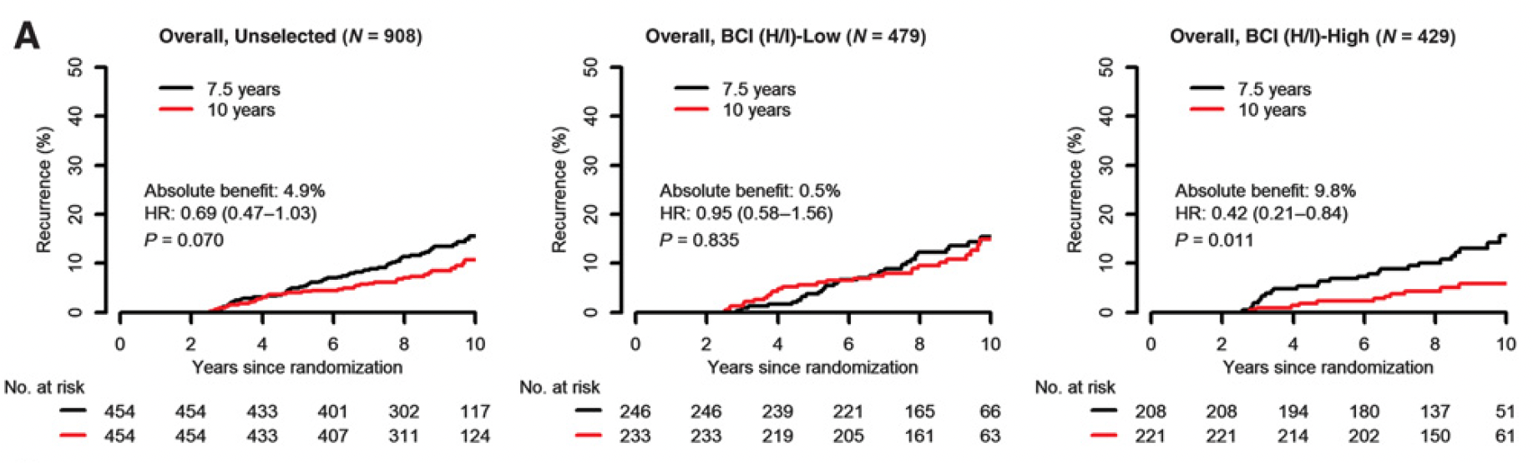
Predictive Performance by BCI H/I Groups Based on Recurrence-Free Interval in the Overall Cohort of the Phase III IDEAL Trial
Noordhoek I et al. Clin Cancer Res 2021;27(1):311-19.

Slide 31
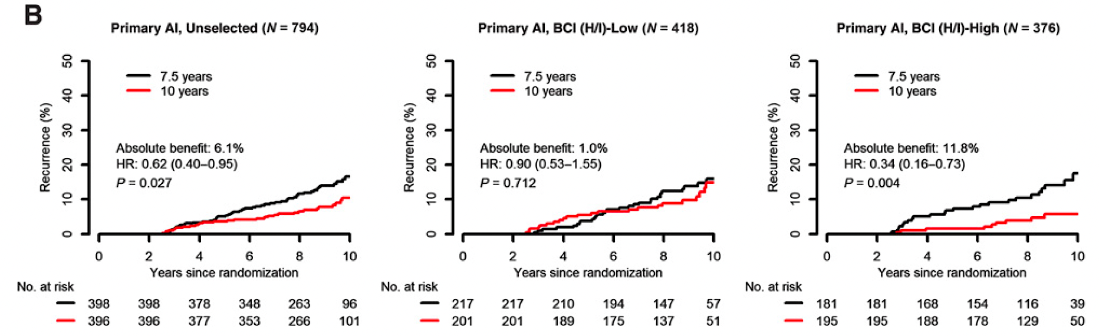
Predictive Performance by BCI H/I Groups Based on
Recurrence-Free Interval in the Subset of Patients in the Phase III IDEAL Trial Who Received a Primary Aromatase Inhibitor (AI)
Noordhoek I et al. Clin Cancer Res 2021;27(1):311-19.

Slide 32
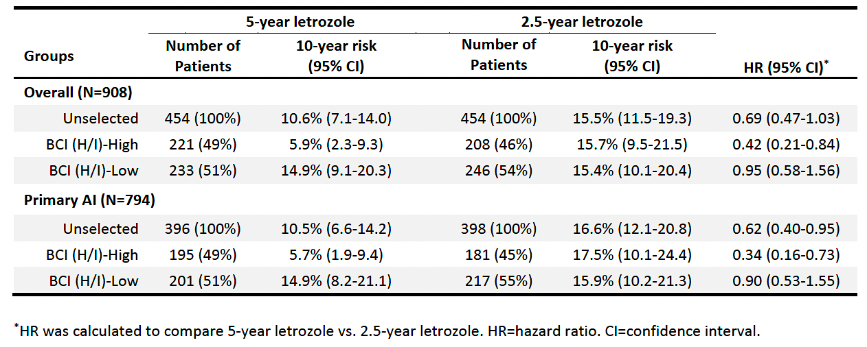
Risk of Recurrence at Year 10 Since Randomization for Patients Who Received 5 Years versus 2.5 Years of Additional Letrozole in the Overall Cohort and in the Primary AI Subset of the Phase III IDEAL Trial
Noordhoek I et al. Clin Cancer Res 2021;27(1):311-19.

Slide 33
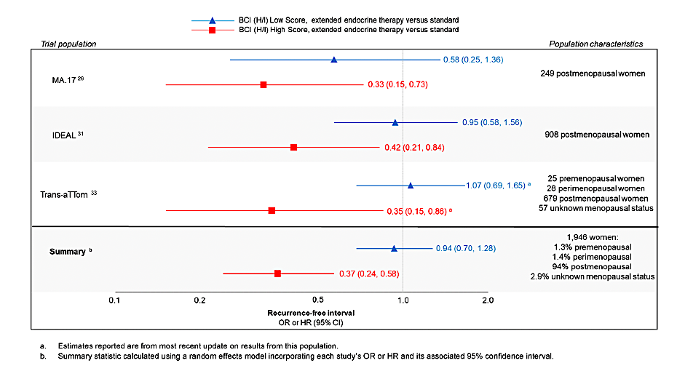
BCI Validation in Extended-Adjuvant Therapy Trials
Woolpert KM et al. Breast Cancer Res Treat 2024;203(3):407-417.

Slide 34
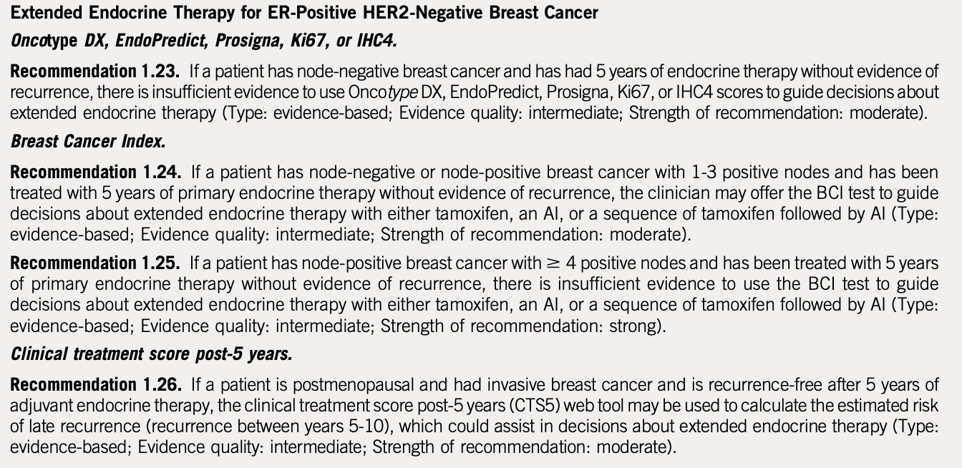
ASCO Guideline: Extended Adjuvant Therapy
Andre F et al. J Clin Oncol. 2022;40:1816-1837

Slide 35
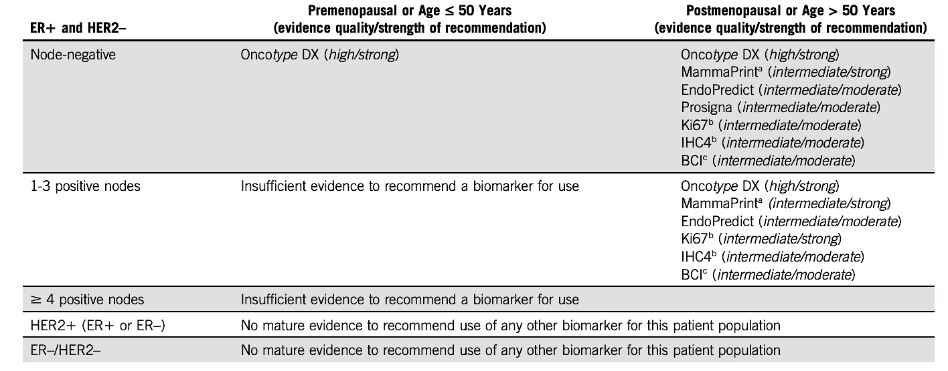
Summary: ASCO Guideline 2022
Andre F et al. J Clin Oncol. 2022;40:1816-1837

Slide 36
Management of Hormone Receptor (HR)-Positive Localized Breast Cancer
Module 1: Risk Assessment and Genomic Assays for HR-Positive, HER2-Negative Localized Breast Cancer
Module 2: Clinician Survey Results
Module 3: Adjuvant CDK4/6 Inhibitors for High-Risk, HR-Positive, HER2-Negative Localized Breast Cancer
Module 4: Clinician Survey Results
Module 5: Tolerability and Other Practical Considerations with Adjuvant CDK4/6 Inhibitor Therapy
Module 6: Clinician Survey Results
Module 7: Adjuvant Oral SERDs for HR-Positive, HER2-Negative Localized
Breast Cancer

Slide 37
Outside of a clinical trial, which genomic assay(s) do you routinely order to assist with decision-making regarding adjuvant systemic therapy for your patients with HR-positive, HER2-negative localized breast cancer (BC)?
Oncotype DX®, MammaPrint®, EndoPredict®, Breast Cancer Index®
Oncotype DX, MammaPrint, Breast Cancer Index
Oncotype DX
Oncotype DX, MammaPrint, Breast Cancer Index
Oncotype DX, MammaPrint, Breast Cancer Index
Oncotype DX and MammaPrint
Oncotype DX and MammaPrint
Oncotype DX and MammaPrint

Slide 38
Would you recommend adjuvant chemotherapy for a 40-year-old premenopausal patient with node-negative, HR-positive, HER2-negative localized BC and the 21-gene Recurrence Score® (RS) listed below?
RS = 8
RS = 17
RS = 20
No
No
Yes, but offer OFS/OA
as alternative
No
Yes, but offer OFS/OA
as alternative
Yes
No
No
Yes
No
Yes, but offer OFS/OA
as alternative
Yes, but offer OFS/OA
as alternative
No
No
No
No
No*
No*
No
No
Yes, but offer OFS/OA
as alternative
No
No
No
OFS/OA = ovarian function suppression/ovarian ablation; * Would offer OFS/OA

Slide 39
Would you recommend adjuvant chemotherapy for a 40-year-old premenopausal patient with HR-positive, HER2-negative localized BC with 3 positive nodes and the 21-gene RS listed below?
RS = 8
RS = 17
RS = 20
Yes, but offer OFS/OA
as alternative
Yes, but offer OFS/OA
as alternative
Yes, but offer OFS/OA
as alternative
Yes
Yes
Yes
Yes
Yes
Yes
Yes
Yes
Yes
Yes, but offer OFS/OA
as alternative
Yes, but offer OFS/OA
as alternative
Yes, but offer OFS/OA
as alternative
Yes
Yes
Yes
Yes
Yes
Yes
Yes
Yes
Yes
OFS/OA = ovarian function suppression/ovarian ablation

Slide 40
Would you recommend adjuvant chemotherapy for a 65-year-old postmenopausal patient with HR-positive, HER2-negative localized BC with 3 positive nodes and the 21-gene RS listed below?
RS = 8
RS = 17
RS = 20
No
No
No
No
No
No
No
No
Yes
No
No
Yes
No
No
No
No
No
No
No
No
No
No
No
No

Slide 41
Have you ordered or would you order a genomic assay to assist with treatment decision-making in the localized setting for any patients with HR-positive, HER2-negative localized BC and 4 or more positive nodes?
I have
I have not but would for the right patient
I have not but would for the right patient
I have not and would not
I have not and would not
I have
I have not and would not
I have

Slide 42
Outside of a clinical trial, which genomic assay(s) do you routinely order to assist with decision-making in the neoadjuvant setting for your patients with HR-positive, HER2-negative localized BC?
MammaPrint
MammaPrint**
MammaPrint
MammaPrint
MammaPrint
MammaPrint and Oncotype DX*
Oncotype DX and MammaPrint
MammaPrint
* All my patients with HR+ disease screen for I-SPY with rare exceptions and we order Mammaprint and BluePrint. I will occasionally order Oncotype DX. ** I-SPY only, I do not routinely order genomic assays in the neoadjuvant setting

Slide 43
Outside of a clinical trial, do you routinely employ Breast Cancer Index (BCI) to determine whether to continue adjuvant endocrine therapy beyond 5 years for patients with HR-positive, HER2-negative localized BC? If so, in which clinical situations?
Yes, for node-positive disease when MammaPrint not available
Yes, primarily for patients with intermediate risk disease who would like more information to assist with making the decision
Yes, in situations where I’m on the fence about extending ET
Yes, for patients with N0 disease or up to 3 pos nodes
Yes, for patients for whom we are considering extended ET
No*
Yes, for patients with high-risk, node-negative disease
Yes, for patients with HR-positive disease who may be
lymph node-negative for whom extended therapy might be beneficial
ET = endocrine therapy; * No due to reimbursement issues, but I would for patients with poor tolerance to ET and high-risk disease

Slide 44
Approximately what proportion of the time would you estimate that having the results from BCI cause you to change your recommendation regarding extended-adjuvant endocrine therapy (ET)?
Recommending ET to not recommending
Not recommending ET to recommending
25%
25%
20%
20%
10%
10%
20%
20%
80%
20%
NA
NA
10%
10%
10%
10%
NA = not applicable

Slide 45
Outside of a clinical trial, do you routinely employ any genomic assays other than Breast Cancer Index to determine whether to continue adjuvant endocrine therapy beyond 5 years for patients with HR-positive, HER2-negative localized BC?
Yes, MammaPrint
No
No
No
Yes, MammaPrint
No
No
Yes, MammaPrint

Slide 46
Have you ordered or would you order a circulating tumor DNA (ctDNA)-based molecular residual disease (MRD) assay to assist with clinical decision-making for a patient with localized BC? If you were to order a ctDNA-based MRD assay for a patient with localized BC, which specific assay(s) would you use?
Order a ctDNA-based MRD assay?
Assay
I have
Signatera™
I have
Personalis® or Signatera
I have not but would for the right patient
Signatera
I have not and would not
NA
I have
Signatera
I have
Signatera
I have not and would not
NA
I have
Signatera or Guardant Reveal™
NA = not applicable

Slide 47
Management of Hormone Receptor (HR)-Positive Localized Breast Cancer
Module 1: Risk Assessment and Genomic Assays for HR-Positive, HER2-Negative Localized Breast Cancer
Module 2: Clinician Survey Results
Module 3: Adjuvant CDK4/6 Inhibitors for High-Risk, HR-Positive, HER2-Negative Localized Breast Cancer
Module 4: Clinician Survey Results
Module 5: Tolerability and Other Practical Considerations with Adjuvant CDK4/6 Inhibitor Therapy
Module 6: Clinician Survey Results
Module 7: Adjuvant Oral SERDs for HR-Positive, HER2-Negative Localized
Breast Cancer

Slide 48
Key Datasets
Johnston S et al. monarchE: Primary overall survival (OS) results of adjuvant abemaciclib + endocrine therapy (ET) for HR+, HER2-, high-risk early breast cancer (EBC). ESMO 2025;Abstract LBA13.
Johnston S et al. Overall survival with abemaciclib in early breast cancer. Ann Oncol 2026;37(2):155-65.
Cortés J et al. monarchE: Subgroup analysis of adjuvant abemaciclib + endocrine therapy for HR+, HER2-, high-risk early breast cancer by nodal status. San Antonio Breast Cancer Symposium 2025;Abstract PS1-08-08.
Crown JP et al. Adjuvant ribociclib (RIB) plus nonsteroidal aromatase inhibitor (NSAI) in patients (pts) with HR+/HER2− early breast cancer (EBC): NATALEE 5-year outcomes. ESMO 2025;Abstract LBA14.
Chia SKL et al. Prognostic and predictive impact of baseline gene expression (exp) in the NATALEE trial of adjuvant (adj) ribociclib (RIB) + nonsteroidal aromatase inhibitor (NSAI) in HR+/HER2- early breast cancer (EBC). ASCO 2026;Abstract 501.

Slide 49
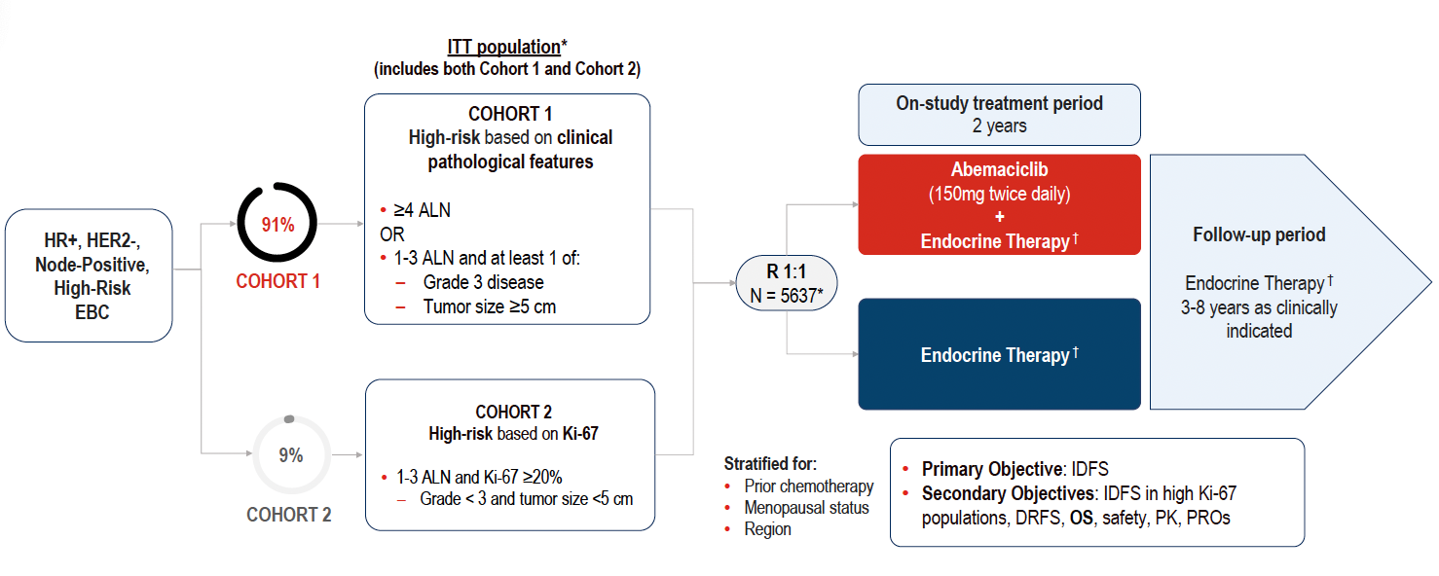
monarchE Study Design
Johnston S et al. ESMO 2025;Abstract LBA13. Johnston S et al. Ann Oncol 2026;37(2):155-65.

Slide 50
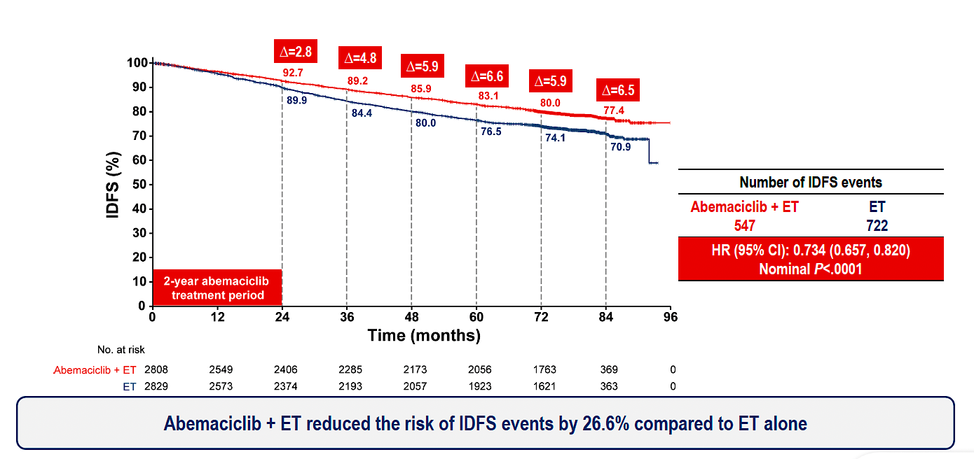
monarchE: Invasive Disease-Free Survival (IDFS) Outcomes
ET = endocrine therapy
Johnston S et al. ESMO 2025;Abstract LBA13. Johnston S et al. Ann Oncol 2026;37(2):155-65.

Slide 51
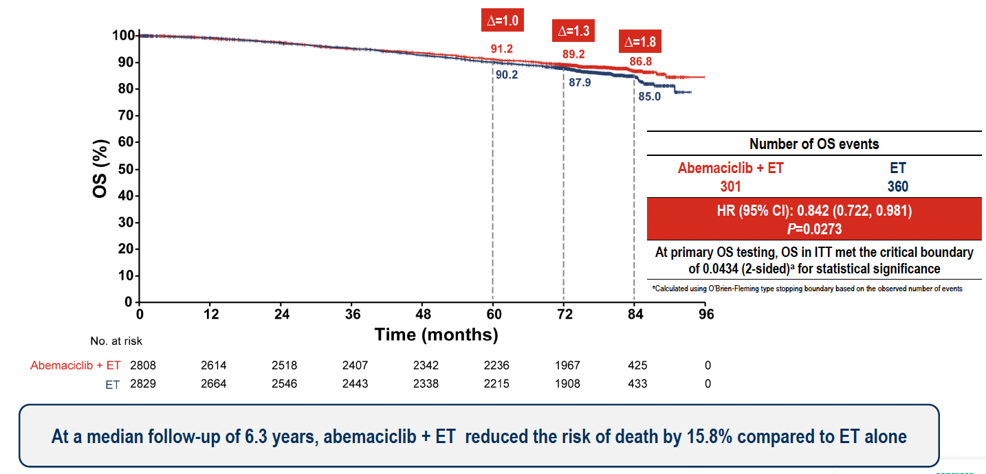
monarchE: Overall Survival (OS) Outcomes
Johnston S et al. ESMO 2025;Abstract LBA13. Johnston S et al. Ann Oncol 2026;37(2):155-65.

Slide 52
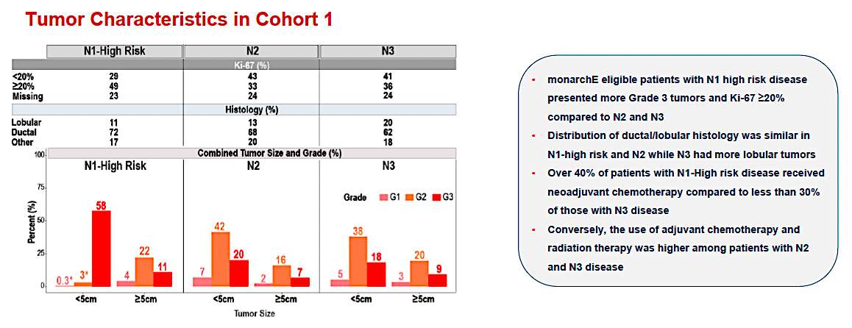
monarchE: Subgroup Analysis by Nodal Status
Cortés J et al. San Antonio Breast Cancer Symposium 2025;Abstract PS1-08-08.

Slide 53
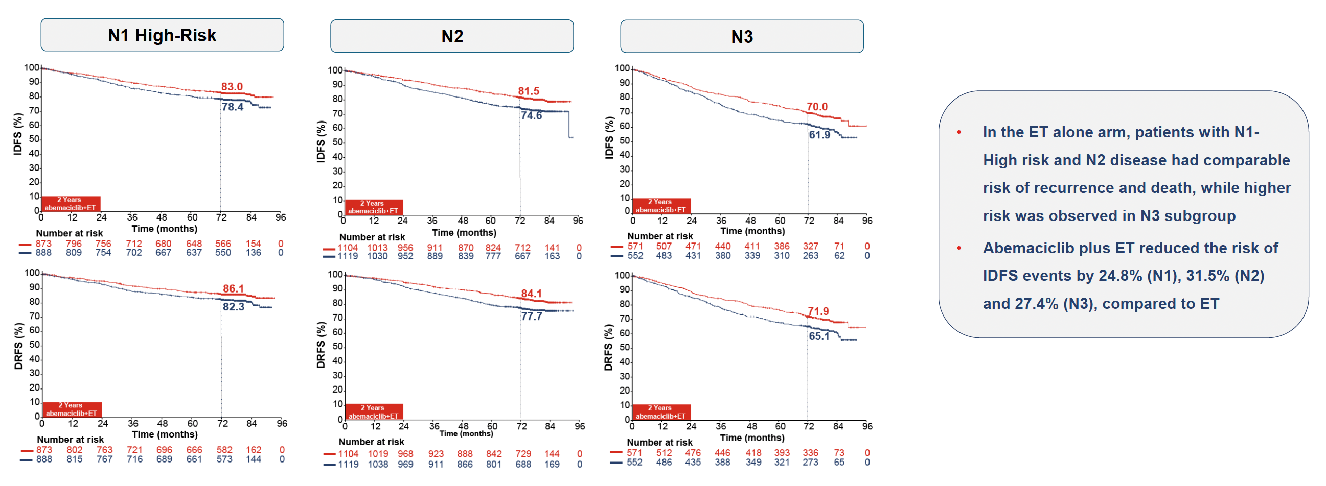
monarchE: IDFS and DRFS by Nodal Status
DRFS = distant relapse-free survival
Cortés J et al. San Antonio Breast Cancer Symposium 2025;Abstract PS1-08-08.

Slide 54
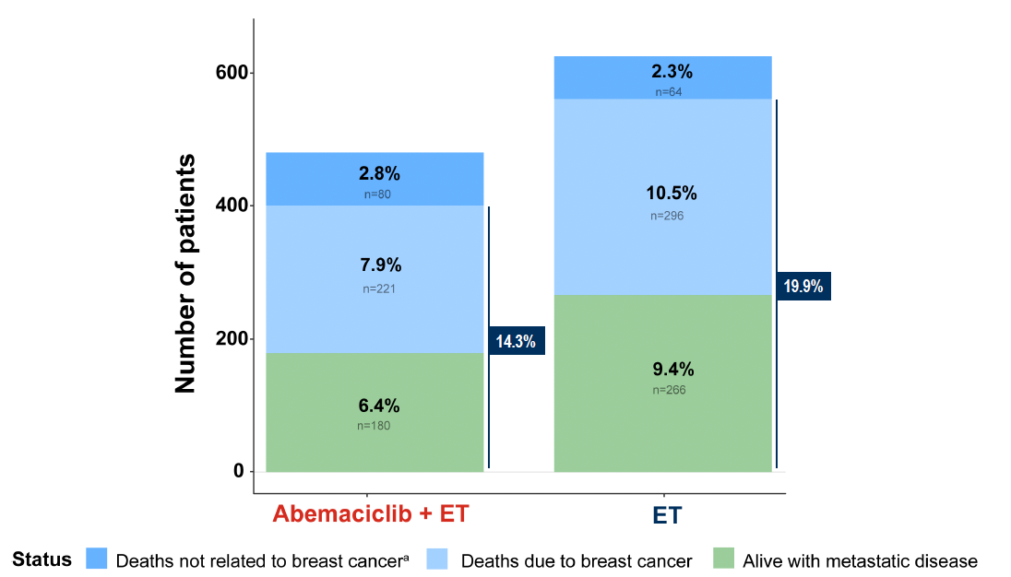
monarchE: Survival Status
Johnston S et al. ESMO 2025;Abstract LBA13. Johnston S et al. Ann Oncol 2026;37(2):155-65.

Slide 55
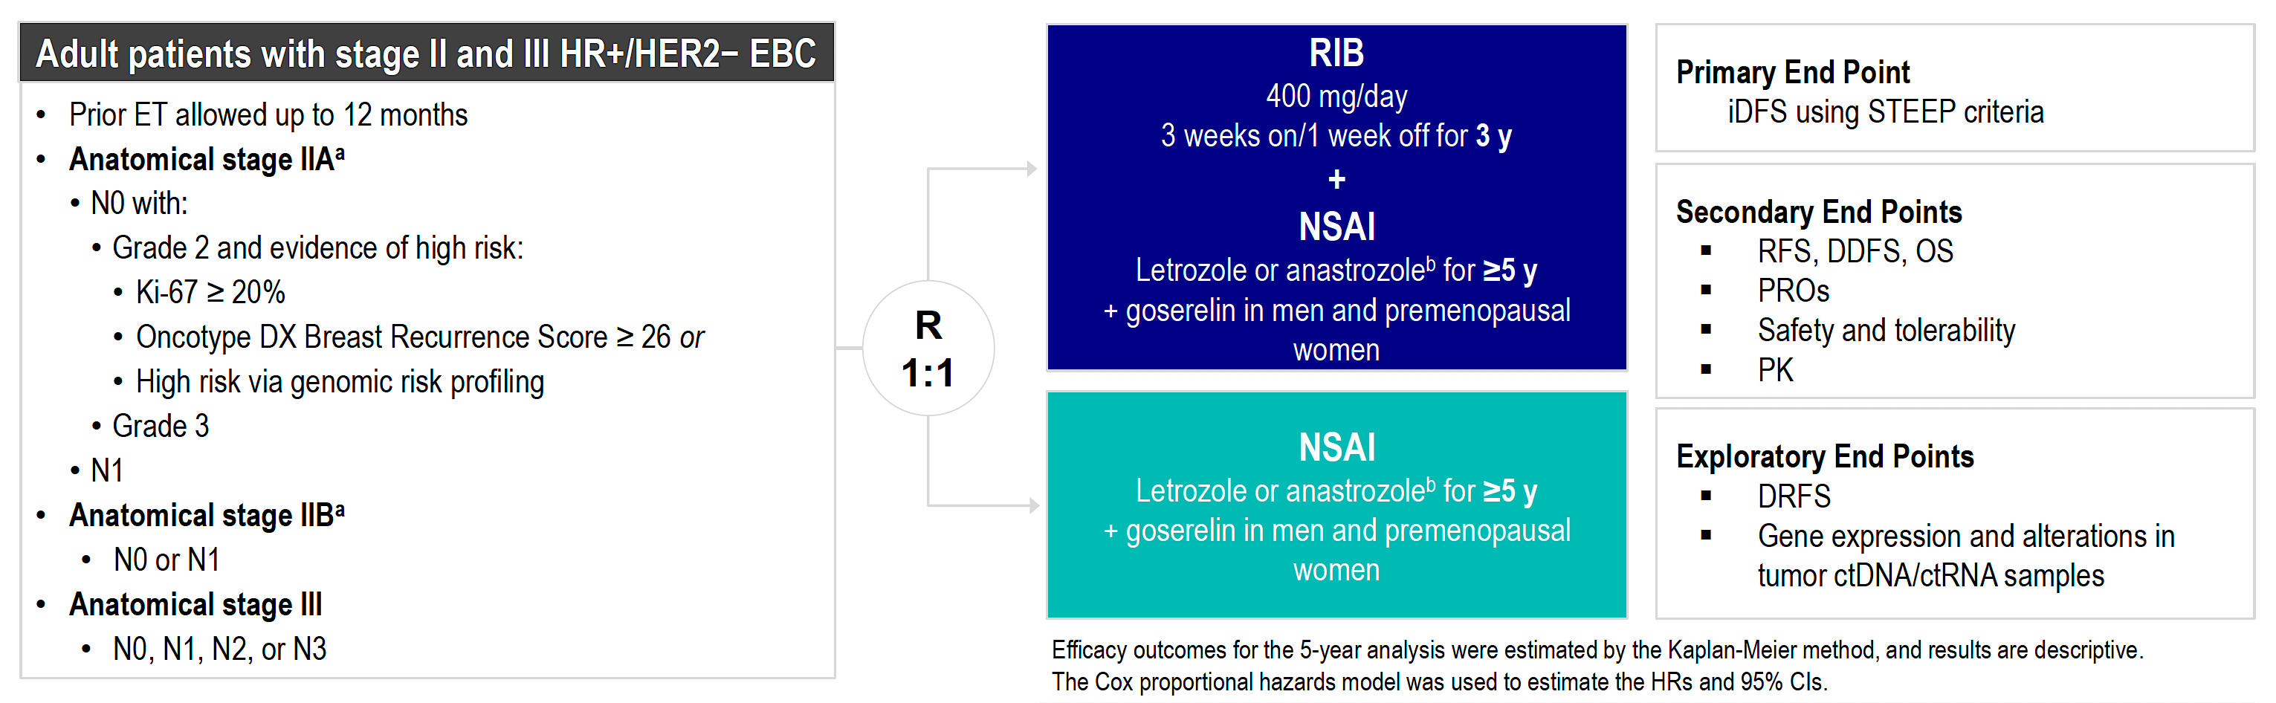
NATALEE Study Design
RIB = ribociclib; NSAI = nonsteroidal aromatase inhibitor
Crown JP et al. ESMO 2025;Abstract LBA14.

Slide 56
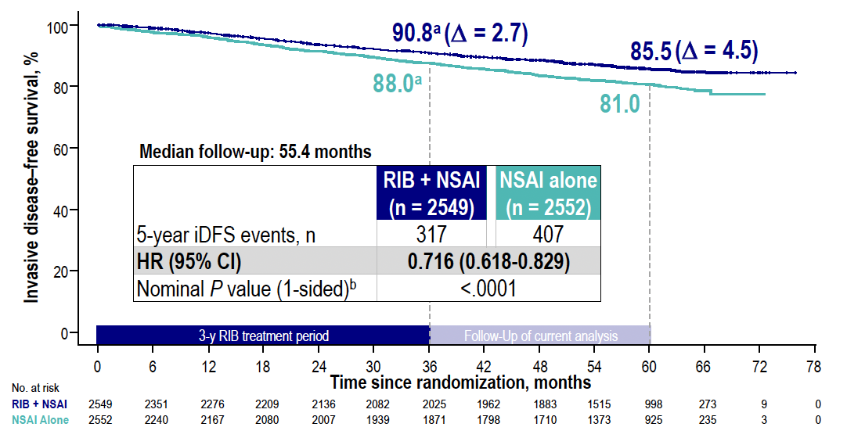
NATALEE: IDFS Outcomes
RIB = ribociclib; NSAI = nonsteroidal aromatase inhibitor
Crown JP et al. ESMO 2025;Abstract LBA14.

Slide 57
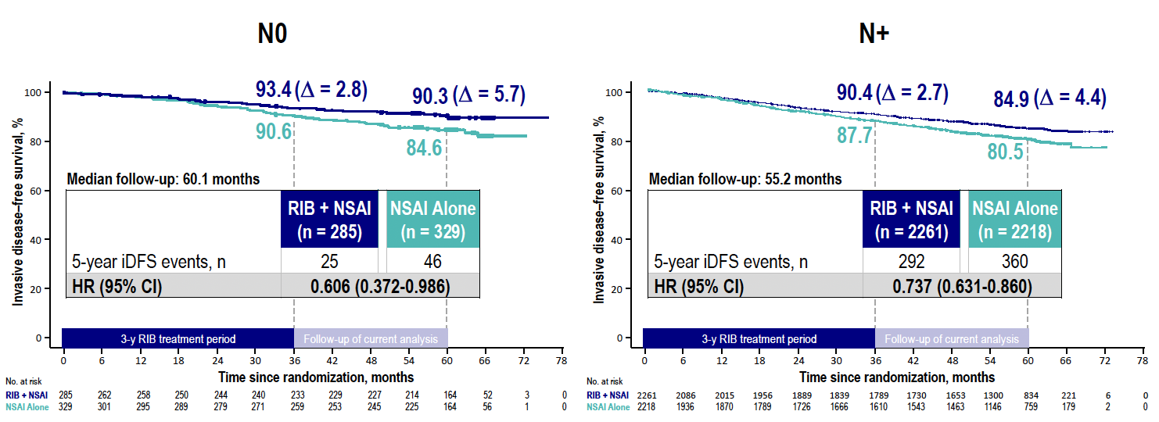
NATALEE: IDFS by Nodal Status
Crown JP et al. ESMO 2025;Abstract LBA14.

Slide 58
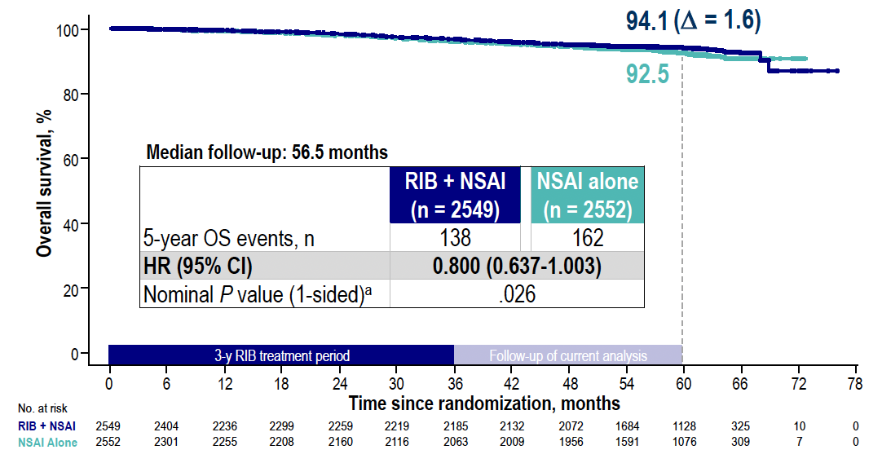
NATALEE: OS Outcomes
Crown JP et al. ESMO 2025;Abstract LBA14.

Slide 59
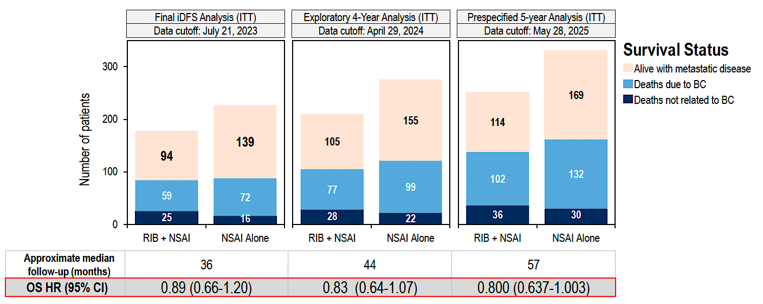
NATALEE: Survival Status over Time
Crown JP et al. ESMO 2025;Abstract LBA14.

Slide 60

NATALEE: Ribociclib Treatment Benefit Is Observed Across PAM50-Based Intrinsic Subtypes
Chia SKL et al. ASCO 2026;Abstract 501.

Slide 61

NATALEE: Higher Genomic Risk Signature and Proliferation Signature Scores Are Associated with Increased Ribociclib Benefit
Chia SKL et al. ASCO 2026;Abstract 501.

Slide 62

NATALEE: Differential Gene Expression Affects Ribociclib Benefit
Chia SKL et al. ASCO 2026;Abstract 501.

Slide 63
Management of Hormone Receptor (HR)-Positive Localized Breast Cancer
Module 1: Risk Assessment and Genomic Assays for HR-Positive, HER2-Negative Localized Breast Cancer
Module 2: Clinician Survey Results
Module 3: Adjuvant CDK4/6 Inhibitors for High-Risk, HR-Positive, HER2-Negative Localized Breast Cancer
Module 4: Clinician Survey Results
Module 5: Tolerability and Other Practical Considerations with Adjuvant CDK4/6 Inhibitor Therapy
Module 6: Clinician Survey Results
Module 7: Adjuvant Oral SERDs for HR-Positive, HER2-Negative Localized
Breast Cancer

Slide 64
Regulatory and reimbursement issues aside, would you generally recommend an adjuvant CDK4/6 inhibitor in addition to adjuvant endocrine therapy to a patient with 5.5-cm, Grade 2, HR-positive, HER2-negative localized BC and the following nodal status?
Node-negative
2 positive nodes
4 positive nodes
Yes, ribociclib
Yes, abemaciclib
Yes, abemaciclib
Yes, ribociclib
Yes, either
Yes, abemaciclib
Yes, ribociclib
Yes, abemaciclib
Yes, abemaciclib
Yes, ribociclib
Yes, either
Yes, either
Yes, ribociclib
Yes, either
Yes, either
Yes, ribociclib
Yes, either
Yes, abemaciclib
Yes, ribociclib
Yes, either
Yes, either
Yes, ribociclib
Yes, ribociclib
Yes, either

Slide 65
Regulatory and reimbursement issues aside, would you generally recommend an adjuvant CDK4/6 inhibitor in addition to adjuvant endocrine therapy to a patient with 2.5-cm Grade 2, HR-positive, HER2-negative localized BC and the following nodal status?
Node-negative
2 positive nodes
4 positive nodes
No
No
Yes, abemaciclib
No
Yes, either
Yes, abemaciclib
Yes, ribociclib
Yes, abemaciclib
Yes, abemaciclib
No
Yes, ribociclib
Yes, either
No
Yes, either
Yes, either
Yes, ribociclib
Yes, either
Yes, abemaciclib
No
Yes, either
Yes, either
Yes, ribociclib
Yes, ribociclib
Yes, either

Slide 66
Management of Hormone Receptor (HR)-Positive Localized Breast Cancer
Module 1: Risk Assessment and Genomic Assays for HR-Positive, HER2-Negative Localized Breast Cancer
Module 2: Clinician Survey Results
Module 3: Adjuvant CDK4/6 Inhibitors for High-Risk, HR-Positive, HER2-Negative Localized Breast Cancer
Module 4: Clinician Survey Results
Module 5: Tolerability and Other Practical Considerations with Adjuvant CDK4/6 Inhibitor Therapy
Module 6: Clinician Survey Results
Module 7: Adjuvant Oral SERDs for HR-Positive, HER2-Negative Localized
Breast Cancer

Slide 67
Key Datasets
Rugo HS et al. Adjuvant abemaciclib combined with endocrine therapy for high-risk early breast cancer: Safety and patient-reported outcomes from the monarchE study. Ann Oncol 2022;33(6):616-27.
Barrios C et al. NATALEE update: Safety and treatment (tx) duration of ribociclib (RIB) + nonsteroidal aromatase inhibitor (NSAI) in patients (pts) with HR+/HER2− early breast cancer (EBC). ESMO Breast 2024;Abstract 113MO.
Mayer EL et al. TRADE: A phase II trial to assess the tolerability of abemaciclib dose escalation in early-stage HR-positive/HER2-negative breast cancer. Ann Oncol 2025;31(1):117-24.

Slide 68

monarchE: Overall Safety Profile
Rugo HS et al. Ann Oncol 2022;33(6):616-27.

Slide 69

monarchE: Serious and Fatal Adverse Events (AEs) in Long-Term Follow-Up
to AEs
SAE = serious adverse event; LTFU = long-term follow-up; SOC = standard of care
Johnston S et al. ESMO 2025;Abstract LBA13. Johnston S et al. Ann Oncol 2026;37(2):155-65.

Slide 70

monarchE: AEs Leading to Discontinuation
Rugo HS et al. Ann Oncol 2022;33(6):616-27.
VTE = venous thromboembolism; ILD = interstitial lung disease

Slide 71

monarchE: AEs Leading to Dose Modifications
Rugo HS et al. Ann Oncol 2022;33(6):616-27.

Slide 72

NATALEE: Overall Safety Profile
ALT = alanine aminostransferase; AST = aspartate aminotransferase
Barrios C et al. ESMO Breast 2024;Abstract 113MO.

Slide 73

NATALEE: AEs of Special Interest (AESIs)
Barrios C et al. ESMO Breast 2024;Abstract 113MO.

Slide 74

NATALEE: AE-Related Dose Reduction and Discontinuation
RDI = relative dose intensity
Barrios C et al. ESMO Breast 2024;Abstract 113MO.

Slide 75
AEs and Dosing Must Be Considered: Distinct AE Profiles and Dosing Schedules of CDK4/6 Inhibitors for Localized Breast Cancer
Abemaciclib
Adverse Events Neutropenia (41%-46%) Diarrhea (81%-86%) Increased ALT (13%-16%) Increased AST (12%-15%) Thromboembolic events (5%) Schedule Continuous daily dosing Dosing Starting dose in EBC: 150 mg BID 1st dose reduction: 100 mg BID 2nd dose reduction: 50 mg BID
Ribociclib
Adverse Events Neutropenia (69%-78%) Diarrhea (29%-35%) Increased ALT (15%-46%) Increased AST (13%-44%) QTc prolongation (6%) Schedule 3 wk on/1 wk off Dosing Starting dose in EBC: 400 mg/day 1 (and only) dose reduction option available in EBC: 200 mg/day
Breast Cancer Status | CDK4/6i | Trial(s) | Discontinuation Rate Due to AE
HR+/HER2– EBC | Abemaciclib | monarchE^{1,a} | 19%
 | Ribociclib | NATALEE^{2,3} | 19%
1. Rugo HS, et al. Ann Oncol. 2022;33(6):616-627. 2. Slamon D, et al. N Engl J Med. 2024 Mar 21;390(12):1080-1091. 3. Hortobagyi GN, et al. SABCS 2023. Abstract GS03-03.
Content courtesy of Komal Jhaveri, MD, FACP, FASCO
EBC = early breast cancer

Slide 76




TRADE: Abemaciclib Dose Escalation
Primary endpoint: composite AE rate (discontinuation of adjuvant abemaciclib for any reason and/or need to dose reduce by 12 weeks of therapy)
Courtesy of Komal Jhaveri, MD, FACP, FASCO
Mayer EL et al. Ann Oncol 2025

Slide 77

NATALEE: IDFS by Dose Reductions
Barrios C et al. ESMO Breast 2024;Abstract 113MO.

Slide 78
Management of Hormone Receptor (HR)-Positive Localized Breast Cancer
Module 1: Risk Assessment and Genomic Assays for HR-Positive, HER2-Negative Localized Breast Cancer
Module 2: Clinician Survey Results
Module 3: Adjuvant CDK4/6 Inhibitors for High-Risk, HR-Positive, HER2-Negative Localized Breast Cancer
Module 4: Clinician Survey Results
Module 5: Tolerability and Other Practical Considerations with Adjuvant CDK4/6 Inhibitor Therapy
Module 6: Clinician Survey Results
Module 7: Adjuvant Oral SERDs for HR-Positive, HER2-Negative Localized
Breast Cancer

Slide 79
Have you employed or would you employ an initial dose-escalation strategy rather than initiating therapy at the recommended starting dose for any of your patients with HR-positive localized BC receiving an adjuvant CDK4/6 inhibitor?
I have not but would for the right patient
I have
I have
I have
I have
I have
I have
I have

Slide 80
Assuming eligibility to receive abemaciclib or ribociclib, which CDK4/6 inhibitor would you prefer in the adjuvant setting for a patient with HR-positive localized BC and a history of …?
Colitis
Chronic liver disease
Chronic renal disease
Ribociclib
Abemaciclib
Ribociclib
Ribociclib
Abemaciclib
No preference
Ribociclib
Abemaciclib
No preference
Ribociclib
Abemaciclib
No preference
Ribociclib
Abemaciclib
Ribociclib
Ribociclib
Abemaciclib
No preference
Ribociclib
Abemaciclib
Ribociclib
Ribociclib
Abemaciclib
No preference

Slide 81
Assuming eligibility to receive abemaciclib or ribociclib, which CDK4/6 inhibitor would you prefer in the adjuvant setting for a patient with HR-positive localized BC and a history of …?
COPD
NYHA Class I congestive
heart failure
No preference
Abemaciclib
No preference
Abemaciclib
No preference
Abemaciclib
No preference
Abemaciclib
Ribociclib
Abemaciclib
No preference
Abemaciclib
No preference
No preference
No preference
No preference
COPD = chronic obstructive pulmonary disease

Slide 82
Management of Hormone Receptor (HR)-Positive Localized Breast Cancer
Module 1: Risk Assessment and Genomic Assays for HR-Positive, HER2-Negative Localized Breast Cancer
Module 2: Clinician Survey Results
Module 3: Adjuvant CDK4/6 Inhibitors for High-Risk, HR-Positive, HER2-Negative Localized Breast Cancer
Module 4: Clinician Survey Results
Module 5: Tolerability and Other Practical Considerations with Adjuvant CDK4/6 Inhibitor Therapy
Module 6: Clinician Survey Results
Module 7: Adjuvant Oral SERDs for HR-Positive, HER2-Negative Localized
Breast Cancer

Slide 83
Key Datasets
Bardia A et al. Giredestrant vs standard-of-care endocrine therapy as adjuvant treatment for patients with estrogen receptor-positive, HER2-negative early breast cancer: Results from the global phase III lidERA Breast Cancer trial. San Antonio Breast Cancer Symposium 2025;Abstract GS1-10.

Slide 84

Abstract GS1-10

Slide 85

lidERA Breast Cancer Study Design
DRFI = distant recurrence-free interval; LRRFI = locoregional recurrence-free interval
Bardia A et al. San Antonio Breast Cancer Symposium 2025;Abstract GS1-10.

Slide 86

lidERA Breast Cancer: Patient Demographics
Bardia A et al. San Antonio Breast Cancer Symposium 2025;Abstract GS1-10.

Slide 87

lidERA Breast Cancer: IDFS Outcomes
Bardia A et al. San Antonio Breast Cancer Symposium 2025;Abstract GS1-10.

Slide 88

lidERA Breast Cancer: IDFS in Key Subgroups
Bardia A et al. San Antonio Breast Cancer Symposium 2025;Abstract GS1-10.

Slide 89

lidERA Breast Cancer: OS Outcomes
Bardia A et al. San Antonio Breast Cancer Symposium 2025;Abstract GS1-10.

Slide 90

lidERA Breast Cancer: Safety Profile
Bardia A et al. San Antonio Breast Cancer Symposium 2025;Abstract GS1-10.

Slide 91
Based on recently presented findings from the Phase III lidERA trial, would you like to have access to adjuvant giredestrant today for your patients with HR-positive, HER2-negative localized BC?
Yes, for patients with higher-risk disease
Yes, for those who can’t tolerate a CDK4/6i or unable to tolerate an AI or in place of tamoxifen for a premenopausal patient with high-risk disease
Yes, for patients with higher-risk disease after CDK4/6i or if cannot
tolerate standard ET
Yes, for patients with high-risk disease
Yes, for patients who are receiving AI monotherapy
Yes, for high-risk disease as defined in the trial
Yes, for patients that match eligibility of the lidERA trial
Yes, for patients with node-negative disease and
those with difficulty tolerating AI, after use of CDK 4/6i
ET = endocrine therapy; CDK4/6i = CDK4/6 inhibitor

Slide 92
If giredestrant were available, regulatory and reimbursement issues aside, what would you generally recommend for patients who met the criteria for both an adjuvant CDK4/6 inhibitor and adjuvant giredestrant?
CDK4/6i with standard adjuvant ET for the initial 2 to 3 years of tx,
then switch to giredestrant after discontinuation of the CDK4/6i
CDK4/6i with standard adjuvant ET for the initial 2 to 3 years of tx,
then switch to giredestrant after discontinuation of the CDK4/6i
CDK4/6i with standard adjuvant ET for the initial 2 to 3 years of tx,
then switch to giredestrant after discontinuation of the CDK4/6i
CDK4/6i with standard adjuvant ET for the initial 2 to 3 years of tx,
then switch to giredestrant after discontinuation of the CDK4/6i
CDK4/6i with standard adjuvant ET for the initial 2 to 3 years of tx,
then switch to giredestrant after discontinuation of the CDK4/6i
CDK4/6i with standard adjuvant ET for the initial 2 to 3 years of tx,
then switch to giredestrant after discontinuation of the CDK4/6i
CDK4/6i with standard adjuvant ET for the initial 2 to 3 years of tx,
then switch to giredestrant after discontinuation of the CDK4/6i
CDK4/6i with standard adjuvant ET for the initial 2 to 3 years of tx,
then switch to giredestrant after discontinuation of the CDK4/6i
ET = endocrine therapy; CDK4/6i = CDK4/6 inhibitor

Slide 93
Questions?

Slide 94
Agenda
Hormone Receptor (HR)-Positive Localized Breast Cancer —
Dr Stringer-Reasor
Diffuse Large B-Cell Lymphoma (DLBCL) — Prof Salles

Slide 95
Optimizing the Use of Novel Therapies for
Patients with Diffuse Large B-Cell Lymphoma
Gilles Salles, MD, PhD
Service Chief, Lymphoma Service
Steven Greenberg Chair
Memorial Sloan Kettering Cancer Center
Weill Cornell Medical College
New York, New York

Slide 96
Disclosures
Advisory Committees | AbbVie Inc, BeOne, Bristol Myers Squibb, Foresight Diagnostics, a wholly-owned subsidiary of Natera Inc, Genentech, a member of the Roche Group, Genmab US Inc, Incyte Corporation, Ipsen Biopharmaceuticals Inc, Janssen Biotech Inc, Kite, A Gilead Company, Lilly, Merck, Novartis, Nurix Therapeutics Inc, Pfizer Inc, SERB Pharmaceuticals
Consulting Agreements | AbbVie Inc, Canopy Life Sciences, Daiichi Sankyo Inc, Ellipses Pharma, Genentech, a member of the Roche Group, Genmab US Inc, Incyte Corporation, Kite, A Gilead Company, ModeX Therapeutics, Treeline Biosciences
Contracted Research | AbbVie Inc, Genentech, a member of the Roche Group, Genmab US Inc, Ipsen Biopharmaceuticals Inc, Janssen Biotech Inc

Slide 97






Program Steering Committee
Jeremy S Abramson, MD, MMSc
Director, Center for Lymphoma
Massachusetts General Hospital
Professor of Medicine
Harvard Medical School
Boston, Massachusetts
Manali Kamdar, MD, MBBS
Professor
Clinical Director of Lymphoma Services
Morton and Sandra Saffer Endowed Chair in Hematology Research
Division of Hematology, Hematologic Malignancies
University of Colorado Cancer Center
Aurora, Colorado
Christopher Flowers, MD, MS, FASCO
Division Head, Division of Cancer Medicine
Chair, Professor, Department of Lymphoma/Myeloma
John Brooks Williams and Elizabeth Williams Distinguished
University Chair in Cancer Medicine
The University of Texas
MD Anderson Cancer Center
Houston, Texas
Ann LaCasce, MD, MMSc
Associate Professor, Hematology and Medical Oncology
Program Director, Dana-Farber/MGB Fellowship
in Hematology/Oncology
Dana-Farber Cancer Institute
Harvard Medical School
Boston, Massachusetts
Matthew Lunning, DO
Professor
Chief of Hematology, Interim
Medical Director, Gene and Cellular Therapy
Assistant Vice Chancellor for Clinical Research
Fred and Pamela Buffett Cancer Center
University of Nebraska Medical Center
Omaha, Nebraska
Brad S Kahl, MD
Professor of Medicine
Washington University School of Medicine
Director, Lymphoma Program
Siteman Cancer Center
St Louis, Missouri

Slide 98




Program Steering Committee
Matthew Matasar, MD
Chief, Division of Blood Disorders
Rutgers Cancer Institute
Hematologist/Oncologist
Professor
Rutgers Robert Wood Johnson Medical School
New Brunswick, New Jersey
Jason Westin, MD, MS, FACP, FASCO
Director, Lymphoma Clinical Research
Lead, Lymphoma and Myeloma Service Line
Professor, Department of Lymphoma
and Myeloma
The University of Texas
MD Anderson Cancer Center
Houston, Texas
Tycel Phillips, MD, FASCO
Associate Professor, Division of Lymphoma
Department of Hematology and Hematopoietic Cell Transplantation
City of Hope Comprehensive Cancer Center
Duarte, California
PROJECT CHAIR
Neil Love, MD
Research To Practice
Miami, Florida
Gilles Salles, MD, PhD
Service Chief, Lymphoma Service
Steven Greenberg Chair
Memorial Sloan Kettering Cancer Center
Weill Cornell Medical College
New York, New York

Slide 99
Optimizing the Use of Novel Therapies for Patients with DLBCL
Module 1: Selection of First-Line Therapy for Patients with Diffuse Large B-Cell Lymphoma (DLBCL)
Module 2: Clinician Survey Results
Module 3: Current and Future Roles of Monoclonal and Bispecific Antibodies in Therapy for Relapsed/Refractory (R/R) DLBCL
Module 4: Clinician Survey Results
Module 5: Evidence-Based Incorporation of Antibody-Drug Conjugates into the Management of R/R DLBCL
Module 6: Clinician Survey Results

Slide 100
Optimizing the Use of Novel Therapies for Patients with DLBCL
Module 1: Selection of First-Line Therapy for Patients with Diffuse Large B-Cell Lymphoma (DLBCL)
Module 2: Clinician Survey Results
Module 3: Current and Future Roles of Monoclonal and Bispecific Antibodies in Therapy for Relapsed/Refractory (R/R) DLBCL
Module 4: Clinician Survey Results
Module 5: Evidence-Based Incorporation of Antibody-Drug Conjugates into the Management of R/R DLBCL
Module 6: Clinician Survey Results

Slide 101
Key Datasets
Morschhauser F et al. Five-year outcomes of the POLARIX study comparing Pola-R-CHP and RCHOP in patients with diffuse large B-cell lymphoma. J Clin Oncol 2025 December 10;43(35):3698-705.
Trněný M et al. Analysis of peripheral neuropathy in the POLARIX study using clinician- and patient-reported outcomes. Blood Adv 2025 July 8;9(13):3263-7.
Lenz G et al. frontMIND: Phase 3 study of tafasitamab (Tafa) plus lenalidomide (Len) and R-CHOP for patients (pts) with newly diagnosed diffuse large B-cell lymphoma (DLBCL). ASCO 2026;Abstract LBA700.
Sehn LH et al. ESCALADE: A phase 3 study of acalabrutinib in combination with rituximab, cyclophosphamide, doxorubicin, vincristine, and prednisone (R-CHOP) for patients ≤65y with untreated non-germinal center B-cell–like (non-GCB) diffuse large B-cell lymphoma (DLBCL). ASCO 2021;Abstract TPS7572.

Slide 102


Phase III POLARIX Study Design
Primary endpoint:
Investigator-assessed PFS
Secondary endpoints:
Investigator-assessed EFS, ORR, OS
POLA
LBCL = large B-cell lymphoma; PFS = progression-free survival; EFS = event-free survival; ORR = overall response rate; OS = overall survival
[from the manufacturer’s website]

Slide 103

Phase III POLARIX: 5-Year PFS (Global Population)
Morschhauser F et al. J Clin Oncol 2025 December 10;43(35):3698-705.

Slide 104

Phase III POLARIX: 5-Year OS (Global Population)
Morschhauser F et al. J Clin Oncol 2025 December 10;43(35):3698-705.

Slide 105

Phase III POLARIX: Adverse Events of Interest
Morschhauser F et al. J Clin Oncol 2025 December 10;43(35):3698-705.

Slide 106

Phase III POLARIX: Peripheral Neuropathy
Trněný M et al. Blood Adv 2025 March 17;9(13):3263-7.

Slide 107

Rationale for Tafasitamab and Lenalidomide Combination Therapy
Vitolo U et al. ASCO 2022;Abstract TPS7590.

Slide 108


Lancet 2026 May 30;[Online ahead of print].

Slide 109

Phase III frontMIND Study Design
Lenz G et al. ASCO 2026;Abstract LBA7000; Lenz G et al. Lancet. 2026 Jun 20;407(10547):2528-2541.

Slide 110

frontMIND Primary Endpoint: Investigator-Assessed
Progression-Free Survival
In key prespecified subgroup analyses, point estimates suggested trends toward PFS advantage with Tafa-Len-R-CHOP
Lenz G et al. ASCO 2026;Abstract LBA7000; Lenz G et al. Lancet 2026 June 20;407(10547):2528-41.

Slide 111

frontMIND Key Secondary Endpoint: Investigator-Assessed
Event-Free Survival
Lenz G et al. ASCO 2026;Abstract LBA7000; Lenz G et al. Lancet 2026 June 20;407(10547):2528-41.

Slide 112

frontMIND: Most Frequent Treatment-Emergent Adverse Events
Safety events with Tafa-Len-R-CHOP were manageable and did not affect the delivery of the
R-CHOP backbone
Lenz G et al. ASCO 2026;Abstract LBA7000; Lenz G et al. Lancet 2026 June 20;407(10547):2528-41.

Slide 113
Studies Supporting the ESCALADE Study
ACCEPT — Davies et al. ASH 2020
  “There is a strong rationale for combining A with R-CHOP in pts with untreated DLBCL, and safety of A + R-CHOP has been shown in a phase 1b/2 study”
PHOENIX — Younes et al. J Clin Oncol 2019;37:1285-9.
  “In untreated non-GCB DLBCL pts, [PHOENIX] showed that addition of the BTKi ibrutinib to R-CHOP (R-CHOP-I) did not improve outcomes in the intent-to-treat population. However, pts age <60y treated with R-CHOP-I had significantly improved progression-free survival (PFS) and overall survival (OS) compared with those receiving R-CHOP alone.”
Sehn LH et al. ASCO 2021;Abstract TPS7572.

Slide 114
Phase III ESCALADE (ACE-LY-312) Study Design
n=661
Patients with newly diagnosed non-GCB DLBCL
Acalabrutinib (100mg BD) + R-CHOP
R-CHOP (cycle 1)
[all pts]
1:1
Placebo + R-CHOP
*All patients will receive primary prophylaxis with
G-CSF accompanying all R-CHOP cycles.
Primary endpoint:
PFS
Secondary endpoints:
EFS, CR rate, OS, pharmacokinetics, safety
GCB = germinal center B-cell-like; CR = complete response; G-CSF = granulocyte-colony stimulating factor
Sehn LH et al. ASCO 2021;Abstract TPS7572.

Slide 115
Optimizing the Use of Novel Therapies for Patients with DLBCL
Module 1: Selection of First-Line Therapy for Patients with Diffuse Large B-Cell Lymphoma (DLBCL)
Module 2: Clinician Survey Results
Module 3: Current and Future Roles of Monoclonal and Bispecific Antibodies in Therapy for Relapsed/Refractory (R/R) DLBCL
Module 4: Clinician Survey Results
Module 5: Evidence-Based Incorporation of Antibody-Drug Conjugates into the Management of R/R DLBCL
Module 6: Clinician Survey Results

Slide 116
Which first-line therapy would you generally recommend for an otherwise healthy patient with Stage IV germinal center B-cell (GCB)-type diffuse large B-cell lymphoma (DLBCL) with an International Prognostic Index (IPI) score of 3?
65-year-old
80-year-old
R-CHP + polatuzumab vedotin
Dose-reduced R-CHP +
polatuzumab vedotin
R-CHP + polatuzumab vedotin
R-CHP + polatuzumab vedotin
R-CHP + polatuzumab vedotin
R-mini-CHOP
R-CHP + polatuzumab vedotin
R-mini-CHP + polatuzumab vedotin
R-CHP + polatuzumab vedotin
R-mini-CHP + polatuzumab vedotin
R-CHP + polatuzumab vedotin
R-mini-CHP + polatuzumab vedotin
R-CHP + polatuzumab vedotin
R-mini-CHP + polatuzumab vedotin
R-CHOP
R-mini-CHOP
R-CHP = rituximab/cyclophosphamide/doxorubicin/prednisone; R-mini-CHOP = rituximab/cyclophosphamide/doxorubicin/vincristine/prednisone (attenuated)

Slide 117
Which first-line therapy would you generally recommend for an otherwise healthy patient with Stage IV activated B-cell (ABC)-type DLBCL with an IPI score of 3?
65-year-old
80-year-old
R-CHP + polatuzumab vedotin
Dose-reduced R-CHP + polatuzumab vedotin
R-CHP + polatuzumab vedotin
R-CHP + polatuzumab vedotin
R-CHP + polatuzumab vedotin
R-mini-CHP + polatuzumab vedotin
R-CHP + polatuzumab vedotin
R-mini-CHP + polatuzumab vedotin
R-CHP + polatuzumab vedotin
R-mini-CHP + polatuzumab vedotin
R-CHP + polatuzumab vedotin
R-mini-CHP + polatuzumab vedotin
R-CHP + polatuzumab vedotin
R-mini-CHP + polatuzumab vedotin
R-CHP + polatuzumab vedotin
R-mini-CHP + polatuzumab vedotin

Slide 118
A 75-year-old woman with a history of congestive heart failure and a LVEF of 45% presents with Stage IV DLBCL with an IPI of 3. Which initial therapy would you most likely recommend if she had the DLBCL molecular subtype below?
GCB-type
ABC-type, high-risk
R-CHOP + dexrazoxane
Pola-R-CHP + dexrazoxane
R-CHP + polatuzumab vedotin (dose adjustments PRN, cardiac monitoring)
R-CHP + polatuzumab vedotin (dose adjustments PRN, cardiac monitoring)
Dose-adjusted R-EPOCH
Pola-R-CHP + dexrazoxane
R-GCVP
Pola-R-CGP
R-GCVP
R-GCVP
Dose-adjusted R-EPOCH
R-CP + Pola + infusional doxorubicin
R-GCVP
R-mini-CGemP-Pola
R-CEOP
RCEP-Pola
R = rituximab; C = cyclophosphamide; E = etoposide; O = vincristine; P = prednisone; G = gemcitabine; V = vincristine; Pola = polatuzumab vedotin

Slide 119
Optimizing the Use of Novel Therapies for Patients with DLBCL
Module 1: Selection of First-Line Therapy for Patients with Diffuse Large B-Cell Lymphoma (DLBCL)
Module 2: Clinician Survey Results
Module 3: Current and Future Roles of Monoclonal and Bispecific Antibodies in Therapy for Relapsed/Refractory (R/R) DLBCL
Module 4: Clinician Survey Results
Module 5: Evidence-Based Incorporation of Antibody-Drug Conjugates into the Management of R/R DLBCL
Module 6: Clinician Survey Results

Slide 120
Key Datasets
Duell J et al. Tafasitamab for patients with relapsed or refractory diffuse large B-cell lymphoma: Final 5-year efficacy and safety findings in the phase II L-MIND study. Haematologica 2024 February 1;109(2):553-66.
Arias DA et al. CD19 expression persists in diffuse large B-cell lymphoma patient biopsies after treatment with tafasitamab. EHA 2024;Abstract P1234.
Kim TM et al. Safety and efficacy of AZD0486, a CD19xCD3 T-cell engager, in relapsed or refractory diffuse large B-cell lymphoma. ASCO 2025;Abstract 7046.
Dickinson MJ et al. Glofitamab for relapsed or refractory diffuse large B-cell lymphoma. N Engl J Med 2022 December 15;387(24):2220-31.
Karimi YH et al. 3-year update from the Epcore NHL-1 trial: Epcoritamab leads to deep and durable responses in relapsed or refractory large B-cell lymphoma.. ASH 2024;Abstract 4480.
Fox CP et al. Results from EPCORE DLBCL-1: Randomized phase 3 study of epcoritamab vs investigator’s choice chemoimmunotherapy in patients with relapsed/refractory large B-cell lymphoma. EHA 2026;Abstract S235.
Abramson JS et al. Glofitamab plus gemcitabine and oxaliplatin (GemOx) versus rituximab-GemOx for relapsed or refractory diffuse large B-cell lymphoma (STARGLO): A global phase 3, randomised, open-label trial. Lancet 2024 November 16;404(10466):1940-54.

Slide 121

Phase II L-MIND Study Design
HDT = high-dose therapy; ASCT = autologous stem cell transplant; SD = stable disease; DoR = duration of response
Duell J et al. Haematologica 2024 February 1;109(2):553-66.

Slide 122

Phase II L-MIND: Efficacy Outcomes (Primary, 3-Year, 5-Year Analyses)
Duell J et al. Haematologica 2024 February 1;109(2):553-66.

Slide 123

Phase II L-MIND: Adverse Events of Special Interest
Duell J et al. Haematologica 2024 February 1;109(2):553-66.

Slide 124

Phase III firmMIND Study Design
Arias DA et al. EHA 2024;Abstract P1234.
Estimated completion (primary): 2026-04-01

Slide 125

AZD0486: A CD19 x CD3 Bispecific T-Cell Engager
Le Gouill S et al. ASCO 2025;Abstract TPS7083.

Slide 126

Phase I AZD0486 Study: Responses by Target Dose (≥7.2 mg)
Kim TM et al. ASCO 2025;Abstract 7046.

Slide 127


Phase I AZD0486 Study: Safety
AEs = adverse events; CRS = cytokine release syndrome; ICANS = immune effector cell-associated neurotoxicity syndrome
Kim TM et al. ASCO 2025;Abstract 7046.

Slide 128

Bispecifics for DLBCL
Brijs J et al. Belg J Hematol 2023;14(2):67-72.

Slide 129

Glofitamab for R/R DLBCL Study: Efficacy (IRC- and Investigator-Assessed)
Dickinson MJ et al. N Engl J Med 2022 December 15;387(24):2220-31.
IRC = independent review committee

Slide 130

Glofitamab for R/R DLBCL: Safety
Dickinson MJ et al. EHA 2022;Abstract S220.

Slide 131

Phase II EPCORE NHL-1 Study Design
PMBCL = primary mediastinal B-cell lymphoma; HGBCL = high-grade B-cell lymphoma; FL = follicular lymphoma; DOCR = duration of complete response; TTNT = time to next treatment; MRD = minimal residual disease; ctDNA = circulating tumor DNA
Karimi YH et al. ASH 2024;Abstract 4480.

Slide 132

Phase II EPCORE NHL-1: Responses
Karimi YH et al. ASH 2024;Abstract 4480.

Slide 133

Phase II EPCORE NHL-1: Overall Survival
Karimi YH et al. ASH 2024;Abstract 4480.

Slide 134

EPCORE DLBCL-1 Phase III Trial of Epcoritamab versus Investigator’s Choice Chemoimmunotherapy (CIT) for R/R LBCL
Fox CP et al. EHA 2026;Abstract S235.

Slide 135

EPCORE DLBCL-1: Efficacy Summary
Epcoritamab resulted in clinically meaningful improvement in CR, DOR and DOCR
OS was not significantly different; confounded by COVID-19 mortality and higher use of effective subsequent treatments in the CIT arm
Fox CP et al. EHA 2026;Abstract S235.

Slide 136

EPCORE DLBCL-1: Most Common Treatment-Emergent Adverse Events
Fox CP et al. EHA 2026;Abstract S235.

Slide 137

Phase III STARGLO Study Design
Primary endpoint:
Overall survival
Secondary endpoints:
Progression-free survival, ORR, DoR
Abramson JS et al. Lancet 2024 November 16;404(10466):1940-54.

Slide 138


Phase III STARGLO 3-Year Follow-Up: Overall Survival
(OS; Primary Endpoint)
Abramson JS et al. Blood Adv 2026 August 11;10(15):5367-77.

Slide 139


Phase III STARGLO 3-Year Follow-up: Progression-Free Survival (PFS)
Abramson JS et al. Blood Adv 2026 August 11;10(15):5367-77.

Slide 140


Phase III STARGLO: Responses
Abramson JS et al. Lancet 2024 November 16;404(10466):1940-54.

Slide 141

Phase III STARGLO: Safety
Abramson JS et al. Lancet 2024 November 16;404(10466):1940-54.

Slide 142
Optimizing the Use of Novel Therapies for Patients with DLBCL
Module 1: Selection of First-Line Therapy for Patients with Diffuse Large B-Cell Lymphoma (DLBCL)
Module 2: Clinician Survey Results
Module 3: Current and Future Roles of Monoclonal and Bispecific Antibodies in Therapy for Relapsed/Refractory (R/R) DLBCL
Module 4: Clinician Survey Results
Module 5: Evidence-Based Incorporation of Antibody-Drug Conjugates into the Management of R/R DLBCL
Module 6: Clinician Survey Results

Slide 143
Regulatory and reimbursement issues aside, which second-line therapy would you generally recommend for an older (85-year-old) patient with DLBCL who experienced disease relapse 18 months after first-line R-CHOP and who was …
CAR T eligible but
transplant ineligible
Transplant and CAR T ineligible
CAR T-cell therapy
Mosunetuzumab/polatuzumab vedotin
Mosunetuzumab/polatuzumab vedotin
Mosunetuzumab/polatuzumab vedotin
CAR T-cell therapy
Tafasitamab/lenalidomide or glofitamab/GemOx
CAR T-cell therapy
Mosunetuzumab/polatuzumab vedotin
CAR T-cell therapy
Glofitamab/GemOx
Mosunetuzumab/polatuzumab vedotin
Mosunetuzumab/polatuzumab vedotin
Glofitamab/GemOx
Glofitamab/GemOx
CAR T-cell therapy
Tafasitamab/lenalidomide or mosunetuzumab/polatuzumab vedotin
GemOx = gemcitabine/oxaliplatin

Slide 144
Regulatory and reimbursement issues aside, which third-line therapy would you generally recommend for a 65-year-old patient with DLBCL who received first-line R-CHOP and subsequently experienced disease progression on second-line CAR T-cell therapy?
Glofitamab/GemOx
Glofitamab
Glofitamab
Glofitamab
Polatuzumab vedotin/R-GemOx
Glofitamab/polatuzumab vedotin
Glofitamab/GemOx or polatuzumab vedotin/glofitamab
Glofitamab/GemOx or polatuzumab vedotin/glofitamab
R-GemOx = rituximab/gemcitabine/oxaliplatin

Slide 145
Regulatory and reimbursement issues aside, which third-line therapy would you generally recommend for a 65-year-old patient with DLBCL who received first-line polatuzumab vedotin/R-CHP and subsequently experienced disease progression on second-line CAR T-cell therapy?
Glofitamab/GemOx
Glofitamab
Glofitamab
Glofitamab
Loncastuximab tesirine
Glofitamab/GemOx
Glofitamab/GemOx
Glofitamab/GemOx

Slide 146
Regulatory and reimbursement issues aside, which third-line therapy would you generally recommend for an 85-year-old patient with DLBCL who received first-line R-mini-CHOP and subsequently experienced disease progression on second-line polatuzumab vedotin with bendamustine/rituximab (BR)?
Glofitamab
Epcoritamab
Glofitamab
Glofitamab
Glofitamab/GemOx
Glofitamab or epcoritamab
Glofitamab/GemOx
Glofitamab or epcoritamab

Slide 147
Assuming equal access, which bispecific antibody would you prefer to use when administering one of these agents as monotherapy for your patients with R/R DLBCL?
Glofitamab
No preference
Glofitamab
Glofitamab
Glofitamab
No preference
Glofitamab
Glofitamab

Slide 148
Based on the published literature and your clinical experience, would you like to have access to surovatamig for your patients with R/R DLBCL today?
Yes, for patients with CD20-negative disease
Yes, as part of second-line combinations prior to CAR T; third-line+ relapse
Yes, for CAR T-ineligible pts in the second-line setting
Yes, for patients who are ineligible for CD19 CAR T
No
Yes, after CAR T-cell therapy
Yes, for patients with PD on CD3 x CD20 combinations or monotherapy,
and for those with CD20-negative disease
Yes, for patients with CD20 loss and non-CAR T eligible

Slide 149
If surovatamig were granted regulatory approval, would you employ a CD20 x CD3 bispecific antibody and surovatamig in sequence for the same patient with R/R DLBCL?
Yes
Yes
Yes
Maybe
Yes
Yes
Yes
Yes

Slide 150
Optimizing the Use of Novel Therapies for Patients with DLBCL
Module 1: Selection of First-Line Therapy for Patients with Diffuse Large B-Cell Lymphoma (DLBCL)
Module 2: Clinician Survey Results
Module 3: Current and Future Roles of Monoclonal and Bispecific Antibodies in Therapy for Relapsed/Refractory (R/R) DLBCL
Module 4: Clinician Survey Results
Module 5: Evidence-Based Incorporation of Antibody-Drug Conjugates into the Management of R/R DLBCL
Module 6: Clinician Survey Results

Slide 151
Key Datasets
Sehn LH et al. Polatuzumab vedotin plus bendamustine and rituximab in relapsed/refractory diffuse large B-cell lymphoma (R/R DLBCL): Final results of a phase Ib/II randomized study and single-arm extension (ext) study. ASH 2022;Abstract 4260.
Matasar M et al. Polatuzumab vedotin, rituximab, gemcitabine and oxaliplatin (Pola-R-GemOx) for relapsed/refractory (R/R) diffuse large B-cell lymphoma (DLBCL): Results from the randomized phase III POLARGO trial. EHA 2025;Abstract S101.
Kim W et al. Mosunetuzumab plus polatuzumab vedotin (Mosun-Pola) versus rituximab, gemcitabine and oxaliplatin (R-GemOx) in patients with relapsed/refractory large B-cell lymphoma (R/R LBCL): Updated efficacy and safety from the phase 3 SUNMO study including in second-line (2L) versus third-line plus (3L+) patient subgroups. ASCO 2026;Abstract 7007.
Kim JA et al. Brentuximab vedotin in combination with lenalidomide and rituximab in patients with relapsed/refractory diffuse large B-cell lymphoma: Results from the phase 3 ECHELON-3 study. ASCO 2024;Abstract LBA7005.
Caimi PF et al. Loncastuximab tesirine in relapsed/refractory diffuse large B-cell lymphoma: Long-term efficacy and safety from the phase II LOTIS-2 study. Haematologica 2024 April 1;109(4):1184-93.
Carlo-Stella C et al. Updated safety run-in results from LOTIS-5: A phase 3, randomized trial of loncastuximab tesirine with rituximab versus immunochemotherapy in patients with R/R DLBCL/HGBL. EHA 2025;Abstract PS1957.
Alderuccio JP et al. Initial results from LOTIS-7: A phase 1b study of loncastuximab tesirine plus glofitamab in patients with relapsed/refractory (R/R) diffuse large B-cell lymphoma (DLBCL). ICML 2025;Abstract 078.

Slide 152

Phase Ib/II GO29365 Study Final Results: Efficacy
Sehn LH et al. ASH 2022;Abstract 4260.

Slide 153

Phase Ib/II GO29365 Final Results: Safety
Sehn LH et al. ASH 2022;Abstract 4260.

Slide 154

Phase III POLARGO Study Design
Matasar M et al. EHA 2025;Abstract S101.

Slide 155

Phase III POLARGO Overall Survival
Matasar M et al. EHA 2025;Abstract S101.

Slide 156

Phase III POLARGO: Progression-Free Survival
Matasar M et al. EHA 2025;Abstract S101.

Slide 157

Phase III POLARGO: Select AEs
Matasar M et al. EHA 2025;Abstract S101.

Slide 158

Phase III POLARGO: Peripheral Neuropathy
Matasar M et al. EHA 2025;Abstract S101.

Slide 159

Phase III SUNMO Study Design
Budde LE et al. EHA 2026;Abstract PF968.

Slide 160

Phase III SUNMO Primary Endpoint: PFS by IRC in the Intention-to-Treat Population (28.3-Month Follow-Up)
Efficacy and safety of mosun-pola were comparable across age groups
Budde LE et al. EHA 2026;Abstract PF968.

Slide 161

Phase III SUNMO: Overall Response Rate and Duration of Complete Response
Kim W et al. ASCO 2026;Abstract 7007.

Slide 162

Phase III SUNMO: Efficacy in the Second-Line Setting
ORR = objective response rate; CR = complete response;
DOR = duration of response; DOCR = duration of complete response
Budde LE et al. EHA 2026;Abstract PF968.

Slide 163


Phase III SUNMO: Efficacy in the Third-Line and Beyond Setting
Budde LE et al. EHA 2026;Abstract PF968.
ORR = objective response rate

Slide 164

Phase III ECHELON-3 Study Design
HSCT = hematopoietic stem cell transplantation; FDG = fluorodeoxyglucose; ITT = intent to treat; SCT = stem cell transplant
Kim JA et al. ASCO 2024;Abstract LBA7005.

Slide 165

Phase III ECHELON-3: Overall Survival (Primary Endpoint)
Kim JA et al. ASCO 2024;Abstract LBA7005.

Slide 166

Phase III ECHELON-3: PFS (Key Secondary Endpoint)
Kim JA et al. ASCO 2024;Abstract LBA7005.

Slide 167

Phase III ECHELON-3: Responses
Kim JA et al. ASCO 2024;Abstract LBA7005.

Slide 168

Phase III ECHELON-3: Safety
Kim JA et al. ASCO 2024;Abstract LBA7005.

Slide 169


Loncastuximab Tesirine: A CD19-Directed Antibody-Drug Conjugate
[Loncastuximab tesirine manufacturer prescribing information].

Slide 170

Phase II LOTIS-2 Study: Overall Response Rate (ORR) and Long-Term Responses — All-Treated Population
No new safety signals were identified during the long-term follow-up
Caimi PF et al. EHA 2023;Abstract P1132.

Slide 171

Phase II LOTIS-2: Progression-Free Survival
Caimi PF et al. Haematologica 2024 April 1;109(4):1184-93.

Slide 172

Phase II LOTIS-2: Overall Survival
Caimi PF et al. Haematologica 2024 April 1;109(4):1184-93.

Slide 173


Phase III LOTIS-5 Study Design
Carlo-Stella C et al. EHA 2025;Abstract PS1957.

Slide 174

Phase III LOTIS-5: Efficacy
Carlo-Stella C et al. EHA 2025;Abstract PS1957.

Slide 175

Phase III LOTIS-5: Safety
Carlo-Stella C et al. EHA 2025;Abstract PS1957.

Slide 176
Results from LOTIS-5 Phase III Confirmatory Clinical Trial of Loncastuximab Tesirine-lpyl in Combination with Rituximab for R/R DLBCL
Press Release: June 3, 2026
“[The manufacturer] today announced topline data from its Phase 3 LOTIS-5 confirmatory trial evaluating loncastuximab tesirine-lpyl in combination with rituximab in patients with relapsed or refractory diffuse large B-cell lymphoma (r/r DLBCL). Loncastuximab tesirine-lpyl plus rituximab achieved statistical significance on the trial's primary endpoint of progression-free survival (PFS) and demonstrated no detrimental effect on the key secondary efficacy endpoint of overall survival (OS). In addition, a higher complete response (CR) rate and duration of CRs (DoCR) were observed with loncastuximab tesirine-lpyl plus rituximab.
Overall, treatment emergent adverse event (TEAE) rates were similar between arms. Similar rates of overall Grade ≥3 TEAEs greater than 5% were observed across both arms, with hematologic TEAEs higher in the control arm and infection, hepatotoxicity, and edema/effusion higher in the test arm. Serious adverse events (SAEs), TEAEs leading to study drug withdrawal, and Grade 5 events were higher in the test arm, with the majority of Grade 5 TEAEs in the test arm occurring in patients aged 75 years or older.”
https://ir.adctherapeutics.com/2026-06-03-ADC-Therapeutics-Announces-Results-From-LOTIS-5-Phase-3-Confirmatory-Clinical-Trial-of-ZYNLONTA-R-in-Combination-with-Rituximab-in-Relapsed-or-Refractory-Diffuse-Large-B-Cell-Lymphoma

Slide 177

Phase Ib LOTIS-7 Study Design
Alderuccio JP et al. ICML 2025;Abstract 078.

Slide 178

Phase Ib LOTIS-7 Initial Results: Safety Outcomes
Alderuccio JP et al. ICML 2025;Abstract 078.

Slide 179

Phase Ib LOTIS-7 Initial Results: CRS and ICANS
Alderuccio JP et al. ICML 2025;Abstract 078.

Slide 180

Phase Ib LOTIS-7 Initial Results: Best Overall Responses, DoR
Alderuccio JP et al. ICML 2025;Abstract 078.

Slide 181

Phase Ib LOTIS-7 Initial Results: Efficacy over Time
Alderuccio JP et al. ICML 2025;Abstract 078.

Slide 182
Updated Data Announced from LOTIS-7 Phase Ib Trial of Loncastuximab Tesirine in Combination with Bispecific Antibody Supporting Potential Best-in-Class Regimen for R/R DLBCL
Press Release: December 3, 2025
“On December 3, 2025, [the manufacturer] announced updated data from the LOTIS-7 Phase 1b open-label clinical trial evaluating the safety and efficacy of loncastuximab tesirine in combination with the bispecific antibody glofitamab in patients with relapsed or refractory diffuse large B-cell lymphoma (r/r DLBCL). The updated data is based on investigator assessment and reflects the 49 efficacy-evaluable patients with a minimum of 6 months of follow-up from treatment initiation.
Enrollment in the LOTIS-7 clinical trial is ongoing, with complete enrollment of approximately 100 patients at the selected 150 µg/kg dose expected during the first half of 2026. The Company plans to share full data at a medical meeting and submit for publication by the end of 2026. In addition, the Company plans to assess regulatory and compendia strategies.”
https://ir.adctherapeutics.com/2025-12-03-ADC-Therapeutics-Announces-Updated-Data-from-LOTIS-7-Phase-1b-Clinical-Trial-of-ZYNLONTA-R-in-Combination-with-Bispecific-Antibody-Supporting-Potential-Best-in-Class-Regimen-in-Patients-with-Relapsed-Refractory-Diffuse-Large-B-cell-Lymphoma

Slide 183
Optimizing the Use of Novel Therapies for Patients with DLBCL
Module 1: Selection of First-Line Therapy for Patients with Diffuse Large B-Cell Lymphoma (DLBCL)
Module 2: Clinician Survey Results
Module 3: Current and Future Roles of Monoclonal and Bispecific Antibodies in Therapy for Relapsed/Refractory (R/R) DLBCL
Module 4: Clinician Survey Results
Module 5: Evidence-Based Incorporation of Antibody-Drug Conjugates into the Management of R/R DLBCL
Module 6: Clinician Survey Results

Slide 184
Outside of a clinical trial, would you partner polatuzumab vedotin with other systemic therapies beyond BR for patients with R/R DLBCL under any circumstances?
Yes, mosunetuzumab and glofitamab
Yes, mosunetuzumab
Yes, mosunetuzumab and glofitamab
Yes, mosunetuzumab and glofitamab
Yes, R-GemOx, R-ICE, mosunetuzumab and glofitamab
Yes, mosunetuzumab and glofitamab
Yes, mainly glofitamab
Yes, mosunetuzumab
R-ICE = rituximab/ifosfamide/carboplatin/etoposide

Slide 185
Where in the treatment course do you typically employ loncastuximab tesirine for your patients with R/R DLBCL? Would you administer it to a patient who has experienced disease progression on one or more other CD19-directed approaches?
When
After PD on other
CD19-directed tx?
After CAR T and BsAb therapies
Yes, but only after assessing CD19 expression
Fourth line or later
Yes, but only after assessing CD19 expression
After CAR T and BsAb therapies
Yes, but only after assessing CD19 expression
After CD20 BsAb therapy
Yes, but only after assessing CD19 expression
3L+ especially post-CAR T
with residual CD19+
Yes, but only after assessing CD19 expression
3L+, after PD on CAR T (early relapse)
or BsAb (late relapse after CAR T)
Yes, but only after assessing CD19 expression
When first-line, CAR T and bispecific Ab treatments have failed
Yes, but only after assessing CD19 expression
If CAR T ineligible and unable/ unwilling/relapsed after BsAb
Yes, but only after assessing CD19 expression
PD = disease progression; BsAb = bispecific antibody

Slide 186
Approximately what proportion of your patients with R/R DLBCL receiving loncastuximab tesirine derive meaningful clinical benefit? What is the longest duration of response that you have observed with loncastuximab tesirine in your own practice?
Patients with clinical benefit
Longest duration of response
30%
>1 year
15%
3 months
20%
9 months
10%
3 months
50%
4 years+
30%
>1 year
30%
6 months
45%
>1 year

Slide 187
Approximately what proportion of your patients with DLBCL receiving loncastuximab tesirine develop clinically significant peripheral edema? In general, how do you manage peripheral edema in patients who are receiving loncastuximab tesirine?
Patients with significant
peripheral edema
Management
25%
Dexamethasone prophylaxis, diuretics
40%
Add spironolactone; dose reduce
30%
Dexamethasone prophylaxis, diuretics
20%
Peri-drug dexamethasone
per label, diuretics
25%
Diuretics
50%
Initiate preventative diuretic in most patients, hold/stop drug if AE
20%
Diuretic and prophylactic steroids,
then diuretic alone
33%
Diuretics and steroids
AE = adverse event

Slide 188
Would you administer brentuximab vedotin/R² to a patient with CD30-negative R/R DLBCL?
Yes
No
Yes
No
No
No
No
No
R² = lenalidomide/rituximab

Slide 189
Questions?

