Slide 1
Optimizing Treatment for Patients with Relapsed/Refractory
Chronic Lymphocytic Leukemia
A CME/MOC-Accredited Live Webinar
Thursday, June 11, 2026
5:00 PM – 6:00 PM ET
Faculty
William G Wierda, MD, PhD
Moderator
Neil Love, MD

Slide 2
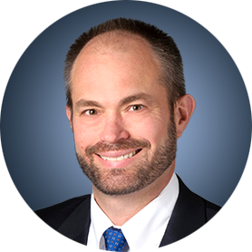

Faculty
William G Wierda, MD, PhD
Jane and John Justin Distinguished Chair in Leukemia Research in Honor of Dr Elihu Estey
Section Chief, Chronic Lymphocytic Leukemia
Center Medical Director
Department of Leukemia, Division of Cancer Medicine
Executive Medical Director, Inpatient Medical Services
The University of Texas MD Anderson Cancer Center
Houston, Texas
MODERATOR
Neil Love, MD
Research To Practice
Miami, Florida

Slide 3
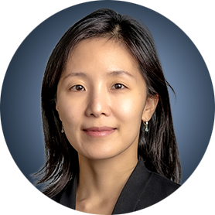





Program Steering Committee
Inhye Ahn, MD
Assistant Professor of Medicine
Dana-Farber Cancer Institute
Boston, Massachusetts
Matthew S Davids, MD, MMSc
Associate Professor of Medicine
Harvard Medical School
Leader, Lymphoma Program
Dana-Farber/Harvard Cancer Center
Director of Clinical Research
Division of Lymphoma
Dana-Farber Cancer Institute
Boston, Massachusetts
Farrukh T Awan, MD, MS, MBA
Professor of Internal Medicine
Associate Director, Section of Hematologic Malignancies/Transplantation and Cellular Therapies
Director of Lymphoid Malignancies Program
Harold C Simmons Comprehensive Cancer Center
University of Texas Southwestern Medical Center
Dallas, Texas
Bita Fakhri, MD, MPH
Assistant Professor of Medicine (Hematology)
Stanford University School of Medicine
Stanford, California
Nicole Lamanna, MD
Judy Horrigan Professor of Medicine
Director of the Chronic Lymphocytic
Leukemia Program
Leukemia Service
Hematologic Malignancies Section
Herbert Irving Comprehensive Cancer Center
NewYork-Presbyterian/Columbia University
Irving Medical Center
New York, New York
Catherine C Coombs, MD
Associate Clinical Professor
Division of Hematology/Oncology
Department of Medicine
UCI Health
Orange County, California

Slide 4

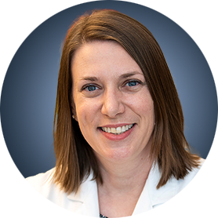

Program Steering Committee
Jeff Sharman, MD
Medical Director of Hematology Research
Sarah Cannon Research Institute
at Willamette Valley Cancer Center
Eugene, Oregon
Jennifer Woyach, MD
Professor
Division of Hematology
Department of Internal Medicine
The Ohio State University Comprehensive Cancer Center
Columbus, Ohio
Meghan C Thompson, MD
Oncologist and Clinical Investigator
Chronic Lymphocytic Leukemia
Assistant Attending, Leukemia Service
Memorial Sloan Kettering Cancer Center
New York, New York
PROJECT CHAIR
Neil Love, MD
Research To Practice
Miami, Florida
William G Wierda, MD, PhD
Jane and John Justin Distinguished Chair in Leukemia Research in Honor of Dr Elihu Estey
Section Chief, Chronic Lymphocytic Leukemia
Center Medical Director
Department of Leukemia, Division of Cancer Medicine
Executive Medical Director, Inpatient Medical Services
The University of Texas MD Anderson Cancer Center
Houston, Texas

Slide 5
Commercial Support
This activity is supported by an educational grant from Lilly.

Slide 6
Dr Love — Disclosures
Dr Love is president and CEO of Research To Practice. Research To Practice receives funds in the form of educational grants to develop CME activities from the following companies: Aadi Bioscience, AbbVie Inc, ADC Therapeutics, Agendia Inc, Alexion Pharmaceuticals, Amgen Inc, Array BioPharma Inc, a subsidiary of Pfizer Inc, Arvinas, Astellas, AstraZeneca Pharmaceuticals LP, Aveo Pharmaceuticals, Bayer HealthCare Pharmaceuticals, BeOne, Biotheranostics Inc, A Hologic Company, Black Diamond Therapeutics Inc, Blueprint Medicines, Boehringer Ingelheim Pharmaceuticals Inc, Bristol Myers Squibb, Catalyst Pharmaceuticals Inc, Celcuity, Clovis Oncology, Coherus BioSciences, Corcept Therapeutics Inc, CTI BioPharma, a Sobi Company, Daiichi Sankyo Inc, Eisai Inc, Elevation Oncology Inc, Exact Sciences Corporation, Exelixis Inc, Genentech, a member of the Roche Group, Genmab US Inc, Geron Corporation, Gilead Sciences Inc, GSK, Helsinn Therapeutics (US) Inc, ImmunoGen Inc, Incyte Corporation, Ipsen Biopharmaceuticals Inc, Jazz Pharmaceuticals Inc, Johnson & Johnson, Karyopharm Therapeutics, Kite, A Gilead Company, Kura Oncology, Legend Biotech, Lilly, MEI Pharma Inc, Merck, Mersana Therapeutics Inc, Mirati Therapeutics Inc, Mural Oncology Inc, Natera Inc, Novartis, Novartis Pharmaceuticals Corporation on behalf of Advanced Accelerator Applications, Novocure Inc, Nuvalent, Nuvation Bio Inc, Pfizer Inc, Pharmacyclics LLC, an AbbVie Company, Puma Biotechnology Inc, Regeneron Pharmaceuticals Inc, Revolution Medicines Inc, Rigel Pharmaceuticals Inc, R-Pharm US, Sanofi, Seagen Inc, Servier Pharmaceuticals LLC, SpringWorks Therapeutics Inc, Stemline Therapeutics Inc, Sumitomo Pharma America, Summit Therapeutics, Syndax Pharmaceuticals, Taiho Oncology Inc, Takeda Pharmaceuticals USA Inc, TerSera Therapeutics LLC, Tesaro, A GSK Company, and Verastem Inc.

Slide 7
Research To Practice CME Planning Committee Members,
Staff and Reviewers
Planners, scientific staff and independent reviewers for Research To Practice have no relevant financial relationships to disclose.

Slide 8
Dr Wierda — Disclosures
Faculty
Consulting/Advisory Boards, No Compensation | AbbVie Inc, Acerta Pharma — A member of the AstraZeneca Group, AstraZeneca Pharmaceuticals LP, BeOne, Bristol Myers Squibb, Intellisphere, Johnson & Johnson, Lilly, Loxo Oncology Inc, a wholly owned subsidiary of Eli Lilly & Company
Contracted Research | AbbVie Inc, Acerta Pharma — A member of the AstraZeneca Group, BeOne, Bristol Myers Squibb, Genentech, a member of the Roche Group, Gilead Sciences Inc, Janssen Biotech Inc, Juno Therapeutics, a Bristol Myers Squibb Company, Loxo Oncology Inc, a wholly owned subsidiary of Eli Lilly & Company, Nurix Therapeutics Inc, Pharmacyclics LLC, an AbbVie Company
Nonrelevant Financial and Nonfinancial Relationships | National Comprehensive Cancer Network (Chair, CLL), Supported by the NIH/NCI under award number P30 CA016672 and used MD Anderson Cancer Center Support Grant (CCSG) shared resources, Wiley China (consulting/advisory board, no compensation)

Slide 9
Dr Ahn — Disclosures
Contributing Clinical Investigator
Consulting Agreements | AstraZeneca Pharmaceuticals LP, BeOne, Lilly
Contracted Research | BeOne, Genentech, a member of the Roche Group, Lilly

Slide 10
Dr Coombs — Disclosures
Contributing Clinical Investigator
Advisory Committees | AbbVie Inc, Allogene Therapeutics, AstraZeneca Pharmaceuticals LP, BeOne, Genentech, a member of the Roche Group, Johnson & Johnson, Lilly, Pharmacyclics LLC, an AbbVie Company
Consulting Agreements | AbbVie Inc, AstraZeneca Pharmaceuticals LP, BeOne, Lilly, Octapharma
Contracted Research | AbbVie Inc, BeOne, Carna Biosciences, Lilly
Speakers Bureaus | AstraZeneca Pharmaceuticals LP, BeOne, Lilly
Stock Options/Stock — Public Companies | Geron Corporation

Slide 11
Dr Davids — Disclosures
Contributing Clinical Investigator
Consulting Agreements | AbbVie Inc, Adaptive Biotechnologies Corporation, Ascentage Pharma, AstraZeneca Pharmaceuticals LP, BeOne, Bristol Myers Squibb, Galapagos NV, Genentech, a member of the Roche Group, Genmab US Inc, Janssen Biotech Inc, Lilly, MEI Pharma Inc, Merck, Nuvalent, Schrödinger, Takeda Pharmaceuticals USA Inc
Contracted Research | Ascentage Pharma, AstraZeneca Pharmaceuticals LP, MEI Pharma Inc, Novartis
Nonrelevant Financial Relationships | UpToDate

Slide 12
Dr Fakhri — Disclosures
Contributing Clinical Investigator
Advisory Committees | AbbVie Inc, AstraZeneca Pharmaceuticals LP, Genentech, a member of the Roche Group, Pharmacyclics LLC, an AbbVie Company
Contracted Research | AbbVie Inc, BeOne, Genmab US Inc, Loxo Oncology Inc, a wholly owned subsidiary of Eli Lilly & Company

Slide 13
Dr Lamanna — Disclosures
Contributing Clinical Investigator
Advisory Committees and Consulting Agreements | AbbVie Inc, AstraZeneca Pharmaceuticals LP, BeOne, Genmab US Inc, Loxo Oncology Inc, a wholly owned subsidiary of Eli Lilly & Company
Contracted Research | AbbVie Inc, AstraZeneca Pharmaceuticals LP, BeOne, Genmab US Inc, Loxo Oncology Inc, a wholly owned subsidiary of Eli Lilly & Company, Octapharma, Oncternal Therapeutics

Slide 14
Dr Woyach — Disclosures
Contributing Clinical Investigator
Advisory Committees and Consulting Agreements | AbbVie Inc, AstraZeneca Pharmaceuticals LP, BeOne, Genentech, a member of the Roche Group, Janssen Biotech Inc, Loxo Oncology Inc, a wholly owned subsidiary of Eli Lilly & Company, Merck, Newave, Pharmacyclics LLC, an AbbVie Company
Contracted Research | AbbVie Inc, Karyopharm Therapeutics, Loxo Oncology Inc, a wholly owned subsidiary of Eli Lilly & Company, MingSight Pharmaceuticals, MorphoSys, Schrödinger, Verastem Inc

Slide 15
This educational activity contains discussion of
non-FDA-approved uses of agents and regimens. Please refer to official prescribing information for each product for approved indications.

Slide 16

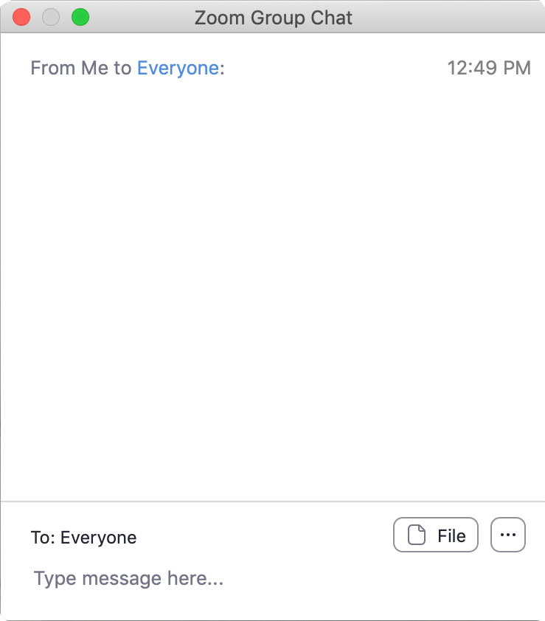
We Encourage Clinicians in Practice to Submit Questions
Feel free to submit questions now before the program begins and throughout the program.

Slide 17

Familiarizing Yourself with the Zoom Interface
Expand chat submission box
Drag the white line above the submission box up to create
more space for your message.

Slide 18

Familiarizing Yourself with the Zoom Interface
Increase chat font size
Press Command (for Mac) or Control (for PC) and the + symbol.
You may do this as many times as you need for readability.

Slide 19


Clinicians in the Audience, Please Complete the Pre- and Postmeeting Surveys
Quick Survey
Quick Poll

Slide 20
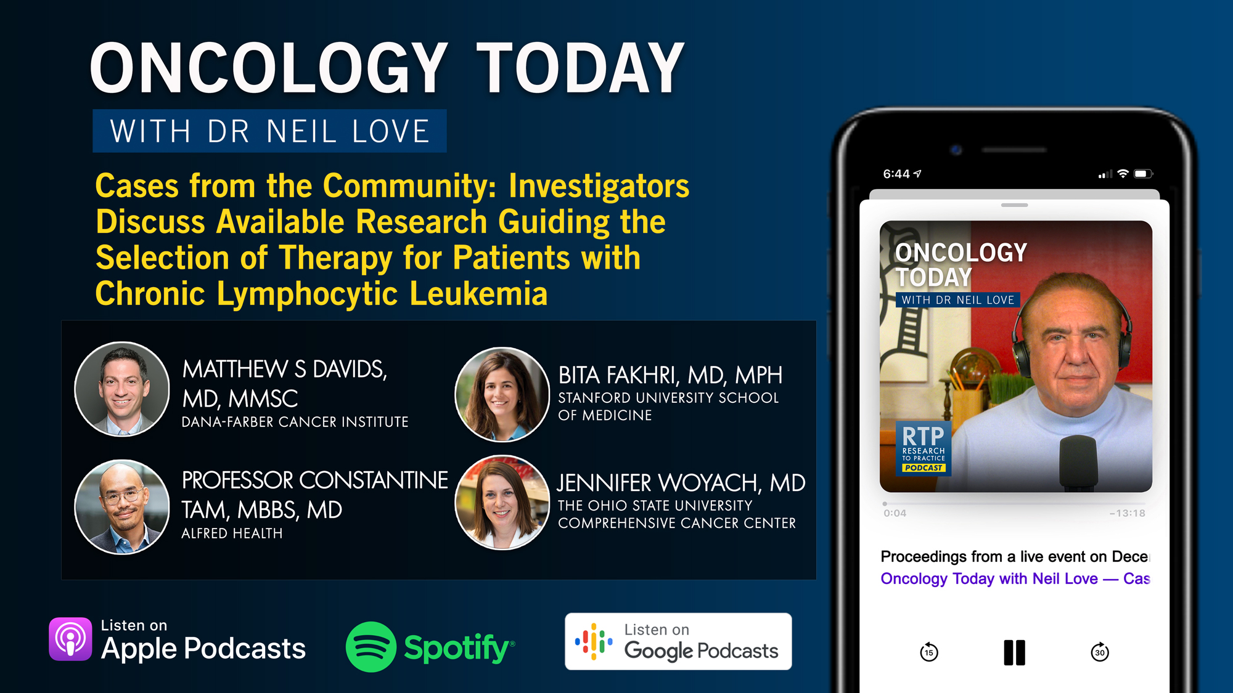

Slide 21
Year in Review: Clinical Investigator Perspectives on the
Most Relevant New Datasets and Advances in Oncology
Novel Treatment Approaches for Non-Hodgkin Lymphoma
A CME/MOC-Accredited Live Webinar
Wednesday, June 17, 2026
5:00 PM – 6:00 PM ET
Faculty
Matthew Matasar, MD
Sonali M Smith, MD
Moderator
Neil Love, MD

Slide 22
Year in Review: Clinical Investigator Perspectives on the
Most Relevant New Datasets and Advances in Oncology
Gastroesophageal Cancers
A CME/MOC-Accredited Live Webinar
Tuesday, June 23, 2026
5:00 PM – 6:00 PM ET
Faculty
David H Ilson, MD, PhD
Kohei Shitara, MD
Moderator
Neil Love, MD

Slide 23
Year in Review: Clinical Investigator Perspectives on the
Most Relevant New Datasets and Advances in Oncology
Multiple Myeloma
A CME/MOC-Accredited Live Webinar
Thursday, June 25, 2026
5:00 PM – 6:00 PM ET
Faculty
Amrita Krishnan, MD
Robert Z Orlowski, MD, PhD
Moderator
Neil Love, MD

Slide 24
Year in Review: Clinical Investigator Perspectives on the
Most Relevant New Datasets and Advances in Oncology
Therapeutic Targets Beyond
EGFR for Non-Small Cell Lung Cancer
A CME/MOC-Accredited Live Webinar
Tuesday, June 30, 2026
5:00 PM – 6:00 PM ET
Faculty
John V Heymach, MD, PhD
Maurice Pérol, MD
Moderator
Neil Love, MD

Slide 25
Grand Rounds
CME/MOC-Accredited Interactive Series
Regional Activities
Two Series
Optimizing the Use of
Novel Therapies for Patients with Diffuse Large B-Cell Lymphoma
Optimizing Therapy for Patients with Hormone Receptor-Positive
Localized Breast Cancer
Host a 1-hour session at your institution:
Email Meetings@ResearchToPractice.com
or call (800) 233-6153

Slide 26
Thank you for joining us! Please take a moment to complete the survey currently up on Zoom.
Your feedback is very important to us.
Information on how to obtain CME and ABIM MOC credit will be provided at the conclusion of the activity in the Zoom chat room. Attendees will also receive an email in 1 to 3 business days with these instructions.

Slide 27
Optimizing Treatment for Patients with Relapsed/Refractory
Chronic Lymphocytic Leukemia
A CME/MOC-Accredited Live Webinar
Thursday, June 11, 2026
5:00 PM – 6:00 PM ET
Faculty
William G Wierda, MD, PhD
Moderator
Neil Love, MD

Slide 28
Faculty
William G Wierda, MD, PhD
Jane and John Justin Distinguished Chair in Leukemia Research in Honor of Dr Elihu Estey
Section Chief, Chronic Lymphocytic Leukemia
Center Medical Director
Department of Leukemia, Division of Cancer Medicine
Executive Medical Director, Inpatient Medical Services
The University of Texas MD Anderson Cancer Center
Houston, Texas
MODERATOR
Neil Love, MD
Research To Practice
Miami, Florida

Slide 29
We Encourage Clinicians in Practice to Submit Questions
Feel free to submit questions now before the program begins and throughout the program.

Slide 30
Clinicians in the Audience, Please Complete the Pre- and Postmeeting Surveys
Quick Survey
Quick Poll

Slide 32
Year in Review: Clinical Investigator Perspectives on the
Most Relevant New Datasets and Advances in Oncology
Novel Treatment Approaches for Non-Hodgkin Lymphoma
A CME/MOC-Accredited Live Webinar
Wednesday, June 17, 2026
5:00 PM – 6:00 PM ET
Faculty
Matthew Matasar, MD
Sonali M Smith, MD
Moderator
Neil Love, MD

Slide 33
Year in Review: Clinical Investigator Perspectives on the
Most Relevant New Datasets and Advances in Oncology
Gastroesophageal Cancers
A CME/MOC-Accredited Live Webinar
Tuesday, June 23, 2026
5:00 PM – 6:00 PM ET
Faculty
David H Ilson, MD, PhD
Kohei Shitara, MD
Moderator
Neil Love, MD

Slide 34
Year in Review: Clinical Investigator Perspectives on the
Most Relevant New Datasets and Advances in Oncology
Multiple Myeloma
A CME/MOC-Accredited Live Webinar
Thursday, June 25, 2026
5:00 PM – 6:00 PM ET
Faculty
Amrita Krishnan, MD
Robert Z Orlowski, MD, PhD
Moderator
Neil Love, MD

Slide 35
Year in Review: Clinical Investigator Perspectives on the
Most Relevant New Datasets and Advances in Oncology
Therapeutic Targets Beyond
EGFR for Non-Small Cell Lung Cancer
A CME/MOC-Accredited Live Webinar
Tuesday, June 30, 2026
5:00 PM – 6:00 PM ET
Faculty
John V Heymach, MD, PhD
Maurice Pérol, MD
Moderator
Neil Love, MD

Slide 36
Grand Rounds
CME/MOC-Accredited Interactive Series
Regional Activities
Two Series
Optimizing the Use of
Novel Therapies for Patients with Diffuse Large B-Cell Lymphoma
Optimizing Therapy for Patients with Hormone Receptor-Positive
Localized Breast Cancer
Host a 1-hour session at your institution:
Email Meetings@ResearchToPractice.com
or call (800) 233-6153

Slide 37
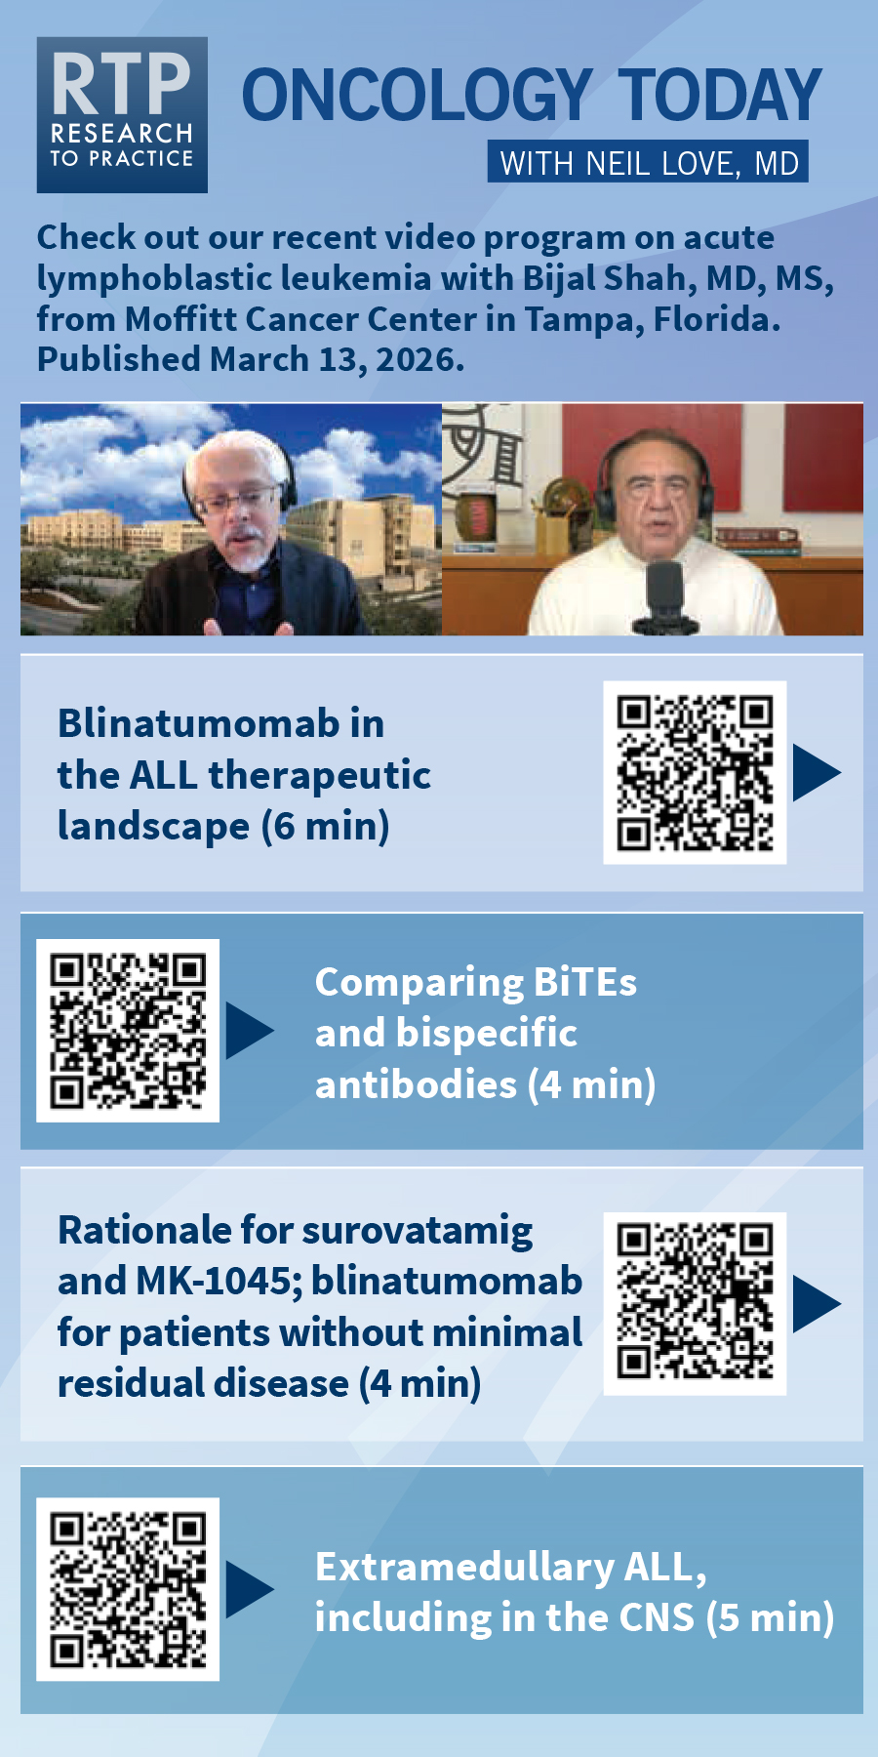
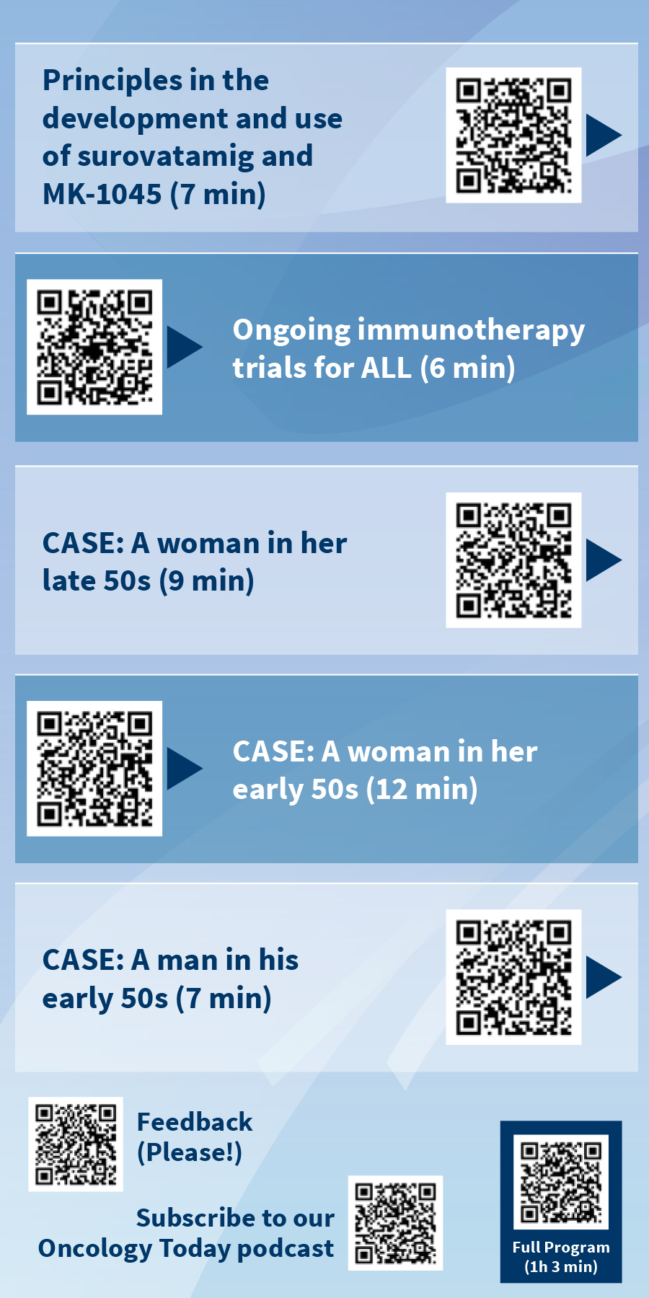

Slide 38
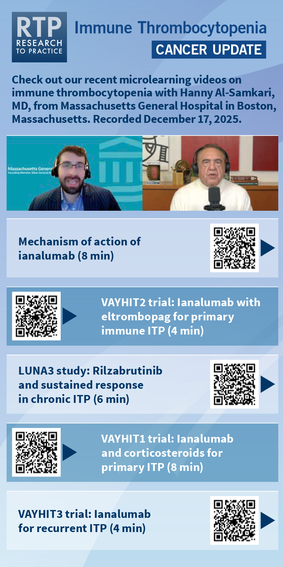
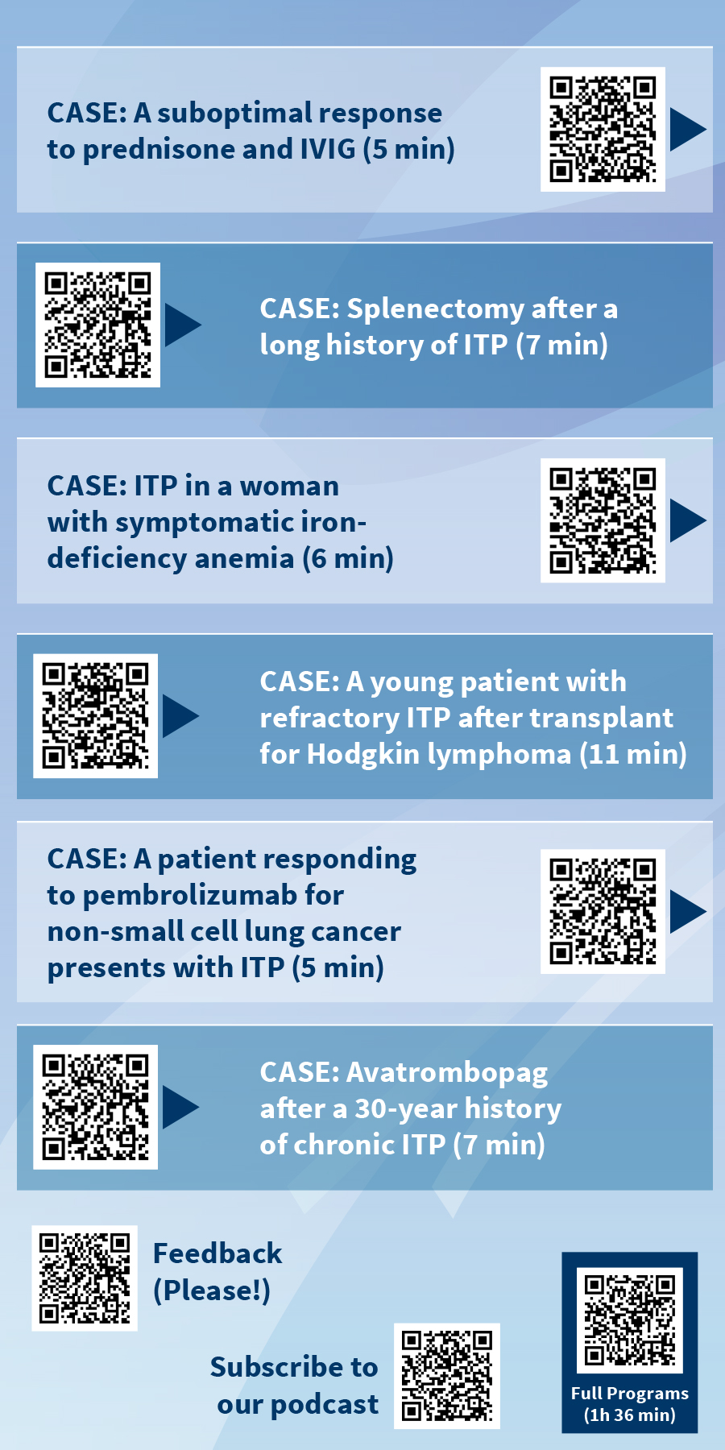

Slide 39
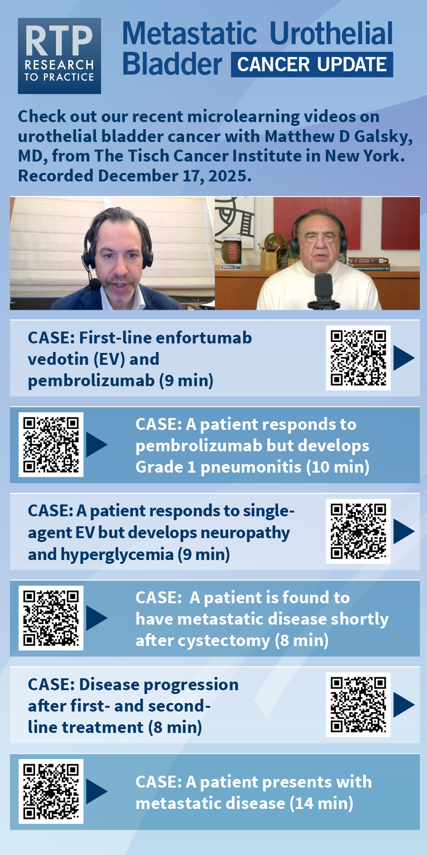
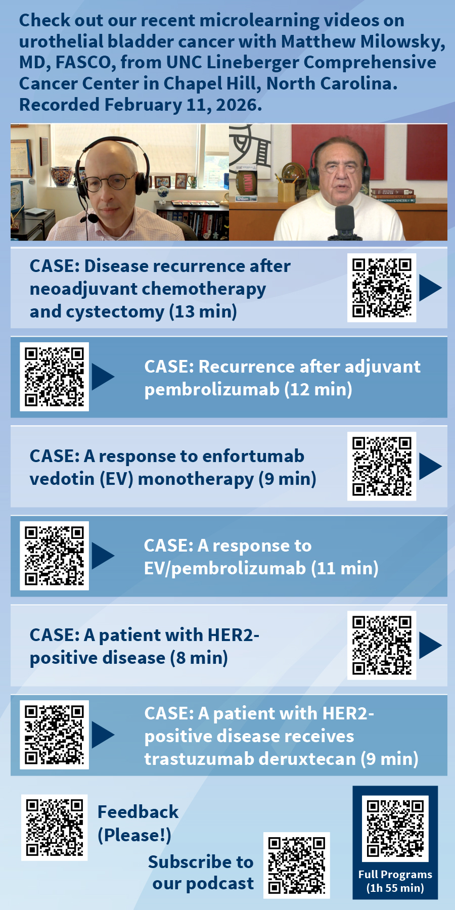

Slide 40
Optimizing Treatment for Patients with Relapsed/Refractory
Chronic Lymphocytic Leukemia
Thursday, June 11, 2026
5:00 PM – 6:00 PM ET
Faculty
William G Wierda, MD, PhD
Moderator
Neil Love, MD

Slide 41
Dr Wierda — Disclosures
Faculty
Consulting/Advisory Boards, No Compensation | AbbVie Inc, Acerta Pharma — A member of the AstraZeneca Group, AstraZeneca Pharmaceuticals LP, BeOne, Bristol Myers Squibb, Intellisphere, Johnson & Johnson, Lilly, Loxo Oncology Inc, a wholly owned subsidiary of Eli Lilly & Company
Contracted Research | AbbVie Inc, Acerta Pharma — A member of the AstraZeneca Group, BeOne, Bristol Myers Squibb, Genentech, a member of the Roche Group, Gilead Sciences Inc, Janssen Biotech Inc, Juno Therapeutics, a Bristol Myers Squibb Company, Loxo Oncology Inc, a wholly owned subsidiary of Eli Lilly & Company, Nurix Therapeutics Inc, Pharmacyclics LLC, an AbbVie Company
Nonrelevant Financial and Nonfinancial Relationships | National Comprehensive Cancer Network (Chair, CLL), Supported by the NIH/NCI under award number P30 CA016672 and used MD Anderson Cancer Center Support Grant (CCSG) shared resources, Wiley China (consulting/advisory board, no compensation)

Slide 42
Dr Ahn — Disclosures
Contributing Clinical Investigator
Consulting Agreements | AstraZeneca Pharmaceuticals LP, BeOne, Lilly
Contracted Research | BeOne, Genentech, a member of the Roche Group, Lilly

Slide 43
Dr Coombs — Disclosures
Contributing Clinical Investigator
Advisory Committees | AbbVie Inc, Allogene Therapeutics, AstraZeneca Pharmaceuticals LP, BeOne, Genentech, a member of the Roche Group, Johnson & Johnson, Lilly, Pharmacyclics LLC, an AbbVie Company
Consulting Agreements | AbbVie Inc, AstraZeneca Pharmaceuticals LP, BeOne, Lilly, Octapharma
Contracted Research | AbbVie Inc, BeOne, Carna Biosciences, Lilly
Speakers Bureaus | AstraZeneca Pharmaceuticals LP, BeOne, Lilly
Stock Options/Stock — Public Companies | Geron Corporation

Slide 44
Dr Davids — Disclosures
Contributing Clinical Investigator
Consulting Agreements | AbbVie Inc, Adaptive Biotechnologies Corporation, Ascentage Pharma, AstraZeneca Pharmaceuticals LP, BeOne, Bristol Myers Squibb, Galapagos NV, Genentech, a member of the Roche Group, Genmab US Inc, Janssen Biotech Inc, Lilly, MEI Pharma Inc, Merck, Nuvalent, Schrödinger, Takeda Pharmaceuticals USA Inc
Contracted Research | Ascentage Pharma, AstraZeneca Pharmaceuticals LP, MEI Pharma Inc, Novartis
Nonrelevant Financial Relationships | UpToDate

Slide 45
Dr Fakhri — Disclosures
Contributing Clinical Investigator
Advisory Committees | AbbVie Inc, AstraZeneca Pharmaceuticals LP, Genentech, a member of the Roche Group, Pharmacyclics LLC, an AbbVie Company
Contracted Research | AbbVie Inc, BeOne, Genmab US Inc, Loxo Oncology Inc, a wholly owned subsidiary of Eli Lilly & Company

Slide 46
Dr Lamanna — Disclosures
Contributing Clinical Investigator
Advisory Committees and Consulting Agreements | AbbVie Inc, AstraZeneca Pharmaceuticals LP, BeOne, Genmab US Inc, Loxo Oncology Inc, a wholly owned subsidiary of Eli Lilly & Company
Contracted Research | AbbVie Inc, AstraZeneca Pharmaceuticals LP, BeOne, Genmab US Inc, Loxo Oncology Inc, a wholly owned subsidiary of Eli Lilly & Company, Octapharma, Oncternal Therapeutics

Slide 47
Dr Woyach — Disclosures
Contributing Clinical Investigator
Advisory Committees and Consulting Agreements | AbbVie Inc, AstraZeneca Pharmaceuticals LP, BeOne, Genentech, a member of the Roche Group, Janssen Biotech Inc, Loxo Oncology Inc, a wholly owned subsidiary of Eli Lilly & Company, Merck, Newave, Pharmacyclics LLC, an AbbVie Company
Contracted Research | AbbVie Inc, Karyopharm Therapeutics, Loxo Oncology Inc, a wholly owned subsidiary of Eli Lilly & Company, MingSight Pharmaceuticals, MorphoSys, Schrödinger, Verastem Inc

Slide 48
Dr Love — Disclosures
Dr Love is president and CEO of Research To Practice. Research To Practice receives funds in the form of educational grants to develop CME activities from the following companies: Aadi Bioscience, AbbVie Inc, ADC Therapeutics, Agendia Inc, Alexion Pharmaceuticals, Amgen Inc, Array BioPharma Inc, a subsidiary of Pfizer Inc, Arvinas, Astellas, AstraZeneca Pharmaceuticals LP, Aveo Pharmaceuticals, Bayer HealthCare Pharmaceuticals, BeOne, Biotheranostics Inc, A Hologic Company, Black Diamond Therapeutics Inc, Blueprint Medicines, Boehringer Ingelheim Pharmaceuticals Inc, Bristol Myers Squibb, Catalyst Pharmaceuticals Inc, Celcuity, Clovis Oncology, Coherus BioSciences, Corcept Therapeutics Inc, CTI BioPharma, a Sobi Company, Daiichi Sankyo Inc, Eisai Inc, Elevation Oncology Inc, Exact Sciences Corporation, Exelixis Inc, Genentech, a member of the Roche Group, Genmab US Inc, Geron Corporation, Gilead Sciences Inc, GSK, Helsinn Therapeutics (US) Inc, ImmunoGen Inc, Incyte Corporation, Ipsen Biopharmaceuticals Inc, Jazz Pharmaceuticals Inc, Johnson & Johnson, Karyopharm Therapeutics, Kite, A Gilead Company, Kura Oncology, Legend Biotech, Lilly, MEI Pharma Inc, Merck, Mersana Therapeutics Inc, Mirati Therapeutics Inc, Mural Oncology Inc, Natera Inc, Novartis, Novartis Pharmaceuticals Corporation on behalf of Advanced Accelerator Applications, Novocure Inc, Nuvalent, Nuvation Bio Inc, Pfizer Inc, Pharmacyclics LLC, an AbbVie Company, Puma Biotechnology Inc, Regeneron Pharmaceuticals Inc, Revolution Medicines Inc, Rigel Pharmaceuticals Inc, R-Pharm US, Sanofi, Seagen Inc, Servier Pharmaceuticals LLC, SpringWorks Therapeutics Inc, Stemline Therapeutics Inc, Sumitomo Pharma America, Summit Therapeutics, Syndax Pharmaceuticals, Taiho Oncology Inc, Takeda Pharmaceuticals USA Inc, TerSera Therapeutics LLC, Tesaro, A GSK Company, and Verastem Inc.

Slide 49
Commercial Support
This activity is supported by an educational grant from Lilly.
Research To Practice CME Planning Committee Members,
Staff and Reviewers
Planners, scientific staff and independent reviewers for Research To Practice have no relevant financial relationships to disclose.

Slide 50
This educational activity contains discussion of
non-FDA-approved uses of agents and regimens. Please refer to official prescribing information for each product for approved indications.

Slide 51
Management of Relapsed/Refractory CLL
Introduction: Overview of Grand Rounds CLL Initiative
Module 1: Sequencing Roadmap
Module 2: Key Datasets — Pirtobrutinib
Module 3: Investigator Survey
Module 4: CAR T-Cell Therapy
Module 5: Other Novel Therapy Approaches
Module 6: EHA 2026

Slide 52
Management of Relapsed/Refractory CLL
Introduction: Overview of Grand Rounds CLL Initiative
Module 1: Sequencing Roadmap
Module 2: Key Datasets — Pirtobrutinib
Module 3: Investigator Survey
Module 4: CAR T-Cell Therapy
Module 5: Other Novel Therapy Approaches
Module 6: EHA 2026

Slide 53
Program Steering Committee
Inhye Ahn, MD
Assistant Professor of Medicine
Dana-Farber Cancer Institute
Boston, Massachusetts
Matthew S Davids, MD, MMSc
Associate Professor of Medicine
Harvard Medical School
Leader, Lymphoma Program
Dana-Farber/Harvard Cancer Center
Director of Clinical Research
Division of Lymphoma
Dana-Farber Cancer Institute
Boston, Massachusetts
Farrukh T Awan, MD, MS, MBA
Professor of Internal Medicine
Associate Director, Section of Hematologic Malignancies/Transplantation and Cellular Therapies
Director of Lymphoid Malignancies Program
Harold C Simmons Comprehensive Cancer Center
University of Texas Southwestern Medical Center
Dallas, Texas
Bita Fakhri, MD, MPH
Assistant Professor of Medicine (Hematology)
Stanford University School of Medicine
Stanford, California
Nicole Lamanna, MD
Judy Horrigan Professor of Medicine
Director of the Chronic Lymphocytic
Leukemia Program
Leukemia Service
Hematologic Malignancies Section
Herbert Irving Comprehensive Cancer Center
NewYork-Presbyterian/Columbia University
Irving Medical Center
New York, New York
Catherine C Coombs, MD
Associate Clinical Professor
Division of Hematology/Oncology
Department of Medicine
UCI Health
Orange County, California

Slide 54
Program Steering Committee
William G Wierda, MD, PhD
Jane and John Justin Distinguished Chair in Leukemia Research in Honor of Dr Elihu Estey
Section Chief, Chronic Lymphocytic Leukemia
Center Medical Director
Department of Leukemia, Division of Cancer Medicine
Executive Medical Director, Inpatient Medical Services
The University of Texas MD Anderson Cancer Center
Houston, Texas
PROJECT CHAIR
Neil Love, MD
Research To Practice
Miami, Florida
Jennifer Woyach, MD
Professor
Division of Hematology
Department of Internal Medicine
The Ohio State University Comprehensive Cancer Center
Columbus, Ohio

Slide 55
Grand Rounds CLL Series 2025-2026
Session number and date | Partnering institution | Speaker
1-November 14, 2025 | Dayton Physicians Network (OH) | Jennifer Woyach, MD
2-January 12, 2026 | Loma Linda University Medical Center (CA) | Catherine Coombs, MD
3-January 16, 2026 | Louisiana State University Shreveport (LA) | William Wierda, MD, PhD
4-February 10, 2026 | Boston Medical Center (MA) | Matthew Davids, MD
5-February 13, 2026 | Blue Ridge Cancer Care (VA) | Farrukh Awan, MD
6-February 14, 2026 | Georgia Cancer Specialists (GA) | Farrukh Awan, MD
7-March 12, 2026 | Jefferson (Albert) Einstein Hospital (PA) | Nicole Lamanna, MD
8-March 13, 2026 | OU Health Stephenson Cancer Center (OK) | Bita Fakhri, MD
9-March 26, 2026 | Advocate Lutheran General Hospital (IL) | Bita Fakhri, MD
10-April 2, 2026 | Loyola University/Edward Hines Jr VA Hospital (IL) | Farrukh Awan, MD
11-April 8, 2026 | Morristown Medical Center (NJ) | Matthew Davids, MD
12-April 16, 2026 | Houston Methodist Hospital (TX) | Farrukh Awan, MD
13-April 17, 2026 | Brooklyn Methodist Hospital (NY) | Nicole Lamanna, MD
14-April 20, 2026 | Lankenau Medical Center (PA) | Nicole Lamanna, MD
15-May 20, 2026 | West Virginia University Cancer Institute (WV) | Inhye Ahn, MD

Slide 56
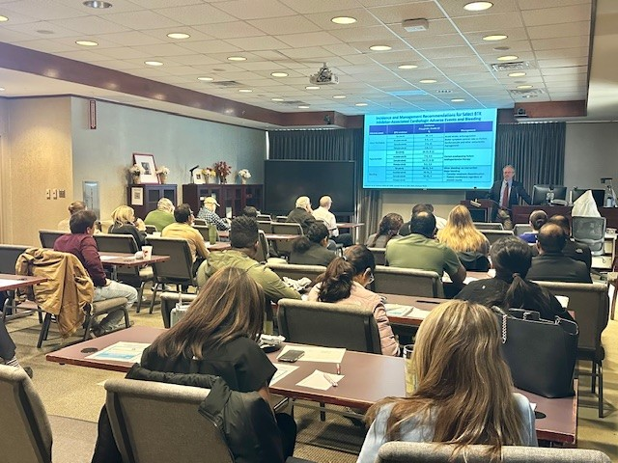

Slide 57
Key Datasets
Thompson PA, Tam CS. Pirtobrutinib: A new hope for patients with BTK inhibitor-refractory lymphoproliferative disorders. Blood 2023 June 29;141(26):3137-42.
Shah NN et al. Pirtobrutinib monotherapy in Bruton tyrosine kinase inhibitor-intolerant patients with B-cell malignancies: Results of the phase I/II BRUIN trial. Haematologica 2025 January 1;110(1):92-102.
Sharman JP et al. Phase III trial of pirtobrutinib versus idelalisib/rituximab or bendamustine/rituximab in covalent Bruton tyrosine kinase inhibitor-pretreated chronic lymphocytic leukemia/small lymphocytic lymphoma (BRUIN CLL-321). J Clin Oncol 2025 August;43(22):2538-49.
Eyre TA et al. BRUIN CLL-322: A phase 3 open-label, randomized study of fixed duration pirtobrutinib plus venetoclax and rituximab versus venetoclax and rituximab in previously treated chronic lymphocytic leukemia/small lymphocytic lymphoma. ASCO 2023;Abstract TPS7583.
Woyach J et al. Pirtobrutinib vs ibrutinib in treatment-naïve and relapsed/refractory CLL/SLL: Results from the first randomized phase III study comparing a non-covalent and covalent BTK inhibitor. ASH 2025;Abstract 683.
Jurczak W et al. Pirtobrutinib vs bendamustine plus rituximab (BR) in patients with CLL/SLL: First results from a randomized phase III study examining a non-covalent BTK inhibitor in untreated patients. ASH 2025;Abstract LBA3.

Slide 58
Key Datasets
Siddiqi T et al. Lisocabtagene maraleucel (liso-cel) in R/R CLL/SLL: 24-month median follow-up of TRANSCEND CLL 004. ASH 2023;Abstract 330.
Wierda WG et al. Lisocabtagene maraleucel (liso-cel) combined with ibrutinib (ibr) for patients (pts) with relapsed or refractory (R/R) chronic lymphocytic leukemia (CLL)/small lymphocytic lymphoma (SLL): Primary results from the open-label, phase 1/2 Transcend CLL 004 study. ASH 2024;Abstract 887.
Danilov A et al. Epcoritamab monotherapy in patients (pts) with relapsed or refractory (R/R) chronic lymphocytic leukemia (CLL): Results from CLL expansion and optimization cohorts of Epcore CLL-1. ASH 2024;Abstract 883.
Woyach JA et al. First-in-human study of the reversible BTK inhibitor nemtabrutinib in patients with relapsed/refractory chronic lymphocytic leukemia and B-cell non-Hodgkin lymphoma. Cancer Discov 2024;14(1):66-75.
Ahn I et al. Updated efficacy and safety results of the Bruton tyrosine kinase (BTK) degrader BGB-16673 in patients with relapsed/refractory chronic lymphocytic leukemia/small lymphocytic lymphoma (CLL/SLL) from the ongoing phase 1 CaDAnCe-101 study. ASH 2025;Abstract 85.
Omer Z et al. Bexobrutideg (NX-5948), a novel Bruton’s tyrosine kinase (BTK) degrader, demonstrates rapid and durable clinical responses in relapsed/refractory chronic lymphocytic leukemia (CLL): New and updated findings from an ongoing Phase 1a/b trial. ASH 2025;Abstract 86.

Slide 59
Consensus or Controversy? Documenting and Discussing
Investigators’ Approaches to the Management of Myelofibrosis
A CME/MOC-Accredited Virtual Event Held
Adjunct with the 2026 ASCO® Annual Meeting
Tuesday, June 2, 2026
5:00 PM – 6:00 PM ET
Faculty
Professor Claire Harrison
Raajit K Rampal, MD, PhD
Moderator
Neil Love, MD

Slide 60
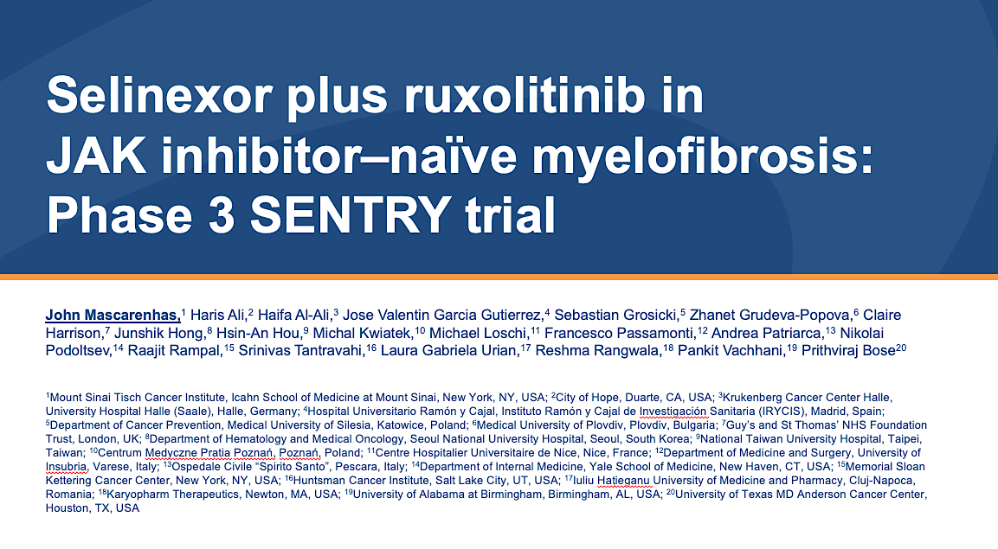
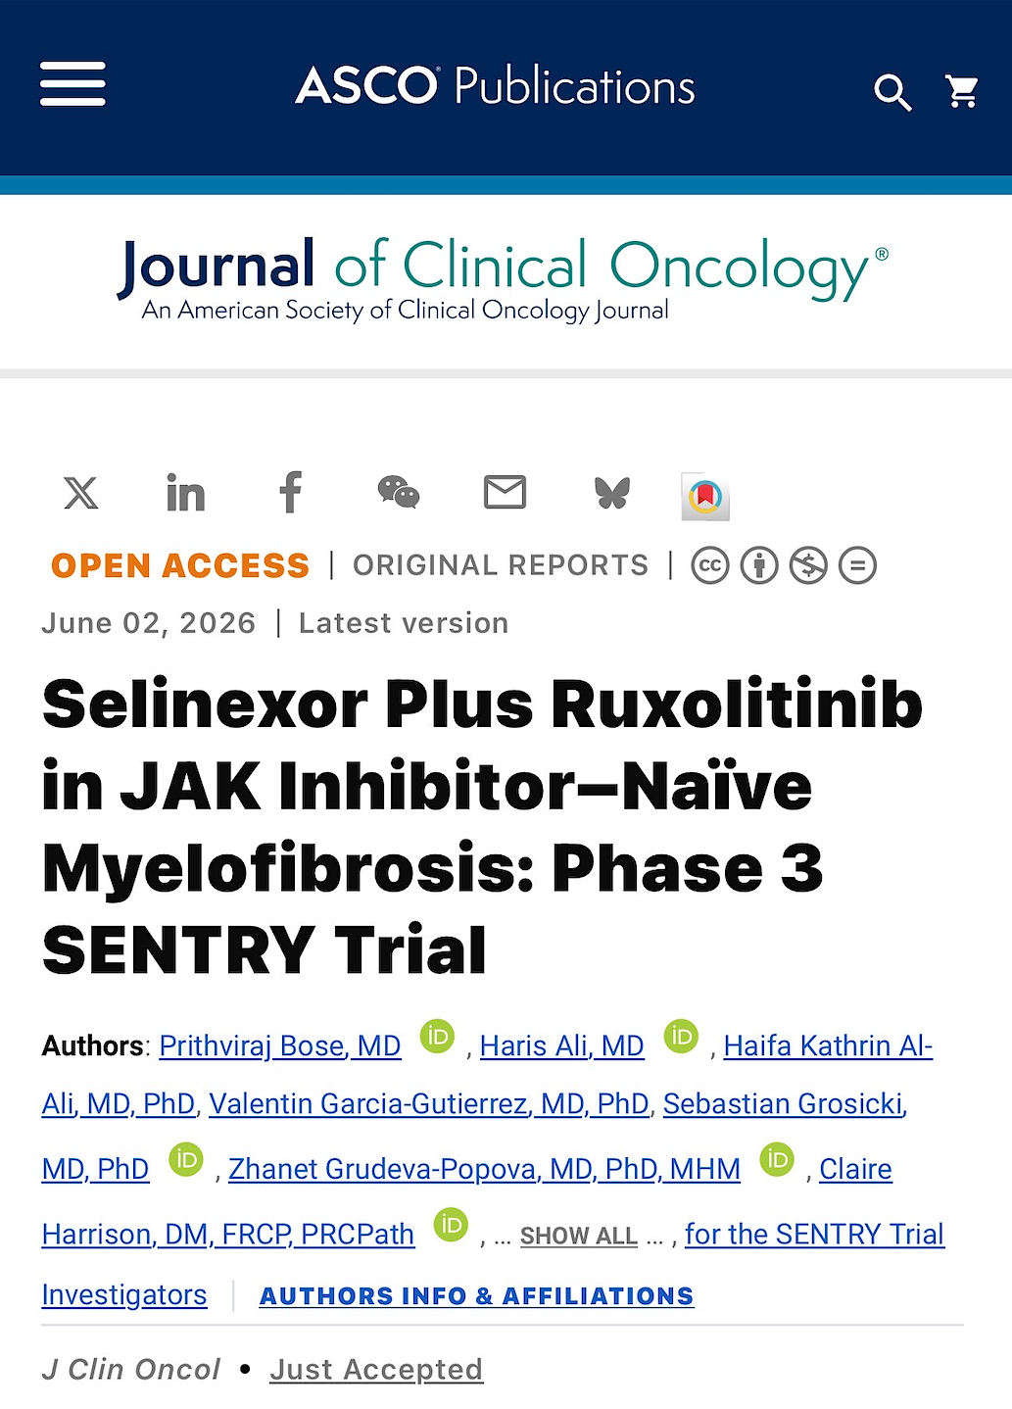
ASCO 2026;Abstract LBA6500

Slide 61
Phase 3 SENTRY study evaluates selinexor + RUX in patients who are JAKi-naïve
Double-blind, placebo-controlled, randomised study to assess the efficacy and safety of selinexor + RUX vs placebo + RUX^{1,2}
Treatment arms^{1,2}
Study population^{1,2}
Co-primary endpoint^{1,2}
SVR35 and absolute mean change in TSS at week 24
Secondary endpoints^{1,2}
Safety and tolerability¹
OS and PFS^{1,2}
SVR35 and absolute mean change in TSS at week 48 and anytime¹
Duration of SVR response¹
Pharmacokinetics¹
Selinexor
60 mg oral tablet QW
days 1, 8, 15, 22
RUX
15 or 20 mg BID starting dose based on baseline platelet count
Adults with JAKi-naive MF (N=353)^{1,2}
DIPSS Int-1 with symptoms, Int-2 or high-risk¹
Measurable splenomegaly¹
Active symptoms of MF¹
ECOG PS ≤2¹
+
Double-blind
randomisation
(2:1) with stratification¹
28-day cycles
Placebo
60 mg oral tablet QW
days 1, 8, 15, 22
RUX
15 or 20 mg BID starting dose based on baseline platelet count
+
Stratified by:¹
DIPSS: Int-1 vs Int-2 or high risk
Spleen volume: <1800 cm³ vs >1800 cm
Baseline platelet counts: 100–200 x 10⁹/L vs >200 x10⁹/L

Slide 62
Significantly higher SVR35 at Week 24 with selinexor + ruxolitinib vs ruxolitinib alone
Difference: 21.8%
(OR 2.58; 95% CI: 1.60, 4.17) One-sided P < 0.0001
60
50
40
30
20
10
0
Change from baseline in spleen volume (Week 24), %
SVR35 at Week 24, %
−10
−20
−30
−40
SVR35 threshold
−50
−60
−70
−80
−90
Selinexor + ruxolitinib
Placebo + ruxolitinib
Data cut off: February 20, 2026.
*Cochran-Mantel-Haenszel test stratified by randomization factors.
Placebo arm scaled 2:1 to compensate for randomization ratio.
CI: confidence interval; OR: odds ratio; SD: standard deviation; SVR35: spleen volume reduction of at least 35% from baseline.
ASCO 2026;Abstract LBA6500.

Slide 63
Meaningful overall survival with selinexor + ruxolitinib vs ruxolitinib alone
1.00
Deaths | Selinexor + ruxolitinib (N = 235) | Placebo + ruxolitinib (N = 118)
Primary cause of death, n (%)
Disease progression | 3 (1.3) | 3 (2.5)
Adverse event | 3 (1.3) | 5 (4.2)
Other | 5 (2.1) | 1 (0.8)
Unknown | 0 | 3 (2.5)
0.75
Probability of survival
0.50
Events: 11 (4.7%) vs 12 (10.2%)
Median follow-up: 11.6 vs 12.6 months
HR 0.43 (95% CI: 0.19, 1.00); nominal one-sided P = 0.022
0.25
0.00
+ Censored
0
1
2
3
4
5
6
7
8
9
10
11
12
13
14
15
16
17
18
19
20
21
22
23
24
25
Months
Number at risk
Selinexor + Ruxolitinib
235
230
222
220
218
215
205
187
168
153
140
123
109
96
84
70
63
48
37
30
19
9
2
0
Placebo + Ruxolitinib
118
115
114
114
114
113
111
101
96
86
71
59
54
50
40
33
27
21
18
15
11
4
2
1
1
0
Data cut off: February 20, 2026.
OS is defined as the duration from date of randomization to date of death due to any cause. Follow-up time based on reverse Kaplan-Meier method by swapping the censoring status. OS analysis stratified by the randomization stratification factors. Hazard ratio based on Cox Proportional Hazard model with Efron's method of handling ties.
CI: confidence interval; HR: hazard ratio; OS: overall survival.
ASCO 2026;Abstract LBA6500.

Slide 64
Pirtobrutinib Significantly Extended PFS When Added to a Venetoclax Time-Limited Regimen for Patients with Previously Treated CLL/SLL
Press Release: April 13, 2026
“[The manufacturer] announced positive topline results from the Phase 3 BRUIN CLL-322 trial of pirtobrutinib, a non-covalent (reversible) Bruton tyrosine kinase (BTK) inhibitor, plus venetoclax and rituximab versus venetoclax and rituximab in patients with relapsed or refractory chronic lymphocytic leukemia or small lymphocytic lymphoma (CLL/SLL). Treatment in both study arms was administered for up to two years, after which patients do not take any CLL therapy until their disease progresses. The study met its primary endpoint, demonstrating that the addition of pirtobrutinib to venetoclax plus rituximab led to a statistically significant and clinically meaningful improvement in progression-free survival (PFS), as assessed by an independent review committee (IRC). Results were consistent across clinically relevant subgroups and regardless of whether patients were previously treated with a covalent BTK inhibitor.
Overall survival (OS), a key secondary endpoint, was not yet mature at this analysis, but was trending in favor of the pirtobrutinib combination regimen. The overall safety profile of this regimen was consistent with the known safety profile of each medicine. Rates of adverse events were similar across the study arms, with low rates of treatment regimen discontinuations, also similar between arms.
Detailed results will be presented at a medical congress and submitted to a peer-reviewed journal. [The company] intends to submit these results to regulators later this year for a label expansion.”
https://investor.lilly.com/news-releases/news-release-details/lillys-jaypirca-pirtobrutinib-significantly-extended-progression

Slide 65
Fixed-Duration Pirtobrutinib plus Venetoclax-Rituximab versus Venetoclax-Rituximab for Patients with Previously Treated CLL/SLL: A Phase 3, Randomized Trial (BRUIN CLL-322)
Davids M et al.
EHA 2026;Abstract LB5001.
Late-Breaking Oral Session
SUNDAY JUNE 14, 2026
9:15 AM CEST

Slide 66

BRUIN CLL-322: An Ongoing Phase III Trial of Pirtobrutinib and Venetoclax/Rituximab for Relapsed/Refractory CLL
Primary endpoint: Progression-free survival per iwCLL 2018 by IRC
Eyre TA et al. ASCO 2023;Abstract TPS7583. Wierda WG et al. SOHO 2022;Abstract CLL-322.

Slide 67
Management of Relapsed/Refractory CLL
Introduction: Overview of Grand Rounds CLL Initiative
Module 1: Sequencing Roadmap
Module 2: Key Datasets — Pirtobrutinib
Module 3: Investigator Survey
Module 4: CAR T-Cell Therapy
Module 5: Other Novel Therapy Approaches
Module 6: EHA 2026

Slide 68
Targeted Therapy Sequencing for CLL
Factors affecting timelines:
Age
Del(17p) / TP53-m
IGHV-MS / Del(11q)
Complex karyotype
cBTKi |  |  |  |  |  |  | BCL2i+CD20 |  |  | ncBTKi | ncBTKi
cBTKi |  |  |  |  |  |  | ncBTKi |  |  | BCL2i+CD20
BCL2i+CD20 |  |  |  |  |  | BCL2i+CD20 |  |  |  | cBTKi
BCL2i+CD20 |  |  |  |  |  | cBTKi |  |  |  |  | ncBTKi
1 | 2 | 3 | 4 | 5 | 6 | 7 | 8 | 9 | 10 | 11 | 12 | 13 | 14
cBTKi + BCL2i not included here
Years
Double Exposed vs. Double Refractory:
Exposed ≠ Refractory
Refractory=progression on treatment
Courtesy of William G Wierda, MD, PhD

Slide 69


Targeted Therapy Sequencing for CLL
Courtesy of William G Wierda, MD, PhD

Slide 70
FDA Approves Acalabrutinib with Venetoclax for Chronic Lymphocytic Leukemia or Small Lymphocytic Lymphoma
Press Release: February 19, 2026
“On February 19, 2026, the Food and Drug Administration approved acalabrutinib tablets and capsules in combination with venetoclax for adults with chronic lymphocytic leukemia (CLL) or small lymphocytic lymphoma (SLL).
Efficacy was evaluated in AMPLIFY (NCT03836261), a randomized, multicenter trial in adult patients previously untreated for CLL without del(17p) or TP53 mutation. Patients were randomized to receive acalabrutinib and venetoclax (AV) or Investigator’s choice of chemotherapy (fludarabine plus cyclophosphamide plus rituximab [FCR] or bendamustine plus rituximab [BR]).
The major efficacy outcome measure was progression-free survival (PFS) as assessed by independent review committee for the AV arm versus the investigator’s choice arm (FCR/BR). The median duration of PFS follow-up was 42.6 months. Median PFS was not estimable (NE) (95% CI: 51.1, NE) in the AV arm and 47.6 months (95% CI: 43.3, NE) in the FCR/BR arm (Hazard ratio 0.65 [95% CI: 0.49, 0.87]; p-value 0.0038). With a median follow-up of 41.0 months, there were 18 (6%) deaths in the AV arm and 42 (14%) in the FCR/BR arm.”
https://www.fda.gov/drugs/resources-information-approved-drugs/fda-approves-acalabrutinib-venetoclax-chronic-lymphocytic-leukemia-or-small-lymphocytic-lymphoma

Slide 71
Management of Relapsed/Refractory CLL
Introduction: Overview of Grand Rounds CLL Initiative
Module 1: Sequencing Roadmap
Module 2: Key Datasets — Pirtobrutinib
Module 3: Investigator Survey
Module 4: CAR T-Cell Therapy
Module 5: Other Novel Therapy Approaches
Module 6: EHA 2026

Slide 72
Key Datasets
Thompson PA, Tam CS. Pirtobrutinib: A new hope for patients with BTK inhibitor-refractory lymphoproliferative disorders. Blood 2023 June 29;141(26):3137-42.
Shah NN et al. Pirtobrutinib monotherapy in Bruton tyrosine kinase inhibitor-intolerant patients with B-cell malignancies: Results of the phase I/II BRUIN trial. Haematologica 2025 January 1;110(1):92-102.
Sharman JP et al. Phase III trial of pirtobrutinib versus idelalisib/rituximab or bendamustine/rituximab in covalent Bruton tyrosine kinase inhibitor-pretreated chronic lymphocytic leukemia/small lymphocytic lymphoma (BRUIN CLL-321). J Clin Oncol 2025 August;43(22):2538-49.
Eyre TA et al. BRUIN CLL-322: A phase 3 open-label, randomized study of fixed duration pirtobrutinib plus venetoclax and rituximab versus venetoclax and rituximab in previously treated chronic lymphocytic leukemia/small lymphocytic lymphoma. ASCO 2023;Abstract TPS7583.
Woyach J et al. Pirtobrutinib vs ibrutinib in treatment-naïve and relapsed/refractory CLL/SLL: Results from the first randomized phase III study comparing a non-covalent and covalent BTK inhibitor. ASH 2025;Abstract 683.
Jurczak W et al. Pirtobrutinib vs bendamustine plus rituximab (BR) in patients with CLL/SLL: First results from a randomized phase III study examining a non-covalent BTK inhibitor in untreated patients. ASH 2025;Abstract LBA3.

Slide 73

Key Differences Between Available Covalent and Reversible Bruton Tyrosine Kinase (BTK) Inhibitors
Thompson PA, Tam CS. Blood 2023;141(26):3137-42.

Slide 74

Haematologica 2025;110(1):92-102.

Slide 75

BRUIN: Pirtobrutinib Efficacy in Patients with CLL or SLL Who Received Prior BTK Inhibitor (BTKi) Treatment
Overall response rate 76.9%
SLL = small lymphocytic lymphoma; SPD = sum of product diameters
Shah NN et al. Haematologica 2025;110(1):92-102.

Slide 76

J Clin Oncol 2025;43:2538-49.

Slide 77

BRUIN CLL-321: A Phase III Trial of Pirtobrutinib Monotherapy for Relapsed/Refractory CLL
Sharman JP et al. ASH 2024;Abstract 886.

Slide 78

BRUIN CLL-321: IRC-Assessed Progression-Free Survival (PFS)
IRC = independent review committee
Sharman JP et al. J Clin Oncol 2025;43:2538-49.

Slide 79

BRUIN CLL-321: Safety Profile
TEAE = treatment-emergent adverse event; IR = incidence rate; IRR = IR ratio
Sharman JP et al. J Clin Oncol 2025;43:2538-49.

Slide 80

ASH 2025;Abstract 683.

Slide 81

BRUIN CLL-314 Study Design
TN = treatment naïve
Woyach J et al. ASH 2025;Abstract 683; Woyach JA et al. J Clin Oncol 2025 December 7;[Online ahead of print].

Slide 82

BRUIN CLL-314: Response Data
ORR = overall response rate; NI = noninferiority; PR-L = partial remission with lymphocytosis
Woyach J et al. ASH 2025;Abstract 683; Woyach JA et al. J Clin Oncol 2025 December 7;[Online ahead of print].

Slide 83

BRUIN CLL-314: PFS in ITT Population
ITT = intent to treat
Woyach J et al. ASH 2025;Abstract 683; Woyach JA et al. J Clin Oncol 2025 December 7;[Online ahead of print].

Slide 84

ASH 2025;Abstract LBA3.

Slide 85

BRUIN CLL-313 Study Design
Jurczak W et al. ASH 2025;Abstract LBA3; J Clin Oncol 2025 December 9;[Online ahead of print].

Slide 86

BRUIN CLL-313: PFS Outcomes
Jurczak W et al. ASH 2025;Abstract LBA3; J Clin Oncol 2025 December 9;[Online ahead of print].

Slide 87

BRUIN CLL-313: AEs of Special Interest
Jurczak W et al. ASH 2025;Abstract LBA3; J Clin Oncol 2025 December 9;[Online ahead of print].

Slide 88
Management of Relapsed/Refractory CLL
Introduction: Overview of Grand Rounds CLL Initiative
Module 1: Sequencing Roadmap
Module 2: Key Datasets — Pirtobrutinib
Module 3: Investigator Survey
Module 4: CAR T-Cell Therapy
Module 5: Other Novel Therapy Approaches
Module 6: EHA 2026

Slide 89
75-year-old patient with relapsed CLL, no del(17p) or TP53 mutation:
Covalent BTKi 6 years → PD → venetoclax/anti-CD20 antibody 2 years →
3 years observation → PD
Pirtobrutinib or venetoclax/anti-CD20 antibody for 2 years
Venetoclax/anti-CD20 antibody
Venetoclax/anti-CD20 antibody
Pirtobrutinib
Venetoclax/anti-CD20 antibody
Pirtobrutinib
Venetoclax/anti-CD20 antibody
BTKi = Bruton tyrosine kinase inhibitor; PD = disease progression; CAR T = chimeric antigen receptor T-cell therapy

Slide 90
In general, what is the minimum duration of remission after second-line venetoclax/ anti-CD20 antibody before you would consider retreatment as third-line therapy?
24 months
12 months
12 months
24 months
>24 months
24 months
36 months

Slide 91
75-year-old patient with relapsed CLL, no del(17p) or TP53 mutation:
Covalent BTKi 6 years → PD → venetoclax/anti-CD20 antibody 2 years →
1 year observation → PD
Pirtobrutinib
Pirtobrutinib
Pirtobrutinib
Pirtobrutinib
Pirtobrutinib
Pirtobrutinib bridge to CAR T
Pirtobrutinib

Slide 92
75-year-old patient with relapsed CLL, no del(17p) or TP53 mutation: Venetoclax/anti-CD20 antibody 1 year → 2 years observation → PD → covalent BTKi 4 years → PD
Pirtobrutinib or Venetoclax/anti-CD20 antibody
Pirtobrutinib
Venetoclax/anti-CD20 antibody
Pirtobrutinib or rechallenge with venetoclax
Pirtobrutinib
Pirtobrutinib
Pirtobrutinib

Slide 93
75-year-old patient with relapsed CLL, no del(17p) or TP53 mutation: Venetoclax/anti-CD20 antibody 1 year → 4 years observation → PD → covalent BTKi 4 years → PD
Pirtobrutinib or Venetoclax/anti-CD20 antibody
Venetoclax/anti-CD20 antibody
Venetoclax/anti-CD20 antibody
Pirtobrutinib or rechallenge with venetoclax
Venetoclax/anti-CD20 antibody
Pirtobrutinib
Pirtobrutinib

Slide 94
75-year-old patient with relapsed CLL, no del(17p) or TP53 mutation:
Covalent BTKi 2 years → responds but stops due to subdural hematoma → 3 years observation → PD → venetoclax/anti-CD20 antibody 2 years → 6 months observation → PD
Re-treatment with venetoclax/anti-CD20 antibody for 2 years
Pirtobrutinib
Venetoclax monotherapy
CAR T-cell therapy or epcoritamab on clinical trial
Venetoclax monotherapy
Pirtobrutinib
Pirtobrutinib or CAR T

Slide 95
Based on current clinical trial data and your personal experience, how would you compare the global efficacy and tolerability/toxicity of pirtobrutinib to that of ibrutinib, acalabrutinib and zanubrutinib for patients with relapsed/refractory CLL?
Efficacy
Tolerability/toxicity
There are not enough
available data at this time
Pirtobrutinib has the least toxicity
There are not enough
available data at this time
Pirtobrutinib has the least toxicity
About the same
Pirtobrutinib has the least toxicity
There are not enough
available data at this time
Pirtobrutinib has the least toxicity
About the same
Pirtobrutinib has the least toxicity
There are not enough
available data at this time
Pirtobrutinib has the least toxicity
There are not enough
available data at this time
Pirtobrutinib has the least toxicity

Slide 96
Approximately how many patients with CLL in your practice have received CAR T-cell therapy on or off protocol?
2 patients
0 patients
10 patients
20 patients
5 patients
30 patients
10 patients

Slide 97
Management of Relapsed/Refractory CLL
Introduction: Overview of Grand Rounds CLL Initiative
Module 1: Sequencing Roadmap
Module 2: Key Datasets — Pirtobrutinib
Module 3: Investigator Survey
Module 4: CAR T-Cell Therapy
Module 5: Other Novel Therapy Approaches
Module 6: EHA 2026

Slide 98
Key Datasets
Siddiqi T et al. Lisocabtagene maraleucel (liso-cel) in R/R CLL/SLL: 24-month median follow-up of TRANSCEND CLL 004. ASH 2023;Abstract 330.
Wierda WG et al. Lisocabtagene maraleucel (liso-cel) combined with ibrutinib (ibr) for patients (pts) with relapsed or refractory (R/R) chronic lymphocytic leukemia (CLL)/small lymphocytic lymphoma (SLL): Primary results from the open-label, phase 1/2 Transcend CLL 004 study. ASH 2024;Abstract 887.

Slide 99


Slide 100

TRANSCEND CLL 004: Duration of Response by Best Overall Response
PEAS (BTKi progression/venetoclax failure subset) at DL2 (n = 50)
Full Study Population at DL2 (n = 88)
Siddiqi T et al. ASH 2023;Abstract 330.

Slide 101


Slide 102

TRANSCEND CLL 004: Lisocabtagene Maraleucel (Liso-cel) and Ibrutinib Combination Cohort
Wierda WG et al. ASH 2024;Abstract 887.

Slide 103

TRANSCEND CLL 004: Efficacy Outcomes with Liso-cel and Ibrutinib
CR = complete response; CRi = CR with incomplete marrow recovery; ORR = overall response rate
Wierda WG et al. ASH 2024;Abstract 887.

Slide 104

TRANSCEND CLL 004: Incidence of Cytokine Release Syndrome (CRS) and Neurological Adverse Events (NEs) with Liso-cel and Ibrutinib
Wierda WG et al. ASH 2024;Abstract 887.

Slide 105
Management of Relapsed/Refractory CLL
Introduction: Overview of Grand Rounds CLL Initiative
Module 1: Sequencing Roadmap
Module 2: Key Datasets — Pirtobrutinib
Module 3: Investigator Survey
Module 4: CAR T-Cell Therapy
Module 5: Other Novel Therapy Approaches
Module 6: EHA 2026

Slide 106
Key Datasets
Danilov A et al. Epcoritamab monotherapy in patients (pts) with relapsed or refractory (R/R) chronic lymphocytic leukemia (CLL): Results from CLL expansion and optimization cohorts of Epcore CLL-1. ASH 2024;Abstract 883.
Ghia P et al. Nemtabrutinib plus venetoclax in relapsed or refractory chronic lymphocytic leukemia/small lymphocytic leukemia (CLL/SLL): Results from the dose escalation and confirmation segment of the Phase 3 BELLWAVE-010 study. ASH 2025;Abstract 2119.
Ahn I et al. Updated efficacy and safety results of the Bruton tyrosine kinase (BTK) degrader BGB-16673 in patients with relapsed/refractory chronic lymphocytic leukemia/small lymphocytic lymphoma (CLL/SLL) from the ongoing phase 1 CaDAnCe-101 study. ASH 2025;Abstract 85.
Omer Z et al. Bexobrutideg (NX-5948), a novel Bruton’s tyrosine kinase (BTK) degrader, demonstrates rapid and durable clinical responses in relapsed/refractory chronic lymphocytic leukemia (CLL): New and updated findings from an ongoing Phase 1a/b trial. ASH 2025;Abstract 86.

Slide 107

ASH 2024;Abstract 883

Slide 108

EPCORE CLL-1: Response Across Subgroups
Danilov A et al. ASH 2024;Abstract 883.

Slide 109

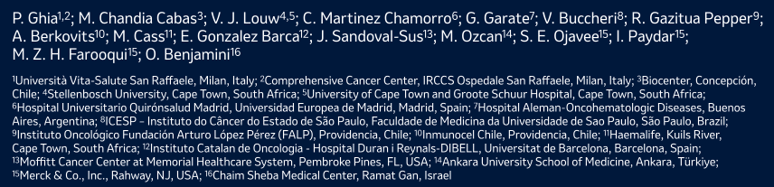
ASH 2025;Abstract 2119

Slide 110
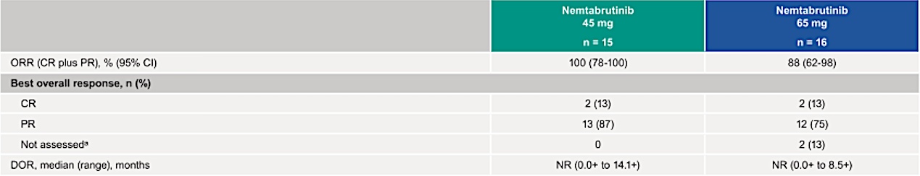
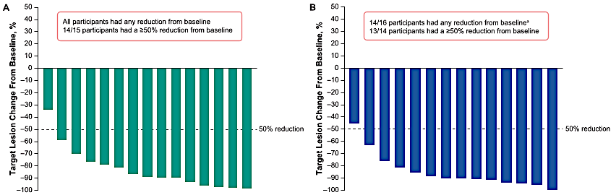
BELLWAVE-010: Response Data
Nemtabrutinib 45 mg
Nemtabrutinib 65 mg
Ghia P et al. ASH 2025;Abstract 2119; Ghia P et al. EHA 2026;Abstract PS1707.

Slide 111
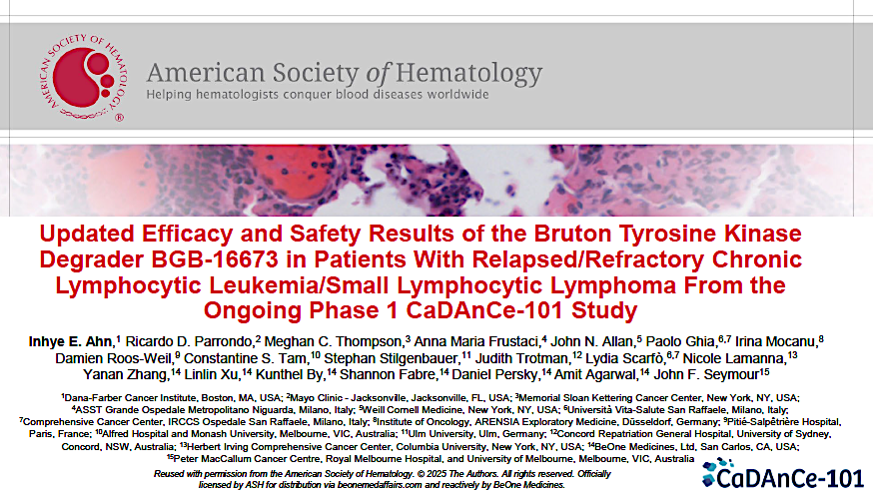
2025;Abstract 85

Slide 112

CaDAnCe-101: Response Data
Ahn I et al. ASH 2025;Abstract 85.

Slide 113
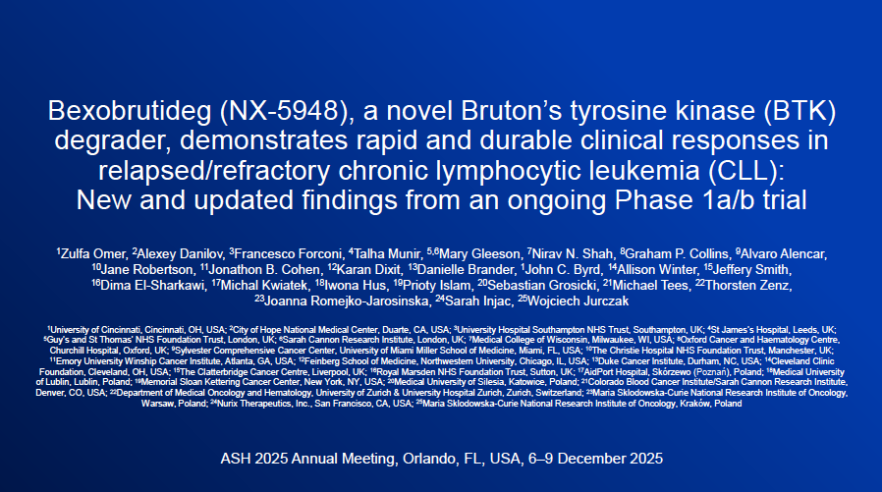
Abstract 86

Slide 114

Bexobrutideg (NX-5948): Objective Response Rate and Median Duration of Response
Omer Z et al. ASH 2025;Abstract 86.

Slide 115
Management of Relapsed/Refractory CLL
Introduction: Overview of Grand Rounds CLL Initiative
Module 1: Sequencing Roadmap
Module 2: Key Datasets — Pirtobrutinib
Module 3: Investigator Survey
Module 4: CAR T-Cell Therapy
Module 5: Other Novel Therapy Approaches
Module 6: EHA 2026

Slide 116
A Phase 2 Study of Fixed-Duration Pirtobrutinib and Obinutuzumab in Previously Untreated CLL
Ahn I et al.
EHA 2026;Abstract S148 (Oral).
Chronic Lymphocytic Leukemia and Related Disorders - Clinical
FRIDAY JUNE 12, 2026

Slide 117
Phase II Study of Pirtobrutinib and Obinutuzumab for Previously Untreated CLL
N = 60 pts in the initial cohort, 20% have completed end of combination therapy (EoCT) response assessment
Most common treatment-emergent adverse events:
  Bruising 30% (all grade [G] 1-2)
  Headache 22% (all G1-2)
Serious infection (5% or 3 pts with G3-4) and infusion-related reaction (2% or 1 pt with G2)
Treatment-emergent hypertension 7% (all G1-2)
Overall response rate (ORR) after C6: 75% (ITT analysis of initial cohort)
ORR after EoCT: 100% (25% CR) of 12 evaluable pts
Undetectable MRD rate in blood based on flow cytometry (<10-4) was 3% after C6 (n = 1/40) and 52% after EoCT (n = 13/25)
Conclusions
“Our early data suggest that fixed-duration pirtobrutinib and obinutuzumab have a favorable safety profile and a high rate of response in TN CLL, including pts achieving CR and undetectable MRD at EoCT. Additional pts and longer follow-up are needed for further evaluation of the efficacy and durability of disease control after treatment cessation.”
Ahn I et al. EHA 2026;Abstract S148.

Slide 118
Pirtobrutinib in Treatment-Naïve Patients with CLL/SLL: Pooled Results from BRUIN CLL-313 and BRUIN CLL-314
Woyach JA et al.
EHA 2026;Abstract PS1701 (Poster).
Chronic Lymphocytic Leukemia and Related Disorders - Clinical
THURSDAY JUNE 11, 2026

Slide 119
Real World Outcomes in 50 Patients with Chronic Lymphocytic Leukemia (CLL) Treated with Pirtobrutinib After a Covalent Bruton Tyrosine Kinase Inhibitor and a Bcl2 Inhibitor: A Gimema Study
Cuneo A et al.
EHA 2026;Abstract PS1712 (Poster).
Chronic Lymphocytic Leukemia and Related Disorders - Clinical
THURSDAY JUNE 11, 2026

Slide 120
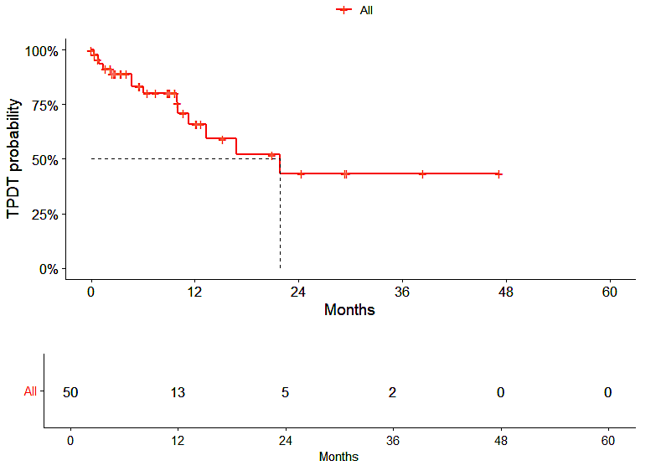
Real World Outcomes from the GIMEMA CLL2121 Study
N = 50 pts with double exposure to a covalent BTK inhibitor and to a Bcl-2 inhibitor (median age 70 years)
Overall response rate 57%
Conclusions
“Our findings show that pirtobrutinib proved to be efficacious and safe in a predominantly elderly and heavily pre-treated patient population. Though the number of patients is relatively small the effectiveness was not influenced by unfavorable clinicobiologic characteristics. The outcome after pirtobrutinib discontinuation was dismal and the causes of death were mostly related to disease progression and Richter transformation.”
Time to discontinuation for progression, death and toxicity (TPDT)
Cuneo A et al. EHA 2026;Abstract PS1712.

Slide 121
First-Line Treatment of CLL/SLL with the All-Oral Combination of Sonrotoclax and Zanubrutinib Achieves Undetectable Minimal Residual Disease Rates of >90%, Including in Patients with Del(17p)/Tp53
Cheah CY et al.
EHA 2026;Abstract S145 (Oral).
Chronic Lymphocytic Leukemia and Related Disorders - Clinical
FRIDAY JUNE 12, 2026

Slide 122
Venetoclax-Obinutuzumab for Previously Untreated Chronic Lymphocytic Leukemia: Final Results of the Randomized CLL14 Study
Fischer K et al.
EHA 2026;Abstract S146 (Oral).
Chronic Lymphocytic Leukemia and Related Disorders - Clinical
FRIDAY JUNE 12, 2026

Slide 123
Fixed Duration Venetoclax plus Epcoritamab Shows Favorable Tolerability and High Response Rates with Early Molecular Responses in R/R CLL/SLL: Interim Analysis of the Randomized HOVON 165/AETHER Trial
Kater AP et al.
EHA 2026;Abstract S154 (Oral).
Chronic Lymphocytic Leukemia and Related Disorders - Clinical
FRIDAY JUNE 12, 2026

Slide 124
Updated Efficacy and Safety Data from an Ongoing Phase 1a/b Trial of the BTK Degrader Bexobrutideg (NX-5948) in Patients with CLL Across Lines of Therapy
Munir T et al.
EHA 2026;Abstract S150 (Oral).
Chronic Lymphocytic Leukemia and Related Disorders - Clinical
FRIDAY JUNE 12, 2026

Slide 125
BGB-16673, a Bruton Tyrosine Kinase (BTK) Degrader, in Patients with Relapsed/Refractory (R/R) Chronic Lymphocytic Leukemia/Small Lymphocytic Lymphoma (CLL/SLL): A Phase 1 CaDAnCe-101 Study Update
Stilgenbauer S et al.
EHA 2026;Abstract S152 (Oral).
Chronic Lymphocytic Leukemia and Related Disorders - Clinical
FRIDAY JUNE 12, 2026

Slide 126
Dual Targeted Lentiviral Transduced
Anti-CD20/Anti-CD19 (LV20.19) CAR T Cells
for Relapsed, Refractory CLL
Shah NV et al.
EHA 2026;Abstract S154 (Oral).
Chronic Lymphocytic Leukemia and Related Disorders - Clinical
FRIDAY JUNE 12, 2026

Slide 127
OxPLoreD: A Multicentre UK-Wide Observational Study to Identify and Prospectively Validate Predictors of Disease Progression in Chronic Lymphocytic Leukaemia (CLL) and MBL
Xu D et al.
EHA 2026;Abstract S147 (Oral).
Chronic Lymphocytic Leukemia and Related Disorders - Clinical
FRIDAY JUNE 12, 2026

Slide 128
Year in Review: Clinical Investigator Perspectives on the
Most Relevant New Datasets and Advances in Oncology
Novel Treatment Approaches for Non-Hodgkin Lymphoma
A CME/MOC-Accredited Live Webinar
Wednesday, June 17, 2026
5:00 PM – 6:00 PM ET
Faculty
Matthew Matasar, MD
Sonali M Smith, MD
Moderator
Neil Love, MD

Slide 129
Thank you for joining us!
Please take a moment to complete the survey currently up on Zoom. Your feedback is very important to us.
The survey will remain open for
5 minutes after the meeting ends.
Information on how to obtain CME and ABIM MOC credit is provided in the Zoom chat room.
Attendees will also receive an email in 1 to 3 business days with these instructions.

