Slide 1
Optimizing Treatment for Patients with Relapsed/Refractory
Chronic Lymphocytic Leukemia
Catherine C Coombs, MD
Associate Clinical Professor
Division of Hematology/Oncology
Department of Medicine
UCI Health
Orange County, California

Slide 2
Disclosures
Advisory Committees | AbbVie Inc, Allogene Therapeutics, AstraZeneca Pharmaceuticals LP, BeOne, Bristol Myers Squibb, Genentech, a member of the Roche Group, Janssen Biotech Inc, Lilly, MingSight Pharmaceuticals, Pharmacyclics LLC, an AbbVie Company
Consulting Agreements | AbbVie Inc, AstraZeneca Pharmaceuticals LP, BeOne, Lilly, Octapharma
Contracted Research | AbbVie Inc, BeOne, Carna Biosciences, Lilly
Speakers Bureaus | AbbVie Inc, AstraZeneca Pharmaceuticals LP, BeOne, Genentech, a member of the Roche Group, Lilly
Stock Options/Stock — Public Companies | Geron Corporation, Pfizer Inc

Slide 3




Program Steering Committee
Catherine C Coombs, MD
Associate Clinical Professor
Division of Hematology/Oncology
Department of Medicine
UCI Health
Orange County, California
Bita Fakhri, MD, MPH
Assistant Professor of Medicine (Hematology)
Stanford University School of Medicine
Stanford, California
Matthew S Davids, MD, MMSc
Associate Professor of Medicine
Harvard Medical School
Leader, Lymphoma Program
Dana-Farber/Harvard Cancer Center
Director of Clinical Research
Division of Lymphoma
Dana-Farber Cancer Institute
Boston, Massachusetts
Nicole Lamanna, MD
Judy Horrigan Professor of Medicine
Director of the Chronic Lymphocytic
Leukemia Program
Leukemia Service
Hematologic Malignancies Section
Herbert Irving Comprehensive Cancer Center
NewYork-Presbyterian/Columbia University
Irving Medical Center
New York, New York

Slide 4



Program Steering Committee
Jeff Sharman, MD
Medical Director of Hematology Research
Sarah Cannon Research Institute
at Willamette Valley Cancer Center
Eugene, Oregon
PROJECT CHAIR
Neil Love, MD
Research To Practice
Miami, Florida
Jennifer Woyach, MD
Professor
Division of Hematology
Department of Internal Medicine
The Ohio State University Comprehensive Cancer Center
Columbus, Ohio

Slide 5
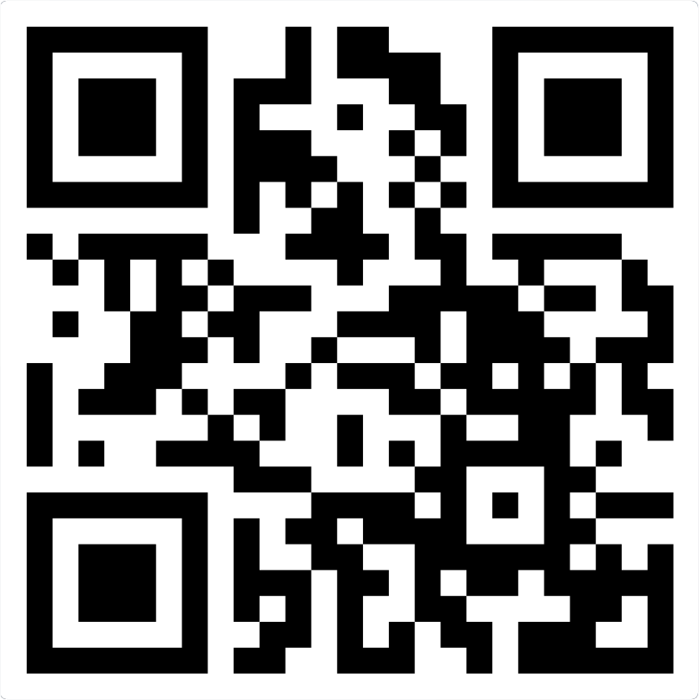
Please scan the QR code below
to participate in our live polling.
Join at:
vevox.app
ID:
412-286-150

Slide 6
Which of the following best represents your clinical background?
1/2
Join at: vevox.app
ID: 412-286-150
Question slide
a. Medical oncologist/hematologic oncologist
b. Radiation oncologist
c. Oncology/hematology fellow
d. Surgical oncologist or surgeon
e. Other MD
f. Nurse practitioner or physician assistant
g. Other nursing professional
h. Researcher
I. Other healthcare professional
j. Other

Slide 7
Which of the following best represents your clinical background?
1/2
Join at: vevox.app
ID: 412-286-150
Preparing Results
a. Medical oncologist/hematologic oncologist
0%
b. Radiation oncologist
0%
c. Oncology/hematology fellow
0%
d. Surgical oncologist or surgeon
100%
e. Other MD
0%
f. Nurse practitioner or physician assistant
0%
g. Other nursing professional
0%
h. Researcher
0%
I. Other healthcare professional
RESULTS SLIDE
0%
j. Other
0%

Slide 8
Key Datasets
Thompson PA, Tam CS. Pirtobrutinib: A new hope for patients with BTK inhibitor-refractory lymphoproliferative disorders. Blood 2023 June 29;141(26):3137-42.
Shah NN et al. Pirtobrutinib monotherapy in Bruton tyrosine kinase inhibitor-intolerant patients with B-cell malignancies: Results of the phase I/II BRUIN trial. Haematologica 2025 January 1;110(1):92-102.
Sharman JP et al. Phase III trial of pirtobrutinib versus idelalisib/rituximab or bendamustine/rituximab in covalent Bruton tyrosine kinase inhibitor-pretreated chronic lymphocytic leukemia/small lymphocytic lymphoma (BRUIN CLL-321). J Clin Oncol 2025 August;43(22):2538-49.
Galitzia A et al. Chronic lymphocytic leukemia: Management of adverse events in the era of targeted agents. Cancers (Basel) 2024 May 24;16(11):1996.
Jurczak W et al. Long-term safety with ≥12 months of pirtobrutinib in relapsed/refractory (R/R) B-cell malignancies. EHA 2023;Abstract P618.
Eyre TA et al. BRUIN CLL-322: A phase 3 open-label, randomized study of fixed duration pirtobrutinib plus venetoclax and rituximab versus venetoclax and rituximab in previously treated chronic lymphocytic leukemia/small lymphocytic lymphoma. ASCO 2023;Abstract TPS7583.
Woyach J et al. Pirtobrutinib vs ibrutinib in treatment-naïve and relapsed/refractory CLL/SLL: Results from the first randomized phase III study comparing a non-covalent and covalent BTK inhibitor. ASH 2025;Abstract 683.
Jurczak W et al. Pirtobrutinib vs bendamustine plus rituximab (BR) in patients with CLL/SLL: First results from a randomized phase III study examining a non-covalent BTK inhibitor in untreated patients. ASH 2025;Abstract LBA3.

Slide 9
Key Datasets
Siddiqi T et al. Lisocabtagene maraleucel (liso-cel) in R/R CLL/SLL: 24-month median follow-up of TRANSCEND CLL 004. ASH 2023;Abstract 330.
Wierda WG et al. Lisocabtagene maraleucel (liso-cel) combined with ibrutinib (ibr) for patients (pts) with relapsed or refractory (R/R) chronic lymphocytic leukemia (CLL)/small lymphocytic lymphoma (SLL): Primary results from the open-label, phase 1/2 Transcend CLL 004 study. ASH 2024;Abstract 887.

Slide 10
Key Datasets
Cassanello G et al. Trial watch: Bispecific antibodies for the treatment of relapsed or refractory large B-cell lymphoma. Oncoimmunology 2024 March 3;13(1):2321648.
Danilov A et al. Epcoritamab monotherapy in patients (pts) with relapsed or refractory (R/R) chronic lymphocytic leukemia (CLL): Results from CLL expansion and optimization cohorts of Epcore CLL-1. ASH 2024;Abstract 883.
Ahn I et al. Updated efficacy and safety results of the Bruton tyrosine kinase (BTK) degrader BGB-16673 in patients with relapsed/refractory chronic lymphocytic leukemia/small lymphocytic lymphoma (CLL/SLL) from the ongoing phase 1 CaDAnCe-101 study. ASH 2025;Abstract 85.
Shah NN et al. Efficacy and safety of the Bruton’s tyrosine kinase (BTK) degrader NX-5948 in patients with relapsed/refractory (R/R) chronic lymphocytic leukemia (CLL): Updated results from an ongoing phase 1a/b study. ASH 2024;Abstract 884.
Woyach JA et al. First-in-human study of the reversible BTK inhibitor nemtabrutinib in patients with relapsed/refractory chronic lymphocytic leukemia and B-cell non-Hodgkin lymphoma. Cancer Discov 2024;14(1):66-75.

Slide 11
Management of Double-Refractory CLL
Introduction: Sequencing of Treatment for CLL
Module 1: Clinician Survey Results
Module 2: Noncovalent BTK Inhibitor Pirtobrutinib
Module 3: Clinician Survey Results
Module 4: CAR T-Cell Therapy
Module 5: Clinician Survey Results
Module 6: Bispecific Antibodies and Promising Investigational Strategies

Slide 12
Management of Double-Refractory CLL
Introduction: Sequencing of Treatment for CLL
Module 1: Clinician Survey Results
Module 2: Noncovalent BTK Inhibitor Pirtobrutinib
Module 3: Clinician Survey Results
Module 4: CAR T-Cell Therapy
Module 5: Clinician Survey Results
Module 6: Bispecific Antibodies and Promising Investigational Strategies

Slide 13
Targeted Therapy Sequencing for CLL
Factors affecting timelines:
Age
Del(17p) / TP53-m
IGHV-MS / Del(11q)
Complex karyotype
cBTKi |  |  |  |  |  |  | BCL2i+CD20 |  |  | ncBTKi | ncBTKi
cBTKi |  |  |  |  |  |  | ncBTKi |  |  | BCL2i+CD20
BCL2i+CD20 |  |  |  |  |  | BCL2i+CD20 |  |  |  | cBTKi
BCL2i+CD20 |  |  |  |  |  | cBTKi |  |  |  |  | ncBTKi
1 | 2 | 3 | 4 | 5 | 6 | 7 | 8 | 9 | 10 | 11 | 12 | 13 | 14
cBTKi + BCL2i not included here
Years
Double Exposed vs. Double Refractory:
Exposed ≠ Refractory
Refractory=progression on treatment
Courtesy of William G Wierda, MD, PhD

Slide 14


Targeted Therapy Sequencing for CLL
Courtesy of William G Wierda, MD, PhD

Slide 15
Management of Double-Refractory CLL
Introduction: Sequencing of Treatment for CLL
Module 1: Clinician Survey Results
Module 2: Noncovalent BTK Inhibitor Pirtobrutinib
Module 3: Clinician Survey Results
Module 4: CAR T-Cell Therapy
Module 5: Clinician Survey Results
Module 6: Bispecific Antibodies and Promising Investigational Strategies

Slide 16
In general, what is the minimum duration of remission after second-line venetoclax/anti-CD20 antibody before you would consider retreatment as third-line therapy?
1/2
Join at: vevox.app
ID: 412-286-150
Question slide
a. At least 6 months
b. At least 12 months
c. At least 24 months
d. At least 36 months
e. I’m not sure

Slide 17
In general, what is the minimum duration of remission after second-line venetoclax/anti-CD20 antibody before you would consider retreatment as third-line therapy?
1/2
Join at: vevox.app
ID: 412-286-150
Preparing Results
a. At least 6 months
0%
b. At least 12 months
0%
c. At least 24 months
0%
d. At least 36 months
0%
e. I’m not sure
100%
RESULTS SLIDE

Slide 18
In general, what is the minimum duration of remission after second-line venetoclax/ anti-CD20 antibody before you would consider retreatment as third-line therapy?
12 months
12 months
24 months
>24 months
24-36 months
36 months

Slide 19
75-year-old patient with relapsed CLL, no del(17p) or TP53 mutation:
Covalent BTKi 6 years → PD → venetoclax/anti-CD20 antibody 2 years →
3 years observation → PD. What would be your preferred next treatment?
1/2
Join at: vevox.app
ID: 412-286-150
Question slide
a. Alternative covalent BTK inhibitor
b. Venetoclax/anti-CD20 antibody
c. Pirtobrutinib
d. CAR T-cell therapy
e. Bispecific antibody
f. I’m not sure
BTKi = Bruton tyrosine kinase inhibitor; PD = disease progression; CAR-T = chimeric antigen receptor T-cell therapy

Slide 20
75-year-old patient with relapsed CLL, no del(17p) or TP53 mutation:
Covalent BTKi 6 years → PD → venetoclax/anti-CD20 antibody 2 years →
3 years observation → PD. What would be your preferred next treatment?
1
Join at: vevox.app
ID: 412-286-150
Preparing Results
a. Alternative covalent BTK inhibitor
0%
b. Venetoclax/anti-CD20 antibody
100%
c. Pirtobrutinib
0%
d. CAR T-cell therapy
0%
e. Bispecific antibody
0%
f. I’m not sure
0%
RESULTS SLIDE
BTKi = Bruton tyrosine kinase inhibitor; PD = disease progression; CAR-T = chimeric antigen receptor T-cell therapy

Slide 21
75-year-old patient with relapsed CLL, no del(17p) or TP53 mutation:
Covalent BTKi 6 years → PD → venetoclax/anti-CD20 antibody 2 years →
3 years observation → PD
Venetoclax/anti-CD20 antibody
Venetoclax/anti-CD20 antibody
Pirtobrutinib
Venetoclax/anti-CD20 antibody
Pirtobrutinib bridge to CAR-T
Venetoclax/anti-CD20 antibody
BTKi = Bruton tyrosine kinase inhibitor; PD = disease progression; CAR-T = chimeric antigen receptor T-cell therapy

Slide 22
75-year-old patient with relapsed CLL, no del(17p) or TP53 mutation:
Covalent BTKi 6 years → PD → venetoclax/anti-CD20 antibody 2 years →
1 year observation → PD
Pirtobrutinib
Pirtobrutinib
Pirtobrutinib
Pirtobrutinib
Pirtobrutinib bridge to CAR-T
Pirtobrutinib

Slide 23
75-year-old patient with relapsed CLL, no del(17p) or TP53 mutation: Venetoclax/anti-CD20 antibody 1 year → 2 years observation → PD → covalent BTKi 4 years → PD. What would be your preferred next treatment?
1/2
Join at: vevox.app
ID: 412-286-150
Question slide
a. Alternative covalent BTK inhibitor
b. Venetoclax/anti-CD20 antibody
c. Pirtobrutinib
d. CAR T-cell therapy
e. Bispecific antibody
f. I’m not sure

Slide 24
75-year-old patient with relapsed CLL, no del(17p) or TP53 mutation: Venetoclax/anti-CD20 antibody 1 year → 2 years observation → PD → covalent BTKi 4 years → PD. What would be your preferred next treatment?
1/2
Join at: vevox.app
ID: 412-286-150
Preparing Results
a. Alternative covalent BTK inhibitor
0%
b. Venetoclax/anti-CD20 antibody
0%
c. Pirtobrutinib
0%
d. CAR T-cell therapy
100%
e. Bispecific antibody
0%
f. I’m not sure
0%
RESULTS SLIDE

Slide 25
75-year-old patient with relapsed CLL, no del(17p) or TP53 mutation: Venetoclax/anti-CD20 antibody 1 year → 2 years observation → PD → covalent BTKi 4 years → PD
Pirtobrutinib
Venetoclax/anti-CD20 antibody
Pirtobrutinib or rechallenge with venetoclax
Pirtobrutinib
Venetoclax/anti-CD20 antibody
Pirtobrutinib

Slide 26
75-year-old patient with relapsed CLL, no del(17p) or TP53 mutation: Venetoclax/anti-CD20 antibody 1 year → 4 years observation → PD → covalent BTKi 4 years → PD
Venetoclax/anti-CD20 antibody
Venetoclax/anti-CD20 antibody
Pirtobrutinib or rechallenge with venetoclax
Venetoclax/anti-CD20 antibody
Venetoclax/anti-CD20 antibody
Pirtobrutinib

Slide 27
75-year-old patient with relapsed CLL, no del(17p) or TP53 mutation:
Covalent BTKi 2 years → responds but stops due to subdural hematoma → 3 years observation → PD → venetoclax/anti-CD20 antibody 2 years → 6 months observation → PD
Pirtobrutinib
Venetoclax monotherapy
CAR T-cell therapy or epcoritamab on clinical trial
Venetoclax monotherapy
Pirtobrutinib or CAR-T
Pirtobrutinib or CAR-T

Slide 28
75-year-old patient with relapsed CLL, no del(17p) or TP53 mutation:
Covalent BTKi 2 years → responds but stops due to arthralgias → 2 years observation → PD → venetoclax/anti-CD20 antibody 2 years → 6 months observation → PD
Alternative covalent BTKi
Alternative covalent BTKi
Alternative covalent BTKi
Alternative covalent BTKi or pirtobrutinib
Alternative covalent BTKi
Alternative covalent BTKi

Slide 29
Management of Double-Refractory CLL
Introduction: Sequencing of Treatment for CLL
Module 1: Clinician Survey Results
Module 2: Noncovalent BTK Inhibitor Pirtobrutinib
Module 3: Clinician Survey Results
Module 4: CAR T-Cell Therapy
Module 5: Clinician Survey Results
Module 6: Bispecific Antibodies and Promising Investigational Strategies

Slide 30
Key Datasets
Thompson PA, Tam CS. Pirtobrutinib: A new hope for patients with BTK inhibitor-refractory lymphoproliferative disorders. Blood 2023 June 29;141(26):3137-42.
Shah NN et al. Pirtobrutinib monotherapy in Bruton tyrosine kinase inhibitor-intolerant patients with B-cell malignancies: Results of the phase I/II BRUIN trial. Haematologica 2025 January 1;110(1):92-102.
Sharman JP et al. Phase III trial of pirtobrutinib versus idelalisib/rituximab or bendamustine/rituximab in covalent Bruton tyrosine kinase inhibitor-pretreated chronic lymphocytic leukemia/small lymphocytic lymphoma (BRUIN CLL-321). J Clin Oncol 2025 August;43(22):2538-49.
Galitzia A et al. Chronic lymphocytic leukemia: Management of adverse events in the era of targeted agents. Cancers (Basel) 2024 May 24;16(11):1996.
Jurczak W et al. Long-term safety with ≥12 months of pirtobrutinib in relapsed/refractory (R/R) B-cell malignancies. EHA 2023;Abstract P618.
Eyre TA et al. BRUIN CLL-322: A phase 3 open-label, randomized study of fixed duration pirtobrutinib plus venetoclax and rituximab versus venetoclax and rituximab in previously treated chronic lymphocytic leukemia/small lymphocytic lymphoma. ASCO 2023;Abstract TPS7583.
Woyach J et al. Pirtobrutinib vs ibrutinib in treatment-naïve and relapsed/refractory CLL/SLL: Results from the first randomized phase III study comparing a non-covalent and covalent BTK inhibitor. ASH 2025;Abstract 683.
Jurczak W et al. Pirtobrutinib vs bendamustine plus rituximab (BR) in patients with CLL/SLL: First results from a randomized phase III study examining a non-covalent BTK inhibitor in untreated patients. ASH 2025;Abstract LBA3.

Slide 31

Key Differences Between Available Covalent and Reversible Bruton Tyrosine Kinase (BTK) Inhibitors
Thompson PA, Tam CS. Blood 2023;141(26):3137-42.

Slide 32

Haematologica 2025;110(1):92-102.

Slide 33

BRUIN: Pirtobrutinib Efficacy in Patients with CLL or SLL Who Received Prior BTK Inhibitor (BTKi) Treatment
Overall response rate 76.9%
SPD = sum of product diameters
Shah NN et al. Haematologica 2025;110(1):92-102.

Slide 34

BRUIN: Median Progression-Free Survival for Patients with CLL/SLL
Shah NN et al. Haematologica 2025;110(1):92-102.

Slide 35

BRUIN: Pirtobrutinib Safety Profile in the Overall Population
Shah NN et al. Haematologica 2025;110(1):92-102.

Slide 36
FDA Grants Traditional Approval to Pirtobrutinib for Chronic Lymphocytic Leukemia and Small Lymphocytic Lymphoma
Press Release: December 3, 2025
“... the Food and Drug Administration granted traditional approval to pirtobrutinib for adults with relapsed or refractory chronic lymphocytic leukemia or small lymphocytic lymphoma (CLL/SLL) who have previously been treated with a covalent BTK inhibitor.
Efficacy was evaluated in BRUIN-CLL-321 (NCT 04666038), a randomized, open-label, active-controlled trial. The trial randomized 238 patients who were previously treated for CLL/SLL, including a covalent BTK inhibitor. Patients previously treated with a non-covalent BTK inhibitor were not permitted. Patients were randomized (1:1) to receive either pirtobrutinib or investigator’s choice of idelalisib plus a rituximab product (IR) or bendamustine plus a rituximab product (BR).
Median PFS was 11.2 months (95% CI: 9.5, 11.4) in the pirtobrutinib arm and 8.7 months (95% CI: 7.2, 10.2) in the investigator’s choice of IR/BR arm (Hazard ratio 0.58 [95% CI: 0.38, 0.89]; p-value 0.0105). Of the 119 patients in the investigator’s choice arm, 50 crossed over to receive pirtobrutinib therapy. At an updated analysis with a median follow-up time of 19.8 months, the HR for overall survival (OS) was 1.09 (95% CI: 0.68, 1.75).”
https://www.fda.gov/drugs/resources-information-approved-drugs/fda-grants-traditional-approval-pirtobrutinib-chronic-lymphocytic-leukemia-and-small-lymphocytic

Slide 37

J Clin Oncol 2025;43:2538-49.

Slide 38
Which of the following best describes the major progression-free survival (PFS) findings from the Phase III BRUIN CLL-321 study of pirtobrutinib monotherapy versus idelalisib/rituximab or bendamustine/rituximab for relapsed/refractory CLL?
1/2
Join at: vevox.app
ID: 412-286-150
Question slide
a. Inferior PFS outcomes with pirtobrutinib monotherapy
b. A numerical but nonsignificant improvement in PFS with pirtobrutinib monotherapy
c. A statistically significant improvement in PFS with pirtobrutinib monotherapy
d. I'm not sure

Slide 39
Which of the following best describes the major progression-free survival (PFS) findings from the Phase III BRUIN CLL-321 study of pirtobrutinib monotherapy versus idelalisib/rituximab or bendamustine/rituximab for relapsed/refractory CLL?
1/2
Join at: vevox.app
ID: 412-286-150
Preparing Results
a. Inferior PFS outcomes with pirtobrutinib monotherapy
0%
b. A numerical but nonsignificant improvement in PFS with pirtobrutinib monotherapy
0%
c. A statistically significant improvement in PFS with pirtobrutinib monotherapy
100%
d. I'm not sure
0%
RESULTS SLIDE

Slide 40

BRUIN CLL-321: A Phase III Trial of Pirtobrutinib Monotherapy for Relapsed/Refractory CLL
Sharman JP et al. ASH 2024;Abstract 886.

Slide 41

BRUIN CLL-321: IRC-Assessed Progression-Free Survival (PFS)
IRC = independent review committee
Sharman JP et al. J Clin Oncol 2025;43:2538-49.

Slide 42

BRUIN CLL-321: Time to Next Treatment
Sharman JP et al. J Clin Oncol 2025;43:2538-49.

Slide 43

BRUIN CLL-321: Overall Survival
Sharman JP et al. J Clin Oncol 2025;43:2538-49.

Slide 44
Which of the following ≥Grade 3 adverse events was most commonly reported in patients receiving pirtobrutinib for previously treated CLL in the Phase III BRUIN CLL-321 trial?
1/2
Join at: vevox.app
ID: 412-286-150
Question slide
a. Atrial fibrillation
b. Infections
c. Keratitis
d. Hemorrhage
e. I’m not sure

Slide 45
Which of the following ≥Grade 3 adverse events was most commonly reported in patients receiving pirtobrutinib for previously treated CLL in the Phase III BRUIN CLL-321 trial?
1/2
Join at: vevox.app
ID: 412-286-150
Preparing Results
a. Atrial fibrillation
0%
b. Infections
0%
c. Keratitis
0%
d. Hemorrhage
100%
e. I’m not sure
0%
RESULTS SLIDE

Slide 46

BRUIN CLL-321: Safety Profile
TEAE = treatment-emergent adverse event; IR = incidence rate; IRR = IR ratio
Sharman JP et al. J Clin Oncol 2025;43:2538-49.

Slide 47
Incidence and Management Recommendations for Select BTK Inhibitor-Associated Cardiologic Adverse Events and Bleeding
Adverse event | BTK inhibitor | Incidence Any grade, Grade ≥3 % | Management
Atrial fibrillation | Ibrutinib | 16, 2-5 | Avoid stroke; anticoagulation Better symptom control: rate vs rhythm Cardiovascular and other comorbidity management
 | Acalabrutinib | 6-9, 1-5
 | Zanubrutinib | 3-6, ≤1
 | Pirtobrutinib | 2.8, 1.2
Hypertension | Ibrutinib | 16-23, 8-12 | Correct predisposing factors Antihypertensive therapy
 | Acalabrutinib | 7-9, 3-4
 | Zanubrutinib | 14-17, 6-15
 | Pirtobrutinib | 9.2, 2.3
Bleeding | Ibrutinib | 36-51, 3-4 | Minor bleeding: no intervention Major bleeding: Consider treatment discontinuation Platelet transfusions regardless of platelet counts
 | Acalabrutinib | 36-51, 3
 | Zanubrutinib | 36-45, 3
 | Pirtobrutinib | —
Galitzia A et al. Cancers 2024;16:1996; Jurczak W et al. EHA 2023;Abstract P618.

Slide 48
Incidence and Management Recommendations for Select BTK Inhibitor-Associated Noncardiovascular Adverse Events
Adverse event | BTK inhibitor | Incidence Any grade, Grade ≥3 % | Management
Neutropenia | Ibrutinib | 25-39, 13-31 | Growth factor support
 | Acalabrutinib | 21-23, 13-19
 | Zanubrutinib | 37-34, 15-19
 | Pirtobrutinib | 25, 20.3
Diarrhea | Ibrutinib | 22-59, <1-4 | Symptomatic treatments and dose adjustments Dietary modifications, hydration, anti-diarrheal medications Probiotics
 | Acalabrutinib | 18-39, 1-5
 | Zanubrutinib | 14-18, <1-2
 | Pirtobrutinib | 24.2, 0-9
Headache | Ibrutinib | 14-18, 1-2 | Moderate dose of caffeine or acetaminophen
 | Acalabrutinib | 22-39, <1
 | Zanubrutinib | 11-12, 0-1
 | Pirtobrutinib | 13.1, 0.5
Galitzia A et al. Cancers 2024;16:1996; Jurczak W et al. EHA 2023;Abstract P618.

Slide 49

BRUIN CLL-322: An Ongoing Phase III Trial of Pirtobrutinib and Venetoclax/Rituximab for Relapsed/Refractory CLL
Primary endpoint: Progression-free survival per iwCLL 2018 by IRC
Eyre TA et al. ASCO 2023;Abstract TPS7583. Wierda WG et al. SOHO 2022;Abstract CLL-322.

Slide 50
Which of the following descriptions best characterizes the study design of the BRUIN CLL-314 trial?
1/2
Join at: vevox.app
ID: 412-286-150
Question slide
a. A Phase II study evaluating time-limited pirtobrutinib for patients with CLL that was pretreated with prior BTK inhibitor and Bcl-2 inhibitor therapy
b. A Phase III superiority study evaluating pirtobrutinib versus ibrutinib for relapsed/refractory CLL
c. A Phase III noninferiority study evaluating pirtobrutinib versus ibrutinib for patients with CLL that was treatment-naïve or pretreated with non-BTK inhibitor therapy
d. I’m not sure

Slide 51
Which of the following descriptions best characterizes the study design of the BRUIN CLL-314 trial?
1/2
Join at: vevox.app
ID: 412-286-150
Preparing Results
a. A Phase II study evaluating time-limited pirtobrutinib for patients with CLL that was pretreated with prior BTK inhibitor and Bcl-2 inhibitor therapy
0%
b. A Phase III superiority study evaluating pirtobrutinib versus ibrutinib for relapsed/refractory CLL
0%
c. A Phase III noninferiority study evaluating pirtobrutinib versus ibrutinib for patients with CLL that was treatment-naïve or pretreated with non-BTK inhibitor therapy
100%
d. I’m not sure
0%
RESULTS SLIDE

Slide 52

ASH 2025;Abstract 683.

Slide 53

BRUIN CLL-314 Study Design
TN = treatment naïve
Woyach J et al. ASH 2025;Abstract 683; Woyach JA et al. J Clin Oncol 2025 December 7;[Online ahead of print].

Slide 54

BRUIN CLL-314: Response Data
ORR = overall response rate; NI = noninferiority; PR-L = partial remission with lymphocytosis
Woyach J et al. ASH 2025;Abstract 683; Woyach JA et al. J Clin Oncol 2025 December 7;[Online ahead of print].

Slide 55

BRUIN CLL-314: PFS in ITT Population
ITT = intent to treat
Woyach J et al. ASH 2025;Abstract 683; Woyach JA et al. J Clin Oncol 2025 December 7;[Online ahead of print].

Slide 56

BRUIN CLL-314: PFS by Prior Treatment Status
Woyach J et al. ASH 2025;Abstract 683; Woyach JA et al. J Clin Oncol 2025 December 7;[Online ahead of print].

Slide 57

BRUIN CLL-314: Safety Profile
Woyach J et al. ASH 2025;Abstract 683; Woyach JA et al. J Clin Oncol 2025 December 7;[Online ahead of print].

Slide 58

BRUIN CLL-314: Adverse Events of Special Interest (AESI)
Woyach J et al. ASH 2025;Abstract 683; Woyach JA et al. J Clin Oncol 2025 December 7;[Online ahead of print].

Slide 59

ASH 2025;Abstract LBA3.

Slide 60

BRUIN CLL-313 Study Design
Jurczak W et al. ASH 2025;Abstract LBA3; J Clin Oncol 2025 December 9;[Online ahead of print].

Slide 61

BRUIN CLL-313: Response Data
ORR = overall response rate; PR = partial response
Jurczak W et al. ASH 2025;Abstract LBA3; J Clin Oncol 2025 December 9;[Online ahead of print].

Slide 62

BRUIN CLL-313: PFS Outcomes
Jurczak W et al. ASH 2025;Abstract LBA3; J Clin Oncol 2025 December 9;[Online ahead of print].

Slide 63

BRUIN CLL-313: OS Outcomes
Jurczak W et al. ASH 2025;Abstract LBA3; J Clin Oncol 2025 December 9;[Online ahead of print].

Slide 64

BRUIN CLL-313: Safety Profile
EAIR = exposure-adjusted incidence rate
Jurczak W et al. ASH 2025;Abstract LBA3; J Clin Oncol 2025 December 9;[Online ahead of print].

Slide 65

BRUIN CLL-313: AEs of Special Interest
Jurczak W et al. ASH 2025;Abstract LBA3; J Clin Oncol 2025 December 9;[Online ahead of print].

Slide 66
Management of Double-Refractory CLL
Introduction: Sequencing of Treatment for CLL
Module 1: Clinician Survey Results
Module 2: Noncovalent BTK Inhibitor Pirtobrutinib
Module 3: Clinician Survey Results
Module 4: CAR T-Cell Therapy
Module 5: Clinician Survey Results
Module 6: Bispecific Antibodies and Promising Investigational Strategies

Slide 67
Based on current clinical trial data and your personal experience, how would you compare the global tolerability/toxicity of pirtobrutinib to that of ibrutinib, acalabrutinib and zanubrutinib for patients with relapsed/refractory CLL?
1/2
Join at: vevox.app
ID: 412-286-150
Question slide
a. About the same
b. Ibrutinib has the least toxicity
c. Acalabrutinib has the least toxicity
d. Zanubrutinib has the least toxicity
e. Pirtobrutinib has the least toxicity
f. I’m not sure

Slide 68
Based on current clinical trial data and your personal experience, how would you compare the global tolerability/toxicity of pirtobrutinib to that of ibrutinib, acalabrutinib and zanubrutinib for patients with relapsed/refractory CLL?
1/2
Join at: vevox.app
ID: 412-286-150
Preparing Results
a. About the same
0%
b. Ibrutinib has the least toxicity
0%
c. Acalabrutinib has the least toxicity
100%
d. Zanubrutinib has the least toxicity
0%
e. Pirtobrutinib has the least toxicity
0%
f. I’m not sure
RESULTS SLIDE
0%

Slide 69
Based on current clinical trial data and your personal experience, how would you compare the global efficacy and tolerability/toxicity of pirtobrutinib to that of ibrutinib, acalabrutinib and zanubrutinib for patients with relapsed/refractory CLL?
Efficacy
Tolerability/toxicity
There are not enough
available data at this time
Pirtobrutinib has the least toxicity
About the same
Pirtobrutinib has the least toxicity
There are not enough
available data at this time
Pirtobrutinib has the least toxicity
About the same
Pirtobrutinib has the least toxicity
There are not enough
available data at this time
Pirtobrutinib has the least toxicity
There are not enough
available data at this time
Pirtobrutinib has the least toxicity

Slide 70
An older patient with newly diagnosed CLL and a significant history of atrial fibrillation has come to you for a second opinion following the recommendation of first-line treatment with pirtobrutinib. How would you respond?
1/2
Join at: vevox.app
ID: 412-286-150
Question slide
a. I agree with this recommendation
b. I do not agree with the recommendation, but it is a valid option
c. I do not agree with this recommendation

Slide 71
An older patient with newly diagnosed CLL and a significant history of atrial fibrillation has come to you for a second opinion following the recommendation of first-line treatment with pirtobrutinib. How would you respond?
1
Join at: vevox.app
ID: 412-286-150
Preparing Results
a. I agree with this recommendation
0%
b. I do not agree with the recommendation, but it is a valid option
0%
c. I do not agree with this recommendation
100%
RESULTS SLIDE

Slide 72
An older patient with newly diagnosed CLL and a significant history of atrial fibrillation has come to you for a second opinion after the recommendation of first-line treatment with pirtobrutinib. How would you respond?
I do not agree with the recommendation, but it is a valid option
I do not agree with the recommendation, but it is a valid option
I do not agree with the recommendation, but it is a valid option
I do not agree with this recommendation
I do not agree with this recommendation
I agree with this recommendation

Slide 73
Management of Double-Refractory CLL
Introduction: Sequencing of Treatment for CLL
Module 1: Clinician Survey Results
Module 2: Noncovalent BTK Inhibitor Pirtobrutinib
Module 3: Clinician Survey Results
Module 4: CAR T-Cell Therapy
Module 5: Clinician Survey Results
Module 6: Bispecific Antibodies and Promising Investigational Strategies

Slide 74
Key Datasets
Siddiqi T et al. Lisocabtagene maraleucel (liso-cel) in R/R CLL/SLL: 24-month median follow-up of TRANSCEND CLL 004. ASH 2023;Abstract 330.
Wierda WG et al. Lisocabtagene maraleucel (liso-cel) combined with ibrutinib (ibr) for patients (pts) with relapsed or refractory (R/R) chronic lymphocytic leukemia (CLL)/small lymphocytic lymphoma (SLL): Primary results from the open-label, phase 1/2 Transcend CLL 004 study. ASH 2024;Abstract 887.

Slide 75


Slide 76

TRANSCEND CLL 004: Duration of Response by Best Overall Response
PEAS (BTKi progression/venetoclax failure subset) at DL2 (n = 50)
Full Study Population at DL2 (n = 88)
Siddiqi T et al. ASH 2023;Abstract 330.

Slide 77
FDA Grants Accelerated Approval to Lisocabtagene Maraleucel for Relapsed/Refractory (R/R) CLL or SLL
Press Release: March 14, 2024
“… the US Food and Drug Administration (FDA) has granted accelerated approval of lisocabtagene maraleucel (liso-cel), a CD19-directed chimeric antigen receptor (CAR) T cell therapy, for the treatment of adult patients with relapsed or refractory chronic lymphocytic leukemia (CLL) or small lymphocytic lymphoma (SLL) who have received at least two prior lines of therapy, including a Bruton tyrosine kinase (BTK) inhibitor and a B-cell lymphoma 2 (BCL-2) inhibitor. This indication is approved under accelerated approval based on response rate and duration of response. Continued approval for this indication may be contingent upon verification and description of clinical benefit in confirmatory trial(s). In R/R CLL or SLL, liso-cel is delivered through a treatment process which culminates in a one-time infusion with a single dose containing 90 to 110 x 10⁶ CAR-positive viable T cells.”
Accelerated approval was based on results from the Phase I/II open-label, single-arm TRANSCEND CLL 004 study for patients with R/R CLL or SLL.
https://news.bms.com/news/details/2024/U.S.-FDA-Approves-Bristol-Myers-Squibbs-Breyanzi--as-the-First-and-Only-CAR-T-Cell-Therapy-for-Adults-with-Relapsed-or-Refractory-Chronic-Lymphocytic-Leukemia-CLL-or-Small-Lymphocytic-Lymphoma-SLL/default.aspx

Slide 78


Slide 79

TRANSCEND CLL 004: Lisocabtagene Maraleucel (Liso-cel) and Ibrutinib Combination Cohort
Wierda WG et al. ASH 2024;Abstract 887.

Slide 80

TRANSCEND CLL 004: Efficacy Outcomes with Liso-cel and Ibrutinib
CR = complete response; CRi = CR with incomplete marrow recovery; ORR = overall response rate
Wierda WG et al. ASH 2024;Abstract 887.

Slide 81

TRANSCEND CLL 004: Incidence of Cytokine Release Syndrome (CRS) and Neurological Adverse Events (NEs) with Liso-cel and Ibrutinib
Wierda WG et al. ASH 2024;Abstract 887.

Slide 82
Management of Double-Refractory CLL
Introduction: Sequencing of Treatment for CLL
Module 1: Clinician Survey Results
Module 2: Noncovalent BTK Inhibitor Pirtobrutinib
Module 3: Clinician Survey Results
Module 4: CAR T-Cell Therapy
Module 5: Clinician Survey Results
Module 6: Bispecific Antibodies and Promising Investigational Strategies

Slide 83
At what point in the treatment course are you referring patients with multiregimen-relapsed CLL for consultation regarding chimeric antigen receptor (CAR) T-cell therapy?
1/2
Join at: vevox.app
ID: 412-286-150
Question slide
a. At first relapse
b. At second relapse
c. At third relapse
d. After third relapse
e. I am not referring patients with CLL for CAR T-cell therapy
f. I’m not sure

Slide 84
At what point in the treatment course are you referring patients with multiregimen-relapsed CLL for consultation regarding chimeric antigen receptor (CAR) T-cell therapy?
1/2
Join at: vevox.app
ID: 412-286-150
Preparing Results
a. At first relapse
0%
b. At second relapse
0%
c. At third relapse
100%
d. After third relapse
0%
e. I am not referring patients with CLL for CAR T-cell therapy
0%
f. I’m not sure
0%
RESULTS SLIDE

Slide 85
At what point in the treatment course are you referring patients with multiregimen-relapsed CLL for consultation regarding chimeric antigen receptor (CAR) T-cell therapy?
After third relapse
After third relapse
At third relapse
After third relapse
At second relapse
At second relapse

Slide 86
Approximately how many patients with CLL in your practice have received CAR T-cell therapy on or off protocol?
0 patients
10 patients
20 patients
5 patients
4 patients
10 patients

Slide 87
Management of Double-Refractory CLL
Introduction: Sequencing of Treatment for CLL
Module 1: Clinician Survey Results
Module 2: Noncovalent BTK Inhibitor Pirtobrutinib
Module 3: Clinician Survey Results
Module 4: CAR T-Cell Therapy
Module 5: Clinician Survey Results
Module 6: Bispecific Antibodies and Promising Investigational Strategies

Slide 88
Key Datasets
Cassanello G et al. Trial watch: Bispecific antibodies for the treatment of relapsed or refractory large B-cell lymphoma. Oncoimmunology 2024 March 3;13(1):2321648.
Danilov A et al. Epcoritamab monotherapy in patients (pts) with relapsed or refractory (R/R) chronic lymphocytic leukemia (CLL): Results from CLL expansion and optimization cohorts of Epcore CLL-1. ASH 2024;Abstract 883.
Ahn I et al. Updated efficacy and safety results of the Bruton tyrosine kinase (BTK) degrader BGB-16673 in patients with relapsed/refractory chronic lymphocytic leukemia/small lymphocytic lymphoma (CLL/SLL) from the ongoing phase 1 CaDAnCe-101 study. ASH 2025;Abstract 85.
Shah NN et al. Efficacy and safety of the Bruton’s tyrosine kinase (BTK) degrader NX-5948 in patients with relapsed/refractory (R/R) chronic lymphocytic leukemia (CLL): Updated results from an ongoing phase 1a/b study. ASH 2024;Abstract 884.
Woyach JA et al. First-in-human study of the reversible BTK inhibitor nemtabrutinib in patients with relapsed/refractory chronic lymphocytic leukemia and B-cell non-Hodgkin lymphoma. Cancer Discov 2024;14(1):66-75.

Slide 89

Mechanism of Action of CD20 x CD3 Bispecific Antibodies
Cassanello G et al. Oncoimmunology 2024;13(1):2321648.

Slide 90

ASH 2024;Abstract 883

Slide 91

EPCORE CLL-1 Trial Expansion and Cycle 1 Optimization
ICANS = immune effector cell-associated neurotoxicity syndrome; TLS = tumor lysis syndrome; PMBC = peripheral blood mononuclear cell
Danilov A et al. ASH 2024;Abstract 883.

Slide 92

EPCORE CLL-1: Response Across Subgroups
Danilov A et al. ASH 2024;Abstract 883.

Slide 93

EPCORE CLL-1: Treatment-Emergent Adverse Events (TEAES)
Danilov A et al. ASH 2024;Abstract 883.

Slide 94


BGB-16673: A Chimeric Degradation Activating Compound
BGB-16673 is an orally available protein degrader that blocks BTK signaling by tagging BTK for degradation through the cell’s proteasome pathway, leading to tumor regression
Scarfò L et al. EHA 2025;Abstract S158.

Slide 95

CaDAnCe-101: A Phase I/II Dose-Escalation/Expansion Study of BGB-16673 for R/R B-Cell Cancers
Scarfò L et al. EHA 2025;Abstract S158.

Slide 96

CaDAnCe-101: Response Data
Ahn I et al. ASH 2025;Abstract 85.

Slide 97

CaDAnCe-101: Overall Response Rate in High-Risk Subgroups
cBTKi = covalent BTK inhibitor; BCL2i = Bcl-2 inhibitor; ncBTKi = noncovalent BTK inhibitor
Ahn I et al. ASH 2025;Abstract 85.

Slide 98

CaDAnCe-101: PFS Outcomes
Ahn I et al. ASH 2025;Abstract 85.

Slide 99

CaDAnCe-101: Safety Profile
Neutropenic fever: n=1
Ahn I et al. ASH 2025;Abstract 85.

Slide 100
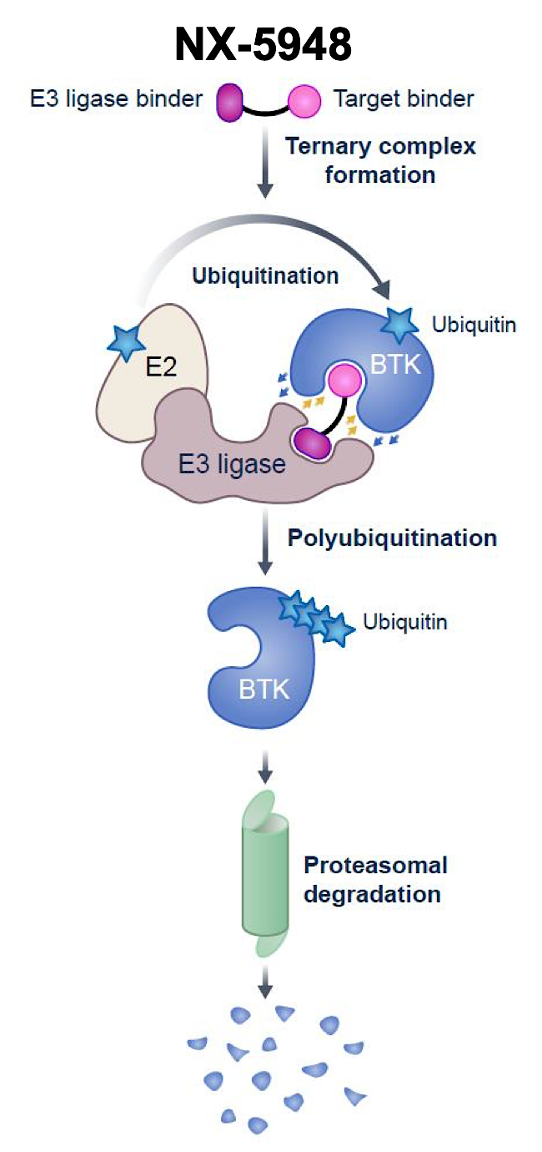
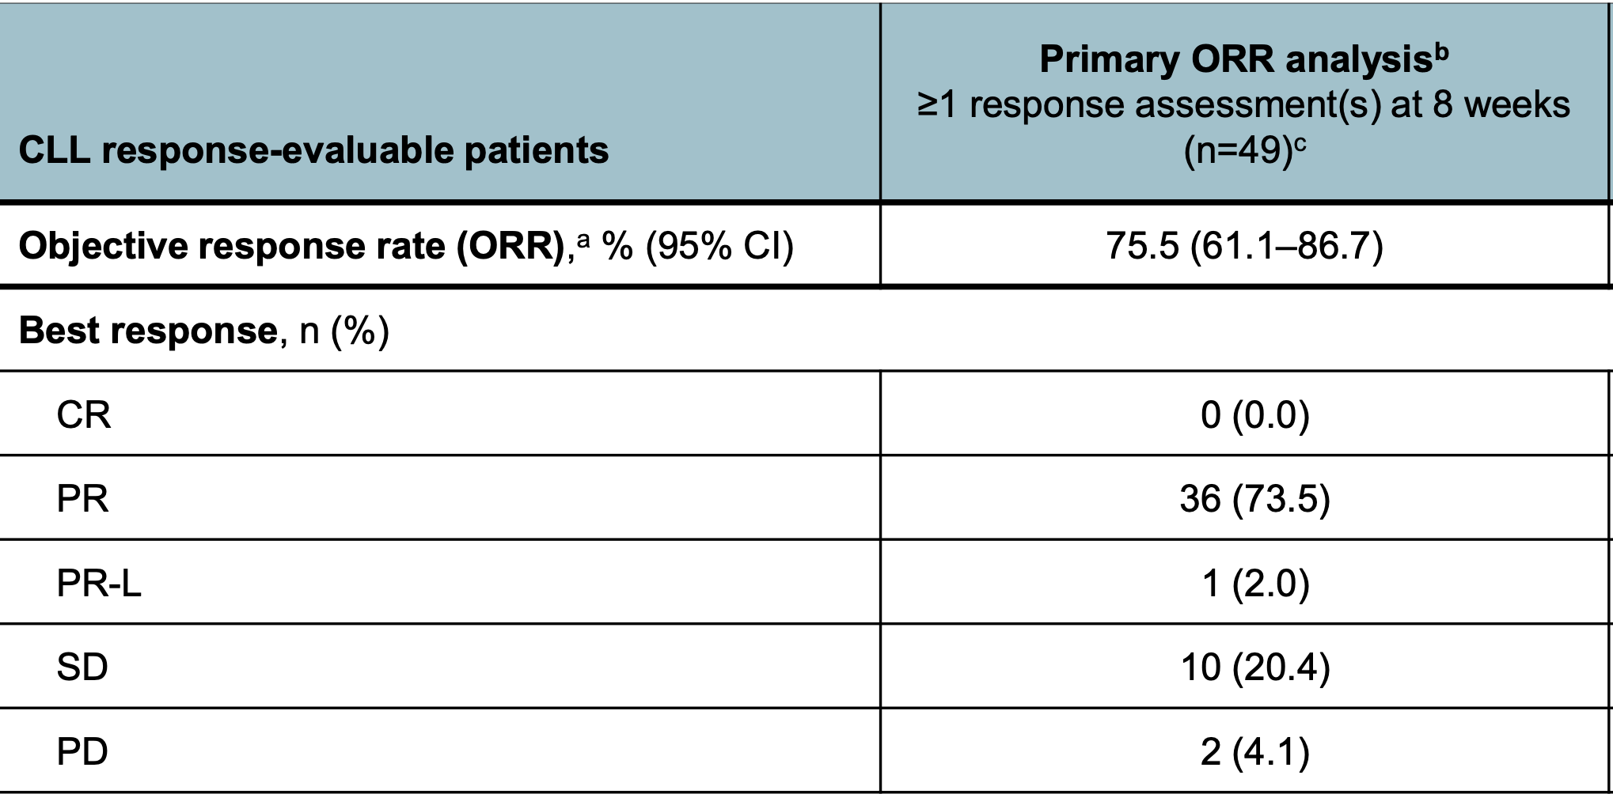
NX-5948: A Novel BTK Degrader
Shah NN et al. ASH 2024;Abstract 884.

Slide 101
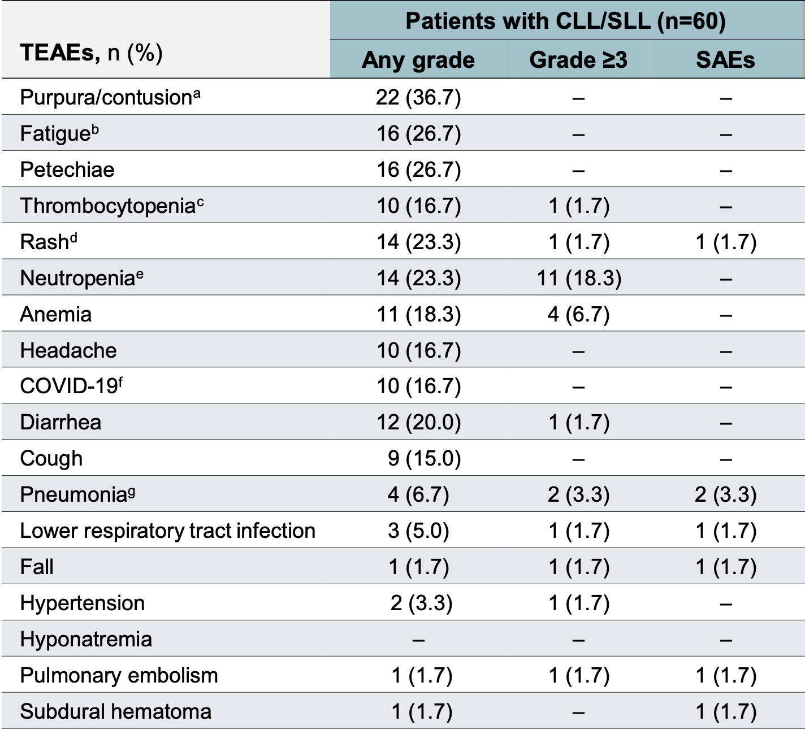
NX-5948: A Novel BTK Degrader – Safety Profile
TEAE = treatment-emergent adverse event; SAE = serious adverse event
Shah NN et al. ASH 2024;Abstract 884.

Slide 102

Nemtabrutinib: A Novel Reversible BTK Inhibitor
In a Phase I study, among the 22 patients with CLL, 8 (36.4%) achieved at least a partial remission with lymphocytosis as best response.
Among the 47 patients with CLL or NHL in the safety analysis, atrial fibrillation was reported in 1 patient (Grade 3), and no ventricular arrhythmias or unexplained deaths were reported. Hypertension was reported in 32% of patients (Grade 2 in 17%, Grade 3 in 15%).
Woyach JA et al. Cancer Discov 2024;14(1):66-75.

Slide 103
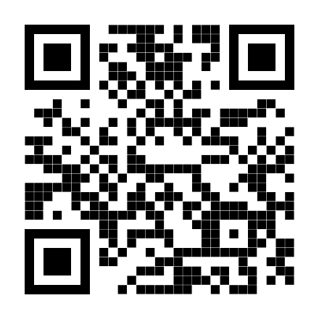
Thank you for attending!
Please complete the postactivity educational survey by scanning
the QR code below, and receive a $50 Amazon gift card.
Your input is greatly appreciated and helps
guide our future educational activities.

