Slide 1

Welcome!
Please complete the preactivity educational survey
by scanning the QR code below.
Your input is greatly appreciated and helps
guide our future educational activities.

Slide 2
Optimizing Therapy for Patients with Hormone Receptor-Positive Localized Breast Cancer
Jane Lowe Meisel, MD
Professor of Hematology and Medical Oncology
Co-Director, Breast Medical Oncology
Associate Vice Chair of Faculty Development and Promotions
Winship Cancer Institute of Emory University
Atlanta, Georgia

Slide 3
Disclosures
Advisory Committees | AstraZeneca Pharmaceuticals LP, GE Healthcare, Novartis, Olema Oncology, Pfizer Inc, Sermonix Pharmaceuticals
Consulting Agreements and Contracted Research | AstraZeneca Pharmaceuticals LP, Olema Oncology, Pfizer Inc, Sermonix Pharmaceuticals
Nonrelevant Financial Relationships | ASCO (DSMB, CDK dosing study)

Slide 4





Program Steering Committee
Adam M Brufsky, MD, PhD
Professor of Medicine
UPMC Hillman Cancer Center
Department of Medicine
University of Pittsburgh
Pittsburgh, Pennsylvania
Komal Jhaveri, MD, FACP, FASCO
Patricia and James Cayne Chair for
Junior Faculty
Associate Attending Physician
Breast Medicine Service and Early Drug Development Service
Section Head, Endocrine Therapy
Research Program
Clinical Director, Early Drug
Development Service
Department of Medicine
Memorial Sloan Kettering Cancer Center
Associate Professor of Medicine
Weill Cornell College of Medicine
New York, New York
Nan Chen, MD
Assistant Professor
The University of Chicago
Chicago, Illinois
Angela DeMichele, MD, MSCE
Mariann T and Robert J MacDonald Professor in Breast Cancer
Director, Clinical/Translational Research, Solid Tumor Oncology Hematology/Oncology Division
Co-Leader, Breast Cancer Program
Abramson Cancer Center
Co-Director, 2-PREVENT Breast Cancer Translational Center
of Excellence
Senior Scholar, Center for Clinical Epidemiology and Biostatistics
Perelman School of Medicine
University of Pennsylvania
Philadelphia, Pennsylvania
Kevin Kalinsky, MD, MS, FASCO
Professor of Medicine
Director, Division of Medical Oncology
Louisa and Rand Glenn Family Chair in Breast Cancer Research
Winship Cancer Institute at Emory University
Atlanta, Georgia

Slide 5






Program Steering Committee
Reshma L Mahtani, DO
Chief of Breast Medical Oncology
Baptist Health Herbert Wertheim Cancer Institute
Miami, Florida
Jason A Mouabbi, MD
Assistant Professor, Breast Medical Oncology
SAB Chair of the Lobular Breast Cancer Alliance
The University of Texas MD Anderson Cancer Center
Houston, Texas
Erica Mayer, MD, MPH, FASCO
Director of Breast Cancer Clinical Research
Breast Oncology Center
Dana-Farber Cancer Institute
Associate Professor of Medicine
Harvard Medical School
Boston, Massachusetts
Rita Nanda, MD
Director, Breast Oncology
Associate Professor of Medicine
Section of Hematology/Oncology
The University of Chicago
Chicago, Illinois
Jane Lowe Meisel, MD
Professor of Hematology and Medical Oncology
Co-Director, Breast Medical Oncology
Associate Vice Chair of Faculty Development and Promotions
Winship Cancer Institute of Emory University
Atlanta, Georgia
Hope S Rugo, MD
Director, Women’s Cancers Program
Division Chief, Breast Medical Oncology
Professor, Department of Medical Oncology and Therapeutics Research
City of Hope Comprehensive Cancer Center
Duarte, California
Professor Emeritus, UCSF

Slide 6




Program Steering Committee
Priyanka Sharma, MD
Frank B Tyler Professor in Cancer Research
Division of Medical Oncology, Department
of Internal Medicine
Co-Program Leader
Drug Discovery, Delivery and Experimental Therapeutics Program
The University of Kansas Cancer Center
Westwood, Kansas
Erica Stringer-Reasor, MD
Associate Professor, Division of Hematology Oncology
Vice Chair of Access and Engagement, DOM
Director, Breast Cancer Program
UAB O’Neal Comprehensive Cancer Center
Birmingham, Alabama
Rebecca Shatsky, MD
Professor of Clinical Medicine
Breast Medical Oncology Team Leader
Director of Breast Cancer Clinical Trials
Director of Inflammatory and Triple Negative Breast Cancer Program
University of California San Diego
Moores Cancer Center
San Diego, California
PROJECT CHAIR
Neil Love, MD
Research To Practice
Miami, Florida

Slide 7
Key Datasets
Andre F et al. Biomarkers for adjuvant endocrine and chemotherapy in early-stage breast cancer: ASCO Guideline update.
J Clin Oncol 2022;40:1816-37.
Sparano JA et al. Trial Assigning Individualized Options for treatment (TAILORx): An update including 12-year event rates. San Antonio Breast Cancer Symposium 2022;Abstract GS1-05.
Sparano JA et al. Clinical outcomes in early breast cancer with a high 21-gene Recurrence Score of 26 to 100 assigned to adjuvant chemotherapy plus endocrine therapy: A secondary analysis of the TAILORx randomized clinical trial. JAMA Oncol 2020;6(3):367-74.
Chen N et al. Impact of anthracyclines in genomic high-risk, node-negative, HR-positive/HER2-negative breast cancer. Ann Oncol 2025;36(11):1356-65.
O’Shaughnessy J et al. Improved 3-year IDFS with anthracycline-based therapy for patients with 70-gene signature high 2, luminal B, HR+HER2- early-stage breast cancer. San Antonio Breast Cancer Symposium 2025;Abstract PS2-07-03.
Kalinsky K et al. 21-gene assay to inform chemotherapy benefit in node-positive breast cancer. N Engl J Med 2021; 385(25):2336-47.
Piccart M et al. 70-gene signature as an aid for treatment decisions in early breast cancer: Updated results of the phase 3 randomised MINDACT trial with an exploratory analysis by age. Lancet Oncol 2021;22(4):476-88.
Sestak I et al. Comparison of the performance of 6 prognostic signatures for estrogen receptor-positive breast cancer: A secondary analysis of a randomized clinical trial. JAMA Oncol 2018;4(4):545-53.
Noordhoek I et al. Breast Cancer Index predicts extended endocrine benefit to individualize selection of patients with HR+ early-stage breast cancer for 10 years of endocrine therapy. Clin Cancer Res 2021;27(1):311-19.

Slide 8
Key Datasets
Woolpert KM et al. Biomarkers predictive of a response to extended endocrine therapy in breast cancer: A systematic review and meta-analysis. Breast Cancer Res Treat 2024;203(3):407-17.
Johnston S et al. monarchE: Primary overall survival (OS) results of adjuvant abemaciclib + endocrine therapy (ET) for HR+, HER2-, high-risk early breast cancer (EBC). ESMO 2025;Abstract LBA13.
Johnston S et al. Overall survival with abemaciclib in early breast cancer. Ann Oncol 2026;37(2):155-65.
Cortés J et al. monarchE: Subgroup analysis of adjuvant abemaciclib + endocrine therapy for HR+, HER2-, high-risk early breast cancer by nodal status. San Antonio Breast Cancer Symposium 2025;Abstract PS1-08-08.
Crown JP et al. Adjuvant ribociclib (RIB) plus nonsteroidal aromatase inhibitor (NSAI) in patients (pts) with HR+/HER2− early breast cancer (EBC): NATALEE 5-year outcomes. ESMO 2025;Abstract LBA14.
Rugo HS et al. Adjuvant abemaciclib combined with endocrine therapy for high-risk early breast cancer: Safety and patient-reported outcomes from the monarchE study. Ann Oncol 2022;33(6):616-27.
Barrios C et al. NATALEE update: Safety and treatment (tx) duration of ribociclib (RIB) + nonsteroidal aromatase inhibitor (NSAI) in patients (pts) with HR+/HER2− early breast cancer (EBC). ESMO Breast 2024;Abstract 113MO.
Mayer EL et al. TRADE: A phase II trial to assess the tolerability of abemaciclib dose escalation in early-stage HR-positive/HER2-negative breast cancer. Ann Oncol 2025;31(1):117-24.
Bardia A et al. Giredestrant vs standard-of-care endocrine therapy as adjuvant treatment for patients with estrogen receptor-positive, HER2-negative early breast cancer: Results from the global phase III lidERA Breast Cancer trial. San Antonio Breast Cancer Symposium 2025;Abstract GS1-10.

Slide 9
Management of Hormone Receptor (HR)-Positive Localized Breast Cancer
Module 1: Risk Assessment and Genomic Assays for HR-Positive, HER2-Negative Localized Breast Cancer
Module 2: Clinician Survey Results
Module 3: Adjuvant CDK4/6 Inhibitors for High-Risk, HR-Positive, HER2-Negative Localized Breast Cancer
Module 4: Clinician Survey Results
Module 5: Tolerability and Other Practical Considerations with Adjuvant CDK4/6 Inhibitor Therapy
Module 6: Clinician Survey Results
Module 7: Adjuvant Oral SERDs for HR-Positive, HER2-Negative Localized
Breast Cancer

Slide 10
Management of Hormone Receptor (HR)-Positive Localized Breast Cancer
Module 1: Risk Assessment and Genomic Assays for HR-Positive, HER2-Negative Localized Breast Cancer
Module 2: Clinician Survey Results
Module 3: Adjuvant CDK4/6 Inhibitors for High-Risk, HR-Positive, HER2-Negative Localized Breast Cancer
Module 4: Clinician Survey Results
Module 5: Tolerability and Other Practical Considerations with Adjuvant CDK4/6 Inhibitor Therapy
Module 6: Clinician Survey Results
Module 7: Adjuvant Oral SERDs for HR-Positive, HER2-Negative Localized
Breast Cancer

Slide 11
Key Datasets
Andre F et al. Biomarkers for adjuvant endocrine and chemotherapy in early-stage breast cancer: ASCO Guideline update.
J Clin Oncol 2022;40:1816-37.
Sparano JA et al. Trial Assigning Individualized Options for treatment (TAILORx): An update including 12-year event rates. San Antonio Breast Cancer Symposium 2022;Abstract GS1-05.
Sparano JA et al. Clinical outcomes in early breast cancer with a high 21-gene Recurrence Score of 26 to 100 assigned to adjuvant chemotherapy plus endocrine therapy: A secondary analysis of the TAILORx randomized clinical trial. JAMA Oncol 2020;6(3):367-74.
Chen N et al. Impact of anthracyclines in genomic high-risk, node-negative, HR-positive/HER2-negative breast cancer. Ann Oncol 2025;36(11):1356-65.
O’Shaughnessy J et al. Improved 3-year IDFS with anthracycline-based therapy for patients with 70-gene signature high 2, luminal B, HR+HER2- early-stage breast cancer. San Antonio Breast Cancer Symposium 2025;Abstract PS2-07-03.
Kalinsky K et al. 21-gene assay to inform chemotherapy benefit in node-positive breast cancer. N Engl J Med 2021; 385(25):2336-47.
Piccart M et al. 70-gene signature as an aid for treatment decisions in early breast cancer: Updated results of the phase 3 randomised MINDACT trial with an exploratory analysis by age. Lancet Oncol 2021;22(4):476-88.

Slide 12
Key Datasets
Sestak I et al. Comparison of the performance of 6 prognostic signatures for estrogen receptor-positive breast cancer: A secondary analysis of a randomized clinical trial. JAMA Oncol 2018;4(4):545-53.
Noordhoek I et al. Breast Cancer Index predicts extended endocrine benefit to individualize selection of patients with HR+ early-stage breast cancer for 10 years of endocrine therapy. Clin Cancer Res 2021;27(1):311-9.
Woolpert KM et al. Biomarkers predictive of a response to extended endocrine therapy in breast cancer: A systematic review and meta-analysis. Breast Cancer Res Treat 2024;203(3):407-17.

Slide 13
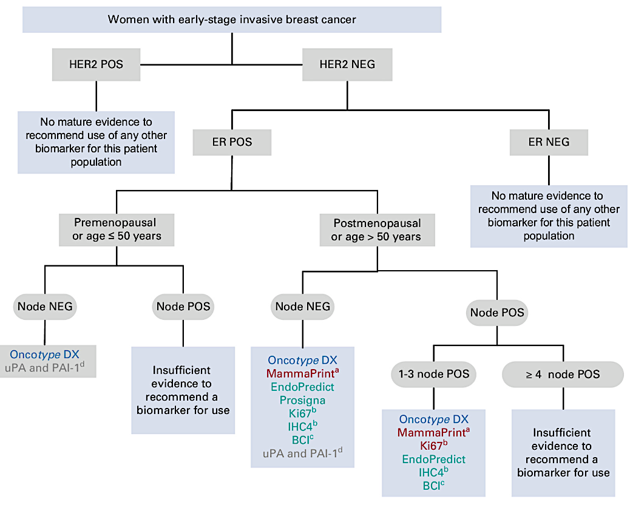
ASCO Guideline
2022
Andre F et al. J Clin Oncol. 2022;40:1816-1837

Slide 14
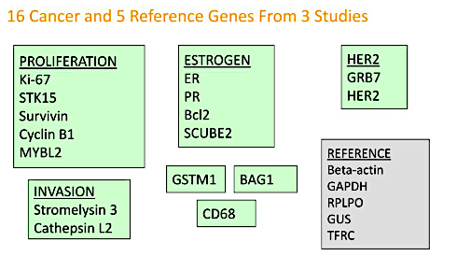
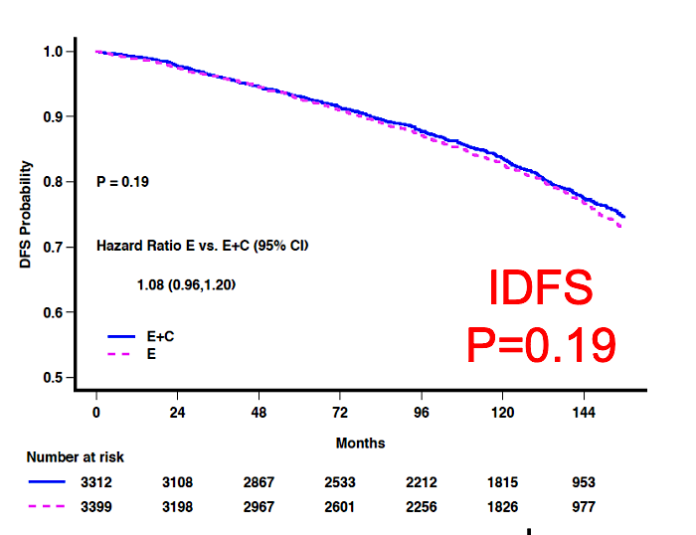
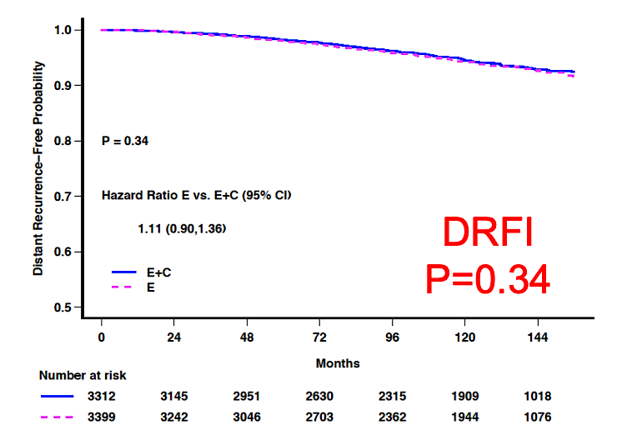
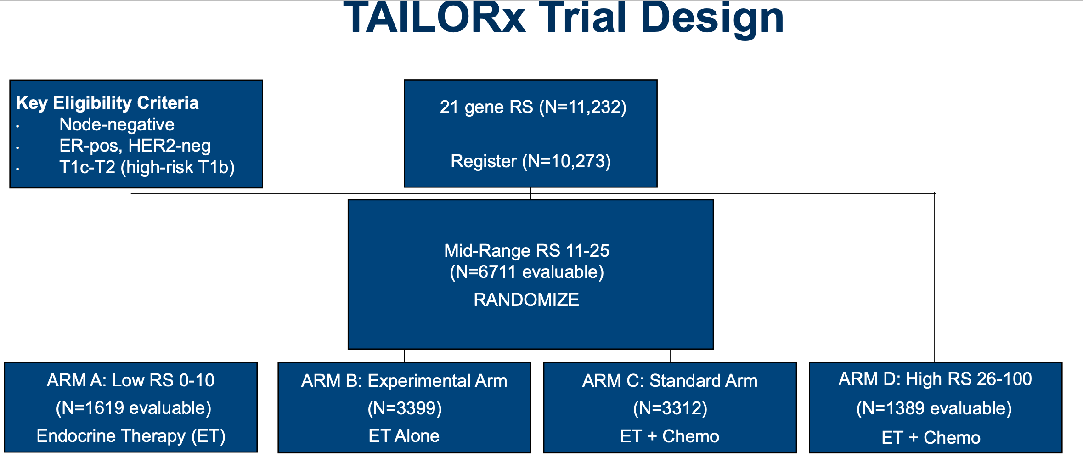
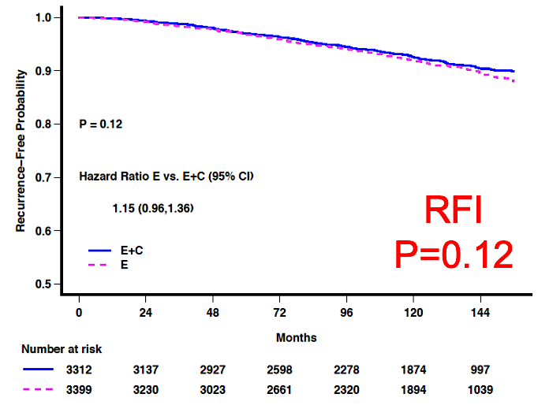
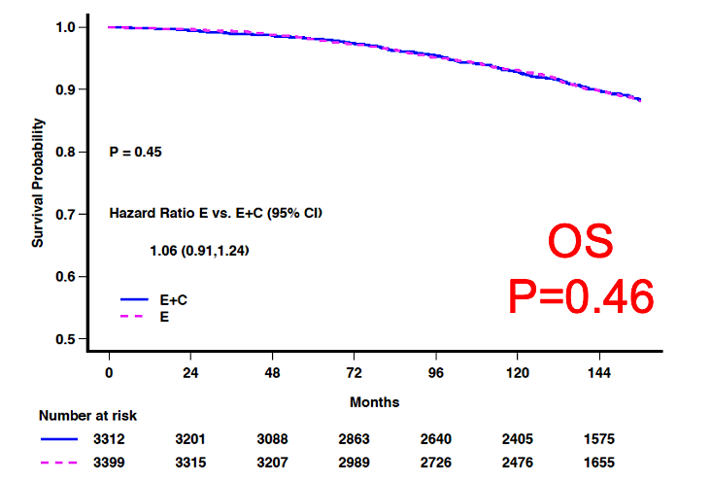
OncotypeDX®: TAILORx Trial Key Results for Node-Negative Disease
Intermediate risk (11-25):
No overall benefit to chemotherapy (2022 update)
Sparano JA et al. SABCS 2022;Abstract GS1-05.
Figures courtesy K. Kalinsky

Slide 15
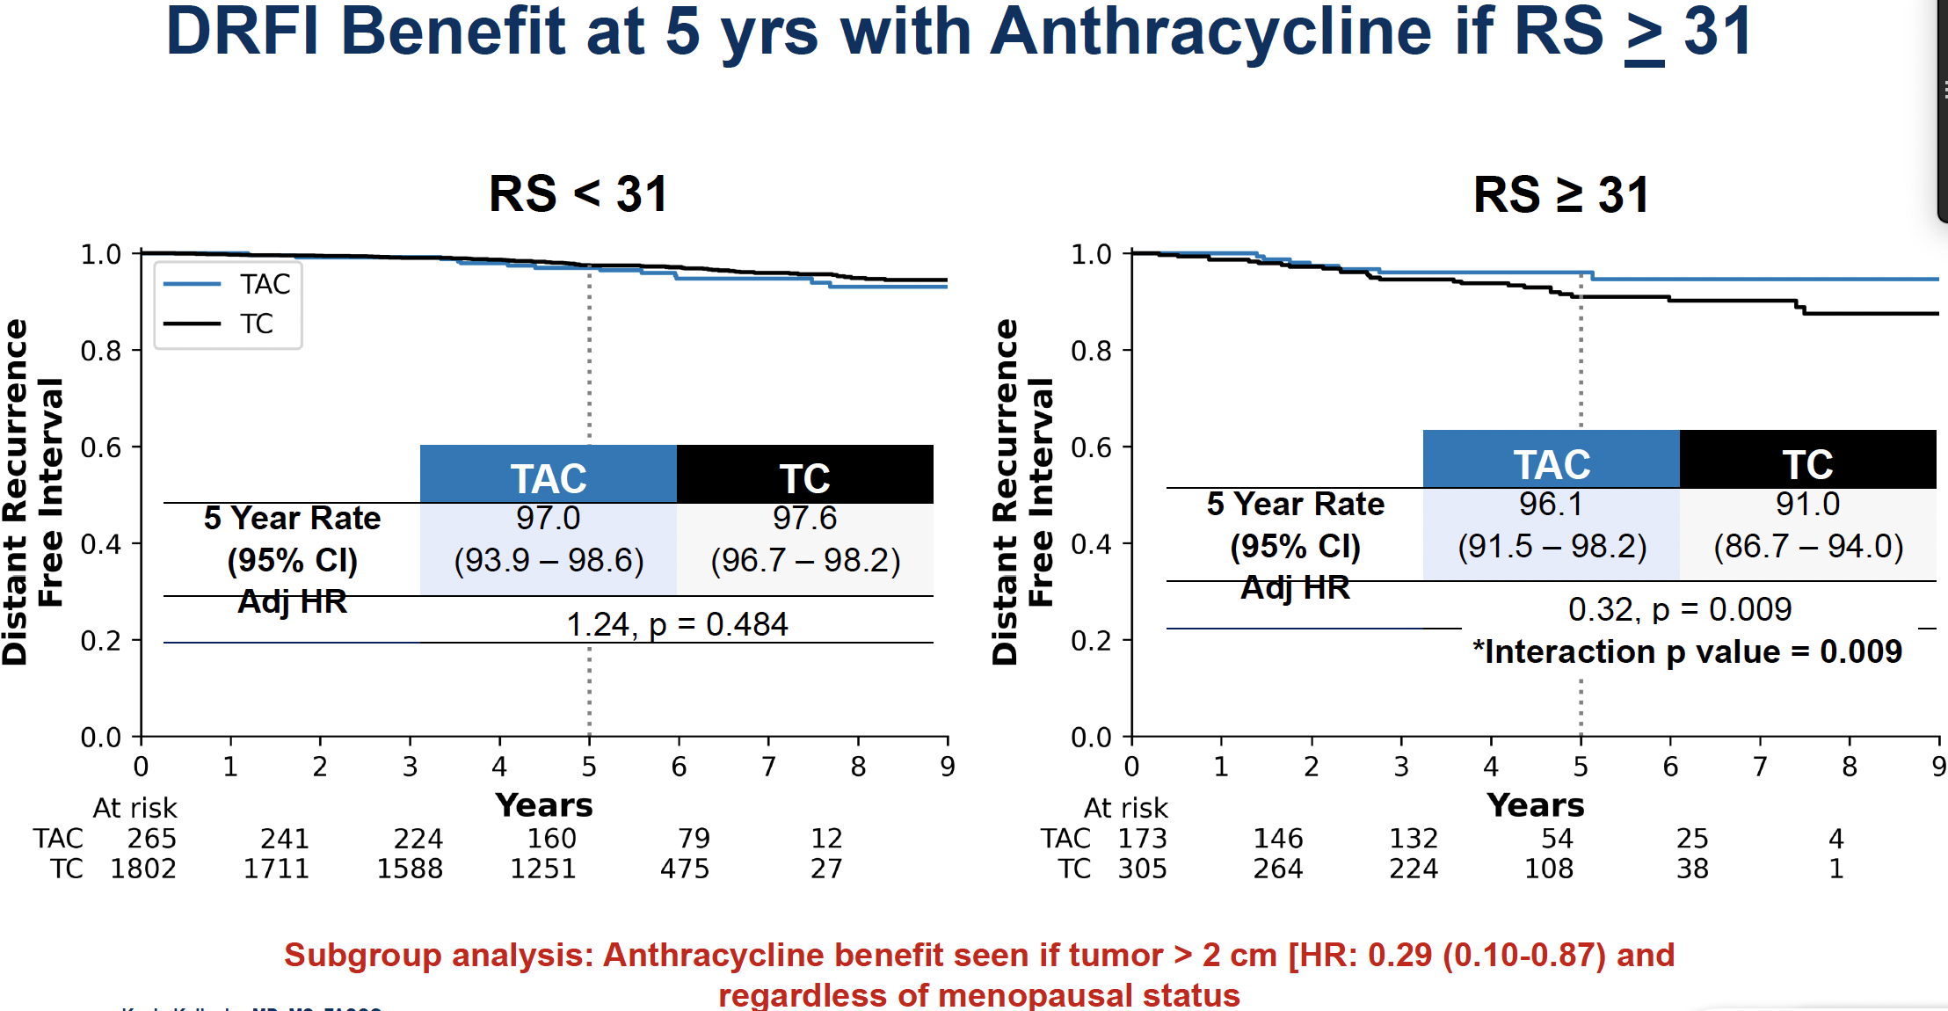
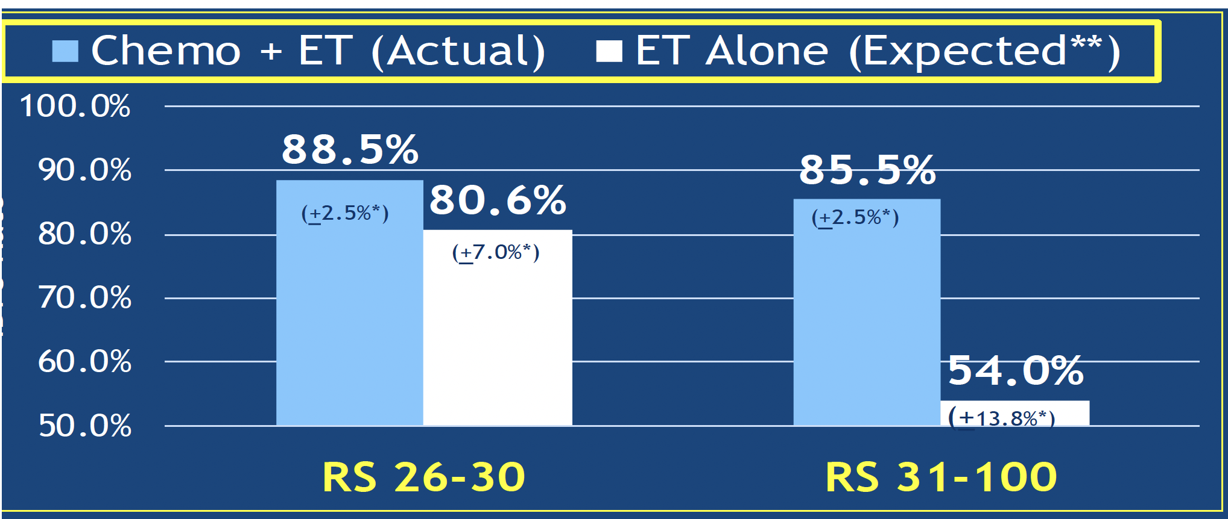
Chemotherapy and Anthracycline Benefits for Patients with High Recurrence Scores® (>25)
DRFI Benefit at 5 y with Anthracycline if RS > 31
High Risk (RS > 25): Expected benefit with chemotherapy
“No chemotherapy” rates estimated by combining
patient-specific distant recurrence risk information with
patient-specific chemotherapy benefit information
from the ERBB2-negative cohort of NSABP B20
TAILORx N = 2,549. T-AC vs TC
5-y DRFI 96.1 vs 91%, HR 0.31, p = 0.006
5-y DRFS 95.4% vs 89.8%, aHR 0.49, p = 0.032
OS NS
Sparano JA et al. JAMA Oncol 2020; Chen N et al. Ann Oncol 2025.

Slide 16
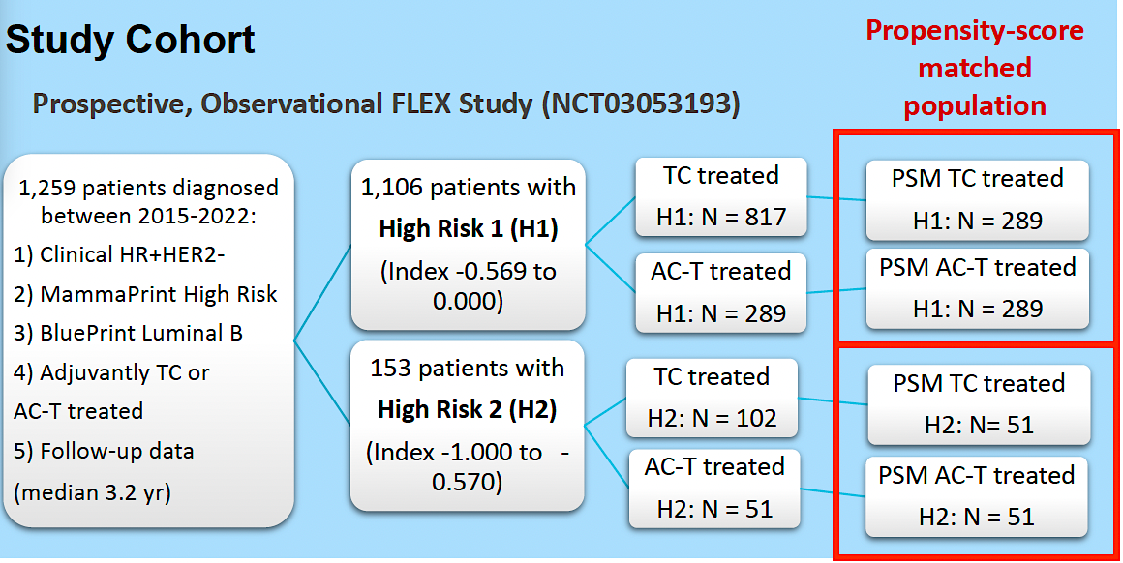
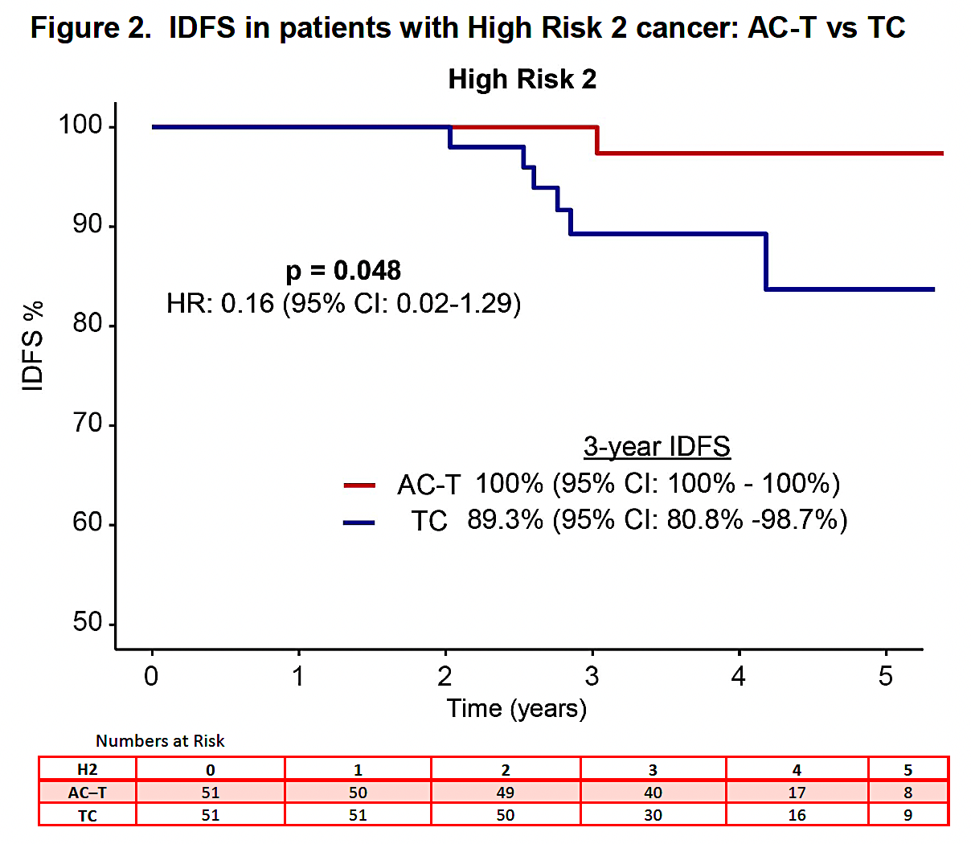
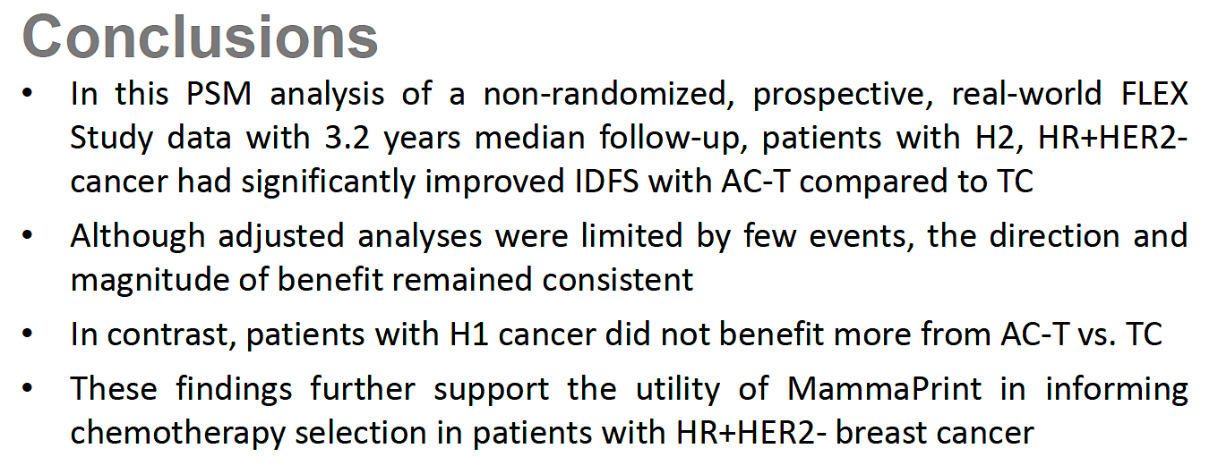
Propensity-Score Matched Analysis of Real-World FLEX Data: IDFS with Anthracycline-Based Therapy for Patients with MammaPrint® High 2, Luminal B, HR-Positive, HER2-Negative Localized Breast Cancer
IDFS = invasive disease-free survival
O’Shaughnessy J et al. SABCS 2025;Abstract PS2-07-03.

Slide 17
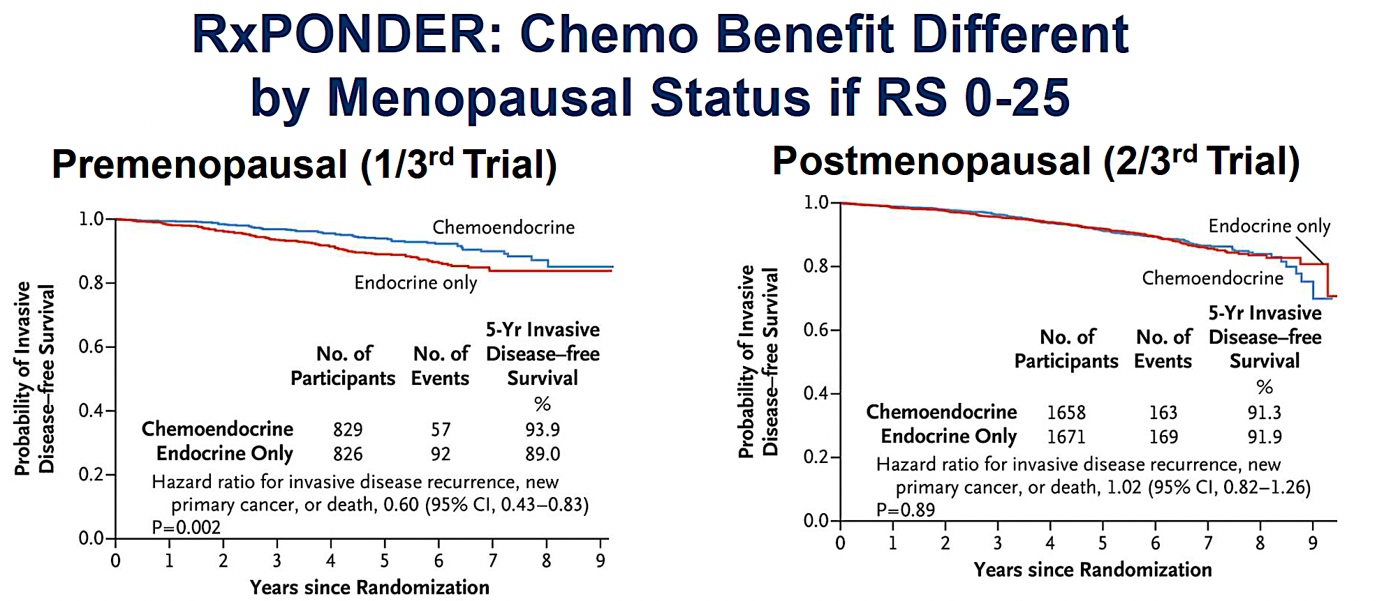
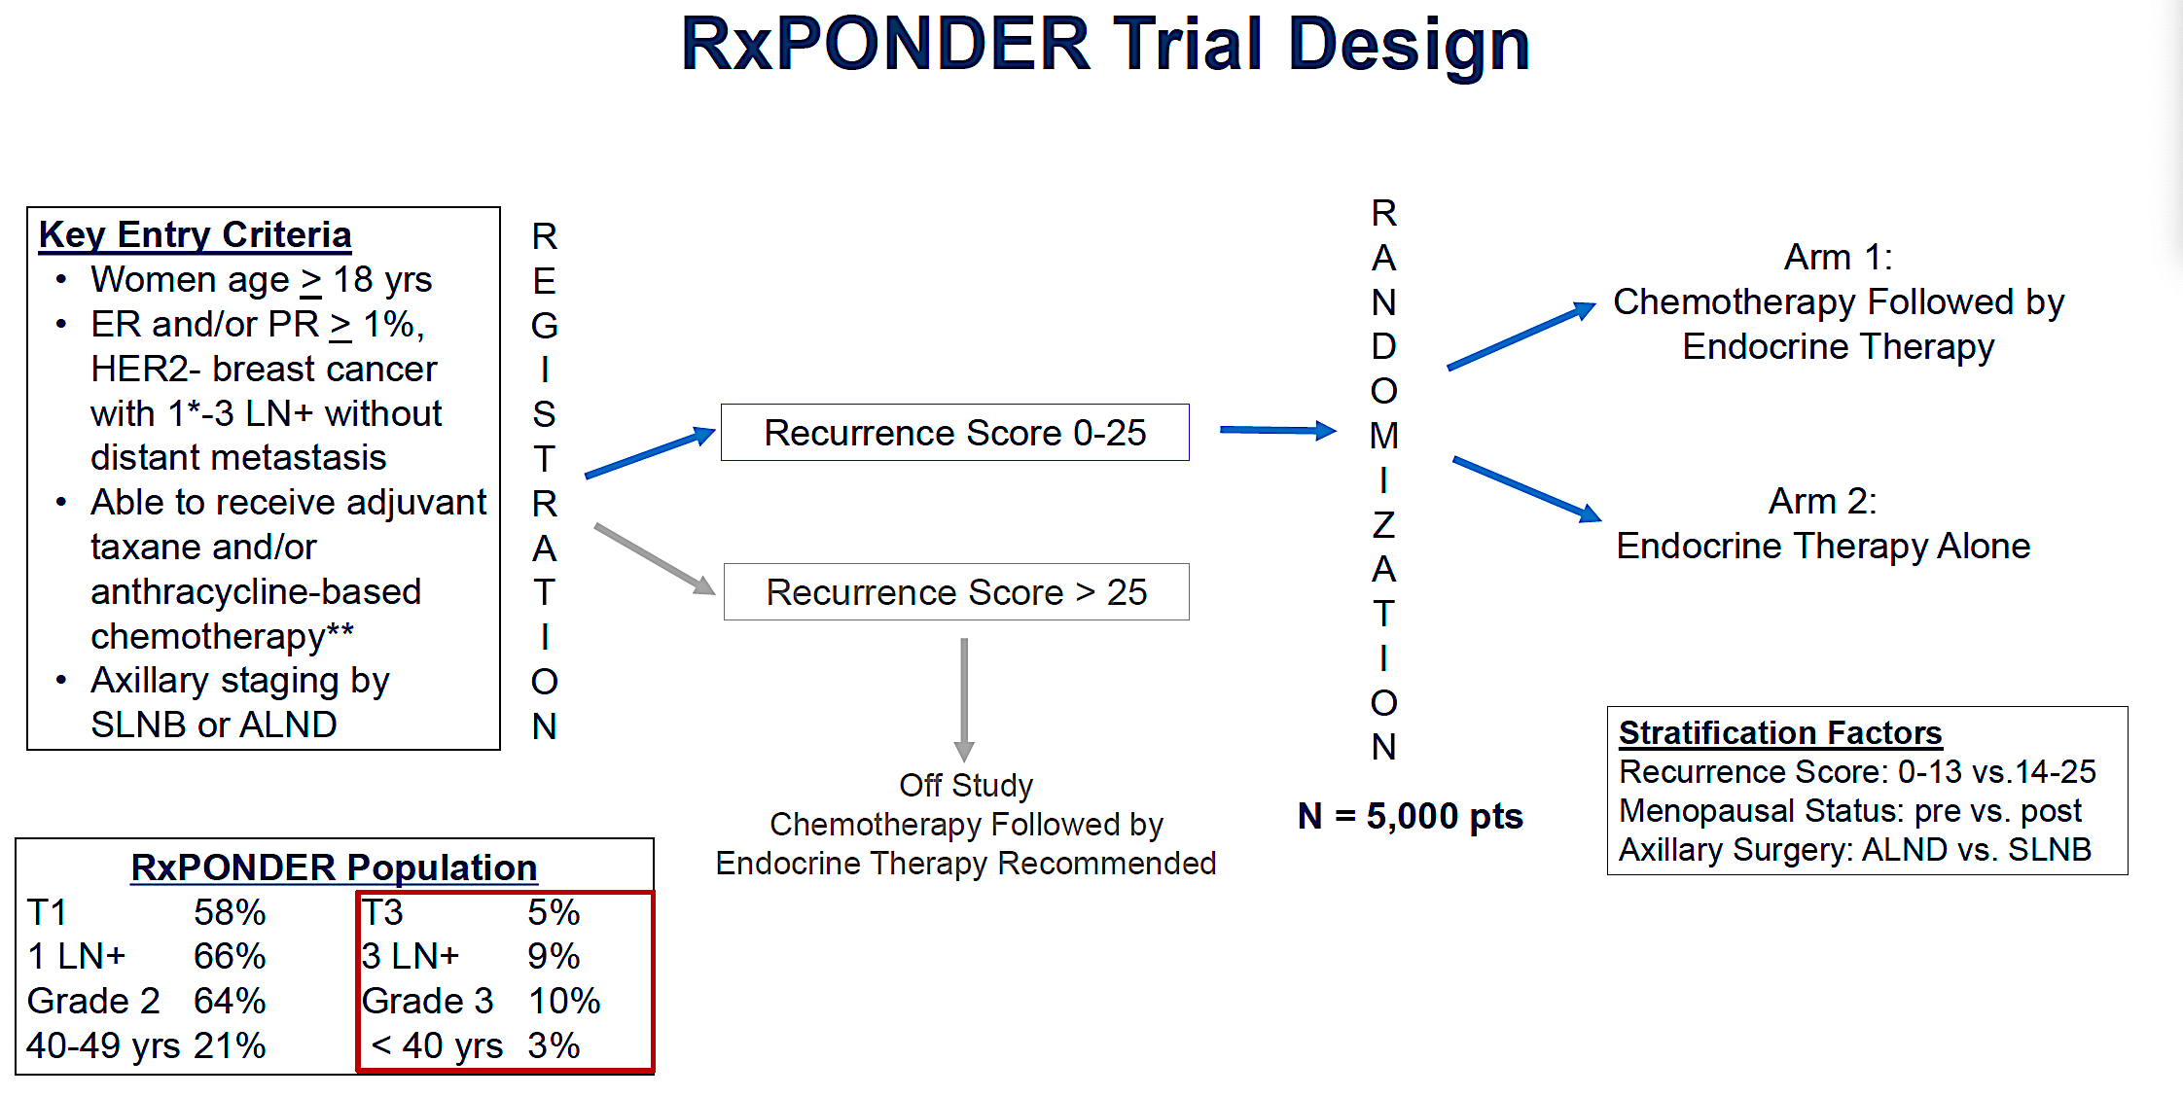
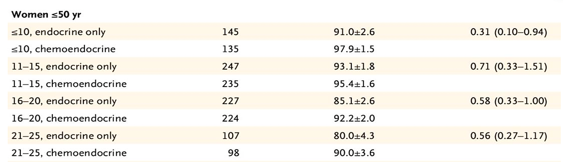
OncotypeDX: RxPONDER Trial
Results Summary
One to Three Positive Lymph Nodes
IDFS Benefit Modified by Score for Women Age ≤50
Sparano JA et al. JAMA Oncol 2020; Chen N et al. Ann Oncol 2025.

Slide 18
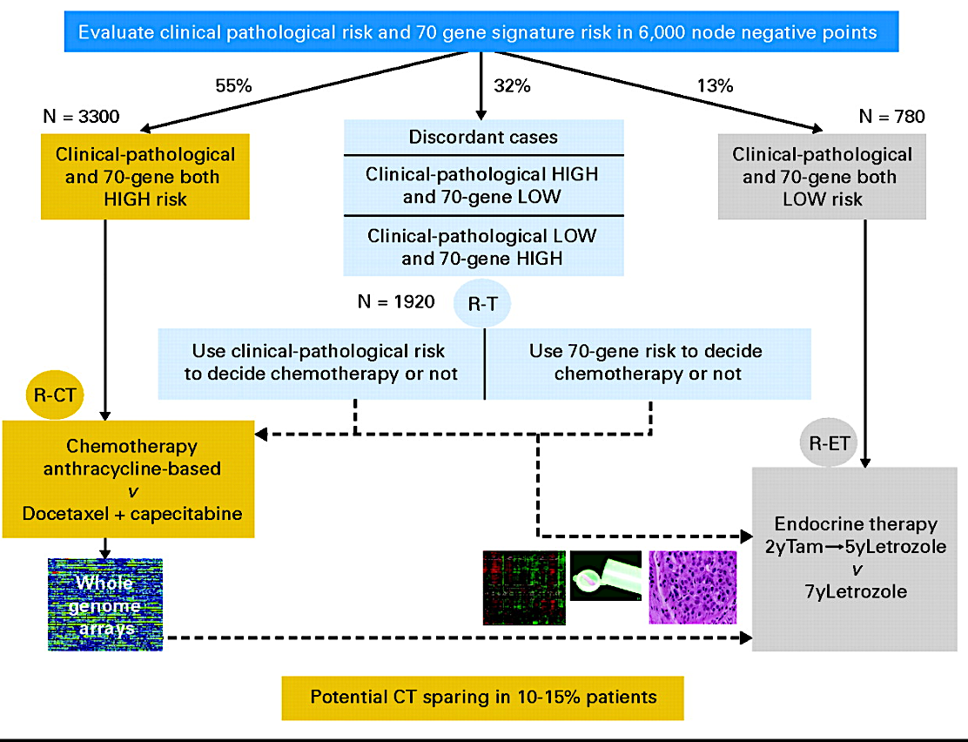
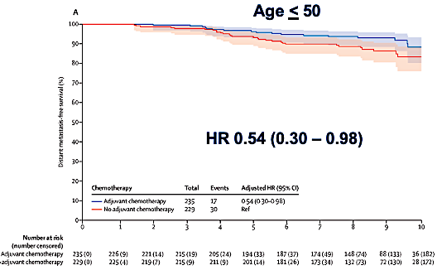
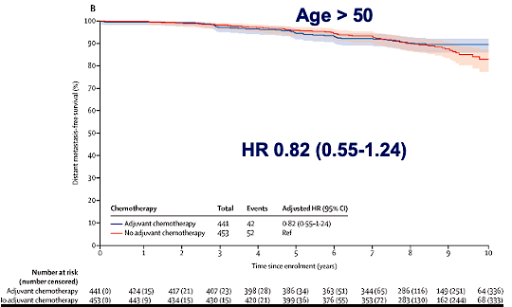
MammaPrint: MindACT Trial Key Results
Chemo benefit increases over time overall. Lost in those age >50, maintained in those age <50
Clinical “high risk”: <88% 10-yr BCSS
Modified Adjuvant! Online to determine
Model included: T size, Node (0-3), grade, ER status, age, comorbidity
 | ET | CET | Absolute diff
5-y DMFS | 94.7% (92.5 – 96.2) | 95.9% (94-97.2) | 1.2%
8-yr DMFS | 89.4% (86.8- 91,5) | 92% (896-93.8) | 2.6%
Met primary outcome: Lower bound of 95% CI >92% 5-y DMFS in the High Clinical/Low Genomic risk group
No adjuvant chemotherapy
No adjuvant chemotherapy
BCSS = breast cancer-specific survival; DMFS = distant metastasis-free survival
Cardoso F et al. N Engl J Med 2016; Piccart M et al. Lancet Oncol 2021.

Slide 19
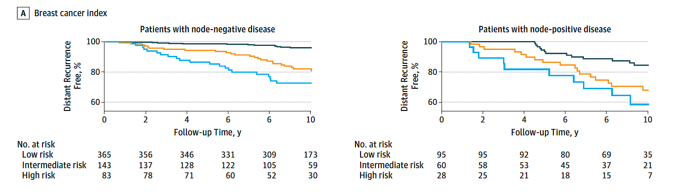
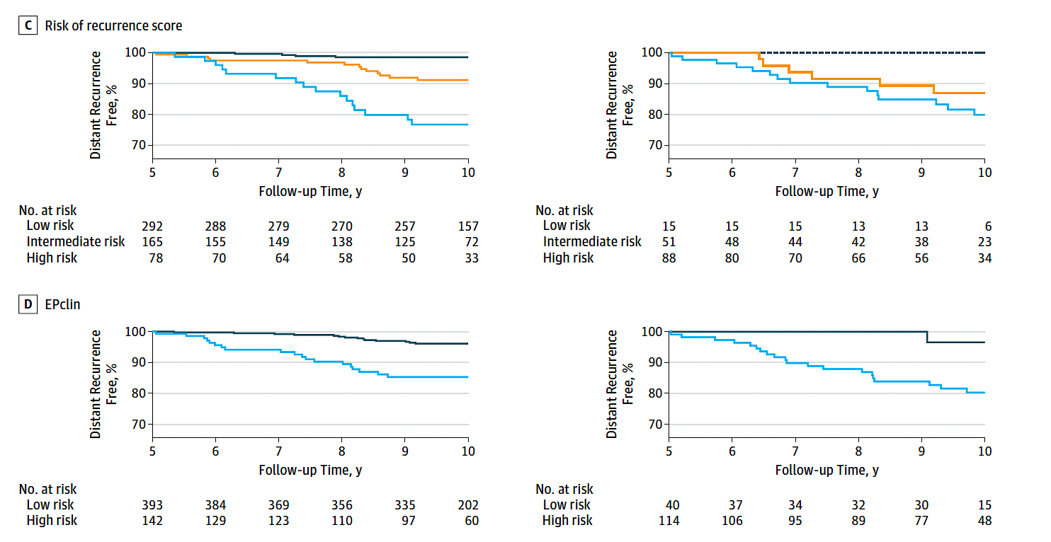
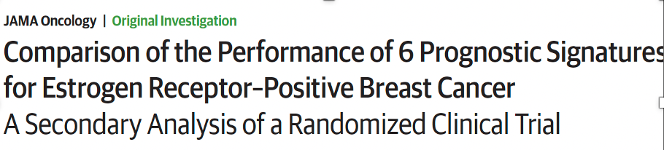
Prosigna® ROR, EndoPredict® EPclin and Breast Cancer Index®
ROR (risk of recurrence, Prosigna)
50-gene RNA-based molecular subtyping assay
ROR available in US; PAM50 not available
EPclin (EndoPredict)
12 genes – Proliferation and hormone receptor
Breast Cancer Index (BCI)
7 genes – Proliferation and hormone receptor (HoxB13/IL17BR)
BCI
ROR
Signatures
Largest retrospective prognostic validation in TransATAC Trial (included Oncotype DX and BCI as well)
N = 535 node-negative, 154 node-positive
Examined risk years 0 to 10
ROR, EPclin and BCI provided most prognostic information
ROR HR 2.56 (1.96-3.35)
EPclin HR 2.14 (1.71-2.68)
BCI HR 2.46 (1.88-3.23)
EPclin
Low risk
Intermediate risk
High risk
Sestak I et al. JAMA Oncol 2018;4(4):545-53.

Slide 20
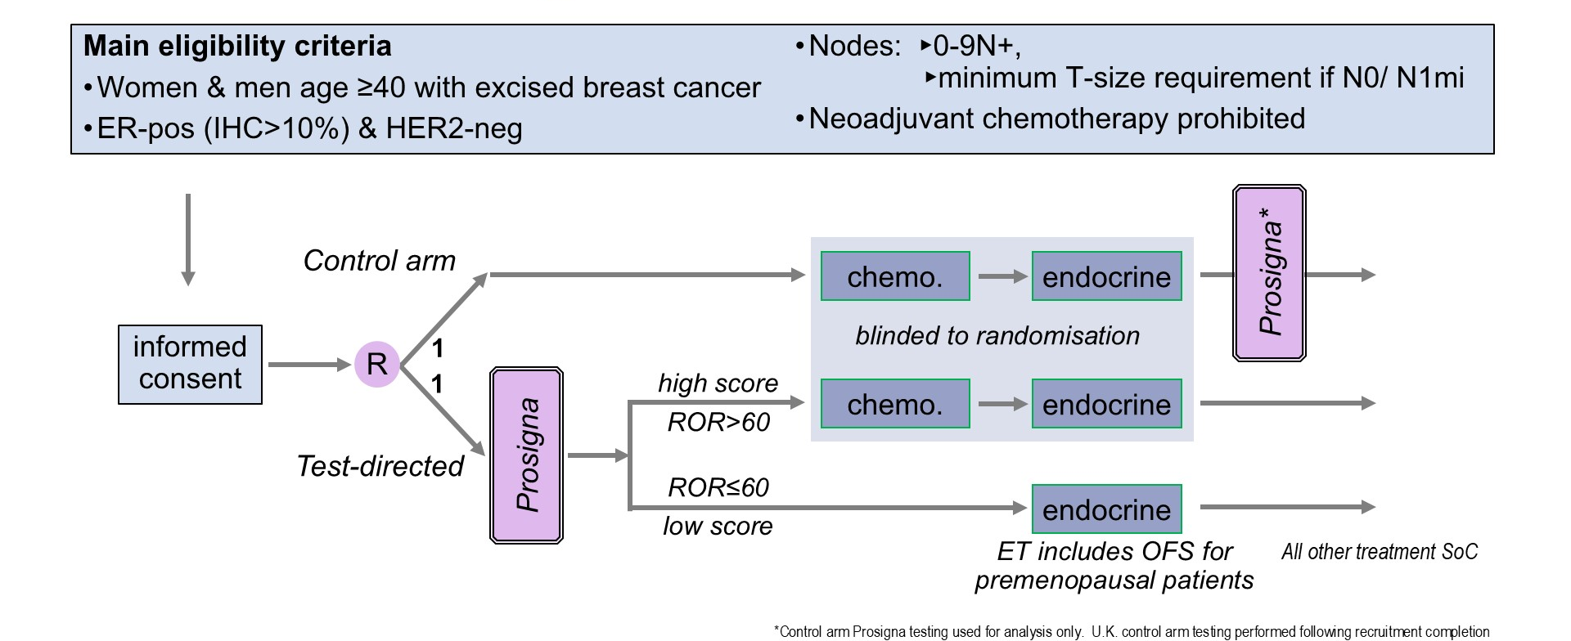
Phase III OPTIMA Study Design
Stein R et al. ASCO 2026;Abstract 500.

Slide 21
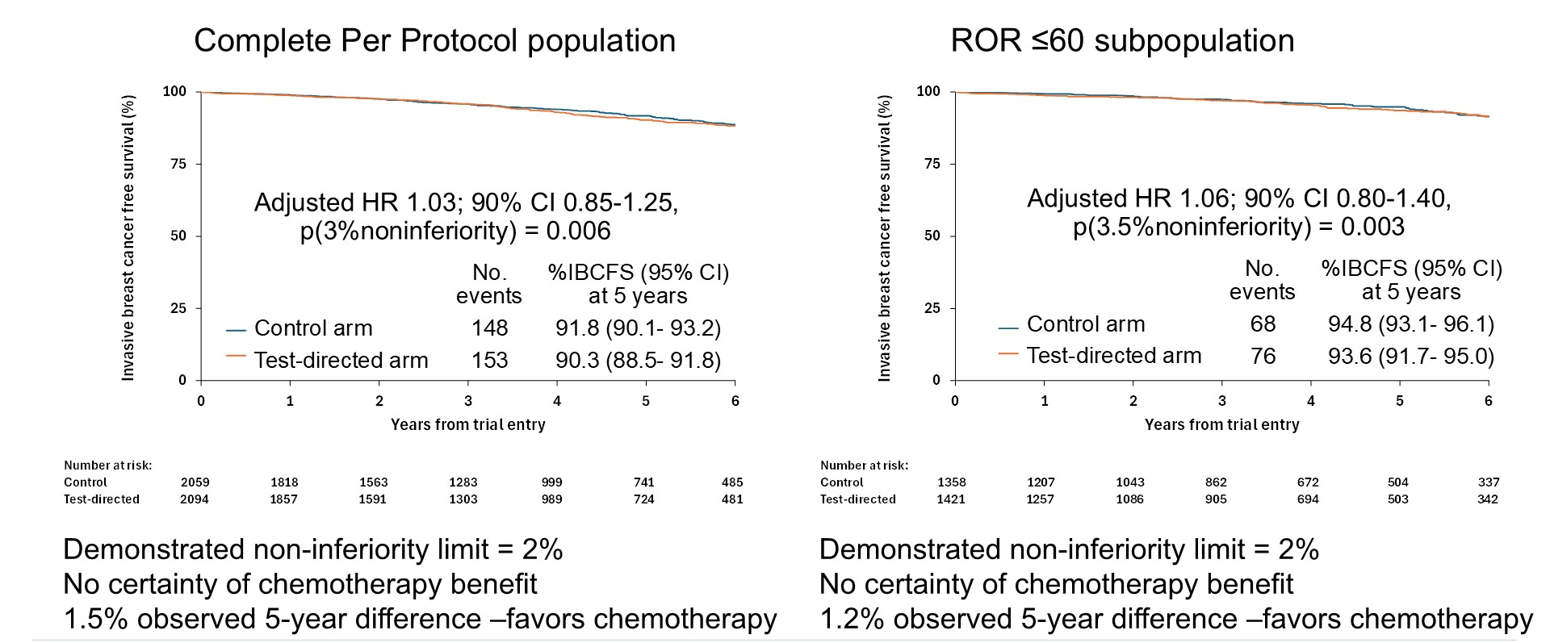
Phase III OPTIMA: Invasive Breast Cancer-Free Survival (IBCFS)
ROR = risk of recurrence
Stein R et al. ASCO 2026;Abstract 500.

Slide 22
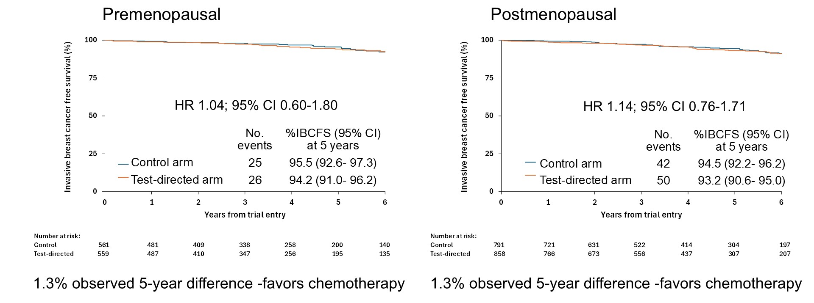
Phase III OPTIMA: IBCFS and Menopausal Status (Low ROR Score)
Stein R et al. ASCO 2026;Abstract 500.

Slide 23
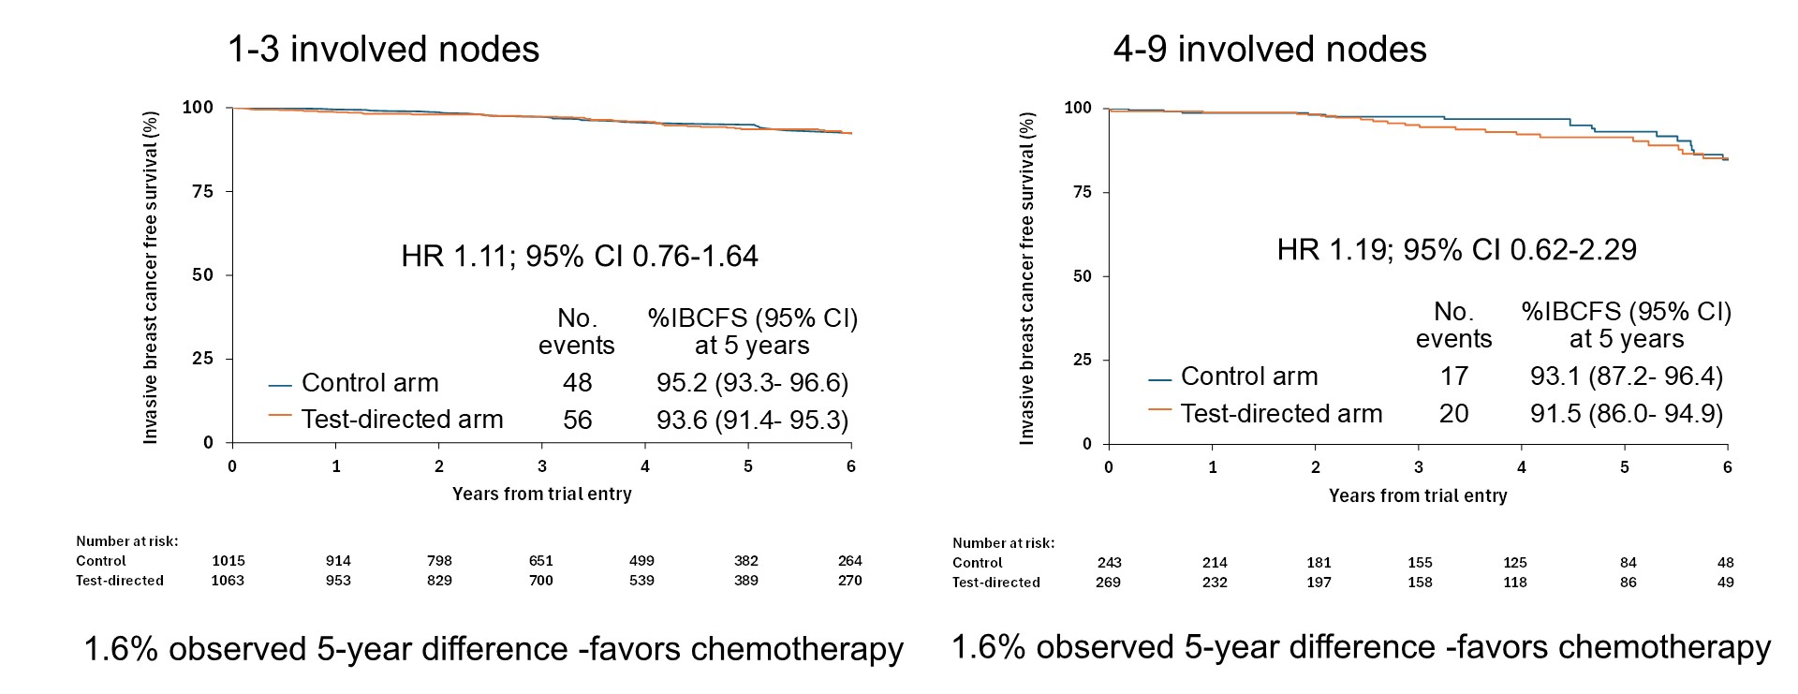
Phase III OPTIMA: IBCFS and Nodal Status (Low ROR Score)
Stein R et al. ASCO 2026;Abstract 500.

Slide 24
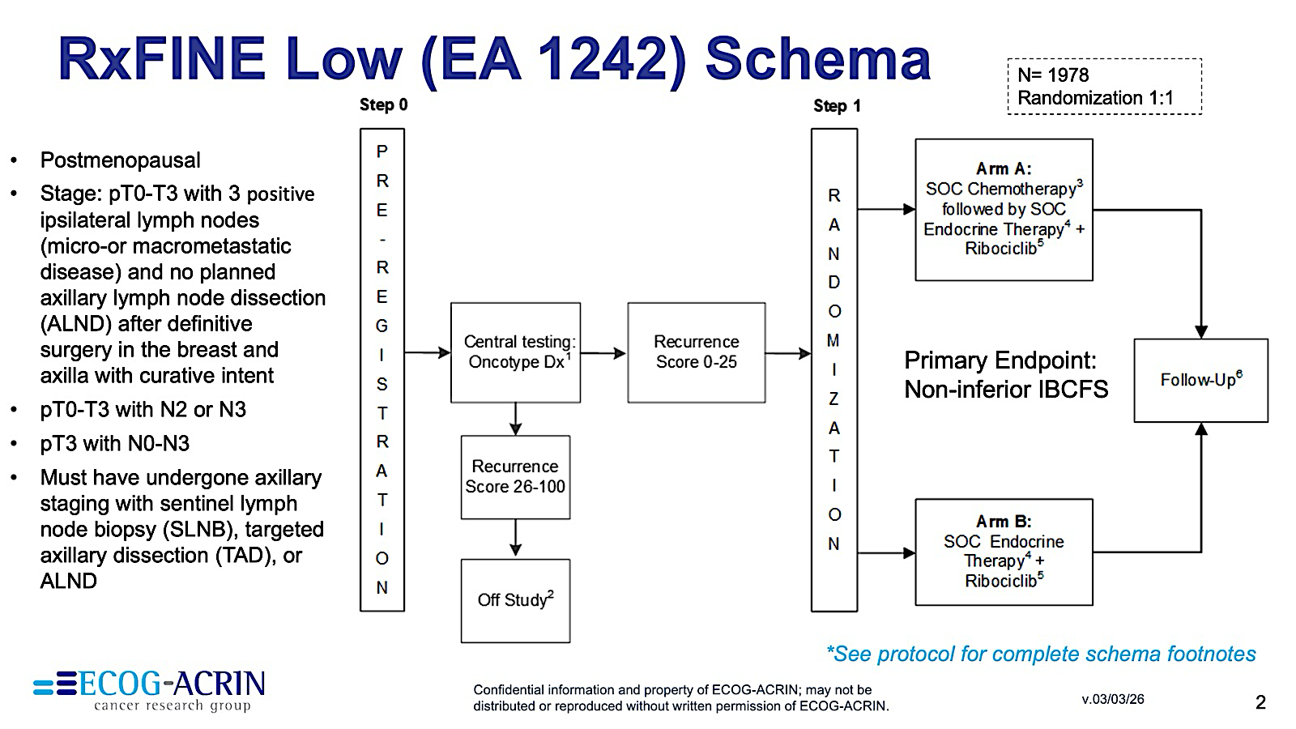
Phase III RxFINE-Low (EA1242) Study Design
https://ecog-acrin.org/clinical-trials/ea1242-rxfine-low-breast-cancer/

Slide 25
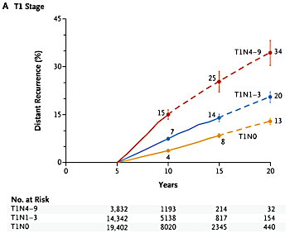
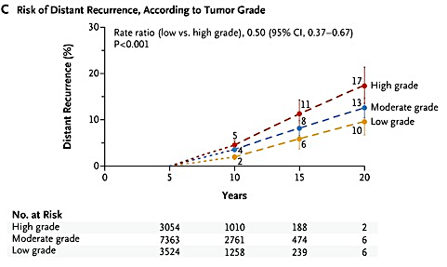
Persistent Long-Term Risk of Distant Recurrence
Risk of late distant recurrence after 5 years of adjuvant endocrine therapy persists across all clinical stages.
Pan H et al. N Engl J Med 2017;377(19):1836-46.

Slide 26
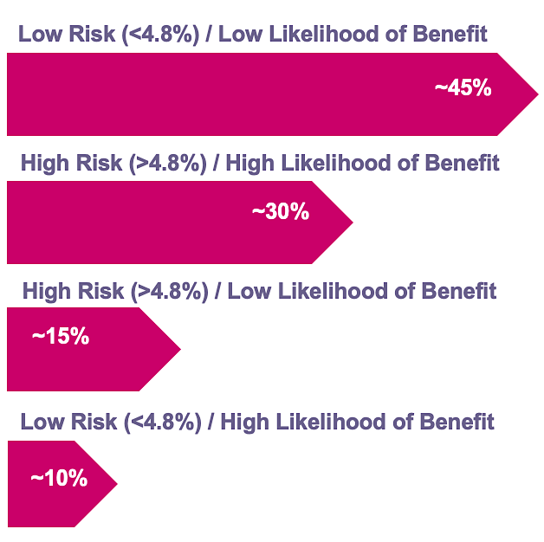
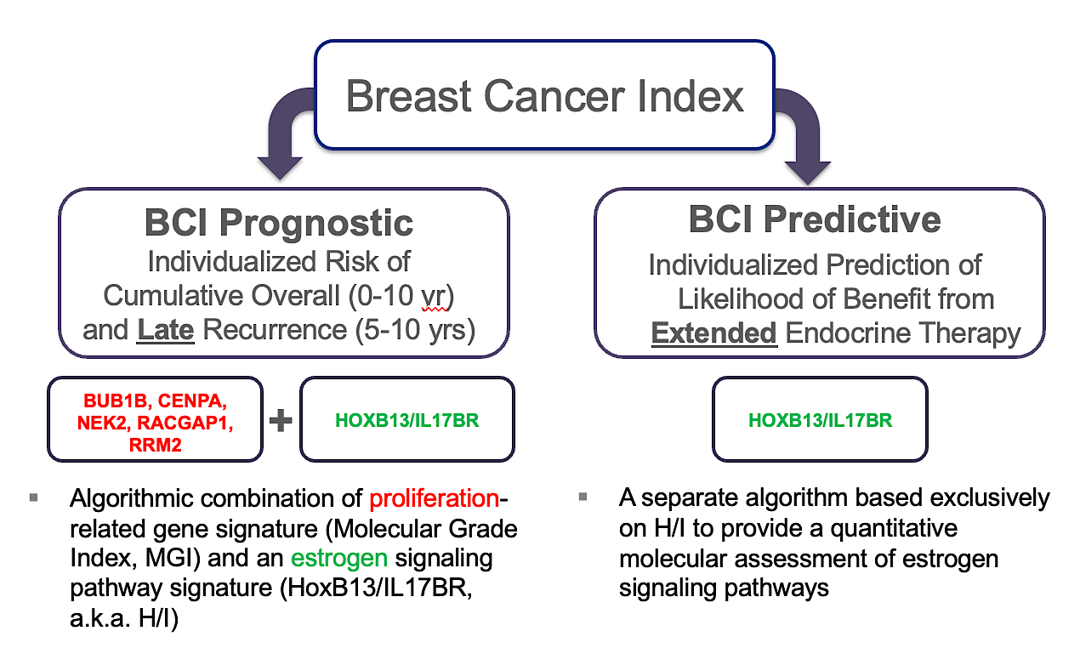
Breast Cancer Index (BCI)
Distribution of BCI scores
BCI Components
Sgroi DC et al. J Natl Cancer Inst 2013;105(14):1036-42.

Slide 27
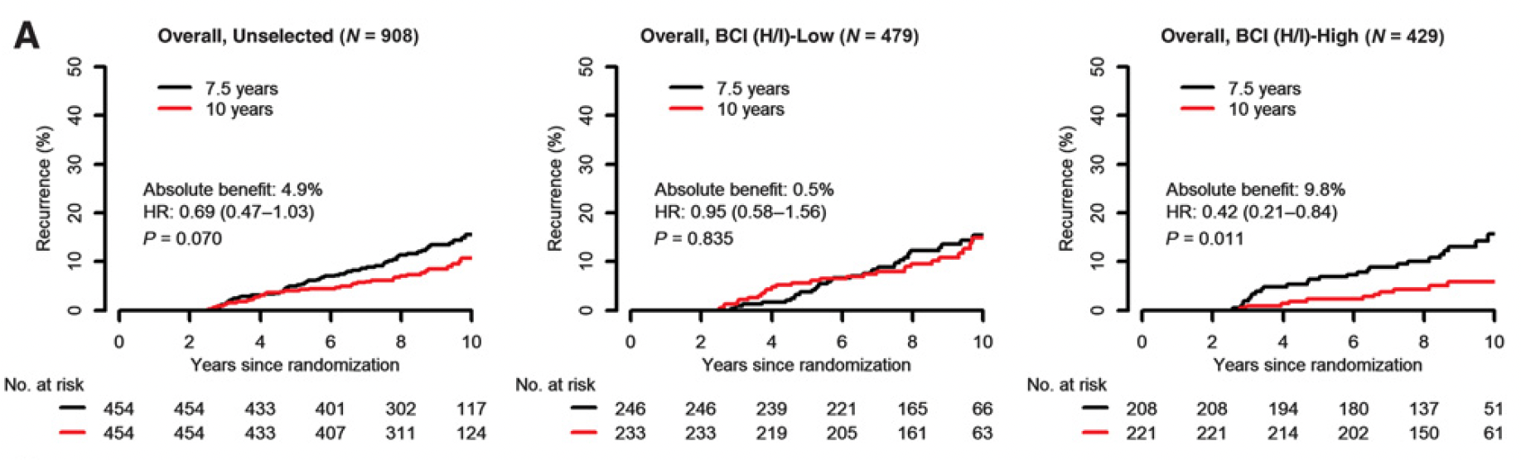
Predictive Performance by BCI H/I Groups Based on Recurrence-Free Interval in the Overall Cohort of the Phase III IDEAL Trial
Noordhoek I et al. Clin Cancer Res 2021;27(1):311-19.

Slide 28
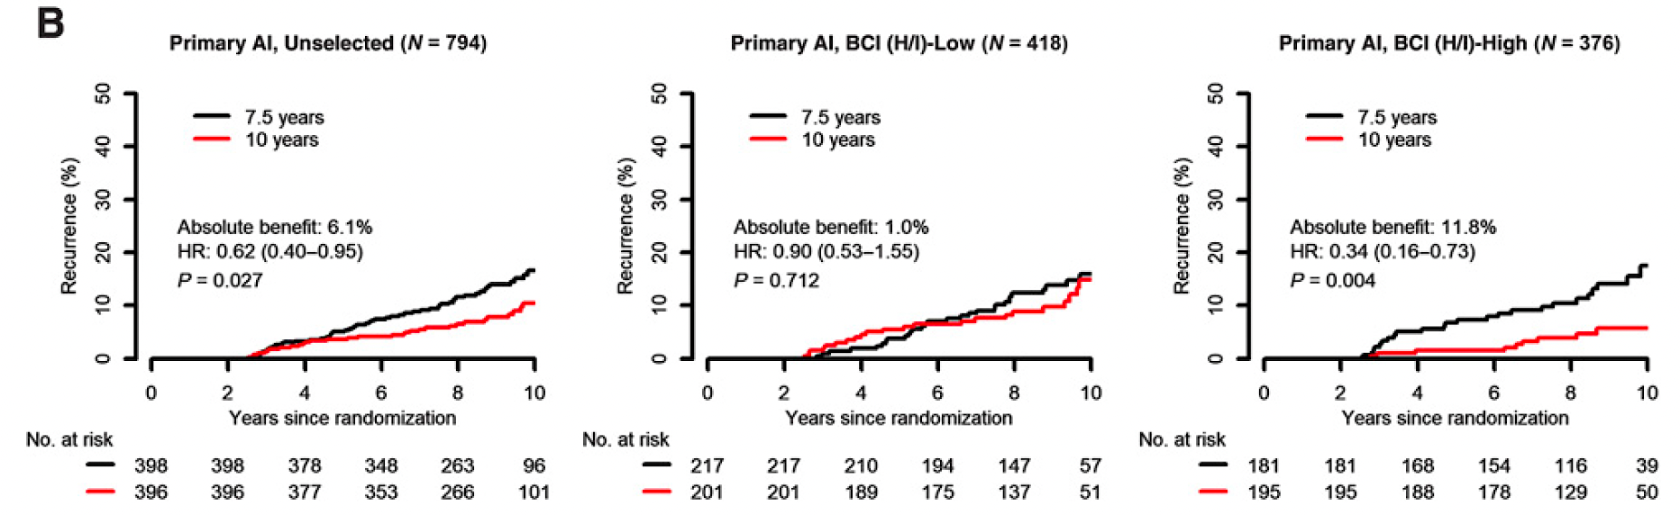
Predictive Performance by BCI H/I Groups Based on
Recurrence-Free Interval in the Subset of Patients in the Phase III IDEAL Trial Who Received a Primary Aromatase Inhibitor (AI)
Noordhoek I et al. Clin Cancer Res 2021;27(1):311-19.

Slide 29
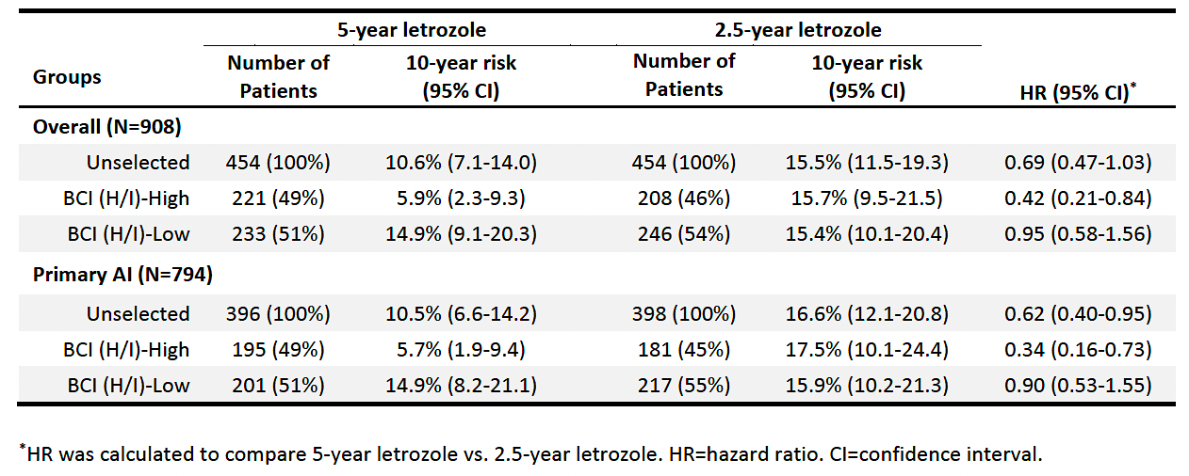
Risk of Recurrence at Year 10 Since Randomization for Patients Who Received 5 Years versus 2.5 Years of Additional Letrozole in the Overall Cohort and in the Primary AI Subset of the Phase III IDEAL Trial
Noordhoek I et al. Clin Cancer Res 2021;27(1):311-19.

Slide 30
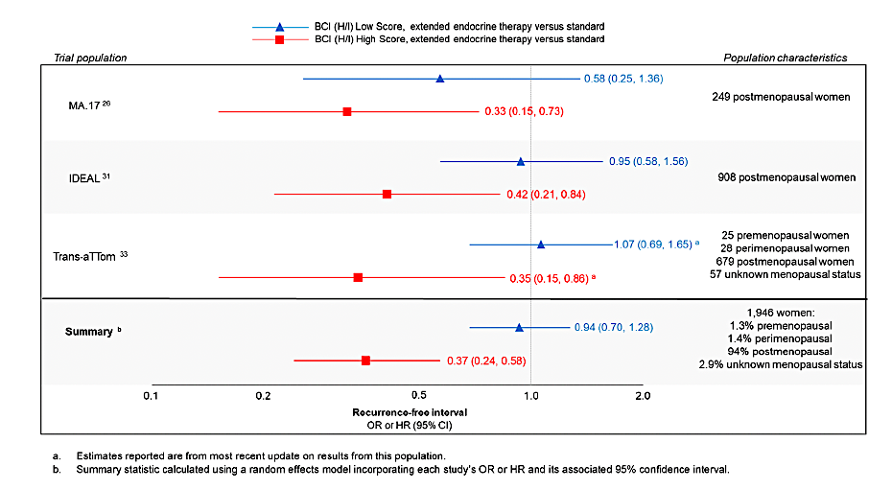
BCI Validation in Extended-Adjuvant Therapy Trials
Woolpert KM et al. Breast Cancer Res Treat 2024;203(3):407-417.

Slide 31
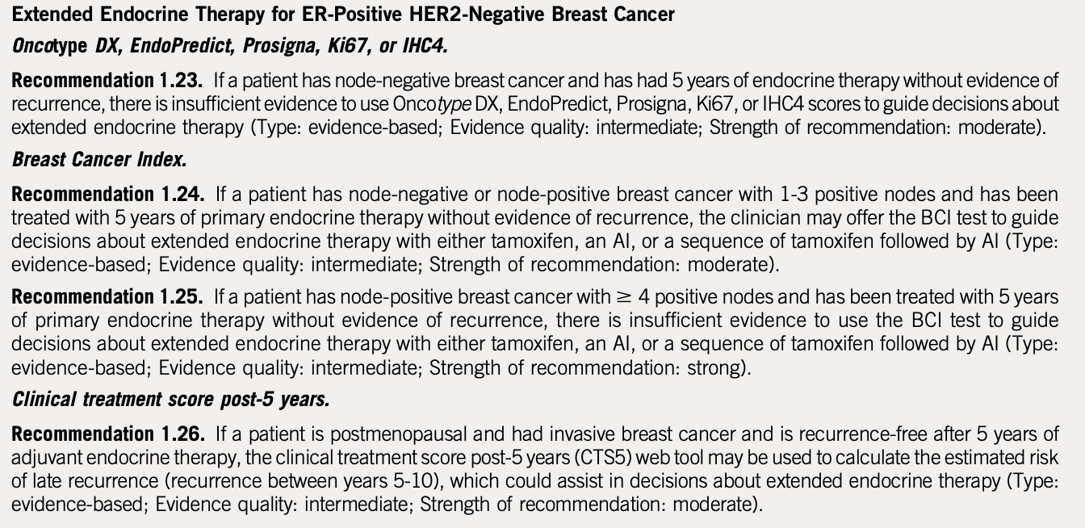
ASCO Guideline: Extended Adjuvant Therapy
Andre F et al. J Clin Oncol. 2022;40:1816-1837

Slide 32
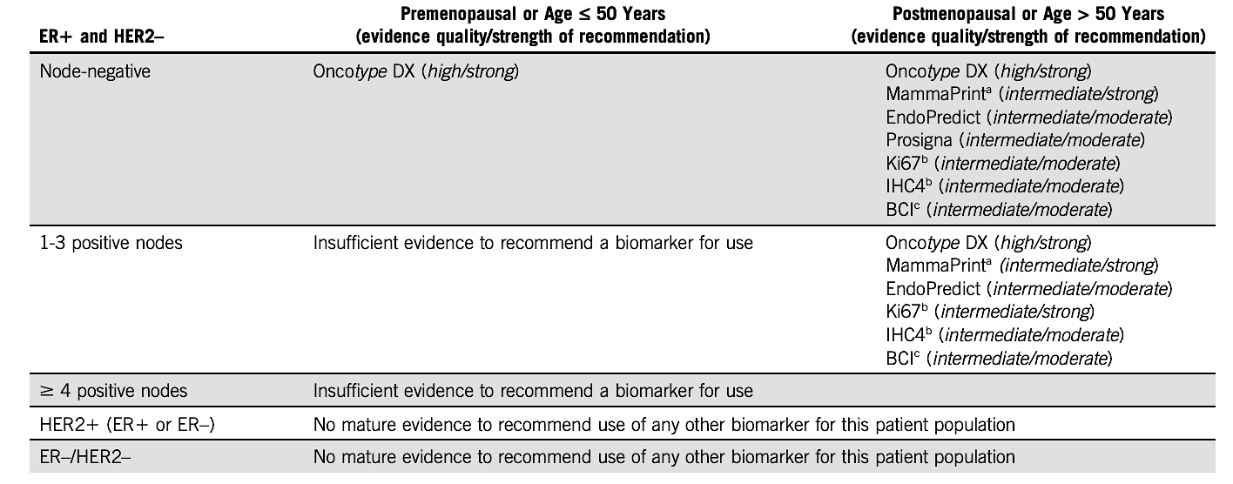
Summary: ASCO Guideline 2022
Andre F et al. J Clin Oncol. 2022;40:1816-1837

Slide 33
Management of Hormone Receptor (HR)-Positive Localized Breast Cancer
Module 1: Risk Assessment and Genomic Assays for HR-Positive, HER2-Negative Localized Breast Cancer
Module 2: Clinician Survey Results
Module 3: Adjuvant CDK4/6 Inhibitors for High-Risk, HR-Positive, HER2-Negative Localized Breast Cancer
Module 4: Clinician Survey Results
Module 5: Tolerability and Other Practical Considerations with Adjuvant CDK4/6 Inhibitor Therapy
Module 6: Clinician Survey Results
Module 7: Adjuvant Oral SERDs for HR-Positive, HER2-Negative Localized
Breast Cancer

Slide 34
Outside of a clinical trial, which genomic assay(s) do you routinely order to assist with decision-making regarding adjuvant systemic therapy for your patients with HR-positive, HER2-negative localized breast cancer (BC)?
Oncotype DX®, MammaPrint®, EndoPredict®, Breast Cancer Index®
Oncotype DX, MammaPrint, Breast Cancer Index
Oncotype DX
Oncotype DX, MammaPrint, Breast Cancer Index
Oncotype DX, MammaPrint, Prosigna, Breast Cancer Index
Oncotype DX and MammaPrint
Oncotype DX and MammaPrint
Oncotype DX and MammaPrint

Slide 35
Would you recommend adjuvant chemotherapy for a 40-year-old premenopausal patient with node-negative, HR-positive, HER2-negative localized BC and the 21-gene Recurrence Score® (RS) listed below?
RS = 8
RS = 17
RS = 20
No
No
Yes, but offer OFS/OA
as alternative
No
Yes, but offer OFS/OA
as alternative
Yes
No
No
Yes
No
Yes, but offer OFS/OA
as alternative
Yes, but offer OFS/OA
as alternative
No
No
Yes, but offer OFS/OA
as alternative
No
No*
No*
No
No
Yes, but offer OFS/OA
as alternative
No
No
No
OFS/OA = ovarian function suppression/ovarian ablation; * Would offer OFS/OA

Slide 36
Would you recommend adjuvant chemotherapy for a 40-year-old premenopausal patient with HR-positive, HER2-negative localized BC with 3 positive nodes and the 21-gene RS listed below?
RS = 8
RS = 17
RS = 20
Yes, but offer OFS/OA
as alternative
Yes, but offer OFS/OA
as alternative
Yes, but offer OFS/OA
as alternative
Yes
Yes
Yes
Yes
Yes
Yes
Yes
Yes
Yes
Yes
Yes
Yes
Yes
Yes
Yes
Yes
Yes
Yes
Yes
Yes
Yes
OFS/OA = ovarian function suppression/ovarian ablation

Slide 37
Would you recommend adjuvant chemotherapy for a 65-year-old postmenopausal patient with HR-positive, HER2-negative localized BC with 3 positive nodes and the 21-gene RS listed below?
RS = 8
RS = 17
RS = 20
No
No
No
No
No
No
No
No
Yes
No
No
Yes
No*
Yes
Yes*
No
No
No
No
No
No
No
No
No
* CDK4/6 inhibitor/AI also a reasonable alternative

Slide 38
Have you ordered or would you order a genomic assay to assist with treatment decision-making in the localized setting for any patients with HR-positive, HER2-negative localized BC and 4 or more positive nodes?
I have
I have not but would for the right patient
I have not but would for the right patient
I have not and would not
I have not but would for the right patient
I have
I have not and would not
I have

Slide 39
Outside of a clinical trial, which genomic assay(s) do you routinely order to assist with decision-making in the neoadjuvant setting for your patients with HR-positive, HER2-negative localized BC?
MammaPrint
MammaPrint†
MammaPrint
MammaPrint
Oncotype DX and MammaPrint
MammaPrint and Oncotype DX*
Oncotype DX and MammaPrint
MammaPrint
* All my patients with HR+ disease screen for I-SPY with rare exceptions and we order Mammaprint and BluePrint. I will occasionally order Oncotype DX. † I-SPY only, I do not routinely order genomic assays in the neoadjuvant setting

Slide 40
Outside of a clinical trial, do you routinely employ Breast Cancer Index (BCI) to determine whether to continue adjuvant endocrine therapy beyond 5 years for patients with HR-positive, HER2-negative localized BC? If so, in which clinical situations?
Yes, for node-positive disease when MammaPrint not available
Yes, primarily for patients with intermediate risk disease who would like more information to assist with making the decision
Yes, in situations where I’m on the fence about extending ET
Yes, for patients with N0 disease or up to 3 pos nodes
Yes, for patients on the fence about continuing endocrine therapy
No*
Yes, for patients with high-risk, node-negative disease
Yes, for patients with HR-positive disease who may be
lymph node-negative for whom extended therapy might be beneficial
ET = endocrine therapy; * No due to reimbursement issues, but I would for patients with poor tolerance to ET and high-risk disease

Slide 41
Approximately what proportion of the time would you estimate that having the results from BCI cause you to change your recommendation regarding extended-adjuvant endocrine therapy (ET)?
Recommending ET to not recommending
Not recommending ET to recommending
25%
25%
20%
20%
10%
10%
20%
20%
30%
20%
NA
NA
10%
10%
10%
10%
NA = not applicable

Slide 42
Outside of a clinical trial, do you routinely employ any genomic assays other than BCI to determine whether to continue adjuvant endocrine therapy beyond 5 years for patients with HR-positive, HER2-negative localized BC?
Yes, MammaPrint
No
No
No
No
No
No
Yes, MammaPrint

Slide 43
Have you ordered or would you order a circulating tumor DNA (ctDNA)-based molecular residual disease (MRD) assay to assist with clinical decision-making for a patient with localized BC? If you were to order a ctDNA-based MRD assay for a patient with localized BC, which specific assay(s) would you use?
Order a ctDNA-based MRD assay?
Assay
I have
Signatera™
I have
Personalis® or Signatera
I have not but would for the right patient
Signatera
I have not and would not
NA
I have
Signatera
I have
Signatera
I have not and would not
NA
I have
Signatera or Guardant Reveal™
NA = not applicable

Slide 44
Management of Hormone Receptor (HR)-Positive Localized Breast Cancer
Module 1: Risk Assessment and Genomic Assays for HR-Positive, HER2-Negative Localized Breast Cancer
Module 2: Clinician Survey Results
Module 3: Adjuvant CDK4/6 Inhibitors for High-Risk, HR-Positive, HER2-Negative Localized Breast Cancer
Module 4: Clinician Survey Results
Module 5: Tolerability and Other Practical Considerations with Adjuvant CDK4/6 Inhibitor Therapy
Module 6: Clinician Survey Results
Module 7: Adjuvant Oral SERDs for HR-Positive, HER2-Negative Localized
Breast Cancer

Slide 45
Key Datasets
Johnston S et al. monarchE: Primary overall survival (OS) results of adjuvant abemaciclib + endocrine therapy (ET) for HR+, HER2-, high-risk early breast cancer (EBC). ESMO 2025;Abstract LBA13.
Johnston S et al. Overall survival with abemaciclib in early breast cancer. Ann Oncol 2026;37(2):155-65.
Cortés J et al. monarchE: Subgroup analysis of adjuvant abemaciclib + endocrine therapy for HR+, HER2-, high-risk early breast cancer by nodal status. San Antonio Breast Cancer Symposium 2025;Abstract PS1-08-08.
Crown JP et al. Adjuvant ribociclib (RIB) plus nonsteroidal aromatase inhibitor (NSAI) in patients (pts) with HR+/HER2− early breast cancer (EBC): NATALEE 5-year outcomes. ESMO 2025;Abstract LBA14.
Chia SKL et al. Prognostic and predictive impact of baseline gene expression (exp) in the NATALEE trial of adjuvant (adj) ribociclib (RIB) + nonsteroidal aromatase inhibitor (NSAI) in HR+/HER2- early breast cancer (EBC). ASCO 2026;Abstract 501.

Slide 46
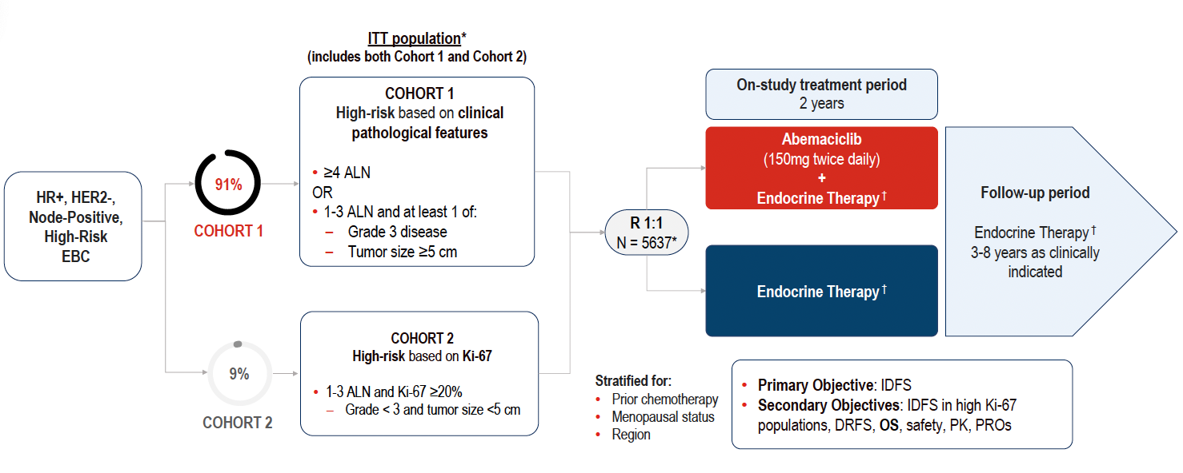
monarchE Study Design
Johnston S et al. ESMO 2025;Abstract LBA13. Johnston S et al. Ann Oncol 2026;37(2):155-65.

Slide 47
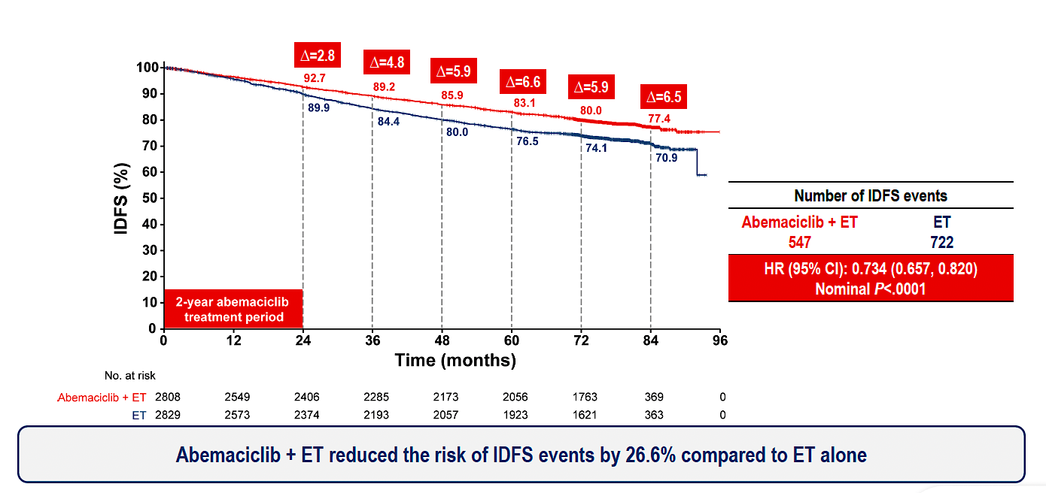
monarchE: Invasive Disease-Free Survival (IDFS) Outcomes
ET = endocrine therapy
Johnston S et al. ESMO 2025;Abstract LBA13. Johnston S et al. Ann Oncol 2026;37(2):155-65.

Slide 48
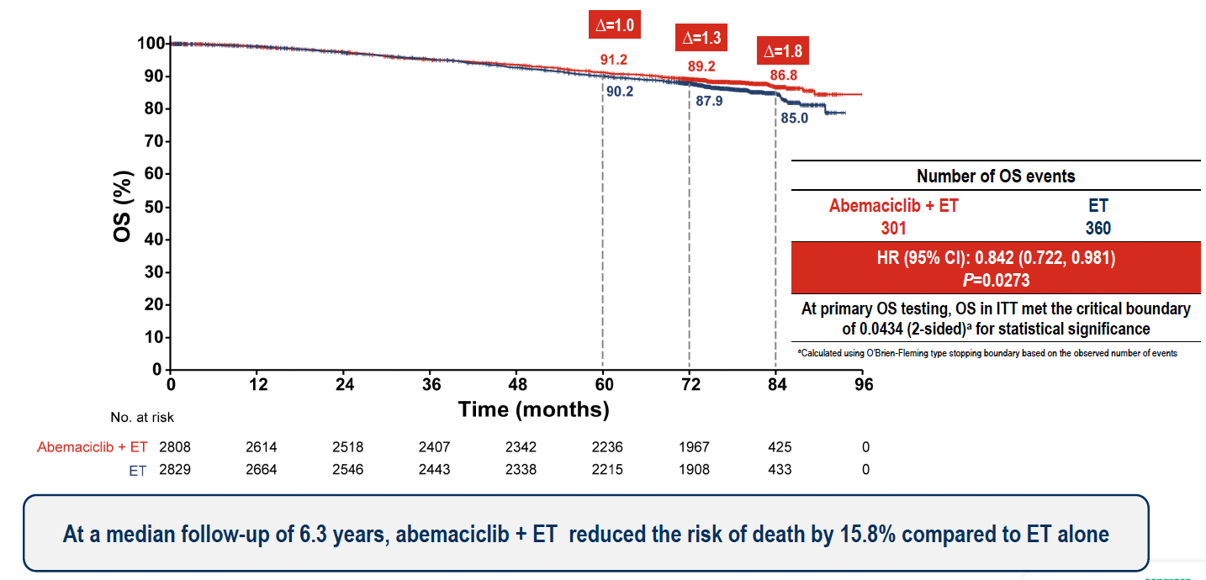
monarchE: Overall Survival (OS) Outcomes
Johnston S et al. ESMO 2025;Abstract LBA13. Johnston S et al. Ann Oncol 2026;37(2):155-65.

Slide 49
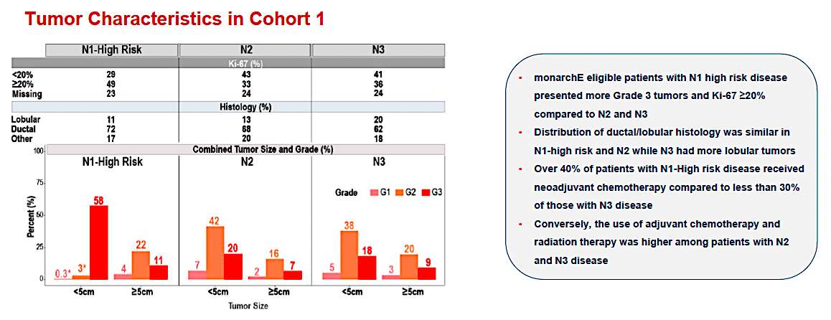
monarchE: Subgroup Analysis by Nodal Status
Cortés J et al. San Antonio Breast Cancer Symposium 2025;Abstract PS1-08-08.

Slide 50
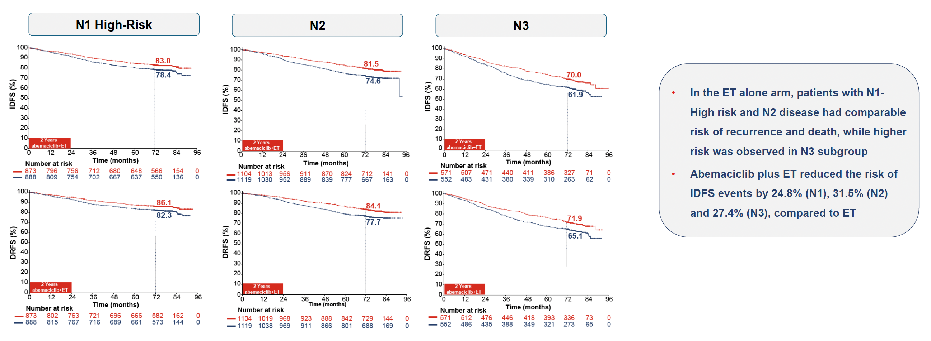
monarchE: IDFS and DRFS by Nodal Status
DRFS = distant relapse-free survival
Cortés J et al. San Antonio Breast Cancer Symposium 2025;Abstract PS1-08-08.

Slide 51
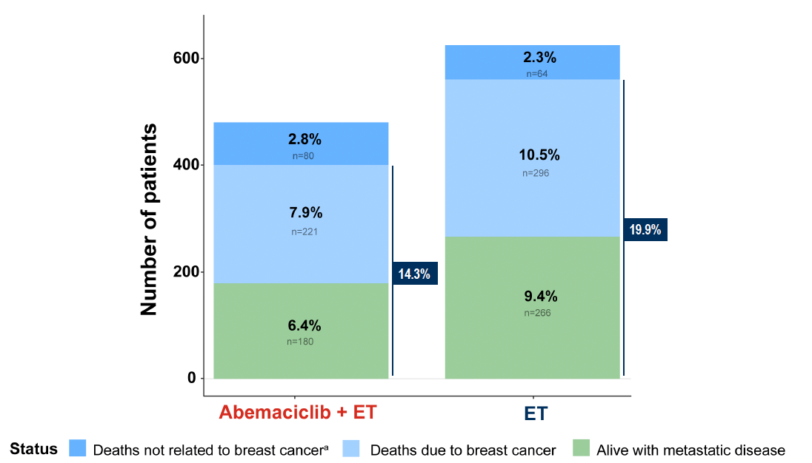
monarchE: Survival Status
Johnston S et al. ESMO 2025;Abstract LBA13. Johnston S et al. Ann Oncol 2026;37(2):155-65.

Slide 52
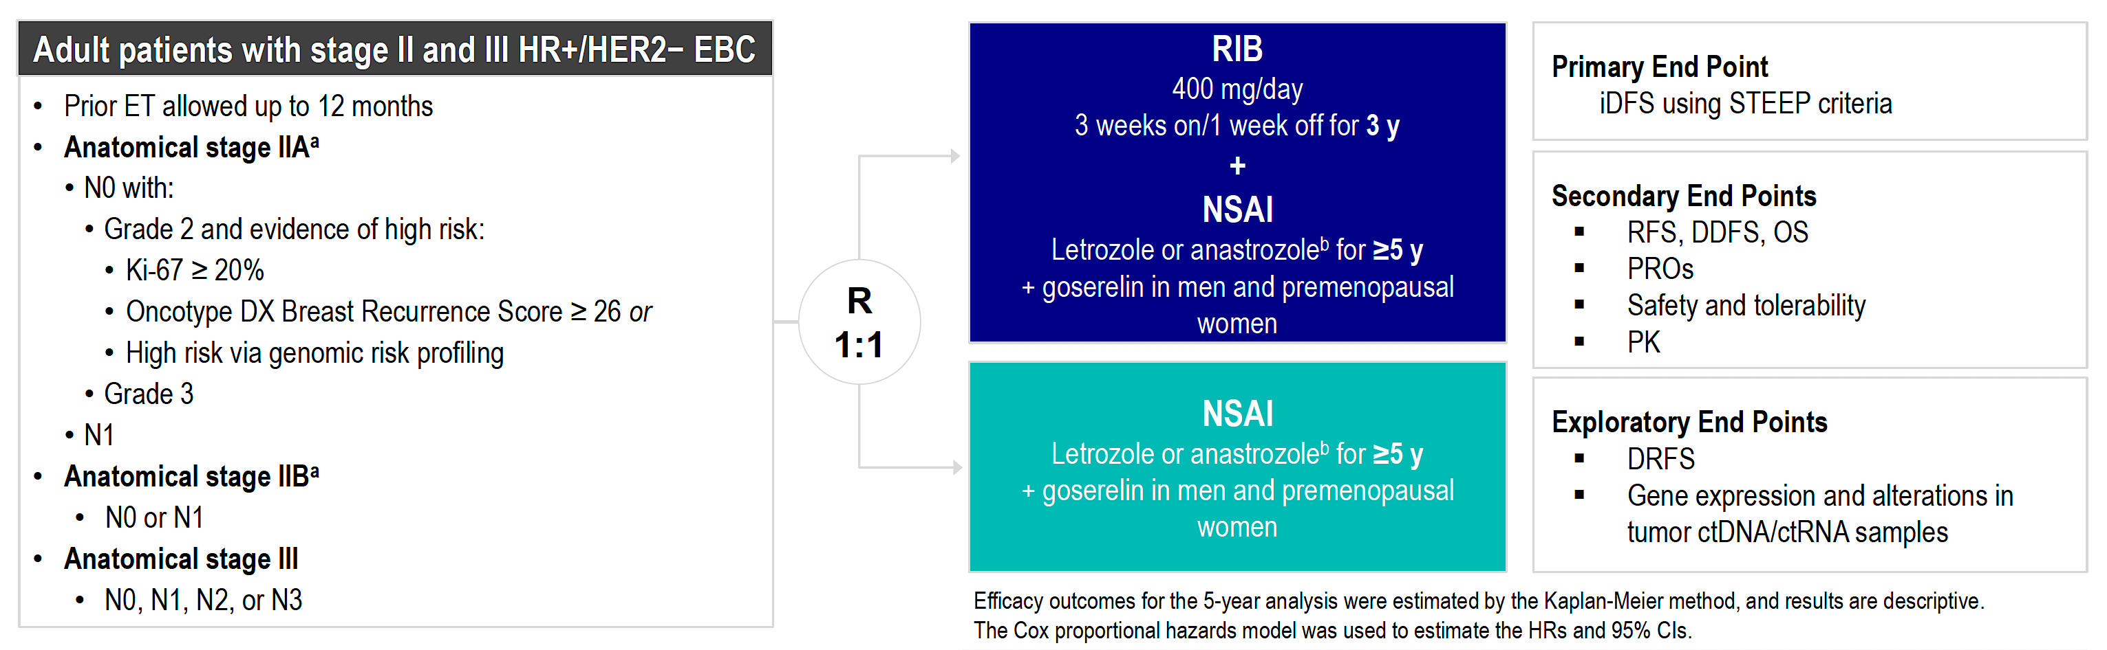
NATALEE Study Design
RIB = ribociclib; NSAI = nonsteroidal aromatase inhibitor
Crown JP et al. ESMO 2025;Abstract LBA14.

Slide 53
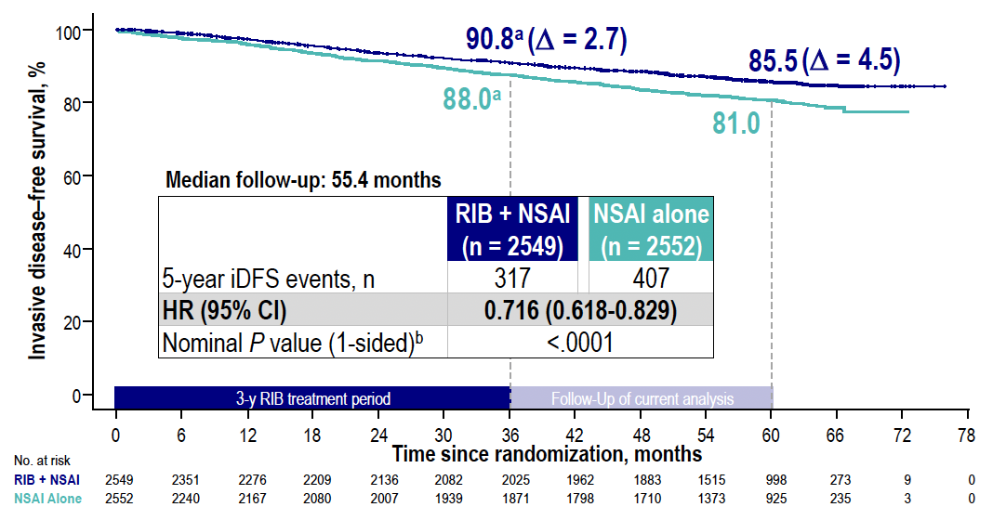
NATALEE: IDFS Outcomes
RIB = ribociclib; NSAI = nonsteroidal aromatase inhibitor
Crown JP et al. ESMO 2025;Abstract LBA14.

Slide 54
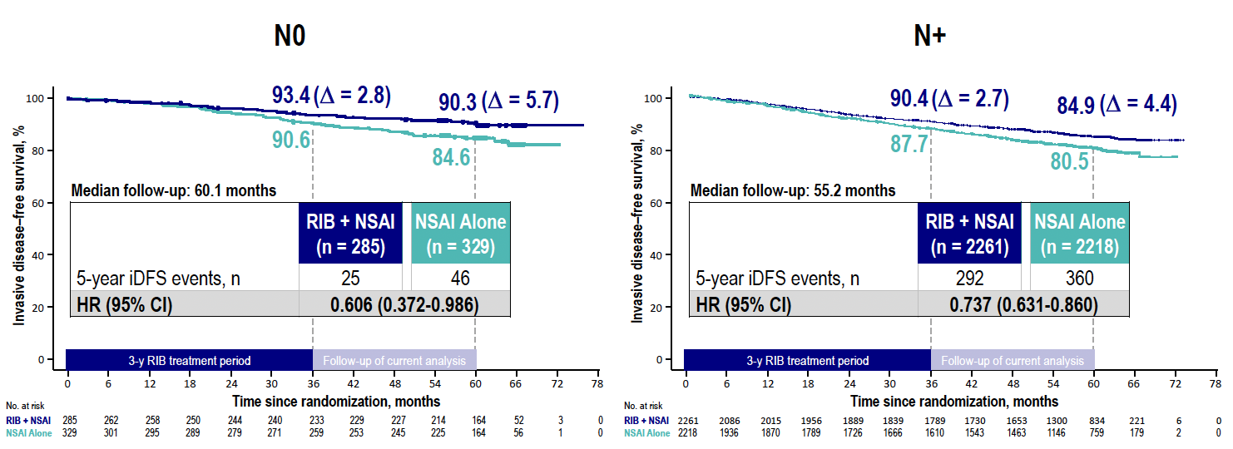
NATALEE: IDFS by Nodal Status
Crown JP et al. ESMO 2025;Abstract LBA14.

Slide 55
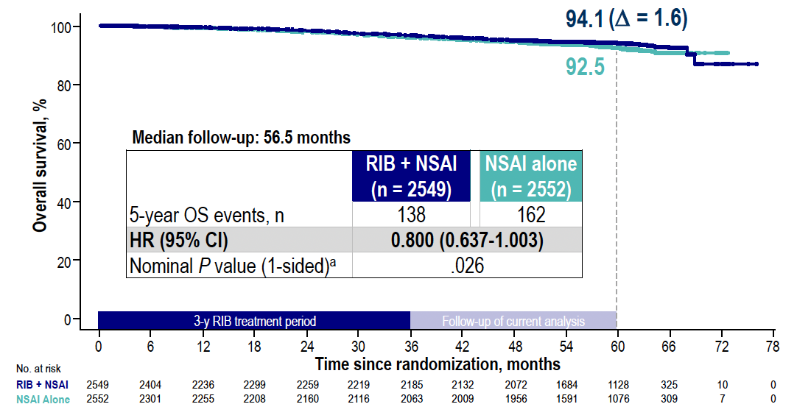
NATALEE: OS Outcomes
Crown JP et al. ESMO 2025;Abstract LBA14.

Slide 56
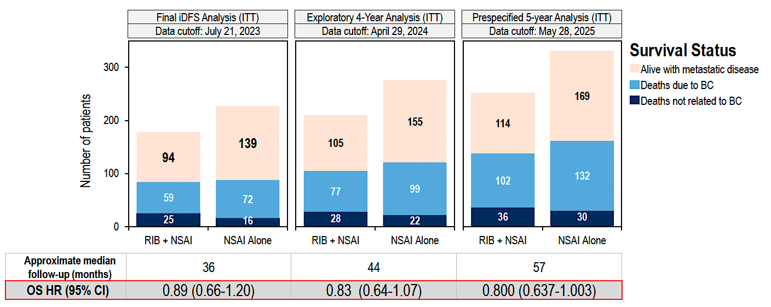
NATALEE: Survival Status over Time
Crown JP et al. ESMO 2025;Abstract LBA14.

Slide 57
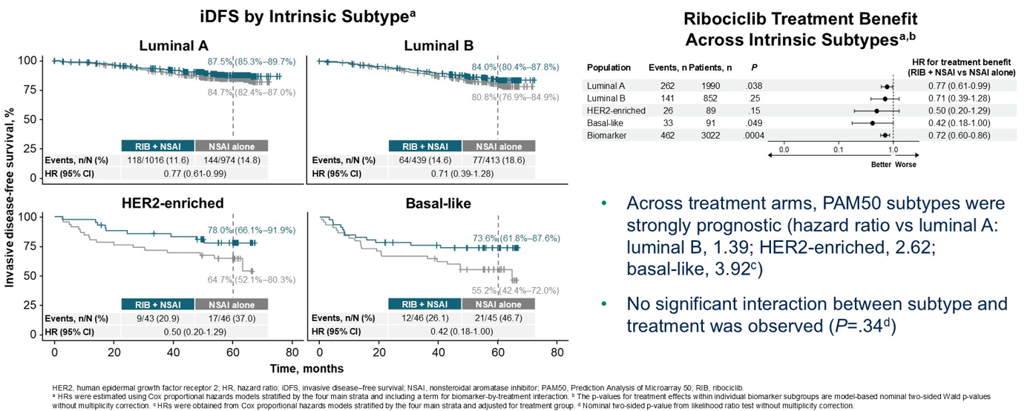
NATALEE: Ribociclib Treatment Benefit Is Observed Across PAM50-Based Intrinsic Subtypes
Chia SKL et al. ASCO 2026;Abstract 501.

Slide 58
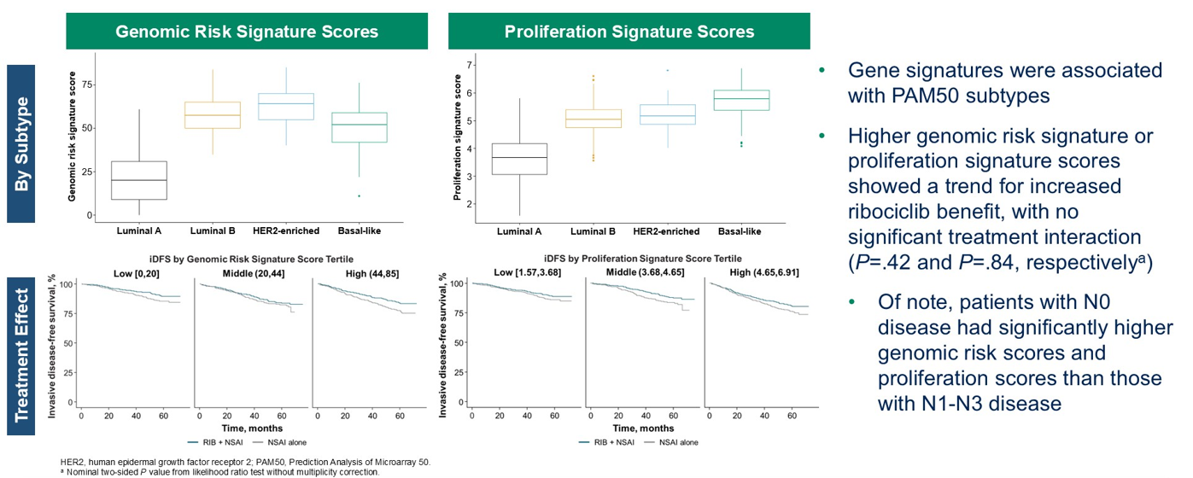
NATALEE: Higher Genomic Risk Signature and Proliferation Signature Scores Are Associated with Increased Ribociclib Benefit
Chia SKL et al. ASCO 2026;Abstract 501.

Slide 59
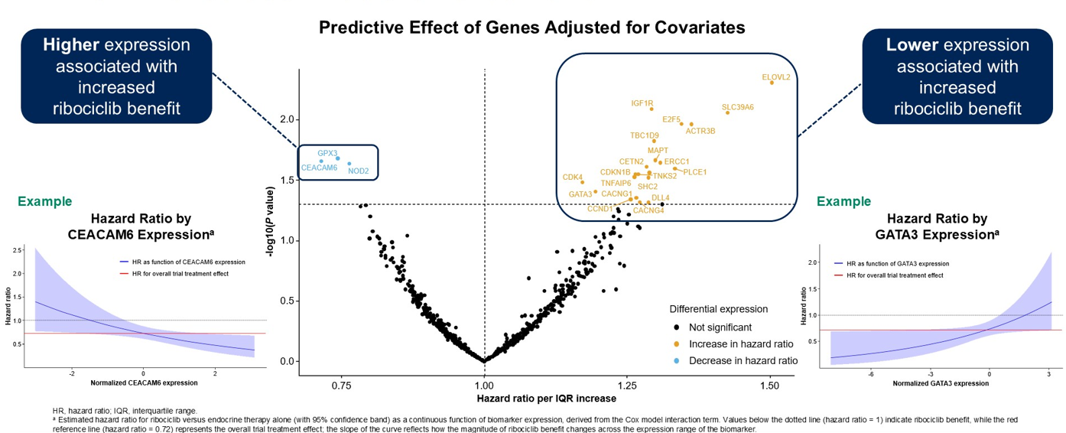
NATALEE: Differential Gene Expression Affects Ribociclib Benefit
Chia SKL et al. ASCO 2026;Abstract 501.

Slide 60
Management of Hormone Receptor (HR)-Positive Localized Breast Cancer
Module 1: Risk Assessment and Genomic Assays for HR-Positive, HER2-Negative Localized Breast Cancer
Module 2: Clinician Survey Results
Module 3: Adjuvant CDK4/6 Inhibitors for High-Risk, HR-Positive, HER2-Negative Localized Breast Cancer
Module 4: Clinician Survey Results
Module 5: Tolerability and Other Practical Considerations with Adjuvant CDK4/6 Inhibitor Therapy
Module 6: Clinician Survey Results
Module 7: Adjuvant Oral SERDs for HR-Positive, HER2-Negative Localized
Breast Cancer

Slide 61
Regulatory and reimbursement issues aside, would you generally recommend an adjuvant CDK4/6 inhibitor in addition to adjuvant endocrine therapy to a patient with 5.5-cm, Grade 2, HR-positive, HER2-negative localized BC and the following nodal status?
Node-negative
2 positive nodes
4 positive nodes
Yes, ribociclib
Yes, abemaciclib
Yes, abemaciclib
Yes, ribociclib
Yes, either
Yes, abemaciclib
Yes, ribociclib
Yes, abemaciclib
Yes, abemaciclib
Yes, ribociclib
Yes, either
Yes, either
Yes, ribociclib
Yes, abemaciclib
Yes, abemaciclib
Yes, ribociclib
Yes, either
Yes, abemaciclib
Yes, ribociclib
Yes, either
Yes, either
Yes, ribociclib
Yes, ribociclib
Yes, either

Slide 62
Regulatory and reimbursement issues aside, would you generally recommend an adjuvant CDK4/6 inhibitor in addition to adjuvant endocrine therapy to a patient with 2.5-cm Grade 2, HR-positive, HER2-negative localized BC and the following nodal status?
Node-negative
2 positive nodes
4 positive nodes
No
No
Yes, abemaciclib
No
Yes, either
Yes, abemaciclib
Yes, ribociclib
Yes, abemaciclib
Yes, abemaciclib
No
Yes, ribociclib
Yes, either
Yes, ribociclib
Yes, ribociclib
Yes, abemaciclib
Yes, ribociclib
Yes, either
Yes, abemaciclib
No
Yes, either
Yes, either
Yes, ribociclib
Yes, ribociclib
Yes, either

Slide 63
Management of Hormone Receptor (HR)-Positive Localized Breast Cancer
Module 1: Risk Assessment and Genomic Assays for HR-Positive, HER2-Negative Localized Breast Cancer
Module 2: Clinician Survey Results
Module 3: Adjuvant CDK4/6 Inhibitors for High-Risk, HR-Positive, HER2-Negative Localized Breast Cancer
Module 4: Clinician Survey Results
Module 5: Tolerability and Other Practical Considerations with Adjuvant CDK4/6 Inhibitor Therapy
Module 6: Clinician Survey Results
Module 7: Adjuvant Oral SERDs for HR-Positive, HER2-Negative Localized
Breast Cancer

Slide 64
Key Datasets
Rugo HS et al. Adjuvant abemaciclib combined with endocrine therapy for high-risk early breast cancer: Safety and patient-reported outcomes from the monarchE study. Ann Oncol 2022;33(6):616-27.
Barrios C et al. NATALEE update: Safety and treatment (tx) duration of ribociclib (RIB) + nonsteroidal aromatase inhibitor (NSAI) in patients (pts) with HR+/HER2− early breast cancer (EBC). ESMO Breast 2024;Abstract 113MO.
Mayer EL et al. TRADE: A phase II trial to assess the tolerability of abemaciclib dose escalation in early-stage HR-positive/HER2-negative breast cancer. Ann Oncol 2025;31(1):117-24.

Slide 65

monarchE: Overall Safety Profile
Rugo HS et al. Ann Oncol 2022;33(6):616-27.

Slide 66

monarchE: Serious and Fatal Adverse Events (AEs) in Long-Term Follow-Up
to AEs
SAE = serious adverse event; LTFU = long-term follow-up; SOC = standard of care
Johnston S et al. ESMO 2025;Abstract LBA13. Johnston S et al. Ann Oncol 2026;37(2):155-65.

Slide 67

monarchE: AEs Leading to Discontinuation
Rugo HS et al. Ann Oncol 2022;33(6):616-27.
VTE = venous thromboembolism; ILD = interstitial lung disease

Slide 68

monarchE: AEs Leading to Dose Modifications
Rugo HS et al. Ann Oncol 2022;33(6):616-27.

Slide 69

NATALEE: Overall Safety Profile
ALT = alanine aminostransferase; AST = aspartate aminotransferase
Barrios C et al. ESMO Breast 2024;Abstract 113MO.

Slide 70

NATALEE: AEs of Special Interest (AESIs)
Barrios C et al. ESMO Breast 2024;Abstract 113MO.

Slide 71

NATALEE: AE-Related Dose Reduction and Discontinuation
RDI = relative dose intensity
Barrios C et al. ESMO Breast 2024;Abstract 113MO.

Slide 72
AEs and Dosing Must Be Considered: Distinct AE Profiles and Dosing Schedules of CDK4/6 Inhibitors for Localized Breast Cancer
Abemaciclib
Adverse Events Neutropenia (41%-46%) Diarrhea (81%-86%) Increased ALT (13%-16%) Increased AST (12%-15%) Thromboembolic events (5%) Schedule Continuous daily dosing Dosing Starting dose in EBC: 150 mg BID 1st dose reduction: 100 mg BID 2nd dose reduction: 50 mg BID
Ribociclib
Adverse Events Neutropenia (69%-78%) Diarrhea (29%-35%) Increased ALT (15%-46%) Increased AST (13%-44%) QTc prolongation (6%) Schedule 3 wk on/1 wk off Dosing Starting dose in EBC: 400 mg/day 1 (and only) dose reduction option available in EBC: 200 mg/day
Breast Cancer Status | CDK4/6i | Trial(s) | Discontinuation Rate Due to AE
HR+/HER2– EBC | Abemaciclib | monarchE^{1,a} | 19%
 | Ribociclib | NATALEE^{2,3} | 19%
1. Rugo HS, et al. Ann Oncol. 2022;33(6):616-627. 2. Slamon D, et al. N Engl J Med. 2024 Mar 21;390(12):1080-1091. 3. Hortobagyi GN, et al. SABCS 2023. Abstract GS03-03.
Content courtesy of Komal Jhaveri, MD, FACP, FASCO
EBC = early breast cancer

Slide 73




TRADE: Abemaciclib Dose Escalation
Primary endpoint: composite AE rate (discontinuation of adjuvant abemaciclib for any reason and/or need to dose reduce by 12 weeks of therapy)
Courtesy of Komal Jhaveri, MD, FACP, FASCO
Mayer EL et al. Ann Oncol 2025

Slide 74

NATALEE: IDFS by Dose Reductions
Barrios C et al. ESMO Breast 2024;Abstract 113MO.

Slide 75
Management of Hormone Receptor (HR)-Positive Localized Breast Cancer
Module 1: Risk Assessment and Genomic Assays for HR-Positive, HER2-Negative Localized Breast Cancer
Module 2: Clinician Survey Results
Module 3: Adjuvant CDK4/6 Inhibitors for High-Risk, HR-Positive, HER2-Negative Localized Breast Cancer
Module 4: Clinician Survey Results
Module 5: Tolerability and Other Practical Considerations with Adjuvant CDK4/6 Inhibitor Therapy
Module 6: Clinician Survey Results
Module 7: Adjuvant Oral SERDs for HR-Positive, HER2-Negative Localized
Breast Cancer

Slide 76
Have you employed or would you employ an initial dose-escalation strategy rather than initiating therapy at the recommended starting dose for any of your patients with HR-positive localized BC receiving an adjuvant CDK4/6 inhibitor?
I have not but would for the right patient
I have
I have
I have
I have
I have
I have
I have

Slide 77
Assuming eligibility to receive abemaciclib or ribociclib, which CDK4/6 inhibitor would you prefer in the adjuvant setting for a patient with HR-positive localized BC and a history of …?
Colitis
Chronic liver disease
Chronic renal disease
Ribociclib
Abemaciclib
Ribociclib
Ribociclib
Abemaciclib
No preference
Ribociclib
Abemaciclib
No preference
Ribociclib
Abemaciclib
No preference
Ribociclib
Abemaciclib
Ribociclib
Ribociclib
Abemaciclib
No preference
Ribociclib
Abemaciclib
Ribociclib
Ribociclib
Abemaciclib
No preference

Slide 78
Assuming eligibility to receive abemaciclib or ribociclib, which CDK4/6 inhibitor would you prefer in the adjuvant setting for a patient with HR-positive localized BC and a history of …?
COPD
NYHA Class I congestive
heart failure
No preference
Abemaciclib
No preference
Abemaciclib
No preference
Abemaciclib
No preference
Abemaciclib
No preference
Abemaciclib
No preference
Abemaciclib
No preference
No preference
No preference
No preference
COPD = chronic obstructive pulmonary disease

Slide 79
Management of Hormone Receptor (HR)-Positive Localized Breast Cancer
Module 1: Risk Assessment and Genomic Assays for HR-Positive, HER2-Negative Localized Breast Cancer
Module 2: Clinician Survey Results
Module 3: Adjuvant CDK4/6 Inhibitors for High-Risk, HR-Positive, HER2-Negative Localized Breast Cancer
Module 4: Clinician Survey Results
Module 5: Tolerability and Other Practical Considerations with Adjuvant CDK4/6 Inhibitor Therapy
Module 6: Clinician Survey Results
Module 7: Adjuvant Oral SERDs for HR-Positive, HER2-Negative Localized
Breast Cancer

Slide 80
Key Datasets
Bardia A et al. Giredestrant vs standard-of-care endocrine therapy as adjuvant treatment for patients with estrogen receptor-positive, HER2-negative early breast cancer: Results from the global phase III lidERA Breast Cancer trial. San Antonio Breast Cancer Symposium 2025;Abstract GS1-10.

Slide 81

Abstract GS1-10

Slide 82

lidERA Breast Cancer Study Design
DRFI = distant recurrence-free interval; LRRFI = locoregional recurrence-free interval
Bardia A et al. San Antonio Breast Cancer Symposium 2025;Abstract GS1-10.

Slide 83

lidERA Breast Cancer: Patient Demographics
Bardia A et al. San Antonio Breast Cancer Symposium 2025;Abstract GS1-10.

Slide 84

lidERA Breast Cancer: IDFS Outcomes
Bardia A et al. San Antonio Breast Cancer Symposium 2025;Abstract GS1-10.

Slide 85

lidERA Breast Cancer: IDFS in Key Subgroups
Bardia A et al. San Antonio Breast Cancer Symposium 2025;Abstract GS1-10.

Slide 86

lidERA Breast Cancer: OS Outcomes
Bardia A et al. San Antonio Breast Cancer Symposium 2025;Abstract GS1-10.

Slide 87

lidERA Breast Cancer: Safety Profile
Bardia A et al. San Antonio Breast Cancer Symposium 2025;Abstract GS1-10.

Slide 88
Based on recently presented findings from the Phase III lidERA trial, would you like to have access to adjuvant giredestrant today for your patients with HR-positive, HER2-negative localized BC?
Yes, for patients with higher-risk disease
Yes, for those who can’t tolerate a CDK4/6i or unable to tolerate an AI or in place of tamoxifen for a premenopausal patient with high-risk disease
Yes, for patients with higher-risk disease after CDK4/6i or if cannot
tolerate standard ET
Yes, for patients with high-risk disease
Yes, for patients who are intolerant of a CDK4/6 inhibitor and those
who are AI intolerant with a medium to high recurrence risk
Yes, for high-risk disease as defined in the trial
Yes, for patients that match eligibility of the lidERA trial
Yes, for patients with node-negative disease and
those with difficulty tolerating AI, after use of CDK 4/6i
ET = endocrine therapy; CDK4/6i = CDK4/6 inhibitor

Slide 89
If giredestrant were available, regulatory and reimbursement issues aside, what would you generally recommend for patients who met the criteria for both an adjuvant CDK4/6 inhibitor and adjuvant giredestrant?
CDK4/6i with standard adjuvant ET for the initial 2 to 3 years of tx,
then switch to giredestrant after discontinuation of the CDK4/6i
CDK4/6i with standard adjuvant ET for the initial 2 to 3 years of tx,
then switch to giredestrant after discontinuation of the CDK4/6i
CDK4/6i with standard adjuvant ET for the initial 2 to 3 years of tx,
then switch to giredestrant after discontinuation of the CDK4/6i
CDK4/6i with standard adjuvant ET for the initial 2 to 3 years of tx,
then switch to giredestrant after discontinuation of the CDK4/6i
CDK4/6i with standard adjuvant ET for the initial 2 to 3 years of tx,
then switch to giredestrant after discontinuation of the CDK4/6i
CDK4/6i with standard adjuvant ET for the initial 2 to 3 years of tx,
then switch to giredestrant after discontinuation of the CDK4/6i
CDK4/6i with standard adjuvant ET for the initial 2 to 3 years of tx,
then switch to giredestrant after discontinuation of the CDK4/6i
CDK4/6i with standard adjuvant ET for the initial 2 to 3 years of tx,
then switch to giredestrant after discontinuation of the CDK4/6i
ET = endocrine therapy; CDK4/6i = CDK4/6 inhibitor

Slide 90
Questions?

