Slide 1

Welcome!
Please complete the preactivity educational survey
by scanning the QR code below.
Your input is greatly appreciated and helps
guide our future educational activities.

Slide 2
Optimizing Therapy for Patients with Hormone Receptor-Positive Localized Breast Cancer
Adam M Brufsky, MD, PhD
Professor of Medicine
UPMC Hillman Cancer Center
Department of Medicine
University of Pittsburgh
Pittsburgh, Pennsylvania

Slide 3
Disclosures
Consulting Agreements | Agendia Inc, AstraZeneca Pharmaceuticals LP, BriaCell, Celcuity, Daiichi Sankyo Inc, Genentech, a member of the Roche Group, Gilead Sciences Inc, Lilly, Merck, Myriad Genetic Laboratories Inc, Novartis, Pfizer Inc, Puma Biotechnology Inc, Sanofi

Slide 4






Program Steering Committee
Adam M Brufsky, MD, PhD
Professor of Medicine
UPMC Hillman Cancer Center
Department of Medicine
University of Pittsburgh
Pittsburgh, Pennsylvania
Kevin Kalinsky, MD, MS, FASCO
Professor of Medicine
Director, Division of Medical Oncology
Louisa and Rand Glenn Family Chair in Breast Cancer Research
Winship Cancer Institute at Emory University
Atlanta, Georgia
Nan Chen, MD
Assistant Professor
The University of Chicago
Chicago, Illinois
Reshma L Mahtani, DO
Chief of Breast Medical Oncology
Miami Cancer Institute
Baptist Health South Florida
Miami, Florida
Komal Jhaveri, MD, FACP, FASCO
Patricia and James Cayne Chair for Junior Faculty
Associate Attending Physician
Breast Medicine Service and Early Drug Development Service
Section Head, Endocrine Therapy Research Program
Clinical Director, Early Drug Development Service
Department of Medicine
Memorial Sloan Kettering Cancer Center
Associate Professor of Medicine
Weill Cornell College of Medicine
New York, New York
Erica Mayer, MD, MPH, FASCO
Director of Breast Cancer Clinical Research
Breast Oncology Center
Dana-Farber Cancer Institute
Associate Professor of Medicine
Harvard Medical School
Boston, Massachusetts

Slide 5





Program Steering Committee
Jason A Mouabbi, MD
Assistant Professor, Breast Medical Oncology
SAB Chair of the Lobular Breast Cancer Alliance
The University of Texas MD Anderson Cancer Center
Houston, Texas
Rebecca Shatsky, MD
Professor of Clinical Medicine
Breast Medical Oncology Team Leader
Director of Breast Cancer Clinical Trials
Director of Inflammatory and Triple Negative Breast Cancer Program
University of California San Diego
Moores Cancer Center
San Diego, California
Hope S Rugo, MD
Director, Women’s Cancers Program
Division Chief, Breast Medical Oncology
Professor, Department of Medical Oncology and Therapeutics Research
City of Hope Comprehensive Cancer Center
Duarte, California
Professor Emeritus, UCSF
PROJECT CHAIR
Neil Love, MD
Research To Practice
Miami, Florida
Priyanka Sharma, MD
Frank B Tyler Professor in Cancer Research
Division of Medical Oncology, Department
of Internal Medicine
Co-Program Leader
Drug Discovery, Delivery and Experimental Therapeutics Program
The University of Kansas Cancer Center
Westwood, Kansas

Slide 6
Key Datasets
Andre F et al. Biomarkers for adjuvant endocrine and chemotherapy in early-stage breast cancer: ASCO Guideline update.
J Clin Oncol 2022;40:1816-37.
Sparano JA et al. Trial Assigning Individualized Options for treatment (TAILORx): An update including 12-year event rates. San Antonio Breast Cancer Symposium 2022;Abstract GS1-05.
Sparano JA et al. Clinical outcomes in early breast cancer with a high 21-gene Recurrence Score of 26 to 100 assigned to adjuvant chemotherapy plus endocrine therapy: A secondary analysis of the TAILORx randomized clinical trial. JAMA Oncol 2020;6(3):367-74.
Chen N et al. Impact of anthracyclines in genomic high-risk, node-negative, HR-positive/HER2-negative breast cancer. Ann Oncol 2025;36(11):1356-65.
O’Shaughnessy J et al. Improved 3-year IDFS with anthracycline-based therapy for patients with 70-gene signature high 2, luminal B, HR+HER2- early-stage breast cancer. San Antonio Breast Cancer Symposium 2025;Abstract PS2-07-03.
Kalinsky K et al. 21-gene assay to inform chemotherapy benefit in node-positive breast cancer. N Engl J Med 2021; 385(25):2336-47.
Piccart M et al. 70-gene signature as an aid for treatment decisions in early breast cancer: Updated results of the phase 3 randomised MINDACT trial with an exploratory analysis by age. Lancet Oncol 2021;22(4):476-88.
Sestak I et al. Comparison of the performance of 6 prognostic signatures for estrogen receptor-positive breast cancer: A secondary analysis of a randomized clinical trial. JAMA Oncol 2018;4(4):545-53.
Noordhoek I et al. Breast Cancer Index predicts extended endocrine benefit to individualize selection of patients with HR+ early-stage breast cancer for 10 years of endocrine therapy. Clin Cancer Res 2021;27(1):311-19.

Slide 7
Key Datasets
Woolpert KM et al. Biomarkers predictive of a response to extended endocrine therapy in breast cancer: A systematic review and meta-analysis. Breast Cancer Res Treat 2024;203(3):407-17.
Johnston S et al. monarchE: Primary overall survival (OS) results of adjuvant abemaciclib + endocrine therapy (ET) for HR+, HER2-, high-risk early breast cancer (EBC). ESMO 2025;Abstract LBA13.
Johnston S et al. Overall survival with abemaciclib in early breast cancer. Ann Oncol 2026;37(2):155-65.
Cortés J et al. monarchE: Subgroup analysis of adjuvant abemaciclib + endocrine therapy for HR+, HER2-, high-risk early breast cancer by nodal status. San Antonio Breast Cancer Symposium 2025;Abstract PS1-08-08.
Crown JP et al. Adjuvant ribociclib (RIB) plus nonsteroidal aromatase inhibitor (NSAI) in patients (pts) with HR+/HER2− early breast cancer (EBC): NATALEE 5-year outcomes. ESMO 2025;Abstract LBA14.
Rugo HS et al. Adjuvant abemaciclib combined with endocrine therapy for high-risk early breast cancer: Safety and patient-reported outcomes from the monarchE study. Ann Oncol 2022;33(6):616-27.
Barrios C et al. NATALEE update: Safety and treatment (tx) duration of ribociclib (RIB) + nonsteroidal aromatase inhibitor (NSAI) in patients (pts) with HR+/HER2− early breast cancer (EBC). ESMO Breast 2024;Abstract 113MO.
Mayer EL et al. TRADE: A phase II trial to assess the tolerability of abemaciclib dose escalation in early-stage HR-positive/HER2-negative breast cancer. Ann Oncol 2025;31(1):117-24.
Bardia A et al. Giredestrant vs standard-of-care endocrine therapy as adjuvant treatment for patients with estrogen receptor-positive, HER2-negative early breast cancer: Results from the global phase III lidERA Breast Cancer trial. San Antonio Breast Cancer Symposium 2025;Abstract GS1-10.

Slide 8
Management of Hormone Receptor (HR)-Positive Localized Breast Cancer
Module 1: Risk Assessment and Genomic Assays for HR-Positive, HER2-Negative Localized Breast Cancer
Module 2: Clinician Survey Results
Module 3: Adjuvant CDK4/6 Inhibitors for High-Risk, HR-Positive, HER2-Negative Localized Breast Cancer
Module 4: Clinician Survey Results
Module 5: Tolerability and Other Practical Considerations with Adjuvant CDK4/6 Inhibitor Therapy
Module 6: Clinician Survey Results
Module 7: Adjuvant Oral SERDs for HR-Positive, HER2-Negative Localized
Breast Cancer

Slide 9
Management of Hormone Receptor (HR)-Positive Localized Breast Cancer
Module 1: Risk Assessment and Genomic Assays for HR-Positive, HER2-Negative Localized Breast Cancer
Module 2: Clinician Survey Results
Module 3: Adjuvant CDK4/6 Inhibitors for High-Risk, HR-Positive, HER2-Negative Localized Breast Cancer
Module 4: Clinician Survey Results
Module 5: Tolerability and Other Practical Considerations with Adjuvant CDK4/6 Inhibitor Therapy
Module 6: Clinician Survey Results
Module 7: Adjuvant Oral SERDs for HR-Positive, HER2-Negative Localized
Breast Cancer

Slide 10
Key Datasets
Andre F et al. Biomarkers for adjuvant endocrine and chemotherapy in early-stage breast cancer: ASCO Guideline update.
J Clin Oncol 2022;40:1816-37.
Sparano JA et al. Trial Assigning Individualized Options for treatment (TAILORx): An update including 12-year event rates. San Antonio Breast Cancer Symposium 2022;Abstract GS1-05.
Sparano JA et al. Clinical outcomes in early breast cancer with a high 21-gene Recurrence Score of 26 to 100 assigned to adjuvant chemotherapy plus endocrine therapy: A secondary analysis of the TAILORx randomized clinical trial. JAMA Oncol 2020;6(3):367-74.
Chen N et al. Impact of anthracyclines in genomic high-risk, node-negative, HR-positive/HER2-negative breast cancer. Ann Oncol 2025;36(11):1356-65.
O’Shaughnessy J et al. Improved 3-year IDFS with anthracycline-based therapy for patients with 70-gene signature high 2, luminal B, HR+HER2- early-stage breast cancer. San Antonio Breast Cancer Symposium 2025;Abstract PS2-07-03.
Kalinsky K et al. 21-gene assay to inform chemotherapy benefit in node-positive breast cancer. N Engl J Med 2021; 385(25):2336-47.
Piccart M et al. 70-gene signature as an aid for treatment decisions in early breast cancer: Updated results of the phase 3 randomised MINDACT trial with an exploratory analysis by age. Lancet Oncol 2021;22(4):476-88.

Slide 11
Key Datasets
Sestak I et al. Comparison of the performance of 6 prognostic signatures for estrogen receptor-positive breast cancer: A secondary analysis of a randomized clinical trial. JAMA Oncol 2018;4(4):545-53.
Noordhoek I et al. Breast Cancer Index predicts extended endocrine benefit to individualize selection of patients with HR+ early-stage breast cancer for 10 years of endocrine therapy. Clin Cancer Res 2021;27(1):311-9.
Woolpert KM et al. Biomarkers predictive of a response to extended endocrine therapy in breast cancer: A systematic review and meta-analysis. Breast Cancer Res Treat 2024;203(3):407-17.

Slide 12
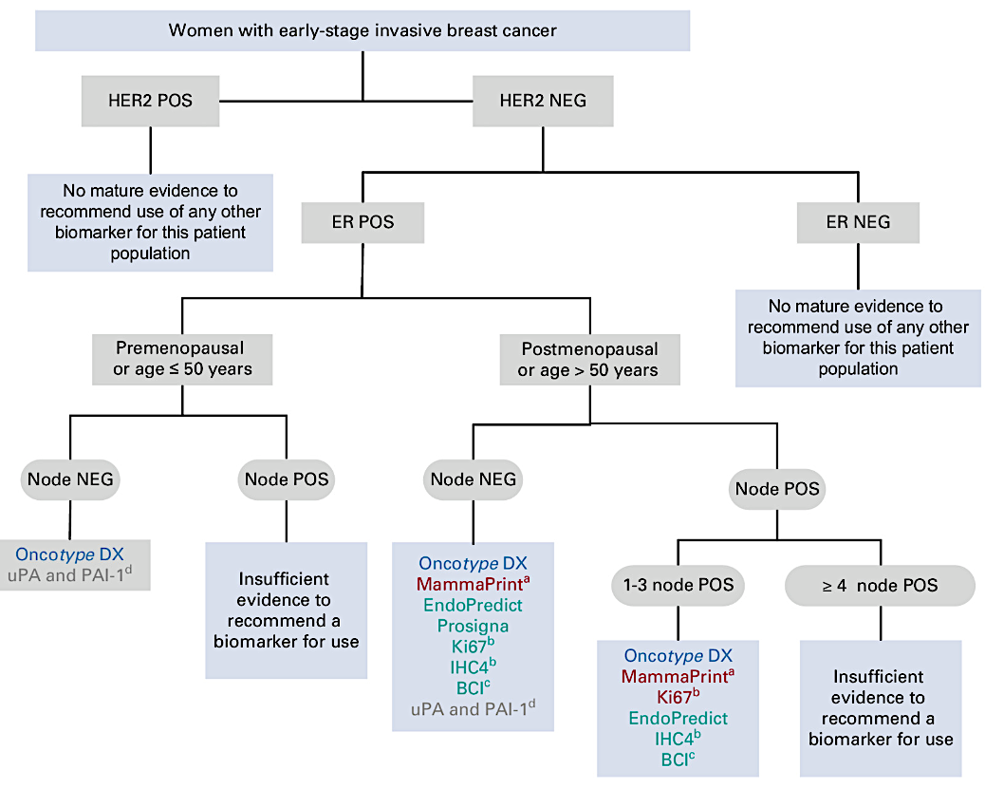
ASCO Guideline
2022
Andre F et al. J Clin Oncol. 2022;40:1816-1837

Slide 13
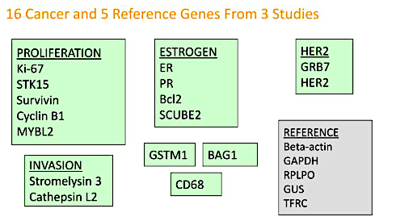
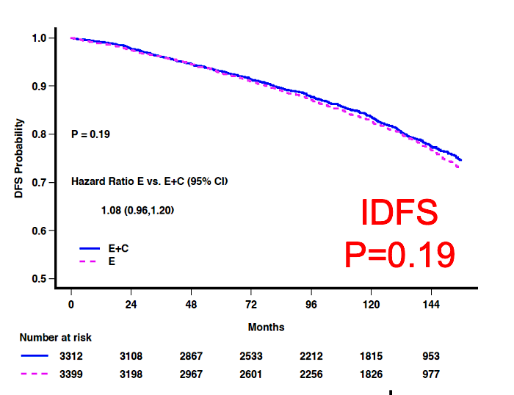
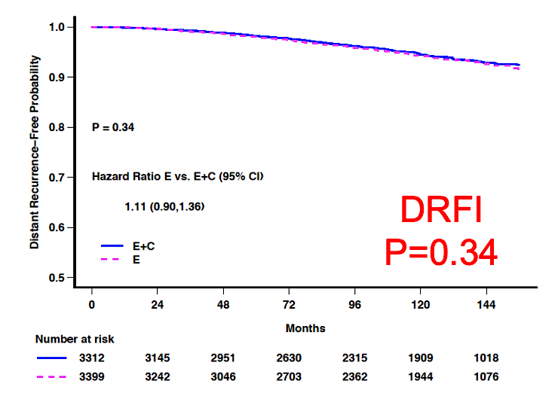
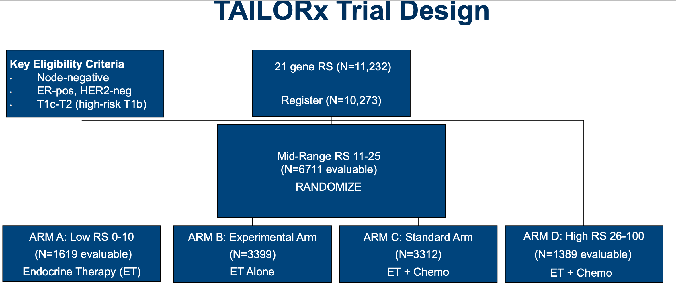
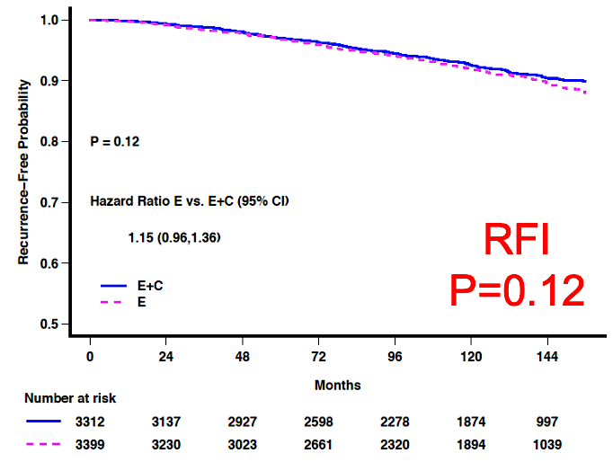
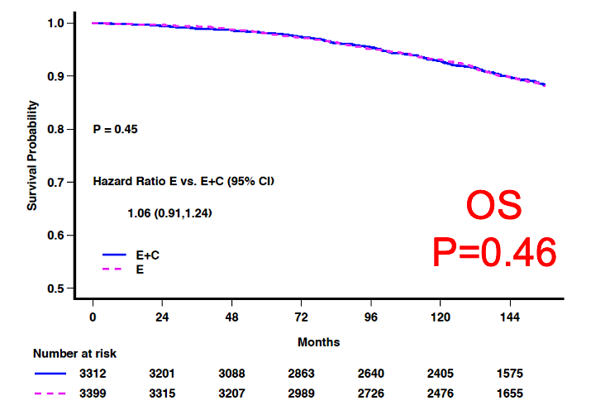
OncotypeDX®: TAILORx Trial Key Results for Node-Negative Disease
Intermediate risk (11-25):
No overall benefit to chemotherapy (2022 update)
Sparano JA et al. SABCS 2022;Abstract GS1-05.
Figures courtesy K. Kalinsky

Slide 14
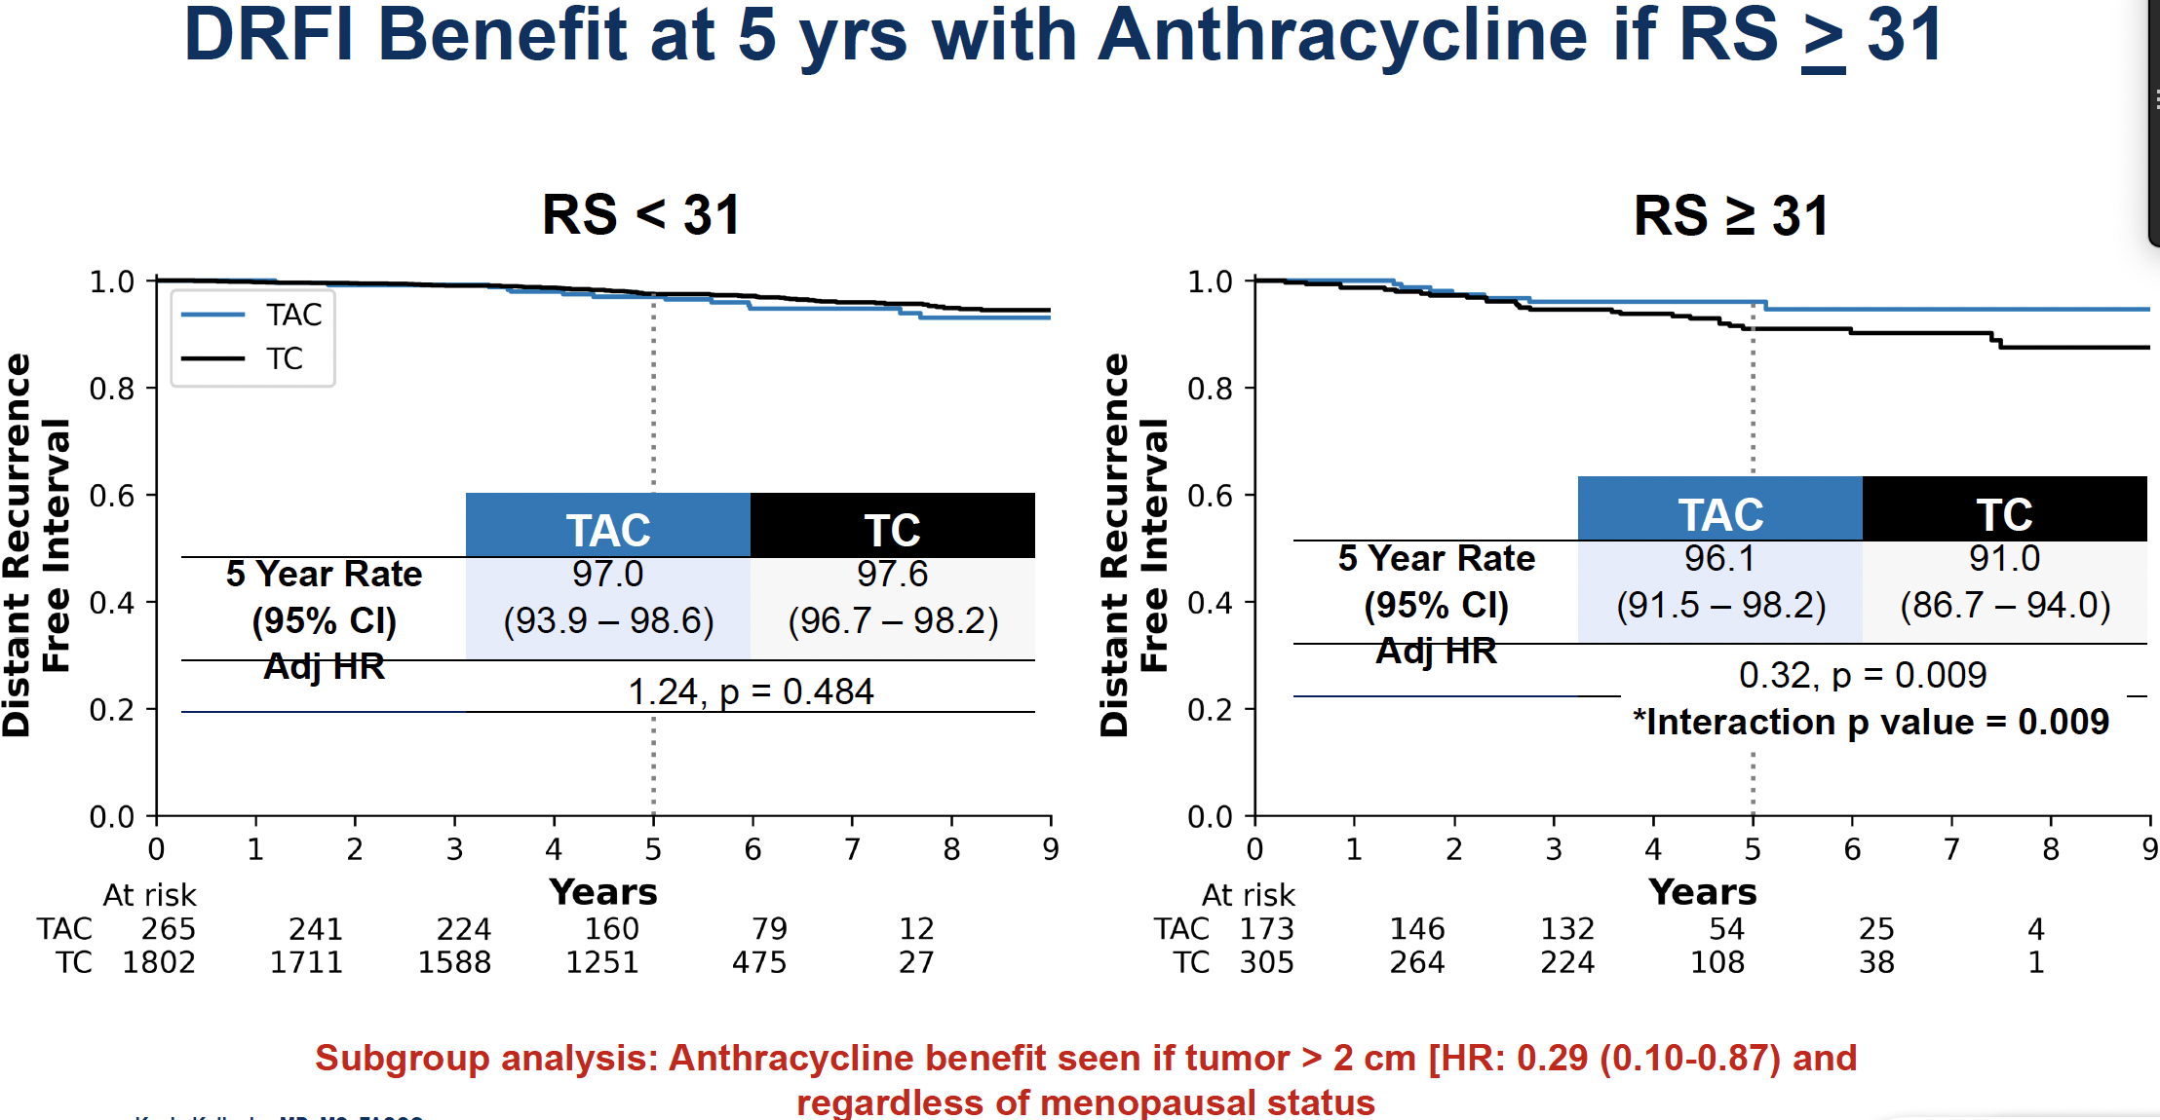
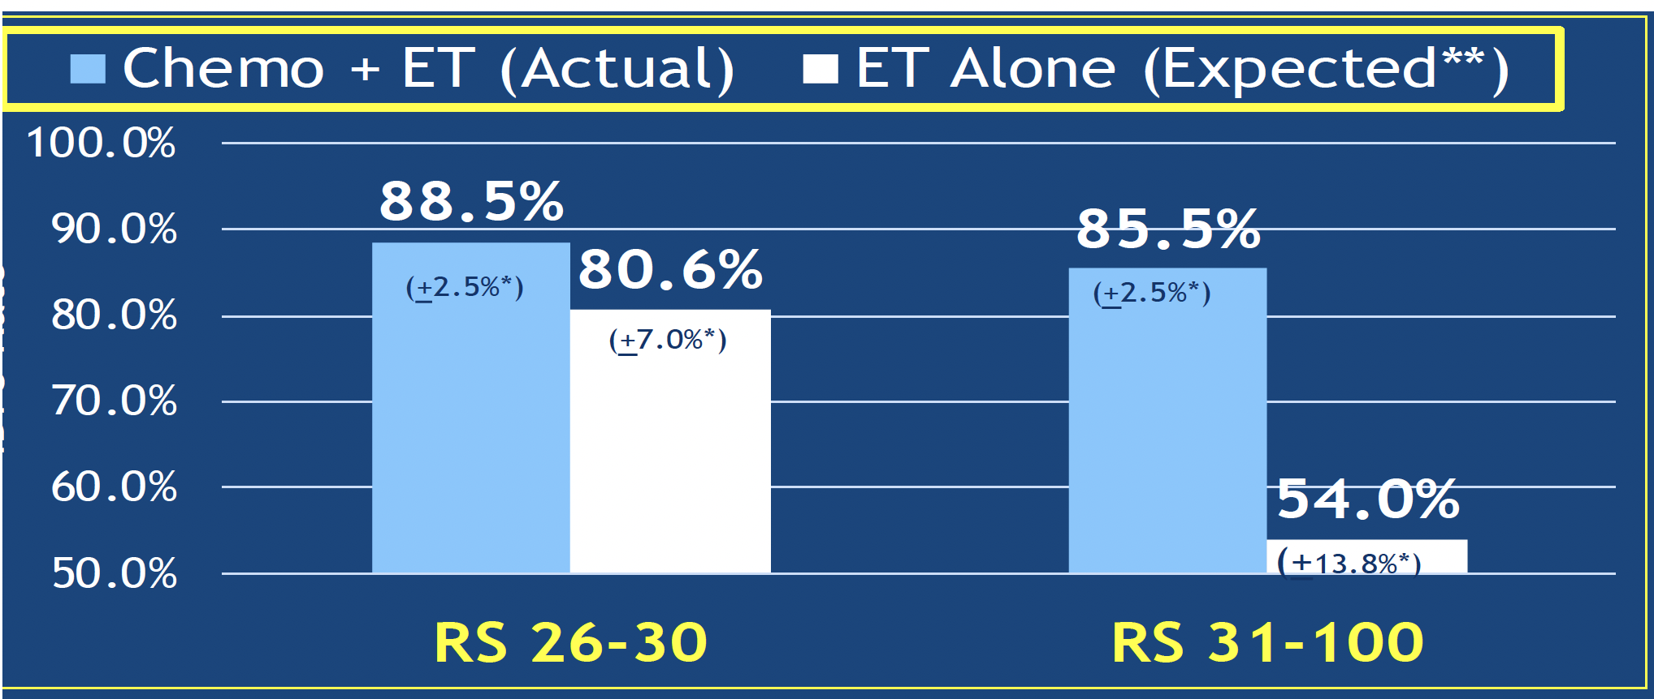
Chemotherapy and Anthracycline Benefits for Patients with High Recurrence Scores® (>25)
DRFI Benefit at 5 y with Anthracycline if RS > 31
High Risk (RS > 25): Expected benefit with chemotherapy
“No chemotherapy” rates estimated by combining
patient-specific distant recurrence risk information with
patient-specific chemotherapy benefit information
from the ERBB2-negative cohort of NSABP B20
TAILORx N = 2,549. T-AC vs TC
5-y DRFI 96.1 vs 91%, HR 0.31, p = 0.006
5-y DRFS 95.4% vs 89.8%, aHR 0.49, p = 0.032
OS NS
Sparano JA et al. JAMA Oncol 2020; Chen N et al. Ann Oncol 2025.

Slide 15
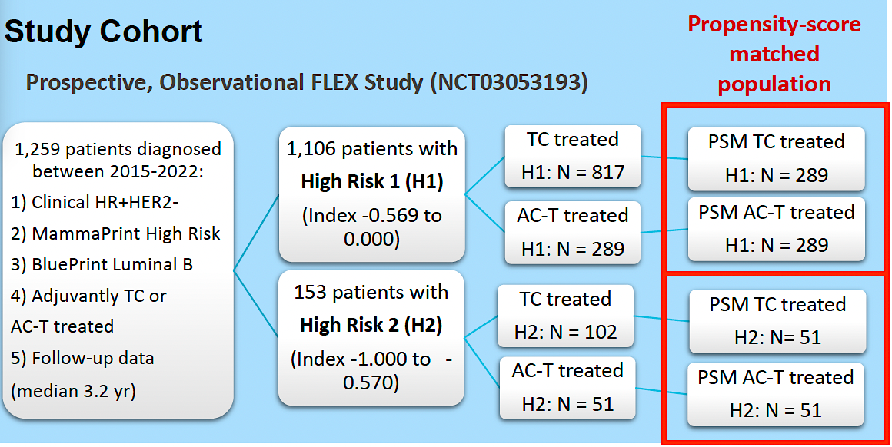
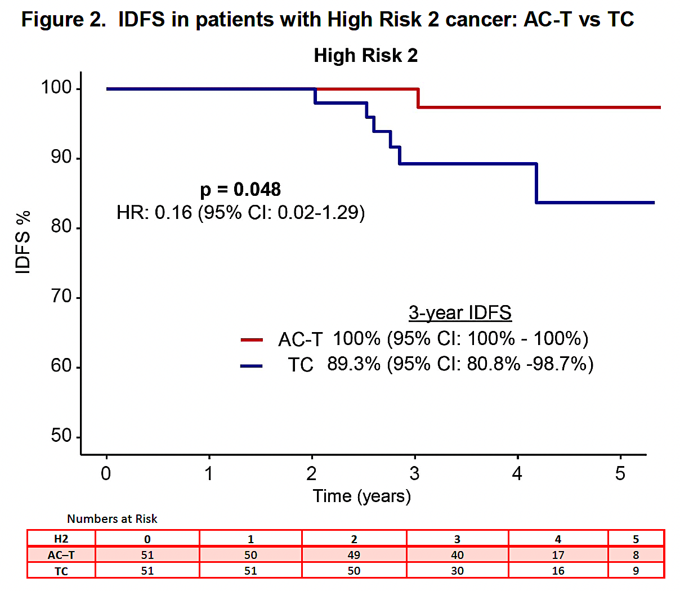
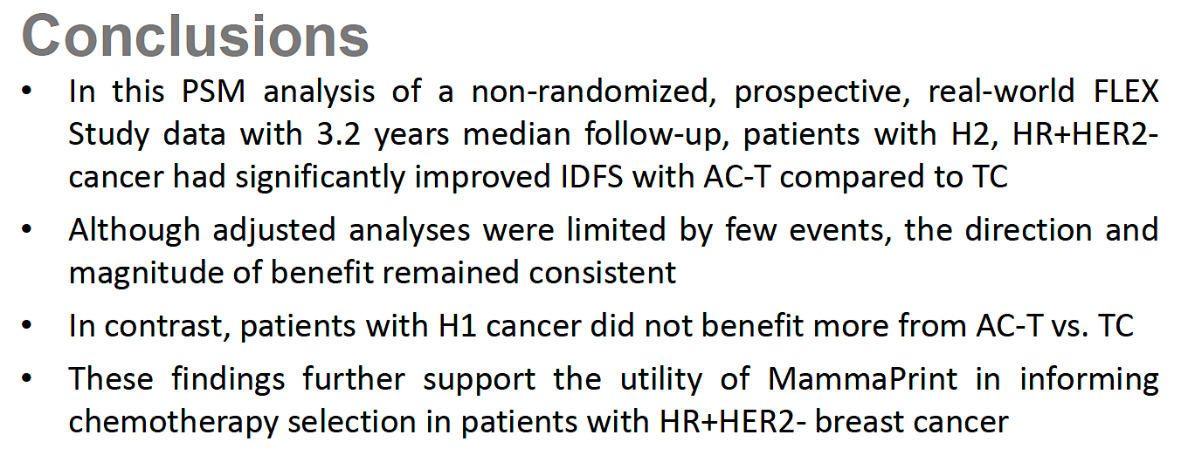
Propensity-Score Matched Analysis of Real-World FLEX Data: IDFS with Anthracycline-Based Therapy for Patients with MammaPrint® High 2, Luminal B, HR-Positive, HER2-Negative Localized Breast Cancer
IDFS = invasive disease-free survival
O’Shaughnessy J et al. SABCS 2025;Abstract PS2-07-03.

Slide 16
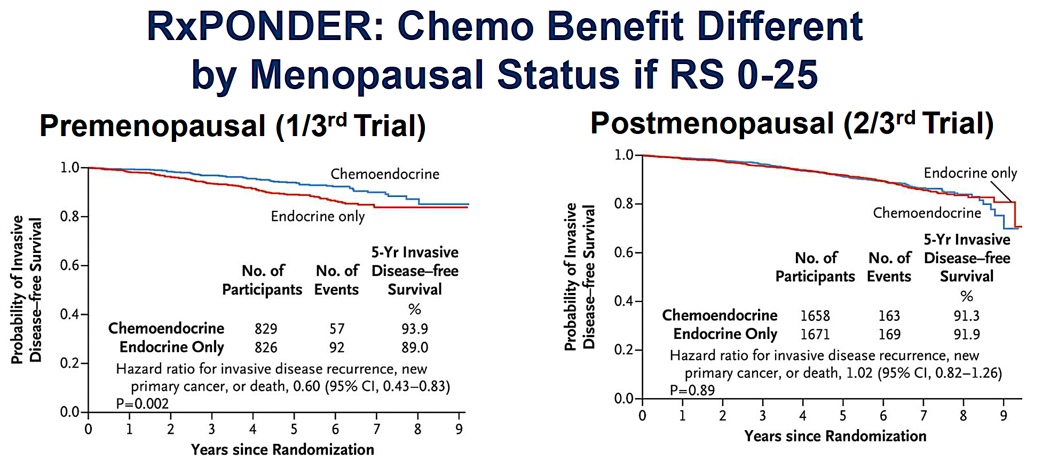
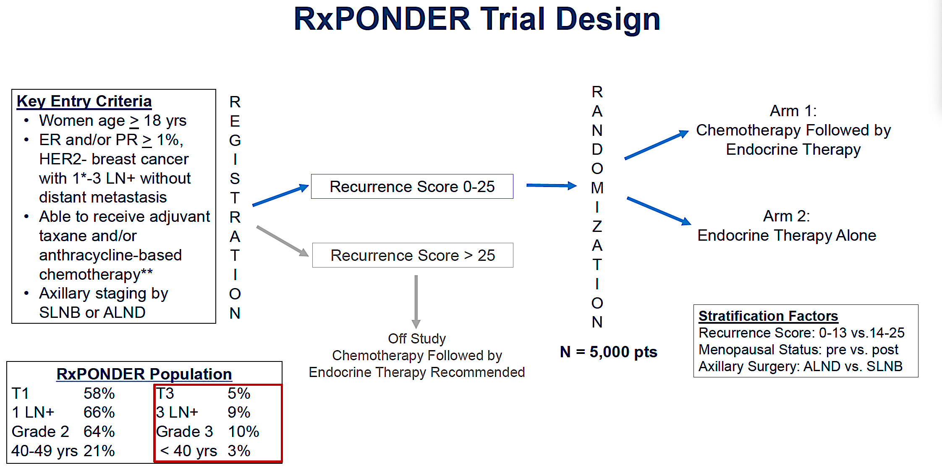
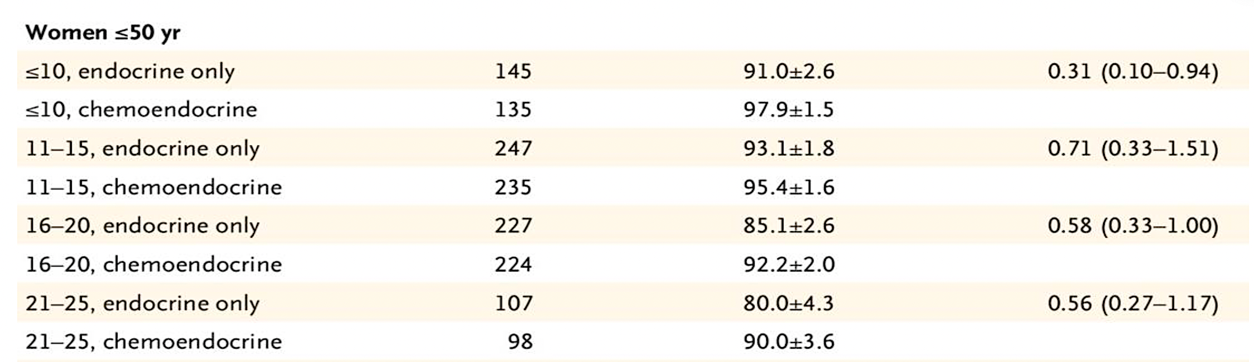
OncotypeDX: RxPONDER Trial
Results Summary
One to Three Positive Lymph Nodes
IDFS Benefit Modified by Score for Women Age ≤50
Sparano JA et al. JAMA Oncol 2020; Chen N et al. Ann Oncol 2025.

Slide 17
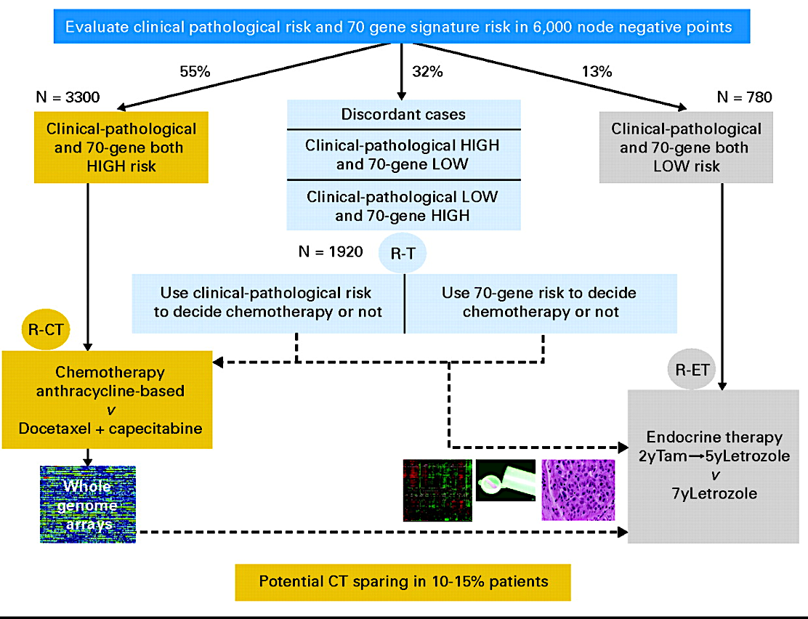
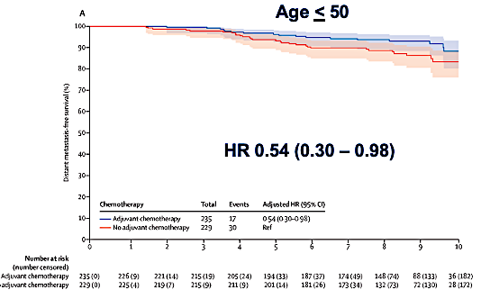
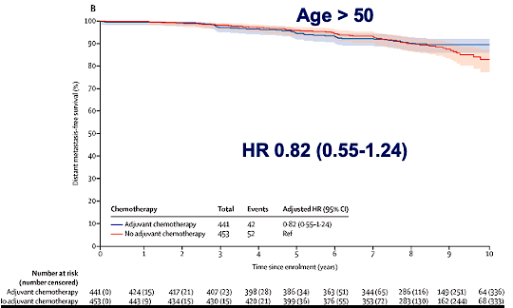
MammaPrint: MindACT Trial Key Results
Chemo benefit increases over time overall. Lost in those age >50, maintained in those age <50
Clinical “high risk”: <88% 10-yr BCSS
Modified Adjuvant! Online to determine
Model included: T size, Node (0-3), grade, ER status, age, comorbidity
 | ET | CET | Absolute diff
5-y DMFS | 94.7% (92.5 – 96.2) | 95.9% (94-97.2) | 1.2%
8-yr DMFS | 89.4% (86.8- 91,5) | 92% (896-93.8) | 2.6%
Met primary outcome: Lower bound of 95% CI >92% 5-y DMFS in the High Clinical/Low Genomic risk group
No adjuvant chemotherapy
No adjuvant chemotherapy
BCSS = breast cancer-specific survival; DMFS = distant metastasis-free survival
Cardoso F et al. N Engl J Med 2016; Piccart M et al. Lancet Oncol 2021.

Slide 18
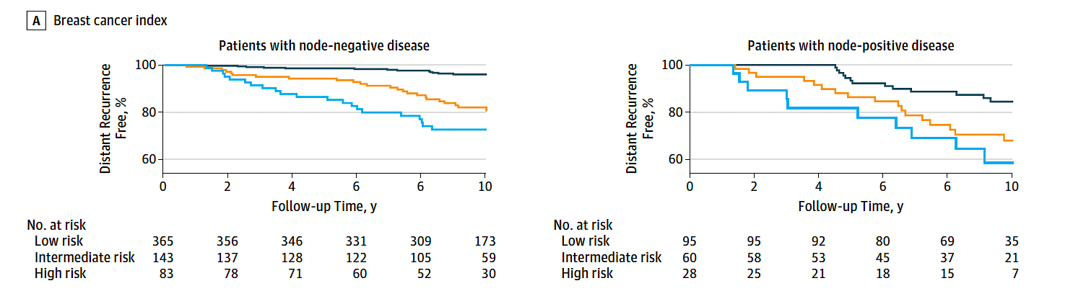
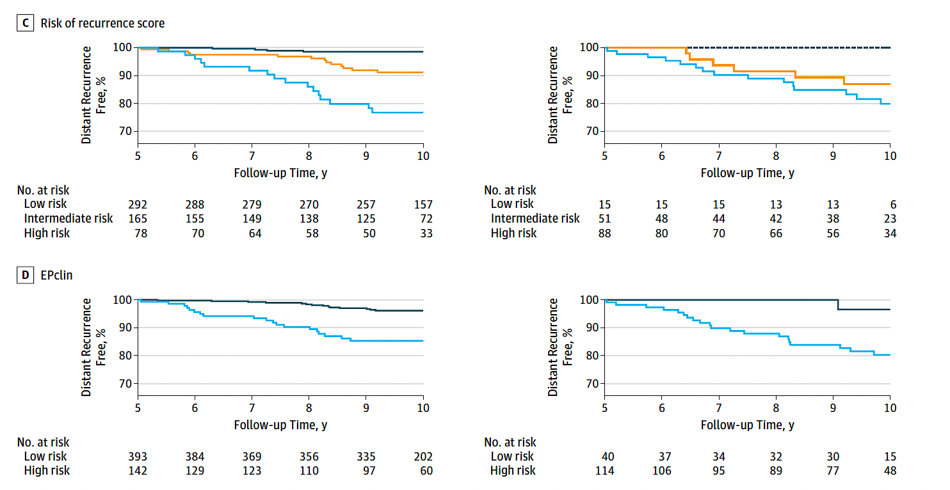
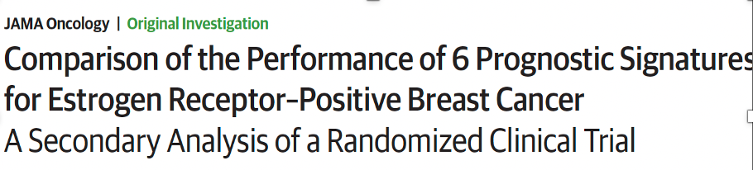
Prosigna® ROR, EndoPredict® EPclin and Breast Cancer Index®
ROR (risk of recurrence, Prosigna)
50-gene RNA-based molecular subtyping assay
ROR available in US; PAM50 not available
EPclin (EndoPredict)
12 genes – Proliferation and hormone receptor
Breast Cancer Index (BCI)
7 genes – Proliferation and hormone receptor (HoxB13/IL17BR)
BCI
ROR
Signatures
Largest retrospective prognostic validation in TransATAC Trial (included Oncotype DX and BCI as well)
N = 535 node-negative, 154 node-positive
Examined risk years 0 to 10
ROR, EPclin and BCI provided most prognostic information
ROR HR 2.56 (1.96-3.35)
EPclin HR 2.14 (1.71-2.68)
BCI HR 2.46 (1.88-3.23)
EPclin
Low risk
Intermediate risk
High risk
Sestak I et al. JAMA Oncol 2018;4(4):545-53.

Slide 19
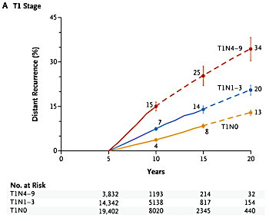
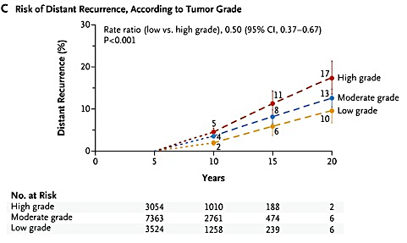
Persistent Long-Term Risk of Distant Recurrence
Risk of late distant recurrence after 5 years of adjuvant endocrine therapy persists across all clinical stages.
Pan H et al. N Engl J Med 2017;377(19):1836-46.

Slide 20
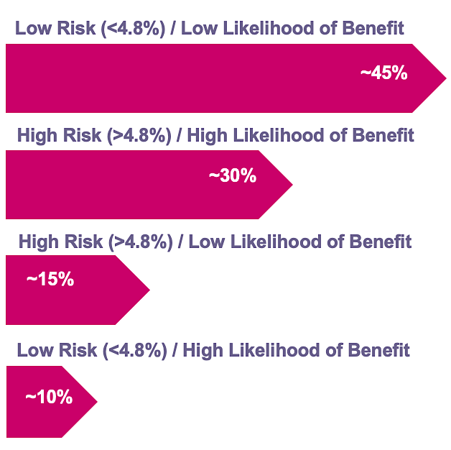
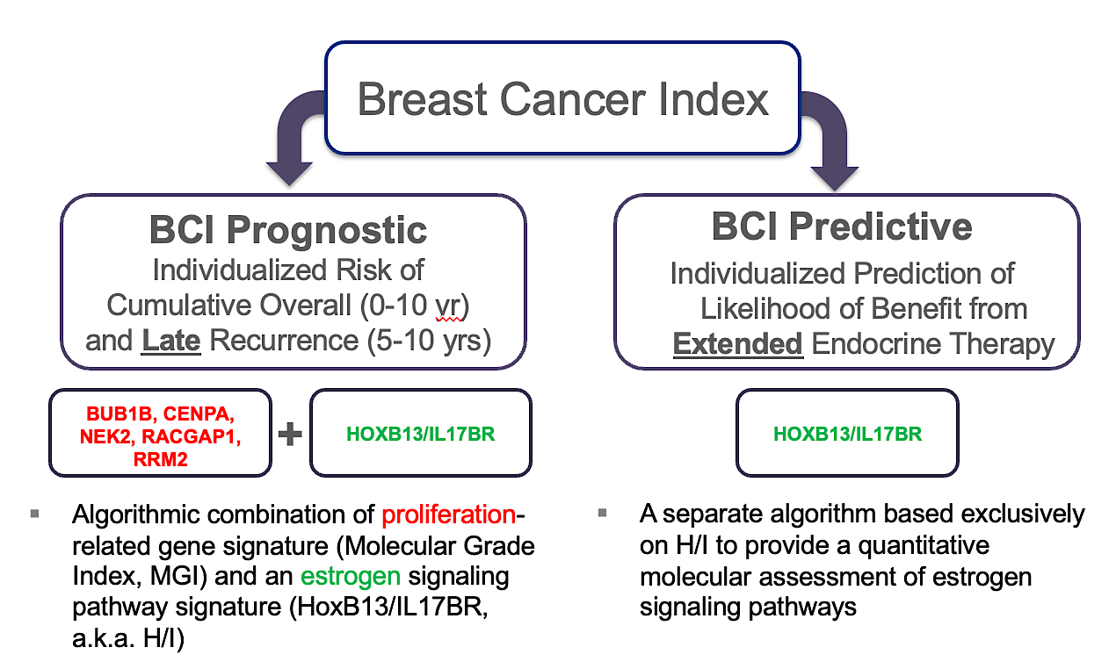
Breast Cancer Index (BCI)
Distribution of BCI scores
BCI Components
Sgroi DC et al. J Natl Cancer Inst 2013;105(14):1036-42.

Slide 21
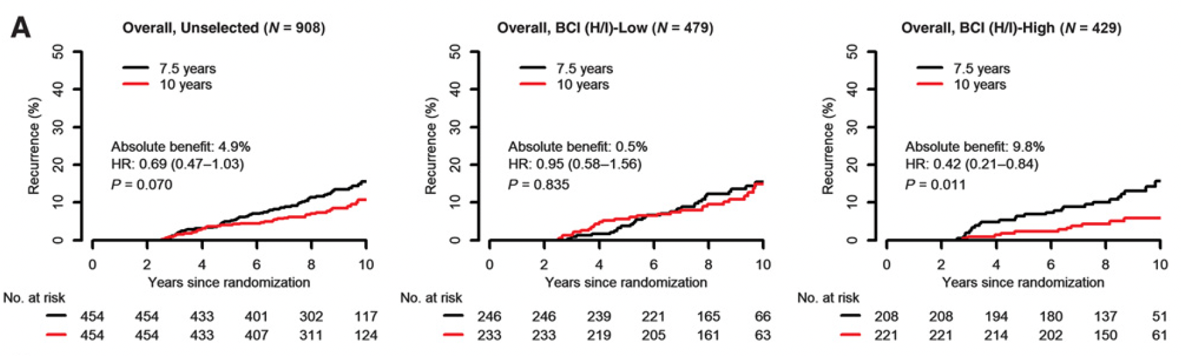
Predictive Performance by BCI H/I Groups Based on Recurrence-Free Interval in the Overall Cohort of the Phase III IDEAL Trial
Noordhoek I et al. Clin Cancer Res 2021;27(1):311-19.

Slide 22
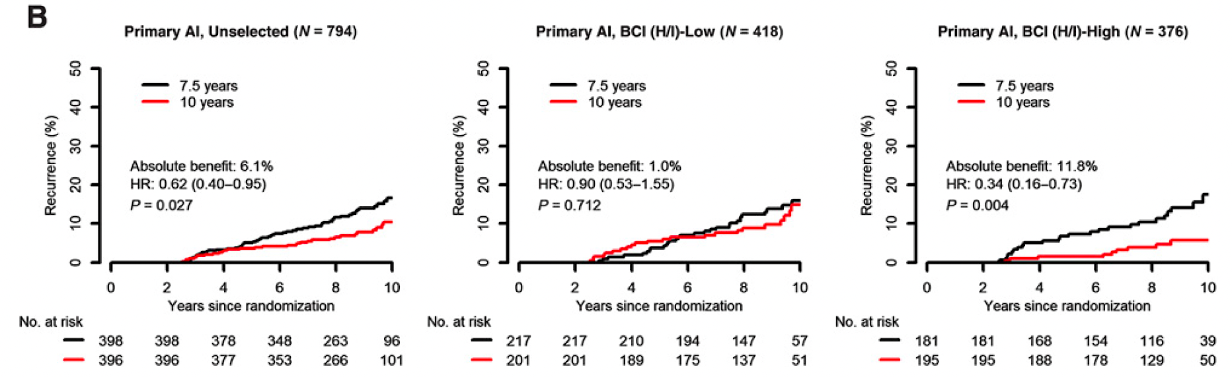
Predictive Performance by BCI H/I Groups Based on
Recurrence-Free Interval in the Subset of Patients in the Phase III IDEAL Trial Who Received a Primary Aromatase Inhibitor (AI)
Noordhoek I et al. Clin Cancer Res 2021;27(1):311-19.

Slide 23
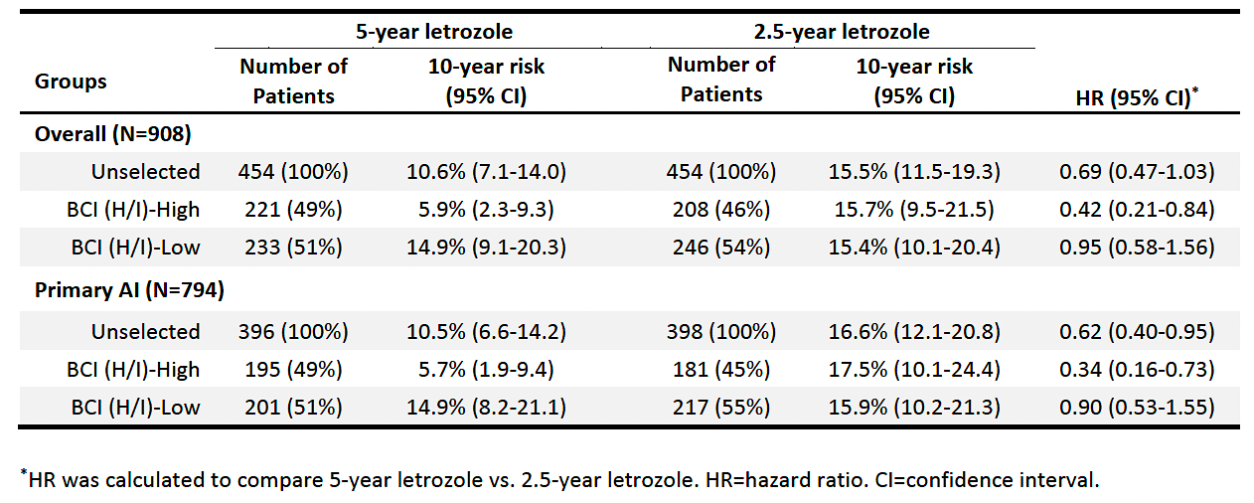
Risk of Recurrence at Year 10 Since Randomization for Patients Who Received 5 Years versus 2.5 Years of Additional Letrozole in the Overall Cohort and in the Primary AI Subset of the Phase III IDEAL Trial
Noordhoek I et al. Clin Cancer Res 2021;27(1):311-19.

Slide 24
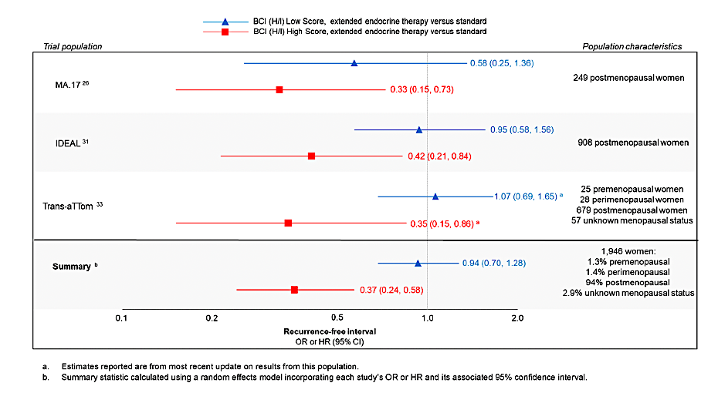
BCI Validation in Extended-Adjuvant Therapy Trials
Woolpert KM et al. Breast Cancer Res Treat 2024;203(3):407-417.

Slide 25
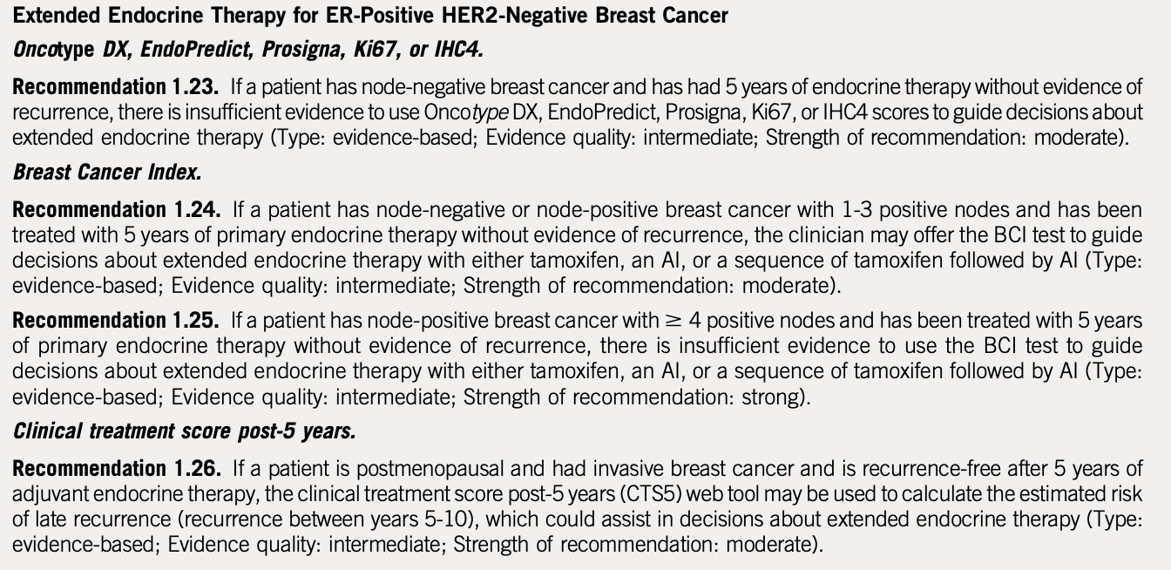
ASCO Guideline: Extended Adjuvant Therapy
Andre F et al. J Clin Oncol. 2022;40:1816-1837

Slide 26
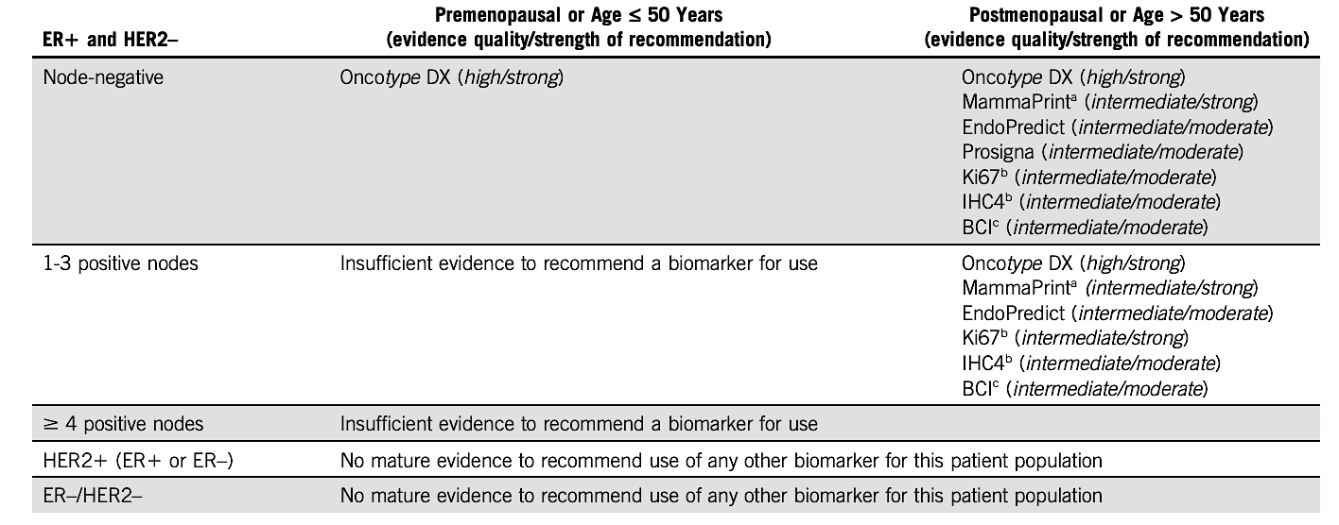
Summary: ASCO Guideline 2022
Andre F et al. J Clin Oncol. 2022;40:1816-1837

Slide 27
Management of Hormone Receptor (HR)-Positive Localized Breast Cancer
Module 1: Risk Assessment and Genomic Assays for HR-Positive, HER2-Negative Localized Breast Cancer
Module 2: Clinician Survey Results
Module 3: Adjuvant CDK4/6 Inhibitors for High-Risk, HR-Positive, HER2-Negative Localized Breast Cancer
Module 4: Clinician Survey Results
Module 5: Tolerability and Other Practical Considerations with Adjuvant CDK4/6 Inhibitor Therapy
Module 6: Clinician Survey Results
Module 7: Adjuvant Oral SERDs for HR-Positive, HER2-Negative Localized
Breast Cancer

Slide 28
Outside of a clinical trial, which genomic assay(s) do you routinely order to assist with decision-making regarding adjuvant systemic therapy for your patients with HR-positive, HER2-negative localized breast cancer (BC)?
Oncotype DX®, MammaPrint®, EndoPredict®, Breast Cancer Index®
Oncotype DX, Breast Cancer Index
Oncotype DX
Oncotype DX
Oncotype DX, MammaPrint, Breast Cancer Index
Oncotype DX, MammaPrint, Breast Cancer Index
Oncotype DX and MammaPrint
Oncotype DX and MammaPrint

Slide 29
Would you recommend adjuvant chemotherapy for a 40-year-old premenopausal patient with node-negative, HR-positive, HER2-negative localized BC and the 21-gene Recurrence Score® (RS) listed below?
RS = 8
RS = 17
RS = 20
No
No
Yes, but offer OFS/OA
as alternative
No
No
Yes, but offer OFS/OA
as alternative
No
Yes, but offer OFS/OA
as alternative
Yes, but offer OFS/OA
as alternative
No
No
Yes
No
Yes, but offer OFS/OA
as alternative
Yes, but offer OFS/OA
as alternative
No
No
No
No
No*
No*
No
No
Yes, but offer OFS/OA
as alternative
OFS/OA = ovarian function suppression/ovarian ablation; * Would offer OFS/OA

Slide 30
Would you recommend adjuvant chemotherapy for a 40-year-old premenopausal patient with HR-positive, HER2-negative localized BC with 3 positive nodes and the 21-gene RS listed below?
RS = 8
RS = 17
RS = 20
Yes, but offer OFS/OA
as alternative
Yes, but offer OFS/OA
as alternative
Yes, but offer OFS/OA
as alternative
Yes, but offer OFS/OA
as alternative
Yes
Yes
Yes
Yes
Yes
Yes
Yes
Yes
Yes
Yes
Yes
Yes, but offer OFS/OA
as alternative
Yes, but offer OFS/OA
as alternative
Yes, but offer OFS/OA
as alternative
Yes
Yes
Yes
Yes
Yes
Yes
OFS/OA = ovarian function suppression/ovarian ablation

Slide 31
Would you recommend adjuvant chemotherapy for a 65-year-old postmenopausal patient with HR-positive, HER2-negative localized BC with 3 positive nodes and the 21-gene RS listed below?
RS = 8
RS = 17
RS = 20
No
No
No
No
No
No
No
No
No
No
No
Yes
No
No
Yes
No
No
No
No
No
No
No
No
No

Slide 32
Have you ordered or would you order a genomic assay to assist with treatment decision-making in the localized setting for any patients with HR-positive, HER2-negative localized BC and 4 or more positive nodes?
I have
I have
I have not but would for the right patient
I have not but would for the right patient
I have not and would not
I have not and would not
I have
I have not and would not

Slide 33
Outside of a clinical trial, which genomic assay(s) do you routinely order to assist with decision-making in the neoadjuvant setting for your patients with HR-positive, HER2-negative localized BC?
MammaPrint
MammaPrint and Oncotype DX
Oncotype DX
MammaPrint
MammaPrint
MammaPrint
MammaPrint and Oncotype DX*
Oncotype DX and MammaPrint
* All my patients with HR+ disease screen for I-SPY with rare exceptions and we order Mammaprint and BluePrint. I will occasionally order Oncotype DX

Slide 34
Outside of a clinical trial, do you routinely employ Breast Cancer Index (BCI) to determine whether to continue adjuvant endocrine therapy beyond 5 years for patients with HR-positive, HER2-negative localized BC? If so, in which clinical situations?
Yes, for node-positive disease when MammaPrint not available
Yes, for Stage II or low-risk Stage III disease in patients
who are tolerating ET well and willing to do more
Yes, per patient preference and for N0 and N1,
especially if patients are struggling with toxicities
Yes, in situations where I’m on the fence about extending ET
Yes, for patients with N0 disease or up to 3 pos nodes
Yes, for patients for whom we are considering extended ET
No*
Yes, for patients with high-risk, node-negative disease
ET = endocrine therapy; * No due to reimbursement issues, but I would for patients with poor tolerance to ET and high-risk disease

Slide 35
Approximately what proportion of the time would you estimate that having the results from BCI cause you to change your recommendation regarding extended-adjuvant endocrine therapy (ET)?
Recommending ET to not recommending
Not recommending ET to recommending
25%
25%
15%
5%
5% to 10%
<5%
10%
10%
20%
20%
80%
20%
NA
NA
10%
10%
NA = not applicable

Slide 36
Outside of a clinical trial, do you routinely employ any genomic assays other than Breast Cancer Index to determine whether to continue adjuvant endocrine therapy beyond 5 years for patients with HR-positive, HER2-negative localized BC?
Yes, MammaPrint
No
No
No
No
Yes, MammaPrint
No
No

Slide 37
Have you ordered or would you order a circulating tumor DNA (ctDNA)-based molecular residual disease (MRD) assay to assist with clinical decision-making for a patient with localized BC? If you were to order a ctDNA-based MRD assay for a patient with localized BC, which specific assay(s) would you use?
Order a ctDNA-based MRD assay?
Assay
I have
Signatera™
I have
Signatera
I have not and would not
NA
I have not but would for the right patient
Signatera
I have not and would not
NA
I have
Signatera
I have
Signatera
I have not and would not
NA
NA = not applicable

Slide 38
Management of Hormone Receptor (HR)-Positive Localized Breast Cancer
Module 1: Risk Assessment and Genomic Assays for HR-Positive, HER2-Negative Localized Breast Cancer
Module 2: Clinician Survey Results
Module 3: Adjuvant CDK4/6 Inhibitors for High-Risk, HR-Positive, HER2-Negative Localized Breast Cancer
Module 4: Clinician Survey Results
Module 5: Tolerability and Other Practical Considerations with Adjuvant CDK4/6 Inhibitor Therapy
Module 6: Clinician Survey Results
Module 7: Adjuvant Oral SERDs for HR-Positive, HER2-Negative Localized
Breast Cancer

Slide 39
Key Datasets
Johnston S et al. monarchE: Primary overall survival (OS) results of adjuvant abemaciclib + endocrine therapy (ET) for HR+, HER2-, high-risk early breast cancer (EBC). ESMO 2025;Abstract LBA13.
Johnston S et al. Overall survival with abemaciclib in early breast cancer. Ann Oncol 2026;37(2):155-65.
Cortés J et al. monarchE: Subgroup analysis of adjuvant abemaciclib + endocrine therapy for HR+, HER2-, high-risk early breast cancer by nodal status. San Antonio Breast Cancer Symposium 2025;Abstract PS1-08-08.
Crown JP et al. Adjuvant ribociclib (RIB) plus nonsteroidal aromatase inhibitor (NSAI) in patients (pts) with HR+/HER2− early breast cancer (EBC): NATALEE 5-year outcomes. ESMO 2025;Abstract LBA14.
Chia SKL et al. Prognostic and predictive impact of baseline gene expression (exp) in the NATALEE trial of adjuvant (adj) ribociclib (RIB) + nonsteroidal aromatase inhibitor (NSAI) in HR+/HER2- early breast cancer (EBC). ASCO 2026;Abstract 501.

Slide 40
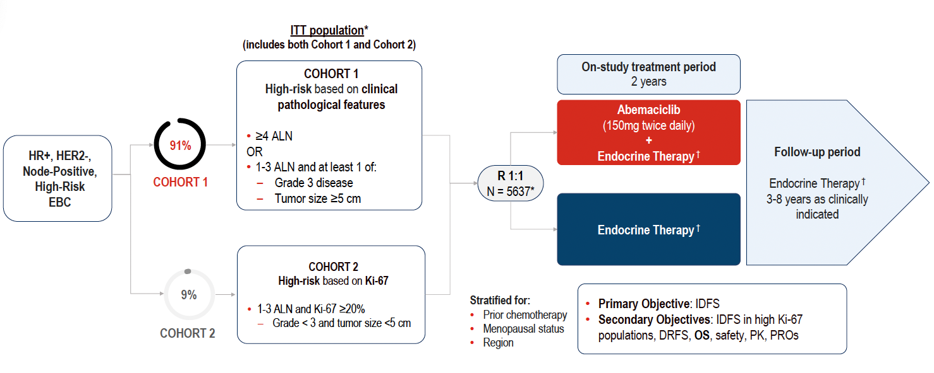
monarchE Study Design
Johnston S et al. ESMO 2025;Abstract LBA13. Johnston S et al. Ann Oncol 2026;37(2):155-65.

Slide 41
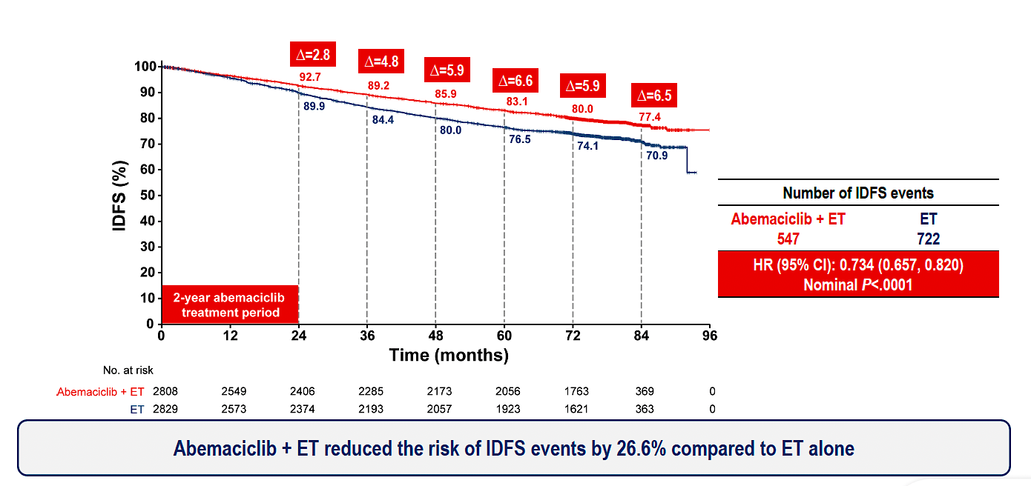
monarchE: Invasive Disease-Free Survival (IDFS) Outcomes
ET = endocrine therapy
Johnston S et al. ESMO 2025;Abstract LBA13. Johnston S et al. Ann Oncol 2026;37(2):155-65.

Slide 42
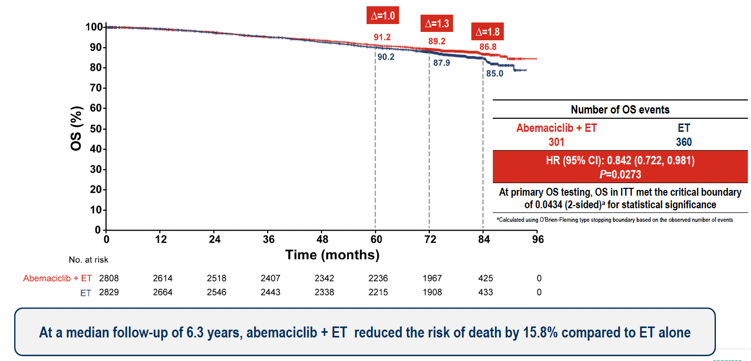
monarchE: Overall Survival (OS) Outcomes
Johnston S et al. ESMO 2025;Abstract LBA13. Johnston S et al. Ann Oncol 2026;37(2):155-65.

Slide 43
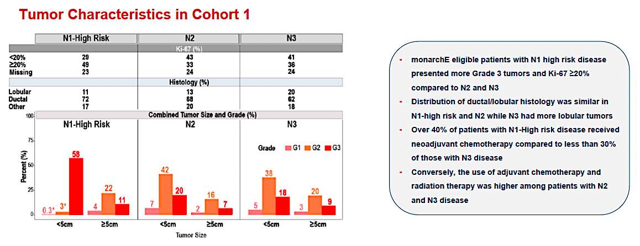
monarchE: Subgroup Analysis by Nodal Status
Cortés J et al. San Antonio Breast Cancer Symposium 2025;Abstract PS1-08-08.

Slide 44
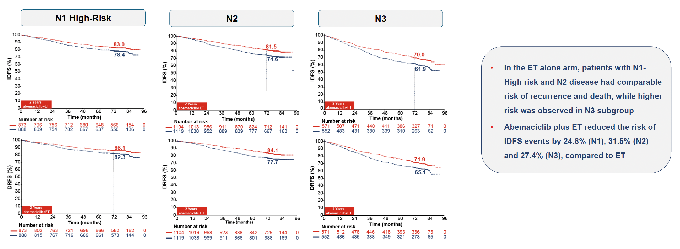
monarchE: IDFS and DRFS by Nodal Status
DRFS = distant relapse-free survival
Cortés J et al. San Antonio Breast Cancer Symposium 2025;Abstract PS1-08-08.

Slide 45
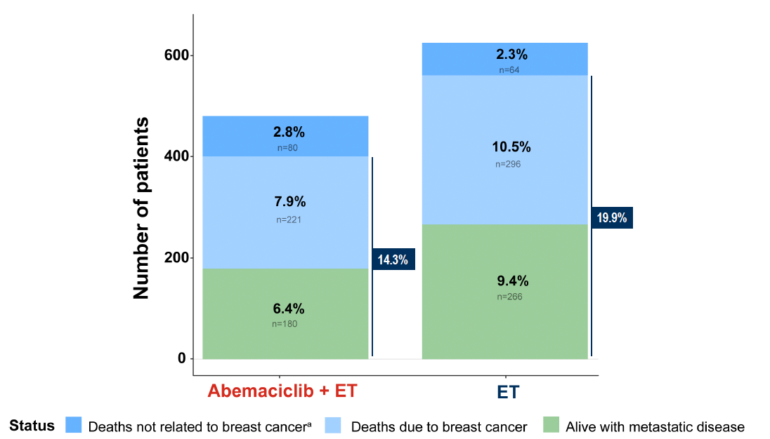
monarchE: Survival Status
Johnston S et al. ESMO 2025;Abstract LBA13. Johnston S et al. Ann Oncol 2026;37(2):155-65.

Slide 46
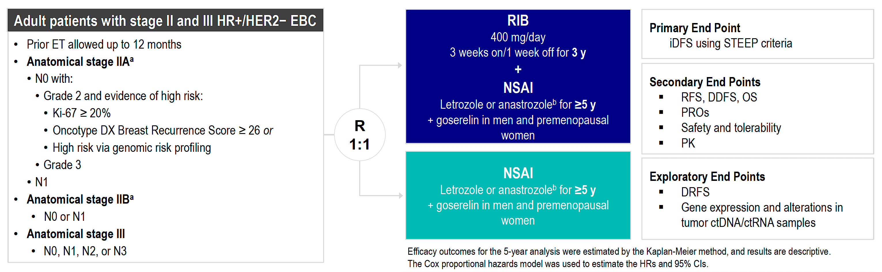
NATALEE Study Design
RIB = ribociclib; NSAI = nonsteroidal aromatase inhibitor
Crown JP et al. ESMO 2025;Abstract LBA14.

Slide 47
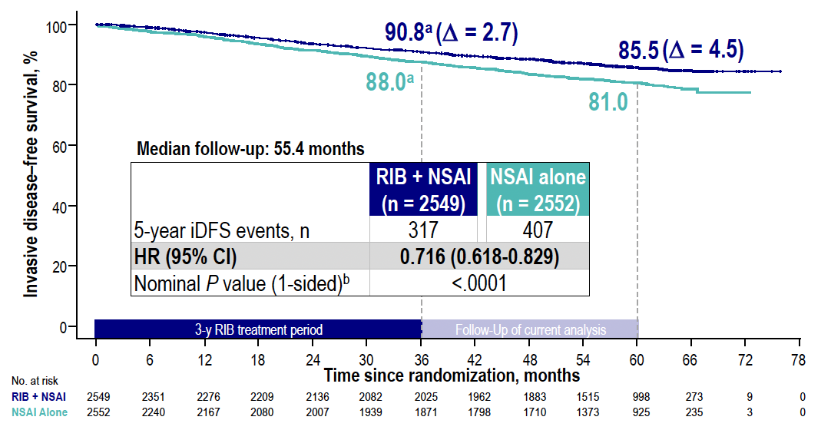
NATALEE: IDFS Outcomes
RIB = ribociclib; NSAI = nonsteroidal aromatase inhibitor
Crown JP et al. ESMO 2025;Abstract LBA14.

Slide 48
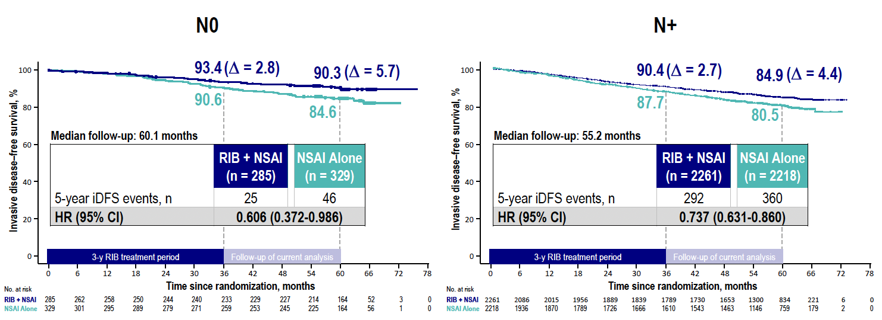
NATALEE: IDFS by Nodal Status
Crown JP et al. ESMO 2025;Abstract LBA14.

Slide 49
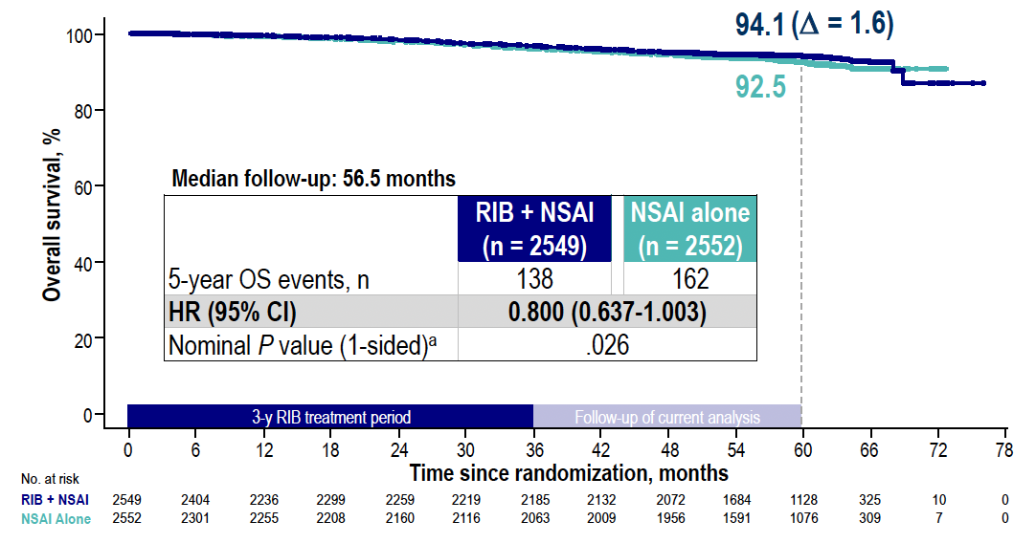
NATALEE: OS Outcomes
Crown JP et al. ESMO 2025;Abstract LBA14.

Slide 50
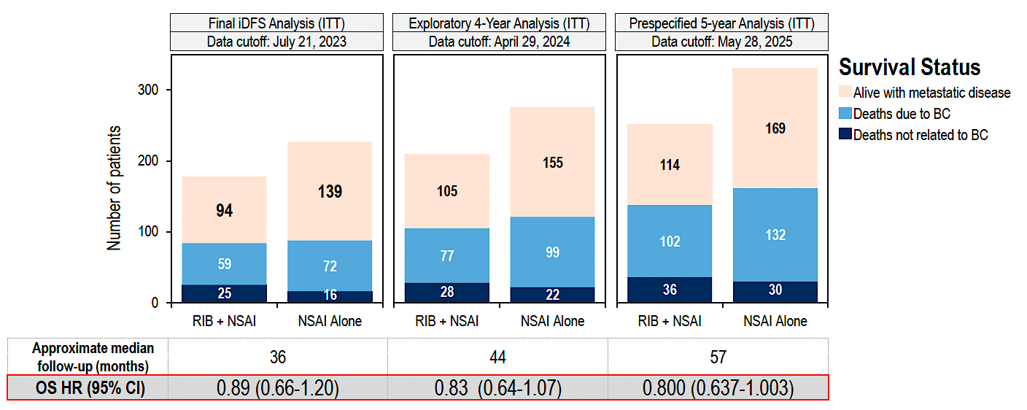
NATALEE: Survival Status over Time
Crown JP et al. ESMO 2025;Abstract LBA14.

Slide 51
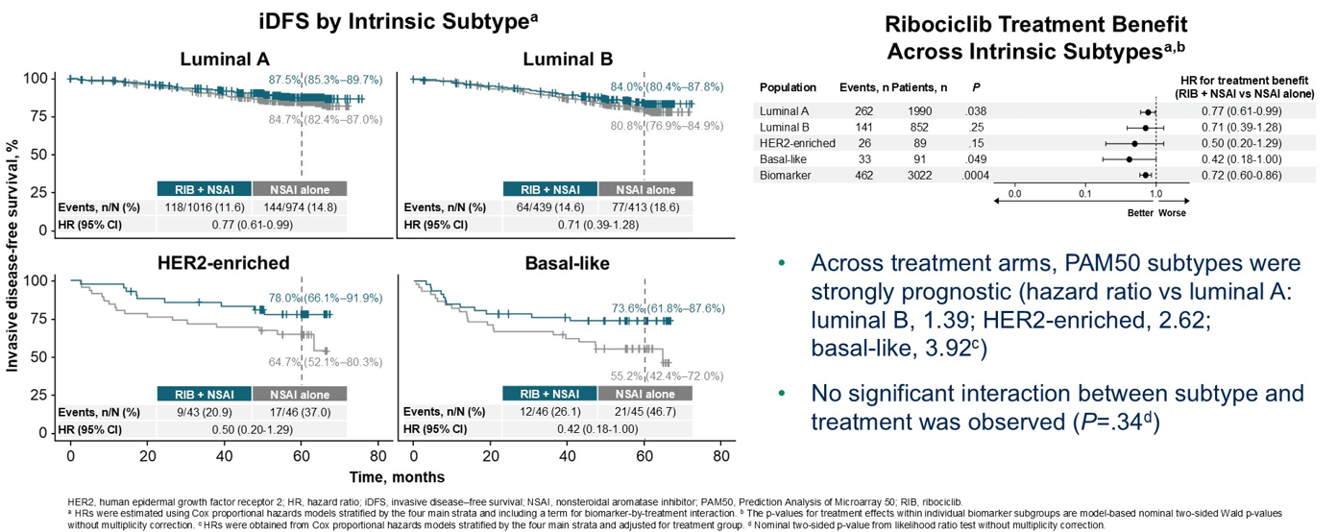
NATALEE: Ribociclib Treatment Benefit Is Observed Across PAM50-Based Intrinsic Subtypes
Chia SKL et al. ASCO 2026;Abstract 501.

Slide 52
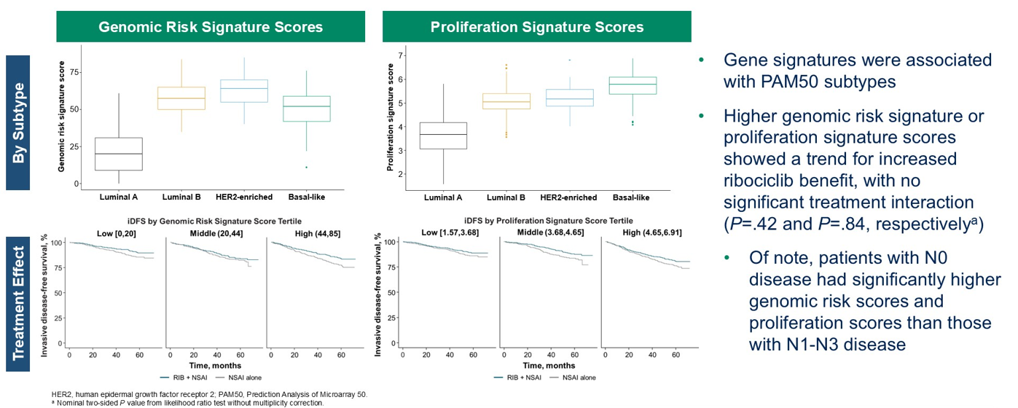
NATALEE: Higher Genomic Risk Signature and Proliferation Signature Scores Are Associated with Increased Ribociclib Benefit
Chia SKL et al. ASCO 2026;Abstract 501.

Slide 53
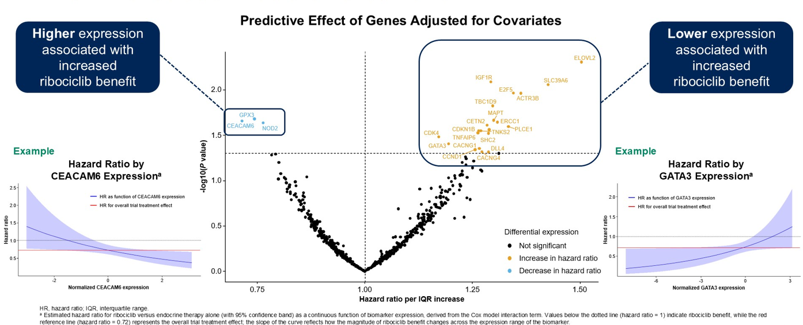
NATALEE: Differential Gene Expression Affects Ribociclib Benefit
Chia SKL et al. ASCO 2026;Abstract 501.

Slide 54
Management of Hormone Receptor (HR)-Positive Localized Breast Cancer
Module 1: Risk Assessment and Genomic Assays for HR-Positive, HER2-Negative Localized Breast Cancer
Module 2: Clinician Survey Results
Module 3: Adjuvant CDK4/6 Inhibitors for High-Risk, HR-Positive, HER2-Negative Localized Breast Cancer
Module 4: Clinician Survey Results
Module 5: Tolerability and Other Practical Considerations with Adjuvant CDK4/6 Inhibitor Therapy
Module 6: Clinician Survey Results
Module 7: Adjuvant Oral SERDs for HR-Positive, HER2-Negative Localized
Breast Cancer

Slide 55
Regulatory and reimbursement issues aside, would you generally recommend an adjuvant CDK4/6 inhibitor in addition to adjuvant endocrine therapy to a patient with 5.5-cm, Grade 2, HR-positive, HER2-negative localized BC and the following nodal status?
Node-negative
2 positive nodes
4 positive nodes
Yes, ribociclib
Yes, abemaciclib
Yes, abemaciclib
Yes, ribociclib
Yes, abemaciclib
Yes, abemaciclib
Yes, ribociclib
Yes, abemaciclib
Yes, abemaciclib
Yes, ribociclib
Yes, abemaciclib
Yes, abemaciclib
Yes, ribociclib
Yes, either
Yes, either
Yes, ribociclib
Yes, either
Yes, either
Yes, ribociclib
Yes, either
Yes, abemaciclib
Yes, ribociclib
Yes, either
Yes, either

Slide 56
Regulatory and reimbursement issues aside, would you generally recommend an adjuvant CDK4/6 inhibitor in addition to adjuvant endocrine therapy to a patient with 2.5-cm Grade 2, HR-positive, HER2-negative localized BC and the following nodal status?
Node-negative
2 positive nodes
4 positive nodes
No
No
Yes, abemaciclib
No
Yes, abemaciclib
Yes, abemaciclib
Yes, ribociclib
Yes, abemaciclib
Yes, abemaciclib
Yes, ribociclib
Yes, abemaciclib
Yes, abemaciclib
No
Yes, ribociclib
Yes, either
No
Yes, either
Yes, either
Yes, ribociclib
Yes, either
Yes, abemaciclib
No
Yes, either
Yes, either

Slide 57
Management of Hormone Receptor (HR)-Positive Localized Breast Cancer
Module 1: Risk Assessment and Genomic Assays for HR-Positive, HER2-Negative Localized Breast Cancer
Module 2: Clinician Survey Results
Module 3: Adjuvant CDK4/6 Inhibitors for High-Risk, HR-Positive, HER2-Negative Localized Breast Cancer
Module 4: Clinician Survey Results
Module 5: Tolerability and Other Practical Considerations with Adjuvant CDK4/6 Inhibitor Therapy
Module 6: Clinician Survey Results
Module 7: Adjuvant Oral SERDs for HR-Positive, HER2-Negative Localized
Breast Cancer

Slide 58
Key Datasets
Rugo HS et al. Adjuvant abemaciclib combined with endocrine therapy for high-risk early breast cancer: Safety and patient-reported outcomes from the monarchE study. Ann Oncol 2022;33(6):616-27.
Barrios C et al. NATALEE update: Safety and treatment (tx) duration of ribociclib (RIB) + nonsteroidal aromatase inhibitor (NSAI) in patients (pts) with HR+/HER2− early breast cancer (EBC). ESMO Breast 2024;Abstract 113MO.
Mayer EL et al. TRADE: A phase II trial to assess the tolerability of abemaciclib dose escalation in early-stage HR-positive/HER2-negative breast cancer. Ann Oncol 2025;31(1):117-24.

Slide 59
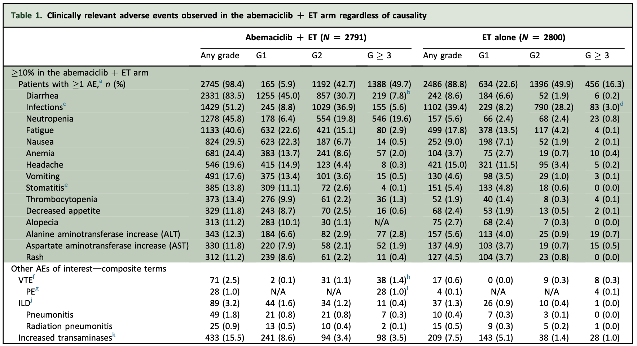
monarchE: Overall Safety Profile
Rugo HS et al. Ann Oncol 2022;33(6):616-27.

Slide 60
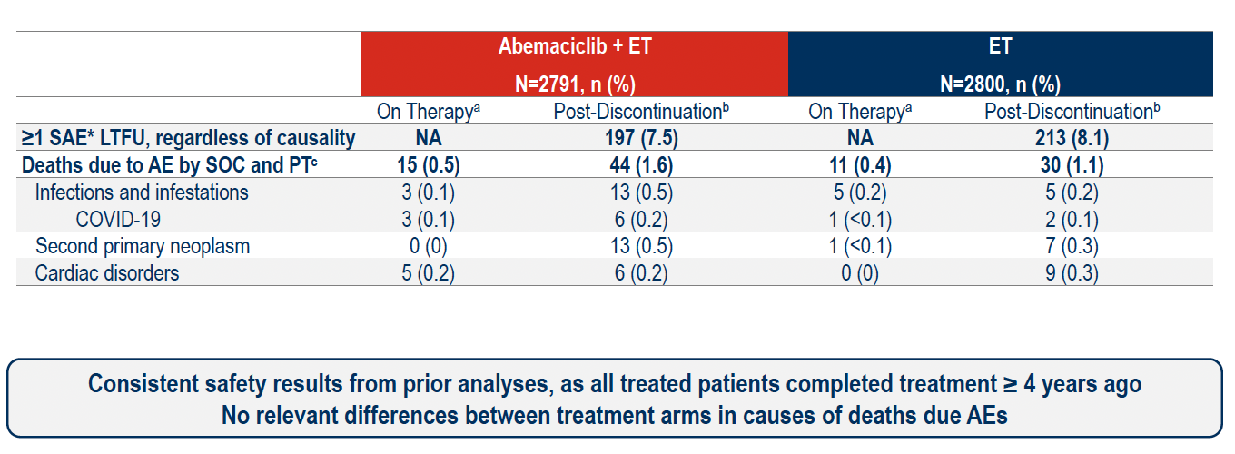
monarchE: Serious and Fatal Adverse Events (AEs) in Long-Term Follow-Up
to AEs
SAE = serious adverse event; LTFU = long-term follow-up; SOC = standard of care
Johnston S et al. ESMO 2025;Abstract LBA13. Johnston S et al. Ann Oncol 2026;37(2):155-65.

Slide 61
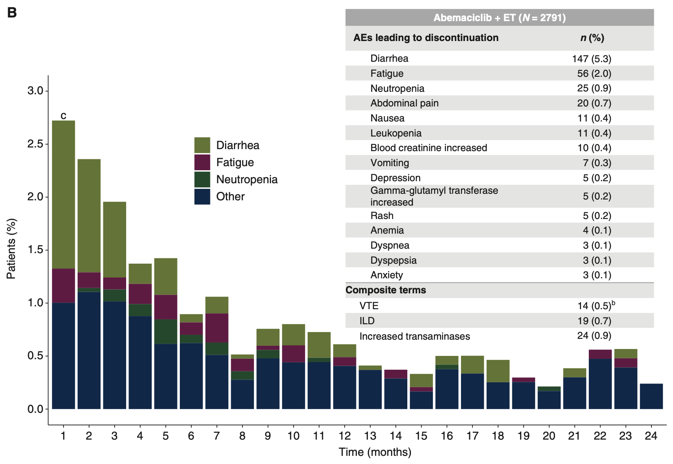
monarchE: AEs Leading to Discontinuation
Rugo HS et al. Ann Oncol 2022;33(6):616-27.
VTE = venous thromboembolism; ILD = interstitial lung disease

Slide 62
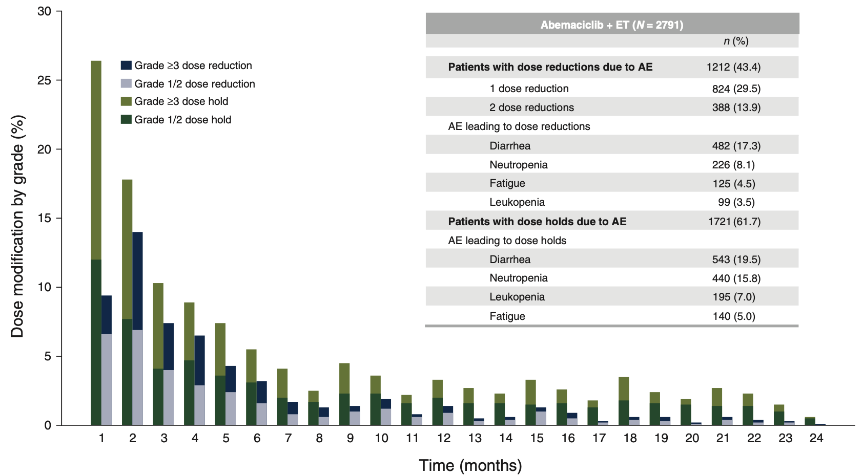
monarchE: AEs Leading to Dose Modifications
Rugo HS et al. Ann Oncol 2022;33(6):616-27.

Slide 63
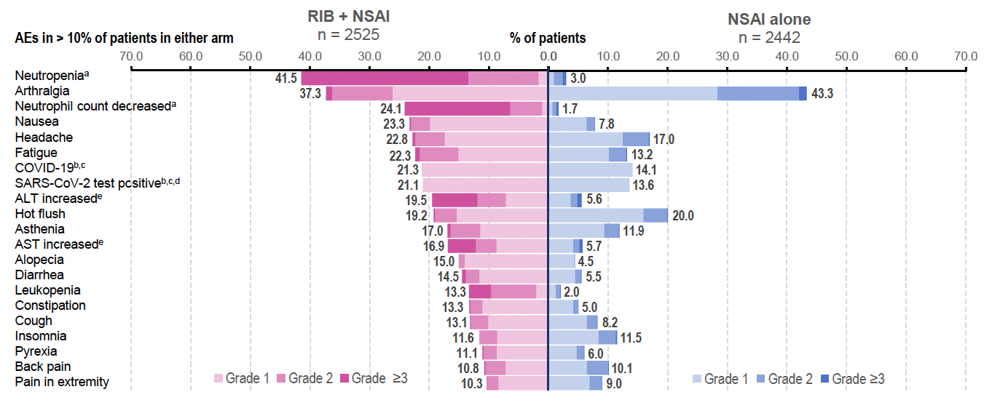
NATALEE: Overall Safety Profile
ALT = alanine aminostransferase; AST = aspartate aminotransferase
Barrios C et al. ESMO Breast 2024;Abstract 113MO.

Slide 64

NATALEE: AEs of Special Interest (AESIs)
Barrios C et al. ESMO Breast 2024;Abstract 113MO.

Slide 65

NATALEE: AE-Related Dose Reduction and Discontinuation
RDI = relative dose intensity
Barrios C et al. ESMO Breast 2024;Abstract 113MO.

Slide 66
AEs and Dosing Must Be Considered: Distinct AE Profiles and Dosing Schedules of CDK4/6 Inhibitors for Localized Breast Cancer
Abemaciclib
Adverse Events Neutropenia (41%-46%) Diarrhea (81%-86%) Increased ALT (13%-16%) Increased AST (12%-15%) Thromboembolic events (5%) Schedule Continuous daily dosing Dosing Starting dose in EBC: 150 mg BID 1st dose reduction: 100 mg BID 2nd dose reduction: 50 mg BID
Ribociclib
Adverse Events Neutropenia (69%-78%) Diarrhea (29%-35%) Increased ALT (15%-46%) Increased AST (13%-44%) QTc prolongation (6%) Schedule 3 wk on/1 wk off Dosing Starting dose in EBC: 400 mg/day 1 (and only) dose reduction option available in EBC: 200 mg/day
Breast Cancer Status | CDK4/6i | Trial(s) | Discontinuation Rate Due to AE
HR+/HER2– EBC | Abemaciclib | monarchE^{1,a} | 19%
 | Ribociclib | NATALEE^{2,3} | 19%
1. Rugo HS, et al. Ann Oncol. 2022;33(6):616-627. 2. Slamon D, et al. N Engl J Med. 2024 Mar 21;390(12):1080-1091. 3. Hortobagyi GN, et al. SABCS 2023. Abstract GS03-03.
Content courtesy of Komal Jhaveri, MD, FACP, FASCO
EBC = early breast cancer

Slide 67




TRADE: Abemaciclib Dose Escalation
Primary endpoint: composite AE rate (discontinuation of adjuvant abemaciclib for any reason and/or need to dose reduce by 12 weeks of therapy)
Courtesy of Komal Jhaveri, MD, FACP, FASCO
Mayer EL et al. Ann Oncol 2025

Slide 68

NATALEE: IDFS by Dose Reductions
Barrios C et al. ESMO Breast 2024;Abstract 113MO.

Slide 69
Management of Hormone Receptor (HR)-Positive Localized Breast Cancer
Module 1: Risk Assessment and Genomic Assays for HR-Positive, HER2-Negative Localized Breast Cancer
Module 2: Clinician Survey Results
Module 3: Adjuvant CDK4/6 Inhibitors for High-Risk, HR-Positive, HER2-Negative Localized Breast Cancer
Module 4: Clinician Survey Results
Module 5: Tolerability and Other Practical Considerations with Adjuvant CDK4/6 Inhibitor Therapy
Module 6: Clinician Survey Results
Module 7: Adjuvant Oral SERDs for HR-Positive, HER2-Negative Localized
Breast Cancer

Slide 70
Have you employed or would you employ an initial dose-escalation strategy rather than initiating therapy at the recommended starting dose for any of your patients with HR-positive localized BC receiving an adjuvant CDK4/6 inhibitor?
I have not but would for the right patient
I have
I have
I have
I have
I have
I have
I have

Slide 71
Assuming eligibility to receive abemaciclib or ribociclib, which CDK4/6 inhibitor would you prefer in the adjuvant setting for a patient with HR-positive localized BC and a history of …?
Colitis
Chronic liver disease
Chronic renal disease
Ribociclib
Abemaciclib
Ribociclib
Ribociclib
Abemaciclib
Ribociclib
Ribociclib
Abemaciclib
Ribociclib
Ribociclib
Abemaciclib
No preference
Ribociclib
Abemaciclib
No preference
Ribociclib
Abemaciclib
Ribociclib
Ribociclib
Abemaciclib
No preference
Ribociclib
Abemaciclib
Ribociclib

Slide 72
Assuming eligibility to receive abemaciclib or ribociclib, which CDK4/6 inhibitor would you prefer in the adjuvant setting for a patient with HR-positive localized BC and a history of …?
COPD
NYHA Class I congestive
heart failure
No preference
Abemaciclib
No preference
No preference
No preference
Abemaciclib
No preference
Abemaciclib
No preference
Abemaciclib
Ribociclib
Abemaciclib
No preference
Abemaciclib
No preference
No preference
COPD = chronic obstructive pulmonary disease

Slide 73
Management of Hormone Receptor (HR)-Positive Localized Breast Cancer
Module 1: Risk Assessment and Genomic Assays for HR-Positive, HER2-Negative Localized Breast Cancer
Module 2: Clinician Survey Results
Module 3: Adjuvant CDK4/6 Inhibitors for High-Risk, HR-Positive, HER2-Negative Localized Breast Cancer
Module 4: Clinician Survey Results
Module 5: Tolerability and Other Practical Considerations with Adjuvant CDK4/6 Inhibitor Therapy
Module 6: Clinician Survey Results
Module 7: Adjuvant Oral SERDs for HR-Positive, HER2-Negative Localized
Breast Cancer

Slide 74
Key Datasets
Bardia A et al. Giredestrant vs standard-of-care endocrine therapy as adjuvant treatment for patients with estrogen receptor-positive, HER2-negative early breast cancer: Results from the global phase III lidERA Breast Cancer trial. San Antonio Breast Cancer Symposium 2025;Abstract GS1-10.

Slide 75

Abstract GS1-10

Slide 76

lidERA Breast Cancer Study Design
DRFI = distant recurrence-free interval; LRRFI = locoregional recurrence-free interval
Bardia A et al. San Antonio Breast Cancer Symposium 2025;Abstract GS1-10.

Slide 77

lidERA Breast Cancer: Patient Demographics
Bardia A et al. San Antonio Breast Cancer Symposium 2025;Abstract GS1-10.

Slide 78

lidERA Breast Cancer: IDFS Outcomes
Bardia A et al. San Antonio Breast Cancer Symposium 2025;Abstract GS1-10.

Slide 79

lidERA Breast Cancer: IDFS in Key Subgroups
Bardia A et al. San Antonio Breast Cancer Symposium 2025;Abstract GS1-10.

Slide 80

lidERA Breast Cancer: OS Outcomes
Bardia A et al. San Antonio Breast Cancer Symposium 2025;Abstract GS1-10.

Slide 81

lidERA Breast Cancer: Safety Profile
Bardia A et al. San Antonio Breast Cancer Symposium 2025;Abstract GS1-10.

Slide 82
Based on recently presented findings from the Phase III lidERA trial, would you like to have access to adjuvant giredestrant today for your patients with HR-positive, HER2-negative localized BC?
Yes, for patients with higher-risk disease
Yes, most beneficial for patients who are not tolerating an AI well
Yes, for those who can’t tolerate a CDK4/6i and those
who are reluctant to take a CDK4/6i due to toxicity
Yes, for patients with higher-risk disease after CDK4/6i or if cannot
tolerate standard ET
Yes, for patients with high-risk disease
Yes, for patients who are receiving AI monotherapy
Yes, for high-risk disease as defined in the trial
Yes, for patients that match eligibility of the lidERA trial
ET = endocrine therapy; CDK4/6i = CDK4/6 inhibitor

Slide 83
If giredestrant were available, regulatory and reimbursement issues aside, what would you generally recommend for patients who met the criteria for both an adjuvant CDK4/6 inhibitor and adjuvant giredestrant?
CDK4/6i with standard adjuvant ET for the initial 2 to 3 years of tx,
then switch to giredestrant after discontinuation of the CDK4/6i
CDK4/6 inhibitor combined with giredestrant
CDK4/6i with standard adjuvant ET for the initial 2 to 3 years of tx,
then switch to giredestrant after discontinuation of the CDK4/6i
CDK4/6i with standard adjuvant ET for the initial 2 to 3 years of tx,
then switch to giredestrant after discontinuation of the CDK4/6i
CDK4/6i with standard adjuvant ET for the initial 2 to 3 years of tx,
then switch to giredestrant after discontinuation of the CDK4/6i
CDK4/6i with standard adjuvant ET for the initial 2 to 3 years of tx,
then switch to giredestrant after discontinuation of the CDK4/6i
CDK4/6i with standard adjuvant ET for the initial 2 to 3 years of tx,
then switch to giredestrant after discontinuation of the CDK4/6i
CDK4/6i with standard adjuvant ET for the initial 2 to 3 years of tx,
then switch to giredestrant after discontinuation of the CDK4/6i
ET = endocrine therapy; CDK4/6i = CDK4/6 inhibitor

Slide 84
Questions?

