Slide 1
Module 6: Desmoid Tumors and Soft Tissue Sarcoma
Desmoid Tumors — Dr Gounder
Soft Tissue Sarcoma — Dr Riedel

Slide 2




Faculty
Mrinal Gounder, MD
Memorial Sloan Kettering Cancer Center
New York, New York
Moderator Neil Love, MD
Research To Practice
Miami, Florida
Richard F Riedel, MD
Duke Cancer Institute
Durham, North Carolina
Co-Moderator Shachar Peles, MD
Florida Cancer Specialists & Research Institute
Lake Worth, Florida

Slide 3
Module 6: Desmoid Tumors and Soft Tissue Sarcoma
Desmoid Tumors — Dr Gounder
Soft Tissue Sarcoma — Dr Riedel

Slide 4
Module 6: Desmoid Tumors and Soft Tissue Sarcoma
We would like to do a “best paper or presentation of the year” activity. Please suggest one “paper of the year” and 2 other worthy papers based on the value in treatment of current and future patients.

Slide 5
Desmoid Tumors
Mrinal Gounder, MD
Associate Attending
Sarcoma Medical Oncology, Early Drug Development (Phase I)
Memorial Sloan Kettering Cancer Center
Associate Professor of Medicine
Weill Cornell School of Medicine, Cornell University
New York, New York

Slide 6
Disclosures
Consulting Agreements | Aadi Bioscience, Avacta Therapeutics, Ayala Pharmaceuticals, Ikena Oncology, Immunome, Ipsen Biopharmaceuticals Inc, Kura Oncology, Orion Corporation, Parabilis Medicines, Rain Oncology, Regeneron Pharmaceuticals Inc, SpringWorks Therapeutics Inc, Syros Pharmaceuticals Inc
Contracted Research | Avacta Therapeutics, Ayala Pharmaceuticals, Ikena Oncology, Immunome, Ipsen Biopharmaceuticals Inc, Kura Oncology, Orion Corporation, Parabilis Medicines, Pyxis Oncology, SpringWorks Therapeutics Inc, Tango Therapeutics, Vivace Therapeutics
Data and Safety Monitoring Boards/Committees | Kura Oncology

Slide 7
Learning Objectives
Apply relevant strategies to address timely diagnosis in patients with desmoid tumors
Discuss patient selection for systemic treatment based on safety and efficacy data

Slide 8
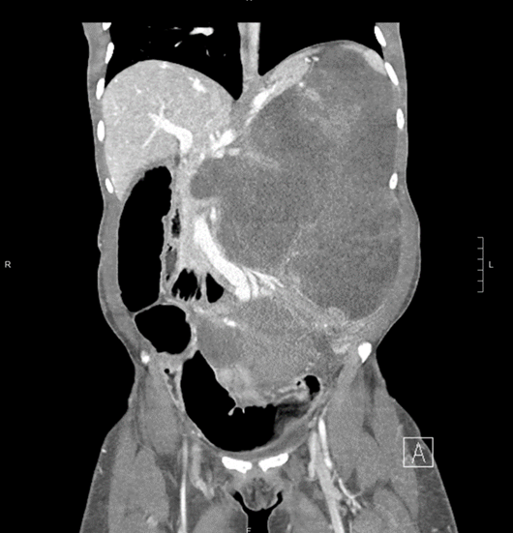
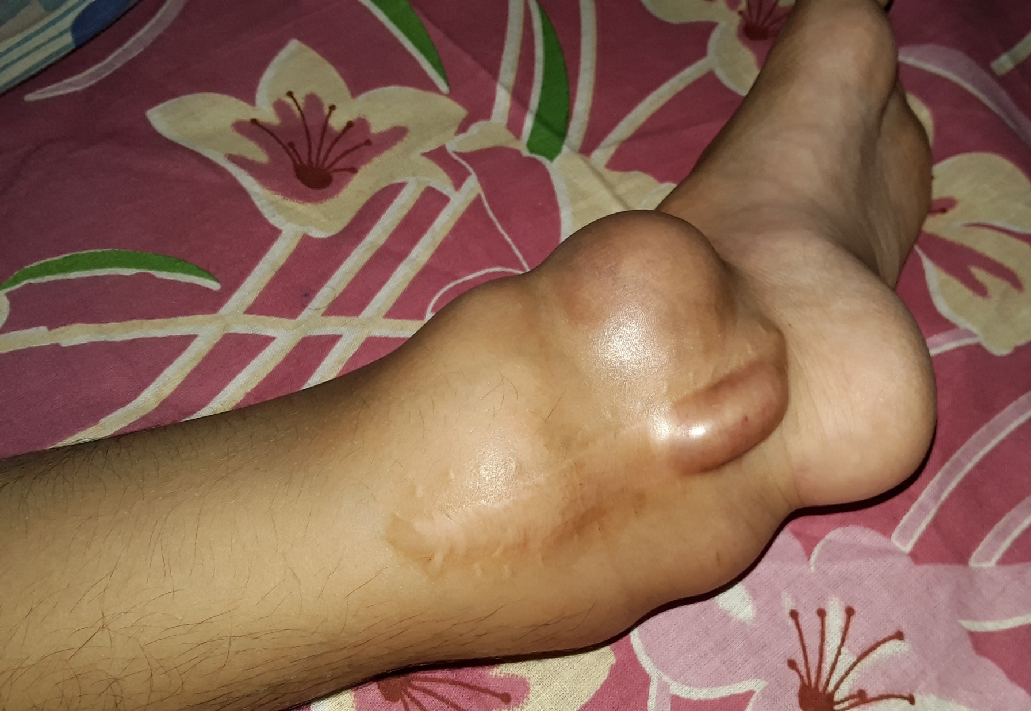
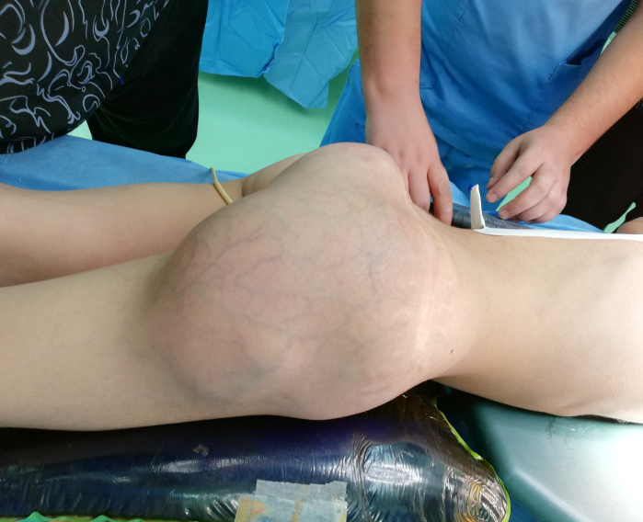
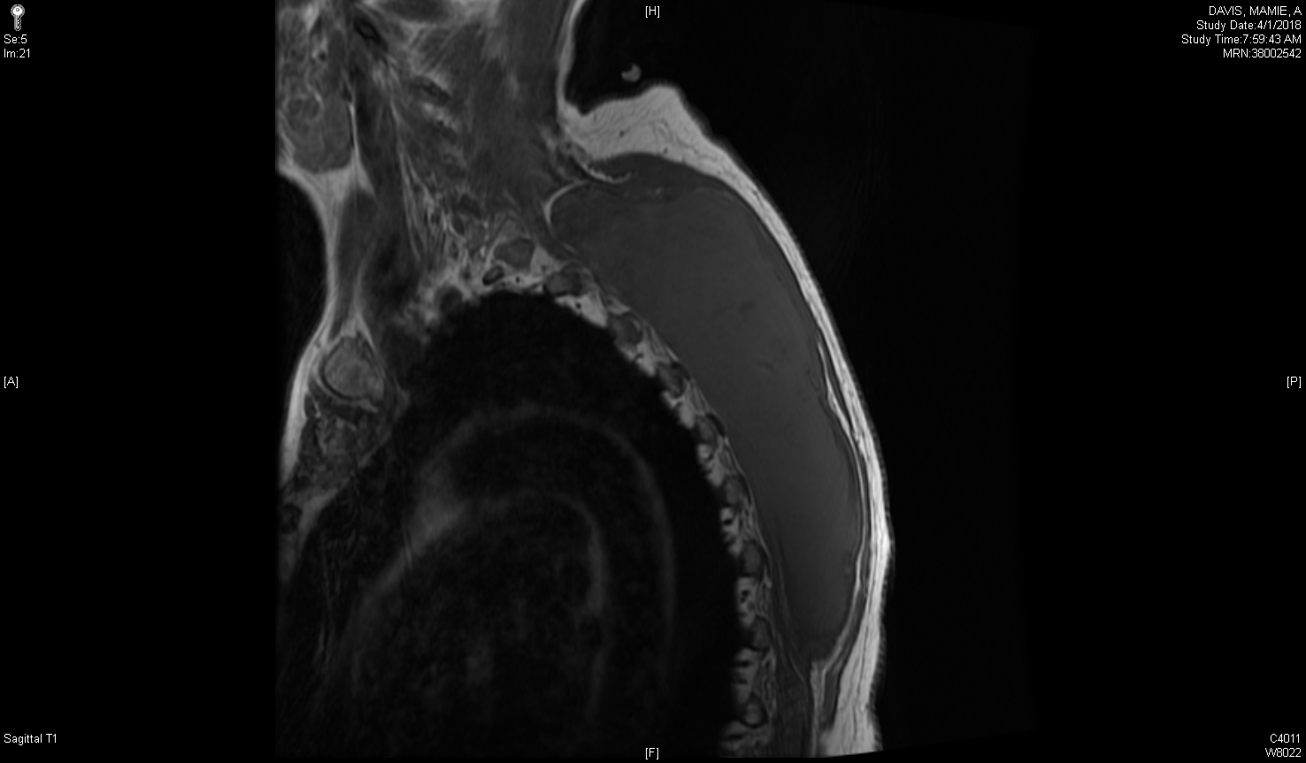
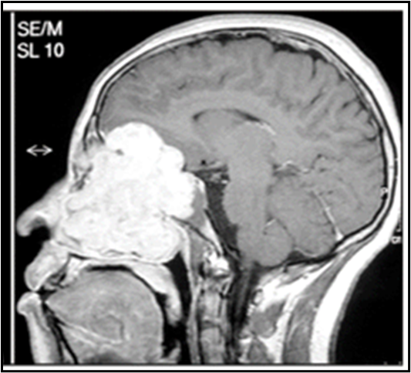
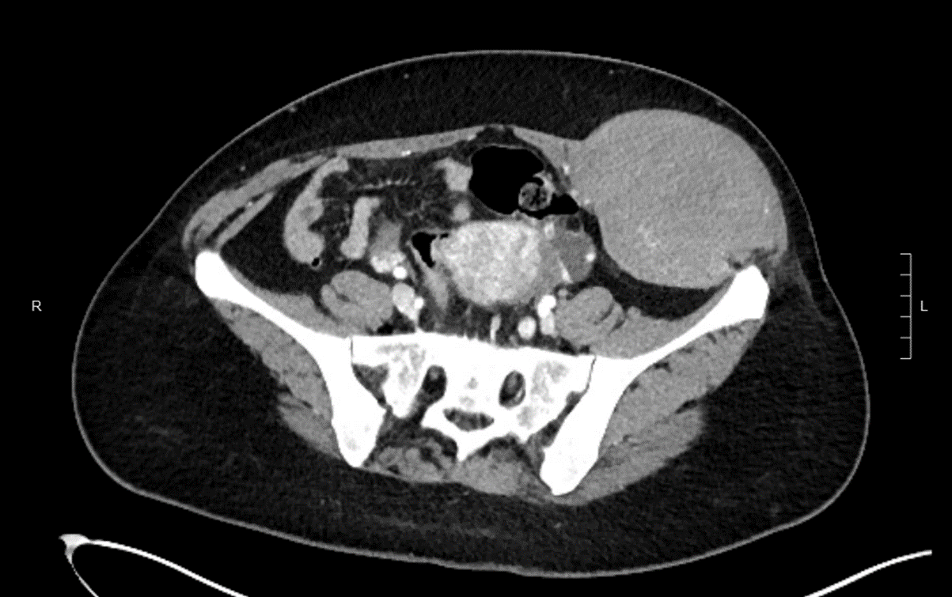
DESMOID TUMORS – Locally aggressive, fibroblastic, connective tissue tumor – rarely fatal

Slide 9
Sites

Slide 10
Overview: Desmoid Tumors (DT)
Rare
<3% of all soft tissue tumors
Incidence 2-4 cases/1,000,000 individuals
Also known as…
Aggressive fibromatosis (AF), Deep fibromatosis, Desmoid-type fibromatosis
Fibrous tissue proliferation
Often indolent
Can be locally invasive and aggressive
No metastatic potential
Can be associated with morbidity and mortality
Desmoid Tumor Working Group. Eur J Cancer. 2020;127:96-107.

Slide 11
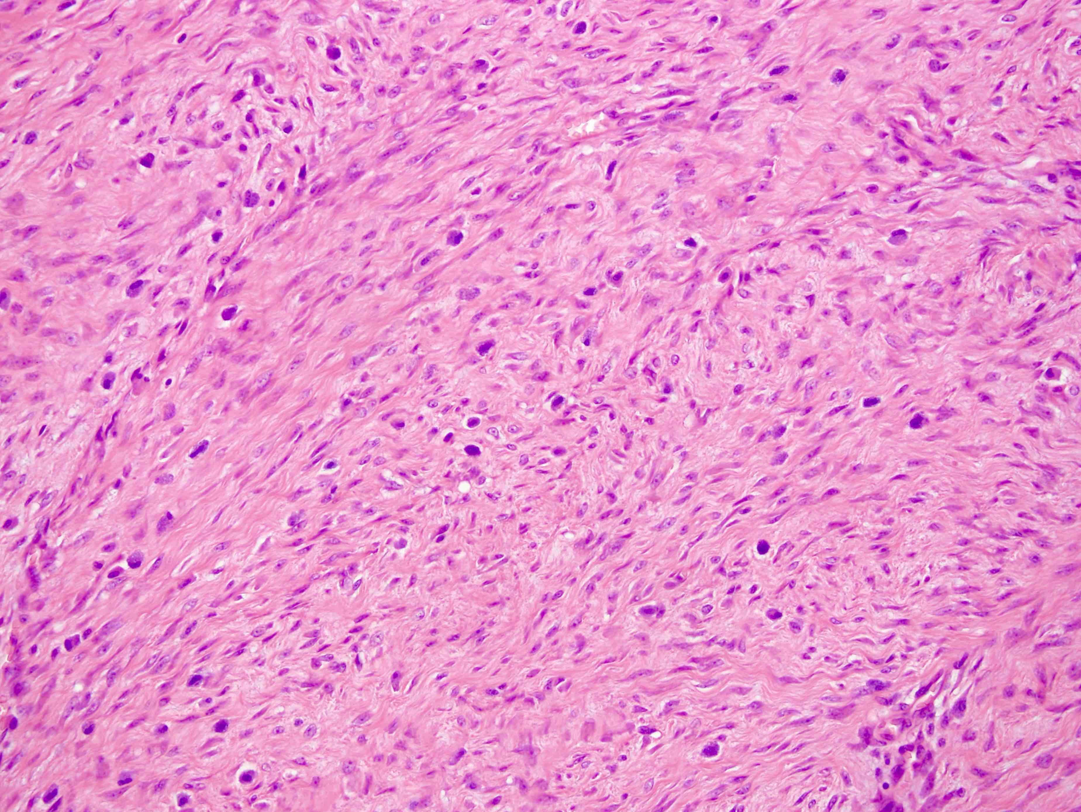
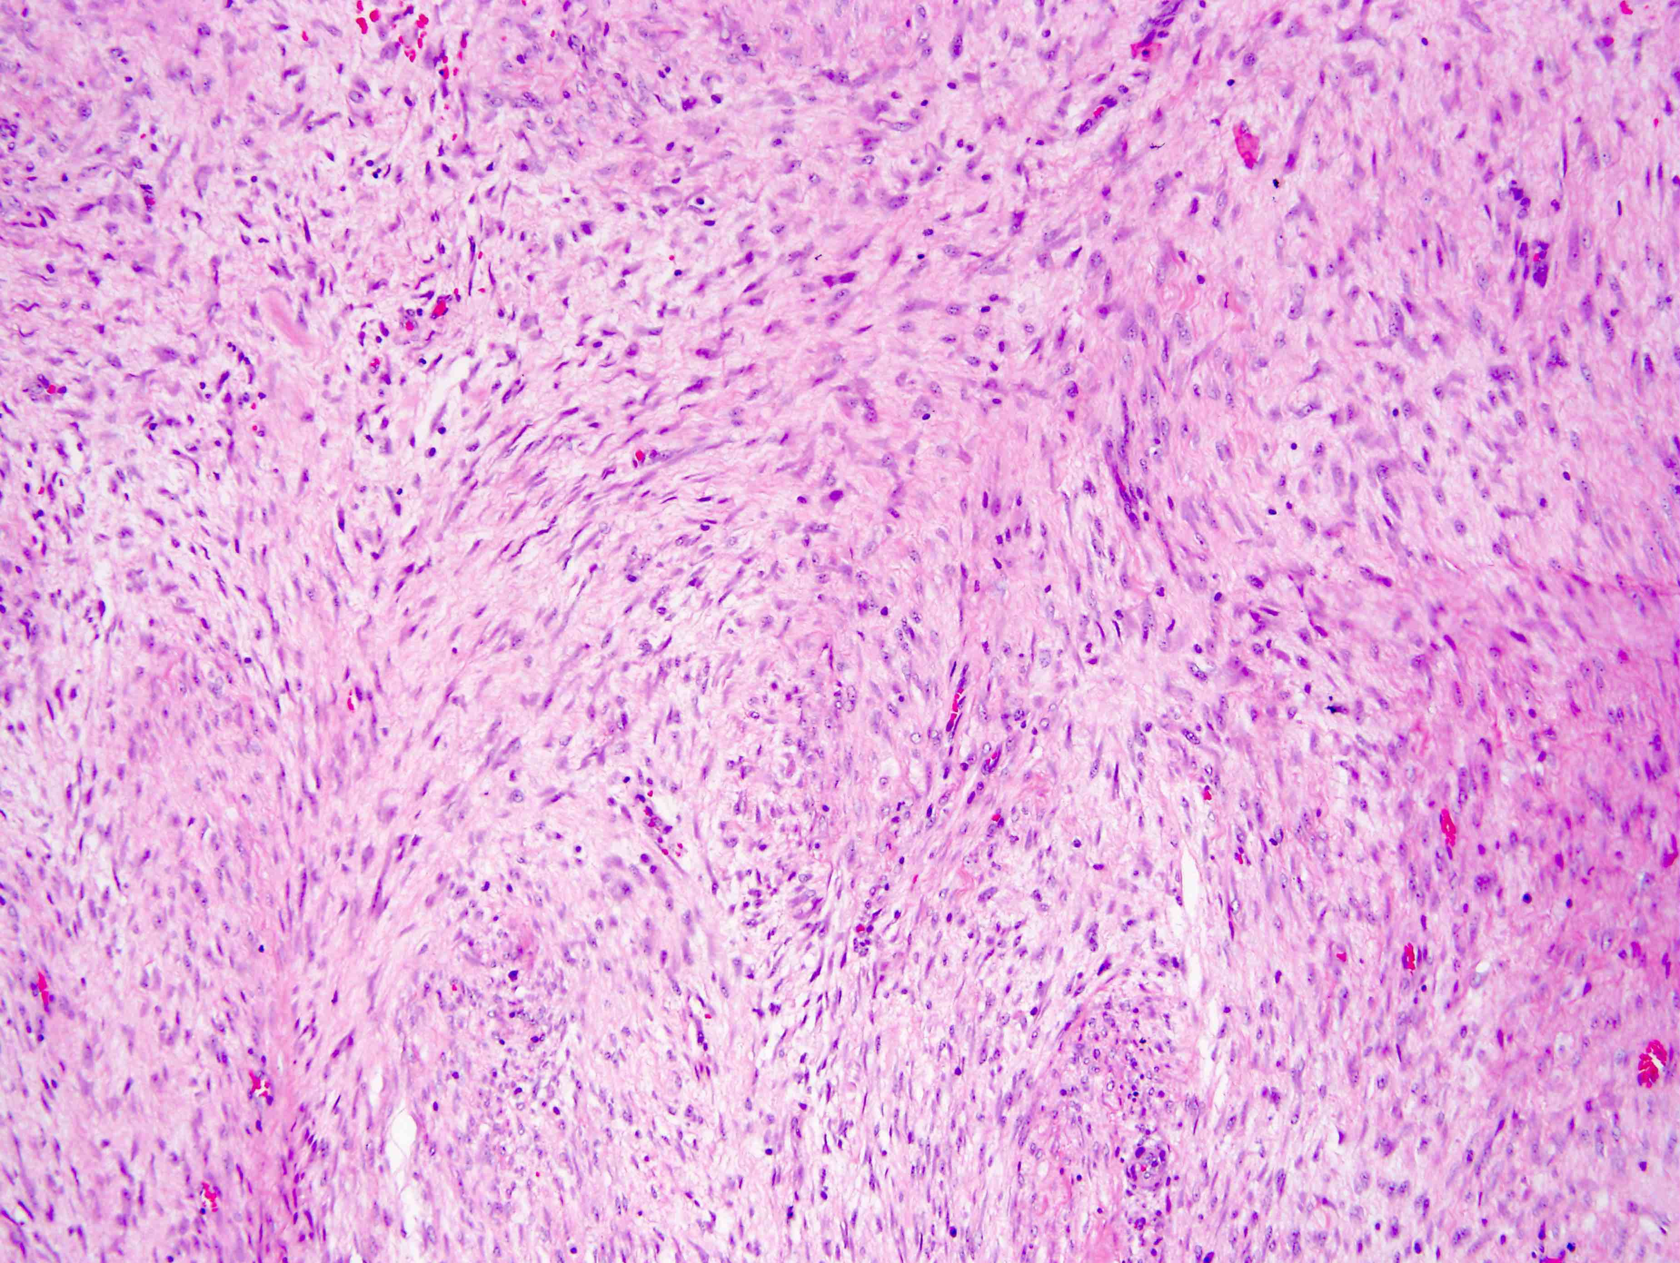
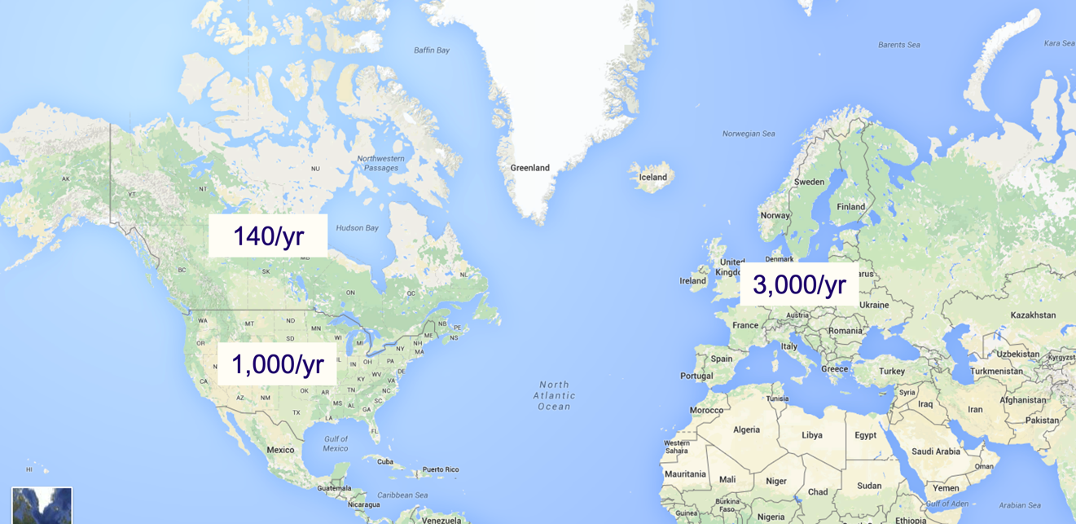
Incidence of Desmoid Tumors Globally
200-250/y
1300-2300/y
900-1,500/y
0.5-0.6/100,000/y
Desmoid Tumor Research Foundation.
Desmoid Tumor Foundation of Canada.
Desmoid Tumor Working Group. Eur J Cancer. 2020;127:96-107.
Obeidin F, Alexiev B. PathologyOutlines.com website.

Slide 12
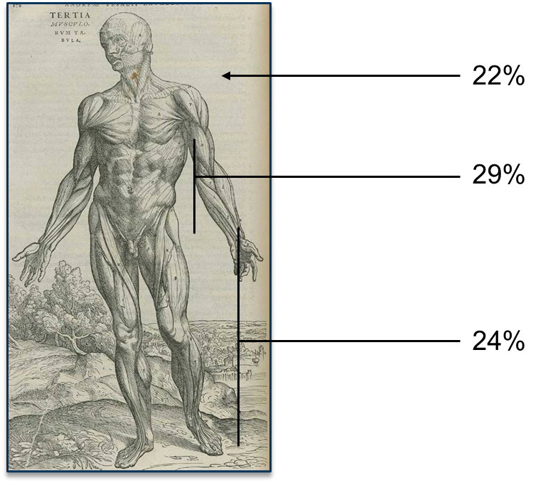
Clinical Presentation
Varied symptoms
Painless or painful
Vast majority occur spontaneously
Association with FAP (Gardner’s syndrome)
Can occur anywhere in the body
Palpable mass in the extremities or trunk
Intra-abdominal desmoid tumors (FAP)
Reports of desmoid tumors in conjunctions with pregnancy, breast implants, orthopedic hardware, etc.
Often misdiagnosed as other sarcomas, leading to poor outcomes due to incorrect management
Desmoid Tumor Working Group. Eur J Cancer. 2020;127:96-107.

Slide 13
Role of Imaging
Whole body staging is not necessary
Ultrasound and PET imaging have limited use
CT and MRI are the preferred imaging modalities
CT for intra-abdominal disease
MRI for extra-abdominal/extremity disease
Braschi-Amirfarzan M et al. Radiographics. 2016;36(3):767-82.

Slide 14
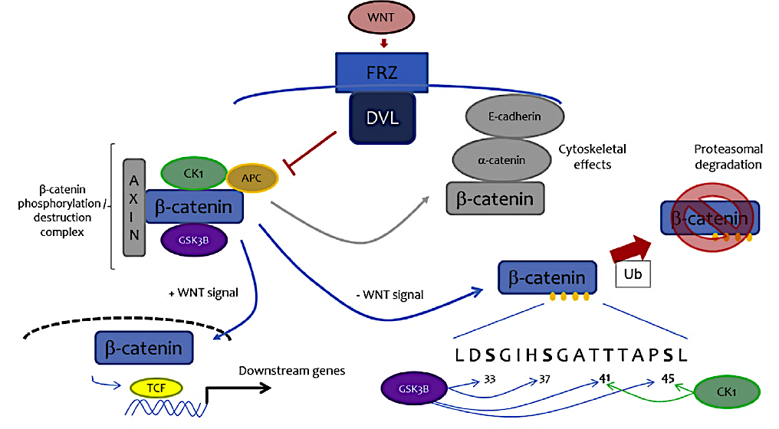
Either CTNNB1 (beta-catenin) or APC loss (FAP) mutations
Both are mediators of the wingless signaling pathway, which gives rise to an uncontrolled proliferation of fibroblasts
Desmoid Tumor Working Group. Eur J Cancer. 2020 Mar:127:96-107.

Slide 15
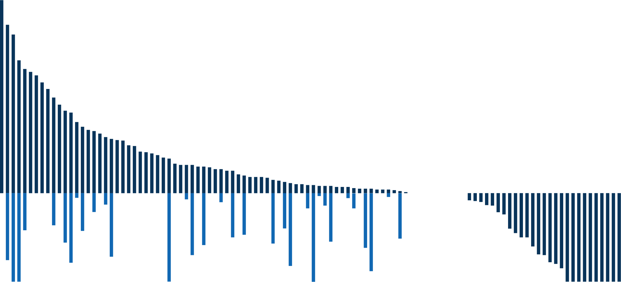
Spontaneous Regression After Progression
Italian Observational Study¹
The GRAFITI Study²
Relative change
Post-PD regression
N = 108
25% initial spontaneous regression
31% spontaneous regression after initial progression
Relative Change, %
Change From Baseline, %
20%
-30%
Time, mo
1. Colombo C et al. Clin Cancer Res. 2022;28:4027-4032. 2. Schut AW et al. Ann Surg. 2023;277(4):689-696. doi: 10.1097/SLA.0000000000005415.

Slide 16
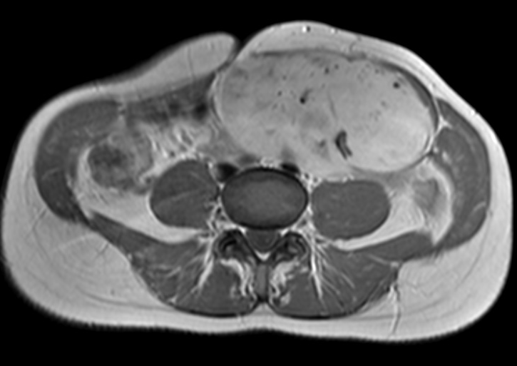
Criteria for Active Treatment
Cosmesis
Pregnancy
Progression
Pain
Surgery in rare cases after tumor board discussion.

Slide 17
Cytotoxic Chemotherapy Progressing and/or Symptomatic
MTX/vinblastine¹
MTX/vinorelbine^{1,2} or vinorelbine alone^{1,3}
Pegylated liposomal doxorubicin (PLD)⁵⁻⁷
Anthracycline-based regimens⁴
1 Skapek SX et al. J Clin Oncol. 2007;25(5):501-6.
2 Weiss AJ et al. Am J Clin Oncol. 1999;22(2):193-195.
3 Mir O et al. J Clin Oncol. 2016;34(suppl; abstr 11050).
4 De Camargo VP et al. Cancer. 2010;116(9):2258-2265.
5 Constantinidou A et al. Eur J Cancer. 2009;45(17):2930-2934.
6 Constantinidou A et al. Acta Oncol. 2011;50(3):455-461.
7 Pang A et al. J Clin Oncol. 2016;34(suppl; abstr 11032).

Slide 18
Phase 3 Randomized Study: Sorafenib Versus Placebo
 | No. of Patients | No. of Events | Median PFS (95% CI), mo
Sorafenib | 49 | 7 | NE (NE-NE)
Placebo | 35 | 22 | 11.3 (5.7-NE)
+
+
+
+
Hazard ratio for progression or death = 0.13 (95% CI, 0.05-0.31)
P < .001
+
+
+
+
+
+
+
+
+
Sorafenib
+
+
+
+
+
+
+
+
+
+
+
+
+
+
+
+
+
+
+
+
+
+
+
+
+
+
+
+
+
+
Patients Without Event, %
+
+
+
+
+
+
+
+
+
+
Placebo
+
+
+
Time, mo
No. at Risk
Sorafenib | 49 | 46 | 41 | 36 | 32 | 29 | 23 | 22 | 17 | 14 | 8 | 4 | 3
Placebo | 35 | 28 | 20 | 18 | 15 | 12 | 11 | 10 | 7 | 3 | 3 | 2 | 2
Gounder MM et al. N Engl J Med.2018;379(25):2417-2428.

Slide 19
Tyrosine Kinase Inhibitors
Reference | n | Inclusion Criteria | Treatment Dose, mg | Treatment Duration | ORR, % | 6-Month PFS, % | 12-Month PFS, % | 24-Month PFS, %
Heinrich et al, 2006 | 19 | “Heavily pretreated patients” | Imatinib 800 mg | 325 days | 16 | 53 | 37 | NE
Penel et al, 2010 | 35 | “Radiological evidence for PD” | Imatinib 400 mg | 1 year | 11 | 80 | 67 | 55
Chugh et al, 2010 | 49 | “Locally advanced disease” | Imatinib 200-600 mg | Until PD 9 patients >3 years | 6 | 84 | 66 | NE
Kasper et al, 2017 | 38 | RECIST PD | Imatinib 800 mg | 2 years | 19 | 65 | 59 | 45
Sorafenib Gounder, 2018 | 50 | “Progressive or symptomatic” | Sorafenib 400 mg | Until PD | 33 | NE | 89 | 81
Pazopanib Toulmond, ASCO 2018 | 48 | RECIST PD | Pazopanib 800 mg | 1 year | 37 | 81 | 86 | NE
Nirogacestat Kummar, 2017 | 17 | “Progressive/ symptomatic” | Nirogacestat 300 mg | Until PD | 29 | 100 | 100 | 100

Slide 20
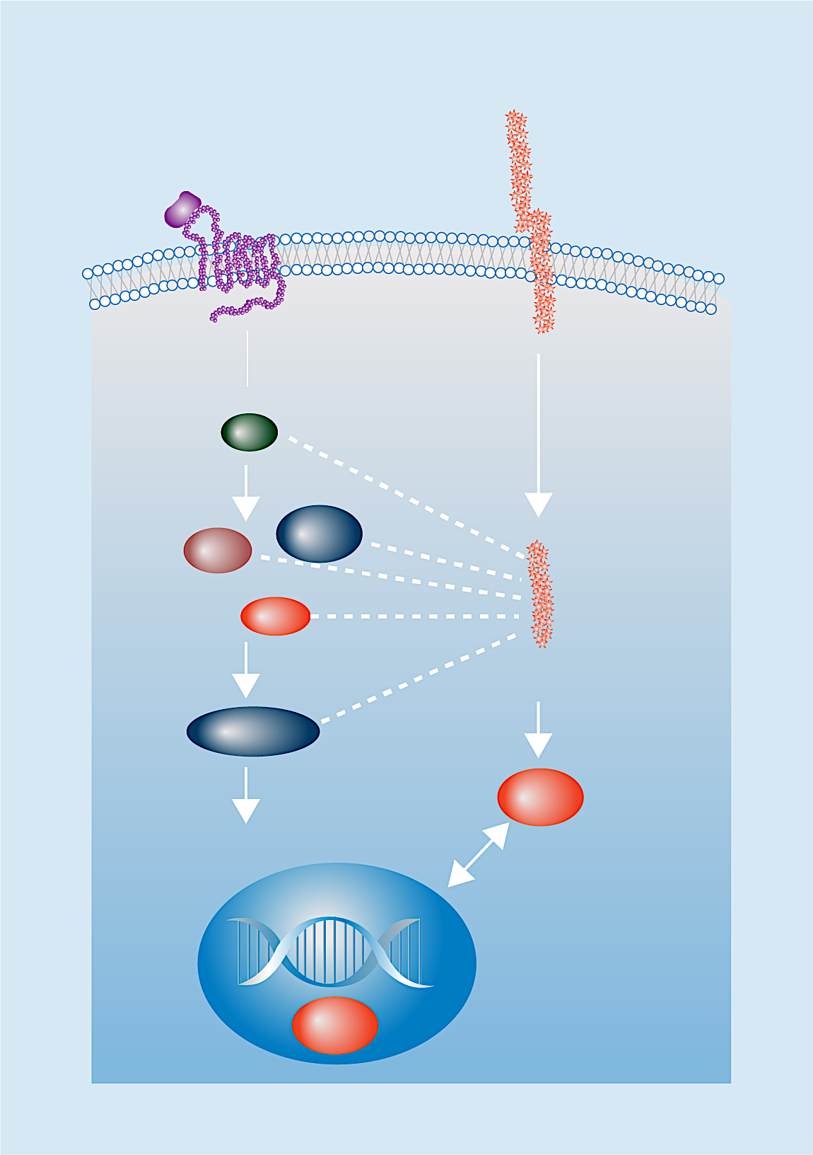
Gamma Secretase Inhibition in Desmoid Tumors
There is mechanistic rationale for the use of GSIs in DTs because these tumors highly express Notch, which can be blocked by GSIs^{5,6}
Wnt pathway
Notch pathway
Notch
Wnt
Extracellular
Plasma membrane
Nirogacestat is an FDA-approved oral, targeted, and selective gamma secretase inhibitor indicated for adult patients with progressing DTs who require systemic treatment
Intracellular
DvI
Axin
GSK3β
AL102 is an investigational, oral, potent inhibitor of gamma secretase
APC
NICD
β-catenin
Canonical Wnt signaling
HES1
Crosstalk
Tcf4
Image adapted from Andersson et al. Development (2011) and Bui and Kummar. Oncotarget (2017).

Slide 21
DeFi: Phase 3 Study of Nirogacestat vs Placebo
Global, randomized, double-blind, placebo-controlled, phase 3 trial comparing the efficacy, safety, and tolerability of nirogacestat vs placebo in adult patients with progressing DTs
142 patients randomized across 37 sites in North America and Europe
Adult eligible patients
Histologically confirmed DT with progressive disease per RECIST v1.1ª
Treatment-naive with DT not amenable to surgery, or
Refractory or recurrent disease (after ≥1 line of therapy)
Stratified by tumor location (intra- vs extra-abdominal)
28-day cycles
Nirogacestat
150 mg BID
Open-label nirogacestat
150 mg BID
Radiographic progressive disease^{b}
R
1:1
Placebo BID
Primary endpoint: PFS^{c}
Secondary endpoints: ORR and PROs, including symptom burden, physical/role function, and overall QoL^{d}
Primary Analysis Data Cutoff: April 7, 2022

Slide 22
Nirogacestat Significantly Reduced the Risk of Disease Progression
1.0
+
+
+
+
+
+
+
+
+
+
+
+
+
Nirogacestat
+
+
+
+
+
+
+
+
+
+
+
+
+
+
+
+
+
+
+
+
+
+
+
+
+
+
+
+
+
+
+
+
+
+
+
+
+
+
Probability, %
+
Placebo
+
+
+
+
+
+
+
+
+
+
+
+
+
+
+
+
+
 | No. of Patients | No. of Events | Median (95% CI) | HR (95% CI)
Nirogacestat | 70 | 12 | NE (NE-NE) | 0.29 (0.15-0.55) P < .001
Placebo | 72 | 37 | 15.1 (8.4-NE)
Progression-Free Survival, mo
No. of Participants at Risk
Nirogacestat | 70 | 63 | 56 | 52 | 52 | 47 | 46 | 44 | 44 | 41 | 26 | 26 | 17 | 12 | 4 | 4 | 0
Placebo | 72 | 67 | 58 | 47 | 45 | 40 | 32 | 29 | 27 | 25 | 10 | 8 | 6 | 5 | 1 | 1 | 0
Gounder M et al. NEJM 2023

Slide 23
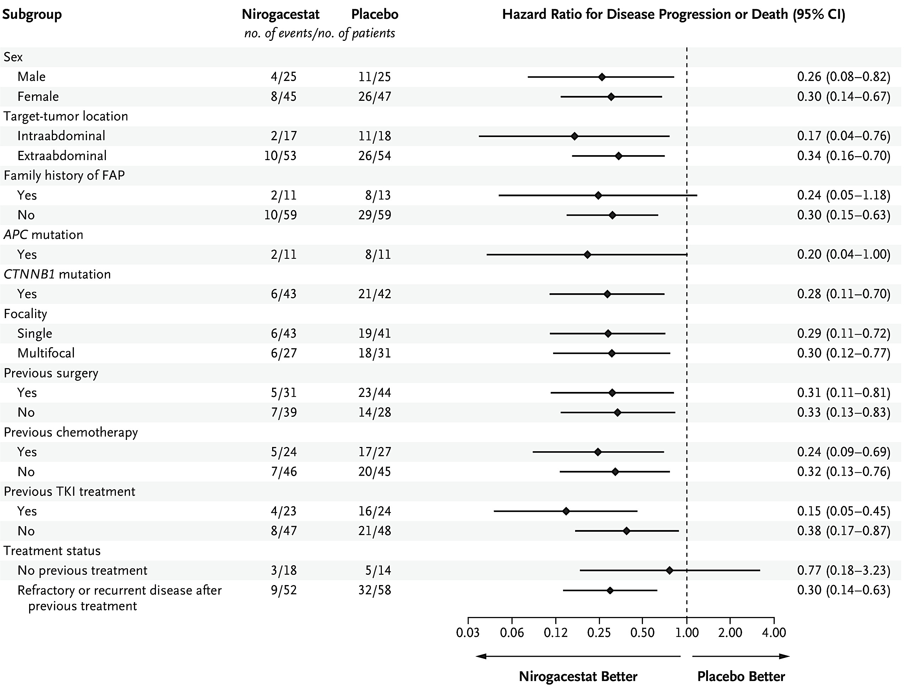
PFS Benefit With Nirogacestat Was Observed Across Pre-specified Subgroups
Gounder M et al. NEJM 2023

Slide 24
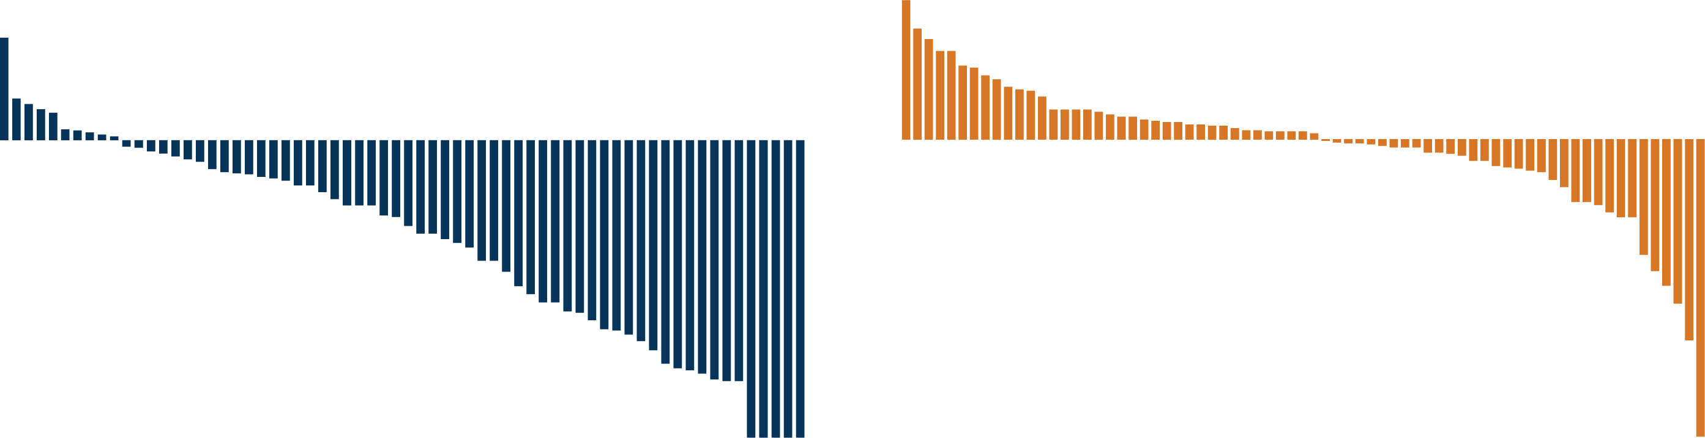
Nirogacestat Resulted in Substantial Reductions in Tumor Size
Nirogacestat
Placebo
Change in Tumor Size, %
ª

Slide 25
Nirogacestat Significantly Reduced Pain
Brief Pain Inventory Short Form: Worst Pain Intensity
LS Mean (SE) | Nirogacestat | Placebo | Difference
Cycle 10 | -1.5 (0.3) | -0.04 (0.3) | -1.5 P < .001
Nirogacestat
Placebo
1.0
Worsening
LS Mean (95% CI) For Change
From Baseline
-1.0
-2.0
Improvement
Analysis Visit
Nirogacestat | 69 | 61 | 57 | 43 | 44 | 46 | 45 | 39 | 41 | 40 | 37 | 40 | 35 | 35 | 39 | 38 | 34 | 32 | 32 | 33 | 34 | 32 | 30 | 31 | 24
Placebo | 71 | 61 | 62 | 43 | 45 | 46 | 40 | 35 | 31 | 31 | 28 | 26 | 23 | 25 | 23 | 25 | 22 | 21 | 23 | 17 | 14 | 19 | 16 | 15 | 11

Slide 26
Nirogacestat Safety Profile
Safety Population, n (%) | Nirogacestat (n = 69) |  | Placebo (n = 72)
Duration of study drug exposure, median (range), mo | 20.6 (0.3-33.6) |  | 11.4 (0.2-32.5)
Dose intensity, median (range), mg/d | 288.3 (169-300) |  | 300.0 (239-300)
 | Any Grade | Grade ≥3 | Any Grade | Grade ≥3
Any TEAE | 69 (100) | 39 (57) | 69 (96) | 12 (17)
TEAEs of any grade reported in ≥25% of patients in either arm
Diarrhea | 58 (84) | 11 (16) | 25 (35) | 1 (1)
Nausea | 37 (54) | 1 (1) | 28 (39) | 0
Fatigue | 35 (51) | 2 (3) | 26 (36) | 0
Hypophosphatemia | 29 (42) | 2 (3) | 5 (7) | 0
Rash, maculopapular | 22 (32) | 4 (6) | 4 (6) | 0
Headache | 20 (29) | 0 | 11 (15) | 0
Stomatitis | 20 (29) | 3 (4) | 3 (4) | 0
TEAEs leading to death | 0 |  | 1 (1)ª
Dose reductions due to TEAEs | 29 (42) |  | 0
Discontinuations due to TEAEs | 14 (20)^{b} |  | 1 (1)^{b}
95% of TEAEs were grade 1 or 2; the first onset of TEAEs in most patients occurred during cycle 1
ªDeath due to sepsis.
^{b}TEAEs leading to discontinuations in ≥1 patient include gastrointestinal disorders (n=5 [4%]), ovarian dysfunction (n=4 [3%]), alanine aminotransferase increase (n=3 [2%]),
aspartate aminotransferase increase (n=2 [1%]), and metabolism/nutritional disorders (n=2 [1%]).
TEAE, treatment-emergent adverse event
Kasper B et al. ESMO 2022. Abstract LBA2.

Slide 27
Frequency and Resolution of Ovarian Dysfunction Observed With Nirogacestat
OD is a composite AE associated with changes in female reproductive hormone levels and clinical manifestations^{2,3}
Protocol-mandated serum hormone collection at baseline and cycles 1, 2, 4, and every 3 thereafter
Among women of childbearing potential, OD was observed in 75% receiving nirogacestat and 0% receiving placebo
Median time to first onset of OD: 8.9 weeks
Median duration of OD events: 21.3 weeks
27 of 36 women of childbearing potential reported OD
(75%)
11 patients discontinued nirogacestat for any reason
(41%)
14 patients ongoing nirogacestat treatment
(52%)
2 patients lost to follow-up after discontinuing nirogacestat
(7%)
OD resolved^{c} in 11 patients
(100%)
OD resolved^{c} in 9 patients
(64%)
Unresolved OD in 5 patients
(36%)
OD status unknown
OD, ovarian dysfunction
1. Thurston et al. Obstet Gynecol Clin North Am. 2011;38:489-501.
2. Mauri et al. Front Endocrinol (Lausanne). 2020;11:572388.
3. Kasper B et al. ESMO 2022. Abstract LBA2.

Slide 28
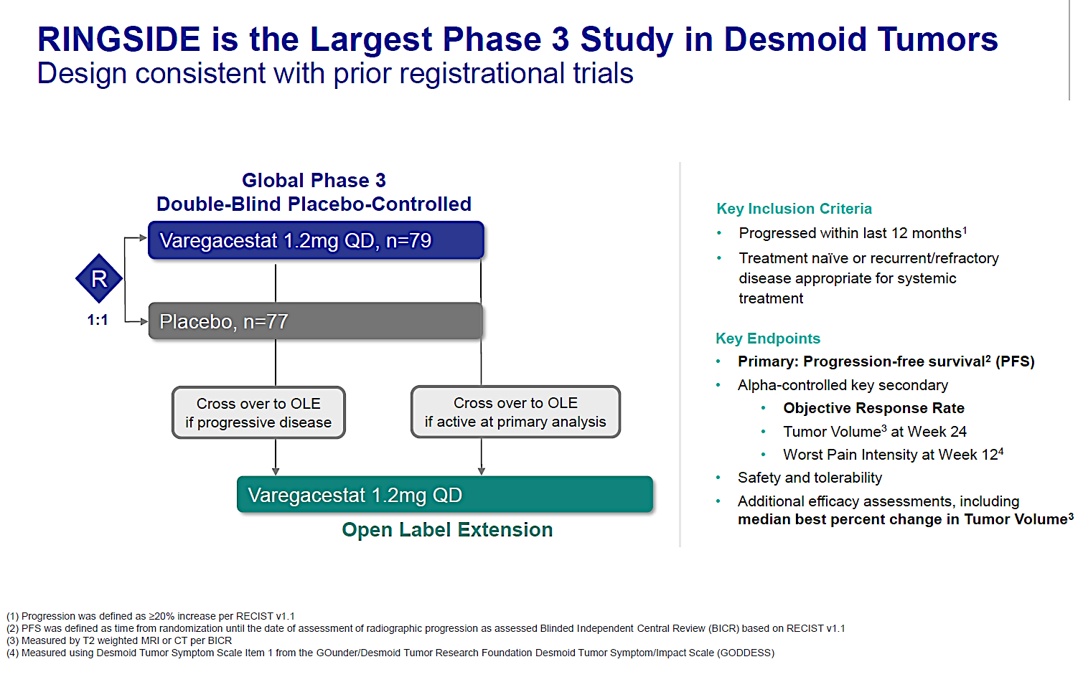
Corporate Presentation – March 2026

Slide 29
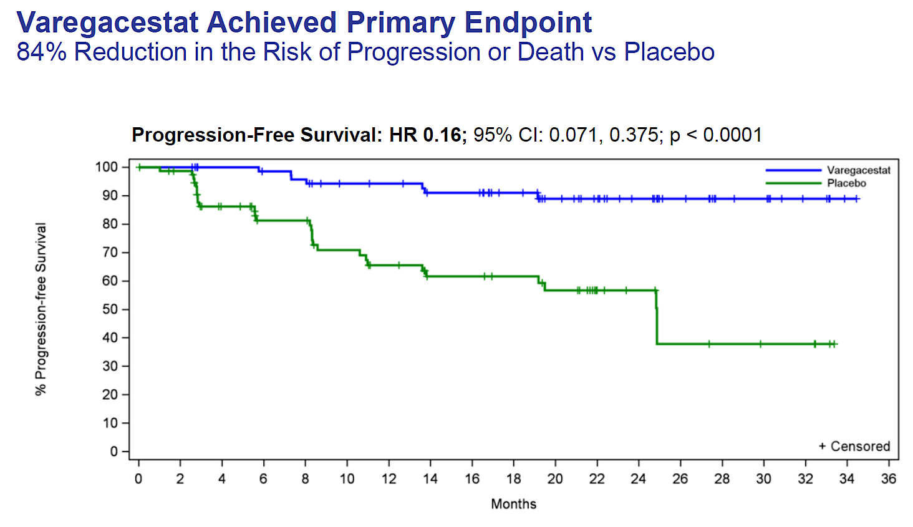
Corporate Presentation – March 2026

Slide 30
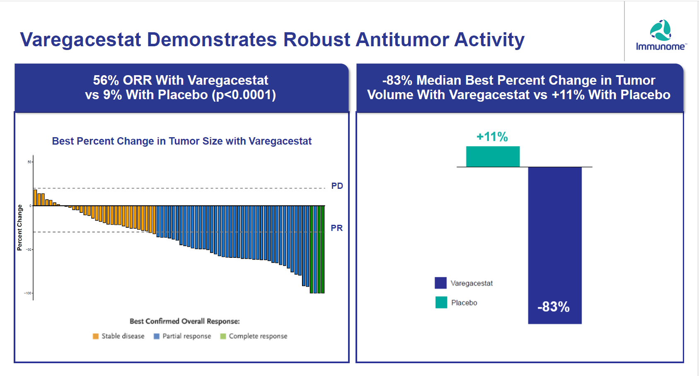
Corporate Presentation – March 2026

Slide 31
The Desmoid Tumor Multidisciplinary Team
Patient
Surgeon
Radiologist
Nurse/ NP/ PA
Physical Therapist
Therapist/ Counselor
Pediatrician/Primary Care
Medical Oncologist/ Sarcoma Specialist
Multidisciplinary care is essential in desmoid tumors
At various stages in their treatment journey, patient care may involve numerous specialties
Allied health professionals such as physical therapists, massage therapists, and mental health specialists are particularly important for long-term patient well-being
Because many patients with desmoid tumors are diagnosed as adolescents, it is important that pediatric providers ensure appropriate transfer of care to adult providers later in life
Desmoid Tumor Working Group. Eur J Cancer. 2020;127:96-107.

Slide 32
QUESTIONS?

Slide 33
Module 6: Desmoid Tumors and Soft Tissue Sarcoma
Desmoid Tumors — Dr Gounder
Soft Tissue Sarcoma — Dr Riedel

Slide 34
Soft Tissue Sarcoma (STS) Fifth Annual National General Medical Oncology Summit
Richard F. Riedel, MD
Duke Cancer Institute
April 25, 2026

Slide 35
Disclosures
Advisory Committees and Consulting Agreements | Aadi Bioscience, Adaptimmune, Bayer HealthCare Pharmaceuticals, Blueprint Medicines, Boehringer Ingelheim Pharmaceuticals Inc, Cogent Biosciences, Daiichi Sankyo Inc, Deciphera Pharmaceuticals Inc, EMD Serono Inc, GSK, Ipsen Biopharmaceuticals Inc, NANO MRNA, Recordati, Replimune, SpringWorks Therapeutics Inc
Contracted Research | Aadi Bioscience, Adaptimmune, Cogent Biosciences, Daiichi Sankyo Inc, Deciphera Pharmaceuticals Inc, GSK, Inhibrx, Intensity Therapeutics, Kura Oncology, Servier Pharmaceuticals LLC, SpringWorks Therapeutics Inc, TRACON Pharmaceuticals Inc
Nonrelevant Financial Relationships | SARC (Sarcoma Alliance for Research through Collaboration)

Slide 36
Objectives
Review historical treatment paradigms for advanced soft tissue sarcoma (STS)
Highlight efficacy and safety findings with nab-sirolimus in PEComa
Introduce key data from trials involving cell-based therapies in STS
Afamitresgene autoleucel (afami-cel) and Letetresgene autoleucel (lete-cel)
Summarize other novel agents in unique STS subtypes

Slide 37
Overview: Sarcomas
Rare
~15,000 cases/yr
1% of cancer in adults
Heterogeneous
>100 histologic subtypes
Location
50% Extremities
40% Trunk
10% Head and Neck
Classification
75% soft tissue
25% bone
Sig Transduct Target Ther 6, 246 (2021).

Slide 38
Limitations/Challenges
Rare
Histologic diversity
Genetic diversity
Prognosis remains for poor for patients with metastatic disease
Suboptimal systemic therapy
Number of treatment options are limited
Effectiveness of available options is limited
Toxicity of our treatments needs to be considered

Slide 39
In my practice*…metastatic (non-GIST) STS
Pre-2012
Post-2012 through 2019
1st line
Anthracycline-based
Single agent vs Combination
+ Ifosfamide (Synovial sarcoma)
Paclitaxel (Angiosarcoma)
Gem/Doce (LMS)
2nd line
Gemcitabine-based
Doxorubicin (if not previously received)
Ifosfamide (good PS)
3rd line
Dacarbazine
1st line
Anthracycline-based
Single agent vs. Combination
+ Ifosfamide (Synovial sarcoma)
Paclitaxel (Angiosarcoma)
2nd line
Gemcitabine-based
Trabectedin (Myxoid liposarcoma)
3rd line
Eribulin (Liposarcoma)
Trabectedin (LMS/Liposarcoma)
Pazopanib (non-Liposarcoma)
4th line and later
Dacarbazine
* Clinical trial always preferred

Slide 40
Systemic Therapy: Recent Advances
Histology-specific
Pexidartinib¹ in tenosynovial giant cell tumor (TGCT)
Ripretinib² in 4th line GIST
Avapritinib² in PDGFR exon 18 mutant positive GIST
Tazemetostat² in epithelioid sarcoma (withdrawn from market in 2026)
nab-sirolimus³ in perivascular epithelioid cell tumor (PEComa)
Crizotinib⁴ in ALK-positive inflammatory myofibroblastic tumor (IMT)
Atezolizumab⁴ in alveolar soft part sarcoma (ASPS)
Nirogacestat⁵ in desmoid tumors
Afamitresgene autoleucel (afami-cel)⁶ in synovial sarcoma
Vimseltinib⁷ in TGCT
Doxorubicin/Trabectedin in leiomyosarcoma (LMS)
Letetresgene autoleucel (lete-cel) in synovial sarcoma and myxoid round cell liposarcoma
1: FDA approved in 2019
2: FDA approved in 2020
3: FDA approved in 2021
4: FDA approved in 2022
5: FDA approved in 2023
6: FDA approved in 2024
7: FDA approved in 2025

Slide 41
Nab-Sirolimus in Malignant Perivascular Epithelioid Cell Tumor (PEComa)

Slide 42
PEComa: Incidence and Presentation
“Ultra-rare” mesenchymal family of neoplasms
Less than 500 cases/year in the U.S.
Less aggressive/Benign: Angiomyolipoma (AML), Clear cell sugar tumor of the lung, Lymphangioleiomyomatosis (LAM)
More aggressive/Malignant: Epithelioid AML, Malignant PEComa
Female predominance
Most common primary sites: kidney, uterus, liver, pancreas
Prognosis is poor for patient with metastatic disease
Review of pathology at a center with expertise is critical
Morphology is variable and IHC overlaps with other cancers
Loss of TSC1/TSC2 (majority) resulting in activation of the mTOR pathway; TFE3 fusion (small subset)
J Clin Oncol. 2010;28(5):835-40.
Pathologe. 2020; 41(Suppl 1): 9–19.
Clin Cancer Res. 2019 Sep 1;25(17):5295-5300.

Slide 43
AMPECT Study: Study Design
Population Enrolled
Adult patients Metastatic or LA PEComa
Treatment
Protein-bound sirolimus*
100 mg/m² IV days 1 and 8 of a 21 day cycle
* Up to 2 dose reductions (to 75 and 56 mg/m2) were allowed
Endpoints
1^{O} - ORR per RECIST 1.1
2º - DOR, PFS, OS
Exploratory – DCR, biomarkers
Prospective
Open-label
Single arm
Phase 2 study
PATIENTS WERE TREATED UNTIL DISEASE PROGRESSION OR UNACCEPTABLE TOXICITY
LA: locally advanced; ORR: overall response rate; DOR: duration of response;
PFS: progression free survival; OS: overall survival; DCR: disease control rate
J Clin Oncol. 2021 Nov 20;39(33):3660-3670.

Slide 44
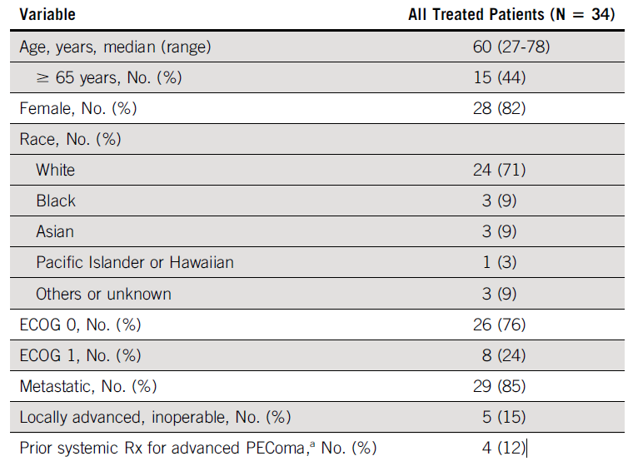
AMPECT Study: Patient Characteristics
ª Includes docetaxel, doxorubicin, gemcitabine, ifosfamide, and olaratumab.
J Clin Oncol. 2021 Nov 20;39(33):3660-3670.

Slide 45
AMPECT Study: Outcomes
 | Efficacy Outcome (n=31)
Overall Response Rate, n (%) | 12 (38.7)
Complete Response (CR), n (%) | 2 (6.5)
Partial Response (PR), n (%) | 10 (32.3)
Stable Disease (SD), n (%) | 16 (51.6)
Progressive Disease (PD), n (%) | 3 (9.7)
Disease Control Rate, n (%) | 22 (71.0)
Median PFS, months (95% CI) | 10.6 (5.5 to 41.2)
Median OS, months (95% CI) | 53.1 (22.2 to Not reached)
J Clin Oncol. 2021 Nov 20;39(33):3660-3670.
J Clin Oncol. 2024; 2024 May 1;42(13):1472-1476.

Slide 46
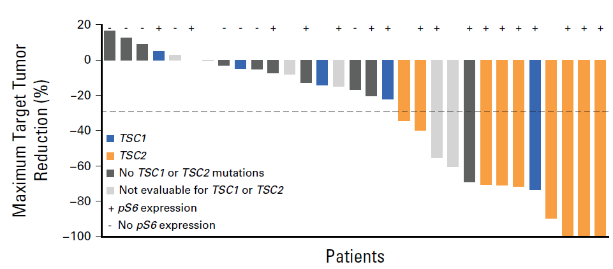
AMPECT Study: Waterfall Plot
J Clin Oncol. 2024; 2024 May 1;42(13):1472-1476.

Slide 47
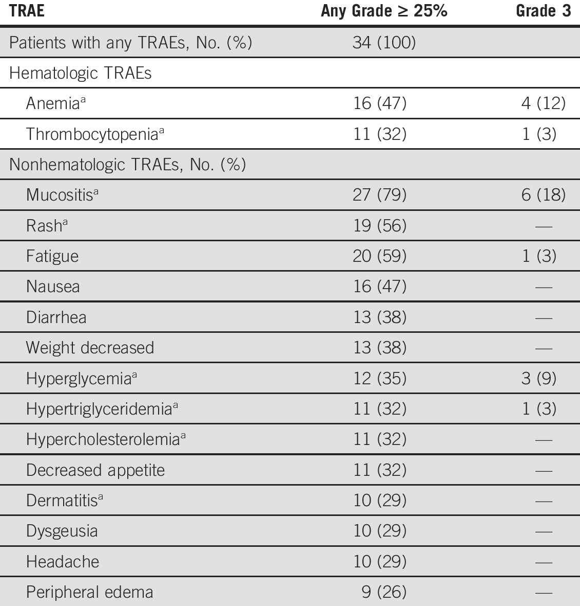
AMPECT Study: Treatment-related AEs
J Clin Oncol. 2021 Nov 20;39(33):3660-3670.

Slide 48
AMPECT Study: Summary
AMPECT study confirmed utility of targeting mTOR pathway, with nab-sirolimus, in malignant PEComa
nab-sirolimus has shown clear efficacy with a reasonable side effect profile and no new safety signals
FDA Approved in November 2021 for adult patients with locally-advanced or metastatic malignant PEComa

Slide 49
Cell-based Therapies in Select Sarcoma Subtypes

Slide 50
Overview: Synovial Sarcoma and MRCLS
Rare (~5-10%) histologic subtypes of STS
~800-1000 cases annually
Translocation Associated Sarcomas
Synovial sarcoma - t(X;18), SS18::SSX fusion
MRCLS – t(12;16), FUS::DDIT3 fusion
Majority express tumor associated antigens
MAGE-A4
NY-ESO
Stat Pearls – Synovial Cell Sarcoma.
https://www.ncbi.nlm.nih.gov/books/NBK587366/
Stat Pearls – Liposarcoma.
https://www.ncbi.nlm.nih.gov/books/NBK538265/
MRCLS: Myxoid/Round Cell Liposarcoma
STS: soft tissue sarcomas

Slide 51
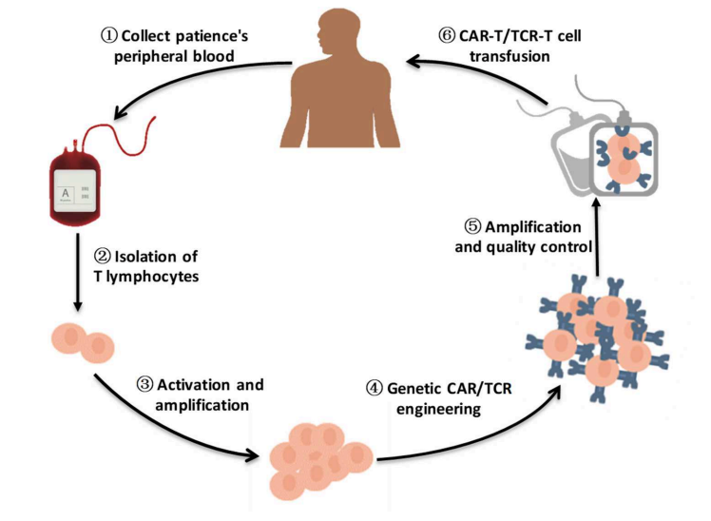
Engineered T-Cell Receptor Cellular Products
Collect patient’s
Front Immunol. 10:2250.

Slide 52
SPEARHEAD-1 Trial
Afamitresgene autoleucel for advanced synovial sarcoma and myxoid round cell liposarcoma (SPEARHEAD-1): an international, open-label, phase 2 trial
Sandra P D’Angelo, Dejka M Araujo, Albiruni R Abdul Razak, Mark Agulnik, Steven Attia, Jean-Yves Blay, Irene Carrasco Garcia, John A Charlson, Edwin Choy, George D Demetri, Mihaela Druta, Edouard Forcade, Kristen N Ganjoo, John Glod, Vicki L Keedy, Axel Le Cesne, David A Liebner, Victor Moreno, Seth M Pollack, Scott M Schuetze, Gary K Schwartz, Sandra J Strauss, William D Tap, Fiona Thistlethwaite, Claudia Maria Valverde Morales, Michael J Wagner, Breelyn A Wilky, Cheryl McAlpine, Laura Hudson, Jean-Marc Navenot, Tianjiao Wang, Jane Bai, Stavros Rafail, Ruoxi Wang, Amy Sun, Lilliam Fernandes, Erin Van Winkle, Erica Elefant, Colin Lunt, Elliot Norry, Dennis Williams, Swethajit Biswas, Brian A Van Tine
Lancet 2024; 403: 1460–71

Slide 53
SPEARHEAD-1 Trial: Patient Characteristics*
 | Synovial Sarcoma Patients (n=44)
Age, years | 40.5 (31.0-46.0)
Male:Female | 22 (50%) : 22(50%)
ECOG PS 0-1 | 43 (97%)
Race Asian Black of African American White | 3 (7%) 2 (5%) 39 (86%)
Prior systemic therapy 1 2 3 >4 | 7 (16%) 14 (32%) 9 (20%) 14 (32%)
* 52 patients enrolled in total (44 with synovial sarcoma; 8 with myxoid round cell liposarcoma)
Lancet 2024; 403: 1460–71

Slide 54
SPEARHEAD-1 Trial: Waterfall Plot
Overall response rate was 37% (19 of 52; 95% CI 24–51)
39% (17 of 44; 24–55) for patients with synovial sarcoma
25% (two of eight; 3–65) for patients with myxoid round cell liposarcoma
Lancet 2024; 403: 1460–71

Slide 55
SPEARHEAD-1 Trial: Spider Plot
Lancet 2024; 403: 1460–71

Slide 56
SPEARHEAD-1 Trial: Overall Survival
Lancet 2024; 403: 1460–71

Slide 57
SPEARHEAD-1 Trial: Subgroup Analyses
Lancet 2024; 403: 1460–71

Slide 58
SPEARHEAD-1 Trial: Adverse Events (>10%)*
 | Grade 1-2 | Grade 3 | Grade 4 | Overall
Cytokine release syndrome | 36 (69%) | 1 (2%) | 0 | 37 (71%)
Leukopenia | 1 (2%) | 8 (15%) | 5 (10%) | 14 (27%)
Pyrexia | 10 (19%) | 1 (2%) | 1 (2%) | 12 (23%)
Lymphopenia | 0 | 3 (6%) | 6 (12%) | 9 (17%)
Nausea | 6 (12%) | 0 | 0 | 6 (12%)
Fatigue | 6 (12%) | 0 | 0 | 6 (12%)
Thrombocytopenia | 3 (6%) | 1 (2%) | 2 (4%) | 6 (12%)
* n=52; AEs related to T-cell infusion; No treatment-related deaths
Lancet 2024; 403: 1460–71

Slide 59
SPEARHEAD-1 Trial: Conclusions
Engineered TCR strategies targeting MAGE-A4 are feasible and have efficacy
HLA-A*02⁺-positive patients
ORR 39% in pretreated synovial sarcoma
Responses were durable
Side effect profile is consistent with other cell-based approaches
Cytokine release syndrome and cytopenias
FDA granted accelerated approval August 2024

Slide 60
IGNYTE-ESO Trial: Study Schema
Letetresgene autoleucel (Lete-cel)
TCR recognizing NY-ESO-1 presented by select HLA-A*02 types
Open-label, phase 2 study
64 patients in Efficacy Population
34 (53%) with synovial sarcoma, 30 (47%) with MRCLS
63 (98%) with metastatic disease
38 (60%) had 2 or more lines of systemic therapy
Primary endpoint: ORR per RECIST
Presented at CTOS 2024 Annual Meeting by Dr. Sandra D’Angelo

Slide 61
IGNYTE-ESO Trial: Waterfall Plot
Presented at CTOS 2024 Annual Meeting by Dr. Sandra D’Angelo

Slide 62
IGNYTE-ESO Trial: Adverse Events
Presented at CTOS 2024 Annual Meeting by Dr. Sandra D’Angelo

Slide 63
IGNYTE-ESO Trial: Conclusions
Engineered TCR strategies targeting NY-ESO are feasible and have efficacy
HLA-A*02⁺-positive patients
ORR 41% in pretreated synovial sarcoma and 43% in MRCLS
Responses were durable
Side effect profile is consistent with other cell-based approaches
Cytokine release syndrome and cytopenias
To be submitted for FDA consideration

Slide 64
Other Novel Agents and Approaches
Atezolizumab for Advanced Alveolar Soft Part Sarcoma – N Eng J Med 2023
ORR 37% (1 CR, 18 PR) in a single-group, phase 2 study
FDA approval
Doxorubicin-Trabectedin with Trabectedin Maintenance in Leiomyosarcoma – N Eng J Med 2024
Improved PFS and OS compared to doxorubicin alone
Study of INBRX-109 in Conventional Chondrosarcoma (ChonDRAgon) – Presented at CTOS Nov 2025
Improved PFS when compared to placebo
PEAK Study: Bezuclastinib in combination with sunitinib in GIST – Positive Study/Presentation TBD
Improved PFS and ORR when compared to sunitinib (Per Press Release)

Slide 65
Other Novel Agents and Approaches
EA7222: A Randomized Phase III Trial of Doxorubicin + Pembrolizumab Versus Doxorubicin Alone for the Treatment of Undifferentiated Pleomorphic Sarcoma (UPS) and Related Poorly Differentiated Sarcomas – Accrual ongoing
Ivosidenib in Participants With Locally Advanced or Metastatic Conventional Chondrosarcoma Untreated or Previously Treated With 1 Systemic Treatment Regimen (CHONQUER) – Accrual ongoing
A Study to Investigate Efficacy & Safety of Intratumoral INT230-6 Compared to US Standard of Care in Adults with Soft Tissue Sarcomas (INVINCIBLE-3) – Accrual ongoing
Study of ADI-PEG 20 or Placebo Plus Gemcitabine and Docetaxel in Previously Treated Subjects with Leiomyosarcoma (ARGSARC) – Accrual ongoing

Slide 66
Conclusion
The treatment landscape for STS is rapidly evolving
Histology-specific and/or molecular defined treatment approaches
Advances, including FDA approvals, are being made in rare histologic subtypes
nab-sirolimus in PEComa
Atezolizumab in alveolar soft part sarcoma (ASPS)
Cellular based approaches are feasible and efficacious
Afamitresgene autoleucel in synovial sarcoma - FDA approved
Letetresgene autoleucel in synovial sarcoma and MRCLS
The future is bright!!!

Slide 67
QUESTIONS?

Slide 68
Module 7: Urothelial Bladder Cancer
Role of Immunotherapeutic Strategies in the Management of Nonmetastatic UBC; Emerging Utility of Circulating Tumor DNA (ctDNA) Evaluation — Dr Friedlander
Other Novel Agents and Strategies for Nonmetastatic and Metastatic UBC — Dr Petrylak

Slide 69



Faculty
Terence Friedlander, MD
UCSF Helen Diller Family Comprehensive Cancer Center
San Francisco, California
Moderator Neil Love, MD
Research To Practice
Miami, Florida
Daniel P Petrylak, MD
Yale Comprehensive Cancer Center
New Haven, Connecticut
Co-Moderator Gustavo Adolf Fonseca, MD
Florida Cancer Specialists & Research Institute
Lecanto, Florida

Slide 70
Module 7: Urothelial Bladder Cancer
Role of Immunotherapeutic Strategies in the Management of Nonmetastatic UBC; Emerging Utility of Circulating Tumor DNA (ctDNA) Evaluation — Dr Friedlander
Other Novel Agents and Strategies for Nonmetastatic and Metastatic UBC — Dr Petrylak

Slide 71
Module 7: Urothelial Bladder Cancer
We would like to do a “best paper or presentation of the year” activity. Please suggest one “paper of the year” and 2 other worthy papers based on the value in treatment of current and future patients.

Slide 72

Immunotherapy in the Management of Nonmetastatic UBC and Emerging Utility of Circulating Tumor DNA (ctDNA)
Terence Friedlander, MD
Clinical Professor
Robert and Virginia O’Reilly Family Endowed Chair Helen Diller Family Comprehensive Cancer Center University of California, San Francisco Chief of Hematology-Oncology Zuckerberg San Francisco General Hospital and Trauma Center San Francisco, California

Slide 73
Disclosures
Advisory Committees | Aadi Bioscience, AbbVie Inc, Adaptimmune, Aktis Oncology, Astellas, Bicycle Therapeutics, Bristol Myers Squibb, Gilead Sciences Inc, Merck, Pfizer Inc, Samsung Bioepis
Consulting Agreements | Astellas, EMD Serono Inc, Genentech, a member of the Roche Group
Contracted Research | AbbVie Inc, Bicycle Therapeutics, Flare Therapeutics, Genentech, a member of the Roche Group, Johnson & Johnson, Pfizer Inc

Slide 74
Outline
NMIBC
Rationale for use of BCG + PD-1 immunotherapy
Safety and Efficacy from recent Phase III trials (CREST, POTOMAC, ALBAN)
Long-term findings with pembrolizumab monotherapy in patients with high-risk BCG-unresponsive NMIBC
MIBC
NIAGARA study of perioperative Platinum + Durvalumab
IMvigor011 trial - ctDNA- guided adjuvant Atezolizumab
Prognostic and predictive impact of ctDNA in nonmetastatic UBC

Slide 75
Outline
NMIBC
Rationale for use of BCG + PD-1 immunotherapy
Safety and Efficacy from recent Phase III trials (CREST, POTOMAC, ALBAN)
Long-term findings with pembrolizumab monotherapy in patients with high-risk BCG-unresponsive NMIBC
MIBC
NIAGARA study of perioperative Platinum + Durvalumab
IMvigor011 trial - ctDNA- guided adjuvant Atezolizumab
Prognostic and predictive impact of ctDNA in nonmetastatic UBC

Slide 76
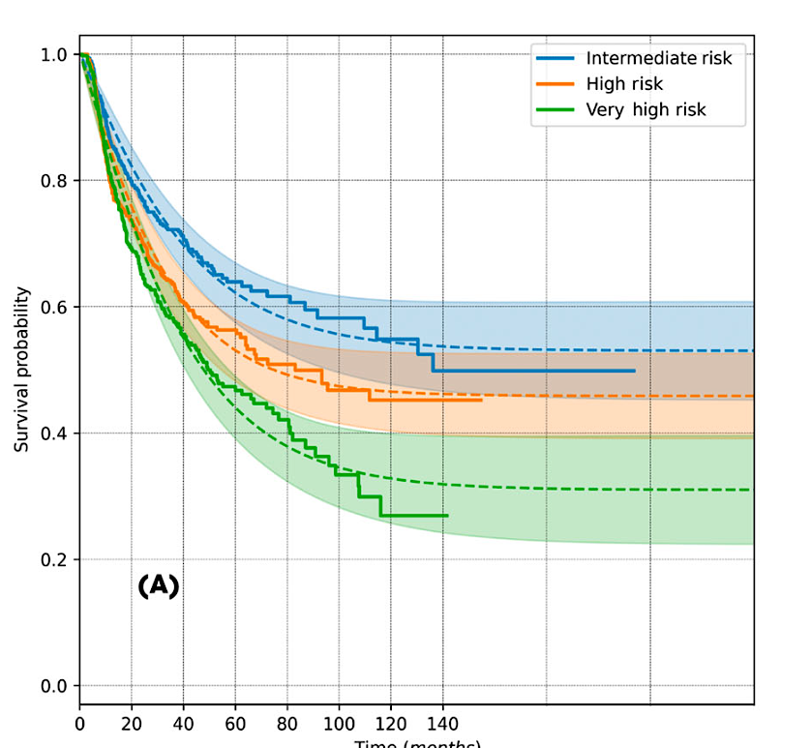
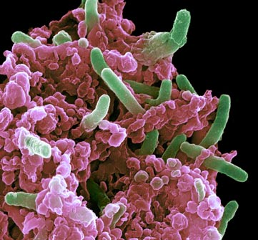
BCG is the Standard of Care for treatment-naïve NMIBC
Recurrence-Free Survival
>50% of patients will not be cured!
Time (months)
Nature Medicine 2011, Subiela et al BJUI 2026

Slide 77
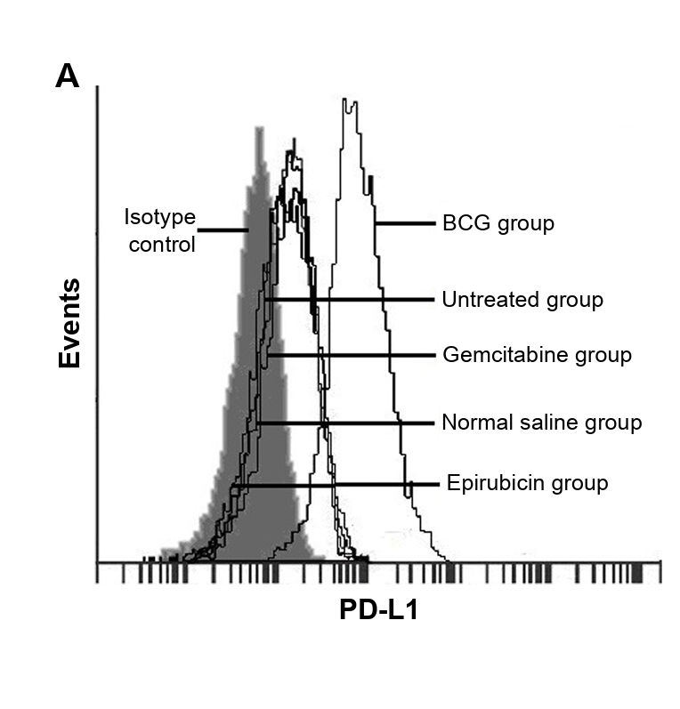
Why add PD-1 immunotherapy to BCG?
Immunologically
BCG upregulates PD-L1 on tumors and tumor infiltrating lymphocytes (TIL)
“Counter-inflammatory response”
Resistance associated with T-cell exhaustion
Clinically
Avoids cystectomy (potentially!)
Synergy of 2 immunotherapies
BCG addresses localized disease
PD-1 addresses any disease beyond the urothelium
Wang et al OncoTarg and Therapy 2018, Fukumoto Ann Surg Onc 2018, Hashizume et al Oncotarget 2018, Lim et al Front Immunol 2021

Slide 78
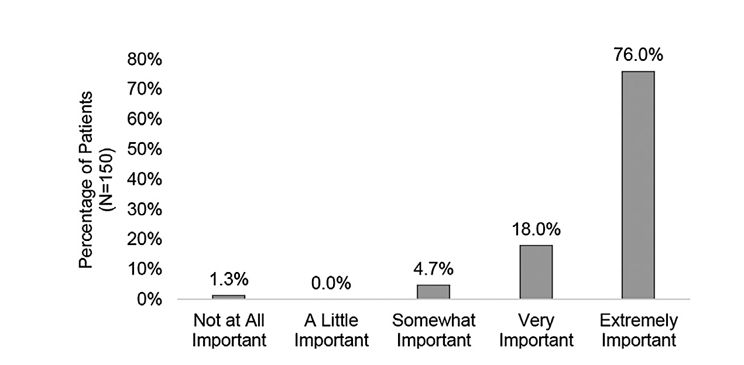
The Patient Perspective?
How important is it to keep the bladder and avoid cystectomy?
Kopenhafer L et al, Urol Oncol 2024

Slide 79
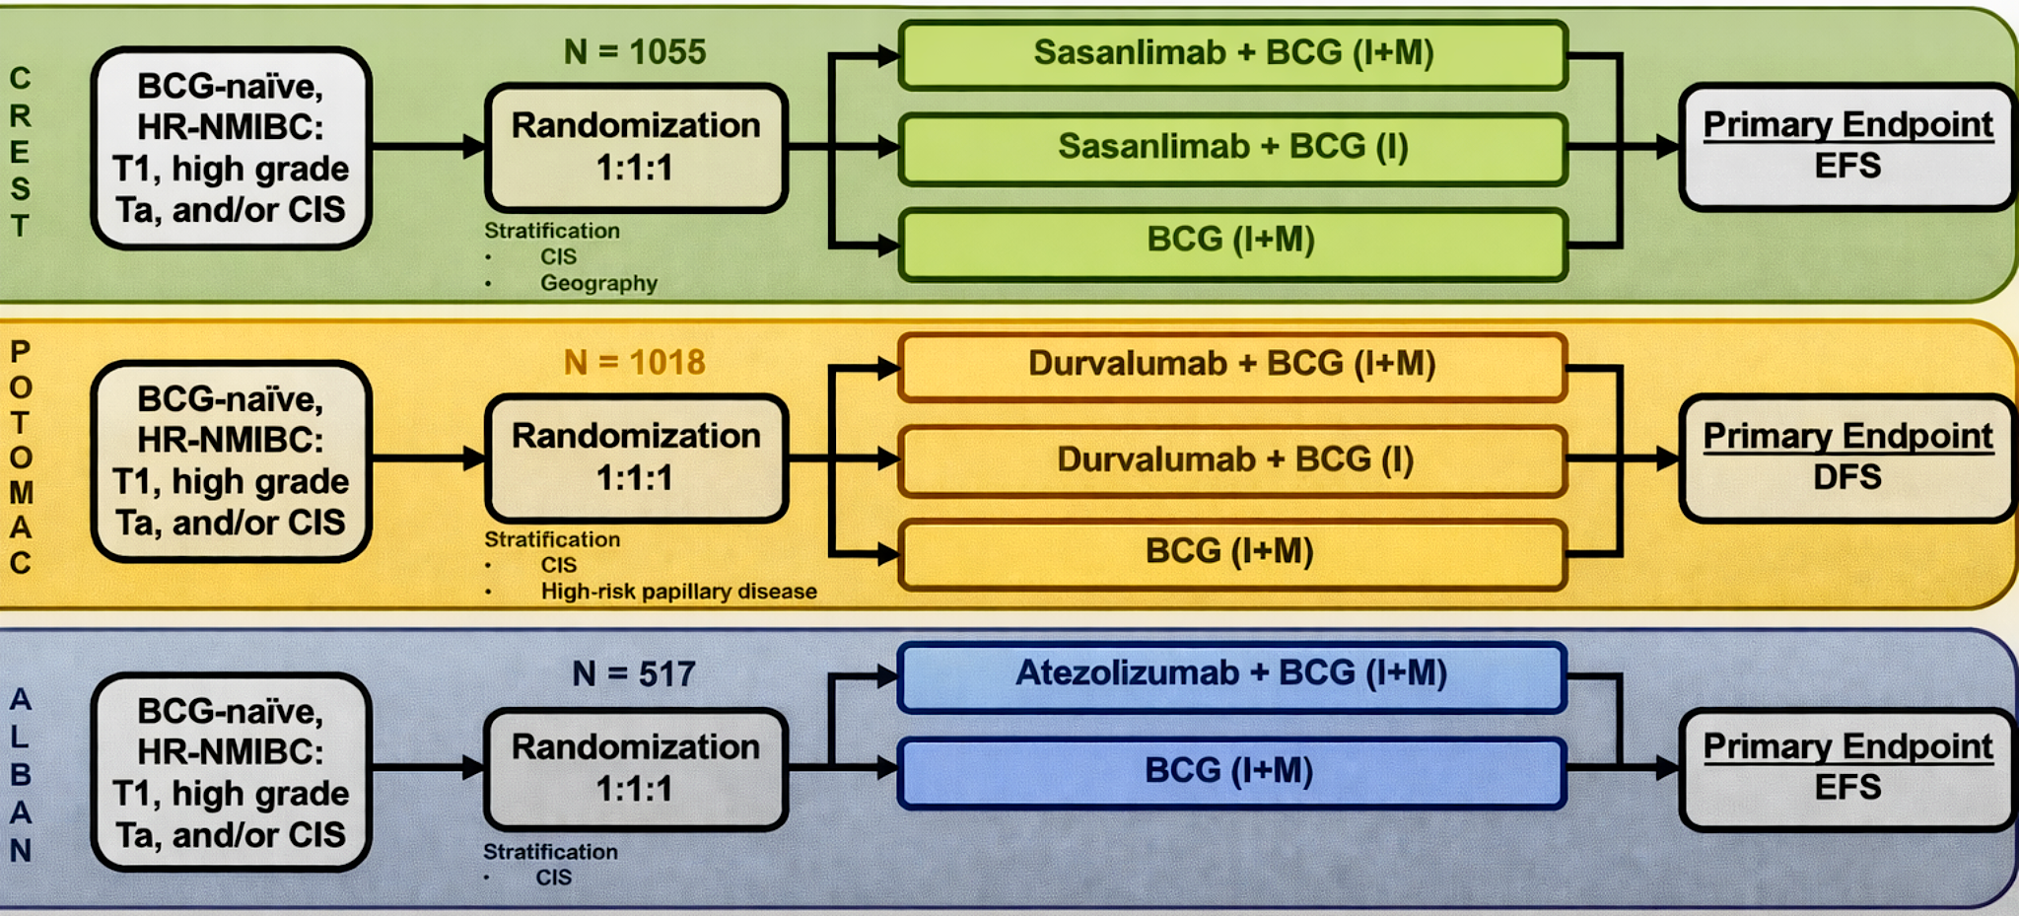
Studies to discuss today
HR-NMIBC = High-risk Non-muscle invasive bladder cancer; I = Induction; M = Maintenance; EFS = Event-free survival; DFS = Disease-free survival
Hahn GU ASCO 2026, Shore NS et al, AUA 2025 / Nat Med 2025;31:2806-14 / De Santis M et al, ESMO 2025 / Lancet 2025;406(10516):2221-2234 / Roupret M et al, ESMO 2025 / Ann Oncol 2026;37(1):44-52

Slide 80
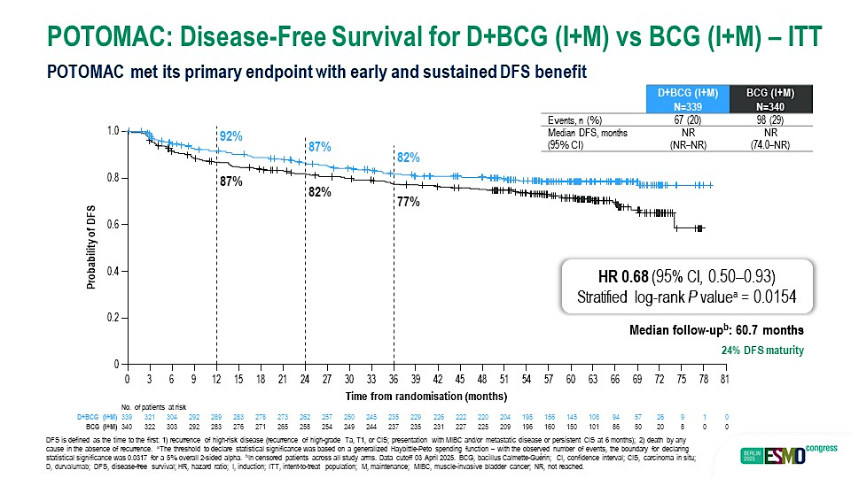
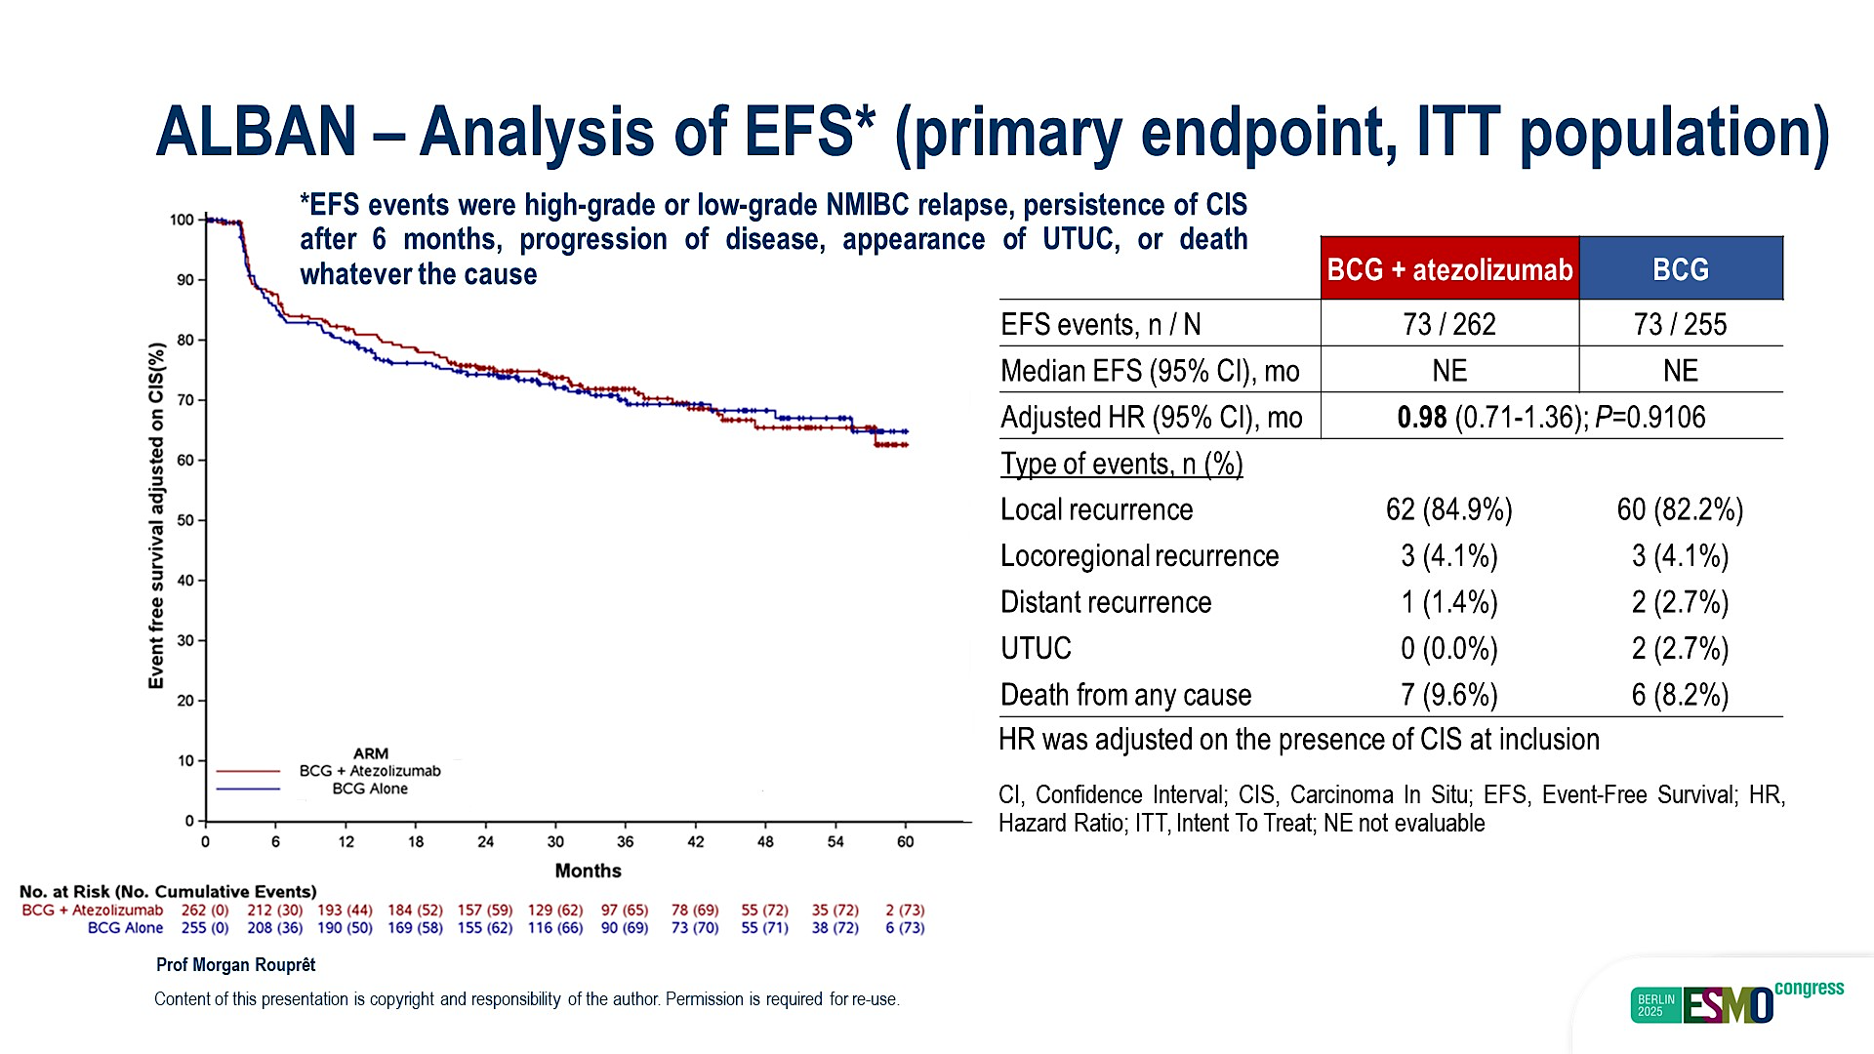
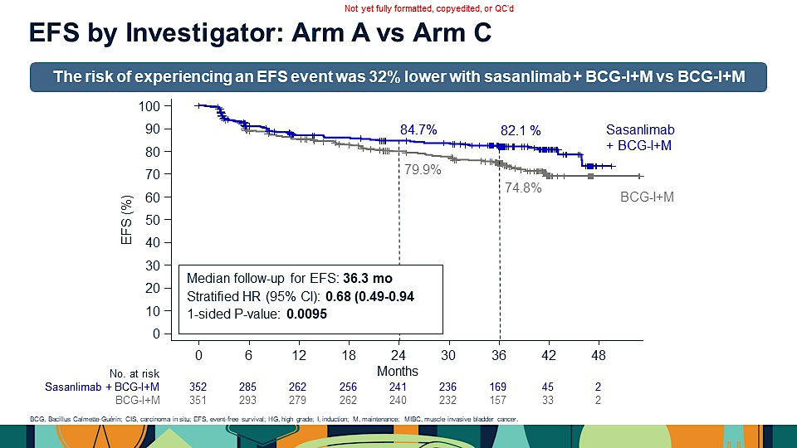
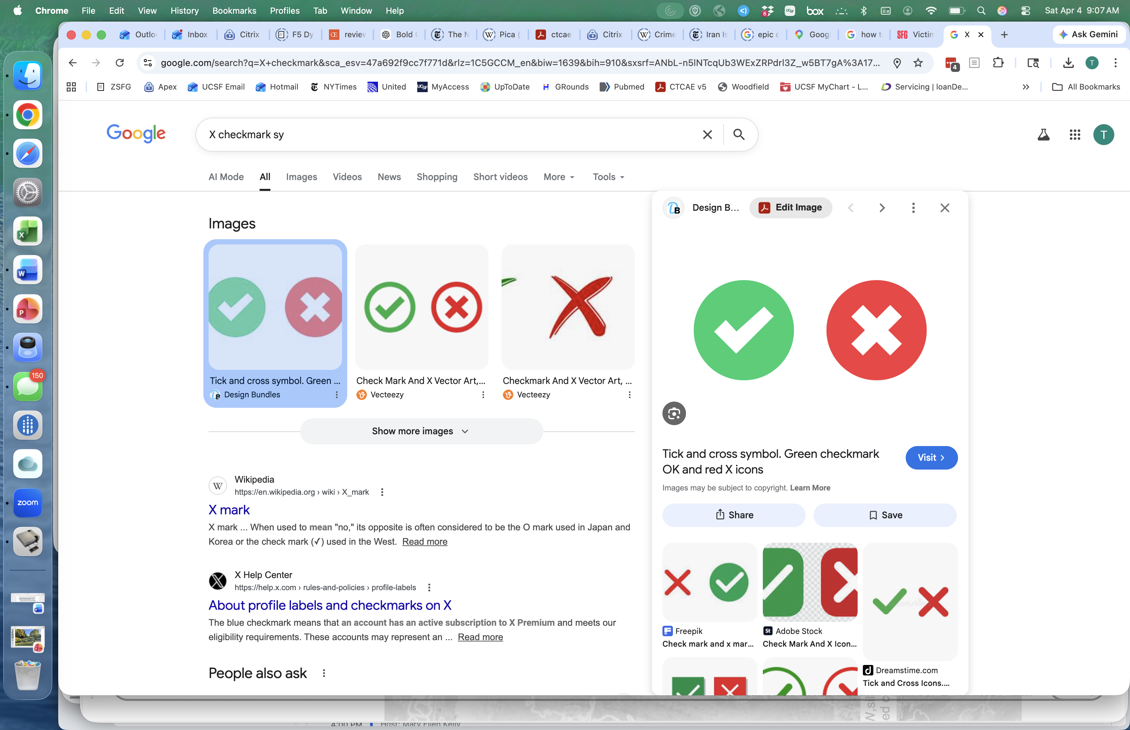
CREST
POTOMAC
ALBAN
2 years BCG
2 years Sasanlimab
2 years BCG
1-year Durvalumab
1 year BCG
1-year Atezolizumab
EFS HR 0.68
primary endpoint
OS HR 1.13 (0.68-1.87)
EFS HR 0.68
primary endpoint
OS HR 0.8 (0.53-1.20)
EFS HR 0.98
primary endpoint
OS HR 1.73 (0.76-3.92)
Shore NS et al, AUA 2025 / Nat Med 2025, De Santis M et al, ESMO 2025 / Lancet 2025 Roupret M et al, ESMO 2025 / Ann Oncol 2026, Hahn GU ASCO 2026

Slide 81
What explains these differences?
 | CREST | POTOMAC | ALBAN
ICI Agent | Sasanlimab (anti-PD-1) | Durvalumab (anti-PD-L1) | Atezolizumab (anti-PD-L1)
Route of Admin | SubQ | IV | IV
Sample Size | 1,055 | 1,018 | 517
High risk population (T1 %)? | Yes - 58% | Yes – 58% | No – 39%
Adequate BCG Maintenance? | Yes - 2 years | Yes - 2 years | No - 1 year
Does EFS Definition include low-grade NMIBC or UTUC? | No | No | Yes
Gr 3+ TRAE | 29% vs 5.4% | 21% vs 4% | 23% vs 9%
DeSantis et al. ESMO 2025; Powles et al. ASCO 2025; Roupret et al. ESMO 2025; Shore et al AUA 2025

Slide 82

Impact on Practice
Either Sasanlimab or Durvalumab combined with BCG induction and maintenance may become an option for high-risk BCG-naïve NMIBC
Benefit mostly in T1 (highest risk) population
Awaiting KEYNOTE-676 trial in similar population
Are autoimmune side effects worth it?
How to balance EFS (positive), OS (immature) and Toxicity (real)?
Likely will allow some patients to avoid cystectomy
But… multiple later-line therapies available for NMIBC
Who will be giving this therapy? Urologists? Medical Oncologists?

Slide 83
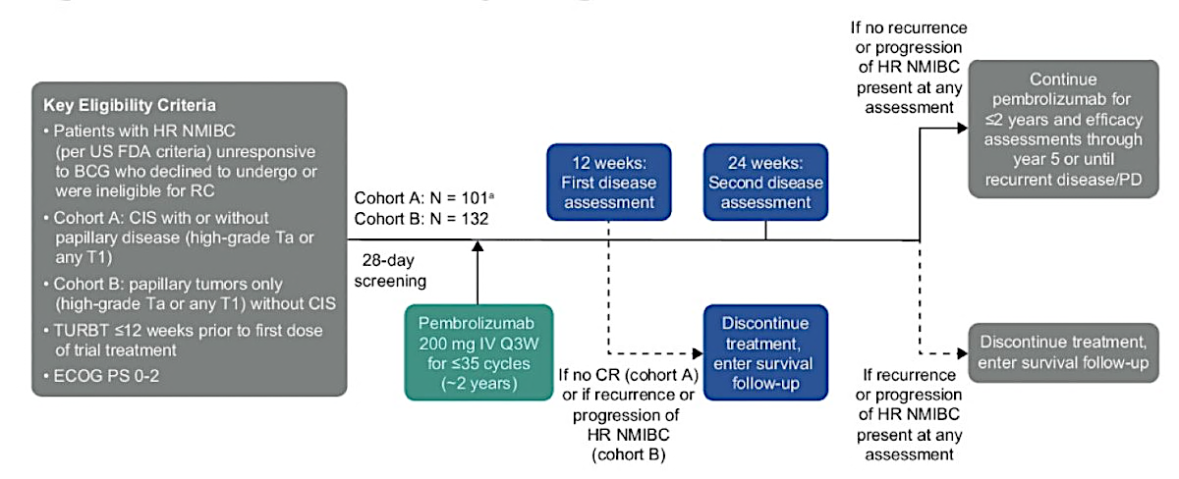
Can we “save” PD-1 for BCG-unresponsive patients?
KEYNOTE 057
Li et al ASCO 2024

Slide 84
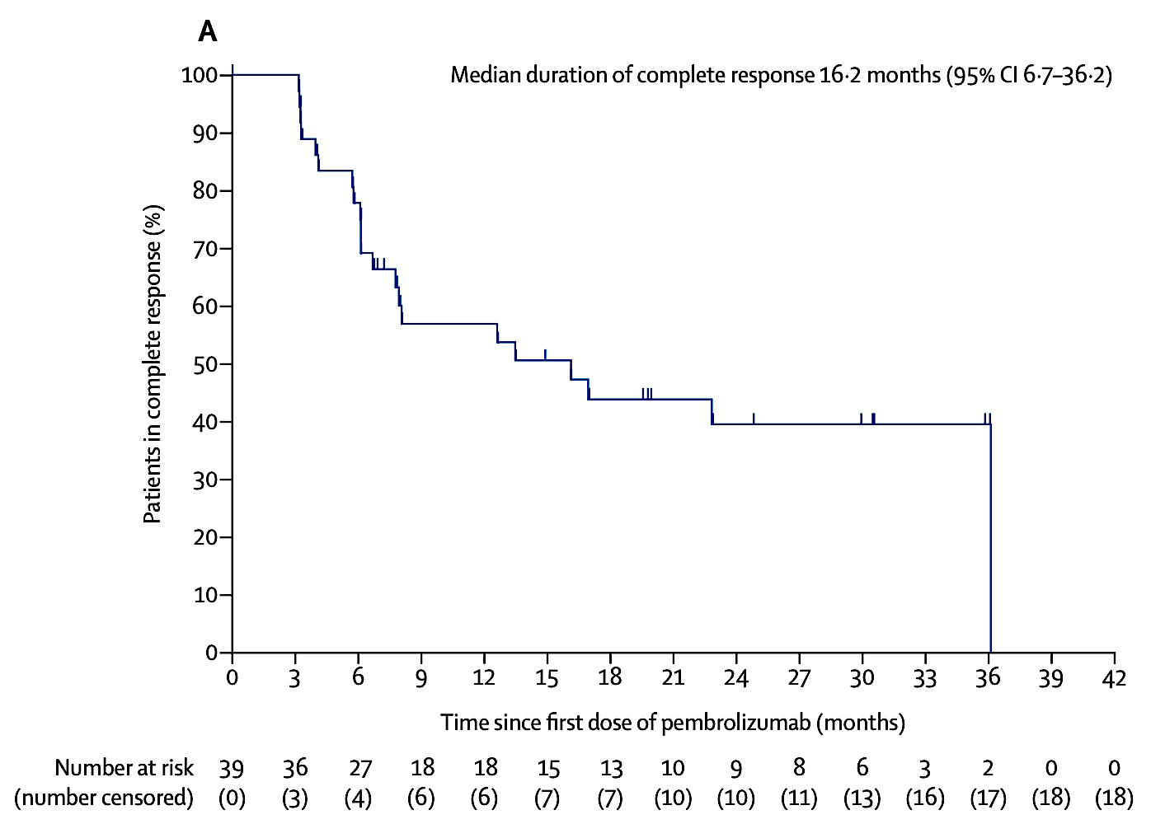
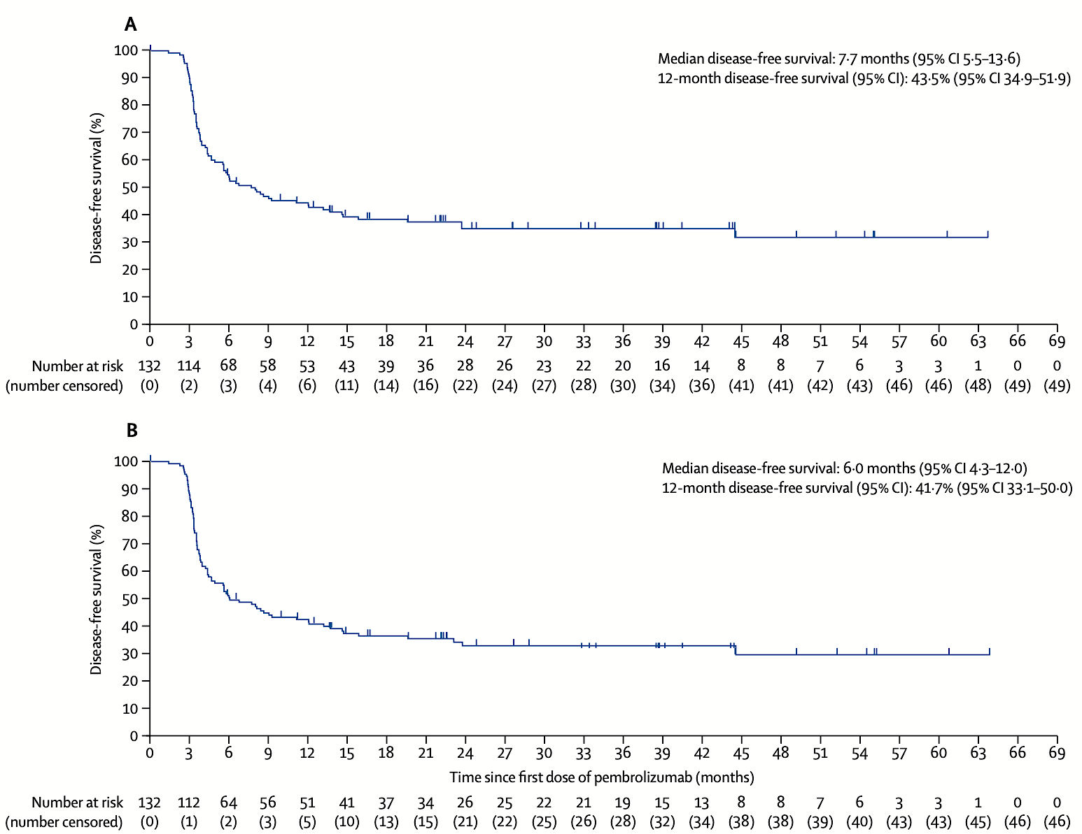

KEYNOTE 057: Pembrolizumab for High-risk (HR) BCG-unresponsive NMIBC
HR NMIBC with CIS
HR NMIBC without CIS
41% CR rate at 3 months
Median duration of CR 16.2 months
9.3% (n=9) remain in CR at 45 months
12 month DFS: 43%
36 month DFS: 33%
Balar et al Lancet Onc 2021, Necchi et al Lancet Onc 2024

Slide 85
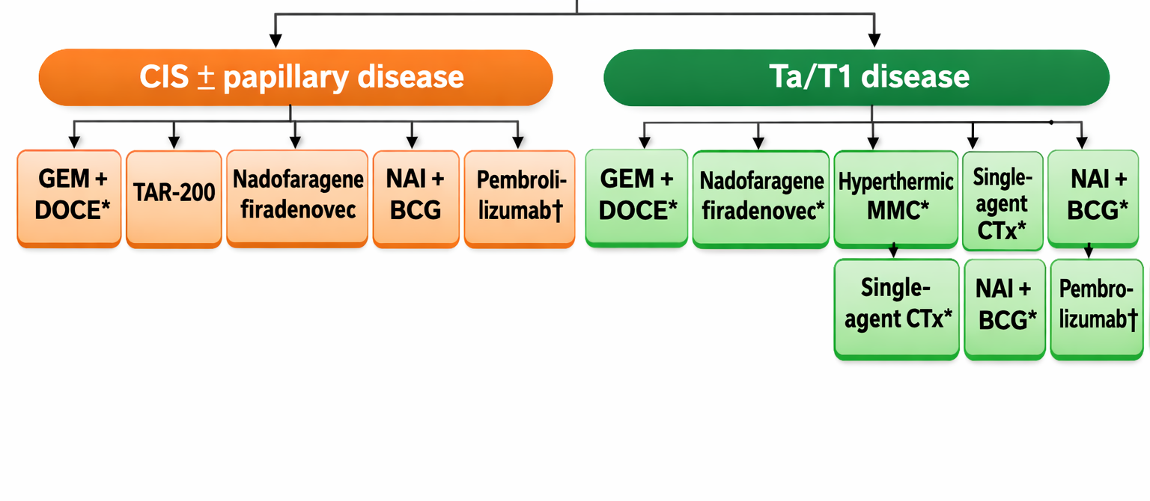
Many options for BCG-unresponsive NMIBC
BCG-Unresponsive NMIBC
Pt refusing or ineligible for RC
Pembro-
lizumab
Adapted from: Li and International Bladder Cancer Group, Eur Urol, 2024
Adapted from: Li and International Bladder Cancer Group, Eur Urol, 2024

Slide 86
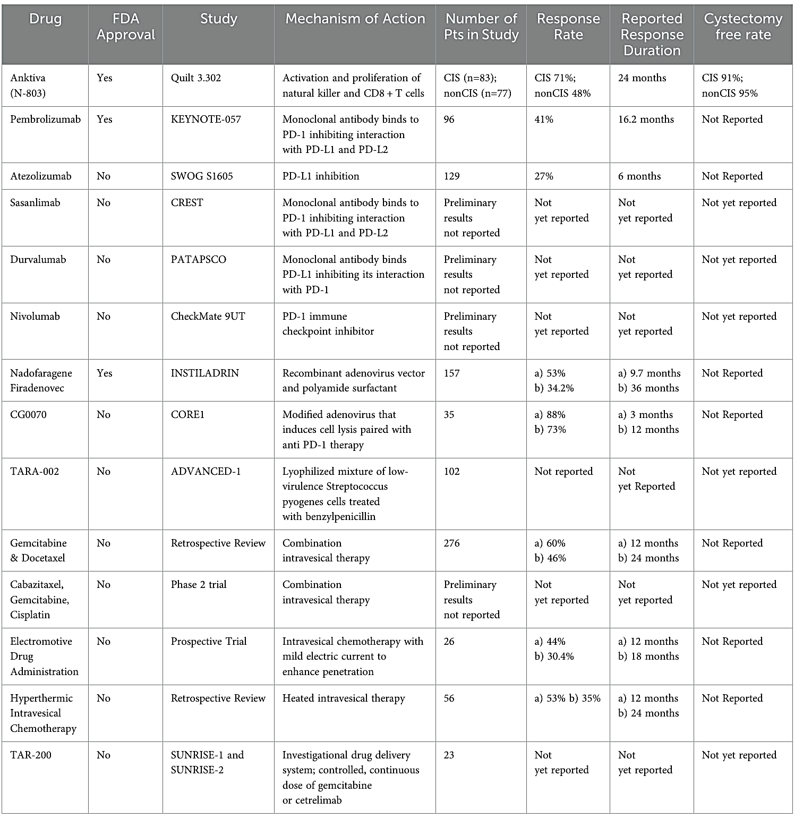
Many Ongoing Trials
Treatment naïve vs BCG-resistant
Multiple Modalities
Intravesical
Systemic
Combinations
Viral or
Bacterial Vector
Chemotherapy
Wiesen B, et al Front. Oncol. 2025

Slide 87
Outline
NMIBC
Rationale for use of BCG + PD-1 immunotherapy
Safety and Efficacy from recent Phase III trials (CREST, POTOMAC, ALBAN)
Long-term findings with pembrolizumab monotherapy in patients with high-risk BCG-unresponsive NMIBC
MIBC
NIAGARA study of perioperative Platinum + Durvalumab
IMvigor011 trial - ctDNA- guided adjuvant Atezolizumab
Prognostic and predictive impact of ctDNA in nonmetastatic UBC

Slide 88
Recent and Ongoing Phase III Neoadjuvant IO-Based Trials in MIBC
Clinical Trial | N | Treatment Arms | Control Arm
KEYNOTE-866 | 907 | Pembrolizumab + GC | GC
NIAGARA | 1063 | Durvalumab + GC | GC
ENERGIZE | 8 | Nivolumab + GC | GC
KEYNOTE-B15/EV-304 | 784 | Pembrolizumab + EV | GC
KEYNOTE-905/EV-303 | 857 | A: Pembrolizumab + EV B: Pembrolizumab mono | RC
VOLGA | 830 | A: Durvalumab-Tremelimumab + EV B: Durvalumab + EV | RC
CISPLATIN
ELIGIBLE
CISPLATIN INELIGIBLE
Clinicaltrials.gov

Slide 89
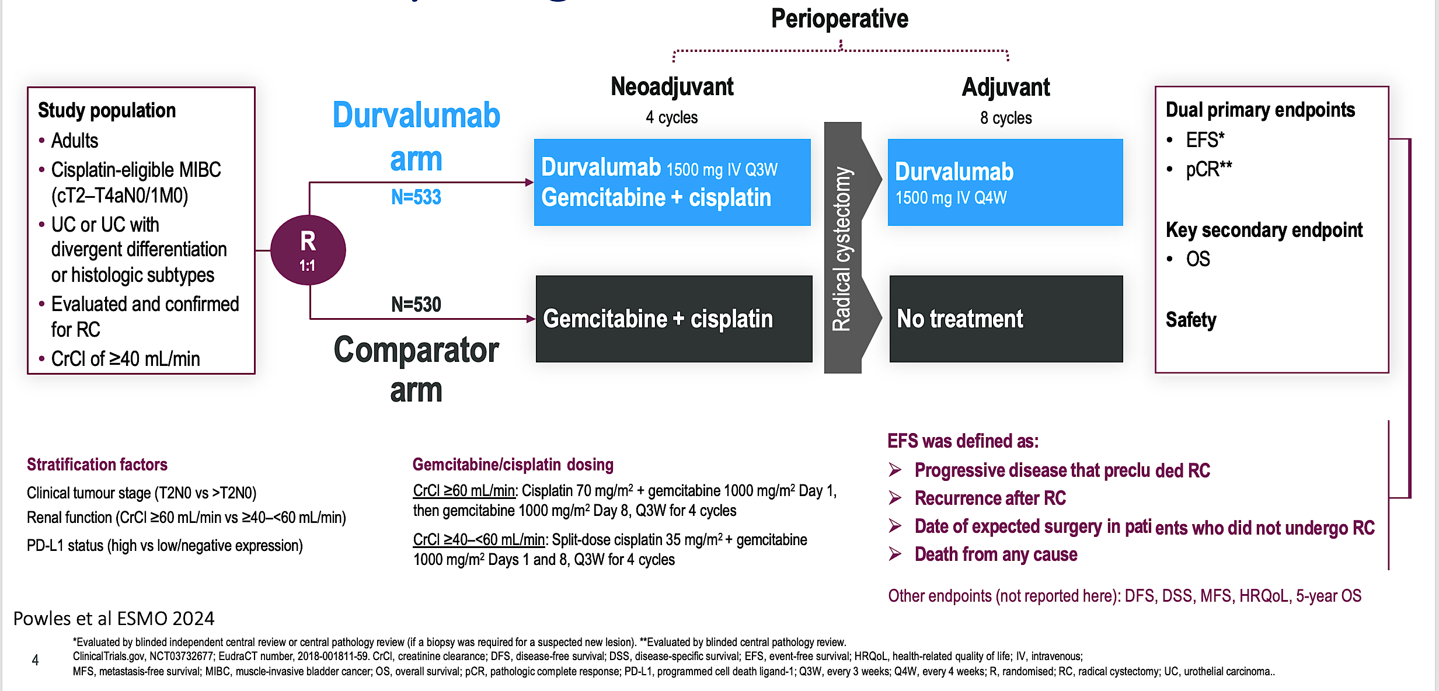
NIAGARA: Study Design

Slide 90
NIAGARA Results Positive
Powles et al ESMO 2024, NEJM 2024

Slide 91
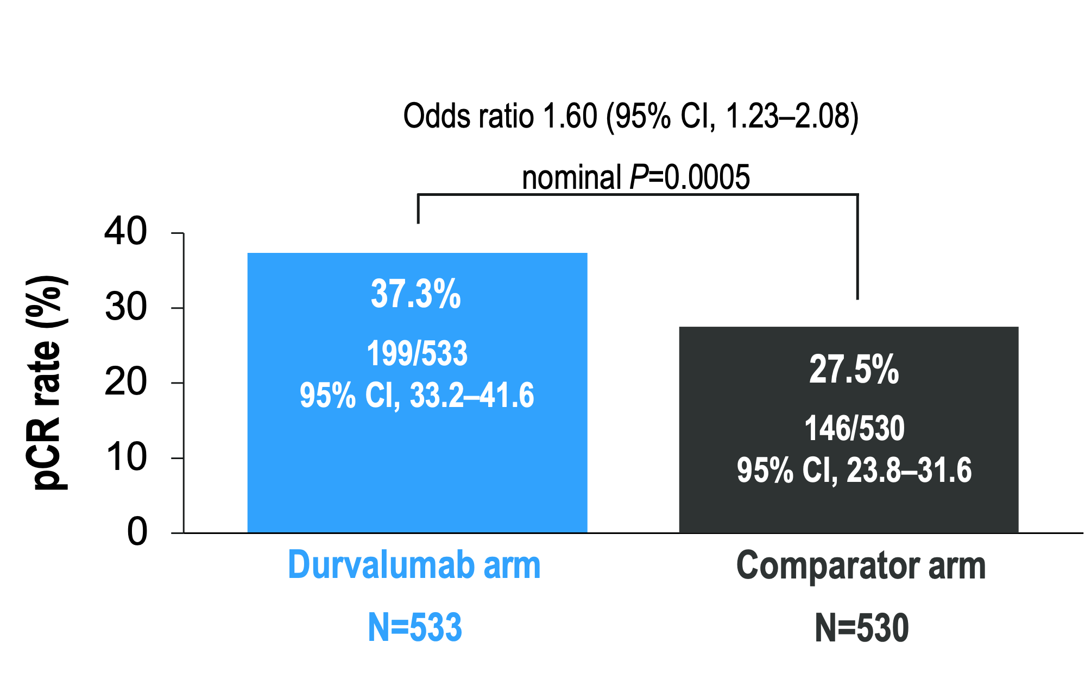
NIAGARA Results Positive
Powles et al ESMO 2024, NEJM 2024

Slide 92
NIAGARA Results Positive
Powles et al ESMO 2024, NEJM 2024

Slide 93
Prognostic Value of ctDNA

Slide 94
IMvigor 011: ctDNA Guided-Adjuvant Therapy
Powles et al ESMO 2025

Slide 95
ctDNA- patients do well without adjuvant therapy
Powles et al ESMO 2025

Slide 96
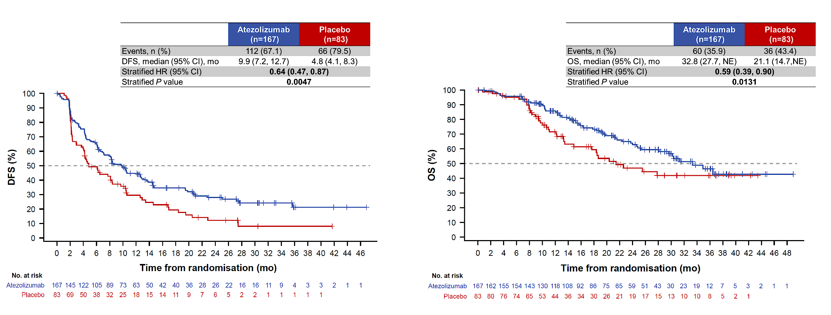
ctDNA+ patients benefit from adjuvant therapy
Powles et al ESMO 2025

Slide 97
ctDNA levels matter…
Bellmunt et al GU ASCO 2026

Slide 98
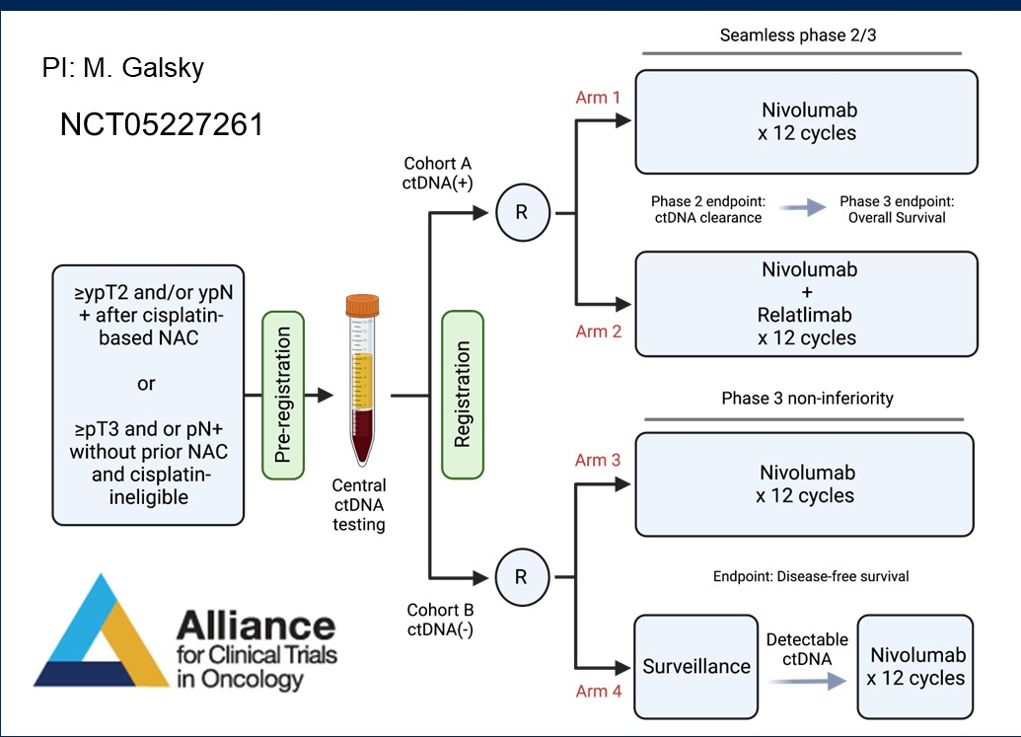
In Progress: Alliance A032103 MODERN trial
Galsky et al ASCO 2024

Slide 99

Summary: MIBC
Combination IO + chemotherapy is effective
Durvalumab + Gem/Cis is a Standard of Care for MIBC
Is perioperative Enfortumab Vedotin + Pembrolizumab data stronger?
Tumor-informed cfDNA identifies patients likely to relapse and to benefit from immediate adjuvant therapy
Await cfDNA results from EV trials, VOLGA, and others
cfDNA as a future tool to personalize treatment strategies

Slide 100
QUESTIONS?

Slide 101
Module 7: Urothelial Bladder Cancer
Role of Immunotherapeutic Strategies in the Management of Nonmetastatic UBC; Emerging Utility of Circulating Tumor DNA (ctDNA) Evaluation — Dr Friedlander
Other Novel Agents and Strategies for Nonmetastatic and Metastatic UBC — Dr Petrylak

Slide 102
Other Novel Agents and Strategies for Nonmetastatic and Metastatic UBC
Metastatic Bladder Cancer/Urothelial Carcinoma: Navigating First-line to Salvage Therapies
Daniel P. Petrylak, MD
Professor of Medicine and Urology
Division Chief, Genitourinary Cancer
Smilow Cancer Center, Yale University

Slide 103
Disclosures
No relevant conflicts of interest to disclose.

Slide 104
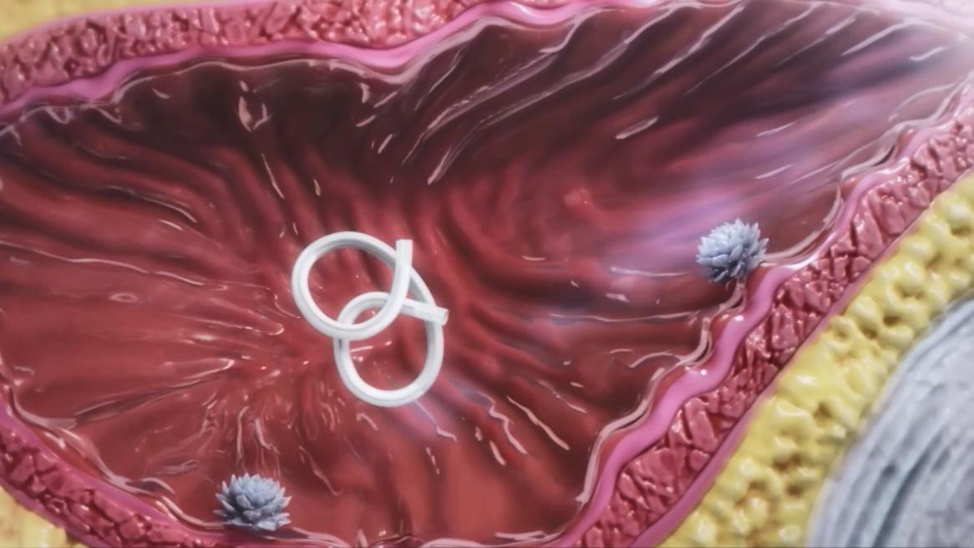
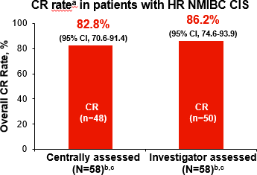
TAR-200: Intravesical Drug Eluting Device-Gemcitabine
High CR rate 83% with CIS NMIBC
Onset of response rapid
98% CRs observed at first assessment on week 12
Jacob et al. AUA 2024

Slide 105
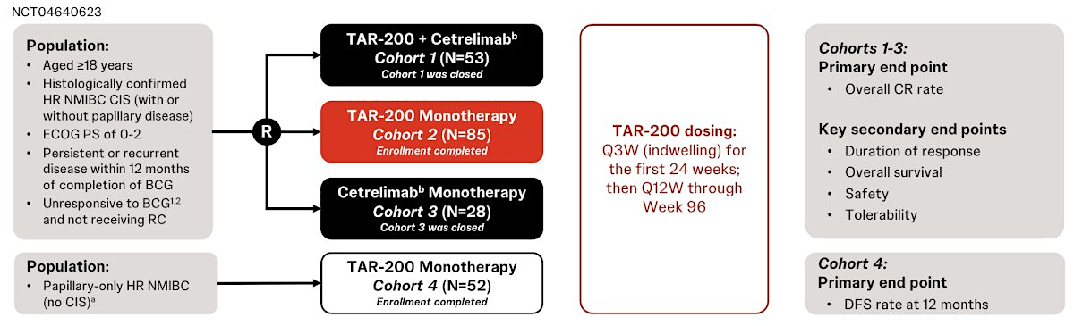
TAR-200 ± Cetrelimab and Cetrelimab Alone in BCG-Unresponsive High-Risk NMIBC: Updated Results from SunRISe-1
Clark et al. SESAUA 2025

Slide 106
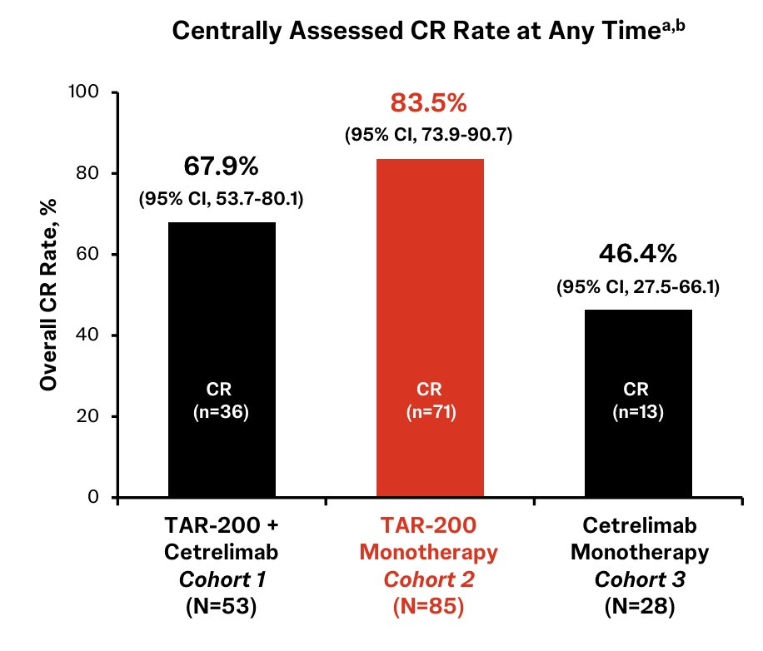
SunRISe-1
Clark et al. SESAUA 2025

Slide 107
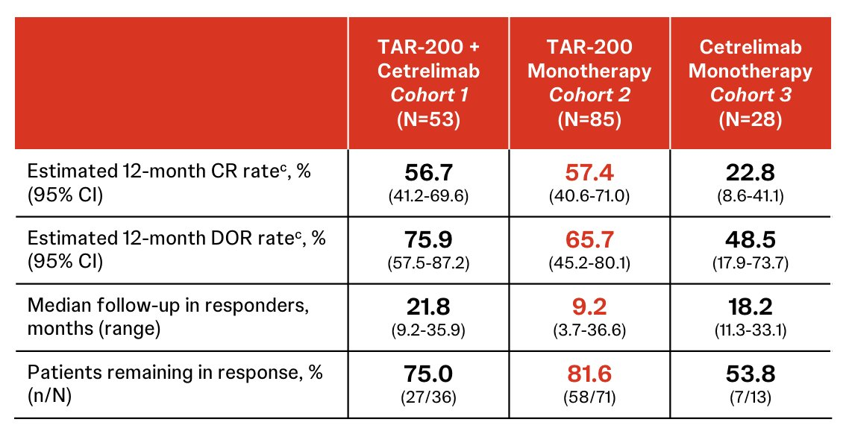
SunRISe-1
Clark et al. SESAUA 2025

Slide 108
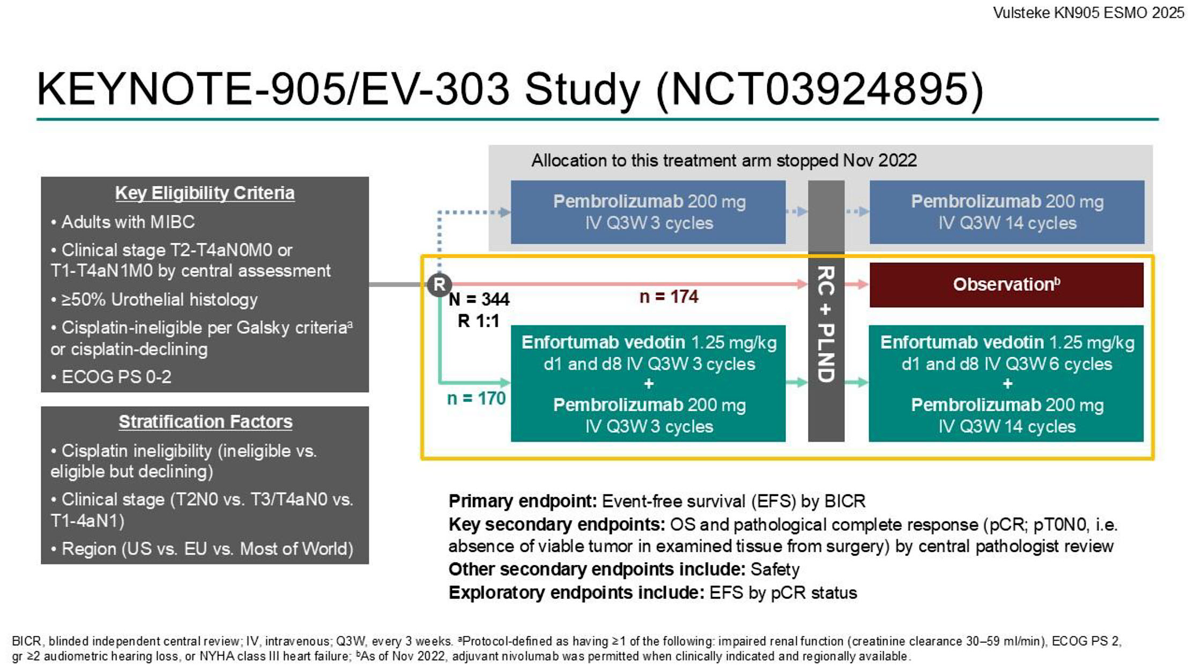

Slide 109
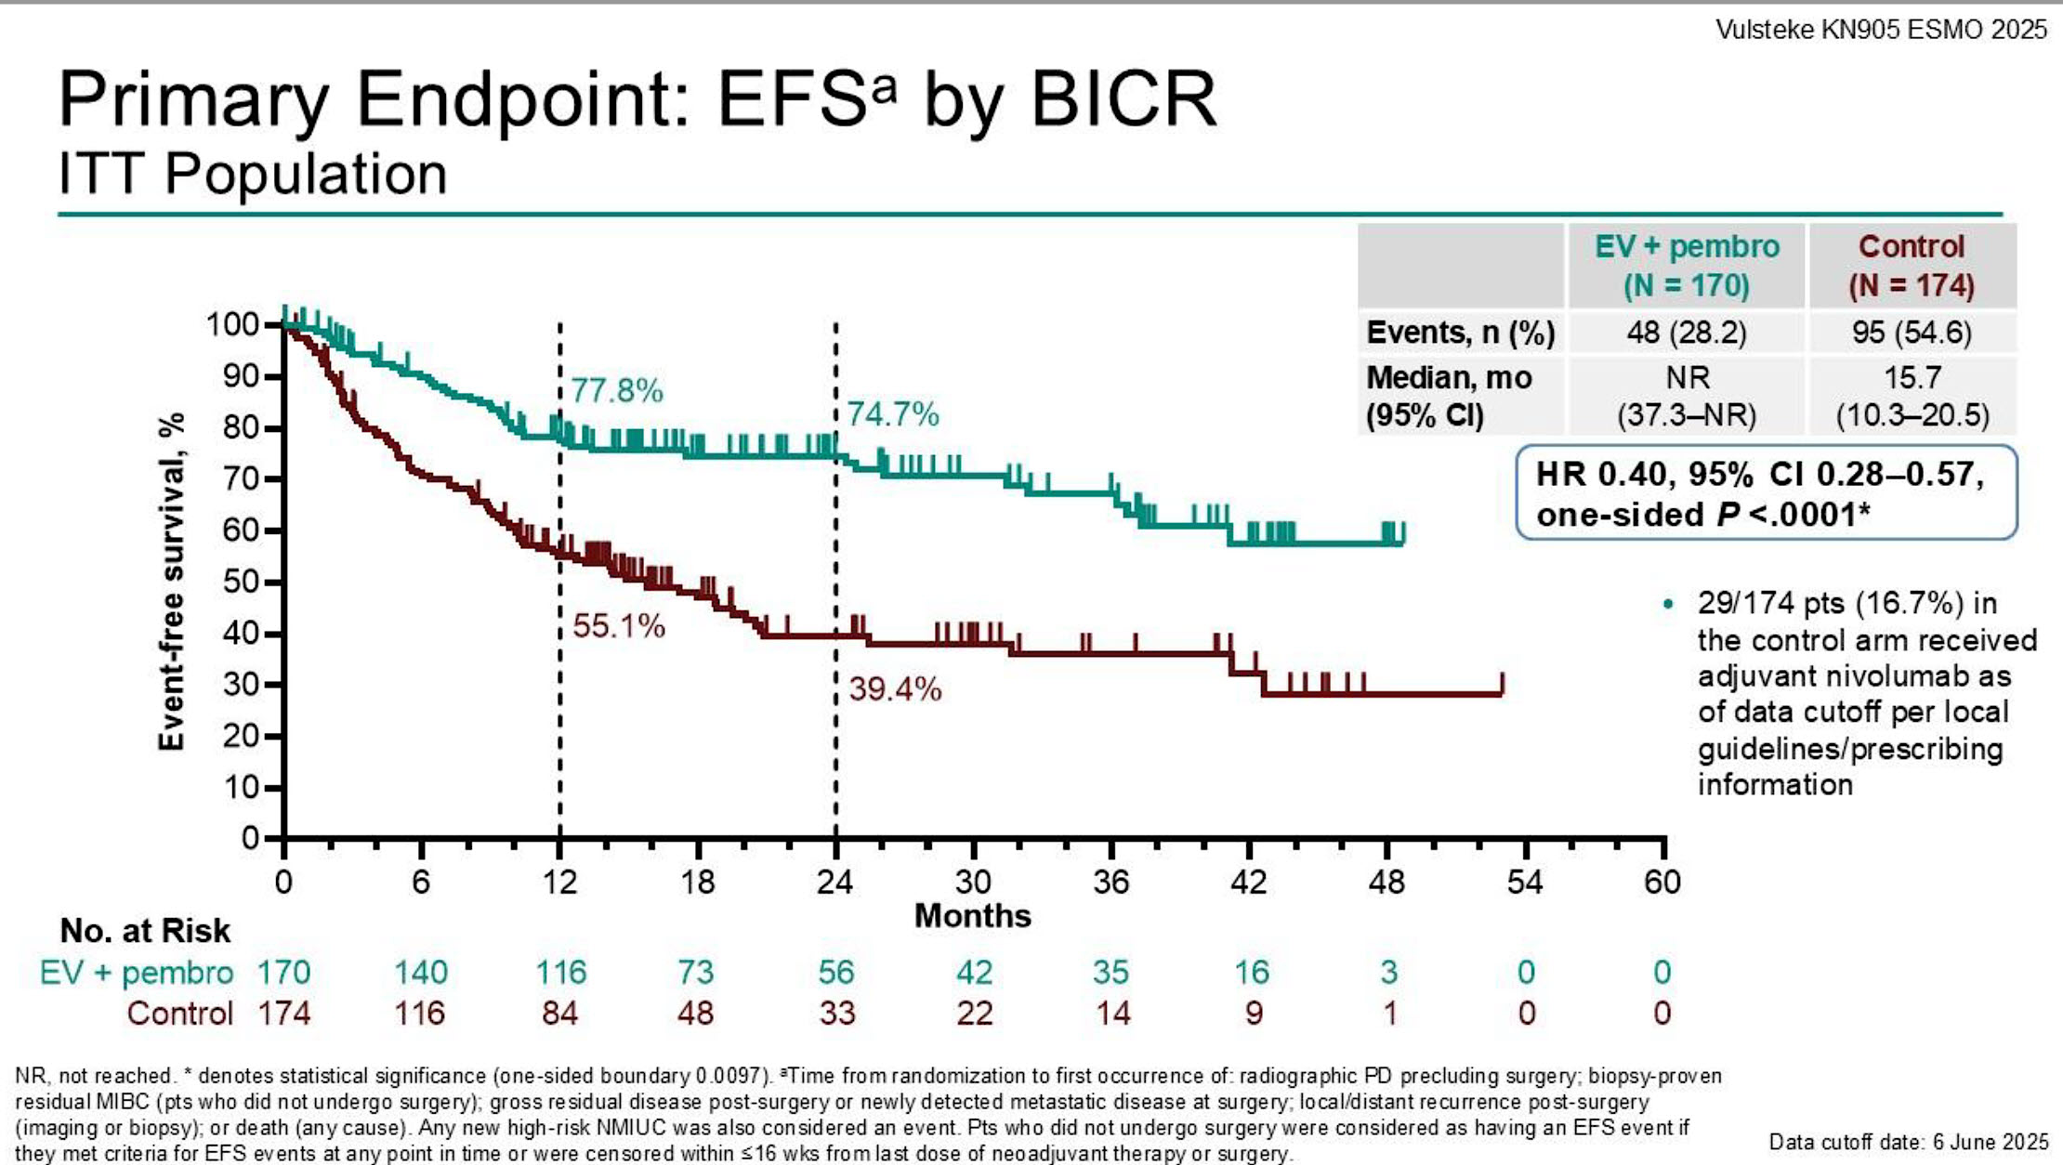

Slide 110
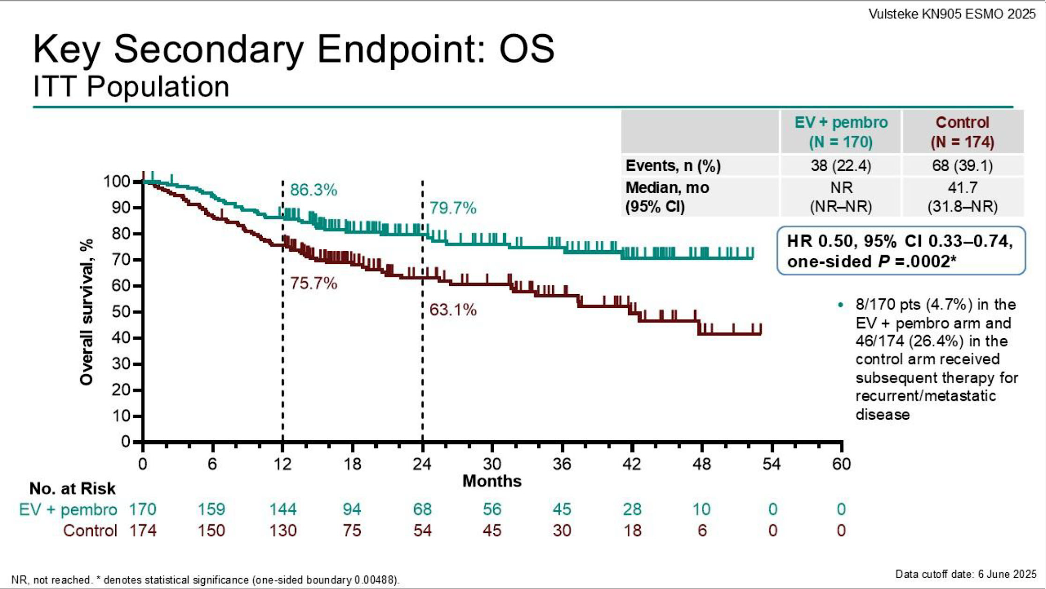

Slide 111
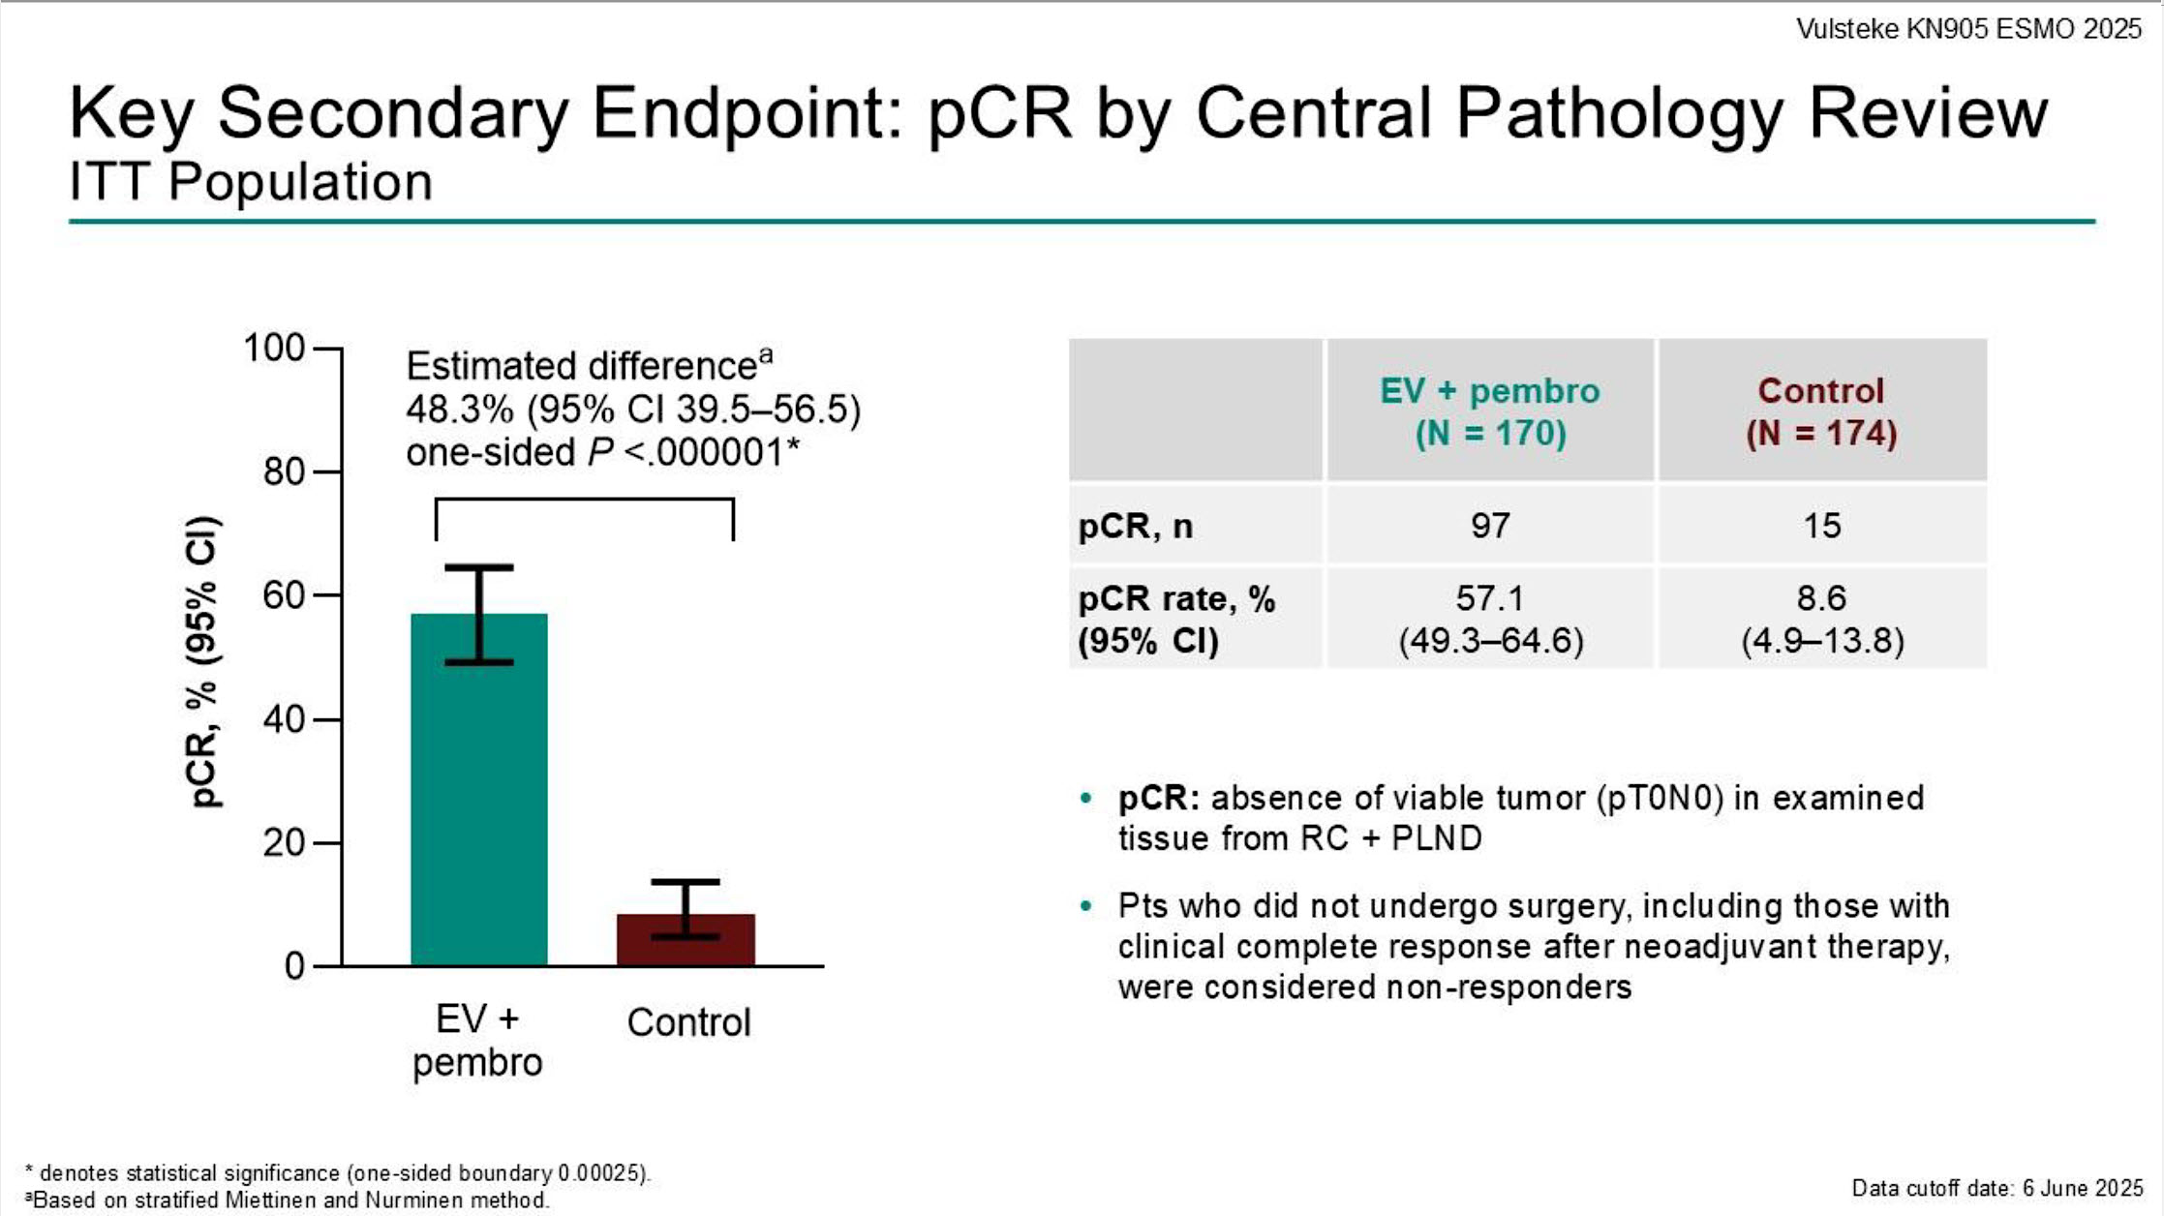

Slide 112

Vulsteke et al. ESMO 2025

Slide 113

Vulsteke et al. ESMO 2025

Slide 114

EV-304
Galsky et al. ASCO GU 2026

Slide 115
Primary Endpoint: EFS by BICR ITT Population
Galsky et al. ASCO GU 2026
 | EV + pembro N = 405 | Cis + gem N = 403
Events, n (%) | 87 (21.5) | 146 (36.2)
Median, mo (95% CI) | NR (NR–NR) | 48.5 (43.3–NR)
HR 0.53, 95% CI 0.41–0.70,
1-sided P <.0001*
Data cutoff date: 27 October 2025

Slide 116
Key Secondary Endpoint: OS ITT Population
Galsky et al. ASCO GU 2026
 | EV + pembro N = 405 | Cis + gem N = 403
Events, n (%) | 69 (17.0) | 99 (24.6)
Median, mo (95% CI) | NR (NR–NR) | NR (NR–NR)
HR 0.65, 95% CI 0.48–0.89,
1-sided P =.0029*
In total, 44/87 (50.6%) of pts with an EFS event in the EV + pembro arm and 86/146 (58.9%) of pts with an EFS event in the cis + gem arm received any subsequent systemic therapy
Data cutoff date: 27 October 2025

Slide 117

Galsky et al. ASCO GU 2026

Slide 118

Galsky et al. ASCO GU 2026

Slide 119
Biomarker Testing in Metastatic Urothelial Cancer
761 patients(pts)received post platinum therapy from 4/1/2019 to 9/1/2021
343 pts (41%) underwent FGFR testing
305 pts had tissue-based testing and 74 had blood-based testing
71 pts (20.7%) had susceptible FGFR alterations
30 pts (30%) received Erdafitinib
Nimgaonkar et al JAMA Oncol. 2022;8(7):1070-1072. doi:10.1001/jamaoncol.2022.1167

Slide 120

FGFR3—Fibroblast Growth Factor Receptor
A membrane based TKR involved in cellular proliferation, differentiation, and steroid biosynthesis (image, right)¹
There are 4 distinct FGFR subtypes
FGFR mutations and overexpression have been implicated in bladder cancer²
April 12, 2019 – FDA granted accelerated approval to the FGFR inhibitor erdafitinib for locally advanced/metastatic bladder cancer with a FGFR2 or FGFR3 alteration, that has progressed during or after platinum chemotherapy³
FGFR inhibitors and anti-FGFR ADCs are in ongoing and upcoming trials in advanced UC⁴
1. Wu X-R. Nat Rev Cancer. 2005;5:713-725; 2. Turo R, et al. J Urol. 2015;193:325-330; 3. https://www.fda.gov/drugs/resources-information-approved-drugs/fda-grants-accelerated-approval-erdafitinib-metastatic-urothelial-carcinoma; 4. ClinicalTrials.gov.
Notes:
Figure 2: Signaling cascades that are potentially involved in urothelial tumorigenesis during fibroblast growth factor receptor 3 and HRAS gene activation

Slide 121

Phase 3 THOR Trial: Study Design
RANDOMIZE
Cohort 1 – Prior PD-1/PD-L1 treatment
Erdafitinib 8 mg po qd, N = 140
Key Inclusion Criteria:
Locally advanced, unresectable, or metastatic UC (minority component histologies allowed)
FGFR inhibitor Clinical Trial Assay to determine molecular eligibility
Only one line of prior systemic therapy
ECOG PS 0, 1, or 2
Docetaxel or Vinflunine IV
Day 1 of a 21-day cycle, N = 140
1:1
Cohort 2 – No prior PD-1/PD-L1 treatment
RANDOMIZE
Erdafitinib 8 mg po qd, N = 175
Pembrolizumab IV
Day 1 of a 21-day cycle, N = 175
Primary Endpoint: Overall survival
Secondary Endpoints: PFS, ORR, duration of response, safety, patient-reported outcomes, pharmacokinetics.
Loriot Y, et al. N Engl J Med. 2023;389(21):1961-1971. NCT03390504.

Slide 122
THOR (Cohort 1): Safety
AEs occurring in ≥30% (any grade) or ≥5% (grade 3-4) of patients | Erdafitinib (n = 135)
 | Any Grade | Grade 3-4
≥1 treatment-related AE | 131 (97.0%) | 62 (45.9%)
Hyperphosphatemia | 106 (78.5%) | 7 (5.2%)
Diarrhea | 74 (54.8%) | 4 (3.0%)
Stomatitis | 62 (45.9%) | 11 (8.1%)
Dry mouth | 52 (38.5%) | 0
PPE syndrome | 41 (30.4%) | 13 (9.6%)
Onycholysis | 31 (23.0%) | 8 (5.9%)
1 treatment-related death in the erdafitinib group (sudden death)
11 patients (8.1%) discontinued study treatment with erdafitinib due to treatment-related AEs
AEs of interest | Erdafitinib (n = 135) |  | Chemotherapy (N = 112)
 | Any Grade | Grade 3-4 | Any Grade | Grade 3-4
Nail disorders | 90 (66.7%) | 15 (11.1%) | 6 (5.4%) | 0
Skin disorders | 74 (54.8%) | 16 (11.9%) | 14 (12.5%) | 0
Eye disorders (excluding central serous retinopathy) | 57 (42.2%) | 3 (2.2%) | 6 (5.4%) | 0
Central serous retinopathy | 23 (17.0%) | 3 (2.2%) | 0 | 0
Loriot Y, et al. N Engl J Med. 2023;389(21):1961-1971.

Slide 123

THOR (Cohort 1): Overall Survival
~20% of patients with advanced UC have FGFR alterations
Erdafitinib is an oral selective pan-FGFR tyrosine kinase inhibitor
 | Median OS
Erdafitinib | 12.1 mo
Chemotherapy | 7.8 mo
HR 0.64 (95% CI, 0.47-0.88), P = 0.005 | HR:
Key eligibility criteria
Unresectable or metastatic UC
Progressed on or after ≥1 prior treatment that included an anti–PD-(L)1
Select FGFR3/2alt (mutation/fusion)
ECOG PS 0-2
Erdafitinib (n = 136)
8 mg PO once daily; up-titration to 9 mg
Chemo (n = 130)
Docetaxel or vinflunine every 3 weeks
Loriot Y, et al. N Engl J Med. 2023;389(21):1961-1971.

Slide 124


Slide 125


HER2-TARGETED ADCs IN la/mUC
ADC | Target | Linker | Payload | Average DAR | Tumor Types | First Approval Date
Trastuzumab deruxtecan (T-DXd)¹ | HER2 | Tetrapeptide-based cleavable | Deruxtecan (topoisomerase I inhibitor) | 7-8 | Breast cancer, GEJ cancer, NSCLC, Tumor agnostic | Breast cancer: 12/2019 Tumor agnostic: 4/2024
Disitamab vedotin (RC48 or DV)² | HER2 | Protease cleavable (mc‒VC‒PABC) | MMAE (microtubule-disrupting agent) | 4 | Urothelial cancer, GEJ cancer | China: 6/2021 Not yet FDA approved
Trastuzumab deruxtecan (T-DXd)
Disitamab vedotin (RC48 or DV)
1. Tarantino P. Nat Rev Clin Oncol. 2023. 2. Shi F. Drug Deliv. 2022. 3. Meric-Bernstam F. ASCO 2023

Slide 126

DESTINY-PanTumor02: Study Design
Advanced solid tumors not eligible for curative therapy
2L patient population
HER2 (IHC 3+ or 2+)
Prior HER2-targeting agents allowed
ECOG PS 0-1
Cohorts with no objective responses in the first 15 patients were to be closed
Meric-Bernstam F et al. ASCO 2023; Meric-Bernstam F, et al. J Clin Oncol. 2024;42(1):47-58.

Slide 127




DESTINY-PanTumor02: Efficacy in Bladder Cancer
Meric-Bernstam F et al. ASCO 2023; Meric-Bernstam F, et al. J Clin Oncol. 2024;42(1):47-58.

Slide 128


DESTINY-PanTumor02: Safety
Overall safety summary
ILD/pneumonitis adjudicated as T-DXd related
Grade | All patients, n (%) n = 267
1 | 6 (2.2)
2 | 12 (4.5)
3 | 1 (0.4)
4 | 0
5 | 1 (0.4)
Any | 20 (7.5)
Left ventricular dysfunction
Grade | All patients, n (%) n = 267
1 | 1 (0.4)
2 | 4 (4.5)
3 | 1 (0.4)
4 | 0
5 | 0
Any | 7 (2.6)
Drug-related TEAEs in ≥ 10% patients
Meric-Bernstam F et al. ASCO 2023; Meric-Bernstam F, et al. J Clin Oncol. 2024;42(1):47-58.

Slide 129


DISITAMAB VEDOTIN (DV) IN PRE-TREATED la/mUC
Activity in HER2-positive patients (IHC 2+/FISH+ or IHC 3+)
Phase II RC48-C005 & RC48-C009 Trials in China (N=107)^{1,2}
Activity in HER2-low patients (IHC 0 or 1+)
Phase II RC48-C011 Trial in China (N=19)³
mPFS: 5.9 months
mOS: 14.2 months
mPFS: 5.5 months
mOS: 16.4 months
Promising results from DV trials in China led to breakthrough therapy designation by the FDA in 9/2020
Phase II & III global registrational studies are accruing (DV monotherapy post-platinum & in combination with ICI)
1. Sheng X. ASCO 2022. Abstract 4520. 2. Sheng X. J Clin Oncol. 2023. 3. Xu H. ASCO 2022. Abstract 4519.
Slide adapted with permission from Vadim Koshkin, MD.

Slide 130

PH III RC48-C016: DV + TORIPALIMAB VS. PBC
cisplatin
Sheng X. Abstr LBA7. ESMO 2025.

Slide 131



PH III RC48-C016: DV + TORIPALIMAB VS. PBC
Median follow up:
18.2 months
PFS
OS
 | DV+T (n=243) | Chemo (n=241) | 95% CI | p-value
ORR | 76.1% | 50.2% | Risk Diff 26.0% (95% CI 17.6-34.1) | N/A
Median DoR, mos | 14.6 | 5.6 | DV+T: 11.3-18.7 Chemo: 5.3-5.8 | N/A
Median PFS, mos | 13.1 | 6.5 | HR 0.36 (95% CI 0.28-0.46) | <0.0001
Median OS, mos | 31.5 | 16.9 | HR 0.54 (95% CI 0.41-0.73) | <0.0001
Sheng X. Abstr LBA7. ESMO 2025.

Slide 132
Conclusions
TAR-200 is a novel delivery system for gemcitabine in non-muscle invasive urothelial cancer
EVP demonstrates consistent pCR rates of approximately 60% in both cisplatin eligible and ineligible patients
Second line treatment should be based on biomarker approaches
Regimens for second line therapy include gemcitabine + cis/carboplatin, FGF targeted therapies and Her-2 neu targeted therapies.

Slide 133
QUESTIONS?

Slide 134
We are taking a short break! The program will resume at 3:20 PM ET Up Next… Drs Adam M Brufsky and Kevin Kalinsky discuss the management of triple-negative breast cancer

