Slide 1
Saturday, April 25, 2026
Moderator
Neil Love, MD
Faculty
John N Allan, MD
Deborah K Armstrong, MD
Adam M Brufsky, MD, PhD
Terence Friedlander, MD
Mrinal Gounder, MD
Erika Hamilton, MD
Yelena Y Janjigian, MD
Kevin Kalinsky, MD, MS, FASCO
Adam Kittai, MD
Samuel J Klempner, MD
Hans Lee, MD
Shanu Modi, MD
David M O’Malley, MD
Eileen M O’Reilly, MD
Daniel P Petrylak, MD
Philip A Philip, MD, PhD
Noopur Raje, MD
Richard F Riedel, MD

Slide 2


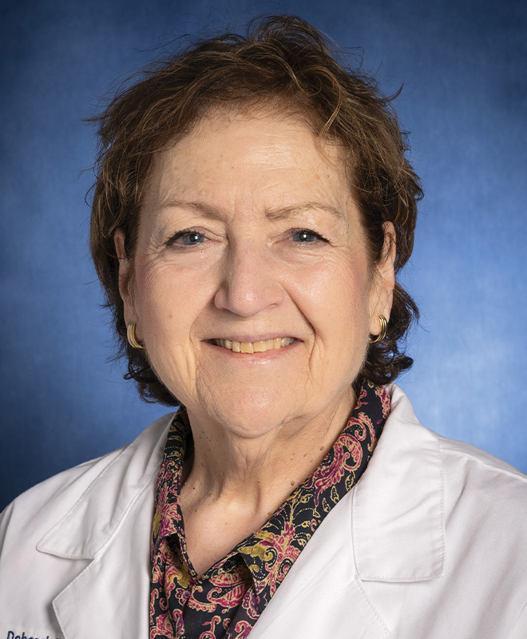
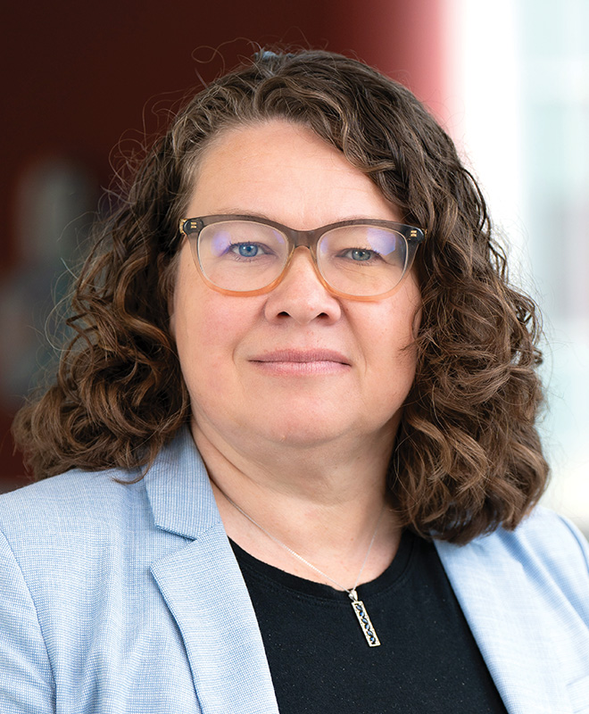


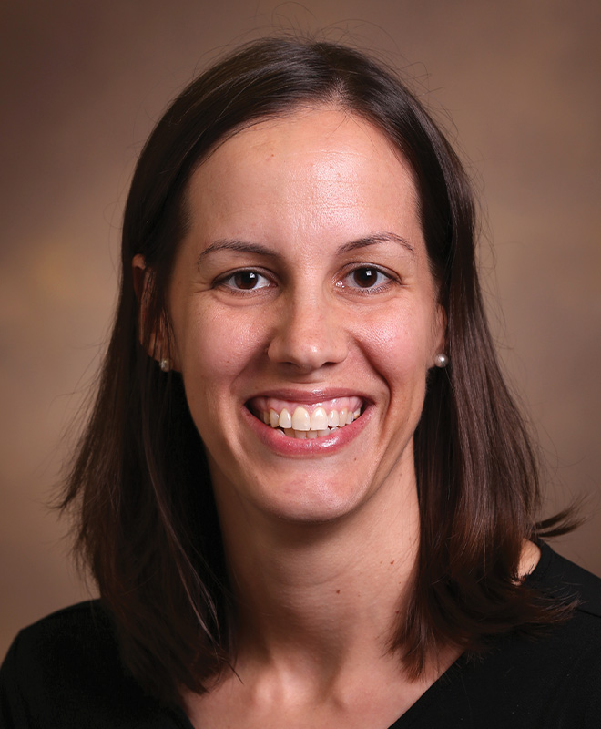
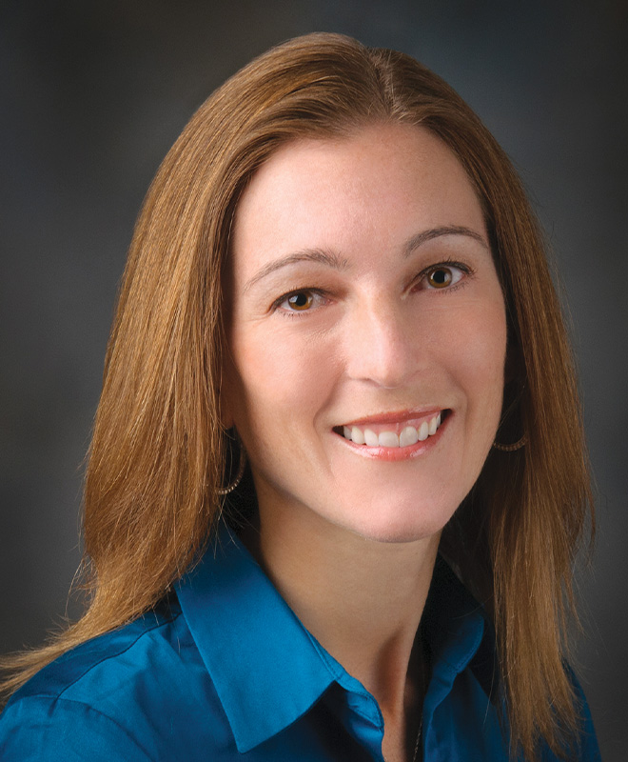






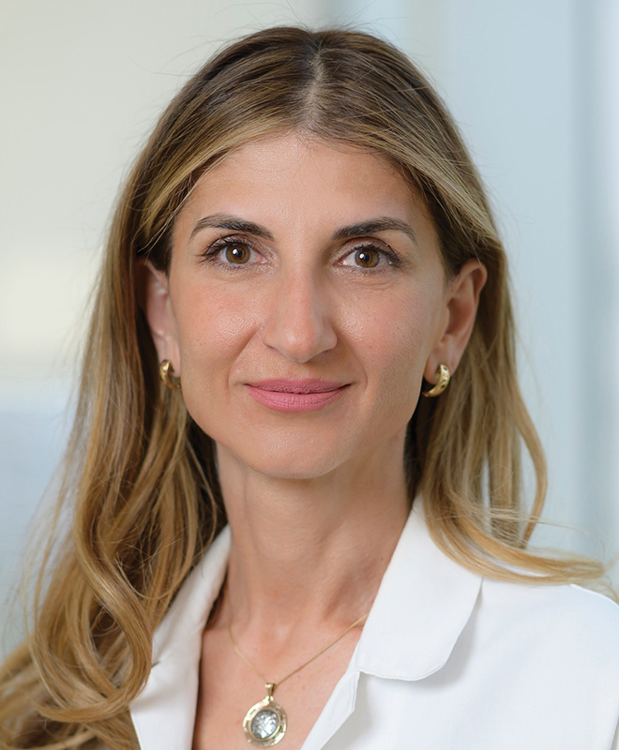







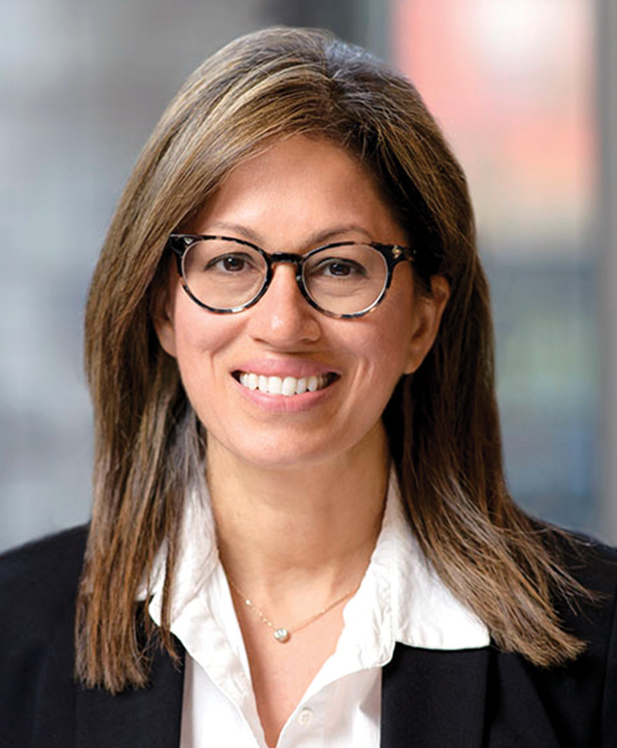




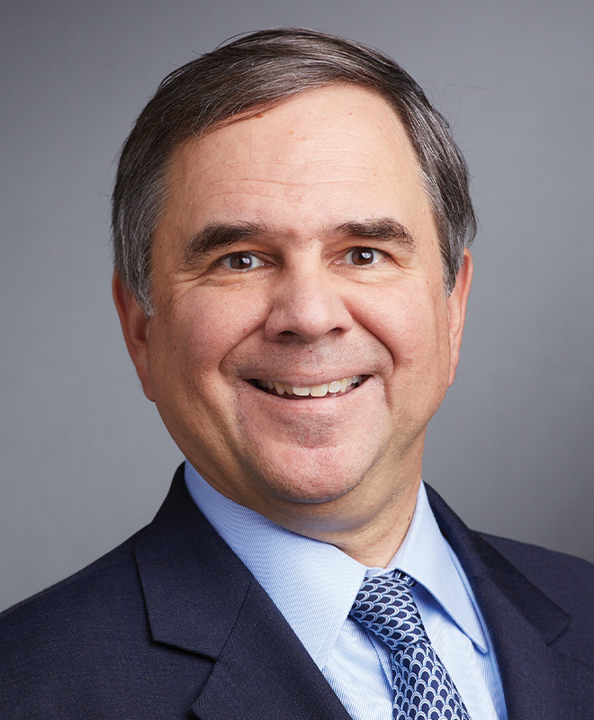
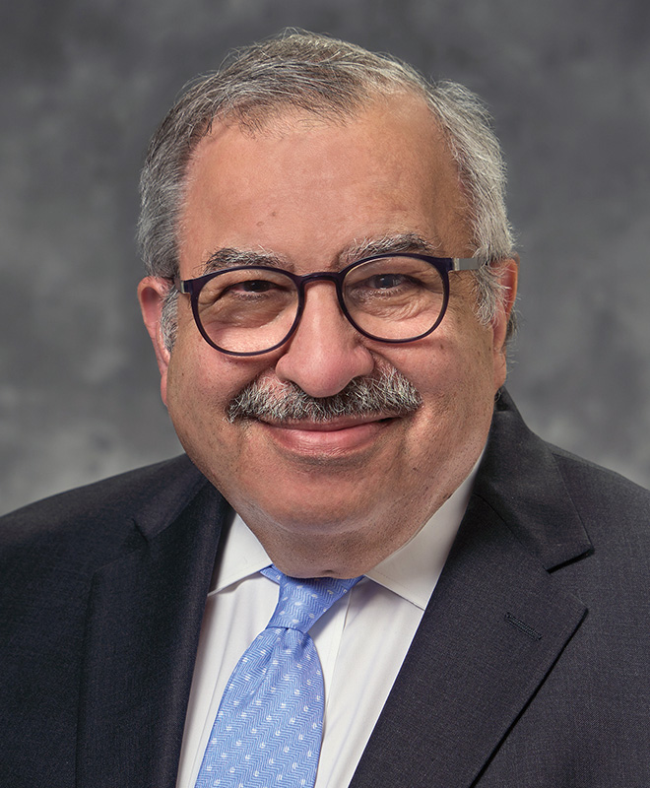
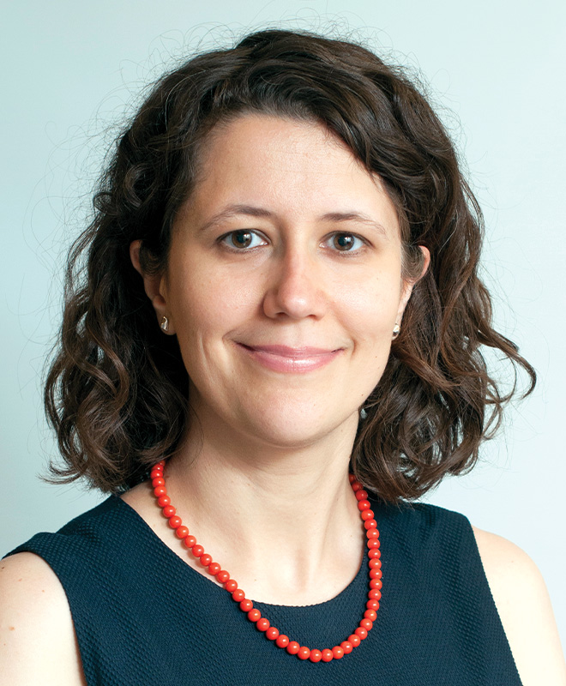
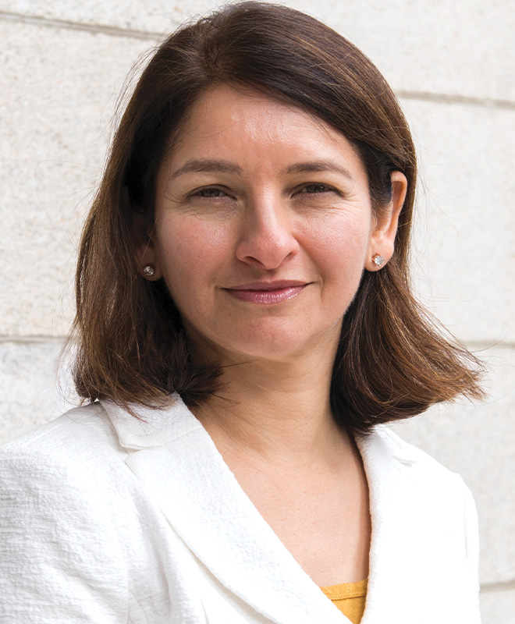




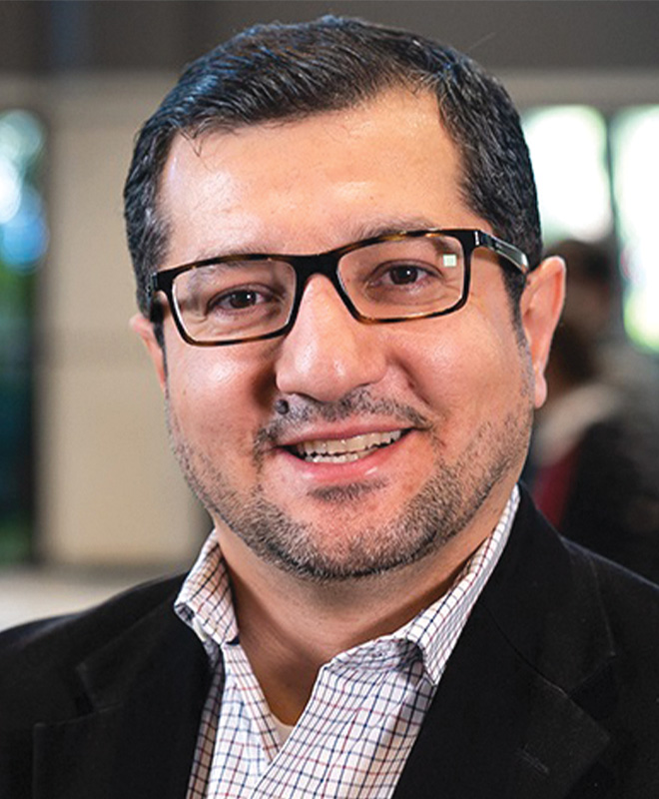
Fifth Annual National General Medical Oncology Summit

Slide 3









Co-Moderators
Susmitha Apuri, MD
Inverness and Lecanto, Florida
Maria Regina Flores, MD
Orlando, Florida
Maen Hussein, MD
The Villages, Florida
Mamta Choksi, MD
Trinity, Florida
Gustavo Adolf Fonseca, MD
Lecanto, Florida
Vikas Malhotra, MD
Spring Hill, Florida
Uday Dandamudi, MD
New Port Richey, Florida
Sunil Gandhi, MD
Lecanto, Florida
Shachar Peles, MD
Lake Worth, Florida

Slide 4
Saturday, April 25, 2026
Co-Moderators
Susmitha Apuri, MD
Mamta Choksi, MD
Uday Dandamudi, MD
Gustavo Adolf Fonseca, MD
Sunil Gandhi, MD
Vikas Malhotra, MD
Shachar Peles, MD

Slide 5
Disclosures for Moderator Neil Love, MD
Dr Love is president and CEO of Research To Practice. Research To Practice receives funds in the form of educational grants to develop CME activities from the following companies: Aadi Bioscience, AbbVie Inc, ADC Therapeutics, Agendia Inc, Alexion Pharmaceuticals, Amgen Inc, Array BioPharma Inc, a subsidiary of Pfizer Inc, Arvinas, Astellas, AstraZeneca Pharmaceuticals LP, Aveo Pharmaceuticals, Bayer HealthCare Pharmaceuticals, BeOne, Biotheranostics Inc, A Hologic Company, Black Diamond Therapeutics Inc, Blueprint Medicines, Boehringer Ingelheim Pharmaceuticals Inc, Bristol Myers Squibb, Celcuity, Clovis Oncology, Coherus BioSciences, Corcept Therapeutics Inc, CTI BioPharma, a Sobi Company, Daiichi Sankyo Inc, Eisai Inc, Elevation Oncology Inc, Exact Sciences Corporation, Exelixis Inc, Genentech, a member of the Roche Group, Genmab US Inc, Geron Corporation, Gilead Sciences Inc, GSK, Helsinn Therapeutics (US) Inc, ImmunoGen Inc, Incyte Corporation, Ipsen Biopharmaceuticals Inc, Jazz Pharmaceuticals Inc, Johnson & Johnson, Karyopharm Therapeutics, Kite, A Gilead Company, Kura Oncology, Legend Biotech, Lilly, MEI Pharma Inc, Merck, Mersana Therapeutics Inc, Mirati Therapeutics Inc, Mural Oncology Inc, Natera Inc, Novartis, Novartis Pharmaceuticals Corporation on behalf of Advanced Accelerator Applications, Novocure Inc, Nuvalent, Nuvation Bio Inc, Pfizer Inc, Pharmacyclics LLC, an AbbVie Company, Puma Biotechnology Inc, Regeneron Pharmaceuticals Inc, Revolution Medicines Inc, Rigel Pharmaceuticals Inc, R-Pharm US, Sanofi, Seagen Inc, Servier Pharmaceuticals LLC, SpringWorks Therapeutics Inc, Stemline Therapeutics Inc, Sumitomo Pharma America, Summit Therapeutics, Syndax Pharmaceuticals, Taiho Oncology Inc, Takeda Pharmaceuticals USA Inc, TerSera Therapeutics LLC, and Tesaro, A GSK Company.

Slide 6
Commercial Support
This activity is supported by educational grants from AbbVie Inc, ADC Therapeutics, Astellas, Astellas and Pfizer Inc, AstraZeneca Pharmaceuticals LP, BeOne, Blueprint Medicines, Bristol Myers Squibb, Corcept Therapeutics Inc, Daiichi Sankyo Inc, Exelixis Inc, Genentech, a member of the Roche Group, Gilead Sciences Inc, GSK, Johnson & Johnson, Kite, A Gilead Company, Legend Biotech, Lilly, Merck, Natera Inc, Novartis, Puma Biotechnology Inc, Regeneron Pharmaceuticals Inc, Revolution Medicines Inc, Rigel Pharmaceuticals Inc, SpringWorks Therapeutics Inc, Stemline Therapeutics Inc, and Summit Therapeutics.
Research To Practice CME Planning Committee Members,
Staff and Reviewers
Planners, scientific staff and independent reviewers for Research To Practice have no relevant financial relationships to disclose.

Slide 7
This educational activity contains discussion of
non-FDA-approved uses of agents and regimens. Please refer to official prescribing information for each product for approved indications.

Slide 8



Clinicians in the Meeting Room
Networked iPads are available.
Review Program Slides: Tap the Program Slides button to review speaker presentations and other program content.
Answer Survey Questions: Complete the premeeting survey.
Ask a Question: Tap Ask a Question to submit a challenging case or question for discussion. We will aim to address as many questions as possible during the program.
For assistance, please raise your hand. Devices will be collected at the conclusion of the activity.
Notes:
8

Slide 9

Clinicians Attending via Zoom
Review Program Slides: A link to the program slides will be posted in the chat room at the start of the program.
Answer Survey Questions: Complete the pre- and postmeeting surveys.
Ask a Question: Submit a challenging case or question for discussion using the Zoom chat room.
Get CE Credit: A CE credit link will be provided in the chat room at the conclusion of the program.
For assistance, please raise your hand. Devices will be collected at the conclusion of the activity.
Notes:
9

Slide 10
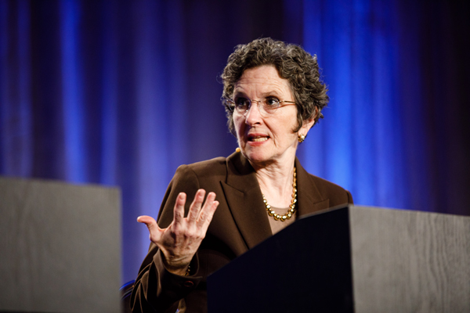
About the Enduring Program
The live meeting is being video
and audio recorded.
The proceedings from this weekend
will be edited and developed into an
enduring web-based program. An email
will be sent to all attendees when the
activity is available.
To learn more about our education programs, visit our website, www.ResearchToPractice.com

Slide 11
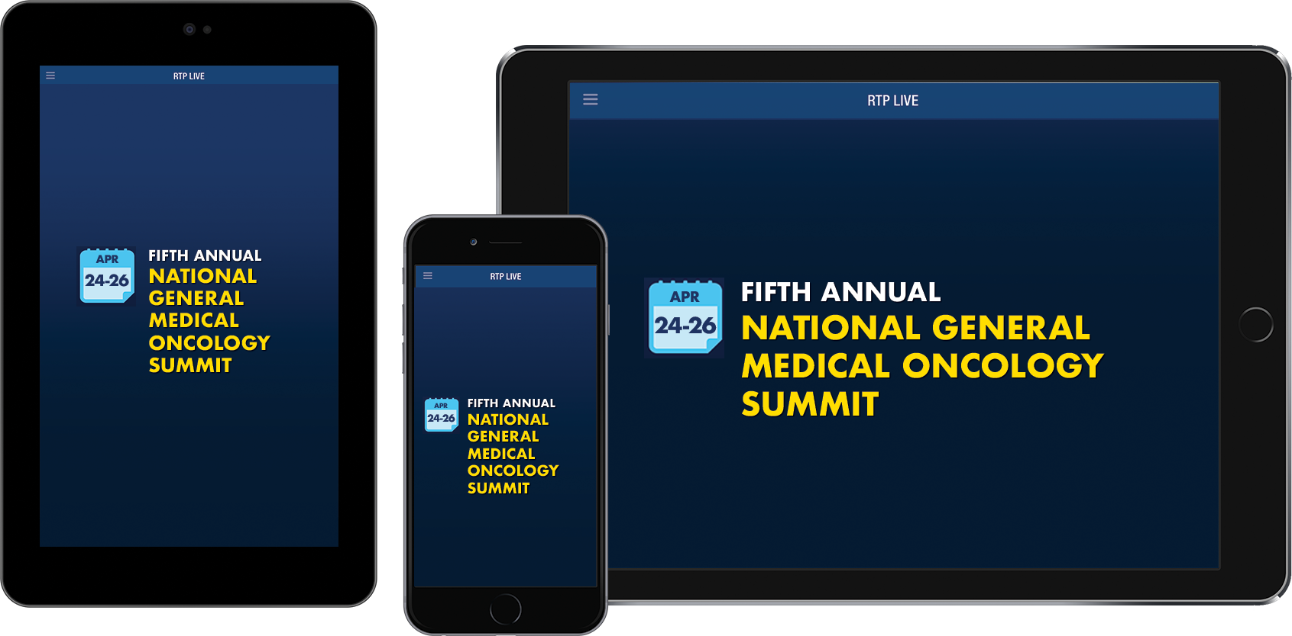
Make the Meeting Even More Relevant to You
Download the RTP Live app on your smartphone or tablet to access program information, including slides being presented during the program:
www.ResearchToPractice.com/RTPLiveApp

Slide 12
Saturday, April 25, 2026
Moderator
Neil Love, MD
Faculty
John N Allan, MD
Deborah K Armstrong, MD
Adam M Brufsky, MD, PhD
Terence Friedlander, MD
Mrinal Gounder, MD
Erika Hamilton, MD
Yelena Y Janjigian, MD
Kevin Kalinsky, MD, MS, FASCO
Adam Kittai, MD
Samuel J Klempner, MD
Hans Lee, MD
Shanu Modi, MD
David M O’Malley, MD
Eileen M O’Reilly, MD
Daniel P Petrylak, MD
Philip A Philip, MD, PhD
Noopur Raje, MD
Richard F Riedel, MD

Slide 13
Module 1: Chronic Lymphocytic Leukemia
Current Management of Newly Diagnosed CLL — Dr Allan
Noncovalent BTK Inhibitors and Other Novel Strategies — Dr Kittai

Slide 14

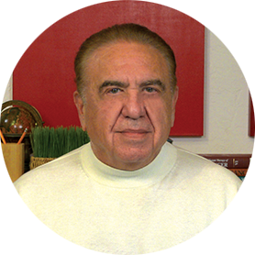

Faculty
John N Allan, MD
Weill Cornell Medicine
New York, New York
Moderator
Neil Love, MD
Research To Practice
Miami, Florida
Adam Kittai, MD
Perlmutter Cancer Center
New York, New York
Co-Moderator
Susmitha Apuri, MD
Florida Cancer Specialists &
Research Institute
Inverness and Lecanto, Florida

Slide 15
Module 1: Chronic Lymphocytic Leukemia
Current Management of Newly Diagnosed CLL — Dr Allan
Noncovalent BTK Inhibitors and Other Novel Strategies — Dr Kittai

Slide 16
Module 1: Chronic Lymphocytic Leukemia
We would like to do a “best paper or presentation of the year” activity. Please suggest one “paper of the year” and 2 other worthy papers based on the value in treatment of current and future patients.

Slide 17
Current Management of CLL in The 1L Setting
Research To Practice
Fifth Annual National General Medical Oncology (GMO) Summit
Orlando, FL, April 25, 2026
John N. Allan
Associate Professor of Clinical Medicine
Weill Cornell

Slide 18
Disclosures
Advisory Committees | NeoGenomics
Consulting Agreements | AbbVie Inc, Adaptive Biotechnologies Corporation, ADC Therapeutics, AstraZeneca Pharmaceuticals LP, BeOne, Genentech, a member of the Roche Group, Janssen Biotech Inc, Lilly, Pharmacyclics LLC, an AbbVie Company
Contracted Research | Adaptive Biotechnologies Corporation, BeOne, Bristol Myers Squibb, Genentech, a member of the Roche Group
Data and Safety Monitoring Boards/Committees | Merck
Speakers Bureaus | AbbVie Inc, BeOne

Slide 19
Shifting Trends in Management of Frontline CLL
Fixed Duration or MRD-Guided Therapy
Treat to Progression
~1-year time-limited therapy (MRD-guided may extend 1-2 years or longer)
Mitigated cardiac risks by discontinuation or use of second-generation BTKi
Less concern over long-term adherence
Potential for cost savings
Time intensive (infusions possible, venetoclax
ramp-up monitoring)
Ideal Patient type for Oral Doublet vs Triplet vs. Ven-G or MRD-guided therapy is not defined (possible benefit of Triplet over Doublet in IGHV unmutated)
Convenience (no infusions or TLS monitoring)
Longer-term efficacy data (movement towards
second-generation selective agents)
Survival advantage compared to chemoimmunotherapy
Improves versus diminishes immune function
Does not cause clonal hematopoiesis
Indefinite treatment
Potential for cumulative cardiac toxicity
BTKi, Bruton’s tyrosine kinase inhibitor; CLL, chronic lymphocytic leukemia; IGHV, immunoglobulin heavy-chain variable region gene; MRD, measurable residual disease; TLS, tumor lysis syndrome; Ven-G, venetoclax, obinutuzumab; vs, versus.
NCCN Clinical Practice Guidelines in Oncology (NCCN Guidelines®) for Guideline Name Chronic Lymphocytic Leukemia/Small Lymphocytic Lymphoma V.2.2026. © 2026 National Comprehensive Cancer Network, Inc. All rights reserved.

Slide 20
Summary of BTKi Monotherapy Data
Study | Treatment | Follow-up | Longest PFS reported | Longest OS reported | AF (Gr ≥3) | Infection (Gr ≥3) | Discontinued due to AEs
RESONATE-2¹ | Ibrutinib | 10.0 years | mPFS: 8.9 years | 68% at 10 years | NR | NR | 33%
NIH Phase 2 (TP53-aberrant / older patients)² | Ibrutinib | 10.0 years | mPFS: 6.8 years | 65.7% at 10 years | NR | NR | 36.9%
ELEVATE-TN³ | Acalabrutinib | 74.5 months | Est. 72m: 61.5% | Est. 72m: 75.5% | 1.7% | Pneumonia 6.1%; COVID-19 7.3% | 17.9%
ELEVATE-TN³ | Acalabrutinib + obinutuzumab | 74.5 months | Est.72: 78% | Est. 72m: 83.9% | 1.7% | Pneumonia 7.3%; COVID-19 9.0% | 21.2%
SEQUOIA^{4,5} | Zanubrutinib (Arm A) | 72.8 months | Est. 72m: 74% | Est. 72m: 84% | NR | Pneumonia 8%; COVID-19 10%; URTI 2% | NR
SEQUOIA^{4,5} | Zanubrutinib (Arm C del(17p)) | 76.7 months | Est. 72m: 64% | Est. 72m: 83% | NR | Pneumonia 6%; COVID-19 7%; URTI 3% | NR
AEs, adverse events; AF, atrial fibrillation; BTKi, Bruton’s tyrosine kinase inhibitor; Est, estimated; Gr, grade; m, month; mPFS, median progression-free survival; NIH, National Institutes of Health; NR, not reached; OS, overall survival; PFS, progression-free survival; TP53, tumor protein p53; URTI, upper respiratory tract infection.
1. Burger, et al. Blood. 2025;146(18):2168-2176. 2. Itsara, et al. Blood. doi:10.1182/blood.2025029971. 3. Sharman, et al. Blood. 2025;146(11):1276-1285. 4. Tam, et al. Blood. 2025;146(Suppl_1):2129. 5. Tam, et al. ASH 2025. Poster 2129.

Slide 21
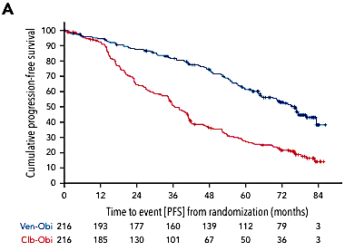
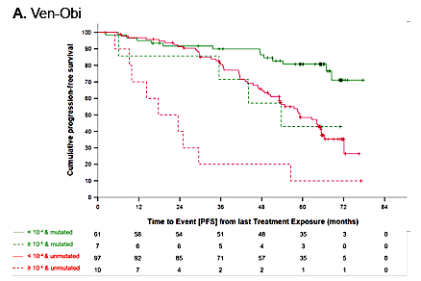
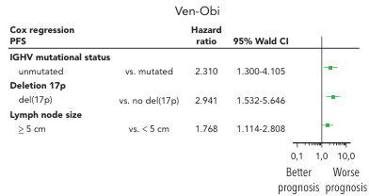
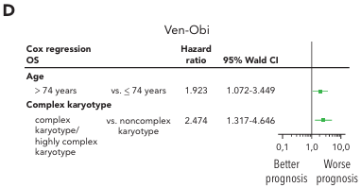
What Have We Learned from CLL14 Our Standard FD Regimen?
PFS
PFS if MRD- vs Not
PFS Multivariate Analysis
Only 8% remain uMRD at 60 months
80% had mutated IGHV
OS Multivariate Analysis
Al Sawaf et al Blood (2024) 144 (18): 1924–1935.

Slide 22
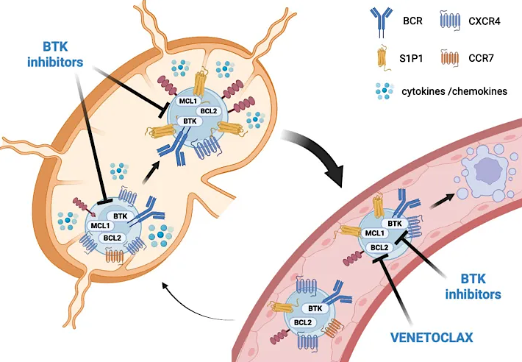
Mechanistic Rationale of Potential Synergies of BTK/BCL2 Dual Inhibition
Visetin and Mauro Oncol. Rev., 17 December 2025

Slide 23
AMPLIFY: Firstline Treatment of CLL With Acalabrutinib + Venetoclax^{1,2}
AMPLIFY, randomized, multicenter, open-label, phase 3
Key Inclusion Criteria
Age ≤ 18 years
TN CLL requiring treatment per iwCLL 2018 criteria
Without del(17p) or TP53ª
ECOG PS ≤ 2
Key Exclusion Criteria
CIRS geriatric > 6
Significant cardiovascular disease
Stratification
Age (> 65 vs ≤ 65 years)
IGHV mutational status
Rai stage ≥3 vs < 3
Geographic region
AV (14 cycles)
n = 291
Primary endpoints
IRC-assessed PFS (AV vs FCR/BR)
If primary endpoint is met, secondary endpoints tested in fixed sequential hierarchy
1. IRC-PFS (AVO vs FCR/BR)
2. uMRD (AV vs FCR/BR)
3. uMRD (AVO vs FCR/BR)
4. OS (AV vs FCR/BR)
5. OS (AVO vs FCR/BR)
N = 867
R
1:1:1
AVO (14 cycles)
n = 286
FCR/BR
(6 cycles)
n = 290
AV and AVO
dosing
schedule
Acalabrutinib 100 mg PO BID (cycles 1–14)
Crossover not built into protocol
Venetoclax 400 mg PO QD (cycles 3–14)
Obinutuzumab (AVO only) 1000 mg (cycles 2–7)
Cycles
(28 days each)
1
2
3
4
5
6
7
8
9
10
11
12
13
14
1. Brown JR, et al. Blood. 2024;144 (Supplement 1):1009. 2. Brown JR, et al. N Engl J Med. 2025 Feb 20;392(8):748-762.

Slide 24
AMPLIFY: IRC-Assessed PFS^{1,2}
EOT
34% MRD4 Rate AV
68% MRD4 Rate AVO
100
83.1%
80
76.5%
AVO
60
 | AV vs FCR/BR n = 581 | AVO vs FCR/BR n = 576
HRª (95% CI) P-Value^{b} | 0.65 (0.49–0.87) P = 0.004 | – – P < 0.0001
66.5%
PFS (%)
AV
40
FCR/BR
20
0
0
6
12
18
24
30
36
42
48
54
60
No. at risk
Months
AV
AVO
FCR/BR
291
286
290
282
272
236
269
258
208
251
237
189
237
225
170
219
219
154
177
191
127
102
116
66
35
51
28
3
7
6
0
0
0
Median PFS was NR for AV and AVO, and was 47.6 mo for FCR/BR
ITT population. Median follow-up from randomization: 40.8 months (range, 0-59 months).
ªHazard ratio (95% CI) computed using a Cox proportional-hazards model stratified by the randomization strata. P-value based on stratified log-rank test. A hazard ratio and corresponding 95% confidence interval is not shown for any comparison that violated the proportional-hazards assumption.
AV, acalabrutinib-venetoclax; AVO, acalabrutinib-venetoclax-obinutuzumab; BR, bendamustine-rituximab; CI, confidence interval; FCR, fludarabine-cyclophosphamide-rituximab; HR, hazard ratio; IRC, independent review committee; ITT, intent-to-treat; NR, not reached; PFS, progression-free survival.
1. Brown JR. N Engl J Med. 2025;392(8):748-762. 2. Brown J, et al. ASH 2024. Oral session 1009.

Slide 25
AMPLIFY: PFS and IGHV Status^{1,2}
PFS in the ulGHV Subgroup
PFS in the mlGHV Subgroup
 | AVO - ulGHV | AV - ulGHV | FCR/BR - ulGHV
Events/N | 36/169 | 61/167 | 67/172
Median (mo) | NR | 51.5 | 43.3
 | AVO - mlGHV | AV - mlGHV | FCR/BR - mlGHV
Events/N | 20/117 | 28/124 | 28/118
Median (mo) | NR | NR | NR
36-mo OS
36-mo OS
82.8%
86.0%
100
68.9%
100
83.6%
56.8%
79.9%
80
AVO - ulGHV
80
AVO - mlGHV
60
60
AV - mlGHV
PFS (%)
AV - ulGHV
PFS (%)
40
40
FCR/BR- mlGHV
HR (95% CI)
AV vs FCR/BR (uIGHV) 0.69 (0.48–0.97)
AVO vs FCR/BR (uIGHV) 0.35 (0.23–0.53)
FCR/BR- ulGHV
HR (95% CI)
AV vs FCR/BR (mIGHV) 0.67 (0.39–1.14)
AVO vs FCR/BR (mIGHV) 0.58 (0.32–1.02)
20
20
0
0
0
6
12
18
24
30
36
42
48
54
60
0
6
12
18
24
30
36
42
48
54
60
No. at risk
Months
No. at risk
Months
AV ulGHV
AVO ulGHV
FCR/BR ulGHV
167
169
172
163
161
137
155
152
122
141
141
108
129
136
94
114
133
82
86
118
62
48
75
38
17
36
19
1
7
4
0
0
0
AV mlGHV
AVO mlGHV
FCR/BR mlGHV
124
117
118
119
111
99
114
106
86
110
96
81
108
89
76
105
86
72
91
73
65
54
41
28
18
15
9
2
0
2
0
0
1. Brown JR. N Engl J Med. 2025;392(8):748-762. 2. Brown J, et al. ASH 2024. Oral session 1009.

Slide 26
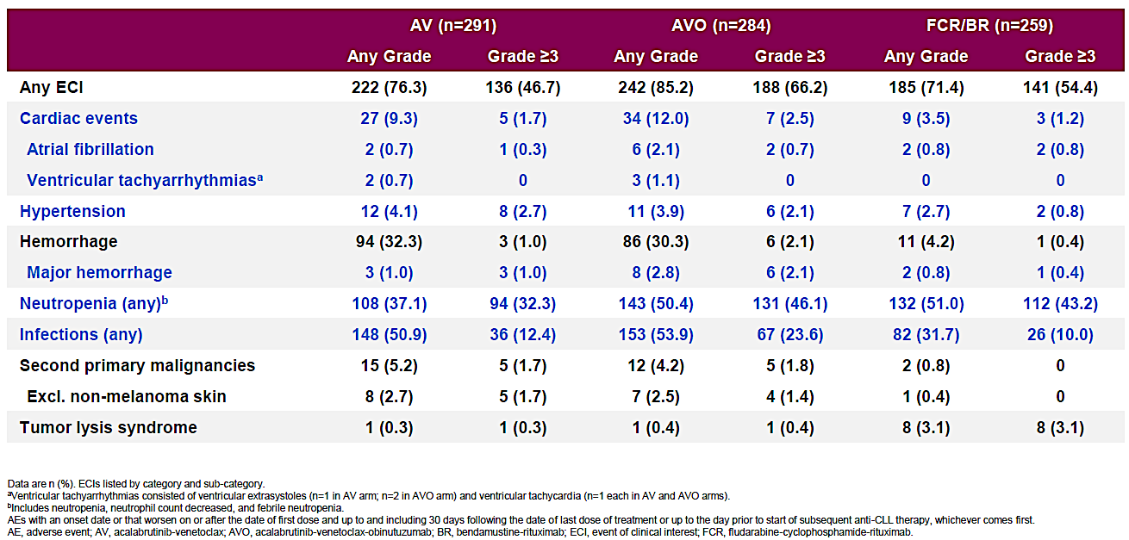
AMPLIFY: AESI
COVID-19 deaths: 10 (AV), 25 (AVO), 21 (FCR/BR)
Brown et al NEJM 2025

Slide 27
SEQUOIA Arm D: Phase 3 Trial of Zanu/Ven Combinations as First-line Treatment for CLL/SLL
Arm A: Zanubrutinib
160 mg bid until PD, intolerable toxicity, or end of study
(n = 241)
Open
label
Key Eligibility Criteria
Untreated CLL/SLL
Met iwCLL criteria for treatment
> 65y or > 18y of age and unsuitable for treatment with FCRª
Anticoagulation and CYP3 inhibitors allowed
Cohort 1
without del(17p)
by central FISH
Arm B: Bendamustine
(90 mg/m² D1 and D2) + rituximab (375 mg/m² C1, then 500 mg/m² C2-C6) for 6 cycles
(n = 238)
Patients with centrally confirmed PD could cross over to receive zanubrutinib
Disease Assessments
Response assessments conducted every 3 cycles until C28 and every 6 cycles after C28 until PD
Bone marrow MRD repeated every 12-24 weeks in pts with CR/CRi and two consecutive PB-undetectable MRDs ~12 wks apart, optional after C27 for pts with detectable MRD in BM
TLS at baseline and pre-venetoclax initiation
Endpoints for Arm D
PFS ORR OS uMRD4 rate (<10⁻⁴ sensitivity) Safety
R
Stratification factors: age, Binet stage, IGHV status, geographic region
Cohort 2
with del(17p)
Arm C: Zanubrutinib
160 mg bid until PD, intolerable toxicity, or end of study
(n = 111)^{b}
NCT03336333
Statistical analysis: Efficacy endpoints analyzed using ITT analysis and the per protocol analysis set. Safety was assessed in all patients who received >1 dose of treatment.
Cohorts 1 and 2
Arm D: Zanubrutinib 160 mg bid starting at C1
+ Venetoclax*
QD from C4-C28
(n = 114)
ª Defined as Cumulative Illness Rating Scale >6, creatinine clearance <70 mL/min, or a history of previous severe infection or multiple infections within the last 2 years;
^{b} One patient without del(17p) was misassigned to the nonrandomly assigned cohort of patients with del(17p). The patient is excluded from the efficacy analysis in this cohort;
^{c} Defined as the time from randomization to death or the date of progression on the next line of therapy subsequent to study treatment.
BID, twice daily; BM, bone marrow; C, cycle; CLL/SLL, chronic lymphocytic leukemia/small lymphocytic lymphoma; CR, complete response; CRi, complete response; FCR, fludarabine, cyclophosphamide, rituximab; FISH, fluorescence in situ hybridization; IGHV, immunoglobulin heavy chain variable region; ITT, intention-to-treat; iwCLL, International Workshop on Chronic Lymphocytic Leukemia; MRD, minimal residual disease; ORR, overall response rate; OS, overall survival; PB, peripheral blood; PD, progressive disease; PFS, progression-free survival; QD, once daily; TLS, tumor lysis syndrome; uMRD4, undetectable minimal residual disease at 10⁻⁴ sensitivity.
*This regimen is not yet FDA-approved
1. Tam, et al. Lancet Oncol. 2022;23(8):1031-1043. 2. Shadman, et al. 17th ICML. June 13-17, 2023; Abstract 154. 3. Shadman, et al. ASCO 2025. May 30 – June 3, 2025. Chicago, IL. Abstract 7009.

Slide 28
SEQUOIA Arm D: Schedule
C1
C4
C7
C10
C13
C16
C19
C22
C25
C28+
Continue zanubrutinib until
uMRD early stopping criteria
Zanubrutinib 160 mg BID
Venetoclax 400 mg QD
Discontinue venetoclax due to uMRD early stopping criteria
Baseline and end of C3:
TLS risk assessment
Hematology/physical examination/imaging
MRD: PB
BM biopsy and
aspirate for CRª
MRD: BM aspirate^{b}
Median follow-up: 38.5 months
uMRD-guided stopping criteria
All conditions must be met:
Response assessed as CR or CRi confirmed by a BM biopsy
uMRD <1x10⁻⁴ (uMRD4) achieved in 2 consecutive peripheral blood MRD tests conducted ≥12 weeks apart
uMRD4 achieved in 2 consecutive BM aspirate MRD tests conducted ≥12 weeks apart
Received:
  i) Minimum of 12 cycles of venetoclax (to stop venetoclax early)
  ii) Minimum of 27 cycles of zanubrutinib (to stop zanubrutinib early)
aBM biopsy and aspirate are required to confirm a suspected CR/Cri (BM biopsy collection timepoint not defined per protocol), starting after cycle 9 and then annually if needed. bPatients with confirmed CR/CRi and 2 consecutive PB-uMRD results at least 12 weeks apart.
BID, twice daily; BM, bone marrow; C, cycle; CR, complete response; CRi, complete response with incomplete hematologic recovery; MRD, minimal residual disease; PB, peripheral blood; QD, once daily; TLS, tumor lysis syndrome; uMRD, undetectable minimal residual disease; uMRD4, undetectable MRD at 10⁻⁴ sensitivity
1. Tam, et al. Lancet Oncol. 2022;23(8):1031-1043. 2. Shadman, et al. 17th ICML. June 13-17, 2023; Abstract 154. 3. Shadman, et al. ASCO 2025. May 30 – June 3, 2025. Chicago, IL. Abstract 7009.
*This regimen is not yet FDA-approved

Slide 29
SEQUOIA Arm D: Response and MRD Rates
Peripheral Blood uMRD Rates by Genomic Risk and Treatment Duration
Response Rates
ORR
98.5%
Outcome | Overall | del(17p) and/or TP53mut | No del(17p)/TP53mut | Unmutated IGHV | Mutated IGHV
Best peripheral blood uMRD rate | 60% | 59% | 62% | - | -
uMRD after 15 cycles | - | 15% | 40% | 23% | 33%
uMRD after 27 cycles | - | 38% | 36% | 40% | 29%
ORR
95.7%
ORR
97.4%
100
90
CR
80
CRi
70
45.5
48.9
47.4
60
0.9
nPR
50
1.5
PR
Patients (%)
2.1
0.9
40
PR-L
30
50.0
44.7
47.4
20
10
1.5
0.9
0
Treatment Discontinuation and Durability
With del(17p) and/or
TP53mut (n = 66)
38.7
(0.4-58.0)
Without del(17p) and/or TP53mut (n = 47)
29.6
(0.6-31.9)
All patients
(n = 114)
31.2
(0.4-58.0)
Median study follow-up, Months (range)
Measure | Value
Patients meeting early stopping criteria | 13/114
Patients meeting criteria to stop ZV | 42/114
Patients maintaining uMRD after discontinuation (18-month follow-up) | 92-100%
CR, complete response; CRi, complete response with incomplete hematopoietic recovery; EOS, end of study; IGHV, immunoglobulin heavy-chain variable region gene; MRD, minimal residual disease; mut, mutation; nPR, nodular partial response; ORR, overall response rate; PB-uMRD, peripheral blood-undetectable minimal residual disease; PD, progressive disease; PR, partial response; PR-L, partial response with lymphocytosis; uMRD, undetectable minimal residual disease; TP53, tumor protein p53;
ZV, zanubrutinib + venetoclax.
*This regimen is not yet FDA-approved
1. Tam, et al. Lancet Oncol. 2022;23(8):1031-1043. 2. Shadman, et al. 17th ICML. June 13-17, 2023; Abstract 154. 3. Shadman, et al. ASCO 2025. May 30 – June 3, 2025. Chicago, IL. Abstract 7009.

Slide 30
SEQUOIA Arm D: PFS
Overall Population and Patients with and without del(17p) and/or TP53mut
Unmutated and Mutated IGHV
36 mo. PFS
36 mo. PFS
100
87%
(95% CI, 78.6-92.4)
100
87%
(95% CI, 76.6-92.8)
80
w/o del(17p) and/or TP53mut
87%
(95% CI, 75.6-93.3)
All patients
80
88%
(95% CI, 66.1-95.8)
IGHV unmutated
60
w/ del(17p) and/or TP53mut
60
IGHV mutated
89%
(95% CI, 75.8-95.3)
PFS Probability
PFS Probability
40
40
20
20
0
0
0
3
6
9
12
15
18
21
24
27
30
33
36
39
42
45
48
51
54
57
60
63
66
0
3
6
9
12
15
18
21
24
27
30
33
36
39
42
45
48
51
54
57
60
63
66
Months
Months
Median study follow-up
  With del(17p) and/or TP53mut: 46.1months
  Without del(17p) and TP53mut: 36.9 months
Zanu + ven demonstrated durable PFS, with comparable outcomes in patients harboring del(17p)/TP53 mutations.
CI, confidence interval; IGHV, immunoglobulin heavy-chain variable region gene; ITT, intention-to-treat; mut, mutation; PFS, progression-free survival; TP53, tumor protein p53; ven, venetoclax; w/o, without; zanu, zanubrutinib.
*This regimen is not yet FDA-approved
1. Tam, et al. Lancet Oncol. 2022;23(8):1031-1043. 2. Shadman, et al. 17th ICML. June 13-17, 2023; Abstract 154. 3. Shadman, et al. ASCO 2025. May 30 – June 3, 2025. Chicago, IL. Abstract 7009.

Slide 31
SEQUOIA Arm D: Safety
TEAEs in >15% of Patients
TEAEs of Special Interest
Any TEAE | All Patients (N=114)
 | Any Grade, n (%) | Grade ≥3, n (%)ª
COVID-19 | 63 (55) | 2 (2)
Diarrhea | 49 (43) | 7 (6)
Contusion | 37 (33) | 0
Nausea | 36 (32) | 0
Neutropenia/neutrophil count decreased | 30 (26) | 27 (24)
Fatigue | 28 (25) | 0
Arthralgia | 24 (21) | 0
Upper respiratory tract infection | 22 (19) | 1 (1)
Cough | 21 (18) | 0
Hypertension | 18 (16) | 10 (9)
 | All Patients (N=114)
 | Any Grade, n (%) | Grade ≥3, n (%)
Any TEAE of special interest | 111 (97) | 50 (44)
Infections | 96 (84) | 14 (12)^{b}
Grade 3 | - | 13 (11)
Hemorrhage | 61 (54) | 2 (3)
Neutropenia | 31 (27) | 27 (24)
Second primary malignancies | 22 (19) | 6 (5)
Skin cancers | 15 (13) | 0
Hypertension | 18 (16) | 10 (9)
Thrombocytopenia | 13 (11) | 5 (4)
Anemia | 10 (9) | 1 (1)
Major hemorrhage | 4 (4) | 3 (3)
Atrial fibrillation and flutter | 3 (3) | 2 (2)
Opportunistic infections | 3 (3) | 0
Tumor lysis syndrome | 1 (1) | 0
Zanubrutinib + venetoclax had a favorable safety profile. Five deaths occurred in this study due to AEs (none were treatment related); no new events were reported at this follow-up at 38.5 months.
ªTEAEs in ≥5% of patients are reported. ^{b}Grade 5 infection occurred in one patient (pneumonia staphylococcal and septic shock).
AE, adverse event; TEAE, treatment-emergent adverse event.
*This regimen is not yet FDA-approved
1. Tam, et al. Lancet Oncol. 2022;23(8):1031-1043. 2. Shadman, et al. 17th ICML. June 13-17, 2023; Abstract 154. 3. Shadman, et al. ASCO 2025. May 30 – June 3, 2025. Chicago, IL. Abstract 7009.

Slide 32
CLL17: Phase 3 Trial of Continuous Ibrutinib Monotherapy vs Fixed-Duration Venetoclax-Based Regimens as First-Line Treatments for CLL
Ibrutinib 420 mg PO daily until PD
Key Eligibility Criteria
Patients with previously untreated CLL
ECOG PS 0-2
Absolute neutrophil count ≥1.0 x 10⁹/L
Platelet counts ≥30 x 10⁹/L
Total haemoglobin ≥8 g/dL
n = 301
Primary Endpoints
Investigator-assessed PFS
Key Secondary Endpoints
Minimal residual disease Response OS Safety
Venetoclax 400 mg PO daily (C1D22 to C12)
Obinutuzumab 100 mg IV (C1D1(2)/8/15, C2-6D1)
R
n = 303
Venetoclax 400 mg PO daily (C4D1 to C15)
Ibrutinib 420 mg PO daily (C1D1 to C15)
n = 305
976 patients screening in 174 sites, across 13 countries
Patient enrollment from February 2021 to November 2022
Median observation time: 34.2 months (IQR 30.3-39.3)
*Venetoclax + ibrutinib is not yet FDA-approved
CLL, chronic lymphocytic leukemia; ECOG PS, Eastern Cooperative Oncology Group Performance Status; IQR, interquartile range; IV, intravenous; PD, progressive disease; PFS, progression-free survival; PO, oral administration; OS, overall survival.
Al-Sawaf, et al. N Engl J Med. Published online December 6, 2025. doi:10.1056/NEJMoa2515458

Slide 33
CLL17: Response to Treatment
iwCLL Response at
Final Restaging (C18D1)
uMRD <10⁻⁴ in Peripheral Blood and Bone Marrow, by Flow Cytometry, at Final Restaging
100
84.2%
88.5%
86%
100
73.3%
222/303
75
62%
188/303
PR: 32.7
PR: 42.3
Response Type
75
47.2%
144/305
50
Partial response
40%
122/305
Patients w/ Response (%)
PR: 77.7
50
Peripheral blood
Complete Response
Percentage of Patients
Bone marrow
25
CR: 51.5
CR: 46.2
25
CR: 8.3
0%
0/301
0%
0/301
0
Venetoclax-Obinutuzumab
Venetoclax-Ibrutinib
Ibrutinib
0
Venetoclax-Obinutuzumab
Venetoclax-Ibrutinib
Ibrutinib
*Venetoclax + ibrutinib is not yet FDA-approved
iwCLL, international workshop on CLL; uMRD, undetectable measurable residual disease.
Al-Sawaf, et al. N Engl J Med. Published online December 6, 2025. doi:10.1056/NEJMoa2515458

Slide 34
CLL17: Survival Across Treatment Arms
PFS by Treatment Arm
OS by Treatment Arm
100
3-year PFS
VO 81.1%
I 81.0%
VI 79.4%
100
3-year OS
VO 91.5%
I 95.7%
VI 96.0%
80
80
60
60
PFS (%)
OS (%)
40
VI vs I: HR 0.84;
type-I-error adjusted CI [98.0%] 0.53-1.32
VO vs I: HR 0.87;
type-I-error adjusted CI [98.3%] 0.54-1.41
40
20
20
VI vs I: HR 0.96; 95% CI 0.45-2.05
VO vs I: HR 1.67; 95% CI 0.86-3.28
0
0
0
12
24
36
48
0
12
24
36
48
Time Since Randomization (months)
Time Since Randomization (months)
No. at risk
VO
VI
I
No. at risk
VO
VI
I
303
305
301
278
278
267
256
267
243
77
82
94
0
0
1
303
305
301
284
281
284
269
279
276
102
114
141
0
1
2
Cause of death | VO | I | VI
Infection | 12 (7 Covid) | 3 | 7 (2 Covid)
Cardiovascular | 5 | 5 | 3
PD/RT | 1 | 0 | 0
SPM | 4 | 2 | 2
Other | 0 | 4 | 1
Total | 22 | 14 | 13
 | VO | I | VI
PD | 25 | 46 | 37
Death | 21 | 11 | 13
Fixed-duration treatment with venetoclax–obinutuzumab or venetoclax–ibrutinib was noninferior to continuous ibrutinib with regards to investigator-assessed PFS.
CI, confidence interval; CLL, chronic lymphocytic leukemia; HR, hazard ratio; I, ibrutinib; no. number; OS, overall survival; PD, progressive disease; PD/RT, progressive disease/Richter transformation; PFS, progression-free survival; SPM, second primary malignancies; VI, venetoclax–ibrutinib; VO, venetoclax–obinutuzumab.
Al-Sawaf, et al. N Engl J Med. Published online December 6, 2025. doi:10.1056/NEJMoa2515458
*Venetoclax + ibrutinib is not yet FDA-approved

Slide 35
CLL17: PFS According to IGHV and TP53/del17p Status
PFS According to IGHV status
PFS According to TP53/del17p status
100
3-year PFS
100
3-year PFS
80
I, uIGHV 79.7%
I, mIGHV 83.5%
VI, uIGHV 78.9%
VI, mIGHV 80.0%
VO, uIGHV 75.8%
VO, mIGHV 87.6%
80
I, TP53del/mut 79.4%
I, TP53-WT 81.0%
VI, TP53del/mut 69.0%
VI, TP53-WT 80.1%
VO, TP53del/mut 62.0%
VO, TP53-WT 82.7%
60
Unmutated IGHV
VI vs I: HR 0.81;
95% CI 0.49-1.32
VO vs I: HR 0.98;
95% CI 0.61-1.59
60
TP53 del/mut
VI vs I: HR 0.70;
95% CI 0.22-2.16
VO vs I: HR 1.20;
95% CI 0.40-3.59
PFS (%)
PFS (%)
40
40
20
20
0
0
0
12
24
36
48
0
12
24
36
48
Time since Randomization (months)
Time since Randomization (months)
No. at risk
VO, unmutated
VO, mutated
VI, unmutated
VI, mutated
I, unmutated
I, mutated
No. at risk
VO, del/mut
VO, WT
VI, del/mut
VI, WT
I, del/mut
I, WT
171
129
172
129
171
126
156
119
157
117
156
108
142
111
151
112
145
95
40
36
50
32
55
37
0
0
0
0
1
0
23
280
25
279
21
279
21
257
20
257
19
247
16
240
18
248
15
227
5
72
4
78
7
87
0
0
0
0
0
1
CI, confidence interval; CLL, chronic lymphocytic leukemia; HR, hazard ratio; I, ibrutinib; IGHV, immunoglobulin heavy-chain variable region gene; mIGHV, mutated IGHV; PFS, progression-free survival; TP53del/mut, TP53 deletion and/or mutation; uIGHV, unmutated IGHV; VI, venetoclax–ibrutinib; VO, venetoclax–obinutuzumab; WT, wild type.
Al-Sawaf, et al. N Engl J Med. Published online December 6, 2025. doi:10.1056/NEJMoa2515458
*Venetoclax + ibrutinib is not yet FDA-approved

Slide 36
CLL17: Selected Adverse Events of Interest
 | VO | VI | I
Safety population – n (%) | 295 | 303 | 298
Blood and lymphatic system disorders | 174 (59.0) | 130 (42.9) | 85 (28.5)
Febrile neutropenia | 14 (4.7) | 7 (2.3) | 0 (0)
Neutropenia | 155 (52.5) | 110 (36.3) | 49 (16.4)
Cardiac disorders | 41 (13.9) | 72 (23.8) | 103 (34.6)
Atrial fibrillation | 11 (3.7) | 38 (12.5) | 50 (16.8)
Gastrointestinal disorders | 176 (59.7) | 225 (74.3) | 189 (63.4)
Diarrhea | 80 (27.1) | 143 (47.2) | 104 (34.9)
Infections and infestations | 225 (76.3) | 243 (80.2) | 238 (79.9)
COVID-19 | 113 (38.3) | 128 (42.2) | 117 (39.3)
Pneumonia | 41 (13.9) | 28 (9.2) | 40 (13.4)
Metabolism and nutrition disorders | 90 (30.5) | 75 (24.8) | 72 (24.2)
Tumor lysis syndrome | 12 (4.1) | 4 (1.3) | 1 (0.3)
Neoplasms benign, malignant and unspecified | 35 (11.9) | 35 (11.6) | 55 (18.5)
Richter Transformation | 4 (1.4) | 1 (0.3) | 4 (1.3)
Vascular disorders | 60 (20.3) | 102 (33.7) | 124 (41.6)
Hypertension | 34 (11.5) | 51 (16.8) | 72 (24.2)
*Venetoclax + ibrutinib is not yet FDA-approved
Al-Sawaf, et al. N Engl J Med. Published online December 6, 2025. doi:10.1056/NEJMoa2515458
I, ibrutinib; VI, venetoclax–ibrutinib; VO, venetoclax–obinutuzumab.

Slide 37
Section Summary
A+V is now approved in the US as a second FD option
  Guidelines do acknowledge Triplet or Response Adapted Approaches allowing coverage and use adding third and “fourth” FD options.
  uIGHV appears to benefit from Triplet Approaches in terms of PFS over VenG or AV
  mIGHV may still benefit from attaining MRD or using antiCD20 but may not require Triplet therapy to achieve the optimal outcome
    Current evidence at short follow-up shows no differences in outcome based on MRD status with oral doublets
CLL17 currently at 3 years of follow-up (1.5 years after cessation) no differences between groups or approaches in PFS or OS.
  Thus at this time anything goes, still about preferences, comorbidities, philosophy

Slide 38
QUESTIONS?

Slide 39
Module 1: Chronic Lymphocytic Leukemia
Current Management of Newly Diagnosed CLL — Dr Allan
Noncovalent BTK Inhibitors and Other Novel Strategies — Dr Kittai

Slide 40
Noncovalent BTK Inhibitors and Other Novel Strategies
Adam S. Kittai, MD, MBA
Associate Professor
Director, CLL – NYU Perlmutter Cancer Center
Research To Practice
Orlando, Florida

Slide 41
Disclosures
Advisory Committees | AbbVie Inc, AstraZeneca Pharmaceuticals LP, Bristol Myers Squibb, Galapagos NV, Genmab US Inc, Pfizer Inc
Consulting Agreements | AbbVie Inc, Lilly
Honoraria for Unbranded Speaking Engagements | AstraZeneca Pharmaceuticals LP, Janssen Biotech Inc, Lilly

Slide 42
Objectives
Pharmacologic similarities and differences between covalent and noncovalent BTK inhibitors
Long-term efficacy and safety findings with pirtobrutinib in patients with BTK inhibitor-pretreated CLL
Key findings from the Phase III BRUIN CLL-314 study of pirtobrutinib versus ibrutinib in patients with treatment-naïve or previously treated, BTK inhibitor-naïve CLL
Efficacy advantage documented with pirtobrutinib versus bendamustine/rituximab for patients with treatment-naïve CLL without del(17p) in the Phase III BRUIN CLL-313 trial
Similarities and differences between sonrotoclax and venetoclax; early data with sonrotoclax in combination with an anti-CD20 antibody in R/R and treatment-naïve CLL and ongoing Phase III evaluation
Mechanistic similarities and differences between BTK degraders and BTK inhibitors; preliminary data with and ongoing evaluation of BTK degraders (eg, BGB-16673) in patients with heavily pretreated CLL

Slide 43
Non-covalent BTKi

Slide 44
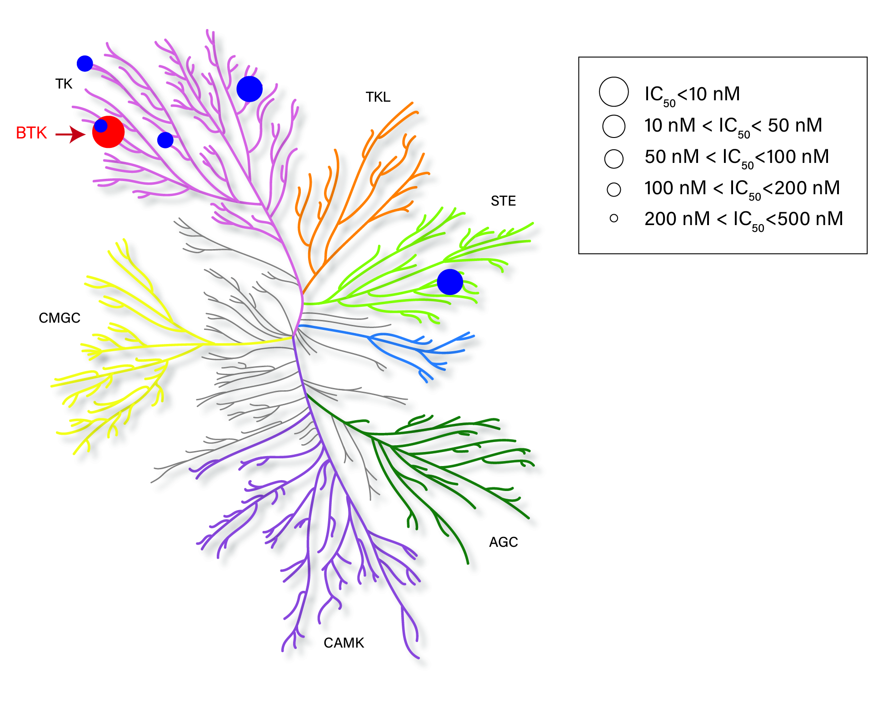
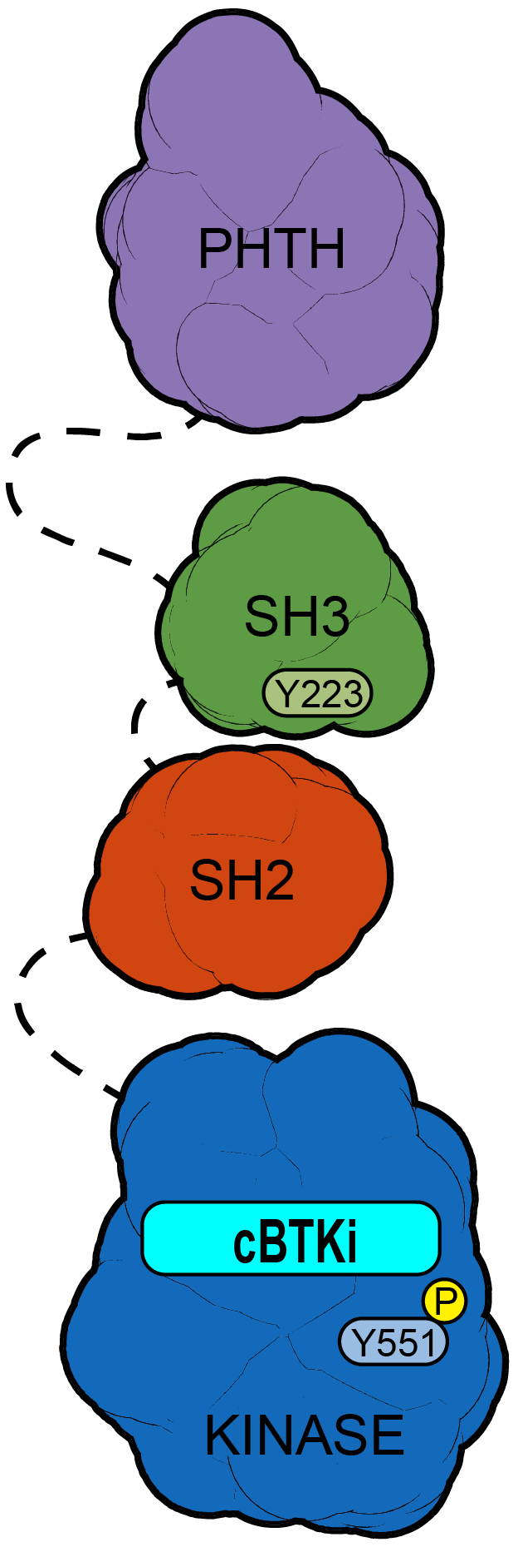
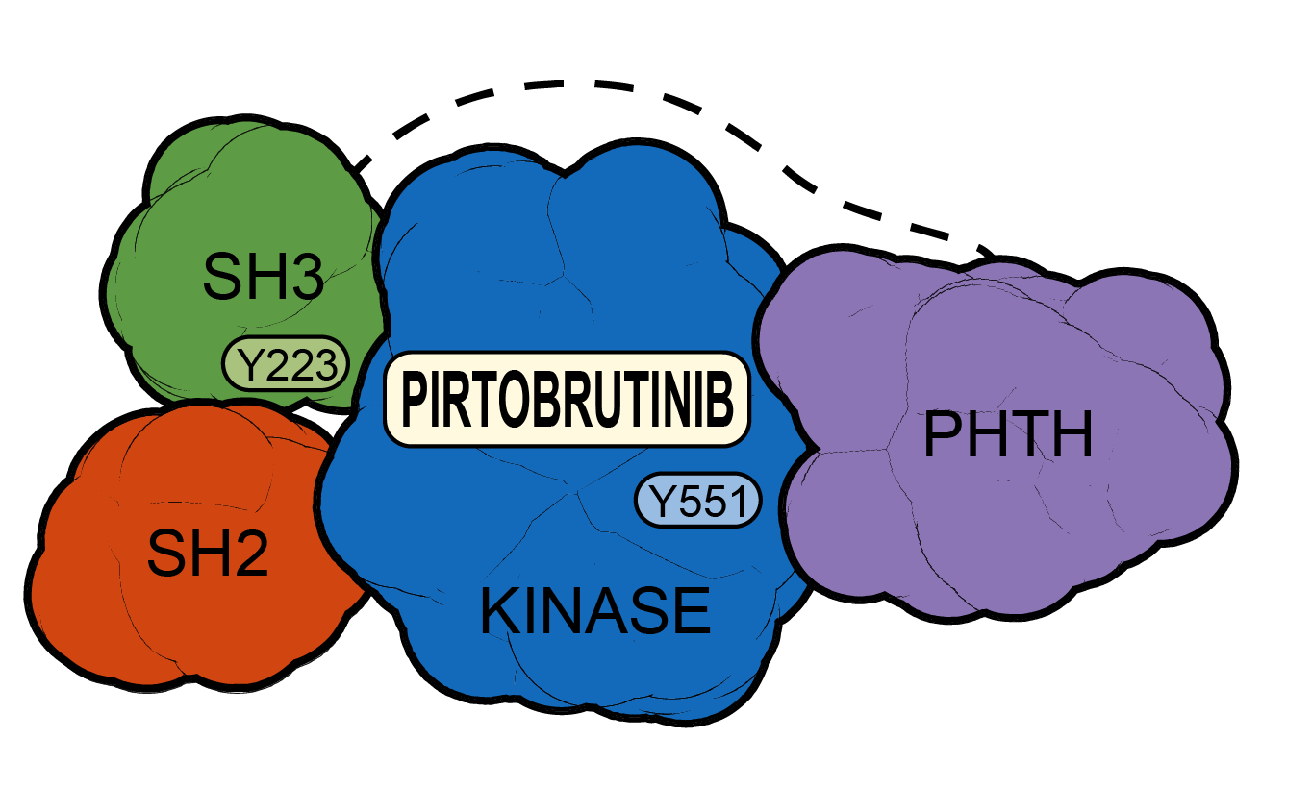
Pirtobrutinib – a non-covalent BTK inhibitor
Highly selective for BTK^{2,3}
Plasma exposures exceeded BTK IC90 throughout the dosing interval^{1,2}
Pirtobrutinib may stabilize/maintain
BTK in a closed inactive conformation⁴
100
A
B
10
Concentration (μg/ml) of pirtobrutinib in plasma
1
BTK IC₉₀
0.1
0
4
8
12
16
18
24
Time (h) on Day 8 (steady-state)
Pirtobrutinib 200 mg QD
Pirtobrutinib shows high selectivity for BTK (more than 300-fold) over other kinases, which may reduce its potential for off-target activity.^{1–3}
Pirtobrutinib concentration in plasma exceeds the BTKi concentration of 90% (IC90) throughout the dosing interval at the recommended dose of
200 mg QD.^{1,2}
In contrast to cBTKi (A), Pirtobrutinib (B) appears to stabilize BTK in a closed, inactive conformation, blocking access to upstream kinases and phosphorylation of Y551,​ thus inhibiting scaffolding interactions that support kinase-independent BTK signaling.^{3,4}
1. Pirtobrutinib. Prescribing Information. Eli Lilly and Company; 12/2025 2. Mato AR, et al. Lancet. 2021;397(10277):892-901. 3. Woyach JA, et al. Poster Presentation ASH 2023. 4. Gomez EB, et al. Blood. 2023;142(1):62-72.

Slide 45
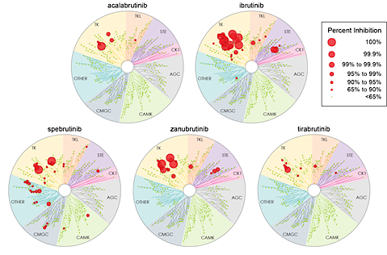
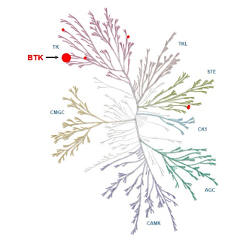

Comparison of Kinome Maps – cBTKi vs. ncBTKi
Acalabrutinib¹
Ibrutinib¹
Pirtobrutinib²
Zanubrutinib¹
Kaptein A, et al. Blood. 2018;132(Suppl 1):1871. 2, Mato AR, et al. Lancet. 2021;397:892-901.

Slide 46
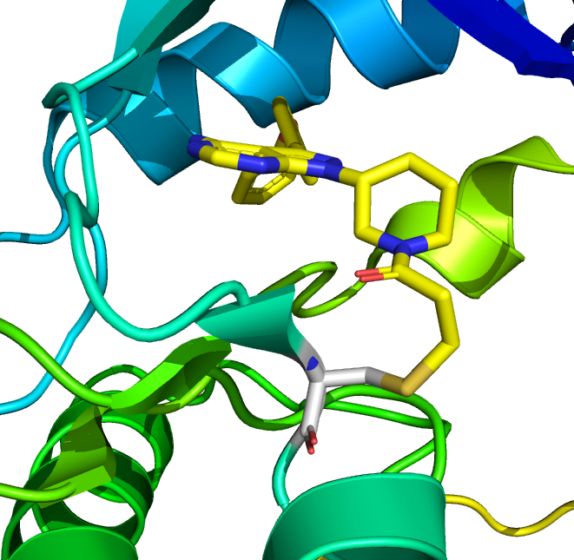
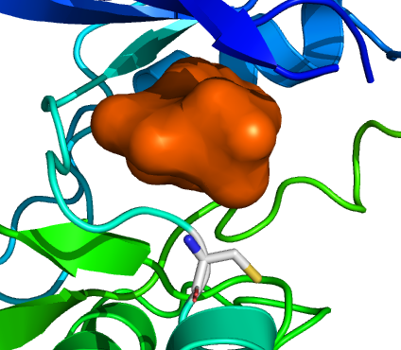
Non-Covalent BTKis overcome C481S resistance
Covalent BTK Inhibitors (Ibrutinib, Acalabrutinib,
Zanubrutinib) Require WT BTK for Activity
Noncovalent BTK Inhibitors (Pirtobrutinib, Nemtabrutinib) Are Active Against Both WT and C481-Mutated BTK
Covalent BTKis
BTK inhibition, regardless of BTK mutation
Noncovalent BTKis
C481
Covalently bound
to C481
C481
Does not require C481 to bind to the kinase domain
Gu. J Hematol Oncol. 2021;14:40.

Slide 47
BTK Resistance Mutations of clinical significance:
C481S – Most common
  C481* - Not always a cysteine to serine, can be other amino acids as well
  Resistance to cBTKi
T474I – Gatekeeper mutation
  Resistance to cBTKi and ncBTKi
L528W – Kinase dead mutation
  Resistance to cBTKi and ncBTKi
PLCG2 – Downstream of BTK
Tam CS et al. Blood. 2025

Slide 48
Phase 1/2 BRUIN Study: CLL Patients
Characteristic | Prior cBTKi (n=282) | BCL2i-N (n=154) | BCL2i-E (n=128)
Median age (range), years | 69 (36-88) | 69 (36-87) | 68 (41-88)
Male, n (%) | 192 (68) | 106 (69) | 86 (67)
Rai staging
0-II | 147 (52) | 94 (61) | 53 (41)
III-IV | 120 (43) | 58 (38) | 62 (48)
Missing | 15 (5) | 2 (1) | 13 (10)
Bulky lymphadenopathy ≥5 cm, n (%) | 88 (31) | 42 (27) | 46 (36)
ECOG PS, n (%)
0 | 144 (51) | 89 (58) | 55 (43)
1 | 118 (42) | 56 (36) | 62 (48)
2 | 20 (7) | 9 (6) | 11 (9)
Median number of prior lines of systemic therapy (range) | 4 (1-11) | 3 (1-9) | 5 (1-11)
Prior therapy, n (%)
BTKi | 282 (100) | 154 (100) | 128 (100)
Anti-CD20 antibody | 251 (89) | 127 (83) | 124 (97)
Chemotherapy | 228 (81) | 114 (74) | 114 (89)
BCL2i | 128 (45) | 0 | 128 (100)
PI3K inhibitor | 71 (25) | 17 (11) | 54 (42)
CAR-T | 17 (6) | 2 (1) | 15 (12)
Allogeneic stem cell transplant | 7 (3) | 1 (1) | 6 (5)
Characteristic | Prior cBTKi (n=282) | BCL2i-N (n=154) | BCL2i-E (n=128)
Median time from diagnosis to first dose (IQR), years | 11 (8-15) | 11 (7-15) | 12 (8-15)
Reason for any prior BTKi discontinuation,ª n (%)
Progressive disease | 217 (77) | 110 (71) | 107 (84)
Toxicity/Other | 64 (23) | 43 (28) | 21 (16)
Baseline Molecular Characteristic^{b} | Prior cBTKi (n=282) | BCL2i-N (n=154) | BCL2i-E (n=128)
Mutation status, n/N available (%)
BCL2 mutated | 19/246 (8) | 0/133 (0) | 19/113 (17)
BTK C481 mutated | 96/245 (39) | 57/138 (41) | 39/107 (36)
PLCg2 mutated | 18/245 (7) | 10/138 (7) | 8/107 (8)
High-risk molecular features, n/N available (%)
17p deletion and/or TP53 mutation | 104/217 (48) | 57/123 (46) | 47/94 (50)
IGHV unmutated | 193/225 (86) | 100/125 (80) | 93/100 (93)
Complex karyotype | 33/73 (45) | 17/41 (42) | 16/32 (50)
11q deletion | 47/202 (23) | 28/115 (24) | 19/87 (22)
Wierda, et al; ASH 2025

Slide 49
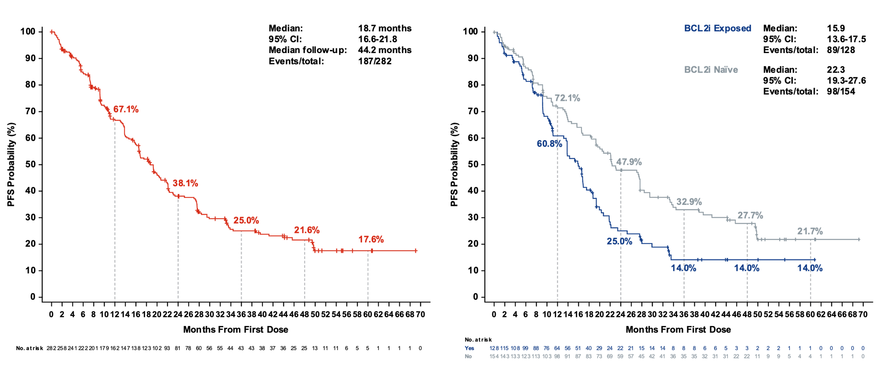
Phase 1/2 BRUIN Study: PFS
Pirtobrutinib PFS in Patients With CLL/SLL
Who Received Prior cBTKi
Pirtobrutinib PFS in Patients With CLL/SLL
Who Received Prior cBTKi, by BCL2i Exposure
Double Exposed
Wierda, et al; ASH 2025
Copyright ©2025 Eli Lilly and Company. All rights reserved.

Slide 50
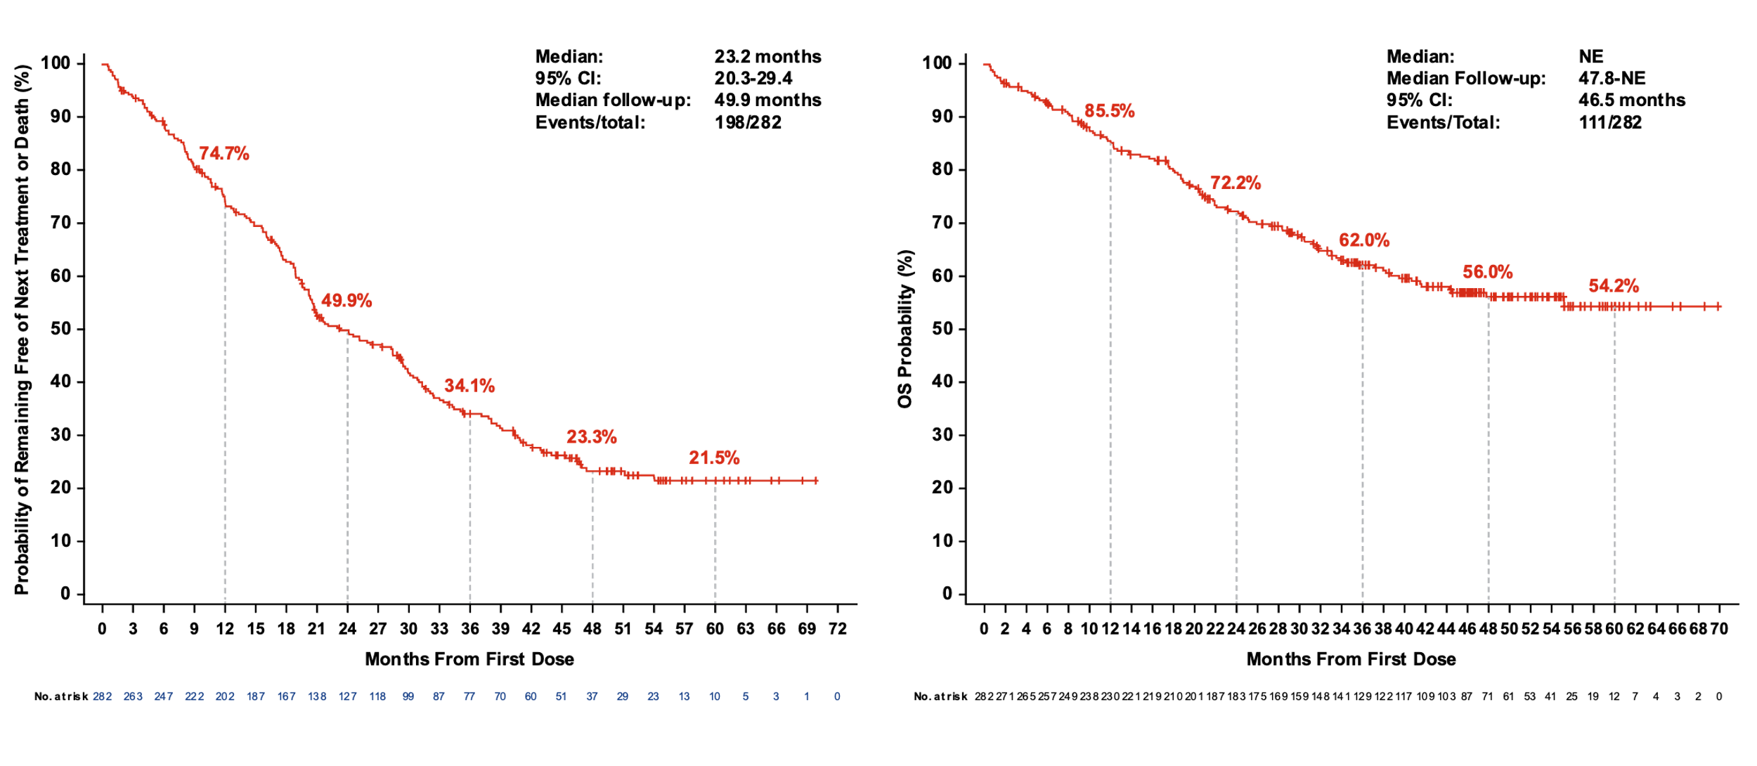
Phase 1/2 BRUIN Study: CLL Patients TTNT + OS
Time to Next Treatmentª in Patients With CLL/SLL
Who Received Prior cBTKi
OS in Patients With CLL/SLL
Who Received Prior cBTKi
Wierda, et al; ASH 2025

Slide 51
Phase 1/2 BRUIN Study: CLL Patients Safety Profile
 | TEAEs in Patients With CLL/SLL (n=282)
 | All-Cause AEs |  | Treatment-Related AEs, %
AE, ≥20% | Any Grade | Grade ≥3 | Any Grade | Grade ≥3
Fatigue | 38.7 | 1.8 | 3.9 | 0.0
Neutropenia^{a,b} | 35.8 | 29.8 | 20.6 | 16.3
Diarrhea | 30.5 | 0.4 | 8.9 | 0.0
Cough | 29.8 | 0.0 | 2.1 | 0.0
Contusion | 27.7 | 0.0 | 18.8 | 0.0
COVID-19 | 28.4 | 6.0 | 0.7 | 0.0
Dyspnea | 23.4 | 2.5 | 0.7 | 0.4
Nausea | 23.4 | 0.0 | 3.9 | 0.0
Abdominal pain | 21.6 | 2.1 | 2.1 | 0.4
AEs of Interest^{c} | Any Grade | Grade ≥3 | Any Grade | Grade ≥3
Infections^{d} | 76.2 | 36.5 | 14.9 | 5.7
Bruising^{e} | 31.2 | 0.0 | 20.2 | 0.0
Rash^{f} | 25.2 | 1.1 | 5.7 | 0.4
Arthralgia | 23.0 | 1.4 | 4.6 | 0.0
Hemorrhage^{g} | 25.2 | 3.2 | 8.2 | 1.4
Hypertension | 16.0 | 5.3 | 3.9 | 0.7
Atrial fibrillation/flutter^{h,i} | 5.0 | 2.1 | 1.4 | 0.7
Median (IQR) time on treatment was 20.0 (9.6-37.7) months
11 (3.9%) patients had
treatment-related AE leading to pirtobrutinib dose reduction
9 (3.2%) patients had
treatment-related AE leading to pirtobrutinib discontinuation
Wierda, et al; ASH 2025

Slide 52
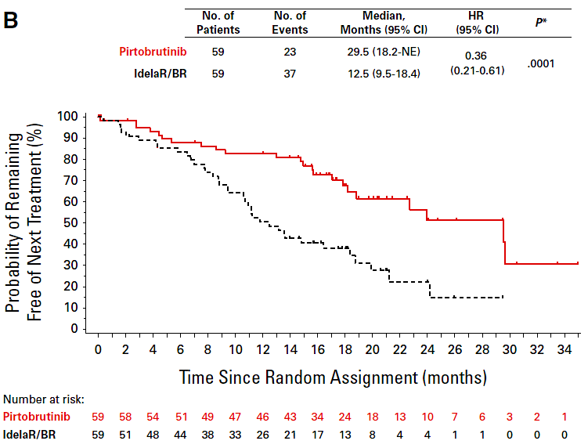
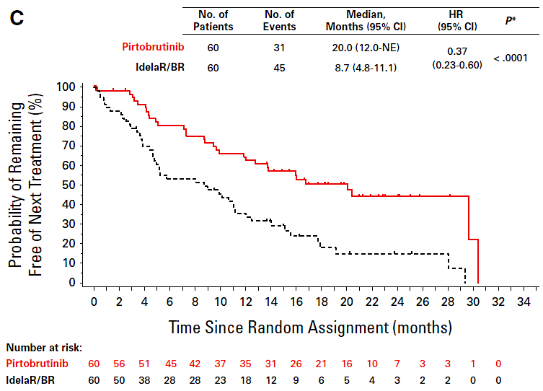
BRUIN CLL-321—Pirto vs IdelaR/BR in BTKi
Prior Venetoclax Exposure Makes an Impact—TTNT
Venetoclax-naive Patients
Venetoclax-Treated Patients
Sharman JP, et al. J Clin Oncol. 2025; 43:2538-2549.

Slide 53
Ph I/II BRUIN & Ph III BRUIN CLL-321 (Pooled Analysis)
Key Efficacy Findings
mF/U: 30.3 months
mPFS: 19.5 months (95% CI 11.7-44.7)
mTTNT: 32.5 months (95% CI 16.6-47.4)
mOS: Not reached
24-month OS rate: 81.1% (95% CI 61.9-91.3)
Adverse Events
Most Common TEAEs (any grade): Anemia: 27%; Neutropenia/neutrophil count decreased: 24%; Hemorrhage/hematoma: 22%; Pneumonia: 22%
Grade ≥3 TEAEs: 68%
TEAEs of Special Interest: Atrial fibrillation/flutter: 1 pt (Grade 3-4); Hypertension: 5 pts total, Grade 3-4: 4 pts; Hemorrhage: 8 pts total; Grade 3: 1 pt, Grade 4: 1 pt
Safety and efficacy of pirtobrutinib for patients with 2L CLL/SLL previously treated with 1L cBTKi therapy and no prior exposure to a BCL2i, using pooled data from the BRUIN and CLL-321
Study Population
37 eligible pts
(BRUIN, n=17; CLL-321, n=20)
Median age: 69 years (range 42-87)
Baseline Characteristics (evaluable samples)
IGHV unmutated: 85% (22/26)
Complex karyotype (≥3 abnmlts): 65% (11/17)
TP53 mutated: 43% (13/30)
Del(17p): 48% (15/31)
Eyre T et al ASH 2025_Abstract 5670

Slide 54
BRUIN CLL-314—Pirto vs Ibr in RR and TN CLL
Global, multicenter, open-label, randomized Phase III study (N = 662)
BTKi-naive disease (relapsed/refractory or treatment-naive)
Primary endpoint: ORR
Key secondary endpoint: PFS
BOR | ITT, n (%) |  | Relapsed/Refractory, n (%) |  | Treatment-naive, n (%)
 | Pirtobrutinib (n = 331) | Ibrutinib (n = 331) | Pirtobrutinib (n = 219) | Ibrutinib (n = 218) | Pirtobrutinib (n = 112) | Ibrutinib (n = 113)
ORR (PR or better) ratio | 1.1080 |  | 1.1233 |  | 1.0797
95% CI | 1.034 to 1.187 |  | 1.020 to 1.237 |  | 0.989 to 1.179
P-value for noninferiority | <.0001 |  | <.0001 |  | —
Woyach JA, et al. J Clin Oncol. 2025 Dec 7:JCO2502477. doi: 10.1200/JCO-25-02477.

Slide 55
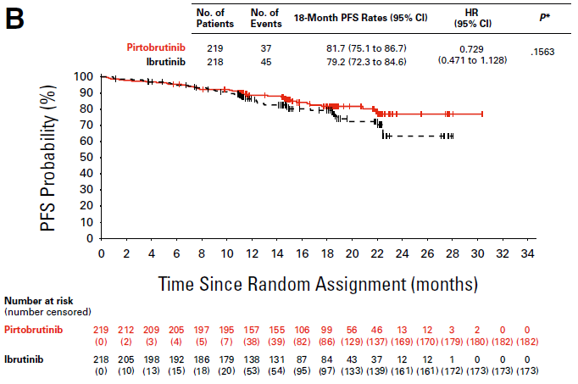
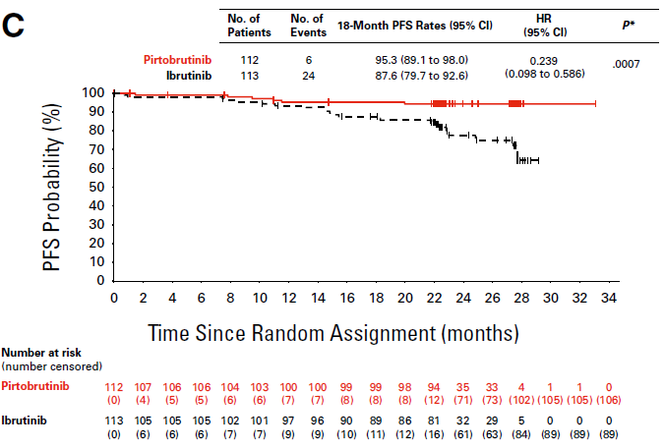
BRUIN CLL-314—PFS
Relapsed/Refractory
Treatment Naive
Woyach JA, et al. J Clin Oncol. 2025 Dec 7.

Slide 56
BRUIN CLL-314 — Safety
AE, n (%) | Pirtobrutinib (n = 330) |  | Ibrutinib (n = 325)
 | Any Grade | Grade ≥3 | Any Grade | Grade ≥3
Any TEAE | 320 (97.0) | 181 (54.8) | 318 (97.8) | 174 (53.5)
AE of Interest
Anemia | 51 (15.5) | 20 (6.1) | 51 (15.7) | 12 (3.7)
Atrial fibrillation and atrial flutter | 8 (2.4) | 3 (0.9) | 44 (13.5) | 13 (4.0)
Bleeding | 115 (34.8) | 11 (3.3) | 118 (36.3) | 9 (2.8)
Hypertension | 35 (10.6) | 11 (3.3) | 49 (15.1) | 16 (4.9)
Infections | 226 (68.5) | 56 (17.0) | 241 (74.2) | 54 (16.6)
Neutropenia | 103 (31.2) | 83 (25.3) | 76 (23.4) | 57 (17.5)
Thrombocytopenia | 39 (11.8) | 12 (3.6) | 57 (17.5) | 13 (4.0)
Woyach JA, et al. J Clin Oncol. 2025 Dec 7. [Epub ahead of print]

Slide 57
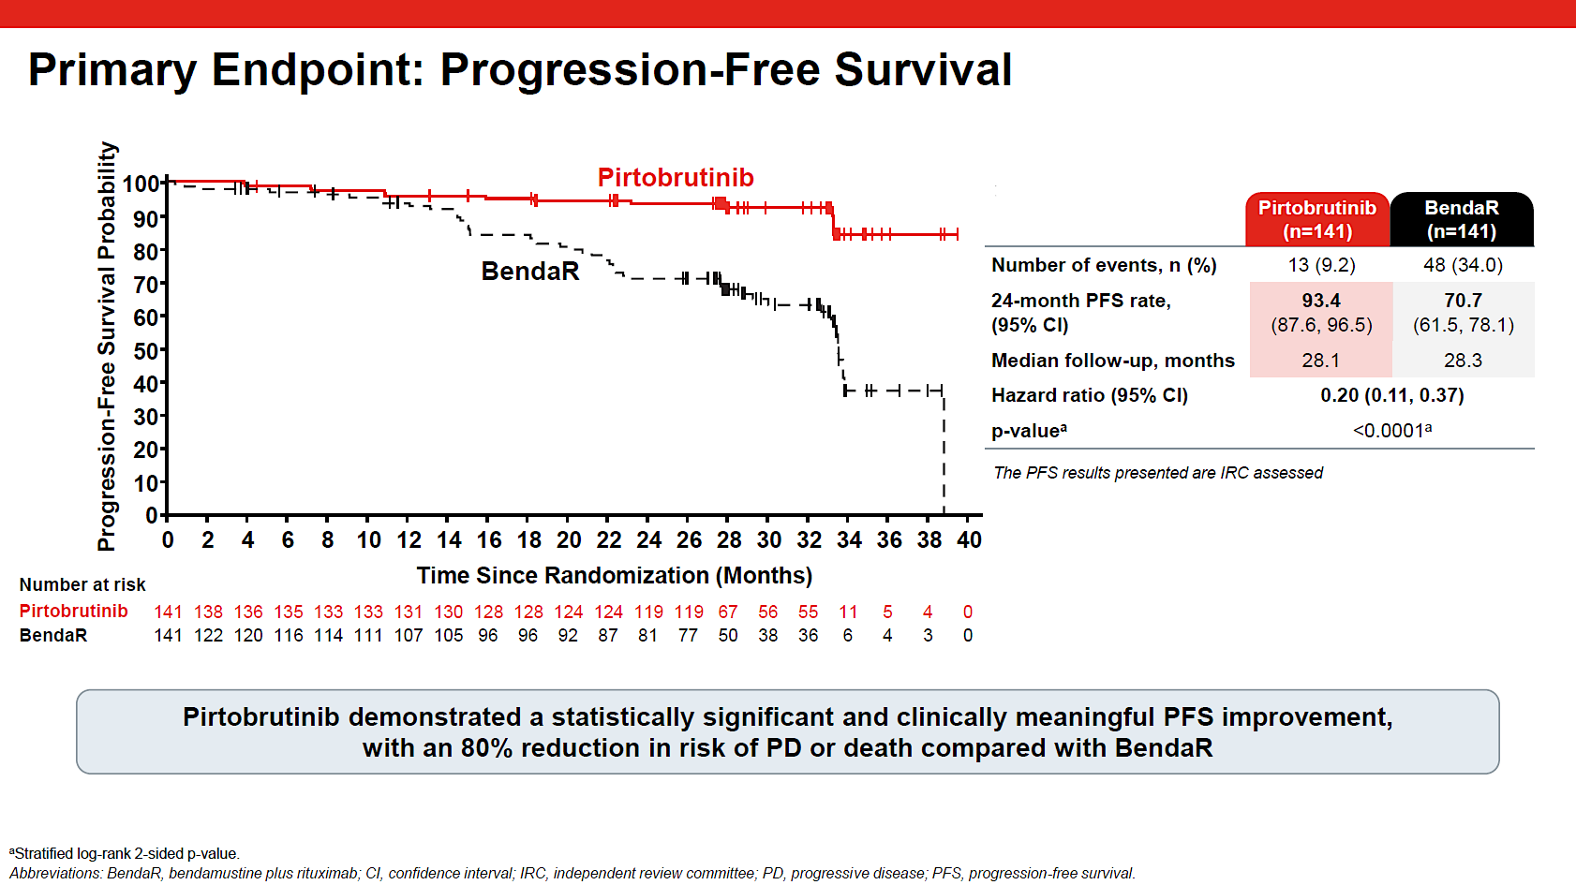
BRUIN CLL-313: Pirto vs BR in TN CLL/SLL
Jurczak W et al. ASH 2025; LBA3

Slide 58
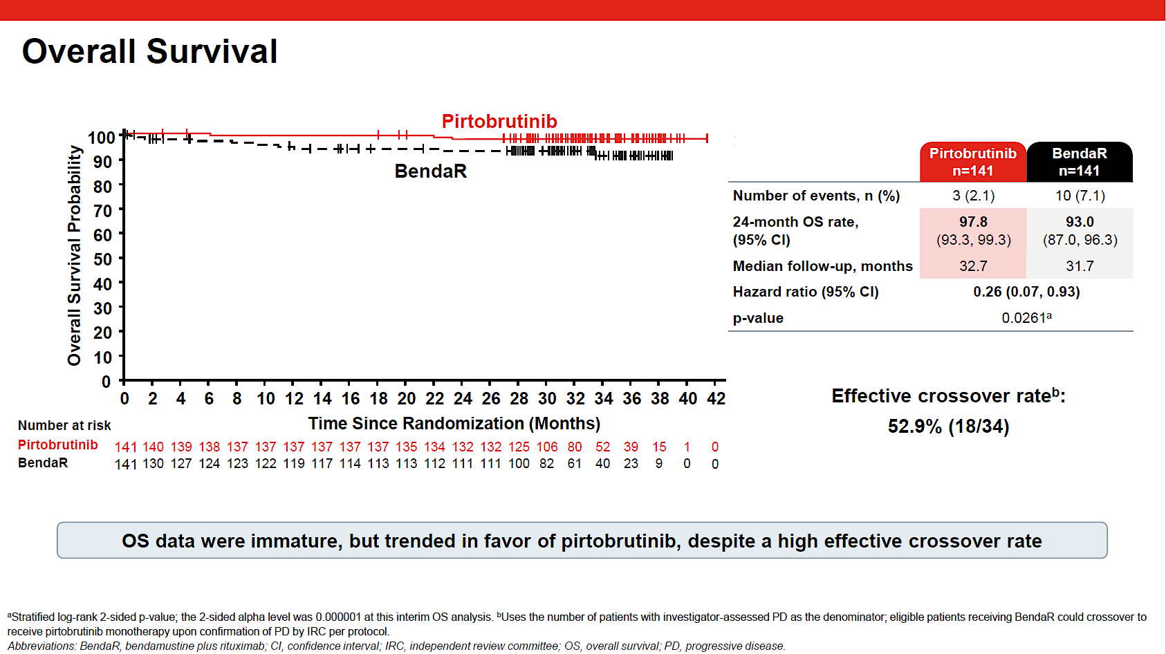
BRUIN CLL-313: Pirto vs BR in TN CLL/SLL
Jurczak W et al. ASH 2025; LBA3

Slide 59
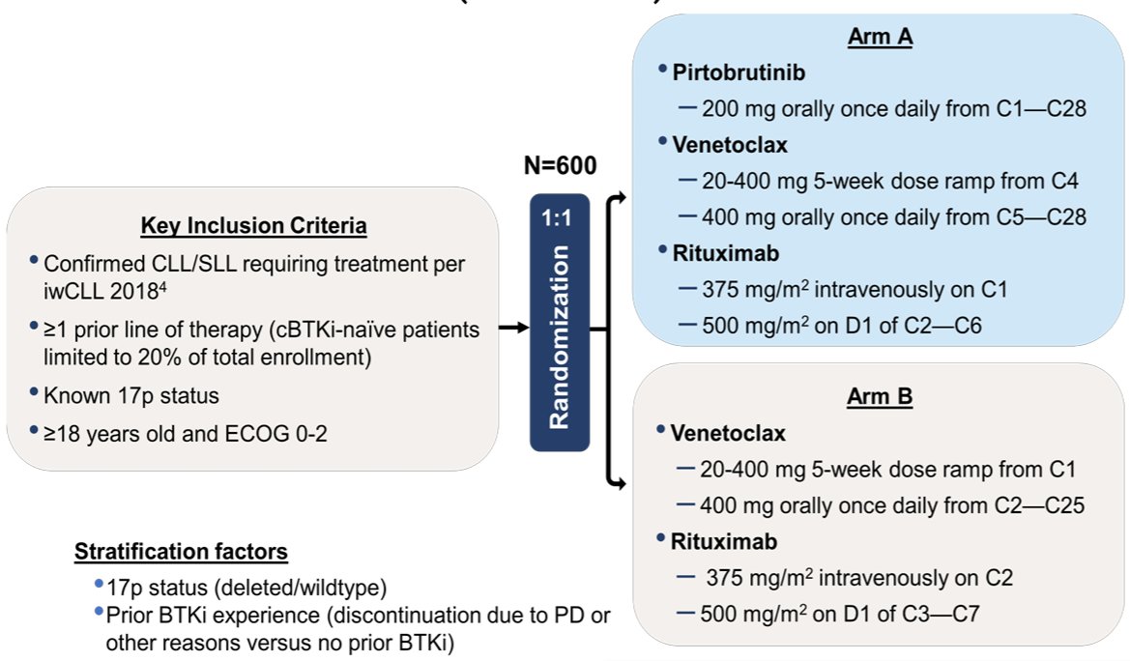
BRUIN CLL-322: An Ongoing Phase III Trial
Primary Endpoint:
PFS by IRC
Eyre TAA et al. ASCO 2023; Leow CC et al. iwCLL 2023

Slide 60
Pirtobrutinib added to venetoclax time-limited regimen significantly increased progression-free survival in patients with previously treated CLL/SLL
On April 13, 2026, positive topline results were announced from the Phase 3 BRUIN CLL-322 trial of pirtobrutinib plus venetoclax and rituximab versus venetoclax and rituximab in patients with relapsed or refractory chronic lymphocytic leukemia or small lymphocytic lymphoma (CLL/SLL).
“Treatment in both study arms was administered for up to two years, after which patients do not take any CLL therapy until their disease progresses. The study met its primary endpoint, demonstrating that the addition of pirtobrutinib to venetoclax plus rituximab led to a statistically significant and clinically meaningful improvement in progression-free survival (PFS), as assessed by an independent review committee (IRC). Results were consistent across clinically relevant subgroups and regardless of whether patients were previously treated with a covalent BTK inhibitor.
Overall survival (OS), a key secondary endpoint, was not yet mature at this analysis, but was trending in favor of the pirtobrutinib combination regimen. The overall safety profile of this regimen was consistent with the known safety profile of each medicine. Rates of adverse events were similar across the study arms, with low rates of treatment regimen discontinuations, also similar between arms.”
https://investor.lilly.com/news-releases/news-release-details/lillys-jaypirca-pirtobrutinib-significantly-extended-progression

Slide 61
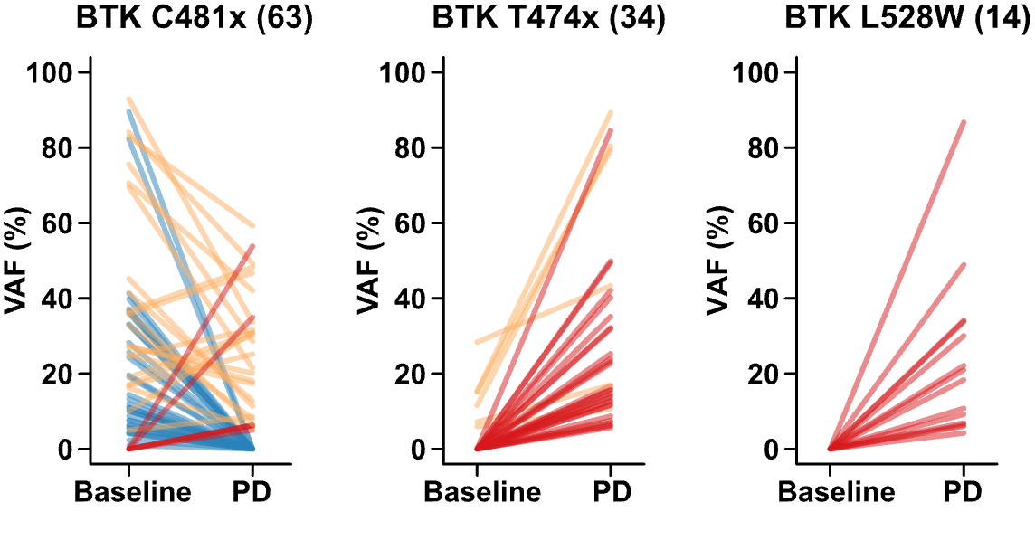
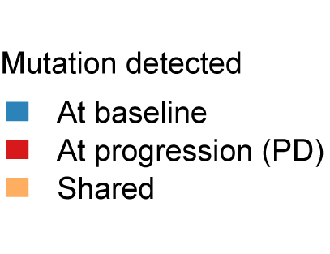
Pirtobrutinib leads to non-C481S mutations
Brown et al ASH 2023

Slide 62
Emerging Therapies – Sonrotoclax + Degraders

Slide 63
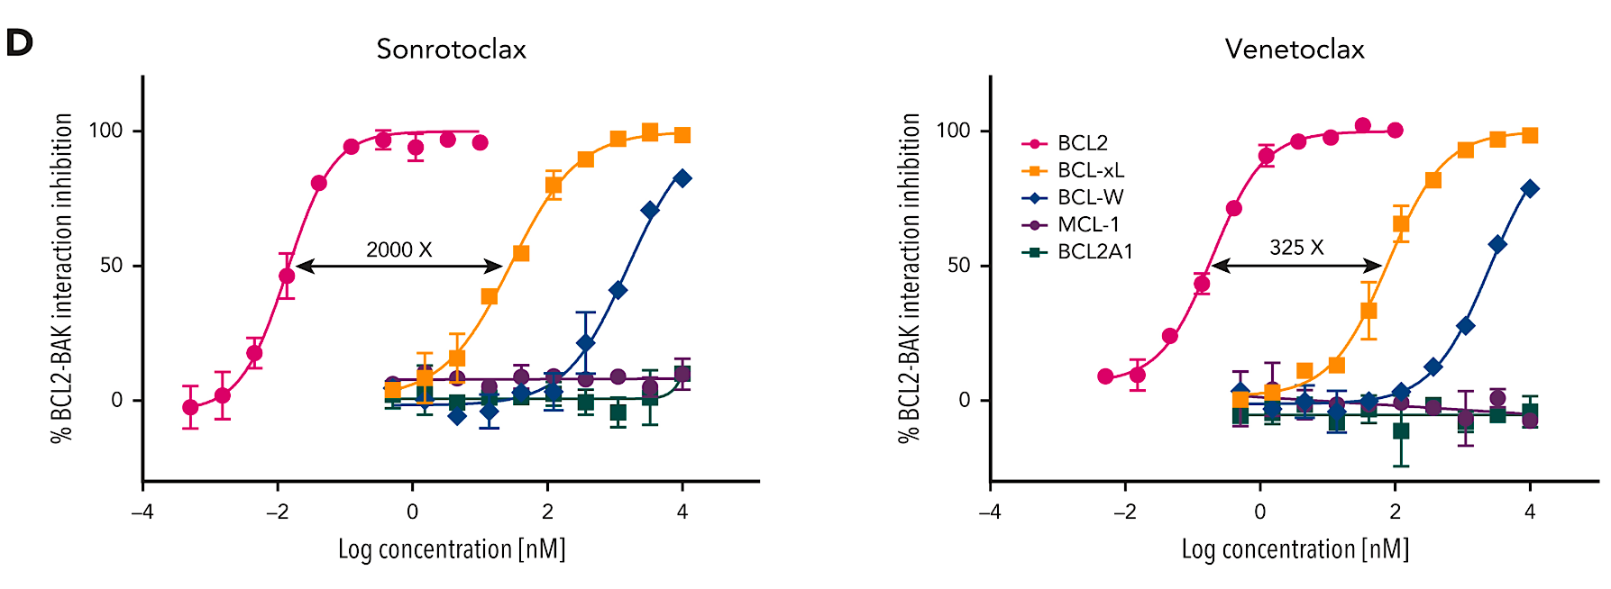
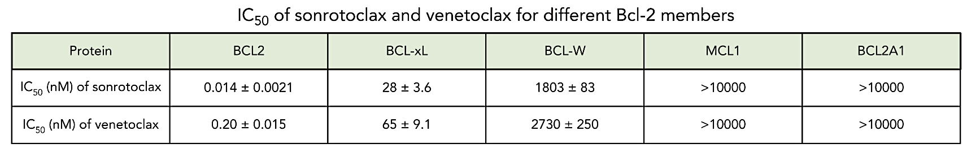
Next Generation BCL2i - Sonrotoclax
Liu et al Blood 2024

Slide 64
Sonrotoclax + Zanu TN CLL
Sonrotoclax + Obin TN CLL
N = 137
60% IGHV unmutated
22% TP53 aberration
78% stopped therapy per protocol after 24 cycles
Most common TEAE – Neutropenia 42%, 27% Grade ≥3
ORR 100% - CR 47%
Median time to response – 2.6 months
uMRD4 – 94%
N = 55
58% IGHV unmutated
17 patients stopped due to uMRD4
Median follow-up was 8.9 months
Most common TEAE – Thrombocytopenia (56%) then infusion reaction (56%) then neutropenia (49%), 38% Grade ≥3 neutropenia
ORR was 89 – CR 46%
Best uMRD4 rate per was 87%
Hoffman et al ASH 2025 Abstract 793, Soumerai et al ASH 2024 Abstract 1012

Slide 65
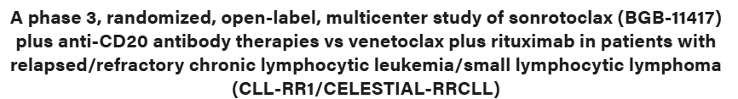
2 Randomized Studies – Celestial
Al-Sawaf O et al. ASH 2025; Patten PEM et al. ASH 2024

Slide 66
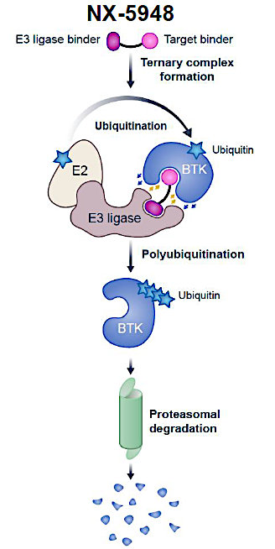
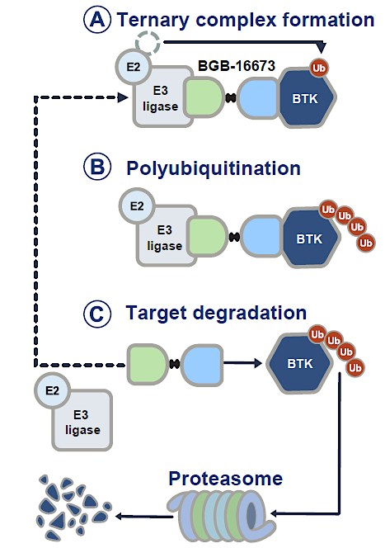
BTK degraders: NX-5948 & BGB-16673
Shah N, et al. ASH 2024. Oral 884. 2. El-Sharkwai D, et al. BSH ASM. 2024. 3. Thompson MC, et al. ASH 2024.Oral 885.

Slide 67
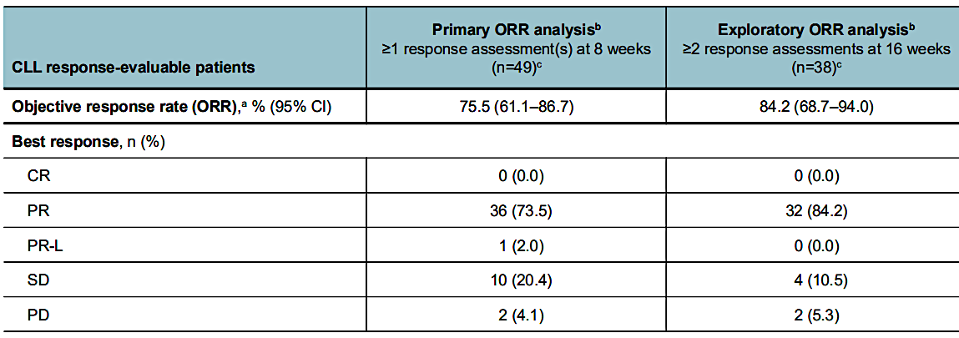
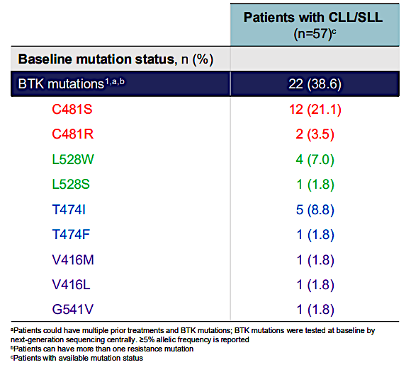
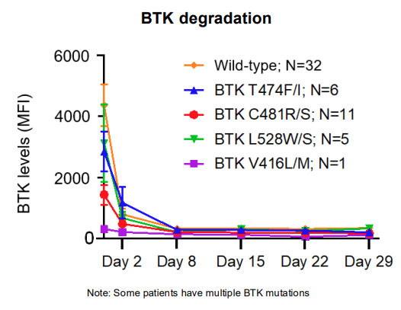
NX-5948
Shah N, et al. ASH 2024. Oral 884.

Slide 68
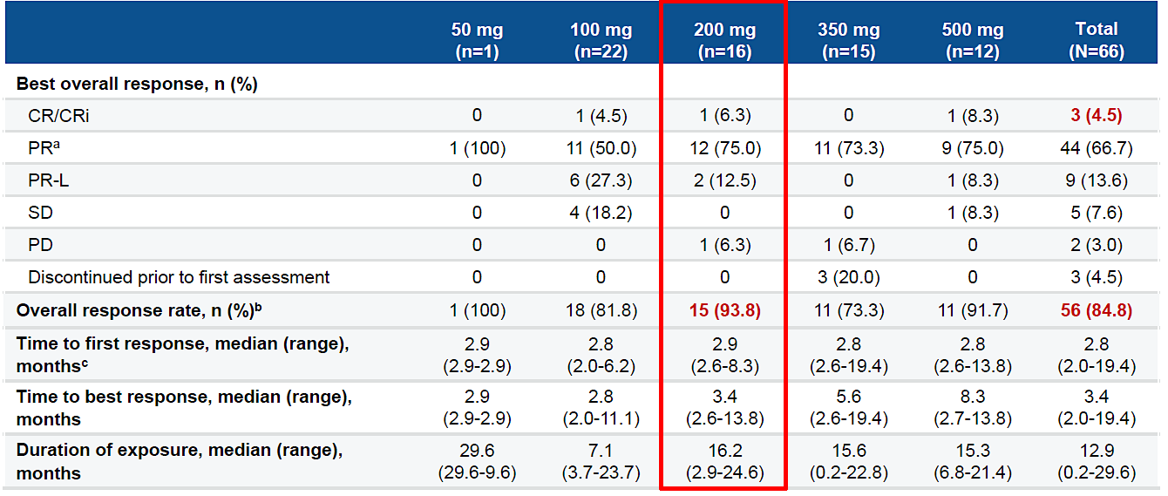
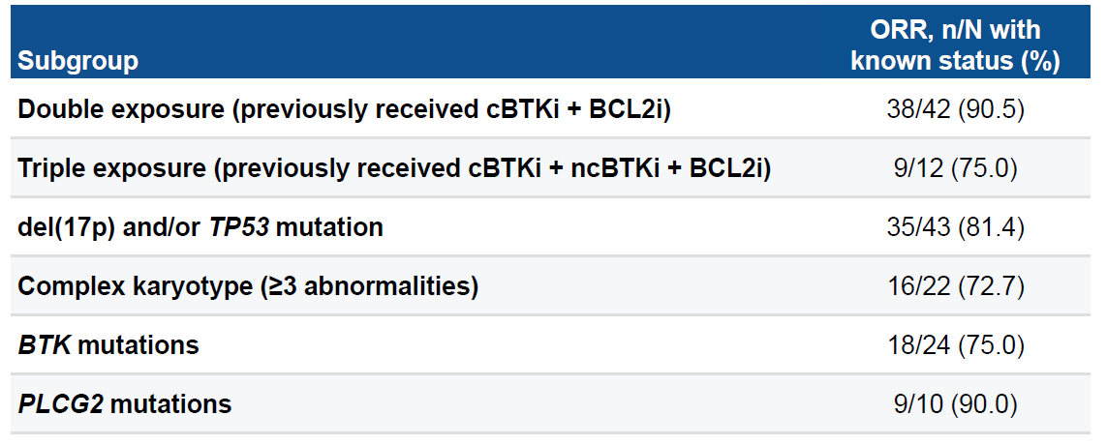
BGB-16673
Scarfò, L, et al. EHA 2025. S158.

Slide 69
QUESTIONS?

Slide 70
Module 2: Pancreatic Cancer
Optimal Incorporation of Chemotherapy into the Management of Advanced Pancreatic Cancer — Dr Philip
Other Available and Emerging Novel Approaches for Pancreatic Cancer — Dr O’Reilly

Slide 71

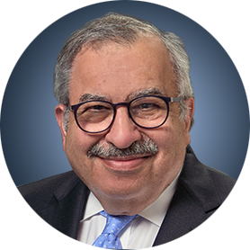
Faculty
Eileen M O’Reilly, MD
Memorial Sloan Kettering Cancer Center
New York, New York
Moderator
Neil Love, MD
Research To Practice
Miami, Florida
Philip A Philip, MD, PhD
Henry Ford Cancer
Detroit, Michigan
Co-Moderator
Vikas Malhotra, MD
Florida Cancer Specialists &
Research Institute
Spring Hill, Florida

Slide 72
Module 2: Pancreatic Cancer
Optimal Incorporation of Chemotherapy into the Management of Advanced Pancreatic Cancer — Dr Philip
Other Available and Emerging Novel Approaches for Pancreatic Cancer — Dr O’Reilly

Slide 73
Module 2: Pancreatic Cancer
We would like to do a “best paper or presentation of the year” activity. Please suggest one “paper of the year” and 2 other worthy papers based on the value in treatment of current and future patients.

Slide 74



Pancreatic Cancer
Philip Agop Philip, MD, PhD, FRCP
Henry Ford Health
Wayne State University School of Medicine
Detroit, Michigan
USA

Slide 75
Disclosures
Advisory Committees | Corcept Therapeutics Inc, Ipsen Biopharmaceuticals Inc, Jazz Pharmaceuticals Inc, Novocure Inc, Revolution Medicines Inc
Consulting Agreements | Novocure Inc
Contracted Research | Bristol Myers Squibb, Novartis, Revolution Medicines Inc, Taiho Oncology Inc
Data and Safety Monitoring Boards/Committees | J-Pharma Co Ltd, Oncolytics Biotech Inc

Slide 76
Clinical and biologic factors affecting choice of up-front and later-line therapy in metastatic PDAC
  Performance status
  Age
  Organ function
    Liver
    Neuropathy
  Genetics (germline)
    BRCA/PALB2
    DYPD
    UGT1A1
  Genomics (somatic)
    KRAS, NRG-1, MSI, NTRK,
  Clinical trial availability
  Patient preference!

Slide 77
Phase 3 trials establishing FOLFIRINOX and gemcitabine nab-paclitaxel as standards of care in frontline metastatic PDAC
FOLFIRINOX
Gemcitabine
Nab paclitaxel
R
R
OS
OS
Gemcitabine
Gemcitabine
N = 342
N = 861
Conroy et al, NEJM, 2011; Von Hoff et al, NEJM, 2013

Slide 78
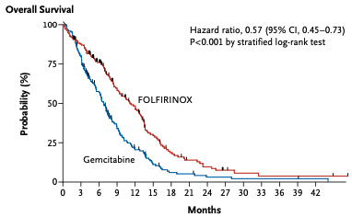



Data establishing efficacy and safety of FOLFIRINOX and gemcitabine/nab paclitaxel for untreated advanced PADC
FOLFIRINOX Gem-Nab paclitaxel
Grade 3 or 4 toxicities %
11.1 vs 6.8 m
8.5 vs 6.7 m
 | FFX | GemNab
Neutrop | 45.7 | 38.0
FN | 5.4 | 3.0
Thromb | 9.1 | 13.0
Diarrhea | 12.7 | 6.0
Neuropa | 9.0 | 17.0
Fatigue | 23.6 | 17.0
6.4 vs 3.3 m
5.5 vs 3.7 m
Conroy et al, NEJM, 2011;
Von Hoff et al, NEJM, 2013

Slide 79
NAPOLI-3: randomised phase 3 trial of NALIRIFOX versus nab-paclitaxel/gemcitabine in treatment-naive pts with metastatic PDAC
NALIRIFOX dosing compared to FOLFIRINOX
mg/m²
NALIRIFOX
 | FOLFIRINOX | NALIRIFOX
5-FU | 2,400 | 2,400
LCV | 400 | 400
IVB 5-FU | 400 (0) | 0
Oxaliplatin | 85 | 60
irinotecan | 180 (150) | 50
R
OS
Gemcitabine
Nab paclitaxel
N = 770
Wainberg et al, Lancet, 2023

Slide 80



NAPOLI-3: Efficacy
Overall Survival
Wainberg et al, Lancet, 2023

Slide 81

Comparative toxicity profile of NALIRIFOX vs. FOLFIRINOX vs. gemcitabine/nab paclitaxel: % grade 3 or 4 toxicities
 | FOLFIRINOX | NALIRIFOX | Gem/Nab Paclitaxel
Neutropenia | 45.7 | 14 | 25
Anemia | 7.8 | 11 | 17
Fatigue | 23.6 | 6 | 5
Vomiting | 14.5 | 7 | 2
Diarrhea | 12.7 | 20 | 5
Neuropathy | 9 | 3 | 6
Appetite | - | 9 | 3
Hypokalemia | - | 15 | 4
Conroy et al, NEJM, 2011; Wainberg et al, Lancet, 2023; Nichetti et al, JAMA Network Open, 2024

Slide 82




NALIRIFOX is as efficacious and tolerable in PDAC patients over 70 years
< 70 years > 70 years
Macarulla et al, ESMO Open 2026

Slide 83

Patients who received NALIRIFOX in NAPOLI-3 and had dose reductions of liposomal irinotecan and/or oxaliplatin did not impact OS
 | N | Median OS months
Liposomal IRI
50 mg/m² | 173 | 9.1
40 mg/m² | 118 | 11.8
32.5 mg/m² | 56 | 16.9
25 mg/m² | 23 | 13.5
Oxaliplatin
60 mg/m² | 150 | 7.9
48 mg/m² | 116 | 11.7
39 mg/m² | 73 | 17.1
30 mg/m² | 30 | 14.4
Patel A et al, ASCO GI 2026, Abs 716

Slide 84

Dose reductions resulted in longer duration of drug exposure and higher cumulative doses
Anjan et al, ASCO GI 2026, Abs 716

Slide 85



NALIRIFOX: Real world data on efficacy, toxicity and impact of KRAS^{mut}
Reichinger et al, ESMO Open, 2025

Slide 86
NAPOLI-1: Phase 3 trial of Nal-IRI plus 5-FU/LV in metastatic PDAC progressing on gem-based therapy
Nal-IRI 70 mg/m²/
5-FU/LCV
R
Nal-IRI
OS
N = 417
5-FU/LCV
Wang-Gillam et al, Lancet, 2015

Slide 87


NAPOLI-1: Nal-IRI/5FU/LCV significantly improved overall survival compared to 5FU/LCV
6.2 vs 4.2 mon
Grade 3 or 4 toxicities %
 | Nal/5FU/LCV | 5FU/LCV
Diarhea | 13 | 4
Vomiting | 11 | 3
Nausea | 8 | 3
Appetite | 4 | 2
Fatigue | 14 | 4
Neutropenia | 27 | 1
Anemia | 9 | 7
Hypokalemia | 3 | 2
3.1 vs 1.5 mon
Wang-Gillam et al, Lancet, 2015; Wang-Gillam et al, ASCO, 2016

Slide 88
Treatment Sequencing Approach For mPDAC In 2026:
A Clinical Trial Must Always Be Considered Before Starting Therapy
1st line
2nd line
3rd line
Nab-paclitaxel + Gemcitabine
Nal-IRI (MM-398) +
5-FU/LV
Platinum-based tx
(depending on
prior exposure)
Daraxonrasib
mFOLFOX6 or CAPOX
Nal-IRI + 5-FU/LV
(depending on
prior exposure)
FOLFIRINOX
NALIRIFOX
BRCA/PALB^{mut}
Capecitabine or
5-FU
Olaparib
Gemcitabine+
Cisplatin
Gemcitabine
Nab-paclitaxel + gemcitabine
(if no neuropathy)
Supported by RCT data
Supported by retrospective data or small, single arm trials

Slide 89
QUESTIONS?

Slide 90
Module 2: Pancreatic Cancer
Optimal Incorporation of Chemotherapy into the Management of Advanced Pancreatic Cancer — Dr Philip
Other Available and Emerging Novel Approaches for Pancreatic Cancer — Dr O’Reilly

Slide 91
Pancreas Adenocarcinoma
The Coming Future!
Research To Practice
Eileen M. O’Reilly, MD, FASCO
Winthrop Rockefeller Endowed Chair, Memorial Sloan Kettering Cancer Center
Chair, Human Research Protection Program and IRB
Professor of Medicine, Weill Cornell Medicine
April 25th, 2026

Slide 92
Disclosures
Advisory Committees and Consulting Agreements (Uncompensated) | Agenus Inc, Alligator Bioscience, Amgen Inc, Arcus Biosciences, Astellas, AstraZeneca Pharmaceuticals LP, BioNTech SE, Bristol Myers Squibb, Ikena Oncology, Immuneering Corporation, Ipsen Biopharmaceuticals Inc, Merck, MOMA Therapeutics, Novartis, Pfizer Inc, Regeneron Pharmaceuticals Inc, Revolution Medicines Inc, Tango Therapeutics
Contracted Research | Agenus Inc, Amgen Inc, Arcus Biosciences,AstraZeneca Pharmaceuticals LP, BioNTech SE, Digestive Care Inc, Elicio Therapeutics, Genentech, a member of the Roche Group, Incyte Corporation, Revolution Medicines Inc, Tango Therapeutics
Nonrelevant Financial Relationships | American Association of Cancer Research (Editor), American Society of Clinical Oncology (Editor), Break Through Cancer, Imedex, National Cancer Institute (Cancer Center Support Grant/Core Grant), National Institutes of Health (research grant), Stand Up 2 Cancer

Slide 93











RAS Mutations in ~20% of All Cancers
KRAS Genomics
RAS Mutations Across
Cancer Types
KRAS Alleles in NSCLC, CRC,
and Pancreatic Cancers
Melanoma
KRAS 1%, HRAS 2%, NRAS 17%
Head and neck
KRAS 2%, HRAS 5%, NRAS 2%
Pancreas
KRAS 88%
Non-small cell lung cancer
KRAS 32%
Esophagogastric
KRAS 3%, KRAS-amp 6%
Gallbladder, cholangiocarcinoma
KRAS 21%, NRAS 2%
Colorectal
KRAS 42%, NRAS 4%
Endometrial
KRAS 17%, NRAS 3%
Ovarian
KRAS 9%, NRAS 2%
Leukemia
KRAS 5%, NRAS 14%
Yang, X. J Haematol Oncol, 2024
Singhal, A… O’Reilly, EM. Nat Med, 2024

Slide 94

Differential Genomic, Prognostic Features of KRAS Variants
KRAS G12R and KRAS Wild-Type Prognostic
KRAS Biology
Prevalence KRAS variants
98% KRAS substitutions G12 (91%), Q61 (7%)
N= 14 (0.6%) multiple hotspot mutations
Kaplan-Meier of OS among KRAS variants
Varghese, A, Perry, M…Schultz, N, Berger, MF, Iacobuzio-Donahue, C, Bandlamudi, C, O’Reilly, EM. Nat Med, 2025

Slide 95
Therapeutic Agents in Development (Incomplete….)
Truly a Feast… and in Pancreas Cancer!
RAS Therapeutics
G12C Inhibitors
Sotorasib (Amgen)
Adagrasib (Mirati/BMS)
Divarasib (Genentech/Roche)
Olomorasib (Lilly)
Fulzerasib/IBI351 (GenFleet)
Glecirasib (Jacobio)
Calderasib/MK-1084 (Merck)
Opnurasib (Novartis)
Garsorasib/D-1553 (InventisBio)
FMC-376 (Frontier Medicines)
RMC-6291 (Rev Medicines)
BBO-8520 (BridgeBio)
D3S-001 (D3Bio)
G12D Inhibitors
ASP3082 (Astellas)
ASP4326 (Astellas)
RMC-9805 (Rev Medicines)
HRS-4642 (Hengrui)
TSN1611 (Taison Biopharma)
QTX3046 (Quanta)
GDC-7035 (Genentech)
AZD0022 (AstraZeneca)
INCB161734 (Incyte)
GFH375/VS-7375 (Genfleet/Verastem)
D3S-003 (D3Bio)
LY3962673 (Lilly)
KQB548 (Kumquat Biosciences)
siG12D-LODER SIL-204 (Silexion)
VRTX153 (Vrise)
ABSK141 (Abbisko Therapeutics)
AZD0240 (AstraZeneca) TCR
RNK08954 (Ranok Ther; Hangzhou)
Pan (K)RAS Inhibitors
RMC-6236/daraxonrasib (Rev Medicines)
BI-2492 (BI)
QTX3034, QTX3544 (Quanta)
PF-07934040 (Pfizer)
PF-07985045 (Pfizer)
BGB-53038 (Beigene)
BBO-11818 (BridgeBio Oncology)
ALTA-3263 (Alterome)
LUNA18 (Chugai)
LY406634 (Lilly)
JAB-23425 (Jacobio)
ABREV001 (Agastiya)
AUBE00 (Chugai)
TRN-372 (Treeline)
AMG410 (Amgen)
ADT-1004
ERAS-0015 (Erasca)
AN9025 (Adlai Nortye)
ASP5834 (Astellas)

Slide 96





Mechanisms of Action Differ between Therapeutics
Mutant/Allele Selective On/Off; Tri-Complex Multi(ON); Degraders
KRAS Biology
*Covalent modification; Approved; Clinical development; Preclinical
Cox AD, Der CJ. Genes Dev. 2025

Slide 97
KRAS G12C (G→C) Allele Inhibitors: Promising Signal
1-2% of Pancreas Cancers
Pancreas Cancer: G12C Inhibitor RAS Therapeutics
 | N | Response Rate | Disease Control | Median PFS | Median OS
Sotorasib (CodeBreaK 100) | 38 | 21% (8/38) | 84% (32/38) | 4 m | 6.9 m
Adagrasib (KRYSTAL-1) | 21 | 33% (7/21) | 81% (17/21) | 5.4 m | 8 m
Divarasib | 7 | 43% (3/7) | 100% (7/7) | - | -
Olomorasib (LY3537982) | 24 | 42% (10/24) | 92% (22/24) | 6.9 m | -
Glecirasib (JAB-21822) | 31 | 42% (13/31) | 93.5% (29/31) | 5.5 m | 10.8 m
HRS-7058 | 9 | 75% (6/8) | 100% (8/8) | - | -
Garorasib | 22 | 45.5% |  | 7.6 m
Stickler, J. New Engl J Med, 2023
Bekaii-Saab, T…Pant, S. J Clin Oncol, 2023
Sacher, A. New Engl J Med, 2023
Murciano-Goroff, Y. AACR, 2023
Hollebecque, A. Gastrointestinal Cancers Symposium, 2024
Li, J. Gastrointestinal Cancers Symposium, 2024
Huang, D. Abstract 9140, ESMO, 2025
Yamamoto, N. BJC, 2025
Li, J. Cancer Communications, 2025
NCCN guidelines: ECOG 0-3

Slide 98



Daraxonrasib: Early Outcomes in 2L PDAC 300 mg PO
Multi-RAS(ON) Tri-Complex Inhibitor (KRAS H, N, Wild-Type)
RAS Therapeutics: PanRas Inhibitor
Response Rate (N= 38)
Overall Survival (N= 38)
 | Overall RR | DCR Rate | PFS (m) | OS (m)
RAS G12X (N= 26) | 35% | 92% | 8.5 (6.7- 10.5) | 13.1 (10.9- NE)
RAS mutant (N= 38) | 29% | 29% | 8.1 (5.9- 10.1) | 15.6 (10.9- NE)
*RAS mutant: G12X, G13X, Q61X; Median f/up > 16 m
Data cut off 06-30-2025
Courtesy Revolution Medicine website 09 2025

Slide 99
Daraxonrasib 300 mg: Safety, Adjustments 2L+ (N= 83)
Toxicity: Primarily Cutaneous/GI
Pancreas Cancer: PanRAS Inhibitor
Toxicity | Any Grade | Grade > 3
Rash | 75 (90%) | 6 (7%)
Mucositis | 45 (54%) | 3 (4%)
Diarrhea | 43 (52%) | 3 (4%)
Nausea/Vomiting | ~39%/ 26% | -
Paronychia | 15 (18%) | --
Fatigue | 14 (17%) | 1 (1%)
Platelets | 8 (10%) | 3 (4%)
Anemia | 7 (8%) | 6 (7%)
AST/ALT | 10%/ 7% | 4%/ 2%
Dose Adjustments | N= 83
Dose modifications | 40 (48%)
Dose interruption | 36 (43%)
Dose reduction | 25 (30%)
Discontinuation AE | -
Data cut off 06-30-2025
Courtesy Revolution Medicine website 09 2025

Slide 100
RASolute 302: Phase III PDAC 2L Daraxonrasib vs Chemo
Accrual Complete
Pancreas Cancer: PanRAS Inhibitor
Daraxonrasib 300 mg PO Daily
N= 230
Metastatic PDAC
Second-Line
ECOG 0-1
RAS G12X (K,H,N), WT
N= 460
1:1
Investigator Choice Chemo
N= 230
Co-primary endpoints: Progression-free survival; OS (G12X)
Secondary endpoints: PFS, OS (all), Overall response rate, duration of response, safety, QoL
HR 0.7 OS (G12X 7.1 → 10.1 m)
HR 0.54 PFS (G12X 3.5 → 6.5 m)
NCT06625320

Slide 101
RASolute 302: Phase III PDAC 2L Daraxonrasib vs Chemo
Pancreas Cancer: PanRAS Inhibitor
Trial met all primary and key secondary endpoints
In the overall (intent-to-treat) study population:
Daraxonrasib demonstrated median OS 13.2 vs 6.7 months for chemotherapy
Hazard ratio of 0.40, p < 0.0001
https://ir.revmed.com/news-releases/news-release-details/daraxonrasib-demonstrates-unprecedented-overall-survival-benefit

Slide 102




Daraxonrasib +/- Gem/nab-Paclitaxel: 1L Pancreas Cancer
Promising Single Agent, Combination Signals in First Line PDAC (AACR 2026)
RAS Therapeutics: PanRAS Inhibitor
Daraxonrasib | N= 38
Overall RR | 47% (31, 64)
Disease control Rate | 89% (79, 98)
6-month OS | 83% (67, 92)
Daraxonrasib+Gem/nab-P | N= 40
Overall RR | 58% (41, 73)
Disease control Rate | 90% (76, 97)
6-month OS | 90% (76, 96)
O’Reilly, EM…Garrido-Laguna, I. AACR, 2026
Wolpin, B….Sohal, D. AACR, 2026

Slide 103
RASolute 303: Phase III 1L Metastatic PDAC
Activated Q1 2026
Pancreas Cancer: PanRAS Inhibitor
Daraxonrasib 300 mg Daily
1L Metastatic PDAC
ECOG 0-1
RAS G12X (K,H,N), WT
N~ 900
1:1:1 Randomization
Daraxonrasib 200 mg + Gem/nabP
→ Daroxonrasib 300 mg
SOC Gemcitabine/nab-Paclitaxel
Co-primary endpoints: Progression-free survival; OS
Secondary endpoints: PFS, OS, Overall response rate, duration of response, safety, QoL
NCT07491445

Slide 104

Zoldonrasib: Phase I G12D RAS-On Allele Specific Inhibitor
Multiple G12D Inhibitors in Development
RAS Therapeutics: Allele Specific
Pancreas Cohort | Dose 1200 mg
Overall RR | 12 (30%)
Disease Control Rate | 32 (80%)
Zoldonrasib (RMC-9805)
Hong, D. EORTC-NCI-AACR, 2024
Spira, A. Gastrointestinal Cancers Symposium, 2025

Slide 105

ASP-3082: Protein-Selective Degradation KRAS G12D
PROTAC: Proteolysis Targeting Chimera (E3 Ubiquitin Ligase and Ligand)
RAS Therapeutics: Degrader
KRAS G12D Mutation: PDAC (35-40%); CRC (15%); NSCLC (5%)
Targeted drug development strategy for intra-cellular proteins
Park, W..Tolcher, A. ESMO, 2024
Lee, JK, NPJ Precision Oncol, 2022
Stickler, S. Oncol, Res, 2024
Yang, J. Cell Discovery, 2024
NCT05382559

Slide 106


ASP-3082/Setidegrasib KRAS G12D Protein Degrader
First in Class: Destruction of Mutant KRAS Alleles
RAS Therapeutics: Degrader
PDAC 2L (N= 7); 3L (N= 14) | N= 21 600 mg IV
Overall RR | 5 (24%)
Median PFS | 3 m (1.14- 6.9)
Median OS | 10.3 (4.2- 13)
Park, W….Tolcher, A. Abst 608O. ESMO, 2024
Park, W. New Eng J Med, 2026

Slide 107
PDAC Selected Other G12Di Monotherapy/ Combination
RAS Therapeutics: G12D Allele Specific Inhibitors
Drug | Mechanism | N | Outcome
GFH375 600 mg P0 VS-7373 Median 2L | G12D ‘on/off’ state | 66 | ORR 40.7%, DCR 96.7% Median PFS 5.2 m Median OS NR
INCB161734 | G12D non-covalent ‘on/off’ state | 25 29 | ORR 20% 600 mg; DCR 64% ORR 34% 1200 mg; DCR 86%
HRS-4642 500/ 1200 mg Gem, nab-P d1,8 q 3w 1L | G12D non-covalent | 30 | ORR 63%, DCR 93% Median PFS NR (est > 1 yr)
Setigrasib (ASP-3082) + mFOLFIRINOX | G12D degrader | 14 | Responses observed
RNK08954 | G12D non-covalent | 13 | ORR 33% PDAC (small N)
Wang, L, LBA84, ESMO, 2025
Desai, J, Abstract 916O, ESMO, 2025
Zhou, A, Abstract 915O, ESMO, 2025
Xie, L. Can Disc, 2026

Slide 108


Phase IIa Atebimetinib, Gem/nab-Paclitaxel 1L (N= 36)
Encouraging Early Signal – Novel MEK Inhibitor
Pancreas Cancer: Revisiting MEK
 | Statistics
Overall RR | 39% (14/36)
Disease control rate | 81% (29/36)
OS (preliminary) | 86% @ 9m
Unpublished; Courtesy Immuneering website, 2025

Slide 109
Selected Phase III Trials Activated / Announced in PDAC
RAS/MAPK Inhibitors: Pancreas Cancer
Trial Name | Therapeutic | Target | N | Disease Setting | Status
RASolute 302 | Daraxonrasib vs Chemo | PanRAS | 460 | 2nd line metastatic | Enrolled/ Awaited
RASolute 303 | Gem/nabP +/- Daraxonrasib, D | PanRAS | ~900 | 1st line metastatic | Activated Q1 2026
RASolute 304 | Daraxonrasib | PanRAS | 500 | Adjuvant | Activated Q4 2025
RASolute 305 | Zoldonrasib + chemo/Z | KRAS G12D |  | 1st line metastatic | Pending 2026
RASolute 309 | Zoldonrasib + Daraxonrasib | KRAS G12D, panRAS |  | 1st line metastatic | Pending 2026
Pending | mFOLFIRINOX +/- Setigrasib | KRAS G12D |  | 1st line metastatic | Pending 2026
DAWN 303 | Chemo +/- INCB161734 | KRAS G12D |  | 1st line metastatic | Pending 2026
MAPKeeper 301 | Gem/nabP +/- Atebimetinib | MEK |  | 1st line metastatic | Pending 2026
HRS-4642-302 China | Chemo +/- HRS-4642 | KRAS G12D |  | 1st line metastatic | Activated Q4 2025
GFH375-X1301 China | VS-7375 vs Chemo | KRAS G12D |  | 2nd line metastatic | Activated Q4 2025

Slide 110

RAS Resistance Targeting
KRAS Therapy
Genetic Resistance to G12C
Adaptive Resistance
Addressing Resistance with Combinations
Combination approaches:
Allele specific, panRAS
+Upstream receptor TKI signaling
+MAPK pathway targeting
+Immunotherapy
+Chemotherapy
+Classical state targeting
*
Singhal, A, Li, B, O’Reilly, EM. Nat Med, 2024

Slide 111
KRAS Wild-Type PDAC

Slide 112


Early Onset PDAC: KRAS^{WT} PDAC (~5-8%)
Rare but Important Oncogenic Drivers beyond RAS
Pancreas Cancer: KRAS Wild-Type
Early onset PDAC (< 55 years)
More likely to be KRAS^{WT} (15-20%)
More likely to have germline alteration
More likely to have fusion
Lee, MS, Pant, S. ASCO Educational Book, 2021
Philip, P. Clin Can Res, 2022
Singh, H. Clin Can Res, 2023
Varghese, A..O’Reilly, EM. JNCI, 2021
Singhi, AD. Gastroenterology, 2019
Varghese, A…O’Reilly, EM. Nat Med, 2025

Slide 113



Zenocutuzumab: Bispecific Ab Targets HER2/HER3
NRG1 Fusion(+) PDAC; Approved PDAC, NSCLC 2024
Pancreas KRAS Wild-Type: Bispecific Antibodies
Zenocutuzumab
Neuregulin 1 (NRG1) ligand binds HER3 → HER2/HER3 heterodimerization, oncogenesis
Zenocutuzumab binds extracellular domains HER2, HER3, blocks anti-tumor activity; ADCC
NRG1(+) PDAC (N= 33)
  ORR 42% (39% PR; 3% CR)
  Tumor reduction 82%
  Med duration response 9.1 m
Time to Response; Time on Therapy
Overall RR 42% (N= 33)
Schram, A……O’Reilly, EM. ESMO, 2023
Schram, A…Drilon, A. New Eng J Med, 2025

Slide 114

Young Man; KRAS Wild-Type: NRG1 Fusion
Zenocutuzumab
Pancreas KRAS Wild-Type: Bispecific Antibodies
Features NRG1(+) PDAC Tumors
Younger patients/ early onset PDAC
KRAS wild-type
Low Ca 19-9, disease bulk
Can respond well to chemotherapy
Testing methodology key:
DNA, RNA
Baseline
Ca 19-9 ~450
T+ 2 m
Ca 19-9 <50
Schram, A. ASCO, 2021
Varghese, A. JNCI, 2021
Singhi, AD. Gastroenterology, 2019
Schram, A. Cancer Discovery, 2022
Schram, A…Drilon A. NEJM, 2025

Slide 115
Other Targets, Claudin, MTAP deletion, PRMT5i and IO in PDAC

Slide 116

Claudin 18.2: Promising Target in PDAC
GLEAM: Randomized Phase II Gemcitabine/nab-Paclitaxel +/- Zolbetuximab
Pancreas Cancer: Surface Tropisms Claudin
Gemcitabine/nab-Paclitaxel + Zolbetuximab N= 238
1000 mg/m² d1 (load); 600 mg/m² IV d1,15
Metastatic PDAC
CLDN 18.2(+) 75%
ECOG 0-1
N= 357
2: 1
Gemcitabine/nab-Paclitaxel
N= 119
Normal pancreas
Zolbetuximab: mAb IgG1 CLDN 18.2: ADCC, CDC
Primary endpoint: OS
10.5 m → 15.0; 80% power, 2-sided 0.05, HR 0.776
Press release 10 2025: Primary endpoint not met
Eligibility: CLDN 18.2 mod/strong > 75% tumor cells (IHC)
Park W…Kunieda F et al. ASCO 2022. Abstract TPS4186
https://newsroom.astellas.com/2025-10-13-Astellas-Confirms-Phase-2-GLEAM-Trial-Did-Not-Meet-Primary-Endpoint-of-Overall-Survival-in-Patients-with-Metastatic-Pancreatic-Cancer

Slide 117

IBI343: Fully Human anti-Claudin 18.2 mAb, Exatecan
Innovent; Arcotatug Tavatecan
Claudin-Based Therapy: ADC
Dose escalation IBI343, dose expansion 6mg/kg IV Q3W (China) CLDN18.2 2+- 3+ ≥40%
Median age 62, 66% 2L+ therapy
cORR 17.9%, DCR 73.2% (N= 56)
mPFS 4.2 m, mOS 8.8 m
ORR 35% mOS 12.1 m irinotecan naïve (N= 20)
N= 62
Grade 3: Anemia 8%, neutrophils 23%, platelets 7%, nausea 3%
NCT05458219

Slide 118
IBI343: G-Hope-002 Phase III
Innovent; Arcotatug Tavatecan: Recruiting Fudan, China
Claudin-Based Therapy: ADC
IBI343 6mg/kg IV Q3 + BSC
LA, Met PDAC
CLDN 18.2(+)
> 2L
ECOG 0-1
N= 201
2: 1
Placebo 6mg/kg IV Q3 + BSC
Primary endpoint: OS
Claudin threshold: not defined
NCT07066098

Slide 119

Synthetic Lethality: New Approach – PRMT5, MTA Inhibition
MTAP Targeting Biology
Methylthioadenosine phosphorylase (MTAP)
MTAP deletion/loss ~15% multiple solid tumors; 8% GI cancers; PDAC 15- 25%
MTAP adjacent, often co-deleted CDKN2A (9p21)
MTAP, CDKN2A associated with resistance to IO therapies (‘cold’ TME)
MTAP-loss novel biomarker for agents inhibiting MAT2A and PRMT5
MTAP associated with resistance to ICB
Ngoi, NYL…Rodon Ahnet. Oncologist, 2024
Stopa, N. Cell Reports, 2016
Rodon, J. AACR-EORTC-NCI, 2023

Slide 120




MTAP-Deleted Solid Tumors: Phase I AMG 193 (2nd Gen)
MTD 1200 mg PO; Efficacy in Multiple Solid Tumors
MTAP Targeting: PRMT5 Inhibitors
PDAC
65 y/o male
2 prior lines
TP53m
CDKN2A/2B-loss,
MTAP-loss
KRAS
ESMO 2024 PDAC sub-cohort N= 23: 5 PR’s (2 confirmed); 4 SD
Multiple PRMT5, MAT2A agents/combinations in development
Rodon J et al. AACR-EORTC-NCI 2023.Abstract PR006
Sacher A et al. ESMO 2024.Abstract 604O
Rodon J…O’Neil B et al. Ann Oncol. 2024

Slide 121
Ongoing/Planned: PRMT5 Inhibitors Solid Tumors/PDAC
Pancreas Cancer: MTAP Targeting
Drug/Target | Trial/Population | Design | NCT
AMG 193 | MTAPESTRY | Phase Ib + mFOLFIRINOX or Gemcitabine/nab-Paclitaxel + RAS therapies | NCT06360354
BMS-986504 (MRTX1719) | Mountain-TAP 30 | 1L Rand Phase II/III Gem/nab-P +/- BMS-986504 | NCT07076121
TNG462 (vopimetostat) |  | Advanced solid tumors PDAC 2L ORR 25%; DCR 79%* | NCT05732831
TNG462 |  | 2L Rand Phase III TNG-462 vs chemo | NCT pending
TNG462 + Daraxonrasib or Zoldonrasib | MTAPdel + RAS^{MUT} or KRAS G12D | Phase I Novel, novel targeting | NCT0692259
AZD3470 | PRIMROSE | Phase I/IIa | NCT06130553
*Press release 10/23/2025

Slide 122

ARC-8: Phase I/IB: Gem/Nab-P + Quemliclustat (anti-CD73)
Promising Early Signal – Phase III PRISM 1 Enrollment Completed
Pancreas Cancer: Adenosine Immune Targeting
 | Pooled Gem/nabP+Q+/-Z N= 122 | SOC Control N= 122
Median OS | 15.7 m | 9.8 m
HR, p-value | 0.634 (0.471, 0.854); p= 0.0030
PRISM 1: Randomized phase III gemcitabine/nab-paclitaxel +/- quemliclustat/placebo (N= 610; 2:1)
Wainberg ZA…O’Reilly EM et al. ASCO GI 2024. Abstract 665
Wainberg, Z…O’Reilly, EM. Nat Med, 2026
NCT06608927

Slide 123
Pancreas Cancer & Therapy 2026 – Changing….
Pancreas Cancer: Advanced Disease
Pancreas Cancer Current 2026
Cytotoxic-based 3 or 2 drug combinations for most
Other Targets
MTAP-loss: PRMT5 inhibitors, Claudin
Immunotherapy: Adenosine modulation, CD40
RAS Therapies
RAS inhibitors – new 2L standard 2026?
Targeted: BRCA/HRD, RAS-wild-type – fusions
Rapidly moving to 1L, Adjuvant
Vaccines: Personalized neoantigen, RAS immunotherapy
Multiple agents, multiple mechanisms in development

Slide 124
QUESTIONS?

Slide 125
We are taking a short break!
The program will resume at 10:00 AM ET
Up Next…
Drs Deborah K Armstrong and David M O’Malley discuss the management of ovarian cancer

