Slide 1
Module 14: Systemic Mastocytosis and Myelofibrosis
Systemic Mastocytosis — Dr Hunter
Myelofibrosis — Dr Yacoub

Slide 2




Faculty
Anthony M Hunter, MD
Winship Cancer Institute of
Emory University
Atlanta, Georgia
Moderator
Neil Love, MD
Research To Practice
Miami, Florida
Abdulraheem Yacoub, MD
The University of Kansas Cancer Center
Fairway, Kansas
Co-Moderator
Maen Hussein, MD
Florida Cancer Specialists &
Research Institute
The Villages, Florida

Slide 3
Module 14: Systemic Mastocytosis and Myelofibrosis
Systemic Mastocytosis — Dr Hunter
Myelofibrosis — Dr Yacoub

Slide 4
Module 14: Systemic Mastocytosis and Myelofibrosis
We would like to do a “best paper or presentation of the year” activity. Please suggest one “paper of the year” and 2 other worthy papers based on the value in treatment of current and future patients.

Slide 5
Systemic Mastocytosis:
An Overview and Review of Therapeutic Advances
Anthony Hunter, MD
Associate Professor
Leader, Myeloproliferative Neoplasm Program
Winship Cancer Institute of Emory University

Slide 6
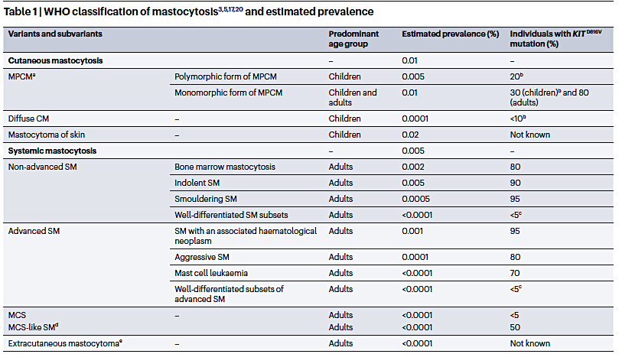
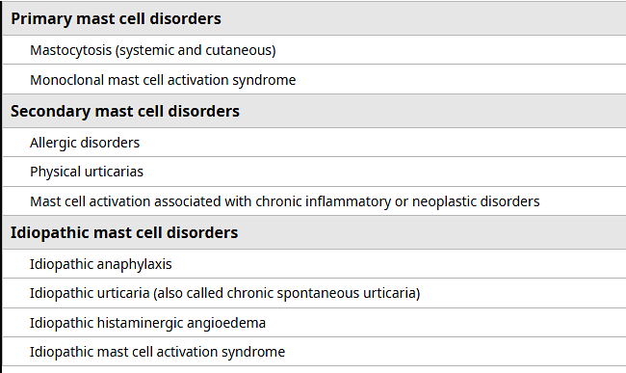
Systemic Mastocytosis Classification
Spectrum of clonal/neoplastic diseases of mast cells
  Characterized by pathologic mast cell accumulation in tissues
  Mast cell activation with related symptoms
Akin, C et al. . Nat Rev Dis Primers 2025; 11(1):30. Khoury JD, et al. Leukemia 2022; 36(7):1703-1719

Slide 7
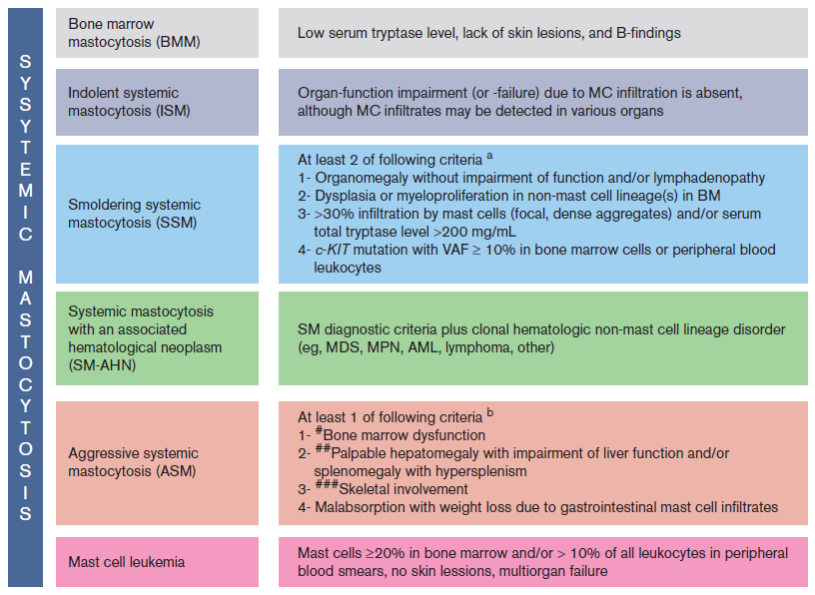
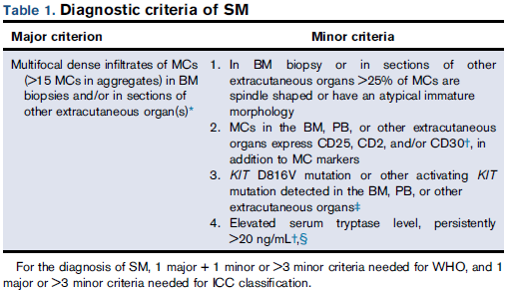
Diagnosis of Systemic Mastocytosis
Non-AdvSM
B
AdvSM
C
Ustun C, et al. Blood Adv 2025; 9(9):2048-2062. Khoury JD, et al. Leukemia 2022; 36(7):1703-1719. Arber DA, et al. Blood 2022; 140(11):1200-1228

Slide 8
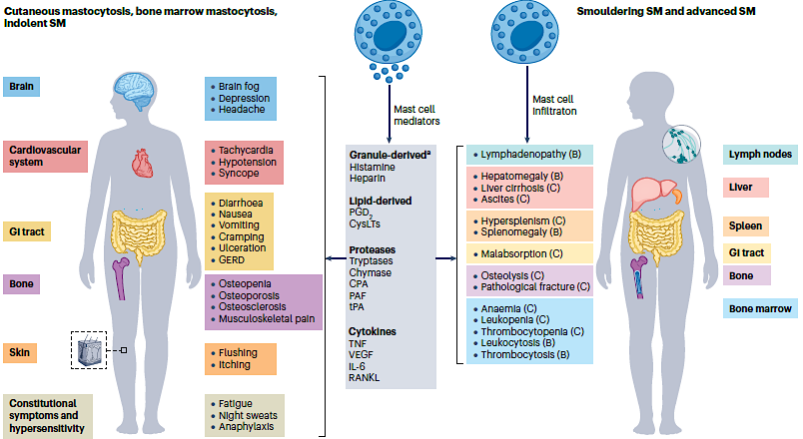
SM Displays Spectrum of Clinical Features with High Degree of Interpatient Variability
Akin, C et al. . Nat Rev Dis Primers 2025; 11(1):30

Slide 9
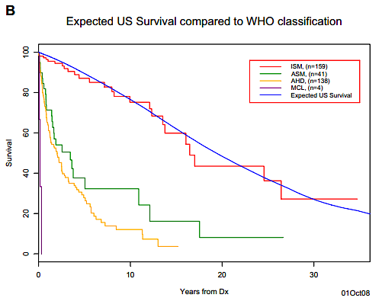
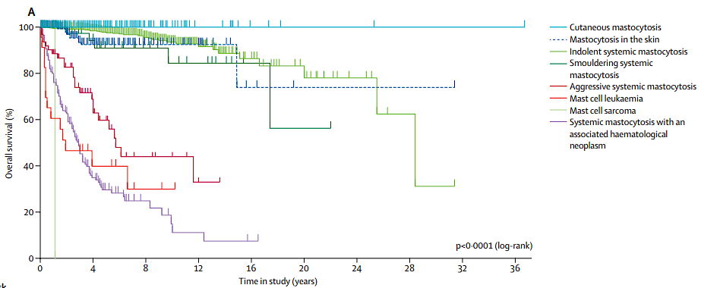
Survival of Systemic Mastocytosis by Subtype
Lim KH, et al. Blood 2009;113(23):5727-5736. Sperr WR, et al. Lancet Haematol 2019;6(12):e638

Slide 10
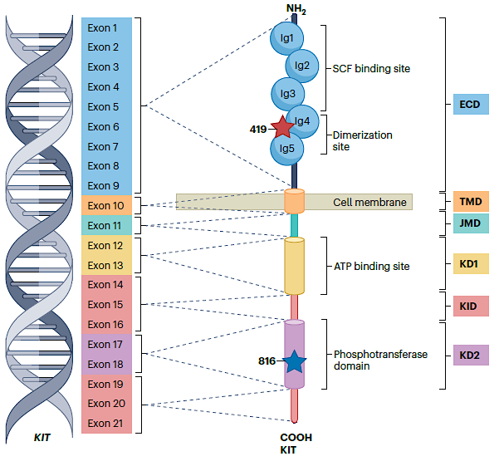
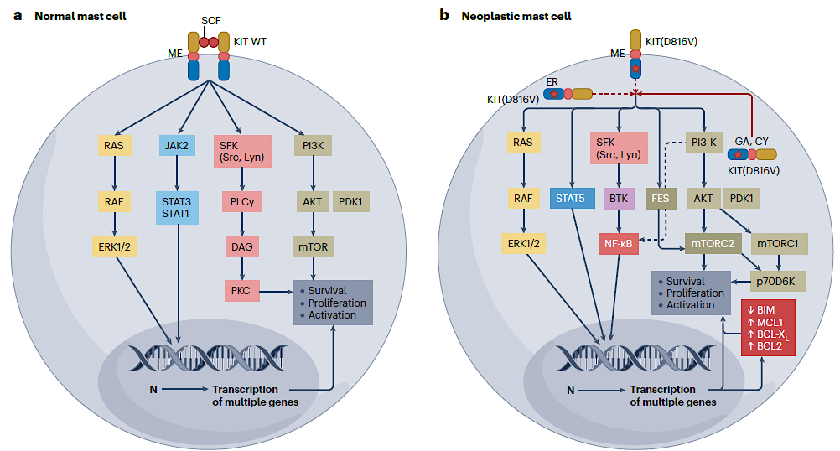
Activating Mutations in KIT Are a Key Biologic Feature of Systemic Mastocytosis
*KIT mutations, predominantly D816V, are present in >90% of patients with SM
Requires high-sensitivity testing (ddPCR or ASO), VAF threshold of 0.01%-0.03%
Akin, C et al. . Nat Rev Dis Primers 2025; 11(1):30. Nagata H, et al. PNAS 1995;92:10560-10564. Longley B, et al. Nat Genet 1996; 12:312-314

Slide 11
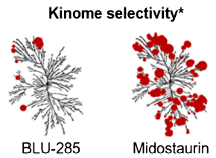
KIT Inhibitors Have Changed the Treatment Paradigm in SM
Logical therapy given high prevalence and key role of KIT in disease biology.
Midostaurin approved for treatment of AdvSM in 2017
  Broad kinase activity, less favorable toxicity profile
  Lower response rates with more stringent criteria
Newer generation of KIT inhibitors are more selective and potent:
Kinase Inhibition Profile (IC₅₀)
Compound | KIT V560G/D816V (HMC 1.2) | WT KIT | PDGFRɑ | PDGFRβ | CSF1R | FLT3 | KDR | CNS Penetration | Approval in NonAdv SM | Approval in Adv SM
Avapritinib | 13 | 114 | 53 | 10 | 249 | 305 | >1000 | + | + | +
Bezuclastinib | 14 | 121 | >10,000 | >10,000 | >10,000 | >1000 | >1000 | - | -* | -*
Elenestinib | 6 | 355 | 21 | 6 | 161 | 345 | >1000 | - | - | -
Guarnieri A. et al. Abstract P257 Molecular Cancer Therapeutics, 2021. 20(12_Supplement), P257-P257.
DeAngelo DJ, et al. Blood 2024;144(Supplement 1):659. Below S, et al. Curr Hematol Malig Rep 2021;16(5):464-472

Slide 12
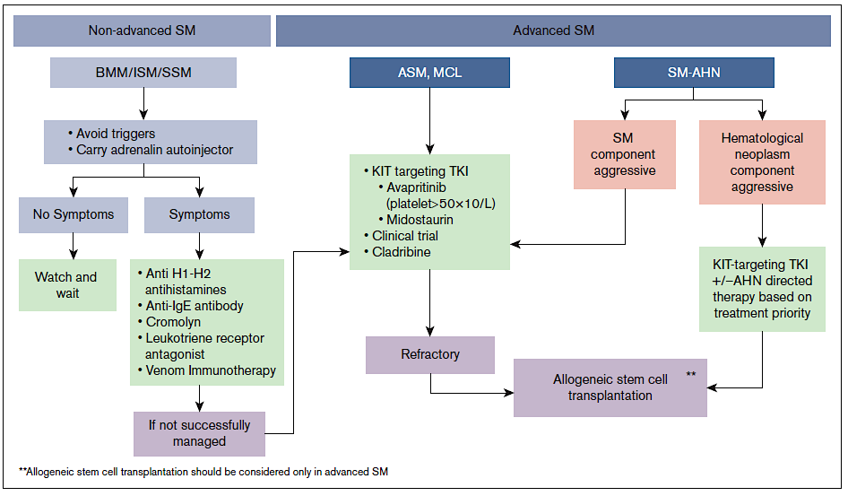
Treatment Framework in SM
Ustun C, et al. Blood Adv 2025; 9(9):2048-2062.

Slide 13
Avapritinib in Advanced SM
Phase 1 (EXPLORER trial): dose escalation and expansion (n = 86)
  Avapritinib 200mg daily as optimal dose
  Substantial activity demonstrated
Phase 2 (PATHFINDER): single-arm, phase 2 study in patients with AdvSM
  AdvSM patients (n = 107; 83 were response evaluable) with or without prior therapy; plts > 50
  Primary Endpoint: Overall response rate
  Led to approval of avapritinib in AdvSM in 2021
DeAngelo DJ, et al. Nat Med 2021;27(12):2183-2191. Gotlib J, et al. Nat Med2021;27(12):2192-2199

Slide 14
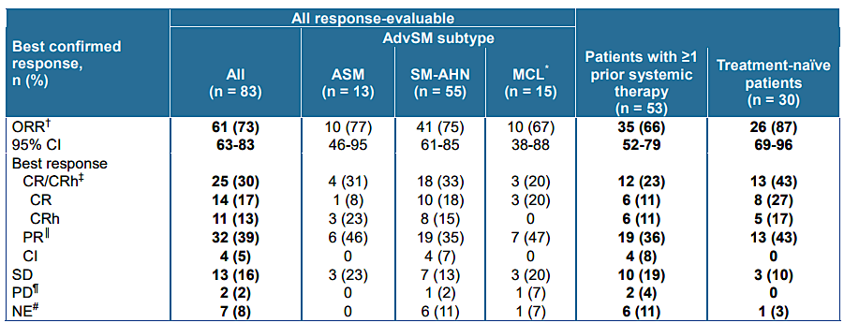
Avapritinib Demonstrates Efficacy in Advanced SM
Responses deepened over time
  Time to response: 2.3 months
  Time to CR/CRh: 9.3 months
Median duration of response: 58 months (not reached in treatment-naïve patients)
Improvements in bone density observed with long-term follow up
Gotlib J, et al. Nat Med2021;27(12):2192-2199. Gotlib J, et al. Blood Adv 2026; 2025017519. Reiter A, et al. Blood 2025; 145 (Supplement 1): 1022

Slide 15
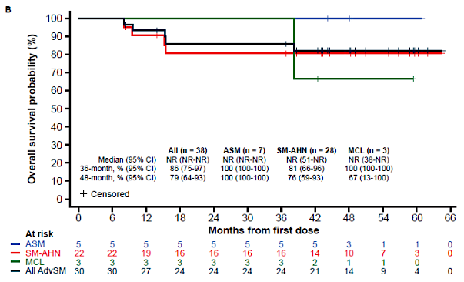
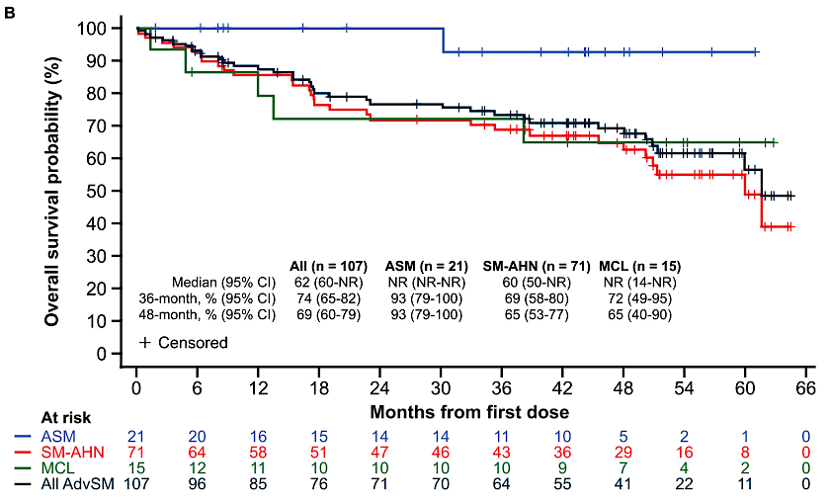
Overall Survival with Avapritinib Compares Favorably to Historical Outcomes
Disease progression observed in 21 patients (6 AML); 19 of whom had an AHN
Gotlib J, et al. Nat Med2021;27(12):2192-2199. Gotlib J, et al. Blood Adv 2026; 2025017519

Slide 16
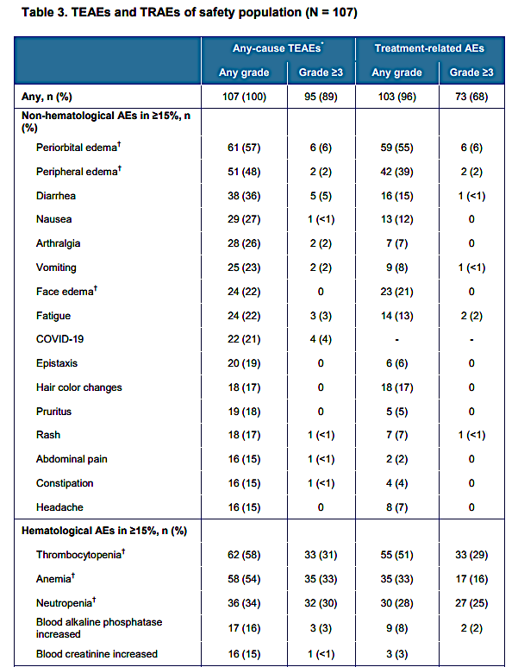
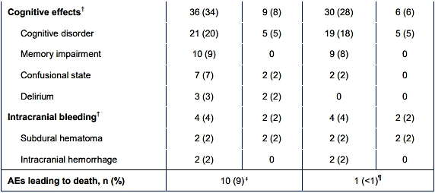
Safety of Avapritinib in AdvSM
19% discontinued due to treatment-related AEs
78% had dose reductions due to treatment-related AEs
Gotlib J, et al. Nat Med2021;27(12):2192-2199. Gotlib J, et al. Blood Adv 2026; 2025017519

Slide 17
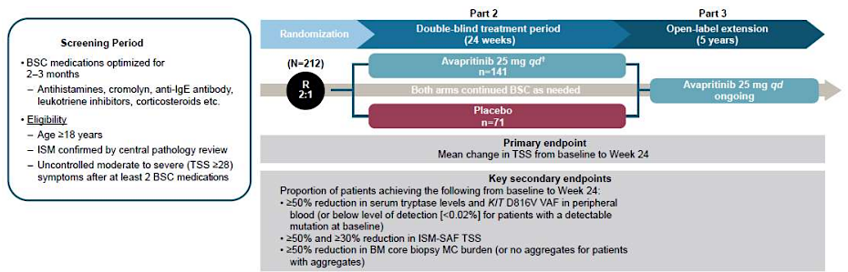
Avapritinib in ISM: PIONEER Study
Gotlib J, et al. NEJM Evid 2023; 2(6)

Slide 18
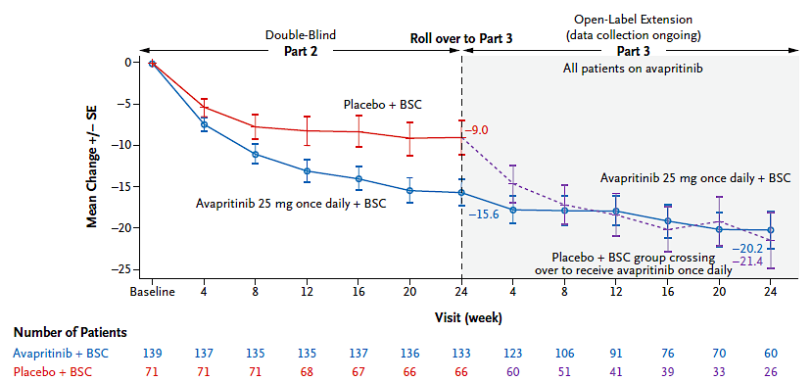
Avapritinib Demonstrates Substantial Symptom Reduction in ISM: Approved 2023
 | Avapritinib | Placebo
>50% reduction in tryptase | 54% | 0%
>50% reduction in KIT D816 VAF | 68% | 6%
>50% reduction in BM MC’s | 53% | 23%
>50% reduction in TSS | 25% | 10%
Gotlib J, et al. NEJM Evid 2023; 2(6)

Slide 19
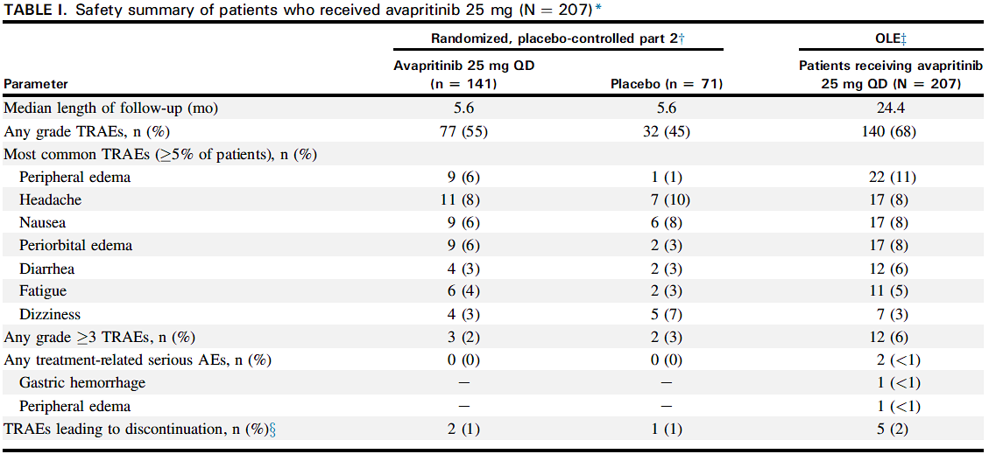
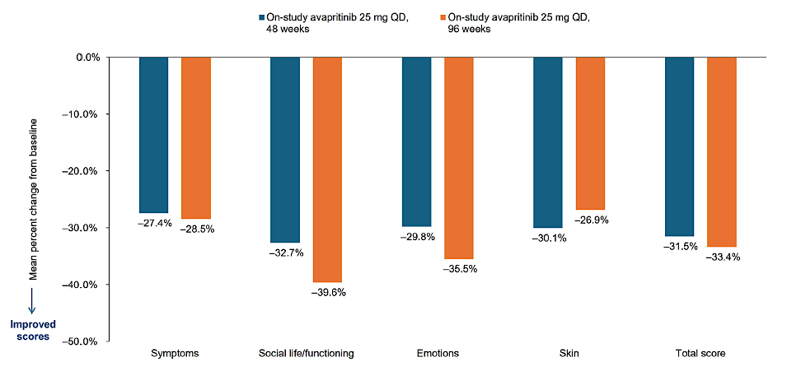
Avapritinib Demonstrates Favorable Safety Profile in ISM and Improved QoL
Anaphylaxis events: 2.8% vs. 4.2%
Castells M, et al. J Allergy Clin Immunol Prac 2025; 13(8):2194-2196. Pongdee T, et al. World Allergy Org J 2026; 19(4):101352

Slide 20
Bezuclastinib Demonstrates Efficacy in AdvSM and non-AdvSM
SUMMIT study: Randomized phase 2, placebo-controlled study in symptomatic, non-AdvSM
APEX study: Open-label, phase 2 study in AdvSM
  ORR: 57%; 80% response by pure pathologic response criteria
Potential approval late 2026, both manuscripts in development
P<0.001
Worsening
Symptoms
MS2D2 TSS
LS Mean (SE) Change From Baseline
Improving
Symptoms
Bezuclastinib
Placebo
0
4
8
12
16
20
24
Time (weeks)
Rein L, et al. Blood 2025; 146(Supplement 1): 80

Slide 21
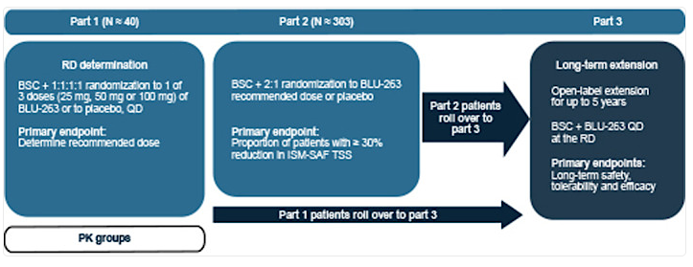
Elenestinib, a Second-Generation KIT Inhibitor Under Investigation in SM
HARBOR: phase 2/3 study in ISM
  Symptom improvement across dose cohorts in Part 1 (75mg dose selected)
  Reductions in tryptase, and KIT D816V VAF
AZURE: phase ½ study in AdvSM
  Monotherapy and in combination with azacitidine
Castells M, et al. AAAAI/WAO Joint Congress 2025; Tashi T, et al. Blood 2023; 142(Supplement 1): 76; DeAngelo DJ et al. Blood 2022 (1_Suppl):6877-6878
Notes:
Castells M et al. HARBOR: an ongoing phase 2/3 study of elenestinib in patients with indolent systemic mastocytosis. Presented at: 2025 AAAAI/WAO Joint Congress.

Slide 22
Summary
Systemic mastocytosis represents a spectrum of clonal mast cell diseases with highly variable clinical course
Improved diagnostic capabilities and increased awareness in recent years
Given the high prevalence of KITD816V mutations, KIT inhibitors have emerged to change the treatment paradigm in advanced and non-advanced SM
  Avapritinib has demonstrated considerable efficacy
  2nd generation KIT inhibitors, bezuclastinib and elenestinib, are under investigation
Still considerable room for improvement, particularly in SM-AHN patients

Slide 23
QUESTIONS?

Slide 24
Module 14: Systemic Mastocytosis and Myelofibrosis
Systemic Mastocytosis — Dr Hunter
Myelofibrosis — Dr Yacoub

Slide 25

Myelofibrosis: Innovations and Challenges
Abdulraheem Yacoub, MD
Professor of Medicine
Clinical Director of Ambulatory Hematology Clinics
Director, Chronic Myeloid Neoplasms Center of Excellence, ChroNEx®
The Division of Hematologic Malignancies and Cellular Therapeutics (HMCT)
The University of Kansas Cancer Center

Slide 26
Disclosures
Consulting Agreements | Blueprint Medicines, GSK, Incyte Corporation, Karyopharm Therapeutics, Novartis, PharmaEssentia, Protagonist Therapeutics, Servier Pharmaceuticals LLC, Takeda Pharmaceuticals USA Inc
Contracted Research | CTI BioPharma, a Sobi Company, Stemline Therapeutics Inc

Slide 27
Introduction: Myelofibrosis (MF)
Myeloproliferative Neoplasms
Philadelphia
chromosome
⁽+⁾
Philadelphia
chromosome
⁽−⁾
Megakaryocyte proliferation (reticulin/collagen fibrosis)
JAK2 (≈50% of patients), CALR, or MPL mutations
Anemia
Leukocytosis
Leukoerythroblastosis
Splenomegaly
Increased serum LDH
Bone marrow trilineage myeloproliferation
JAK2 mutation
(nearly all patients)
Increased Hb, Hct, or RCM
Subnormal serum EPO
Megakaryocyte proliferation (enlarged, mature
morphology)
JAK2 (≈50% of patients), CALR, or MPL mutations
Thrombocytosis (platelet
count ≥450×10⁹/L)
MFª
PV
ET
CML
BM, bone marrow; CALR, calreticulin; CML, chronic myeloid leukemia; EPO, erythropoietin; ET, essential thrombocythemia; Hb, hemoglobin; Hct, hematocrit; JAK, Janus kinase; LDH, lactate dehydrogenase; MPL, myeloproliferative leukemia; MPN, myeloproliferative neoplasm; PV, polycythemia vera; RCM, red cell mass.
ª MF includes primary MF, post-PV MF, and post-ET MF.
Arber DA, et al. Blood. 2016;127(20):2391-2405.

Slide 28
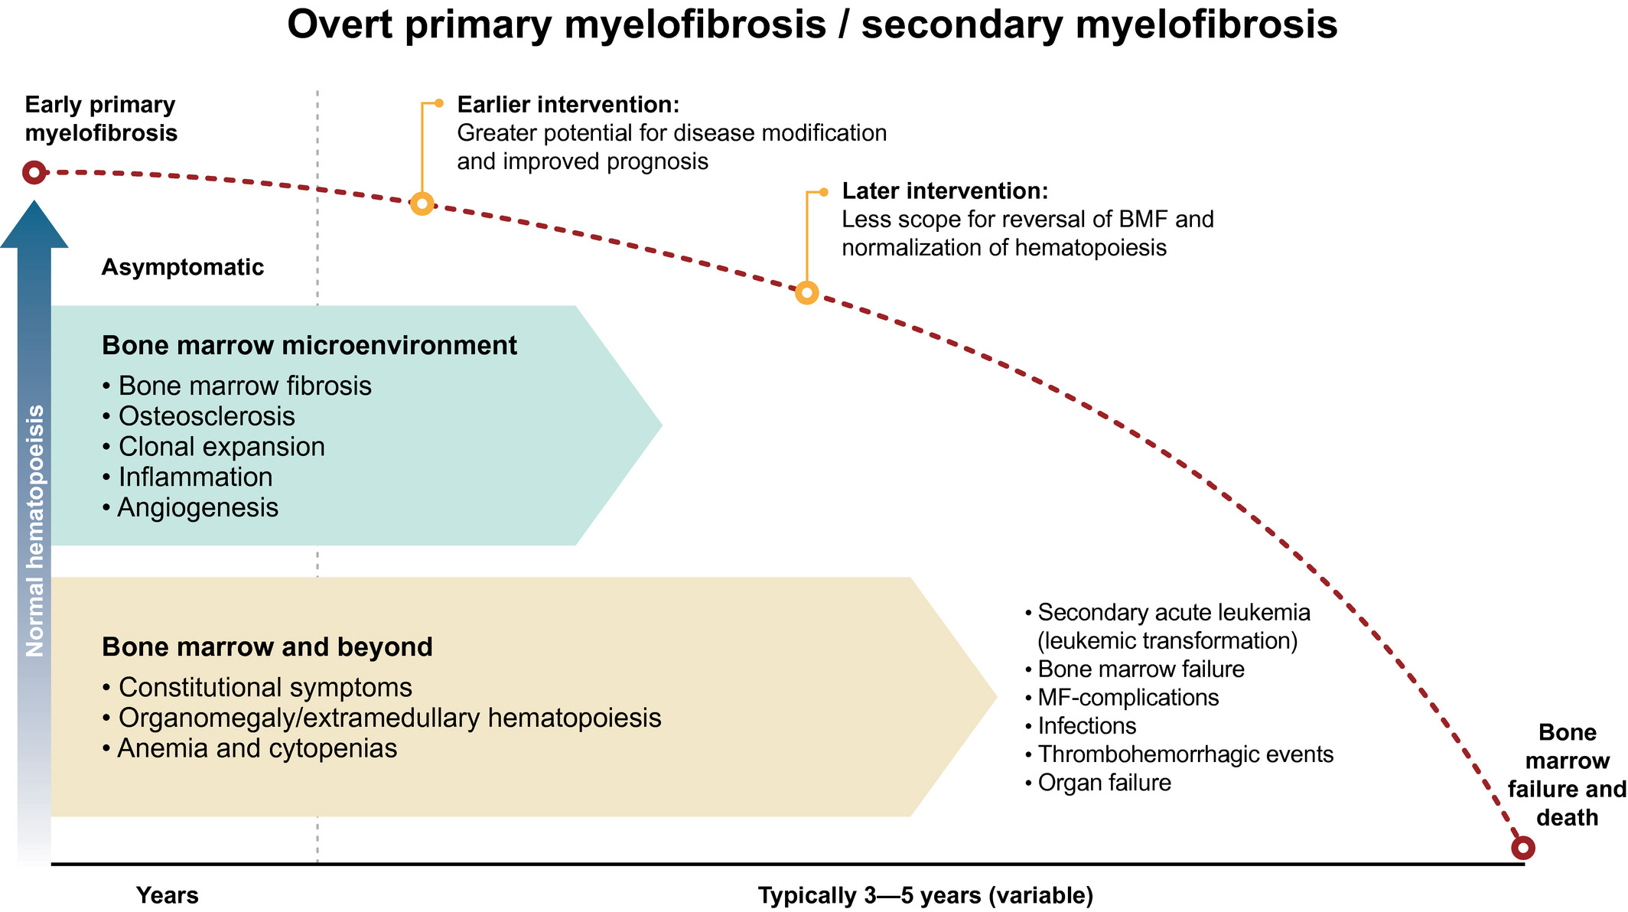
Early PMF
Overt PMF
Post-ET MF/post-PV MF
Short term:
vascular events
Progressive
constitutional
symptoms
Progressive
cytopenias
Progressive
organomegaly/EMH
Decreased QOL and PS
Progressive incapacitation
Immobility
Normal hematopoiesis
Leukemic
transformation (~25%)
MF-related
complications*
Premature
death
Time: typically many years (~15y)
Time: variable (5-7 years common)
Mughal TI, et al. Int J Gen Med. 2014
Pemmaraju, et al. 2022
Notes:
Outcome can be poor, but is very variable and not generalizable
Need to classify
PMF is th sterotype, generalization to SMF

Slide 29
MF Management Goals
Reduce Splenomegaly
Improve Symptoms
Improve Survival
Management goals may evolve over time and may vary based on risk

Slide 30
Treatment of MF Based on Risk and Symptoms/Signs
Lower Risk
MIPSS-70: ≤3
MIPSS-70+ Version 2.0: ≤3
DIPSS-Plus: ≤1
DIPSS: ≤2
MYSEC-PM: <14
Low Risk
Observation, ruxolitinib (if symptomatic) or clinical trial
Management of cytopenias
Allogeneic HSCT (selected patients)
Intermediate-1
Projected Median OS 5 years
Higher Risk
MIPSS-70: ≥4
MIPSS-70+ Version 2.0: ≥4
DIPSS-Plus: >1
DIPSS: >2
MYSEC-PM: ≥14
Intermediate-2
Allogeneic HSCT
Ruxolitinib, or fedratinib, momelotinib or pacritinib (platelet <50x10⁹), or clinical trial
Anemia, thrombocytopenia (<50X10⁹) clinical trial
High Risk
Adapted from National Comprehensive Cancer Network (NCCN). Myeloproliferative Neoplasms (Version 1.2020), https://www.nccn.org/professionals/physician_gls/pdf/mpn.pdf.

Slide 31
Therapeutic Approaches for Higher-Risk MF
First line therapy
Beyond First line Therapy
Allogenic SCT
Other JAK-I
Fedratinib
  Preferred for preserved Plts and Hgb, need for rapid SVR
Pacritinib
  Preferred for low Plts, Cytopenic MF
Momelotinib
  Preferred for Anemia
Higher-risk MF
Platelet <25
Pacritinib
Platelet 25-50
Pacritinib or Momelotinib
Platelet >50
Ruxolitinib (preferred)
Momelotinib (preferred in severe anemia)
Pacritinib
Fedratinib
Supportive care
Luspatercept off label for anemia
Danazol for Anemia
Low dose prednisone
HU for very proliferative disease
1. NCCN Guidelines Myeloproliferative Neoplasms. V2.2022. https://www.nccn.org/. Accessed April 28,2022.
2. Yacoub, A. MPN-MDS US Focus Meeting 2022

Slide 32
COMFORT-I and-II Studies: Ruxolitinib for MF
COMFORT-I¹
PMF or PPV-MF, or PET-MF (N=309)
Intermediate-2 or high risk by IWG-MRT
Palpable spleen ≥5 cm
Platelet count ≥100 x 10⁹/L
JAK2-V617F positive or negative
RANDOMIZE
Ruxolitinib
15 or 20 mg twice daily
1:1
Placebo
COMFORT-II²
RANDOMIZE
Ruxolitinib
15 or 20 mg twice daily
(n=146)
Patients with PMF, PPV-MF, or PET MF
with ≥2 IWG risk factors (N=219)
2:1
Best available therapy (BAT) arm: patients with PD eligible for crossover to ruxolitinib
Ruxolitinib arm: patients with PD eligible for extension phase
Best available therapy
(n=73)
1. Verstovsek S et al. N Engl J Med. 2012;366:799-807. 2. Harrison C et al. N Engl J Med. 2012;366:787-798.

Slide 33
Long-Term Results With Ruxolitinib
SPLEEN VOLUME REDUCTION^{2,3}
(SVR >35% by imaging or >50% palpation)
  60% at any time
  42% at 24 weeks
  Median duration of response: 3.2 years
  Dose 10 mg BID or high is more effective
1
Why are these results important?
  Reduction of spleen-related symptoms
  Reversal of weight loss
  Baseline splenomegaly is a surrogate of increased mortality (1.14-fold higher risk of death for each additional 5 dL)
  Reduction in splenomegaly is proportionately associated with improved survival
2
SYMPTOM BURDEN REDUCTION³ (>50% reduction in TSS)
  46% at 24 weeks
3
OVERALL SURVIVAL
  ...
1. Yacoub, A. MPN-MDS US Focus Meeting. 2. Verstovsek S, et al. J Hematol Oncol. 2017;10(1):55. 3. Verstovsek S, et al. N Engl J Med. 2012;366(9):799-807.

Slide 34
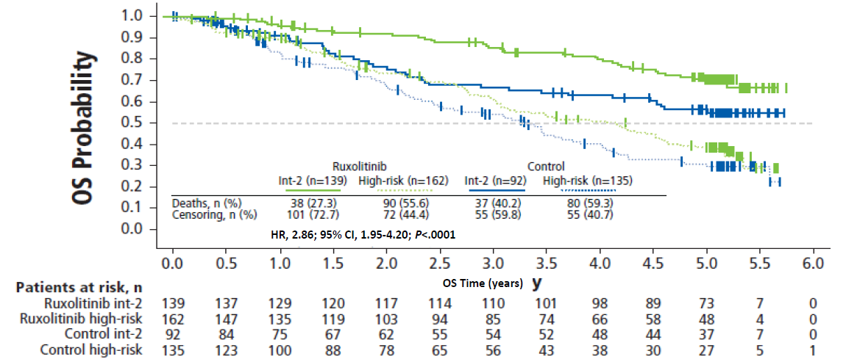
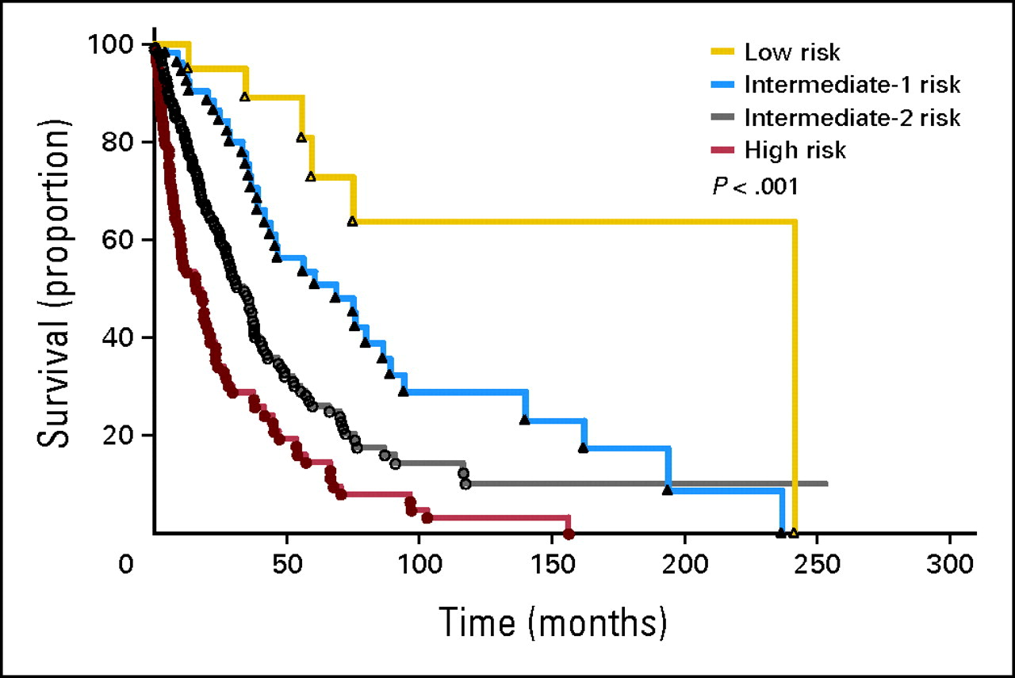
Long-Term Survival in Patients Treated With Ruxolitinib for MF:
COMFORT-I and –II Pooled Analyses
Among patients randomized to ruxolitinib, patients with int-2 MF had a longer OS than those with high-risk MFa (HR high risk vs int-2: 2.86; 95% CI, 1.95-4.20; P<.0001)
Median OS
  Int-2: not reached (estimated 8.5 years)
  High-risk: 4.2 years
ª Per International Prognostic Scoring System (IPSS).
Gangat N et al. J Clin Oncol. 2011 Feb 1;29(4):392-7.
Verstovsek S, et al. J Hematol Oncol. 2017;10(1):156.

Slide 35
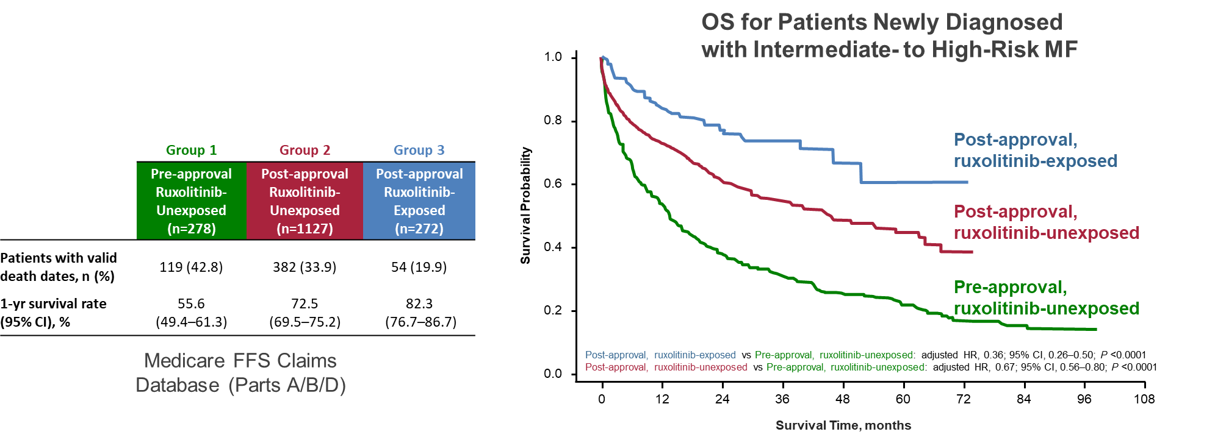
Real-World Survival in higher-risk MF: Impact of Ruxolitinib Approval
Mortality was lowest and OS was longest among ruxolitinib-exposed patients
Verstovsek S, et al. Ann Hematol. 2022.

Slide 36
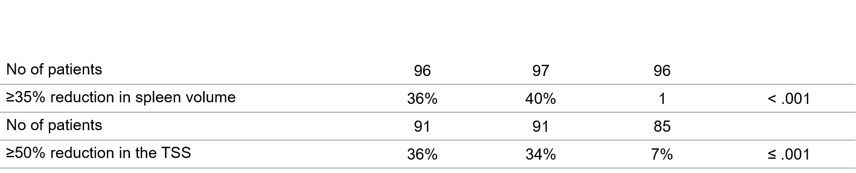
Fedratinib in MF
Approved in August 2019
JAKARTA: Phase 3 study of fedratinib (400 or 500 mg/d) vs placebo in patients with int-2 or high-risk MF
with splenomegaly
Recommended dose: 400 mg once a day
The most common AEs: anemia, gastrointestinal symptoms
Boxed warning: encephalopathy, can be fatal
Pardanani A, et al. JAMA Oncol. 2015;1:643-651.

Slide 37
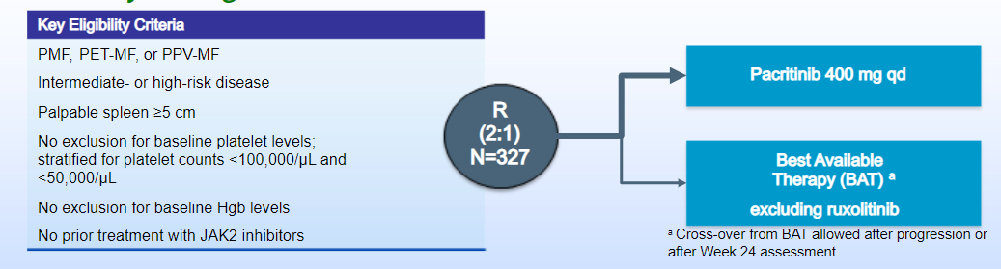
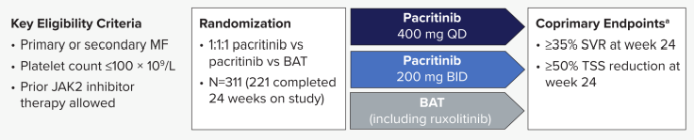
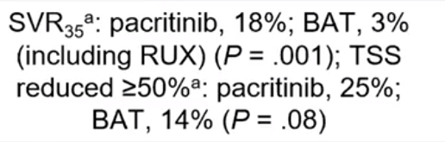
Pacritinib Development
PERSIST-1: Pacritinib versus Best Available Therapy (BAT) to treat myelofibrosis
PERSIST-2 Study Design
  FDA announces full clinical hold Feb 8, 2016
    Interim survival results, bleeding and CV events
  FDA removes hold Jan 5, 2017

Slide 38
PERSIST-2: Baseline Characteristics and BAT Received
Key Baseline Characteristics in ITT-Efficacy Population^{1,2} | PAC 200 mg BID (n = 74) | BAT (n = 72)
Median age, years ≥65 years, % | 67 62 | 69 71
Male, % | 65 | 54
MF diagnosis: PMF, PPV-MF, PET-MF, % | 74, 19, 7 | 60, 22, 18
DIPSS scoreª: Int-1, Int-2, High, % | 19, 51, 30 | 18, 51, 31
Median spleen length, cmª | 15 | 13
JAK2^{V617F} positive, % | 80 | 71
JAK2^{V617F} allele burden, median | 30 | 25
Platelet count <50 × 10⁹/L, % | 42 | 44
Hemoglobin <10 g/dL, % | 59 | 57
RBC transfusion dependence^{b}: dependent, independent, indeterminate, % | 19, 50, 30 | 19, 51, 29
Prior JAK1/2 inhibitors, % Prior ruxolitinib | 45 42 | 47 46
Of the BAT patients who received ruxolitinib, 93% began treatment at ≤10 mg BID, including 64% at ≤5 mg BID³
BAT Received in >2 Patients, %¹ | BAT (n = 98)
Ruxolitinib^{c} | 45
Hydroxyurea | 19
Watch-and-wait only | 19
Prednisone/prednisolone | 13
Danazol | 5
Thalidomide | 3
Mascarenhas J, et al. JAMA Oncol. 2018;4:652-659

Slide 39
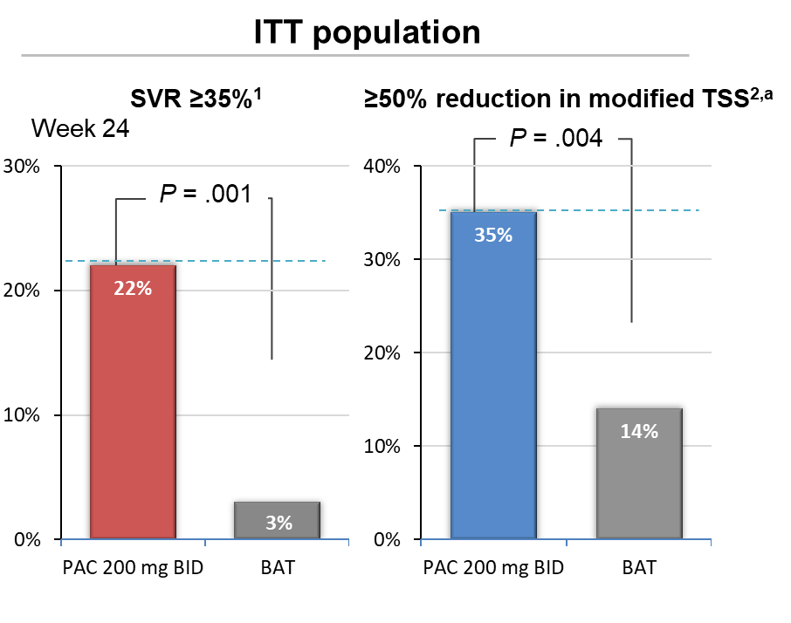
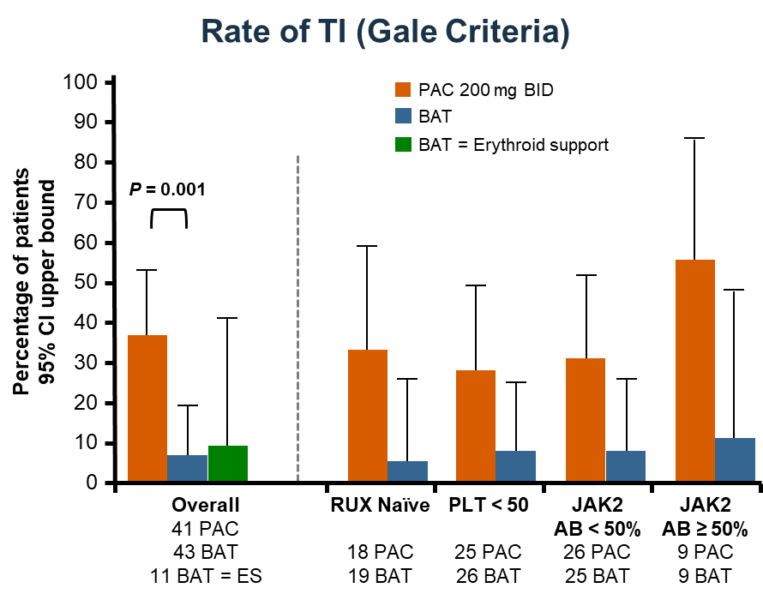
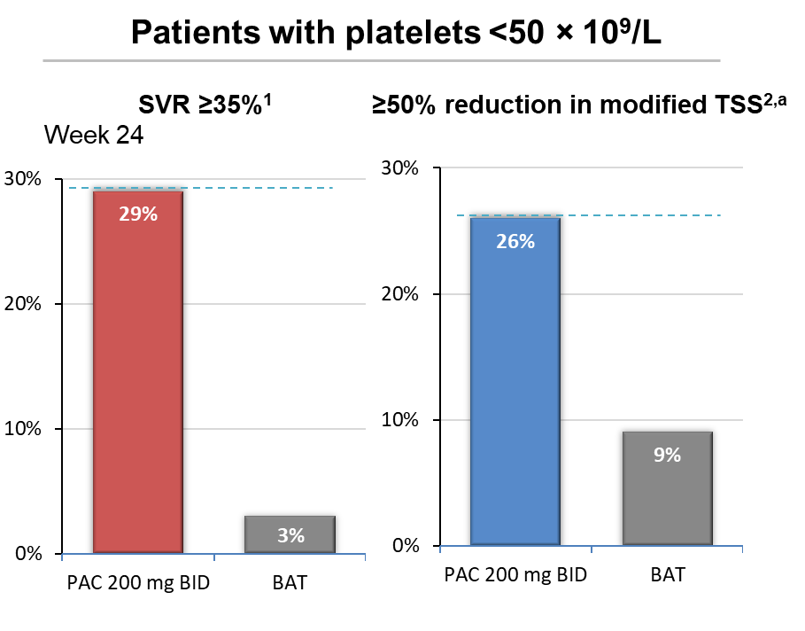
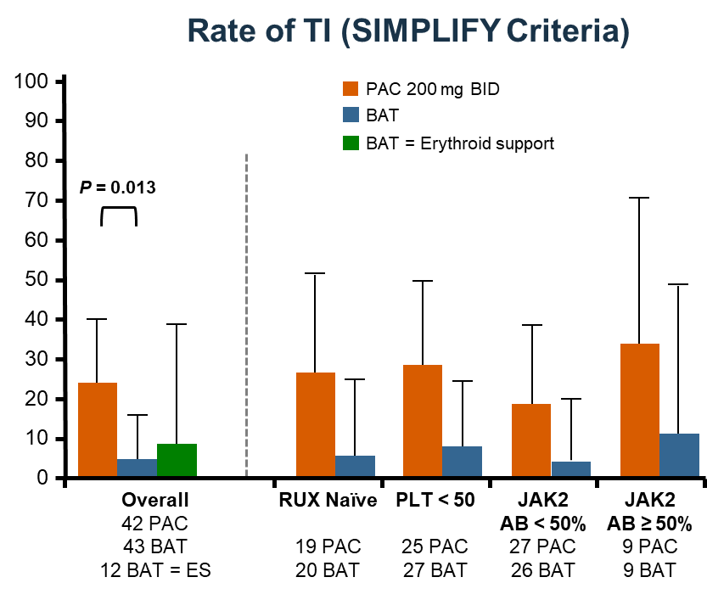
PERSIST-2: highlights
Mascarenhas J, et al. JAMA Oncol. 2018;4:652-659
Oh ST. Blood Adv. 2023;7:5835-5842.

Slide 40
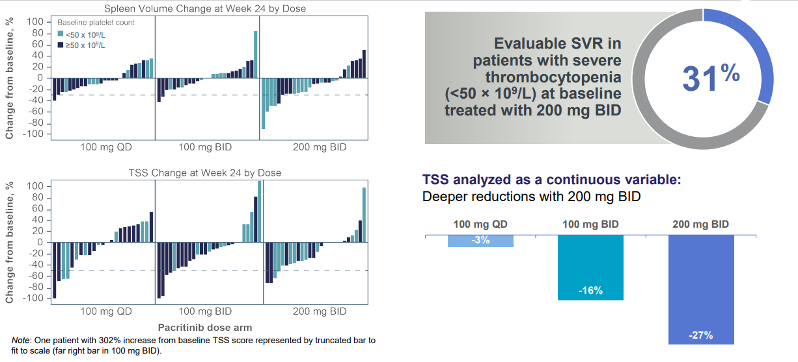
PAC203: Greatest efficacy of Pacritinib at 200 mg BID in Advanced Myelofibrosis
The 200 mg BID arm had the highest rates of SVR ≥ 35% (200 mg BID: 9.3%; 100 mg BID: 1.8%; 100 mg QD: 0.0%) and TSS ≥ 50% (200 mg BID: 7.4%; 100 mg BID: 5.5%; 100 mg QD: 5.8%).¹
Pharmacokinetic and pharmacodynamic data support testing pacritinib 200 mg BID in the pivotal randomized PACIFICA phase 3 trial.¹
Pacritinib demonstrated clinical benefit and was well tolerated in advanced myelofibrosis patients, including those with severe thrombocytopenia.¹
1. Gerds et al., Blood Adv, 2020; 2. Gerds et al., ASH 2019 #667; NCT03165734

Slide 41
SIMPLIFY-1: Momelotinib First Line
MMB (n = 184)
RUX (n = 204)
MMB (n = 174)
RUX (n = 190)
150
150
100
100
50
50
Change in spleen volume from baseline (%)
Change in TSS from baseline (%)
0
0
-50
35% decrease
-50
50% decrease
-100
Individual Patients
-100
Individual Patients
SRR
TSS response rate
26.5% (57 of 215)
29.0% (63 of 217)
28.4% (60 of 211)
42.2% (89 of 211)
Proportion difference of 0.09 (95% CI, 0.02 to 0.16) P = 0.011
Noninferiority proportion difference of 0.09 (95% CI, -0.08 to 0.08) P = 0.98
Momelotinib was noninferior for spleen reduction but NOT noninferior for
symptom improvement
Mesa RA. J Clin Oncol. 2017;35:3844-3850.
Notes:
Lastly, this bring us to momelotinib – which is a JAK1/2 inhibitor that also inhibits ACVR1 and has been extensively studied in MF over the years. It was studied head to head v rux in the SIMPLIFY-1 study and demonstrated comparable spleen volume reduction, though symptom improvement appeared less robust.

Slide 42
SIMPLIFY-1: Patients With Hb ≤10 g/dL Achieving TI Stratified by EPO Level
60
60
52%
50
48%
50
40%
Momelotinib
40%
40
40
36%
33%
Ruxolitinib
33%
TI rate at week 24 (%)
TI rate at week 24 (%)
30
30
20
20
18%
11%
11%
10
10
n = 79
n = 84
n = 5
n = 9
n = 64
n = 73
n = 15
n = 11
n = 5
n = 9
0
0
EPO <500 U/L
EPO ≥500 U/L
EPO
<125 U/L
EPO
125-500 U/L
EPO
>500 U/L
 | EPO ≤500 U/L | EPO ≥500 U/L
OR (95% CI) for momelotinib vs ruxolitinib | 2.34 (1.19-4.61) | 6.30 (0.40-99.84)
 | EPO <125 U/L | EPO 125-500 U/L | EPO >500 U/L
OR (95% CI) for momelotinib vs ruxolitinib | 2.31 (1.12-4.76) | 3.35 (0.49-23.09) | 6.25 (0.39-99.15)
Oh ST, et al. ASH 2025

Slide 43
MOMENTUM: Momelotinib vs Danazol in Symptomatic, Anemic, JAKi-Experienced Patients
Previously treated with JAKi
Symptomatic (TSS ≥ 10)
Anemic (Hgb < 10 g/dL)
Platelets ≥ 25 x 10⁹/L
Stratification
TSS
Palpable spleen length
Transfused units in prior 8 weeks
Study site
Double-blind treatment
Open-label crossover
Long-term follow-up
MMB 200 mg daily
+ PBO
MMB
200 mg daily
R
N = 195
2:1
Early crossover if confirmed progression
DAN 600 mg daily
+ PBO
JAKi
taper/washout
≥ 21 days
Primary endpoint
Day 1
Week 24
Summary of Primary and Key Secondary Efficacy Endpoint Analyses at Week 24
Endpoints | Test order | Criterion for significance | Momelotinib group (n = 130) | Danazol group (n = 65) | P value
TSS response rate | 1 | Superiority (P ≤ 0.05) | 32 (25%) | 6 (9%) | Two-sided 0.0095 (superior)
Transfusion independence rate | 2 | Noninferiority | 39 (30%) | 13 (20%) | One-sided 0.0116 (non-inferior)
Splenic response rate (≥ 25% reduction) | 3 | Superiority (P ≤ 0.05) | 51 (39%) | 4 (6%) | Two-sided < 0.0001 (superior)
Absolute TSS change from baseline | 4 | Superiority (P ≤ 0.05) | -11.5 | -3.9 | Two-sided 0.0014 (superior)
Splenic response rate (≥ 35% reduction) | 5 | Superiority (P ≤ 0.05) | 29 (22%) | 2 (3%) | Two-sided 0.0011 (superior)
Rate of zero transfusions to week 24 | 6 | Superiority (P ≤ 0.05) | 46 (35%) | 11 (17%) | Two-sided 0.0012 (superior)
Verstovsek S. Lancet. 2023;401:269-280.

Slide 44
Momelotinib vs Danazol: MOMENTUM – Transfusion Independence at Week 24, Mean Hemoglobin Over Time
P = .0116 (noninferior)
Double-blind
randomization period
Open-label period
35
11.0
30%
Momelotinib
Momelotinib
30
Danazol
Danazol → Momelotinib
10.0
25
20%
20
Mean Hemoglobin Levels (g/dL)
Transfusion Independence Rate, %
9.0
15%
15
13%
10
8.0
5
BL
4
8
12
16
20
24
28
32
36
40
44
48
No. of Patients
Weeks Since Randomization
0
Momelotinib
129
105
112
93
87
88
83
67
56
44
42
36
28
Baseline
Week 24
Baseline
Week 24
Momelotinib (N = 130)
Danazol (N = 65)
Danazol
65
54
50
38
36
36
29
31
21
19
18
13
7
Verstovsek S, et al. EHA 2022. Abstract S195; Mesa R, et al. ASCO 2022. Abstract 7002; Verstovsek S, et al. Lancet 2023;401(10373):269-80.

Slide 45
JAKi | Ruxolitinib | Fedratinib | Pacritinib | Momelotinib
Approval | 2011 | 2019 | 2022 | 2023
Targets | JAK1, JAK2 | JAK2, JAK1, FLT3, TYK2, | JAK2, IRAK1, FLT3, ACVR1 | JAK1, JAK2, ACVR1
Indication | Intermediate1, Intermediate2, high-risk MF platelets ≥50k | Intermediate-2 high-risk MF platelets ≥50k | Intermediate high-risk MF platelets <50k | MF patients with anemia Plt >25
Dose | 10 BID 15 BID 20 BID | 400 daily | 200 BID | 200 once daily
Risk of withdrawal | high | low | low | possible
Clinical practice points | Hematologic toxicities | Hematologic GI toxicities Monitor and replace thiamine | Less cytopenia High GI toxicities Monitor QTc Monitor for bleeding | Less cytopenia-inducing Rare peripheral neuropathy

Slide 46
Earlier Intervention, New Paradigm
Therapeutic clinical trials in myelofibrosis (MF) have predominantly focused on higher-risk disease:
Patients at higher risk of morbidity and mortality due to their diseases.
May accept a higher risk/benefit ratio
Intervention may be more impactful
Study endpoints target regularly measurable disease parameters including:
    Splenic volume reduction
    Symptom burden reduction
    PFS and OS
    Disease / response surrogates: Fibrosis, driver mutation VAF reduction
Author’s Opinion

Slide 47
Opportunities for Early Intervention
Therapy in Pre fibrotic disease
More Intense Therapy
MPN CHIP
PV and ET
Pre-MF
Lower Risk MF
Higher Risk MF
Accelerated Disease
Therapy at Pre-MF phase
Therapy at lower risk disease
Earlier exposure to therapy
Yacoub. SOHO 2022
Yacoub, et al. CLML 2024

Slide 48
Early Intervention: COMFORT Studies
Patients randomized to Ruxolitinib, Median OS difference was 1.5 years (5.3 vs. 3.8m HR 0.7, P=0.0065), despite cross over at median of around 9 months.
Among patients randomized to ruxolitinib, patients with int-2 MF had a longer OS than those with high-risk MFa (HR high risk vs int-2: 2.86; 95% CI, 1.95-4.20; P<.0001)
Median OS
  Int-2: not reached (estimated 8.5 years)
  High-risk: 4.2 years
Verstovsek S, et al. J Hematol Oncol. 2017.

Slide 49
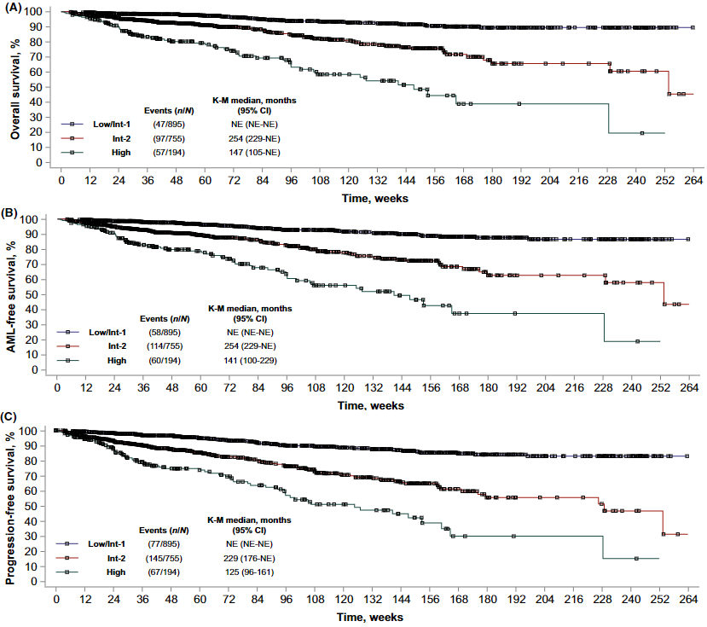
Early Intervention: JUMP Study
Al-Ali HK, et al. Br J Haematol. 2020

Slide 50
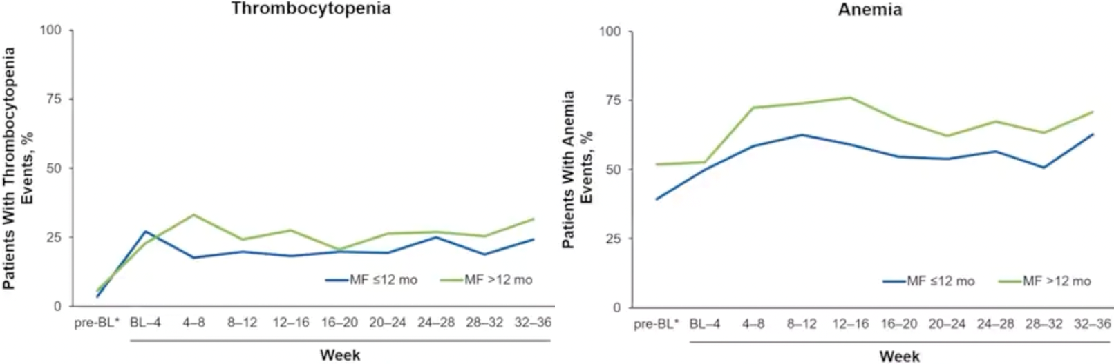
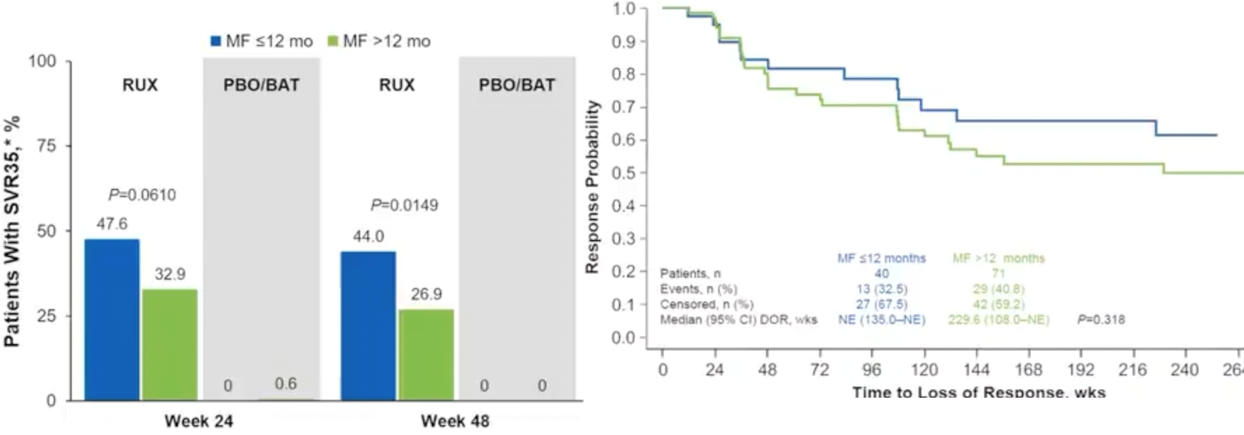
Early Intervention: Since diagnosis
Subgroup analysis of patients enrolled on COMFORT studies:
  Ruxolitinib therapy since diagnosis: ≤ 12 month vs. > 12 month
Verstovsek S et al. Cancer. 2023
Notes:
Post-hoc analysis

Slide 51
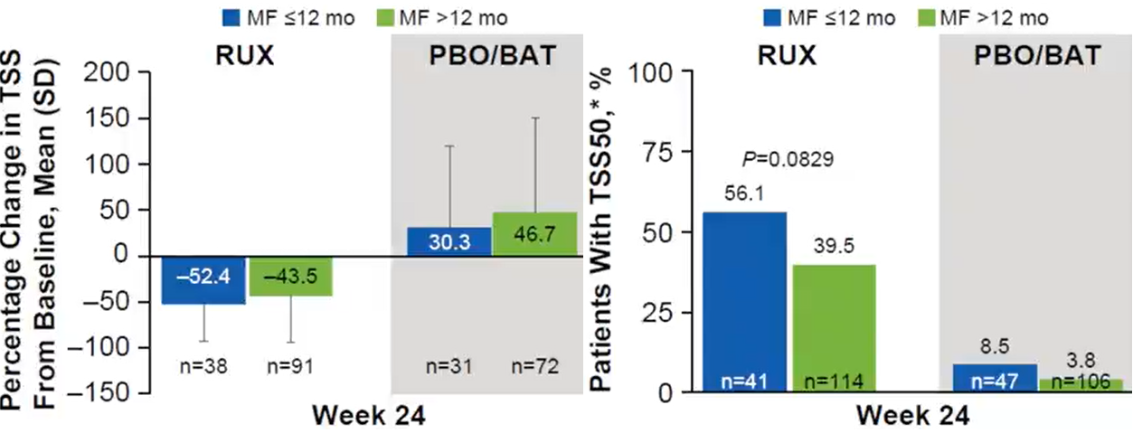
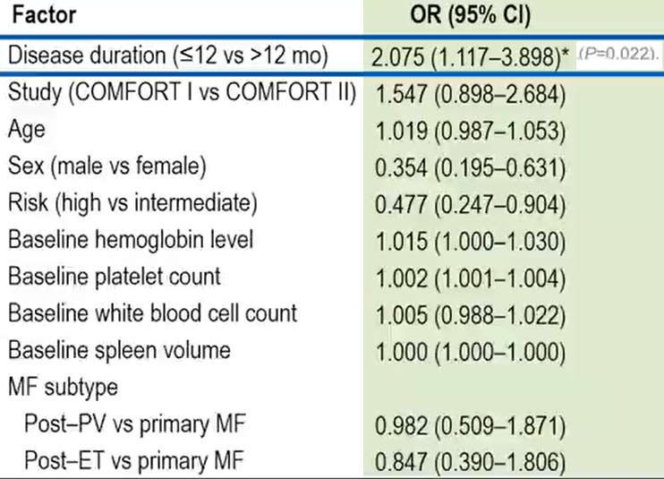
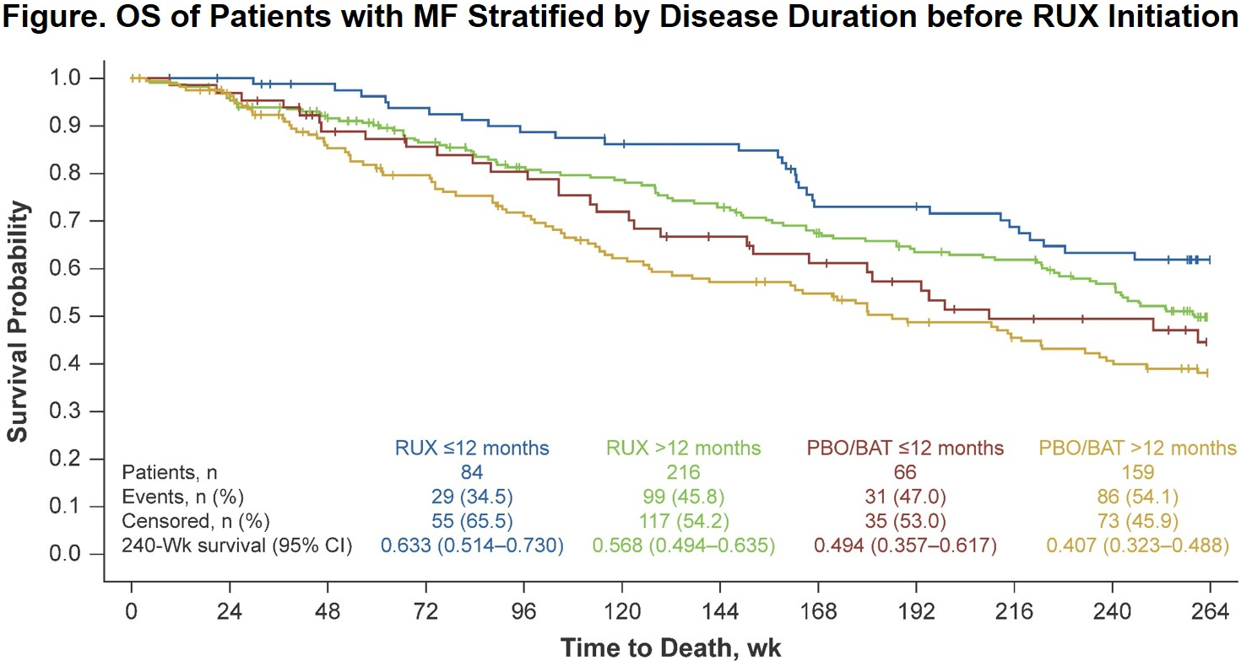
Early Intervention: Since diagnosis
P=0.0430
Verstovsek S et al. Cancer. 2023
Notes:
Post-hoc analysis

Slide 52
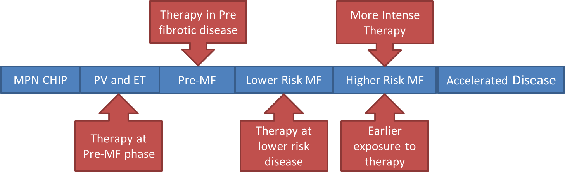
Level of Evidence of Early Intervention
Early intervention is recognized as a new frontier in managing MF
Challenges continue to exist in identifying the target patients, appropriate disease stage, methods of intervention, and definitions of endpoints and outcomes.
Evolving Evidence
Evolving Evidence
Some Evidence
Strong Evidence
Strong Evidence
Author’s Opinion

Slide 53
Investigational Approaches for Higher-Risk MF
First line therapy
Beyond First line Therapy
Allogenic SCT
Other JAK-I
Higher-risk MF
Platelet <25
Pacritinib
Platelet 25-50
Pacritinib or
Momelotinib
Investigational Single Agent
    Pelabresib
    Navitoclax
    Selinexor
    Parsaclisib
    Imetelstat
    CALR-directed therapy
    JAK2V617F inhibiter
    Type II JAKi
    Interferon
    Tagraxofusp
    …
Early Intervention???
?
First line Combination
?
Platelet >50
Ruxolitinib
Momelotinib
Pacritinib
Fedratinib
?
Add-On Approach
    “suboptimum”
?

Slide 54
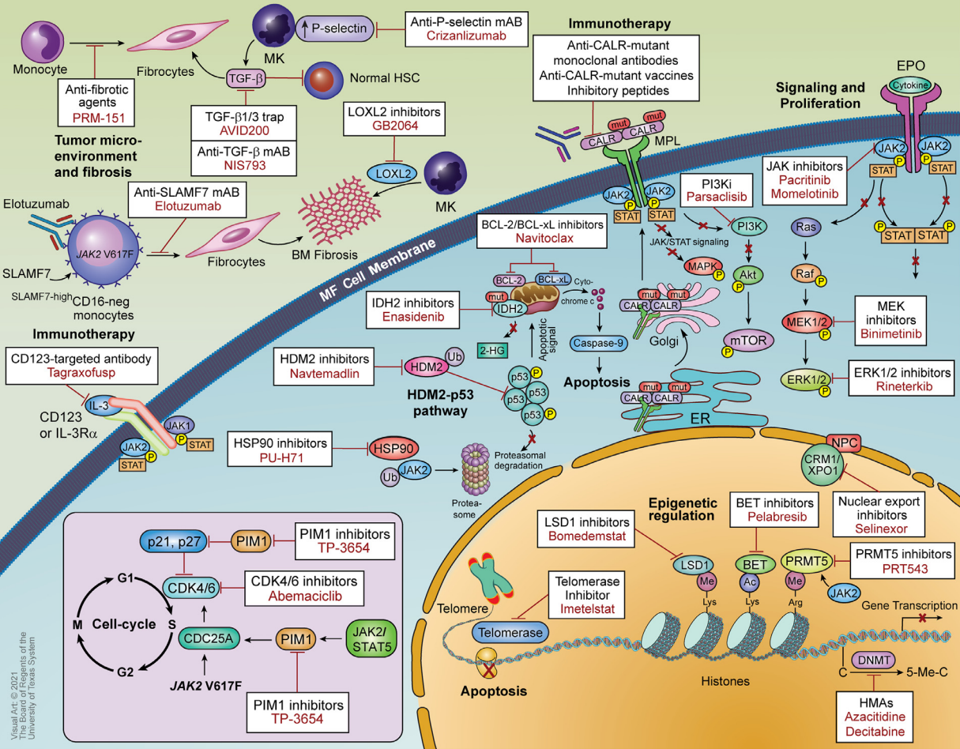
Ruxolitinib with Parsaclisib (PI3K δ i)
Ruxolitinib with Navitoclax (BCL-X_{L} i)
Ruxolitinib with Pelabresib (BET i)
Ruxolitinib and Luspatercept
Ruxolitinib and Selinexor
Ruxolitinib and KRT-232
Imetelstat
Ruxolitinib and CALRi
Momelotinib and Luspatercept
Pacritinib and Tagraxofusp
Elritercept With Ruxolitinib
Nuvisertib with Momelotinib
Chifotides HT et al. Clin Lymphoma Myeloma Leuk. 2022;22(4):210-223.

Slide 55

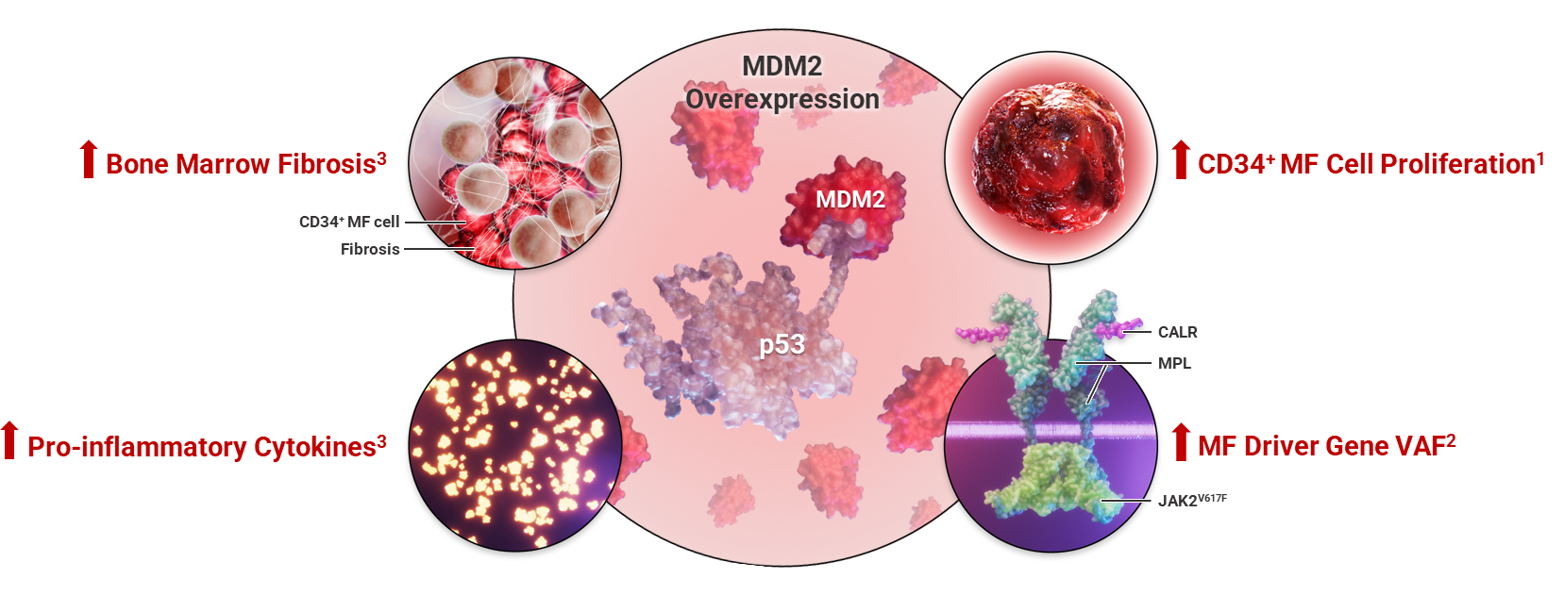
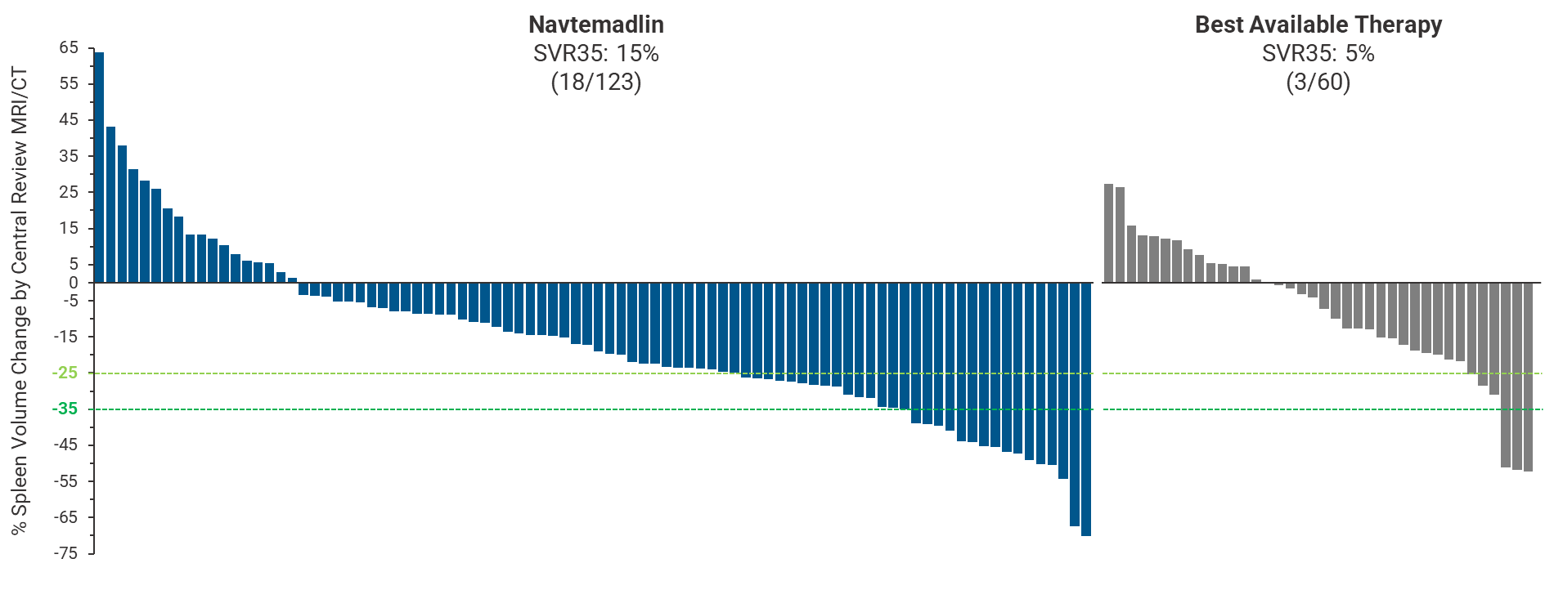
A Phase 3 Randomized, Double-blind, Add-on Study Evaluating the Safety and Efﬁcacy of Navtemadlin and Ruxolitinib in JAK Inhibitor-naïve Patients With Myeloﬁbrosis Who Have a Suboptimal Response to Ruxolitinib Treatment
Enrollment
Run-in Period
Assessment
Add-on Period (Blinded)
MF Patients
Who are JAK Inhibitor-naïve
Rux Monotherapy
≥ 18 weeks of treatment on a stable Rux dose¹
Navtemadlin + Ruxolitinib
Suboptimal
Response
Arm 1
Randomized
Spleen or TSS Responders or Refractory
Non-responders
Placebo + Ruxolitinib
Arm 2
End-of-Study

Slide 56
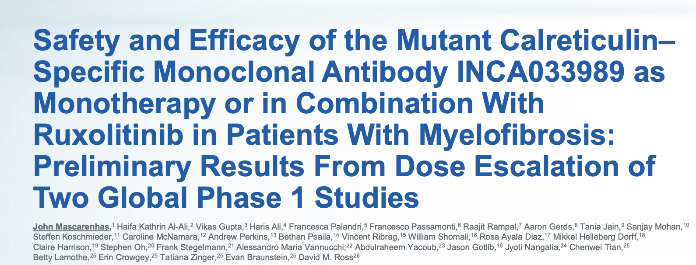
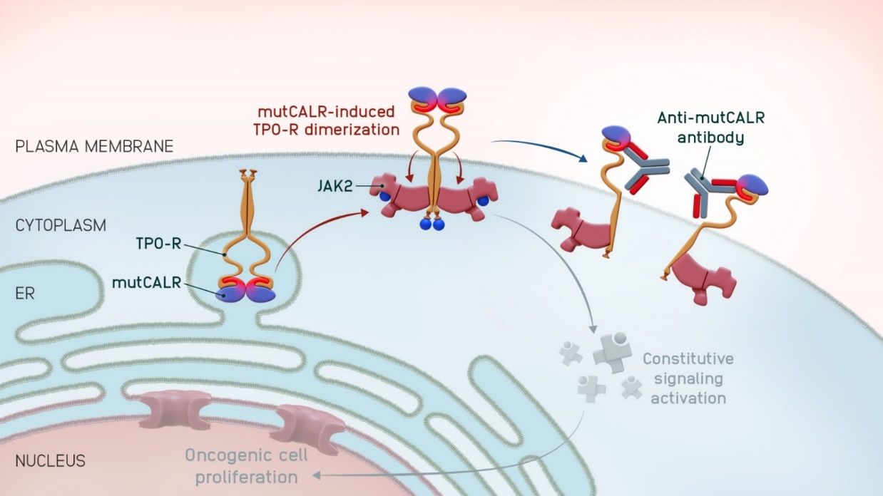
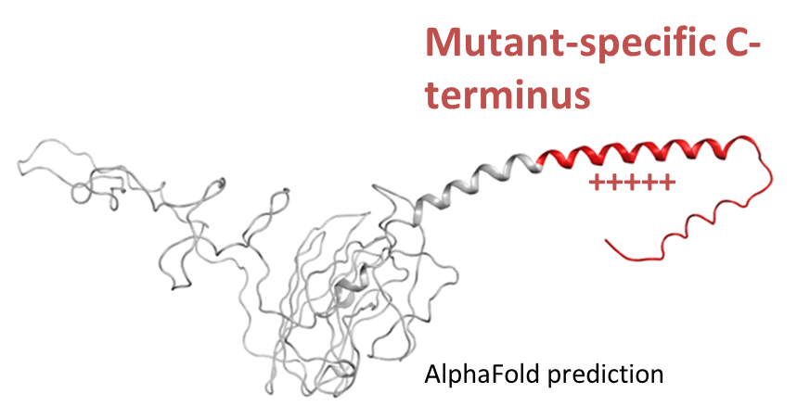
Fully human IgG1
Fc-silent
Selective binding to mutCALR
Excellent safety profile
52-bp deletion (Type 1)
5 bp-insertion (Type 2)
Mascarenhas JO, et al. ASH 2025;Abstract 484

Slide 57
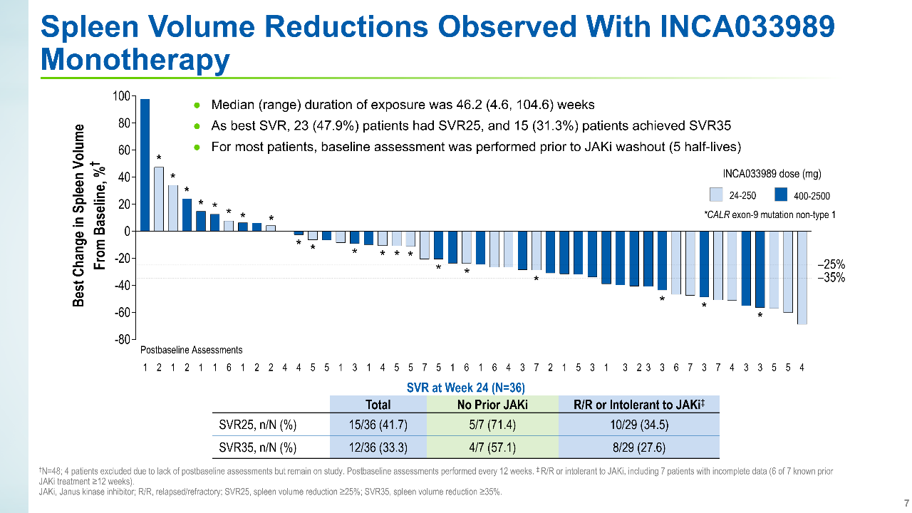
Mascarenhas JO, et al. ASH 2025;Abstract 484

Slide 58
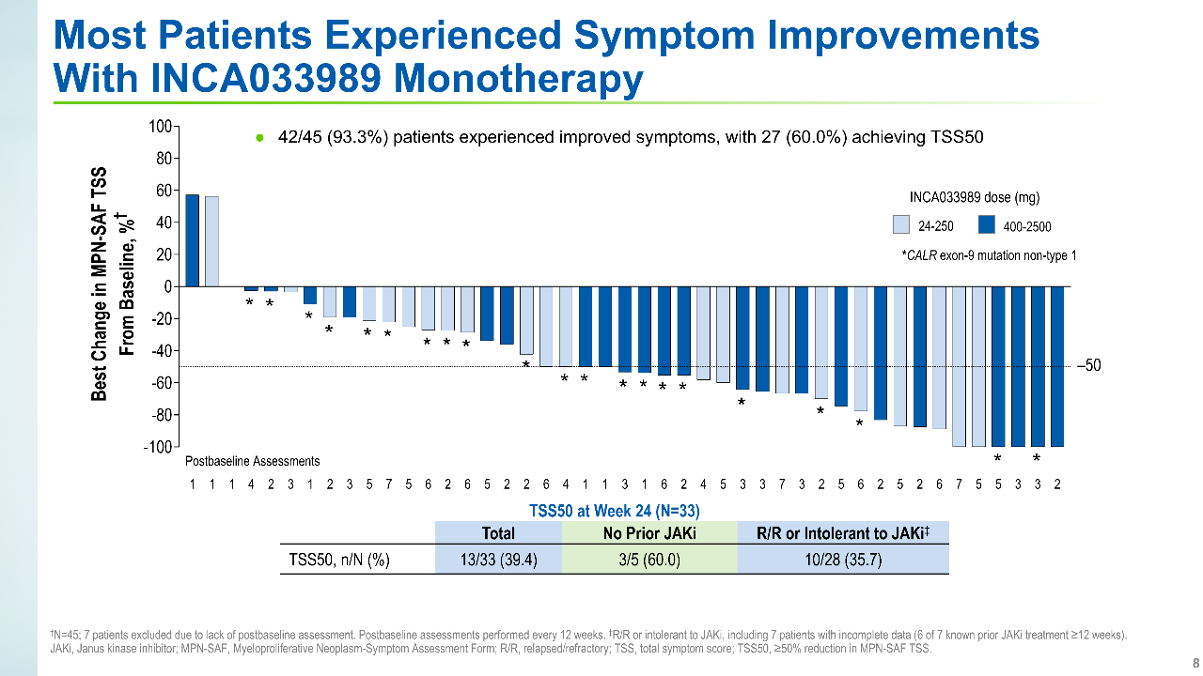
Mascarenhas JO, et al. ASH 2025;Abstract 484

Slide 59
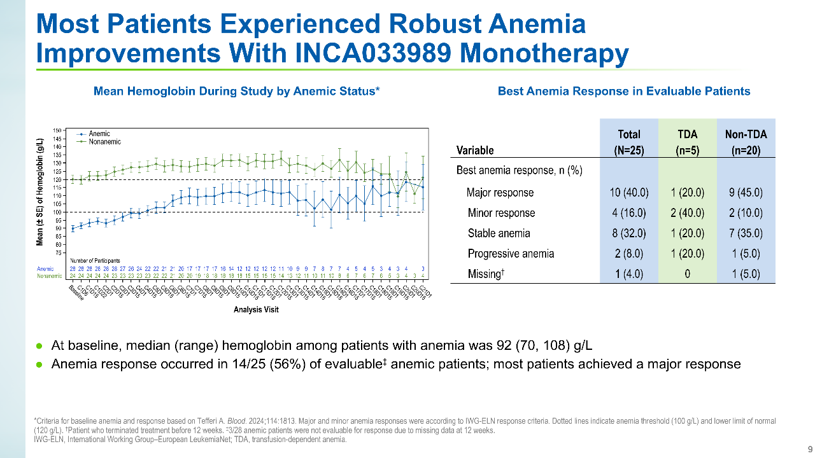
Mascarenhas JO, et al. ASH 2025;Abstract 484

Slide 60

Mascarenhas JO, et al. ASH 2025;Abstract 484

Slide 61
Molecular Responses are Rapid and Frequent
A reduction in mutCALR VAF from baseline occurred in 34/38 (89%) evaluable patients
  18/38 (47%) achieved >20% best reduction in VAF
  8/38 (21%) achieved >50% best reduction in VAF
All 18 molecular responders all achieved >20% VAF reduction by the end of 6 cycles of therapy
Of the 18 molecular responders, 16 (89%) achieved a hematological response of durable CR or PR
*
*
*
*
*
*
24mg
*
*
*
*
*
*
*
*
*
*
*
*Indicates patients with no VAF assessments
beyond 3 cycles of therapy
2500mg
Mascarenhas JO, et al. EHA 2025;Abstract LBA4002
Notes:
Dose correlation with VAF change, higher doses less timepoint available, longer follow up is needed.

Slide 62



Novel JAK2 V617F inhibition
AJX-101: A Multicenter, Open-Label, Phase 1 Study of AJ1-11095 Administered as Oral Monotherapy in Patients with Myelofibrosis Who Have Been Failed by a Type 1 JAK2 Inhibitor
All current JAK2 inhibitors are Type I inhibitors that bind the active conformation
Type II JAK2 inhibition overcomes ruxolitinib persistent MPN cells
Mascarenhas JO. MPN Education Foundation

Slide 63

Novel JAK2 V617F inhibition
INCB 160058-101: Multicenter Study of INCB160058 (selective JAK2V617F inhibitor) in Participants With Myeloproliferative Neoplasms

Slide 64

Conclusions
Significant advances in the understanding of MPN biology has led to many novel and promising therapeutic agents in investigation in Myelofibrosis
First line therapy for MF will likely be re-defined by the ongoing clinical trials
Correlative studies, and clinical and molecular predictors are needed to better guide future clinical trial design
Advocacy for clinical trial enrolment is a must to advance the therapeutic field forward
Thank you
Abdulraheem Yacoub, MD
Assistant Professor
The University of Kansas Cancer Center
Email: ayacoub@kumc.edu
Cell phone: 314-882-7124

Slide 65
QUESTIONS?

Slide 66
Module 15: Targeted Therapies for NSCLC
Therapeutic Approaches Targeting HER2 and RET —
Dr Bazhenova
Therapeutic Approaches Targeting ALK and ROS1 —
Dr Langer

Slide 67



Faculty
Lyudmila Bazhenova, MD
UC San Diego Moores Cancer Center
San Diego, California
Moderator
Neil Love, MD
Research To Practice
Miami, Florida
Corey J Langer, MD
Abramson Cancer Center
Philadelphia, Pennsylvania
Co-Moderator
Sunil Gandhi, MD
Florida Cancer Specialists &
Research Institute
Lecanto, Florida

Slide 68
Module 15: Targeted Therapies for NSCLC
Therapeutic Approaches Targeting HER2 and RET —
Dr Bazhenova
Therapeutic Approaches Targeting ALK and ROS1 —
Dr Langer

Slide 69
Module 15: Targeted Therapies for NSCLC
We would like to do a “best paper or presentation of the year” activity. Please suggest one “paper of the year” and 2 other worthy papers based on the value in treatment of current and future patients.

Slide 70
Therapeutic Approaches Targeting HER2 and RET
Lyudmila Bazhenova, MD, FASCO
Professor of Medicine
Lung Cancer Unit Leader
Director Hematology Oncology training program
UC San Diego Moores Cancer Center.

Slide 71
Disclosures
Advisory Committees | AbbVie Inc, Bayer HealthCare Pharmaceuticals, Boehringer Ingelheim Pharmaceuticals Inc, Bristol Myers Squibb, Genentech, a member of the Roche Group, Janssen Biotech Inc, Lilly, Merck, Natera Inc, Nuvalent, Pfizer Inc, Revolution Medicines Inc, Summit Therapeutics, Taiho Oncology Inc
Nonrelevant Financial Relationships | Alliance for Clinical Trials in Oncology Foundation

Slide 72
HER 2 alterations

Slide 73

What Is “HER2+” Lung Cancer?
ALL
HER2 in NSCLC | Frequency
Protein overexpression | 59%
Overexpression (IHC 2+/ 3+) | 15-30%
Overexpression (IHC 3+ only) | 2-6%
Amplification (FISH) GCN to CEP 17 >=2 | 2-6%
Mutations | 1-5%
NSCLC
Breast
TKD mutations: ~ 50% to 60%
  Exon 20 insertions (most common): Y772_A775dup (aka ins YVMA)
  Other rare TKD mutations: L755P in exon 19, etc
Trans/juxtamembrane domain mutations: ~ 5% to 10% G660D, V659E, etc
Extracellular domain mutations: ~10% to 20% S310F, S310Y, etc
Colon
Robichaux et al Cancer cell 2020
ECD = extracellular domain; TMD = transmembrane domain.
Pillai RN, et al. Cancer. 2017;123(21):4099-4105. Liu S, et al. J Clin Oncol. 2010;28(25):4006-4012. Nakamura H, et al. Cancer. 2005;92(6):1033-1037. Bansal P, et al. Front Oncol. 2016;6:112. Heinmoller P, et al. Clin Cancer Res. 2003;9(14):5238-5243. Menard S, et al. Ann Oncol. 2001;12(Suppl 1):S15-S19. Peters S, et al. Transl Lung Cancer Res. 2014;3(2):84-88. Rothschild SI. Cancer (Basel). 2015;7(2):930-949. Hyman DM, et al. Nature. 2018;554(7691):189-194.

Slide 74
Two major approaches with FDA approval in NSCLC
ADC
HER2 3+ overexpressing after failure of platinum doublet
TKI
Sevabertinib
Zongertinib
Trastuzumab deruxtecan (T-DXd)
HER2 mt

Slide 75


Trastuzumab Deruxtecan in HER2 mt NSCLC ( DESTINY LUNG 01)
T-DXd is a Humanized anti-HER2 IgG1 mAB with a topoisomerase I inhibitor payload, cleavable linker and DAR of ≈8
mPFS 8.2 months (95% CI, 6.0 to 11.9)
mOS 17.8 months (95% CI, 13.8 to 22.1)
Li BT et al. N Engl J Med. 2021;386:241-251.
Notes:
N Engl J Med
. Author manuscript; available in PMC: 2022 May 3.
Published in final edited form as: N Engl J Med. 2021 Sep 18;386(3):241–251. doi: 10.1056/NEJMoa2112431

Slide 76


Randomized phase II trial ( DESTINY LUNG 02)
Response by BICR | T-DXd 5.4 mg/kg N=102 | T-DXd 6.4 mg/kg N=50
Confirmed ORR % ( CI) | 49 (39-59) | 56 (41.3-70))
mDOR, Months | 16.8 (6.4-NE) | NE (8.3-NE)
mPFS | 9.9 (7.4-NE) | 15.4 (8.3-NE)
mOS | 19.5 (13.6 –NE) | NE (12.1-NE)
Key Eligibility criteria
Stage IV
Activating HER 2 mutations
2L +
ECOG 0-1
Patients, investigators and study staff are blinded to dose level
The study was not powered to statistically compare two arms.
Adjudicated Drug related ILD
 | T-DXd 5.4 mg/kg N=101 | T-DXd 6.4 mg/kg N=50
Any Grade n(%) | 13 ( 12.9%) | 14 (28%)
K Goto et al ESMO 2022, Goto et al JCO 2023

Slide 77

CNS activity of T-DxD
Janne et al JAMA network open 2025

Slide 78
Efficacy of sevabertinib in patients with HER2 mutations
 | COHORT D Previously treated Naïve to HER2 therapy | Cohort E Prior HER2 ADC | Cohort F Treatment naive
N | 81 | 55 | 73
ORR BICR | 64% | 38% | 71%
DOR 95% ( CI) | 9.2 (6.3, 13.5) | 8.5 (5.6, 16.4) | 11 ( 8.1 NE)
PFS | 8.3 (6.9, 12.3) | 5.5 (0.3 to 8.3) | Not mature
Le X et al. NEJM. 2025: Le et al ESMO 2025
Efficacy of zongertinib in patients with HER2 mutations
 | COHORT 1 Previously treated Naïve to HER2 therapy | Cohort 5 Prior HER 2 ADC | Cohort 2 Treatment Naive
N | 75 | 31 | 74
ORR BICR | 71% | 48% | 76%
DOR 95% ( CI) | 14.1 (6.9-NE) | 5.3 | 15.2 (9.8 – NE)
PFS | 12.4 (8.2 NE) | 6.8 | 14.4 (11.1-NE)
Heymach JV et al. NEJM. 2025;392:2321-33, Sanjay Popat, ESMO 2025., Heymach et al NEJM 2026

Slide 79


Side effect profile
Sevabertinib all cohorts
Zongertinib 1L
Sanjay Popat, ESMO 2025
Le et al ESMO 2025

Slide 80

Does the type of the mutation matter?
Sevabertinib
ORR 71%
mPFS 9.6m
ORR 78%
mPFS 12.2m
ORR
mPFS 7m
Le X et al. NEJM. 2025

Slide 81

Does the type of the mutation matter?
Zongertinib
Cohort 3. Non TKD mutation, pretreated, naïve to HER2 therapy
(S310F, V659E, S310Y, P1199S, D277Y, S113F, G660D)
COHORT 1 Previously treated Naïve to HER2 therapy
N=75
ORR 71%
mDOR 14.1 (6.9-NE)
mPFS 12.4 (8.2 NE)
Heymach et al NEJM 2025

Slide 82

Zongertinib CNS activity
Confirmed Intracranial Response in Patients with Active Brain Metastases
Treated with Zongertinib 120 mg in Beamion LUNG-1 Cohort 4, as Assessed by
Blinded Independent Central Review. TKD mutation
Ruiter G et al. WCLC 2025, Heymach et al, NEJM 2026

Slide 83


T-DXd in HER2-overexpressing lung cancer ( IHC 2+/3+)
Destiny Lung 01
N=41
Destiny Lung 03
N=36
ORR 34% (95% CI 20.1 -50.6) combined 2+ and 3+ mDOR 6.2 months (4.2-9.8)
mPFS 6.7 months (95% CI (4.2–8.4)
mOS: 11.2 months (95% CI, 8·4–not evaluable)
ORR 44.4 (16) 27.9–61.9) combined 2+ and 3+
mDOR 11.0 ( 5.5-16.7)
mPFS 8.2 months (6.7–11.1)
mOS:17.1 months (11.6–23.8)
Smit al Lancet Oncology 2024
Planchard et al JCO 2025

Slide 84



Ongoing 1L studies with T-DXD, zongertinib, sevabertinib
ESMO 2023

Slide 85
Summary
HER2 mutation and over expressions are targetable alterations therefore testing is important
Three FDA approved agents: sevabertinib, zongertinib, Trastuzumab deruxtecan
CNS activity has been confirmed with zongertinib and T-DXd
Several unanswered questions.
  Impact of the specific HER2 mutation on treatment selection
  How to best sequence TKIs and ADCs
  CNS activity
  Use of TKIs as single-agent vs combination

Slide 86
RET rearranged NSCLC

Slide 87

RET Alterations
RET (REarranged during Transfection) can be altered in two distinct ways
  Point mutations found predominantly in MTC
  Fusions seen in papillary thyroid cancer and NSCLC
    Many known fusion partners
    Intact tyrosine kinase domain fused with upstream partner.
    KIF5B is the most common fusion partner in lung cancer
      Other partners are CCDC6, NCOA4, and TRIM33
    Typically, do not occur concurrently with alterations in EGFR, ALK, ROS1, BRAF, or KRAS
Frequency in lung cancer: 1-2 % overall
Ju YS et al. Genome Res. 2012;22:436-445. Drilon A et al. Cancer Discov. 2013;3:630-635.
Wang R et al. J Clin Oncol. 2012;30:4352-4359; Kohno T et al. Cancer Sci. 2013;104:1396-1400.

Slide 88


Efficacy of Selective RET Inhibitors in NSCLC
Selpercatinib (treatment naïve)
Pralsetinib (treatment naïve)
 | Platinum pretreated N = 247 |  |  |  |  | Treatment Naïve N = 69
 | IRC ORR % (95% CI) | mDOR, months (95% CI) | mDOR, months (95% CI) | mPFS, months (95% CI) | Intracranial ORR (95% CI) | IRC ORR % (95% CI) | mDOR, months (95% CI) | mDOR months (95% CI) | mPFS,months (95% CI) | mPFS Months (95% CI)
Selpercatinib¹⁻⁴ | 61 (55, 67) | 28.6 (20.4, NE) | 28.6 (20.4, NE) | 24.9 (19.3, NE) | 85 (65 -96) | 84 (73, 92) | 20.2 (13.0, NE) | NE (12.0–NE) | 22.0 (13.8, NE) | NE (13.8–NE)
 | N=130 for ORR, N=141 for PFS and OS |  |  |  |  | N=106 for ORR N=116 for PFS and OS
Pralsetinib^{5,6,7} | 63 (54-71) | 31.8 (15.1-40.4) |  | 16.4 (11.4 -23.5) | 56 (21-86) | 78 (69-86) |  | 13.4 (9.4-21.7) |  | 12.1 (9.2-16.6)
1. Drilon A et al. J Clin Oncol. 2023;41(2):385-394. 2. Drilon A et al, N Engl J Med. 2020;383(9):813-824. 3. Besse B et al. J Clin Oncol 2021;39(no. 15_suppl):9065-9065. 4. Drilon A et al. Ann Oncol. 2022;33:S43. 5. Gainor JF et al. Lancet Oncol. 2021;22(7):959-969. 6. Griesinger F et al. Ann Oncol. 2022 ;33(11):1168-1178.7 Besse et al JCO 2026

Slide 89

CNS Activity in Measurable CNS Metastases
Selpercatinib ( treatment naive)
Pralsetinib
icORR 85% (22/26; 95% CI, 65 - 96)
Seven patients (27%) with intracranial CR
icORR 70% (7/10; 95% CI, 35 - 93)
Three patients (30%) with intracranial CR
Drilon A et al. J Clin Oncol. 2023;41(2):385-394.
Griesinger F et al. Ann Oncol. 2022 ;33(11):1168-1178.

Slide 90


Adverse Events
Selpercatinib
Pralsetinib
Drilon A et al. J Clin Oncol. 2023;41(2):385-394.
Griesinger F et al. Ann Oncol. 2022 ;33(11):1168-1178.

Slide 91



 | Selpercatinib | Chemo + Pembro
PFS | 24.8 mo | 11.2 mo
ORR | 84% | 65%
DoR | 24.2 mo | 11.5 mo
±pembrolizumab⨥
Zhou. NEJM. 2023;389:1839; Solomon. Future Oncology 2021;17:763-773
Notes:
Solomon BJ et al. Future Oncology 2021

Slide 92


Libretto 432
EFS benefit has been reported for selpercatinib as adjuvant therapy in early stage RET fusion-positive NSCLC
https://investor.lilly.com/news-releases/news-release-details/lillys-retevmo-selpercatinib-delivers-substantial-event-free

Slide 93
Summary
RET fusions are targetable in NSCLC
Selective RET inhibitors appear to be effective and well tolerated
  Pralsetinib, selpercatinib
  Both with extracranial and intracranial activity
Drugs that address RET inhibitor resistance are in development

Slide 94
QUESTIONS?

Slide 95
Module 15: Targeted Therapies for NSCLC
Therapeutic Approaches Targeting HER2 and RET —
Dr Bazhenova
Therapeutic Approaches Targeting ALK and ROS1 —
Dr Langer

Slide 96
Targeting ALK and ROS1 in NSCLC: State-of-the-Art - 2026
Division of Hematology & Oncology
Corey J. Langer, MD, FACP
Director of Thoracic Oncology
Abramson Cancer Center
Professor of Medicine
Perelman School of Medicine
University of Pennsylvania
Philadelphia, PA 19104
Corey.langer@uphs.upenn.edu
CP: 215-806-6152
RTP 2026: Orlando, FL

Slide 97
Disclosures
Advisory Committees | Oncocyte, Summit Therapeutics; Consulting Agreements: Amgen Inc, AstraZeneca Pharmaceuticals LP, Bayer HealthCare Pharmaceuticals, Boehringer Ingelheim Pharmaceuticals Inc, Caris Life Sciences, Fosun Pharma, Genentech, a member of the Roche Group, Gilead Sciences Inc, Guardant Health, Jazz Pharmaceuticals Inc, Merck, Novartis, Novocure Inc, Onyx Pharmaceuticals, an Amgen subsidiary, Pfizer Inc, Regeneron Pharmaceuticals Inc, Takeda Pharmaceuticals USA Inc
Contracted Research (Institutional Support) | Advangene, Amgen Inc, AstraZeneca Pharmaceuticals LP, Daiichi Sankyo Inc, FUJIFILM Pharmaceuticals USA Inc, Genentech, a member of the Roche Group, Guardant Health, Inovio Pharmaceuticals Inc, Lilly, Merck, Navire, Novocure Inc, Pfizer Inc, Takeda Pharmaceuticals USA Inc, Trizell
Data and Safety Monitoring Boards/Committees | Incyte Corporation, Summit Therapeutics
Research Colloquia | Aptitude Health
Nonrelevant Financial Relationships | Valor (VA)

Slide 98




ALK+ NSCLC in brief
1. Incidence of ALK rearrangements: 5-7% of all NSCLC*
2. Testing for ALK rearrangements is mandatory
* Over 50.000 new cases/year worldwide
3. ALK-Is are extending survival in ALK+ NSCLC
4. No role for IT as single agent or in combination with ALK-Is
OS time 81 months (6.8 years)
1. Goodman, A. The ASCO Post. June 25, 2017, 2. Lindeman NI et al. Arch Pathol Lab Med 2018 Mar;142(3):321-346. 3. Pacheco JM et al. J Thorac Oncol . 2019 Apr;14(4):691-700 4. Calles A, et al.Am Soc Clin Oncol Educ Book . 2020 May:40:372-384.

Slide 99
ALK is an oncogenic driver mutation for a distinct subset of NSCLC
Lung Cancer
Driver mutations in lung cancer¹
Patients tend to be…
~5%
ALK
Younger^{2–4}
Median age ~52 years versus
~70 years for other types of NSCLC
EGFR
sensitising
17%
EGFR other 4%
MET 3%
>1 mutation 3%
HER2 2%
Never or light smokers^{3,5,6}
~70% patients with ALK+ NSCLC have
never smoked
HER2 2%
ROS1 2%
ROS1 2%
BRAF 2%
BRAF 2%
RET 2%
RET 2%
NTRK ~1%
KRAS
25%
NTRK 1%
PIK3CA 1%
PIK3CA 1%
MEK1 <1%
MEK1 <1%
Unknown oncogenic driver detected
31%
Advanced disease at presentation^{7–9}
Pleural/pericardial effusion
Multiple lesions/sites
Symptomatic
CNS metastases – high propensity
Poor prognosis without TKIs
1. Tsao, et al. J Thorac Oncol 2016;
2. Chia, et al. Clin Epidemiol 2014;
3. Camidge, et al. Lancet 2012;
4. SEER Cancer Stat Fact Sheets Lung and Bronchus Cancer
5. Tao, et al. Thorac Cancer 2017
6. Kayaniyil, et al. Curr Oncol 2016;
7. Solomon, et al. N Engl J Med 2014;
8. Soria, et al. Lancet 2017;
9. Peters, et al. N Engl J Med 2017

Slide 100

ALINA: phase III, open-label superiority study

Slide 101

ALINA: Disease-free survival

Slide 102

Disease-free survival subgroup analysis (ITT)

Slide 103

CNS disease-free survival in the ITT population

Slide 104
Other key trials of alectinib in stage I–III NSCLC
NAUTIKA-1
NCT04302025
Phase II study in resectable stage IB–IIIA NSCLC, which includes
a cohort of patients receiving perioperative alectinib¹
HORIZON-1
NCT05170204
Phase III, open-label, randomised cohort of patients with
unresectable stage III, ALK+ NSCLC receiving alectinib
vs durvalumab following chemoradiotherapy
1. Lee et al. WCLC 2023 (Abs EP02.04)

Slide 105
How do we manage advanced/metastatic ALK+ NSCLC?
1L
Ceritinib
Lorlatinib
Crizotinib
Alectinib
Brigatinib
Ensartinib
2010
2014
2018
2022
2L
2012
2016
2020
2024
Ceritinib
Brigatinib
Alectinib
Lorlatinib
XALKORI (crizotinib) US PI; XALKORI (crizotinib) SmPC; ZYKADIA (ceritinib) US PI; ZYKADIA (ceritinib) SmPC; TECENTRIQ (atezolizumab) US PI; TECENTRIQ (atezolizumab) SmPC;
ALUNBRIG (brigatinib) US PI; ALUNBRIG (brigatinib) SmPC; LORBRENA (lorlatinib) US PI; LORVIQUA (lorlatinib) SmPC; ENSACOVE (ensartinib) US PI

Slide 106
Efficacy of Next-Generation ALK TKIs for 1L Treatment of ALK+ NSCLC
 | ALECTINIB (Global ALEX^{1,2}) | BRIGATINIB (ALTA-1L^{3,4}) | ENSARTINIB* (eXalt-3⁵) | LORLATINIB (Interim CROWN^{6,7})
Comparator | Crizotinib | Crizotinib | Crizotinib | Crizotinib
N | ALEC: 152 CRZ: 151 | BRIG: 137 CRZ: 138 | ENSAR: 143 CRZ: 147 | LOR: 149 CRZ: 147
PFS, median (BIRC) | ALEC: 34.8 mos CRZ: 10.4 mos HR 0.43 (0.32–0.58) | BRIG: 24.0 mos CRZ: 11.0 mos HR 0.48 (0.35-0.66) | ENSAR: 25.8 mos CRZ: 12.7 mos HR 0.51 (0.35-0.72) | LOR: NR CRZ: 9.6 mos HR 0.27 (0.18-0.39)
Median follow-up for PFS above | ALEC: 18.6 mos CRZ: 17.6 mos | BRIG: 40.4 mos CRZ: 15.2 mos | ENSAR: 23.8 mos CRZ: 20.2 mos | LOR: 36.7 mos CRZ: 29.3 mos
CNS mets at baseline | ALEC: 42% CRZ: 38% | BRIG: 29% CRZ: 30% | ENSAR: 33% CRZ: 39% | LOR: 26% CRZ: 27%
PFS in pts with brain mets | ALEC: 25.4 mos^ CRZ: 7.4 mos^ HR 0.37 (0.23-0.58) | BRIG: 24.0 mos CRZ: 5.6 mos HR 0.25 (0.14-0.46) | ENSAR: 11.8 mos CRZ: 7.5 mos HR 0.55 (0.30-1.01) | LOR: NR CRZ: 7.2 mos HR 0.21 (0.10-0.44)
PFS in pts without brain mets | ALEC: 38.6 mos^ CRZ: 14.8 mos ^ HR 0.46 (0.31-0.68) | BRIG: 24.0 mos CRZ: 13.0 mos HR 0.62 (0.43-0.91) | ENSAR: NR CRZ: 16.6 mos HR 0.40 (0.23-0.70) | LOR: NR CRZ: 11.0 mos HR 0.29 (0.19-0.44)
ORR | ALEC: 83%^ CRZ: 76%^ | BRIG: 74% CRZ: 62% | ENSAR: 74% CRZ: 67% | LOR: 77% CRZ: 58%
^By investigator assessment. *Investigational (not FDA-approved)
¹Peters S, et al. N Engl J Med. 2017;377(9):829-838. ²Mok T, et al., Ann Oncol. 2020; ³ Camidge DR, et al. N Engl J Med. 2018;379(21):2027-2039. ⁴Camidge DR, et al. J Thorac Oncol. 2021;16(12):2091-2108. ⁵Horn L, et al. JAMA Oncol. 2021;7(11):1617-1625. ⁶ Shaw AT, et al. N Engl J Med. 2020;383(21):2018-2029. ⁷Solomon BJ, et al. Presented at: AACR;2022. Abstract CT223.

Slide 107

Evaluating CROWN in the context of ALK treatment landscape: systemic efficacy
J. Lin ASCO 2024

Slide 108

Evaluating CROWN in the context of ALK treatment landscape: CNS efficacy
Evaluating CROWN in the Context of ALK Treatment Landscape: CNS Efficacy
J. Lin ASCO 2024

Slide 109

Timing and Incidence of Most Common Adverse Reactions Based on Data from the CROWN and Phase I/2 Trials
Patient Guide to Common Side Effects of Lorlatinib
- PP-LOR-USA-0557-LORBRENA-Patient-AE-Timeline-Digital
- https://www.lorbrena.com/files/PP-LOR-USA-0557-LORBRENA-Patient-AE-Timeline-Digital.pdf

Slide 110
ALK Inhibition: Conclusions
Alk fusions: 3-8% of all NonSq NSCLC
  Younger pts; minimal or no smoking hx; aggressive clinical course
  High propensity for CNS invasion
TKIs: standard of care
  LTS: previously < 12-18 mos, now 6-8+ yrs
  US: Alectinib vs Lorlatinib: latter appears to have better PFS, potentially more CNS penetrance; but clearly heightened toxicity
Salvage Tx: depends on initial choice of TKI and subsequent NGS testing
  Final common pathway: Pem/Carbo +/- Bev
  CPIs: marginal, if any activity
Clear role in Adjuvant setting (Optimal Duration and Need for DDP in question)

Slide 111





Standard 1L ROS1 TKIs
Crizotinib and Entrectinib: Systemic Efficacy
Crizotinib
Entrectinib
ORR | 72% (58-83)
mDoR | 24.7 mos (15.2-45.3)
mPFS | 19.3 mos (15.2-39.1)
ORR | 68% (60-75)
mDoR | 20.5 mos (14.8-34.8)
mPFS | 15.7 mos (12.0-21.1)
Shaw AT, et al. N Engl J Med. 2014;371:1963-71.
Shaw AT, et al. Ann Oncol. 2019;30:1121-6. Drilon A, et al. JTO Clin Res Rep. 2022;3:100332.

Slide 112

Evolving Specificity of ROS1 Inhibitors over Time
Increasing
Systemic activity including CNS coverage
Capacity to work after prior TKI exposure
Coverage of Resistance Mutations

Slide 113

Activity of TKIs in TKI-Naïve ROS1 (+) mNSCLC

Slide 114

Differential Safety Profiles of ROS1 TKIs

Slide 115

Repotrectinib – TRIDENT-1
WCLC ’25: MA02.03 – Repotrectinib in Patients With ROS1 Fusion-Positive (ROS1+) NSCLC: Long-Term Follow-Up From the Phase 1/2 TRIDENT-1 Trial. Cho BC, et al

Slide 116

Repotrectinib – TRIDENT-1
WCLC ’25: MA02.03 – Repotrectinib in Patients With ROS1 Fusion-Positive (ROS1+) NSCLC: Long-Term Follow-Up From the Phase 1/2 TRIDENT-1 Trial. Cho BC, et al

Slide 117




Taletrectinib
Toxicity Profile: With 5 months of additional follow-up,1 no new safety signals were identified
• Rates of neurologic TEAEs were low and limited to Grade 1 or 2 Dysgeusia: 15.2% Grade 1; 4.1% Grade 2
Dizziness: 15.2% Grade 1; 2.3% Grade 2
• 2.3% of patients discontinued treatment due to treatment-related AEs. No patients in TRUST-II discontinued treatment due to increased ALT or AST
WCLC ’25: MA02.02 -Updated Efficacy and Safety of Taletrectinib in Patients With ROS1+ Non-Small Cell Lung Cancer: The Global TRUST-II Study

Slide 118

Zidesamtinib
PL02.15 – Pivotal ARROS-1 Efficacy and Safety Data: Zidesamtinib in TKI Pre-treated Patients with Advanced/Metastatic ROS1+ NSCLC. Drilon AE, et al

Slide 119


Zidesamtinib
18 m PFS %
40
68
PL02.15 – Pivotal ARROS-1 Efficacy and Safety Data: Zidesamtinib in TKI Pre-treated Patients with Advanced/Metastatic ROS1+ NSCLC. Drilon AE, et al

Slide 120

Zidesamtinib
PL02.15 – Pivotal ARROS-1 Efficacy and Safety Data: Zidesamtinib in TKI Pre-treated Patients with Advanced/Metastatic ROS1+ NSCLC. Drilon AE, et al

Slide 121

Selecting Tx for ROS1 TKI Pre-treated Pts

Slide 122

Acquired ROS1 Mutation Coverage Correlates with Activity
TKI Pre-treated Pts

Slide 123
Activity of Zidesamtinib in ROS1 TKI-Exposed mNSCLC

Slide 124

Strategies for Off-Target or Polclonal Resistance
ROS1 TKI-Exposed mNSCLC

Slide 125
ROS1 Inhibition: Conclusions
ROS1 fusions: ~ 2% of all NonSq NSCLC
  Younger pts; minimal or no smoking hx; aggressive clinical course
  High propensity for CNS invasion
TKIs: standard of care
  LTS: previously < 12-18 mos, now > 4-5+ yrs
  Crizotinib and Entrectinib: “historic interest”
  US: Taletrectinib > Repotrectinib: Both have RR% ~ 80-90% in Tx-naïve pts, CNS penetrance, mPFS 3-4 yrs
  Zidesamtinib: “may” be superior
Salvage Tx: depends on initial choice of TKI and subsequent NGS testing
  Final common pathway: Pem/Carbo +/- Bev
  CPIs: marginal, if any activity

Slide 126
QUESTIONS?

Slide 127
Module 16: Acute Myeloid Leukemia (AML)
Current Management Approaches for FLT3- and IDH-Mutated AML — Dr DiNardo
Current and Future Role of Menin Inhibitors for Patients with AML — Dr Erba

Slide 128



Faculty
Courtney D DiNardo, MD, MSCE
The University of Texas
MD Anderson Cancer Center
Houston, Texas
Moderator
Neil Love, MD
Research To Practice
Miami, Florida
Harry Paul Erba, MD, PhD
Duke University School of Medicine
Durham, North Carolina
Co-Moderator
Gustavo Adolf Fonseca, MD
Florida Cancer Specialists &
Research Institute
Lecanto, Florida

Slide 129
Module 16: Acute Myeloid Leukemia (AML)
Current Management Approaches for FLT3- and IDH-Mutated AML — Dr DiNardo
Current and Future Role of Menin Inhibitors for Patients with AML — Dr Erba

Slide 130
Module 16: Targeted Treatment of AML
We would like to do a “best paper or presentation of the year” activity. Please suggest one “paper of the year” and 2 other worthy papers based on the value in treatment of current and future patients.

Slide 131

Fathi AT et al. ASH 2025;Abstract 6.

Slide 132

PARADIGM: Conclusions
Fathi AT et al. ASH 2025;Abstract 6.

Slide 133
Current Management Approaches for FLT3 and IDH Mutant AML
Courtney DiNardo, MD MSCE
Department of Leukemia
MD Anderson Cancer Center

Slide 134
Disclosures
Advisory Committees | Astellas, Bristol Myers Squibb, Kura Oncology
Consulting Agreements | AbbVie Inc, AstraZeneca Pharmaceuticals LP, Bristol Myers Squibb, Genmab US Inc, Molecular Partners, Rigel Pharmaceuticals Inc, Servier Pharmaceuticals LLC
Contracted Research | AbbVie Inc, Astex Pharmaceuticals, Auron Therapeutics, Remix Therapeutics, Rigel Pharmaceuticals Inc, Servier Pharmaceuticals LLC, SillaJen, SystImmune Inc

Slide 135

Characteristics of FLT3 Mutations in AML
FLT3-ITD in ~25% and FLT3-TKD in ~10% AML
More frequent in younger pts, de novo AML and diploid cytogenetics
Leads to constitutive activation of FLT-3 receptor
FLT3-ITD independent predictor of poor prognosis; often associated with more proliferative disease
Immunoglobulin-like loops
Transmembrane domain
Extracellular
Juxtamembrane domain
ITD
Up to 30%
of patients
Kinase 1 domain
Kinase 2 domain
TK domain
C-terminus
Activated proliferation and pro-survival pathways
Litzow MR et al, Blood 2015

Slide 136

Approved Regimens for Newly Dx FLT3-Mutated AML
HR: 0.78
FLT3-ITD and FLT3-TKD mutations, age < 60 yrs
60-day mortality: not reported
FLT3-ITD only, and age < 75 yrs
60-day mortality: quizartinib 7.5%, placebo 4.9% (mostly infections)
Stone RM, et al. N Engl J Med. 2017 Aug 3;377(5):454-464
Erba HP, et al. Lancet. 2023 May 13;401(10388):1571-1583

Slide 137

Quick Review of FLT3 Inhibitors
Midostaurin
(Type 1 – TKD and ITD)
Approved in Newly Dx Fit AML in combo w/ chemotx
Quizartinib
(Type 2 – FLT3-ITD only)
Approved in Newly Dx Fit AML in combo with chemotx
Gilteritinib
(Type 1 – TKD and ITD)
Approved in R/R AML as monotherapy
QTc prolongation, myelosuppression, and transaminitis
QTC prolongation, potential ventricular arrhythmias, myelosuppression, transaminitis
GI effects/nausea/diarrhea, transaminitis, rash

Slide 138
Important Differences of FLT3 inhibitors
 |  | First generation | Second generation
 |  | Lack specificity for FLT3 | More specific and potent
Type I | Pure ATP-competitive* Active on ITD+ and TKD+ | Sunitinib Lestaurtinib Midostaurin | Gilteritinib Crenolanib
Type II | Maintain the inactive conformation† Active on ITD+ only | Sorafenib Tandutinib | Quizartinib Ponatinib Pacritinib Ibrutinib
2nd GEN:
More potent and selective:
FLT3, KIT, CSF1R, PDGFRA/B
*blue and green compounds are clinically used in the US for FLT3-mutated AML
*Bind to the ATP-binding site when the receptor is in the active conformation.
†Interact with a hydrophobic region immediately adjacent to the ATP binding site that is only accessible when the receptor is in the inactive conformation; prevent receptor activation. As most TKD (D835) mutations favor the active conformation, Type II inhibitors are usually ineffective on TKD-positive cells.
Larrosa-Garcia M, et al. Mol Cancer Ther. 2017;16:991-1001
Smith CC, et al. Nature. 2012 Apr 15;485(7397):260-3
Whartenby K, et al. PNAS. 2005 Nov 15;102(46):16741-6
Levis M, Perl AE. Blood Adv. 2020 Mar 24;4(6):1178-1191

Slide 139
QuANTUM-First Phase 3 Trial: Quizartinib Plus Standard Induction Chemotherapy Followed by Single-Agent Quizartinib –
Enrollment dates: September 2016 to August 2019
*trial designed and started before midostaurin approval, so randomization is to placebo
Induction
(Up to 2 cycles)
Consolidation
(Up to 4 cycles)
Continuation
(Up to 36 cycles)
Cytarabine
days 1-7
+
Daunorubicin or
idarubicin
days 1-3
+
Quizartinib (40 mg)
days 8-21
HiDAC
+
Quizartinib (40 mg)
and/or allo-HCT
Quizartinib (60 mg)
once daily
Newly diagnosed FLT3-ITD+ AML
18-75 years of age
≥3% FLT3-ITD allelic frequency
Randomization (1:1)
day 7
Cytarabine
days 1-7
+
Daunorubicin or
idarubicin
days 1-3
+
Placebo
days 8-21
HiDAC
+
Placebo
and/or allo-HCT
Placebo
once daily
Selected endpoints
Primary endpoint: OS
Secondary endpoints: EFS, CR/CRc, Safety
Exploratory endpoints: RFS, DoCR
Allo-HCT per
institutional policies
Erba HP et al, Lancet 2023

Slide 140
Primary Endpoint: Overall Survival
Newly Diagnosed FLT3-ITD+ AML; Ph3 Quizartinib + Chemotherapy
1.0
**FDA Approved**
Frontline option for FIT Newly Dx FLT3-ITD AML
0.8
Quizartinib^{b}
mOS: 31.9 mo
0.6
Overall survival probability
Placebo^{c}
mOS: 15.1 mo
0.4
∆mOS: 16.8 mo
HR, 0.776 (95% CI, 0.615-0.979)
P=.0324 (2-sided)ª
0.2
0.0
0
3
6
9
12
15
18
21
24
27
30
33
36
39
42
45
48
51
54
57
60
No. at risk
Time, months
Quizartinib
268
233
216
195
176
162
153
145
139
126
110
96
83
68
53
36
24
8
4
1
0
Placebo
271
249
211
175
151
131
126
121
117
103
97
81
70
56
39
31
17
8
5
0
0
Erba HP et al, Lancet 2023

Slide 141
Quizartinib Treatment Is Associated with 3-Fold Lower Level of FLT3-ITD MRD, Among CRc Patients by the End of Induction
100
Median = 0.01% quizartinib vs 0.03% placebo
Nominal P value (2-sided) = 0.0251
10
1
n=125 (77.2%)
n=140 (88.1%)
FLT3-ITD MRD VAF (%)
0.1
0.01
10⁻⁴ Cutoff:
0.001
Not detectable
n=37 (22.8%)
n=19 (11.9%)
Cutoff 0 (Quiz 2x clearance rate
Quizartinib (n=162)
Placebo (n=159)
Erba HP et al, Lancet 2023
10⁻⁴ cutoff chosen for analysis per ELN and FDA cutoff

Slide 142
Impact of QUIZ maintenance in patients without SCT in CR1
OS in Patients Who Received Continuation Therapy Without Allo-HCT
100
Similar number of patients without allo-SCT in both groups were able to reach continuation phase (about 60-70% of non-SCT pts)
80
Quizartinib (n=46)
60
OS probability (%)
Placebo (n=43)
40
20
0
+ CENSORED
0
3
6
9
12
15
18
21
24
27
30
33
36
39
42
45
48
51
54
57
Time (months)
No. at risk
Quizartinib | 46 | 46 | 46 | 45 | 45 | 44 | 42 | 41 | 38 | 34 | 29 | 25 | 22 | 17 | 11 | 7 | 5 | 1 | 0 | 0
Placebo | 43 | 43 | 43 | 39 | 36 | 31 | 29 | 28 | 28 | 23 | 18 | 15 | 12 | 10 | 7 | 4 | 3 | 1 | 0 | 0
Allo-HCT, allogeneic hematopoietic cell transplantation; CI, confidence interval; HR, hazard ratio; NR, not reached; OS, overall survival.
Notes:
In this Kaplan-Meier plot of OS in patients who received continuation without prior allo-HCT, the number of patients in the two treatment groups is balanced
An OS benefit was observed in the quizartinib arm, with a 60% reduction in the risk of death
Notes:
The number of OS events was 31 including both treatment arms (31/89 → 34.8%)
The 95% CI of the HR was narrow: 0.192-0.838
The median OS was not reached with quizartinib
In QuANTUM-First, there were 6 patients who underwent transplantation during continuation (4 in the quizartinib arm and 2 in the placebo arm): these are included in this plot
The median of OS was calculated using the Kaplan-Meier method, its 2-sided 95% CIs using the method of Brookmeyer and Crowley, and the HR with its 95% CI using unstratified Cox regression
Note that the OS data in continuation by allo-HCT was presented at an FDA workshop held at ASH 2023 (although the analysis presented by the FDA was slightly different)

Slide 143
PETHEMA-QUIWI Study
Quizartinib for Newly Diagnosed Adult Patients with FLT3-WILD TYPE AML?!?
Induction
1-4 cycles
12 months
AML
age 18-70 years
FLT3-ITD NEG
N = 273
7+3
+ Quizartinib
HiDAC + Quizartinib
Quizartinib
R
2:1
7+3
+ Placebo
HiDAC
+ Placebo
Placebo
Primary endpoint: EFS
Secondary endpoint: OS
Stratification Factor: age < or > 60 yrs
AlloHCT at discretion of physician
Maintenance Post-HCT
Montesinos, P et al., J Clin Oncol 2025

Slide 144
QUIWI: Efficacy Results: EFS and OS
EFS
OS
100
100
1-year
76.9%
63.4%
2-year
66.1%
50.5%
3-year
60.8%
45.7%
1-year
58.3%
47.3%
4-year
57.1%
44.3%
75
2-year
49.2%
36.6%
3-year
44.6%
32.1%
75
4-year
44.6%
32.1%
Quizartinib
EFS (%)
50
Quizartinib
OS (%)
50
Placebo
Placebo
25
25
0
0
0
3
6
9
12
15
18
21
24
27
30
33
36
39
42
45
48
51
54
57
60
0
3
6
9
12
15
18
21
24
27
30
33
36
39
42
45
48
51
54
57
60
No. at risk
Time (months)
No. at risk
Time (months)
Quizartinib
180
137
128
116
103
98
91
88
87
83
81
70
55
44
33
21
11
0
0
0
0
Quizartinib
180
166
158
148
136
131
123
117
117
113
110
94
75
56
38
22
11
0
0
0
0
Placebo
93
68
60
51
44
38
38
34
34
34
31
27
20
18
13
6
2
0
0
0
0
Placebo
93
81
74
66
59
51
50
47
47
47
46
40
32
25
17
10
5
0
0
0
0
 | Quizartinib (n = 180) | Placebo (n = 93)
Events, n (%) | 98 (54.4) | 63 (67.7)
Median EFS, months | 18.8 | 9.9
 | HR, 0.72 (95% CI, 0.53-1.00); P=0.045
 | Quizartinib (n = 180) | Placebo (n = 93)
Events, n (%) | 72 (40.0) | 51 (54.8)
Median OS, months | NR | 29.3
 | HR, 0.63 (95% CI, 0.44-0.91); P=0.01
Median follow-up: 39.4 months.
CI, confidence interval; EFS, event-free survival; HR, hazard ratio; NR, not reached; OS, overall survival
Montesinos P, et al. ASH 2024. Abstract 1512.
Montesinos, P et al., J Clin Oncol 2025

Slide 145
OS Benefit with Quizartinib was Observed across most of the Assessed Subgroups including NPM1^{mut}, DNMT3A^{mut} and FLT3-TKD^{mut}
OS in patients with NPM1 mutation
OS in patients with DNMT3A mutation
OS in patients with FLT3-TKD mutation
1.00
Quizartinib
1.00
1.00
Quizartinib
0.75
0.75
Quizartinib
0.75
Quizartinib
OS (%)
OS (%)
OS (%)
0.50
Placebo
0.50
0.50
Placebo
0.25
0.25
0.25
Placebo
0
0
0
0
12
24
36
48
60
0
12
24
36
48
60
0
12
24
36
48
60
Time (months)
Time (months)
Time (months)
No. at risk
Quizartinib | 40 | 39 | 38 | 28 | 5 | 0
Placebo | 17 | 13 | 10 | 7 | 1 | 0
No. at risk
Quizartinib | 45 | 37 | 33 | 25 | 4 | 0
Placebo | 21 | 14 | 10 | 9 | 1 | 0
No. at risk
Quizartinib | 20 | 19 | 19 | 14 | 3 | 0
Placebo | 6 | 5 | 3 | 2 | 0 | 0
 | Quizartinib | Placebo
Number of events | 3/40 | 8/17
3-years OS | 92% | 53%
 | HR, 0.123 (95% CI, 0.033-0.467); p=2e-04
 | Quizartinib | Placebo
Number of events | 13/45 | 11/21
3-years OS | 71% | 48%
 | HR, 0.458 (95% CI, 0.205-1.024); p=0.051
 | Quizartinib | Placebo
Number of events | 1/20 | 4/6
3-years OS | 95% | 33%
 | HR, 0.057 (95% CI, 0.006-0.514); p=5e-04
OS benefits with Quiz vs. PBO were observed across most assessed subgroups, including NPM1^{mut} and DNMT3A^{mut}; FLT3-TKD^{mut}; IDH2^{mut} (3-years OS 72% and 47%, respectively; HR, 0.503 [0.204, 1.24])
Martínez-Cuadrón D, et al. ASH 2024. Abstract 2895; Montesinos P et al, JCO 2025

Slide 146

“FLT3-like” Gene Expression Predicts Outcome with Quizartinib
80 / 180 cases (~ 45-50%) of FLT3 WT were “FLT3-like” and benefitted from QUIZ
Enrichment of NPM1, DNMT3A, and FLT3-TKD mutations in “FLT3-like” patients
Expands potential of patients who may benefit from IC + QUIZ : FLT3m 30% + FLT3-like 30-35%: 60-65%
HR/p Value | Not FLT3-like QUIZ vs NO | FLT3-like QUIZ vs NO
EFS | 1.07/.8 | 0.45/.009
RFS | 0.88/.76 | 0.37/.01
OS | 1.22/.62 | 0.41/.01
Mosquera-Orgueira. Blood 142: abst 974; 2023

Slide 147

Phase 3 QuANTUM-WILD trial design for Newly Dx AML
Primary Endpoint: OS (Arm A vs Arm B)
A vs C: Randomization to quiz vs placebo maintenance
Courtesy of Courtney DiNardo, MD, MSCE

Slide 148

ADMIRAL Phase 3 RCT: Overall survival (n=371)
Gilteritinib monotherapy vs SOC salvage (MEC, FLAG-IDA, azacitidine, LDAC)
 | GILT | Chemotx
CR | 21% | 11%
CRc | 54% | 22%
SCT | 26% | 15%
Perl A et al NEJM 2019

Slide 149


ADMIRAL Trial: Long-term follow up
Perl AE et al, Blood 2022

Slide 150

Characteristics of IDH mutations in AML
IDH mutations occur in ~ 20% of AML
  Most (~85%) occur in de novo, diploid or +8 AML
  IDH1 in ~8-10% AML, IDH2 in ~ 12-15% AML
  ↑ prevalence with ↑ patient age (~ 25% of older “unfit” AML)
  Often sustained platelet count
Hot-Spot mutations in enzyme active site
  IDH1-R132 (~40%), IDH2-R140 (~55%)
  or IDH2-R172 (~5%)
Can be acquired at progression
    ~10-15% of AML from MDS
    ~20-25% of AML from MPN
IDH2-R172
IDH1-R132
Dang L. Trends in Mol Med, 2010
Chou et al, Leukemia 2011
Molenaar et al, Leukemia 2015
IDH2-R140

Slide 151



Long-term follow up of IDH1^{MUT} AML with HMA-based doublet therapy
VIALE-A¹
AGILE²
AZA ± VEN
AZA ± IVO
Median OS: 10.2 months
CRc: 66.7%
Median OS: 29.3 months
CRc: 52.8%
¹Pollyea et al., Clin Cancer Research 2022; Pratz et al., AJH 2024
²Montesinos et al., NEJM 2022; Dohner et al., EHA 2023; Montesinos et al. Blood Advances 2025

Slide 152

AGILE: Ivosidenib+Aza vs Pbo+Aza in ND IDH1^{mut} AML
Randomized, Ph3 trial in patients with untreated AML and an IDH1 mutation (N=146)
Response
Grade ≥3 AEs in ≥20% of patients in either arm, n (%) | Ivo+Aza (n=71) | Pbo+Aza (n=73)
Hematologic AEs | 50 (70) | 47 (64)
Anemia | 18 (25) | 19 (26)
Febrile neutropenia | 20 (28) | 25 (34)
Neutropenia | 19 (27) | 12 (16)
Thrombocytopenia | 17 (24) | 15 (21)
Non-hematologic AEs
Pneumonia | 16 (23) | 21 (29)
Infections | 15 (21) | 22 (30)
Overall survival
Other safety events, n (%) | Ivo+Aza (n=71) | Pbo+Aza (n=73)
Differentiation syndrome (any grade) Grade ≥3 | 10 (14) 3 (4) | 6 (8) 3 (4)
QT interval prolonged on ECG (any grade) Grade ≥3 | 14 (20) 7 (10) | 5 (7) 2 (3)
Discontinuation as a result of AEs | 19 (27) | 19 (26)
Montesinos P, et al. N Engl J Med 2022; 386:1519–1531; Dohner H et al, EHA Hemasphere 2023 ;Montesinos et al. Blood Advances 2025
Aza, azacitidine; ECG, electrocardiography; Ivo, ivosidenib; mut, mutated; ND, newly diagnosed.

Slide 153
Olutasidenib and Ivosidenib
Olutasidenib has a smaller molecular weight
Binds both protein units in the dimer (2:1)
CNS penetration
Ivosidenib has a larger molecular weight
Binds at one of the 2 allosteric sites
Different binding kinetics:
Ivosidenib has slower & tighter binding; greater inhibition of mutant and wild-type, with longer half-life
Olutasidenib binds more quickly and more transiently (quick off-rate)
Reinbold R et al, Nat Commun 2022

Slide 154
Olutasidenib and Ivosidenib Data in R/R AML
*NOTE: This is a summary of data from independent trials, not a head-to-head comparison within a single study.
PARAMETERS | OLUTASIDENIB¹ | IvoSIDENIB^{2,3}
Composite complete remission (CR + CRh) | 35% | 33%
Median duration of CR/CRh (95% CI) | 25.3 months (13.5, NR) | 8.2 months (5.6, 12)
Complete remission rate (CR) | 32% | 25%
Median duration of CR | 28.1 months | 10.1 months
Overall response rate (CR + CRh + CRi + PR + MLFS) | 48% | 42%
Median duration of overall response | 15.5 months | 6.5 months
Response rates are quite similar, but duration of remissions favor OLUTA
1. de Botton S, et al. Blood Adv. 2023;bloodadvances.2022009411; Cortes J et al. J Hematol Oncol 2025;18(1):102. 2. Ivosidenib. Prescribing information. 3. DiNardo CD, et al. N Engl J Med. 2018;378:2386-2398.
Notes:
1. De botton/ p8/¶1/ln1 (CI)
2. Tibsovo PI/ p29/Table 16 /row12
(95% CR)

Slide 155
Olutasidenib and Ivosidenib Baseline Demographics and Disease Characteristics in Approval R/R AML Study Populations
 | OLUTASIDENIB^{1,2} N=147 | IVOSIDENIB^{3,4} N=174
Age, median (range) | 71 (32-87) | 67 (18-87)
Cytogenetic risk, n (%)
Favorable | 6 (4) | –
Intermediate | 107 (73) | 104 (60)
Poor | 25 (17) | 47 (27)
Missing/unknown | 9 (6) | 23 (13)
Comutations, n (%)*
NPM1 | 31 (21) | 44 (26)
FLT3 | 15 (10) | 11 (7)
TP53 | 9 (6) | 21 (13)
 | OLUTASIDENIB^{1,2} N=147 | IVOSIDENIB^{3,4} N=174
Prior AML therapy outcome, n (%)
Primary refractory | 46 (31) | 64 (37)
Untreated relapse | 81 (55) | 65 (37)
Refractory relapse | 20 (14) | 45 (26)
Prior regimens, median (range) | 2 (1-7) | 2 (1-6)
Prior Venetoclax, n (%) | 12 (8) | 0
Prior HSCT, n (%) | 17 (12) | 40 (23)
ECOG PS, n (%)
0 | 45 (31) | 36 (21)
1 | 76 (52) | 97 (56)
2 | 23 (16) | 39 (22)
3 | 0 (0) | 2 (1)
ECOG, Eastern Cooperative Oncology Group; PS, performance status.
*For ivosidenib, comutation analysis based on Choe et al. (2020), which had a baseline of 167 samples (ie, denominator=167).
1. de Botton S, et al. Blood Adv. 2023;bloodadvances.2022009411. 2. Olutasidenib. Prescribing information. 3. Ivosidenib. Prescribing information.
4. Choe S, et al. Blood Adv. 2020;4(9):1894-1905.

Slide 156

Olutasidenib 5-Year Results - TEAEs
Cortes J et al. J Hematol Oncol 2025;18(1):102.

Slide 157

Post-Venetoclax Olutasidenib Outcomes
In 12 pts R/R to venetoclax (median duration of previous venetoclax therapy of 6.7 mo), olutasidenib yielded:
  CR/CRh: 33%
  Median time to CR/CRh: 2.4 mo (1-2.8)
  Median duration of CR/CRh: not reached (range: 4.8-50.6 mo)
ORR: 50%; CR: 25%; CRh: 8%; CRi: 17%
  Median time to ORR: 1.7 mo
  Median duration of ORR: NR (1.2-52.5 mo)
54
Abaza. Am J Hematol. 2024;99:606. Cortes. EHA 2024; Abstract P614. Cortes. EHA 2024; Abstract 6528.

Slide 158

Randomized Phase III HOVON 150 / AMLSG 29-18 Trial
12 APR 2023: IDH2 cohort has completed enrollment
17 SEPT 2024: IDH1 cohort has completed enrollment
Study design provided courtesy of HOVON and AMSLG chairs.
Courtesy of Courtney DiNardo, MD, MSCE

Slide 159

7+3+IVO in ND IDH1^{mut} AML: 3-year overall survival was 67%
Overall survival^{b}: IVO cohorts
 | IVO 500 mg + Cytarabine + Dauno (n=30) | IVO 500 mg + Cytarabine + Ida (n=30) | Total (N=60)
OS probability,ª % 12 months 24 months 36 months 48 months 60 months | 76 73 62 58 58 | 83 76 73 65 65 | 80 75 67 61 61
OS duration, mo, median (95% CI) Sensitivity analysis, median (95% CI) | NE (25.8–NE) 30.6 (6.1–NE) | NE (39.4–NE) NE (39.4–NE) | NE (39.4–NE) 42.6 (25.8–NE)
12-month EFS, % | 41 | 58 | 49
29 pts (48%) underwent HSCT; 13 (22%) after induction, 14 (23%) after consolidation, 2 (3%) during maintenance
19 pts (32%) received IVO maintenance (median time maintenance 19.4 mo, and 10 pts still on study survival f/u)
Data cutoff: 16 January 2025
ªCalculated using Kaplan-Meier estimate of survival function.
^{b}OS sensitivity analyses censored patients at their time of HSCT, or the last dose date + 28 days if the HSCT date is not available.
Stein EM et al, ASH 2025

Slide 160
AE Profiles and Clinical Expectations of IDH Inhibitors as monotherapy in R/R AML
CR = 20%
CRc = 26%
mOS= 9mo
(~20mo if CR)
CR = 25%
CRc = 33%
mOS= 9mo
(~20mo if CR)
CR = 32%
CRc = 35%
mOS= 12mo
(NR if CR, 18mo OS 78%)
Treatment-Related TEAEs, Grade 3/4, n (%) | Enasidenib (IDH2i) 100 mg/d (n = 153)^{[1]} | Ivosidenib (IDH1i) 500 mg/d (n = 179)^{[2]} | Olutasidenib (IDH1i) 150 mg BID (n = 153)^{[3]}
Hyperbilirubinemia | 13 (8) | NR | 2 (1)
Prolonged QT interval | --- | 14 (8) | 1 (<1)
IDH differentiation syndrome | 11 (7) | 7 (4) | 12 (7)
Anemia | 10 (7) | 4 (2) | 7 (5)
Thrombocytopenia | 8 (5) | 3 (2) | 6 (4)
Tumor lysis syndrome | 5 (3) | --- | 3 (2)
Decreased appetite | 3 (2) | --- | ---
Leukocytosis | 2 (1) | 3 (2) | 7 (5)
Hepatic AESI (transaminitis) | --- | ---- | 23 (15)
NR, not reported; TEAEs, treatment-emergent adverse events.
1. Stein EM, et al. Blood. 2017;130:722-731; 2. DiNardo CD, et al. N Engl J Med. 2018;378:2386-2398; 3. De Botton S, et al. Blood Adv. 2023;7:3117-3127.

Slide 161
QUESTIONS?

Slide 162
Module 16: Acute Myeloid Leukemia (AML)
Current Management Approaches for FLT3- and IDH-Mutated AML — Dr DiNardo
Current and Future Role of Menin Inhibitors for Patients with AML — Dr Erba

Slide 163
Menin Inhibitors In Acute Myeloid Leukemia:
Current and Future
Harry P. Erba, MD PhD
Professor, Medicine
Director, Leukemia Program
Division of Hematologic Malignancies and Cellular Therapy
Duke University
Durham, NC

Slide 164
Disclosures
Advisory Committees | Daiichi Sankyo Inc, GlycoMimetics Inc, Kura Oncology, Sumitomo Pharma America
Consulting Agreements | AbbVie Inc, AstraZeneca Pharmaceuticals LP, Daiichi Sankyo Inc, GlycoMimetics Inc, Kura Oncology, Schrödinger, Servier Pharmaceuticals LLC, Stemline Therapeutics Inc, Sumitomo Pharma America, Taiho Oncology Inc
Contracted Research | Agios Pharmaceuticals Inc, ALX Oncology, Aptose Biosciences Inc, Ascentage Pharma, AstraZeneca Pharmaceuticals LP, Daiichi Sankyo Inc, Gilead Sciences Inc, ImmunoGen Inc, Kura Oncology, MacroGenics Inc, Novartis, Oryzon, Rigel Pharmaceuticals Inc, Sumitomo Pharma America, Taiho Oncology Inc
Speakers Bureaus | AbbVie Inc, Incyte Corporation, Jazz Pharmaceuticals Inc, Kura Oncology, Servier Pharmaceuticals LLC, Syndax Pharmaceuticals

Slide 165




Features of NPM1m AML
Duke Health
One of the three most common genetic lesions in adult AML (30-35%)
Typically associated with normal karyotype (85% of NPM1m cases)
An AML driver mutation, not observed in clonal hematopoiesis
Genetically-defined AML per ICC-2022 (>10% blasts) and WHO 2022 (regardless blast %)
Frequently co-occurs with mutant FLT3, DNMT3A, IDH1, and IDH2
Myeloid immunophenotype with decreased/absent expression of CD34 and HLA-Dr
Deep invaginations of the nuclear envelope (fish mouth or cup-like nuclei)
Falini B, et al. Blood 2020; 136: 1707

Slide 166

Duke Health
Overall Survival of Adults with Acute Myeloid Leukemia (SAL Registry)
1570 adults received cytarabine plus anthracycline/mitoxantrone induction
followed by high dose cytarabine based consolidation, +/- auto or allo HSCT
Ruhnke L, et al. Blood Adv. 2025; 9(6): 1392

Slide 167

Venetoclax in Combination with HMA or Intensive Chemotherapy is Effective in NPM1 Mutated AML
Duke Health
Adverse: TP53^{mut} or MECOMr
Intermediate-2: -5/del(5q), -7, -17, or abn(17p)
Favorable: diploid cytogenetics and NPM1^{mut} or CEBPA^{bZIP}
Intermediate-1: all others
Higher benefit: TP53^{WT}, no FLT3 ITD, NRAS^{WT}, KRAS^{WT}
FLAG-IDA + VEN
CLIA + VEN
CPX-351 + VEN
Dohner H, et al. Blood 2024; 144(21): 2211 1311; Jen W-Y, et al. EHA 2025

Slide 168


Duke Health
FLAG-IDA and Gemtuzumab are Associated with Higher Rate of MRD Negative Remission, Improved Survival and Lower Cumulative Incidence of Relapse in Younger NPM1m AML Patients
Othman J, et al. Blood 2024; 144(7): 714-728

Slide 169
Rel/Ref NPM1m AML Patients (MDACC Retrospective)
Duke Health
Median OS for NPM1m vs NPM1wt | NPM1m had no impact on risk of relapse or death
After salvage 1 After salvage 2 After salvage 3 | 7.8 vs 6.0 mos 5.3 vs 4.1 mos 3.5 vs 3.6 mos
Issa GC, et al. Blood Adv. 2023;7(6):933.

Slide 170
KMT2A-r Is a Stable Driver of Leukemogenesis with over 100 Fusion Partners ¹⁻³
Pediatric acute leukemia
Adult acute leukemia
AML
ALL
AML
ALL
MPAL
Infant: 35%-60%²
Pediatric: ~10%-15%^{1,2}
Infant: >80%³
Pediatric: 5%-6%³
~10%²
15%³
1%-3%⁴
The median age at diagnosis for KMT2A-r AML is lower than for all AML (52 vs. 68 years)^{5,6}
1. Issa GC, et al. Leukemia. 2021;35:2482-2495. 2. Conneely SE, Rau RE. Cancer Metastasis Rev. 2020;39(1):189-209.
3. Górecki M, et al. Biomedicines. 2023;11:821. 4. George BS, et al. Biomedicines. 2022;10(8):1974.
5. Issa GC, et al. Blood Cancer J. 2021;11:162. 6. Appelbaum FR, et al. Blood. 2006;107:3481-3485.

Slide 171
Clinical Characteristics and Outcomes of Adults With KMT2Ar AML
Adult patients with ND 11q23/KMT2A‑
rearranged AML
(N = 325)
MARROW Consortium
10 comprehensive cancer centers
n = 175
Baseline demographics | All N = 325 | MARROW Consortium n = 175 | Flatiron n = 150 | P-value*
Median age, yr (range) | 55 (18-79) | 50 (18-79) | 62 (20-84) | <0.001
Age ≥60 yrs, n (%) | 132 (41%) | 48 (27%) | 84 (56%) | <0.001
Non-Hispanic black, n (%) | 32 (11%) | 16 (10%) | 16 (13%) | 0.12
Hispanic, n (%) | 32 (11%) | 20 (12%) | 12 (11%) | 0.63
t(9;11), n (%) | 147 (45%) | 68 (39%) | 79 (63%) | 0.01
Flatiron
Nationwide cancer network
n = 150
Molecular profile | All N = 325
NRAS | 23%
KRAS | 21%
TP53 | 13%
FLT-TKD/FLT3-ITD | 12%/10%
TET2 | 11%
Independent and combined analyses of data from patients with 11q23/KMT2A-r AML in 2 datasets
McMahon C, et al. ASH 2025. Abstract 292.

Slide 172


Outcomes of Adults With KMT2Ar AML
Duke Health
 | IC N = 214 | VEN/HMA N = 54 | HMA mono N = 35 | P-value
CRc | 75% | 37% | 20% | <0.001
Survival outcomes improved with IC vs VEN/HMA or HMA monotherapy in patients with KMT2Ar AML
McMahon C, et al. ASH 2025. Abstract 292.

Slide 173

Patients with Relapsed/Refractory KMT2Ar AML have Poor Outcome
Duke Health
In a retrospective analysis, 112 adult patients with R/R KMT2Ar AML were identified and compared with 217 age-matched patients with a normal karyotype
112 patients with R/R KMT2Ar after ≥3 lines of therapy
Response to SOC therapies
9% | CR + CRi
91% | No response
Survival outcomes
2.4 mo | Median OS
7% | 1-y OS
Relapse
85% | 1-y CIR
Issa GC, et al. Blood Cancer J. 2021;11:162.

Slide 174

Menin Inhibitors are Active in KMT2Ar and NPM1m AML
Duke Health
Inhibitor
Inhibitor
Targeting the menin-KMT2A(MLL) interaction to reverse epigenetic dysregulation in MLL-rearranged AML
A central role for menin-KMT2A(MLL) interaction in epigenetic dysregulation in NPM1-mutant AML
Kühn MW, et al. Cancer Discov. 2016;6(10):1166-1181; Thorsteinsdottir U, et al. Mol Cell Biol. 2001;21(1):224-234
Patel SS, et al. Curr Hematol Malig Rep. 2020;15(4):350-359; Brunetti L, et al. Cancer Cell. 2018;34(3):499-512

Slide 175
Menin inhibitors are not the same with differences in chemical structure and physiochemical properties
Duke Health
 | Revumenib | Ziftomenib | Bleximenib | Enzomenib
Structure*
 | Tertiary amine bond | Tertiary amine bond | Tertiary amine bond | Amide bond
*National Center for Biotechnology Information (2024). PubChem Compound Summary for CID 132212657, 138497449, 156498110, 146430058
Each menin inhibitor has a different chemical structure and different physiochemical properties such as polar surface area, lipophilicity, and basicity that may impact safety and efficacy^{1,2}
Enzomenib was specifically and intentionally designed to have low lipophilicity and basicity, which preliminary clinical data from the ongoing phase 1 trial has shown results in rapid clearance and minimal to no accumulation⁴
Chemical Property* | Polar Surface Area^{1,2,3} | Lipophilicity^{1,2} | Basicity^{1,2}
Target Value | PSA > 75 | ClogP <3.0 | Pka <7.4
Enzomenib | 89.8 | 2.9 | 6.68
Revumenib | 106.9 | 3.13 | 9.27
Bleximenib | 85.6 | 3.63 | 9.48
Ziftomenib | 119.7 | 5.88 | 8.85
*Numeric values derived from ChemDraw based on NIH CID
Hughes, J., et. Al (2008) Biorg Med. Chem. Lett., 18, 17, 4872-4875
Yukawa T., Naven R. (2020) ACS Med. Chem. Lett., 11, 203-209
The surface area of a compound associated with polar atoms
Zeidner et al, ASH 2024
Daver N, et al. ASH 2025

Slide 176
Duke Health
Menin inhibitors: A New Class of Acute Leukemia Therapeutics Agents
Revumenib is approved for patients with relapsed/refractory (R/R) KMT2Ar AML and for patients with R/R NPM1m AML; Ziftomenib is only approved for patients with R/R NPM1m AML
The safety profile for both agents includes differentiation syndrome (DS) and QTc interval prolongation
CR+CRh is 21-23% and MEN1 mutations are reported in 35-40% of patients receiving revumenib, likely contributing to a short duration of CR-CRh of 4.5 to 6.3 months
 | Revumenib¹ |  | Ziftomenib²
Genetic subtype | KMT2Ar | NPM1m | NPM1m
CR + CRh | 21.2% (22/104) | 23.1% (15/65) | 21.4% (24/112)
CR-CRh Duration | 6.4 months | 4.5 months | 5 months
Differentiation Syndrome | Any Grade: 33%, G3: 12% | Any Grade: 18%, Gr3: 12% | Any Grade 26%, G3: 13%
QTc Interval Prolongation | Any Grade: 36%, Gr ≥3: 17% |  | Any Grade: 12%, Gr ≥3: 8%
Dose Modification Required for Strong CYP 3A4 Inhibitor | YES |  | NO
1. Revumenib (Revuforj) FDA prescribing information; 2. Ziftomenib (Komzifti) FDA prescribing information

Slide 177
Enzomenib Monotherapy Safety Profile
Duke Health
Wide therapeutic window with no DLTs seen at any dose levels (n = 116)
No treatment-related deaths
Enzomenib has been well tolerated
  Differentiation syndrome (DS):
  Any grade DS was reported in 12.9% and Gr ≥3 in 7.8%
  No mortality or permanent discontinuations of enzomenib due to DS
  No DS prophylaxis or ramp-up used with enzomenib
  QTc interval prolongation:
  Any cause QTc interval prolongation of any grade was reported in 11 patients (9.5%)
  Any cause Grade 3 QTc interval prolongation was reported in 3 patients (2.6%) and none were considered related to enzomenib treatment
  No permanent discontinuations of enzomenib due to QTc interval prolongation
Daver N, et al. ASH 2025

Slide 178
Enzomenib Monotherapy in Rel/Ref Acute Leukemia: Response Rates
Duke Health
KMT2Ar AL (n = 39)
Optimal RP2D as monotherapy is 300 mg po bid (n=15)
At RP2D
  Overall Response rate (CR/CRh/CRi/MLFS) 73.3%
  Composite CR rate (CR/CRh/CRi) 60%
  CR + CRh rate 40%
NPM1m AML (n = 25)
Dose optimization is ongoing at 200, 300 and 400 mg po bid and initial activity is similar across dose levels
Response Category* | NPM1m
 | 200 mg BID (n = 10) | 300 mg BID (n = 7) | 400 mg BID (n = 8)
Overall Response rate (CR/CRh/CRi/MLFS) | 60% (6/10) | 57.1% (4/7) | 37.5% (3/8)
Composite CR rate (CR/CRh/CRi) | 50% (5/10) | 42.9% (3/7) | 37.5% (3/8)
CR/CRh rate | 50% (5/10) | 42.9% (3/7) | 37.5% (3/8)
* Pts who achieved CRh and CRi or MLFS were counted as CRh
The efficacy analysis population (n = 64) did not include < 200 mg BID enzomenib (n = 16), prior menin inhibitor (n = 11), BM blasts < 5% (n = 4)
Daver N, et al. ASH 2025

Slide 179
Bleximenib Menin Inhibitor Monotherapy in R/R Acute Leukemia
Most Common Related TEAEs with Bleximenib 90/100 mg BID vs 150 mg BID Dose​
Key Observations
Safety profile optimized with bleximenib 90/100 mg BID dose level
  Bleximenib discontinuations due to related TEAEs at 90/100 mg BID: 6.5%
Dose modifications and discontinuations occurred more frequently at bleximenib 150 mg BID due to AEs
≥Grade 3 related neutropenia more commonly reported with bleximenib 150 mg BID
TEAE, n (%)* | 150 mg BID (n=33) |  | 90/100 mg BID (n=31)
 | All grade | Grade ≥3 | All grade | Grade ≥3
Total | 28 (84.8) | 12 (36.4) | 17 (54.8) | 7 (22.6)
DS | 6 (18.2) | 3 (9.1) | 6 (19.4) | 2 (6.5)
Neutropenia | 6 (18.2) | 5 (15.2) | 1 (3.2) | 1 (3.2)
Thrombocytopenia | 4 (12.1) | 3 (9.1) | 3 (9.7) | 3 (9.7)
Nausea | 6 (18.2) | 0 | 4 (12.9) | 0
Vomiting | 5 (15.2) | 1 (3.0) | 0 (0) | 0
AST or ALT increase | 4 (12.1) | 0 | 1 (3.2) | 0
*Occurring in ≥10% pts relative to 150 mg BID dose level (all grades)
Searle E, et al. ASH 2025

Slide 180
Bleximenib Menin Inhibitor Monotherapy in R/R Acute Leukemia:
Differentiation Syndrome (DS)
AE, n (%) | All-dosed population (n=146) |  | 90/100 mg BID (n=31)
 | All grade | Grade ≥3 | All grade | Grade ≥3
DS | 21 (14.4) | 10 (6.8) | 6 (19.4) | 2 (6.5)
Key Observations
Majority of DS events observed were low grade
DS observed similarly across KMT2A and NPM1
2 fatal cases of DS observed (all-dosed)
Median time to onset: 8 days
some pts experienced recurrent DS
Most initial cases of DS occurred in Cycle 1
Most common signs/symptoms (n≥3) of DS include:
DS mitigation measures
Temporary interruption of bleximenib with initiation of hemodynamic monitoring
Systemic corticosteroids +/- hydroxyurea
Supportive care as indicated
Consider resuming bleximenib when signs/symptoms resolve to Grade 1 or baseline
Leukocytosis
Elevated ferritin
Dyspnea
Hypotension
Increased body weight
Bone pain
Searle E, et al. ASH 2025

Slide 181
Bleximenib Menin Inhibitor Monotherapy in R/R Acute Leukemia:
ITT Efficacy in Dosing Subgroups – R/R KMT2Ar or NPM1m AML
Efficacy Parameter | Bleximenib 45 mg BID (n=11) | Bleximenib 90/100 mg BID (n=21) | Bleximenib 150 mg BID (n=20)
ORR (≥PR), n (%) | 4 (36.4) | 10 (47.6) | 11 (55.0)
Best response
Composite CR (CR/CRh/CRi), n (%) | 2 (18.2) | 8 (38.1) | 8 (40.0)
CR/CRh, n (%) | 2 (18.2) | 7 (33.3) | 8 (40.0)
Median time to first response, months (range) | 1.5 (1.0–1.9) | 1.4 (0.9–4.7) | 1.0 (0.9–2.1)
Pts proceeded to allogeneic HCT (%) | 1 (9%) | 3 (14.3%) | 2 (10%)
Best overall response by mutation, n (%) | Bleximenib 90/100 mg BID cohort
 | KMT2Ar (n=9) | NPM1m (n=12)
cCR, n (%) | 4 (44.4) | 4 (33.3)
CR/CRh , n (%) | 3 (33.3) | 4 (33.3)
All dosed population:
Median follow-up 6.5 months (N=146; 0.07–25.9)
  Median duration of CR/CRh = 6 mos
  (95% CI: 1.9–NE)
Responses were investigator-assessed per modified ELN 2017
Searle E, et al. ASH 2025

Slide 182
Duration of Response and Overall Survival in
Rel/Ref NPM1 AML with Menin Inhibitor Monotherapy
Duke Health
Rel/Ref NPM1m AML
Rel/Ref KMT2Ar AML
Menin Inhibitor | Duration of CR/CRh | Median OS
Revumenib 160-270 mg bid | 4.4 mos | 4.0 mos
Ziftomenib 600 mg qd | 4.6 mos | 6.6 mos
Enzomenib 300 mg bid | 5.7 mos | 8.5 mos
Bleximenib 200-300 mg bid | 6.0 mos | Not reported
Menin Inhibitor | Duration of CR/CRh | Median Overall Survival
Revumenib 160-270 bid | 6.4 mos | 8.0 mos
Enzomenib 300 mg BID | 12.5 mos | 11.8 mos
Bleximenib 100 mg BID | 6.0 mos | Not reported
Arellano M et al Blood 2025; Wang E et al JCO 2025; Watts J et al ASH 2025; Searle E et al ASH 2024
Issa G et al JCO 2024; Watts J et al ASH 2025; Searle E et al ASH 2024

Slide 183
VEN/HMA Plus Menin Inhibitor for Rel/Ref KMT2Ar or NPM1m AML
Duke Health
Agent (# pts) | Bleximenib + Ven/Aza | Revumenib + Ven/DEC-C (SAVE) | Ziftomenib + Ven/Aza (K-007) | Enzomenib + Ven/Aza
Trial | Phase 1 | Phase 1 | Phase 1 | Phase 1
Number Pts | N=125 | N =33 | N=83 | N=22
Start Menin Inhib | C1 D4 | C1 D1 | C1 D8 | C1 D1
DS | 6% (5 Gr3) | 9% (1 Gr3) | 1% | 10% (no Gr3)
QTc prolongation | 4% | 64%; 9% ≥Gr3 | 0% | 10% (no Gr 3)
CR | Not reported | 39% | 27%/6% | Not reported
CR/CRh | 40.9% | 48% | NPM 40%/KMT2A 22% | Not reported
CRc (CR/CRh/CRi) | 59.1% | 60% | NPM 48%/KMT2A 28% | 50%
ORR | 81.8% | 82% | NPM 65%/KMT2A 41% | 77%
Median DOR | Not reported | Not reached (F/u 9 mo) | NPM1: 10 mos | Not reported
Median OS | Not reported | Not reached | NPM1: 13.7 mos | Not reported
Wei et al EHA 2025; Issa et al ASH 2024; Issa G et al ASH 2025; Watts J et al ASH 2025

Slide 184
Safety of Ziftomenib plus 7+3 in Newly Diagnosed AML:
Grade >3 in >10% of Patients
Duke Health
n (%) | NPM1-m | KMT2A-r | All Patients
 | 600 mg (n=49) | 600 mg (n=33) | 600 mg (N=82)
Grade ≥3 | 42 (86) | 29 (88) | 71 (87)
Febrile neutropenia | 25 (51) | 20 (61) | 45 (55)
Platelet count decreased | 23 (47) | 12 (36) | 35 (43)
Anemia | 16 (33) | 8 (24) | 24 (29)
Neutrophil count decreased | 14 (29) | 6 (18) | 20 (24)
White blood cell count decreased | 10 (20) | 7 (21) | 17 (21)
Sepsis | 8 (16) | 5 (15) | 13 (16)
Lymphocyte count decreased | 5 (10) | 4 (12) | 9 (11)
  29 Patients (35%) had Grade ≥3 ziftomenib-related adverse events:
    Most common (≥10%) were febrile neutropenia (15%), decreased platelet count (15%), anemia (11%),
    and decreased neutrophil count (11%)
    1 case of differentiation syndrome (KMT2A-r, Gr3), which was successfully managed
    2 cases of investigator-assessed QTc prolongation (both KMT2A-r, Gr3)*
Erba H, et al. EHA 2025 Abstract S136

Slide 185
Duke Health
Ziftomenib plus 7+3 in Newly Diagnosed AML:
Neutrophil and Platelet Recovery in CRc Responders
Median days (range), Cycle 1 | NPM1-m | KMT2A-r | All Patients
 | 600 mg (n=41) | 600 mg (n=24) | 600 mg (n=65)
ANC ≥0.5 × 10⁹/L | 28 (19–66) | 32 (20–63) | 31 (19–66)
ANC ≥1.0 × 10⁹/L | 30.5 (20–88) | 33 (20–63) | 32 (20–88)
Platelets ≥50 × 10⁹/L | 27 (18–105) | 31.5 (20–63) | 27 (18–105)
Platelets ≥100 × 10⁹/L | 28 (20–105) | 32 (20–63) | 29 (20–63)
  Time to neutrophil and platelet recovery was comparable to that for intensive chemotherapy regimens^{1,2}
1. Lancet JE et al. J Clin Oncol. 2018; 36(26):2684-92; 2. Erba HP et al. Lancet. 2023; 401(10388):1571-83.​
Erba H, et al. EHA 2025 Abstract S136

Slide 186
Duke Health
Ziftomenib plus 7+3 in Newly Diagnosed NPM1m and KMT2Ar AML
n (%) | NPM1-m | KMT2A-r | All Patients
 | 600 mg (n=44) | 600 mg (n=27) | 600 mg (N=71)
CRc | 41 (93) | 24 (89) | 65 (92)
ORR CR CRh CRi MLFS PR NR NE | 43 (98) 37 (84) 1 (2) 3 (7) 2 (5) 0 1 (2) 0 | 24 (89) 20 (74) 0 4 (15) 0 0 2 (7) 1 (4) | 67 (94) 57 (80) 1 (1) 7 (10) 2 (3) 0 3 (4) 1 (1)
CR MRD-negativity, n/N (%)^{b} CRc MRD-negativity, n/N (%)^{b} | 24/34 (71) 26/38 (68) | 14/16 (88) 15/18 (83) | 38/50 (76) 41/56 (73)
Median time to CR MRD-negativity, weeks (range) Median time to CRc MRD-negativity, weeks (range) | 4.7 (2–17) 4.7 (2–17) | 4.4 (3–12) 4.1 (3–12) | 4.5 (2–17) 4.3 (2–17)
  NPM1m: Median follow-up = 24.9 weeks
  - Median DOR = not reached
    Median OS = not reached
    2 NPM1-m patients received HSCT
    96% (47/49) of pts alive on-study
  KMT2Ar: Median follow-up = 15.7 weeks
    Median DOR = 25.6 weeks
    Median OS = not reached
    6 KMT2A-r pts received HSCT.
    88% (29/33) of pts alive on-study
Erba H, et al. EHA 2025; Abstract S136

Slide 187
Duke Health
VEN/HMA plus Menin Inhibitor for
Newly Diagnosed KMT2Ar or NPM1m AML
 | AZA/VEN + Revumenib (D1-28) |  | ASTX727/VEN + Revumenib (D1-28) |  | AZA/VEN + Ziftomenib (D8) | AZA/VEN + Bleximenib (D4)
Trial | Beat AML¹ |  | SAVE² |  | KOMET-007³ | ALE1002⁴
Population | Newly Dx AML >60 years NPM1m, KMT2Ar |  | Newly Dx AML or MPAL >18 years unfit NPM1m, KMT2Ar, NUP98r |  | Newly Dx AML >18 years unfit NPM1m | Newly Dx AML >18 years unfit NPM1m, KMT2Ar
Therapeutic Dose(s) | 220 mg BID; 270 mg BID Dose-adjusted with azoles |  | 220 mg BID; 270 mg BID Dose-adjusted for azoles |  | 600 mg daily | 100 mg BID
Subtype | KMT2Ar n=9 | NPM1m n=34 | KMT2Ar n=7 | NPM1m n=14 | NPM1m n=34 | KMT2Ar n=4 | NPM1m n=16
ORR | 100% | 85% | 86% | 86% | 89% | 75% | 94%
CR/CRh | 78% | 68% | 86% | 79% | 78% | 75% | 75%
CR | 78% | 65% | 86% | 71% | 73% | NR | NR
DS (any) | 19% |  | 19% |  | 3% | NR
1- Zeidner, J Clin Oncol 2025; 2-Jen, Blood [ASH] 2025; 3-Roboz, Blood [ASH] 2025; 4-Wei, HemaSphere [EHA] 2025

Slide 188
Ziftomenib Phase 3 Newly Diagnosed AML Combination Studies
Duke Health
KOMET-017-NIC: Non-intensive therapyª – Ziftomenib + venetoclax/azacitidine combo
Patients
NPM1-m AML
Age ≥75 yrs, or 18 to <75 yrs with comorbidities
Arm A
Ziftomenib
Primary endpoints
CR
OS
R
1:1
Venetoclax + Azacitidine
Two independently powered, registration-enabling, randomized phase 3 studies in fit and unfit newly diagnosed AML (N=1300)
Placebo
Arm B
Venetoclax + Azacitidine
KOMET-017-IC: Intensive therapyª – Ziftomenib and 7+3 combo
Patients
NPM1-m or KMT2A-r AML^{b}
FLT3 wildtype or ITD ratio
of <0.05^{c}
Age ≥18 yrs
ECOG PS 0–2
Arm A
Ziftomenib
Ziftomenib maintenance
Primary endpoints
CR MRD-negativity (NPM1-m only)
EFS
7+3 Induction(s)
Consolidation
R
1:1:1
Arm B
Ziftomenib
Placebo maintenance
7+3 Induction(s)
Consolidation
Arm C
Placebo
Placebo maintenance
7+3 Induction(s)
Consolidation
ªHSCT allowed on both studies. ^{b}Excluding partial tandem duplication. ^{c}Unless ineligible for FLT3-targeted therapy.
Currently enrolling as of September 2025 (NCT07007312)
CR, complete remission; ECOG PS, Eastern Cooperative Oncology Group performance status; EFS, event-free survival; HSCT, hematopoietic stem cell transplant; ITD, internal tandem duplication; MRD, measurable residual disease; OS, overall survival.

Slide 189
Duke Health
Menin Inhibitors in Acute Myeloid Leukemia:
Current Knowledge and Future Challenges
Menin inhibitor monotherapy is active in KMT2Ar and NPM1m AML.
  However, CR+CRh rates are generally low, and duration of response is short
NPM1c and KMT2Ar mutations drive leukemogenesis through Menin-KMT2A directed expression of HOX and MEIS1
  NPM1 mutations may be acquired following other leukemogenic driver mutations
  Menin mutations and other pathways lead to resistance
Toxicity management:
  QT prolongation observed with revu-, zifto-, and blexi-, but not enzomenib
  Differentiation syndrome common to all Menin inhibitors, but can be difficult distinguishing DS from disease progression/lack of response
  Myelosuppression should be expected based on preclinical data
Addition of Menin inhibitors to current intensive and less intensive therapy may improve outcomes

Slide 190
QUESTIONS?

Slide 191
Thank you for joining us!
Your feedback is very important to us.
Please complete the survey currently up on the iPads for attendees
in the room and on Zoom for those attending virtually.
The survey will remain open up to 5 minutes after the meeting ends.
To Claim CME, ACPE or NCPD Credit
In-person attendees: Please refer to the program syllabus
for the CME credit link or QR code.
Online/Zoom attendees: The CME credit link
is posted in the chat room.

