Slide 1
Module 12: EGFR-Mutated Non-Small Cell Lung Cancer (NSCLC)
Current Management of Metastatic EGFR-Mutated NSCLC — Dr Goldman
Nonmetastatic EGFR-Mutated NSCLC, Exon 20 Insertion Mutations and Novel Agents — Dr Piotrowska

Slide 2




Faculty
Jonathan Goldman, MD
UCLA Health
Santa Monica, California
Moderator Neil Love, MD
Research To Practice
Miami, Florida
Zofia Piotrowska, MD, MHS
Massachusetts General Brigham Cancer Institute
Boston, Massachusetts
Co-Moderator Maria Regina Flores, MD
Advent Health Orlando
Orlando, Florida

Slide 3
Module 12: EGFR-Mutated Non-Small Cell Lung Cancer (NSCLC)
Current Management of Metastatic EGFR-Mutated NSCLC — Dr Goldman
Nonmetastatic EGFR-Mutated NSCLC, Exon 20 Insertion Mutations and Novel Agents — Dr Piotrowska

Slide 4
Module 12: EGFR-Mutated Non-Small Cell Lung Cancer
We would like to do a “best paper or presentation of the year” activity. Please suggest one “paper of the year” and 2 other worthy papers based on the value in treatment of current and future patients.

Slide 5
Current Management of Metastatic EGFR Mutation-Positive Non-Small Cell Lung Cancer (NSCLC)
Jonathan W. Goldman, MD
Professor, UCLA Hematology & Oncology Director of Clinical Trials in Thoracic Oncology
Associate Director of Drug Development

Slide 6
Disclosures
Consulting Agreements | AbbVie Inc, Amgen Inc, AstraZeneca Pharmaceuticals LP, Bristol Myers Squibb, Genentech, a member of the Roche Group, Janssen Biotech Inc, Lilly, Pfizer Inc, Summit Therapeutics
Contracted Research | AbbVie Inc, Agenus Inc, Amgen Inc, Astellas, AstraZeneca Pharmaceuticals LP, Bristol Myers Squibb, Genentech, a member of the Roche Group, GSK, Janssen Biotech Inc, Lilly, Merck, Pfizer Inc, Puma Biotechnology Inc, RayzeBio, Summit Therapeutics, Tango Therapeutics

Slide 7
What's new for metastatic EGFR-mutated NSCLC therapy?
First line options: FLAURA2 and MARIPOSA
Subcutaneous amivantamab
Data for continued TKI on progression
Later-line options: MARIPOSA2 and Datopotamab deruxtecan

Slide 8
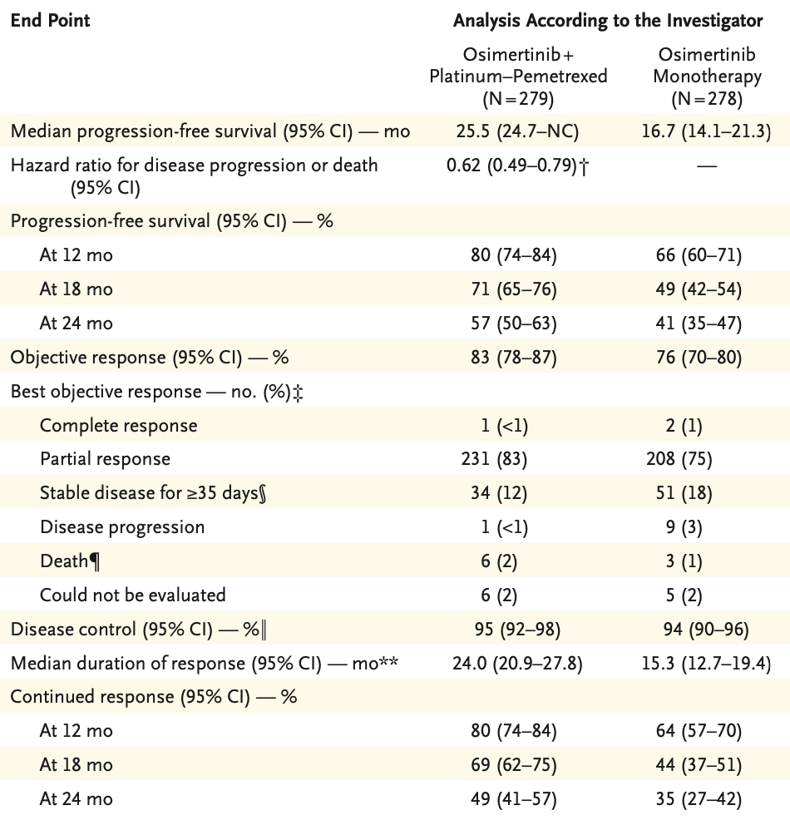
FLAURA2 Trial
Osimertinib+Chemo vs Osimertinib
Addition of platinum and pemetrexed improved:
ORR from 76 to 83%
Duration of response from 15.3 to 24.0m
mPFS from 16.7 to 25.5 months (HR 0.62)
Planchard D, Janne P, Cheng Y, et al. NEJM 2023;389: 1935-1948

Slide 9
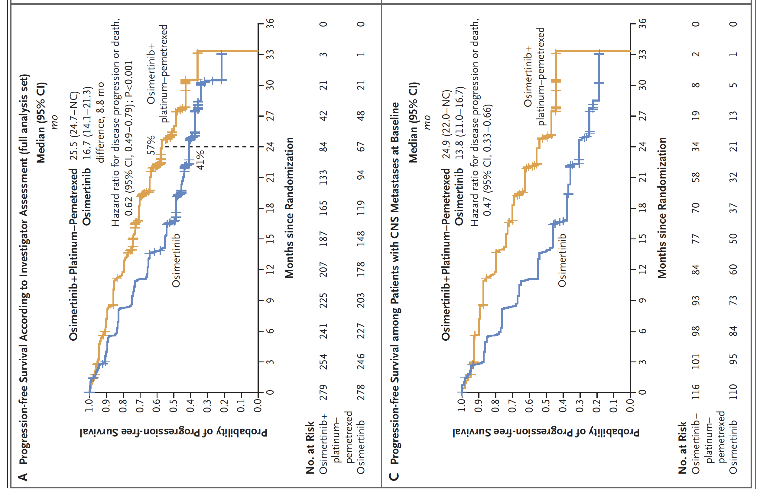
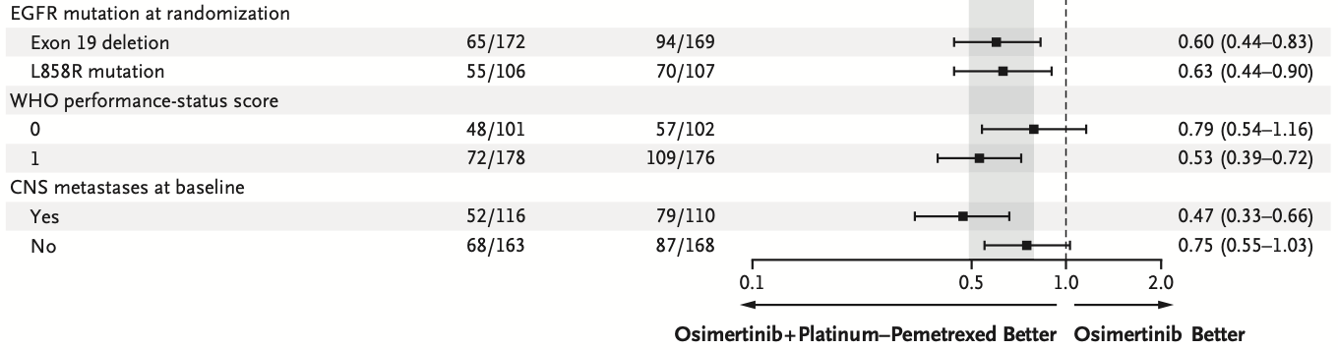
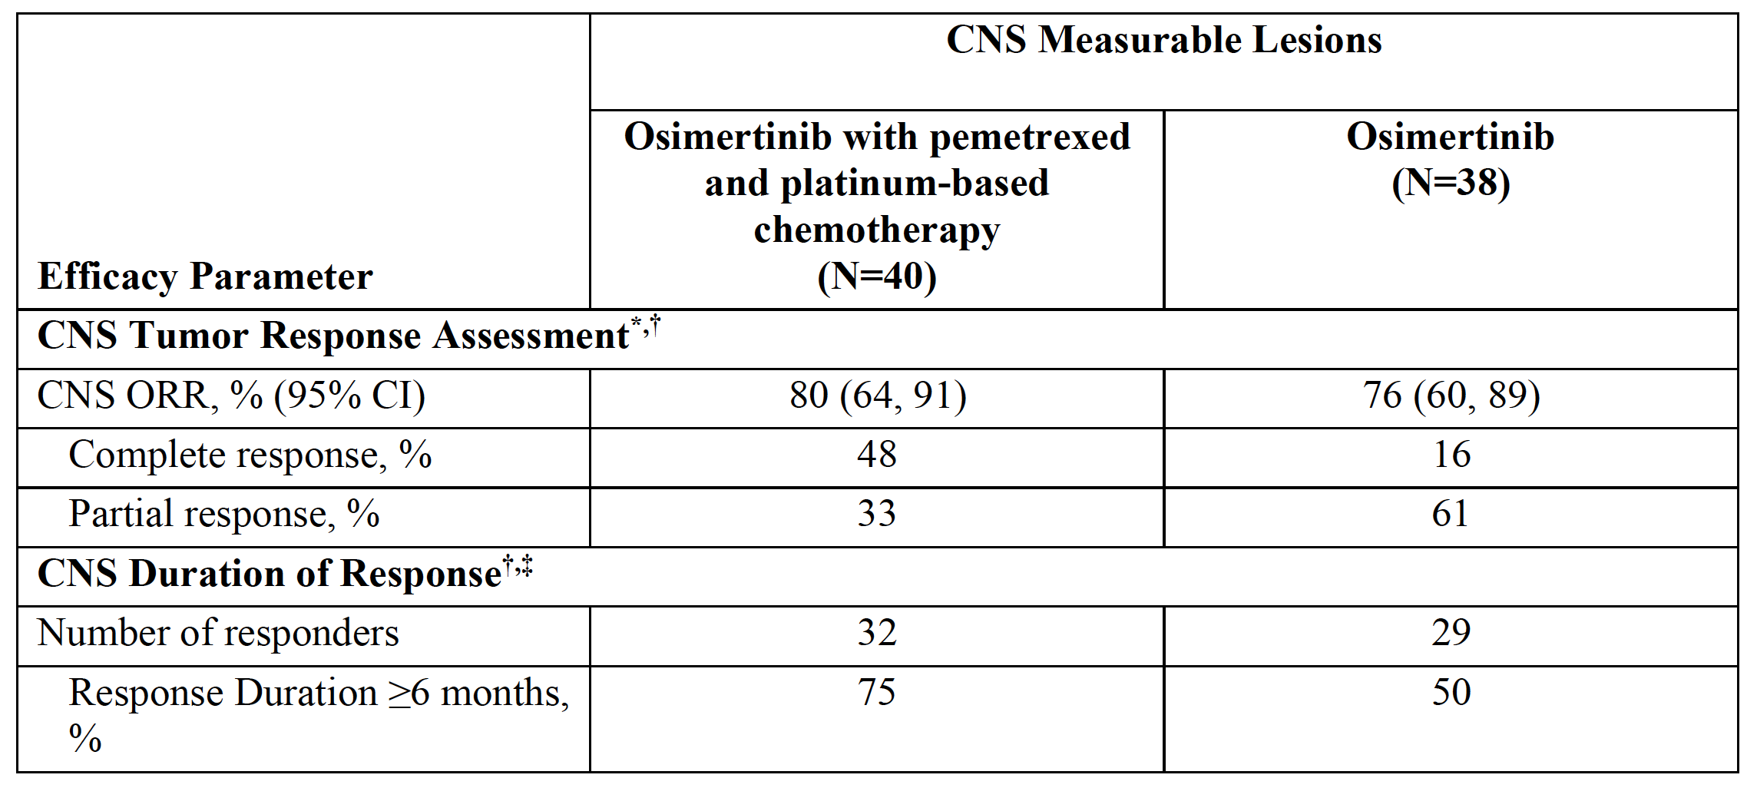
FLAURA2: Benefits
Planchard D, Janne P, Cheng Y, et al. NEJM 2023;389: 1935-1948 Osimertinib package insert, released 4/29/24, accessdata.fda.gov

Slide 10
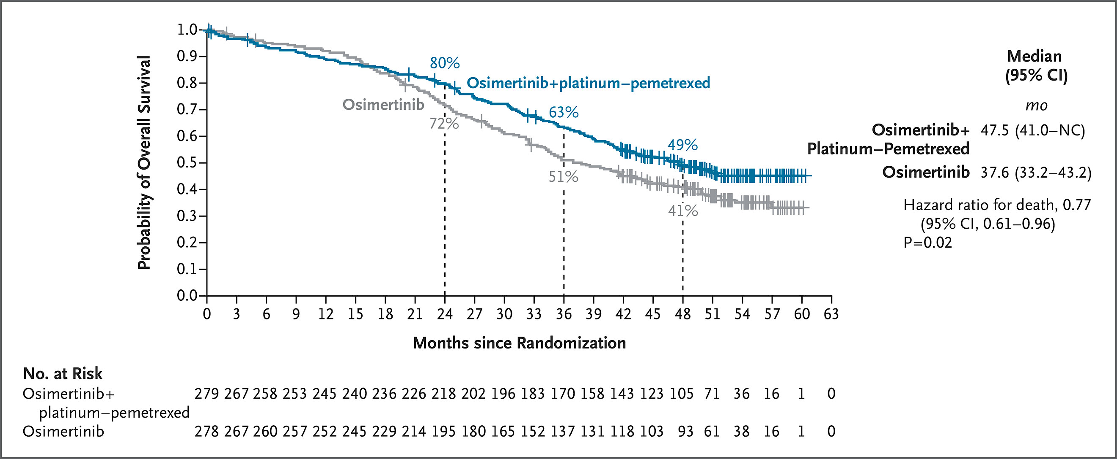
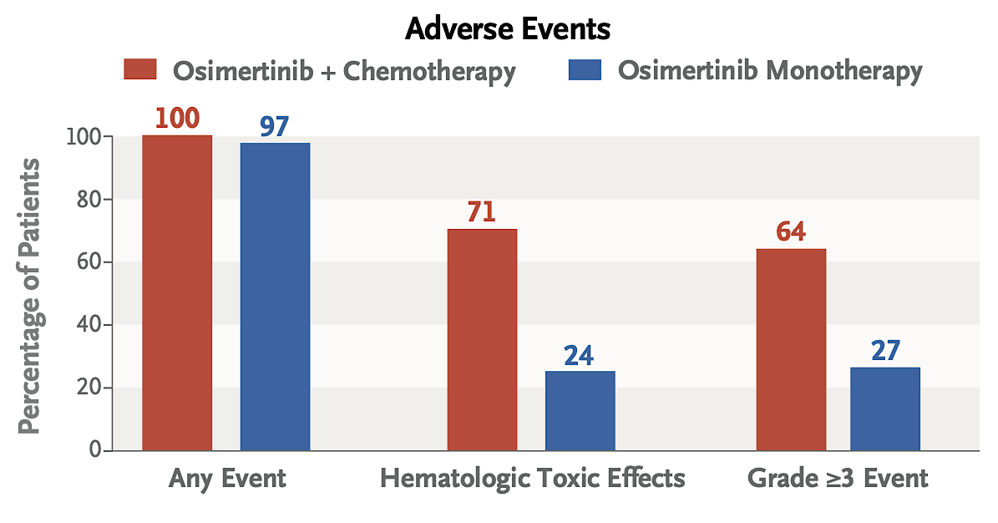
FLAURA2: Overall Survival
Benefit similar across subgroups, including similar HR’s for Exon 19 del’n & L858R, & those with/without brain mets.
Most patients who discontinued 1L treatment due to disease progression received 2L treatment: 69% of pts on osimertinib-chemo and 77% of pts on osimertinib monotherapy.
Jänne P, Planchard D, et al. NEJM 2026;39: 27-38.
Planchard, et al, NEJM Research Summary. DOI: 10.1056/NEJMoa2306434

Slide 11
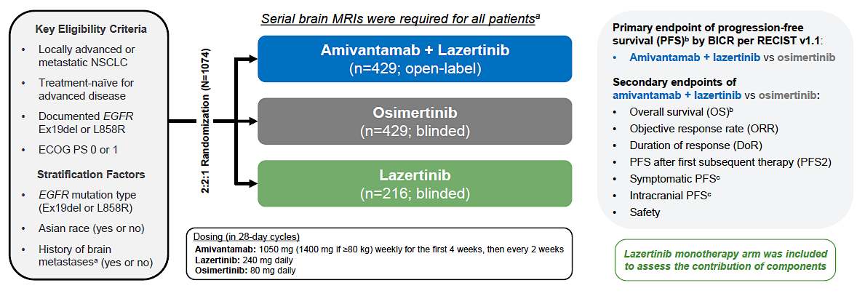
MARIPOSA:
Cho BC, Felip E, Spira A. ESMO Congress, Madrid 2023.

Slide 12
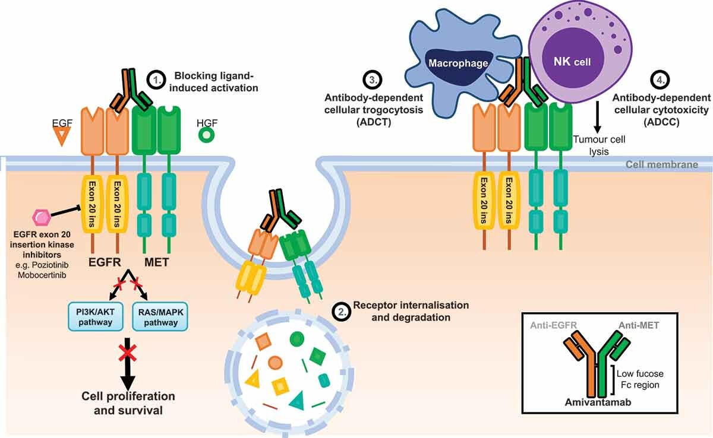
Amivantamab: Mechanism of Action
Vyse S, Huang PH. Expert Rev Anticancer Ther. 2022 Jan;22(1):3-16.

Slide 13
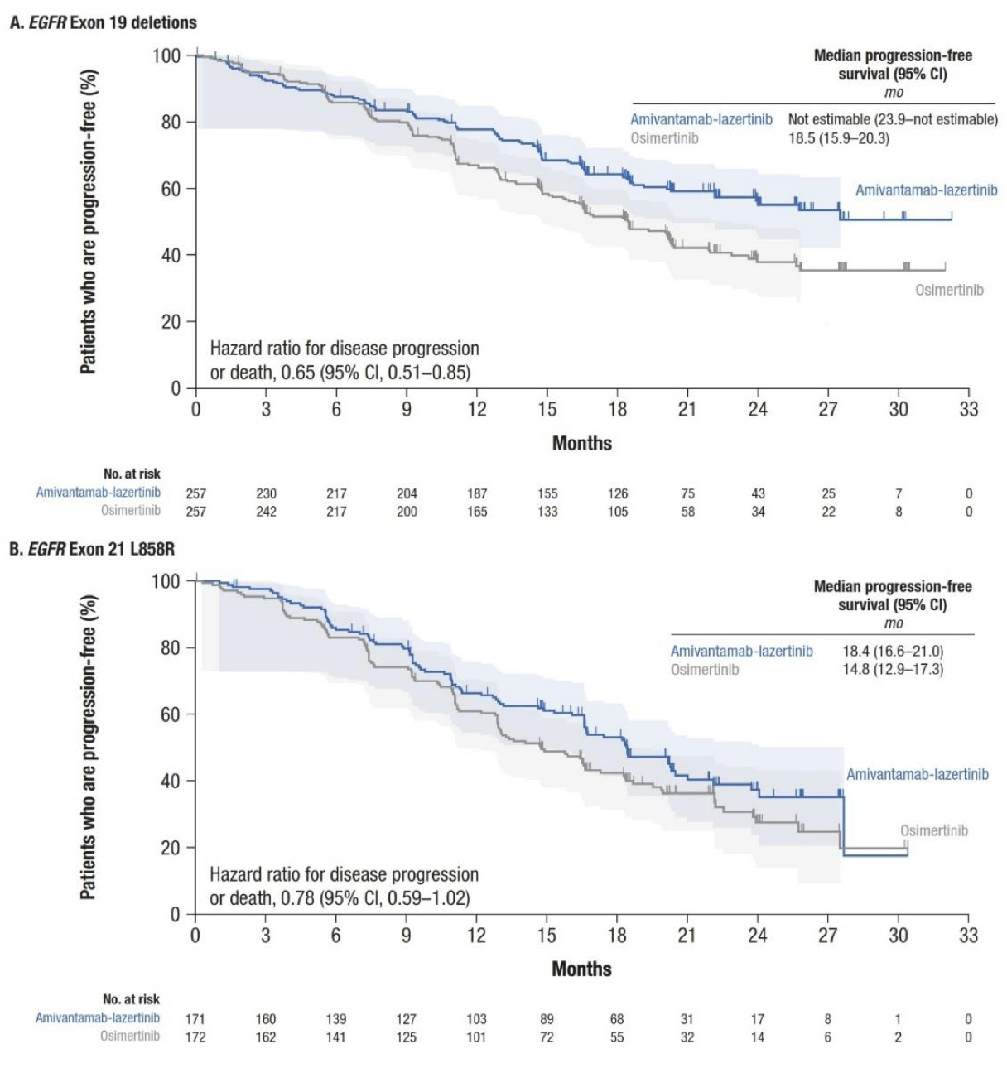
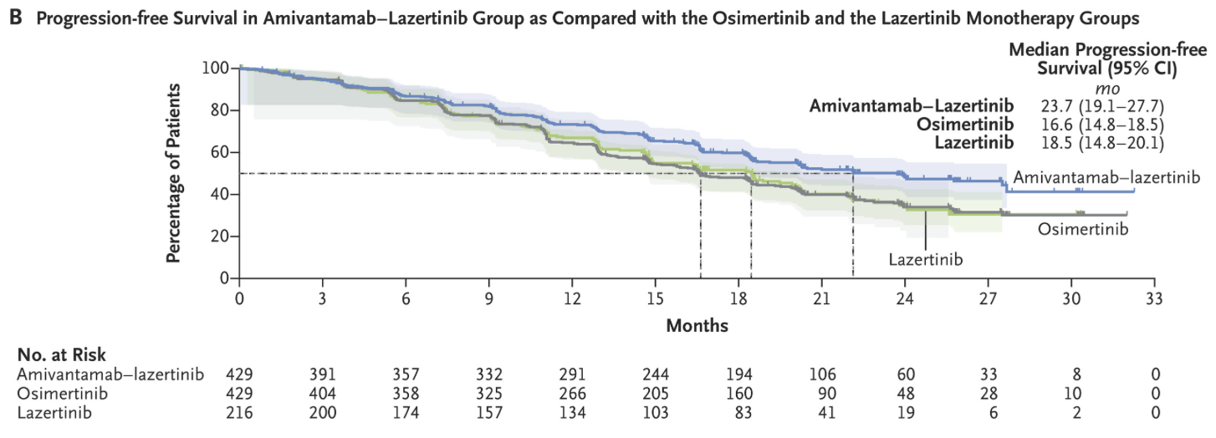
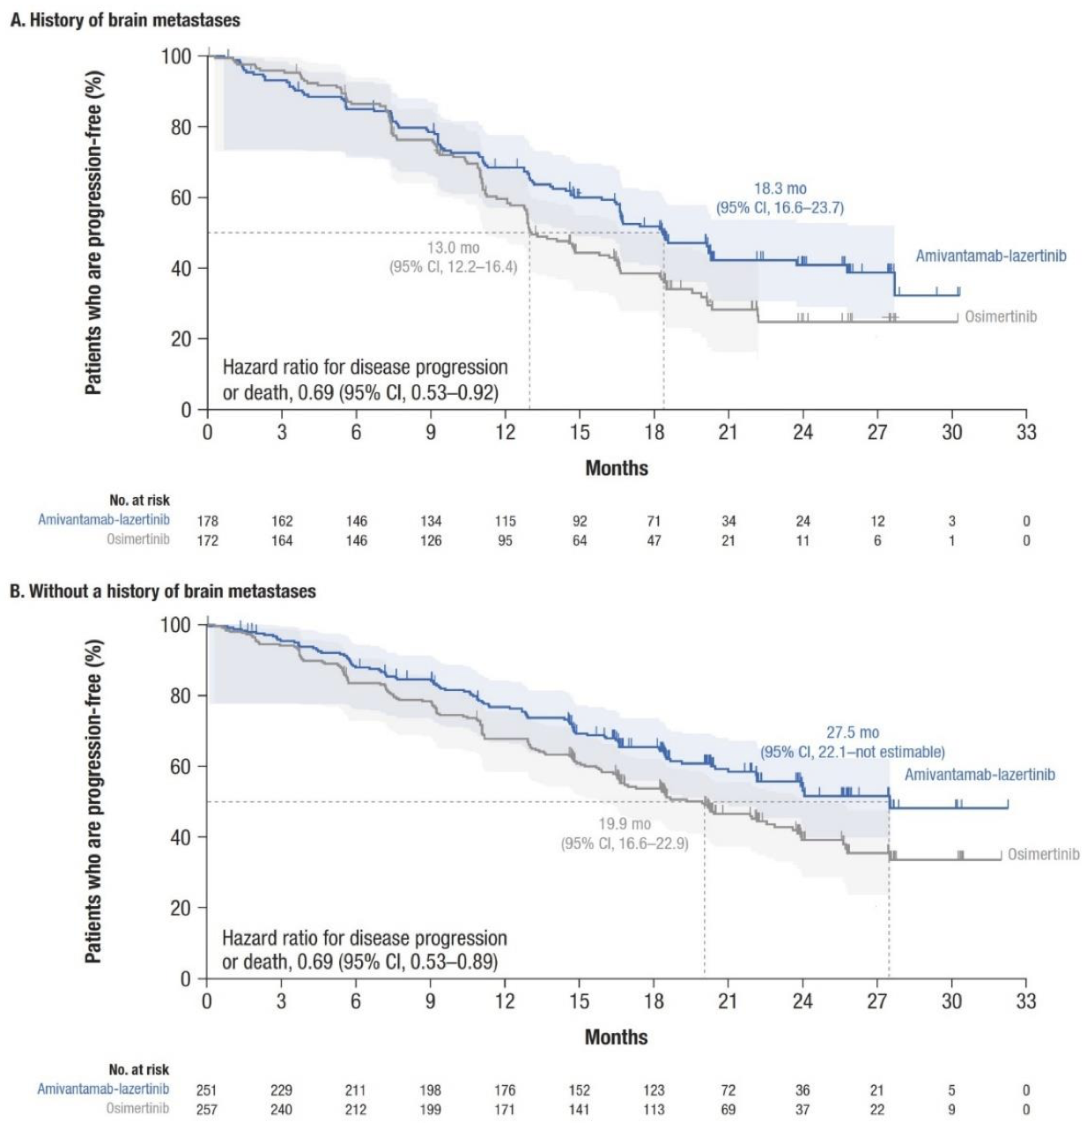
MARIPOSA: PFS Benefit
Cho BC, et al. NEJM, 2024

Slide 14
MARIPOSA: toxicity
Toxicities and QOL may determine if the benefit is “worth it.”
SKIPPirr trial developed extended course dexamethasone to reduce infusion related reactions by 2/3
COCOON trial optimized dermatologic management with oral doxy/minocycline, topical clindamycin and chlorhexidine, and ceramide moisturizer.
Cho BC, Felip E, Spira A. ESMO Congress, Madrid 2023.
Spira A, Paz-Ares L, Jan J-Y. JTO, 2025.
Cho BC, Li W, Spira A. JTO, 2025.

Slide 15

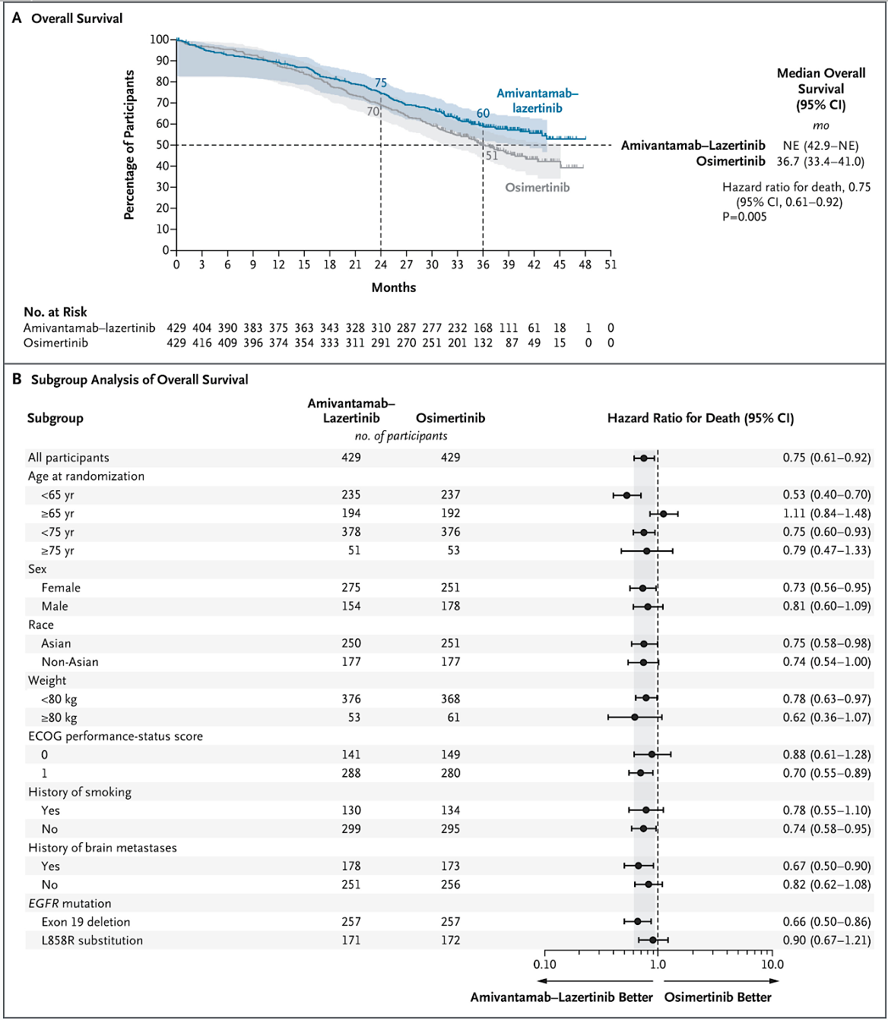
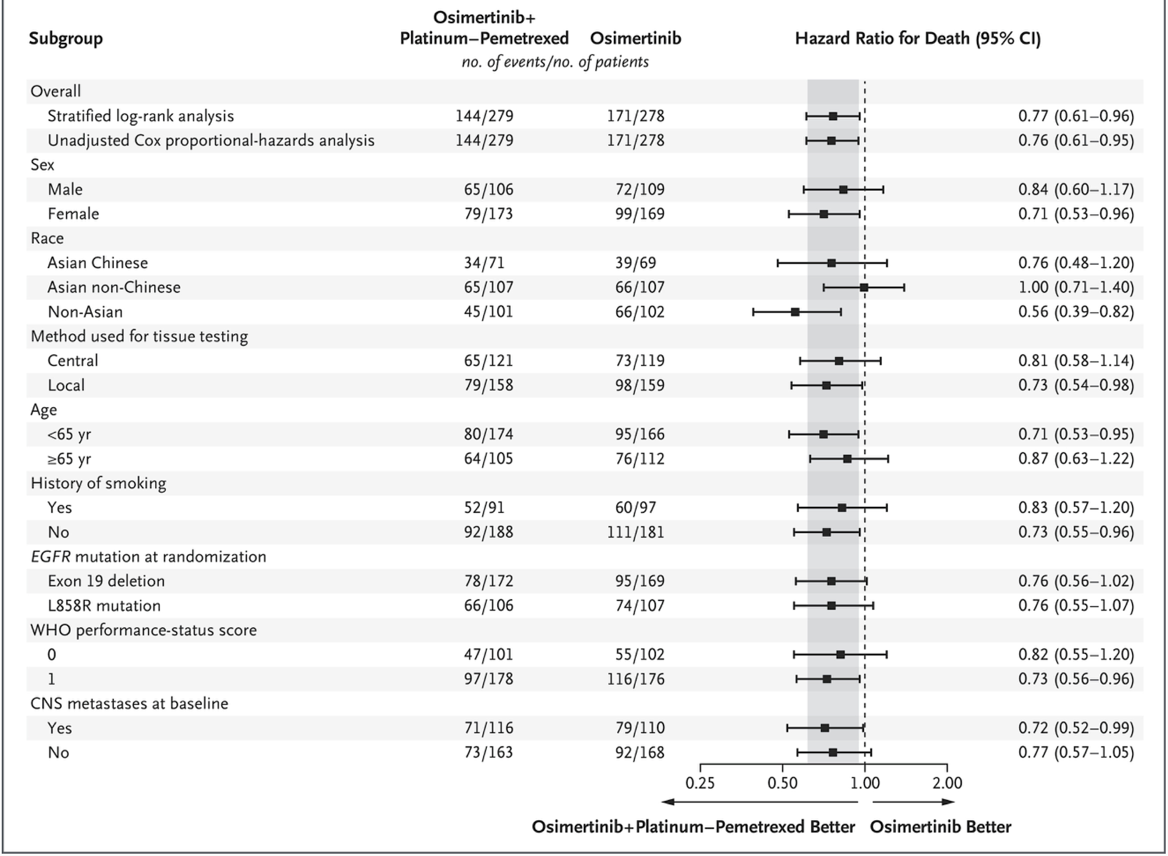
MARIPOSA
FLAURA-2
OS Comparison
Janne PA, et al. NEJM, 2026
Yang JC, et al. NEJM, 2025

Slide 16
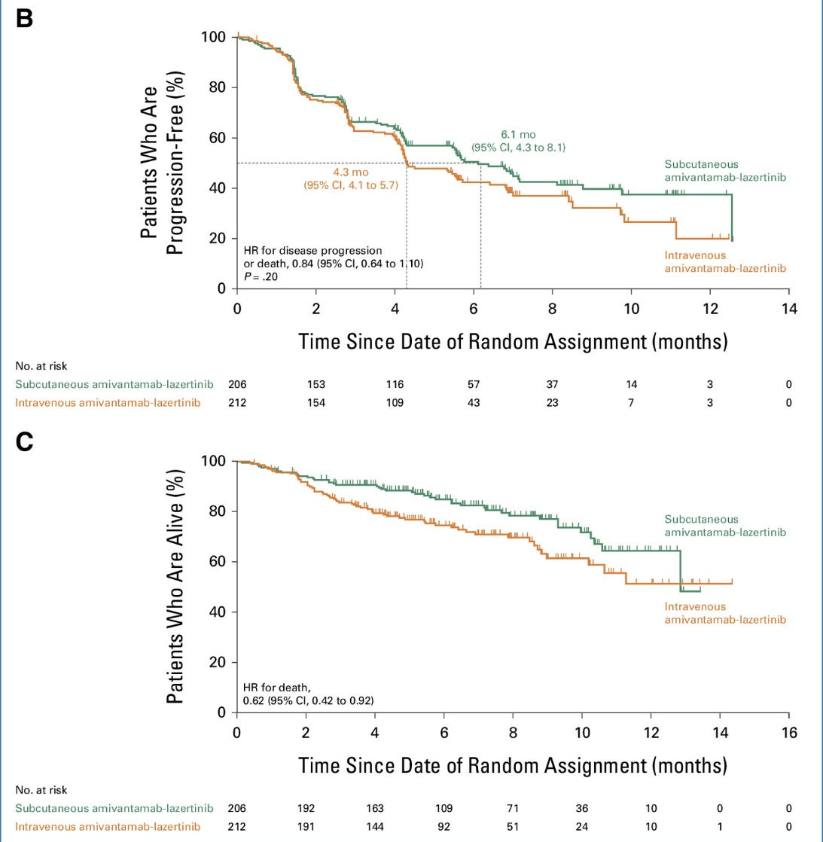
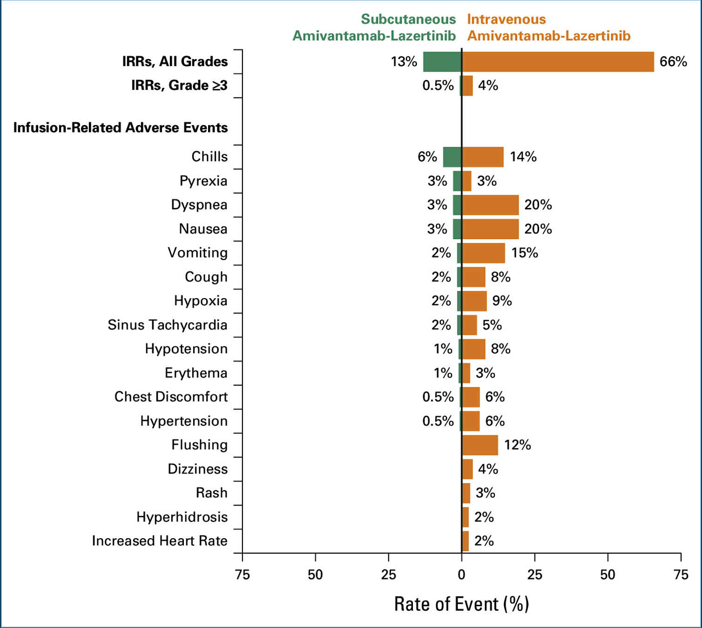
Subcutaneous Amivantamab
Reduced infusion time and improved patient convenience
Reduced infusion related reactions
Similar dermatologic AE profile; no new safety signals
Enhances therapeutic accessibility
PALOMA-3 study unexpectedly with OS HR 0.62
Leighl N, et al. JCO, 2025

Slide 17
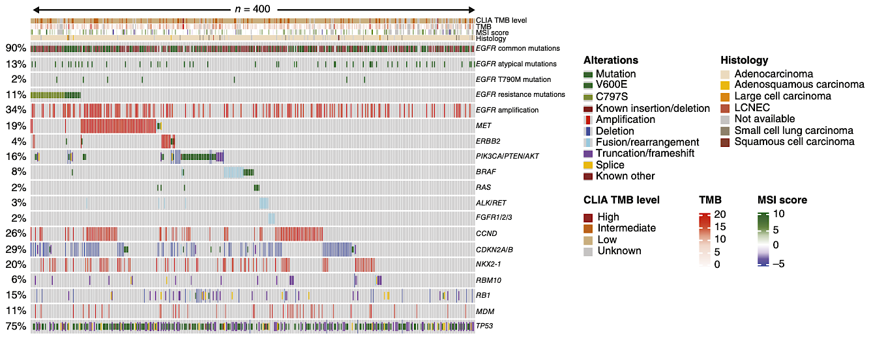
Resistance mechanisms to first line osimertinib
Orchard Trial: biomarker-based platform trial with pts progressing on 1L osimertinib: 400 tissue and 191 plasma samples.
87% with resistance alterations, 46% with multiple ones
MET amplification seen in 18%
Secondary EGFR mut in 11% (21% in plasma)
EGFR amplification in 35%
BRAF fusion in 5%, mut 3%
Alterations in HER2, RAS and FGFR in 4, 2 and 2%
Histologic transformation in 5% (likely underrepresented)
Yu H…Goldman J…Piotrowska Z. Clin Cancer Res, 2026 Mar 6.

Slide 18
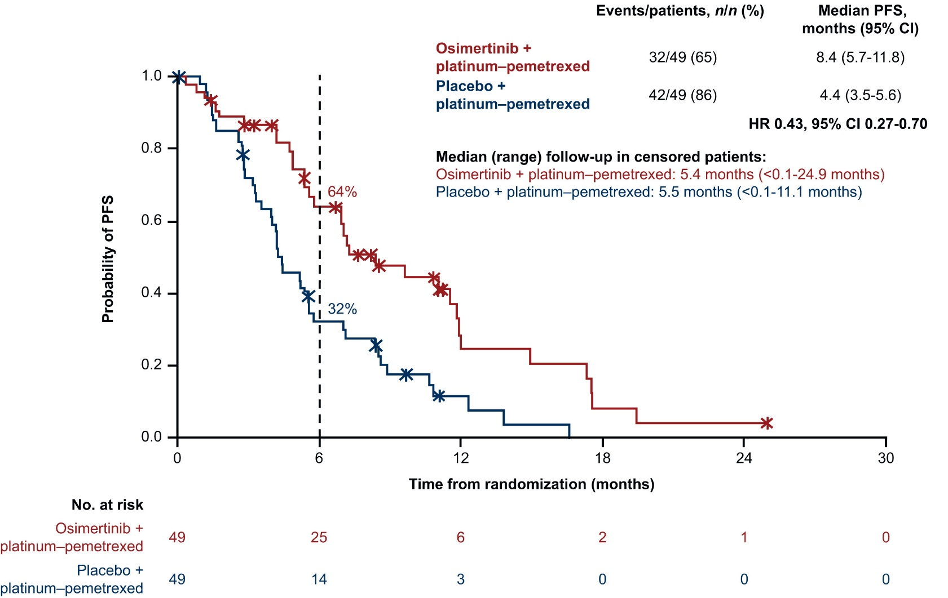
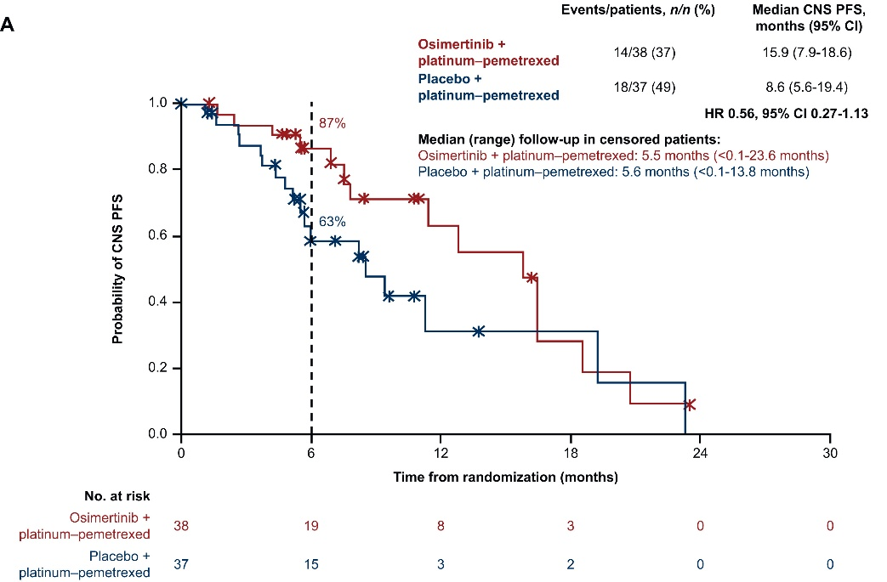
COMPEL Trial
Phase III trial of platinum-based chemotherapy ± Osimertinib in patients with non-CNS progression after first-line Osimertinib
Peled N, et al. ESMO Open, 2025

Slide 19
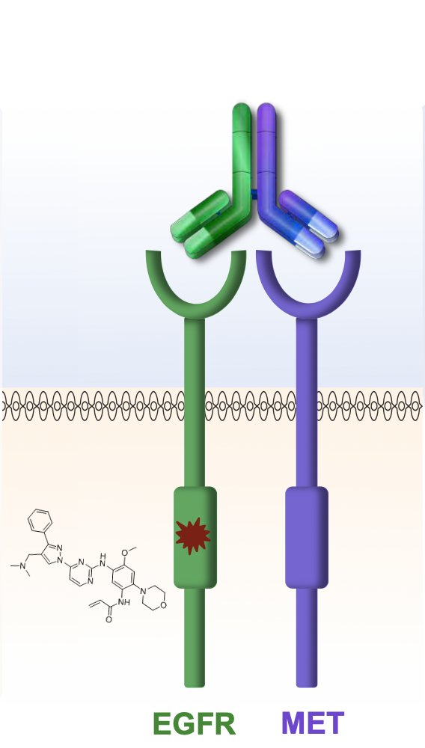
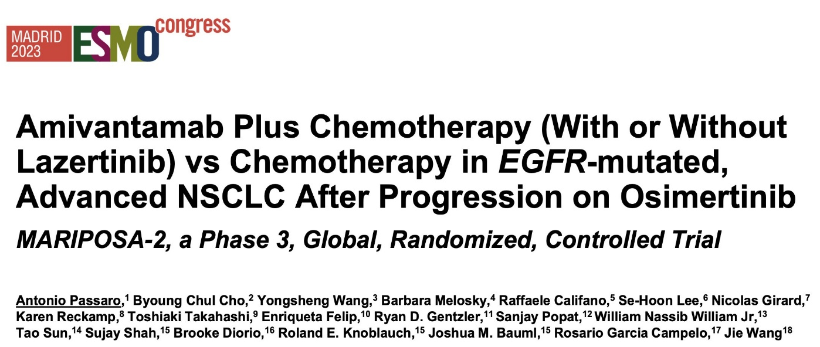
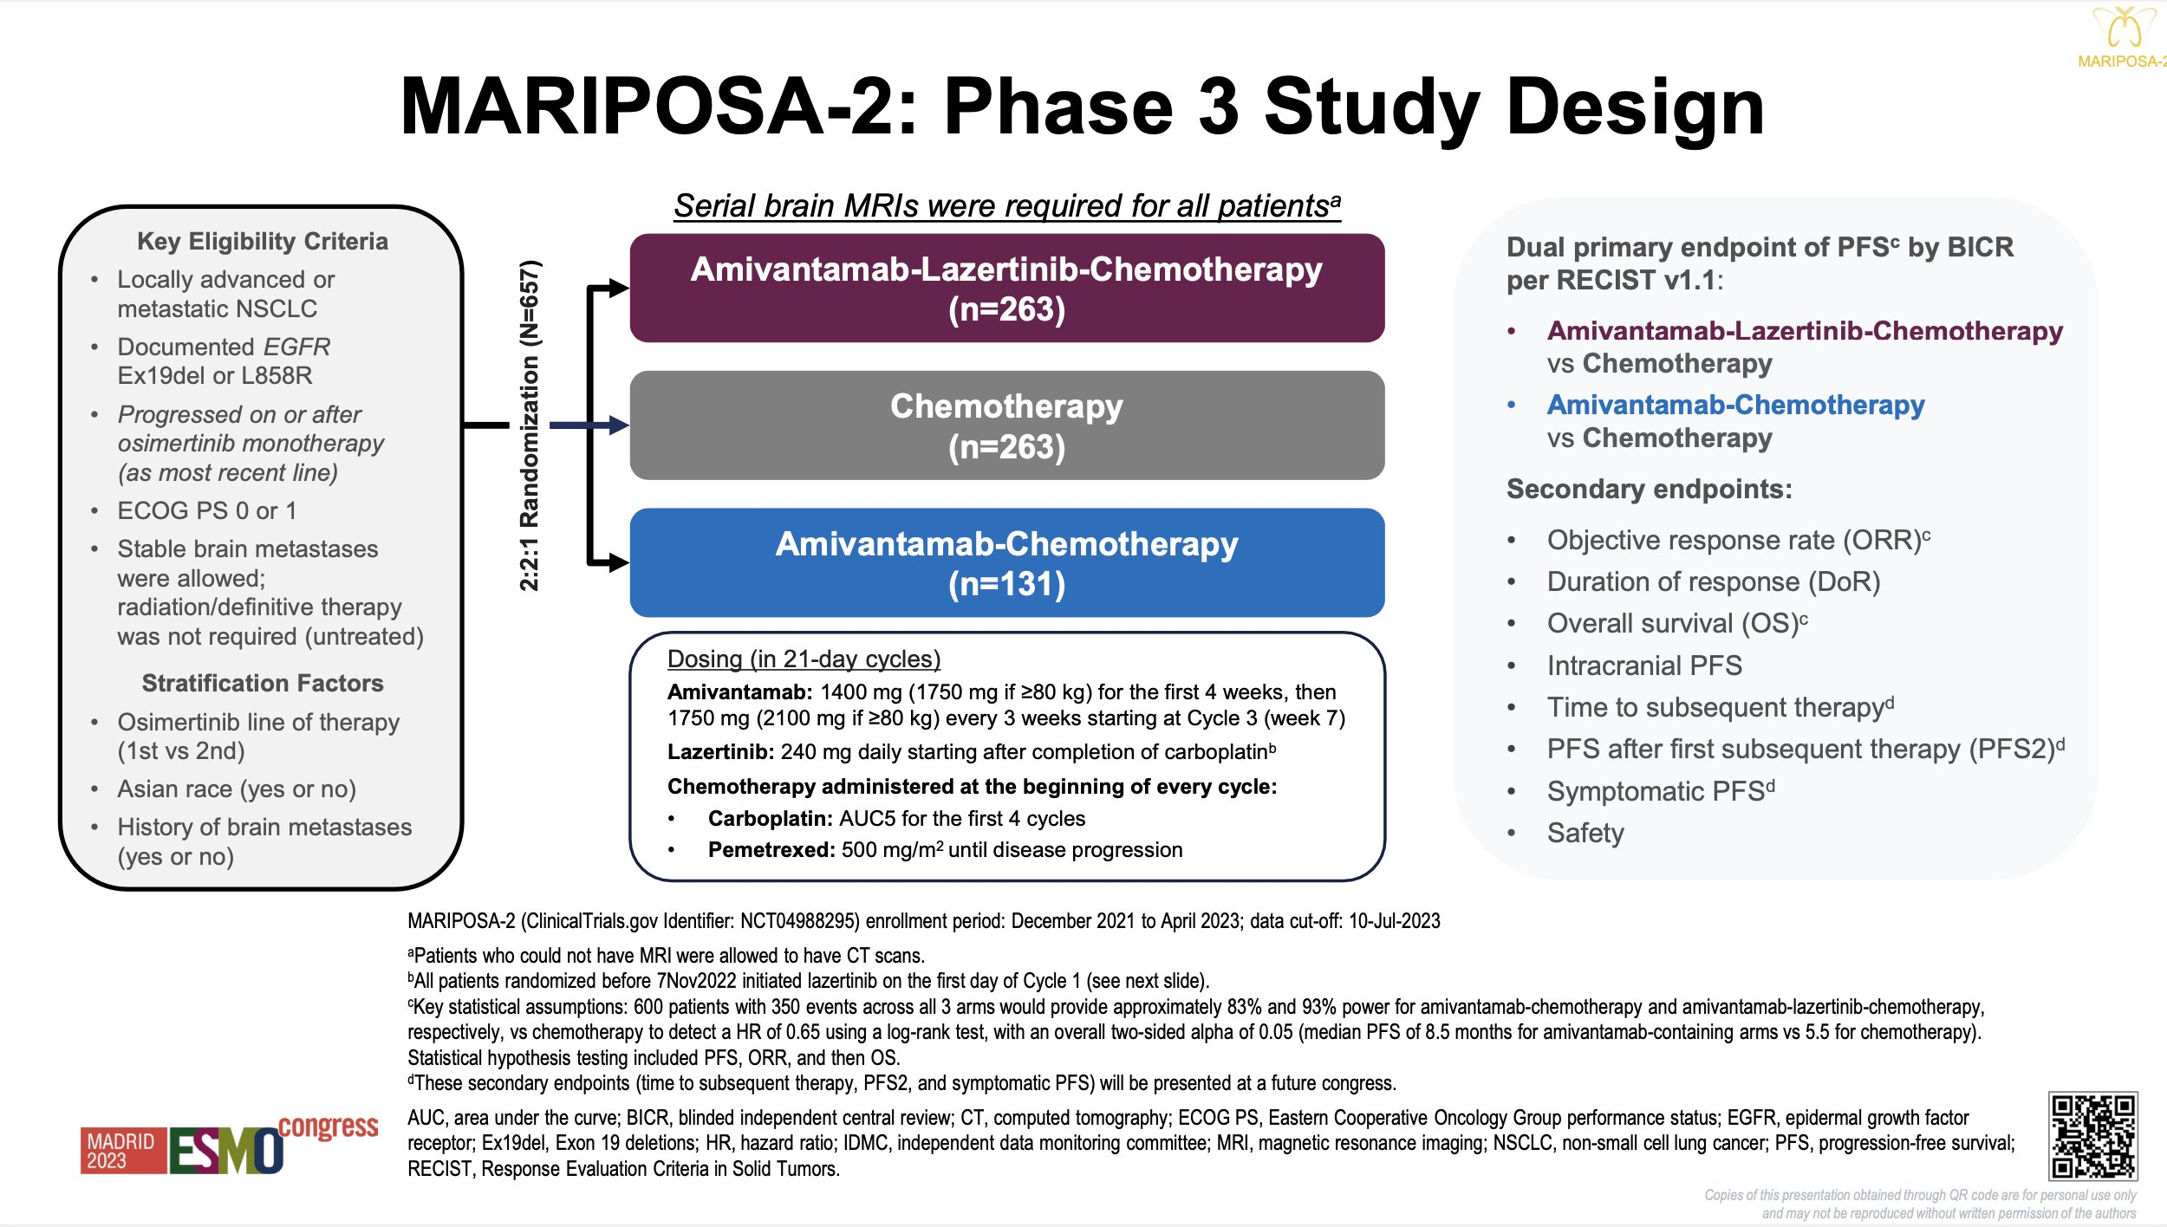
MARIPOSA-2
Vyse, et al, Exp Rev of Anti-infective Therapy, 2021.
Passaro A, Cho B.C., Wang Y, et al. ESMO Congress, Madrid 2023.

Slide 20
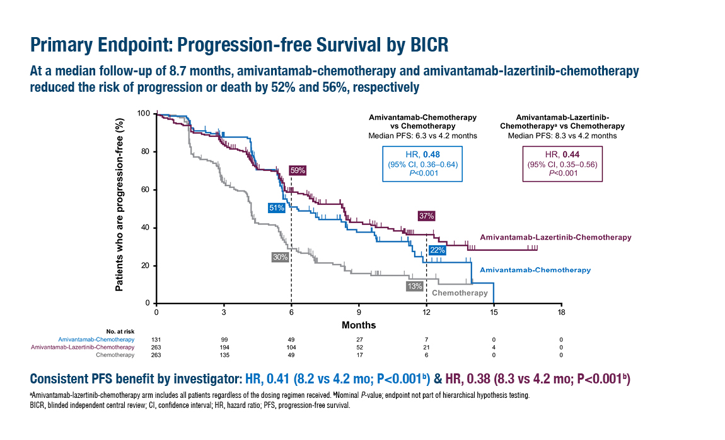
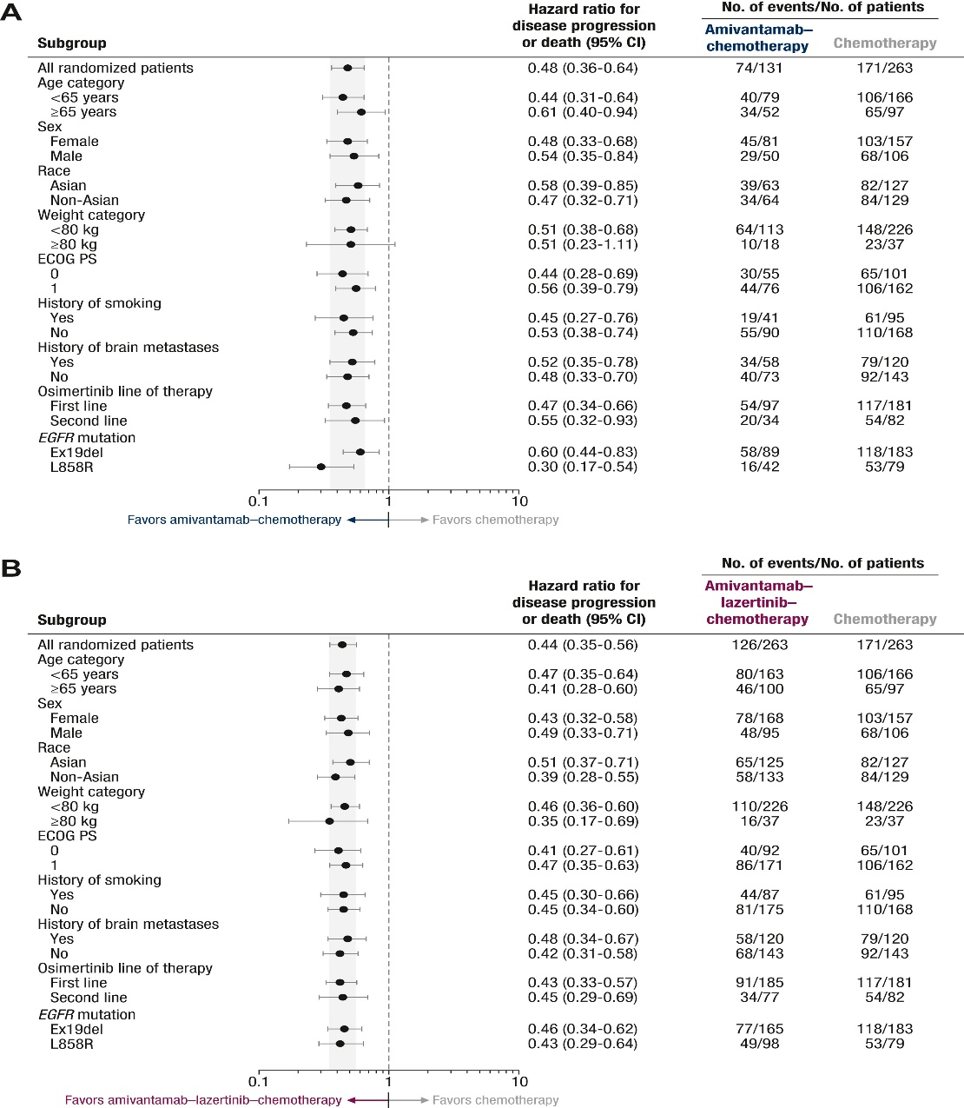
MARIPOSA-2: PFS Benefit
Significantly longer mPFS with ami+chemo and ami+laz+chemo than with chemo alone
Passaro A, Cho B.C., Wang Y, et al. ESMO Congress, Madrid 2023.
Passaro A, Wang J, Wang Y, et al. Ann Oncol 2024 1:35;77-90.

Slide 21
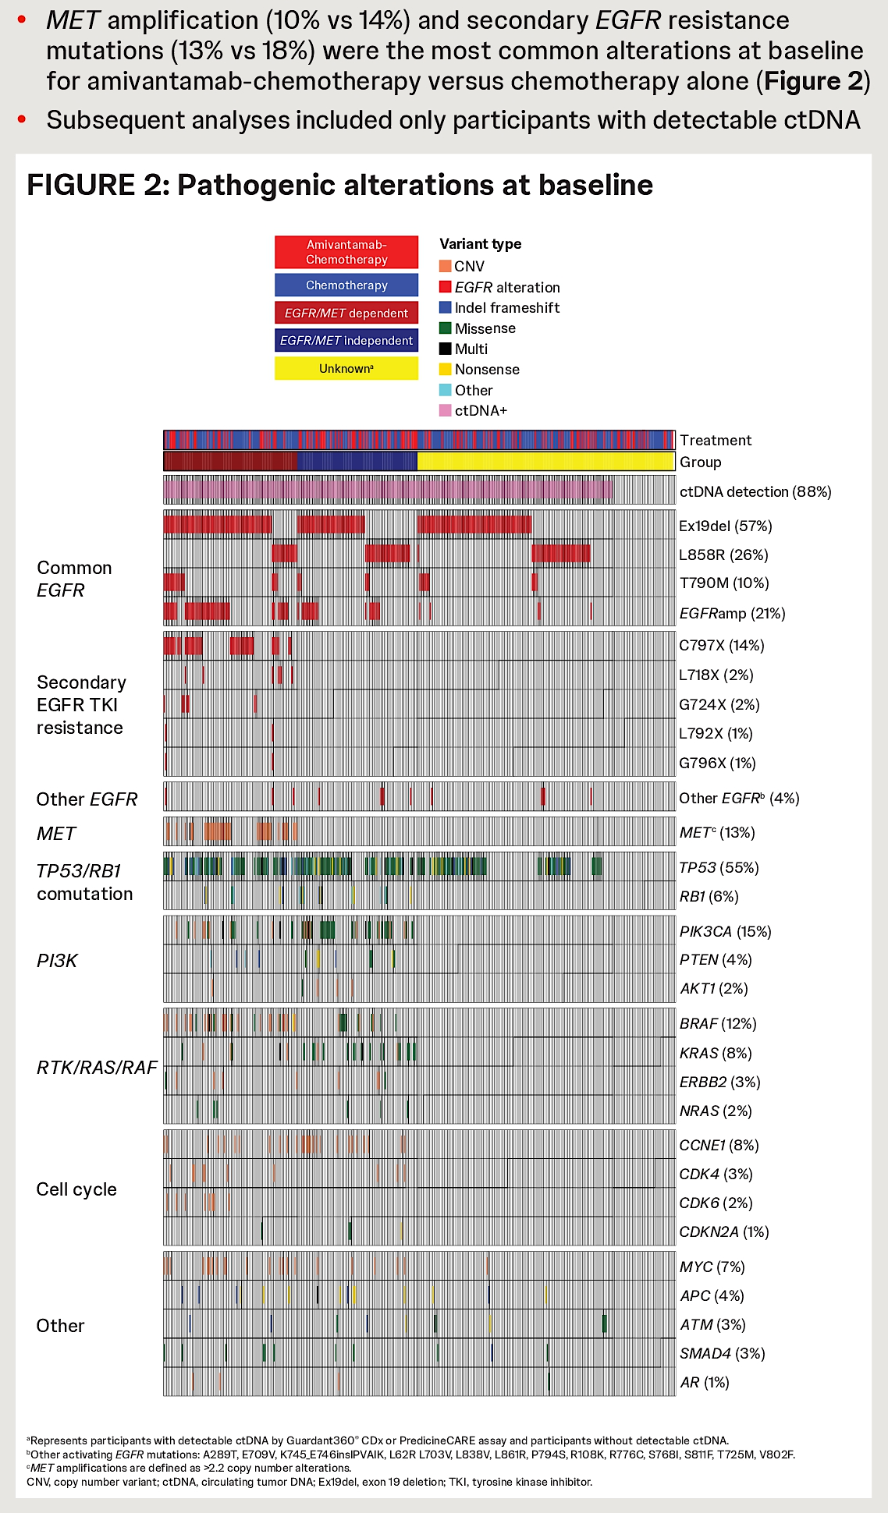
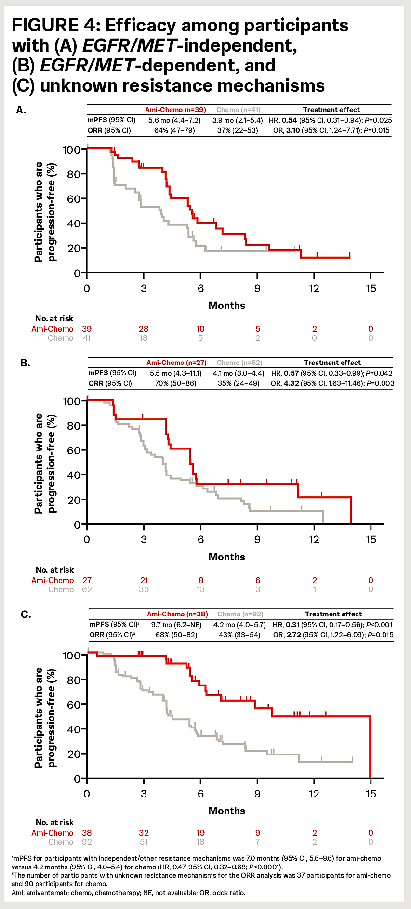
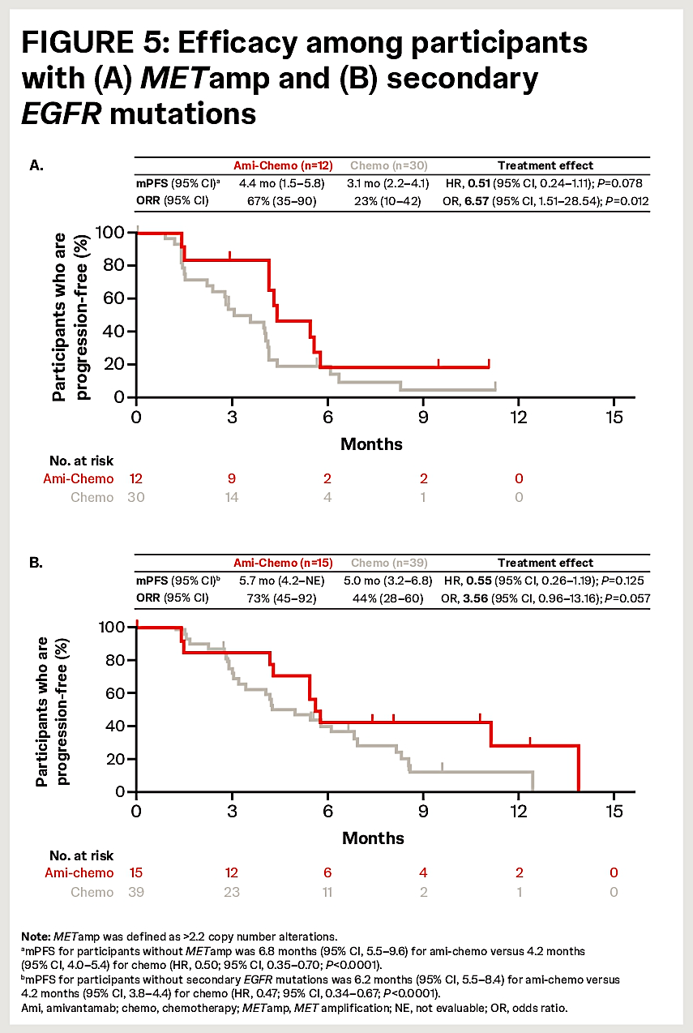
MARIPOSA-2: PFS by subgroup
Califano, et al. Abstract 8639, ASCO 2025.

Slide 22
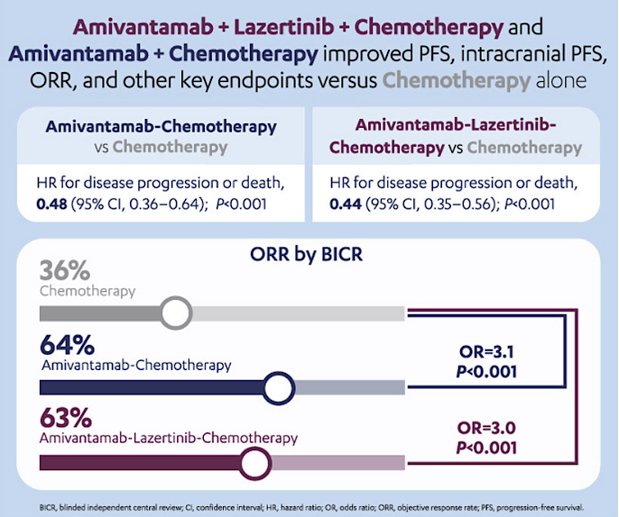
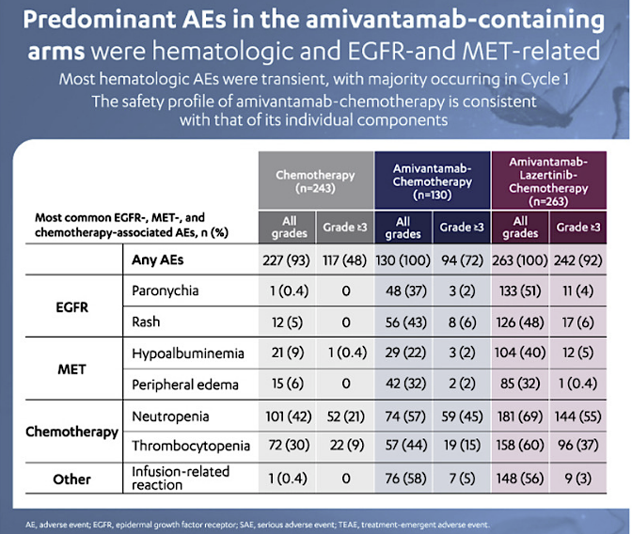
MARIPOSA-2: Adverse Events
Passaro A, Wang J, Wang Y, et al. Ann Oncol 2024 1:35;77-90.

Slide 23
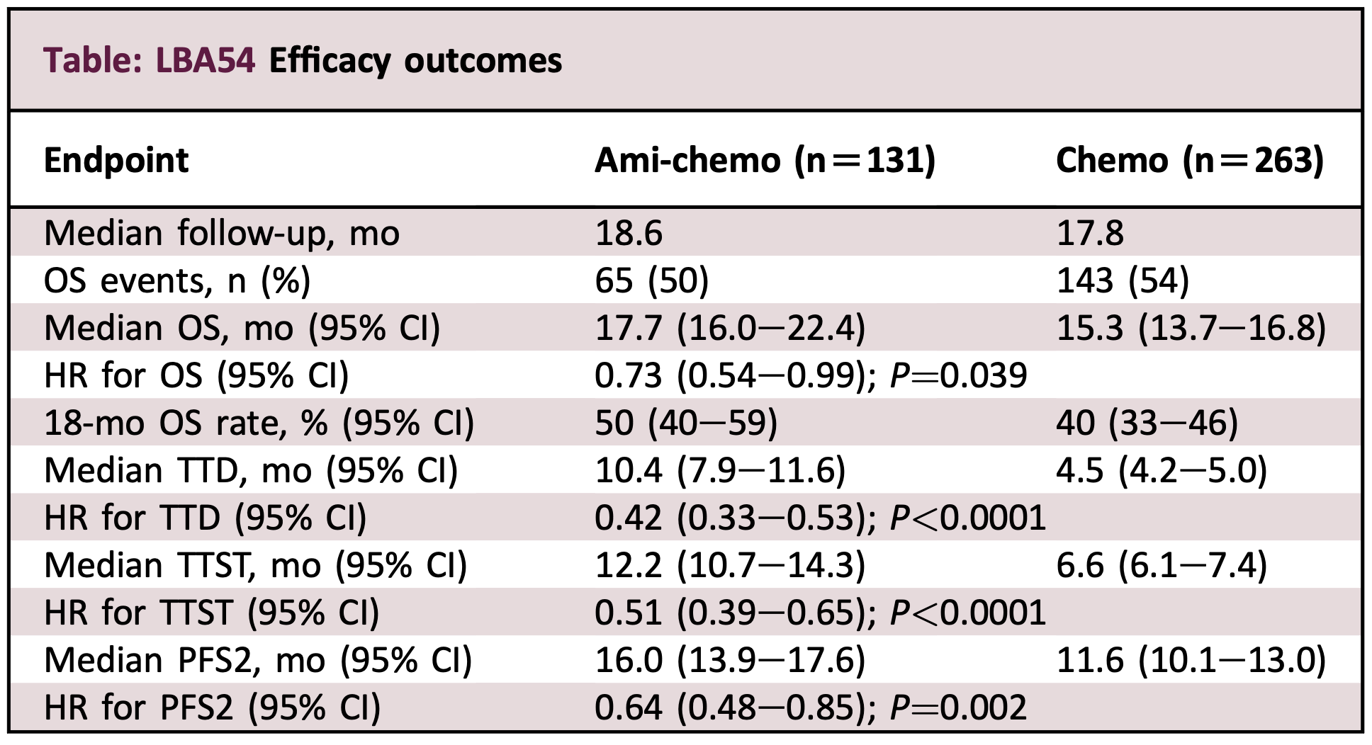
MARIPOSA-2: 2nd Interim OS update
Popat S, et al. Abstract LBA54,
ESMO 2024.

Slide 24
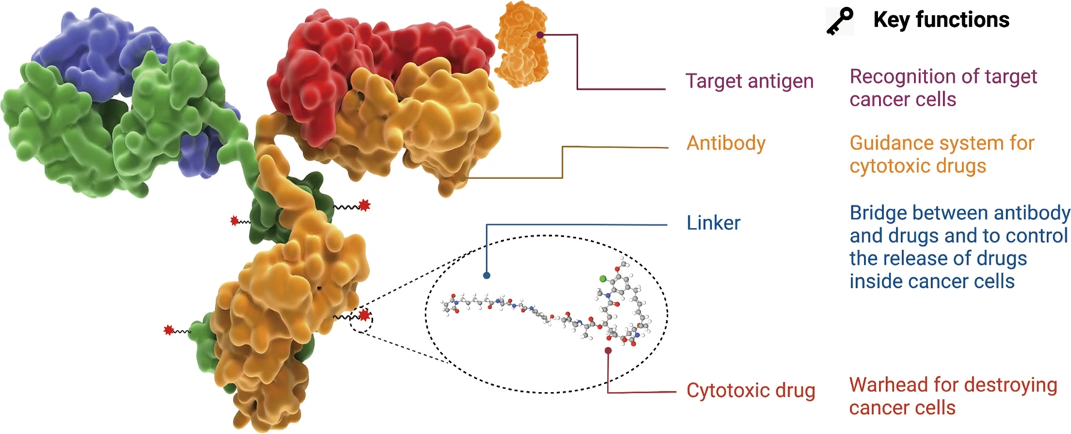
Antibody Drug Conjugates
ADC components
Target antigen selection, antibody subtype, internalization optimization, linkers, cytotoxic payloads, conjugation methods, Drug-Antibody Ratio.
Fu, Z., et al. Antibody drug conjugate. Sig Transduct Target Ther 7, 93 (2022).

Slide 25
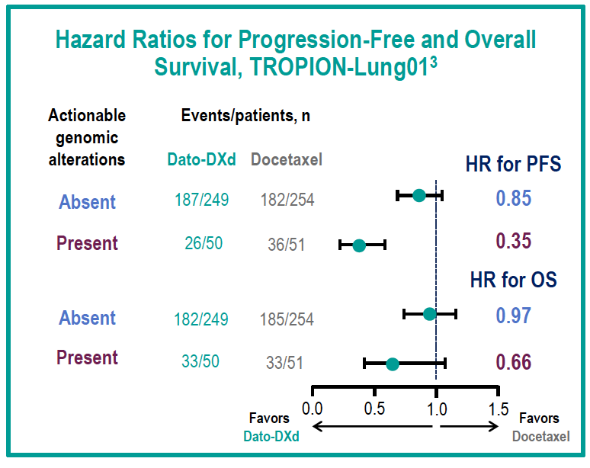
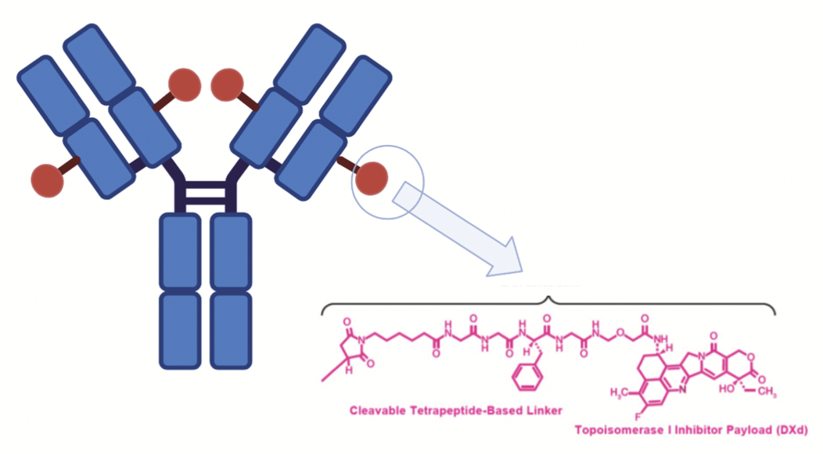
Datopotamab deruxtecan (Dato-DXd)
Trop2-directed ADC
Topoisomerase I inhibitor payload
Ahn, M-J, ESMO Asia, 2024.

Slide 26
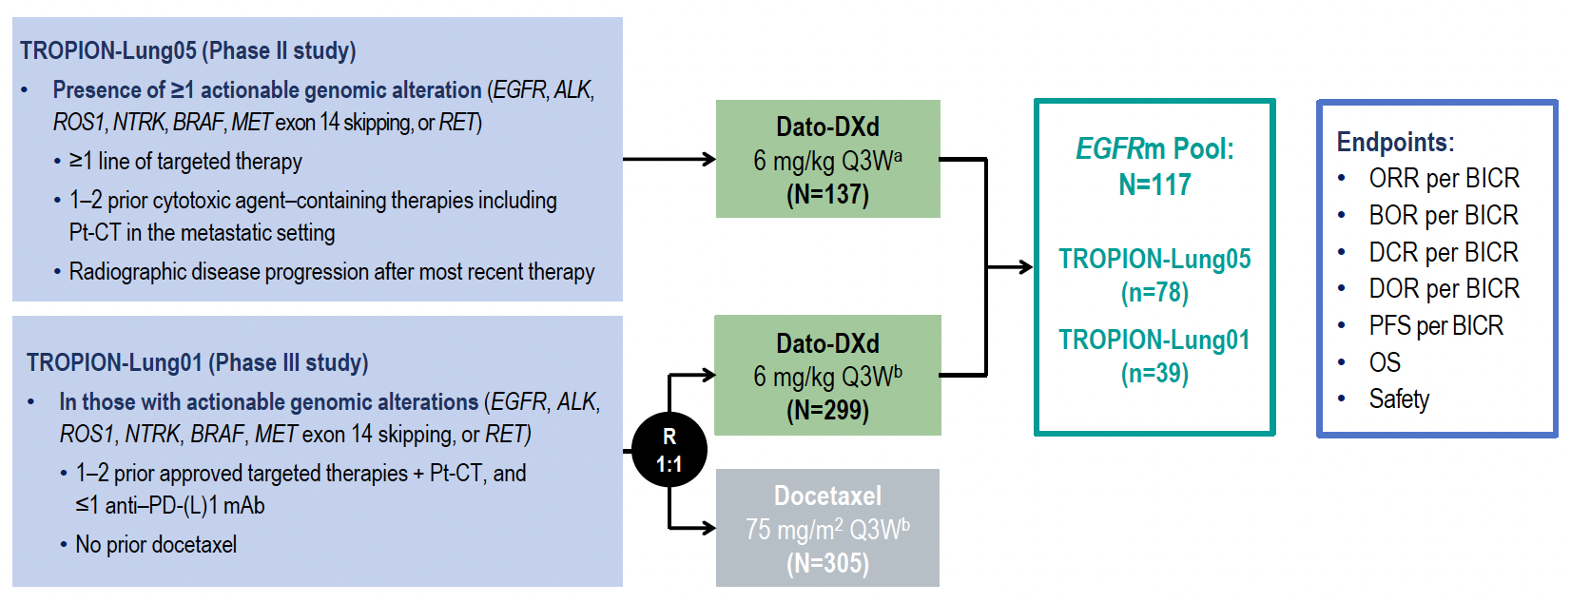
Dato-DXd in EGFRm NSCLC Pooled Analysis from TROPION-Lung05 and 01
Ahn, M-J, ESMO Asia, 2024.

Slide 27
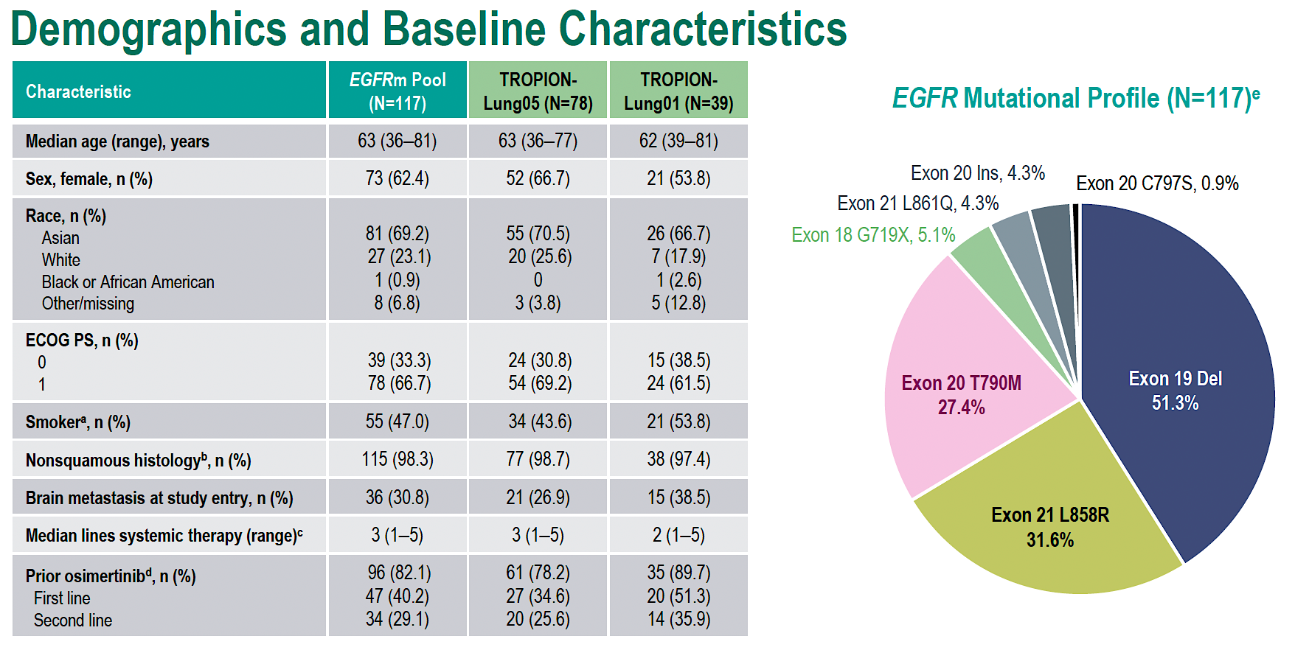
TROPION-Lung01 & 05 EGFRm cohort
Ahn, M-J, ESMO Asia, 2024.

Slide 28
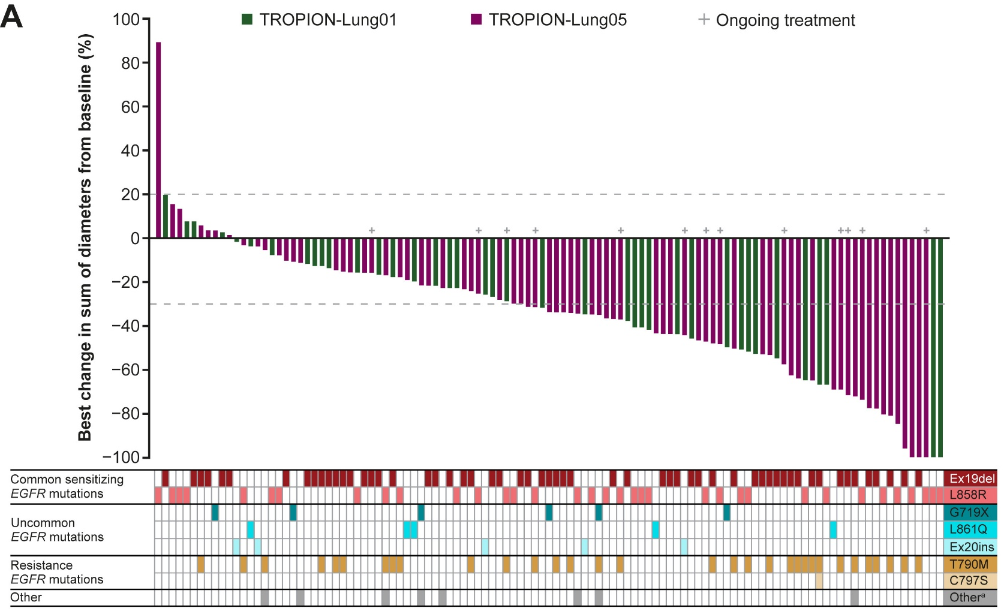
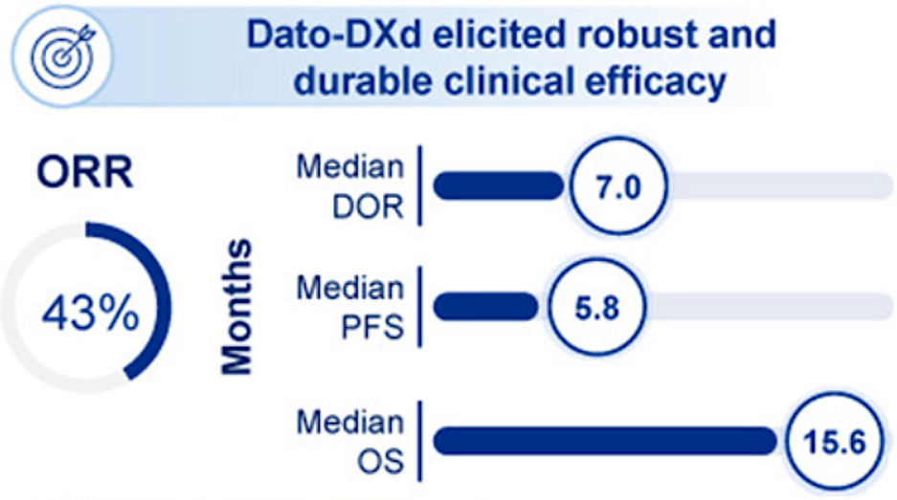
Dato-DXd Efficacy in EGFRm cohort
Confirmed ORR 43%
For 45 docetaxel-treated pts ORR 9%
Ahn, M-J, Lisberg A, Goto Y, et al. J Thor Oncol, 2025 Nov.

Slide 29
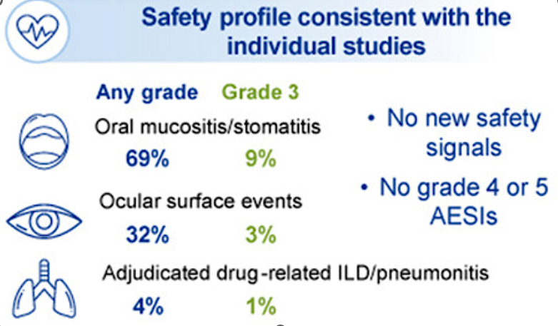
Dato-DXd Efficacy in EGFRm cohort
Ahn, M-J, Lisberg A, Goto Y, et al. J Thor Oncol, 2025 Nov.

Slide 30
For metastatic EGFR-mutated NSCLC, we reviewed:
First line options: FLAURA2 and MARIPOSA
Subcutaneous amivantamab
Data for continued TKI on progression
Later-line options: MARIPOSA2 and Datopotamab deruxtecan

Slide 31
QUESTIONS?

Slide 32
Module 12: EGFR-Mutated Non-Small Cell Lung Cancer (NSCLC)
Current Management of Metastatic EGFR-Mutated NSCLC — Dr Goldman
Nonmetastatic EGFR-Mutated NSCLC, Exon 20 Insertion Mutations and Novel Agents — Dr Piotrowska

Slide 33
Other Relevant Topics in EGFR Mutation-Positive NSCLC (eg, Nonmetastatic Disease, Exon 20 Insertion Mutations, Novel Agents)
Zosia Piotrowska, MD, MHS
Associate Professor of Medicine, Harvard Medical School Clinical Co-Director, MGB Thoracic Medical Oncology Program
Massachusetts General Hospital
Boston, MA

Slide 34
Disclosures
Consulting Agreements | AbbVie Inc, AstraZeneca Pharmaceuticals LP, Bayer HealthCare Pharmaceuticals, Black Diamond Therapeutics Inc, BlossomHill Therapeutics, Boehringer Ingelheim Pharmaceuticals Inc, Daiichi Sankyo Inc, Genentech, a member of the Roche Group, Genmab US Inc, Gilead Sciences Inc, Janssen Biotech Inc, Lilly, Natera Inc, Regeneron Pharmaceuticals Inc, Revolution Medicines Inc, Summit Therapeutics, Taiho Oncology Inc, Takeda Pharmaceuticals USA Inc, Tubulis
Contracted Research | AbbVie Inc, AstraZeneca Pharmaceuticals LP, BlossomHill Therapeutics, Blueprint Medicines, Cullinan Therapeutics, Daiichi Sankyo Inc, Janssen Biotech Inc, Novartis, Nuvalent, Spectrum Pharmaceuticals Inc, SystImmune Inc, Takeda Pharmaceuticals USA Inc, Tesaro, A GSK Company
Data and Safety Monitoring Boards/Committees | Genentech, a member of the Roche Group

Slide 35
Other Relevant Topics in EGFR-mutation Positive NSCLC
EGFR Exon 20 Insertions
Novel agents in EGFR-mutant NSCLC
Non-metastatic EGFR-positive disease

Slide 36
Other Relevant Topics in EGFR-mutation Positive NSCLC
EGFR Exon 20 Insertions
Novel agents in EGFR-mutant NSCLC
Non-metastatic EGFR-positive disease

Slide 37
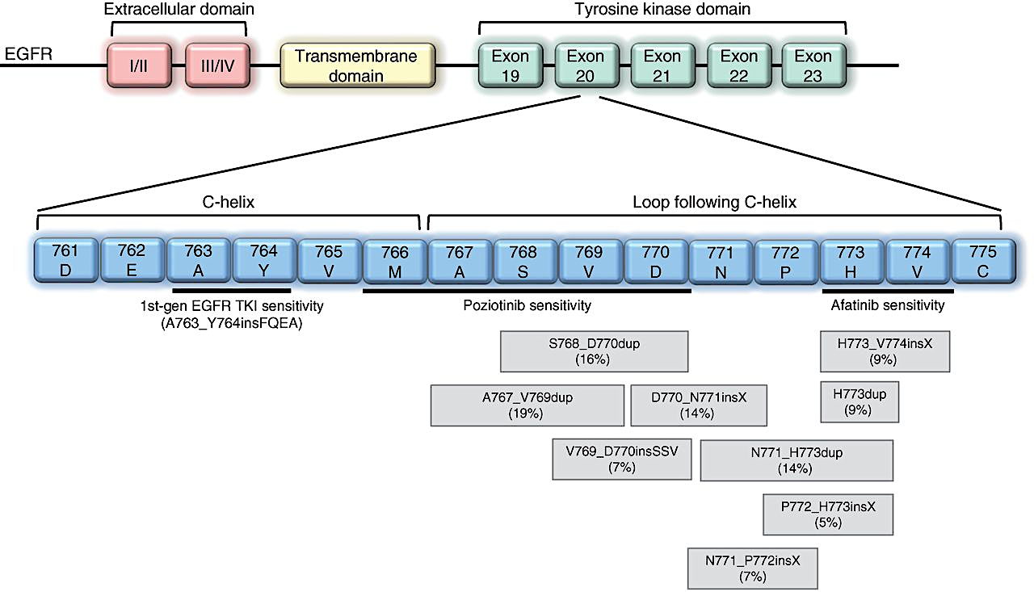
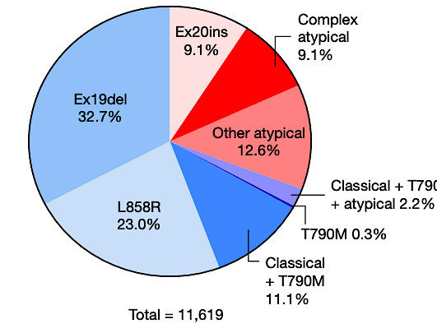
Molecular Landscape of EGFR Exon 20 Insertions
Robichaux JP et al. Nature. 2021;597:732-737. Meador CB et al. Cancer Disc. 2021;11(9):2145-2157.

Slide 38
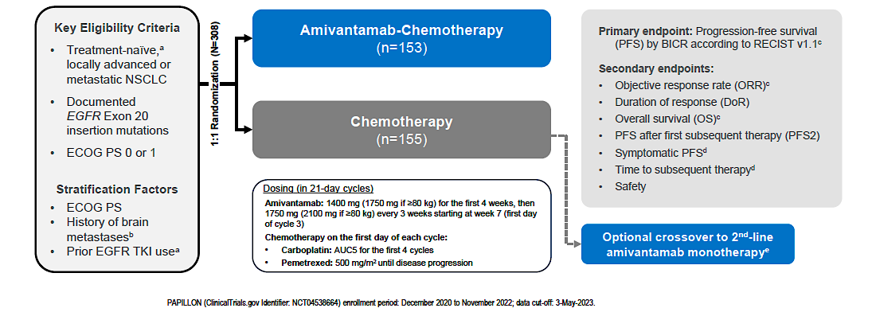
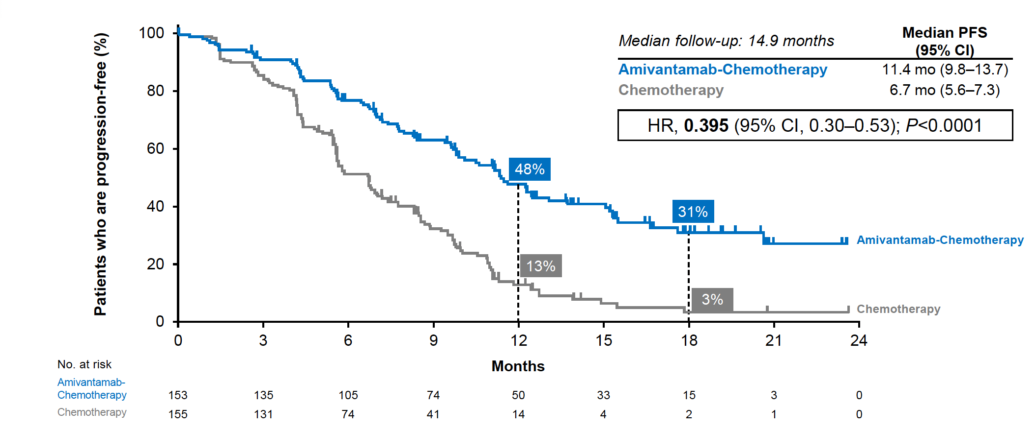
PAPILLON: Front-Line Amivantamab + Chemo
Progression-Free Survival by BICR
 | Amivantamab-Chemo | Chemo
ORR | 73% (95% CI, 65-80) | 47% (95% CI, 39-56)
mPFS | 11.4 mo (9.8-13.7) | 6.7 (95% CI, 5.6-7.3) | HR 0.395 (95% CI, 0.30-0.53)
[OS (interim*) | NE | 24.4 mo (95% CI, 22.1-NE) | HR 0.675 (95% CI, 0.42-1.09)]
Girard N et al. ESMO 2023. Abstract LBA5.
Zhou C et al. N Engl J Med. 2023;389(22):2039-2051.
OS data are immature (~33% maturity), 66% of patients who progressed crossed over to amivantamab.

Slide 39
Positive Top-Line Phase III Results from the WU-KONG28 Study: Oral, Once-Daily Sunvozertinib versus Platinum-Containing Chemo Doublet for First-Line NSCLC with EGFR Exon 20 Insertion Mutation Press Release: March 31, 2026
“[The manufacturer] today announced that its multinational Phase 3 WU-KONG28 study evaluating sunvozertinib monotherapy as first-line treatment in non-small cell lung cancer (NSCLC) with EGFR exon 20 insertion mutations (exon20ins) met its primary endpoint with positive topline results.
The findings suggest that sunvozertinib monotherapy has the potential to become the first and only chemo free, oral agent to treat newly diagnosed NSCLC patients with EGFR exon20ins.
In the first-line setting, sunvozertinib has been granted Breakthrough Therapy Designations by both the U.S. Food and Drug Administration (FDA) and China Center for Drug Evaluation (CDE). Based on WU-KONG28 study results, [the Manufacturer] plans to engage with regulatory authorities regarding potential new drug applications (NDAs).”
https://www.dizalpharma.com/news/detail?id=109

Slide 40
Sunvozertinib (DZD9008)
WU-KONG 1B Global Phase 2 Study:
NSCLC with EGFR exon 20 insertions, post-chemotherapy
 | 200 mg (N = 85) | 300 mg (N = 89)
Confirmed ORR | 45.9 (33.6, 58.5) | 47.2 (35.1, 59.5)
mDOR | 11.1 (8.2, NE) | 13.8 (8.3, NE)
mPFS | 8.4 (6.8, 13.9) | 7.7 (6.0, 9.8)
Prior Ami (n = 12/cohort) | 25% | 41.7%
Baseline CNS mets (n = 21/cohort) | 28.6% | 52.4%
Janne P et al. WCLC 2025. Abstract PL02.06. Yang JCH et al. J Clin Oncol. 2025;43:3198-3208.

Slide 41
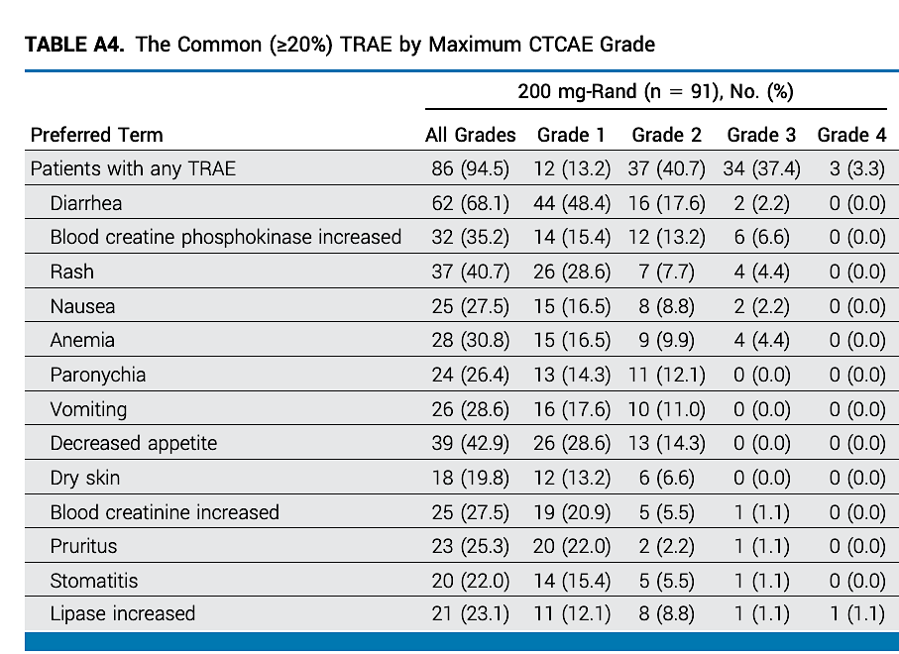
Sunvozertinib (DZD9008)
WU-KONG 1B Global Phase 2 Study:
NSCLC with EGFR exon 20 insertions, post-chemotherapy
 | 200 mg (N = 85) | 300 mg (N = 89)
Confirmed ORR | 45.9 (33.6, 58.5) | 47.2 (35.1, 59.5)
mDOR | 11.1 (8.2, NE) | 13.8 (8.3, NE)
mPFS | 8.4 (6.8, 13.9) | 7.7 (6.0, 9.8)
Prior Ami (n = 12/cohort) | 25% | 41.7%
Baseline CNS mets (n = 21/cohort) | 28.6% | 52.4%
Janne P et al. WCLC 2025. Abstract PL02.06. Yang JCH et al. J Clin Oncol. 2025;43:3198-3208.

Slide 42
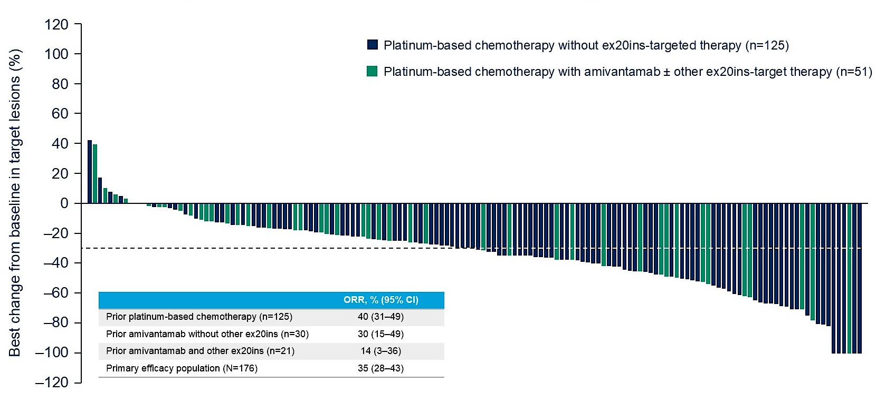

Zipalertinib: Activity after Amivantamab
 | ORR
Prior Chemo only (n = 125) | 40% (31-49)
Prior Ami, no other Exon 20 TKIs (n = 30) | 30% (15-49)
Prior Ami + prior Exon 20 TKIs (n = 21) | 14% (3-36)
Yu HA et al. ASCO 2025;Abstract 8503. Piotrowska Z. J Clin Oncol. 2025;43(13):1523-1526. Yu HA et al. ESMO 2025;Abstract 1847MO.

Slide 43
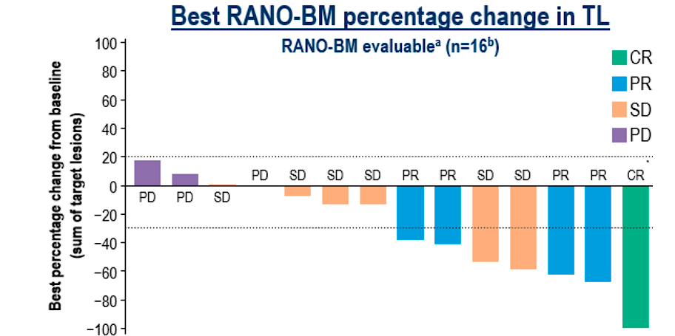
Zipalertinib: Activity after Amivantamab
 | ORR
Prior Chemo only (n = 125) | 40% (31-49)
Prior Ami, no other Exon 20 TKIs (n = 30) | 30% (15-49)
Prior Ami + prior Exon 20 TKIs (n = 21) | 14% (3-36)
Yu HA et al. ASCO 2025;Abstract 8503. Piotrowska Z. J Clin Oncol. 2025;43(13):1523-1526. Yu HA et al. ESMO 2025;Abstract 1847MO.

Slide 44
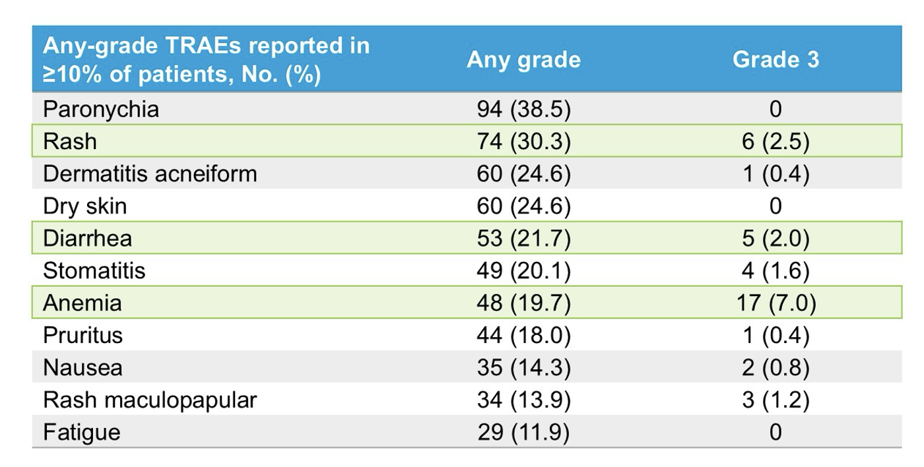
Zipalertinib: Activity after Amivantamab
 | ORR
Prior Chemo only (n = 125) | 40% (31-49)
Prior Ami, no other Exon 20 TKIs (n = 30) | 30% (15-49)
Prior Ami + prior Exon 20 TKIs (n = 21) | 14% (3-36)
Yu HA et al. ASCO 2025;Abstract 8503. Piotrowska Z. J Clin Oncol. 2025;43(13):1523-1526. Yu HA et al. ESMO 2025;Abstract 1847MO.

Slide 45
Ongoing First-Line EGFR Exon 20 TKI Trials
Zipalertinib + Chemo
REZILIENT3
NCT05973773
Not Recruiting
Chemo
Sunvozertinib
WU-KONG28
NCT05668988
Not Recruiting
Chemo
Furmonertinib
FURVENT
NCT05607550
Not Recruiting
Chemo

Slide 46
Other Relevant Topics in EGFR-mutation Positive NSCLC
EGFR Exon 20 Insertions
Novel agents in EGFR-mutant NSCLC
Non-metastatic EGFR-positive disease

Slide 47
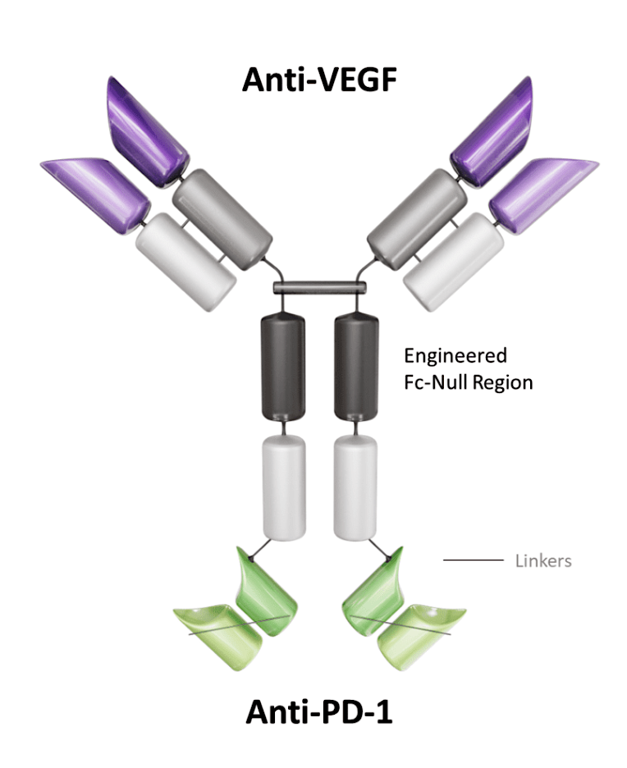
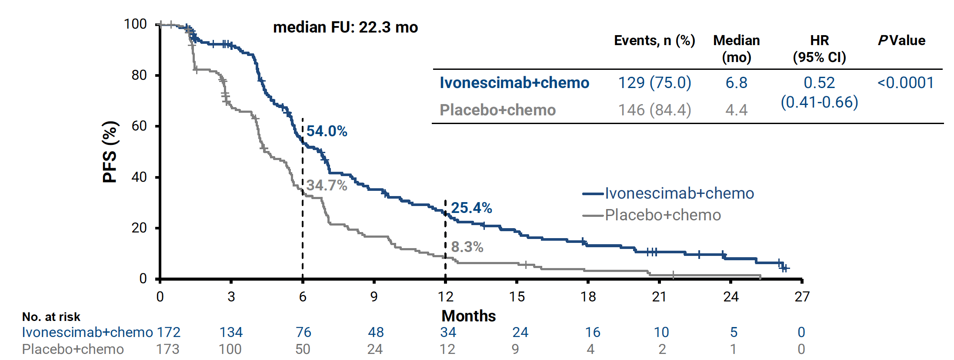
Ivonescimab
Ivonescimab vs Placebo Plus Chemo, Phase 3 in Patients with EGFR+ NSCLC Progressed with 3rd gen EGFR-TKI Treatment: HARMONi
Primary Endpoint: PFS (BICR)
Goldman J, et al, WCLC 2025

Slide 48
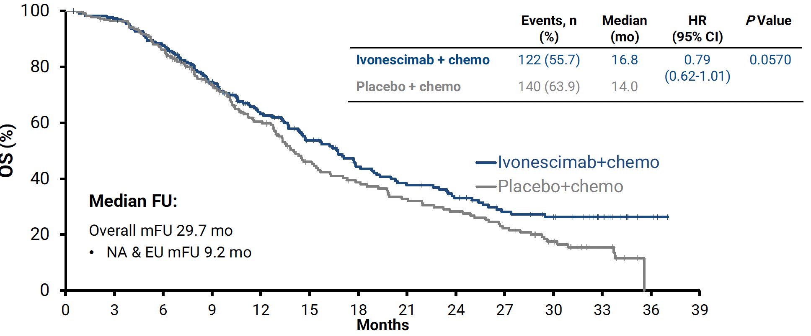
Ivonescimab
Ivonescimab vs Placebo Plus Chemo, Phase 3 in Patients with EGFR+ NSCLC Progressed with 3rd gen EGFR-TKI Treatment: HARMONi
Primary Endpoint: OS
Goldman J, et al, WCLC 2025

Slide 49
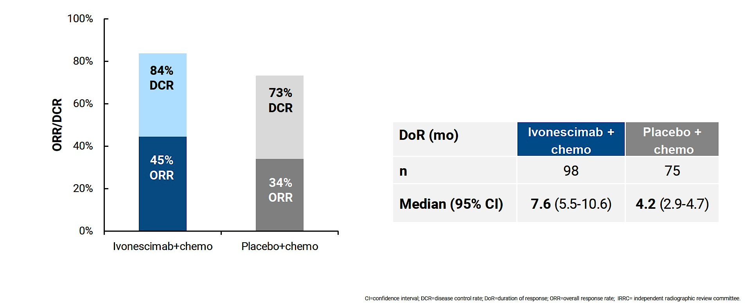
Phase III HARMONi: Responses (by IRRC)
Goldman JW et al. WCLC 2025;Abstract PL02.12

Slide 50
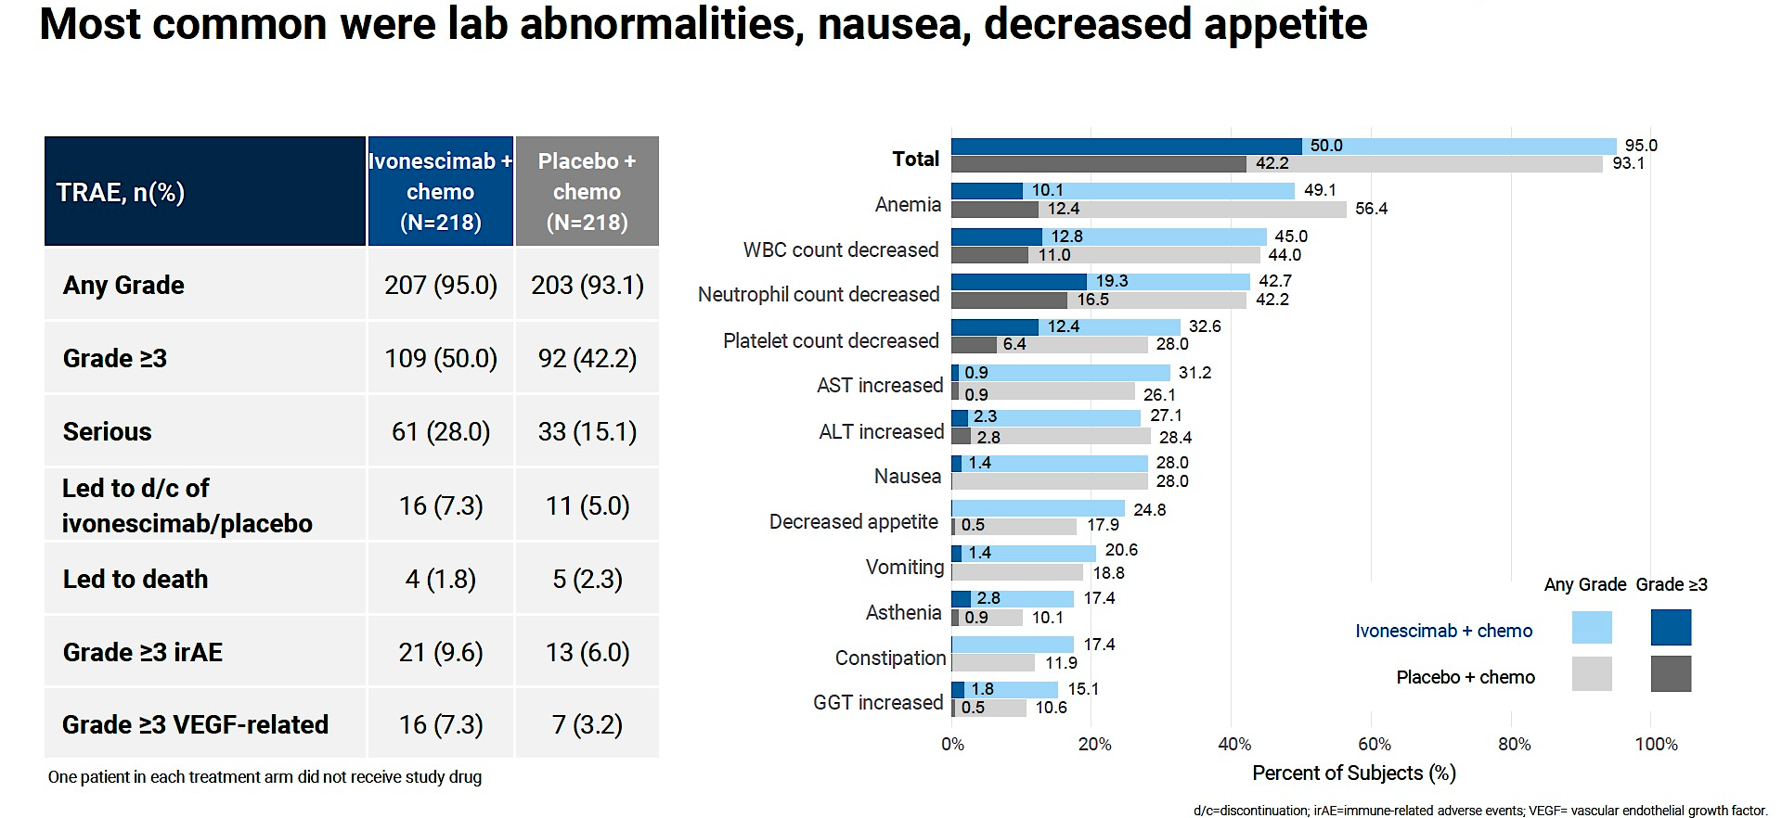
Phase III HARMONi: Safety
TRAE = treatment-related adverse event
Goldman JW et al. WCLC 2025;Abstract PL02.12

Slide 51

Phase III HARMONi: irAEs and VEGF-Related TRAEs
Goldman JW et al. WCLC 2025;Abstract PL02.12

Slide 52
Emerging Agents in TKI-resistant, EGFR-mutant NSCLC
 | MoA | n | ORR | mPFS HR vs. chemo (95% CI) | mOS (HR vs chemo) | Key Toxicities | Grade > 3 AEs
Amivantamab + Chemo MARIPOSA-2^{1,2} | EGFR/MET Ab | 130 | 64% | 6.3 mo HR 0.48 (0.36-0.64) | 17.7 mo *IA2 HR 0.73 (0.54–0.99) P=0.039 | Paronychia, rash, neutropenia, edema, hypoalbuminemia | 72% (TEAEs)
Ivonescimab + Chemo Harmoni-A⁴ | PD1/VEGF Ab | 219 | 45% | 6.8 mo HR 0.52 (0.41-0.66) | 16.8 mo HR 0.79 (0.62-1.01) P=0.0570 | Anemia, leukopenia, neutropenia, thrombocytopenia, VEGF-related tox | 50% (TRAEs)
Sac-TMT Opti-Trop4⁵ | Trop2 ADC (Topo I) | 188 | 61% | 8.3 mo HR 0.49 (0.39–0.62) | Median NE** HR 0.60 (0.44–0.82) P=0.001 | Anemia, leukopenia, alopecia, stomatitis, nausea | 58% (TRAEs)
Dato-Dxd⁶ | Trop2 ADC (Topo I) | 117 Post-TKI, post-PBC | 43% | 5.8 months | 15.6 mos (13.1–19.0) | Stomatitis, alopecia, nausea, ocular surface events | 23% (TRAEs)
Iza-Bren⁷ | EGFR/HER3 ADC (Topo I) | 50 Post-TKI, chemo naive | 56% | 12.5 months | Not Reached (12-mo OS rate 80%) | High-grade (grade 3-4) hematologic toxicities | NR
Randomized vs. PBC
Non-randomized
* Interim Analysis 2; **Median OS for chemotherapy 17.4 months
1. Passaro A, et al. Annals of Oncology, Volume 35, Issue 1, 77 – 90; 2. Popat S, et al, Annals of Oncology, Volume 35, S1244 - S1245; 3. Peled N, et al. ESMO Open, Volume 10, Issue 10, 105807; 4. Goldman J, et al. WCLC 2025; 5. Fang W, et al. NEJM 2024; 6. Ahn MJ, et al. ESMO Asia 2024; 7. Fang W, et al. WCLC 2025.

Slide 53
Other Relevant Topics in EGFR-mutation Positive NSCLC
EGFR Exon 20 Insertions
Novel agents in EGFR-mutant NSCLC
Non-metastatic EGFR-positive disease

Slide 54


ADAURA demonstrated improvement in DFS and OS with adjuvant osimertinib in EGFR+ NSCLC
ADAURA Study Design
Adjuvant osimertinib
x 3 years
Stage IB-IIIA (7th ed) NSCLC
Fully resected
Classical EGFR mutations
Adjuvant Chemo
(if clinically indicated)
R
Placebo
N=682
Primary Endpoint: PFS in Stage II-IIIA Disease
Overall Survival, Stage IB-IIIA Disease
Wu YL, NEJM 2020 and Tsuboi M, et al, NEJM 2023

Slide 55

NeoADAURA demonstrated improvement in MPR with neoadjuvant Osi and Osi/Chemo
MPR 26%
pCR 4%
EFS* HR 0.5
NeoADAURA Study Design
Chemo + Osi
(3 cycles)
Resectable stage II-IIIB NSCLC
Classical EGFR mutations
R
Osimertinib
(9 wks)
MPR 25%
pCR 9%
EFS* HR 0.73
Chemo + PBO
(3 cycles)
N=358
MPR 2%
pCR 0%
He J et al, J Clin Oncol 43, 2875-2887(2025)
*EFS vs chemo; immature.

Slide 56

LAURA demonstrated improvement in PFS with consolidation after chemoRT
LAURA Study Design
Osimertinib until PD
Unresectable stage III NSCLC
Classical EGFR mutations
ChemoRT
(No progression)
R
2:1
Placebo
N=216
Lu S, et al, N Engl J Med 2024;391:585-597 and Ramalingam S, ASCO 2024

Slide 57
Treatment Approaches for nonmetastatic EGFR-mutant NSCLC
Resection
Adjuvant Chemo
(if clinically indicated)
Adjuvant osimertinib
Resectable NSCLC
Classical EGFR mutations
Neoadjuvant* Osimertinib +/- Chemo
Resection
Adjuvant osimertinib
Borderline resectable NSCLC
Classical EGFR mutations
MDT
*Neoadjuvant osimertinib not yet FDA approved.
Unresectable stage III NSCLC
Classical EGFR mutations
ChemoRT
(No progression)
Osimertinib until PD

Slide 58
Summary and Conclusions
EGFR exon 20 insertions represent a unique NSCLC subtype and are treated differently than classical EGFR mutations.
Carboplatin/Pemetrexed/Amivantamab remains the preferred first-line therapy
Sunvozertinib has accelerated approval post-chemotherapy but is not currently available in the US market
New agents in development for EGFR-mutant NSCLC include ivonescimab, sac-TMT and other novel ADCs.
Osimertinib now has a growing role in early-stage disease (adjuvant, post-chemoRT and likely neoadjuvant)

Slide 59
QUESTIONS?

Slide 60
Module 13: Prostate Cancer
Optimizing the Role of Hormonal Therapy in the Care of Patients with Prostate Cancer — Dr Bryce
Other Available and Emerging Therapeutic Approaches — Dr Agarwal

Slide 61



Faculty
Neeraj Agarwal, MD, FASCO
University of Utah Huntsman Cancer Institute
Salt Lake City, Utah
Moderator Neil Love, MD
Research To Practice
Miami, Florida
Alan H Bryce, MD
Translational Genomics Research Institute (TGen)
City of Hope
Phoenix, Arizona
Co-Moderator Uday Dandamudi, MD
Florida Cancer Specialists & Research Institute
New Port Richey, Florida

Slide 62
Second Opinion: Clinical Investigators Provide Perspectives on the Future Role of AKT Inhibition in the Management of Prostate Cancer
A CME Symposium Held Adjunct to the 2026 ASCO® Genitourinary Cancers Symposium
Friday, February 27, 2026 6:00 PM – 7:30 PM PT (9:00 PM – 10:30 PM ET)
Faculty
Professor Karim Fizazi, MD, PhD
Daniel George, MD
Moderator
Elisabeth I Heath, MD

Slide 63



Faculty
Professor Karim Fizazi, MD, PhD
Head of Service and Full Professor
Institut Gustave Roussy
University of Paris Saclay
Villejuif, France
Moderator Elisabeth I Heath, MD
Chair, Department of Oncology
Mayo Clinic
Rochester, Minnesota
Daniel George, MD
Eleanor Easley Distinguished Chair
Professor of Medicine, Surgery and Urology
Duke University School of Medicine
ACS Research Professor
Co-Lead, DCI Center for Prostate and Urologic Cancers
Duke Cancer Institute
Durham, North Carolina

Slide 64


Second Opinion
Neil Love, MD Research To Practice Miami, Florida
Neeraj Agarwal, MD, FASCO
Professor of Medicine
Senior Director for Clinical Research
Huntsman Cancer Institute Presidential Endowed Chair of Cancer Research
Director, Center of Investigational Therapeutics
Director, Genitourinary Oncology Program
Huntsman Cancer Institute, University of Utah (NCI-CCC)
Salt Lake City, Utah
Rana R McKay, MD, FASCO
Professor of Medicine, Urology, and Radiation Medicine and Applied Sciences
Associate Director, Clinical Research
Co-Lead, Genitourinary Program
Moores Cancer Center
University of California San Diego
San Diego, California

Slide 65
Module 13: Prostate Cancer
Optimizing the Role of Hormonal Therapy in the Care of Patients with Prostate Cancer — Dr Bryce
Other Available and Emerging Therapeutic Approaches — Dr Agarwal

Slide 66
Module 13: Prostate Cancer
We would like to do a “best paper or presentation of the year” activity. Please suggest one “paper of the year” and 2 other worthy papers based on the value in treatment of current and future patients.

Slide 67
Optimizing the Role of Hormonal Therapy in the Care of Patients with Prostate Cancer (PC)
Fifth Annual National General Medical Oncology (GMO) Summit
Alan H. Bryce, M.D.
Chief Clinical Officer, City of Hope Cancer Center, Phoenix Clinical Professor, Department of Medical Oncology Professor of Molecular Medicine, TGen Research Institute
@AlanBryce9

Slide 68
Disclosures
Advisory Committees | AstraZeneca Pharmaceuticals LP, Bayer HealthCare Pharmaceuticals, Johnson & Johnson, Lantheus, MOMA Therapeutics, Novartis, Pfizer Inc
Consulting Agreements | Astellas, Johnson & Johnson
Contracted Research | Johnson & Johnson
Data and Safety Monitoring Boards/Committees | Lantheus

Slide 69





Metastasis-free survival
Phase III EMBARK Trial
Study Design & Results
Enzalutamide + Leuprolide
Enzalutamide only
Freedland SJ et al, NEJM 2023

Slide 70




Phase III EMBARK Trial
Additional Secondary Endpoints
Overall survival
First use of new antineoplastic therapy
Enzalutamide + Leuprolide
Enzalutamide only
Freedland SJ et al., NEJM, 2023; Shore ND et al., NEJM, 2026

Slide 71
Phase III EMBARK Trial
Safety
Adverse Events - N (%) | Enzalutamide + Leuprolide (N=353) | Leuprolide Alone (N=354) | Enzalutamide Monotherapy (N=354)
Adverse event that emerged during treatment | 346 (98.0) | 347 (98.0) | 348 (98.3)
AE primary reason for discontinuation of treatment | 97 (27.5) | 45 (12.7) | 73 (20.6)
AE during treatment leading to death | 10 (2.8) | 5 (1.4) | 12 (3.4)
Any grade ≥3 AE during treatment | 185 (52.4) | 175 (49.4) | 203 (57.3)
AE during treatment related to trial drug | 307 (87.0) | 286 (80.8) | 316 (89.3)
Grade ≥3 AE during treatment related to trial drug | 68 (19.3) | 34 (9.6) | 72 (20.3)
Serious AE during treatment | 143 (40.5) | 133 (37.6) | 154 (43.5)
Serious AE during treatment related to trial drug | 30 (8.5) | 9 (2.5) | 27 (7.6)
Hot flash | 246 (69.7) | 206 (58.2) | 80 (22.6)
Fatigue | 154 (43.6) | 119 (33.6) | 170 (48.0)
Arthralgia | 104 (29.5) | 75 (21.2) | 89 (25.1)
Fall | 104 (29.5) | 60 (16.9) | 71 (20.1)
Hypertension | 92 (26.1) | 75 (21.2) | 76 (21.5)
Back pain | 62 (17.6) | 56 (15.8) | 67 (18.9)
Diarrhea | 55 (15.6) | 31 (8.8) | 47 (13.3)
Constipation | 53 (15.0) | 35 (9.9) | 38 (10.7)
Hematuria | 50 (14.2) | 57 (16.1) | 53 (15.0)
Dizziness | 46 (13.0) | 44 (12.4) | 47 (13.3)
Headache | 46 (13.0) | 36 (10.2) | 47 (13.3)
Insomnia | 45 (12.7) | 40 (11.3) | 26 (7.3)
Nausea | 43 (12.2) | 31 (8.8) | 57 (16.1)
Asthenia | 42 (11.9) | 21 (5.9) | 41 (11.6)
Pain in arm or leg | 42 (11.9) | 37 (10.5) | 44 (12.4)
Coronavirus disease 2019 | 38 (10.8) | 51 (14.4) | 50 (14.1)
Urinary incontinence | 38 (10.8) | 35 (9.9) | 40 (11.3)
Urinary tract infection | 33 (9.3) | 28 (7.9) | 46 (13.0)
Peripheral edema | 32 (9.1) | 40 (11.3) | 37 (10.5)
Shore ND et al., NEJM, 2026

Slide 72



Phase III PRESTO Trial
Study Design
Aggarwal R et al., ESMO, 2025

Slide 73
Phase III PRESTO Trial
Baseline Characteristics
 | ADT | Apalutamide + ADT | Apalutamide + Abiraterone Acetate + ADT
 | (N=166) | (N=168) | (N=169)
Median age in years (IQR) | 67.0 (60.3, 71.1) | 66.0 (60.7, 70.3) | 67.3 (62.4, 71.3)
Race — N (%)
White | 142 (85.5) | 144 (85.7) | 135 (79.9)
Black or African-American | 7 (4.2) | 13 (7.7) | 12 (7.1)
Asian | 3 (1.8) | 0 (0.0) | 2 (1.2)
Native Hawaiian/Pacific Islander | 1 (0.6) | 0 (0.0) | 1 (0.6)
American Indian/Alaska Native | 1 (0.6) | 0 (0.0) | 2 (1.2)
Other/Unknown/Not Reported/Missing | 12 (7.1) | 11 (6.6) | 9 (5.3)
Ethnicity — N (%)
Non-Hispanic | 151 (91.0) | 152 (90.5) | 155 (91.7)
Hispanic | 10 (6.0) | 10 (6.0) | 7 (4.1)
Unknown/Not Reported/Missing | 5 (3.0) | 6 (3.6) | 7 (4.1)
Prior androgen-deprivation therapy — N (%) | 71 (42.8) | 75 (44.6) | 67 (39.6)
Prior radiotherapy — N (%) | 147 (88.6) | 142 (84.5) | 137 (81.1)
ADT: LHRH Analog as Androgen Deprivation Therapy
Aggarwal R et al., ESMO, 2025

Slide 74






Phase III PRESTO Trial
Results
PSA Progression-free Survival
Time to Testosterone Recovery
Apalutamide
HR, 0.94
(95% CI; 0.68 to 1.29)
HR, 0.52
(95% CI; 0.35 to 0.77)
P = .00047
HR, 0.75
(95% CI; 0.54 to 1.03)
Apalutamide + Abiraterone
HR, 0.48
(95% CI; 0.32 to 0.71)
P = .0008
Aggarwal R et al., JCO, 2024

Slide 75






Phase III PRESTO Trial
Results: Secondary Endpoint(s)
Time to mCRPC
PSA-PFS in testosterone recovered subset
Time to subsequent therapy
(both focal and systemic)
Apalutamide
72% recovered
testosterone
HR, 0.75
(95% CI; 0.56 to 1.00)
P = 0.0078
HR, 0.58
(95% CI; 0.36 to 0.95)
P = 0.03
HR, 0.72
(95% CI; 0.55 to 0.93)
P = 0.03
HR, 0.55
(95% CI; 0.34 to 0.90)
P = 0.02
68% recovered
testosterone
HR, 0.64
(95% CI; 0.47 to 0.86)
P = 0.0028
Apalutamide + Abiraterone
HR, 0.67
(95% CI; 0.50 to 0.90)
P = 0.008
Aggarwal R et al., ESMO, 2025

Slide 76
Phase III PRESTO Trial
Arm 1
LHRH Analog
Arm 2
LHRH Analog with Apalutamide
Results: Adverse Events
Arm 3
LHRH Analog with Apalutamide, Abiraterone Acetate and Prednisone
Adverse Events (AE) - N (%) | Arm A (n=160) | Arm B (n=167) | Arm C (n=164)
Any AE | 153 (96) | 167 (100) | 163 (99)
Grade 3 or 4 AE | 35 (22) | 43 (26) | 67 (41)
AE leading to treatment discontinuation | 1 (0.6) | 2 (1) | 4 (2)
Adverse Events (AE) - N (%) | Arm A |  | Arm B |  | Arm C
 | Grade 2 | Grade ≥3 | Grade 2 | Grade ≥3 | Grade 2 | Grade ≥3
Hypertension | 19 (12) | 12 (8) | 30 (18) | 13 (8) | 20 (12) | 34 (21)
Hot flashes | 22 (14) | 1 (1) | 12 (7) | 1 (1) | 24 (15) | 1 (1)
Fatigue | 16 (10) | 0 | 9 (5) | 3 (2) | 19 (12) | 2 (1)
Injection site reaction | 11 (7) | 0 | 11 (7) | 0 | 11 (7) | 0
Insomnia | 11 (7) | 0 | 6 (4) | 0 | 8 (5) | 0
Hyperglycemia | 1 (1) | 3 (2) | 7 (4) | 2 (1) | 6 (4) | 6 (4)
Rash | 2 (1) | 1 (1) | 8 (5) | 3 (2) | 3 (2) | 5 (3)
Erectile dysfunction | 9 (6) | 1 (1) | 6 (4) | 1 (1) | 3 (2) | 0
Arthralgia | 4 (3) | 1 (1) | 4 (2) | 0 | 2 (1) | 0
Fall | 0 | 3 (2) | 7 (4) | 0 | 4 (2) | 0
Aggarwal R et al., ESMO, 2025

Slide 77







Abiraterone acetate
Overall survival
STAMPEDE trial
Abiraterone w/ pred + ADT
Overall population
High volume
Low volume
Abiraterone w/ pred + Enzalutamide + ADT
Attard G et al., Lancet Oncol, 2023

Slide 78



Abiraterone acetate
Overall survival
LATITUDE trial
Overall population
High volume
Low volume
Fizazi K et al., Lancet Oncol, 2019

Slide 79



Apalutamide
TITAN Trial
Overall survival
Subgroup analysis
Cross-over adjusted analysis
Chi K et al., JCO, 2021

Slide 80



Enzalutamide
ARCHES Trial
LV: Low volume; HV: High volume
Armstrong AJ et al., EU, 2025

Slide 81


Enzalutamide
ENZAMET Trial
Outcome | ENZA (N=563) | NSAA (N=562)
All participants
Deaths due to prostate cancer, n | 207 | 261
sdHR (95% CI) | 0.72 (0.60–0.87)
Deaths due to other causes, n | 78 | 76
sdHR (95% CI) | 1.24 (1.06–1.45)
Participants with PSA ≤0.2 at 7 months
8-year survival | 56% | 54%
8-year PC mortality rate | 26% | 31%
8-year non-PC mortality rate | 13% | 10%
Participants with PSA >0.2 at 7 months
8-year survival | 25% | 22%
8-year PC mortality rate | 57% | 61%
8-year non-PC mortality rate | 11% | 14%
Median OS: 8.0 vs 5.8 years 8-year OS: 50% vs 40% HR 0.73 (95% CI, 0.63–0.86; p=0.0001)
Zhang AY et al., ASCO, 2025

Slide 82



Phase III ARANOTE Trial
Radiographic PFS
Darolutamide + ADT
Study Design
HR: 0.54 (95% CI, 0.41 to 0.71)
P < .0001
Saad F et al., JCO, 2024

Slide 83



Phase III ARANOTE Trial
Time to mCRPC
Darolutamide + ADT
Overall survival
Time to PSA Progression
Saad F et al., JCO, 2024

Slide 84
Phase III ARANOTE Trial
Darolutamide + ADT
Adverse Event - N (%) | Darolutamide + ADT (n=445) | Placebo + ADT (n=221)
Any adverse event | 405 (91.0) | 199 (90.0)
Serious adverse event | 105 (23.6) | 52 (23.5)
Grade 3 or 4 adverse event | 137 (30.8) | 67 (30.3)
Grade 5 adverse event | 21 (4.7) | 12 (5.4)
Adverse event leading to permanent discontinuation of study drug | 27 (6.1) | 20 (9.0)
Adverse Event - N (%) | Darolutamide |  | Placebo
 | Any Grade | Grade 3/4 | Any Grade | Grade 3/4
Anemia | 91 (20.4) | 14 (3.1) | 39 (17.6) | 8 (3.6)
Arthralgia | 55 (12.4) | 5 (1.1) | 25 (11.3) | 0
Urinary tract infection | 52 (11.7) | 8 (1.8) | 17 (7.7) | 1 (0.5)
Back pain | 43 (9.7) | 5 (1.1) | 23 (10.4) | 2 (0.9)
Increased aspartate aminotransferase | 43 (9.7) | 10 (2.2) | 17 (7.7) | 1 (0.5)
Constipation | 42 (9.4) | 0 | 16 (7.2) | 0
Hot flush | 41 (9.2) | 0 | 16 (7.2) | 0
Increased alanine aminotransferase | 40 (9.0) | 9 (2.0) | 18 (8.1) | 1 (0.5)
Pain in extremity | 38 (8.5) | 1 (0.2) | 20 (9.0) | 4 (1.8)
Hypertension | 38 (8.5) | 19 (4.3) | 19 (8.6) | 8 (3.6)
Bone pain | 33 (7.4) | 9 (2.0) | 27 (12.2) | 3 (1.4)
Increased weight | 33 (7.4) | 4 (0.9) | 17 (7.7) | 1 (0.5)
COVID-19 | 32 (7.2) | 1 (0.2) | 15 (6.8) | 2 (0.9)
Increased alkaline phosphatase | 30 (6.7) | 0 | 13 (5.9) | 3 (1.4)
Insomnia | 28 (6.3) | 0 | 6 (2.7) | 1 (0.5)
Hyperglycemia | 27 (6.1) | 1 (0.2) | 8 (3.6) | 0
Fatigue | 25 (5.6) | 0 | 18 (8.1) | 1 (0.5)
Increased creatinine | 21 (4.7) | 2 (0.4) | 15 (6.8) | 0
Headache | 18 (4.0) | 0 | 14 (6.3) | 2 (0.9)
Saad F et al., JCO, 2024

Slide 85




Phase III ARASENS Trial
Overall survival
Darolutamide + Docetaxel + ADT
HR: 0.68 (95% CI, 0.57 to 0.80)
P < .001
Study Design
High volume
Low volume
Smith M et al., NEJM, 2022; Hussain M et al., JCO, 2023

Slide 86


Phase III ARASENS Trial
Darolutamide + Docetaxel + ADT
Adverse Event - N (%) | Darolutamide–ADT–Docetaxel (N=652) | Placebo–ADT–Docetaxel (N=650)
Any adverse event | 649 (99.5) | 643 (98.9)
Worst grade
Grade 1 | 28 (4.3) | 35 (5.4)
Grade 2 | 162 (24.8) | 169 (26.0)
Grade 3 | 248 (38.0) | 232 (35.7)
Grade 4 | 183 (28.1) | 181 (27.8)
Grade 5 | 27 (4.1) | 26 (4.0)
Serious adverse event | 292 (44.8) | 275 (42.3)
Adverse event leading to permanent discontinuation of trial agent
Darolutamide/placebo | 88 (13.5) | 69 (10.6)
Docetaxel | 52 (8.0) | 67 (10.3)
Selected grade 3 or 4 adverse event
Neutropenia | 220 (33.7) | 222 (34.2)
Febrile neutropenia | 51 (7.8) | 48 (7.4)
Hypertension | 42 (6.4) | 21 (3.2)
Anemia | 31 (4.8) | 33 (5.1)
Pneumonia | 21 (3.2) | 20 (3.1)
Hyperglycemia | 18 (2.8) | 24 (3.7)
Increased ALT | 18 (2.8) | 11 (1.7)
Increased AST | 17 (2.6) | 7 (1.1)
Increased weight | 14 (2.1) | 8 (1.2)
Urinary tract infection | 13 (2.0) | 12 (1.8)
Time to CRPC
Time to pain progression
Smith M et al., NEJM, 2022

Slide 87


Biologic justification for targeting the PI3K/AKT/mTOR pathway
Capivasertib in PTEN-deficient PC
PTEN loss removes pathway inhibition, causing oncogenic PI3K/Akt/mTOR hyperactivation.
PTEN loss occurs in ~40–50% of advanced PC and is associated with worse prognosis and reduced benefit from AR-targeted therapy.
PTEN loss with subsequent AKT activation may also promote radiation and chemotherapy resistance.
Capivasertib, a pyrrolopyrimidine-derived compound, is a potent and selective inhibitor of all three AKT isoforms (AKT1-3).
By binding to AKT and inhibiting phosphorylation of downstream substrates, capivasertib reduces the activation of AKT signaling processes that contribute to tumor growth
Shorning BY et al., Int J. Mol. Sci, 2020; Taylor BS et al., Cancer cell, 2010; Robinson D et al., Cell, 2015; Jamaspishvili T et al., Nat Rev Urol 2018; Grunwald V et al., Cancer research, 2002; Qian DZ et al., The Prostate, 2010; Fizazi K et al., ESMO, 2025

Slide 88

Capivasertib in PTEN-deficient PC
Phase III CAPItello-281 Trial
Study Design
Fizazi K et al., ESMO, 2025; Fizazi K et al., Ann Oncol, 2026

Slide 89

Capivasertib in PTEN-deficient PC
Phase III CAPItello-281 Trial
Radiographic progression free survival
Fizazi K et al., ESMO, 2025; Fizazi K et al., Ann Oncol, 2026

Slide 90

Capivasertib in PTEN-deficient PC
Phase III CAPItello-281 Trial
Fizazi K et al., ESMO, 2025; Fizazi K et al., Ann Oncol, 2026

Slide 91
Capivasertib in PTEN-deficient PC
Phase III CAPItello-281 Trial
Adverse Event - N (%) | Capivasertib + Abiraterone (n=503) |  | Placebo + Abiraterone (n=503)
 | All Grades | Grade ≥3 | All Grades | Grade ≥3
Any adverse event | 497 (98.8) | 337 (67.0) | 463 (92.0) | 203 (40.4)
Diarrhea | 261 (51.9) | 31 (6.2) | 40 (8.0) | 2 (0.4)
Hyperglycemia | 191 (38.0) | 52 (10.3) | 65 (12.9) | 3 (0.6)
Rash | 178 (35.4) | 62 (12.3) | 35 (7.0) | 1 (0.2)
Anemia | 120 (23.9) | 26 (5.2) | 64 (12.7) | 5 (1.0)
Hypokalemia | 111 (22.1) | 44 (8.7) | 64 (12.7) | 24 (4.8)
Hypertension | 100 (19.9) | 29 (5.8) | 120 (23.9) | 39 (7.8)
Fatigue | 80 (15.9) | 2 (0.4) | 63 (12.5) | 4 (0.8)
ALT increased | 71 (14.1) | 22 (4.4) | 67 (13.3) | 17 (3.4)
Urinary tract infection | 69 (13.7) | 21 (4.2) | 51 (10.1) | 6 (1.2)
AST increased | 65 (12.9) | 13 (2.6) | 59 (11.7) | 10 (2.0)
Nausea | 61 (12.1) | 3 (0.6) | 22 (4.4) | 0
COVID-19 | 59 (11.7) | 4 (0.8) | 44 (8.7) | 3 (0.6)
Asthenia | 57 (11.3) | 4 (0.8) | 25 (5.0) | 2 (0.4)
Pyrexia | 55 (10.9) | 6 (1.2) | 14 (2.8) | 0
Hot flush | 53 (10.5) | 1 (0.2) | 68 (13.5) | 0
Pruritus | 53 (10.5) | 1 (0.2) | 13 (2.6) | 0
Back pain | 50 (9.9) | 3 (0.6) | 55 (10.9) | 0
Constipation | 42 (8.3) | 1 (0.2) | 60 (11.9) | 0
Arthralgia | 38 (7.6) | 2 (0.4) | 51 (10.1) | 2 (0.4)
Fizazi K et al., Ann Oncol, 2026

Slide 92
QUESTIONS?

Slide 93
Module 13: Prostate Cancer
Optimizing the Role of Hormonal Therapy in the Care of Patients with Prostate Cancer — Dr Bryce
Other Available and Emerging Therapeutic Approaches — Dr Agarwal

Slide 94
Other Available and Emerging Therapeutic Approaches in Metastatic Prostate Cancer
Neeraj Agarwal, MD, FASCO
Professor of Medicine
Senior Director for Clinical Research, Huntsman Cancer Institute (HCI)
HCI Presidential Endowed Chair of Cancer Research
Director, Center of Investigational Therapeutics
Director, Genitourinary Oncology Program
Huntsman Cancer Institute, University of Utah (NCI-CCC)
Salt Lake City, UT, USA

Slide 95
Disclosures
No relevant financial relationships to disclose.

Slide 96
Emerging Therapeutics in Metastatic Prostate Cancer
PARP inhibitors
Radioligand therapies
Antibody-drug conjugates
T-cell engagers
CYP11A1 inhibitor

Slide 97

The Rationale for Combining PARPi with ARPI
ARPIs induce a phenotype resembling HRR deficiency
Suppressed AR function causes an upregulation of PARP
ARPIs prime tumor cells for PARP inhibition
PARP augments AR activity
PARP inhibitors may attenuate resistance to ARPIs
PARP inhibitors extend the benefits of ARPIs
Adapted from Bin Gui et al., PNAS 2019 June, DOI https://doi.org/10.1073/pnas.1908547116
Agarwal N, European Journal of Cancer, 2023.
Notes:
AR inhibition upregulate PARP (as a matter of defence) and PARP augments AR activity (trying to negate the action of AR inhibitor).
beyond DNA damage repair function, PARP-2, but not PARP-1, is a critical component in AR transcriptional machinery through interacting with the pioneer factor FOXA1 and facilitating AR recruitment to genome-wide prostate-specific enhancer regions

Slide 98



Phase 3 PARPi + ARPI Trials Design
Clarke, NW. et al. NEJM Evidence, 2022
Chi, KN. et al. JCO, 2022
98
Agarwal, N. et al. Lancet, 2023

Slide 99
Phase 3 Combination trials of PARP inhibitors with an ARPI
 | PROpel (N = 796) | MAGNITUDE (N = 423) | TALAPRO-2 (Cohort 1: N = 805) | TALAPRO-2 (Cohort 2: N = 399)
Trial population mCRPC 1st line | Docetaxel / ARSI in mCSPC setting allowed (ARSI without progression and > 12 months ago) | Docetaxel / ARSI in mCSPC setting allowed ; Abiraterone in mCRPC allowed if given < 4 months | Docetaxel / Abiraterone in mCSPC setting allowed | Yes (abiraterone only)
Design and randomization | 1 : 1 randomisation Abiraterone + olaparib (n = 399) vs abiraterone + placebo (n = 397) | Cohort 1: HRR cohort 1 : 1 randomisation abiraterone + niraparib (n = 212) vs abiraterone + placebo (n = 211) Cohort 2: non-HRR cohort (closed prematurely because of futility) | All-comer population 1 : 1 randomisation Enzalutamide + talazoparib (n = 402) vs enzalutamide + placebo (n = 403) | HRR cohort 1 : 1 randomisation Enzalutamide + talazoparib (n = 200) vs enzalutamide + placebo (n = 199)
HRR analysis | Tissue or ctDNA / retrospective | 100% tissue / prospective | 100% tissue / prospective | 99.5% tissue / prospective 0.5% ctDNA or unspecified tissue source / prospective
Primary endpoint | rPFS (investigator review) | rPFS (central review) | rPFS (central review) | rPFS (central review)
rPFS, HR (95% CI)
All comers | HR 0.66 (0.54-0.81) | NR | HR 0.63 (0.51-0.78) | Not included
HRR -ve | HR 0.76 (0.6-0.97) | HR 1.09 (0.75-1.57) | HR 0.70 (0.54-0.89) | Not included
HRR +ve | HR 0.50 (0.34-0.73) | HR 0.73 (0.56-0.96) | HR 0.46 (0.30-0.70) | HR 0.45 (0.33-0.61)
BRCA+ | HR 0.23 (0.12-0.43) | HR 0.53 (0.36-0.79) | HR 0.23 (0.10-0.53) | HR 0.20 (0.11-0.36)
ORR (all comers) | 58% vs 48% | 60% vs 28% (only HRR+ pts) | 61.7% vs 43.9% | 67% vs 40%
OS (all comers) | HR 0.81 (0.67-1) | HR 0.66 (0.46-0.95) (only for BRCA 1/2) | 45.8 vs 37 months HR 0.80 (0.66–0.96) | 45.1 vs 31.1 months HR 0.62 (0.48–0.81)
FDA approval; EMA approval | mCRPC with BRCA1/2 mutations; mCRPC when chemotherapy is not indicated | mCRPC with BRCA1/2 mutations | mCRPC with any HRR mutations; mCRPC when chemotherapy is not clinically indicated
Publication | Clarke N….Saad F. NEJM Evidence, 2022 | Chi K….Sandhu S. JCO, 2023 | Agarwal N….Fizazi K. The Lancet, 2025 | Fizazi K….Agarwal N. The Lancet, 2025

Slide 100


AMPLITUDE Phase 3 Trial: PARPi in mHSPC
Key Eligibility
Pathological diagnosis of prostate adenocarcinoma
Positive for deleterious homologous recombination repair (HRR) gene mutations
Radiation with curative intent or prior treatment with PARPi is not allowed
Patients with long-term use of systemically administered corticosteroids or a history of MDS or AML were excluded
R A N D O M I Z E D
n=788
Niraparib 200 mg qd +
Abiraterone Acetate
1000 mg qd.
+
Prednisone 5 mg qd
Efficacy end points
Primary:
rPFS
Secondary:
OS
Symptomatic PFS
Time to subsequent therapy
Duration of response (DOR)
Safety and tolerability
Placebo
+
Abiraterone Acetate
1000 mg qd.
+
Prednisone 5 mg qd
www.clinicaltrials.gov: (NCT04497844)
Eligible HRR genes were: BRCA1, BRCA2, BRIP1, PALB2, RAD51B, RAD54L, CDK12, CHEK2and FANCA.
Attard, Agarwal…Rathkopf. Nature Medicine, 2025

Slide 101

Slide 9
Attard

Slide 102
AMPLITUDE Trial: PARPi in mHSPC
Endpoint |  | Niraparib + Abiraterone | Placebo + Abiraterone | Hazard Ratio (HR) (95% CI) | P-value
rPFS (median, mo) | All | Not reached | 29.5 | 0.63 (0.49–0.80) | 0.0001
 | BRCA1/2 | Not reached | 26 | 0.52 (0.37-0.72) | <0.0001
Time to pain progression (median, mo) | All | Not reached | Not reached | 0.50 (0.36–0.69) | <0.0001
 | BRCA1/2 | Not reached | Not reached | 0.44 (0.29-0.68) | 0.0001
OS (median, mo) | All | Not reached | Not reached | 0.79 (0.59–1.04) | 0.10
 | BRCA1/2 | Not reached | Not reached | 0.75 (0.51-1.11) | 0.15
Attard G, Agarwal N…. Rathkopf. Nature Medicine 2025

Slide 103
Phase 3 TALAPRO-3 Trial
Key Eligibility
Men with confirmed mHSPC
Positive for deleterious germline or somatic homologous recombination repair (HRR) gene mutations
Radiation/surgery with curative intent or prior treatment with chemotherapy or PARPi is not allowed
Patients with brain metastases or a history of MDS or AML were excluded
R A N D O M I Z E D
N = 550
1:1
Efficacy end points
Primary:
rPFS
Secondary:
OS
ORR
PSA response
Health-related quality of life
Talazoparib
+
enzalutamide
Placebo
+
enzalutamide
www.clinicaltrials.gov: (NCT04821622)
Agarwal… Fizazi. Future Oncology, 2024

Slide 104
Phase 3 TALAPRO-3 Trial Press Release
TALAZOPARIB Plus ENZALUTAMIDE Significantly Improves Radiographic Progression-Free Survival in Metastatic Prostate Cancer
Thursday, March 19, 2026
Primary endpoint met in Phase 3 TALAPRO-3 study demonstrating a statistically significant and clinically meaningful reduction in risk of disease progression or death in HRR gene-mutated metastatic hormone sensitive prostate cancer
Consistent rPFS efficacy benefit was observed in patients whose tumors harbored BRCA and non-BRCA HRR gene alterations
Interim analysis showed a strong trend toward improvement in overall survival
These results will be discussed with global health authorities to potentially expand TALAZOPARIB indication in this earlier stage disease

Slide 105


Saruparib (AZD5305) – Selective PARP1 Inhibitor
Illuzzi G et al. Clin Cancer Res 2022;28(21):4724-36.

Slide 106
EvoPAR-Prostate01 : Phase 3 Trial Design (mHSPC)
A Phase III, 2-cohort, 2-arm, randomized, double-blind, placebo-controlled study evaluating the efficacy and safety of saruparib plus physician’s choice of NHA (abiraterone, darolutamide, or enzalutamide) versus placebo plus physician’s choice of NHA in participants with mCSPC
Eligibility criteria
≈550 patients
Saruparib 60 mg plus physician’s choice NHA
Select endpoints
HRRm
HRRm cohort
rPFS
OS
Non-HRRm cohort
rPFS
OS
Aged ≥18 years
Histologically confirmed mCSPC (de novo or recurrent low- or high-volume disease)
ECOG PS 0–1
Prospectively defined HRRm status*
Must be receiving ADT throughout the study or have undergone bilateral orchiectomy, and must be suitable for treatment with NHAs
No prior treatment with PARP inhibitors, CT, or NHAs in the metastatic setting†
No suspected or prior history of myelodysplastic syndrome/acute myeloid leukemia
R 1:1
Placebo plus physician’s choice NHA
No crossover between cohorts
Saruparib 60 mg plus physician’s choice NHA
Statistical analyses
Non-HRRm
rPFS and OS will be tested for each cohort separately using a stratified log-rank test
R 1:1
Placebo plus physician’s choice NHA
≈1250 patients
Treatment will continue until disease progression, unacceptable toxicity, or participant-initiated withdrawal
Agarwal N. et al, AUA 2024;
Azad A et al, ASCO 2025
www.clinicaltrials.gov: (NCT06120491)

Slide 107

¹⁷⁷Lu-PSMA-617 Targeted Radioligand Therapy

Slide 108
Phase 3 trials with Lu-177-PSMA-617
 | VISION | PSMAfore
Patient Population | mCRPC with prior progression on ≥ 1 ARPI and 1 or 2 taxane regimens and PSMA positive disease | Taxane-naïve mCRPC with progression once on prior ARPI and PSMA positive disease
Design of the trial | 2 : 1 | 1 : 1
Control Arm | Protocol-permitted SOC (not including chemotherapy, radium-223, immunotherapy, or investigational drugs) | ARPI change
Primary endpoints | rPFS (central review); OS | rPFS (central review)
Key secondary endpoints | Objective response and disease control (per RECIST v1.1); time to first symptomatic skeletal event | OS (prespecified crossover-adjusted analysis)
rPFS | 8.7 vs. 3.4 mo (HR 0.4, 99.2% CI 0.29 – 0.57, p < 0.001) | Primary analysis: 9.3 vs. 5.6 mo (HR 0.41, 95% CI 0.29 – 0.56) Updated 3rd analysis: 11·6 vs. 5·59 mo (HR 0·49 [95% CI 0·39-0·61]).
OS | 15.3 vs. 11.3 mo (HR 0.62, 95% CI 0.52 – 0.74, p < 0.001) | 24.5 vs. 23.1 mo (HR 0.91, 95% CI 0.72 – 1.14) (77.5% crossover)
Sartor et al., NEJM, 2021; Morris Lancet, 2024

Slide 109
Phase 3 PSMAddition Trial Design
Key Eligibility
Inclusion
Men aged ≥ 18 years with confirmed de novo mHSPC (adenocarcinoma)
≥ 1 PSMA-positive lesion as seen on a 68Ga-PSMA-11 PET/CT scan
ECOG 0 - 2
Exclusion
Any prior systemic anti-prostate cancer therapy
Efficacy end points
Primary:
rPFS per PCWG 3
Secondary:
OS
PSA90 response
Time to mCRPC
PFS
PFS2
Time to SSE
ORR
DCR
R A N D O M I Z E D
1:1
177Lu-PSMA-617
+ ADT + ARPI
ADT + ARPI
www.clinicaltrials.gov: NCT04720157

Slide 110
Phase 3 PSMAddition trial
 | PSMAddition
NCT# | NCT04720157
Radioligand | 177Lu-PSMA-617
Patient Population | Patients with PSMA-positive mHSPC, and who are either treatment-naïve or minimally treated with short-term hormone therapy or AR-targeted therapy
Number of patients | 1144
Randomization | 1:1
Treatment arm | 177Lu-PSMA-617 + ADT + ARPI
Primary endpoints | rPFS
Key secondary endpoints | OS, PSA90, time to mCRPC, composite PFS, safety and tolerability, health-related quality of life
rPFS | NR vs. NR HR 0.72 (0.58- 0.90), p = 0.002
OS | HR 0.84 (95% CI, 0.63–1.13) p = 0.125
Tagawa S, ESMO 2025

Slide 111
Phase 3 ProstACT Global: Lu-177-Rosopatamab Tetraxetan (Lu-TLX591) in mCRPC (post ARPI mCRPC)
Key Eligibility
Inclusion criteria:
Patients with mCRPC
ECOG 0–2
On ADT, T <50 ng/dL
Progressed on 1 ARPI
PSMA+ (PET, BICR)
PSA or radiographic progression
Exclusion criteria:
Prior PSMA therapy
Chemo in mCRPC/nmCRPC
Recent systemic tx / RT
Prior radioisotopes
Brain/liver mets ≥1 cm
Prior PARPi or platinum
Efficacy end points
Primary:
rPFS per PCWG 3
Secondary:
OS
ORR
SSE
PSA response
HRQoL
R A N D O M I Z E D
N = 490
2:1
177Lu-TLX591 + Enzalutamide or Abiraterone or Docetaxel
Enzalutamide or Abiraterone or Docetaxel
www.clinicaltrials.gov: NCT06520345
Tagawa..Agarwal, ASCO, 2025

Slide 112
Phase 3 AcTFirst: 225Ac-PSMA-617 (AAA817) + ARPI in PSMA-positive mCRPC (post ARPI mCRPC)
Key Eligibility
Key Inclusion
ECOG 0–2
Prostate adenocarcinoma
Taxane in mHSPC allowed
PSMA-PET positive disease
mCRPC with progression on ≤1 prior ARPI
Key Exclusion
Prior radiopharmaceutical therapy
Efficacy end points
Primary Outcome
rPFS
Secondary Outcomes
OS
rPFS (PCWG3-modified)
PFS
PFS2
ORR
PSA50 / PSA90
AAA817 + ARPI (enzalutamide or abiraterone)
R A N D O M I Z E D
N = 940
1:1:1
AAA817
SoC (ARPI or chemotherapy) or AAA617
www.clinicaltrials.gov: NCT06855277

Slide 113

Antibody Drug Conjugates: Mechanism of Action
Ozay ZI...Agarwal N. Therapeutic Advances in Medical Oncology, 2026

Slide 114
Phase I/II Prospective Studies of PSMA Targeting ADCs in Prostate Cancer
114
 | MLN2704 | PSMA-MMAE | MEDI3726 | ARX517
NCT# | NCT00070837 | NCT01414283 | NCT02991911 | NCT04662580
Patient population | mCRPC | mCRPC with prior progression on abiraterone and/or enzalutamide | mCRPC with prior progression on taxane-based CT and abiraterone and/or enzalutamide | mCRPC
Study design | Phase I / II | Phase II | Phase I / Ib | Phase I
Tumor antigen target | PSMA | PSMA | PSMA | PSMA
Payload | Maytansinoid-1 (DM-1) | Monomethyl auristatin E(MMAE) | Pyrrolobenzodiazepine | Amberstatin-269
Primary endpoint | DLT, MTD, PSA50 | Antitumor activity, safety, tolerability | Safety, DLT, MTD | Safety, PK and clinical efficacy
No. of patients | 62 | 119 | 33 | 24
Median number of prior lines of therapy, n (range) | - | - | 4 (NA) | 4 (NA)
Prior Taxane, n (%) | 33 (53) | - | 33 (100) | 12 (50)
Prior ARPI, n (%) | - | 119 (100) | 33 (100) | 24 (100)
PSA50 responses, n (%) | 5 of 62 (8) | 16 of 113 (14) | - | 0 of 24 (33.3)
ORR, n (%) | 0 of 27 (0) | - | 0 of 33 (0) | 2 of 7 (28.5)
Peripheral neuropathy, any G – G ≥ 3 (%) | 71 – 10 | NA – 7.6 | - | -
Neutropenia, any G – G ≥ 3 (%) | - | NA – 31.4 | - | -
Nausea, any G – G ≥ 3 (%) | 61 - NA | NA – 2.5 | 21.2 - 0 | -
Fatigue, any G – G ≥ 3 (%) | 60 - NA | NA – 16.8 | 30.3 – 6.1 | 33.3 - 0
Reference | Milowsky et al., Urologic Oncology, 2016 | Petrylak et al., The Prostate, 2020 | de Bono et al., Clinical Cancer Research, 2021 | Shen et al., ESMO 2023

Slide 115
Phase I/II Prospective Studies of ADCs in Prostate Cancer (non-PSMA targets)
115
 | DSTP3086S | Sacituzumab govitecan | FOR46 | Ifinatamab Deruxtecan/DS-7300a | DB 1311/BNT324
NCT# | NCT01283373 | NCT03725761 | NCT03575819 | NCT04145622 | NCT05914116
Patient population | mCRPC | mCRPC with prior progression on ARPI | mCRPC previously treated with an ARPI but chemotherapy-naïve in the mCRPC setting | mCRPC | Advanced/metastatic solid tumors (including mCPRC)
Study design | Phase I | Phase II | Phase I | Phase I/II | Phase I / II
Tumor antigen target | STEAP-1 | TROP-2 | CD46 | B7-H3 | B7-H3
Payload | Monomethyl auristatin E | SN-38 | Monomethyl auristatin E | DNA topoisomerase I | DNA topoisomerase 1
Primary endpoint | Safety, RP2D | PSA response rate | MTD | Safety and tolerability | ORR
No. of patients | 77 | 30 | 56 | 29 | 73 (patients with mCRPC)
Median number of prior lines of therapy, n (range) | - | - | 5 (2 – 14) | Part 1 (dose-escalation): Median 6.0 prior lines of therapy (range 2–10) Part 2 (dose-expansion): Median 5.0 prior lines of therapy (range 3–10) | 4 (1 – 14)
Prior taxane, n (%) | Docetaxel: 43 (56) Cabazitaxel: 8 (10) | 6 (30) in mHSPC | 0 (0) | - | Docetaxel: 68 (93.2) Cabazitaxel: 29 (39.7)
Prior ARPI, n (%) | Abiraterone: 52 (68) Enzalutamide: 35 (45) | 20 (100) | 56 (100) | - | 70 (95.9)
PSA50 response, n (%) | 11 of 77 (14.3) | 0 (0) | 14 of 39 (36) | - | -
ORR, n (%) | 1 of 46 (2.7) | - | 5 of 25 (20) | 6 of 29 (20.7) | 22 of 52 (42.3)
Median rPFS, months (95% CI) | - | - | 8.7 (NA) | 5.5 (5.3 – NR) | NE (5.7 – NE)
Peripheral neuropathy, any G – G ≥ 3 (%) | 51 – 4 | - | 32.1 - NA | - | -
Neutropenia, any G – G ≥ 3 (%) | - | 85 - NA | 41.1 - NA | - | 13.2 – 7.9
Nausea, any G – G ≥ 3 (%) | 38 – 1 | - | - | - | 44.7 - 0
Fatigue, any G – G ≥ 3 (%) | 56 – 4 | - | - | - | 21.1 - 0
References | Danila et al., ASCO 2019 | Lang et al., ESMO 2024 | Aggarwal et al., Journal of Clinical Oncology, 2025 | Patel MR, et al., ASCO 2022 | Parsonson et al., ASCO 2025

Slide 116
Phase 3 IDeate-Prostate01 trial: B7-H3-directed ADC vs Docetaxel
Key Eligibility
Inclusion Criteria:
mCRPC
Progression while on ADT within 6 months prior to entering the study
Prior progression on ARPI
Exclusion Criteria:
Received prior treatment with a taxane-based chemotherapy agent for mCRPC
Key endpoints
Primary Outcomes
OS
rPFS
Secondary Outcomes
Time to First Subsequent Therapy
OR
DOR
Time to Pain Progression
Time to PSA Progression
PSA Response
Time to First Symptomatic Skeletal-Related Event
Incidence of Adverse Events
R A N D O M I Z E D
N = ~1440
1:1
Ifinatamab deruxtecan
(B7-H3-directed ADC)
Docetaxel
www.clinicaltrials.gov: NCT06925737

Slide 117





117
T-cell Engagers: Mechanism of Action
MHC-TCR engagement (and co-stimulation) is required for T-cell stimulation in normal circumstances
MHC expression is downregulated in cancer cells
TCEs bypass the steps needed for MHC-TCR-dependent T-cell activation
TCEs engage both CD3 on T-cells and a tumor-associated antigen on cancer cells, leading to T-cell mediated killing of cancer cells
BiTE-mediated T cell Engagement
Bispecific T cell engager
Perforin
Cancer Cell
CD3
Granzymes
MHC, Major Histocompatibility Complex; TCR, T-Cell Receptor
Hage Chehade C…Agarwal N, EU, 2025

Slide 118
Bispecific T-Cell Engagers in Prostate Cancer
118
 | Pasotuxizumab | JNJ-63898081 | AMG 160 | LAVA-1207 | Xaluritamig | Tarlatamab | Pasritamig
Patient Population | mCRPC with prior progression on ≥ 1 taxane and abiraterone and/or enzalutamide | mCRPC with prior progression on taxane or ARPI | mCRPC with prior progression on 1 to 2 taxane-based regimens and ARPI | Treatment refractory mCRPC | mCRPC with prior progression on ARPI and 1 – 2 taxane regimens | Metastatic de novo or treatment-emergent NEPC with prior progression on ≥ 1 platinum CT or ARPI | mCRPC with prior receipt of ARPI and/or chemotherapy
Study Design | Phase 1 Dose escalation | Phase 1 Dose escalation + dose expansion | Phase 1 Dose escalation + dose expansion | Phase 1/2a Dose escalation + dose expansion | Phase 1 Dose escalation | Phase 1b Dose expansion | Phase 1 Dose escalation + dose expansion
Tumor Antigen Target | PSMA | PSMA | PSMA | PSMA | STEAP-1 | DLL3 | KLK2
Primary Endpoint | Safety, MTD | Safety, anti-tumor response | Safety, MTD, RP2D | Safety, RP2D | Safety, MTD, RP2D | Safety | Safety, RP2D
No. of Patients | 47 | 39 | 133 | 20 | 97 | 40 | 174
Visceral Metastases, n (%) | - | - | 22 (16.5) | - | 51 (53) | - | 42 (24.3)
Median number of prior lines of therapy, n (range) | - | - | - | 4 (3 – 10) | 4 (1 – 9) | 3 (2 – 4) | 4 (1 – 13)
Prior Taxane, n (%) | - | 30 (76.9) | 128 (96.2) | - | 82 (85) | - | 136 (78.2)
Prior ARPI, n (%) | - | 38 (97.4) | 132 (99.2) | - | 96 (99) | - | 173 (99.4)
PSA50 Responses, n (%) | 12 of 39 (30.7) | 2 of 26 (7.7) | 42 of 133 (31.6) | - | 43 of 87 (49) | - | 14 of 33 (42.4)
ORR, n (%) | 0 of 18 (0) | 0 of 23 (0) | 7 of 59 (10.6) | 0 | 16 of 67 (24) | 4 of 38 (10.5) in all pts, 4 of 18 (22.2) in DLL3+ pts | 7 of 84 (8.3)
Median rPFS, months (95% CI) | - | - | 3.8 (3.5 – 4.9) | - | - | 2.1 for all pts, 3.7 for DLL3+ pts | 7.9 (2.9 – NE)
Antidrug antibodies, n (%) | 30 of 31 (96.7%) in SC cohort 0 of 16 (0) in IV cohort | 17 of 27 (63%) in SC cohort 2 of 12 (16.7%) in IV cohort | 30 of 81 (37%) in dose escalation 29 of 53 (55%) in dose expansion | - | 49 of 90 (54%) | - | -
CRS, any G – G ≥ 3 (%) | 6 – 2.1 | 66.7 – 0 | 97.7 – 20.3 | ~ 10 - 0 | 72 – 2 | 75 – 2.5 | 8.9 - 0
Fatigue, any G – G ≥ 3 (%) | 34 – 2.1 | 41 – 0 | 53.2 – 23.4% of dose exploration cohort (n = 77) | ~ 45 - 0 | 45 – 11 | - | 15 - 0
Hummel H et al., Immunotherapy, 2020; Lim E et al., CGUC, 2023; Dorff T et al., CCR, 2024; Mehra N et al., ASCO 2023; Kelly W et al., Cancer Discovery, 2023; Aggarwal R et al., ASCO 2024; Baldini et al., ASCO 2025
Hage Chehade C…Agarwal N, EU, 2025

Slide 119


PSA Response with Pasritamig in mCRPC (phase 1 study)
PSA response in patients treated by SC administration
PSA response in patients treated by IV administration
Stein M et al., JCO, 2025

Slide 120
Mechanism of Action of Opevesostat (CYP11A1 inhibitor)
Cholesterol
OPEVESOSTAT
MK-5684
ODM-208
CYP11A1
Pregnenolone
Progesterone
Deoxy corticosterone
Corticosterone
Aldosterone
17 Hydroxy-Pregnenolone
17 Hydroxy-progesterone
11-Deoxy cortisol
Cortisol
DHEA
Androstenedione
Testosterone
DHT
Adapted from Agarwal N, Future Oncology, 2010

Slide 121
Phase 3 OMAHA-003: Opevesostat (CYP11A1 inhibitor) in mCRPC
(post prior ARPI and taxane in mCRPC)
Key endpoints
Primary Outcomes
rPFS
Secondary Outcomes
OS
Time to First Subsequent Therapy (TFST)
ORR
DOR
Time to Pain Progression
FACT-G: Change / Deterioration / Improvement
Time to PSA Progression
PSA Response Rate
Time to First Symptomatic Skeletal Event
Adverse Events
Key Eligibility
Inclusion Criteria
mPC progressing on ADT
Prior treatment with ≥1 ARPI and 1–2 taxane
ECOG 0–1
Ongoing ADT (testosterone <50 ng/dL)
R A N D O M I Z E D
N = 1310
1:1
Opevesostat
(oral inhibitor of CYP11A1)
Abiraterone / Enzalutamide
(based on prior ARPI)
www.clinicaltrials.gov: NCT06136624
Yu E..Antonarakis E. 2025 ASCO GU symposium.

Slide 122
Phase 3 OMAHA-004: Opevesostat (CYP11A1 inhibitor) in mCRPC (post prior ARPI in mCRPC)
Key endpoints
Primary Outcomes
rPFS
secondary outcomes:
OS
Time to First Subsequent Therapy
ORR
DOR
Time to Pain Progression
FACT-G: Change / Deterioration / Improvement
Time to PSA Progression
PSA Response Rate
Time to First Symptomatic Skeletal Event
Adverse Events
Key Eligibility
Inclusion criteria
Prostate adenocarcinoma (no small cell)
Progressive disease on ADT
Metastatic disease
Prior progression on ARPI
Prior progression on or ineligible for PARPi
ECOG 0–1
Exclusion
Prior taxane for mCRPC
R A N D O M I Z E D
1:1
N = ~1500
Opevesostat
(oral inhibitor of CYP11A1)
Abiraterone / Enzalutamide
(based on prior ARPI)
www.clinicaltrials.gov: NCT06136650
Gratzke C..Fizazi K. 2025 ASCO GU symposium.

Slide 123
Conclusions
Treatment of metastatic prostate cancer has undergone a revolution in the last decade leading to approval of multiple novel agents, and more coming soon
However, disease eventually progresses and remains lethal
Identification of new molecular targets and biomarkers of response remains critical to improve our patients’ lives

Slide 124
QUESTIONS?

Slide 125
We are taking a short break! The program will resume at 1:15 PM ET Up Next… Drs Anthony M Hunter and Abdulraheem Yacoub discuss the management of myelofibrosis and systemic mastocytosis

