Slide 1
What Clinicians Want to Know: First-Line and Maintenance Therapy for Patients with ER-Positive, HER2-Positive Metastatic Breast Cancer
A CME/MOC-Accredited Live Webinar
Wednesday, March 18, 2026 5:00 PM – 6:00 PM ET
Faculty
Virginia F Borges, MD, MMSc
Ian E Krop, MD, PhD
Moderator
Neil Love, MD

Slide 2



Faculty
Virginia F Borges, MD, MMSc
Professor of Medicine with Tenure
Robert F and Patricia Young Connor Endowed Chair in Young Women’s Breast Cancer Research
Deputy Division Head, Medical Oncology
Co-Director, Diane O’Connor Thompson
Breast Center
Co-Director, Breast Cancer Research Program
Director, Young Women’s Breast Cancer Translational Program
University of Colorado Anschutz Medical Campus
Aurora, Colorado
MODERATOR
Neil Love, MD Research To Practice Miami, Florida
Ian E Krop, MD, PhD
Associate Cancer Center Director for Clinical Research
Medical Director, Clinical Trials Office
Yale Cancer Center
Chief Scientific Officer
Translational Breast Cancer Research Consortium
New Haven, Connecticut

Slide 3
Commercial Support
This activity is supported by an educational grant from Pfizer Inc.

Slide 4
Dr Love — Disclosures
Dr Love is president and CEO of Research To Practice. Research To Practice receives funds in the form of educational grants to develop CME activities from the following companies: Aadi Bioscience, AbbVie Inc, ADC Therapeutics, Agendia Inc, Alexion Pharmaceuticals, Amgen Inc, Array BioPharma Inc, a subsidiary of Pfizer Inc, Arvinas, Astellas, AstraZeneca Pharmaceuticals LP, Aveo Pharmaceuticals, Bayer HealthCare Pharmaceuticals, BeOne, Biotheranostics Inc, A Hologic Company, Black Diamond Therapeutics Inc, Blueprint Medicines, Boehringer Ingelheim Pharmaceuticals Inc, Bristol Myers Squibb, Celcuity, Clovis Oncology, Coherus BioSciences, Corcept Therapeutics Inc, CTI BioPharma, a Sobi Company, Daiichi Sankyo Inc, Eisai Inc, Elevation Oncology Inc, Exact Sciences Corporation, Exelixis Inc, Genentech, a member of the Roche Group, Genmab US Inc, Geron Corporation, Gilead Sciences Inc, GSK, Helsinn Therapeutics (US) Inc, ImmunoGen Inc, Incyte Corporation, Ipsen Biopharmaceuticals Inc, Jazz Pharmaceuticals Inc, Johnson & Johnson, Karyopharm Therapeutics, Kite, A Gilead Company, Kura Oncology, Legend Biotech, Lilly, MEI Pharma Inc, Merck, Mersana Therapeutics Inc, Mirati Therapeutics Inc, Mural Oncology Inc, Natera Inc, Novartis, Novartis Pharmaceuticals Corporation on behalf of Advanced Accelerator Applications, Novocure Inc, Nuvalent, Nuvation Bio Inc, Pfizer Inc, Pharmacyclics LLC, an AbbVie Company, Puma Biotechnology Inc, Regeneron Pharmaceuticals Inc, Revolution Medicines Inc, Rigel Pharmaceuticals Inc, R-Pharm US, Sanofi, Seagen Inc, Servier Pharmaceuticals LLC, SpringWorks Therapeutics Inc, Stemline Therapeutics Inc, Sumitomo Pharma America, Syndax Pharmaceuticals, Taiho Oncology Inc, Takeda Pharmaceuticals USA Inc, TerSera Therapeutics LLC, and Tesaro, A GSK Company.

Slide 5
Research To Practice CME Planning Committee Members, Staff and Reviewers
Planners, scientific staff and independent reviewers for Research To Practice have no relevant financial relationships to disclose.

Slide 6
Dr Borges — Disclosures
Advisory Committees | AstraZeneca Pharmaceuticals LP, Gilead Sciences Inc, Pfizer Inc
Consulting Agreements | Gilead Sciences Inc, Olema Oncology, Pfizer Inc
Contracted Research | AstraZeneca Pharmaceuticals LP, Gilead Sciences Inc, Merck, Olema Oncology, Pfizer Inc

Slide 7
Dr Krop — Disclosures
Advisory Committees | AstraZeneca Pharmaceuticals LP, Bristol Myers Squibb, Daiichi Sankyo Inc, EMD Serono Inc, Genentech, a member of the Roche Group, Lilly, Seagen Inc
Consulting Agreements | ALX Oncology, AstraZeneca Pharmaceuticals LP, Genentech, a member of the Roche Group, Halda Therapeutics, Novartis
Contracted Research | Pfizer Inc
Data and Safety Monitoring Boards/Committees | Novartis, Seagen Inc

Slide 8
This educational activity contains discussion of non-FDA-approved uses of agents and regimens. Please refer to official prescribing information for each product for approved indications.

Slide 9
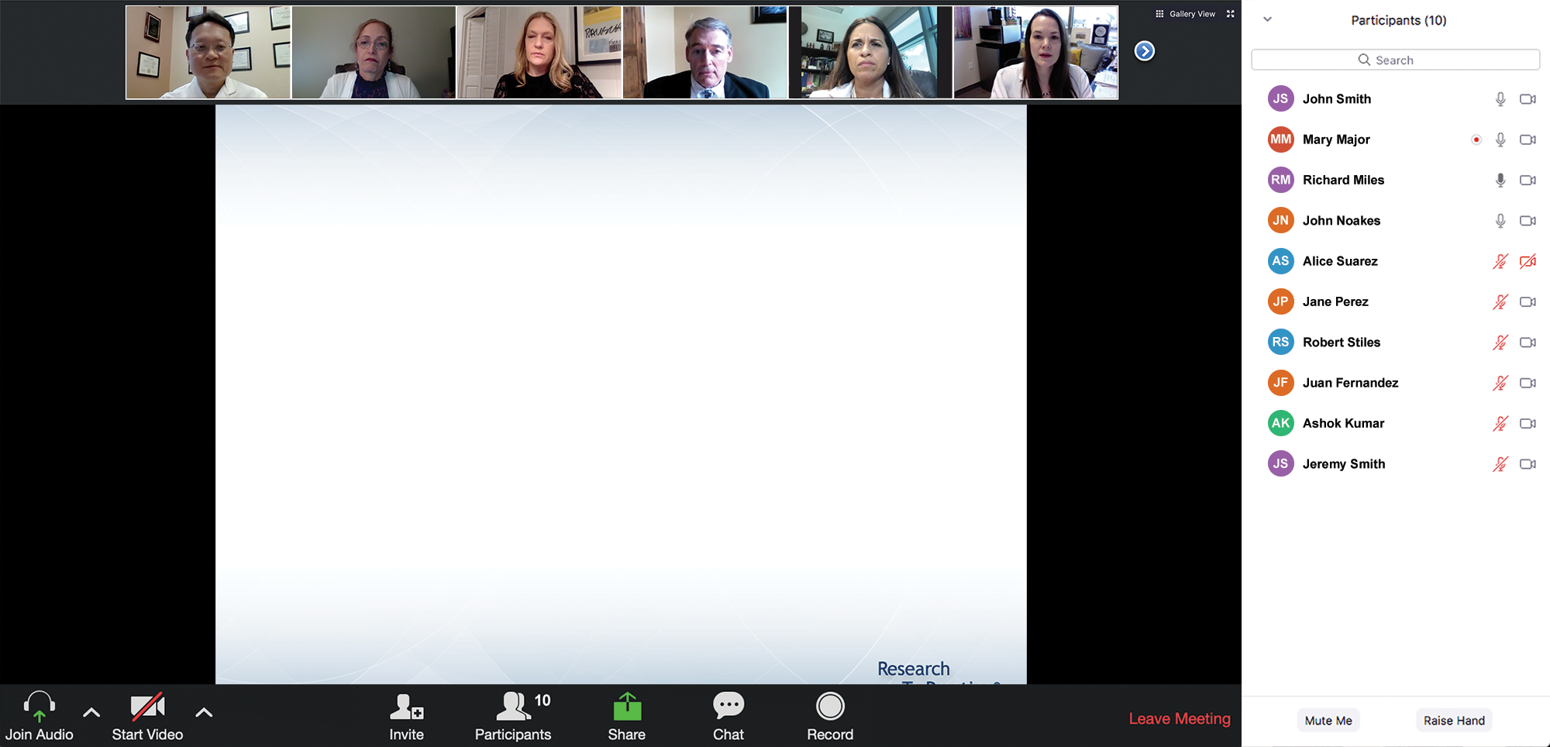

We Encourage Clinicians in Practice to Submit Questions
Feel free to submit questions now before the program begins and throughout the program.

Slide 10
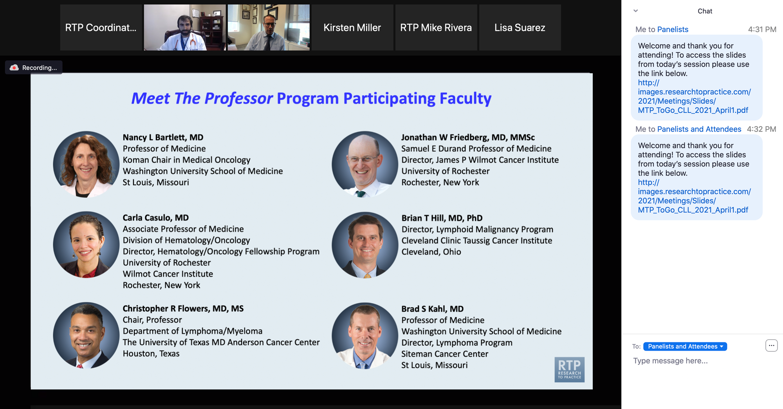
Familiarizing Yourself with the Zoom Interface
Expand chat submission box
Drag the white line above the submission box up to create more space for your message.

Slide 11
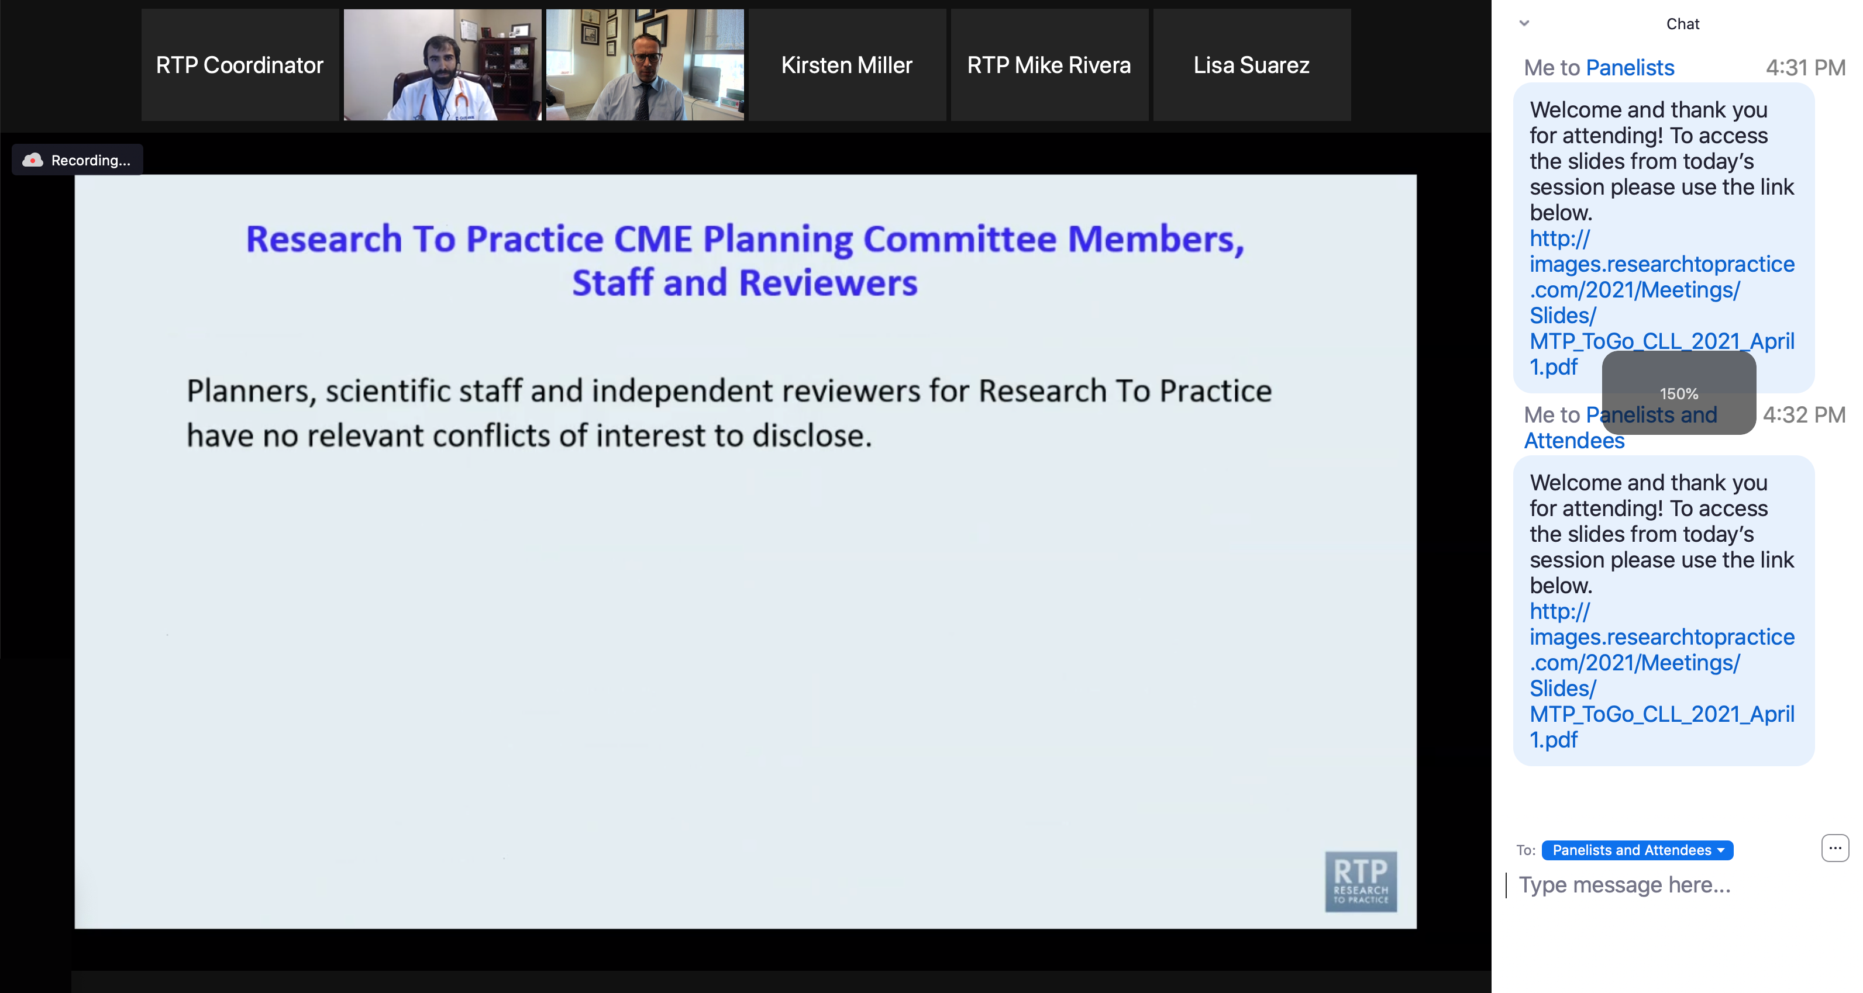
Familiarizing Yourself with the Zoom Interface
Increase chat font size
Press Command (for Mac) or Control (for PC) and the + symbol. You may do this as many times as you need for readability.

Slide 12
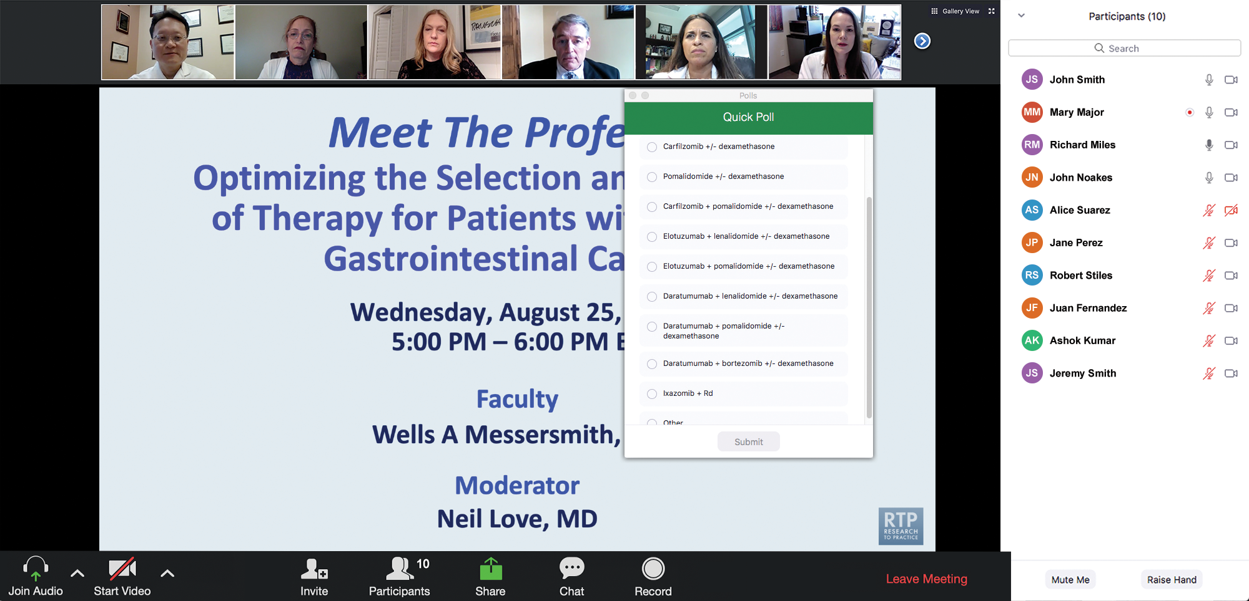
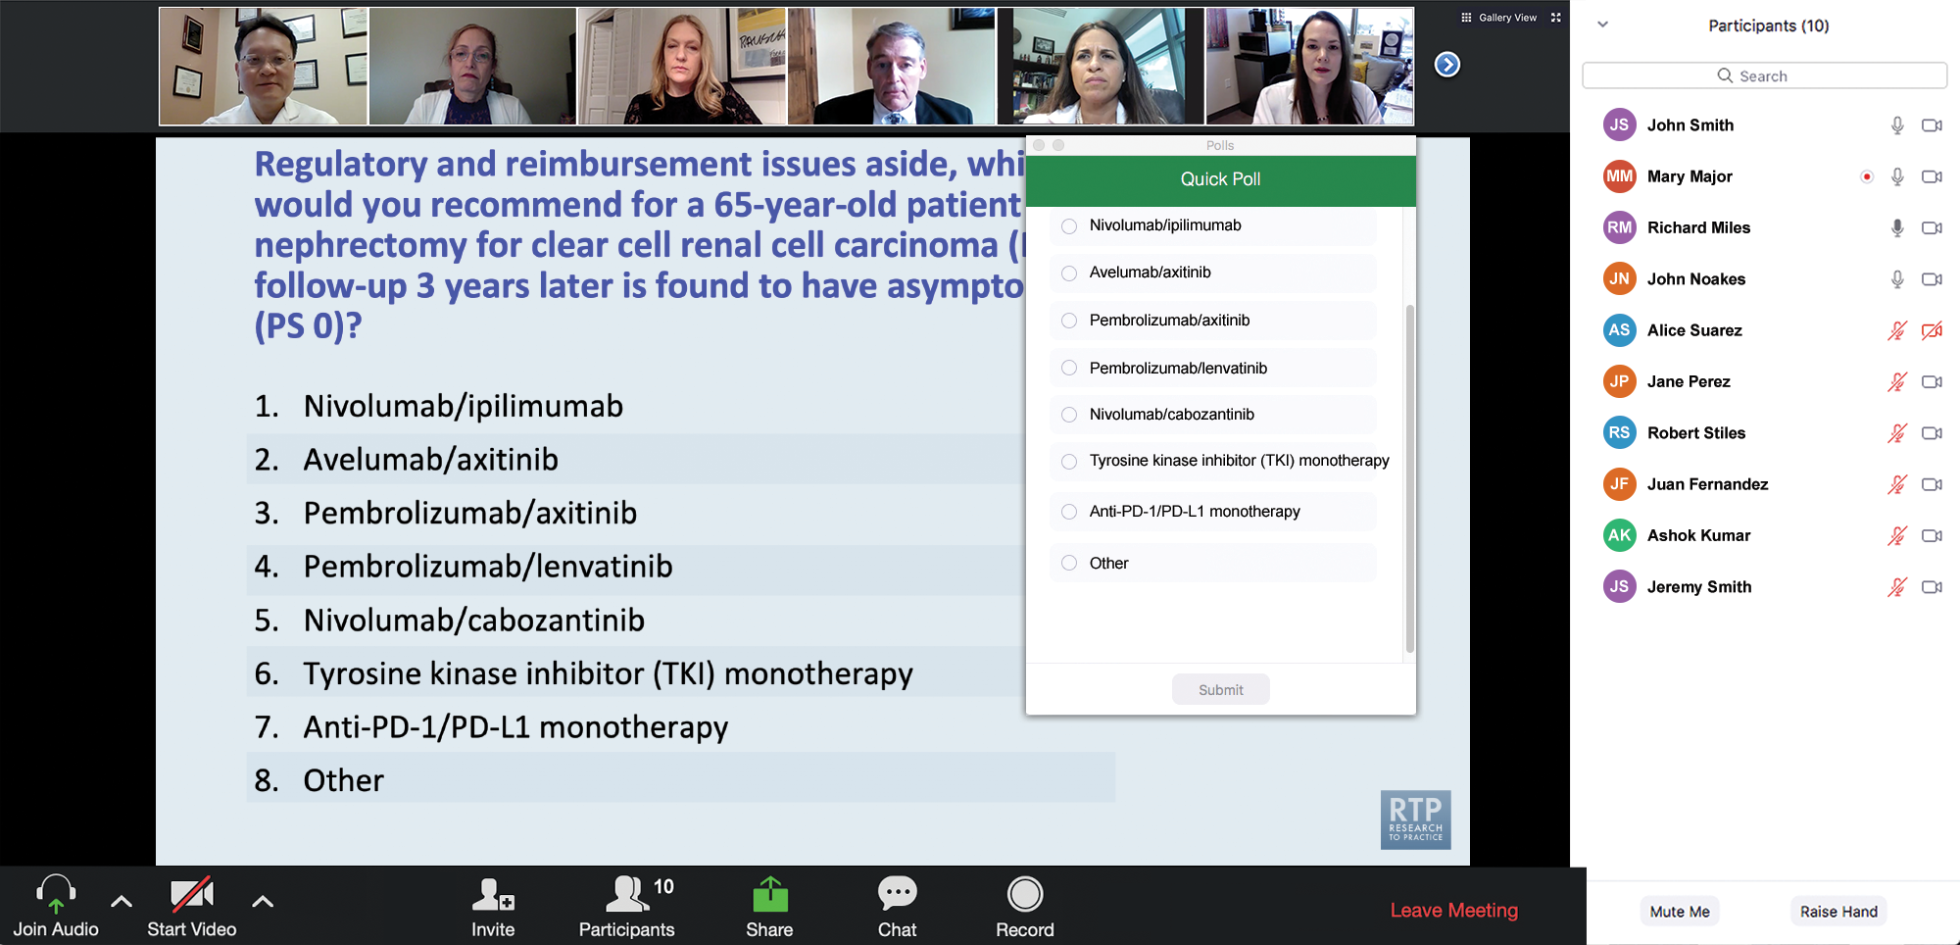
Clinicians in the Audience, Please Complete the Pre- and Postmeeting Surveys
Quick Survey
Quick Poll

Slide 13
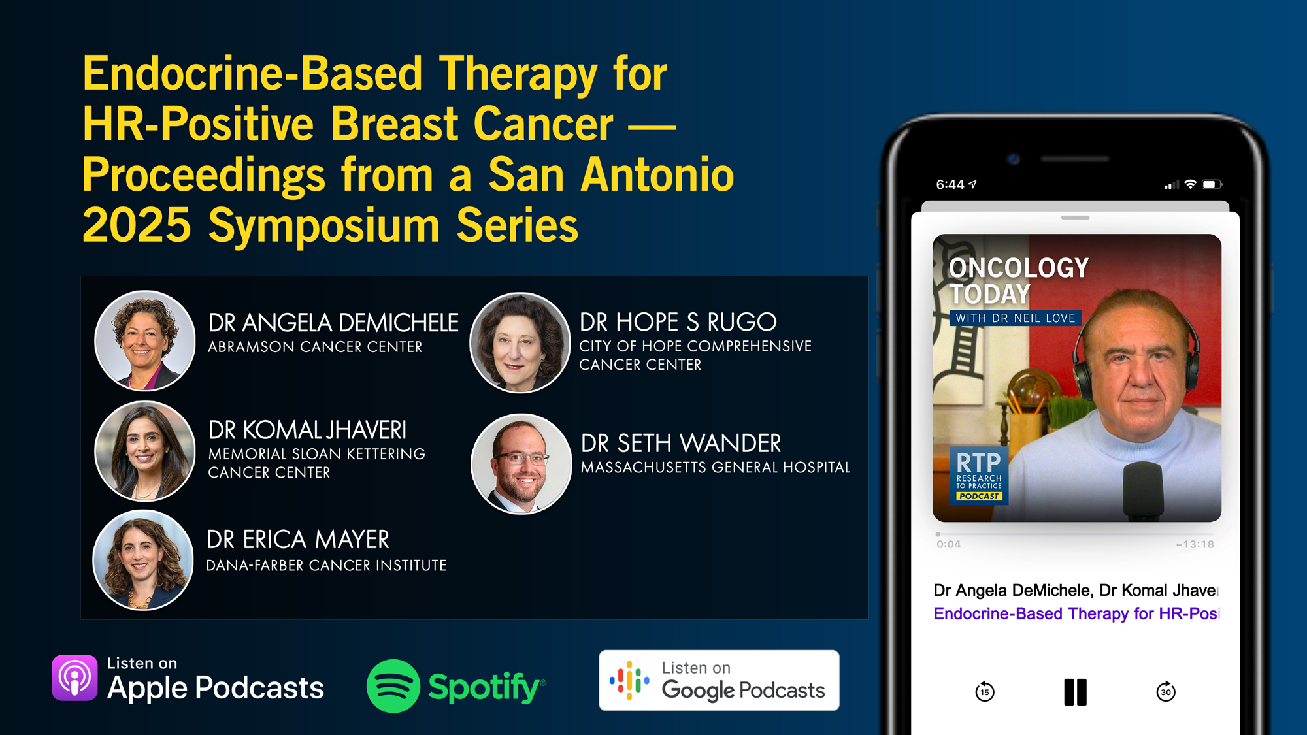

Slide 14
Year in Review: Clinical Investigator Perspectives on the Most Relevant New Datasets and Advances in Oncology
Prostate Cancer
A CME/MOC-Accredited Live Webinar
Wednesday, March 25, 2026 5:00 PM – 6:00 PM ET
Faculty
Andrew J Armstrong, MD, ScM
Scott T Tagawa, MD, MS
Moderator
Neil Love, MD

Slide 15
Year in Review: Clinical Investigator Perspectives on the Most Relevant New Datasets and Advances in Oncology
Menin Inhibitors for Acute Leukemias
A CME/MOC-Accredited Live Webinar
Thursday, March 26, 2026 5:00 PM – 6:00 PM ET
Faculty
Amir Fathi, MD
Eunice S Wang, MD
Moderator
Neil Love, MD

Slide 16
Year in Review: Clinical Investigator Perspectives on the Most Relevant New Datasets and Advances in Oncology
Oral SERDs for Breast Cancer
A CME/MOC-Accredited Live Webinar
Tuesday, March 31, 2026 5:00 PM – 6:00 PM ET
Faculty
Aditya Bardia, MD, MPH
Erica Mayer, MD, MPH, FASCO
Moderator
Neil Love, MD

Slide 17
Year in Review: Clinical Investigator Perspectives on the Most Relevant New Datasets and Advances in Oncology
EGFR-Mutant Non-Small Cell Lung Cancer
A CME/MOC-Accredited Live Webinar
Tuesday, April 7, 2026 5:00 PM – 6:00 PM ET
Faculty
Suresh S Ramalingam, MD Helena Yu, MD
Moderator
Neil Love, MD

Slide 18
Grand Rounds
CME/MOC-Accredited Interactive Series
Regional Activities
Three Series
Optimizing Treatment for Patients with Relapsed/Refractory Chronic Lymphocytic Leukemia
Optimizing the Use of Novel Therapies for Patients with Diffuse Large B-Cell Lymphoma
Optimizing Therapy for Patients with Hormone Receptor-Positive Localized Breast Cancer
Host a 1-hour session at your institution: Email Meetings@ResearchToPractice.com or call (800) 233-6153

Slide 19

Save The Date
A Multitumor CME/MOC-, NCPD- and ACPE-Accredited Educational Conference Developed in Partnership with Florida Cancer Specialists & Research Institute
Friday to Sunday, April 24 to 26, 2026
The Ritz-Carlton Orlando, Grande Lakes | Orlando, Florida
Moderated by Neil Love, MD

Slide 20
Thank you for joining us! Please take a moment to complete the survey currently up on Zoom. Your feedback is very important to us. Information on how to obtain CME, ABIM MOC and ABS credit will be provided at the conclusion of the activity in the Zoom chat room. Attendees will also receive an email in 1 to 3 business days with these instructions.

Slide 21
What Clinicians Want to Know: First-Line and Maintenance Therapy for Patients with ER-Positive, HER2-Positive Metastatic Breast Cancer
A CME/MOC-Accredited Live Webinar
Wednesday, March 18, 2026 5:00 PM – 6:00 PM ET
Faculty
Virginia F Borges, MD, MMSc
Ian E Krop, MD, PhD
Moderator
Neil Love, MD

Slide 22
Faculty
Virginia F Borges, MD, MMSc
Professor of Medicine with Tenure
Robert F and Patricia Young Connor Endowed Chair in Young Women’s Breast Cancer Research
Deputy Division Head, Medical Oncology
Co-Director, Diane O’Connor Thompson
Breast Center
Co-Director, Breast Cancer Research Program
Director, Young Women’s Breast Cancer Translational Program
University of Colorado Anschutz Medical Campus
Aurora, Colorado
MODERATOR
Neil Love, MD Research To Practice Miami, Florida
Ian E Krop, MD, PhD
Associate Cancer Center Director for Clinical Research
Medical Director, Clinical Trials Office
Yale Cancer Center
Chief Scientific Officer
Translational Breast Cancer Research Consortium
New Haven, Connecticut

Slide 23
We Encourage Clinicians in Practice to Submit Questions
Feel free to submit questions now before the program begins and throughout the program.

Slide 24
Clinicians in the Audience, Please Complete the Pre- and Postmeeting Surveys
Quick Survey
Quick Poll

Slide 26
Year in Review: Clinical Investigator Perspectives on the Most Relevant New Datasets and Advances in Oncology
Prostate Cancer
A CME/MOC-Accredited Live Webinar
Wednesday, March 25, 2026 5:00 PM – 6:00 PM ET
Faculty
Andrew J Armstrong, MD, ScM
Scott T Tagawa, MD, MS
Moderator
Neil Love, MD

Slide 27
Year in Review: Clinical Investigator Perspectives on the Most Relevant New Datasets and Advances in Oncology
Menin Inhibitors for Acute Leukemias
A CME/MOC-Accredited Live Webinar
Thursday, March 26, 2026 5:00 PM – 6:00 PM ET
Faculty
Amir Fathi, MD
Eunice S Wang, MD
Moderator
Neil Love, MD

Slide 28
Year in Review: Clinical Investigator Perspectives on the Most Relevant New Datasets and Advances in Oncology
Oral SERDs for Breast Cancer
A CME/MOC-Accredited Live Webinar
Tuesday, March 31, 2026 5:00 PM – 6:00 PM ET
Faculty
Aditya Bardia, MD, MPH
Erica Mayer, MD, MPH, FASCO
Moderator
Neil Love, MD

Slide 29
Year in Review: Clinical Investigator Perspectives on the Most Relevant New Datasets and Advances in Oncology
EGFR-Mutant Non-Small Cell Lung Cancer
A CME/MOC-Accredited Live Webinar
Tuesday, April 7, 2026 5:00 PM – 6:00 PM ET
Faculty
Suresh S Ramalingam, MD Helena Yu, MD
Moderator
Neil Love, MD

Slide 30
Grand Rounds
CME/MOC-Accredited Interactive Series
Regional Activities
Three Series
Optimizing Treatment for Patients with Relapsed/Refractory Chronic Lymphocytic Leukemia
Optimizing the Use of Novel Therapies for Patients with Diffuse Large B-Cell Lymphoma
Optimizing Therapy for Patients with Hormone Receptor-Positive Localized Breast Cancer
Host a 1-hour session at your institution: Email Meetings@ResearchToPractice.com or call (800) 233-6153

Slide 31
Save The Date
A Multitumor CME/MOC-, NCPD- and ACPE-Accredited Educational Conference Developed in Partnership with Florida Cancer Specialists & Research Institute
Friday to Sunday, April 24 to 26, 2026
The Ritz-Carlton Orlando, Grande Lakes | Orlando, Florida
Moderated by Neil Love, MD

Slide 32
What Clinicians Want to Know: First-Line and Maintenance Therapy for Patients with ER-Positive, HER2-Positive Metastatic Breast Cancer
A CME/MOC-Accredited Live Webinar
Wednesday, March 18, 2026 5:00 PM – 6:00 PM ET
Faculty
Virginia F Borges, MD, MMSc
Ian E Krop, MD, PhD
Moderator
Neil Love, MD

Slide 33
Dr Borges — Disclosures
Advisory Committees | AstraZeneca Pharmaceuticals LP, Gilead Sciences Inc, Pfizer Inc
Consulting Agreements | Gilead Sciences Inc, Olema Oncology, Pfizer Inc
Contracted Research | AstraZeneca Pharmaceuticals LP, Gilead Sciences Inc, Merck, Olema Oncology, Pfizer Inc

Slide 34
Dr Krop — Disclosures
Advisory Committees | AstraZeneca Pharmaceuticals LP, Bristol Myers Squibb, Daiichi Sankyo Inc, EMD Serono Inc, Genentech, a member of the Roche Group, Lilly, Seagen Inc
Consulting Agreements | ALX Oncology, AstraZeneca Pharmaceuticals LP, Genentech, a member of the Roche Group, Halda Therapeutics, Novartis
Contracted Research | Pfizer Inc
Data and Safety Monitoring Boards/Committees | Novartis, Seagen Inc

Slide 35
Dr Love — Disclosures
Dr Love is president and CEO of Research To Practice. Research To Practice receives funds in the form of educational grants to develop CME activities from the following companies: Aadi Bioscience, AbbVie Inc, ADC Therapeutics, Agendia Inc, Alexion Pharmaceuticals, Amgen Inc, Array BioPharma Inc, a subsidiary of Pfizer Inc, Arvinas, Astellas, AstraZeneca Pharmaceuticals LP, Aveo Pharmaceuticals, Bayer HealthCare Pharmaceuticals, BeOne, Biotheranostics Inc, A Hologic Company, Black Diamond Therapeutics Inc, Blueprint Medicines, Boehringer Ingelheim Pharmaceuticals Inc, Bristol Myers Squibb, Celcuity, Clovis Oncology, Coherus BioSciences, Corcept Therapeutics Inc, CTI BioPharma, a Sobi Company, Daiichi Sankyo Inc, Eisai Inc, Elevation Oncology Inc, Exact Sciences Corporation, Exelixis Inc, Genentech, a member of the Roche Group, Genmab US Inc, Geron Corporation, Gilead Sciences Inc, GSK, Helsinn Therapeutics (US) Inc, ImmunoGen Inc, Incyte Corporation, Ipsen Biopharmaceuticals Inc, Jazz Pharmaceuticals Inc, Johnson & Johnson, Karyopharm Therapeutics, Kite, A Gilead Company, Kura Oncology, Legend Biotech, Lilly, MEI Pharma Inc, Merck, Mersana Therapeutics Inc, Mirati Therapeutics Inc, Mural Oncology Inc, Natera Inc, Novartis, Novartis Pharmaceuticals Corporation on behalf of Advanced Accelerator Applications, Novocure Inc, Nuvalent, Nuvation Bio Inc, Pfizer Inc, Pharmacyclics LLC, an AbbVie Company, Puma Biotechnology Inc, Regeneron Pharmaceuticals Inc, Revolution Medicines Inc, Rigel Pharmaceuticals Inc, R-Pharm US, Sanofi, Seagen Inc, Servier Pharmaceuticals LLC, SpringWorks Therapeutics Inc, Stemline Therapeutics Inc, Sumitomo Pharma America, Syndax Pharmaceuticals, Taiho Oncology Inc, Takeda Pharmaceuticals USA Inc, TerSera Therapeutics LLC, and Tesaro, A GSK Company.

Slide 36
Commercial Support
This activity is supported by an educational grant from Pfizer Inc.
Research To Practice CME Planning Committee Members, Staff and Reviewers
Planners, scientific staff and independent reviewers for Research To Practice have no relevant financial relationships to disclose.

Slide 37
This educational activity contains discussion of non-FDA-approved uses of agents and regimens. Please refer to official prescribing information for each product for approved indications.

Slide 38
Agenda
Introduction: Biology of “Triple-Positive” Breast Cancer; Implications for Therapeutic Development
Module 1: Cases from the GMO Survey
Module 2: First-Line Therapy for Metastatic HER2-Positive Disease
Module 3: Cases from the GMO Survey
Module 4a: Maintenance Therapy for HR-Positive, HER2-Positive Disease
Module 4b: Maintenance Therapy for HR-Negative, HER2-Positive Disease
Module 5: Ongoing Clinical Trials Attempting to Address These Decisions
Module 6: Cases from the GMO Survey

Slide 39
Survey of 50 Community-Based General Medical Oncologists
Optimizing the Selection of First-Line and Maintenance Therapy for Patients with HER2-Positive Metastatic Breast Cancer
March 10 to 13, 2026

Slide 40
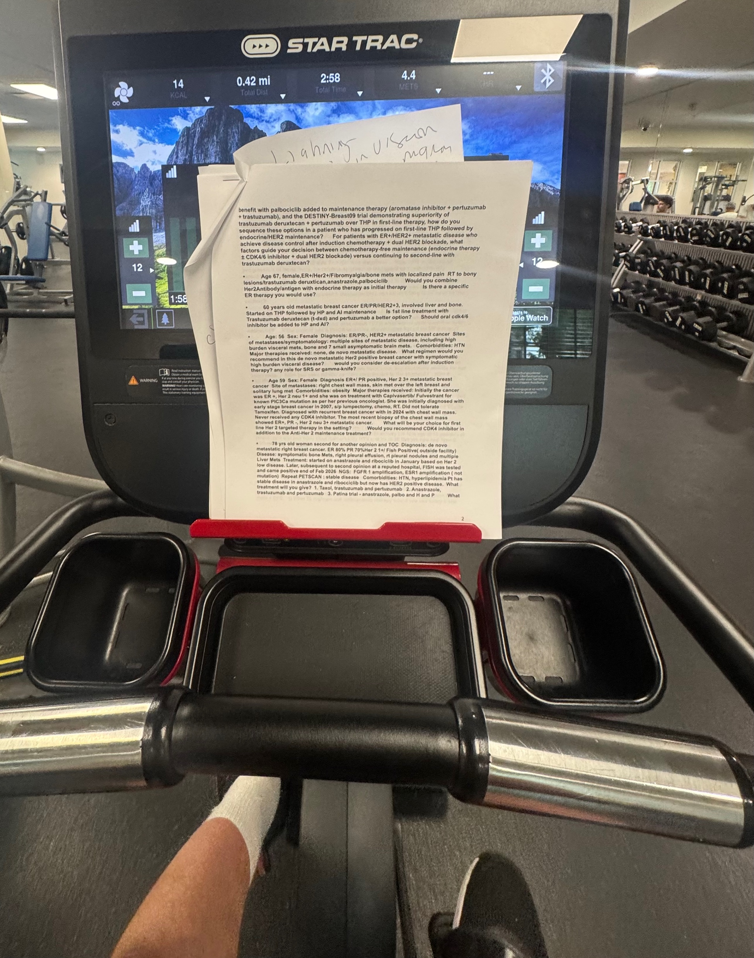

Slide 41
Agenda
Introduction: Biology of “Triple-Positive” Breast Cancer; Implications for Therapeutic Development
Module 1: Cases from the GMO Survey
Module 2: First-Line Therapy for Metastatic HER2-Positive Disease
Module 3: Cases from the GMO Survey
Module 4a: Maintenance Therapy for HR-Positive, HER2-Positive Disease
Module 4b: Maintenance Therapy for HR-Negative, HER2-Positive Disease
Module 5: Ongoing Clinical Trials Attempting to Address These Decisions
Module 6: Cases from the GMO Survey

Slide 42
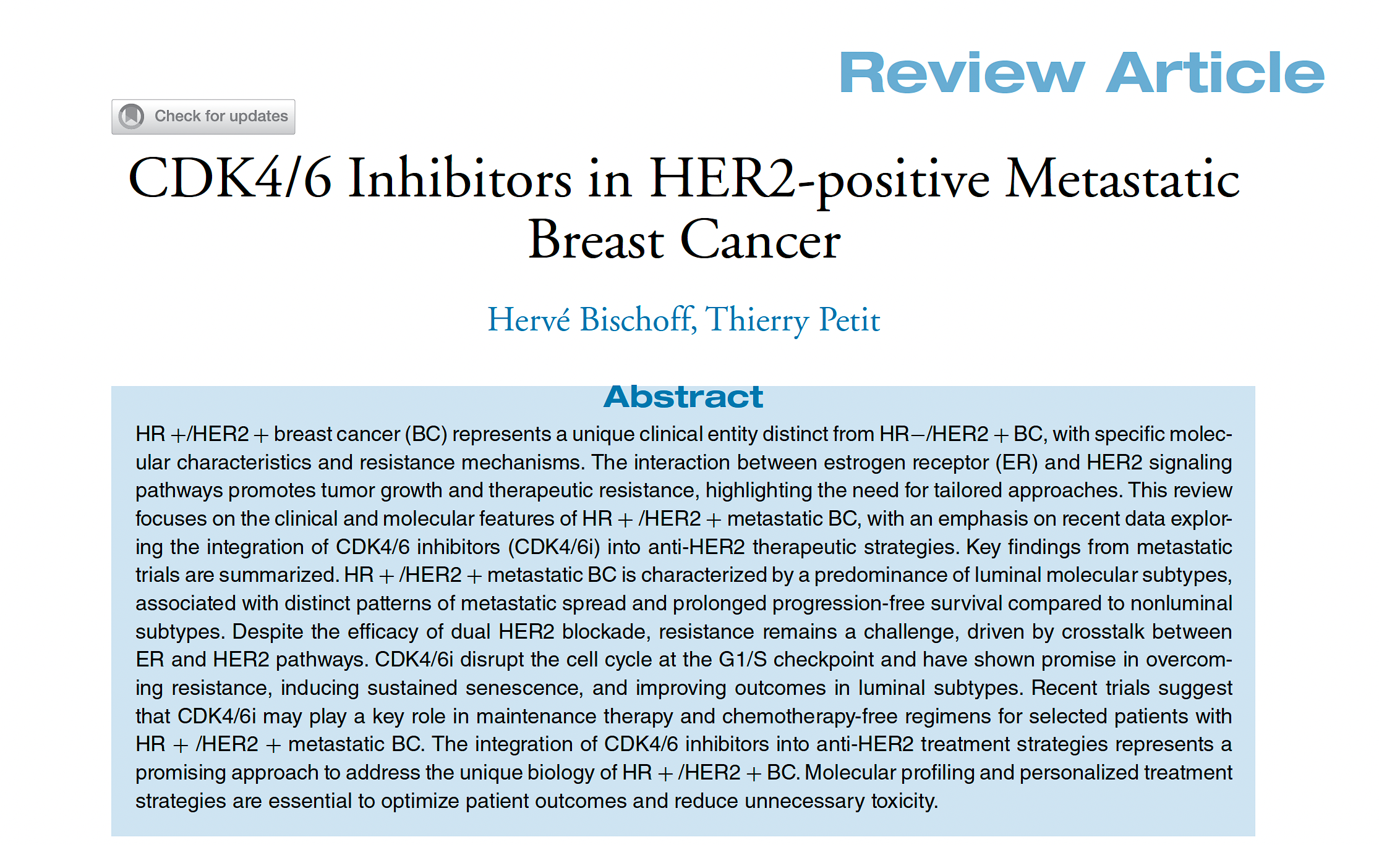
Clin Breast Cancer 2026;26(2):93-104.

Slide 43
Changes in Features of Triple-Positive Breast Cancer (TPBC) Compared to ER-Negative, HER2-Positive Disease
Late relapse (DFI ≥60 months)
Bone-only metastases
Median OS
De novo metastatic disease
Visceral metastases
Grade 3 tumors
Adapted from Bischoff et al. Clin Cancer Breast 2026;26(2):93-104.

Slide 44
Questions About Biology and Therapeutic Implications
How do you explain the interaction between the HER2 and ER pathways in normal tissue and in breast cancer (BC), and what potential synergies occur?
What is known about the relative efficacy of anti-HER2 therapy in HR-positive versus HR-negative HER2-positive BC?
Does this explain the differential effect of neratinib seen in the ExteNET trial?

Slide 45
Questions About Biology and Therapeutic Implications
What is known about the relative efficacy of endocrine therapy in HER2-positive versus HER2-negative, HR-positive BC?
What outcomes have been reported with the use of CDK inhibitors in HER2-positive disease?

Slide 46
Agenda
Introduction: Biology of “Triple-Positive” Breast Cancer; Implications for Therapeutic Development
Module 1: Cases from the GMO Survey
Module 2: First-Line Therapy for Metastatic HER2-Positive Disease
Module 3: Cases from the GMO Survey
Module 4a: Maintenance Therapy for HR-Positive, HER2-Positive Disease
Module 4b: Maintenance Therapy for HR-Negative, HER2-Positive Disease
Module 5: Ongoing Clinical Trials Attempting to Address These Decisions
Module 6: Cases from the GMO Survey

Slide 47
Cases from General Medical Oncologists
70 yo woman
De novo HR+/HER2+ widely metastatic breast cancer including a solitary, asymptomatic brain metastasis.
Started T-DXd + pertuzumab complicated by severe diarrhea requiring hospitalization and treatment interruption. Pertuzumab discontinued after 2 cycles, T-DXd continued. She responded to therapy at all sites including the brain.
Would you rechallenge with pertuzumab + T-DXd? At what time point or degree of response would you switch to AI + Palbo + trastuzumab per PATINA? Is this your new standard?

Slide 48
Cases from General Medical Oncologists
69 yo woman
Presents with a palpable left neck node 12/22.
Biopsy: ER+HER2+ metastatic lobular cancer.
No breast mass and mammo is negative; staging shows multiple bone mets and upper endoscopy reveals a gastric polyp containing lobular cancer.
HP/paclitaxel and after 12 weeks switched to letrozole and palbociclib in June 2023. She remains well with no toxicity on maint subcut HP/palbo and letrozole with a stable bone scan. She continues zoledronic acid for her bone mets.
Have you seen lobular cancers metastasize to the stomach? After a negative endoscopy in 5/23, would you repeat any further endoscopies?

Slide 49
Agenda
Introduction: Biology of “Triple-Positive” Breast Cancer; Implications for Therapeutic Development
Module 1: Cases from the GMO Survey
Module 2: First-Line Therapy for Metastatic HER2-Positive Disease
Module 3: Cases from the GMO Survey
Module 4a: Maintenance Therapy for HR-Positive, HER2-Positive Disease
Module 4b: Maintenance Therapy for HR-Negative, HER2-Positive Disease
Module 5: Ongoing Clinical Trials Attempting to Address These Decisions
Module 6: Cases from the GMO Survey

Slide 50
Questions About First Line Induction Treatment
What is your usual first-line therapy for metastatic HER2-positive disease?
What duration of treatment do you usually employ, assuming the patient has acceptable treatment tolerance?
How do you factor in prior adjuvant and/or neoadjuvant anti-HER2 therapy?

Slide 51
Questions About First Line Induction Treatment
Does your approach change if the patient is younger (40) or older (85)?
Does your approach change based on the degree of symptomatology?
Does your approach change based on location of metastatic disease (eg, visceral, bone only, CNS)?
How does HR status affect your approach?

Slide 52
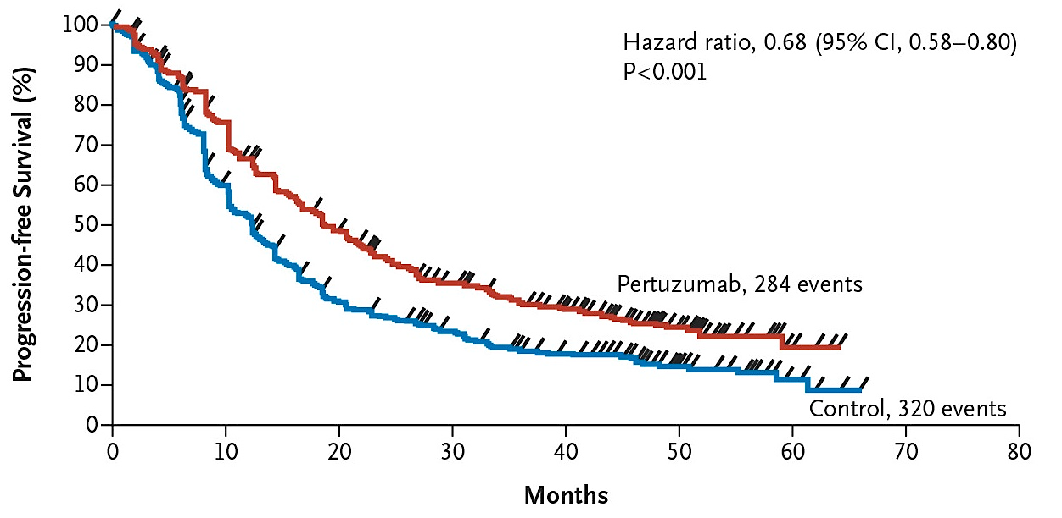
Phase III CLEOPATRA: Final Progression-Free Survival
Swain SM et al. N Engl J Med 2015 February 19;372(8):724-34.

Slide 53
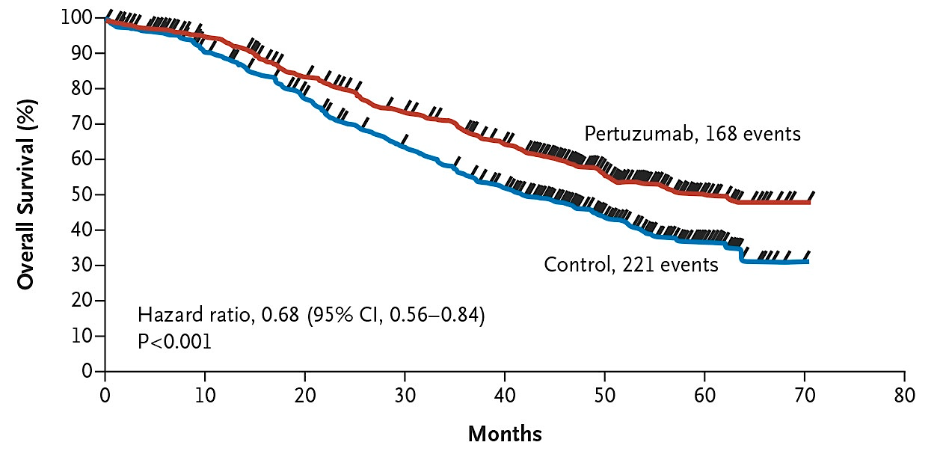
Phase III CLEOPATRA: Final Overall Survival
Swain SM et al. N Engl J Med 2015 February 19;372(8):724-34.

Slide 54
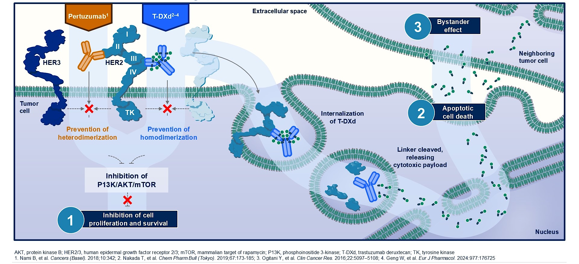
Rationale for Pertuzumab and T-DXd Combination Therapy
Tolaney SM et al. ASCO 2025;Abstract LBA1008.

Slide 55
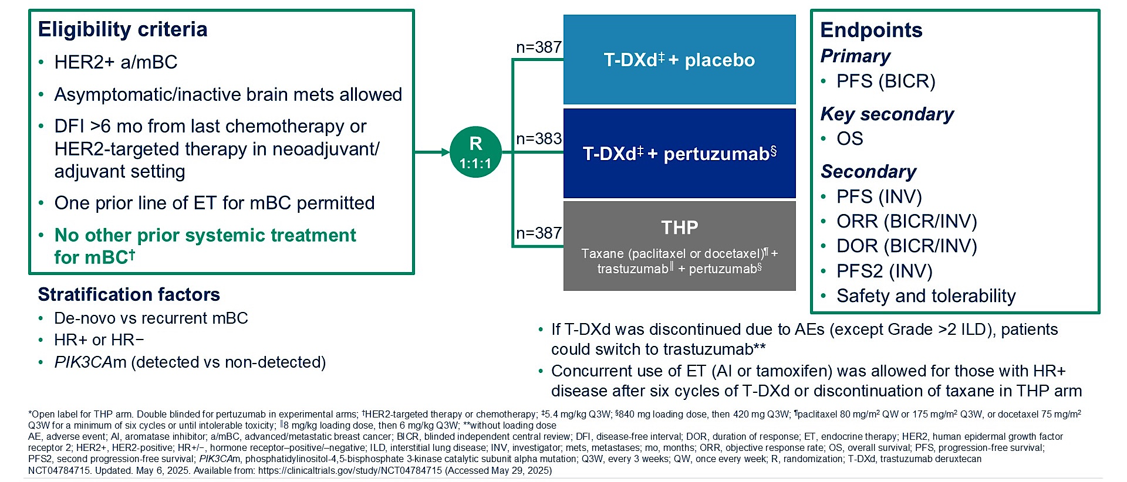
Phase III DESTINY-Breast09 Study Design
Tolaney SM et al. ASCO 2025;Abstract LBA1008.

Slide 56
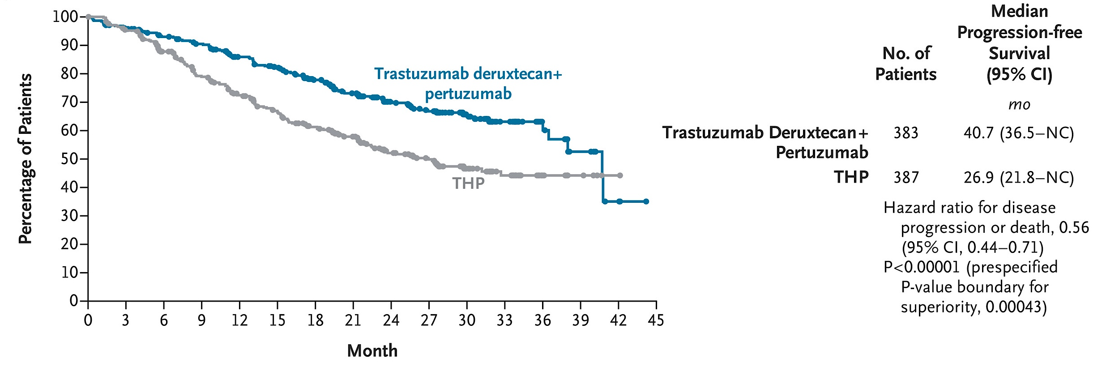
Phase III DESTINY-Breast09: Progression-Free Survival (Blinded Independent Central Review)
Tolaney SM et al. N Engl J Med 2026;394;551-62.

Slide 57
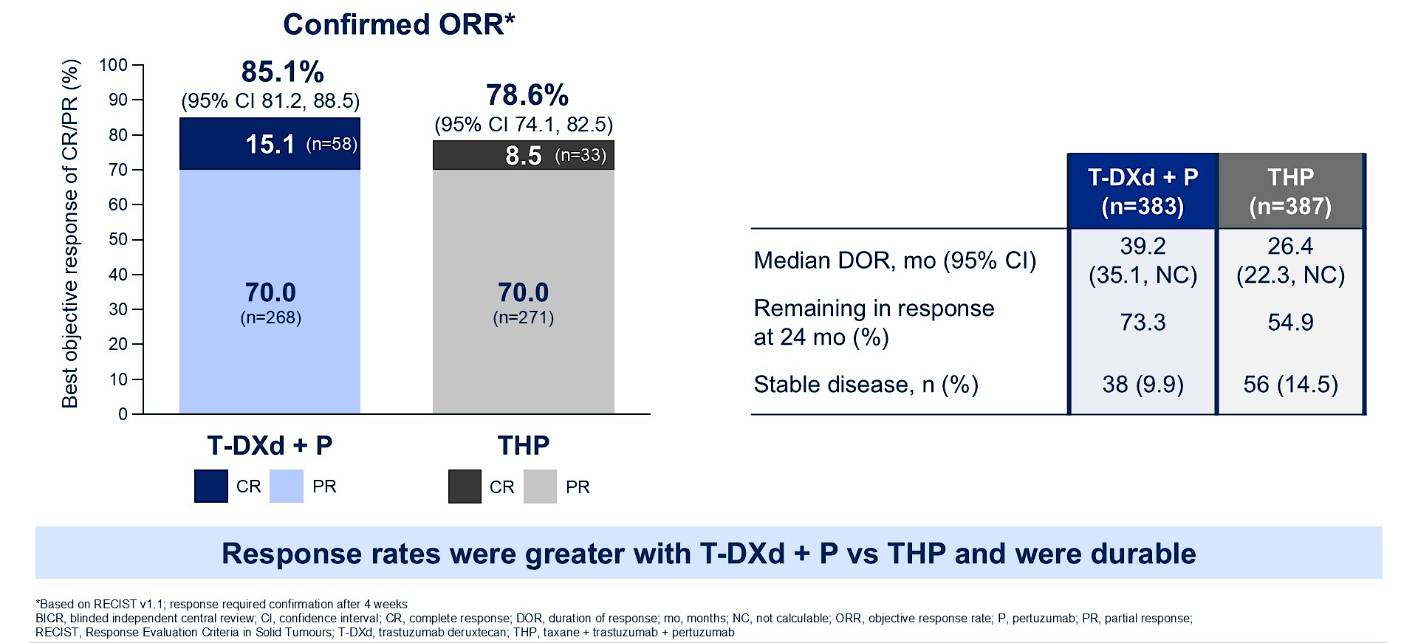
Phase III DESTINY-Breast09: Efficacy
Tolaney SM et al. ASCO 2025;Abstract LBA1008; Tolaney SM et al. N Engl J Med 2026;394;551-62.

Slide 58
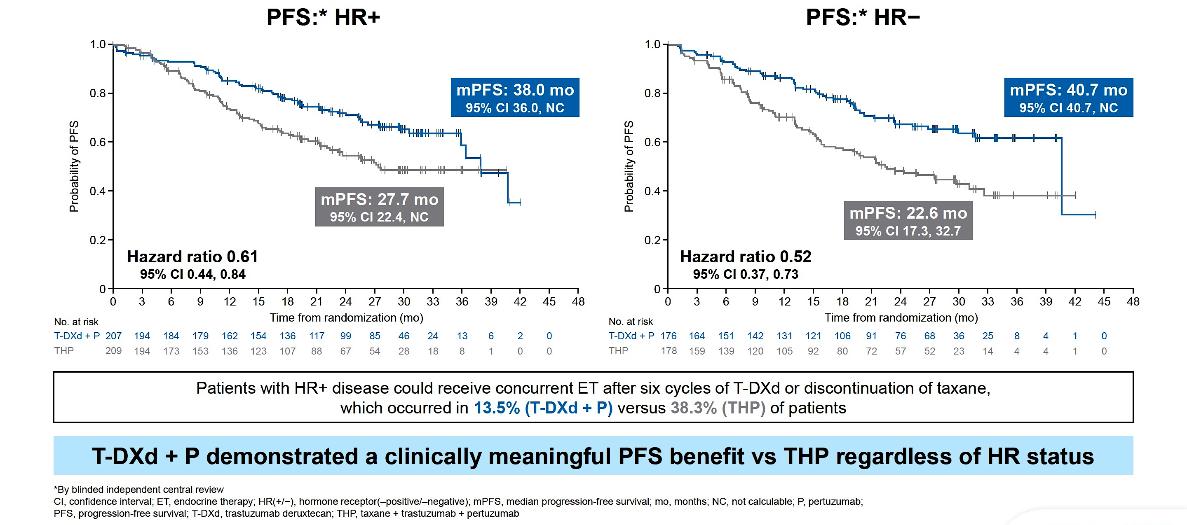
Phase III DESTINY-Breast09: PFS by HR Status
Loibl S et al. ESMO 2025;Abstract LBA18.

Slide 59
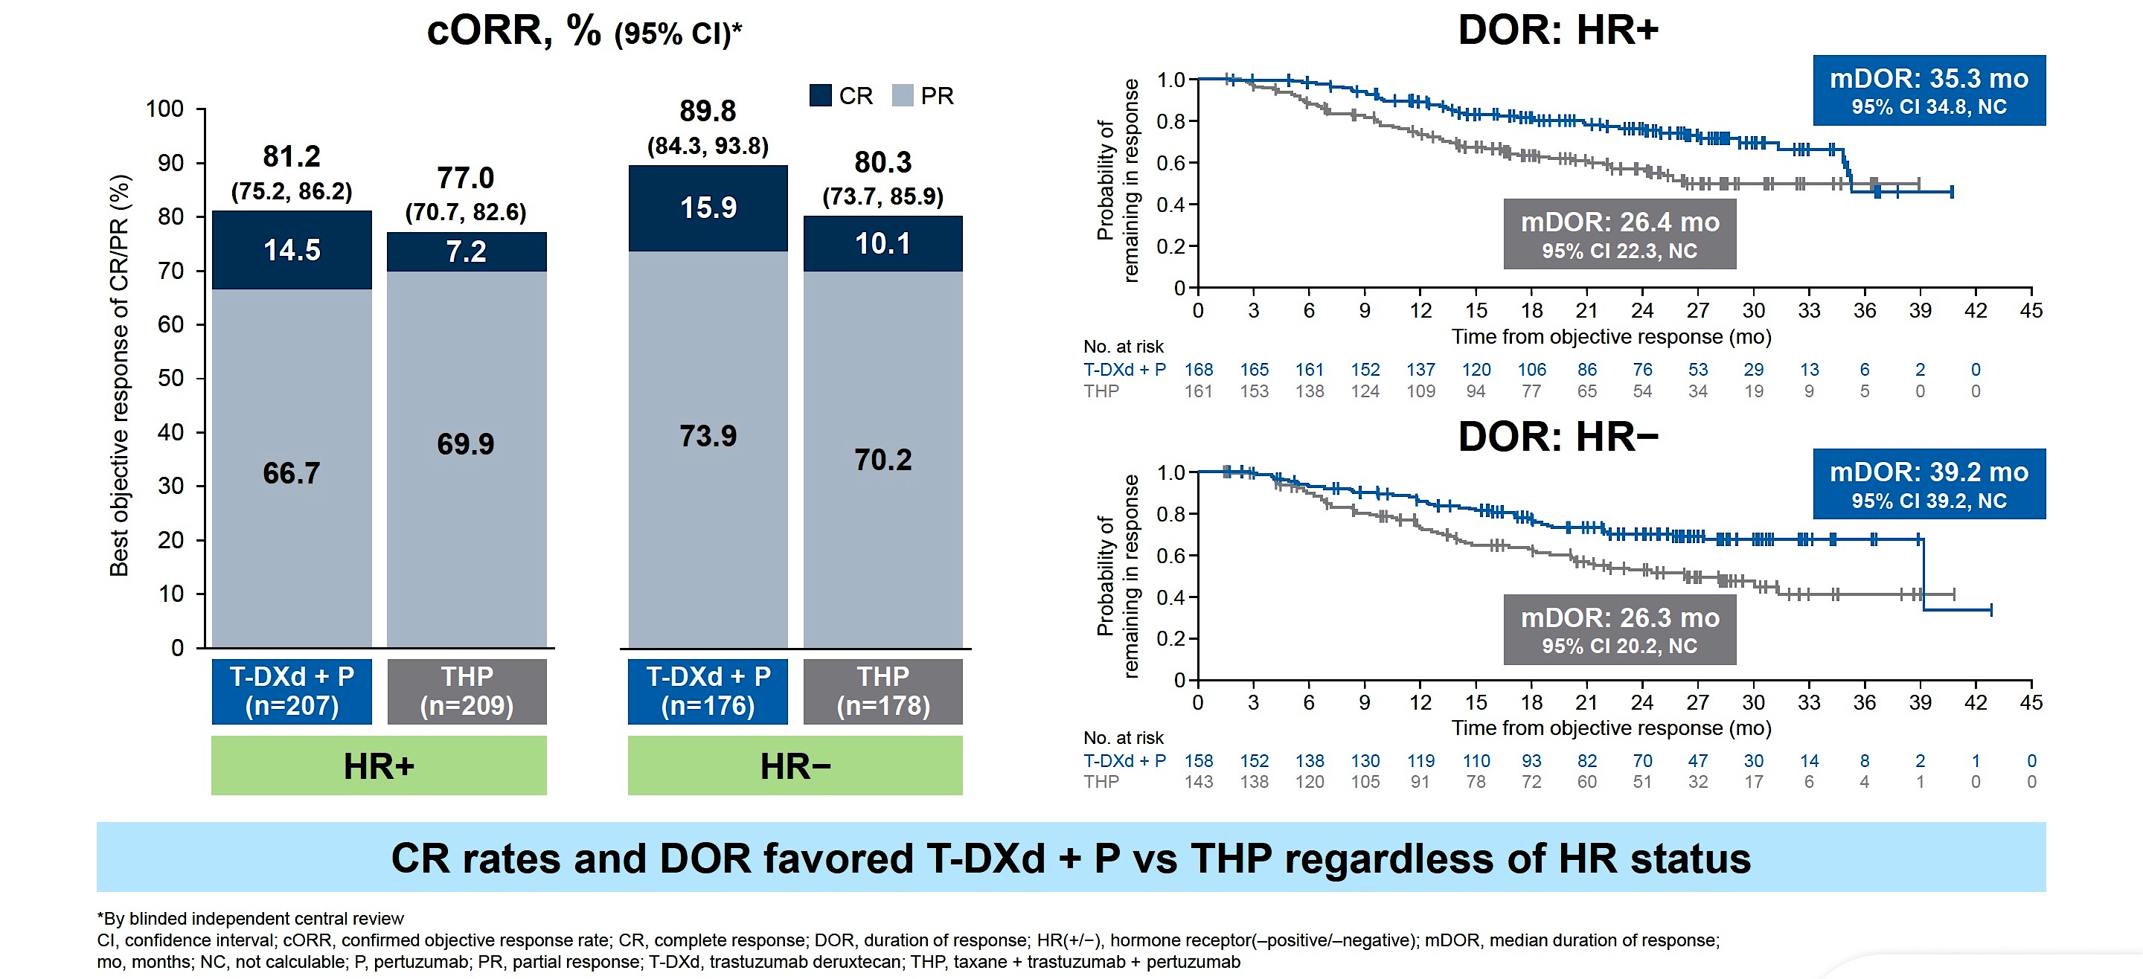
Phase III DESTINY-Breast09: Responses by HR Status
Loibl S et al. ESMO 2025;Abstract LBA18.

Slide 60
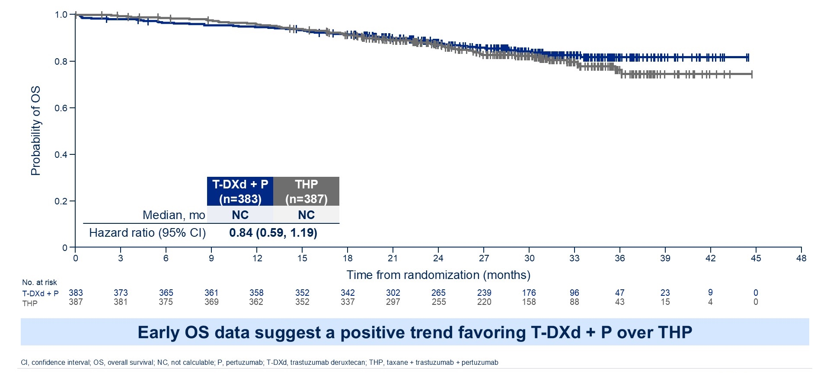
Phase III DESTINY-Breast09: Overall Survival (16% Maturity)
Tolaney SM et al. ASCO 2025;Abstract LBA1008.

Slide 61
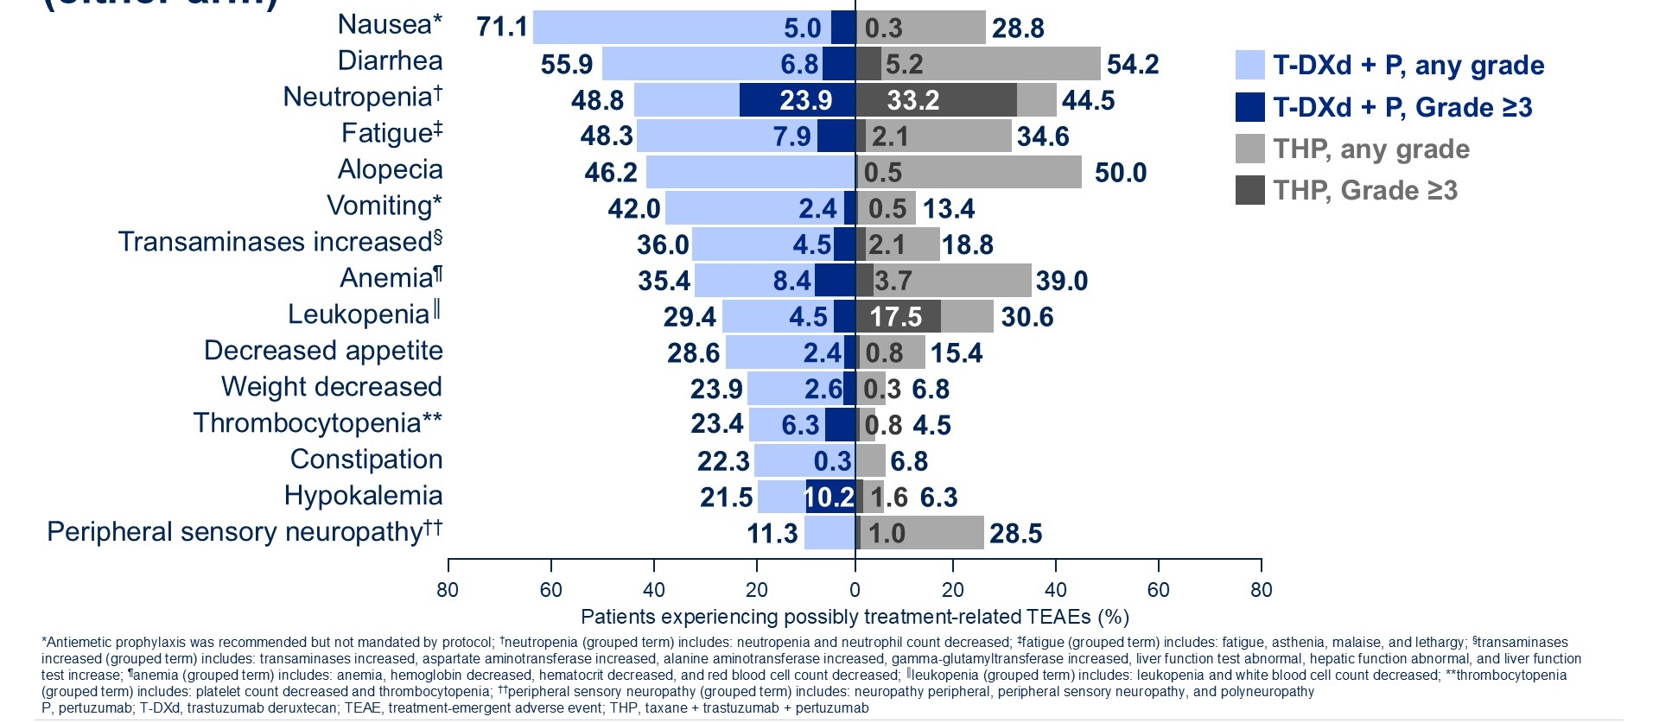
Phase III DESTINY-Breast09: Common Adverse Events
Tolaney SM et al. ASCO 2025;Abstract LBA1008.

Slide 62
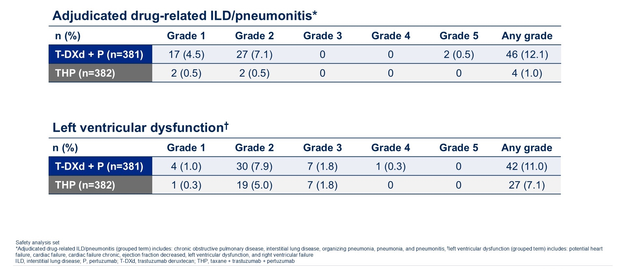
Phase III DESTINY-Breast09: Adverse Events of Special Interest
Tolaney SM et al. ASCO 2025;Abstract LBA1008; Tolaney SM et al. N Engl J Med 2026;394;551-62.

Slide 63
FDA Approves Fam-Trastuzumab Deruxtecan-nxki with Pertuzumab for Unresectable or Metastatic HER2-Positive Breast Cancer Press Release: December 15, 2025
“On December 15, 2025, the Food and Drug Administration approved fam-trastuzumab deruxtecan-nxki in combination with pertuzumab for the first-line treatment of adults with unresectable or metastatic HER2-positive (IHC 3+ or ISH+) breast cancer as determined by an FDA-approved test.
Efficacy was evaluated in DESTINY-Breast09 (NCT04784715), a randomized, three-arm, multicenter, global trial that enrolled 1157 adults with HER2-positive advanced or metastatic breast cancer who had not received prior chemotherapy or HER2-targeted therapy or had received neoadjuvant or adjuvant HER2-targeted therapy more than six months before the diagnosis of advanced or metastatic disease.”
https://www.fda.gov/drugs/drug-approvals-and-databases/fda-approves-fam-trastuzumab-deruxtecan-nxki-pertuzumab-unresectable-or-metastatic-her2-positive

Slide 64
A woman presents with de novo HR-positive, HER2-positive mBC. Regulatory and reimbursement issues aside, which first-line anti-HER2 induction therapy would you most likely recommend for each of the following scenarios?
Age 65, PS 0
Asymptomatic bone metastases:
* OFS + CDK4/6i first then if pt develops symptomatic PD with measurable lesions, will give T-DXd
Symptomatic liver metastases:
* May consider TCHP option

Slide 65
A woman presents with de novo HR-positive, HER2-positive mBC. Regulatory and reimbursement issues aside, which first-line anti-HER2 induction therapy would you most likely recommend for each of the following scenarios? (continued)
Age 65, PS 0
Multiple brain metastases requiring SRS:

Slide 66
A woman presents with de novo HR-positive, HER2-positive metastatic breast cancer (mBC). Regulatory and reimbursement issues aside, which first-line anti-HER2 induction therapy would you most likely recommend for each asymptomatic bone metastases?
Age 40 (premenopausal), PS 0
Age 85, PS 1
* Trastuzumab + chemotherapy (+/- pertuzumab); Trastuzumab + ET; Trastuzumab/pertuzumab and consider adding AI if low-volume disease; AI + CDK4/6i first and ONLY if pt develops symptomatic PD will give THP

Slide 67
Agenda
Introduction: Biology of “Triple-Positive” Breast Cancer; Implications for Therapeutic Development
Module 1: Cases from the GMO Survey
Module 2: First-Line Therapy for Metastatic HER2-Positive Disease
Module 3: Cases from the GMO Survey
Module 4a: Maintenance Therapy for HR-Positive, HER2-Positive Disease
Module 4b: Maintenance Therapy for HR-Negative, HER2-Positive Disease
Module 5: Ongoing Clinical Trials Attempting to Address These Decisions
Module 6: Cases from the GMO Survey

Slide 68
Cases from General Medical Oncologists
52 yo woman
ER/PR-, HER2+
Comorbidities: HTN, syncope, GERD, depression.
Original diagnosis: ER/PR-, HER2+ stage IIB T1N1M0.
Neoadjuvant TCHP; Adjuvant radiation/HP.
Surveillance for 2 years, then progression to asymptomatic bone metastases.
Treated with THP and HP maintenance.
If she presented today would you use T-DXd/pertuzumab? What about tucatinib/HP maintenance?

Slide 69
Cases from General Medical Oncologists
86 yr old woman
Hx DCIS, presents with weight loss. CT scans show liver masses — biopsy ER/PR neg, HER2 2+, FISH negative, high grade IDC, palpable right breast mass ER/PR negative, HER2 2+ FISH+
KPS 90
Would you treat as HER2+ disease given breast FISH+, liver 2+? Any experience with T-DXd in older patients? Recommendations for initial dose reduction? Hold pertuzumab cycle 1, add if tolerated? Maintenance HP/tucatinib?

Slide 70
Cases from General Medical Oncologists
49 yo woman
Triple-positive breast cancer with liver and bone mets.
6 cycles of THP, then HP maintenance (subcut) plus letrozole w T-DXd is an option now for front line therapy. However, the indication is a forever treatment, aka we cannot de-escalate off chemo.
Would investigators use a similar approach — 6 cycles of T-DXd, followed by maintenance HP? Or would they do T-DXd until intolerance or progression? That to me would seem to increase long term risk for pneumonitis.
This patient actually achieved excellent response on maintenance HP for ~2 years. She then developed new liver mets, biopsied still HER2+ IHC 3+. I have changed therapy to T-DXd. Pt stays on letrozole too.
What would investigators do in this scenario?

Slide 71
Agenda
Introduction: Biology of “Triple-Positive” Breast Cancer; Implications for Therapeutic Development
Module 1: Cases from the GMO Survey
Module 2: First-Line Therapy for Metastatic HER2-Positive Disease
Module 3: Cases from the GMO Survey
Module 4a: Maintenance Therapy for HR-Positive, HER2-Positive Disease
Module 4b: Maintenance Therapy for HR-Negative, HER2-Positive Disease
Module 5: Ongoing Clinical Trials Attempting to Address These Decisions
Module 6: Cases from the GMO Survey

Slide 72
Questions About Maintenance Therapy for HR-Positive, HER2-Positive Disease
What is your usual approach to maintenance therapy for a patient with HR-positive, HER2-positive metastatic disease?
What duration of maintenance therapy do you employ, assuming the patient has acceptable treatment tolerance?
How do you factor in prior adjuvant endocrine treatment?
How do you factor in prior HER2-targeted treatment?

Slide 73
Questions About Maintenance Therapy for HR-Positive, HER2-Positive Disease
Does your approach vary if the patient is younger (40) or older (85)?
Does tucatinib currently have a role in this setting?
If you are using a CDK inhibitor, do you prefer palbociclib?
For patients receiving palbociclib, how do you manage neutropenia?

Slide 74
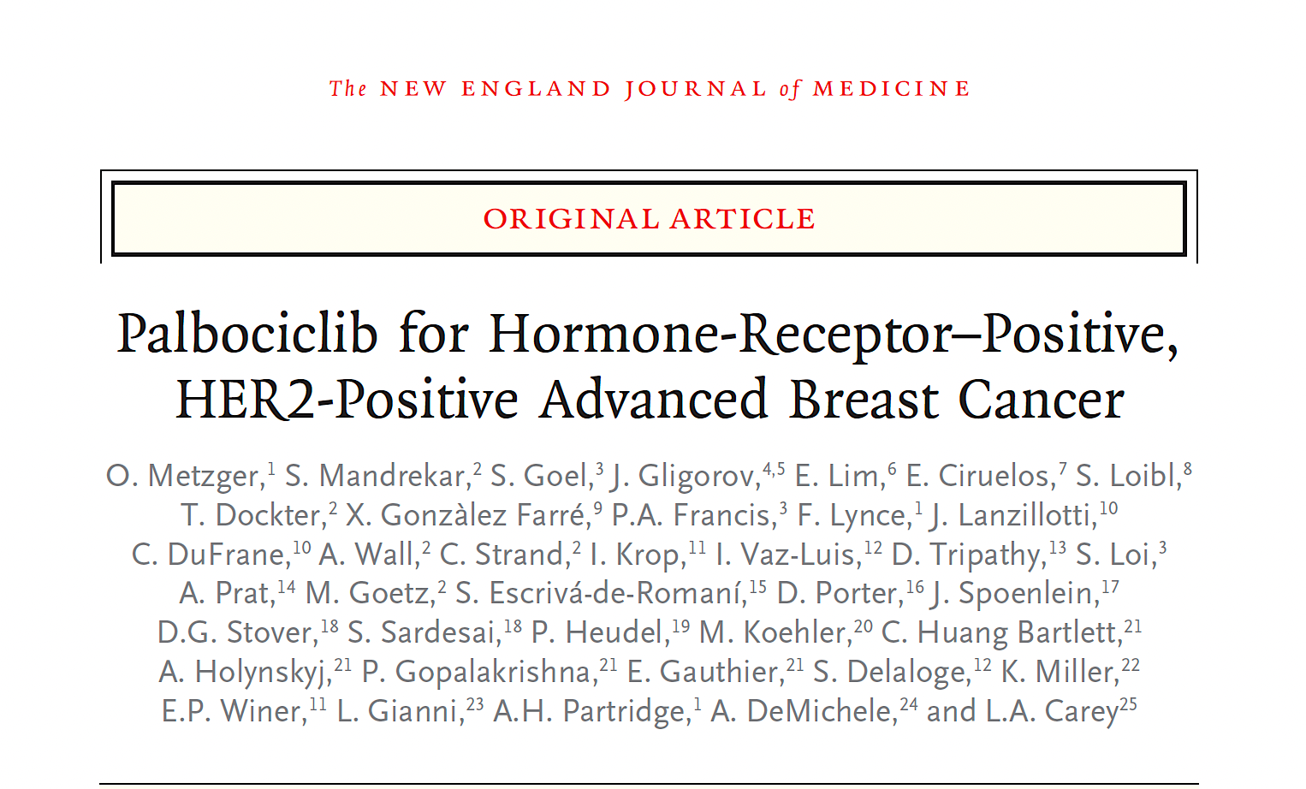
2026;394(5):451-62.
Clin Breast Cancer 2026;26(2):93–104.

Slide 75
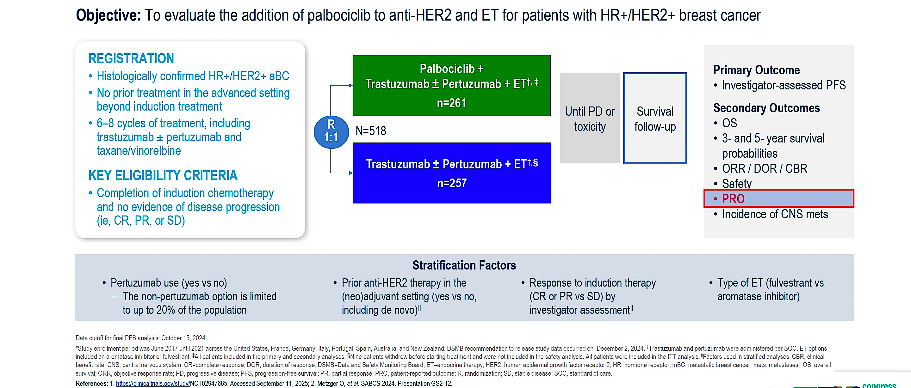
Phase III PATINA Study Design
Vaz-Luis I et al. ESMO 2025;Abstract 485MO.

Slide 76
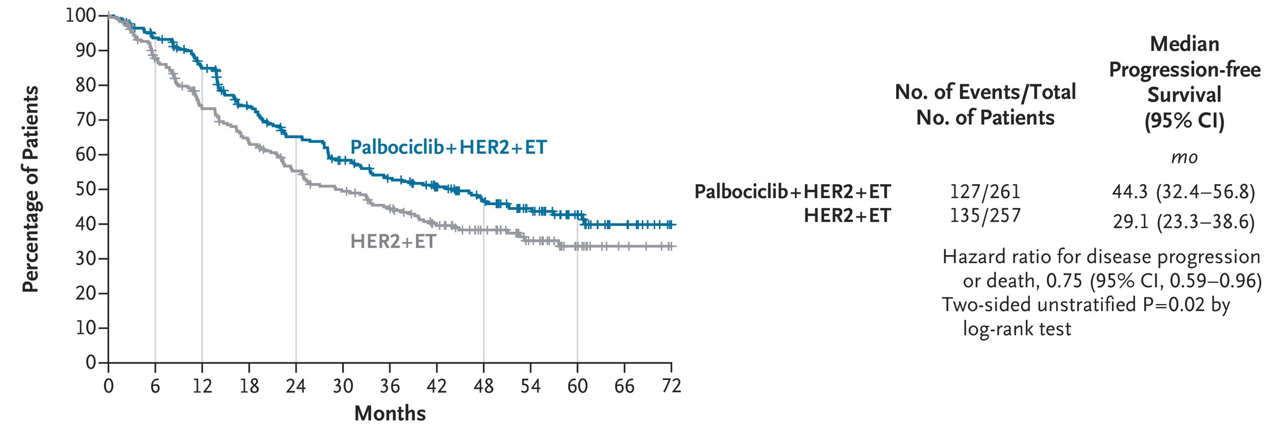
Phase III PATINA: Progression-Free Survival (Intention-to-Treat Population)
Metzger O et al. N Engl J Med 2026;394(5):451-62.

Slide 77
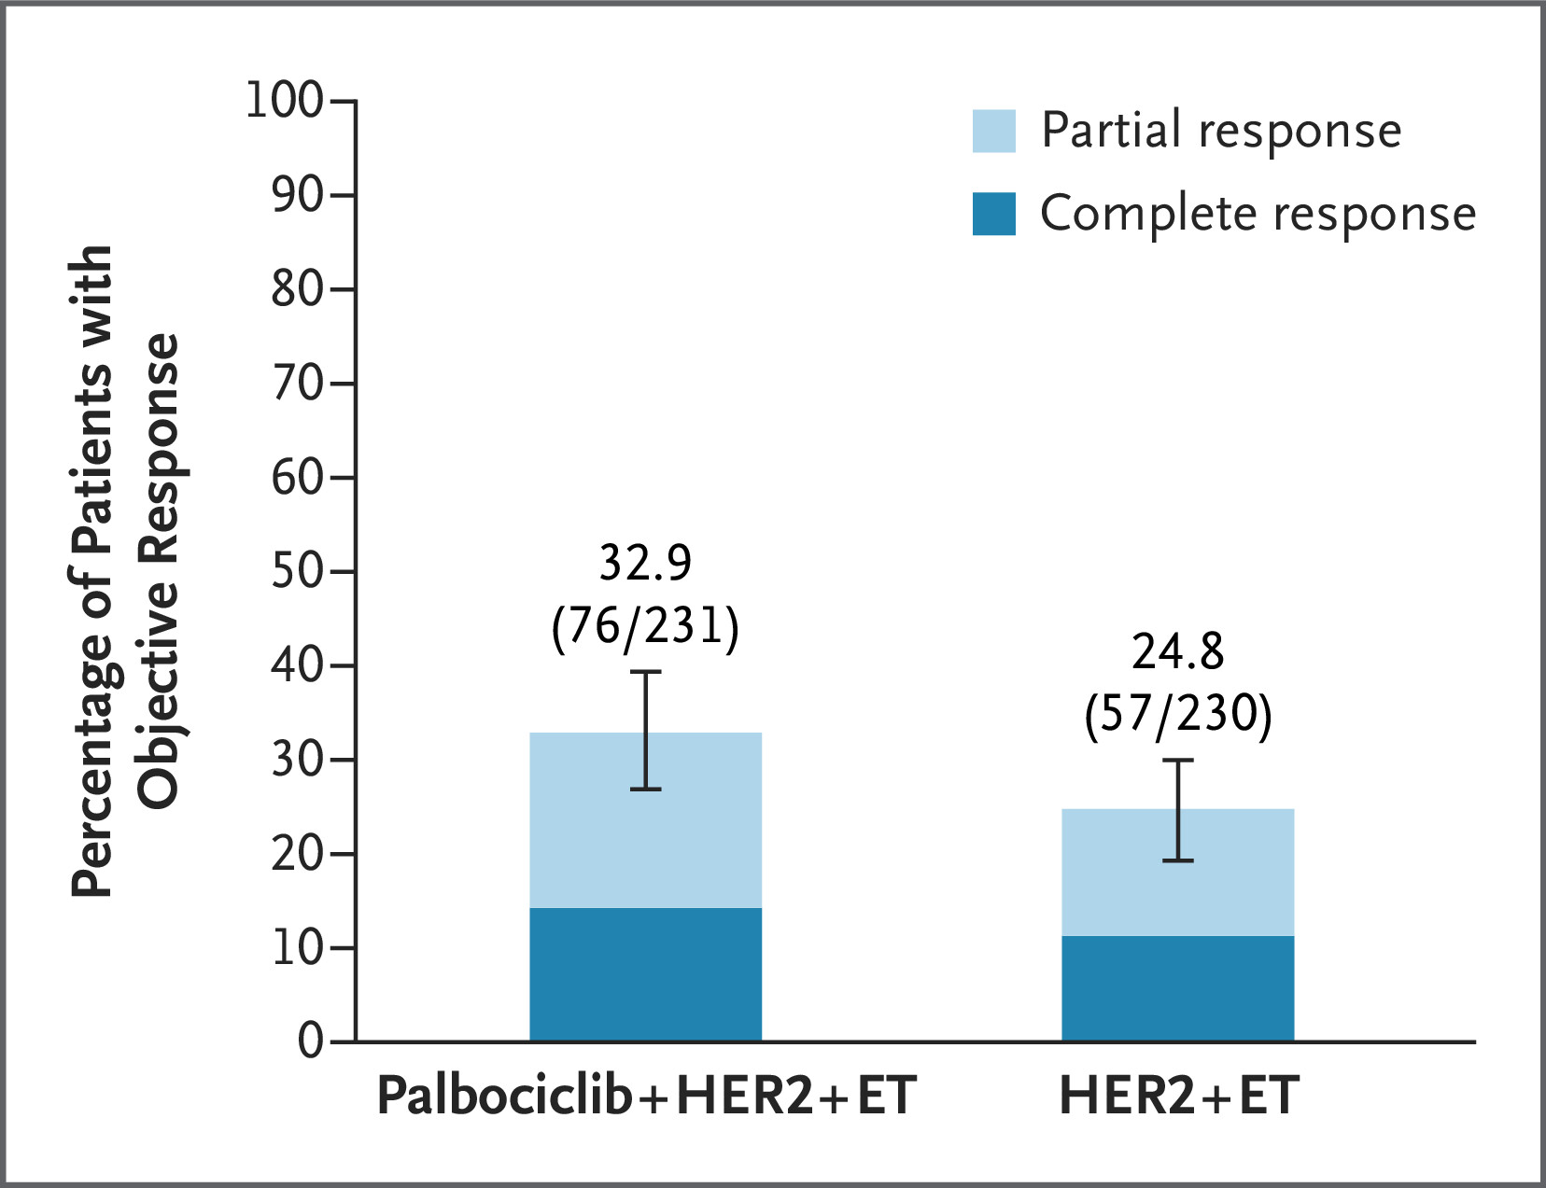
Phase III PATINA: Tumor Response
Metzger O et al. N Engl J Med 2026;394(5):451-62.

Slide 78
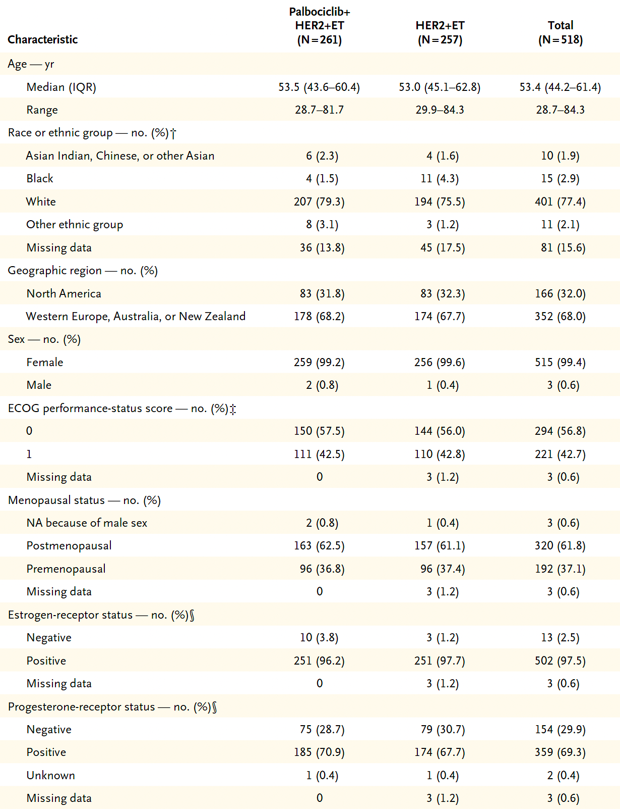
PATINA: Select Baseline Characteristics of All Patients
Metzger O et al. N Engl J Med 2026;394(5):451-62.

Slide 79
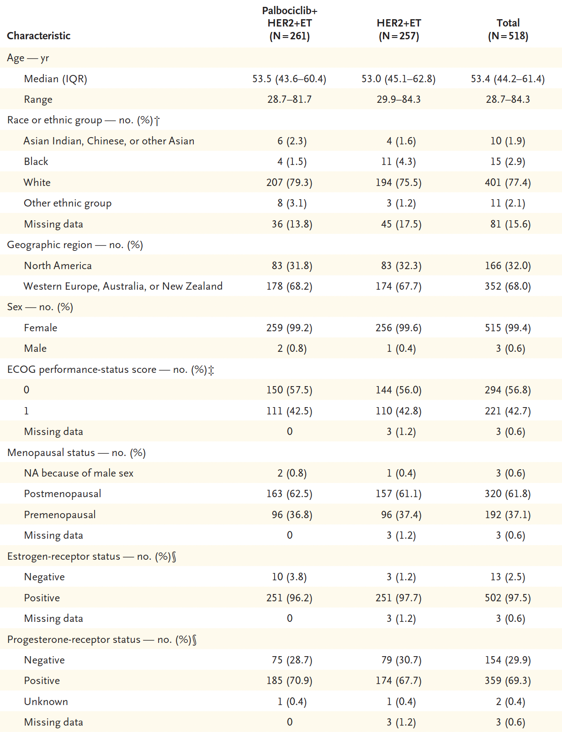
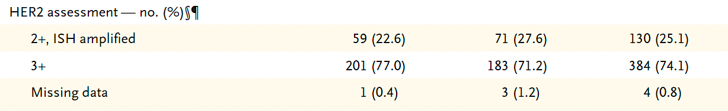
PATINA: Select Baseline Characteristics of All Patients (Continued)
Metzger O et al. N Engl J Med 2026;394(5):451-62.

Slide 80
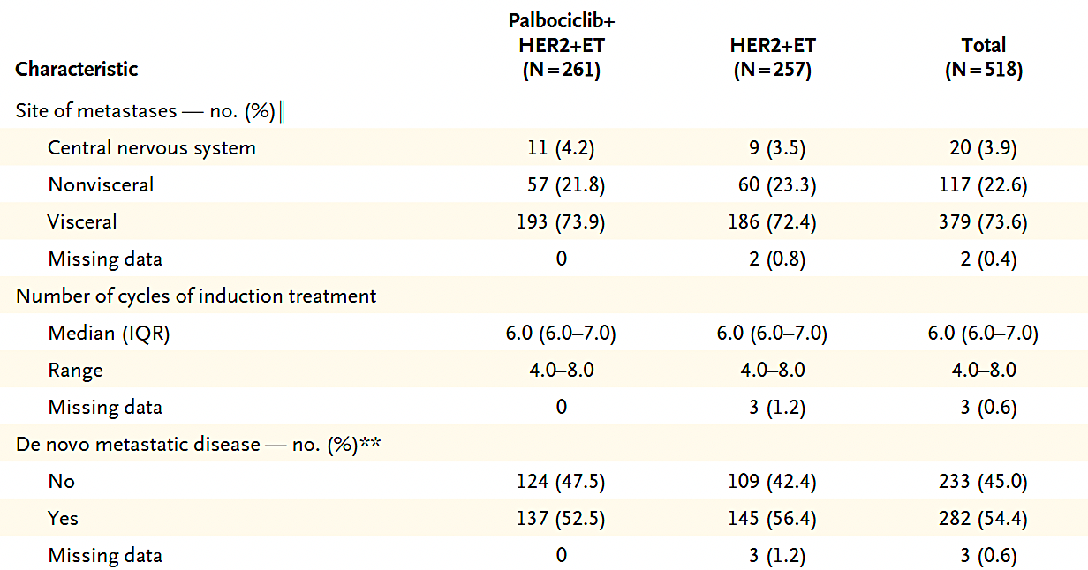
PATINA: Select Baseline Characteristics of All Patients (Continued)
Metzger O et al. N Engl J Med 2026;394(5):451-62.

Slide 81
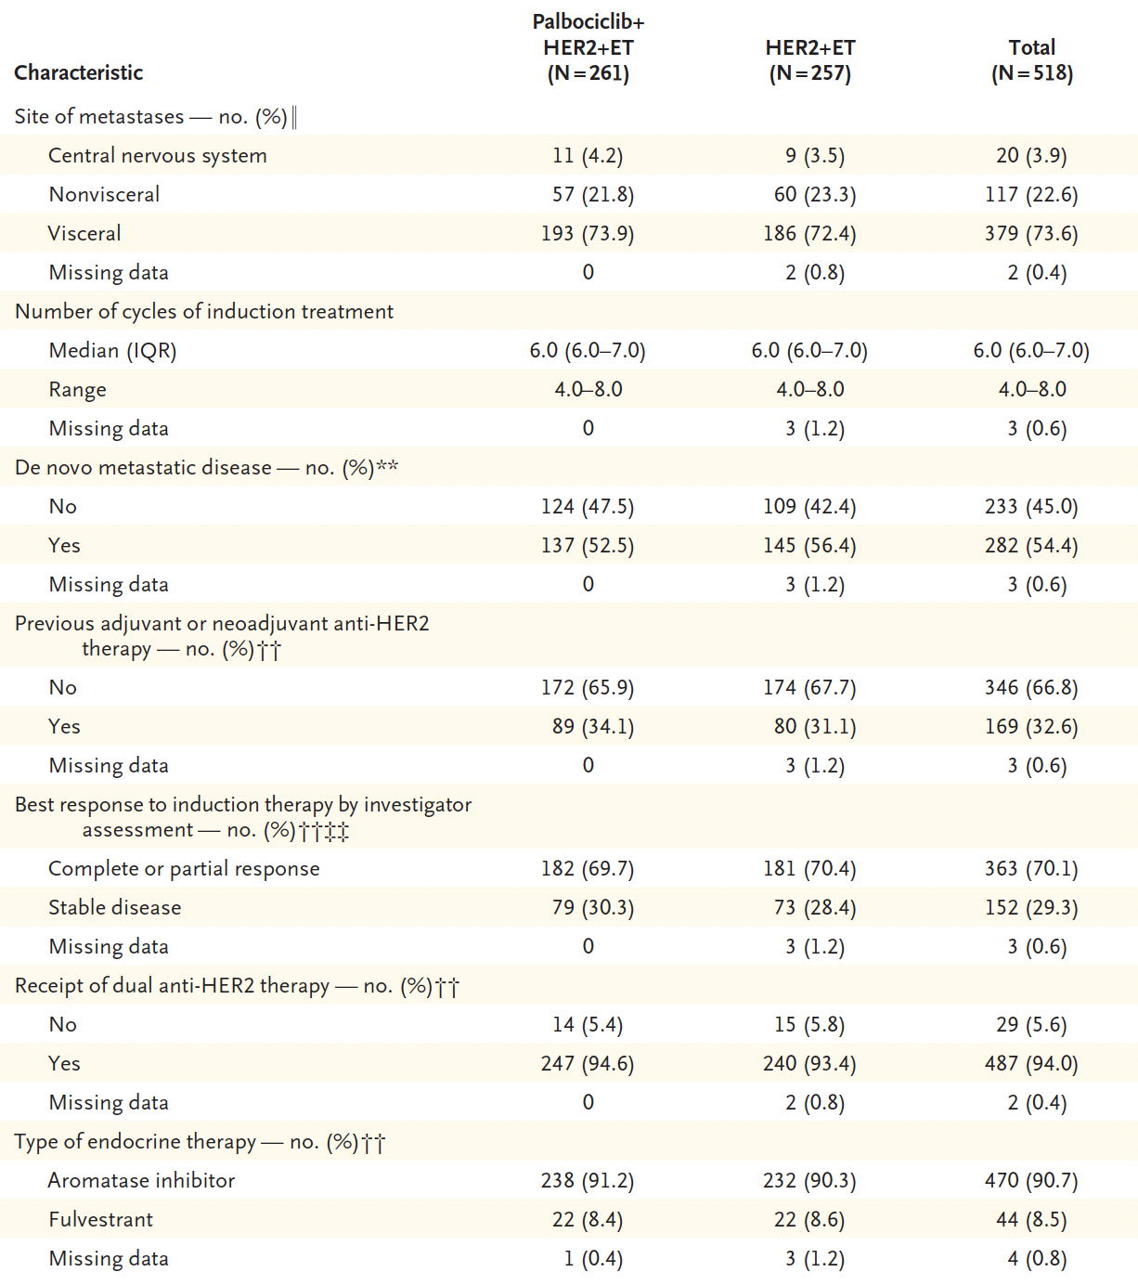
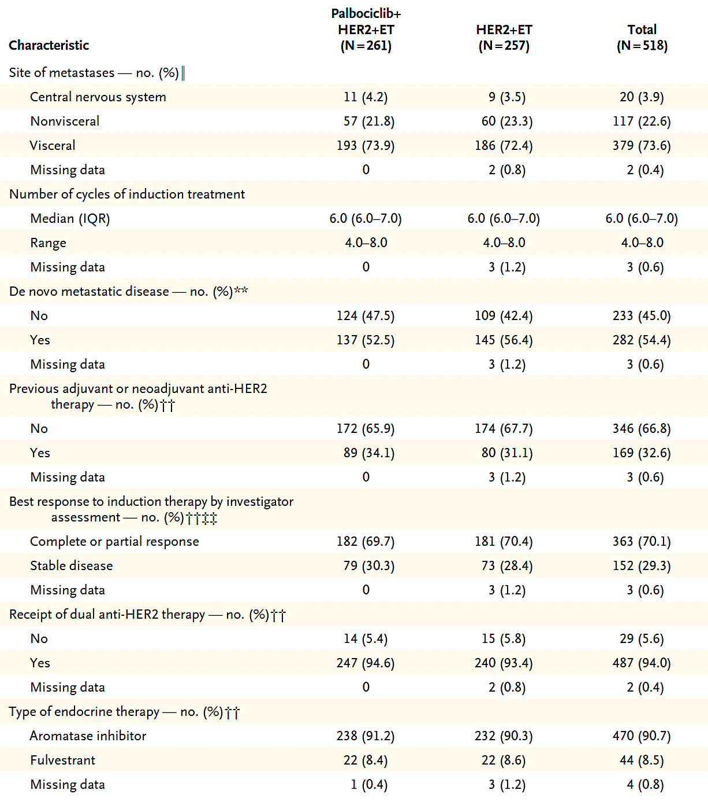
PATINA: Select Baseline Characteristics of All Patients (Continued)
Metzger O et al. N Engl J Med 2026;394(5):451-62.

Slide 82
PATINA: Select Baseline Characteristics of All Patients (Continued)
Metzger O et al. N Engl J Med 2026;394(5):451-62.

Slide 83
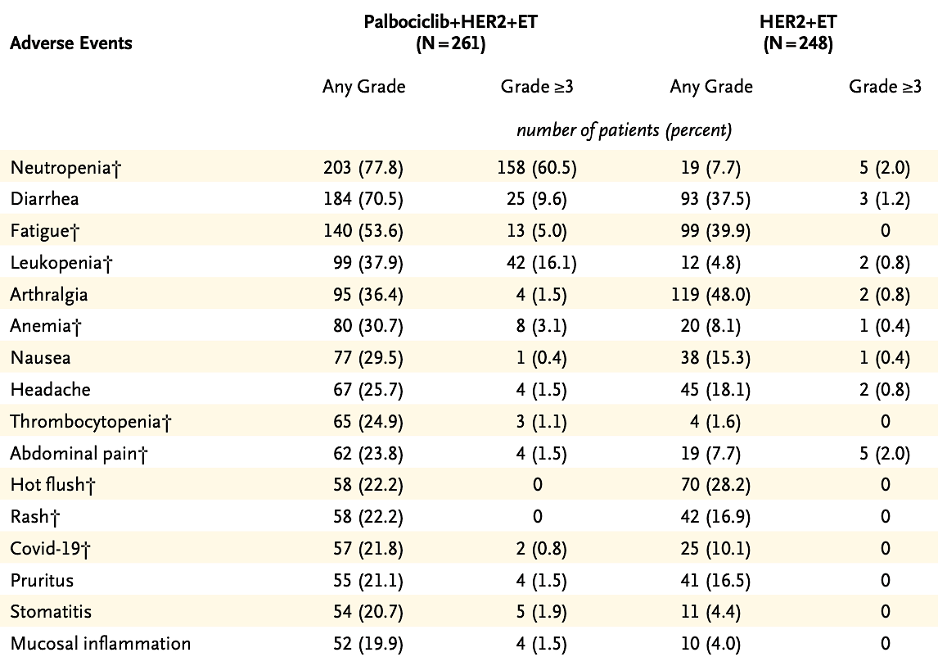
Phase III PATINA: Select Common Adverse Events
Metzger O et al. N Engl J Med 2026;394(5):451-62.

Slide 84
PATINA: Cumulative Incidence of CNS Progression or Death Among Patients without CNS Metastases at Baseline
 | Palbociclib + anti-HER2 + ET (n = 250) | Anti-HER2 + ET (n = 248)
CNS PFS event (n) | 35 | 48
Death | 3 | 1
CNS progression | 32 | 47
Cumulative risk of CNS progression or death (%)
12 months | 4.6% | 6.9%
24 months | 9.7% | 15.7%
36 months | 13.0% | 19.2%
Metzger O et al. SABCS 2025;Abstract RF4-01.

Slide 85
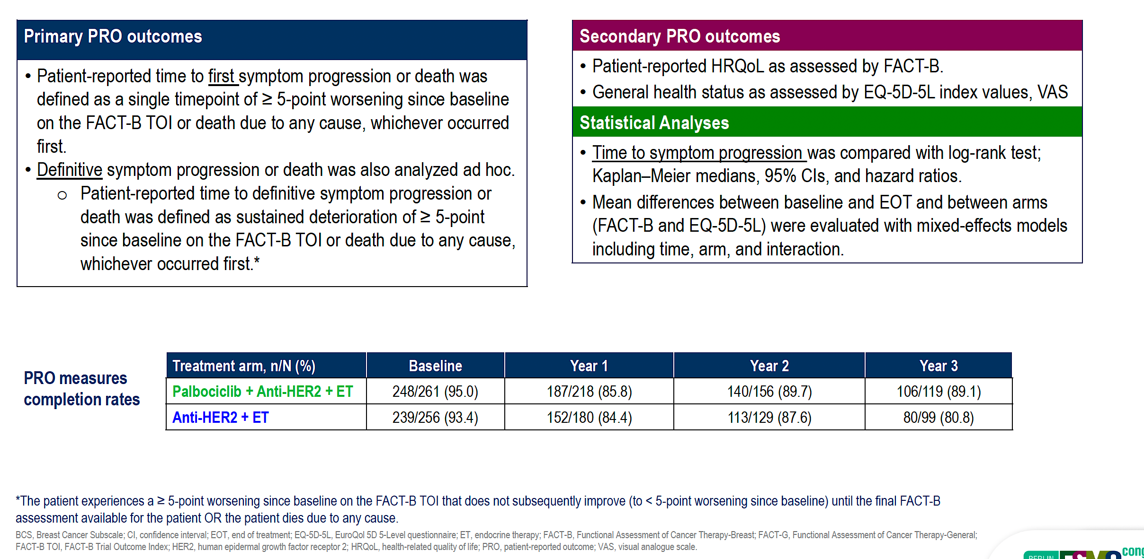
PATINA: PRO Outcomes and Analysis
Vaz-Luis I et al. ESMO 2025;Abstract 485MO.

Slide 86
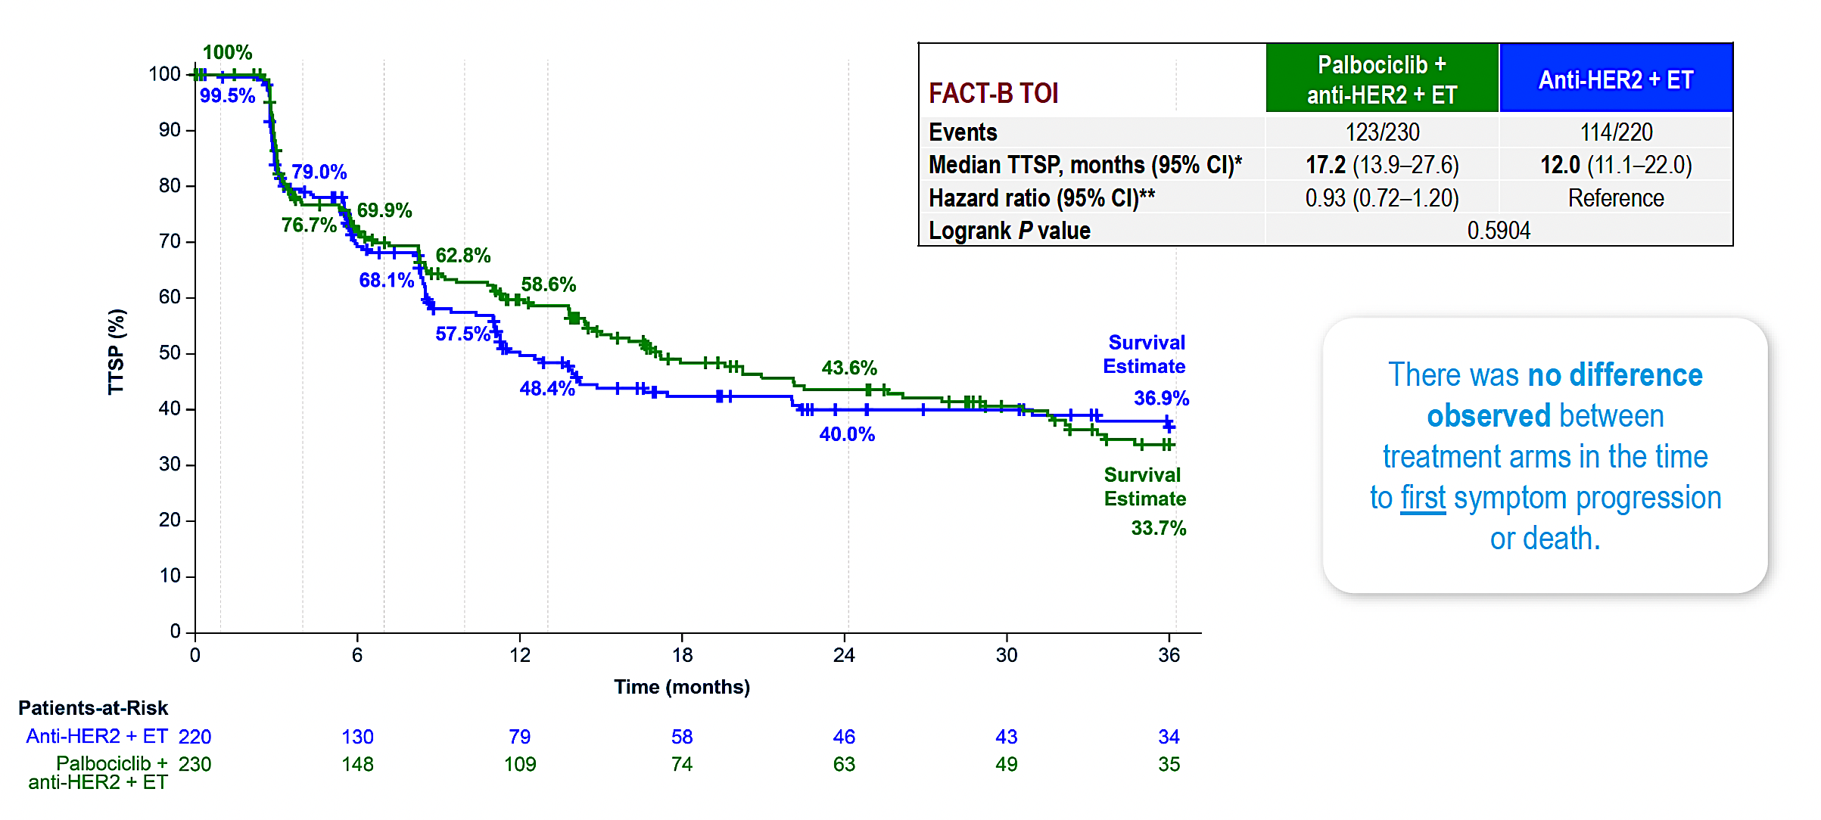
PATINA: Time to First Symptom Progression or Death
TTSP = time to symptomatic progression
Vaz-Luis I et al. ESMO 2025;Abstract 485MO.

Slide 87
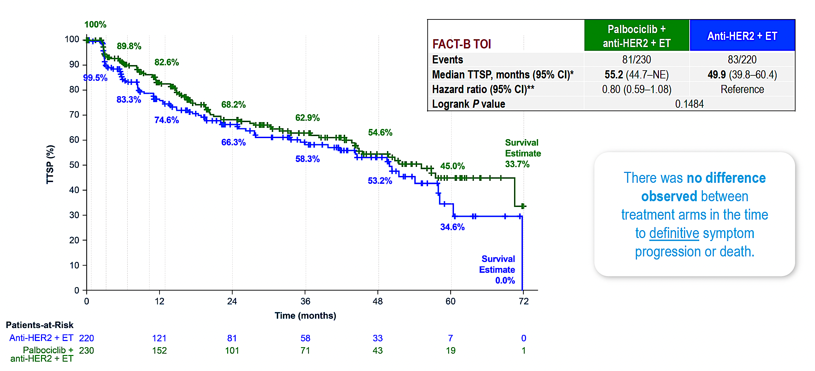
PATINA: Time to Definitive Symptom Progression or Death
Vaz-Luis I et al. ESMO 2025;Abstract 485MO.

Slide 88
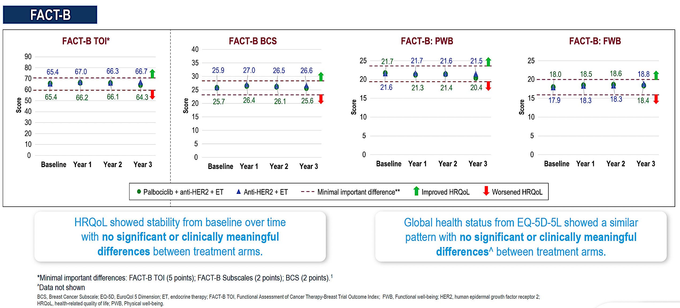
PATINA: HRQoL Scores
Vaz-Luis I et al. ESMO 2025;Abstract 485MO.

Slide 89
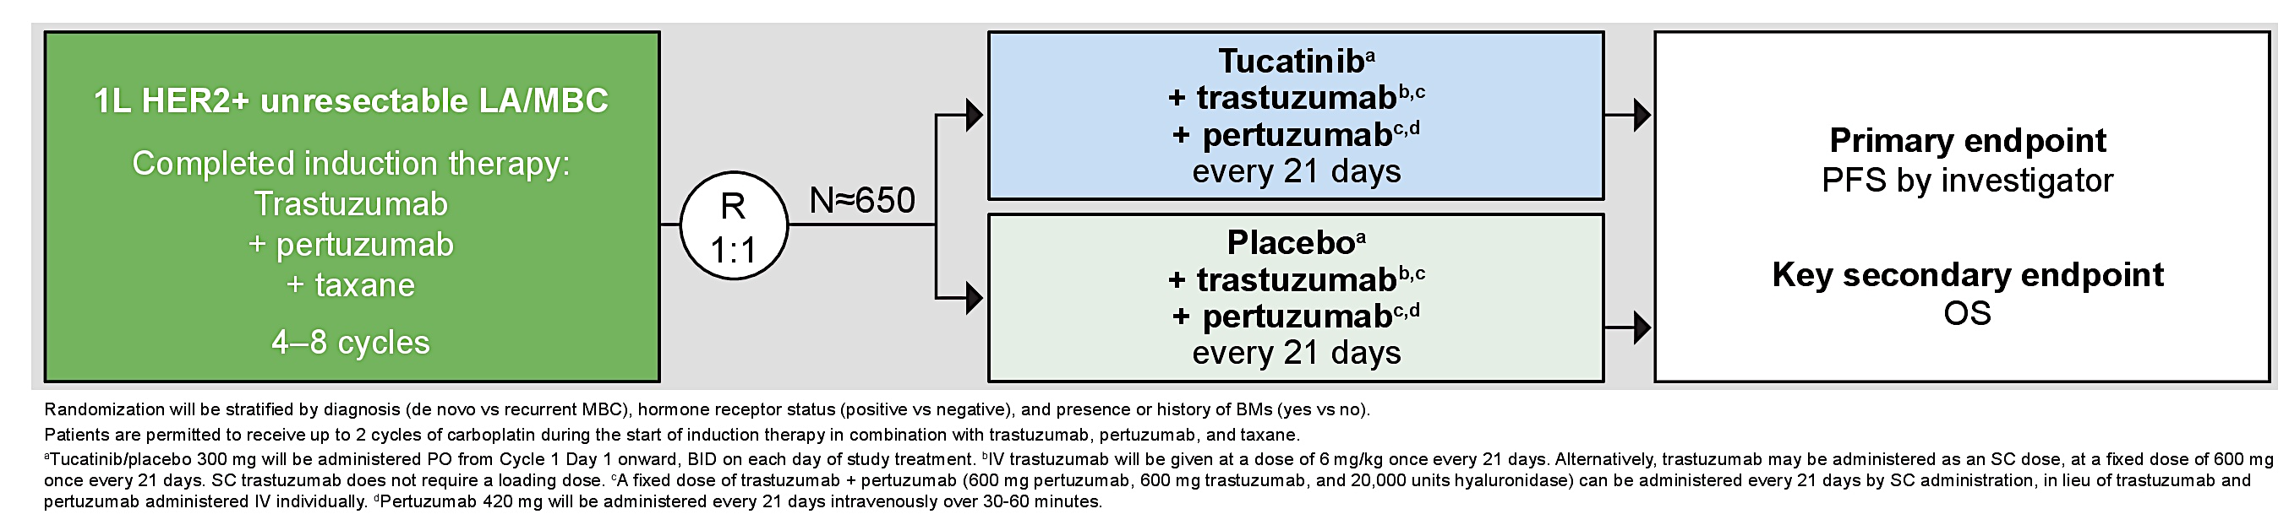
Phase III HER2CLIMB-05 Study Design
Hamilton EP et al. ASCO 2023;Abstract TPS1115.

Slide 90
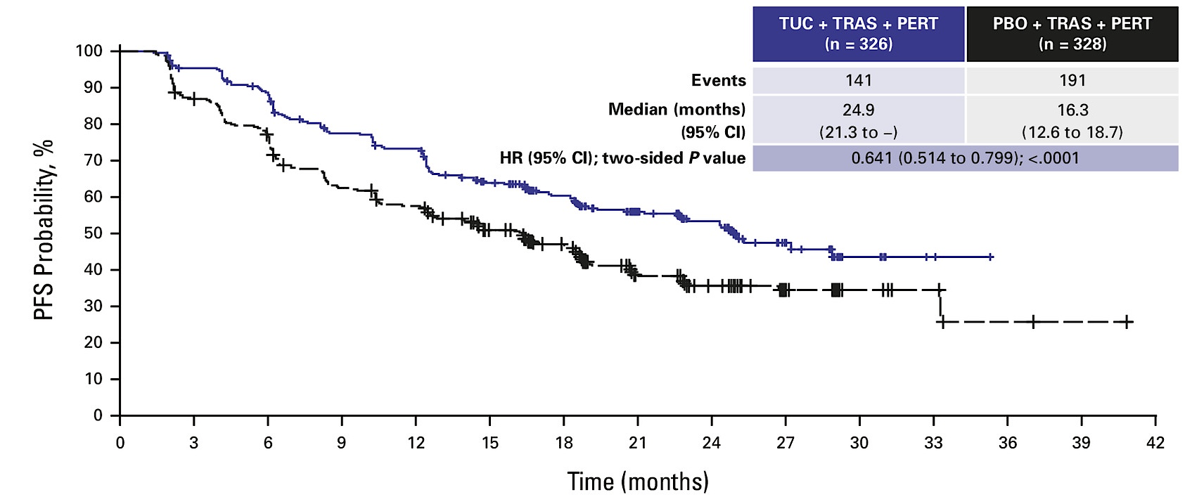
Phase III HER2CLIMB-05: Investigator-Assessed PFS (Intention-to-Treat Population)
TUC = tucatinib; TRAS = trastuzumab; PERT = pertuzumab; PBO = placebo
Dieras V et al. J Clin Oncol 2025; December 10;[Online ahead of print].

Slide 91
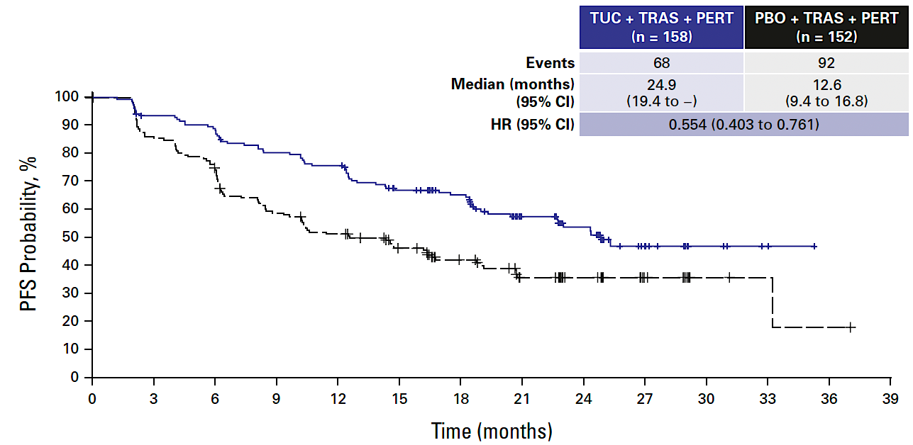
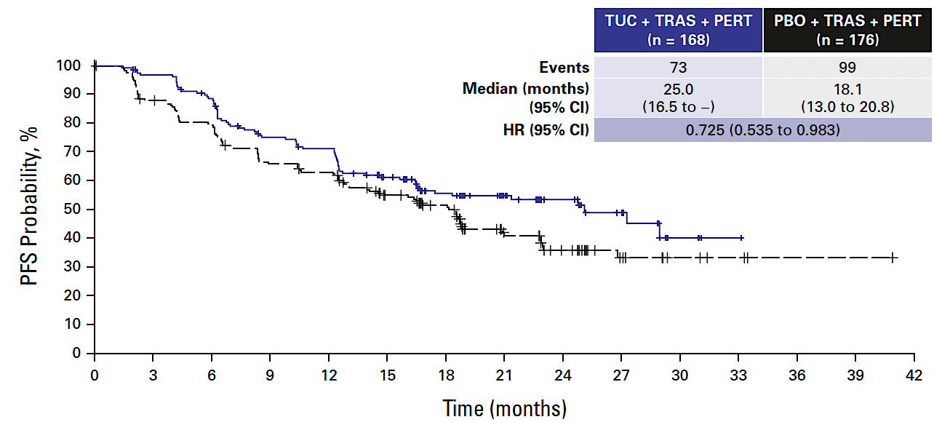
Phase III HER2CLIMB-05: Investigator-Assessed PFS by HR Status
HR-negative
HR-positive
Dieras V et al. J Clin Oncol 2025; December 10;[Online ahead of print].

Slide 92
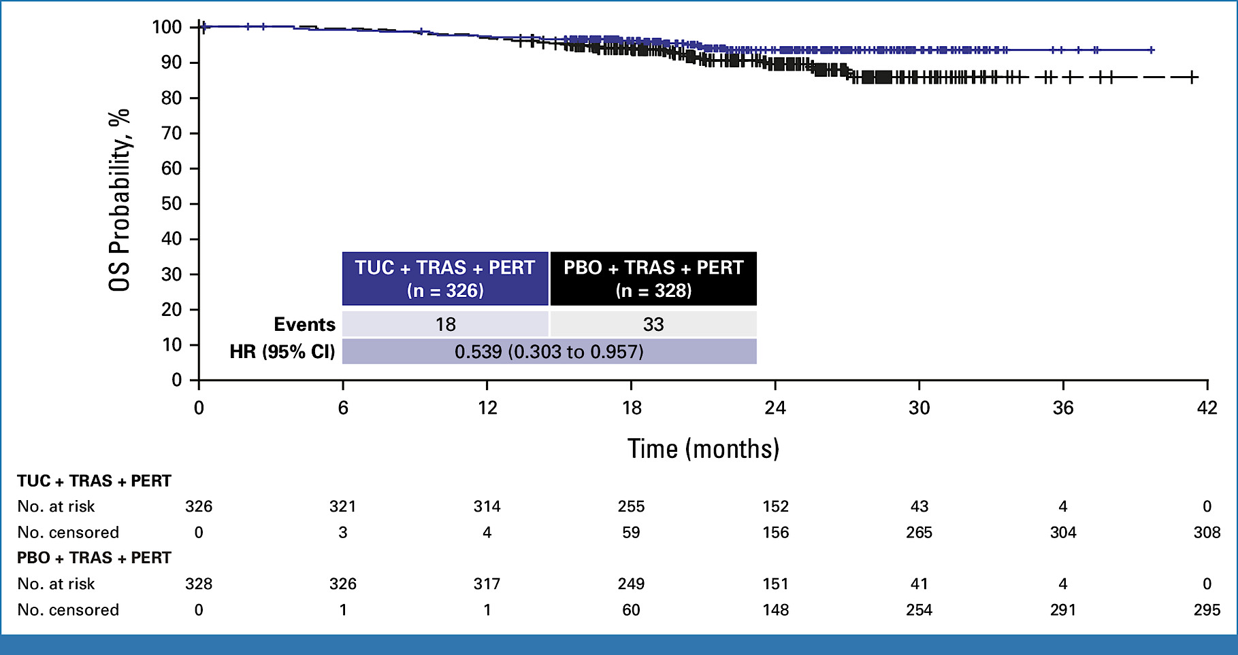
Phase III HER2CLIMB-05: Investigator-Assessed OS (Intention-to-Treat Population)
Dieras V et al. J Clin Oncol 2025; December 10;[Online ahead of print].

Slide 93
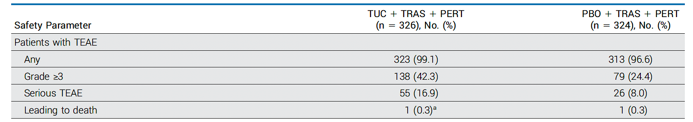
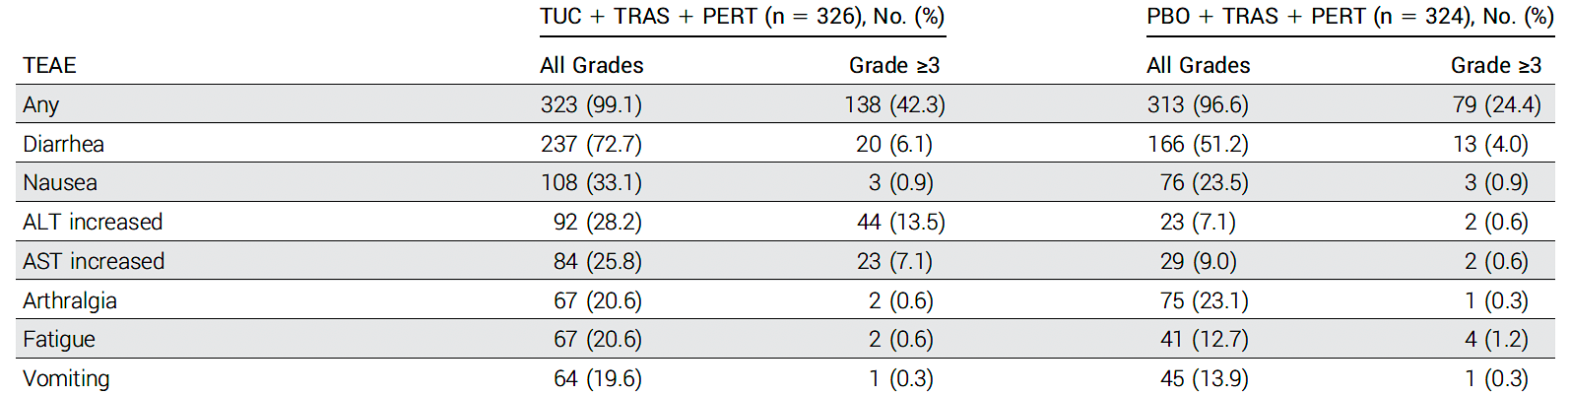
Phase III HER2CLIMB-05: Safety and Common Adverse Events
TEAE = treatment-emergent adverse event
Dieras V et al. J Clin Oncol 2025; December 10;[Online ahead of print].

Slide 94
A patient with HR-positive, HER2-positive mBC receives 6 cycles of THP as first-line induction therapy. Regulatory and reimbursement issues aside, which maintenance regimen would you recommend?
Age 65, PS 0
Achieved a complete response:
* HP/ET/abemaciclib
Achieved a partial response:
* HP/ET/abemaciclib; T-DXd

Slide 95
A patient with HR-positive, HER2-positive mBC receives T-DXd/pertuzumab as first-line induction therapy. Regulatory and reimbursement issues aside, which maintenance regimen would you recommend?
Age 65, PS 0
Achieved a complete response:
* T-DXd/pertuzumab/ET

Slide 96
A patient with HR-positive, HER2-positive mBC receives T-DXd/pertuzumab as first-line induction therapy. Regulatory and reimbursement issues aside, which maintenance regimen would you recommend?
Age 65, PS 0
Achieved a partial response:
* T-DXd/P/ET; T-DXd/pertuzumab/ET

Slide 97
Other than palbociclib, would you use any other CDK4/6 inhibitor in combination with maintenance HER2-targeted therapy and endocrine therapy after induction treatment for HR-positive, HER2-positive mBC?

Slide 98
A 65-year-old patient with HR-positive, HER2-positive mBC receives 6 cycles of THP as first-line induction therapy followed by HP/ET/palbociclib but develops asymptomatic moderate neutropenia (ANC = 750/µL) while receiving maintenance therapy. Regulatory and reimbursement issues aside, what would be your next course of action?
* ANC can run low on palbo but does not appear to increase infection, I would use lower threshold such as ANC < 500; Reduce dose and also change schedule

Slide 99
A patient with de novo HR-positive, HER2-positive mBC is receiving first-line T-DXd and pertuzumab with response and reasonably good tolerability. Regulatory and reimbursement issues aside, what would be your most likely approach to maintenance therapy?
* AI alone plus or minus palbociclib; Depends on patient age, comorbidities, burden of disease and degree of response

Slide 100
Agenda
Introduction: Biology of “Triple-Positive” Breast Cancer; Implications for Therapeutic Development
Module 1: Cases from the GMO Survey
Module 2: First-Line Therapy for Metastatic HER2-Positive Disease
Module 3: Cases from the GMO Survey
Module 4a: Maintenance Therapy for HR-Positive, HER2-Positive Disease
Module 4b: Maintenance Therapy for HR-Negative, HER2-Positive Disease
Module 5: Ongoing Clinical Trials Attempting to Address These Decisions
Module 6: Cases from the GMO Survey

Slide 101
Questions About Maintenance Treatment for HR-Negative, HER2-Positive Disease
What is your usual approach to maintenance therapy for a patient with HR-negative, HER2-positive metastatic disease?
How, if at all, does your choice of induction therapy impact your approach to maintenance?
What duration of maintenance therapy do you employ, assuming the patient has acceptable treatment tolerance?
Does your approach change if the patient is younger (40) or older (85)?
In what situations, if any, are you recommending tucatinib in this setting?

Slide 102
A patient with HR-negative, HER2-positive mBC receives 6 cycles of THP as first-line induction therapy. Regulatory and reimbursement issues aside, which maintenance regimen would you recommend?
Age 65, PS 0
Achieved a complete response:
Achieved a partial response:
* T-DM1; T-DXd

Slide 103
A patient with HR-negative, HER2-positive mBC receives 6 cycles of T-DXd/pertuzumab as first-line induction therapy. Regulatory and reimbursement issues aside, which maintenance regimen would you recommend?
Age 65, PS 0
Achieved a complete response:
* T-DXd/pertuzumab
Achieved a partial response:
* T-DXd/pertuzumab

Slide 104
A patient with HR-negative, HER2-positive mBC receives 6 cycles of T-DXd/pertuzumab as first-line induction therapy. Regulatory and reimbursement issues aside, which maintenance regimen would you recommend?
Age 85, PS 1
Achieved a complete response:
* Trastuzumab only; Capecitabine trastuzumab
Achieved a partial response:

Slide 105
A patient with de novo HR-negative, HER2-positive mBC is receiving first-line T-DXd and pertuzumab with response and reasonably good tolerability. Regulatory and reimbursement issues aside, what would be your most likely approach to maintenance therapy?
* Treat to maximum response and then switch to HER2CLIMB-05 regimen; Depends as above, any of these may be appropriate

Slide 106
Agenda
Introduction: Biology of “Triple-Positive” Breast Cancer; Implications for Therapeutic Development
Module 1: Cases from the GMO Survey
Module 2: First-Line Therapy for Metastatic HER2-Positive Disease
Module 3: Cases from the GMO Survey
Module 4a: Maintenance Therapy for HR-Positive, HER2-Positive Disease
Module 4b: Maintenance Therapy for HR-Negative, HER2-Positive Disease
Module 5: Ongoing Clinical Trials Attempting to Address These Decisions
Module 6: Cases from the GMO Survey

Slide 107
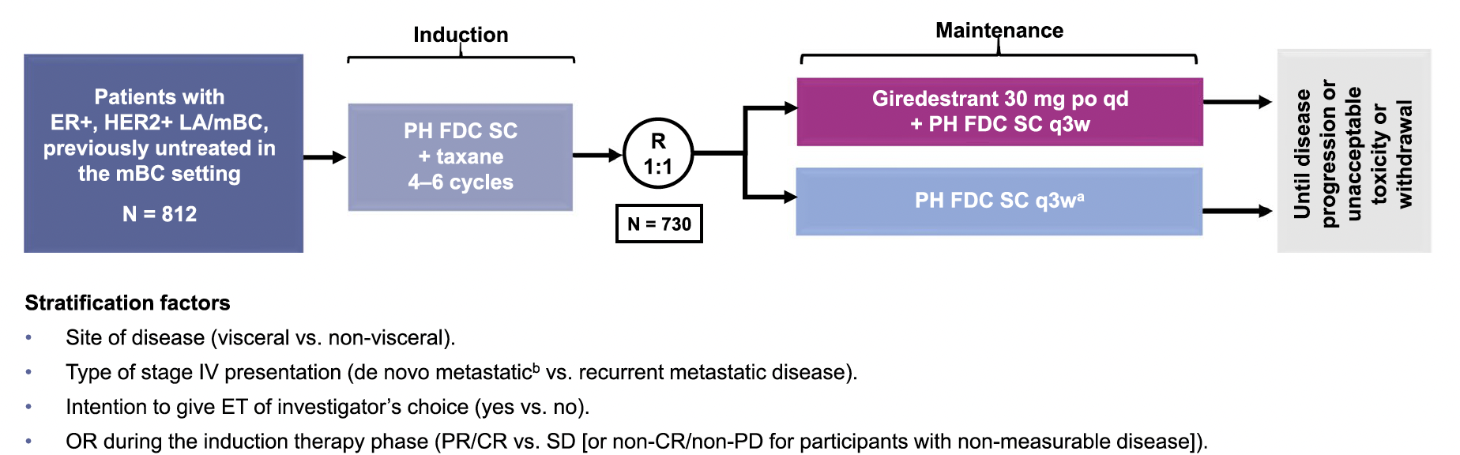
heredERA: An Ongoing Phase III Study of Giredestrant and the Fixed‑Dose Combination of Pertuzumab and Trastuzumab for Subcutaneous Injection
LA = locally advanced; PH FDC SC = fixed-dosed combination of pertuzumab and trastuzumab for subcutaneous injection
Kuemmel S et al. BMC Cancer 2024;24:641.

Slide 108
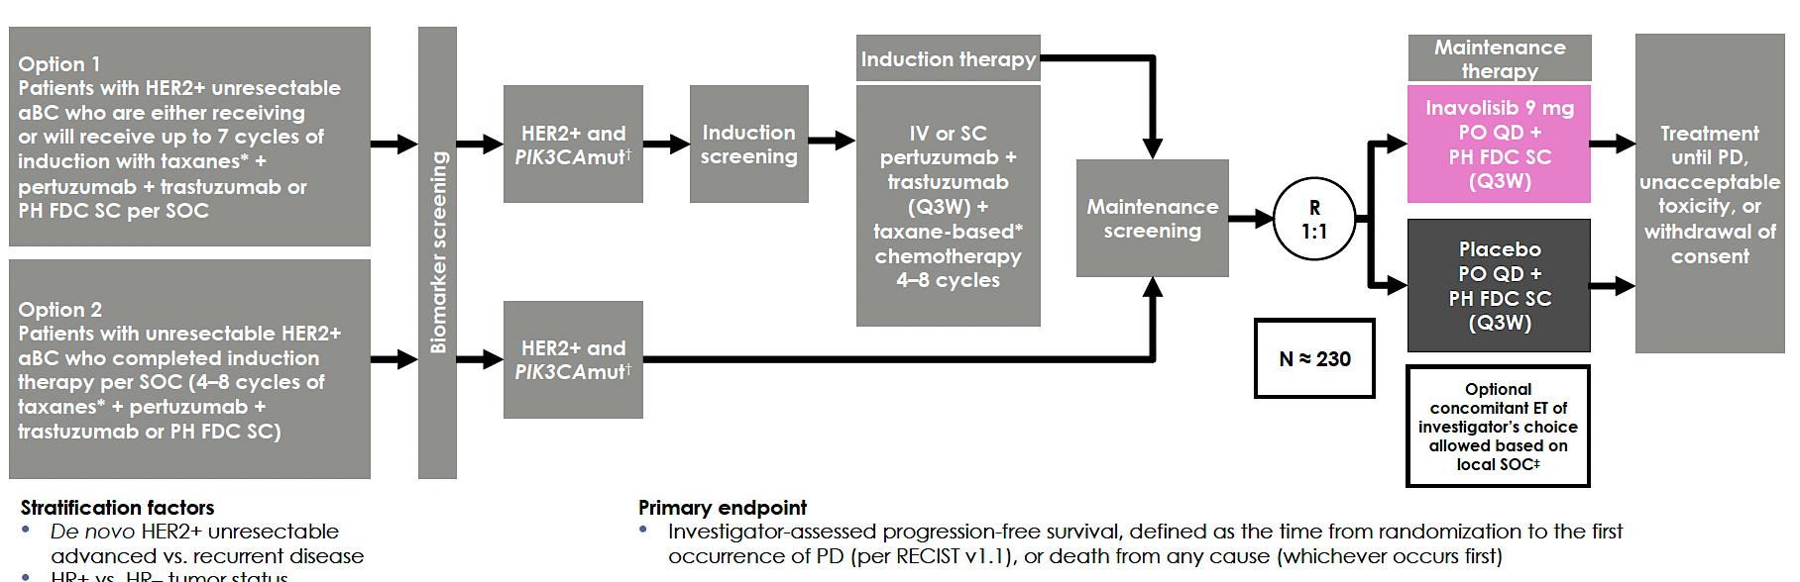
INAVO122: An Ongoing Phase III Study of Maintenance Inavolisib or Placebo with Pertuzumab and Trastuzumab for Patients with PIK3CA-Mutant, HER2-Positive Advanced Breast Cancer
Swain SM et al. ASCO 2024;Abstract TPS1124.

Slide 109
Select Other Ongoing Trials in the Front-Line Setting for HR-Positive, HER2-Positive mBC
Trial identifier | Phase | Status | Intervention
NCT03304080 | I/II | Active, not recruiting | Anastrozole + palbociclib + trastuzumab + pertuzumab
FAVOR (NCT04337658) | III | Not yet recruiting | Pertuzumab + trastuzumab + fulvestrant Pertuzumab + trastuzumab + capecitabine
NCT04646759 | III | Recruiting | Fulvestrant + pyrotinib Capecitabine + pyrotinib
www.clinicaltrials.gov. Accessed March 2026.

Slide 110
Agenda
Introduction: Biology of “Triple-Positive” Breast Cancer; Implications for Therapeutic Development
Module 1: Cases from the GMO Survey
Module 2: First-Line Therapy for Metastatic HER2-Positive Disease
Module 3: Cases from the GMO Survey
Module 4a: Maintenance Therapy for HR-Positive, HER2-Positive Disease
Module 4b: Maintenance Therapy for HR-Negative, HER2-Positive Disease
Module 5: Ongoing Clinical Trials Attempting to Address These Decisions
Module 6: Cases from the GMO Survey

Slide 111
Cases from General Medical Oncologists
59 yo woman
Early stage breast cancer in 2007 (ER+, HER2 1+) s/p lumpectomy, chemo, RT. Did not tolerate tamoxifen.
Metastatic disease 2024 with chest wall mass: multiple therapies including capivasertib/ fulvestrant (PIK3+).
Most recent biopsy of the chest wall mass: ER+, PR-, HER2 3+.
What will be your next treatment? No prior CDK. Would you recommend CDK4 and anti-HER2 maintenance treatment?

Slide 112
Cases from General Medical Oncologists
56 yo woman
ER/PR-, HER2+, multiple sites of metastatic disease, including high burden visceral mets, bone and 7 small asymptomatic brain mets.
What induction regimen would you recommend? Would you consider de-escalation after induction therapy? Any role for SRS or Gamma Knife?

Slide 113
Cases from General Medical Oncologists
78 yr old woman (second opinion)
De novo metastatic right breast cancer. ER 80% PR 70% HER2 1+/FISH positive.
Symptomatic bone Mets, right pleural effusion, rt pleural nodules and multiple liver Mets.
Treatment: anastrozole and ribociclib.
FISH was tested and was positive (end of Feb 2026).
NGS: FGFR1 amplification, ESR1 amplification (not mutation).
Pt has stable disease in anastrozole and ribociclib but now has HER2 positive disease.
What treatment will you give?
Paclitaxel, trastuzumab and pertuzumab
Anastrozole, trastuzumab and pertuzumab
PATINA trial — anastrozole, palbo and H and P
What is the significance of ESR1 amplification? Same as ESR1 mutation?

Slide 114
Cases from General Medical Oncologists
43 yo woman
ER/PR+, HER2+ de novo metastatic breast cancer, minimally symptomatic bone and nodal metastases.
1L induction THP for 6 cycles, then HP maintenance plus leuprolide and AI, remains NED for over 2 years.
2 years of zoledronic acid.
What 1L regimen and maintenance therapy would you use if she presented today? Would T-DXd + pertuzumab induction be appropriate? What about incorporating palbociclib into the endocrine therapy component given HR+ alongside HP maintenance per PATINA?

Slide 115
Cases from General Medical Oncologists
52 year old woman
Triple-positive inflammatory breast cancer.
Neoadjuvant TCHP, mastectomy, axillary dissection with positive nodes, radiation and T-DM1.
Relapsed 2 years later with intracranial-only disease.
Very symptomatic in terms of headaches and unilateral weakness.
This patient got HER2CLIMB regimen (plus brain RT given so symptomatic). This was prior to T-DXd trial.
Would you use T-DXd/pertuzumab now?

Slide 116
Cases from General Medical Oncologists
72 yo woman
ER/PR+, HER2+ metastatic breast cancer asymptomatic liver and bone metastases
PMH: THP- HP + AI + palbo.
Today would faculty consider T-DXd + Pertuzumab until best response, then Pertuzumab plus AI and palbo? Any role for CT DNA monitoring to guide de-escalation or discontinuation of maintenance therapy in this setting?

Slide 117
Year in Review: Clinical Investigator Perspectives on the Most Relevant New Datasets and Advances in Oncology
Prostate Cancer
A CME/MOC-Accredited Live Webinar
Wednesday, March 25, 2026 5:00 PM – 6:00 PM ET
Faculty
Andrew J Armstrong, MD, ScM
Scott T Tagawa, MD, MS
Moderator
Neil Love, MD

Slide 118
Thank you for joining us! Please take a moment to complete the survey currently up on Zoom. Your feedback is very important to us. The survey will remain open for 5 minutes after the meeting ends. Information on how to obtain CME, ABIM MOC and ABS credit is provided in the Zoom chat room. Attendees will also receive an email in 1 to 3 business days with these instructions.

