Slide 1
Exploring Current Patterns of Care in the Community:
Selection of First-Line and Maintenance Therapy for
Patients with Extensive-Stage Small Cell Lung Cancer
A CME/MOC-Accredited Live Webinar
Wednesday, February 4, 2026
5:00 PM – 6:00 PM ET
Faculty
Hossein Borghaei, DO, MS
Anne Chiang, MD, PhD
Moderator
Neil Love, MD

Slide 2

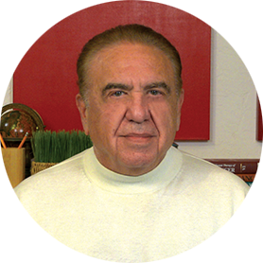

Faculty
Hossein Borghaei, DO, MS
Chief, Division of Thoracic Medical Oncology
Professor, Department of Hematology/Oncology
Co-Director, Immune Monitoring Facility
The Gloria and Edmund M Dunn Chair in Thoracic Oncology
Fox Chase Cancer Center
Philadelphia, Pennsylvania
MODERATOR
Neil Love, MD
Research To Practice
Miami, Florida
Anne Chiang, MD, PhD
Associate Professor
Yale University School of Medicine
Associate Cancer Center Director
Clinical Initiatives
Yale Cancer Center
New Haven, Connecticut

Slide 3
Commercial Support
This activity is supported by educational grants from Genentech, a member of the Roche Group, and Jazz Pharmaceuticals Inc.

Slide 4
Dr Love — Disclosures
Dr Love is president and CEO of Research To Practice. Research To Practice receives funds in the form of educational grants to develop CME activities from the following companies: Aadi Bioscience, AbbVie Inc, ADC Therapeutics, Agendia Inc, Alexion Pharmaceuticals, Amgen Inc, Array BioPharma Inc, a subsidiary of Pfizer Inc, Arvinas, Astellas, AstraZeneca Pharmaceuticals LP, Aveo Pharmaceuticals, Bayer HealthCare Pharmaceuticals, BeOne, Biotheranostics, A Hologic Company, Black Diamond Therapeutics Inc, Blueprint Medicines, Boehringer Ingelheim Pharmaceuticals Inc, Bristol Myers Squibb, Celcuity, Clovis Oncology, Coherus BioSciences, Corcept Therapeutics Inc, CTI BioPharma, a Sobi Company, Daiichi Sankyo Inc, Eisai Inc, Elevation Oncology Inc, Exact Sciences Corporation, Exelixis Inc, Genentech, a member of the Roche Group, Genmab US Inc, Geron Corporation, Gilead Sciences Inc, GSK, Helsinn Therapeutics (US) Inc, ImmunoGen Inc, Incyte Corporation, Ipsen Biopharmaceuticals Inc, Jazz Pharmaceuticals Inc, Johnson & Johnson, Karyopharm Therapeutics, Kite, A Gilead Company, Kura Oncology, Legend Biotech, Lilly, MEI Pharma Inc, Merck, Mersana Therapeutics Inc, Mirati Therapeutics Inc, Mural Oncology Inc, Natera Inc, Novartis, Novartis Pharmaceuticals Corporation on behalf of Advanced Accelerator Applications, Novocure Inc, Nuvalent, Nuvation Bio Inc, Pfizer Inc, Pharmacyclics LLC, an AbbVie Company, Puma Biotechnology Inc, Regeneron Pharmaceuticals Inc, Rigel Pharmaceuticals Inc, R-Pharm US, Sanofi, Seagen Inc, Servier Pharmaceuticals LLC, SpringWorks Therapeutics Inc, Stemline Therapeutics Inc, Sumitomo Pharma America, Syndax Pharmaceuticals, Taiho Oncology Inc, Takeda Pharmaceuticals USA Inc, TerSera Therapeutics LLC, and Tesaro, A GSK Company.

Slide 5
Research To Practice CME Planning Committee Members,
Staff and Reviewers
Planners, scientific staff and independent reviewers for Research To Practice have no relevant conflicts of interest to disclose.

Slide 6
Dr Borghaei — Disclosures
Advisory Committees and Consulting Agreements | AbbVie Inc, Amgen Inc, Astellas, AstraZeneca Pharmaceuticals LP, Axiom Healthcare Strategies, Bayer HealthCare Pharmaceuticals, BeOne, BerGenBio ASA, BioNTech SE, Boehringer Ingelheim Pharmaceuticals Inc, Bristol Myers Squibb, Daiichi Sankyo Inc, EMD Serono Inc, Genentech, a member of the Roche Group, Genmab US Inc, Gilead Sciences Inc, Grid Therapeutics, Guardant Health, IO Biotech, iTeos Therapeutics, Janssen Biotech Inc, Jazz Pharmaceuticals Inc, Lilly, Merck, Mirati Therapeutics Inc, Natera Inc, Novartis, Novocure Inc, Oncocyte, Pfizer Inc, PharmaMar, Puma Biotechnology Inc, RAPT Therapeutics, Regeneron Pharmaceuticals Inc, Summit Therapeutics, SystImmune Inc, Takeda Pharmaceuticals USA Inc
Contracted Research | Amgen Inc, Bristol Myers Squibb, Lilly
Data and Safety Monitoring Boards/Committees | Incyte Corporation, Novartis, Servier Pharmaceuticals LLC, SpringWorks Therapeutics Inc, Takeda Pharmaceuticals USA Inc
Honoraria | Amgen Inc, Daiichi Sankyo Inc, Janssen Biotech Inc, Jazz Pharmaceuticals Inc, Pfizer Inc, Regeneron Pharmaceuticals Inc
Stock OPTIONS — Private Companies | Inspirna, Nucleai, Sonnet BioTherapeutics Holdings Inc
Travel | Amgen Inc, Bristol Myers Squibb, EMD Serono Inc, Genentech, a member of the Roche Group, Jazz Pharmaceuticals Inc, Lilly, Merck, Mirati Therapeutics Inc, Regeneron Pharmaceuticals Inc
Nonrelevant Financial Relationships | University of Pennsylvania

Slide 7
Dr Chiang — Disclosures
Advisory Committees | AbbVie Inc, Amgen Inc, AstraZeneca Pharmaceuticals LP, Boehringer Ingelheim Pharmaceuticals Inc, Daiichi Sankyo Inc, Genentech, a member of the Roche Group, Janssen Biotech Inc, Merck, Zai Lab
Consulting Agreements | AbbVie Inc, Merck
Contracted Research | AbbVie Inc, Amgen Inc, AstraZeneca Pharmaceuticals LP, Bristol Myers Squibb, Genentech, a member of the Roche Group, Zai Lab
Data and Safety Monitoring Boards/Committees | AstraZeneca Pharmaceuticals LP
Honoraria for Lectures | Genentech, a member of the Roche Group, Jazz Pharmaceuticals Inc

Slide 8
This educational activity contains discussion of
non-FDA-approved uses of agents and regimens. Please refer to official prescribing information for each product for approved indications.

Slide 9
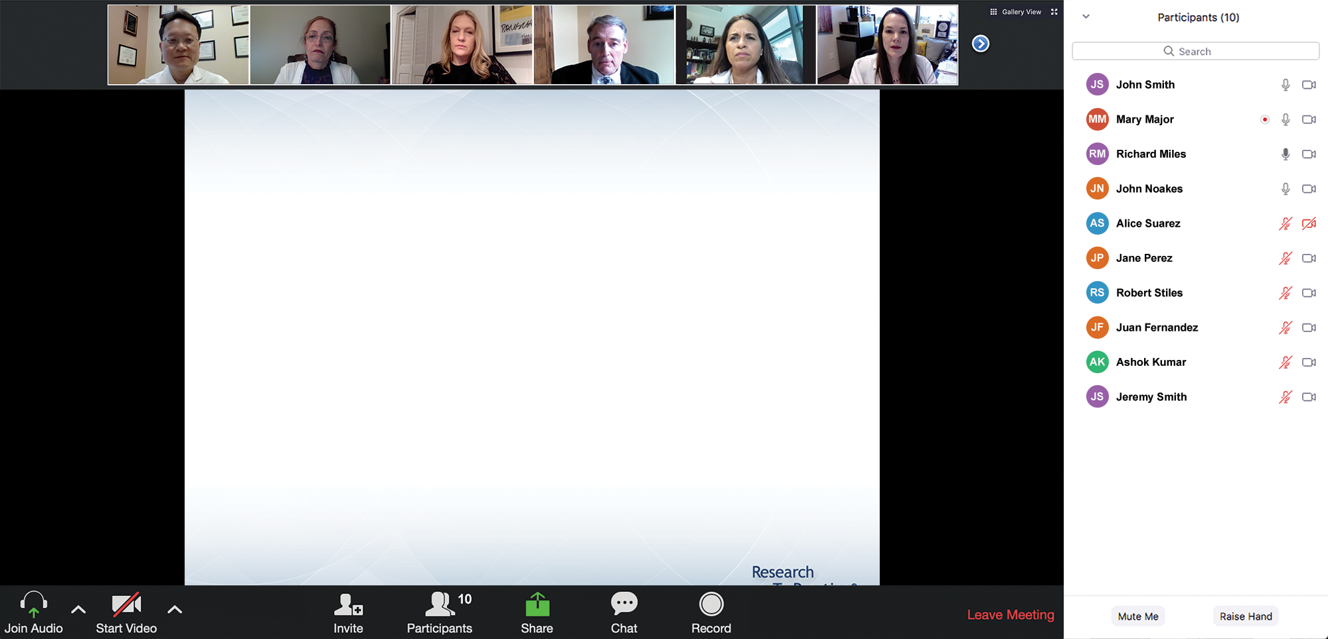
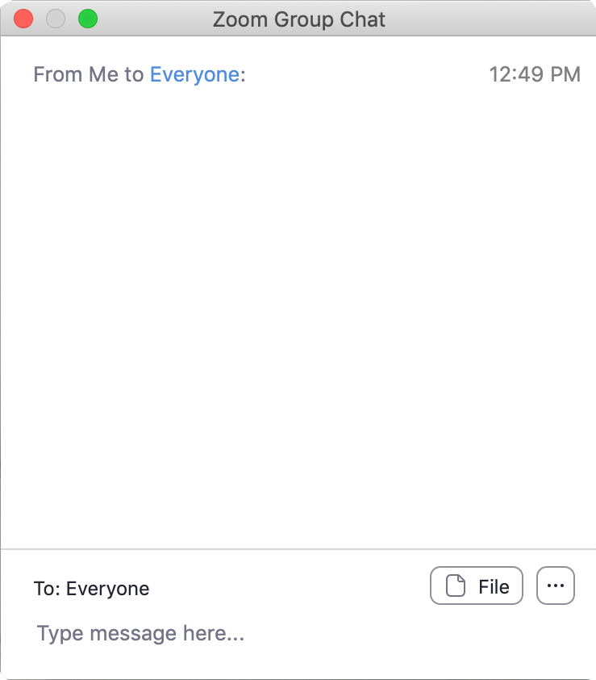
We Encourage Clinicians in Practice to Submit Questions
Feel free to submit questions now before the program begins and throughout the program.

Slide 10
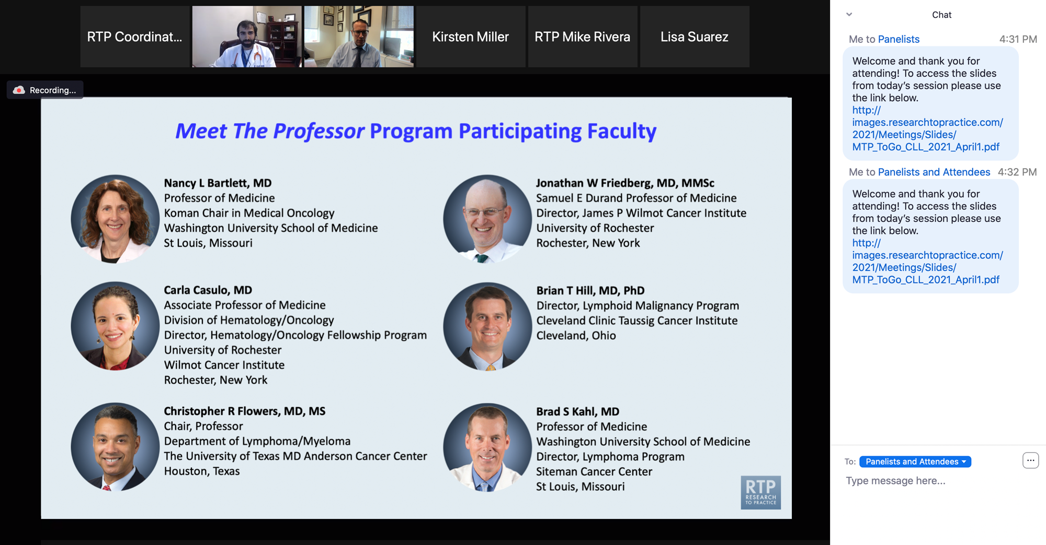
Familiarizing Yourself with the Zoom Interface
Expand chat submission box
Drag the white line above the submission box up to create
more space for your message.

Slide 11
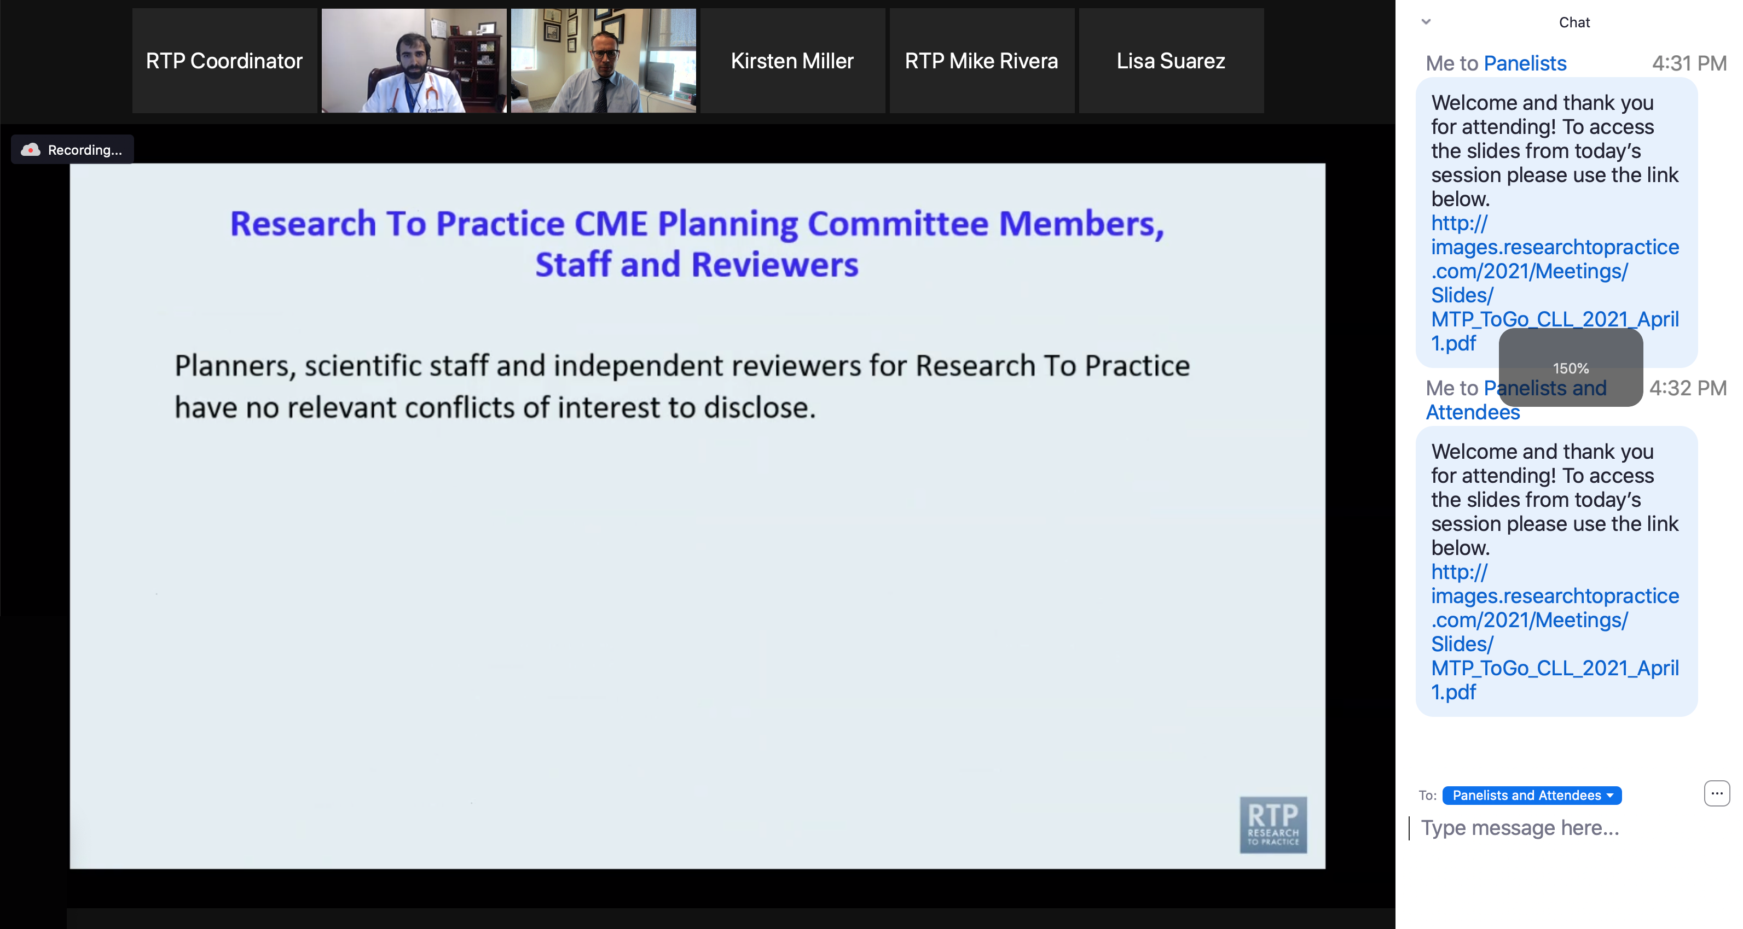
Familiarizing Yourself with the Zoom Interface
Increase chat font size
Press Command (for Mac) or Control (for PC) and the + symbol.
You may do this as many times as you need for readability.

Slide 12
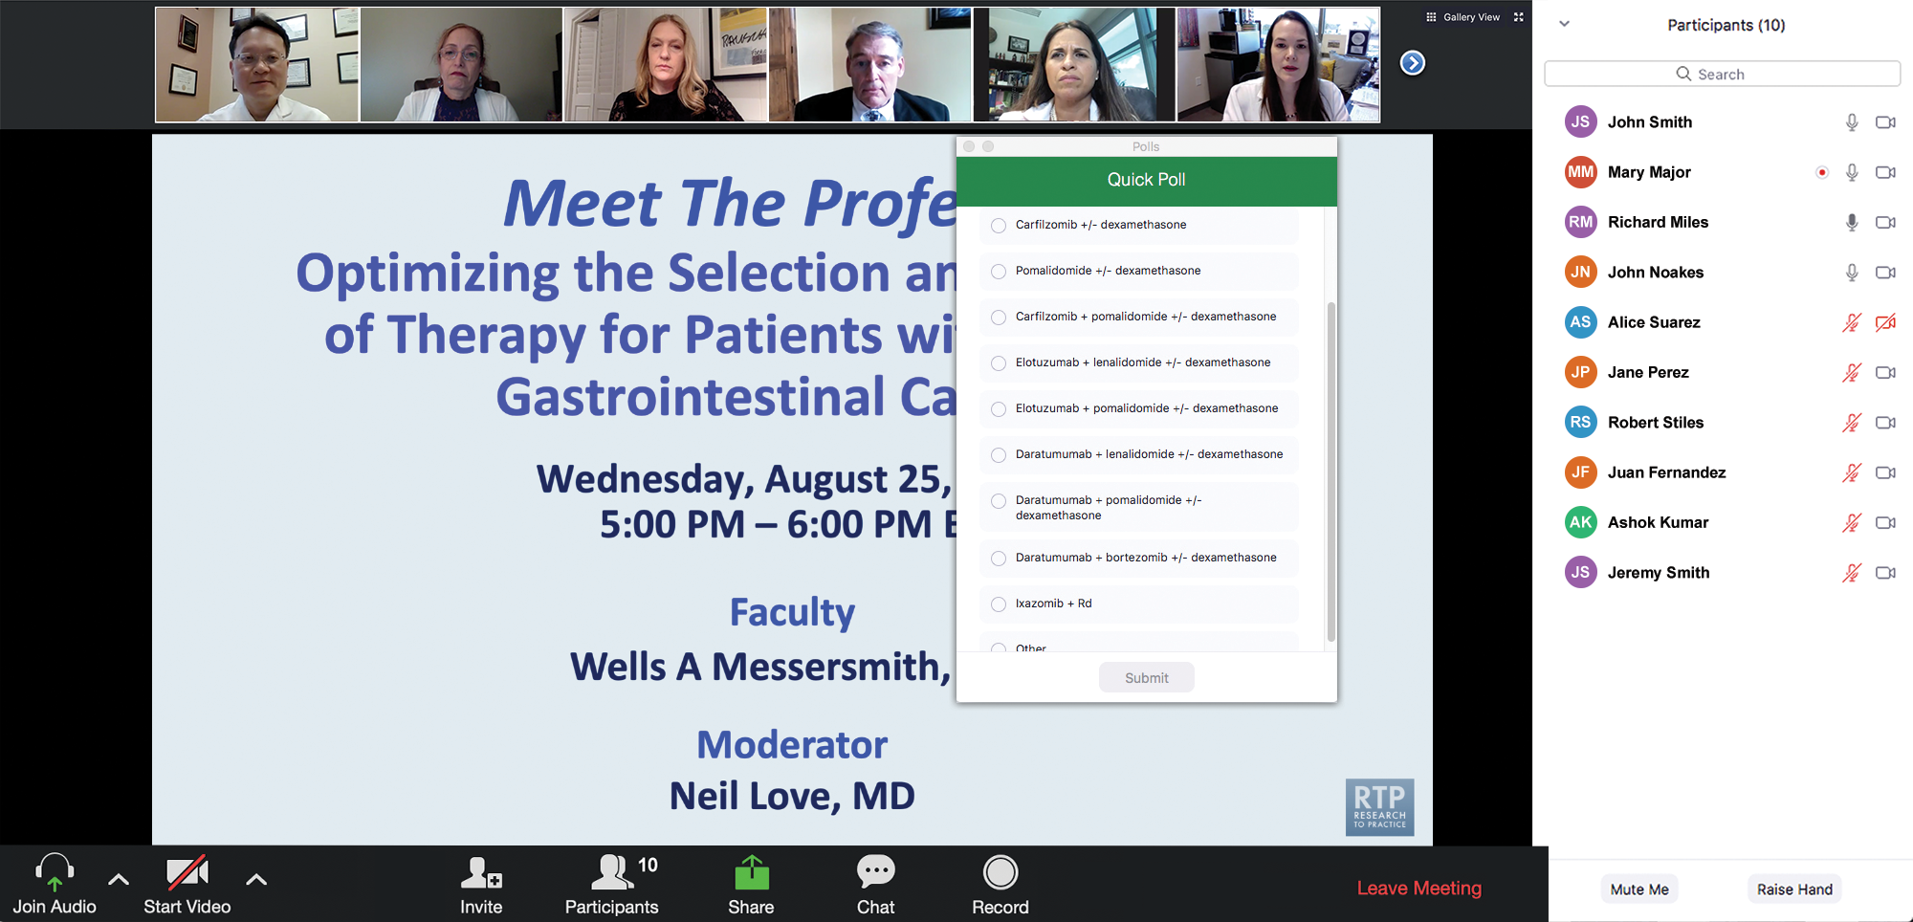
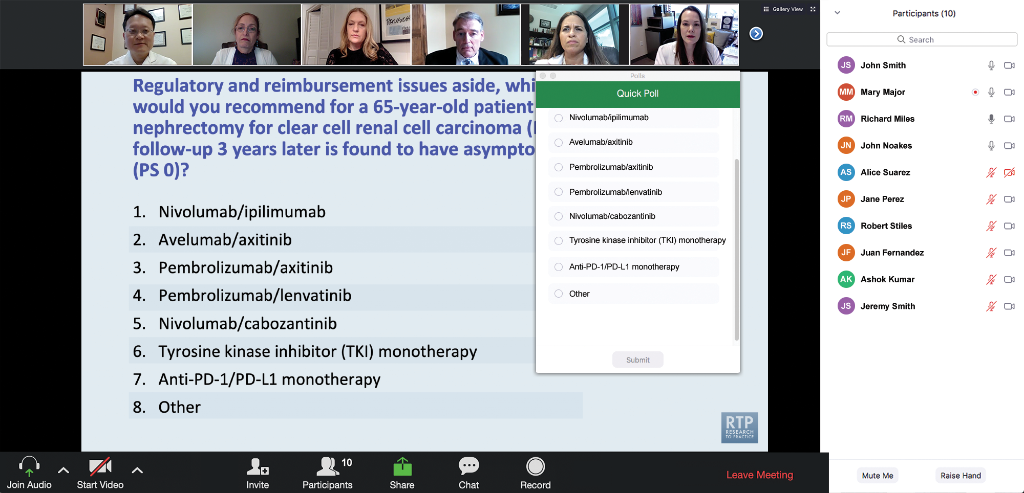
Clinicians in the Audience, Please Complete the Pre- and Postmeeting Surveys
Quick Survey
Quick Poll

Slide 13
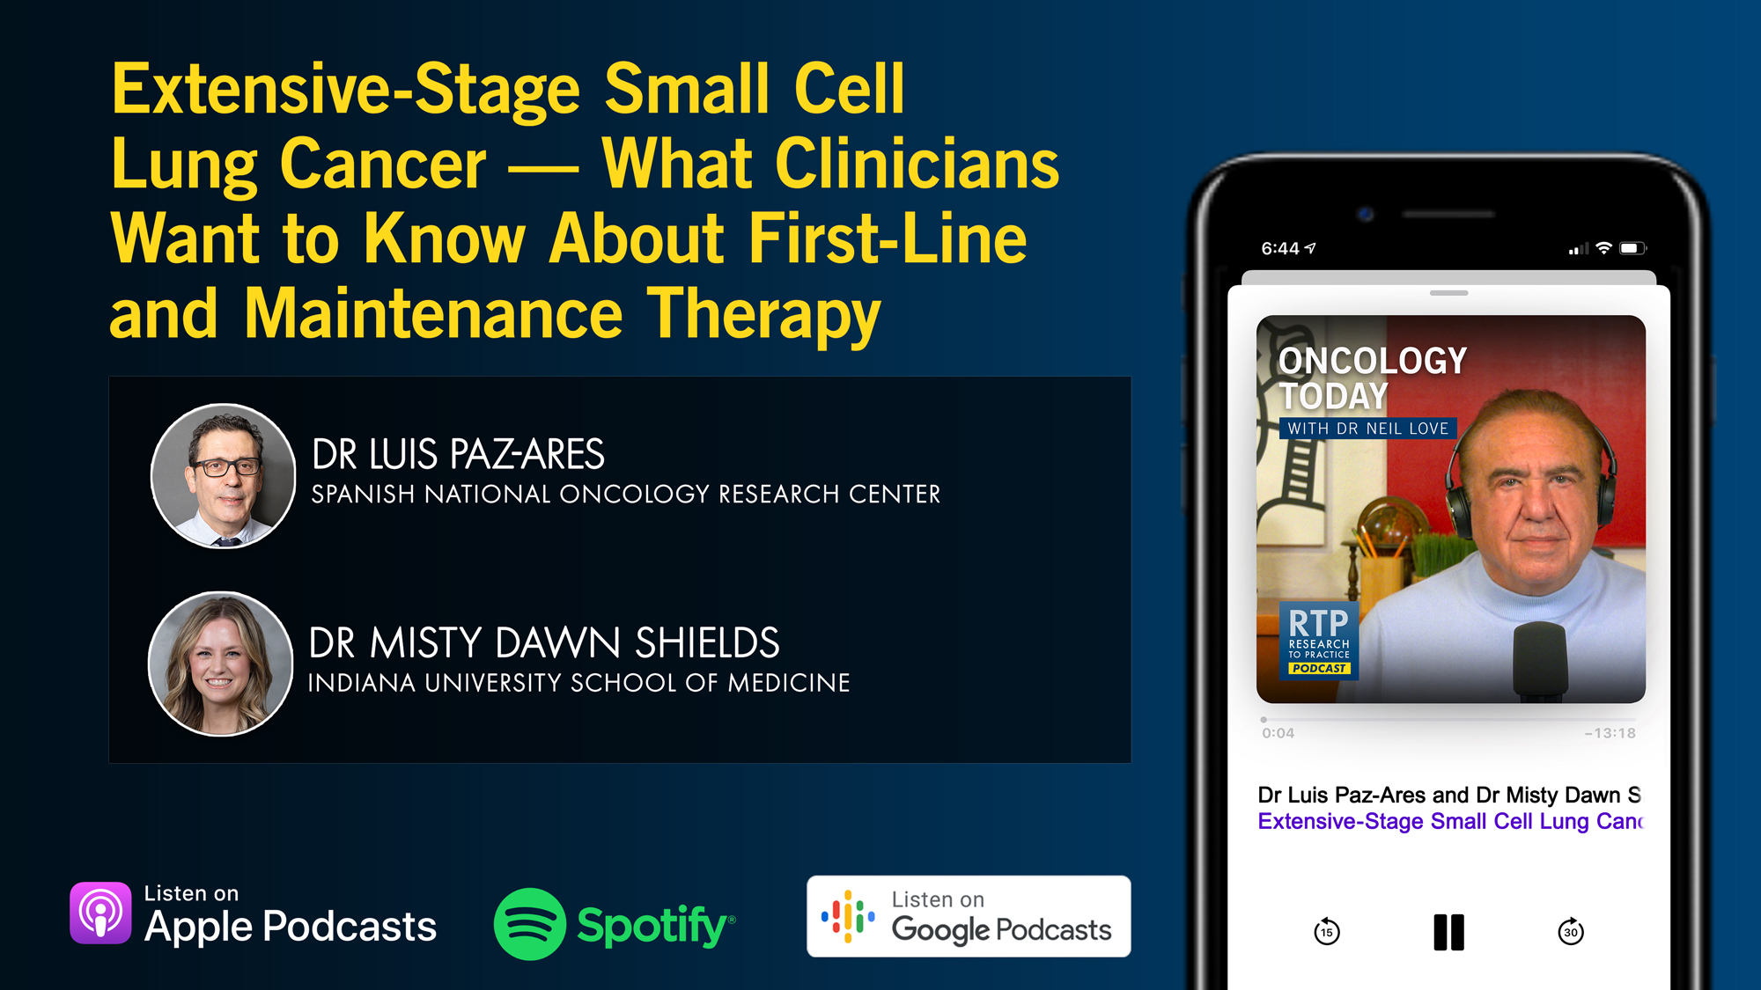

Slide 14
Year in Review: Clinical Investigator Perspectives on the
Most Relevant New Datasets and Advances in Oncology
Antibody-Drug Conjugates for Breast Cancer
A CME/MOC-Accredited Live Webinar
Wednesday, February 18, 2026
5:00 PM – 6:00 PM ET
Faculty
Hope S Rugo, MD
Sara M Tolaney, MD, MPH
Moderator
Neil Love, MD

Slide 15
Year in Review: Clinical Investigator Perspectives on the
Most Relevant New Datasets and Advances in Oncology
Ovarian Cancer
A CME/MOC-Accredited Live Webinar
Thursday, February 19, 2026
5:00 PM – 6:00 PM ET
Faculty
Nicoletta Colombo, MD
Angeles Alvarez Secord, MD, MHSc
Moderator
Neil Love, MD

Slide 16
Second Opinion: Integrating Novel Approaches into the Management of Non-Muscle-Invasive and Muscle-Invasive Bladder Cancer
A CME Symposium Held Adjunct to the
2026 ASCO® Genitourinary Cancers Symposium
Thursday, February 26, 2026
7:00 PM – 9:00 PM PT (10:00 PM – 12:00 AM ET)
Faculty
Matthew D Galsky, MD
Shilpa Gupta, MD
Andrea Necchi, MD
Moderator
Terence Friedlander, MD

Slide 17
Second Opinion: Clinical Investigators Provide
Perspectives on the Future Role of AKT Inhibition in the Management of Prostate Cancer
A CME Symposium Held Adjunct to the
2026 ASCO® Genitourinary Cancers Symposium
Friday, February 27, 2026
6:00 PM – 7:30 PM PT (9:00 PM – 10:30 PM ET)
Faculty
Professor Karim Fizazi, MD, PhD
Daniel George, MD
Moderator
Elisabeth I Heath, MD

Slide 18
Grand Rounds
CME/MOC-Accredited Interactive Series
Regional Activities
Three Series
Optimizing Treatment
for Patients with Relapsed/Refractory Chronic Lymphocytic Leukemia
Optimizing the Use of
Novel Therapies for Patients with Diffuse
Large B-Cell Lymphoma
Optimizing Therapy for Patients with Hormone Receptor-Positive
Localized Breast Cancer
Host a 1-hour session at your institution:
Email Meetings@ResearchToPractice.com
or call (800) 233-6153

Slide 19

Save The Date
A Multitumor CME/MOC-, NCPD- and ACPE-Accredited Educational Conference Developed in Partnership with Florida Cancer Specialists & Research Institute
Friday to Sunday, April 24 to 26, 2026
The Ritz-Carlton Orlando, Grande Lakes | Orlando, Florida
Moderated by Neil Love, MD

Slide 20
Thank you for joining us! Please take a moment to complete the survey currently up on Zoom.
Your feedback is very important to us.
Information on how to obtain CME, ABIM MOC and ABS credit will be provided at the conclusion of the activity in the Zoom chat room. Attendees will also receive an email in 1 to 3 business days with these instructions.

Slide 21
Exploring Current Patterns of Care in the Community:
Selection of First-Line and Maintenance Therapy for
Patients with Extensive-Stage Small Cell Lung Cancer
A CME/MOC-Accredited Live Webinar
Wednesday, February 4, 2026
5:00 PM – 6:00 PM ET
Faculty
Hossein Borghaei, DO, MS
Anne Chiang, MD, PhD
Moderator
Neil Love, MD

Slide 22
Faculty
Hossein Borghaei, DO, MS
Chief, Division of Thoracic Medical Oncology
Professor, Department of Hematology/Oncology
Co-Director, Immune Monitoring Facility
The Gloria and Edmund M Dunn Chair in Thoracic Oncology
Fox Chase Cancer Center
Philadelphia, Pennsylvania
MODERATOR
Neil Love, MD
Research To Practice
Miami, Florida
Anne Chiang, MD, PhD
Associate Professor
Yale University School of Medicine
Associate Cancer Center Director
Clinical Initiatives
Yale Cancer Center
New Haven, Connecticut

Slide 23
We Encourage Clinicians in Practice to Submit Questions
Feel free to submit questions now before the program begins and throughout the program.

Slide 24
Clinicians in the Audience, Please Complete the Pre- and Postmeeting Surveys
Quick Survey
Quick Poll

Slide 26
Year in Review: Clinical Investigator Perspectives on the
Most Relevant New Datasets and Advances in Oncology
Antibody-Drug Conjugates for Breast Cancer
A CME/MOC-Accredited Live Webinar
Wednesday, February 18, 2026
5:00 PM – 6:00 PM ET
Faculty
Hope S Rugo, MD
Sara M Tolaney, MD, MPH
Moderator
Neil Love, MD

Slide 27
Year in Review: Clinical Investigator Perspectives on the
Most Relevant New Datasets and Advances in Oncology
Ovarian Cancer
A CME/MOC-Accredited Live Webinar
Thursday, February 19, 2026
5:00 PM – 6:00 PM ET
Faculty
Nicoletta Colombo, MD
Angeles Alvarez Secord, MD, MHSc
Moderator
Neil Love, MD

Slide 28
Second Opinion: Integrating Novel Approaches into the Management of Non-Muscle-Invasive and Muscle-Invasive Bladder Cancer
A CME Symposium Held Adjunct to the
2026 ASCO® Genitourinary Cancers Symposium
Thursday, February 26, 2026
7:00 PM – 9:00 PM PT (10:00 PM – 12:00 AM ET)
Faculty
Matthew D Galsky, MD
Shilpa Gupta, MD
Andrea Necchi, MD
Moderator
Terence Friedlander, MD

Slide 29
Second Opinion: Clinical Investigators Provide
Perspectives on the Future Role of AKT Inhibition in the Management of Prostate Cancer
A CME Symposium Held Adjunct to the
2026 ASCO® Genitourinary Cancers Symposium
Friday, February 27, 2026
6:00 PM – 7:30 PM PT (9:00 PM – 10:30 PM ET)
Faculty
Professor Karim Fizazi, MD, PhD
Daniel George, MD
Moderator
Elisabeth I Heath, MD

Slide 30
Grand Rounds
CME/MOC-Accredited Interactive Series
Regional Activities
Three Series
Optimizing Treatment
for Patients with Relapsed/Refractory Chronic Lymphocytic Leukemia
Optimizing the Use of
Novel Therapies for Patients with Diffuse
Large B-Cell Lymphoma
Optimizing Therapy for Patients with Hormone Receptor-Positive
Localized Breast Cancer
Host a 1-hour session at your institution:
Email Meetings@ResearchToPractice.com
or call (800) 233-6153

Slide 31
Save The Date
A Multitumor CME/MOC-, NCPD- and ACPE-Accredited Educational Conference Developed in Partnership with Florida Cancer Specialists & Research Institute
Friday to Sunday, April 24 to 26, 2026
The Ritz-Carlton Orlando, Grande Lakes | Orlando, Florida
Moderated by Neil Love, MD

Slide 32
Exploring Current Patterns of Care in the Community:
Selection of First-Line and Maintenance Therapy for
Patients with Extensive-Stage Small Cell Lung Cancer
A CME/MOC-Accredited Live Webinar
Wednesday, February 4, 2026
5:00 PM – 6:00 PM ET
Faculty
Hossein Borghaei, DO, MS
Anne Chiang, MD, PhD
Moderator
Neil Love, MD

Slide 33
Dr Borghaei — Disclosures
Advisory Committees and Consulting Agreements | AbbVie Inc, Amgen Inc, Astellas, AstraZeneca Pharmaceuticals LP, Axiom Healthcare Strategies, Bayer HealthCare Pharmaceuticals, BeOne, BerGenBio ASA, BioNTech SE, Boehringer Ingelheim Pharmaceuticals Inc, Bristol Myers Squibb, Daiichi Sankyo Inc, EMD Serono Inc, Genentech, a member of the Roche Group, Genmab US Inc, Gilead Sciences Inc, Grid Therapeutics, Guardant Health, IO Biotech, iTeos Therapeutics, Janssen Biotech Inc, Jazz Pharmaceuticals Inc, Lilly, Merck, Mirati Therapeutics Inc, Natera Inc, Novartis, Novocure Inc, Oncocyte, Pfizer Inc, PharmaMar, Puma Biotechnology Inc, RAPT Therapeutics, Regeneron Pharmaceuticals Inc, Summit Therapeutics, SystImmune Inc, Takeda Pharmaceuticals USA Inc
Contracted Research | Amgen Inc, Bristol Myers Squibb, Lilly
Data and Safety Monitoring Boards/Committees | Incyte Corporation, Novartis, Servier Pharmaceuticals LLC, SpringWorks Therapeutics Inc, Takeda Pharmaceuticals USA Inc
Honoraria | Amgen Inc, Daiichi Sankyo Inc, Janssen Biotech Inc, Jazz Pharmaceuticals Inc, Pfizer Inc, Regeneron Pharmaceuticals Inc
Stock OPTIONS — Private Companies | Inspirna, Nucleai, Sonnet BioTherapeutics Holdings Inc
Travel | Amgen Inc, Bristol Myers Squibb, EMD Serono Inc, Genentech, a member of the Roche Group, Jazz Pharmaceuticals Inc, Lilly, Merck, Mirati Therapeutics Inc, Regeneron Pharmaceuticals Inc
Nonrelevant Financial Relationships | University of Pennsylvania

Slide 34
Dr Chiang — Disclosures
Advisory Committees | AbbVie Inc, Amgen Inc, AstraZeneca Pharmaceuticals LP, Boehringer Ingelheim Pharmaceuticals Inc, Daiichi Sankyo Inc, Genentech, a member of the Roche Group, Janssen Biotech Inc, Merck, Zai Lab
Consulting Agreements | AbbVie Inc, Merck
Contracted Research | AbbVie Inc, Amgen Inc, AstraZeneca Pharmaceuticals LP, Bristol Myers Squibb, Genentech, a member of the Roche Group, Zai Lab
Data and Safety Monitoring Boards/Committees | AstraZeneca Pharmaceuticals LP
Honoraria for Lectures | Genentech, a member of the Roche Group, Jazz Pharmaceuticals Inc

Slide 35
Dr Love — Disclosures
Dr Love is president and CEO of Research To Practice. Research To Practice receives funds in the form of educational grants to develop CME activities from the following companies: Aadi Bioscience, AbbVie Inc, ADC Therapeutics, Agendia Inc, Alexion Pharmaceuticals, Amgen Inc, Array BioPharma Inc, a subsidiary of Pfizer Inc, Arvinas, Astellas, AstraZeneca Pharmaceuticals LP, Aveo Pharmaceuticals, Bayer HealthCare Pharmaceuticals, BeOne, Biotheranostics, A Hologic Company, Black Diamond Therapeutics Inc, Blueprint Medicines, Boehringer Ingelheim Pharmaceuticals Inc, Bristol Myers Squibb, Celcuity, Clovis Oncology, Coherus BioSciences, Corcept Therapeutics Inc, CTI BioPharma, a Sobi Company, Daiichi Sankyo Inc, Eisai Inc, Elevation Oncology Inc, Exact Sciences Corporation, Exelixis Inc, Genentech, a member of the Roche Group, Genmab US Inc, Geron Corporation, Gilead Sciences Inc, GSK, Helsinn Therapeutics (US) Inc, ImmunoGen Inc, Incyte Corporation, Ipsen Biopharmaceuticals Inc, Jazz Pharmaceuticals Inc, Johnson & Johnson, Karyopharm Therapeutics, Kite, A Gilead Company, Kura Oncology, Legend Biotech, Lilly, MEI Pharma Inc, Merck, Mersana Therapeutics Inc, Mirati Therapeutics Inc, Mural Oncology Inc, Natera Inc, Novartis, Novartis Pharmaceuticals Corporation on behalf of Advanced Accelerator Applications, Novocure Inc, Nuvalent, Nuvation Bio Inc, Pfizer Inc, Pharmacyclics LLC, an AbbVie Company, Puma Biotechnology Inc, Regeneron Pharmaceuticals Inc, Rigel Pharmaceuticals Inc, R-Pharm US, Sanofi, Seagen Inc, Servier Pharmaceuticals LLC, SpringWorks Therapeutics Inc, Stemline Therapeutics Inc, Sumitomo Pharma America, Syndax Pharmaceuticals, Taiho Oncology Inc, Takeda Pharmaceuticals USA Inc, TerSera Therapeutics LLC, and Tesaro, A GSK Company.

Slide 36
Commercial Support
This activity is supported by educational grants from Genentech, a member of the Roche Group, and Jazz Pharmaceuticals Inc.
Research To Practice CME Planning Committee Members,
Staff and Reviewers
Planners, scientific staff and independent reviewers for Research To Practice have no relevant conflicts of interest to disclose.

Slide 37
This educational activity contains discussion of
non-FDA-approved uses of agents and regimens. Please refer to official prescribing information for each product for approved indications.

Slide 38
Agenda
Introduction: Rational Treatment Goals for Extensive-Stage Disease?
Module 1: Current Considerations in the Selection of First-Line and Maintenance Therapy — Dr Borghaei
Module 2: Clinician Survey Results
Module 3: Promising Investigational Strategies — Dr Chiang

Slide 39
Survey of 50 Community-Based
General Medical Oncologists
Patterns of Care: Optimizing the Selection of
First-Line and Maintenance Therapy for Patients
with Extensive-Stage Small Cell Lung Cancer
January 28, 2026 – February 3, 2026

Slide 40
Agenda
Introduction: Rational Treatment Goals for Extensive-Stage Disease?
Module 1: Current Considerations in the Selection of First-Line and Maintenance Therapy — Dr Borghaei
Module 2: Clinician Survey Results
Module 3: Promising Investigational Strategies — Dr Chiang

Slide 41
Integrating New Advances into the Care of Patients with Cancer
A Multitumor Symposium in Partnership with the American Oncology Network
CME/MOC, NCPD and ACPE Accredited
Saturday, November 8, 2025
10:00 AM – 3:00 PM CT

Slide 42




Lung Cancer Faculty
Justin F Gainor, MD
Director, Center for Thoracic Cancers Program
Director of Targeted Immunotherapy in the Henri and Belinda Termeer Center for Targeted Therapies
Massachusetts General Hospital
Associate Professor of Medicine
Harvard Medical School
Boston, Massachusetts
Misty Dawn Shields, MD, PhD
Assistant Professor of Clinical Medicine
Indiana University School of Medicine
Adjunct Assistant Professor of Medical
and Molecular Genetics
Associate Member, Experimental and Developmental Therapeutics
Department of Medicine, Division of Hematology/Oncology, Thoracic Oncology
Indiana University Melvin and Bren Simon Comprehensive Cancer Center
Indianapolis, Indiana
Corey J Langer, MD
Director of Thoracic Oncology
Abramson Cancer Center
Professor of Medicine
Perelman School of Medicine
University of Pennsylvania
Philadelphia, Pennsylvania
MODERATOR
Stephen "Fred" Divers, MD
Chief Medical Officer
American Oncology Network
Hot Springs, Arkansas

Slide 43
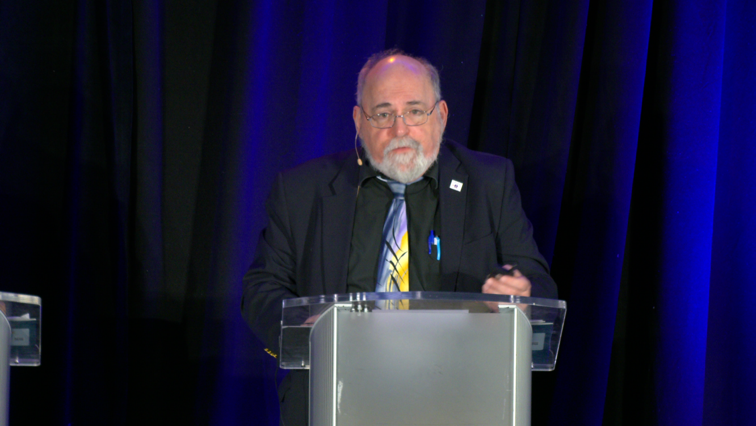
Corey J Langer, MD
Philadelphia, Pennsylvania
Notes:
C

Slide 44
What Clinicians Want to Know: First-Line and Maintenance
Therapy for Patients with Extensive-Stage Small Cell Lung Cancer
A CME/MOC-Accredited Live Webinar
Tuesday, November 11, 2025
5:00 PM – 6:00 PM ET
Faculty
Luis Paz-Ares, MD, PhD
Misty Dawn Shields, MD, PhD
Moderator
Neil Love, MD

Slide 45
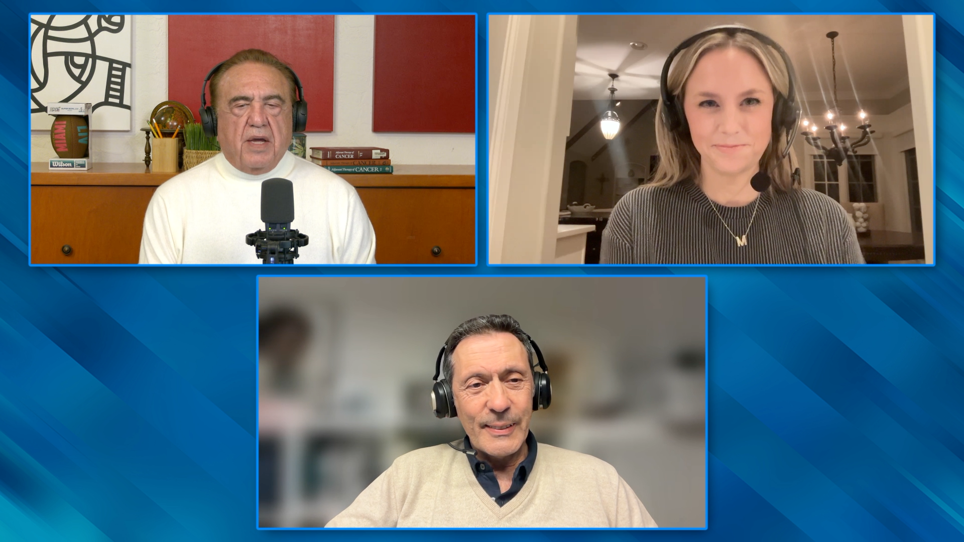

Slide 46

Lancet 2025;405(10495):2129-43
JAMA 2025;333(21):1906-17
For patients with LS-SCLC, 5-year overall survival with chemotherapy and radiation therapy was 16.1% to 27.7% prior to introduction of durvalumab. With the addition of 2 years of consolidation
durvalumab, overall survival for LS-SCLC has improved from a median of 33.4 months to 55.9 months, with 3-year overall survival of 56.5%. Patients with ES-SCLC have an initial response
rate of approximately 60% to 80% to chemoimmunotherapy, with 3-year overall survival of 17.6% and 5-year overall survival of 12%.
Notes:
C

Slide 47
When counseling a typical patient with extensive-stage small-cell lung cancer (ES-SCLC), how do you respond if the patient asks the percent chance of being alive and relatively well considering their disease in 5 years after receiving available treatments?
Median: 10%
Mean: 13%
When counseling a typical patient with ES-SCLC, how do you respond if the patient asks the percent chance of cure after receiving available treatments?
Median: 5%
Mean: 6%

Slide 48
Agenda
Introduction: Rational Treatment Goals for Extensive-Stage Disease?
Module 1: Current Considerations in the Selection of First-Line and Maintenance Therapy — Dr Borghaei
Module 2: Clinician Survey Results
Module 3: Promising Investigational Strategies — Dr Chiang

Slide 49
FDA Approves Lurbinectedin in Combination with Atezolizumab or Atezolizumab and Hyaluronidase-tqjs for ES-SCLC
Press Release: October 2, 2025
“On October 2, 2025, the Food and Drug Administration approved lurbinectedin in combination with atezolizumab or atezolizumab and hyaluronidase-tqjs for the maintenance treatment of adult patients with extensive-stage small cell lung cancer (ES-SCLC) whose disease has not progressed after first-line induction therapy with atezolizumab or atezolizumab and hyaluronidase-tqjs, carboplatin, and etoposide.
Efficacy was evaluated in IMforte (NCT05091567), a randomized, multicenter, open-label trial in patients receiving first-line treatment for ES-SCLC. In IMforte, 483 patients with ES-SCLC whose disease had not progressed after completion of four cycles of atezolizumab, carboplatin, and etoposide (induction treatment) were randomized (1:1) to receive either lurbinectedin in combination with atezolizumab administered intravenously (IV) or atezolizumab IV alone until disease progression or unacceptable toxicity.”
https://www.fda.gov/drugs/resources-information-approved-drugs/fda-approves-lurbinectedin-combination-atezolizumab-or-atezolizumab-and-hyaluronidase-tqjs-extensive

Slide 50

Current Considerations in the Selection of First-Line and Maintenance Therapy for Extensive-Stage Small Cell Lung Cancer (ES-SCLC)
Hossein Borghaei, MS, DO
Professor and Chief of Thoracic Oncology
The Gloria and Edmund M. Dunn Chair in Thoracic Oncology
RTP 2026

Slide 51
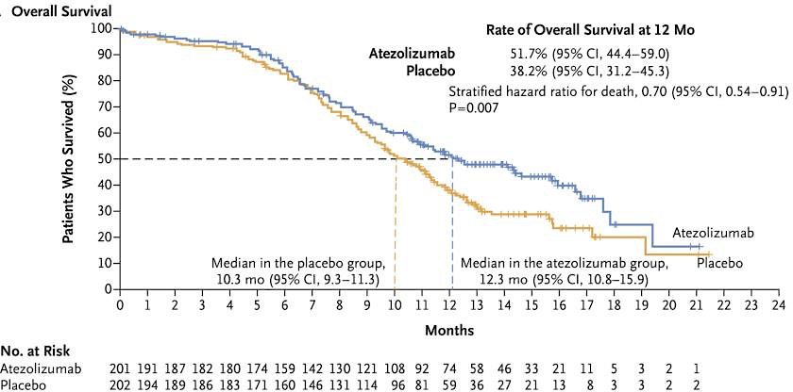
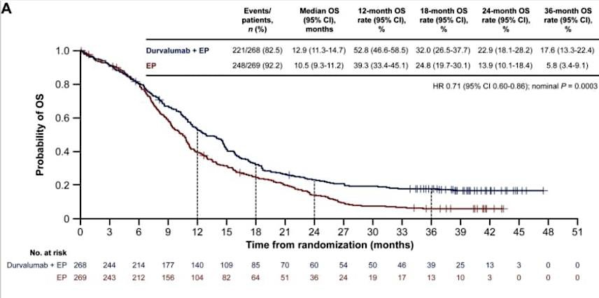
Current Paradigm for Treatment of ES-SCLC
mOS
~12.5 mo
EP + PD-L1 induction PD-L1 maintenance
Atezolizumab + EP → atezolizumab
maintenance - IMpower133
  mOS 12.3 vs 10.3 mo; HR 0.70
Durvalumab + EP → durvalumab
maintenance - CASPIAN
  mOS 12.9 vs 10.5 mo; HR ~0.71 at >3 years.
Horn L et al. N Engl J Med. 2018; Paz-Ares L et al. ESMO Open 2022

Slide 52
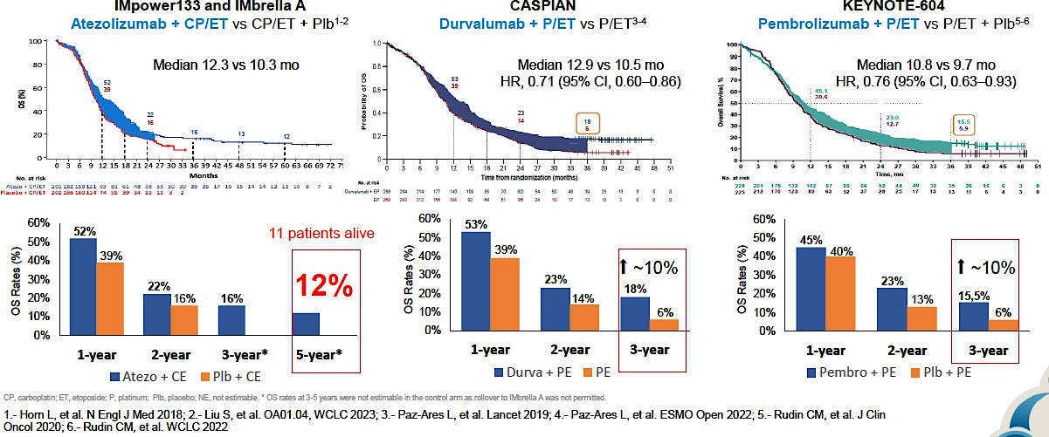
Pivotal Trials – Long term outcome
Notes:
Paz-Ares L et al. ESMO Open 2022

Slide 53
ES-SCLC
Other positive randomized 1L chemo-IO trials:
  Serplulimab (PD-1) + EP (ASTRUM-005): mOS 15.4 vs 10.9 mo, HR 0.63.
  Adebrelimab (PD-L1) + EP (CAPSTONE-1): mOS 15.3 vs 12.8 mo, HR 0.72.
What has NOT improved OS in 1L ES-SCLC:
  Pembrolizumab + EP (KEYNOTE-604): PFS ↑, OS not significant.
  TIGIT add-on (tiragolumab) to atezo-EP (SKYSCRAPER-02): negative.
Cheng Y et al. JAMA 2022; Rudin CM et al. ASCO 2023; Rudin CM et al. J Clin Oncol. 2020; Wang PJ et al. Lancet Oncol. 2022

Slide 54
IMforte study design
First screening
Induction phase
Second screening
Maintenance phase
Eligibility criteria
No prior systemic treatment for
ES-SCLC
No CNS metastases
ECOG PS 0/1
N=660
Eligibility criteria
Ongoing CR/PR or SD following induction therapy
ECOG PS 0/1
N=483^{b}
Lurbi (3.2 mg/m²) +
atezo (1200 mg)
IV q3w^{c}
Treat until PD or unacceptable toxicity
No crossover allowed
ENR
Atezo +
carbo + etop
(4 cycles q3w)ª
R
1:1
Follow-up
Atezo (1200 mg)
IV q3w
Efficacy endpoint assessments started from randomization into the maintenance phase; safety analyses were from MC1D1
Stratification factors for randomization
ECOG PS (0/1)
LDH (≤ULN/>ULN)
Presence of liver metastases (Y/N) at induction BL
Prior receipt of PCI (Y/N)
Primary endpoints
IRF-PFS and OS
Secondary endpoints included
INV-PFS, ORR, DOR, and safety
Luis Paz-Ares, MD, PhD
IMforte ASCO 2025 Abstract 8006

Slide 55
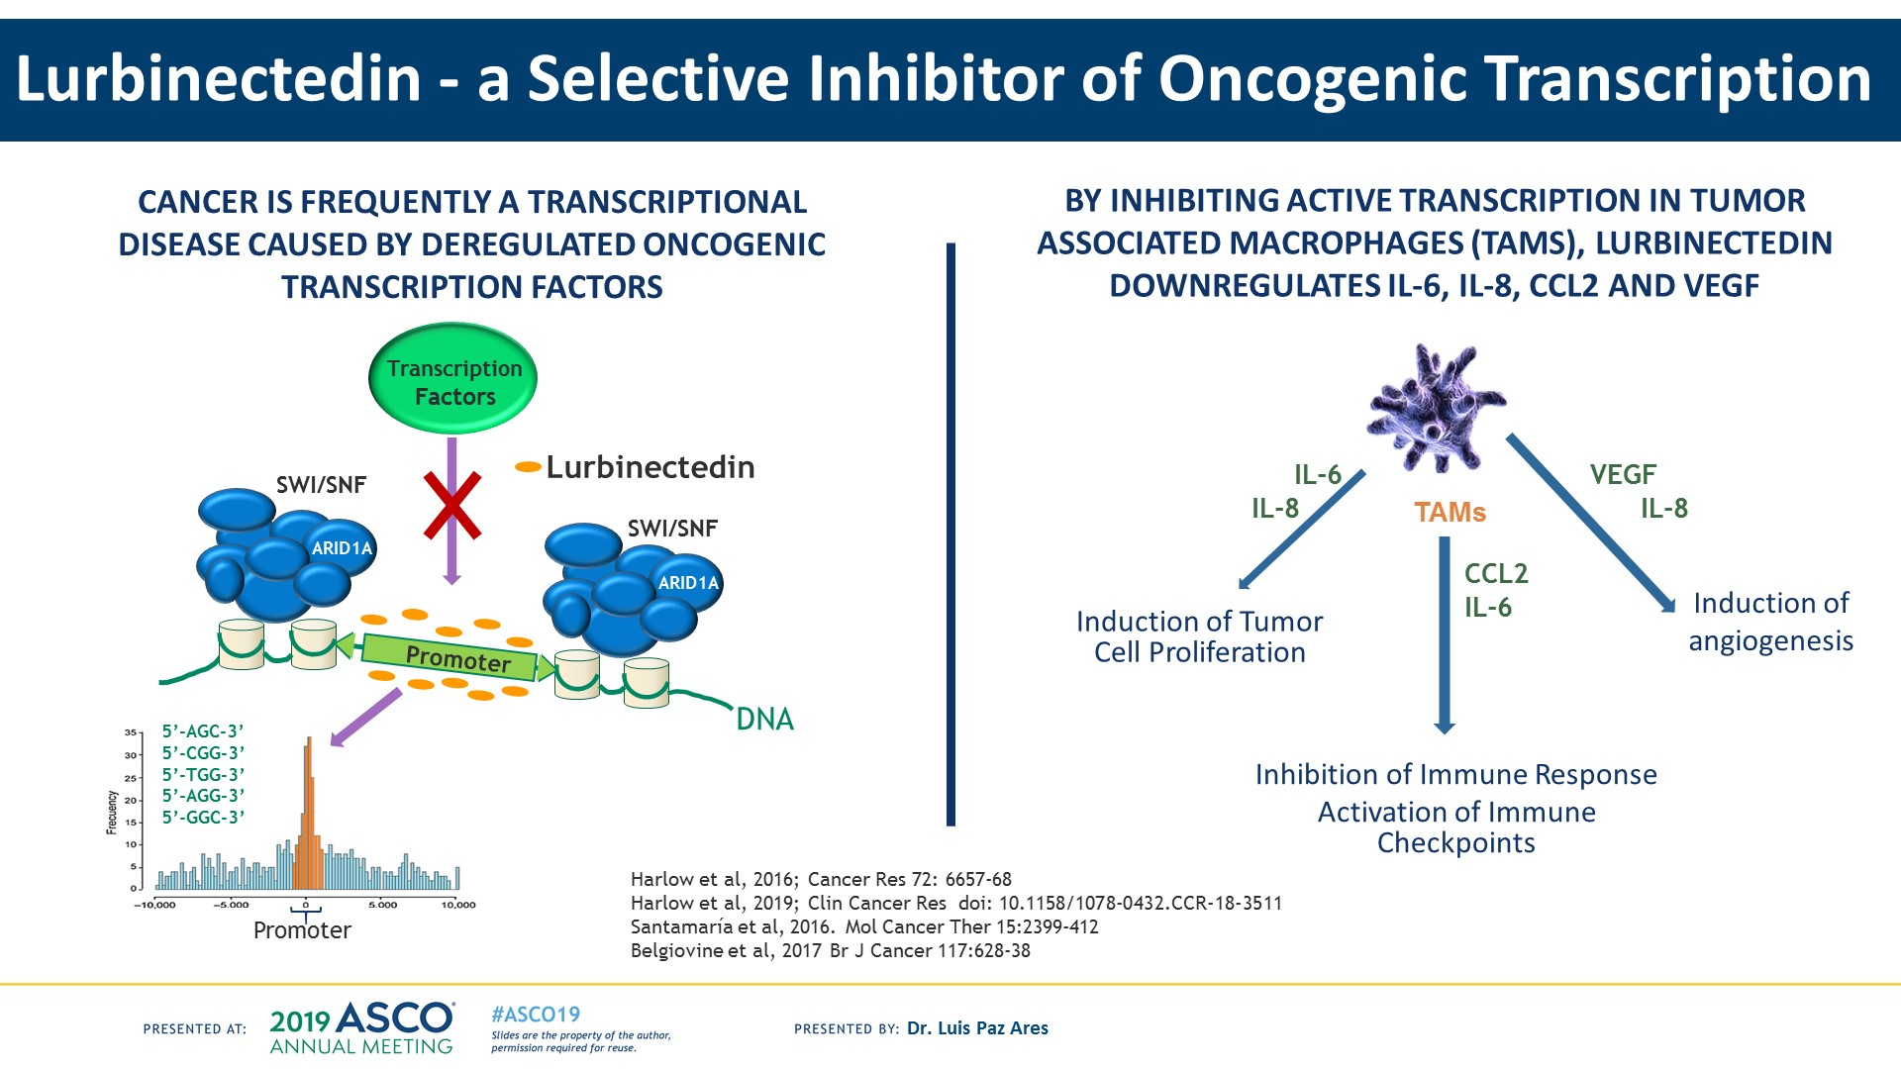
How Does Lurbinectedin Work?
Presented By Luis Paz-Ares at 2019 ASCO Annual Meeting

Slide 56
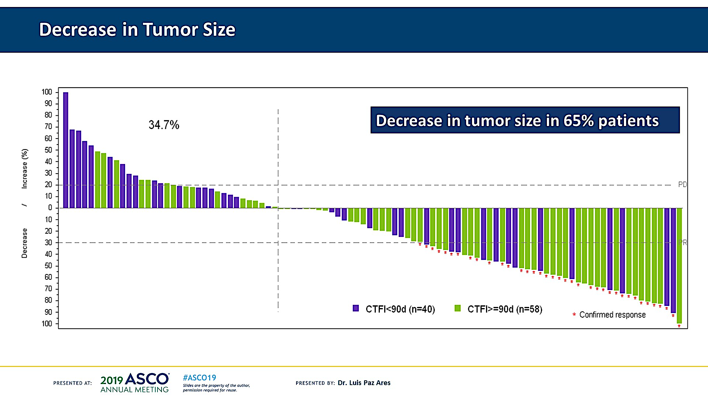
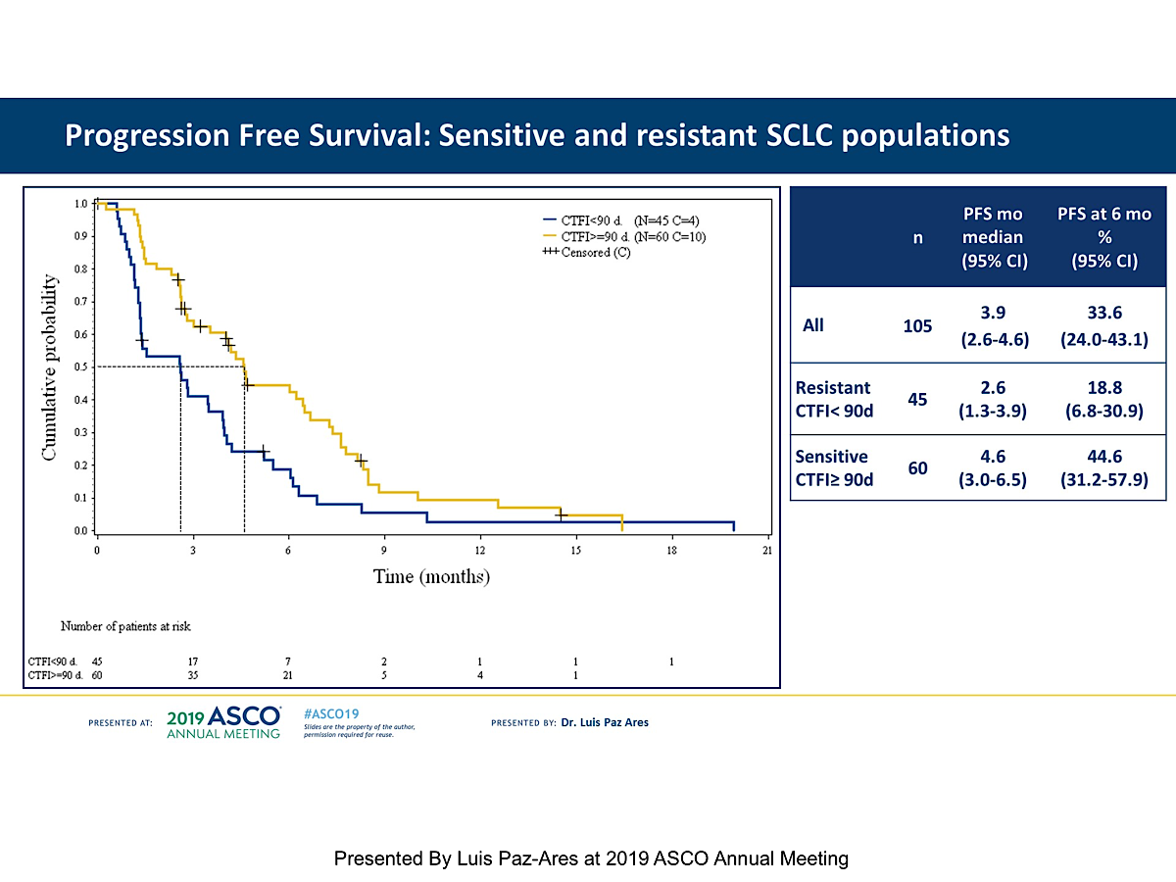
Slide 10
How Does Lurbinectedin Work?
Presented By Luis Paz-Ares at 2019 ASCO Annual Meeting

Slide 57
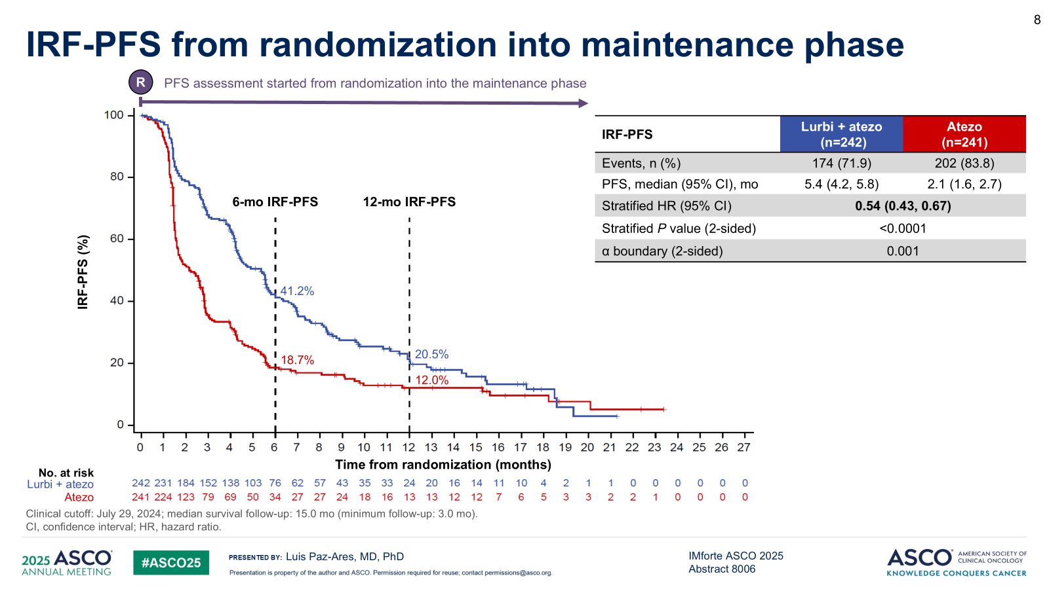
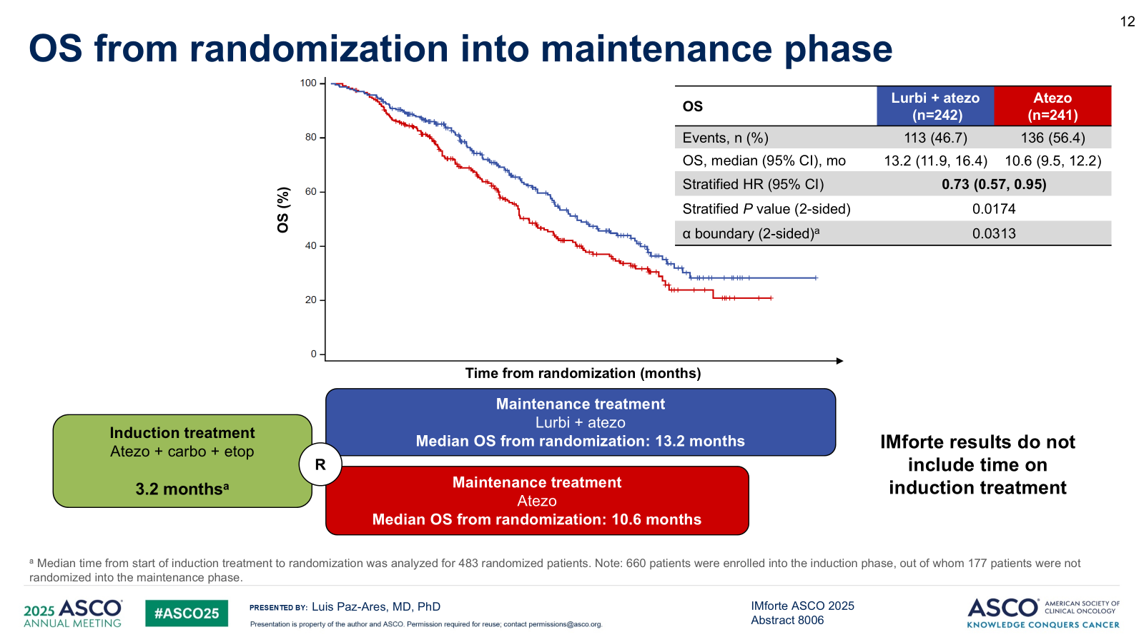
IMforte Results

Slide 58
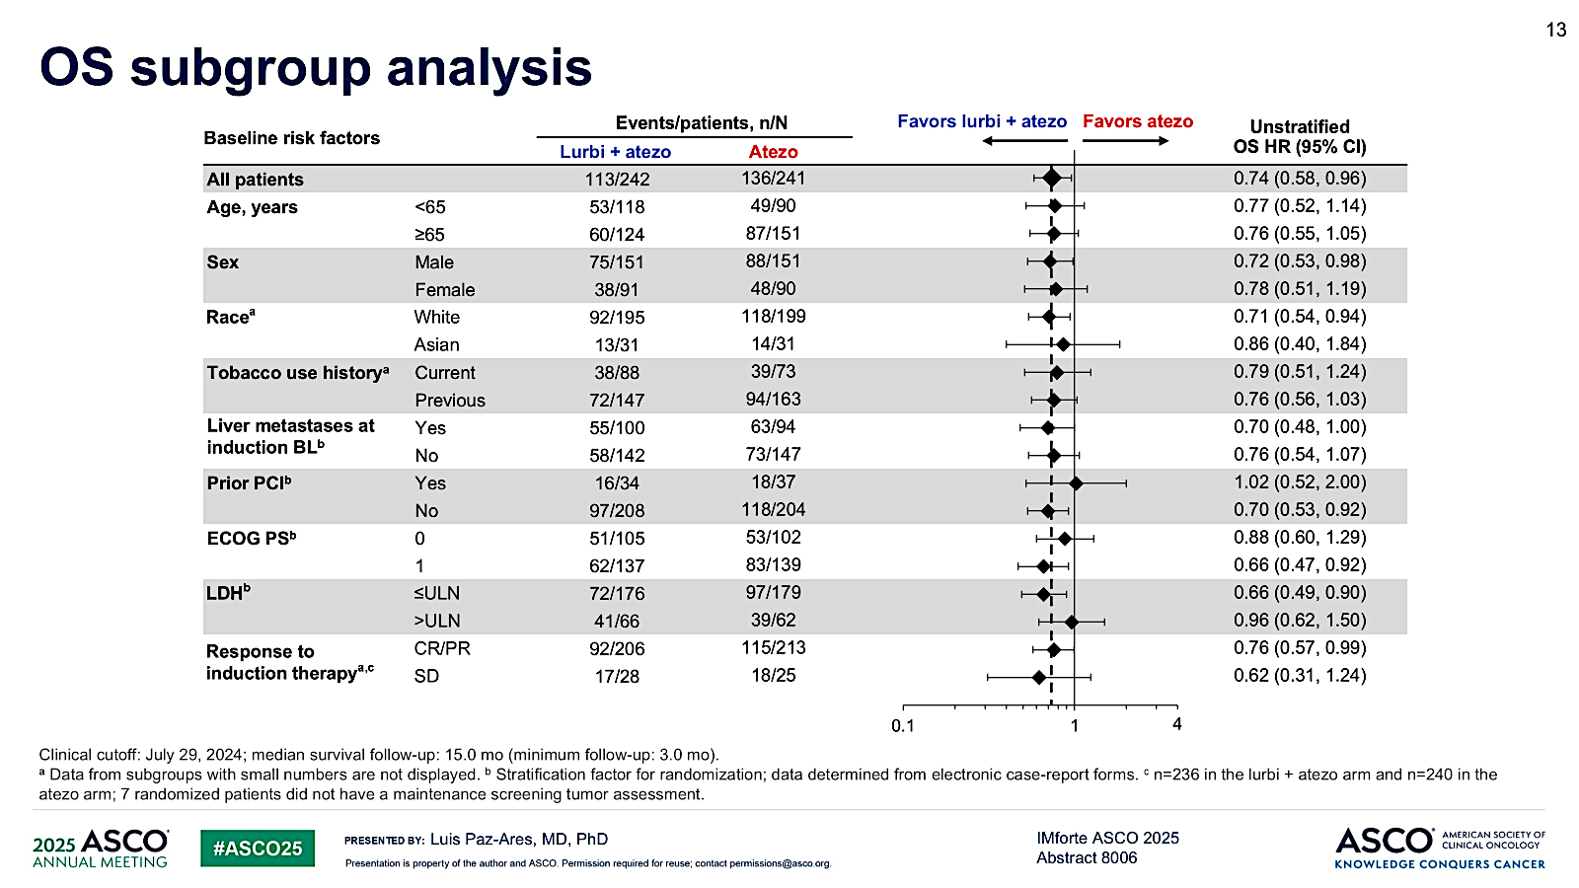
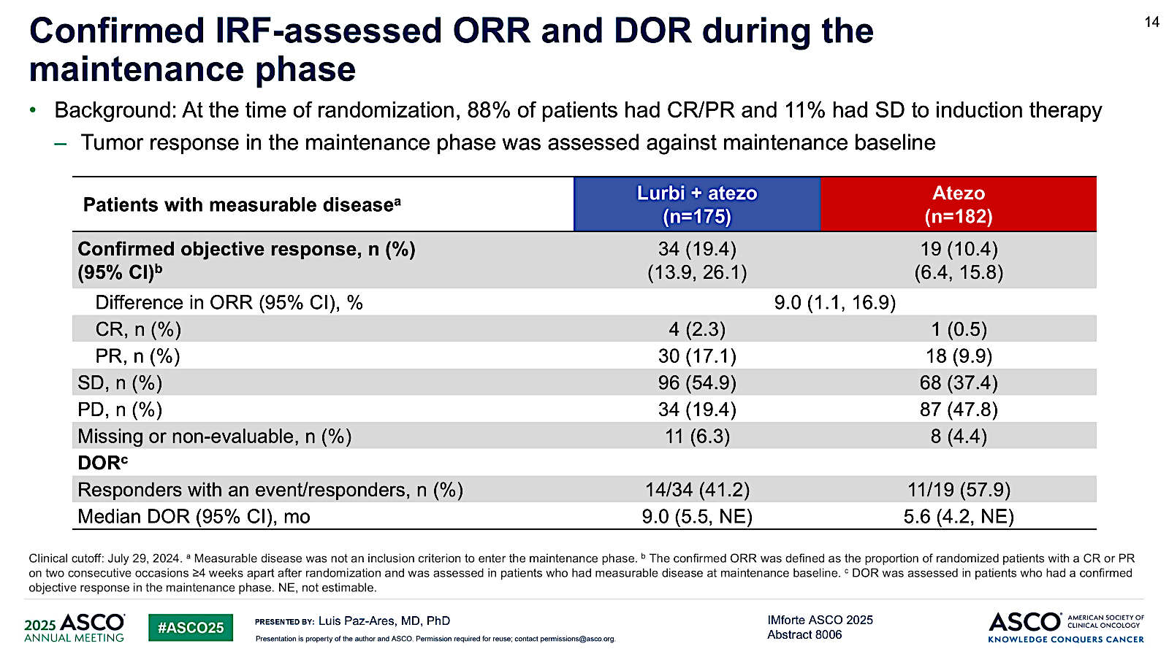
IMforte Results

Slide 59
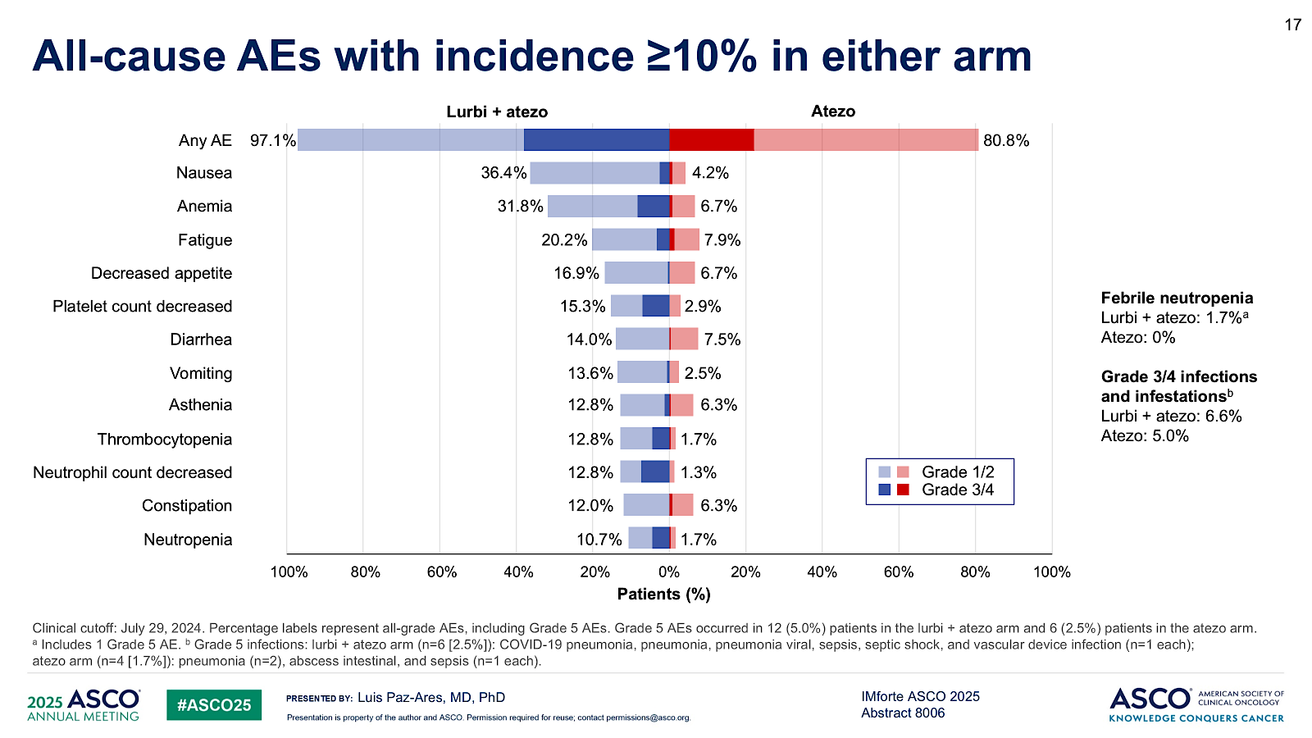
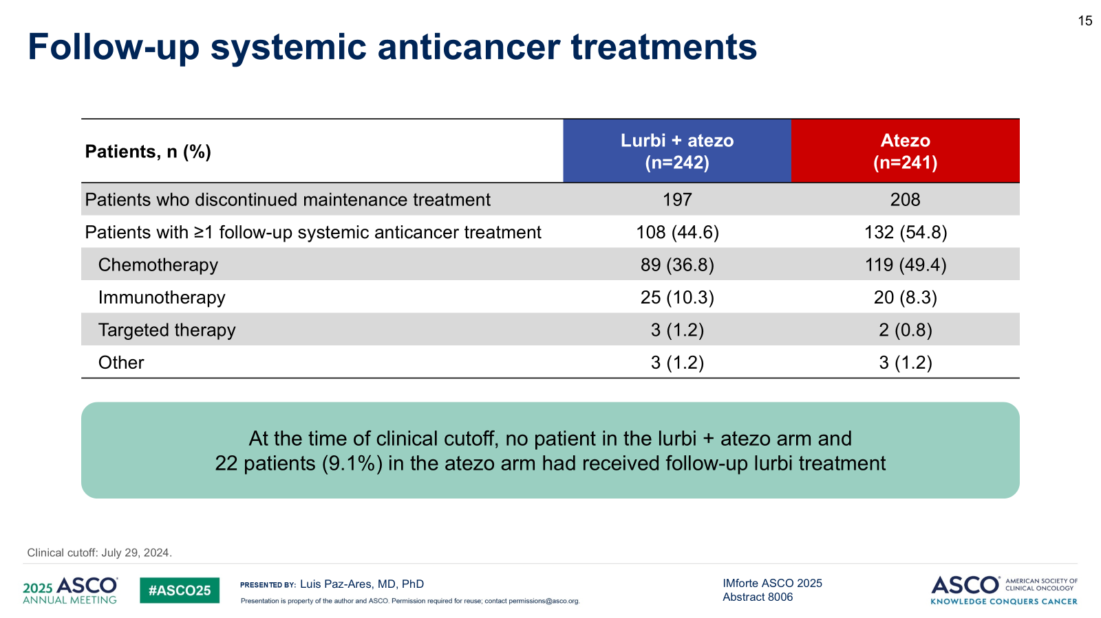
IMforte Results

Slide 60
Dr Borghaei: Case Presentation 1
60 Y Old female, 35 pack Yr smoking history presented with two months of progressive shortness of breath with intermittent cough, wheezing and sputum production.
She did not have a response to antibiotics and steroids
CT showed a mass involving the mediastinum and right upper lobe with partial extrinsic compression of vascular structures, the right bronchus intermedius, and the right upper lobe. Additionally, there was evidence of lymphadenopathy and a new hepatic lesion in the right hepatic lobe that was highly suspicious for metastatic disease.

Slide 61
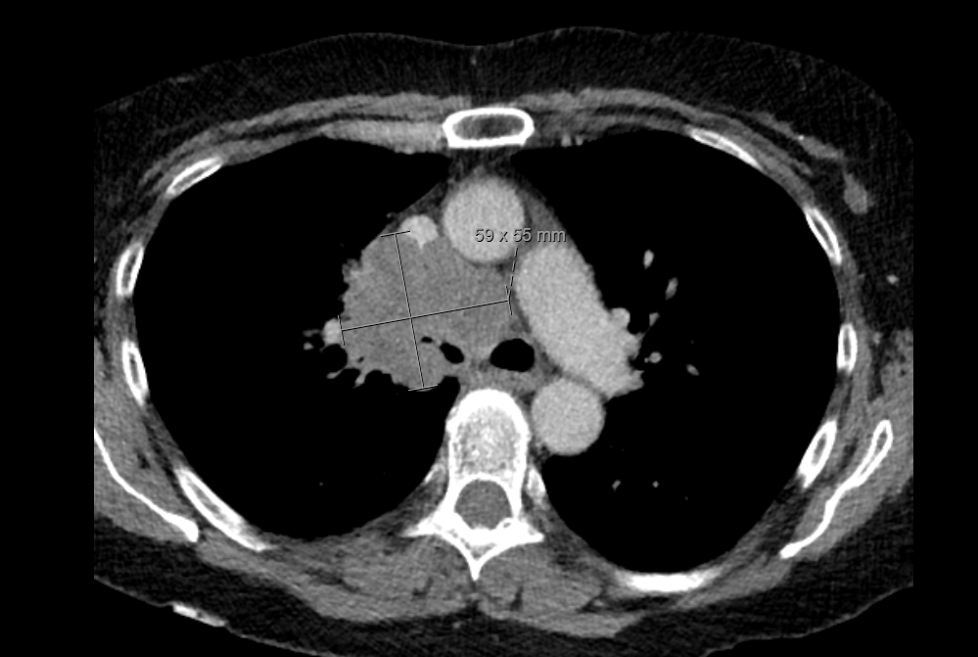
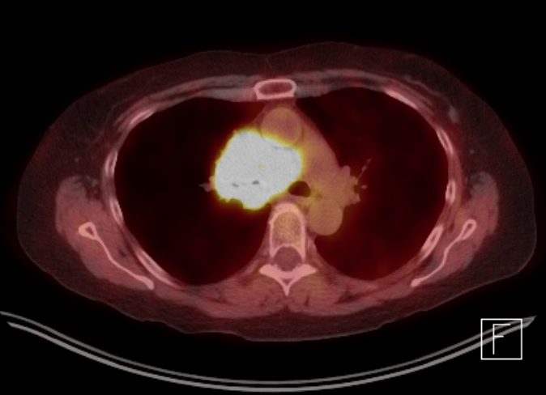
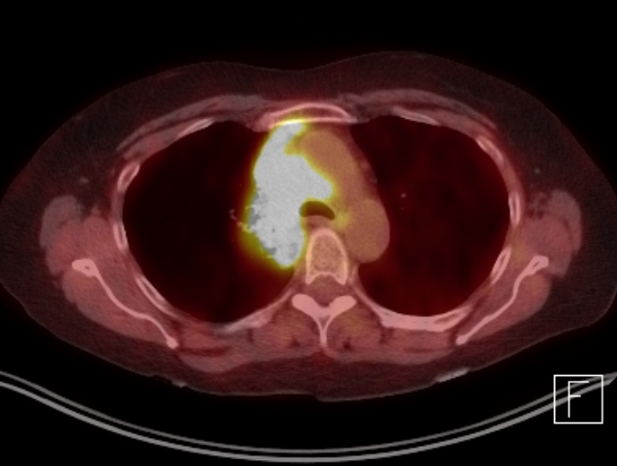
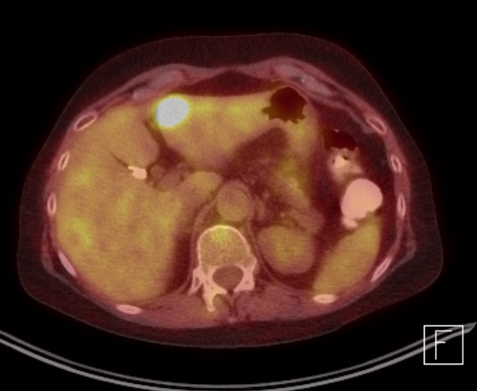
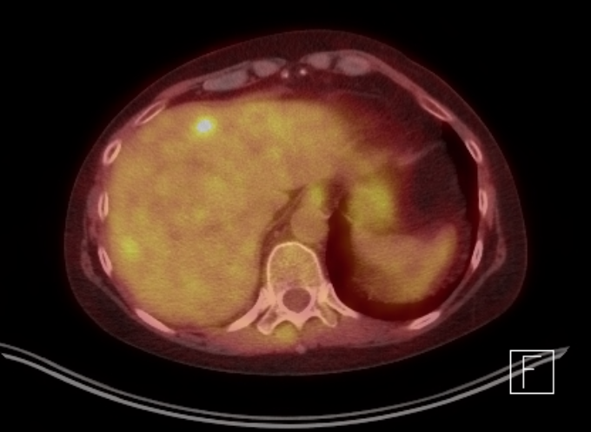
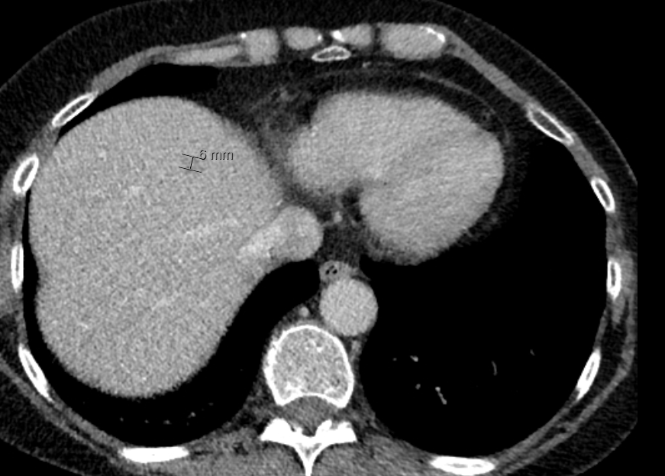
Dr Borghaei: Case Presentation 1 (Continued)

Slide 62
Dr Borghaei: Case Presentation 1 (Continued)
Bronchoscopy and biopsy showed Small Cell lung Cancer
Liver biopsy confirmed SCLC
Brain MRI was negative at baseline
Treatment with carboplatin, etoposide and atezolizumab was initiated
G-CSF was used as prophylaxis from cycle 1
She developed myelosuppression requiring blood transfusions

Slide 63
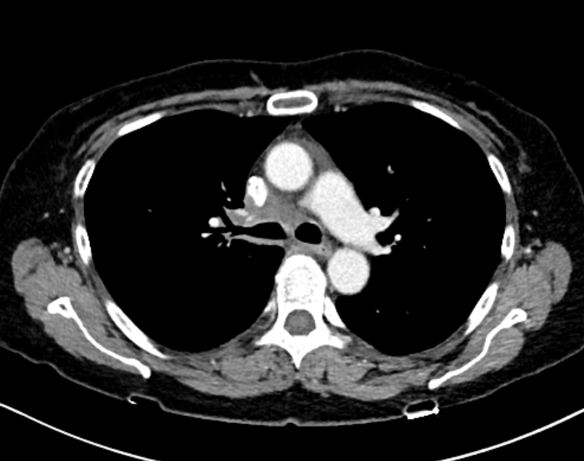
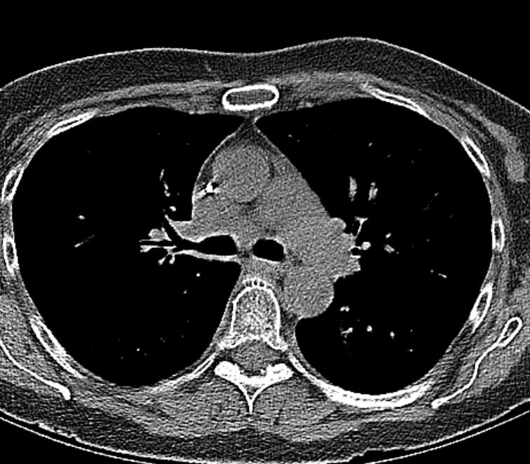
Dr Borghaei: Case Presentation 1 (Continued)
Pre Treatment
Post 2 Cycles of Induction
Post 4 cycles of Induction

Slide 64
Dr Borghaei: Case Presentation 1 (Continued)
She completed four cycles of induction chemotherapy plus IO
There was a one-week delay in treatment due to anemia in cycle 3
After the 4th cycle of induction, imaging studies showed disease stability
Maintenance atezolizumab was initiated. She had significant fatigue. I decided to delay initiation of lurbinectedin to allow for recovery
Lurbi was added with cycle 2 of atezolizumab and is continuing now (total of 3 cycles)

Slide 65
Dr Borghaei: Case Presentation 2
64 y.o. female former smoker, quit approximately 13 months prior to diagnosis, started smoking about 41 years ago (40 pack years) was seen with a diagnosis of SCLC and positive QuantiFERON gold.
Past medical history is significant for latent TBI, CAD, HFrEF, reported COPD, most recent PFT's display moderately severe obstruction with relatively preserved diffusion.
She had been retired since 2009 and remains active. She is able to walk 10 blocks, climb the stairs and perform her own ADL's. She does note dyspnea at the top of the stairs.

Slide 66
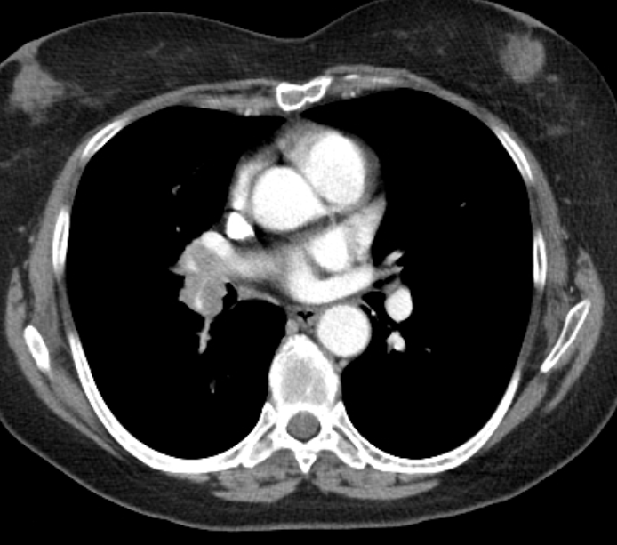
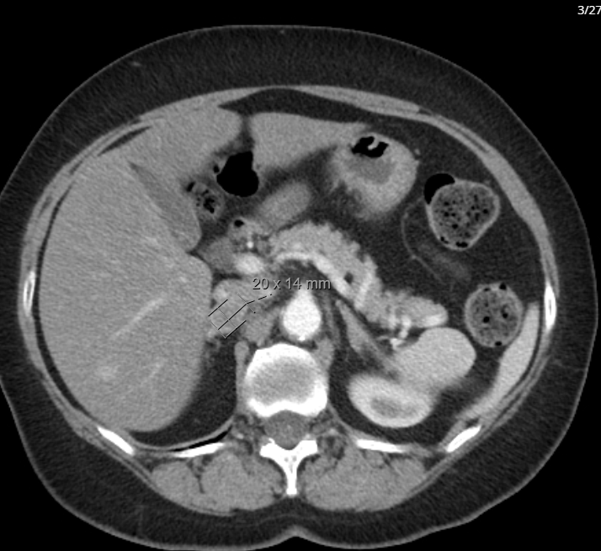
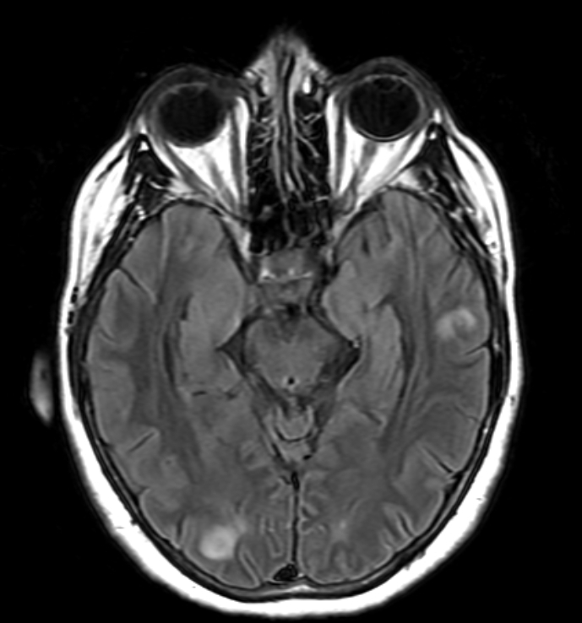
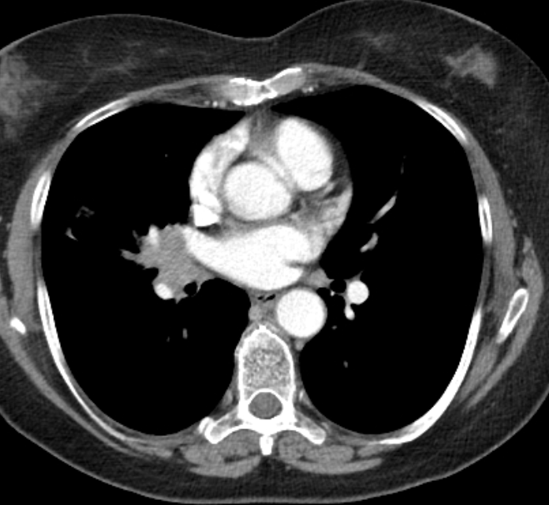
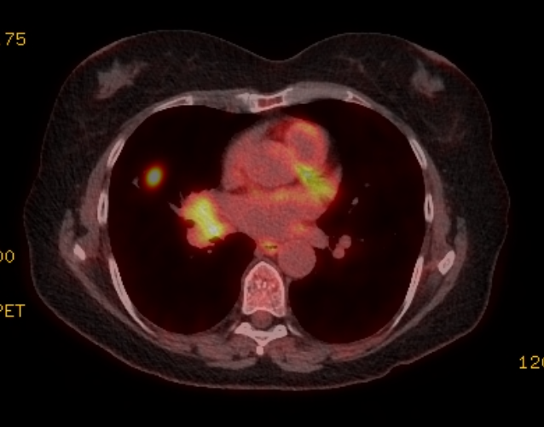
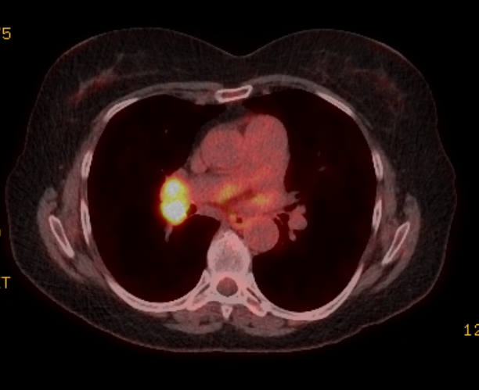
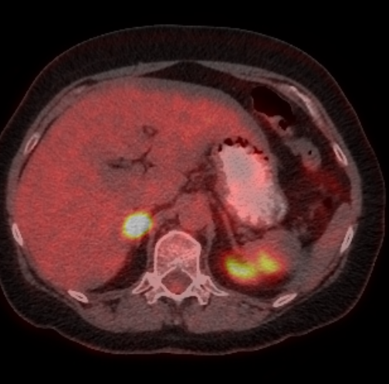
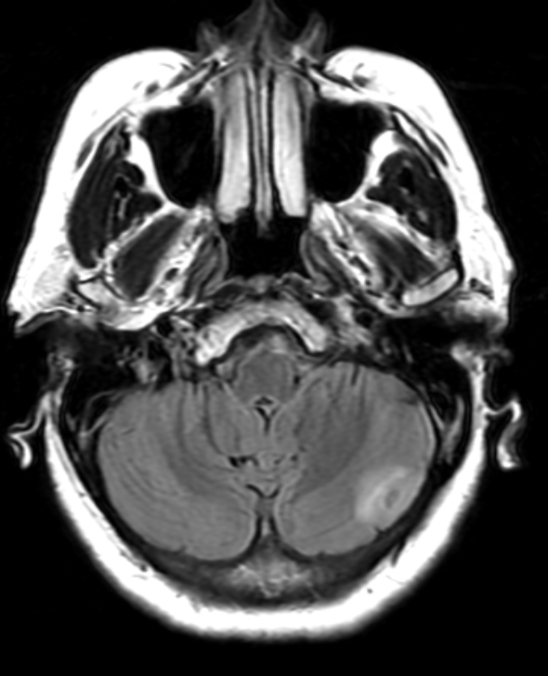
Dr Borghaei: Case Presentation 2 (Continued)

Slide 67
Dr Borghaei: Case Presentation 2 (Continued)
She began systemic therapy with carboplatin, etoposide and atezolizumab. Trilaciclib was added for marrow protection
Interim imaging showed a response to treatment, including intracranial response (radiation to the brain was held)
She completed four cycles of induction with the above regimen without significant toxicities
Maintenance treatment with atezolizumab plus lurbinectedin was offered and accepted by the patient

Slide 68

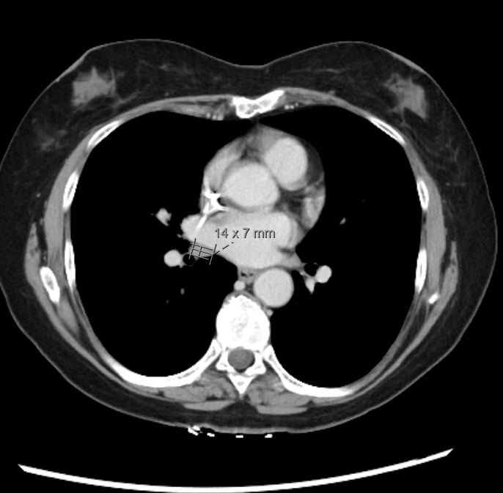
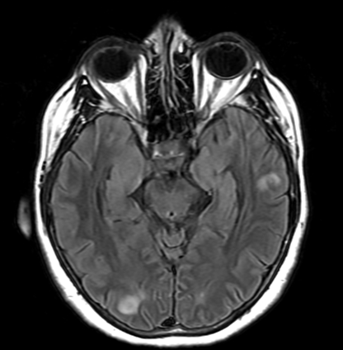
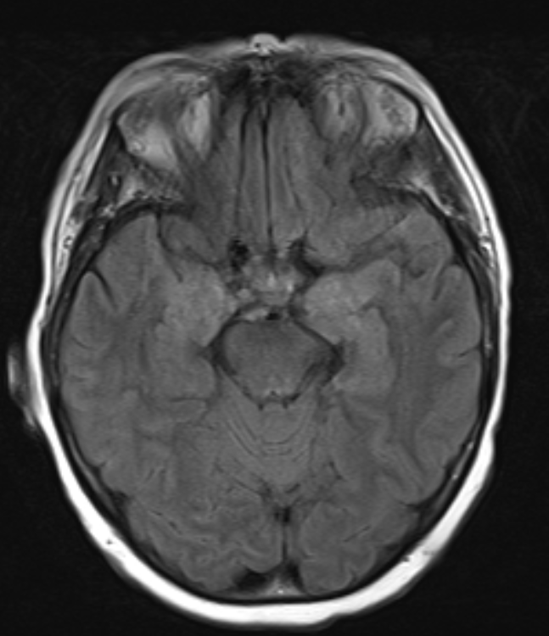
Dr Borghaei: Case Presentation 2 (Continued)
Pre treatment
Post Induction
Pre treatment
Post induction

Slide 69
Dr Borghaei: Case Presentation 2 (Continued)
She presented to an ER for evaluation of dizziness, hypertension and palpitation after the first cycle of maintenance treatment. No etiology was found despite hospitalization and full evaluation
Lurbi was held for cycle 2 but added for cycle 3
After cycle 3 she again presented to the ER with the same symptoms. Again, work up was negative
Lurbi was held for cycles 4 and 5 and no ER visits occurred
Cycle 6 included both drugs and again the same pattern returned
Lurbi has been discontinued and she remains on maintenance atezolizumab
Progression in brain was documented after cycle 2 of maintenance and SRS was used for treatment

Slide 70
Agenda
Introduction: Rational Treatment Goals for Extensive-Stage Disease?
Module 1: Current Considerations in the Selection of First-Line and Maintenance Therapy — Dr Borghaei
Module 2: Clinician Survey Results
Module 3: Promising Investigational Strategies — Dr Chiang

Slide 71
Which first-line treatment would you most likely recommend for a 65-year-old patient (PS 0) with de novo ES-SCLC and no CNS involve­ment?

Slide 72
The benefits and risks of durvalumab/platinum/etoposide and atezolizumab/carboplatin/etoposide are very similar, and from a clinical point of view selecting between the 2 regimens as first-line treatment for a patient with ES-SCLC can be considered a “coin flip.”

Slide 73
Regulatory and reimbursement issues aside, which first-line treatment would you most likely recommend for a 65-year-old patient (PS 0) who received concurrent platinum/etoposide and radiation therapy followed by durvalumab consolidation for LS-SCLC and experienced disease progression to ES-SCLC 2 years after completing treatment?
* Carboplatin/etoposide

Slide 74
Regulatory and reimbursement issues aside, which first-line treatment would you most likely recommend for a 65-year-old patient (PS 0) who received concurrent platinum/etoposide and radiation therapy followed by durvalumab consolidation for limited-stage (LS)-SCLC and experienced disease progression to ES-SCLC 6 months after completing treatment?
* Platinum/etoposide

Slide 75
Regulatory and reimbursement issues aside, which first-line treatment would you most likely recommend for a 65-year-old patient (PS 0) who received concurrent platinum/etoposide and radiation therapy followed by durvalumab consolidation for LS-SCLC and experienced disease progression to ES-SCLC while receiving durvalumab consolidation?
* Carboplatin, etoposide, lurbinectedin or tarlatamab depending on progression-free interval

Slide 76
Regulatory and reimbursement issues aside, what would you most likely recommend as maintenance therapy for a 65-year-old patient with ES-SCLC (PS 0) who received induction therapy with atezolizumab and platinum/etoposide and attained a complete response with good tolerability?
* Atezolizumab + tarlatamab 2%. Would be a discussion — you would not know if lurbinectedin is working as there is no remaining target. And have to explain the toxicity — really a patient decision.

Slide 77
Regulatory and reimbursement issues aside, what would you most likely recommend as maintenance therapy for a 65-year-old patient with ES-SCLC (PS 0) who received induction therapy with atezolizumab and platinum/etoposide and attained a partial response with good tolerability?

Slide 78
Regulatory and reimbursement issues aside, what would you most likely recommend as maintenance therapy for a 65-year-old patient with ES-SCLC (PS 0) who received induction therapy with atezolizumab and platinum/etoposide and attained a partial response but required numerous dose reductions and holds for toxicity?

Slide 79
Regulatory and reimbursement issues aside, what would you most likely recommend as maintenance therapy for a 65-year-old patient with ES-SCLC (PS 0) who received induction therapy with atezolizumab and platinum/etoposide and attained stable disease with good tolerability?

Slide 80
Regulatory and reimbursement issues aside, what would you most likely recommend as maintenance therapy for a 65-year-old patient with ES-SCLC (PS 0) and an isolated asymptomatic brain metastasis who received induction therapy with atezolizumab and platinum/etoposide (in addition to concurrent radiation therapy), responded and tolerated treatment well?
* Atezolizumab + tarlatamab. Discussion if CR, combo if PR or less

Slide 81
Regulatory and reimbursement issues aside, what would you most likely recommend as maintenance therapy for a 65-year-old patient with ES-SCLC (PS 0) and multiple bilateral asymptomatic brain metastases who received induction therapy with atezolizumab and platinum/etoposide (in addition to concurrent radiation therapy), responded and tolerated treatment well?
* Atezolizumab + tarlatamab. Discussion of combo vs immune therapy alone

Slide 82
Regulatory and reimbursement issues aside, what would you most likely recommend as maintenance therapy for an 85-year-old frail patient with ES-SCLC (PS 1) who received induction therapy with atezolizumab and platinum/etoposide, responded and tolerated treatment well?
* Atezolizumab + tarlatamab

Slide 83
In general, for how long do you continue an anti-PD-1/PD-L1 antibody in the maintenance setting for patients with ES-SCLC who respond to induction chemoimmunotherapy and tolerate treatment well?

Slide 84
In general, for how long do you continue atezolizumab in combination with lurbinectedin in the maintenance setting for patients with ES-SCLC who respond to induction chemoimmunotherapy and tolerate treatment well?

Slide 85
To approximately how many patients with ES-SCLC have you administered atezolizumab with lurbinectedin in the maintenance setting?
Median: 1 patient
Range: 0-15 patients
In general, which lurbinectedin-associated side effect is most detrimental to quality of life for patients with ES-SCLC who are receiving combination maintenance therapy?
Myelosuppression/cytopenias/neutropenia | 33
Fatigue | 23
GI toxicity | 8
Neuropathy | 2
Increase creatinine | 1
Tolerable/none | 4

Slide 86
In general, do you administer prophylactic G-CSF for patients with ES-SCLC who are going to receive atezolizumab and lurbinectedin as maintenance therapy?
* Low counts after cycle 1
With cytopenias
Persistent low neutrophil counts and older patients
Frail, with borderline cytopenias
Older pt, with history of chemo
Hx of cytopenia
Poor PS, multiple comorbidities
Age and baseline cytopenias
If significant neutropenia
Only if they are neutropenic at any point during treatment, then I would continue
Only if cytopenias persist despite dose reductions
Age >65

Slide 87
Regulatory and reimbursement issues aside, what would you most likely recommend as maintenance therapy for a 65-year-old patient with ES-SCLC (PS 0) who received induction therapy with durvalumab and platinum/etoposide and attained a complete response with good tolerability?
* Atezolizumab + tarlatamab. Discuss with patient (no target and toxicity risks)

Slide 88
Regulatory and reimbursement issues aside, what would you most likely recommend as maintenance therapy for a 65-year-old patient with ES-SCLC (PS 0) who received induction therapy with durvalumab and platinum/etoposide and attained a partial response with good tolerability?

Slide 89
Regulatory and reimbursement issues aside, what would you most likely recommend as maintenance therapy for a 65-year-old patient with ES-SCLC (PS 0) who received induction therapy with durvalumab and platinum/etoposide and attained stable disease with good tolerability?

Slide 90
Have you administered or would you administer durvalumab in combination with lurbinectedin as maintenance therapy for a patient with ES-SCLC who received induction durvalumab with platinum/etoposide, responded and tolerated treatment well?

Slide 91
Agenda
Introduction: Rational Treatment Goals for Extensive-Stage Disease?
Module 1: Current Considerations in the Selection of First-Line and Maintenance Therapy — Dr Borghaei
Module 2: Clinician Survey Results
Module 3: Promising Investigational Strategies — Dr Chiang

Slide 92
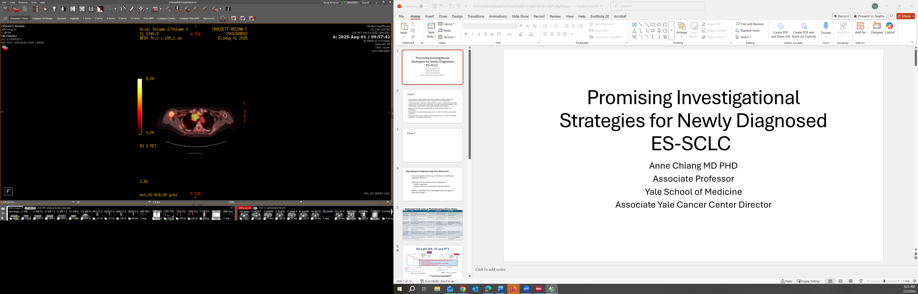
Dr Chiang: Case Presentation 1
72 yo female never smoker with HTN, arthritis, remote history of melanoma s/p excision in 1997, also DVT on anticoagulation
Presented summer 2025 with RUL lesion, mediastinal and right supraclavicular LAD, liver, pancreas, and bone lesions consistent with metastases. Brain MRI showed right parietal bone lesion.
Biopsy of the sternum revealed SCLC. NGS showed TP53, RB1 mutations.
Treated with carbo/etop/atezolizumab x 4, with CT CAP showing good response, tolerated well with good PS1
Starting lurbinectedin/atezolizumab maintenance C1 in 2/2026 after discussion of options, including clinical trials.
Notes:
Teaching points: never smoker, do NGS, also candidate for lurbi maintenance: no brain mets, good PS 1, restaging with response.

Slide 93
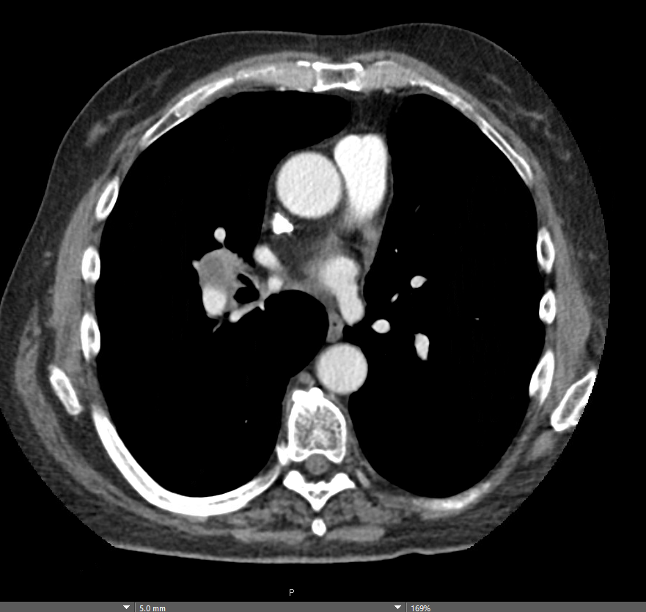
Dr Chiang: Case Presentation 2
75 yo male h/o of 50py tobacco use, COPD, HTN, stage 1A squamous cell carcinoma of the lung s/p left upper lobectomy in 2019.
Also h/o Limited stage SCLC treated with concurrent chemoradiation with cisplatin, etoposide completed in 2023.
Restaging scans in 12/2025 showing new right hilar, posterior mediastinal and retroperitoneal lymphadenopathy, and right chest wall lesion involving right 11th rib.
FNA of 11R LN positive for small cell carcinoma.
Consented to clinical trial DeLLphi-312: 1L combination durva/carbo/etop +/- tarlatamab. Randomized to SOC arm with C1D1 in 1/2026.
Notes:
Teaching points: smoking history increases risk of multiple cancers, need to rebiopsy, also randomization to ph3 trial may be on SOC arm.

Slide 94
FDA Grants Traditional Approval to Tarlatamab-dlle for Extensive- Stage Small Cell Lung Cancer
Press Release: November 19, 2025
“On November 19, 2025, the Food and Drug Administration granted traditional approval to tarlatamab-dlle for adults with extensive stage small cell lung cancer (ES-SCLC) with disease progression on or after platinum-based chemotherapy. Tarlatamab-dlle received accelerated approval for this indication in 2024.
Efficacy was evaluated in DeLLphi-304 (NCT05740566), a multicenter, randomized, open-label trial in patients with SCLC with disease progression following treatment with platinum-based chemotherapy with or without an anti-PD-(L)1 antibody. In DeLLPhi-304, 509 patients were randomized (1:1) to receive either tarlatamab-dlle or investigator’s choice of standard of care (SOC) chemotherapy (topotecan, lurbinectedin, or amrubicin) until disease progression or unacceptable toxicity.”
https://www.fda.gov/drugs/resources-information-approved-drugs/fda-grants-traditional-approval-tarlatamab-dlle-extensive-stage-small-cell-lung-cancer

Slide 95
Promising Investigational Strategies for Newly Diagnosed ES-SCLC
Anne Chiang MD PHD
Associate Professor
Yale School of Medicine
Associate Yale Cancer Center Director

Slide 96
Approaches to Improve Long-term Outcomes for ES-SCLC Patients
Use active agents earlier, e.g. in frontline or maintenance setting for ES-SCLC
Optimize 1L therapy with combinations
  Additive approach to current 1L
  Replace 1L components with alternatives
Seek to understand SCLC heterogeneity and biology and target biomarkers
Notes:
18 pts on extension study

Slide 97
Selected First Line or Maintenance SCLC Trials
Strategy | Trial | NCT | Drug/MOA | Prior Data
Maintenance: Add DLL3 bispecific | DeLLphi-305: Ph3 Tarla/Durva vs Durva after Induction | NCT06211036 | Tarlatamab; bispecific anti-DLL3/CD3 Ab | DeLLphi-303 Ph1b: mOS 25.3 mo with IO in maintenance
1L: Add DLL3 bispecific | DeLLphi-312: Ph 3 Tarla/Durva/Chemo vs Durva/Chemo | NCT07005128 | Tarlatamab: bispecific anti-DLL3/CD3 Ab | DeLLphi-304 2L: mOS 13.6 vs. 8.3 mo chemo
1L: Add Anti-fGM1 Ab | TIGOS: Ph3 Atigo/Nivo/Chemo vs Atigo/Chemo | NCT06646276 | BMS986012 (Atigotatug); Anti-fucosyl-GM1 Ab | Interim Analysis: Ph2 1L (NCT04702880) mOS 15.6 vs. 11.4 mo
1L: Replace w PD1/VEGF bispecific | Rosetta Lung-01: Ph 3 Pumi/Chemo vs Atezo/Chemo | NCT06712355 | BNT327 (Pumitamig); bispecific anti- PD-1/VEGF Ab | Ph2 1L (NCT05844150) mOS 16.8 mo
1L: Replace w PD1/VEGF bispecific | Ph 2/3 PF08634404/Chemo single arm, then with Atezo vs Atezo/Chemo | NCT07226999 | PF08634404; bispecific anti-PD-1/VEGF Ab
1L: Replace chemo w ADC | SEZanne: Ph 2 ABBV-706/Atezo vs Atezo/Chemo | NCT07155174 | ABBV-706; SEZ6 Antibody-drug conjugate | Ph1 2L/3L (NCT05599984; ORR 60-80% as monotherapy
This table is courtesy of Anne Chiang, MD, PhD
Notes:
Some trials add an agent, some trials replace an agent – mention the drug and MOAs
Ph3 designs except PF drug is phase2/3 and SEZanne is ph2

Slide 98
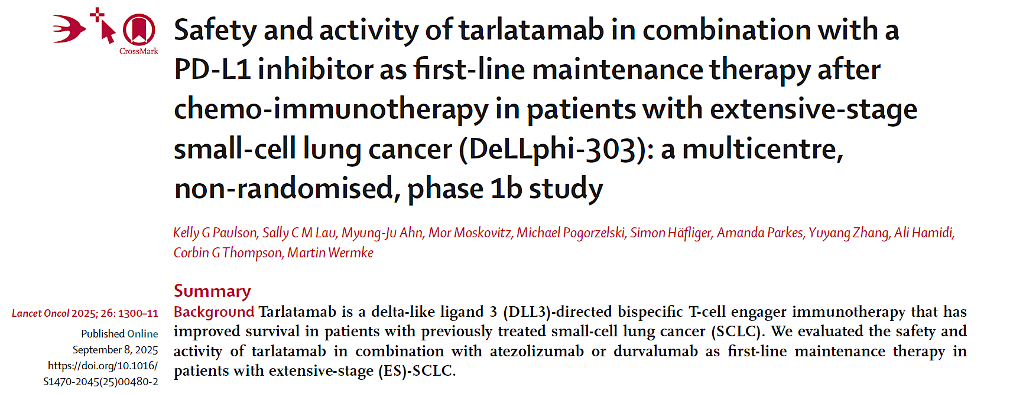

Slide 99
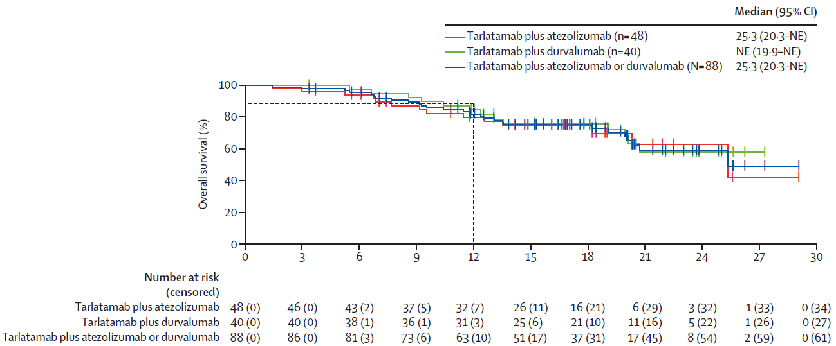
Phase 1b DeLLphi-303: Tarlatamab Maintenance
Median OS: 25.3 months
Median PFS: 5.6 months
ORR: 24% (2 complete responses, 19 partial responses)
Disease Control Rate (DCR): 60%
36% of patients had disease control for at least 52 weeks
Manageable safety profile, CRS 56% mostly G1-2 c/w prior studies
Findings support ongoing phase 3 DeLLphi-305 Maintenance study
Paulson KG et al. Lancet Oncol. 2025
Notes:
Moving tarla into 1L or maintenance is an

Slide 100
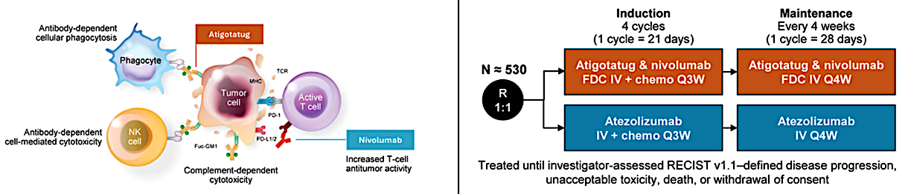
TIGOS: A Study to Compare the Efficacy and Safety of BMS-986489 (BMS-986012+ Nivolumab Fixed Dose Combination) in Combination With Carboplatin Plus Etoposide to That of Atezolizumab With Carboplatin Plus Etoposide as First-Line Therapy in Participants With Extensive-Stage Small Cell Lung Cancer
Phase I/II atigotatug/nivo study in relapsed/refractory SCLC (NCT02247349)
  ORR 38%, mDOR 26.4 mo
  Low-grade pruritus most common TRAE
Randomized phase II study atigotatug/nivo/carbo/etop as 1L ES-SCLC therapy vs nivo/carbo/etop (NCT04702880) Interim Analysis
  mPFS 5.8 mo vs. 5.1 mo; HR 0.81 (95% CI 0.53–1.23)
  OS (15.6 vs. 11.4 months; HR 0.71 (95% CI 0.44–1.16)
  Safety profile similar in both arms, increase in low-grade, self-resolving pruritus with atigo
  Baseline Fuc-GM1 expression did not correlate with treatment outcomes.¹⁶
Chu, 2022 JTO Clin Res Rep; Kalinka, ESMO 2024; Paz-Ares, 2025 ASCO; Paz-Ares, 2025 Clin Lung Cancer
Notes:
Paz-Ares, 2026 Clinical Lung Cancer
Phase III TIGOS assesses 1L atigotatug and nivolumab FDC + chemotherapy in ES-SCLC
Atigotatug is a monoclonal antibody acting as a tumor-targeted innate immune inducer that binds fucosyl-monosialoganglioside-1, which is expressed on ≤ 90% of SCLC tumor cells and minimally in normal tissues.
Dual innate plus adaptive immune activation designed to enhance tumor killing
Endpoints: primary, OS; key secondary, time to definitive deterioration
Recruiting ≈530 patients at 182 sites globally; primary completion expected 2028

Slide 101
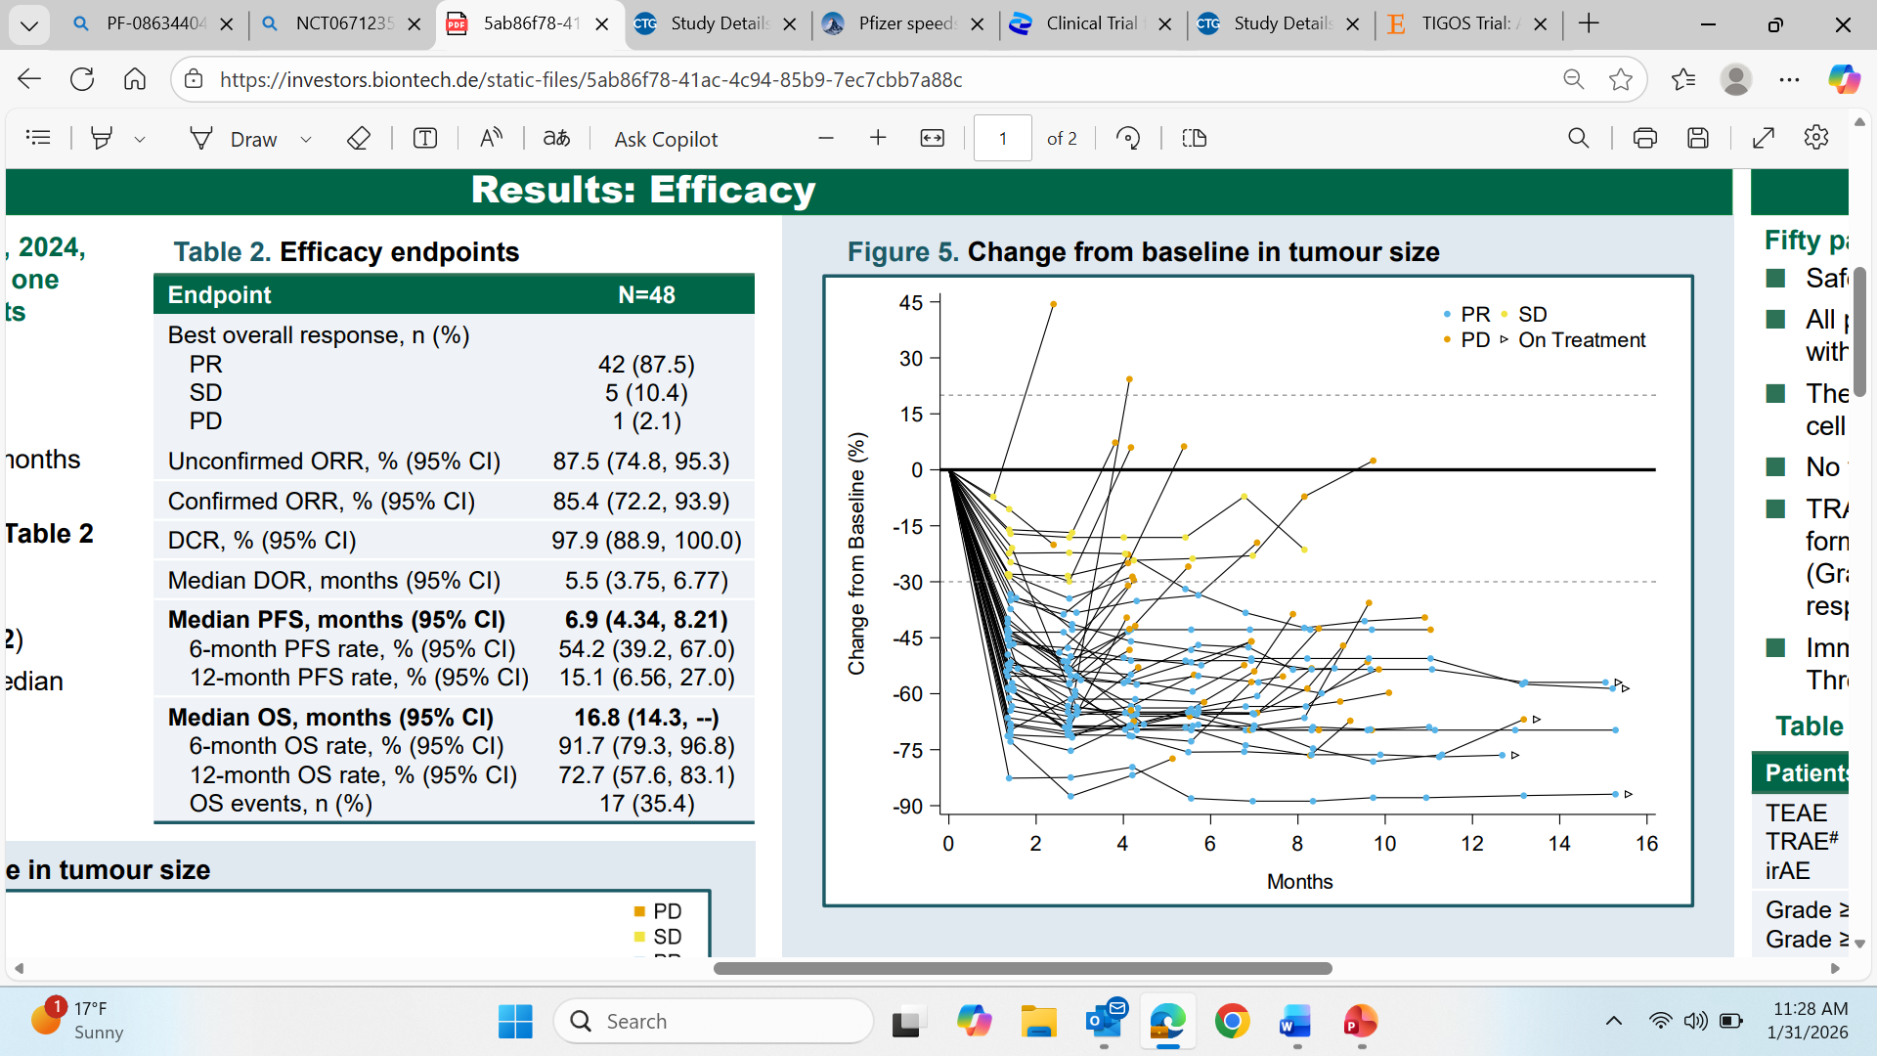
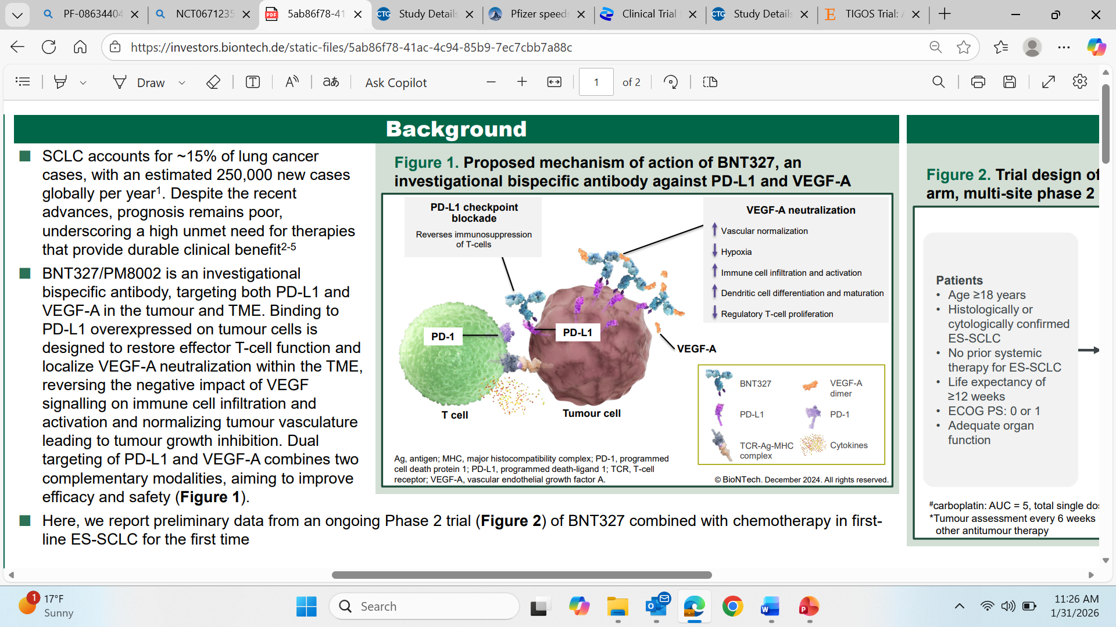
Phase 2 study of efficacy and safety of BNT327/PM8002 plus systemic chemotherapy as first-line therapy for ES-SCLC (NCT05844150)
Ying Cheng 2025 ELCC
Notes:
Ying Cheng 2025 ELCC Phase 2 NCT05844150 Phase 2 study of the efficacy and safety of BNT327/PM8002 plus systemic chemotherapy as first-line therapy for extensive-stage small-cell lung cancer (ES-SCLC)

Slide 102
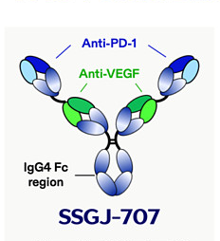
A Study to Learn About the Study Medicine Called PF-08634404 in Combination With Chemotherapy in Adult Participants With Extensive-Stage Small Cell Lung Cancer
PF‑08634404 (SSGJ-707) is an investigational bispecific antibody targeting PD‑1 and VEGF, with a tetravalent structure in which each arm can engage both targets
In the presence of VEGF, PF‑08634404 forms multimers that facilitate PD-1 binding interactions
PF-08634404 has a VEGF Fab arm that interacts with vasculature and modulates VEGF-related immune pathways
PF‑08634404 is built on an IgG4 backbone
Clinicaltrials.gov identifier NCT07222566. https://clinicaltrials.gov/study/NCT07222566; SSGJ-707. MedChemExpress.com/SSGJ-707.html

Slide 103
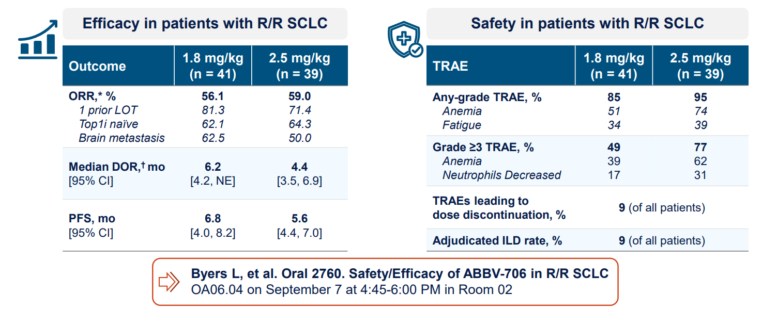
ABBV-706 SEZ6 Antibody-Drug Conjugate (ADC) in Relapsed/Recurrent SCLC Patients
The SEZanne ph2 trial randomizes 1L SCLC patients to ADC+ immunotherapy (platinum free) vs platinum doublet/immunotherapy SOC!
Byers 2025 IASLC 2025 WCLC; Clinicaltrials.gov identifier NCT07155174. https://clinicaltrials.gov/study/NCT07155174

Slide 104



Step 1: Tissue screening & Induction (n=838)
Step 2: Randomization (n=312)
Histologically or pathologically confirmed diagnosis of ES-SCLC
No history of limited stage SCLC
Zubrod Performance Status 0-2
Adequate organ function
Tissue available for testing
Asymptomatic or Stable Treated Brain Lesions allowed
Allows consent after initial cycle for tissue screening
No immunotherapy other than durvalumab (e.g. atezolizumab) prior to enrollment
Receipt of at least 4 cycles including durvalumab during induction
This biomarker trial is the first trial testing precision treatments based on four novel SCLC subtypes.
This trial is one of the largest efforts to integrate precision medicine into SCLC treatment.
Tissue will hopefully no longer be “the issue”
SCLC patients will have access to novel therapeutic combinations through the cooperative group networks
Primary Endpoints: PFS
Secondary Endpoints: OS,
Frequency, Severity of Adverse Events
Safety Run-in for Durva + saruparib
swog.org/clinical-trials/s2409
Notes:
Primary study objective(s):
To compare progression-free survival (PFS) in ES-SCLC subtype patients randomized to durvalumab with or without subtype-directed therapy as maintenance therapy following induction carboplatin, etoposide, and durvalumab.
Secondary study objective(s):
To compare overall survival (OS) between the arms
To evaluate the frequency and severity of adverse events within each treatment arm

Slide 105
Year in Review: Clinical Investigator Perspectives on the
Most Relevant New Datasets and Advances in Oncology
Antibody-Drug Conjugates for Breast Cancer
A CME/MOC-Accredited Live Webinar
Wednesday, February 18, 2026
5:00 PM – 6:00 PM ET
Faculty
Hope S Rugo, MD
Sara M Tolaney, MD, MPH
Moderator
Neil Love, MD

Slide 106
Thank you for joining us!
Please take a moment to complete the survey currently up on Zoom. Your feedback is very important to us.
The survey will remain open for
5 minutes after the meeting ends.
Information on how to obtain CME, ABIM MOC and ABS credit is provided in the Zoom chat room.
Attendees will also receive an email in 1 to 3 business days with these instructions.

