Slide 1
Patterns of Care: Exploring How
Community Oncologists Manage HR-Positive,
HER2-Positive Metastatic Breast Cancer
A CME/MOC-Accredited Live Webinar
Wednesday, July 1, 2026
5:00 PM – 6:00 PM ET
Faculty
Lisa A Carey, MD, ScM, FASCO
Reshma L Mahtani, DO
Moderator
Neil Love, MD

Slide 2



Faculty
Lisa A Carey, MD, ScM, FASCO
L Richardson and Marilyn Jacobs Preyer Distinguished Professor for Breast Cancer Research
University of North Carolina at Chapel Hill
Deputy Director for Clinical Sciences
Lineberger Comprehensive Cancer Center
Chief Clinical Research Officer, Clinical Research Partners
UNC Health
Chapel Hill, North Carolina
MODERATOR
Neil Love, MD
Research To Practice
Miami, Florida
Reshma L Mahtani, DO
Chief of Breast Medical Oncology
Miami Cancer Institute
Baptist Health South Florida
Miami, Florida

Slide 3
Commercial Support
This activity is supported by an educational grant from Pfizer Inc.

Slide 4
Dr Love — Disclosures
Dr Love is president and CEO of Research To Practice. Research To Practice receives funds in the form of educational grants to develop CME activities from the following companies: Aadi Bioscience, AbbVie Inc, ADC Therapeutics, Agendia Inc, Alexion Pharmaceuticals, Amgen Inc, Array BioPharma Inc, a subsidiary of Pfizer Inc, Arvinas, Astellas, AstraZeneca Pharmaceuticals LP, Aveo Pharmaceuticals, Bayer HealthCare Pharmaceuticals, BeOne, Biotheranostics Inc, A Hologic Company, Black Diamond Therapeutics Inc, Blueprint Medicines, Boehringer Ingelheim Pharmaceuticals Inc, Bristol Myers Squibb, Catalyst Pharmaceuticals Inc, Celcuity, Clovis Oncology, Coherus BioSciences, Corcept Therapeutics Inc, CTI BioPharma, a Sobi Company, Daiichi Sankyo Inc, Eisai Inc, Elevation Oncology Inc, Exact Sciences Corporation, Exelixis Inc, Genentech, a member of the Roche Group, Genmab US Inc, Geron Corporation, Gilead Sciences Inc, GSK, Helsinn Therapeutics (US) Inc, ImmunoGen Inc, Incyte Corporation, Ipsen Biopharmaceuticals Inc, Jazz Pharmaceuticals Inc, Johnson & Johnson, Karyopharm Therapeutics, Kite, A Gilead Company, Kura Oncology, Legend Biotech, Lilly, MEI Pharma Inc, Merck, Mersana Therapeutics Inc, Mirati Therapeutics Inc, Mural Oncology Inc, Natera Inc, Novartis, Novartis Pharmaceuticals Corporation on behalf of Advanced Accelerator Applications, Novocure Inc, Nuvalent, Nuvation Bio Inc, Pfizer Inc, Pharmacyclics LLC, an AbbVie Company, Puma Biotechnology Inc, Regeneron Pharmaceuticals Inc, Revolution Medicines Inc, Rigel Pharmaceuticals Inc, R-Pharm US, Sanofi, Seagen Inc, Servier Pharmaceuticals LLC, SpringWorks Therapeutics Inc, Stemline Therapeutics Inc, Sumitomo Pharma America, Summit Therapeutics, Syndax Pharmaceuticals, Taiho Oncology Inc, Takeda Pharmaceuticals USA Inc, TerSera Therapeutics LLC, Tesaro, A GSK Company, and Verastem Inc.

Slide 5
Research To Practice CME Planning Committee Members,
Staff and Reviewers
Planners, scientific staff and independent reviewers for Research To Practice have no relevant financial relationships to disclose.

Slide 6
Dr Carey — Disclosures
No relevant financial relationships to disclose.

Slide 7
Dr Mahtani — Disclosures
Consulting Agreements | Agendia Inc, AstraZeneca Pharmaceuticals LP, Bicycle Therapeutics, Biotheranostics Inc, A Hologic Company, Celcuity, Daiichi Sankyo Inc, Genentech, a member of the Roche Group, Gilead Sciences Inc, Lilly, Novartis, Pfizer Inc, Stemline Therapeutics Inc
Contracted Research (Paid to Institution) | Gilead Sciences Inc

Slide 8
This educational activity contains discussion of
non-FDA-approved uses of agents and regimens. Please refer to official prescribing information for each product for approved indications.

Slide 9


We Encourage Clinicians in Practice to Submit Questions
Feel free to submit questions now before the program begins and throughout the program.

Slide 10

Familiarizing Yourself with the Zoom Interface
Expand chat submission box
Drag the white line above the submission box up to create
more space for your message.

Slide 11

Familiarizing Yourself with the Zoom Interface
Increase chat font size
Press Command (for Mac) or Control (for PC) and the + symbol.
You may do this as many times as you need for readability.

Slide 12


Clinicians in the Audience, Please Complete the Pre- and Postmeeting Surveys
Quick Survey
Quick Poll

Slide 13


Slide 14
Year in Review: Clinical Investigator Perspectives on the
Most Relevant New Datasets and Advances in Oncology
PI3K/AKT/mTOR Pathway in
HR-Positive Metastatic Breast Cancer
A CME/MOC-Accredited Live Webinar
Wednesday, July 15, 2026
5:00 PM – 6:00 PM ET
Faculty
Virginia Kaklamani, MD, DSc
Hope S Rugo, MD
Moderator
Neil Love, MD

Slide 15
The Implications of Recent Datasets for the Current and Future Management of Genitourinary Cancers — An ASCO 2026 Review
A CME/MOC-Accredited Live Webinar
Thursday, July 16, 2026
5:00 PM – 6:30 PM ET
Faculty
Matthew D Galsky, MD
Tian Zhang, MD, MHS
Moderator
Neil Love, MD

Slide 16
Patterns of Care: Exploring How
Community Oncologists Manage
Metastatic Triple-Negative Breast Cancer
A CME/MOC-Accredited Live Webinar
Tuesday, July 21, 2026
5:00 PM – 6:00 PM ET
Faculty
Professor Peter Schmid, FRCP, MD, PhD
Melinda Telli, MD, FASCO
Moderator
Neil Love, MD

Slide 17
Integrating New Advances into the Care of Patients with Cancer
A Multitumor Symposium in Partnership with the American Oncology Network
Join Us In Person or Virtually
Saturday, August 22, 2026
JW Marriott Nashville | Nashville, Tennessee
Chronic Lymphocytic Leukemia
9:00 AM – 9:50 AM CT
Diffuse Large B-Cell Lymphoma
12:35 PM – 1:25 PM CT
Gastroesophageal Cancers
9:50 AM – 10:40 AM CT
Lung Cancer
1:25 PM – 2:15 PM CT
Gynecologic Cancers
10:55 AM – 11:45 AM CT
Moderator
Stephen “Fred” Divers, MD

Slide 18
Grand Rounds
CME/MOC-Accredited Interactive Series
Regional Activities
Two Series
Optimizing the Use of
Novel Therapies for Patients with Diffuse Large B-Cell Lymphoma
Optimizing Therapy for Patients with Hormone Receptor-Positive
Localized Breast Cancer
Host a 1-hour session at your institution:
Email Meetings@ResearchToPractice.com
or call (800) 233-6153

Slide 19
Thank you for joining us! Please take a moment to complete the survey currently up on Zoom.
Your feedback is very important to us.
Information on how to obtain CME and ABIM MOC credit will be provided at the conclusion of the activity in the Zoom chat room. Attendees will also receive an email in 1 to 3 business days with these instructions.

Slide 20
Patterns of Care: Exploring How
Community Oncologists Manage HR-Positive,
HER2-Positive Metastatic Breast Cancer
A CME/MOC-Accredited Live Webinar
Wednesday, July 1, 2026
5:00 PM – 6:00 PM ET
Faculty
Lisa A Carey, MD, ScM, FASCO
Reshma L Mahtani, DO
Moderator
Neil Love, MD

Slide 21
Faculty
Lisa A Carey, MD, ScM, FASCO
L Richardson and Marilyn Jacobs Preyer Distinguished Professor for Breast Cancer Research
University of North Carolina at Chapel Hill
Deputy Director for Clinical Sciences
Lineberger Comprehensive Cancer Center
Chief Clinical Research Officer, Clinical Research Partners
UNC Health
Chapel Hill, North Carolina
MODERATOR
Neil Love, MD
Research To Practice
Miami, Florida
Reshma L Mahtani, DO
Chief of Breast Medical Oncology
Miami Cancer Institute
Baptist Health South Florida
Miami, Florida

Slide 22
We Encourage Clinicians in Practice to Submit Questions
Feel free to submit questions now before the program begins and throughout the program.

Slide 23
Clinicians in the Audience, Please Complete the Pre- and Postmeeting Surveys
Quick Survey
Quick Poll

Slide 25
Year in Review: Clinical Investigator Perspectives on the
Most Relevant New Datasets and Advances in Oncology
PI3K/AKT/mTOR Pathway in
HR-Positive Metastatic Breast Cancer
A CME/MOC-Accredited Live Webinar
Wednesday, July 15, 2026
5:00 PM – 6:00 PM ET
Faculty
Virginia Kaklamani, MD, DSc
Hope S Rugo, MD
Moderator
Neil Love, MD

Slide 26
The Implications of Recent Datasets for the Current and Future Management of Genitourinary Cancers — An ASCO 2026 Review
A CME/MOC-Accredited Live Webinar
Thursday, July 16, 2026
5:00 PM – 6:30 PM ET
Faculty
Matthew D Galsky, MD
Tian Zhang, MD, MHS
Moderator
Neil Love, MD

Slide 27
Patterns of Care: Exploring How
Community Oncologists Manage
Metastatic Triple-Negative Breast Cancer
A CME/MOC-Accredited Live Webinar
Tuesday, July 21, 2026
5:00 PM – 6:00 PM ET
Faculty
Professor Peter Schmid, FRCP, MD, PhD
Melinda Telli, MD, FASCO
Moderator
Neil Love, MD

Slide 28
Integrating New Advances into the Care of Patients with Cancer
A Multitumor Symposium in Partnership with the American Oncology Network
Join Us In Person or Virtually
Saturday, August 22, 2026
JW Marriott Nashville | Nashville, Tennessee
Chronic Lymphocytic Leukemia
9:00 AM – 9:50 AM CT
Diffuse Large B-Cell Lymphoma
12:35 PM – 1:25 PM CT
Gastroesophageal Cancers
9:50 AM – 10:40 AM CT
Lung Cancer
1:25 PM – 2:15 PM CT
Gynecologic Cancers
10:55 AM – 11:45 AM CT
Moderator
Stephen “Fred” Divers, MD

Slide 29
Grand Rounds
CME/MOC-Accredited Interactive Series
Regional Activities
Two Series
Optimizing the Use of
Novel Therapies for Patients with Diffuse Large B-Cell Lymphoma
Optimizing Therapy for Patients with Hormone Receptor-Positive
Localized Breast Cancer
Host a 1-hour session at your institution:
Email Meetings@ResearchToPractice.com
or call (800) 233-6153

Slide 30
Patterns of Care: Exploring How
Community Oncologists Manage HR-Positive,
HER2-Positive Metastatic Breast Cancer
A CME/MOC-Accredited Live Webinar
Wednesday, July 1, 2026
5:00 PM – 6:00 PM ET
Faculty
Lisa A Carey, MD, ScM, FASCO
Reshma L Mahtani, DO
Moderator
Neil Love, MD

Slide 31
Dr Carey — Disclosures
No relevant financial relationships to disclose.

Slide 32
Dr Mahtani — Disclosures
Consulting Agreements | Agendia Inc, AstraZeneca Pharmaceuticals LP, Bicycle Therapeutics, Biotheranostics Inc, A Hologic Company, Celcuity, Daiichi Sankyo Inc, Genentech, a member of the Roche Group, Gilead Sciences Inc, Lilly, Novartis, Pfizer Inc, Stemline Therapeutics Inc
Contracted Research (Paid to Institution) | Gilead Sciences Inc

Slide 33
Dr Love — Disclosures
Dr Love is president and CEO of Research To Practice. Research To Practice receives funds in the form of educational grants to develop CME activities from the following companies: Aadi Bioscience, AbbVie Inc, ADC Therapeutics, Agendia Inc, Alexion Pharmaceuticals, Amgen Inc, Array BioPharma Inc, a subsidiary of Pfizer Inc, Arvinas, Astellas, AstraZeneca Pharmaceuticals LP, Aveo Pharmaceuticals, Bayer HealthCare Pharmaceuticals, BeOne, Biotheranostics Inc, A Hologic Company, Black Diamond Therapeutics Inc, Blueprint Medicines, Boehringer Ingelheim Pharmaceuticals Inc, Bristol Myers Squibb, Catalyst Pharmaceuticals Inc, Celcuity, Clovis Oncology, Coherus BioSciences, Corcept Therapeutics Inc, CTI BioPharma, a Sobi Company, Daiichi Sankyo Inc, Eisai Inc, Elevation Oncology Inc, Exact Sciences Corporation, Exelixis Inc, Genentech, a member of the Roche Group, Genmab US Inc, Geron Corporation, Gilead Sciences Inc, GSK, Helsinn Therapeutics (US) Inc, ImmunoGen Inc, Incyte Corporation, Ipsen Biopharmaceuticals Inc, Jazz Pharmaceuticals Inc, Johnson & Johnson, Karyopharm Therapeutics, Kite, A Gilead Company, Kura Oncology, Legend Biotech, Lilly, MEI Pharma Inc, Merck, Mersana Therapeutics Inc, Mirati Therapeutics Inc, Mural Oncology Inc, Natera Inc, Novartis, Novartis Pharmaceuticals Corporation on behalf of Advanced Accelerator Applications, Novocure Inc, Nuvalent, Nuvation Bio Inc, Pfizer Inc, Pharmacyclics LLC, an AbbVie Company, Puma Biotechnology Inc, Regeneron Pharmaceuticals Inc, Revolution Medicines Inc, Rigel Pharmaceuticals Inc, R-Pharm US, Sanofi, Seagen Inc, Servier Pharmaceuticals LLC, SpringWorks Therapeutics Inc, Stemline Therapeutics Inc, Sumitomo Pharma America, Summit Therapeutics, Syndax Pharmaceuticals, Taiho Oncology Inc, Takeda Pharmaceuticals USA Inc, TerSera Therapeutics LLC, Tesaro, A GSK Company, and Verastem Inc.

Slide 34
Commercial Support
This activity is supported by an educational grant from Pfizer Inc.
Research To Practice CME Planning Committee Members,
Staff and Reviewers
Planners, scientific staff and independent reviewers for Research To Practice have no relevant financial relationships to disclose.

Slide 35
This educational activity contains discussion of
non-FDA-approved uses of agents and regimens. Please refer to official prescribing information for each product for approved indications.

Slide 36
Agenda
Introduction: HER2 History
Module 1: Cases from the GMO Survey
Module 2: Biology and Selection of First-Line Therapy for HR-Positive, HER2-Positive Metastatic Breast Cancer (mBC) — Dr Mahtani
Module 3: Faculty Case Presentations
Module 4: Patterns of Care Survey — Part 1
Module 5: Optimizing the Use of Up-Front Maintenance Therapy for HER2-Positive mBC — Dr Carey
Module 6: Faculty Case Presentations
Module 7: Patterns of Care Survey — Part 2

Slide 37
Survey of 50 Community-Based
General Medical Oncologists
Optimizing the Selection of
First-Line and Maintenance Therapy for Patients
with HER2-Positive Metastatic Breast Cancer
March 10 to 13, 2026

Slide 38
Agenda
Introduction: HER2 History
Module 1: Cases from the GMO Survey
Module 2: Biology and Selection of First-Line Therapy for HR-Positive, HER2-Positive Metastatic Breast Cancer (mBC) — Dr Mahtani
Module 3: Faculty Case Presentations
Module 4: Patterns of Care Survey — Part 1
Module 5: Optimizing the Use of Up-Front Maintenance Therapy for HER2-Positive mBC — Dr Carey
Module 6: Faculty Case Presentations
Module 7: Patterns of Care Survey — Part 2

Slide 39
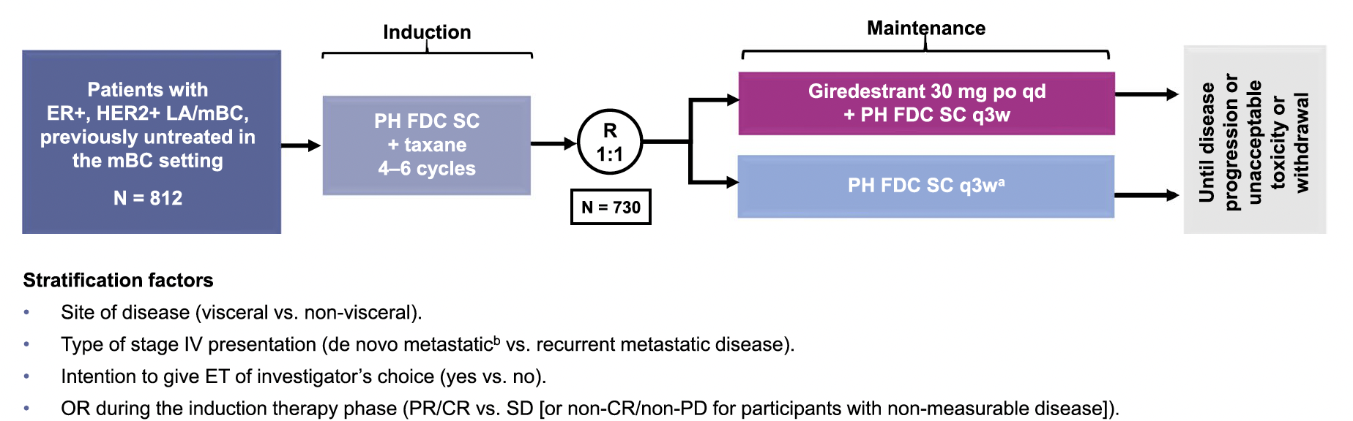
heredERA: An Ongoing Phase III Study of Giredestrant and the Fixed‑Dose Combination of Pertuzumab and Trastuzumab for Subcutaneous Injection
LA = locally advanced; PH FDC SC = fixed-dosed combination of pertuzumab and trastuzumab for subcutaneous injection
Kuemmel S et al. BMC Cancer 2024;24:641.

Slide 40
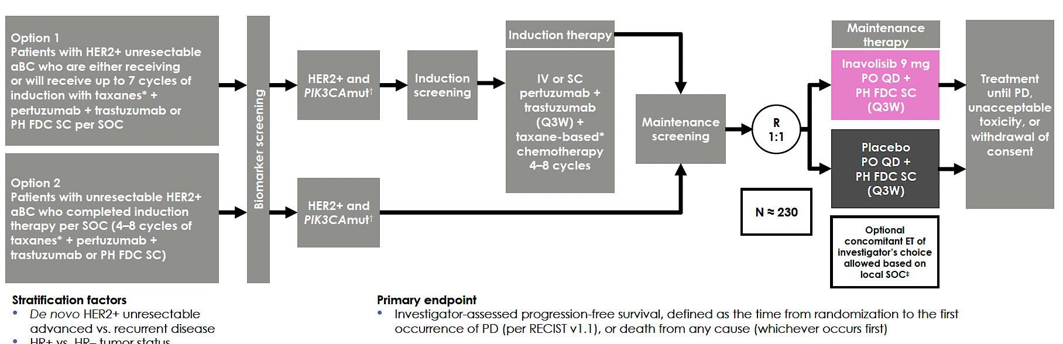
INAVO122: An Ongoing Phase III Study of Maintenance Inavolisib or Placebo with Pertuzumab and Trastuzumab for Patients with PIK3CA-Mutant, HER2-Positive Advanced Breast Cancer
Swain SM et al. ASCO 2024;Abstract TPS1124.

Slide 41
Agenda
Introduction: HER2 History
Module 1: Cases from the GMO Survey
Module 2: Biology and Selection of First-Line Therapy for HR-Positive, HER2-Positive Metastatic Breast Cancer (mBC) — Dr Mahtani
Module 3: Faculty Case Presentations
Module 4: Patterns of Care Survey — Part 1
Module 5: Optimizing the Use of Up-Front Maintenance Therapy for HER2-Positive mBC — Dr Carey
Module 6: Faculty Case Presentations
Module 7: Patterns of Care Survey — Part 2

Slide 42
Cases from General Medical Oncologists
70 yo woman
De novo HR+/HER2+ widely metastatic breast cancer including a solitary, asymptomatic brain metastasis.
Started T-DXd + pertuzumab complicated by severe diarrhea requiring hospitalization and treatment interruption. Pertuzumab discontinued after 2 cycles, T-DXd continued. She responded to therapy at all sites including the brain.
Would you rechallenge with pertuzumab + T-DXd? At what time point or degree of response would you switch to AI + Palbo + trastuzumab per PATINA? Is this your new standard?

Slide 43
Cases from General Medical Oncologists
43 yo woman
ER/PR+, HER2+ de novo metastatic breast cancer, minimally symptomatic bone and nodal metastases.
1L induction THP for 6 cycles, then HP maintenance plus leuprolide and AI, remains NED for over 2 years.
2 years of zoledronic acid.
What 1L regimen and maintenance therapy would you use if she presented today? Would T-DXd + pertuzumab induction be appropriate? What about incorporating palbociclib into the endocrine therapy component given HR+ alongside HP maintenance per PATINA?

Slide 44
Cases from General Medical Oncologists
72 yo woman
ER/PR+, HER2+ metastatic breast cancer asymptomatic liver and bone metastases
PMH: THP- HP + AI + palbo.
Today would faculty consider T-DXd + Pertuzumab until best response, then Pertuzumab plus AI and palbo?
Any role for CT DNA monitoring to guide de-escalation or discontinuation of maintenance therapy in this setting?

Slide 45
Cases from General Medical Oncologists
56 yo woman
ER/PR-, HER2+, multiple sites of metastatic disease, including high burden visceral mets, bone and 7 small asymptomatic brain mets.
What induction regimen would you recommend? Would you consider de-escalation after induction therapy? What about tucatinib/trastuzumab/pertuzumab as maintenance?
Any role for SRS or Gamma Knife?

Slide 46
Agenda
Introduction: HER2 History
Module 1: Cases from the GMO Survey
Module 2: Biology and Selection of First-Line Therapy for HR-Positive, HER2-Positive Metastatic Breast Cancer (mBC) — Dr Mahtani
Module 3: Faculty Case Presentations
Module 4: Patterns of Care Survey — Part 1
Module 5: Optimizing the Use of Up-Front Maintenance Therapy for HER2-Positive mBC — Dr Carey
Module 6: Faculty Case Presentations
Module 7: Patterns of Care Survey — Part 2

Slide 47
Biology and Selection of First-Line Therapy for HR-Positive, HER2-Positive mBC
Reshma L Mahtani, DO
Chief of Breast Medical Oncology
Miami Cancer Institute
Baptist Health South Florida
Miami, Florida

Slide 48
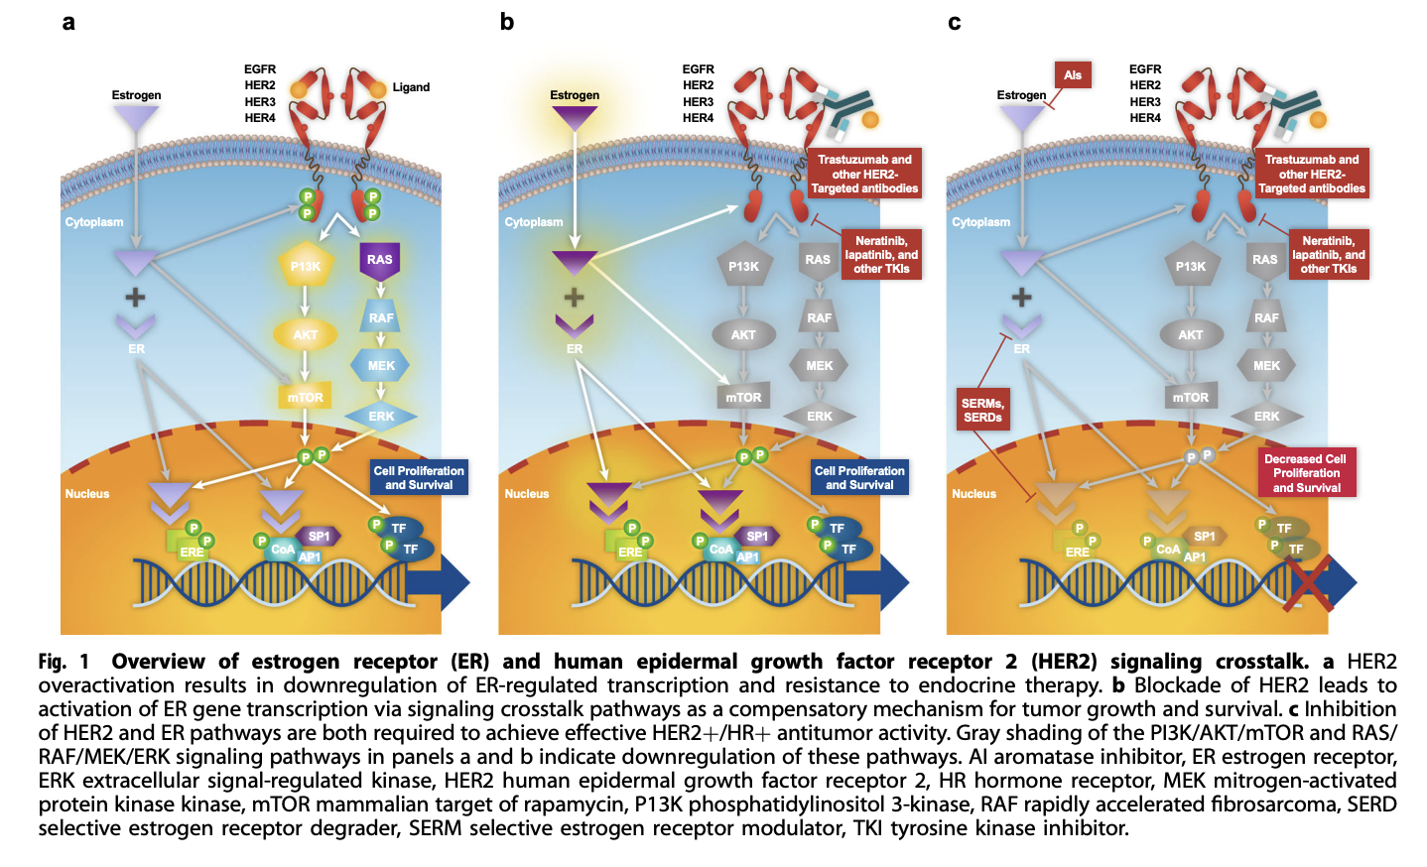
Crosstalk Between ER and HER2
Pegram M, et al. NPJ Breast Cancer. 2023 May 31;9(1):45

Slide 49
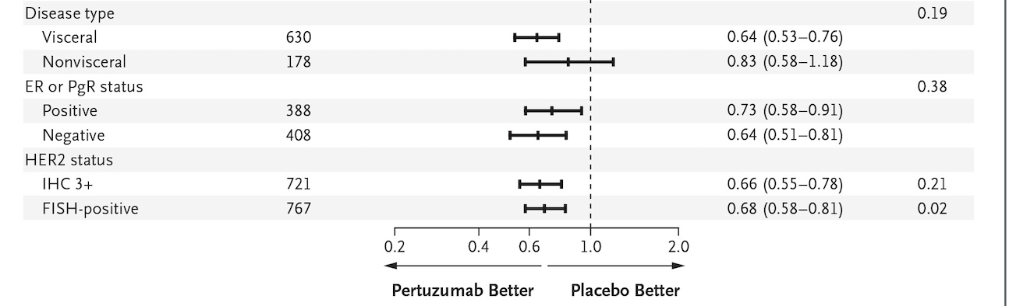
Phase 3 CLEOPATRA Study of Pertuzumab, Trastuzumab, and Docetaxel
8-year follow-up
OS at 8 years of follow-up
Key eligibility criteria
HER2+ mBC
ECOG PS 0–1
of ≥50% at baseline
Received no prior treatments for metastatic disease
100
Pertuzumab, trastuzumab, and docetaxel
80
Placebo, trastuzumab, and docetaxel
60
Landmark OS at 8 years 37%, 235 events (58%)
OS (%)
40
Trastuzumab (T) + pertuzumab (P) + docetaxel (n = 402)
20
N = 808
T+P given until PD or toxicity
Docetaxel given for
≥6 cycles
Landmark OS at 8 years 23%, 280 events (69%)
R
1:1
0
0
10
20
30
40
50
60
70
80
90
100
110
120
Trastuzumab + placebo + docetaxel (n = 406)
Time since randomization (months)
Number at risk
P 402(0) 318 (23) 228 (41) 165 (50) 137 (56) 71 (102) 0 (167)
Placebo 406 (0) 289 (30) 181 (41) 115 (52) 88 (53) 44 (84) 1 (125)
Primary endpoint: IRC-assessed PFS
Key secondary endpoints: OS, INV-assessed PFS, ORR, DOR, safety, time to symptom progression
Subgroup Analysis of OS
Data cutoff date: 11/23/2018.
DOR = duration of response; ECOG = Eastern Cooperative Oncology Group; HR = hazard ratio; INV = investigator; IRC = independent review committee; = left ventricular ejection fraction; ORR = objective overall response rate; PD = progressive disease; PFS = progression-free survival; PS = performance status; R = randomization.
Swain SM, et al. Lancet Oncol. 2020;21:519-530.

Slide 50
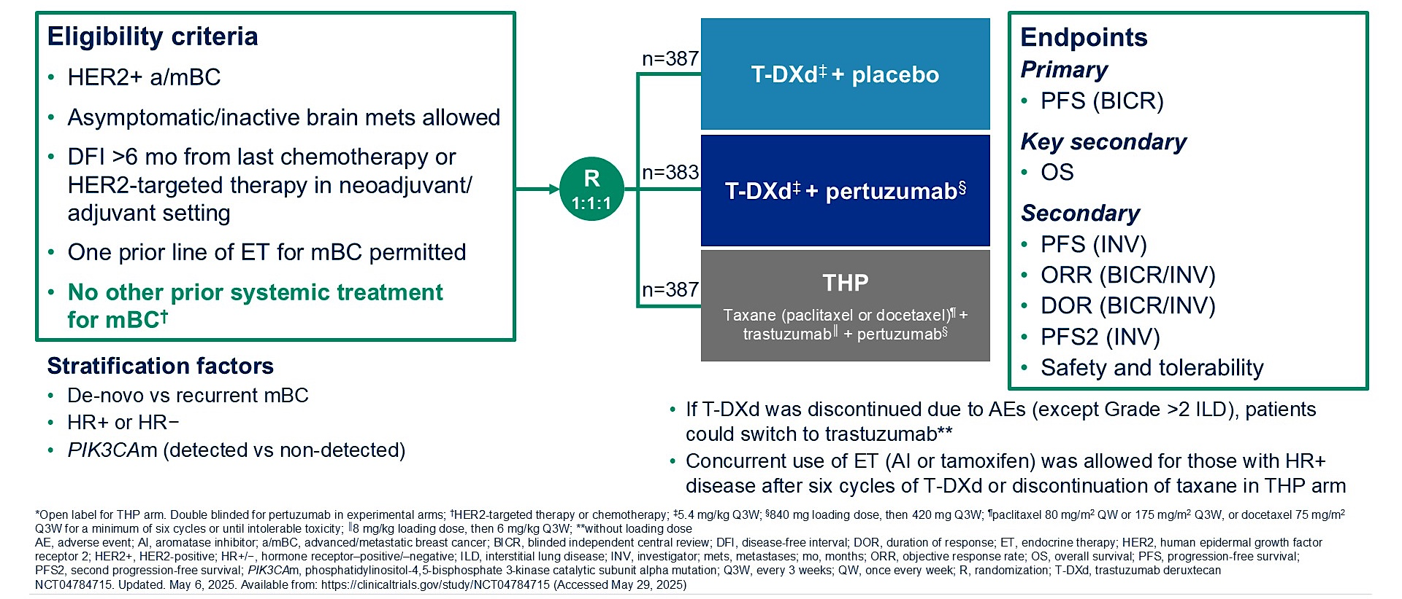
Phase III DESTINY-Breast09 Study Design
Tolaney SM et al. ASCO 2025;Abstract LBA1008.

Slide 51
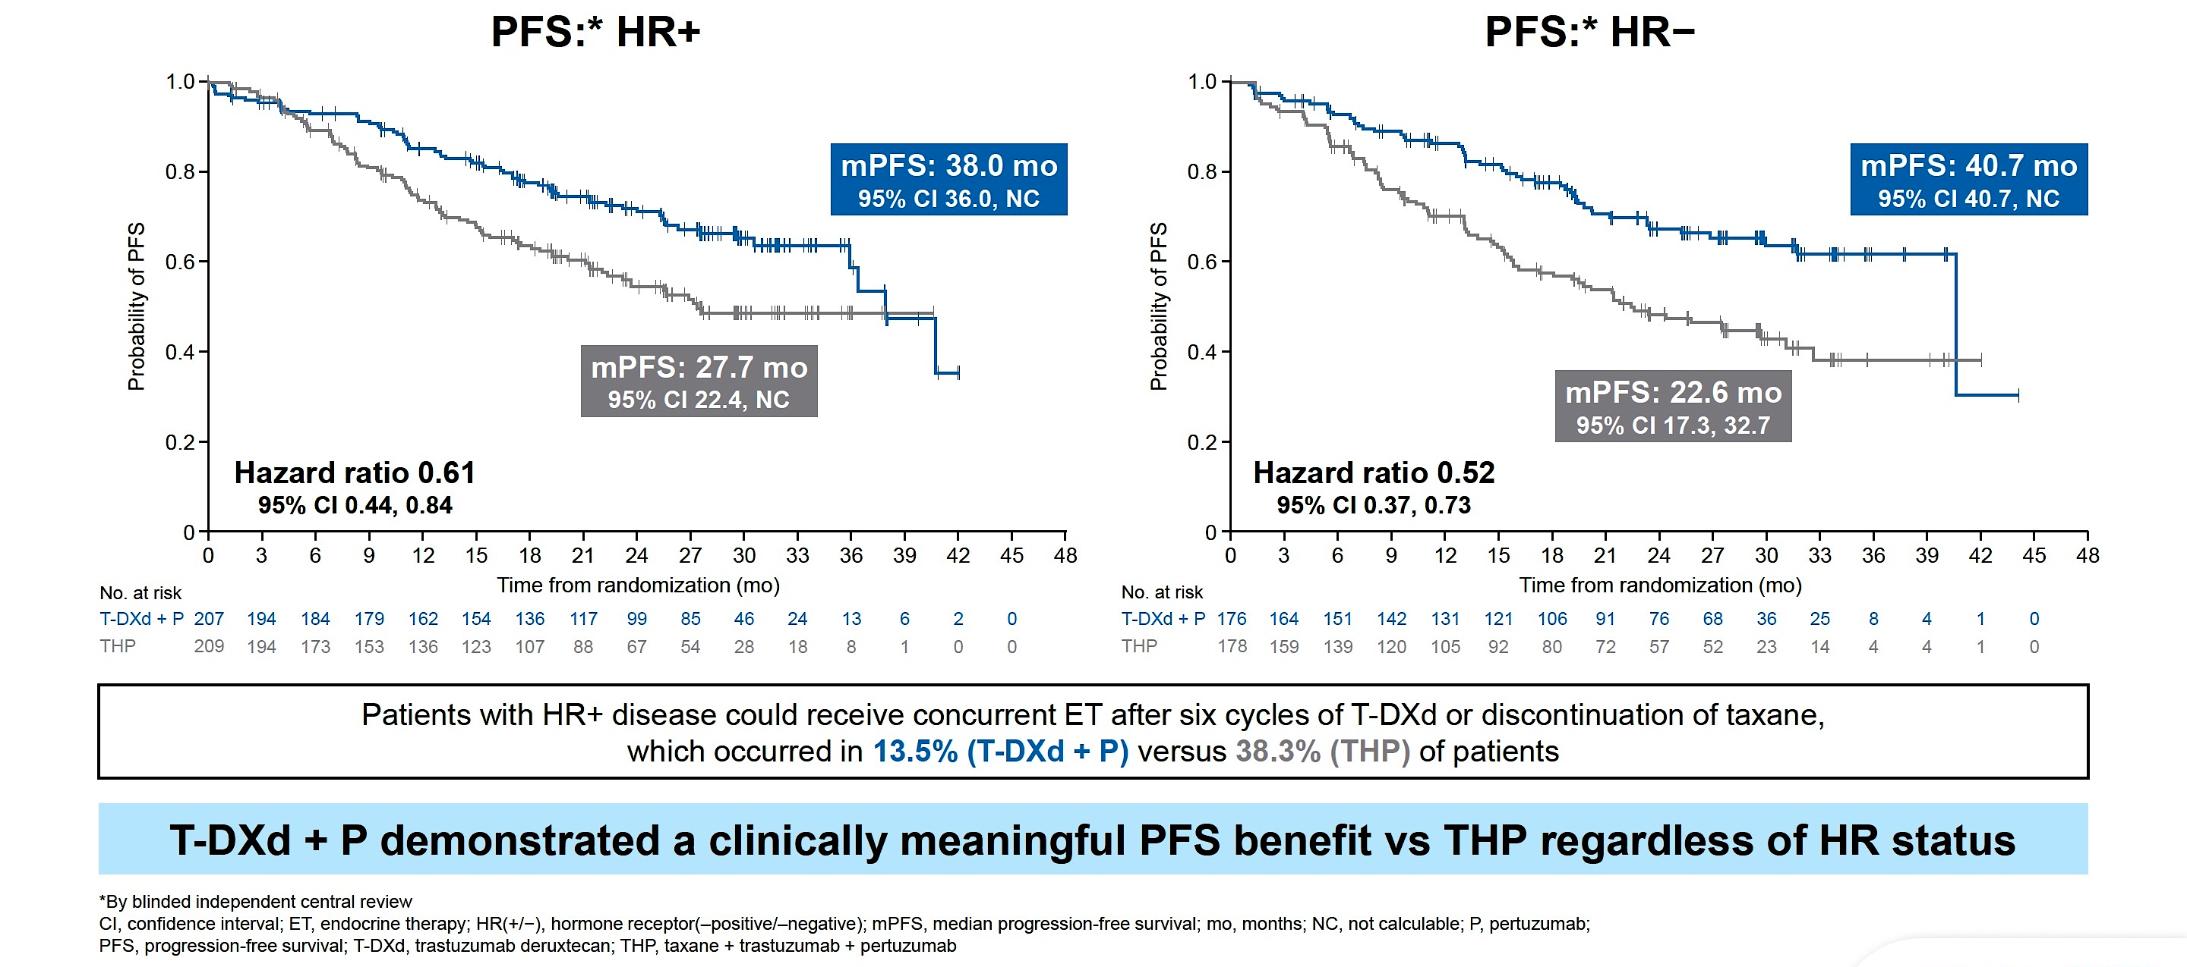
Phase III DESTINY-Breast09: PFS by HR Status
Loibl S et al. ESMO 2025;Abstract LBA18.

Slide 52
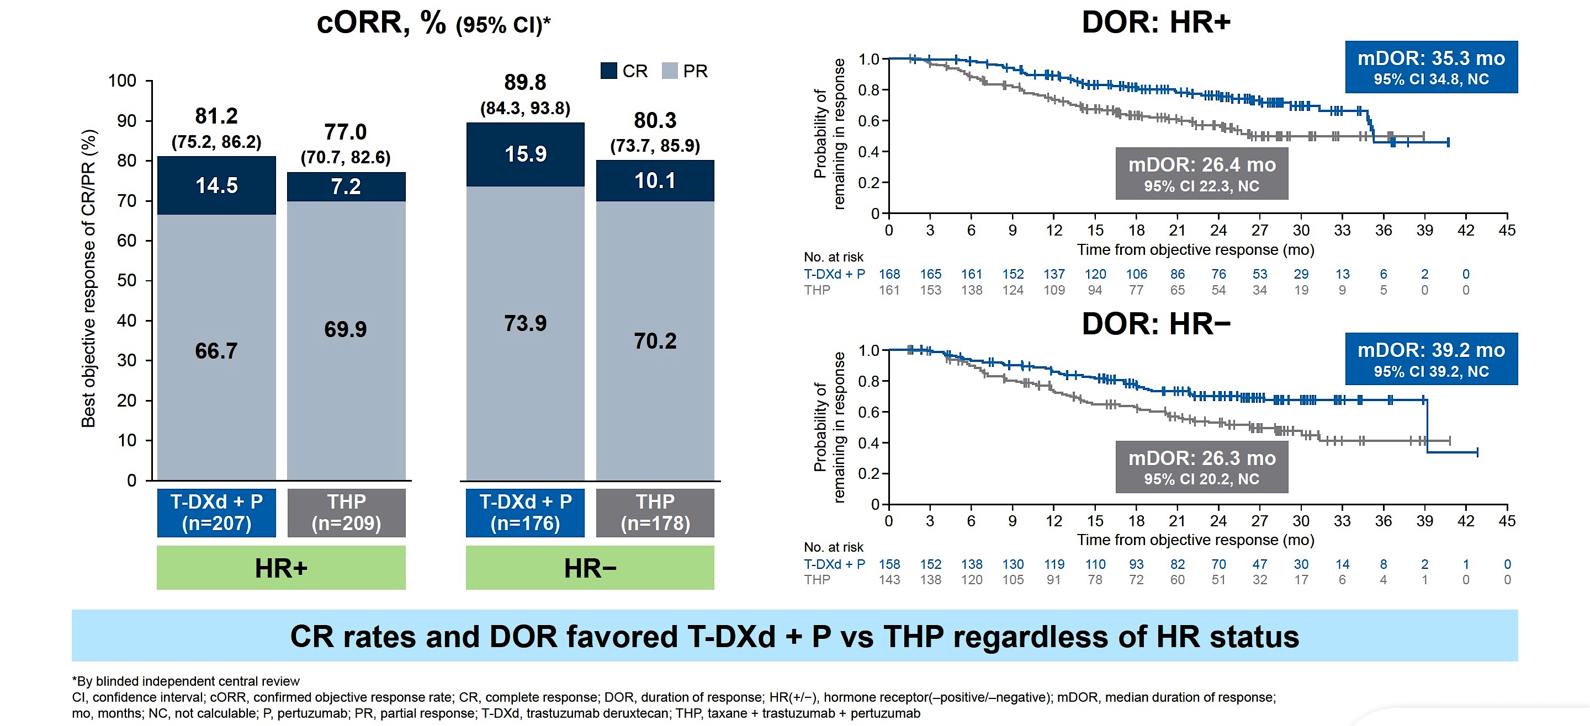
Phase III DESTINY-Breast09: Responses by HR Status
Loibl S et al. ESMO 2025;Abstract LBA18.

Slide 53
DESTINY-Breast09: Response Characteristics
80% of patients (ITT) achieved maximal tumor reduction by
24 months
Pts achieving CR and deep PR had the longest treatment duration, with responses deepening over time
T-DXd + P arm | CR (n=58) 15.4% | Deep PR* (n=141) 37.4% | PR (<80%) (n=127) 33.7% | SD/PD (n=51) 13.5%
Time to best response (median, mo) [95% CI] | 8.4 [5.6, 11.1] | 9.6 [6.8, 11.0] | 1.5 [1.4, 2.0] | NA
Duration of best response (median, mo) [95% CI] | NC [35.1, NC] | 39.2 [35.3, NC] | 34.8 [22.8, NC] | NA
Patients remaining in best response, % [95% CI]
12 mo | 94.8 [84.8, 98.3] | 91.3 [85.1, 95.0] | 78.9 [70.1, 85.3] | NA
24 mo | 85.0 [72.1, 92.3] | 78.9 [70.4, 85.2] | 60.4 [50.0, 69.3] | NA
Total treatment duration, (median, mo) [range]^{b} | 28.0 [4.8–44.5] | 25.4 [3.4–42.7] | 20.6 [2.8–41.8] | 4.4 [0.3–37.2]
PFS at 24 mo, % [95% CI] | 85.1 [72.2, 92.3] | 80.0 [71.7, 86.1] | 64.3 [54.3, 72.8] | 35.5 [21.1, 50.2]
THP arm | CR (n=33) 8.5% | Deep PR^{b} (n=110) 28.4% | PR (<80%) (n=161) | SD/PD (n=68)
Time to best response (median, mo) [95% CI] | 5.6 [2.8, 9.8] | 8.2 [6.8, 9.6] | 1.5 [1.4, 1.5] | NA
Duration of best response (median, mo) [95% CI] | 31.3 [31.3, NC] | NC [22.3, NC] | 20.1 [13.1, 30.1] | NA
Total treatment duration (median, mo), range^{c} | 28.1 (7.6–38.2) | 20.2 (2.7–40.8) | 17.9 (2.9–41.7) | 5.9 (1.4–35.2)
PFS at 24 mo, % [95% CI] | 76.7 [56.9, 88.2] | 60.7 [50.3, 69.6] | 48.5 [39.8, 56.6] | 31.7 [18.6, 45.5]
In the THP arm, achieving deep PR was not associated with similar outcomes to achieving CR
*Deep PR: (≥80% to <100%)
Yeon Hee Park, MD, PhD, ASCO 2026

Slide 54
1L Trials in HER2+ MBC
Trial | Regimen | De Novo MBC (%) | Prior H(P)? (%) | HR+ Patients (%) | Endocrine therapy (%) | Brain mets (baseline) (%) | Median CNS PFS (M) | Median PFS & OS (months [M])
CLEOPATRA (2012) N= 808 | Taxane + trastuzumab + placebo (TH) vs. taxane+ trastuzumab + pertuzumab (THP) | 54 | H: 11 P: N/A | 48 | Not permitted | Not eligible | N/A | mPFS: 18.5 vs. 12.4 M (HR = 0.62) mOS: 56.5 vs. 40.8 M (HR = 0.68, P<0.001)
Destiny-Breast09 (2025) N=770 | T-DXd + P vs. T-DXd + placebo vs. THP | 52 | H: 27.9-28.7 P: 6.2-8.1 | 54 | T-DXd ± P: 13.5 THP: 38.3 | ~5-7 | Substantial benefit | mPFS: 40.7 vs. 26.9 M mOS : immature (HR = 0.56)
PATINA (2024) N= 518 | Post THP: maintenance H(P) + palbociclib (Pb) or placebo (Pbo) | 55 | H ± P: 71 | 100 | 100 | 4 | Risk CNS progression 13.0 %- Pb 19.2 %- Pbo P-0.0378 | mPFS: 44.3 vs. 29.1 M (HR = 0.75) mOS : immature
HER2CLIMB-05 (2025) N=654 | Post THP: maintenance HP + tucatinib or placebo | 69.3 | H: 60-67 P: 16-19 | ~51-54 | 45.1 | 12.4 | 8.5 vs. 4.3M (HR = 0.719 ) | mPFS: 24.9 vs. 16.3 M mOS : immature
Abbreviations: N/A, not applicable; H, trastuzumab, P, pertuzumab, M, months; OS, overall survival
1. Swain et al., 2013; 2. Swain et al., 2015; 3. Tolaney et al., 2025; 4. Metzger et al., 2024 & 2025; 5. Hamilton et al., 2025
This Slide Credit: osullivan.ciara@mayo.edu

Slide 55
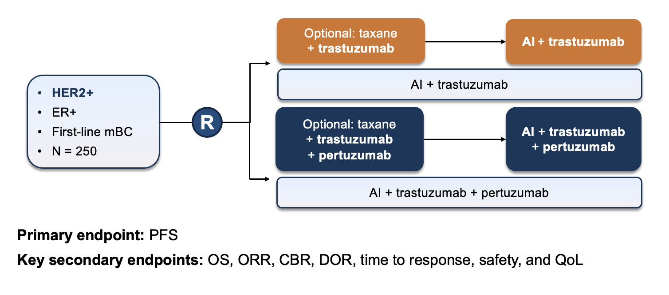
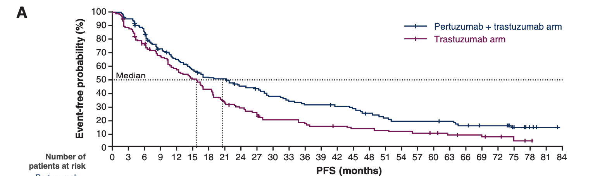
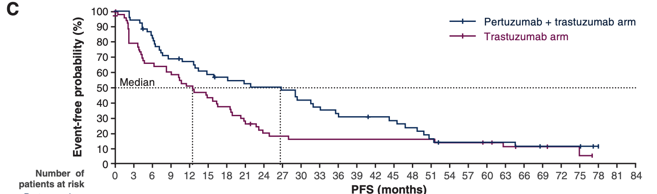
First Line Treatment for HER2+ mBC: PERTAIN Study
ITT population:
20.6m
72% trastuzumab-naïve
All patients received endocrine therapy
Induction chemo per investigator choice
15.8m
Pts chosen to not receive induction chemotherapy
26.6m
12.5m
(1) Gennari et al. Ann Oncol. 2021;32(12):1475-1495; (2) Arpino G, et al. Clin Cancer Res. 2023;29(8):1468-1476.

Slide 56
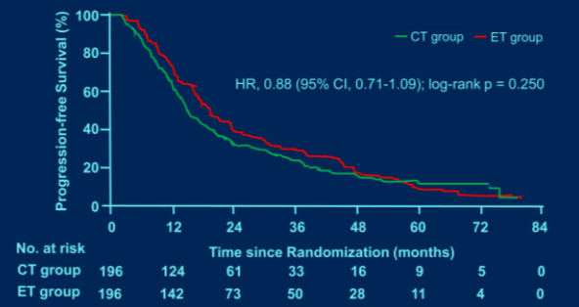
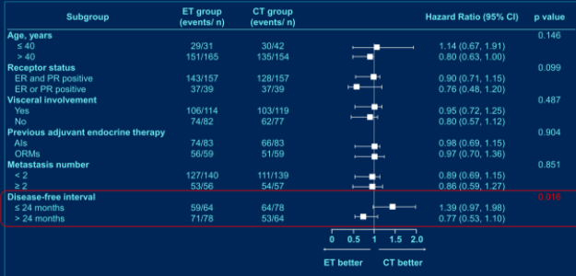
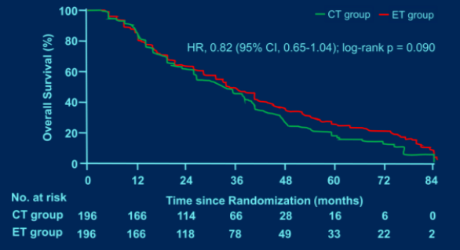
SYSUCC-002: Trastuzumab + ET or Chemotherapy as First-Line Treatment for HR+, HER2+ mBC
PFS (Primary Endpoint)
Subgroup Analyses of PFS
PFS, %
Chemo group
ET group
HR = 0.88 (95% Cl, 0.71-1.09)
Log-rank P = .250
Subgroup | ET Group (Events/n) | Chemo Group (Events/n) |  |  |  |  |  | HR (95% Cl) | P
Age, y |  |  |  |  |  |  |  |  | .146
≤40 | 29/31 | 30/42 |  |  |  |  |  | 1.14 (0.67-1.91)
>40 | 151/165 | 135/154 |  |  |  |  |  | 0.80 (0.63-1.00)
Receptor status |  |  |  |  |  |  |  |  | .099
ER and PR positive | 143/157 | 128/157 |  |  |  |  |  | 0.90 (0.71-1.15)
ER or PR positive | 37/39 | 37/39 |  |  |  |  |  | 0.76 (0.48-1.20)
Visceral involvement |  |  |  |  |  |  |  |  | .487
Yes | 106/114 | 103/119 |  |  |  |  |  | 0.95 (0.72-1.25)
No | 74/82 | 62/77 |  |  |  |  |  | 0.80 (0.57-1.12)
Previous adjuvant endocrine therapy |  |  |  |  |  |  |  |  | .904
AIs | 74/83 | 66/83 |  |  |  |  |  | 0.98 (0.69-1.15)
ORMs | 56/59 | 51/59 |  |  |  |  |  | 0.97 (0.70-1.36)
Metastasis number |  |  |  |  |  |  |  |  | .851
<2 | 127/140 | 111/139 |  |  |  |  |  | 0.89 (0.69-1.15)
≥2 | 53/64 | 54/57 |  |  |  |  |  | 0.86 (0.59-1.27)
DFS interval |  |  |  |  |  |  |  |  | .016
≤24 mo | 59/64 | 64/78 |  |  |  |  |  | 1.39 (0.97-1.98)
>24 mo | 71/78 | 53/64 |  |  |  |  |  | 0.77 (0.53-1.10)
 |  |  | 0 | 0.5 | 1 | 1.5
Time, mo
No. at Risk
Chemo | 196 | 124 | 61 | 33 | 16 | 9 | 5 | 0
ET | 196 | 142 | 73 | 50 | 28 | 11 | 4 | 0
Overall Survival
Chemo group
ET group
HR = 0.82 (95% Cl, 0.65-1.04)
Log-rank P = .090
OS, %
2.0
Time, mo
ET better Chemo better
No. at Risk
Chemo | 196 | 166 | 114 | 66 | 28 | 16 | 6 | 0
ET | 196 | 166 | 118 | 78 | 49 | 33 | 22 | 2

Slide 57
Rationale for Blocking HER2 and CDK4/6 Pathways
Trastuzumab
Pertuzumab
CDK4/6i
The cyclin D1-CDK4 axis is critical in HER2+ BC.
Persistent cyclin D1-CDK4 activity drives resistance to the HER2 pathway blockade.
Dual inhibition of CDK4/6 and HER2 shows synergistic anti-tumor effects in preclinical models by activating TSC2, leading to mTOR inhibition.
Malumbres M et al. Cancer Cell 2016
1. Yu Q, et al. Nature. 2001;411(6841):1017-1021.
2. Yu Q, et al. Cancer Cell. 2006;9(1):23-32.
3. Choi YJ, et al. Cancer Cell. 2012;22(4):438-451.
4. Goel S, et al. Cancer Cell. 2016;29(3):255-269.

Slide 58
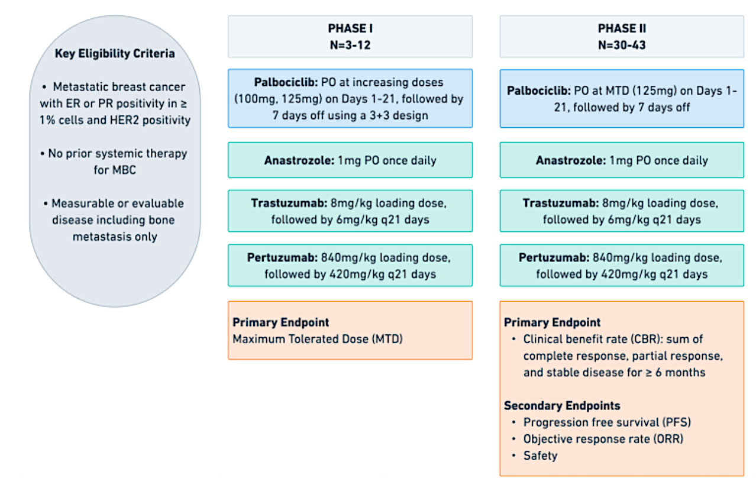
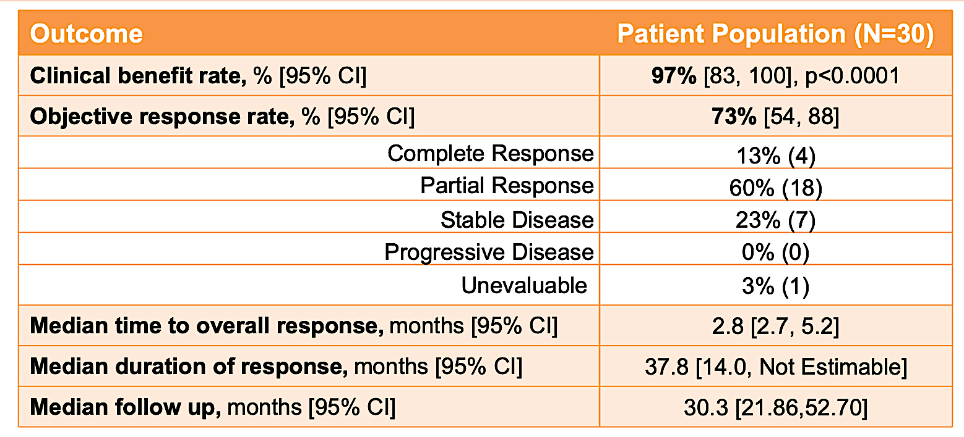
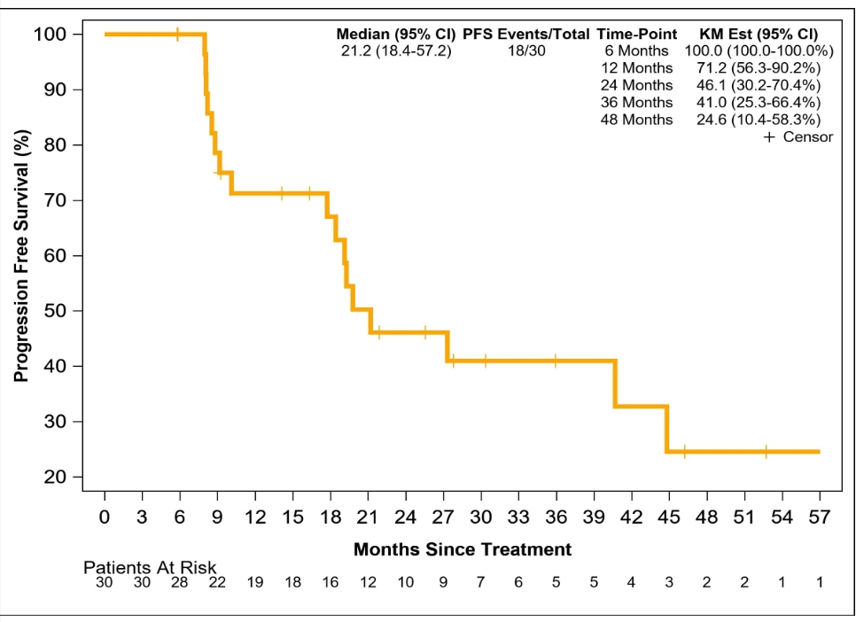
CDK4/6 inhibition in HER2+ ABC
ASPIRE trial
57% recurrent disease
63.3% visceral disease
PFS
Median PFS
21.2 (95% CI: 18.4-57.2)
Patel R et al. SABCS 2023
Slide credit: Otto Metzger
Patel R et al. SABCS 2023

Slide 59
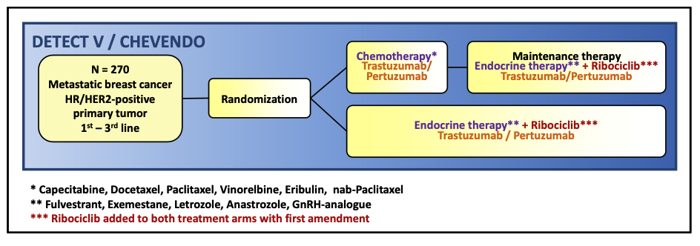
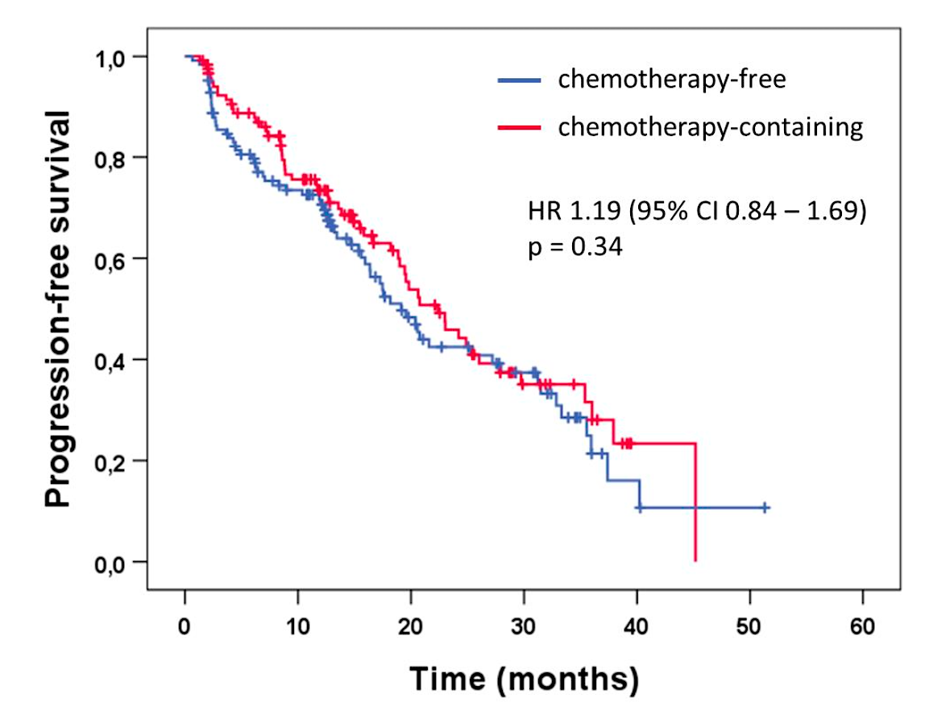
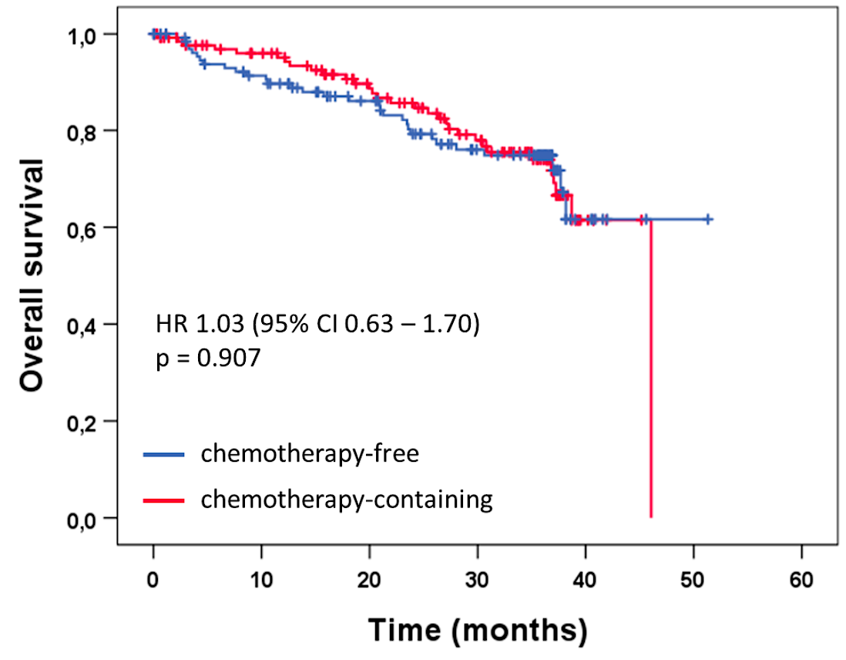
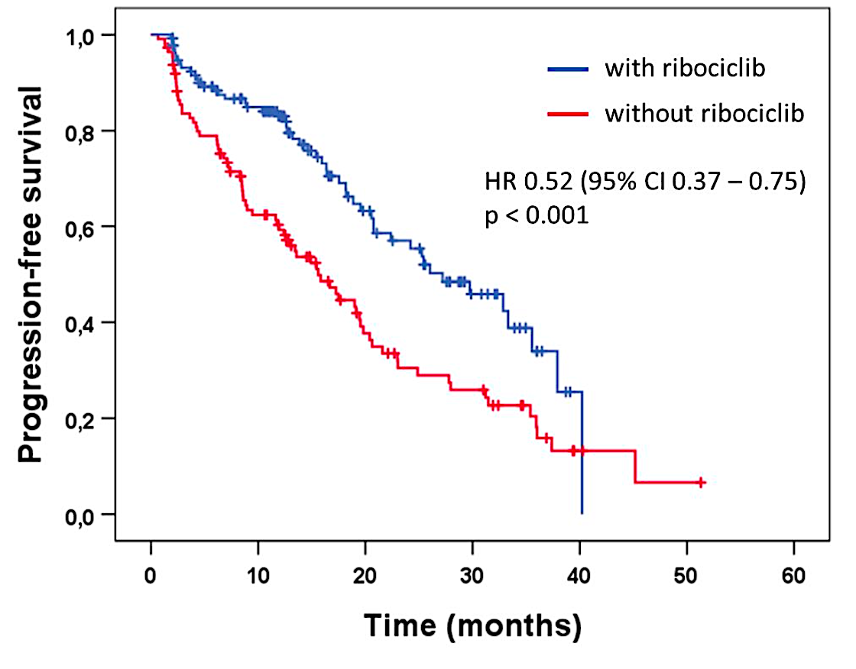
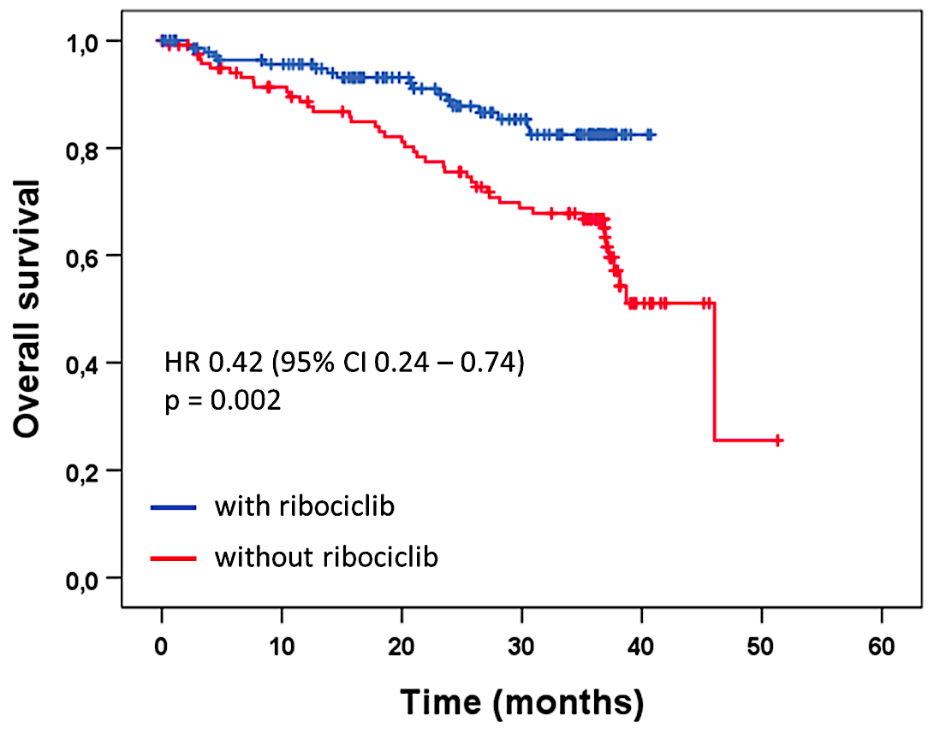
CDK4/6 inhibition in HER2+ ABC
DETECT V trial
After 124pts enrolled, amendment to add ribociclib in both treatment arms
76% pts treated in first line; 55% with visceral disease
Primary endpoint: tolerability; Secondary endpoints: PFS/OS
*Comparison of subsequent study cohorts, no randomized comparison
No differences in SAE but higher AEs grade 3/4 for ribo (neutropenia(74%), liver enzyme elevation)
Janni et al. ESMO 2024. 350MO.
Slide credit: Otto Metzger

Slide 60
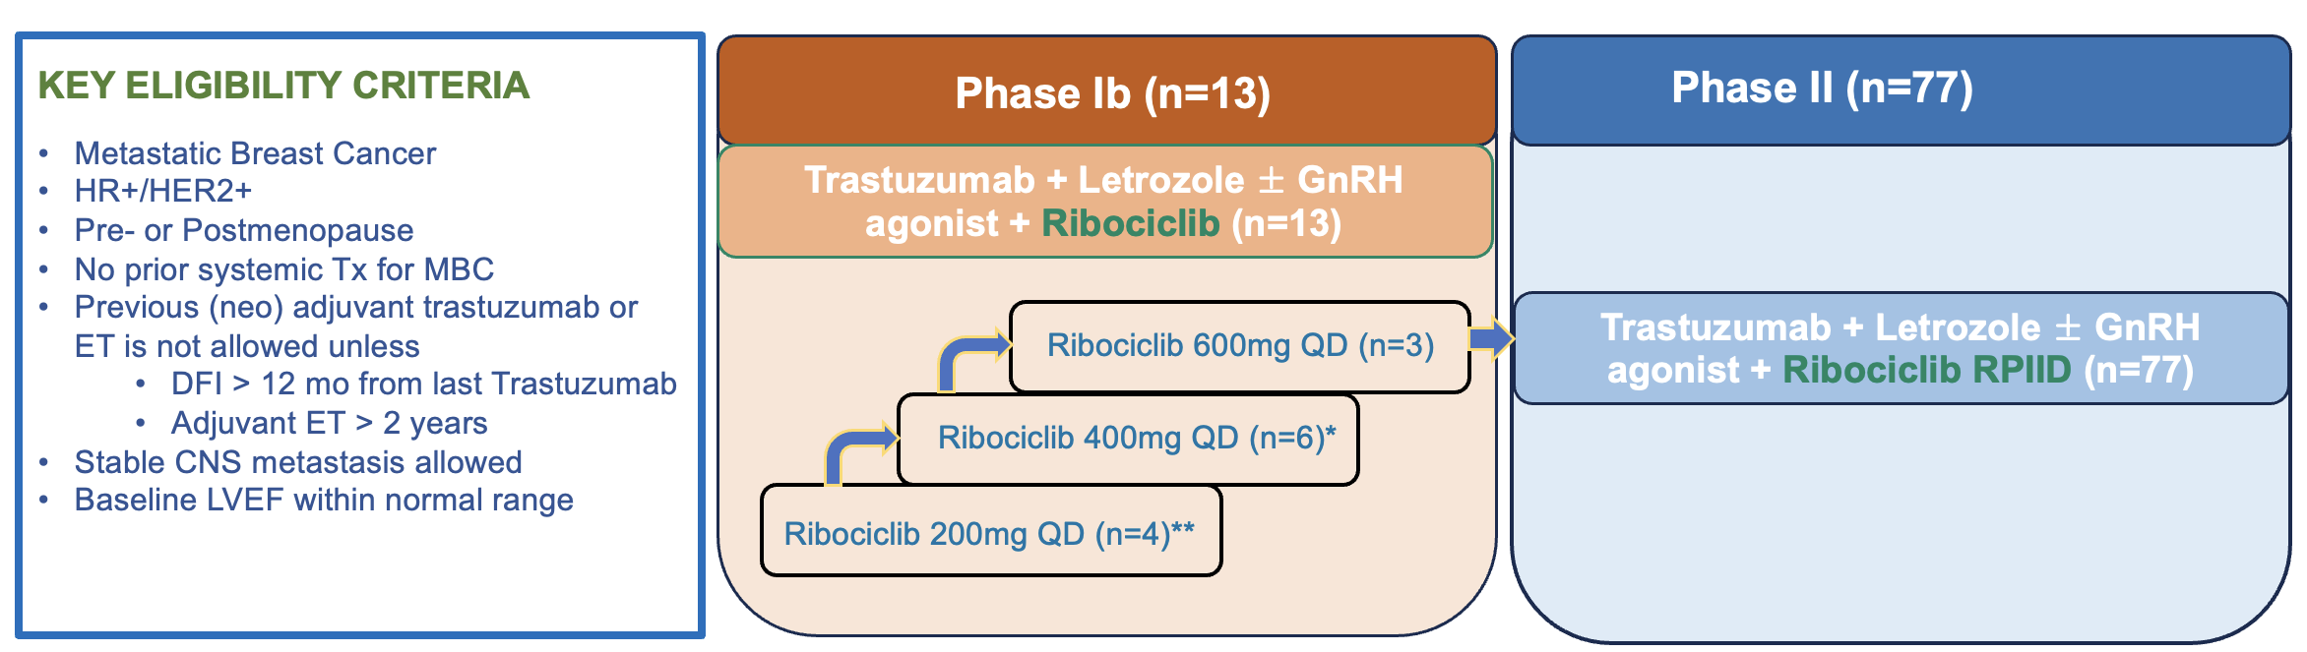
CDK4/6 inhibition in HER2+ ABC
MINI trial – ASCO 2025
Primary endpoint: Phase Ib – Determination RP2D; Phase II – PFS
Secondary endpoints: OS, ORR, DoR, Safety
58.9% recurrent disease; 66.7% visceral disease
Median PFS
30.4 (95% CI: 19.6-NR)
ORR = 61.1%
Slide credit: Otto Metzger
Sohn J et al. ASCO 2025

Slide 61
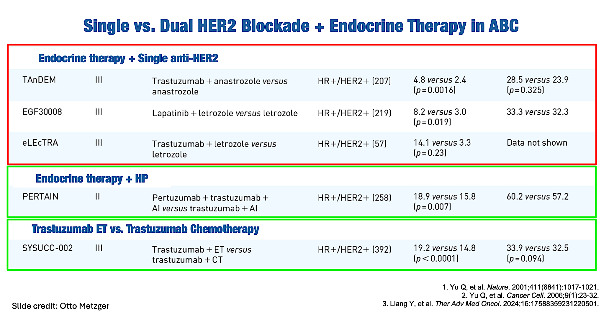

Slide 62
Agenda
Introduction: HER2 History
Module 1: Cases from the GMO Survey
Module 2: Biology and Selection of First-Line Therapy for HR-Positive, HER2-Positive Metastatic Breast Cancer (mBC) — Dr Mahtani
Module 3: Faculty Case Presentations
Module 4: Patterns of Care Survey — Part 1
Module 5: Optimizing the Use of Up-Front Maintenance Therapy for HER2-Positive mBC — Dr Carey
Module 6: Faculty Case Presentations
Module 7: Patterns of Care Survey — Part 2

Slide 63
Dr Mahtani: Case
56yo diagnosed with breast cancer in 2019
S/P B/L mastectomy: Left: pT1aN0, ER 20%, P 5%, HER2 3+; Right: extensive DCIS spanning 4 cm, no invasive disease, ER 90%, PR 80%
No adjuvant chemo/HER2 directed therapy
Tamoxifen 2020-2025
3 months post discontinuation of tamoxifen presented with DOE while exercising, persistent cough, went to ER with worsening symptoms

Slide 64
Dr Mahtni: Case (Cont)
Echo: large pericardial effusion, impending cardiac tamponade
Emergent pericardial window and biopsy: IDC, ER 10%, PR 0, HER2 3+
CT C/A/P: pleural effusion, multiple small lung nodules, no liver/bone mets
Brain MRI (asymptomatic): no mets
Started T-DXd + pertuzumab with rapid improvement after 2 cycles of therapy

Slide 65
Dr Carey: Case
59 yo patient with longstanding triple-positive mBC
Six years without relapse, relapse bone-only
Key treatments:
  ET + H then ET + HL (+ bone-directed Rx) x 10 years
  Vinorelbine + HP (d/c for chemotherapy-induced peripheral neuropathy)
  T-DXd (d/c for non-ILD AE)
  AI + HP + palbociclib ongoing
PS continues to be very good

Slide 66
Agenda
Introduction: HER2 History
Module 1: Cases from the GMO Survey
Module 2: Biology and Selection of First-Line Therapy for HR-Positive, HER2-Positive Metastatic Breast Cancer (mBC) — Dr Mahtani
Module 3: Faculty Case Presentations
Module 4: Patterns of Care Survey — Part 1
Module 5: Optimizing the Use of Up-Front Maintenance Therapy for HER2-Positive mBC — Dr Carey
Module 6: Faculty Case Presentations
Module 7: Patterns of Care Survey — Part 2

Slide 67
Discussion Questions
In general, how you approach induction and maintenance therapy for a patient with HR-positive, HER2-positive mBC?
How do age, site(s) of metastases and tumor symptom status impact your approach?

Slide 68
A woman presents with de novo HR-positive, HER2-positive mBC. Regulatory and reimbursement issues aside, which first-line anti-HER2 induction therapy would you most likely recommend for each of the following scenarios?
Age 65, PS 0
Asymptomatic bone metastases:
* OFS + CDK4/6i first then if pt develops symptomatic PD with measurable lesions, will give T-DXd
Symptomatic liver metastases:
* May consider TCHP option

Slide 69
A woman presents with de novo HR-positive, HER2-positive mBC. Regulatory and reimbursement issues aside, which first-line anti-HER2 induction therapy would you most likely recommend for each of the following scenarios? (continued)
Age 65, PS 0
Multiple brain metastases requiring SRS:

Slide 70
A patient with HR-positive, HER2-positive mBC receives 6 cycles of THP as first-line induction therapy. Regulatory and reimbursement issues aside, which maintenance regimen would you recommend?
Age 65, PS 0
Achieved a complete response:
* HP/ET/abemaciclib
Achieved a partial response:
* HP/ET/abemaciclib; T-DXd

Slide 71
A patient with HR-positive, HER2-positive mBC receives T-DXd/pertuzumab as first-line induction therapy. Regulatory and reimbursement issues aside, which maintenance regimen would you recommend?
Age 65, PS 0
Achieved a complete response:
* T-DXd/pertuzumab/ET

Slide 72
A patient with HR-positive, HER2-positive mBC receives T-DXd/pertuzumab as first-line induction therapy. Regulatory and reimbursement issues aside, which maintenance regimen would you recommend?
Age 65, PS 0
Achieved a partial response:
* T-DXd/P/ET; T-DXd/pertuzumab/ET

Slide 73
Other than palbociclib, would you use any other CDK4/6 inhibitor in combination with maintenance HER2-targeted therapy and endocrine therapy after induction treatment for HR-positive, HER2-positive mBC?

Slide 74
Discussion Questions
In general, how you approach induction and maintenance therapy for a patient with HR-negative, HER2-positive mBC?
How do age, site(s) of metastases and tumor symptom status impact your approach?

Slide 75
A patient with HR-negative, HER2-positive mBC receives 6 cycles of THP as first-line induction therapy. Regulatory and reimbursement issues aside, which maintenance regimen would you recommend?
Age 65, PS 0
Achieved a complete response:
Achieved a partial response:
* T-DM1; T-DXd

Slide 76
A patient with HR-negative, HER2-positive mBC receives 6 cycles of
T-DXd/pertuzumab as first-line induction therapy. Regulatory and reimbursement issues aside, which maintenance regimen would you recommend?
Age 65, PS 0
Achieved a complete response:
* T-DXd/pertuzumab
Achieved a partial response:
* T-DXd/pertuzumab

Slide 77
A patient with de novo HR-negative, HER2-positive mBC is receiving first-line T-DXd and pertuzumab with response and reasonably good tolerability. Regulatory and reimbursement issues aside, what would be your most likely approach to maintenance therapy?
* Treat to maximum response and then switch to HER2CLIMB-05 regimen; Depends as above, any of these may be appropriate

Slide 78
Agenda
Introduction: HER2 History
Module 1: Cases from the GMO Survey
Module 2: Biology and Selection of First-Line Therapy for HR-Positive, HER2-Positive Metastatic Breast Cancer (mBC) — Dr Mahtani
Module 3: Faculty Case Presentations
Module 4: Patterns of Care Survey — Part 1
Module 5: Optimizing the Use of Up-Front Maintenance Therapy for HER2-Positive mBC — Dr Carey
Module 6: Faculty Case Presentations
Module 7: Patterns of Care Survey — Part 2

Slide 79
Optimizing the Use of Up-Front or Maintenance
Therapy for HER2-Positive mBC, Including
Patients with HR-Positive Disease
Lisa A Carey, MD, ScM, FASCO
UNC Lineberger Comprehensive Cancer Center
Chapel Hill, North Carolina

Slide 80
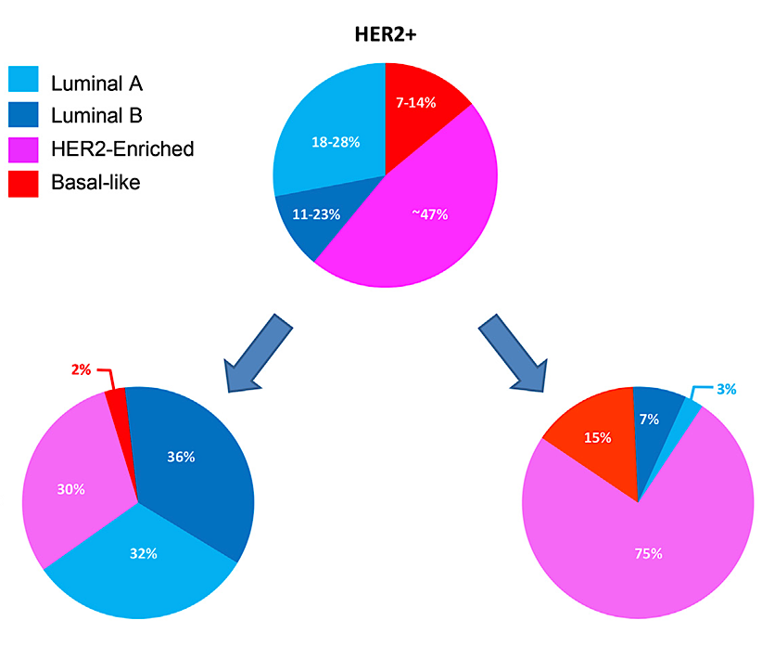
Molecular and Clinical Features of Triple-Positive Breast Cancer
Most triple-positive cases (68%) are “luminal”
Compared to HR-negative, HER2-positive disease:
More likely to have late relapse,
bone-only disease, better prognosis
Less likely to have de novo, visceral
or Grade 3 disease.
HR+ HER2+
HR- HER2+
Schettini et al. Breast 2021 October;59:339-50. Bischoff et al. Clin Cancer Breast 2026;26(2):93-104.

Slide 81
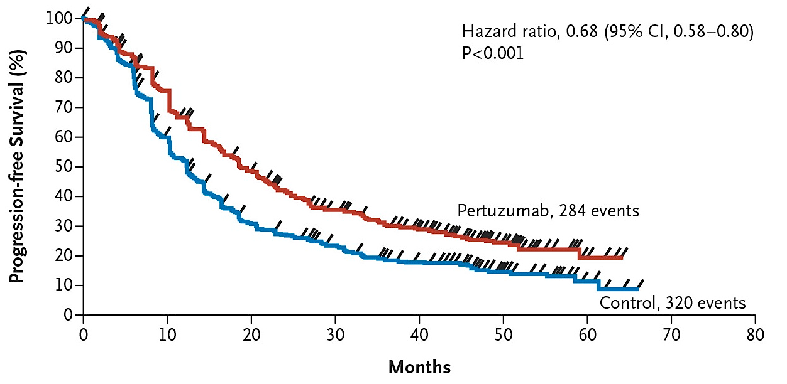
Phase III CLEOPATRA Trial: First-Line Treatment of HER2-Positive Breast Cancer
Benefit of pertuzumab added to first-line trastuzumab + taxane. THP = standard therapy for 10 years
PFS: 18.5 vs 12.4 mo
OS: 57.1 vs 40.8 mo
PFS = progression-free survival; OS = overall survival
Swain SM et al. N Engl J Med 2015;372(8):724-34; Swain SM et al. Lancet Oncol 2020;21:519-30; Miles D et al. Ann Oncol 2017;28(11):2761-7.

Slide 82
Phase III CLEOPATRA Trial: First-Line Treatment of HER2-Positive Breast Cancer
Benefit of pertuzumab added to first-line trastuzumab + taxane. THP = standard therapy for 10 years
Allowed discontinuation of taxane after 6 cycles (move to maintenance HP).
Post-hoc no outcome difference between 6 cycles THP and longer.
THP x 6 → HP became the norm
(CLEOPATRA not designed to test importance of induction therapy)
PFS: 18.5 vs 12.4 mo
OS: 57.1 vs 40.8 mo
PFS = progression-free survival; OS = overall survival
Swain SM et al. N Engl J Med 2015;372(8):724-34; Swain SM et al. Lancet Oncol 2020;21:519-30; Miles D et al. Ann Oncol 2017;28(11):2761-7.

Slide 83
Phase III DESTINY-Breast09 Trial
(continuous)
(induction then HP)
Triple-positive disease: ET allowed after 6 cycles of DXd, administered to 13%, or after taxane, administered to 38%
a/mBC = advanced or metastatic breast cancer; DFI = disease-free interval; ET = endocrine therapy; mBC = metastatic breast cancer; T-DXd = trastuzumab deruxtecan; THP = docetaxel/trastuzumab/pertuzumab
Tolaney SM et al. N Engl J Med 2026;394;551-62.

Slide 84
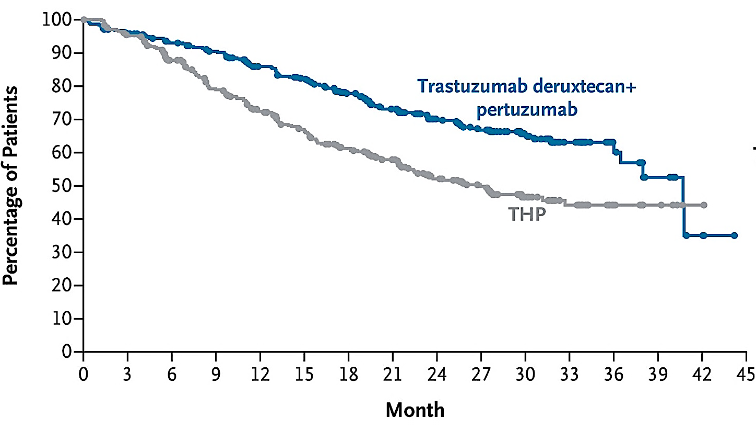
Phase III DESTINY-Breast09: Progression-Free Survival (PFS) by Blinded Independent Central Review
(continuous)
mPFS 40.7m vs 26.9m
HR 0.56
(0.44-0.71)
(induction)
Similar effect in HR-positive (HR 0.61) and HR-negative (HR 0.52)
Toxicity as expected with T-DXd + pertuzumab: GI, fatigue, ANC, alopecia; ILD 12%, EF decline ~10%
mPFS = median progression-free survival; ANC = absolute neutrophil count, ILD = interstitial lung disease; EF = ejection fraction
Tolaney SM et al. N Engl J Med 2026;394;551-62.

Slide 85
Phase III DESTINY-Breast09: Progression-Free Survival by Blinded Independent Central Review
(continuous)
Approved 12/2025
Optimal regimen IF administering a chemotherapy-based regimen first
(Did not test induction strategy. Most clinicians plan to use as induction)
mPFS 40.7m vs 26.9m
HR 0.56
(0.44-0.71)
(induction)
Similar effect in HR-positive (HR 0.61) and HR-negative (HR 0.52)
Toxicity as expected with T-DXd + pertuzumab: GI, fatigue, ANC, alopecia; ILD 12%, EF decline ~10%
mPFS = median progression-free survival; ANC = absolute neutrophil count, ILD = interstitial lung disease; EF = ejection fraction
Tolaney SM et al. N Engl J Med 2026;394;551-62.

Slide 86
What About “Maintenance” or Up-Front Nonchemotherapy Options?
CLEOPATRA trial established trastuzumab/pertuzumab as standard maintenance after THP.
  Did not add ET to HP for triple-positive disease.
PERTAIN trial: Good outcomes with ET + HP regardless of induction.
PATINA and HER2CLIMB-05 trials have further optimized nonchemotherapy treatment.
  Both required induction chemotherapy + anti-HER2 therapy for eligibility.

Slide 87
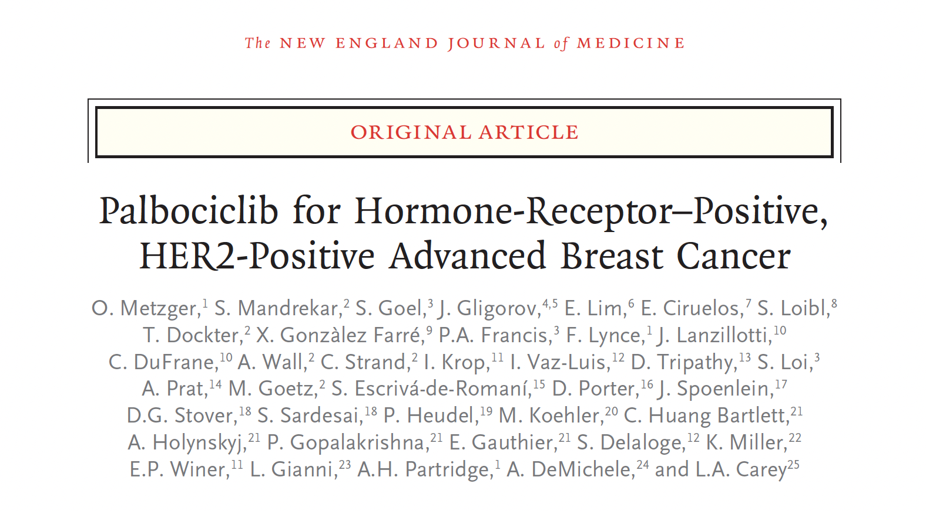
2026:394;451-62.

Slide 88
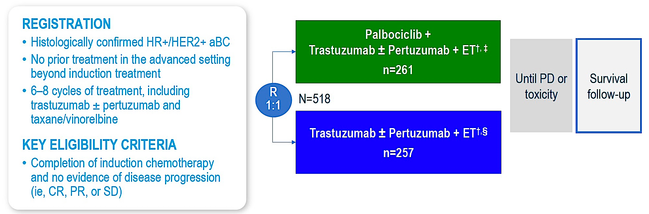
Phase III PATINA Trial: First-Line Therapy for Triple-Positive mBC
Tested addition of CDK4/6 inhibitor to maintenance ET + HP
after induction chemotherapy + HP without disease progression
CR = complete response, PR = partial response; SD = stable disease
Metzger O et al. N Engl J Med 2026;394(5):451-62.

Slide 89
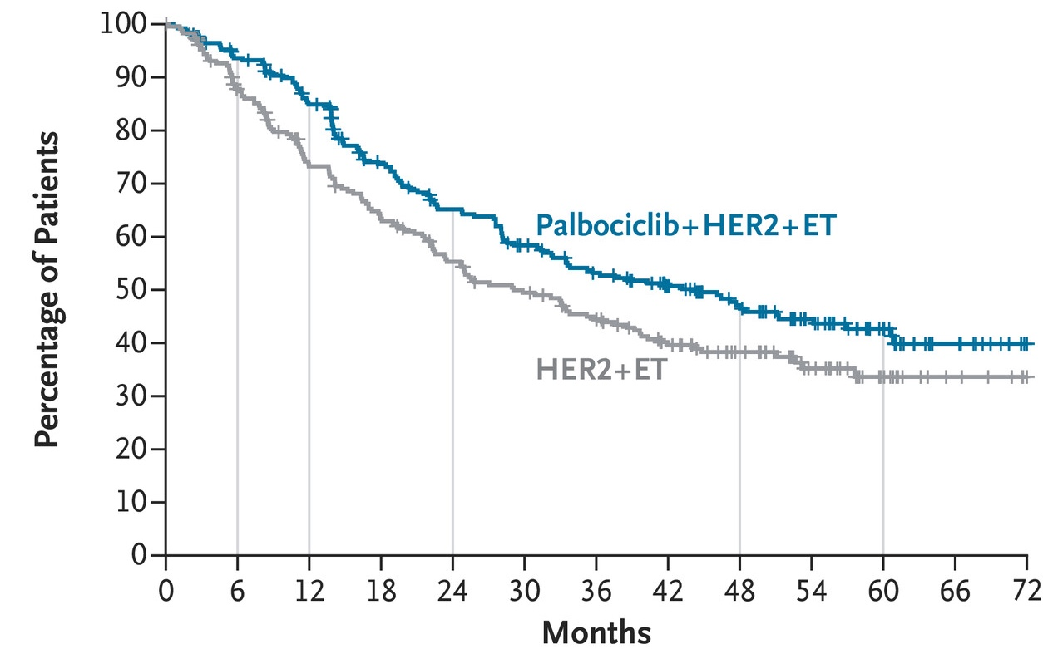
Phase III PATINA: Progression-Free Survival
(Intention-to-Treat Population)
mPFS 44.3 mo vs 29.1 mo
HR 0.75 (0.59-0.96)
Metzger O et al. N Engl J Med 2026;394(5):451-62.

Slide 90
Phase III PATINA: Progression-Free Survival
(Intention-to-Treat Population)
mPFS 44.3 mo vs 29.1 mo
HR 0.75 (0.59-0.96)
For triple-positive mBC, optimizing both ET and HER targeting
works in maintenance therapy
Metzger O et al. N Engl J Med 2026;394(5):451-62.

Slide 91
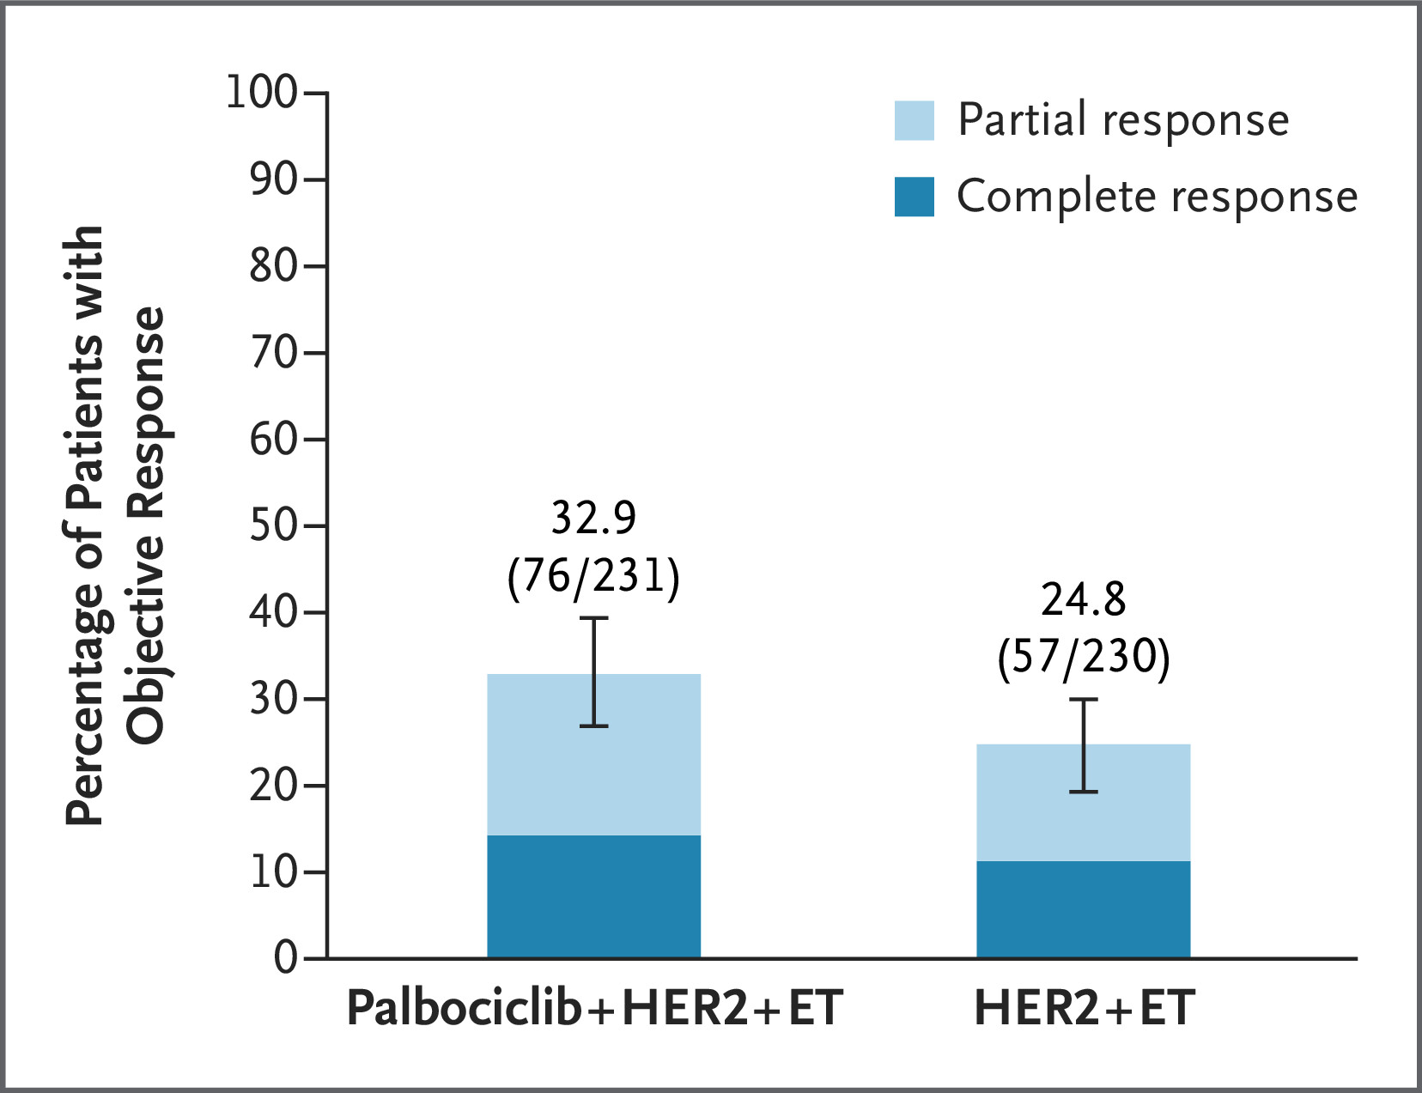
Phase III PATINA: Tumor Response
Metzger O et al. N Engl J Med 2026;394(5):451-62.

Slide 92
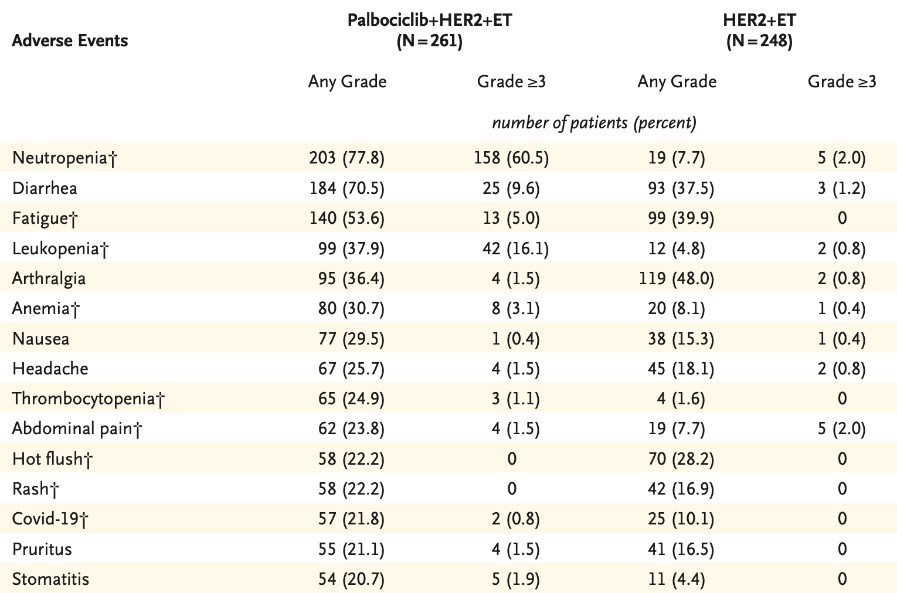
Phase III PATINA: Common Adverse Events
Metzger O et al. N Engl J Med 2026;394(5):451-62.

Slide 93
FDA Approves Palbociclib with Trastuzumab, with or without Pertuzumab, and ET as Maintenance Therapy for HR-Positive, HER2-Positive mBC
Press Release: June 24, 2026
“On June 24, 2026, the Food and Drug Administration approved palbociclib in combination with trastuzumab, with or without pertuzumab, and endocrine therapy for the maintenance treatment of adults with HR-positive, HER2-positive locally advanced or metastatic breast cancer following induction treatment.
Efficacy was evaluated in PATINA (NCT02947685), a randomized, open-label trial in 518 patients with HR-positive, HER2-positive locally advanced or metastatic breast cancer who had no evidence of disease progression after induction treatment with a taxane and trastuzumab, with or without pertuzumab, for their advanced disease. Patients were randomized (1:1) to receive either palbociclib with trastuzumab, with or without pertuzumab, and endocrine therapy (fulvestrant or an aromatase inhibitor [anastrozole, letrozole, or exemestane]) or trastuzumab, with or without pertuzumab, and endocrine therapy alone. Patients received treatment until disease progression or unacceptable toxicity.
The palbociclib prescribing information includes warnings and precautions for neutropenia, interstitial lung disease/pneumonitis, and embryo-fetal toxicity.”
https://www.fda.gov/drugs/resources-information-approved-drugs/fda-approves-palbociclib-trastuzumab-or-without-pertuzumab-and-endocrine-therapy-maintenance

Slide 94
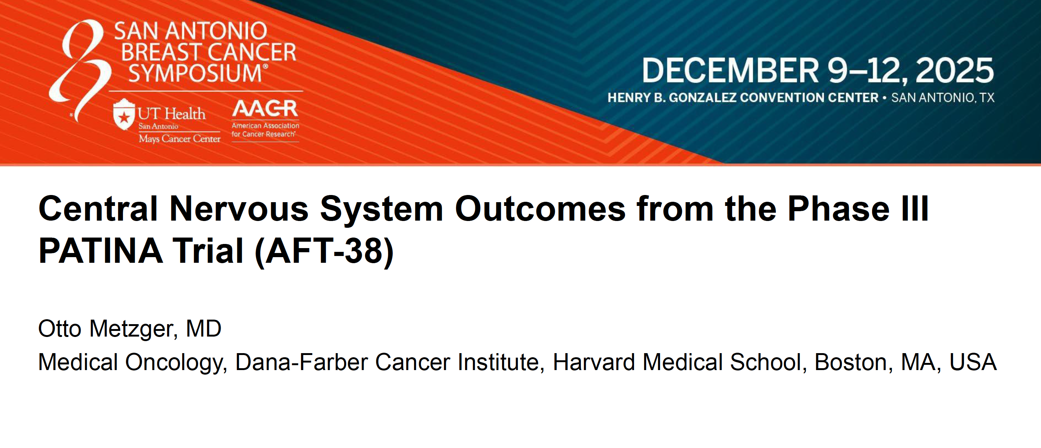
Abstract RF4-01

Slide 95
PATINA: Cumulative Incidence of CNS Progression or Death Among Patients without CNS Metastases at Baseline
 | Palbociclib + anti-HER2 + ET (n = 250) | Anti-HER2 + ET (n = 248)
CNS PFS event (n) | 35 | 48
Death | 3 | 1
CNS progression | 32 | 47
Cumulative risk of CNS progression or death (%)
12 months | 4.6% | 6.9%
24 months | 9.7% | 15.7%
36 months | 13.0% | 19.2%
Metzger O et al. SABCS 2025;Abstract RF4-01.

Slide 96
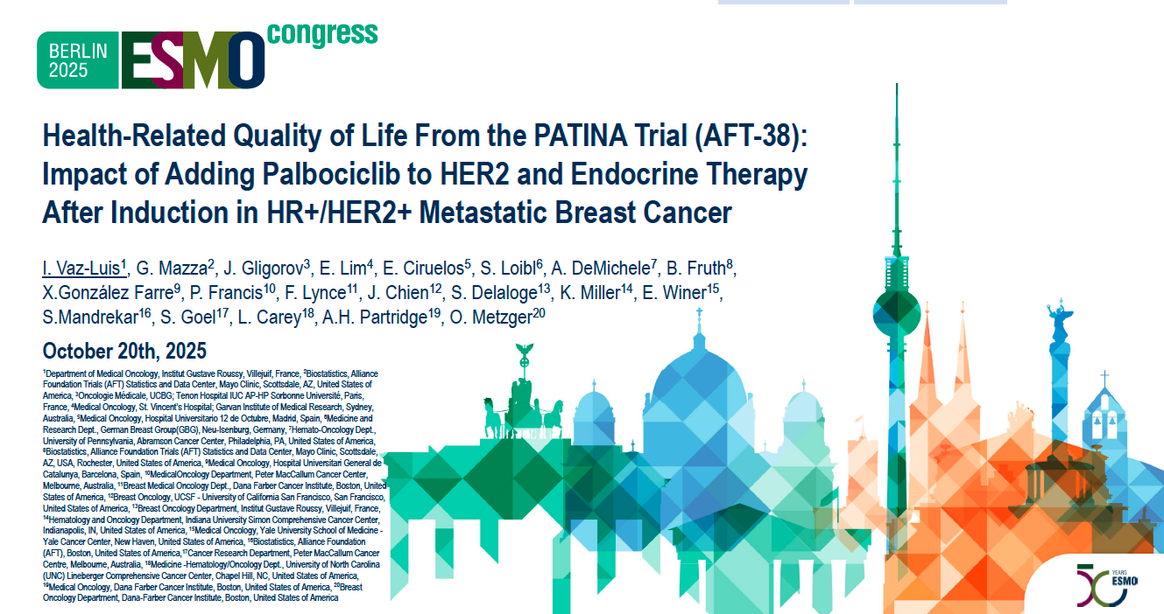

Slide 97
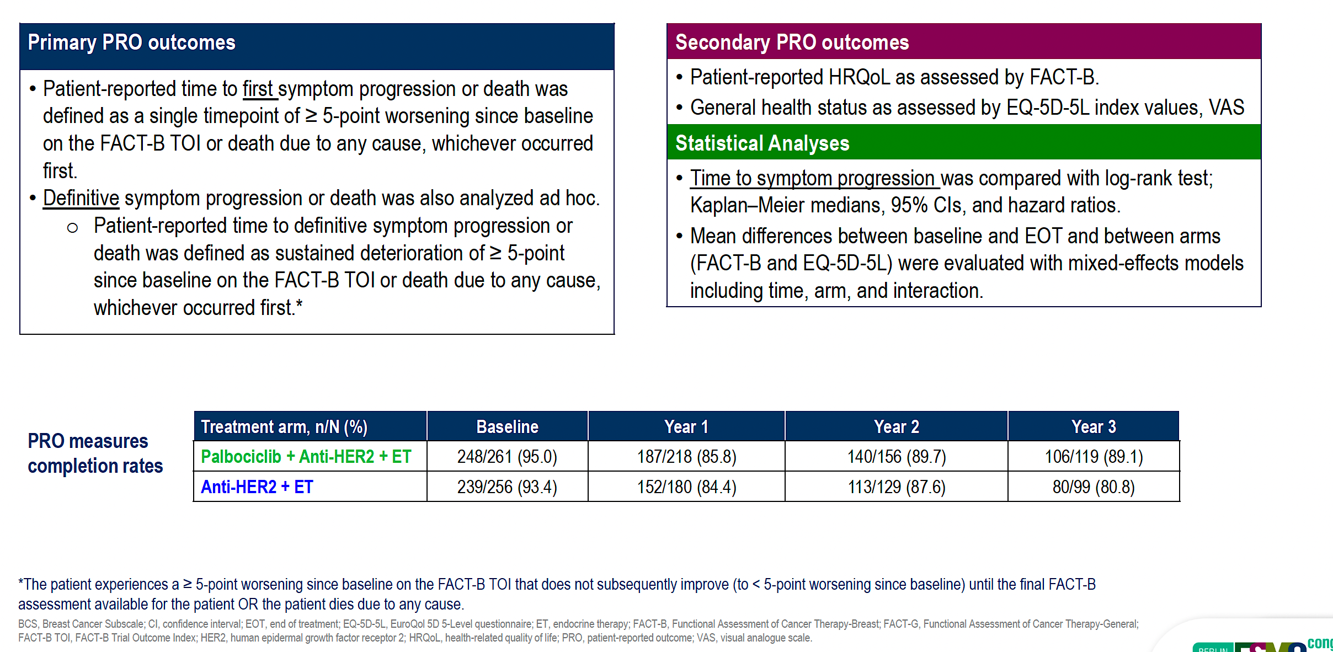
PATINA: PRO Outcomes and Analysis
Vaz-Luis I et al. ESMO 2025;Abstract 485MO.

Slide 98
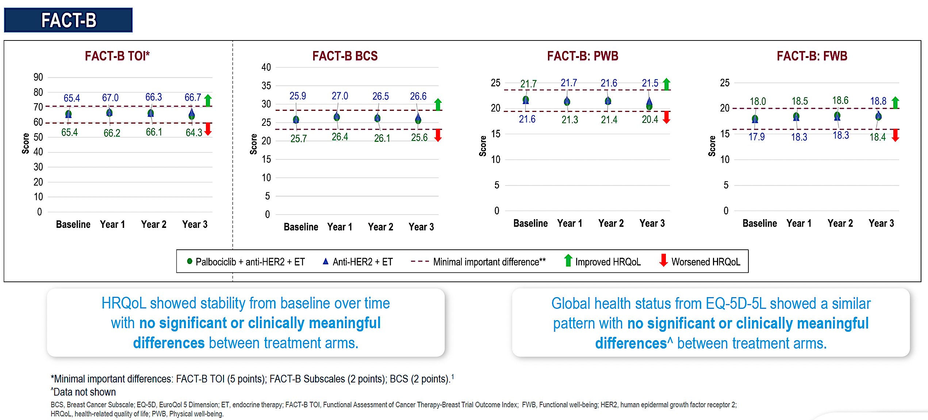
PATINA: HRQoL Scores
Vaz-Luis I et al. ESMO 2025;Abstract 485MO.

Slide 99
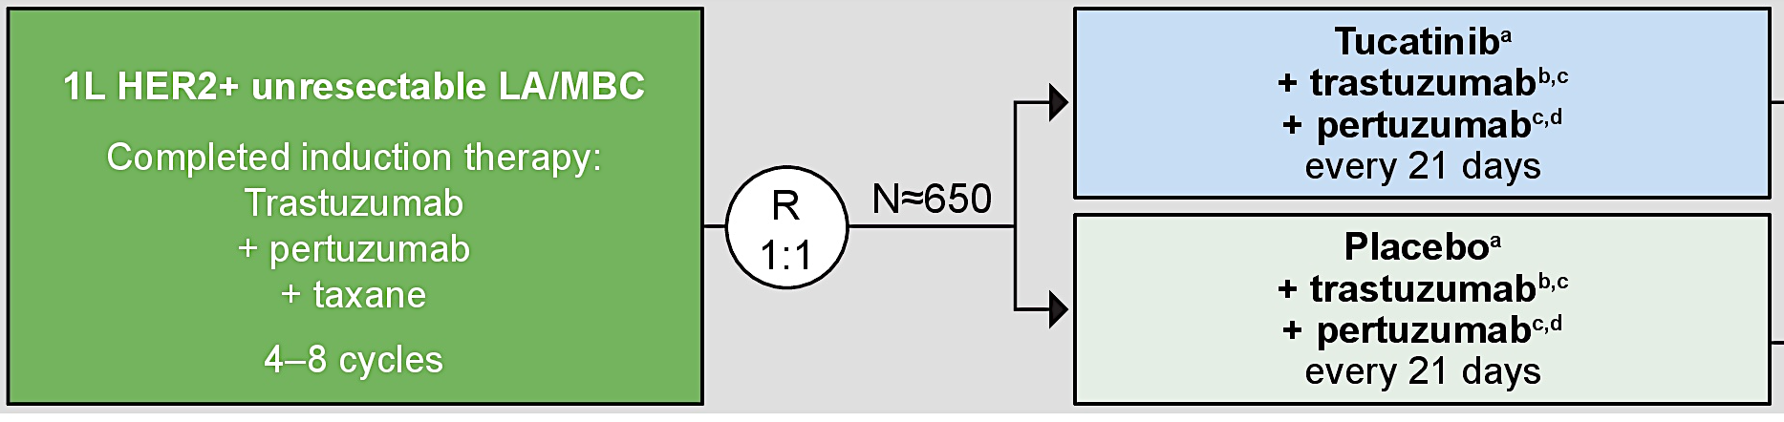
Phase III HER2CLIMB-05 Trial Maintenance Regimen
Tested addition of tucatinib to maintenance HP
after induction chemotherapy + HP without disease progression
(45% of patients with triple-positive disease also received ET)
Dieras V et al. J Clin Oncol 2025 December 10;44(17):1597-607.

Slide 100
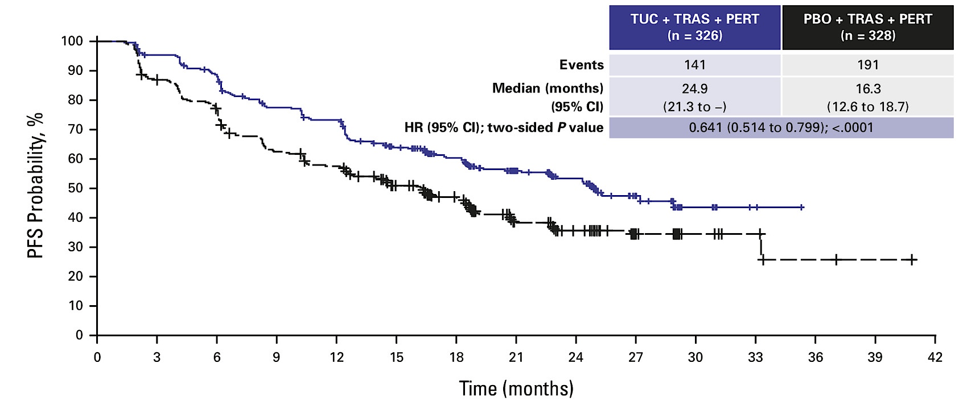
Phase III HER2CLIMB-05: Investigator-Assessed PFS
(Intention-to-Treat Population)
TUC = tucatinib; TRAS = trastuzumab; PERT = pertuzumab; PBO = placebo
PFS ∼25 mo regardless of HR status
Toxicity as expected (more GI, transaminase with tucatinib added)
Dieras V et al. J Clin Oncol 2025 December 10;44(17):1597-607.

Slide 101
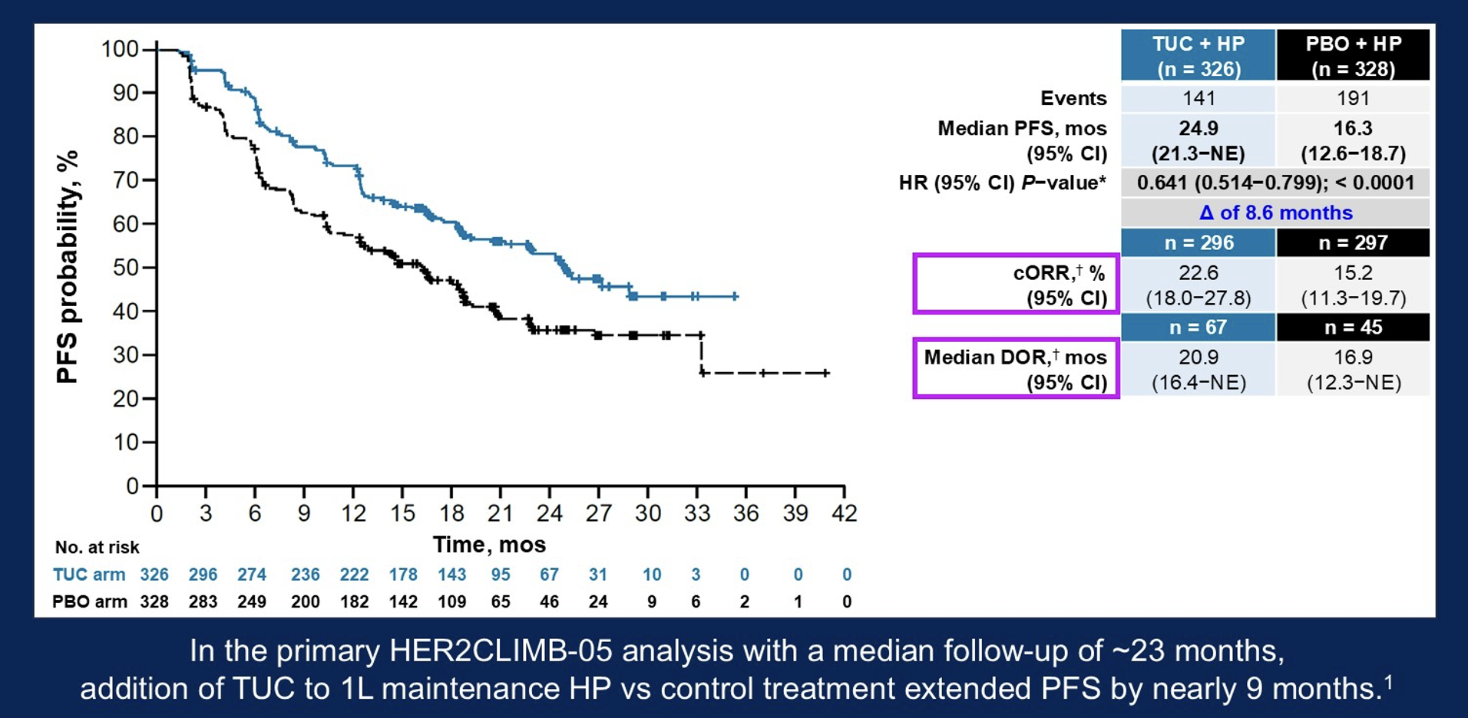
HER2CLIMB-05: Progression-Free Survival (PFS) in the Overall Population
TUC = tucatinib; HP = trastuzumab and pertuzumab; PBO = placebo; cORR = confirmed objective response rate; DOR = duration of response; NE = not estimable
Hamilton E et al. ASCO 2026;Abstract 1005.

Slide 102
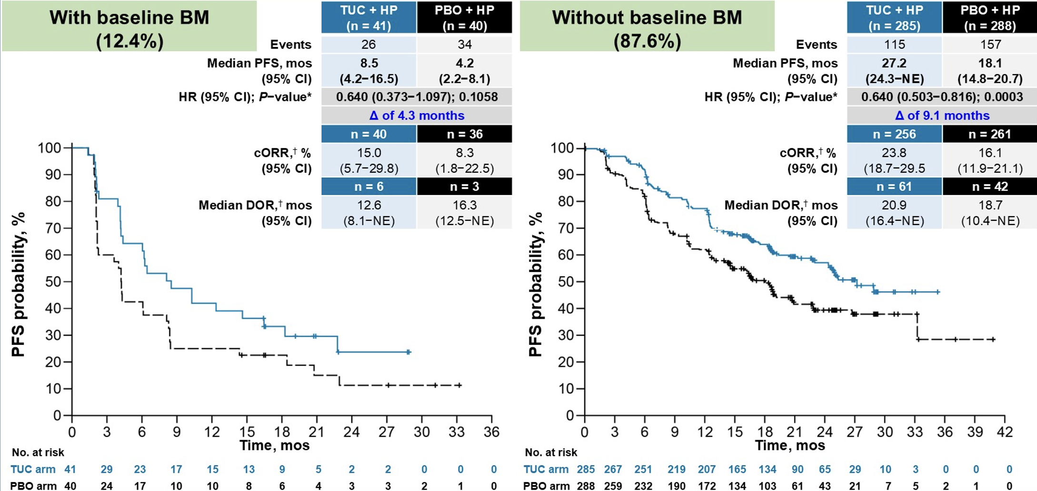
HER2CLIMB-05: PFS by Brain Metastases (BM) at Baseline
Hamilton E et al. ASCO 2026;Abstract 1005.

Slide 103
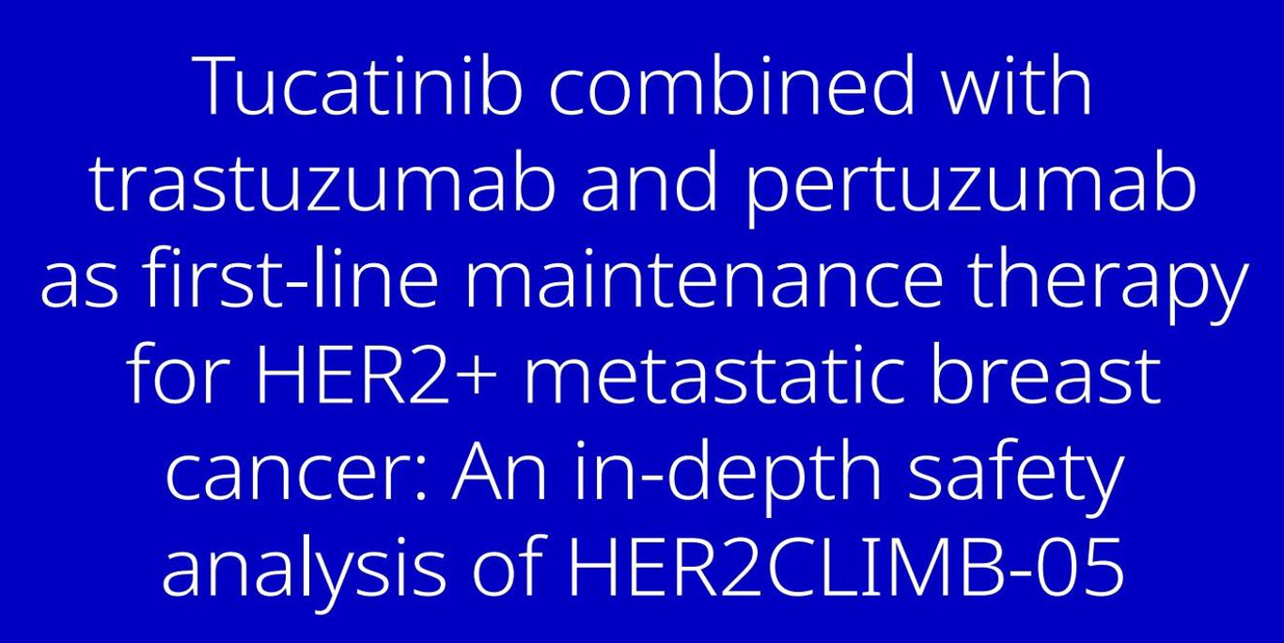
Dieras VC et al. ASCO 2026;Abstract 1042.

Slide 104
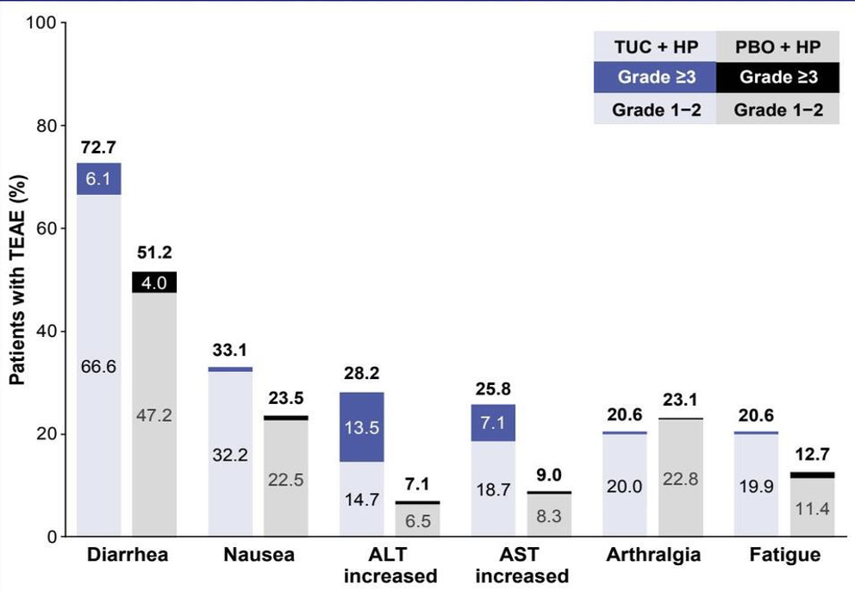
HER2CLIMB-05: Safety Overview
TEAE = treatment-emergent adverse event; ALT = alanine transaminase; AST = aspartate transferase
Dieras VC et al. ASCO 2026;Abstract 1042.

Slide 105
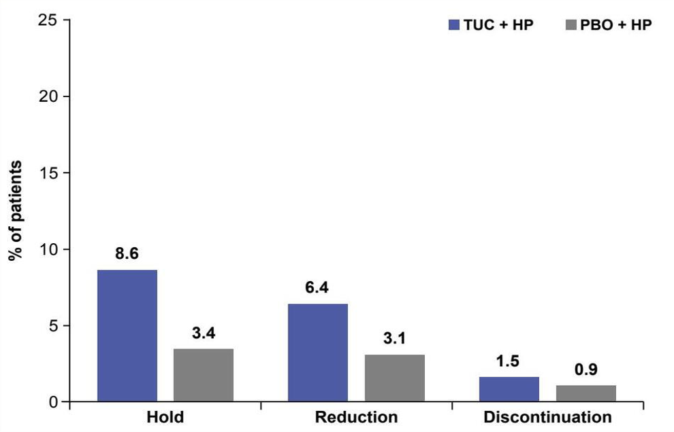
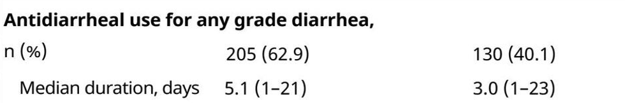
HER2CLIMB-05: Dose Modifications Due to Diarrhea
Dieras VC et al. ASCO 2026;Abstract 1042.

Slide 106
Treatment Considerations for First-Line HER2-Positive mBC
Conventional treatment is induction chemotherapy, including antibody-drug conjugates, with anti-HER2 therapy before a nonchemotherapy maintenance regimen.
Nonchemotherapy regimens are now markedly more effective, calling into question the role of induction chemotherapy.
Options:
  Any HR status: Tucatinib + HP regardless of HR status.
  Triple positive: ET + CDK4/6 inhibitor + HP.
  PATINA outcomes are so favorable and molecular phenotype so strongly luminal that AI + palbociclib + HP may be favored for triple-positive disease.

Slide 107
Agenda
Introduction: HER2 History
Module 1: Cases from the GMO Survey
Module 2: Biology and Selection of First-Line Therapy for HR-Positive, HER2-Positive Metastatic Breast Cancer (mBC) — Dr Mahtani
Module 3: Faculty Case Presentations
Module 4: Patterns of Care Survey — Part 1
Module 5: Optimizing the Use of Up-Front Maintenance Therapy for HER2-Positive mBC — Dr Carey
Module 6: Faculty Case Presentations
Module 7: Patterns of Care Survey — Part 2

Slide 108
Dr Mahtani: Case
92yo with de novo triple-positive MBC
PMHx: Osteopenia, HTN
Underwent screening mammo in July 2024: right breast asymmetry noted, US confirmed 6mm suspicious lesion, no abnormal axillary nodes. Patient declined the suggested biopsy.
May 2026: presented with painful right breast mass with nipple retraction, skin thickening. Repeat imaging confirmed 5.9cm mass with multiple suspicious axillary nodes.
Biopsy: IDC, ER 80%, PR 60%, HER2 3+

Slide 109
Dr Mahtani: Case (Cont)
PET: Multiple focal areas of abnormal uptake within the liver. Largest lesion 3.5cm. Right breast mass noted with abnormal uptake, multiple FDG avid axillary, subpectoral, mediastinal nodes
Liver biopsy: confirmed mBC, triple positive; AST/ALT in the 200s
Patient/family declined chemotherapy, consented to HP and “anything oral”
Started HP, letrozole, palbociclib with initial improvement on exam after 3 months, falling LFTs (pending repeat imaging)
Excellent tolerance to therapy

Slide 110
Dr Carey: Case
63 yo woman with triple-positive mBC in 2025 after an 8-year relapse-free interval
Exemestane + palbociclib + HP + zoledronic acid
  Fatigue and GI symptoms (diarrhea), declined dose reduction
  Palliative RT at outset (spine, left pelvis) improved symptoms

Slide 111
Agenda
Introduction: HER2 History
Module 1: Cases from the GMO Survey
Module 2: Biology and Selection of First-Line Therapy for HR-Positive, HER2-Positive Metastatic Breast Cancer (mBC) — Dr Mahtani
Module 3: Faculty Case Presentations
Module 4: Patterns of Care Survey — Part 1
Module 5: Optimizing the Use of Up-Front Maintenance Therapy for HER2-Positive mBC — Dr Carey
Module 6: Faculty Case Presentations
Module 7: Patterns of Care Survey — Part 2

Slide 112
A 65-year-old patient with HR-positive, HER2-positive mBC receives 6 cycles of THP as first-line induction therapy followed by HP/ET/palbociclib but develops asymptomatic moderate neutropenia (ANC = 750/µL) while receiving maintenance therapy. Regulatory and reimbursement issues aside, what would be your next course of action?
* ANC can run low on palbo but does not appear to increase infection, I would use lower threshold such as ANC < 500; Reduce dose and also change schedule

Slide 113
A patient with de novo HR-positive, HER2-positive mBC is receiving first-line T-DXd and pertuzumab with response and reasonably good tolerability. Regulatory and reimbursement issues aside, what would be your most likely approach to maintenance therapy?
* AI alone plus or minus palbociclib; Depends on patient age, comorbidities, burden of disease and degree of response

Slide 114
Year in Review: Clinical Investigator Perspectives on the
Most Relevant New Datasets and Advances in Oncology
PI3K/AKT/mTOR Pathway in
HR-Positive Metastatic Breast Cancer
A CME/MOC-Accredited Live Webinar
Wednesday, July 15, 2026
5:00 PM – 6:00 PM ET
Faculty
Virginia Kaklamani, MD, DSc
Hope S Rugo, MD
Moderator
Neil Love, MD

Slide 115
Thank you for joining us!
Please take a moment to complete the survey currently up on Zoom. Your feedback is very important to us.
The survey will remain open for
5 minutes after the meeting ends.
Information on how to obtain CME and ABIM MOC credit is provided in the Zoom chat room.
Attendees will also receive an email in 1 to 3 business days with these instructions.

