Slide 1
Bispecific Antibodies and
CELMoDs in Multiple Myeloma
Paul G Richardson, MD

Slide 2
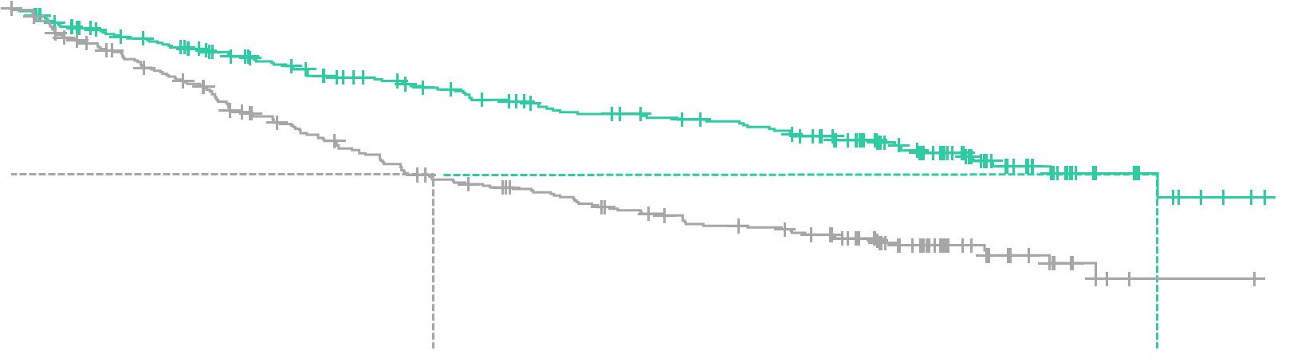
Belantamab mafodotin for early-relapse RRMM
DREAMM-7: Belantamab mafodotin + Vd vs Dara-Vd as ≥2nd-line therapy
Suggest inserting prior to slide 29
 | BVd | DVd
Median PFS (95% CI), months | 36.6 (28.4-NR) | 13.4 (11.1-17.5)
HR (95% CI) | 0.41 (0.31-0.53), P<0.00001
Phase 3 DREAMM-7 study
Belamaf+Vd x 8 cycles, then belamaf Q3W, N=243
Dara-Vd x 8 cycles, then Dara Q4W, N=251
1.0
0.8
Patients | Belamaf-Vd, N=243 | Dara-Vd, N=251
Median age, years | 65 | 64
Age ≥75 years | 15% | 12%
High-risk cytogenetics | 28% | 27%
EMD | 5% | 10%
1 / 2-3 / ≥4 prior lines | 51 / 36 / 12% | 50 / 39 / 11%
Prior PI | 90% | 86%
Prior IMiD | 81% | 86%
R-refractory | 33% | 35%
Prior Dara | 1% | 2%
Prior ASCT | 67% | 69%
0.6
69%
Probability of PFS
0.4
43%
0.2
BVd
DVd
0.0
0
3
6
9
12
15
18
21
24
27
30
33
36
39
Time since randomization (months)
Outcomes
Significant PFS benefit seen across prespecified subgroups, including R-refractory patients (HR 0.37), patients with high-risk cytogenetics (HR 0.36), and patients with prior V (HR 0.45)
Early OS trend favoring belamaf-Vd – 18-month OS 84% vs 73% (HR 0.57)
Hungria V, et al. N Engl J Med 2024;391(5):393–407.

Slide 3



Belantamab mafodotin for early-relapse RRMM
DREAMM-7: Belantamab mafodotin + Vd vs Dara-Vd as ≥2nd-line therapy
Suggest inserting prior to slide 29
ORR 83.1%
≥VGPR 66.3%
≥CR 35.8%
Safety | Belamaf-Vd, N=243 | Dara-Vd, N=251
Grade 3-4 AE | 95% | 78%
Related | 92% | 67%
Discontinuation due to AEs | 32% | 19%
SAEs | 53% | 38%
Death due to AEs | 11% | 8%
Grade ≥3 hematologic AEs
Thrombocytopenia | 56% | 35%
Neutropenia | 14% | 10%
Anemia | 9% | 10%
Infections | 73% | 68%
Grade ≥3 | 33% | 20%
Pneumonia | 12% | 4%
Ocular AEs (Grade ≥3) | 79% (34%) | 29% (3%)
Vision blurred | 68% (24%) | 11% (<1%)
Dry eye | 51% (7%) | 7% (0)
Photophobia | 47% (2%) | 2% (0)
Eye irritation | 43% (5%) | 5% (0)
ORR 71.3%
≥VGPR 46.2%
≥CR 17.5%
MRD-neg
38.7%
Indirect comparisons: Bela-Vd vs SoC / Dara-Tec
Sustained MRD status: Bela-Vd vs Dara-Vd
2025
  Patients achieving MRD-neg status
    Patients with CR: 70% vs 59% (10⁻⁵) / 45% vs 23% (10⁻⁶)
    ITT: 25% vs 10% (10⁻⁵) / 16% vs 4% (10⁻⁶)
    Median time to first MRD-neg status: 11.1 vs 17.0 months
  Patients achieving sustained MRD-neg status (10⁻⁵)
    Patients with CR: 57% vs 42%
    ITT: 14% vs 4%
  Mateos M-V, et al. Blood 2025;146(Supplement 1):2265.
  Indirect treatment comparisons of PFS and OS:
  Bela-Vd vs Pom-Vd / Elo-Pom-dex / Isa-Pom-dex / ide-cel
    PFS HRs 0.52 / 0.34 / 0.54 / 0.47
    OS HRs 0.60 / 0.41 / 0.35 / 0.51
  Richter JR, et al. J Clin Oncol 2026;44(16_Suppl):7568.
  Matching adjusted indirect comparison of OS restricted mean survival time (RMST) and infections: Bela-Vd vs Dara-Tec
    OS RMST ratio 1.01–1.04 at 1–3 years
    Odds ratio for infections 0.24
  Richter J, et al. HemaSphere 2026;10(S1):PS1933.
MRD-neg
17.1%
Median DOR 40.8 vs 17.8 months
Median PFS2 NR vs 33.4 months (HR 0.59)
Hungria V, et al. N Engl J Med 2024;391(5):393–407. Hungria V, et al. Blood 2024;144(supplement 1):772.

Slide 4

Belantamab mafodotin for early-relapse RRMM
DREAMM-8: Belantamab mafodotin + Pom-dex vs Pom-Vd as ≥2nd-line therapy
Suggest inserting prior to slide 31
UPDATE: median follow-up 35.8 months²
 | BPd | Pom-Vd
Median PFS (95% CI), months | 32.6 (21.1-NR) | 12.5 (9.1-17.6)
HR (95% CI) | 0.49 (0.36-0.67), P<0.001
 | BPd | Pom-Vd
Median PFS (95% CI), months | NR (20.6-NR) | 12.7 (9.1-18.5)
HR (95% CI) | 0.52 (0.37-0.73), P<0.001
Phase 3 DREAMM-8 study¹
Belamaf-Pom-dex until PD/death, N=155
Pom-Vd until PD/death, N=147
Patients with ≥1 prior line, including lenalidomide
1.0
0.8
71%
2025
Patients | Belamaf-Pom-dex, N=155 | Pom-Vd, N=147
Median age, years | 67 | 68
Age ≥75 years | 12% | 24%
High-risk cytogenetics | 34% | 32%
EMD | 13% | 7%
1 / 2 or 3 / ≥4 prior lines | 53 / 35 / 12% | 52 / 33 / 15%
Prior PI | 90% | 93%
Prior IMiD | 100% | 100%
IMiD-refractory | 82% | 76%
Prior CD38 mAb | 25% | 29%
CD38 mAb-refractory | 23% | 24%
Prior ASCT | 64% | 56%
0.6
Probability of PFS
0.4
51%
0.2
Belamaf-Pom-dex
Pom-Vd
0.0
0
3
6
9
12
15
18
21
24
27
30
33
36
39
Time since randomization (months)
Outcomes
Significant PFS benefit – seen across prespecified subgroups, including R-refractory patients (HR 0.45), CD38 mAb-refractory patients (HR 0.65), and patients with high-risk cytogenetics (HR 0.57)¹
PFS2 benefit (median 47.1 vs 21.7 months, HR 0.52) seen across patient subgroups including R-refractory and CD38-exposed/refractory patients³
Early OS trend favoring belamaf-Pom-dex – 12-month OS 83% vs 76% (HR 0.77)¹
1. Dimopoulos MA, et al. N Engl J Med 2024;391(5):408–421. 2. Trudel S, et al. Blood 2025;146(Supplement 1):2264.
3. Cengiz Seval G, et al. J Clin Oncol 2026;44(16_suppl):7566.

Slide 5
Belantamab mafodotin for early-relapse RRMM
DREAMM-8: Belantamab mafodotin + Pom-dex vs Pom-Vd as ≥2nd-line therapy
Suggest inserting prior to slide 31
ORR 76%¹
≥VGPR 63%
≥CR 43%
ORR 72%
≥VGPR 39%
≥CR 17%
Safety² | Belamaf-Pom-dex, N=155 | Pom-Vd, N=147
Grade ≥3 AE | 94% | 76%
Related | 80% | 59%
Discontinuation due to AEs | 15% | 12%
SAEs | 63% | 45%
Death due to AEs | 11% | 11%
Grade ≥3 hematologic AEs
Thrombocytopenia | 24% | 20%
Neutropenia | 42% | 28%
Anemia | 10% | 13%
Infections | 82% | 68%
Grade ≥3 | 49% | 26%
Ocular AEs, ≥25% (Grade ≥3 AEs, ≥10%)
Blurred vision | 79% (17%) | 15% (0)
Dry eye | 61% (8%) | 10% (0)
Foreign body sensation in eye | 61% (6%) | 6% (0)
Eye irritation | 50% (4%) | 9% (0)
Photophobia | 44% (3%) | 4% (0)
Eye pain | 33% (2%) | 5% (0)
Cataract | 27% (6%) | 10% (4%)
Reduced visual acuity | 23% (13%) | 6% (1%)
2025
MRD-neg
35%
Indirect comparison of Bela-Pom-dex vs Dara-Pom-dex
  DREAMM-8 vs APOLLO, matching adjusted indirect comparisons of PFS and MRD-neg rate
  After matching
    17% aged ≥75 years, 36% ECOG PS 1
    22% ISS stage III, 38% high-risk cytogenetics
    75% 2–3 prior lines, 79% IMiD-refractory, 47% PI-refractory
  Median PFS 18.1 vs 12.4 months, HR 0.74
  MRD-neg 25.8% vs 8.6%, odds ratio 2.73
  Richter J, et al. HemaSphere 2026;10(S1):PF832.
MRD-neg
7%
24-month DOR 65% vs 40%¹
Long-term responders (PFS ≥30 months):
38% vs 15%³
Sustained 12-month MRD-neg ≥CR 15% vs 3%¹
1. Trudel S, et al. Blood 2025;146(Supplement 1):2264. 2. Dimopoulos MA, et al. N Engl J Med 2024;391(5):408–421.
3. Dimopoulos MA, et al. J Clin Oncol 2026;44(16_suppl):7565.

Slide 6
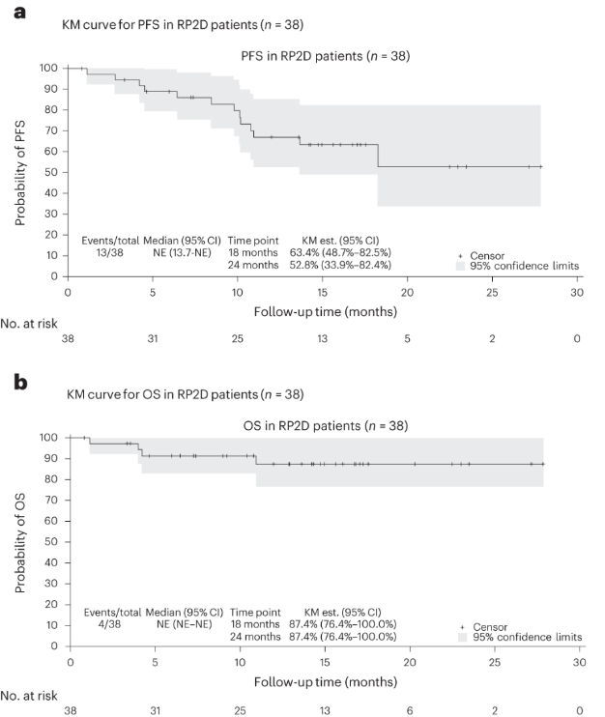
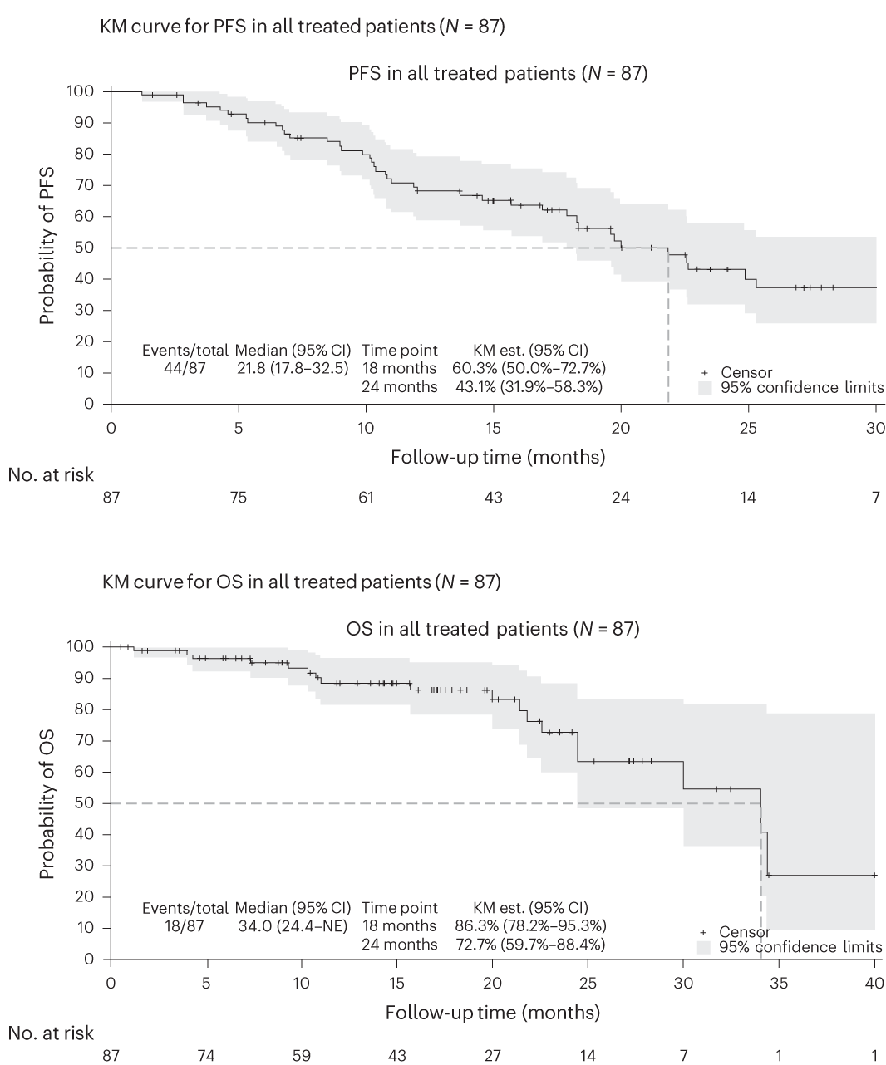
Belantamab mafodotin for early-relapse RRMM
ALGONQUIN: supportive findings from a phase 1/2 study of Bela-Pom-dex
Suggest inserting prior to slide 33
  RP2D Bela 2.5 mg/kg Q8W + Pom-dex
  Other Bela doses 1.9/2.5 mg/kg Q4W, 2.5 mg/kg Q12W, 2.5 mg/kg loading/split, 3.4 mg/kg split
ORR 85.3%
ORR 87.7%
Patients | RP2D, N=38 | All, N=87
Median age, years | 71 | 67
High-risk cytogenetics | 18.5% | 18.4%
Median prior lines | 3 | 3
Prior PI | 100% | 100%
Prior R | 100% | 100%
Prior CD38 mAb | 78.9% | 66.7%
Prior ASCT | 47.4% | 69.0%
PI-refractory | 84.2% | 86.2%
R-refractory | 94.7% | 96.6%
CD38-refractory | 78.9% | 66.7%
Triple-class refractory | 63.2% | 55.2%
Median PFS (RP2D) NR
Median PFS (all) 21.8 months
Median OS (RP2D)
NR
Median OS (all) 34.0 months
AE (grade 3/4), % | RP2D, N=38 | All, N=87
Keratopathy | 65.8 (52.6) | 71.3 (55.2)
Decreased visual acuity | 71.1 (39.5) | 78.2 (43.7)
Fatigue | 57.9 (5.3) | 59.8 (11.5)
Infection | 47.4 (7.9) | 50.6 (20.7)
Neutropenia | 39.5 (36.8) | 49.4 (41.4)
Thrombocytopenia | 39.5 (34.2) | 43.7 (33.3)
Trudel S, et al. Nat Med 2024;30(2):543–51. Figures reproduced under Creative Commons CC BY 4.0 license.

Slide 7
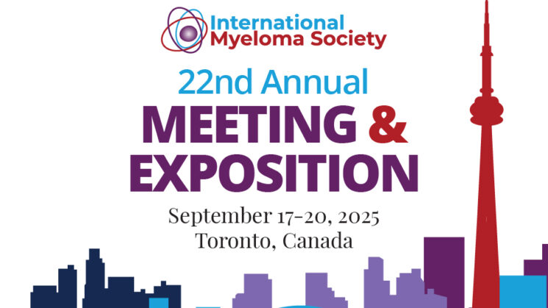

AMaRC 19-02 BelaCarD study:
Belantamab mafodotin + Kd in RRMM
Suggest inserting prior to slide 33
Treatment exposure
Phase 1/2 study
  Median 11 cycles (range 1–38) received
  Belamaf + Kd in RRMM after 1-3 prior lines
  N=70, median age 69.8 years
  27% high-risk cytogenetics
  77% with 2 or 3 prior lines
  11% double-class refractory
  9% triple-class refractory
Safety
DREAMM-20: Belantamab (naked BCMA mAb) in RRMM
  Grade ≥3 AEs 70%
  Grade ≥3 hematologic toxicity 41%, infections 39%
  SAEs 71%
  Ocular symptoms (blurred vision, photophobia, pain, dry eyes) 94%
  (Grade ≥3 12.8%)
  BCVA reduction 81% (Grade 3 37%; Grade 4 1%)
  Keratopathy 76% (Grade 3 51%; Grade 4 0%)
  BCVA decline to 20/50 or worse (both eyes) 8.5%
  18 patients with RRMM after ≥3 prior lines
    Median age 76 years
    17/18 triple-class exposed, 2/18 prior BCMA-targeted therapy
  ORR 28% (2 VGPR, 3 PR)
  Treatment-related AEs 67%
    4 infusion-related reactions, 4 neutrophil count decreased, 2 anemia, 2 vision blurred, 2 platelet count decreased
  No belantamab-related grade ≥2 corneal events
  Quach H, et al. J Clin Oncol 2025;43(16_supplement):7550.
Efficacy
  By end of cycle 2, ORR 79%, ≥VGPR 34%
  Best ORR 83%, CR 41%
  Median follow-up 27.4 months
  Median PFS 22.6 months
  24-month OS 70.5%
Lasica M, et al. Clin Lymphoma Myeloma Leuk 2025;22(suppl):S29–30, abstract OAB-048.

Slide 8
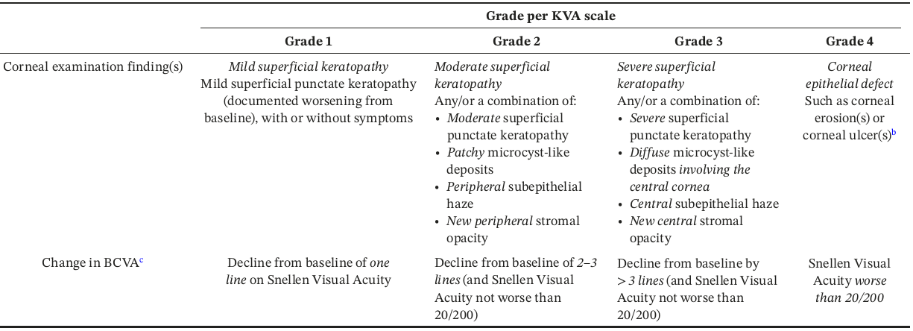



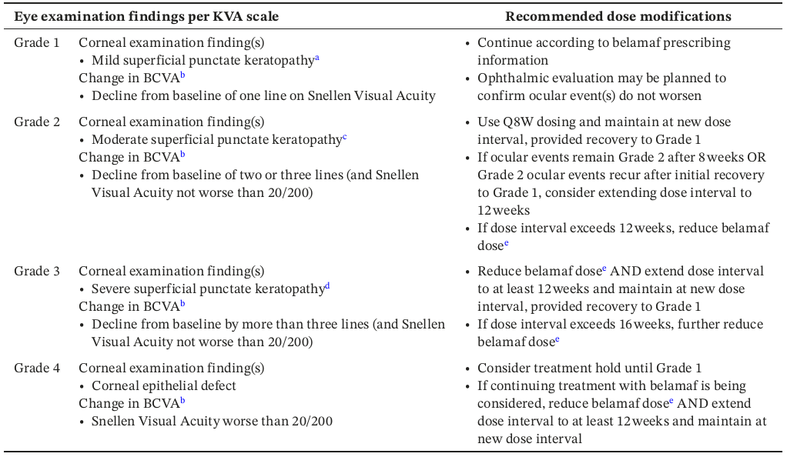
Real-world practical guidance for the clinical management of belantamab mafodotin-associated ocular events
Suggest inserting prior to slide 38
Expert Experience Program
  Independent expert panel of hematologists and ophthalmologists
  Recommendations provided on identifying, treating, and managing ocular events
  Specialist follow-up recommended using KVA scale to inform need for dose modification
  Recommended dose modifications per KVA scale grade provided
Illustrative images of changes in visual acuity included in KVA scale
20/20
20/50
20/200
Key questions addressed
  Best practices for screening, identifying, monitoring, and follow-up
  Key events of importance to the patient and clinically, and patient concerns
  Risk factors for ocular events
  Modifications of dose and/or treatment schedule
  Best practices for referral to and collaboration with an eye specialist
  Communication of benefits and risks
Terpos E, Richardson PG, et al. Am J Hematol 2025;100(10):1839–50.

Slide 9

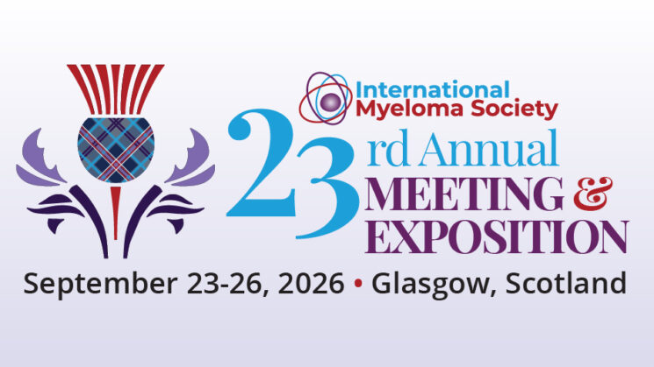
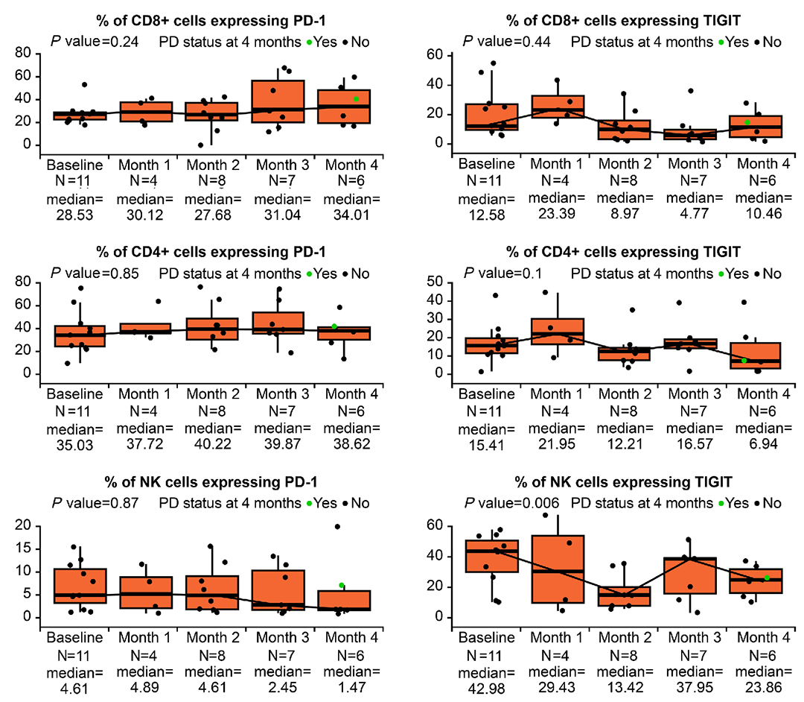
Treatment sequencing of BCMA-targeted therapies
Feasibility of sequential use based on differing MOAs¹
Suggest inserting prior to slide 39
BCMA-targeted ADCs
BCMA-targeted strategies⁸
  e.g. belantamab mafodotin
  Eliminate myeloma cells via direct cell kill and through an anti-MM immune response
  Includes proposed mechanisms such as ADCC, ADCP, and ICD^{2,3}
ADC
CAR-T
BsAb
No impact of belantamab mafodotin on T-cell exhaustion markers PD-1 and TIGIT¹⁰
Payload-dependent
Non-T-cell-dependent
T-cell dependent
CAR-T therapies
T-cell-redirecting therapies post-Belamaf
  e.g. ide-cel and cilta-cel
  Genetically modified T cells
  Recognize and kill BCMA-expressing myeloma cells^{3–5}
NK cells,
Monocytes,
Macrophages
CAR-T cells
T cells
  21 patients in DREAMM-7/DREAMM-8 received subsequent T-cell-redirecting therapies (TCRTs)
  Median 84.1 weeks from end of Belamaf to TCRT
  ORR 92%, including 46% sCR
  Median PFS on TCRTs NR (DREAMM-7 patients) and 6.6 months (DREAMM-8 patients)
  Among patients who received TCRTs immediately after Belamaf, all evaluable patients responded
  Hajek R, et al. Clin Lymphoma Myeloma Leuk 2026;26(Suppl 2):S64, abstract PA-031.
Payload
Bispecific antibodies
Myeloma
cell
BCMA
Myeloma
cell
BCMA
Myeloma
cell
BCMA
  e.g. teclistamab, elranatamab, and linvoseltamab
  Dual antigen specificity facilitating cell-to-cell interactions between T cells and myeloma cells^{3,6,7}
Following ADC therapy
  Near-baseline (s)BCMA levels at PD^{9,10}
  No evidence of T-cell exhaustion¹⁰
  No structural changes to BCMA binding site¹⁰
Myeloma cell
apoptosis
Myeloma cell
lysis
1. Quach H, et al. Blood 2024;144:2356–67. 2. Offidani M, et al. Drug Des Devel Ther 2021;15:2401–15. 3. Shah N, et al. Leukemia 2020;34:985–1005.
4. Rodriguez-Otero P, et al. N Engl J Med 2023;388:1002–14. 5. Berdeja JG, et al. Lancet 2021;398(10297):314–24. 6. Usmani SZ, et al. Lancet 2021;398(10301):665–74. 7. Lesokhin AM, et al. Nat Med 2023;29:2259–67. 8. Cho SF, et al. Front Immunol 2018;9:1821. 9. Hungria V, et al. N Engl J Med 2024;391:393–407. 10. Musa H, et al. Haematologica 2026;111(2):665–78.

Slide 10
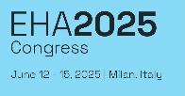
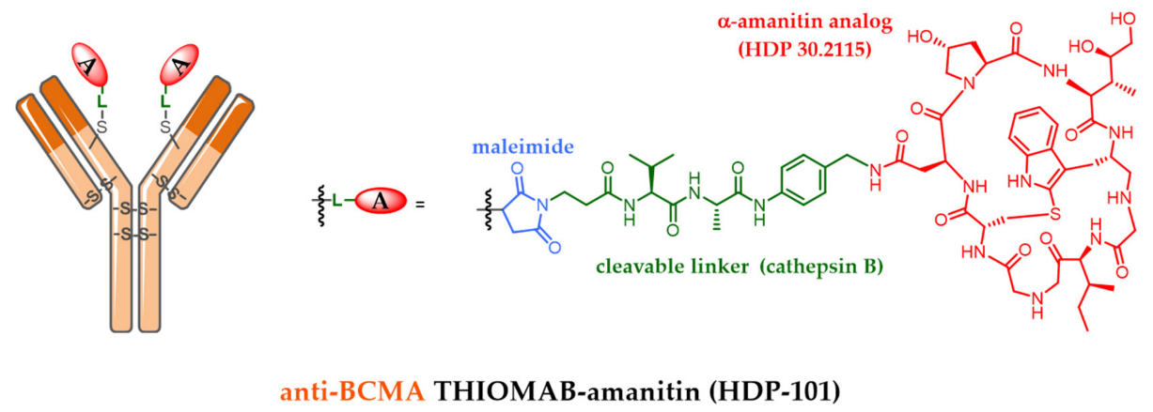
Novel BCMA-targeted ADC: HDP-101
Suggest inserting prior to slide 39
First-in-human phase 1/2a study⁴
34 RRMM patients
  Median age 69 years
  Median 6 prior regimens
Safety
  Grade 2–4 transient, asymptomatic thrombocytopenia in most patients at 100 µg/kg Q3W
  Reduced thrombocytopenia with 90 µg/kg Q3W + premedication, 30 µg/kg, days 1, 8, and 15, and 45 µg/kg, days 1 and 8
  No ocular toxicity to date
Antibody-targeted amanitin conjugate (ATAC; RNA polymerase II inhibitor)¹
ATAC mechanism based on internalization and lysosomal degradation in BCMA-positive tumor cells
HDP-101 resulted in complete tumor remissions in mice in vivo²
Favorable therapeutic window in mice and monkeys²
Potent anti-myeloma activity against cell lines³
Potential activity (↑ belantamab mafodotin) in del17p MM models³
Efficacy
  100 µg/kg Q3W: 1 sCR after 15 months on treatment (patient had prior BCMA CAR T and GPRC5D BsAb); 2 PRs; 1 SD (17 cycles)
  90 µg/kg Q3W: 2 PRs, 2 SDs (n=10)
1. Joubert N, et al. Pharmaceuticals 2020;13(9):245. 2. Figueroa-Vazquez V, et al. Mol Cancer Ther 2021;20(2):367–78.
3. Kumar Singh R, et al. Res Sq [preprint] 2024;rs.3.rs-3843028. 4. Richards S, et al. HemaSphere 2025;9(S1):885–6, abstract PF749.

Slide 11
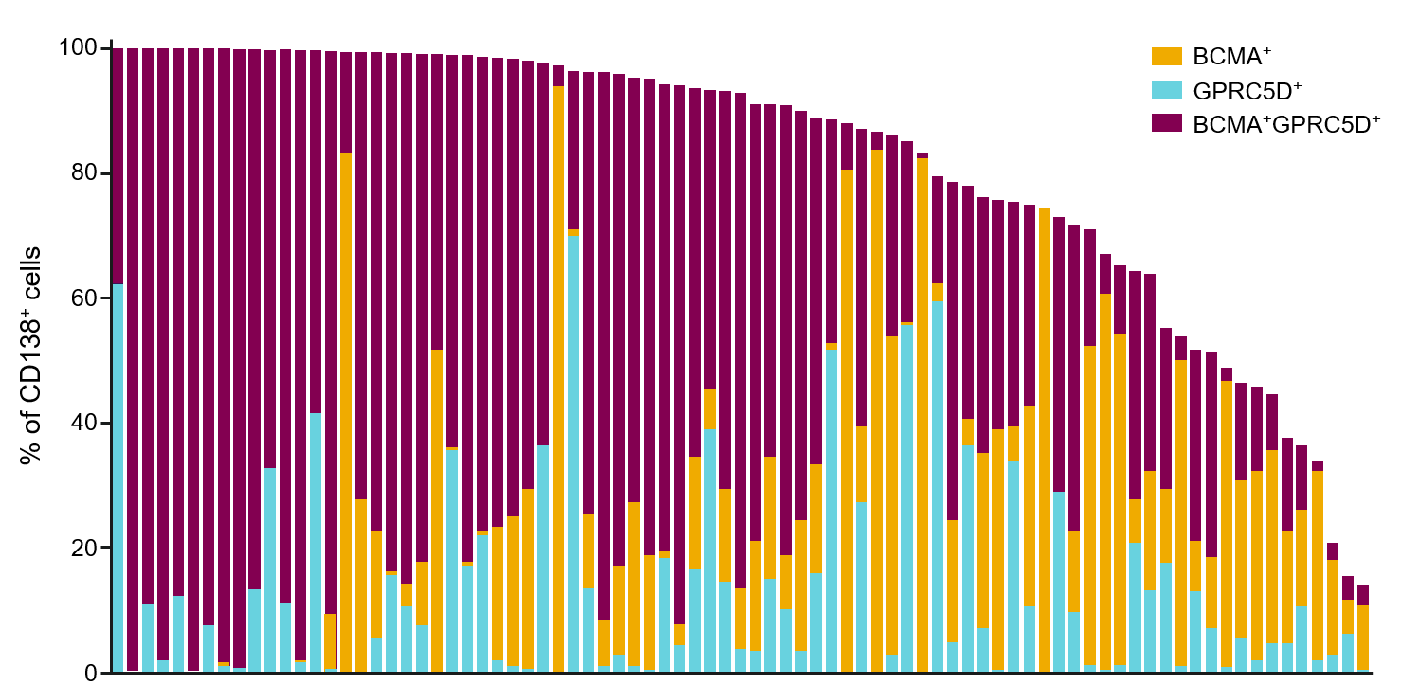
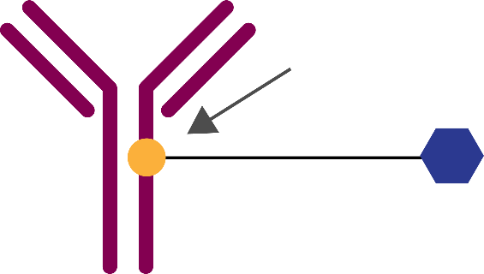
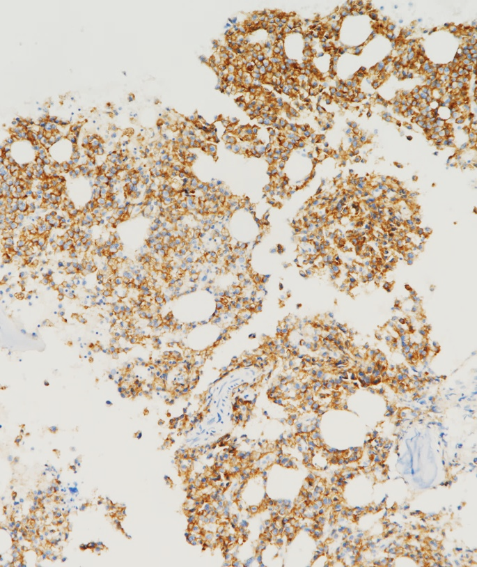
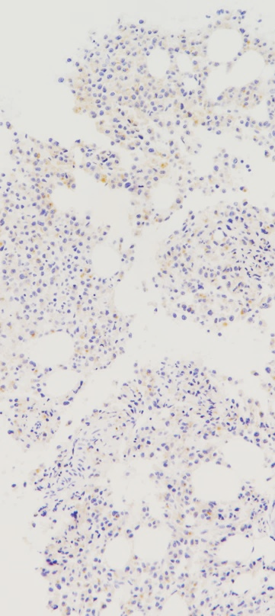
Novel ADCs for RRMM
GPRC5D ADC for targeting RRMM
Suggest inserting prior to slide 39
GPRC5D is a validated target in MM, expressed at all stages of disease^{1,2}
AZD0305 is a GPRC5D-targeting ADC^{2,3}
Rationale for GPRC5D-targeting ADC²
GPRC5D expressed in MM patient samples…
Activity may not rely on immune fitness in late-line patients
Ongoing phase 1/2 study of AZD0305 in RRMM
Conjugation site cysteine alkylation
AZD0305 mAB
  NCT06106945
  Patients with RRMM enrolled to three modules:
    AZD0305 alone (≥3 prior lines)
    AZD0305 + elranatamab (1–3 prior lines)
    AZD0305 + Pom-dex (1–3 prior lines)
  Estimated enrolment: 226 patients
  Primary endpoints: DLTs, safety, tolerability
  Estimated primary completion date: August 2027
Potential for rapid administration
Linker cleavable
Payload antimitotic agent: vc-MMAE
…including post-BCMA therapy
GPRC5D
BCMA
May be for use in orthogonal combination
1. Smith EL, et al. Sci Transl Med 2019;11(485):eaau7746.
2. In-house data, AstraZeneca Pharmaceuticals LP.
3. Huang W, et al. Cancer Res 2022;82(12_Supplement):abstract 6020, poster presentation at AACR 2022.
ADC, antibody-drug conjugate; BCMA, B-cell maturation antigen; GPRC5D, G protein-coupled receptor, class C, group 5, member D; mAB, monoclonal antibody; (RR)MM, (relapsed/refractory) multiple myeloma; vc-MMAE, valine-citrulline monomethyl auristatin E.

Slide 12
CELMoDs slides

Slide 13
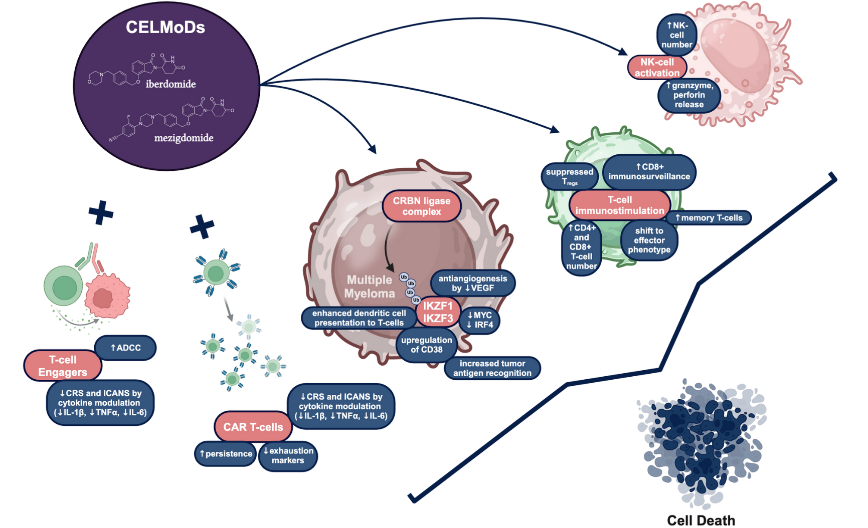
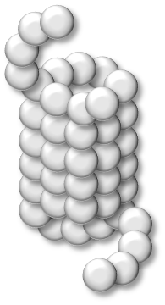
CELMoDs: summary of pharmacodynamics
Enhanced effects seen with anti-MM agents, potential mechanisms of resistance
Suggest inserting prior to slide 64
CELMoDs: overview of immunologic effects
Sensitization/potentiation
Direct immune/antitumor effects
Enhanced/synergistic effects
  ↑ Cytotoxicity of BCMA-targeted BsAb alnuctamab, greater enhancement of activity with mezigdomide vs pom
  ↑ Alnuctamab antitumor activity in vivo, T-cell activation, tumor tissue infiltration
  ↑ Adhesion molecules, T-cell-mediated killing
  ↑ Regressions and PFS in vivo with mezigdomide + GPRC5D-targeted BsAb forimtamig
  ↑ Durable responses, favorable T-cell profile
  ↑ Cytokine production
  ↑ T cell activation and proliferation
  ↑ NK cell cytotoxicity
  ↓ Exhausted/senescent T and NK cells
  Activated innate/adaptive immunity
  Modulation of adhesion molecules
  ↑ Antigen presentation via MHC-I
  ↑ Tumor growth inhibition, synergistic cell killing – mezigdomide + V±dex
  Potent immunomodulation with mezigdomide + Vd
  ↑ Apoptotic activity vs pom with mezigdomide + V or K at 100-fold lower concentration of mezigdomide vs pom
  Near-complete regressions, prolonged survival in vivo with mezigdomide + Vd vs pom-Vd
+BsAbs
+PIs
Enhanced viability/persistence
CUL4A
CD38 priming, enhanced apoptosis
  ↑ Viability in IL-2-starved CAR T cells
  ↑ Activation markers HLA-DR, CD69
  ↑ Effector memory phenotype CAR T cells
  ↑ Production of IL-2, IL-17a, TNFα antigen-specific cytokines by CD8+ and CD4+ CAR T cells against BCMA-expressing MM cells
  ↑ Antigen-specific toxicity
DDB1
  ↑ CD38 cell surface expression
  ↑ ADCC / ADCP with subsequent Dara
  ↑ Apoptosis with mezigdomide + Dara
  ↑ Proliferative CD3+ T cells, effector memory CD4+ T cells, HLA-DR-expressing CD4+ T cell activation
+CAR T
RBX1
+mAbs
CRBN
Ikaros/ Aiolos
Mezi
+Novel
Potential resistance mechanisms
CKS1B downregulation
  CRBN alterations
  Monoallelic 3p26 loss
  ↓ Expression of COP9 signalosome protein complex
  ↑ USP15 expression
  Alterations in SREBP lipid synthesis pathway
  High baseline EZH2 expression → poorer PFS
  ↑ Apoptosis, ↓ cell proliferation with mezigdomide + bromodomain-containing protein 4 (BRD4) inhibitor
  Potential for activity in gain/amp 1q21 MM
Kegyes D, et al. Biomarker Res 2025;13(1):105.
Mo CC, et al. Expert Opin Emerg Drugs 2025;30(3):209–19.

Slide 14
CELMoD doublet for later-relapse RRMM
Mezigdomide + dex: Phase 1/2 study, N=178
Suggest inserting prior to slide 69
CC-92480-MM-001 first-in-human phase 1 trial: Mezigdomide + Dex
Dose escalation
30% high-risk cytogenetics, 35% EMD
Median 6 prior therapies
56% triple-class-refractory
Efficacy in dose expansion cohort
Median DOR 7.6 months
77 heavily pretreated RRMM patients
Dose expansion at RP2D
101 heavily pretreated RRMM patients
37% high-risk cytogenetics, 40% EMD
Median 6 prior therapies
100% triple-class-refractory
Median PFS 4.4 months
In patients with prior anti-BCMA therapy, median DOR 6.9 months and median PFS 5.4 months
ORR 25%
ORR 41%
ORR 30%
ORR 50%
Safety in dose escalation/expansion cohorts
Grade 3/4 neutropenia 71%/76%, anemia 38%/36%, thrombocytopenia 24%/28%, febrile neutropenia 9%/15%
Infections 74%/65% (Grade 3/4 40%/35%)
Treatment discontinuation due to AEs NR/6%
Richardson PG, et al. N Engl J Med 2023;389(11):1009–22.

Slide 15
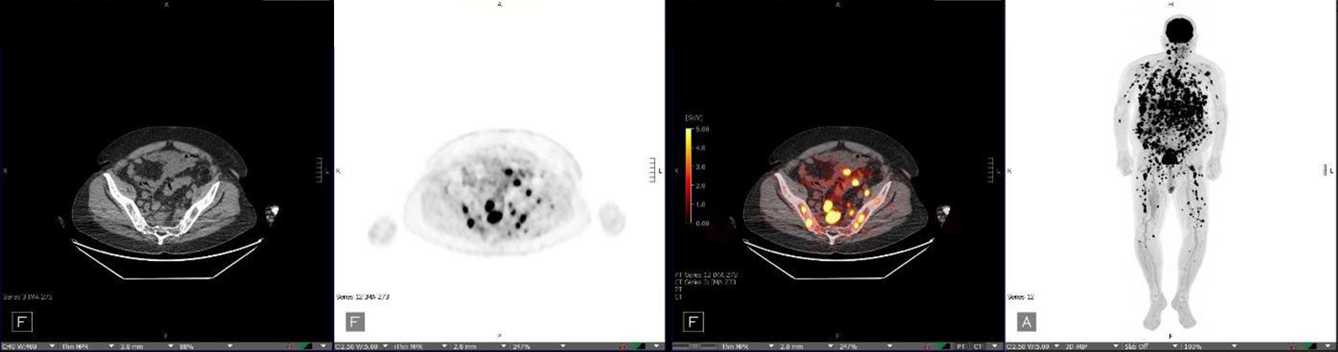
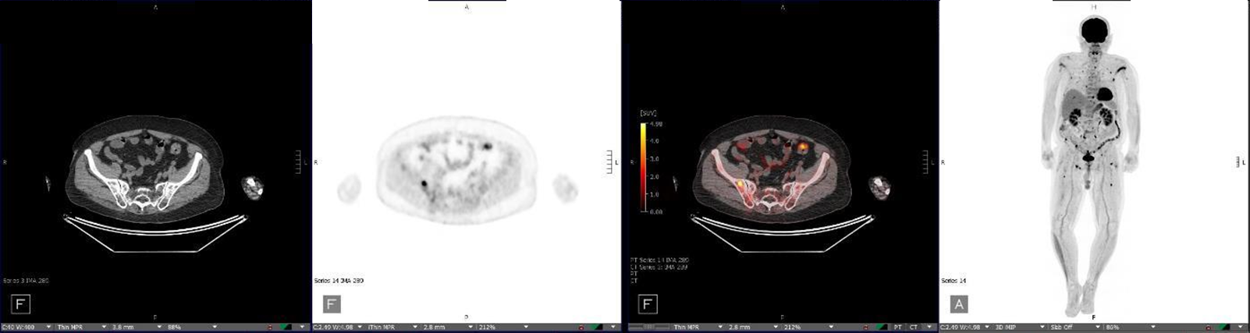
CELMoD doublet for later-relapse RRMM
Mezigdomide + dex induces responses in patients with EMD
Suggest inserting prior to slide 69
At start of treatment (study entry)
After 4 months of treatment with Mezi 1.0 mg,
D1–21 every 28 days, + Dex
Richardson PG, et al. Blood 2022;140(Supplement 1):1366–8. Richardson PG, et al. N Engl J Med 2023;389(11):1009–22.

Slide 16
SUCCESSOR-2: Subgroup analysis of PFS
Suggest inserting prior to slide 71
Subgroup analysis of PFS in confirmatory analysis group by ITT, n = 479
Subgroup | N | Favors MeziKd | Favors Kd | HR (95% CI)
Age, years
< 65 | 181 |  |  | 0.52 (0.34–0.80)
65 to < 75 | 178 |  |  | 0.43 (0.27–0.67)
≥ 75 | 120 |  |  | 0.52 (0.29–0.94)
Baseline ISS disease stage
I | 245 |  |  | 0.42 (0.28–0.64)
II | 146 |  |  | 0.51 (0.31–0.84)
III | 88 |  |  | 0.60 (0.34–1.05)
Cytogenetic risk groups
High risk | 136 |  |  | 0.49 (0.30–0.80)
Standard risk | 280 |  |  | 0.51 (0.35–0.74)
Soft-tissue plasmacytomas
Yes | 118 |  |  | 0.34 (0.21–0.54)
No | 361 |  |  | 0.58 (0.42–0.82)
Extra-medullary plasmacytomas
Yes | 45 |  |  | 0.33 (0.16–0.67)
No | 434 |  |  | 0.51 (0.38–0.69)
Subgroup | N | Favors MeziKd | Favors Kd | HR (95% CI)
Prior LOTs
≤ 2 | 253 |  |  | 0.54 (0.37–0.80)
> 2 | 226 |  |  | 0.44 (0.30–0.64)
Refractory to anti-CD38 mAbs
Yes | 411 |  |  | 0.48 (0.36–0.64)
No | 68 |  |  | 0.50 (0.23–1.08)
Refractory to LEN
Yes | 363 |  |  | 0.50 (0.36–0.67)
No | 116 |  |  | 0.40 (0.21–0.76)
Refractory to anti-CD38 mAbs and LEN
Yes | 326 |  |  | 0.47 (0.34–0.65)
No | 153 |  |  | 0.48 (0.28–0.82)
Refractory to POM
Yes | 155 |  |  | 0.51 (0.33–0.78)
No | 324 |  |  | 0.44 (0.31–0.64)
0.01
0.1
1
10
0.01
0.1
1
10
PFS survival benefit with MeziKd superior across all prespecified subgroups
Richardson PG, et al. J Clin Oncol 2026;44(16_suppl):LBA7506. Dimopoulos MA, et al. HemaSphere 2026;10(S1):LB5004. Dimopoulos MA, et al. Lancet 2026;408(10551):219–33.

Slide 17
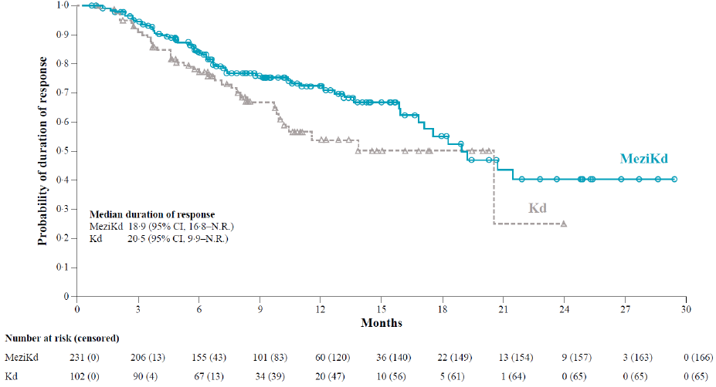
SUCCESSOR-2: Response and DOR
Suggest inserting prior to slide 71
Treatment response, n = 479
DOR, n = 333
12-month DoR | 72% | 54%
ORR
80.2%
≥CR
26.7%
ORR
53.4%
≥CR
8.9%
≥VGPR
60.1%
≥VGPR
30.9%
Median time to response | 1.1 mos | 1.1 mos
Addition of Mezi to Kd deepened response, doubling the rate of ≥VGPR and tripling the rate of ≥CR
Richardson PG, et al. J Clin Oncol 2026;44(16_suppl):LBA7506. Dimopoulos MA, et al. HemaSphere 2026;10(S1):LB5004. Dimopoulos MA, et al. Lancet 2026;408(10551):219–33.

Slide 18
SUCCESSOR-2: How does it compare?
Suggest inserting prior to slide 72
Contextualization of clinical benefit seen in SUCCESSOR-2 for anti-CD38 mAb- and R-exposed RRMM patients across multiple settings and implications for real-world practice¹
SUCCESSOR-2
ITT
SELECT¹
ITT
KARMMA-3²
ITT
CARTITUDE-4³
Dara-exposed sub-group
HR: 0.48
HR: 0.49
HR: 0.24
Median PFS, months
All patientsª were anti-CD38 mAb- and
R-exposed
KPd
N= 191
N = 288
N = 52
N = 132
N = 254
N = 54
N = 51
Median prior LoT, n (range) | 2 (1–9) | 2 (1–9) | 2 (1–2) | 3 (2-4) | 3 (2-4) | NR | NR
R refractory, % | 76.9 | 74.4 | 100 | 73 | 79 | 100 | 100
Anti-CD38 refractory, % | 85.3 | 86.1 | 75 | 95 | 94 | 83.3 | 90.5
Trials are not intended for direct comparison. Side-by-side data are presented solely to summarize information.
ª77% of patients received prior anti-CD38 mAb in the SELECT trial.
Richardson PG, et al. J Clin Oncol 2026;44(16_suppl):LBA7506. Dimopoulos MA, et al. HemaSphere 2026;10(S1):LB5004. Dimopoulos MA, et al. Lancet 2026;408(10551):219–33.
1. Richardson PG, et al. Blood Cancer J 2018;8(11):109. 2. Perrot A, et al. Leuk Lymphoma 2024;65(6):833-842; 3. Ailawadhi S, et al. Blood 2024;144(23):2389-2401;
4. Einsele H, et al. Lancet Oncol 2026;27(2):254-268.

Slide 19
EXCALIBER-RRMM: Dual primary endpoint
MRD-negative CR at any time – subgroup analysis
Suggest inserting prior to slide 67
Subgroup | N | Favors DVd | Favors IberDd | MRD-neg CR rate, %
 |  |  |  | IberDd | DVd
Age, years
< 64 | 160 |  |  | 52.5 | 25.0
65 to 74 | 184 |  |  | 35.2 | 19.8
≥ 75 | 76 |  |  | 30.8 | 13.5
Baseline ISS disease stage
I | 265 |  |  | 46.8 | 27.7
II | 103 |  |  | 37.3 | 9.1
III | 52 |  |  | 20.8 | 3.6
Cytogenetic risk groups
High risk^{b} | 92 |  |  | 27.1 | 15.9
Standard risk | 267 |  |  | 45.5 | 24.1
Expanded cytogenetic risk groups
High risk^{c} | 205 |  |  | 33.7 | 21.8
Standard risk | 145 |  |  | 51.3 | 20.3
Soft-tissue plasmacytomas
Yes | 47 |  |  | 21.7 | 8.3
No | 373 |  |  | 43.5 | 22.2
Subgroup | N | Favors DVd | Favors IberDd | MRD-neg CR rate, %
 |  |  |  | IberDd | DVd
Renal function (eGFR), mL/min
< 45 | 38 |  |  | 35.7 | 8.3
45 to < 60 | 59 |  |  | 46.9 | 18.5
≥ 60 | 322 |  |  | 40.4 | 23.0
Number of prior LOTs
1 | 282 |  |  | 42.4 | 23.1
2 | 138 |  |  | 38.2 | 15.7
Previous LEN exposure
Yes | 292 |  |  | 40.1 | 18.7
No | 128 |  |  | 43.1 | 25.4
Previous LEN exposure in the last prior LOT
Yes | 267 |  |  | 41.2 | 19.9
No | 153 |  |  | 40.8 | 22.1
Refractory to LEN
Yes | 183 |  |  | 35.9 | 23.1
No | 237 |  |  | 45.2 | 18.9
Refractory to LEN in the last prior LOT
Yes | 173 |  |  | 36.7 | 24.1
No | 247 |  |  | 44.4 | 18.5
−75
−50
−25
0
25
50
75
−75
−50
−25
0
25
50
75
Treatment benefit with IberDd was consistent across prespecified subgroups, including LEN-exposed/-refractory patients
Lonial S, et al. Clin Lymphoma Myeloma Leuk 2026;26(Suppl 2):S378–9, abstract LBA-12. Lonial S, et al. Lancet Oncol 2026;doi:10.1016/S1470-2045(26)00450-X

Slide 20
CELMoD triplets and quadruplets for RRMM: combination with mAbs or PIs
Iberdomide + Isa-dex or Dara-Kd
Suggest inserting prior to slide 69
2025
Iberdomide + Isa-dex for functional high-risk RRMM
IBIS AMaRC 20-01 study¹
Iberdomide + Dara-Kd in RRMM
(Phase 2 ReKInDLE study)²
29/50 functional high-risk RRMM patients relapsing ≤18 months after first-line therapy
Efficacy, follow-up ≥12 months
ORR 69%
9-month PFS 51% / OS 82%
Safety
Grade 3/4 neutropenia 52%, insomnia 8%, infusion-related reaction 2%, upper respiratory tract infection 4%
Of 29 patients, 15 progression-free and alive, 8 alive with PD, 6 died
Median age 65 years (range 43–82)
24% R-ISS III
1 / 2 / 3 HRCAs in 32% / 16% / 12% (N=50)
Median time to IBIS salvage 6.3 months
2 grade 5 AEs: lung infection, sepsis
Median age 63 years (range 44–77); 33% high-risk (IMWG 2025); 16% EMD
Efficacy
ORR 92% (38% ≥CR, 35% VGPR)
Safety
Grade ≥3 hematologic AEs: 50% neutropenia, 10% thrombocytopenia, 3% anemia
30 RRMM patients after 1–3 prior lines
Median 1 prior line
93% R-refractory; 27% CD38 mAb-exposed; 30% prior K
47% prior ASCT
8/12 (67%) MRD-neg CR and PET-neg
27 patients remain on treatment for up to 17 months
6 (20%) SAEs, including 3 (10%) lung infections
1. Lim S-L, et al. Blood 2025;146(Supplement 1):5841. 2. Landgren O, et al. Blood 2025;146(Supplement 1):251.

Slide 21

Overcoming T-cell exhaustion
Improving CAR T-cell function with CELMoDs
Suggest inserting prior to slide 74
2024
In vitro evaluation of impact of mezigdomide and iberdomide
Preclinical benefit of CELMoD-dex on TCE outcome
Immune system reactivation with mezigdomide regimens
2024
  Evaluation of the persistence, proliferation, and activation of healthy donor-derived anti-BCMA CAR T cells in response to addition of CELMoDs
  40-color spectral flow cytometry panels used to investigate dynamics of CAR T-cell phenotypes and proliferation
  Evaluation of effect of CELMoDs on antigen-specific cytokine production and cytotoxic activity of CAR T cells
  Immunocompetent CRBN+ mouse model
  Dex alone shown to moderate T-cell proliferation in response to TCE and to give moderate sustained cytokine production
  Incremental TCE step-up dosing combined with iberdomide or mezigdomide plus dex was feasible and tolerable
  Pretreatment with iber-dex before TCE gave 100% response rate, highest overall survival, and more favorable T-cell profiling over time
  Meermeier EW, et al. Blood 2024;144(supplement 1):356.
  Analysis of immune profiles in 56 patients with RRMM receiving mezigdomide-dexamethasone-based regimens
  28 patients had T cell redirecting therapy (TCRT) in last regimen
  TCRT-treated patients had increases in immune cell subsets related to persistent activation and lower Treg counts
  Mezigdomide treatment resulted in increased proliferation levels, enhanced CD4+/CD8+ T cell and NK/NKT cell activation, and a shift to an effector memory phenotype, regardless of prior TCRT
  Kurtova A, et al. HemaSphere 2025;9(S1):PS1674.
Cellular effects
  Significant decrease in Ikaros and Aiolos in CAR T cells by 24 hours
  Persistence and increased viability in IL-2-starved CAR T cells
  Median viability 82% vs 45% (p<0.001) after CELMoD treatment
Mezigdomide / iberdomide: potential strategy for overcoming immune exhaustion
Use of T cell ‘energizing’ agents in combination with/after T cell exhausting agents
Enhancing CAR T cells and
immune effects with iberdomide
Activation
Expansion of highly activated CAR T cell
population after mezigdomide exposure post–ide-cel
  Analysis of immunomodulatory effect of iberdomide-dex on CAR T cells in murine models and on the bone marrow compartment in patients with RRMM
  Iberdomide-primed CAR T cells had superior in vivo anti-MM activity versus non-primed CAR T cells
  In 21 patients progressing after BCMA therapy, iberdomide-dex resulted in:
    Significant increases in NK cells, γδT cells, and CD8+ T cells
    Shift towards effector memory T cells and reduced naïve T cells
    Increase in activated CD4+ and CD8+ T cells
  Findings consistent with previous report showing that CAR T cells manufactured from iberdomide-treated patient samples had greater proliferative capacity, activation, and cytotoxicity
  Aleman A, et al. Clin Lymphoma Myeloma Leuk 2026;26(Suppl 2):S20–21, abstract OA-31.
  Mezigdomide tripled and iberdomide doubled presence of activation markers HLA-DR and CD69
  CELMoDs during CAR T cell transduction doubled production of effector memory phenotype CAR T cells, potentially promoting survival and function
  Phase 1 study (NCT06048250) of mezigdomide started 60–120 days post-ide-cel; 6 RRMM patients (median age 81 years, median 5 prior lines) with peripheral blood immunoprofiling data
  Trend towards increased BCMA CAR T cells by C1D8 – % of BCMA CAR T cells associated with achieving CR
  Early increases in HLA-DR+/CD38+ T cells/CAR T cells – associated with inflammation and disease activity in other settings
  Early increases in CD8+ effector memory cells, CTLA-4+ T cells
  Early decreases in suppressive cells (e.g. CD8+ TEMRA)
  Shift from exhausted to activated T-cell phenotype
  Liu LW, et al. J Clin Oncol 2026;44(16_suppl):7540.
Cytokine production and cytotoxicity
  Increased production of IL-2, IL-17a, TNFα antigen-specific cytokines by CD8+ and CD4+ CAR T cells against BCMA-expressing MM cells
  46% increase in antigen-specific toxicity with CELMoDs
Aleman A, et al. Blood 2024;144(supplement 1):3259.

Slide 22
ASH 2025/IMS 2026: Novel combination studies in RRMM with CELMoDs and TCEs
Suggest inserting prior to slide 74
2025
MagnetisMM-30: Elranatamab + iberdomide¹
CA057-1040: Elranatamab + mezigdomide⁴
  22 patients with RRMM following 2–4 prior lines
  Median age 68 yrs, 41% high-risk cytogenetics, 18% EMD
  Median 2.5 prior lines; 50% triple-class refractory
  Median follow-up 6.1 months
    Unconfirmed ORR 91%; 68% ≥VGPR, 46% ≥CR
  Grade 3/4 AEs 68%, including neutropenia 59%, anemia 14%, thrombocytopenia 14%
  CRS 68% (all Grade 1/2), 9% ICANS
  Infections 41% (5% Grade 3/4)
  Phase 1b/2a study (NCT06988488) of elranatamab plus mezigdomide
    Phase 1 dose-escalation and phase 2 dose-expansion study, 22 patients in 2 phase 2 arms
    Patients with RRMM following 2–4 prior lines of therapy, including an IMiD, a PI, and a CD38 mAb
  Primary endpoint: AEs and DLTs
    Secondary endpoints: ORR, CR rate, VGPR rate, TTR, DOR, PFS and OS
CA088-1005: Arlo-cel + mezigdomide³ or iberdomide
  Phase 1 study (NCT06121843) of arlo-cel plus novel therapies including mezigdomide and iberdomide
    Dose-finding and dose-expansion study, with up to 30 patients in the latter part
    Patients with RRMM following ≥3 (dose-finding, n=10 in dose-expansion) and 1–3 (n=20 in dose-expansion) prior lines of therapy
  Primary endpoint: AEs and RP2D
    Secondary endpoints: preliminary efficacy (ORR, CR rate, VGPR rate) and pharmacokinetics
MELT-MM: Elranatamab + mezigdomide⁵
CADMIUM (Alliance A062102):
Ide-cel + iberdomide²
Mezi maintenance following ide-cel
  Phase 1/2 study (NCT06645678) of elranatamab plus mezigdomide
    75 patients receiving one of 3 dose levels of mezigdomide
    Patients with RRMM ≥2 prior lines of therapy, including R and a PI
  13 evaluable patients enrolled to date: 7 at mezi 0.3 mg/kg, 6 at mezi 0.6 mg/kg; median 4 prior lines
    ORR (n=13) 100% (92.3% CR/sCR)
    MRD-neg sCR 7/8 evaluable patients (87.5%)
    CRS 77% (all grade 1/2), no ICANS
  Randomized Phase 2 study (NCT06179888) of iberdomide maintenance post ide-cel
  Patients with RRMM, ≥4 prior lines of therapy
  6–12 patients in part 1 (safety run-in)
    60 patients in part 2, randomized to iberdomide or observation post ide-cel
  Primary endpoint: PFS
    Secondary endpoints: OS, best response, deepening of response, including MRD-neg CR conversion
  7 patients; median age 81 years; median 5 prior lines
  Median 108 days from ide-cel to mezi
  ORR 85.7%, including 71.4% sCR – deepening of response to ide-cel seen in 5/6 (83.3%) responding patients
  Median follow-up 17.9 months; median PFS 16.5 months
  Most common grade ≥3 AE was neutropenia (85.7%)
  No recurrent CRS, ICANS, or persistent cytopenias
  Janakiram M, et al. Clin Lymphoma Myeloma Leuk 2026;26(Suppl 2):S219, abstract PA-304.
1. Suvannasankha A, et al. Blood 2025;146(Supplement 1):100. 2. Tuchman S, et al. Blood 2025;146(Supplement 1):2289 . 3. Bal S, et al. Blood 2025;146(Supplement 1):5807. 4. Bar N, et al. Blood 2025;146(Supplement 1):8246. 5. Byun JM, et al. Clin Lymphoma Myeloma Leuk 2026;26(Suppl 2):S34–5, abstract OA-52.

