Slide 1
Integrating New Advances into
Community Oncology Practice
CME/MOC, NCPD and ACPE Accredited
Saturday, October 17, 2026
7:15 AM – 12:00 PM ET

Slide 2
Agenda
Module 1 — Breast Cancer: Drs Geyer, Lustberg, Nanda and Wander
Module 2 — Prostate Cancer: Drs Agarwal and Antonarakis
Module 3 — Multiple Myeloma: Drs Lonial and Richardson

Slide 3


Prostate Cancer Faculty
Neeraj Agarwal, MD, FASCO
Faculty Medical Oncologist
Dana-Farber Cancer Institute
Co-Director, Prostate Cancer Program
Harvard Cancer Consortium
The Lank Center for Genitourinary Oncology
Boston, Massachusetts
Emmanuel S Antonarakis, MD
Clark Endowed Professor of Medicine
Division of Hematology, Oncology and
Transplantation
University of Minnesota
Minneapolis, Minnesota

Slide 4
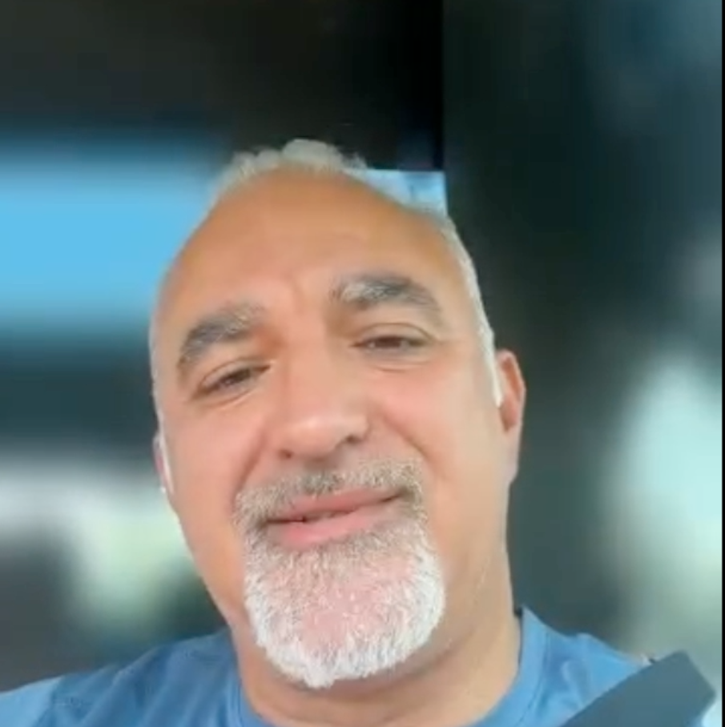

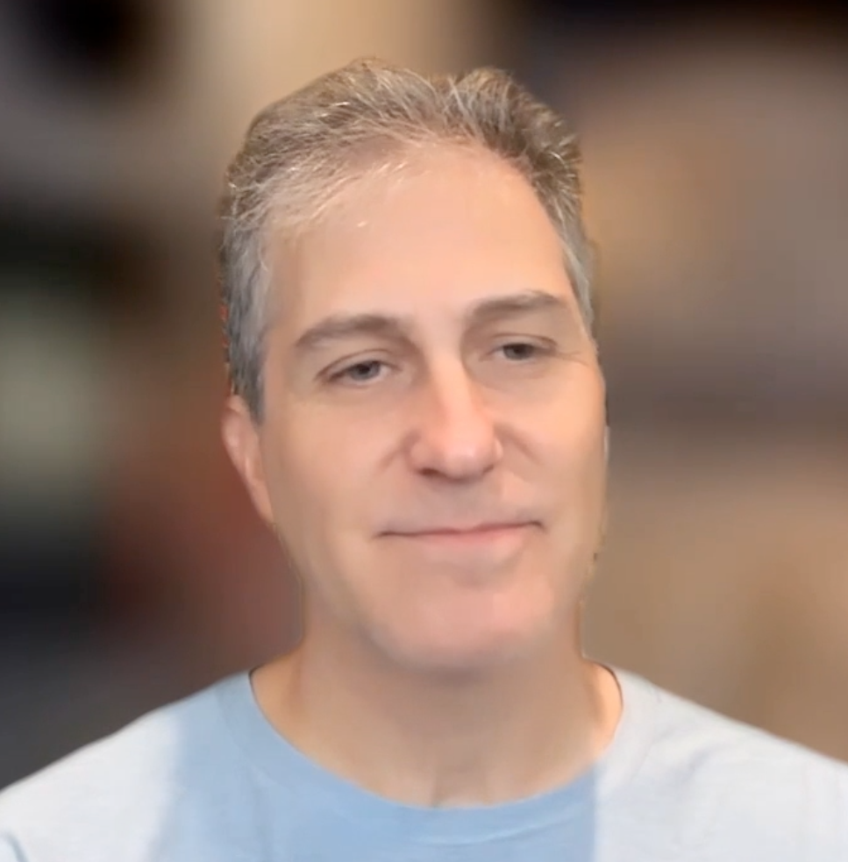


Consulting General Medical Oncologists
Susmitha Apuri, MD
Florida Cancer Specialists & Research Institute
Inverness and Lecanto, Florida
Maen Hussein, MD
Florida Cancer Specialists & Research Institute
The Villages, Florida
Mamta Choksi, MD
Florida Cancer Specialists & Research Institute
Trinity, Florida
Renjitha Ignatius, MD
Florida Cancer Specialists & Research Institute
Sun City Center, Florida
Sunil Gandhi, MD
Florida Cancer Specialists & Research Institute
Lecanto, Florida
Shachar Peles, MD
Florida Cancer Specialists & Research Institute
Lake Worth, Florida
Shaachi Gupta, MD, MPH
Florida Cancer Specialists & Research Institute
West Palm Beach, Florida
Syed F Zafar, MD
Florida Cancer Specialists & Research Institute
Fort Myers, Florida

Slide 5
Agenda
Introduction: ESMO 2026; Recent FDA Approvals
Selection of Endocrine Therapy – Dr Antonarakis
Utility of PARP Inhibitors – Dr Agarwal
AKT Inhibition for PTEN-Deficient Disease – Dr Antonarakis
Radiopharmaceuticals – Dr Agarwal

Slide 6
Agenda
Introduction: ESMO 2026; Recent FDA Approvals
Selection of Endocrine Therapy – Dr Antonarakis
Utility of PARP Inhibitors – Dr Agarwal
AKT Inhibition for PTEN-Deficient Disease – Dr Antonarakis
Radiopharmaceuticals – Dr Agarwal

Slide 7
Select ESMO 2026 Abstracts
Prostate Cancer
Abstract LBA4
Darolutamide with androgen deprivation therapy (ADT) and definitive or salvage locoregional radiation therapy (RT) for localised, very high-risk prostate cancer: Interim analysis of an international, placebo-controlled, randomised phase 3 trial (DASL-HiCaP; ANZUP1801).
Niazi T et al.
Abstract LBA53
Perioperative apalutamide (APA) plus androgen deprivation therapy (ADT) with radical prostatectomy plus pelvic lymph node dissection (RP + PLND) vs RP + PLND alone in patients (pts) with high-risk localized or locally advanced prostate cancer (HR LPC/LAPC): PROTEUS substudy.
Briganti A et al.
Abstract LBA56
Capivasertib (capi) + abiraterone (abi) vs placebo (pbo) + abi in patients (pts) with PTEN-deficient metastatic hormone sensitive prostate cancer (mHSPC): Updated overall survival (OS) from CAPItello-281.
Fizazi K et al.

Slide 8
Select ESMO 2026 Abstracts
Prostate Cancer
Abstract 2215O
Long-term overall survival with abiraterone acetate plus prednisone in the PEACE-1 phase 3 trial for de novo metastatic castration-sensitive prostate cancer (mCSPC).
Fizazi K et al.
Abstract 2219RO
Utility of ctDNA tumor fraction (TF) as a prognostic biomarker in TALAPRO-3: Phase 3 study of talazoparib (TALA) + enzalutamide (ENZA) vs placebo (PBO) + ENZA in patients (pts) with homologous recombination repair (HRR) gene–mutated metastatic castration-sensitive prostate cancer (mCSPC).
Azad A et al.
Abstract 2222RO
Patient-reported outcomes (PROs) in men with metastatic castration-sensitive prostate cancer (mCSPC) and homologous recombination repair (HRR) gene alterations receiving talazoparib (TALA) + enzalutamide (ENZA) vs placebo (PBO) + ENZA: Results from the Phase 3 TALAPRO-3 study.
Azad A et al.

Slide 9
Recent FDA Approvals
FDA APPROVAL
June 12, 2026
Capivasertib with abiraterone and prednisone for PTEN-deficient androgen pathway modulation-naïve or -sensitive prostate cancer
FDA APPROVAL
July 31, 2026
Lutetium Lu 177 vipivotide tetraxetan with androgen receptor pathway inhibitor therapy for metastatic androgen pathway modulation-naïve or -sensitive prostate cancer

Slide 10
Agenda
Introduction: ESMO 2026; Recent FDA Approvals
Selection of Endocrine Therapy – Dr Antonarakis
Endocrine Treatment for Localized Disease
Treatment for M0 Disease
First-Line Endocrine Treatment
Utility of PARP Inhibitors – Dr Agarwal
AKT Inhibition for PTEN-Deficient Disease – Dr Antonarakis
Radiopharmaceuticals – Dr Agarwal

Slide 11
Endocrine Treatment for Localized Disease
Select Datasets
  Taplin ME et al. Perioperative (neoadjuvant and adjuvant) apalutamide (APA) + androgen deprivation therapy (ADT) vs placebo (PBO) + ADT with radical prostatectomy (RP) in high-risk localized or locally advanced prostate cancer (HR LPC/LAPC): Final analysis of the PROTEUS phase 3 study. ASCO 2026;Abstract LBA1.
  Taplin ME et al. Perioperative apalutamide in high-risk localized prostate cancer. N Engl J Med 2026;395(6):546-60.

Slide 12
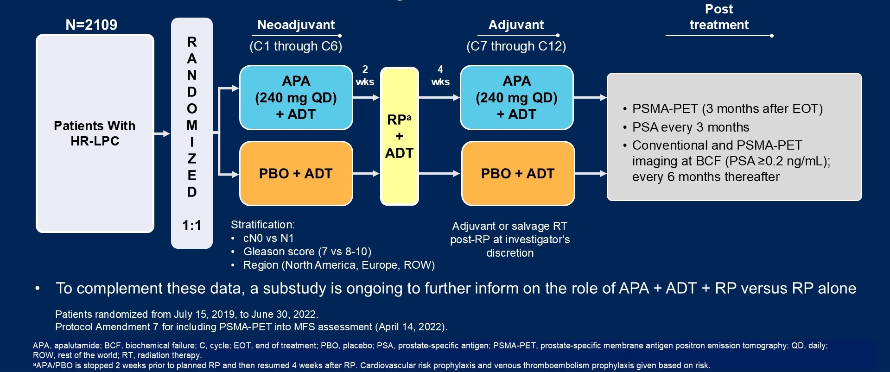
Phase III PROTEUS Study Design
Dual primary endpoints: pathologic complete response/minimal residual disease, metastasis-free survival
Taplin ME et al. ASCO 2026;Abstract LBA1.
Taplin ME et al. N Engl J Med 2026;395(6):546-60.

Slide 13
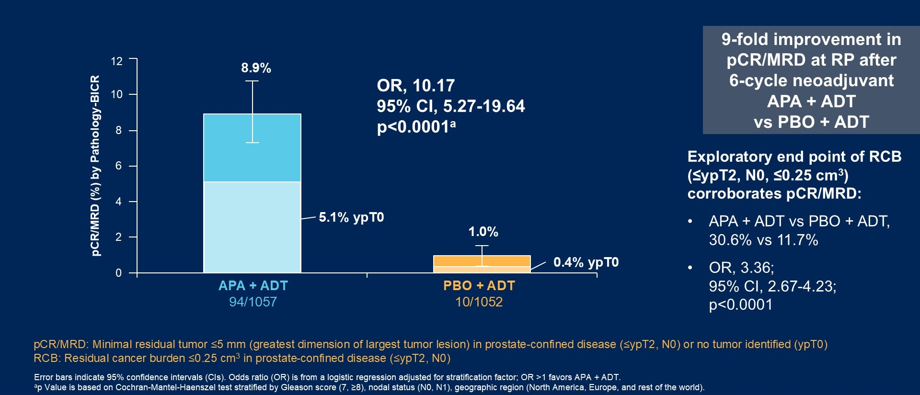
Phase III PROTEUS Dual Primary Endpoint: Pathologic Complete Response (pCR)/Minimal Residual Disease (MRD)
BICR = blinded independent central review; RCB = residual cancer burden
Taplin ME et al. ASCO 2026;Abstract LBA1.
Taplin ME et al. N Engl J Med 2026;395(6):546-60.

Slide 14
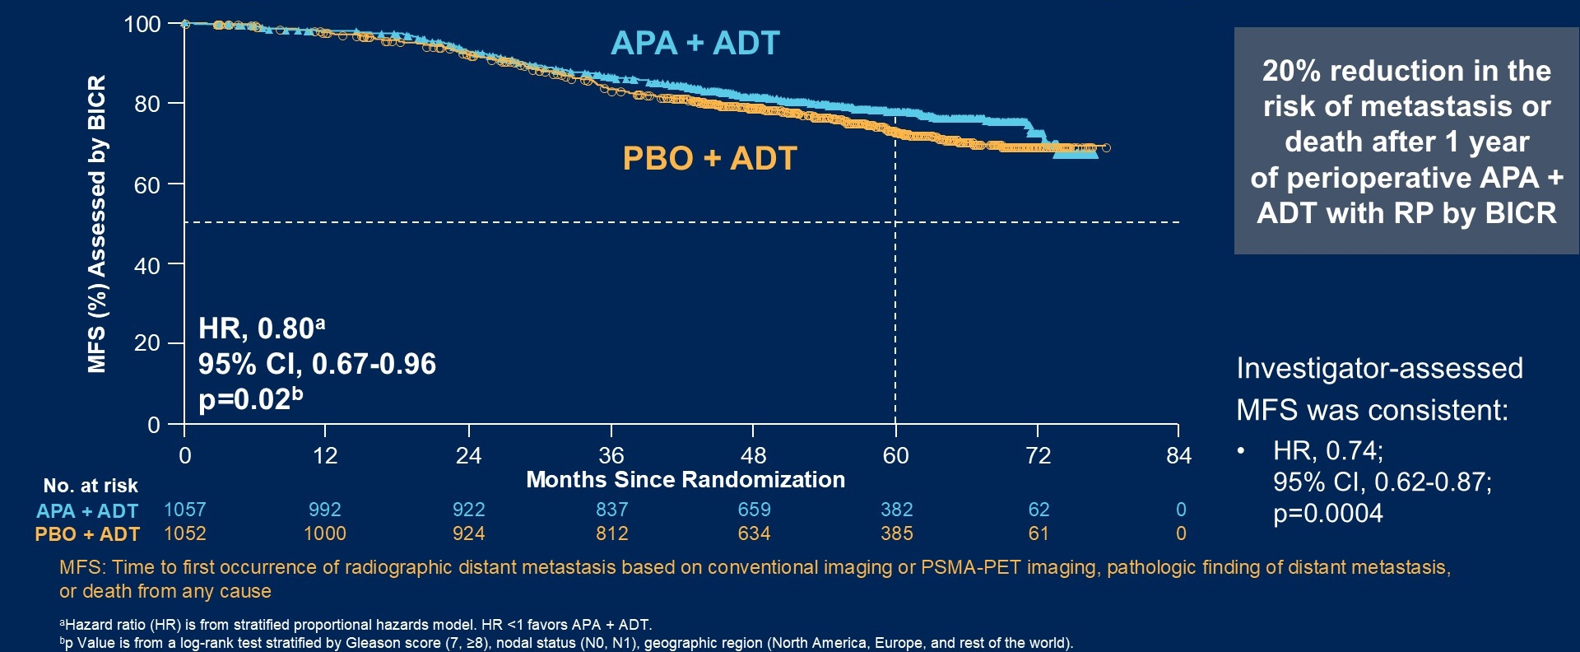
Phase III PROTEUS Dual Primary Endpoint: Metastasis-Free Survival (MFS)
Taplin ME et al. ASCO 2026;Abstract LBA1.
Taplin ME et al. N Engl J Med 2026;395(6):546-60.

Slide 15
Treatment for M0 Disease
Select Datasets
  Shore ND et al. Outcomes of men with high-risk biochemically recurrent prostate cancer who suspended enzalutamide monotherapy treatment in the phase 3 EMBARK study. Genitourinary Cancers Symposium 2024;Abstract 15.
  Freedland SJ et al. Improved outcomes with enzalutamide in biochemically recurrent prostate cancer. N Engl J Med 2023;389(16):1453-65.
  Shore ND et al. Improved survival with enzalutamide in biochemically recurrent prostate cancer. N Engl J Med 2026;394(6):563-75.

Slide 16
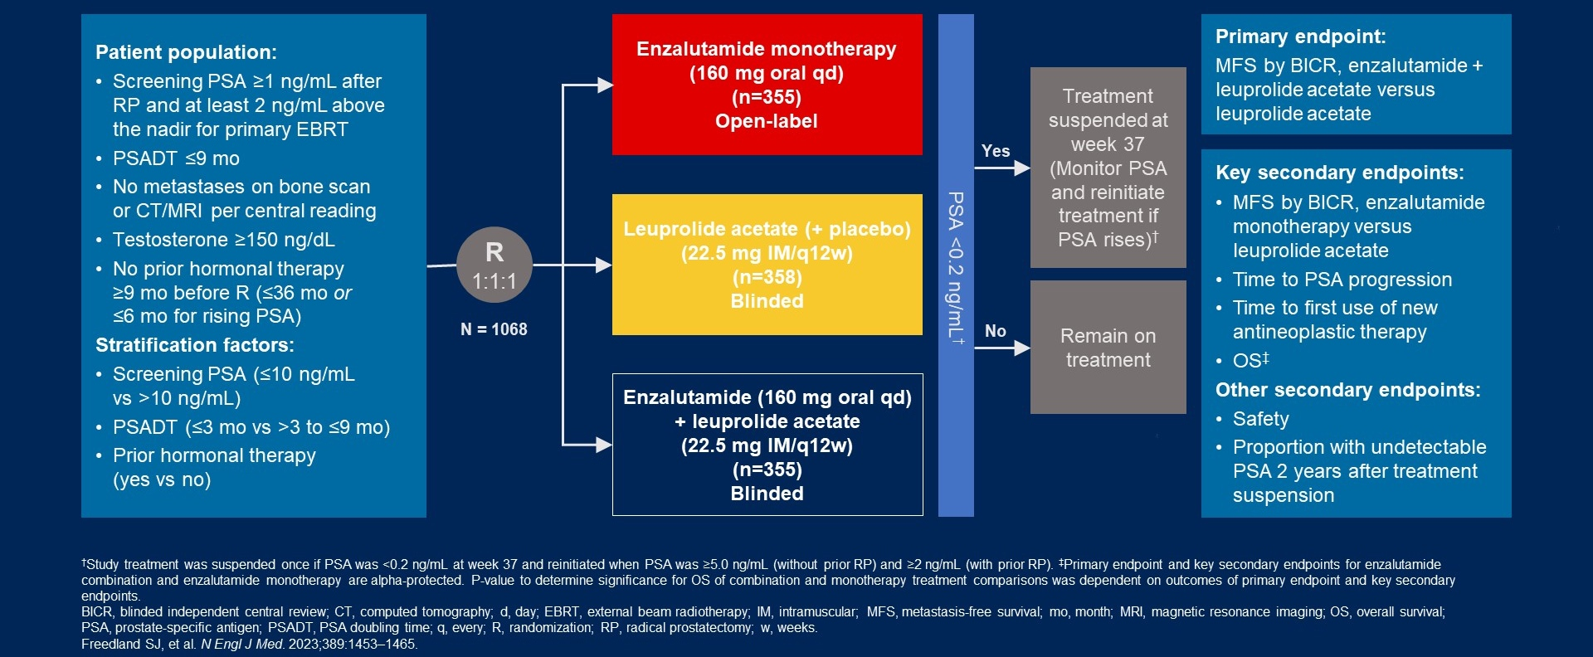
Phase III EMBARK Study Design
Shore ND et al. Genitourinary Cancers Symposium 2024;Abstract 15.

Slide 17
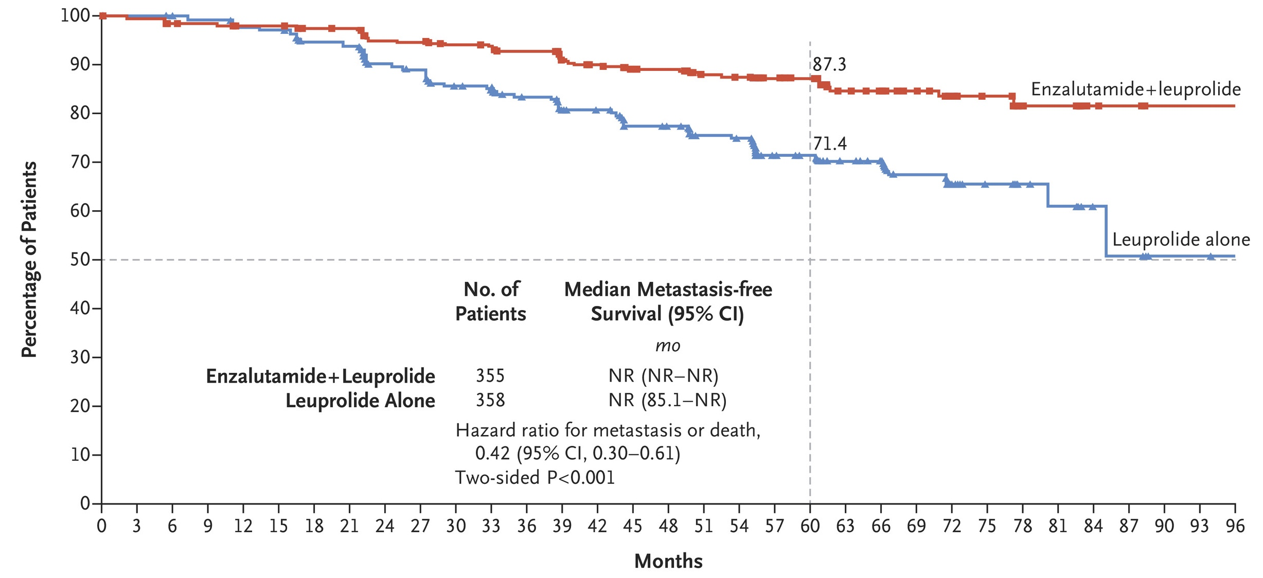
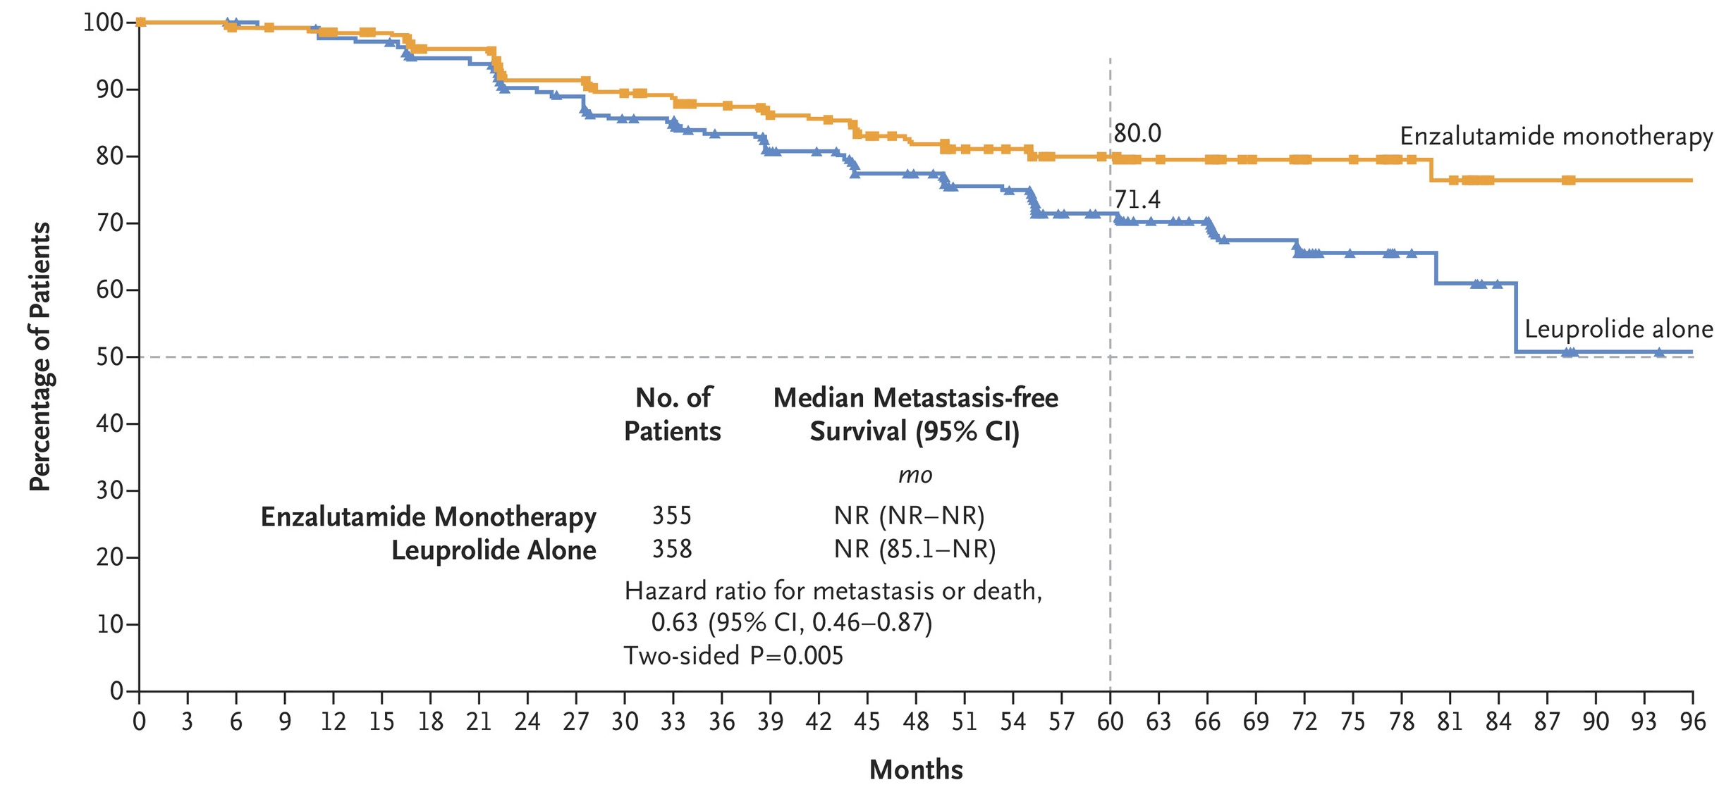
Phase III EMBARK: Metastasis-Free Survival
Enza + leuprolide
Enza monotherapy
Freedland SJ et al. N Engl J Med 2023;389(16):1453-65.
NR = not reached

Slide 18
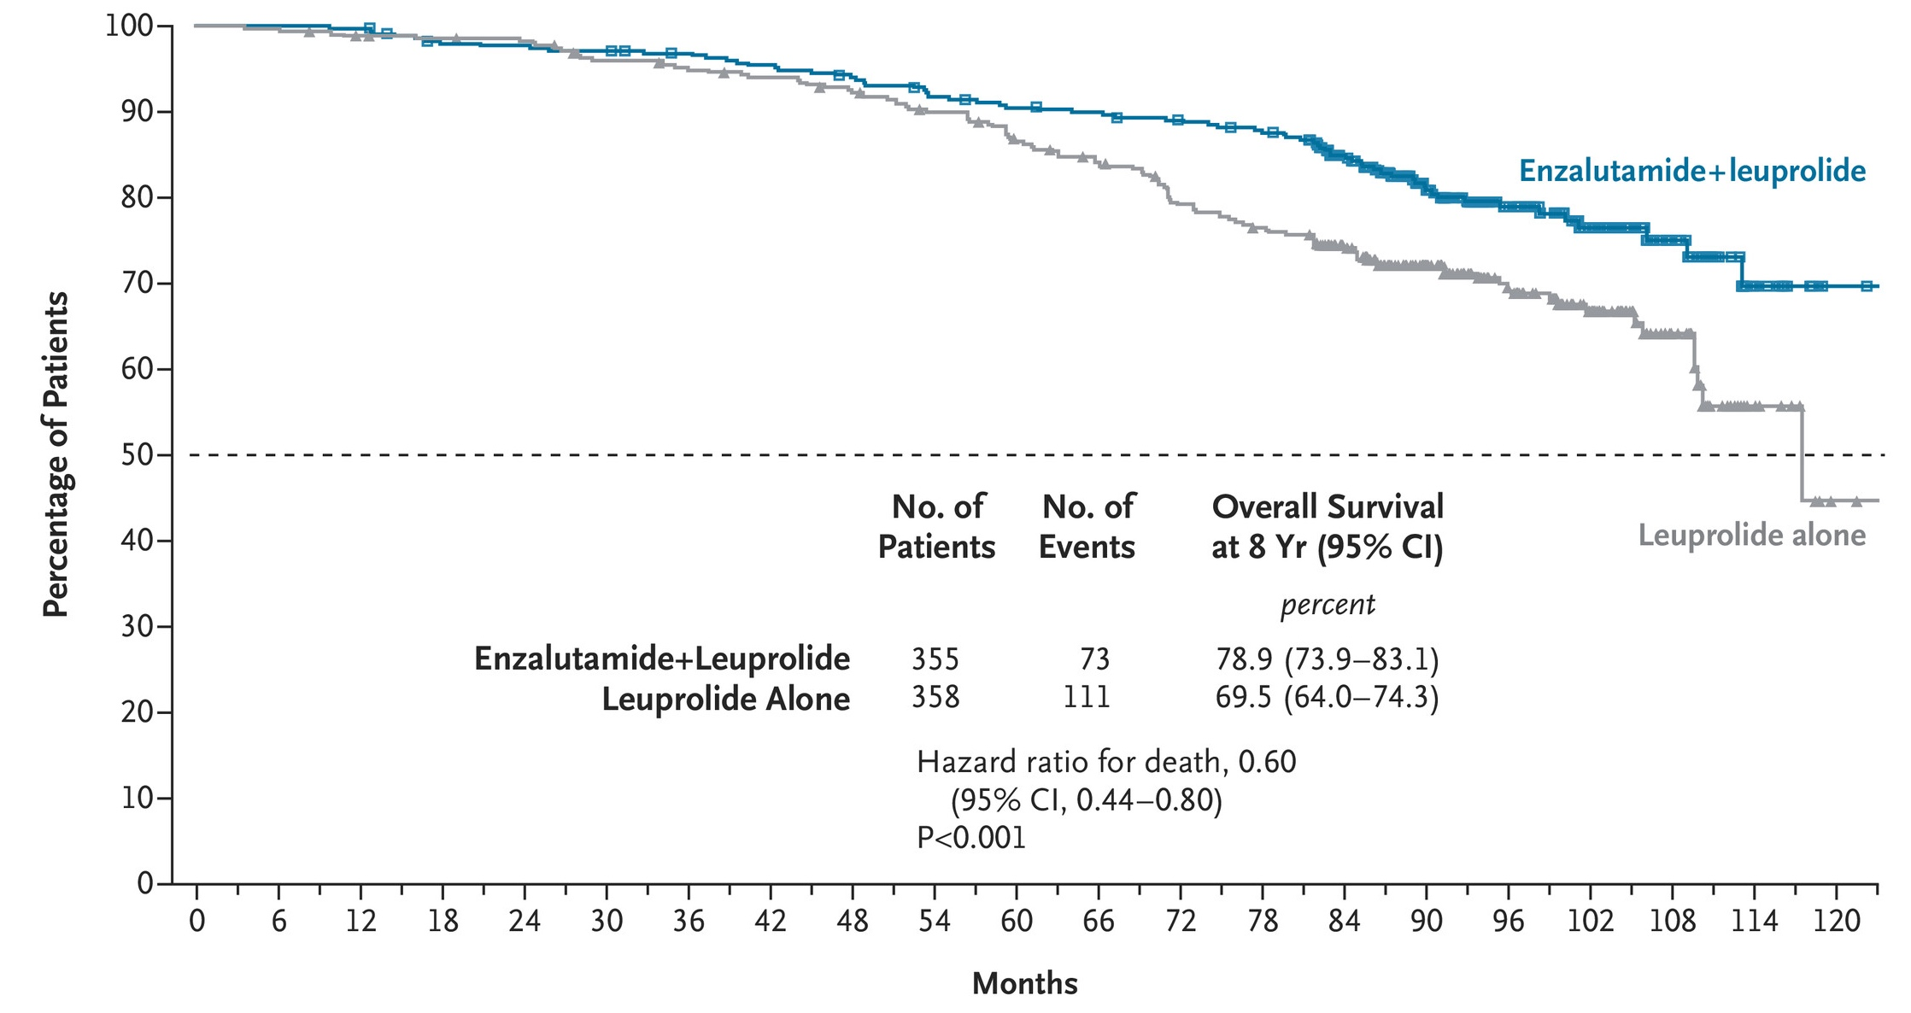
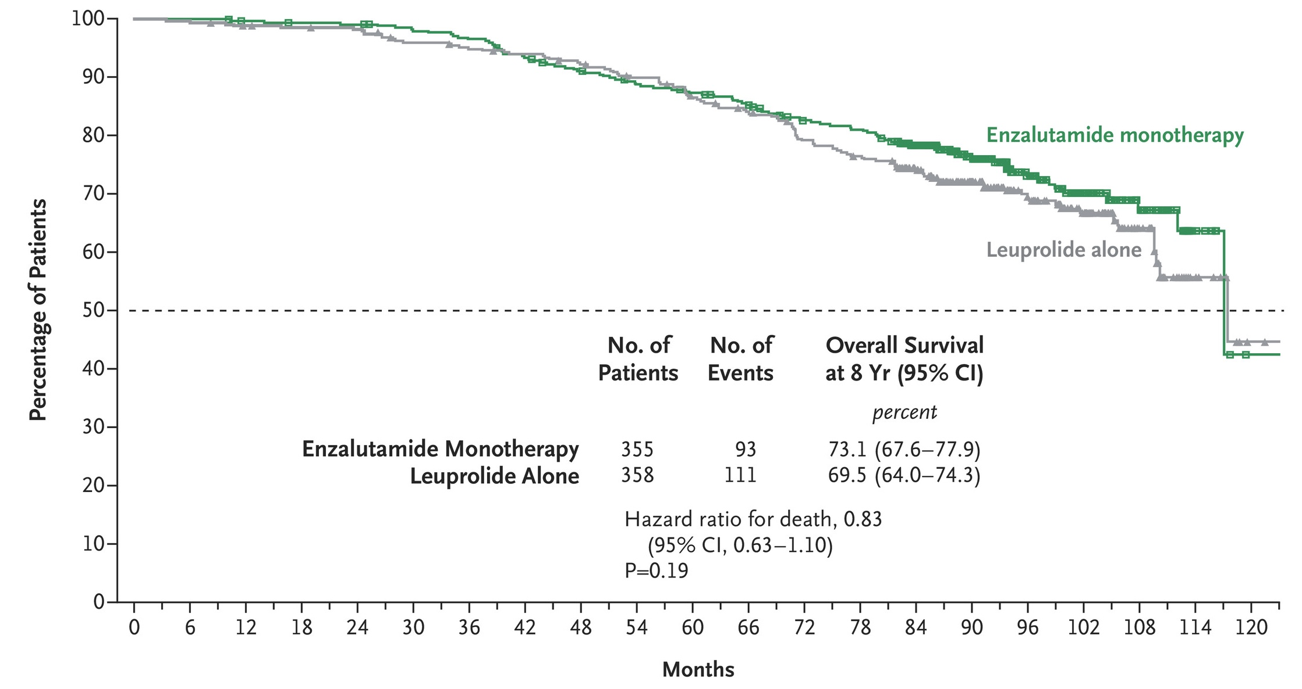
Phase III EMBARK: 8-Year Overall Survival
Enza + leuprolide
Enza monotherapy
Shore ND et al. N Engl J Med 2026;394(6):563-75.

Slide 19

First-Line Endocrine Treatment
Select Datasets
Davis ID. Combination therapy in metastatic hormone-sensitive prostate cancer: Is three a crowd? Ther Adv Med Oncol 2022 March 29;14:17588359221086827.
Saad F et al. Efficacy and safety of darolutamide plus androgen-deprivation therapy (ADT) in patients with metastatic hormone-sensitive prostate cancer (mHSPC) from the phase III ARANOTE trial. ESMO 2024;Abstract LBA68.
Saad F et al. Darolutamide in combination with androgen-deprivation therapy in patients with metastatic hormone-sensitive prostate cancer from the phase III ARANOTE trial. J Clin Oncol 2024;42(36):4271-81.
Saad F et al. Darolutamide plus androgen-deprivation therapy in metastatic hormone-sensitive prostate cancer by disease volume and risk subgroups in the phase 3 ARANOTE trial. Eur Urol 2026:S0302-2838(26)02313-4.

Slide 20
First-Line Endocrine Treatment
Select Datasets (Continued)
Smith MR et al. Darolutamide and survival in metastatic, hormone-sensitive prostate cancer. N Engl J Med 2022;386(12):1132-42.
Smith MR et al. Overall survival with darolutamide versus placebo in combination with androgen-deprivation therapy and docetaxel for metastatic hormone-sensitive prostate cancer in the phase 3 ARASENS trial. Genitourinary Cancers Symposium 2022;Abstract 13.
Hussain M et al. Darolutamide plus androgen-deprivation therapy and docetaxel in metastatic hormone-sensitive prostate cancer by disease volume and risk subgroups in the phase III ARASENS trial. J Clin Oncol 2023;41(20):3595-607.
Hussain MHA et al. Efficacy and safety of darolutamide (DARO) in combination with androgen-deprivation therapy (ADT) and docetaxel (DOC) by disease volume and disease risk in the phase 3 ARASENS study. Genitourinary Cancers Symposium 2023;Abstract 15.

Slide 21
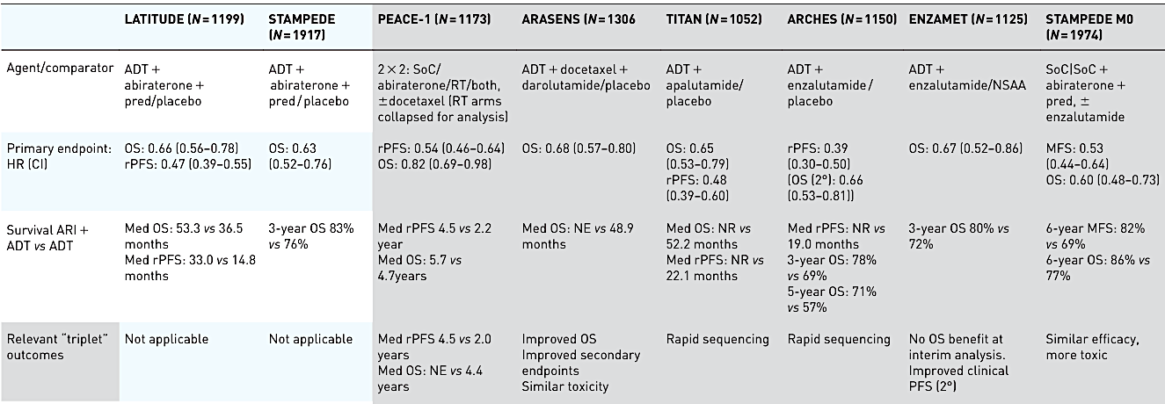
Extended Follow-Up with ADT Combination Therapies
Abiraterone
Darolutamide
Apalutamide
Enzalutamide
ARASENS (N=1306)
rPFS = radiographic progression-free survival; ARI = androgen receptor inhibitor
Davis ID. Ther Adv Med Oncol 2022 March 29;14:17588359221086827.

Slide 22
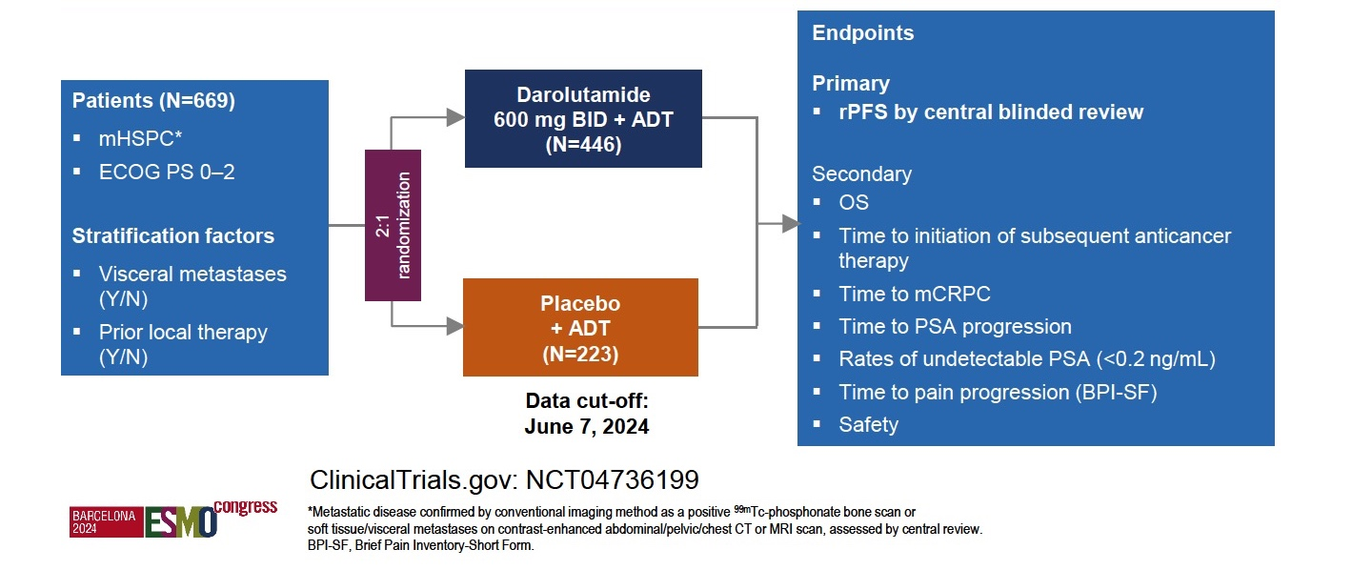
Phase III ARANOTE Study Design
Saad F et al. ESMO 2024;Abstract LBA68.
Saad F et al. J Clin Oncol 2024;42(36):4271-81.

Slide 23
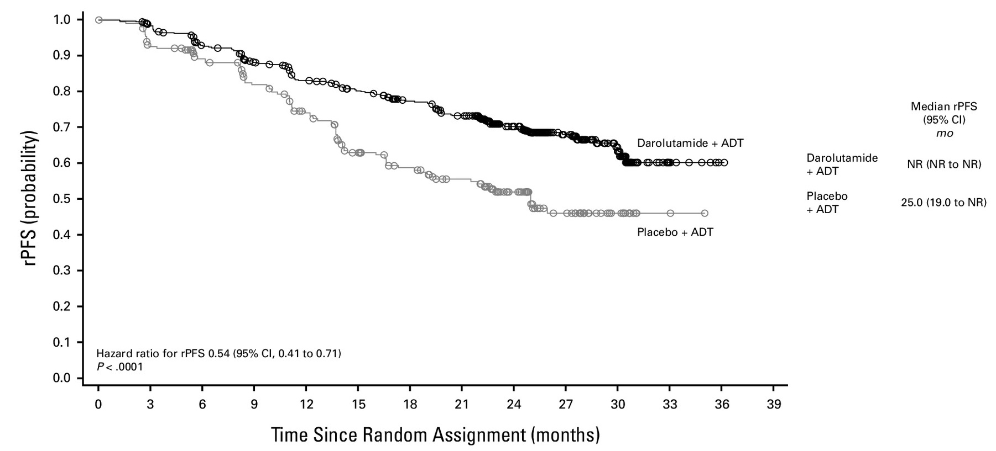

Phase III ARANOTE Primary Endpoint: Radiographic Progression-Free Survival (rPFS)
Saad F et al. J Clin Oncol 2024;42(36):4271-81.

Slide 24
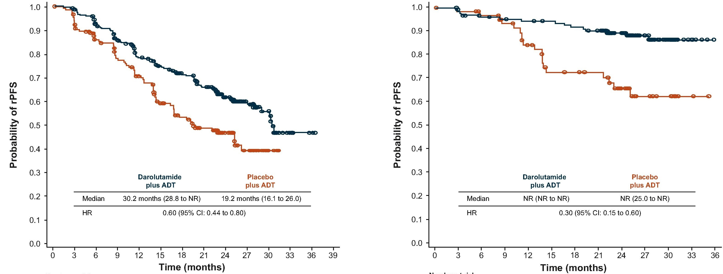
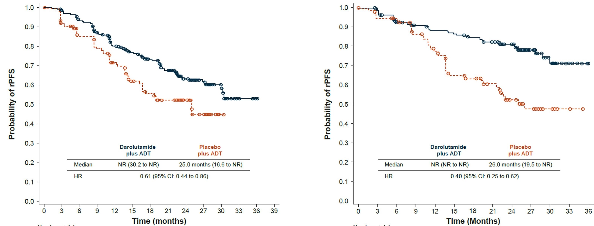
Phase III ARANOTE: rPFS by Disease Volume and Risk
High-volume
Low-volume
High-risk
Low-risk
Saad F et al. Eur Urol 2026:S0302-2838(26)02313-4.

Slide 25
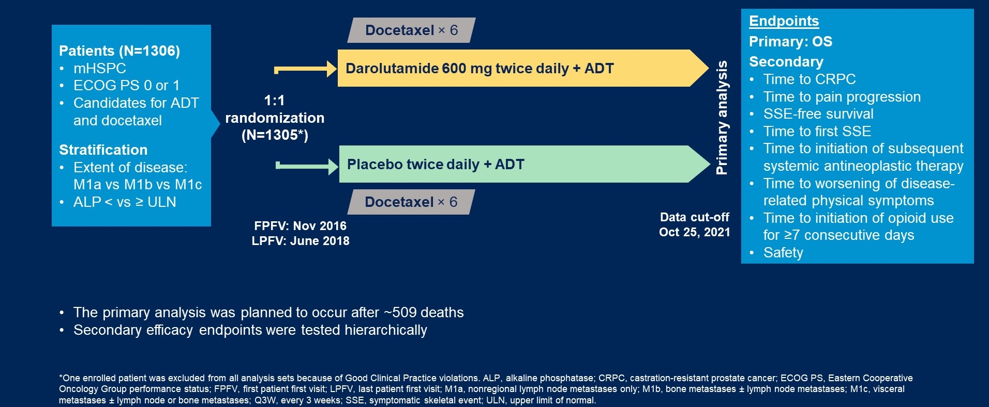
Phase III ARASENS Study Design
Smith MR et al. N Engl J Med 2022;386(12):1132-42.
Smith MR et al. Genitourinary Cancers Symposium 2022;Abstract 13.

Slide 26
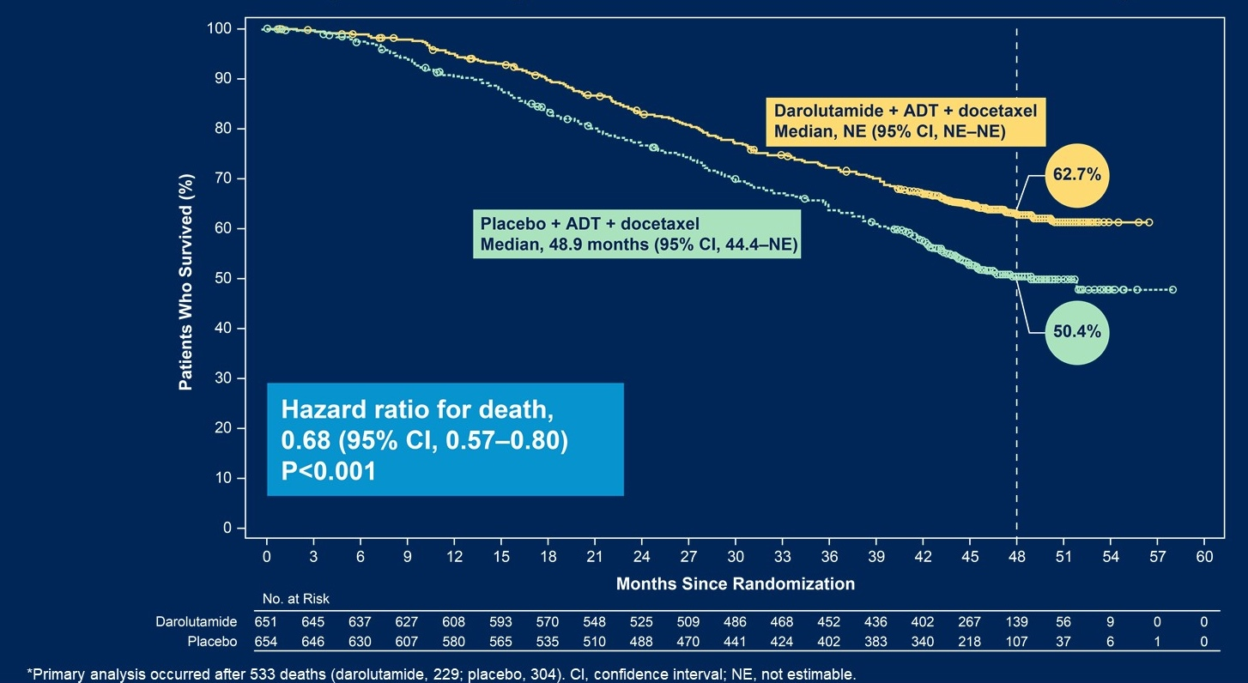
Phase III ARASENS Primary Endpoint: Overall Survival
Smith MR et al. N Engl J Med 2022;386(12):1132-42.
Smith MR et al. Genitourinary Cancers Symposium 2022;Abstract 13.

Slide 27
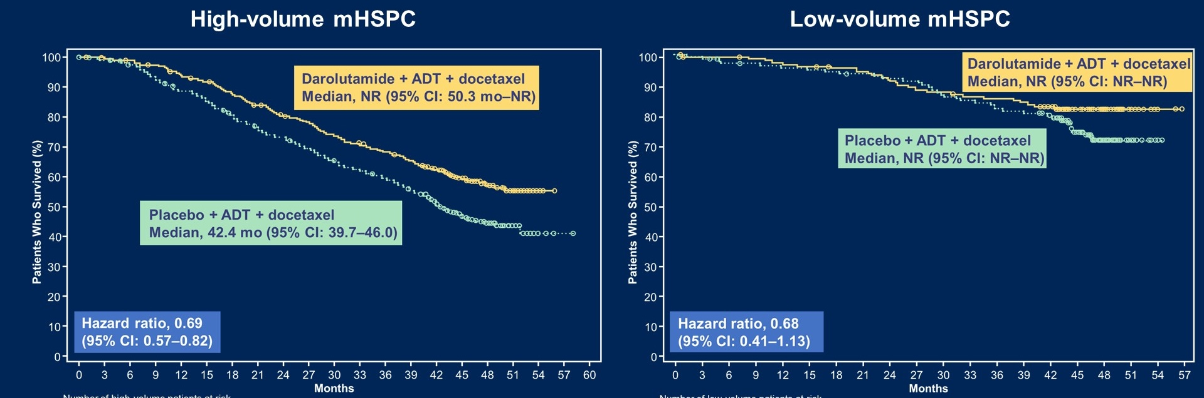
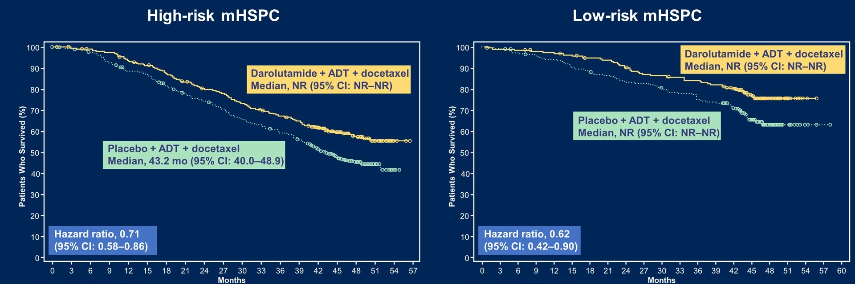
Phase III ARASENS: OS by Disease Volume and Risk
Hussain MHA et al. J Clin Oncol 2023;41(20):3595-3607.
Hussain MHA et al. Genitourinary Cancers Symposium 2023;Abstract 15.

Slide 28
First-Line Endocrine Treatment
Select Datasets
Choudhury AD et al. Comeback from long-course ADT with relugolix (rel) and darolutamide (daro) in hormone-sensitive prostate cancer (PC) (CLEARED). ASCO 2026;Abstract 5083.

Slide 29
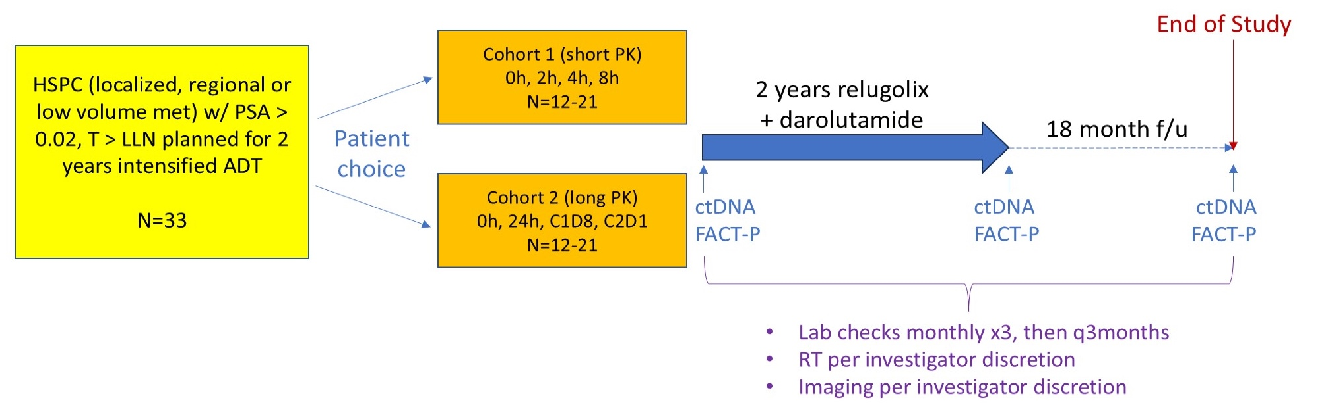
Phase II CLEARED Study Design
T = testosterone; LLN = lower limit of normal; PK = pharmacokinetics; ctDNA = circulating tumor DNA
Choudhury AD et al. ASCO 2026;Abstract 5083.

Slide 30
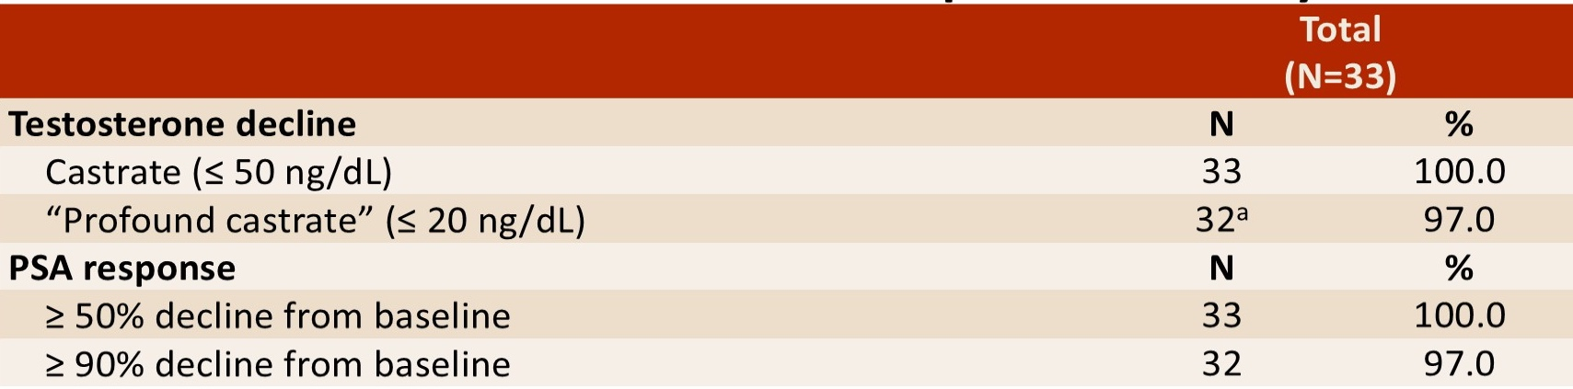
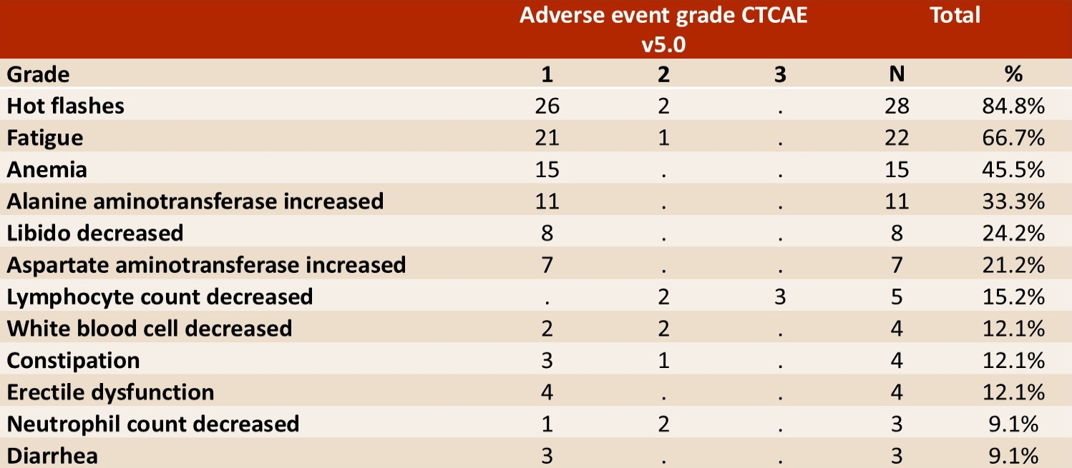
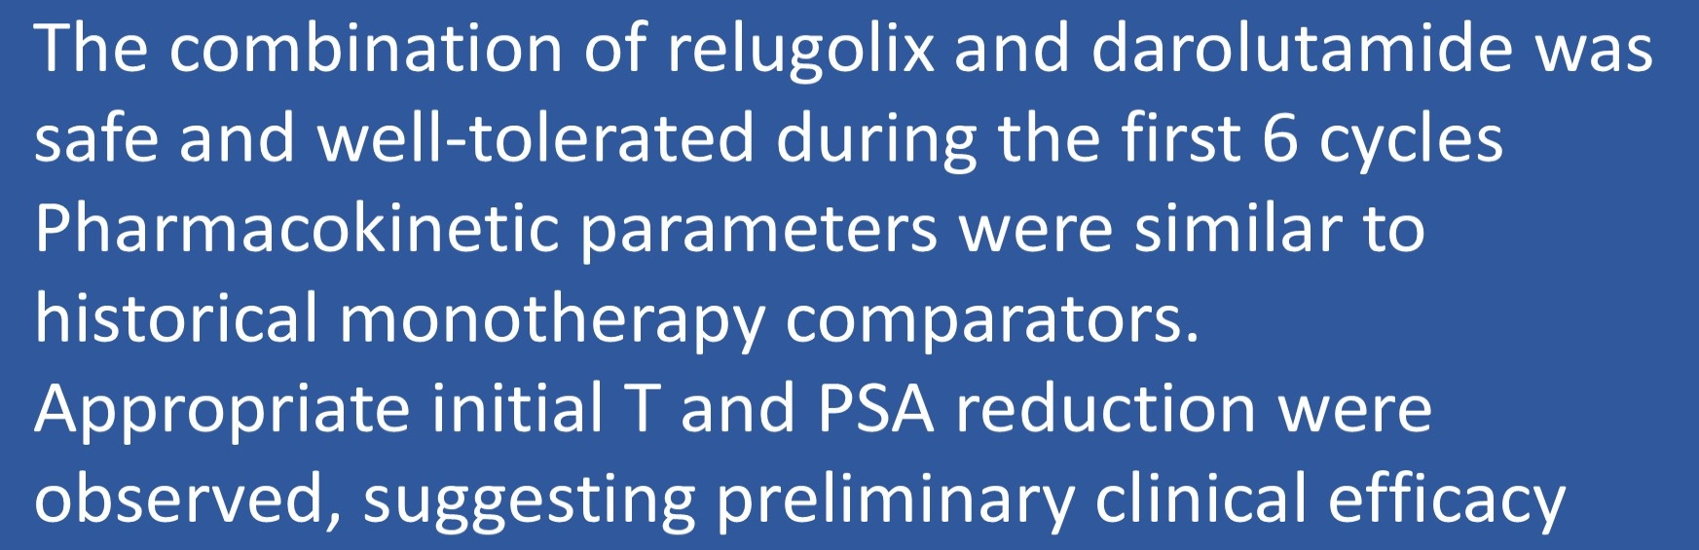
Phase II CLEARED: Testosterone Decline, PSA Response, Safety
.
.
Choudhury AD et al. ASCO 2026;Abstract 5083.

Slide 31
Faculty Discussion

Slide 32
Questions for the Faculty
In what situations are you recommending radical prostatectomy for patients with high/risk localized/locally advanced prostate cancer?
For which patients would you use the PROTEUS strategy?
For a patient who received the PROTEUS strategy and attained a pathologic complete response, would you offer the option of forgoing postoperative treatment?
Do you use intensification of endocrine therapy for patients with high/risk localized/locally advanced disease who are receiving primary radiation therapy?
For which patients do you use the EMBARK strategy? In which situations, if any, are you recommending enzalutamide monotherapy? In what situations, if any, are you utilizing an intermittent treatment strategy?

Slide 33
Questions for the Faculty
Dr Choksi
66-year-old man presented with PSA of 56 and bone metastases. Very hesitant to receive therapy but agreed to apalutamide/leuprolide. Experienced decreased libido and extreme fatigue. Elected to stop therapy when PSA became undetectable. Disease recurred 9 months later with progressive pain, lymph node involvement, and PSA now more than 100.
Questions
When and how do you use intermittent hormone therapy?
What treatment options would you offer this man with a positive PSMA scan who is very hesitant about chemotherapy?

Slide 34
Questions for the Faculty
Dr Ignatius
92-year-old man, ECOG PS 1, somewhat frail, presented with de novo mets to bone, PSA 54. Very supportive family who wished to minimize treatment side effects. Receiving relugolix but hesitant to add darolutamide.
Questions
Endocrine approach for very elderly, frail patients?
Choice of ARPI (androgen receptor pathway inhibitor)

Slide 35
Agenda
Introduction: ESMO 2026; Recent FDA Approvals
Selection of Endocrine Therapy – Dr Antonarakis
Utility of PARP Inhibitors – Dr Agarwal
AKT Inhibition for PTEN-Deficient Disease – Dr Antonarakis
Radiopharmaceuticals – Dr Agarwal

Slide 36
Utility of PARP Inhibitors
Select Datasets
Attard G et al. Niraparib and abiraterone acetate plus prednisone for HRR-deficient metastatic castration-sensitive prostate cancer: A randomized phase 3 trial. Nat Med 2025;31(12):4109-18.
Attard G et al. Phase 3 AMPLITUDE trial: Niraparib (NIRA) and abiraterone acetate plus prednisone (AAP) for metastatic castration-sensitive prostate cancer (mCSPC) patients (pts) with alterations in homologous recombination repair (HRR) genes. ASCO 2025;Abstract LBA5006.
Agarwal N et al. PARP and androgen-signaling inhibition plus ADT in metastatic prostate cancer. N Engl J Med 2026;395(5):427-39.

Slide 37
PARP Inhibition
Select Datasets (Continued)
Agarwal N et al. TALAPRO-3: Talazoparib (TALA) + enzalutamide (ENZA) compared with placebo (PBO) + ENZA for the treatment of patients (pts) with metastatic castration-sensitive prostate cancer (mCSPC) harboring homologous recombination repair (HRR) gene alterations. ASCO 2026;Abstract LBA5007.
Azad A et al. Saruparib + androgen receptor pathway inhibitor (ARPI) + androgen deprivation therapy (ADT) in patients (pts) with metastatic hormone-sensitive prostate cancer (mHSPC): The phase 1/2 PETRANHA trial. Genitourinary Cancers Symposium 2026;Abstract 177.

Slide 38
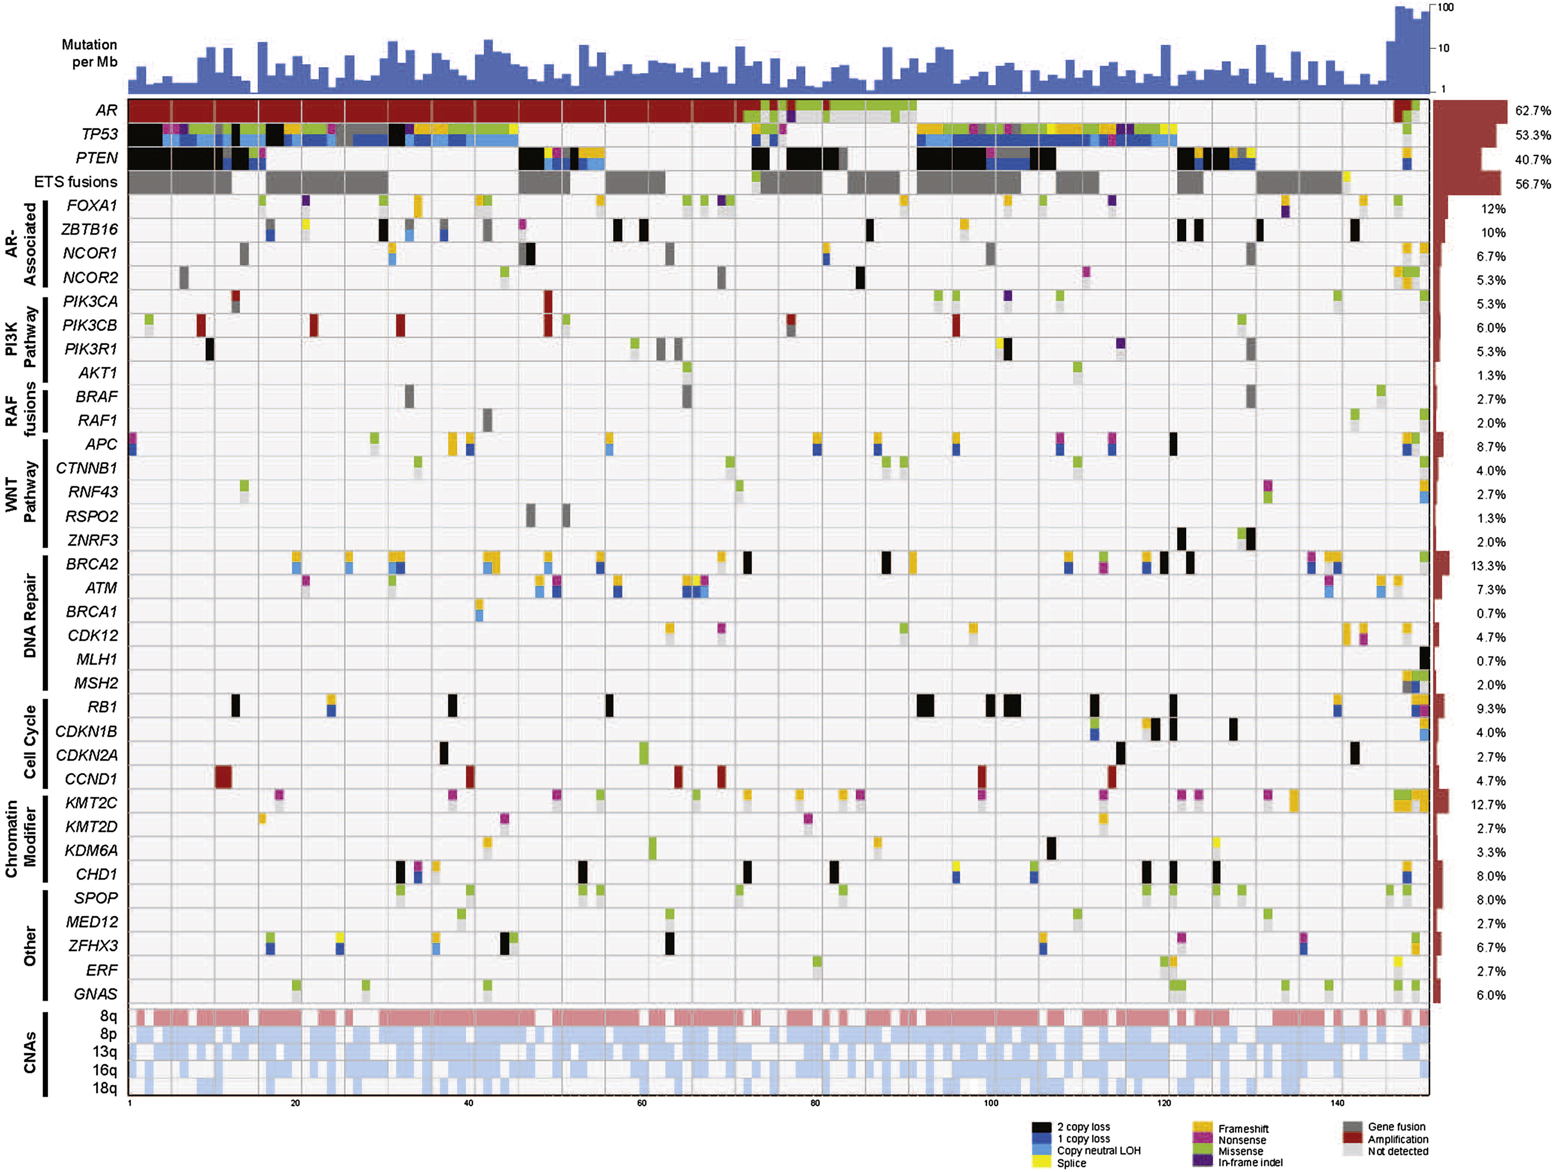
Alterations to DNA Repair Pathways in Prostate Cancer
DNA repair gene alterations occur in ~20% of pts with mCRPC
BRCA2 mutations occur in ~13% of pts
Robinson D et al. Cell 2015;161(5):1215-28.

Slide 39
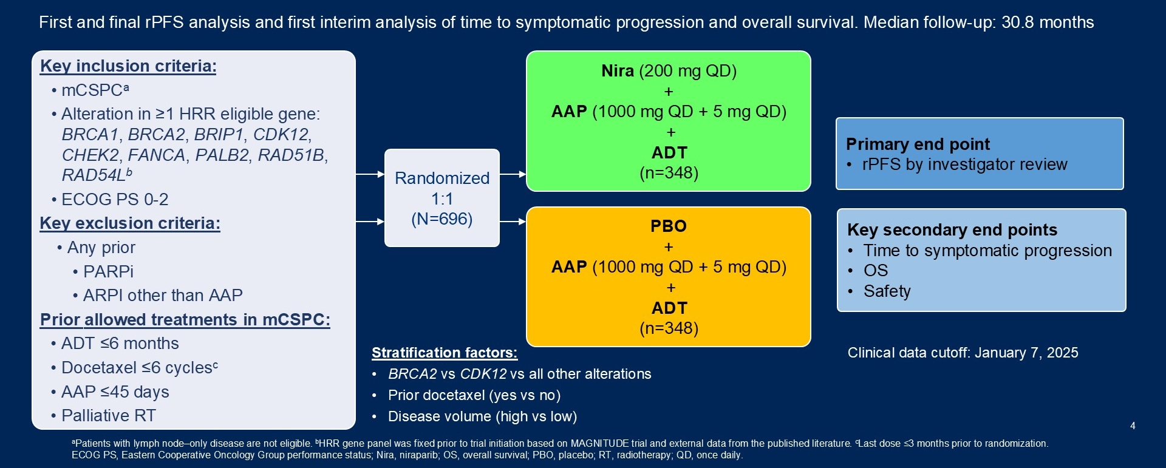
Phase III AMPLITUDE Study Design
HRR = homologous recombination repair
Attard G et al. Nat Med 2025;31(12):4109-4118.
Attard G et al. ASCO 2025;Abstract LBA5006.

Slide 40
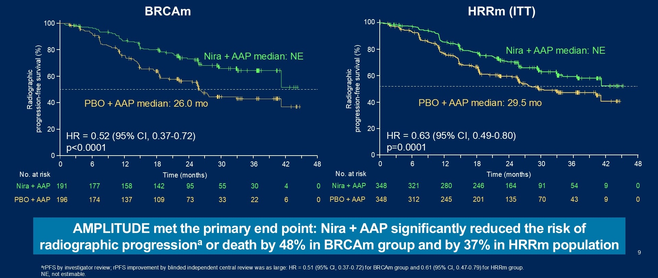
Phase III AMPLITUDE Primary Endpoint: rPFS
Attard G et al. Nat Med 2025;31(12):4109-4118.
Attard G et al. ASCO 2025;Abstract LBA5006.

Slide 41
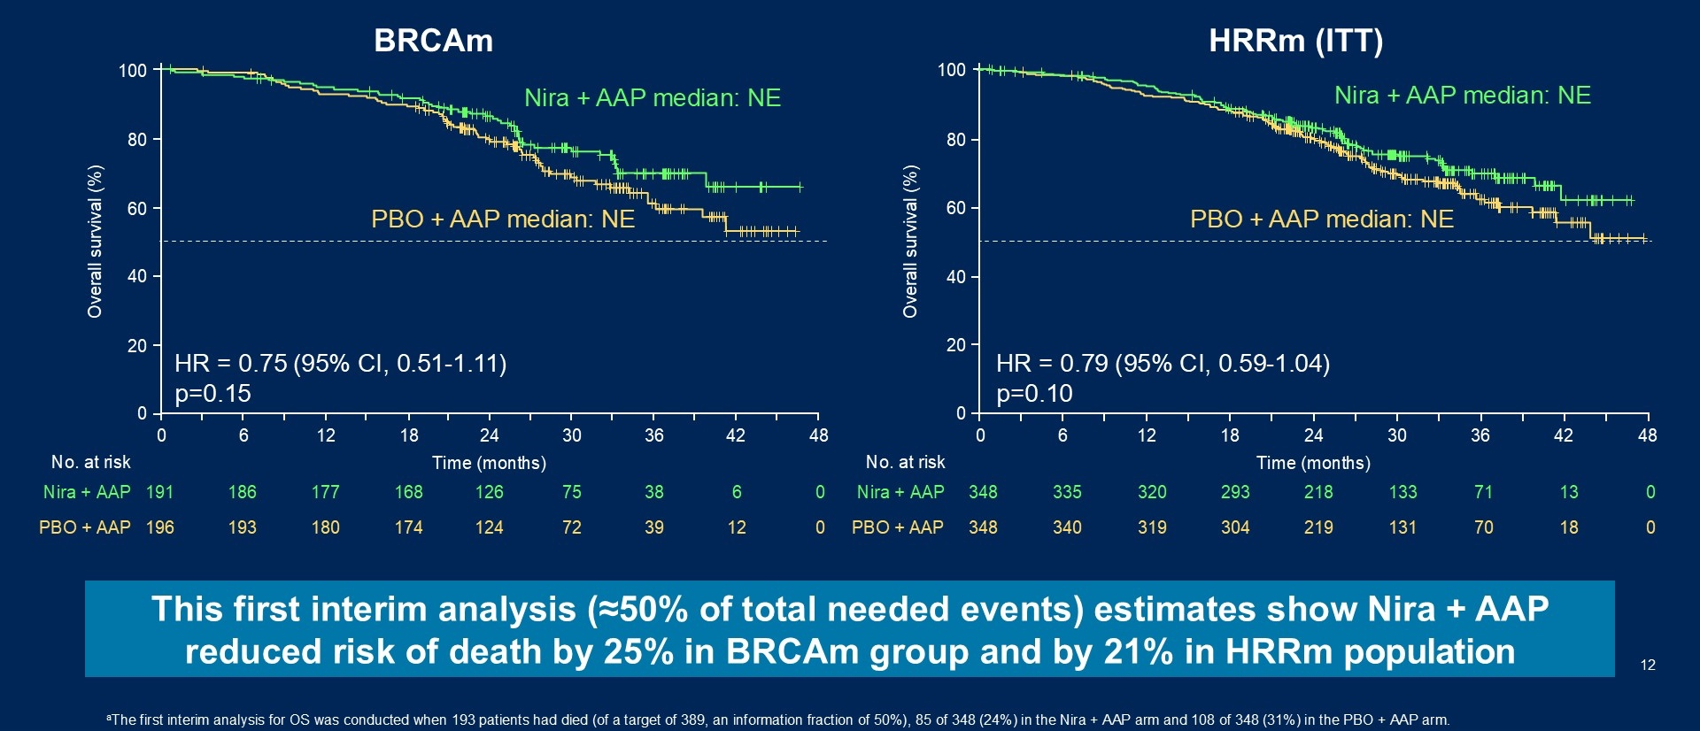
Phase III AMPLITUDE Secondary Endpoint: OS – First Interim Analysis
Attard G et al. Nat Med 2025;31(12):4109-4118.
Attard G et al. ASCO 2025;Abstract LBA5006.

Slide 42
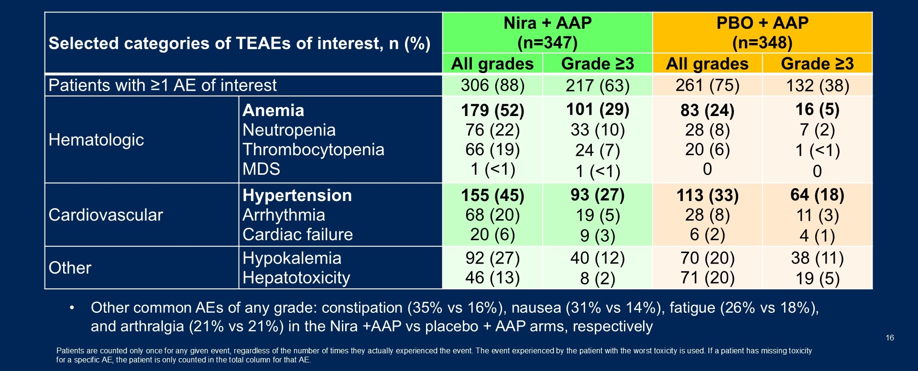
Phase III AMPLITUDE: Safety
TEAEs = treatment-emergent adverse events; MDS = myelodysplastic syndromes
Attard G et al. Nat Med 2025;31(12):4109-4118.
Attard G et al. ASCO 2025;Abstract LBA5006.

Slide 43
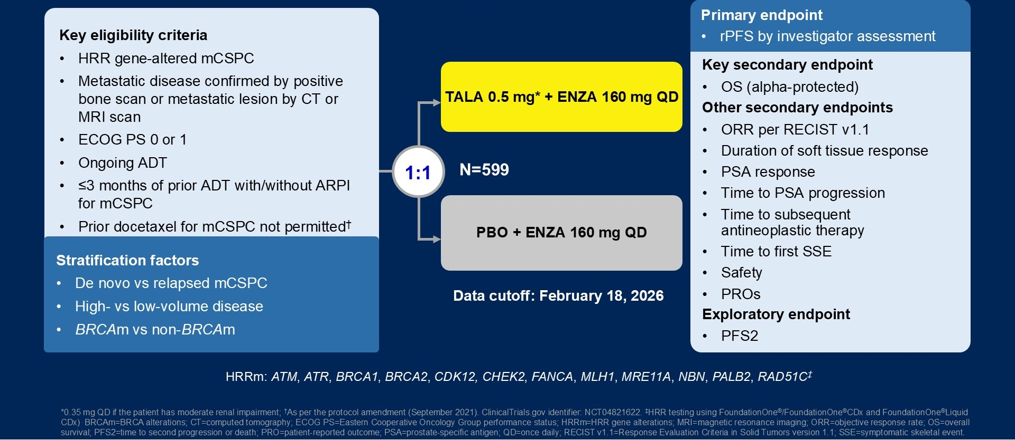
Phase III TALAPRO-3 Study Design
Agarwal N et al. N Engl J Med 2026;395(5):427-439.
Agarwal N et al. ASCO 2026;Abstract LBA5007.

Slide 44
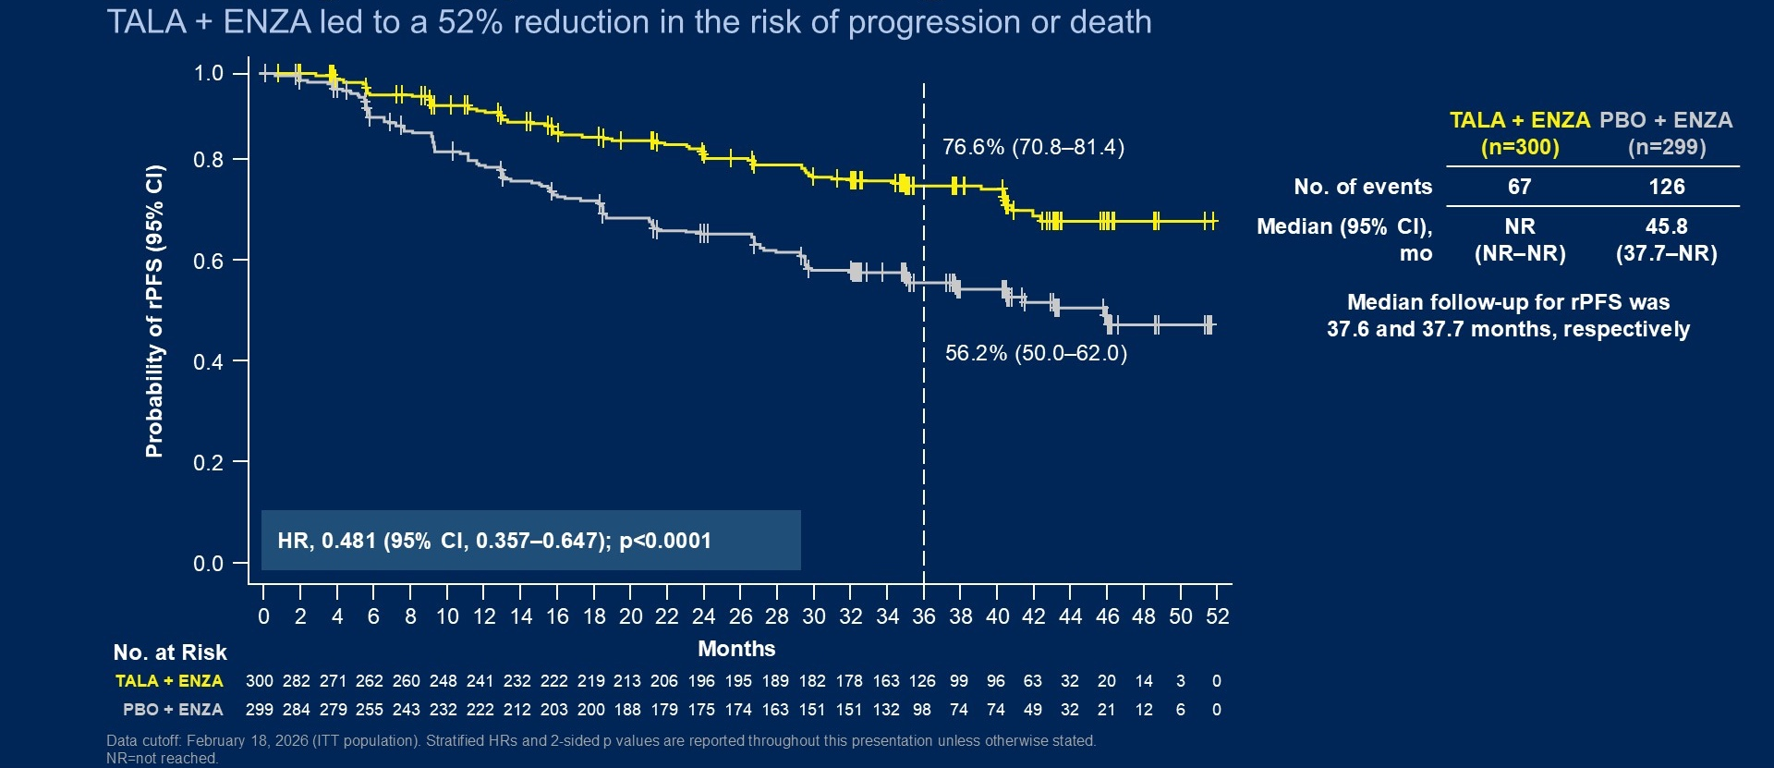
Phase III TALAPRO-3 Primary Endpoint: rPFS
Agarwal N et al. N Engl J Med 2026;395(5):427-439.
Agarwal N et al. ASCO 2026;Abstract LBA5007.

Slide 45
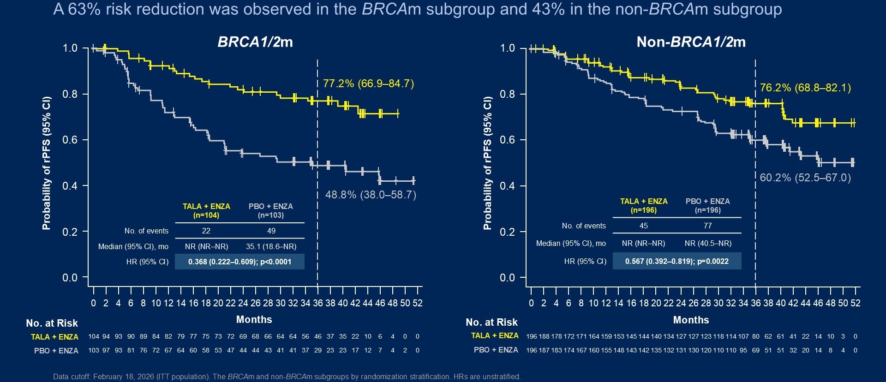
Phase III TALAPRO-3: rPFS by BRCA Mutation Status
Agarwal N et al. N Engl J Med 2026;395(5):427-439.
Agarwal N et al. ASCO 2026;Abstract LBA5007.

Slide 46
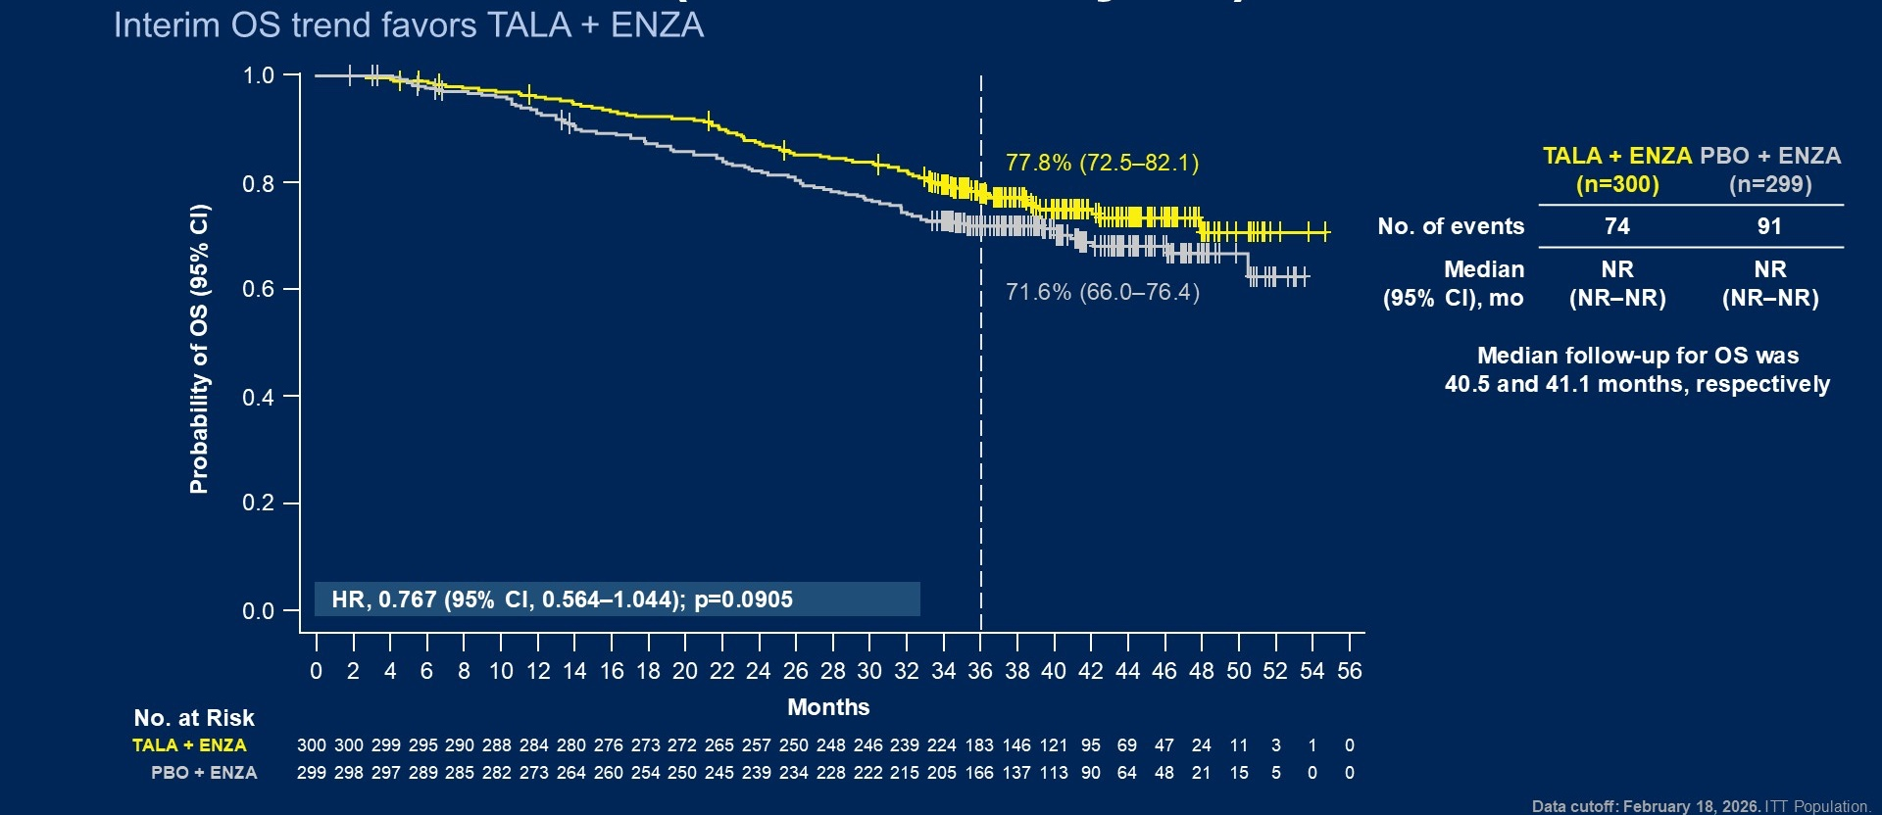
Phase III TALAPRO-3 Interim Analysis: Overall Survival
Agarwal N et al. N Engl J Med 2026;395(5):427-439.
Agarwal N et al. ASCO 2026;Abstract LBA5007.

Slide 47
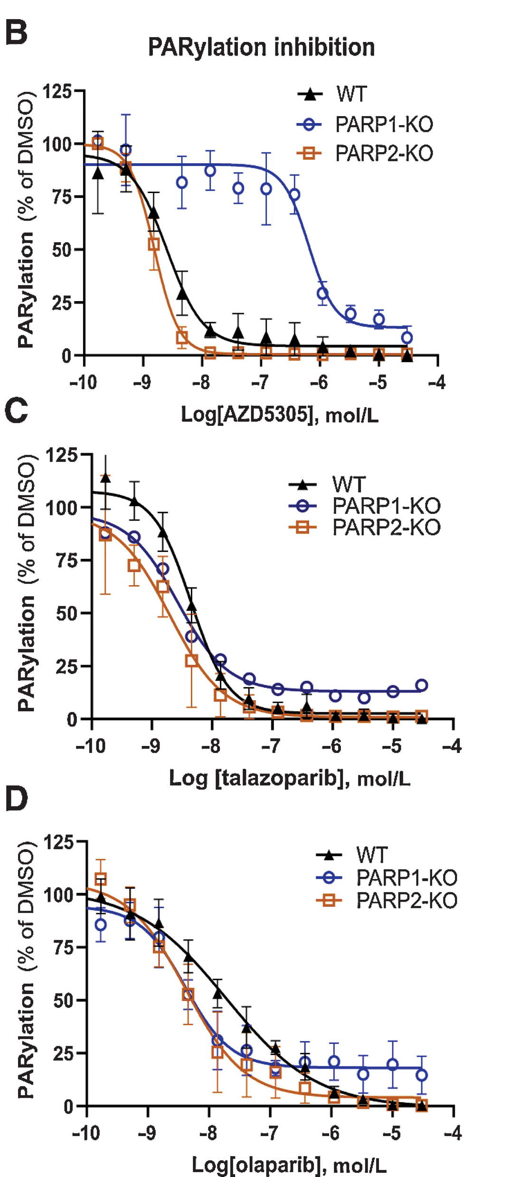
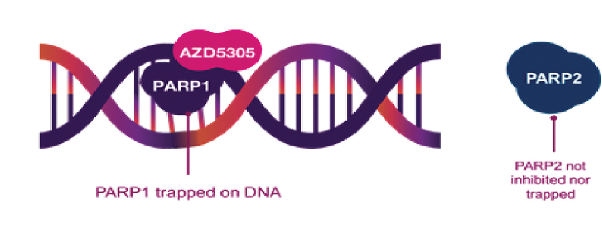
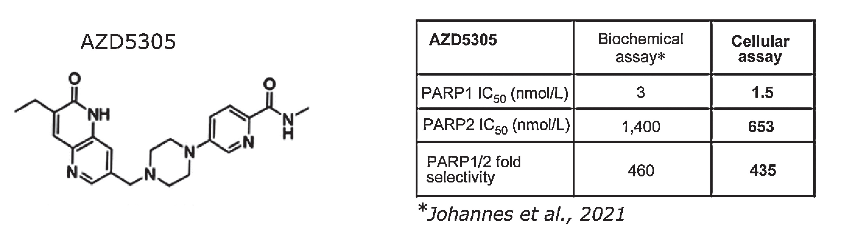
Saruparib (AZD5305): A PARP1-Specific Inhibitor
Saruparib selectively inhibits PARP1, reducing hematologic toxicities
Illuzi G et al. Clin Cancer Res 2022;28(21):4724-36.

Slide 48
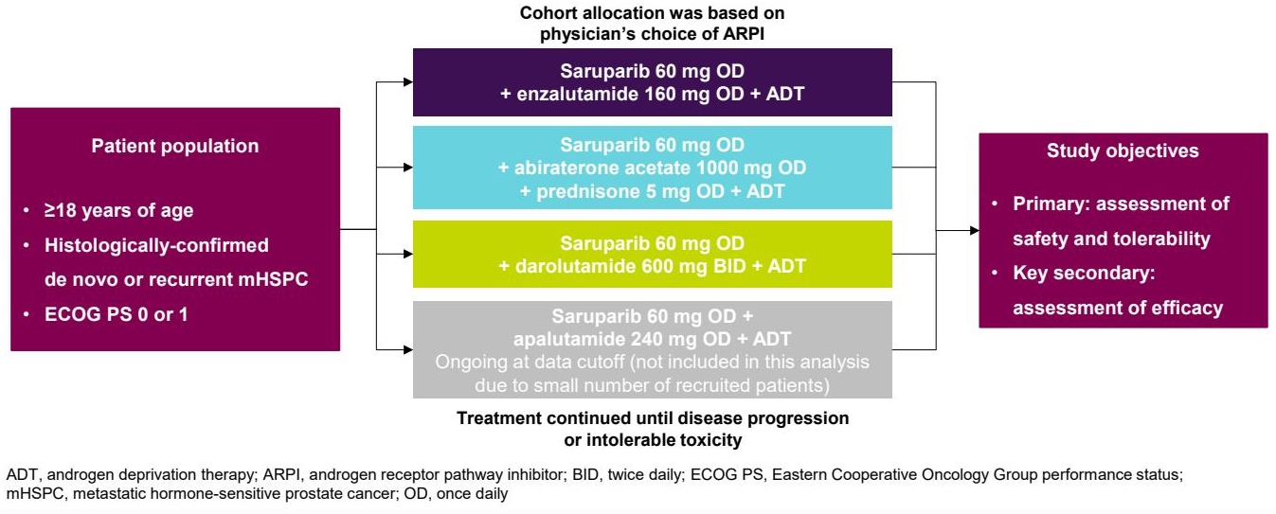
Phase I/II PETRANHA Study Design
Azad A et al. Genitourinary Cancers Symposium 2026;Abstract 177.

Slide 49
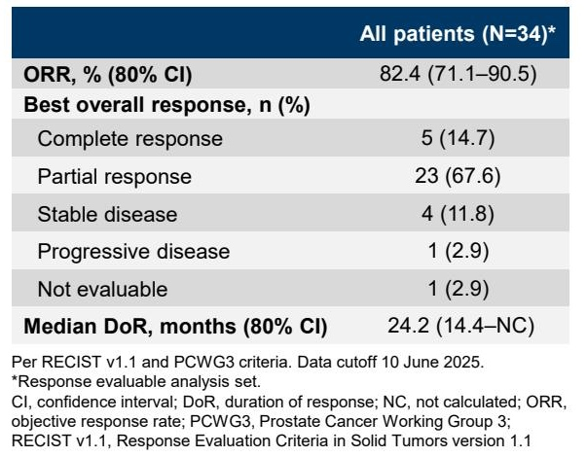
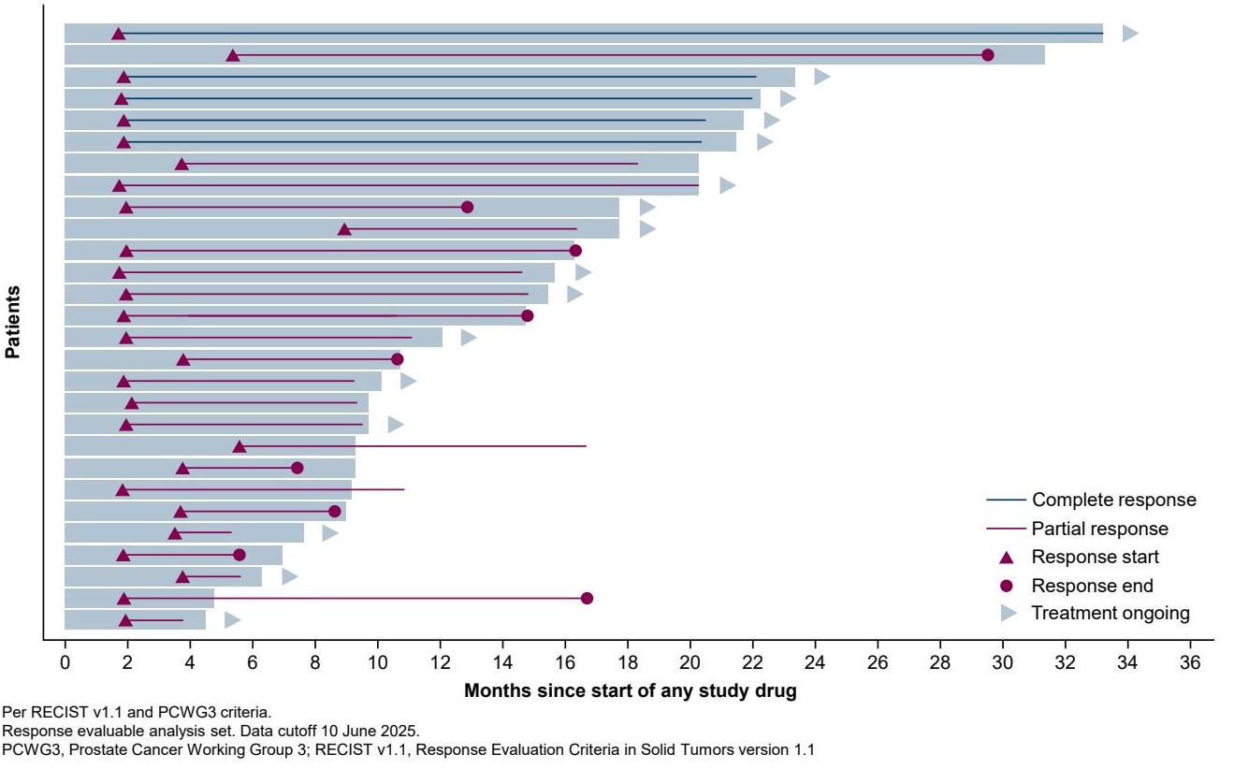
Phase I/II PETRANHA: Responses
Azad A et al. Genitourinary Cancers Symposium 2026;Abstract 177.

Slide 50
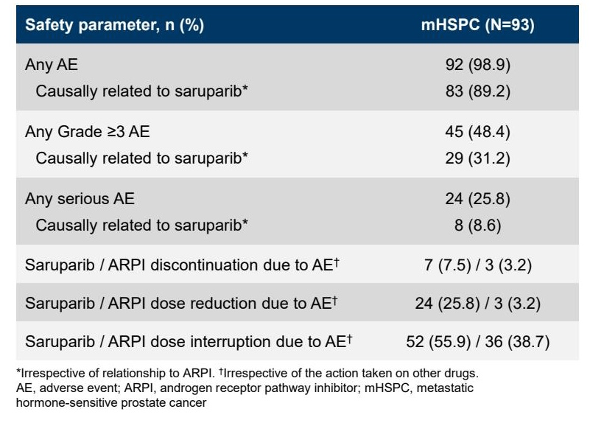
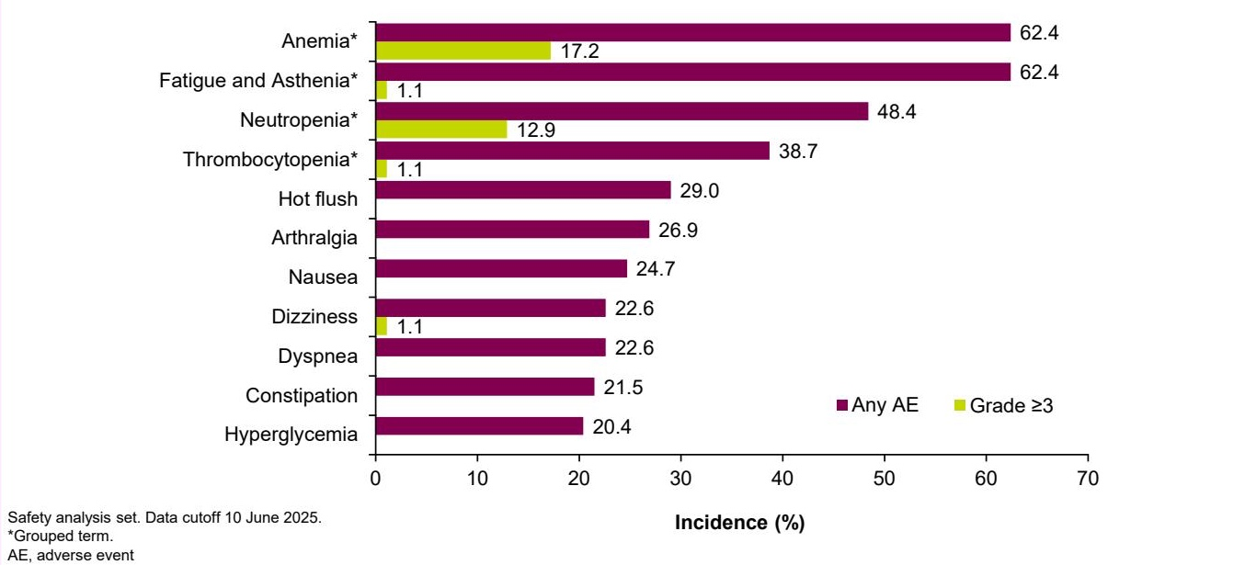
Phase I/II PETRANHA: Safety
Azad A et al. Genitourinary Cancers Symposium 2026;Abstract 177.

Slide 51
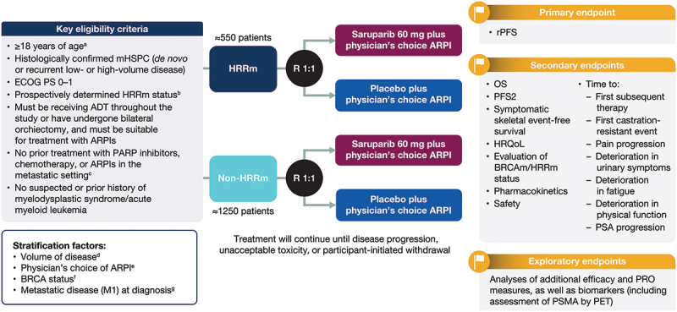
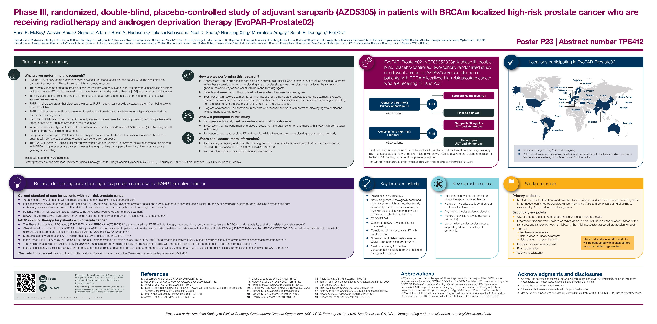
Ongoing Phase III Trials with Saruparib
EvoPAR-Prostate01
EvoPAR-Prostate02
EvoPAR-Prostate05
Cohort A: Prior Docetaxal
Saruparib 60 mg plus ARPI
R
1:1
Placebo plus ARPI
Primary Endpoint: rPFS
Secondary Endpoints: OS, PFS2
Saruparib 60 mg plus ARPI
Cohort B: Prior PSMA-Directed ¹⁷⁷Lu
R
1:1
Placebo plus ARPI
Azad A et al. Genitourinary Cancers Symposium 2025;Abstract TPS279.
McKay R et al. Genitourinary Cancers Symposium 2026;Abstract TPS412.
www.clinicaltrials.gov. NCT07711002. Accessed October 2026.

Slide 52
Faculty Discussion

Slide 53
Questions for the Faculty
A man in his early 80s with mCRPC with BRCA2 somatic prostate cancer has been on olaparib for 8 months. The patient has fatigue, which is likely multifactorial but in general he is doing well.
Questions
How do you select a PARP inhibitor for mCRPC, and if paired with endocrine therapy, which one?
When are you opting for PARP inhibitor-based therapy for your patients with mHSPC?
For which mutations would you use a PARPi?
Somatic versus germline testing?
Liquid biopsy, tissue or both, and when?
How do you prevent and manage cytopenias, including anemia, and GI and other quality-of-life adverse effects?
Dr Apuri

Slide 54
Agenda
Introduction: ESMO 2026; Recent FDA Approvals
Selection of Endocrine Therapy – Dr Antonarakis
Utility of PARP Inhibitors – Dr Agarwal
AKT Inhibition for PTEN-Deficient Disease – Dr Antonarakis
Radiopharmaceuticals – Dr Agarwal

Slide 55
AKT Inhibition for PTEN-Deficient Disease
Select Datasets
Kisiel F et al. Prognostic significance of PTEN loss in prostate cancer: A meta-analysis of Gleason grade and clinical outcomes. Cancers (Basel) 2025 August 30;17(17):2862.
George DJ et al. Patient reported outcomes (PRO) and tolerability of capivasertib (capi) plus abiraterone (abi) versus placebo (pbo) plus abi in patients (pts) with PTEN-deficient metastatic hormone-sensitive prostate cancer (mHSPC): CAPItello-281. Genitourinary Cancers Symposium 2026;Abstract 14.
Fizazi K et al. Capivasertib plus abiraterone in PTEN-deficient metastatic hormone-sensitive prostate cancer: CAPItello-281 phase III study. Ann Oncol 2026;37(1):53-68.

Slide 56
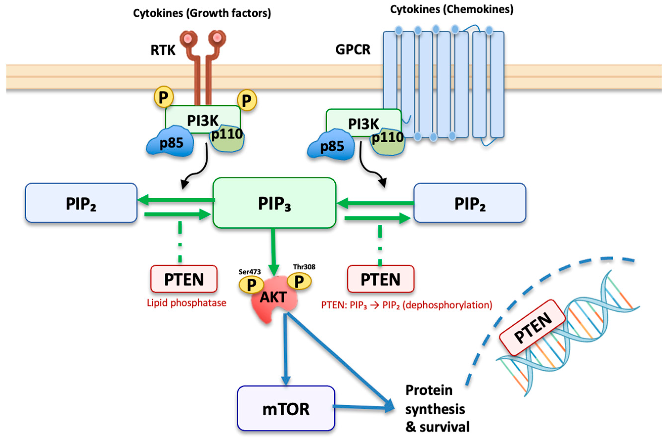
Wild-Type PTEN Signaling and the AKT/mTOR Pathway
In the nucleus, PTEN promotes DNA repair pathways and cell cycle control
PTEN promotes the dephosphorylation of PIP₃ to PIP₂, inhibiting downstream AKT/mTOR activation
Kisiel F et al. Cancers (Basel) 2025 August 30;17(17):2862.

Slide 57
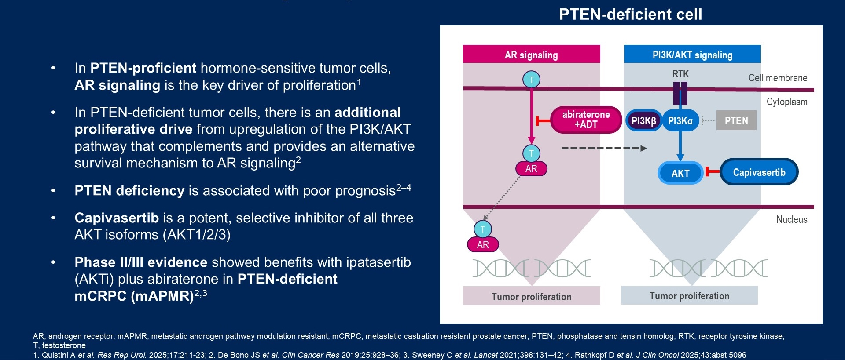
PTEN Deficiency in Prostate Cancer
George DJ et al. Genitourinary Cancers Symposium 2026;Abstract 14.

Slide 58
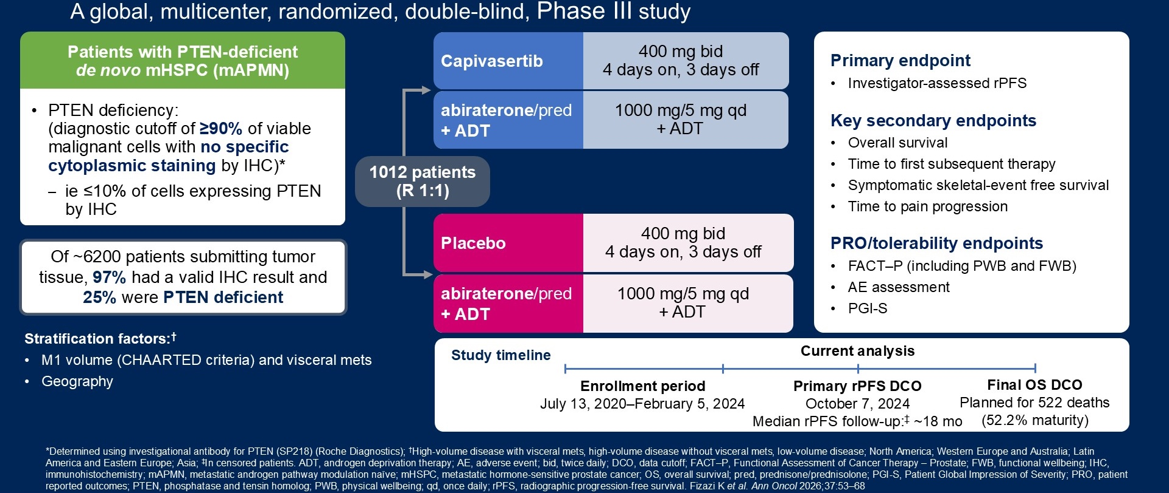
Phase III CAPItello-281 Study Design
Fizazi K et al. Ann Oncol 2026;37(1):53-68.
George DJ et al. Genitourinary Cancers Symposium 2026;Abstract 14.

Slide 59
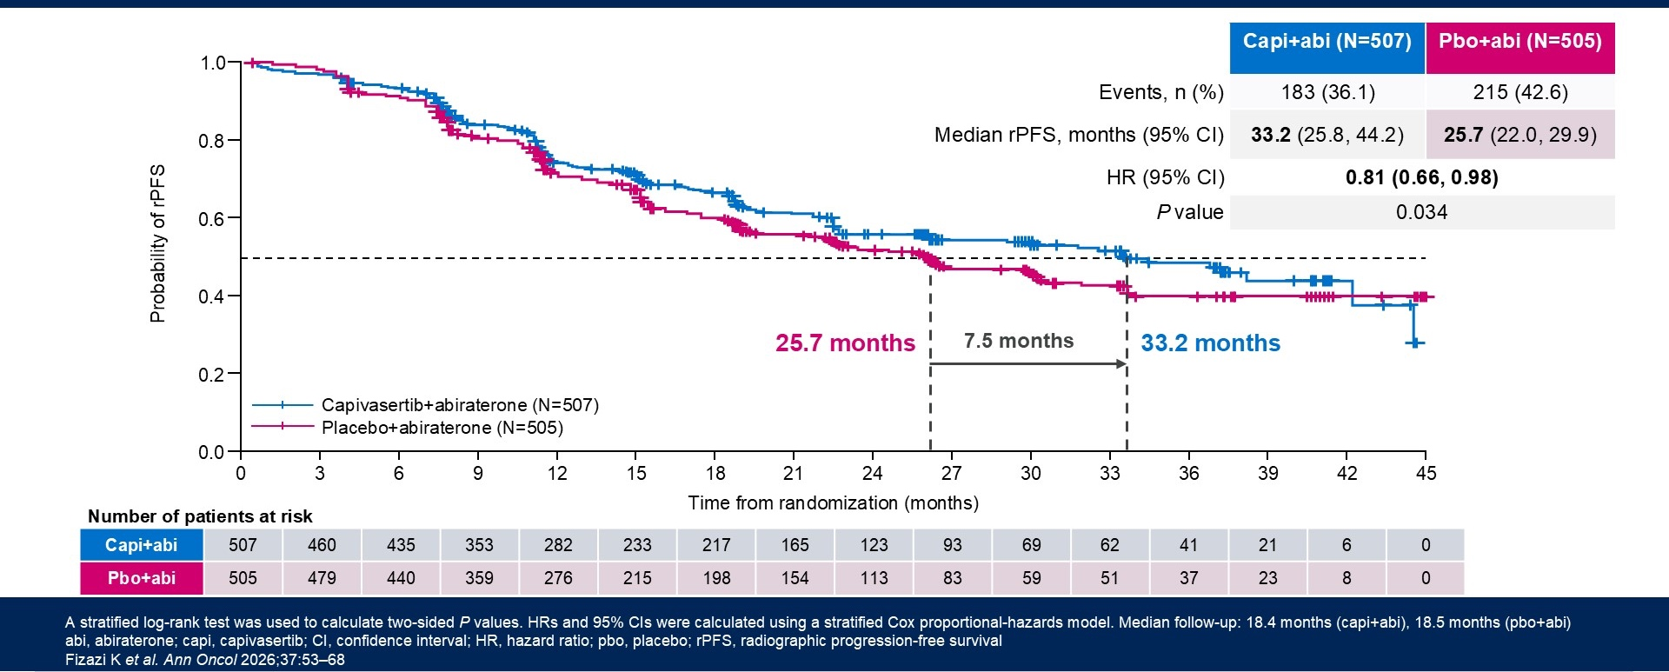
Phase III CAPItello-281 Primary Endpoint: rPFS
rPFS = radiographic progression-free survival
Fizazi K et al. Ann Oncol 2026;37(1):53-68.
George DJ et al. Genitourinary Cancers Symposium 2026;Abstract 14.

Slide 60
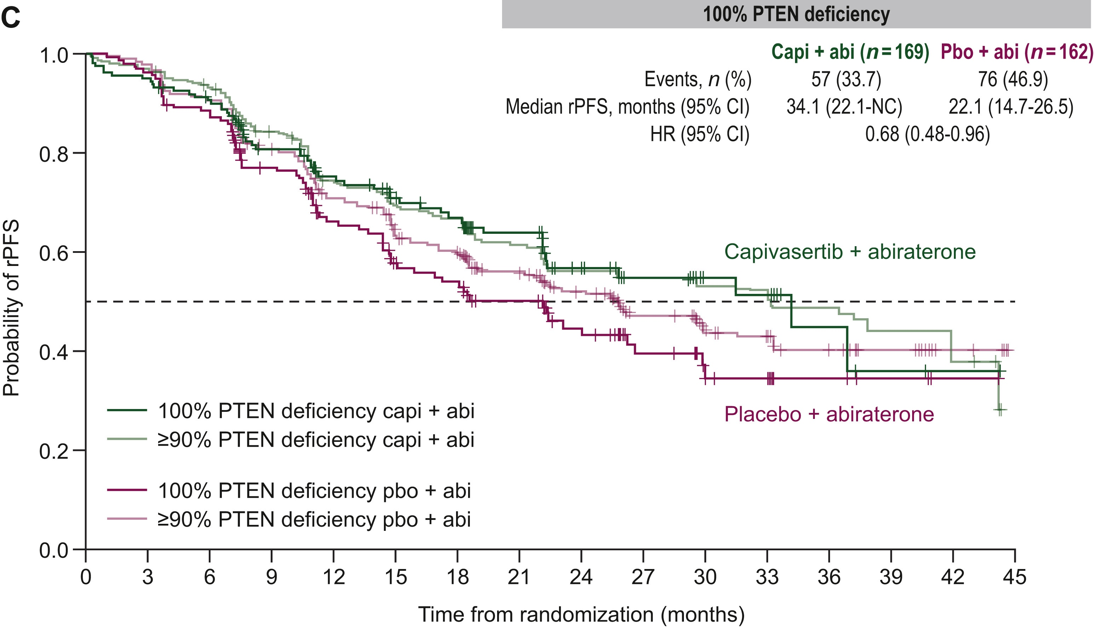
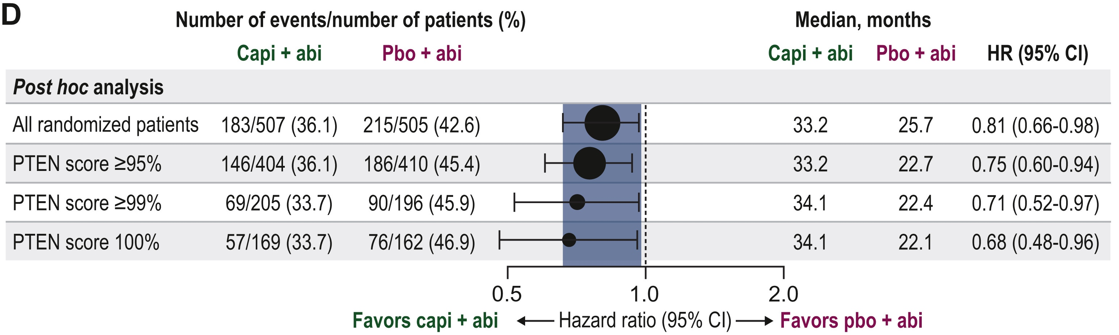
Phase III CAPItello-281 PTEN Subgroup Analysis: rPFS
Fizazi K et al. Ann Oncol 2026;37(1):53-68.

Slide 61
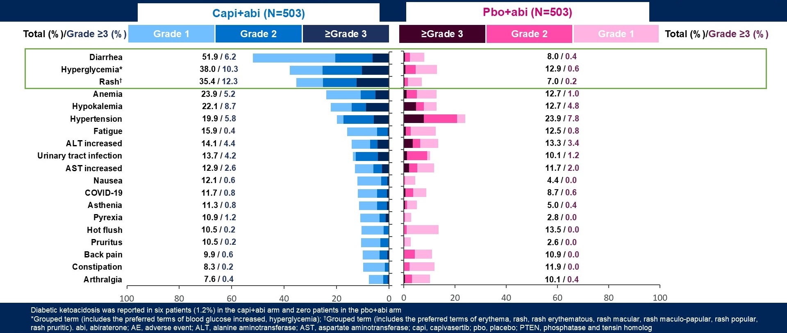
Phase III CAPItello-281: Safety
papular,
Fizazi K et al. Ann Oncol 2026;37(1):53-68.
George DJ et al. Genitourinary Cancers Symposium 2026;Abstract 14.

Slide 62
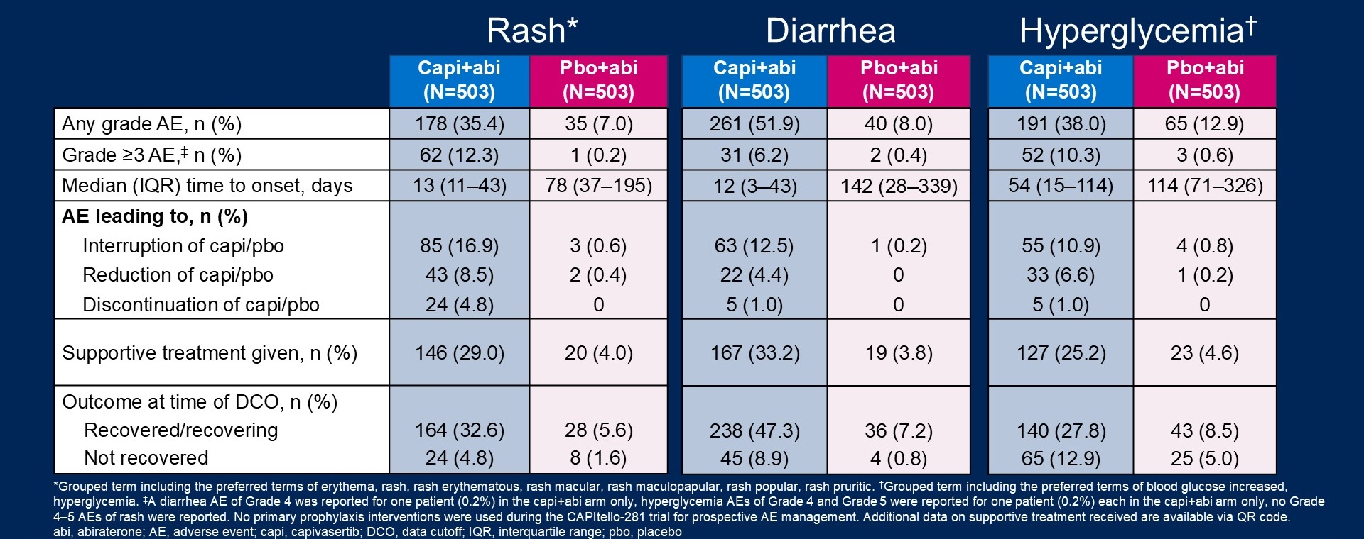
Phase III CAPItello-281: AEs Associated with AKT Inhibition
papular,
AE = adverse event
Fizazi K et al. Ann Oncol 2026;37(1):53-68.
George DJ et al. Genitourinary Cancers Symposium 2026;Abstract 14.

Slide 63
Questions for the Faculty
Optimal method to test for PTEN deficiency — IHC vs NGS? Is % positivity important?
What are the clinical implications of PTEN phenotype? (Poor prognosis, clinical/imaging progression without PSA progression)
Use of capivasertib in patients with suboptimal response to initial therapy
Contraindications to capivasertib? HbA1c; indications for metformin
Tolerability in men

Slide 64
Agenda
Introduction: ESMO 2026; Recent FDA Approvals
Selection of Endocrine Therapy – Dr Antonarakis
Utility of PARP Inhibitors – Dr Agarwal
AKT Inhibition for PTEN-Deficient Disease – Dr Antonarakis
Radiopharmaceuticals – Dr Agarwal

Slide 65
Radiopharmaceuticals
Select Datasets
Gillessen S et al. Final overall survival results from EORTC 1333/PEACE-3 trial of enzalutamide plus radium-223 in metastatic castration-resistant prostate cancer. Ann Oncol 2026;37(5):736-42.
Gallardo E et al. Final overall survival results from the EORTC 1333/PEACE-3 trial: Enzalutamide with or without radium-223 in metastatic castration-resistant prostate cancer. Genitourinary Cancers Symposium 2026;Abstract 15.
Fizazi K et al. Final overall survival and safety analyses of the phase III PSMAfore trial of [¹⁷⁷Lu]Lu-PSMA-617 versus change of androgen receptor pathway inhibitor in taxane-naive patients with metastatic castration-resistant prostate cancer. Ann Oncol 2025;36(11):1319-30.
Sartor O et al. Phase III trial of [177Lu]Lu-PSMA-617 in taxane-naive patients with metastatic castration-resistant prostate cancer (PSMAfore). ESMO 2023;Abstract LBA13.
Tagawa ST et al. [¹⁷⁷Lu]Lu-PSMA-617 in patients with PSMA-positive metastatic androgen pathway modulator-naive/sensitive prostate cancer (PSMAddition): A phase 3 randomised, controlled trial. Lancet 2026;408(10557):793-807.

Slide 66
Radiopharmaceuticals
Select Datasets (Continued)
Saad F et al. Subgroup analyses by disease volume and de novo/recurrent mHSPC in the PSMAddition study of [¹⁷⁷Lu]Lu-PSMA-617. ASCO 2026;Abstract 5020.
Tagawa ST et al. Phase 3 trial of [177Lu]Lu-PSMA-617 combined with ADT + ARPI in patients with PSMA-positive metastatic hormone-sensitive prostate cancer (PSMAddition). ESMO 2025;Abstract LBA6.
Saad F et al. First-in-human assessment of actinium-225-prostate-specific membrane antigen (²²⁵Ac-PSMA)-Trillium (BAY 3563254) in mCRPC: Dose-escalation results of the phase 1 PAnTHa study. Genitourinary Cancers Symposium 2026;Abstract 19.
Delpassand E et al. Preliminary efficacy and safety results from the (TATCIST) trial: A PSMA-directed targeted alpha therapy with FPI-2265 (225Ac-PSMA-I&T) for the treatment of metastatic castration-resistant prostate cancer (mCRPC). AACR 2024;84(7_Supplement):CT224.
Emmett L et al. AcTION: Phase 1 study of [²²⁵Ac]AC-PSMA-617 (²²⁵Ac-PSMA-617) in men with metastatic castration-resistant prostate cancer (mCRPC) with or without prior [¹⁷⁷Lu]Lu-PSMA (¹⁷⁷Lu-PSMA) radioligand therapy (RLT). ASCO 2026;Abstract 5010.

Slide 67

Phase III PEACE-3 Study Design
Gillessen S et al. Ann Oncol 2026;37(5):736-742.
Gallardo E et al. Genitourinary Cancers Symposium 2026;Abstract 15.

Slide 68

Phase III PEACE-3: Final rPFS
Gillessen S et al. Ann Oncol 2026;37(5):736-742.
Gallardo E et al. Genitourinary Cancers Symposium 2026;Abstract 15.

Slide 69

Phase III PEACE-3: Final Overall Survival
Gillessen S et al. Ann Oncol 2026;37(5):736-742.
Gallardo E et al. Genitourinary Cancers Symposium 2026;Abstract 15.

Slide 70

Phase III PEACE-3: Grade ≥3 TEAEs
MDS = myelodysplastic syndromes; AML = acute myeloid leukemia; CML = chronic myeloid leukemia
Gillessen S et al. Ann Oncol 2026;37(5):736-742.
Gallardo E et al. Genitourinary Cancers Symposium 2026;Abstract 15.

Slide 71

Phase III PSMAFore Study Design
Fizazi K et al. Ann Oncol 2025;36(11):1319-1330.
Sartor O et al. ESMO 2023;Abstract LBA13.

Slide 72


Phase III PSMAFore: Survival
rPFS (Primary endpoint)
Final OS (ITT analysis)
ITT = intention to treat
Fizazi K et al. Ann Oncol 2025;36(11):1319-1330.
Sartor O et al. ESMO 2023;Abstract LBA13.

Slide 73

Phase III PSMAddition Study Design
Tagawa ST et al. Lancet 2026;408(10557):793-807.
Saad F et al. ASCO 2026;Abstract 5020.

Slide 74

Phase III PSMAddition: Key Results from Second Interim Analysis
Tagawa ST et al. Lancet 2026;408(10557):793-807.
Tagawa ST et al. ESMO 2025;Abstract LBA6.
Saad F et al. ASCO 2026;Abstract 5020.

Slide 75

Phase III PSMAddition: rPFS by Subgroup
Tagawa ST et al. Lancet 2026;408(10557):793-807.
Saad F et al. ASCO 2026;Abstract 5020.

Slide 76

Phase III PSMAddition: Safety
Tagawa ST et al. Lancet 2026;408(10557):793-807.
Saad F et al. ASCO 2026;Abstract 5020.

Slide 77

Phase I AcTION Study Design
²²⁵Ac-PSMA-617
Emmett L et al. ASCO 2026;Abstract 5010.

Slide 78

Phase I AcTION: Safety Profile and Antitumor Activity
²²⁵Ac-PSMA-617
ChT = chemotherapy; RLT = radioligand therapy
Emmett L et al. ASCO 2026;Abstract 5010.

Slide 79

Phase II TATCIST Study Design
²⁵⁵Ac-PSMA-I&T - zadavotide guraxetan
Delpassand et al. AACR 2024;Abstract CT224.

Slide 80

Phase II TATCIST: PSA50 Response
²⁵⁵Ac-PSMA-I&T
²⁵⁵Ac-PSMA-I&T - zadavotide guraxetan
PSA50 = drop in blood PSA level by at least 50% from baseline
Delpassand et al. AACR 2024;Abstract CT224.

Slide 81

Phase I PAnTHa Study Design
²⁵⁵Ac-PSMA-Trillium
Saad F et al. Genitourinary Cancers Symposium 2026;Abstract 19.

Slide 82

Phase I PAnTHa: Responses
²⁵⁵Ac-PSMA-Trillium
Saad F et al. Genitourinary Cancers Symposium 2026;Abstract 19.

Slide 83
Select Ongoing Phase III Trials for PSMA-Positive mCRPC
Trial name | ClinicalTrials.gov ID | Investigational agent | Comparator arm
VECTRA-01 | NCT07611110 | ²²⁵Ac-PSMA-I&T (zadavotide guraxetan) | Investigator’s choice of SOC
AcTFirst | NCT06855277 | ²⁵⁵Ac-PSMA-Trillium | Investigator’s choice of SOC
PSMAcTION | NCT06780670 | ²²⁵Ac-PSMA-617 | Investigator’s choice of SOC

Slide 84
Faculty Discussion

Slide 85
Questions for the Faculty
A man in his mid 50s presented with de novo metastatic, high-volume, mostly bone disease. Very healthy otherwise. Very educated. He meets the CHAARTED criteria with multiple bone lesions but also the recent first-line lutetium approval, but I told him we don’t have any overall survival data
The patient did his own research. We went back and forth about doublet versus triplet. But he decided to do the lutetium and he just started, and he’s also receiving relugolix and darolutamide.
Questions
When are you opting for lutetium-based therapy for your patients with mHSPC? What about mCRPC?
Do you see cytopenias with lutetium? What management strategies do you employ to treat dry mouth?
Do you think it’s necessary to give patients all 6 doses of lutetium?
Dr Zafar

Slide 86
Questions for the Faculty
88-year-old Vietnamese man with de novo metastatic disease to the bone did well for 3 years on hormone management but then had disease progression
Now doing very well on lutetium with relief of bone pain and reduced PSA levels — no tolerability issues at all
Questions
If he has disease progression and a return of his bone pain, what do I do?
Like almost all patients this age, he does not want chemotherapy. Any new agents in clinical trials that might be helpful? Other radioligands (actinium)? PROTACs? Bispecific antibodies? Novel agents that would be safe in very elderly patients?
Dr Gandhi

Slide 87
Integrating New Advances into
Community Oncology Practice
CME/MOC, NCPD and ACPE Accredited
Saturday, October 17, 2026
7:15 AM – 12:00 PM ET

Slide 88
Agenda
Module 1 — Breast Cancer: Drs Geyer, Lustberg, Nanda and Wander
Module 2 — Prostate Cancer: Drs Agarwal and Antonarakis
Module 3 — Multiple Myeloma: Drs Lonial and Richardson

Slide 89


Multiple Myeloma Faculty
Sagar Lonial, MD, FACP, FASCO
Chair and Professor
Department of Hematology and Medical Oncology
Anne and Bernard Gray Family Chair in Cancer
Chief Medical Officer
Winship Cancer Institute
Emory University School of Medicine
Atlanta, Georgia
Paul G Richardson, MD
Clinical Program Leader and Director of Clinical Research
Jerome Lipper Multiple Myeloma Center
Dana-Farber Cancer Institute
RJ Corman Professor of Medicine
Harvard Medical School
Boston, Massachusetts

Slide 90
Consulting General Medical Oncologists
Susmitha Apuri, MD
Florida Cancer Specialists & Research Institute
Inverness and Lecanto, Florida
Maen Hussein, MD
Florida Cancer Specialists & Research Institute
The Villages, Florida
Mamta Choksi, MD
Florida Cancer Specialists & Research Institute
Trinity, Florida
Renjitha Ignatius, MD
Florida Cancer Specialists & Research Institute
Sun City Center, Florida
Sunil Gandhi, MD
Florida Cancer Specialists & Research Institute
Lecanto, Florida
Shachar Peles, MD
Florida Cancer Specialists & Research Institute
Lake Worth, Florida
Shaachi Gupta, MD, MPH
Florida Cancer Specialists & Research Institute
West Palm Beach, Florida
Syed F Zafar, MD
Florida Cancer Specialists & Research Institute
Fort Myers, Florida

Slide 91
Agenda
Introduction: ESMO 2026; Recent FDA Approvals
Chimeric Antigen Receptor T-Cell Therapy – Dr Lonial
Bispecific Antibodies – Dr Lonial
Antibody-Drug Conjugates – Dr Richardson
Up-Front Treatment; CELMoDs – Dr Richardson

Slide 92
Agenda
Introduction: ESMO 2026; Recent FDA Approvals
Chimeric Antigen Receptor T-Cell Therapy – Dr Lonial
Bispecific Antibodies – Dr Lonial
Antibody-Drug Conjugates – Dr Richardson
Up-Front Treatment; CELMoDs – Dr Richardson

Slide 93
Select ESMO 2026 Abstracts
Multiple Myeloma
Abstract 1454O
High MRD Negativity Rates and Prolonged PFS with Belantamab Mafodotin plus Daratumumab, Lenalidomide, and Dexamethasone in Transplant Ineligible Newly-Diagnosed Myeloma: Results of the Bela-DRd Study
Meletios A Dimopoulos et al.
Abstract 1455O
Belantamab Mafodotin with Lenalidomide/Dexamethasone in Newly Diagnosed Not Transplant Eligible Multiple Myeloma: Long-Term Results from the Phase 1/2 BelaRd Clinical Trial
Ioannis Ntanasis-Stathopoulos et al.
Abstract 1456O
A First-in-Human Phase I Study of LBL-034, a GPRC5D/CD3 Bispecific Antibody, in Relapsed/Refractory Multiple Myeloma (RRMM)
Xuelin Dou et al.

Slide 94
Recent FDA Approvals
FDA APPROVAL
August 13, 2026
Accelerated Approval to Iberdomide with Daratumumab and Hyaluronidase-fihj and Dexamethasone for Multiple Myeloma
FDA APPROVAL
March 5, 2026
Teclistamab in Combination with Daratumumab and Hyaluronidase-fihj for Relapsed or Refractory Multiple Myeloma
FDA APPROVAL
January 27, 2026
Daratumumab and Hyaluronidase-fihj with Bortezomib, Lenalidomide, and Dexamethasone for Newly Diagnosed Multiple Myeloma

Slide 95
Recent FDA Approvals (Continued)
FDA APPROVAL
November 6, 2025
Daratumumab and Hyaluronidase-fihj for High-Risk Smoldering
Multiple Myeloma
FDA APPROVAL
October 23, 2025
Belantamab Mafodotin-blmf for Relapsed or Refractory
Multiple Myeloma

Slide 96
Agenda
Introduction: ESMO 2026; Recent FDA Approvals
Chimeric Antigen Receptor T-Cell Therapy – Dr Lonial
Idecabtagene Vicleucel and Ciltacabtagene Autoleucel
Anitocabtagene Autoleucel and Arlocabtagene Autoleucel
Bispecific Antibodies – Dr Lonial
Antibody-Drug Conjugates – Dr Richardson
Up-Front Treatment; CELMoDs – Dr Richardson

Slide 97
Chimeric Antigen Receptor T-Cell Therapy:
Idecabtagene Vicleucel and Ciltacabtagene Autoleucel
Select Datasets
Einsele H et al. Cilta-cel in Lenalidomide-Refractory Multiple Myeloma (CARTITUDE-4): An Updated Analysis Including Overall Survival from an Open-Label, Multicentre, Randomised, Phase 3 Trial. Lancet Oncol 2026;27(2):254-68.
Cohen AD et al. Long-Term (≥5-Year) Remission and Survival with Ciltacabtagene Autoleucel in Relapsed/Refractory Multiple Myeloma with 1-3 Prior Lines of Therapy: CARTITUDE-2 Cohort A. IMS 2026;Abstract PA-288.

Slide 98


Ide-cel and Cilta-cel Constructs
Idecabtagene vicleucel (ide-cel) CAR T
Ciltacabtagene autoleucel (cilta-cel) CAR T
Two BCMA-targeting domains³
The two BCMA-targeting single-domain antibodies were designed to confer high avidity binding
4-1BB⁴
CD3-ζ⁵
Second-generation CAR construct¹
Dual epitope-binding CAR construct^{1,2}
Content courtesy of Noopur Raje, MD
CAR = chimeric antigen receptor; BCMA = B-cell maturation antigen; CD = cluster of differentiation
1. Raje N et al. N Engl J Med 2019;380(18):1726-37. 2. Friedman KM et al. Hum Gene Ther 2018;29(5):585-601. 3. Song DG et al. Cancer Res 2011;71(13):4617-27.
Zhao WH et al. J Hematol Oncol 2018;11(1):141. Berdeja JG et al. ASCO 2020;Abstract 8505.

Slide 99
Ide-cel and Cilta-cel for Heavily Pretreated Multiple Myeloma
Parameter | KarMMa¹ Ide-cel N = 128 | CARTITUDE-1^{2,3} Cilta-cel N = 97
Inclusion criteria | ≥3 prior regimens Prior PI, IMiD and anti-CD38 mAb exposure | ≥3 prior regimens or double refractory to a PI and an IMiD Prior PI, IMiD and anti-CD38 mAb exposure
Overall response | 73% | 97.9%
PFS | Median 8.6 mo | 33% of patients were progression-free at ≥5 years
Median OS | 24.8 mo | 60.7 mo
PI = proteasome inhibitor; IMiD = immunomodulatory drug; mAb = monoclonal antibody; PFS = progression-free survival; OS = overall survival
¹ Anderson LD et al. IMW 2021;Abstract OAB27; ² Voorhees PM et al. ASCO 2025;Abstract 7507; ³ Jagannath S et al. J Clin Oncol 2025;43(25):2766-71.

Slide 100


CARTITUDE-4 Study: PFS and OS with Cilta-cel versus Standard Therapy After 1 to 3 Prior Lines of Treatment
(HR 0.55 [95% CI 0.39-0.79]; p=0·0009)
(HR 0.29 [95% CI 0.22-0.39])
Einsele H et al. Lancet Oncol 2026;27(2):254-68.

Slide 101

Phase II CARTITUDE-2 Study of Cilta-cel for Relapsed/Refractory MM: Cohort A
Cohen AD et al. IMS 2026;Abstract PA-288.

Slide 102

CARTITUDE-2 Cohort A: Long-Term Remissions and Survival with
Cilta-cel for Relapsed/Refractory MM
Cohen AD et al. IMS 2026;Abstract PA-288.

Slide 103
CAR T-Cell Therapy: Anitocabtagene Autoleucel and Arlocabtagene Autoleucel
Select Datasets
Patel K et al. Phase 2 Registrational Study of Anitocabtagene Autoleucel for the Treatment of Patients with Relapsed and/or Refractory Multiple Myeloma: Updated Results from iMMagine-1. ASH 2025;Abstract 256.
Martin T et al. IMMAGINE-3: A Phase 3, Randomized Study to Compare the Efficacy and Safety of Anitocabtagene Autoleucel (Anito-cel) with Standard of Care in Patients with Relapsed/Refractory Multiple Myeloma (RRMM). EHA 2024;Abstract PB2724.
Bal S et al. Arlocabtagene Autoleucel: A GPRC5D-targeted CAR T-Cell Therapy for Heavily Pretreated Relapsed/Refractory Multiple Myeloma. Blood 2026;148(10):1240-50.
Bal S et al. Efficacy and Safety with Extended Follow-Up in a Phase 1 Study of BMS-986393, a G Protein-Coupled Receptor Class C Group 5 Member D (GPRC5D)-Targeted CAR T Cell Therapy, in Patients (Pts) with Heavily Pretreated Relapsed/Refractory (RR) Multiple Myeloma (MM). ASH 2024;Abstract 922.
Lebel E et al. QUINTESSENTIAL-2: A Phase 3 Study of Arlocabtagene Autoleucel versus Standard of Care in Adult Patients with Relapsed and Refractory Multiple Myeloma (RRMM) Exposed to Lenalidomide. ASCO 2026;Abstract TPS7577.

Slide 104






Anitocabtagene Autoleucel (Anito-cel, CART-ddBCMA)
Autologous BCMA-directed CAR T-cell therapy using a novel D-Domain binder¹
D-Domain attributes: nonantibody-derived synthetic protein^{1,2}
Small D-Domain construct facilitates high transduction efficiency, CAR positivity, and CAR density on the T-cell surface²⁻⁴
Size
Rapid D-Domain folding, lack of disulfide bonds, and a hydrophobic core enables stability at and beyond physiologic conditions^{5,6}
Stability
Due to small size and compact structure, D-Domain CARs have a low risk of tonic signaling⁶
scFv (~25 kDa)
Bivalent camelid VHh (~25 kDa)
D-Domain (~8 kDa)
Structure
¹ Rotte A et al. Immuno-oncol Insights 2022;3(1):13-24; ² Frigault MJ et al. Blood Adv 2023;7(5):768-77; ³ Canté-Barrett K et al. BMC Res Notes 2016;9:312; ⁴ Buonato JM et al. Mol Cancer The 2022;21(7):1171-83; ⁵ Zhu Y et al. Proc Nat Acad Sci 2003;100(26):15486-91; ⁶ Qin H et al. Mol Ther 2019;27(7):1262-74.

Slide 105

Phase II iMMagine-1 Trial: Overall Response Rate (ORR) and Depth of Response with Anito-cel for Relapsed/Refractory MM
IRC = independent review committee; sCR = stringent complete response; CR = complete response; VGPR = very good partial response; PR = partial response
Patel K et al. ASH 2025;Abstract 256.

Slide 106

iMMagine-1: Safety Update
February 23, 2026: Biologics license application for anito-cel as a fourth-line treatment for patients with relapsed or refractory multiple myeloma is supported by results from the Phase 1 study (NCT04155749) and the pivotal Phase 2 iMMagine-1 study (NCT05396885) and has been accepted by the FDA with an anticipated Prescription Drug User Fee Act (PDUFA) action date of December 23, 2026.
Patel K et al. ASH 2025;Abstract 256; https://www.gilead.com/news/news-details/2026/gilead-sciences-to-acquire-arcellx-to-maximize-long-term-potential-of-anito-cel. Accessed October 2026.

Slide 107
iMMagine-3: A Phase III Study of Anito-cel
Anito-cel infusion with optional bridging therapy
Inclusion Criteria
Patients with R/R MM who received 1-3 prior lines of therapy, including an IMiD and anti-CD38 mAb
R
1:1
N = 450
Standard therapy
(PVd, DPd, KDd, or Kd)
Primary endpoint: PFS per independent review
Key secondary endpoints: CR rate (CR/sCR), MRD negativity, OS, safety
R/R = relapsed/refractory; MRD = minimal residual disease
Martin T et al. EHA 2024;Abstract PB2724.

Slide 108
Phase I Study of Arlocabtagene Autoleucel for R/R MM:
Extended Follow-Up
ORR 87%
ORR 91%
100
90
80
70
60
50
40
30
20
10
0
Median PFS | mo (95% CI)
All evaluable patients (n = 79) | 18.3 (11.8 -21.9)
Prior anti-BCMA therapy (n = 38) | 19.0 (8.9-NA)
No prior anti-BCMA therapy (n = 41) | 18.3 (11.8-23.9)
42
35
sCR
CRR 48%
Patients (%)
CRR 53%
CR
13
VGPR
11
22
PR
23
Overall (n = 79)
150 x 10⁶
CAR T-cells (n = 23)
OS | All patients (n = 84)
Median OS, mo | NR
12-mo OS rate, % (95% CI) | 90 (81-95)
18-mo OS rate, % (95% CI) | 87 (76-93)
21-mo OS rate, % (95% CI) | 84 (72-91)
Response | Evaluable patients (n = 79)
Median DoR, mo (95% CI) | 18.0 (13.3-23.0)
Median TTR, mo (range) | 1 .0 (0.9-6.0)
Median follow-up, mo (range) | 16.1 (2.8-25.2)
DoR = duration of response; TTR = time to response
Bal S et al. Blood 2026;148(10):1240-50; Bal S et al. ASH 2024;Abstract 922.

Slide 109
Phase I Study of Arlocabtagene Autoleucel for R/R MM: Select Treatment-Related Adverse Events (TRAEs)
TRAE, n (%) | All patients (n = 84)
 | Any grade | Grade 3/4
CRS | 69 (82) | 3 (4)
ICANS | 8 (10) | 2 (2)
Other neurotoxicity events | 10 (12) | 6 (7)
MAS/HLH | 0 | 3 (4)
On-target/off-tumor event | All patients (N = 84)
Skin* Patients with an event, n (%) Patients with event resolution, n (%) Median time to resolution, days | 25 (30) 22 (88) 26
Nail* Patients with an event, n (%) Patients with event resolution, n (%) Median time to resolution, days | 16 (19) 12 (75) 98
Oral*† Patients with an event, n (%) Patients with event resolution, n (%) Median time to resolution, days | 27 (32) 19 (70) 66
CRS was primarily Grade 1 and 2. Grade 5 CRS occurred in 1 patient, who received the 450 x 10⁶ dose
Select Grade ≤4 neurotoxicity events occurred at the
150-450 x 10⁶ dose level: dizziness, ataxia, neurotoxicity dysarthria, and/or nystagmus
  Median time to onset: 30.5 days
Weight loss (n = 5), palsy and Guillain-Barré syndrome were also reported
No reports of parkinsonism, cranial nerve
* No Grade 3 or 4; intervention was not required for 79% of patients
† Including dysgeusia and dysphagia
CRS = cytokine release syndrome; MAS = macrophage activation syndrome; HLH = hemophagocytic lymphohistiocytosis
Bal S et al. Blood 2026;148(10):1240-50; Bal S et al. ASH 2024;Abstract 922.
▪

Slide 110
Positive Topline Results Announced from the Registrational
Phase II QUINTESSENTIAL Trial of Arlocabtagene Autoleucel
Press Release: September 8, 2026
“[The manufacturer] announced positive Phase 2 results from the registrational QUINTESSENTIAL trial (NCT06297226) of arlocabtagene autoleucel (arlo-cel; BMS-986393) in adult patients with quadruple-class exposed relapsed and refractory multiple myeloma (RRMM).
Results show the study met its primary endpoint with arlo-cel demonstrating a statistically significant and clinically meaningful overall response rate (ORR) in patients with quadruple-class exposed RRMM who had received four or more prior lines of therapy. Quadruple-class exposed consists of those who had been treated with an immunomodulatory inhibitor (IMiD), a proteasome inhibitor (PI), an anti-CD38 therapy and a BCMA-targeted therapy.
The study also met the key secondary endpoint of complete response rate (CRR) in patients with RRMM who had been quadruple-class exposed after four or more prior lines of therapy, and the key secondary endpoints of ORR and CRR after three or more prior lines of therapy. The safety profile of arlo-cel was consistent with that of other CAR T cell therapies and other GPRC5D-targeting therapies in multiple myeloma.”
https://news.bms.com/news/corporate-financial/2026/Bristol-Myers-Squibb-Announces-Positive-Topline-Results-from-Registrational-Phase-2-QUINTESSENTIAL-Trial-of-the-Potential-First-in-Class-GPRC5D-Directed-CAR-T-Cell-Therapy-Arlocabtagene-Autoleucel----/default.aspx

Slide 111


QUINTESSENTIAL-2: A Phase III Study of Arlo-cel
Lebel E et al. ASCO 2026;Abstract TPS7577.

Slide 112
Faculty Discussion

Slide 113
Questions for the Faculty
Dr Gandhi
82-year-old man with MM who received ide-cel CAR-T therapy 18 months ago for relapsed standard-risk disease. Responded with minimal toxicity, currently under observation
Questions
Choice of CAR T-cell therapy
Age, performance status and eligibility for CAR-T
Current requirements for social support and remaining closer to tertiary centers
Post-CAR-T management: vaccines, IVIG, prophylactic antimicrobials

Slide 114
Questions for the Faculty
Dr Hussein
70-year-old man with relapsed MM who received ida-cel CAR T-cell therapy: Responded but disease progressed after 1 year, received second GPRC5 directed CAR T-cell therapy and responded again.
Questions
Are there any situations in which you would consider repeating CAR T-cell therapy a second time in the same patient? Would you use the same or different constructs?
Have you used the novel CAR T-cell therapies anito-cel and arlo-cel? What is your experience with these constructs?

Slide 115
Agenda
Introduction: ESMO 2026; Recent FDA Approvals
Chimeric Antigen Receptor T-Cell Therapy – Dr Lonial
Bispecific Antibodies – Dr Lonial
Antibody-Drug Conjugates – Dr Richardson
Up-Front Treatment; CELMoDs – Dr Richardson

Slide 116
Bispecific Antibodies
  Select Datasets
  Mateos M-V et al. Phase 3 Randomized Study of Teclistamab plus Daratumumab versus Investigator’s Choice of Daratumumab and Dexamethasone with Either Pomalidomide or Bortezomib in Patients with Relapsed Refractory Multiple Myeloma: Results of Majestec-3. ASH 2025;Abstract LBA-6.
  Costa LJ et al. Teclistamab plus Daratumumab in Relapsed or Refractory Multiple Myeloma. N Engl J Med 2026;394:739-52.
  Mina R et al. MajesTEC-9: A Phase 3 Randomized Study of Teclistamab Monotherapy vs Investigator’s Choice of Pomalidomide, Bortezomib, and Dexamethasone or Carfilzomib and Dexamethasone (PVd/Kd) in Patients (Pts) with Relapsed Refractory Multiple Myeloma (RRMM). ASCO 2026;Abstract 7507.
  Touzeau C et al. Teclistamab in Multiple Myeloma with One to Three Previous Lines of Therapy. N Engl J Med 2026;395:440-53.
  Voorhees P et al. Phase 3, Randomized Study of Talquetamab (TAL) plus Daratumumab (Dara) + Pomalidomide (Pom) vs Dara plus Pom and Dexamethasone (DPD) in Relapsed/Refractory Multiple Myeloma (RRMM): MonumenTAL-3. EHA 2026;Abstract S100 and IMS 2026;Abstract PA-350.
  Mina R et al. Talquetamab-Daratumumab in Relapsed or Refractory Myeloma. N Engl J Med 2026;395:671-83.

Slide 117

Bispecific Antibody Targets and Mechanism of Action
 | BCMA | GPRC5D | FcRH5
Expression | Plasma cells, plasmablasts | Plasma cells, hair follicles, eccrine glands, filiform papillae of tongue | B-cell lineage cells, including plasma cells
Biological significance | Survival/growth of plasma cells | Unclear | Unclear
Location | 16p13 | 12p13 | 1q21
Extracellular shedding? | Yes | No | Yes
Select agents | Elranatamab, teclistamab, linvoseltamab | Talquetamab | Cevostamab
Rees M et al. Front Immunol 2024;15:1424925; Yu B et al. J Hematol Oncol 2020;13:125; Rodrigueze-Otero P et al. Blood Cancer J 2024;14:24; Li J et al. Cancer Cell 2017;31:383-95; Ise T et al. Leukemia 2007;21:169-74.
Adapted from content provided courtesy of Hans Lee, MD

Slide 118
Approved Bispecific T-Cell Antibodies as Monotherapy: Clinical Data
Drug | N | Pivotal trial | Response | PFS/DOR | CRS
Teclistamab¹ FDA approved, 2022 | 165 | MajesTEC-1 | ORR 63% ≥VGPR 59% | Median PFS 11.4 mo Median DOR 24 mo | All grade (72%) Grade 3/4 (0.6%)
Elranatamab² FDA approved, 2023 | 123 | MagnetisMM-3 | ORR 61% ≥VGPR 56% | Median PFS: 17.2 months 18-month DOR: 68.8% | All grade (56%), Grade 2 (14%); Grade 3-4 (0%)
Linvoseltamab³ FDA approved, 2025 | 117 | LINKER-MM1 | ORR 71% ≥VGPR (200 mg cohort) 63% | 12-month median PFS: 70% Median DOR: 29.4 months | 200 mg cohort: All grade (46%), Grade 2 (10%), Grade 3 (1%),
Talquetamab⁴ FDA approved, 2023 | 232 | MonumenTAL-1 | ORR 70% (405 𝜇g/kg weekly) ORR 64% (800 𝜇g/kg biweekly) | Median DOR 10.2 mo (405 𝜇g/kg weekly) Median DOR 7.8 mo (800 𝜇g/kg biweekly) | All grade 405 𝜇g/kg weekly (77%) All grade 800 𝜇g/kg biweekly (80%)
¹ Garfall A et al. ASCO 2024;Abstract 7540; ² Lesokhin A et al. Nat Med 2023;29:2259-67; ³ Bumma N et al. J Clin Oncol 2024;42:2702-12;
⁴ Chari A et al. N Engl J Med 2022;387:2232-44.

Slide 119


MajesTEC-3 Phase III Study of Teclistamab with Daratumumab for MM After 1 to 3 Prior Lines of Therapy
Mateos M-V et al. ASH 2025;Abstract LBA-6.

Slide 120


MajesTEC-3: Survival
Mateos M-V et al. ASH 2025;Abstract LBA-6; Costa LJ et al. N Engl J Med 2026;394:739-52.

Slide 121

MajesTEC-3: Most Common Adverse Events — Safety Population
Mateos M-V et al. ASH 2025;Abstract LBA-6; Costa LJ et al. N Engl J Med 2026;394:739-52.

Slide 122

MajesTEC-9: A Phase III Study of Teclistamab for MM After 1 to 3 Prior Lines of Therapy
Mina R et al. ASCO 2026;Abstract 7507.

Slide 123

MajesTEC-9 Primary Endpoint: PFS
Mina R et al. ASCO 2026;Abstract 7507; Touzeau C et al. N Engl J Med 2026;395:440-53.

Slide 124

MajesTEC-9: OS
Mina R et al. ASCO 2026;Abstract 7507; Touzeau C et al. N Engl J Med 2026;395:440-53.

Slide 125
Elranatamab Significantly Improves Progression-Free Survival for Double Class-Exposed Patients with R/R MM
Press Release: April 29, 2026
“[The manufacturer] announced positive topline results from the Phase 3 MagnetisMM-5 study evaluating elranatamab as monotherapy in adults with relapsed or refractory multiple myeloma (RRMM) who received at least one prior line of treatment.
The study demonstrated a statistically significant and clinically meaningful improvement in the primary endpoint of progression‑free survival (PFS), as assessed by blinded independent central review (BICR), versus standard-of-care daratumumab plus pomalidomide and dexamethasone (DPd). The safety and tolerability of elranatamab was consistent with its known safety profile.
The PFS results exceeded the pre-specified interim analysis target hazard ratio for efficacy, with most elranatamab-treated patients remaining progression-free. The trial remains ongoing to assess overall survival, a key secondary endpoint, which was not yet mature at the time of this interim analysis. These data will be discussed with global health authorities, and detailed results from MagnetisMM-5 will be submitted for presentation at a future medical congress.”
https://www.pfizer.com/news/press-release/press-release-detail/pfizers-elrexfio-significantly-improves-progression-free

Slide 126

MonumenTAL-3: A Phase III Study of Talquetamab with Daratumumab with or without Pomalidomide for MM After 1 or More Prior Lines of Therapy
Content courtesy of Hans Lee, MD
Voorhees P et al. EHA 2026;Abstract S100.

Slide 127


MonumenTAL-3 Primary Endpoint: PFS
Voorhees P et al. EHA 2026;Abstract S100; Mina R et al. N Engl J Med 2026;395:671-83; Voorhees PM et al. IMS 2026;Abstract PA-350.

Slide 128


MonumenTAL-3: OS
Voorhees P et al. EHA 2026;Abstract S100; Mina R et al. N Engl J Med 2026;395:671-83; Voorhees PM et al. IMS 2026;Abstract PA-350.

Slide 129
Positive Topline Results from the MonumenTAL-6 Phase III Trial of Teclistamab with Talquetamab in Earlier Lines of Therapy for R/R MM
Press Release: July 23, 2026
“[The manufacturer] announced positive topline results from the three-arm investigational Phase III MonumenTAL-6 study evaluating teclistamab-cqyv + talquetamab-tgvs, a BCMA and GPRC5D dual antigen targeting regimen, and talquetamab-tgvs + pomalidomide in adult patients with relapsed or refractory multiple myeloma (RRMM) who received 1 to 4 prior lines of therapy, including an anti-CD38 antibody and lenalidomide.
The study demonstrated statistically significant and clinically meaningful improvements in progression-free survival and overall survival for both investigational arms compared with investigator’s choice standard of care. Teclistamab-cqyv + talquetamab-tgvs delivered the greatest benefit, reducing the risk of disease progression or death by 89% (HR, 0.11) and the risk of death by 62% (HR, 0.38).
Based on the strength of the data, the Independent Data Monitoring Committee recommended unblinding the study at the first interim analysis. The full results of the Phase 3 MonumenTAL-6 study will be presented at a future major medical meeting and shared with global health authorities.”
https://www.jnj.com/media-center/press-releases/tecvayli-talvey-reduced-the-risk-of-disease-progression-or-death-by-89-and-the-risk-of-death-by-62-in-earlier-line-relapsed-refractory-multiple-myeloma.

Slide 130
Faculty Discussion

Slide 131
Questions for the Faculty
Dr Peles
61-year-old woman with standard-risk MM who received RVd induction and autologous transplant followed by maintenance lenalidomide for 10 years. Now with disease progression. Clinically well: PS 0
Questions
For a 61-year-old patient, do you generally recommend CAR T before bispecific antibodies or vice versa?
Do you normally use bispecific antibodies as monotherapy or in combination?
How concerned are you about the risk of infections for your patients receiving teclistamab/daratumumab? Are there any other complications or recommendations about that? Do you use IVIG?

Slide 132
Questions for the Faculty
Dr Zafar
A man in his early 60s with del(17p) IgA kappa MM and rapid progression with extramedullary disease through quadruplet induction. His disease progressed through salvage treatment. Couldn’t get to CAR T. Treated with teclistamab with progression in the liver.
Questions
What other options? CAR T? Talquetamab alone or with daratumumab or teclistamab? Belantamab? Can we get a BCMA assay?
New agents? What about trispecific antibodies?

Slide 133
Agenda
Introduction: ESMO 2026; Recent FDA Approvals
Chimeric Antigen Receptor T-Cell Therapy – Dr Lonial
Bispecific Antibodies – Dr Lonial
Antibody-Drug Conjugates – Dr Richardson
Up-Front Treatment; CELMoDs – Dr Richardson

Slide 134
Antibody-Drug Conjugates
  Select Datasets
Hungria V et al. Belantamab Mafodotin, Bortezomib, and Dexamethasone vs Daratumumab, Bortezomib, and Dexamethasone in Relapsed/Refractory Multiple Myeloma: Updated 4-Year Results of the Phase 3 DREAMM-7 Trial. IMS 2026;Abstract PA-049.
Trudel S et al. Deep Responses and Durable Outcomes in Patients Treated with Belantamab Mafodotin plus Pomalidomide and Dexamethasone from Long-Term Follow-Up of the Phase 3 DREAMM-8 Study. ASH 2025; Abstract 2264.
Trudel S et al. Long-Term Outcomes with Sustained Minimal Residual Disease Negativity in Belantamab Mafodotin–Treated Patients with Relapsed/Refractory Multiple Myeloma: An Update from DREAMM-8. IMS 2026;Abstract OA-38.
Mateos MV et al. Modification of Belantamab Mafodotin Dosing to Balance Efficacy and Tolerability in the DREAMM-7 and DREAMM-8 Trials. Blood Adv 2025;9(22):5708-19.
Usmani SZ et al. DREAMM-9 Patient-Reported Vision-Related Function with Extended Belantamab Mafodotin Dosing Intervals with Bortezomib, Lenalidomide, Dexamethasone (BRVD) in Transplant Ineligible Multiple Myeloma. IMS 2026;Abstract OA-20.

Slide 135

Belantamab Mafodotin Mechanism of Action
Cho, Front Immunol 2018; Sheikh, Future Oncol 2020
Content courtesy of Douglas W Sborov, MD, MS

Slide 136

DREAMM-7: A Phase III Trial of Belantamab Mafodotin (Belamaf) with Bortezomib/Dexamethasone (BVd) versus Daratumumab with Vd (DVd) for R/R MM
Mateos M-V et al. ASCO 2024;Abstract 7503.

Slide 137

Belantamab mafodotin for early-relapse RRMM
DREAMM-7: Belantamab mafodotin + Vd vs Dara-Vd as ≥2nd-line therapy
 | BVd | DVd
Median PFS (95% CI), months | 36.6 (28.4-NR) | 13.4 (11.1-17.5)
HR (95% CI) | 0.41 (0.31-0.53), P<0.00001
Phase 3 DREAMM-7 study
Belamaf+Vd x 8 cycles, then belamaf Q3W, N=243
Dara-Vd x 8 cycles, then Dara Q4W, N=251
1.0
0.8
Patients | Belamaf-Vd, N=243 | Dara-Vd, N=251
Median age, years | 65 | 64
Age ≥75 years | 15% | 12%
High-risk cytogenetics | 28% | 27%
EMD | 5% | 10%
1 / 2-3 / ≥4 prior lines | 51 / 36 / 12% | 50 / 39 / 11%
Prior PI | 90% | 86%
Prior IMiD | 81% | 86%
R-refractory | 33% | 35%
Prior Dara | 1% | 2%
Prior ASCT | 67% | 69%
0.6
69%
Probability of PFS
0.4
43%
0.2
BVd
DVd
0.0
0
3
6
9
12
15
18
21
24
27
30
33
36
39
Time since randomization (months)
Outcomes
Significant PFS benefit seen across prespecified subgroups, including R-refractory patients (HR 0.37), patients with high-risk cytogenetics (HR 0.36), and patients with prior V (HR 0.45)
Early OS trend favoring belamaf-Vd – 18-month OS 84% vs 73% (HR 0.57)
Hungria V, et al. N Engl J Med 2024;391(5):393–407.

Slide 138



Belantamab mafodotin for early-relapse RRMM
DREAMM-7: Belantamab mafodotin + Vd vs Dara-Vd as ≥2nd-line therapy
ORR 83.1%
≥VGPR 66.3%
≥CR 35.8%
Safety | Belamaf-Vd, N=243 | Dara-Vd, N=251
Grade 3-4 AE | 95% | 78%
Related | 92% | 67%
Discontinuation due to AEs | 32% | 19%
SAEs | 53% | 38%
Death due to AEs | 11% | 8%
Grade ≥3 hematologic AEs
Thrombocytopenia | 56% | 35%
Neutropenia | 14% | 10%
Anemia | 9% | 10%
Infections | 73% | 68%
Grade ≥3 | 33% | 20%
Pneumonia | 12% | 4%
Ocular AEs (Grade ≥3) | 79% (34%) | 29% (3%)
Vision blurred | 68% (24%) | 11% (<1%)
Dry eye | 51% (7%) | 7% (0)
Photophobia | 47% (2%) | 2% (0)
Eye irritation | 43% (5%) | 5% (0)
ORR 71.3%
≥VGPR 46.2%
≥CR 17.5%
MRD-neg
38.7%
Indirect comparisons: Bela-Vd vs SoC / Dara-Tec
Sustained MRD status: Bela-Vd vs Dara-Vd
2025
  Patients achieving MRD-neg status
    Patients with CR: 70% vs 59% (10⁻⁵) / 45% vs 23% (10⁻⁶)
    ITT: 25% vs 10% (10⁻⁵) / 16% vs 4% (10⁻⁶)
    Median time to first MRD-neg status: 11.1 vs 17.0 months
  Patients achieving sustained MRD-neg status (10⁻⁵)
    Patients with CR: 57% vs 42%
    ITT: 14% vs 4%
  Mateos M-V, et al. Blood 2025;146(Supplement 1):2265.
  Indirect treatment comparisons of PFS and OS:
  Bela-Vd vs Pom-Vd / Elo-Pom-dex / Isa-Pom-dex / ide-cel
    PFS HRs 0.52 / 0.34 / 0.54 / 0.47
    OS HRs 0.60 / 0.41 / 0.35 / 0.51
  Richter JR, et al. J Clin Oncol 2026;44(16_Suppl):7568.
  Matching adjusted indirect comparison of OS restricted mean survival time (RMST) and infections: Bela-Vd vs Dara-Tec
    OS RMST ratio 1.01–1.04 at 1–3 years
    Odds ratio for infections 0.24
  Richter J, et al. HemaSphere 2026;10(S1):PS1933.
MRD-neg
17.1%
Median DOR 40.8 vs 17.8 months
Median PFS2 NR vs 33.4 months (HR 0.59)
Hungria V, et al. N Engl J Med 2024;391(5):393–407. Hungria V, et al. Blood 2024;144(supplement 1):772.

Slide 139

DREAMM-8: A Phase III Trial of Belamaf with Pomalidomide/ Dexamethasone (BPd) versus Pomalidomide with Vd (PVd) for R/R MM
Trudel S et al. ASCO 2024;Abstract LBA105.

Slide 140

Belantamab mafodotin for early-relapse RRMM
DREAMM-8: Belantamab mafodotin + Pom-dex vs Pom-Vd as ≥2nd-line therapy
UPDATE: median follow-up 35.8 months²
 | BPd | Pom-Vd
Median PFS (95% CI), months | 32.6 (21.1-NR) | 12.5 (9.1-17.6)
HR (95% CI) | 0.49 (0.36-0.67), P<0.001
 | BPd | Pom-Vd
Median PFS (95% CI), months | NR (20.6-NR) | 12.7 (9.1-18.5)
HR (95% CI) | 0.52 (0.37-0.73), P<0.001
Phase 3 DREAMM-8 study¹
Belamaf-Pom-dex until PD/death, N=155
Pom-Vd until PD/death, N=147
Patients with ≥1 prior line, including lenalidomide
1.0
0.8
71%
2025
Patients | Belamaf-Pom-dex, N=155 | Pom-Vd, N=147
Median age, years | 67 | 68
Age ≥75 years | 12% | 24%
High-risk cytogenetics | 34% | 32%
EMD | 13% | 7%
1 / 2 or 3 / ≥4 prior lines | 53 / 35 / 12% | 52 / 33 / 15%
Prior PI | 90% | 93%
Prior IMiD | 100% | 100%
IMiD-refractory | 82% | 76%
Prior CD38 mAb | 25% | 29%
CD38 mAb-refractory | 23% | 24%
Prior ASCT | 64% | 56%
0.6
Probability of PFS
0.4
51%
0.2
Belamaf-Pom-dex
Pom-Vd
0.0
0
3
6
9
12
15
18
21
24
27
30
33
36
39
Time since randomization (months)
Outcomes
Significant PFS benefit – seen across prespecified subgroups, including R-refractory patients (HR 0.45), CD38 mAb-refractory patients (HR 0.65), and patients with high-risk cytogenetics (HR 0.57)¹
PFS2 benefit (median 47.1 vs 21.7 months, HR 0.52) seen across patient subgroups including R-refractory and CD38-exposed/refractory patients³
Early OS trend favoring belamaf-Pom-dex – 12-month OS 83% vs 76% (HR 0.77)¹
1. Dimopoulos MA, et al. N Engl J Med 2024;391(5):408–421. 2. Trudel S, et al. Blood 2025;146(Supplement 1):2264.
3. Cengiz Seval G, et al. J Clin Oncol 2026;44(16_suppl):7566.

Slide 141
Belantamab mafodotin for early-relapse RRMM
DREAMM-8: Belantamab mafodotin + Pom-dex vs Pom-Vd as ≥2nd-line therapy
ORR 76%¹
≥VGPR 63%
≥CR 43%
ORR 72%
≥VGPR 39%
≥CR 17%
Safety² | Belamaf-Pom-dex, N=155 | Pom-Vd, N=147
Grade ≥3 AE | 94% | 76%
Related | 80% | 59%
Discontinuation due to AEs | 15% | 12%
SAEs | 63% | 45%
Death due to AEs | 11% | 11%
Grade ≥3 hematologic AEs
Thrombocytopenia | 24% | 20%
Neutropenia | 42% | 28%
Anemia | 10% | 13%
Infections | 82% | 68%
Grade ≥3 | 49% | 26%
Ocular AEs, ≥25% (Grade ≥3 AEs, ≥10%)
Blurred vision | 79% (17%) | 15% (0)
Dry eye | 61% (8%) | 10% (0)
Foreign body sensation in eye | 61% (6%) | 6% (0)
Eye irritation | 50% (4%) | 9% (0)
Photophobia | 44% (3%) | 4% (0)
Eye pain | 33% (2%) | 5% (0)
Cataract | 27% (6%) | 10% (4%)
Reduced visual acuity | 23% (13%) | 6% (1%)
2025
MRD-neg
35%
Indirect comparison of Bela-Pom-dex vs Dara-Pom-dex
  DREAMM-8 vs APOLLO, matching adjusted indirect comparisons of PFS and MRD-neg rate
  After matching
    17% aged ≥75 years, 36% ECOG PS 1
    22% ISS stage III, 38% high-risk cytogenetics
    75% 2–3 prior lines, 79% IMiD-refractory, 47% PI-refractory
  Median PFS 18.1 vs 12.4 months, HR 0.74
  MRD-neg 25.8% vs 8.6%, odds ratio 2.73
  Richter J, et al. HemaSphere 2026;10(S1):PF832.
MRD-neg
7%
24-month DOR 65% vs 40%¹
Long-term responders (PFS ≥30 months):
38% vs 15%³
Sustained 12-month MRD-neg ≥CR 15% vs 3%¹
1. Trudel S, et al. Blood 2025;146(Supplement 1):2264. 2. Dimopoulos MA, et al. N Engl J Med 2024;391(5):408–421.
3. Dimopoulos MA, et al. J Clin Oncol 2026;44(16_suppl):7565.

Slide 142





Real-world practical guidance for the clinical management of belantamab mafodotin-associated ocular events
Expert Experience Program
  Independent expert panel of hematologists and ophthalmologists
  Recommendations provided on identifying, treating, and managing ocular events
  Specialist follow-up recommended using KVA scale to inform need for dose modification
  Recommended dose modifications per KVA scale grade provided
Illustrative images of changes in visual acuity included in KVA scale
20/20
20/50
20/200
Key questions addressed
  Best practices for screening, identifying, monitoring, and follow-up
  Key events of importance to the patient and clinically, and patient concerns
  Risk factors for ocular events
  Modifications of dose and/or treatment schedule
  Best practices for referral to and collaboration with an eye specialist
  Communication of benefits and risks
Terpos E, Richardson PG, et al. Am J Hematol 2025;100(10):1839–50.

Slide 143

DREAMM-9 Trial: Patient-Reported Vision-Related Functioning (VRF) and Blurred Vision with Extended Belamaf Dosing Intervals
DREAMM-9 explored the safety and efficacy of multiple doses and schedules of belamaf in the BVRd combination for transplant-ineligible newly diagnosed MM
Extended dosing schedules were associated with maintained VRF
Usmani SZ et al. IMS 2026;Abstract OA-20.

Slide 144

Steps Prior to First Infusion of Belamaf
Content courtesy of Douglas W Sborov, MD, MS

Slide 145


Novel BCMA-targeted ADC: HDP-101
First-in-human phase 1/2a study⁴
34 RRMM patients
  Median age 69 years
  Median 6 prior regimens
Safety
  Grade 2–4 transient, asymptomatic thrombocytopenia in most patients at 100 µg/kg Q3W
  Reduced thrombocytopenia with 90 µg/kg Q3W + premedication, 30 µg/kg, days 1, 8, and 15, and 45 µg/kg, days 1 and 8
  No ocular toxicity to date
Antibody-targeted amanitin conjugate (ATAC; RNA polymerase II inhibitor)¹
ATAC mechanism based on internalization and lysosomal degradation in BCMA-positive tumor cells
HDP-101 resulted in complete tumor remissions in mice in vivo²
Favorable therapeutic window in mice and monkeys²
Potent anti-myeloma activity against cell lines³
Potential activity (↑ belantamab mafodotin) in del17p MM models³
Efficacy
  100 µg/kg Q3W: 1 sCR after 15 months on treatment (patient had prior BCMA CAR T and GPRC5D BsAb); 2 PRs; 1 SD (17 cycles)
  90 µg/kg Q3W: 2 PRs, 2 SDs (n=10)
1. Joubert N, et al. Pharmaceuticals 2020;13(9):245. 2. Figueroa-Vazquez V, et al. Mol Cancer Ther 2021;20(2):367–78.
3. Kumar Singh R, et al. Res Sq [preprint] 2024;rs.3.rs-3843028. 4. Richards S, et al. HemaSphere 2025;9(S1):885–6, abstract PF749.

Slide 146




Novel ADCs for RRMM
GPRC5D ADC for targeting RRMM
GPRC5D is a validated target in MM, expressed at all stages of disease^{1,2}
AZD0305 is a GPRC5D-targeting ADC^{2,3}
Rationale for GPRC5D-targeting ADC²
GPRC5D expressed in MM patient samples…
Activity may not rely on immune fitness in late-line patients
Ongoing phase 1/2 study of AZD0305 in RRMM
Conjugation site cysteine alkylation
AZD0305 mAB
  NCT06106945
  Patients with RRMM enrolled to three modules:
    AZD0305 alone (≥3 prior lines)
    AZD0305 + elranatamab (1–3 prior lines)
    AZD0305 + Pom-dex (1–3 prior lines)
  Estimated enrolment: 226 patients
  Primary endpoints: DLTs, safety, tolerability
  Estimated primary completion date: August 2027
Potential for rapid administration
Linker cleavable
Payload antimitotic agent: vc-MMAE
…including post-BCMA therapy
GPRC5D
BCMA
May be for use in orthogonal combination
1. Smith EL, et al. Sci Transl Med 2019;11(485):eaau7746.
2. In-house data, AstraZeneca Pharmaceuticals LP.
3. Huang W, et al. Cancer Res 2022;82(12_Supplement):abstract 6020, poster presentation at AACR 2022.
ADC, antibody-drug conjugate; BCMA, B-cell maturation antigen; GPRC5D, G protein-coupled receptor, class C, group 5, member D; mAB, monoclonal antibody; (RR)MM, (relapsed/refractory) multiple myeloma; vc-MMAE, valine-citrulline monomethyl auristatin E.

Slide 147
Faculty Discussion

Slide 148
Questions for the Faculty
Dr Ignatius
91-year-old woman with IgG kappa MM and complex karyotype initially treated with daratumumab/lenalidomide/dexamethasone. Lenalidomide was discontinued due to poor tolerance. This 91-year-old is extremely focused on quality of life, as she should be.
Subsequently received ixazomib, and more recently she was started on belantamab single-agent therapy, which she is tolerating well with close ophthalmologic evaluation. Goals of care we discuss every time, and she has great support.
Questions
Dose was reduced from the get-go just to ensure her tolerance. Would you do that for a patient to avoid toxicity and maintain quality of life?
How long would you wait to assess a response to belantamab therapy? She really doesn’t get symptomatic with treatment, even with biochemical progression.

Slide 149
Questions for the Faculty (Continued)
Dr Ignatius
Questions
Would you, for such a patient, focus on the development of CRAB features, concerning symptoms or biochemical progression alone before you consider stopping or switching treatment?
What other treatment options would you consider for this woman just to maintain quality of life? And given the improved tolerance of bispecific and CAR-T therapy, would you even look at such therapies?
Belantamab mafodotin has been very a manageable drug, and I have been able to establish a good connection with an ophthalmologist nearby. Anything else I should be aware of other than the ophthalmic toxicity, especially for the older population we cater to?

Slide 150
Questions for the Faculty
80-year-old man with MM who received belamaf (years ago) and was stable for 9 months and died due to an unrelated cardiac event. No issues with eye toxicities
Questions
We participated the DREAMM-7 and 8 trials in FCS that led to the reapproval of belamaf. Now we are participating in the Phase III DREAMM-10 trial evaluating belamaf, lenalidomide and dexamethasone up front versus daratumumab/len/dex for transplant-ineligible patients. What other up-front trials of belamaf are ongoing, and is it likely this will become part of first-line treatment?
What’s the ideal time between belamaf treatments? Can you give it every 3 months?
Dr Gandhi

Slide 151
Agenda
Introduction: ESMO 2026; Recent FDA Approvals
Chimeric Antigen Receptor T-Cell Therapy – Dr Lonial
Bispecific Antibodies – Dr Lonial
Antibody-Drug Conjugates – Dr Richardson
Up-Front Treatment; CELMoDs – Dr Richardson
Up-Front Treatment; Ongoing Trials
CELMoDs

Slide 152
Up-Front Treatment; Ongoing Trials
  Select Dataset
  NCT07624513: DETERMINATION 2 - Isatuximab, Iberdomide, Bortezomib and Dexamethasone Induction, Followed by Risk- and Response-Adapted Consolidation and Maintenance Therapy, in Transplant-Eligible Patients with Newly Diagnosed Multiple Myeloma (NDMM)

Slide 153

Iberdomide in NDMM: a replacement for lenalidomide?
Phase 3 studies
DETERMINATION 2 study design
EXCALIBER-Maintenance
(NCT05827016)
GEM21menos65
(NCT05558319)
MIDAS / IFM 2020-02
(NCT04934475)
GMMG-HD9/DSMM XVIII
(NCT06216158)
Post-ASCT maintenance
3–6 PI+IMiD-based induction cycles
≥PR post-ASCT
Transplant-eligible patients
Age ≤65 years
ECOG PS ≤2
Transplant-eligible patients
Age ≤65 years
ECOG PS ≤2
Post-ASCT maintenance
Prior treatment in GMMG-HD8/DSMM XIX, ≥PR post-ASCT
~120 patients
1:1:1:1 Iber (3 dose levels) or R
~480 patients
1:1:1
791 patients
6 x Isa-KRd
~411 patients
1:1 randomization
Optimal Iber dose selected
~1096 patients
1:1
Isa-RVd
RVd
Iber-Isa-Vd
MRD-pos (1:1)
MRD-neg (1:1)
ASCT
ASCT
ASCT
ASCT +
2 x Isa-KRd
Double ASCT
ASCT +
2 x Isa-KRd
6 x
Isa-KRd
Iber
Iber + Isa
Isa-RVd
RVd ext
Iber-Isa-Vd
Iber
R
Isa-R
Rd / ERI*
Iber-Isa
Iber-Isa 3 yr
Iber-Isa 3 yr
R 3 yr
R 3 yr
Potential benefits of iberdomide vs lenalidomide maintenance
Low rates of infection in studies to date
Possibility of reduced secondary cancer risk (preclinical data suggestive, confirmatory clinical observation ongoing)
Sperling AS, et al. Blood 2022;140(16):1753–63.
Primary endpoint: PFS
Primary endpoint: MRD-neg rate
Primary endpoint: MRD-neg rate
Primary endpoint: MRD-neg at 2 yr
Estimated primary completion:
March 2029
Estimated primary completion:
April 2027
Primary completion: September 2024
Study completion: September 2028
Estimated primary completion:
December 2028
Mo CC, Richardson PG, Jacobus SJ, Wei LJ, Liu Y, et al. DETERMINATION 2 Investigator Meeting; ASH; 2024.
*Early rescue intervention: Isa-Iber-d
ClinicalTrials.gov, February 23, 2026. Liu Y, et al. Expert Rev Hematol 2024;17(8):445–65.
Perrot A, et al. Blood 2025;146(1):52–61. Perrot A, et al. N Engl J Med 2025;393(5):425–37.

Slide 154
Faculty Discussion

Slide 155
Questions for the Faculty
35-year-old man with recently diagnosed del(17p) MM who is receiving daratumumab/RVd induction with a plan for transplant
Questions
Myeloma in young patients?
How, if at all, does your treatment approach to relapsed myeloma change if the patient still has del(17p) disease?
Current role of transplant for high- and standard-risk disease?
Current or future role of CAR T, bispecifics for high- and standard-risk disease?
MRD and duration of maintenance therapy?
Interesting ongoing trials in the up-front setting? DETERMINATION-2?
Dr Hussein

Slide 156
CELMoDs (Cereblon E3 Ligase Modulators)
  Select Datasets
  Lonial S et al. Iberdomide plus Daratumumab and Dexamethasone versus Daratumumab, Bortezomib, and Dexamethasone in Patients with Relapsed or Refractory Multiple Myeloma (EXCALIBERRRMM): An Open-label, Randomised, Controlled, Phase 3 Trial. Lancet Oncol 2026 September 25;[Online ahead of print].
  Lonial S et al. Iberdomide, Daratumumab, Dexamethasone (IberDd) vs Daratumumab, Bortezomib, Dexamethasone (DVd) in Patients With Relapsed/Refractory Multiple Myeloma (RRMM): Results from EXCALIBER-RRMM Phase 3 Study. IMS 2026;Abstract LBA-12.
  Richardson PG et al. Mezigdomide, Carfilzomib, and Dexamethasone (MeziKd) vs Carfilzomib and Dexamethasone (Kd) in Relapsed/Refractory Multiple Myeloma (RRMM): Results from the Phase 3 SUCCESSOR-2 Trial. ASCO 2026;Abstract LBA7506.
  Dimopoulos MA et al. Mezigdomide, Carfilzomib, and Dexamethasone versus Carfilzomib and Dexamethasone in Patients with Relapsed or Refractory Multiple Myeloma (SUCCESSOR-2): A Phase 3, Open-Label, Randomized Controlled Trial. Lancet 2026;408(10551):219-33.
  Dimopoulos MA et al. Mezigdomide, Carfilzomib, and Dexamethasone (MeziKd) vs Carfilzomib and Dexamethasone (Kd) in Relapsed/Refractory Multiple Myeloma (RRMM): Results from the Phase 3 SUCCESSOR-2 trial. IMS 2026;Abstract PA-305.

Slide 157


CELMoDs: summary of pharmacodynamics
Enhanced effects seen with anti-MM agents, potential mechanisms of resistance
CELMoDs: overview of immunologic effects
Sensitization/potentiation
Direct immune/antitumor effects
Enhanced/synergistic effects
  ↑ Cytotoxicity of BCMA-targeted BsAb alnuctamab, greater enhancement of activity with mezigdomide vs pom
  ↑ Alnuctamab antitumor activity in vivo, T-cell activation, tumor tissue infiltration
  ↑ Adhesion molecules, T-cell-mediated killing
  ↑ Regressions and PFS in vivo with mezigdomide + GPRC5D-targeted BsAb forimtamig
  ↑ Durable responses, favorable T-cell profile
  ↑ Cytokine production
  ↑ T cell activation and proliferation
  ↑ NK cell cytotoxicity
  ↓ Exhausted/senescent T and NK cells
  Activated innate/adaptive immunity
  Modulation of adhesion molecules
  ↑ Antigen presentation via MHC-I
  ↑ Tumor growth inhibition, synergistic cell killing – mezigdomide + V±dex
  Potent immunomodulation with mezigdomide + Vd
  ↑ Apoptotic activity vs pom with mezigdomide + V or K at 100-fold lower concentration of mezigdomide vs pom
  Near-complete regressions, prolonged survival in vivo with mezigdomide + Vd vs pom-Vd
+BsAbs
+PIs
Enhanced viability/persistence
CUL4A
CD38 priming, enhanced apoptosis
  ↑ Viability in IL-2-starved CAR T cells
  ↑ Activation markers HLA-DR, CD69
  ↑ Effector memory phenotype CAR T cells
  ↑ Production of IL-2, IL-17a, TNFα antigen-specific cytokines by CD8+ and CD4+ CAR T cells against BCMA-expressing MM cells
  ↑ Antigen-specific toxicity
DDB1
  ↑ CD38 cell surface expression
  ↑ ADCC / ADCP with subsequent Dara
  ↑ Apoptosis with mezigdomide + Dara
  ↑ Proliferative CD3+ T cells, effector memory CD4+ T cells, HLA-DR-expressing CD4+ T cell activation
+CAR T
RBX1
+mAbs
CRBN
Ikaros/ Aiolos
Mezi
+Novel
Potential resistance mechanisms
CKS1B downregulation
  CRBN alterations
  Monoallelic 3p26 loss
  ↓ Expression of COP9 signalosome protein complex
  ↑ USP15 expression
  Alterations in SREBP lipid synthesis pathway
  High baseline EZH2 expression → poorer PFS
  ↑ Apoptosis, ↓ cell proliferation with mezigdomide + bromodomain-containing protein 4 (BRD4) inhibitor
  Potential for activity in gain/amp 1q21 MM
Kegyes D, et al. Biomarker Res 2025;13(1):105.
Mo CC, et al. Expert Opin Emerg Drugs 2025;30(3):209–19.

Slide 158

EXCALIBER-RRMM: A Phase III Trial of Iberdomide in Combination with Daratumumab and Dexamethasone for R/R MM
Lonial S et al. Future Oncol 2025;21(14):1761-69.

Slide 159

EXCALIBER-RRMM: Dual primary endpoint
MRD-negative CR at any time – subgroup analysis
Subgroup | N | Favors DVd | Favors IberDd | MRD-neg CR rate, %
 |  |  |  | IberDd | DVd
Age, years
< 64 | 160 |  |  | 52.5 | 25.0
65 to 74 | 184 |  |  | 35.2 | 19.8
≥ 75 | 76 |  |  | 30.8 | 13.5
Baseline ISS disease stage
I | 265 |  |  | 46.8 | 27.7
II | 103 |  |  | 37.3 | 9.1
III | 52 |  |  | 20.8 | 3.6
Cytogenetic risk groups
High risk^{b} | 92 |  |  | 27.1 | 15.9
Standard risk | 267 |  |  | 45.5 | 24.1
Expanded cytogenetic risk groups
High risk^{c} | 205 |  |  | 33.7 | 21.8
Standard risk | 145 |  |  | 51.3 | 20.3
Soft-tissue plasmacytomas
Yes | 47 |  |  | 21.7 | 8.3
No | 373 |  |  | 43.5 | 22.2
Subgroup | N | Favors DVd | Favors IberDd | MRD-neg CR rate, %
 |  |  |  | IberDd | DVd
Renal function (eGFR), mL/min
< 45 | 38 |  |  | 35.7 | 8.3
45 to < 60 | 59 |  |  | 46.9 | 18.5
≥ 60 | 322 |  |  | 40.4 | 23.0
Number of prior LOTs
1 | 282 |  |  | 42.4 | 23.1
2 | 138 |  |  | 38.2 | 15.7
Previous LEN exposure
Yes | 292 |  |  | 40.1 | 18.7
No | 128 |  |  | 43.1 | 25.4
Previous LEN exposure in the last prior LOT
Yes | 267 |  |  | 41.2 | 19.9
No | 153 |  |  | 40.8 | 22.1
Refractory to LEN
Yes | 183 |  |  | 35.9 | 23.1
No | 237 |  |  | 45.2 | 18.9
Refractory to LEN in the last prior LOT
Yes | 173 |  |  | 36.7 | 24.1
No | 247 |  |  | 44.4 | 18.5
−75
−50
−25
0
25
50
75
−75
−50
−25
0
25
50
75
Treatment benefit with IberDd was consistent across prespecified subgroups, including LEN-exposed/-refractory patients
Lonial S, et al. Clin Lymphoma Myeloma Leuk 2026;26(Suppl 2):S378–9, abstract LBA-12. Lonial S, et al. Lancet Oncol 2026;doi:10.1016/S1470-2045(26)00450-X

Slide 160
Superior PFS with Iberdomide, Daratumumab and Dexamethasone versus Standard Therapy for R/R MM in the Phase III EXCALIBER-RRMM Trial
Press Release: October 8, 2026
Positive topline results were announced from the Phase 3 EXCALIBER-RRMM study, evaluating iberdomide in combination with daratumumab and dexamethasone (ZDd) in 800 patients with multiple myeloma (MM), as early as first relapse.
“Results showed ZDd demonstrated a statistically significant improvement in the dual-primary endpoint of progression-free survival (PFS), with median PFS of 42 months for ZDd vs. 20 months for daratumumab, bortezomib and dexamethasone (DVd) [HR:0.49, p<0.000001], representing a 51% reduction in the risk of disease progression or death. Median follow-up was 23 months. The safety profile of iberdomide in combination with standard therapies remained consistent with previously reported safety findings from the study.
These results build on the previously reported improvement in minimal residual disease (MRD)-negative complete response vs. DVd, the other dual-primary endpoint, which supported the U.S Food and Drug Administration approval of iberdomide for RRMM. Detailed MRD results were presented at the International Myeloma Society 23rd annual meeting and simultaneously published in Lancet Oncology.”
https://news.bms.com/news/corporate-financial/2026/Bristol-Myers-Squibb-Announces-ZENBEXUSTM-iberdomide-in-Combination-with-Daratumumab-and-Dexamethasone-ZDd-Demonstrates-Superior-Progression-Free-Survival-vs--Standard-of-Care-in-Relapsed-and-Refractory-Multiple-Myeloma-in-Phase-3---/default.aspx

Slide 161


CELMoD doublet for later-relapse RRMM
Mezigdomide + dex induces responses in patients with EMD
At start of treatment (study entry)
After 4 months of treatment with Mezi 1.0 mg,
D1–21 every 28 days, + Dex
Richardson PG, et al. Blood 2022;140(Supplement 1):1366–8. Richardson PG, et al. N Engl J Med 2023;389(11):1009–22.

Slide 162

SUCCESSOR-2: A Phase III Trial of Mezigdomide, Carfilzomib and Dexamethasone versus Carfilzomib and Dexamethasone for R/R MM
Richardson PG et al. ASCO 2026;Abstract LBA7506.

Slide 163
SUCCESSOR-2: Subgroup analysis of PFS
Subgroup analysis of PFS in confirmatory analysis group by ITT, n = 479
Subgroup | N | Favors MeziKd | Favors Kd | HR (95% CI)
Age, years
< 65 | 181 |  |  | 0.52 (0.34–0.80)
65 to < 75 | 178 |  |  | 0.43 (0.27–0.67)
≥ 75 | 120 |  |  | 0.52 (0.29–0.94)
Baseline ISS disease stage
I | 245 |  |  | 0.42 (0.28–0.64)
II | 146 |  |  | 0.51 (0.31–0.84)
III | 88 |  |  | 0.60 (0.34–1.05)
Cytogenetic risk groups
High risk | 136 |  |  | 0.49 (0.30–0.80)
Standard risk | 280 |  |  | 0.51 (0.35–0.74)
Soft-tissue plasmacytomas
Yes | 118 |  |  | 0.34 (0.21–0.54)
No | 361 |  |  | 0.58 (0.42–0.82)
Extra-medullary plasmacytomas
Yes | 45 |  |  | 0.33 (0.16–0.67)
No | 434 |  |  | 0.51 (0.38–0.69)
Subgroup | N | Favors MeziKd | Favors Kd | HR (95% CI)
Prior LOTs
≤ 2 | 253 |  |  | 0.54 (0.37–0.80)
> 2 | 226 |  |  | 0.44 (0.30–0.64)
Refractory to anti-CD38 mAbs
Yes | 411 |  |  | 0.48 (0.36–0.64)
No | 68 |  |  | 0.50 (0.23–1.08)
Refractory to LEN
Yes | 363 |  |  | 0.50 (0.36–0.67)
No | 116 |  |  | 0.40 (0.21–0.76)
Refractory to anti-CD38 mAbs and LEN
Yes | 326 |  |  | 0.47 (0.34–0.65)
No | 153 |  |  | 0.48 (0.28–0.82)
Refractory to POM
Yes | 155 |  |  | 0.51 (0.33–0.78)
No | 324 |  |  | 0.44 (0.31–0.64)
0.01
0.1
1
10
0.01
0.1
1
10
PFS survival benefit with MeziKd superior across all prespecified subgroups
Richardson PG, et al. J Clin Oncol 2026;44(16_suppl):LBA7506. Dimopoulos MA, et al. HemaSphere 2026;10(S1):LB5004. Dimopoulos MA, et al. Lancet 2026;408(10551):219–33.

Slide 164

SUCCESSOR-2: Response and DOR
Treatment response, n = 479
DOR, n = 333
12-month DoR | 72% | 54%
ORR
80.2%
≥CR
26.7%
ORR
53.4%
≥CR
8.9%
≥VGPR
60.1%
≥VGPR
30.9%
Median time to response | 1.1 mos | 1.1 mos
Addition of Mezi to Kd deepened response, doubling the rate of ≥VGPR and tripling the rate of ≥CR
Richardson PG, et al. J Clin Oncol 2026;44(16_suppl):LBA7506. Dimopoulos MA, et al. HemaSphere 2026;10(S1):LB5004. Dimopoulos MA, et al. Lancet 2026;408(10551):219–33.

Slide 165
SUCCESSOR-2: How does it compare?
Contextualization of clinical benefit seen in SUCCESSOR-2 for anti-CD38 mAb- and R-exposed RRMM patients across multiple settings and implications for real-world practice¹
SUCCESSOR-2
ITT
SELECT¹
ITT
KARMMA-3²
ITT
CARTITUDE-4³
Dara-exposed sub-group
HR: 0.48
HR: 0.49
HR: 0.24
Median PFS, months
All patientsª were anti-CD38 mAb- and
R-exposed
KPd
N= 191
N = 288
N = 52
N = 132
N = 254
N = 54
N = 51
Median prior LoT, n (range) | 2 (1–9) | 2 (1–9) | 2 (1–2) | 3 (2-4) | 3 (2-4) | NR | NR
R refractory, % | 76.9 | 74.4 | 100 | 73 | 79 | 100 | 100
Anti-CD38 refractory, % | 85.3 | 86.1 | 75 | 95 | 94 | 83.3 | 90.5
Trials are not intended for direct comparison. Side-by-side data are presented solely to summarize information.
ª77% of patients received prior anti-CD38 mAb in the SELECT trial.
Richardson PG, et al. J Clin Oncol 2026;44(16_suppl):LBA7506. Dimopoulos MA, et al. HemaSphere 2026;10(S1):LB5004. Dimopoulos MA, et al. Lancet 2026;408(10551):219–33.
1. Richardson PG, et al. Blood Cancer J 2018;8(11):109. 2. Perrot A, et al. Leuk Lymphoma 2024;65(6):833-842; 3. Ailawadhi S, et al. Blood 2024;144(23):2389-2401;
4. Einsele H, et al. Lancet Oncol 2026;27(2):254-268.

Slide 166
Faculty Discussion

Slide 167
Questions for the Faculty
How are you planning to use IberDd relative to other options in the R/R setting?
If mezigdomide is approved, how will you decide between iberdomide- and mezigdomide-containing regimens? Are there specific patients for which you would prefer one over the other? Would you use them in sequence?
How do CELMoDs compare to standard IMiDs in terms of gastrointestinal toxicities and rates of second cancer?

Slide 168
Susmitha Apuri, MD
Mamta Choksi, MD
Sunil Gandhi, MD
Shaachi Gupta, MD, MPH
Maen Hussein, MD
Renjitha Ignatius, MD
Shachar Peles, MD
Syed F Zafar, MD

Slide 169
Thank you for joining us!
Your feedback is very important to us.
Please complete the survey currently up on the iPads for attendees in the room and on Zoom for those attending virtually. The survey will remain open up to 5 minutes after the meeting ends.
How to Obtain Credit
In-person attendees: Please refer to the program syllabus for the CME/MOC, NCPD and ACPE credit link or QR code.
Online/Zoom attendees: The CME/MOC, NCPD and ACPE credit link is posted in the chat room.

