Slide 1
Integrating New Advances into
Community Oncology Practice
CME/MOC, NCPD and ACPE Accredited
Saturday, October 17, 2026
7:15 AM – 12:00 PM ET

Slide 2

Welcome FCS Members!

Slide 3



Clinicians in the Meeting Room
Networked iPads are available.
Review Program Slides: Tap the Program Slides button to review speaker presentations and other program content.
Answer Survey Questions: Complete the premeeting survey.
Ask a Question: Tap Ask a Question to submit a challenging case or question for discussion. We will aim to address as many questions as possible during the program.
For assistance, please raise your hand. Devices will be collected at the conclusion of the activity.
Notes:
3

Slide 4

Clinicians Attending via Zoom
Review Program Slides: A link to the program slides will be posted in the chat room at the start of the program.
Answer Survey Questions: Complete the premeeting surveys.
Ask a Question: Submit a challenging case or question for discussion using the Zoom chat room.
Get CME/ACPE/NCPD Credit: A credit link will be provided in the chat room at the conclusion of the program.
Notes:
4

Slide 5
This educational activity contains discussion of
non-FDA-approved uses of agents and regimens. Please refer to official prescribing information for each product for approved indications.

Slide 6
Where We Are, Where We’re Headed:
Bispecific Antibodies in the
Management of Follicular Lymphoma
A CME/MOC-Accredited Live Webinar
Thursday, October 22, 2026
5:00 PM – 6:00 PM ET
Faculty
Professor Chan Cheah, MBBS (Hons), DMSc
Matthew Matasar, MD
Moderator
Neil Love, MD

Slide 7
Second Opinion: A Case-Based Exploration of Clinical Investigator Best Practices Related to the Management of Breast Cancer
A CME Satellite Symposium Series at the San Antonio Breast Cancer Conference
HER2-Positive Breast Cancer
Tuesday, December 8, 2026
7:00 PM – 9:00 PM CT
Localized HR-Positive
Breast Cancer
Thursday, December 10, 2026
7:00 PM – 9:00 PM CT
PI3K/AKT/mTOR Inhibitors for HR-Positive Breast Cancer
Tuesday, December 8, 2026
7:00 PM – 9:00 PM CT
Oral SERDs for HR-Positive Breast Cancer
Thursday, December 10, 2026
7:00 PM – 9:00 PM CT
Triple-Negative Breast Cancer
Wednesday, December 9, 2026
7:00 PM – 9:00 PM CT

Slide 8
A Friday Satellite Symposium Series Preceding the
68th ASH Annual Meeting in New Orleans
Friday, December 11, 2026
Acute Myeloid Leukemia
7:30 AM – 9:30 AM CT
Myelofibrosis
3:15 PM – 5:15 PM CT
Chronic Lymphocytic Leukemia
7:30 AM – 9:30 AM CT
BCMA ADCs and Bispecific Antibodies for Multiple Myeloma
7:00 PM – 9:00 PM CT
Non-Hodgkin Lymphoma
11:30 AM – 1:30 PM CT
Novel Therapies for
Non-Hodgkin Lymphoma
7:00 PM – 9:00 PM CT
Multiple Myeloma
11:30 AM – 1:30 PM CT

Slide 9
Grand Rounds
CME/MOC-Accredited Interactive Series
Regional Activities
Four Series
Squamous Cell Carcinoma of the
Head and Neck
Gastroesophageal Cancers
Hormone-Sensitive Prostate Cancer
HER2-Positive
Breast Cancer
Host a 1-hour session at your institution:
Email Meetings@ResearchToPractice.com
or call (800) 233-6153

Slide 10

Save The Date
A Multitumor CME/MOC, NCPD- and ACPE-Accredited Educational Conference Developed in Partnership with Florida Cancer Specialists & Research Institute
Friday to Sunday, April 23 to 25, 2027
The Ritz-Carlton Orlando, Grande Lakes | Orlando, Florida
Moderated by Neil Love, MD

Slide 11



Slide 12
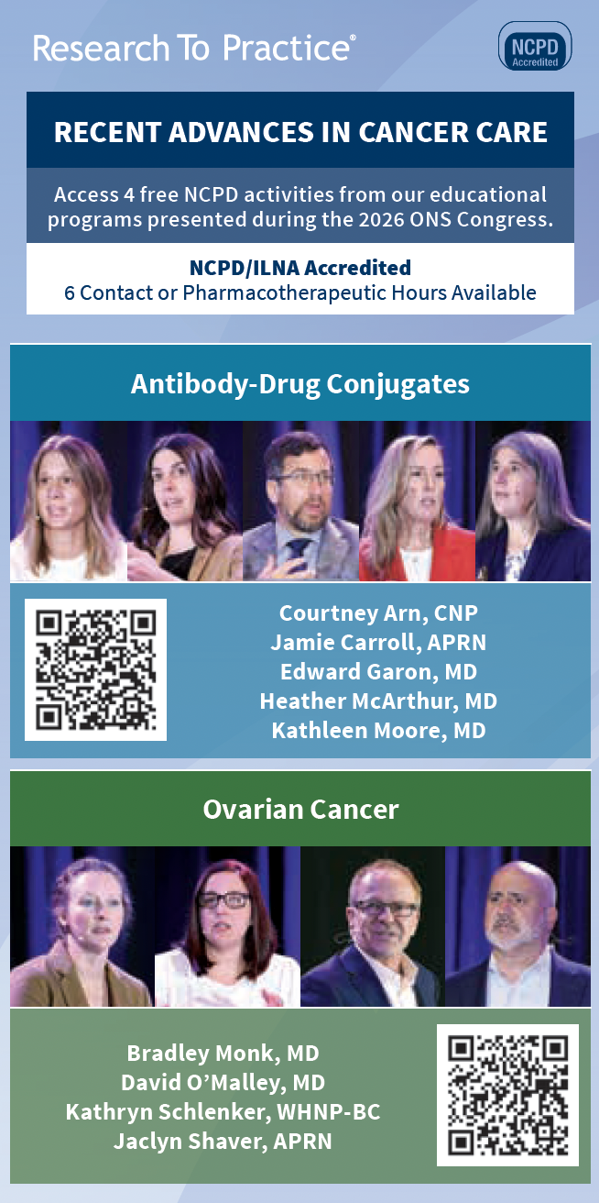


Slide 13
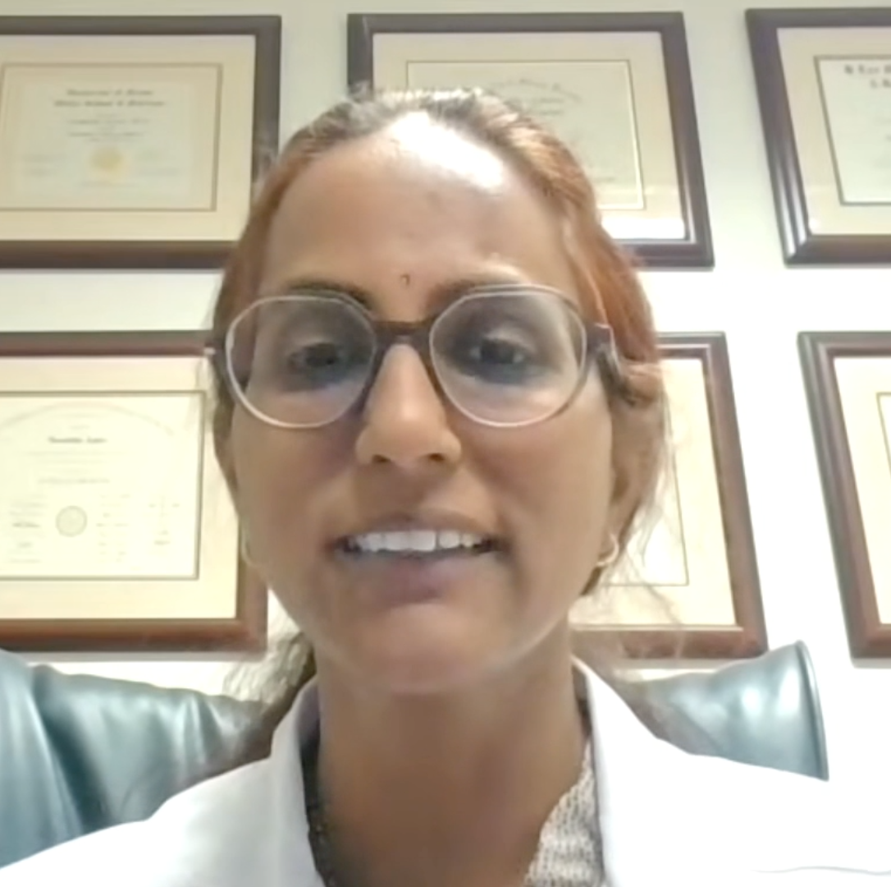
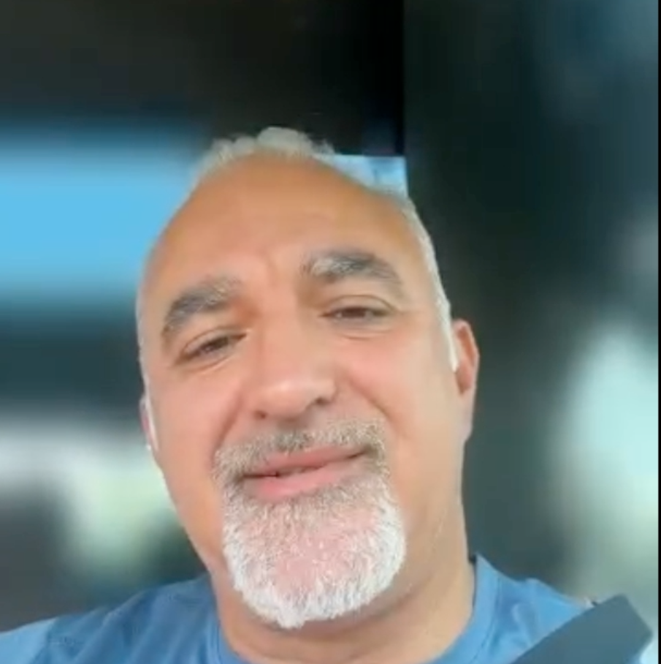
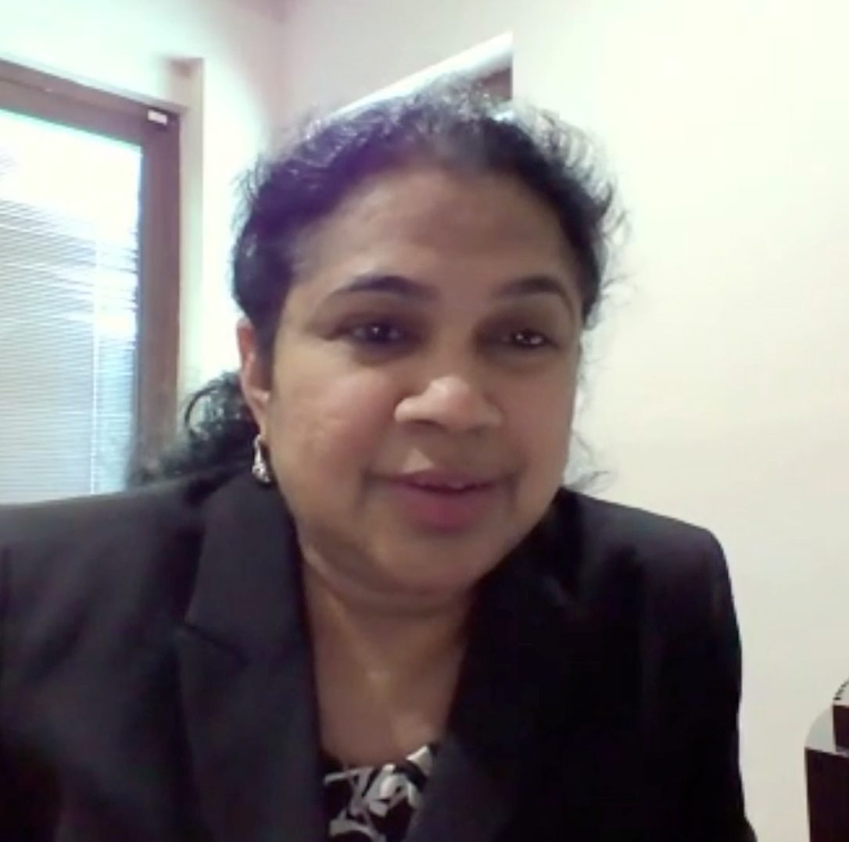





Consulting General Medical Oncologists
Susmitha Apuri, MD
Florida Cancer Specialists & Research Institute
Inverness and Lecanto, Florida
Maen Hussein, MD
Florida Cancer Specialists & Research Institute
The Villages, Florida
Mamta Choksi, MD
Florida Cancer Specialists & Research Institute
Trinity, Florida
Renjitha Ignatius, MD
Florida Cancer Specialists & Research Institute
Sun City Center, Florida
Sunil Gandhi, MD
Florida Cancer Specialists & Research Institute
Lecanto, Florida
Shachar Peles, MD
Florida Cancer Specialists & Research Institute
Lake Worth, Florida
Shaachi Gupta, MD, MPH
Florida Cancer Specialists & Research Institute
West Palm Beach, Florida
Syed F Zafar, MD
Florida Cancer Specialists & Research Institute
Fort Myers, Florida

Slide 14
Dr Peles
“I walk into one room ... it’s a man with prostate cancer. The next patient has myeloma, and the next patient has lung cancer, and then maybe I'm seeing a patient with ITP.
Oncology is just exploding — accelerating as we go along. It’s a challenge to keep up with all the details and really helpful for us to have input from docs who focus on one area and can really tease out the nuances. Figuring out how to do that efficiently and obtain that input is critical for patient care.”

Slide 15
Select ESMO 2026 Abstracts
Presidential
Abstract LBA1
INTerpath-001: Phase 3 study of the mRNA-based individualized neoantigen therapy (INT) intismeran autogene (intismeran) plus pembrolizumab (pembro) vs pembro alone for adjuvant treatment of resected stage IIB-IV melanoma (MEL)
Georgina V Long
Abstract LBA2
Perioperative durvalumab with or without tremelimumab plus neoadjuvant enfortumab vedotin in muscle-invasive bladder cancer: Results from the phase 3 VOLGA trial
Thomas B Powles
Abstract LBA3
Tarlatamab plus durvalumab (durva) vs durva as 1L maintenance (1LM) therapy following durva, platinum, and etoposide (1L durva + EP) in extensive-stage small cell lung cancer (ES-SCLC): Primary analysis of the phase 3 DeLLphi-305 trial
Jacob Sands

Slide 16
Select ESMO 2026 Abstracts
Presidential
Abstract LBA4
Darolutamide with androgen deprivation therapy (ADT) and definitive or salvage locoregional radiation therapy (RT) for localised, very high-risk prostate cancer: Interim analysis of an international, placebo-controlled, randomised phase 3 trial (DASL-HiCaP; ANZUP1801)
Tamim Niazi
Abstract LBA5
Krascendo 1: Efficacy and safety of divarasib (diva) vs sotorasib (soto) or adagrasib (ada) in previously treated locally advanced or metastatic KRAS G12C-mutated NSCLC
Ferdinandos Skoulidis
Abstract LBA7
CLARITY-Gastric 01 (CG-01): A phase 3 study of sonesitatug vedotin (Sone-Ve) in second or later-line (2L+) advanced or metastatic claudin 18.2 (CLDN18.2) positive gastroesophageal carcinoma (GEC)
Rui-Hua Xu

Slide 17
Select ESMO 2026 Abstracts
Presidential
Abstract LBA8
Ivonescimab plus chemotherapy versus durvalumab plus chemotherapy as first-line treatment for advanced biliary tract cancer: A randomized, controlled, double-blinded, phase 3 trial (HARMONi-GI1)
Jian Zhou (Shanghai, China)
Abstract LBA11
Sacituzumab tirumotecan in previously treated advanced or recurrent endometrial
cancer: Results from the phase 3 TroFuse-005/ENGOT-en23/GOG-3095 study
Domenica Lorusso
Abstract LBA12
KEYNOTE-C93/GOG-3064/ENGOT-en15: Phase 3, randomized, open-label study of
first-line (1L) pembrolizumab (pembro) vs carboplatin (C) + paclitaxel (P) in mismatch repair-deficient (dMMR) advanced or recurrent endometrial carcinoma (a/rEC)
Brian M Slomovitz

Slide 18
Agenda
Module 1 — Breast Cancer: Drs Geyer, Lustberg, Nanda and Wander
Module 2 — Prostate Cancer: Drs Agarwal and Antonarakis
Module 3 — Multiple Myeloma: Drs Lonial and Richardson

Slide 19
Agenda
Module 1 — Breast Cancer: Drs Geyer, Lustberg, Nanda and Wander
Module 2 — Prostate Cancer: Drs Agarwal and Antonarakis
Module 3 — Multiple Myeloma: Drs Lonial and Richardson

Slide 20




Breast Cancer
Charles E Geyer Jr, MD
Professor of Medicine
University of Pittsburgh School of Medicine
Division Chief, Malignant Hematology and Medical Oncology
UPMC Hillman Cancer Center
Chief Scientific Officer, NSABP Foundation
Associate Group Chair, NRG Oncology
Pittsburgh, Pennsylvania
Rita Nanda, MD
Director, Breast Oncology
Associate Professor of Medicine
Section of Hematology/Oncology
The University of Chicago
Chicago, Illinois
Maryam Lustberg, MD, MPH
Professor of Internal Medicine (Medical Oncology)
Director, Center for Breast Cancer
Chief, Breast Medical Oncology
Yale School of Medicine
New Haven, Connecticut
Seth Wander, MD, PhD
Director of Precision Medicine
Termeer Center for Targeted Therapies
Director of Translational Research
Breast Oncology Program
Massachusetts General Hospital
Assistant Professor of Medicine
Harvard Medical School
Boston, Massachusetts

Slide 21
Agenda
Introduction: ESMO 2026; Recent FDA Approvals
ER-Positive Breast Cancer
HER2-Positive Breast Cancer
Triple-Negative Breast Cancer

Slide 22
Agenda
Introduction: ESMO 2026; Recent FDA Approvals
ER-Positive Breast Cancer
HER2-Positive Breast Cancer
Triple-Negative Breast Cancer

Slide 23
Select ESMO 2026 Abstracts
Breast Cancer
Abstract LBA17
HER2-PET imaging to predict trastuzumab deruxtecan (T-DXd) efficacy in advanced breast cancer: The phase II PREDICT-HER trial.
Juan Jin et al.
Abstract LBA23
Final results of TALENT: A neoadjuvant trial of T-DXd with or without anastrozole, or in sequence with chemotherapy for HER2-low, HR+ early-stage breast cancer.
Sara Hurvitz et al.
Abstract LBA25
Adjuvant ribociclib (RIB) + nonsteroidal aromatase inhibitor (NSAI) in patients (pts) with HR+/HER2- early breast cancer (EBC): NATALEE 6-y overall survival (OS) and efficacy outcomes.
Dennis Slamon et al.
Abstract LBA28
Compression therapy using normal-sized surgical gloves for prevention of paclitaxel-induced peripheral neuropathy in breast cancer: Results from the multicenter randomized AIUR trial.
Young-Joon Kang et al.

Slide 24
Select ESMO 2026 Abstracts
Breast Cancer
Abstract LBA49
A DESTINY-Breast09 (DB-)09 analysis of trastuzumab deruxtecan (T-DXd) + pertuzumab (P) vs taxane + trastuzumab + pertuzumab (THP) for patients (pts) with HER2+ advanced/metastatic breast cancer (a/mBC) and baseline (BL) brain metastases (BM).
Cristina Saura Manich et al.
Abstract LBA51
Results from KEYNOTE-B49: A phase 3, randomized, double-blind study of pembrolizumab (Pembro)
vs placebo (Pbo) plus chemotherapy (CT) in participants (pts) with HR+/HER2- advanced breast
cancer (ABC).
Hope Rugo et al.
Abstract LBA96
First-line (1L) datopotamab deruxtecan (Dato-DXd) vs chemotherapy in patients (pts) with locally recurrent inoperable or metastatic triple-negative breast cancer (mTNBC) for whom immunotherapy was not an option: Exploratory analysis of pts with brain metastases in TROPION-Breast02.
Rebecca Dent et al.
Abstract 1RO
Overall survival from the Phase 3 postMONARCH trial of abemaciclib + fulvestrant vs placebo + fulvestrant for HR+, HER2- advanced breast cancer following progression on a prior CDK4/6 inhibitor + endocrine therapy.
Kevin Kalinsky et al.

Slide 25
Select ESMO 2026 Abstracts
Breast Cancer
Abstract 4RO
Target switching with conserved-payload novel ADCs in patients with metastatic breast cancer following prior ADC therapy (SWITCH): A prospective, open-label, phase 2 platform trial.
Xiyu Liu et al.
Abstract 540RO
Ultrasensitive monitoring of early ctDNA dynamics during neoadjuvant treatment in early-stage triple-negative breast cancer: Pre-interim results from the B-STRONGER-I study.
Carlos Barcenas et al.

Slide 26
Recent FDA Approvals
FDA APPROVAL
October 7, 2026
Tucatinib with trastuzumab and pertuzumab for the maintenance treatment of HER2-positive breast cancer
FDA APPROVAL
September 18, 2026
Imlunestrant in combination with abemaciclib for ER-positive, HER2-negative, ESR1-mutated advanced or metastatic breast cancer
FDA APPROVAL
September 4,
2026
Accelerated approval for camizestrant with a CDK4/6 inhibitor for
ESR1-mutated HR-positive, HER2-negative locally advanced or metastatic breast cancer
FDA APPROVAL
July 14, 2026
Gedatolisib with fulvestrant, with or without palbociclib, for HR-positive, HER2-negative locally advanced or metastatic breast cancer

Slide 27
Recent FDA Approvals (Continued)
FDA APPROVAL
June 24, 2026
Palbociclib with trastuzumab, with or without pertuzumab, and endocrine therapy for maintenance treatment of HR-positive,
HER2-positive metastatic breast cancer
FDA APPROVAL
June 24, 2026
Sacituzumab govitecan-hziy as monotherapy and in combination with pembrolizumab for first-line treatment of unresectable or metastatic triple-negative breast cancer
FDA APPROVAL
May 22, 2026
Datopotamab deruxtecan for first-line treatment of unresectable or metastatic triple-negative breast cancer
FDA APPROVAL
May 15, 2026
Fam-trastuzumab deruxtecan-nxki for 2 indications in HER2-positive early-stage breast cancer

Slide 28
Recent FDA Approvals (Continued)
FDA APPROVAL
May 1, 2026
Vepdegestrant for ER-positive, HER2-negative, ESR1-mutated advanced or metastatic breast cancer

Slide 29
Agenda
Introduction: ESMO 2026; Recent FDA Approvals
ER-Positive Breast Cancer
  CDK4/6 Inhibitors and Oral SERDs in the Adjuvant Setting – Dr Geyer
  Novel Approaches to First-Line Treatment of ER-Positive, HER2-Negative Metastatic Breast Cancer (mBC); PROTACs – Dr Lustberg
  Oral SERDs in the Metastatic Setting – Dr Wander
  Relapsed/Refractory HR-Positive mBC: PI3K/AKT/mTOR Pathway Inhibitors –
  Dr Nanda
HER2-Positive Breast Cancer
Triple-Negative Breast Cancer

Slide 30
CKD4/6 Inhibitors and Oral SERDs in the Adjuvant Setting
Dr Geyer
Select Datasets
Johnston S et al. Overall survival with abemaciclib in early breast cancer. Ann Oncol 2026;37(2):155-65.
Mayer EL et al. TRADE: A phase II trial to assess the tolerability of abemaciclib dose escalation in early-stage HR-positive/HER2-negative breast cancer. Ann Oncol 2026;37(1):117-24.
Crown J et al. Adjuvant ribociclib plus nonsteroidal aromatase inhibitor therapy in patients with HR-positive/HER2-negative early breast cancer: 5-year follow-up of NATALEE efficacy outcomes and updated overall survival. ESMO Open 2025;10(11):105858.
Bardia A et al. Giredestrant vs standard-of-care endocrine therapy as adjuvant treatment for patients with estrogen receptor-positive, HER2-negative early breast cancer: Results from the global Phase III lidERA Breast Cancer trial. San Antonio Breast Cancer Symposium 2025;Abstract GS1-10.
Schmid P et al. Efficacy and safety of giredestrant in patients with estrogen receptor-positive, HER2-negative early breast cancer in the phase III lidERA BC clinical trial: Results by menopausal status. ASCO 2026;Abstract 502.

Slide 31
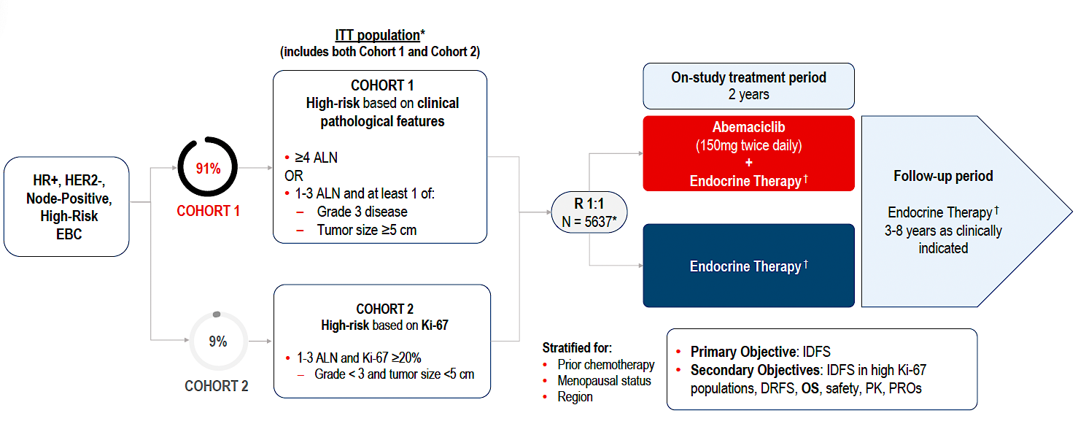
monarchE Study Design
EBC = early breast cancer; ALN = axillary lymph nodes
Johnston S et al. ESMO 2025;Abstract LBA13. Johnston S et al. Ann Oncol 2026;37(2):155-65.

Slide 32
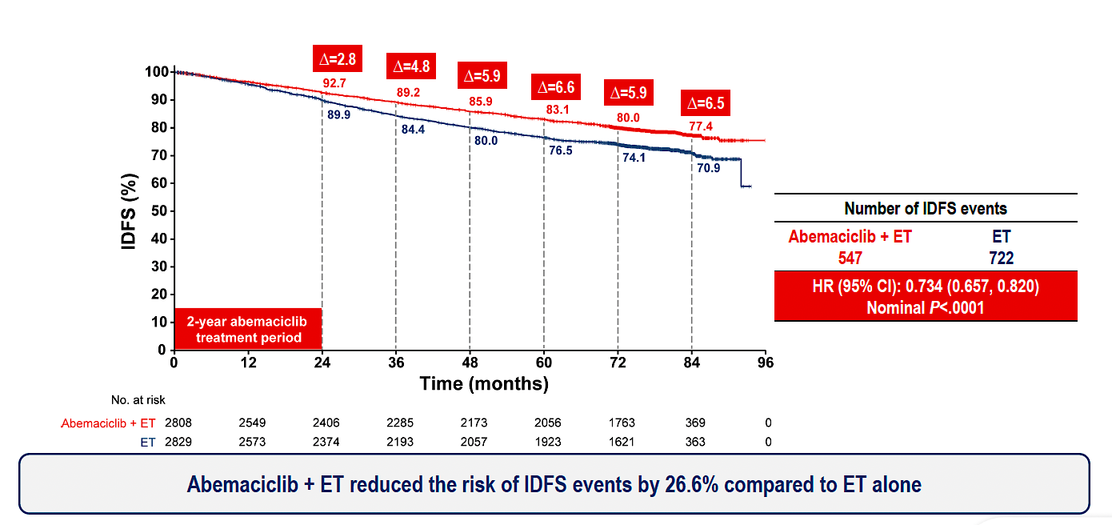
monarchE: Invasive Disease-Free Survival (IDFS) Outcomes
ET = endocrine therapy
Johnston S et al. ESMO 2025;Abstract LBA13. Johnston S et al. Ann Oncol 2026;37(2):155-65.

Slide 33
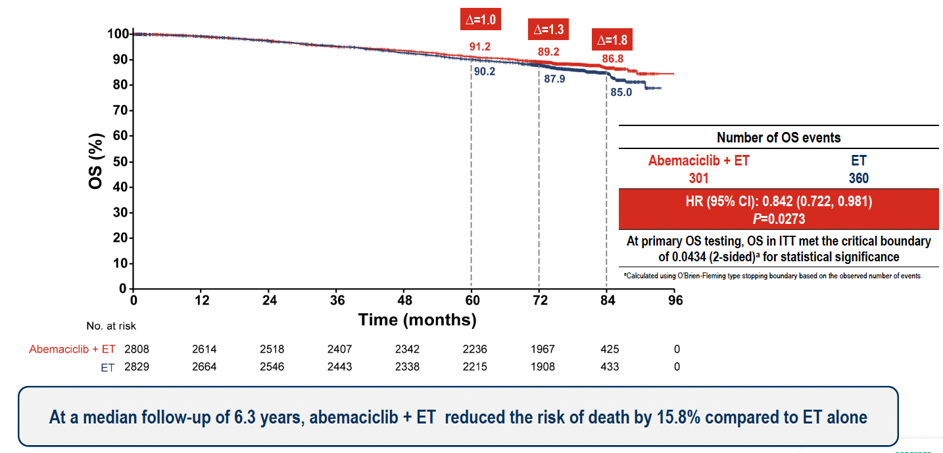
monarchE: Overall Survival (OS) Outcomes
Johnston S et al. ESMO 2025;Abstract LBA13. Johnston S et al. Ann Oncol 2026;37(2):155-65.

Slide 34
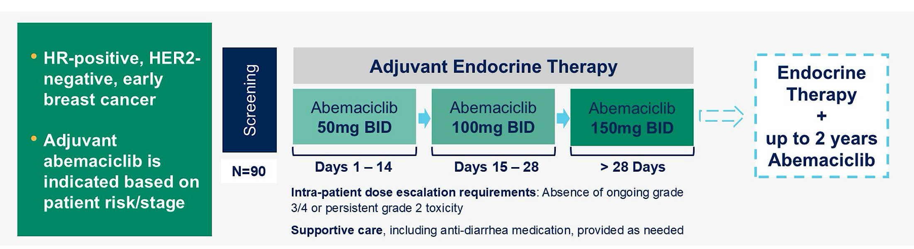
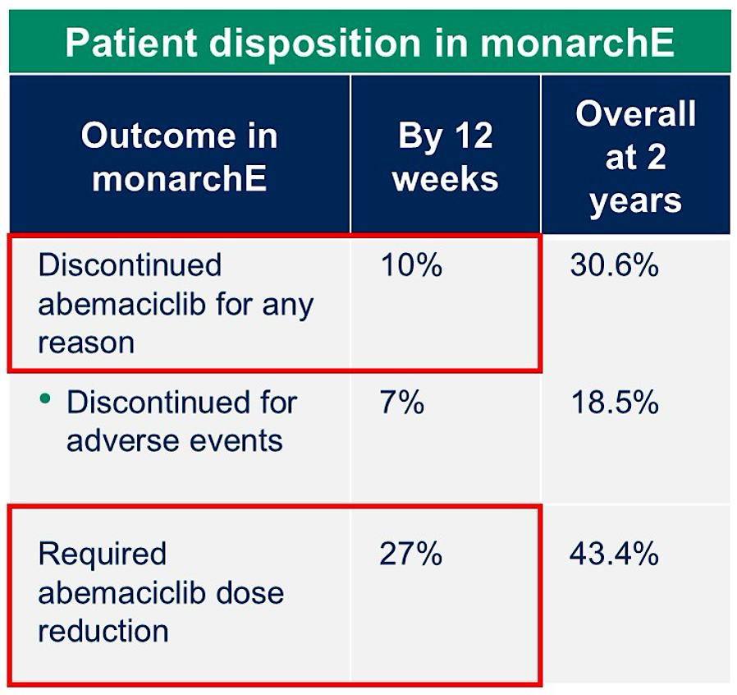
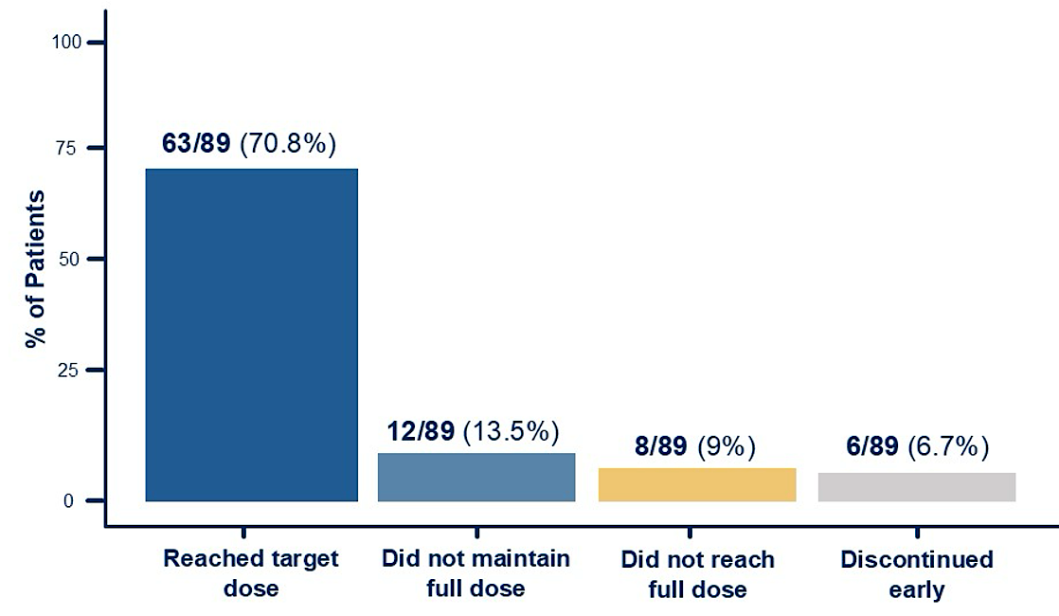
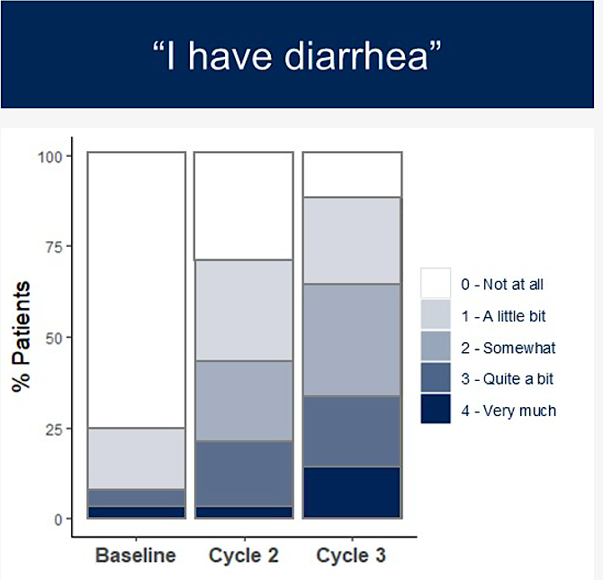
TRADE Trial: Abemaciclib Dose Escalation
Primary endpoint: composite AE rate (discontinuation of adjuvant abemaciclib for any reason and/or need to dose reduce by 12 weeks of therapy)
Content courtesy of Komal Jhaveri, MD, FACP, FASCO
Mayer EL et al. Ann Oncol 2025.

Slide 35
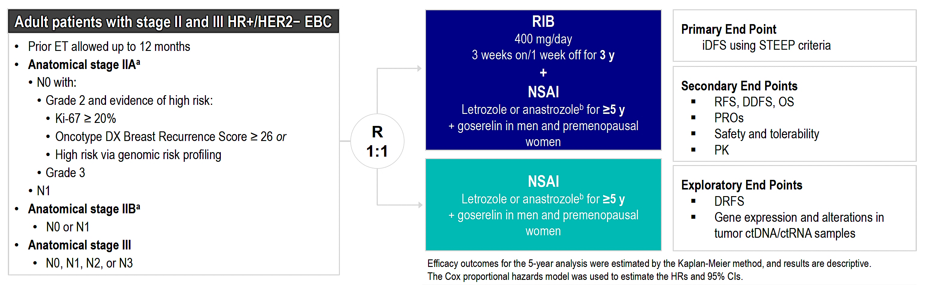
NATALEE Study Design
RIB = ribociclib; NSAI = nonsteroidal aromatase inhibitor
Crown JP et al. ESMO 2025;Abstract LBA14. Crown JP et al. ESMO Open 2025;10(11):105858.

Slide 36
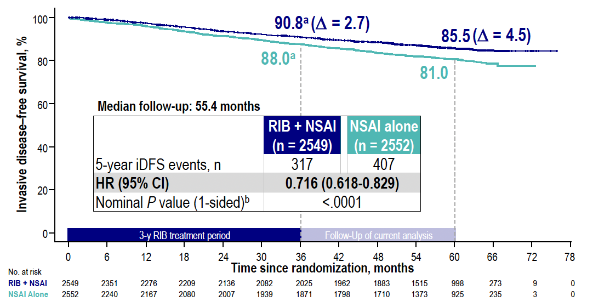
NATALEE: IDFS Outcomes
RIB = ribociclib; NSAI = nonsteroidal aromatase inhibitor
Crown JP et al. ESMO 2025;Abstract LBA14. Crown JP et al. ESMO Open 2025;10(11):105858.

Slide 37
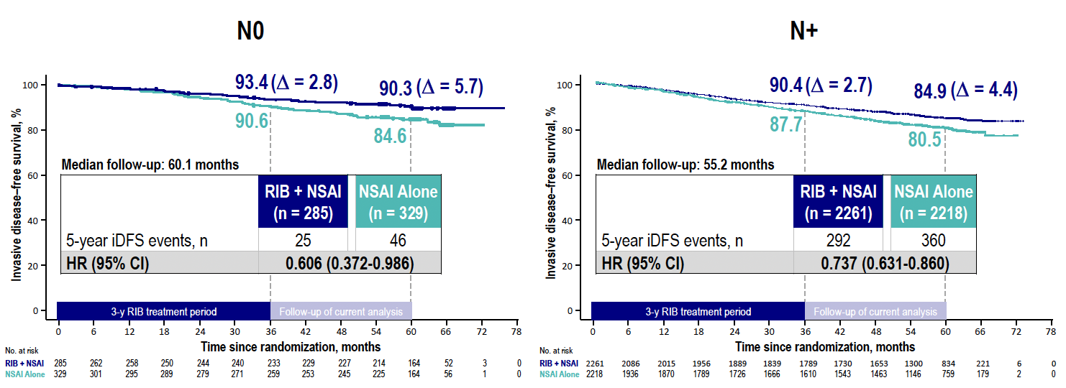
NATALEE: IDFS by Nodal Status
Crown JP et al. ESMO 2025;Abstract LBA14. Crown JP et al. ESMO Open 2025;10(11):105858.

Slide 38
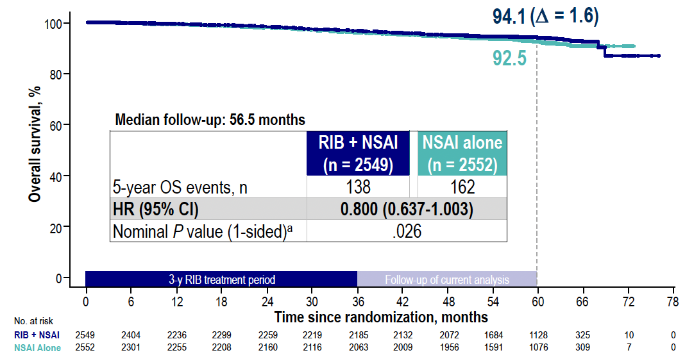
NATALEE: OS Outcomes
Crown JP et al. ESMO 2025;Abstract LBA14. Crown JP et al. ESMO Open 2025;10(11):105858.

Slide 39
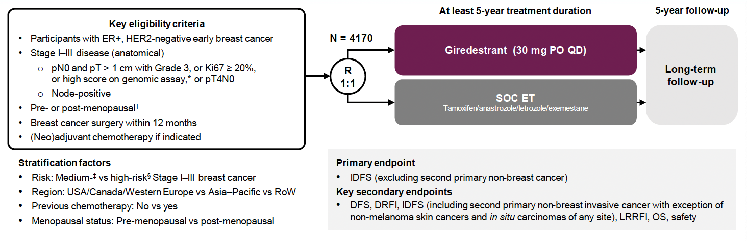
lidERA Breast Cancer Study Design
SOC = standard of care; ET = endocrine therapy; DRFI = distant recurrence-free interval; LRRFI = locoregional recurrence-free interval
Bardia A et al. San Antonio Breast Cancer Symposium 2025;Abstract GS1-10.

Slide 40
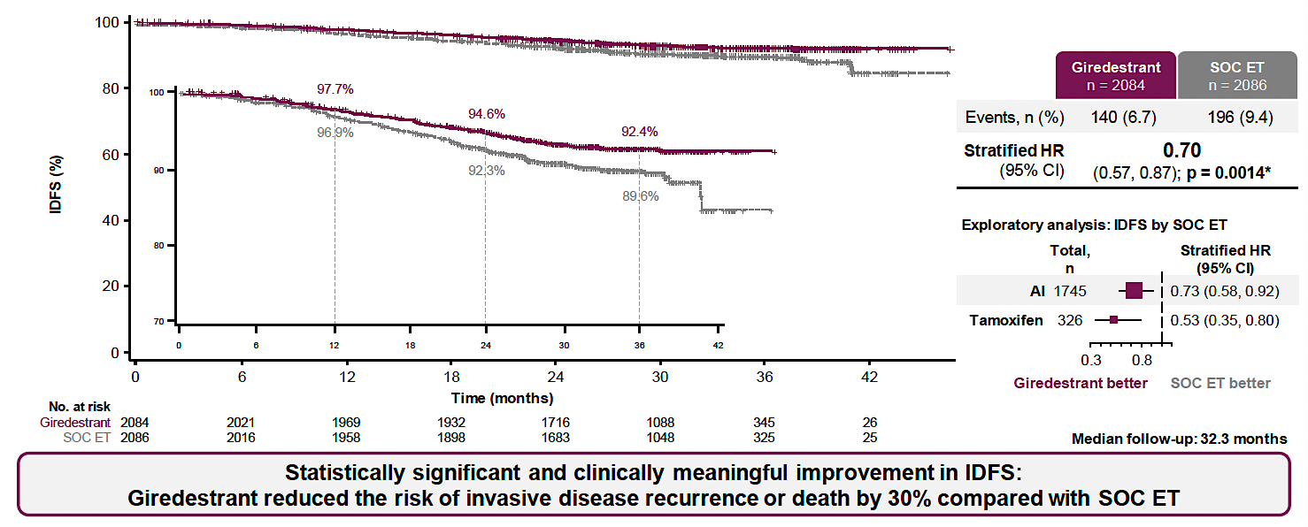
lidERA Breast Cancer: IDFS Outcomes
Bardia A et al. San Antonio Breast Cancer Symposium 2025;Abstract GS1-10.

Slide 41
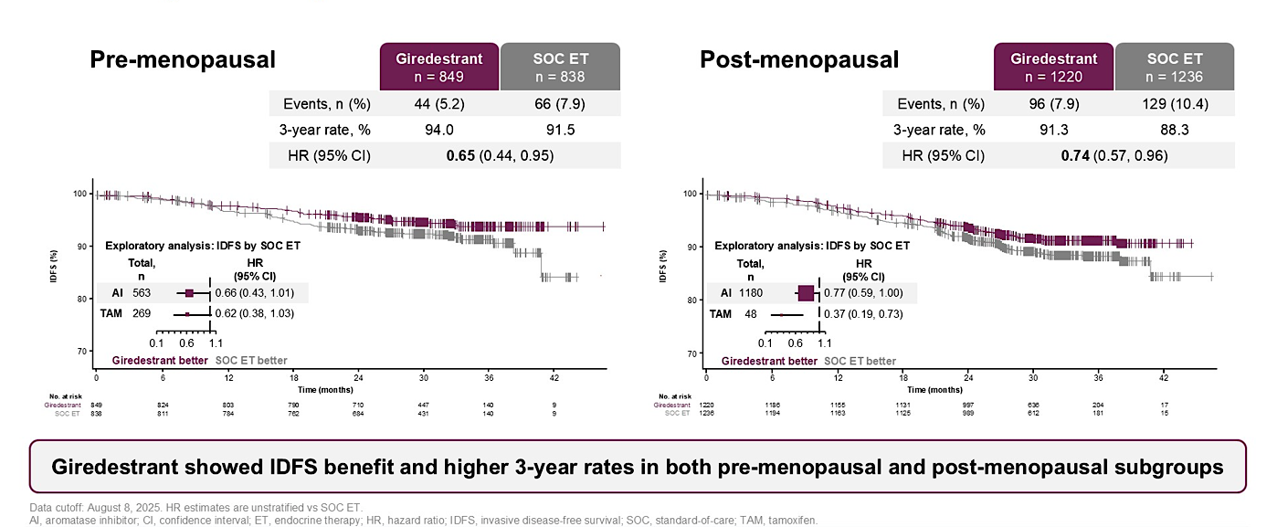
lidERA Breast Cancer: IDFS by Menopausal Status
Schmid P et al. ASCO 2026;Abstract 502.

Slide 42
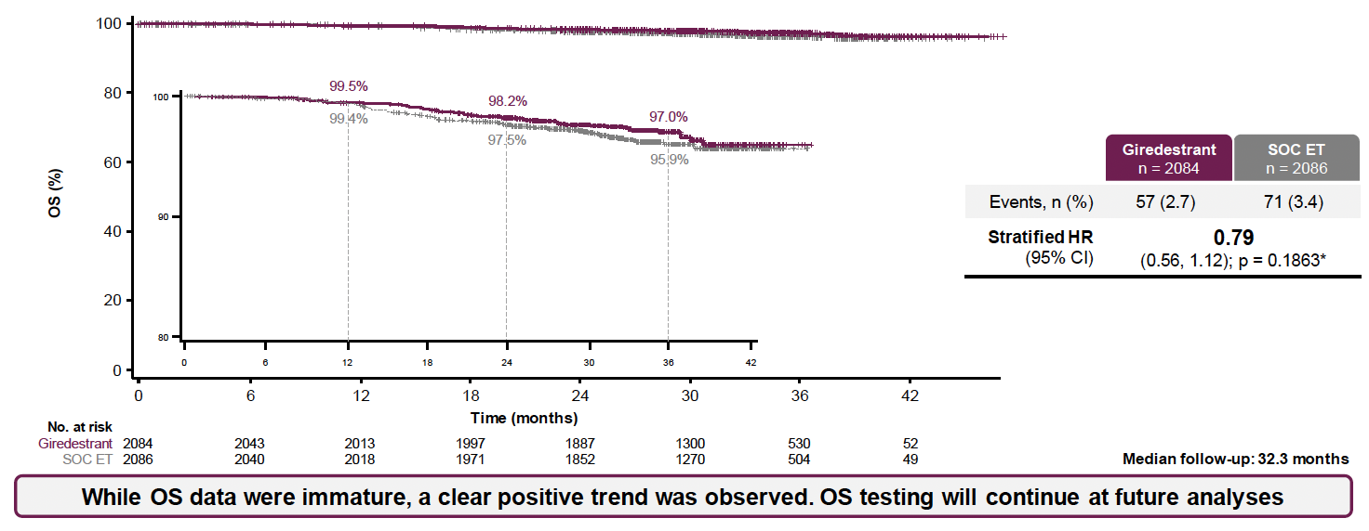
lidERA Breast Cancer: OS Outcomes
Bardia A et al. San Antonio Breast Cancer Symposium 2025;Abstract GS1-10.

Slide 43

Select Ongoing Phase III Trials of Oral SERDs for
HR-Positive, HER2-Negative Localized Breast Cancer
Bardia A et al. ELEGANT: Elacestrant versus standard endocrine therapy (ET) in women and men with node-positive, estrogen receptor-positive (ER+), HER2-negative (HER2-), early breast cancer (eBC) with high risk of recurrence in a global, multicenter, randomized, open-label phase 3 study. ASCO 2025;Abstract TPS619.
Dynamic marker-adjusted therapy comparing adjuvant elacestrant with standard endocrine treatment in genomically and/or clinically high-risk ER+/HER2- early breast cancer (ADAPTela). NCT072423352
Ignatiadis M et al. EORTC-2129-BCG: Elacestrant for treating ER+/HER2- breast cancer patients with ctDNA relapse (TREAT ctDNA). ASCO 2025;Abstract TPS620.
Jhaveri K et al. EMBER-4: A phase 3 adjuvant trial of imlunestrant vs standard endocrine therapy (ET) in patients with ER+, HER2- early breast cancer (EBC) with an increased risk of recurrence who have previously received 2 to 5 years of adjuvant ET. SABCS 2022;Abstract OT1-01-02.
Hamilton EP et al. CAMBRIA-1 & CAMBRIA-2 phase III trials: Camizestrant versus standard endocrine therapy in ER+/HER2- early breast cancer. Future Oncol 2025;21(7):795-806.
A phase IIIb, single-arm, open-label study evaluating adherence, tolerability, and patient reported outcomes (PRO) of giredestrant in patients with ER+/HER2- early breast cancer who are intolerant to adjuvant aromatase inhibitor therapy. NCT07541079

Slide 44
Faculty Discussion

Slide 45
Questions for the Faculty
In general, do you follow the criteria outlined in the FDA approvals when selecting patients to receive a CDK4/6 inhibitor in the adjuvant setting?
For patients who are eligible to receive either adjuvant abemaciclib or ribociclib, how do you select between the two agents?
Do you employ a dose-escalation strategy with abemaciclib?
If adjuvant giredestrant were to become available, for which specific patients would you recommend it, and what would be your clinical approach? Are other oral SERDs being investigated in the adjuvant setting?
Regulatory and reimbursement issues aside, for a patient who is not tolerating an adjuvant AI, would you consider switching to giredestrant?

Slide 46
Novel Approaches to First-Line Treatment of ER-Positive, HER2-Negative mBC; PROTACs
Dr Lustberg
Select Datasets
Bidard FC et al. First-line camizestrant for emergent ESR1 mutations in advanced breast cancer: Final progression-free survival 2 from the phase III SERENA-6 trial. ASCO 2026;Abstract LBA1007.
Jhaveri KL et al. Overall survival with inavolisib in PIK3CA-mutated advanced breast cancer. N Engl J Med 2025;393(2):151-61.
Campone M et al. Vepdegestrant, a PROTAC estrogen receptor degrader, in advanced breast cancer. N Engl J Med 2025;393(6):556-68.

Slide 47
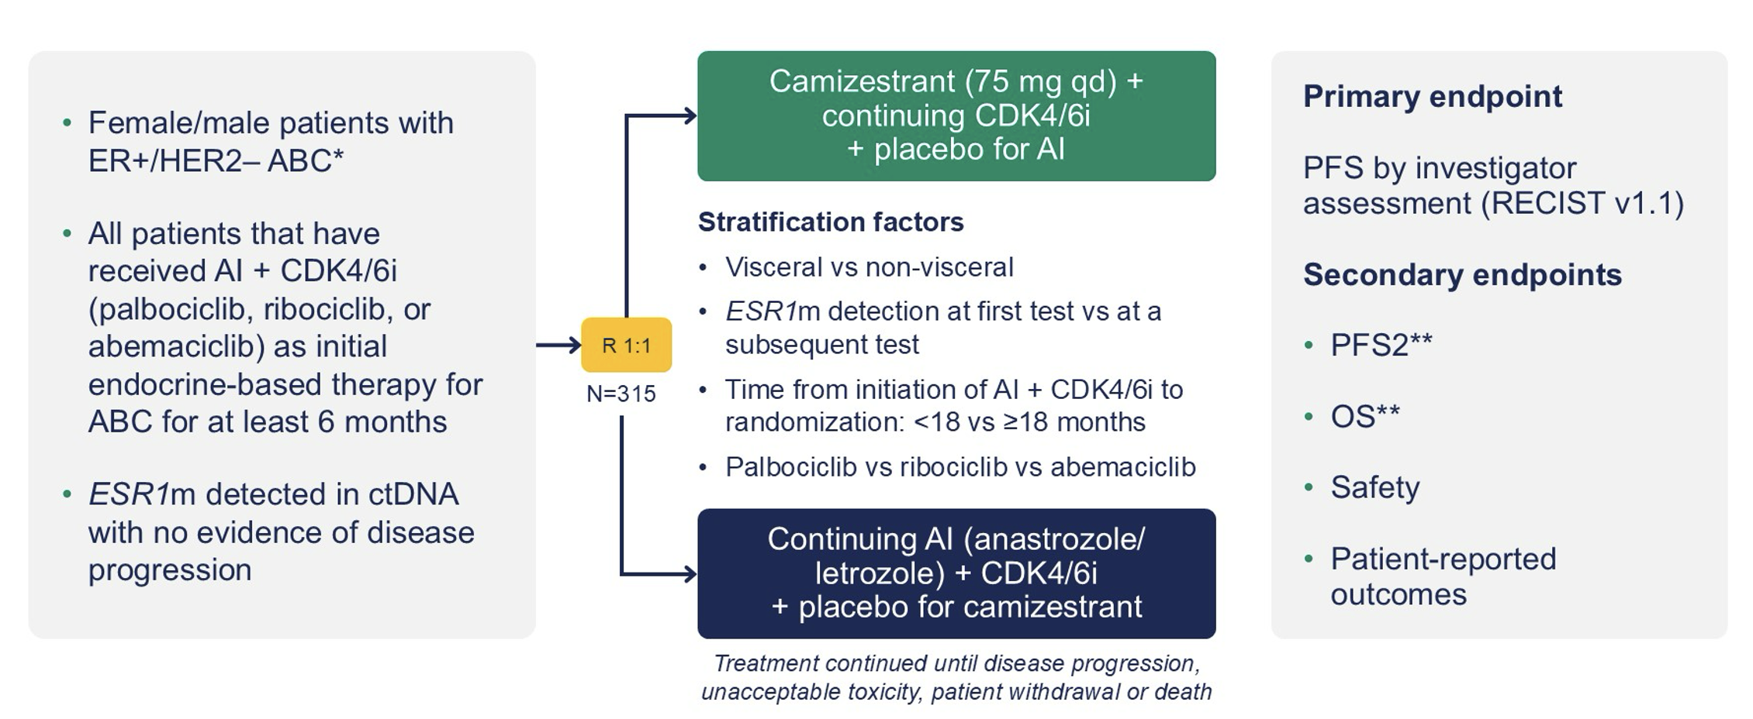
SERENA-6 Study Design
AI = aromatase inhibitor; CDK4/6i = CDK4/6 inhibitor; ctDNA = circulating tumor DNA
Turner N et al. ASCO 2025;Abstract LBA4.

Slide 48
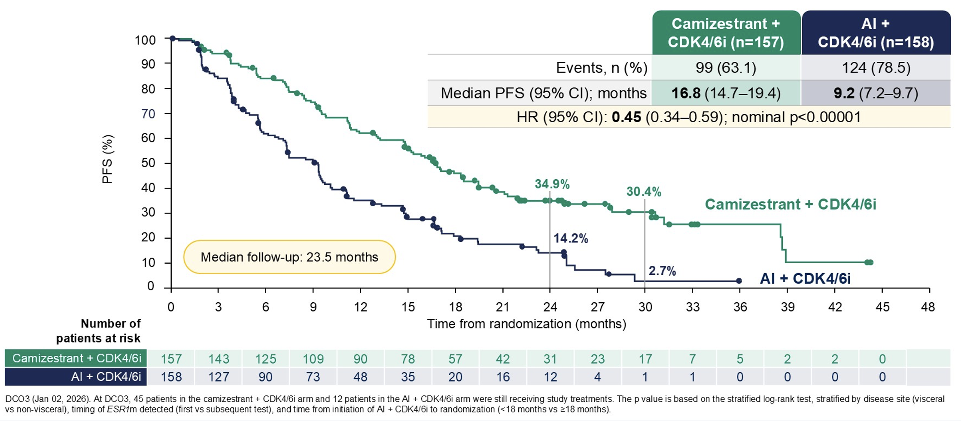
SERENA-6: Investigator-Assessed Progression-Free Survival (PFS)
DCO3 = third data cutoff date
Bidard FC et al. ASCO 2026;Abstract LBA1007.

Slide 49
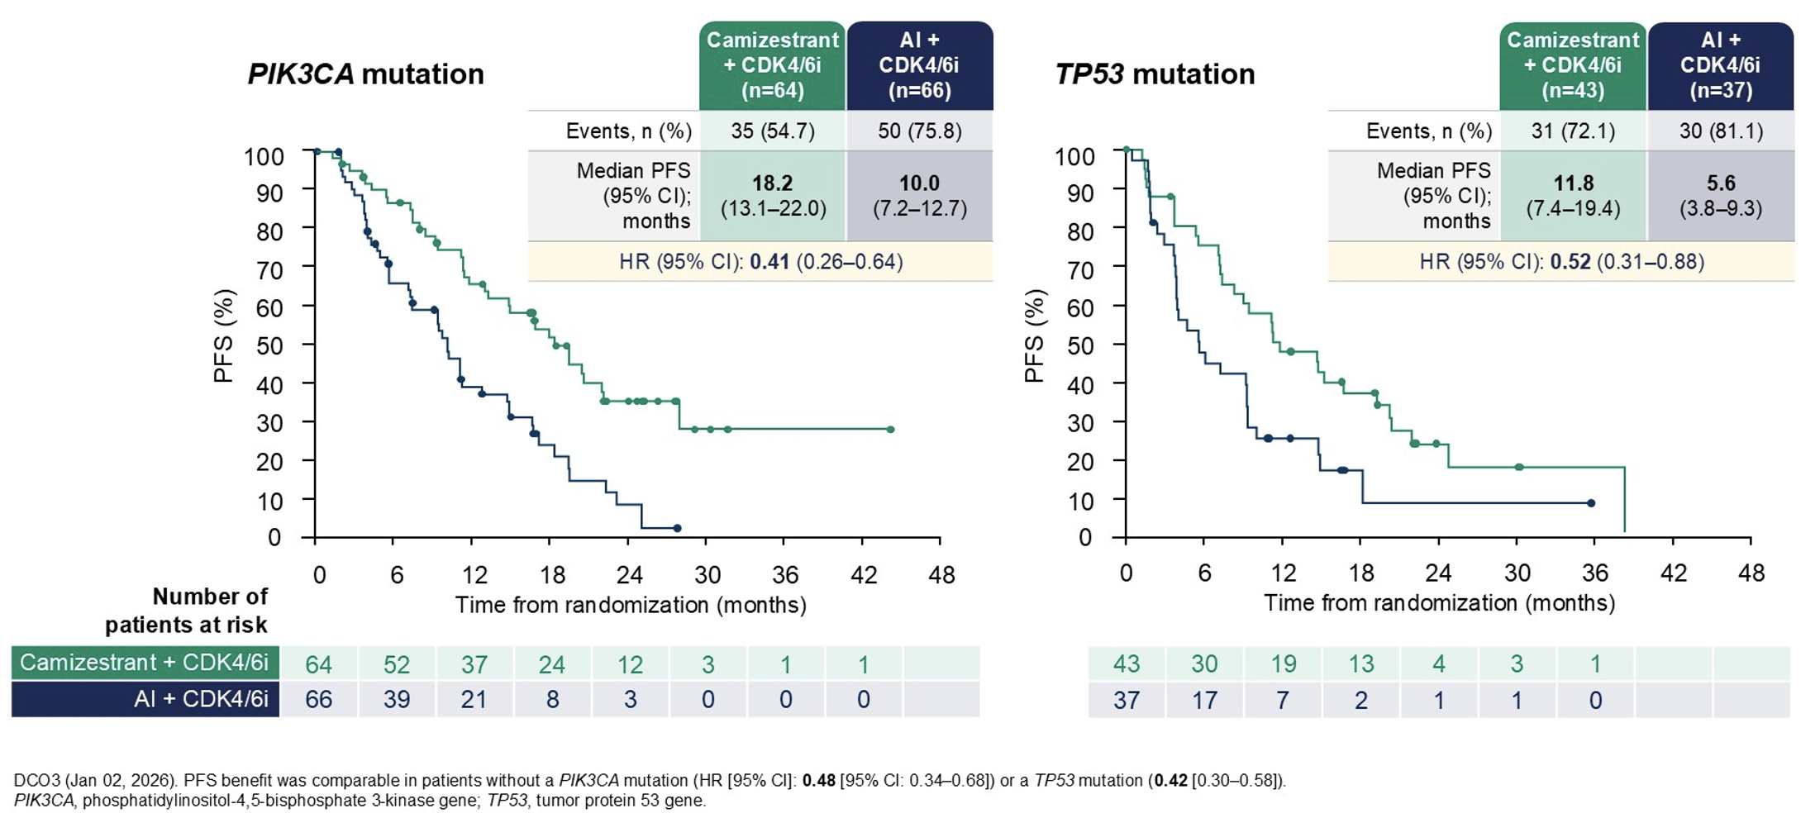
SERENA-6: PFS by Co-Mutation Status
Bidard FC et al. ASCO 2026;Abstract LBA1007.

Slide 50
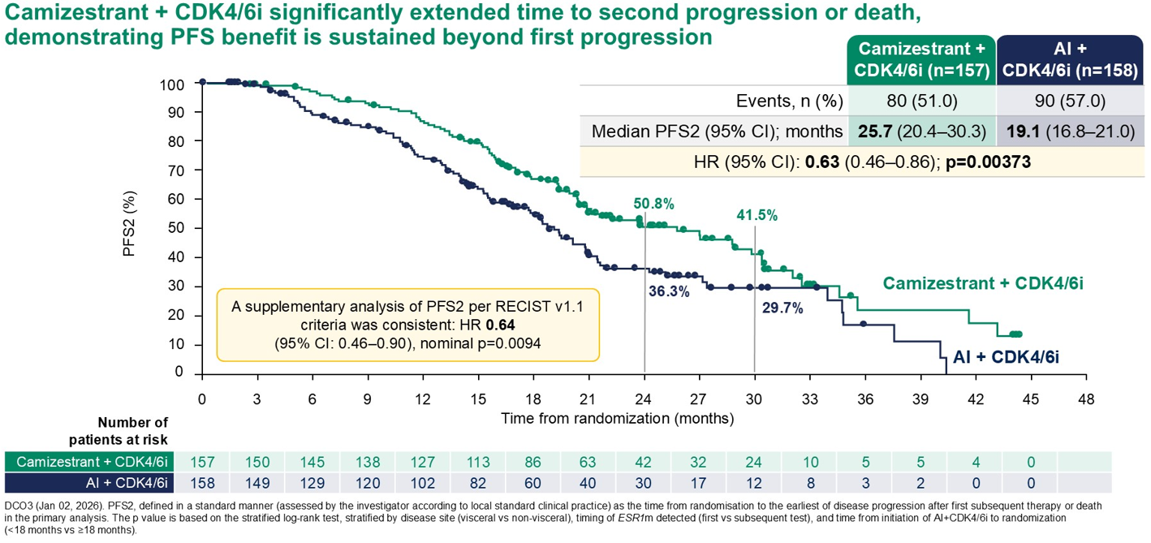
SERENA-6: Final PFS2
Bidard FC et al. ASCO 2026;Abstract LBA1007.

Slide 51
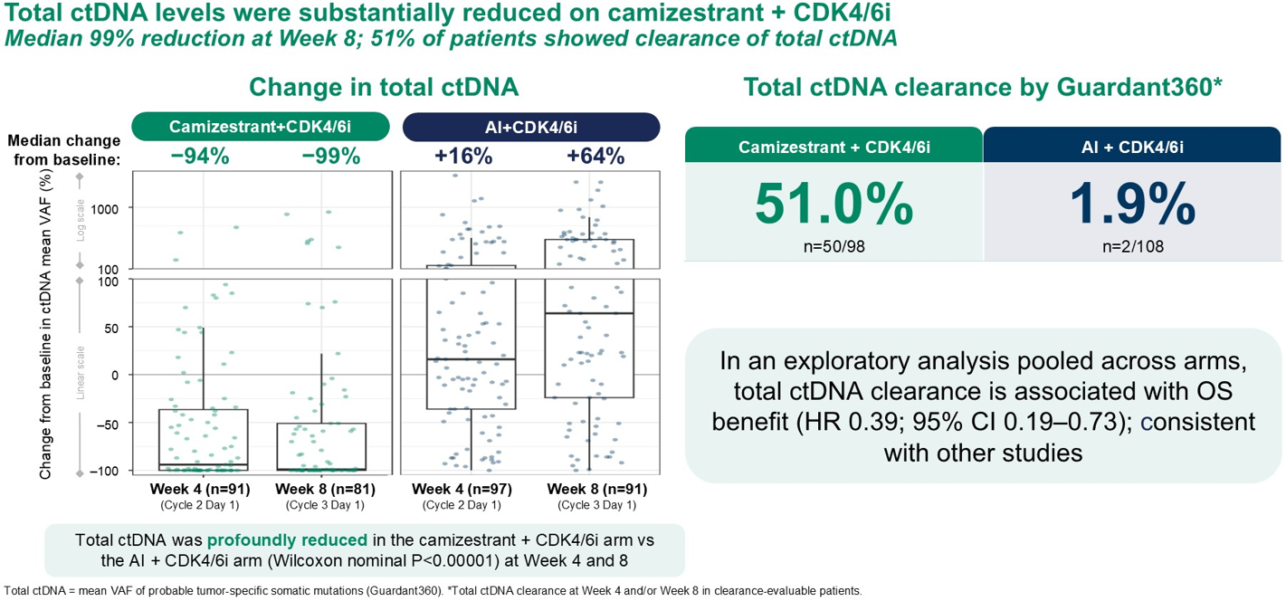
SERENA-6: Total ctDNA and OS Outcomes
VAF = variant allele frequency
Bidard FC et al. ASCO 2026;Abstract LBA1007.

Slide 52
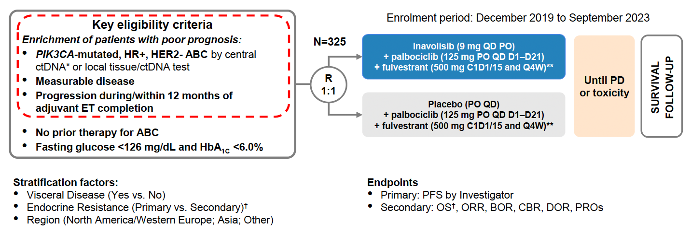
INAVO120 Study Design
Jhaveri KL et al. SABCS 2023;Abstract GS03-13.

Slide 53
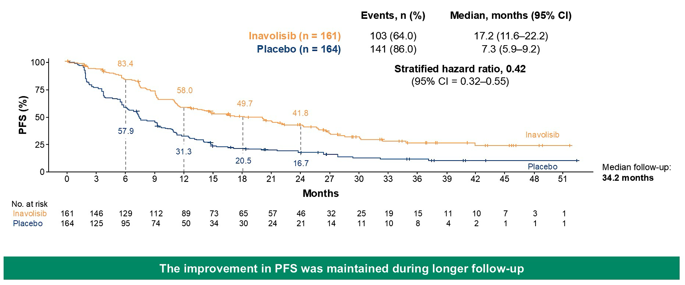
INAVO120: PFS Outcomes
Turner N et al. ASCO 2025;Abstract 1003; Jhaveri KL et al. N Engl J Med 2025;393(2):151-61.

Slide 54
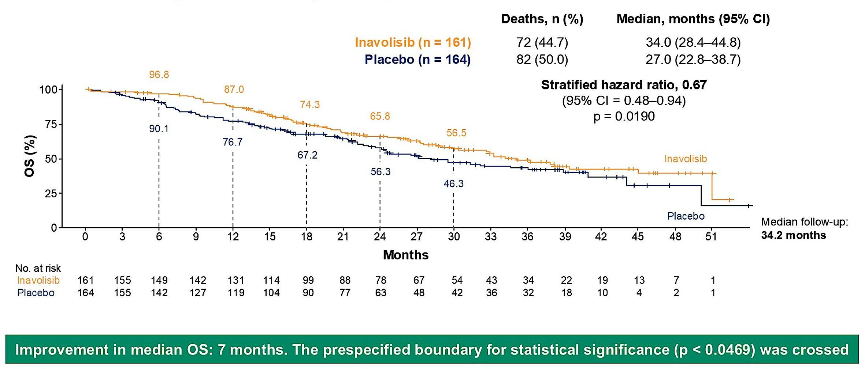
INAVO120: Final OS
Turner N et al. ASCO 2025;Abstract 1003; Jhaveri KL et al. N Engl J Med 2025;393(2):151-61

Slide 55
Select Ongoing Phase III Trials Evaluating PI3K/AKT/mTOR Pathway Inhibitors as First-Line Treatment
Cortes J et al. INAVO123: Phase III study of first-line (1L) inavolisib/placebo + a CDK4/6 inhibitor + letrozole (INAVO/PBO + CDK4/6i + LET) in participants (pts) with PIK3CA-mutated (mut), hormone receptor-positive (HR+), HER2-negative (HER2-), endocrine-sensitive advanced breast cancer (aBC): ESMO Breast 2025;Abstract 408TiP
Rugo H et al. CAPItello-292 Phase 3: An open-label, randomized study of capivasertib, fulvestrant, and investigator’s choice of CDK4/6 inhibitor (palbociclib or ribociclib) in HR+/HER2– advanced breast cancer. SABCS 2023;Abstract PO2-19-10.
Hurvitz S et al. A randomized, open-label, phase 3 study of fulvestrant and CDK4/6 inhibitors with or without gedatolisib as first-line treatment in patients with HR+/HER2- advanced breast cancer (VIKTORIA-2). AACR 2025;Abstract CT258.

Slide 56
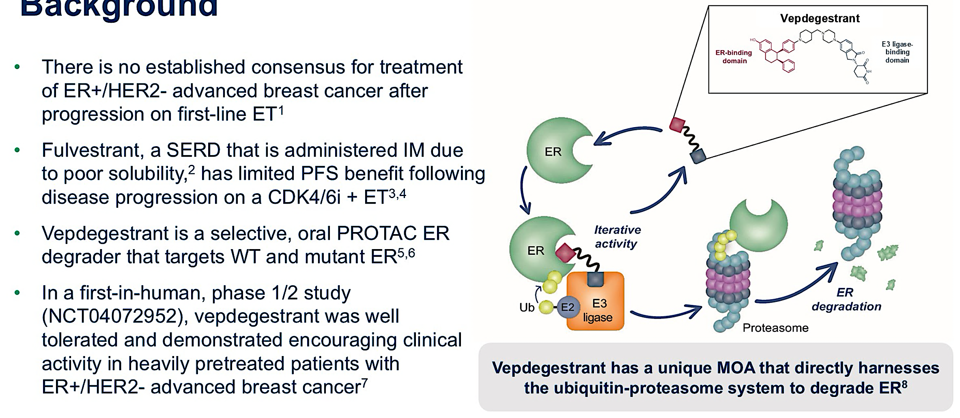
Background and Vepdegestrant Mechanism of Action (MOA)
IM = intramuscularly; WT = wild type
Hamilton E et al. ASCO 2025;Abstract LBA1000. Campone M et al. N Engl J Med 2025;393:556-68.

Slide 57
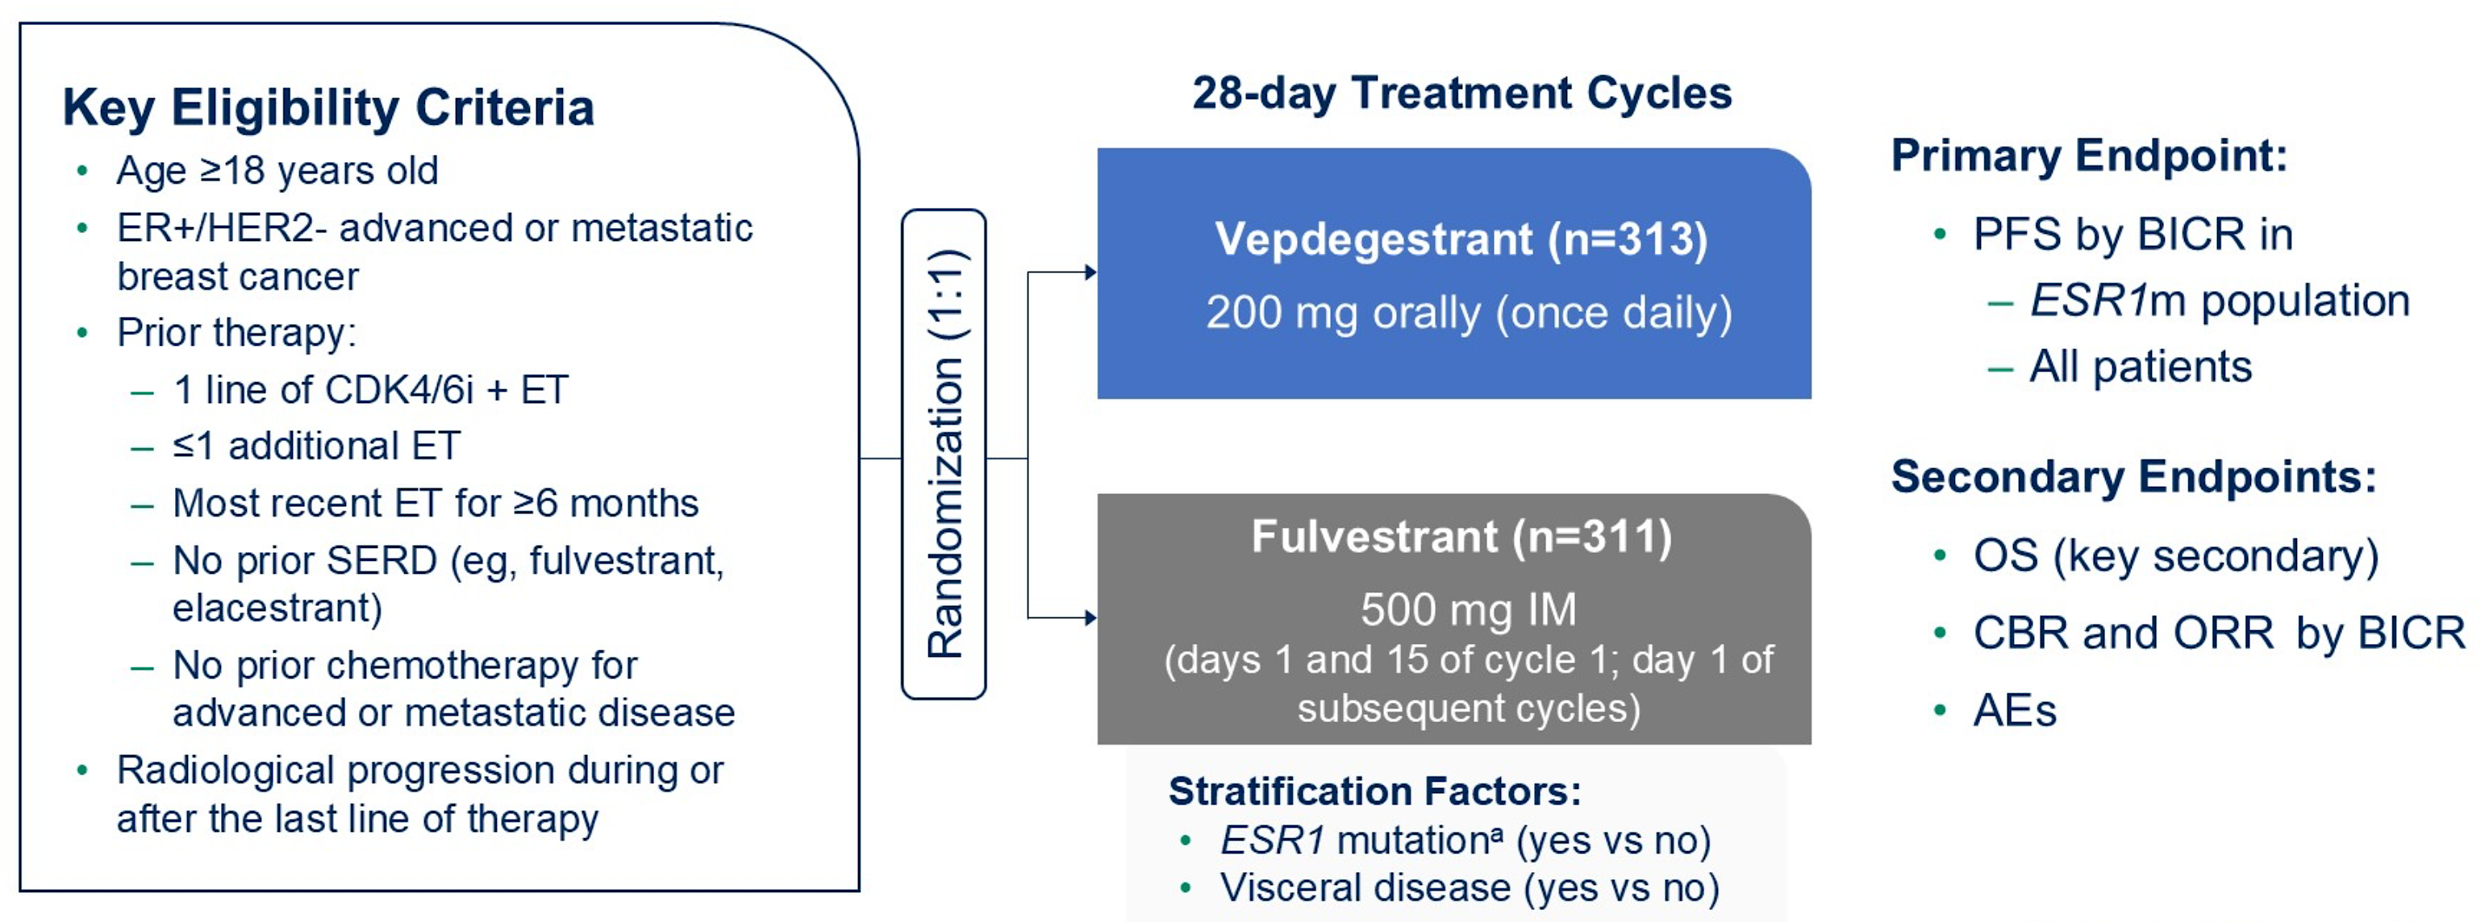
VERITAC-2 Study Design
Hamilton E et al. ASCO 2025;Abstract LBA1000. Campone M et al. N Engl J Med 2025;393:556-68.

Slide 58
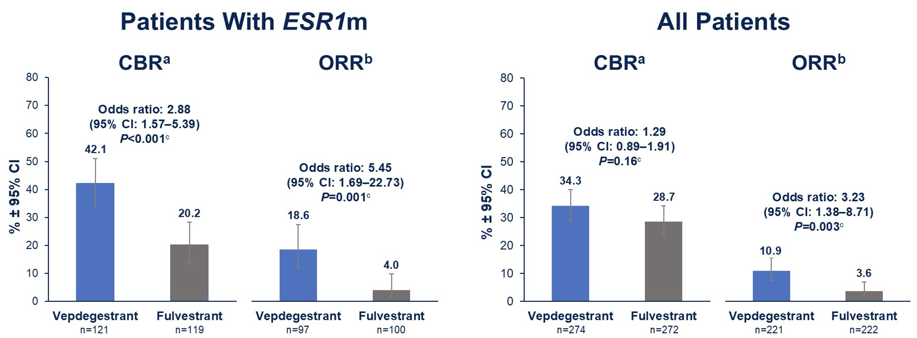
VERITAC-2: Clinical Benefit Rate (CBR) and Objective Response Rate (ORR)
Hamilton E et al. ASCO 2025;Abstract LBA1000.

Slide 59
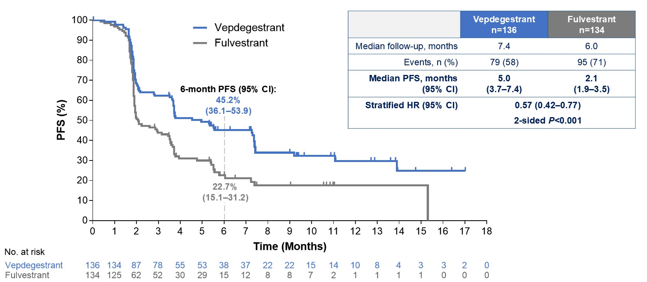
VERITAC-2: PFS by BICR in the ESR1 Mutation Population
BICR = blinded independent central review
Hamilton E et al. ASCO 2025;Abstract LBA1000. Campone M et al. N Engl J Med 2025;393:556-68.

Slide 60
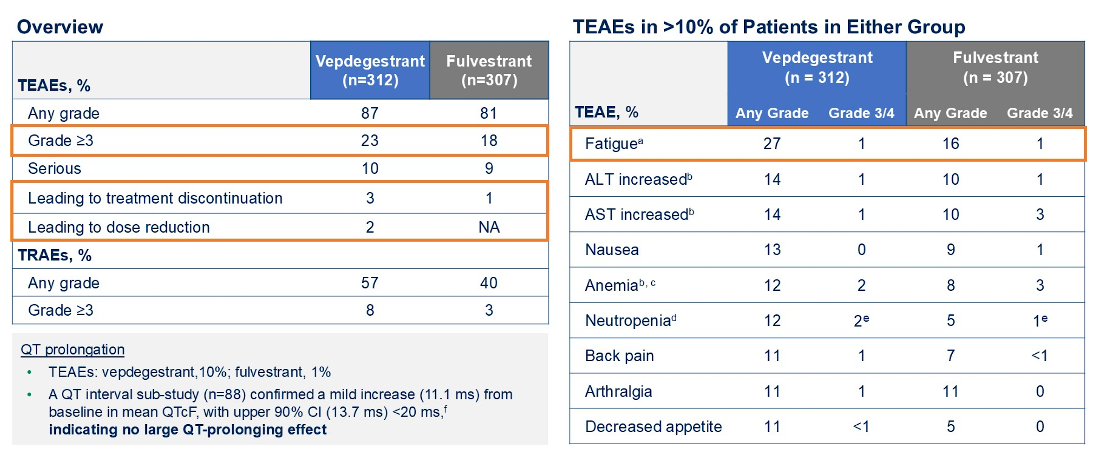
VERITAC-2: Safety Profile
TEAEs = treatment-emergent adverse events
Hamilton E et al. ASCO 2025;Abstract LBA1000. Campone M et al. N Engl J Med 2025;393:556-68.

Slide 61
Faculty Discussion

Slide 62
Questions for the Faculty
In what situations, if any, are you utilizing the SERENA-6 strategy?
How would you approach ctDNA testing for consideration of the SERENA-6 strategy? How long after starting first-line Al + CDK4/6i do you starting monitoring? How often do you test?
What is the side effect profile of camizestrant?
How do you counsel your patients who are about to receive camizestrant about potential ocular toxicity?

Slide 63
Questions for the Faculty
52-year-old woman with ER+, HER2-neg disease with recurrence during 4th year of adjuvant AI. PIK3CA mutation-positive, gPALB2 mutation.
Receiving the INAVO120 protocol of inavolisib/palbociclib/fulvestrant; she was having some mouth sores. We did prophylactically use dexamethasone oral rinse, but I dose reduced to 6 mg and that helped.
She’s already on a GLP-1 agonist for weight loss, and she has good glucose control.
Questions
Would the presence of a gPALB2 mutation affect your adjuvant treatment selection?
How would you integrate a PARP inhibitor for this patient who is also PIK3CA mutation-positive? Which PARP inhibitor would you choose?
Dr Gupta

Slide 64
Questions for the Faculty (Continued)
Questions
What are your criteria to use the INAVO120 triplet? What about patients with disease recurrence more than a year off an adjuvant aromatase inhibitor?
What adverse effects have you observed with the triplet?
Do you use the INAVO120 triplet for patients with well-controlled diabetes? If not well controlled, do you have them intensify diabetic treatment (GLP-1?) and then treat? Which HbA1c level is necessary to start inavolisib?
How do you approach dose reduction?
Dr Gupta

Slide 65
Questions for the Faculty
64-year-old woman with ER+, HER2-neg bone-only metastatic disease who received PROTAC vepdegestrant on a clinical trial with good response and excellent tolerability for 4 years. Now with disease progression. PIK3CA and ESR1 mutations.
I switched her to capivasertib and fulvestrant, and she is doing well.
Questions
When and for whom are you using vepdegestrant?
What have you observed regarding the tolerability/toxicity profile of vepdegestrant?
What would be a logical next endocrine treatment? Imlunestrant alone or with abemaciclib?
Dr Gupta

Slide 66
Oral SERDs in the Metastatic Setting
Dr Wander
Select Datasets
Bidard FC et al. Elacestrant (oral selective estrogen receptor degrader) versus standard endocrine therapy for estrogen receptor-positive, human epidermal growth factor receptor 2-negative advanced breast cancer: Results from the randomized phase III EMERALD trial. J Clin Oncol 2022;40(28):3246-56.
Lloyd MR et al. Clinical and genomic factors associated with elacestrant outcomes in ESR1-mutant metastatic breast cancer. Clin Cancer Res 2026;32(1):169-78.
Jhaveri KL et al. Imlunestrant with or without abemaciclib in advanced breast cancer: Updated efficacy results from the phase III EMBER-3 trial. Ann Oncol 2026;37(4):532-43.
Mayer E et al. Giredestrant (GIRE), an oral selective oestrogen receptor (ER) antagonist and degrader, + everolimus (E) in patients (pts) with ER-positive, HER2-negative advanced breast cancer (ER+, HER2– aBC) previously treated with a CDK4/6 inhibitor (i): Primary results of the phase III evERA BC trial. ESMO 2025; Abstract LBA16.
Notes:
Bidard FC et al. J Clin Oncol. 2022;40(28):3246-3256.

Slide 67
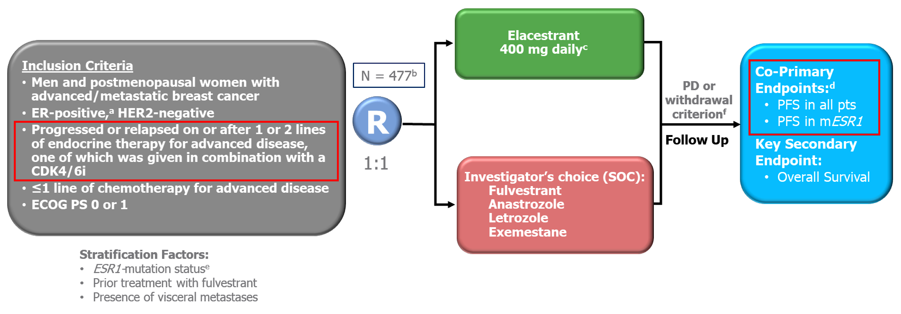
EMERALD Study Design
SOC = standard of care; PD = disease progression
Bardia A et al. SABCS 2021;Abstract GS2-02. Bidard FC et al. J Clin Oncol 2022;40(28):3246-56.

Slide 68
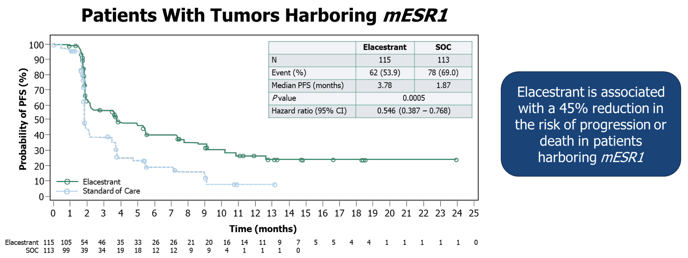
EMERALD: PFS for Patients with ESR1 Mutations (mESR1)
Bardia A et al. SABCS 2021;Abstract GS2-02. Bidard FC et al. J Clin Oncol 2022;40(28):3246-56.

Slide 69


Slide 70
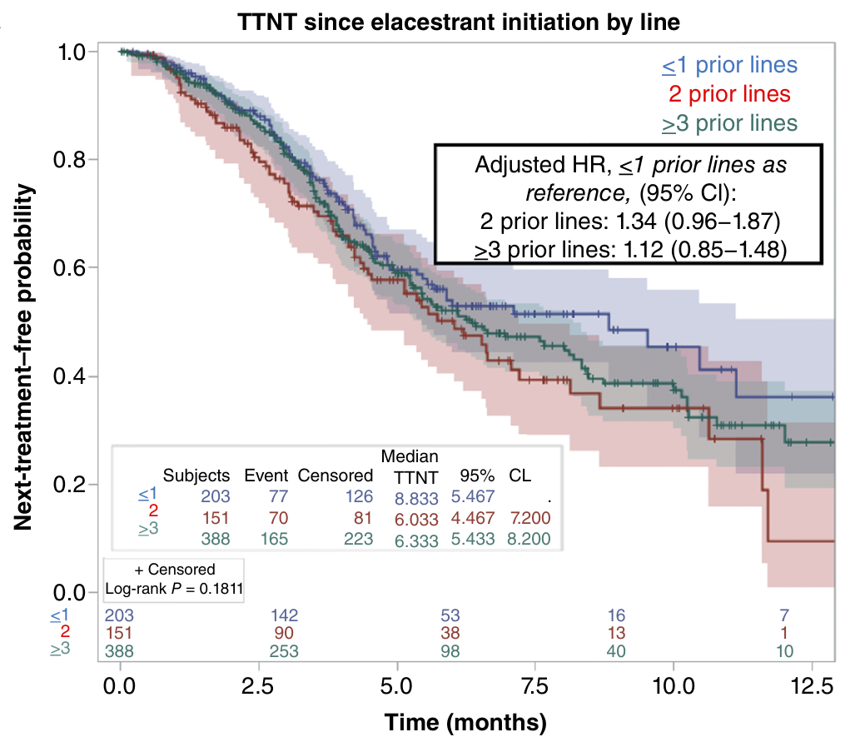
Real-World Time to Next Treatment (rwTTNT) Since Elacestrant Initiation by Line of Treatment
Patients treated in earlier lines (ie, 2L) seemed to have a longer rwTTNT.
Observational retrospective analyses are not intended for direct comparisons with clinical trials.
Lloyd MR et al. Clin Cancer Res 2026;32(1):169-78.
Content courtesy of Joyce O’Shaughnessy, MD

Slide 71
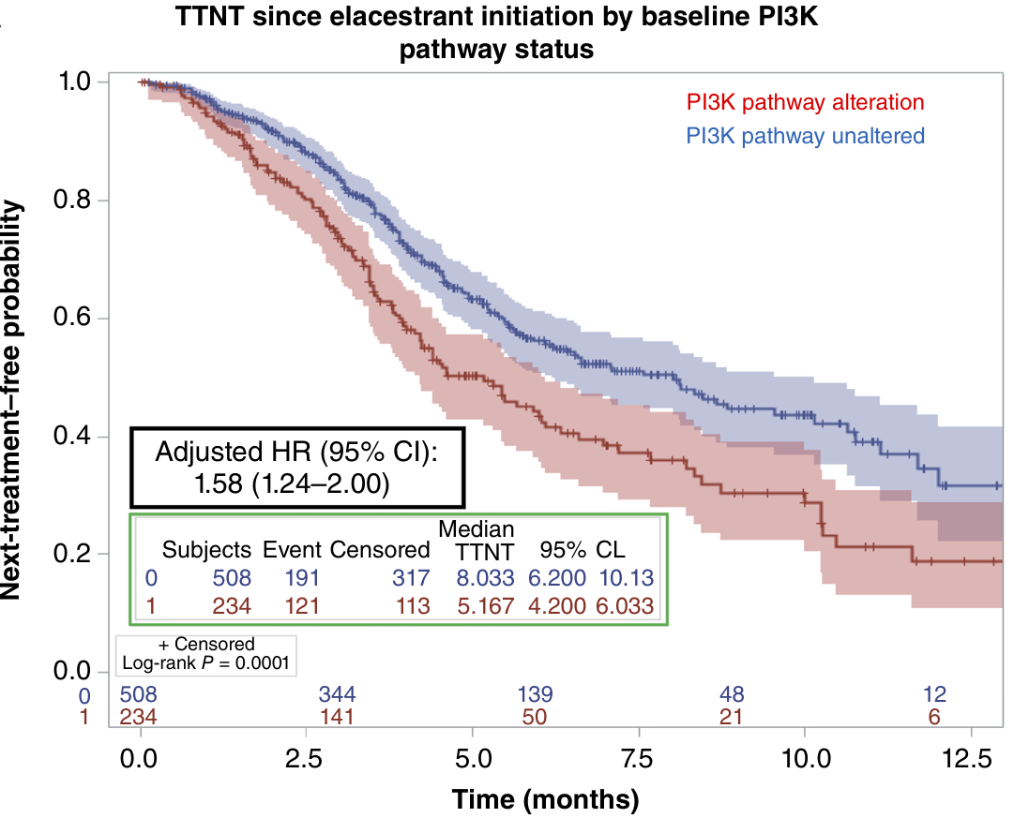
rwTTNT Since Elacestrant Initiation by Baseline PI3K Pathway Status
Patients without oncogenic PI3K pathway alterations showed to have a longer rwTTNT (8.0 mo vs 5.2 mo)
compared to those having an alteration in this pathway.
Observational retrospective analyses are not intended for direct comparisons with clinical trials.
Lloyd MR et al. Clin Cancer Res 2026;32(1):169-78.
Content courtesy of Joyce O’Shaughnessy, MD

Slide 72
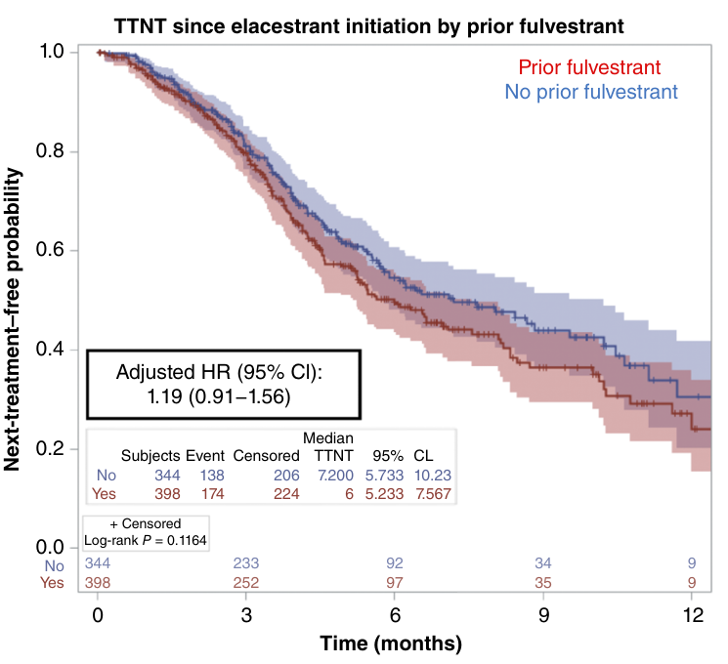
rwTTNT Since Elacestrant Initiation by Prior Fulvestrant
Patients without prior fulvestrant versus those with previous fulvestrant exposure trended toward better rwTTNT on elacestrant.
Observational retrospective analyses are not intended for direct comparisons with clinical trials.
Lloyd MR et al. Clin Cancer Res 2026;32(1):169-78.
Content courtesy of Joyce O’Shaughnessy, MD

Slide 73
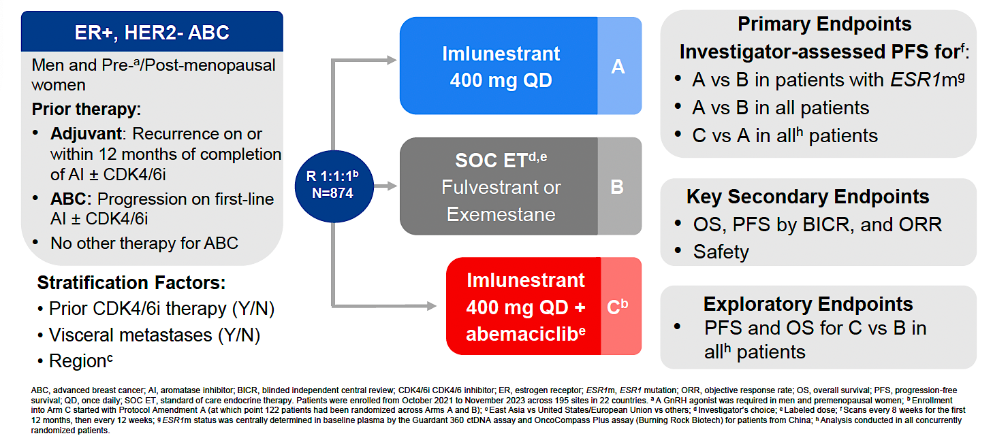
EMBER-3 Study Design
for patients from China; ^{h} Analysis conducted in all concurrently randomized patients.
Jhaveri KL et al. San Antonio Breast Cancer Symposium 2024;Abstract GS1-01.

Slide 74
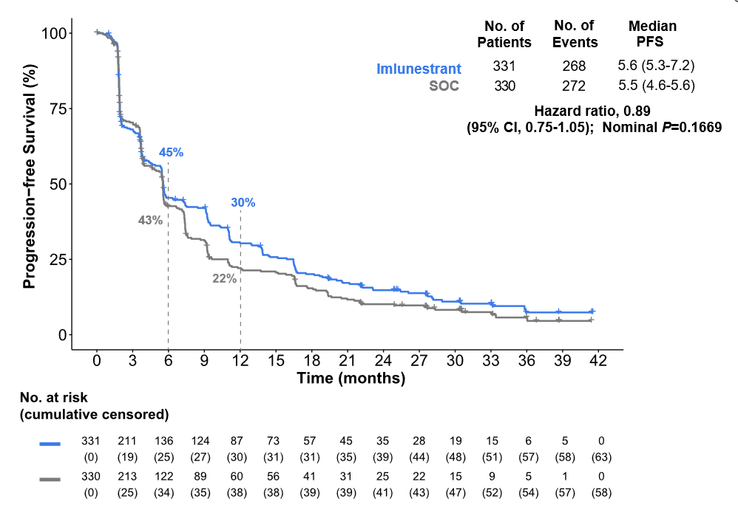
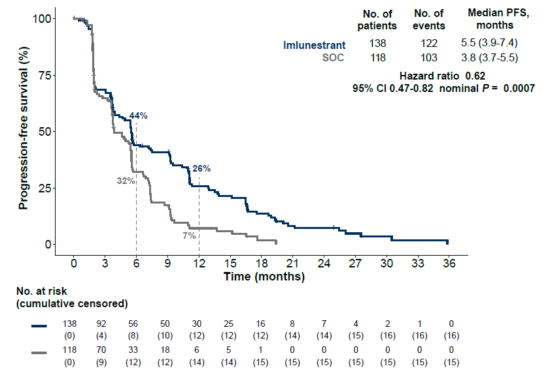
EMBER-3: PFS with Imlunestrant Monotherapy
All Patients
Patients with ESR1m
Jhaveri KL et al. Ann Oncol 2026;37(4):532-43.

Slide 75
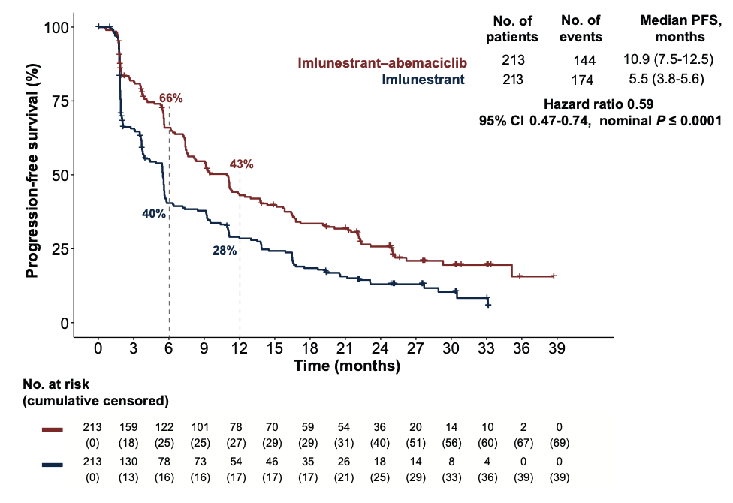
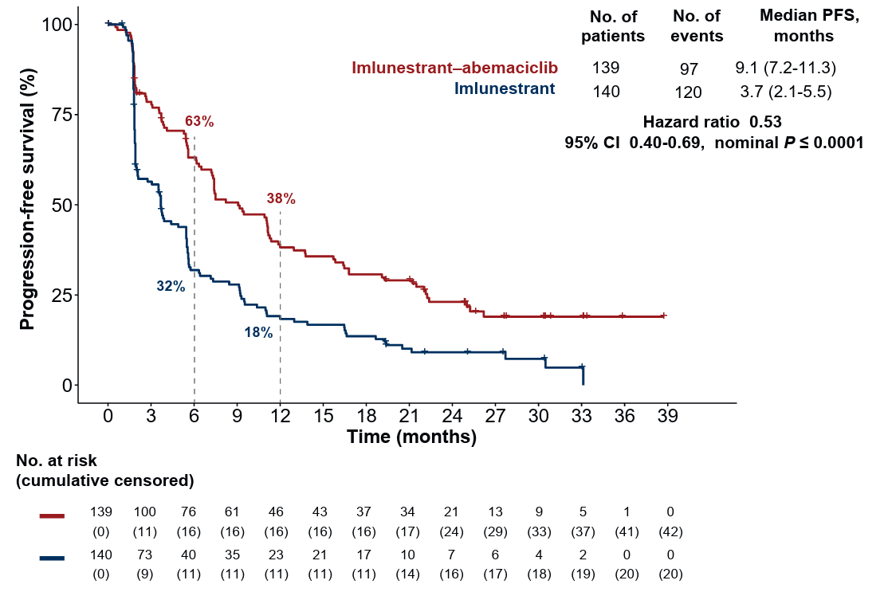
EMBER-3: PFS with Imlunestrant and Abemaciclib
All patients
Patients who previously received a CDK4/6i
Jhaveri KL et al. Ann Oncol 2026;37(4):532-43.

Slide 76
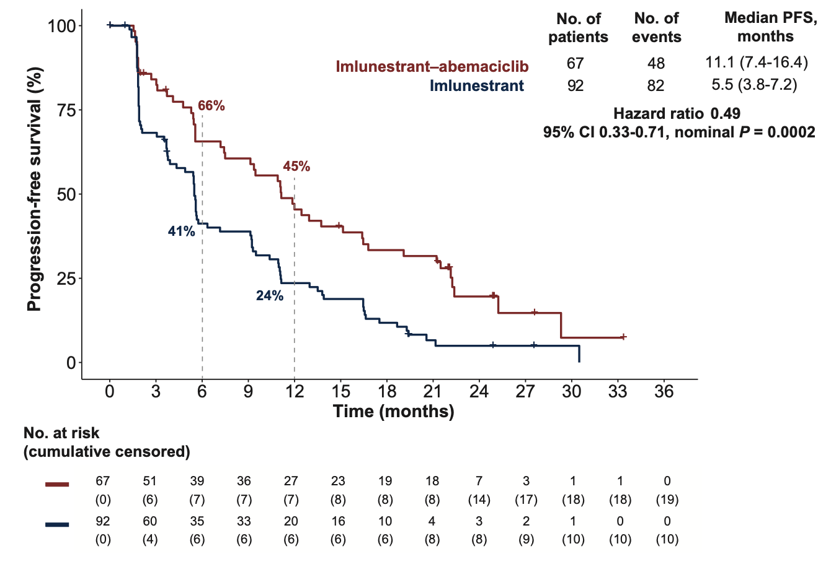
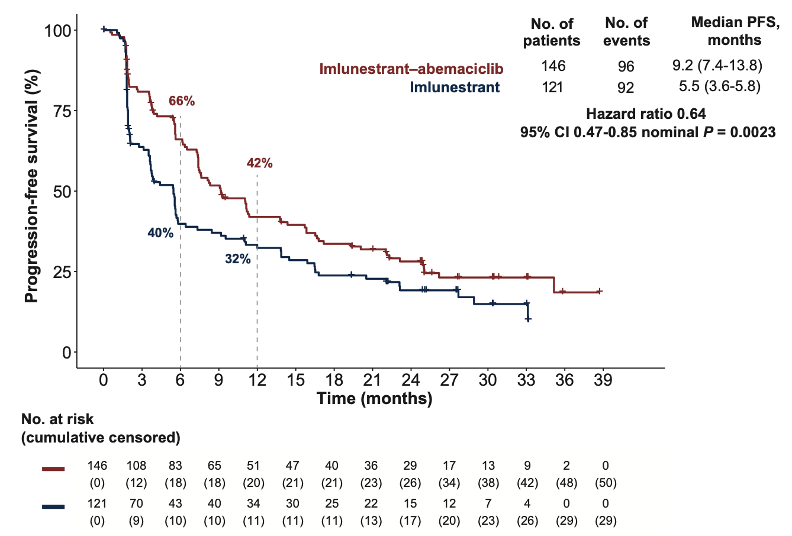
EMBER-3: PFS with Imlunestrant and Abemaciclib by ESR1 Mutation Status
With ESR1 mutation
Without ESR1 mutation
Jhaveri KL et al. Ann Oncol 2026;37(4):532-43.

Slide 77
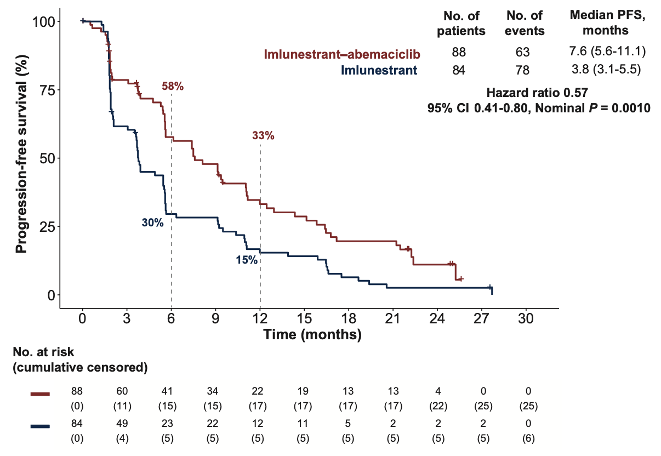
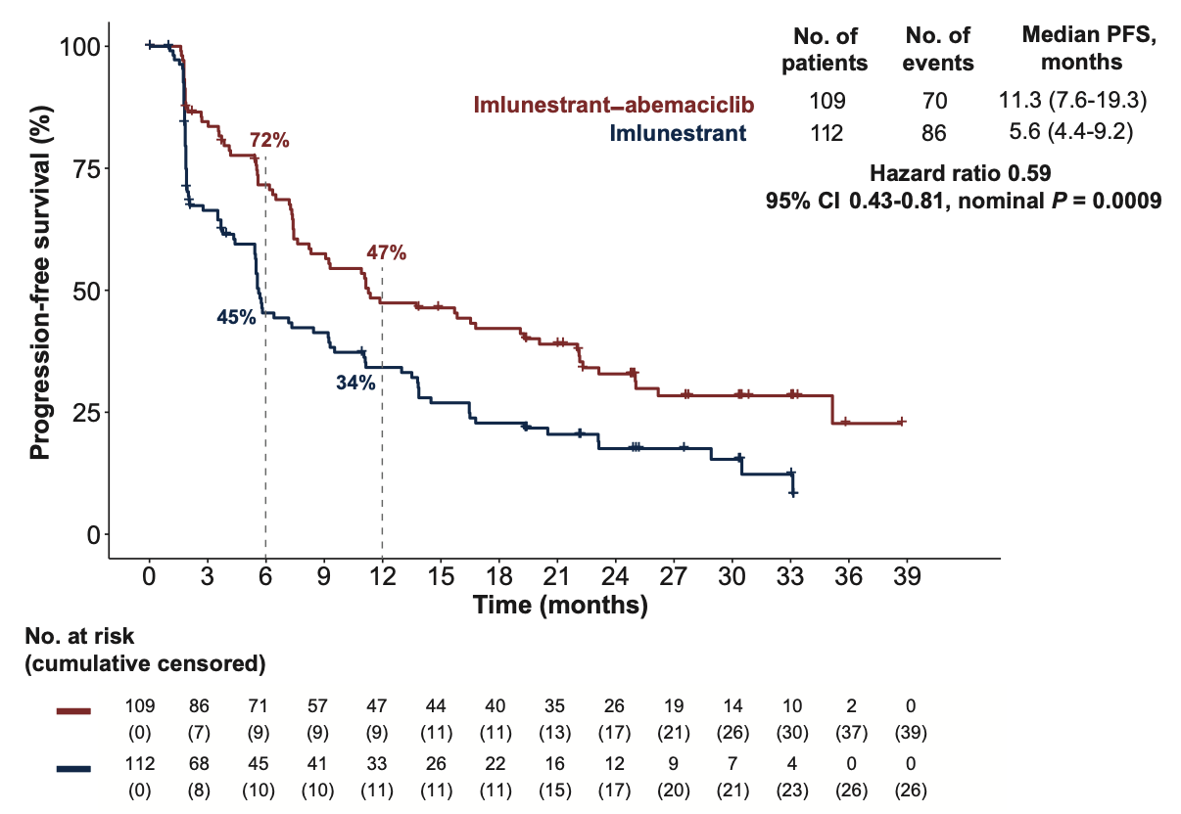
EMBER-3: PFS with Imlunestrant and Abemaciclib by PI3K Mutation Status
With PI3K pathway mutation
Without PI3K pathway mutation
Jhaveri KL et al. Ann Oncol 2026;37(4):532-43.

Slide 78
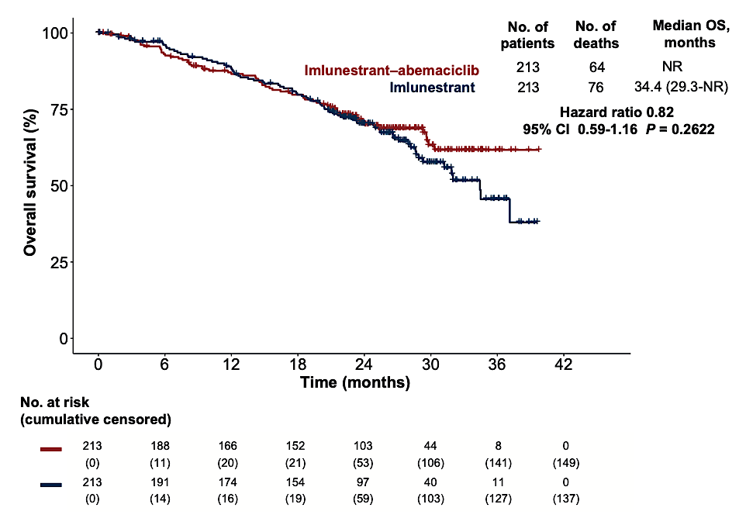
EMBER-3: OS with Imlunestrant and Abemaciclib for All Patients
Jhaveri KL et al. Ann Oncol 2026;37(4):532-43.

Slide 79
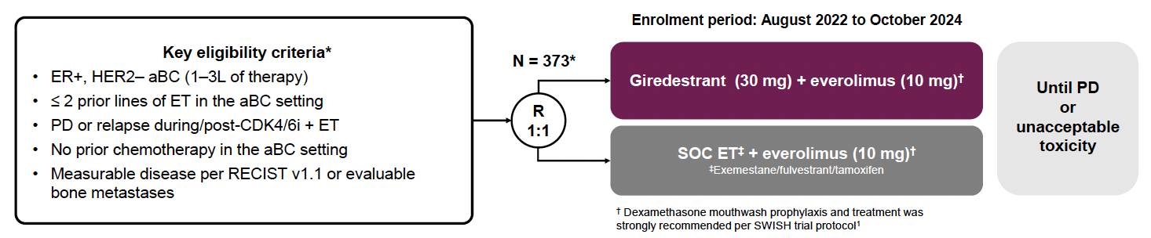
evERA Study Design
PD = disease progression
Mayer E et al. ESMO 2025;Abstract LBA16.

Slide 80
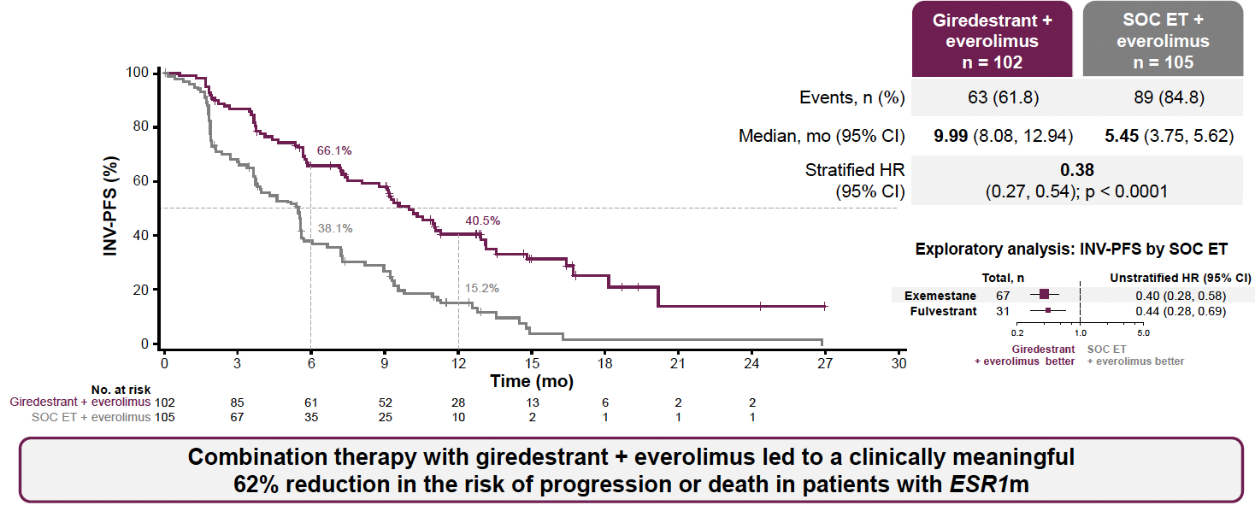
evERA: PFS in the ESR1 Mutation (ESR1m) Population
INV-PFS = investigator-assessed progression-free survival
Mayer E et al. ESMO 2025;Abstract LBA16.

Slide 81
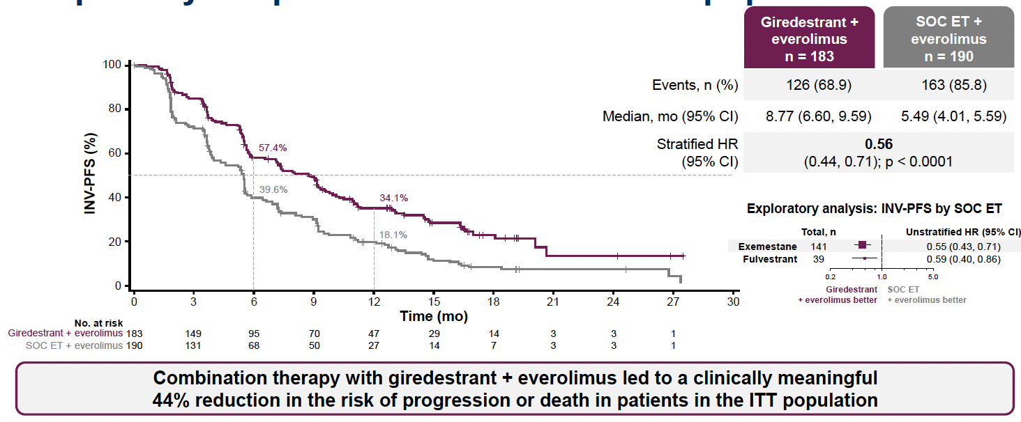
evERA: PFS in the Intent-to-Treat (ITT) Population
Mayer E et al. ESMO 2025;Abstract LBA16.

Slide 82

evERA: Interim OS in the ESR1m and ITT Populations
Mayer E et al. ESMO 2025;Abstract LBA16.

Slide 83
Faculty Discussion

Slide 84
Questions for the Faculty
Dr Hussein
A woman in her early 70s with asymptomatic bone-only ER+, HER2-low (1+) metastatic disease with progression after 2 years of palbociclib/anastrozole. Liquid biopsy reveals ESR1 and PIK3CA mutations.
Questions
How do you care for patients with both mutations? Would you have given her capivasertib? I chose elacestrant because you don’t need fulvestrant injections as with capi and I have seen very few adverse effects — occasionally abdominal discomfort, nausea, maybe fatigue, but no serious issues. With capivasertib I worry about the blood sugar and other side effects, but I wasn’t sure.
Now that imlunestrant/abemaciclib is available, when would you opt for it over oral SERD monotherapy?
Do you think giredestrant plus everolimus will have a future role? For which patients would you consider this combination?

Slide 85
Questions for the Faculty (Continued)
Dr Hussein
She did well on elacestrant for 18 months but then had disease progression but not with liver metastases. She’s still in good shape, with mild bone aches.
Questions
How would you treat this patient?
I recently started her on T-DXd, and she tolerated the first 2 doses very well. What exact antiemetic strategy do you use with T-DXd, and how often do you do pulmonary imaging?
Can we come back to capivasertib in the future ?

Slide 86
Relapsed/Refractory HR-Positive mBC:
PI3K/AKT/mTOR Pathway Inhibitors
Dr Nanda
Select Datasets
Turner NC et al. Capivasertib in hormone receptor-positive advanced breast cancer.
N Engl J Med 2023;388(22):2058-70.
Rugo HS et al. Capivasertib (C) and fulvestrant (F) for patients (pts) with HR+/HER2- advanced breast cancer (ABC): Final overall survival (OS) results from the phase III CAPItello-291 trial. ESMO Breast 2026;Abstract 4170.
Hurvitz SA et al. VIKTORIA-1 trial of gedatolisib plus fulvestrant with or without palbociclib in hormone receptor-positive/HER2-/PIK3CA wild-type advanced breast cancer. J Clin Oncol 2026;44(12):1108-19.
Hurvitz SA et al. A randomized, open-label, phase 3 study of gedatolisib + fulvestrant ± palbociclib vs standard of care in HR+/HER2−/PIK3CA-mutant (MT) advanced breast cancer (VIKTORIA-1 Study 2). ASCO 2026;Abstract LBA1008.

Slide 87

CAPItello-291 Study Design
Turner N et al. San Antonio Breast Cancer Symposium 2022;Abstract GS3-04; Turner NC et al. N Engl J Med 2023;388(22):2058-70.

Slide 88

CAPItello-291: PFS in the AKT Pathway-Altered Population
Turner N et al. San Antonio Breast Cancer Symposium 2022;Abstract GS3-04; Turner NC et al. N Engl J Med 2023;388(22):2058-70.

Slide 89

CAPItello-291: Final OS in the AKT Pathway-Altered Population
Rugo HS et al. ESMO Breast 2026;Abstract 4170.

Slide 90

Gedatolisib: A PI3K/AKT/mTOR Pathway Inhibitor
Hurvitz SA et al. ESMO 2025;Abstract LBA17.

Slide 91

VIKTORIA-1 Study 1: A Phase III Trial of Gedatolisib for PIK3CA Wild-Type mBC
T2DM = Type 2 diabetes; TTP = time to disease progression; ROW = rest of world
Hurvitz SA et al. ESMO 2025;Abstract LBA17.

Slide 92


VIKTORIA-1 Study 1: PFS
 | Gedatolisib and fulvestrant | Fulvestrant | Gedatolisib, palbociclib and fulvestrant | Fulvestrant
Median PFS, months (95% CI) | 7.4 (5.5 to 9.9) | 2.0 (1.8 to 2.3) | 9.3 (7.2 to 16.6) | 2.0 (1.8 to 2.3)
Adjusted HR | 0.33 (0.24-0.48) |  | 0.24 (0.17-0.35)
p-value | <0.001 |  | <0.001
Gedatolisib plus fulvestrant
Fulvestrant
Hurvitz SA et al. J Clin Oncol 2026;44(12):1108-19.

Slide 93


VIKTORIA-1 Study 1: OS
 | Gedatolisib and fulvestrant | Fulvestrant | Gedatolisib, palbociclib and fulvestrant | Fulvestrant
Median OS, months (95% CI) | NR (NE, NE) | 18.5 (15.8, NE) | 23.7 (21.4, NE) | 18.5 (15.8, NE)
Adjusted HR | 0.74 (0.46-1.19) |  | 0.69 (0.43-1.12)
NR = not reached; NE = not estimable
Hurvitz SA et al. J Clin Oncol 2026;44(12):1108-19.

Slide 94

VIKTORIA-1 Study 2: A Phase III Trial of Gedatolisib for PIK3CA-Mutant mBC
Hurvitz SA et al. ASCO 2026;Abstract LBA1008.

Slide 95

VIKTORIA-1 Study 2: Gedatolisib/Palbociclib/Fulvestrant Triplet – PFS
Hurvitz SA et al. ASCO 2026;Abstract LBA1008.

Slide 96

VIKTORIA-1 Study 2: Gedatolisib/Fulvestrant Doublet – PFS
Hurvitz SA et al. ASCO 2026;Abstract LBA1008.

Slide 97

VIKTORIA-1 Study 2: Interim OS
Hurvitz SA et al. ASCO 2026;Abstract LBA1008.

Slide 98

Key Toxicity Experience Across PI3K/AKT/mTOR Pathway Inhibitors
CAPItello-291
All Grades
All Grades
All Grades
All Grades
Courtesy of Seth Wander, MD, PhD
Andre F et al. NEJM 2019; Turner NC et al. NEJM 2024; Turner NC et al. NEJM 2023; Hurvitz SA et al. ESMO 2025.

Slide 99
Faculty Discussion

Slide 100
Questions for the Faculty
Dr Hussein
82-year-old woman with PIK3CA-mutant mBC with bone and liver metastases. Was on ribociclib/letrozole for 3 years and on disease progression received capivasertib with good response and tolerance, very different from what we saw with alpelisib. She had no issues with hyperglycemia.
Questions
How do you decide between second-line endocrine treatment and an ADC? How do you factor in the amount of time on prior endocrine treatment?
Do you use capivasertib for patients with well-controlled diabetes? If not well controlled, do you have them intensify diabetic treatment (GLP-1?) and then treat? Which HbA1c level is necessary to start capivasertib?
How do you approach dose reduction?
For which patients are you considering gedatolisib in combination with fulvestrant and palbociclib? Are there patients for whom you would omit the palbociclib?
How is gedatolisib tolerated relative to other PI3K/AKT/mTOR Inhibitors?

Slide 101
Questions for the Faculty
Dr Choksi
62-year-old woman with recurrent ER+, HER2-negative mBC in the bones and lymph nodes s/p adjuvant chemotherapy and CDK4/6 inhibitor/AI, just received cycle 6 of datopotamab deruxtecan with partial response on CT scan and good tolerance. Tumor-related symptoms like not feeling well, asthenia and fatigue have improved on the treatment.
Questions
How do you decide between datopotamab deruxtecan and sacituzumab govitecan for ER-positive disease?
Where does T-DXd fit in for HER2-low disease?
Do TROP2-targeted agents work in the CNS?

Slide 102
Agenda
Introduction: ESMO 2026; Recent FDA Approvals
ER-Positive Breast Cancer
HER2-Positive Breast Cancer
  HER2-Positive Localized BC: Trastuzumab deruxtecan and neratinib – Dr Geyer
  HER2-Positive Metastatic BC: First-Line Treatment and Maintenance Therapy –
  Dr Wander
Triple-Negative Breast Cancer

Slide 103
HER2-Positive Localized Breast Cancer:
Trastuzumab Deruxtecan and Neratinib
Dr Geyer
Select Datasets
Harbeck N et al. Neoadjuvant trastuzumab deruxtecan alone or followed by paclitaxel, trastuzumab, and pertuzumab for high-risk HER2-positive early breast cancer (DESTINY-Breast11): A randomized, open-label, multicentre, phase III trial. Ann Oncol 2026;37:166-79.
Pusztai L et al. Residual cancer burden (RCB) following neoadjuvant treatment with trastuzumab deruxtecan (T-DXd) followed by paclitaxel + trastuzumab + pertuzumab (THP) vs dose-dense doxorubicin + cyclophosphamide followed by THP in high-risk, HER2+ early-stage breast cancer. ESMO Breast 2026;Abstract LBA1.
Loibl S et al. Trastuzumab deruxtecan in residual HER2-positive early breast cancer. New Engl J Med 2026;394:845-57.
Untch M et al. Secondary safety analysis of trastuzumab deruxtecan (T-DXd) vs trastuzumab emtansine (T-DM1) in DESTINY-Breast05: Clinical and demographic risk factors of interstitial lung disease and radiation pneumonitis. ASCO 2026;Abstract 516.
Luftner D et al. Extended adjuvant neratinib in HER2+/HR+ early breast cancer in clinical routine – Final results from the multinational, prospective, observational study ELEANOR. ESMO 2025;Abstract 299P.

Slide 104

Phase III DESTINY-Breast11 Study Design
T-DXd = trastuzumab deruxtecan
Harbeck N et al. ESMO 2025;Abstract 291O. Harbeck N et al. Ann Oncol 2026;37:166-79.

Slide 105

Phase III DESTINY-Breast11: Pathologic Complete Response (pCR) (ypT0/is ypN0)
Harbeck N et al. ESMO 2025;Abstract 291O. Harbeck N et al. Ann Oncol 2026;37:166-79.

Slide 106

Phase III DESTINY-Breast11 Event-Free Survival (EFS)
Harbeck N et al. ESMO 2025;Abstract 291O. Harbeck N et al. Ann Oncol 2026;37:166-79.

Slide 107

Phase III DESTINY-Breast05 Study Design
Geyer CE et al. ESMO 2025;Abstract 291O; Loibl S et al. N Engl J Med 2026;394:845-57.

Slide 108

Phase III DESTINY-Breast05: IDFS
Geyer CE et al. ESMO 2025;Abstract 291O; Loibl S et al. N Engl J Med 2026;394:845-57

Slide 109

ELEANOR: A Multinational, Prospective, Observational Study of Extended-Adjuvant Neratinib for HR-Positive, HER2-Positive Breast Cancer
Luftner D et al. ESMO 2025;Abstract 299P.

Slide 110

ELEANOR: A Multinational, Prospective, Observational Study of Extended-Adjuvant Neratinib for HR-Positive, HER2-Positive Breast Cancer
Luftner D et al. ESMO 2025;Abstract 299P.
MAS = main analysis set

Slide 111

ELEANOR: A Multinational, Prospective, Observational Study of Extended-Adjuvant Neratinib for HR-Positive, HER2-Positive Breast Cancer
Luftner D et al. ESMO 2025;Abstract 299P.

Slide 112
Faculty Discussion

Slide 113
Questions for the Faculty
Dr Apuri
42-year-old woman with localized HER2-positive breast cancer with residual disease in the breast and 1 node after neoadjuvant TCHP. Receiving T-DXd post-op. Doing well after dose reduction for extreme fatigue, myalgias and rash.
Questions
Criteria to use neoadjuvant T-DXd? What about postneoadjuvant T-DXd? What about patients who have received neoadjuvant T-DXd and have residual disease?
Quality of life, side effects and dose reduction with T-DXd?
In which situations are you using postadjuvant neratinib? Are you using a dose-escalation approach? Do you use pre-emptive loperamide?

Slide 114
HER2-Positive Metastatic Breast Cancer:
First-Line Treatment and Maintenance Therapy
Dr Wander
Select Datasets
Tolaney SM et al. Trastuzumab deruxtecan plus pertuzumab for HER2-positive metastatic breast cancer. N Engl J Med 2026;394;551-62.
Loibl S et al. Trastuzumab deruxtecan (T-DXd) + pertuzumab vs taxane + trastuzumab + pertuzumab (THP) for patients with HER2+ advanced/metastatic breast cancer: Additional analyses of DESTINY-Breast09 in key subgroups of interest. ESMO 2025;Abstract LBA18.
Park YH et al. A DESTINY-Breast09 analysis of treatment duration and clinical outcomes by best response to trastuzumab deruxtecan (T-DXd) + pertuzumab (P). ASCO 2026;Abstract 1021.
Harbeck N et al. Trastuzumab deruxtecan in HER2-positive advanced breast cancer with or without brain metastases: A phase 3b/4 trial. Nat Med 2024;30:3717-27.
Dieras V et al. HER2CLIMB-05: A phase III study of tucatinib versus placebo in combination with trastuzumab and pertuzumab as first-line maintenance therapy for HER2+ metastatic breast cancer. J Clin Oncol 2026;44:1597-607.
Metzger O et al. Palbociclib for hormone-receptor-positive, HER2-positive advanced breast cancer. N Engl J Med 2026;394:451-62.
Metzger O et al. Central nervous system outcomes from the phase III PATINA trial (AFT-38). SABCS 2025;Abstract RF4-01.

Slide 115

Phase III DESTINY-Breast09 Study Design
Tolaney SM et al. ASCO 2025;Abstract LBA1008; Tolaney SM et al. N Engl J Med 2026;394:551-62.

Slide 116

Phase III DESTINY-Breast09: PFS by Blinded Independent
Central Review
Tolaney SM et al. ASCO 2025;Abstract LBA1008; Tolaney SM et al. N Engl J Med 2026;394:551-62.

Slide 117

Phase III DESTINY-Breast09 Subgroup Analysis: PFS by HR Status
Loibl S et al. ESMO 2025;Abstract LBA18.

Slide 118

Phase III DESTINY-Breast09 Subgroup Analysis: PFS by PIK3CA Mutation Status
Loibl S et al. ESMO 2025;Abstract LBA18.

Slide 119

DESTINY-Breast09 Exploratory Analysis: PFS with T-DXd and Pertuzumab by Best Response
 | T-DXd + pertuzumab | THP
Median time to deep PR mo (95% CI) | 9.6 (6.8-11.0) | 8.2 (6.8-9.6)
CR = complete response; PR = partial response; SD = stable disease; PD = progressive disease
Park YH et al. ASCO 2026;Abstract 1021.

Slide 120

Phase III DESTINY-Breast09: Overall Survival at 16% Maturity
Tolaney SM et al. ASCO 2025;Abstract LBA1008; Tolaney SM et al. N Engl J Med 2026;394:551-62.

Slide 121

Phase IIIb/IV DESTINY-Breast12 Study Design
Lin N et al. ESMO 2024; Harbeck N et al. Nat Med 2024;30:3717-27.

Slide 122

Phase III HER2CLIMB-05 Study Design
1L = first line; LA = locally advanced; MBC = metastatic breast cancer
Hamilton EP et al. ASCO 2023;Abstract TPS1115.

Slide 123

Phase III HER2CLIMB-05: Investigator-Assessed PFS in the ITT Population
TUC = tucatinib; TRAS = trastuzumab; PERT = pertuzumab; PBO = placebo
Dieras V et al. J Clin Oncol 2026;44:1597-607.

Slide 124

Phase III HER2CLIMB-05: Investigator-Assessed OS in the ITT Population
Dieras V et al. J Clin Oncol 2026;44:1597-607.

Slide 125


Phase III HER2CLIMB-05: Investigator-Assessed PFS by HR Status
HR-negative
HR-positive
Dieras V et al. J Clin Oncol 2026;44:1597-607.

Slide 126

Phase III PATINA Study Design
Vaz-Luis I et al. ESMO 2025;Abstract 485MO.

Slide 127

Phase III PATINA: PFS in the ITT Population
HER2 = anti-HER2 therapy
Metzger O et al. N Engl J Med 2026;394(5):451-62.

Slide 128
PATINA: Cumulative Incidence of CNS Disease Progression or Death Among Patients without CNS Metastases at Baseline
 | Palbociclib + anti-HER2 + ET (n = 250) | Anti-HER2 + ET (n = 248)
CNS PFS event (n) | 35 | 48
Death | 3 | 1
CNS progression | 32 | 47
Cumulative risk of CNS progression or death (%)
12 months | 4.6% | 6.9%
24 months | 9.7% | 15.7%
36 months | 13.0% | 19.2%
Metzger O et al. SABCS 2025;Abstract RF4-01.

Slide 129
Faculty Discussion

Slide 130
Questions for the Faculty
Dr Choksi
This 68-year-old woman presented with a palpable breast lump and had some financial and insurance restrictions in the beginning, so it took months before she could have medical care and evaluation. Her disease was ER-positive, HER2-positive, and by the time we saw her she had a positive lymph node in the axilla, but also disease in the bones. She received taxane-based chemotherapy with trastuzumab and pertuzumab and is about to finish chemotherapy and start maintenance.
Questions
What are your criteria to use T-DXd in the first line? How long do you give it? How do you approach maintenance?
For “triple-positive” disease do you use maintenance endocrine treatment including a CDK4/6 inhibitor (palbociclib)?
Are you using tucatinib maintenance in patients with ER-negative, HER2-positive disease?

Slide 131
Agenda
Introduction: ESMO 2026; Recent FDA Approvals
ER-Positive Breast Cancer
HER2-Positive Breast Cancer
Triple-Negative Breast Cancer
  Localized TNBC – Dr Lustberg
  Metastatic TNBC: First-Line Treatment with TROP2-Directed ADCs – Dr Nanda

Slide 132
Localized TNBC
Dr Lustberg
Select Datasets
Schmid P et al. Neoadjuvant pembrolizumab or placebo plus chemotherapy followed by adjuvant pembrolizumab or placebo for high-risk early-stage TNBC: Final analysis results from the phase 3 KEYNOTE-522 study. ASCO 2026;Abstract 507.
Garber JE et al. Sustained benefit of adjuvant olaparib in women with germline BRCA1- and BRCA2-associated high-risk HER2-negative early breast cancer: Updated results from the OlympiA phase III trial. Ann Oncol 2026;[Online ahead of print].

Slide 133

Phase III KEYNOTE-522 Study Design
Schmid P et al. ASCO 2026;Abstract 507.

Slide 134

Phase III KEYNOTE-522 Study: Overall Survival
Schmid P et al. ASCO 2026;Abstract 507.

Slide 135


Slide 136

Phase III OlympiA Study Design
NACT = neoadjuvant chemotherapy; CPS + EG = clinical and pathological stage and estrogen receptor and nuclear grade; ACT = adjuvant chemotherapy
Goncalves A et al. Cancers (Basel) 2020;12:1378.

Slide 137

Phase III OlympiA: Invasive Disease-Free Survival (IDFS)
Garber JE et al. Ann Oncol 2026;[Online ahead of print].

Slide 138

Phase III OlympiA: OS
Garber JE et al. Ann Oncol 2026;[Online ahead of print].

Slide 139
Localized TNBC: Select Ongoing Antibody-Drug Conjugate (ADC) Trials
Sacituzumab Govitecan
Tolaney SM et al. OptimICE-RD: Sacituzumab govitecan + pembrolizumab vs pembrolizumab
(± capecitabine) for residual triple-negative breast cancer. Future Oncol 2024;20:2343-55.
Tolaney SM et al. ASCENT-05/OptimICE-RD (AFT-65): Phase 3, randomized, open-label study of adjuvant sacituzumab govitecan (SG) + pembrolizumab (pembro) vs pembro ± capecitabine (cape) in patients (pts) with triple-negative breast cancer (TNBC) and residual disease after neoadjuvant therapy (NAT) and surgery. ASCO 2023;Abstract TPS619.
Schmid P et al. Neoadjuvant sacituzumab govitecan versus sacituzumab govitecan plus pembrolizumab in low-risk, triple-negative early breast cancer: WSG-ADAPT-TN-III. Ann Oncol 2025; 36(Suppl 2):376-7.
ADAPT-TN-IV: Neoadjuvant dynamic marker-adjusted personalized therapy comparing sacituzumab govitecan + pembrolizumab vs SoC chemotherapy in clinical stage II-III, triple-negative early breast cancer. NCT07178730.

Slide 140
Localized TNBC: Select Ongoing ADC Trials (Continued)
Datopotamab Deruxtecan
Loibl S et al. TROPION-Breast04: Phase (ph) III study of neoadjuvant (neoadj) datopotamab deruxtecan (Dato-DXd) + durvalumab (D) followed by adjuvant (adj) D vs standard of care (SoC) in treatment-naïve, triple-negative (TN) and HR-low/HER2-breast cancer. ESMO Breast 2024;Abstract 159TiP.
Bardia A et al. TROPION-Breast03: A randomized phase III global trial of datopotamab deruxtecan ± durvalumab in patients with triple-negative breast cancer and residual invasive disease at surgical resection after neoadjuvant therapy. Ther Adv Med Oncol 2024;16:17588359241248336.

Slide 141
Localized TNBC: Select Ongoing ADC Trials (Continued)
Sacituzumab Tirumotecan
McArthur HL et al. TroFuse-012: A phase 3, randomized study of adjuvant sacituzumab tirumotecan plus pembrolizumab vs treatment of physician’s choice in participants with triple-negative breast cancer who received neoadjuvant therapy and did not achieve a pathological complete response at surgery. SABCS 2025;Abstract PS5-12-22.
Harbeck N et al. TroFuse-032: A phase 3, randomized study of pembrolizumab plus sacituzumab tirumotecan or chemotherapy followed by pembrolizumab plus chemotherapy for early-stage triple-negative breast cancer or hormone receptor-low-positive (HR-low+)/human epidermal growth factor receptor 2-negative
(HER2-) breast cancer. SABCS 2025;Abstract PS5-12-25.

Slide 142
Faculty Discussion

Slide 143
Questions for the Faculty
60-year-old woman with a long history of lupus, mainly with cutaneous effects but not on current treatment. Presented with localized Stage T2N1 TNBC: left breast mass, multiple hypermetabolic left axillary nodes. Her rheumatologist cleared her for IO treatment, and she received the KEYNOTE-522 regimen. She had an excellent response but with some residual disease: 2.5 mm with only scattered tumor cells in the nodes (ypT1 pN1a). No evidence of any lupus flare-up, but while receiving adjuvant pembrolizumab she developed hyponatremia and adrenal insufficiency requiring hydrocortisone replacement. Pembrolizumab was discontinued. She is being followed with no evidence of recurrence.
Questions
Is there a role for ctDNA surveillance for a patient like this or for any patient with breast cancer?
Do you discontinue IO for patients with adrenal insufficiency?
What is the spectrum of autoimmune toxicity that you’ve observed in the neoadjuvant setting with the KEYNOTE-522 regimen?
Dr Ignatius

Slide 144
Metastatic TNBC First-Line Treatment: TROP2-Directed ADCs
Dr Nanda
Select Datasets
Tolaney SM et al. Sacituzumab govitecan plus pembrolizumab for advanced triple-negative breast cancer. N Engl J Med 2026;394:354-66.
Cortés J et al. Sacituzumab govitecan in untreated, advanced triple-negative breast cancer. N Engl J Med 2025;393(19):1912-25.
Dent R et al. Datopotamab deruxtecan in patients with untreated, advanced triple-negative breast cancer (TROPION-Breast02): A randomized, open-label, international, phase III trial. Ann Oncol 2026;37(8):1066-80.

Slide 145

Phase III ASCENT-04 Study Design
CPS = combined positive score; SG = sacituzumab govitecan; pembro = pembrolizumab
Kalinsky K et al. ASCO 2026;Abstract LBA1000.

Slide 146

Phase III ASCENT-04/KEYNOTE-D19 Study: PFS
Tolaney SM et al. NEJM 2026;394:354-66.

Slide 147

Phase III ASCENT-04: PFS After Next Line of Treatment (PFS2)
Kalinsky K et al. ASCO 2026;Abstract LBA1000. Tolaney SM et al. NEJM 2026;394:354-66.

Slide 148

Phase III ASCENT-04: Safety Summary
SAE = serious adverse event
Kalinsky K et al. ASCO 2026;Abstract LBA1000. Tolaney SM et al. NEJM 2026;394:354-66.

Slide 149

Phase III ASCENT-03 Study Design
Cortés J et al. ESMO 2025;Abstract LBA20. Cortés J et al. N Engl J Med 2025;393(19):1912-25.

Slide 150

Phase III ASCENT-03: PFS by BICR
Cortés J et al. ESMO 2025;Abstract LBA20. Cortés J et al. N Engl J Med 2025;393(19):1912-25.

Slide 151

Phase III ASCENT-03: Descriptive OS and PFS2
Cortés J et al. ESMO 2025;Abstract LBA20. Cortés J et al. N Engl J Med 2025;393(19):1912-25.

Slide 152

Phase III ASCENT-03: Common Adverse Events
Cortés J et al. ESMO 2025;Abstract LBA20. Cortés J et al. N Engl J Med 2025;393(19):1912-25.

Slide 153

Phase III TROPION-Breast02 Study Design
Dato-DXd = datopotamab deruxtecan
Dent R et al. ESMO 2025;Abstract LBA21. Dent R et al. Ann Oncol 2026;37(8):1066-80.

Slide 154

Phase III TROPION-Breast02: PFS by BICR
Dent R et al. ESMO 2025;Abstract LBA21. Dent R et al. Ann Oncol 2026;37(8):1066-80.

Slide 155

Phase III TROPION-Breast02: OS in the ITT Population
Dent R et al. ESMO 2025;Abstract LBA21. Dent R et al. Ann Oncol 2026;37(8):1066-80.

Slide 156

Phase III TROPION-Breast02: Common TRAEs
Dent R et al. ESMO 2025;Abstract LBA21. Dent R et al. Ann Oncol 2026;37(8):1066-80.

Slide 157
Faculty Discussion

Slide 158
Questions for the Faculty
Dr Apuri
A woman in her late 60s with localized TNBC treated initially with surgery, adjuvant chemotherapy and radiation therapy 4 years ago and during surveillance developed upper respiratory symptoms related to lymphadenopathy in the neck. She also had positive intramammary lymph nodes, and biopsies of both demonstrated recurrence. PD-L1 is 0.
Started on sacituzumab govitecan, which resulted in rapid symptom relief and eventually a CR on imaging. She tolerated this well but had neutropenia, which concerned me because she is a school nurse and exposed to multiple young kids on a day-to-day basis, despite the fact that she wears a mask.
Unfortunately, her insurance would not cover long-acting growth factors initially, so I had to write a letter of appeal, and they did agree to it finally, but she was getting short-acting initially.

Slide 159
Questions for the Faculty (Continued)
Dr Apuri
Questions
Are there any predictors of benefit for TROP2 ADCs? (TROP2 levels?)
Would a ctDNA test help in deciding when I can hold the treatment?
Do you use preemptive growth factors for all or select patients receiving sacituzumab? Which preparation and exactly how?
Do you use preemptive antidiarrheal medication for patients on sacituzumab?

Slide 160
We are taking a short break!
The program will resume at 10:00 AM ET
Up Next …
Drs Neeraj Agarwal and Emmanuel S Antonarakis discuss the management of prostate cancer

