Slide 1
Diabetology for the Medical Oncologist: Managing Hyperglycemia in Patients with Breast Cancer Receiving Agents Targeting the PI3K/AKT/PTEN Pathway
A CME/MOC-Accredited Live Webinar
Thursday, March 5, 2026 5:00 PM – 6:15 PM ET
Faculty
Jamie Carroll, APRN, MSN, CNP
Professor Giuseppe Curigliano, MD, PhD
Marie E McDonnell, MD
Hope S Rugo, MD
Moderator
Neil Love, MD

Slide 2

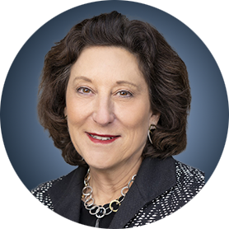

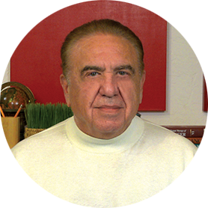
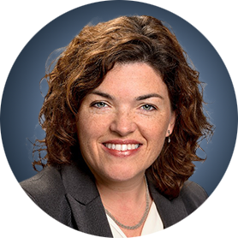
Faculty
Jamie Carroll, APRN, MSN, CNP
Assistant Professor, Oncology
Mayo Clinic
Rochester, Minnesota
Hope S Rugo, MD
Director, Women’s Cancers Program
Division Chief, Breast Medical Oncology
Professor, Department of Medical Oncology
and Therapeutics Research
City of Hope Comprehensive Cancer Center
Duarte, California
Professor Emeritus, UCSF
Professor Giuseppe Curigliano, MD, PhD
Clinical Director
Division of Early Drug Development for Innovative Therapy
Co-Chair, Cancer Experimental Therapeutics Program
Department of Oncology and Hemato-Oncology
University of Milano
European Institute of Oncology
Milano, Italy
MODERATOR
Neil Love, MD Research To Practice Miami, Florida
Marie E McDonnell, MD
Associate Professor of Medicine
Harvard Medical School
Director, Diabetes Program
Brigham and Women’s Hospital
Boston, Massachusetts

Slide 3
Commercial Support
This activity is supported by an educational grant from AstraZeneca Pharmaceuticals LP.

Slide 4
Dr Love — Disclosures
Dr Love is president and CEO of Research To Practice. Research To Practice receives funds in the form of educational grants to develop CME activities from the following companies: Aadi Bioscience, AbbVie Inc, ADC Therapeutics, Agendia Inc, Alexion Pharmaceuticals, Amgen Inc, Array BioPharma Inc, a subsidiary of Pfizer Inc, Arvinas, Astellas, AstraZeneca Pharmaceuticals LP, Aveo Pharmaceuticals, Bayer HealthCare Pharmaceuticals, BeOne, Biotheranostics, A Hologic Company, Black Diamond Therapeutics Inc, Blueprint Medicines, Boehringer Ingelheim Pharmaceuticals Inc, Bristol Myers Squibb, Celcuity, Clovis Oncology, Coherus BioSciences, Corcept Therapeutics Inc, CTI BioPharma, a Sobi Company, Daiichi Sankyo Inc, Eisai Inc, Elevation Oncology Inc, Exact Sciences Corporation, Exelixis Inc, Genentech, a member of the Roche Group, Genmab US Inc, Geron Corporation, Gilead Sciences Inc, GSK, Helsinn Therapeutics (US) Inc, ImmunoGen Inc, Incyte Corporation, Ipsen Biopharmaceuticals Inc, Jazz Pharmaceuticals Inc, Johnson & Johnson, Karyopharm Therapeutics, Kite, A Gilead Company, Kura Oncology, Legend Biotech, Lilly, MEI Pharma Inc, Merck, Mersana Therapeutics Inc, Mirati Therapeutics Inc, Mural Oncology Inc, Natera Inc, Novartis, Novartis Pharmaceuticals Corporation on behalf of Advanced Accelerator Applications, Novocure Inc, Nuvalent, Nuvation Bio Inc, Pfizer Inc, Pharmacyclics LLC, an AbbVie Company, Puma Biotechnology Inc, Regeneron Pharmaceuticals Inc, Revolution Medicines Inc, Rigel Pharmaceuticals Inc, R-Pharm US, Sanofi, Seagen Inc, Servier Pharmaceuticals LLC, SpringWorks Therapeutics Inc, Stemline Therapeutics Inc, Sumitomo Pharma America, Syndax Pharmaceuticals, Taiho Oncology Inc, Takeda Pharmaceuticals USA Inc, TerSera Therapeutics LLC, and Tesaro, A GSK Company.

Slide 5
Research To Practice CME Planning Committee Members, Staff and Reviewers
Planners, scientific staff and independent reviewers for Research To Practice have no relevant financial relationships to disclose.

Slide 6
Ms Carroll — Disclosures
Consulting Agreements | AstraZeneca Pharmaceuticals LP, Lilly, Novartis

Slide 7
Prof Curigliano— Disclosures
Advisory Committees, Consulting Agreements and Speakers Bureaus | AstraZeneca Pharmaceuticals LP, Daiichi Sankyo Inc, Gilead Sciences Inc, Lilly, Menarini Group, Novartis, Pfizer Inc
Data and Safety Monitoring Boards/Committees | Roche Laboratories Inc

Slide 8
Dr McDonnell — Disclosures
Contracted Research | Abbott

Slide 9
Dr Rugo — Disclosures
Advisory Committees and Consulting Agreements | BioNTech SE, Bristol Myers Squibb, Helsinn Therapeutics (US) Inc, Napo Pharmaceuticals
Contracted Research (Funding to City of Hope) | Bicycle Therapeutics, Genentech, a member of the Roche Group, Merck, Stemline Therapeutics Inc
Contracted Research (Funding to Prior Institution, UCSF) | Ambrx, AstraZeneca Pharmaceuticals LP, Daiichi Sankyo Inc, Genentech, a member of the Roche Group, Gilead Sciences Inc, Lilly, Merck, Novartis, Pfizer Inc, Stemline Therapeutics Inc.

Slide 10
This educational activity contains discussion of non-FDA-approved uses of agents and regimens. Please refer to official prescribing information for each product for approved indications.

Slide 11
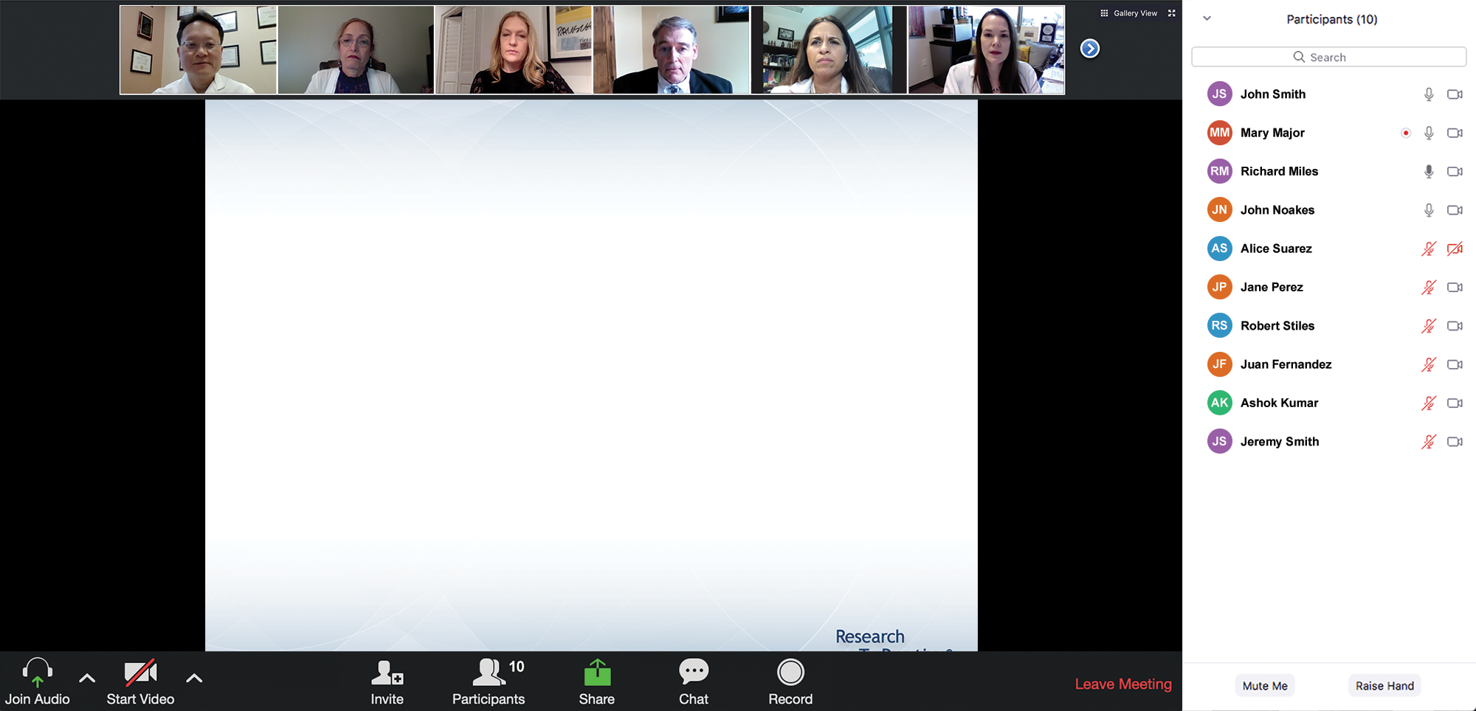

We Encourage Clinicians in Practice to Submit Questions
Feel free to submit questions now before the program begins and throughout the program.

Slide 12
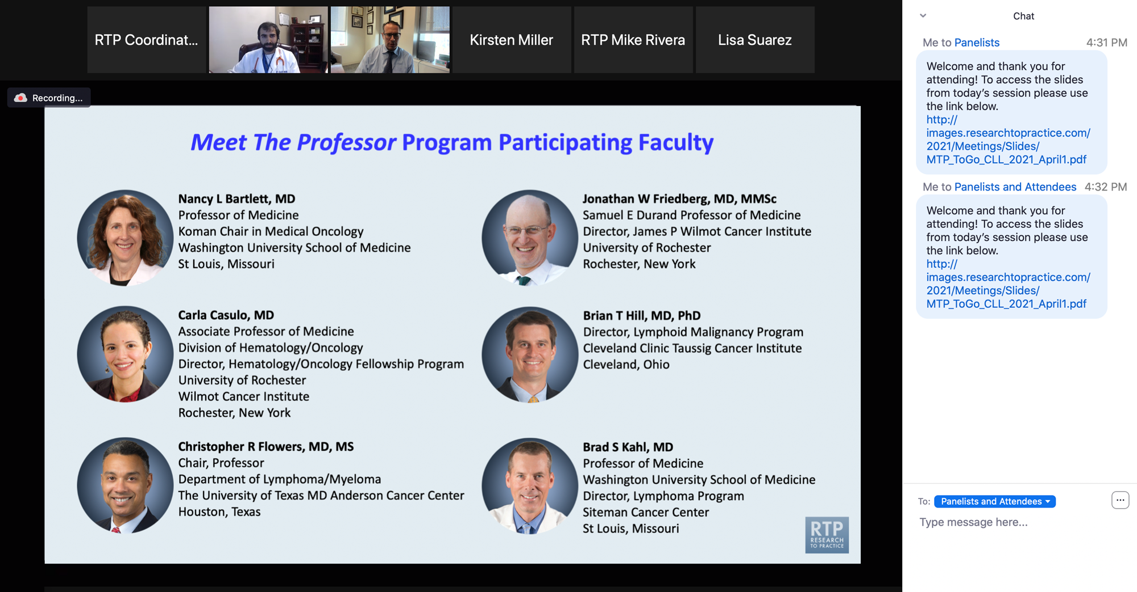
Familiarizing Yourself with the Zoom Interface
Expand chat submission box
Drag the white line above the submission box up to create more space for your message.

Slide 13
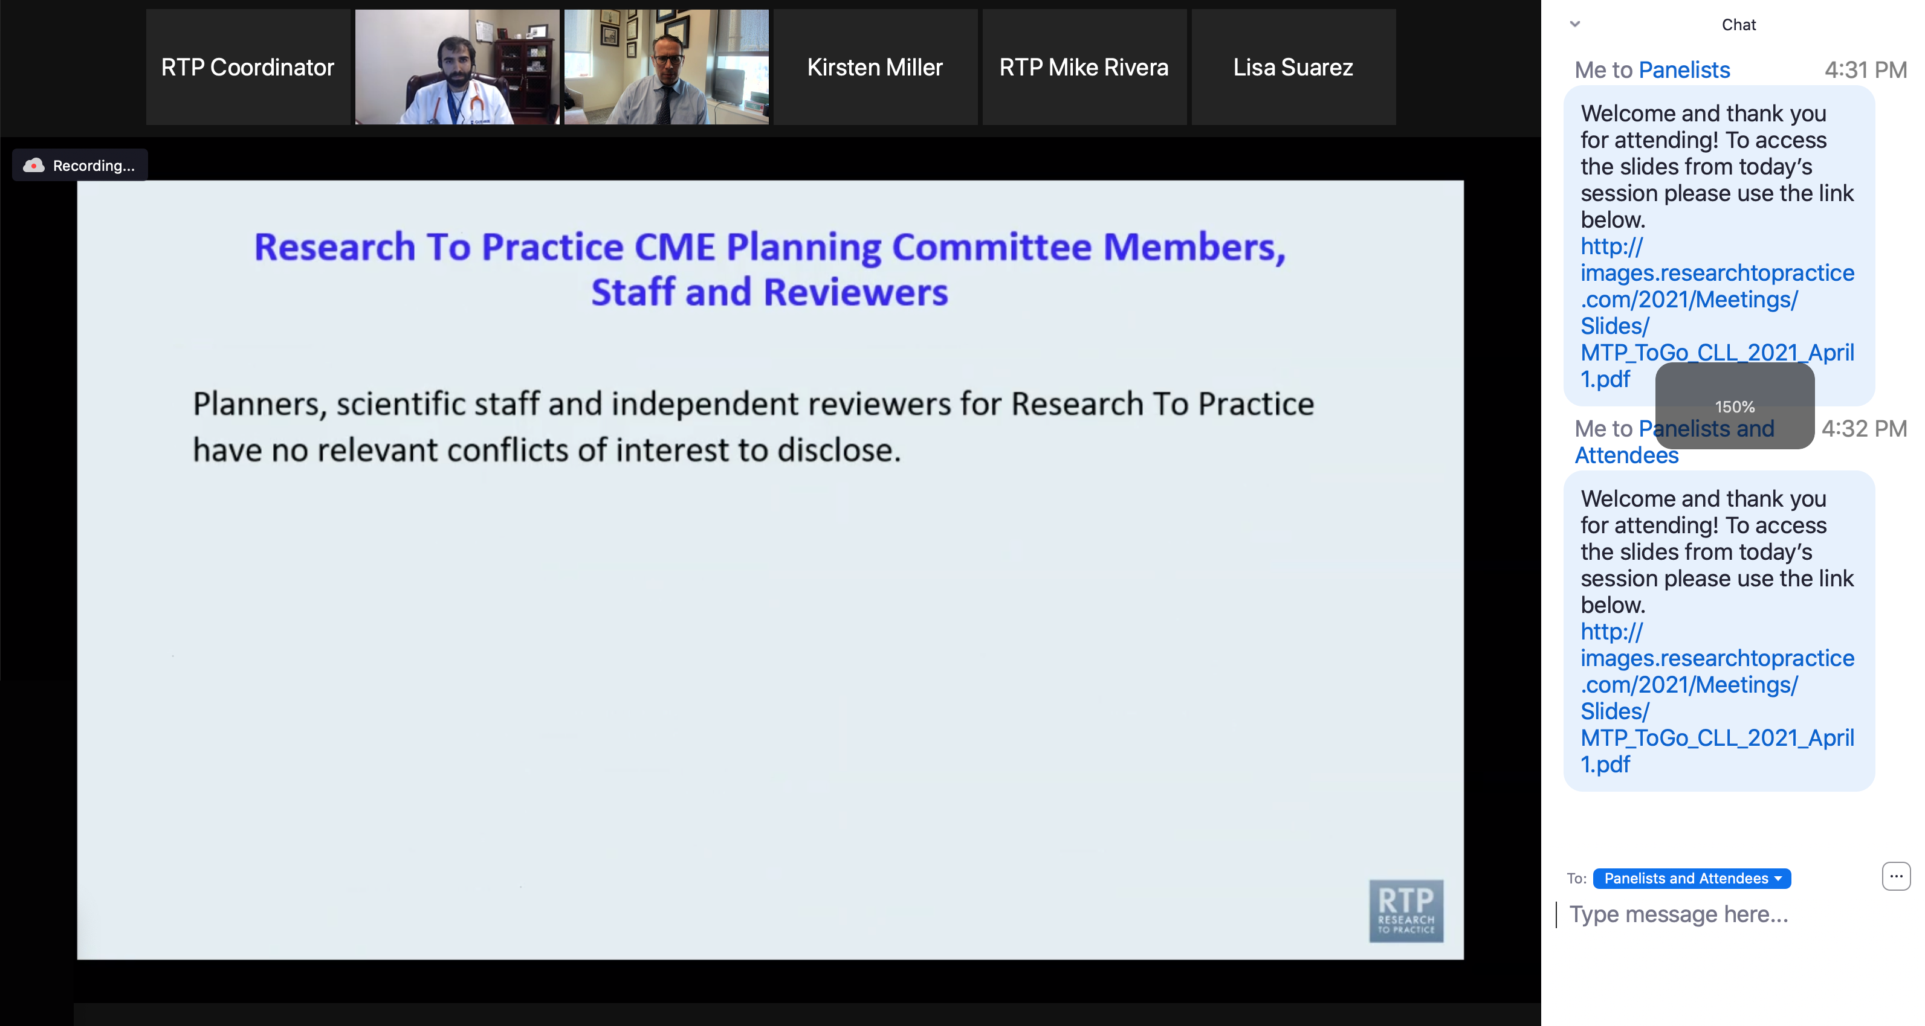
Familiarizing Yourself with the Zoom Interface
Increase chat font size
Press Command (for Mac) or Control (for PC) and the + symbol. You may do this as many times as you need for readability.

Slide 14
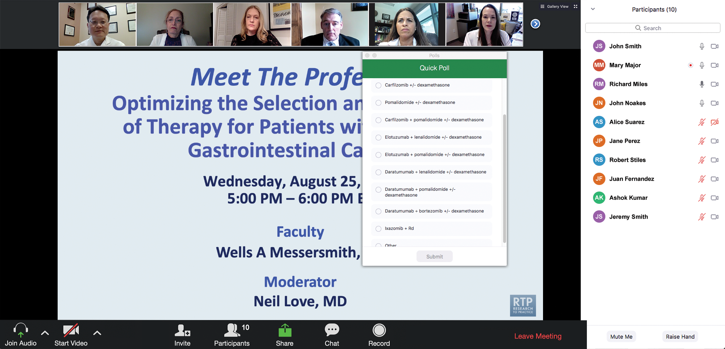
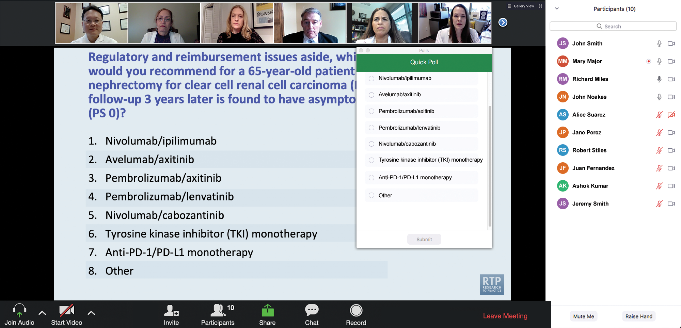
Clinicians in the Audience, Please Complete the Pre- and Postmeeting Surveys
Quick Survey
Quick Poll

Slide 15
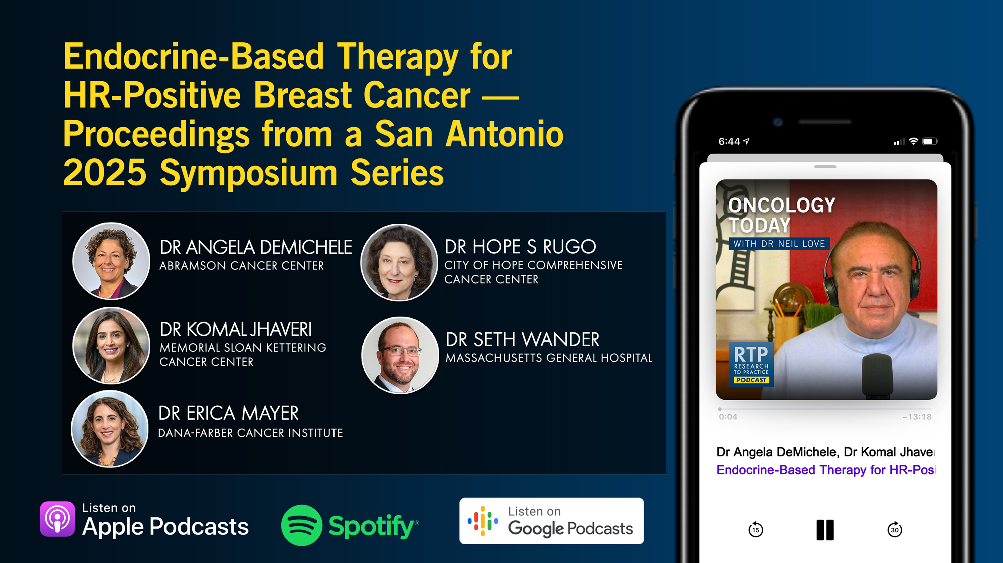

Slide 16
Year in Review: Clinical Investigator Perspectives on the Most Relevant New Datasets and Advances in Oncology
Bruton Tyrosine Kinase Inhibitors for Chronic Lymphocytic Leukemia
A CME/MOC-Accredited Live Webinar
Wednesday, March 11, 2026 5:00 PM – 6:00 PM ET
Faculty
Jennifer R Brown, MD, PhD
Wojciech Jurczak, MD, PhD
Moderator
Neil Love, MD

Slide 17
What Clinicians Want to Know: First-Line and Maintenance Therapy for Patients with ER-Positive, HER2-Positive Metastatic Breast Cancer
A CME/MOC-Accredited Live Webinar
Wednesday, March 18, 2026 5:00 PM – 6:00 PM ET
Faculty
Virginia F Borges, MD, MMSc
Ian E Krop, MD, PhD
Moderator
Neil Love, MD

Slide 18
Year in Review: Clinical Investigator Perspectives on the Most Relevant New Datasets and Advances in Oncology
Prostate Cancer
A CME/MOC-Accredited Live Webinar
Wednesday, March 25, 2026 5:00 PM – 6:00 PM ET
Faculty
Andrew J Armstrong, MD, ScM
Scott T Tagawa, MD, MS
Moderator
Neil Love, MD

Slide 19
Year in Review: Clinical Investigator Perspectives on the Most Relevant New Datasets and Advances in Oncology
Menin Inhibitors for Acute Leukemias
A CME/MOC-Accredited Live Webinar
Thursday, March 26, 2026 5:00 PM – 6:00 PM ET
Faculty
Amir Fathi, MD
Eunice S Wang, MD
Moderator
Neil Love, MD

Slide 20
Grand Rounds
CME/MOC-Accredited Interactive Series
Regional Activities
Three Series
Optimizing Treatment for Patients with Relapsed/Refractory Chronic Lymphocytic Leukemia
Optimizing the Use of Novel Therapies for Patients with Diffuse Large B-Cell Lymphoma
Optimizing Therapy for Patients with Hormone Receptor-Positive Localized Breast Cancer
Host a 1-hour session at your institution: Email Meetings@ResearchToPractice.com or call (800) 233-6153

Slide 21

Save The Date
A Multitumor CME/MOC-, NCPD- and ACPE-Accredited Educational Conference Developed in Partnership with Florida Cancer Specialists & Research Institute
Friday to Sunday, April 24 to 26, 2026
The Ritz-Carlton Orlando, Grande Lakes | Orlando, Florida
Moderated by Neil Love, MD

Slide 22
Thank you for joining us! Please take a moment to complete the survey currently up on Zoom. Your feedback is very important to us. Information on how to obtain CME, ABIM MOC and ABS credit will be provided at the conclusion of the activity in the Zoom chat room. Attendees will also receive an email in 1 to 3 business days with these instructions.

Slide 23
Diabetology for the Medical Oncologist: Managing Hyperglycemia in Patients with Breast Cancer Receiving Agents Targeting the PI3K/AKT/PTEN Pathway
A CME/MOC-Accredited Live Webinar
Thursday, March 5, 2026 5:00 PM – 6:15 PM ET
Faculty
Jamie Carroll, APRN, MSN, CNP
Professor Giuseppe Curigliano, MD, PhD
Marie E McDonnell, MD
Hope S Rugo, MD
Moderator
Neil Love, MD

Slide 24
Faculty
Jamie Carroll, APRN, MSN, CNP
Assistant Professor, Oncology
Mayo Clinic
Rochester, Minnesota
Hope S Rugo, MD
Director, Women’s Cancers Program
Division Chief, Breast Medical Oncology
Professor, Department of Medical Oncology
and Therapeutics Research
City of Hope Comprehensive Cancer Center
Duarte, California
Professor Emeritus, UCSF
Professor Giuseppe Curigliano, MD, PhD
Clinical Director
Division of Early Drug Development for Innovative Therapy
Co-Chair, Cancer Experimental Therapeutics Program
Department of Oncology and Hemato-Oncology
University of Milano
European Institute of Oncology
Milano, Italy
MODERATOR
Neil Love, MD Research To Practice Miami, Florida
Marie E McDonnell, MD
Associate Professor of Medicine
Harvard Medical School
Director, Diabetes Program
Brigham and Women’s Hospital
Boston, Massachusetts

Slide 25
We Encourage Clinicians in Practice to Submit Questions
Feel free to submit questions now before the program begins and throughout the program.

Slide 26
Clinicians in the Audience, Please Complete the Pre- and Postmeeting Surveys
Quick Survey
Quick Poll

Slide 28
Year in Review: Clinical Investigator Perspectives on the Most Relevant New Datasets and Advances in Oncology
Bruton Tyrosine Kinase Inhibitors for Chronic Lymphocytic Leukemia
A CME/MOC-Accredited Live Webinar
Wednesday, March 11, 2026 5:00 PM – 6:00 PM ET
Faculty
Jennifer R Brown, MD, PhD
Wojciech Jurczak, MD, PhD
Moderator
Neil Love, MD

Slide 29
What Clinicians Want to Know: First-Line and Maintenance Therapy for Patients with ER-Positive, HER2-Positive Metastatic Breast Cancer
A CME/MOC-Accredited Live Webinar
Wednesday, March 18, 2026 5:00 PM – 6:00 PM ET
Faculty
Virginia F Borges, MD, MMSc
Ian E Krop, MD, PhD
Moderator
Neil Love, MD

Slide 30
Year in Review: Clinical Investigator Perspectives on the Most Relevant New Datasets and Advances in Oncology
Prostate Cancer
A CME/MOC-Accredited Live Webinar
Wednesday, March 25, 2026 5:00 PM – 6:00 PM ET
Faculty
Andrew J Armstrong, MD, ScM
Scott T Tagawa, MD, MS
Moderator
Neil Love, MD

Slide 31
Year in Review: Clinical Investigator Perspectives on the Most Relevant New Datasets and Advances in Oncology
Menin Inhibitors for Acute Leukemias
A CME/MOC-Accredited Live Webinar
Thursday, March 26, 2026 5:00 PM – 6:00 PM ET
Faculty
Amir Fathi, MD
Eunice S Wang, MD
Moderator
Neil Love, MD

Slide 32
Grand Rounds
CME/MOC-Accredited Interactive Series
Regional Activities
Three Series
Optimizing Treatment for Patients with Relapsed/Refractory Chronic Lymphocytic Leukemia
Optimizing the Use of Novel Therapies for Patients with Diffuse Large B-Cell Lymphoma
Optimizing Therapy for Patients with Hormone Receptor-Positive Localized Breast Cancer
Host a 1-hour session at your institution: Email Meetings@ResearchToPractice.com or call (800) 233-6153

Slide 33
Save The Date
A Multitumor CME/MOC-, NCPD- and ACPE-Accredited Educational Conference Developed in Partnership with Florida Cancer Specialists & Research Institute
Friday to Sunday, April 24 to 26, 2026
The Ritz-Carlton Orlando, Grande Lakes | Orlando, Florida
Moderated by Neil Love, MD

Slide 34
Diabetology for the Medical Oncologist: Managing Hyperglycemia in Patients with Breast Cancer Receiving Agents Targeting the PI3K/AKT/PTEN Pathway
A CME/MOC-Accredited Live Webinar
Thursday, March 5, 2026 5:00 PM – 6:15 PM ET
Faculty
Jamie Carroll, APRN, MSN, CNP
Professor Giuseppe Curigliano, MD, PhD
Marie E McDonnell, MD
Hope S Rugo, MD
Moderator
Neil Love, MD

Slide 35
Ms Carroll — Disclosures
Consulting Agreements | AstraZeneca Pharmaceuticals LP, Lilly, Novartis

Slide 36
Prof Curigliano— Disclosures
Advisory Committees, Consulting Agreements and Speakers Bureaus | AstraZeneca Pharmaceuticals LP, Daiichi Sankyo Inc, Gilead Sciences Inc, Lilly, Menarini Group, Novartis, Pfizer Inc
Data and Safety Monitoring Boards/Committees | Roche Laboratories Inc

Slide 37
Dr McDonnell — Disclosures
Contracted Research | Abbott

Slide 38
Dr Rugo — Disclosures
Advisory Committees and Consulting Agreements | BioNTech SE, Bristol Myers Squibb, Helsinn Therapeutics (US) Inc, Napo Pharmaceuticals
Contracted Research (Funding to City of Hope) | Bicycle Therapeutics, Genentech, a member of the Roche Group, Merck, Stemline Therapeutics Inc
Contracted Research (Funding to Prior Institution, UCSF) | Ambrx, AstraZeneca Pharmaceuticals LP, Daiichi Sankyo Inc, Genentech, a member of the Roche Group, Gilead Sciences Inc, Lilly, Merck, Novartis, Pfizer Inc, Stemline Therapeutics Inc.

Slide 39
Dr Love — Disclosures
Dr Love is president and CEO of Research To Practice. Research To Practice receives funds in the form of educational grants to develop CME activities from the following companies: Aadi Bioscience, AbbVie Inc, ADC Therapeutics, Agendia Inc, Alexion Pharmaceuticals, Amgen Inc, Array BioPharma Inc, a subsidiary of Pfizer Inc, Arvinas, Astellas, AstraZeneca Pharmaceuticals LP, Aveo Pharmaceuticals, Bayer HealthCare Pharmaceuticals, BeOne, Biotheranostics, A Hologic Company, Black Diamond Therapeutics Inc, Blueprint Medicines, Boehringer Ingelheim Pharmaceuticals Inc, Bristol Myers Squibb, Celcuity, Clovis Oncology, Coherus BioSciences, Corcept Therapeutics Inc, CTI BioPharma, a Sobi Company, Daiichi Sankyo Inc, Eisai Inc, Elevation Oncology Inc, Exact Sciences Corporation, Exelixis Inc, Genentech, a member of the Roche Group, Genmab US Inc, Geron Corporation, Gilead Sciences Inc, GSK, Helsinn Therapeutics (US) Inc, ImmunoGen Inc, Incyte Corporation, Ipsen Biopharmaceuticals Inc, Jazz Pharmaceuticals Inc, Johnson & Johnson, Karyopharm Therapeutics, Kite, A Gilead Company, Kura Oncology, Legend Biotech, Lilly, MEI Pharma Inc, Merck, Mersana Therapeutics Inc, Mirati Therapeutics Inc, Mural Oncology Inc, Natera Inc, Novartis, Novartis Pharmaceuticals Corporation on behalf of Advanced Accelerator Applications, Novocure Inc, Nuvalent, Nuvation Bio Inc, Pfizer Inc, Pharmacyclics LLC, an AbbVie Company, Puma Biotechnology Inc, Regeneron Pharmaceuticals Inc, Revolution Medicines Inc, Rigel Pharmaceuticals Inc, R-Pharm US, Sanofi, Seagen Inc, Servier Pharmaceuticals LLC, SpringWorks Therapeutics Inc, Stemline Therapeutics Inc, Sumitomo Pharma America, Syndax Pharmaceuticals, Taiho Oncology Inc, Takeda Pharmaceuticals USA Inc, TerSera Therapeutics LLC, and Tesaro, A GSK Company.

Slide 40
Commercial Support
This activity is supported by an educational grant from AstraZeneca Pharmaceuticals LP.
Research To Practice CME Planning Committee Members, Staff and Reviewers
Planners, scientific staff and independent reviewers for Research To Practice have no relevant financial relationships to disclose.

Slide 41
This educational activity contains discussion of non-FDA-approved uses of agents and regimens. Please refer to official prescribing information for each product for approved indications.

Slide 42
Agenda
Introduction: Use of On-Body Glucose Monitoring Devices
Module 1: Overview of Breast Cancer and Diabetes
Module 2: PI3K/AKT/mTOR Pathway and Glucose Metabolism
Module 3: Case Presentations — Part 1
Module 4: Current Data with Alpelisib, Capivasertib and Inavolisib
Module 5: Prevention and Management of Hyperglycemia
Module 6: Case Presentations — Part 2

Slide 43
Agenda
Introduction: Use of On-Body Glucose Monitoring Devices
Module 1: Overview of Breast Cancer and Diabetes
Module 2: PI3K/AKT/mTOR Pathway and Glucose Metabolism
Module 3: Case Presentations — Part 1
Module 4: Current Data with Alpelisib, Capivasertib and Inavolisib
Module 5: Prevention and Management of Hyperglycemia
Module 6: Case Presentations — Part 2

Slide 44
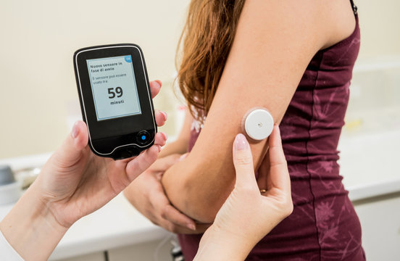

Slide 45
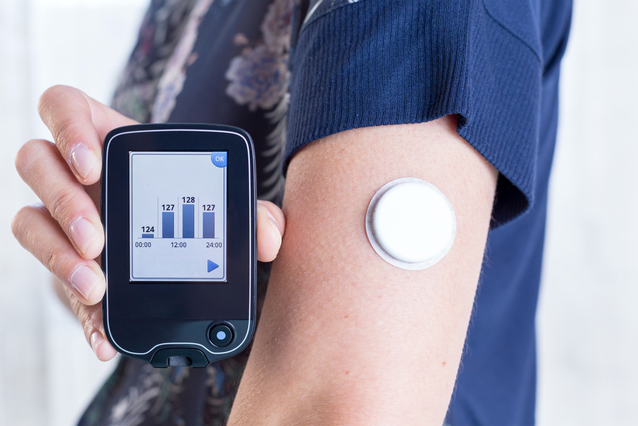

Slide 46


Slide 47
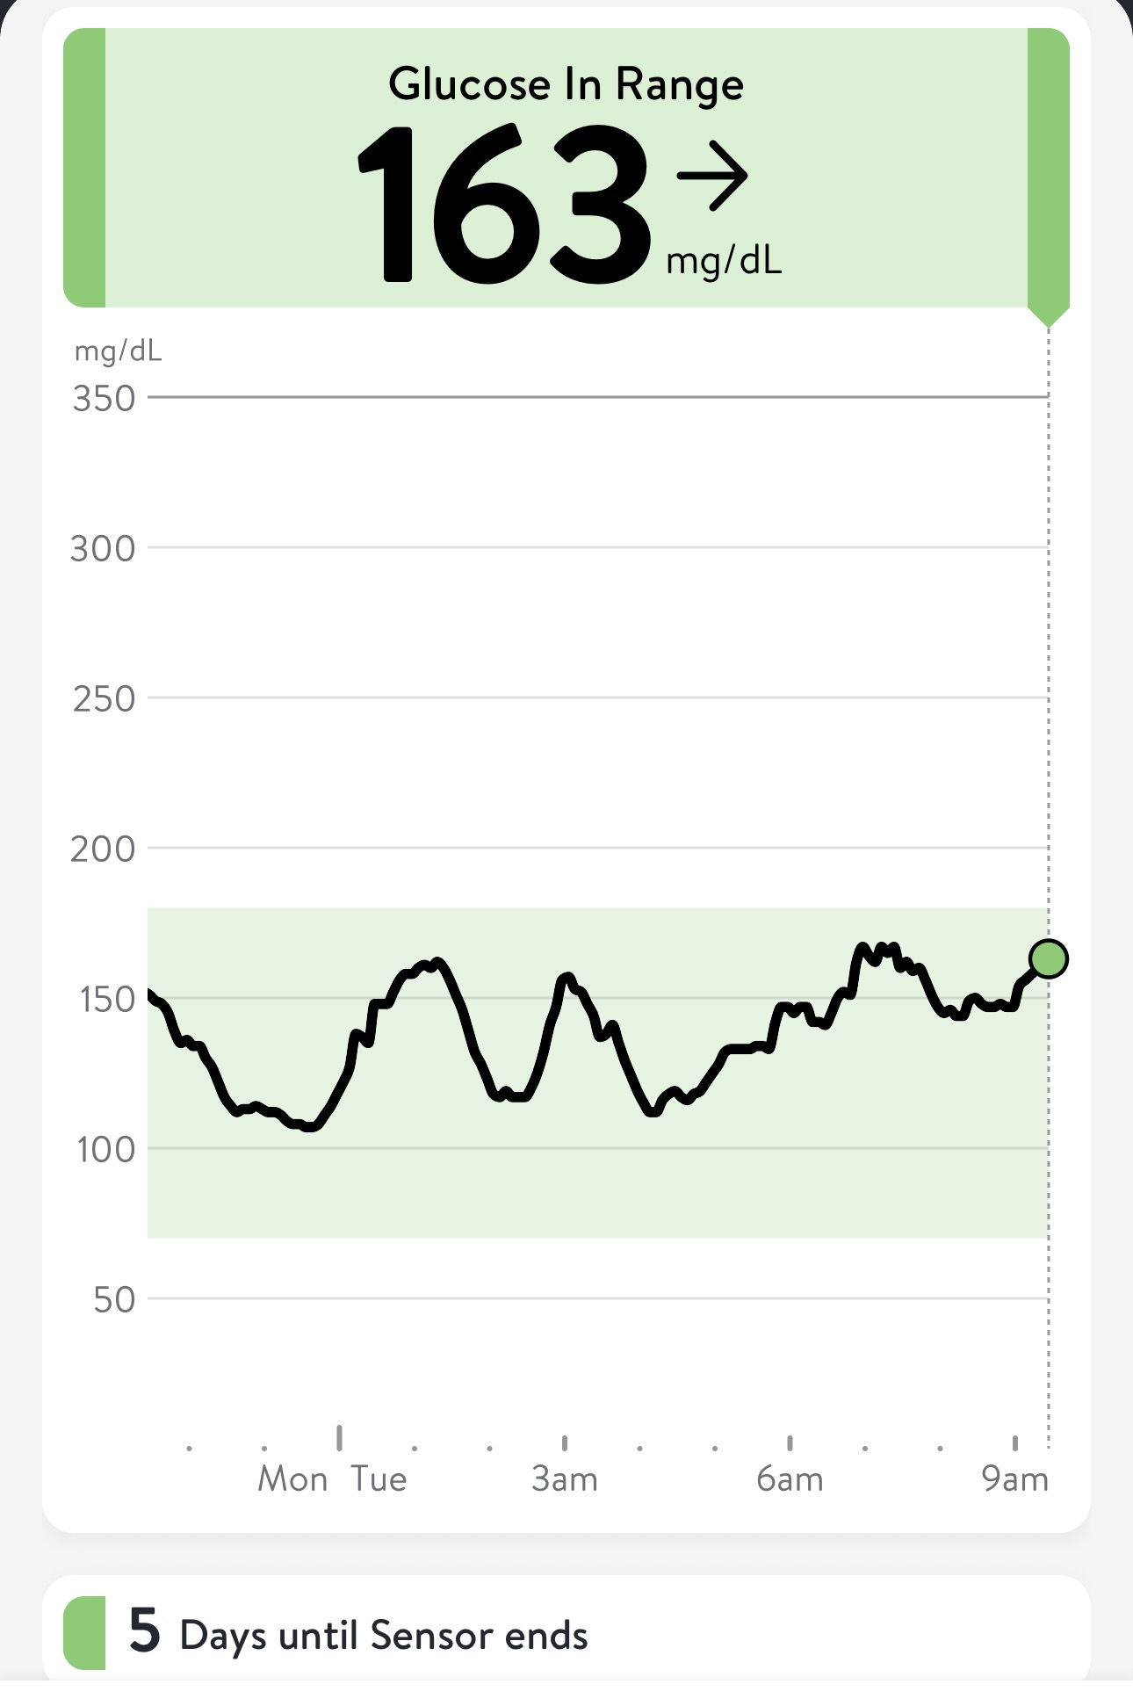

Slide 48
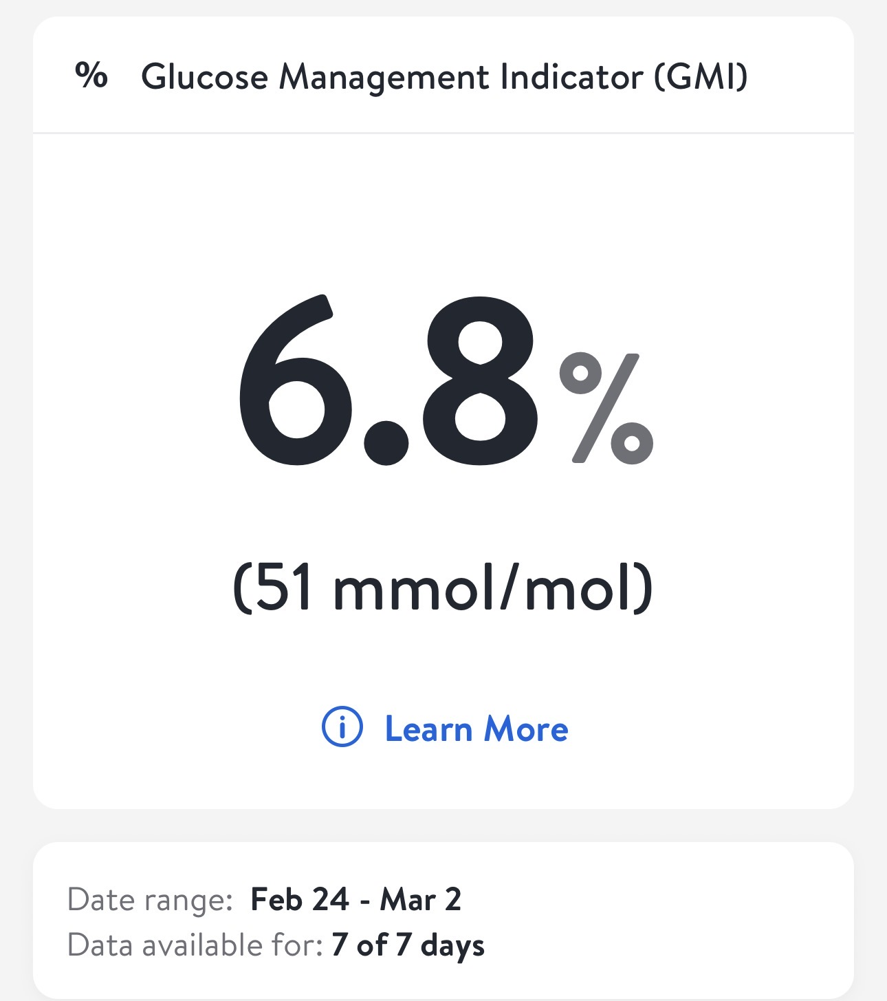

Slide 49
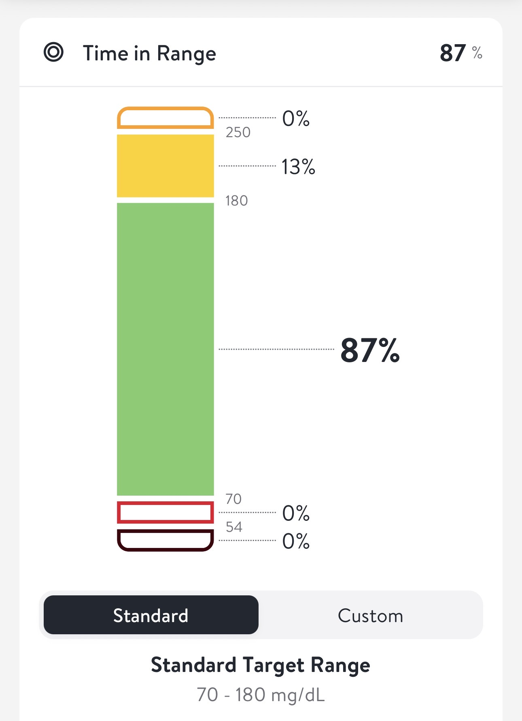

Slide 50
QUESTIONS FOR THE FACULTY
What are the advantages and disadvantages of on-body glucose monitoring systems, and what specific systems are most useful?
Can physicians access the data from on-body glucose monitoring systems directly?
In which situations should an on-body glucose monitoring system be used when starting treatment with a PI3K/AKT inhibitor?

Slide 51
Agenda
Introduction: Use of On-Body Glucose Monitoring Devices
Module 1: Overview of Breast Cancer and Diabetes
Module 2: PI3K/AKT/mTOR Pathway and Glucose Metabolism
Module 3: Case Presentations — Part 1
Module 4: Current Data with Alpelisib, Capivasertib and Inavolisib
Module 5: Prevention and Management of Hyperglycemia
Module 6: Case Presentations — Part 2

Slide 52

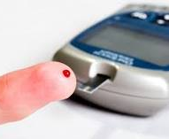


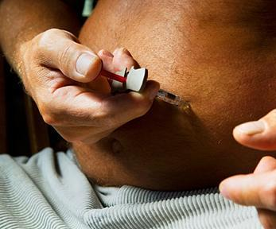


Marie E. McDonnell, MD Director, Brigham and Women's Diabetes Program Chief, Diabetes Section Division of Endocrinology, Diabetes and Hypertension Brigham and Women’s Hospital Associate Professor of Medicine Harvard Medical School
Managing Hyperglycemia associated with agents targeting the PI3K/AKT/mTOR pathway

Slide 53
Today’s Discussion
Brief Background
Review the PI3K/AKT/mTOR pathway and link to glucose levels
The problem of acute hyperglycemia in people with cancer
Explore the available agents targeting the PI3K/AKT/mTOR pathway : Comparative incidence, severity and timing of onset of hyperglycemia with approved (capivasertib, alpelisib, inavolisib) and investigational (eg, gedatolisib)
Discuss current guidelines on optimal monitoring and management of patients receiving approved AKT and PI3K inhibitors

Slide 54


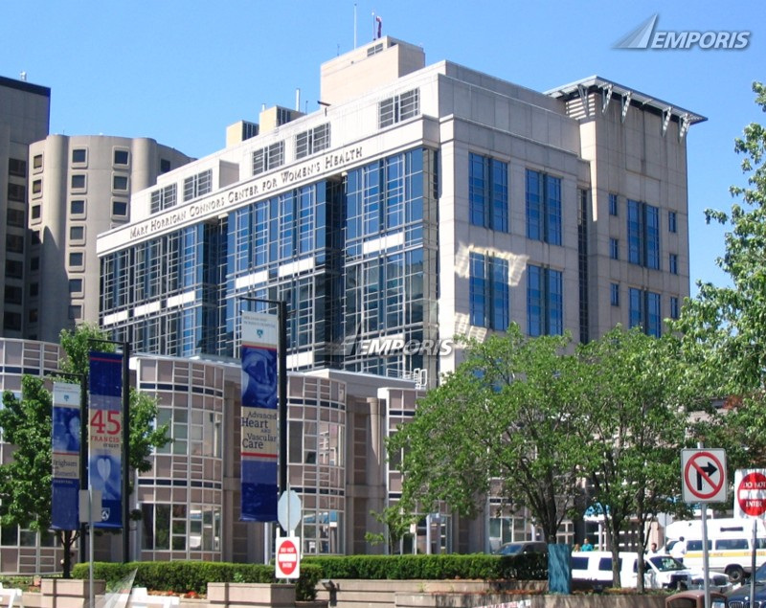
Brigham & Women’s Diabetes program
T1 and T2 Diabetes
Monogenic diabetes
CFRD (Boston Children’s Hospital)
Post-pancreatectomy diabetes
Cancer-related diabetes (Dana Farber Cancer Institute and MGB Cancer Center)
Diabetes in Pregnancy (BWH Maternal Fetal Medicine)
Syndromic diabetes
Secondary diabetes

Slide 55
Diabetes among DFCI patients in Boston, MA
In just 3 years, previous 7 year prevalence doubled
 | 2010 - 2017 | 2010-2020
Total | 1471 | 2805
A1C < 7 | 783 | 1536
A1C > 7 | 500 | 1025
Total number of patients with breast cancer and the diagnosis of type 2 diabetes (A1c + medications OR diagnosis code)

Slide 56
Diabetes & Cancer
Diabetes and cancer:
Multidimensional link
Rising prevalence of obesity & DM
Biological link: Dysmetabolism, immune dysfunction, and cancer
Surge in new cancer therapies
Disjointed patient care services

Slide 57
The breast cancer case
>20% of women with breast cancer in the US have diabetes (approx. double the prevalence in general adult population)
Type 2 diabetes is undiagnosed in almost one-third of individuals with the disease: “surprise” diagnoses are common
Breast cancer survivors with type 2 diabetes
38% higher breast cancer-specific mortality; 49% higher all-cause mortality
For early-stage breast cancer survivors, type 2 diabetes is associated with significantly shorter median disease-free survival (36 vs. 81 months); diabetes may be less impactful on metastatic disease survival
Cheung YM, McDonnell ME, et al. JCEM 107(9), 2022
Eketunde et al, Cureus 12:e8010, 2020
Peairs et al, J Clin Oncol 29:40-6, 2011
Wolf et al, Lancet Onc 6:103-11, 2005

Slide 58
It’s not only common, it’s complicated
Diabetes issues can be complex in cancer and usual care leads to issues such as disruption in chemotherapy or suboptimal management
Patient engagement is challenging because diabetes self-management can be burdensome and may not be prioritized, and >30% of patients express depressive symptoms
Specialized cancer-diabetes care delivery models have not been formally developed and studied
Srokowski TP et al, J Clin Oncol 27:2170-2176, 2009
Rodriguez KM, Clinical Therapeutics 35:170-178, 2013
Harrod JC…McDonnell ME. Diabet Med. 2024 Apr;41(4)

Slide 59
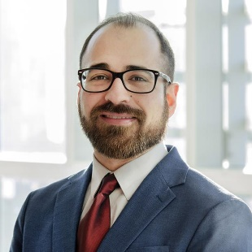

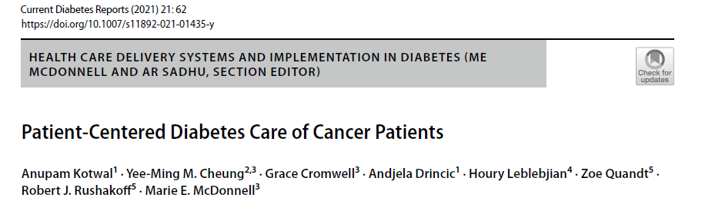
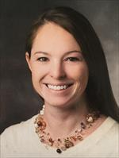

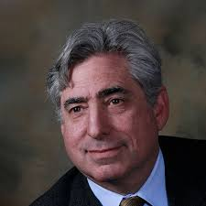

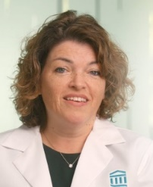
Groups are attempting to organize
Cheung YM, McDonnell M, Hamnvik OR. A targeted approach to phosphoinositide-3-kinase/Akt/mammalian target of rapamycin-induced hyperglycemia. Curr Probl Cancer. 2022
Gallagher EJ, Managing hyperglycemia and rash associated with alpelisib: expert consensus recommendations using the Delphi technique. NPJ Breast Cancer. 2024 Jan 31;10(1):12. doi: 10.1038/s41523-024-00613-x.

Slide 60
Agenda
Introduction: Use of On-Body Glucose Monitoring Devices
Module 1: Overview of Breast Cancer and Diabetes
Module 2: PI3K/AKT/mTOR Pathway and Glucose Metabolism
Module 3: Case Presentations — Part 1
Module 4: Current Data with Alpelisib, Capivasertib and Inavolisib
Module 5: Prevention and Management of Hyperglycemia
Module 6: Case Presentations — Part 2

Slide 61

the PI3K/AKT/mTOR pathway and link to glucose levels

Slide 62
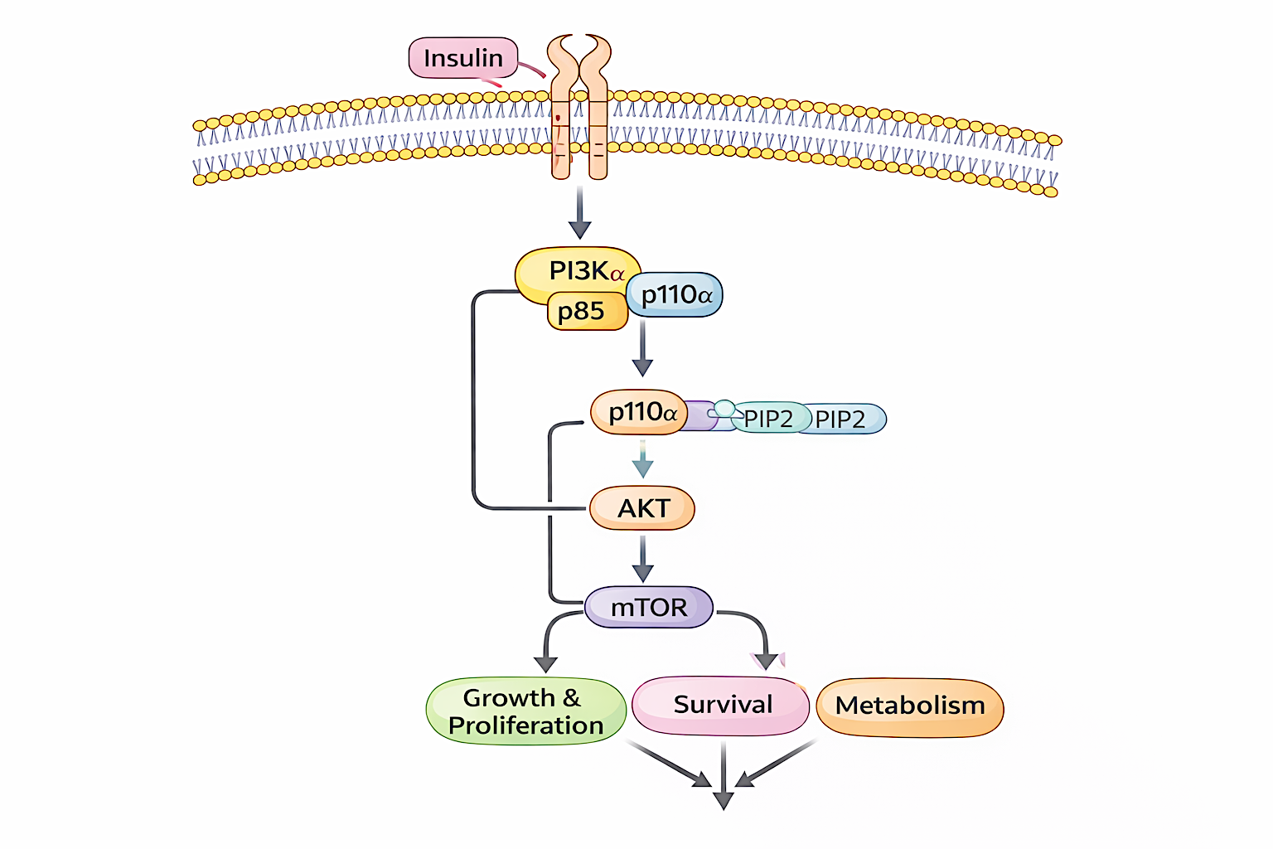
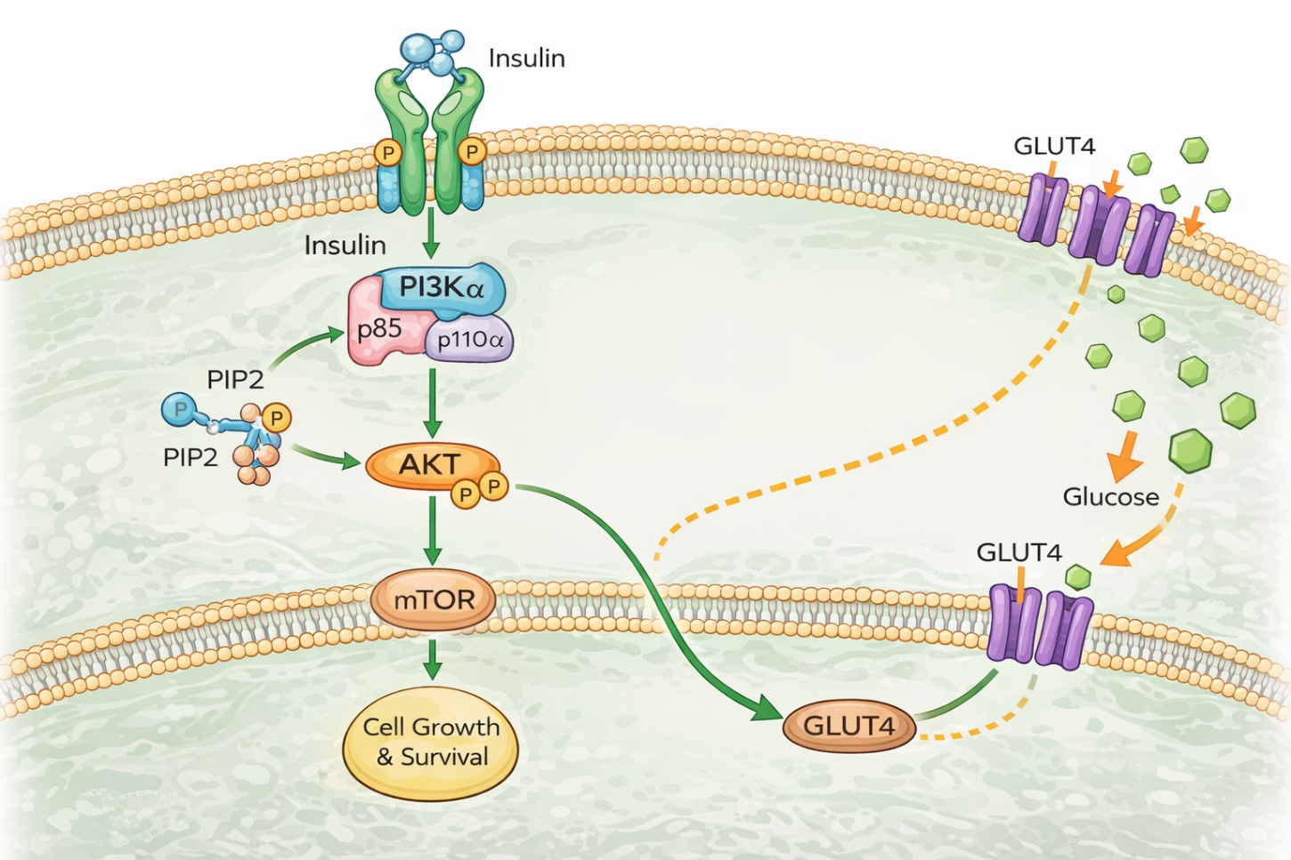
Some cancer cells are dependent on growth signals from insulin-mediated pathways activated by mutated oncogenes
In cancer cells with a PIK3CA mutation, PIK3K α activity increases. Inhibiting PI3K decreases PI3K α activity
Direct inhibition of mTORC1 can upregulate AKT and increase PI3K activity, so either upstream or dual blockade is necessary when mTOR is inhibited
*
*
* Normally PI3Kα supports Glucose transport only into skeletal, adipose cells
*

Slide 63

Some cancer cells are dependent on growth signals from insulin-mediated pathways activated by mutated oncogenes
In cancer cells with a PIK3CA mutation, PIK3K α activity increases. Inhibiting PI3K decreases PI3K α activity
Direct inhibition of mTORC1 can upregulate AKT and increase PI3K activity, so either upstream or dual blockade is necessary when mTOR is inhibited
* PI3Kα supports Glucose transport into skeletal, adipose cells

Slide 64
Isoforms matter
PI3K isoforms are expressed in different tissues and possess specialized functions, hence their inhibition leads to unique adverse effects
PI3Kα (alpelisib, inavolisib) - specific to uptake of glucose into skeletal and adipose tissues, regulates glucose output from liver
Other - PI3K (idelalisib, duvelisib) – nonspecific nor potent inhibitors of PI3Kα
Srokowski TP et al, J Clin Oncol 27:2170-2176, 2009
Rodriguez KM, Clinical Therapeutics 35:170-178, 2013
Harrod JC…McDonnell ME. Diabet Med. 2024 Apr;41(4).C

Slide 65
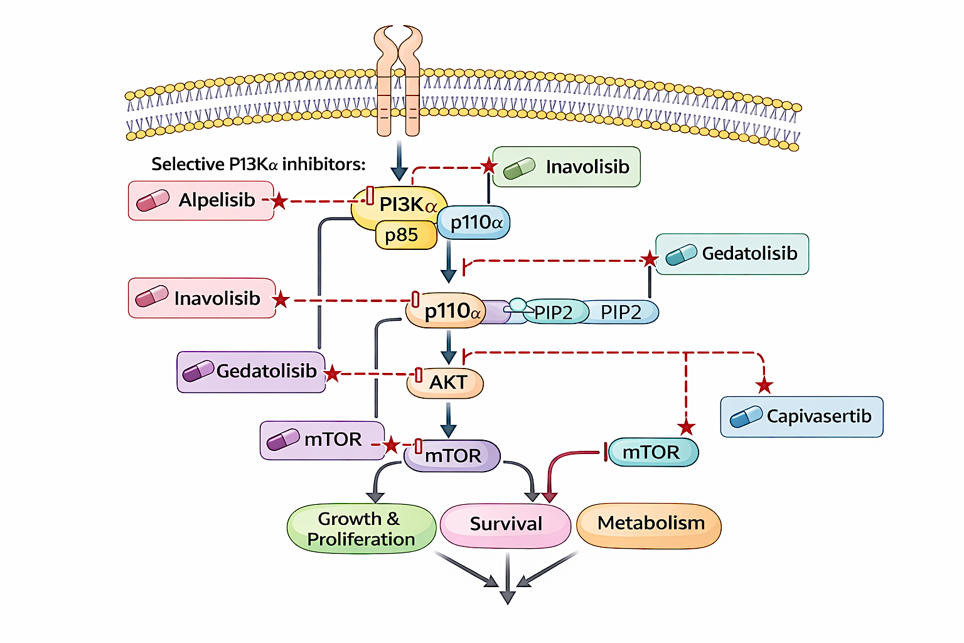
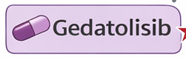
Insulin
*
*
* Supports Glucose transport into skeletal, adipose and
Hepatocytes
*

Slide 66
Downstream Pan-AKT Inhibition
Capivasertib targets all 3 AKT isoforms (AKT1/2/3), inhibiting signaling driven by PIK3CA, AKT1 and/or PTEN alterations.
In combination with fulvestrant, capivasertib is approved in the US for adults with HR-positive, HER2-negative locally advanced or metastatic breast cancer with ≥1 PIK3CA, AKT1 or PTEN alterations, after disease progression on ≥1 endocrine therapy (ET)-based regimen in the metastatic setting or recurrence on or within 12 months of completing adjuvant ET.
As capivasertib inhibits physiologic PI3K/AKT pathway signaling, it leads to on-target, off-tumor toxicities. The most common adverse events are diarrhea, cutaneous adverse reactions and elevated glucose levels.
Iyengar NM et al. NPJ Breast Cancer 2025 December 4;12(1):16.

Slide 67
QUESTIONS FOR THE FACULTY
By what mechanism do PI3K/AKT inhibitors cause hyperglycemia?
By what mechanism do corticosteroids cause hyperglycemia?

Slide 68
Agenda
Introduction: Use of On-Body Glucose Monitoring Devices
Module 1: Overview of Breast Cancer and Diabetes
Module 2: PI3K/AKT/mTOR Pathway and Glucose Metabolism
Module 3: Case Presentations — Part 1
Module 4: Current Data with Alpelisib, Capivasertib and Inavolisib
Module 5: Prevention and Management of Hyperglycemia
Module 6: Case Presentations — Part 2

Slide 69
Dr Rugo Case: 79-year-old woman HR+/HER2- MBC: Capivasertib and Fulvestrant
79 yo woman
Left breast ER+/PR- ILD diagnosed in 2001 with 1/14 positive nodes
Treated with chemotherapy, surgery, radiation, tamoxifen for 2.5 years, then exemestane for 8 years stopping in 2012
2020 diagnosed with metastatic disease to pleura and bone; ER+/PR-/HER2 1+
Treated with letrozole/palbociclib x 2.5 years then letrozole/abemaciclib (due to anemia) for 1.5 years with PD in liver and Tx dependent anemia
Liver biopsy ER/PR+/HER2 0; NGS + ESR1 (40%) and PIK3CA (38%) mutations
Treated with elacestrant/ribociclib on a clinical trial x one year with slow progression in liver
12/2024 Fulvestrant and capivasertib 400 mg BID
Normal fasting glucose and HgbA1c (5.4)

Slide 70
Dr Rugo Case: 79-year-old woman (continued) Hyperglycemia
12/29/24 after visiting with family developed low grade fever, diarrhea
12/30/24 labs: normal glucose
12/31/24 fever returned with worsening diarrhea and malaise
Sent to ED
Glucose 461!
Cultures negative, capivasertib held, hydrated and treated with insulin with normalization of labs, resolution of diarrhea
1/15/25
Restarted capivasertib at 320 mg, and metformin 500 mg BID
Tolerated well without further hyperglycemic episodes
12/25 progressive disease with ascites, bowel involvement
Started on dose reduced T-DXd

Slide 71
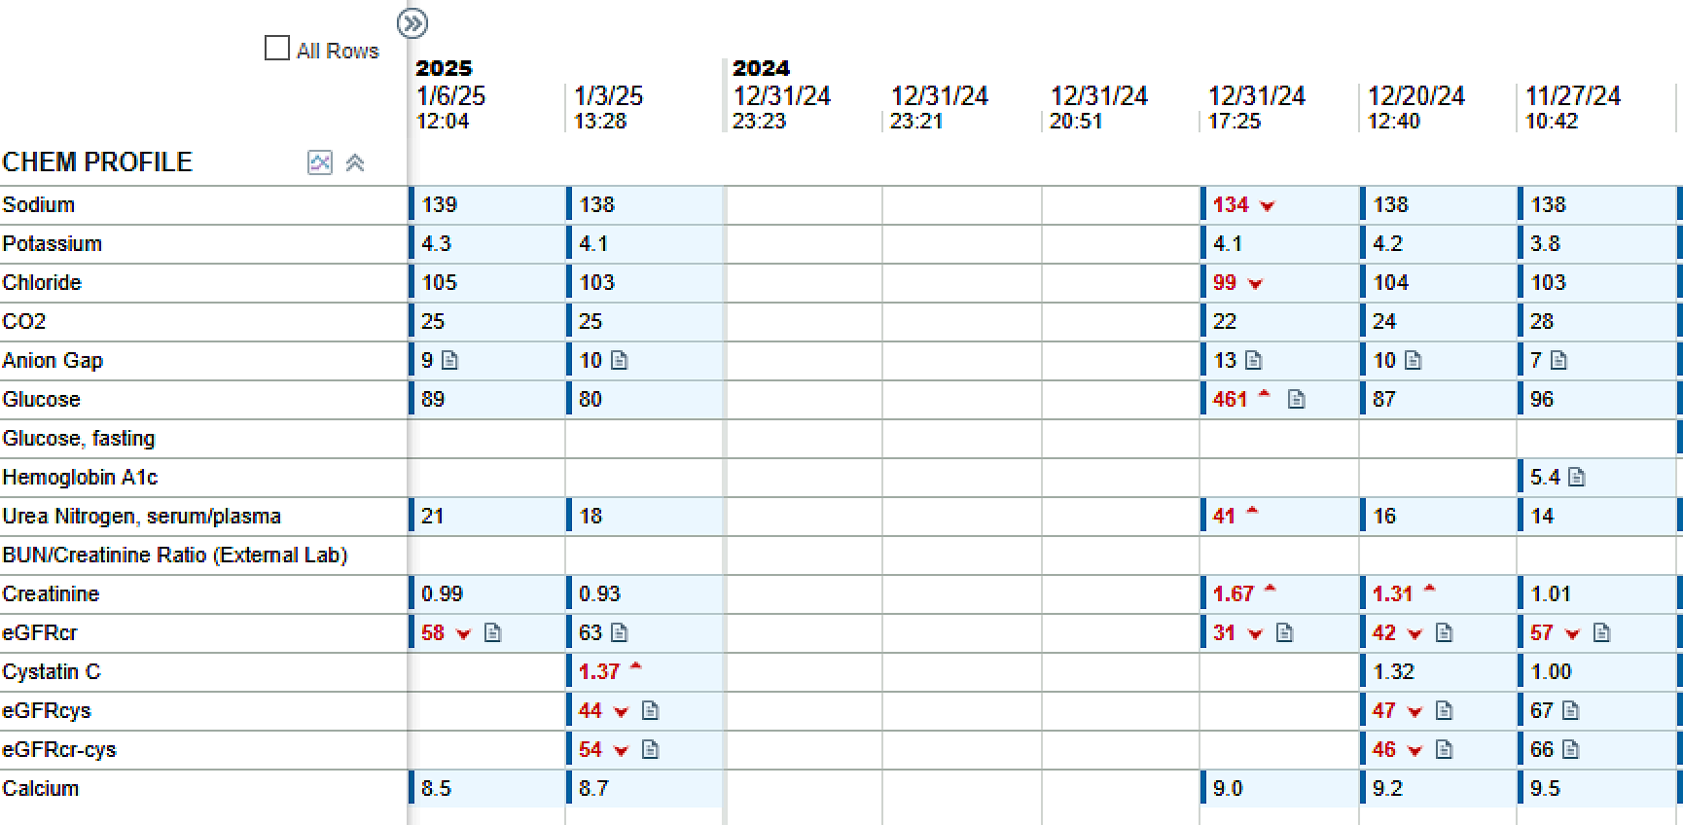
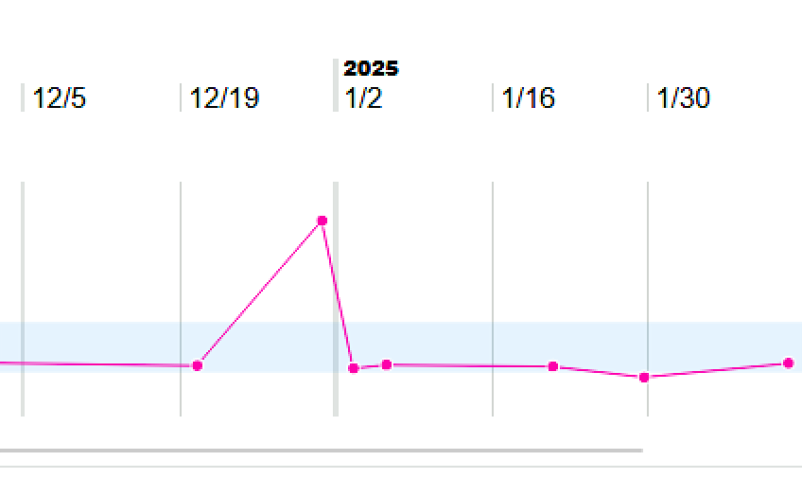
Dr Rugo Case: 79-year-old woman (continued)

Slide 72

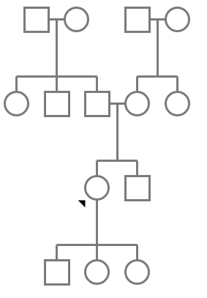
Prof Curigliano Case: 61-year-old woman
61-year-old overweight woman (BMI: 31 kg/m²) with family history of cancer
Diagnosed with metastatic ER+/HER2-low BC (germline BRCA2 mutation)
Receives first-line ribociclib/letrozole
One year later undergoes bilateral nipple-sparing mastectomies for disease progression
Genetic testing reveals PIK3CA E542K mutation
Patient receives capivasertib/fulvestrant
Baseline assessment:
Fasting glucose: 126 mg/dL
Hemoglobin A1C 5.2%
Ovarian
cancer
Died 53y
Pancreatic
cancer
Died 57y
Prostate
cancer
Died 65y
Deceased
BMI: Body mass index; y: years

Slide 73
Ms Carroll Case: 79-year-old woman
79 yo female, diagnosed in 2020. IDC, Grade III, ER/PR positive, HER2 Negative by FISH s/p bilateral mastectomy (pT2N3a). Adjuvant AC/T, radiation and Anastrozole.
Presented fall of 2025 with acute SOB. Imaging revealed pleural effusion and cytology from thoracentesis was positive for malignancy, consistent with breast primary.

Slide 74
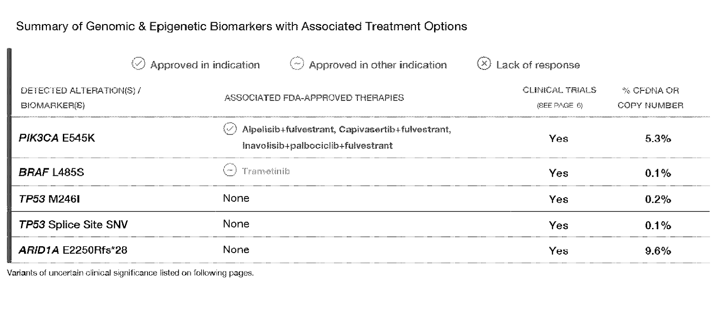
Ms Carroll Case: 79-year-old woman (continued)

Slide 75
Ms Carroll Case: 79-year-old woman (continued)
Started Palbociclib 125 mg, Inavolisib 9 mg and Fulvestrant
Within 2 weeks, FG 199
Patient instructed to hold Inavolisib but continue to check BG
One week later, FG 214
Two days later, FG 229
Addit. Two days later, FG 262

Slide 76
Agenda
Introduction: Use of On-Body Glucose Monitoring Devices
Module 1: Overview of Breast Cancer and Diabetes
Module 2: PI3K/AKT/mTOR Pathway and Glucose Metabolism
Module 3: Case Presentations — Part 1
Module 4: Current Data with Alpelisib, Capivasertib and Inavolisib
Module 5: Prevention and Management of Hyperglycemia
Module 6: Case Presentations — Part 2

Slide 77
Patient Eligibility in Randomized Clinical Trials of Approved PI3K/AKT Inhibitors
Trial | Agent | Eligibility by fasting glucose | Eligibility by HbA1c
SOLAR-1 | Alpelisib | ≤140 mg/dL | ≤6.4%
CAPItello-291 | Capivasertib | _ | <8%
INAVO120 | Inavolisib | <126 mg/dL | <6%
André F et al. Ann Oncol 2021;32(2):208-17; Turner NC et al. N Engl J Med 2023:388(22):2058-70; Jhaveri KL et al. N Engl J Med 2025;393(2):151-61.

Slide 78
Hyperglycemia Grading for Approved PI3K/AKT Inhibitors
Grade 1 | Grade 2 | Grade 3 | Grade 4
FG > 125-150 mg/dL or 6.9 to 8.9 mmol/L or HBA1C > 7%* | FG > 160 to 250 mg/dL or > 8.9 to 13.9 mmol/L | FG > 250 to 500 mg/dL or > 13.9 to 27.8 mmol/L | FG > 500 mg/dL or > 27.8 mmol/L
* Capivasertib only
Alpelisib package insert, July 2025; capivasertib package insert, February 2025; inavolisib package insert, December 2025.

Slide 79
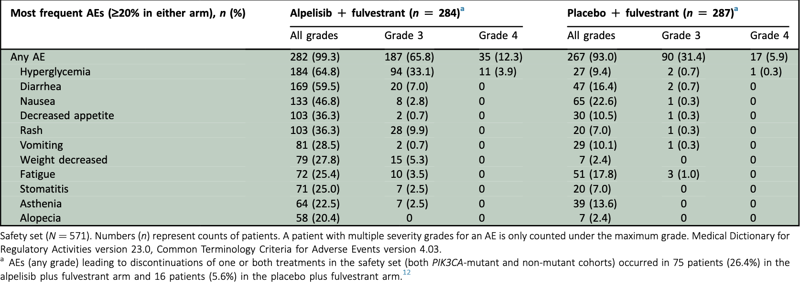
SOLAR-1 Trial: Updated Adverse Events (AEs) with Alpelisib in Combination with Fulvestrant for Advanced Breast Cancer with a PIK3CA Mutation
André F et al. Ann Oncol 2021;32(2):208-17.

Slide 80
SOLAR-1: Hyperglycemia (≥20% in Either Arm)
Alpelisib + fulvestrant (n = 284) |  |  | Placebo + fulvestrant (n = 287)
All grades | Grade 3 | Grade 4 | All grades | Grade 3 | Grade 4
184 (64.8) | 94 (33.1) | 11 (3.9) | 27 (9.4) | 2 (0.7) | 1 (0.3)
n (%)
André F et al. Ann Oncol 2021;32(2):208-17.

Slide 81
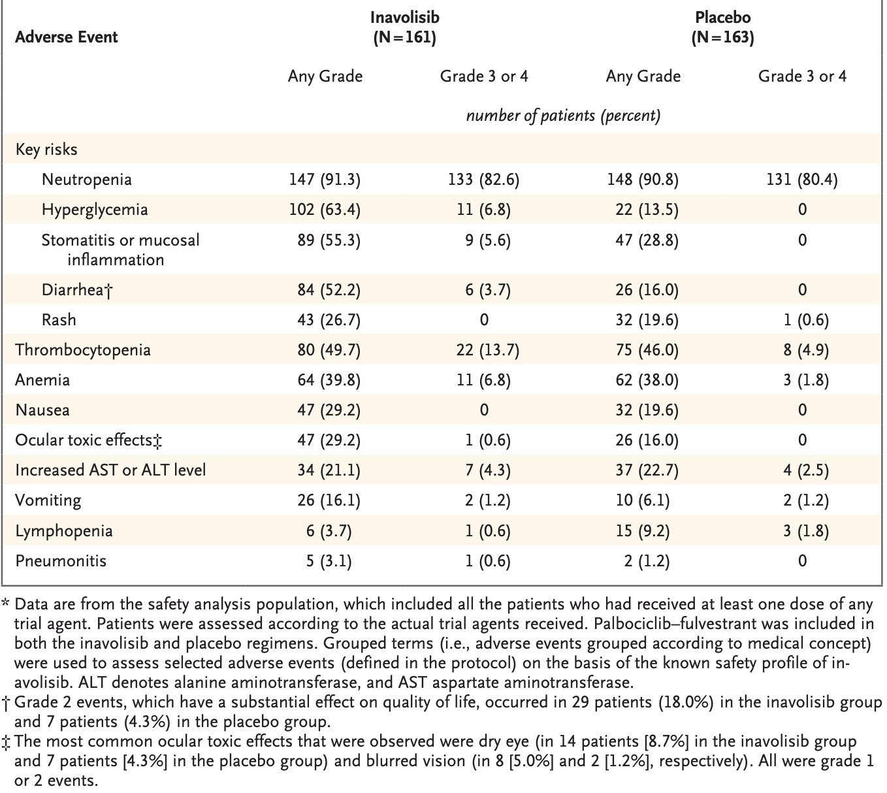
INAVO120 Trial: Select Adverse Events with Inavolisib
Jhaveri KL et al. N Engl J Med 2025;393(2):151-61.

Slide 82
INAVO120: Hyperglycemia
Inavolisib (n = 161) |  | Placebo (n = 163)
Any grade | Grade 3 or 4 | Any grade | Grade 3 or 4
102 (63.4) | 11 (6.8) | 22 (13.5) | 0
n (%)
Jhaveri KL et al. N Engl J Med 2025;393(2):151-61.

Slide 83
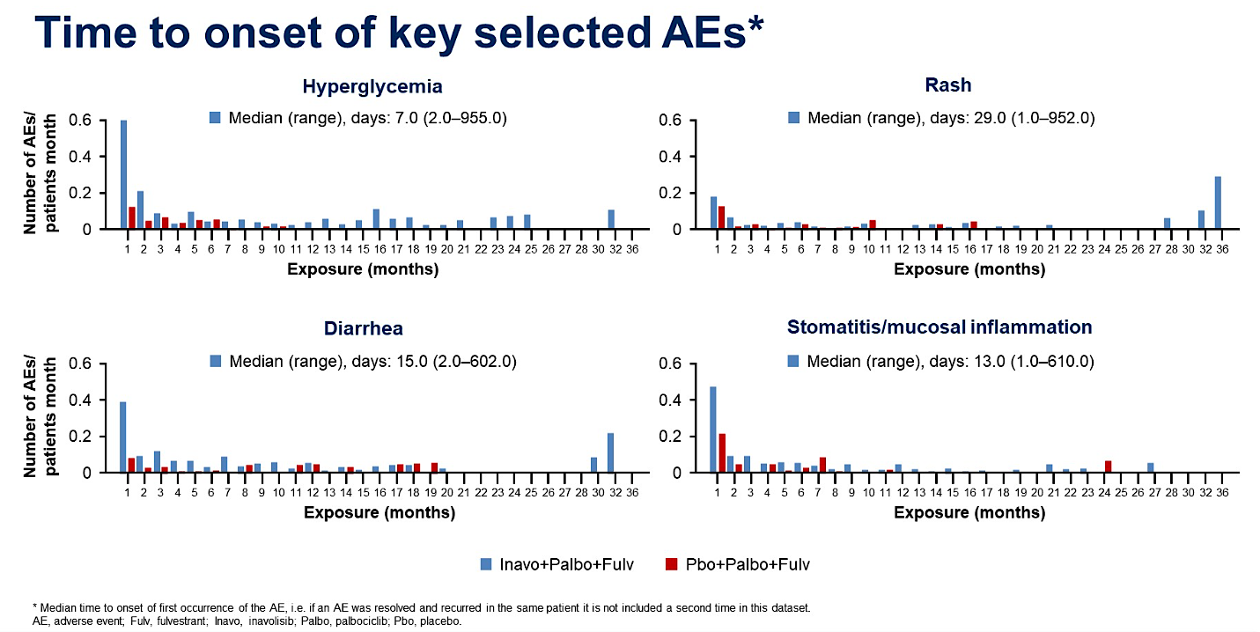
Hyperglycemia in patients receiving inavolisib
Jhaveri KL et al. N Engl J Med. 2025 Jul 10;393(2):151-161; Juric D et al. ASCO 2024
Courtesy of Prof Giuseppe Curigliano MD, PhD

Slide 84
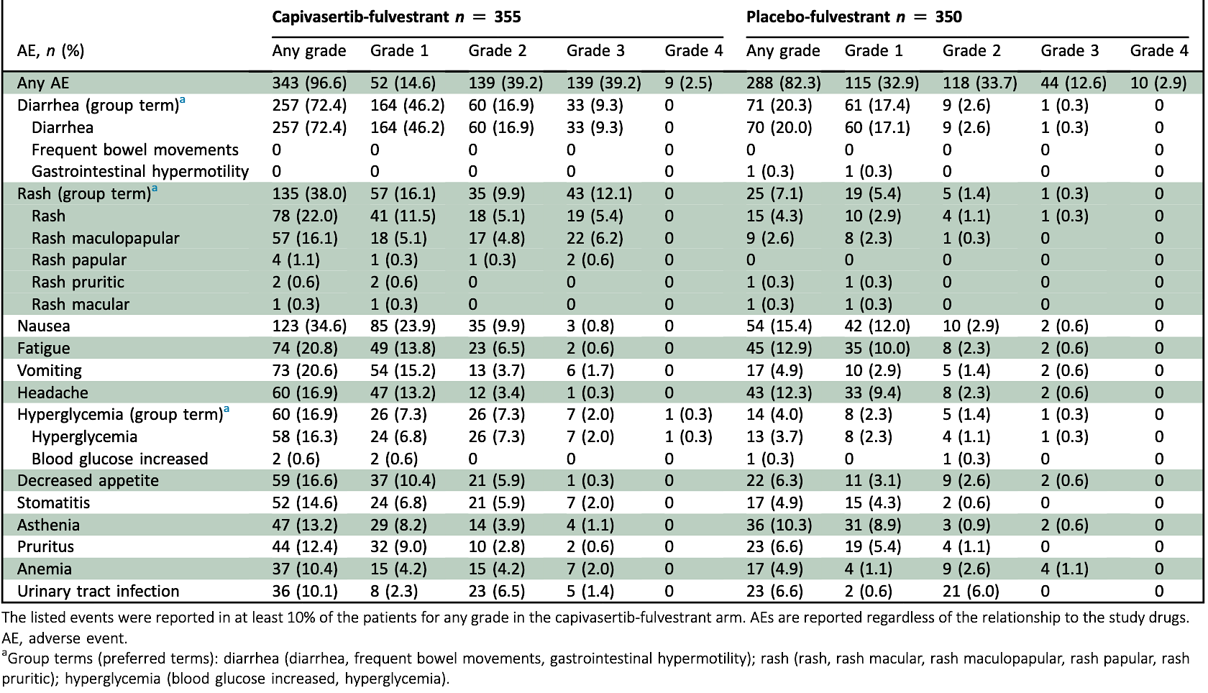
CAPItello-291 Trial: Most Frequent Adverse Events of Any Grade
Rugo H et al. ESMO Open 2024;9(9):103697.

Slide 85
CAPItello-291: Hyperglycemia
Capivasertib + fulvestrant (n = 355) |  |  |  |  | Placebo + fulvestrant (n = 350)
Any grade | Grade 1 | Grade 2 | Grade 3 | Grade 4 | Any grade | Grade 1 | Grade 2 | Grade 3 | Grade 4
60 (16.9) | 26 (7.3) | 26 (7.3) | 7 (2.0) | 1 (0.3) | 14 (4.0) | 8 (2.3) | 5 (1.4) | 1 (0.3) | 0
n (%)
Rugo H et al. ESMO Open 2024;9(9):103697.

Slide 86
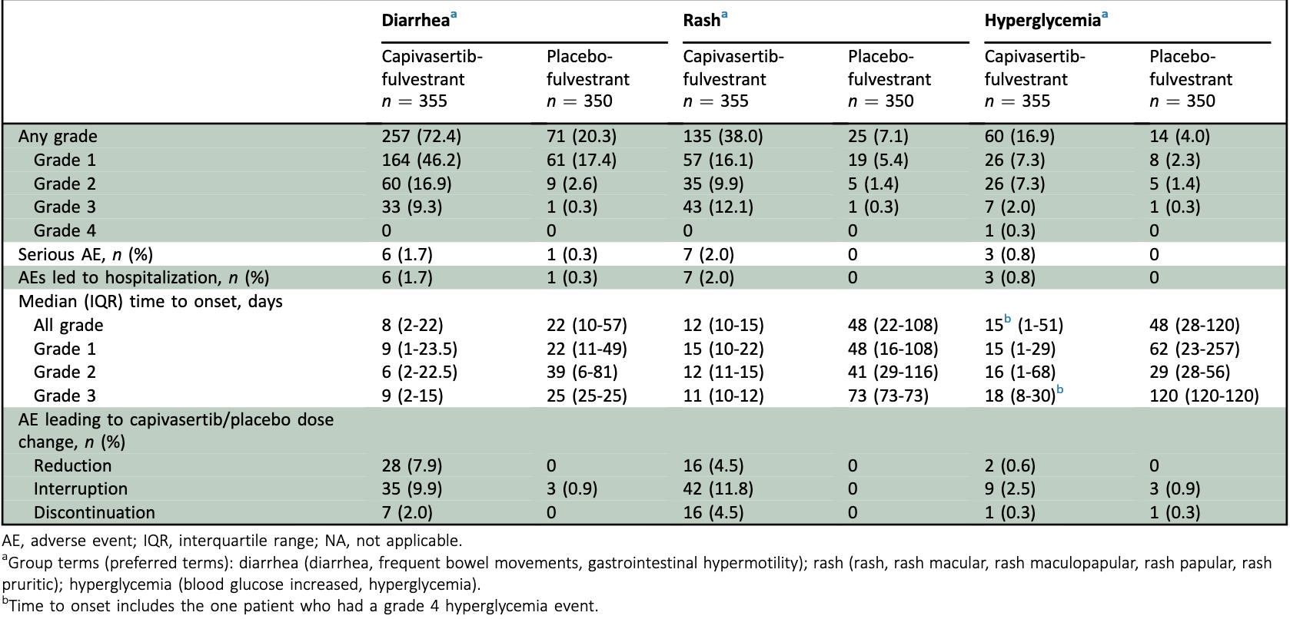
CAPItello-291: Hyperglycemia with Capivasertib/Fulvestrant
Rugo H et al. ESMO Open 2024;9(9):103697.

Slide 87
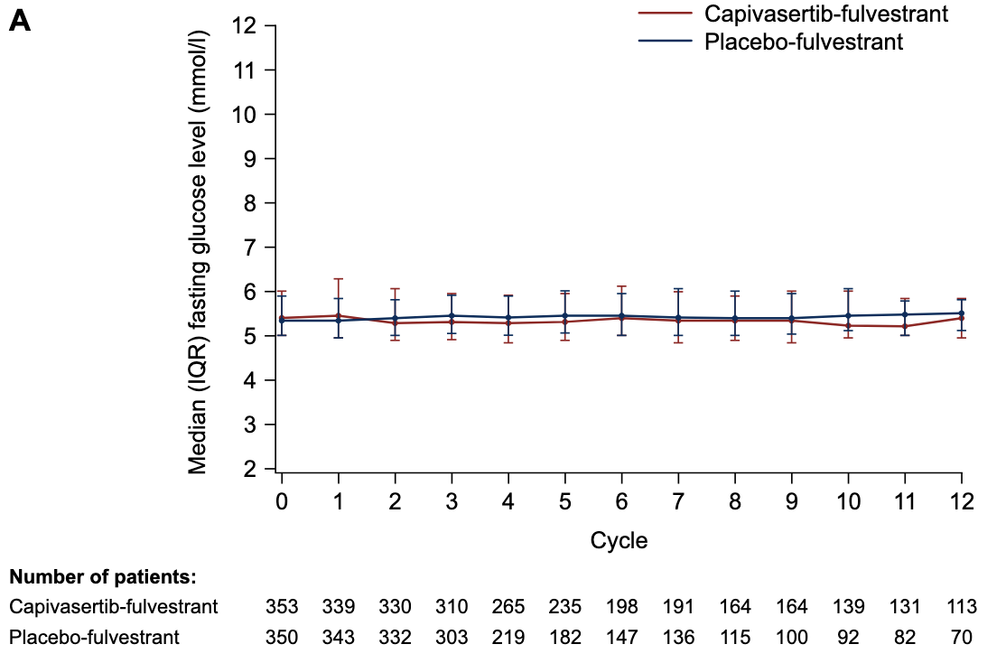
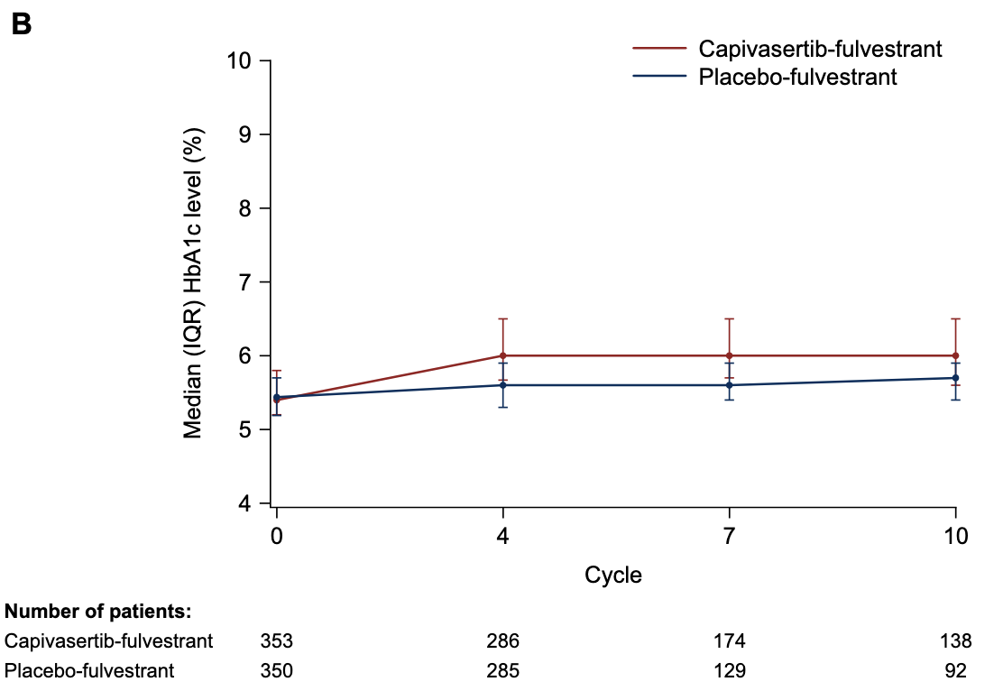
CAPItello-291: Hyperglycemia Markers over Time for Fasting Glucose and HbA1c
Rugo H et al. ESMO Open 2024;9(9):103697.

Slide 88
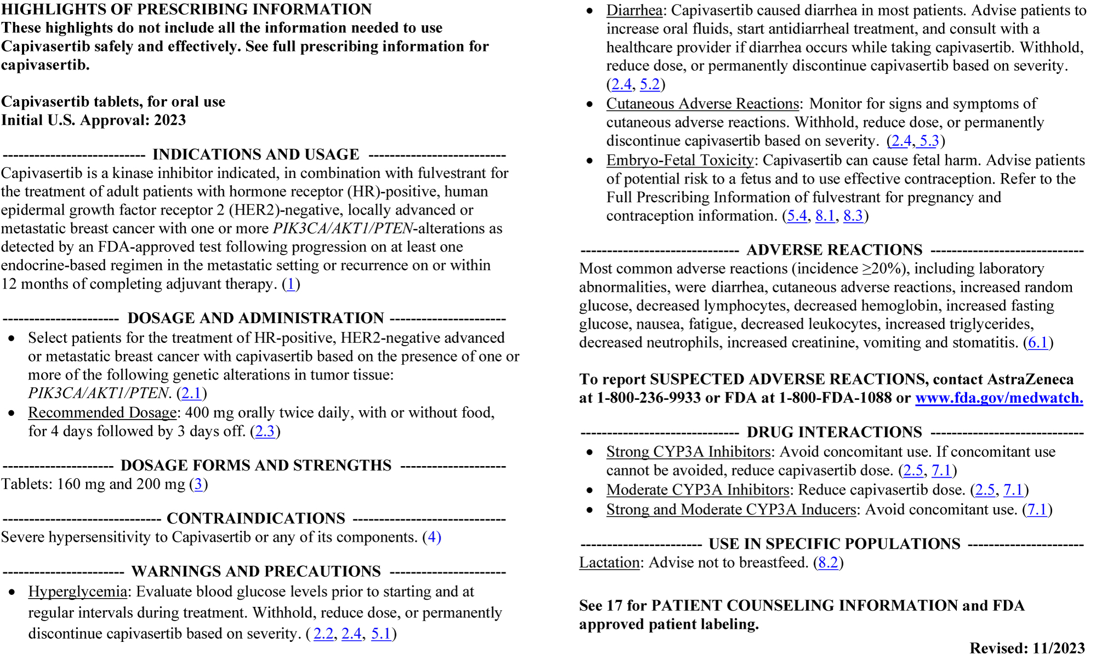
Capivasertib Package Insert November 2023
https://www.accessdata.fda.gov/drugsatfda_docs/label/2023/218197s000lbl.pdf

Slide 89
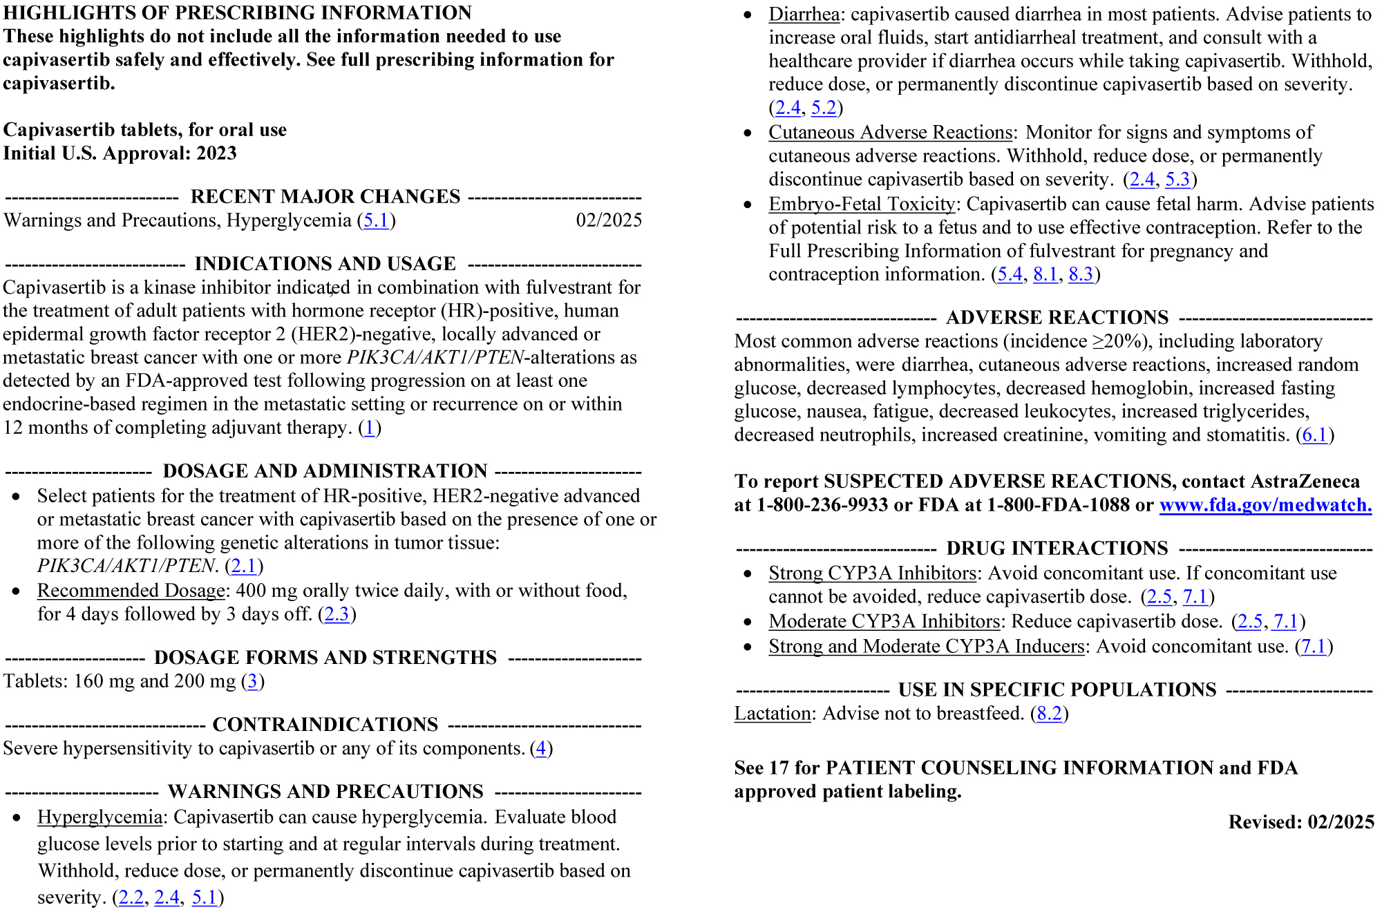
Capivasertib Package Insert February 2025
https://www.accessdata.fda.gov/drugsatfda_docs/label/2025/218197s002lbl.pdf

Slide 90
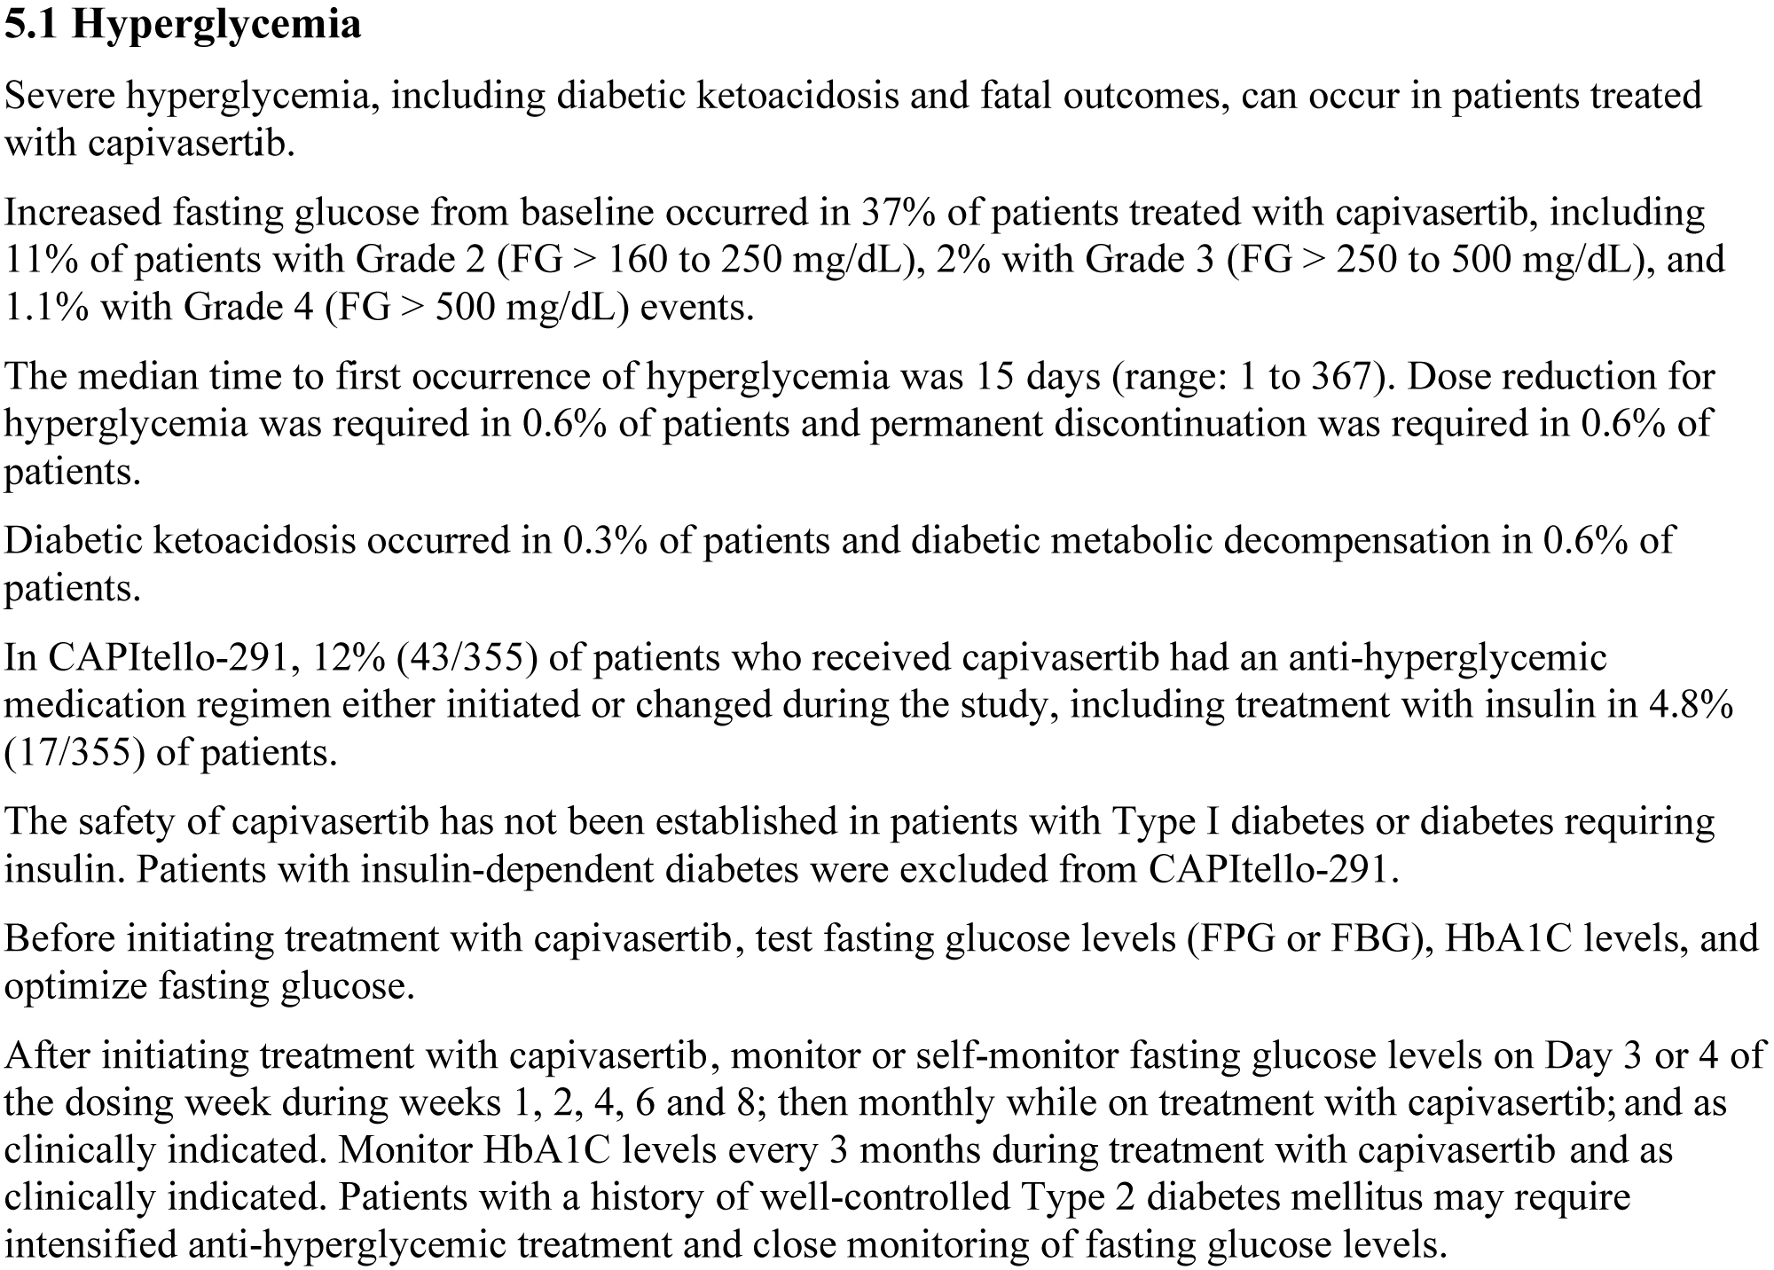
Warnings and Precautions, Hyperglycemia — February 2025
https://www.accessdata.fda.gov/drugsatfda_docs/label/2025/218197s002lbl.pdf

Slide 91
Recommended Monitoring for Hyperglycemia for Approved PI3K/AKT Inhibitors
Agent | Before treatment | After treatment initiation
Alpelisib | Baseline FG and HbA1c* | FG weekly every 2 weeks then at least once every 4 weeks
Capivasertib | Baseline FG and HbA1c* | FG on day 3 or 4 of the dosing week during weeks 1, 2, 4, 6, then 8, then monthly while on treatment
Inavolisib | Baseline FG and HbA1c* | FG every 3 days week 1; once weekly for next 3 weeks; every 2 weeks for 8 weeks; then monthly
*Obtain HbA1c every 3 months, FG = fasting glucose
Alpelisib package insert, July 2025; capivasertib package insert, February 2025; inavolisib package insert, December 2025.

Slide 92
Recommended Dose Modifications for Approved PI3K/AKT Inhibitors
Agent | Starting dose | First dose reduction | Second dose reduction
Alpelisib | 300 mg daily | 250 mg daily | 200 mg daily
Capivasertib | 400 mg BID for 4 days followed by 3 days off | 320 mg BID for 4 days followed by 3 days off | 200 mg BID for 4 days followed by 3 days off
Inavolisib | 9 mg daily | 6 mg daily | 3 mg daily
BID = twice a day
Alpelisib package insert, July 2025; capivasertib package insert, February 2025; inavolisib package insert, December 2025.

Slide 93
QUESTIONS FOR THE FACULTY
What were the entry criteria for the major trials of PI3K/AKT inhibitors in terms of fasting glucose levels and hemoglobin A1c levels? How were the trials designed?
What specifically has been observed in the in trials of PI3K/AKT inhibitors in terms of the timing of onset and frequency of hyperglycemia and diabetes?

Slide 94
Agenda
Introduction: Use of On-Body Glucose Monitoring Devices
Module 1: Overview of Breast Cancer and Diabetes
Module 2: PI3K/AKT/mTOR Pathway and Glucose Metabolism
Module 3: Case Presentations — Part 1
Module 4: Current Data with Alpelisib, Capivasertib and Inavolisib
Module 5: Prevention and Management of Hyperglycemia
Module 6: Case Presentations — Part 2

Slide 95
Second Opinion: Clinical Investigators Provide Perspectives on the Future Role of AKT Inhibition in the Management of Prostate Cancer
A CME Symposium Held Adjunct to the 2026 ASCO® Genitourinary Cancers Symposium
Friday, February 27, 2026 6:00 PM – 7:30 PM PT (9:00 PM – 10:30 PM ET)
Faculty
Professor Karim Fizazi, MD, PhD
Daniel George, MD
Moderator
Elisabeth I Heath, MD

Slide 96

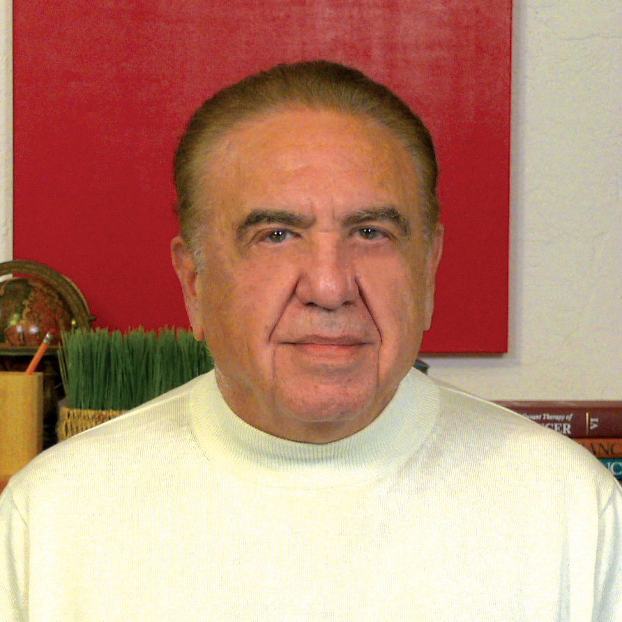
Second Opinion
Rana R McKay, MD, FASCO
Neil Love, MD

Slide 97
71-year-old obese man with Type 2 diabetes (HbA1c 7.4%) presents with high volume mHSPC, PTEN deficient on NGS
71-year-old gentleman who presented with a PSA of 85 ng/mL and bone pain
Workup showed Gleason 8 prostate cancer
PSMA PET scan shows widespread bony metastases, retroperitoneal adenopathy
PTEN deficient on NGS
Patient has Type 2 diabetes, receiving metformin
Last HbA1c was 7.4% and fasting blood sugars are in the 140 to 160 range
He is obese (BMI 31)
GFR ~55 mL/min/1.73 m²

Slide 98
QUESTIONS FOR THE FACULTY
What issues are likely to occur related to hyperglycemia in patients with prostate cancer receiving abiraterone/prednisone/capivasertib?

Slide 99
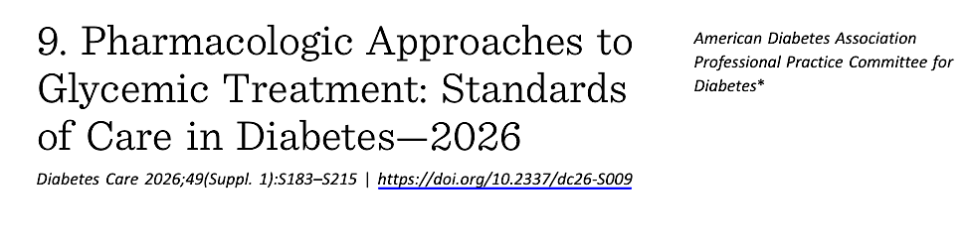
2026 American Diabetes Association Diabetes Standards of Care includes Therapeutic Strategies for Individuals Receiving Cancer Treatment
Courtesy of Marie McDonnell, MD

Slide 100
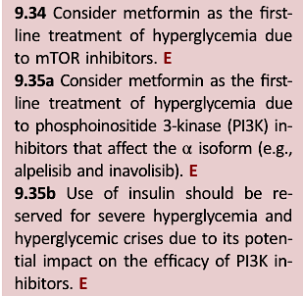
2026 American Diabetes Association Diabetes Standards of Care Therapeutic Strategies for Individuals Receiving Cancer Treatment
Evidence is lacking for strong recommendations on prescreening, prevention and management
Courtesy of Marie McDonnell, MD

Slide 101
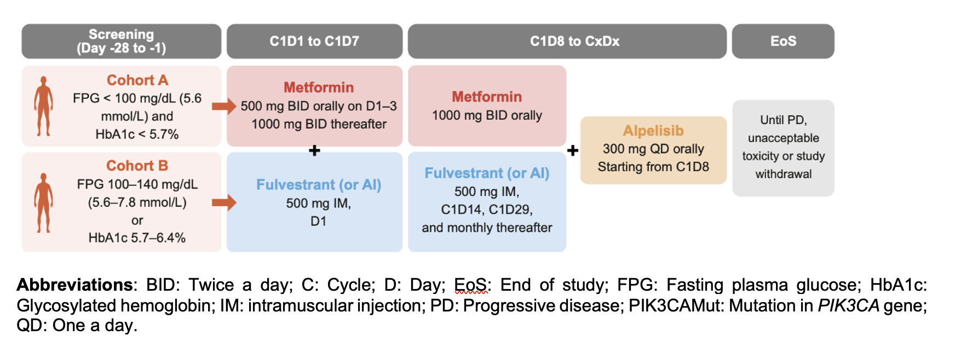
Phase II METALLICA Study: Metformin for Preventing Alpelisib-Associated Hyperglycemia in Hormone Receptor-Positive, HER2-Negative, PIK3CA-Mutated Breast Cancer
Llombart-Cussac A et al. EClinicalMedicine 2024;71:102520.

Slide 102
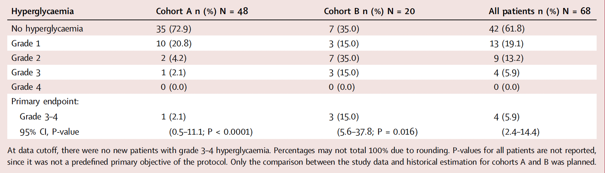
METALLICA: Hyperglycemia over the First 8 Weeks of Treatment
Llombart-Cussac A et al. EClinicalMedicine 2024;71:102520.

Slide 103
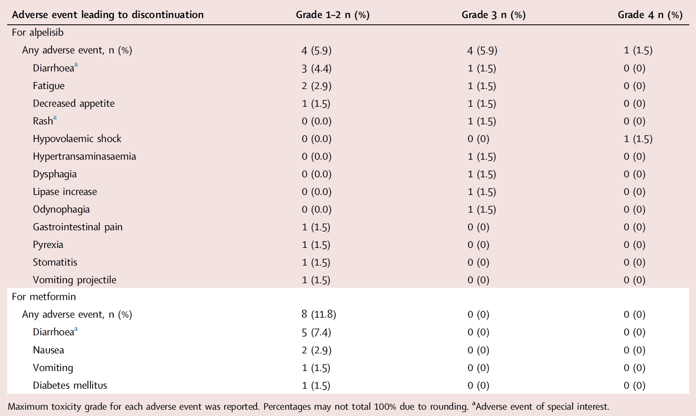
METALLICA: Adverse Events Leading to Discontinuation
Llombart-Cussac A et al. EClinicalMedicine 2024;71:102520.

Slide 104
Preferred second line agents to add after metformin
Class | Mechanism of Action | Key Clinical Considerations
Thiazolidinediones (TZDs): Daily pill Pioglitazone | PPAR-γ agonists → ↑ insulin sensitivity in adipose tissue, muscle, and liver | Avoid in heart failure (fluid retention, edema risk) Time for full effect: 4-6 weeks
SGLT-2 inhibitors: Daily pill Empagliflozin; Dapagliflozin; Canagliflozin | Block renal glucose reabsorption in proximal tubule → ↑ urinary glucose excretion | ⚠️ Monitor for DKA (including euglycemic DKA). Advise increased hydration Time for effect: 2 days
GLP-1 receptor agonists Daily pill or weekly injection Semaglutide; Tirzepatide | Enhance glucose-dependent insulin secretion, suppress glucagon, slow gastric emptying, ↑ satiety | ⚠️ Use only if baseline nausea is controlled. Increases early post-meal insulin secretion but overall insulin dependence is reduced so on balance may have anti-tumor effect Time for effect: 1 week
Basal insulin Daily injection Glargine | Provides steady background insulin → suppresses hepatic glucose production | ⚠️Requires glucose monitoring and hypoglycemia education
Sulfonylureas Glimepiride, glipizide, glyburide | Increases endogenous secretion of insulin | ⚠️Requires glucose monitoring and hypoglycemia education
Courtesy of Marie McDonnell, MD

Slide 105
QUESTIONS FOR THE FACULTY
What is the optimal approach to therapy for a patient with preexisting hyperglycemia or diabetes who is a candidate to receive a PI3K/AKT inhibitor?
What preemptive therapies (eg, metformin) should be recommended to patients starting on PI3K/AKT inhibitors?
Which preparation and dosing schedule of metformin is preferred? What side effects and toxicities need to be managed?

Slide 106
QUESTIONS FOR THE FACULTY
What is the role of other agents used to manage hyperglycemia and diabetes, including insulin, for patients with PI3K/AKT inhibitor-associated hyperglycemia?
What is the role of GLP-1 receptor agonists for patients about to receive PI3K/AKT inhibitors?

Slide 107
QUESTIONS FOR THE FACULTY
What dietary recommendations do you provide to patients receiving PI3K/AKT inhibitors, and in which situations do you refer patients to see a nutritional counselor or dietician?
What recommendations do you provide to patients receiving PI3K/AKT inhibitors regarding exercise?

Slide 108
Agenda
Introduction: Use of On-Body Glucose Monitoring Devices
Module 1: Overview of Breast Cancer and Diabetes
Module 2: PI3K/AKT/mTOR Pathway and Glucose Metabolism
Module 3: Case Presentations — Part 1
Module 4: Current Data with Alpelisib, Capivasertib and Inavolisib
Module 5: Prevention and Management of Hyperglycemia
Module 6: Case Presentations — Part 2

Slide 109
HR+/HER2- MBC: Inavolisib, Palbociclib and Fulvestrant
Dr Rugo Case: 69-year-old woman
69 yo woman from Mexico
2007 stage II node positive HR+ breast cancer
Rx: TAC x 6, tamoxifen to 2014
2021 axillary node recurrence, HR+
TC x 1, then paclitaxel x 9 weeks, mastectomy/AXLD
2021 – 2025 exemestane
Late 2024: bone pain, then axillary node enlargement
3-5/25 workup: grade II IDC in node, extensive bone metastases
Tamoxifen x 3 weeks, then Fulvestrant x 2 with abemaciclib x 5 days (stopped due to toxicity), relocated to U.S. with severe bone pain
U.S.
PET/CT: extensive disease in left breast, bone, nodes, liver
Guardant ctDNA: PIK3CA C420R 9.5%, TMB 9.49
Left breast bx: grade 2 IDC, ER 50%, PR 0, HER2 2+/FISH NA, Ki67 25%
7/25 RT: C7-T2, L3-4 x 5 fractions
8/25: Palbociclib 125 mg, inavolisib 9 mg with continued fulvestrant
HgbA1c: 6.2
Glucose 107

Slide 110
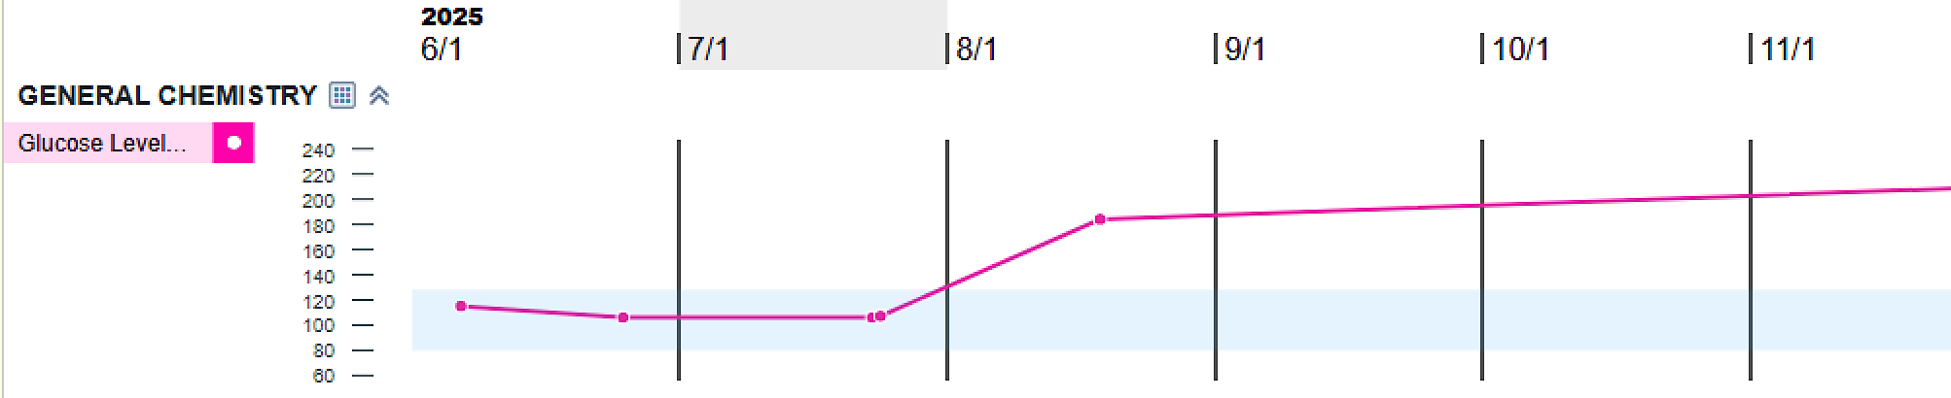
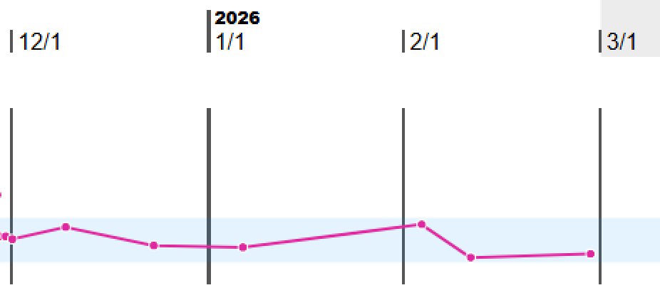
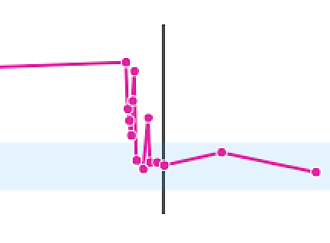
Dr Rugo Case: 69-year-old woman (continued)
8/9/25: Palbo 125 mg 21 days on 7 days off and Inavolisib 9 mg daily.
Meformin 500 mg BID
9/5/25 Sitagliptin 100 mg/d
Meformin 1000 mg BID
8/27/25 Dose reduced inavolisib to 6 mg
ANC 0.51, Palbociclib held, resumed at 100 mg
11/25/25 hospitalized for pneumonia, held Inavolisib and Palbociclib
12/23/25 restart inavolisib 3mg and palbociclib 75mg

Slide 111
Hyperglycemia
Dr Rugo Case: 69-year-old woman (continued)
Bone pain quickly resolved but complicated by diarrhea and hyperglycemia
Dose reduced inavolisib (6 mg) and palbociclib (100 mg)
Anihyperglycemic medications in consult with endocrinology
Imaging: dramatic response with resolution of adenopathy, now sclerotic bone lesions, tiny residual liver lesions
Admitted with fever, hypoxia and diagnosed with pneumonia
Palbociclib and inavolisib held
With recovery, restarted inavolisib at 3 mg and palbociclib

Slide 112
Prof Curigliano Case: 69-year-old woman
69-year-old overweight woman (BMI: 29 kg/m²)
ER+/HER2-low BC (cT2 (m) cN0 cM0) with PIK3CA E542K mutation
Surgery ➞ adjuvant letrozole
Approximately 1 year later PD in liver
Receives inavolisib/fulvestrant
Baseline assessment:
Fasting glucose: 126 mg/dL
Hemoglobin A1C 5.2%
MH and diagnosis | Surgery | Chemotherapy | Radiotherapy | ET + Treatment escalation

Slide 113
Ms Carroll Case: 74-year-old woman
74 yo female, initially diagnosed in 1996. Underwent mastectomy, AC/T and completed 5 years of Tamoxifen in 2001.
2016: Recurrence to bone, ER/PR positive, HER2 Negative. She started ET. Received several therapies (AI, SERD, Tam, CDK4/6i) over the years.
2021: Progression noted in bone, liver and mediastinal LN

Slide 114
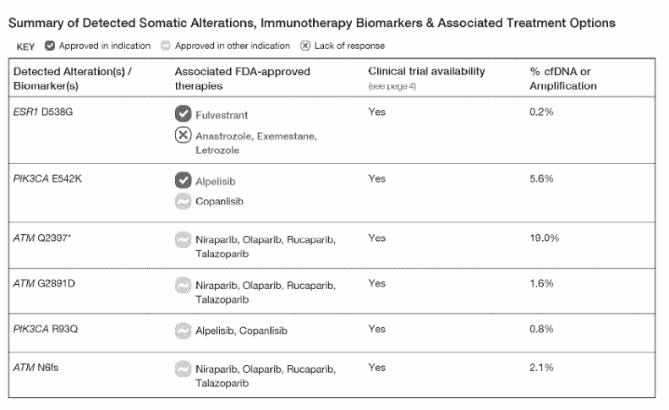
Ms Carroll Case: 74-year-old woman (continued)

Slide 115
Ms Carroll Case: 74-year-old woman (continued)
Started Alpelisib at 150 mg daily
7 days later: FG completed locally but facility did not receive results
4 days later: Patient presented to the ED with weakness, obtunded and BG 700
Stopped Alpelisib and patient declined to restart after hospitalization

Slide 116
Ms Carroll Case: 83-year-old woman
83 year old female, initially diagnosed in 2021 with invasive lobular carcinoma, Grade II, ER/PR positive, HER2 Negative. Upfront mastectomy, pT3N1mi, Oncotype 11.
Recommended radiation, AI with zoledronic acid
2024: Presented with SOB. Imaging revealed large pleural effusion, LN and bony involvement. Started 1L CKD4/6i/Fulvestrant. Progression within one year.

Slide 117

Ms Carroll Case: 83-year-old woman (continued)

Slide 118
Ms Carroll Case: 83-year-old woman (continued)
Started capivasertib 400 mg BID 4 on/3 off/fulvestrant
Baseline hemoglobin A1c 5.5
Patient BG checks on Day 3 of each cycle
Very diligent about ensuring care team responds to her messages

Slide 119
APPENDIX

Slide 120
Prof Curigliano Case: 61-year-old woman
Patient history
Patient profile
61-year-old woman
Caucasian ethnicity
BMI: 31 kg/sm (overweight)
G3P3, menopause at 47 y
Non-smoker, drinks socially
No relevant major comorbidities
No allergies
Family history of cancer:
Father deceased for prostate cancer (65 years old)
Paternal uncle deceased for pancreatic cancer (57 years old)
Paternal grandmother deceased for ovarian cancer (53 years old)
Ovarian
cancer
Died 53y
Pancreatic
cancer
Died 57y
Prostate
cancer
Died 65y
Deceased
BMI: Body mass index; G: gravidity; P: parity; y: years
MH and diagnosis | Surgery | Chemotherapy | Radiotherapy | ET + Treatment escalation

Slide 121



Prof Curigliano Case: 61-year-old woman (continued)
Diagnosis of HR+/HER2-low breast cancer
Aug 2024
Timeline
Diagnosis
Initial presentation
Biannual screening mammography with evidence of new calcifications.
Breast US: at left breast, two hypoechogenic nodules measuring 21x14 mm (A), in the left supero-external quadrant, and 14x9 mm (B), in the superior parareolar site. No axillary lymphadenomegalies. BIRADS: 4c.
A
BIRADS: Breast Imaging-Reporting and Data System; US: ultrasound
B
MH and diagnosis | Surgery | Chemotherapy | Radiotherapy | ET + Treatment escalation

Slide 122

Prof Curigliano Case: 61-year-old woman (continued)
Diagnosis of HR+/HER2-low breast cancer
Aug 2024
Timeline
Diagnosis
Initial presentation
Core biopsy (A). Pathology report
Biannual screening mammography with evidence of new calcifications.
Breast US: at left breast, two hypoechogenic nodules measuring 21x14 mm (A), in the left supero-external quadrant, and 14x9 mm (B), in the superior parareolar site. Axillary lymphadenomegalies. BIRADS: 4c.
IDC NOS, G2.
ER (IHC): 65%; PgR (IHC): 5%; Ki67: 40%; HER2 IHC score: 2+
ISH test: negative.
A
FNAC (B). Pathology report
C5
BIRADS: Breast Imaging-Reporting and Data System; ER: estrogen receptor; FNAC, fine-needle aspiration cytology; G: grade; HER2: human epidermal growth factor receptor 2; IDC: invasive ductal carcinoma; IHC: immunohistochemistry; ISH: in situ hybridization; NOS: not otherwise specified; PgR: progesterone receptor; TNM, tumour–node–metastasis; US: ultrasound
B
Stage: cT2 (m) cN1 cM0 (II)
MH and diagnosis | Surgery | Chemotherapy | Radiotherapy | ET + Treatment escalation

Slide 123
Prof Curigliano Case: 61-year-old woman (continued)
Diagnosis of HR+/HER2-low breast cancer
Aug 2024
Timeline
Diagnosis
Invasive ductal carcinoma G2 of the left breast
ER: 65%; PgR: 5%; Ki67: 40%; HER2-positive
Stage: cT2 (m) cN1 M1 (Liver metastases)
Germline mutation of BRCA2: c.6313delA p.(Ile2105Tyrfs) – class 5
First line treatment with letrozole and ribociclib
+ genetic counseling indicated
ER: estrogen receptor; G: grade; HER2: human epidermal growth factor receptor 2; PgR: progesterone receptor; TNM, tumour–node–metastasis
MH and diagnosis | Surgery | Chemotherapy | Radiotherapy | ET + Treatment escalation

Slide 124
Prof Curigliano Case: 61-year-old woman (continued)
First line therapy
Aug 2024
Sept 2024
Timeline
Diagnosis
First line treatment
Letrozole and ribociclib
MH and diagnosis | Surgery | Chemotherapy | Radiotherapy | ET + Treatment escalation

Slide 125

Prof Curigliano Case: 61-year-old woman (continued)
First line therapy
Aug 2024
Sept 2024
October 2025
Timeline
Diagnosis
First line therapy
Surgery on primary
Left and right nipple-sparing mastectomy: 4 confluent lumps measuring more than 2 cm on left breast
SLND. Frozen section examination: metastasis of carcinoma with extranodal extension in 2/2 sentinel lymph nodes.
Axillary dissection
Bilateral Mastectomy and annessectomy indicated
2/2 metastatic lymph nodes
Extranodal extension
SOC for >2 N+
Surgery
ESMO Guidelines 2022; Donker, Lancet Oncol 2014; Sávolt, Eur J Surg Oncol 2017
MH and diagnosis | Surgery | Chemotherapy | Radiotherapy | ET + Treatment escalation

Slide 126

Prof Curigliano Case: 61-year-old woman (continued)
Surgery
Aug 2024
Sept 2024
October 2025
Timeline
Diagnosis
First line therapy
Surgery for local control
Genetic counseling
Left and right nipple-sparing mastectomy: 4 confluent lumps measuring more than 4 cm
Left axillary lymph node dissection
Immediate breast reconstruction
Germline mutation of BRCA2: c.6313delA p.(Ile2105Tyrfs) – class 5
Bilateral prophylactic adnexectomy and right prophylactic mastectomy indicated
First degree relatives counseling indicated
Histology
IDC NOS, G2. pLVI1
ER (IHC): 65%; PgR (IHC): 5%; Ki67: 40%; HER2 IHC score: 2+; ISH test: negative. PIK3CA E542K
Stage: pT2 (4.2 cm) pN2a (6/16) cM1 (progressive disease on lung)
ESMO Guidelines 2022; Donker, Lancet Oncol 2014; Sávolt, Eur J Surg Oncol 2017
MH and diagnosis | Surgery | Chemotherapy | Radiotherapy | ET + Treatment escalation

Slide 127
Prof Curigliano Case: 61-year-old woman (continued)
Surgery
Aug 2024
Sept 2024
October 2025
Timeline
Diagnosis
First line therapy
Surgery
Which therapy?
Olaparib?
Fulvestrant and Capivasertib?
Fulvestrant and alpelisib?
ESMO Guidelines 2022; Donker, Lancet Oncol 2014; Sávolt, Eur J Surg Oncol 2017
MH and diagnosis | Surgery | Chemotherapy | Radiotherapy | ET + Treatment escalation

Slide 128

Prof Curigliano Case: 61-year-old woman (continued)
Surgery
Aug 2024
Sept 2024
October 2025
December 2025
Timeline
Diagnosis
First line therapy
Surgery
Fulvestrant and capivasertib
Fasting glucose: 126 mg/dL; Hemoglobin A1C 5.2.0% at baseline
Baseline assessment
MH and diagnosis | Surgery | Chemotherapy | Radiotherapy | ET + Treatment escalation

Slide 129
Prof Curigliano Case: 61-year-old woman (continued)
Surgery
Aug 2024
Sept 2024
October 2025
December 2025
Jan 2026
Timeline
Diagnosis
First line therapy
Surgery
Fulvestrant and capivasertib
Fulvestrant and capivasertib
What to do?
Fasting blood glucose of 450 mg/dL
MH and diagnosis | Surgery | Chemotherapy | Radiotherapy | ET + Treatment escalation

Slide 130
Hyperglycemia in patients receiving capivasertib
Capivasertib [Prescribing Information]. 2025; Rugo H et al. ESMO Open. 2024 Sep;9(9):103697.

Slide 131
Hyperglycemia in patients receiving capivasertib
Capivasertib [Prescribing Information] 2025; Rugo H et al. ESMO Open. 2024 Sep;9(9):103697.

Slide 132
Prof Curigliano Case: 69-year-old woman
Patient history
Patient profile
69-year-old woman
Caucasian ethnicity
BMI: 29 kg/sm (overweight)
G1P1, menopause at 47 y
Non-smoker, drinks socially
No relevant major comorbidities
No allergies
BMI: Body mass index; G: gravidity; P: parity; y: years
MH and diagnosis | Surgery | Chemotherapy | Radiotherapy | ET + Treatment escalation

Slide 133
Prof Curigliano Case: 69-year-old woman (continued)
Diagnosis of HR+/HER2- breast cancer
Aug 2024
Timeline
Diagnosis
Initial presentation
Annual screening mammography with evidence of new calcifications.
Breast US: at left breast, two hypoechogenic nodules measuring 44x54 mm (A), in the left supero-external quadrant, and 24x19 mm (B), in the superior parareolar site. Bilateral axillary lymphadenomegalies.
BIRADS: 4c.
A
BIRADS: Breast Imaging-Reporting and Data System; US: ultrasound
B
MH and diagnosis | Surgery | Chemotherapy | Radiotherapy | ET + Treatment escalation

Slide 134
Prof Curigliano Case: 69-year-old woman (continued)
Diagnosis of HR+/HER2-low breast cancer
Aug 2024
Timeline
Diagnosis
Initial presentation
Annual screening mammography with evidence of new calcifications.
Breast US: at left breast, two hypoechogenic nodules measuring 44x54 mm (A), in the left supero-external quadrant, and 24x19 mm (B), in the superior parareolar site. No axillary lymphadenomegalies.
BIRADS: 4c.
Core biopsy (A). Pathology report
IDC NOS, G2.
ER (IHC): 95%; PgR (IHC): 15%; Ki67: 20%; HER2 IHC score: 1+
A
Stage: cT2 (m) cN0 cM0
BIRADS: Breast Imaging-Reporting and Data System; ER: estrogen receptor; FNAC, fine-needle aspiration cytology; G: grade; HER2: human epidermal growth factor receptor 2; IDC: invasive ductal carcinoma; IHC: immunohistochemistry; ISH: in situ hybridization; NOS: not otherwise specified; PgR: progesterone receptor; TNM, tumour–node–metastasis; US: ultrasound
B
MH and diagnosis | Surgery | Chemotherapy | Radiotherapy | ET + Treatment escalation

Slide 135
Prof Curigliano Case: 69-year-old woman (continued)
Diagnosis of HR+/HER2-low breast cancer
Aug 2024
Timeline
Diagnosis
Invasive ductal carcinoma G2 of the left breast
ER: 65%; PgR: 15%; Ki67: 20%; HER2: 1+
Stage: cT2 (m) cN0 M0
Surgery
ER: estrogen receptor; G: grade; HER2: human epidermal growth factor receptor 2; PgR: progesterone receptor; TNM, tumour–node–metastasis
MH and diagnosis | Surgery | Chemotherapy | Radiotherapy | ET + Treatment escalation

Slide 136
Prof Curigliano Case: 69-year-old woman (continued)
Adjuvant therapy
Aug 2024
Sept 2024
Nov 2024
Timeline
Diagnosis
Surgery
Left nipple-sparing mastectomy: 4 confluent lumps measuring more than 4 cm
Left axillary lymph node biopsy
Immediate breast reconstruction
Adjuvant letrozole
Histology
IDC NOS, G2. pLVI1
ER (IHC): 95%; PgR (IHC): 95%; Ki67: 10%; HER2 IHC score: 1+. PIK3CA E542K
Stage: pT2 (2.2 cm) (m) pN0 sent (0/1) cM0
MH and diagnosis | Surgery | Chemotherapy | Radiotherapy | ET + Treatment escalation

Slide 137
Prof Curigliano Case: 69-year-old woman (continued)
Adjuvant therapy
Aug 2024
Sept 2024
Nov 2024
Dec 2025
Timeline
Diagnosis
Surgery
Left nipple-sparing mastectomy: 4 confluent lumps measuring more than 4 cm
Left axillary lymph node biopsy
Immediate breast reconstruction
Adjuvant letrozole
Progressive disease in lung and liver
Histology
IDC NOS, G2. pLVI1
ER (IHC): 95%; PgR (IHC): 95%; Ki67: 10%; HER2 IHC score: 1+. PIK3CA E542K
Stage: pT2 (2.2 cm) (m) pN0 sent (0/1) cM0
MH and diagnosis | Surgery | Chemotherapy | Radiotherapy | ET + Treatment escalation

Slide 138
Prof Curigliano Case: 69-year-old woman (continued)
First line therapy
Aug 2024
Sept 2024
Nov 2024
Dec 2025
Timeline
Diagnosis
Surgery
Left nipple-sparing mastectomy: 4 confluent lumps measuring more than 4 cm
Left axillary lymph node biopsy
Immediate breast reconstruction
Which therapy?
Fulvestrant and Capivasertib?
Fulvestrant and inavolisib?
Adjuvant letrozole
Histology
IDC NOS, G2. pLVI1
ER (IHC): 95%; PgR (IHC): 95%; Ki67: 10%; HER2 IHC score: 1+. PIK3CA E542K
Progressive disease in lung and liver
Stage: pT2 (2.2 cm) (m) pN0 sent (0/1) cM0
MH and diagnosis | Surgery | Chemotherapy | Radiotherapy | ET + Treatment escalation

Slide 139
Prof Curigliano Case: 69-year-old woman (continued)
First line therapy
Aug 2024
Sept 2024
Nov 2024
Dec 2025
Timeline
Diagnosis
Surgery
Left nipple-sparing mastectomy: 4 confluent lumps measuring more than 4 cm
Left axillary lymph node biopsy
Immediate breast reconstruction
Adjuvant letrozole
Fulvestrant and inavolisib
Histology
IDC NOS, G2. pLVI1
ER (IHC): 95%; PgR (IHC): 95%; Ki67: 10%; HER2 IHC score: 1+. PIK3CA E542K
Stage: pT2 (2.2 cm) (m) pN0 sent (0/1) cM0
MH and diagnosis | Surgery | Chemotherapy | Radiotherapy | ET + Treatment escalation

Slide 140
Prof Curigliano Case: 69-year-old woman (continued)
First line therapy
Aug 2024
Sept 2024
Nov 2024
Dec 2025
Timeline
Diagnosis
Surgery
Adjuvant letrozole
Fulvestrant and inavolisib
Baseline assessment
Fasting glucose: 126 mg/dL; Hemoglobin A1C 5.2.0% at baseline
MH and diagnosis | Surgery | Chemotherapy | Radiotherapy | ET + Treatment escalation

Slide 141
Prof Curigliano Case: 69-year-old woman (continued)
First line therapy
Aug 2024
Sept 2024
Nov 2024
Dec 2025
Timeline
Diagnosis
Surgery
Adjuvant letrozole
Fulvestrant and inavolisib
Assessment after 10 days
Fasting blood glucose of 450 mg/dL
MH and diagnosis | Surgery | Chemotherapy | Radiotherapy | ET + Treatment escalation

Slide 142
Hyperglycemia in patients receiving inavolisib
Jhaveri KL et al. N Engl J Med. 2025 Jul 10;393(2):151-161.

Slide 143
Year in Review: Clinical Investigator Perspectives on the Most Relevant New Datasets and Advances in Oncology
Bruton Tyrosine Kinase Inhibitors for Chronic Lymphocytic Leukemia
A CME/MOC-Accredited Live Webinar
Wednesday, March 11, 2026 5:00 PM – 6:00 PM ET
Faculty
Jennifer R Brown, MD, PhD
Wojciech Jurczak, MD, PhD
Moderator
Neil Love, MD

Slide 144
Thank you for joining us! Please take a moment to complete the survey currently up on Zoom. Your feedback is very important to us. The survey will remain open for 5 minutes after the meeting ends. Information on how to obtain CME, ABIM MOC and ABS credit is provided in the Zoom chat room. Attendees will also receive an email in 1 to 3 business days with these instructions.

